Slide 1
The Mad Hedge Fund Trader “Trading One Uncertainty for Another”
With John Thomas Lake Tahoe, NV November 6, 2024 www.madhedgefundtrader.com
Notes:
*

Slide 2
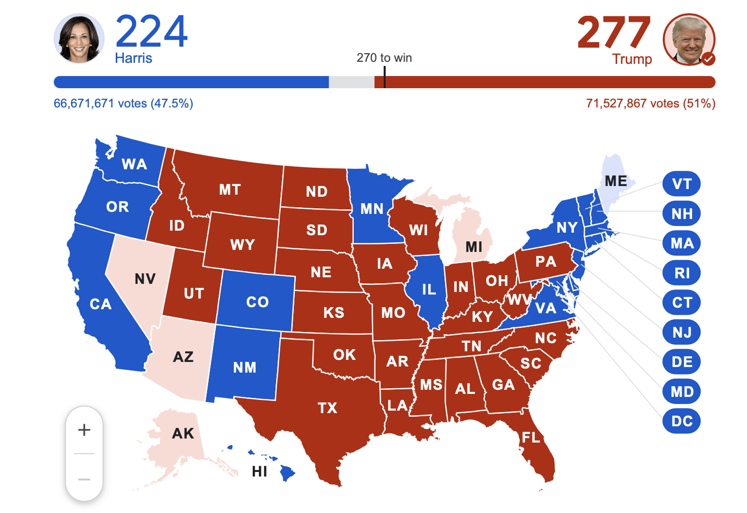
Harris Loses by 247,000 Votes out of 140 Million in Blue Wall States 4.9 Million Popular Votes, or 0.19%

Slide 3
Election Outcomes – You lose the entire interest rate sensitive sectors of the economy
*Higher inflation *Higher interest rates *Much higher national debt *Government shutdowns on Dem house win *less regulation – Full Self Driving in US *No environmental control *accelerated global warming *Extreme labor shortages at low end hitting agriculture, restaurants, and construction
Democratic control of congress in 2026 Ukraine withdrawal Taiwan at risk Retreat from international commitments More concentration of wealth at the top Earlier stock market top Earlier recession Earlier stock market crash All antitrust actions cease

Slide 4
Winners and Losers
Winners Energy Financials Crypto Tesla Health Insurance Vladimir Putin
Losers All interest rate plays All Bonds Housing Real Estate Construction

Slide 5
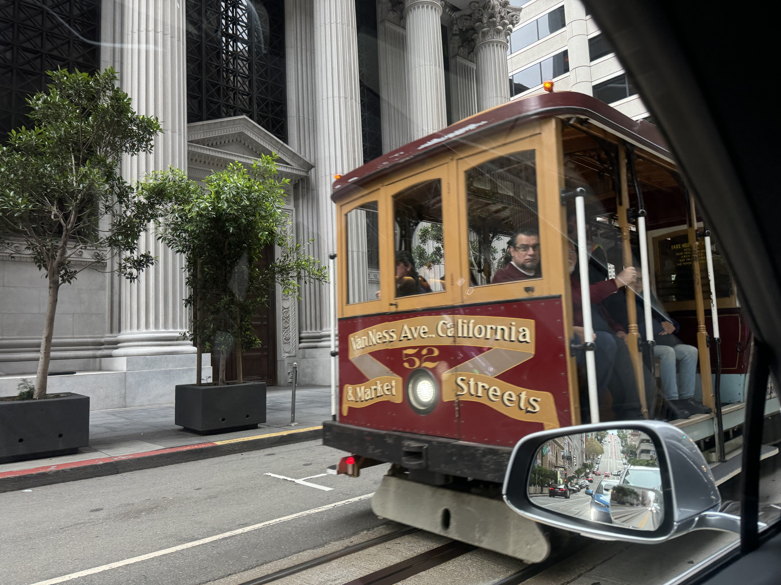

Slide 6
Trade Alert Performance New All-Time Highs!
*January -4.28% Final *July +10.92% Final *February +7.42% Final *August +3.74% Final *March +6.23% Final *September +10.28% MTD *April +5.24% Final *October +7.59% Final *May +3.74% Final *November +0.30 Final *June +1.94% Final *December -2.27% Final *2024 YTD +53.34%, versus +15.9% for the S&P 500 and +729.97% since inception *Versus 84.63% for all of 2022 *Versus 79.79% for all of 2023 *Average annualized return of +51.62% for 16 years

Slide 7
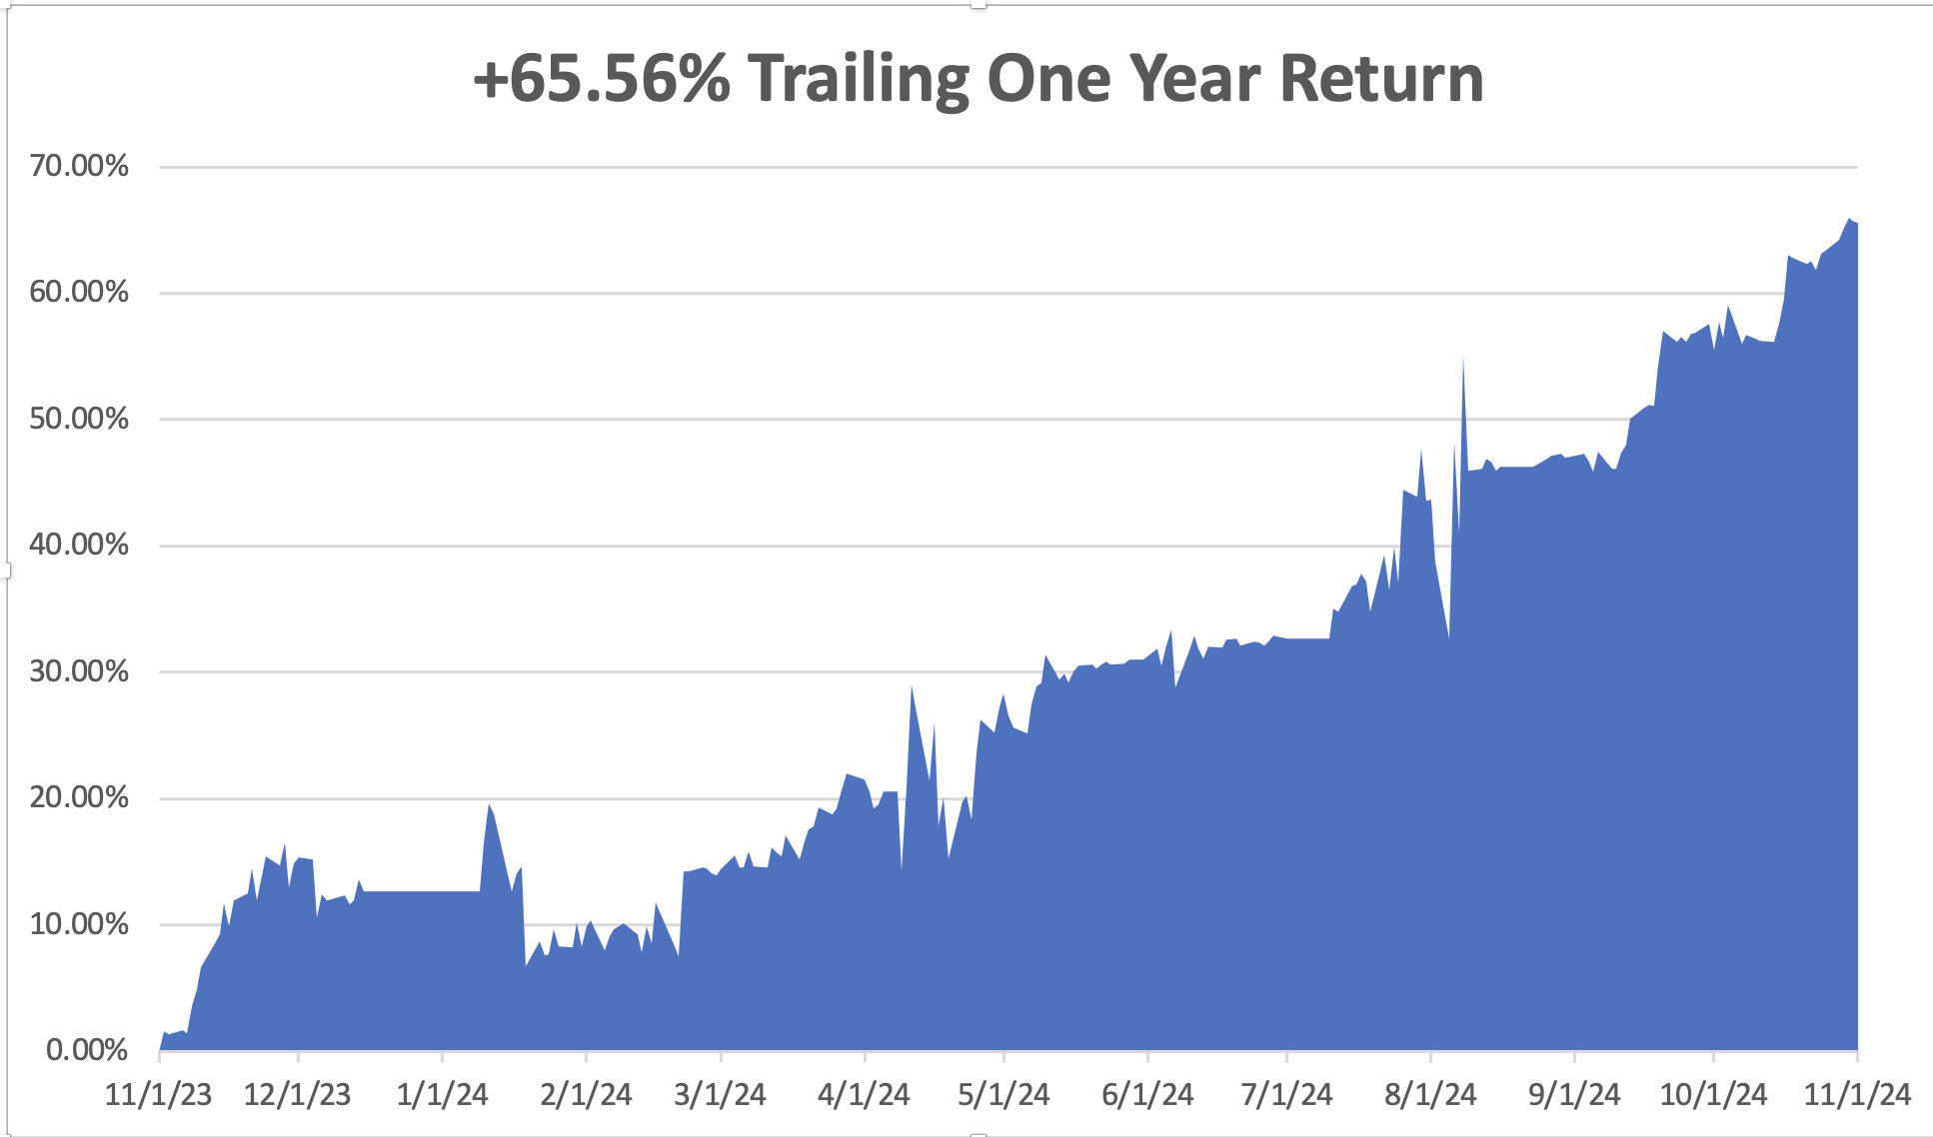

Slide 8
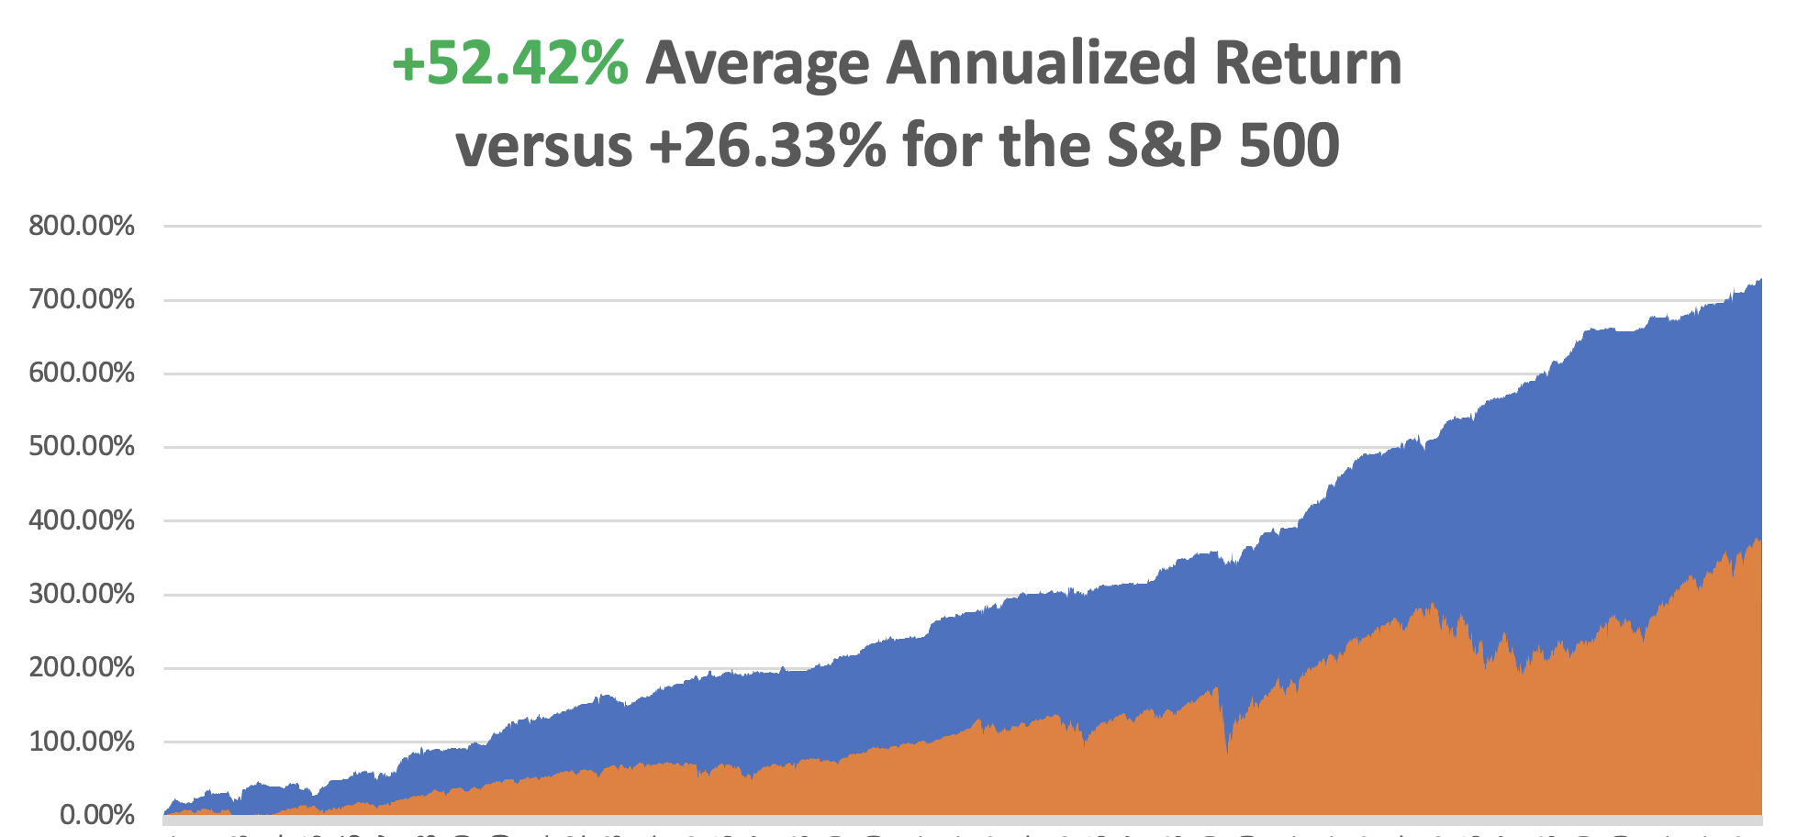

Slide 10
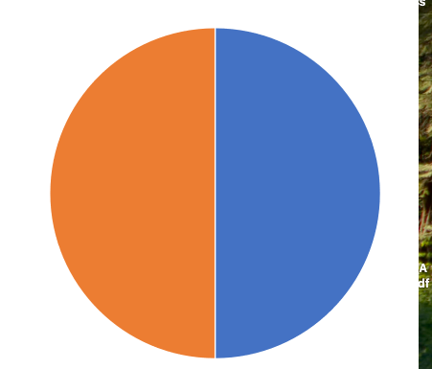
Portfolio Review – Aggressively Long 20% risk on long, 0% risk off, 80% cash
Risk On
(JPM) 11/$195-$205 call spread | 10.00%
(NVDA) 12/$117-$120 call spread | 10.00%
Risk Off
NO POSITIONS
Total Net Position | 20.00%
Total Aggregate Position | 20.00%
Expiration Value +53.79%

Slide 11
The Method to My Madness
*On Wednesday, we flip from one type of risk to another *All interest rate plays looking at big selloffs *US Dollar hits one year high *Technology stocks still attractive for long term *Stand by and wait for the initial election euphoria to pass *Energy rallies on deregulation, but not oil supply *Stand by and wait for the initial election euphoria to pass and see where the money flows

Slide 12
The Global Economy – Sure Thing
*Nonfarm Payroll Collapses at 12,000, down sharply from September and below the Dow Jones estimate for 100,00 *The headline unemployment rate held at 4.1%, in line with expectations *The BLS noted that the Boeing strike likely subtracted 44,000 jobs in the manufacturing sector, while hurricanes also likely held back the total. *It makes a 25-basis point interest rate cut on Wednesday a sure thing.
*Personal Consumption Expenditures Price Index Rose in September, up 0.3%, which remains above the central bank’s target *Q3 GDP Comes in Weak, with real gross domestic product grew at a hardy 2.8% *Consumer Sentiment Hits 6-Month High,

Slide 13
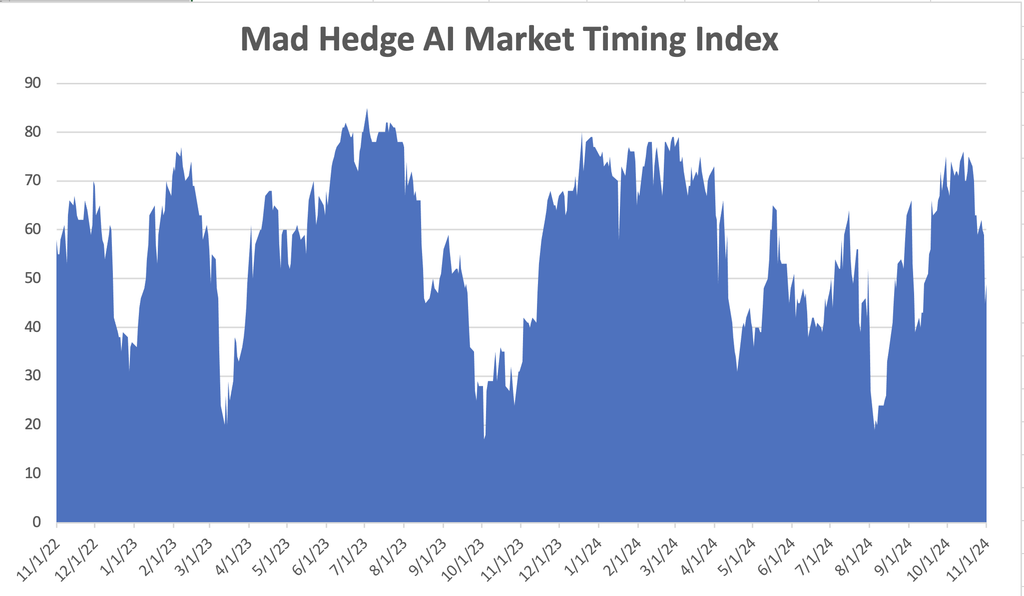
The Mad Hedge Profit Predictor Market Timing Index – Keep Risk Low An artificial intelligence driven algorithm that analyzes 30 different economic, technical, and momentum driven indicators
SELL
BUY

Slide 14
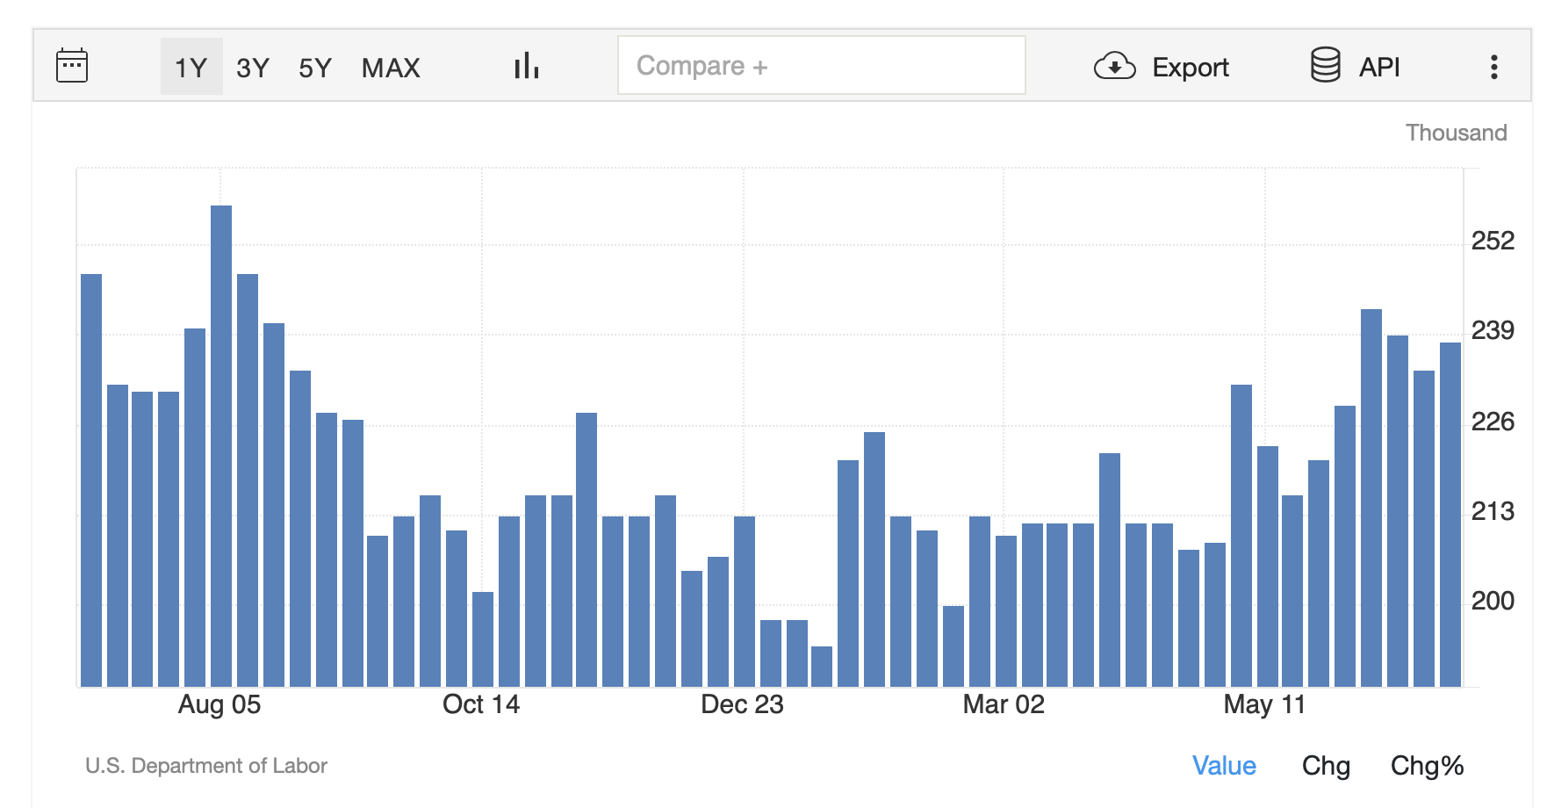
Weekly Jobless Claims – Falling 241,000 -9,000

Slide 15
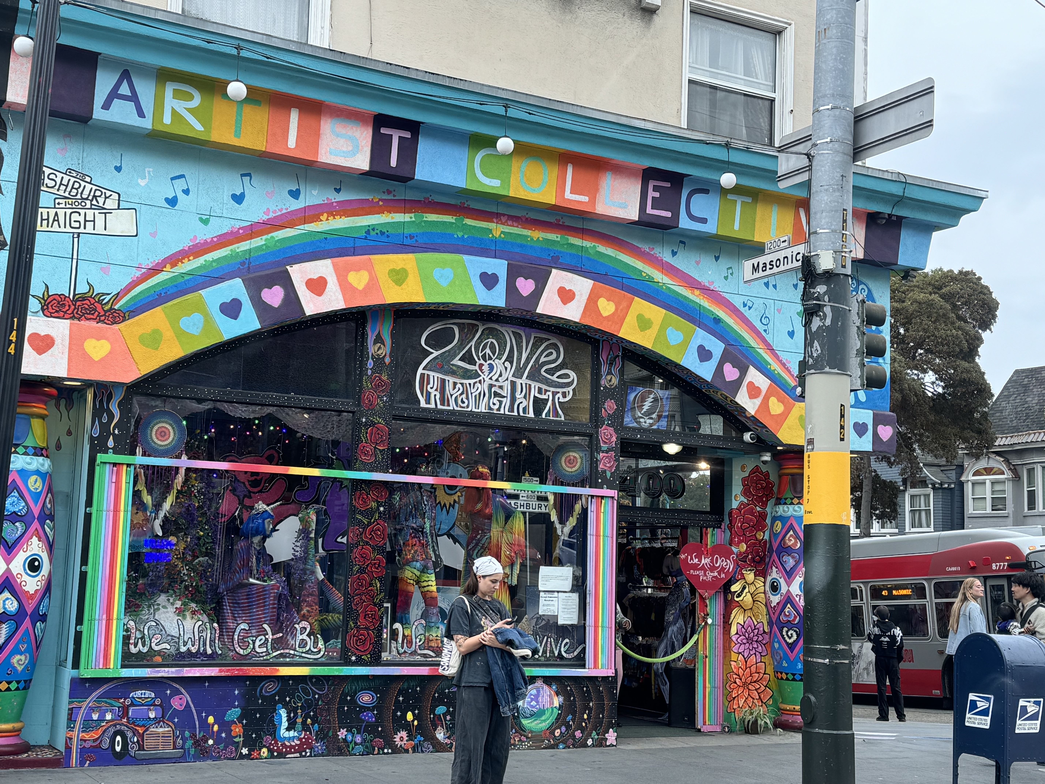

Slide 16
Stocks – Post Election Melt Up Arrives would have happened no matter who won- Dow rises $1,300
*Money Market Funds See Massive Pre-election Inflows, as investors see to avoid promised post-election violence *Nvidia Tops $3.5 Trillion, as the shares hit a new all-time high at $144.45. It looks like it’s on a run to $150, then $160 *Apple iPhone Sales are Lagging, according to a leading analyst, with a drop in 10 million orders expected, down to 84 million unit *MacDonalds Kills Two in E. Coli Outbreak, linked to quarter pounders, avoid (MCD) *Hedge Funds Ramping up Risk Going into the Election, with more equity leverage in their portfolios than they had in the beginning of the year, indicating higher risk appetite, *IMF Cuts Global Growth Forecast, seeing wars and protectionism posing threats to expansion *Lockheed Martin Dives on F-35 Delays

Slide 17
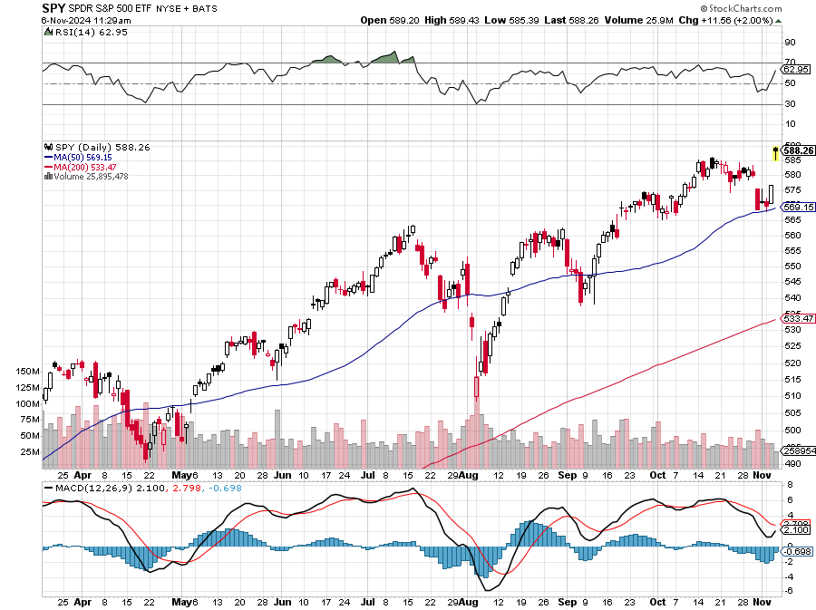
S&P 500 – Trend is Your Friend
Yearend Target $600 +25%
$540 -5.3% 1st support
$520 -8.8% 1st support

Slide 18
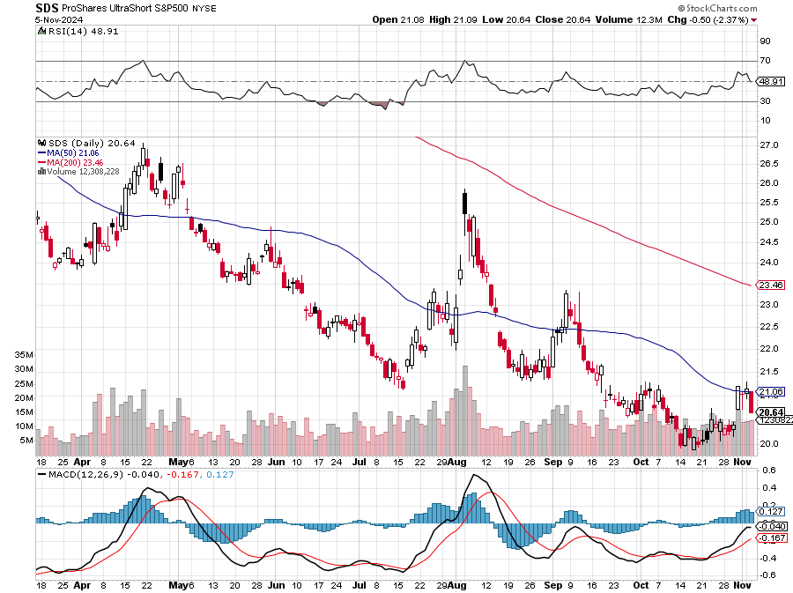
ProShares Ultra Short S&P 500 (SDS)- a great hedge for long stocks and bonds long 2X position has a hedge against longs and bond shorts

Slide 19
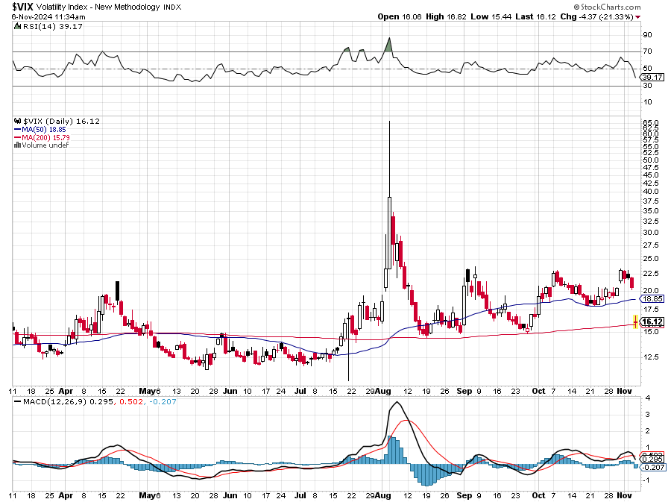
(VIX) – Rare Spike Volatility Index Hits Four Year High at $65, the most since the 2020 pandemic. That implies a 2% move in the S&P 500 (SPX) every day for the next 30 days

Slide 20
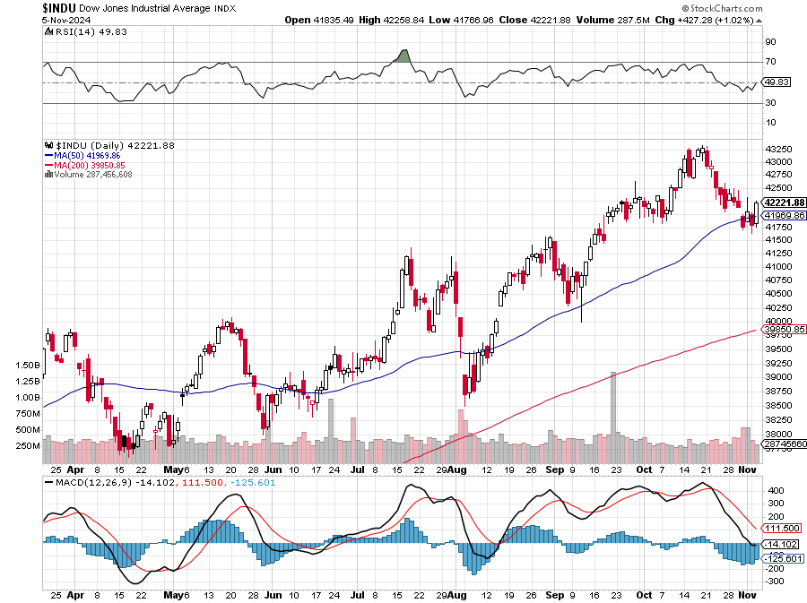
Dow Average ($INDU)-

Slide 21
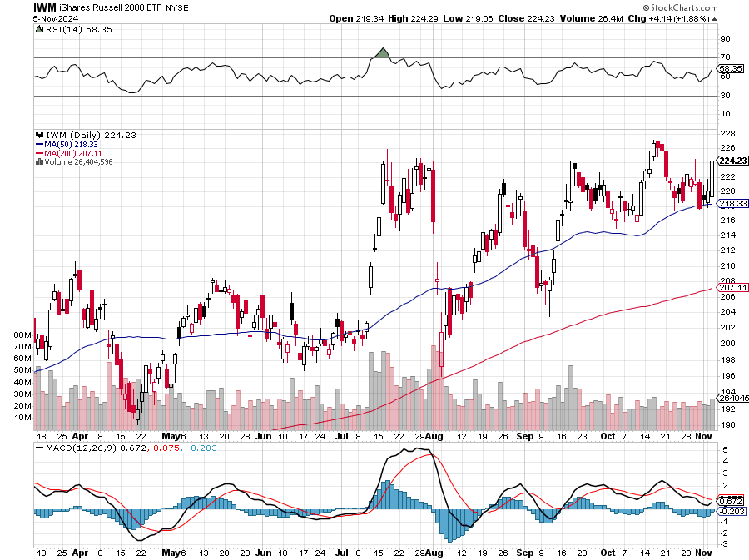
Russell 2000 (IWM)- took profits on Long 10/$137-$142 vertical bull call spread took profits on Long 10/$153-$156 vertical bear put spread

Slide 22
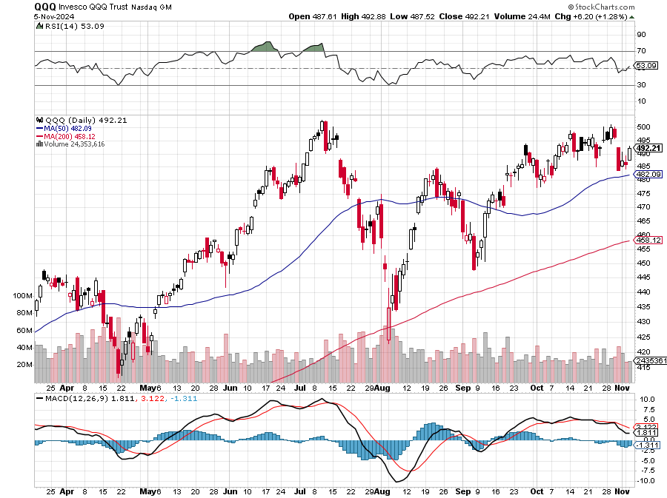
NASDAQ (QQQ) – took profits on Long 5/$335-$345 put spread took profits on long (QQQ) 1/$290-$300 put spread, took profits on long (QQQ) 4/$330-$335 put spread took profits on long (QQQ) 3/$340-$345 put spread, covered long (QQQ) $325-$330 put spread

Slide 23
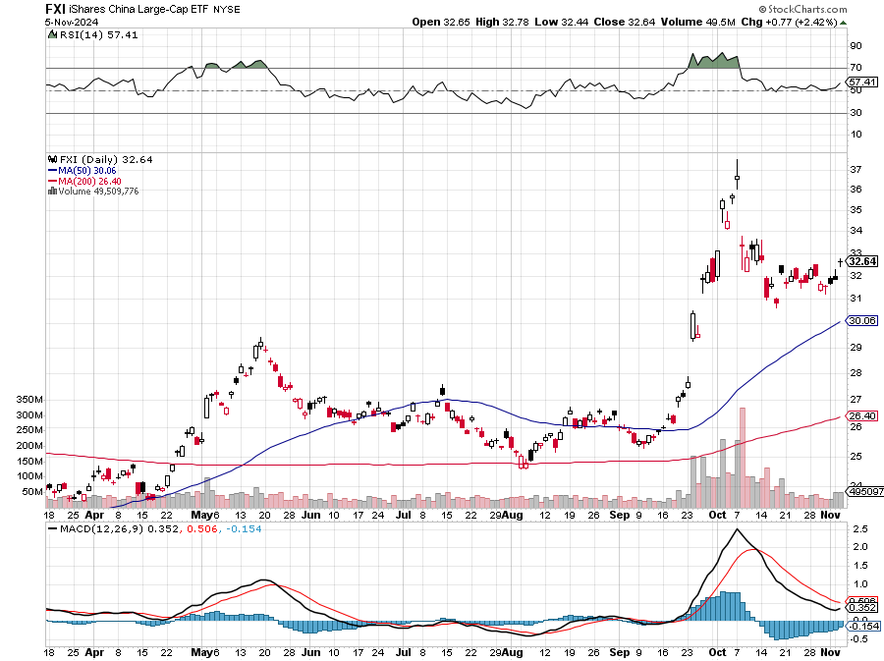
China (FXI)

Slide 24
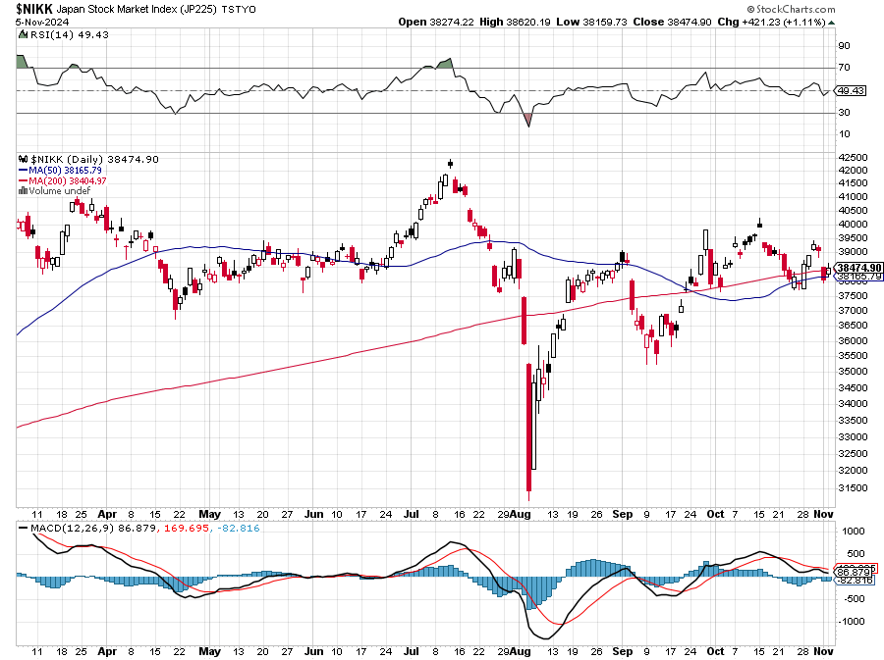
Japan ($NIKK)

Slide 25
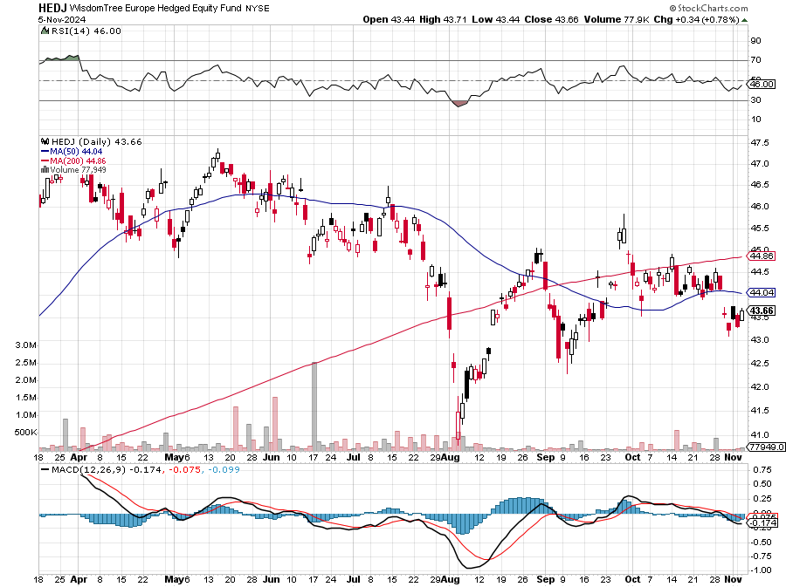
Europe Hedged Equity (HEDJ)-

Slide 26
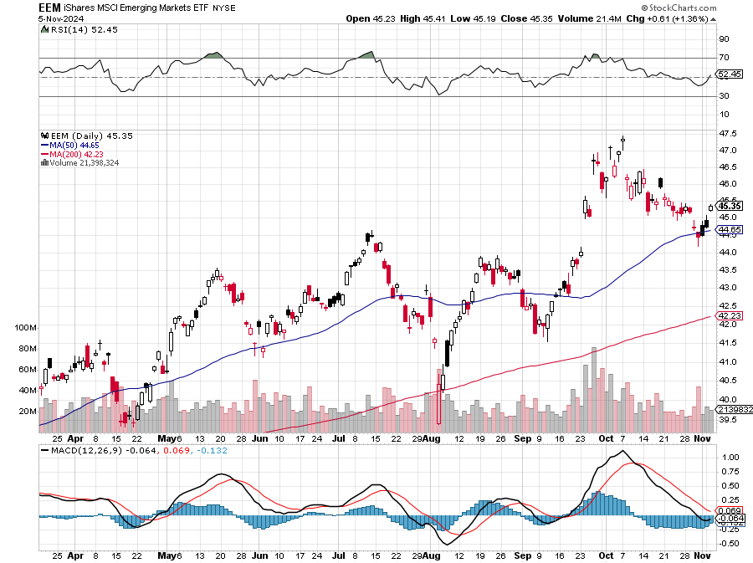
Emerging Markets (EEM) - Pro trade, Weak Dollar, Long Recovery Play Traders are Lining up for a Big Emerging Market Bet. Falling US interest rates will bring a weak US dollar and runaway bull markets in most emerging markets, which have remained unchanged for more than a decade

Slide 27
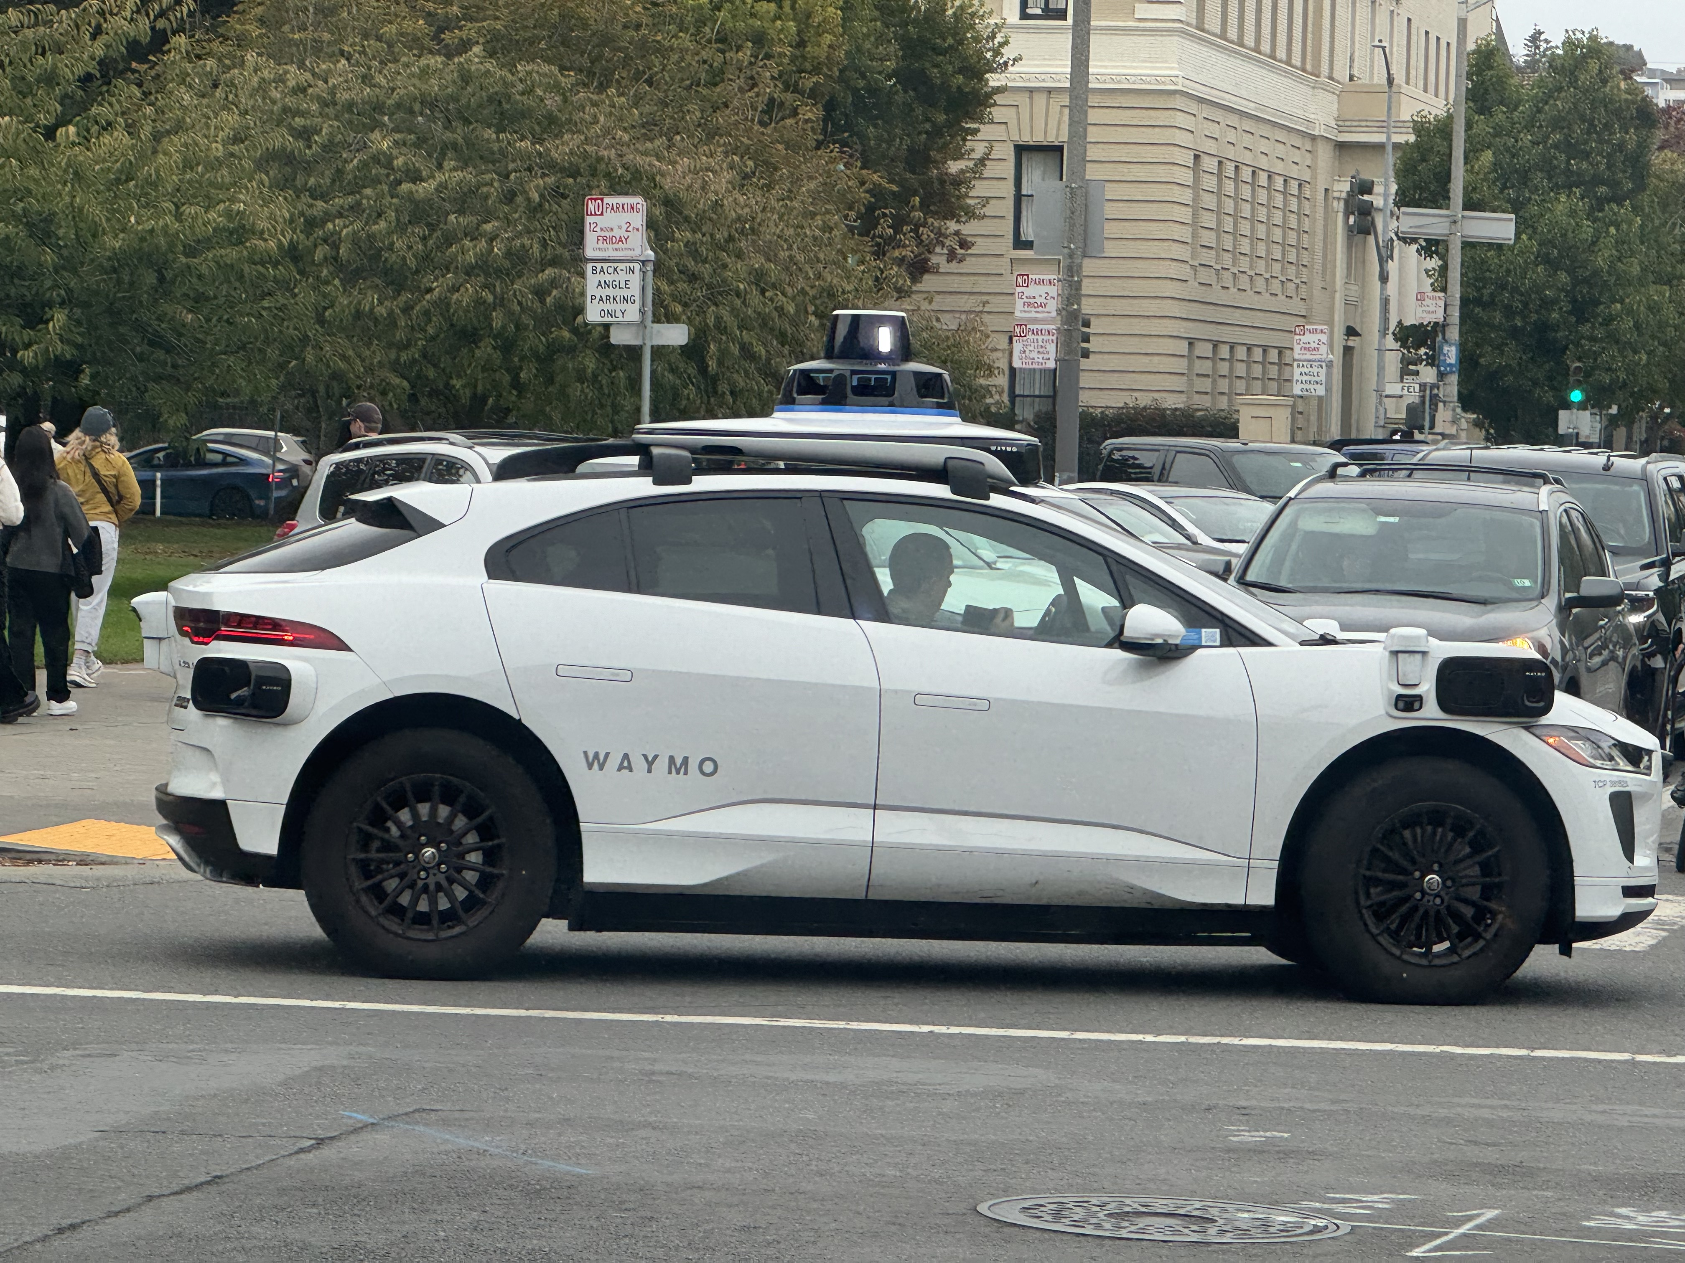

Slide 28
THE MAD HEDGE FUND TRADER
The Barbell Portfolio
*75% Big Tech – 2% of US workforce, 25% of market cap and 25% of US earnings 25% Domestic Recovery, including: Railroads, airlines, cruise lines, Couriers, steel companies Banks, commodities Construction Credit Card Companies Hotels, casinos Online Ticket Sales

Slide 29
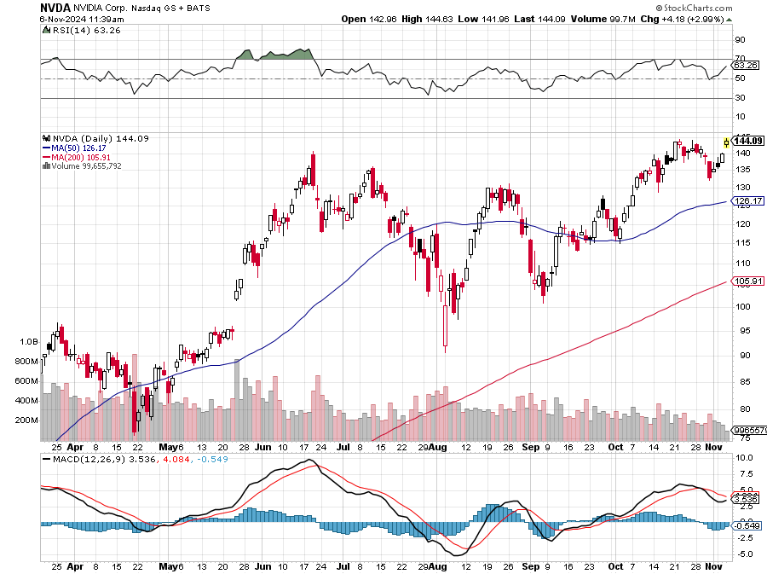
NVIDIA (NVDA) – Joins the Dow Average Club Taiwan Semiconductor Soars on Spectacular Earnings, dragging up the rest of the chip sector with it Long the 12/$117-$120 call spread took profits on long 8/70-$73 call spread took profits on long 8/137-$140 put spread, took profits on long 8/85-$ call spread took profits on long 5/155-$160 put spread, took profits on long 5/98-$99 put spread

Slide 30
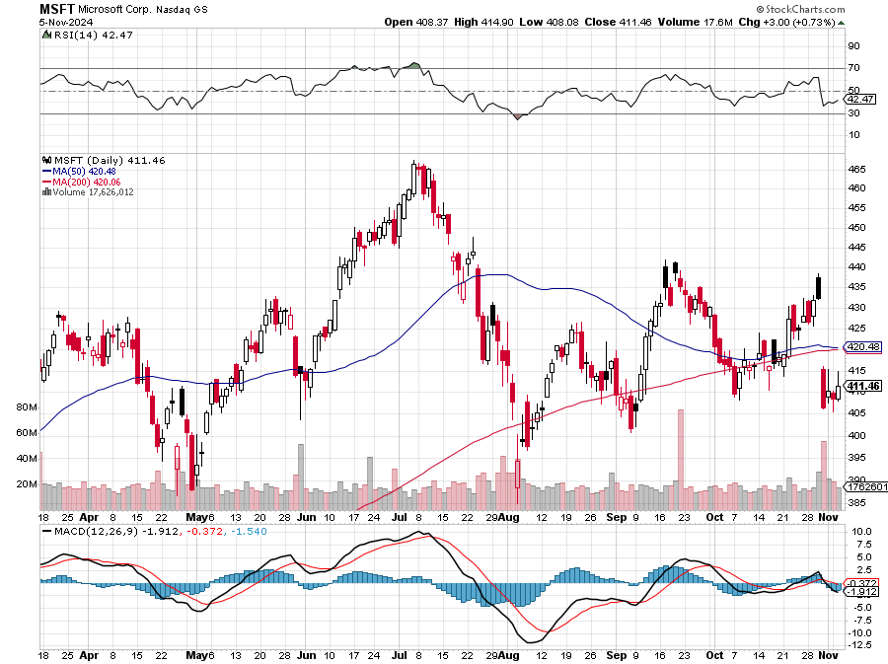
Microsoft (MSFT)-Microsoft Bombs, with an earnings and revenue beat, but with a slight shortfall in their Azure cloud business took profits on long 5/$430-$440 put spread Took profits on long 2/$330-$340 call spread, took profits on long 12/$320-$330 call spread took profits on long 9/$235-$245 call spread, took profits on long 7/$220-$210 call spread, took profits on long 6/$220-$230 call spread, took profits on long 2/$200-$210 bear put spread

Slide 31
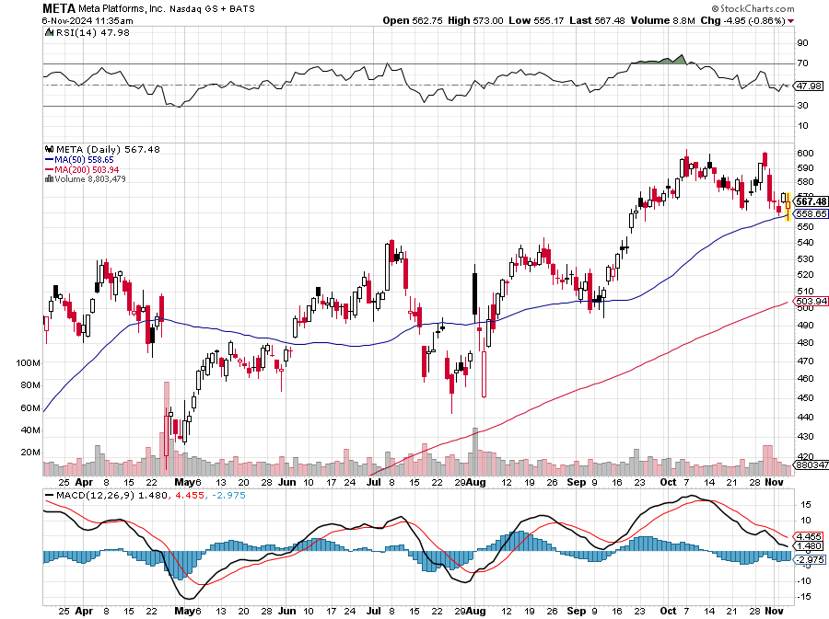
Meta (META) Reporting weaker-than-expected user numbers in its third-quarter earnings report took profits on Long 8/$420-$430 call spread took profits on Long 5/$360-$370 vertical bull call spread, took profits on Long 9/$290-$300 vertical bear put spread, stopped out of Long 9/$190-$200 vertical bear put spread

Slide 32
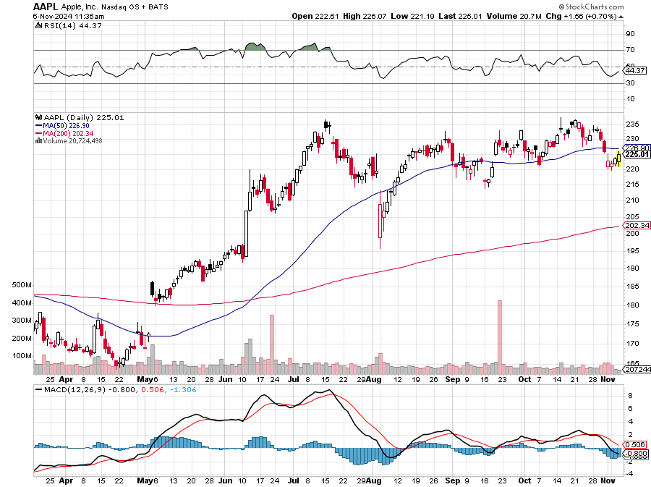
Apple (AAPL) Beats, on earnings and guidance, with sales up 6%. Some $46.2 billion worth of iPhones were sold in Q3 took profits on Long 5/$225-$235 vertical bear put spread, took profits on Long 8/$160-$170 call spread took profits on Long 6/$200-$210 bear put spread, stopped out of Long 5/$185-$195 vertical bear put spread took profits on long 1/$145-$155 put spread, Took profits on long 10/$165-$175 put spread

Slide 33
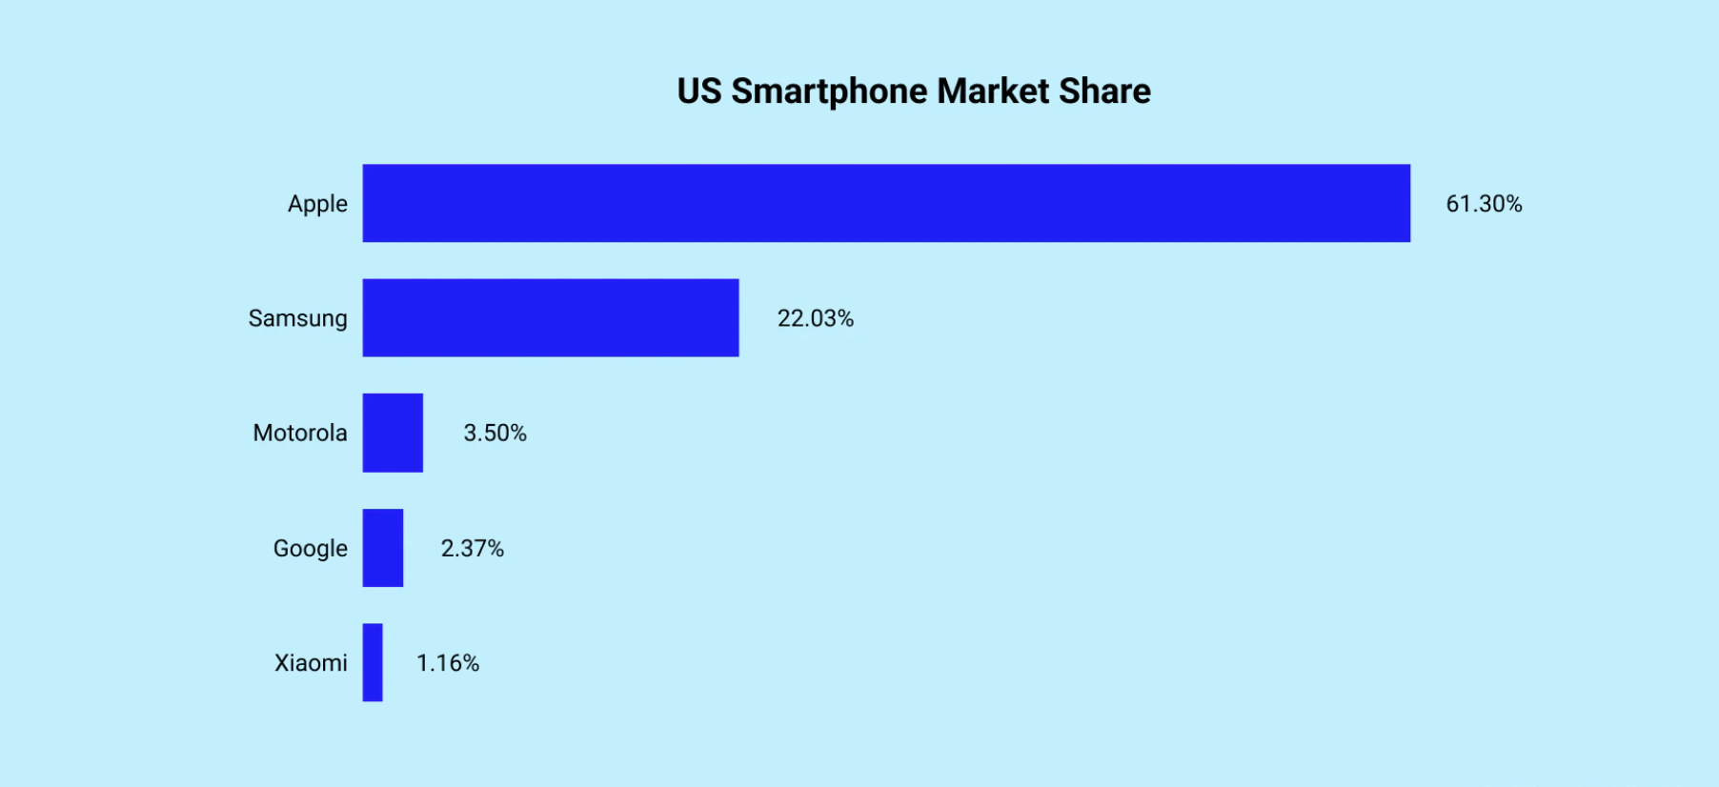

Slide 34
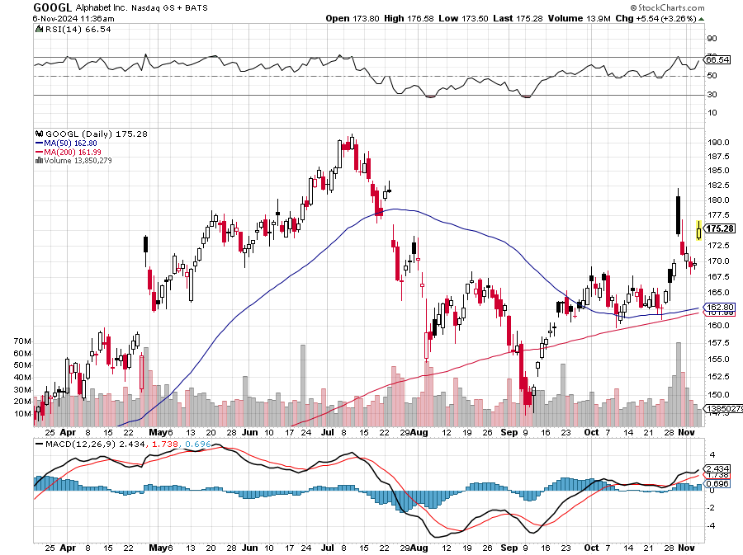
Alphabet (GOOGL) – Back in Play Google Gets Hit with an Antitrust Suit took profits on long 12/$110-$120 call spread took profits on long 12/$1,200-$1,230 bull call spread, took profits on long 9/$1,030-$1,080 vertical bull call spread

Slide 35
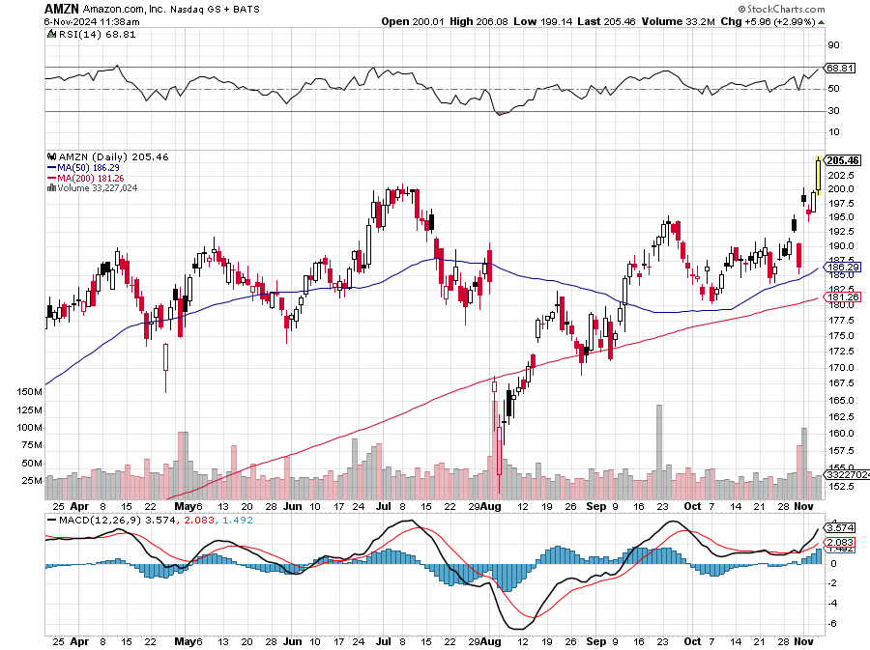
Amazon (AMZN) – Best Value AI Play Beats, on better revenues, earnings, margins, and guidance, popping the stock $11 Stopped out of long 3/$150-$160 bull call spread, took profits on long 3/$155-$160 bull call spread , took profits on long 2/$130-$135 bull call spread

Slide 36
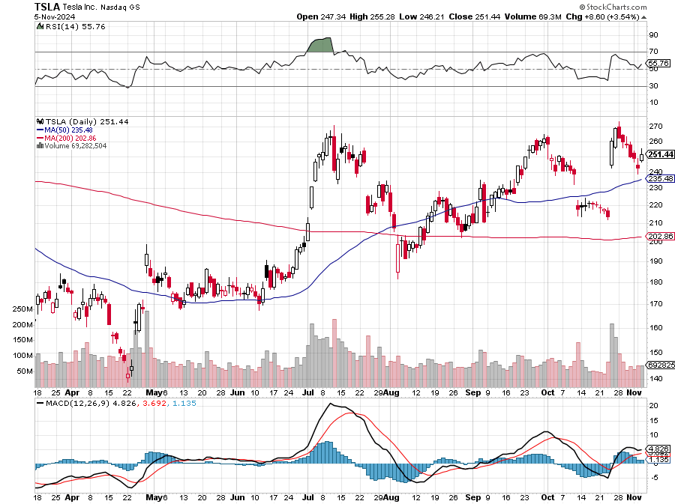
Tesla (TSLA) –Tesla Insiders Selling $300 Million in Stock, Tesla Earnings Shock to the Upside took profits on long 11/$320-$330 put spread took profits on Long 10/$180-$190 call spread, stopped out of long 9/$250-$260 put spread Took profits on long 8/$245-$255 put spread, Took profits on long 8/$150-$160 call spread, Took profits on long 6/$310-$320 put spread, Stopped out of long 4/$140-4150 call spread,

Slide 37
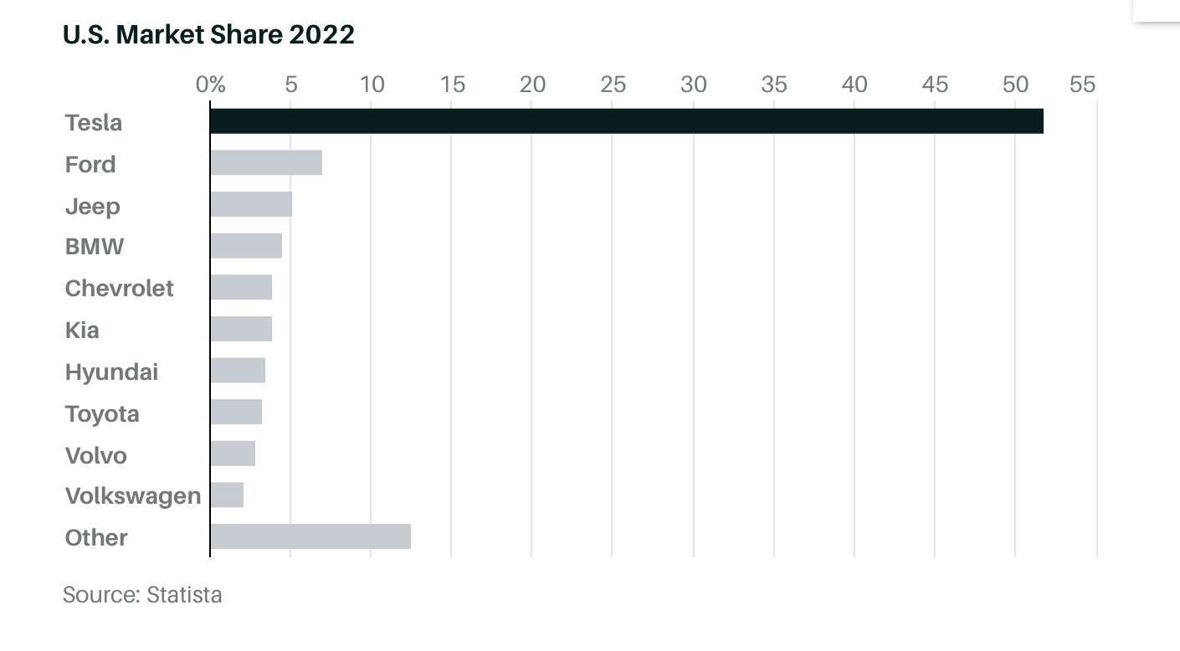

Slide 38
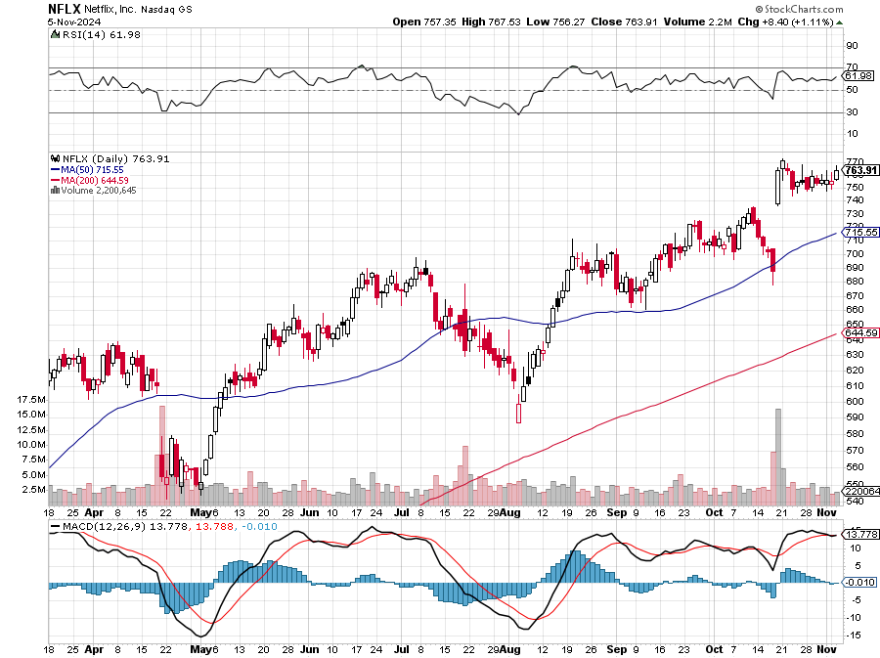
Netflix (NFLX) – Netflix Soars on Blockbuster Earnings on a 5 million gain in subscribers

Slide 39
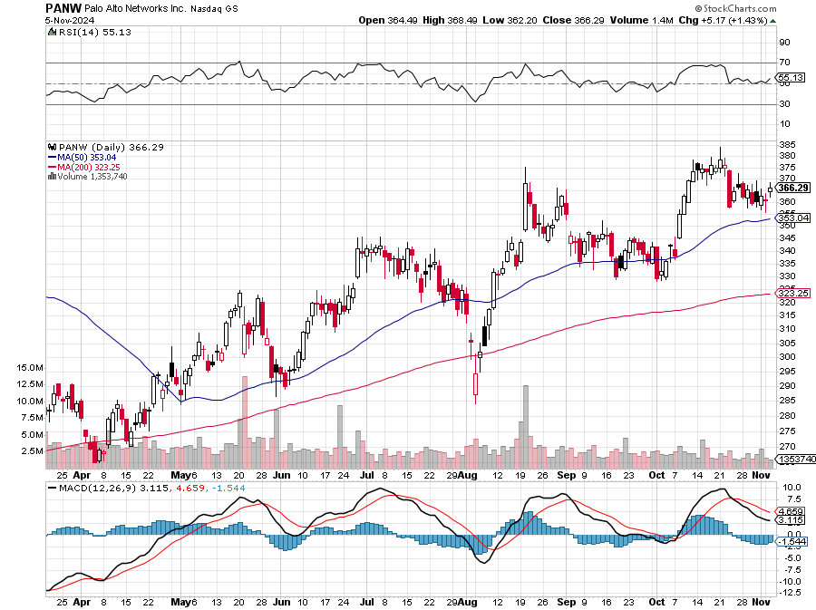
Palo Alto Networks (PANW)- Hacking never goes out of fashion Palo Alto Networks Disappoints took profits on long 2/$260-$270 call spread, took profits on long 10/$130-$140 call spread

Slide 40
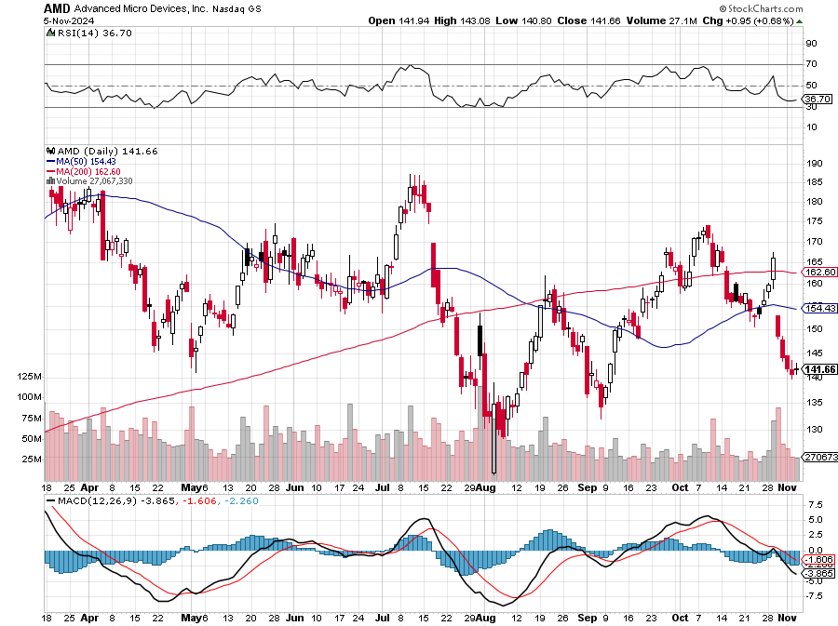
Advanced Micro Devices (AMD)- Recession fears programable logic devices took profits on long 2/$75-$80 call spread

Slide 41
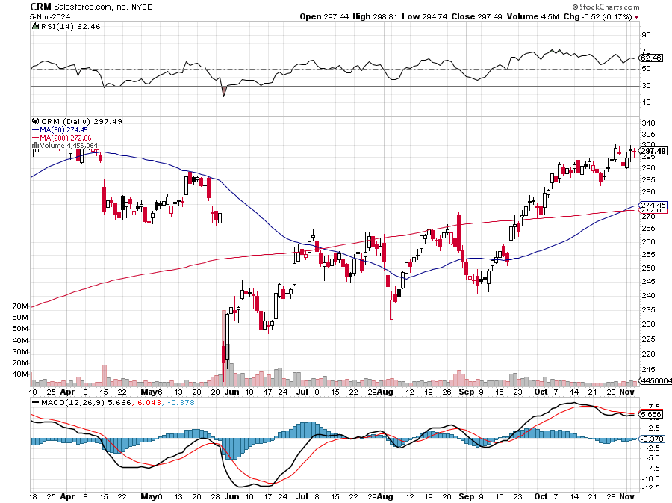
Salesforce (CRM)- Massive Online Migration Salesforce Soars 16%, on better-than-expected guidance took profits on long 12/$185-$195 call spread took profits on long 9/$125-$130 vertical bull call spread took profits on long 8/$125-$130 vertical bull call spread

Slide 42
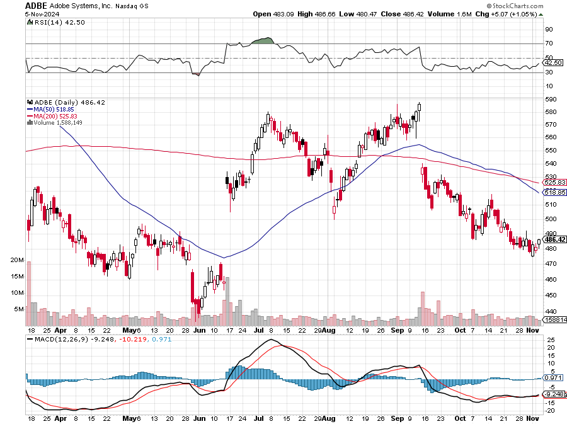
Adobe (ADBE)- Cloud play The Quality Non-China tech play

Slide 43
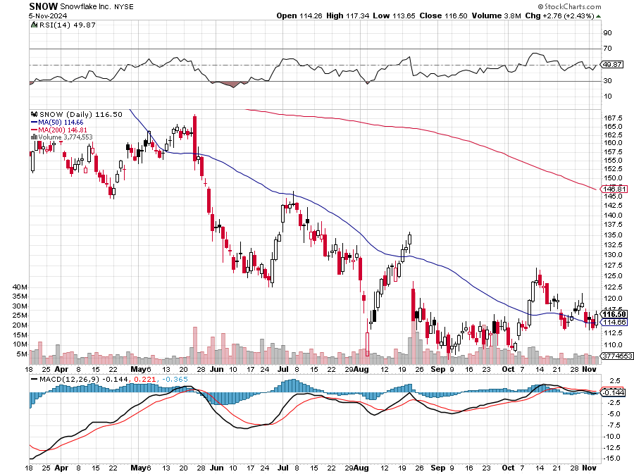
Snowflake (SNOW)- Blockbuster AI Earnings Snowflake Crashes, down 20%, on weak guidance. CEO Frank Slootman is retiring stopped out of long 4/$150-$255 call spread, took profits on long 12/$135-$140 call spread

Slide 44
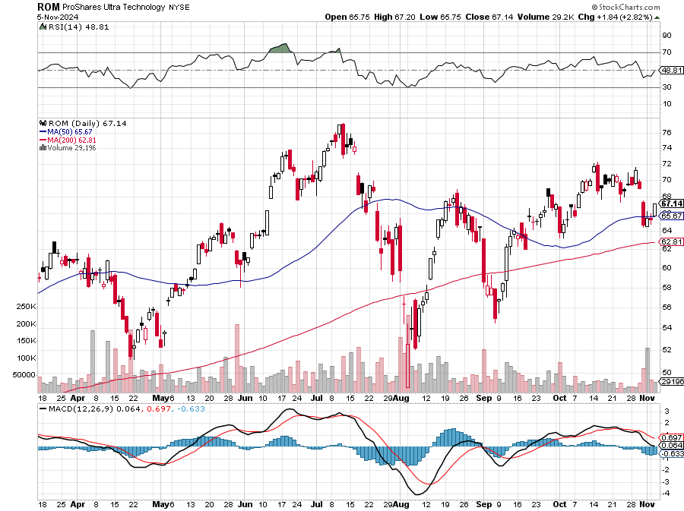
ProShares Ultra Technology ETF (ROM) – 2X Long Technology ETF took profits on long 10/$62-65 call spread

Slide 45
Tamara de Lempicka

Slide 46
The Second Half of the Barbell
*Bets on a domestic recovery in 2022 Q4 *Upside potential in 2024 far greater than tech *Some of these have not moved for 5 or 10 years *Focuses on economically sensitive cyclical industries *Makes a great counterweight to high-growth technology *We could spend all of next ten years rotating between the two groups

Slide 47
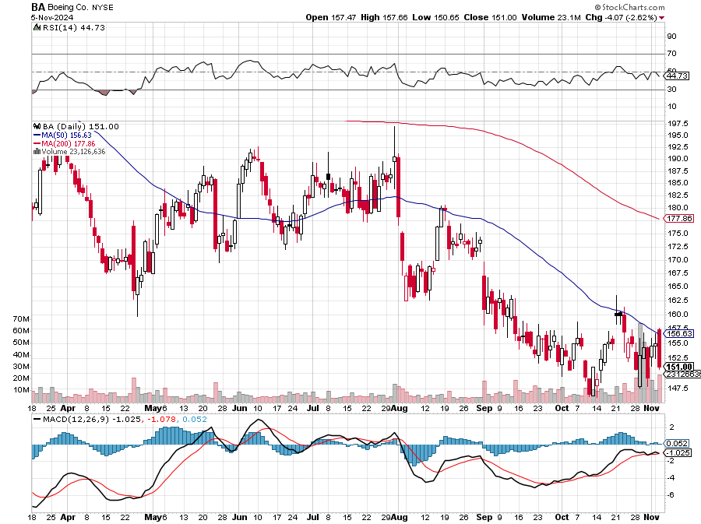
Boeing (BA) – Q3 $6 Billion Loss –b Strike Continues “il pesce marcisce dalla testa” stopped out of long 2/$190-$200 call spread, took profits on long 5/$17-$175 call spread

Slide 48
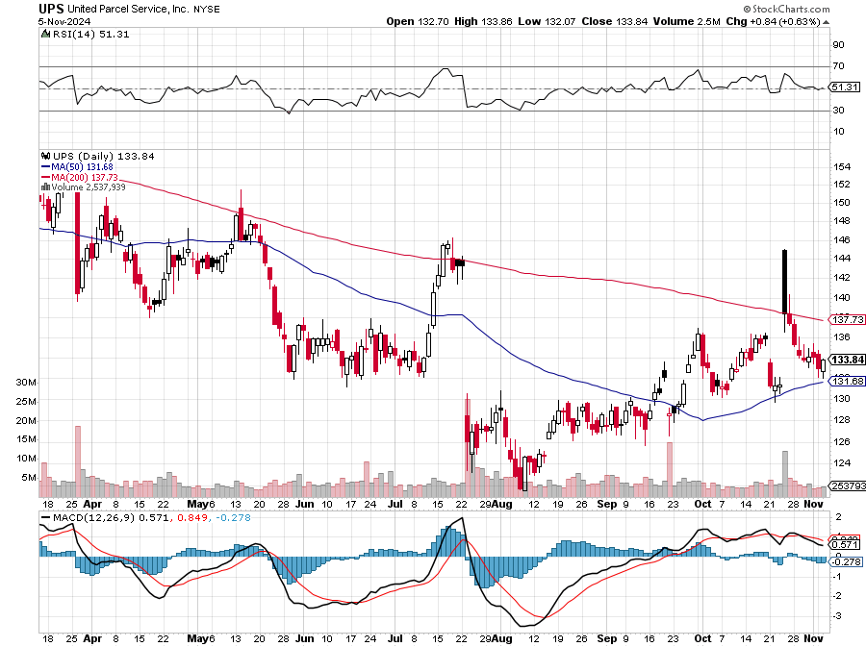
Package Delivery- United Parcel Service (UPS) – strike averted took profits on long 11/$130-$140 call spread

Slide 49
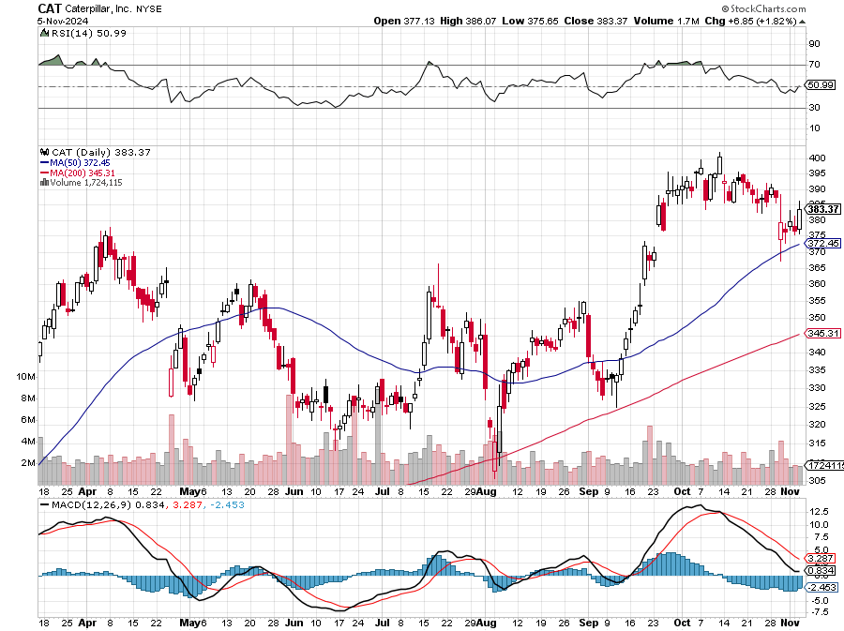
Caterpillar (CAT)- Ag + Infrastructure + Housing stopped out of long 8/$310-$320 call spread, took profits on long 12/$220-$230 calls spread took profits on long 12/$145-$150 call spread, took profits on long 11/$125-$135 call spread

Slide 50
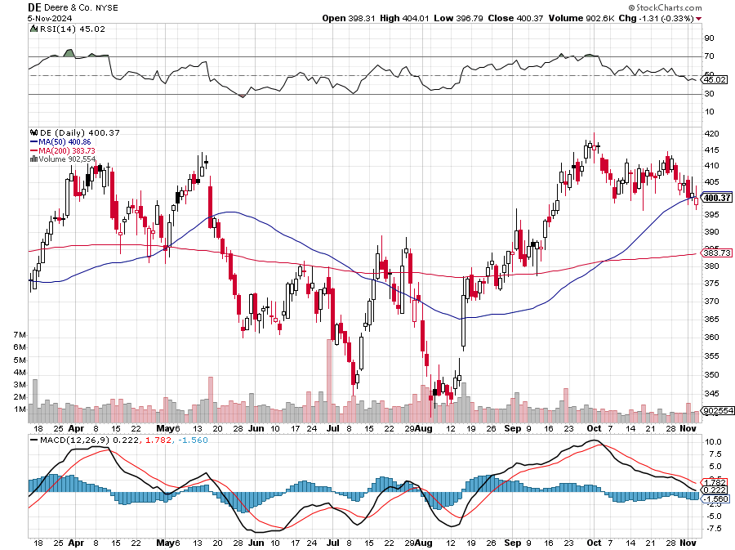
Deere & Co. (DE)- Ag + Infrastructure + Housing took profits on long 8/$330-$340 put spread stopped out of long 8/$330-$340 calls spread

Slide 51
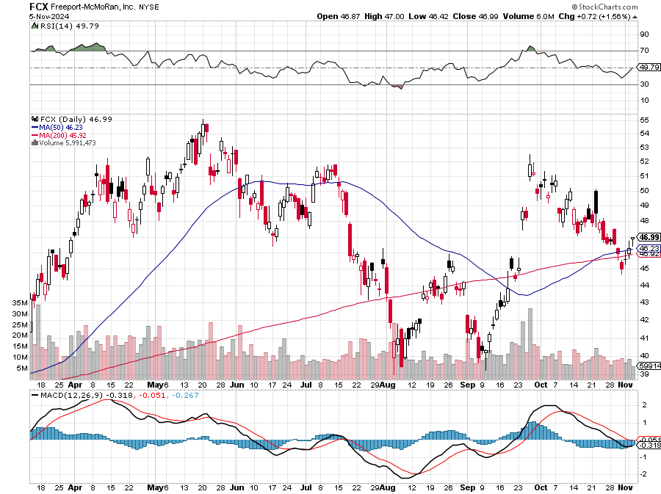
Freeport McMoRan - (FCX)- Coming Copper Crisis Freeport McMoRan Beats, helped by higher production and easing costs took profits on long 4/$37-$40 call spread, took profits on long 5/$42-$45 call spread, stopped out of long $48-$51 put spread, profits on long 6/$32-$35 call spread took profits on long 4/$30-$33 call spread, took profits on long 10/$20-$23 call spread

Slide 52
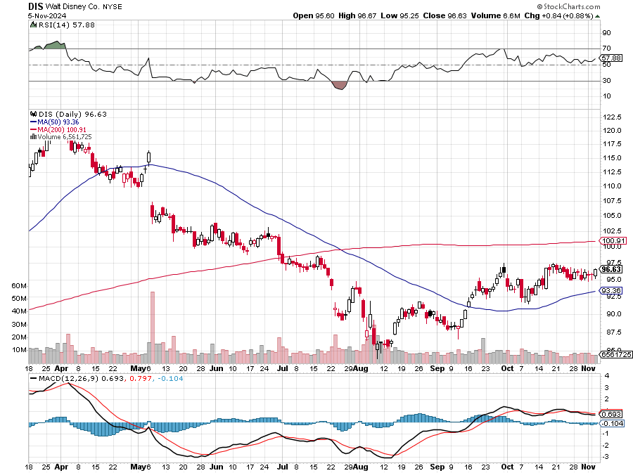
Walt Disney (DIS) -Disney Beats Disney Dives on Earnings Bust, although streaming broke even versus an expected loss

Slide 53
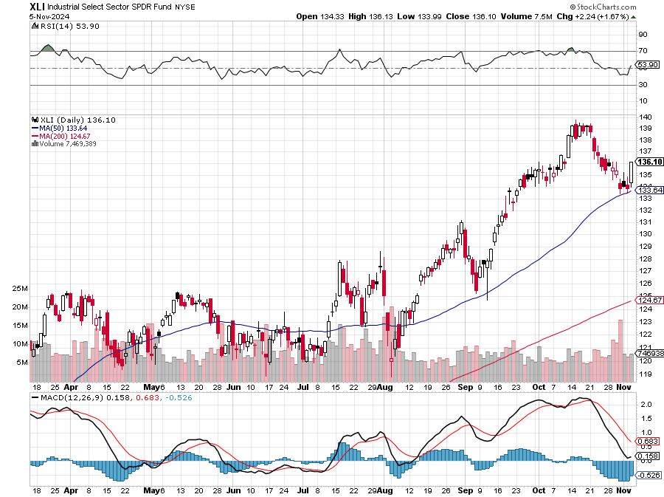
Industrials Sector SPDR (XLI)- (GE), (MMM), (UNP), (UTX), (BA), (HON)

Slide 54
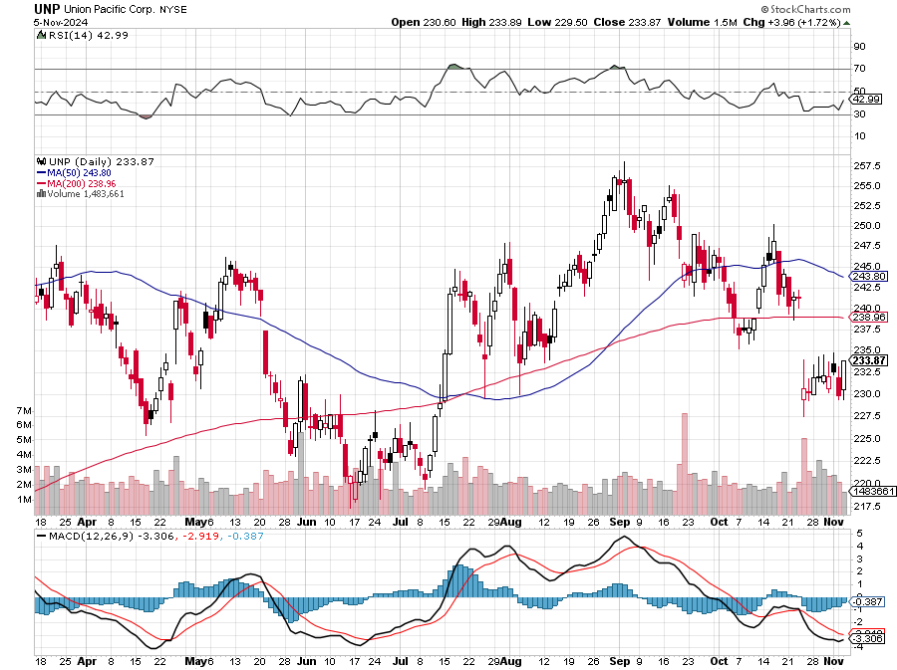
Union Pacific RR (UNP)- Big Stuff to Ship took profits on long 5/$200-$210 call spread took profits on 11/$150-$160 call spread

Slide 55
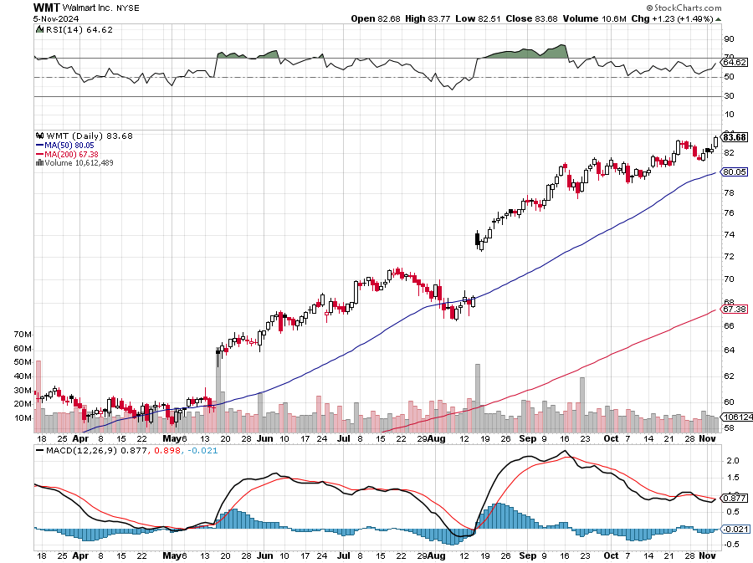
Wal-Mart (WMT)- took profit on Long 11/$125-$130 bear put spread took profit on Long 10/$119-$121 bear put spread took profits on Long 8/$114-$117 bear put spread

Slide 56
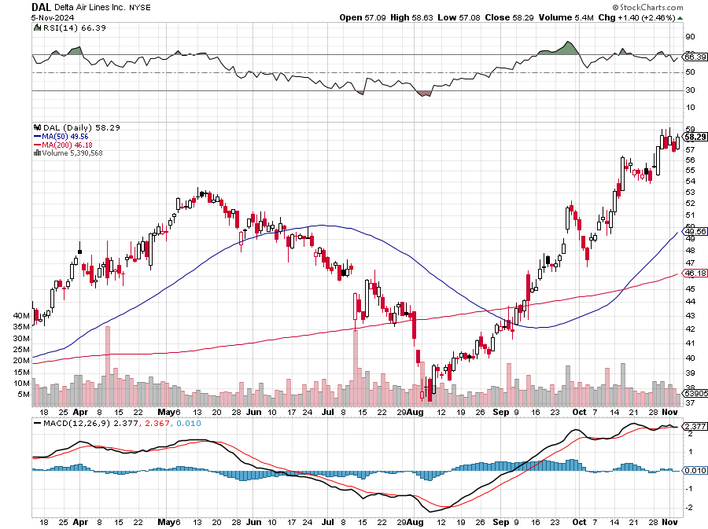
Delta Airlines (DAL) – Travel is Back! The Non-Boeing Airline – uses Airbuses stopped out of long 2/$35-$38 call spread

Slide 57
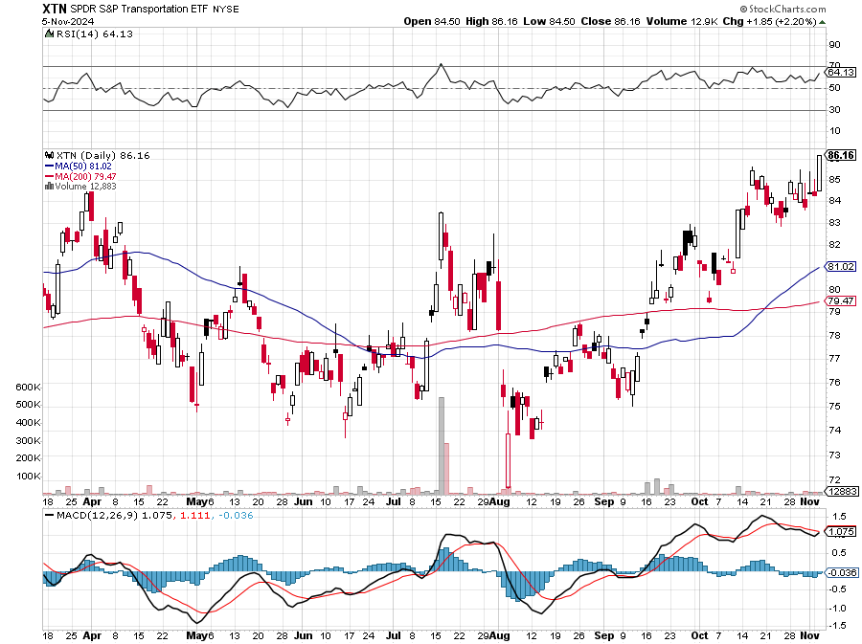
Transports Sector SPDR (XTN)- Worst Hit Sector (ALGT), (ALK), (JBLU), (LUV), (CHRW), (DAL)

Slide 58
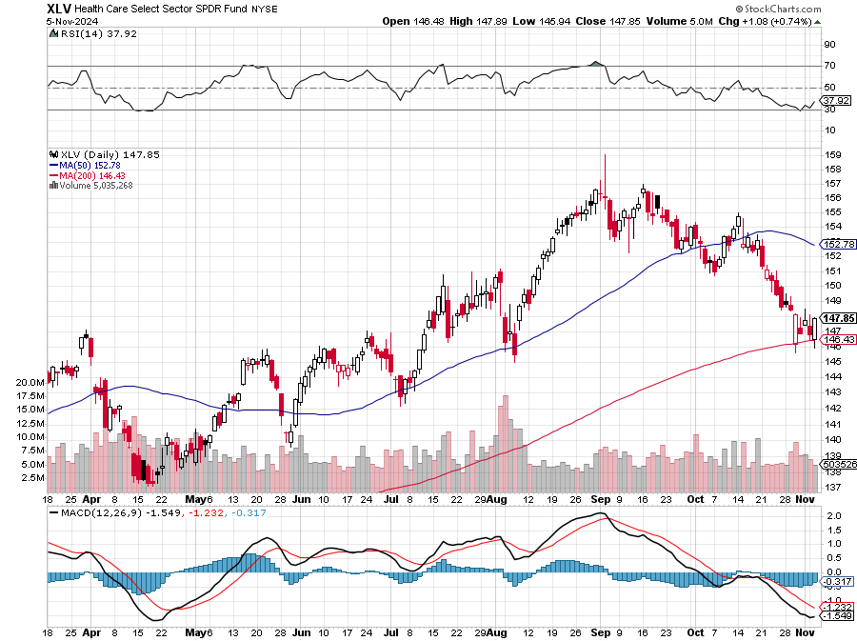
Health Care Sector (XLV) (JNJ), (PFE), (MRK), (GILD), (ACT), (AMGN)

Slide 59
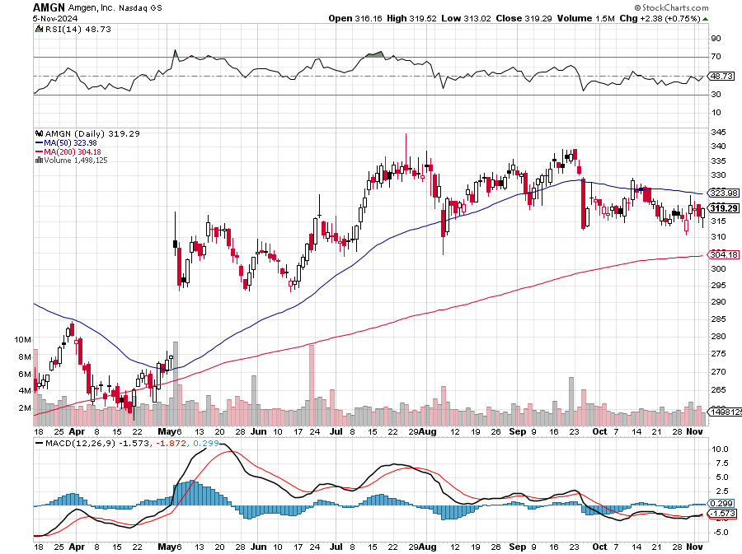
Amgen (AMGN) took profits on long 11/$185-$200 bull call spread

Slide 60
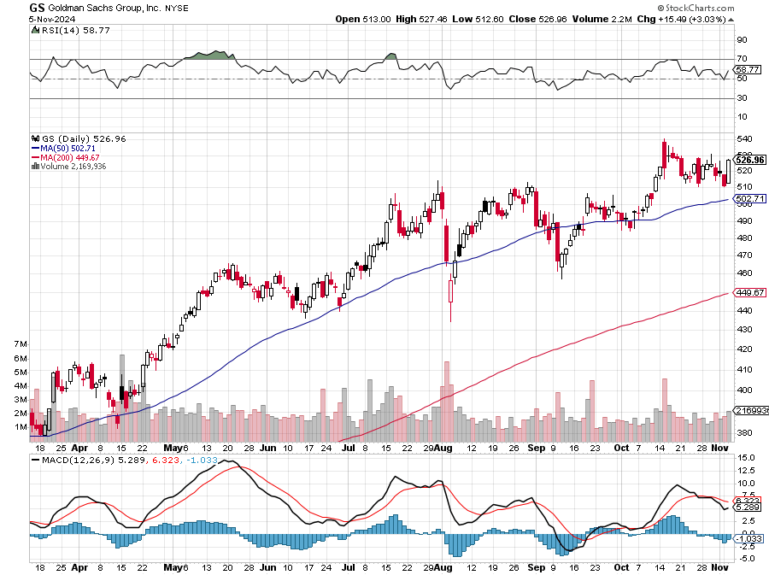
Goldman Sachs (GS) – Goldman Sachs Beats, with Revenues of $12.73 billion vs. $12.46 billion estimate took profits 12/$330-$350 call spread took profits 11/$330-$350 call spread stop loss on long 11/$385-$395 call spreads

Slide 61
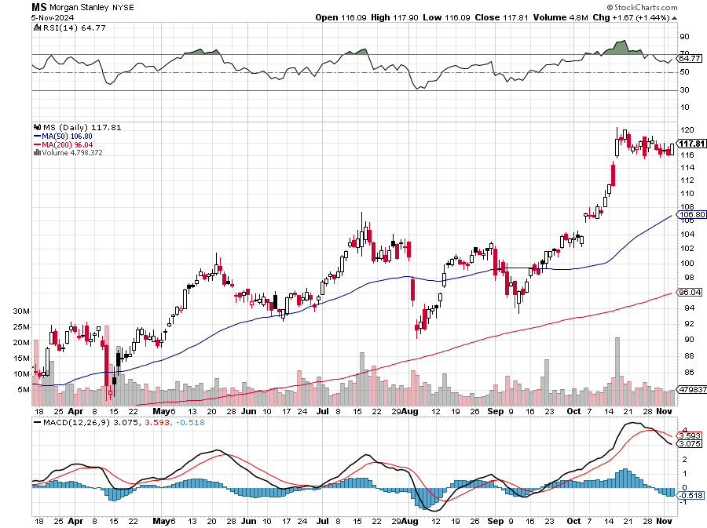
Morgan Stanley (MS) Morgan Stanley Beats, with Revenues in at $15.02 billion vs. $14.3 billion estimate took profits on long 4/$65-$70 call spread

Slide 62
JP Morgan Chase (JPM) – JP Morgan Delivers Blowout Earnings 11/$195-$205 call spread took profits on 4/$215-225 put spread, took profits on 4/$190-$195 call spread , took profits on long 4/$105-$115 call spread

Slide 63
Bank of America (BAC) – Buffet Hammers (BAC) for a 9th Straight Days, taking profits from a much lower level. took profits on long 4/$20-$23 call spread

Slide 64
Citigroup (C) – took profits on long 4/$30-$35 call spread

Slide 65
Charles Schwab (SCHW) – LEAPS expire at Max profit took profits on long 4/$30-$35 call spread

Slide 66
Interactive Brokers (IBKR) – LEAPS expired at Max Profit stopped out of long 8/$110-$115 call spread , took profits on long 4/$60-$65 call spread

Slide 67
SPDR Metals & Mining ETF (XME) – long 2/$28-$30 call spread

Slide 68
Blackrock (BLK)-Asset Collection Boom took profits on long 3/$770-$790 call spread took profits on long 3/$310-$340 call spread

Slide 69
Visa (V) – Inflation boost Justice Hits Visa (V) with Antitrust Suit, with a 47% market share took profits on long 2/$240-$250 bull call spread took profits on long 10/$160-$170 bull call spread, took profits on long 6/$150-$160 bull call spread

Slide 70
Consumer Discretionary SPDR (XLY) (DIS), (AMZN), (HD), (CMCSA), (MCD), (SBUX)

Slide 71
Berkshire Hathaway (BRKB)- Natural Barbell Buffet Sells More Apple, taking Berkshire Hathaway cash up to a record $325 billion stopped out of long 12/$405-$415 call spread, took profits on long 12/$320-$330 call spread took profits on long 4/$260-$270 call spread, took profits on long 1/$290-$300 call spread

Slide 72
Bonds – Election Play
*Bonds Plunge Anticipating a Trump Win, with the (TLT) down $10 from the recent high *If he does win, expect another $10 decline to $82. If Harris wins expect a $10 rally *This is the best election trade out there. *It’s a choice between Harris, who will increase the deficit by $2.5 trillion , or Trump, who will increase by $15 trillion *Either way, the bond market loses *Bond Yields Soar Above 4.32% Yield, on fears of massive deficit spending by a future Donald Trump. Estimates of his deficits over four years go as high as $15 trillion *Buy (TLT), (JNK), (NLY), (SLRN) and REITS on this dip

Slide 73
Treasury ETF (TLT) – took profits on long 10/$103-$106 put spread took profits on long 6/$$94-$97 put spread, took profits on long 5/$82-$85 calls spread took profits on long 4/$87-$90 call spread took profits on long 2/$90-$93 call spread,

Slide 74
Ten Year Treasury Yield ($TNX) – 4.48%

Slide 75
Junk Bonds (JNK) 6.43% Yield

Slide 76
Municipal Bonds (MUB) 2.87% Yield-

Slide 77
Emerging Market Debt (ELD) 5.14% Yield-

Slide 78
2X Short Treasuries (TBT)-Out of Favor

Slide 79
Anally Capital Management (NLY) – Leveraged REIT Play Yield 13.25% took profits on long 12/$15-$16 call spread

Slide 80
Acelryn (SLRN) – Double B Bond Fund took profits on long 12/$15-$16 call spread

Slide 82
Foreign Currencies – US Dollar Reborn
*Dollar Hits Two Month High, on rising US interest rates. Ten-year US Treasuries have risen from 3.55% to 4.35% Harris rise in the polls is killing the US dollar as the prospect of falling interest rates improves *Lower interest rates make the US dollar much less attractive to traders and investors *This may be the last chance to sell short the US dollar at a high price *The long-term downtrend in the dollar is still intact *There is no way the dollar can stand up to cuts down to 3.5% by summer *Buy (FXA), (FXE), (FXB), (FXC), and (FXY).

Slide 83
THE MAD HEDGE FUND TRADER
Australian Dollar (FXA) - Major Long-Term Bottom is In Targeting Parity – A call option on a global synchronized recovery
1:1
BUY

Slide 84
Japanese Yen (FXY)

Slide 85
Euro (FXE)-
2023 Target 25%

Slide 86
British Pound (FXB)-
2023 Target 15%

Slide 87
Emerging Market Currencies (CEW)
2023 Target 40%

Slide 89
Energy & Commodities – Oil Crash
*Oil Crashes 5%, as the Israeli retaliation on Iran avoided oil facilities *Fusion is going Commercial in San Francisco, with a German company, Focused Energy, making a $65 million investment *US Nuclear Regulatory Commission has new nuclear move, sending all stock plays into a tailspin It’s a great opportunity to buy (CCJ) and (VST) on the dip

Slide 90
Oil-($WTIC)

Slide 91
United States Oil Fund (USO)

Slide 92
Energy Select Sector SPDR (XLE)-No Performance! (XOM), (CVX), (SLB), (KMI), (EOG), (COP)

Slide 93
ExxonMobile (XOM)- Exxon Moves Big into Lithium, with the construction of a major mining operation in Arkansas took profits on Long 4/$100-$105 call spread, took profits on long 12/$120-$125 put spread

Slide 94
Occidental Petroleum (OXY)- Buffet’s a Buyer took profits on long 4/$59-$62 call spread took profits on long 2/$55-$60 call spread, took profits on long 12/$77.50-$82.50 put spread

Slide 95
Natural Gas (UNG) – Free Fall on Warm Winter took profits on Long January 2025 $7-8 Call Spread LEAPS

Slide 96
Cameco (CCJ) – Global Uranium Renaissance Microsoft to Reopen Three Mile Island to power AI data centers took profits on long 12/$35-$38 call spread, took profits on long 5/$20-$23 bull call spread

Slide 97
Vista Energy (VST) – Global Uranium Renaissance

Slide 99
Precious Metals – New Highs
*Silver & Gold is consolidating until a post election upside breakout to new all-time highs *The white metal is a predictor of a healthy recovery and a solar rebound *Newmont Mining Dives 7%, after missing Wall Street expectations for third-quarter profit *Money Pours into Gold ETF’s, taking Gold up to new Highs, at $2,761 an ounce, as hedge funds pour in *Seasonals for the barbarous relic are now the most positive of the year *Gold holding up in the face of big interest rate rises shows it only wants to go up *Escalation of Middle East war is very pro-gold Buy (GLD), (SLV), (AGQ), and (WPM) on dips

Slide 100
Gold (GLD) – China and Falling Rate took profits on Long 10/$230-$235 call spread took profits on Long 10/$220-$225 call spread, took profits on Long 8/$210-215 call spread, took profits on Long 7/$200-205 call spread, Long 6/$207.5-$212.5 call spread took profits on Long 4/$194-$197 call spread, took profits on long 5/$165-$170 bull call spread

Slide 101
Market Vectors Gold Miners ETF- (GDX) – took profit on long 6/$207.50-$212.50 call spread, took profit on long 7/$200-$205 call spread

Slide 102
Barrick Gold (GOLD) took profit on long 1/$15.50-$16.50 call spread

Slide 103
Newmont Mining- (NEM)- long 10/$47-$50 call spread, took profits on long $55-60 call spread

Slide 104
Silver- (SLV)- stopped out of long 6/$23-$25 call spread, took profits on long 11/$19-$20 call spread

Slide 105
Silver Miners - (SIL)-

Slide 106
Wheaton Precious Metals - (WPM)- LEAPS Approaching Max Profit took profits on long 4/$39-$42 call spread , took profits on long 1/$36-$39 call spread

Slide 107
Platinum- (PPLT)- 556,000-ounce shortage this year took profits on long 1/$36-$39 call spread

Slide 108
Real Estate – Pre-Election Freeze
*Virtually all real estate transactions have ceased over pre-election fears *But they will resume on any post election fall in interest rates *Pending Home Sales Jump 7.4%, on a signed contract basis, the highest since March *New Home Sales Jump 4.1%, in September at 738,000 seasonally adjusted unit on a signed contract basis *The median home price rose to $426,300 *This despite a roller coaster month on interest rates, falling to 6.0% for the 30-year, then jumping back up to 7.0%. *Existing Home Sales Drop 1% in September, a 14-year low, down to 3.84 million units annualized

Slide 109
S&P Case Shiller Turns Hot S&P Case Shiller Rises to +6.3% YOY in May, with its National Home Price Index San Diego gained +11.4%, Chicago +8.9%, and Detroit +8.9%.

Slide 110
Crown Castle International (CCI) – 6.62% yielding 5G cell phone tower REIT Eliot Management Pushes up stock with activist bid Long 8/$90-$95 call spread,

Slide 111
US Home Construction Index (ITB) (DHI), (LEN), (PHM), (TOL), (NVR)

Slide 112
DH Horton (DHI) Horton Bombs, with the stock dropping some 11% in Tuesday morning trading after the U.S.'s largest homebuilder issued its fiscal 2025 guidance took profits on long 11/$165-$175

Slide 113
Trade Sheet- So What Do We Do About All This? Wait for the dust to settle
*Stocks – Stand aside *Bonds – Stand aside *Commodities - Stand aside *Currencies - Stand aside *Precious Metals – Stand aside *Energy – Stand aside *Volatility – sell over $30 *Real estate – stand aside

Slide 114
Next Strategy Webinar 12:00 EST Wednesday, November 20 from Lake Tahoe, Nevada email me questions at support@madhedgefundtrader.com
Good Luck and Good Trading!
Notes:
*

