Slide 1
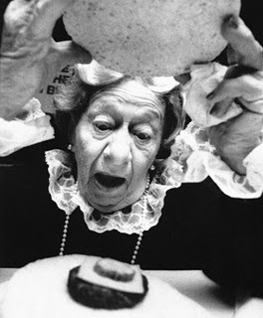
The Mad Hedge Fund Trader “Where’s the Recovery?”
With John Thomas from Silicon Valley, CA, May 9, 2018 www.madhedgefundtrader.com
Notes:
*

Slide 3
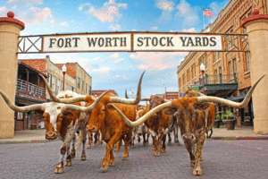
MHFT Global Strategy Luncheons Buy tickets at www.madhedgefundtrader.com
Fort Worth, TX June 11

Slide 4
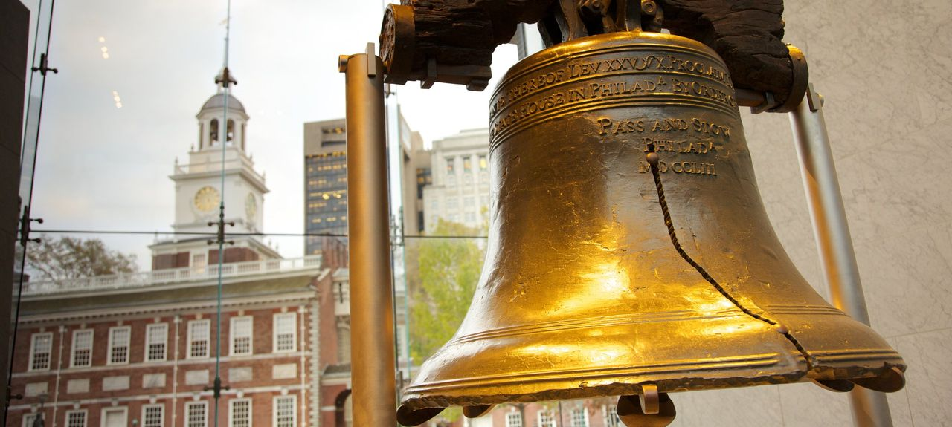
MHFT Global Strategy Luncheons Buy tickets at www.madhedgefundtrader.com
New Orleans, LA June 12
Philadelphia, PA June 13

Slide 5
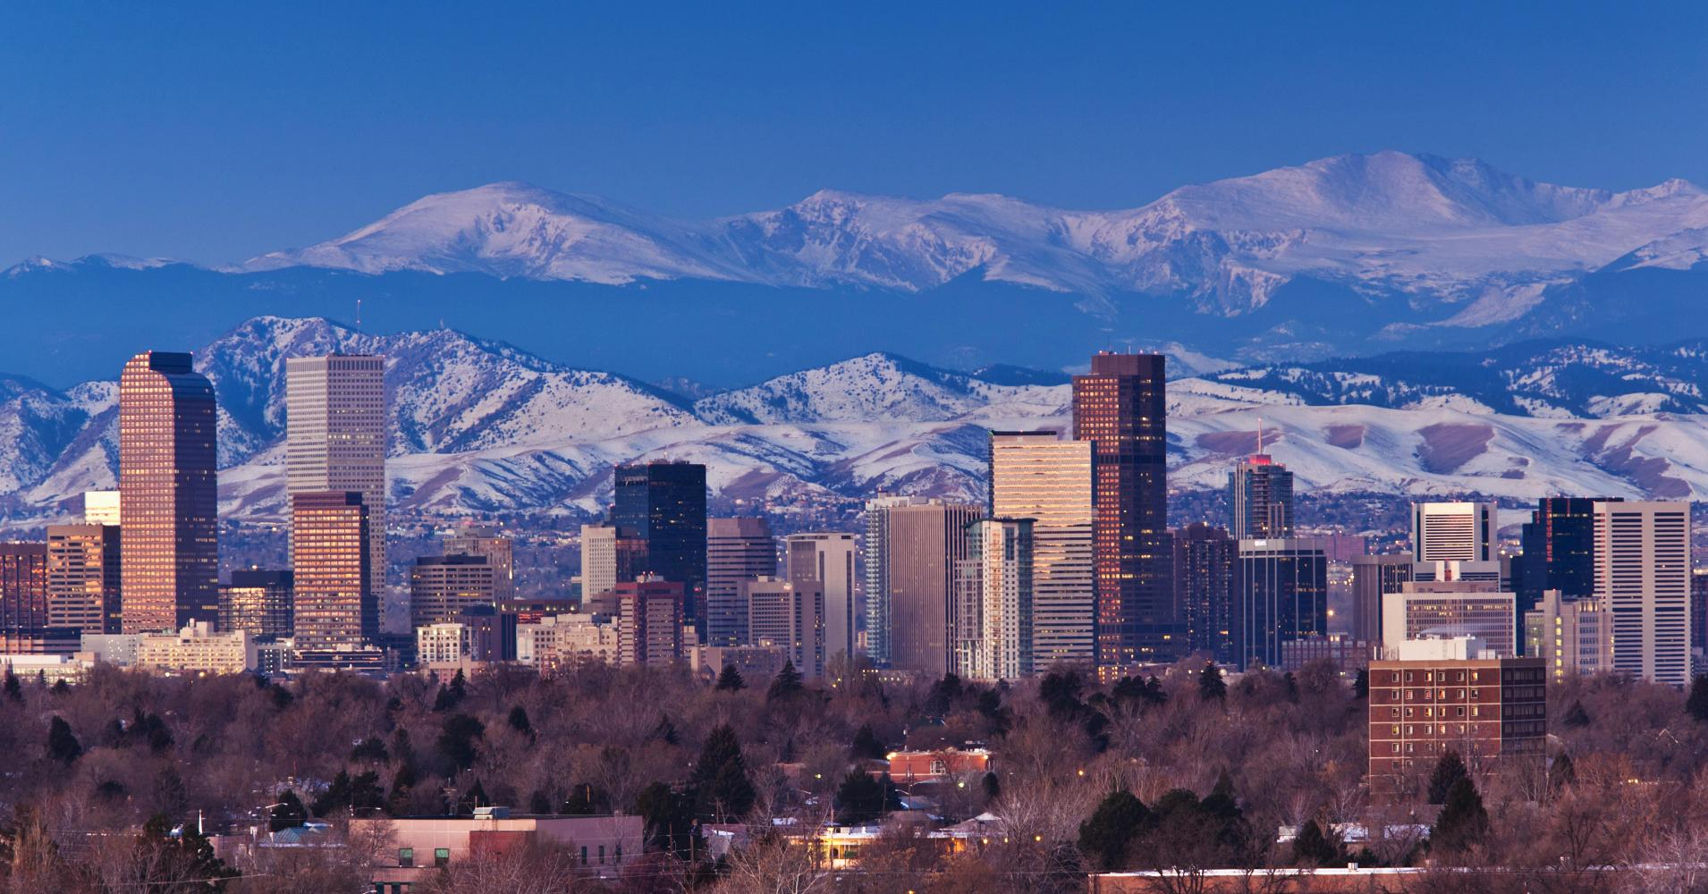
MHFT Global Strategy Luncheons Buy tickets at www.madhedgefundtrader.com
New York, NY June 14
Denver, CO June 15
Soon to be Posted: The Queen Mary II Seminar at Sea in July, Paris, France, Zermatt, Switzerland, and Geneva Switzerland

Slide 6
Trade Alert Performance New All Time High!!
*January 4.09% Final *July +1.95% Final *February +1.54% Final *August +18.38% Final *March +1.13% Final *September +7.65% Final *April +12.54% Final *October +1.39% Final *May +0% MTD *November +2.08% Final *June +0.70% Final *December +3.76% Final *2018 Year to Date 19.30% compared to -1.27% for the Dow Average *Trailing One year return +56.09%, +295.77% since inception, *Average annualized return of 35.55%

Slide 7
Portfolio Review 100% Cash ”RISK OFF” Ran to sidelines to protect Performance Risk/Reward is now terrible-Waiting for the fat pitch Hedges paid off big time
No Positions

Slide 8
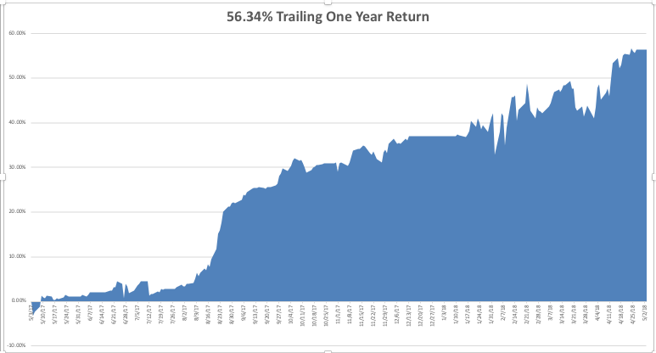
GTD Daily Audited Performance

Slide 9
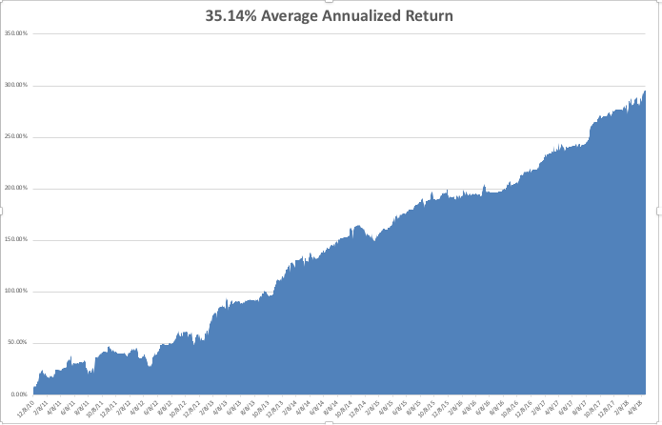
GTD Eight Year Daily Audited Performance
There is only one letter I know about doing better

Slide 10
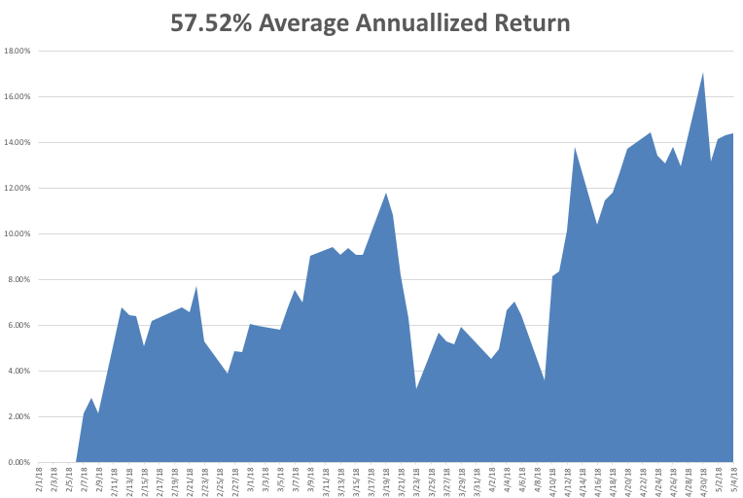
Mad Hedge Technology Letter a $2,500 a year upgrade

Slide 11
The Method to My Madness
*As bounces in the stock market get smaller, I took profits on all remaining positions *All other asset classes, including bonds, gold, and commodities *Missed the dollar breakout to new highs because I was too busy with equities and volatility *Rising interest rates says we have to sell currencies on every rally *Wide trading ranges until the November election continues

Slide 12
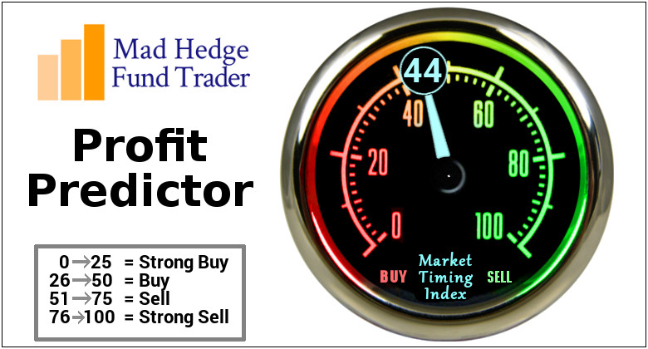
The Mad Hedge Profit Predictor Market Timing Index-Hits Top of New Range at 44 An artificial intelligence driven algorithm that analyzes 30 different economic, technical, and momentum driven indicators

Slide 13
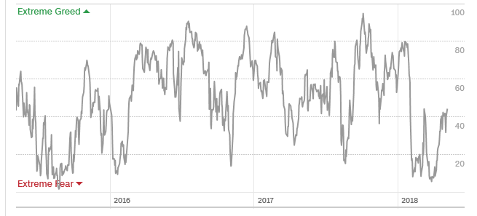
The Mad Hedge Profit Predictor Collapse Back to Extreme Fear A New 5-45 Trading Range?
SELL
BUY

Slide 14
The Global Economy – More Slowing
*Q1 GDP growth falls from 2.9% to 2.3%, is the first read on the effect of the tax bill, April Chicago PMI 58.3 down to 57.6, March Construction Spending down 1.7%, April Consumer Sentiment drops from 101.4 to 98.8 *US Auto Sales falling off a cliff, Toyota down -4.7% in April *Peoples Bank of China cuts reserve requirements to stimulate the economy *Euro zone Q1 GDP growth falls to 0.4% because of cold weather, strikes, and the flu *Weak global stock markets creating a negative wealth effect, bringing recession fears forward *FOMC does nothing on interest rates at last meeting

Slide 15
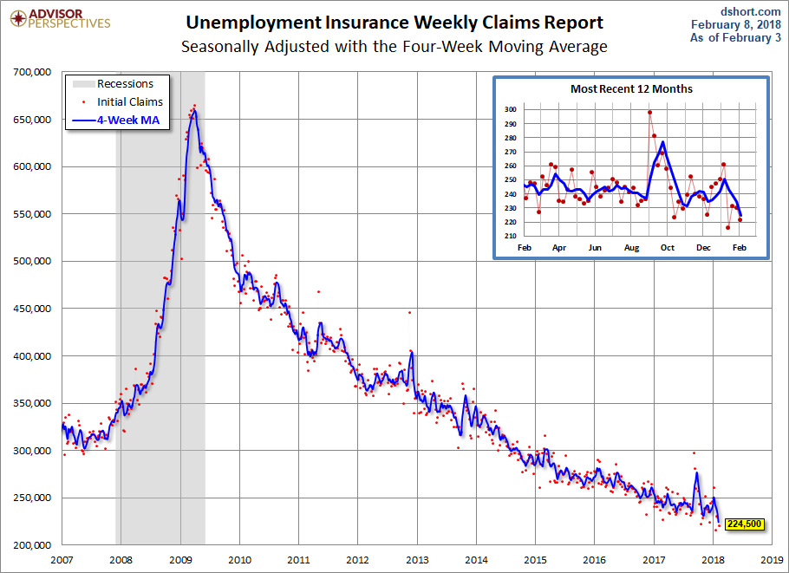
Weekly Jobless Claims –The Most Important Statistic +20,000 to 211,000- New 43 Year Low

Slide 16
The Bill Davis View A $1,500 Upgrade for the Mad Day Trader Service
Buys: | Entry | Target
Biogen Inc. (BIIB) | $ 265.00 | $ 300.00
WageWorks Inc. (WAGE) | $ 42.00 | $ 55.00
Vertex Pharmacueticals (VRTX) | $ 150.00 | $ 175.00
Splunk Inc. (SPLK) | $ 105.00 | $ 113.00
Allscripts,Inc.(MDRX) | $ 12.50 | $ 16.00
Sells:
Celgene Corp (CELG) | $ 88.00 | $ 62.00
Ambarella, Inc. (AMBA) | $ 52.00 | $ 42.00
Scotts Co. (SMG)-xx | $ 87.00 | $ 76.00
AGCO Corp (AGCO)-xx | $ 65.00 | $ 58.00
Tesla Inc. (TSLA)-xx | $ 312.00 | $ 265.00

Slide 17
Stocks-Smaller Bounces
*Stock bounces are getting smaller and smaller, approaching a final breakdown, then upside breakout *Stocks are rising on small volume and falling on large volume, suggesting that the major correction continues *US companies have become the sole buyers of the stock market, increasing buybacks this year from $500 billion to $800 billion *Short term Buffet Apple rally give the market a reprieve *Stocks setting up for a range for the next six months going into the November election *We are now in seasonal headwind and “Sell in May and Go away”, but did it start in February? *Bottom Line: Look for weakness into the summer, then a rally into yearend to new highs

Slide 18
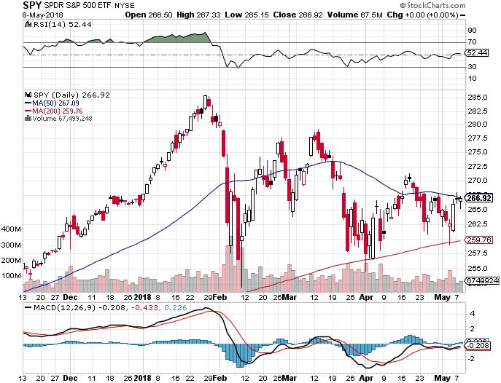
S&P 500-Moving Into a Range 200-day MA in Play took profits on long 5/$277-$280 put spread double weighting

Slide 19
S&P 500-Moving Into a Range 200-day MA in Play, If it fails looks for $245 down another 5% and down 14% from top- PE Multiple of 15X! took profits on long 5/$277-$280 put spread double weighting
Next support

Slide 20
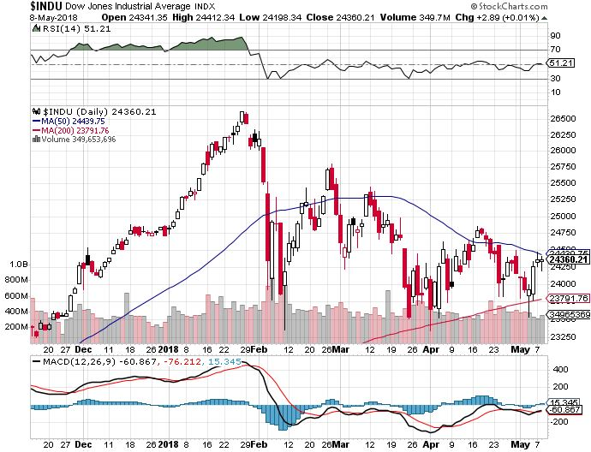
Dow Average- Downtrend

Slide 21
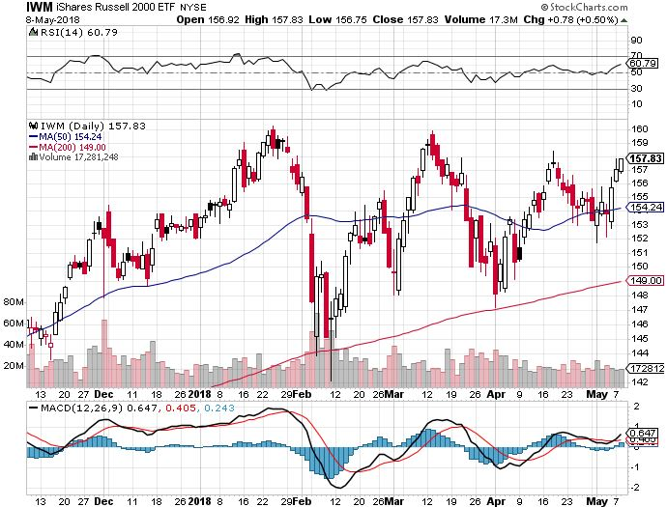
Russell 2000 (IWM)-Breakout Approaching? has become the lead index on tax breaks

Slide 22
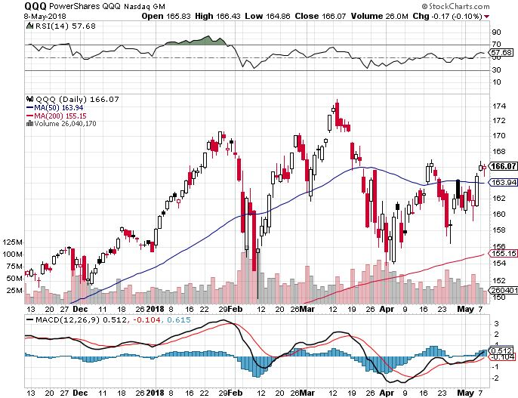
NASDAQ (QQQ)- Settling Into a Range for the rest of 2018
Washington chaos, Trade Wars, Iran, NK, and Syria wars, rising oil
High earnings growth, Good valuations, Buybacks, nothing else to buy

Slide 23
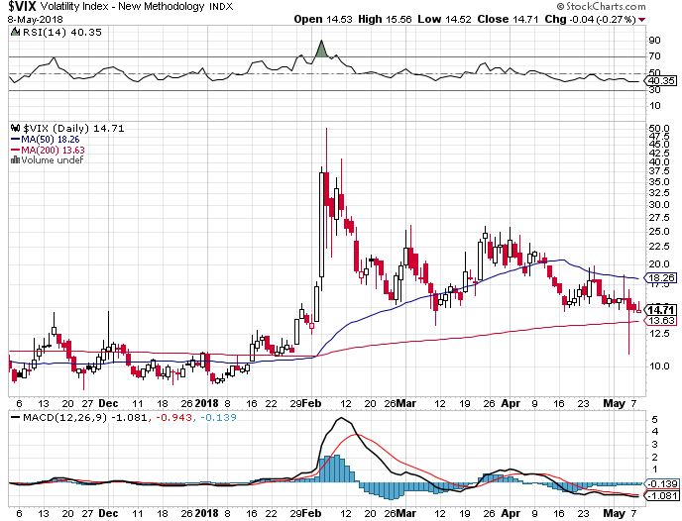
(VIX)- Up 25% in one day and we were long!
This is where it now lives

Slide 24
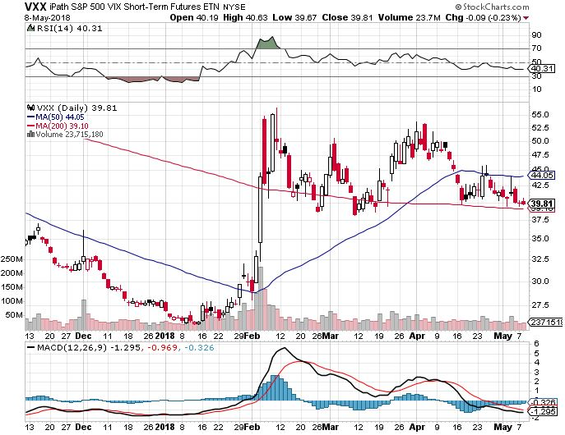
iPath S&P 500 VIX Short-Term Futures ETN (VXX) long 5/$32-$35 call spread took profits on long 3/$60-$65 bear put spread took profits on long 3/$55-$60 bear put spread

Slide 25
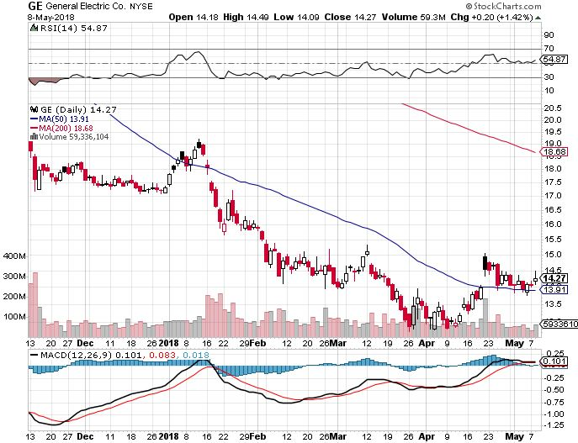
General Electric (GE)-Short Covering Rally Breakup Value is $15

Slide 26
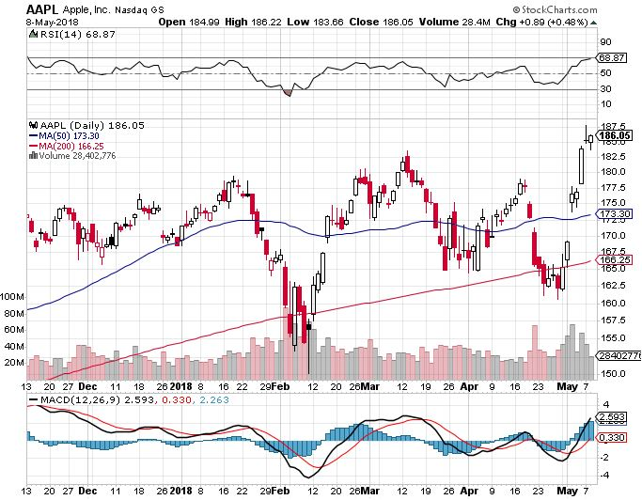
Apple (AAPL)-The Buffet Bump Warren Buffett now owns 5% of Apple, wishes he owned the whole company took profits on long 3/$140-$150 calls spread took profits on long 3/$140-$145 calls took profits on long 4/$155-$165 calls spread

Slide 27
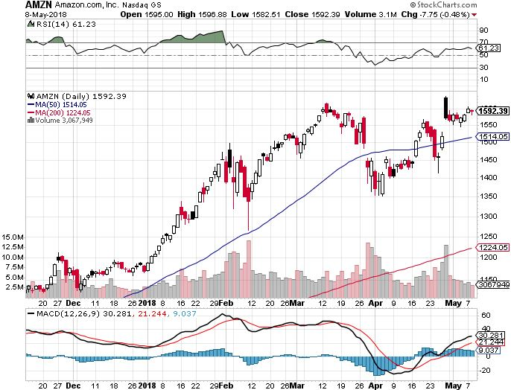
Amazon (AMZN) took profits on long 3/$1200-$1250 call spread (Tech Letter)

Slide 28
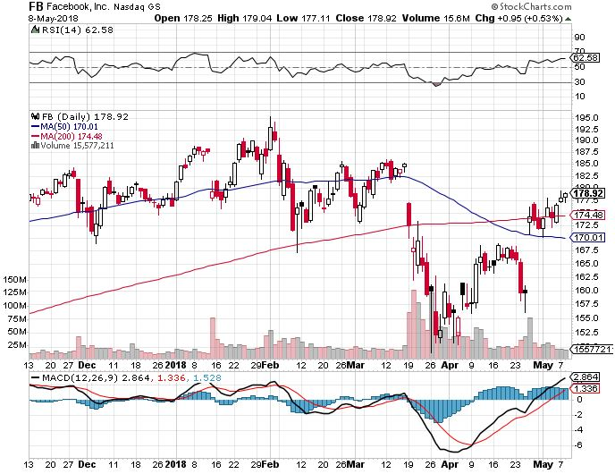
Facebook (FB)- stopped out of long 4/$150-$160 call spread took profits on long 6/$130-$140 bull call spread took profits on long 3/$155-$165 bull call spread took profits on long 3/$190-$195 bear put spread

Slide 29
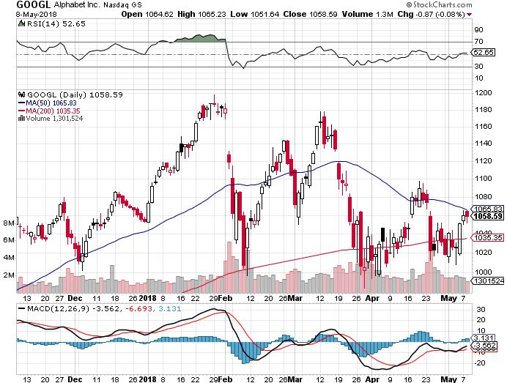
Alphabet (GOOGL)- took profits on long 4/$900-$930 call spread

Slide 30
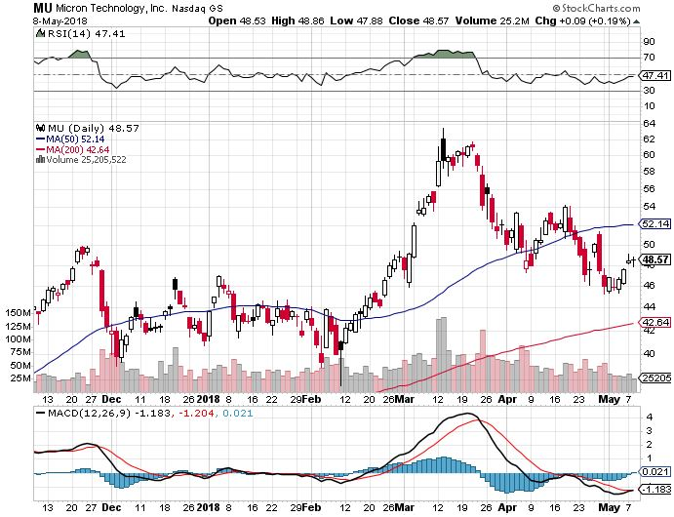
Micron Technology (MU)-Spectacular Earnings took profits on long 3/$34-$37 bull call spread in Mad Hedge Technology Letter Only UBS bearish report decimates the entire chip industry

Slide 31
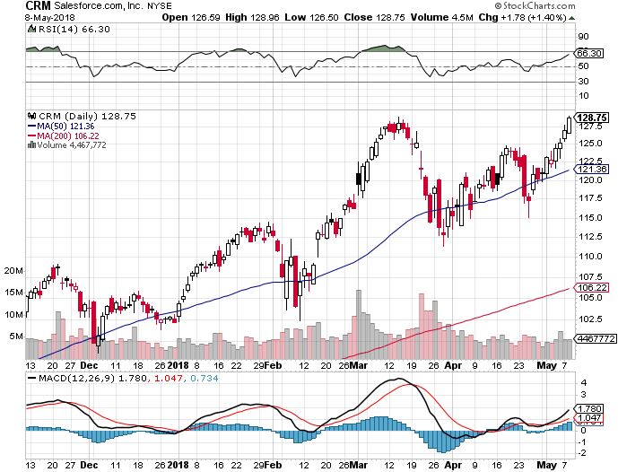
Salesforce (CRM)-New High took profits on long 6/$105-$110 call spread took profits on long 3/$90-$95 bull call spread in Mad Hedge Technology Letter

Slide 32
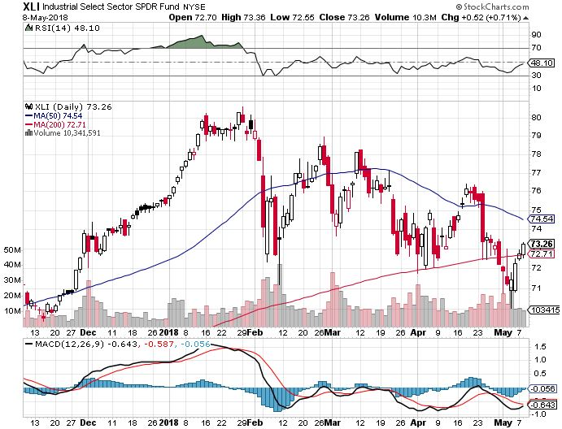
Industrials Sector SPDR (XLI)-Yuck! (GE), (MMM), (UNP), (UTX), (BA), (HON)

Slide 33
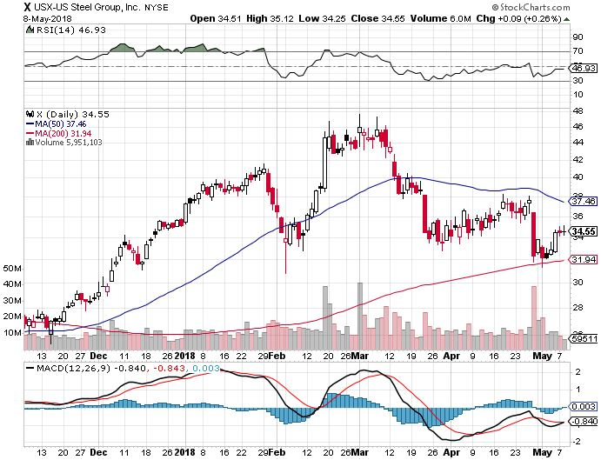
US Steel (X)-Earnings Disappointment took profits on long the 9/$21-$22 vertical bull call spread

Slide 34
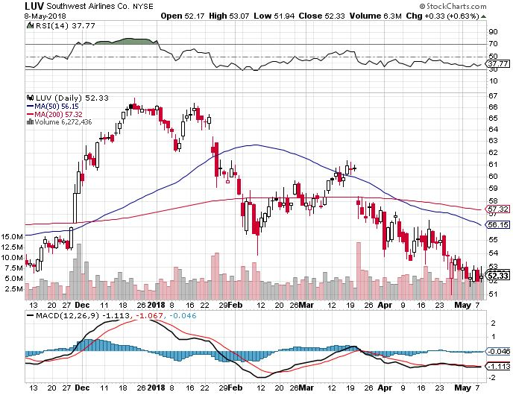
Southwest Airlines (LUV)- Warren Buffett’s Favorite Airline

Slide 35
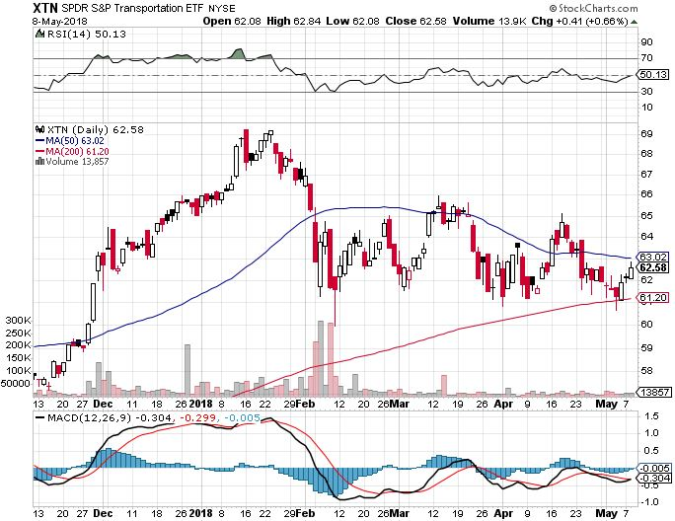
Transports Sector SPDR (XTN)- (ALGT), (ALK), (JBLU), (LUV), (CHRW), (DAL)

Slide 36
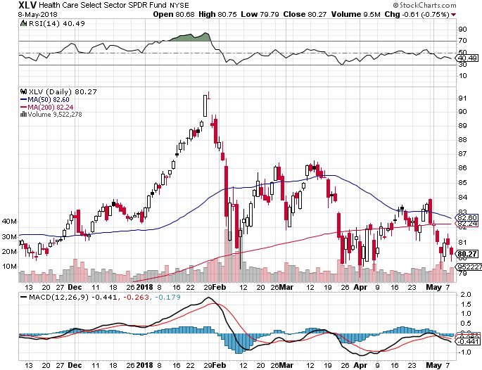
Health Care Sector (XLV), (RXL)- (JNJ), (PFE), (MRK), (GILD), (ACT), (AMGN)

Slide 37
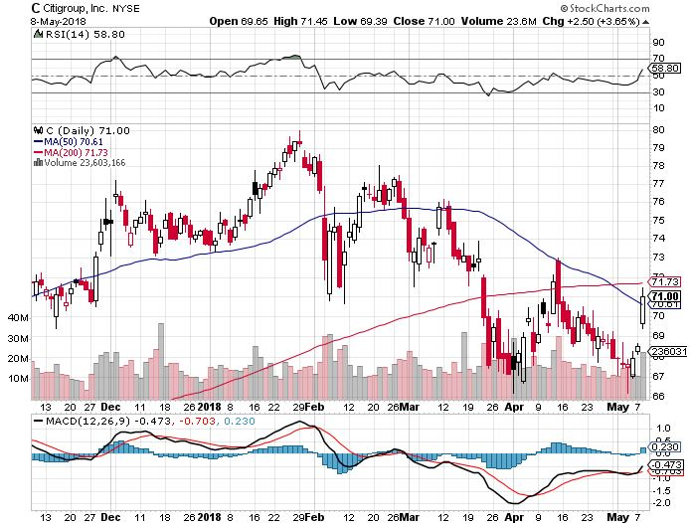
Citigroup (C)-Earnings up 25% took profits on long 6/$60-$65 bull call spread

Slide 38
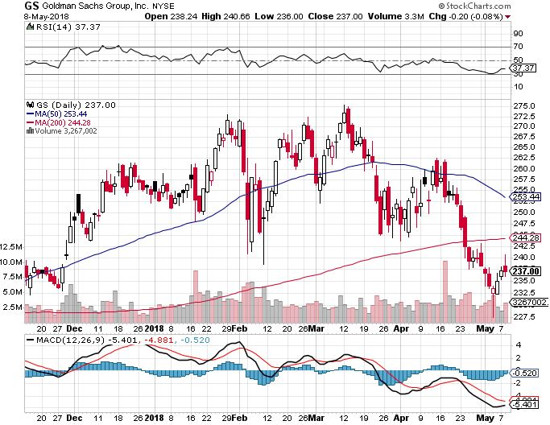
Goldman Sachs (GS)-Earnings Disappointment on bond losses stopped out of long 4/240-$245 call spread stopped out of long 10/$220-$225 vertical bull call spread took profits on long 10/$227.50-$232.50 vertical bull call spread

Slide 39
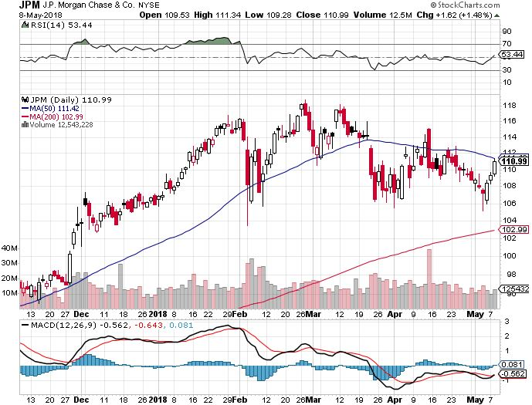
JP Morgan (JPM)- took profits on long 4/$95-$100 call spread

Slide 40
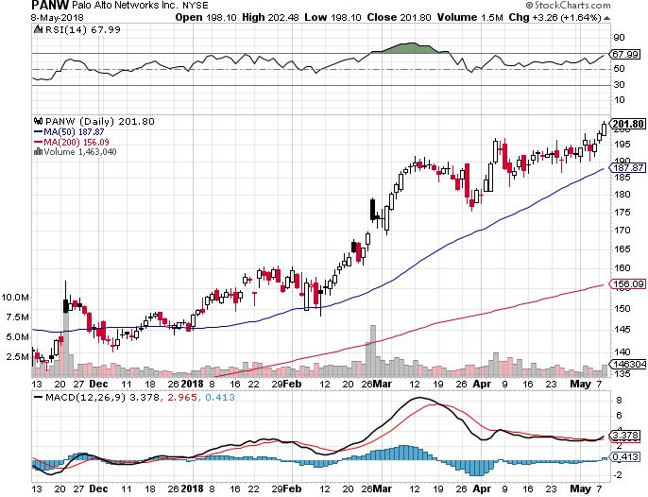
Palo Alto Networks (PANW)-New High

Slide 41
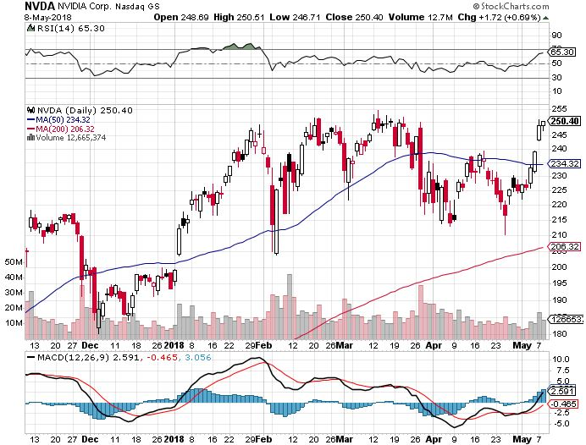
NVIDIA (NVDA)-Great Earnings End of chip cycle fears

Slide 42
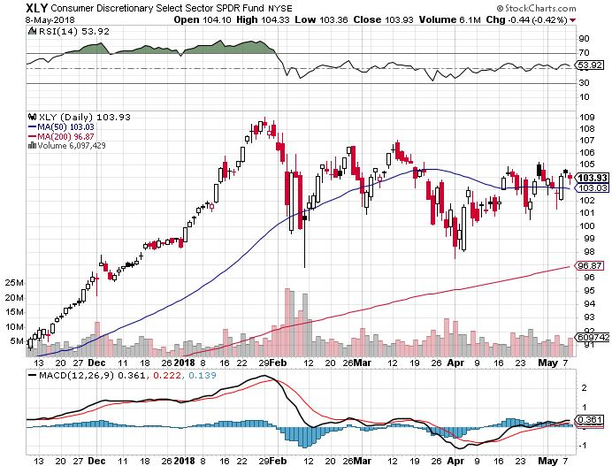
Consumer Discretionary SPDR (XLY) (DIS), (AMZN), (HD), (CMCSA), (MCD), (SBUX)

Slide 43
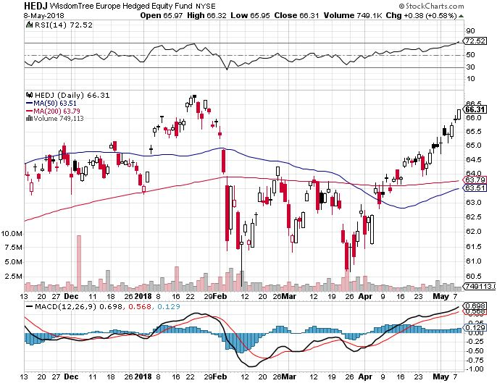
Europe Hedged Equity (HEDJ)-Euro crash

Slide 44
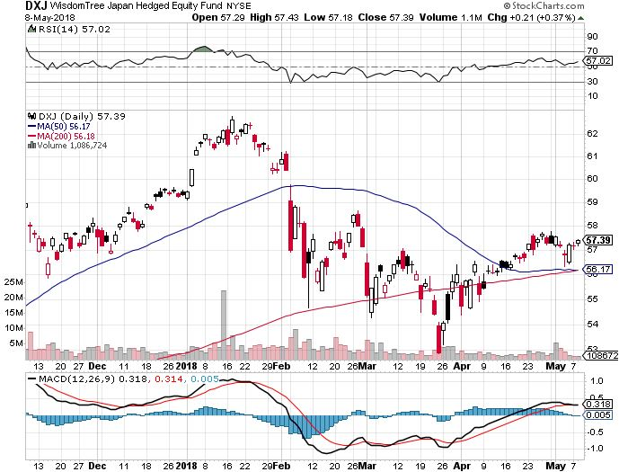
Japan (DXJ)-Falling Yen Move

Slide 45
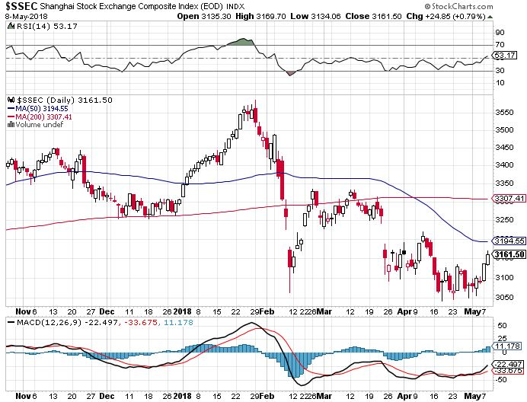
China ($SSEC)-Economic Recovery on Track

Slide 46
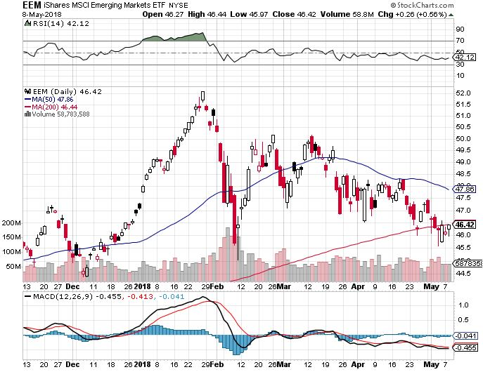
Emerging Markets (EEM)- Killed by Strong Dollar

Slide 48
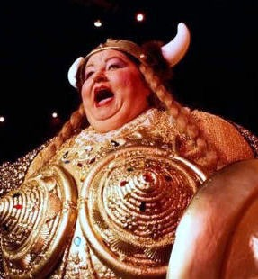
Bonds- The Fat Lady is Singing
*Bonds give up the breakout and fall back below 3.00% *Cherry pick your next trade, wait for yields to move back below 2.90% to sell short again *18 consecutive bond short sells in 9 months have all been profitable *Wait for next big read on inflation before making a move *Still looking for 3.25%-3.5% ten year US Treasury yield by yearend *Exploding deficits will weigh on bond for the next decade, sell every rally across the space Bottom Line: Sell every four point rally in the (TLT)

Slide 49
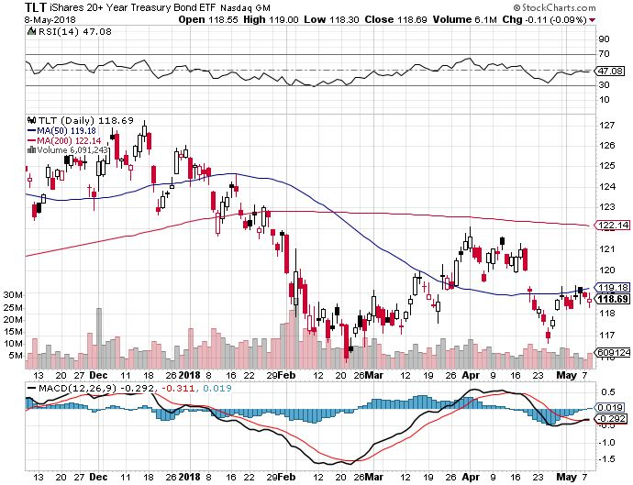
Treasury ETF (TLT) – 2.78 Bottoming Out took profits on long 5/$124-$127 vertical bear put spread took profits on long 4/$123-$126 vertical bear put spread Took profits on long the (TLT) 2/$124-$127 vertical bear put spread again

Slide 50
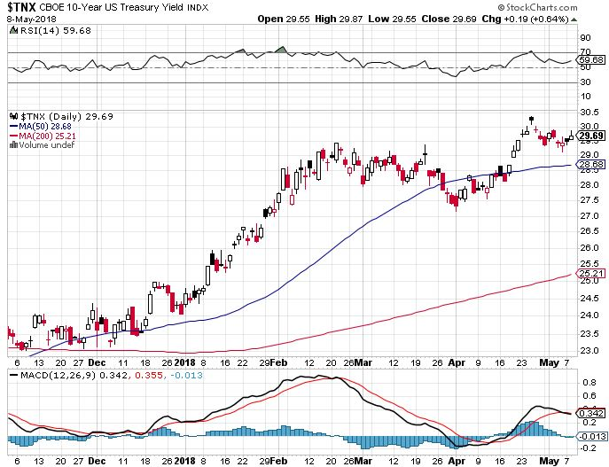
Ten Year Treasury Yield ($TNX) 2.98% Breakdown, Now major Support

Slide 51
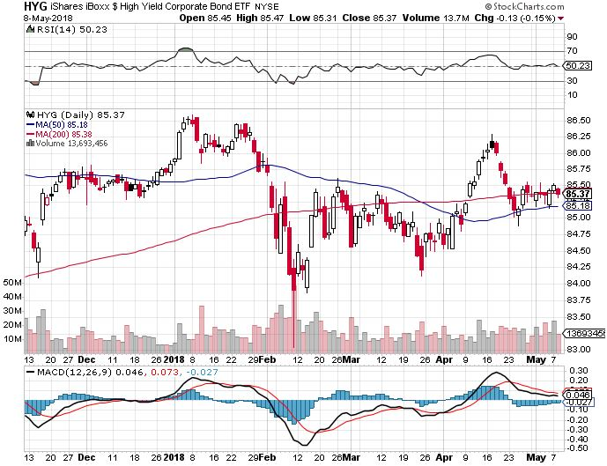
Junk Bonds (HYG) 5.51% Yield 60 basis point pop in yield on stock crash

Slide 52
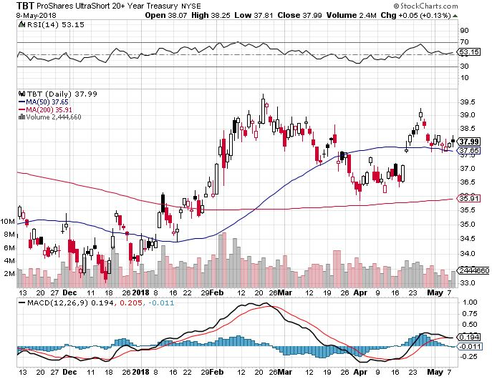
2X Short Treasuries (TBT)- Take Profits

Slide 53
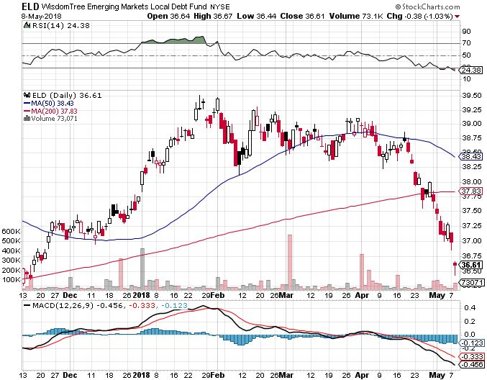
Emerging Market Debt (ELD) 5.68% Yield-

Slide 54
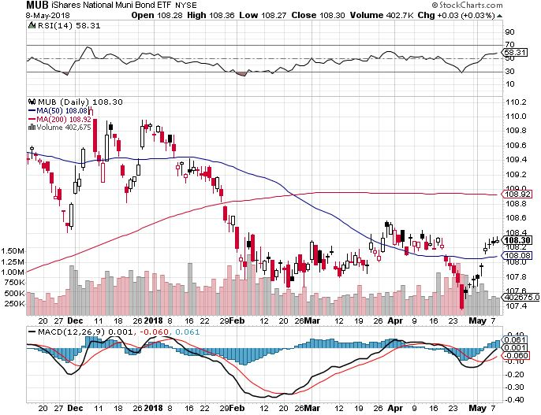
Municipal Bonds (MUB)-2.32% Mix of AAA, AA, and A rated bonds Huge 40 basis point yield pop on tax bill

Slide 56
Foreign Currencies- QE versus QT
*Latest ECB meeting says Europe sticks with QE, while the US pursues more QT and finally get s a stronger dollar and weaker currencies *Euro and Japanese yen breakdown from 2018 ranges on fears of rising interest rates *No respite for commodity currencies either *Bank of England meets this week, but will do nothing *Out of tax overhang, Bitcoin returns to top of recent range Bottom Line: Sell rallies on any currencies

Slide 57
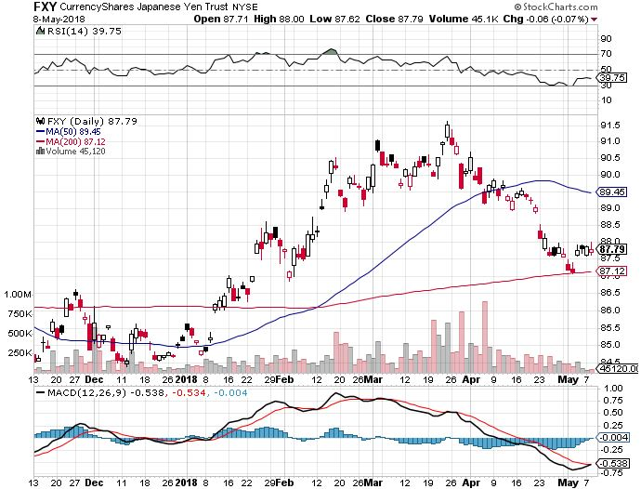
Japanese Yen (FXY), (YCS) took profits on long (FXY) 3/$91-$93 bear put spread

Slide 58
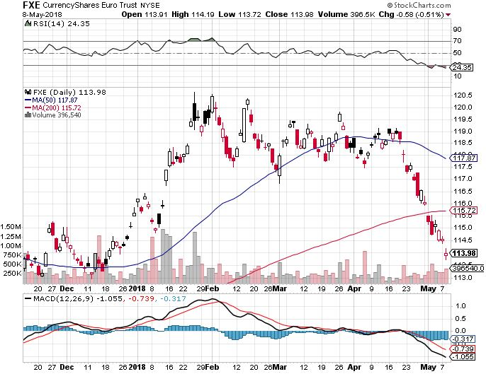
Euro ($XEU), (FXE), (EUO)- Triple Top took profits on long (FXE) 3/$120-$123 vertical bear put spread took profits on long (FXE) 12/$116-$118 vertical bear put spread took profits on long (FXE) 12/$111-$113 vertical bull call spread

Slide 59
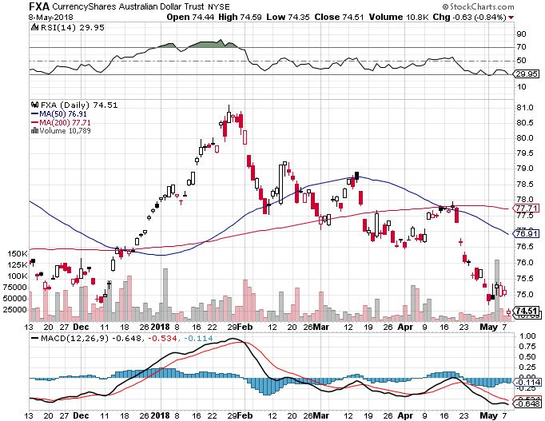
Australian Dollar (FXA)

Slide 60
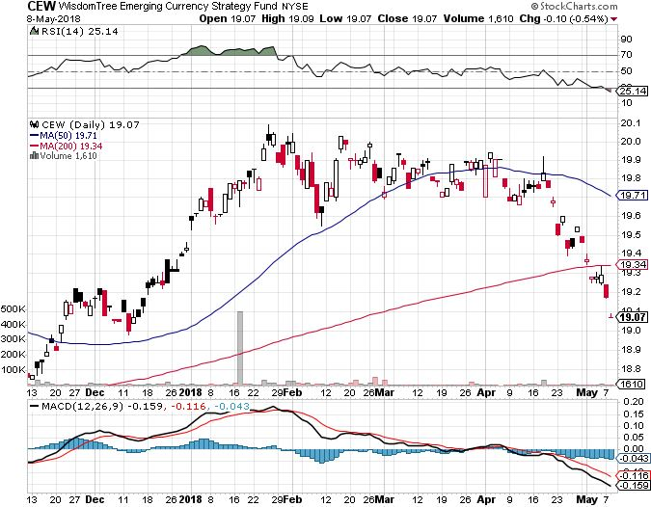
Emerging Market Currencies (CEW)

Slide 61
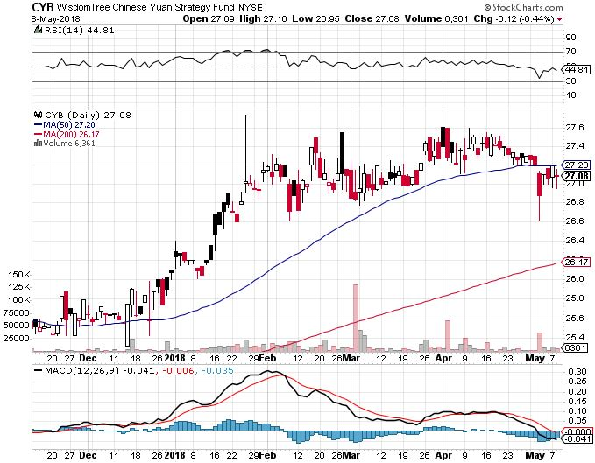
Chinese Yuan- (CYB)-Stabilizing on Government Support

Slide 62
Bitcoin-Modern Day Tulips! Charlie Munger’s Turds, Artificial gold

Slide 63
Energy- New Highs!
*The geopolitical premium is back, takes oil over $70, a new three year high *US withdrawal from Iran deal causes huge ramp up in oil prices, then a selloff on the news *US oil production hits new all time high as exports ramp up *Conoco moves to seize Venezuelan Caribbean assets for non payment, will lead to complete oil production shut down taking 1.5 million of oil off the market *Saudi Arabia now looking to extend production quotas into 2019, which have been hugely successful *Fracking supply is on the rebound, Baker Hughes US Rig Count rises sharply by 11 to 1,032 *Bottom Line: Oil may be peaking here so stand aside

Slide 64
Oil-New High and Inflation Push

Slide 65
United States Oil Fund (USO)

Slide 66
Energy Select Sector SPDR (XLE)-No Performance! (XOM), (CVX), (SLB), (KMI), (EOG), (COP)

Slide 67
Alerian MLP ETF (AMLP)- Basket Approach

Slide 68
Exxon (XOM)-Earnings Dive

Slide 69
Schlumberger (SLB)-

Slide 70
Halliburton (HAL)-

Slide 71
Natural Gas (UNG)-

Slide 72
Copper (COPX)-Trade War Fears

Slide 73
Precious Metals-Rising Rate Drag
*American gold eagle coin sales fall 60% YOY in Q1 as retail interest fades *Collapsing Euro and Japanese yen also feeding into weaker gold *Q1 Gold demand falls 7% to 973.5 metric tonnes, the lowest in ten years, ETF flows falling, jewelry demand unchanged *Technology demand for chip manufacture has risen for six consecutive quarters *Narrow trading range is flagging interest and shrinking volume *Bottom Line: Buy gold and silver stocks on the next big dip, as it is still early days for the bull market

Slide 74
Gold (GLD)-Upside Breakout Imminent! long 5/$119-$122 bull call spread took profits on long (GLD) $12/$116-$119 bull call spread

Slide 75
Market Vectors Gold Miners ETF- (GDX) Took profits on long the 9/$20.50-$21.50 bull call spread

Slide 76
Barrick Gold (ABX) stopped out of long 9/$15-16 call spread

Slide 77
Newmont Mining- (NEM)-Breakout stopped out of 2/$36-$39 bull call spread for small loss took profits on long the 9/$32-$34 bull call spread

Slide 78
Global X Silver Miners ETF- (SIL)-Breakout took profits on long the 9/$31-$33 bull call spread

Slide 79
Real Estate- The Melt Up Continues
*Housing confidence at all time high as the melt up continues, San Francisco entry level homes selling for 40% over asking price *March home price up 7%, biggest jump in four years *Home prices now rising five times faster than incomes, as residents fear being priced out of their home market *Millennial buying fell in Q1 *30 year fixed mortgage approaching 4.55%, near five year lows, causing new mortgages to drop 2.5% *S&P 500 Case-Shiller maintains strong 6.3%, with absolute prices hitting new all time highs *Bottom Line: Buy real estate plays on dips

Slide 80
February Corelogic S&P Case Shiller Home Price Index +6.3% YOY, Seattle (+12.7%), Las Vegas (+11.6%), San Francisco (+10.1%) still leaders price rises accelerating

Slide 81
Simon Property Group (SPG)-

Slide 82
US Home Construction Index (ITB) (DHI), (LEN), (PHM), (TOL), (NVR)

Slide 83
Trade Sheet- So What Do We Do About All This?
*Stocks- Buy the Next Capitulation selloff *Bonds-sell any and all rallies *Commodities-stand aside *Currencies-sell rallies in currencies *Precious Metals –buy dips *Volatility-go short on runs up to $20 *Real estate-buy dips

Slide 84
Next Strategy Webinar 12:00 EST Wednesday, May 23, 2018 San Francisco, CA For Lunches Please Go to www.madhedgefundtrader.com and click “Store”
Good Luck and Good Trading!
Notes:
*

