Slide 1
The Mad Hedge Fund Trader “No Trade!”
With John Thomas from Silicon Valley, CA, May 23, 2018 www.madhedgefundtrader.com
Notes:
*

Slide 2
MHFT Global Strategy Luncheons Buy tickets at www.madhedgefundtrader.com
Fort Worth, TX June 11

Slide 3
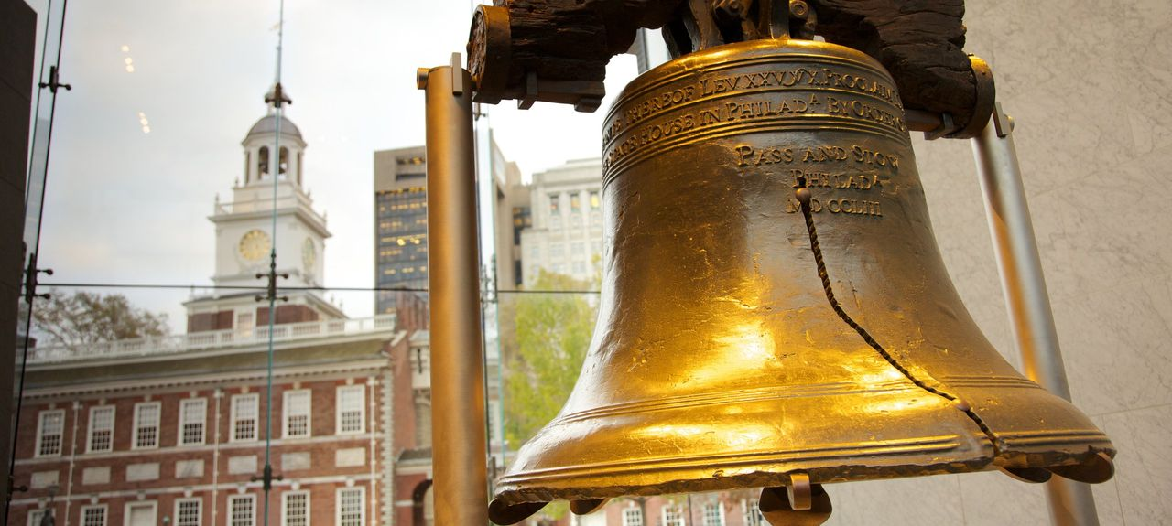
MHFT Global Strategy Luncheons Buy tickets at www.madhedgefundtrader.com
New Orleans, LA June 12
Philadelphia, PA June 13

Slide 4
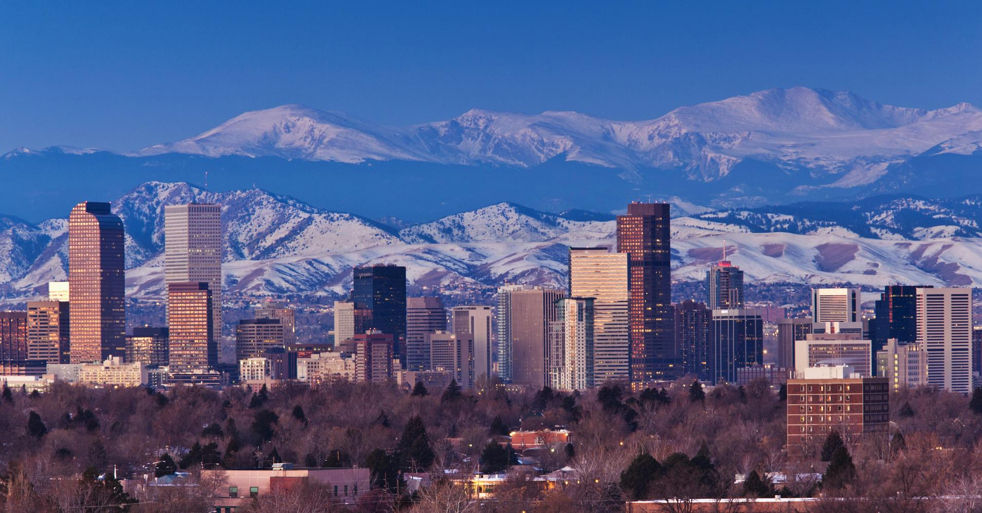
MHFT Global Strategy Luncheons Buy tickets at www.madhedgefundtrader.com
New York, NY June 14
Denver, CO June 15

Slide 5
MHFT Global Strategy Luncheons Buy tickets at www.madhedgefundtrader.com
Seminar at Sea July 13
Paris, France July 17
Soon to be Posted: Zermatt, Switzerland, and Amsterdam

Slide 6
Trade Alert Performance New All Time High!!
*January 4.09% Final *July +1.95% Final *February +1.54% Final *August +18.38% Final *March +1.13% Final *September +7.65% Final *April +12.54% Final *October +1.39% Final *May +1.30% MTD *November +2.08% Final *June +0.70% Final *December +3.76% Final *2018 Year to Date 20.60% compared to -.20% for the Dow Average *Trailing One year return +56.25%, +296.50% since inception, *Average annualized return of 35.35%

Slide 7
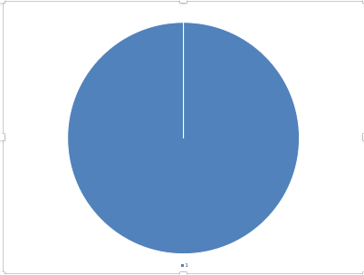
Portfolio Review 90% Cash, 10% short ”RISK OFF” Ran to sidelines to protect performance at all time high Risk/Reward is now terrible-Waiting for the fat pitch Hedges paid off big time
Current Capital at Risk
Risk On
World is Getting Better
NO POSITION
Risk Off
(SPY) 6/$280-$283 put spread | -10.00%
Total Net Position | -10.00%
Expiration P&L 20.94%

Slide 8
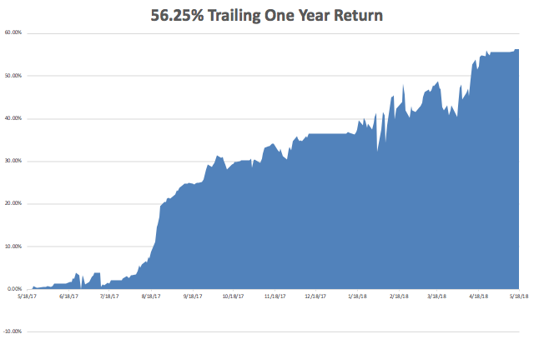
GTD Daily Audited Performance

Slide 9
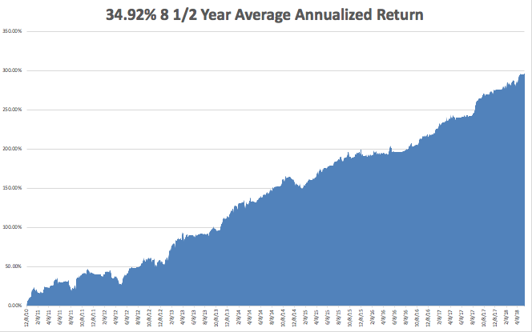
GTD Eight Year Daily Audited Performance
There is only one letter I know about doing better

Slide 10
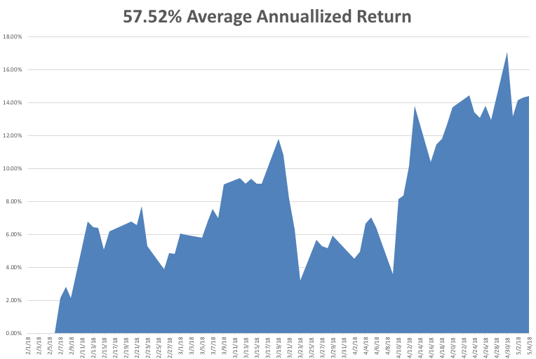
Mad Hedge Technology Letter a $2,500 a year upgrade

Slide 11
The Method to My Madness
*Stocks too high to buy *Bonds too low to sell *Missed the dollar breakout to new highs because I was too busy with equities and volatility *Rising interest rates says we have to sell currencies on every rally *Rising rates also say that precious metals and yield plays are DOA *Start planning that vacation now, it’s setting upto be a dreadful summer

Slide 12
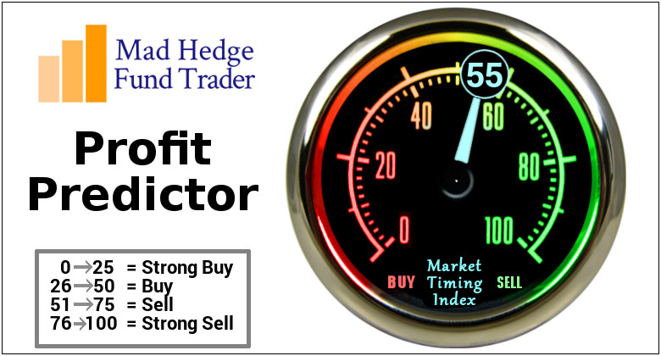
The Mad Hedge Profit Predictor Market Timing Index-Hits Top of New Range at 44 An artificial intelligence driven algorithm that analyzes 30 different economic, technical, and momentum driven indicators

Slide 13
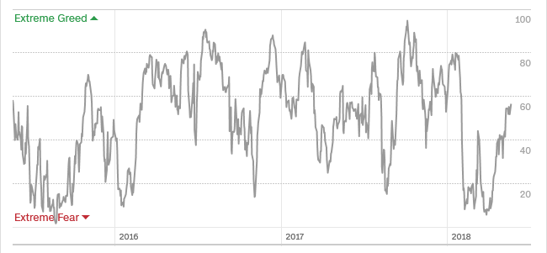
The Mad Hedge Profit Predictor Collapse Back to Extreme Fear A New 5-45 Trading Range?
SELL
BUY

Slide 14
The Global Economy – Rolling Over
*China trade war on hold really means that the China trade war is over, and China won *Steel and aluminum tariff increases have been suspended *April Consumer Sentiment was up, but only slightly, from 98.0 to 98.8, April Producer Price Index up a non-inflationary 0.1%, up 2.3% YOY, *Europe is falling off a cliff with PMI’s down to an 18 month low, corporate profits up 3.25% YOY vs 26% in the US *Global slowdown means the bull market is on hold *FOMC to raise interest rates by 25 basis points in a month

Slide 15
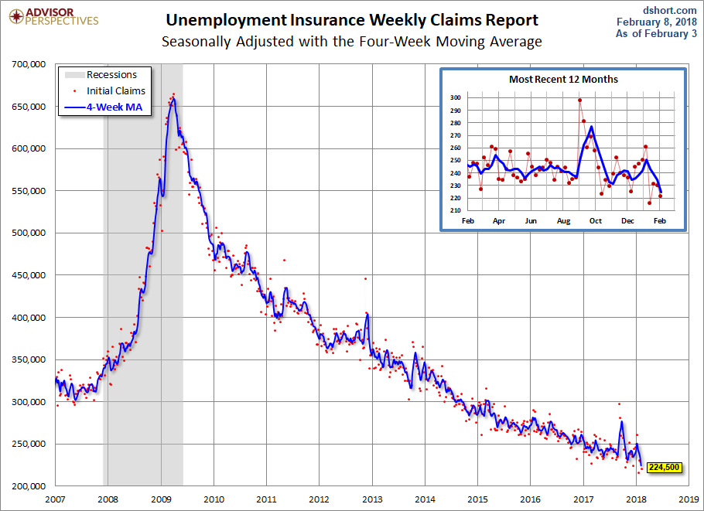
Weekly Jobless Claims –The Most Important Statistic +11,000 to 222,000- 43 Year Low

Slide 16
The Bill Davis View A $1,500 Upgrade for the Mad Day Trader Service
 | Buys: | Entry | Target
 | Welltower Inc. (WELL) | $ 53.00 | $ 62.00
 | Kimberly Clark Corp (KMB) | $ 106.00 | $ 120.00
 | Monster Beverage (MNST) | $ 49.00 | $ 60.00
 | Cirrus Logic Inc. (CRUS) | $ 37.00 | $ 50.00
 | Patterson Dental (PDCO) | $ 22.00 | $ 35.00
 | Sells:
 | Celgene Corp (CELG) | $ 81.00 | $ 72.00
 | Tesla Inc. (TSLA)-xx | $ 290.00 | $ 265.00
 | Cummins Inc. (CMI) | $ 162.00 | $ 148.00
 | Oshkosh Corp (OSK) | $ 82.00 | $ 70.00
 | Verisk Analytics (VRSK) | $ 105.00 | $ 92.00

Slide 17
Stocks- Losing Interest
*Stocks move to high end of recent trading range, but no breakout is imminent *No breakout possible until we get the next batch of earnings reports in two months *Earnings multiples have been falling since February 1, indicating that the end of the bull market is approaching *Stocks are rising on small volume and falling on large volume, suggesting that the major correction continues *Estimated US data center growth in five years are doubling to $60 billion a year, so all tech selloffs will be temporary *Stocks stuck in a range for the next five months going into the November election *We are now in seasonal stock market headwind *Bottom Line: Look for weakness into the summer, then a rally into yearend to new highs

Slide 18
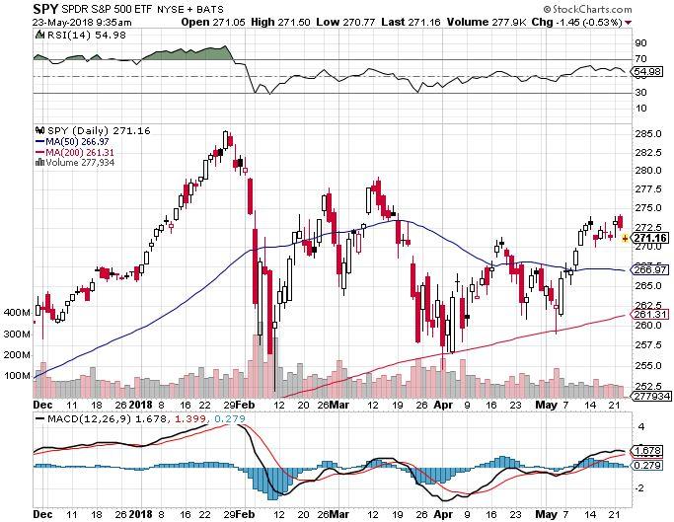
S&P 500- Stuck In a Range took profits on long 5/$277-$280 put spread double weighting
Next support

Slide 19
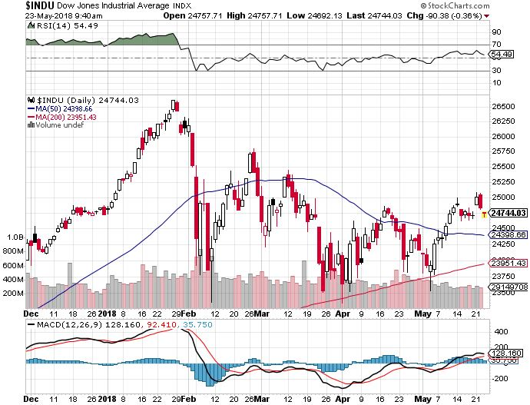
Dow Average- Downtrend

Slide 20
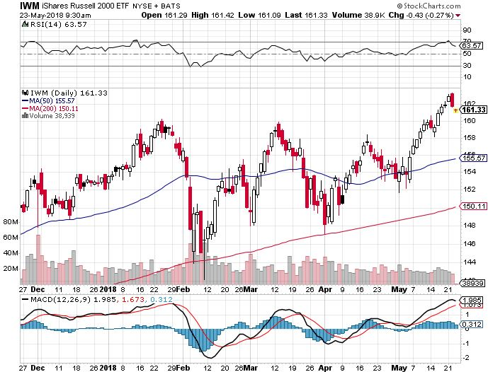
Russell 2000 (IWM)-Breakout Approaching? has become the lead index on tax breaks

Slide 21
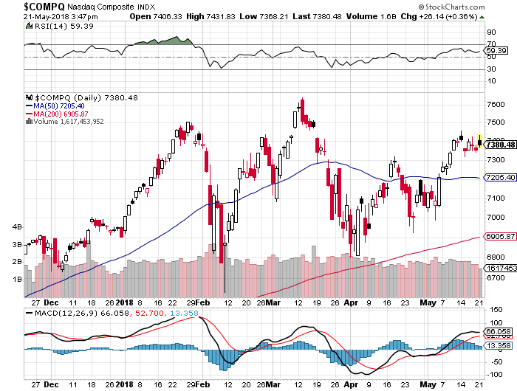
NASDAQ (QQQ)- Settling Into a Range for the rest of 2018
Washington chaos, Trade Wars, Iran, NK, and Syria wars, rising oil, PE at 20X
High earnings growth, Good valuations, Buybacks, nothing else to buy PE at 16X

Slide 22
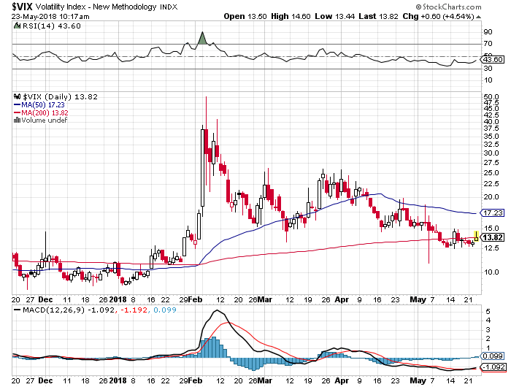
(VIX)- Gone to Sleep
This is where it now lives

Slide 23
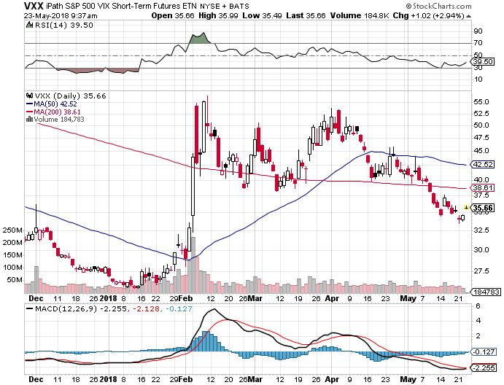
iPath S&P 500 VIX Short-Term Futures ETN (VXX) long 5/$32-$35 call spread took profits on long 3/$60-$65 bear put spread took profits on long 3/$55-$60 bear put spread

Slide 24
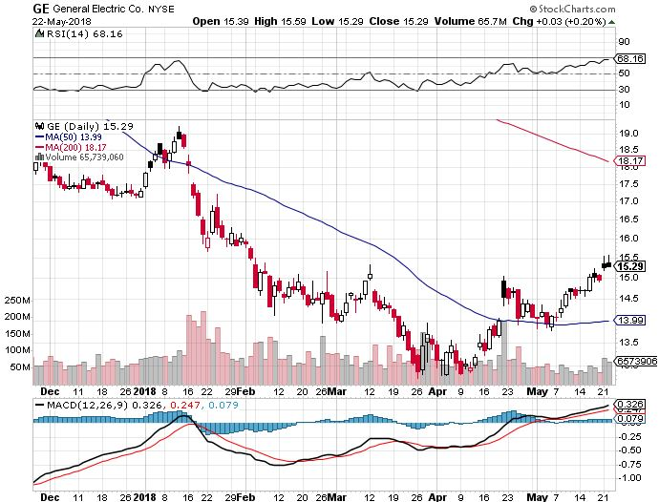
General Electric (GE)-Short Covering Rally Breakup Value is $15

Slide 25
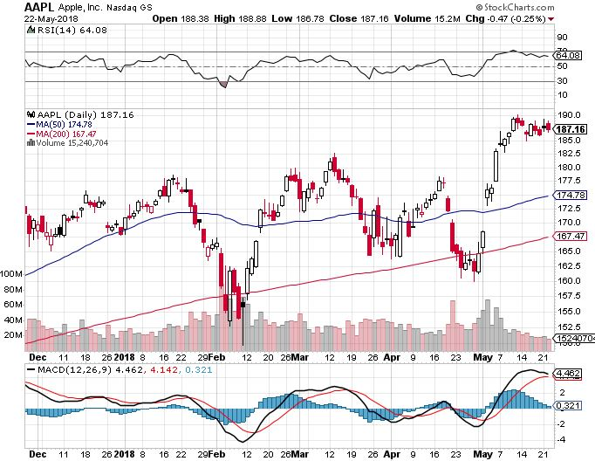
Apple (AAPL)-The Buffet Bump Warren Buffett now owns 5% of Apple, wishes he owned the whole company took profits on long 6/$130-$140 calls spread profits on long 3/$140-$150 calls spread took profits on long 3/$140-$145 calls took profits on long 4/$155-$165 calls spread

Slide 26
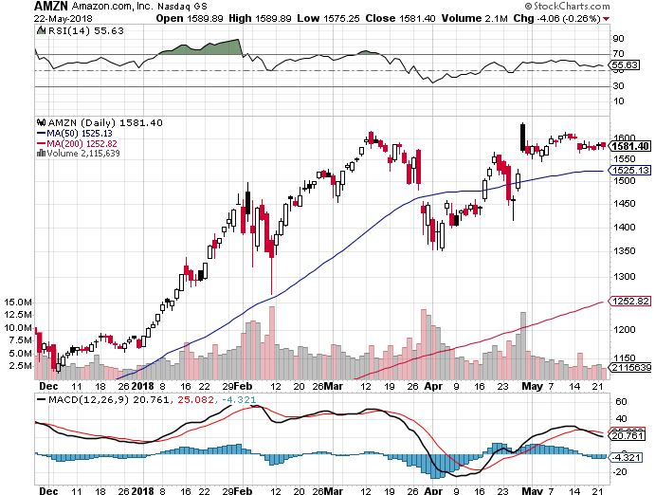
Amazon (AMZN) – Targeting $2,000 took profits on long 3/$1200-$1250 call spread (Tech Letter)

Slide 27
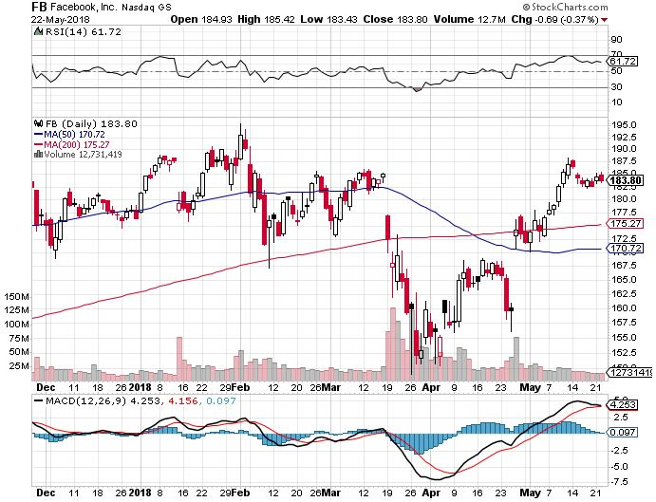
Facebook (FB)- Reality Returns stopped out of long 4/$150-$160 call spread took profits on long 6/$130-$140 bull call spread took profits on long 3/$155-$165 bull call spread took profits on long 3/$190-$195 bear put spread

Slide 28
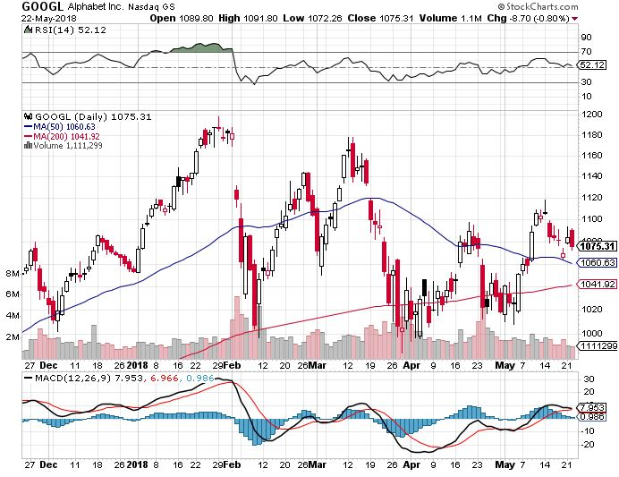
Alphabet (GOOGL)- 60 Minutes Drag took profits on long 4/$900-$930 call spread

Slide 29
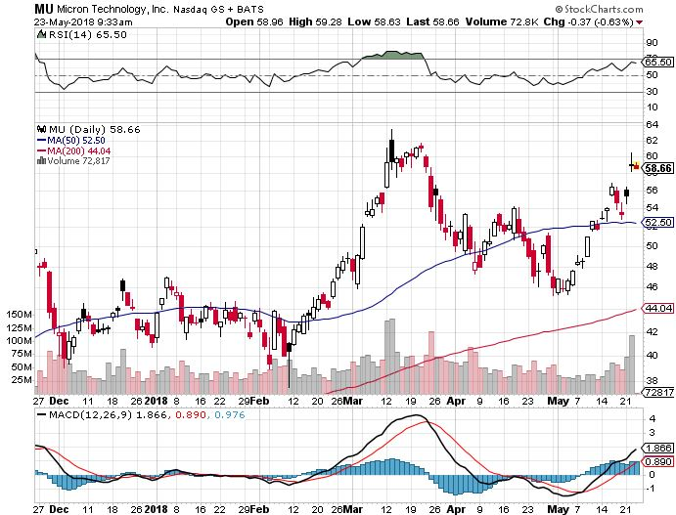
Micron Technology (MU)-Spectacular Earnings took profits on long 3/$34-$37 bull call spread in Mad Hedge Technology Letter Only UBS bearish report decimates the entire chip industry

Slide 30
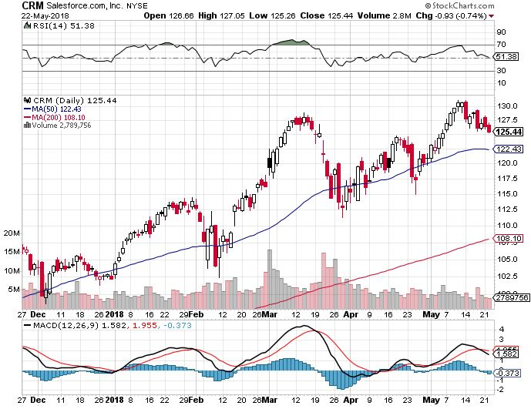
Salesforce (CRM)-New High took profits on long 6/$105-$110 call spread took profits on long 3/$90-$95 bull call spread

Slide 31
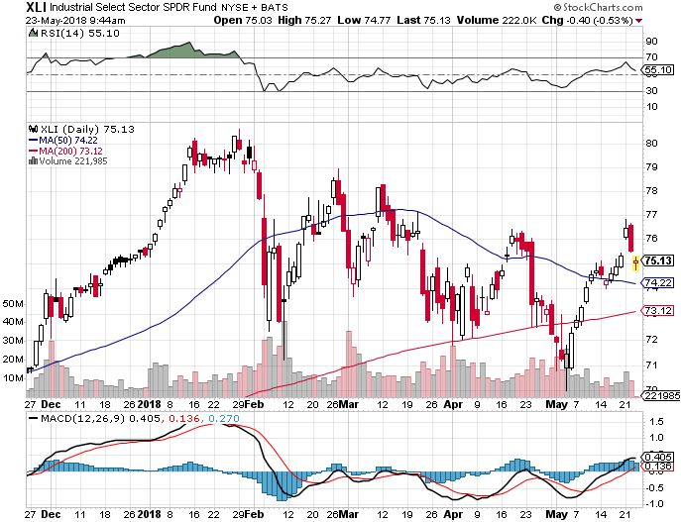
Industrials Sector SPDR (XLI)-Yuck! (GE), (MMM), (UNP), (UTX), (BA), (HON)

Slide 32
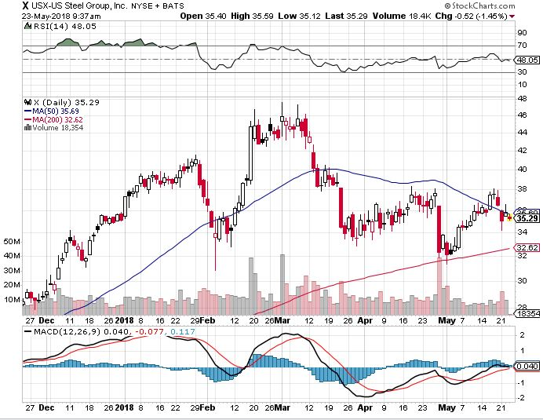
US Steel (X)-Earnings Disappointment Import duties cause users to abandon steel took profits on long the 9/$21-$22 vertical bull call spread

Slide 33
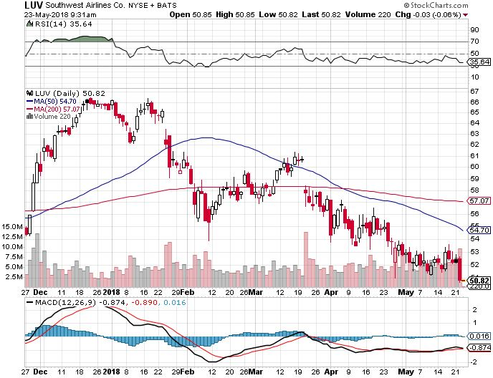
Southwest Airlines (LUV)- High Oil Prices Hurt Warren Buffett’s Favorite Airline

Slide 34
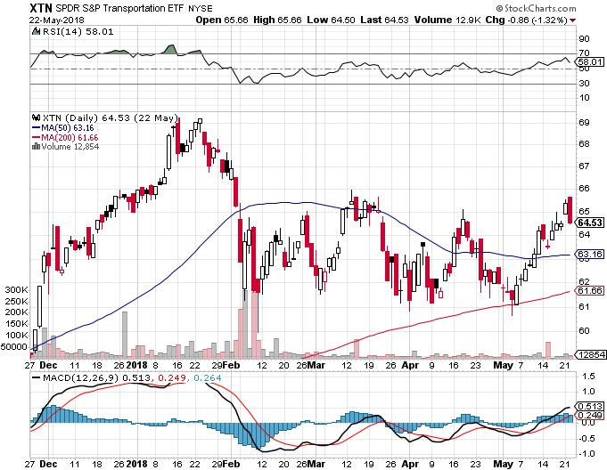
Transports Sector SPDR (XTN)- (ALGT), (ALK), (JBLU), (LUV), (CHRW), (DAL)

Slide 35
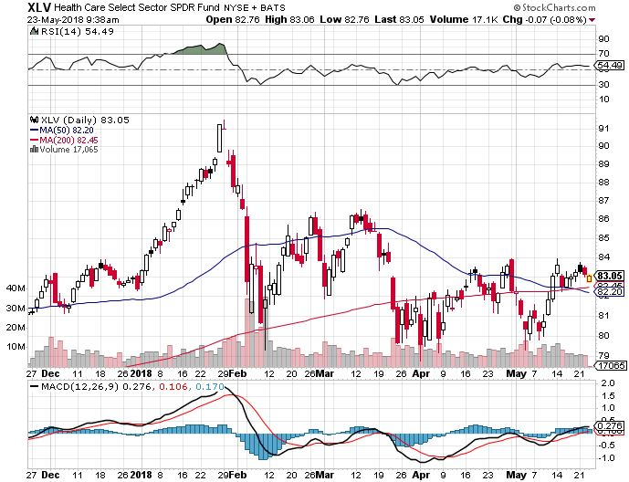
Health Care Sector (XLV), (RXL)- (JNJ), (PFE), (MRK), (GILD), (ACT), (AMGN)

Slide 36
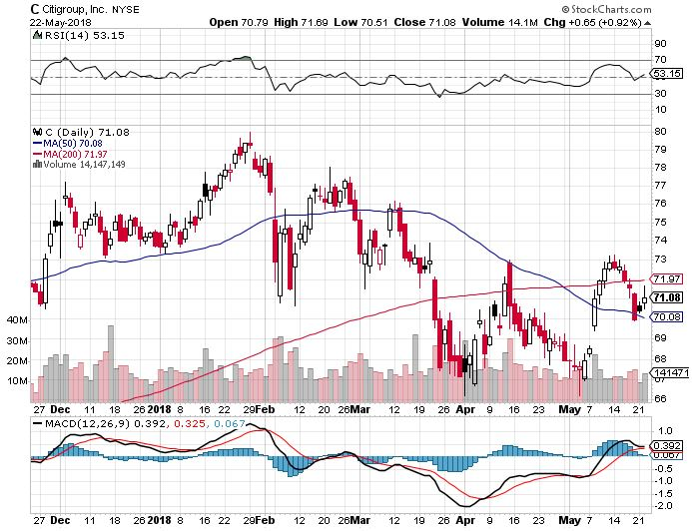
Citigroup (C)-Earnings up 25% took profits on long 6/$60-$65 bull call spread

Slide 37
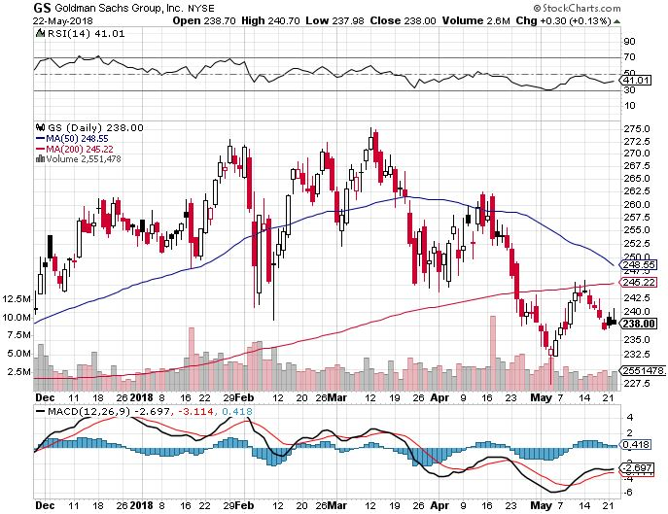
Goldman Sachs (GS)-Rising Rates Fail to Help stopped out of long 4/240-$245 call spread stopped out of long 10/$220-$225 vertical bull call spread took profits on long 10/$227.50-$232.50 vertical bull call spread

Slide 38
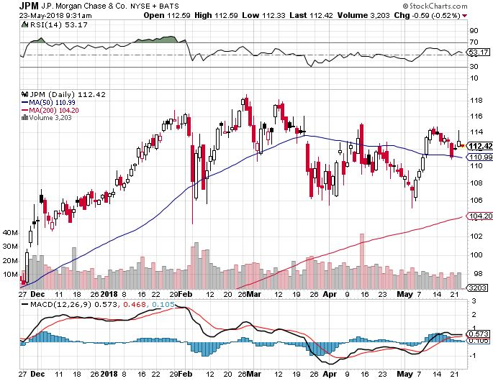
JP Morgan (JPM)- took profits on long 4/$95-$100 call spread

Slide 39
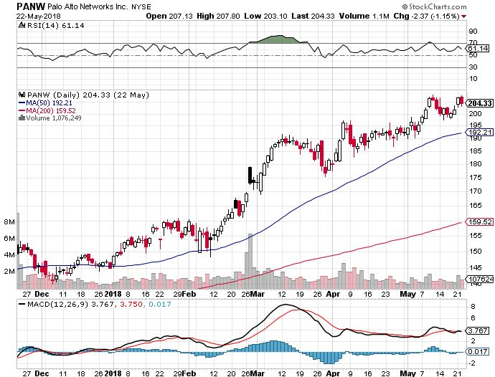
Palo Alto Networks (PANW)-New High Hacking never goes out of fashion

Slide 40
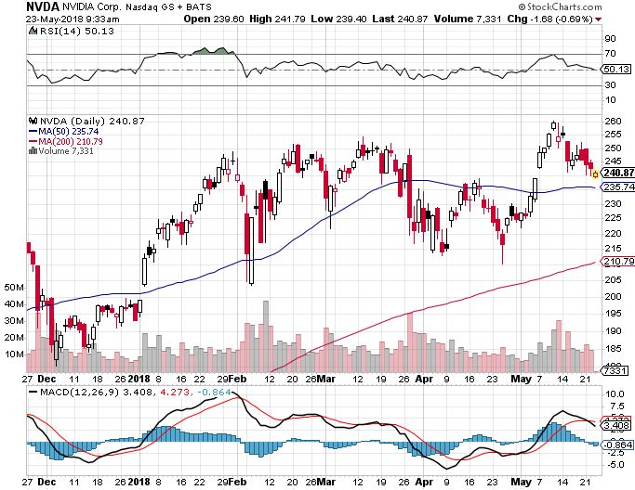
NVIDIA (NVDA)-Great Earnings

Slide 41
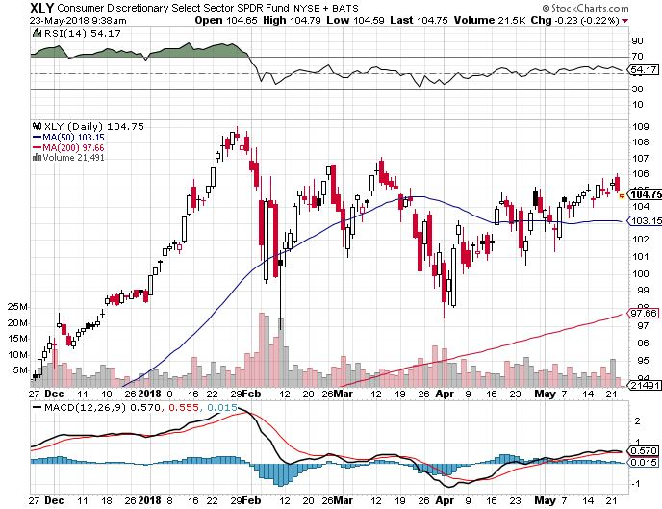
Consumer Discretionary SPDR (XLY) (DIS), (AMZN), (HD), (CMCSA), (MCD), (SBUX)

Slide 42
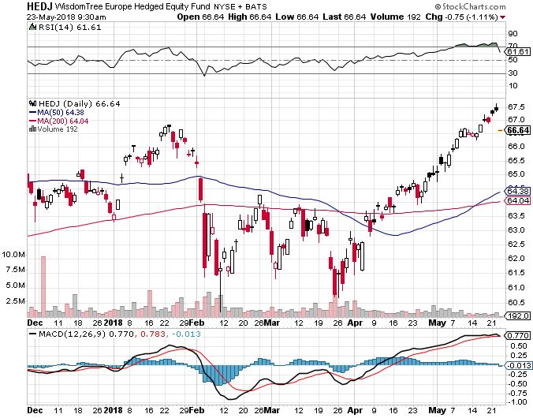
Europe Hedged Equity (HEDJ)-Euro crash

Slide 43
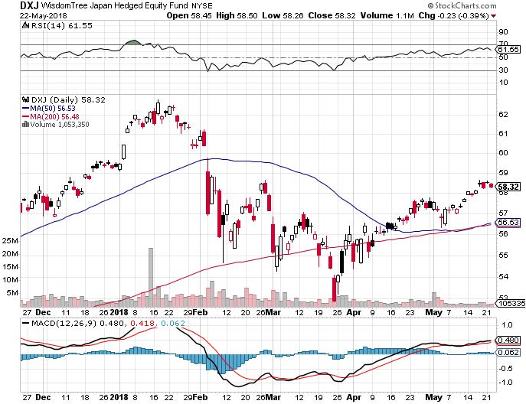
Japan (DXJ)-Falling Yen Move

Slide 44
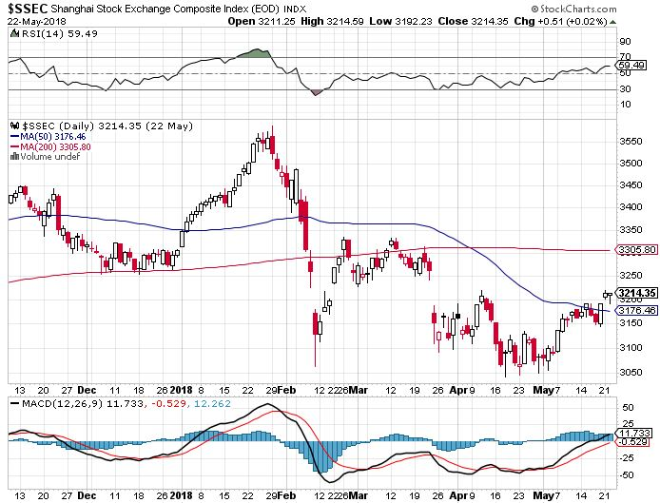
China ($SSEC)-Economic Recovery on Track

Slide 45
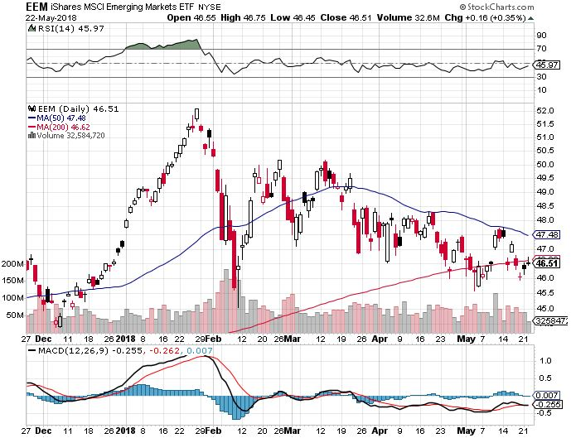
Emerging Markets (EEM)- Killed by Strong Dollar

Slide 46
Bonds- 7 Year High
*Ten year bonds yields breakout to a 3.12% yield, all yield plays collapse *It could take several weeks of sideways action to digest to new breakout *Cherry pick your next trade, wait for yields to move back below 2.90% to sell short again *Wait for next big read on inflation before making a move *Still looking for 3.25%-3.5% ten year US Treasury yield by yearend, and 4% in a year *Exploding deficits will weigh on bond for the next decade, sell every rally across the space *Someday there will be a big Treasury auction and no one will show, gapping rates up 50 basis points Bottom Line: Sell every four point rally in the (TLT)

Slide 47
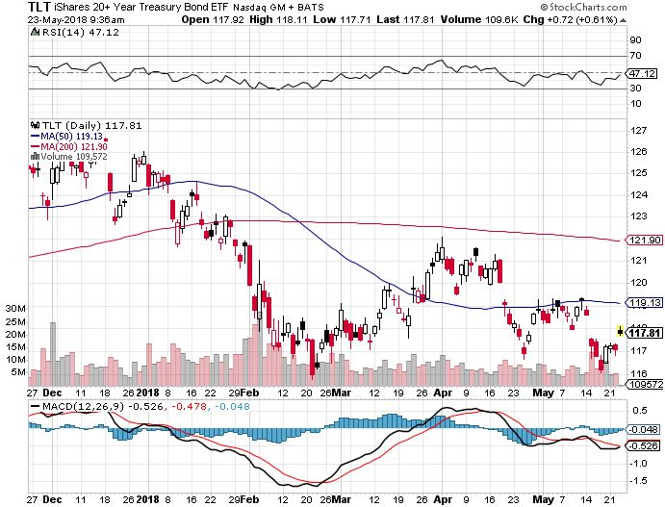
Treasury ETF (TLT) – 18 Profitable Trade Alerts in 8 Months took profits on long 5/$124-$127 vertical bear put spread took profits on long 4/$123-$126 vertical bear put spread Took profits on long the (TLT) 2/$124-$127 vertical bear put spread again

Slide 48
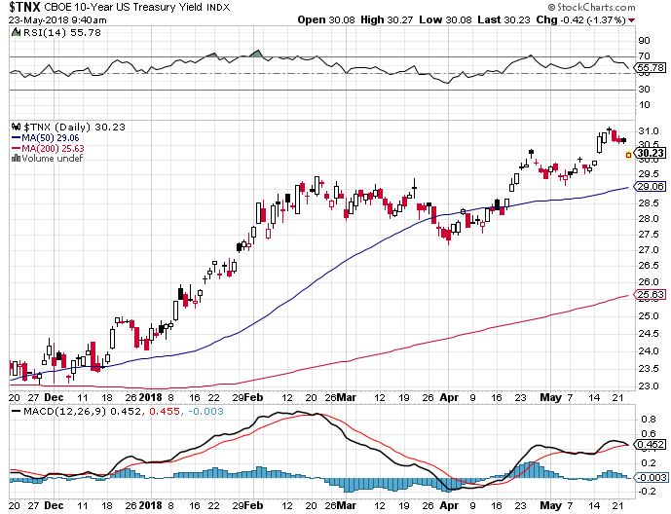
Ten Year Treasury Yield ($TNX) 3.06% Breakdown, Now major Support

Slide 49
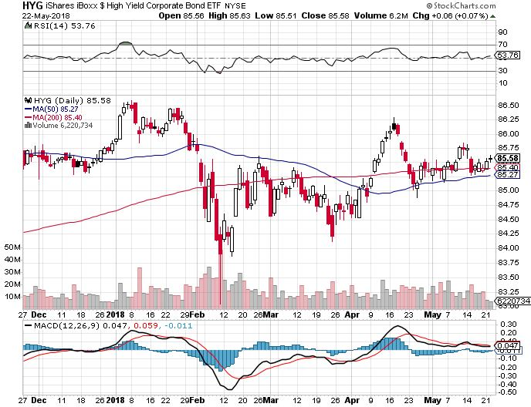
Junk Bonds (HYG) 5.51% Yield 60 basis point pop in yield on stock crash

Slide 50
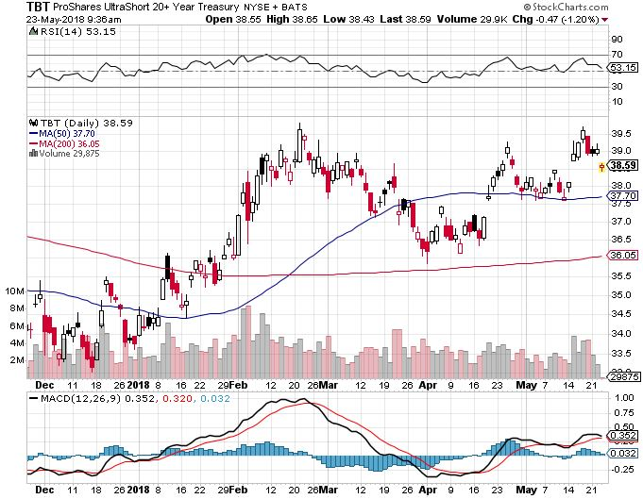
2X Short Treasuries (TBT)- Take Profits

Slide 51
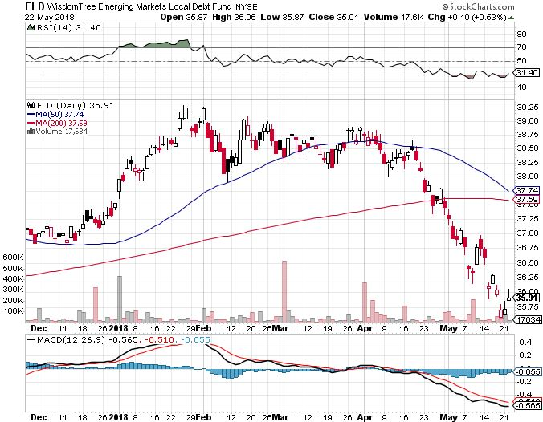
Emerging Market Debt (ELD) 5.84% Yield-

Slide 52
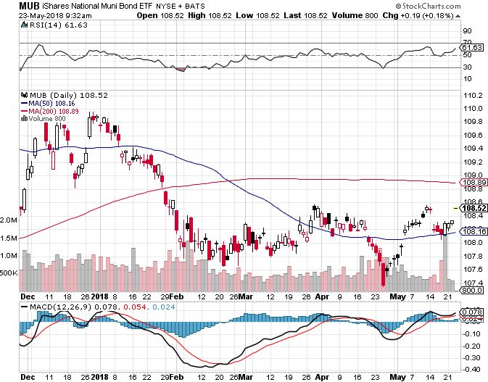
Municipal Bonds (MUB)-2.32% Mix of AAA, AA, and A rated bonds Huge 40 basis point yield pop on tax bill

Slide 53
Foreign Currencies- One Year Dollar High
*Oil currencies of Canadian dollar (FXC), Mexican Peso, and Russian Ruble get a nice boost *A NAFTA treaty would also be positive for loonie and peso. *Reserve Bank of Australia may tighten soon, providing relative strength to the Aussie *Dollar is rising enough to become a drag on the US economy *Bitcoin downtrend intact Bottom Line: Sell rallies on any currencies

Slide 54
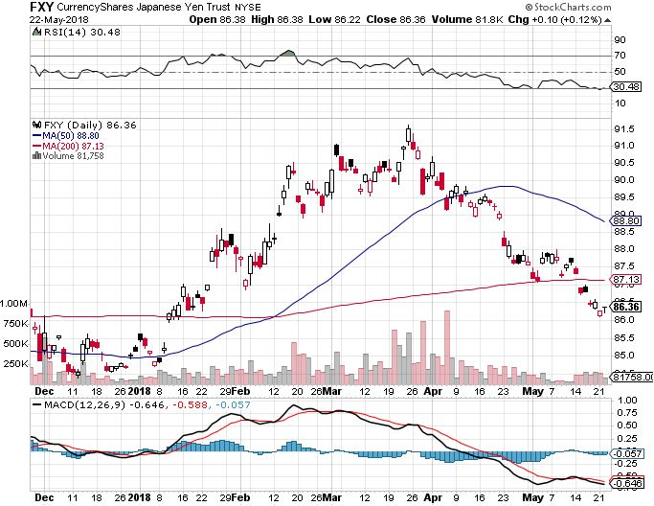
Japanese Yen (FXY), (YCS) took profits on long (FXY) 3/$91-$93 bear put spread

Slide 55
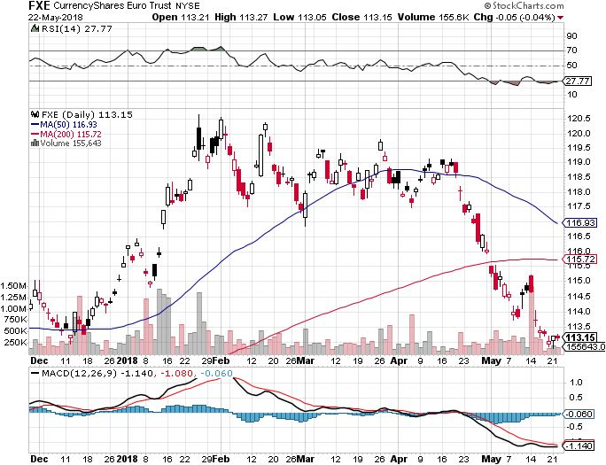
Euro ($XEU), (FXE), (EUO)- Triple Top took profits on long (FXE) 3/$120-$123 vertical bear put spread took profits on long (FXE) 12/$116-$118 vertical bear put spread took profits on long (FXE) 12/$111-$113 vertical bull call spread

Slide 56
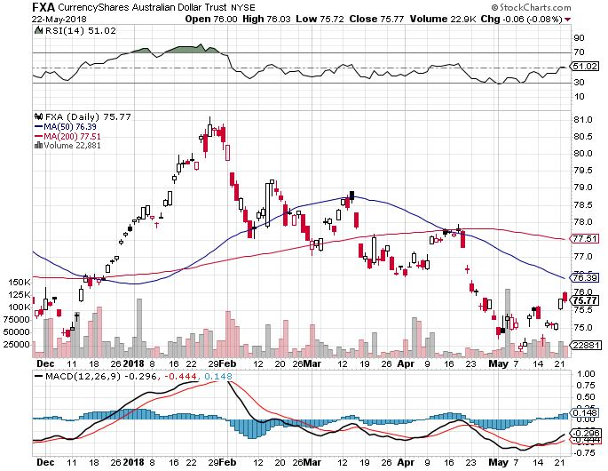
Australian Dollar (FXA)

Slide 57
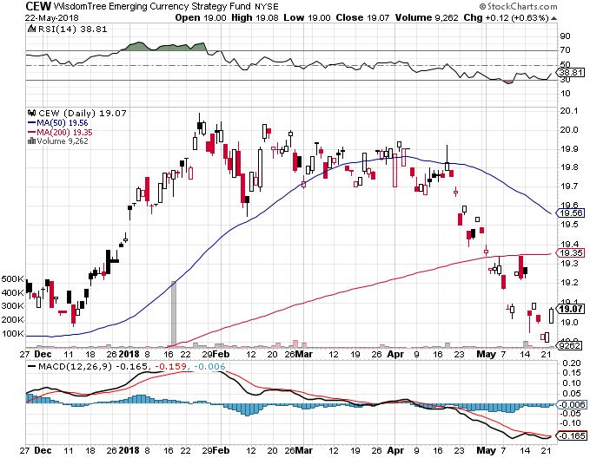
Emerging Market Currencies (CEW)

Slide 58
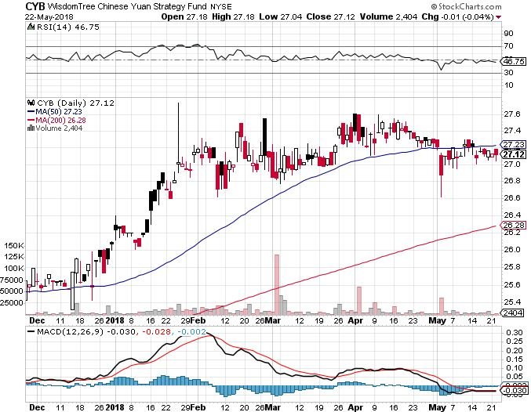
Chinese Yuan- (CYB)-Stabilizing on Government Support

Slide 59
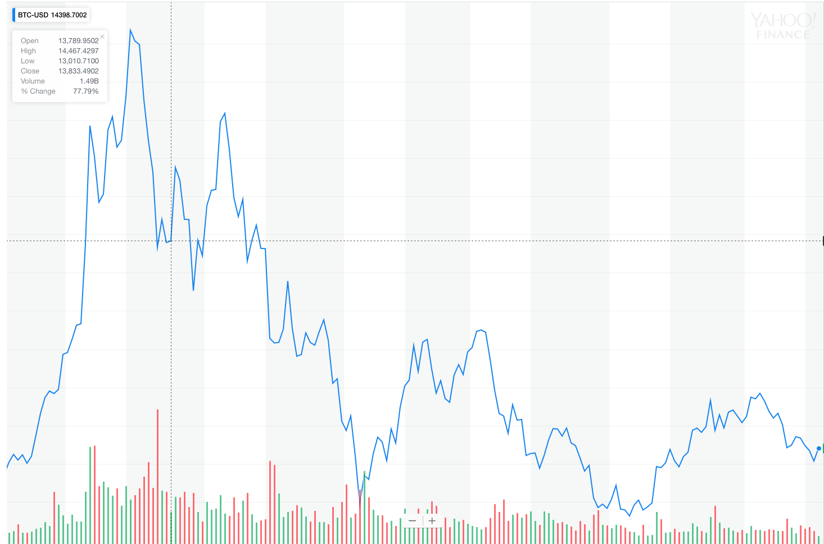
Bitcoin- Downtrend Intact

Slide 60
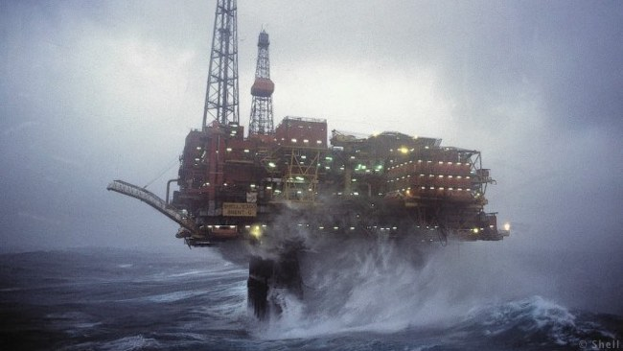
Energy- The Peak Storm Continues
*Venezuela approaching failed state status, may take 1 million b/d off the market *US ban on Venezuelan asset purchases will shut down the oil industry *US oil production hits new all time high as exports ramp up, approaching 11 million barrels a day *Saudi Arabia now looking to extend production quotas into 2019, which have been hugely successful *Baker Hughes US Rig Count unchanged for the first time in months *Bottom Line: Oil may be peaking here so stand aside

Slide 61
Oil-New High and Inflation Push

Slide 62
United States Oil Fund (USO)

Slide 63
Energy Select Sector SPDR (XLE)-No Performance! (XOM), (CVX), (SLB), (KMI), (EOG), (COP)

Slide 64
Alerian MLP ETF (AMLP)- Basket Approach

Slide 65
Exxon (XOM)-Earnings Dive

Slide 66
Schlumberger (SLB)-

Slide 67
Halliburton (HAL)-

Slide 68
Natural Gas (UNG)-

Slide 69
Copper (COPX)-Trade War Fears

Slide 70
Precious Metals-Rising Rate Drag
*Bond yield breakout to 7 year high is terrible news for non-yielding gold *Collapsing Euro and Japanese yen also feeding into weaker gold *Narrow trading range is flagging interest and shrinking volume *Bottom Line: Buy gold and silver stocks on the next big dip, as it is still early days for the bull market

Slide 71
Gold (GLD)-Upside Breakout Imminent! long 5/$119-$122 bull call spread took profits on long (GLD) $12/$116-$119 bull call spread

Slide 72
Market Vectors Gold Miners ETF- (GDX) Took profits on long the 9/$20.50-$21.50 bull call spread

Slide 73
Barrick Gold (ABX) stopped out of long 9/$15-16 call spread

Slide 74
Newmont Mining- (NEM)-Breakout stopped out of 2/$36-$39 bull call spread for small loss took profits on long the 9/$32-$34 bull call spread

Slide 75
Global X Silver Miners ETF- (SIL)- took profits on long the 9/$31-$33 bull call spread

Slide 76
Real Estate- The Melt Up Continues
*April Housing Starts fall -3.7%, but up 10.5% YOY, Housing Permits down by -1.8% *Conventional mortgage rates hit a seven year high, but hasn’t lead to falling prices yet *With 35% a purchase for all cash, the housing market is much less sensitive to interest rates than in past cycles *Mortgage Applications down 2.7% *S&P 500 Case-Shiller maintains strong 6.3%, with absolute prices hitting new all time highs *Bottom Line: Buy real estate plays on dips

Slide 77
February Corelogic S&P Case Shiller Home Price Index +6.3% YOY, Seattle (+12.7%), Las Vegas (+11.6%), San Francisco (+10.1%) still leaders price rises accelerating

Slide 78
Simon Property Group (SPG)-

Slide 79
US Home Construction Index (ITB) (DHI), (LEN), (PHM), (TOL), (NVR)

Slide 80
Trade Sheet- So What Do We Do About All This?
*Stocks- Sell the Next Capitulation peak *Bonds-sell any and all rallies *Commodities-stand aside *Currencies-sell rallies in currencies *Precious Metals –stand aside *Volatility-go short on runs up to $20 *Real estate-buy dips

Slide 81
Next Strategy Webinar 12:00 EST Wednesday, June 6, 2018 San Francisco, CA For Lunches Please Go to www.madhedgefundtrader.com and click “Store”
Good Luck and Good Trading!
Notes:
*

