Slide 1
The Mad Hedge Fund Trader “It’s War!”
With John Thomas from Silicon Valley, CA, August 8, 2018 www.madhedgefundtrader.com
Notes:
*

Slide 3
October 26-27 Lake Tahoe Conference
*Two days of informative speakers on crucial trading and investment issues *Trade tips with the most successful Mad Hedge traders *2 nights in the Hyatt, including all you can eat and drink *Tickets are a bargain at $599 to $1,799 *Buy now, upper ticket classes sell out first

Slide 4
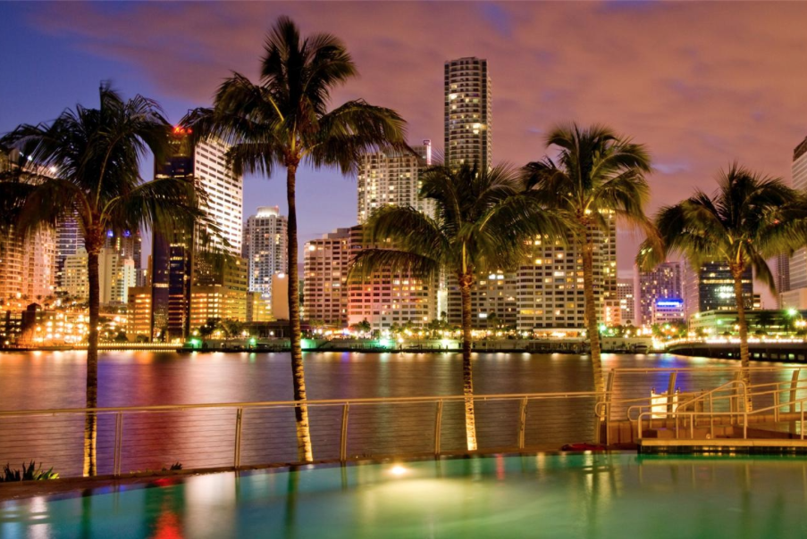
MHFT Global Strategy Luncheons Buy tickets at www.madhedgefundtrader.com
Atlanta, GA October 15
Miami, FL October 16

Slide 5
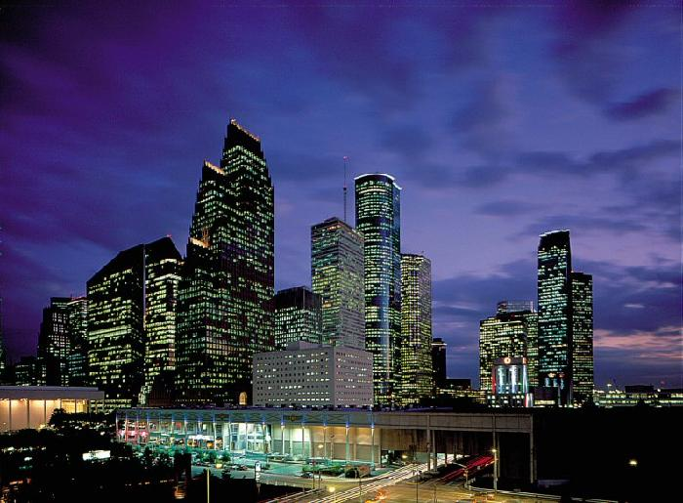
MHFT Global Strategy Luncheons Buy tickets at www.madhedgefundtrader.com
Houston, TX October 17

Slide 6
Trade Alert Performance New All Time High!!
*January 4.09% Final *July +0% Final *February +1.54% Final *August +2.19% MTD *March +1.13% Final *September 0.85% MTD *April +12.54% Final *October +1.39% Final *May +1.07% Final *November +2.08% Final *June +4.15% Final *December +3.76% Final *2018 Year to Date 27.86% compared to +4.6% for the Dow Average *Trailing One year return +41.86%, +304.33% since inception, *Average annualized return of 34.34%

Slide 7
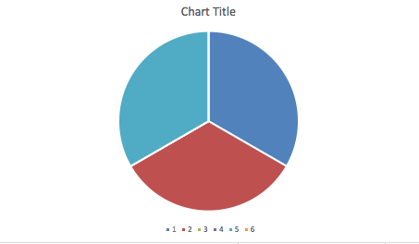
Portfolio Review 10% long tech, 10% short bonds, 10% short S&P 500 at market all time highs
Risk On
World is Getting Better
(TLT) 9/$123-$126 put spread | 10.00%
(MSFT) 9/$102-$105 calls pread | 10.00%
Risk Off
(SPY) 9/$294-$297 put spread | -10.00%
Total Net Position | 10.00%
Expiration P&L 29.72%

Slide 8
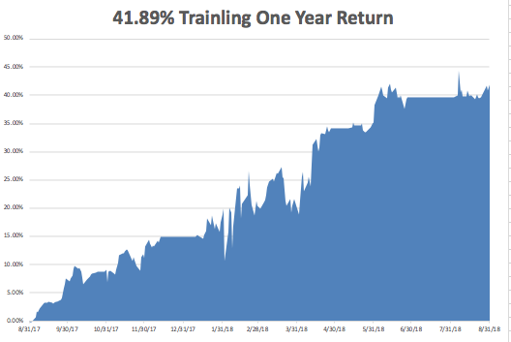
GTD Daily Audited Performance All Time High

Slide 9
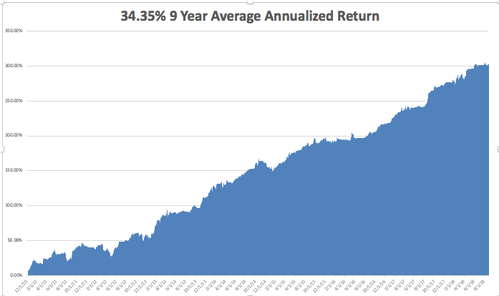
GTD 9 Year Daily Audited Performance

Slide 10
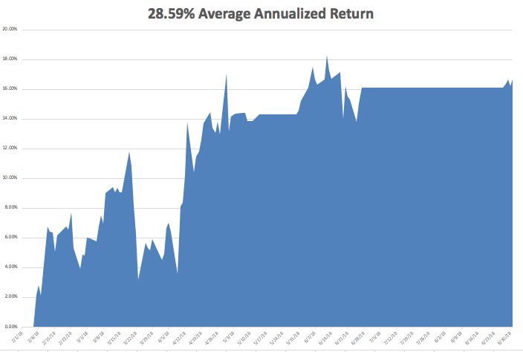
Mad Hedge Technology Letter a $2,500 a year upgrade

Slide 11
The Method to My Madness
*The risk/reward for the market now is still terrible, with Mad Hedge Market Timing Index stuck in the 70’s *Escalation of trade war on every front is bad for risk taking *Big tech rallies show where the quality trade is *Dollar takes a break but another leg up is in the cards *Rising rates also say that precious metals and yield plays are DOA *September has a terrible history *All that said, I still expect the S&P 500 to be up 10% by the end of the year and there is still good money to be made

Slide 12
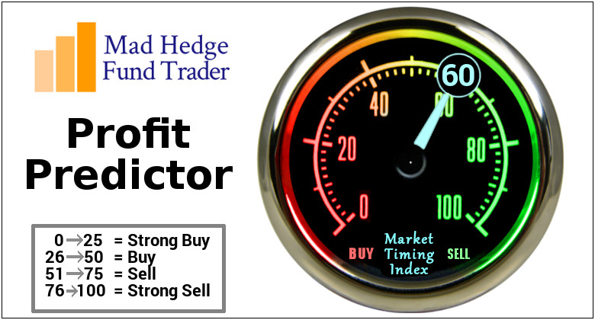
The Mad Hedge Profit Predictor Market Timing Index- An artificial intelligence driven algorithm that analyzes 30 different economic, technical, and momentum driven indicators

Slide 13
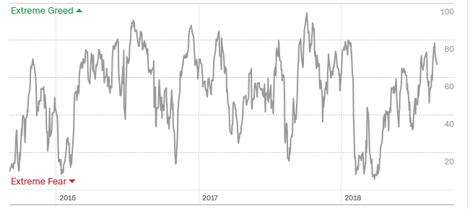
The Mad Hedge Profit Predictor Approaching Top of 2018 Range
SELL
BUY

Slide 14
The Global Economy –Uneven
*Tax cuts and deficit spending have another 5 months to work their way through the system, after that it’s gone *August University of Michigan Consumer Sentiment rises from 95.4 to 96.6, August Consumer Spending up a hot 0.40%, August Personal Incomes up 0.3% *Strong dollar is still demolishing emerging markets, from China to South Africa *Commodities will keep collapsing as long as trade war intensifies *Fed 25 basis point Rate Rise to 2.0%-2.25% a sure thing on September 20 *In Europe consumer prices are weak and business and consumer prices are falling off a cliff

Slide 15
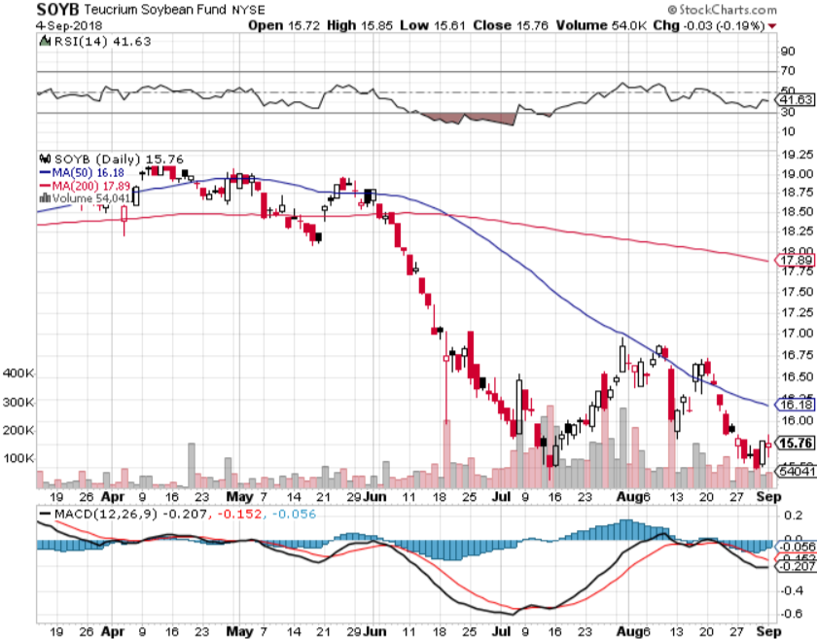
Soybeans (-20%)-Trade War Indicator

Slide 16
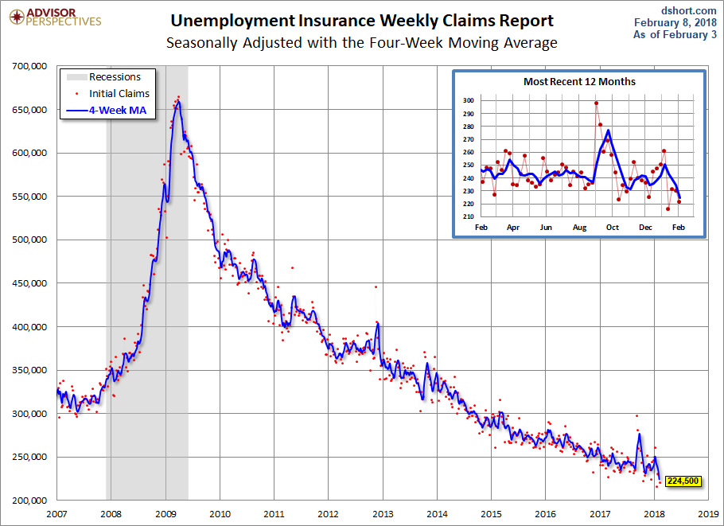
Weekly Jobless Claims –The Most Important Statistic +3,000 to 213,000- 43 Year Low

Slide 17
The Bill Davis View A $1,500 Upgrade for the Mad Day Trader Service
Buys: | Entry | Target
Vulcan Materials (VMC) x | $ 110.00 | $ 125.00
Toll Brothers, Inc. (TOL) | $ 37.00 | $ 43.00
Owens Illinois, Inc. (OI) | $ 18.00 | $ 25.00
Sina.com (SINA) | $ 69.00 | $ 76.00
NetEase.com, Ince (NTES) | $ 200.00 | $ 260.00
Sells:
Gilead Sciences (GILD) x | $ 75.00 | $ 62.00
Edgewell Personal Care (EPC) x | $ 56.00 | $ 40.00
Perrigo Co (PRGO) x | $ 82.00 | $ 67.00
Celgene Corp (CELG) | $ 92.00 | $ 74.00
Chipotle Mexican Grill (CMG) | $ 500.00 | $ 438.00

Slide 18
Stocks-Nosebleed Territory
*Stocks now in extreme overbought territory and there are a million reasons for it to correct and September is usually the worst month of the year *Hedge downside risk with short (SPY) and long (VXX) positions *Most recent buying was in defensive sectors like consumer staples *Apple and Amazon are the only tech stocks that move to new highs, are they now ”safe” defensive stocks? *SPY now at 120% of US GDP compared to 50% in 2010 and 130% at Dotcom Bubble top at 130% *Bottom Line: minimize risk

Slide 20
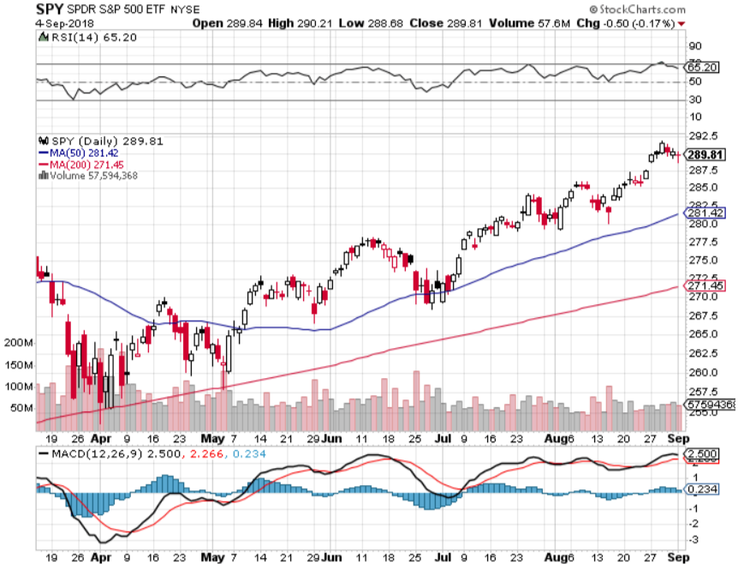
S&P 500- Top of the Range took profits on long 5/$277-$280 put spread double weighting

Slide 21
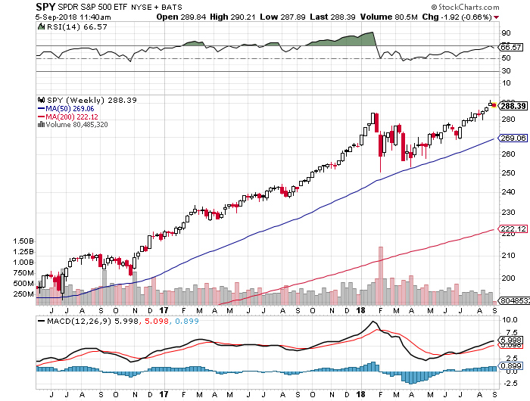
S&P 500- Overshoot Risk took profits on long 5/$277-$280 put spread double weighting

Slide 22
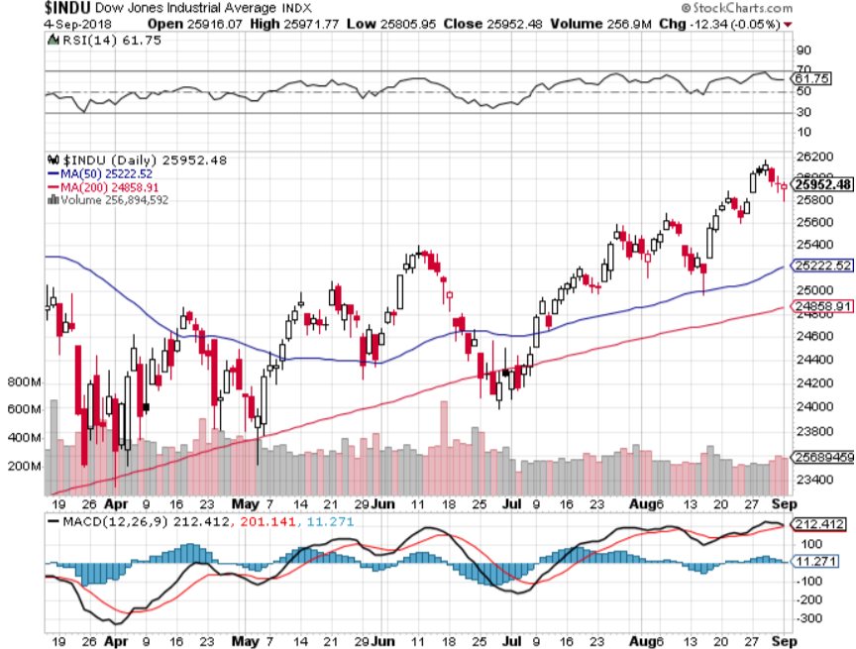
Dow Average- New High

Slide 23
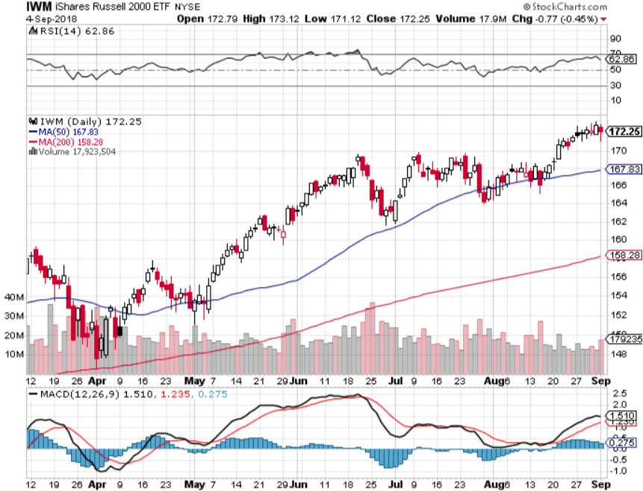
Russell 2000 (IWM)- Topping Out has become the lead index on tax breaks

Slide 24
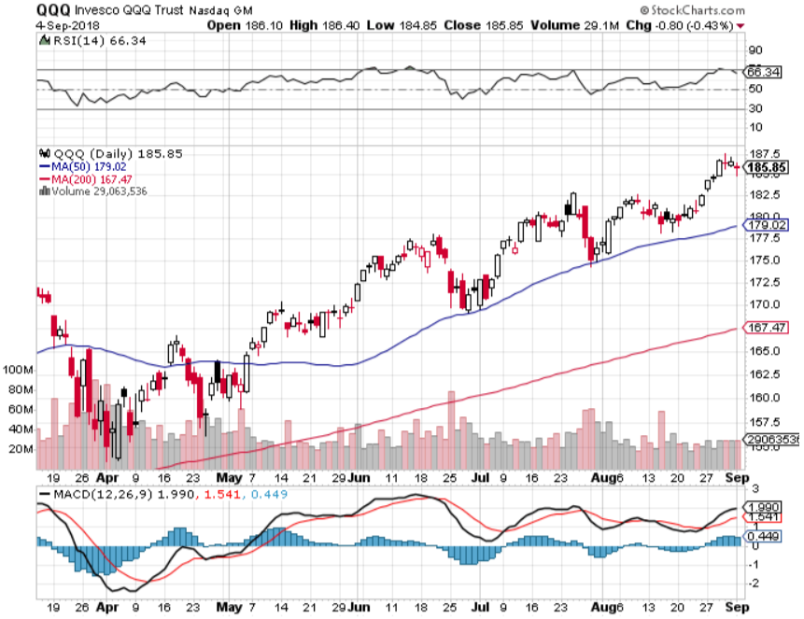
NASDAQ (QQQ)- Settling Into a Range for the rest of 2018
High earnings growth, Good valuations, Buybacks, nothing else to buy PE at 16X

Slide 25
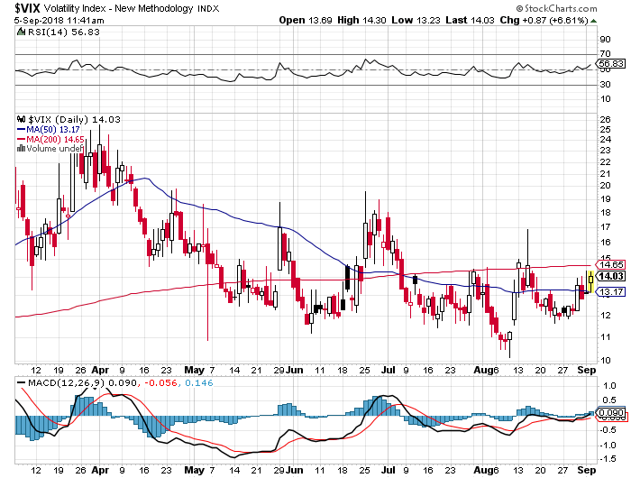
(VIX)- Spike Time

Slide 26
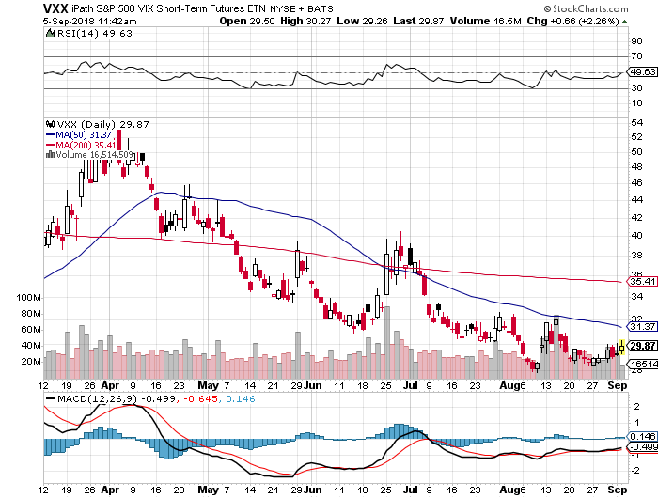
iPath S&P 500 VIX Short-Term Futures ETN (VXX) took profits on long 1/$40 calls took profits on long 3/$60-$65 bear put spread took profits on long 3/$55-$60 bear put spread

Slide 27
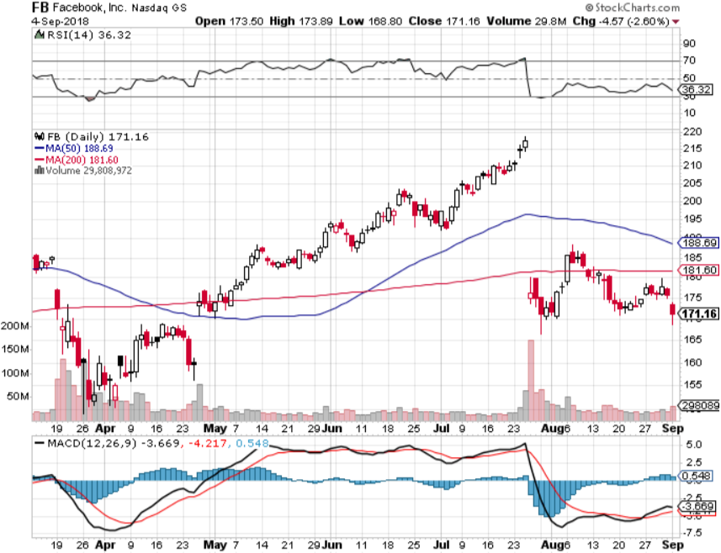
Facebook (FB)- Reality Returns stopped out of long 4/$150-$160 call spread took profits on long 6/$130-$140 bull call spread took profits on long 3/$155-$165 bull call spread took profits on long 3/$190-$195 bear put spread

Slide 28
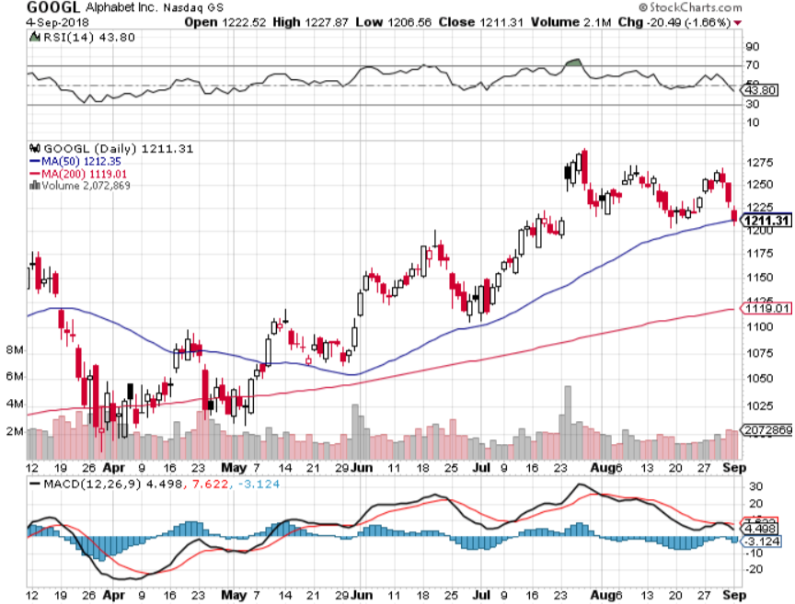
Alphabet (GOOGL)- took profits on long 4/$900-$930 call spread

Slide 29
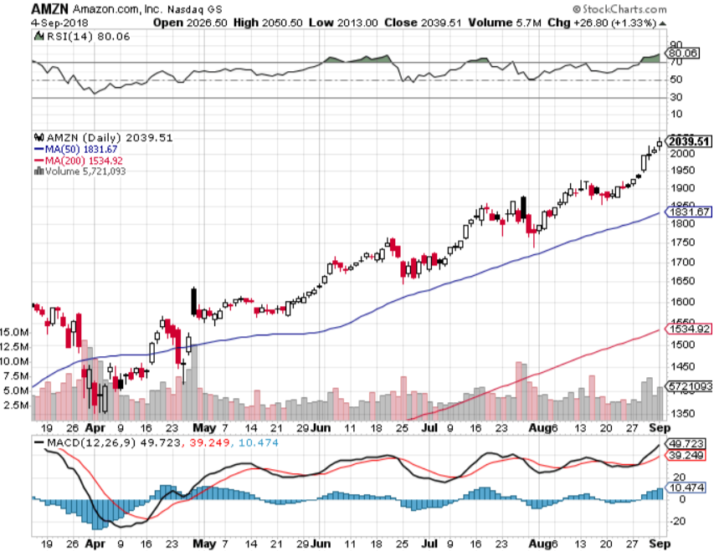
Amazon (AMZN)-Also Correction Proof New $1 trillion company

Slide 30
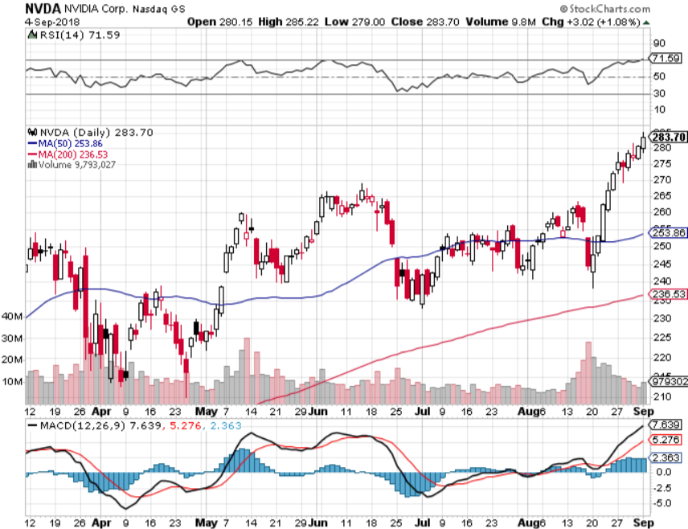
NVIDIA (NVDA)-New Highs

Slide 31
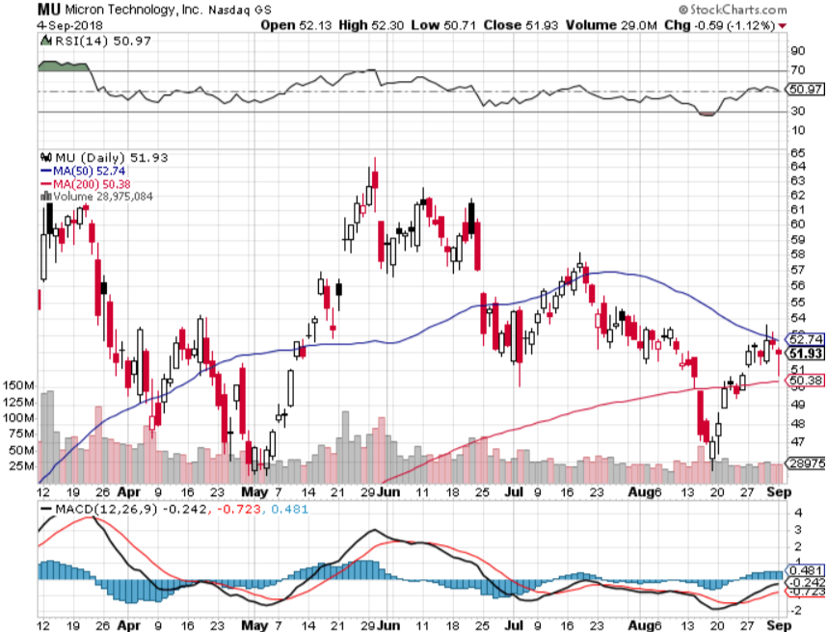
Micron Technology (MU)-Trade Wars took profits on long 3/$34-$37 bull call spread in Mad Hedge Technology Letter Only

Slide 32
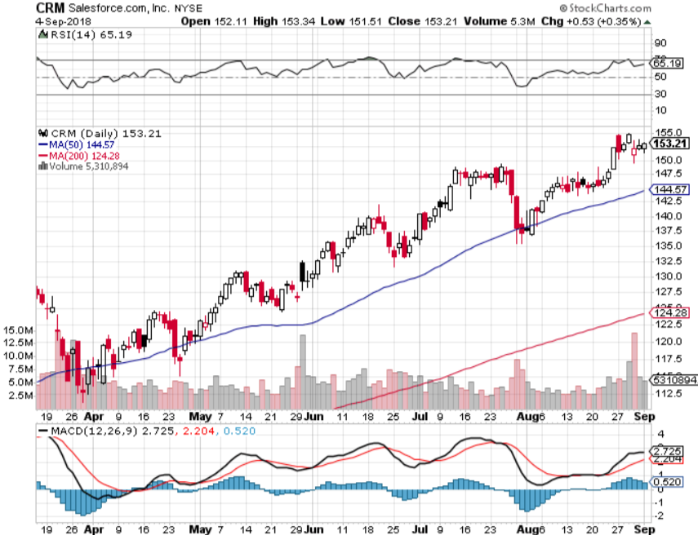
Salesforce (CRM)-New Highs took profits on long 7/$115-$120 call spread (tech letter) took profits on long 6/$105-$110 call spread took profits on long 3/$90-$95 bull call spread

Slide 33
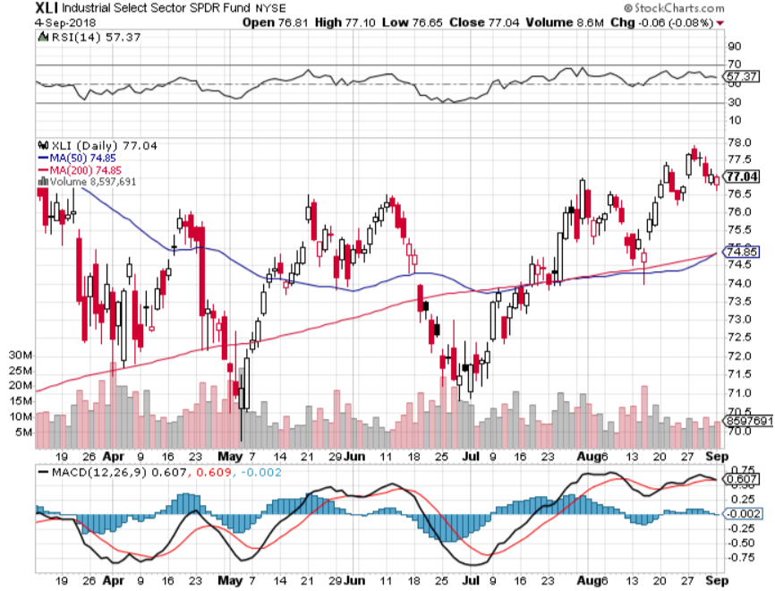
Industrials Sector SPDR (XLI)-Rotation Target (GE), (MMM), (UNP), (UTX), (BA), (HON)

Slide 34
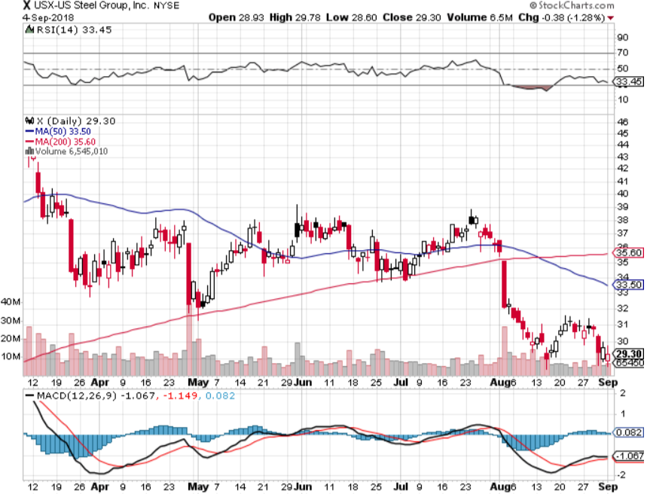
US Steel (X)-Tariffs Trouble Import duties cause users to abandon steel took profits on long the 9/$21-$22 vertical bull call spread

Slide 35
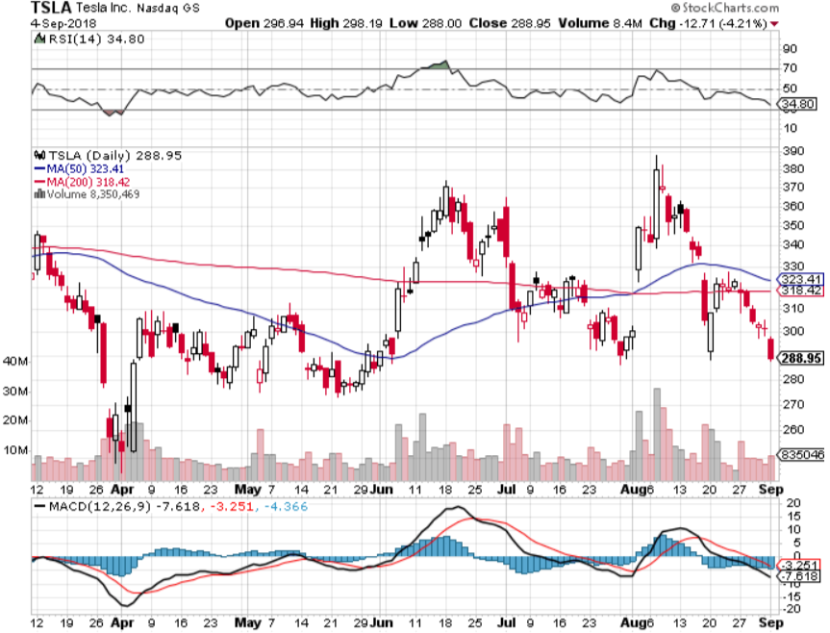
Tesla (TSLA)- Has largest short position in the market Buyout attempt t $420 fails

Slide 36
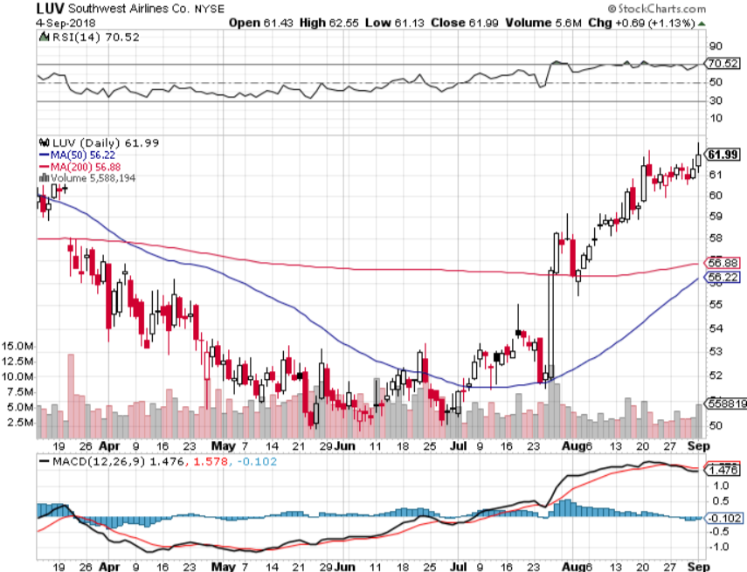
Southwest Airlines (LUV)- Earnings Pop Warren Buffett’s Favorite Airline

Slide 37
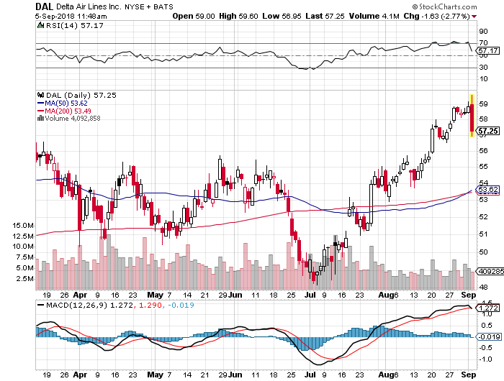
Delta Airlines (DAL)- Poisoning took profits on 3/$40-$45 call spread

Slide 38
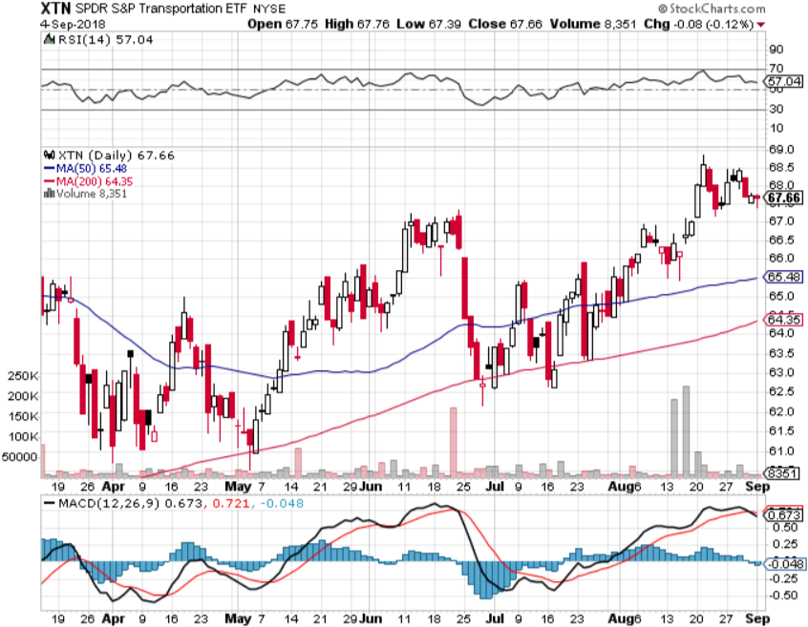
Transports Sector SPDR (XTN)- (ALGT), (ALK), (JBLU), (LUV), (CHRW), (DAL)

Slide 39
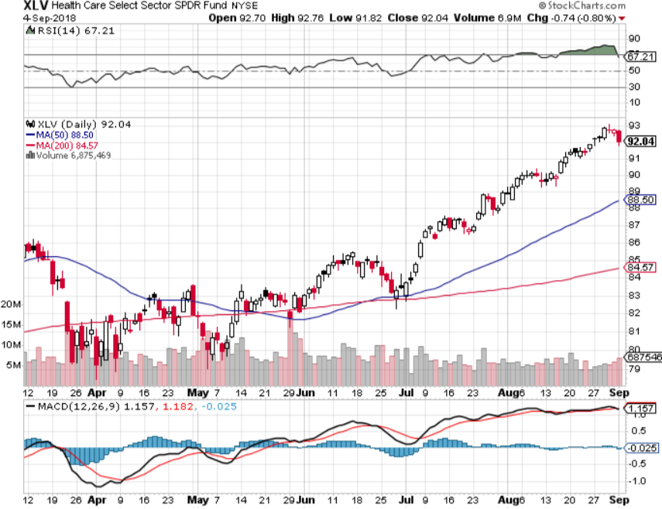
Health Care Sector (XLV), (RXL)-New Highs (JNJ), (PFE), (MRK), (GILD), (ACT), (AMGN)

Slide 40
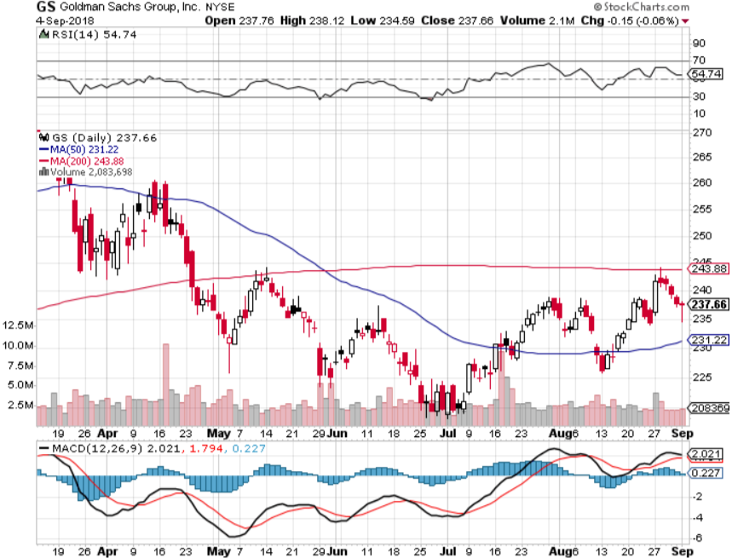
Goldman Sachs (GS)-Head and Shoulders Bottom stopped out of long 4/240-$245 call spread stopped out of long 10/$220-$225 vertical bull call spread took profits on long 10/$227.50-$232.50 vertical bull call spread

Slide 41
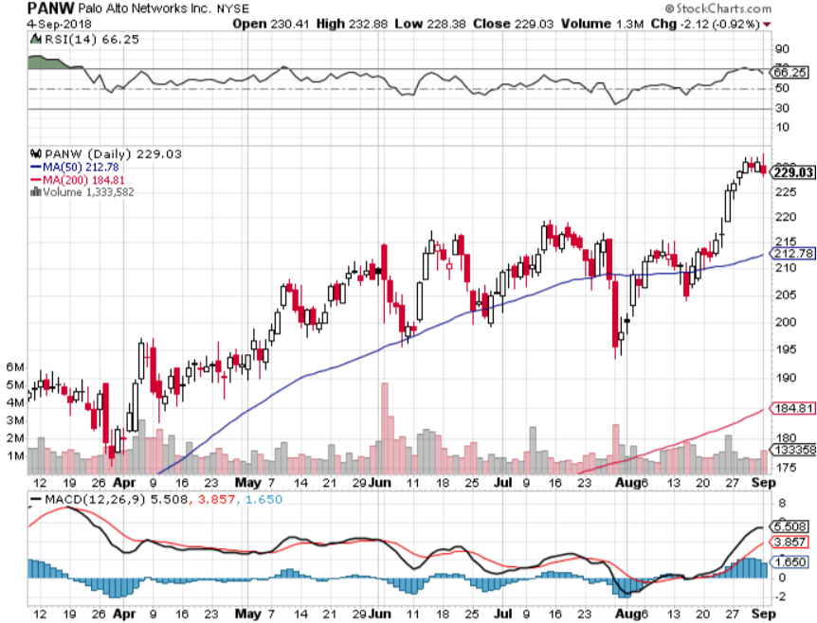
Palo Alto Networks (PANW)- Hacking never goes out of fashion

Slide 42
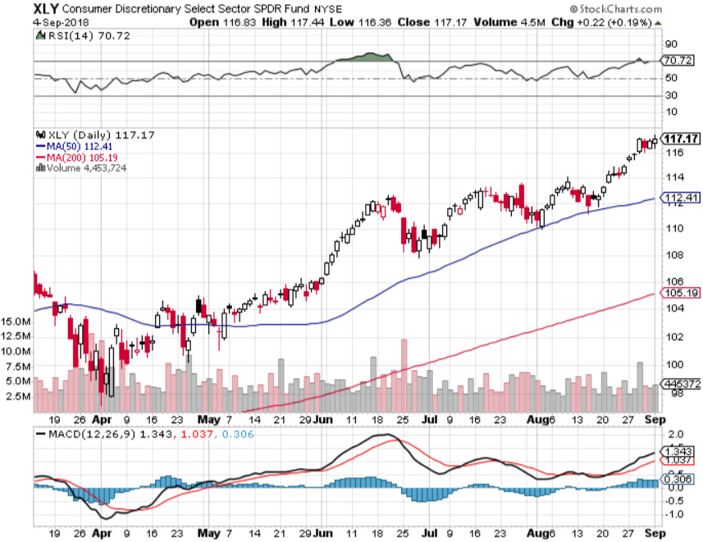
Consumer Discretionary SPDR (XLY) (DIS), (AMZN), (HD), (CMCSA), (MCD), (SBUX)

Slide 43
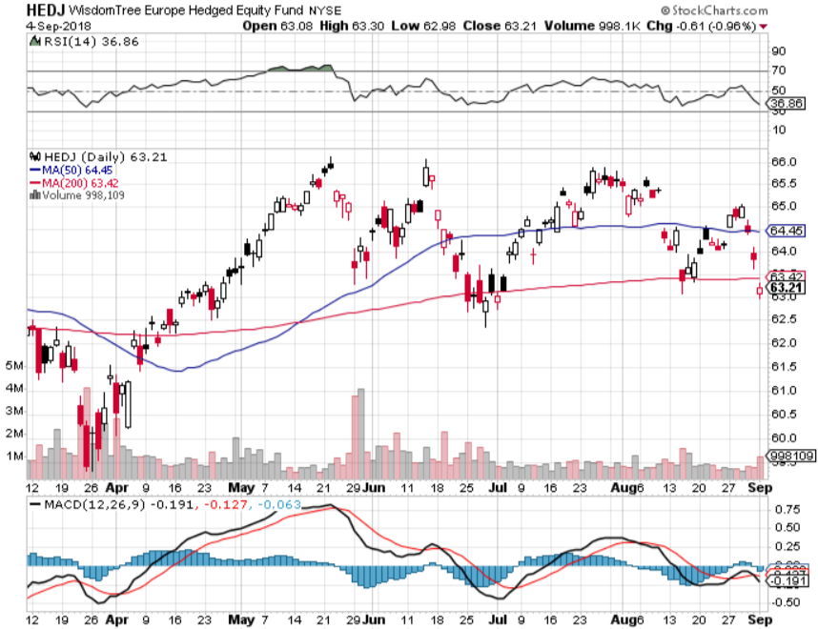
Europe Hedged Equity (HEDJ)-Quadruple top Top

Slide 44
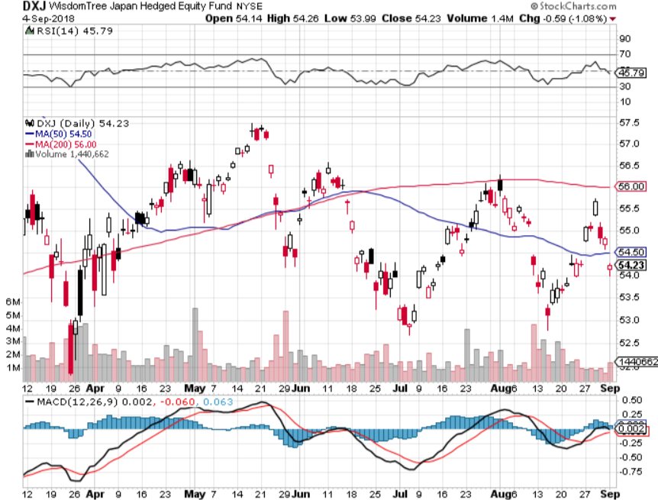
Japan (DXJ)-

Slide 45
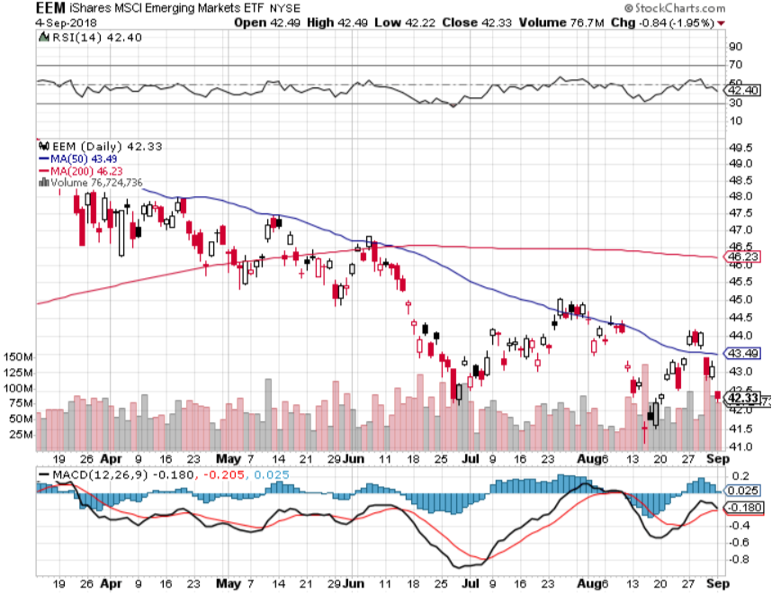
Emerging Markets (EEM)- Killed by Strong Dollar

Slide 46
Bonds- Trading the Uptrend
*Bonds still stuck in incredibly narrow uptrend since February, up 5 points in 8 months *We played from the short side on every trade and made money on all, shows the benefit of trading for the short term and deep in the money *Huge short positions are supporting the market *Massive liquidity created by global QE will drive all asset classes for years, or least prevent them from falling *Still looking for 3.25%-3.5% ten year US Treasury yield by yearend, and 4% in a year *Exploding deficits will weigh on bonds for the next decade, sell every rally across the space, up 67% YOY Bottom Line: Sell every four point rally in the (TLT)

Slide 47
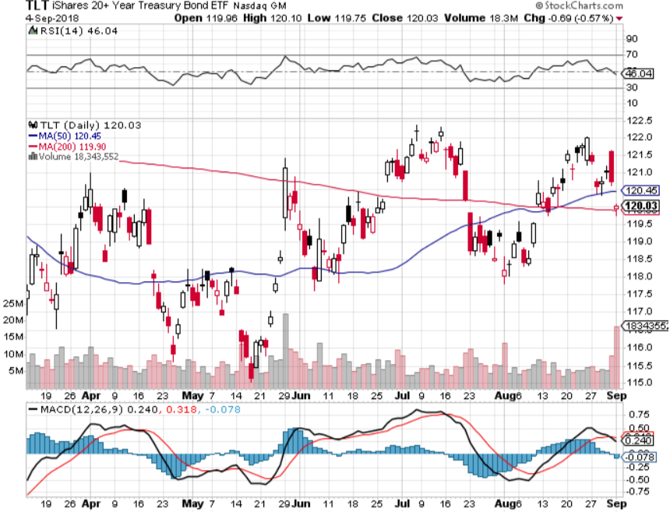
Treasury ETF (TLT) – Top of Range long the (TLT) 9/$123-$126 put spread

Slide 48
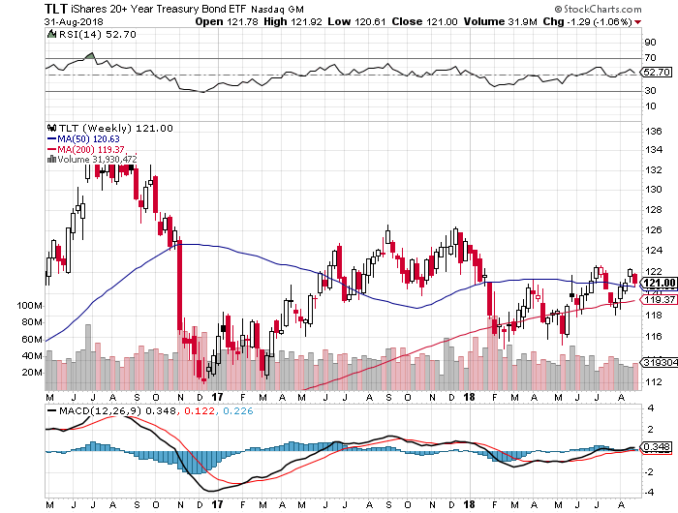
Treasury ETF (TLT) Long Term Up 5 Points in 8 Months

Slide 49
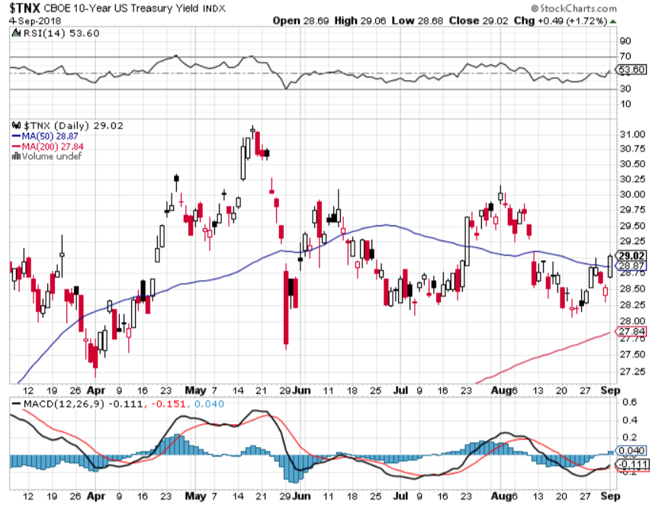
Ten Year Treasury Yield ($TNX) 2.96% Breakdown, Now major Support

Slide 50
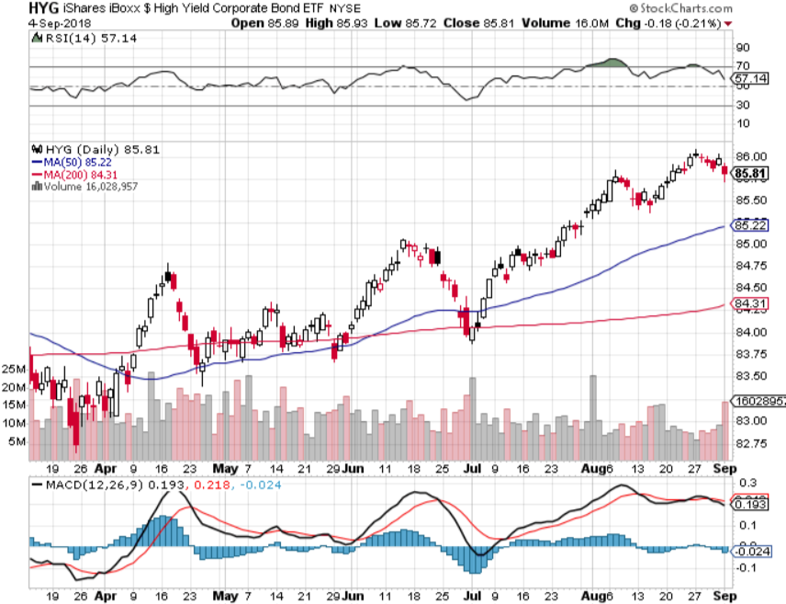
Junk Bonds (HYG) 5.78% Yield

Slide 51
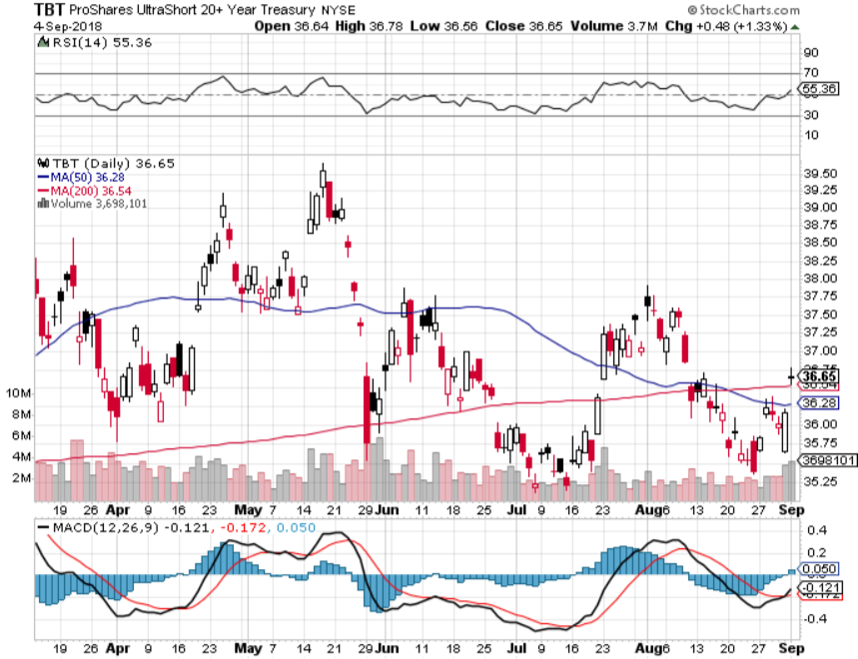
2X Short Treasuries (TBT)-Buy Territory

Slide 52
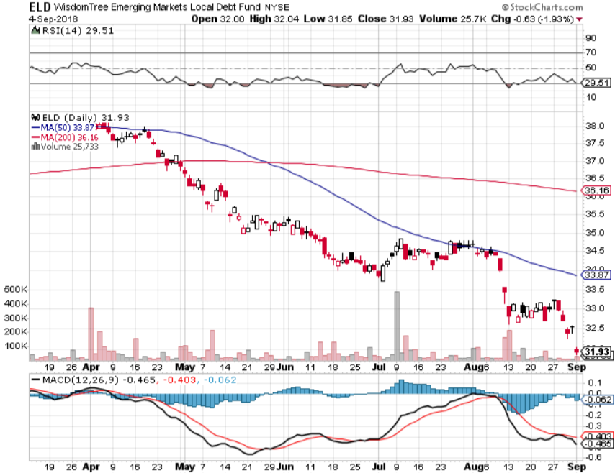
Emerging Market Debt (ELD) 5.64% Yield-

Slide 53
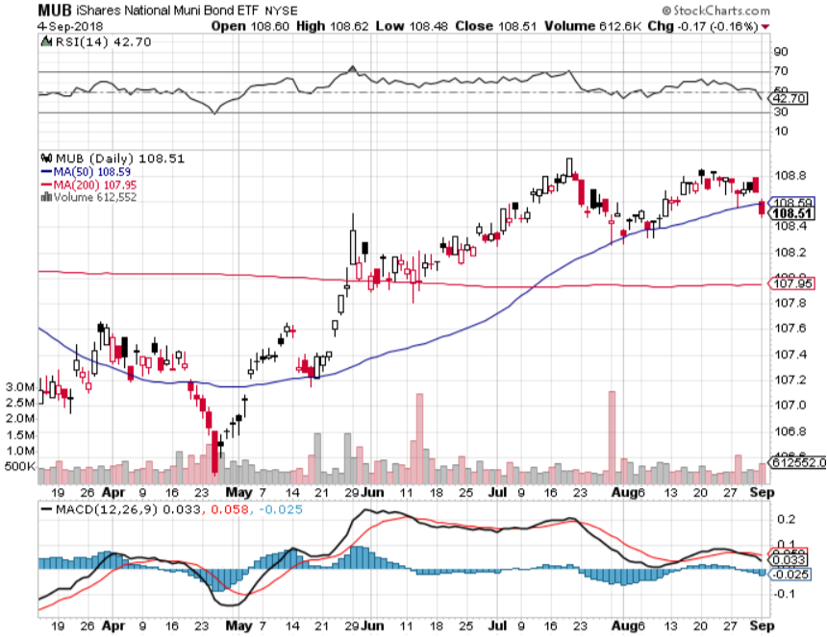
Municipal Bonds (MUB)-2.32% Mix of AAA, AA, and A rated bonds Huge 40 basis point yield pop on tax bill

Slide 54
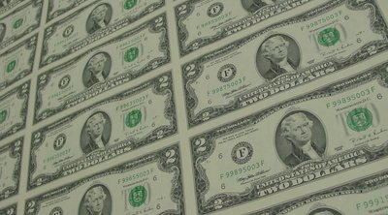
Foreign Currencies- Dollar Pause
*US dollar takes a break from its relentless uptrend, a break or a reversal? *September 25 Fed rate rise promises to keep dollar strong *US trade war with China is escalating, dragging on the Yuan *Euro attempting to put in a bottom *In the meantime, Fed is committed to another year of rate rises *Bitcoin holds $6,000 this time *Bottom Line: stand aside

Slide 55
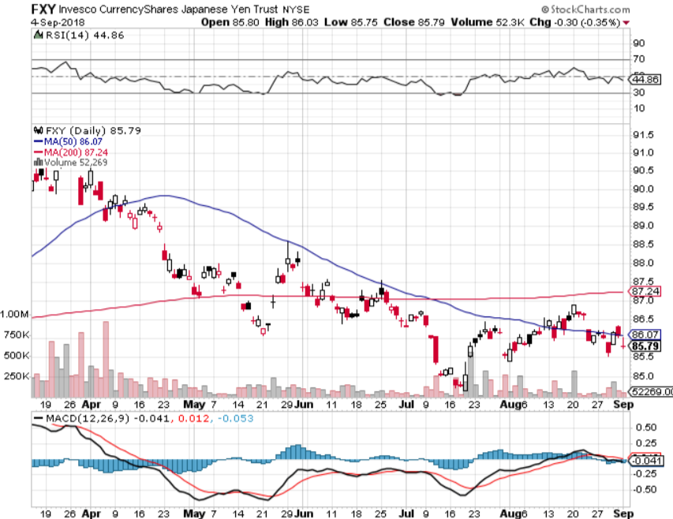
Japanese Yen (FXY), (YCS) took profits on long (FXY) 3/$91-$93 bear put spread

Slide 56
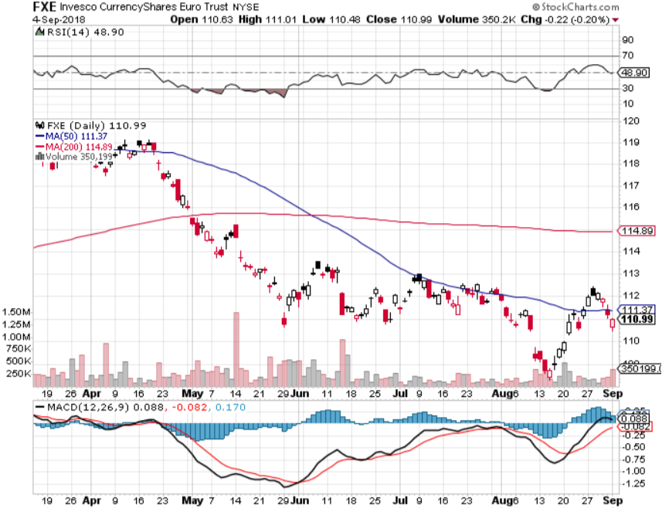
Euro ($XEU), (FXE), (EUO)- Trying to Break Down took profits on long (FXE) 3/$120-$123 vertical bear put spread

Slide 57
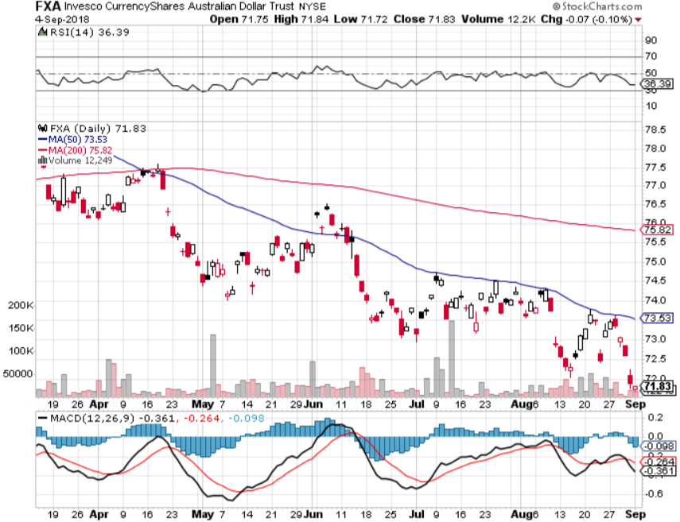
Australian Dollar (FXA)-Trade war China drag

Slide 58
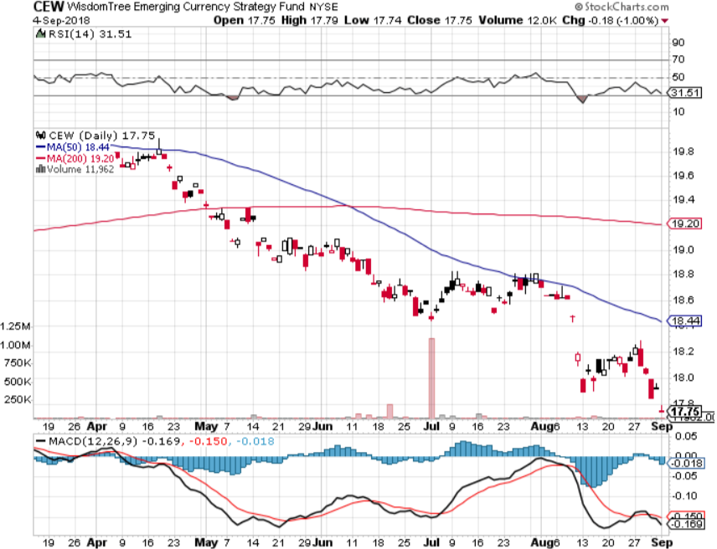
Emerging Market Currencies (CEW)

Slide 59
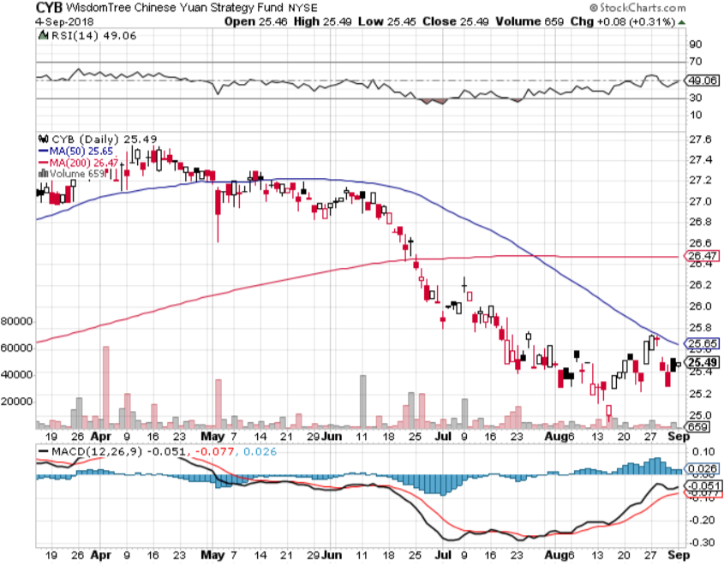
Chinese Yuan- (CYB)-Trade War Tonic

Slide 60
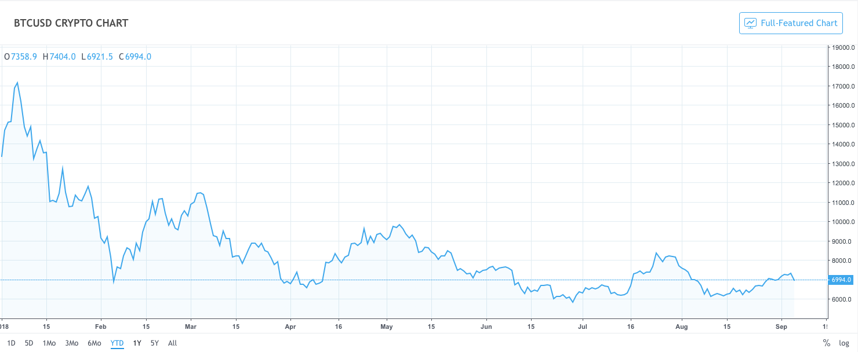
Bitcoin- Downtrend Intact

Slide 61
Energy – Entering the Shoulder Season
*Iran threatens to cut off the Straights of Hormuz, choking off China’s oil supply *Hurricane seasons begins with Hurricanes Gordon, increasing oil volatility, will global warming take a toll? *Peak demand season is behind us *Potential “Head and Shoulders” top setting up on the charts *Trade wars slicing international demand *Bottom Line: Oil may be peaking here so stand aside

Slide 62
Oil-China drag

Slide 63
United States Oil Fund (USO)

Slide 64
Energy Select Sector SPDR (XLE)-No Performance! (XOM), (CVX), (SLB), (KMI), (EOG), (COP)

Slide 65
Halliburton (HAL)-New Low

Slide 66
Natural Gas (UNG)-

Slide 67
Copper (COPX)-Trade War Fears

Slide 68
Precious Metals-Selling to the Rest of the World
*Will the $1,170 bottom hold, or do we have to revisit the 2017 low of $1,120? *Rising overnight interest rates continue to crush gold, even though long rates have been stagnant *Russia, China, and Europe are the only gold buyers *Venezuela and Turkey are still hammering the market *Bitcoin stealing away speculative activity, even though it is falling faster, use jumps 21% in Turkey because of collapsing currency *Bottom Line: Stand aside

Slide 69
Gold (GLD)-No Help from Trade War Took profits on long 5/$119-$122 bull call spread took profits on long (GLD) $12/$116-$119 bull call spread

Slide 70
Gold Long Term
2017 Low

Slide 71
Market Vectors Gold Miners ETF- (GDX) – Yikes! Took profits on long the 9/$20.50-$21.50 bull call spread

Slide 72
Barrick Gold (ABX)

Slide 73
Newmont Mining- (NEM)-

Slide 74
Real Estate-Rising Inventories
*High end real estate is collapsing, while the low end is moderating *July Pending Home Sales down -0.7%, down -2.3% YOY, 8th consecutive month of falling numbers, big fall in the west *Lack of supply and affordability still the big issues *Pace of price increases finally starting to moderate, going from 3 bids for a house to only 1. *S&P 500 Case-Shiller maintains strong 6.3%, with absolute prices hitting new all time highs, first fall in pace of increase in years *Bottom Line: Stand aside

Slide 75
May Corelogic S&P Case Shiller Home Price Index Seattle (+12.8%), Las Vegas (+10.3%) San Francisco 10.7% leaders price rises accelerating

Slide 76
Simon Property Group (SPG)- Falling rates and rotation push

Slide 77
US Home Construction Index (ITB) (DHI), (LEN), (PHM), (TOL), (NVR)

Slide 78
Trade Sheet- So What Do We Do About All This?
*Stocks-topping out *Bonds-sell any and all rallies *Commodities-stand aside *Currencies-stand aside *Precious Metals –stand aside *Volatility-buy dips to $11 *Real estate-stand aside

Slide 79
Next Strategy Webinar 12:00 EST Wednesday, September 19, 2018 from San Francisco, CA For Lunches and Tahoe Conference Please Go to www.madhedgefundtrader.com and click “Store”
Good Luck and Good Trading!
Notes:
*

