Slide 1
The Mad Hedge Fund Trader “Sell First, Ask Questions Later”
With John Thomas Incline Village, NV 19, 2025 www.madhedgefundtrader.com
Notes:
*

Slide 2
The Highlights
*A five-year bull market is over *Economic growth has turned negative 2025, and risks are risen *Tariff driven Inflation is about to rear its ugly head once again *Weak economy will force Fed to cut rates but no until yearend *Stock valuations are just coming off a 26-year high and uncertainty is exploding….a toxic combination *Cutting government spending by half means loss of 12% GDP = recession *Stagflation is most likely outcome = SELL! *Worst case scenario: Government austerity budget in a recession = depression!

Slide 4
Trade Alert Performance New All-Time Highs!
*January +5.80% Final *July +10.92% Final *February +3.66% Final. *August +3.74% Final *March +10.94% MTD *September +10.28% Final *April +5.24% Final *October +7.59% Final *May +3.74% Final *November +18.96 Final *June +1.94% Final *December +3.26% Final *2025 Year To Date +17.14% +769.06% since inception *Versus 84.63% for all of 2022 *Versus 79.79% for all of 2023 *Versus 75.29% for all of 2024

Slide 5
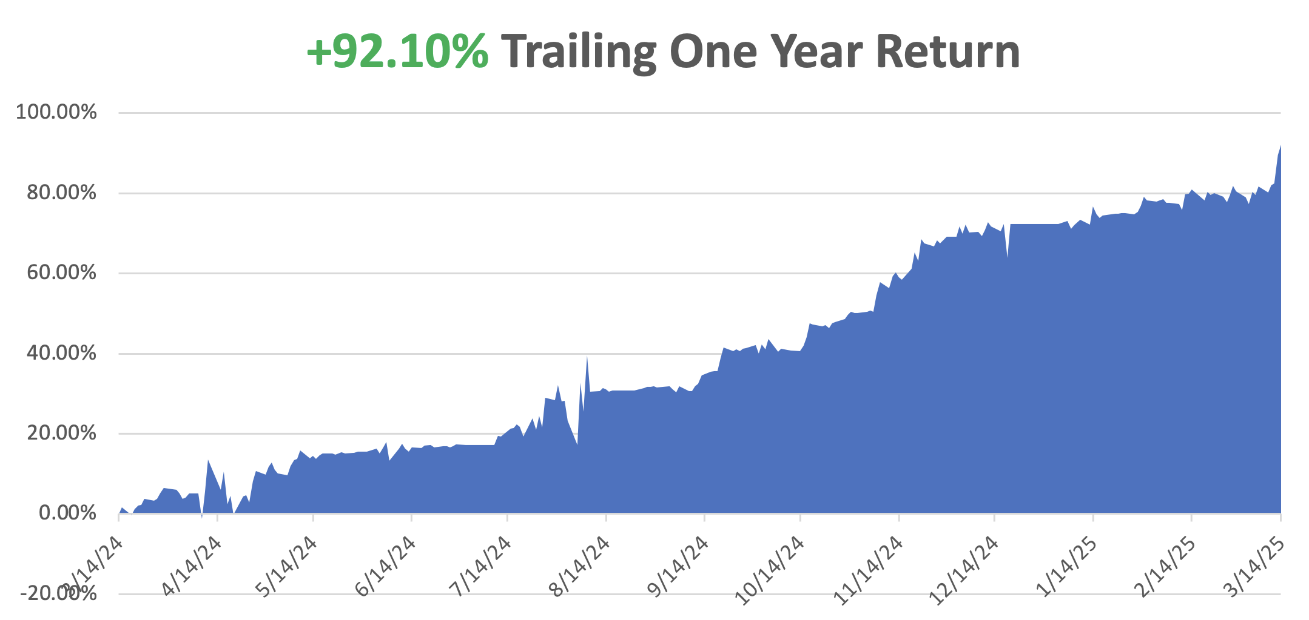

Slide 6
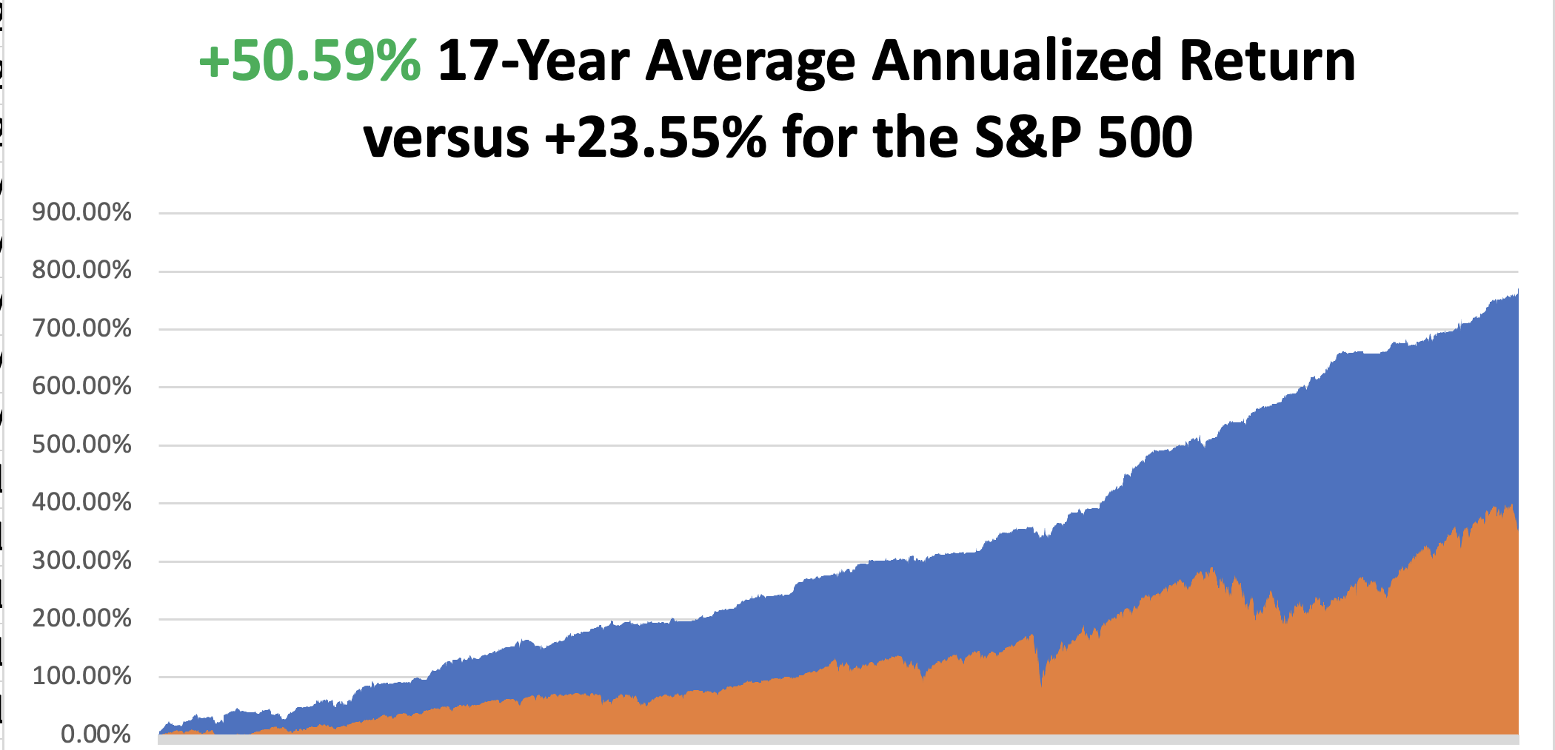

Slide 7
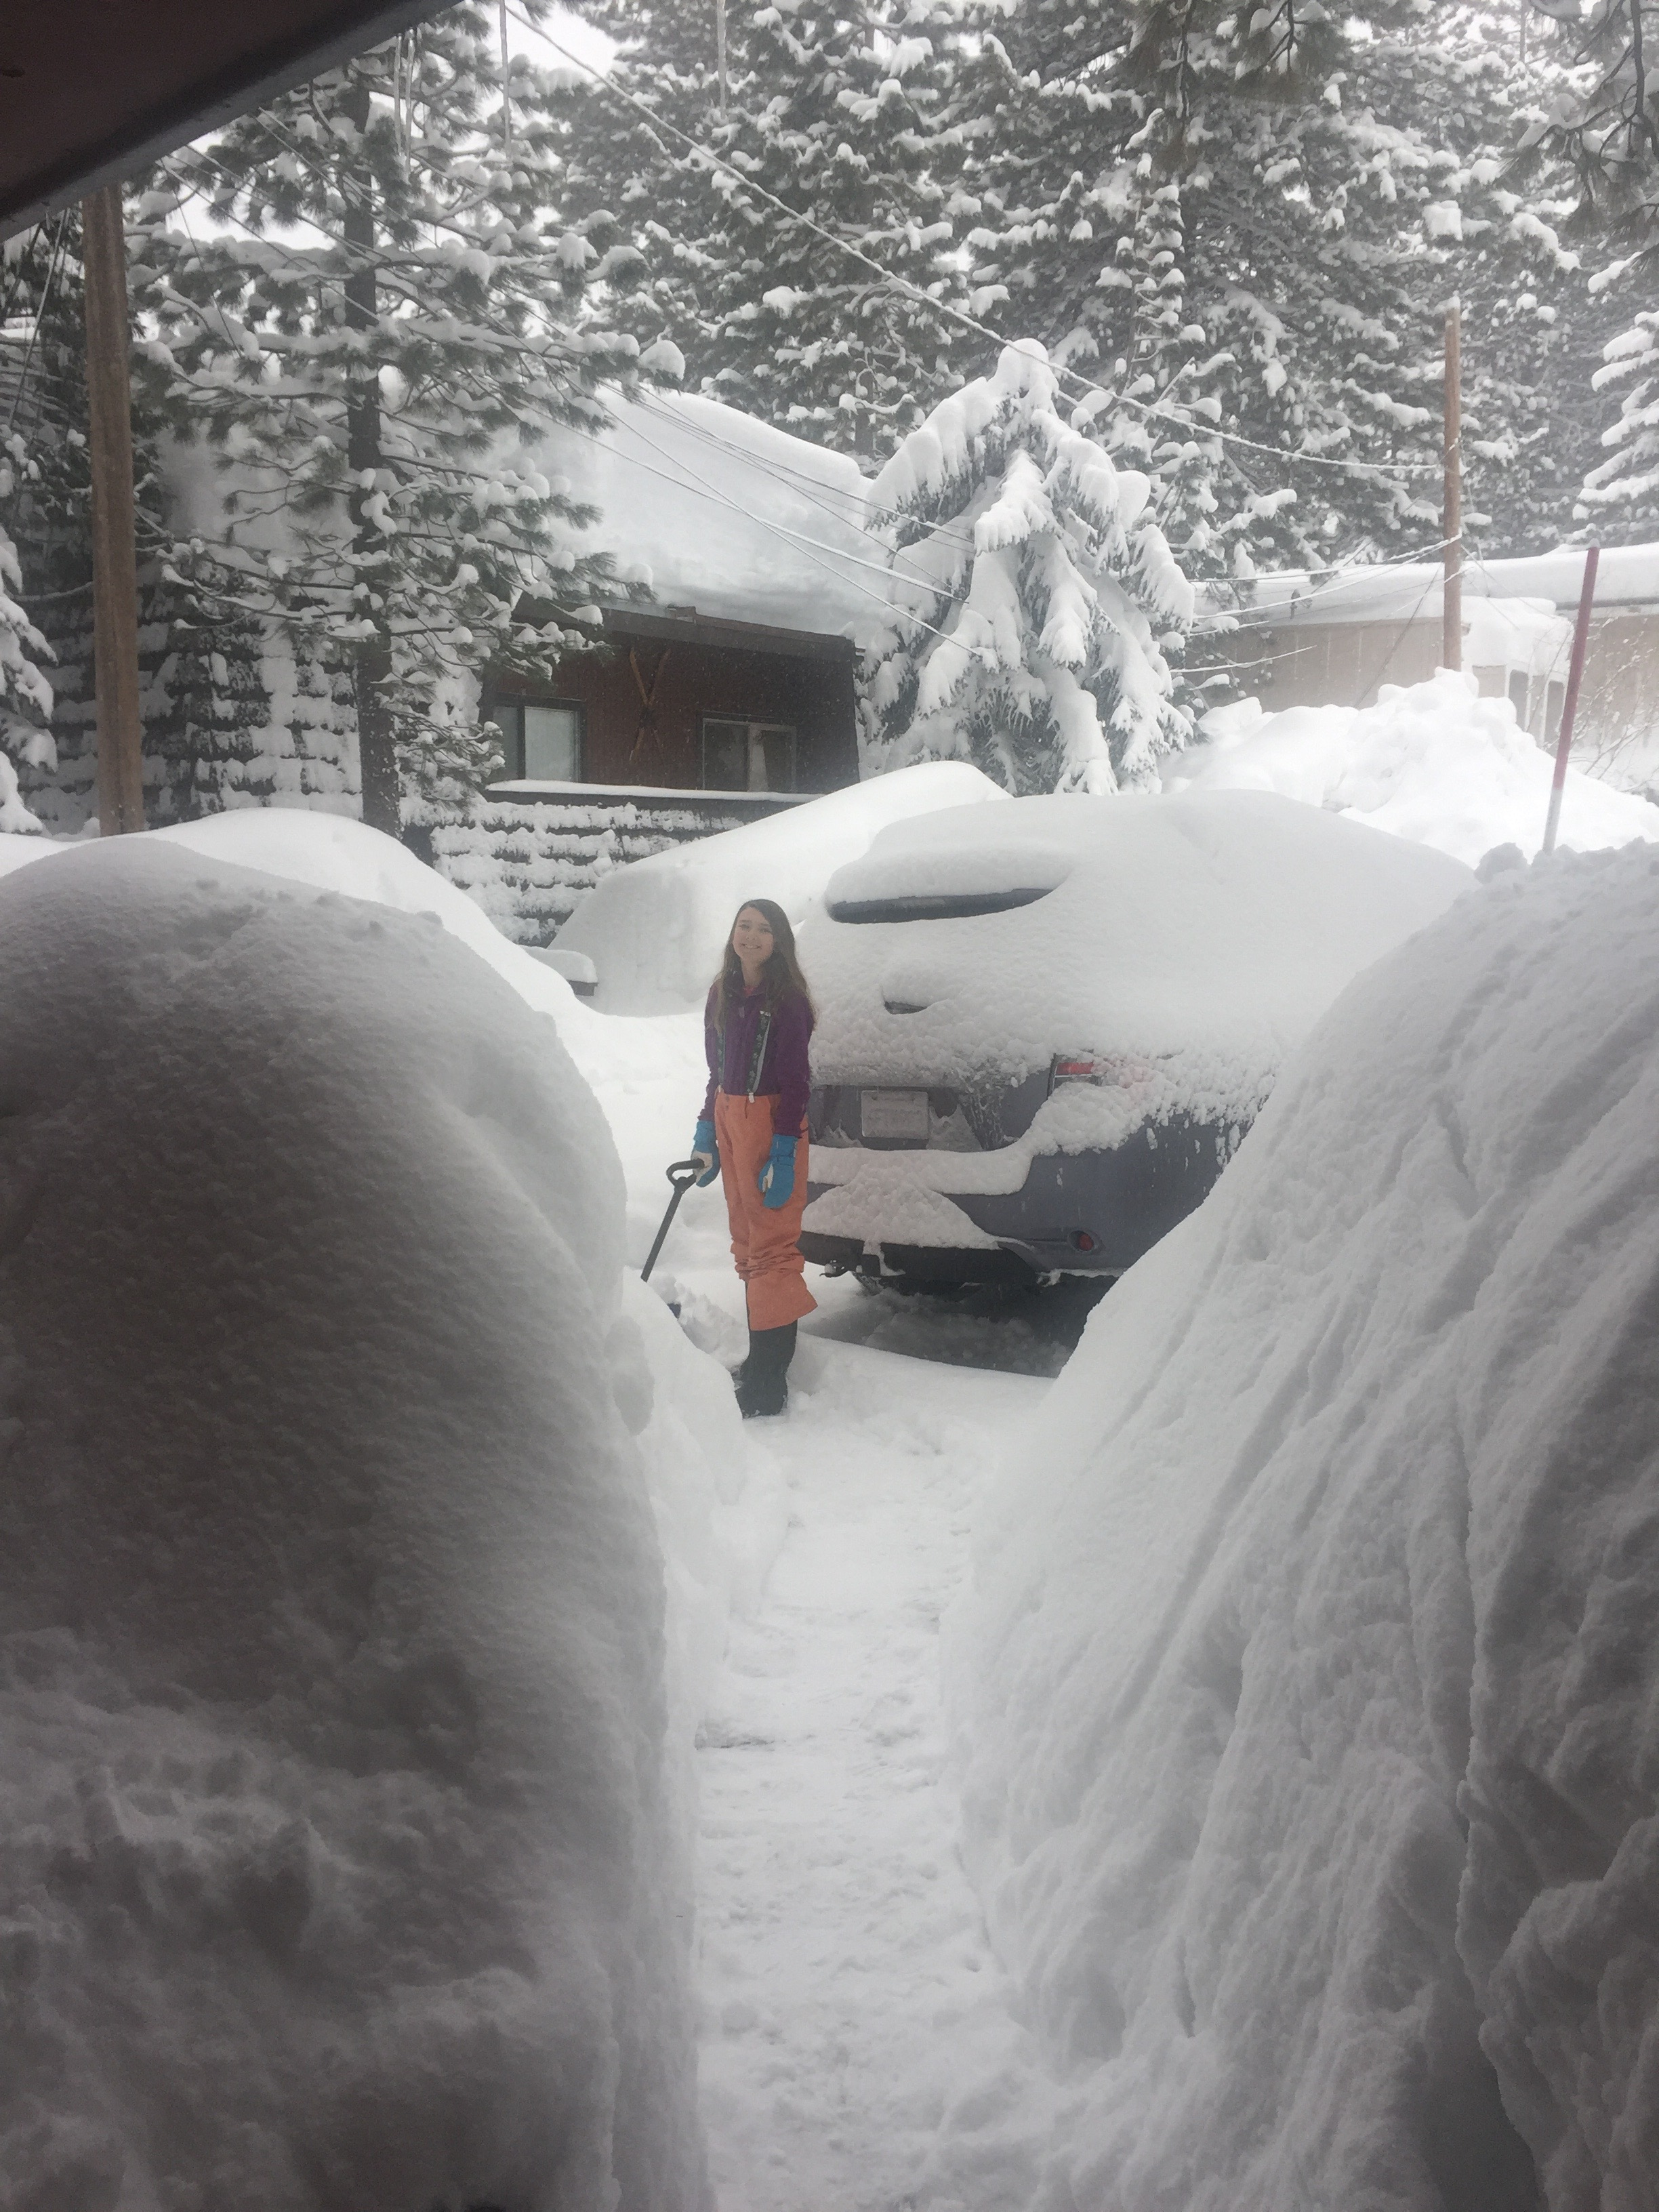

Slide 8
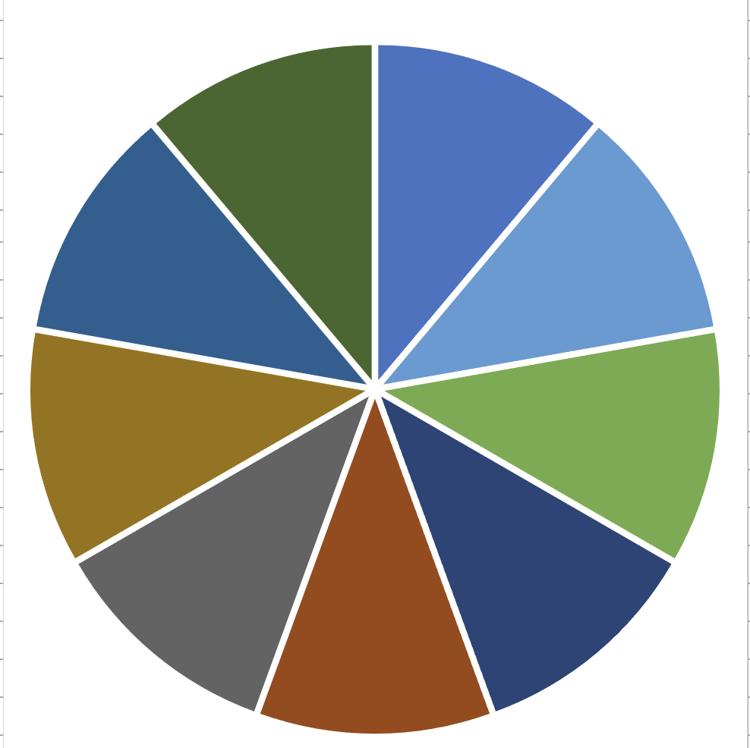
Portfolio Review – Big Bet We Don’t Go to New Highs by April 17 10% risk on, 80% risk off, 10% cash
Risk On
(NVDA) 3/$88-$90 call spread | 10.00%
Risk Off
(GLD) 3/$240-$250 call spread | -10.00%
(SH) 3/$38-$41 call spread | -10.00%
(SH) 4/$40-$43 put spread | -10.00%
(GM) 3/$53-$56 put spread | -10.00%
(NVDA) 4/$140-$145 put spread | -10.00%
(TSLA) 4/$310/$320 put spread | -10.00%
(GM) 4/$52.50-$57.50 put spread | -10.00%
(TLT) 4/$84-$87 call spread | -10.00%
Total Net Position | -70.00%
Total Aggregate Position | 90.00%
Expiration Value +26.95%

Slide 9
The Method to My Madness
*The US economy is now in recession, but it won’t be confirmed by the data until August. *Stocks have given up all gains since September, losing $5 trillion in market cap in a month *Interest rate plays are back in favor as recession fears drive rates down *Deregulation plays take biggest hits as it never showed *US Dollar enters free fall with declining rates cutting it off at the knees *Big Technology was the most expensive and saw biggest falls *Energy sells off on global recession fears with oil hitting four-year lows *Cash is king - $1 at market top is worth $10 at bottom

Slide 10
The Global Economy – Global Fears
*The economy is now solidly moving into recession * University of Michigan Consumer Confidence Collapses, at 57.0 versus an estimated 63.2, a four-year low. * Consumer Price Index Slows, with the CPI increased 2.8% * Small Business Confidence Falls off a Cliff * Government to Change GDP Calculations, knocking out government spending * Nonfarm Payroll Report Comes in Weak, at 151,000 * Layoffs Hit Five Year High * Germany Passes Massive $1.3 Trillion Spending Stimulus, devoted to defense spending and infrastructure

Slide 11
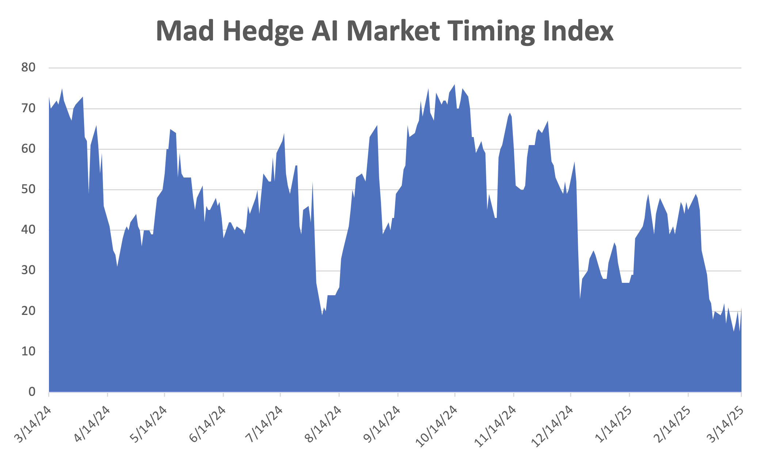
The Mad Hedge Profit Predictor Market Timing Index – New Range? An artificial intelligence driven algorithm that analyzes 30 different economic, technical, and momentum driven indicators
SELL
BUY

Slide 12
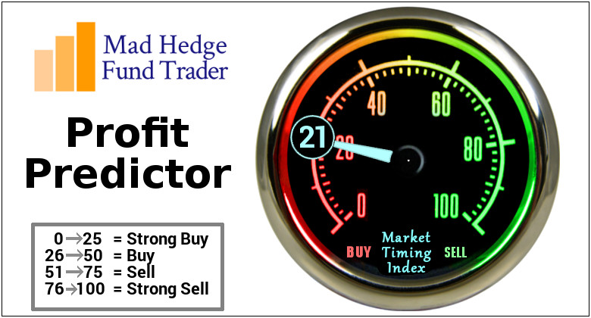

Slide 13
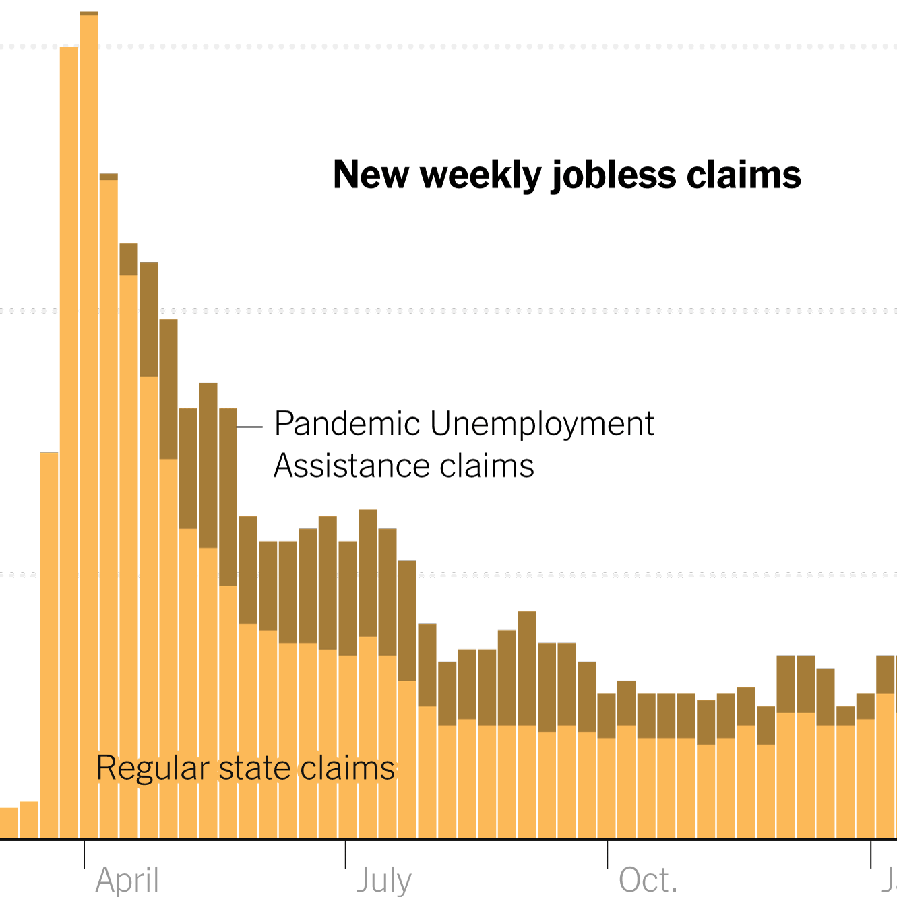
Weekly Jobless Claims – 4 Month Low -2,000 to 220,000

Slide 15
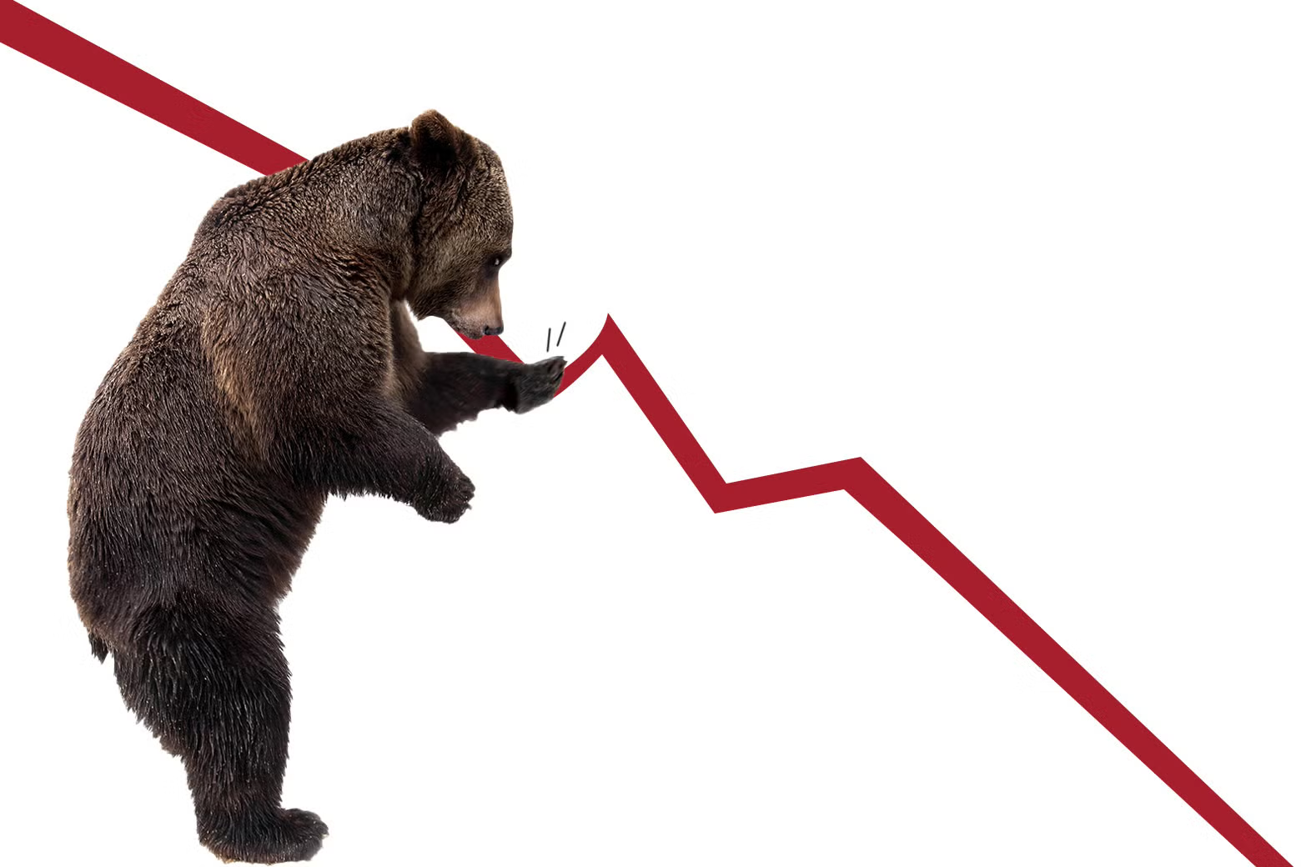
Stocks – Welcome to the Bear Market
*Stocks lost 10% in a month and there is another 10% to go *NASDAQ is down 14% *The Volatility Index peaked at $30, but there are higher higher to come *Biggest degrossing since the pandemic has taken place, cutting back of total positions longs and shorts *Nvidia was the first stock to attract serious institutional buying *Tesla has become a no touch on global boycotts and falling sales *Markets have flipped from FOMO to capital preservation *The average American now has to work seven more years to get his retirement funds back to where they were a month ago *Any 3% rally should invite heavy selling and new lows *Sell first and ask questions later

Slide 16
The Ultimate Hedge – Defensive stocks only go down at a slower rate 90 - day US Treasury Bills (Warren Buffet owns $300 billion)
*Government Guaranteed principal *Endless liquidity, trade like water *100% collateral value for margin *Lock in guaranteed income *Can be sold at any time to earn full interest *Will survive any bear market *Ask your broker how to buy

Slide 17
ARE WE TRANSITIONING FROM THE BOTTOM OF THE OLD RANGE TO THE TOP OF A NEW RANGE

Slide 18
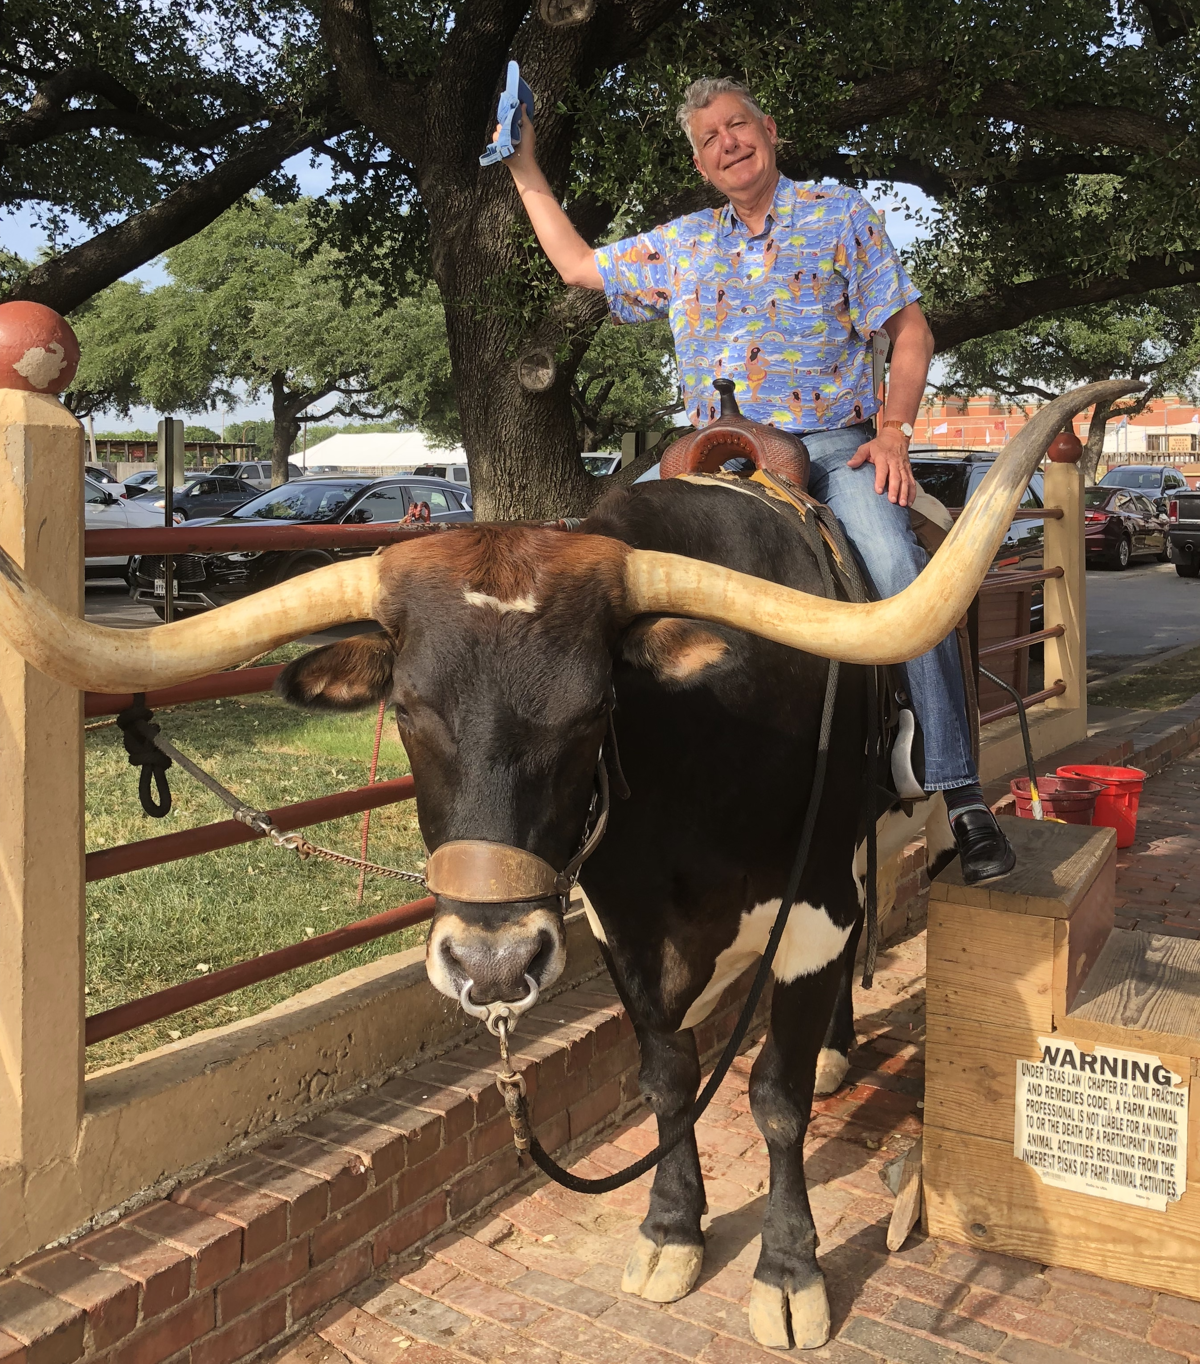
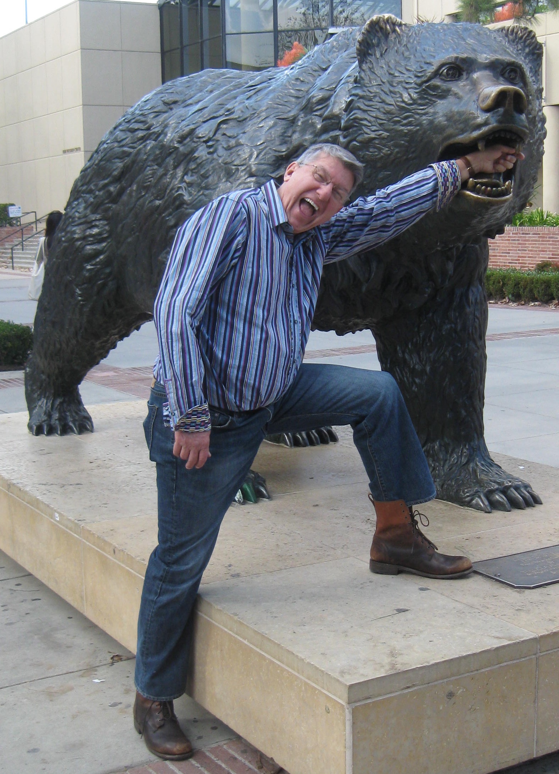
The Worst-Case Scenarios
The Bull Case We are now in a recession that will probably cost us -6%-7% over 2-3 quarters and then ends with a renewal of a $5 trillion tax cut for 2026 (SPY) down 20%-30%, (SPY) multiple drips from 22X to 18X last seen in 2018 Or The Bear Case No tax cut means we enter a depression and lose 25% of GDP over 4 years (SPY) down 60% if (SPY) PE falls from 22X to 9X 240% of stock gains since 2009 have been multiple expansion

Slide 19
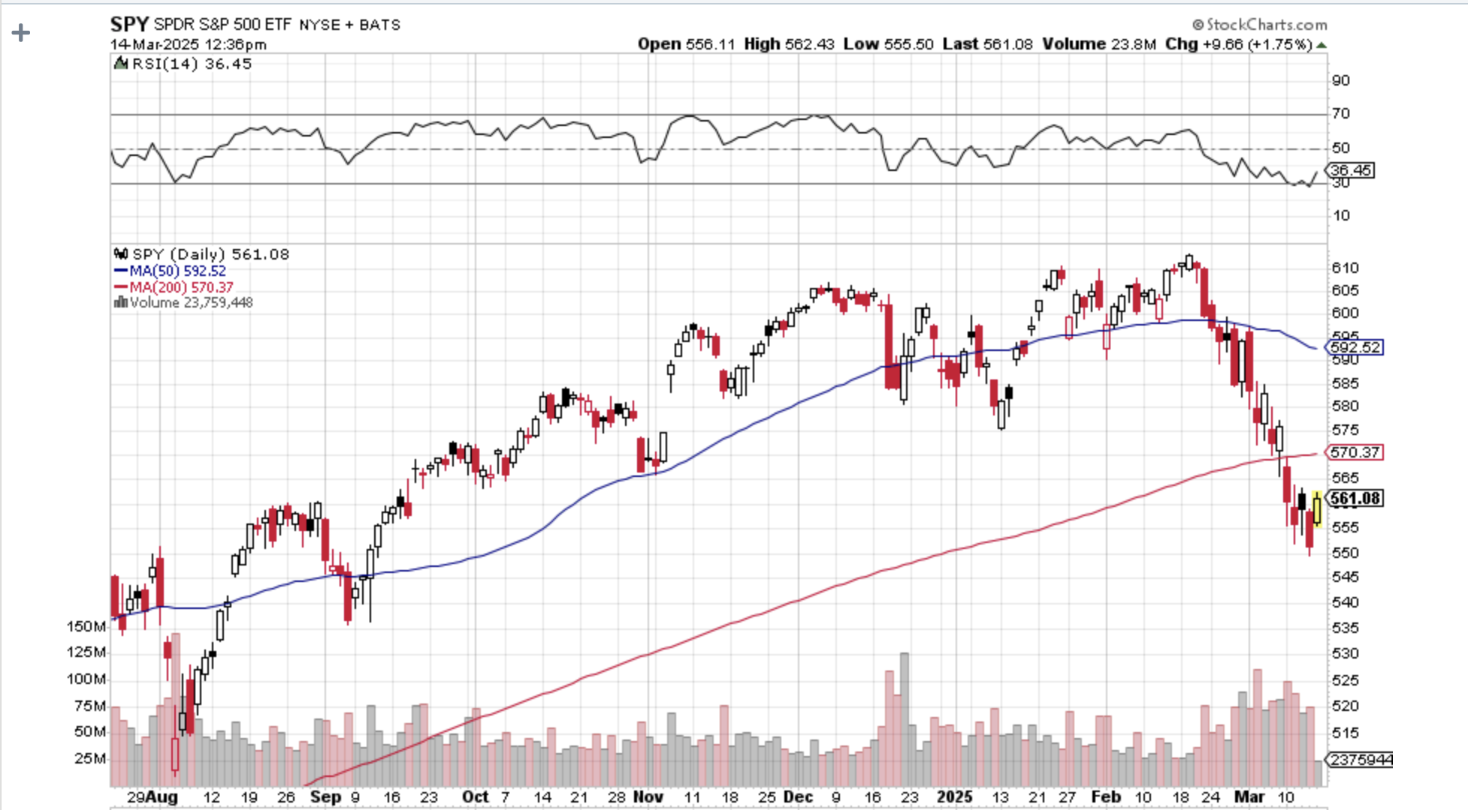
S&P 500 – Downside Targets – down 6% on year
Depression Worst Case $250 -60% PE 9X
$535 -12.7% 1st support
$500 -18.4% 1st support

Slide 20
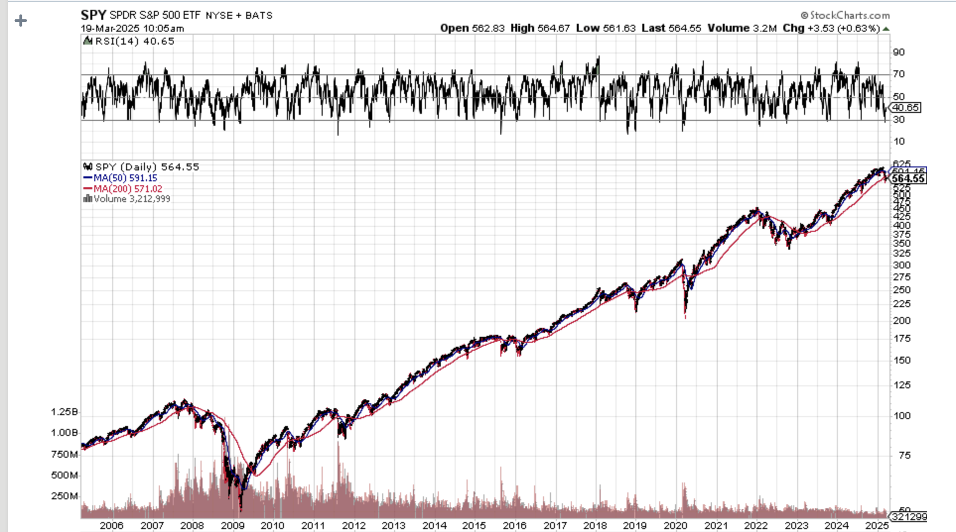
S&P 500 – Downside Targets- The Worst Worst Case $613 down to $250 – After 1929 it took 25 years to recover the old high
Depression Worst Case $250 -60% PE 9X

Slide 21
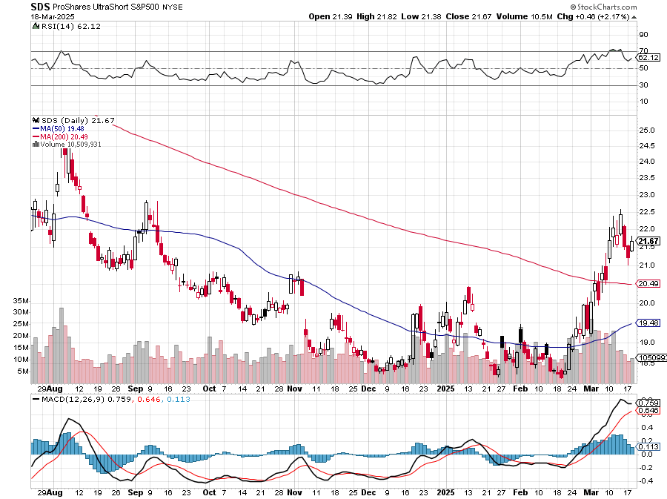
ProShares -2X Short S&P 500 (SDS) - a great 2X hedge for falling long stocks Long 3/$38-$41 call spread – expires in 2 days, long $40-$43 calls prad – expires in 21 days up 40%

Slide 22
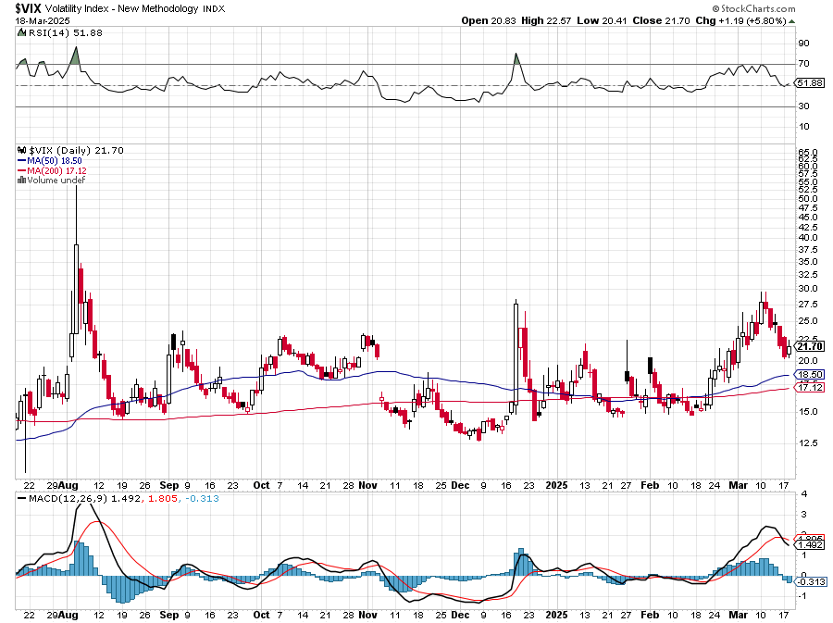
(VIX) – Volatility Index Hits Four Year High at $65, the most since the 2020 pandemic. That implies a 2% move in the S&P 500 (SPX) every day for the next 30 days

Slide 23
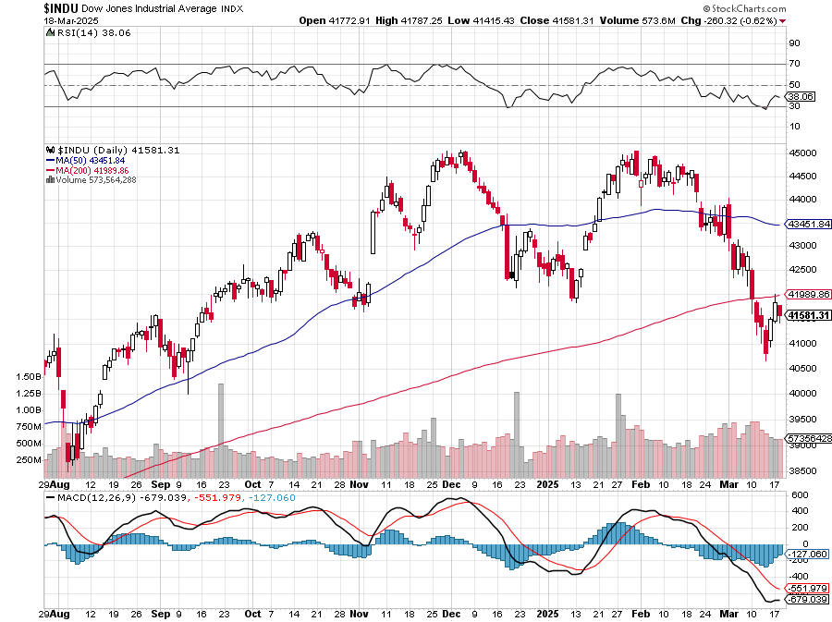
Dow Average ($INDU)-

Slide 24
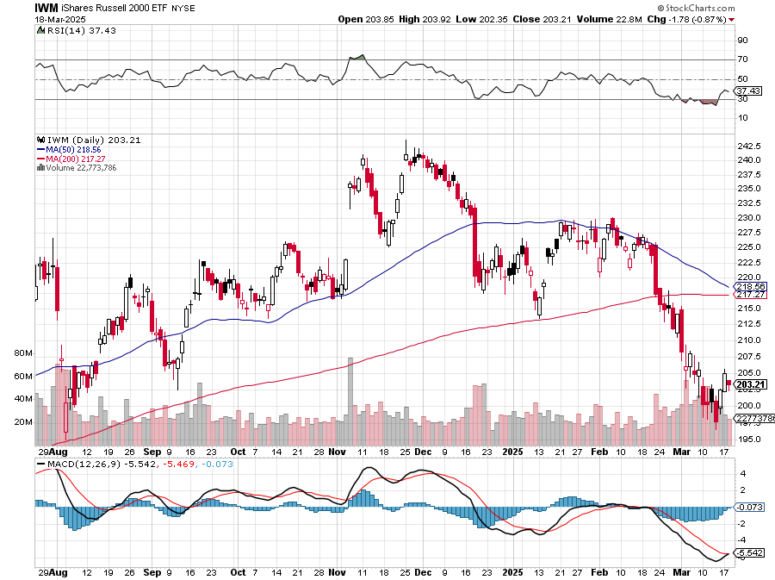
Russell 2000 (IWM)- took profits on Long 10/$137-$142 vertical bull call spread took profits on Long 10/$153-$156 vertical bear put spread

Slide 25
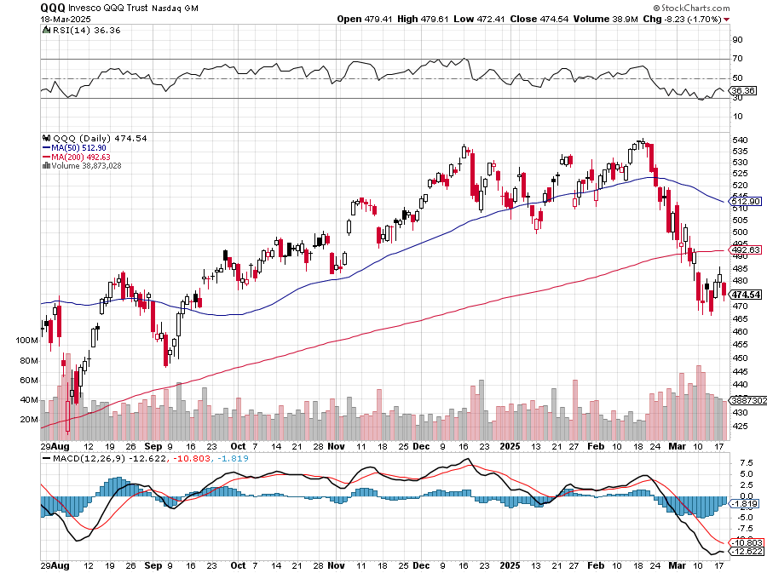
NASDAQ (QQQ) – Down 15% took profits on Long 5/$335-$345 put spread took profits on long (QQQ) 1/$290-$300 put spread, took profits on long (QQQ) 4/$330-$335 put spread took profits on long (QQQ) 3/$340-$345 put spread, covered long (QQQ) $325-$330 put spread

Slide 26
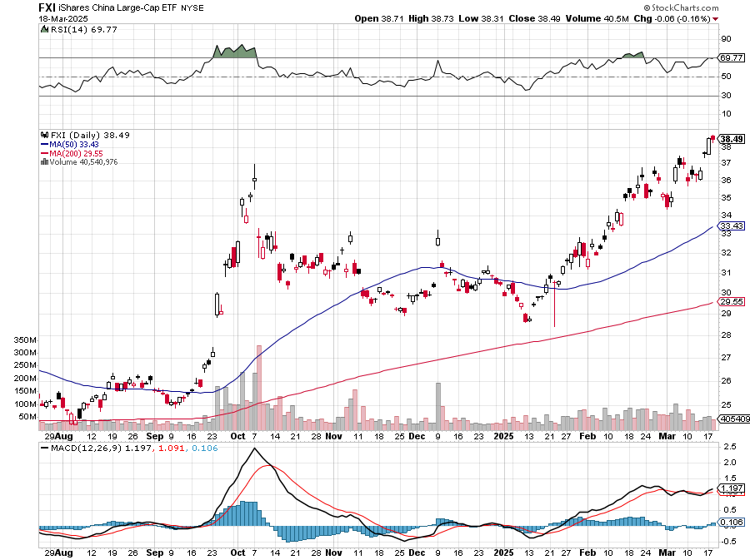
China (FXI) + 36%

Slide 27
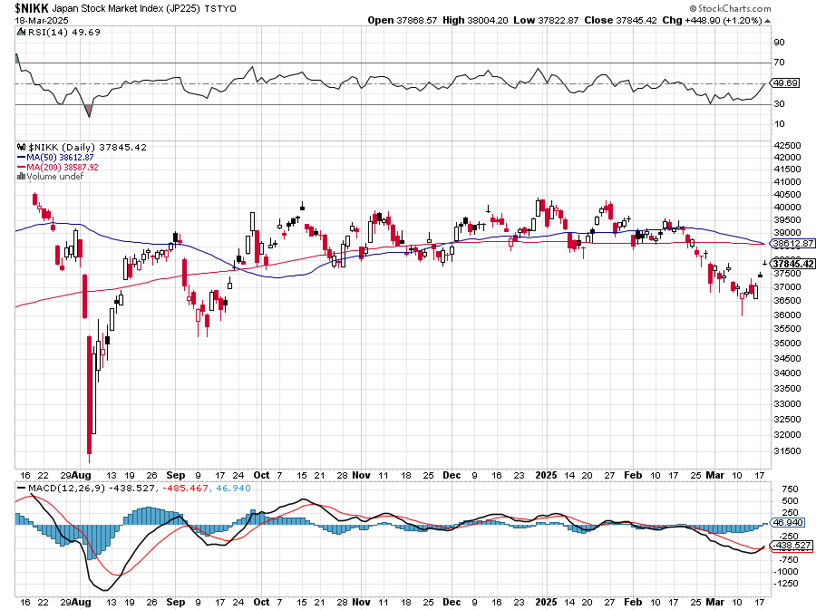
Japan ($NIKK) – down 10%

Slide 28
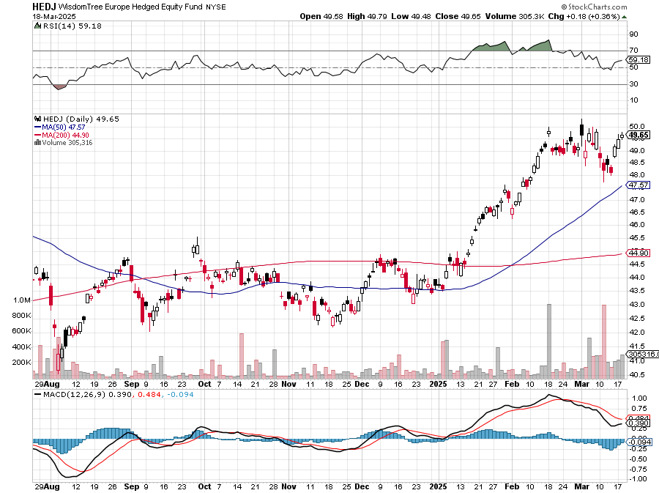
Europe Hedged Equity (HEDJ)- +19%

Slide 29
German Dax (DAX)- +30%

Slide 30
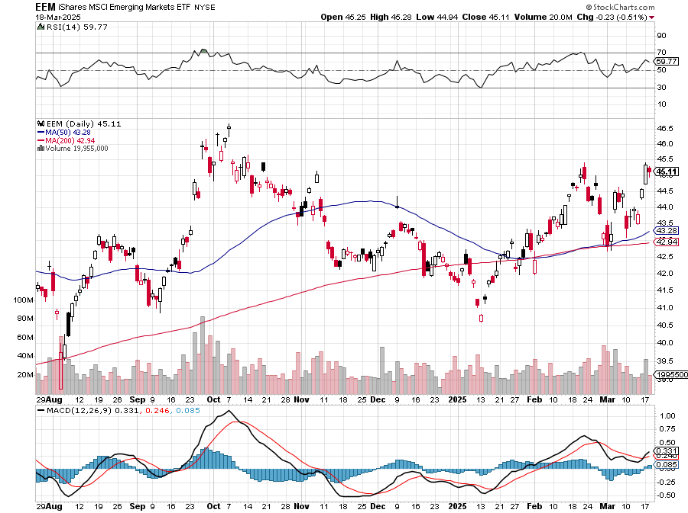
Emerging Markets (EEM) - +8% Weak Dollar, Long Recovery Play

Slide 31
THE MAD HEDGE FUND TRADER
The Barbell Portfolio
*75% Big Tech – 2% of US workforce, 25% of market cap and 25% of US earnings 25% Domestic Recovery, including: Railroads, airlines, cruise lines, Couriers, steel companies Banks, commodities Construction Credit Card Companies Hotels, casinos Online Ticket Sales

Slide 32
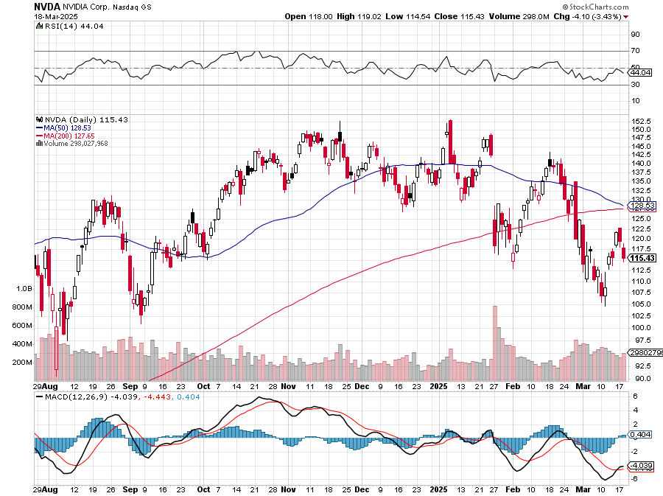
NVIDIA (NVDA) – Blackwell Chips @ $70,000 each Nvidia Tanks Again, as the incoming government plans new China export restrictions on the company long 3/$88-$90 call spread - expires in 2 trading days, long 4/$140-$145 puts spread - expires in 21 trading days took profits on Long 2/$90-$95 call spread, took profits on Long 12/$117-$120 call spread

Slide 33
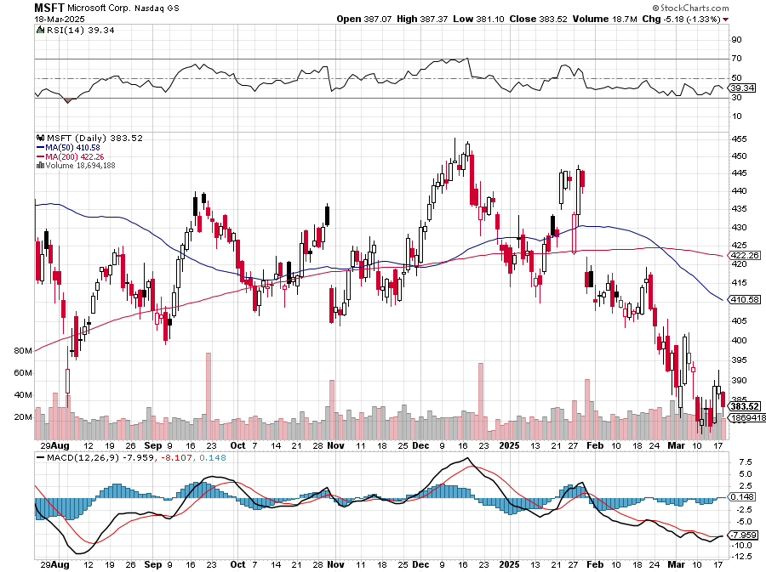
Microsoft (MSFT)-Microsoft Bombs, Microsoft Blows Up on Cloud Guidance took profits on long 5/$430-$440 put spread Took profits on long 2/$330-$340 call spread, took profits on long 12/$320-$330 call spread took profits on long 9/$235-$245 call spread, took profits on long 7/$220-$210 call spread,

Slide 34
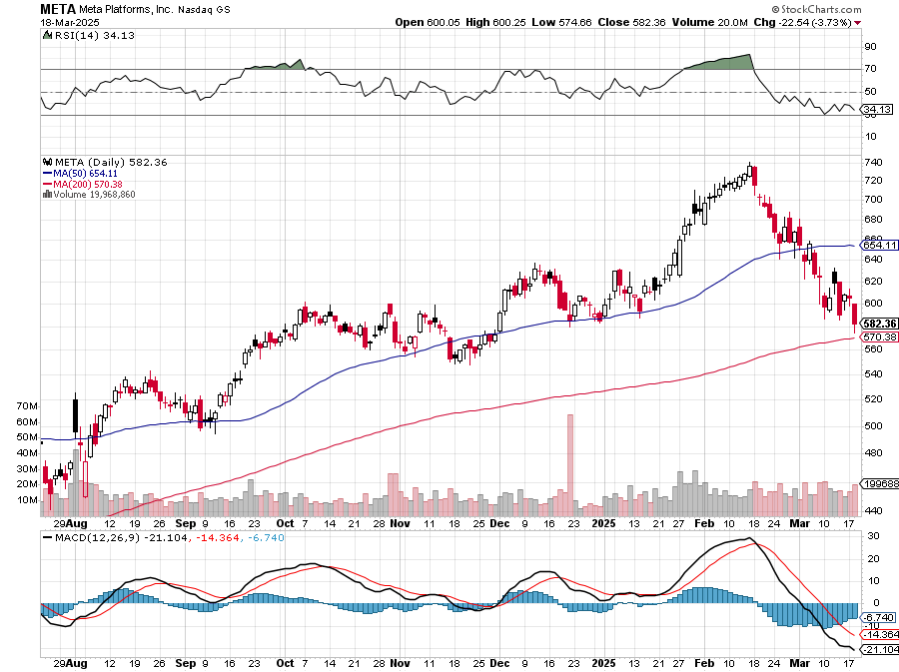
Meta (META) Meta Beats, on improving ad sales, a preeminent AI user took profits on Long 8/$420-$430 call spread took profits on Long 5/$360-$370 vertical bull call spread, took profits on Long 9/$290-$300 vertical bear put spread, stopped out of Long 9/$190-$200 vertical bear put spread

Slide 35
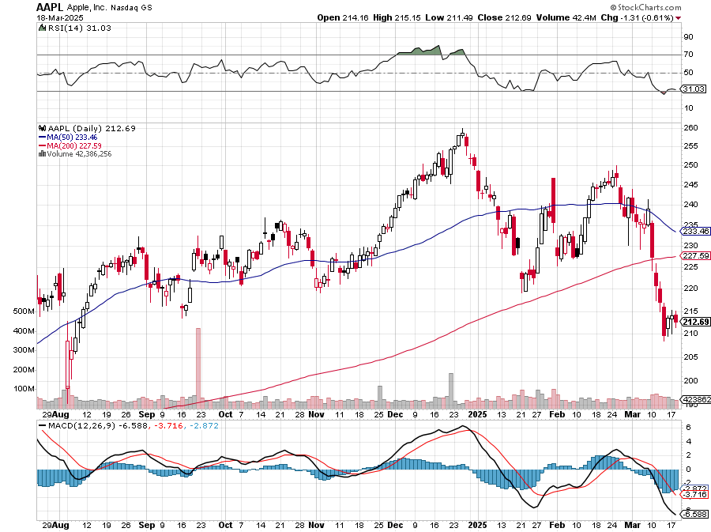
Apple (AAPL) AI Delayed took profits on Long 5/$225-$235 vertical bear put spread, took profits on Long 8/$160-$170 call spread took profits on Long 6/$200-$210 bear put spread,

Slide 36
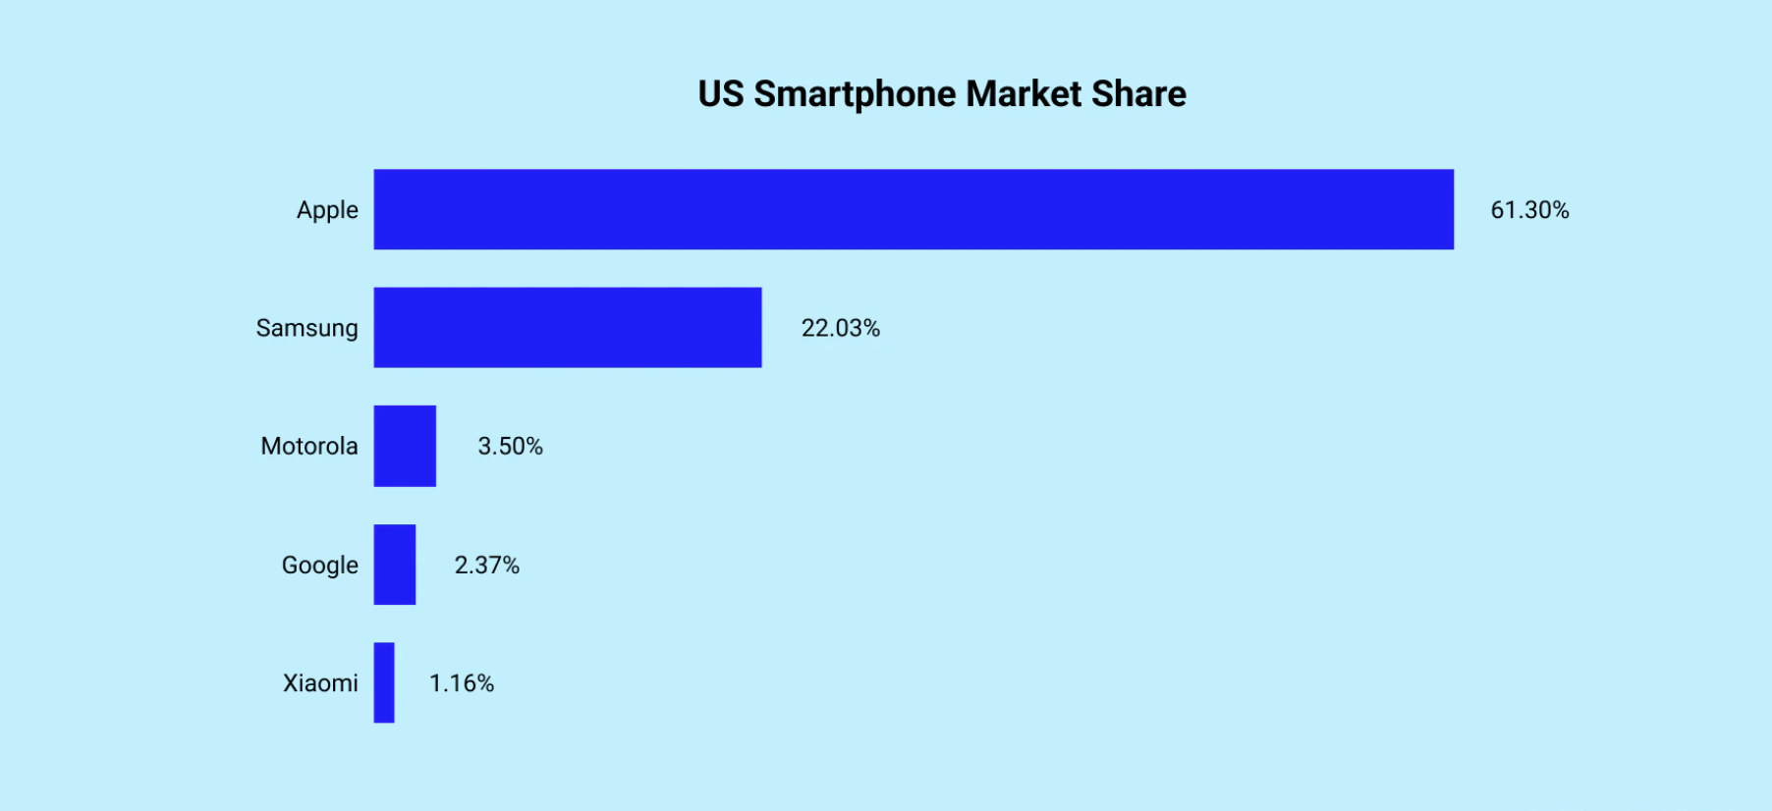

Slide 37
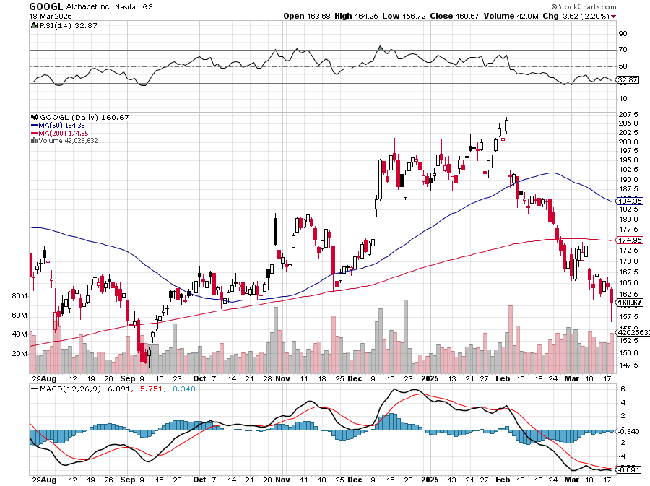
Alphabet (GOOGL) – Breakup Target Trump Administration to Pursue Alphabet Breakup took profits on long 12/$110-$120 call spread took profits on long 12/$1,200-$1,230 bull call spread, took profits on long 9/$1,030-$1,080 vertical bull call spread

Slide 38
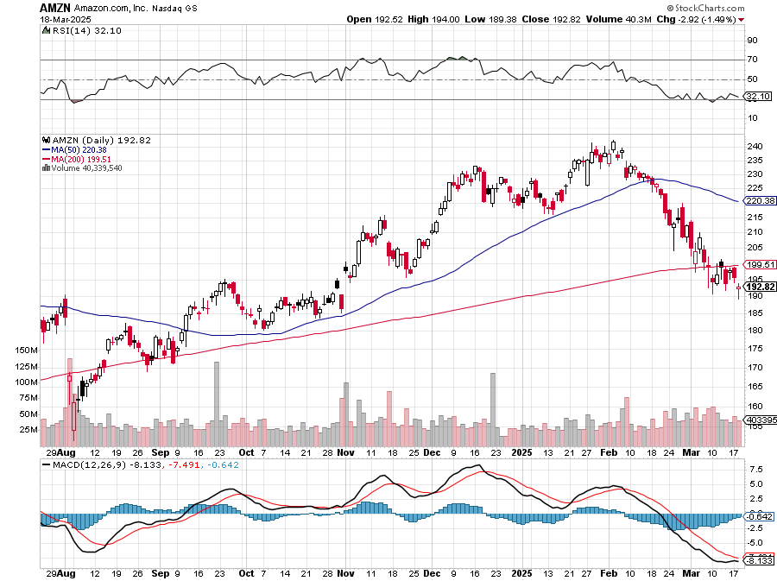
Amazon (AMZN) – Antirust Target took profits on long 3/$155-$160 bull call spread , took profits on long 2/$130-$135 bull call spread

Slide 39
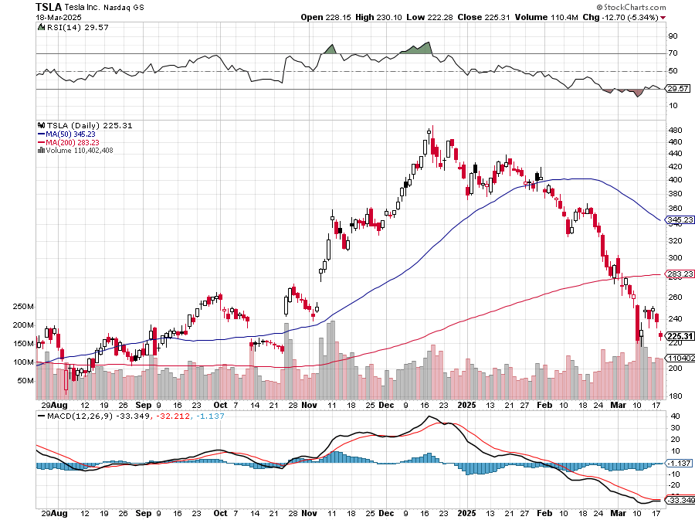
Tesla (TSLA) – Global Brand Destroyed European Boycott is Hurting - will miss 2025 sales target by a large margin long $310-$320 put spread, took profits on long 3/$350-$360 put spread, stopped out of 3/$210-$220 call spread, profits on long 2/$300-$310 call spread, took profits on long 2/$300-$310 call spread, 2/$540-$550 put spread 7 days to expiration took profits on long 1/$330-$340 call spread, took profited on long 12/$270-$275 call spread

Slide 40
Netflix (NFLX) – Netflix Earnings Rocket, on the back of 19 million new subscriber

Slide 41
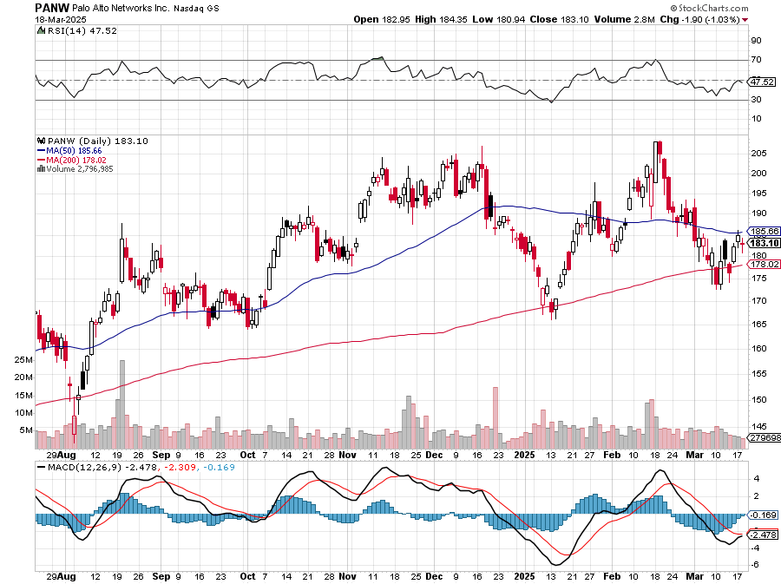
Palo Alto Networks (PANW)- Hacking never goes out of fashion Palo Alto Announced\s 2:1 Split took profits on long 2/$260-$270 call spread, took profits on long 10/$130-$140 call spread

Slide 42
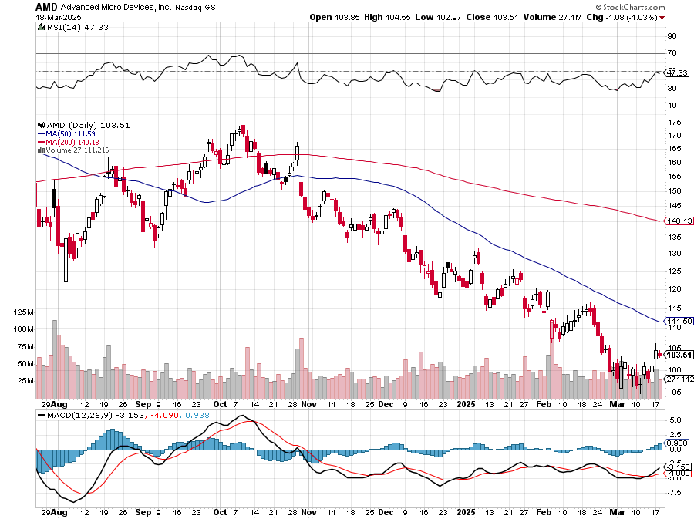
Advanced Micro Devices (AMD)- Recession fears programable logic devices took profits on long 2/$75-$80 call spread

Slide 43
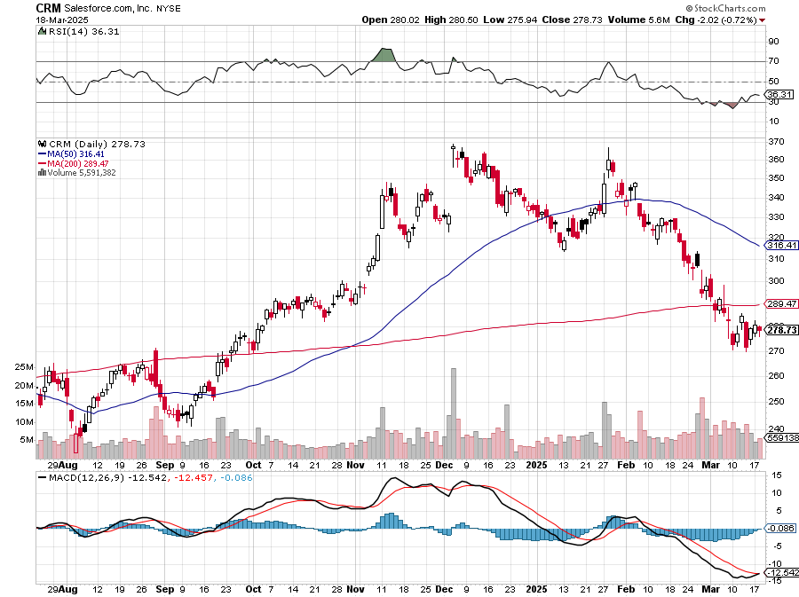
Salesforce (CRM)- Massive Online Migration took profits on long 12/$185-$195 call spread, took profits on long 9/$125-$130 vertical bull call spread took profits on long 8/$125-$130 vertical bull call spread

Slide 44
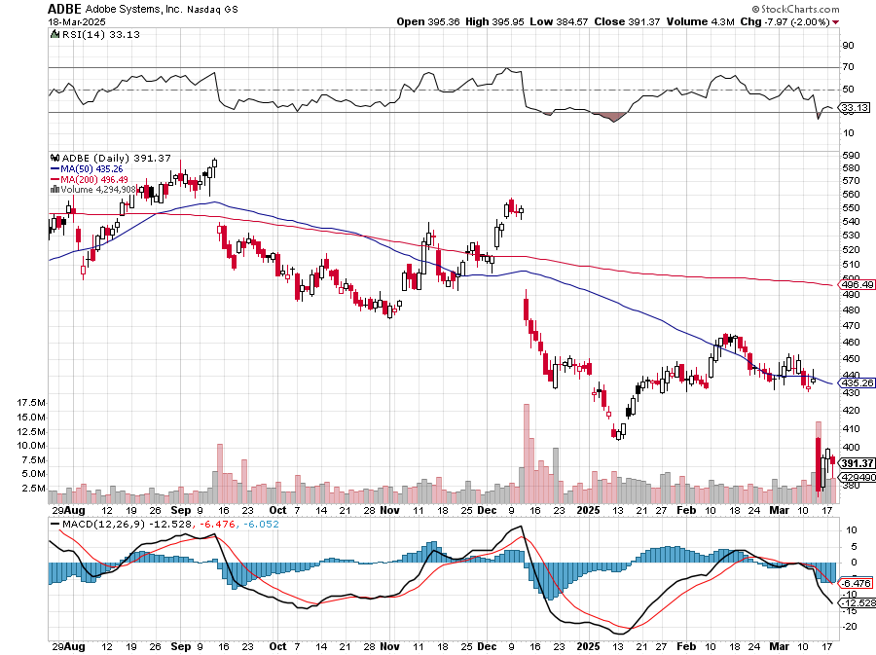
Adobe (ADBE)- Cloud play The Quality Non-China tech play

Slide 45
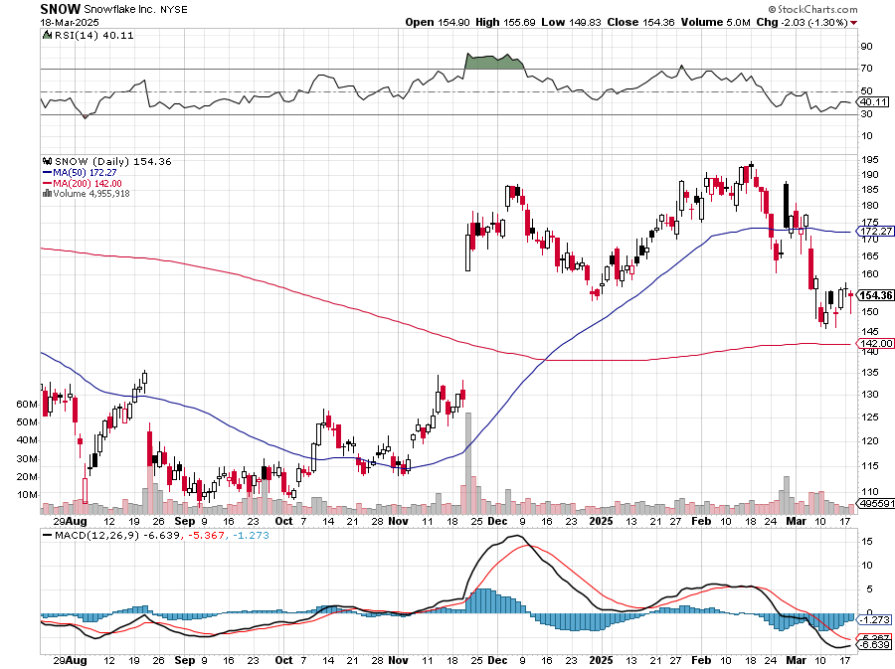
Snowflake (SNOW)- Blockbuster AI Earnings stopped out of long 4/$150-$255 call spread, took profits on long 12/$135-$140 call spread

Slide 46
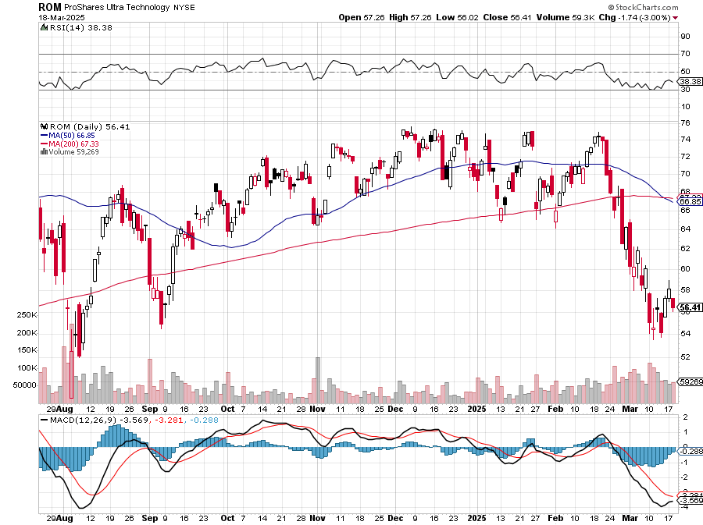
ProShares Ultra Technology ETF (ROM) – 2X Long Technology ETF took profits on long 10/$62-65 call spread

Slide 48
The Second Half of the Barbell
*Bets on a domestic recovery in 2022 Q4 *Upside potential in 2024 far greater than tech *Some of these have not moved for 5 or 10 years *Focuses on economically sensitive cyclical industries *Makes a great counterweight to high-growth technology *We could spend all of next ten years rotating between the two groups

Slide 49
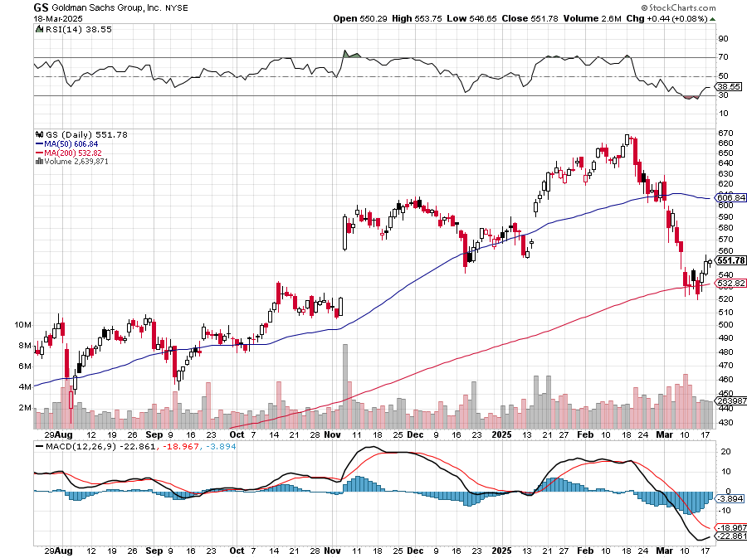
Goldman Sachs (GS) – Goldman Sachs Beats, with Revenues of $12.73 billion vs. $12.46 billion estimate stopped out of 3/$380-$390 call spread, profits on long 12/$330-$350 call spread, took profits on long 11/$330-$350 call spread

Slide 50
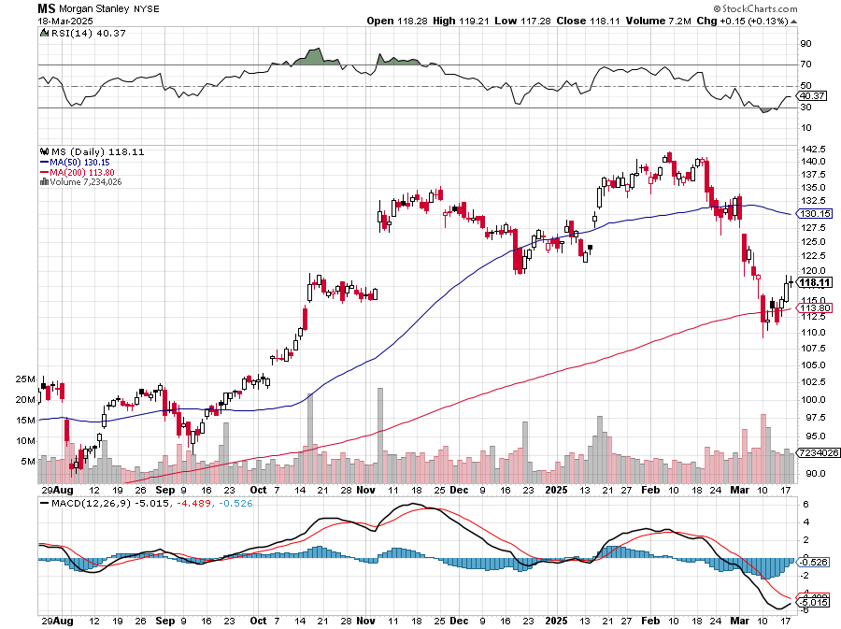
Morgan Stanley (MS) Morgan Stanley Doubles Profits took profits on long $12/210-$220 call spread, Took profits on long $195-$205 call spread, took profits on long 4/$65-$70 call spread

Slide 51
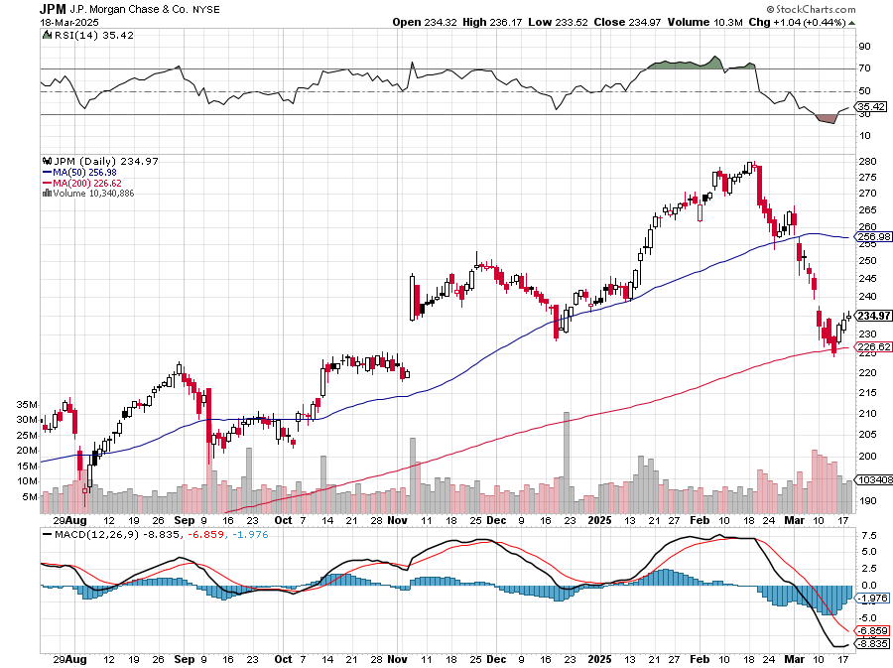
JP Morgan Chase (JPM) – Jamie Diamond Sells 30% of JP Morgan Stock stopped out of 3/$235-$245 calls spread, profits on long 12/$210-$220 call spread, took profits on long 11/$195-$205 call spread, took profits on 4/$215-225 put spread, took profits on long 4/$105-$115 call spread

Slide 52
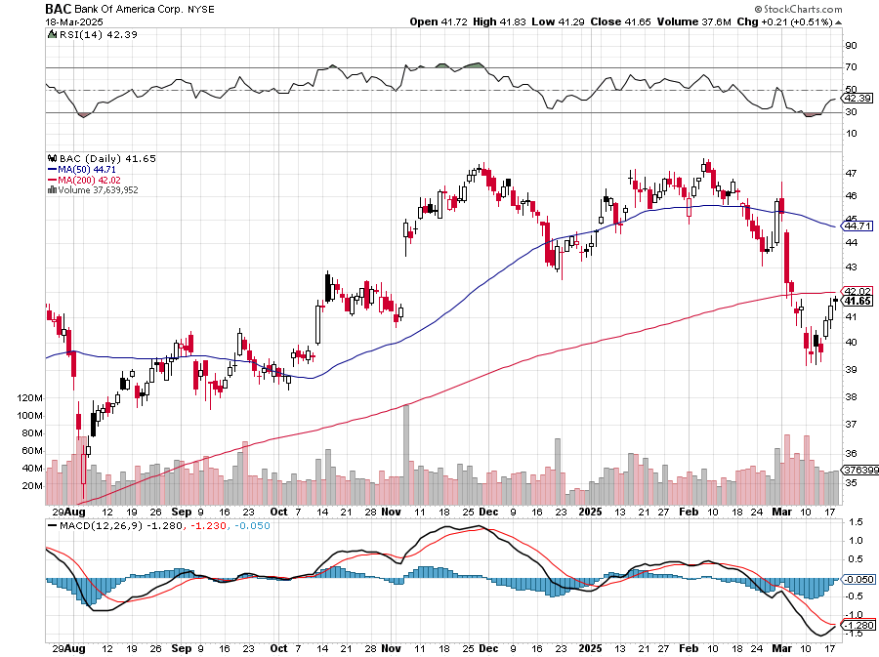
Bank of America (BAC) – Deregulation play took profits on long long 12/$41-$44 call spread, took profits on long 4/$20-$23 call spread

Slide 53
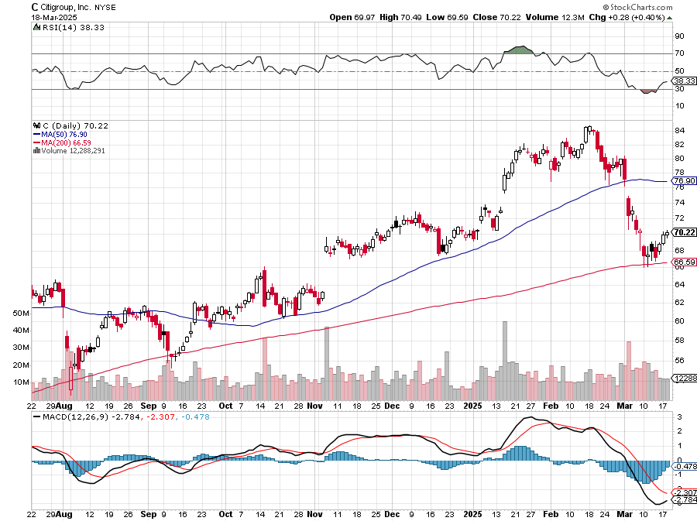
Citigroup (C) – took profits on long long 12/$60-$65 call spread , took profits on long 4/$30-$35 call spread

Slide 54
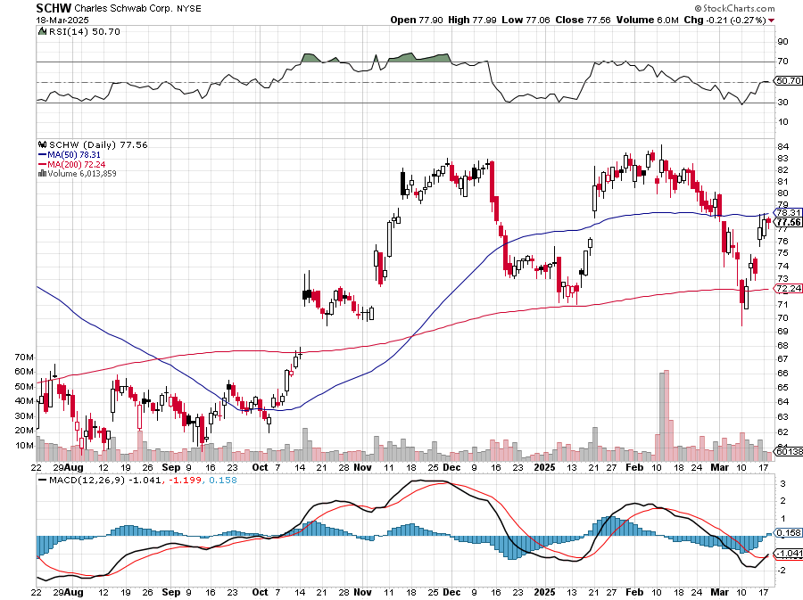
Charles Schwab (SCHW) – LEAPS expire at Max profit took profits on long 4/$30-$35 call spread

Slide 55
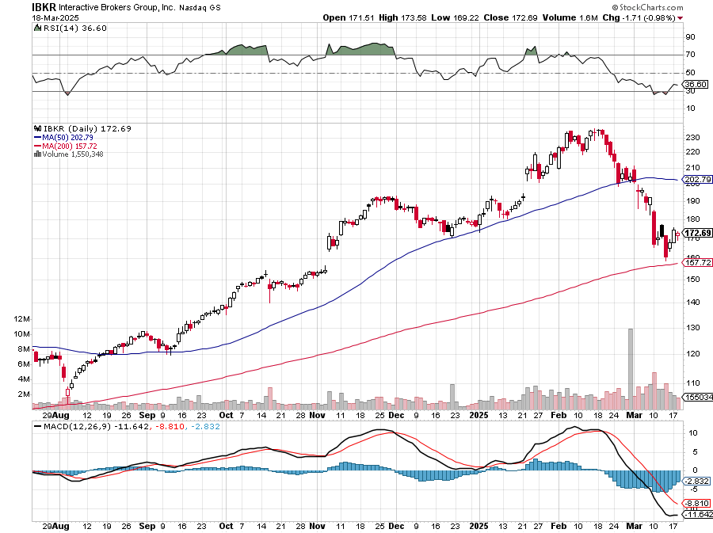
Interactive Brokers (IBKR) – LEAPS expired at Max Profit stopped out of long 3/$160-$170 call spread, out of long 8/$110-$115 call spread , took profits on long 4/$60-$65 call spread

Slide 56
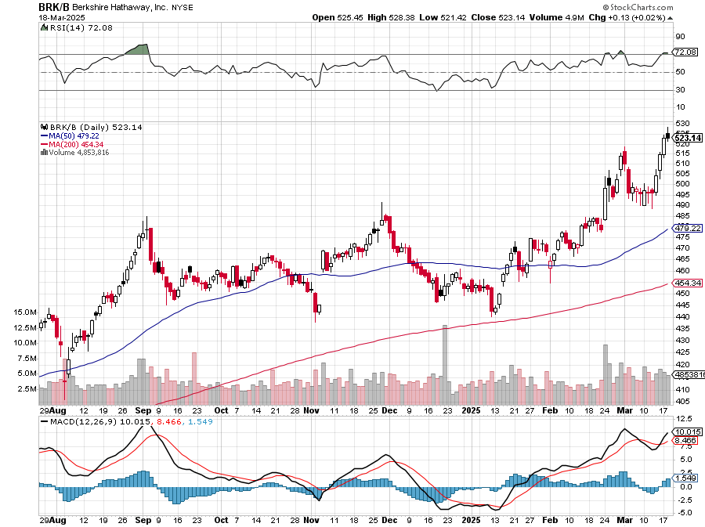
Berkshire Hathaway (BRKB)- Ultimate defensive stock Berkshire Hathaway Builds Record Cash, at $334 billion – Is the new T Bill proxy stopped out of long 12/$405-$415 call spread, took profits on long 12/$320-$330 call spread took profits on long 4/$260-$270 call spread, took profits on long 1/$290-$300 call spread

Slide 57
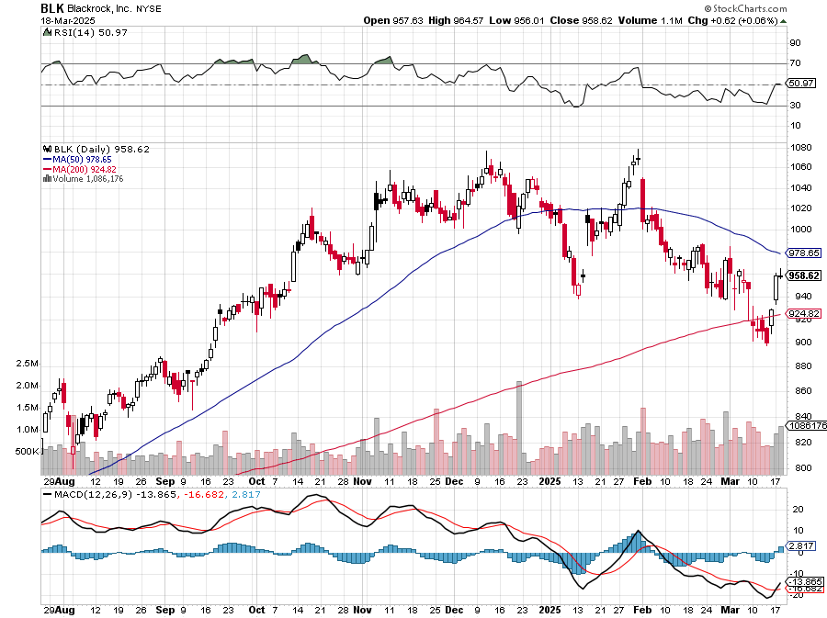
Blackrock (BLK)-Asset Collection Boom took profits on long 12/$850-$860 call spread took profits on long 3/$770-$790 call spread, took profits on long 3/$310-$340 call spread

Slide 58
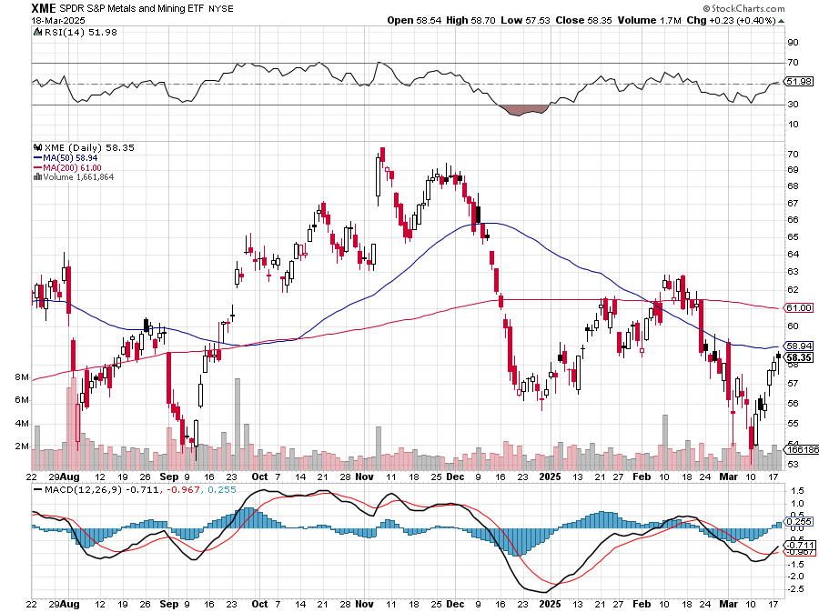
SPDR Metals & Mining ETF (XME) – long 2/$28-$30 call spread

Slide 59
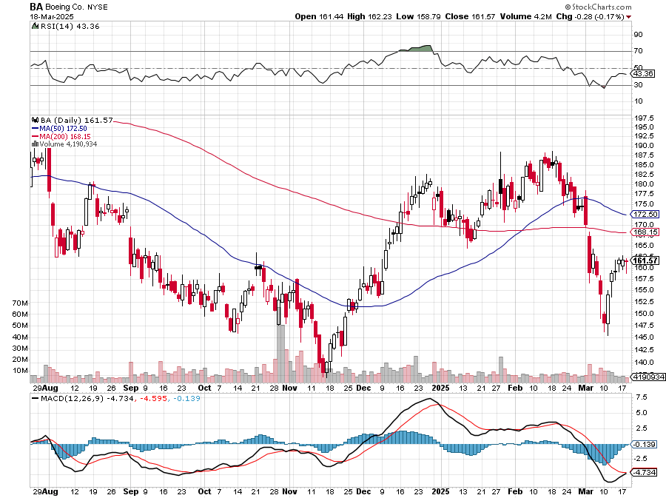
Boeing (BA) – Q3 $6 Billion Loss –b Strike Continues “il pesce marcisce dalla testa” stopped out of long 2/$190-$200 call spread, took profits on long 5/$17-$175 call spread

Slide 60
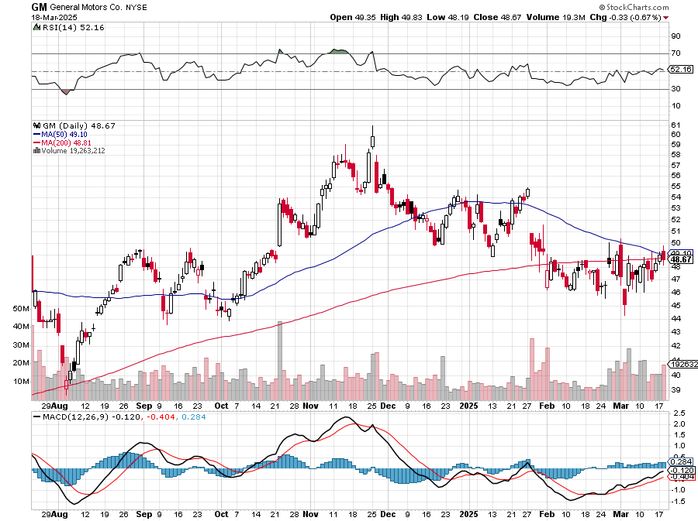
General Motors (GM) – Worst Off Trade War Victim long 4/$52.50-$57.50 put spread, long 3/$53-$56 put spread – expires in 2 days

Slide 61
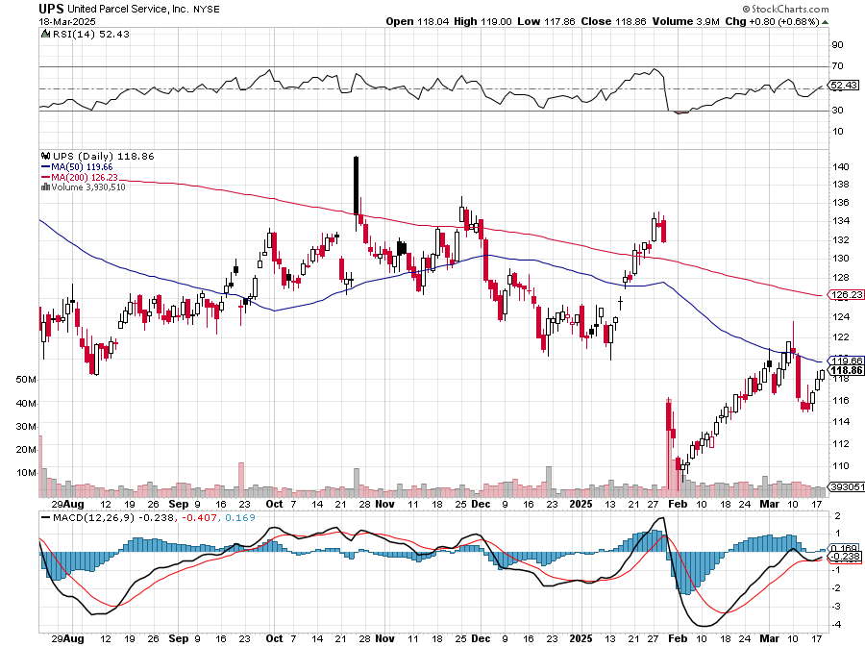
Package Delivery- United Parcel Service (UPS) – strike averted took profits on long 11/$130-$140 call spread

Slide 62
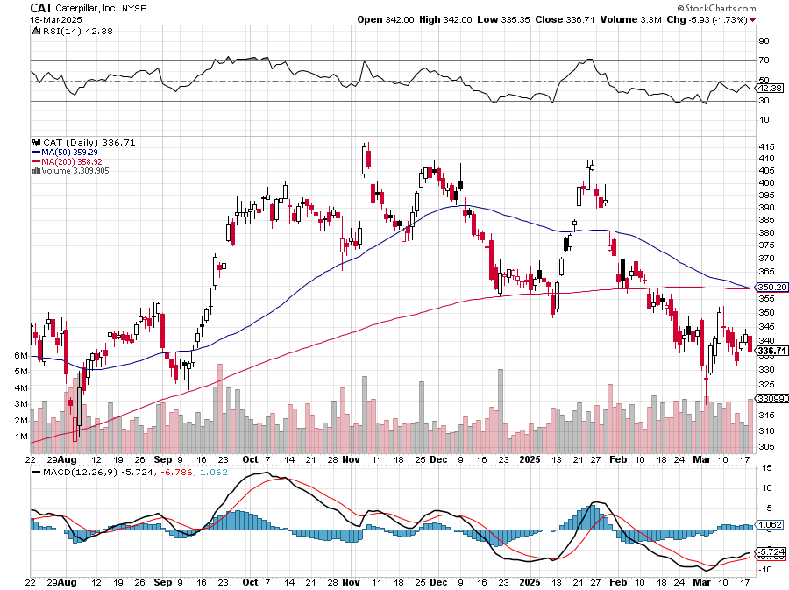
Caterpillar (CAT)- Ag + Infrastructure + Housing stopped out of long 8/$310-$320 call spread, took profits on long 12/$220-$230 calls spread took profits on long 12/$145-$150 call spread, took profits on long 11/$125-$135 call spread

Slide 63
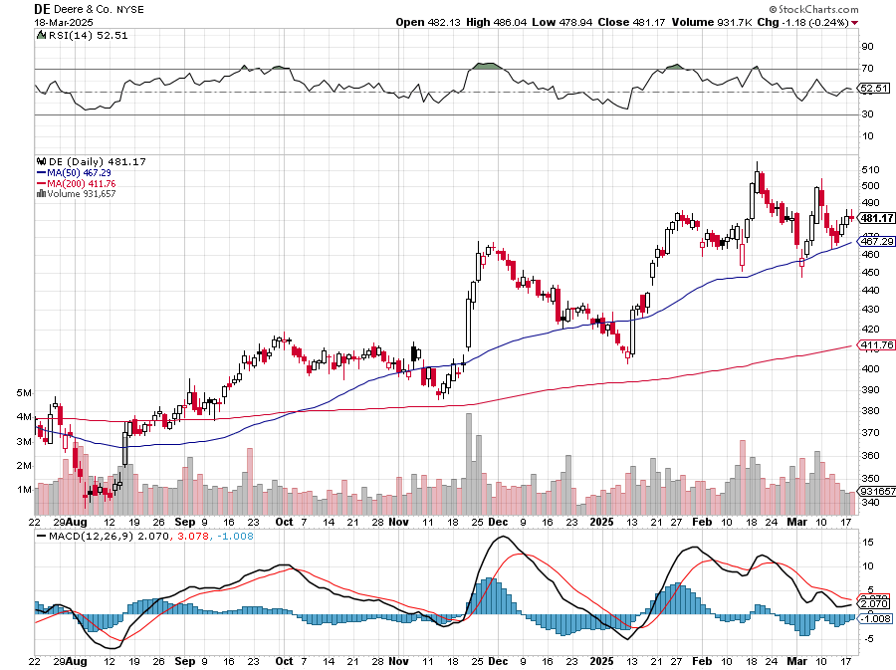
Deere & Co. (DE)- Ag + Infrastructure + Housing took profits on long 8/$330-$340 put spread stopped out of long 8/$330-$340 calls spread

Slide 64
Freeport McMoRan - (FCX)- Coming Copper Crisis Freeport McMoRan Beats, helped by higher production and easing costs took profits on long 4/$37-$40 call spread, took profits on long 5/$42-$45 call spread, stopped out of long $48-$51 put spread, profits on long 6/$32-$35 call spread took profits on long 4/$30-$33 call spread, took profits on long 10/$20-$23 call spread

Slide 65
Walt Disney (DIS) -Disney Beats Disney Dives on Earnings Bust, although streaming broke even versus an expected loss

Slide 66
Industrials Sector SPDR (XLI)- (GE), (MMM), (UNP), (UTX), (BA), (HON)

Slide 67
Union Pacific RR (UNP)- Big Stuff to Ship took profits on long 5/$200-$210 call spread took profits on 11/$150-$160 call spread

Slide 68
Wal-Mart (WMT) – The New AI Stock took profit on Long 11/$125-$130 bear put spread, took profit on Long 10/$119-$121 bear put spread took profits on Long 8/$114-$117 bear put spread

Slide 69
Delta Airlines (DAL) – Recession Warning The Non-Boeing Airline – uses Airbuses stopped out of long 2/$35-$38 call spread

Slide 70
Transports Sector SPDR (XTN)- Worst Hit Sector (ALGT), (ALK), (JBLU), (LUV), (CHRW), (DAL)

Slide 71
Health Care Sector (XLV) – Defensive Play and Cheap (JNJ), (PFE), (MRK), (GILD), (ACT), (AMGN)

Slide 72
Amgen (AMGN) took profits on long 11/$185-$200 bull call spread

Slide 73
Visa (V) – Inflation boost Justice Hits Visa (V) with Antitrust Suit, with a 47% market share took profits on long 2/$240-$250 bull call spread took profits on long 10/$160-$170 bull call spread, took profits on long 6/$150-$160 bull call spread

Slide 74
Consumer Discretionary SPDR (XLY) (DIS), (AMZN), (HD), (CMCSA), (MCD), (SBUX)

Slide 76
Bonds – New Bull Market
*Rising recession risks put bonds back in the spotlight *If the recession actually happens, the (TLT) easily rises above $100 *During the pandemic recession, the (TLT) rose to $165 *Interest Payments on the National Debt already Top $1 Trillion per year, will become largest budget item topping Social Security at $1.2 trillion *Recession risks have suddenly moderated providing more bond support *Fed will eventually have to cut interest rates, but not now *Buy (TLT), (JNK), (NLY), (SLRN) and REITS on dips

Slide 77
Treasury ETF (TLT) – long 4/$84-$87 call spread stopped out of long 1/$82-$85 call spread, took profits on long 10/$103-$106 put spread took profits on long 6/$$94-$97 put spread, took profits on long 5/$82-$85 calls spread

Slide 78
Treasury ETF (TLT) – 5 years long 4/$84-$87 call spread stopped out of long 1/$82-$85 call spread, took profits on long 10/$103-$106 put spread took profits on long 6/$$94-$97 put spread, took profits on long 5/$82-$85 calls spread
$155 2020 Top

Slide 79
Ten Year Treasury Yield ($TNX) – 4.28%

Slide 80
Junk Bonds (JNK) 6.54% Yield

Slide 81
Municipal Bonds (MUB) 4.21% Yield-

Slide 82
Emerging Market Debt (ELD) 5.62% Yield-

Slide 83
2X Short Treasuries (TBT)-Out of Favor

Slide 84
Anally Capital Management (NLY) – Leveraged REIT Play Yield 13.25% took profits on long 12/$15-$16 call spread

Slide 85
Acelryn (SLRN) – Double B Bond Fund took profits on long 12/$15-$16 call spread

Slide 87
Foreign Currencies – New Lead Currencies better late than never
*Prospect of falling interest rates is demolishing the US dollar * Yen Carry Trade Unwind Send Japanese Currency Soaring, *Expected interest rates differentials are the principal foreign currency driver *Recession fears are bringing forward Fed interest rate cuts *The Trump economy is forcing investors to flee all US assets, including stocks and currency *Massive cash flight is running away from the US and into Europe and China *Buy (FXA), (FXE), (FXB), (FXC), and (FXY)

Slide 88
THE MAD HEDGE FUND TRADER
Australian Dollar (FXA) - Major Long-Term Bottom is In Targeting Parity – A call option on a global synchronized recovery

Slide 89
Japanese Yen (FXY)

Slide 90
Euro (FXE)-

Slide 91
British Pound (FXB)-

Slide 92
Emerging Market Currencies (CEW)

Slide 94
Energy & Commodities – Global Recession Fears
*The Oil Market is in Turmoil, with crude prices dropping below $66, a four-year low *A global recession is looming large *The administration has pulled Chevron out of Venezuela, losing 300,000 a barrels a day there *Tax subsidized over production and increased OPEC quotas are overwhelming demand *Oil prices have already fallen below 2026 downside targets *Avoid all energy plays like the plague

Slide 95
Oil-($WTIC)

Slide 96
United States Oil Fund (USO)

Slide 97
Energy Select Sector SPDR (XLE)-No Performance! (XOM), (CVX), (SLB), (KMI), (EOG), (COP)

Slide 98
ExxonMobil (XOM)- Exxon Moves Big into Lithium, with the construction of a major mining operation in Arkansas took profits on Long 4/$100-$105 call spread, took profits on long 12/$120-$125 put spread

Slide 99
Occidental Petroleum (OXY)- Buffet’s a Buyer took profits on long 4/$59-$62 call spread took profits on long 2/$55-$60 call spread, took profits on long 12/$77.50-$82.50 put spread

Slide 100
Natural Gas (UNG) – Free Fall on Warm Winter took profits on Long January 2025 $7-8 Call Spread LEAPS

Slide 101
Cameco (CCJ) – Global Uranium Renaissance Microsoft to Reopen Three Mile Island to power AI data centers took profits on long 12/$41-$44 call spread, took profits on long 12/$35-$38 call spread, took profits on long 5/$20-$23 bull call spread

Slide 102
Vistra Corp. (VST) – Global Uranium Renaissance long 2/$100-$110 call spread - 7 days to expiration

Slide 104
Precious Metals – New High
*Falling interest rates have given gold a new lease on life *The opportunity cost of owning gold has fallen sharply *Central bank buying never stopped *Now silver is starting to play catch up *Gold is still the favored saving means by Chinese who don’t trust their own currency, banks, or government *That’s why the metals have outperformed the miners which the Chinese don’t buy *Looking for $5,000 by 2028 *Buy (GLD), (SLV), (AGQ), and (WPM) on dips

Slide 105
THE MAD HEDGE FUND TRADER
Gold (GLD)-A New Leg took profits on Long 10/$230-$235 call spread took profits on Long 10/$220-$225 call spread, took profits on Long 8/$210-215 call spread, took profits on Long 7/$200-205 call spread, Long 6/$207.5-$212.5 call spread took profits on Long 4/$194-$197 call spread, took profits on long 5/$165-$170 bull call spread
$5,000 in 2028 +66%
BUY

Slide 106
Gold (GLD) – China and Falling Rate took profits on Long 10/$230-$235 call spread took profits on Long 10/$220-$225 call spread, took profits on Long 8/$210-215 call spread, took profits on Long 7/$200-205 call spread, Long 6/$207.5-$212.5 call spread took profits on Long 4/$194-$197 call spread, took profits on long 5/$165-$170 bull call spread

Slide 107
Market Vectors Gold Miners ETF- (GDX) – took profit on long 6/$207.50-$212.50 call spread, took profit on long 7/$200-$205 call spread

Slide 108
Barrick Gold (GOLD) took profit on long 1/$15.50-$16.50 call spread

Slide 109
Newmont Mining- (NEM)- Sometimes you Just Get Lucky took profits on long 10/$47-$50 call spread, took profits on long $55-60 call spread

Slide 110
THE MAD HEDGE FUND TRADER
iShares Silver Trust (SLV) - The Better Play Industrial demand, solar panels, electric cars
2025 Target $50 +50%
BUY

Slide 111
Silver Miners - (SIL)-

Slide 112
Wheaton Precious Metals - (WPM)- LEAPS Approaching Max Profit took profits on long 4/$39-$42 call spread , took profits on long 1/$36-$39 call spread

Slide 113
Platinum- (PPLT)- 556,000-ounce shortage this year took profits on long 1/$36-$39 call spread

Slide 115
Real Estate – Stay Away
*Pending Home Sales Hit All-Time Low, in January down 4.6% MOM and 5.2% YOY *Inventories are rising but affordability is at record lows *Exceptionally cold weather was a factor *Homebuilder Sentiment plummeted to 42, a two-year low, and tariff concerns *Our dry wall comes from Mexico and our lumber comes from Canada *Avoid all real estate plays like the plague.

Slide 116
S&P Case Shiller Slows S&P Case Shiller Rises to +4.7% YOY in Decemberber, with its National Home Price Index New York gained +7.2%, Chicago +6.3%, and Boston +6.2%. Washington DC was down -1.1%

Slide 117
Crown Castle International (CCI) – 6.62% yielding 5G cell phone tower REIT Eliot Management Pushes up stock with activist bid Long 8/$90-$95 call spread,

Slide 118
US Home Construction Index (ITB) (DHI), (LEN), (PHM), (TOL), (NVR)

Slide 119
DH Horton (DHI) Horton Bombs, with the stock dropping some 11% in Tuesday morning trading after the U.S.'s largest homebuilder issued its fiscal 2025 guidance took profits on long 11/$165-$175

Slide 120
Trade Sheet- The Recession Trade So What Do We Do About All This?
*Stocks –sell rallies *Bonds – buy dips *Commodities - stand aside *Currencies – buy dips *Precious Metals – buy dips *Energy – stand aside *Volatility – sell over $30 *Real estate – stand aside

Slide 121
Next Strategy Webinar 12:00 EST Wednesday, April 2, 2025 from Incline Village, NV email me questions at support@madhedgefundtrader.com
Good Luck and Good Trading!
Notes:
*

