Slide 1
The Mad Hedge Fund Trader “Trade Terrors”
With John Thomas Incline Village, NV April 2, 2025 www.madhedgefundtrader.com
Notes:
*

Slide 2
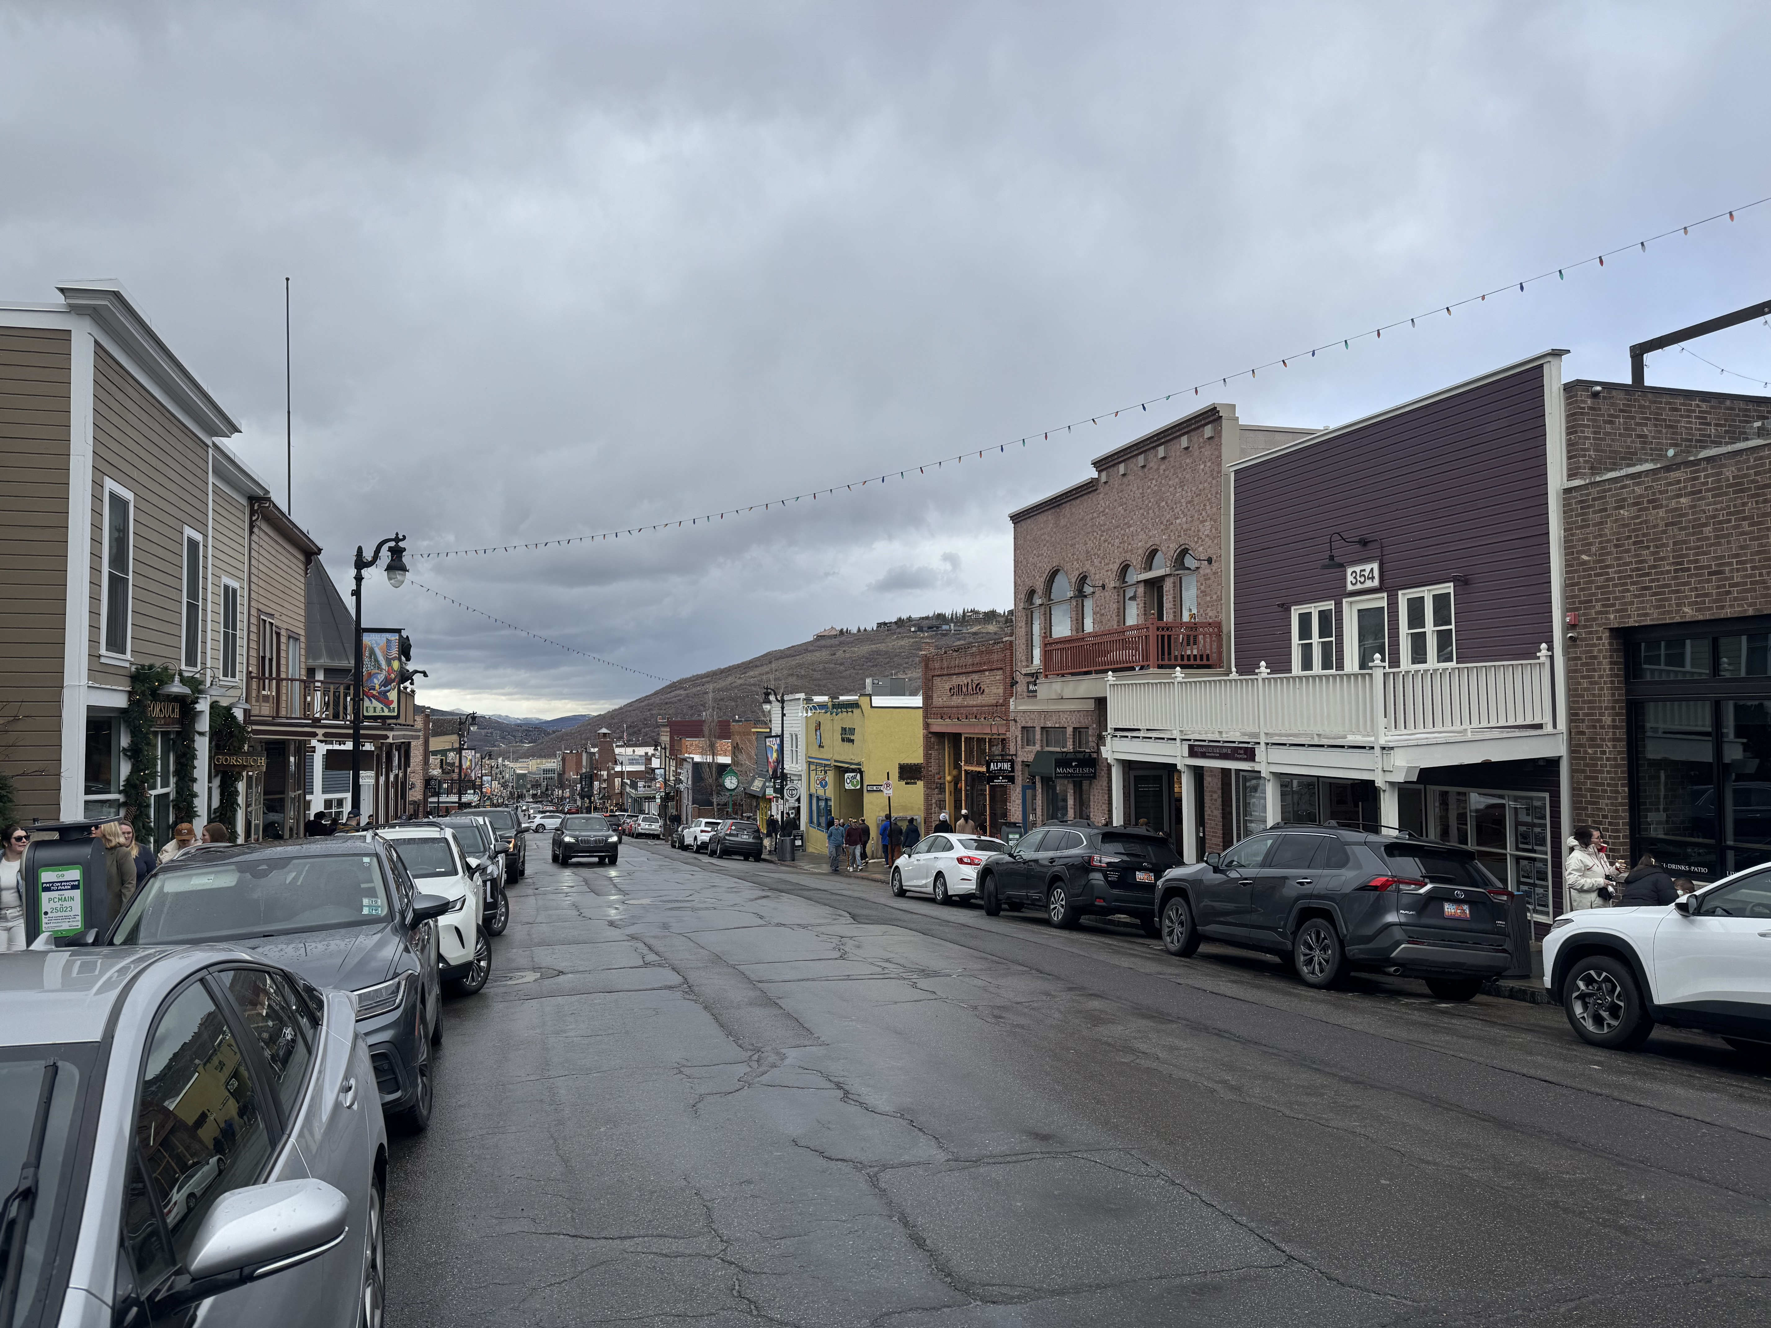

Slide 3
Trade Alert Performance New All-Time Highs!
*January +5.80% Final *July +10.92% Final *February +3.66% Final. *August +3.74% Final *March +4.36% Final *September +10.28% Final *April +0.61% MTD *October +7.59% Final *May +3.74% Final *November +18.96 Final *June +1.94% Final *December +3.26% Final *2025 Year To Date +14.44% +766.33% since inception *Versus 84.63% for all of 2022 *Versus 79.79% for all of 2023 *Versus 75.29% for all of 2024

Slide 4
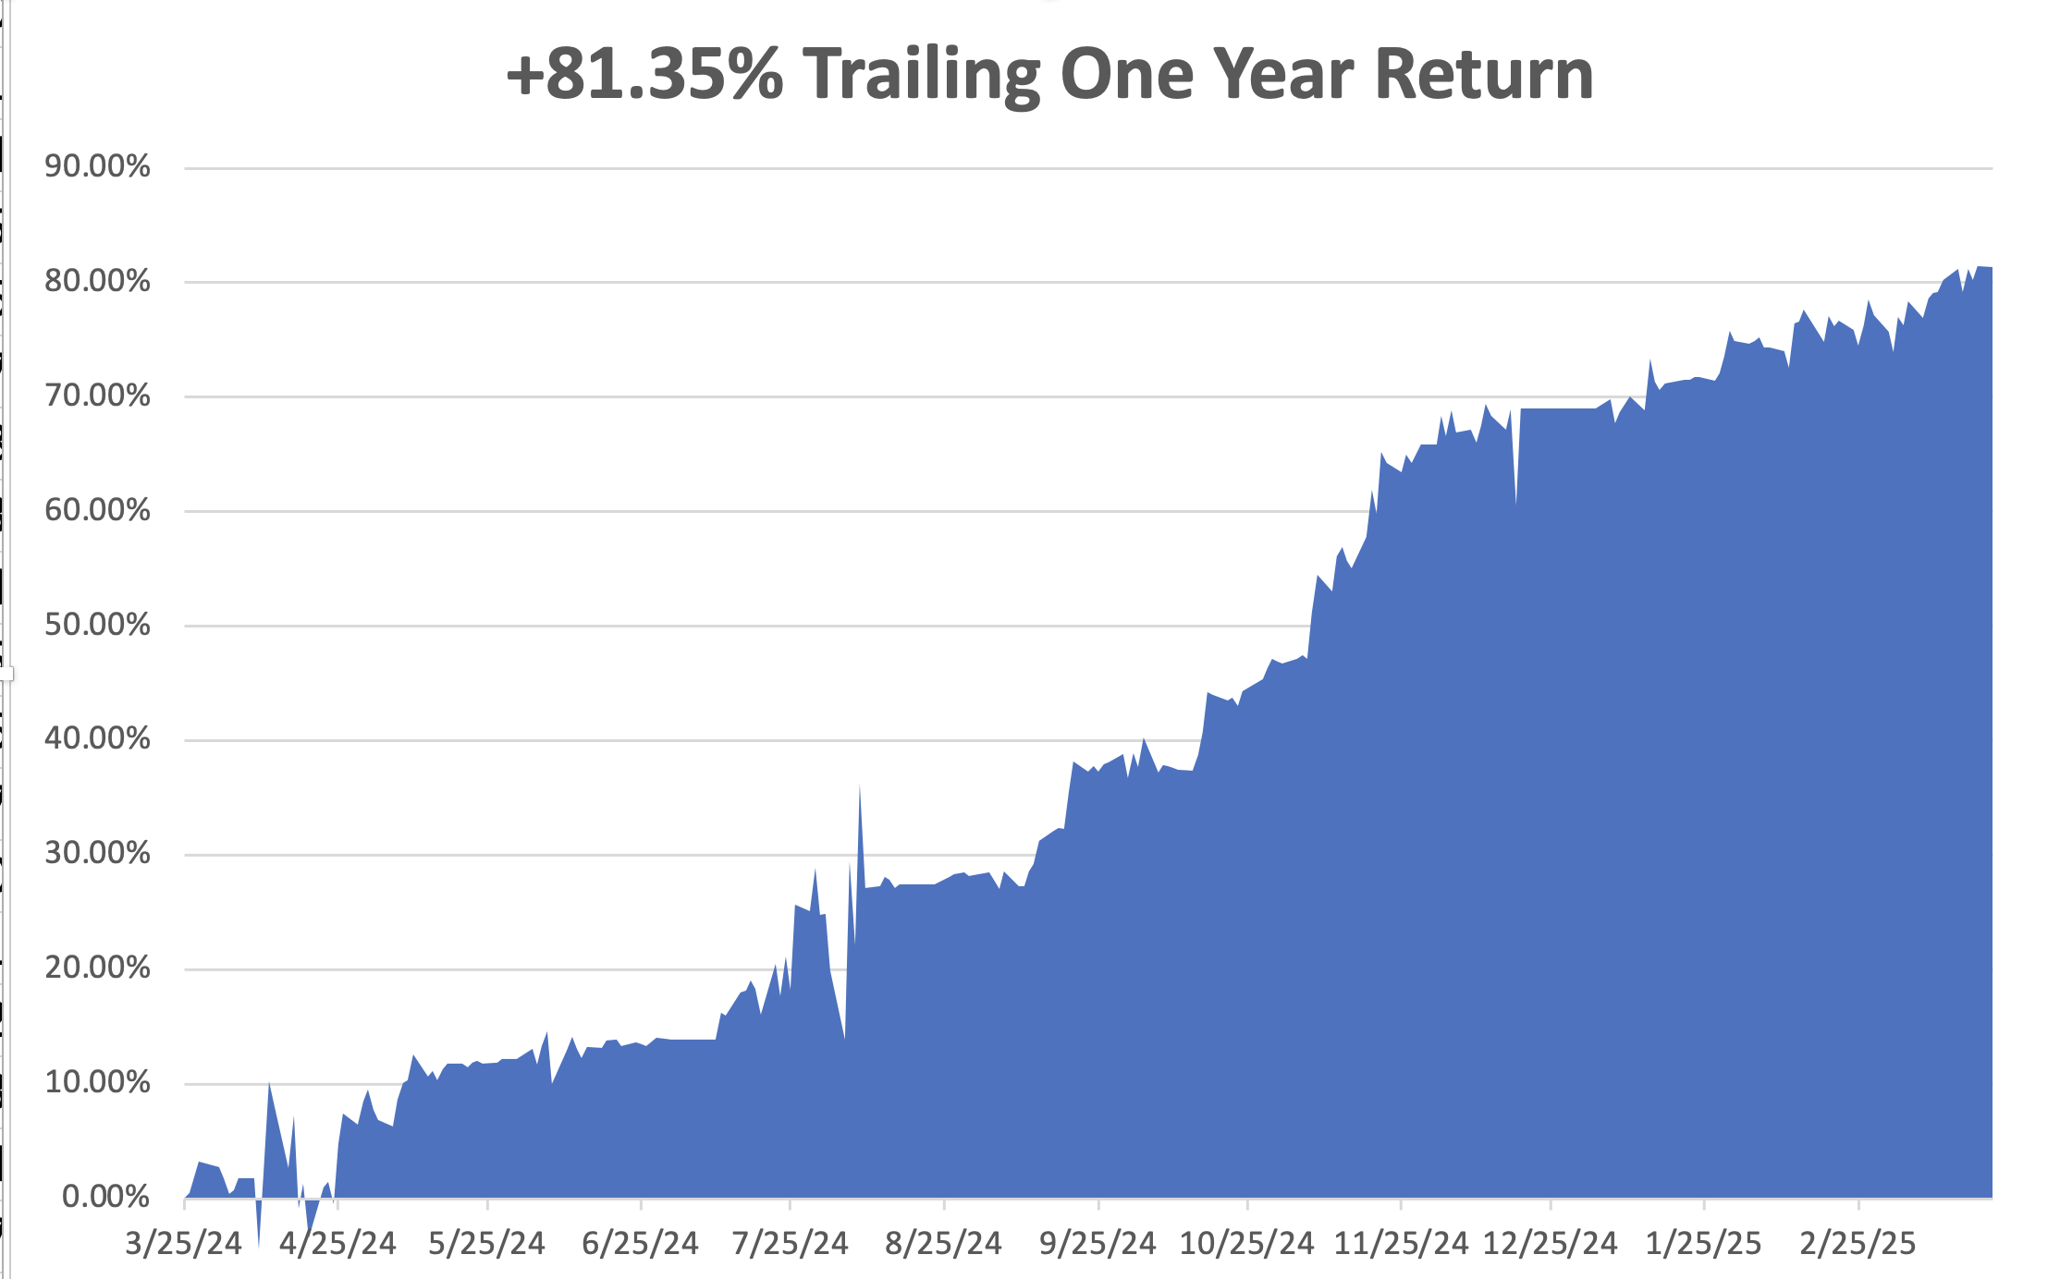

Slide 5
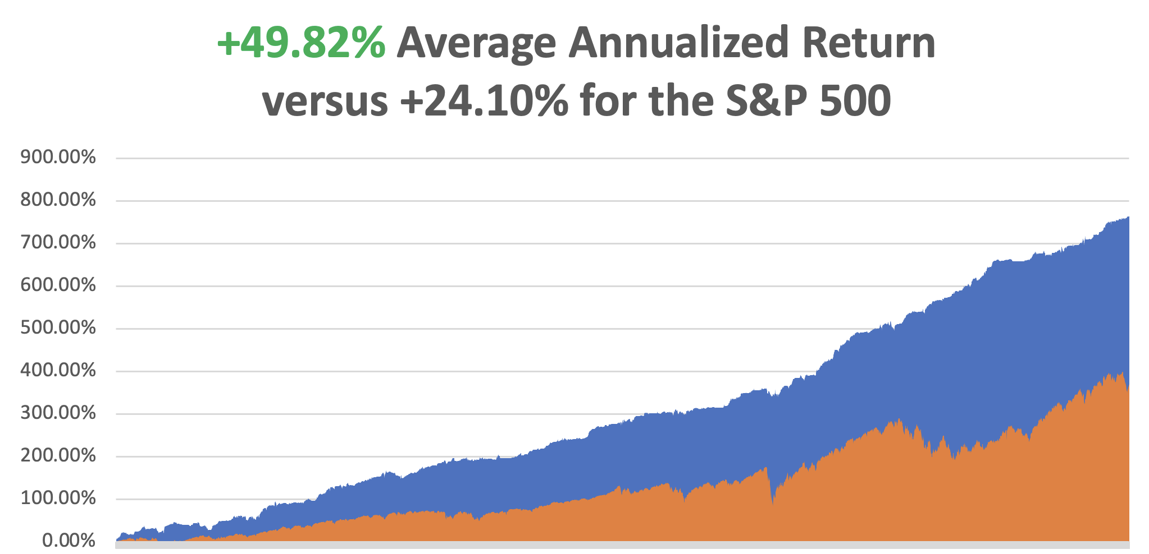

Slide 6
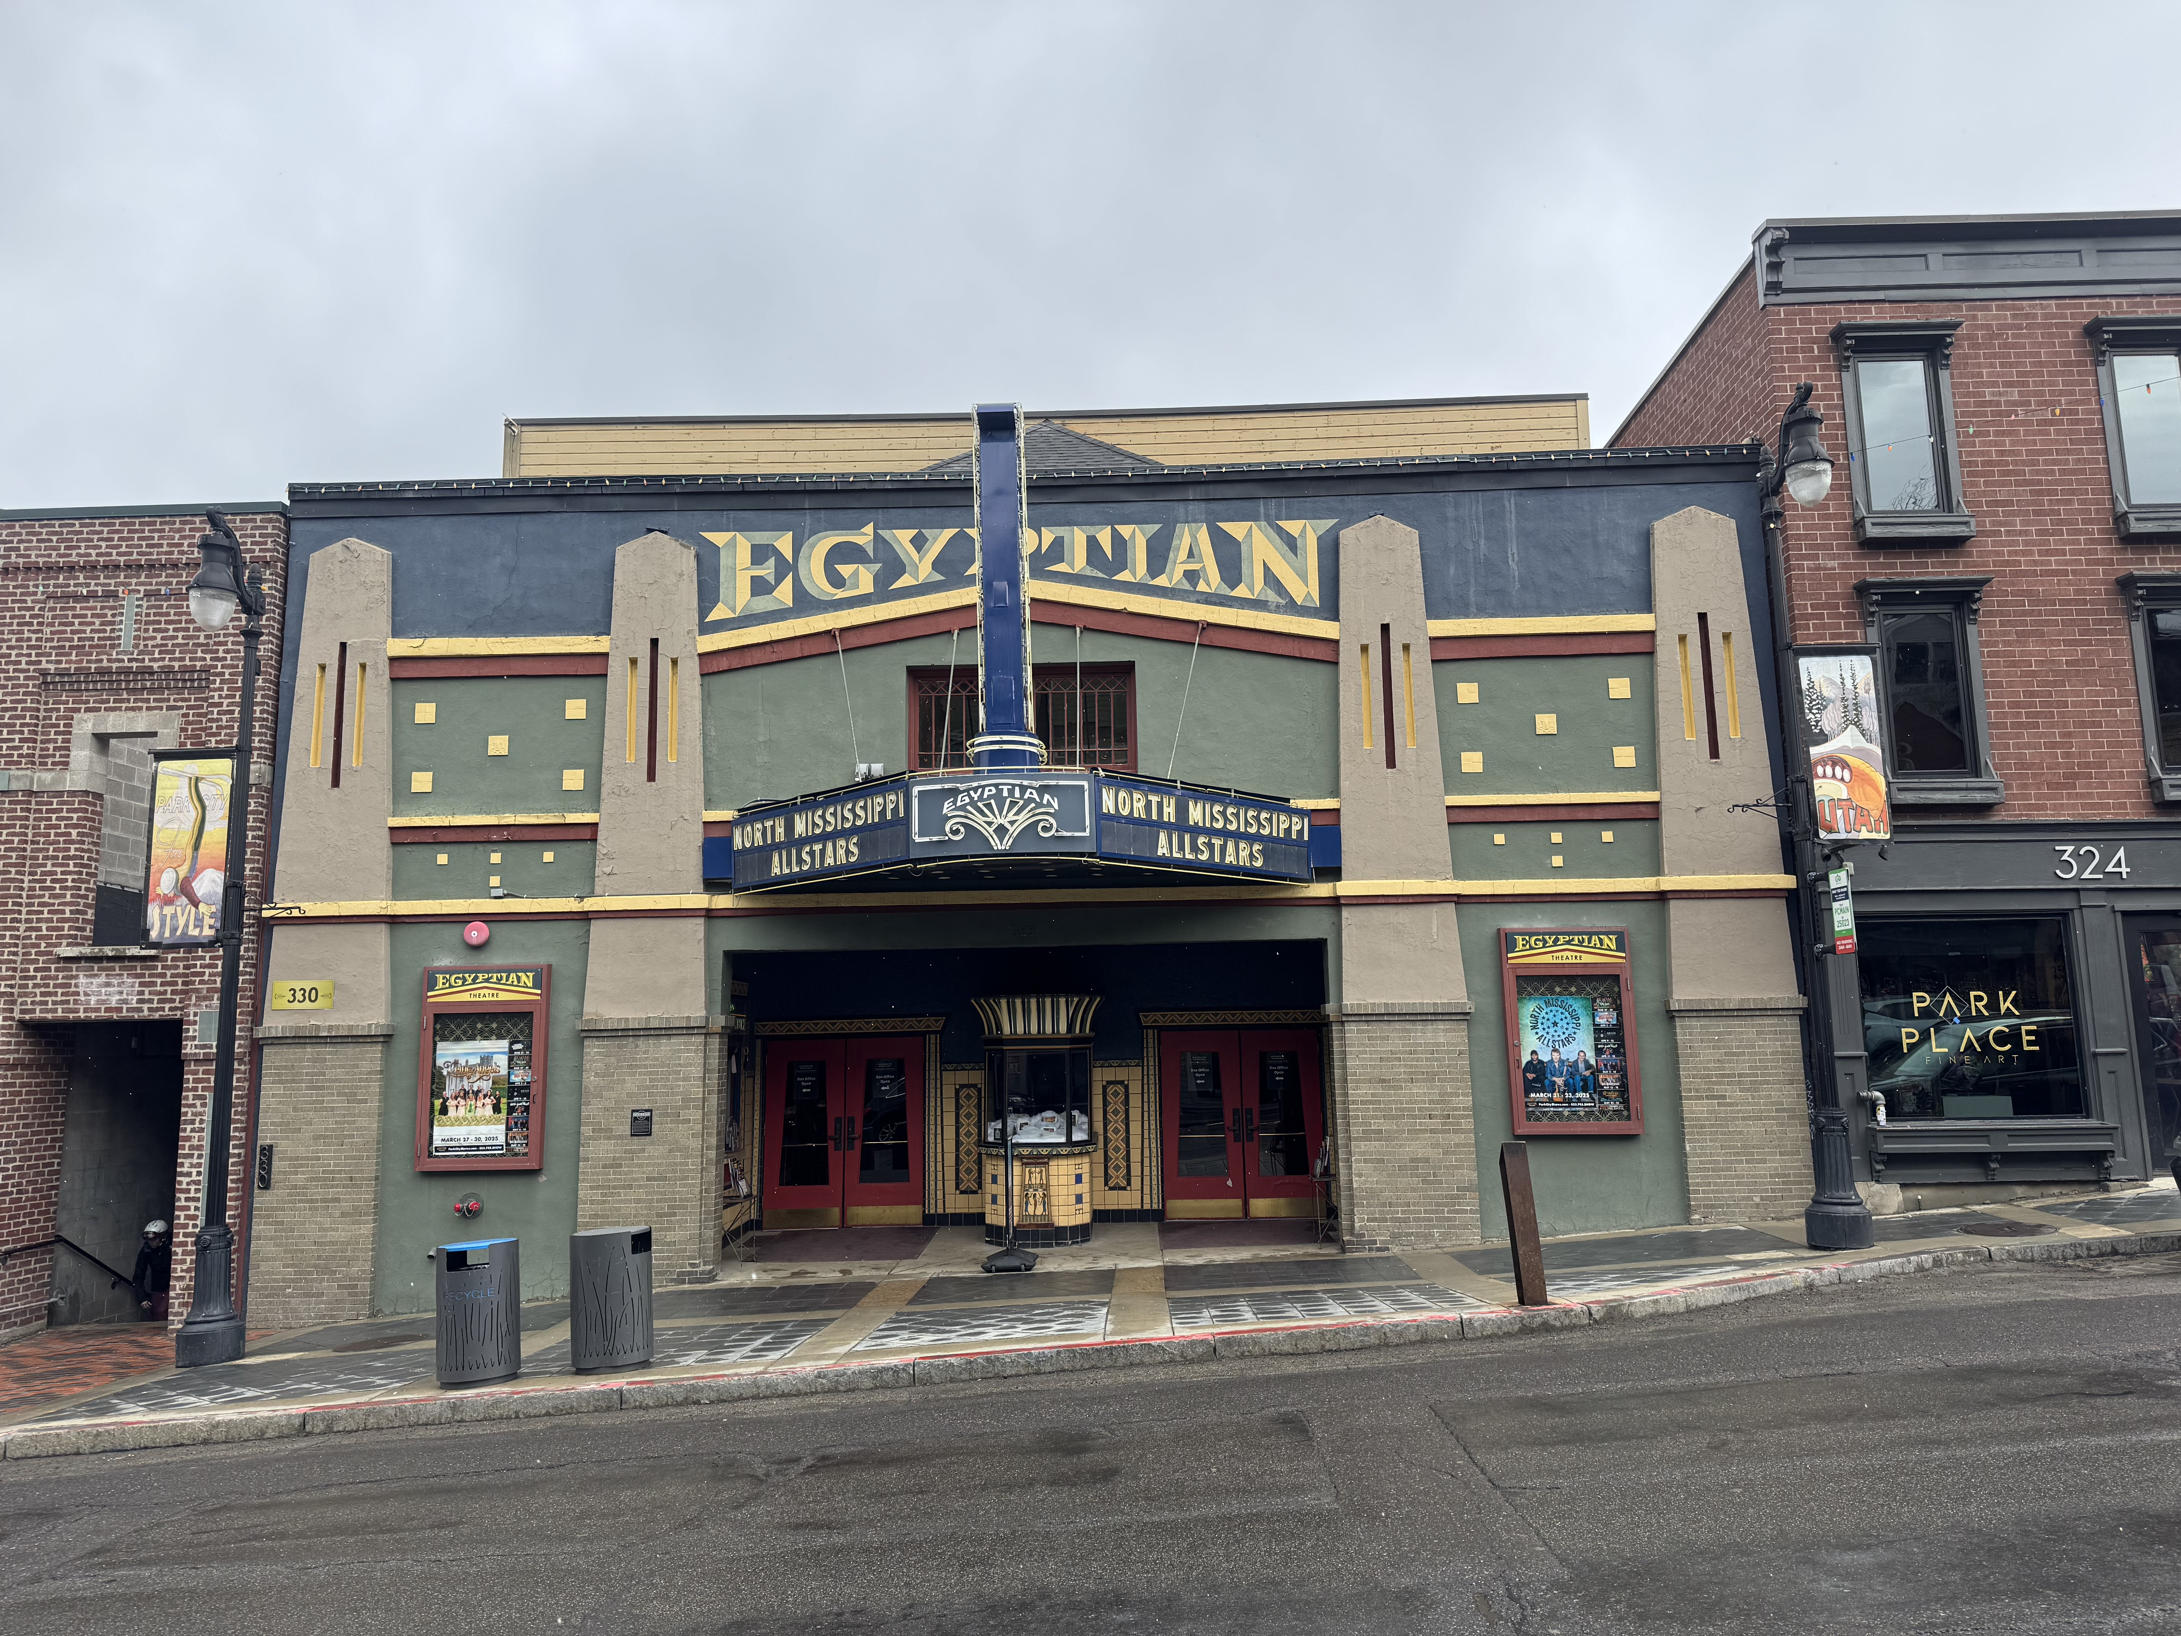

Slide 7
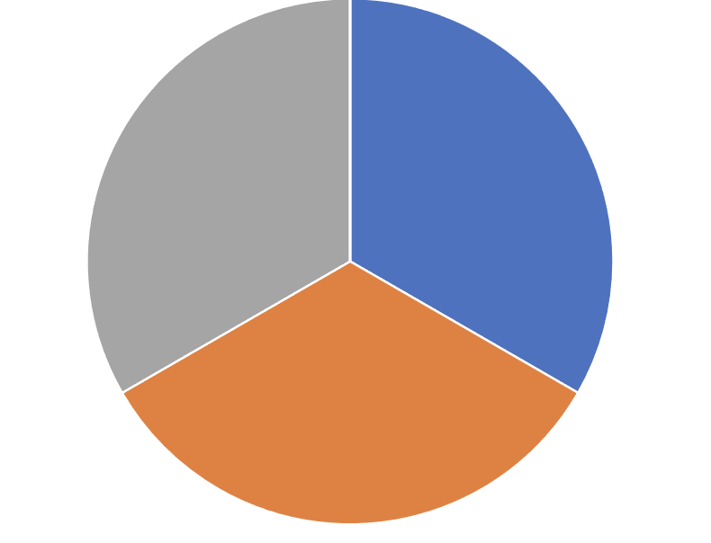
Portfolio Review – Big Bet We Don’t Go to New Highs by April 17 30% risk on, 0% risk off, 70% cash
Portfolio Review – Big Bet We Don’t Go to New Highs by April 17 30% risk on, 0% risk off, 70% cash
Current Capital at Risk
Risk On
(NVDA) $90-$95 call spread | 10.00%
(COST) 4/$840-$850 call spread | 10.00%
(TSLA) 4/$160/$170 put spread | 10.00%
Risk Off
NO POSITIONS | 0.00%
Total Net Position | 30.00%
Total Gross Position | 30.00%
Expiration Value +15.37%

Slide 8
The Method to My Madness
*$700 billion tax increase starts today, the biggest in 85 years. The depressing effects on the economy will be immense *The US economy is now in recession, how long it will last nobody knows. *Interest rate plays like bonds are back in favor as recession fears drive rates down *Gold hits new highs on major upside breakout *US Dollar enters free fall with declining rates cutting it off at the knees *Big Technology was the most expensive and saw biggest falls *Energy gets a rare rally after hitting four-year lows *Cash is king - $1 at market top is worth $10 at bottom

Slide 9
The Global Economy – Dying on the Vine
*Stagflation Accelerates, with a hot 0.4% increase in the Consumer Price Index and a tepid 0.1% increase in Consumer Spending, the worth since the Pandemic. One year inflation expectations have shot up to 5.0%. *Fed leaves interest rates unchanged at 4.25%, Cuts Quantitative Tightening, to from $25 billion a month to $5 billion a month, to head off a coming recession *US GDP Grows 2.4%, during the October-December quarter. These may be the last positive numbers we see for a while as the country heads into recession. *Equipment Rentals Fall 7%, in February. *Consumer Confidence Plunges, by the most in five years, *Weekly Jobless Claims Rise 2,000, to 223,000 *UCLA Andersen School of Business Announces “Recession Watch,” the first ever issued

Slide 10
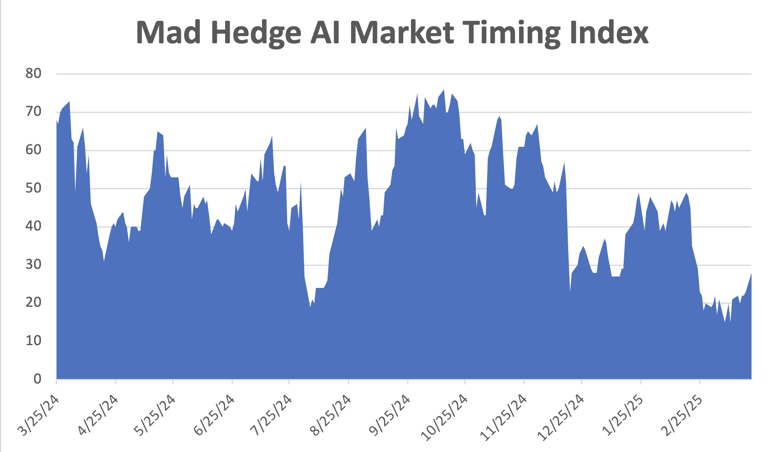
The Mad Hedge Profit Predictor Market Timing Index – New Range? An artificial intelligence driven algorithm that analyzes 30 different economic, technical, and momentum driven indicators
SELL
BUY

Slide 11
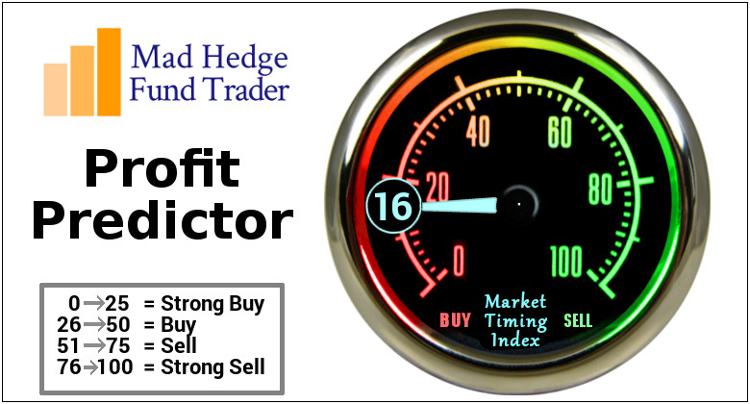

Slide 12
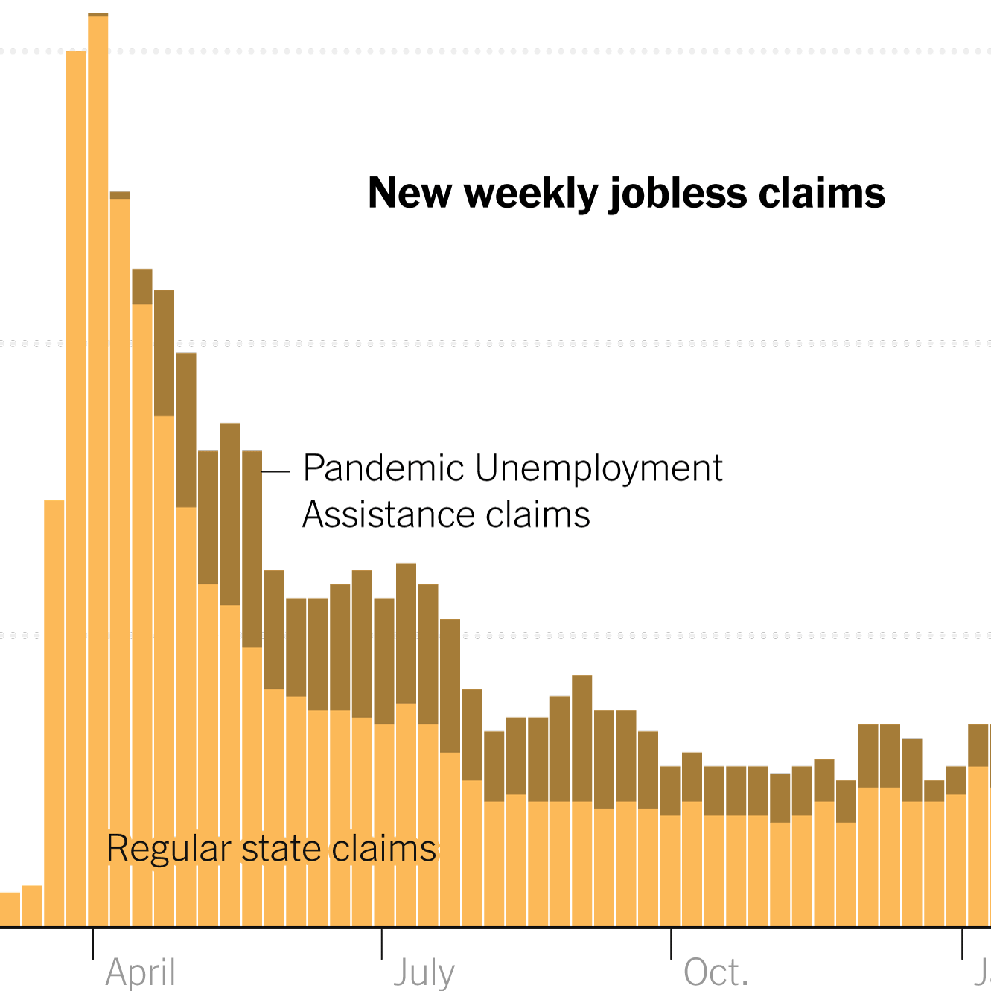
Weekly Jobless Claims – 4 Month Low +2,000 to 224,000

Slide 13
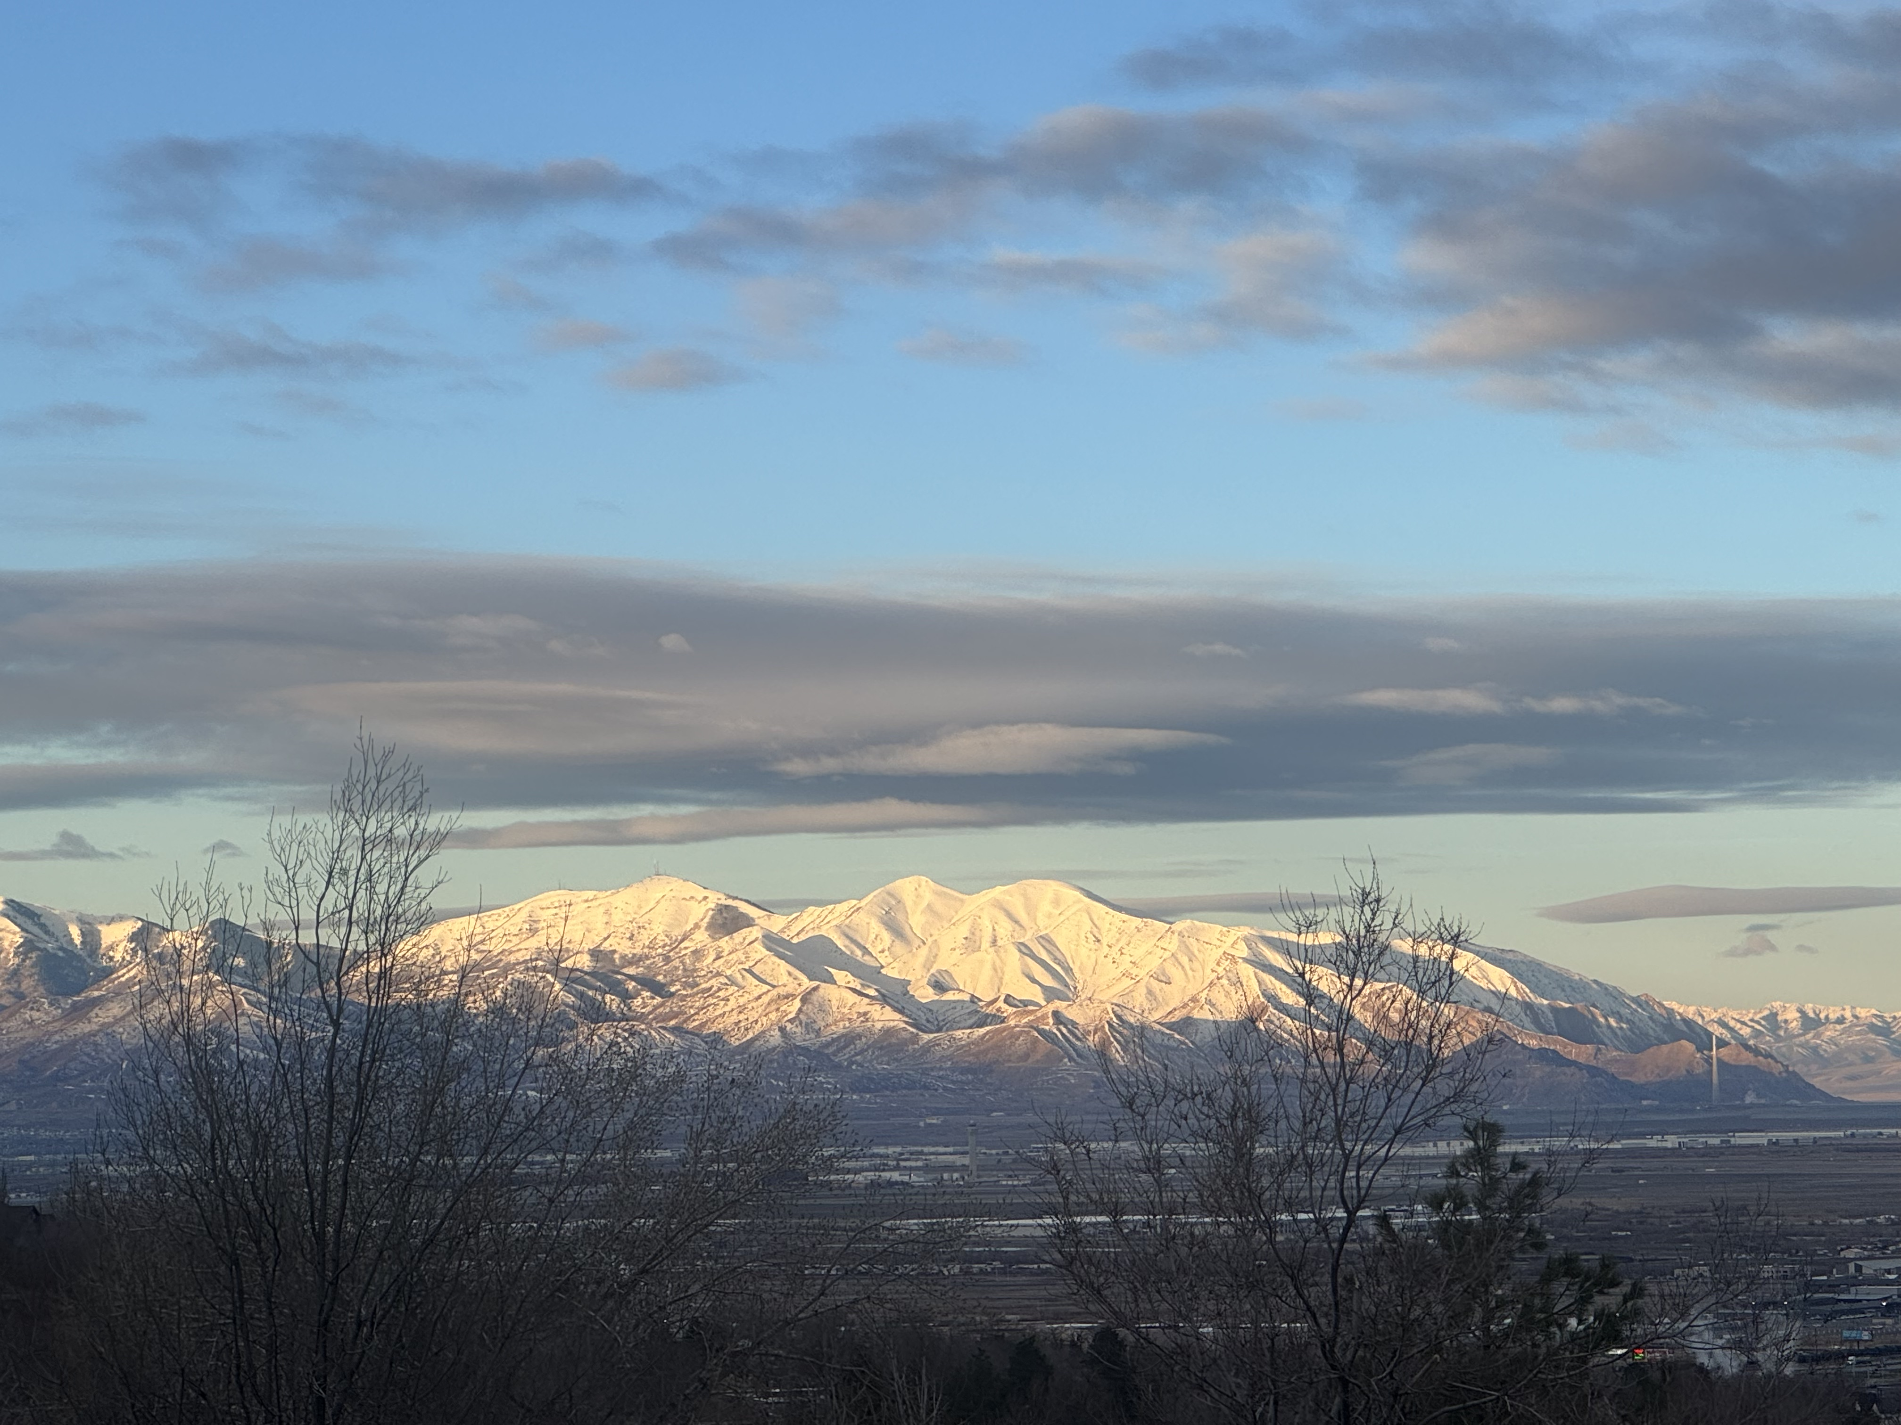

Slide 14
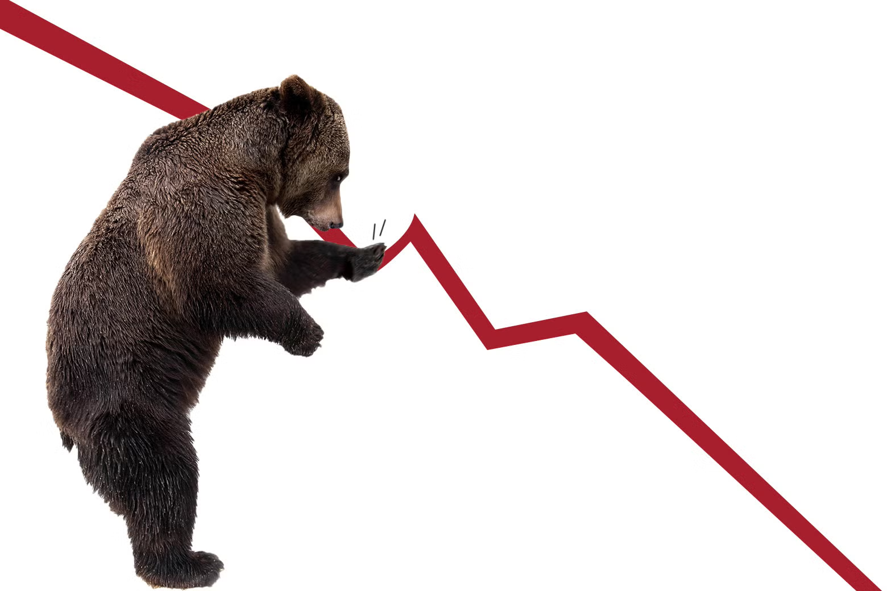
Stocks – Sell All Rallies
*Stocks are oversold so expect a 3%-5% rally *But sell on any rally as much lower lows beckon *All long-term technical indicators have rolled over, meaning that the bear market could continue until summer at the eeliest and next year at the latest *Hedge Funds are Still Dumping Technology Stocks, as they still command big premiums to the main market. *Vaccine Stocks Get Nailed, as the FDA moves the eliminate the vaccine establishment Travel Demand is Collapsing, as consumer rush to cut back discretionary spending *This Has Been One of the Most Rapid Corrections in History; loss of momentum has been the greatest in 40 years *The Volatility Index peaked at $25, this time, but there are higher highs to come

Slide 15
The Ultimate Hedge – Defensive stocks only go down at a slower rate 90 - day US Treasury Bills (Warren Buffet owns $300 billion)
*Government Guaranteed principal *Endless liquidity, trade like water *100% collateral value for margin *Lock in guaranteed income *Can be sold at any time to earn full interest *Will survive any bear market *Ask your broker how to buy

Slide 16
WE ARE TRANSITIONING FROM THE TOP of a NEW RANGE (-10%) TO THE BOTTOM OF A NEW RANGE ANOTHER -20% FROM THE TOP

Slide 17
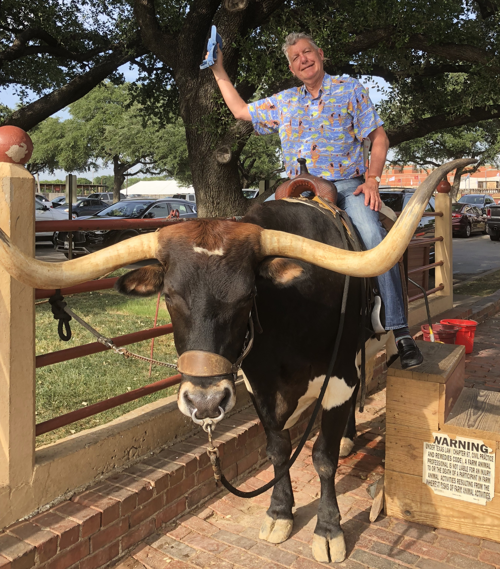
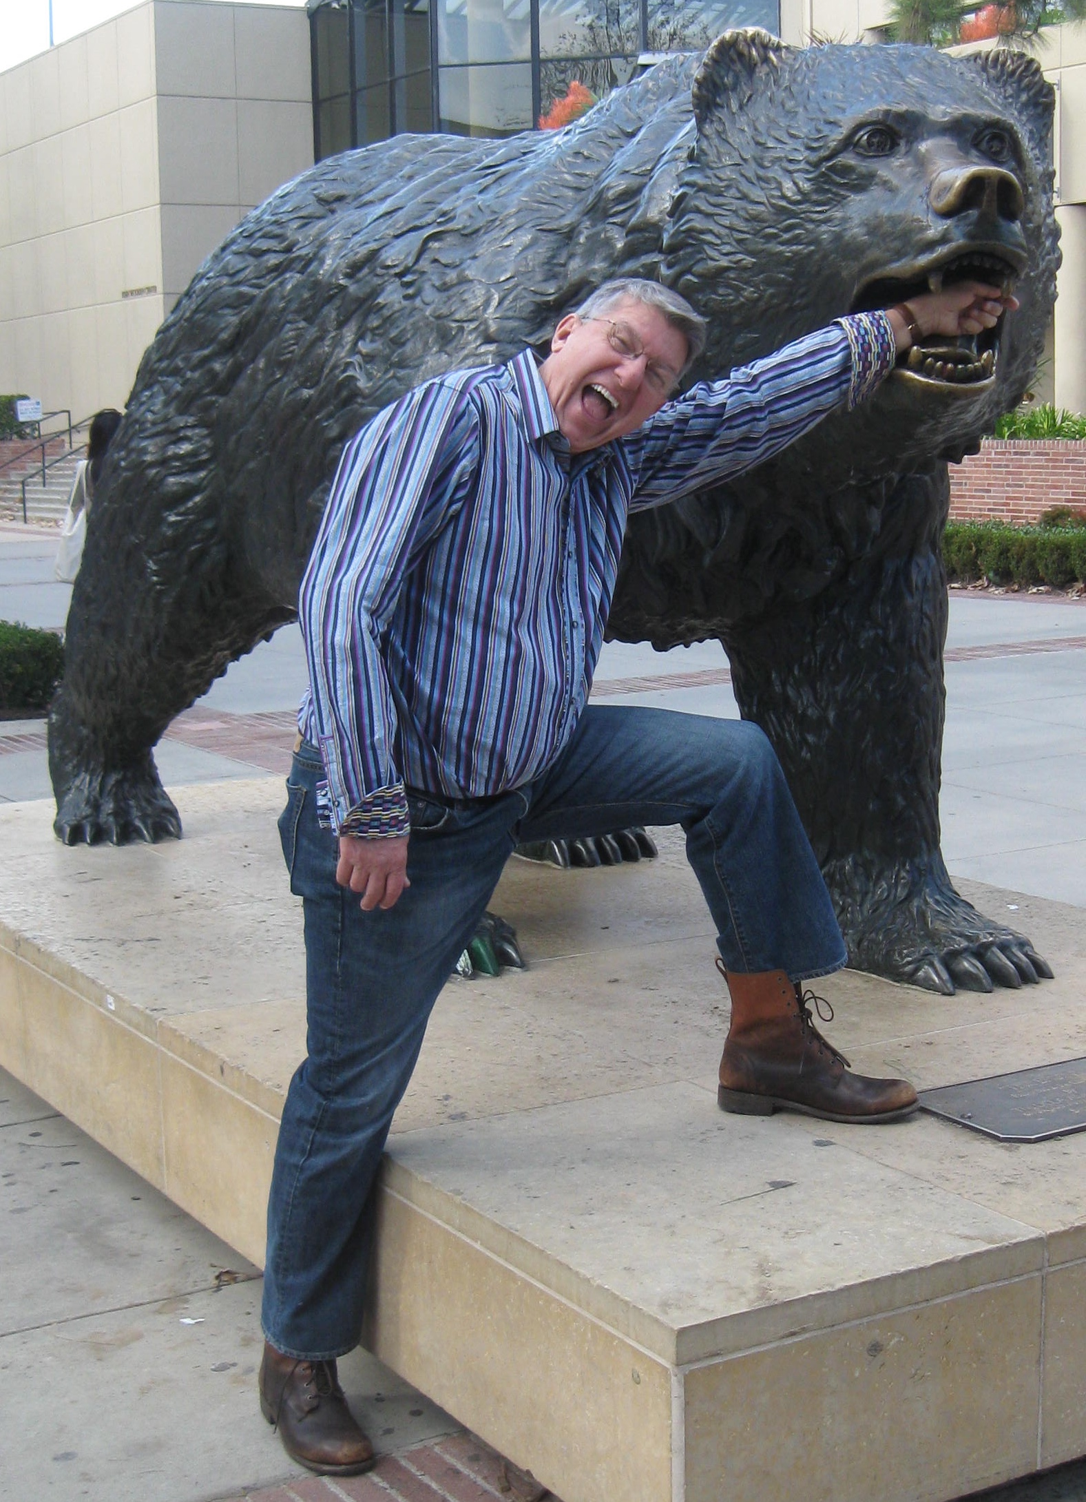
The Worst-Case Scenarios
The Bull Case We are now in a recession that will probably cost us -6%-7% over 2-3 quarters and then ends with a renewal of a $5 trillion tax cut for 2026 (SPY) down 20%-30%, (SPY) multiple drips from 22X to 18X last seen in 2018 Or The Bear Case No tax cut means we enter a depression and lose 25% of GDP over 4 years (SPY) down 60% if (SPY) PE falls from 22X to 9X 240% of stock gains since 2009 have been multiple expansion

Slide 18
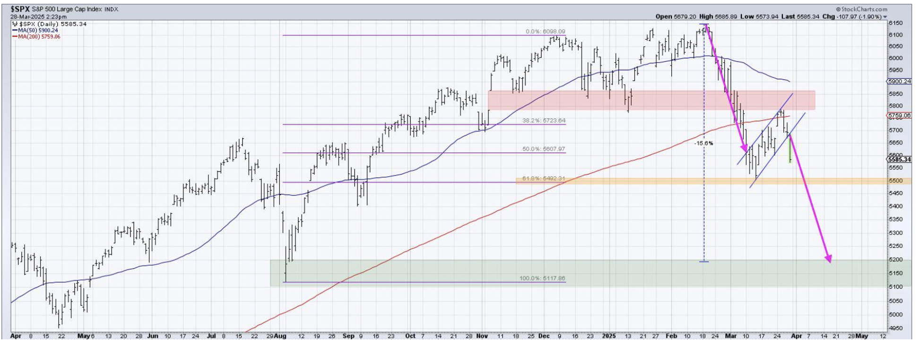
S&P 500 – Downside Targets – down 10% on year
Depression Worst Case $250 -60% PE 9X
$535 -12.7% 1st support
$500 -18.4% 1st support

Slide 19
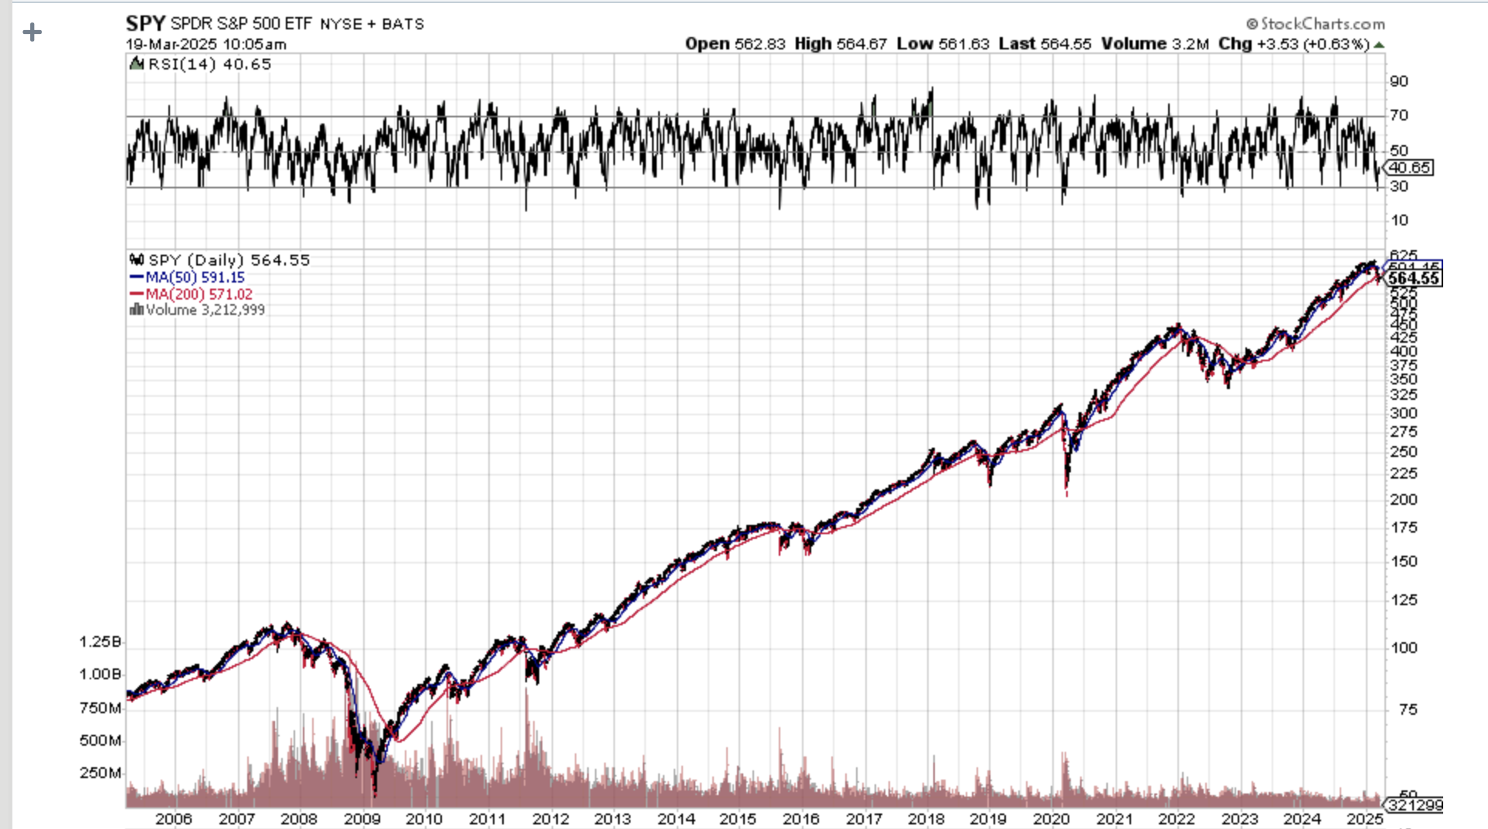
S&P 500 – Downside Targets- The Worst Worst Case $613 down to $250 – After 1929 it took 25 years to recover the old high
Depression Worst Case $250 -60% PE 9X

Slide 20
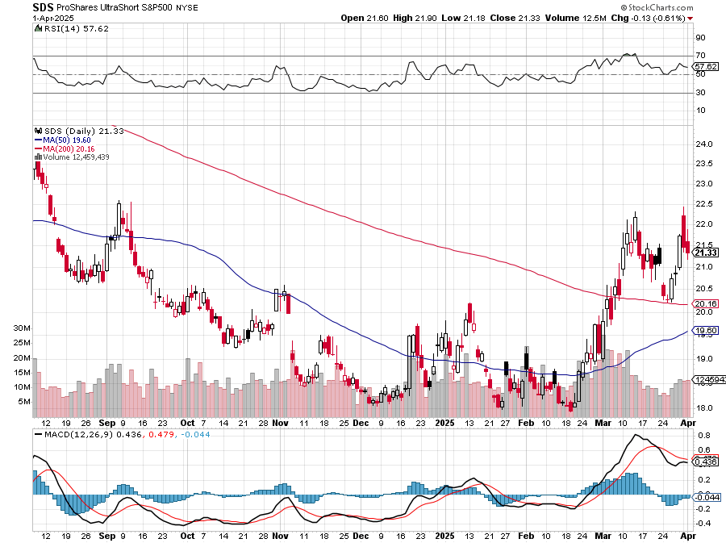
ProShares -2X Short S&P 500 (SDS) - a great 2X hedge for falling long stocks Long 3/$38-$41 call spread – expires in 2 days, long $40-$43 calls prad – expires in 21 days up 40%

Slide 21
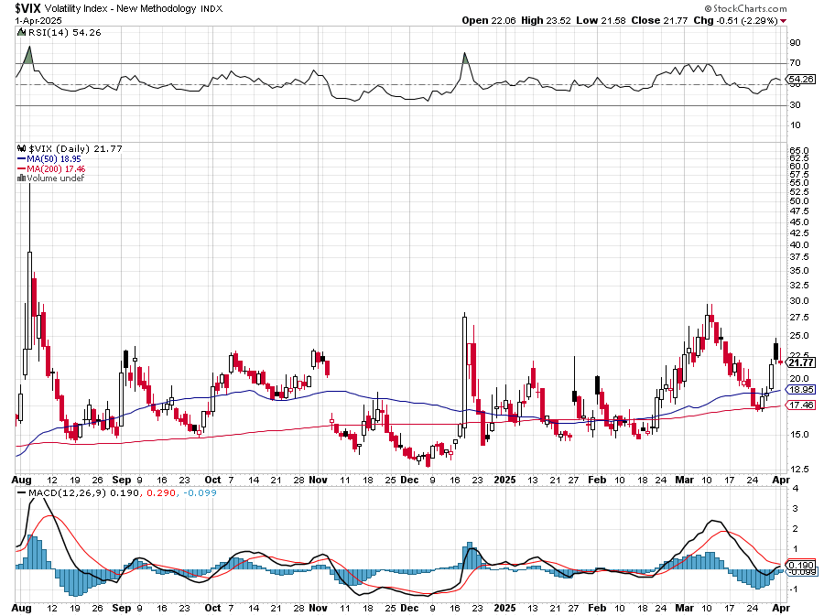
(VIX) – Volatility Index Hits Four Year High at $65, the most since the 2020 pandemic. That implies a 2% move in the S&P 500 (SPX) every day for the next 30 days

Slide 22
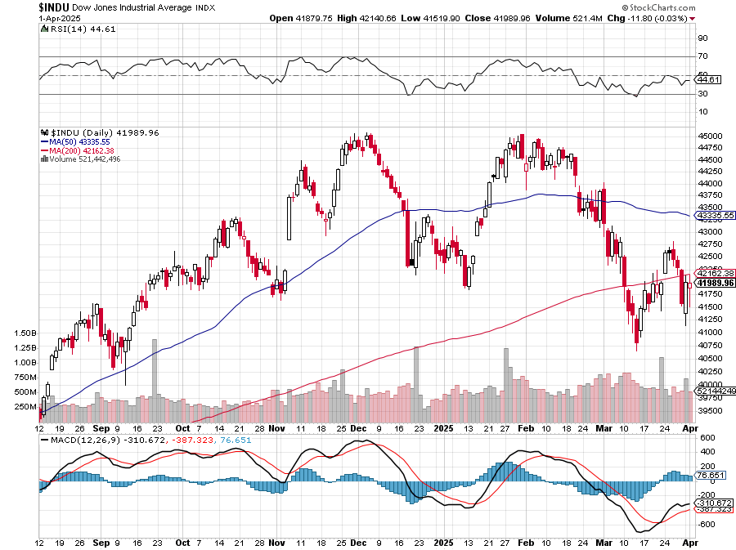
Dow Average ($INDU)-

Slide 23
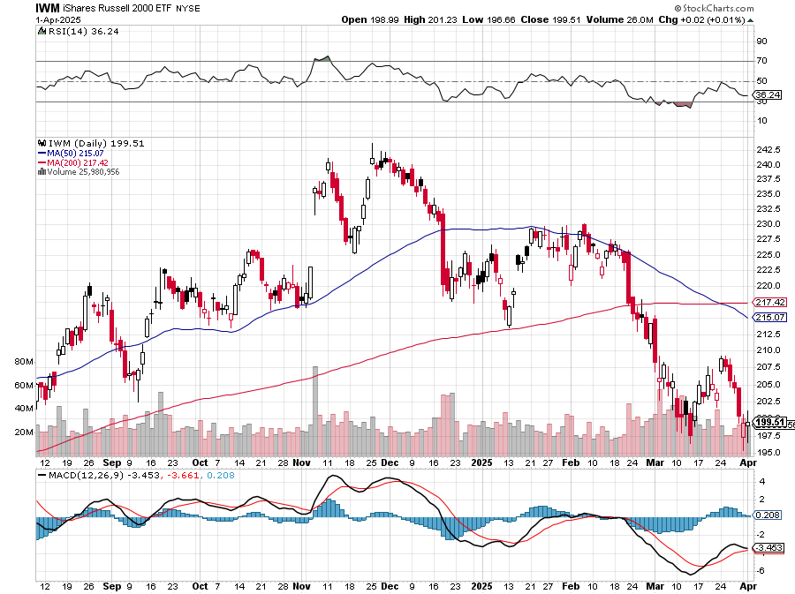
Russell 2000 (IWM)- took profits on Long 10/$137-$142 vertical bull call spread took profits on Long 10/$153-$156 vertical bear put spread

Slide 24
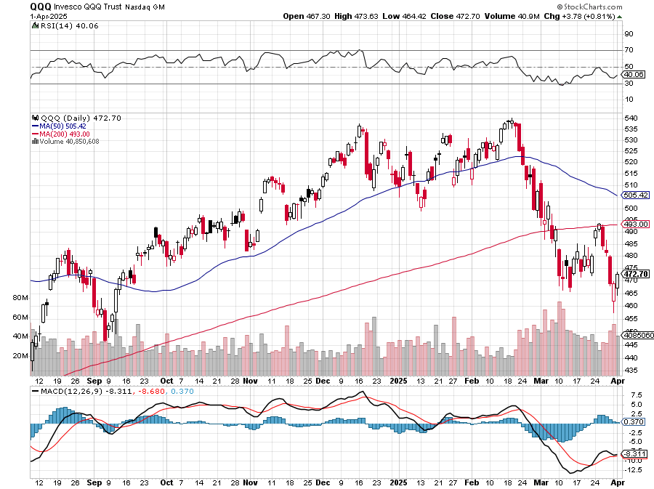
NASDAQ (QQQ) – Down 15% took profits on Long 5/$335-$345 put spread took profits on long (QQQ) 1/$290-$300 put spread, took profits on long (QQQ) 4/$330-$335 put spread took profits on long (QQQ) 3/$340-$345 put spread, covered long (QQQ) $325-$330 put spread

Slide 25
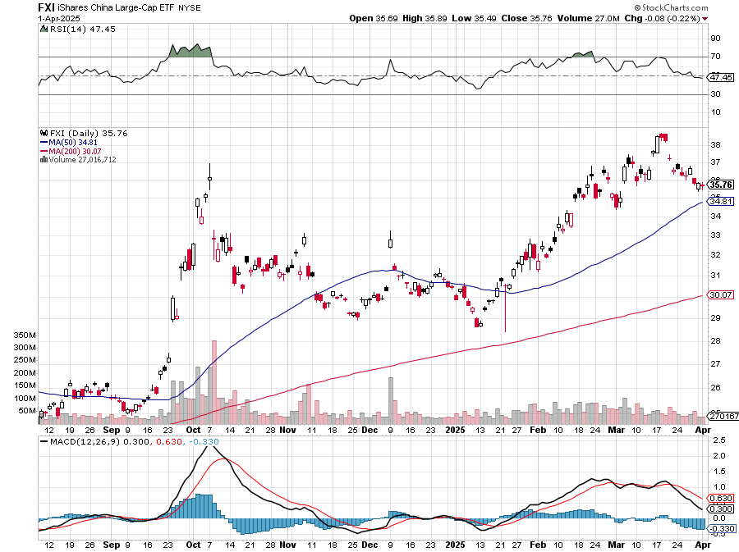
China (FXI) + 36%

Slide 26
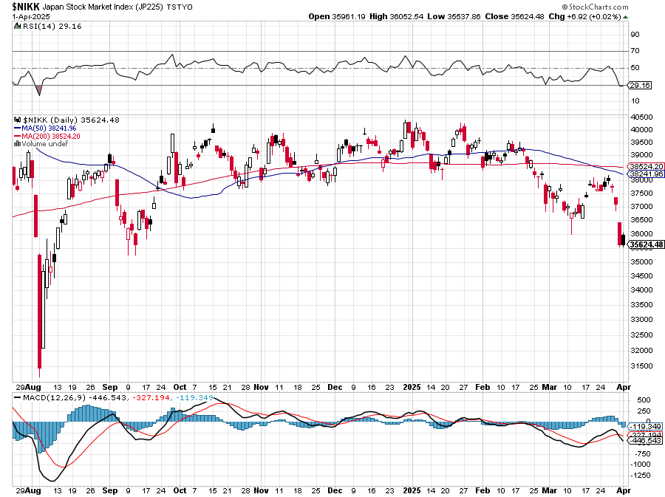
Japan ($NIKK) – down 10%

Slide 27
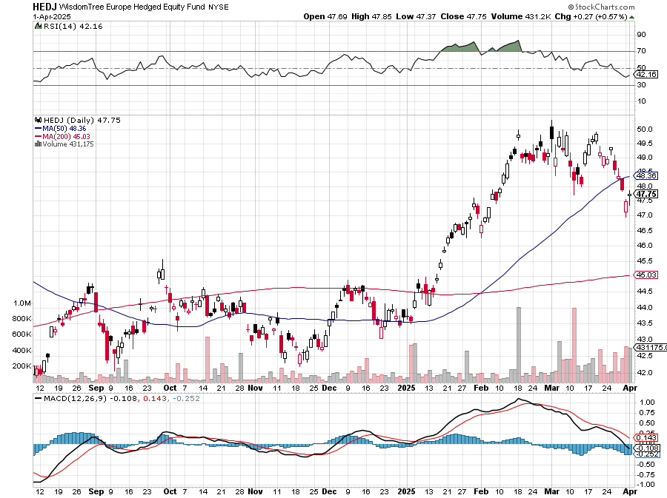
Europe Hedged Equity (HEDJ)- +19%

Slide 28
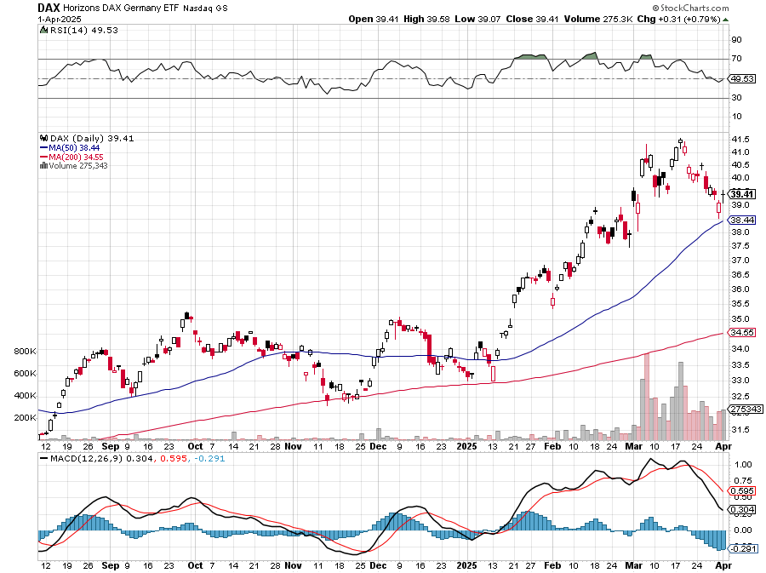
German Dax (DAX)- +30%

Slide 29
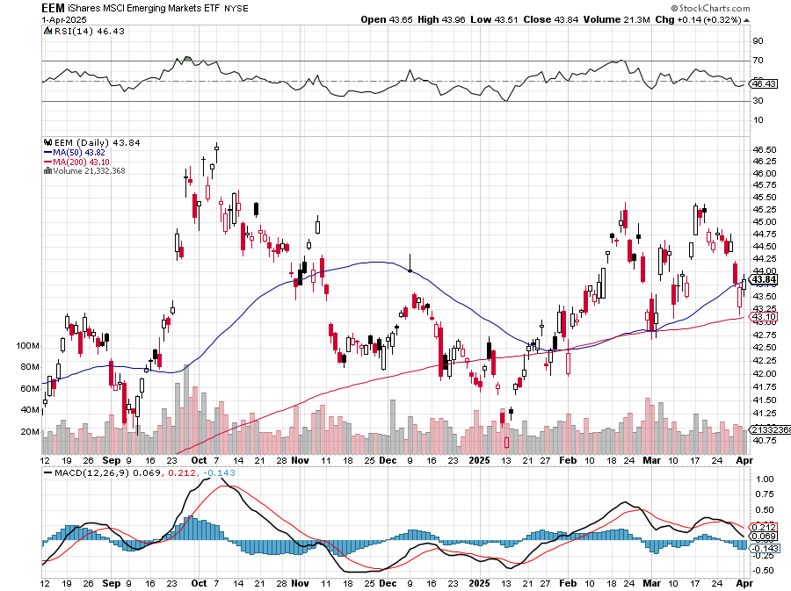
Emerging Markets (EEM) - +8% Weak Dollar, Long Recovery Play

Slide 30
THE MAD HEDGE FUND TRADER
The Barbell Portfolio
*75% Big Tech – 2% of US workforce, 25% of market cap and 25% of US earnings 25% Domestic Recovery, including: Railroads, airlines, cruise lines, Couriers, steel companies Banks, commodities Construction Credit Card Companies Hotels, casinos Online Ticket Sales

Slide 31
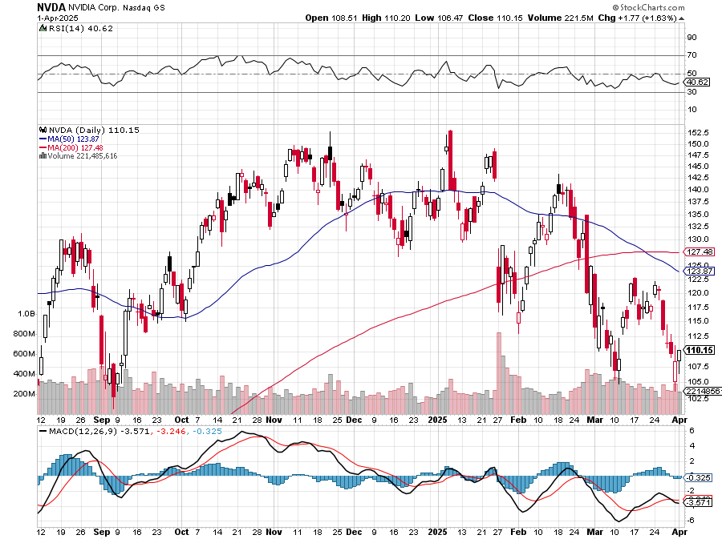
NVIDIA (NVDA) – Blackwell Chips @ $70,000 each Nvidia Tanks Again, as the incoming government plans new China export restrictions on the company took profits on long 3/$88-$90 call spread, took profits on long 4/$140-$145 puts spread took profits on Long 2/$90-$95 call spread, took profits on Long 12/$117-$120 call spread

Slide 32
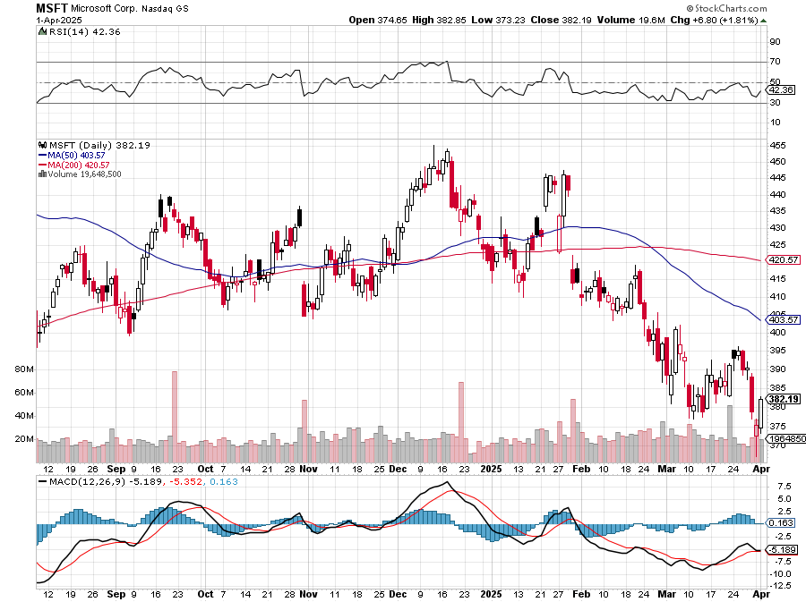
Microsoft (MSFT)-Microsoft Bombs, Microsoft Blows Up on Cloud Guidance took profits on long 5/$430-$440 put spread Took profits on long 2/$330-$340 call spread, took profits on long 12/$320-$330 call spread took profits on long 9/$235-$245 call spread, took profits on long 7/$220-$210 call spread,

Slide 33
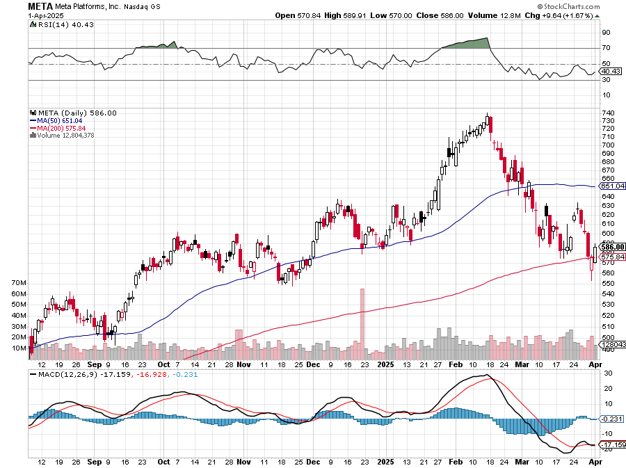
Meta (META) Meta Beats, on improving ad sales, a preeminent AI user took profits on Long 8/$420-$430 call spread took profits on Long 5/$360-$370 vertical bull call spread, took profits on Long 9/$290-$300 vertical bear put spread, stopped out of Long 9/$190-$200 vertical bear put spread

Slide 34
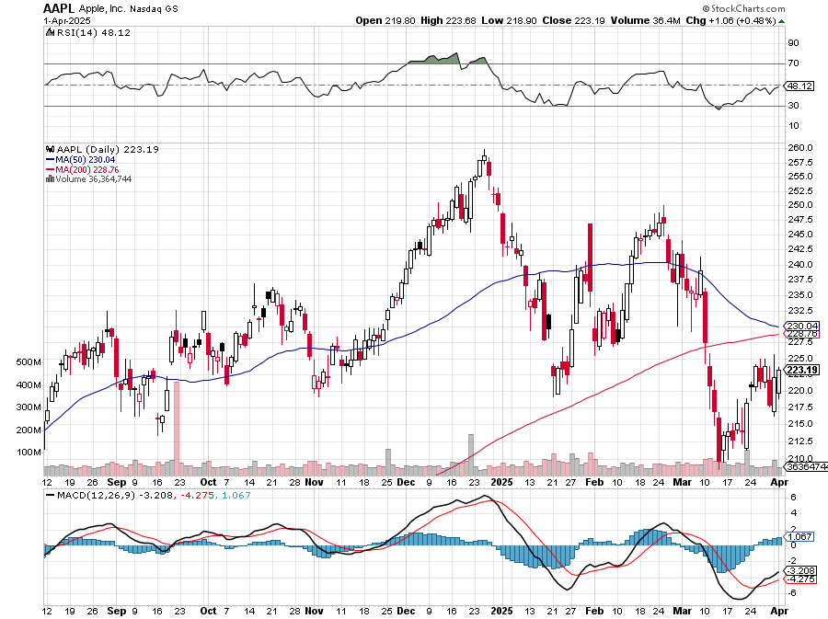
Apple (AAPL) AI Delayed took profits on Long 5/$225-$235 vertical bear put spread, took profits on Long 8/$160-$170 call spread took profits on Long 6/$200-$210 bear put spread,

Slide 35
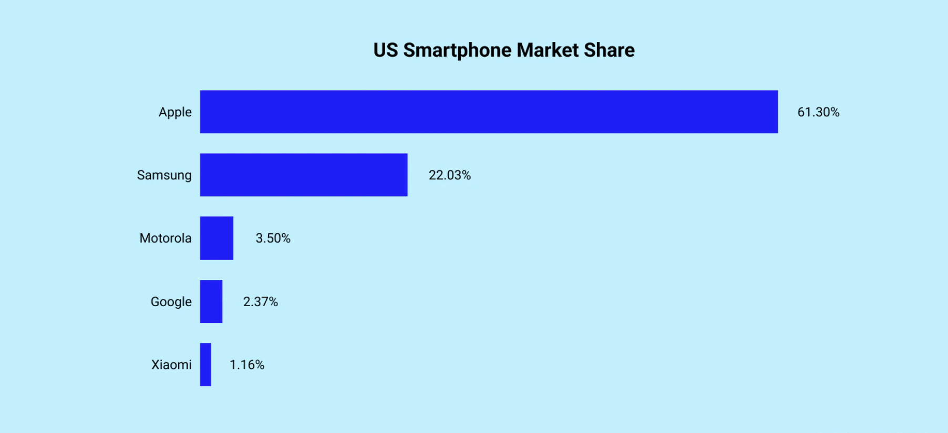

Slide 36
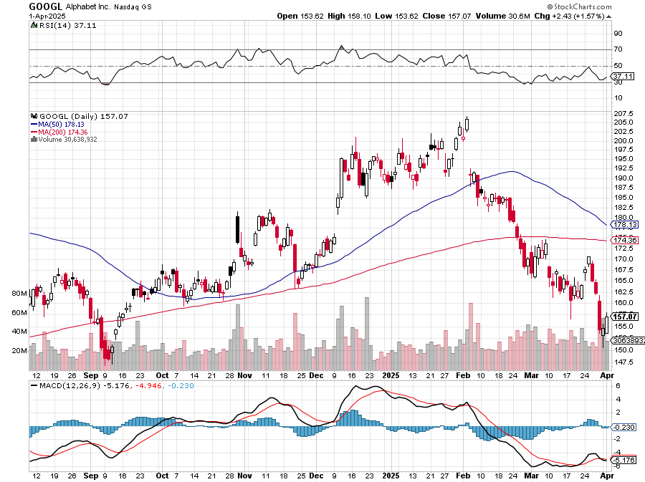
Alphabet (GOOGL) – Breakup Target Trump Administration to Pursue Alphabet Breakup, Alphabet’s Waymo Expands to Washington DC took profits on long 12/$110-$120 call spread took profits on long 12/$1,200-$1,230 bull call spread, took profits on long 9/$1,030-$1,080 vertical bull call spread

Slide 37
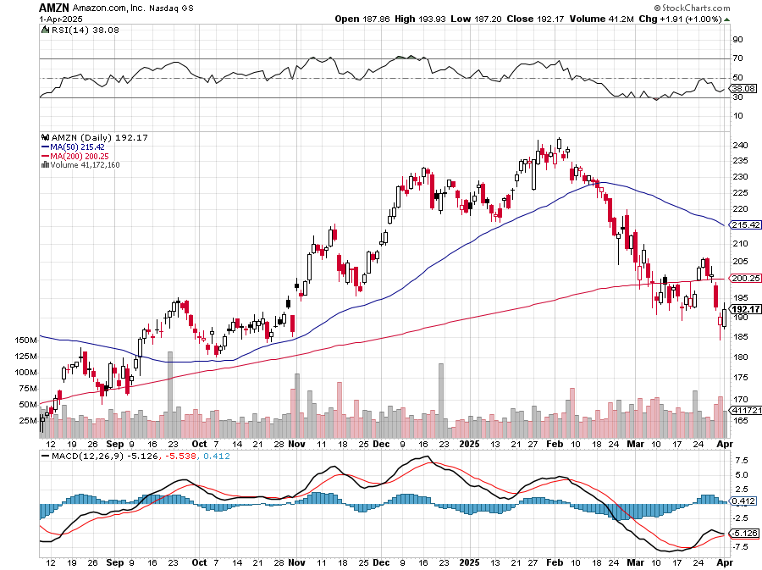
Amazon (AMZN) – Antirust Target took profits on long 3/$155-$160 bull call spread , took profits on long 2/$130-$135 bull call spread

Slide 38
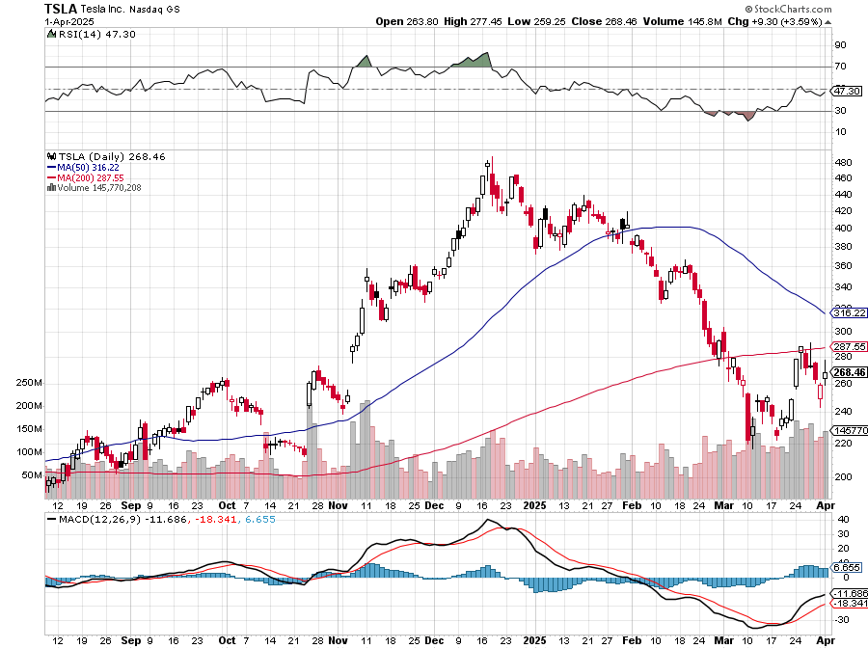
Tesla (TSLA) – Global Brand Destroyed Q1 Sales fall off a cliff down 13%, Tesla Stock Falls to 2020 Levels stopped out of long $310-$320 put spread at cost, took profits on long 3/$350-$360 put spread, stopped out of 3/$210-$220 call spread, profits on long 2/$300-$310 call spread, took profits on long 2/$300-$310 call spread,

Slide 39
WHY A CEO SHOULD NEVER GO INTO POLITICS

Slide 40
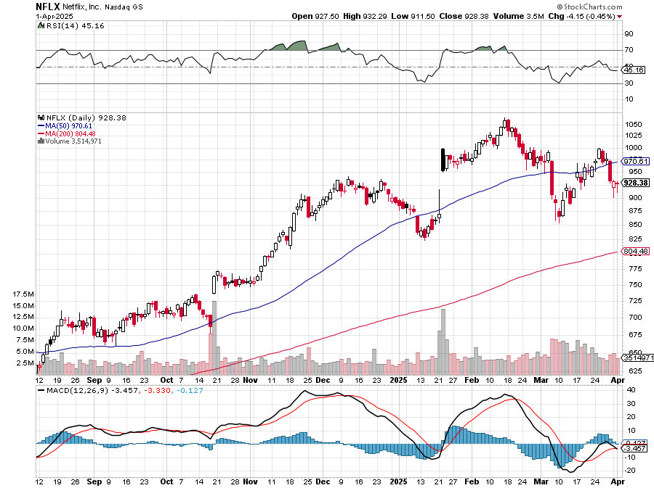
Netflix (NFLX) – Netflix Earnings Rocket, on the back of 19 million new subscriber

Slide 41
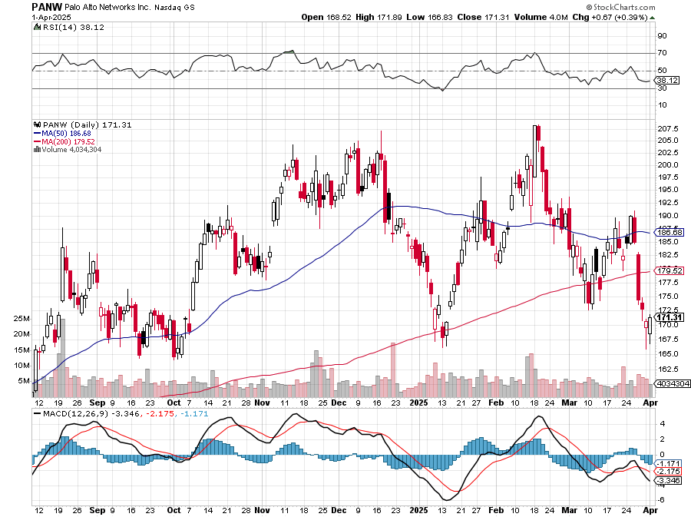
Palo Alto Networks (PANW)- Hacking never goes out of fashion Palo Alto Announced\s 2:1 Split took profits on long 2/$260-$270 call spread, took profits on long 10/$130-$140 call spread

Slide 42
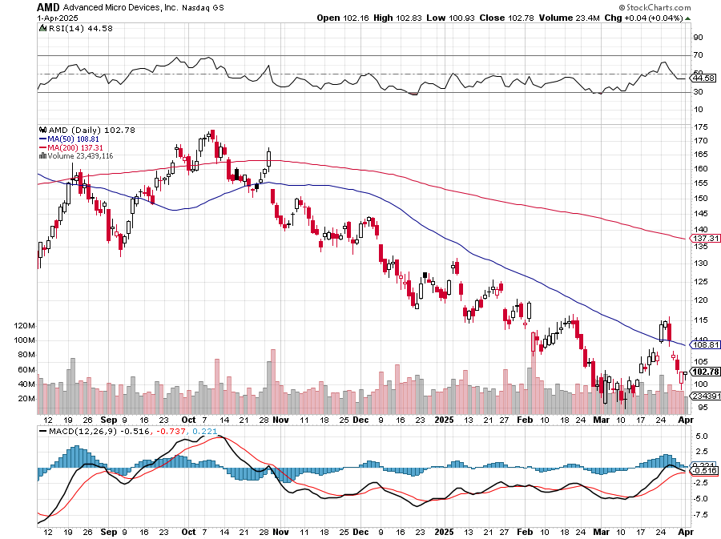
Advanced Micro Devices (AMD)- Recession fears programable logic devices took profits on long 2/$75-$80 call spread

Slide 43
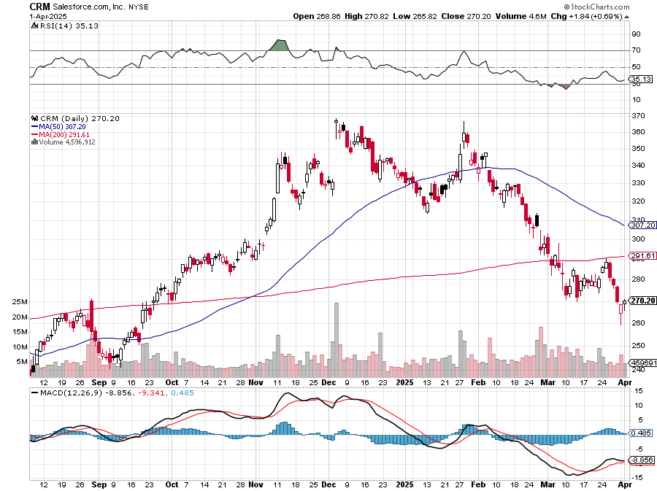
Salesforce (CRM)- Massive Online Migration took profits on long 12/$185-$195 call spread, took profits on long 9/$125-$130 vertical bull call spread took profits on long 8/$125-$130 vertical bull call spread

Slide 44
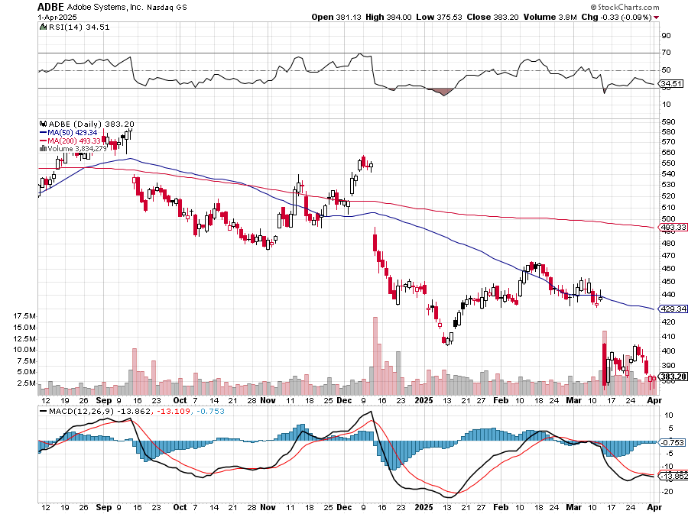
Adobe (ADBE)- Cloud play The Quality Non-China tech play

Slide 45
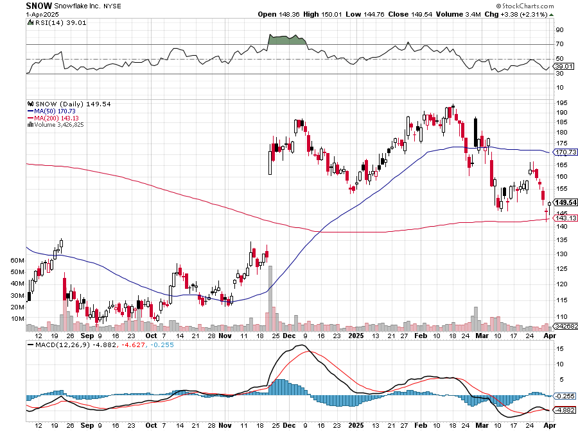
Snowflake (SNOW)- Blockbuster AI Earnings stopped out of long 4/$150-$255 call spread, took profits on long 12/$135-$140 call spread

Slide 46
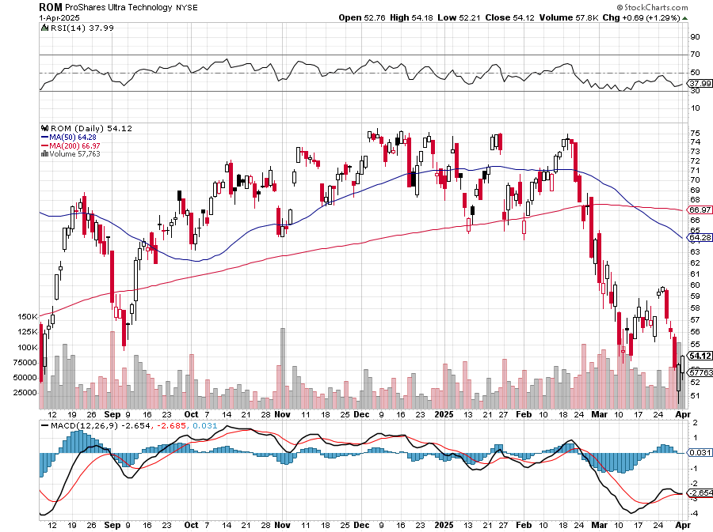
ProShares Ultra Technology ETF (ROM) – 2X Long Technology ETF took profits on long 10/$62-65 call spread

Slide 47
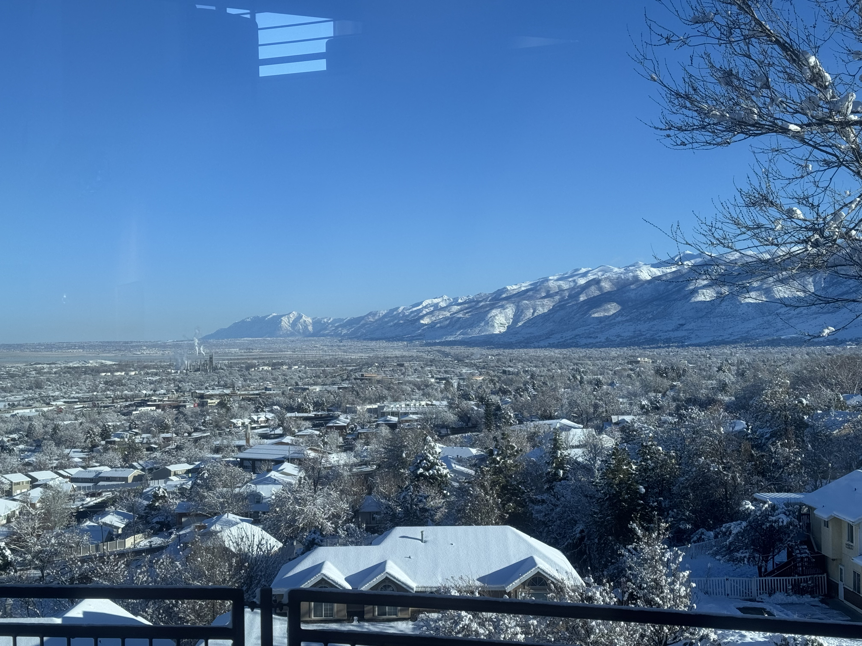

Slide 48
The Second Half of the Barbell
*Bets on a domestic recovery in 2022 Q4 *Upside potential in 2024 far greater than tech *Some of these have not moved for 5 or 10 years *Focuses on economically sensitive cyclical industries *Makes a great counterweight to high-growth technology *We could spend all of next ten years rotating between the two groups

Slide 49
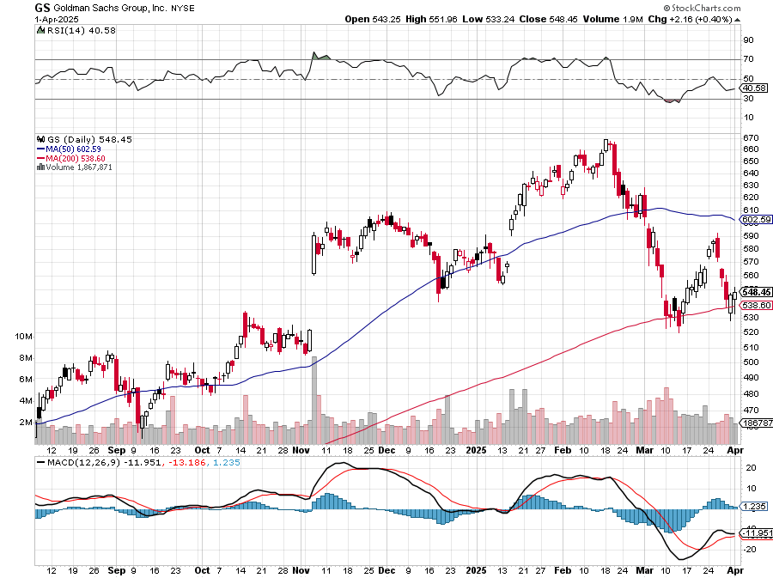
Goldman Sachs (GS) – Goldman Sachs Beats, with Revenues of $12.73 billion vs. $12.46 billion estimate stopped out of 3/$380-$390 call spread, profits on long 12/$330-$350 call spread, took profits on long 11/$330-$350 call spread

Slide 50
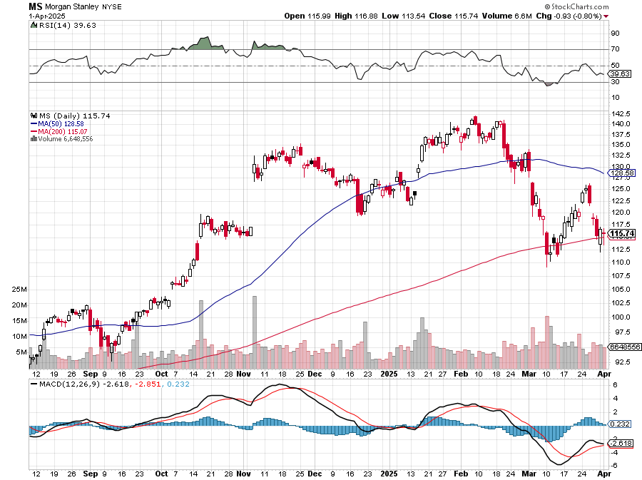
Morgan Stanley (MS) Morgan Stanley Doubles Profits took profits on long $12/210-$220 call spread, Took profits on long $195-$205 call spread, took profits on long 4/$65-$70 call spread

Slide 51
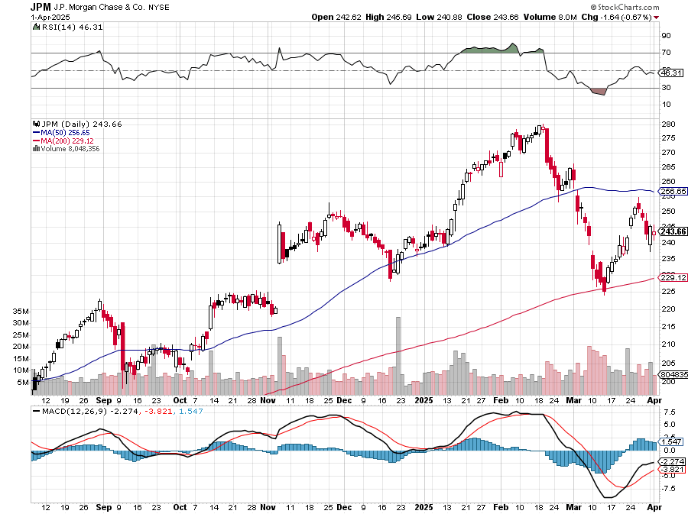
JP Morgan Chase (JPM) – Jamie Diamond Sells 30% of JP Morgan Stock stopped out of 3/$235-$245 calls spread, profits on long 12/$210-$220 call spread, took profits on long 11/$195-$205 call spread, took profits on 4/$215-225 put spread, took profits on long 4/$105-$115 call spread

Slide 52
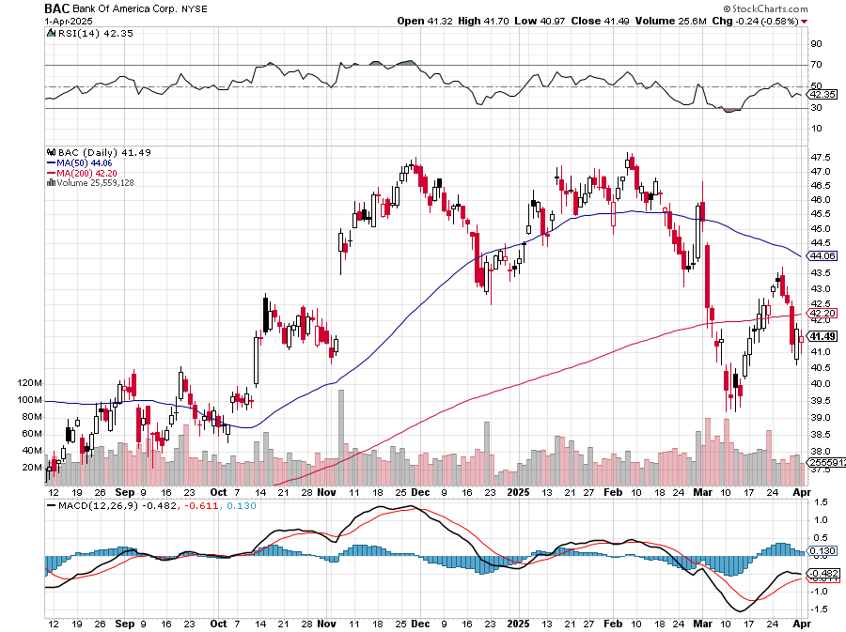
Bank of America (BAC) – Deregulation play took profits on long long 12/$41-$44 call spread, took profits on long 4/$20-$23 call spread

Slide 53
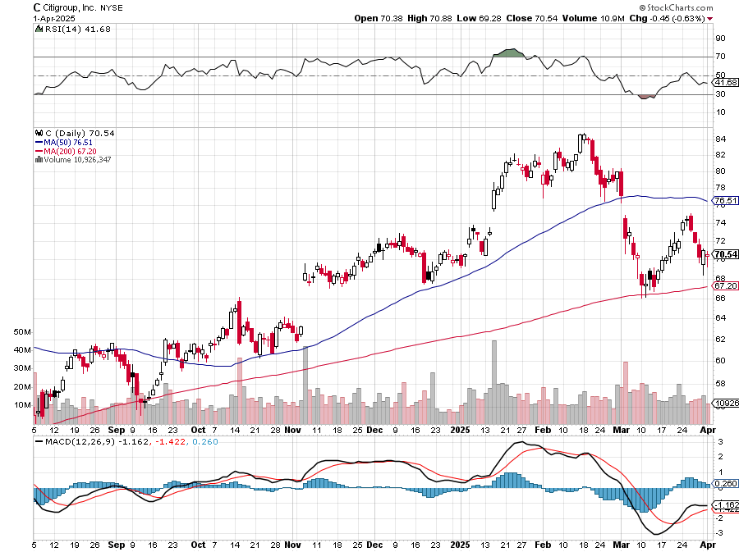
Citigroup (C) – took profits on long long 12/$60-$65 call spread , took profits on long 4/$30-$35 call spread

Slide 54
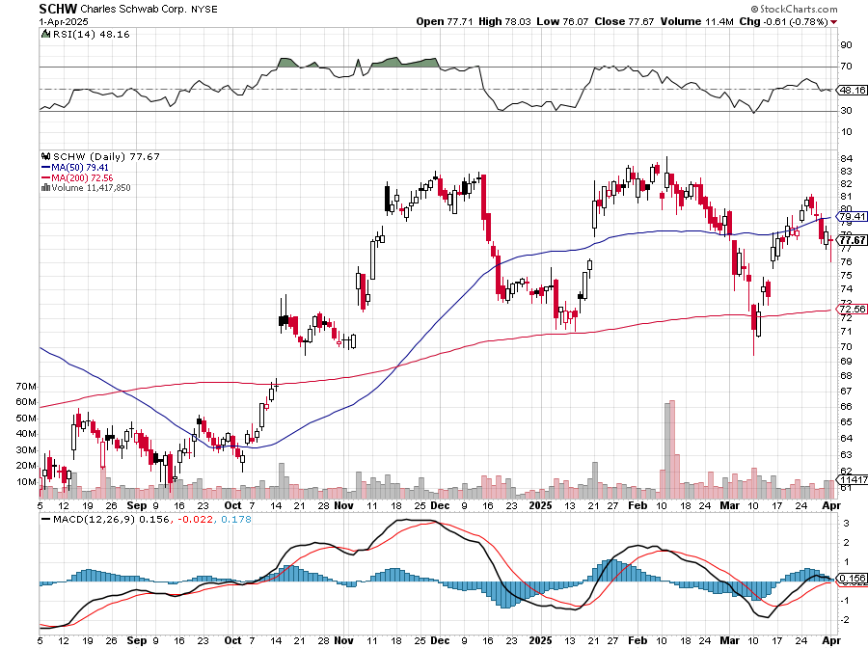
Charles Schwab (SCHW) – LEAPS expire at Max profit took profits on long 4/$30-$35 call spread

Slide 55
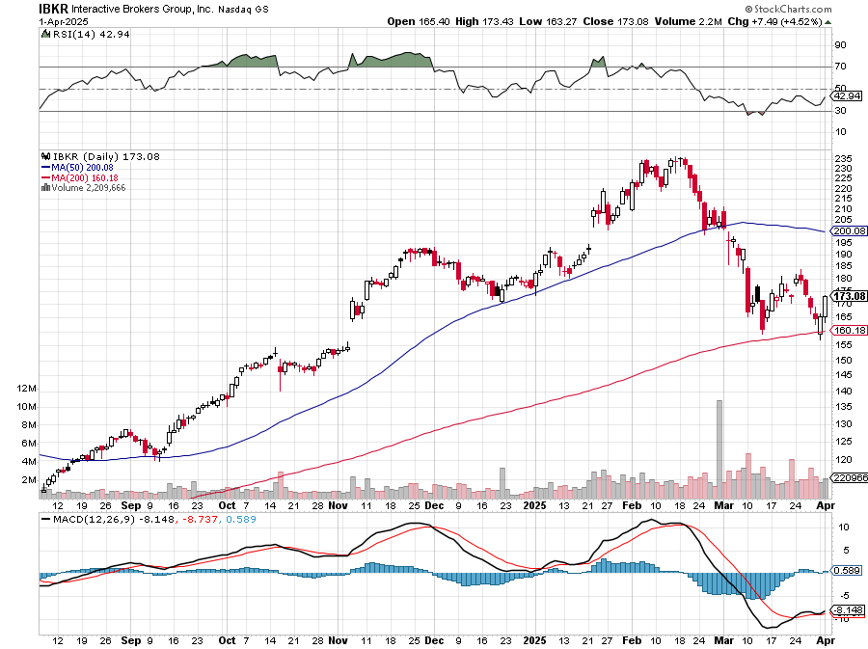
Interactive Brokers (IBKR) – LEAPS expired at Max Profit stopped out of long 3/$160-$170 call spread, out of long 8/$110-$115 call spread , took profits on long 4/$60-$65 call spread

Slide 56
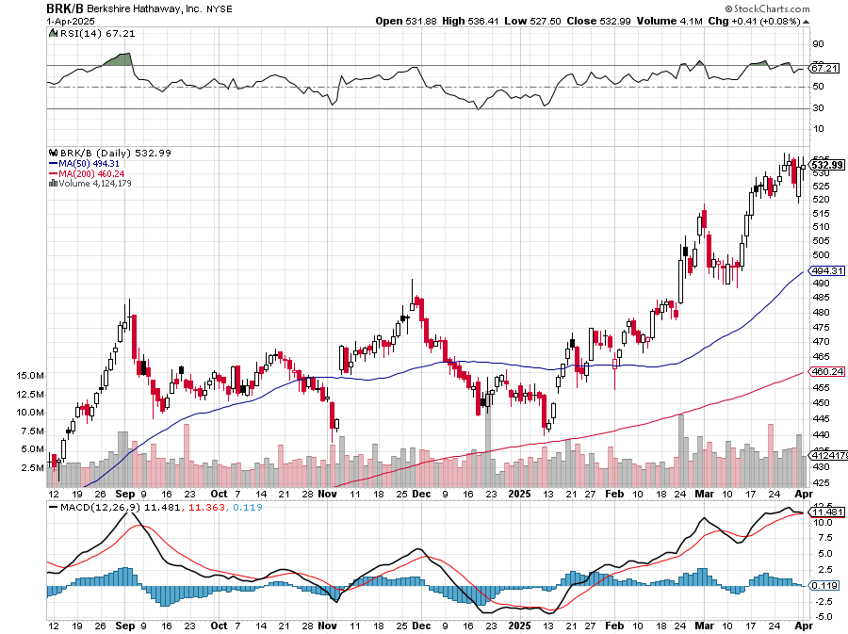
Berkshire Hathaway (BRKB)- Ultimate defensive stock Berkshire Hathaway Builds Record Cash, at $334 billion – Is the new T Bill proxy stopped out of long 12/$405-$415 call spread, took profits on long 12/$320-$330 call spread took profits on long 4/$260-$270 call spread, took profits on long 1/$290-$300 call spread

Slide 57
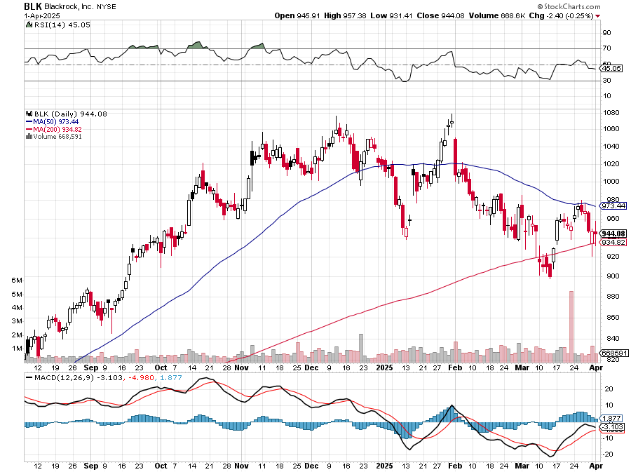
Blackrock (BLK)-Asset Collection Boom took profits on long 12/$850-$860 call spread took profits on long 3/$770-$790 call spread, took profits on long 3/$310-$340 call spread

Slide 58
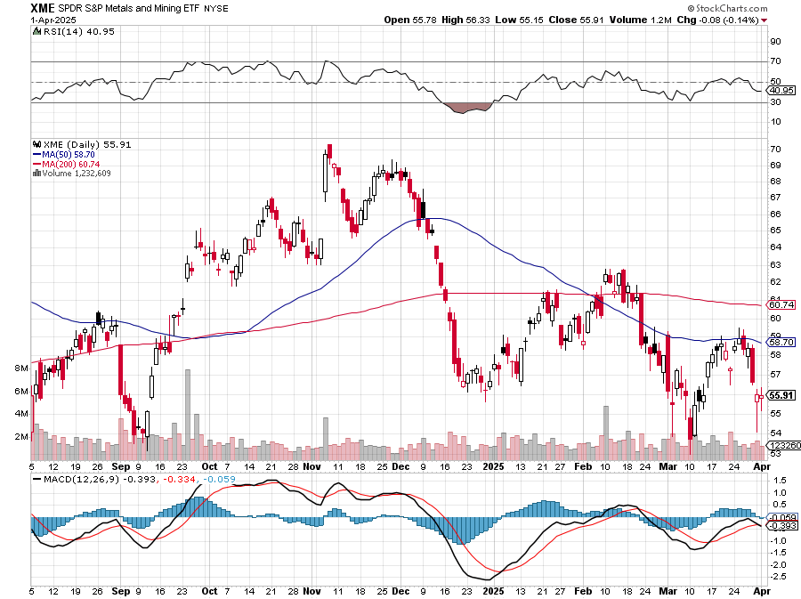
SPDR Metals & Mining ETF (XME) – long 2/$28-$30 call spread

Slide 59
Boeing (BA) – Q3 $6 Billion Loss –b Strike Continues Boeing Beats Lockheed for Next Gen Fighter Contract, for the F-47 “il pesce marcisce dalla testa”

Slide 60
General Motors (GM) – Worst Off Trade War Victim stopped out of long 4/$52.50-$57.50 put spread at cost, long 3/$53-$56 put spread

Slide 61
Package Delivery- United Parcel Service (UPS) – strike averted took profits on long 11/$130-$140 call spread

Slide 62
Caterpillar (CAT)- Ag + Infrastructure + Housing stopped out of long 8/$310-$320 call spread, took profits on long 12/$220-$230 calls spread took profits on long 12/$145-$150 call spread, took profits on long 11/$125-$135 call spread

Slide 63
Deere & Co. (DE)- Ag + Infrastructure + Housing took profits on long 8/$330-$340 put spread stopped out of long 8/$330-$340 calls spread

Slide 64
Freeport McMoRan - (FCX)- Coming Copper Crisis Freeport McMoRan Beats, helped by higher production and easing costs took profits on long 4/$37-$40 call spread, took profits on long 5/$42-$45 call spread, stopped out of long $48-$51 put spread, profits on long 6/$32-$35 call spread took profits on long 4/$30-$33 call spread, took profits on long 10/$20-$23 call spread

Slide 65
Walt Disney (DIS) -Disney Beats Disney Dives on Earnings Bust, although streaming broke even versus an expected loss

Slide 66
Industrials Sector SPDR (XLI)- (GE), (MMM), (UNP), (UTX), (BA), (HON)

Slide 67
Union Pacific RR (UNP)- Big Stuff to Ship took profits on long 5/$200-$210 call spread took profits on 11/$150-$160 call spread

Slide 68
Wal-Mart (WMT) – The New AI Stock took profit on Long 11/$125-$130 bear put spread, took profit on Long 10/$119-$121 bear put spread took profits on Long 8/$114-$117 bear put spread

Slide 69
Costco (COST) – Permanent Compounder took profit on Long 11/$125-$130 bear put spread, took profit on Long 10/$119-$121 bear put spread took profits on Long 8/$114-$117 bear put spread

Slide 70
Delta Airlines (DAL) – Recession Warning-Travel Collapse The Non-Boeing Airline – uses Airbuses stopped out of long 2/$35-$38 call spread

Slide 71
Transports Sector SPDR (XTN)- Worst Hit Sector (ALGT), (ALK), (JBLU), (LUV), (CHRW), (DAL)

Slide 72
Health Care Sector (XLV) – Defensive Play and Cheap (JNJ), (PFE), (MRK), (GILD), (ACT), (AMGN)

Slide 73
Amgen (AMGN) took profits on long 11/$185-$200 bull call spread

Slide 74
Visa (V) – Inflation boost Justice Hits Visa (V) with Antitrust Suit, with a 47% market share took profits on long 2/$240-$250 bull call spread took profits on long 10/$160-$170 bull call spread, took profits on long 6/$150-$160 bull call spread

Slide 75
Consumer Discretionary SPDR (XLY) (DIS), (AMZN), (HD), (CMCSA), (MCD), (SBUX)

Slide 77
Bonds – Recession Boost
*Bonds Rocket, with a stock market crash prompting a run into safe assets *Moody’s Downgrades the United States, saying Trump’s trade tariffs could hamper the country’s ability to cope with a growing debt pile and higher interest rates. Recession risks are rising. *Rising recession risks put bonds back in the spotlight *During the pandemic recession, the (TLT) rose to $165 *Shocking CPI at 5.0% annualized gives bonds a boost *It means that the next Fed move will be a raise, not a cut *Buy (TLT), (JNK), (NLY), (SLRN) and REITS on dips

Slide 78
Treasury ETF (TLT) – Head & Shoulders Bottom took profits on long 4/$84-$87 call spread stopped out of long 1/$82-$85 call spread, took profits on long 10/$103-$106 put spread took profits on long 6/$$94-$97 put spread, took profits on long 5/$82-$85 calls spread

Slide 79
Treasury ETF (TLT) – 5 years The Last Time we had a Head & Shoulders bottom
$155 2020 Top!

Slide 80
Ten Year Treasury Yield ($TNX) – 4.15%

Slide 81
Junk Bonds (JNK) 6.54% Yield

Slide 82
Municipal Bonds (MUB) 4.21% Yield-

Slide 83
Emerging Market Debt (ELD) 5.62% Yield-

Slide 84
2X Short Treasuries (TBT)-Out of Favor

Slide 85
Anally Capital Management (NLY) – Leveraged REIT Play Yield 13.25% took profits on long 12/$15-$16 call spread

Slide 86
Acelryn (SLRN) – Double B Bond Fund took profits on long 12/$15-$16 call spread

Slide 88
Foreign Currencies – Dead Dollar better late than never
*Prospect of falling interest rates is demolishing the US dollar * Yen Carry Trade Unwind Send Japanese Currency Soaring, *Expected interest rates differentials are the principal foreign currency driver *Recession fears are bringing forward Fed interest rate cuts *The Trump economy is forcing investors to flee all US assets, including stocks and currency *Massive cash flight is running away from the US and into Europe and China *Buy (FXA), (FXE), (FXB), (FXC), and (FXY)

Slide 89
THE MAD HEDGE FUND TRADER
Australian Dollar (FXA) - Major Long-Term Bottom is In Targeting Parity – A call option on a global synchronized recovery

Slide 90
Japanese Yen (FXY)

Slide 91
Euro (FXE)-

Slide 92
British Pound (FXB)-

Slide 93
Emerging Market Currencies (CEW)

Slide 95
Energy & Commodities – Rare Rally
*Trump threatens 25% tariff against anyone who buys Russian oil, same with Venezuela *That gives oil a rare rally to sell into *US Drillers Cut Back on New Rigs, as the country is glutted with over production, according to Baker Hughs data out today. Recession fears are the gasoline on the fire. Unemployment will rise in the oil producing states *Copper Hits New All-Time High, at $5.02 a pound. The red metal has outperformed gold by 25% to 15% YTD *The Oil Market is in Turmoil, with crude prices bouncing offour year low *A global recession is looming large *Avoid all energy plays like the plague

Slide 96
Oil-($WTIC)

Slide 97
United States Oil Fund (USO)

Slide 98
Energy Select Sector SPDR (XLE)-No Performance! (XOM), (CVX), (SLB), (KMI), (EOG), (COP)

Slide 99
ExxonMobil (XOM)- Exxon Moves Big into Lithium, with the construction of a major mining operation in Arkansas took profits on Long 4/$100-$105 call spread, took profits on long 12/$120-$125 put spread

Slide 100
Occidental Petroleum (OXY)- Buffet’s a Buyer took profits on long 4/$59-$62 call spread took profits on long 2/$55-$60 call spread, took profits on long 12/$77.50-$82.50 put spread

Slide 101
Natural Gas (UNG) – Free Fall on Warm Winter took profits on Long January 2025 $7-8 Call Spread LEAPS

Slide 102
Cameco (CCJ) – Global Uranium Renaissance Microsoft to Reopen Three Mile Island to power AI data centers took profits on long 12/$41-$44 call spread, took profits on long 12/$35-$38 call spread, took profits on long 5/$20-$23 bull call spread

Slide 103
Vistra Corp. (VST) – Global Uranium Renaissance long 2/$100-$110 call spread - 7 days to expiration

Slide 105
Precious Metals – New High
*Gold is over extended and due for a correction *But long-term targets are getting raised across the board *No upside resistance above $3,200, setting up a possible melt up *Falling interest rates have given gold a new lease on life *Gold Stocks in Comex Warehouses Hit Record high, due to the risk of import tariffs curtailing shipments to the United States from other countries *Will import duties divide the gold market into American and foreign gold?

Slide 106
THE MAD HEDGE FUND TRADER
Gold (GLD)-A New Leg took profits on Long 10/$230-$235 call spread took profits on Long 10/$220-$225 call spread, took profits on Long 8/$210-215 call spread, took profits on Long 7/$200-205 call spread, Long 6/$207.5-$212.5 call spread took profits on Long 4/$194-$197 call spread, took profits on long 5/$165-$170 bull call spread
$5,000 in 2028 +66%
BUY

Slide 107
Gold (GLD) –Falling Rate took profits on Long 10/$230-$235 call spread took profits on Long 10/$220-$225 call spread, took profits on Long 8/$210-215 call spread, took profits on Long 7/$200-205 call spread, Long 6/$207.5-$212.5 call spread took profits on Long 4/$194-$197 call spread, took profits on long 5/$165-$170 bull call spread

Slide 108
Market Vectors Gold Miners ETF- (GDX) – took profit on long 6/$207.50-$212.50 call spread, took profit on long 7/$200-$205 call spread

Slide 109
Barrick Gold (GOLD) took profit on long 1/$15.50-$16.50 call spread

Slide 110
Newmont Mining- (NEM)- Sometimes you Just Get Lucky took profits on long 10/$47-$50 call spread, took profits on long $55-60 call spread

Slide 111
THE MAD HEDGE FUND TRADER
iShares Silver Trust (SLV) - The Better Play Industrial demand, solar panels, electric cars
2025 Target $50 +50%
BUY

Slide 112
Silver Miners - (SIL)-

Slide 113
Wheaton Precious Metals - (WPM)- LEAPS Approaching Max Profit took profits on long 4/$39-$42 call spread , took profits on long 1/$36-$39 call spread

Slide 114
Platinum- (PPLT)- 556,000-ounce shortage this year took profits on long 1/$36-$39 call spread

Slide 116
Real Estate – Green Shoots?
*US Mortgage Rates Drop to 6.65%, for 30-year fixed rate loans. Recession fears have driven interest rates from over 7.30% down a full 10.65%. Recession fears have been driving rates down *Pending Home Sales Rise, based on signed contracts, rose 2.0% to 72.0Pending home sales decreased 3.6% from a year earlier. US Home Sales Rise, but the stocks still look awful, increasing 1.8% to 676,000 units last month. The sales pace for January was revised up to a rate of 664,000 units from the previously reported 657,000 units *Homebuilder Sentiment Craters, to a seven-month low in March as tariffs on imported materials raised construction costs *Existing Home Sales Jump, in February, with a decent push from falling interest rates, increasing 4.2% from the annual rate of 4.26 million

Slide 117
S&P Case Shiller Slows S&P Case Shiller Rises to +4.1% YOY in January, with its National Home Price Index New York gained +7.7%, Chicago +7.5%, and Boston +6.5%. Washington DC was down -1.1%

Slide 118
Crown Castle International (CCI) – 6.62% yielding 5G cell phone tower REIT Eliot Management Pushes up stock with activist bid Long 8/$90-$95 call spread,

Slide 119
US Home Construction Index (ITB) (DHI), (LEN), (PHM), (TOL), (NVR)

Slide 120
DH Horton (DHI) Horton Bombs, with the stock dropping some 11% in Tuesday morning trading after the U.S.'s largest homebuilder issued its fiscal 2025 guidance took profits on long 11/$165-$175

Slide 122
Trade Sheet- The Recession Trade So What Do We Do About All This?
*Stocks –sell rallies *Bonds – buy dips *Commodities - stand aside *Currencies – buy dips *Precious Metals – buy dips *Energy – stand aside *Volatility – sell over $30 *Real estate – stand aside

Slide 123
Next Strategy Webinar 12:00 EST Wednesday, April 16, 2025 from Incline Village, NV email me questions at support@madhedgefundtrader.com
Good Luck and Good Trading!
Notes:
*

