Slide 1
The Mad Hedge Fund Trader “The NVIDIA BOOM”
With John Thomas Incline Village, NV May 29, 2024 www.madhedgefundtrader.com
Notes:
*

Slide 3
Trade Alert Performance New All-Time Highs!
*January -4.28% Final *July +0.44% Final *February +7.42% Final *August -4.70% Final *March +6.23% Final *September +00% Final *April +5.24% Final *October -5.37% Final *May +3.74% MTD *November +15.37 Final *June +3.01% Final *December -2.27% Final *2024 YTD +18.35%, versus +11.11% for the S&P 500 and +694.98% since inception *Versus 84.63% for all of 2022 *Versus 79.79% for all of 2023 *Average annualized return of +51.79% for 16 years

Slide 4
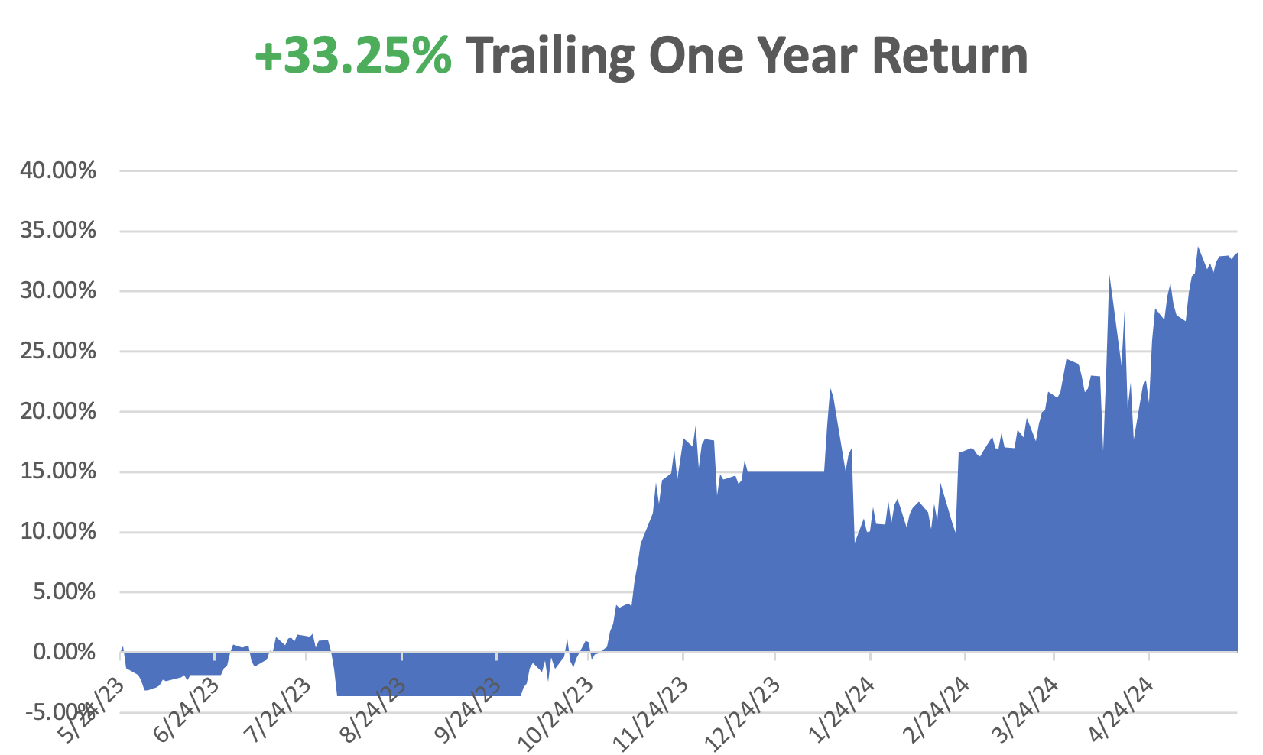

Slide 5
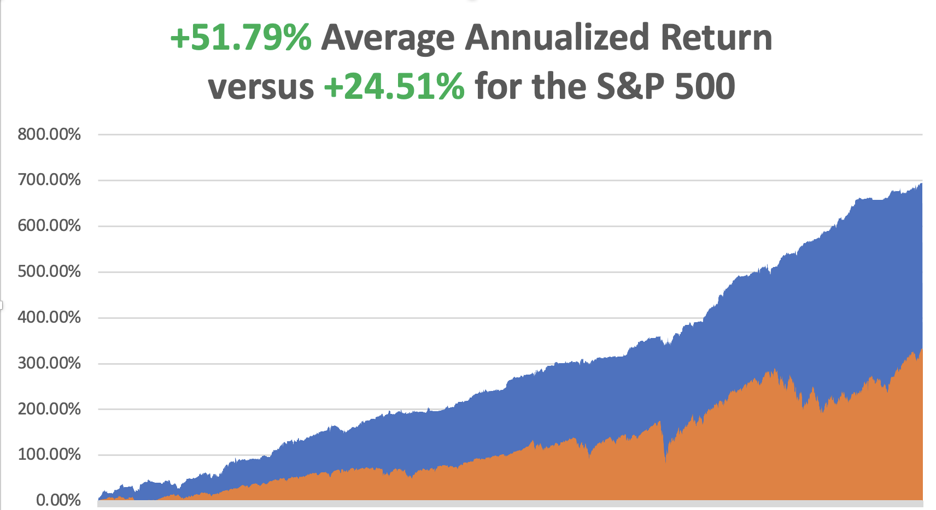

Slide 6
Portfolio Review – Aggressively Neutral 100% cash
Expiration Value +18.35%
NO POSITIONS

Slide 7
The Method to My Madness
*The focus has shifted to the spectacular performance of NVIDIA and other AI stocks *The general downside is limited to 5%-8% with $8 trillion in cash on the sidelines and a further $26.8 trillion in short-term US treasury Bills *Technology stocks won’t crash, just have a sideways “time” correction *All economic data is globally slowing, including the US, with the only good economy in the world *Interest rates are higher for longer but September is back on the plate in view of recent date releases *Buy stocks and bonds on dips

Slide 8
The Global Economy – Still slowing
*CPI Comes in Cool, in April at 0.3% versus 0.4% expected *S&P Global Flash PMI Jumps, 50.9 for services 54.8 for manufacturing, a one year high *Weekly Jobless Claims Fall, down 215,000, down 8,000, the steepest decline since September *Federal Reserve officials are looking for further weakening in demand as they try to tame inflation without triggering a surge in unemployment. *Consumer Inflation Expectations at 3.3%, according to the University of Michigan, the amount of price rises expected in the coming year. *Fed Minutes Turn Bearish, from their last meeting a month ago *Chinese Government to Buy Unsold Homes, to rescue the local real estate market

Slide 9
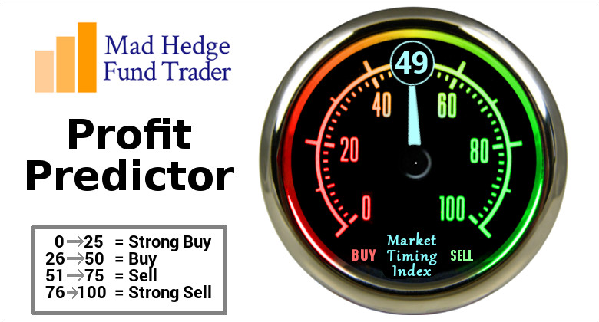
The Mad Hedge Profit Predictor Market Timing Index – Approaching low end of historic range An artificial intelligence driven algorithm that analyzes 30 different economic, technical, and momentum driven indicators

Slide 10
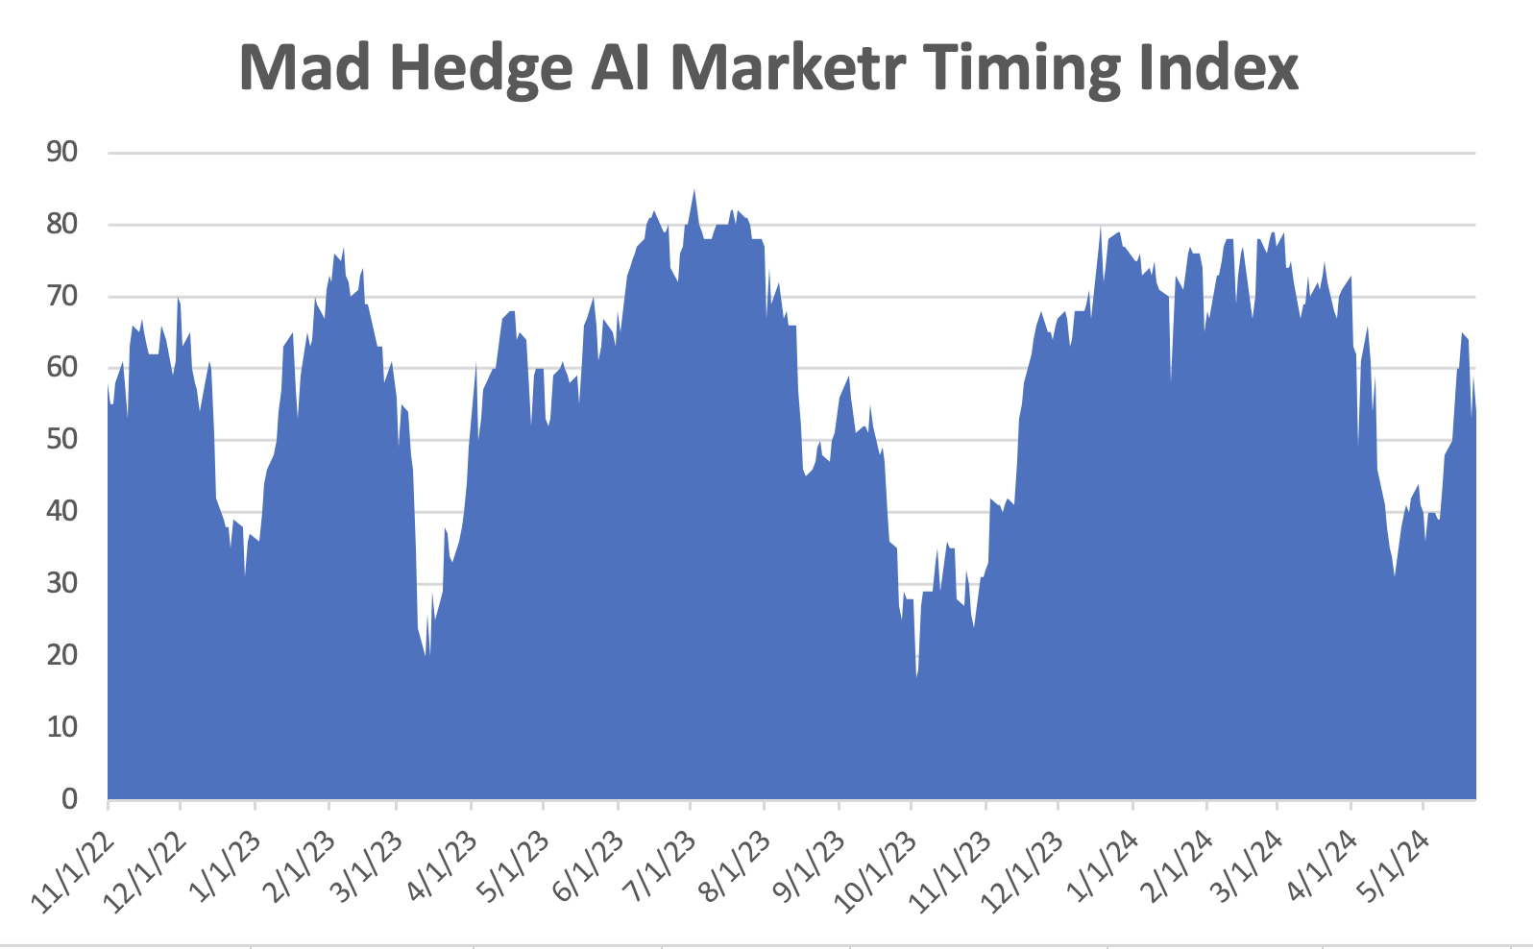
NEUTRAL Territory
SELL
NOW
BUY

Slide 11
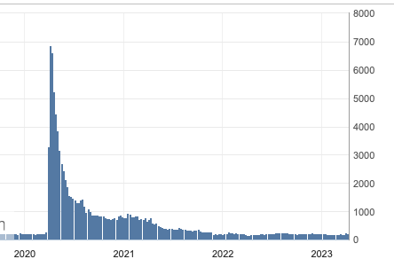
Weekly Jobless Claims – Falling 215,000 +8,000

Slide 12
Stocks – Blowoff Top
*As the Dow Tops 40,000, investors are pouring money into both bonds and stocks, according to the Bank of America. Equity funds saw $11.9 billion in inflows, while bond funds drew in $11.7 billion *NVIDIA has Triggered Split Fever in the wake of its own 10:1 announcement last week, and traders are piling into the shares of next candidates *DOJ to Break Up Live Nation, seeking to end the monopoly on ticket sales which have sent ticket prices soaring *Thousands of Young Traders are Getting Wiped Out, following the trading advice of London based IM Academy and the so-called guru, Chris Terry *Biggest Bear on Wall Street Turns Bullish, Mike Wilson at Morgan Stanley, who jumped his 12-month target for the S&P 500 by 20% to $5,400, or $100 high than it is now. Ouch

Slide 13
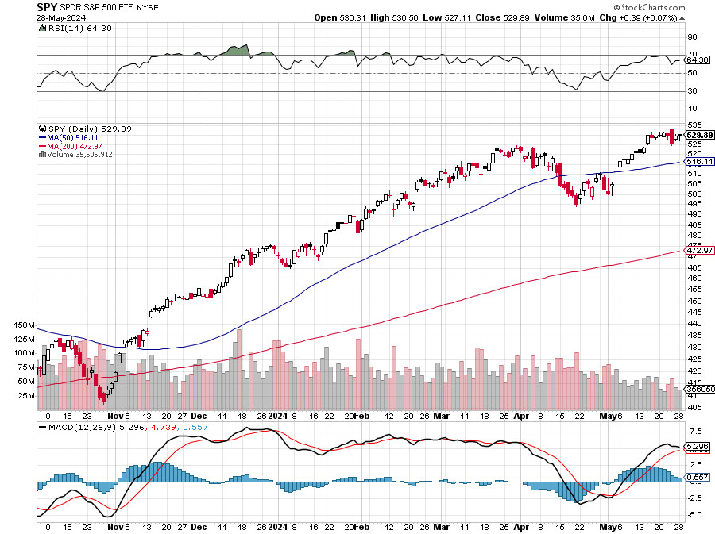
S&P 500 – Upside Breakout Here
Yearend Target $600 +25%
$495 -6.4% 1st support

Slide 14
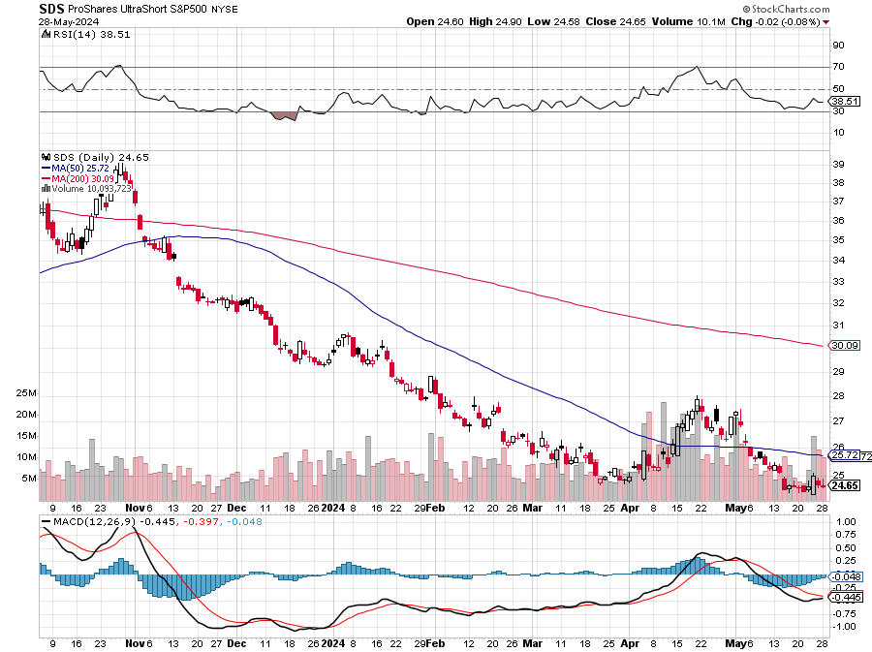
ProShares Ultra Short S&P 500 (SDS)- a great hedge for long stocks and bonds long 2X position has a hedge against longs and bond shorts

Slide 15
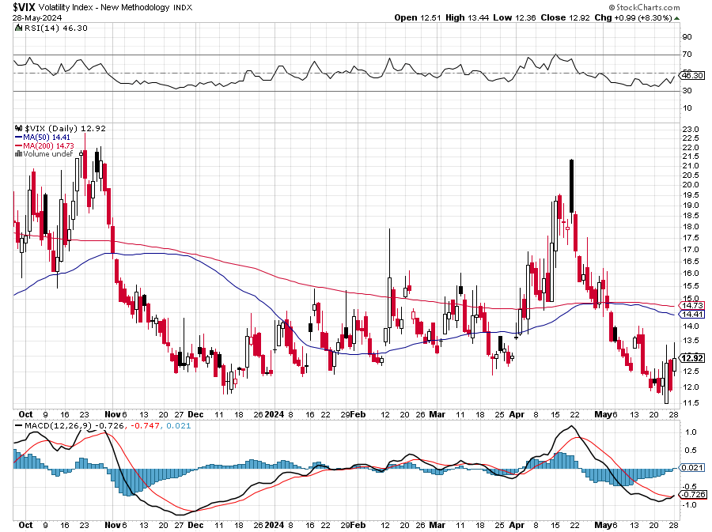
(VIX) – Bargain of the Century

Slide 16
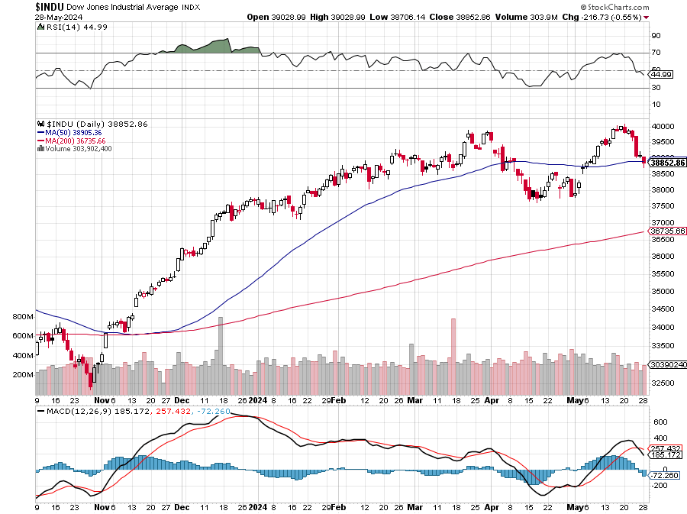
Dow Average ($INDU)-

Slide 17
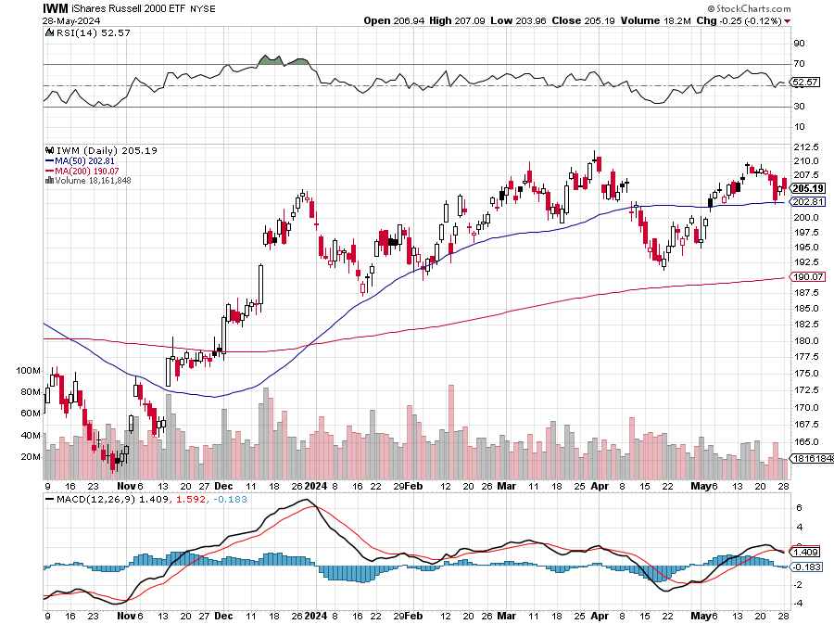
Russell 2000 (IWM)- took profits on Long 10/$137-$142 vertical bull call spread took profits on Long 10/$153-$156 vertical bear put spread

Slide 18
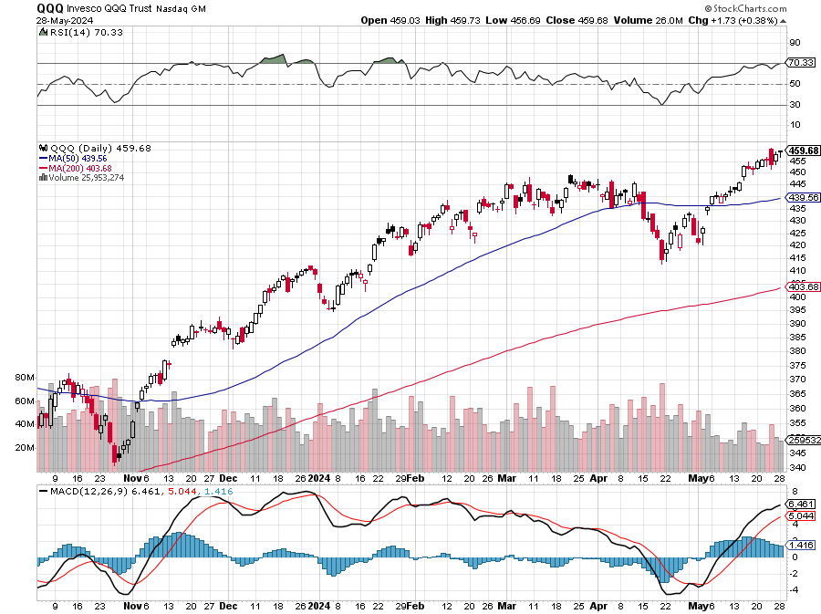
NASDAQ (QQQ) – took profits on Long 5/$335-$345 put spread took profits on long (QQQ) 1/$290-$300 put spread, took profits on long (QQQ) 4/$330-$335 put spread took profits on long (QQQ) 3/$340-$345 put spread, covered long (QQQ) $325-$330 put spread

Slide 19
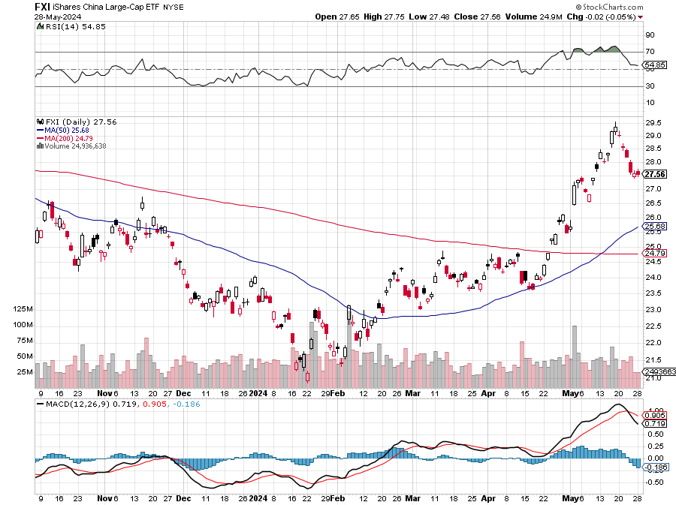
China (FXI)

Slide 20
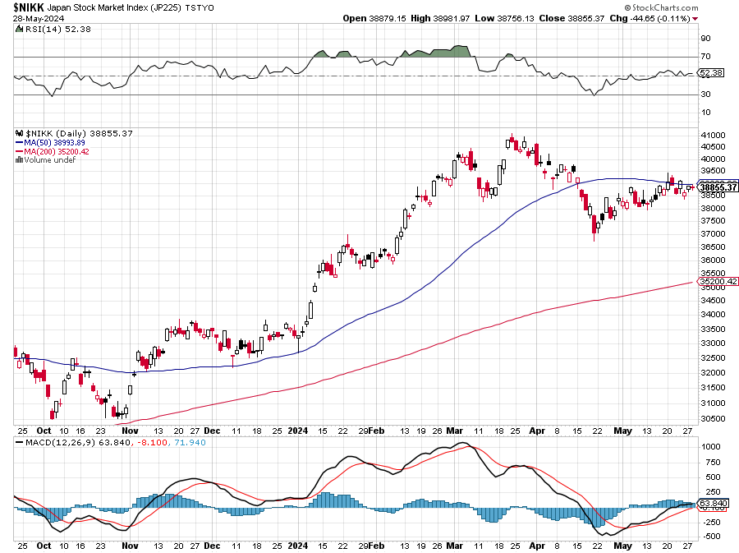
Japan ($NIKK)

Slide 21
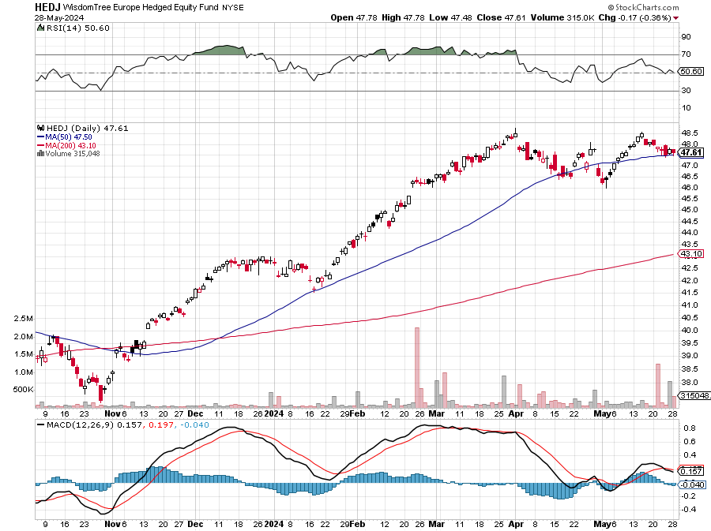
Europe Hedged Equity (HEDJ)-

Slide 22
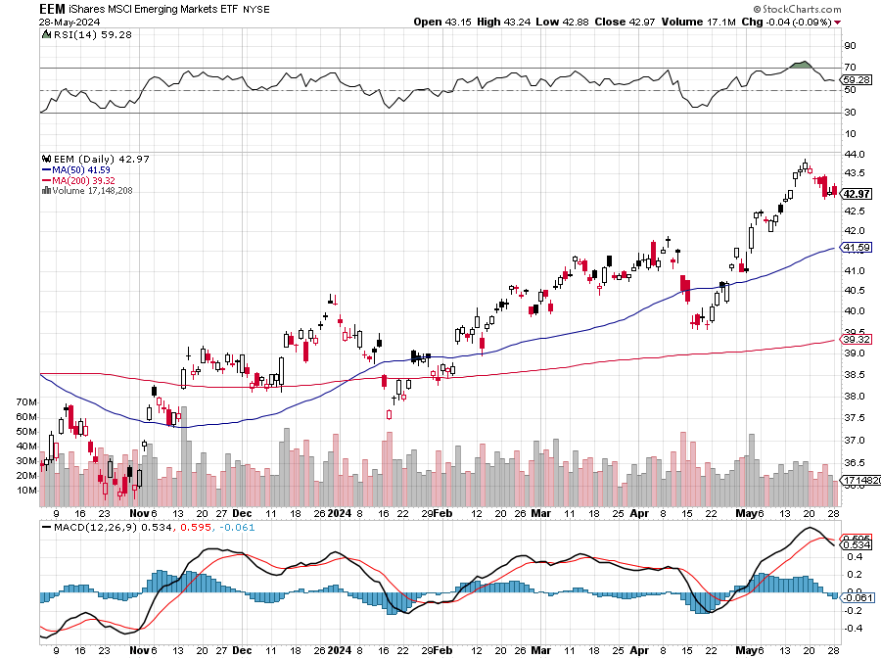
Emerging Markets (EEM) - Pro trade, Weak Dollar, Long Recovery Play Traders are Lining up for a Big Emerging Market Bet. Falling US interest rates will bring a weak US dollar and runaway bull markets in most emerging markets, which have remained unchanged for more than a decade

Slide 24
THE MAD HEDGE FUND TRADER
The Barbell Portfolio
*75% Big Tech – 2% of US workforce, 25% of market cap and 25% of US earnings 25% Domestic Recovery, including: Railroads, airlines, cruise lines, Couriers, steel companies Banks, commodities Construction Credit Card Companies Hotels, casinos Online Ticket Sales

Slide 25
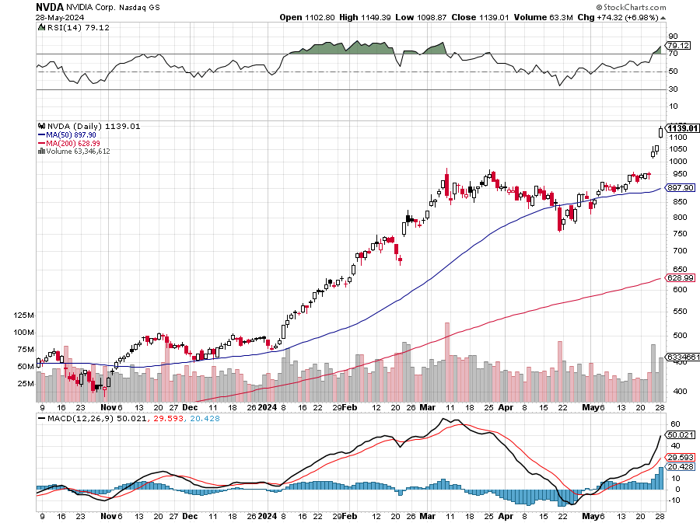
NVIDIA (NVDA) – Blowoff Top At $2.8 trillion (NVDA) could become the largest publicly traded company in the world in another day took profits on long 5/980-$990 put spread stopped out of long 5/960-$970 put spread took profits on long 5/710-$720 call spread, stopped out of long 5/740-$750 call spread, took profits on long 3/$600-$610, took profits on long 3/$600-$610

Slide 26
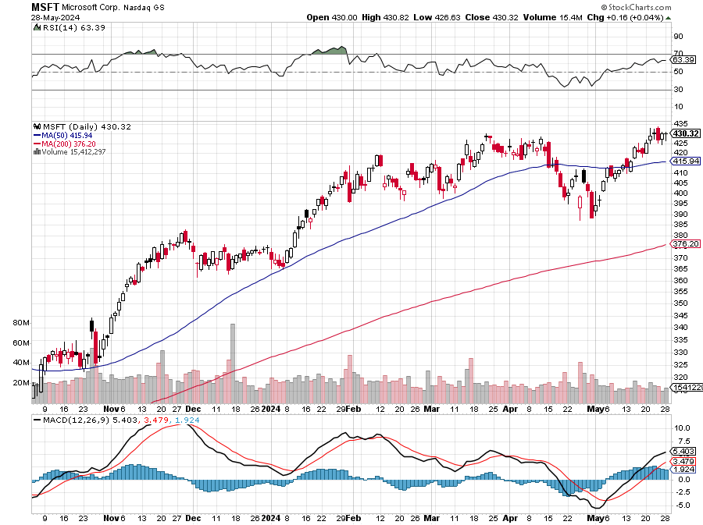
Microsoft (MSFT)- Microsoft Beats Estimates, with the steady growth of its azure cloud business Microsoft Holds Developer Conference aimed at AI Products took profits on long 5/$430-$440 put spread Took profits on long 2/$330-$340 call spread, took profits on long 12/$320-$330 call spread took profits on long 9/$235-$245 call spread, took profits on long 7/$220-$210 call spread, took profits on long 6/$220-$230 call spread, took profits on long 2/$200-$210 bear put spread

Slide 27
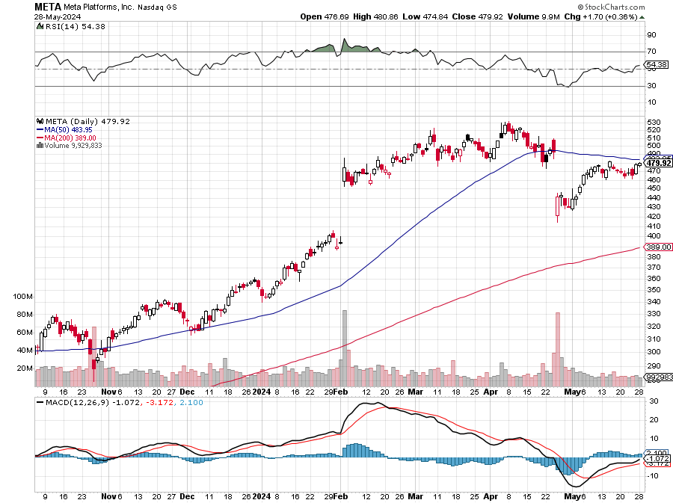
Meta (META) Announces Partnership with Google took profits on Long 5/$360-$370 vertical bull call spread, took profits on Long 9/$290-$300 vertical bear put spread stopped out of Long 9/$190-$200 vertical bear put spread

Slide 28
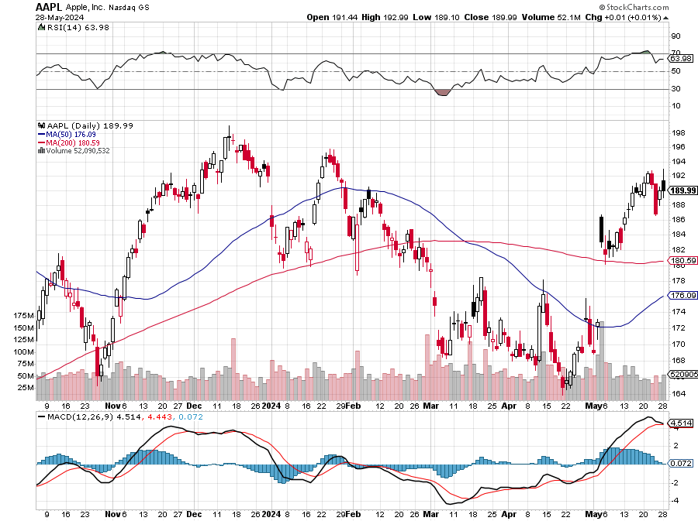
Apple (AAPL) – June Developers Conference Driver Slashes iPhone Prices in China to Fight Flagging Sales took profits on Long 6/$200-$210 bear put spread, stopped out of Long 5/$185-$195 vertical bear put spread took profits on long 1/$145-$155 put spread, Took profits on long 10/$165-$175 put spread took profits on long 6/$155-$165 put spread, stopped out of long 6/$125-135 call spread, took profits on long 6/$110-$120 call spread, took profits on long 2/$180-$190 put spread

Slide 29
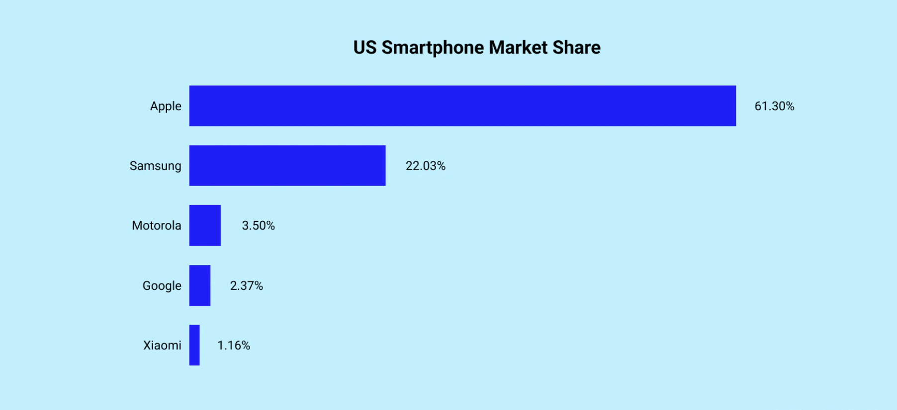

Slide 30
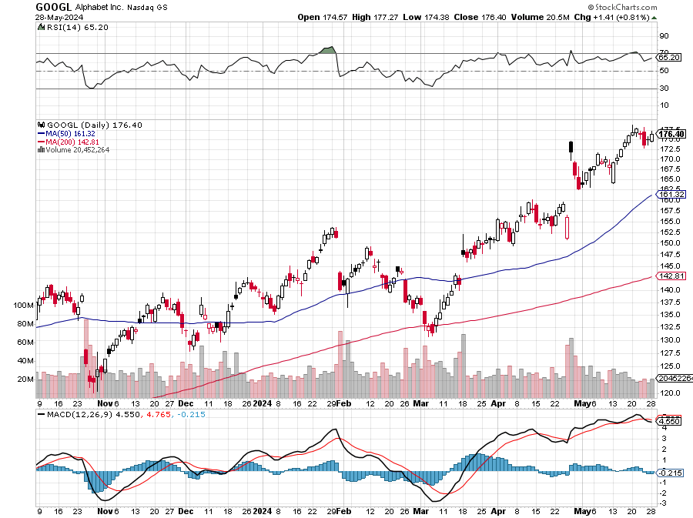
Alphabet (GOOGL) – Back in Play Alphabet Earnings Beat Delivers Monster 10% Move, recovering a $2 trillion market cap took profits on long 12/$110-$120 call spread took profits on long 12/$1,200-$1,230 bull call spread, took profits on long 9/$1,030-$1,080 vertical bull call spread

Slide 31
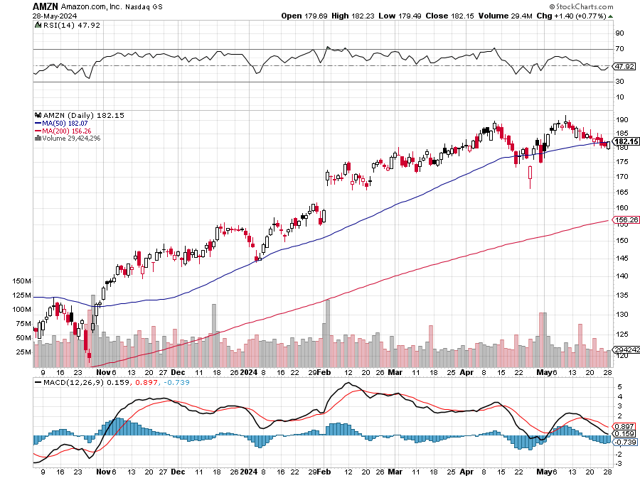
Amazon (AMZN) – Amazon Blows Out Earnings took profits on long 3/$155-$160 bull call spread , took profits on long 2/$130-$135 bull call spread

Slide 32
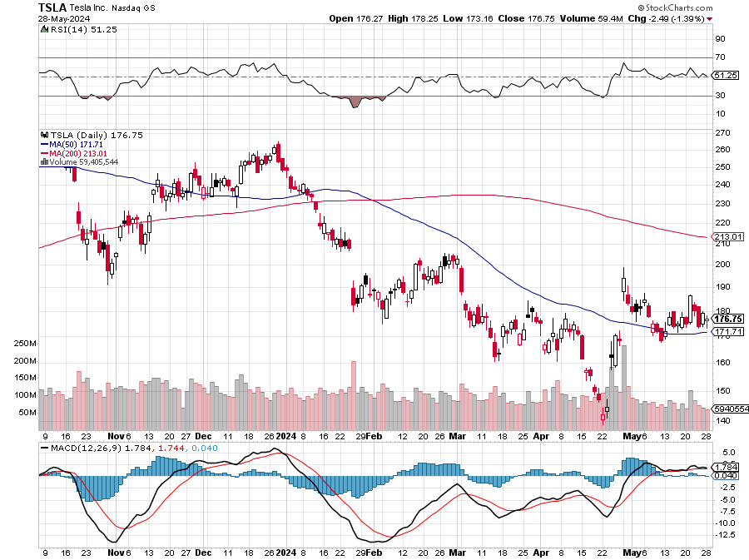
Tesla (TSLA) – SPACE X HAS 3 Million Starlink Subscribers, the next Tesla cash cow at $200 billion at 42% Stopped out of long 4/$140-4150 call spread, took profits on long 10/$200-$210 call spread took profits on long 6/$120-$130 call spread, stopped out of long 6/$210-$220 put spread took profits on long 5/$110-$120 call spread, took profits on long 5/$220-$230 put spread

Slide 33
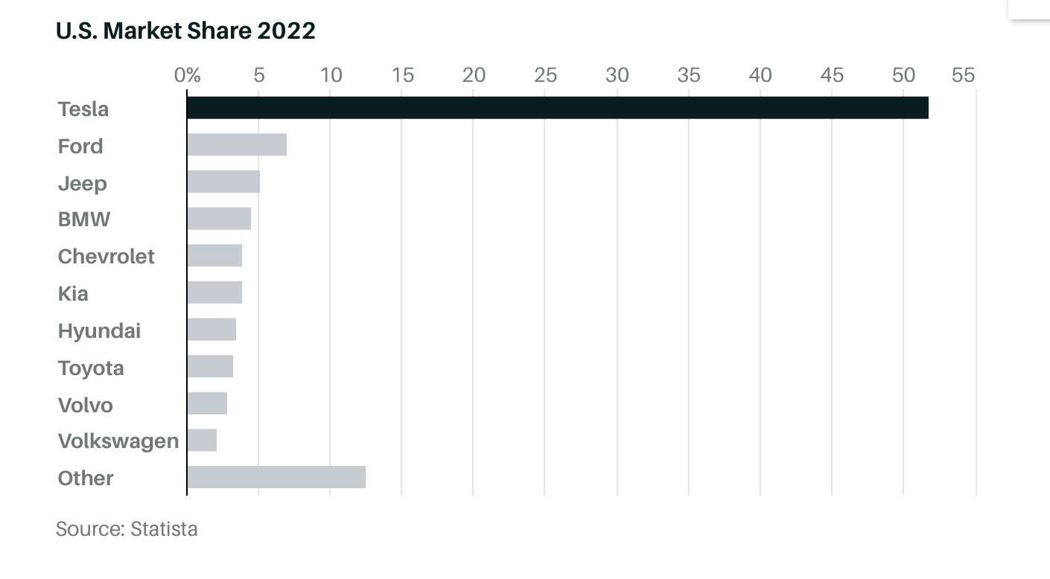

Slide 34
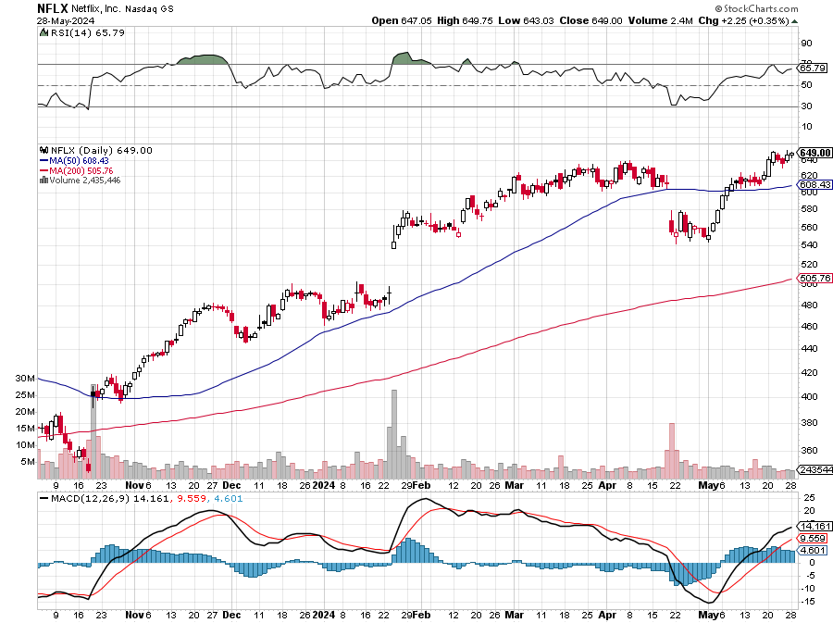
Netflix (NFLX) – Netflix to Stream NFL Games from Christmas, creating another huge revenue stream for the dominant player in the sector

Slide 35
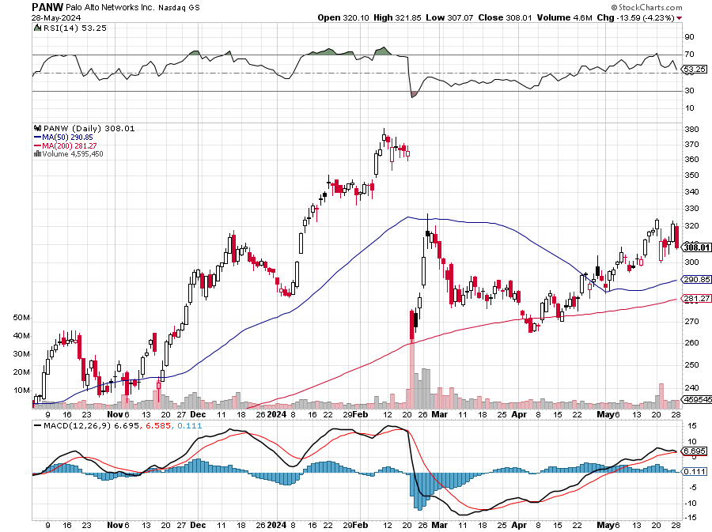
Palo Alto Networks (PANW)- Hacking never goes out of fashion Palo Alto Networks Disappoints took profits on long 2/$260-$270 call spread, took profits on long 10/$130-$140 call spread

Slide 36
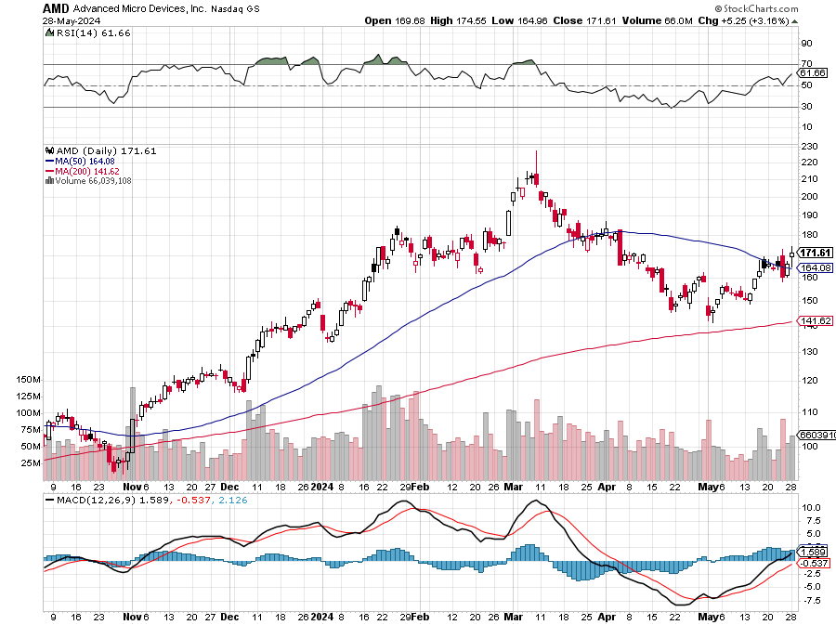
Advanced Micro Devices (AMD)- Recession fears programable logic devices-Catching the crumbs falling off of NVIDIA’s table took profits on long 2/$75-$80 call spread

Slide 37
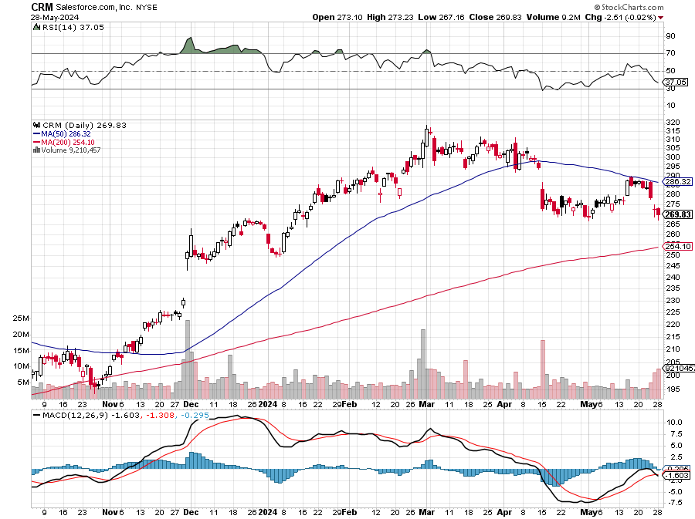
Salesforce (CRM)- Massive Online Migration Salesforce Soars 16%, on better-than-expected guidance took profits on long 12/$185-$195 call spread took profits on long 9/$125-$130 vertical bull call spread took profits on long 8/$125-$130 vertical bull call spread

Slide 38
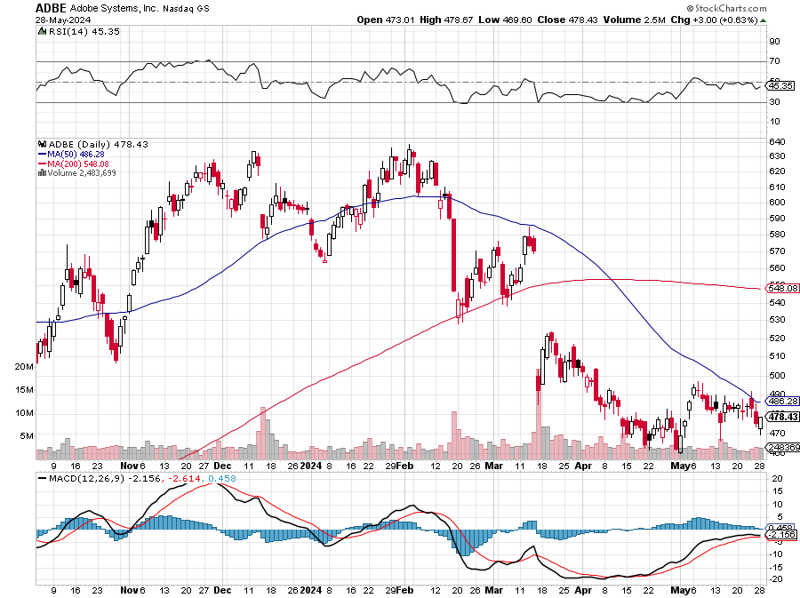
Adobe (ADBE)- Cloud play The Quality Non-China tech play

Slide 39
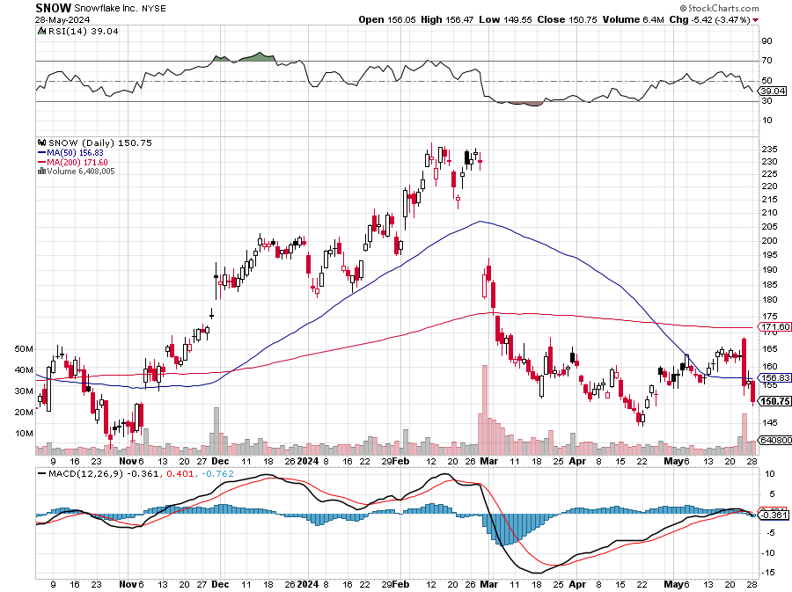
Snowflake (SNOW)- Blockbuster AI Earnings Snowflake Crashes, down 20%, on weak guidance. CEO Frank Slootman is retiring stopped out of long 4/$150-$255 call spread, took profits on long 12/$135-$140 call spread

Slide 40
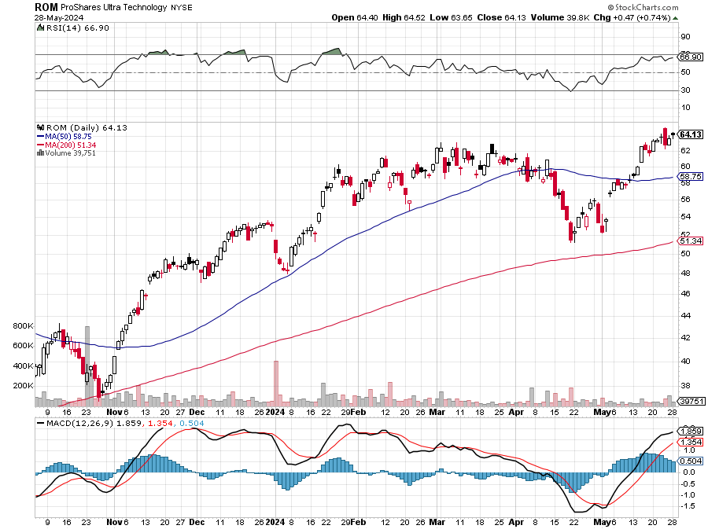
ProShares Ultra Technology ETF (ROM) – 2X Long Technology ETF took profits on long 10/$62-65 call spread

Slide 41
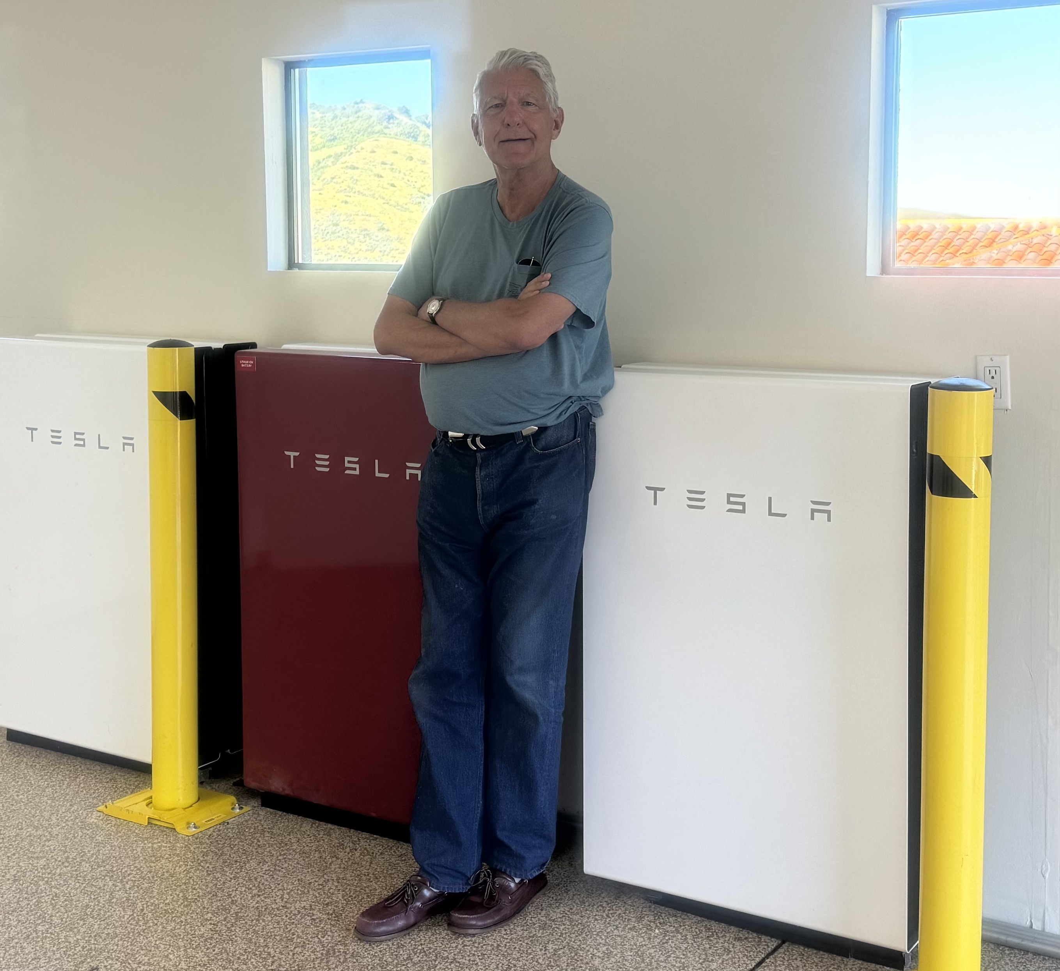

Slide 42
The Second Half of the Barbell
*Bets on a domestic recovery in 2022 Q4 *Upside potential in 2024 far greater than tech *Some of these have not moved for 5 or 10 years *Focuses on economically sensitive cyclical industries *Makes a great counterweight to high-growth technology *We could spend all of next ten years rotating between the two groups

Slide 43
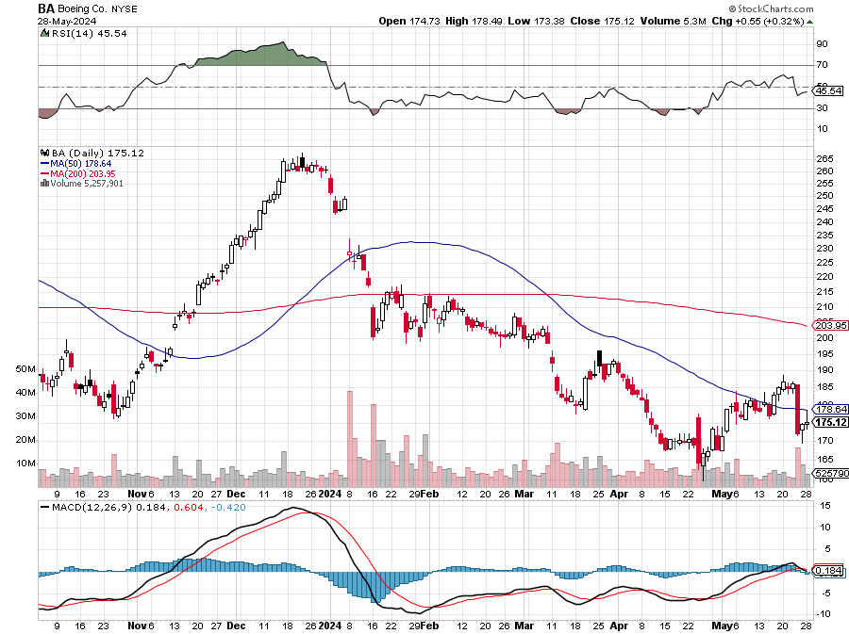
Boeing (BA) – The Bad News Continues Boeing Boss Gets $33 Million Golden Parachute “il pesce marcisce dalla testa” stopped out of long 2/$190-$200 call spread, took profits on long 5/$17-$175 call spread

Slide 44
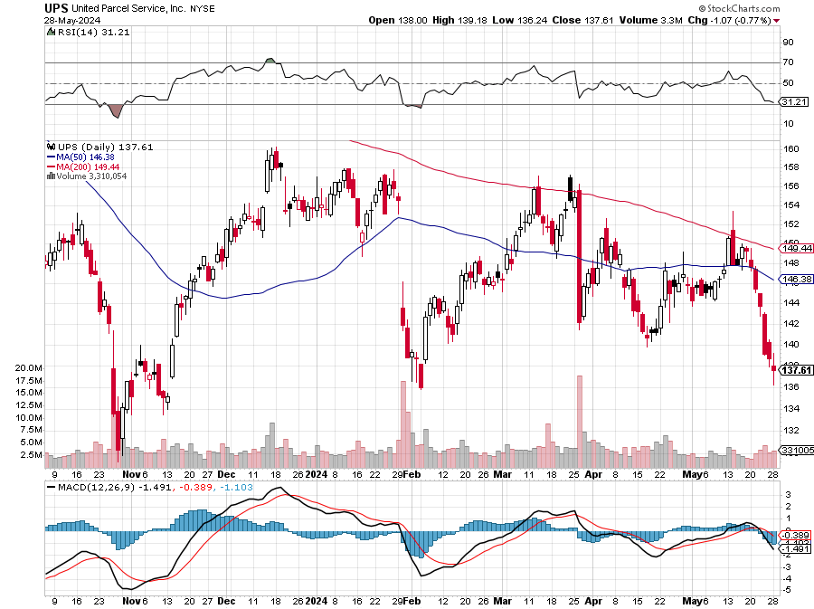
Package Delivery- United Parcel Service (UPS) – strike averted took profits on long 11/$130-$140 call spread

Slide 45
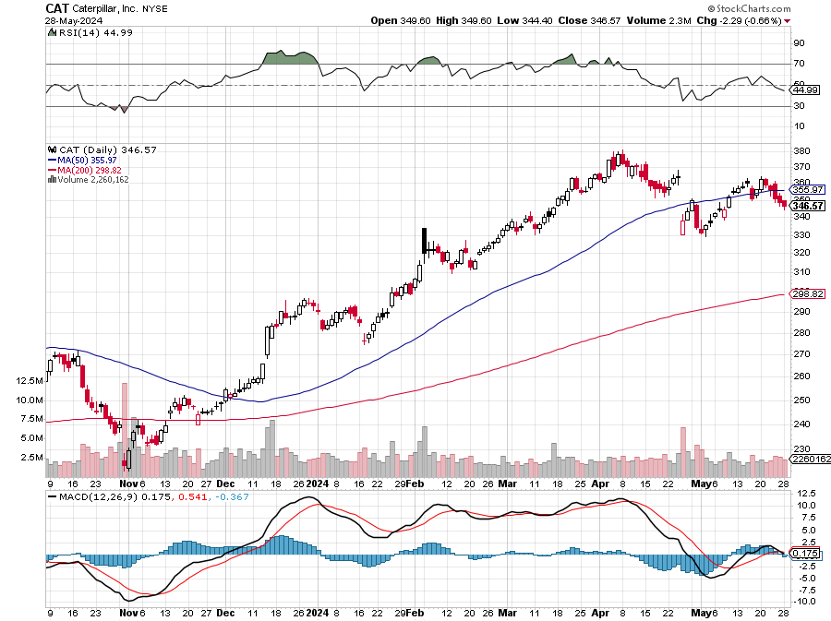
Caterpillar (CAT)- Ag + Infrastructure + Housing took profits on long 12/$220-$230 calls took profits on long 12/$145-$150 call spread, took profits on long 11/$125-$135 call spread

Slide 46
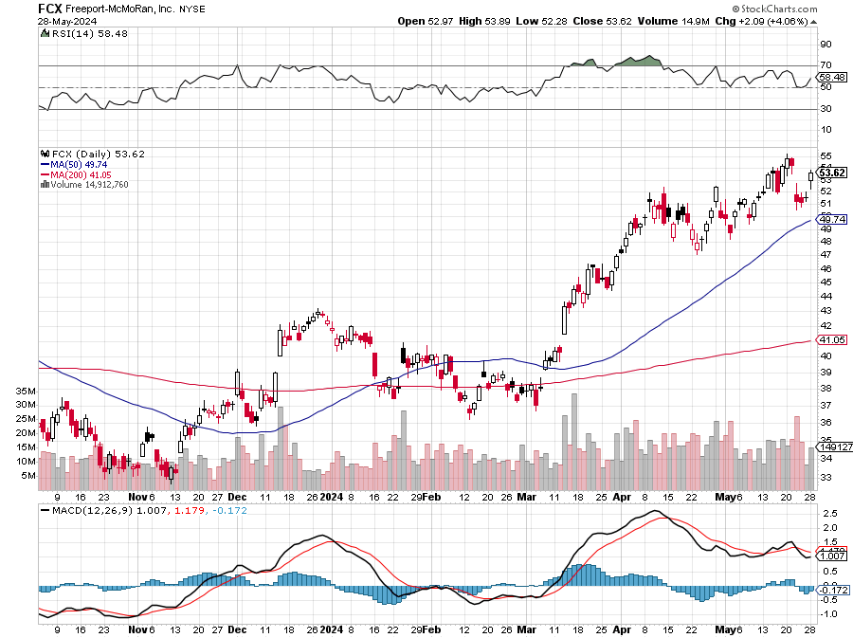
Freeport McMoRan - (FCX)- Coming Copper Crisis Freeport McMoRan Beats, helped by higher production and easing costs took profits on long 4/$37-$40 call spread, took profits on long 5/$42-$45 call spread, stopped out of long $48-$51 put spread, profits on long 6/$32-$35 call spread took profits on long 4/$30-$33 call spread, took profits on long 10/$20-$23 call spread

Slide 47
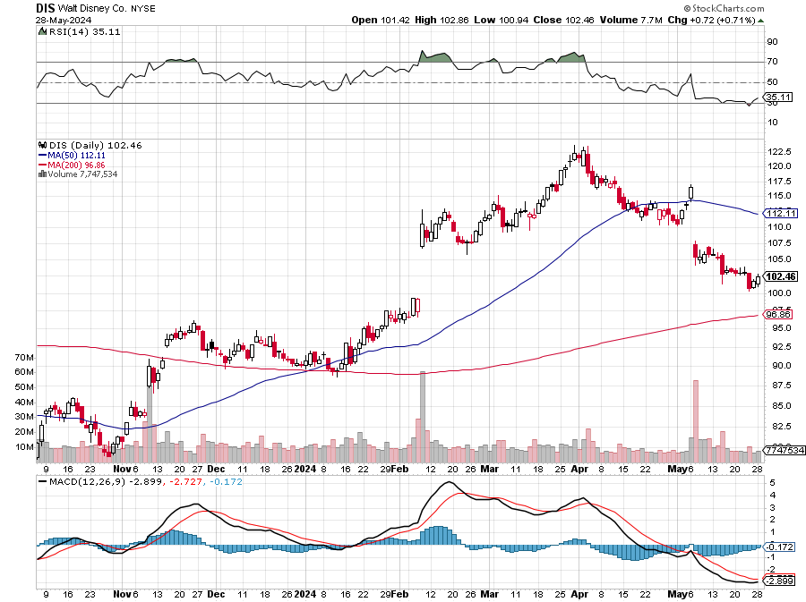
Walt Disney (DIS) -Disney Beats Disney Dives on Earnings Bust, although streaming broke even versus an expected loss

Slide 48
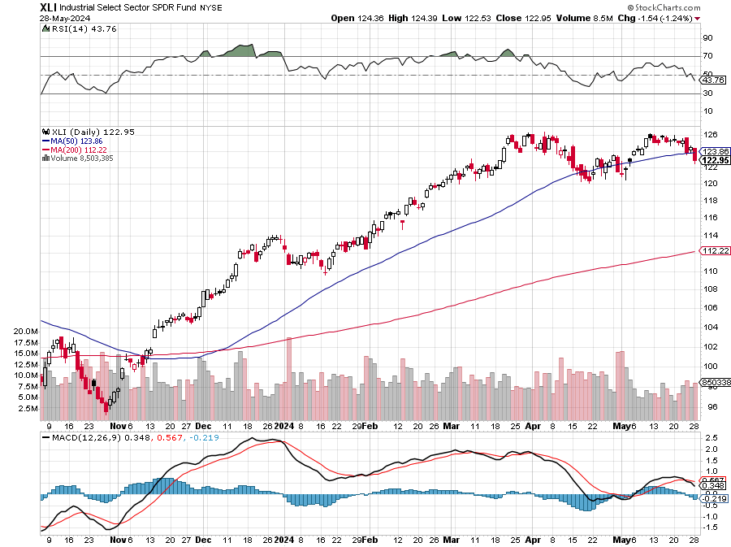
Industrials Sector SPDR (XLI)- (GE), (MMM), (UNP), (UTX), (BA), (HON)

Slide 49
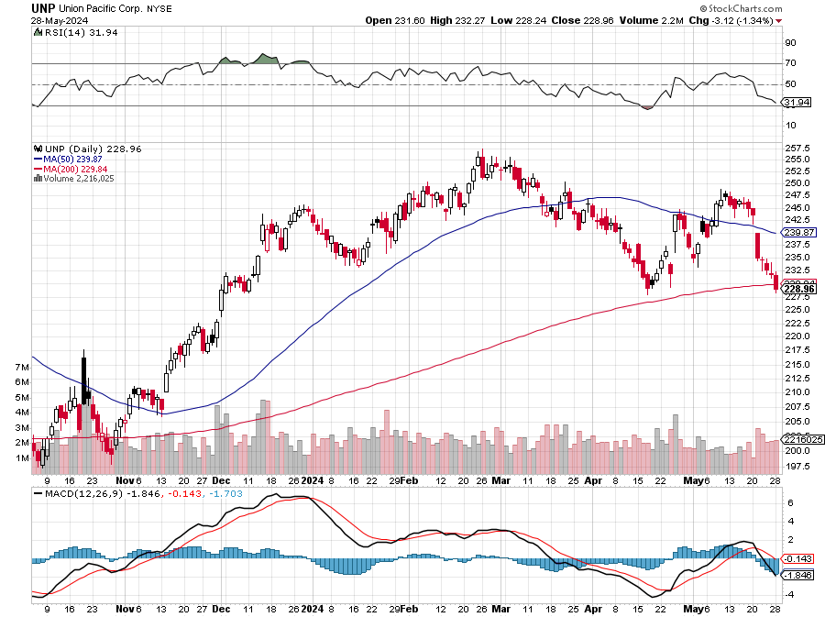
Union Pacific RR (UNP)- Big Stuff to Ship took profits on long 5/$200-$210 call spread took profits on 11/$150-$160 call spread

Slide 50
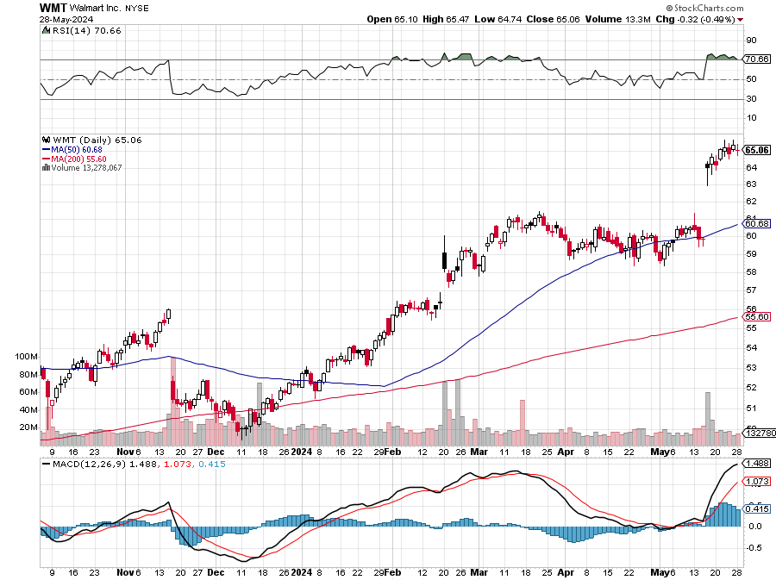
Wal-Mart (WMT)- took profit on Long 11/$125-$130 bear put spread took profit on Long 10/$119-$121 bear put spread took profits on Long 8/$114-$117 bear put spread

Slide 51
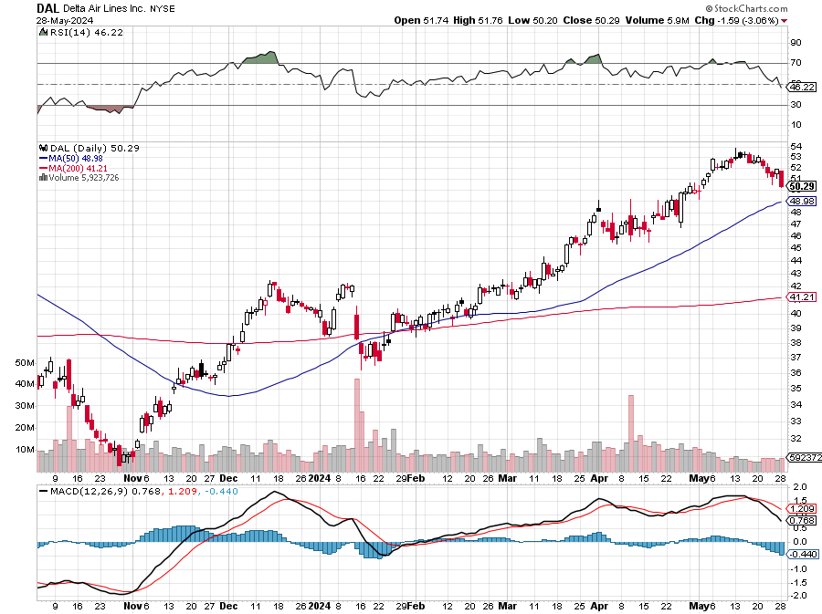
Delta Airlines (DAL) – Travel is Back! The Non-Boeing Airline – uses Airbuses stopped out of long 2/$35-$38 call spread

Slide 52
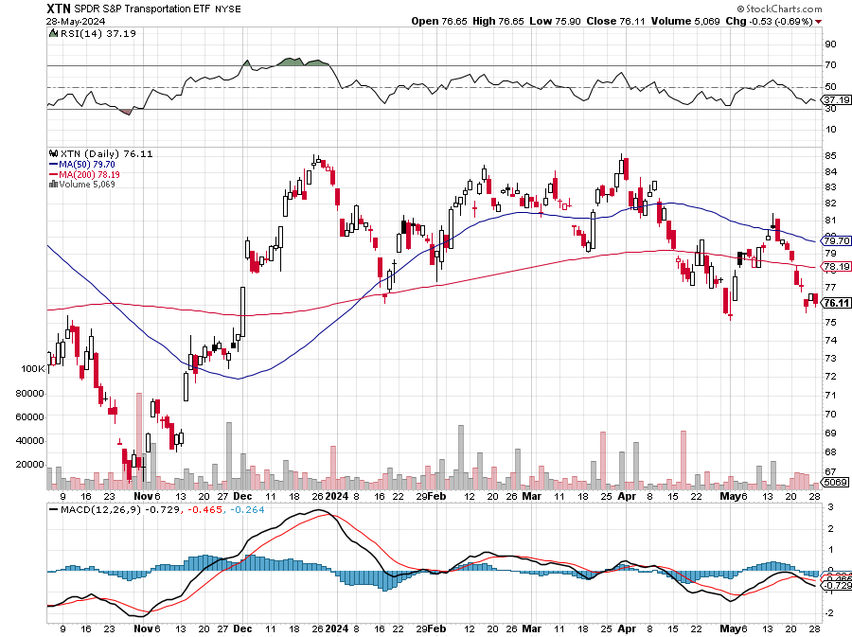
Transports Sector SPDR (XTN)- Worst Hit Sector (ALGT), (ALK), (JBLU), (LUV), (CHRW), (DAL)

Slide 53
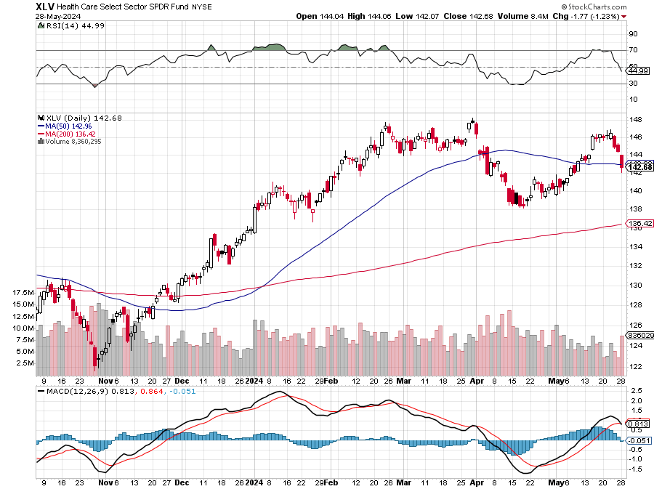
Health Care Sector (XLV) (JNJ), (PFE), (MRK), (GILD), (ACT), (AMGN)

Slide 54
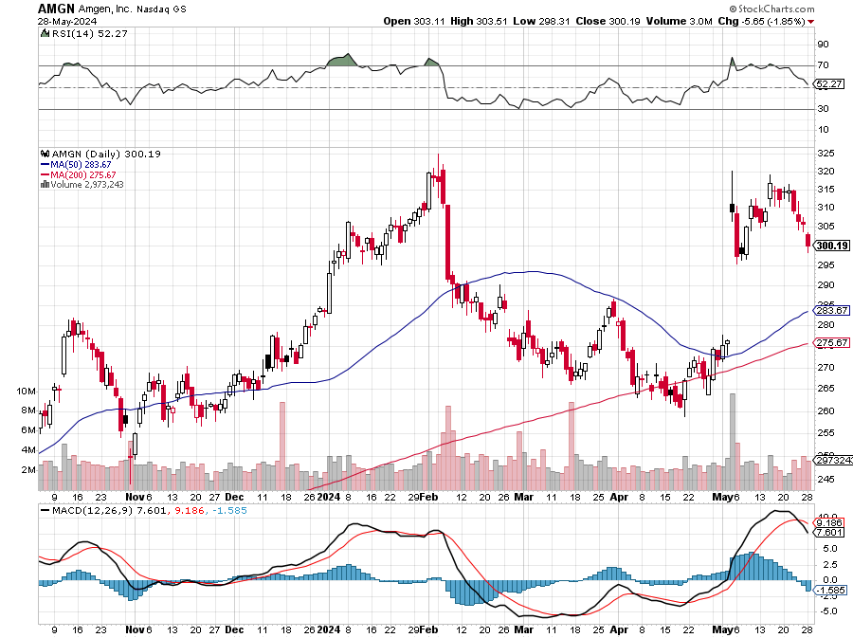
Amgen (AMGN) took profits on long 11/$185-$200 bull call spread

Slide 55
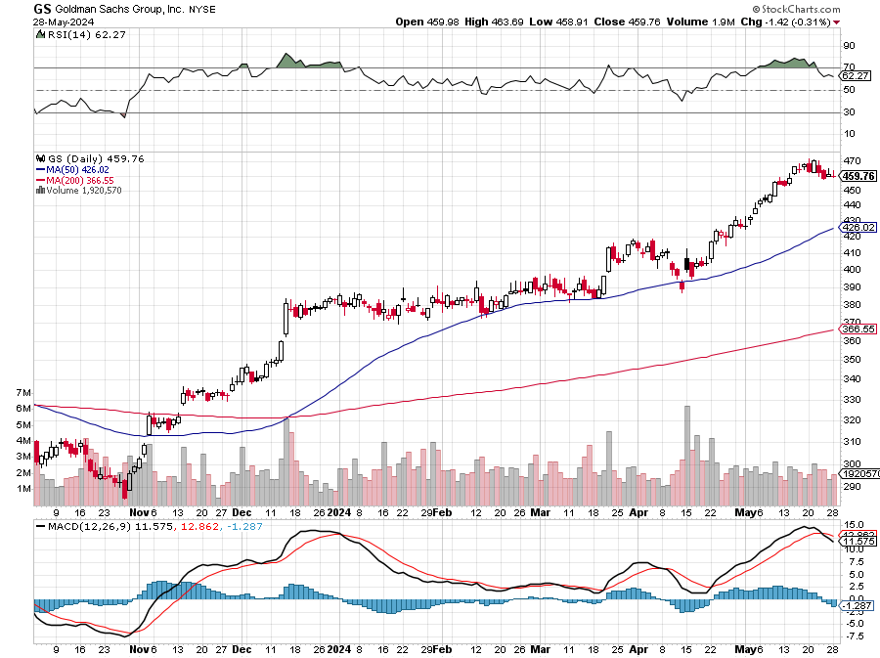
Goldman Sachs (GS) – Goldman Sachs Blows Out Earnings on a surge in bond trading took profits 12/$330-$350 call spread took profits 11/$330-$350 call spread stop loss on long 11/$385-$395 call spreads

Slide 56
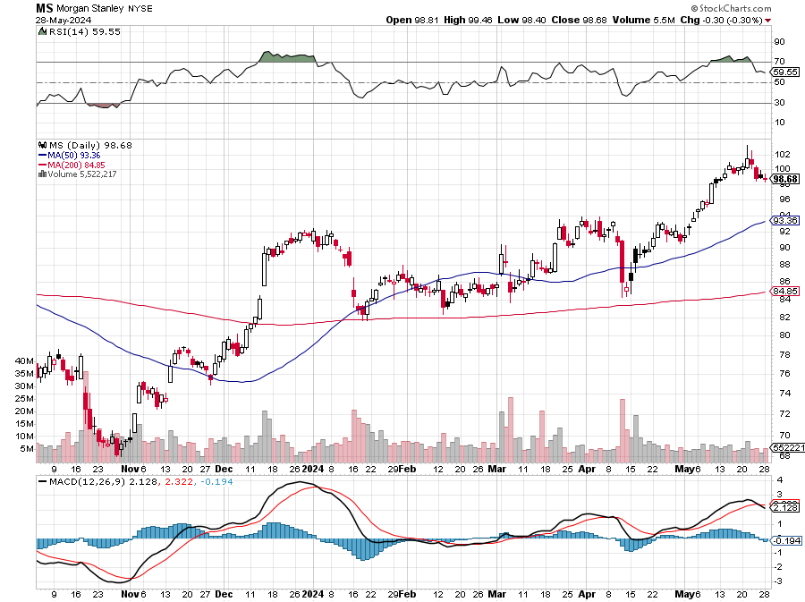
Morgan Stanley (MS) Morgan Stanley Beats, on surge in investment banking business took profits on long 4/$65-$70 call spread

Slide 57
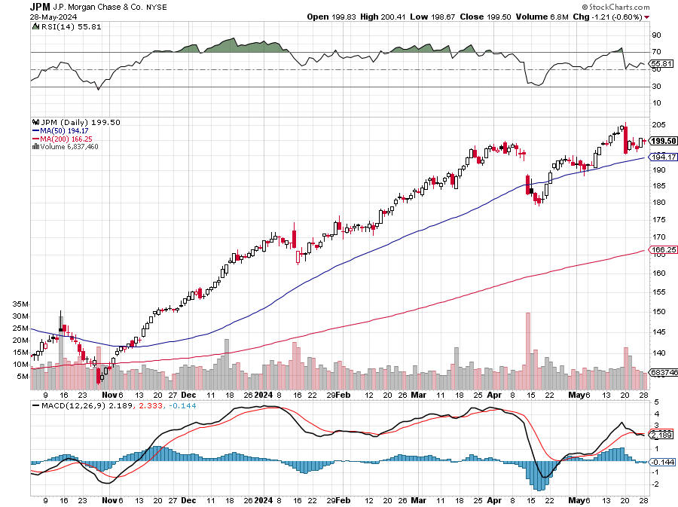
JP Morgan Chase (JPM) – JP Morgan Misses on Earnings, tanking the shares by $10 took profits on long 4/$105-$115 call spread

Slide 58
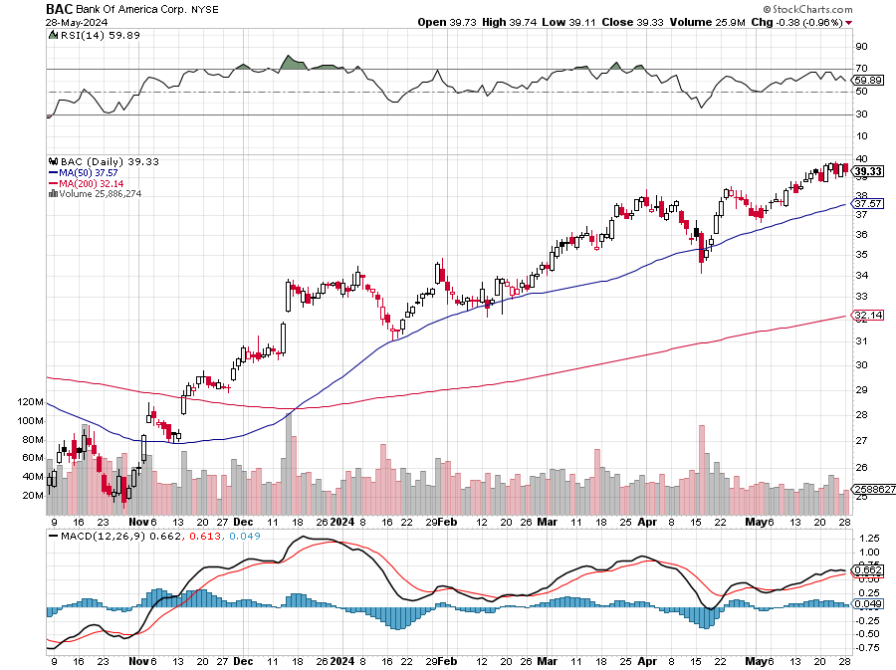
Bank of America (BAC) – Bank of America Rips, on a great earnings report took profits on long 4/$20-$23 call spread

Slide 59
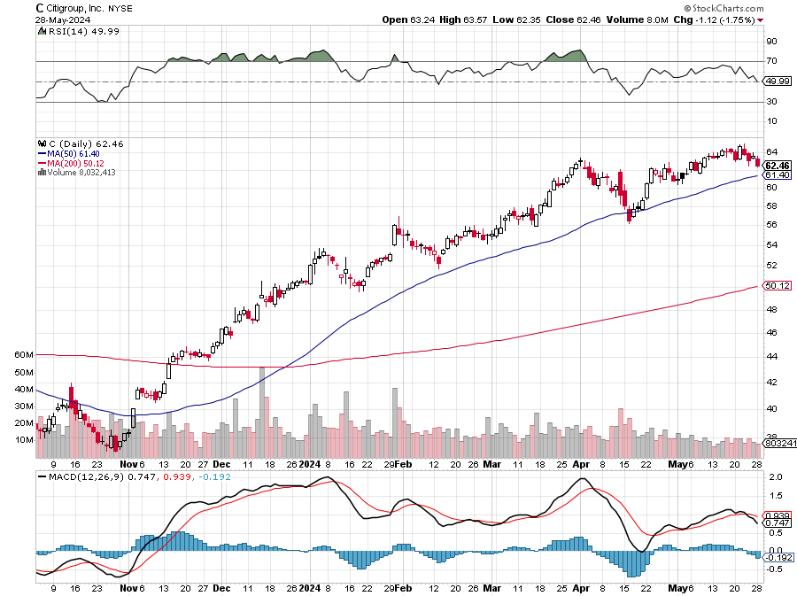
Citigroup (C) – took profits on long 4/$30-$35 call spread

Slide 60
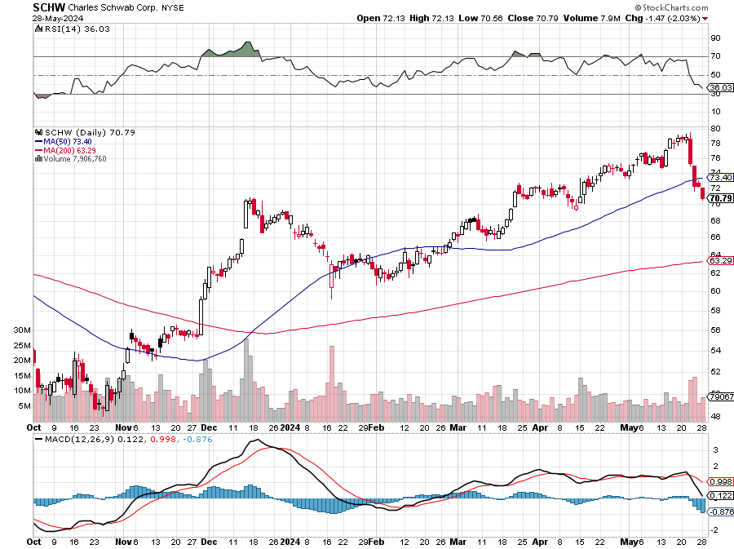
Charles Schwab (SCHW) – LEAPS expire at Max profit took profits on long 4/$30-$35 call spread

Slide 61
Interactive Brokers (IBKR) – LEAPS expire at Max Profit took profits on long 4/$60-$65 call spread

Slide 62
SPDR Metals & Mining ETF (XME) – long 2/$28-$30 call spread

Slide 63
Blackrock (BLK)-Asset Collection Boom took profits on long 3/$770-$790 call spread took profits on long 3/$310-$340 call spread

Slide 64
Visa (V) – Inflation boost Visa Pops on Earnings Beat, showing a 10% revenue increase YOY took profits on long 2/$240-$250 bull call spread took profits on long 10/$160-$170 bull call spread, took profits on long 6/$150-$160 bull call spread

Slide 65
Consumer Discretionary SPDR (XLY) (DIS), (AMZN), (HD), (CMCSA), (MCD), (SBUX)

Slide 66
Berkshire Hathaway (BRKB)- Natural Barbell Announces Blockbuster earnings at $93 billion for 2023 took profits on long 12/$320-$330 call spread took profits on long 4/$260-$270 call spread, took profits on long 1/$290-$300 call spread took profits on long 10/$220-$230 call spread, took profits on long 7/$220-$230 call spread took profits on long 7/$220-$230 call spread, took profits on long 6/$260-$270 call spread

Slide 68
Bonds – Taking it on the Nose
*Today’s Treasury Auction Bombed, for two- and five-year notes, taking the (TLT) down $1.31. Over supply is the big problem. Traders are nervous about this week’s looming inflation data. *Bond Investors are Making a Killing, with the US Treasury paying out $900 billion in interest in 2023.\ *That’s double the annual cost of the past decade. Remember those coupons? *That’s another reason for the Fed o cut rates soon, to lesson this backbreaking burden on the government *After being held hostage by zero-rate policies for almost two decades, US Treasuries are finally reverting back to their traditional role in the economy *Bonds are becoming respectable again after a long winter. Buy (TLT) on dips The US Treasury Announced a Bond Buyback Program, with the first scheduled on May 29 *The Treasury's last regular buyback program began in the early 2000s and ended in April 2002

Slide 69
Treasury ETF (TLT) – long 6/$$94-$97 put spread, took profits on long 5/$82-$85 calls spread took profits on long 4/$87-$90 call spread took profits on long 2/$90-$93 call spread, Took profits in $100-$103 put spread, took profits on long 12/$95-$98 put spread took profits on long 12/$79-$82 call spread, took profits on long 11/$76-79 call spread,

Slide 70
Ten Year Treasury Yield ($TNX) – 4.57%

Slide 71
Junk Bonds (JNK) 7.47% Yield

Slide 72
Municipal Bonds (MUB) 3.38% Yield-

Slide 73
Emerging Market Debt (ELD) 6.56% Yield-

Slide 74
2X Short Treasuries (TBT)-Out of Favor

Slide 75
Anally Capital Management (NLY) – Leveraged REIT Play Yield 14.10% took profits on long 12/$15-$16 call spread

Slide 76
Foreign Currencies – Dollar Rolling Over
*Most currencies hitting two-month highs in coming dollar interest rate cuts and are close to upside breakouts *Japanese yen collapses to at ¥160 and looking for lower lows *Bank of Japan intervened with a $35 billion yen buy, dollar sell. Avoid (FXY). *Chinese Yuan remains weak. International trade is collapsing *Declining exports, collapsing foreign investment, minimal population growth, it all adds up to a weaker Chinese currency *Higher for Longer Rates means higher for Longer Greenback *You need a falling interest rates interest rates guarantee a falling dollar for 2024

Slide 77
THE MAD HEDGE FUND TRADER
Australian Dollar (FXA) - Major Long-Term Bottom is In Targeting Parity – A call option on a global synchronized recovery
1:1
BUY

Slide 78
Japanese Yen (FXY)

Slide 79
Euro (FXE)-
2023 Target 25%

Slide 80
British Pound (FXB)-
2023 Target 15%

Slide 81
Emerging Market Currencies (CEW)
2023 Target 40%

Slide 83
Energy & Commodities – Chevron Win
*Chevron Takeover of Hess for $53 Billion Goes Through, creating the second largest US oil major *The approval clears one hurdle, but the deal still requires regulatory approval and must face a lengthy arbitration battle with Exxon and CNOOC, Hess' partners in Guyana *Buy (CVX) on dips *Copper Slide Continues, down 7% in three days, as the extent of Chinese speculation becomes clear *The Takeover Battle for Anglo American Continues, with the company turning down the latest $49 billion offer from BHP *While Anglo’s copper assets have long been coveted by rivals, its complicated corporate structure and unusual mix of commodities has largely deterred potential suitors until now.

Slide 84
Oil-($WTIC)

Slide 85
United States Oil Fund (USO)

Slide 86
Energy Select Sector SPDR (XLE)-No Performance! (XOM), (CVX), (SLB), (KMI), (EOG), (COP)

Slide 87
ExxonMobile (XOM)- Exxon Moves Big into Lithium, with the construction of a major mining operation in Arkansas took profits on Long 4/$100-$105 call spread, took profits on long 12/$120-$125 put spread

Slide 88
Occidental Petroleum (OXY)- Buffet’s a Buyer took profits on long 4/$59-$62 call spread took profits on long 2/$55-$60 call spread, took profits on long 12/$77.50-$82.50 put spread

Slide 89
Natural Gas (UNG) – Free Fall on Warm Winter took profits on Long January 2025 $7-8 Call Spread LEAPS

Slide 90
Cameco (CCJ) – Global Uranium Renaissance Uranium Goes Nuclear, with yellow cake prices up 45% since May took profits on long 12/$35-$38 call spread, took profits on long 5/$20-$23 bull call spread

Slide 91
Precious Metals – New Highs
*Silver goes ballistic on Chinese speculation to $32.70/ounce headed for $50 *Gold follows by half to $2,460 headed for $3,000 *Solar Panels are Driving Global Silver Demand *Global investment in solar PV manufacturing more than doubled last year to around $80 billion *Miners are expanding their operations and ramping up production as prices for the precious metal climb to decade highs *Demand for silver from the makers of solar PV panels, particularly those in China, is forecast to increase by almost 170% by 2030, to roughly 273 million ounces—or about one-fifth of total silver demand Buy (SLV) and (WPM) on dips.

Slide 92
Gold (GLD) – China and Millennial call took profits on Long 4/$194-$197 call spread, took profits on long 5/$165-$170 bull call spread

Slide 93
Market Vectors Gold Miners ETF- (GDX) –

Slide 94
Barrick Gold (GOLD) took profit on long 1/$15.50-$16.50 call spread

Slide 95
Newmont Mining- (NEM)- took profits on long $55-60 call spread

Slide 96
Silver- (SLV)- took profits on long 11/$19-$20 call spread

Slide 97
Silver Miners - (SIL)-

Slide 98
Wheaton Precious Metals - (WPM)- LEAPS Approaching Max Profit took profits on long 4/$39-$42 call spread , took profits on long 1/$36-$39 call spread

Slide 99
Platinum- (PPLT)- 556,000-ounce shortage this year took profits on long 1/$36-$39 call spread

Slide 101
Real Estate – Soaring Prices, Falling Sales
*New Home Sales Tank in April, down 4.4%, and 7.7% in March. *The median price of a new home was $433,500, 4% higher than it was in April 2023 *Builders say they cannot lower prices due to high costs for land, labor and materials. *The big production builders have been buying down mortgage rates to help boost sales, as they are able to do that because of their size. Smaller ones can’t *30-Year Fixed Rate Mortgage Drops Below 7.0%. The housing market taking a step back in April after a strong performance in the first quarter *Existing Home Sales Fall, down for the second month in a row at -1.9% to 4.14 million rate in Apri *The nascent recovery in demand from a 13-year low in October is being hindered by limited inventory that’s keeping asking prices elevated

Slide 102
S&P Case Shiller Turns Hot S&P Case Shiller Rises to +6.50% YOY in March, with its National Home Price Index San Diego gained +11.4%, Chicago +8.9%, and Detroit +8.9%.

Slide 103
Crown Castle International (CCI) – 5.45% yielding 5G cell phone tower REIT Eliot Management Pushes up stock with activist bid

Slide 104
US Home Construction Index (ITB) (DHI), (LEN), (PHM), (TOL), (NVR)

Slide 106
Trade Sheet- So What Do We Do About All This?
*Stocks – buy any dips *Bonds – buy dips *Commodities-buy dips *Currencies- sell dollar rallies, buy currencies *Precious Metals – buy dips *Energy – buy dips *Volatility - buy $12 *Real estate – buy dips

Slide 108
Next Strategy Webinar 12:00 EST Wednesday, June 12 from Incline Village, Nevada email me questions at support@madhedgefundtrader.com
Good Luck and Good Trading!
Notes:
*

