Slide 1
The Mad Hedge Fund Trader “Vote for Me”
Write in John Thomas Lake Tahoe, NV October 21, 2024 www.madhedgefundtrader.com
Notes:
*

Slide 2
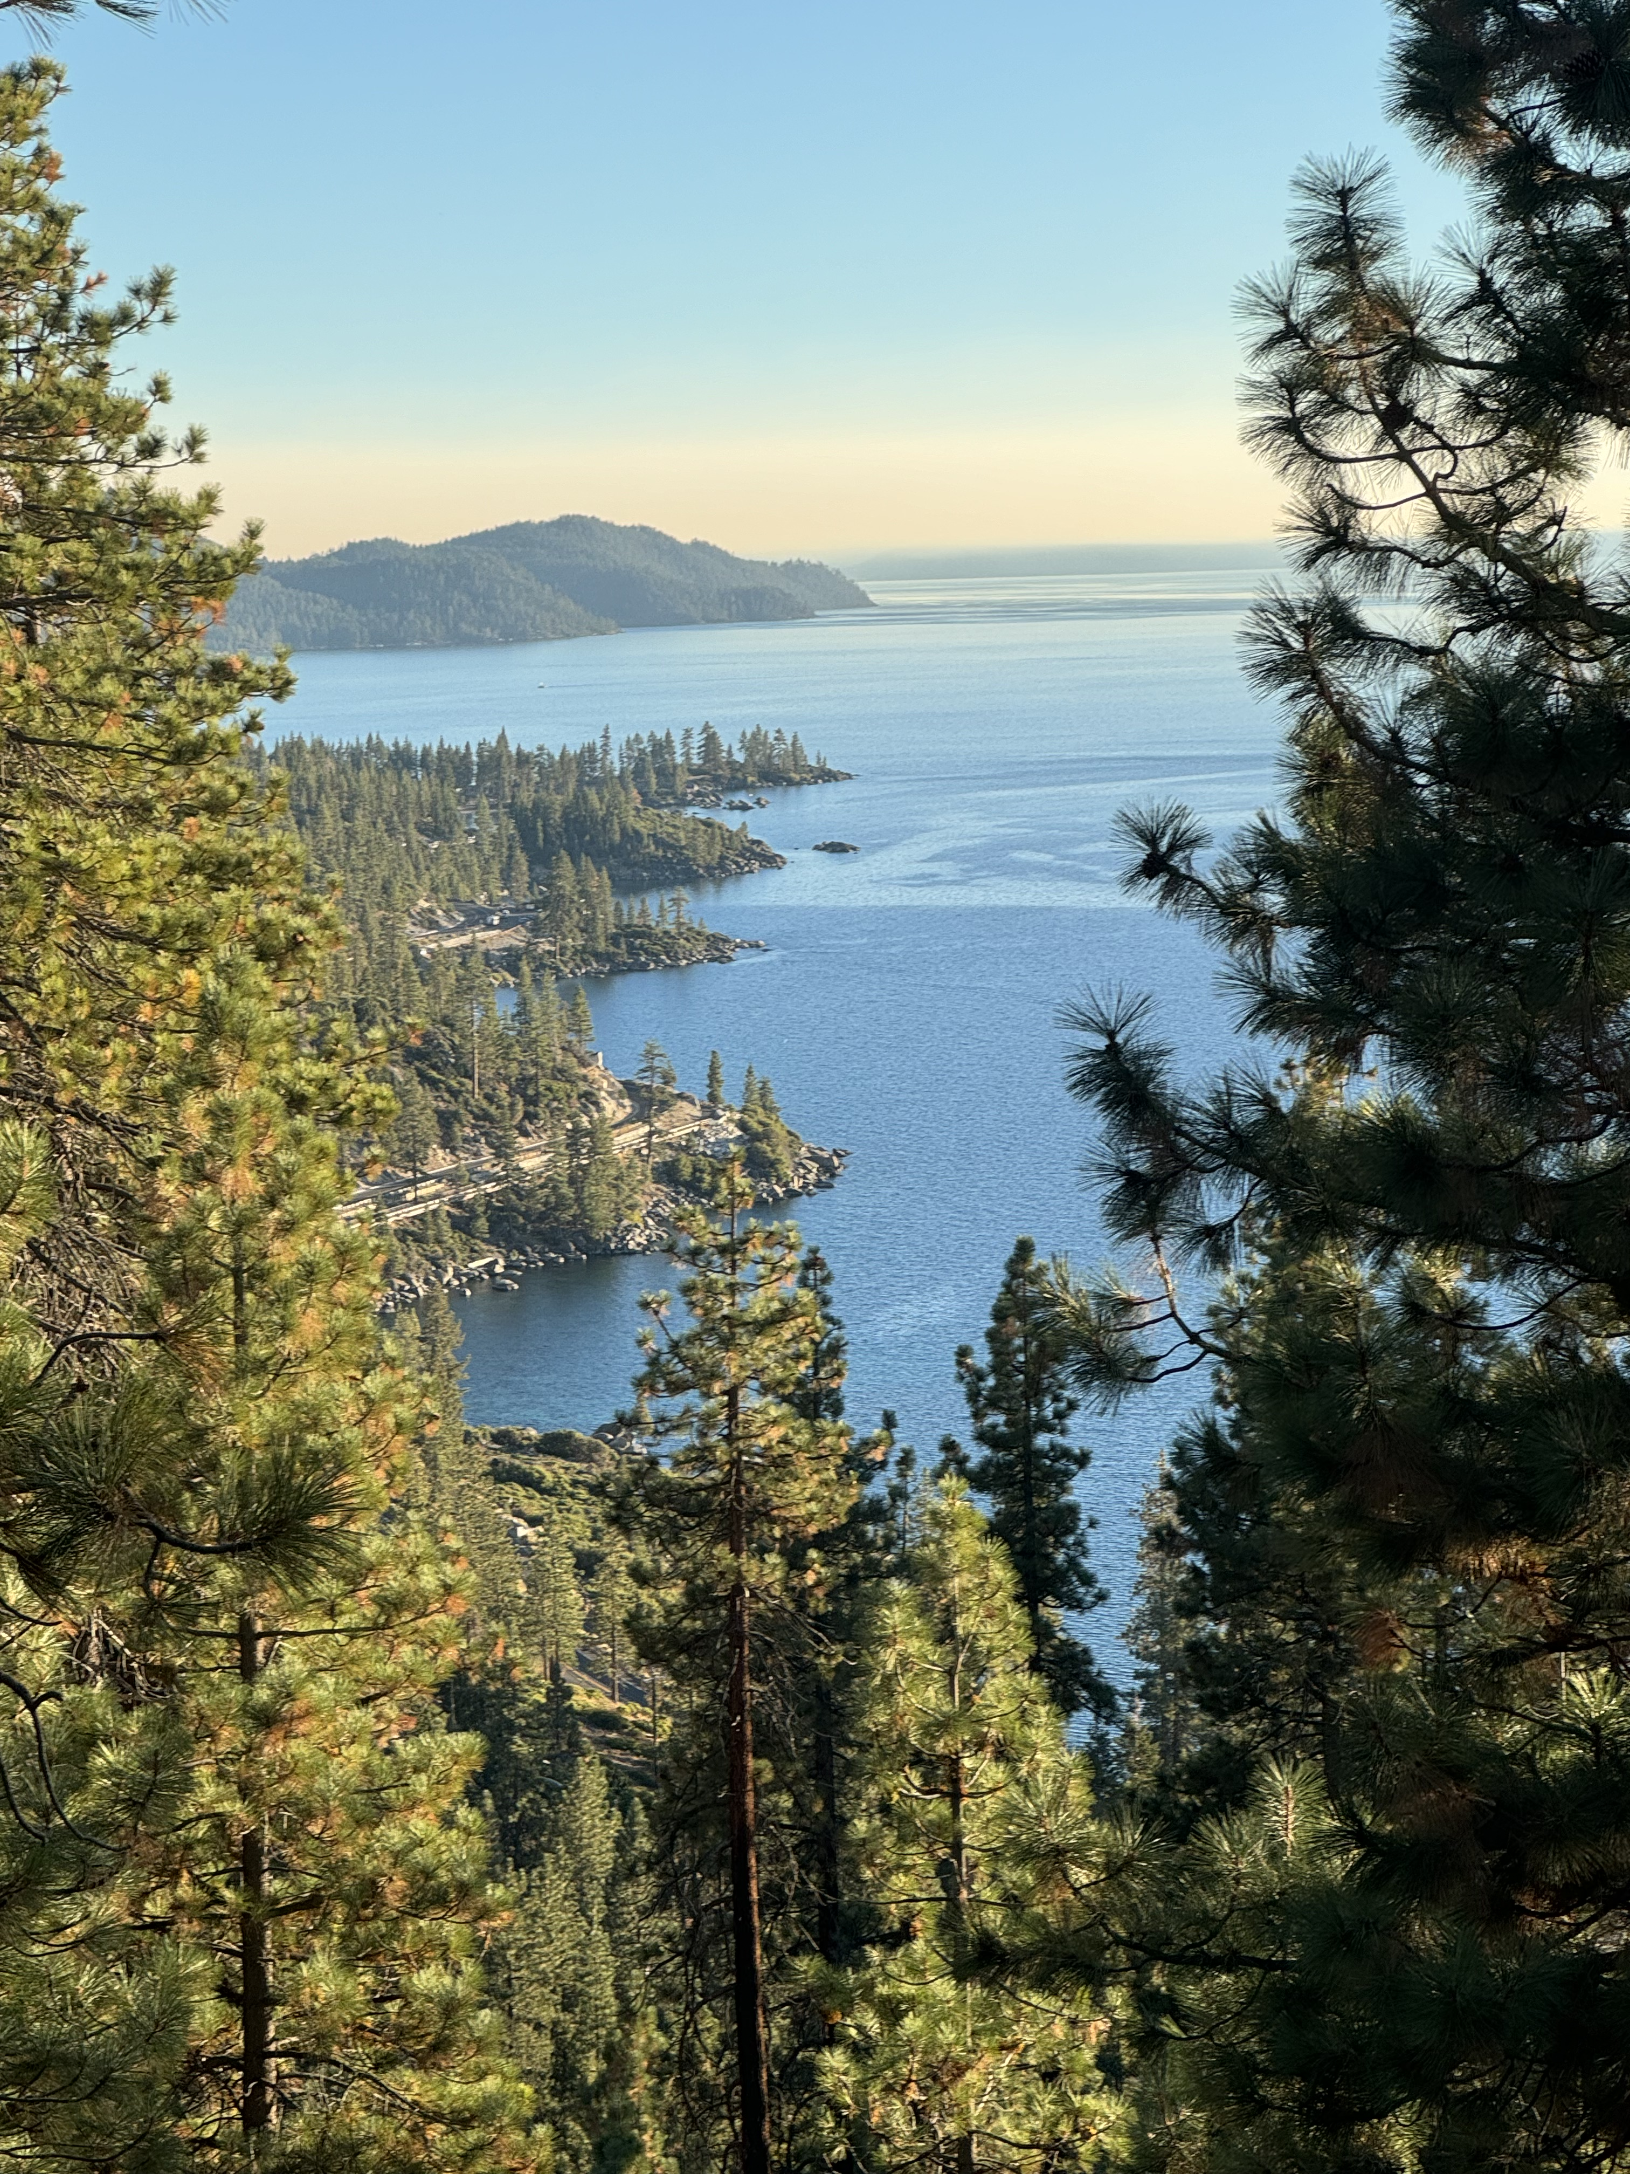

Slide 3
Trade Alert Performance New All-Time Highs!
*January -4.28% Final *July +10.92% Final *February +7.42% Final *August +3.74% Final *March +6.23% Final *September +10.28% MTD *April +5.24% Final *October +4.89% Final *May +3.74% Final *November +15.37 Final *June +1.94% Final *December -2.27% Final *2024 YTD +50.13%, versus +22.22% for the S&P 500 and +726.76% since inception *Versus 84.63% for all of 2022 *Versus 79.79% for all of 2023 *Average annualized return of +51.62% for 16 years

Slide 4
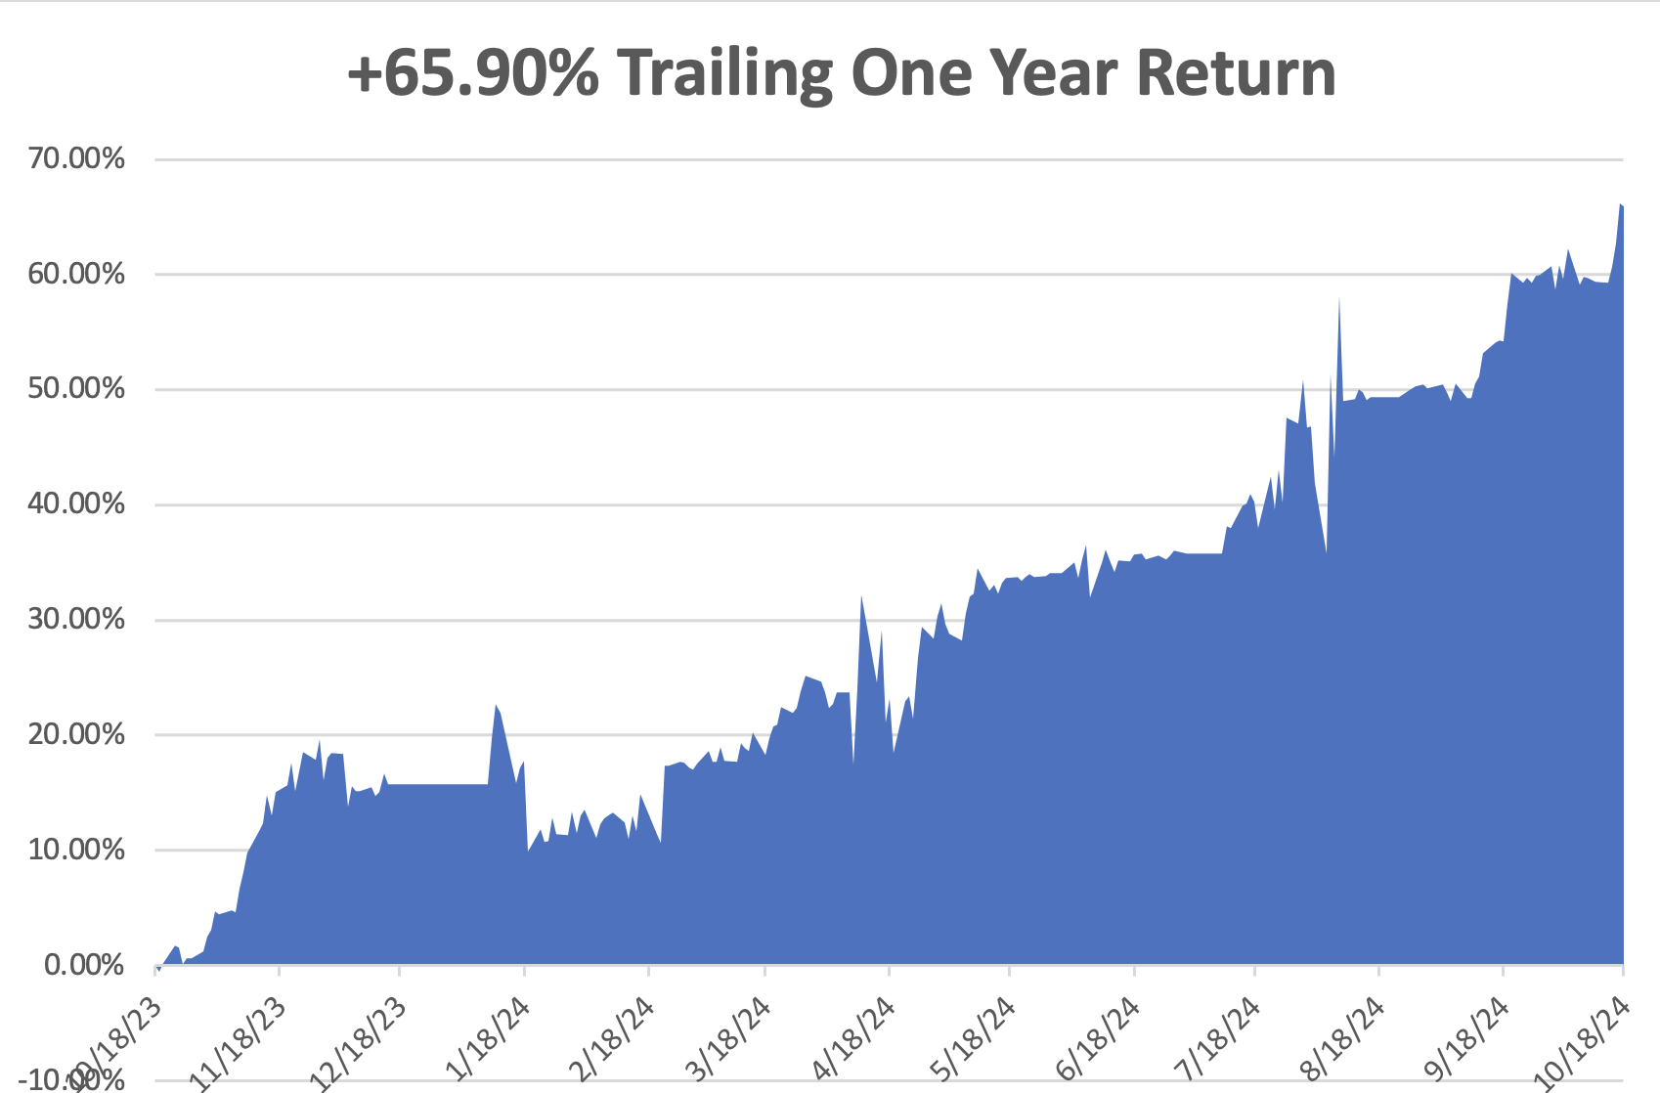

Slide 5
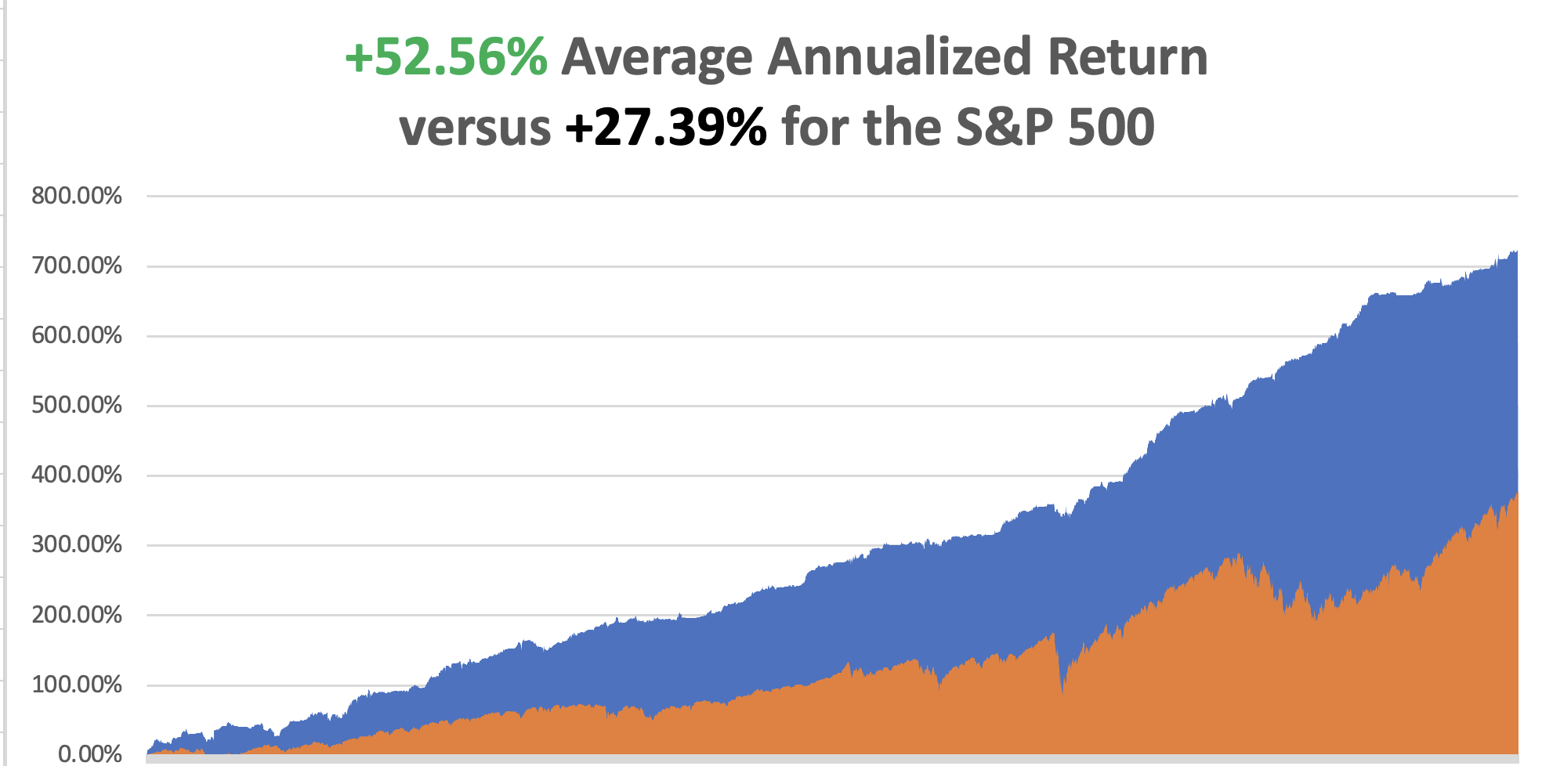

Slide 7
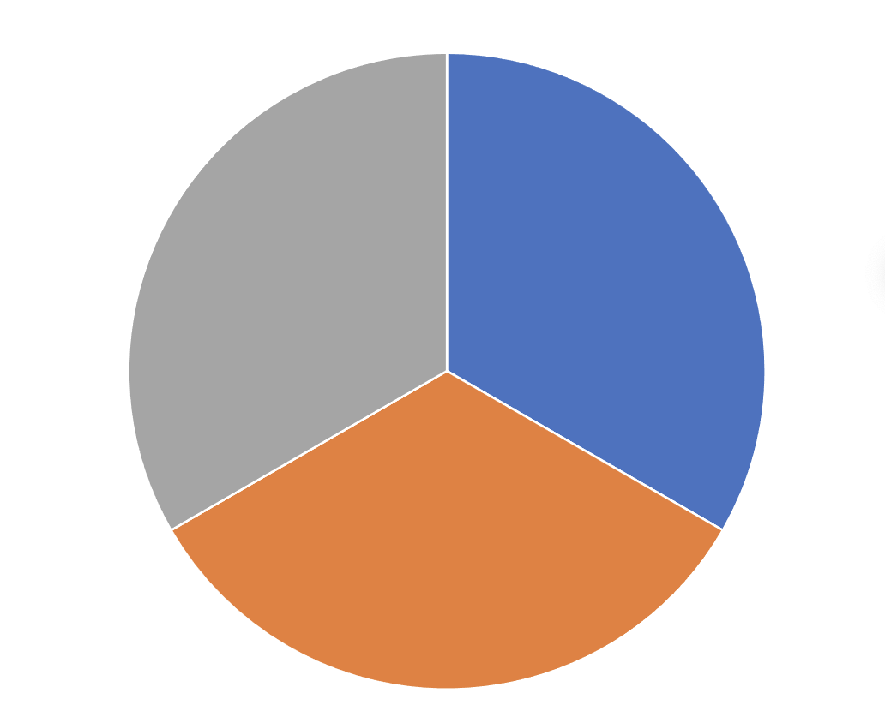
Portfolio Review – Aggressively Long 0% risk on, long, 0% risk off, 100% cash
Risk On
(NEM) 10/$47-$50 call spread | 10.00%
(TSLA) 10/$200-$210 call spread | 10.00%
(DHI) 10/$165-$175 call spread | 10.00%
Risk Off
NO POSITIONS | 0.00%
Total Net Position | 30.00%
Total Aggregate Position | 30.00%
Expiration Value +51.57%

Slide 8
The Method to My Madness
*There is a global derisking going on ahead of the US elections *All interest rate plays sell off. Bonds are discounting a Trump win, stocks a Harris win Watch for a melt up in both post election *We are unlikely to see a more than 5% drop in indexes for the rest of 2024 because of massive cash holdings *US Dollar touches high for the year on rising rates *Technology stocks have recovered with (NVDA) at highs *Energy gets dumped on global oversupply *Buy stocks and bonds on dips, but now it’s ALL sectors

Slide 9
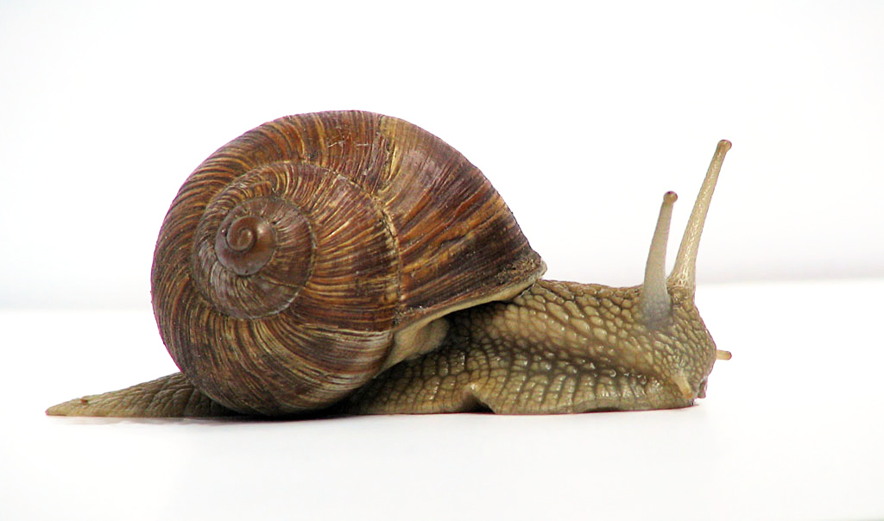
The Global Economy – Slowing
*CPI Comes in Warm at 0.3% for September, and 2.4% YOY. *Europe Cuts Interest Rates by 25 Basis Points *New Zealand Cuts Interest Rates by 50 Basis Points *US Retail Sales Gain 0.4%, up from the unrevised 0.1% gain in August *New York Empire State Manufacturing Index Plunges It could be an election effect *PPI Comes in Flat, and up 1.8% YOY *Social Security gets a 2.5% Raise in 2025

Slide 10
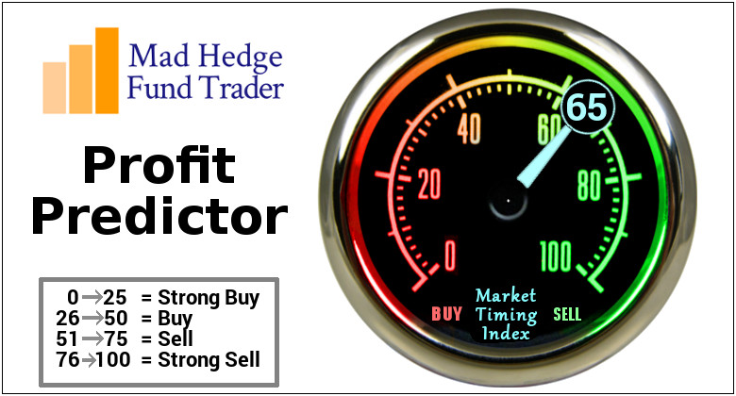
The Mad Hedge Profit Predictor Market Timing Index – DO NOTHING Territory An artificial intelligence driven algorithm that analyzes 30 different economic, technical, and momentum driven indicators

Slide 11
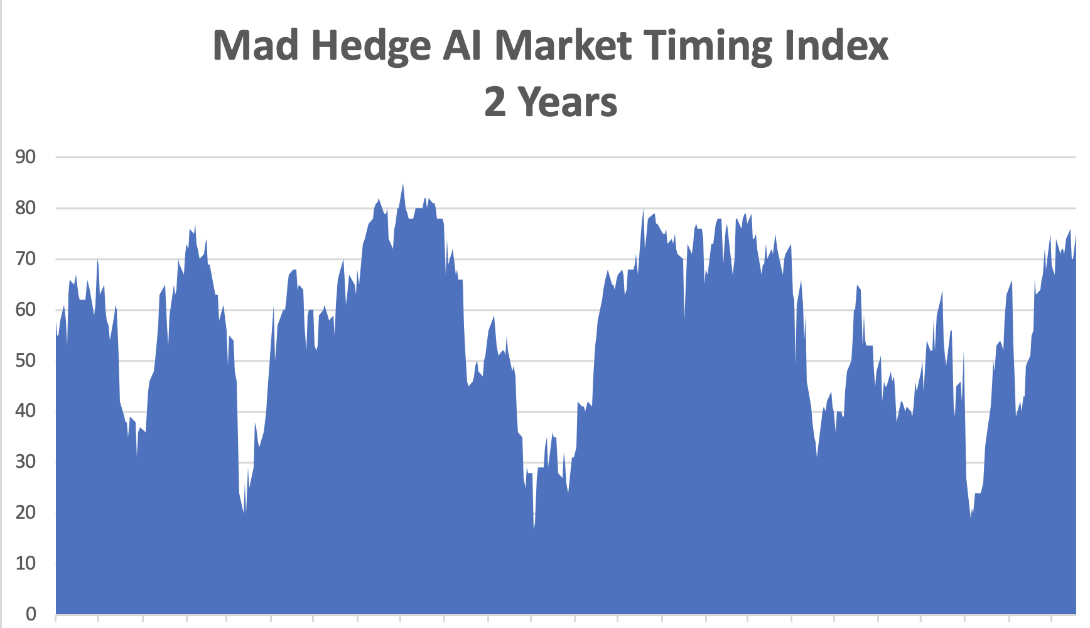
Sell Territory
SELL
BUY

Slide 12
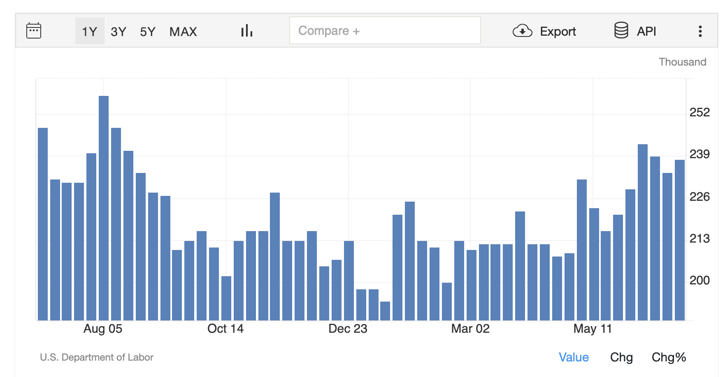
Weekly Jobless Claims – Falling 241,000 -9,000

Slide 14
Stocks – From Strength to Strength
Hedge Funds Pouring into Technology Stocks, such as semiconductors and hardware, at the fastest in five months amid the start of the third-quarter earnings season *S&P 500 Value Gain Hits $50 Trillion, since the 1982 bottom *Morgan Stanley Announces Blowout Earnings, fueling a 32% profit jump for the third quarter *ASML Plunges 16% on Poor Earnings, *Tesla Gets Approval to Double Berlin Factory, *Global EV Sales Up 30% in September *Delta Warns of Presidential Election Travel Dip, as fears of violence over the new two weeks keep traveler’s home.

Slide 15
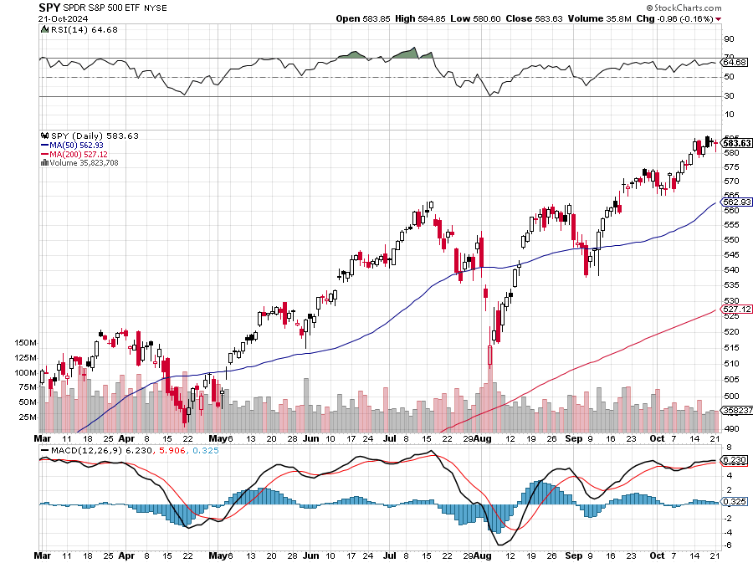
S&P 500 – Gone Ballistic
Yearend Target $600 +25%
$510 -9.7% 1st support
$493 -12.7% 1st support

Slide 16
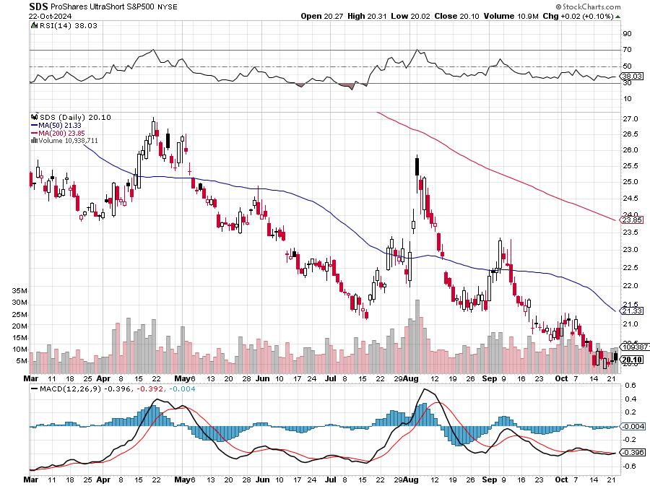
ProShares Ultra Short S&P 500 (SDS)- a great hedge for long stocks and bonds long 2X position has a hedge against longs and bond shorts

Slide 17
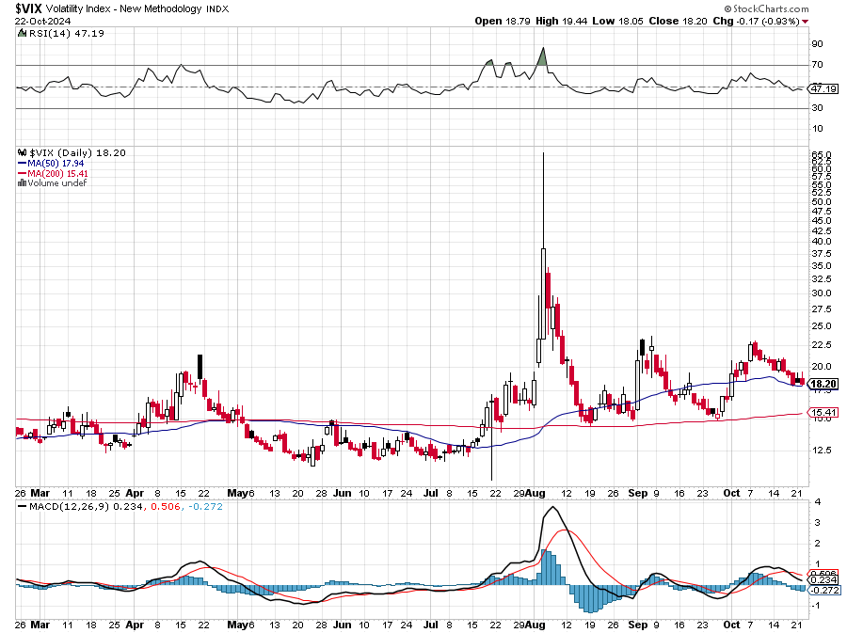
(VIX) – Range Trade Volatility Index Hits Four Year High at $65, the most since the 2020 pandemic. That implies a 2% move in the S&P 500 (SPX) every day for the next 30 days

Slide 18
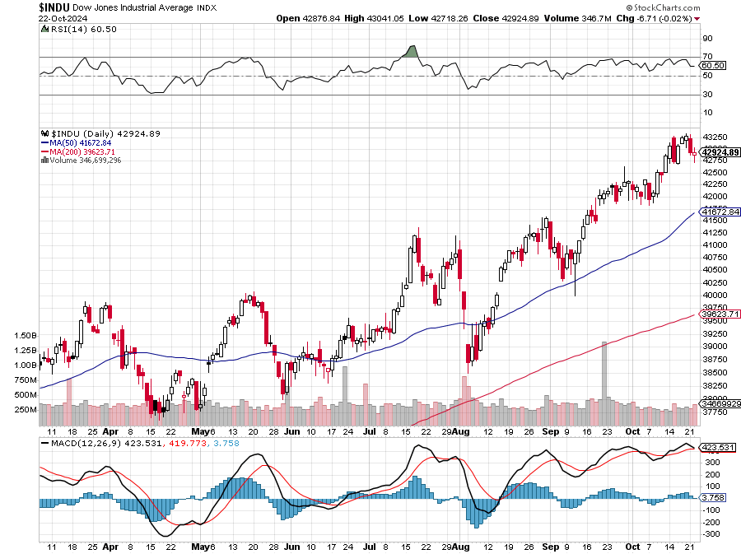
Dow Average ($INDU)-

Slide 19
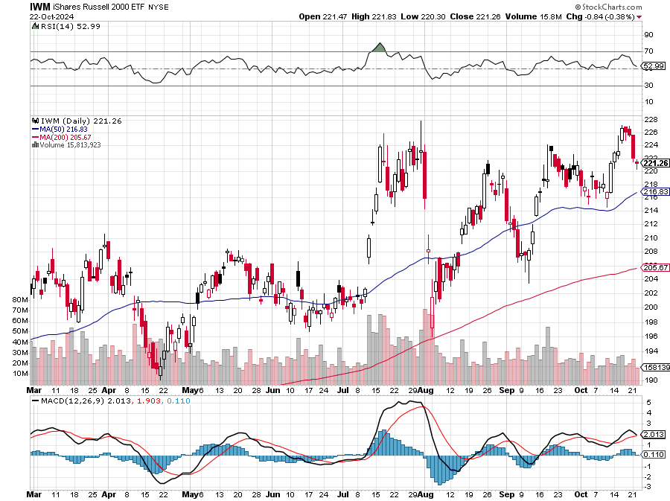
Russell 2000 (IWM)- took profits on Long 10/$137-$142 vertical bull call spread took profits on Long 10/$153-$156 vertical bear put spread

Slide 20
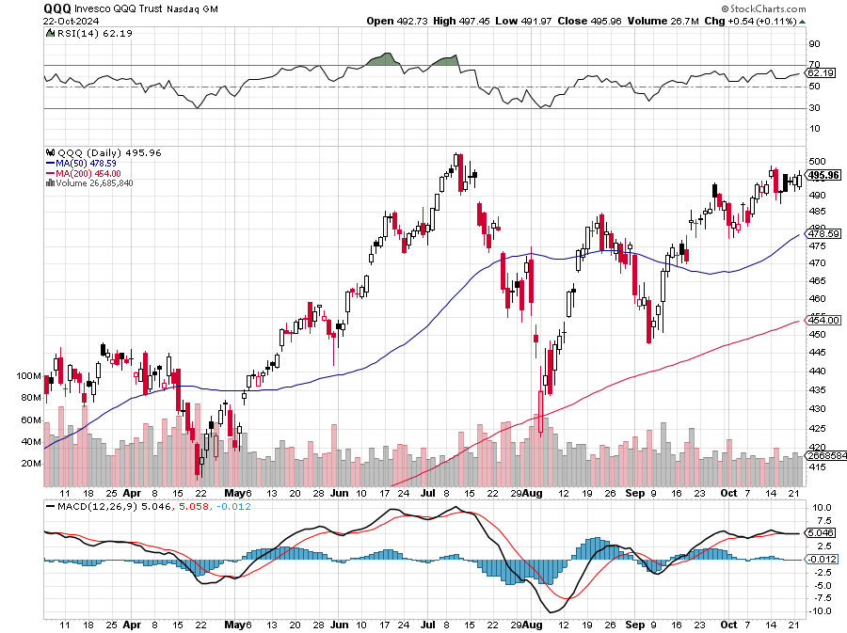
NASDAQ (QQQ) – took profits on Long 5/$335-$345 put spread took profits on long (QQQ) 1/$290-$300 put spread, took profits on long (QQQ) 4/$330-$335 put spread took profits on long (QQQ) 3/$340-$345 put spread, covered long (QQQ) $325-$330 put spread

Slide 21
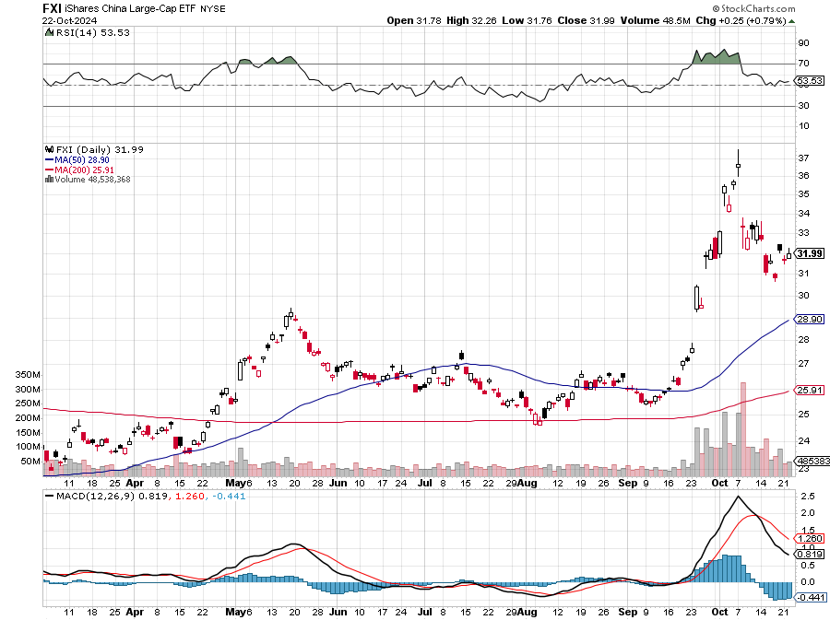
China (FXI)

Slide 22
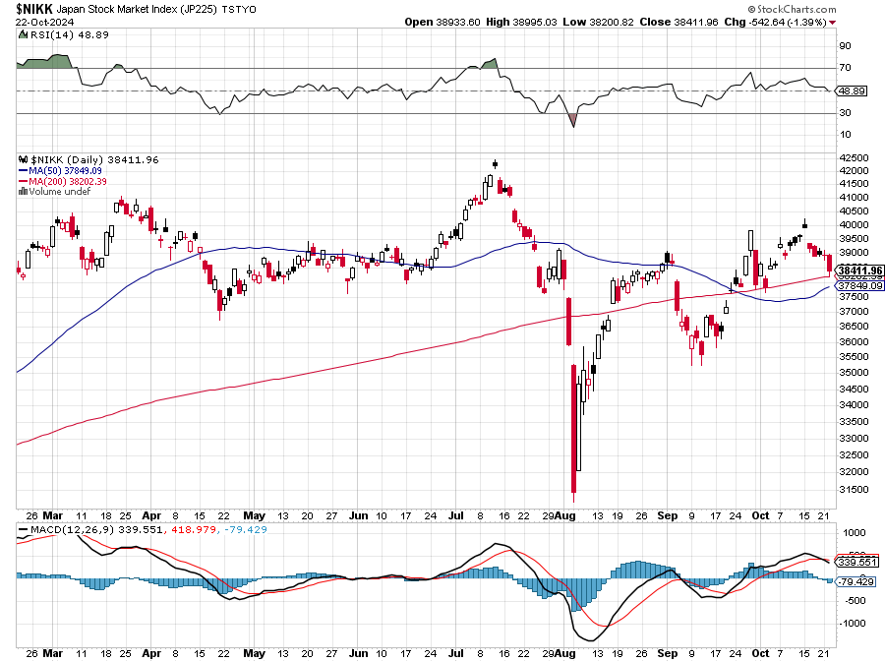
Japan ($NIKK)

Slide 23
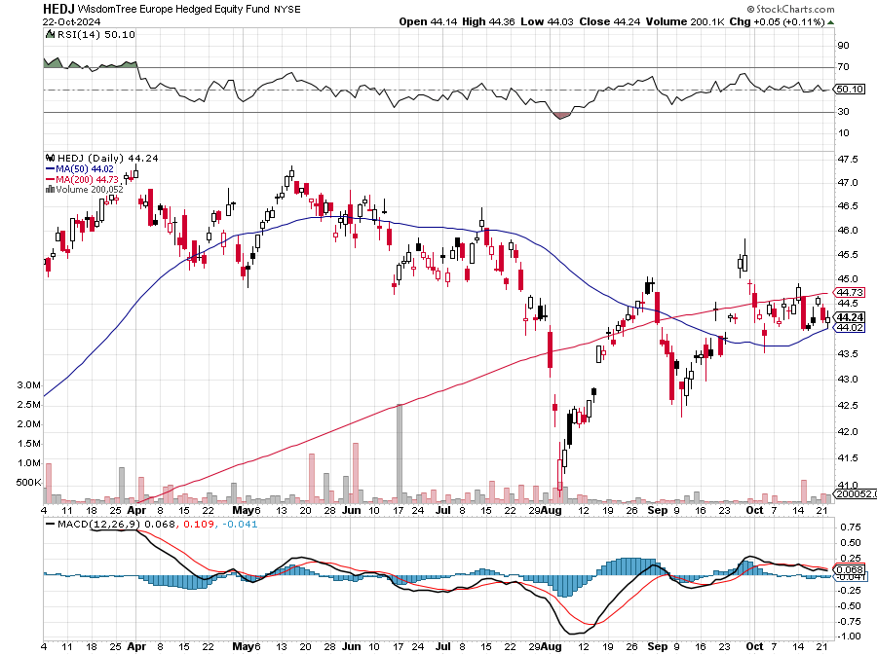
Europe Hedged Equity (HEDJ)-

Slide 24
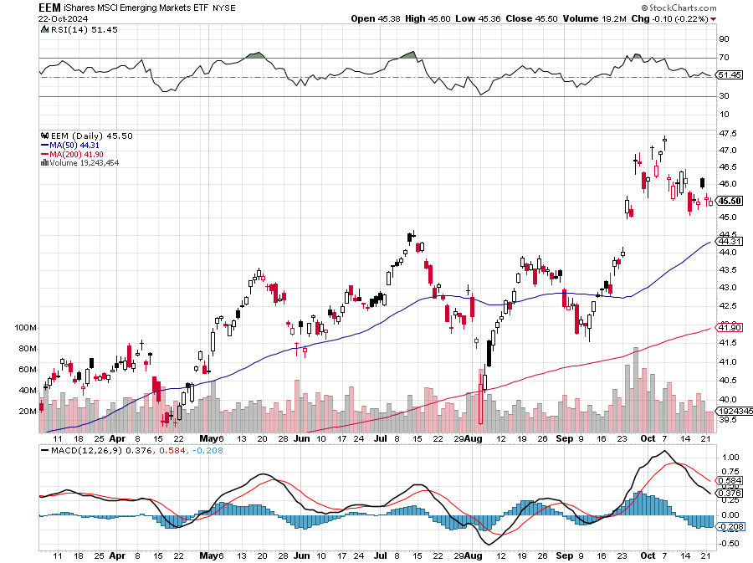
Emerging Markets (EEM) - Pro trade, Weak Dollar, Long Recovery Play Traders are Lining up for a Big Emerging Market Bet. Falling US interest rates will bring a weak US dollar and runaway bull markets in most emerging markets, which have remained unchanged for more than a decade

Slide 25
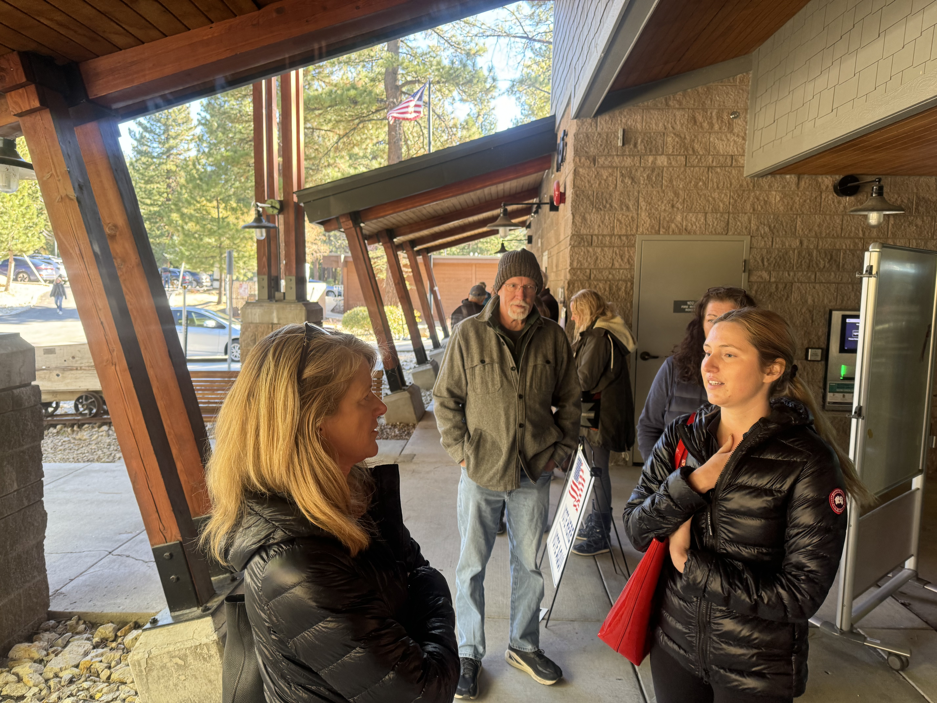

Slide 26
THE MAD HEDGE FUND TRADER
The Barbell Portfolio
*75% Big Tech – 2% of US workforce, 25% of market cap and 25% of US earnings 25% Domestic Recovery, including: Railroads, airlines, cruise lines, Couriers, steel companies Banks, commodities Construction Credit Card Companies Hotels, casinos Online Ticket Sales

Slide 27
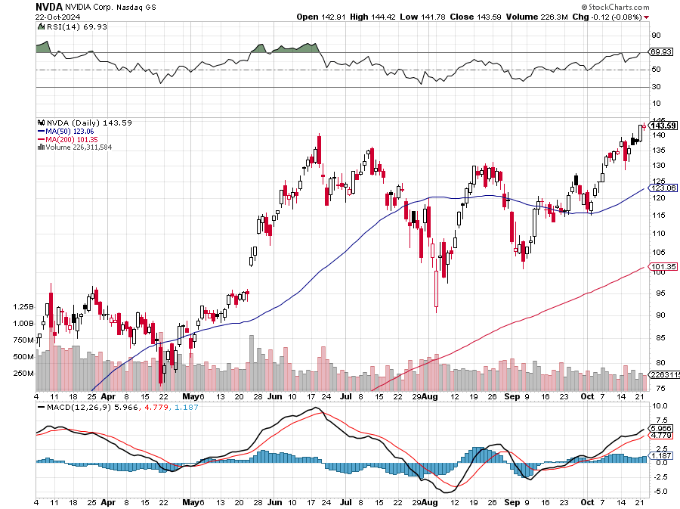
NVIDIA (NVDA) – Upside Breakout Taiwan Semiconductor Soars on Spectacular Earnings, dragging up the rest of the chip sector with it took profits on long 8/70-$73 call spread took profits on long 8/137-$140 put spread, took profits on long 8/85-$ call spread took profits on long 5/155-$160 put spread, took profits on long 5/98-$99 put spread

Slide 28
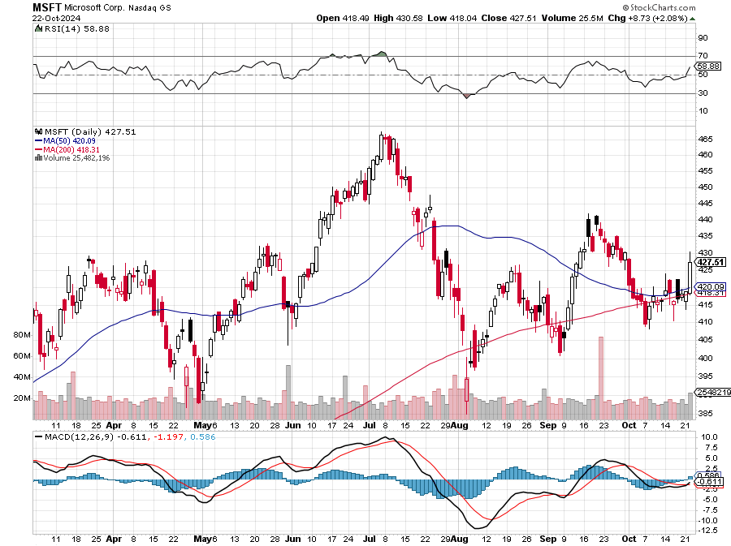
Microsoft (MSFT)-Microsoft Bombs, with an earnings and revenue beat, but with a slight shortfall in their Azure cloud business took profits on long 5/$430-$440 put spread Took profits on long 2/$330-$340 call spread, took profits on long 12/$320-$330 call spread took profits on long 9/$235-$245 call spread, took profits on long 7/$220-$210 call spread, took profits on long 6/$220-$230 call spread, took profits on long 2/$200-$210 bear put spread

Slide 29
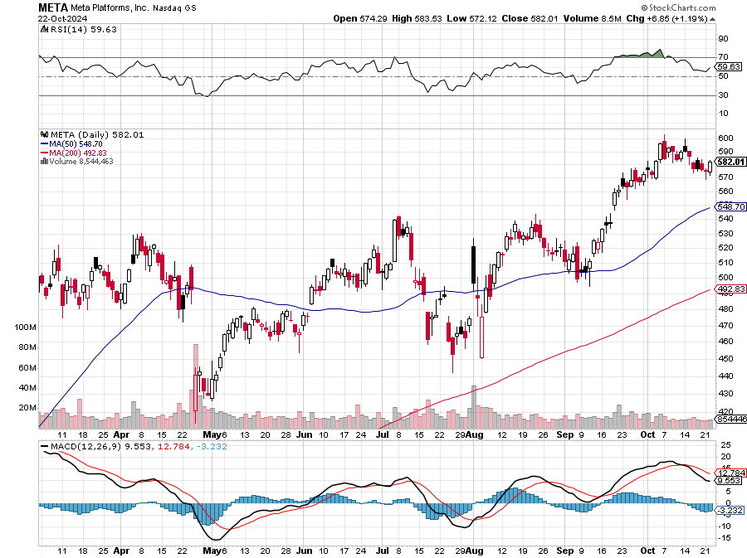
Meta (META) Meta Beats, as advertising revenue kicks in big time took profits on Long 8/$420-$430 call spread took profits on Long 5/$360-$370 vertical bull call spread, took profits on Long 9/$290-$300 vertical bear put spread, stopped out of Long 9/$190-$200 vertical bear put spread

Slide 30
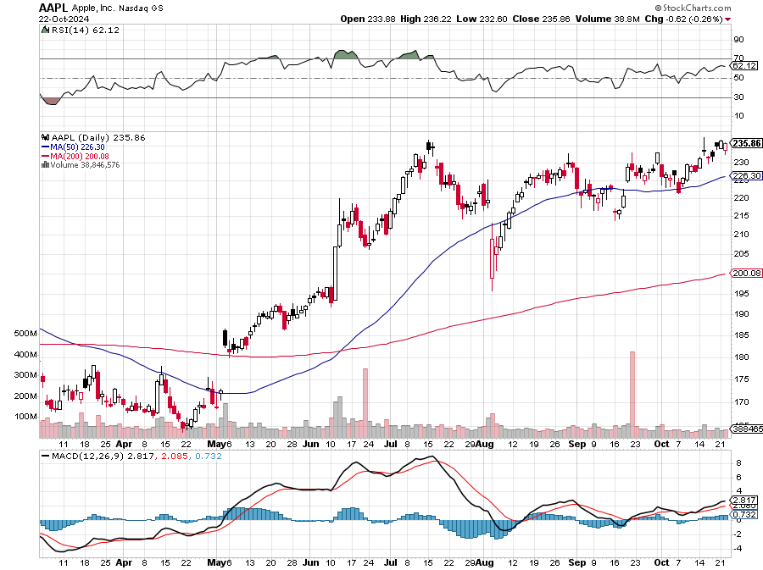
Apple (AAPL) Apple China Sales Jump 20% on the new iPhone 16 launch took profits on Long 5/$225-$235 vertical bear put spread, took profits on Long 8/$160-$170 call spread took profits on Long 6/$200-$210 bear put spread, stopped out of Long 5/$185-$195 vertical bear put spread took profits on long 1/$145-$155 put spread, Took profits on long 10/$165-$175 put spread

Slide 31
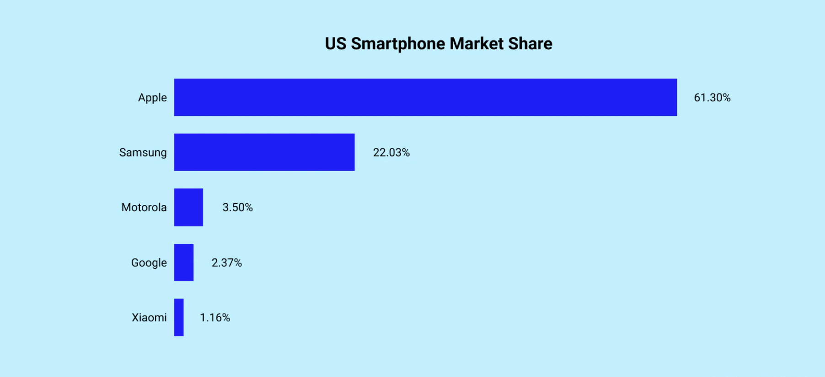

Slide 32
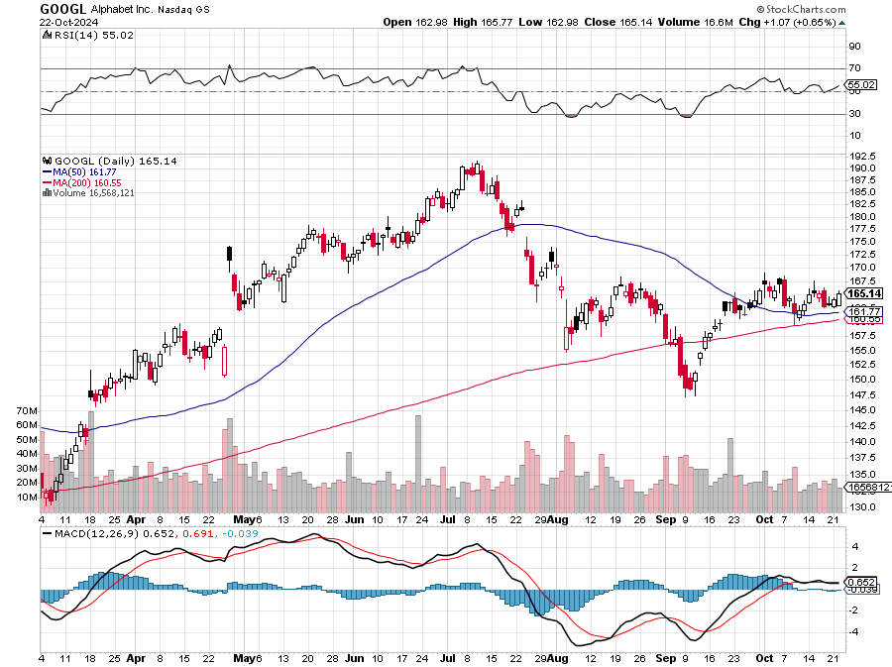
Alphabet (GOOGL) – Back in Play Google Gets Hit with an Antitrust Suit took profits on long 12/$110-$120 call spread took profits on long 12/$1,200-$1,230 bull call spread, took profits on long 9/$1,030-$1,080 vertical bull call spread

Slide 33
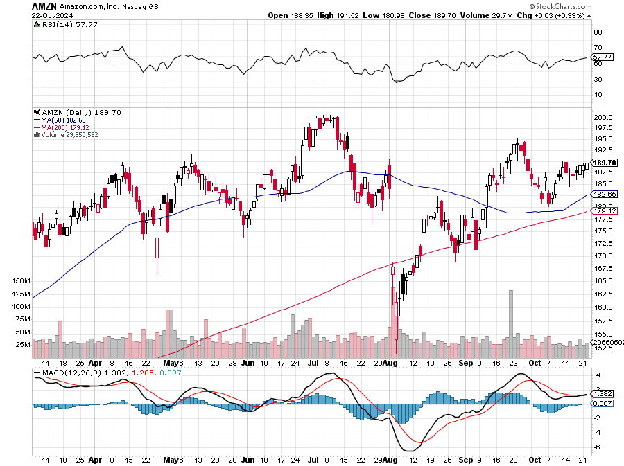
Amazon (AMZN) – Best Value AI Play Amazon Expanding Health Care Business, bringing same-day prescription delivery to an additional 20 U.S. cities next year Stopped out of long 3/$150-$160 bull call spread, took profits on long 3/$155-$160 bull call spread , took profits on long 2/$130-$135 bull call spread

Slide 34
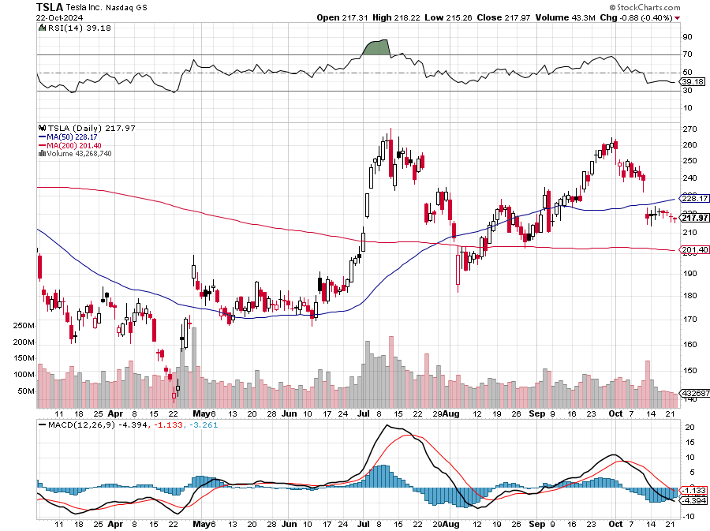
Tesla (TSLA) – US Investigates Tesla Full Self Driving Cras< Elon Musk Reveals Tesla Robotaxi took profits on Long 10/$180-$190 call spread, stopped out of long 9/$250-$260 put spread Took profits on long 8/$245-$255 put spread, Took profits on long 8/$150-$160 call spread, Took profits on long 6/$310-$320 put spread, Stopped out of long 4/$140-4150 call spread,

Slide 35
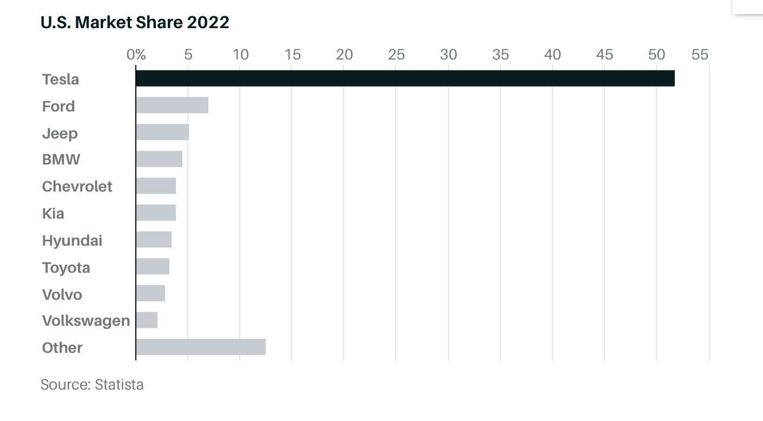

Slide 36
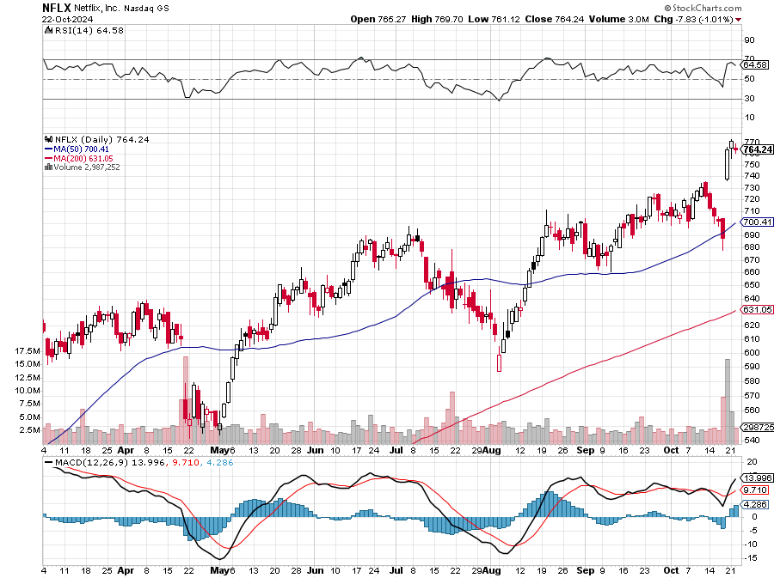
Netflix (NFLX) – Netflix Soars on Blockbuster Earnings on a 5 million gain in subscribers

Slide 37
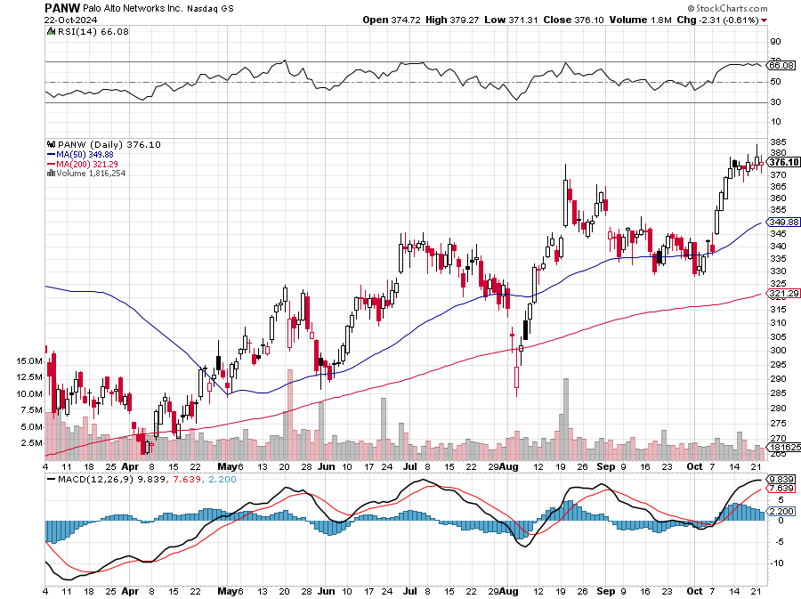
Palo Alto Networks (PANW)- Hacking never goes out of fashion Palo Alto Networks Disappoints took profits on long 2/$260-$270 call spread, took profits on long 10/$130-$140 call spread

Slide 38
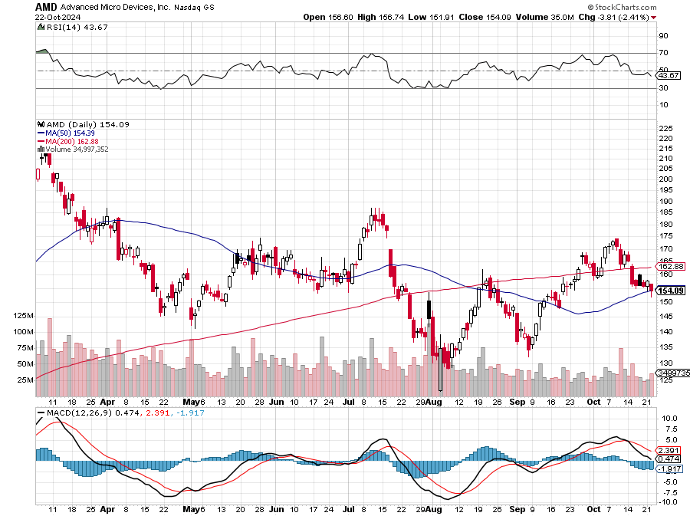
Advanced Micro Devices (AMD)- Recession fears programable logic devices took profits on long 2/$75-$80 call spread

Slide 39
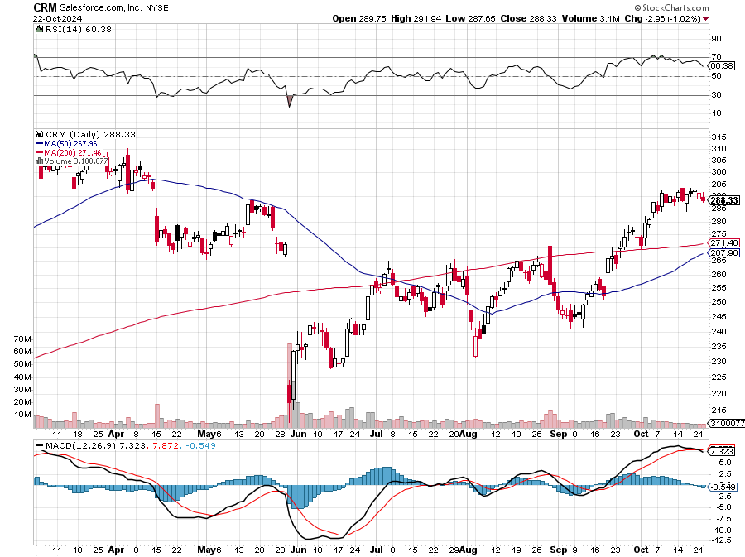
Salesforce (CRM)- Massive Online Migration Salesforce Soars 16%, on better-than-expected guidance took profits on long 12/$185-$195 call spread took profits on long 9/$125-$130 vertical bull call spread took profits on long 8/$125-$130 vertical bull call spread

Slide 40
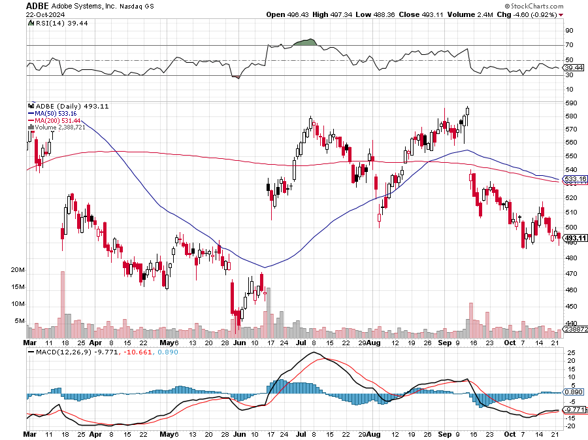
Adobe (ADBE)- Cloud play The Quality Non-China tech play

Slide 41
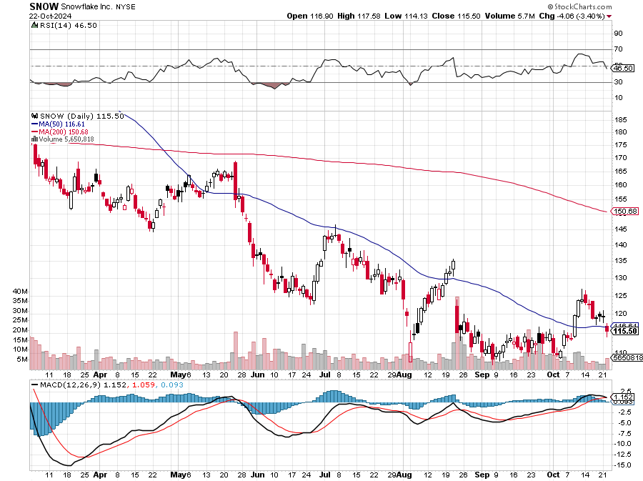
Snowflake (SNOW)- Blockbuster AI Earnings Snowflake Crashes, down 20%, on weak guidance. CEO Frank Slootman is retiring stopped out of long 4/$150-$255 call spread, took profits on long 12/$135-$140 call spread

Slide 42
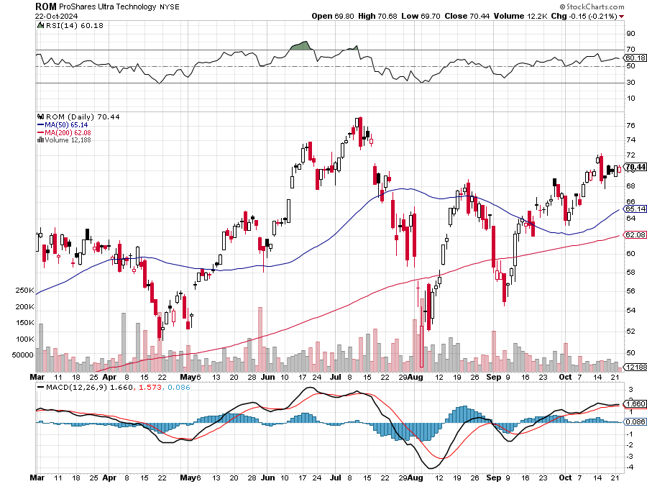
ProShares Ultra Technology ETF (ROM) – 2X Long Technology ETF took profits on long 10/$62-65 call spread

Slide 43
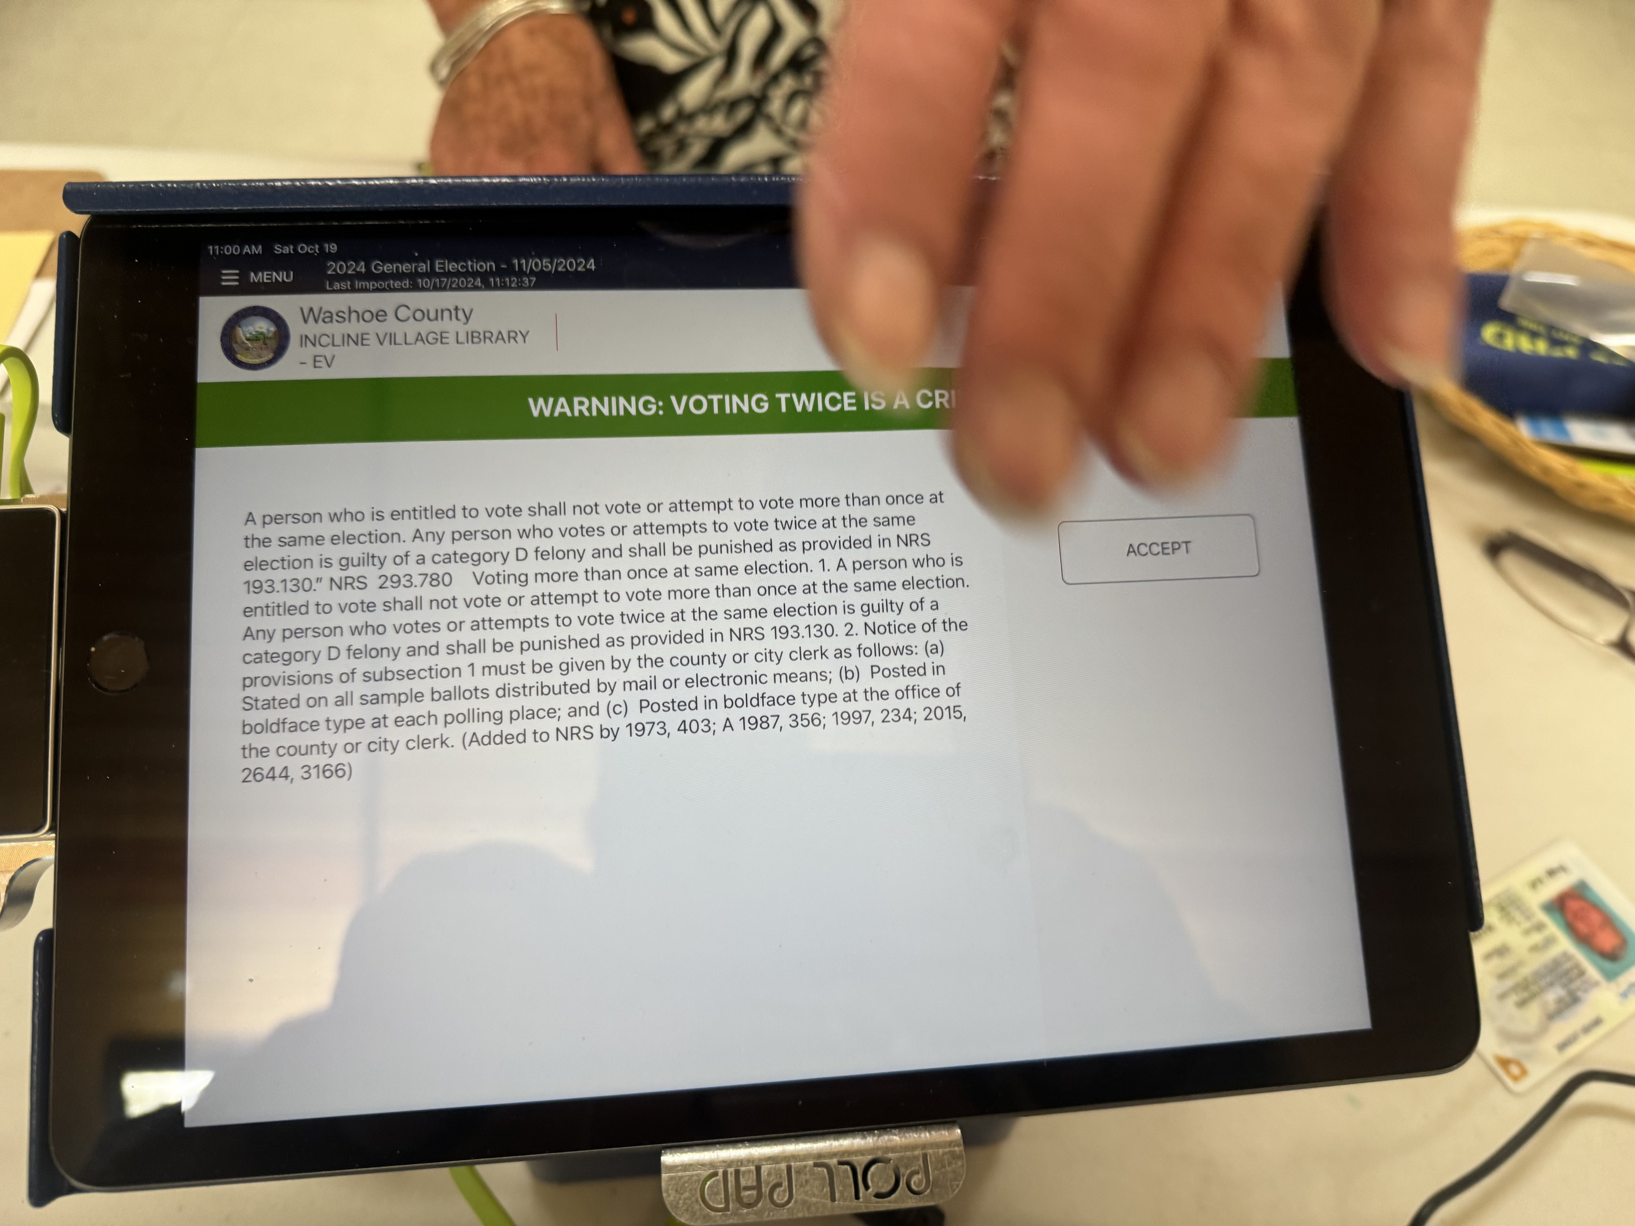

Slide 44
The Second Half of the Barbell
*Bets on a domestic recovery in 2022 Q4 *Upside potential in 2024 far greater than tech *Some of these have not moved for 5 or 10 years *Focuses on economically sensitive cyclical industries *Makes a great counterweight to high-growth technology *We could spend all of next ten years rotating between the two groups

Slide 45
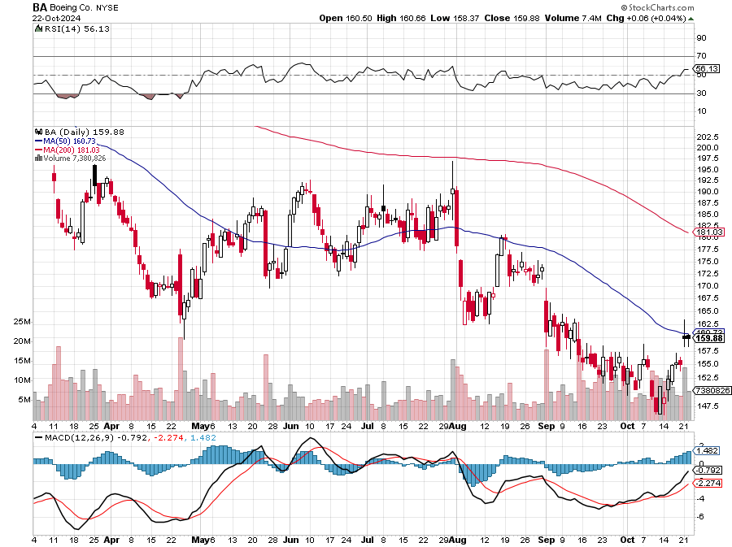
Boeing (BA) – Boeing Lays Off 17,000 “il pesce marcisce dalla testa” stopped out of long 2/$190-$200 call spread, took profits on long 5/$17-$175 call spread

Slide 46
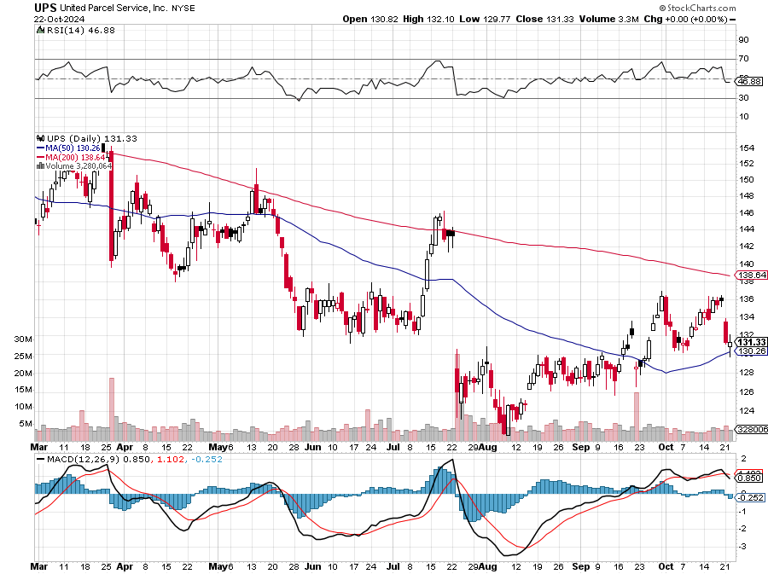
Package Delivery- United Parcel Service (UPS) – strike averted took profits on long 11/$130-$140 call spread

Slide 47
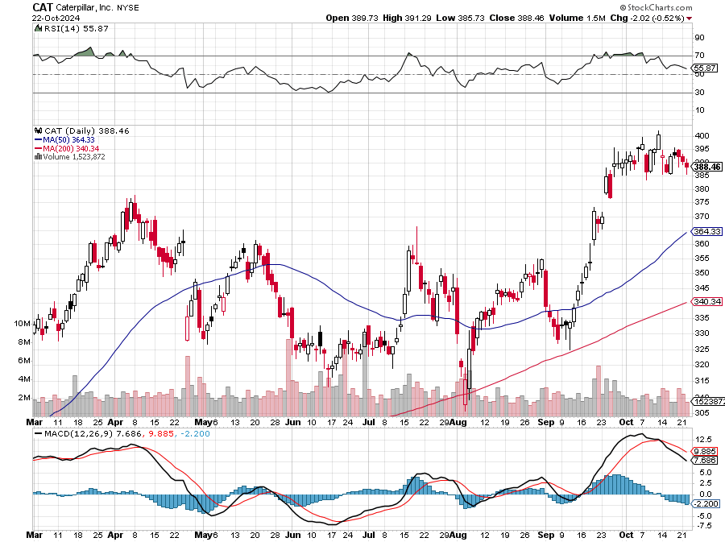
Caterpillar (CAT)- Ag + Infrastructure + Housing stopped out of long 8/$310-$320 call spread, took profits on long 12/$220-$230 calls spread took profits on long 12/$145-$150 call spread, took profits on long 11/$125-$135 call spread

Slide 48
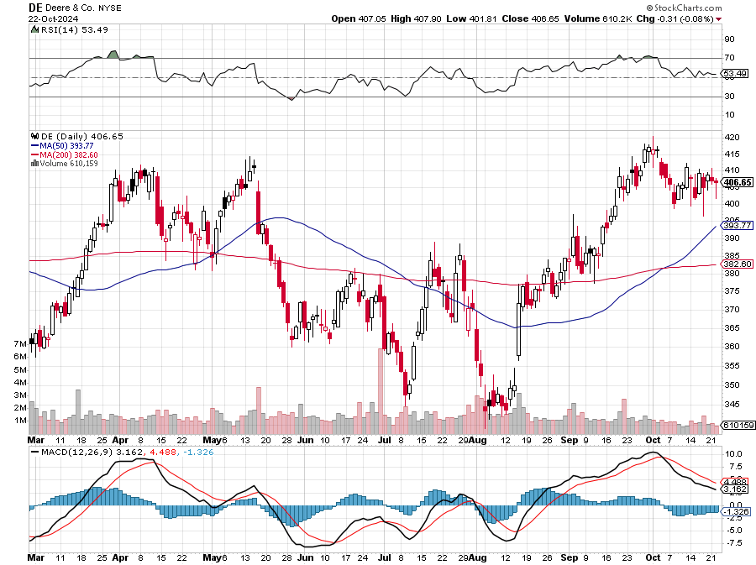
Deere & Co. (DE)- Ag + Infrastructure + Housing took profits on long 8/$330-$340 put spread stopped out of long 8/$330-$340 calls spread

Slide 49
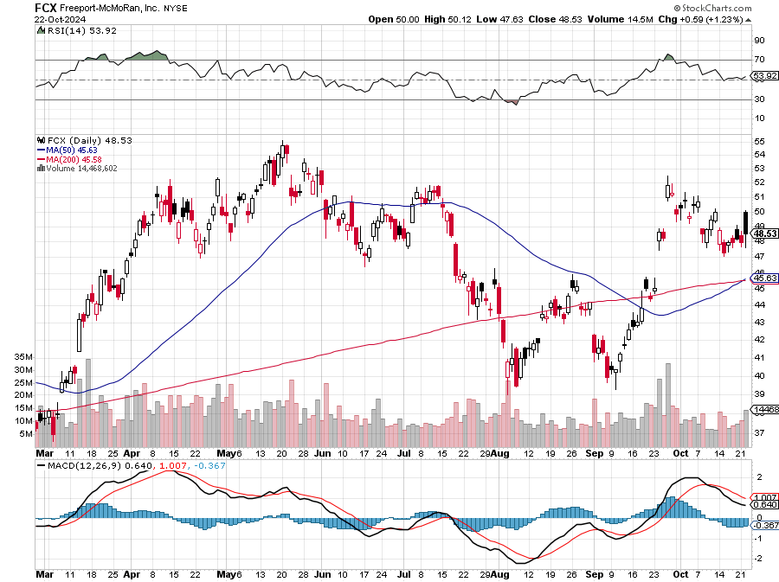
Freeport McMoRan - (FCX)- Coming Copper Crisis Beats, helped by higher production and easing costs took profits on long 4/$37-$40 call spread, took profits on long 5/$42-$45 call spread, stopped out of long $48-$51 put spread, profits on long 6/$32-$35 call spread took profits on long 4/$30-$33 call spread, took profits on long 10/$20-$23 call spread

Slide 50
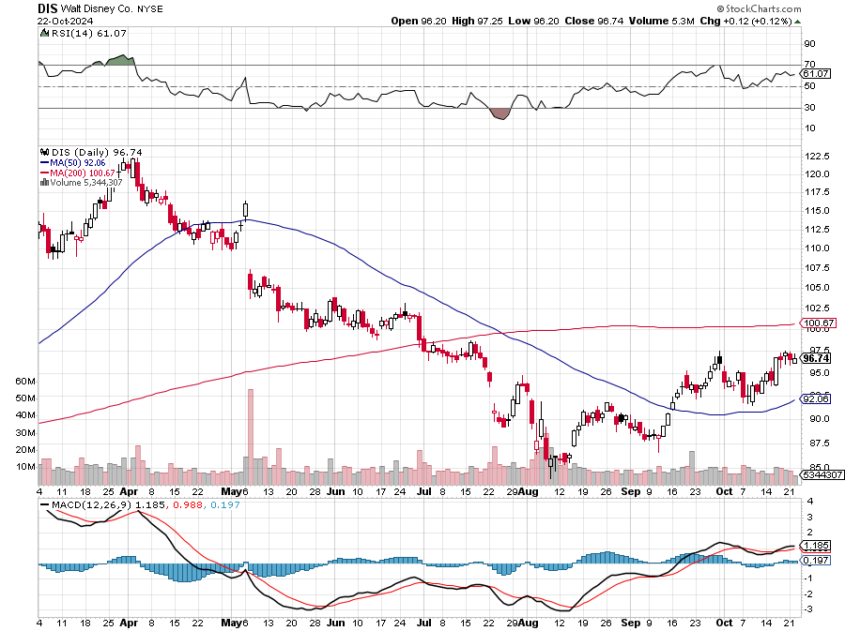
Walt Disney (DIS) -Disney Beats Disney Dives on Earnings Bust, although streaming broke even versus an expected loss

Slide 51
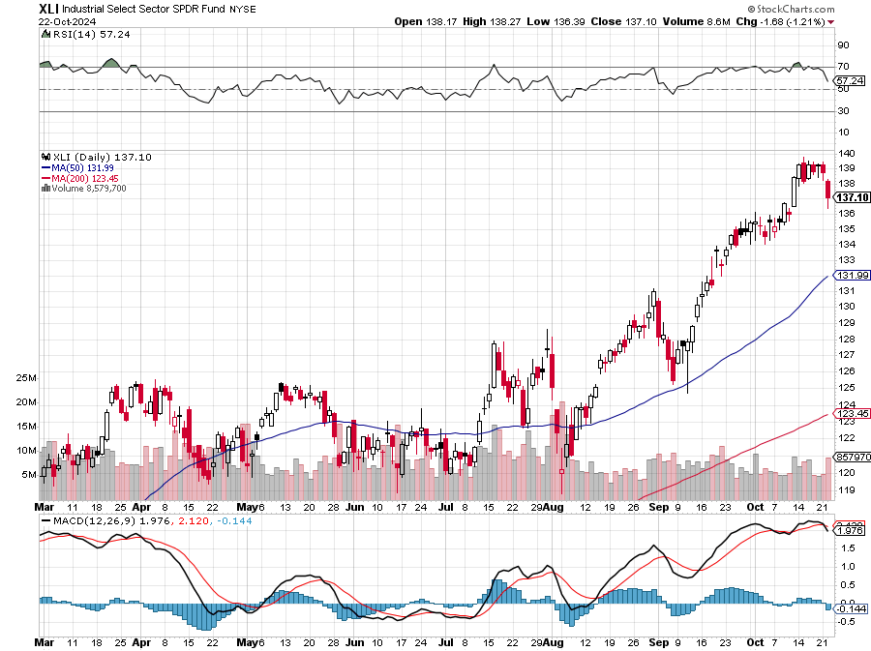
Industrials Sector SPDR (XLI)- (GE), (MMM), (UNP), (UTX), (BA), (HON)

Slide 52
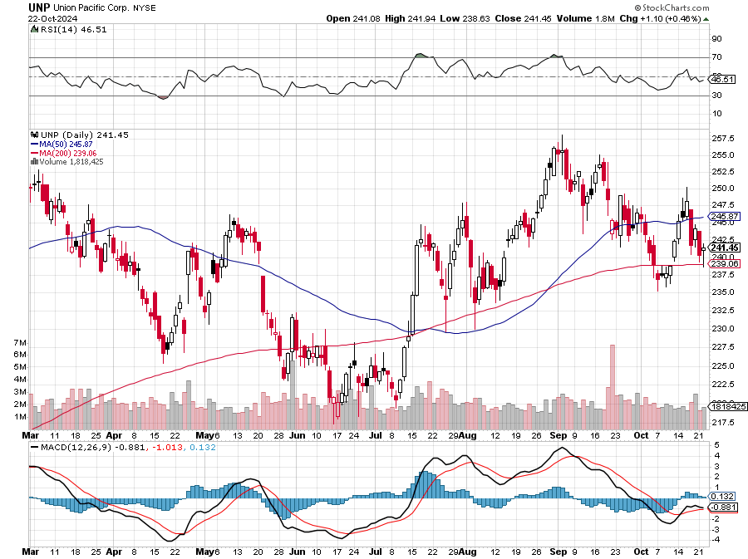
Union Pacific RR (UNP)- Big Stuff to Ship took profits on long 5/$200-$210 call spread took profits on 11/$150-$160 call spread

Slide 53
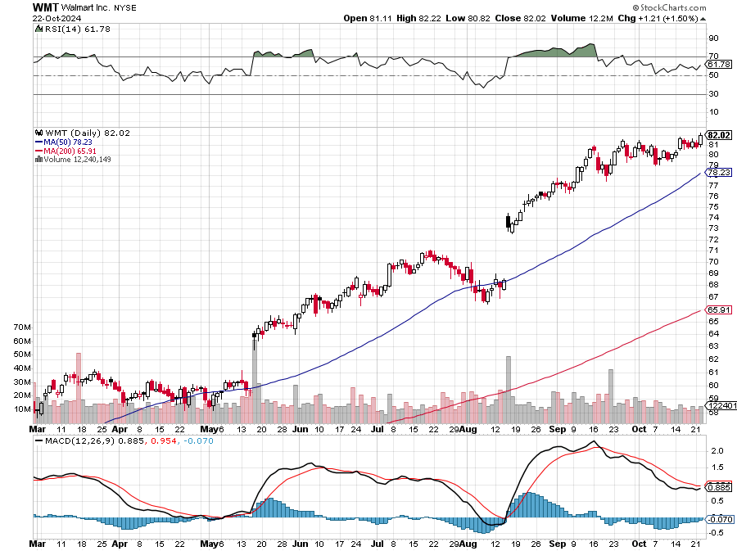
Wal-Mart (WMT)- took profit on Long 11/$125-$130 bear put spread took profit on Long 10/$119-$121 bear put spread took profits on Long 8/$114-$117 bear put spread

Slide 54
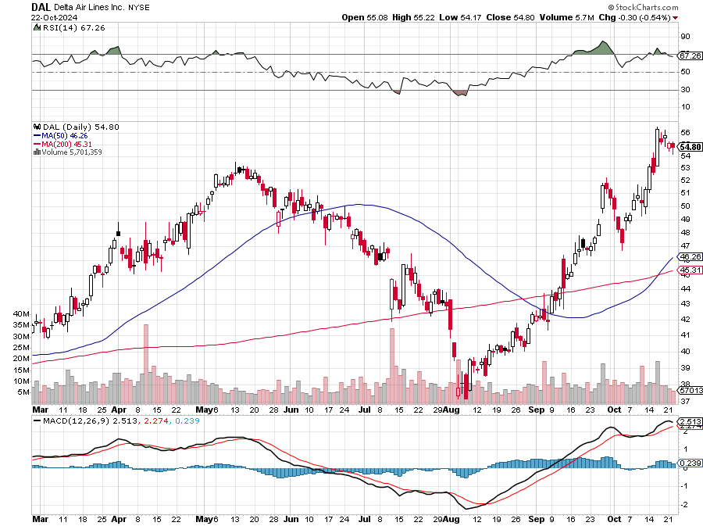
Delta Airlines (DAL) – Travel is Back! The Non-Boeing Airline – uses Airbuses stopped out of long 2/$35-$38 call spread

Slide 55
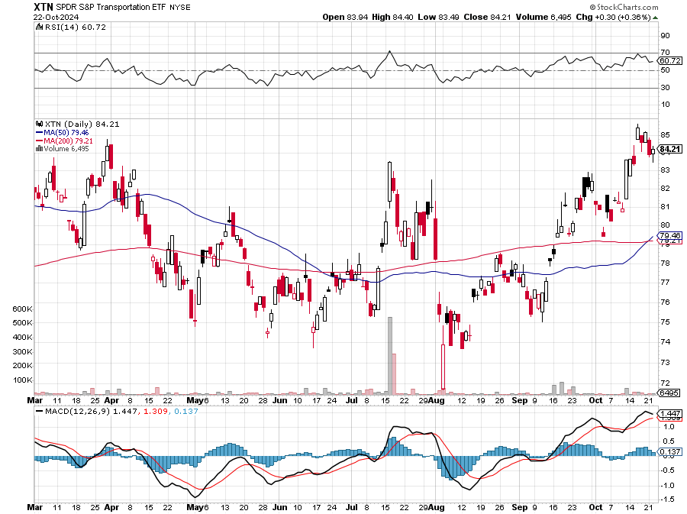
Transports Sector SPDR (XTN)- Worst Hit Sector (ALGT), (ALK), (JBLU), (LUV), (CHRW), (DAL)

Slide 56
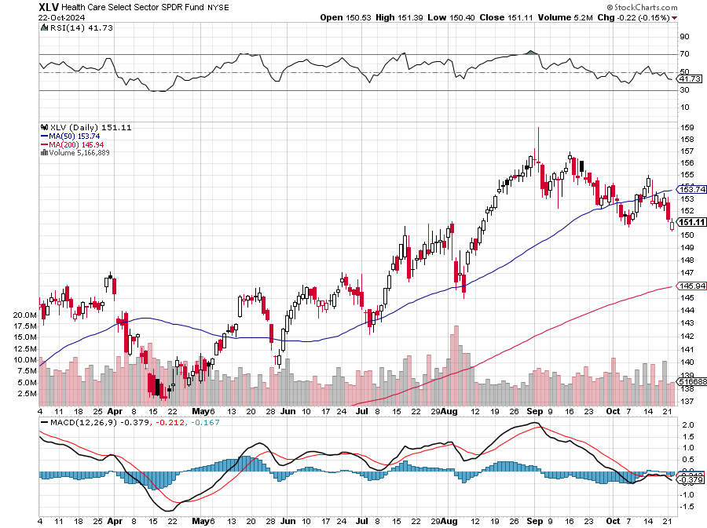
Health Care Sector (XLV) (JNJ), (PFE), (MRK), (GILD), (ACT), (AMGN)

Slide 57
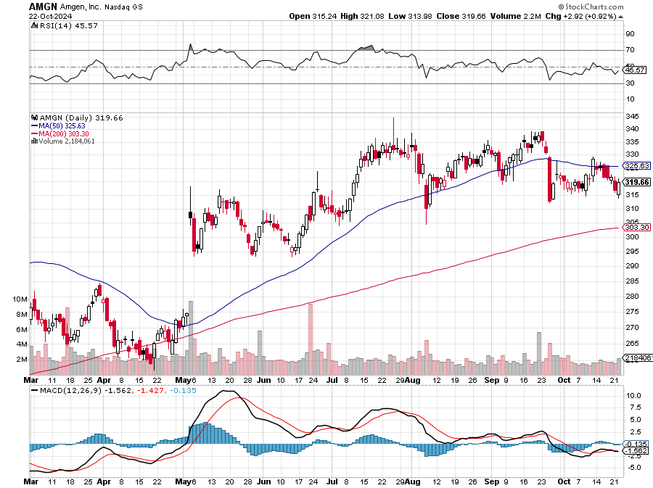
Amgen (AMGN) took profits on long 11/$185-$200 bull call spread

Slide 58
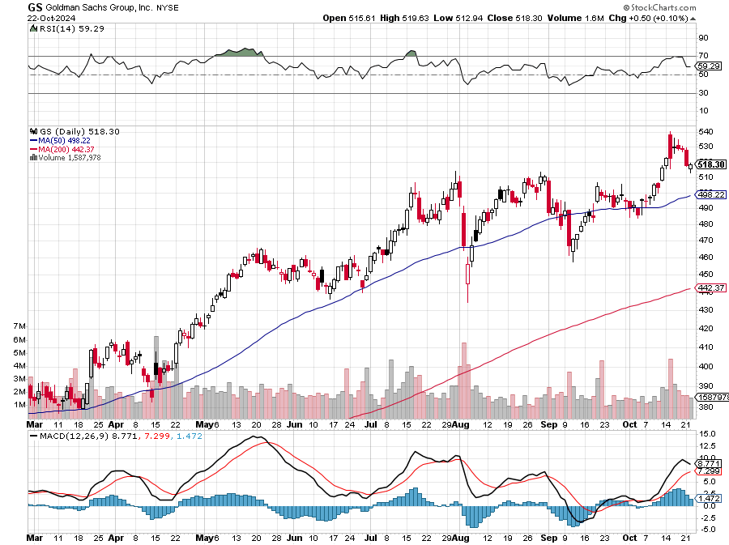
Goldman Sachs (GS) – Goldman Sachs Beats, with Revenues of $12.73 billion vs. $12.46 billion estimate took profits 12/$330-$350 call spread took profits 11/$330-$350 call spread stop loss on long 11/$385-$395 call spreads

Slide 59
Morgan Stanley (MS) Morgan Stanley Beats, with Revenues in at $15.02 billion vs. $14.3 billion estimate took profits on long 4/$65-$70 call spread

Slide 60
JP Morgan Chase (JPM) – JP Morgan Delivers Blowout Earnings 11/$195-$205 call spread took profits on 4/$215-225 put spread, took profits on 4/$190-$195 call spread , took profits on long 4/$105-$115 call spread

Slide 61
Bank of America (BAC) – Buffet Hammers (BAC) for a 9th Straight Days, taking profits from a much lower level. took profits on long 4/$20-$23 call spread

Slide 62
Citigroup (C) – took profits on long 4/$30-$35 call spread

Slide 63
Charles Schwab (SCHW) – LEAPS expire at Max profit took profits on long 4/$30-$35 call spread

Slide 64
Interactive Brokers (IBKR) – LEAPS expired at Max Profit stopped out of long 8/$110-$115 call spread , took profits on long 4/$60-$65 call spread

Slide 65
SPDR Metals & Mining ETF (XME) – long 2/$28-$30 call spread

Slide 66
Blackrock (BLK)-Asset Collection Boom took profits on long 3/$770-$790 call spread took profits on long 3/$310-$340 call spread

Slide 67
Visa (V) – Inflation boost Justice Hits Visa (V) with Antitrust Suit, with a 47% market share took profits on long 2/$240-$250 bull call spread took profits on long 10/$160-$170 bull call spread, took profits on long 6/$150-$160 bull call spread

Slide 68
Consumer Discretionary SPDR (XLY) (DIS), (AMZN), (HD), (CMCSA), (MCD), (SBUX)

Slide 69
Berkshire Hathaway (BRKB)- Natural Barbell Berkshire Hathaway Cash Approaches $300 Billion stopped out of long 12/$405-$415 call spread, took profits on long 12/$320-$330 call spread took profits on long 4/$260-$270 call spread, took profits on long 1/$290-$300 call spread

Slide 70
Bonds – Election Play
*It’s a choice between Harris, who will increase the deficit by $2.5 trillion , or Trump, who will increase by $15 trillion *Either way, the bond market loses *Bond Yields Soar Above 4.24% Yield, on fears of massive deficit spending by a future Donald Trump. Estimates of his deficits over four years go as high as $15 trillion *US Budget Deficit Tops $1.8 Trillion in Fiscal 2024, which ends on October 30. *It’s the highest outside of the COVID era *Interest on the federal debt exceeded $1 trillion for the first time and spending grew for the Social Security retirement program, health care and the military *The deficit for the year ended Sept. 30 was up 8%, or $138 billion, from the $1.695 trillion recorded in fiscal 2023 *Buy (TLT), (JNK), (NLY), (SLRN) and REITS on this dip

Slide 71
Treasury ETF (TLT) – long 10/$103-$106 put spread took profits on long 6/$$94-$97 put spread, took profits on long 5/$82-$85 calls spread took profits on long 4/$87-$90 call spread took profits on long 2/$90-$93 call spread,

Slide 72
Ten Year Treasury Yield ($TNX) – 4.24%

Slide 73
Junk Bonds (JNK) 6.43% Yield

Slide 74
Municipal Bonds (MUB) 2.87% Yield-

Slide 75
Emerging Market Debt (ELD) 5.14% Yield-

Slide 76
2X Short Treasuries (TBT)-Out of Favor

Slide 77
Anally Capital Management (NLY) – Leveraged REIT Play Yield 13.25% took profits on long 12/$15-$16 call spread

Slide 78
Acelryn (SLRN) – Double B Bond Fund took profits on long 12/$15-$16 call spread

Slide 80
Foreign Currencies – Dollar Peak
*Dollar Hits Two Month High, on rising US interest rates. Ten-year US Treasuries have risen from 3.55% to 4.20% *Dollar gets sudden new lease on life, on interest rate spike *Higher interest rates make the US dollar much more attractive to traders and investors *This is a short-term rally only and may be the last chance to sell short the US dollar *The long-term downtrend in the dollar is still intact *There is no way the dollar can stand up to cuts down to 3.5% by summer *Buy (FXA), (FXE), (FXB), (FXC), and (FXY).

Slide 81
THE MAD HEDGE FUND TRADER
Australian Dollar (FXA) - Major Long-Term Bottom is In Targeting Parity – A call option on a global synchronized recovery
1:1
BUY

Slide 82
Japanese Yen (FXY)

Slide 83
Euro (FXE)-
2024 Target 25%

Slide 84
British Pound (FXB)-
2024 Target 15%

Slide 85
Emerging Market Currencies (CEW)
2024 Target 40%

Slide 87
Energy & Commodities – Oil Crash
*Chronic global oversupply finally overwhelms Middle East threats *Air Conditioning Demand to Rise by 280% by 2050, thanks to higher temperatures and rising incomes according to the International Energy Agency *The Nuclear Boom is On, with Amazon Web Services announcing it has signed an agreement to explore the development of a small module nuclear reactor (SMR), as it expands its services into generative AI *Rio Tinto Buys Arcadium for $6.7 Billion, in a bid to become one of the world’s largest lithium producers *My Cameco (CCJ) trade alert went ballistic, up 25% in two weeks *The nuclear trade is still on with all plays hitting new highs

Slide 88
Oil-($WTIC)

Slide 89
United States Oil Fund (USO)

Slide 90
Energy Select Sector SPDR (XLE)-No Performance! (XOM), (CVX), (SLB), (KMI), (EOG), (COP)

Slide 91
ExxonMobile (XOM)- Exxon Moves Big into Lithium, with the construction of a major mining operation in Arkansas took profits on Long 4/$100-$105 call spread, took profits on long 12/$120-$125 put spread

Slide 92
Occidental Petroleum (OXY)- Buffet’s a Buyer took profits on long 4/$59-$62 call spread took profits on long 2/$55-$60 call spread, took profits on long 12/$77.50-$82.50 put spread

Slide 93
Natural Gas (UNG) – Free Fall on Warm Winter took profits on Long January 2025 $7-8 Call Spread LEAPS

Slide 94
Cameco (CCJ) – Global Uranium Renaissance Microsoft to Reopen Three Mile Island to power AI data centers took profits on long 12/$35-$38 call spread, took profits on long 5/$20-$23 bull call spread

Slide 96
Precious Metals – New Highs
*Silver Breaks Out to the Upside, after a years long range trade *The white metal is a predictor of a healthy recovery and a solar rebound *It’s a long overdue catch up with (GLD). Buy (AGQ) on dips. *Money Pours into Gold ETF’s, taking Gold up to new Highs, at $2,761 an ounce, as hedge funds pour in *Seasonals for the barbarous relic are now the most positive of the year *Gold holding up in the face of big interest rate rises shows it only wants to go up *Escalation of Middle East war is very pro-gold Buy (GLD), (SLV), (AGQ), and (WPM) on dips

Slide 97
Gold (GLD) – China and Falling Rate Long 10/$230-$235 call spread took profits on Long 10/$220-$225 call spread, took profits on Long 8/$210-215 call spread, took profits on Long 7/$200-205 call spread, Long 6/$207.5-$212.5 call spread took profits on Long 4/$194-$197 call spread, took profits on long 5/$165-$170 bull call spread

Slide 98
Market Vectors Gold Miners ETF- (GDX) – took profit on long 6/$207.50-$212.50 call spread, took profit on long 7/$200-$205 call spread

Slide 99
Barrick Gold (GOLD) took profit on long 1/$15.50-$16.50 call spread

Slide 100
Newmont Mining- (NEM)- long 10/$47-$50 call spread, took profits on long $55-60 call spread

Slide 101
Silver- (SLV)- stopped out of long 6/$23-$25 call spread, took profits on long 11/$19-$20 call spread

Slide 102
Silver Miners - (SIL)-

Slide 103
Wheaton Precious Metals - (WPM)- LEAPS Approaching Max Profit took profits on long 4/$39-$42 call spread , took profits on long 1/$36-$39 call spread

Slide 104
Platinum- (PPLT)- 556,000-ounce shortage this year took profits on long 1/$36-$39 call spread

Slide 106
Real Estate – Grind to a Halt
*Election has brought real estate market to a complete halt *Inventory is rising and prices are falling, especially in Florida *Single Family Home Builds are Ticking Up, and are T a five-month high in September, *Permits for future construction rose only marginally amid excess supply of new homes on the market and prospective buyers holding out for lower mortgage rates *We need lower interest rates to get more traction *Weekly Home. Mortgages Tank 17%, on the sudden rise in interest rates.

Slide 107
S&P Case Shiller Turns Hot S&P Case Shiller Rises to +6.3% YOY in May, with its National Home Price Index San Diego gained +11.4%, Chicago +8.9%, and Detroit +8.9%.

Slide 108
Crown Castle International (CCI) – 6.62% yielding 5G cell phone tower REIT Eliot Management Pushes up stock with activist bid Long 8/$90-$95 call spread,

Slide 109
US Home Construction Index (ITB) (DHI), (LEN), (PHM), (TOL), (NVR)

Slide 110
DH Horton (DHI) Blowout Earnings Report long 10/$165-$175

Slide 112
Trade Sheet- So What Do We Do About All This?
*Stocks – buy the next big dip *Bonds – buy dips *Commodities-buy dips *Currencies- sell dollar rallies, buy currencies *Precious Metals – buy dips *Energy – buy dips *Volatility – sell over $30 *Real estate – buy dips

Slide 113
Next Strategy Webinar 12:00 EST Wednesday, November 6 from Lake Tahoe, Nevada email me questions at support@madhedgefundtrader.com
Good Luck and Good Trading!
Notes:
*

