Slide 1
Mad Day Trader
Bill Davis
Webinar – January 30, 2019

Slide 2
Long Term

Slide 3
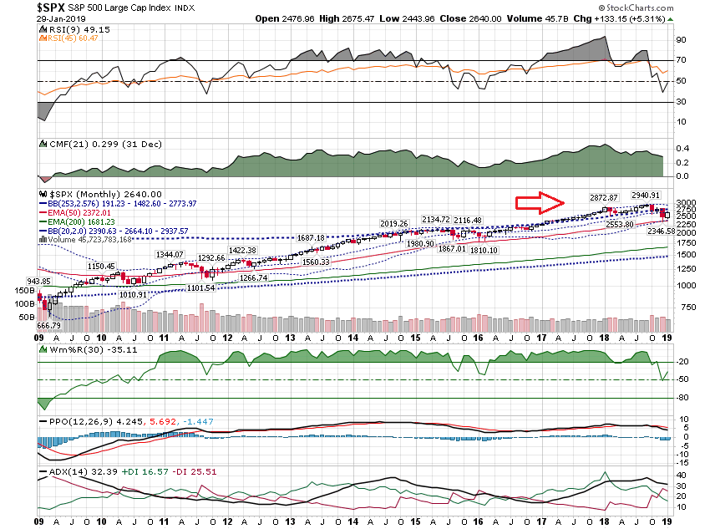

Slide 4
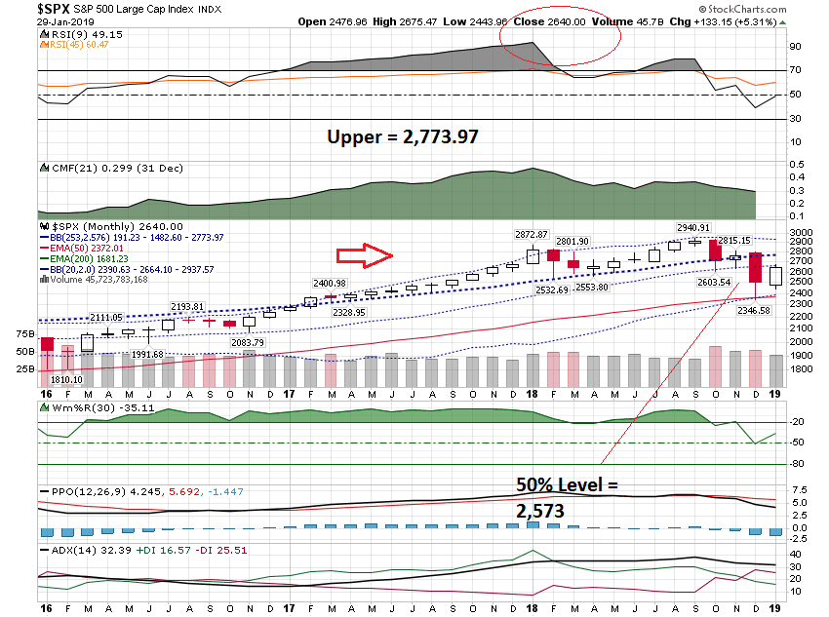

Slide 5
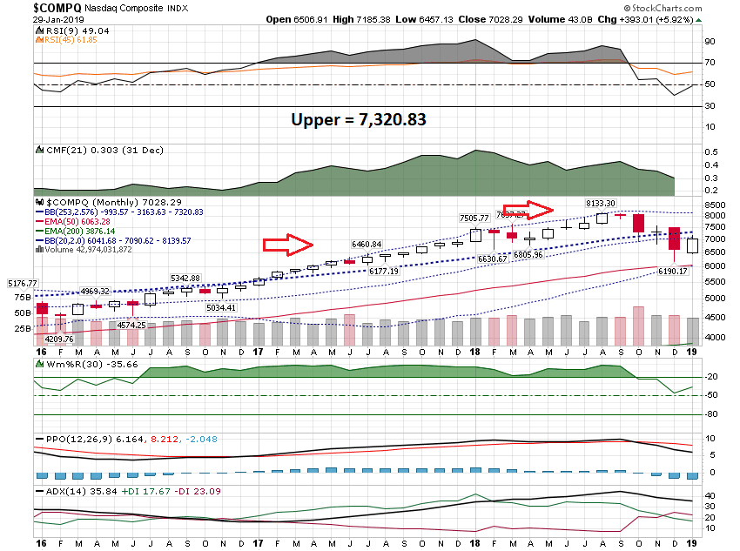

Slide 6
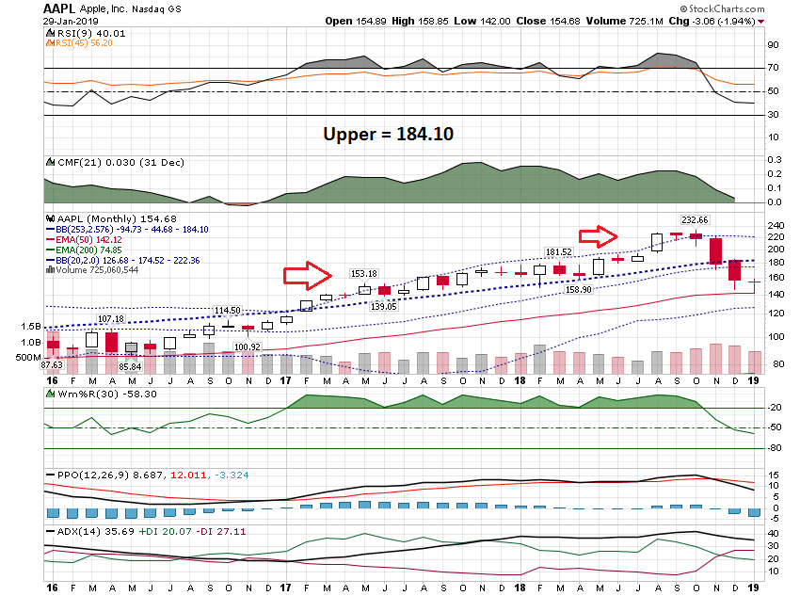

Slide 7
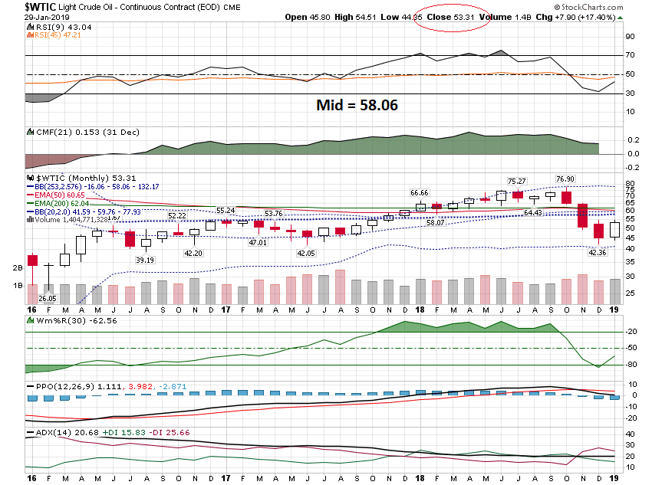

Slide 8
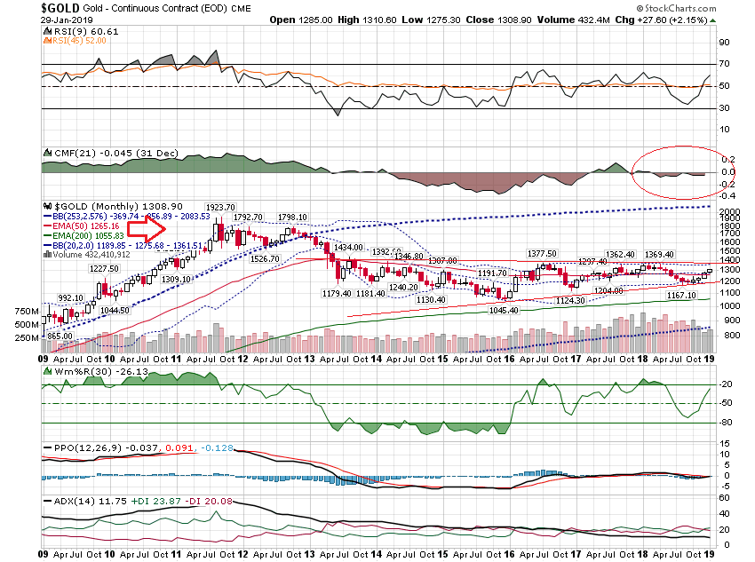

Slide 9
Short Term

Slide 10
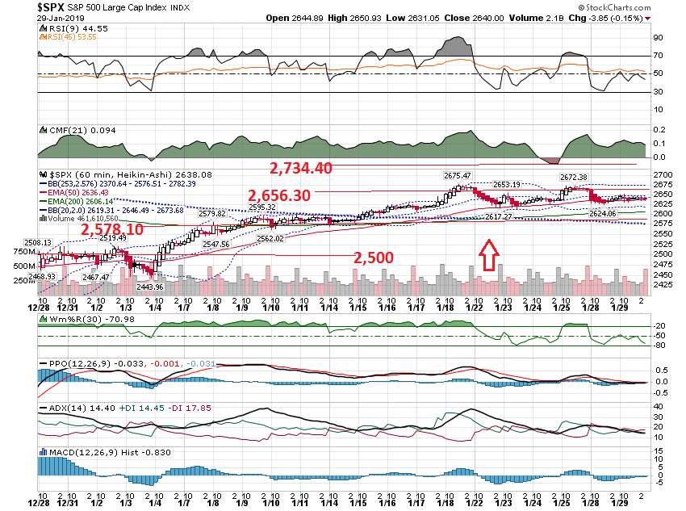

Slide 11
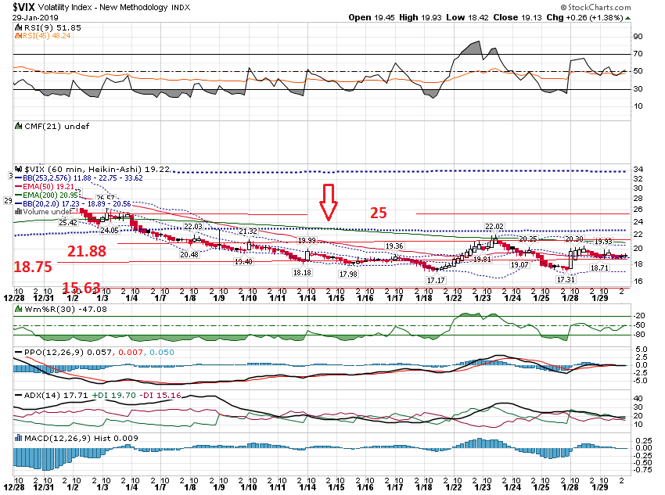

Slide 12
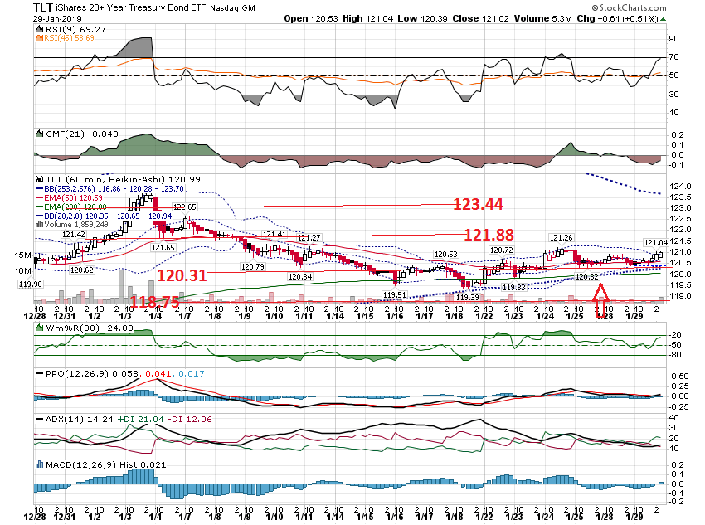

Slide 13
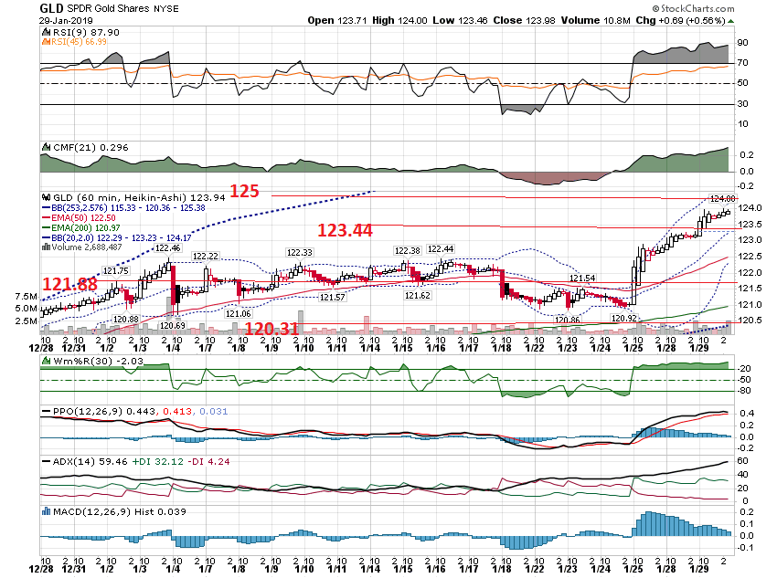

Slide 14
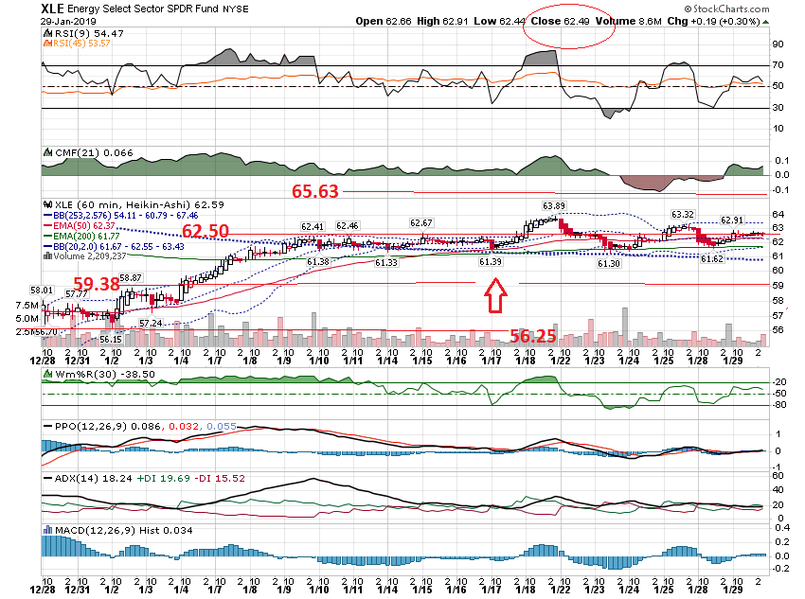

Slide 15
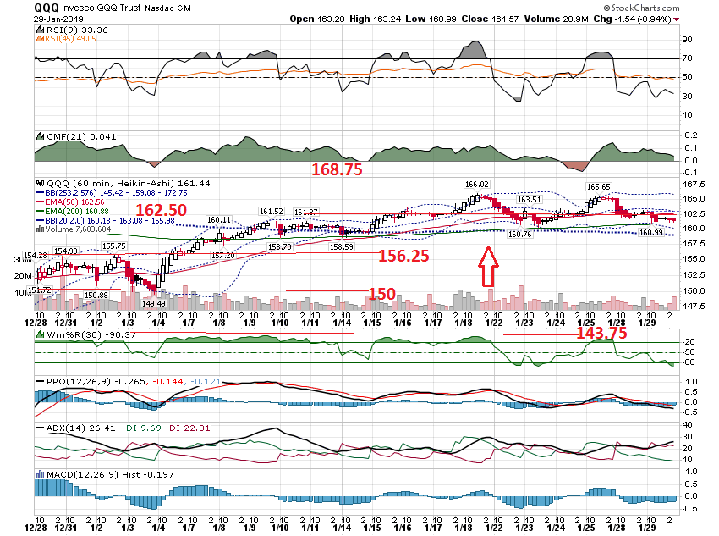

Slide 16
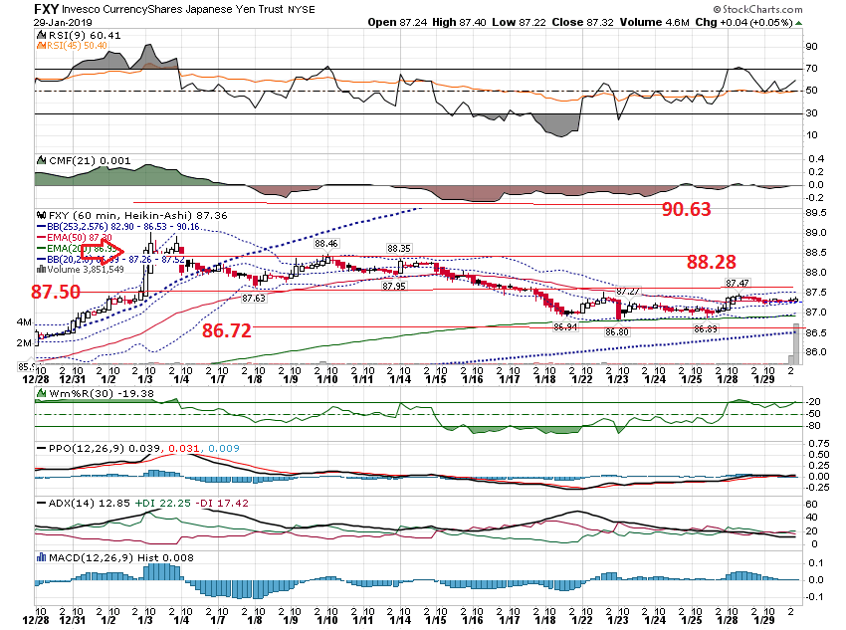

Slide 17
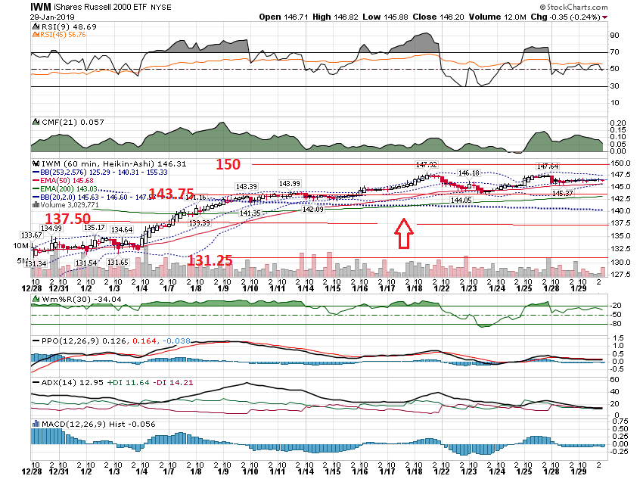

Slide 18
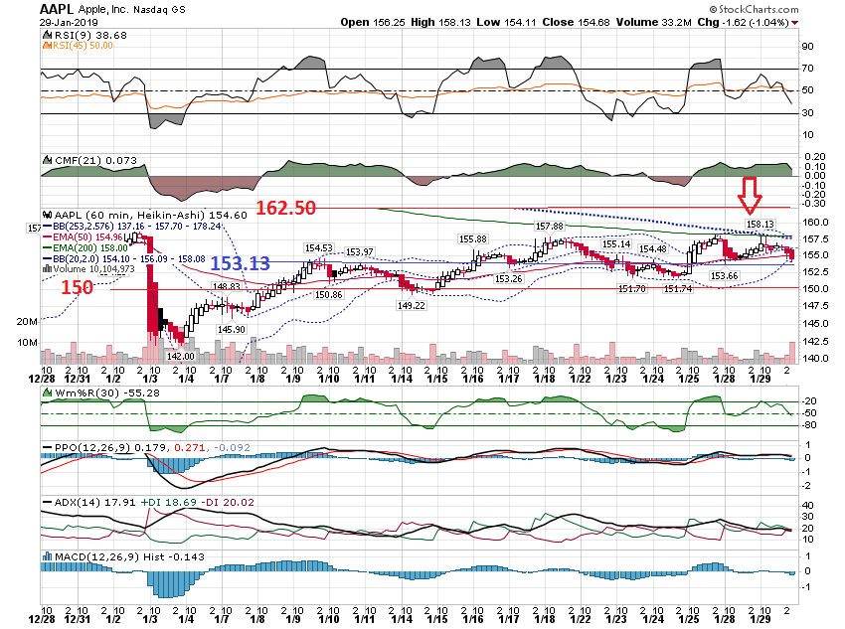

Slide 19
Post Earnings

Slide 20
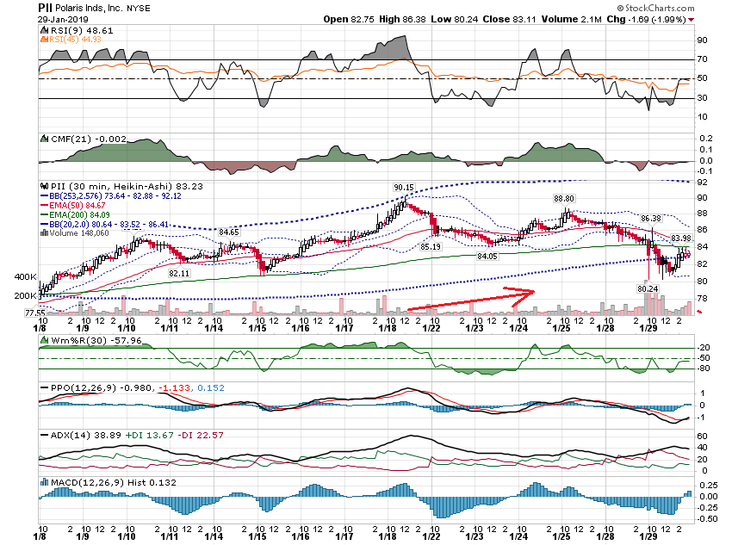

Slide 21
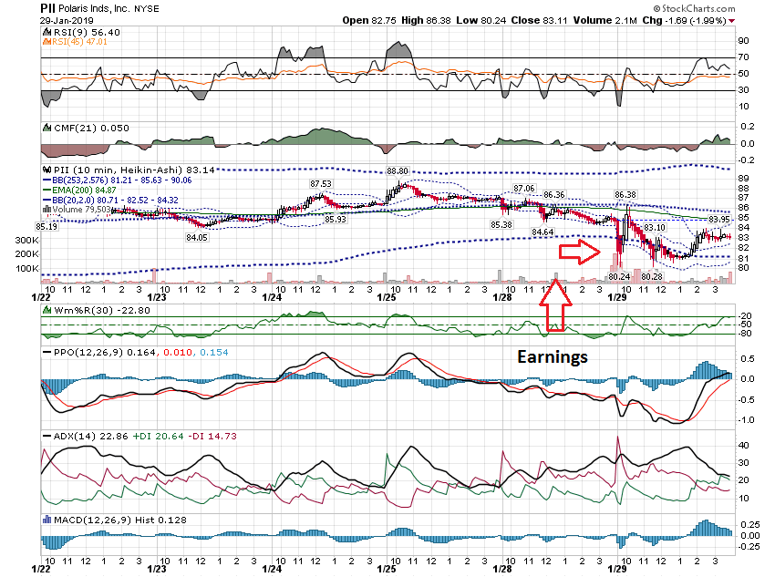

Slide 22
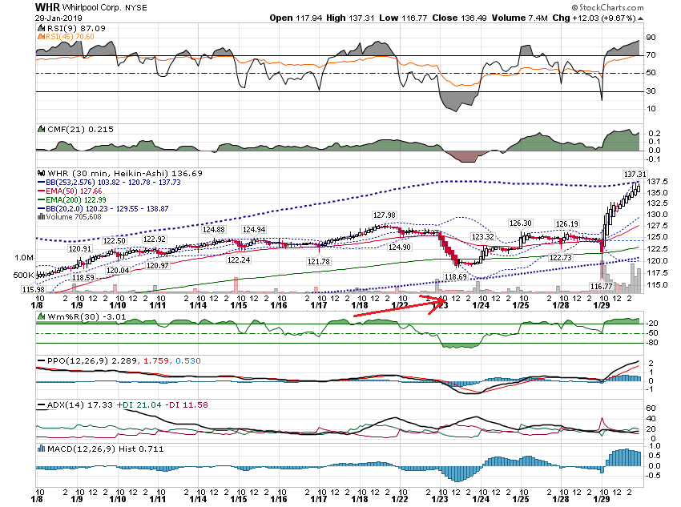

Slide 23
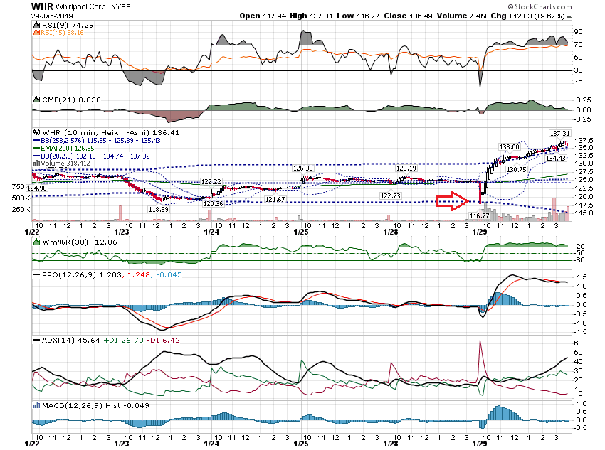

Slide 24
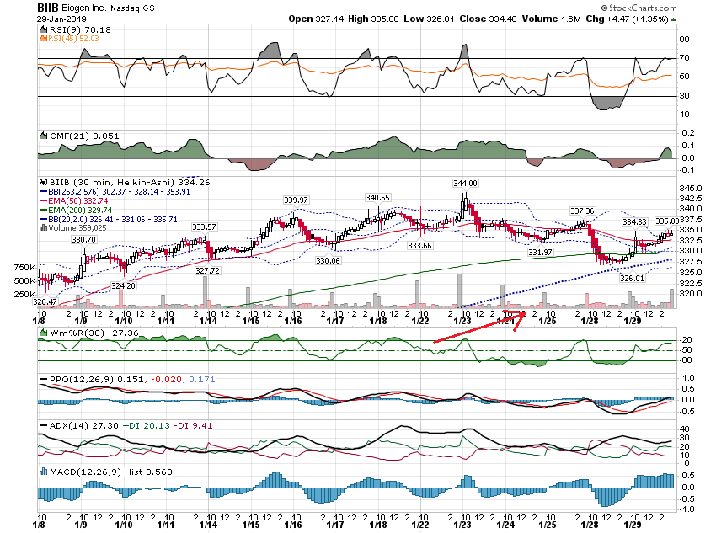

Slide 25
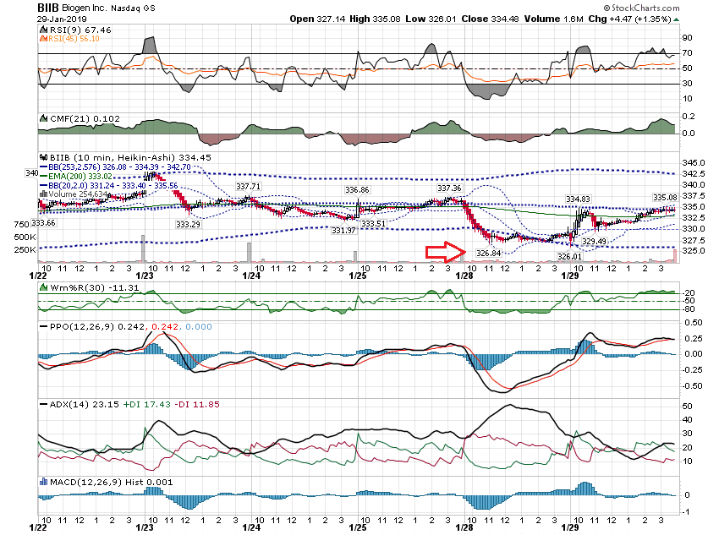

Slide 26
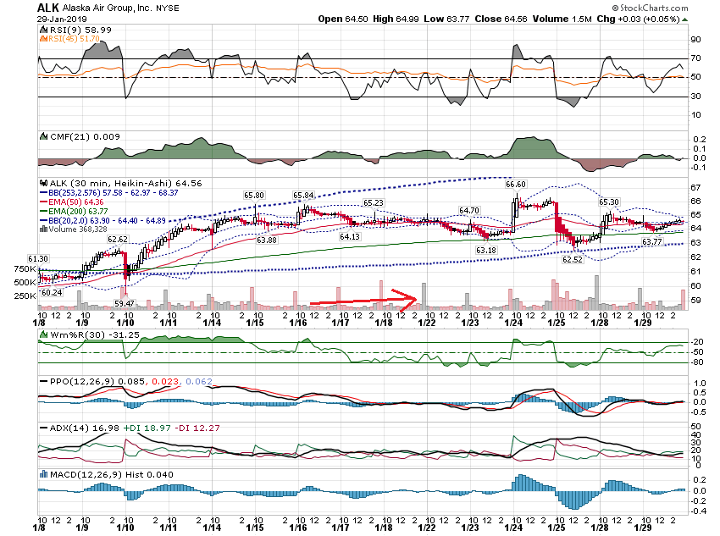

Slide 27
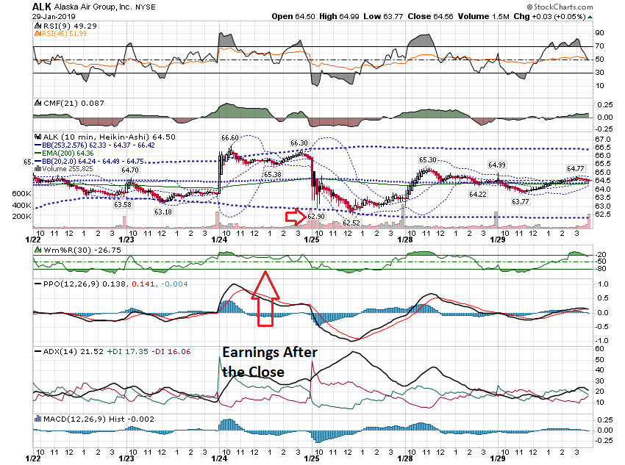

Slide 28
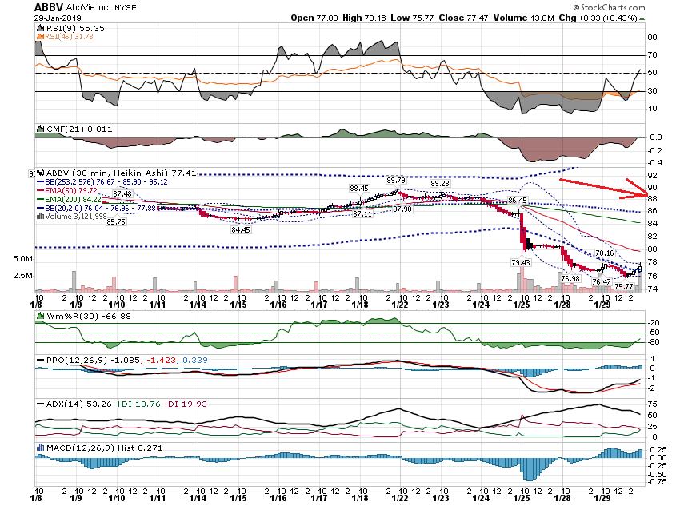

Slide 29
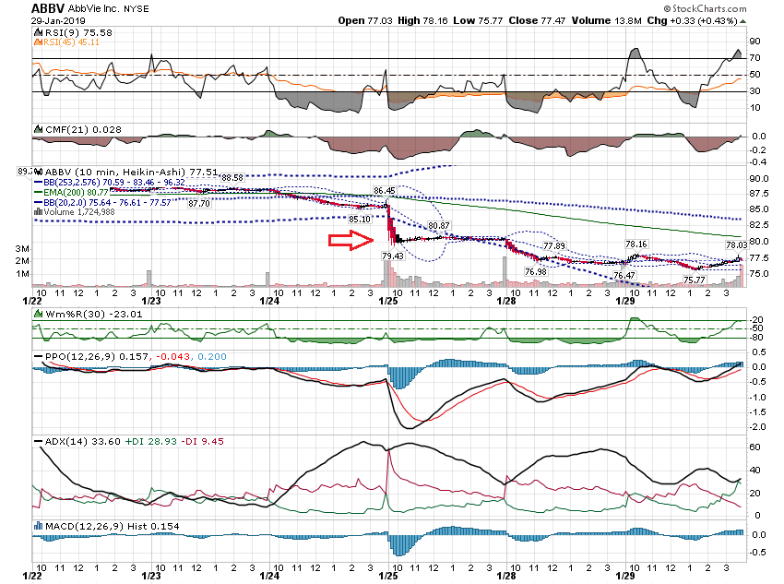

Slide 30
Apple $154.68 Close January 29, 2019 Earnings After Close 155 Call $10.85 155 Put $11.10 Total $21.95 150% 32.92

Slide 31
Close 154.68 Move Plus 50% 32.93 121.76 $125 Put $2.15 $120 Put $1.55 0.60 5.00 12% $120 Put $1.55 $115 Put $0.97 0.58 5.00 12%

Slide 32
Thanks for watching! Bill Davis Mad Day Trader January 30, 2019 davismdt@gmail.com

