Slide 1
The Mad Hedge Fund Trader “Heading for New Highs”
With John Thomas from Silicon Valley, CA, May 20, 2019 www.madhedgefundtrader.com
Notes:
*

Slide 3
October 25-26 Lake Tahoe Conference
*Two days of informative speakers on crucial trading and investment issues *Trade tips with the most successful Mad Hedge traders *2 nights in the Hyatt, including all you can eat and drink *Tickets are a bargain at $599 to $1,899 *Buy now, upper ticket classes sell out first

Slide 4
Trade Alert Performance A Brief Setback
*January 9.49% Final *July +0.0% Final *February +4.64% Final *August +2.19% MTD *March +1.54% MTD *September 1.38% Final *April +12.54% Final *October +1.37% Final *May +1.07% Final *November -1.83% Final *June +4.15% Final *December -4.13% Final *2019 Year to Date +10.26% compared to +11.46% for the Dow Average *Trailing One year return +32.90%, +311.60% since inception, *Average annualized return of 33.69% for 9 years

Slide 5
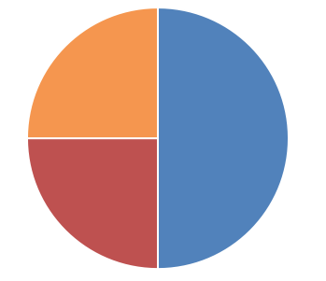
Portfolio Review running small short after great market run
Current Capital at Risk
Risk On
World is Getting Better
(FCX) 4/$10-$11 call spread | 20.00%
(BA) 4/$315-$335 call spread | 10.00%
DOS 4/$100-$104 call spread | 10.00%
Risk Off
(IWM) 4/$160-$165 put spread | -10.00%
Total Net Position | 30.00%
Expiration P&L 14.73%

Slide 6
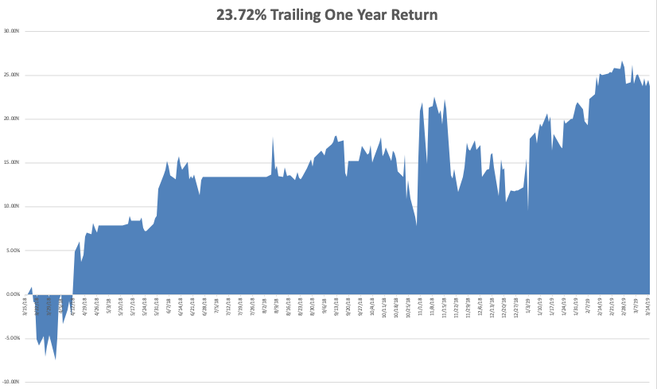
GTD Daily Audited Performance

Slide 7
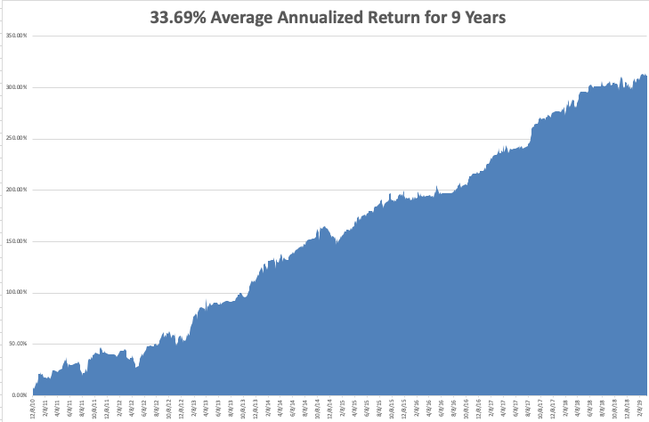
GTD 9 Year Daily Audited Performance

Slide 8
The Method to My Madness
*The Fed “pause” lives preventing serious downside moves in risk assets *Low interest rates are the main driver now and trading are ignoring everything else, like earnings and valuations, and the economy *With foreign interest rates falling faster than ours that makes US assets the most attractive in the world, both stocks AND bonds *No rate rises bring new one year lows in bond rates *Decline in earnings growth is accelerating *Oil remains strong on Venezuela collapse, inventory shortfall, China stimulus, and OPEC caps *With much more stimulus than the US, China could outperform the US in 2019

Slide 9
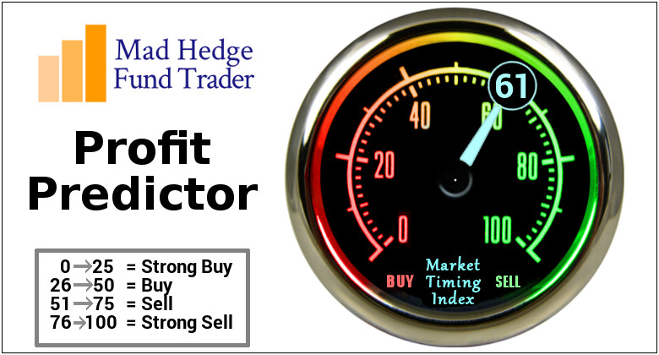
The Mad Hedge Profit Predictor Market Timing Index- An artificial intelligence driven algorithm that analyzes 30 different economic, technical, and momentum driven indicators

Slide 10
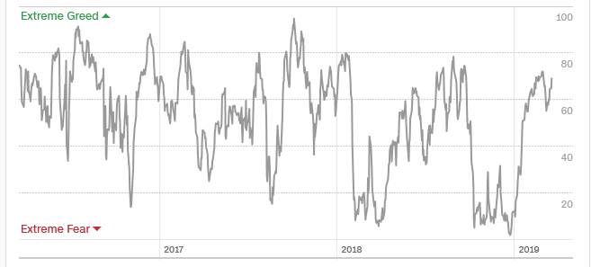
The Mad Hedge Profit Predictor
SELL
BUY

Slide 11
The Global Economy – Waiting for the Ax
*Investors are waiting for the ax to fall with the Q1 GDP print out April 23 *Economic data flow is almost all terrible, issuing a loud recession warning, Weekly Jobless Claims Jump, by 6,000 to a seasonally adjusted 229,000, a 0.4% decline in manufacturing activity in February, but January Construction Spending is Up 1.3%, in a rare positive data point. *Bonds yields hit new low for 2019 at 2.58% *China cuts US imports by 20% in trade war fallout *Europe is close to printing actual recession numbers *Newly strong dollar will hurt non-dollar plays, like emerging markets (EEM) and the currencies (FXE) and (FXA), and oil (USO)

Slide 12
Soybeans (-20%)-Trade War Indicator rolling over price action hits on a big “Sell the news” on China trade deal, or no China trade deal

Slide 13
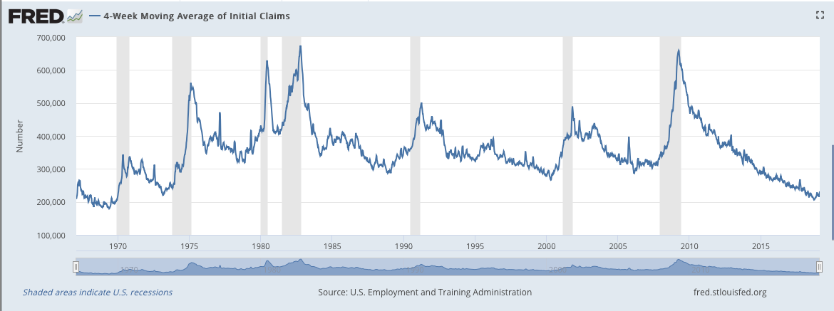
Weekly Jobless Claims –The Most Important Statistic -6,000 to 229,000

Slide 14
The Bill Davis View A $1,500 Upgrade for the Mad Day Trader Service
Buys: | Entry | Target
CenturyLink, Inc. (CTL)-X | $ 12.00 | $ 17.00
DaVita Inc.(DVA) | $ 51.00 | $ 65.00
Tenneco Automotive (TEN) | $ 29.00 | $ 40.00
Kimberly Clark Corp (KMB) | $ 117.00 | $ 125.00
Baidu, Inc. (BIDU) | $ 167.00 | $ 177.00
Sells:
Tesla Inc. (TSLA) | $ 181.00 | $ 160.00
FleetCor Technologies (FLT) | $ 250.00 | $ 220.00
WorkDay Inc. (WDAY) | $ 200.00 | $ 170.00
DexCom Inc. (DXCM) | $ 155.00 | $ 140.00
Omega Heathcare (OMI) | $ 37.00 | $ 28.00

Slide 15
Stocks – Bull Trap
*Stocks are breaking out to new highs *Trading focusing on low and falling interest rates on the sole drive of stock prices and ignoring everything else *Investors flushed out during the December bottom are piling back in at the top, when they’re done, it’s over *Analysts are now looking for negative earnings growth in 2019 *Trade war settlement is 95% in the market, if it doesn’t happen the market will back that 95% out very quickly *Main indexes off 3.4% of upside versus 20% downside risk *Bottom Line: its bet the ranch time on tech longs, but stay away from those with big China exposure, like Apple, and weak dollar plays like energy, and emerging markets

Slide 16
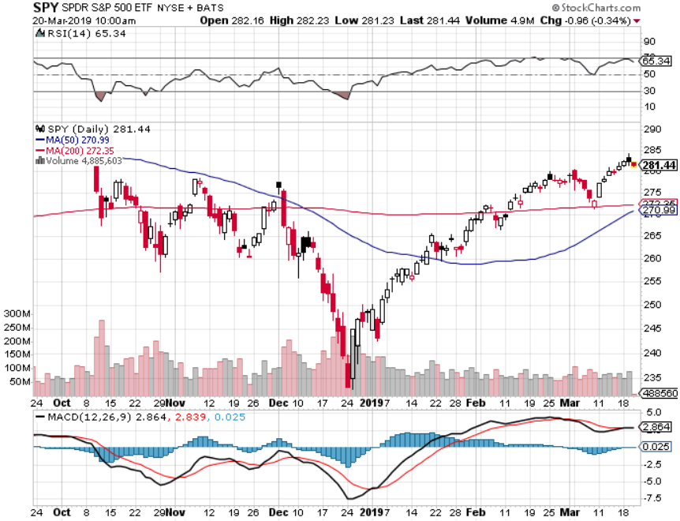
S&P 500- stopped out of long 2/$285-$290 bear put spread took profits on long 2/$270-$275 bear put spread

Slide 17
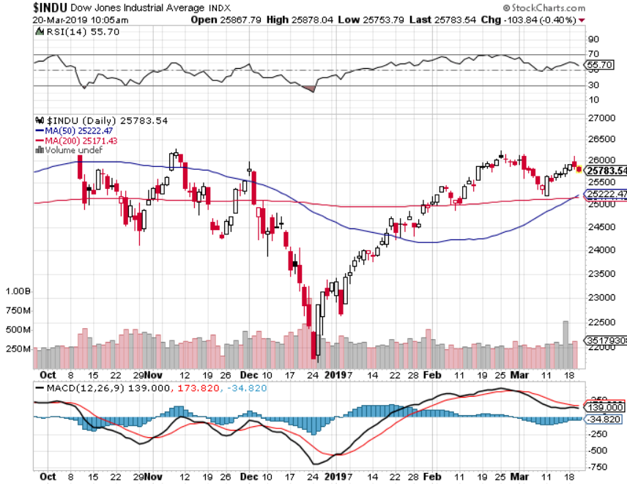
Dow Average-

Slide 18
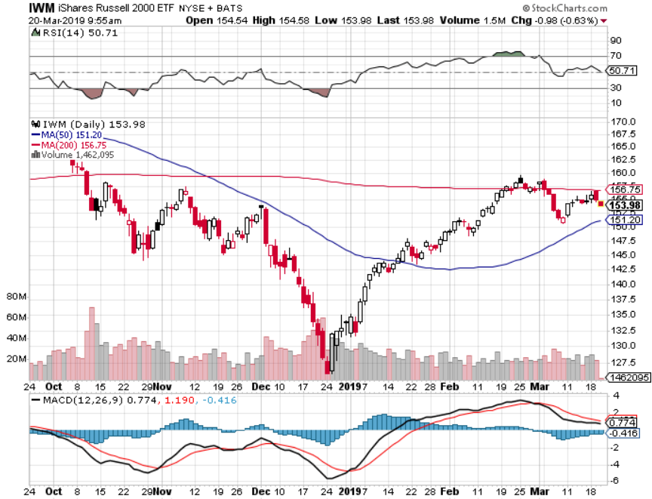
Russell 2000 (IWM)- Long 4/$160-$165 vertical bear put spread

Slide 19
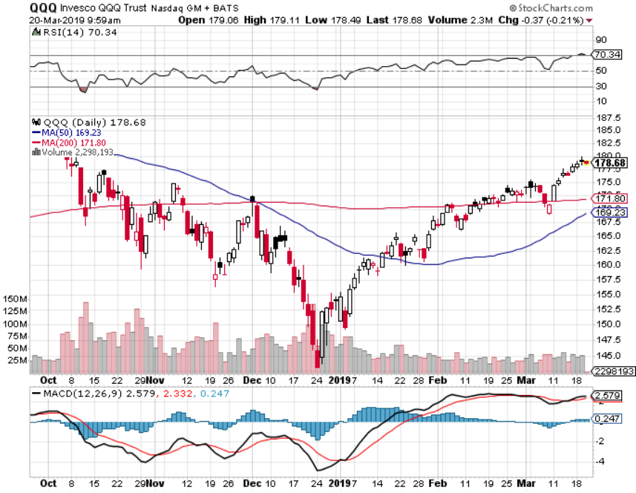
NASDAQ (QQQ)

Slide 20
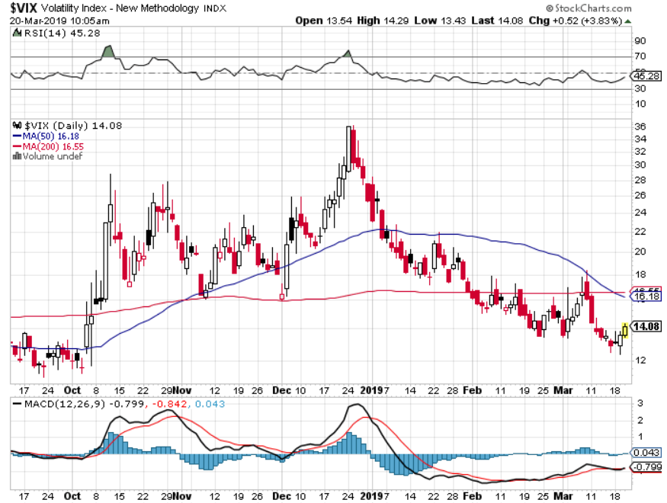
(VIX)- Probing Lows

Slide 21
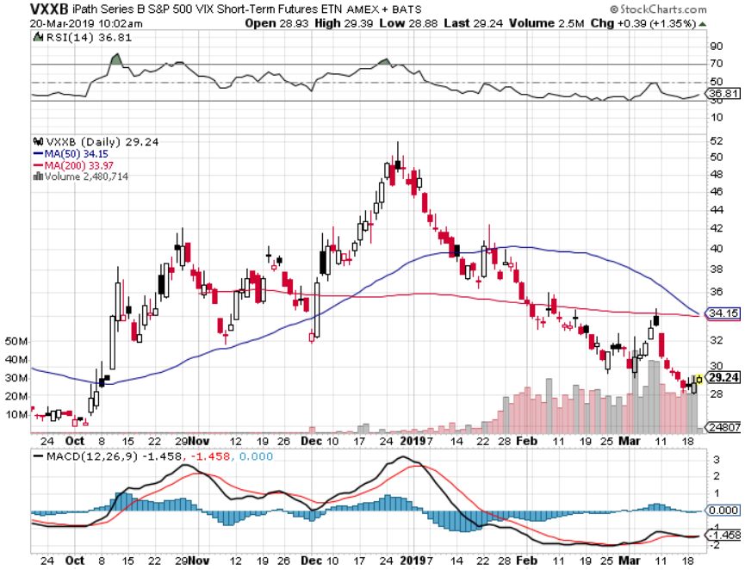
iPath S&P 500 VIX Short-Term Futures ETN (VXX)

Slide 22
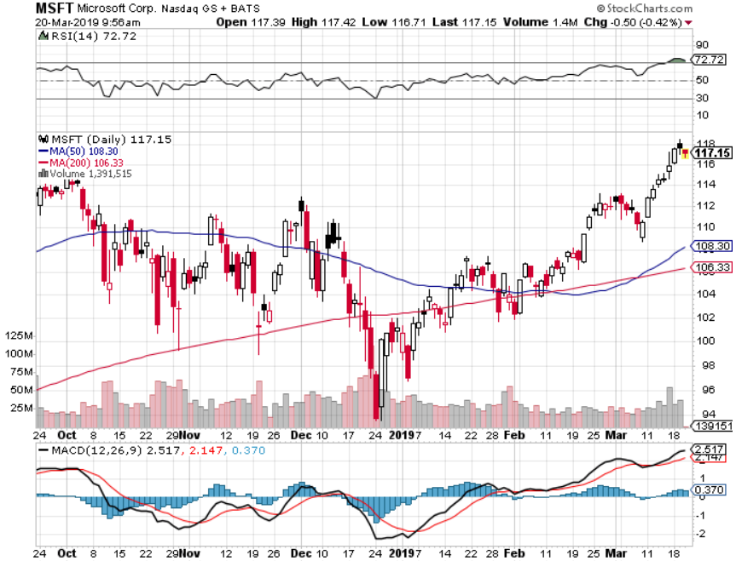
Microsoft (MSFT)- Earnings beat took profits on long 2/$85-$90 call spread

Slide 23
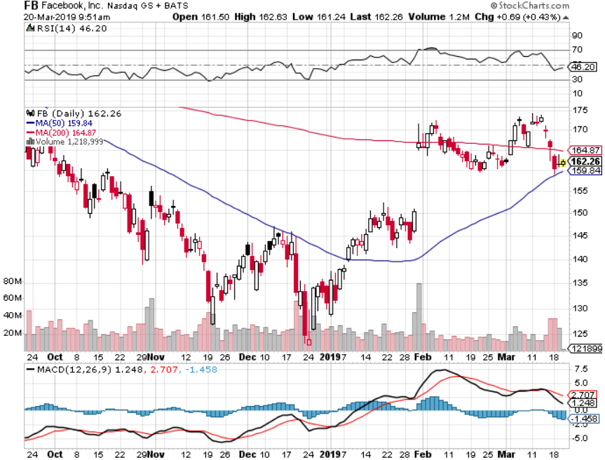
Facebook (FB)- Struggling

Slide 24
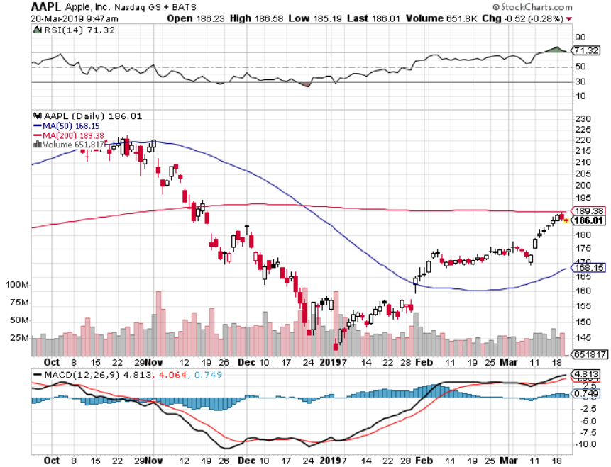
Apple (AAPL)- Underperforming Earnings mixed stopped out of long 3/$180-$185 bear put spread stopped out of long 11/$175-$180 bear put spread took profits on long 11/$165-$175 bear put spread

Slide 25
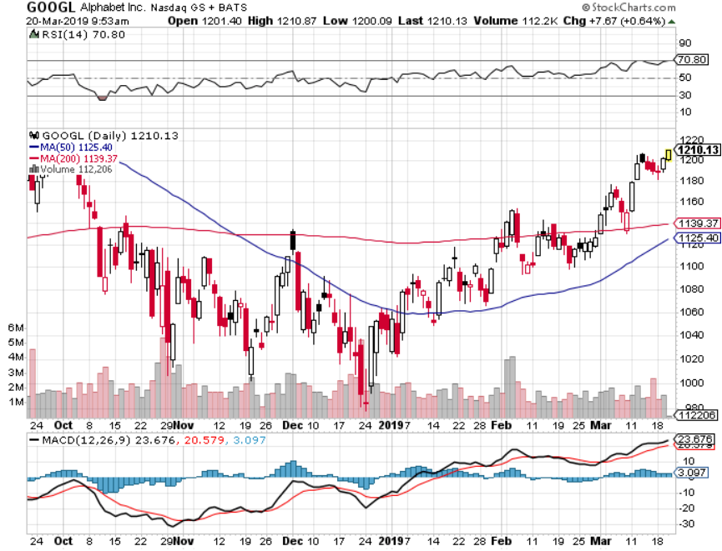
Alphabet (GOOGL)- Hit With $1.7 billion European fine

Slide 26
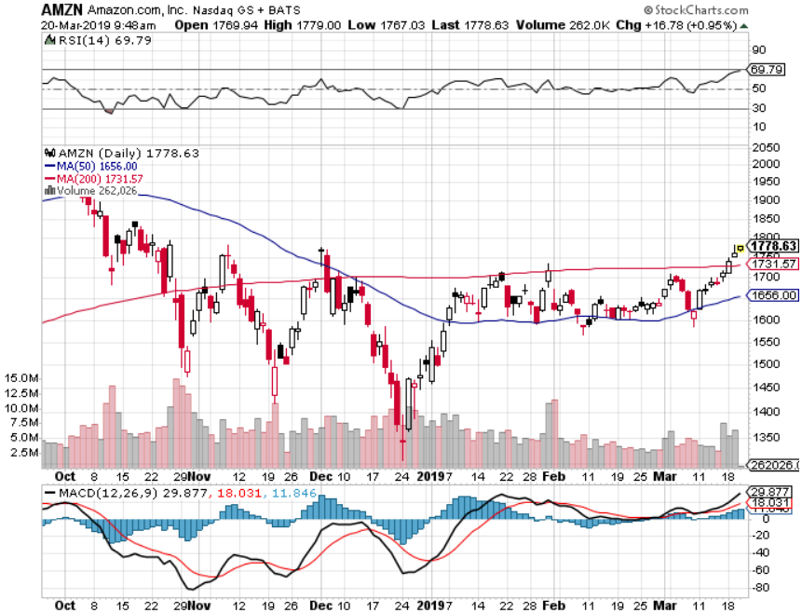
Amazon (AMZN)-Back to Top of Range Cancelled NY HQ2 to duck coming recession took profits on long 2/$1,200-$1,300 call spread

Slide 27
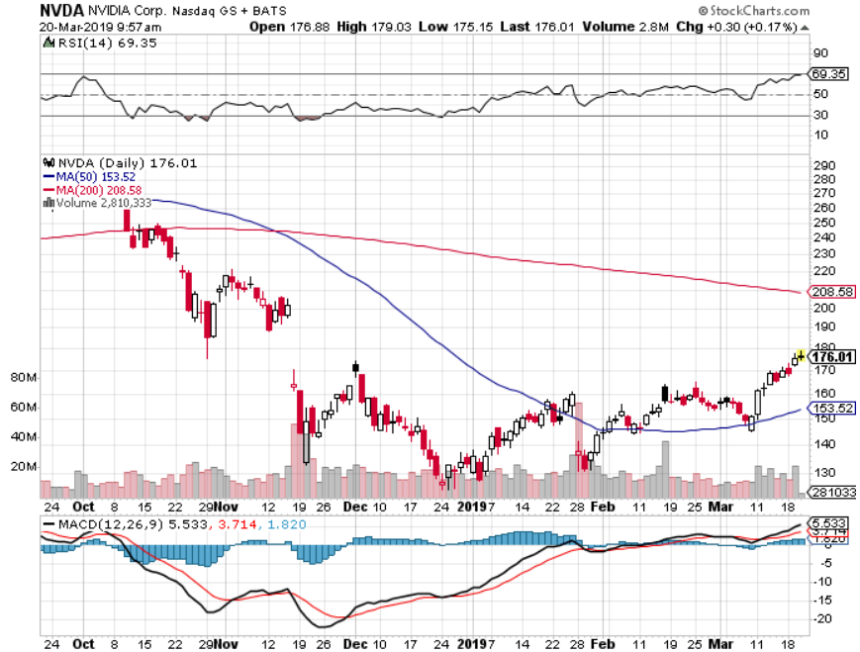
NVIDIA (NVDA)- earnings beat

Slide 28
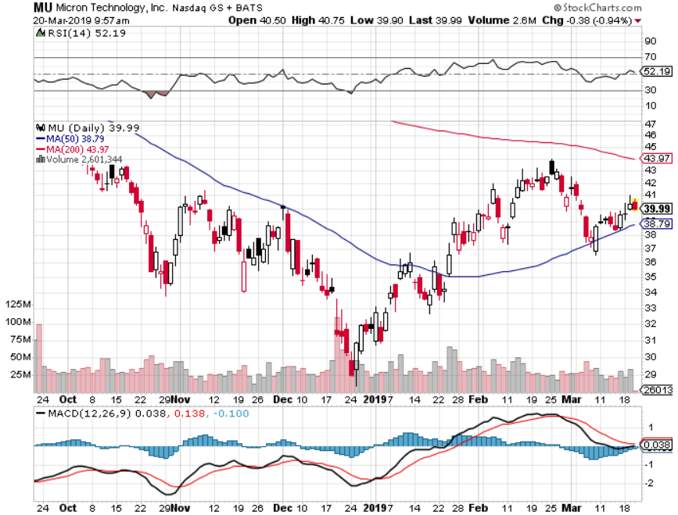
Micron Technology (MU)-

Slide 29
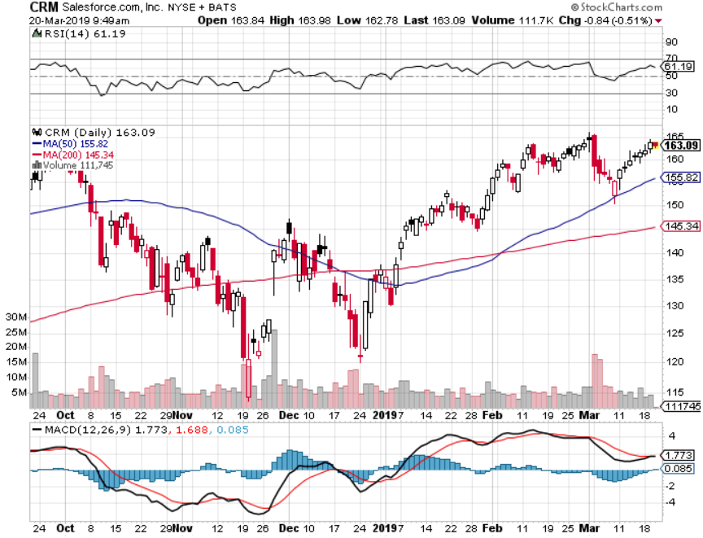
Salesforce (CRM)-Great Earnings-Poor Guidance took profits on long 2/$105-$115 call spread

Slide 30
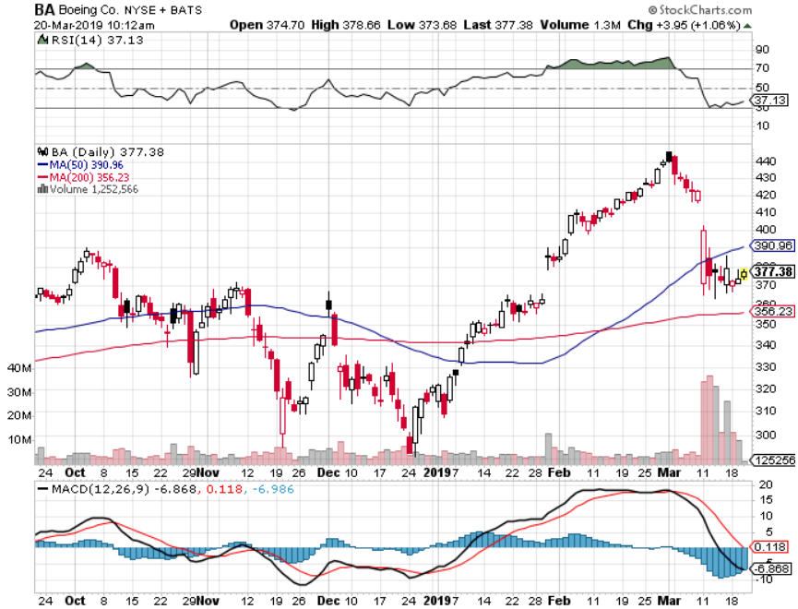
Boeing (BA)- Next to happen in the recertification bounce Long 4/$315-$335 vertical bull call spread

Slide 31
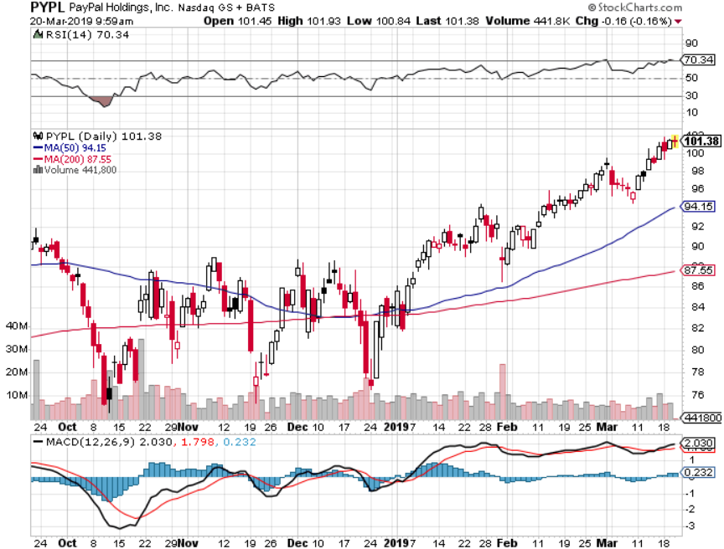
PayPal (PYPL)-

Slide 32
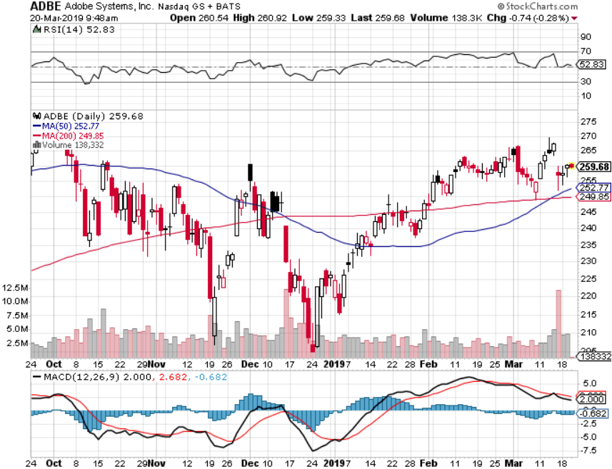
Adobe (ADBE)- The Quality Non-China tech play

Slide 33
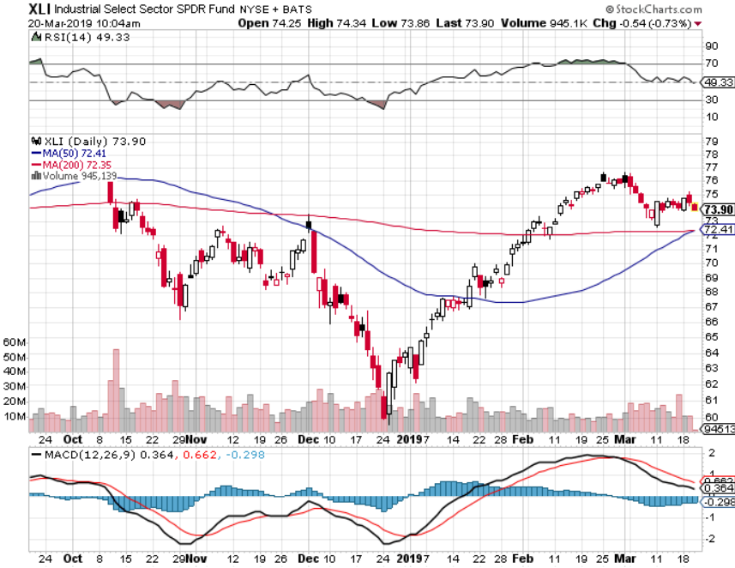
Industrials Sector SPDR (XLI)- (GE), (MMM), (UNP), (UTX), (BA), (HON)

Slide 34
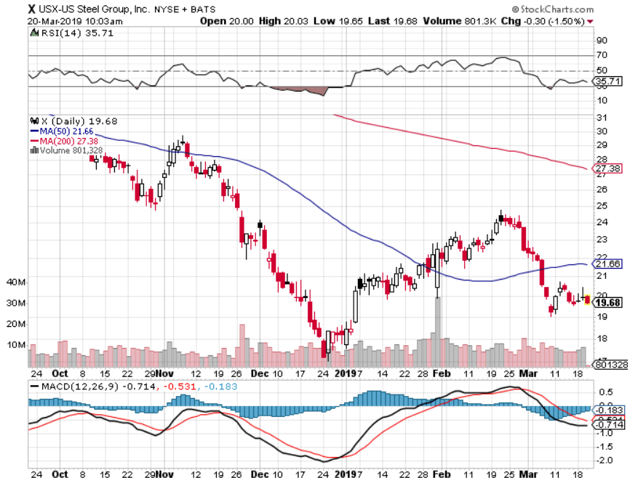
US Steel (X)-Tariffs Trouble Import duties cause users to abandon steel Unwound the entire Trump trade

Slide 35
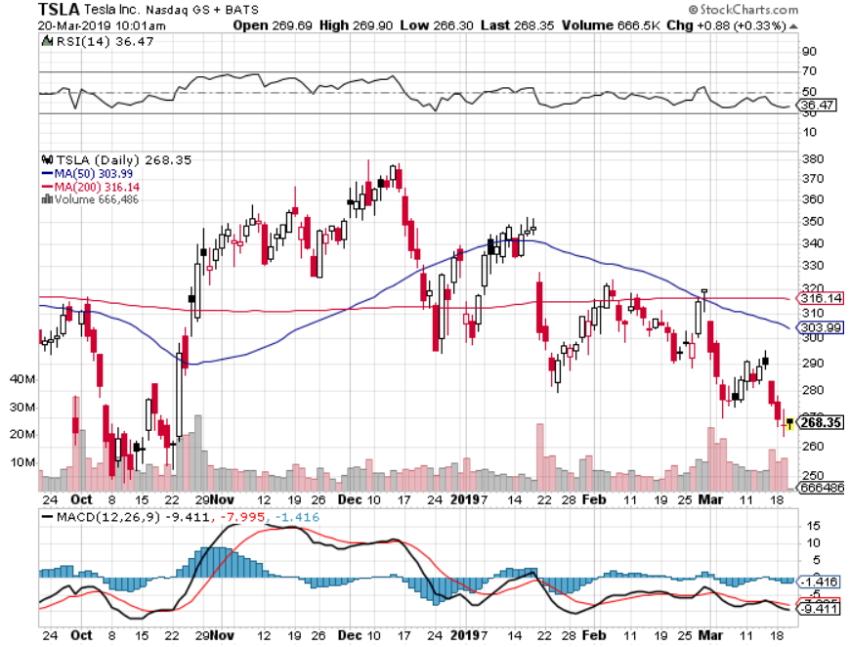
Tesla (TSLA)-Second Quarter of Earnings the Model Y is Out at $39,000 but won’t be available until 2021

Slide 36
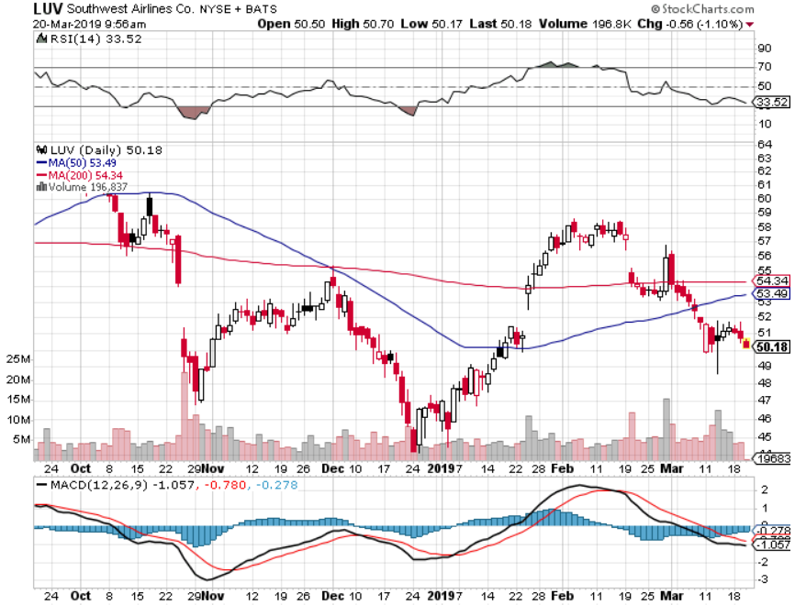
Southwest Airlines (LUV)-No oil help Warren Buffett’s Favorite Airline

Slide 37
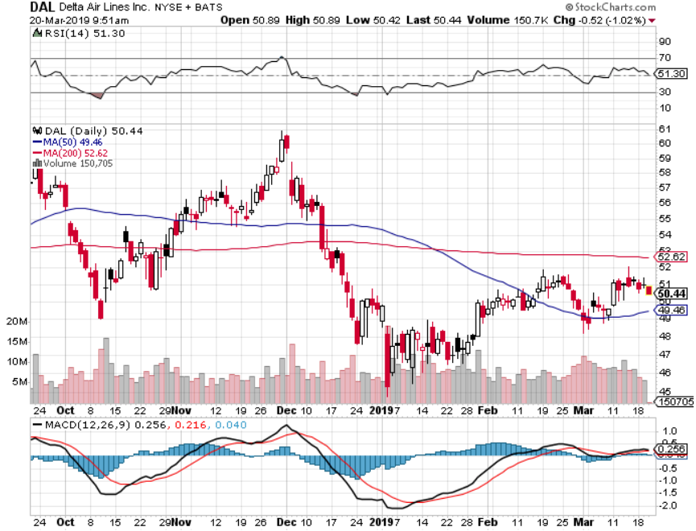
Delta Airlines (DAL)

Slide 38
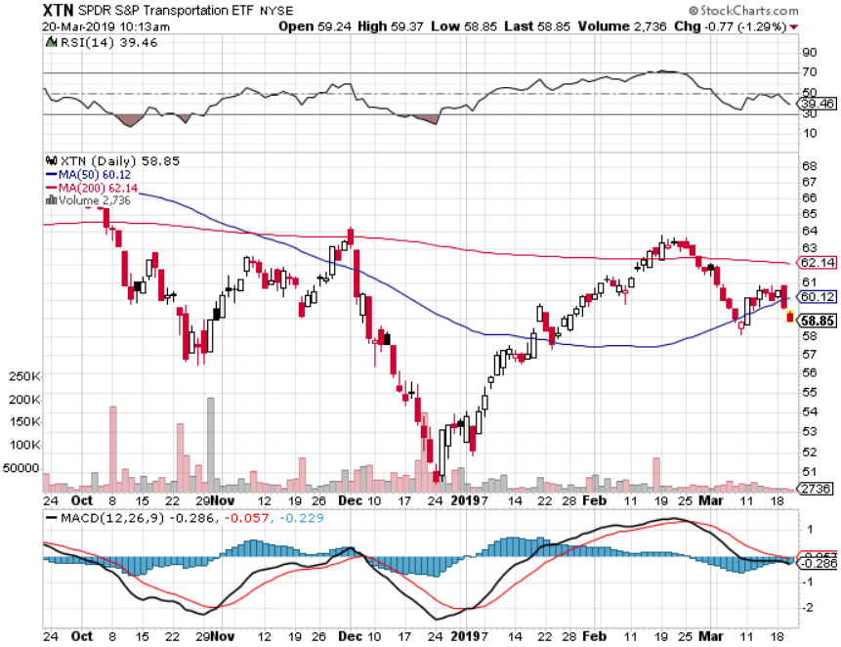
Transports Sector SPDR (XTN)- (ALGT), (ALK), (JBLU), (LUV), (CHRW), (DAL)

Slide 39
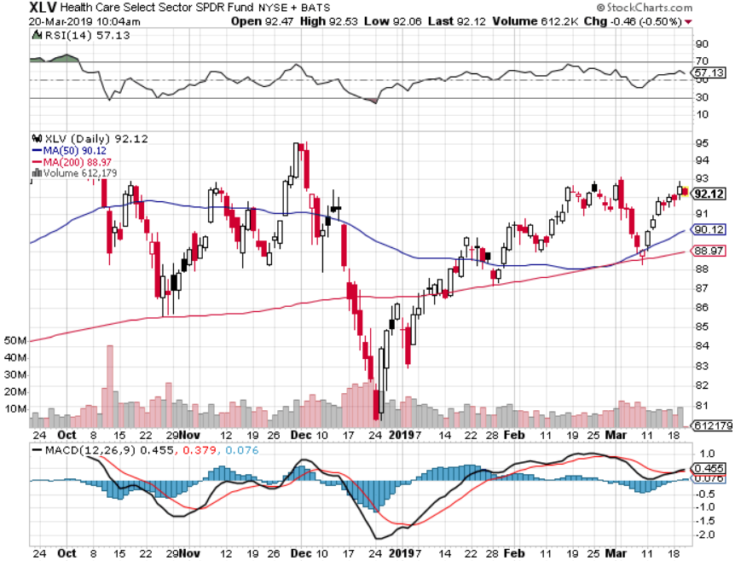
Health Care Sector (XLV), (RXL)-New Highs (JNJ), (PFE), (MRK), (GILD), (ACT), (AMGN)

Slide 40
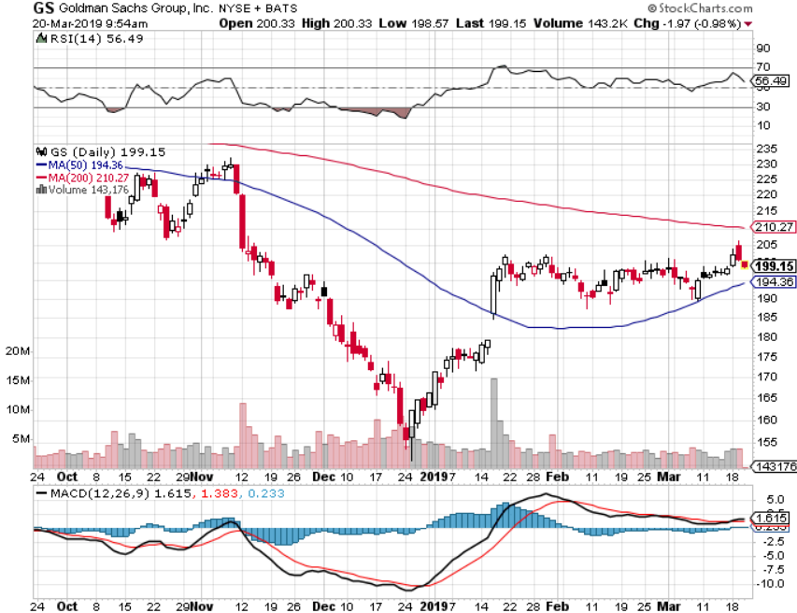
Goldman Sachs (GS)-Now looking at huge Malaysia fines

Slide 41
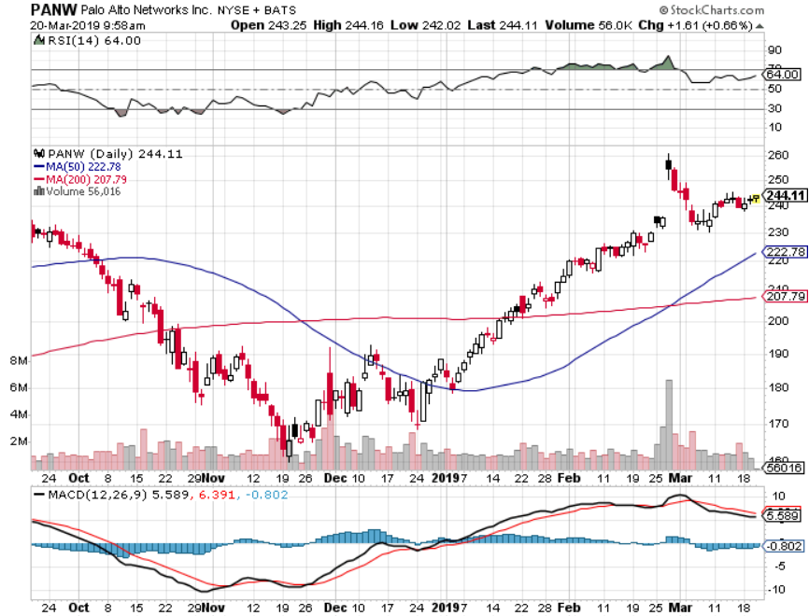
Palo Alto Networks (PANW)- Hacking never goes out of fashion

Slide 42
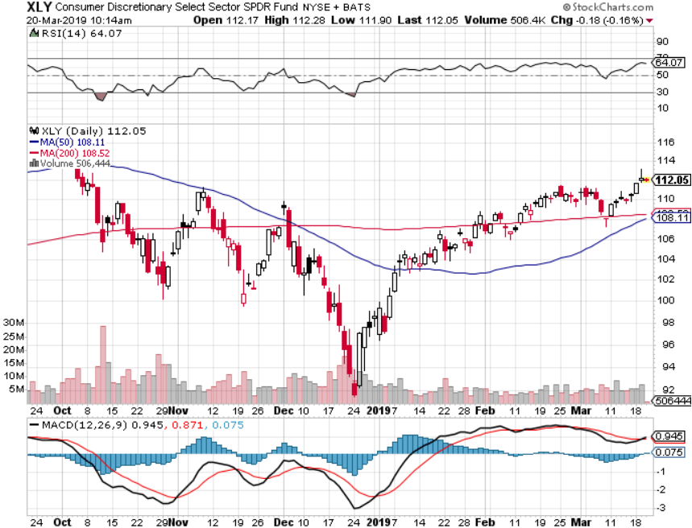
Consumer Discretionary SPDR (XLY) (DIS), (AMZN), (HD), (CMCSA), (MCD), (SBUX)

Slide 43
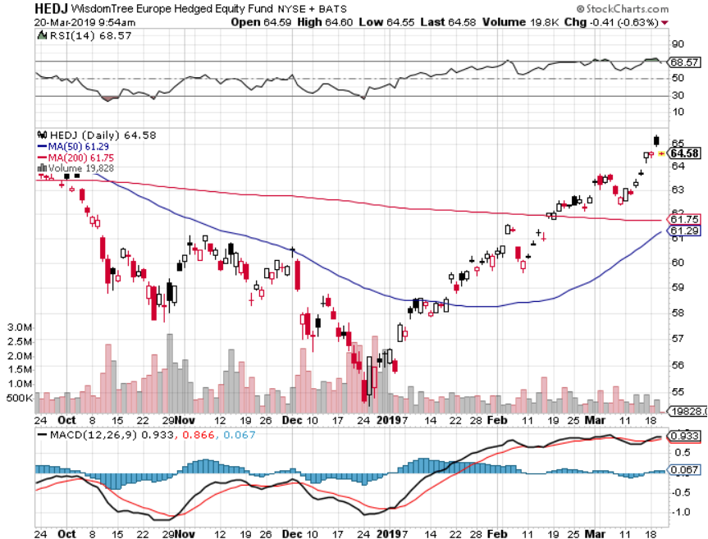
Europe Hedged Equity (HEDJ)-Quadruple top Top

Slide 44
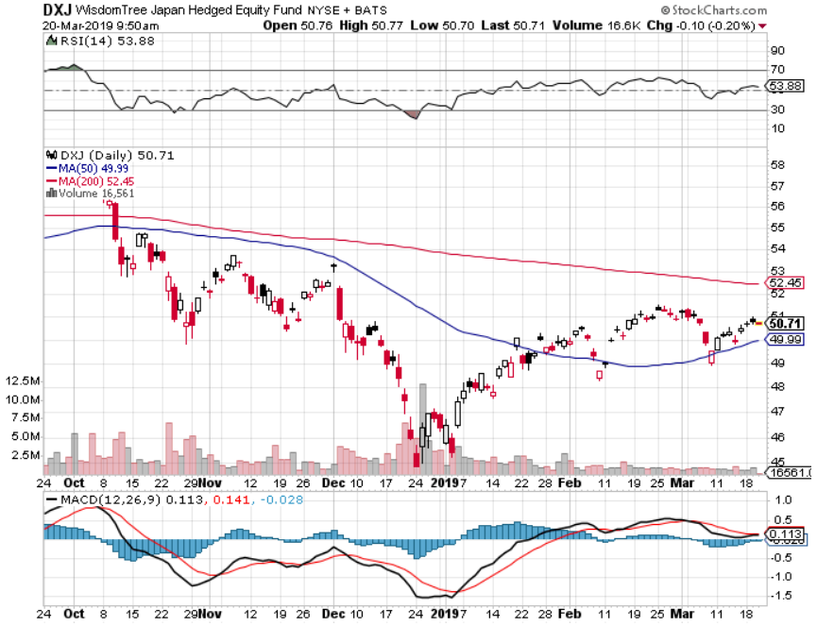
Japan (DXJ)-

Slide 45
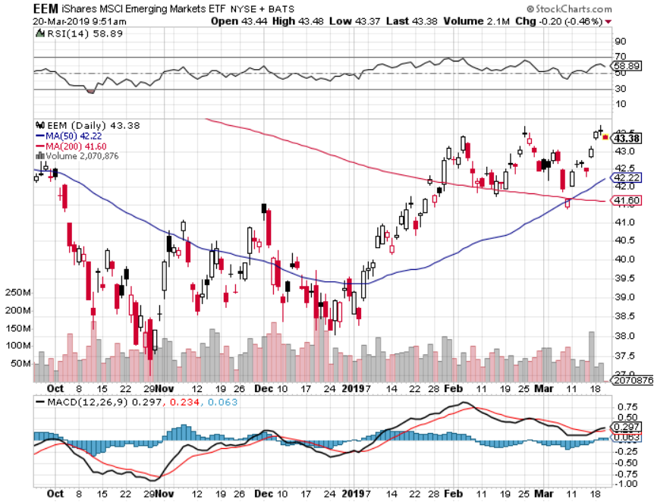
Emerging Markets (EEM)- Time to Buy on Weak Dollar

Slide 46
Bonds – New Highs
*New highs in bond prices bring new lows in ten year yields *US rates are being pulled down by lower rates in Europe and Japan rather than pulled down from US economic weakness. *German bund yields plunge to 0.10%, while Japan government bonds turn in a -0.05% yield *Peak in this cycle is already in at 3.25%, so I’m giving up on short positions in bonds for the time being *Wait for this bond rally to run its course before stepping back in

Slide 47
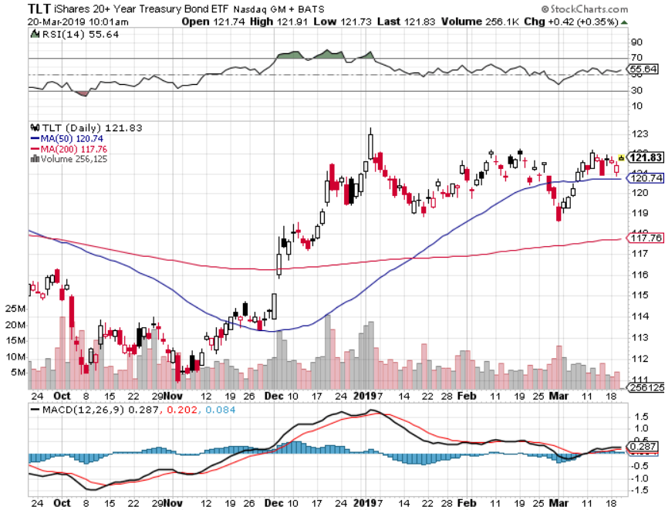
Treasury ETF (TLT) – Bottom of Range long 3/$124-$126 put spread- expired at maximum profit point Expiration of long 2/$124-$126 put spread at maximum profit point took profits on long 2/$125-$128 call spread again took profits on long 1/$124-$127 call spread took profits on long 2/$125-$128 call spread

Slide 48
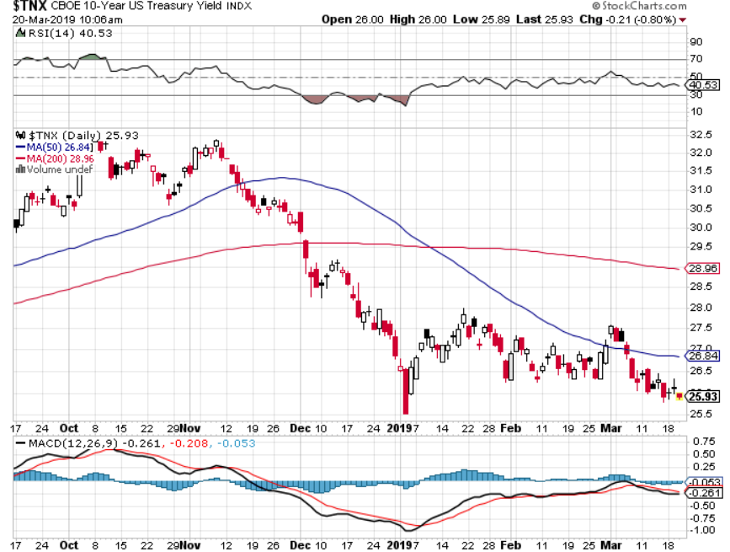
Ten Year Treasury Yield ($TNX) 2.59% Breakdown

Slide 49
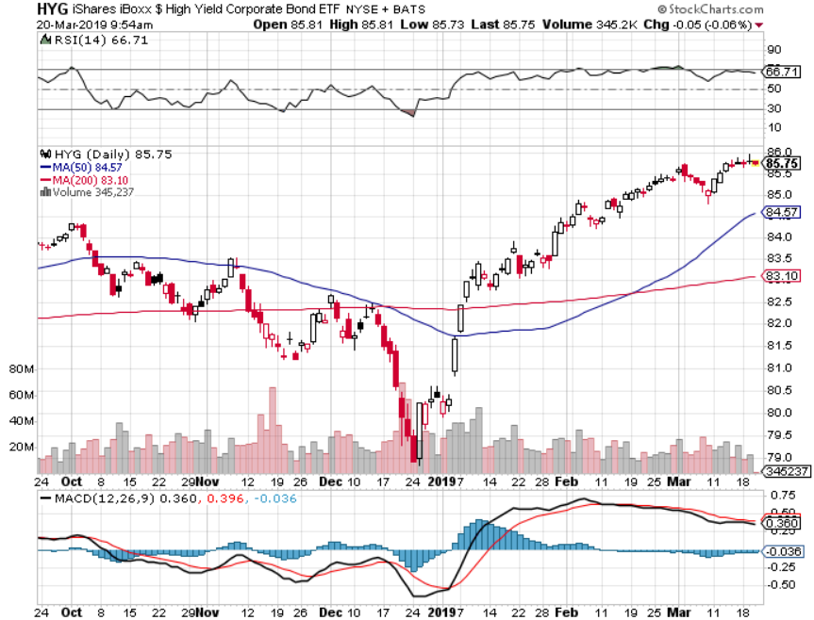
Junk Bonds (HYG) 5.60% Yield

Slide 50
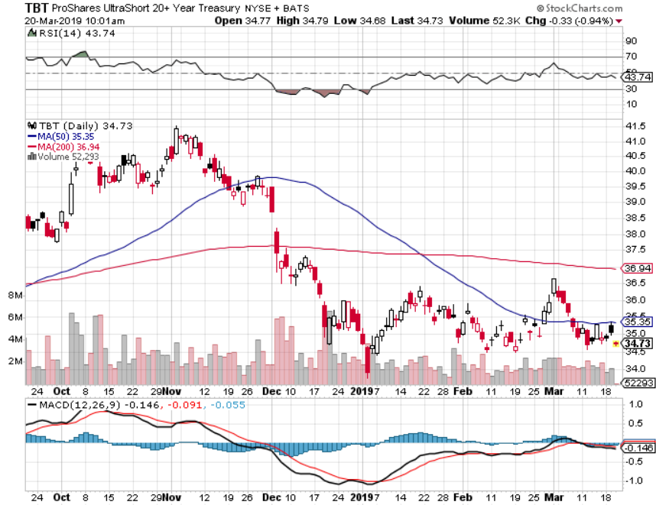
2X Short Treasuries (TBT)-Buy Territory

Slide 51
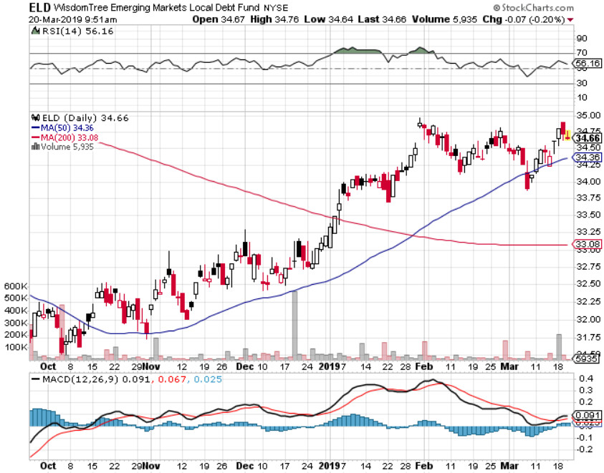
Emerging Market Debt (ELD) 6.02% Yield-

Slide 52
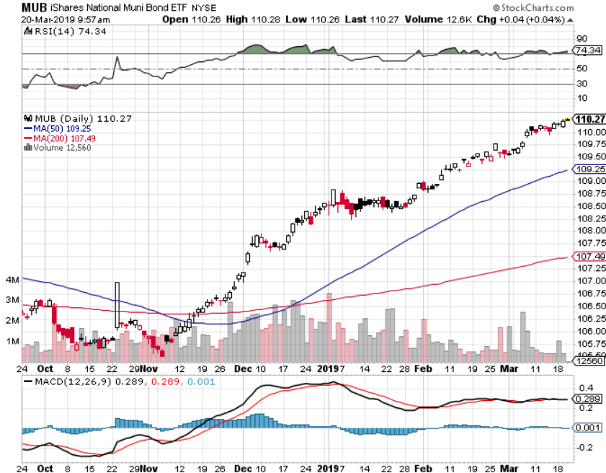
Municipal Bonds (MUB)-2.52% Mix of AAA, AA, and A rated bonds

Slide 53
Foreign Currencies – Weak again
*US dollar recovers to new one year high *Makes no sense in the face of falling US rates, so are foreign rates falling faster? *British pound stages another huge rally on Brexit fail *Massive Chinese economic stimulus drives Yuan higher *Bitcoin rally continues, but futures cease trading *Bottom Line: stand aside

Slide 54
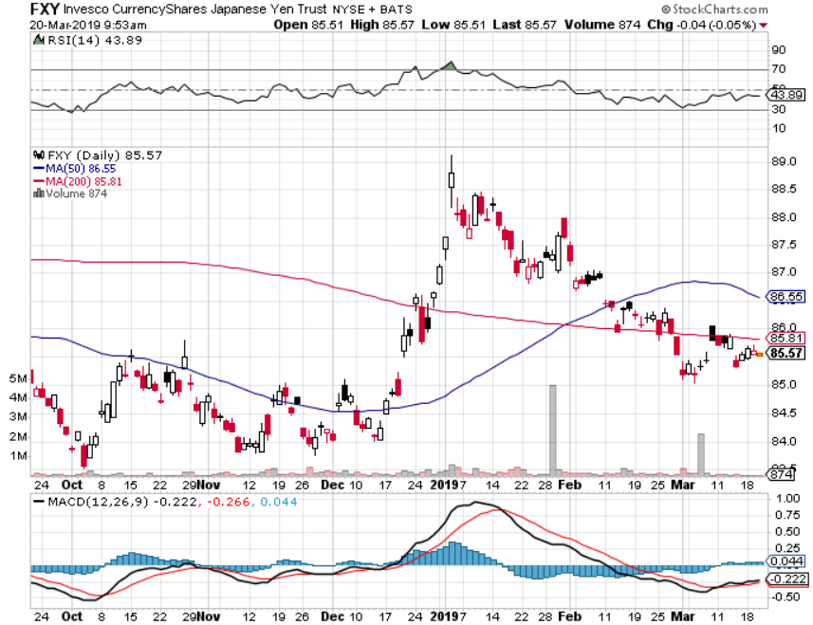
Japanese Yen (FXY), (YCS)

Slide 55
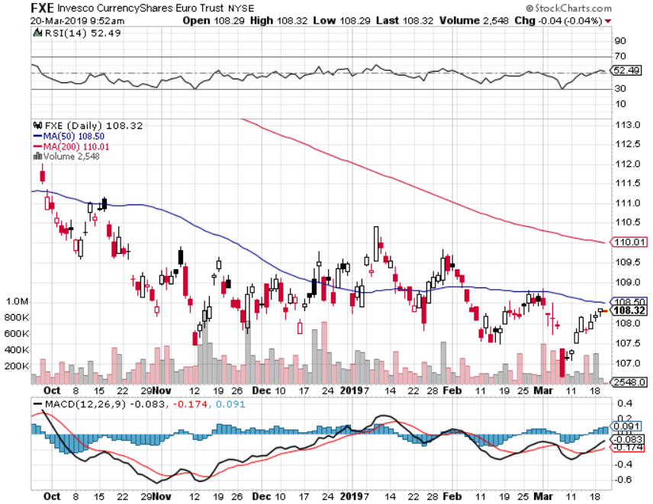
Euro ($XEU), (FXE), (EUO)- Trying to Break Down long 2/$105-$108 call spread

Slide 56
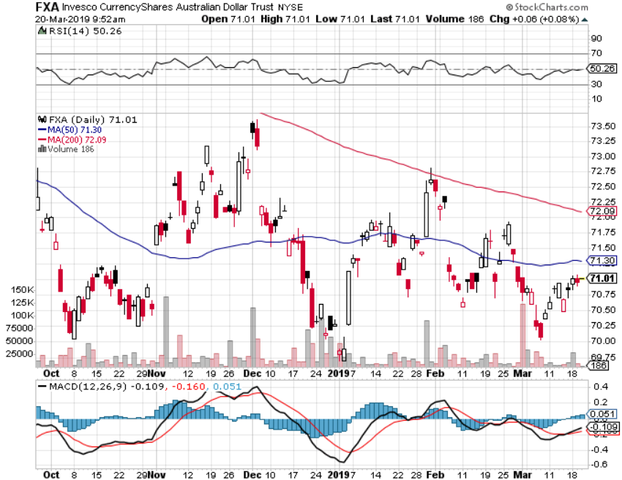
Australian Dollar (FXA)-

Slide 57
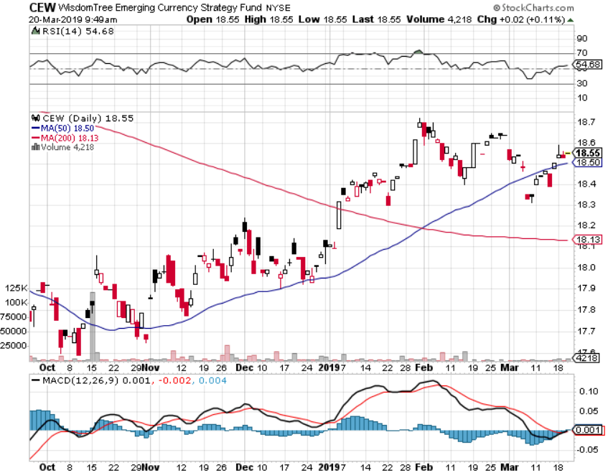
Emerging Market Currencies (CEW)

Slide 58
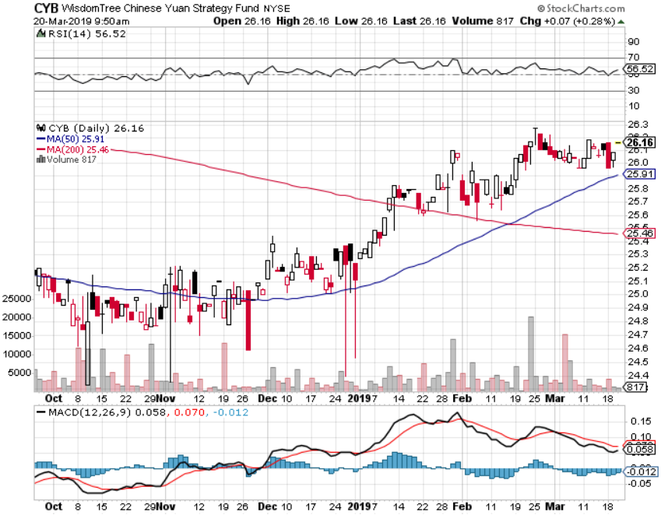
Chinese Yuan- (CYB)-

Slide 59
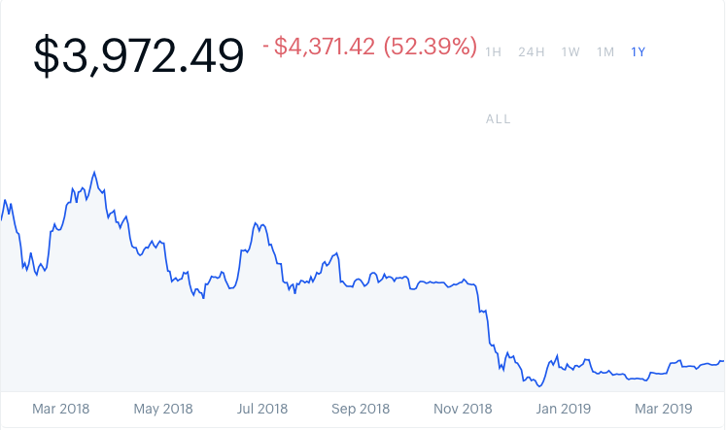
Bitcoin- 10% Rally Venezuela collapse is creating demand

Slide 60
Energy –
*Norwegian labor strikes could take 100,000 b/d off the market *Venezuelan production shrinks to only 500,000 b/d because of power outages *Saudi Arabian production now 300,000 below cap, Russia down 200,000 b/d *Massive draw down in inventories boosts prices *Recovering China economy is another major positive *Bottom Line: Buy the dips

Slide 61
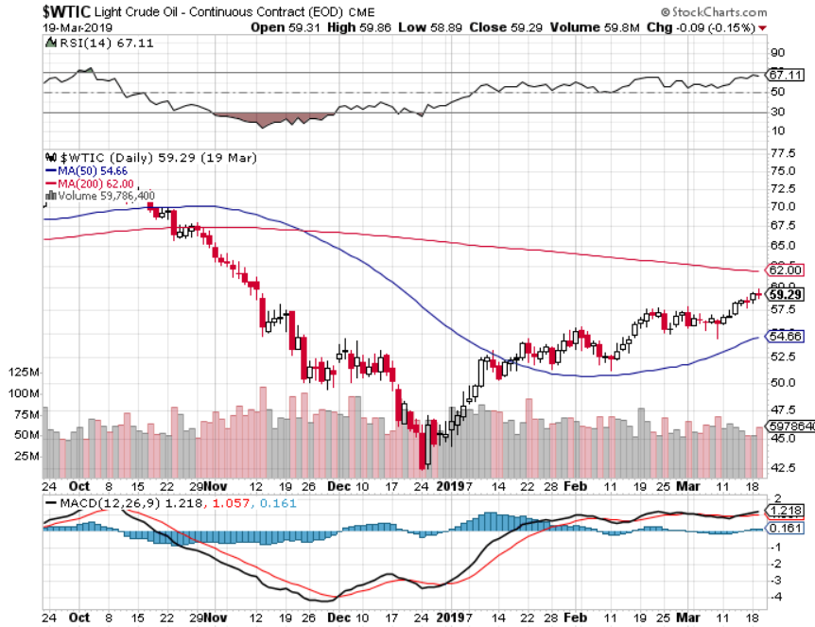
Oil-Bouncing

Slide 62
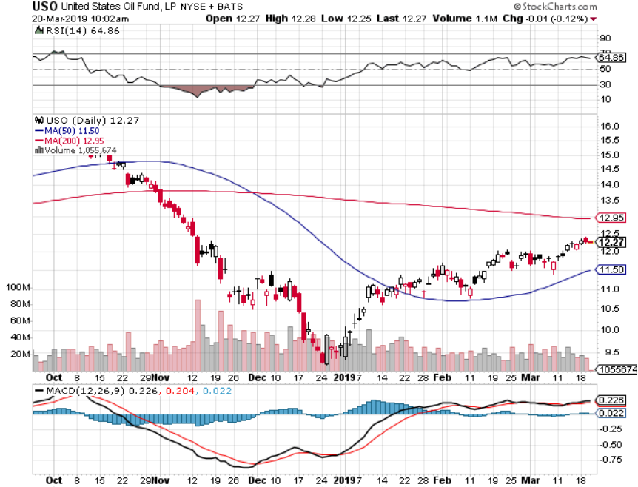
United States Oil Fund (USO)

Slide 63
Energy Select Sector SPDR (XLE)-No Performance! (XOM), (CVX), (SLB), (KMI), (EOG), (COP)

Slide 64
Halliburton (HAL)-

Slide 65
Natural Gas (UNG)- Major Hedge Fund Blow Up

Slide 66
Copper (COPX)- Upside breakout Trade War Deal Coming

Slide 67
Precious Metals – Taking a Break
*Sudden plunge in US interest rates forces gold to take a break *This makes no sense as gold usually does well in a falling rate environment because there is less yield competition *China gold reserves rise for third year to $79.5 billion, and more is coming as deficit driven distrust of the dollar rises *Central bank buying continues in major way as most foreign governments see Trump economic policies blowing up *However, the long term trend is intact until the Fed starts raising rates again. *Buy Dips

Slide 68
Gold (GLD)- The flight to safety bid is coming Stopped out of 3/$119-$122 vertical bull call spread

Slide 69
Market Vectors Gold Miners ETF- (GDX) – Yikes!

Slide 70
Barrick Gold (GOLD)

Slide 71
Newmont Mining- (NEM)-

Slide 72
Palladium - (PALL)-

Slide 73
Real Estate – Bracing for the Worst
*Homebuilder Sentiment drops from 70 to 62 in a year, all eyes are now on the spring selling season with most builders in defensive mode *Loss of real estate taxes and mortgage interest deductions is definitely hurting the market *California far and away the worst place for first time home buyers, Pitssburgh, Minneapolis, and Kansas City the best *30 year fixed rate loan drops to 4.64% *December S&P 500 Case-Shiller drops to 4.2%, annual gain, the lowest gain in 3 ½ years *Bottom Line: Stand aside for a trade but buy for long term investment

Slide 74
December Corelogic S&P Case Shiller Home Price Index Las Vegas (11.4%), Phoenix (8%), and Atlanta (5.9%) showing biggest gains
Tradingeconomics.com

Slide 75
Simon Property Group (SPG)-

Slide 76
US Home Construction Index (ITB) (DHI), (LEN), (PHM), (TOL), (NVR)

Slide 77
Trade Sheet- So What Do We Do About All This?
*Stocks-chase with a tight stop *Bonds-stand aside *Commodities-buy dips *Currencies-stand aside *Precious Metals – buy dips *Volatility-buy dips to $12 *Real estate-stand aside

Slide 78
Next Strategy Webinar 12:00 EST Wednesday, April 3, 2019 from Lake Tahoe, Nevada www.madhedgefundtrader.com email me at support@madhedgefundtrader.com
Good Luck and Good Trading!
Notes:
*

