Slide 1
The Mad Hedge Fund Trader “The Inmates Have Taken Over the Asylum”
With John Thomas from Silicon Valley, CA, April, 3, 2019 www.madhedgefundtrader.com
Notes:
*

Slide 2
October 25-26 Lake Tahoe Conference 50% of seats already sold out
*Two days of informative speakers on crucial trading and investment issues *Trade tips with the most successful Mad Hedge traders *2 nights in the Hyatt, including all you can eat and drink *Tickets are a bargain at $699 to $1,999 *Buy now, upper ticket classes sell out first

Slide 3
Trade Alert Performance New Highs!
*January 9.49% Final *July +0.0% Final *February +4.64% Final *August +2.19% MTD *March +1.78% Final *September 1.38% Final *April -0.36% Final *October +1.37% Final *May +1.07% Final *November -1.83% Final *June +4.15% Final *December -4.13% Final *2019 Year to Date +15.42% compared to +11.78% for the Dow Average *Trailing One year return +35.16%, +315.56% since inception, *Average annualized return of 33.81% for 9 1/2 years

Slide 4
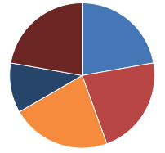
Portfolio Review Running aggressively large portfolio with a bullish tilt 13 positions across GTD and Tech Letter
Risk On
World is Getting Better
(DIS) 4/$100-$104 call spread | 10.00%
(TLT) 4/$128-$130 put spread | 10.00%
Risk Off
(IWM) 4/$160-$165 put spread | -10.00%
(DIS) 4/$114 calls | -5.00%
(TSLA) 4/$300-$320 put spread | -10.00%
Total Net Position | -5.00%
Expiration P&L 19.86%

Slide 5
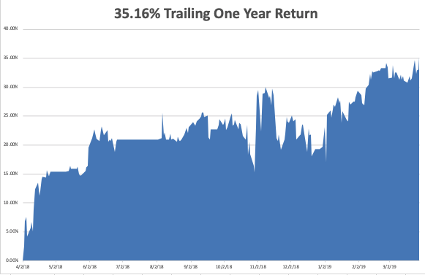
GTD Daily Audited Performance

Slide 6
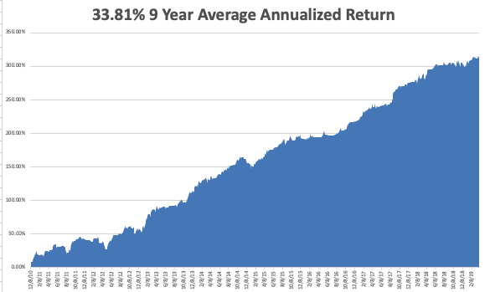
GTD 9 Year Daily Audited Performance

Slide 7
The Method to My Madness
*Market trapped in narrow ranges as positives counter balance negatives *Foreign capital pouring into the US is pricing all assets at a premium *Low interest rates are the main driver now and traders are ignoring everything else, like earnings and valuations, and the economy *US Bonds melt up returning ultra low interest rates *Decline in earnings growth is accelerating but may bounce back in Q2 and Q3 *Oil remains strong *China trade war moves to the back burner overshadowed by international bond markets

Slide 8
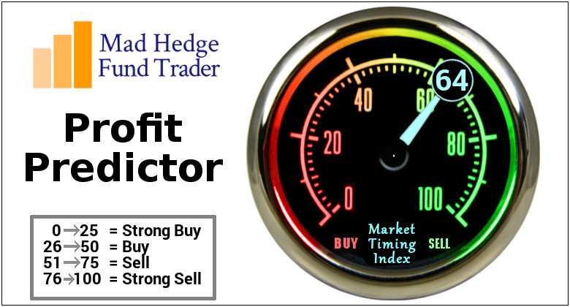
The Mad Hedge Profit Predictor Market Timing Index- An artificial intelligence driven algorithm that analyzes 30 different economic, technical, and momentum driven indicators

Slide 9
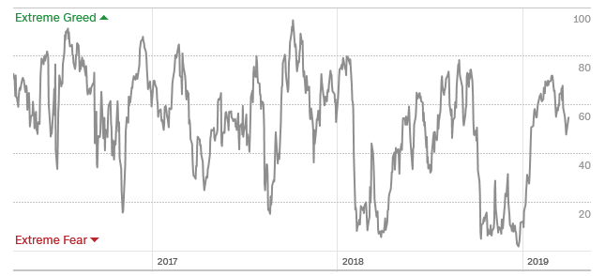
The Mad Hedge Profit Predictor Taking another run at the highs
SELL
BUY

Slide 10
The Global Economy – Weak
*Investors are waiting for the ax to fall with the Q1 GDP print out April 23, so the global easing trend is accelerating, Q4 GDP Final Report Comes in at 2.2%, February Durable Goods -1.6%, March Nonfarm Payroll Report is more important than usual this week *Economic data flow is almost all terrible, except for housing, which had a couple of positive data points *Bonds yields hit new low for 2019 at 2.33% *Europe is close to printing actual recession numbers *Newly strong dollar will hurt non-dollar plays, like emerging markets (EEM) and the currencies (FXE) and (FXA), and oil (USO)

Slide 11
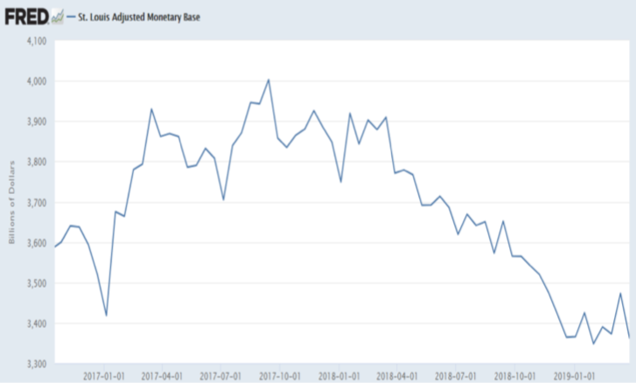
Here’s a Big Problem Shrinkage of Fed Balance Sheet Means Less Money to Buy Stocks

Slide 12
Soybeans (-20%)-Trade War Indicator rolling over price action hits on a big “Sell the news” on China trade deal, or no China trade deal-no flood boost

Slide 13
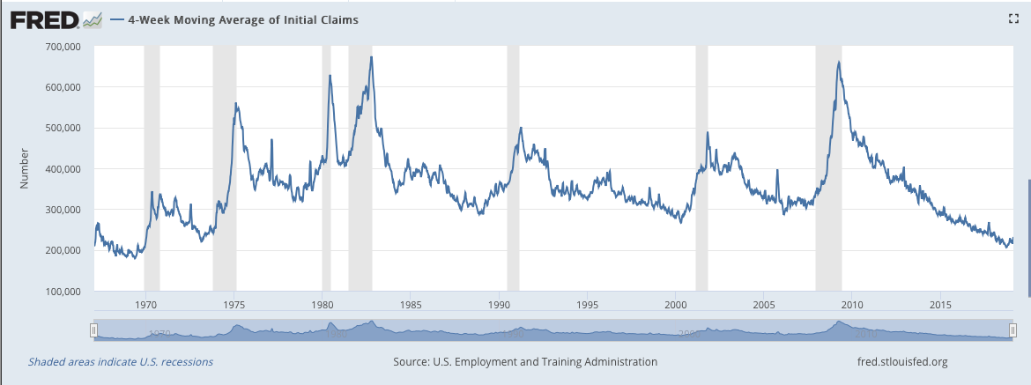
Weekly Jobless Claims –The Most Important Statistic -5,000 to 211,000

Slide 14
The Bill Davis View A $1,500 Upgrade for the Mad Day Trader Service
Buys: | Entry | Target
GrubHub Inc. (GRUB) | $ 68.00 | $ 88.00
National Beverage Corp (FIZZ) | $ 58.00 | $ 75.00
Logmein Inc. (LOGM) | $ 81.00 | $ 94.00
Upwork Inc, (UPWK) | $ 19.00 | $ 28.00
Becton Dickinson (BDX) | $ 245.00 | $ 255.00
Sells:
Tesla Inc. (TSLA) | $ 310.00 | $ 250.00
DexCom Inc. (DXCM) | $ 134.00 | $ 110.00
RH (RH) | $ 122.00 | $ 100.00
Herballife Nutrition Ltd.(HLF) | $ 55.00 | $ 45.00
Polo Ralph Lauren Corp (RL) | $ 130.00 | $ 108.00

Slide 15
Stocks – Wrong!
* The Stock Market is Got it Wrong, seeing plunging rates as a sign of imminent recession, instead of a massive foreign capital inflow. When the market figured this out this error, stocks rallied hard to new highs *Stocks are trapped in narrow sideways range with push and pull fundamentals canceling each other out, but the Dow is just 2.7% of new all time highs *When markets stop focusing on the awful Q1 GDP, they will look at better Q2 and Q3 numbers *Analysts are now looking for negative earnings growth in 2019 *Trade war has gone to sleep and nobody cares *Bottom Line: its bet the ranch time on tech longs, but stay away from those with big China exposure, like Apple, and weak dollar plays like energy, and emerging markets

Slide 16
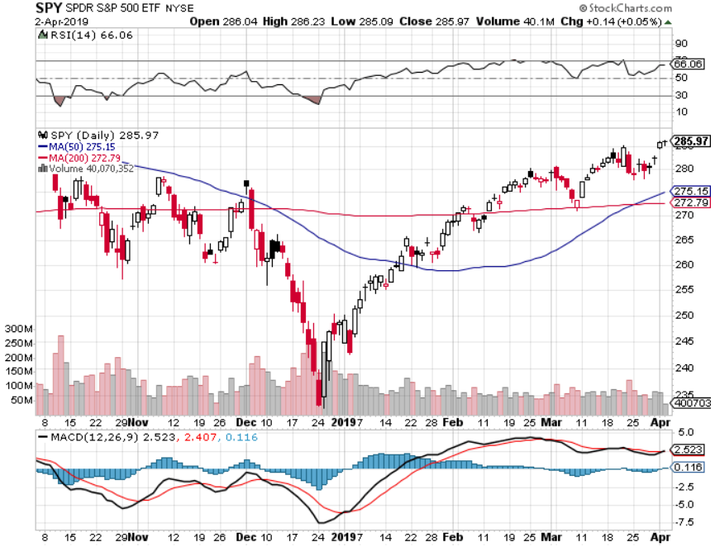
S&P 500- stopped out of long 2/$285-$290 bear put spread took profits on long 2/$270-$275 bear put spread

Slide 17
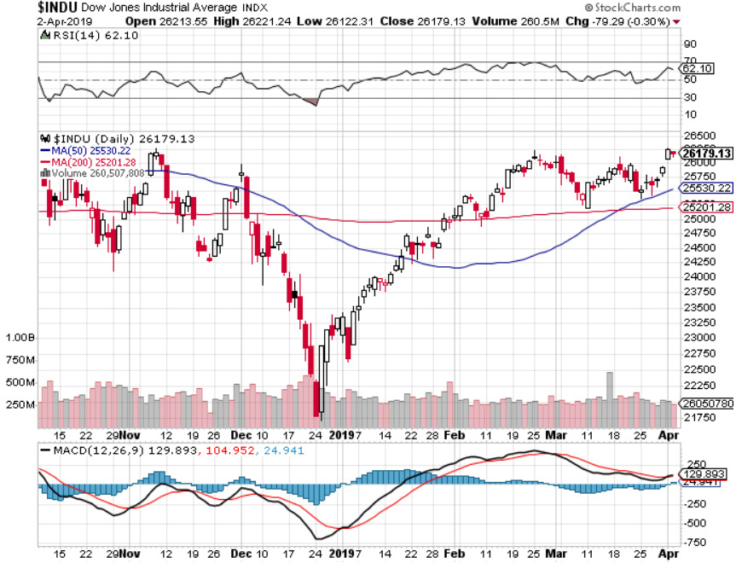
Dow Average-

Slide 18
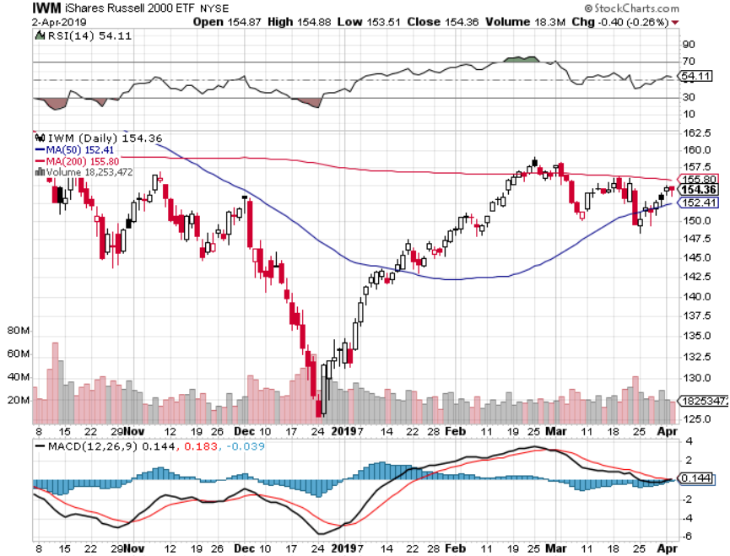
Russell 2000 (IWM)- Long 4/$160-$165 vertical bear put spread - expires in 12 trading days

Slide 19
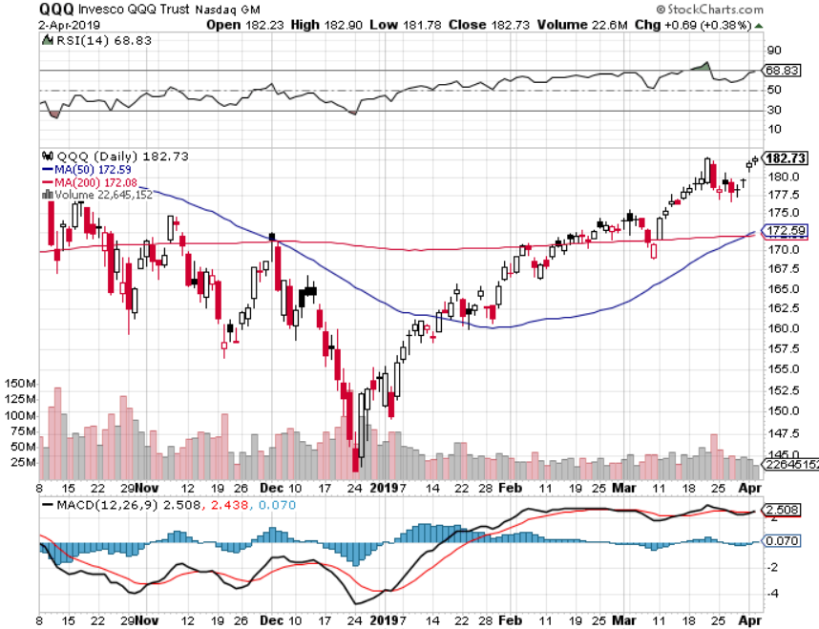
NASDAQ (QQQ)

Slide 20
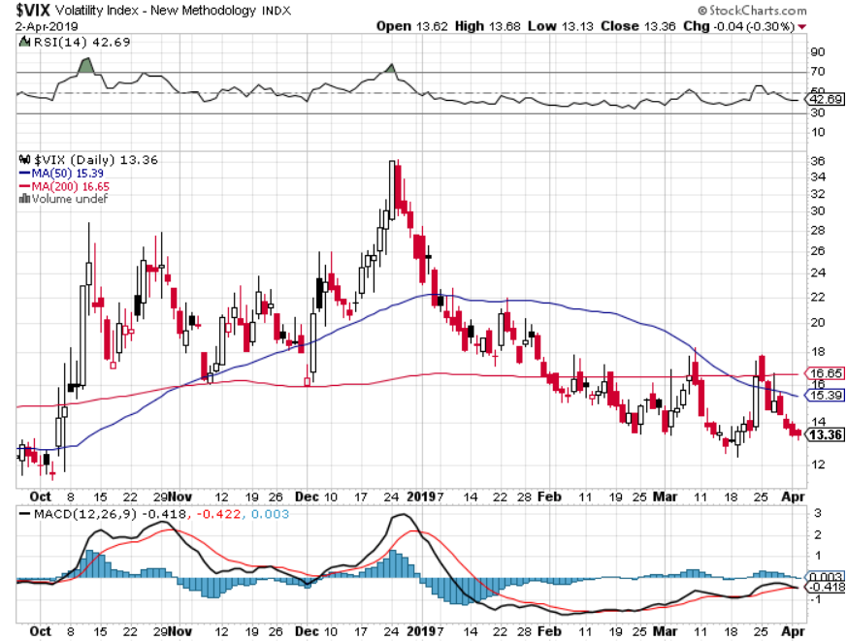
(VIX)- Probing Lows

Slide 21
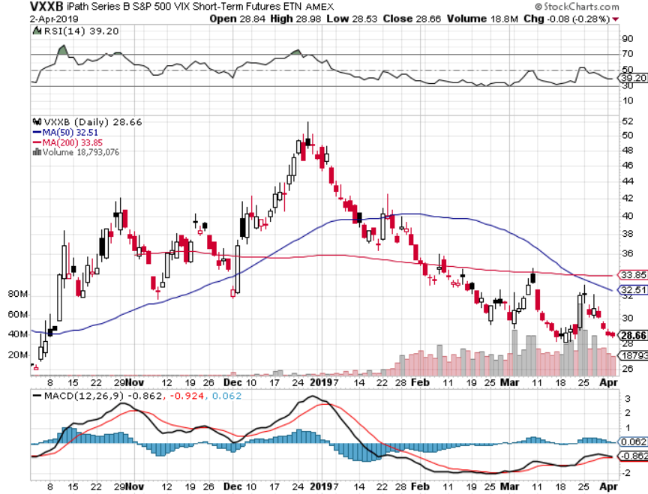
iPath S&P 500 VIX Short-Term Futures ETN (VXX)

Slide 22
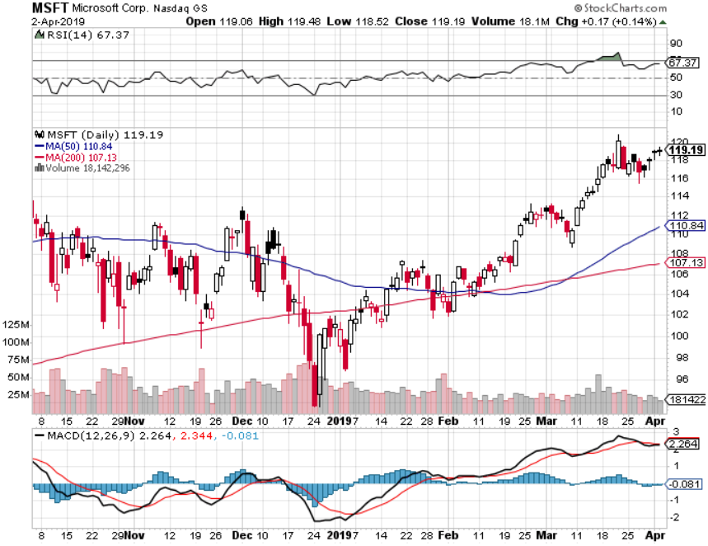
Microsoft (MSFT)- Earnings beat long 4/$108-$113 call spread - expires in 12 trading days took profits on long 2/$85-$90 call spread

Slide 23
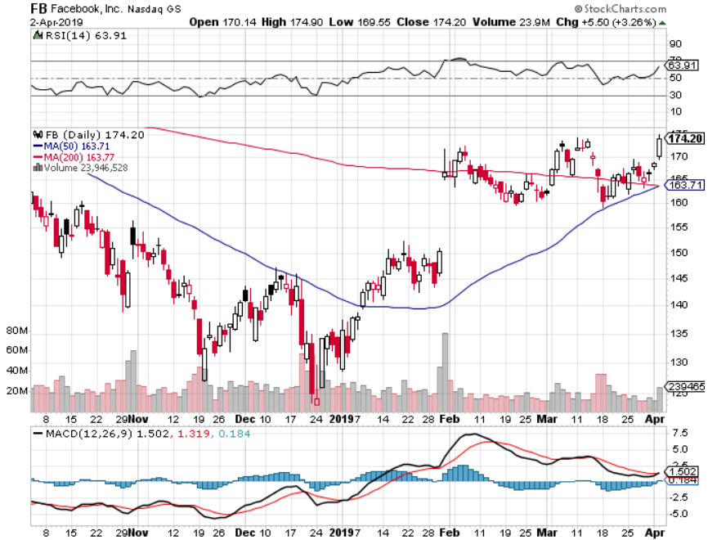
Facebook (FB)- FANG bounce

Slide 24
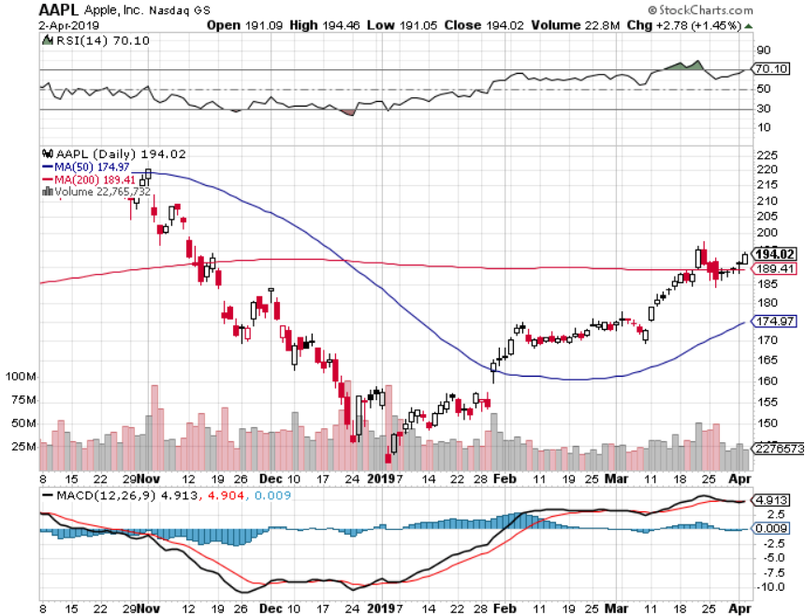
Apple (AAPL)- Bull Run New Apple Plus Streaming Service stopped out of long 3/$180-$185 bear put spread stopped out of long 11/$175-$180 bear put spread took profits on long 11/$165-$175 bear put spread

Slide 25
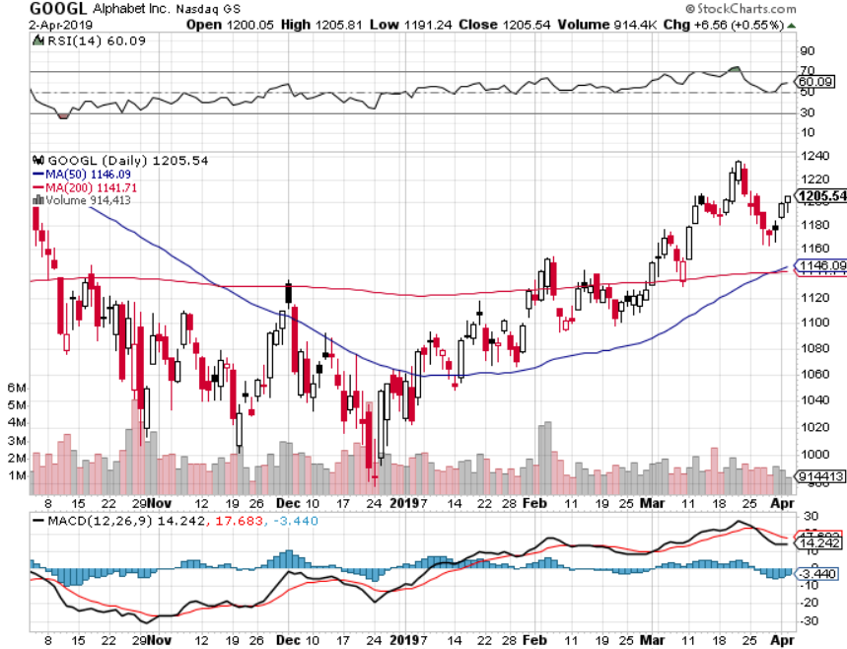
Alphabet (GOOGL)- long 4/$1,080-$1,120 bull call spread expires in 12 trading days

Slide 26
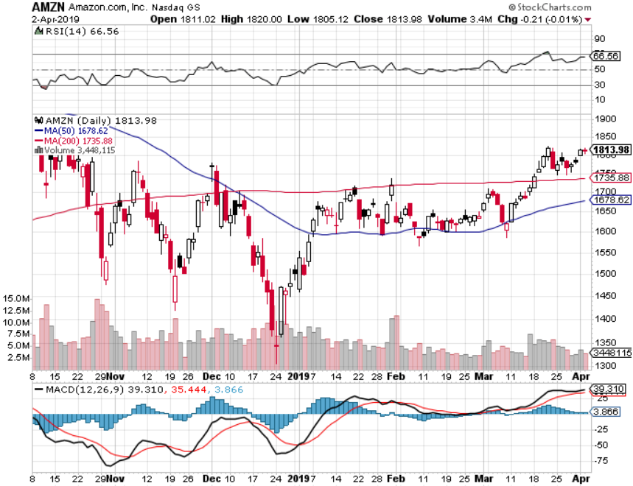
Amazon (AMZN)-Back to Top of Range long 4/$1,600-$1,650 call spread expires in 12 trading days took profits on long 2/$1,200-$1,300 call spread

Slide 27
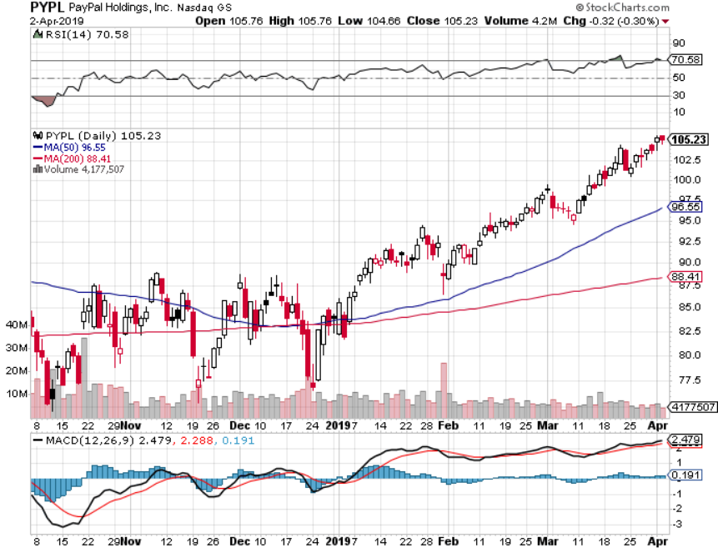
PayPal (PYPL)-Fintech Star long 4/$90-$95 call spread expires in 12 trading days

Slide 28
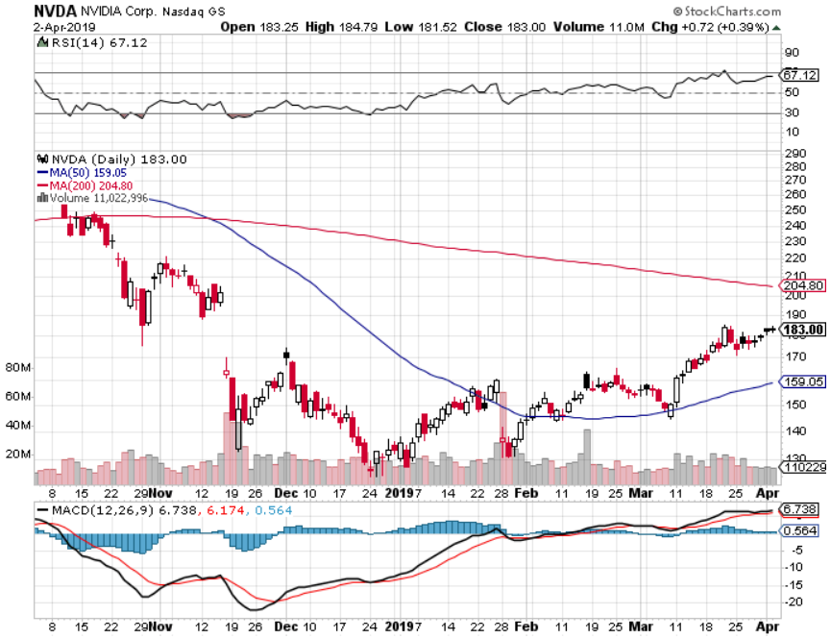
NVIDIA (NVDA)- earnings beat

Slide 29
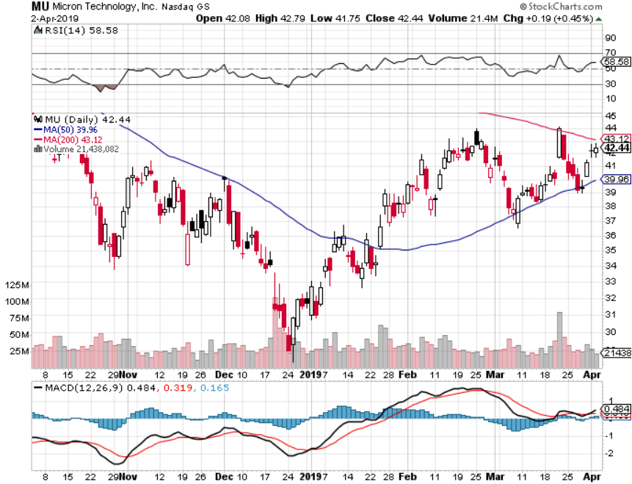
Micron Technology (MU)-

Slide 30
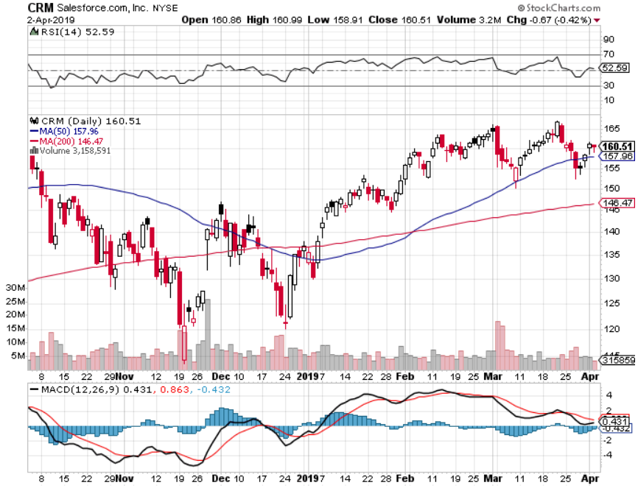
Salesforce (CRM)- took profits on long 2/$105-$115 call spread

Slide 31
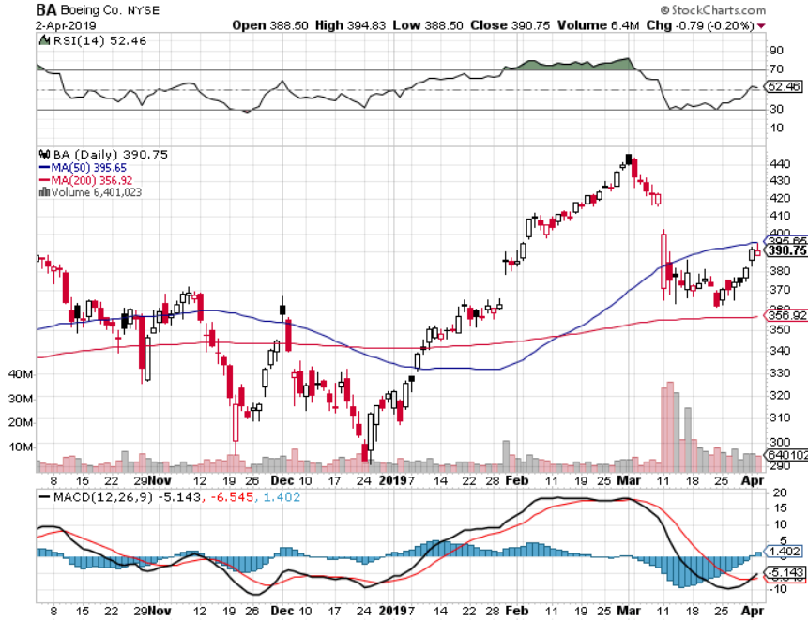
Boeing (BA)- took profits on long 4/$315-$335 call spread Next to happen in the recertification bounce

Slide 32
PayPal (PYPL)- long 4/$90-$95 call spread expires in 7 trading days

Slide 33
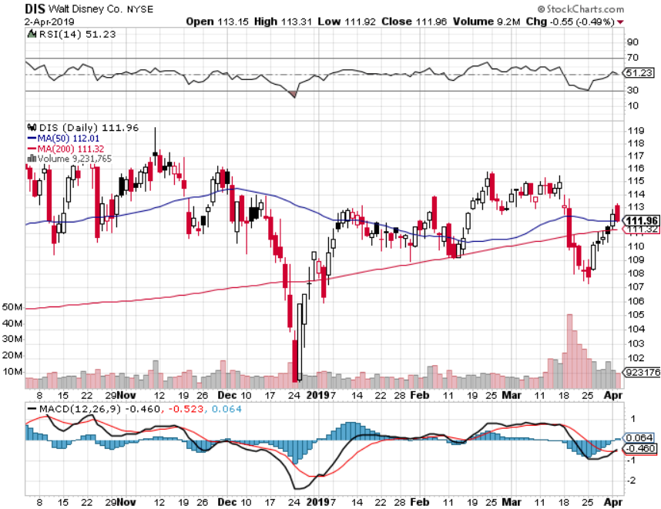
Walt Disney (DIS)- long 4/$100-$104 call spread expires in 7 trading days Short 4/$114 calls expires in 7 trading days

Slide 34
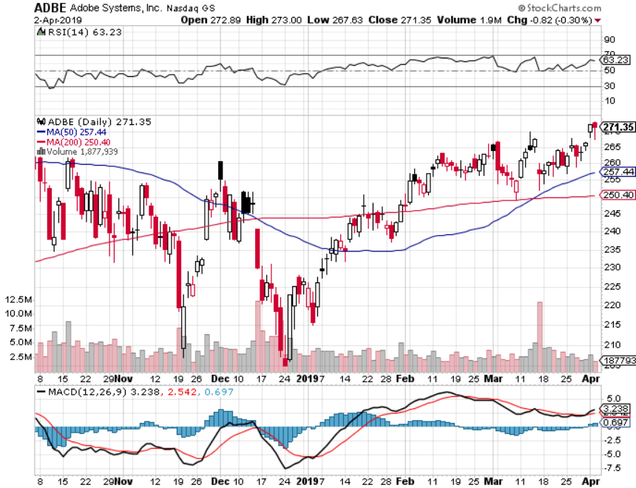
Adobe (ADBE)- The Quality Non-China tech play

Slide 35
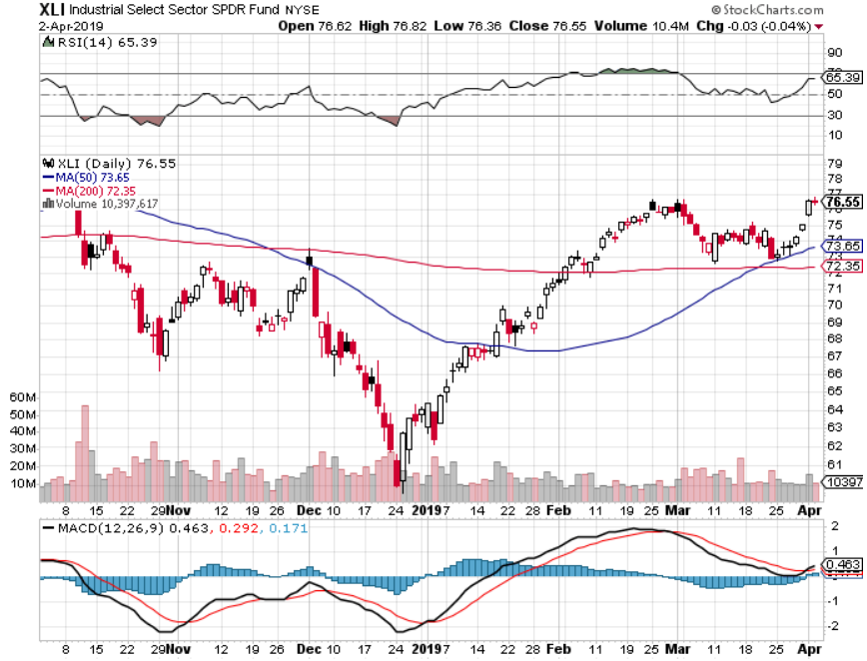
Industrials Sector SPDR (XLI)- (GE), (MMM), (UNP), (UTX), (BA), (HON)

Slide 36
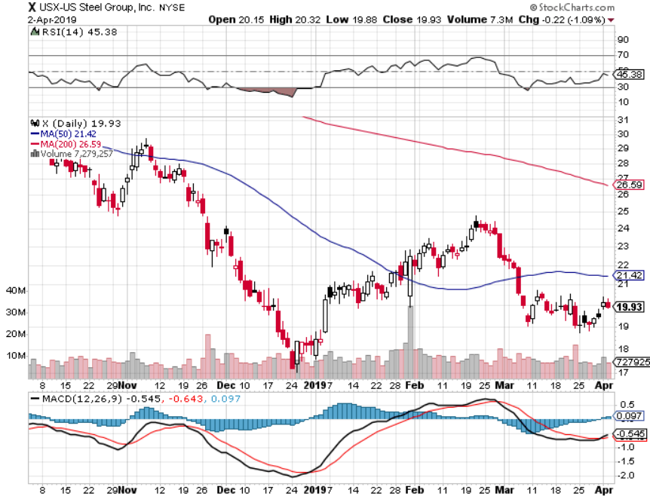
US Steel (X)-Tariffs Trouble Import duties cause users to abandon steel Unwound the entire Trump trade

Slide 37
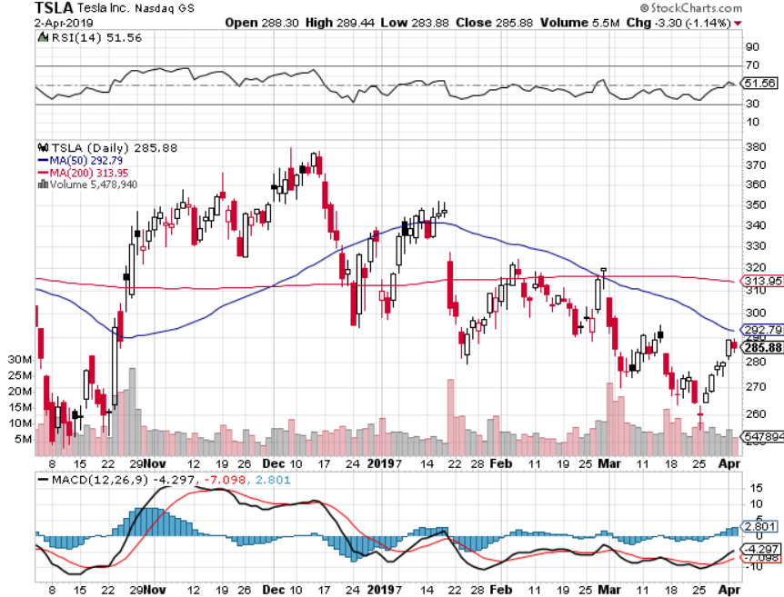
Tesla (TSLA)-Q1 Earnings stopped out of long 4/$300-$320 put spread Elon Musk goes to court on Thursday Q1 sales out

Slide 38
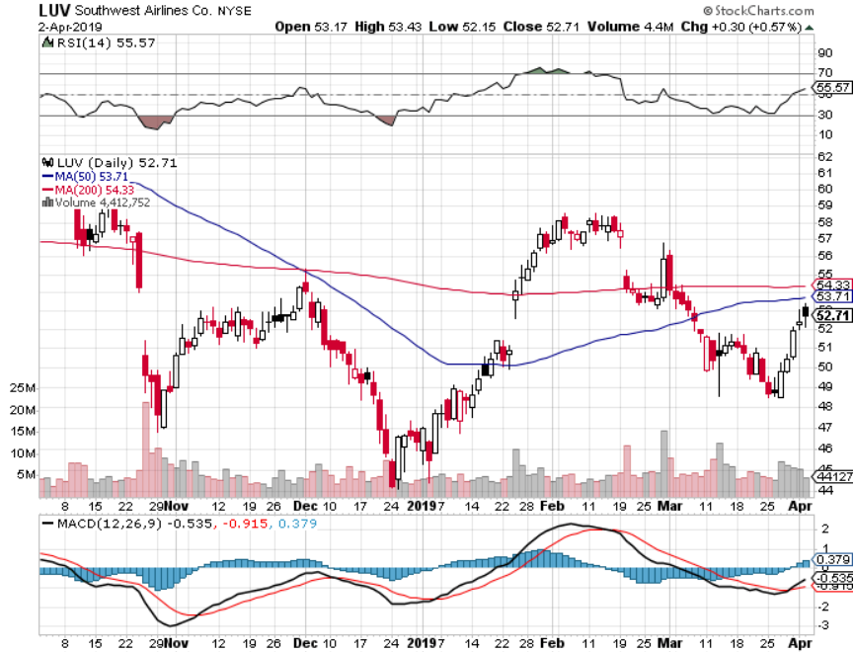
Southwest Airlines (LUV)- Boeing 737 Max biggest buyer

Slide 39
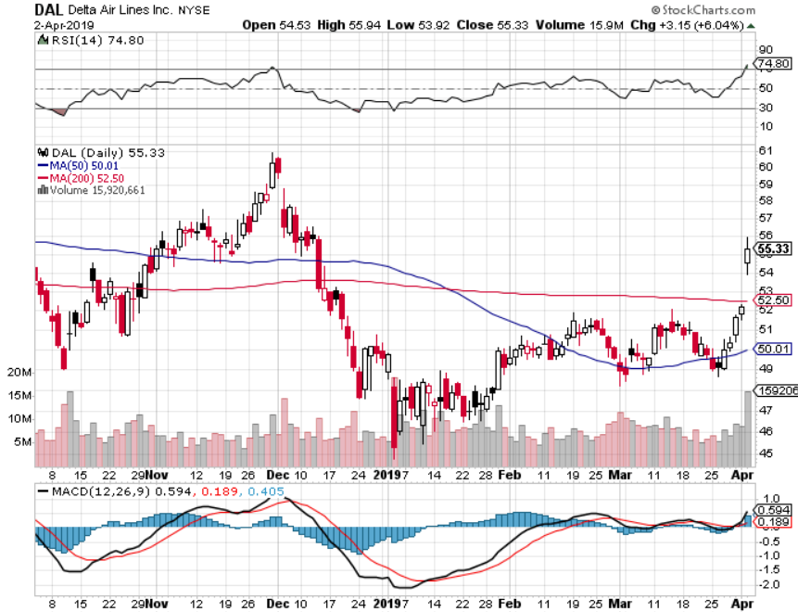
Delta Airlines (DAL)

Slide 40
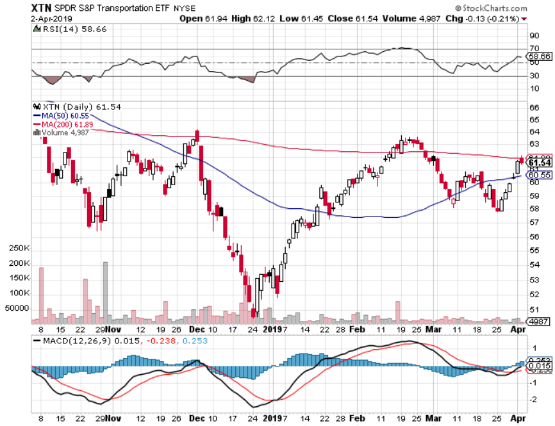
Transports Sector SPDR (XTN)- (ALGT), (ALK), (JBLU), (LUV), (CHRW), (DAL)

Slide 41
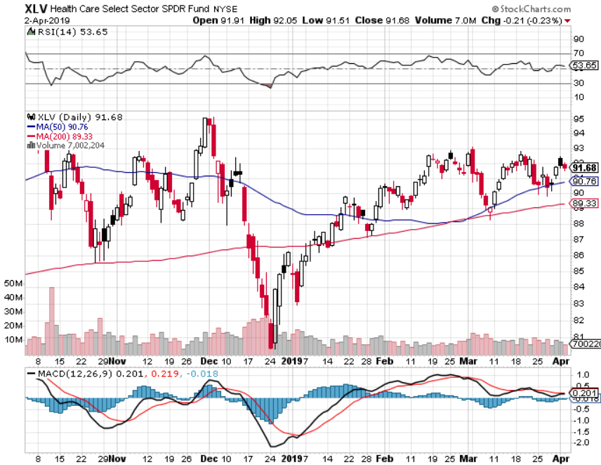
Health Care Sector (XLV), (RXL)-New Highs (JNJ), (PFE), (MRK), (GILD), (ACT), (AMGN)

Slide 42
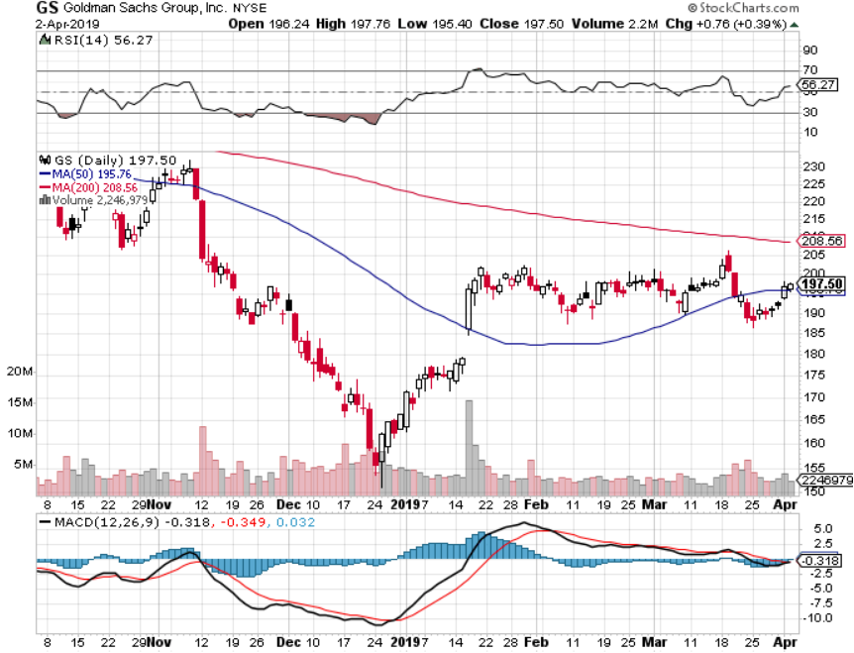
Goldman Sachs (GS)-Crushed by low rates

Slide 43
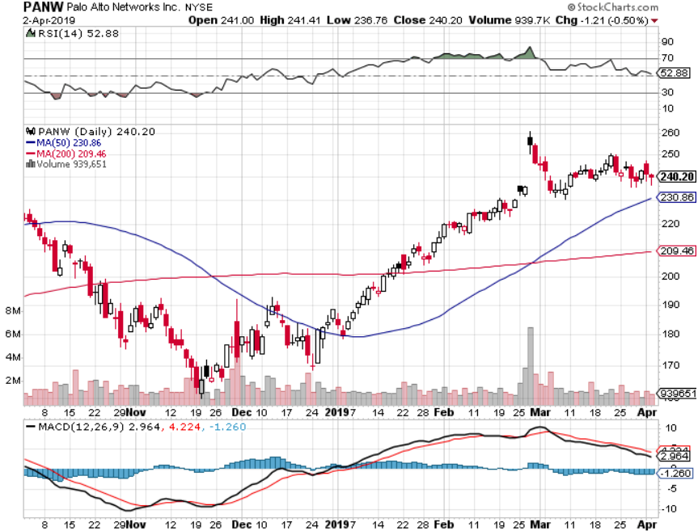
Palo Alto Networks (PANW)- Hacking never goes out of fashion

Slide 44
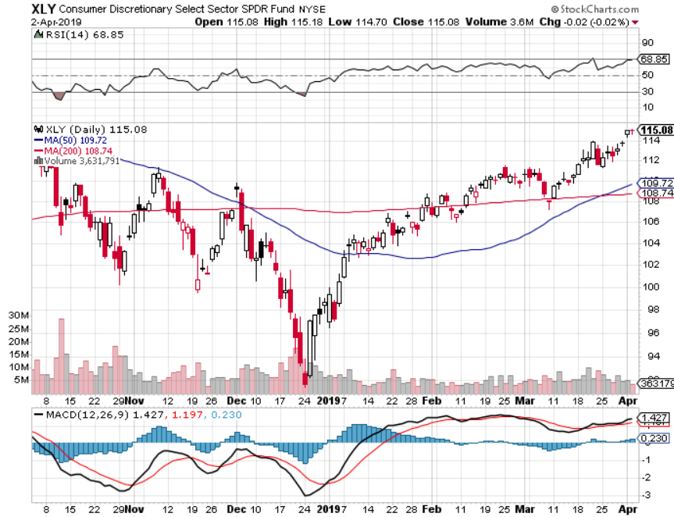
Consumer Discretionary SPDR (XLY) (DIS), (AMZN), (HD), (CMCSA), (MCD), (SBUX)

Slide 45
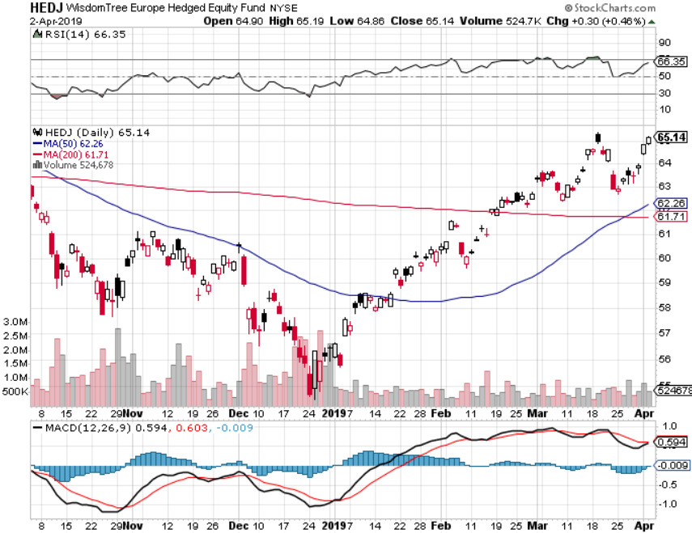
Europe Hedged Equity (HEDJ)-

Slide 46
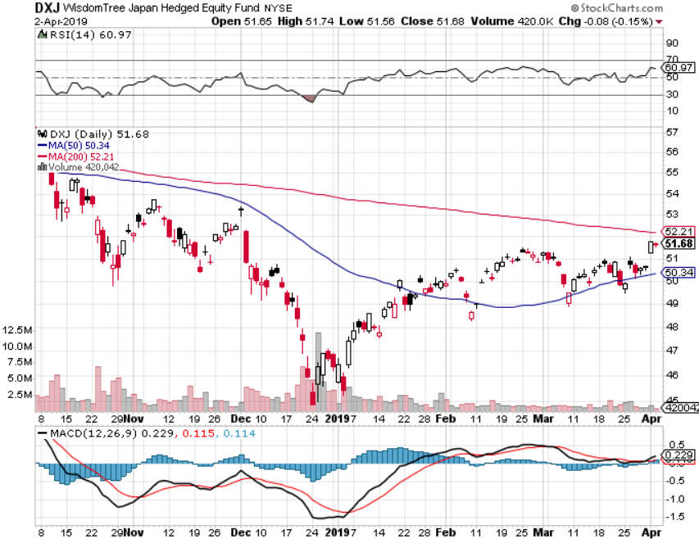
Japan (DXJ)-

Slide 47
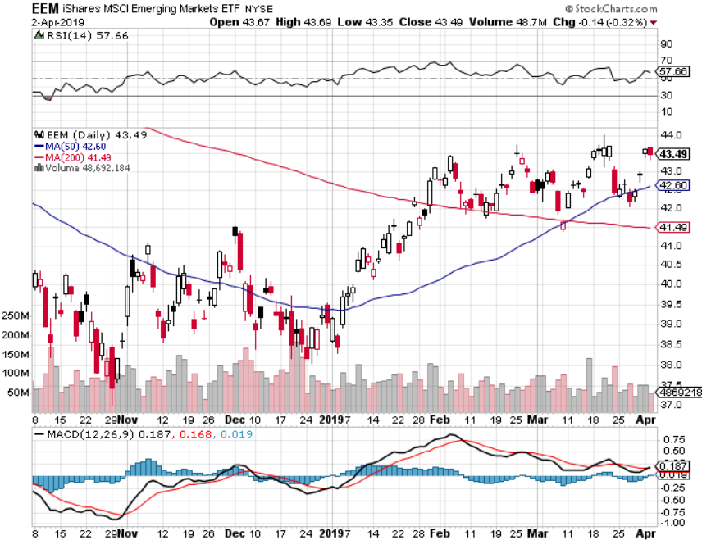
Emerging Markets (EEM)- Time to Buy on Weak Dollar

Slide 48
Bonds – Melt Up
*Bonds have moved into a new yield range of 2.25%-2.75%, may be stuck there for six months *The Existing Yield Inversion is Fake, recessions only occur when yield spikes create inversions * The Global Bond Short Covering Panic Continues, with ten-year US Treasury yields dropping to an eye popping 2.33%. Slowing global growth is to blame. *New highs in bond prices bring new lows in ten year yields *US rates are being pulled down by negative rates in Europe and Japan rather than pulled down from US economic weakness. *Foreign Investors Pour into the US Bond Market *German bund yields plunge to 0.0%, while Japan government bonds turn in a -0.05% yield

Slide 49
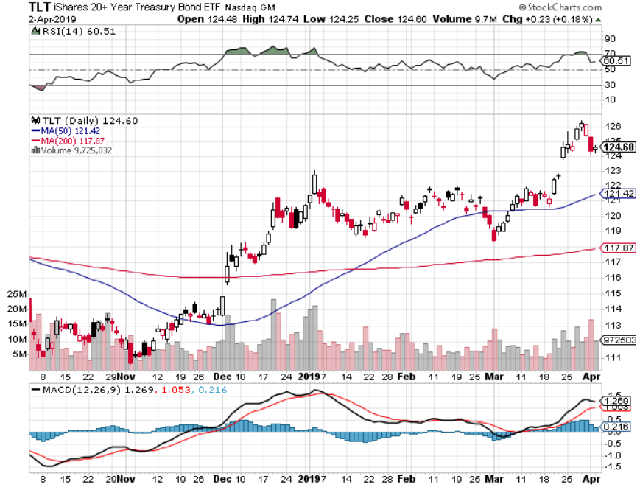
Treasury ETF (TLT) – Bottom of Range long 4/$128-$130 bear put spread- expires in 12 trading days long 3/$124-$126 put spread- expired at maximum profit point Expiration of long 2/$124-$126 put spread at maximum profit point took profits on long 2/$125-$128 call spread again took profits on long 1/$124-$127 call spread took profits on long 2/$125-$128 call spread

Slide 50
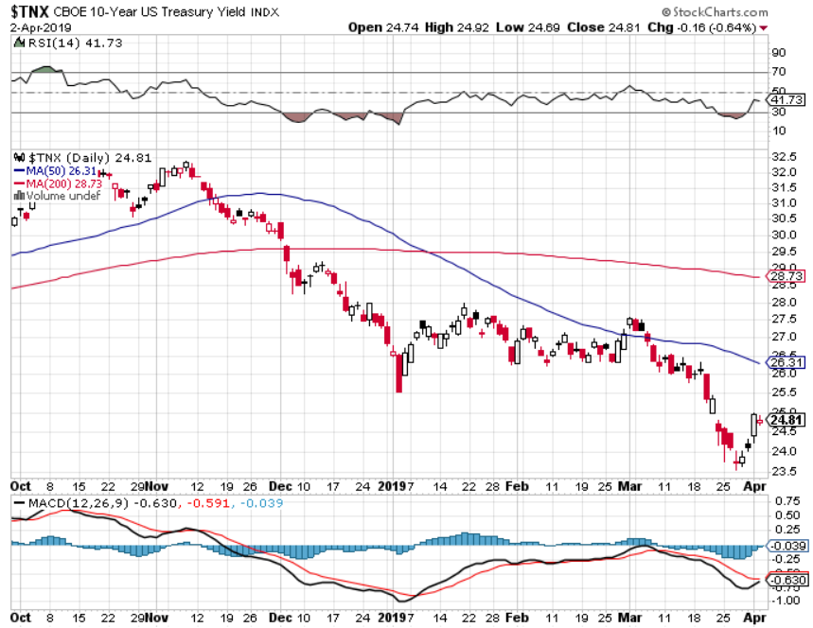
Ten Year Treasury Yield ($TNX) 2.50% Breakdown

Slide 51
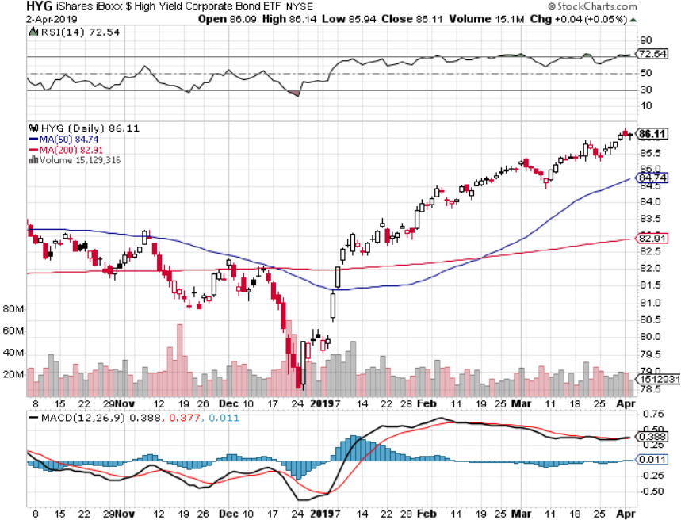
Junk Bonds (HYG) 5.27% Yield

Slide 52
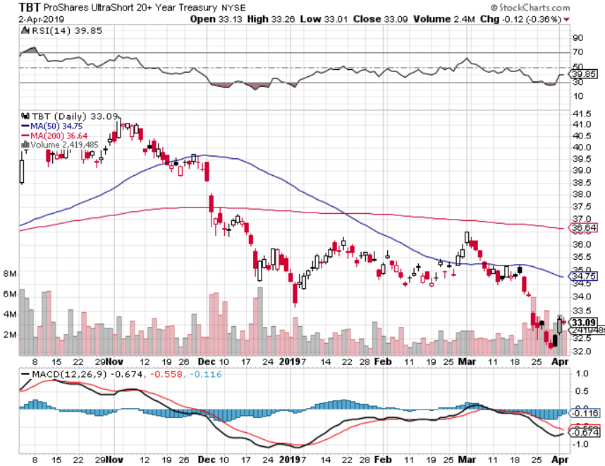
2X Short Treasuries (TBT)-Buy Territory

Slide 53
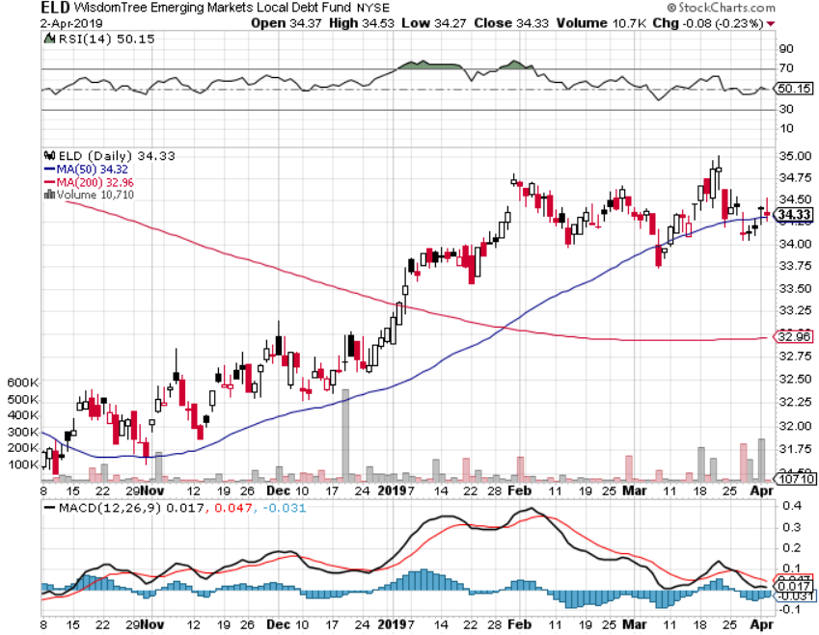
Emerging Market Debt (ELD) 5.92% Yield-

Slide 54
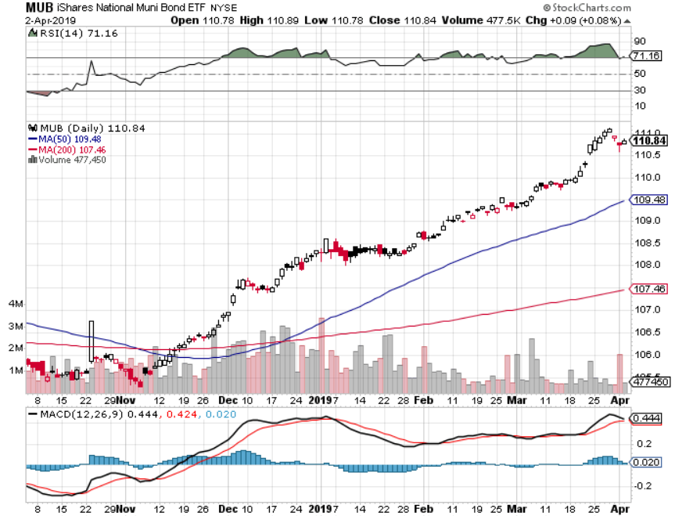
Municipal Bonds (MUB)-2.26% Mix of AAA, AA, and A rated bonds

Slide 55
Foreign Currencies – Probing Lows
*US dollar still hanging on to highs on the back of huge foreign buying *Demolishes all weak dollar plays *British pound hanging on to hopes of outright Brexit fail *Massive Chinese economic stimulus lets Yuan maintain highs *Bitcoin hits new highs of the year in Venezuelan crisis *Bottom Line: stand aside

Slide 56
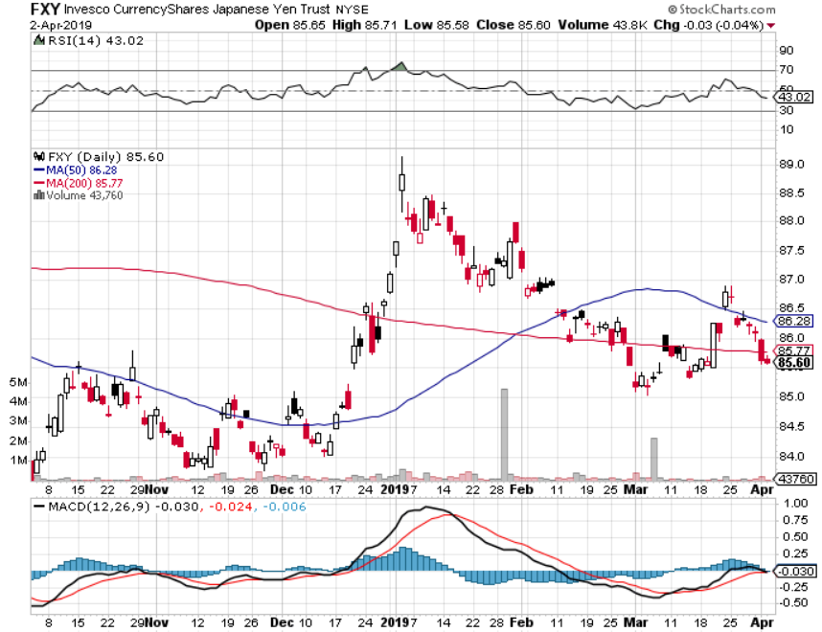
Japanese Yen (FXY), (YCS)

Slide 57
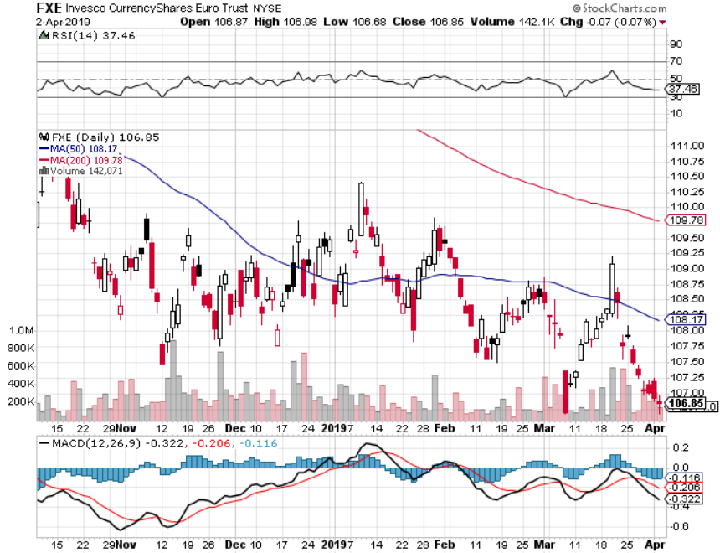
Euro ($XEU), (FXE), (EUO)- Trying to Break Down long 2/$105-$108 call spread

Slide 58
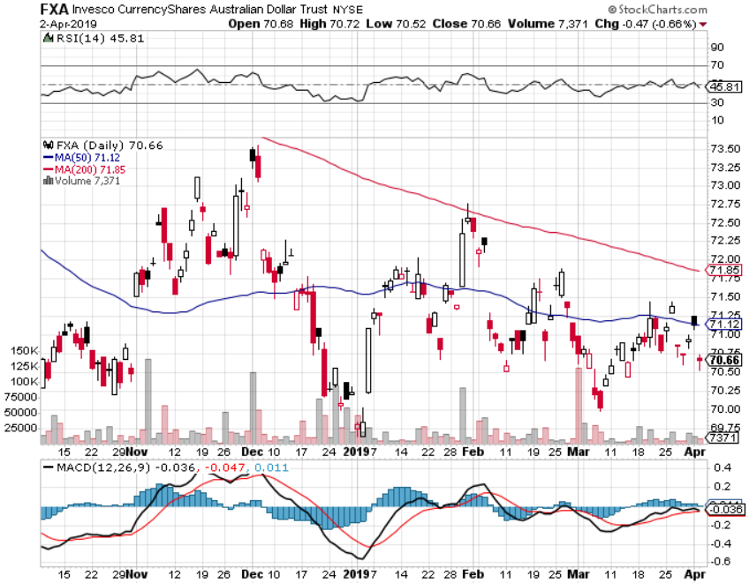
Australian Dollar (FXA)-

Slide 59
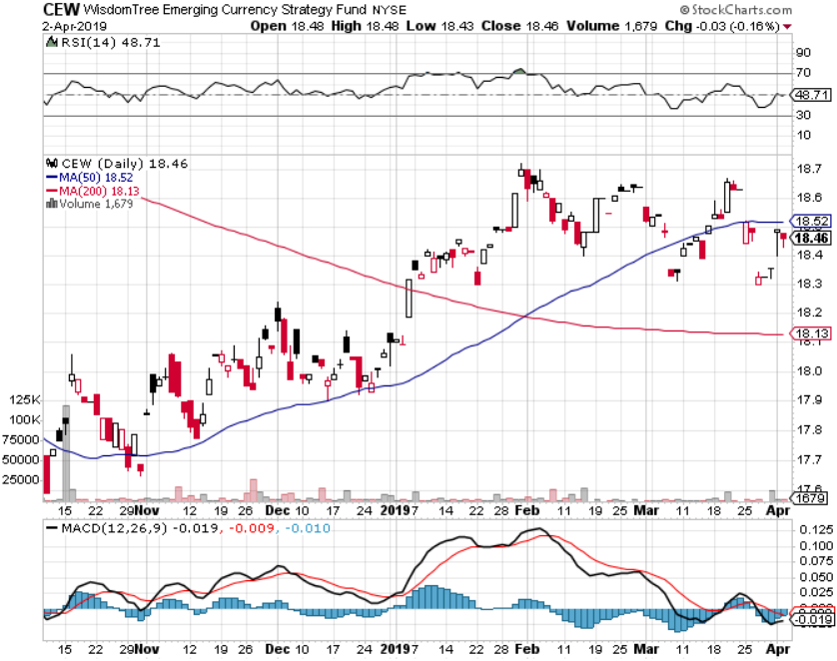
Emerging Market Currencies (CEW)

Slide 60
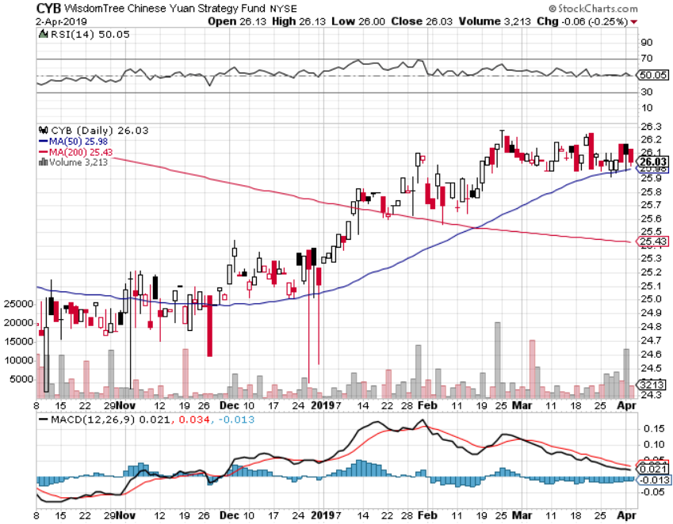
Chinese Yuan- (CYB)-

Slide 61
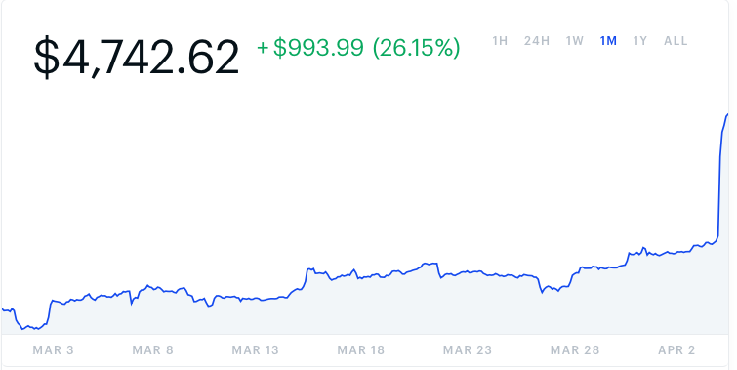
Bitcoin- 45% Rally Venezuela collapse is creating demand

Slide 62
Energy –
*Oil pushed up to new one year highs, putting $70 a barrel within range *Russian production down 153,000 b/d in six months, targeting 228,000 *Baker-Hughes rig count falls to a one year low at 816 *Front month futures contracts in backwardation, which is always bullish for prices *Saudi Aramco announced $81 billion in profits last year, making it the world’s most profitable company, in a dress up for going public *Bottom Line: Buy the dips

Slide 63
Oil-Bouncing

Slide 64
United States Oil Fund (USO)

Slide 65
Energy Select Sector SPDR (XLE)-No Performance! (XOM), (CVX), (SLB), (KMI), (EOG), (COP)

Slide 66
Halliburton (HAL)-

Slide 67
Natural Gas (UNG)- Major Hedge Fund Blow Up

Slide 68
Copper (COPX)- Upside breakout Trade War Deal Coming

Slide 69
Precious Metals – Stock Attack
*Suddenly, large amounts of capital are being shifted out of gold into US stocks *Turkey has joined Venezuela in dumping gold reserves, dumping $10 billion in one month to stabilize the Turkish lira *Big stop loss sell order at $1,285 an ounce *Central bank buying continues in major way as most foreign governments see Trump economic policies blowing up *However, the long term trend is intact until the Fed starts raising rates again. *Stand aside

Slide 70
Gold (GLD)- The flight to safety bid is coming Stopped out of 3/$119-$122 vertical bull call spread

Slide 71
Market Vectors Gold Miners ETF- (GDX) – Yikes!

Slide 72
Barrick Gold (GOLD)

Slide 73
Newmont Mining- (NEM)-

Slide 74
Palladium - (PALL)-

Slide 75
Freeport McMoRan - (FCX)- took profits on long 4/$10-$11 call spread took profits on short 4/$114 calls

Slide 76
Real Estate – Light at the end of the Tunnel?
*Home Price Appreciation Hits a Four Year Low *February US Existing Home Sales Jump 11.8% as ultra low interest rates return and weather improves, will it rescue the spring selling season? *February Housing Starts drop 8.7%, *30 year fixed rate loan drops to 4.23% *December S&P 500 Case-Shiller drops to 4.2%, annual gain, the lowest gain in 4 years *Bottom Line: Stand aside for a trade but buy for long term investment

Slide 77
December Corelogic S&P Case Shiller Home Price Index Las Vegas (11.4%), Phoenix (8%), and Atlanta (5.9%) showing biggest gains
Tradingeconomics.com

Slide 79
Simon Property Group (SPG)-

Slide 80
US Home Construction Index (ITB) (DHI), (LEN), (PHM), (TOL), (NVR)

Slide 81
Trade Sheet- So What Do We Do About All This?
*Stocks-buy dips *Bonds-sell rallies *Commodities-buy dips *Currencies-stand aside *Precious Metals – stand aside *Volatility-buy dips to $12 *Real estate-stand aside

Slide 82
Next Strategy Webinar 12:00 EST Wednesday, April 17, www.madhedgefundtrader.com email me at support@madhedgefundtrader.com
Good Luck and Good Trading!
Notes:
*

