Slide 1
The Mad Hedge Fund Trader “Liquidity Surge”
With John Thomas from Silicon Valley, CA, April, 17, 2019 www.madhedgefundtrader.com
Notes:
*

Slide 2
October 25-26 Lake Tahoe Conference 50% of seats already sold out
*Two days of informative speakers on crucial trading and investment issues *Trade tips with the most successful Mad Hedge traders *2 nights in the Hyatt, including all you can eat and drink *Tickets are a bargain at $699 to $1,999 *Buy now, upper ticket classes sell out first

Slide 3
Trade Alert Performance New Highs!
*January 9.49% Final *July +0.0% Final *February +4.64% Final *August +2.19% MTD *March +1.78% Final *September 1.38% Final *April -1.50% MTD *October +1.37% Final *May +1.07% Final *November -1.83% Final *June +4.15% Final *December -4.13% Final *2019 Year to Date +13.92% compared to +13.22% for the Dow Average *Trailing One year return +27.22%, +314.06% since inception, *Average annualized return of 33.65% for 9 1/2 years

Slide 4
Portfolio Review Out of the Market at an All Time High
No Positions
Expiration P&L

Slide 5
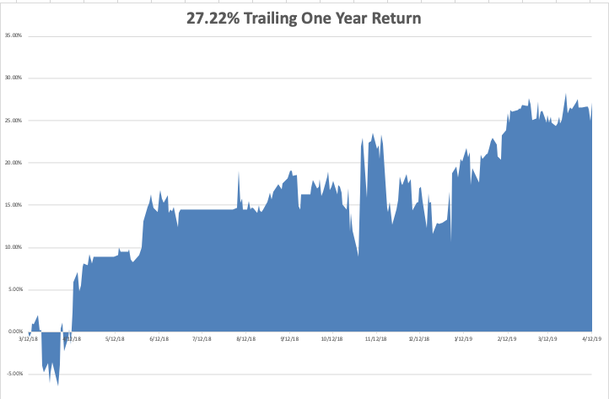
GTD Daily Audited Performance

Slide 6
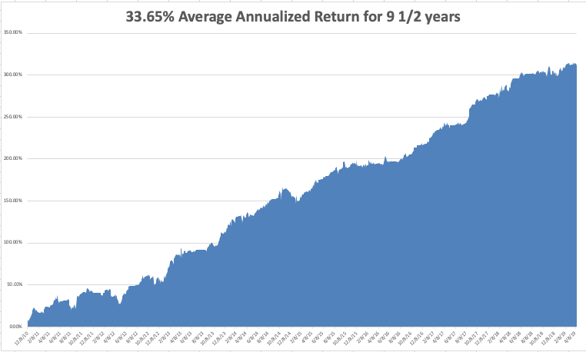
GTD 9 Year Daily Audited Performance

Slide 7
The Method to My Madness
*Sudden global liquidity surge is driving all asset prices upward simultaneously….BUY EVERYTHING FOR A TRADE *Foreign capital pouring into the US is pricing all assets at a premium *Low interest rates are the main driver now and traders are ignoring everything else, like earnings and valuations, and the economy *Profit taking in bonds knocks them for 4 points *Decline in earnings growth is accelerating but may bounce back in Q2 and Q3 *Oil remains strong *China trade war moves to the back burner overshadowed by international bond markets

Slide 8
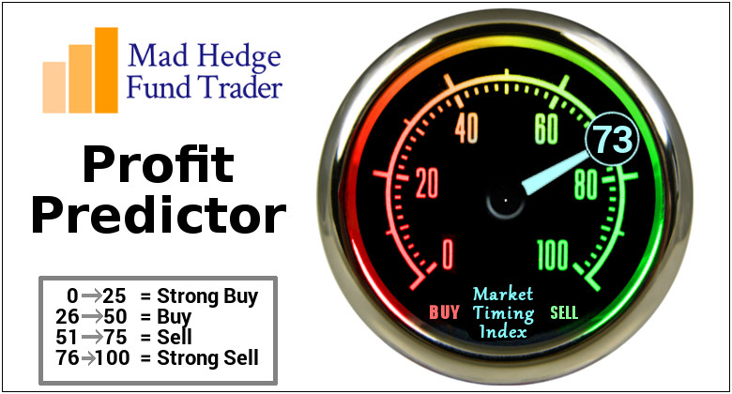
The Mad Hedge Profit Predictor Market Timing Index- An artificial intelligence driven algorithm that analyzes 30 different economic, technical, and momentum driven indicators

Slide 9
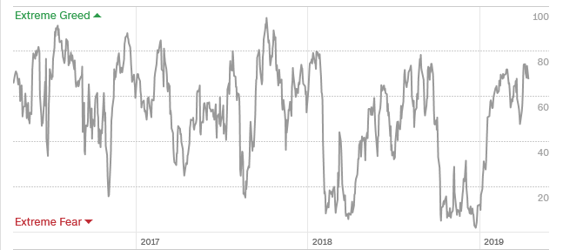
The Mad Hedge Profit Predictor Firmly in “SELL” Territory-Risk is Extreme
SELL
BUY

Slide 10
The Global Economy – Global Synchronized Weakness
*March Nonfarm Payroll Report comes in at a stable 196,000, Headline Unemployment Rate at 3.8% *Economic data flow is almost all terrible, except for housing, which had a couple of positive data points *Trump threatens to move the trade war from China to Europe *Europe is close to printing actual recession numbers *Stable dollar will help non-dollar plays, like emerging markets (EEM) and the currencies (FXE) and (FXA), and oil (USO)

Slide 11
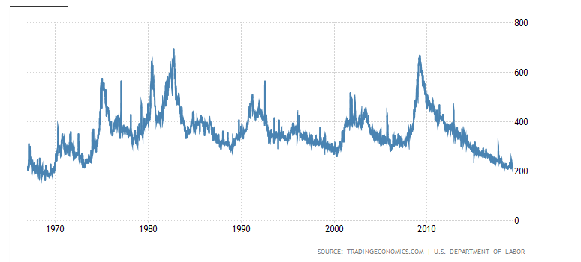
Weekly Jobless Claims New 49 Year Low -8,000 at 196,000

Slide 12
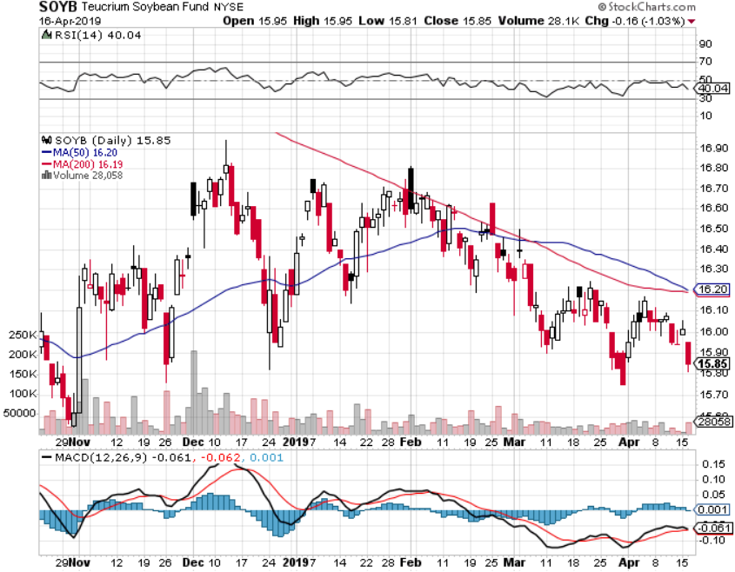
Soybeans (-20%)-Trade War Indicator rolling over price action hits on a big “Sell the news” on China trade deal, or no China trade deal-no flood boost

Slide 13
The Bill Davis View A $1,500 Upgrade for the Mad Day Trader Service
Buys: | Entry | Target
Core Laboratories (CLB) | $ 70.00 | $ 90.00
National Beverage Corp (FIZZ)-X | $ 55.00 | $ 75.00
Prestige Consumer Healthcare (PBH) | $ 29.00 | $ 40.00
Alibaba Group (BABA) | $ 182.00 | $ 191.00
Starbucks Corp (SBUX) | $ 75.00 | $ 82.00
Sells:
Fiserv Inc. (FISV) | $ 87.00 | $ 75.00
Moelis & Co (MC) | $ 39.00 | $ 32.00
Jazz Pharmeceuticals (JAZZ) | $ 140.00 | $ 120.00
Republic Services, Inc. (RSG) | $ 79.00 | $ 67.00
Universal Health Services (UHS) | $ 134.00 | $ 115.00

Slide 14
Stocks – All Eyes on Q1
*All eyes now on Q1 earnings, which are coming in stronger than expected because of excessive forecast cuts in December *The market is looking tired with volume collapsing and valuations at multi year highs *Investors focusing on an economic bounce back in Q2 and Q3 and ignoring a weak Q1 *A lot of investors flushed out in December have still not gotten back in, so a slow low volume grind up could continue for a few more weeks *Analysts are now looking for negative earnings growth in 2019 *Is a big “Sell in May” setting up? *Mad Hedge has gone to a rare 100% cash position in all portfolios *Bottom Line: its bet the ranch time on tech longs, but stay away from those with big China exposure, like Apple, and weak dollar plays like energy, and emerging markets

Slide 15
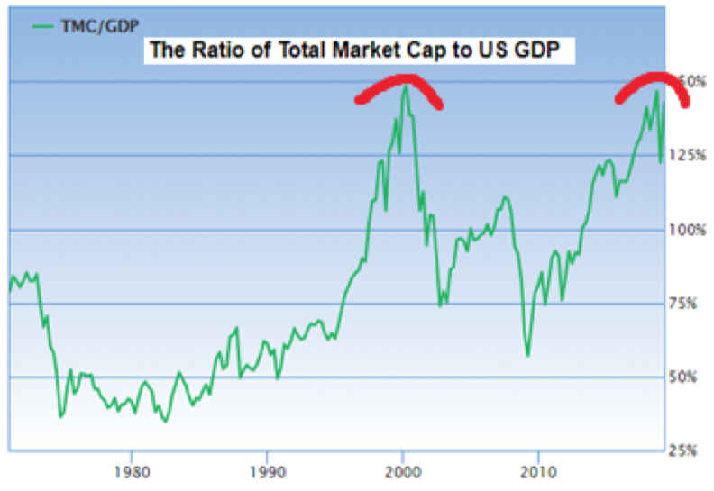

Slide 16
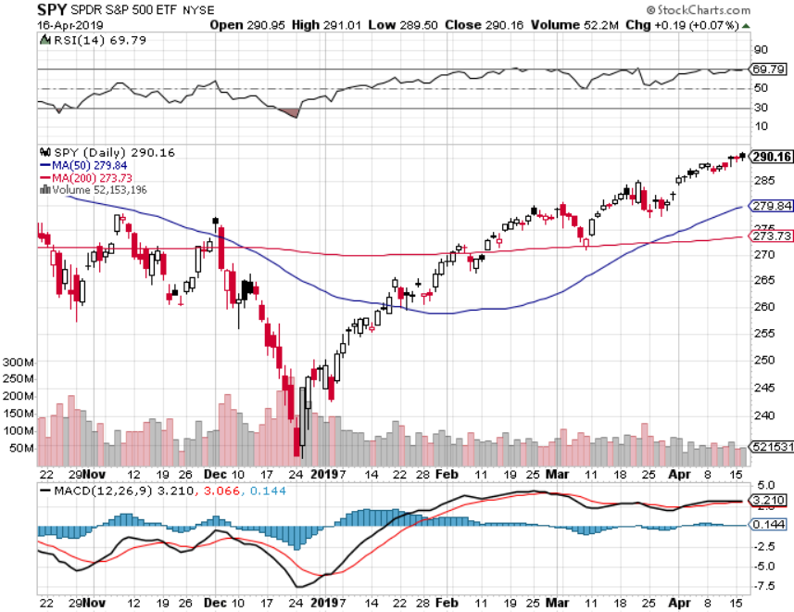
S&P 500- stopped out of long 2/$285-$290 bear put spread took profits on long 2/$270-$275 bear put spread

Slide 17
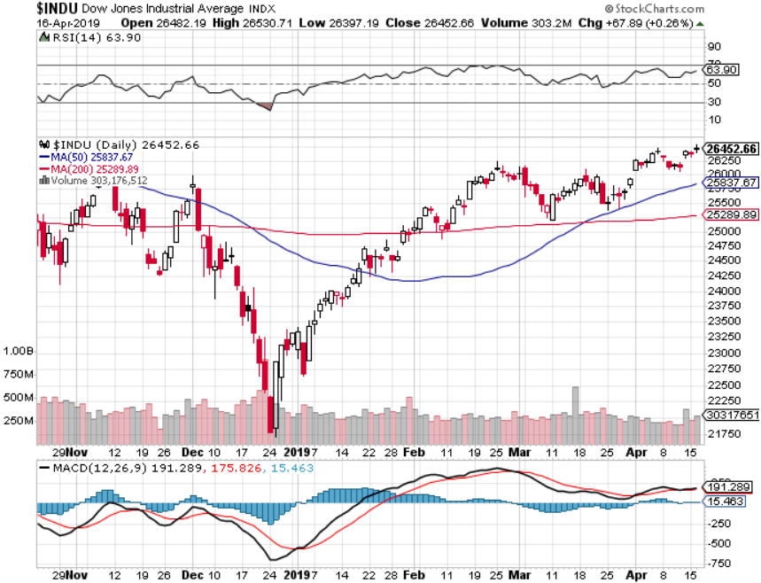
Dow Average-

Slide 18
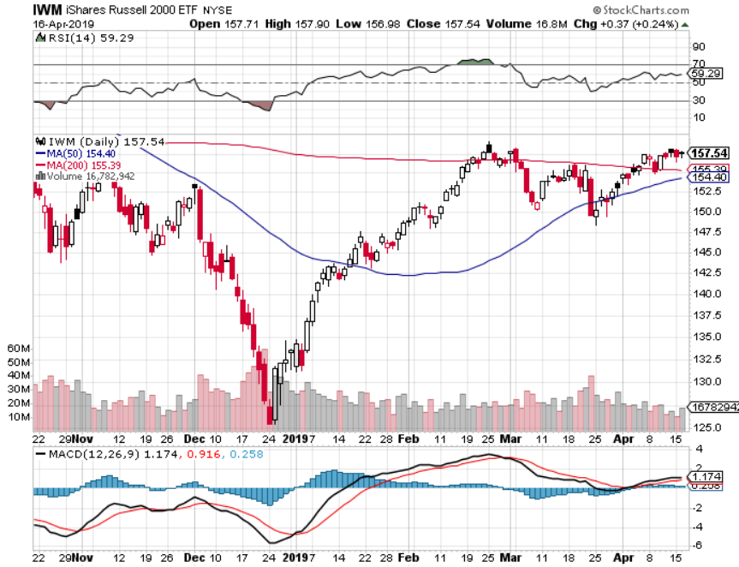
Russell 2000 (IWM)- out for even Long 4/$160-$165 vertical bear put spread

Slide 19
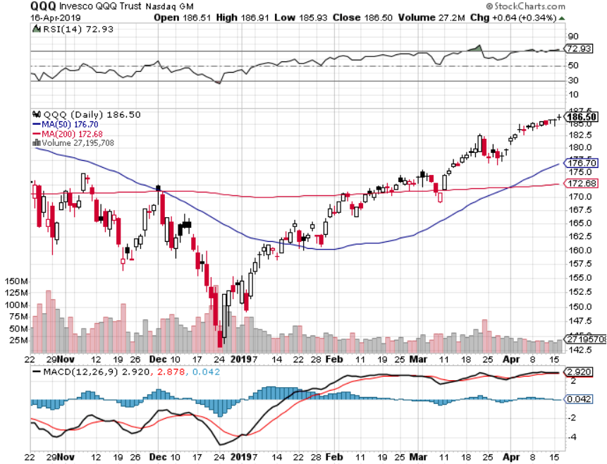
NASDAQ (QQQ)

Slide 20
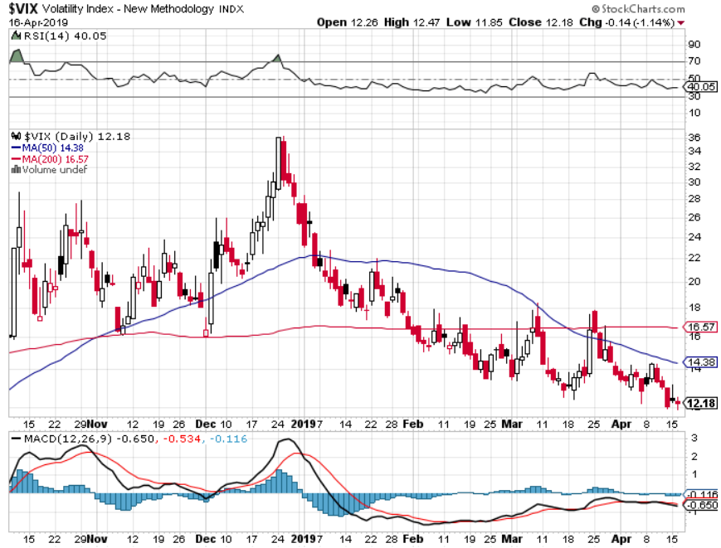
(VIX)- In “BUY” Territory

Slide 21
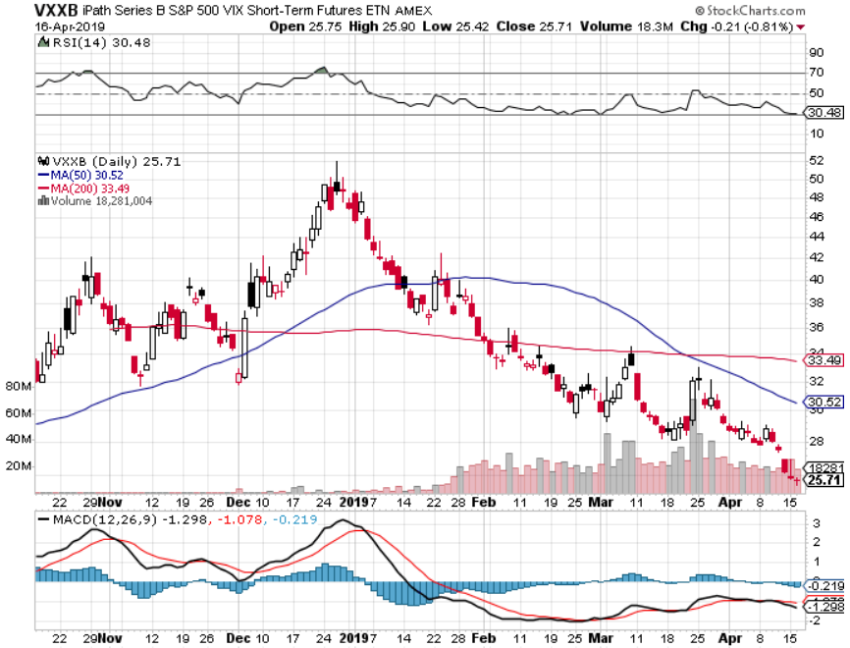
iPath S&P 500 VIX Short-Term Futures ETN (VXX)

Slide 22
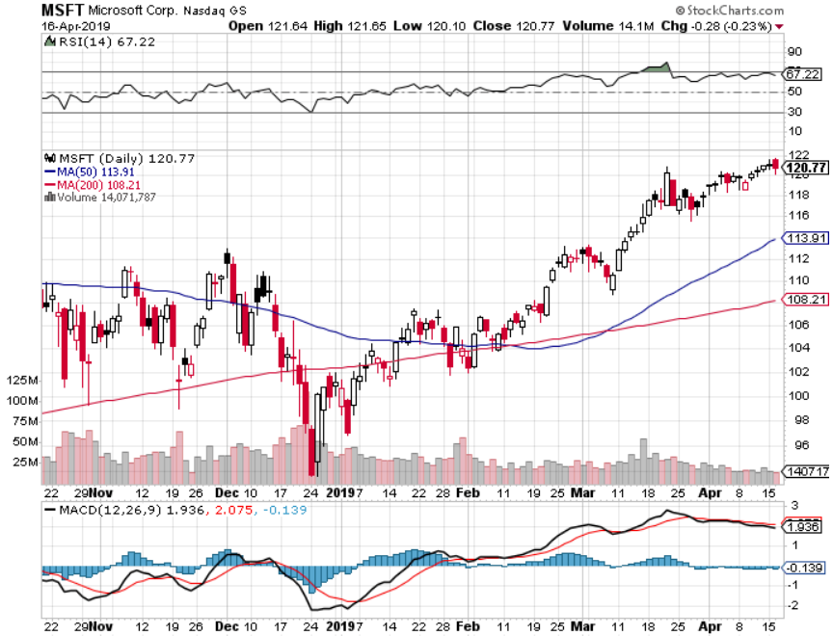
Microsoft (MSFT)- Earnings beat took profits on long 4/$108-$113 call spread took profits on long 2/$85-$90 call spread

Slide 23
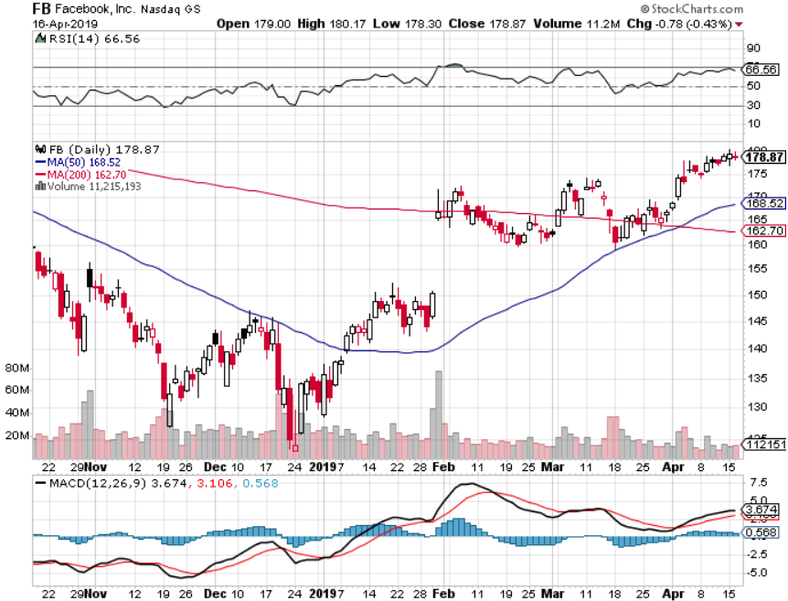
Facebook (FB)- FANG bounce

Slide 24
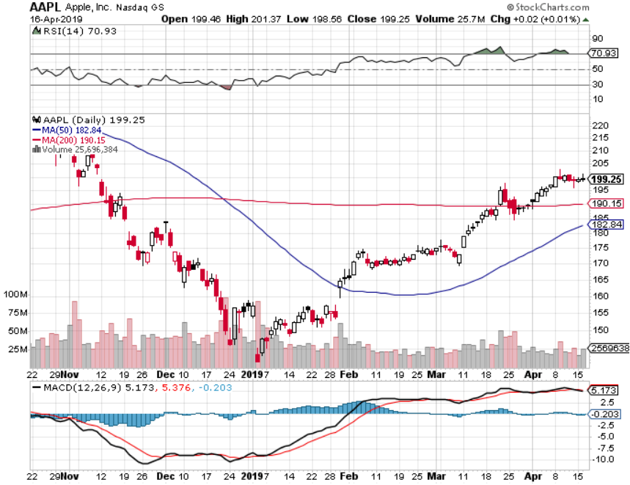
Apple (AAPL)- Bull Run New Apple Plus Streaming Service stopped out of long 3/$180-$185 bear put spread stopped out of long 11/$175-$180 bear put spread took profits on long 11/$165-$175 bear put spread

Slide 25
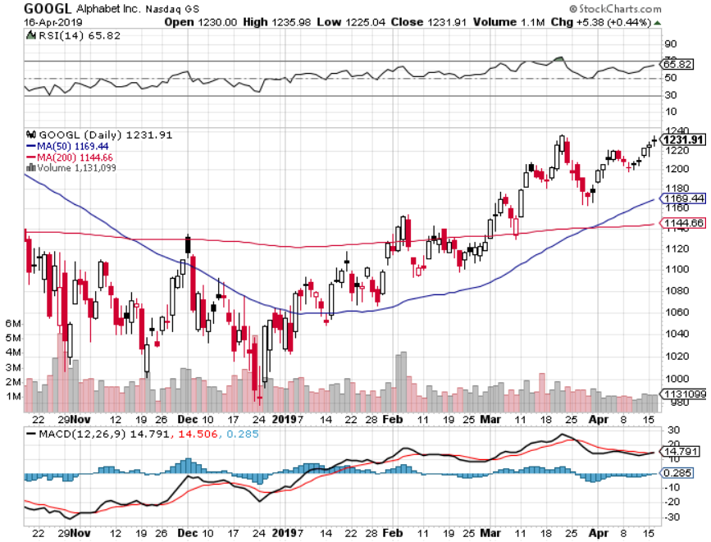
Alphabet (GOOGL)- took profits on long 4/$1,080-$1,120 bull call spread

Slide 26
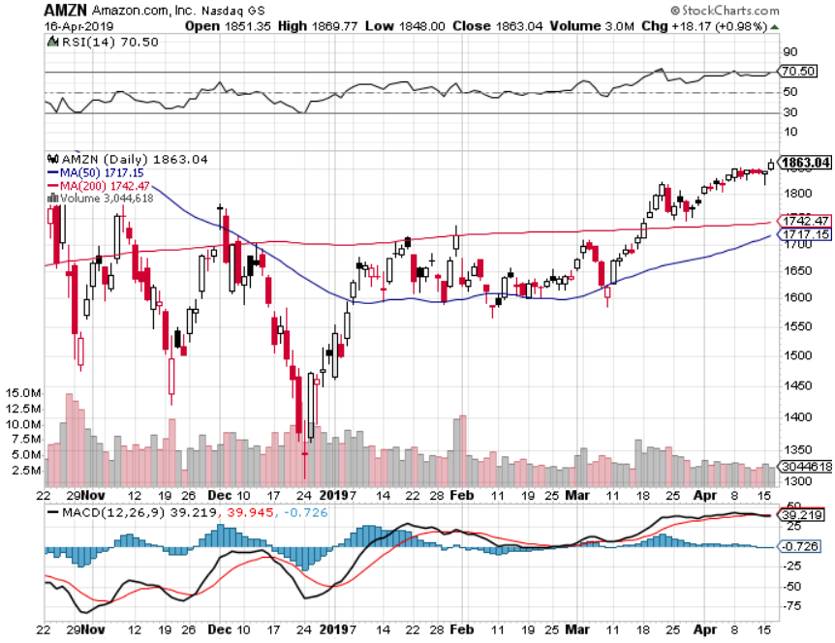
Amazon (AMZN)-Back to Top of Range took profits on long 4/$1,600-$1,650 call spread took profits on long 2/$1,200-$1,300 call spread

Slide 27
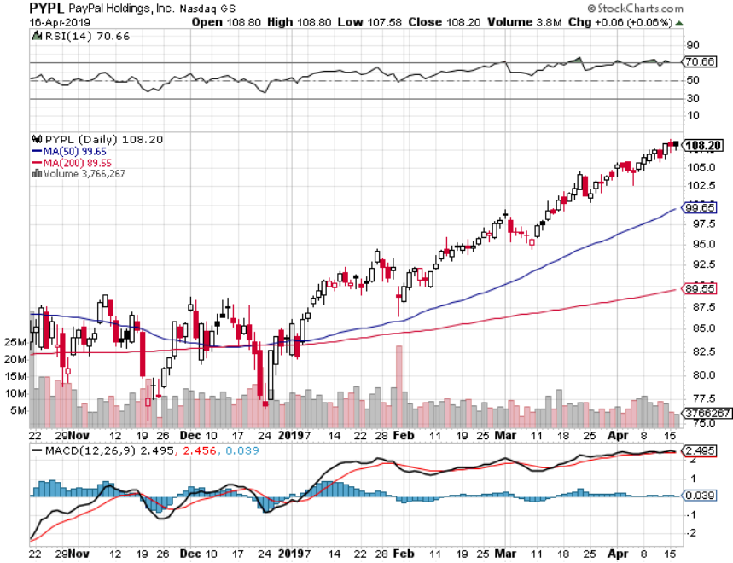
PayPal (PYPL)-Fintech Star took profits on long 4/$90-$95 call spread

Slide 28
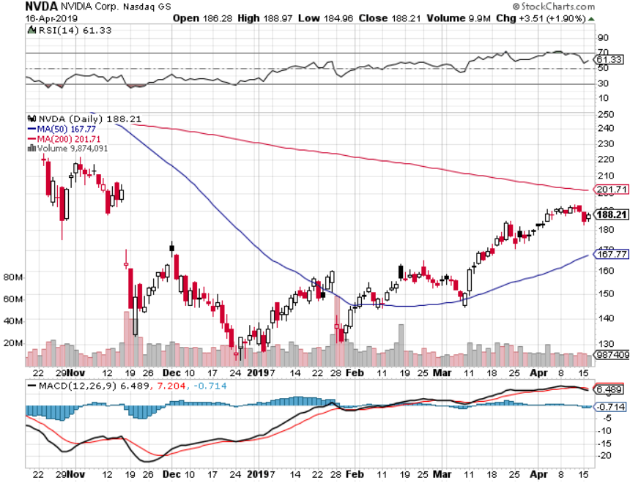
NVIDIA (NVDA)- earnings beat

Slide 29
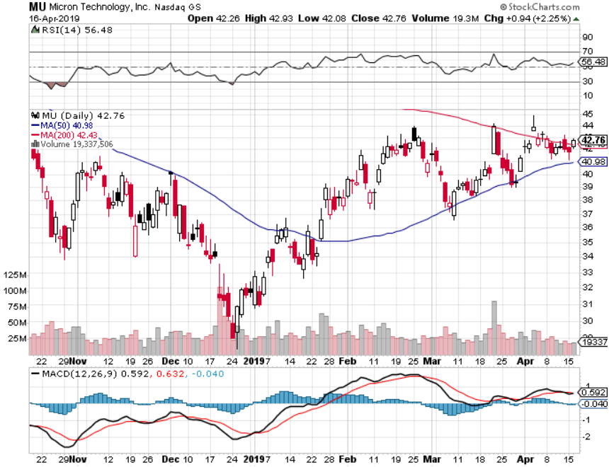
Micron Technology (MU)-

Slide 30
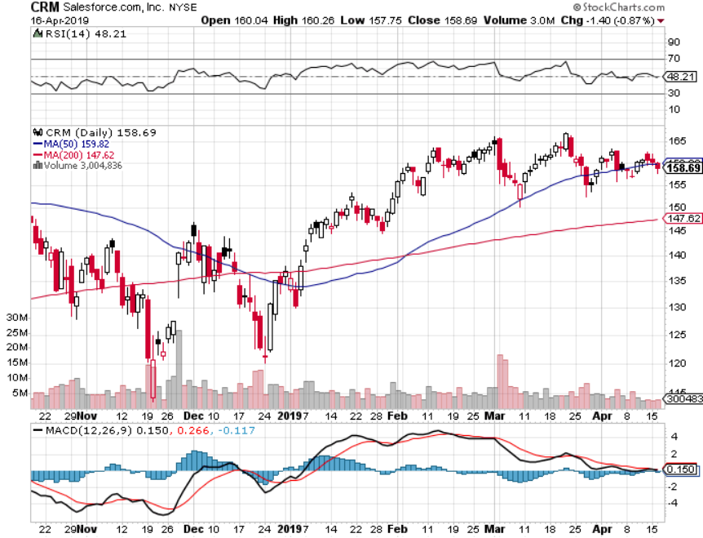
Salesforce (CRM)- took profits on long 2/$105-$115 call spread

Slide 31
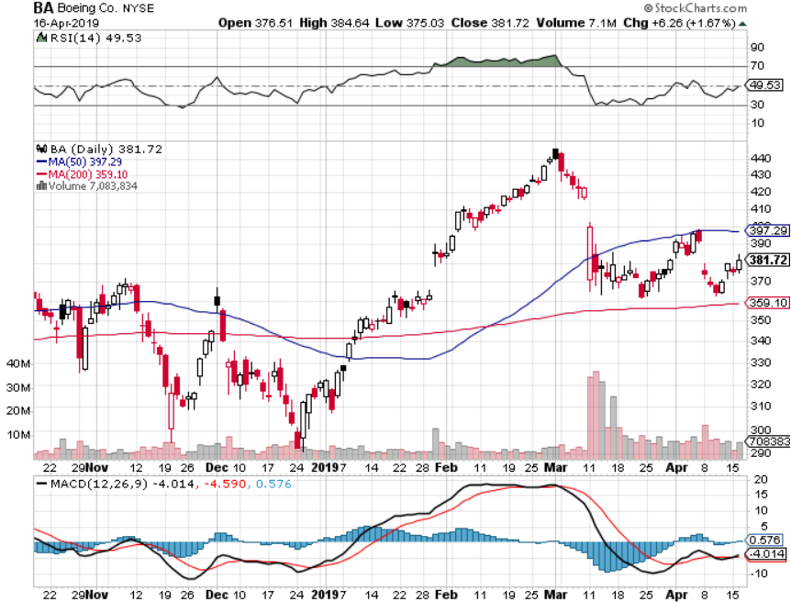
Boeing (BA)- took profits on long 4/$315-$335 call spread Next to happen in the recertification bounce

Slide 32
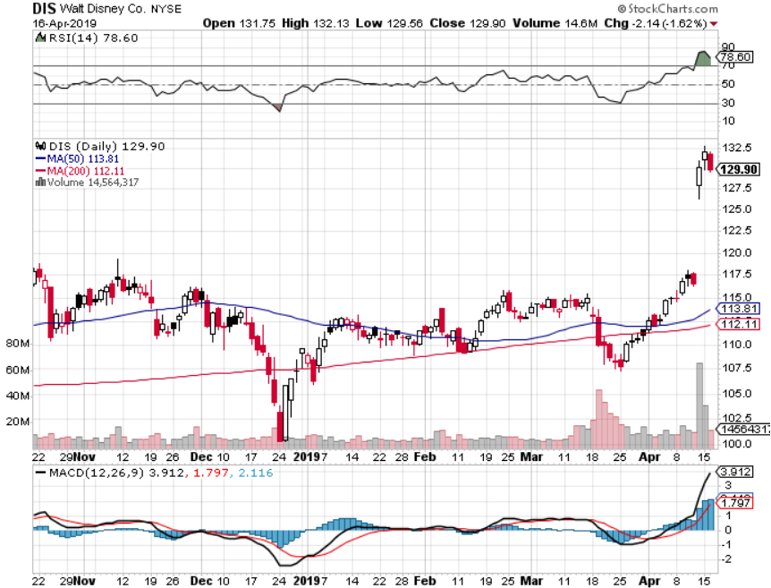
Walt Disney (DIS)- took profits on long 4/$100-$104 call spread Covered Short 4/$114 calls

Slide 33
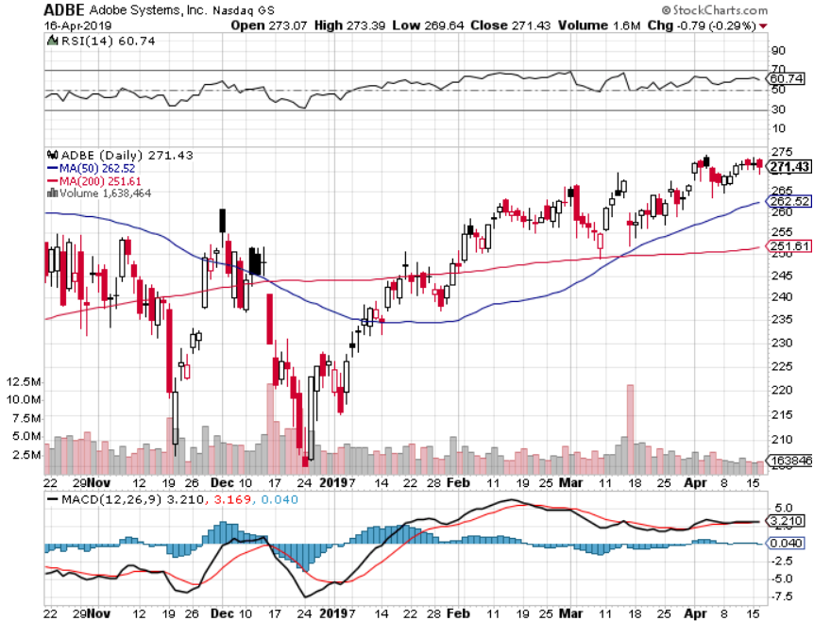
Adobe (ADBE)- The Quality Non-China tech play

Slide 34
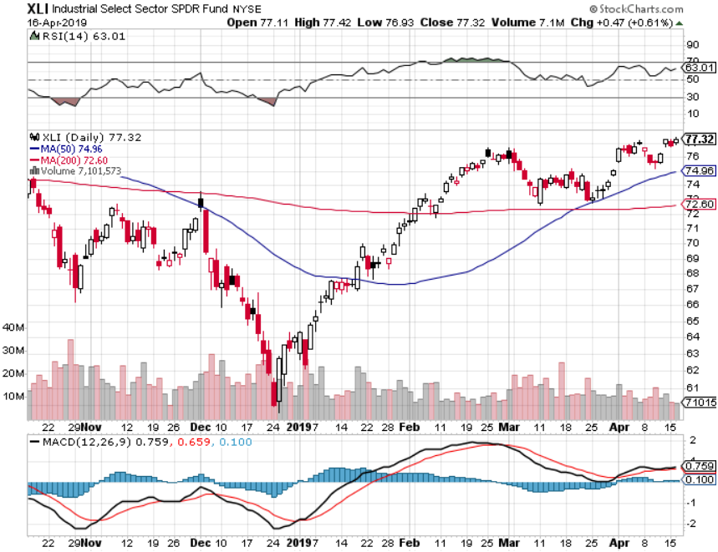
Industrials Sector SPDR (XLI)- (GE), (MMM), (UNP), (UTX), (BA), (HON)

Slide 35
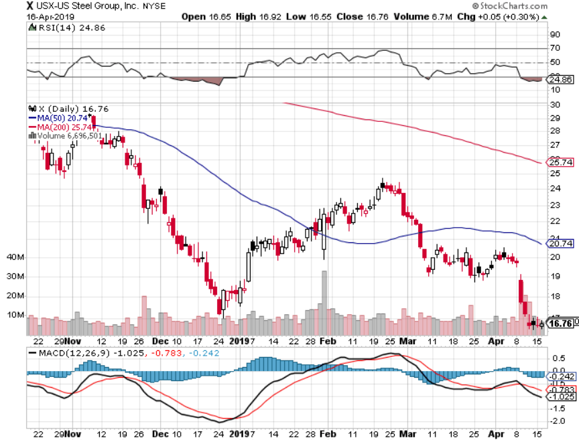
US Steel (X)-Tariffs Trouble Import duties cause users to abandon steel Unwound the entire Trump trade

Slide 36
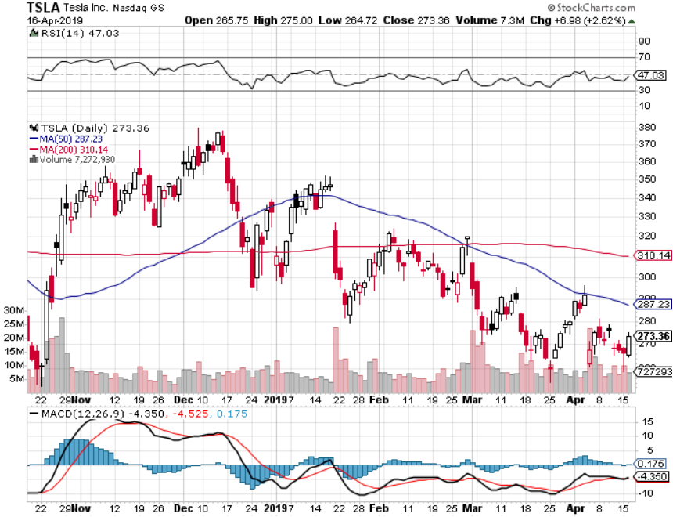
Tesla (TSLA)-Q1 Earnings stopped out of long 4/$300-$320 put spread delayed Phase II Gigafactory

Slide 37
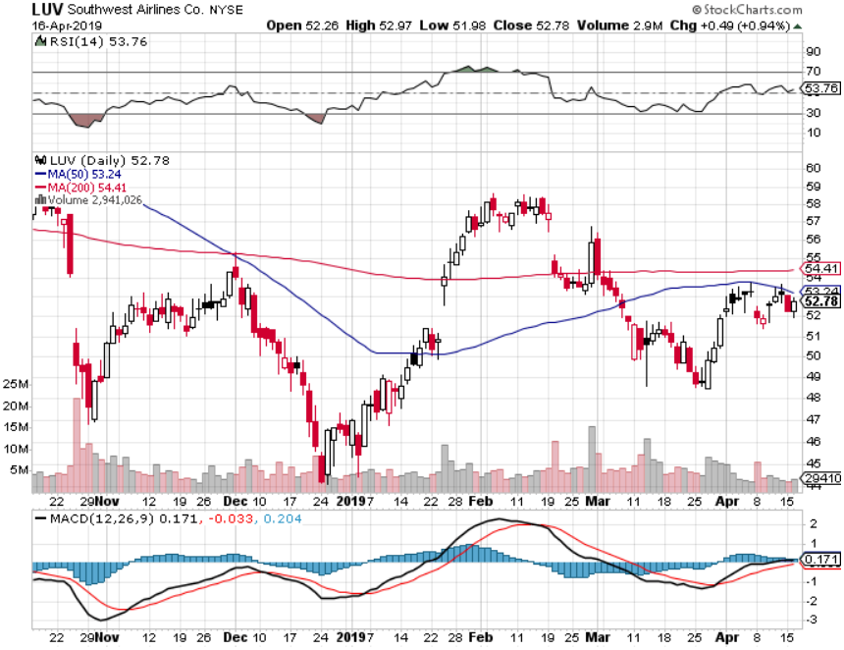
Southwest Airlines (LUV)- Boeing 737 Max biggest buyer

Slide 38
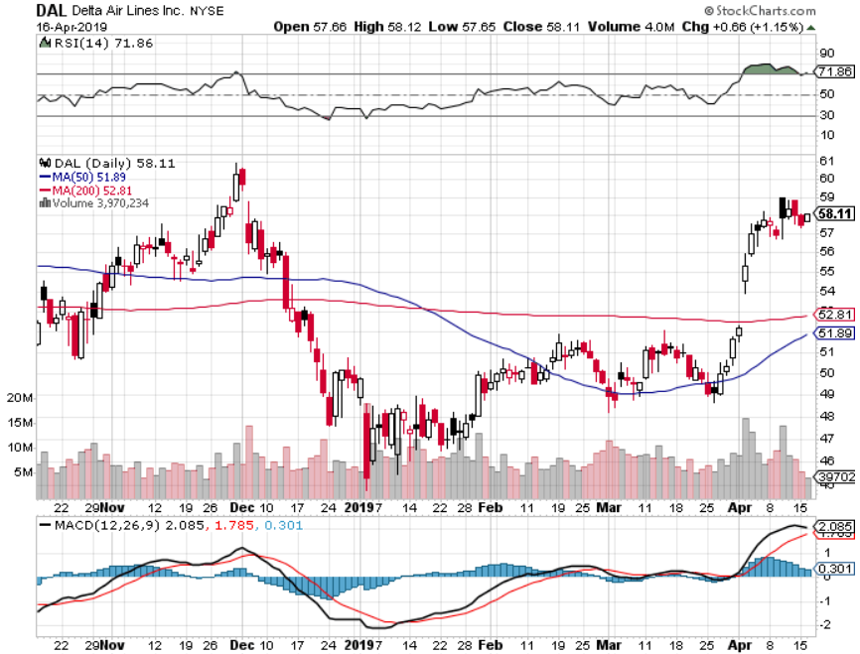
Delta Airlines (DAL)

Slide 39
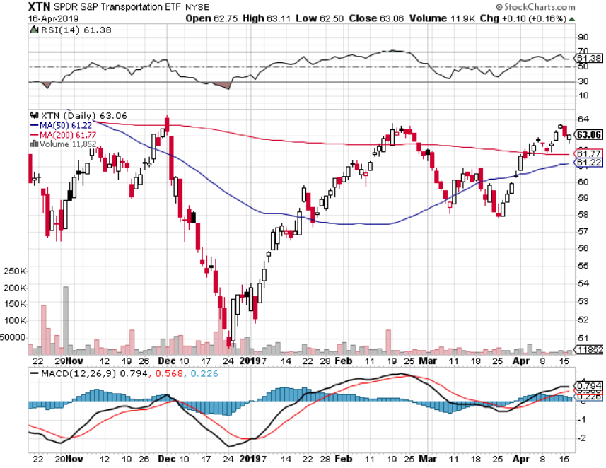
Transports Sector SPDR (XTN)- (ALGT), (ALK), (JBLU), (LUV), (CHRW), (DAL)

Slide 40
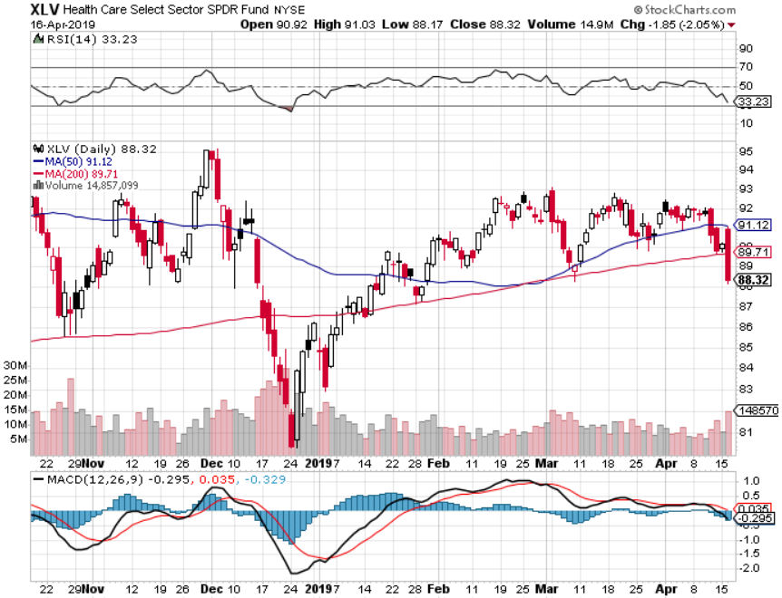
Health Care Sector (XLV), (RXL)-New Highs (JNJ), (PFE), (MRK), (GILD), (ACT), (AMGN)

Slide 41
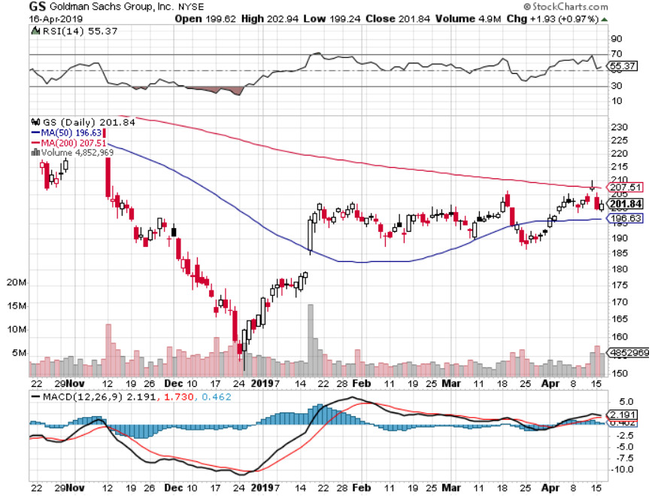
Goldman Sachs (GS)-falling trading volume

Slide 42
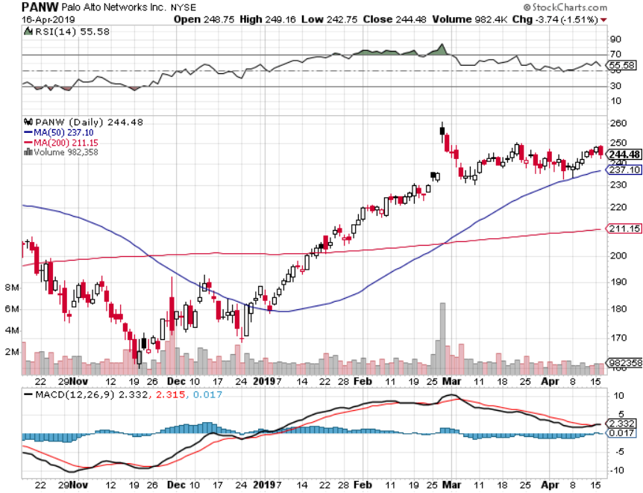
Palo Alto Networks (PANW)- Hacking never goes out of fashion

Slide 43
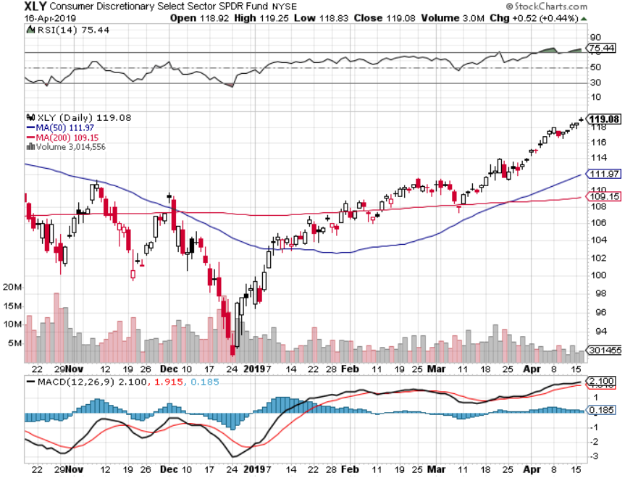
Consumer Discretionary SPDR (XLY) (DIS), (AMZN), (HD), (CMCSA), (MCD), (SBUX)

Slide 44
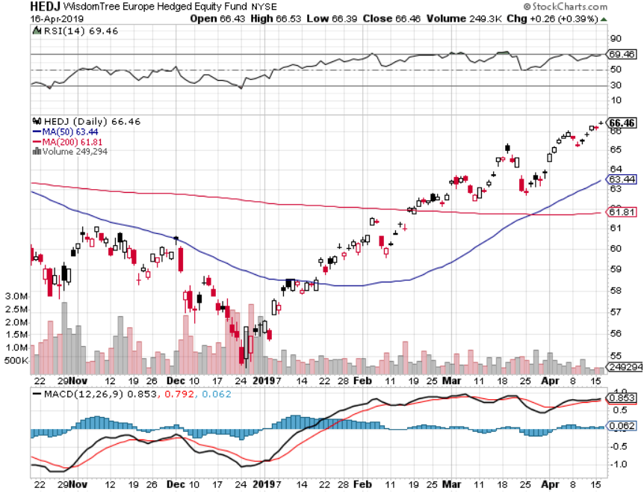
Europe Hedged Equity (HEDJ)-

Slide 45
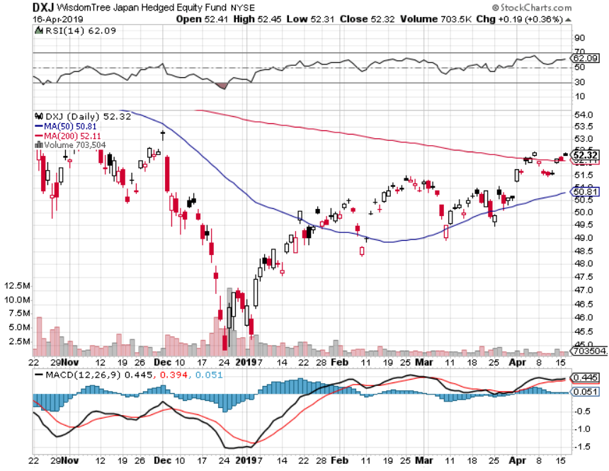
Japan (DXJ)-

Slide 46
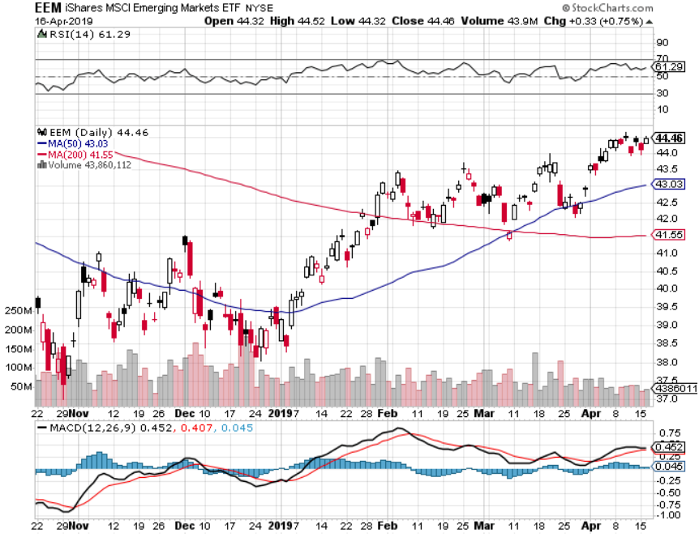
Emerging Markets (EEM)- Time to Buy on Weak Dollar

Slide 47
Bonds – Battle of the Fed
*President demanding artificially low interest rates and more QE to create a stock market bubble going into the 2020 election *Fed has cancelled all 2019 rate rises but won’t go further *Loss of SALT deductions is pouring money into muni bonds as high end investors seek new tax breaks. Illinois is paying 3.1% despite being on the edge of bankruptcy *10 year rates have backed off 27 basis points, from 2.33% to 2.60% *Foreign Investors Pour into the US Bond Market *German bund yields plunge to +0.05%, while Japan government bonds turn in a -0.04% yield

Slide 48
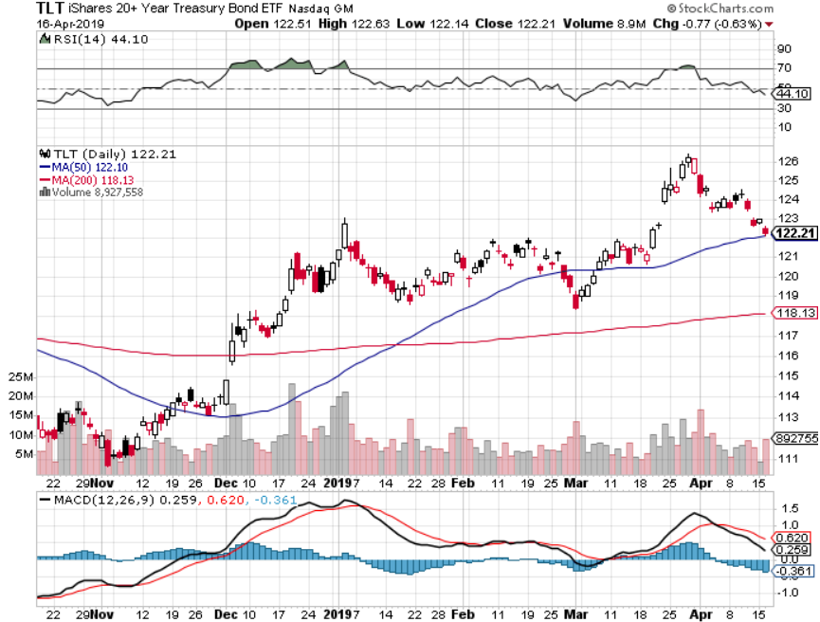
Treasury ETF (TLT) – Bottom of Range took profits on long 4/$128-$130 bear put spread long 3/$124-$126 put spread- expired at maximum profit point Expiration of long 2/$124-$126 put spread at maximum profit point took profits on long 2/$125-$128 call spread again took profits on long 1/$124-$127 call spread took profits on long 2/$125-$128 call spread

Slide 49
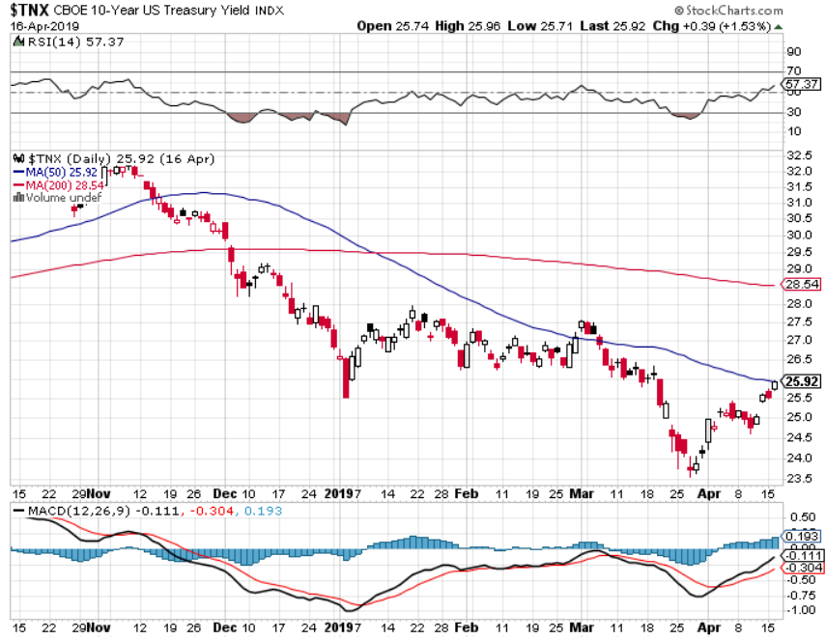
Ten Year Treasury Yield ($TNX) 2.50% Breakdown

Slide 50
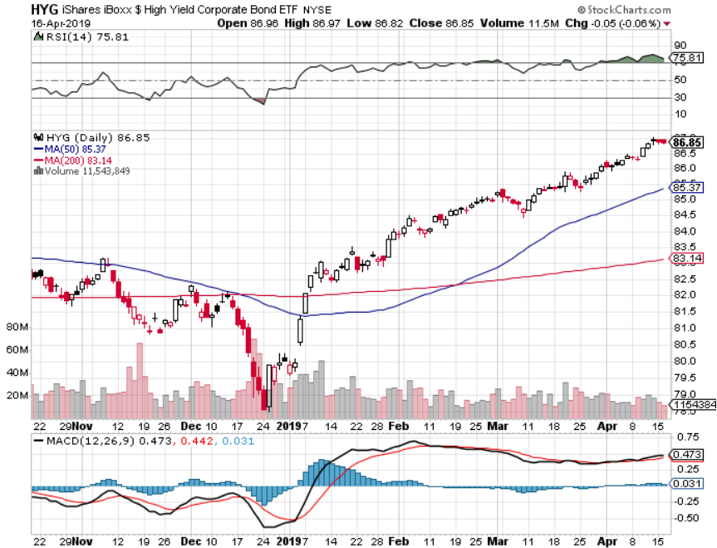
Junk Bonds (HYG) 5.27% Yield

Slide 51
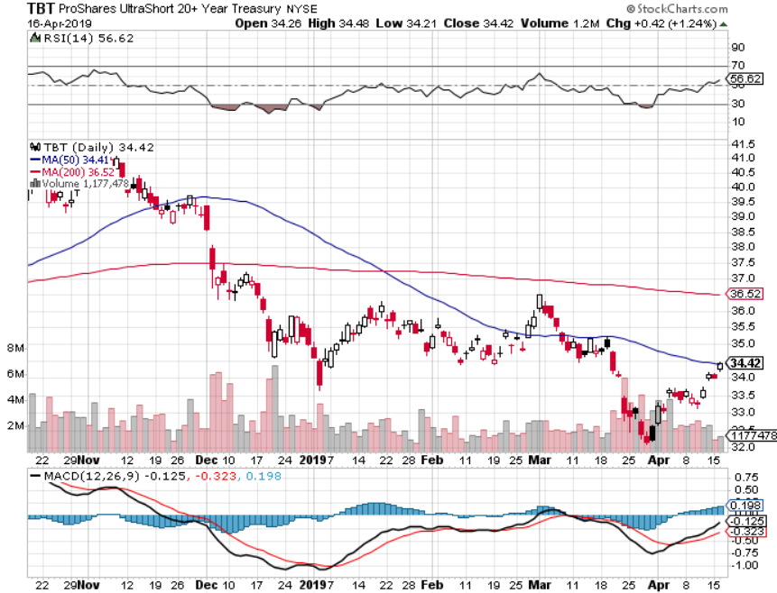
2X Short Treasuries (TBT)-Buy Territory

Slide 52
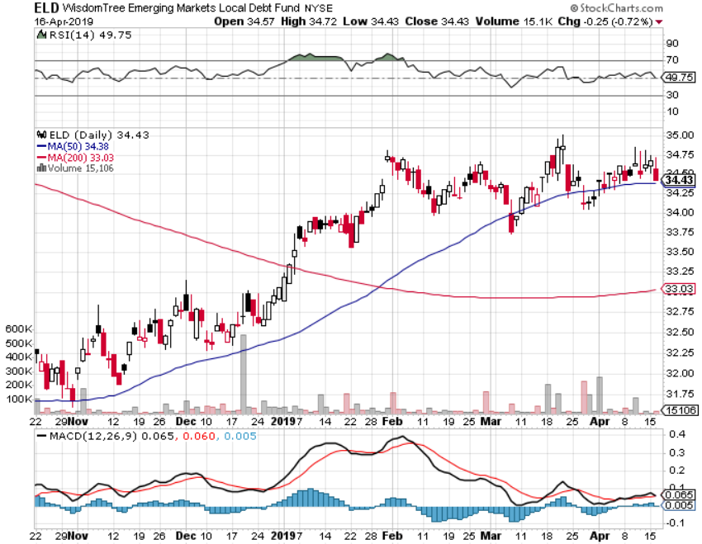
Emerging Market Debt (ELD) 5.92% Yield-

Slide 53
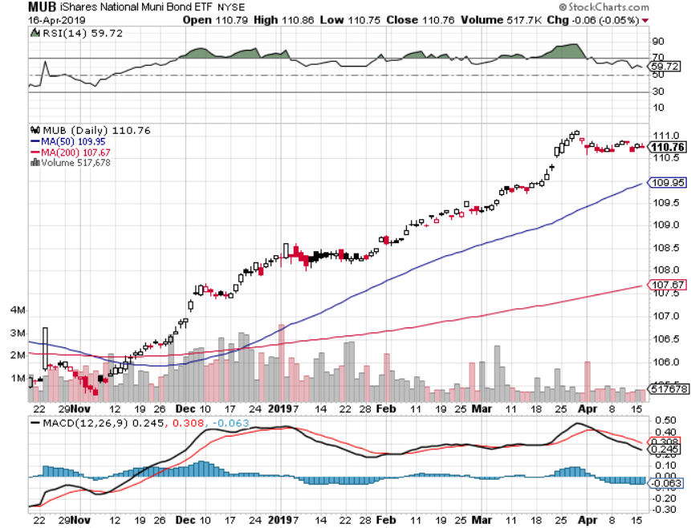
Municipal Bonds (MUB)-2.26% Mix of AAA, AA, and A rated bonds

Slide 54
Foreign Currencies – Dollar Hanging High
*US dollar still hanging on to highs on the back of huge foreign buying *But weak dollar plays holding up on massive liquidity surge *British pound flat lining pending Brexit news *Massive Chinese economic stimulus lets Yuan maintain highs *Bitcoin holding new highs of the year *Bottom Line: stand aside

Slide 55
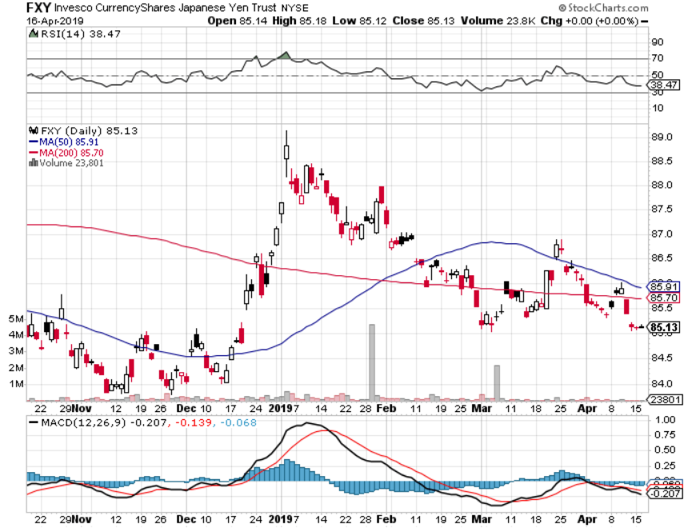
Japanese Yen (FXY), (YCS)

Slide 56
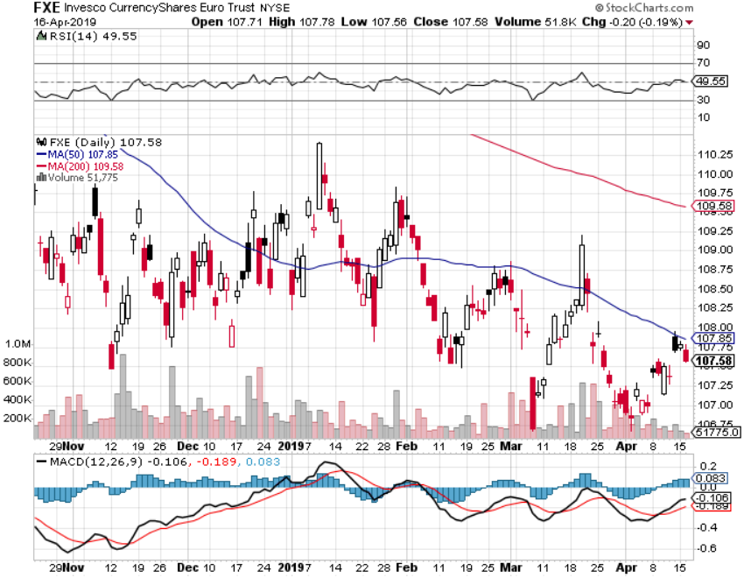
Euro ($XEU), (FXE), (EUO)- Trying to Break Down long 2/$105-$108 call spread

Slide 57
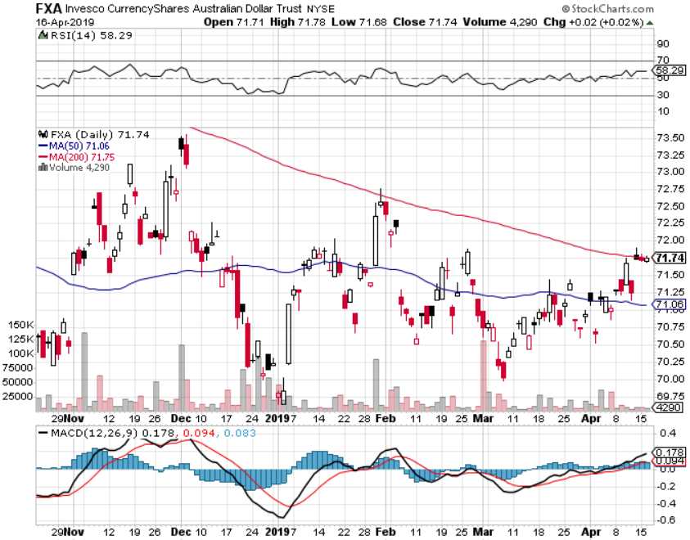
Australian Dollar (FXA)-

Slide 58
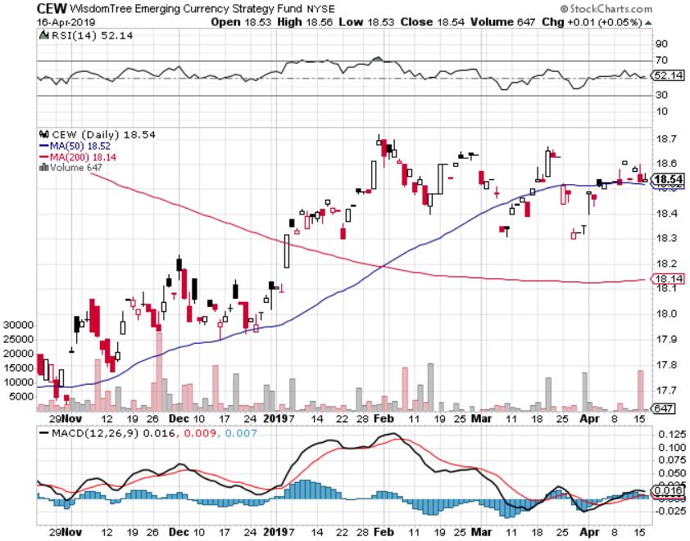
Emerging Market Currencies (CEW)

Slide 59
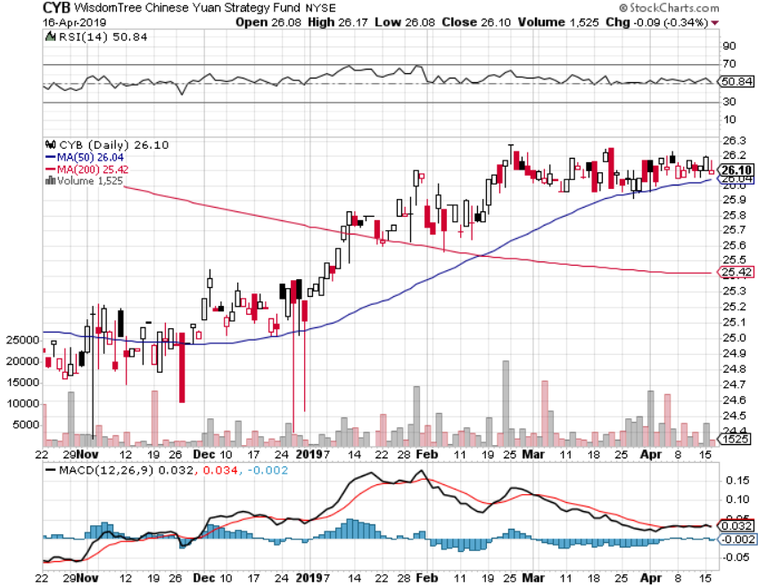
Chinese Yuan- (CYB)-

Slide 60
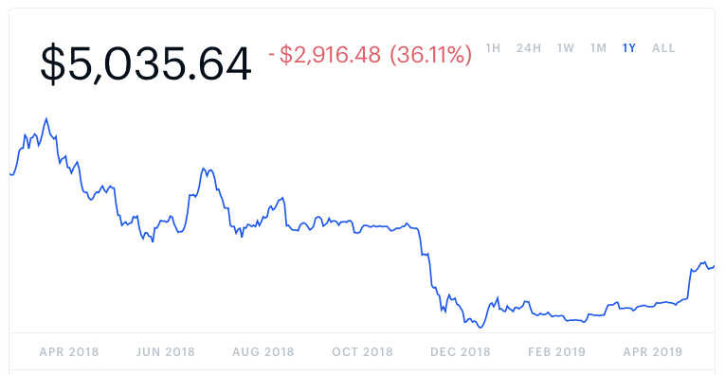
Bitcoin- 45% Rally Global Liquidity Surge

Slide 61
Energy – Strength to Strength
*Oil pushed up to new one year highs at $65, breaking the 200-day moving average with authority *Russian and Saudi production down *Baker-Hughes rig count falls to a one year low at 816 *Front month futures contracts in backwardation, which is always bullish for prices *Venezuela collapse still squeezing supply, from 1 million barrels a day to 100,000 *Bottom Line: Buy the dips

Slide 62
Oil-Bouncing

Slide 63
United States Oil Fund (USO)

Slide 64
Energy Select Sector SPDR (XLE)-No Performance! (XOM), (CVX), (SLB), (KMI), (EOG), (COP)

Slide 65
Halliburton (HAL)-

Slide 66
Natural Gas (UNG)- Major Hedge Fund Blow Up

Slide 67
Copper (COPX)- Upside breakout Trade War Deal Coming

Slide 68
Precious Metals – Stabbed in the Back
*”RISK ON” world has no room for gold *Capital is being shifted out of gold into US stocks *Rising rates, with the ten year up 25 basis points in two weeks, is another stab in the back *Big stop loss sell order at $1,285 an ounce, but technical support is crumbling *Central bank buying continues in major way *However, the long term trend is intact until the Fed starts raising rates again. *Stand aside

Slide 69
Gold (GLD)- The flight to safety bid is coming Stopped out of 3/$119-$122 vertical bull call spread

Slide 70
Market Vectors Gold Miners ETF- (GDX) – Yikes!

Slide 71
Barrick Gold (GOLD)

Slide 72
Newmont Mining- (NEM)-

Slide 73
Palladium - (PALL)-

Slide 74
($COPPER)- Copper

Slide 75
Freeport McMoRan - (FCX)- took profits on long 4/$10-$11 call spread took profits on short 4/$114 calls

Slide 76
5 Million Total Electric Cars by June 22 pounds of copper per car

Slide 78
Real Estate – Rates to the Rescue
*30 year fixed rate loan drops to a one year low of 4.03%, new mortgage demand is suddenly soaring *May rescue the spring selling season which had been written off *April Homebuilder Sentiment crawls up 1 point to 63 *30 year fixed rate loan drops to a one year low of 4.03%, new mortgage demand is suddenly soaring *December S&P 500 Case-Shiller drops to 4.2%, annual gain, the lowest gain in 4 years *Bottom Line: Stand aside for a trade but buy for long term investment

Slide 79
December Corelogic S&P Case Shiller Home Price Index Las Vegas (11.4%), Phoenix (8%), and Atlanta (5.9%) showing biggest gains
Tradingeconomics.com

Slide 80
Simon Property Group (SPG)-

Slide 81
US Home Construction Index (ITB) (DHI), (LEN), (PHM), (TOL), (NVR)

Slide 82
Trade Sheet- So What Do We Do About All This?
*Stocks-stand aside *Bonds-buy dips *Commodities-buy dips *Currencies-stand aside *Precious Metals – stand aside *Volatility-buy dips to $12 *Real estate-stand aside

Slide 83
Next Strategy Webinar 12:00 EST Wednesday, May 1, www.madhedgefundtrader.com email me at support@madhedgefundtrader.com
Good Luck and Good Trading!
Notes:
*

