Slide 1
The Mad Hedge Fund Trader “RISK ON” Again”
With John Thomas from Silicon Valley, CA, May 1, 2019 www.madhedgefundtrader.com
Notes:
*

Slide 2
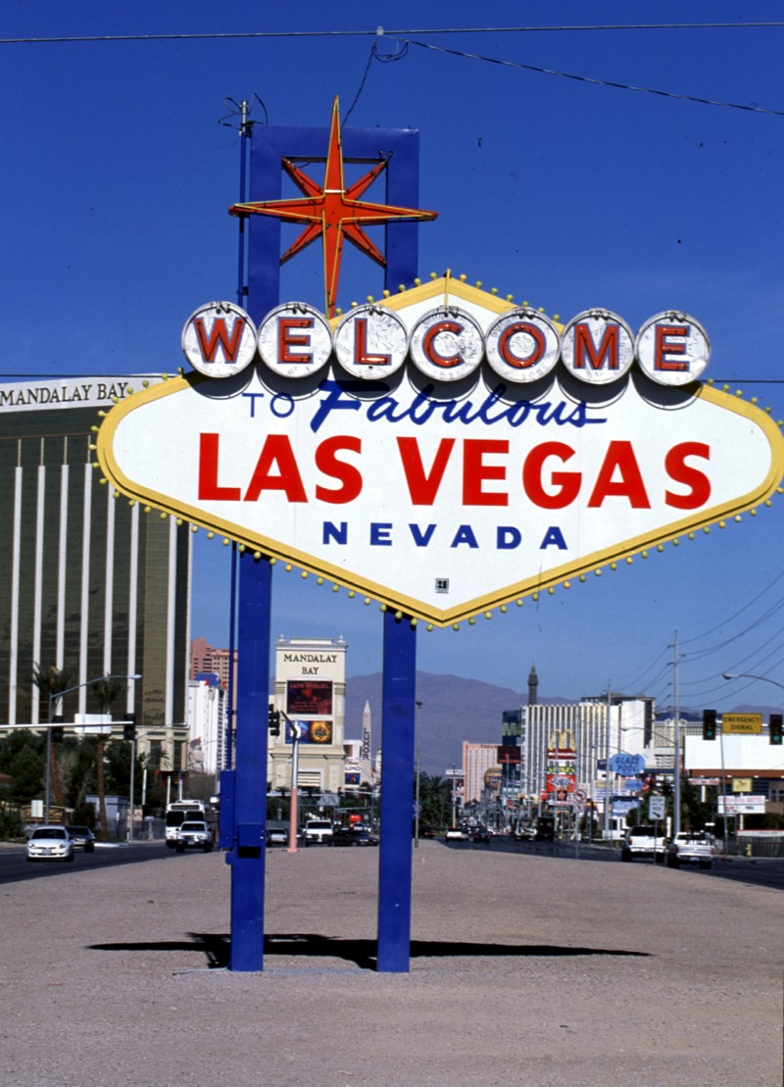
MHFT Global Strategy Luncheons Buy tickets at www.madhedgefundtrader.com
Las Vegas, May 9

Slide 3
MHFT Global Strategy Luncheons 2019 World Tour Buy tickets at www.madhedgefundtrader.com
Friday June 21 12:30 PM Auckland, New Zealand Monday June 24 12:30 PM Melbourne, Australia Tuesday June 25 12:30 PM Sydney, Australia Wednesday June 26 12:30 PM Brisbane, Australia Friday June 28 12:30 PM Perth, Australia Sunday June 30 12:30 PM Manila, Philippines Tuesday July 2 12:30 PM New Delhi, India Friday July 5 12:30 PM Cairo, Egypt Monday July 8 12:30 PM Venice, Italy Wednesday July 10 12:30 PM Budapest, Hungary

Slide 4
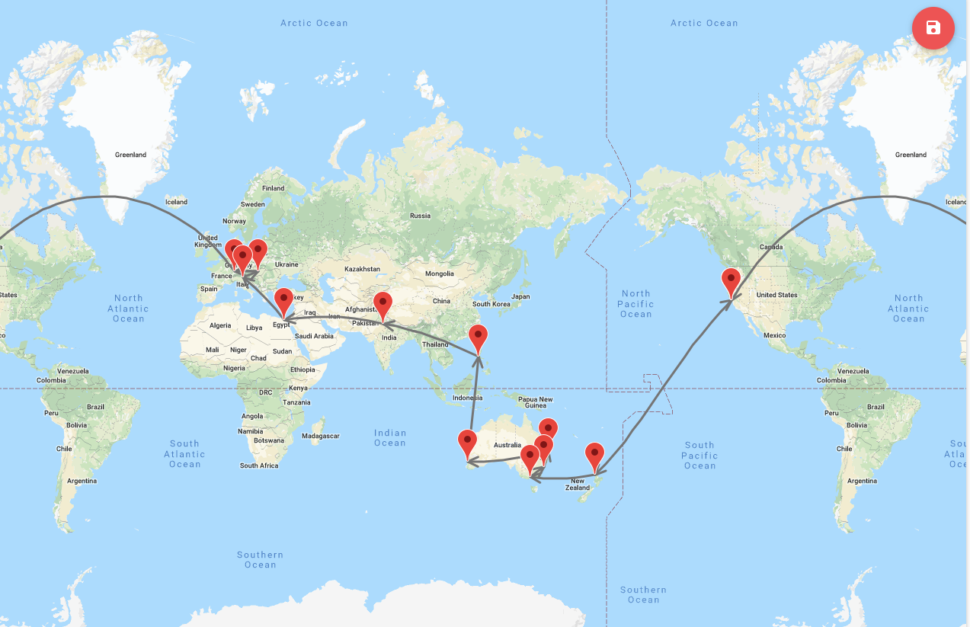
START

Slide 5
October 25-26 Lake Tahoe Conference 50% of seats already sold out
*Two days of informative speakers on crucial trading and investment issues *Trade tips with the most successful Mad Hedge traders *2 nights in the Hyatt, including all you can eat and drink *Tickets are a bargain at $699 to $1,999 *Buy now, upper ticket classes sell out first

Slide 6
Trade Alert Performance New Highs!
*January 9.49% Final *July +0.0% Final *February +4.64% Final *August +2.19% MTD *March +1.78% Final *September 1.38% Final *April +0.30% Final *October +1.37% Final *May +1.07% Final *November -1.83% Final *June +4.15% Final *December -4.13% Final *2019 Year to Date +16.02% compared to +14.60% for the Dow Average *Trailing One year return +21.17%, +316.16% since inception, *Average annualized return of 33.87% for 9 1/2 years

Slide 7
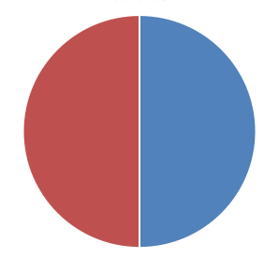
Portfolio Review Keeping Small Positions at Market Highs New All Time High
Current Capital at Risk
Risk On
World is Getting Better
(FCX) 5/$10-50-$11.50 call spread | 10.00%
(DIS) 5/$125-$130 call spread | 10.00%
Risk Off
No Positions
Total Net Position | 20.00%
Expiration P&L 17.46%

Slide 8
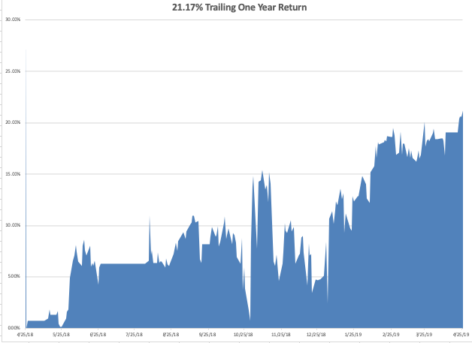
GTD Daily Audited Performance New All Time High

Slide 9
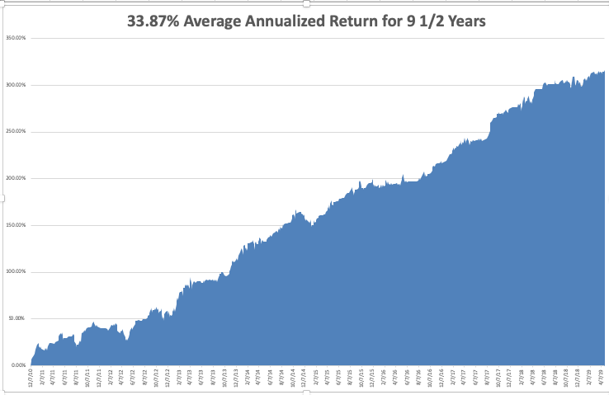
GTD 9 Year Daily Audited Performance

Slide 10
The Method to My Madness
*Red hot Q1 G could give another leg to the bull market, maybe 5% more over a few weeks *Tech is still leading with a dead cat bouncing happening in the banks *Low interest rates are the main driver now and traders are ignoring everything else, like earnings and valuations, and the economy *Bonds narrow down to a small range, may not move for the rest of 2019 *Bounce back in Q2 and Q3 earnings now the main play *Oil remains strong *China trade war moves to the back burner overshadowed by international bond markets

Slide 11
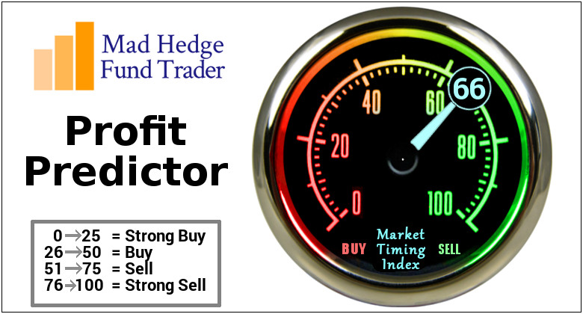
The Mad Hedge Profit Predictor Market Timing Index- An artificial intelligence driven algorithm that analyzes 30 different economic, technical, and momentum driven indicators

Slide 12
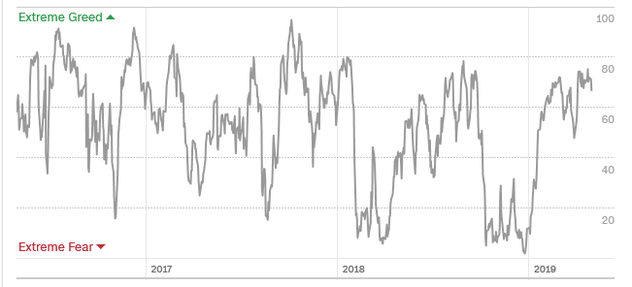
The Mad Hedge Profit Predictor Firmly in “SELL” Territory watch the time at the tip for timing
SELL
BUY

Slide 13
The Global Economy – Q1 Surprise
*Blistering 3.2% Q1 GDP may bring a few more weeks of life to the bull market. However, have was due to one time anomalies, like exports and inventories, which bring the core rate down to 1.8%. Lack of market reactions b\means investors believe the core rate. *There are now 6.5 million job openings in the US, a record high *German March PPI down -0.1%, up 2.4% as deflation keeps a grip *Chicago March PMI takes a dive *New dollar high hits weak dollar plays, like emerging markets (EEM) and the currencies (FXE) and (FXA), and oil (USO)

Slide 14
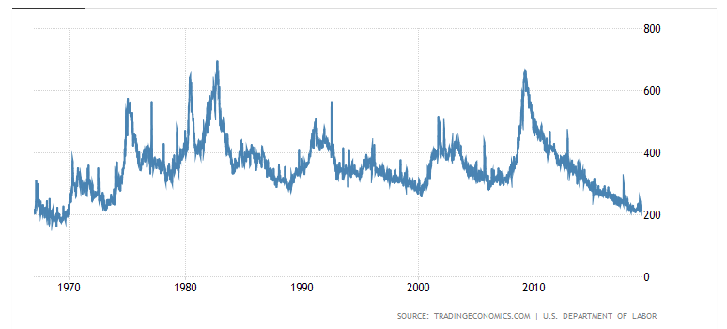
Weekly Jobless Claims +37,000 to 230,000 monster gain

Slide 15
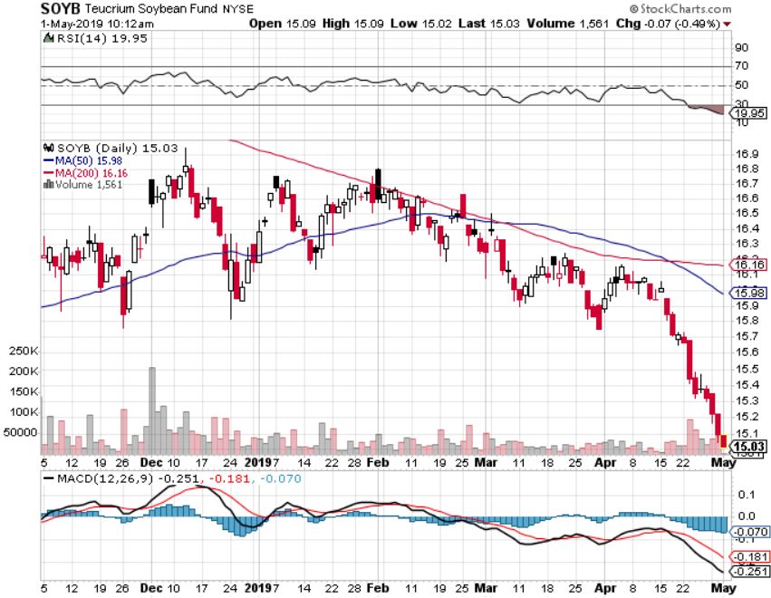
Soybeans (-20%)-Trade War Indicator rolling over price action hits on a big “Sell the news” on China trade deal, or no China trade deal-no flood boost

Slide 16
The Bill Davis View A $1,500 Upgrade for the Mad Day Trader Service
Buys: | Entry | Target
Usana Health Sciences, Inc. (USNA) | $ 85.00 | $ 100.00
Quest Diagnostics Inc. (DGX) | $ 91.00 | $ 100.00
Twitter, Inc. (TWTR) | $ 38.00 | $ 45.00
Amazon.Com (AMZN) | $ 1,895.00 | $ 2,000.00
Alphabet, Inc. (GOOGL) | $ 1,188.00 | $ 1,220.00
Sells:
Becton Dickinson Co, (BDX) | $ 242.00 | $ 225.00
Regeneron Pharmeceuticals (REGN) | $ 360.00 | $ 338.00
Vertex Pharmeceuticals (VRTX) | $ 172.00 | $ 158.00
ConocoPhilips (COP) | $ 68.00 | $ 60.00
Steel Dynamics, INC (STLD) | $ 35.00 | $ 28.00

Slide 17
Stocks – Grinding Up
*100% of stock market gains this year have come through multiple expansion. In other words, you are paying more for less *Tech is leading again, 33% compounded annual growth rate for the past five years *The market is looking tired with volume collapsing and valuations at multi year highs *Investors focusing on an economic bounce back in Q2 and Q3 and ignoring a weak Q1 *A lot of investors flushed out in December have still not gotten back in, so a slow low volume grind up could continue for a few more weeks *Back up in rates has been a plus for financials, which have been in the dog house for 2 years *Bottom Line: its bet the ranch time on tech longs, but stay away from those with big China exposure, like Apple, and weak dollar plays like energy, and emerging markets

Slide 18
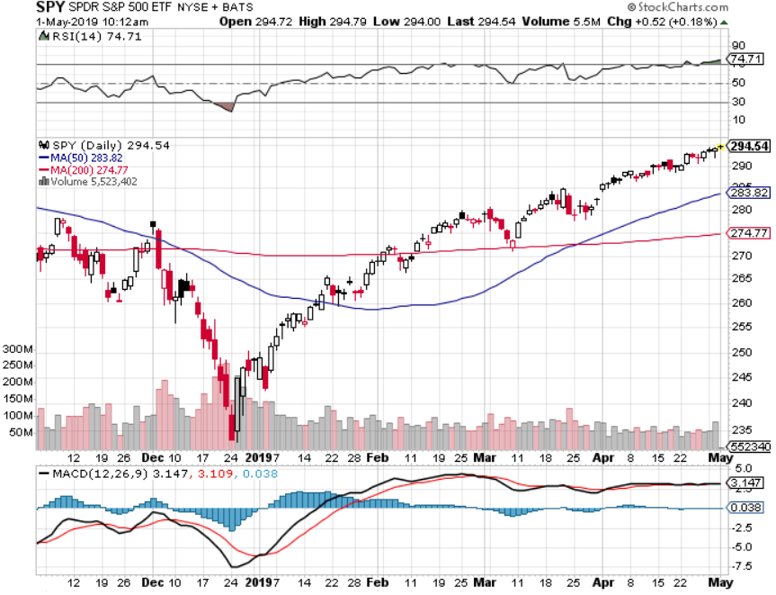
S&P 500- stopped out of long 2/$285-$290 bear put spread took profits on long 2/$270-$275 bear put spread

Slide 19
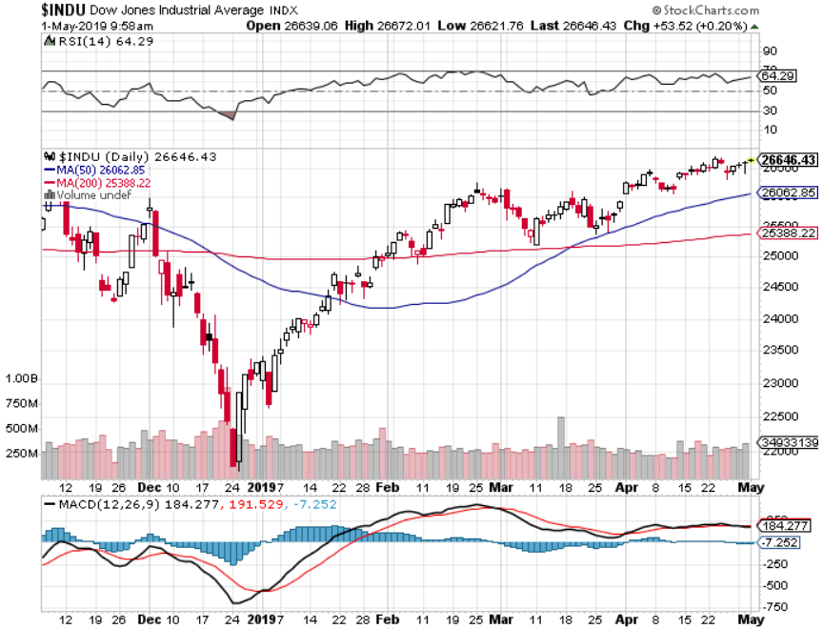
Dow Average-

Slide 20
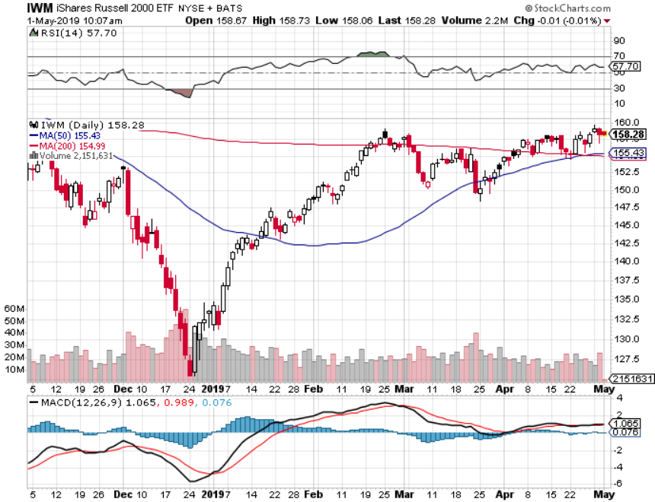
Russell 2000 (IWM)- out for even Long 4/$160-$165 vertical bear put spread

Slide 21
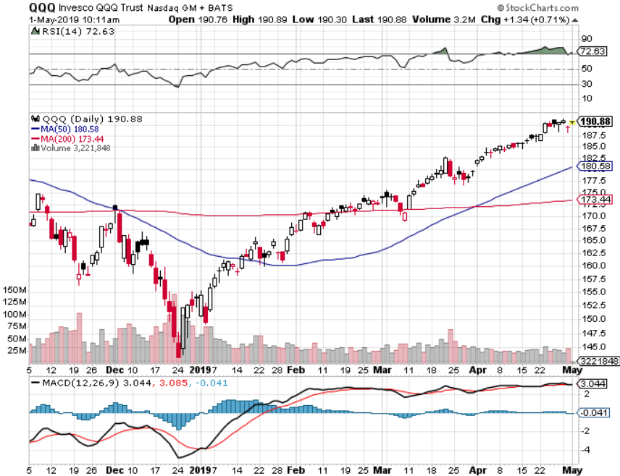
NASDAQ (QQQ)

Slide 22
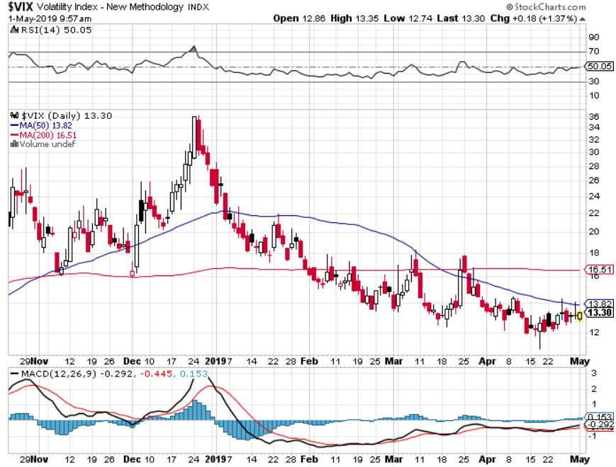
(VIX)- Probing Lows

Slide 23
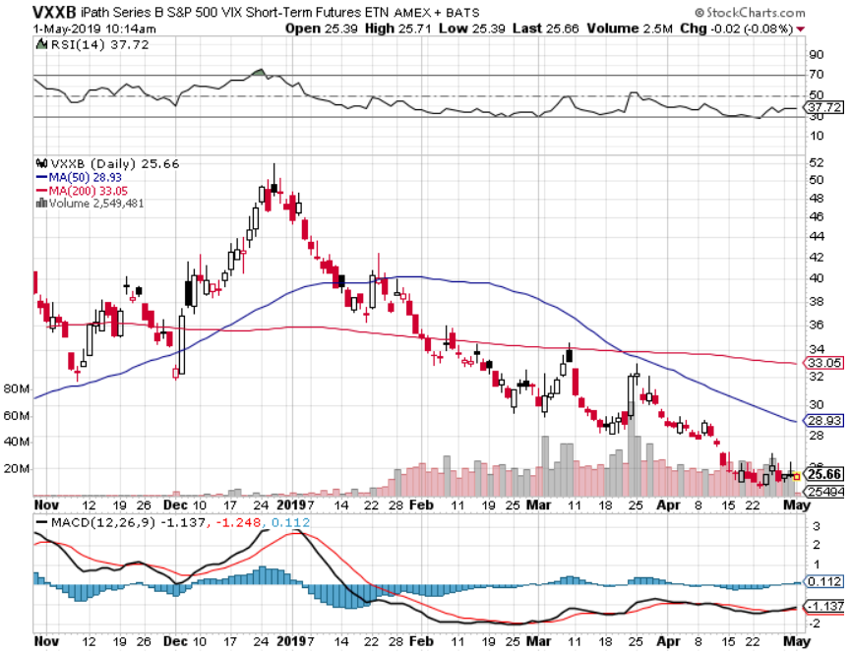
iPath S&P 500 VIX Short-Term Futures ETN (VXX)

Slide 24
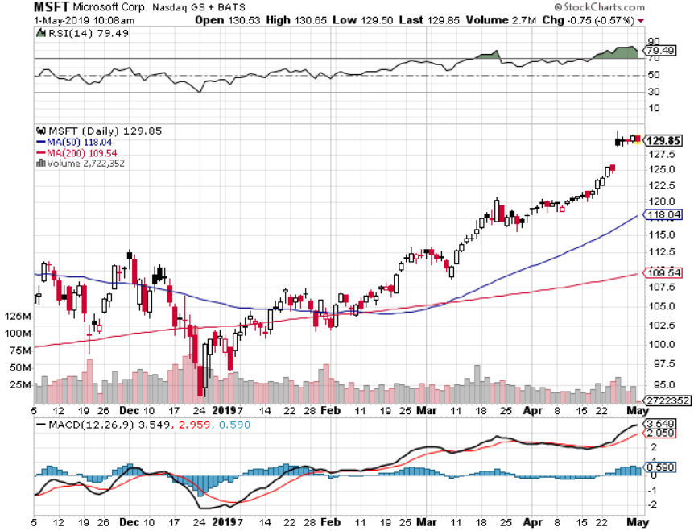
Microsoft (MSFT)- Earnings beat took profits on long 4/$108-$113 call spread took profits on long 2/$85-$90 call spread

Slide 25
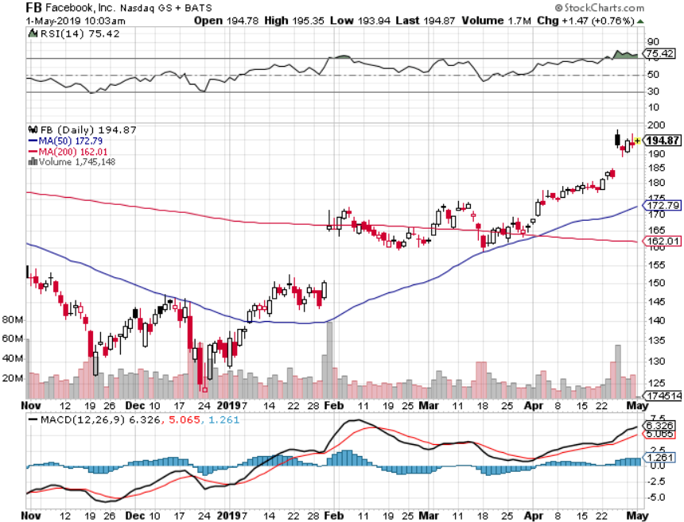
Facebook (FB)-Run at the Highs

Slide 26
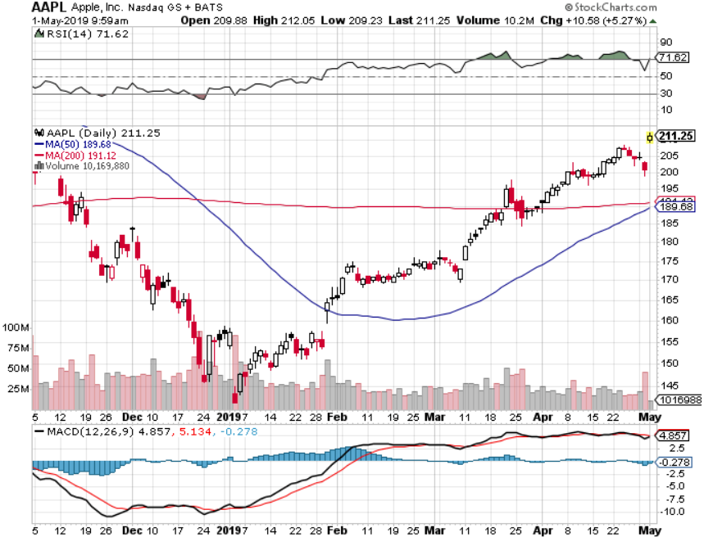
Apple (AAPL)- Bull Run Earning blow out- $30 billion hardware-$11 billion services stopped out of long 3/$180-$185 bear put spread stopped out of long 11/$175-$180 bear put spread took profits on long 11/$165-$175 bear put spread

Slide 27
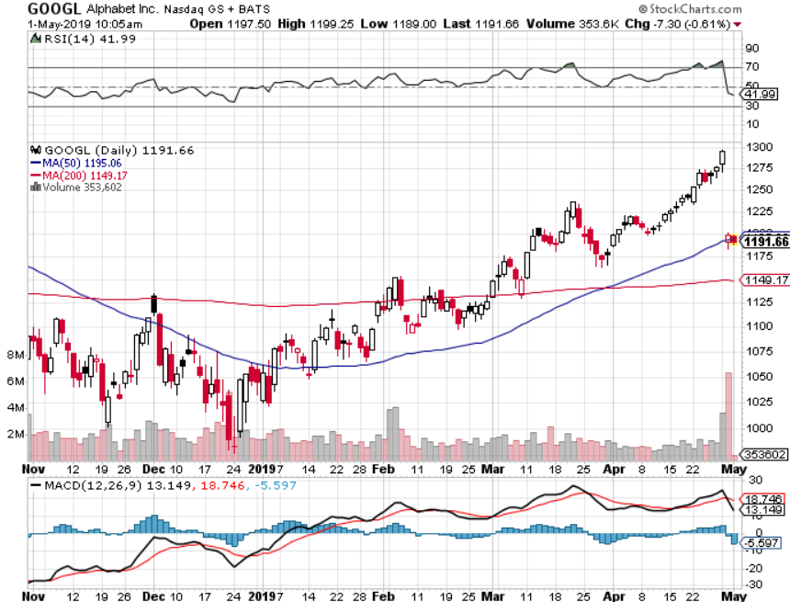
Alphabet (GOOGL)- Earnings Shock long 5/$1,100-$1,120 bull call spread-12 days to expiration took profits on long 4/$1,080-$1,120 bull call spread

Slide 28
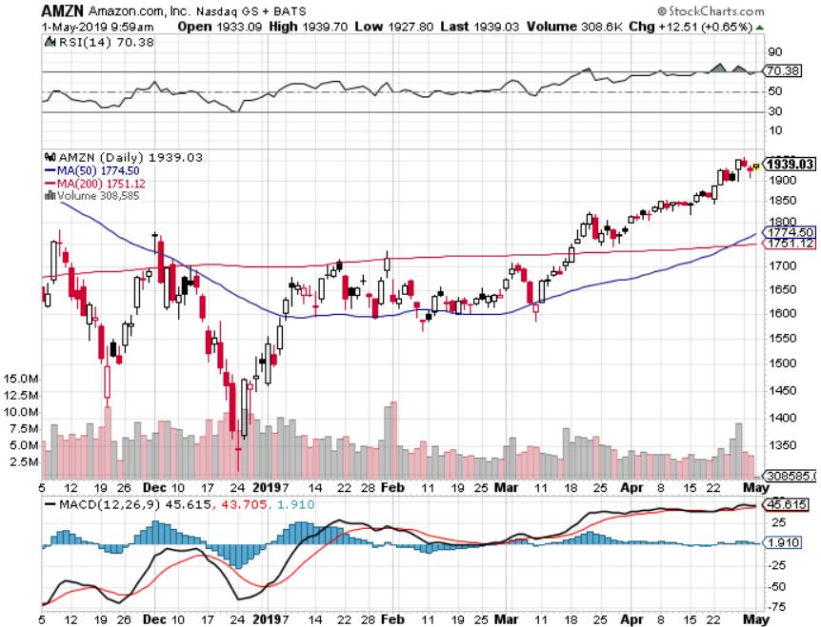
Amazon (AMZN)-Run at the Highs took profits on long 4/$1,600-$1,650 call spread took profits on long 2/$1,200-$1,300 call spread

Slide 29
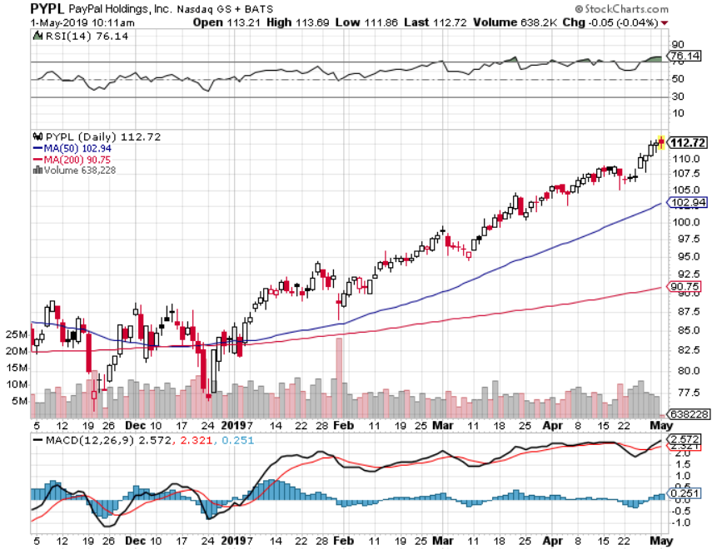
PayPal (PYPL)-Fintech Star took profits on long 4/$90-$95 call spread

Slide 30
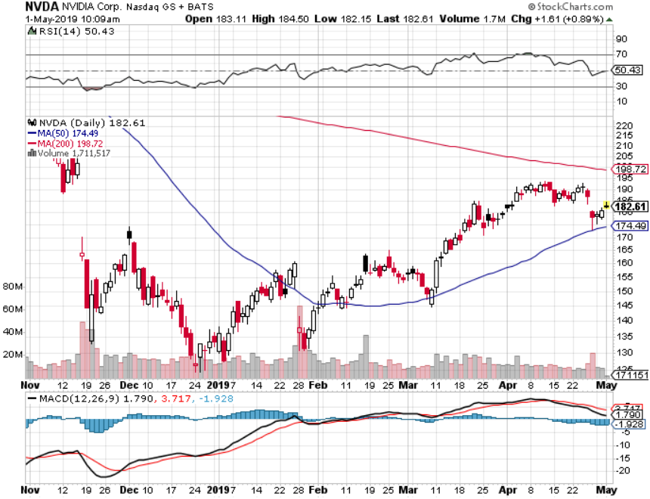
NVIDIA (NVDA)- earnings beat

Slide 31
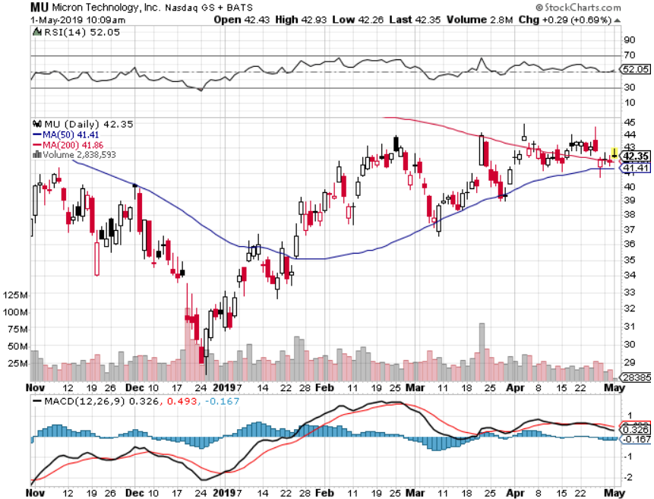
Micron Technology (MU)-

Slide 32
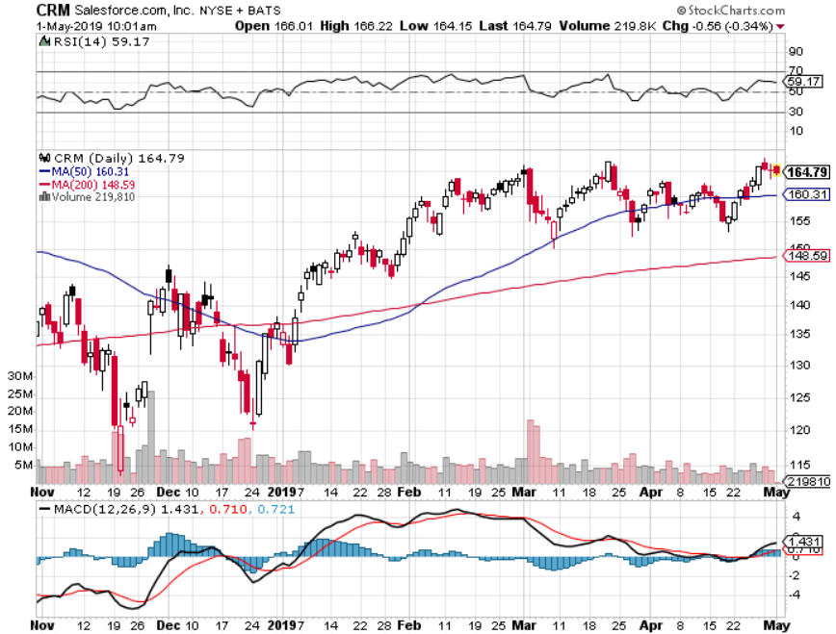
Salesforce (CRM)- took profits on long 2/$105-$115 call spread

Slide 33
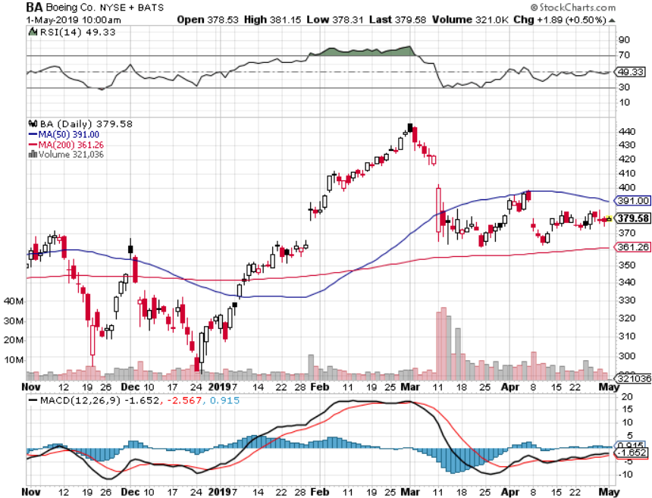
Boeing (BA)- took profits on long 4/$315-$335 call spread Next to happen in the recertification bounce

Slide 34
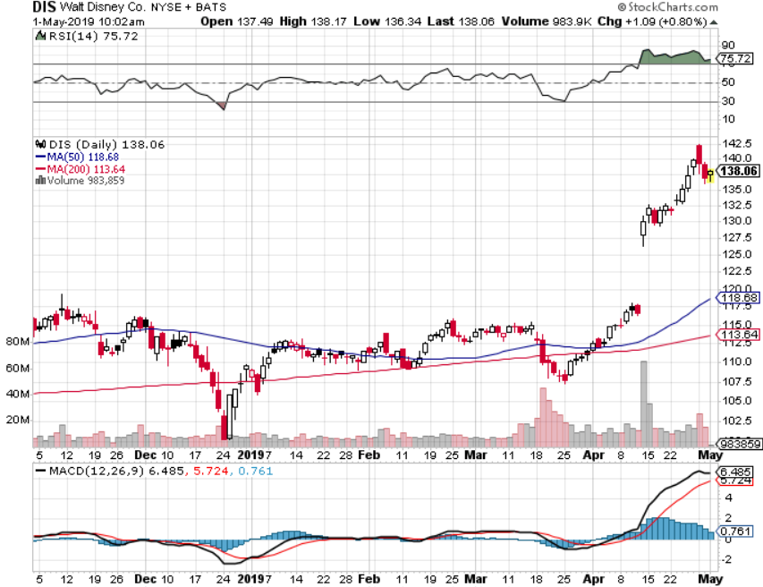
Walt Disney (DIS)- long 4/$125-$130 call spread-12 days to expiration took profits on long 4/$100-$104 call spread Covered Short 4/$114 calls

Slide 35
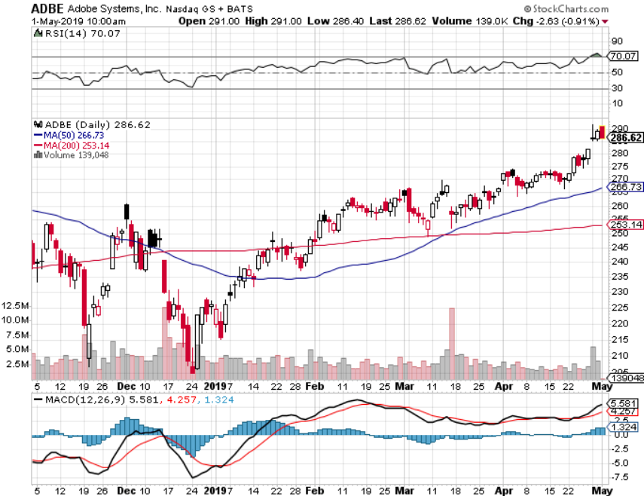
Adobe (ADBE)- The Quality Non-China tech play

Slide 36
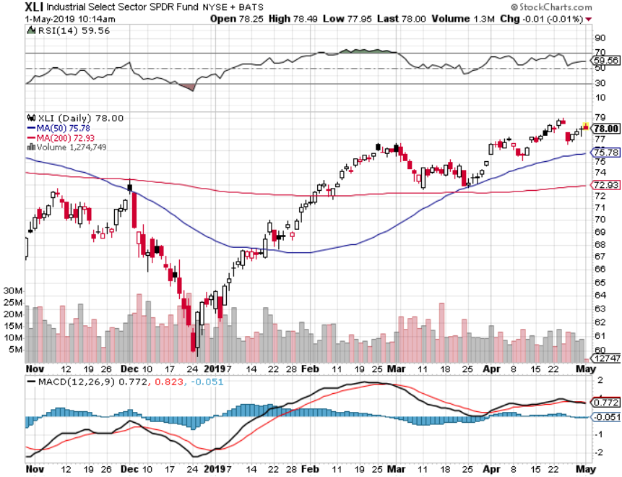
Industrials Sector SPDR (XLI)- (GE), (MMM), (UNP), (UTX), (BA), (HON)

Slide 37
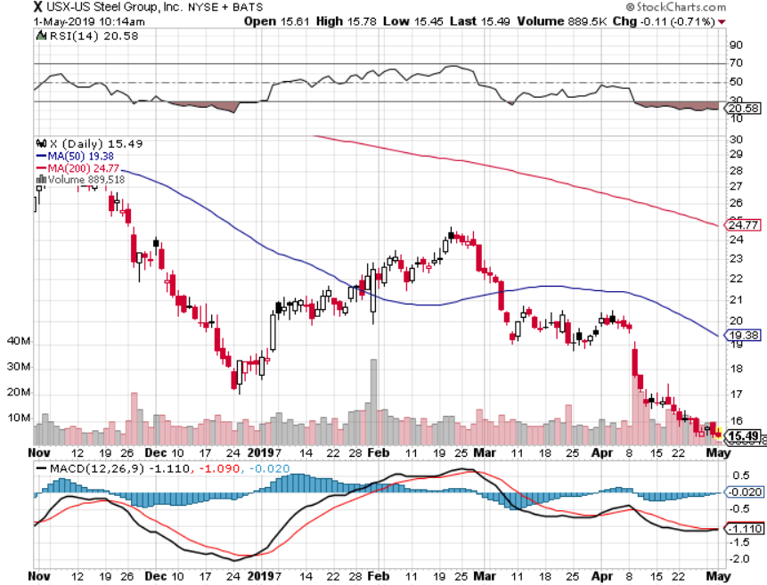
US Steel (X)-Tariffs Trouble Import duties cause users to abandon steel Unwound the entire Trump trade

Slide 38
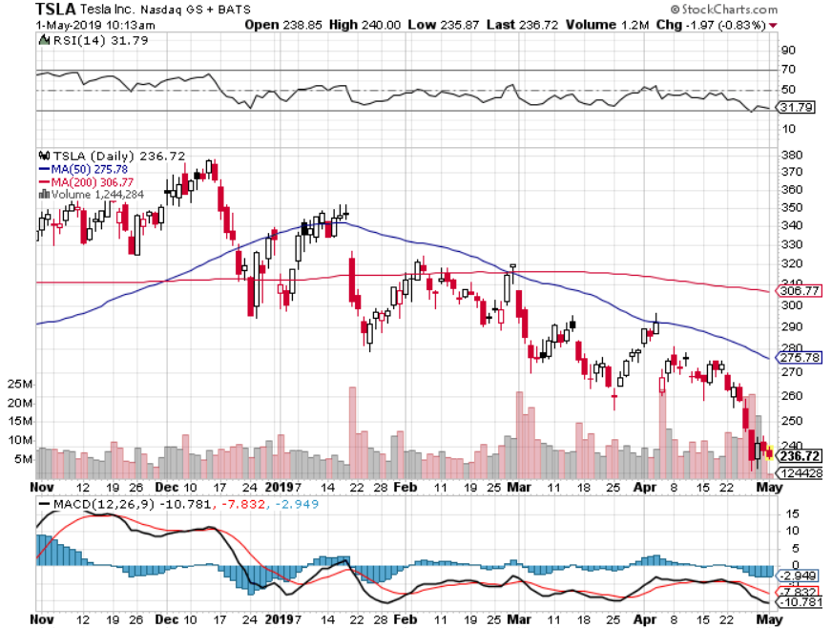
Tesla (TSLA)-Q1 Earnings stopped out of long 4/$300-$320 put spread delayed Phase II Gigafactory, disastrous Q1 earnings

Slide 39
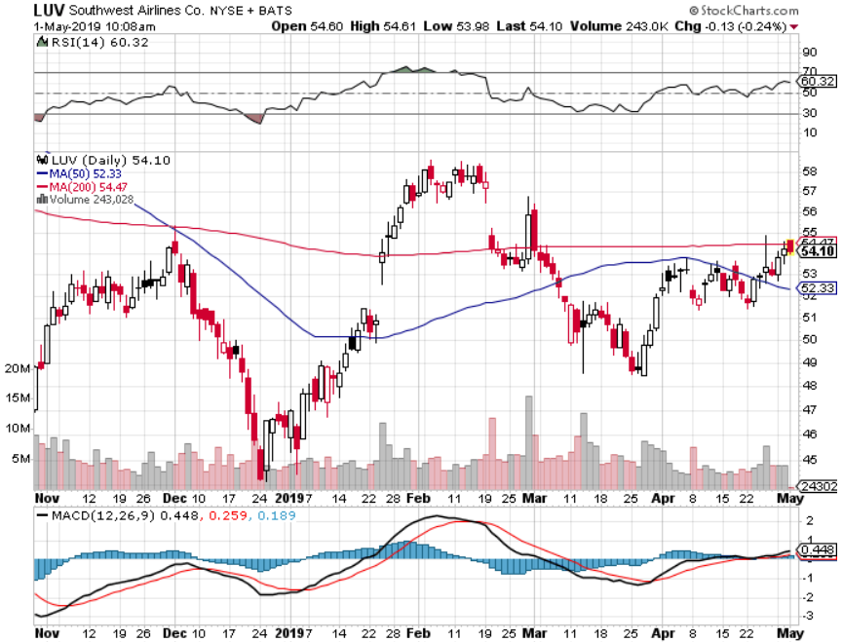
Southwest Airlines (LUV)- Boeing 737 Max biggest buyer

Slide 40
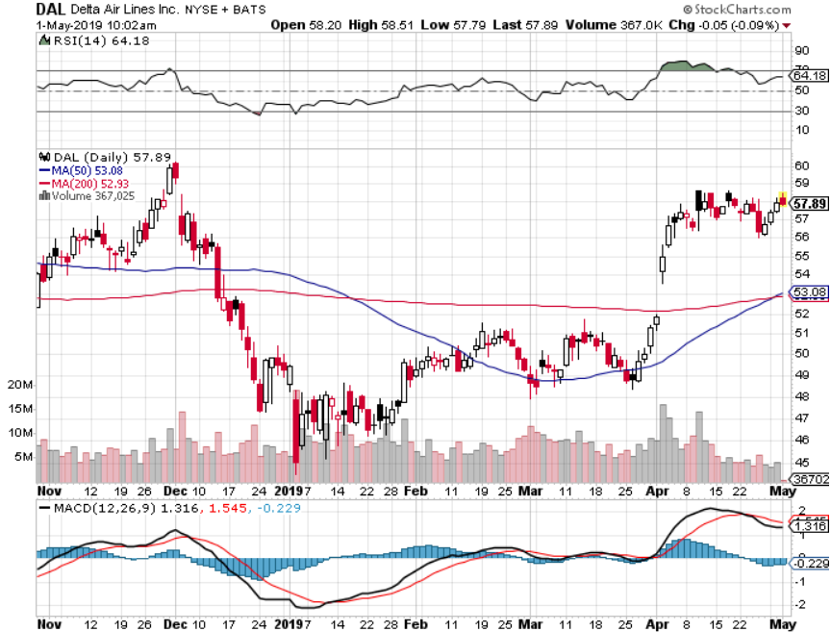
Delta Airlines (DAL)

Slide 41
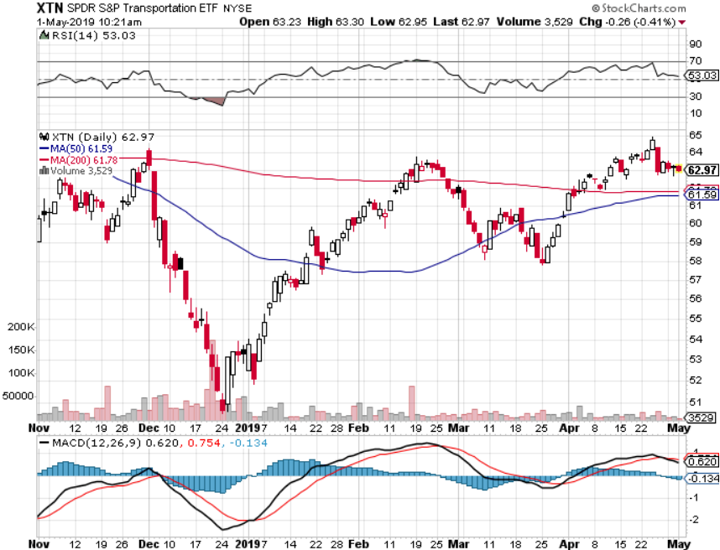
Transports Sector SPDR (XTN)- (ALGT), (ALK), (JBLU), (LUV), (CHRW), (DAL)

Slide 42
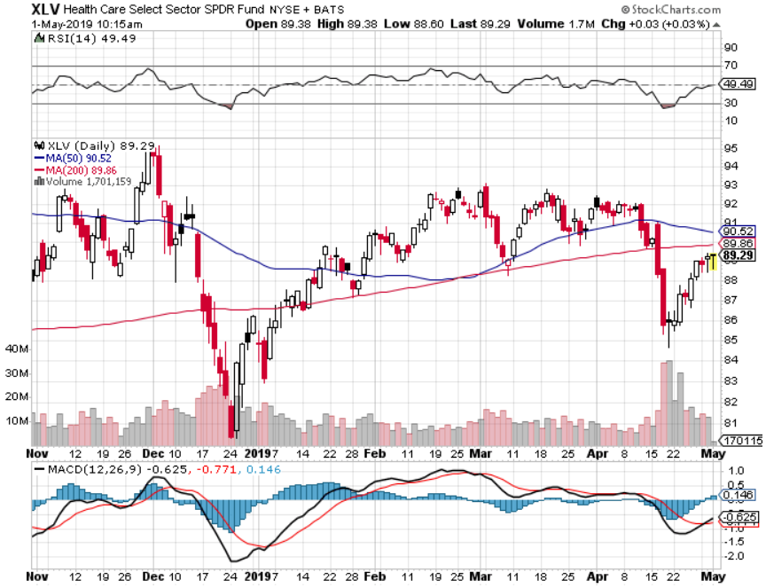
Health Care Sector (XLV), (RXL)-New Highs (JNJ), (PFE), (MRK), (GILD), (ACT), (AMGN)

Slide 43
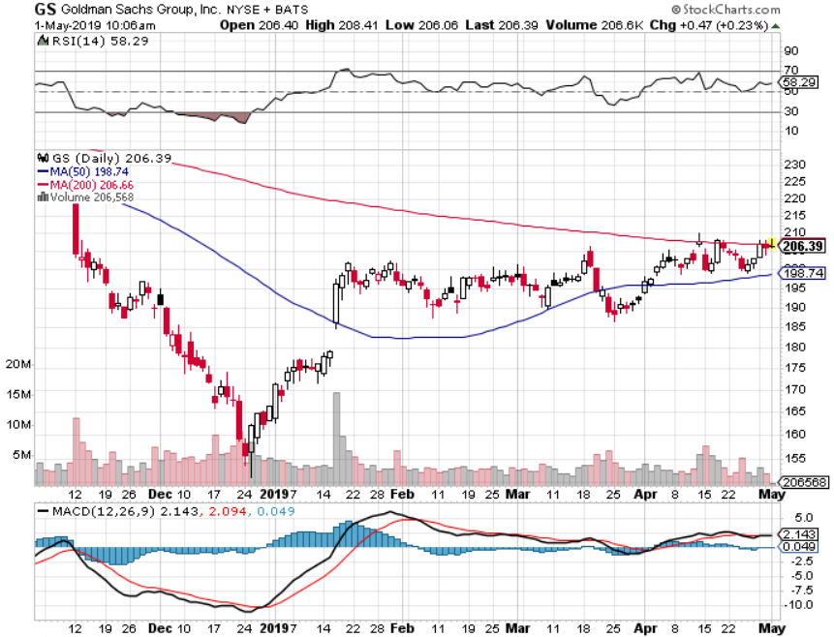
Goldman Sachs (GS)-falling trading volume

Slide 44
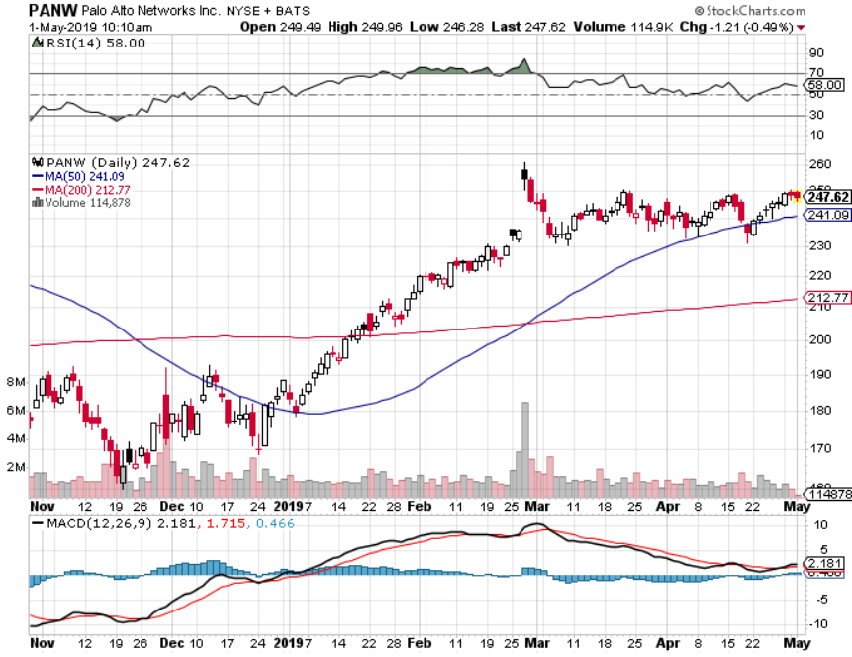
Palo Alto Networks (PANW)- Hacking never goes out of fashion

Slide 45
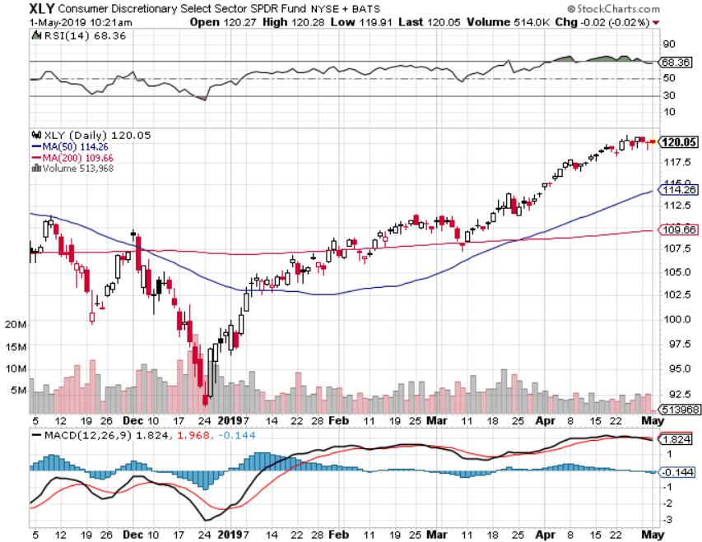
Consumer Discretionary SPDR (XLY) (DIS), (AMZN), (HD), (CMCSA), (MCD), (SBUX)

Slide 46
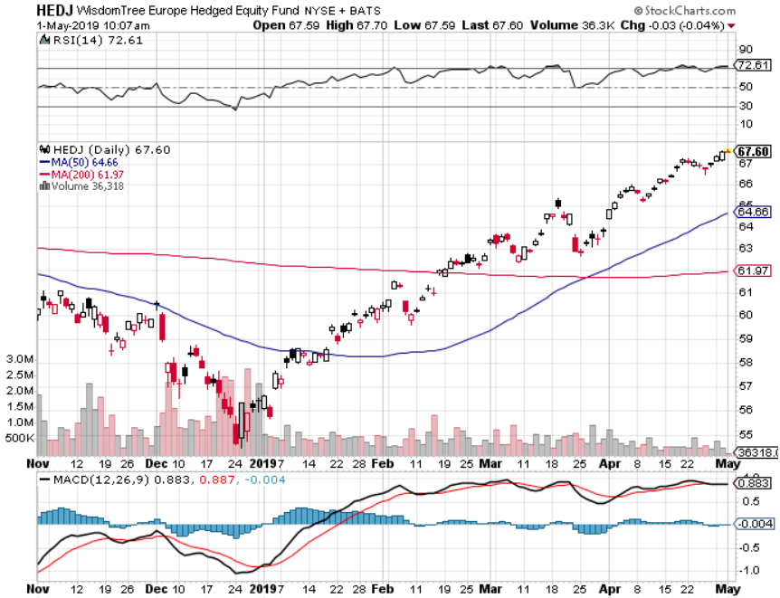
Europe Hedged Equity (HEDJ)-

Slide 47
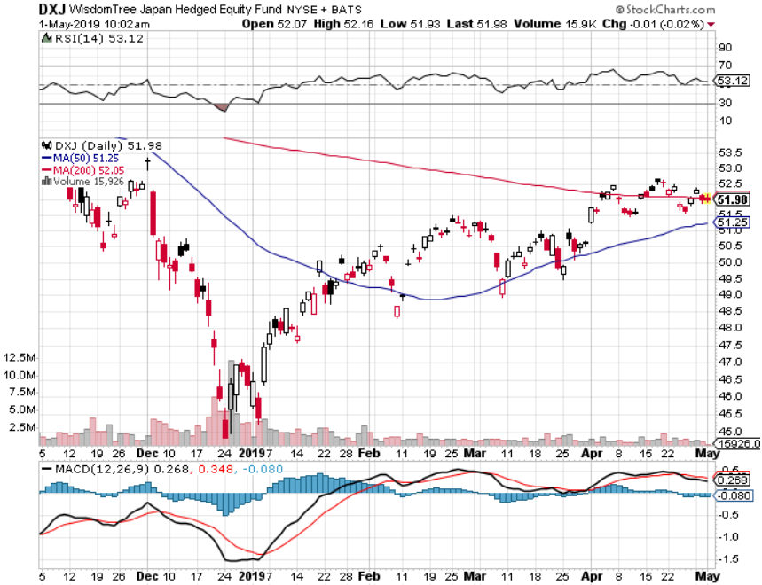
Japan (DXJ)-

Slide 48
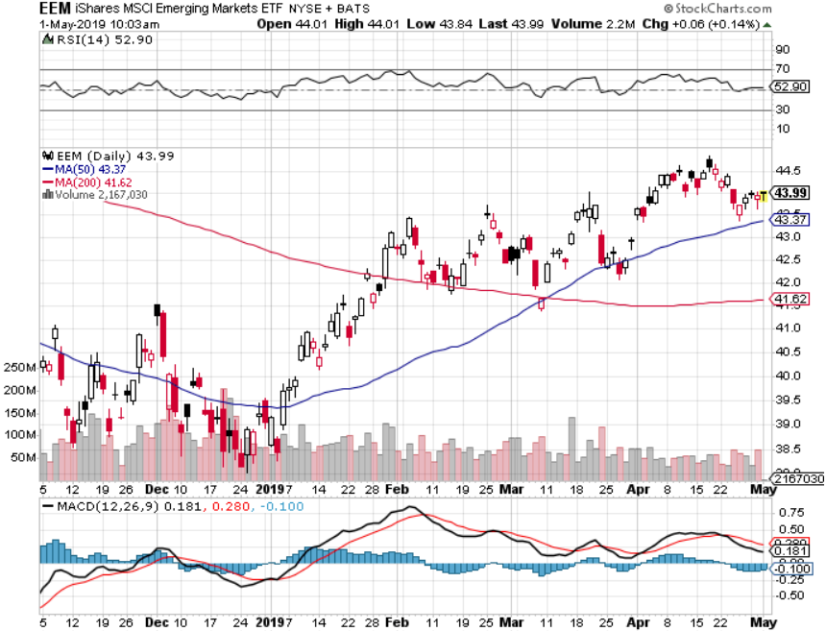
Emerging Markets (EEM)- Time to Buy on Weak Dollar

Slide 49
Bonds – Going Nowhere
*Bonds are now trapped in a narrow range and could go nowhere for the rest of 2019 *Fed has cancelled at 2019 rate rises but won’t go further, but supper strong economy and stock market may put a rate rise back on the table *10 year rates have backed off 30 basis points, from 2.33% to 2.63% *Foreign Investors Pour into the US Bond Market *German bund yields plunge to +0.00%, while Japan government bonds turn in a -0.06% yield *Bottom line: buy every 2 point dip and sell every 2 point rally

Slide 50
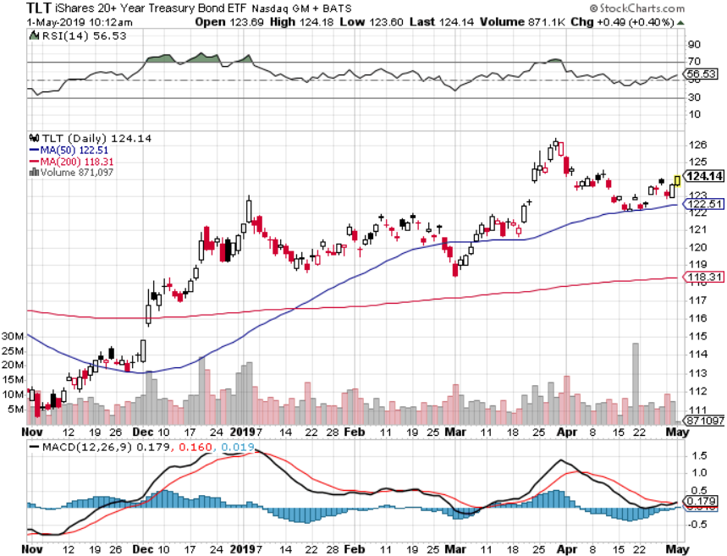
Treasury ETF (TLT) – Bottom of Range took profits on long 5/$116-$119 bull call spread took profits on long 4/$128-$130 bear put spread long 3/$124-$126 put spread- expired at maximum profit point Expiration of long 2/$124-$126 put spread at maximum profit point took profits on long 2/$125-$128 call spread again took profits on long 1/$124-$127 call spread took profits on long 2/$125-$128 call spread

Slide 51
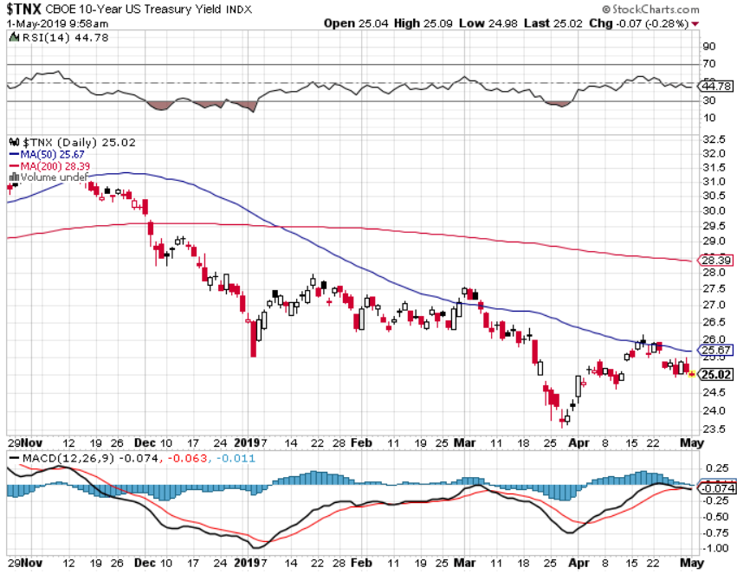
Ten Year Treasury Yield ($TNX) 2.50% Breakdown

Slide 52
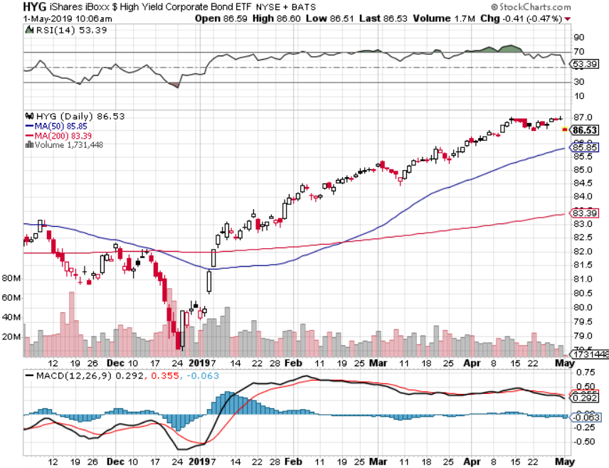
Junk Bonds (HYG) 5.27% Yield

Slide 53
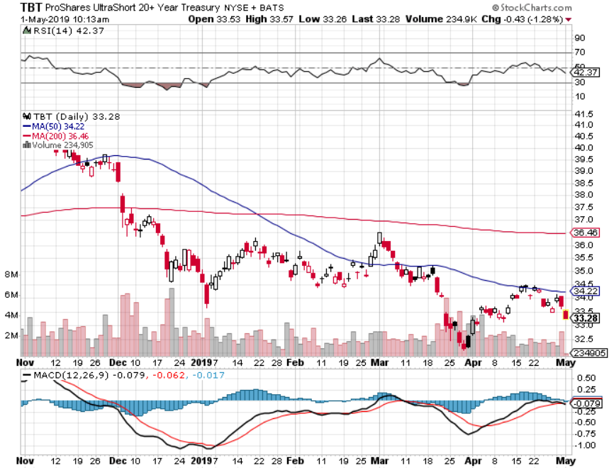
2X Short Treasuries (TBT)-Buy Territory

Slide 54
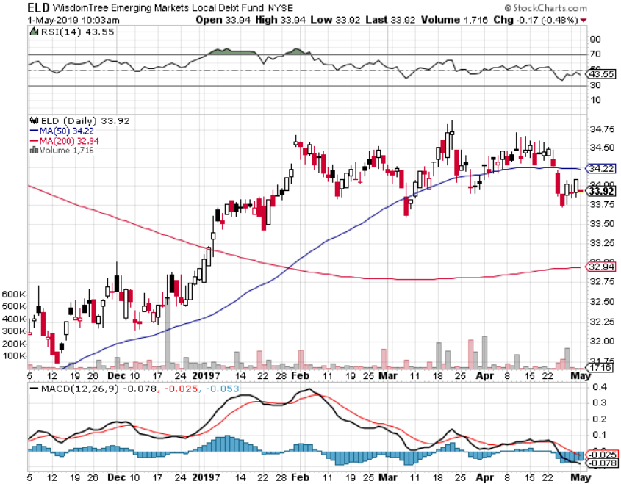
Emerging Market Debt (ELD) 5.92% Yield-

Slide 55
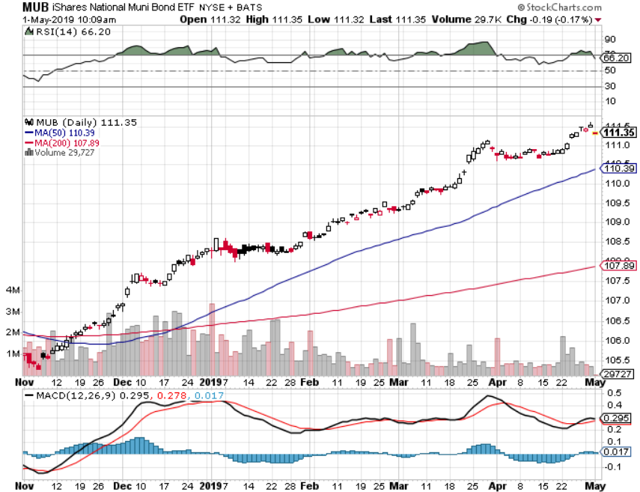
Municipal Bonds (MUB)-2.26% Mix of AAA, AA, and A rated bonds

Slide 56
Foreign Currencies – New Two Year High
*Back up in US interest rates brings new strength to the US dollar *But weak dollar plays holding up on massive liquidity surge *British pound shrinks to new 2 month low on Brexit stall *Massive Chinese economic stimulus lets Yuan maintain highs *Bitcoin flatlining at a high *Bottom Line: stand aside

Slide 57
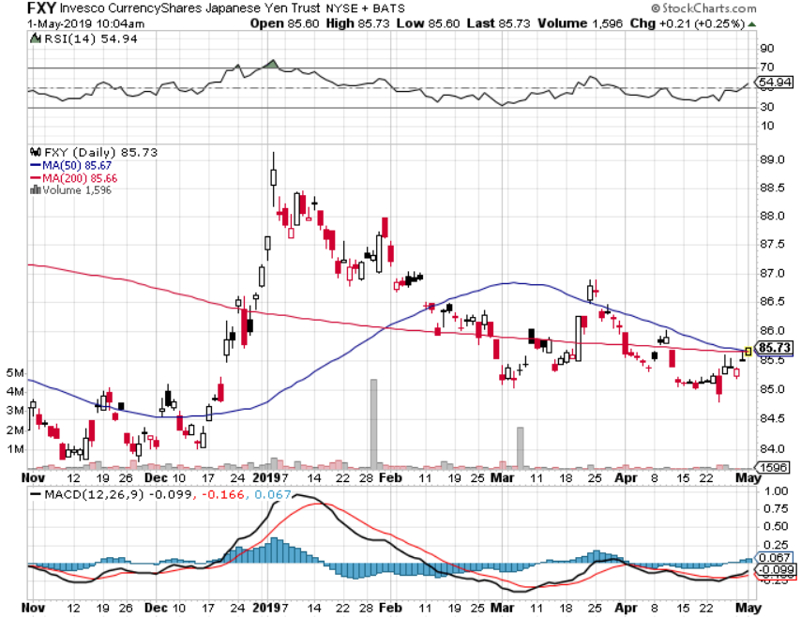
Japanese Yen (FXY), (YCS)

Slide 58
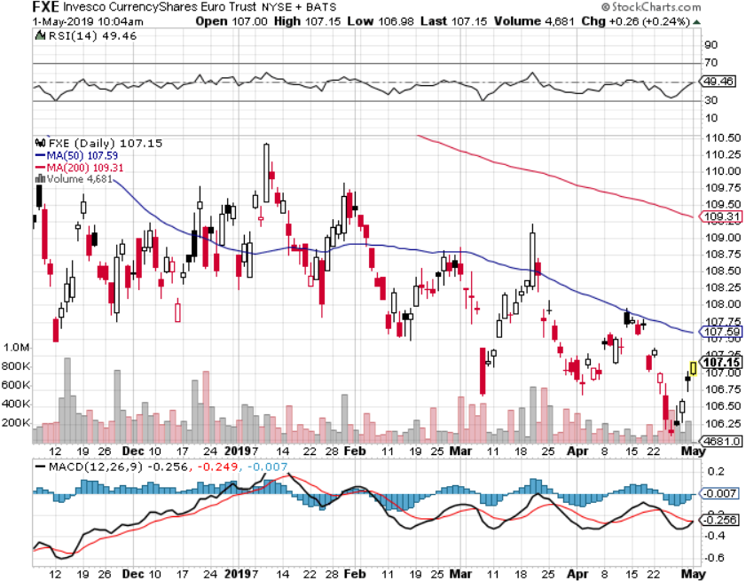
Euro ($XEU), (FXE), (EUO)- Trying to Break Down long 2/$105-$108 call spread

Slide 59
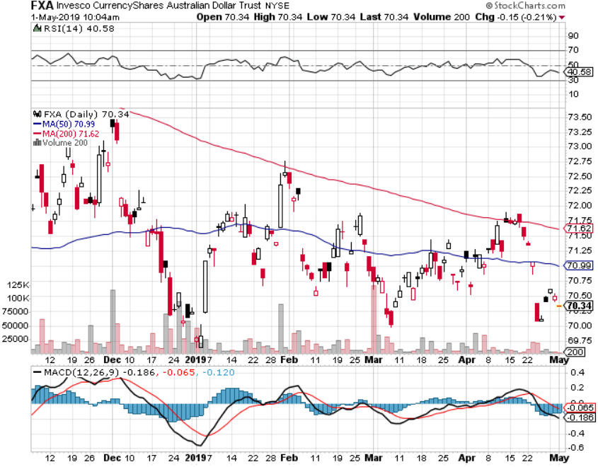
Australian Dollar (FXA)-

Slide 60
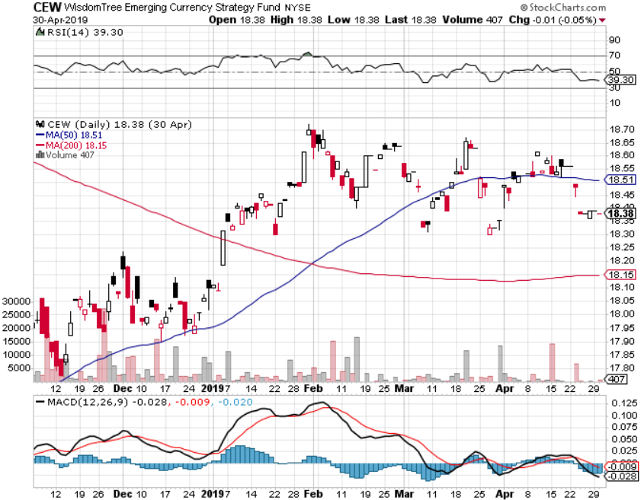
Emerging Market Currencies (CEW)

Slide 61
Chinese Yuan- (CYB)-

Slide 62
Bitcoin- 45% Rally Global Liquidity Surge

Slide 63
Energy – A Perfect Storm
*US ending Iran oil exemptions for 8 countries pours gasoline on the fire China is the world’s largest marginal new buyer of oil *Massive stimulus there will revive the economy and substantially increase demand *Trumps says he ordered Saudi’s to raise production and prices suddenly plunge $4, even though the Saudis denied it *Warren puts $10 billion into the sector with a new Occidental Petroleum stake (OXY) *US still infrastructure constrained on production expansion *Bottom Line: buy the dips

Slide 64
Oil-Bouncing

Slide 65
United States Oil Fund (USO)

Slide 66
Energy Select Sector SPDR (XLE)-No Performance! (XOM), (CVX), (SLB), (KMI), (EOG), (COP)

Slide 67
Halliburton (HAL)-

Slide 68
Natural Gas (UNG)- Major Hedge Fund Blow Up

Slide 69
Copper (COPX)-Weakness on China stats Trade War Deal Coming

Slide 70
Freeport McMoRan (FCX)-Weakness on China stats Trade War Deal Coming long $10.50-$11.50 bull call spread – expires in 12 days

Slide 71
Precious Metals – Still in the Penalty Box
*”RISK ON” world has no room for gold *Capital is being shifted out of gold into US stocks *Rising rates, with the ten year up 25 basis points in two weeks, is another stab in the back *Charts showing gold is now in down trend *Central bank buying continues in major way *However, the long term trend is intact until the Fed starts raising rates again. *Stand aside

Slide 72
Gold (GLD)- The flight to safety bid is coming Stopped out of 3/$119-$122 vertical bull call spread

Slide 73
Market Vectors Gold Miners ETF- (GDX) – Yikes!

Slide 74
Barrick Gold (GOLD)

Slide 75
Newmont Mining- (NEM)-

Slide 76
Palladium - (PALL)-

Slide 77
($COPPER)- Copper

Slide 78
Freeport McMoRan - (FCX)- long 5/$10.50-$11.50 call spread took profits on long 4/$10-$11 call spread took profits on short 4/$114 calls

Slide 79
Real Estate –
*30 year fixed rate loan bounce back to 4.30%, new mortgage demand is suddenly soaring *May rescue the spring selling season which had been written off *New Home Sales up 4.5% in March, an 18 month high, but Existing Home Sales off 4.9% 5.21 million annualized *San Francisco home prices drop for the first time in 7 years, taking the median home price down to $830,000, off 0.1% YOY *February S&P 500 Case-Shiller drops to 4.0%, annual gain, the lowest gain in 6 1/2 years *Bottom Line: Stand aside for a trade but buy for long term investment

Slide 80
February Corelogic S&P Case Shiller Home Price Index Las Vegas (9.7%), Phoenix (6.7%), and Tampa (5.4%) showing biggest gains
Tradingeconomics.com

Slide 81
Simon Property Group (SPG)-

Slide 82
US Home Construction Index (ITB) (DHI), (LEN), (PHM), (TOL), (NVR)

Slide 83
Trade Sheet- So What Do We Do About All This?
*Stocks-stand aside *Bonds-buy dips *Commodities-buy dips *Currencies-stand aside *Precious Metals – stand aside *Volatility-buy dips to $12 *Real estate-stand aside

Slide 84
Next Strategy Webinar 12:00 EST Wednesday, May 15, www.madhedgefundtrader.com email me at support@madhedgefundtrader.com
Good Luck and Good Trading!
Notes:
*

