Slide 1
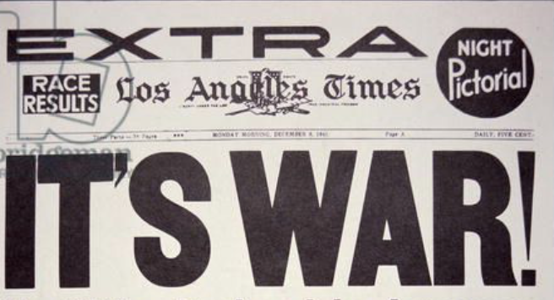
The Mad Hedge Fund Trader “It’s War!”
With John Thomas from Silicon Valley, CA, May 15, 2019 www.madhedgefundtrader.com
Notes:
*

Slide 2
MHFT Global Strategy Luncheons 2019 World Tour Buy tickets at www.madhedgefundtrader.com
Friday June 21 12:30 PM Auckland, New Zealand Monday June 24 12:30 PM Melbourne, Australia Tuesday June 25 12:30 PM Sydney, Australia Wednesday June 26 12:30 PM Brisbane, Australia Friday June 28 12:30 PM Perth, Australia Sunday June 30 12:30 PM Manila, Philippines Tuesday July 2 12:30 PM New Delhi, India Friday July 5 12:30 PM Cairo, Egypt Monday July 8 12:30 PM Venice, Italy Wednesday July 10 12:30 PM Budapest, Hungary

Slide 3
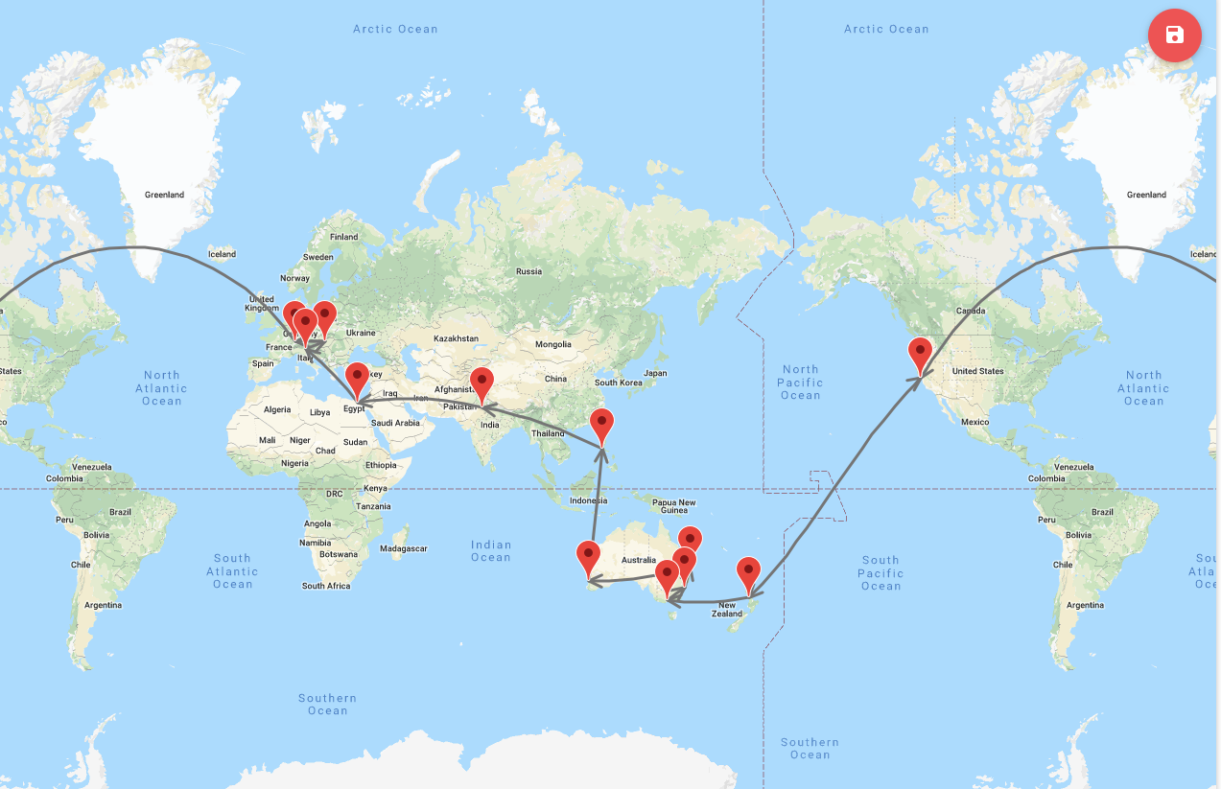
START

Slide 4
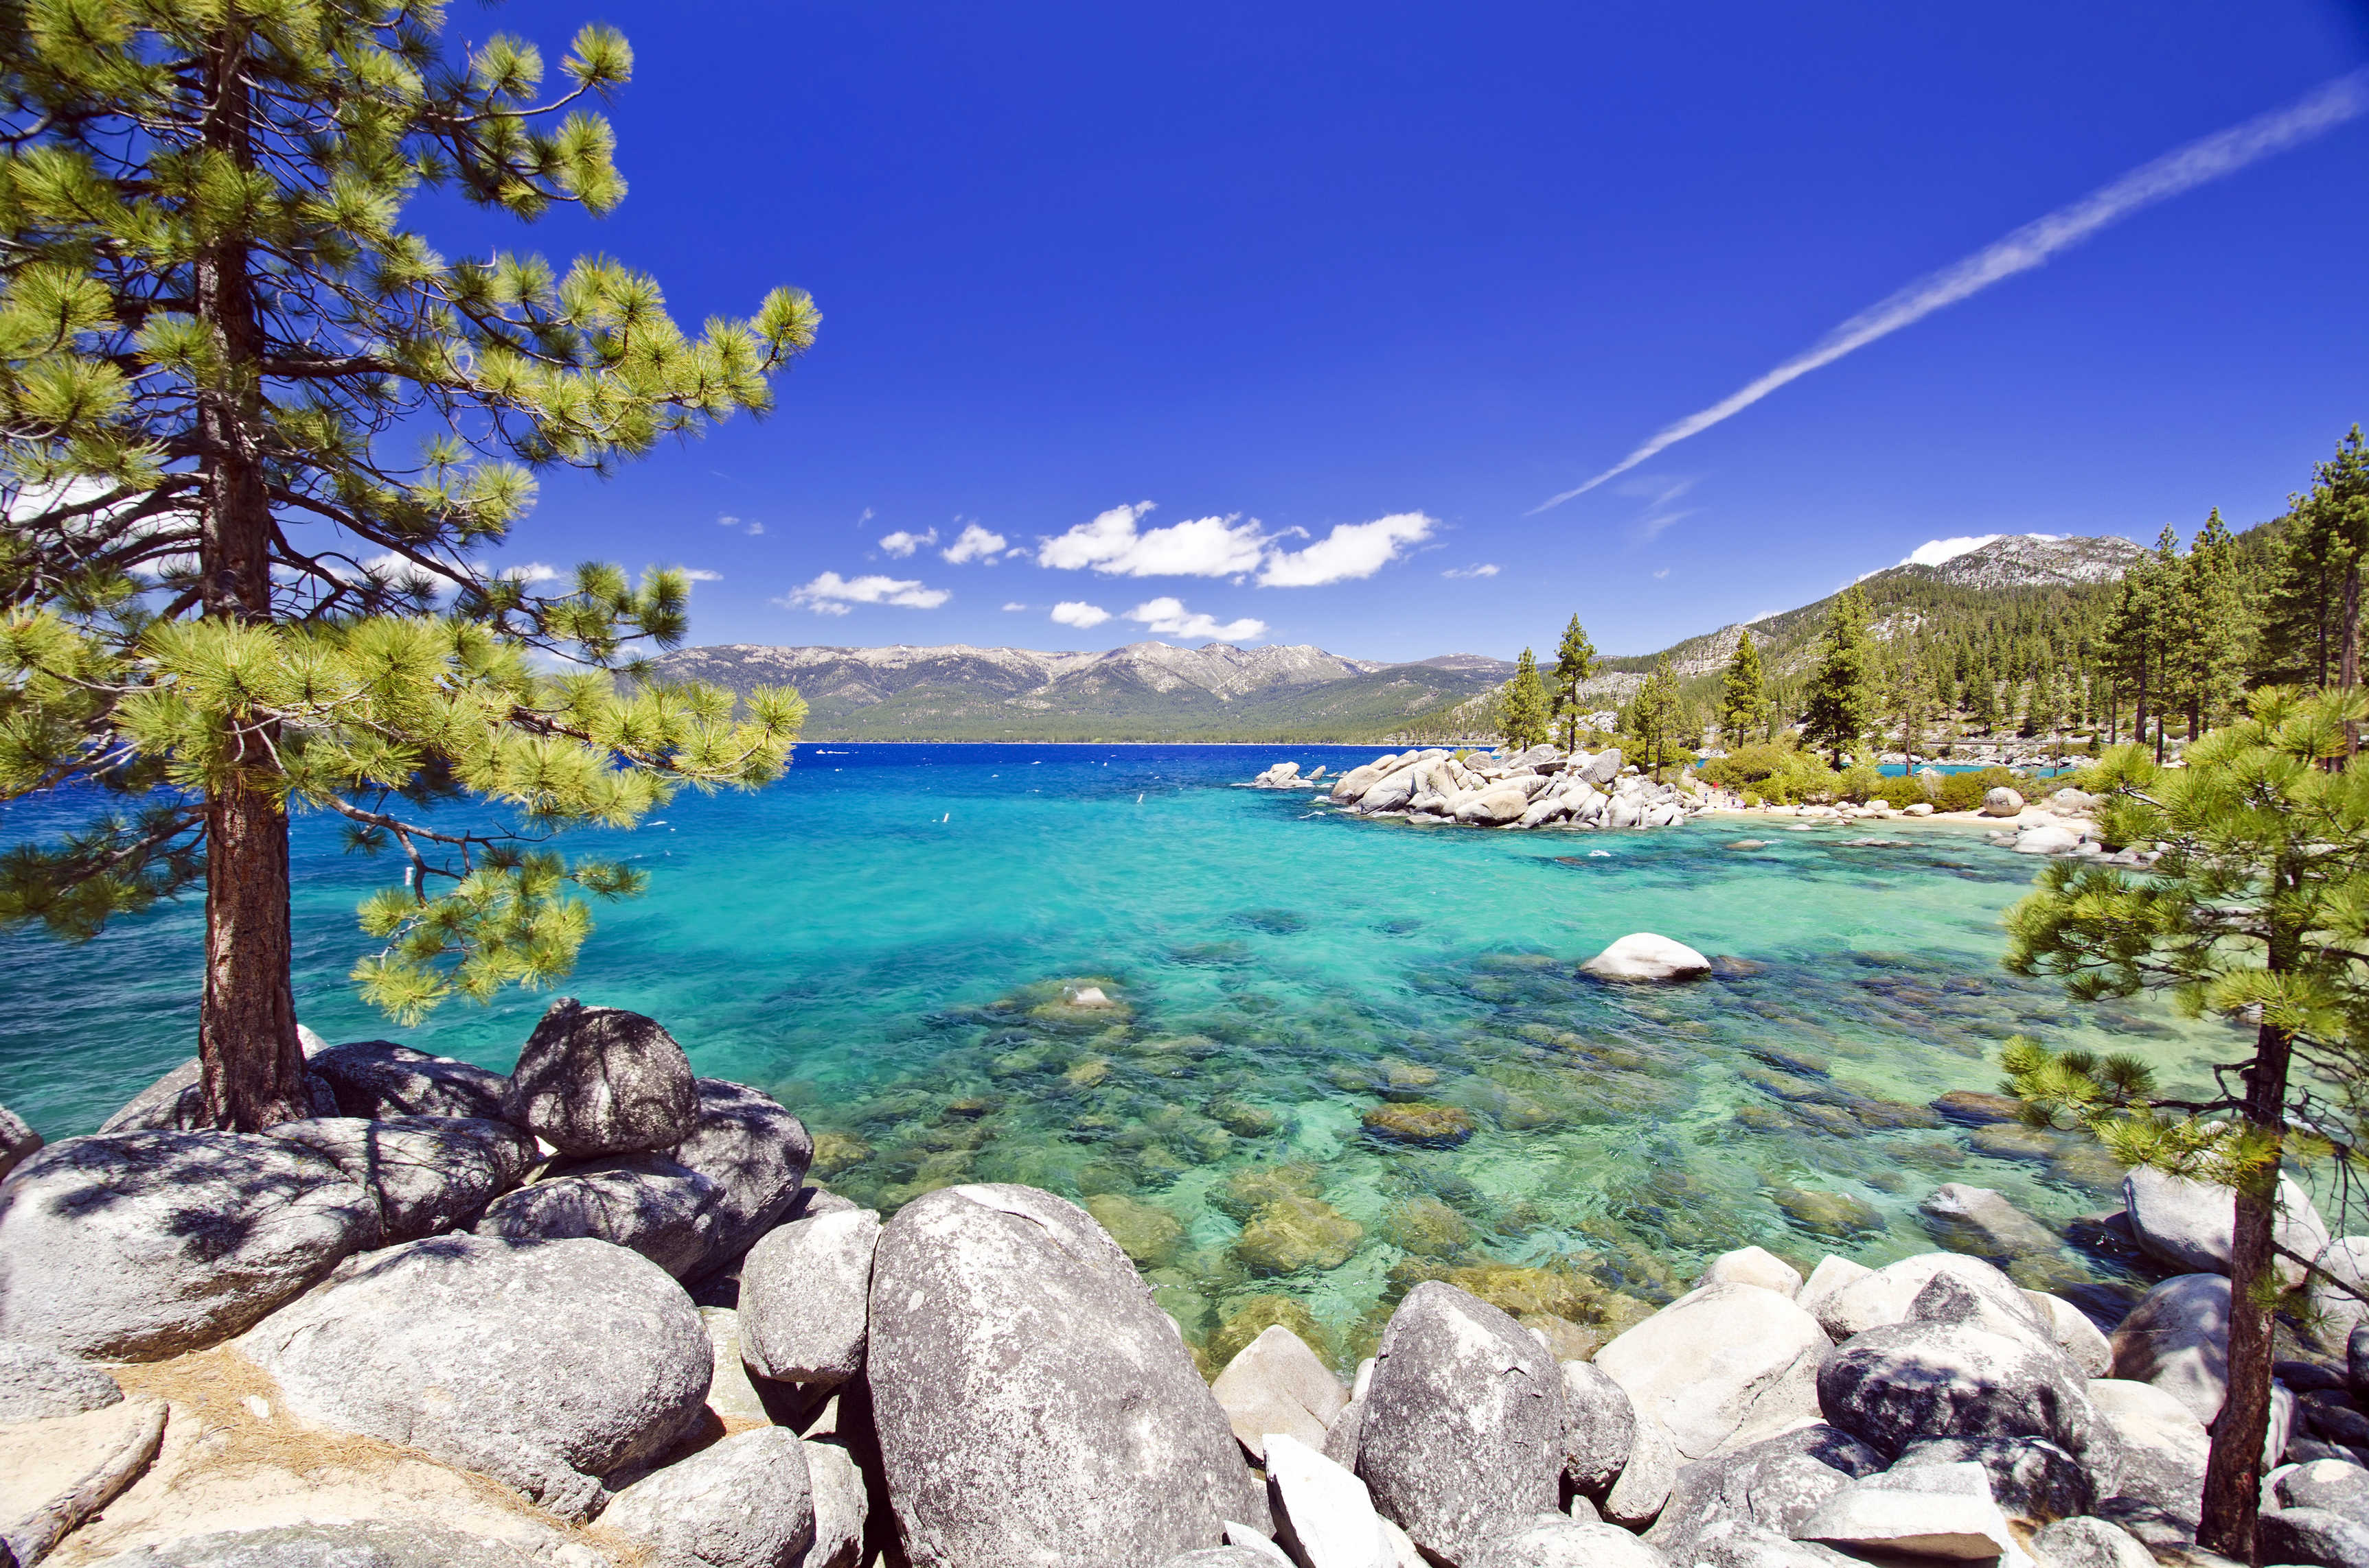
October 25-26 Lake Tahoe Conference 50% of seats already sold out
*Two days of informative speakers on crucial trading and investment issues *Trade tips with the most successful Mad Hedge traders *2 nights in the Hyatt, including all you can eat and drink *Tickets are a bargain at $699 to $1,999 *Buy now, upper ticket classes sell out first

Slide 5
Trade Alert Performance New Highs!
*January 9.49% Final *July +0.0% Final *February +4.64% Final *August +2.19% MTD *March +1.78% Final *September 1.38% Final *April -0.79% MTD *October +1.37% Final *May +1.07% Final *November -1.83% Final *June +4.15% Final *December -4.13% Final *2019 Year to Date +14.93% compared to +9.57% for the Dow Average *Trailing One year return +18.93%, +315.07% since inception, *Average annualized return of 33.16% for 9 1/2 years

Slide 6
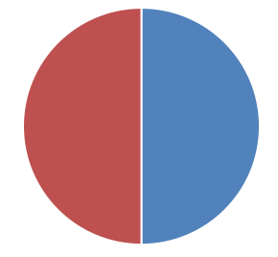
Portfolio Review Keeping Small Positions at Market Highs New All Time High
Current Capital at Risk
Risk On
World is Getting Better
(MSFT) 6/$110-$115 call spread | 10.00%
(TLT) 6/$128-$131 put spread | 10.00%
Risk Off
NO POSITIONS
Total Net Position | 20.00%
Expiration P&L 17.21%

Slide 7
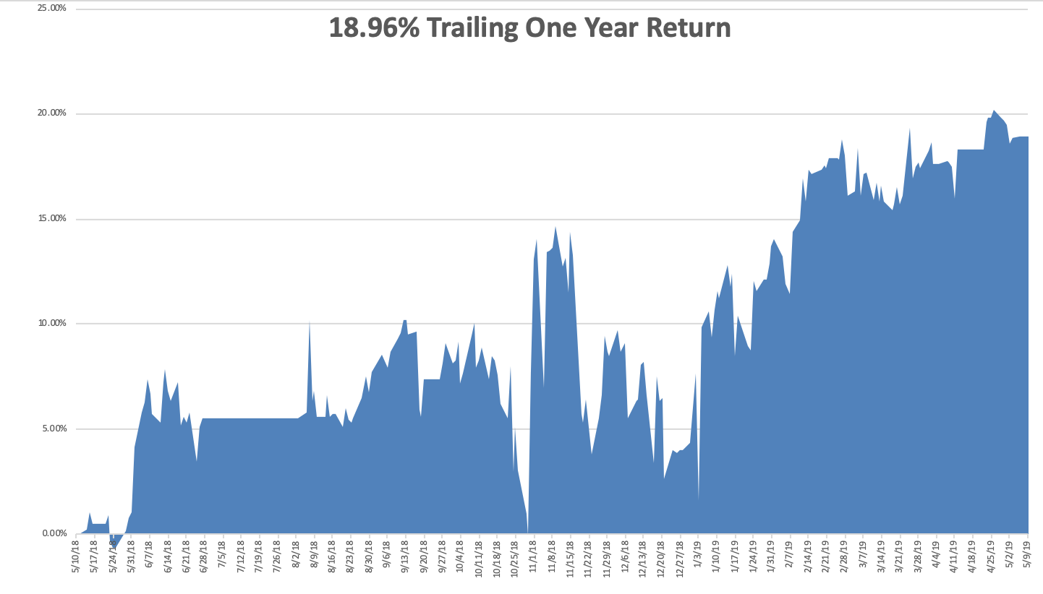
GTD Daily Audited Performance New All Time High

Slide 8
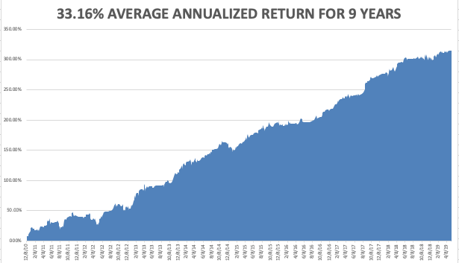
GTD 9 Year Daily Audited Performance

Slide 9
The Method to My Madness
*Trade war kills the bull, unless we get positive news soon stocks will quickly give up half of all gains since December, or 2,250 points *However, at the end of the day, no Fed rate rises in 2019 is far more important that a trade war, so no major stock market crash, unless it goes on for two years *Traders now desperate to get out at last week’s prices *The meltdown happened so fast that no one could get shorts off *Bonds spike on huge “RISK OFF” bid *Oil suffers instant 10% correction on global recession fears *No one has an advantage here, its all about negotiations held in a dark room

Slide 10
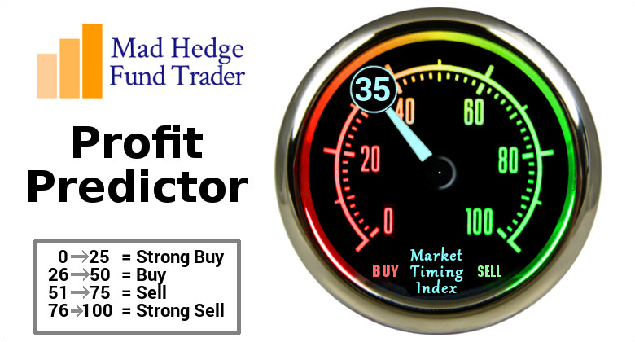
The Mad Hedge Profit Predictor Market Timing Index- An artificial intelligence driven algorithm that analyzes 30 different economic, technical, and momentum driven indicators

Slide 11
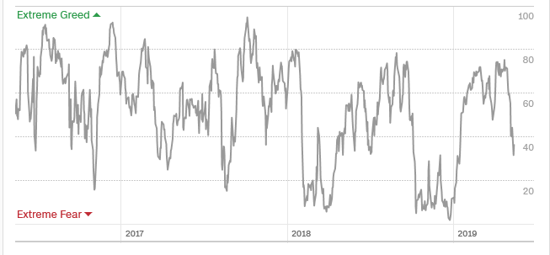
The Mad Hedge Profit Predictor Profit Predictor Wins Again!
SELL
BUY

Slide 12
The Global Economy – Trade War Disaster
*If Chinese trade war continues to the max a global recession will ensue *Millions of small US retailing and manufacturing companies will go under *ISM Factory Orders dive in April to 52.8, a six-month low, US Retail Sales Crater, in March while Industrial Production is off 0.5%. Why is the data suddenly turning recessionary? It isn’t even reflecting the heightened trade war yet. *Stephen Moore and Herman Cain Withdraw Fed Nominations, removing two ultra doves from the Fed, Fed also warns against high stock prices in the face of record business borrowing *Chinese Exports to the US fall, as US price increases start to take a bite. The Middle Kingdom is no longer able to cut their own prices through Yuan depreciation, thanks to their own economic stimulus program

Slide 13
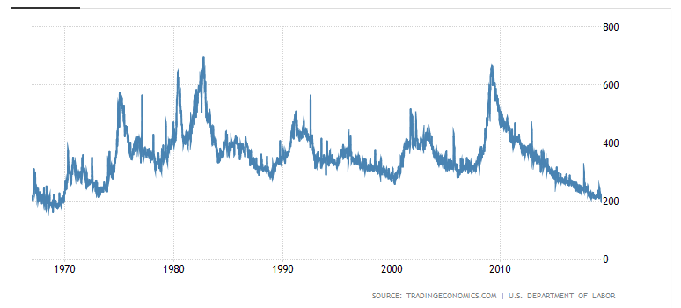
Weekly Jobless Claims -2,000 to 228,000 holding last week’s monster gain

Slide 14
Soybeans (-20%)-Trade War Indicator China trade deal collapse brings new 7 year low

Slide 15
The Bill Davis View A $1,500 Upgrade for the Mad Day Trader Service
Buys: | Entry | Target
Quest Diagnostics Inc. (DGX) | $ 97.00 | $ 106.00
3M Co. (MMM) | $ 178.00 | $ 200.00
Amgen, Inc. (AMGN) | $ 170.00 | $ 190.00
Palo Alto Networks (PANW) | $ 225.00 | $ 250.00
Universal Health Services (UHS) | $ 121.00 | $ 135.00
Sells:
Avista Corp (AVA) | $ 46.00 | $ 38.00
Premier, Inc. (Pinc) | $ 38.00 | $ 29.00
Jazz Pharmaceuticals,Inc (JAZZ) | $ 150.00 | $ 130.00
Goldman Sachs (GS) | $ 210.00 | $ 195.00
Bluebird Bio (Inc) | $ 145.00 | $ 120.00

Slide 16
Stocks – The Tweet that Killed Wall Street
*Market turns on a dime, bullish at the Friday close, gap down opening at the Monday morning opening *We got out of our last long on the only rally on Monday, but couldn’t get off shorts fast enough That means there is a huge amount of frustrated selling above the market *Tech that led the upside led the downside too *Earnings have become completely irrelevant, it’s all abut global macro now *Apple takes a big 13% hit on prospect of 25% tariff on iPhones, all done in the name of bogus national defense claims *Bottom line: wait for new range to establish, then go in on the long side in tech *Bottom Line: its bet the ranch time on tech longs, but stay away from those with big China exposure, like Apple, and weak dollar plays like energy, and emerging markets

Slide 17
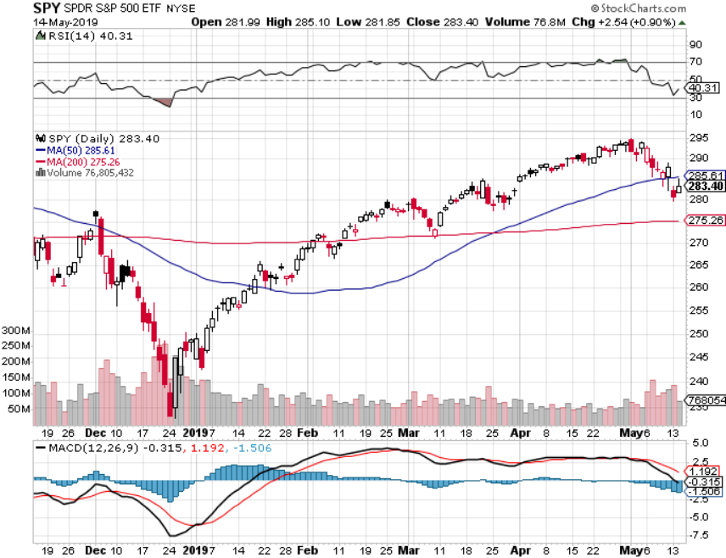
S&P 500- stopped out of long 2/$285-$290 bear put spread took profits on long 2/$270-$275 bear put spread

Slide 18
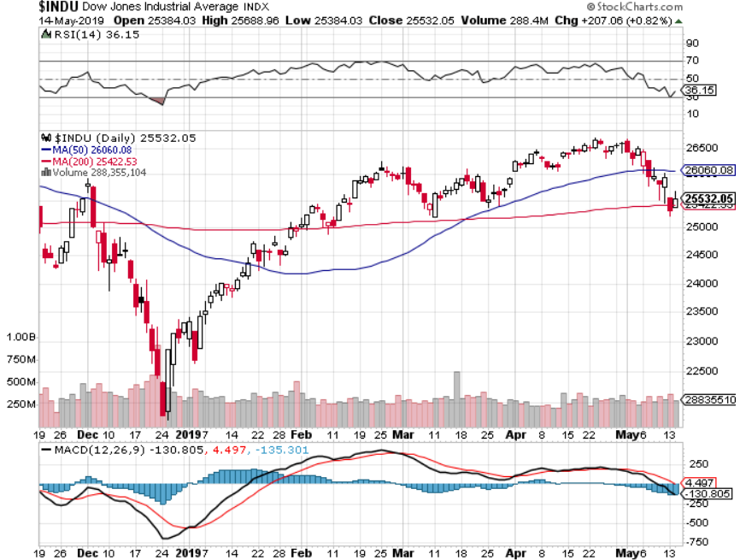
Dow Average-

Slide 19
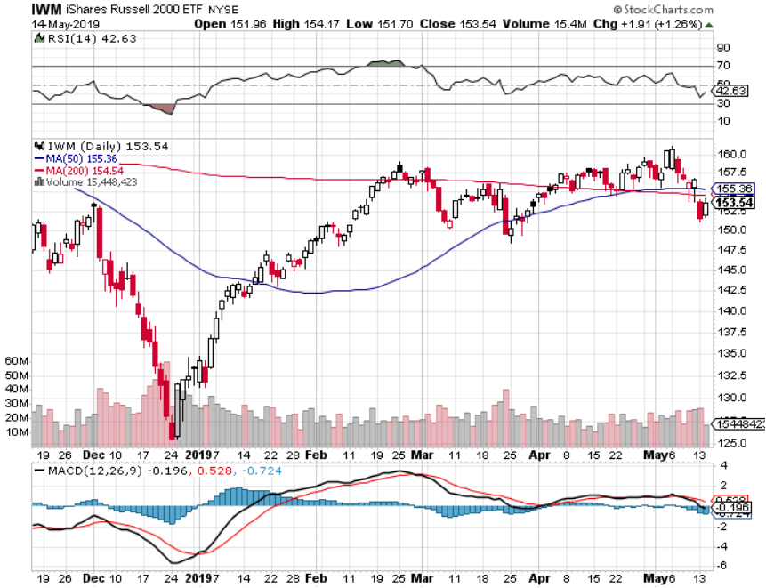
Russell 2000 (IWM)- out for even Long 4/$160-$165 vertical bear put spread

Slide 20
NASDAQ ($COMPQ)

Slide 21
(VIX)- Probing Lows

Slide 22
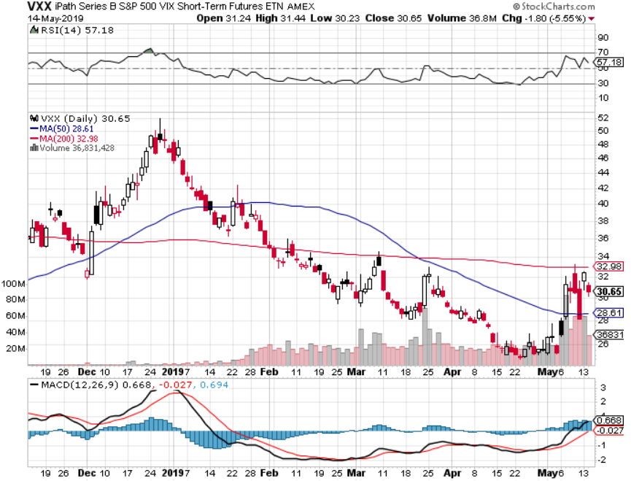
iPath S&P 500 VIX Short-Term Futures ETN (VXX)

Slide 23
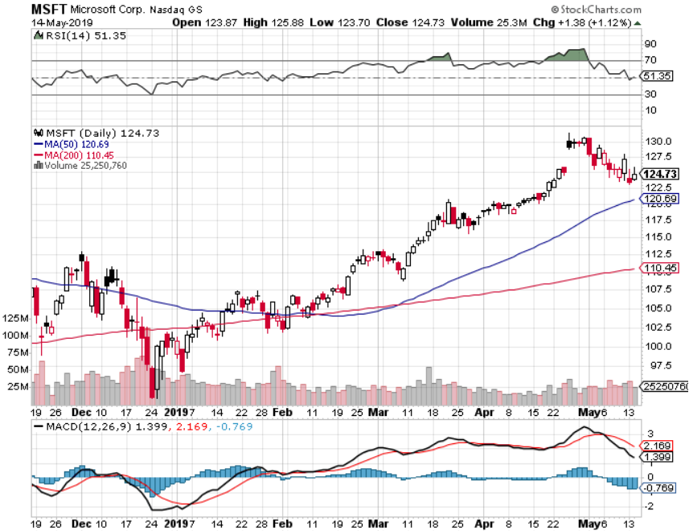
Microsoft (MSFT)- Earnings beat long 6/$110-$115 call spread took profits on long 4/$108-$113 call spread took profits on long 2/$85-$90 call spread

Slide 24
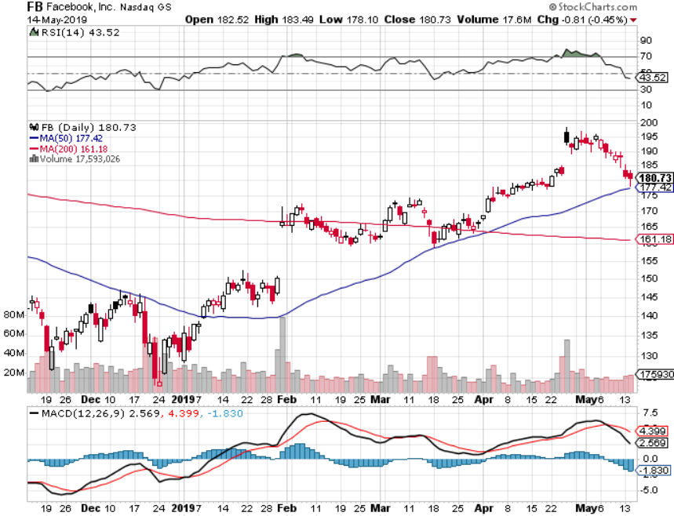
Facebook (FB)- FANG bounce

Slide 25
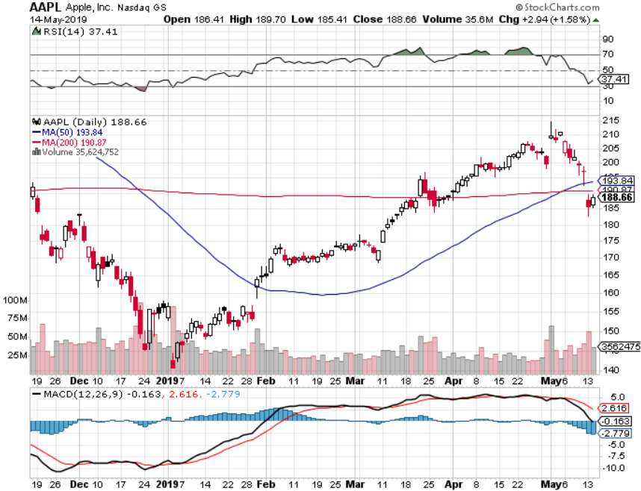
Apple (AAPL)- China Target New Apple Plus Streaming Service stopped out of long 3/$180-$185 bear put spread stopped out of long 11/$175-$180 bear put spread took profits on long 11/$165-$175 bear put spread

Slide 26
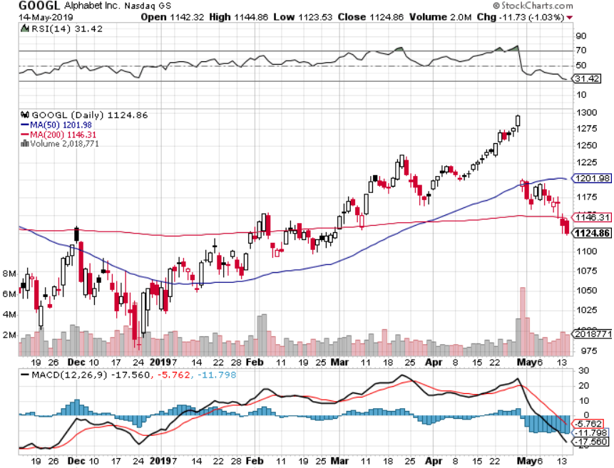
Alphabet (GOOGL)- Earnings Shock stopped out of long 5/$1,100-$1,130 bull call spread took profits on long 4/$1,080-$1,120 bull call spread

Slide 27
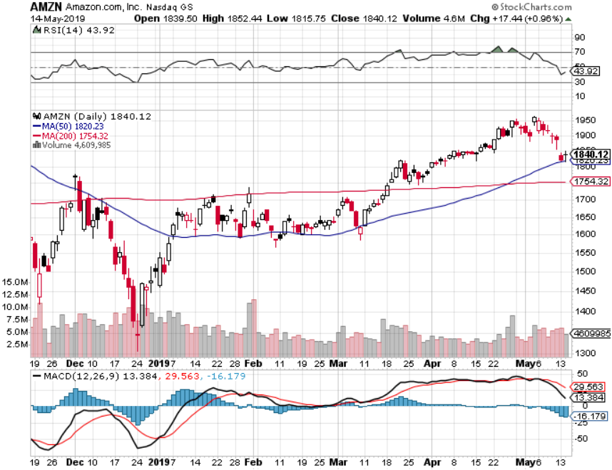
Amazon (AMZN)-Back to Top of Range took profits on long 4/$1,600-$1,650 call spread took profits on long 2/$1,200-$1,300 call spread

Slide 28
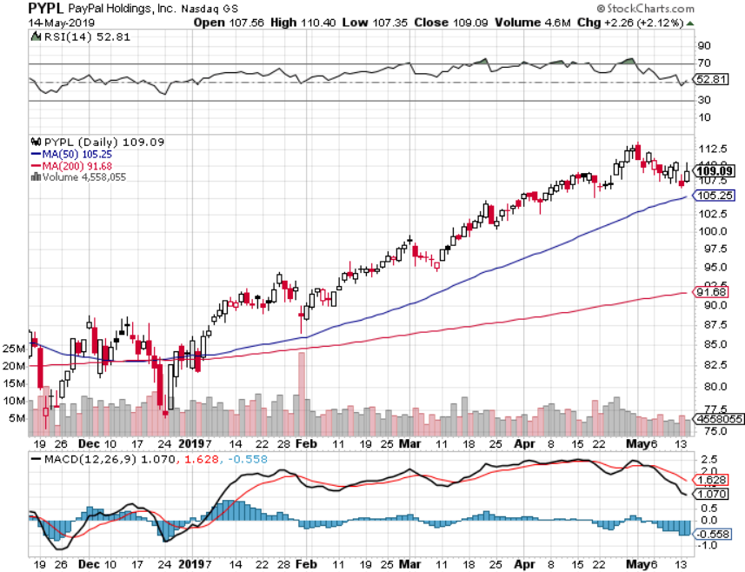
PayPal (PYPL)-Fintech Star took profits on long 4/$90-$95 call spread

Slide 29
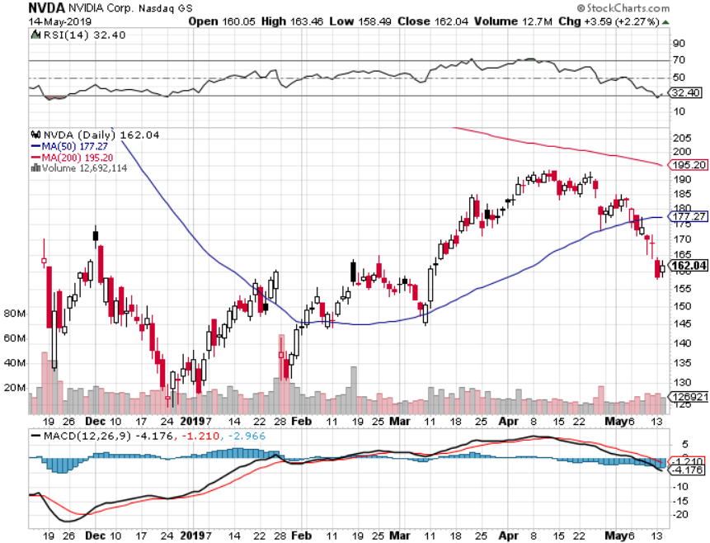
NVIDIA (NVDA)- earnings beat

Slide 30
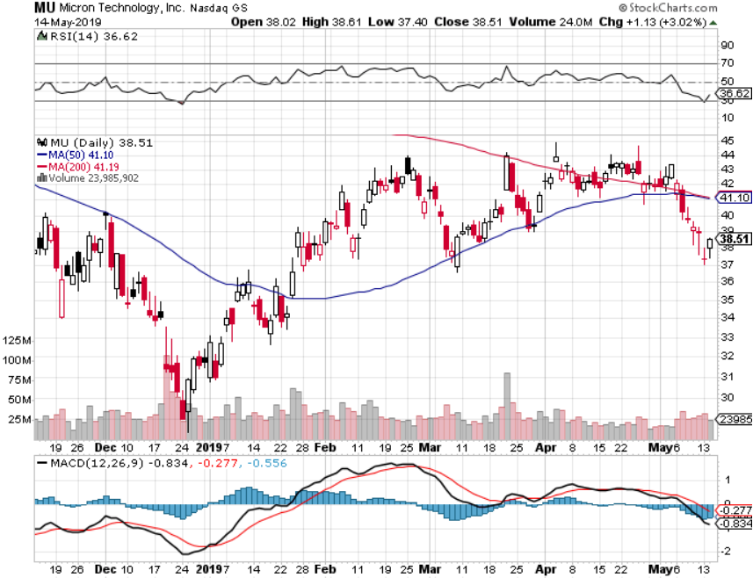
Micron Technology (MU)-

Slide 31
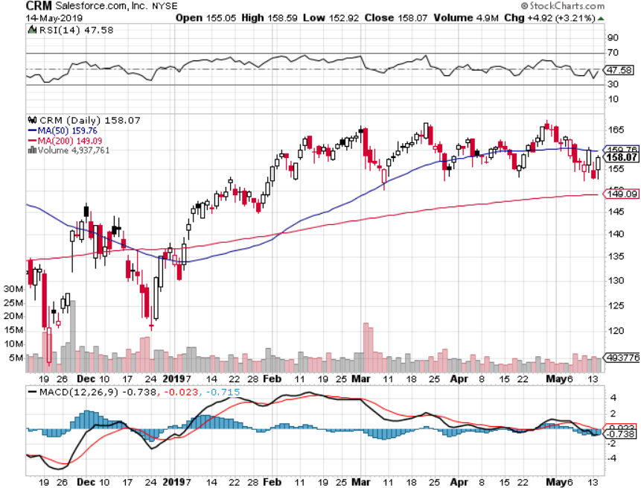
Salesforce (CRM)- took profits on long 2/$105-$115 call spread

Slide 32
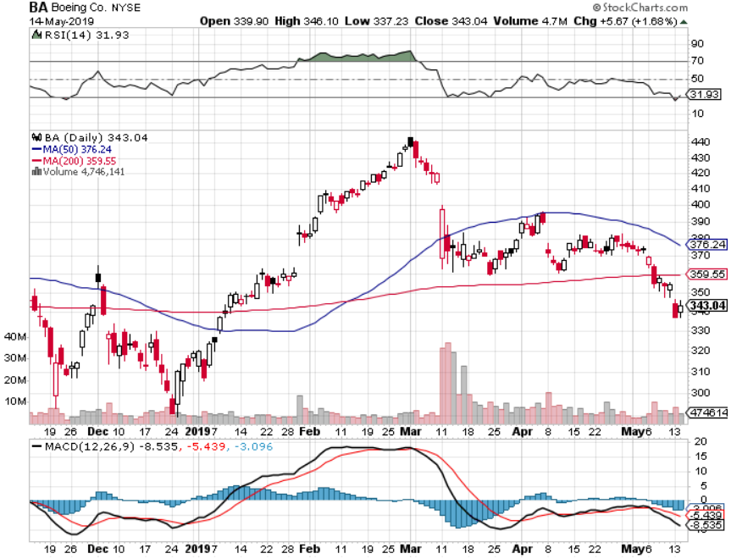
Boeing (BA)- took profits on long 4/$315-$335 call spread Next to happen in the recertification bounce

Slide 33
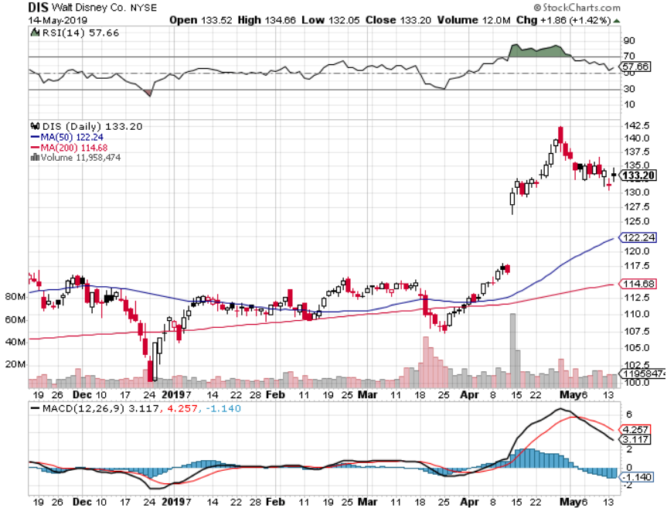
Walt Disney (DIS)- Summer Blockbuster Wave Stopped out of $125-$130 call spread for small loss took profits on long 4/$100-$104 call spread Covered Short 4/$114 calls

Slide 34
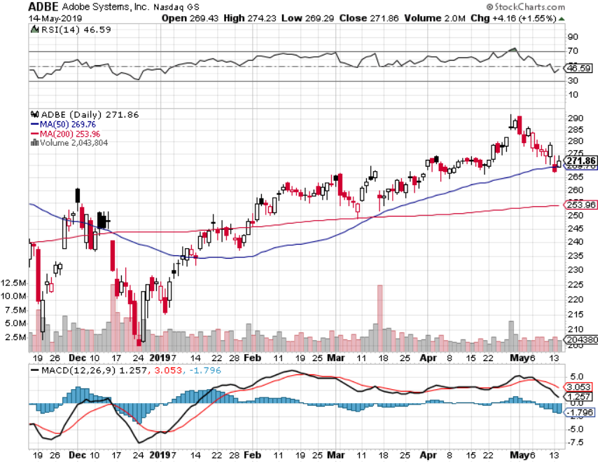
Adobe (ADBE)- The Quality Non-China tech play

Slide 35
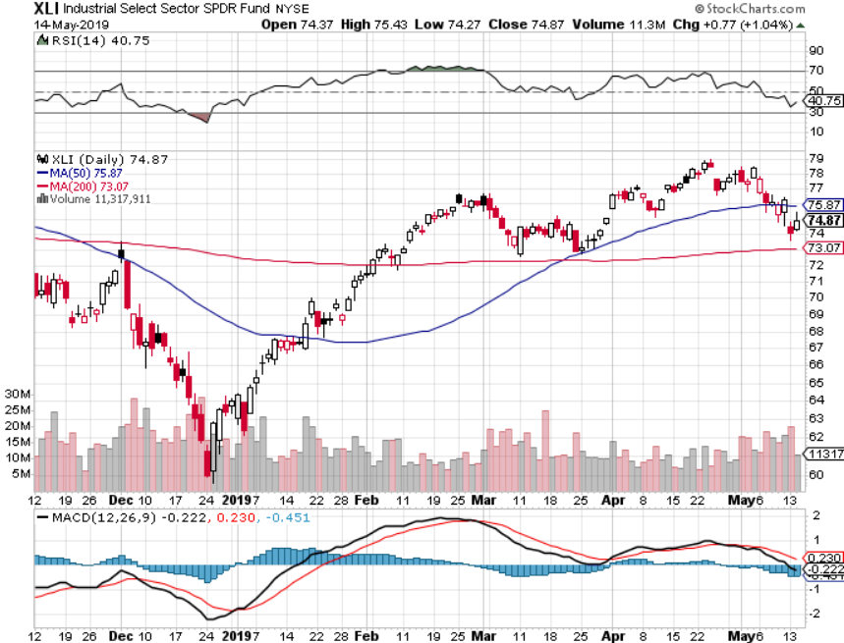
Industrials Sector SPDR (XLI)- (GE), (MMM), (UNP), (UTX), (BA), (HON)

Slide 36
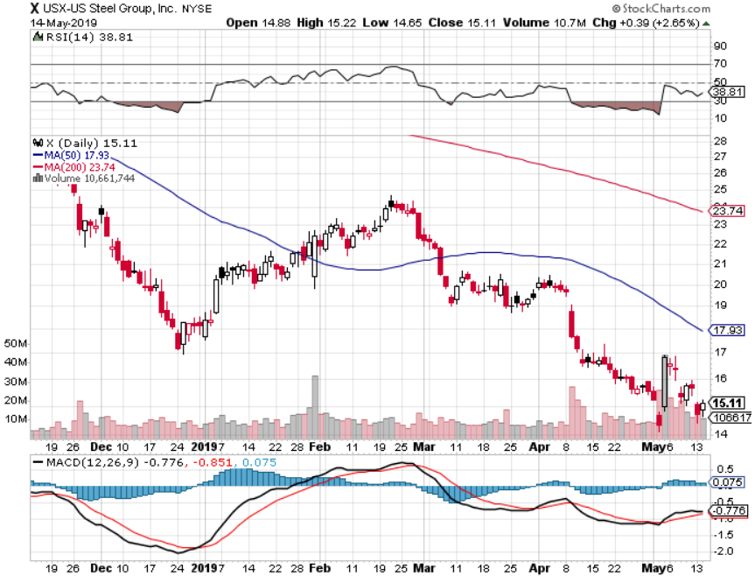
US Steel (X)-Tariffs Trouble Import duties cause users to abandon steel Unwound the entire Trump trade

Slide 37
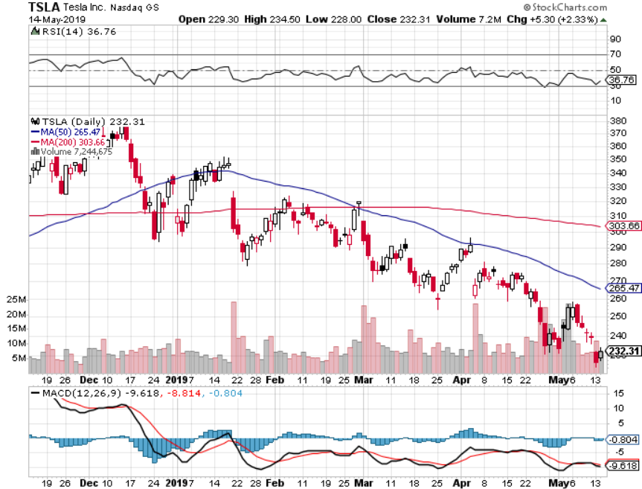
Tesla (TSLA)-Q1 Earnings stopped out of long 4/$300-$320 put spread delayed Phase II Gigafactory

Slide 38
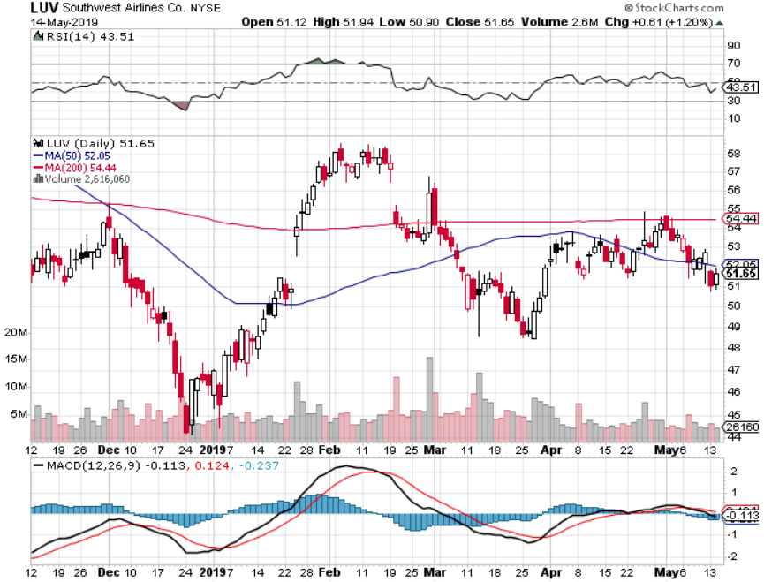
Southwest Airlines (LUV)- Boeing 737 Max biggest buyer

Slide 39
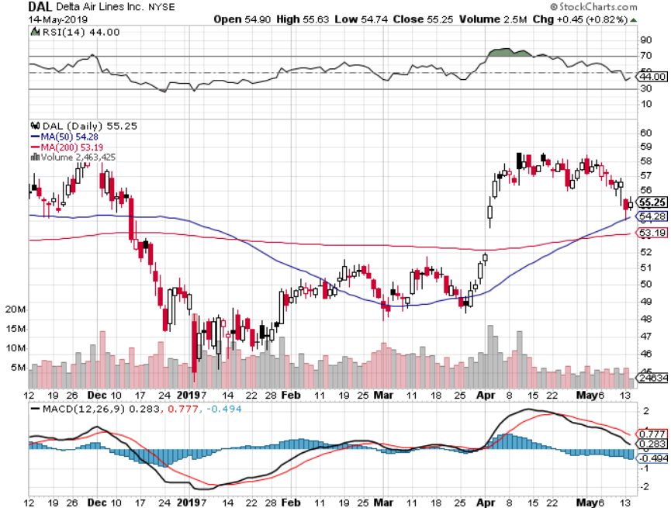
Delta Airlines (DAL)

Slide 40
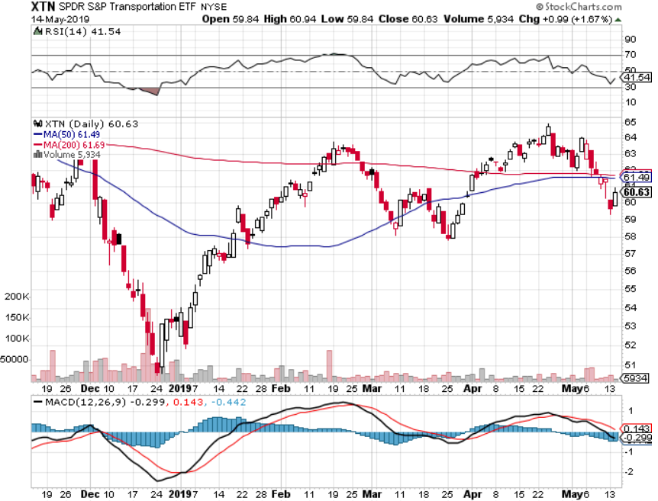
Transports Sector SPDR (XTN)- (ALGT), (ALK), (JBLU), (LUV), (CHRW), (DAL)

Slide 41
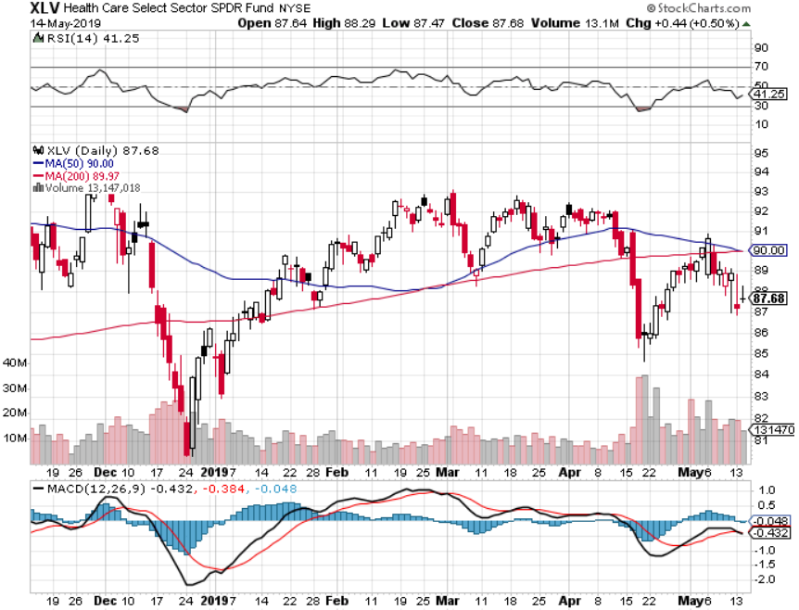
Health Care Sector (XLV), (RXL)-New Highs (JNJ), (PFE), (MRK), (GILD), (ACT), (AMGN)

Slide 42
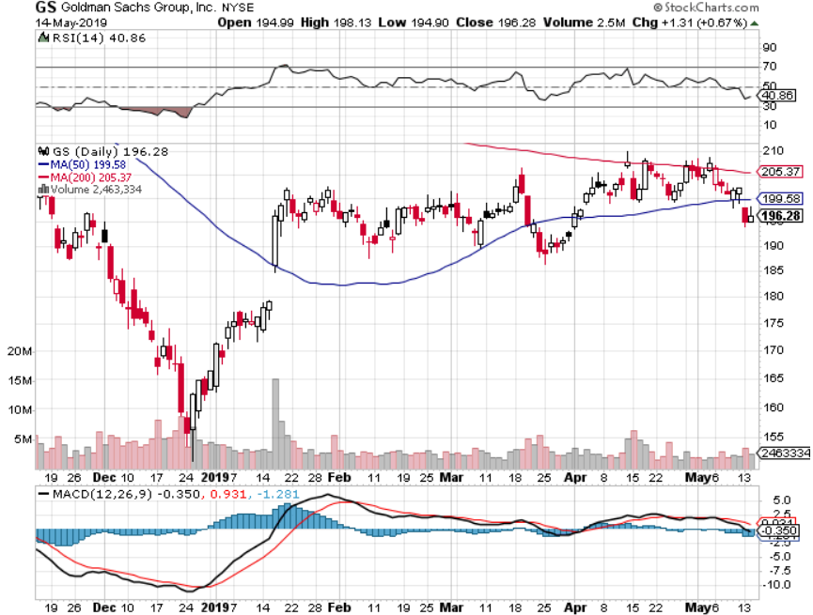
Goldman Sachs (GS)-Inverting Yield Curve

Slide 43
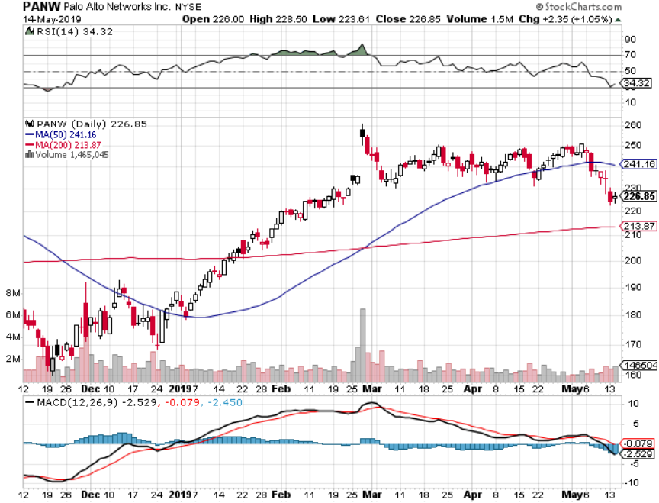
Palo Alto Networks (PANW)- Hacking never goes out of fashion

Slide 44
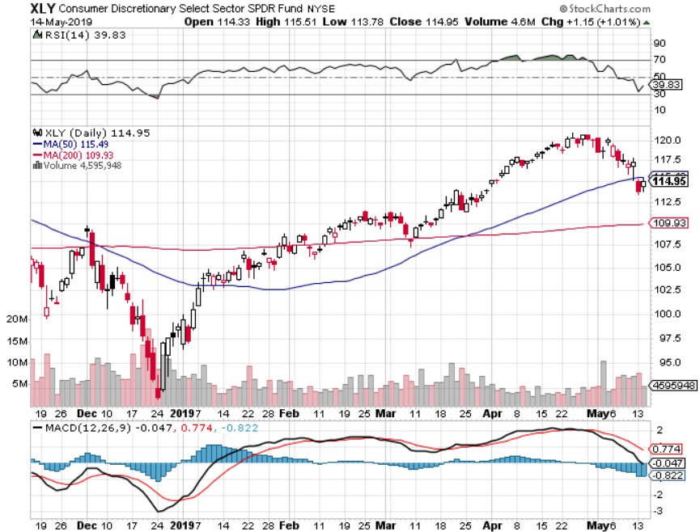
Consumer Discretionary SPDR (XLY) (DIS), (AMZN), (HD), (CMCSA), (MCD), (SBUX)

Slide 45
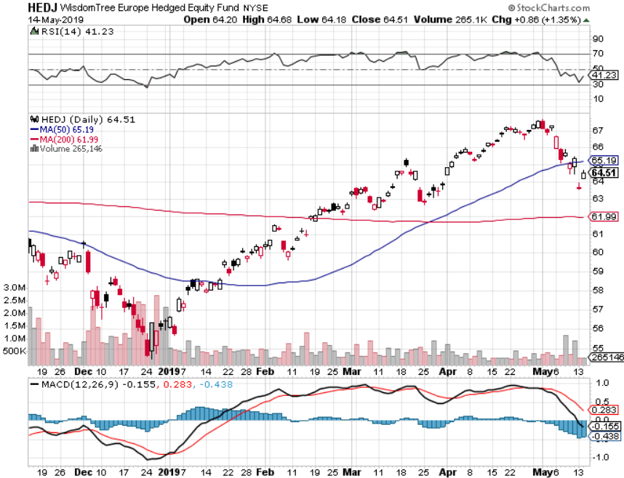
Europe Hedged Equity (HEDJ)-

Slide 46
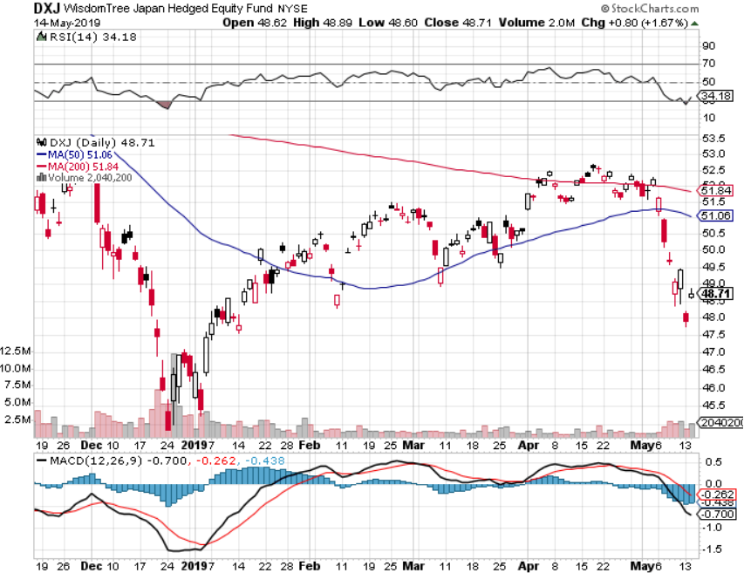
Japan (DXJ)-

Slide 47
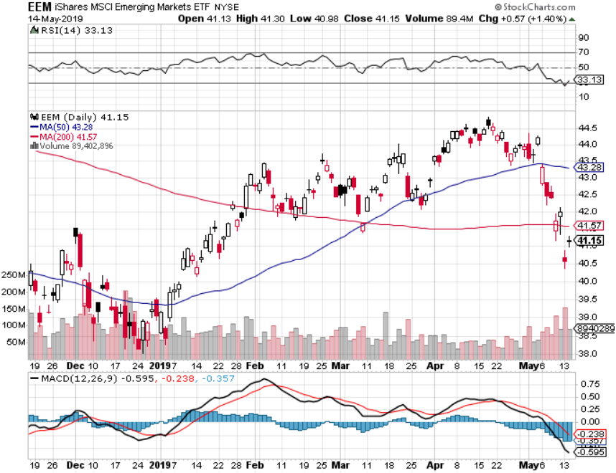
Emerging Markets (EEM)- Time to Buy on Weak Dollar

Slide 48
Bonds – ”RISK OFF” Spike
*Global recession fears brought on my trade war escalation trigger monster spike in bond prices, plunge in yields *Fed has cancelled at 2019 rate rises which should stabilize extend of rate moves for foreseeable future *10 year rates have backed off 16 basis points, from 2.55% to 2.39% *Foreign Investors Pour into the US Bond Market *German bund yields plunge to -0.05%, while Japan government bonds turn in a -0.06% yield *Bottom line: buy every 2 point dip and sell every 2 point rally

Slide 49
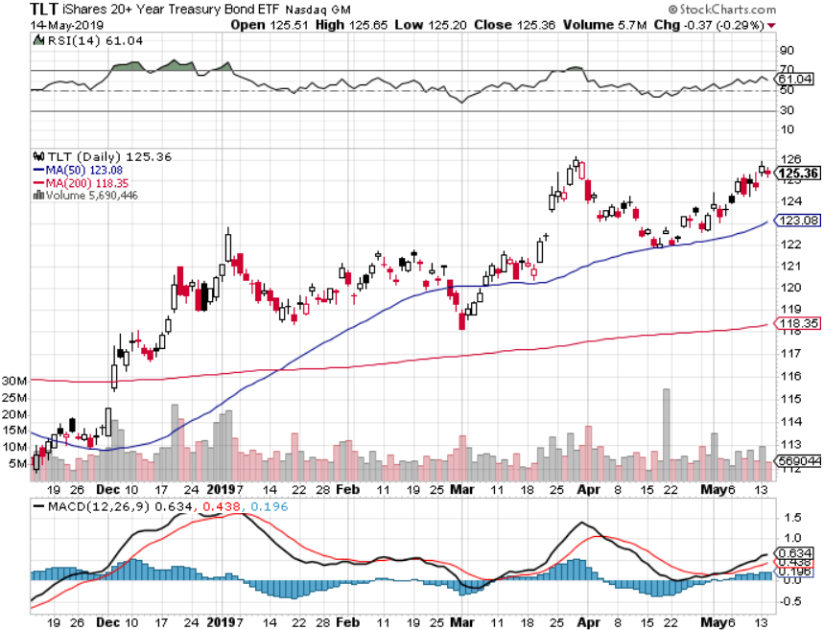
Treasury ETF (TLT) – Top of Range long 6/$128-131 bear put spread long 5/$116-$119 bull call spread took profits on long 4/$128-$130 bear put spread long 3/$124-$126 put spread- expired at maximum profit point Expiration of long 2/$124-$126 put spread at maximum profit point took profits on long 2/$125-$128 call spread again took profits on long 1/$124-$127 call spread took profits on long 2/$125-$128 call spread

Slide 50
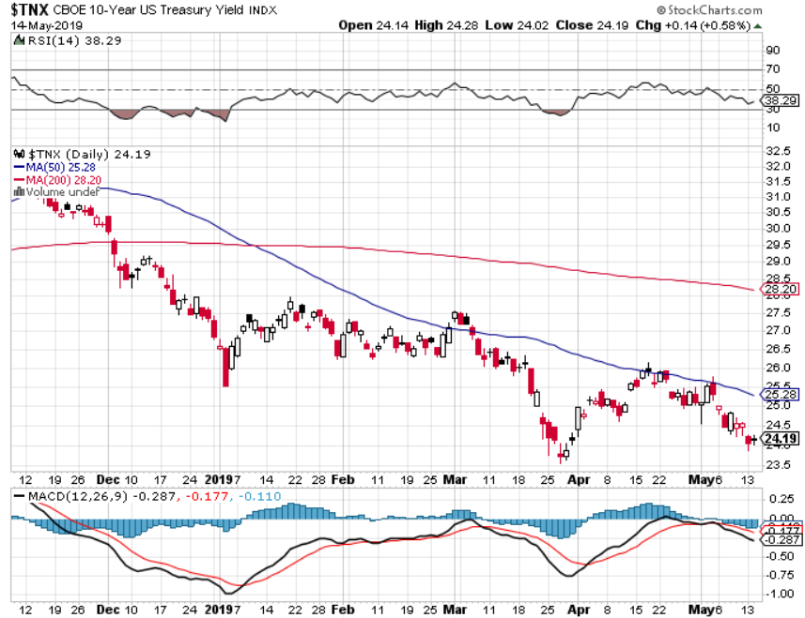
Ten Year Treasury Yield ($TNX) 2.50% Breakdown

Slide 51
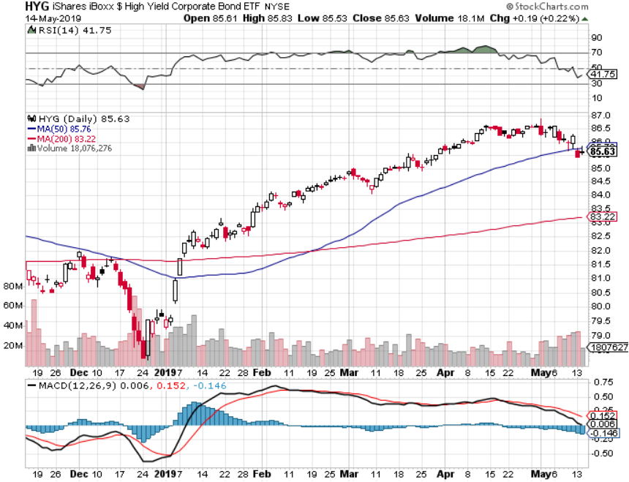
Junk Bonds (HYG) 5.27% Yield

Slide 52
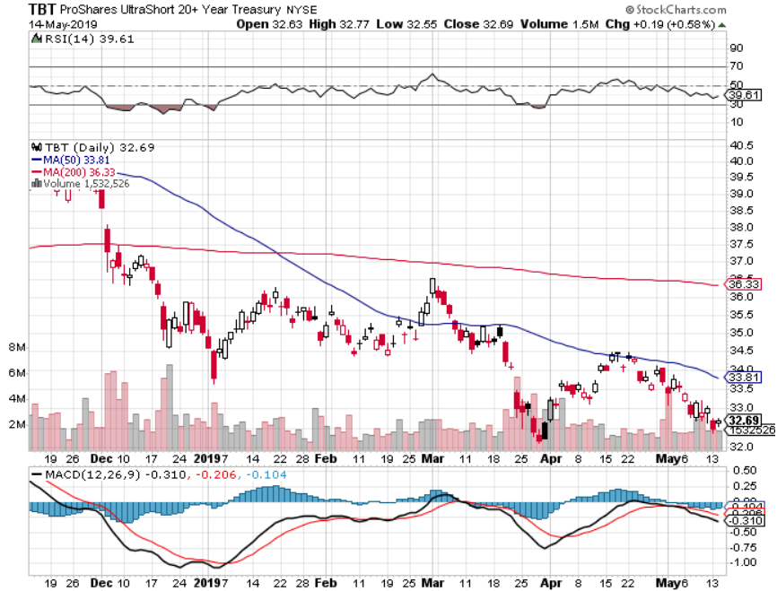
2X Short Treasuries (TBT)-Buy Territory

Slide 53
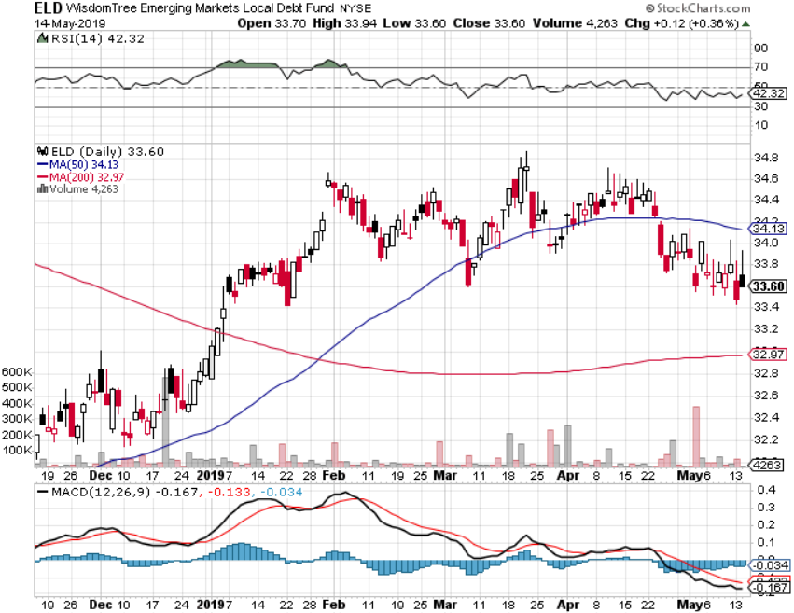
Emerging Market Debt (ELD) 5.92% Yield-

Slide 54
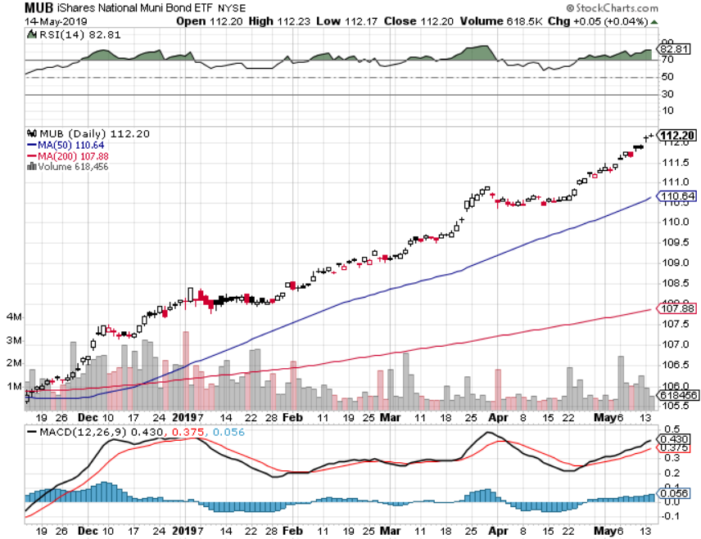
Municipal Bonds (MUB)-2.26% Mix of AAA, AA, and A rated bonds

Slide 55
Foreign Currencies – Dollar Panic
*Ratchet up in trade war crushes both combatant currencies, the US dollar and the Chinese Yuan *Japanese yen spikes on hedge fund covering of shorts to unwind “RISK ON” positions *Euro barely moves because they may be the next trade target. Butting 25% tariffs on German cars, already threatened would be an economic disaster *British pound stalls on lack of Brexit progress *Bitcoin rallies big on flight to safety, capital flight from China fleeing weak Yuan replacing gold *Bottom Line: stand aside until move is done

Slide 56
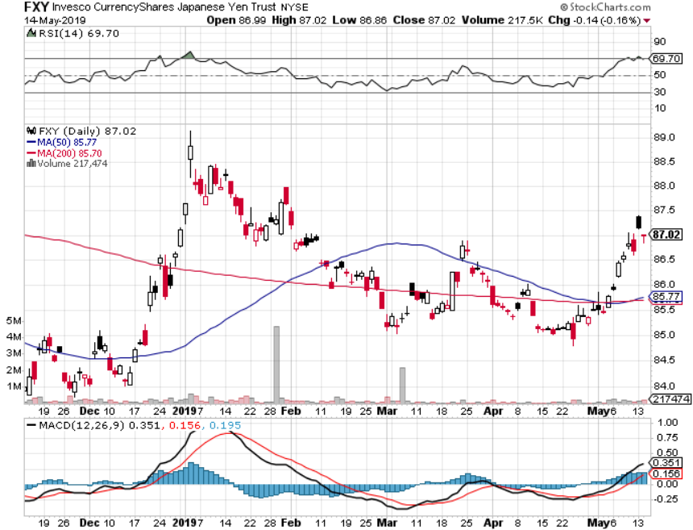
Japanese Yen (FXY), (YCS)

Slide 57
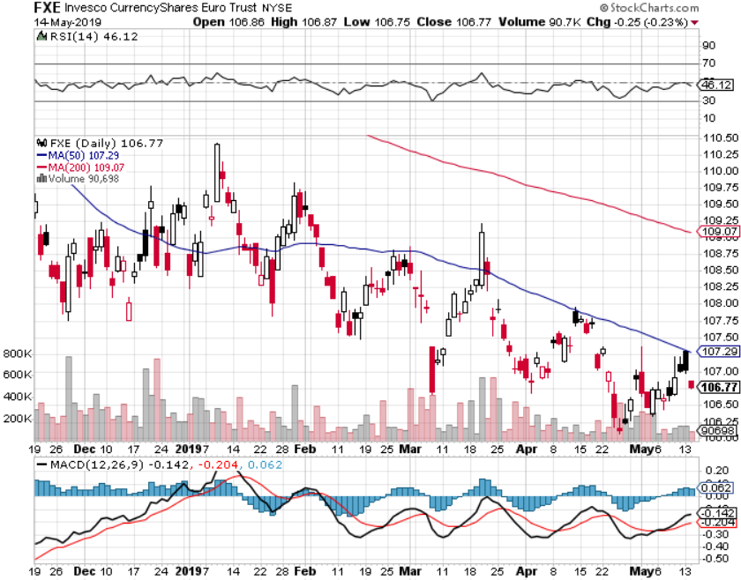
Euro ($XEU), (FXE), (EUO)- Trying to Break Down long 2/$105-$108 call spread

Slide 58
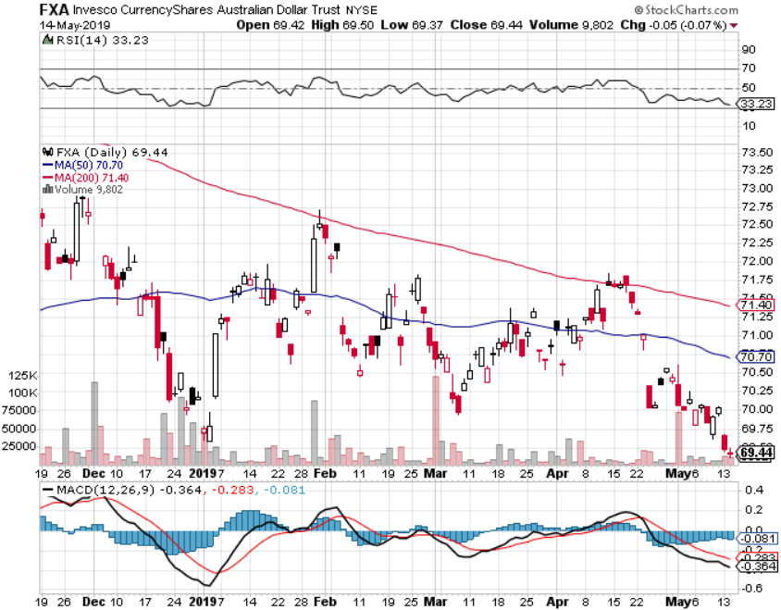
Australian Dollar (FXA)-

Slide 59
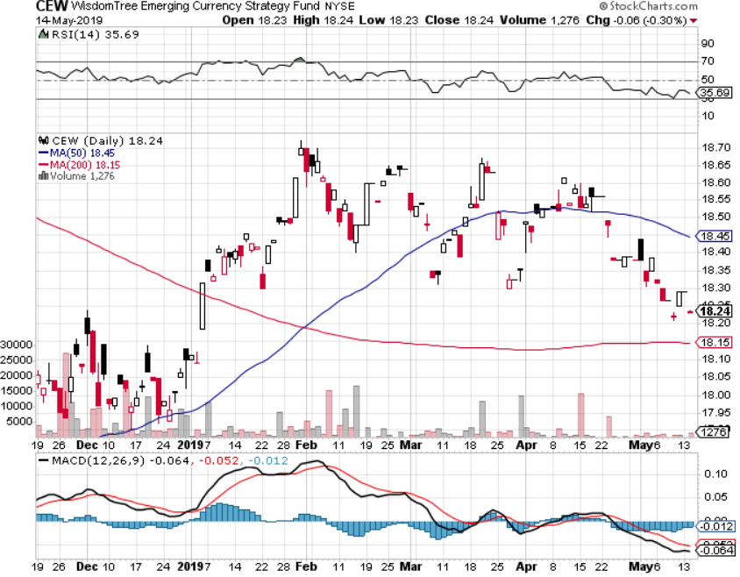
Emerging Market Currencies (CEW)

Slide 60
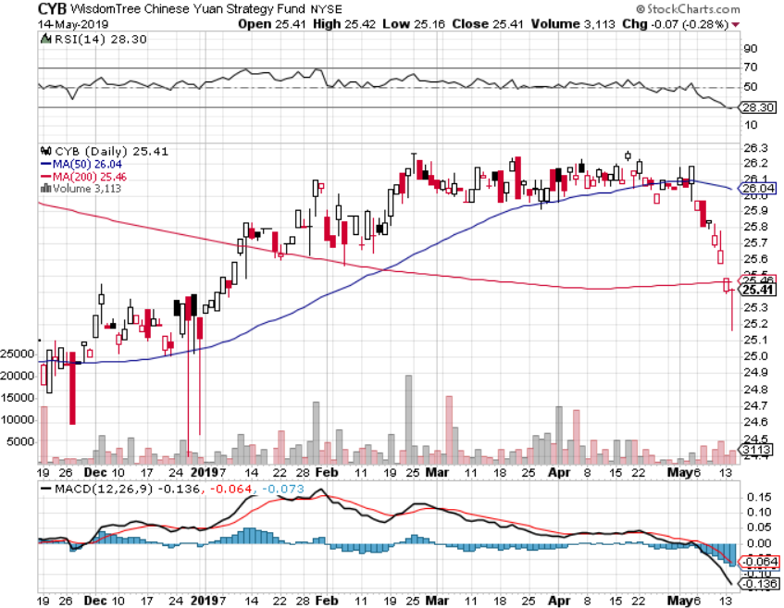
Chinese Yuan- (CYB)-

Slide 61
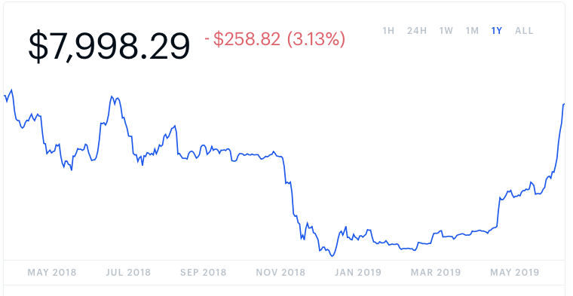
Bitcoin- 100% Rally On Massive Chinese Buying

Slide 62
Energy – Global Recession Fears
*Oil plunges 10% on sudden global recession fears prompted by China trade war, then bounces on drone attach on Saudi tankers *US Moving carrier group to close the Straights of Hormuz to enforce Iran Oil sanctions on 8 former exemption countries *Drone attack on Saudi ships *Occidental Petroleum (OXY) wins Anadarko takeover battle with Buffet Financing *Libya civil war still crimping supply *So is Venezuela failed state *Bottom Line: buy the dips

Slide 63
Oil-Recession Trumps War

Slide 64
United States Oil Fund (USO)

Slide 65
Energy Select Sector SPDR (XLE)-No Performance! (XOM), (CVX), (SLB), (KMI), (EOG), (COP)

Slide 66
Halliburton (HAL)-

Slide 67
Natural Gas (UNG)- Major Hedge Fund Blow Up

Slide 68
Precious Metals – “RISK OFF” Bid, But Not Much
*Gold should be flying here and the fact that it isn’t is a problem for gold. *Big Bitcoin rally means it is stealing gold’s thunder again, with much speculative short term trading moving there *Interest rates plunge should be very positive, but gold ain't moving *Venezuela is done dumping the last of its gold *Central bank buying continues in major way, especially by Russia and China *Stand aside

Slide 69
Gold (GLD)- The flight to safety bid is coming Stopped out of 3/$119-$122 vertical bull call spread

Slide 70
Market Vectors Gold Miners ETF- (GDX) – Yikes!

Slide 71
Barrick Gold (GOLD)

Slide 72
Newmont Mining- (NEM)-

Slide 73
Palladium - (PALL)-

Slide 74
Copper (COPX)-Collapse Trade War Disaster

Slide 75
Freeport McMoRan (FCX)-Collapse Trade War Disaster took profits on long 4/$10-$11 call spread took profits on short 4/$114 calls

Slide 76
Real Estate – Still Falling
*Stock market crash hasn’t hit the housing market yet, mortgage applications up 2.7% last week *March Pending Homes Sales up 3.8%, but down 1.2% YOY. *Corelogic says 40% of US homes undervalued, 16% fair valued, and 44% undervalued, with rate of price gains slowing sharply *Biggest hits taken by luxury end of the market, with some markets, like NY and SF mansions completely drying up *February S&P 500 Case-Shiller drops to 4.0%, annual gain, the lowest gain in 6 1/2 years *Bottom Line: Stand aside for a trade but buy for long term investment

Slide 77
February Corelogic S&P Case Shiller Home Price Index Las Vegas (9.7%), Phoenix (6.7%), and Tampa (5.4%) showing biggest gains
Tradingeconomics.com

Slide 78
Simon Property Group (SPG)-

Slide 79
US Home Construction Index (ITB) (DHI), (LEN), (PHM), (TOL), (NVR)

Slide 80
Trade Sheet- So What Do We Do About All This?
*Stocks-buy big dips *Bonds-sell rallies *Commodities-stand aside *Currencies-stand aside *Precious Metals – stand aside *Volatility-buy dips to $12 *Real estate-stand aside

Slide 81
Next Strategy Webinar 12:00 EST Wednesday, May 29, www.madhedgefundtrader.com email me at support@madhedgefundtrader.com
Good Luck and Good Trading!
Notes:
*

