Slide 1
The Mad Hedge Fund Trader
“Skirting the Edge”
With John Thomas
from Silicon Valley, CA, May 29, 2019
www.madhedgefundtrader.com
Notes:
*

Slide 2
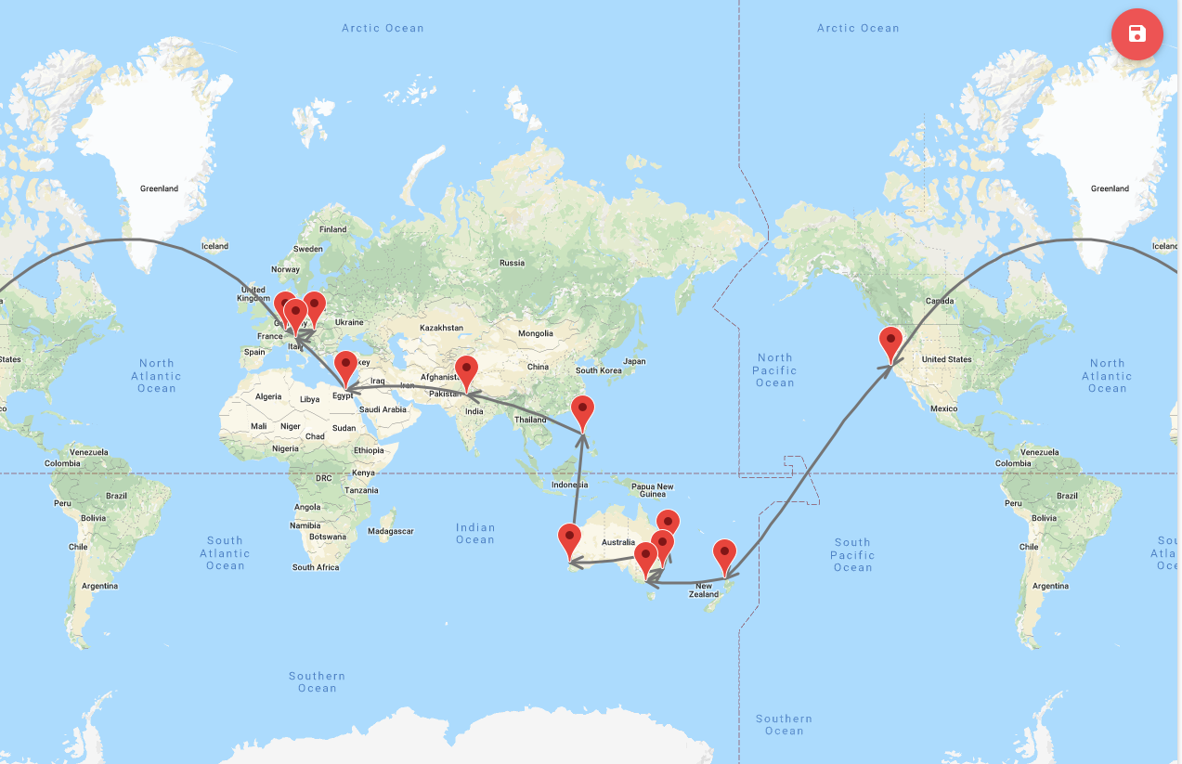
START

Slide 3
MHFT Global Strategy Luncheons
2019 World Tour
Buy tickets at www.madhedgefundtrader.com
Friday June 21 12:30 PM Auckland, New Zealand
Monday June 24 12:30 PM Melbourne, Australia
Tuesday June 25 12:30 PM Sydney, Australia
Wednesday June 26 12:30 PM Brisbane, Australia
Friday June 28 12:30 PM Perth, Australia
Sunday June 30 12:30 PM Manila, Philippines
Tuesday July 2 12:30 PM New Delhi, India
Friday July 5 12:30 PM Cairo, Egypt
Monday July 8 12:30 PM Venice, Italy
Wednesday July 10 12:30 PM Budapest, Hungary
Friday, July 19, 3:00 PM Zermatt, Switzerland

Slide 4
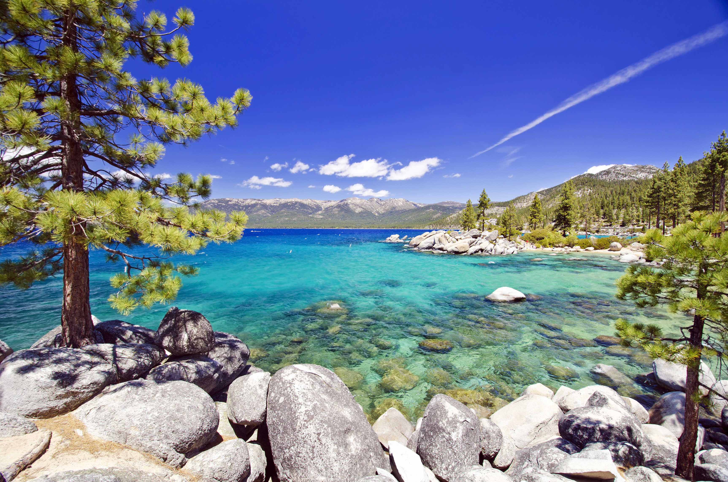
October 25-26 Lake Tahoe Conference
50% of seats already sold out
*Two days of informative speakers on crucial trading and investment issues
*Trade tips with the most successful Mad Hedge traders
*2 nights in the Hyatt, including all you can eat and drink
*Tickets are a bargain at
$699 to $1,999
*Buy now, upper ticket classes
sell out first

Slide 5

Trade Alert Performance
New Highs!
*January 9.49% Final *July +0.0% Final
*February +4.64% Final *August +2.19% MTD
*March +1.78% Final *September 1.38% Final
*April +0.30% Final *October +1.37% Final
*May +0.06% MTD *November -1.83% Final
*June +4.15% Final *December -4.13% Final
*2019 Year to Date +15.78%
compared to +9.3% for the Dow Average
*Trailing One year return +20.71%, +215.92% since inception,
*Average annualized return of 33.24% for 9 1/2 years

Slide 6
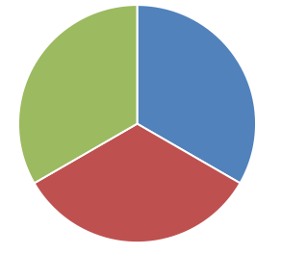
Portfolio Review
Keeping Small Positions
Only Buying Very Deep in-the-Money on Capitulation Days
Current Capital at Risk
Risk On
World is Getting Better
(MSFT) 6/$110-$115 call spread | 10.00%
(AMZN) 6/$1650-$1700 call soread | 10.00%
(TSLA) 6/$140-$150 call spread | 10.00%
Risk Off
NO POSITIONS
Total Net Position | 30.00%
Expiration P&L
18.58%

Slide 7
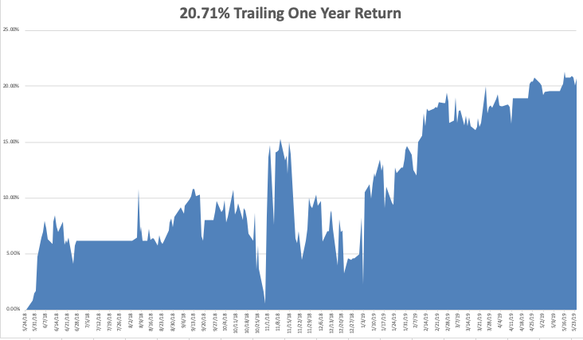
GTD Daily Audited Performance
New All Time High

Slide 8
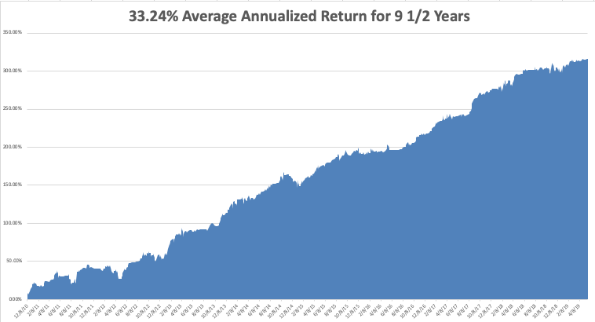
GTD 9 Year Daily Audited Performance

Slide 9

The Method to My Madness
*It’s all about the trade war now and for the rest of the year
*Upside risks are minimal, but downside ones are huge
*Expect a tape driven market driven by daily bombshells
*Bonds now discounting an imminent recession at 2.30%
*Strong US dollar demolishes foreign earnings
*Oil suffers instant 15% correction on global recession fears

Slide 10
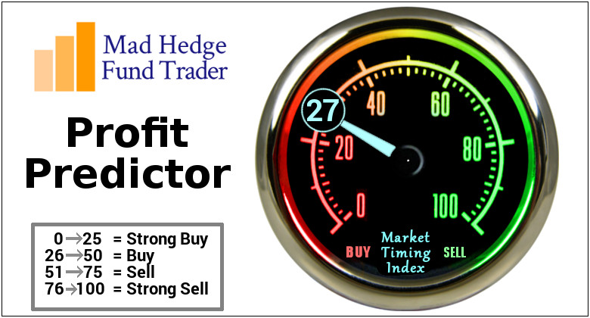
The Mad Hedge Profit Predictor
Market Timing Index-
An artificial intelligence driven algorithm that analyzes 30 different economic, technical, and momentum driven indicators

Slide 11
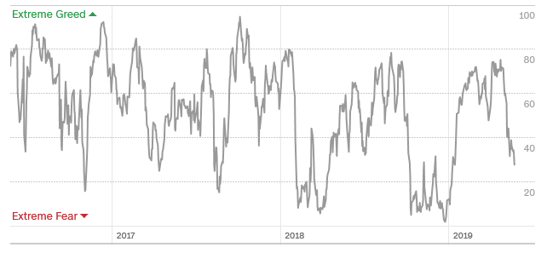
The Mad Hedge Profit Predictor
Profit Predictor Wins Again!
SELL
BUY

Slide 12
The Global Economy – Global Tailspin
*If Chinese trade war continues to the max a global recession will ensure
*Companies are reassessing future earnings with big downgrades to come
*Big chunks of small US retailing and manufacturing will go under
*Trade war is spilling into Europe, slowing economies
further there
*Big Chinese yuan devaluation offsetting
cost of tariffs, will continue,
*The world turning to negative
interest rates tells us that worst to come
*”No Deal” Brexit acceleration
throws the fat on the fire

Slide 13
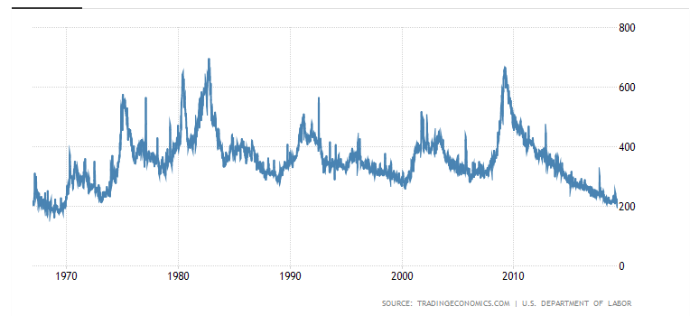
Weekly Jobless Claims
-1,000 to 211,000 holding last week’s monster gain

Slide 14
Soybeans (-20%)-Trade War Indicator
Can’t Get any worse- Lucky farmers had their insured crops destroyed

Slide 15
The Bill Davis View
A $1,500 Upgrade for the Mad Day Trader Service
Buys: | Entry | Target
Dycom Industries (DY) | $ 50.00 | $ 68.00
Tesla Inc. (TSLA) | $ 188.00 | $ 225.00
Las Vegas Sands Corp (LVS) | $ 56.00 | $ 65.00
Freeport McMoran, Inc. (FCX) | $ 9.00 | $ 13.00
Medtronic, Inc. (MDT) | $ 88.00 | $ 100.00
Sells:
Chipotle Mexican Grill Inc. (CMG) | $ 700.00 | $ 660.00
Jazz Pharmaceuticals,Inc (JAZZ) | $ 138.00 | $ 122.00
Goldman Sachs (GS) | $ 200.00 | $ 185.00
Deere & Co. (DE) | $ 142.00 | $ 125.00
WageWorks, Inc. (WAGE) | $ 52.00 | $ 45.00

Slide 16
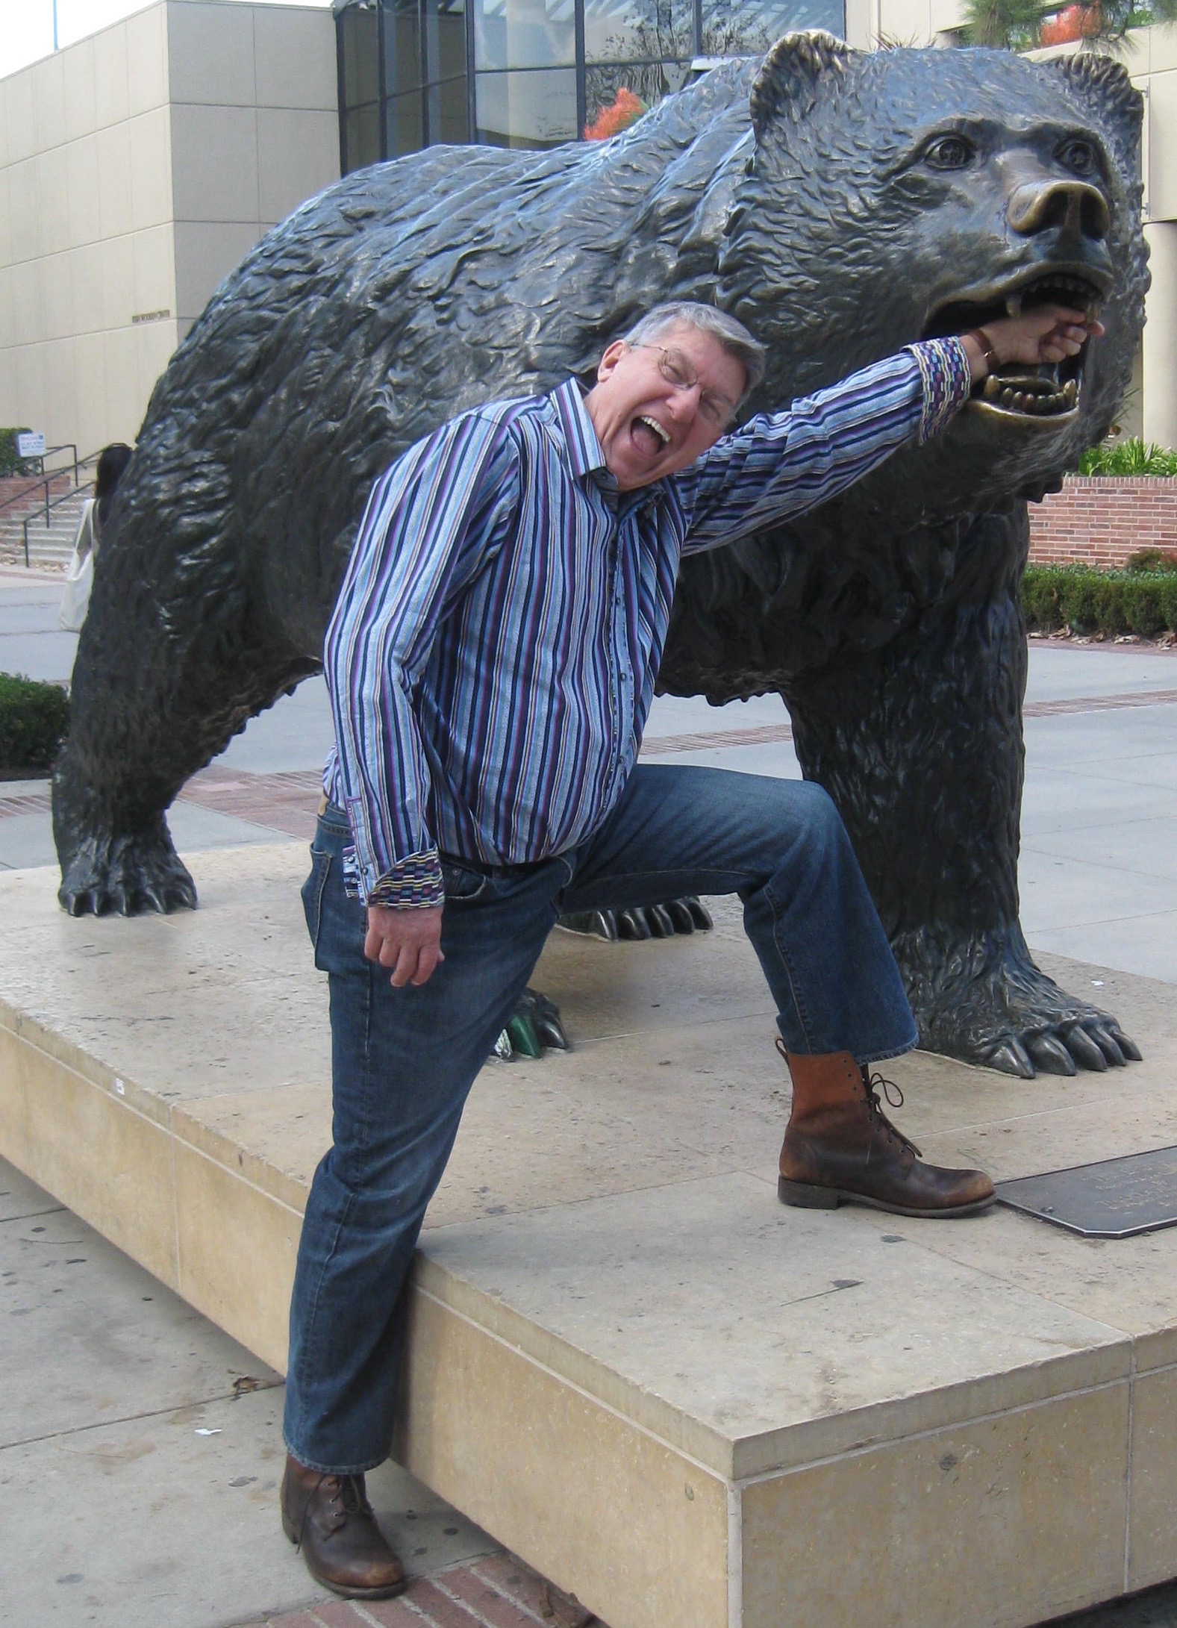
Stocks – Flirting with the Bear
*Companies dialing back earnings forecast as fast as they can, watch for the sushi to hit the fan during the Q2 earnings season in July
*Market is rising on small volume and falling on big volume, a classic bear market indicator
*Stocks with the biggest gains are delivering the sharpest falls as traders take profits, especially in technology
*Earnings have become completely irrelevant, it’s
all abut global macro now, with slowing China,
Europe, and Britain dragging the US into recession
*Wait for the Mad Hedge Market Timing Index
to spend two months under 20 before going
aggressively long again
*Bottom Line: its bet the ranch time on tech longs,
but stay away from those with big China exposure,
like Apple, and weak dollar plays like energy, and
emerging markets

Slide 17
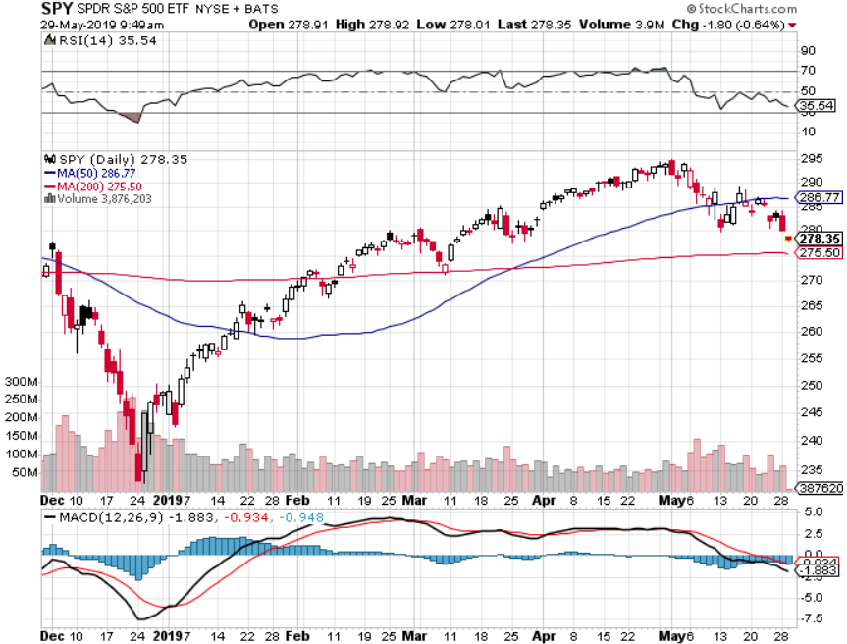
S&P 500- stopped out of long 2/$285-$290 bear put spread took profits on long 2/$270-$275 bear put spread

Slide 18
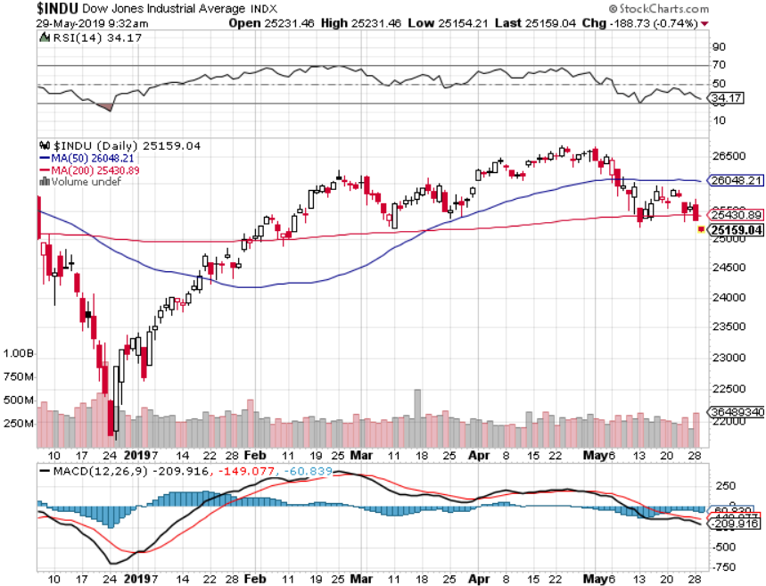
Dow Average-

Slide 19
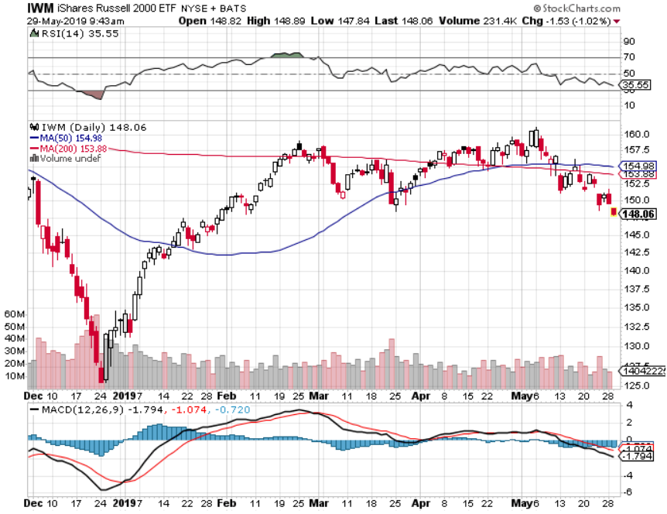
Russell 2000 (IWM)- out for even Long 4/$160-$165 vertical bear put spread

Slide 20
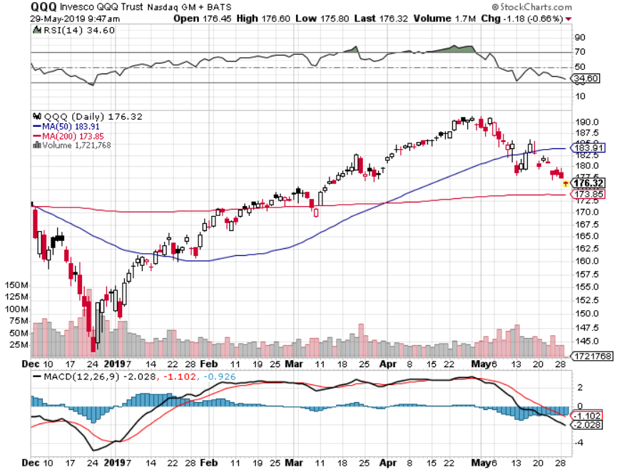
NASDAQ (QQQ)

Slide 21
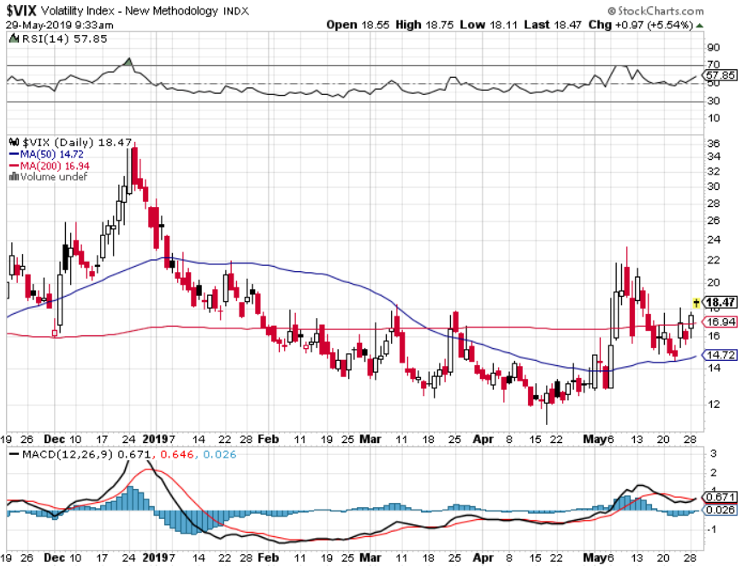
(VIX)- Looking for a Rocky Summer

Slide 22
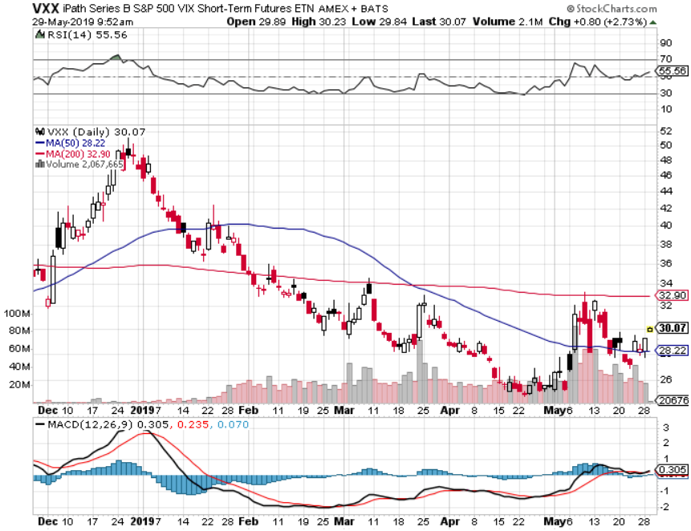
iPath S&P 500 VIX Short-Term Futures ETN (VXX)

Slide 23
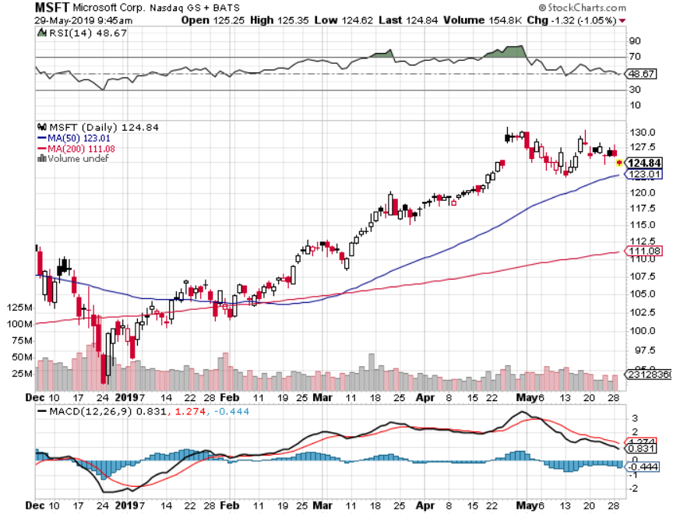
Microsoft (MSFT)- Earnings beat long 6/$110-$115 call spread-expires in 17 trading days took profits on long 4/$108-$113 call spread took profits on long 2/$85-$90 call spread
Break
Even

Slide 24
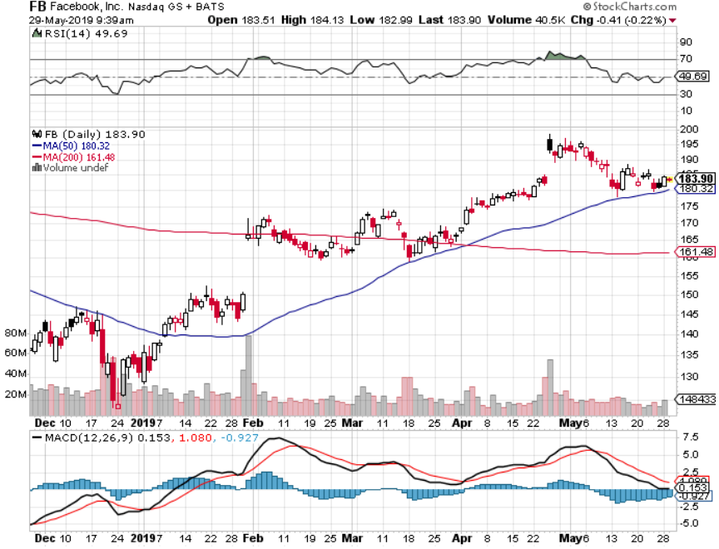
Facebook (FB)- FANG bounce

Slide 25
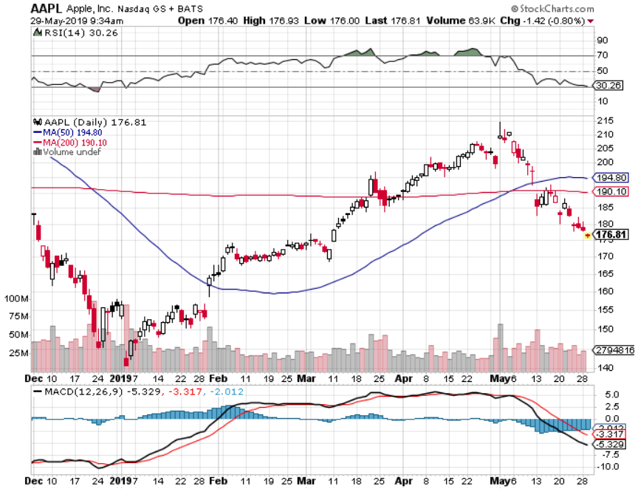
Apple (AAPL)- China Target stopped out of long 3/$180-$185 bear put spread stopped out of long 11/$175-$180 bear put spread took profits on long 11/$165-$175 bear put spread

Slide 26
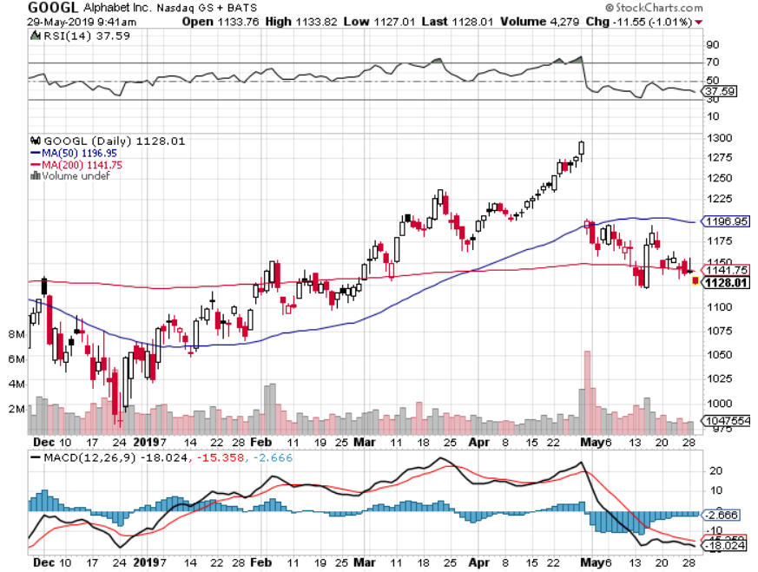
Alphabet (GOOGL)- Earnings Shock stopped out of long 5/$1,100-$1,130 bull call spread took profits on long 4/$1,080-$1,120 bull call spread

Slide 27
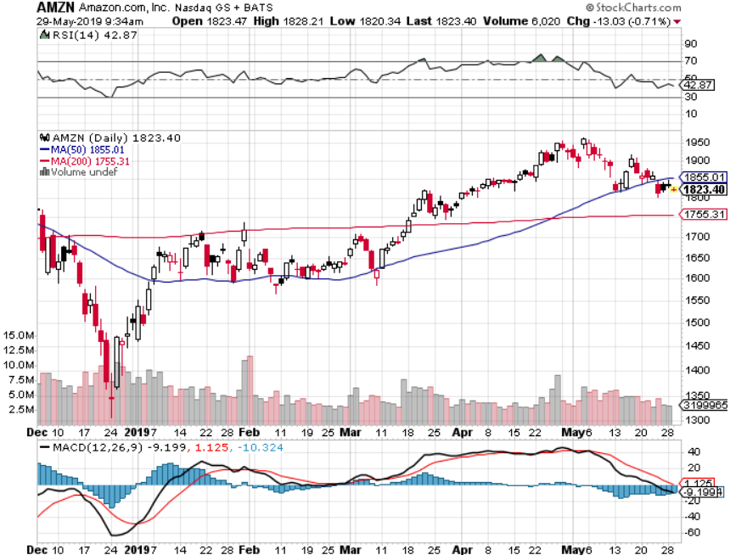
Amazon (AMZN)-Back to Top of Range long 4/$1,650-$1,700 call spread-expires in 17 trading days took profits on long 4/$1,600-$1,650 call spread took profits on long 2/$1,200-$1,300 call spread
Break
Even

Slide 28
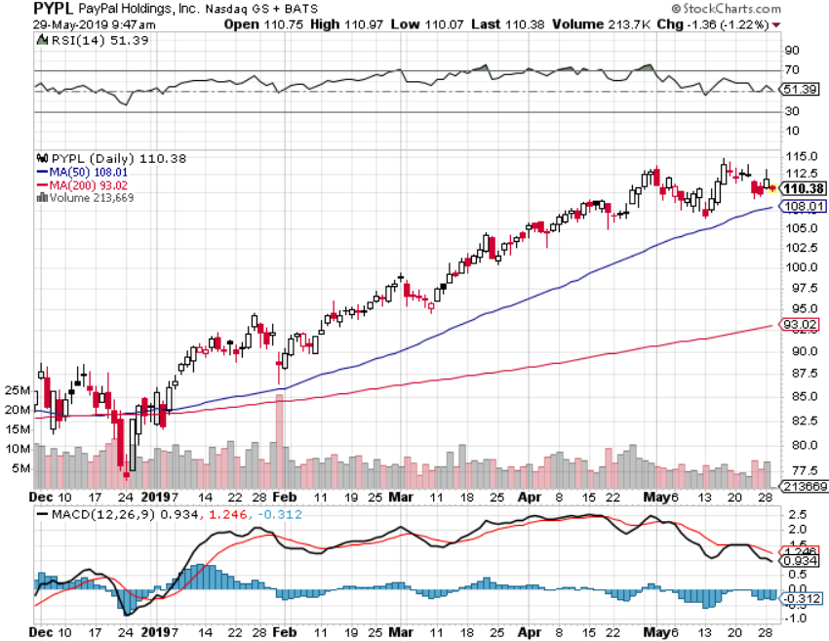
PayPal (PYPL)-Fintech Star took profits on long 4/$90-$95 call spread

Slide 29
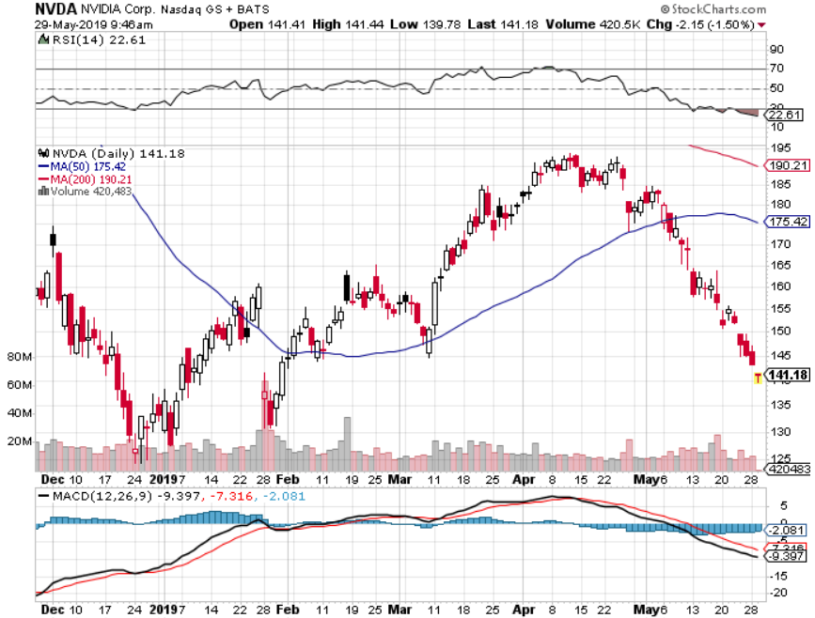
NVIDIA (NVDA)- earnings beat

Slide 30
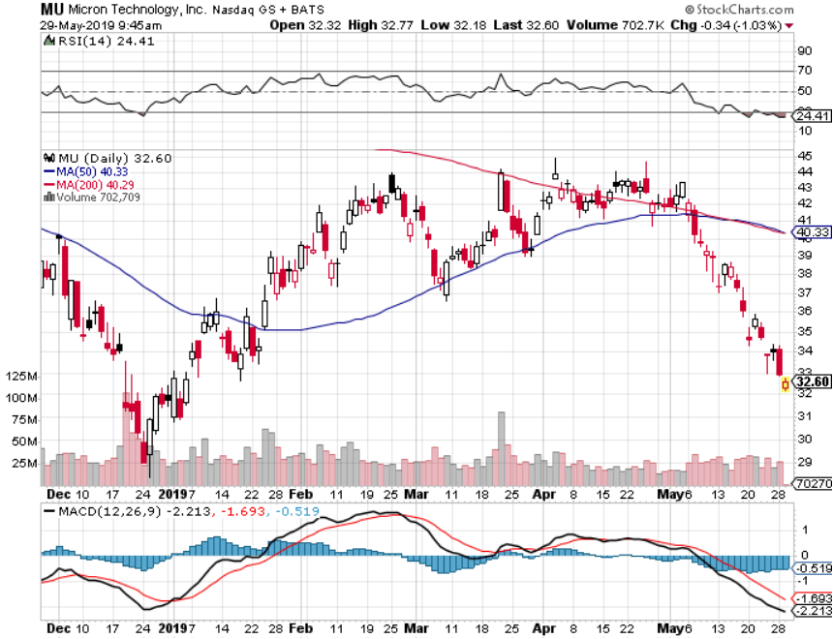
Micron Technology (MU)-

Slide 31
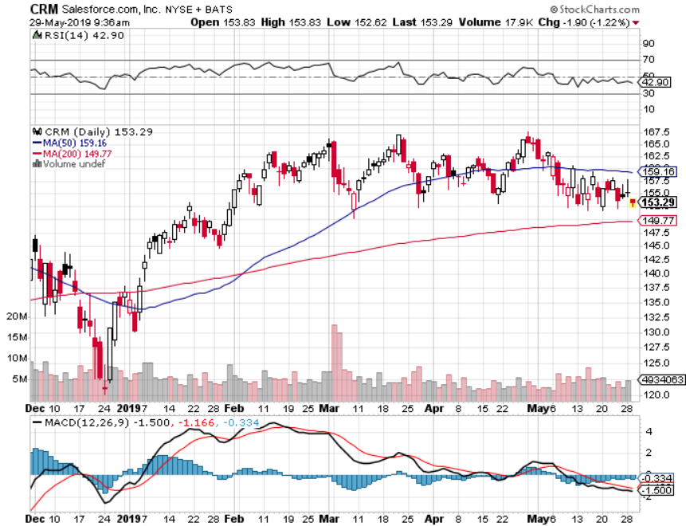
Salesforce (CRM)- took profits on long 2/$105-$115 call spread

Slide 32
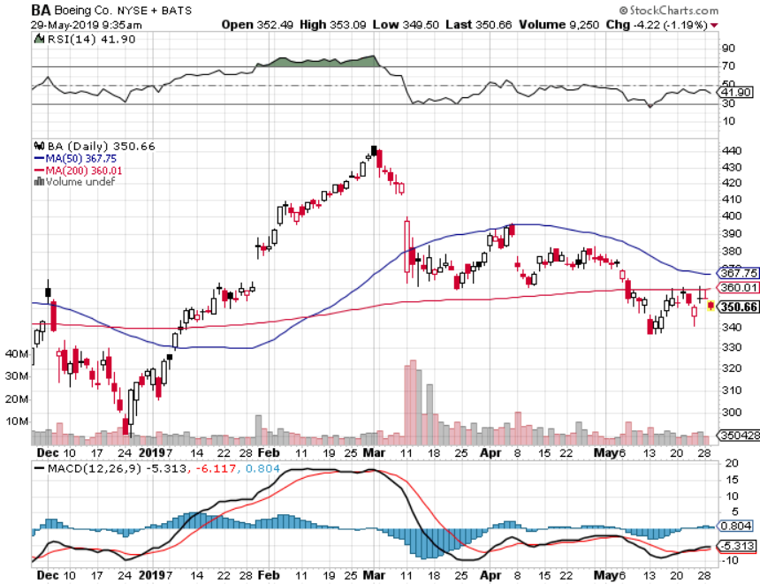
Boeing (BA)- took profits on long 4/$315-$335 call spread
Next to happen in the recertification bounce

Slide 33
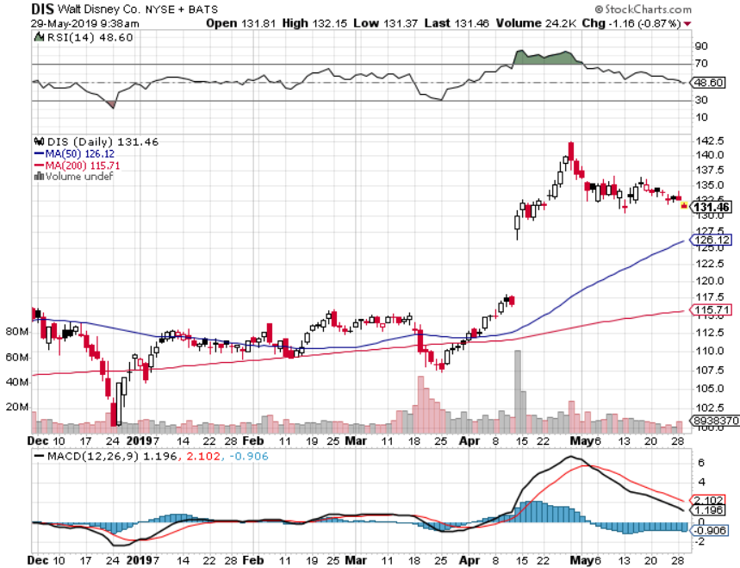
Walt Disney (DIS)-
Summer Blockbuster Wave
Stopped out of $125-$130 call spread for small loss took profits on long 4/$100-$104 call spread
Covered Short 4/$114 calls

Slide 34
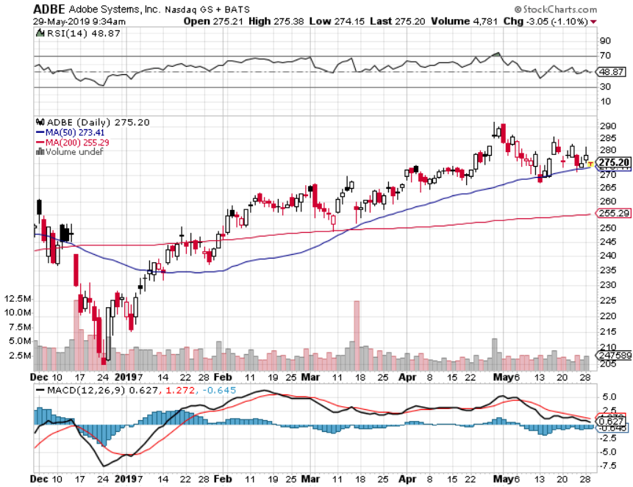
Adobe (ADBE)-
The Quality Non-China tech play

Slide 35
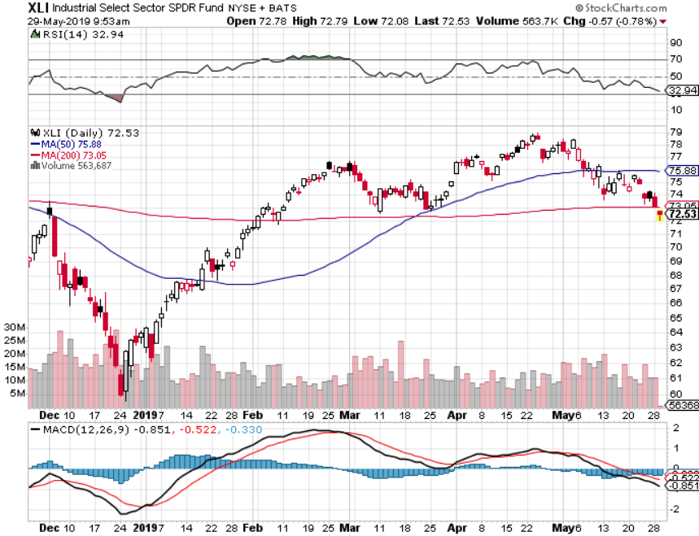
Industrials Sector SPDR (XLI)-
(GE), (MMM), (UNP), (UTX), (BA), (HON)

Slide 36
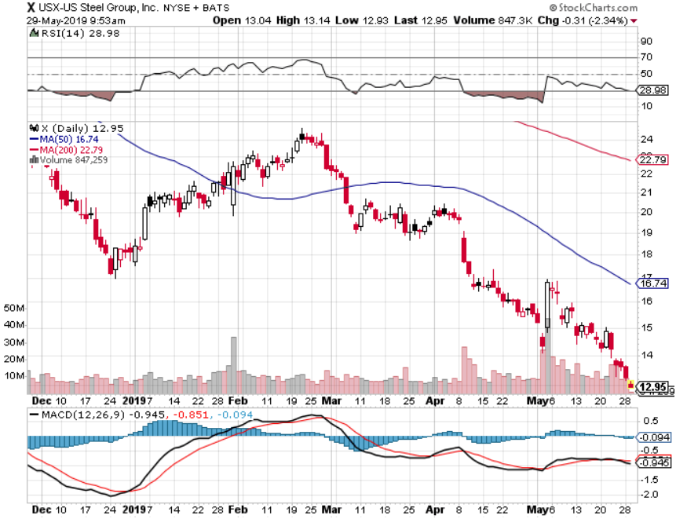
US Steel (X)-Tariffs Trouble
Import duties cause users to abandon steel
Unwound the entire Trump trade

Slide 37
Tesla (TSLA)- A Crisis a Day long 6/$140-$150 call spread – expires in 17 trading days stopped out of long 4/$300-$320 put spread
Elon Musk’s margin position
Major
Support
Break
Even

Slide 38
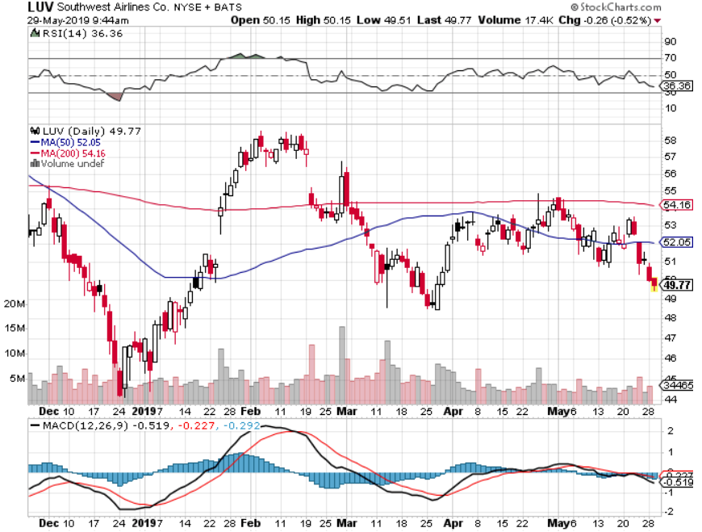
Southwest Airlines (LUV)-
Boeing 737 Max biggest buyer

Slide 39
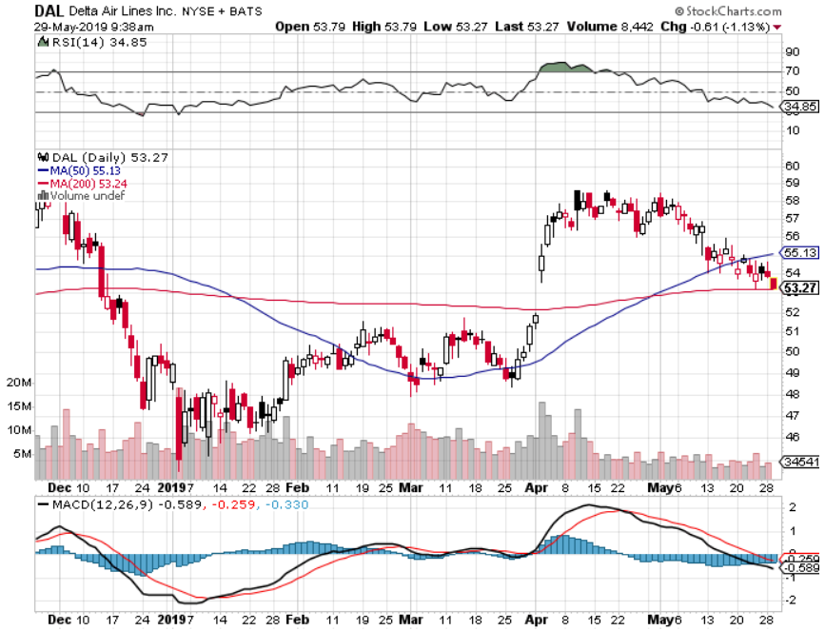
Delta Airlines (DAL)

Slide 40
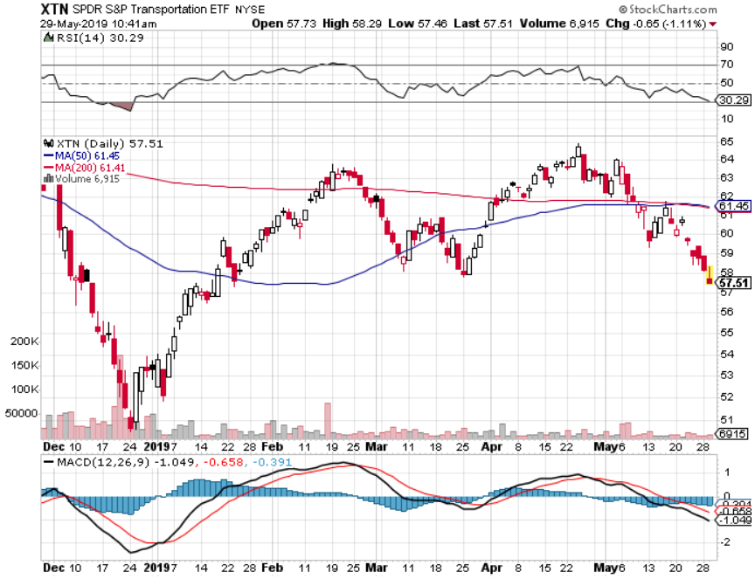
Transports Sector SPDR (XTN)-
(ALGT), (ALK), (JBLU), (LUV), (CHRW), (DAL)

Slide 41
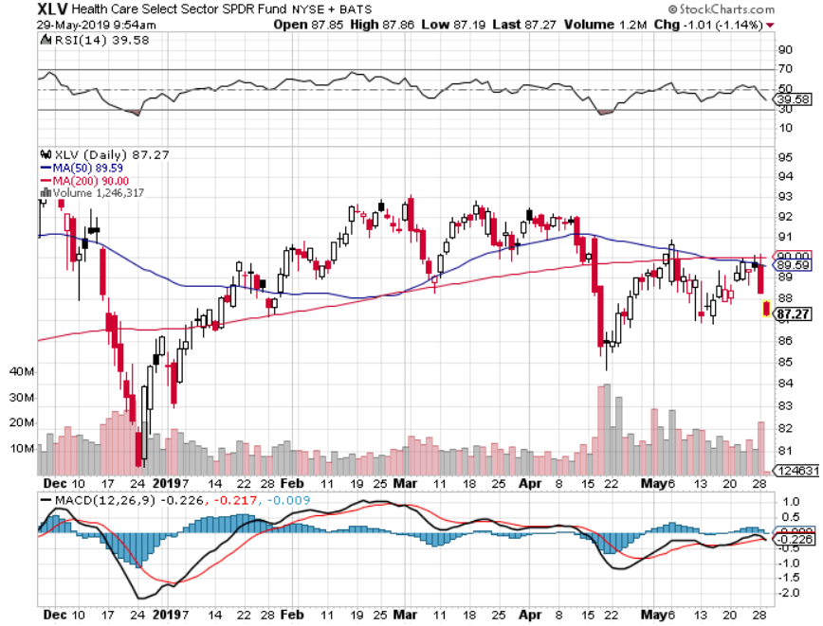
Health Care Sector (XLV), (RXL)-New Highs
(JNJ), (PFE), (MRK), (GILD), (ACT), (AMGN)

Slide 42
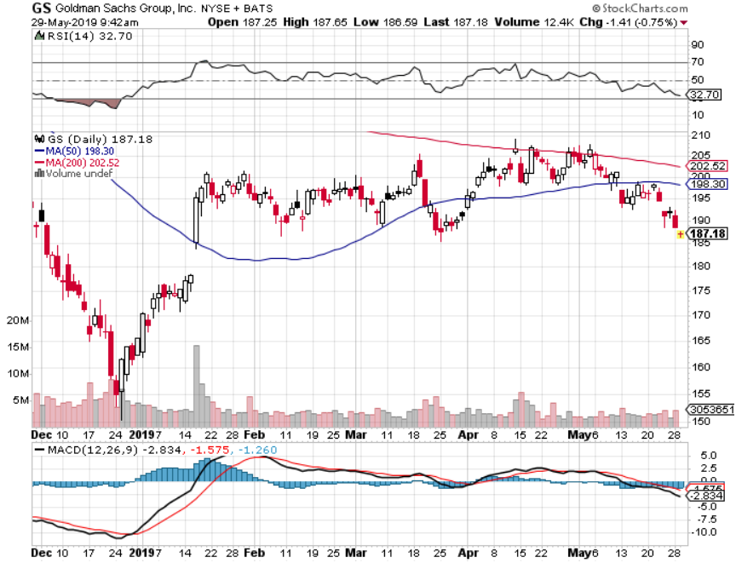
Goldman Sachs (GS)-falling trading volume

Slide 43
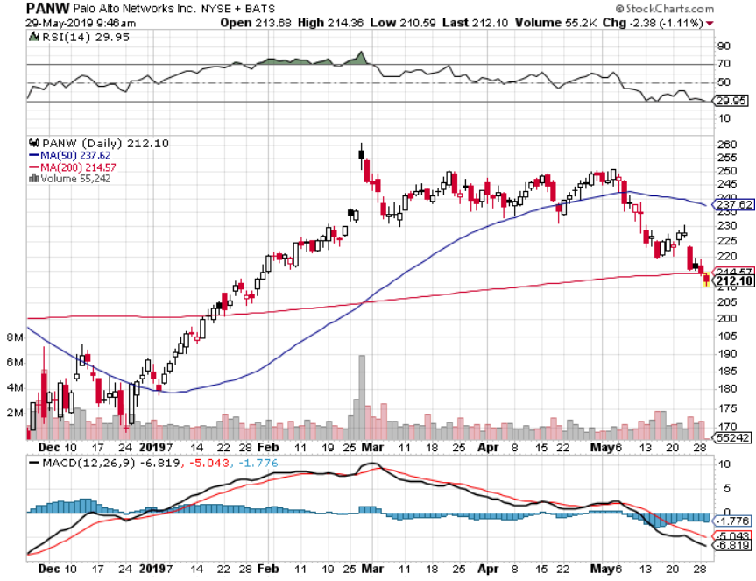
Palo Alto Networks (PANW)-
Hacking never goes out of fashion

Slide 44
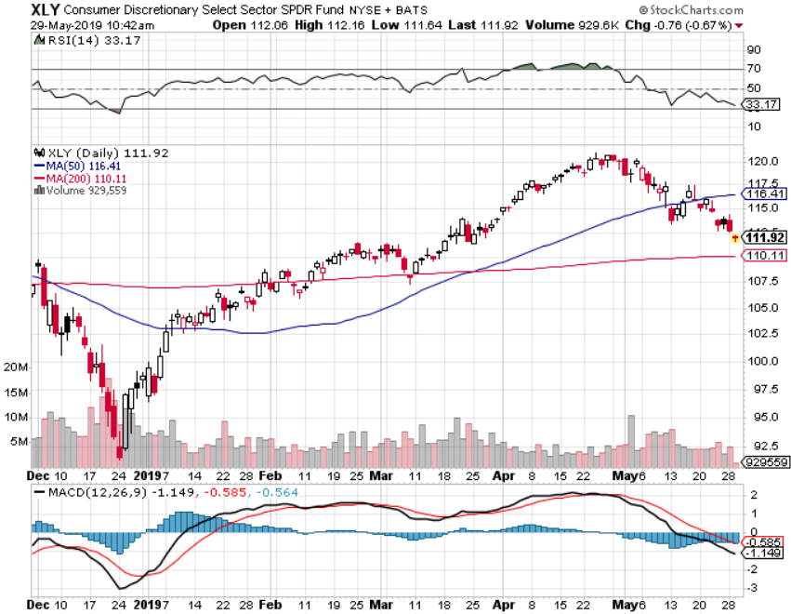
Consumer Discretionary SPDR (XLY)
(DIS), (AMZN), (HD), (CMCSA), (MCD), (SBUX)

Slide 45
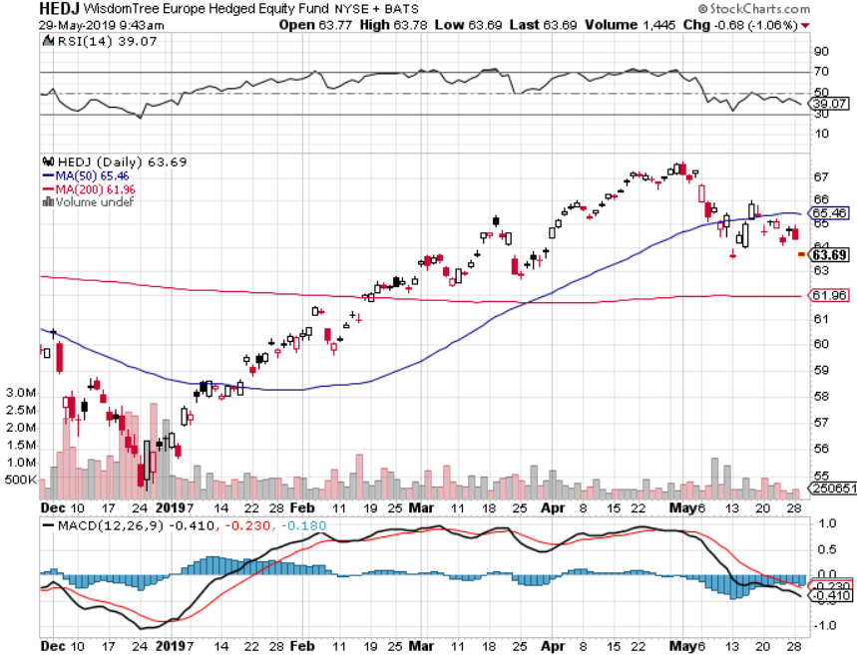
Europe Hedged Equity (HEDJ)-

Slide 46
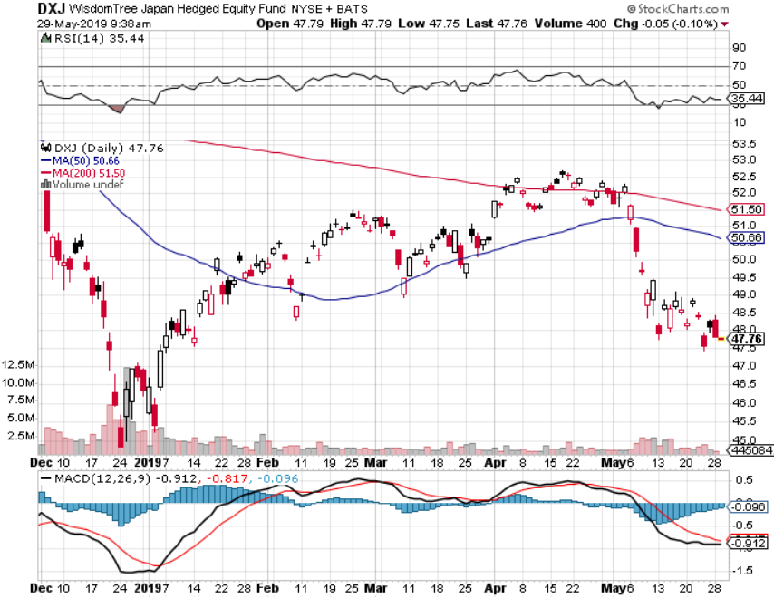
Japan (DXJ)-

Slide 47
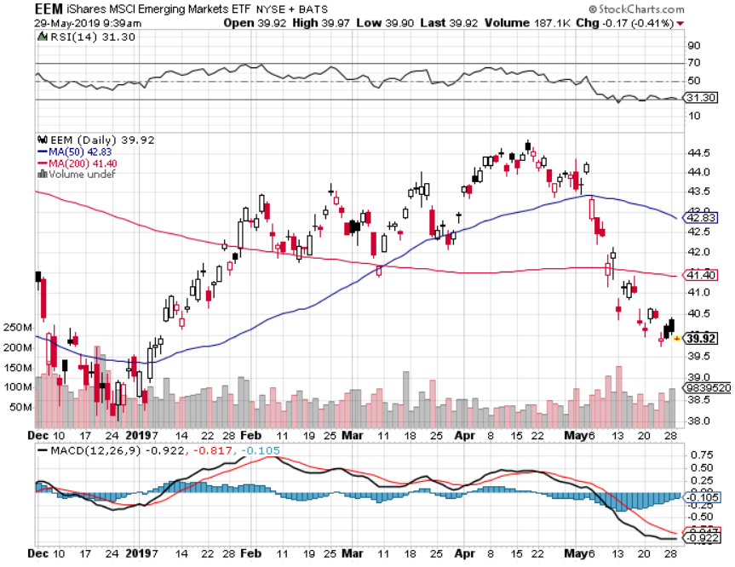
Emerging Markets (EEM)- Time to Buy on Weak Dollar

Slide 48
Bonds – The Recession is Here
*Or at least so says the bond market with a 2.22% yield, headed to 2.0%
*Collapsing global economies sending a huge flight to safety bid to bonds
*Yields have fallen 1% since September, from 3.25%
*The huge move has taken place despite a Chinese boycott of the market, historically 50% of the market
*German bund yields plunge to -0.17%,
while Japan government bonds turn
in a -0.10% yield
*Stand aside and wait for new
range to establish

Slide 49
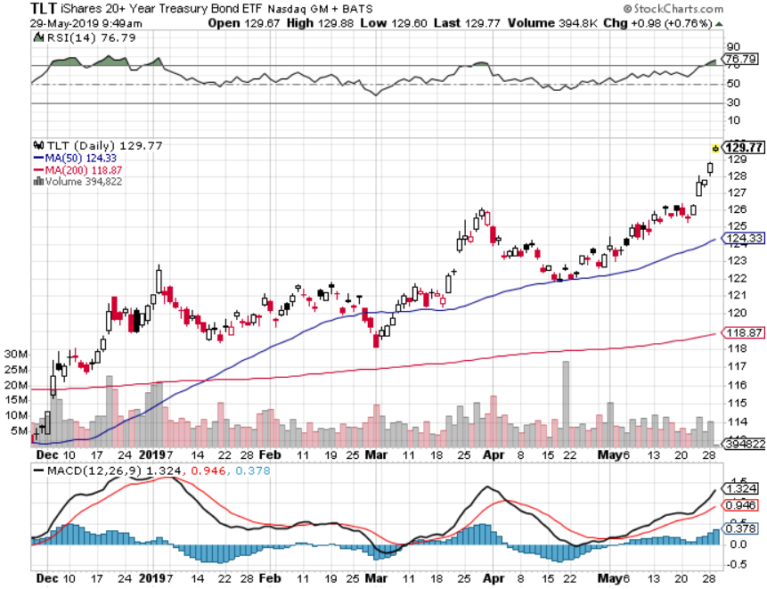
Treasury ETF (TLT) –
Waiting for new range after major upside breakout took profits on long 6/$128-131 bear put spread took profits on long 5/$116-$119 bull call spread

Slide 50
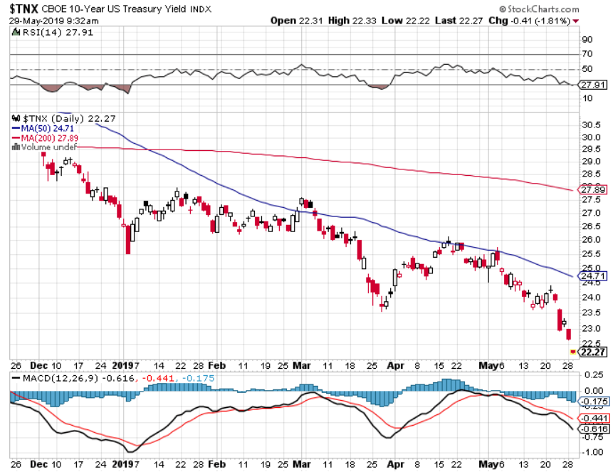
Ten Year Treasury Yield ($TNX) 2.22%
Breakdown

Slide 51
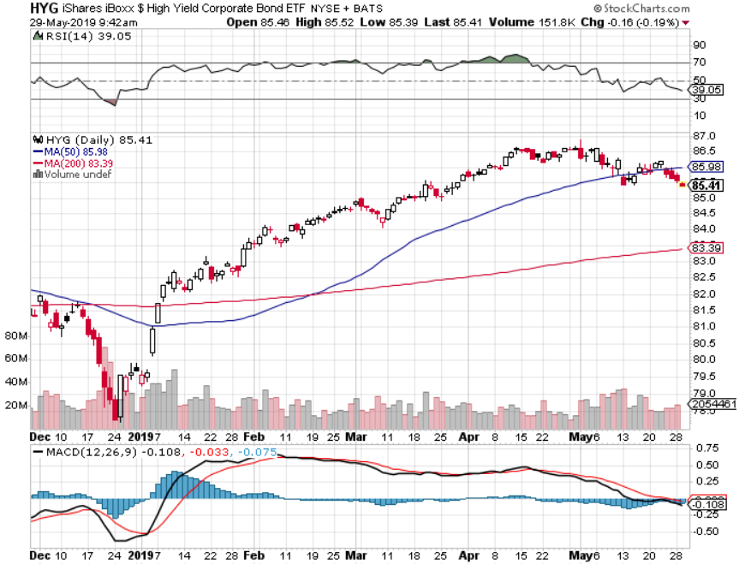
Junk Bonds (HYG) 5.58% Yield big jump in yields on stock selloff and recession fears

Slide 52
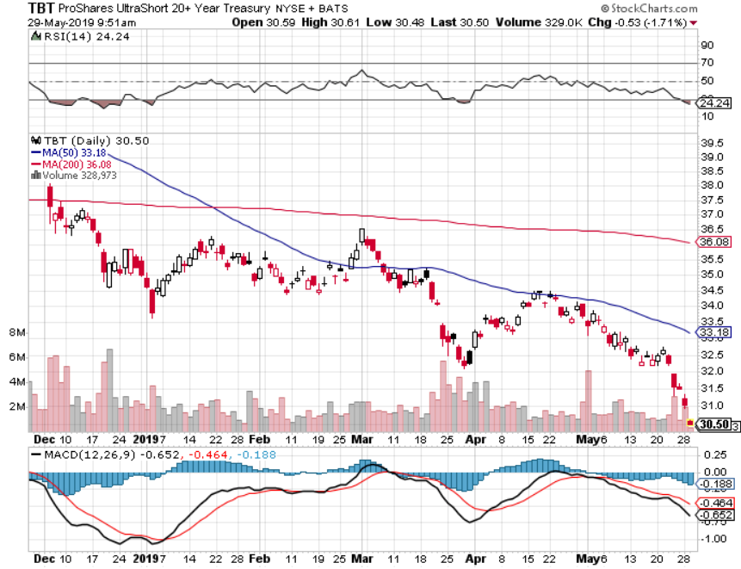
2X Short Treasuries (TBT)-Buy Territory

Slide 53
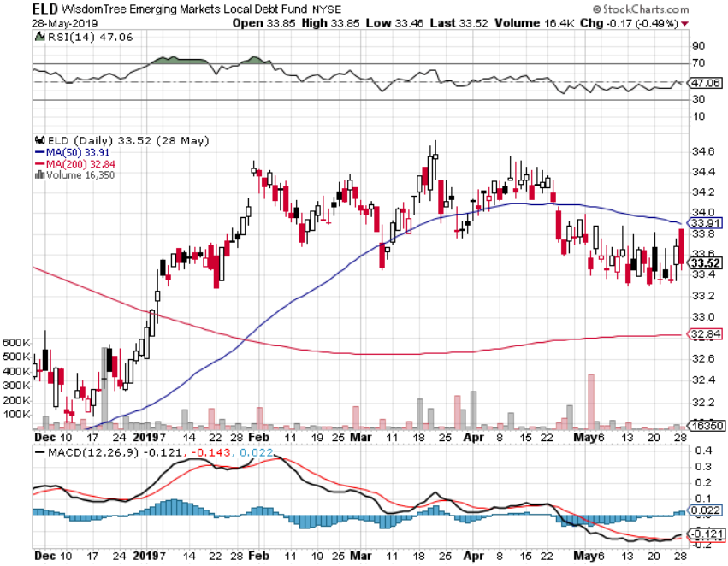
Emerging Market Debt (ELD) 5.80% Yield-

Slide 54
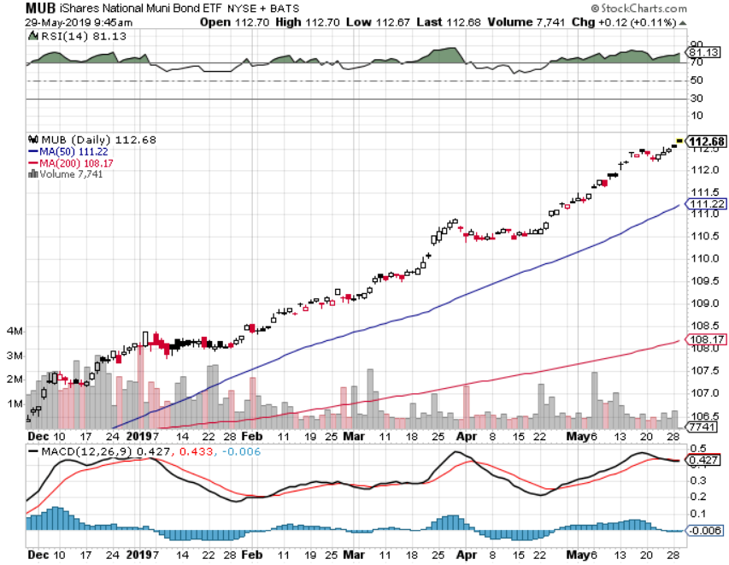
Municipal Bonds (MUB)-2.03%
Mix of AAA, AA, and A rated bonds

Slide 55
Foreign Currencies – Strong Dollar Topping
*Euro bottoming on worst case recession fears and European breakup, new lows on Aussie on commodities collapse
*Yen has already bottomed
*Worst case scenario has happen with May resignation and “no deal” Brexit on the table
*Chinese yuan continues fall on weakening economy,
will offset part of US tariffs
*Bitcoin rallies big on flight to safety, capital
flight from China fleeing weak Yuan
replacing gold
*Bottom Line: stand aside until move is done

Slide 56
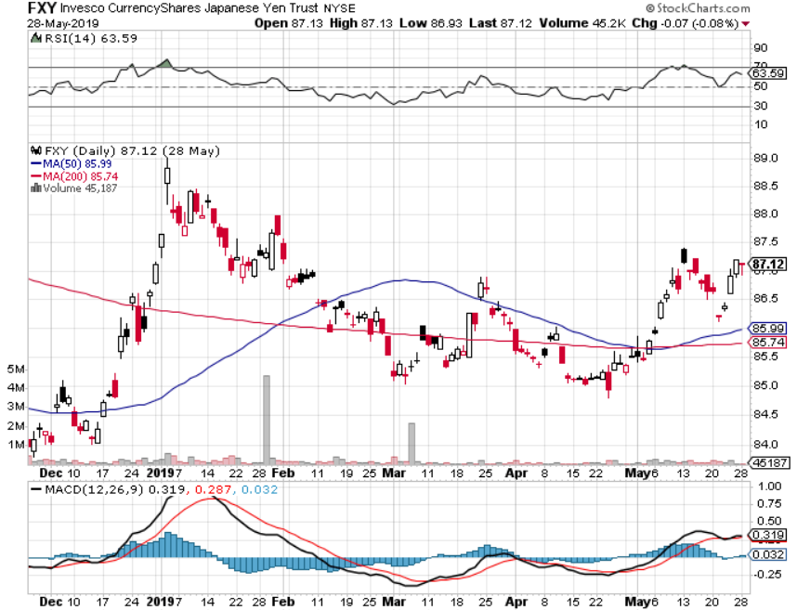
Japanese Yen (FXY), (YCS)

Slide 57
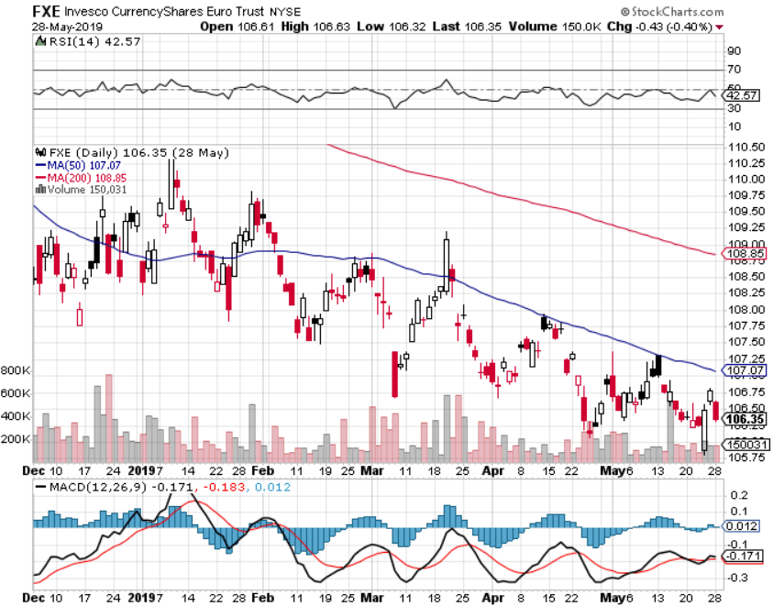
Euro ($XEU), (FXE), (EUO)- Trying to Break Down

Slide 58
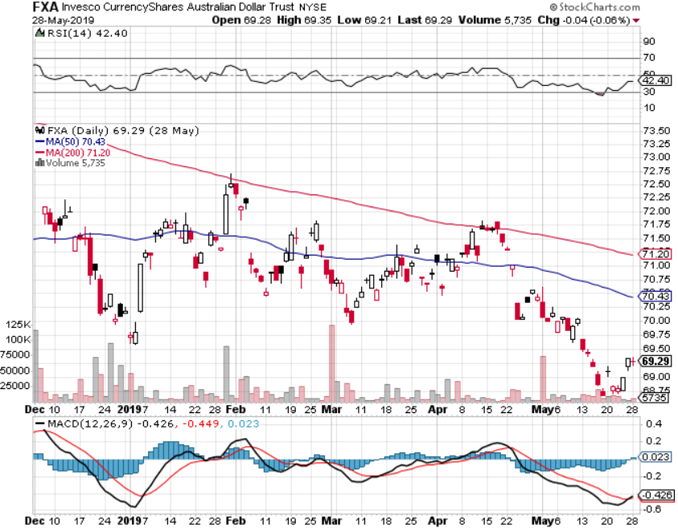
Australian Dollar (FXA)-

Slide 59
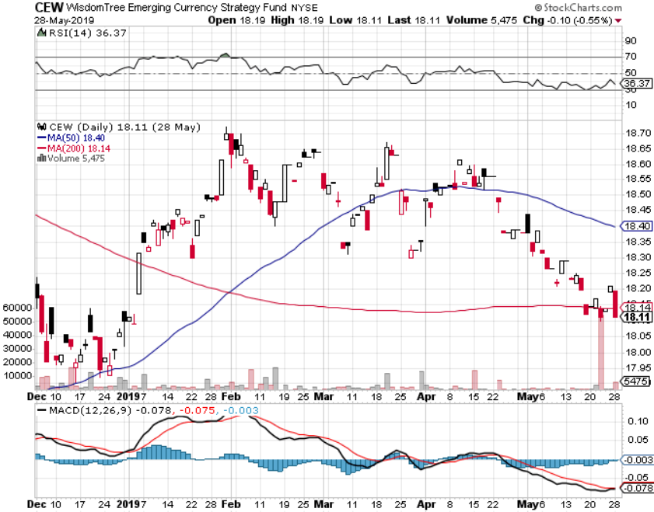
Emerging Market Currencies (CEW)

Slide 60
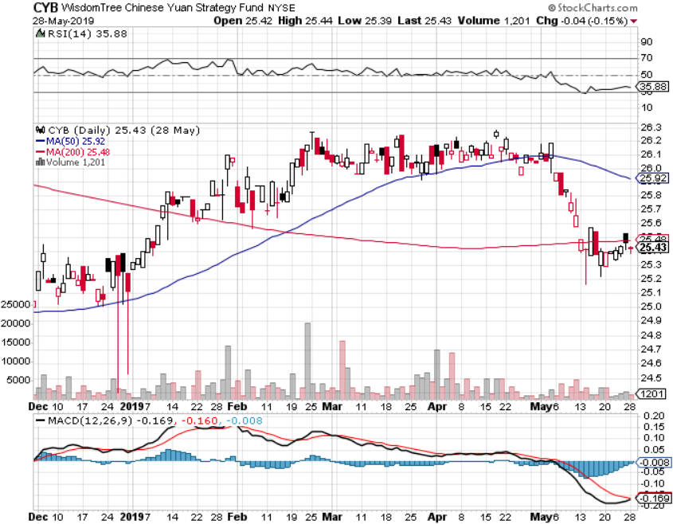
Chinese Yuan- (CYB)-

Slide 61

Bitcoin- 120% Rally
Global Liquidity Surge

Slide 62
Energy – Global Recession Fears
*Oil plunges 15% on sudden global recession fears prompted by China trade war
*US oil production soars to 12.3 million b/d, but China bans all US imports
*Libya civil war still crimping supply
*So is Venezuela failed state
*Contamination of Russian oil
restricting supplies to Europe
*Bottom Line: stand aside

Slide 63


Slide 64

Oil-

Slide 65

United States Oil Fund (USO)

Slide 66

Energy Select Sector SPDR (XLE)-No Performance!
(XOM), (CVX), (SLB), (KMI), (EOG), (COP)

Slide 67

Halliburton (HAL)-

Slide 68

Natural Gas (UNG)-

Slide 69
Precious Metals – No Action
*Entire flight to safety bid moves to crypto currencies
*Big Bitcoin rally means it is stealing gold’s thunder again, with much speculative short term trading moving there
*Bitcoin tops $8,000, a double this year
*Venezuela is done dumping the last of its gold
*Central bank buying continues in major way,
especially by Russia and China
*Stand aside

Slide 70

Gold (GLD)- Where is the flight to safety bid?
Stopped out of 3/$119-$122 vertical bull call spread

Slide 71

Market Vectors Gold Miners ETF- (GDX) – Yikes!

Slide 72

Barrick Gold (GOLD)

Slide 73

Newmont Mining- (NEM)-

Slide 74

Palladium - (PALL)-

Slide 75

Copper (COPX)-Collapse
Trade War Disaster

Slide 76

Freeport McMoRan (FCX)-Collapse
Trade War Disaster took profits on long 4/$10-$11 call spread took profits on short 4/$114 calls

Slide 77
Real Estate – Still Falling
*April New Home Sales down 6.9% to 673,000 on a signed contract basis during strongest period of the year
*Median prices rise thanks to trade tariffs, up to $342,000 from $314,000, inventories at a high 5.9 months
*30 year fixed Mortgage rates hit two year lows under 4.00%, thanks to panic buying in the bond market
*March S&P 500 Case-Shiller drops to 3.7%,
annual gain, the lowest gain in 6 1/2 years
*Bottom Line: Stand aside for a trade
but buy for long term investment

Slide 78

February Corelogic S&P Case Shiller Home Price Index
Las Vegas (8.2%), Phoenix (6.1%), and Tampa (5.3%) showing biggest gains
Tradingeconomics.com

Slide 79

Simon Property Group (SPG)-

Slide 80

US Home Construction Index (ITB)
(DHI), (LEN), (PHM), (TOL), (NVR)

Slide 81

Trade Sheet-
So What Do We Do About All This?
*Stocks-buy the big 500 point down days
*Bonds-stand aside
*Commodities-stand aside
*Currencies-stand aside
*Precious Metals – stand aside
*Volatility-buy dips
*Real estate-stand aside

Slide 82

Next Strategy Webinar
12:00 EST Wednesday, June 12, www.madhedgefundtrader.com email me at support@madhedgefundtrader.com
Good Luck and Good Trading!
Notes:
*

