Slide 1
The Mad Hedge Fund Trader “Trading the Chaos”
With John Thomas from Silicon Valley, CA, June 12, 2019 www.madhedgefundtrader.com
Notes:
*

Slide 2
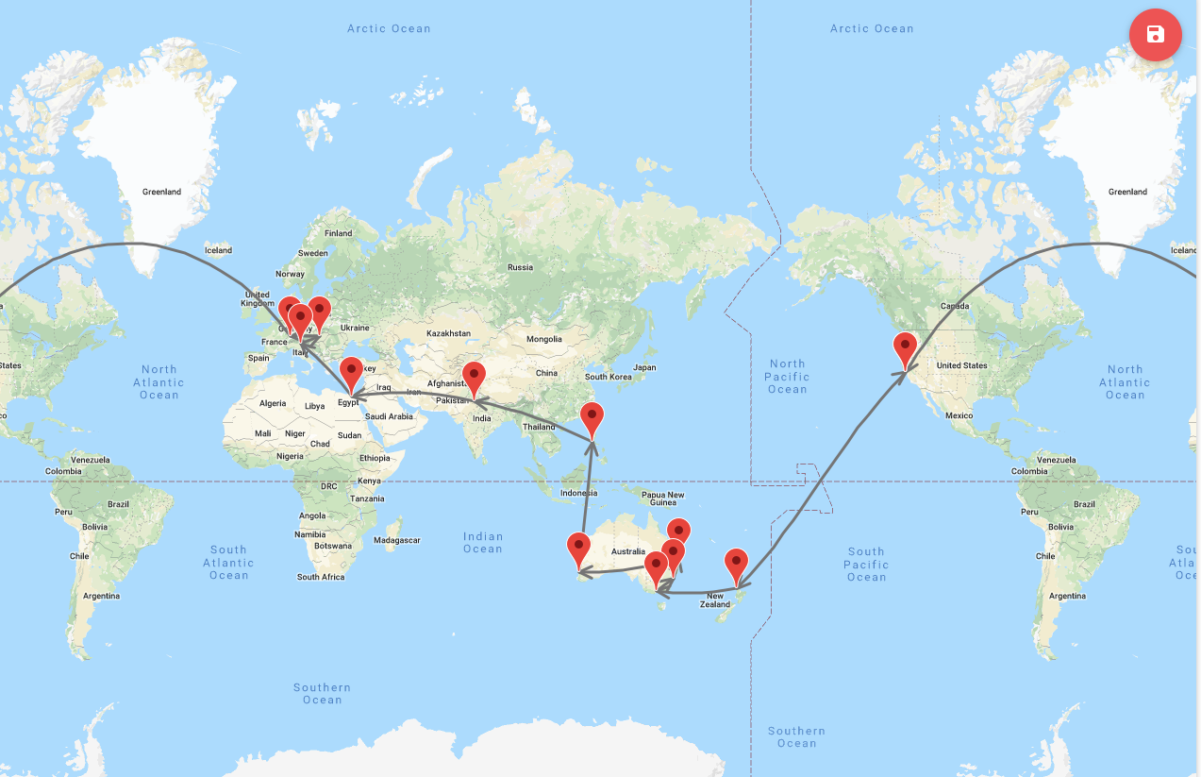
START

Slide 3
MHFT Global Strategy Luncheons 2019 World Tour Buy tickets at www.madhedgefundtrader.com
Friday June 21 12:30 PM Auckland, New Zealand Monday June 24 12:30 PM Melbourne, Australia Tuesday June 25 12:30 PM Sydney, Australia Wednesday June 26 12:30 PM Brisbane, Australia Friday June 28 12:30 PM Perth, Australia Sunday June 30 12:30 PM Manila, Philippines Tuesday July 2 12:30 PM New Delhi, India Friday July 5 12:30 PM Cairo, Egypt Monday July 8 12:30 PM Venice, Italy Wednesday July 10 12:30 PM Budapest, Hungary Friday, July 19, 3:00 PM Zermatt, Switzerland

Slide 4
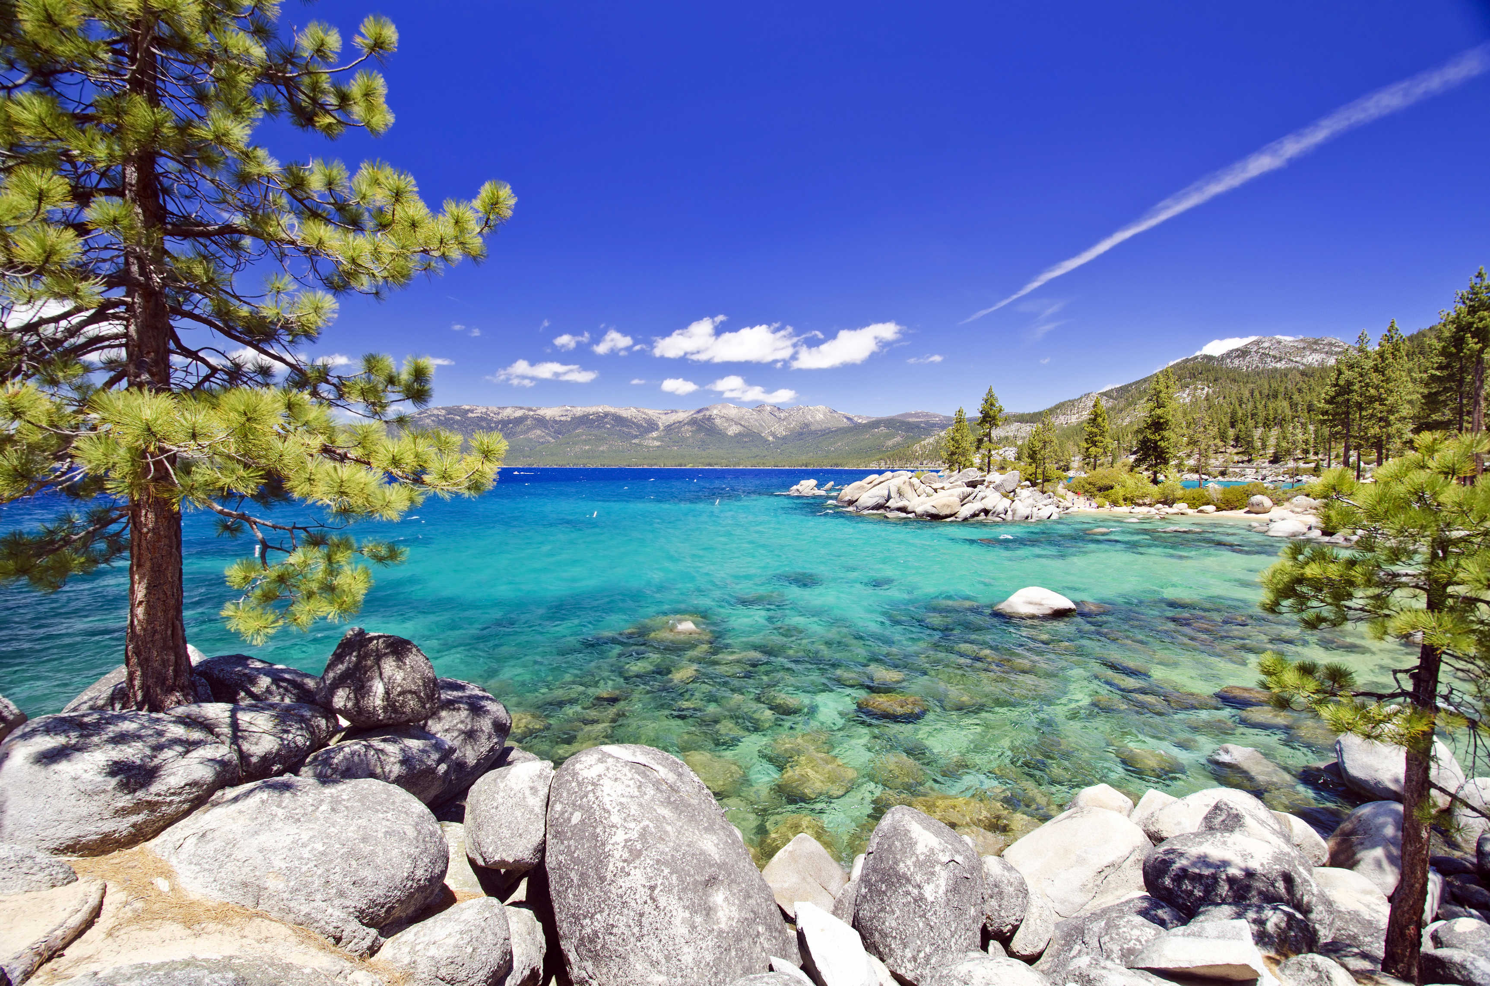
October 25-26 Lake Tahoe Conference 50% of seats already sold out
*Two days of informative speakers on crucial trading and investment issues *Trade tips with the most successful Mad Hedge traders *2 nights in the Hyatt, including all you can eat and drink *Tickets are a bargain at $699 to $1,999 *Buy now, upper ticket classes sell out first

Slide 5
Trade Alert Performance New Highs!
*January 9.49% Final *July +0.0% Final *February +4.64% Final *August +2.19% MTD *March +1.78% Final *September 1.38% Final *April +0.30% Final *October +1.37% Final *May +0.25% Final *November -1.83% Final *June -0.50% MTD *December -4.13% Final *2019 Year to Date +15.22% compared to +11.2% for the Dow Average *Trailing One year return +20.71%, +315.36% since inception, *Average annualized return of 33.18% for 9 1/2 years

Slide 6
Portfolio Review Keeping Small Positions Only Buying Very Deep in-the-Money on Capitulation Days
Risk On
World is Getting Better
(TSLA) 6/$140-$150 call spread | 10.00%
Risk Off
(TSLA) 6/$240-$250 put spread | -10.00%
Total Net Position | 0.00%
Expiration P&L 15.70%

Slide 7
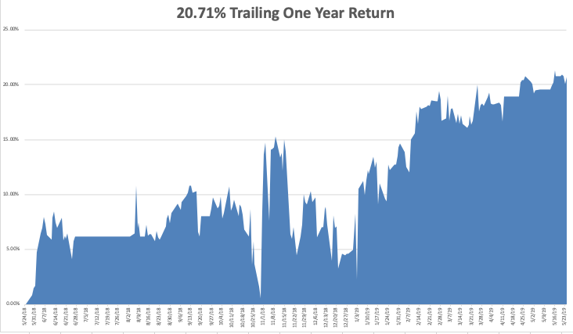
GTD Daily Audited Performance New All Time High

Slide 8
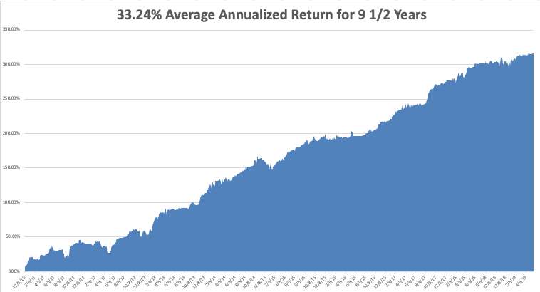
GTD 9 Year Daily Audited Performance

Slide 9
The Method to My Madness
*It’s all about the trade war now and for the rest of the year *Upside potential is minimal, but downside risks are about 10% *Expect a tape driven market driven by daily bombshells *Bonds now discounting an imminent recession at 2.06% *Expect Fed rate cuts by July, if not, stock market will collapse *Plunging rates have killed the US dollar *Oil suffers instant 20% correction on global recession fears

Slide 10
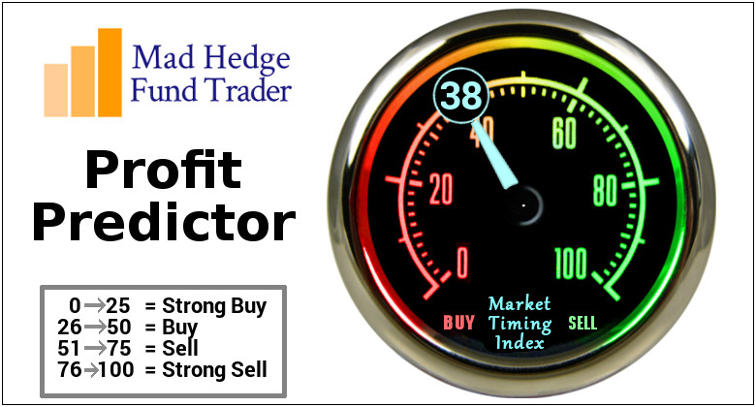
The Mad Hedge Profit Predictor Market Timing Index- An artificial intelligence driven algorithm that analyzes 30 different economic, technical, and momentum driven indicators

Slide 11
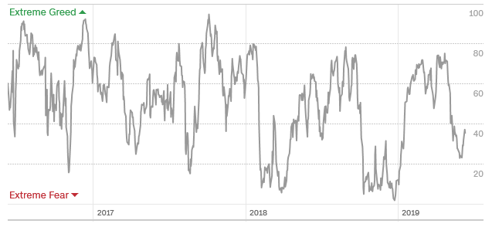
The Mad Hedge Profit Predictor Middle of the Range-No Trade
SELL
BUY

Slide 12
The Global Economy – Global Tailspin
*If Chinese trade war continues to the max a global recession will ensure *Companies are reassessing future earnings with big downgrades to come *Big chunks of small US retailing and manufacturing will go under *Trade war is spilling into Europe, slowing economies further there *Big Chinese yuan devaluation offsetting cost of tariffs, will continue, *The world turning to negative interest rates tells us that worst to come *”No Deal” Brexit acceleration throws the fat on the fire

Slide 13
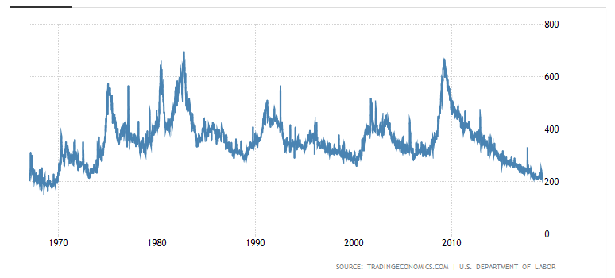
Weekly Jobless Claims Unchanged at 218,000

Slide 14
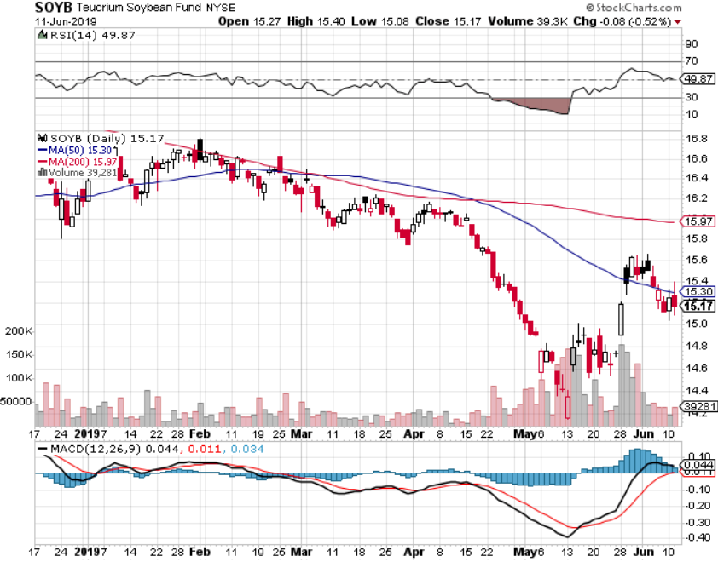
Soybeans (-20%)-Trade War Indicator Can’t Get any worse- Lucky farmers had their insured crops destroyed

Slide 15
The Bill Davis View A $1,500 Upgrade for the Mad Day Trader Service
Buys: | Entry | Target
Palo Alto Networks (PANW) | $ 198.00 | $ 215.00
Dillards Inc. (DDS) | $ 56.00 | $ 72.00
International Business (IBM) | $ 132.00 | $ 145.00
Treehouse Foods (THS) | $ 55.00 | $ 65.00
CommVault Systems Inc.(CVLT) | $ 47.00 | $ 55.00
Sells:
Becton Dickinson Inc.(BDX) | $ 240.00 | $ 220.00
Fed Ex Corp (FDX) | $ 161.00 | $ 145.00
General Dynamics Corp (GD) | $ 175.00 | $ 155.00
Intuitive Surgical, Inc. (ISRG) | $ 520.00 | $ 480.00
Caterpillar, Inc. (CAT) | $ 133.00 | $ 120.00

Slide 16
Stocks – A Pause in the Party
*Trade wars are now weighing heavily on stocks *The longer it lasts the more damage it causes, and the Chinese are in no hurry to help Trump get reelected *July will bring a round of earnings downgrades and disappointments, taking markets to new 2019 lows *Antitrust threats put a cloud over the FANG’s (FB), (AAPL), (NFLX), (GOOGL) *However, the prospect of sharp interest rate cuts is putting a high floor under stock prices *With interest rates approaching zero there is no place else to go except cash *Bottom line: flat to 10% down market for the next 3-6 months, then new highs propelled by ultra low interest rates or a China trade deal *Bottom Line: its bet the ranch time on tech longs, but stay away from those with big China exposure, like Apple, and weak dollar plays like energy, and emerging markets

Slide 17
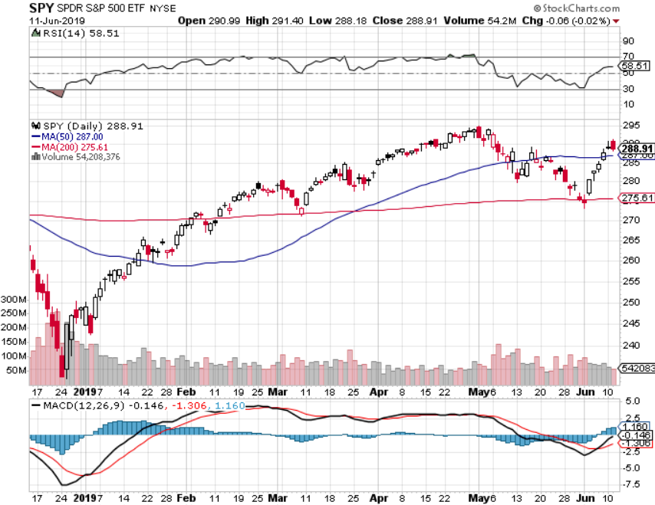
S&P 500- stopped out of long 2/$285-$290 bear put spread took profits on long 2/$270-$275 bear put spread

Slide 18
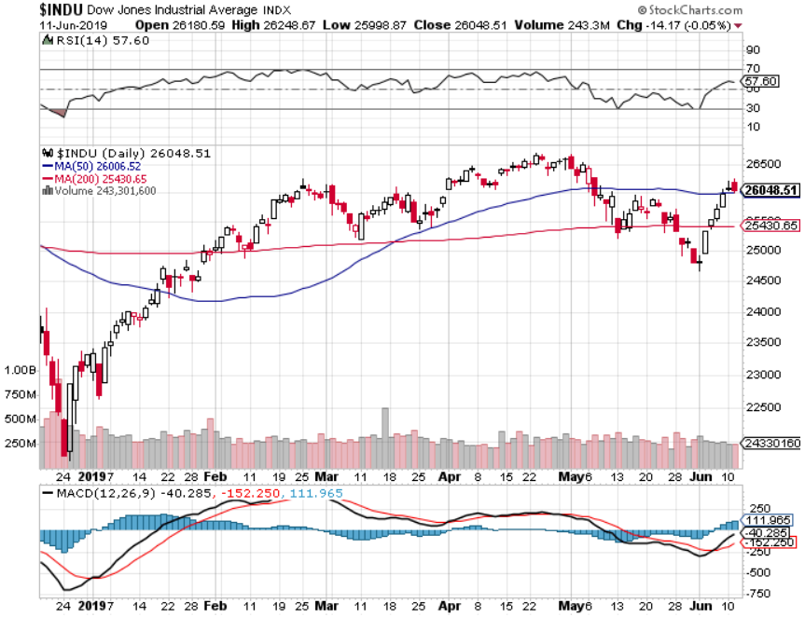
Dow Average-

Slide 19
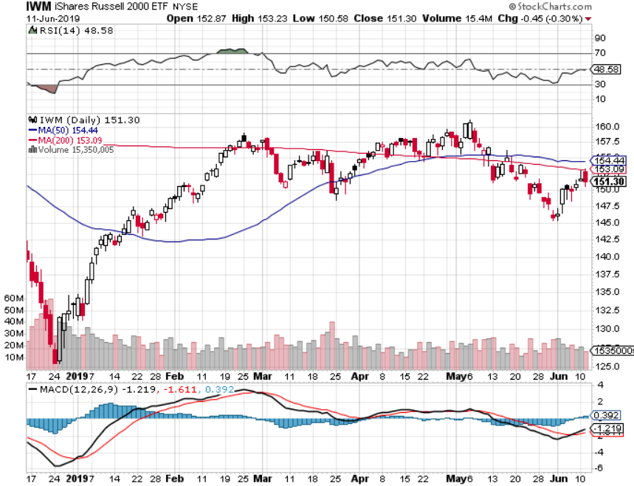
Russell 2000 (IWM)- out for even Long 4/$160-$165 vertical bear put spread

Slide 20
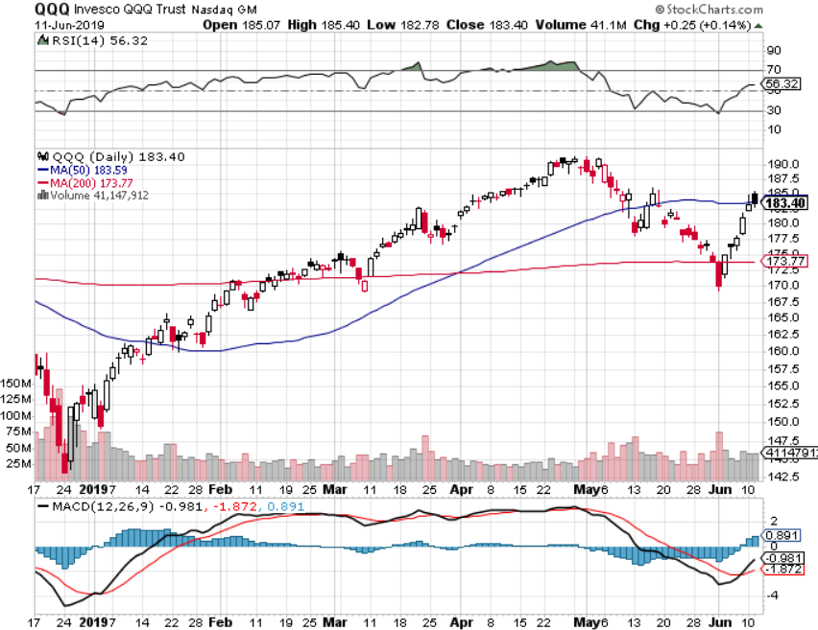
NASDAQ (QQQ)

Slide 21
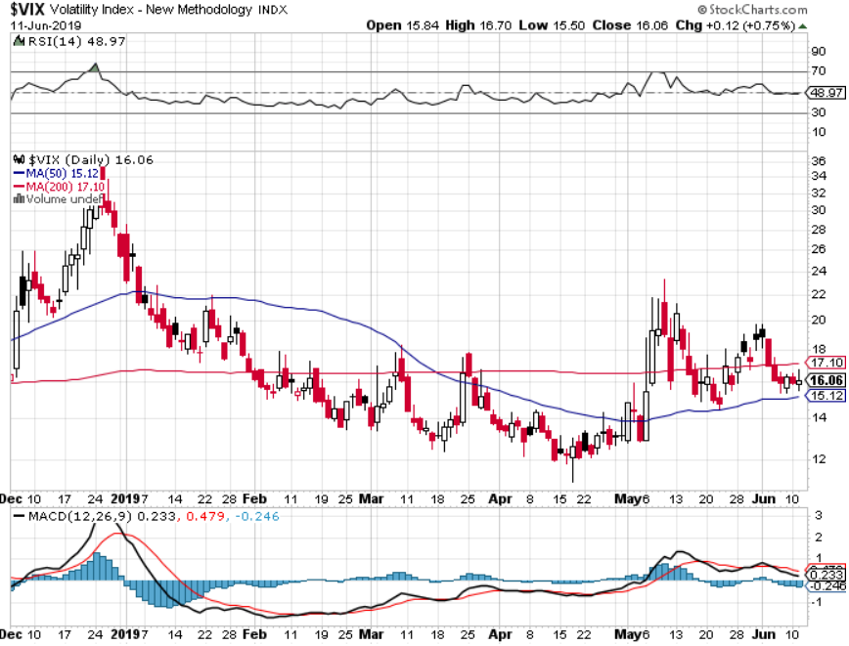
(VIX)- Looking for a Rocky Summer

Slide 22
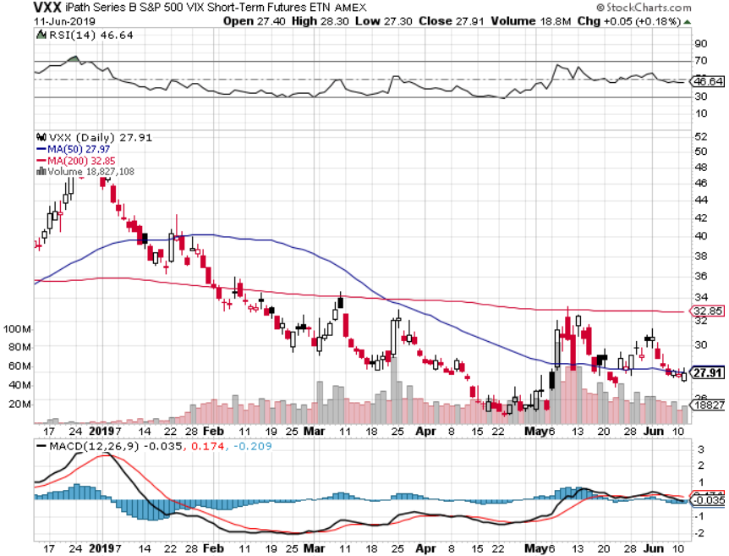
iPath S&P 500 VIX Short-Term Futures ETN (VXX)

Slide 23
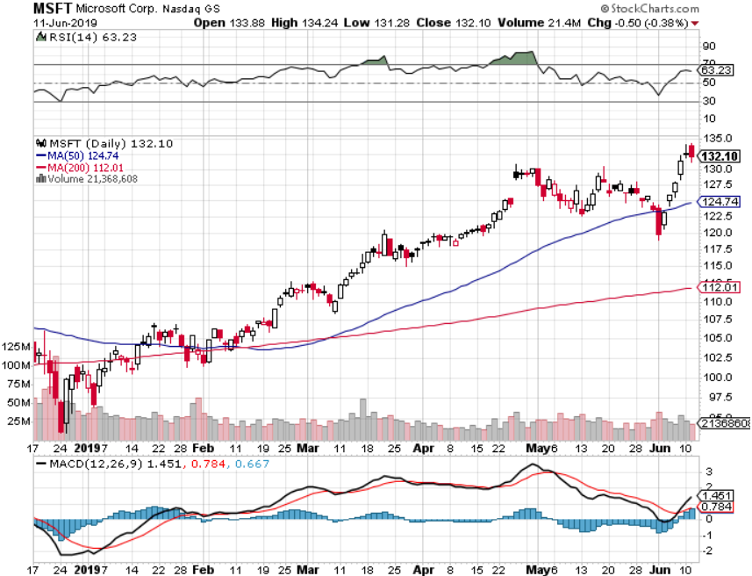
Microsoft (MSFT)- New High long 6/$110-$115 call spread-out at cost on antitrust fears took profits on long 4/$108-$113 call spread took profits on long 2/$85-$90 call spread

Slide 24
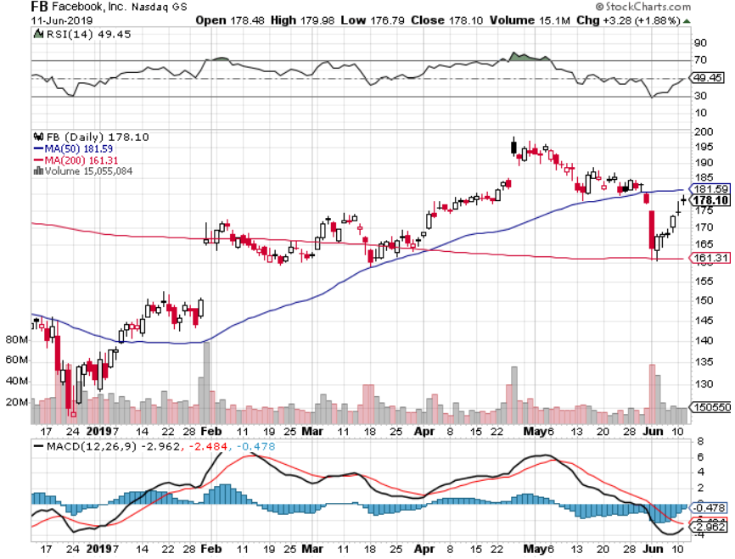
Facebook (FB)- FANG bounce

Slide 25
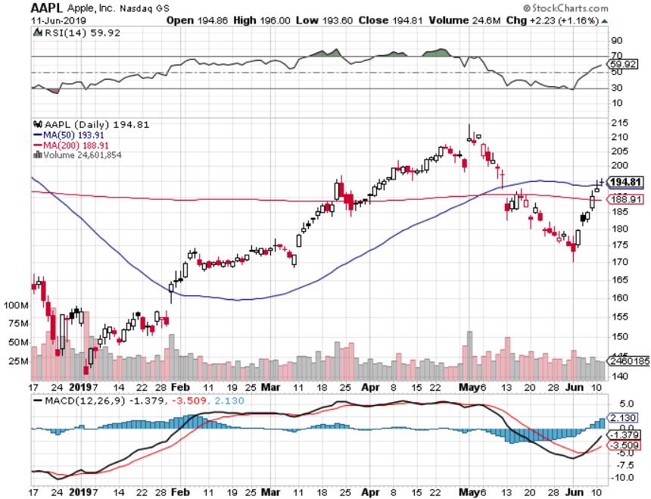
Apple (AAPL)- China Target stopped out of long 3/$180-$185 bear put spread stopped out of long 11/$175-$180 bear put spread took profits on long 11/$165-$175 bear put spread

Slide 26
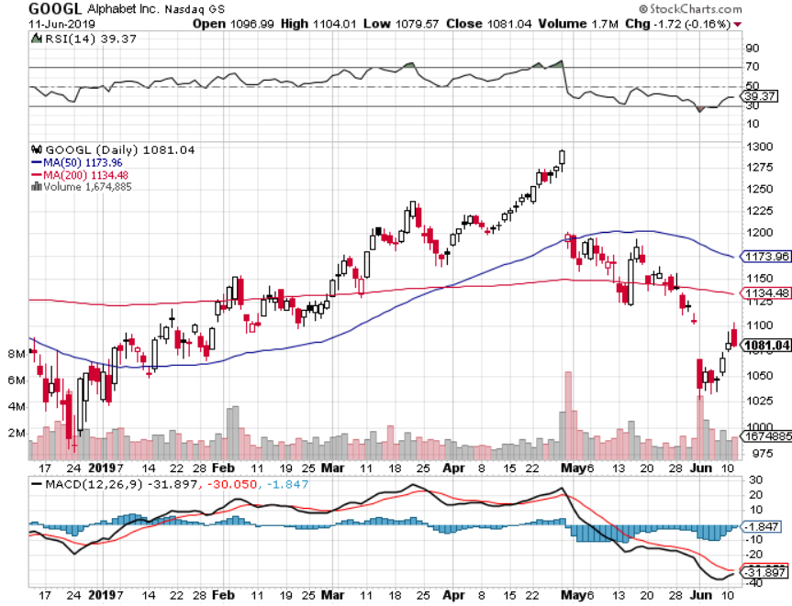
Alphabet (GOOGL)- Antitrust Shock stopped out of long 5/$1,100-$1,130 bull call spread took profits on long 4/$1,080-$1,120 bull call spread

Slide 27
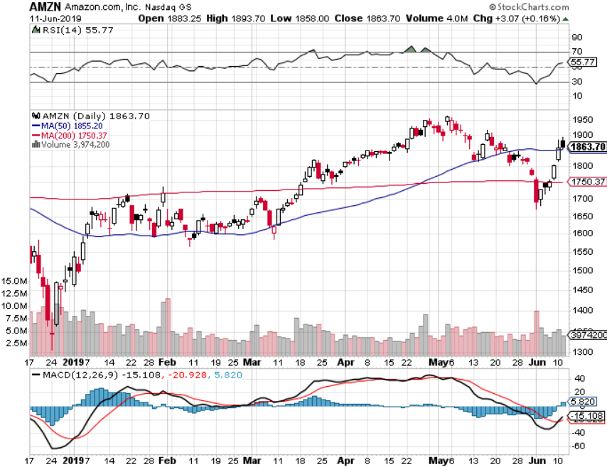
Amazon (AMZN)-Back to Top of Range stopped out of long 4/$1,650-$1,700 call spread took profits on long 4/$1,600-$1,650 call spread took profits on long 2/$1,200-$1,300 call spread

Slide 28
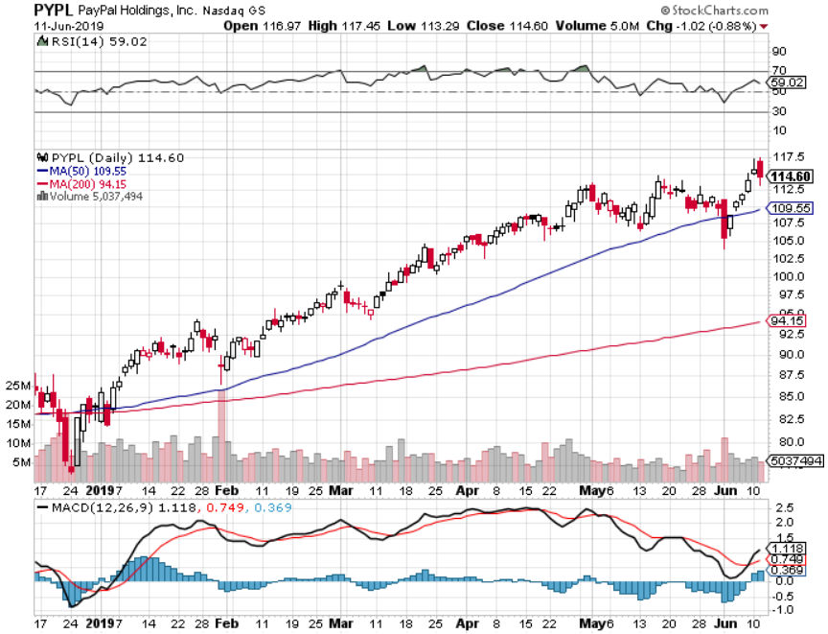
PayPal (PYPL)-Fintech Star took profits on long 4/$90-$95 call spread

Slide 29
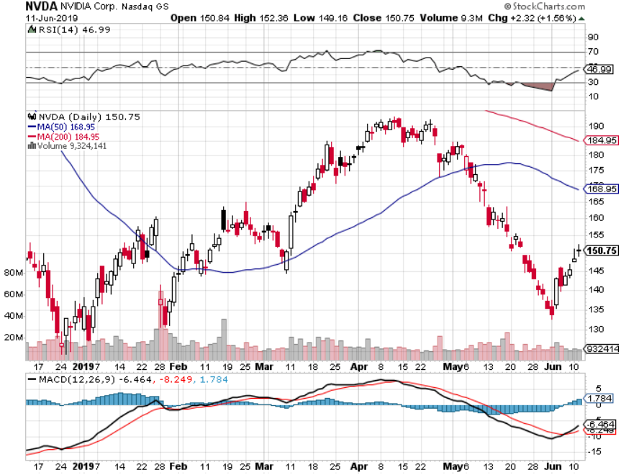
NVIDIA (NVDA)- earnings beat

Slide 30
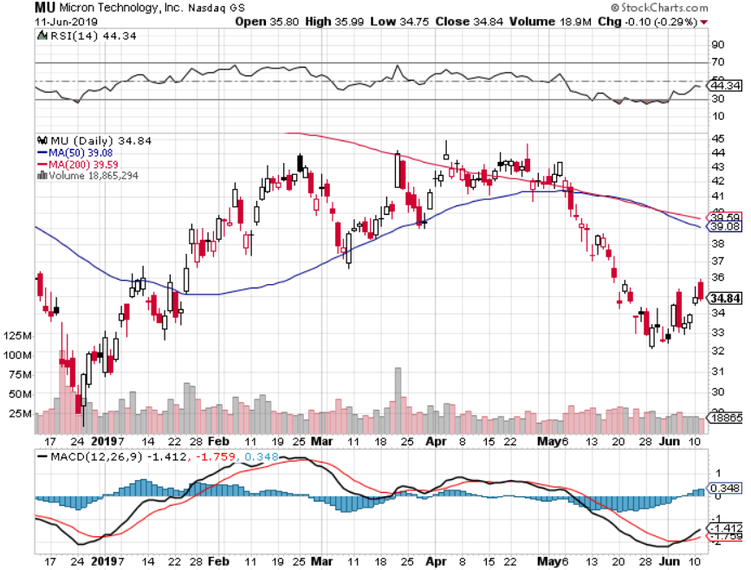
Micron Technology (MU)-

Slide 31
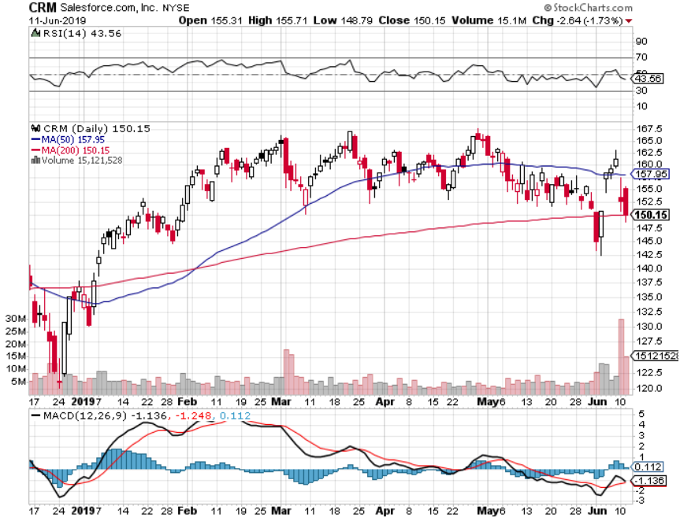
Salesforce (CRM)-Takeover hit took profits on long 2/$105-$115 call spread

Slide 32
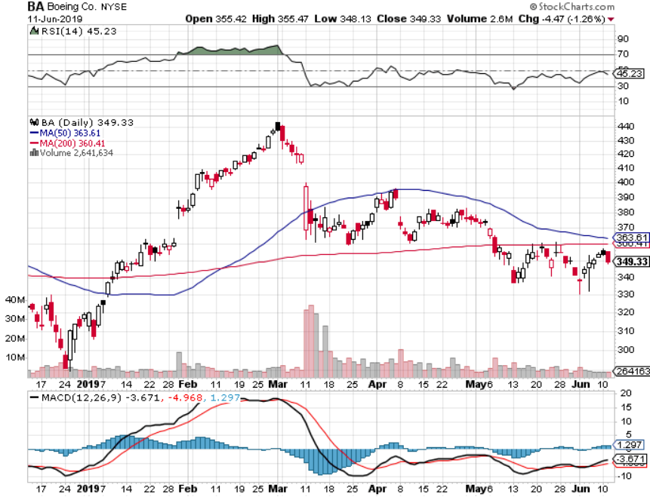
Boeing (BA)- took profits on long 4/$315-$335 call spread Next to happen in the recertification bounce

Slide 33
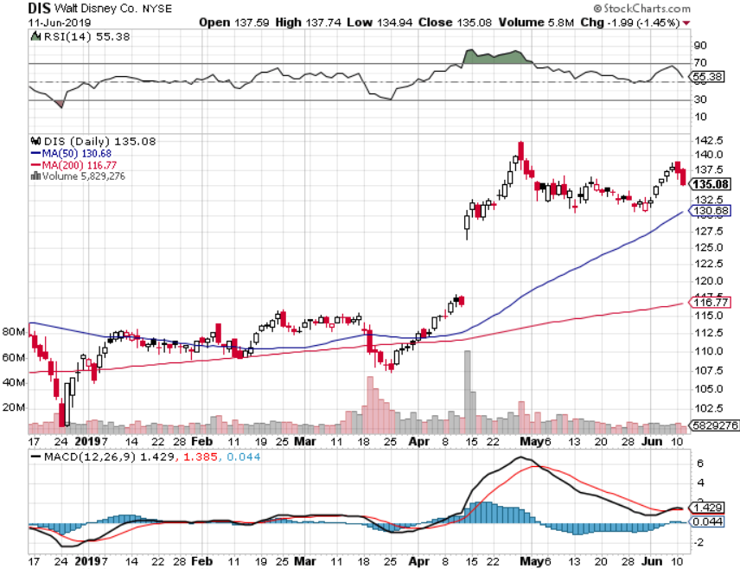
Walt Disney (DIS)- Summer Blockbuster Wave Stopped out of $125-$130 call spread for small loss took profits on long 4/$100-$104 call spread Covered Short 4/$114 calls

Slide 34
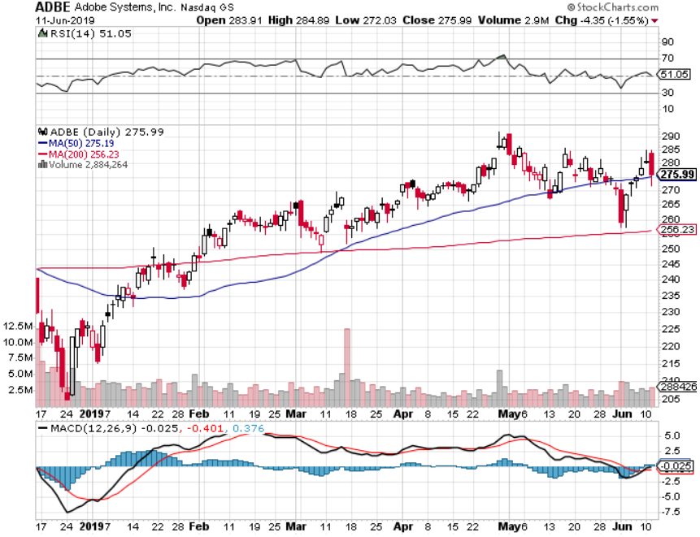
Adobe (ADBE)- The Quality Non-China tech play

Slide 35
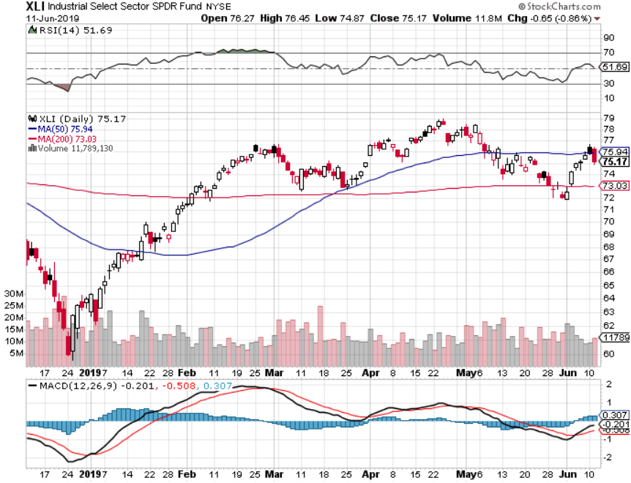
Industrials Sector SPDR (XLI)- (GE), (MMM), (UNP), (UTX), (BA), (HON)

Slide 36
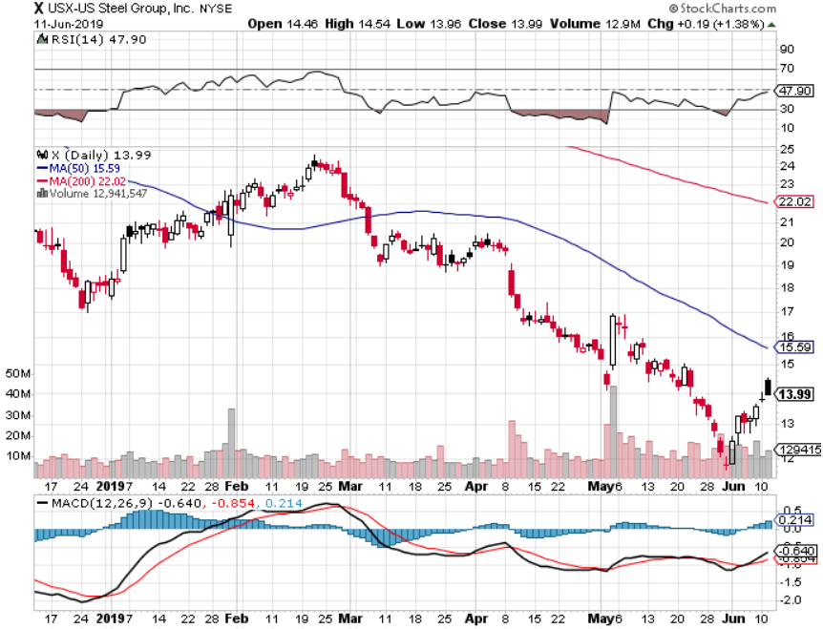
US Steel (X)-Tariffs Trouble Import duties cause users to abandon steel Unwound the entire Trump trade

Slide 37
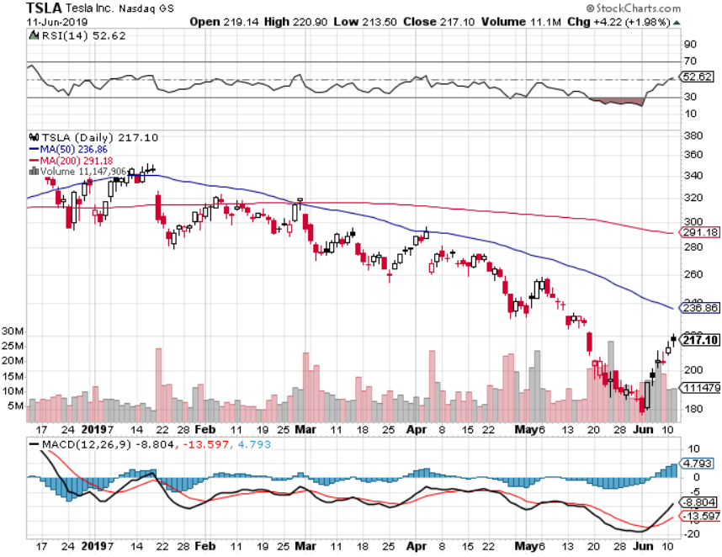
Tesla (TSLA)- looking for big Q2 improvement announced in July long 6/$140-$150 call spread – expires in 7 trading days long 6/$240-$250 put spread – expires in 7 trading days stopped out of long 4/$300-$320 put spread
Major Resistance
Major Support

Slide 38
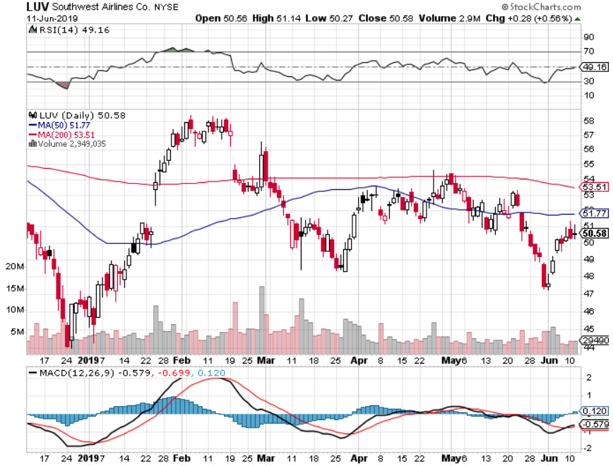
Southwest Airlines (LUV)- Boeing 737 Max biggest buyer

Slide 39
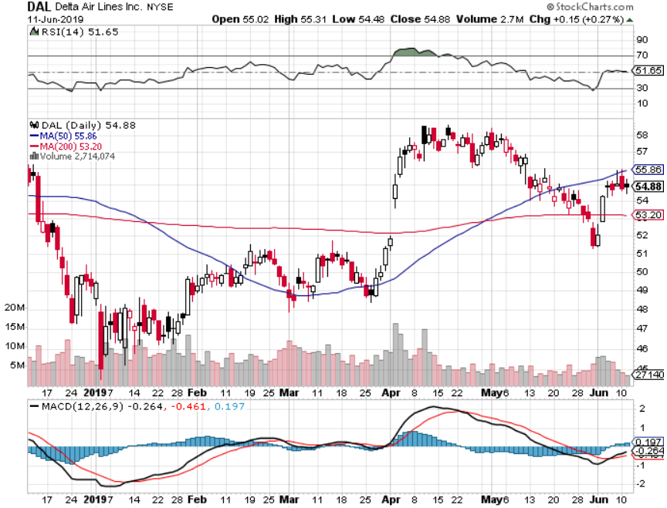
Delta Airlines (DAL)

Slide 40
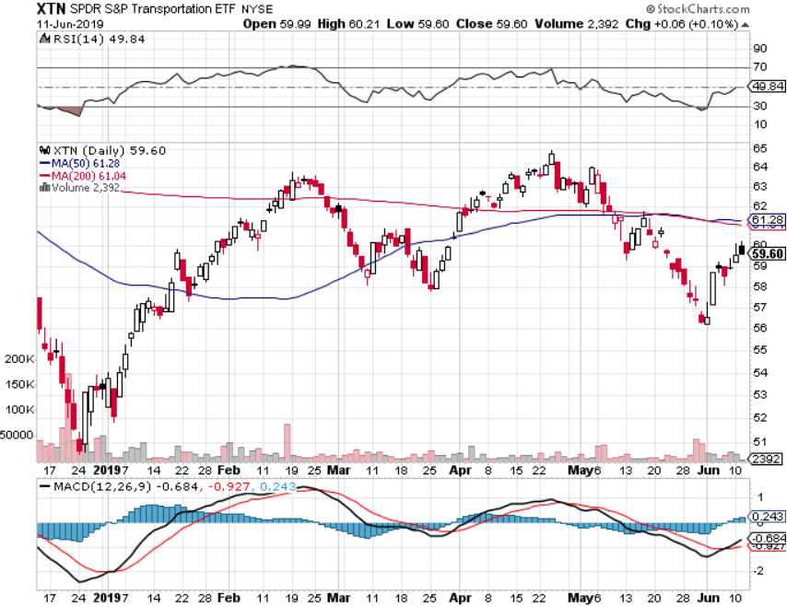
Transports Sector SPDR (XTN)- (ALGT), (ALK), (JBLU), (LUV), (CHRW), (DAL)

Slide 41
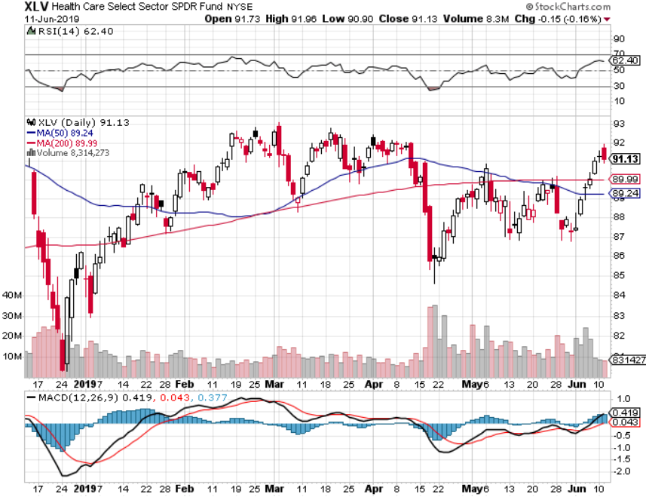
Health Care Sector (XLV), (RXL)-New Highs (JNJ), (PFE), (MRK), (GILD), (ACT), (AMGN)

Slide 42
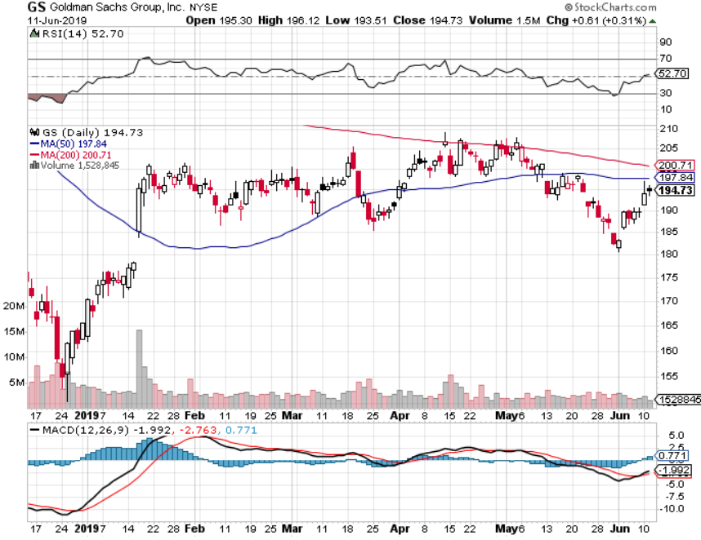
Goldman Sachs (GS)-falling trading volume

Slide 43
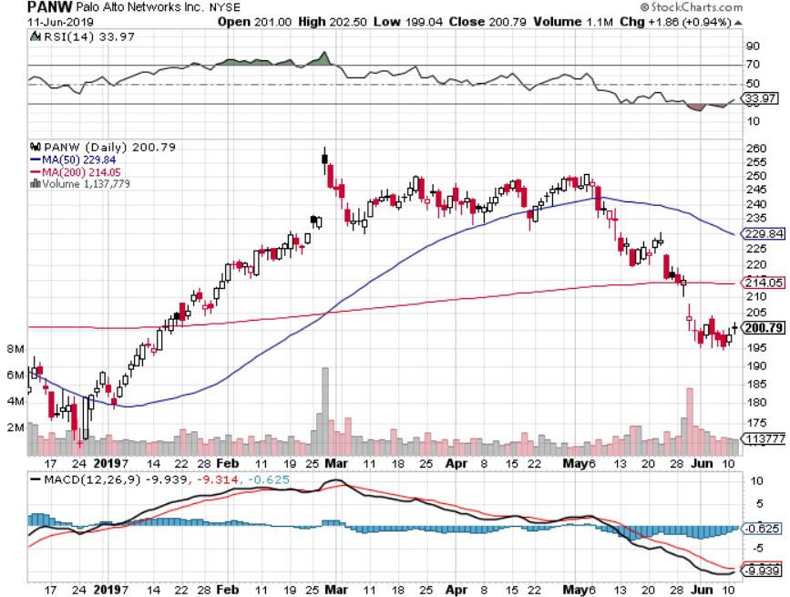
Palo Alto Networks (PANW)- Hacking never goes out of fashion

Slide 44
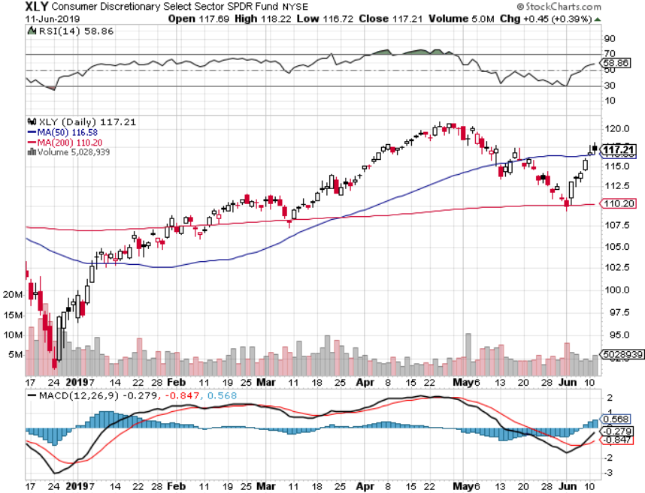
Consumer Discretionary SPDR (XLY) (DIS), (AMZN), (HD), (CMCSA), (MCD), (SBUX)

Slide 45
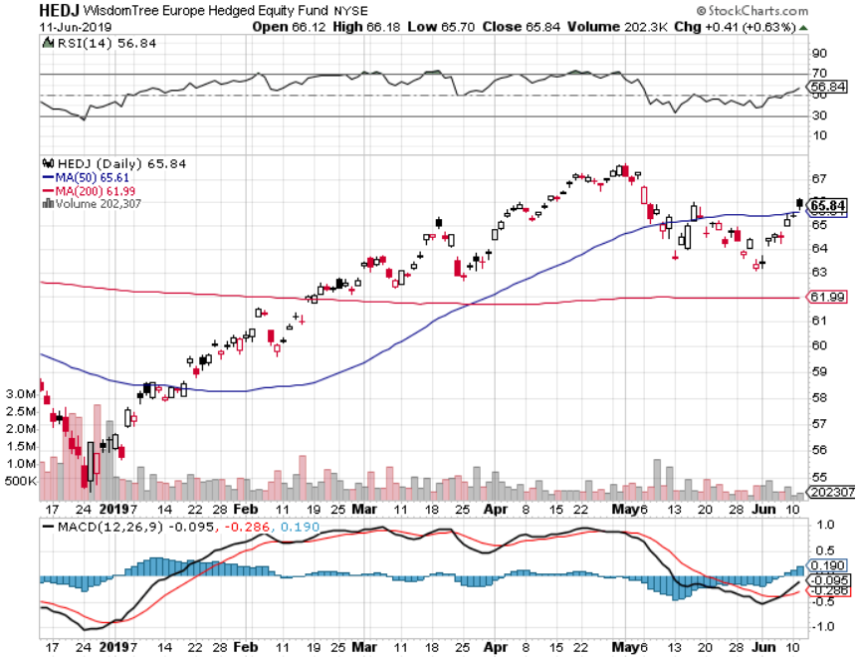
Europe Hedged Equity (HEDJ)-

Slide 46
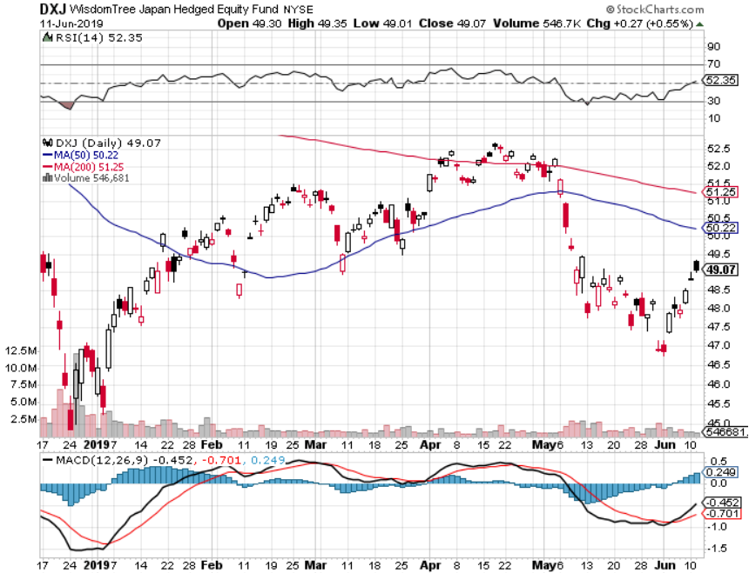
Japan (DXJ)-

Slide 47
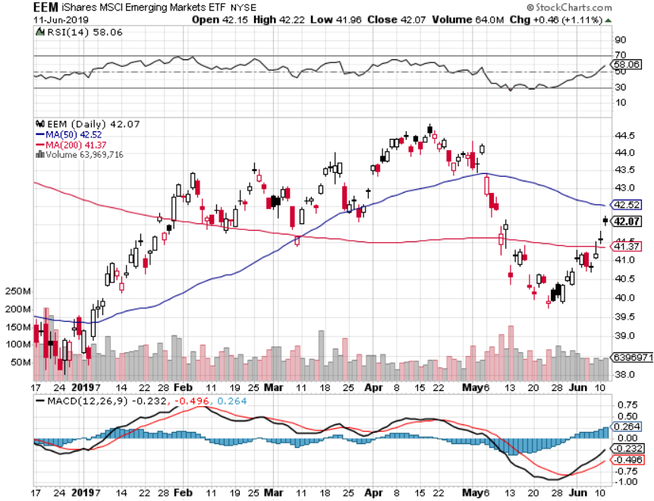
Emerging Markets (EEM)- Time to Buy on Weak Dollar

Slide 48
Bonds – The Recession is Here
*Or at least so says the bond market with the US at a 2.06% ten year yield, headed to 1.33% and then zero *Collapsing global economies sending a huge flight to safety bid to bonds *Yields have fallen nearly 1.19% since September, from 3.25% *The huge move has taken place despite a Chinese boycott of the market, historically 50% of the new issue market *German bund yields plunge to -0.21%, while Japan government bonds turn in a -0.11% yield *Global free money puts a high floor under all asset classes, but won’t spur them to new highs either

Slide 49
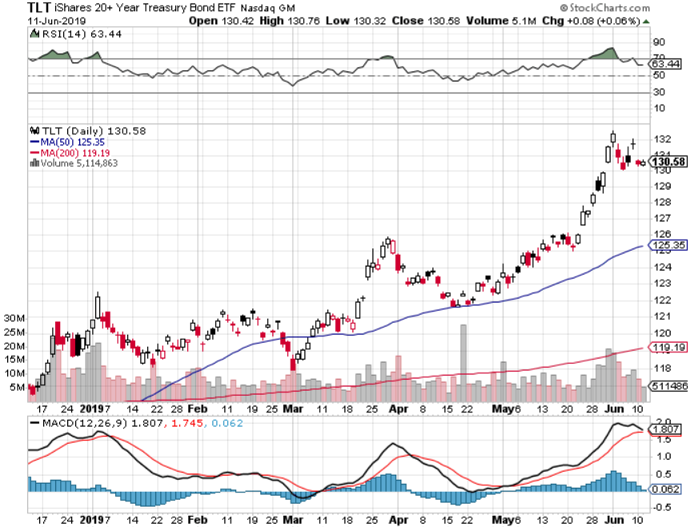
Treasury ETF (TLT) – Waiting for new range after major upside breakout took profits on long 6/$128-131 bear put spread took profits on long 5/$116-$119 bull call spread

Slide 50
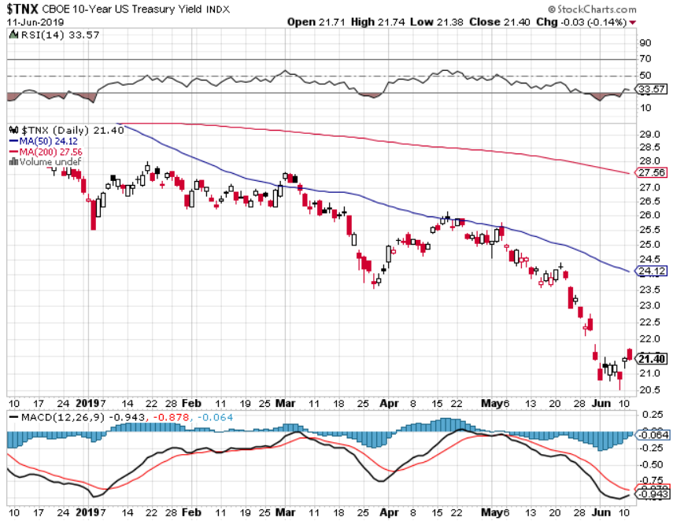
Ten Year Treasury Yield ($TNX) 2.13% Breakdown

Slide 51
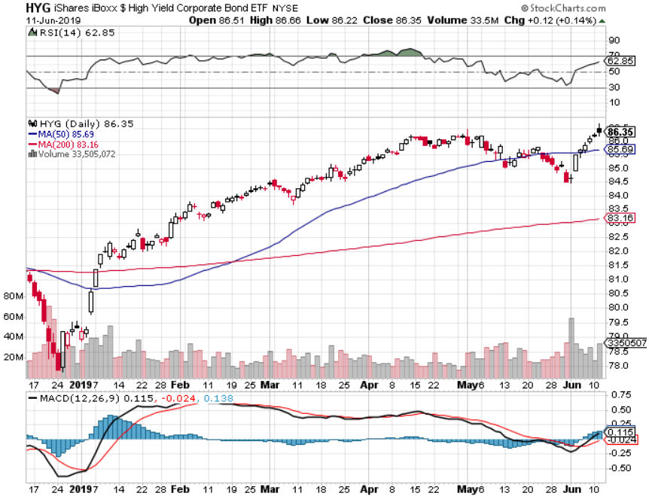
Junk Bonds (HYG) 5.68% Yield big jump in yields on stock selloff and recession fears

Slide 52
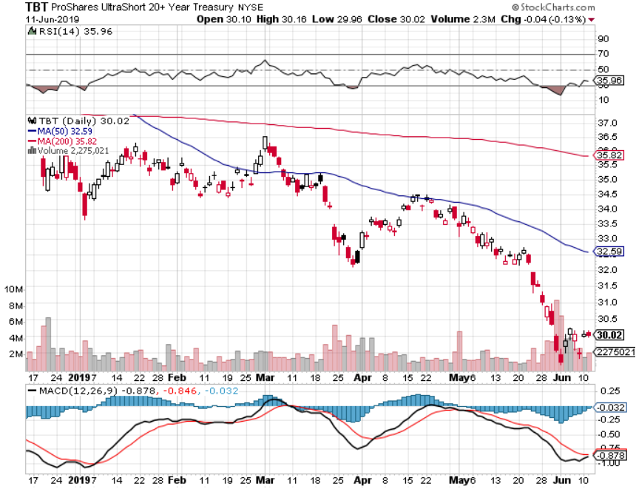
2X Short Treasuries (TBT)-Buy Territory

Slide 53
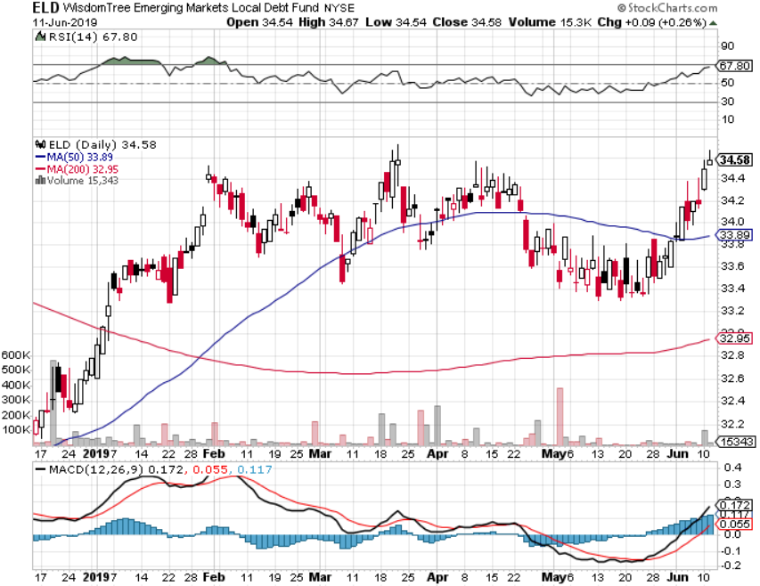
Emerging Market Debt (ELD) 5.66% Yield-

Slide 54
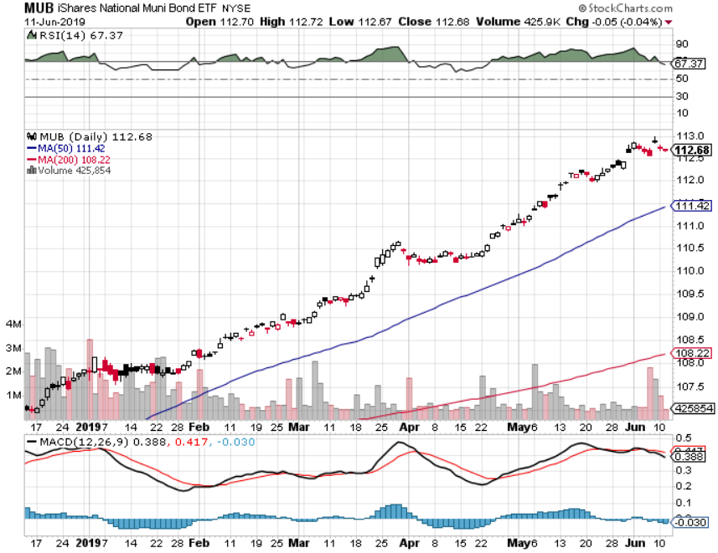
Municipal Bonds (MUB)-1.92% Mix of AAA, AA, and A rated bonds

Slide 55
Foreign Currencies – Dollar Hit
*Sudden decline of US interest rates has cut the knees out from under the US dollar *Japanese yen has taken off *In Britain the worst case scenario has happen with May resignation and “no deal” Brexit *Chinese yuan continues fall on weakening economy, will offset part of US tariffs *Bitcoin rallies big on flight to safety, capital flight from China fleeing weak Yuan replacing gold *Bottom Line: sell the US dollar against everything

Slide 56
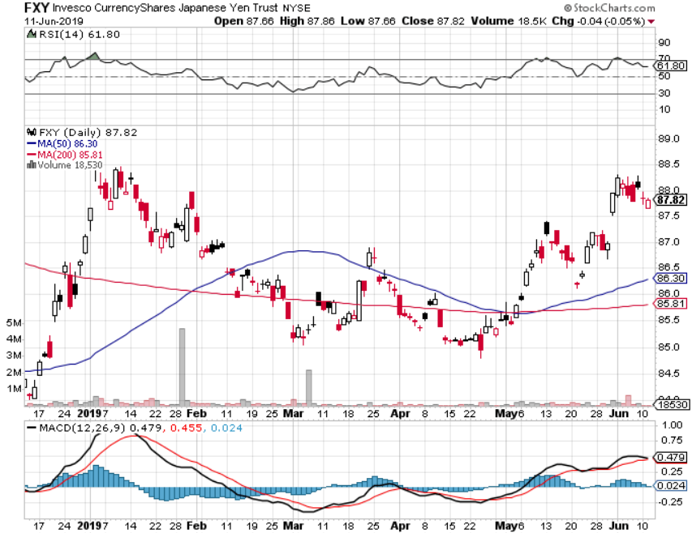
Japanese Yen (FXY), (YCS)

Slide 57
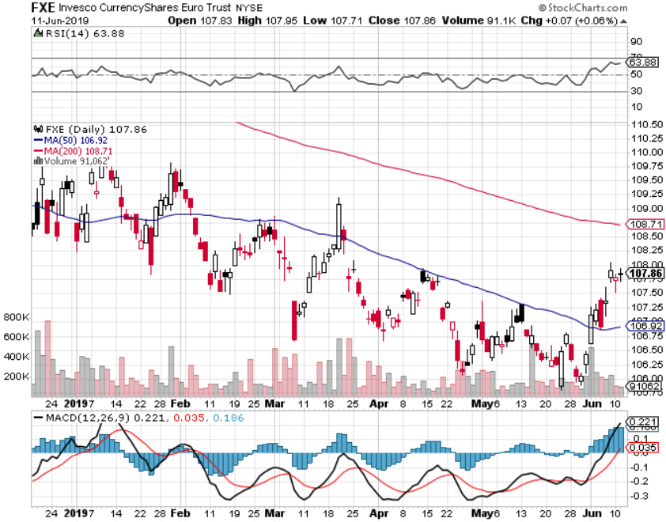
Euro ($XEU), (FXE), (EUO)- Trying to Break Down

Slide 58
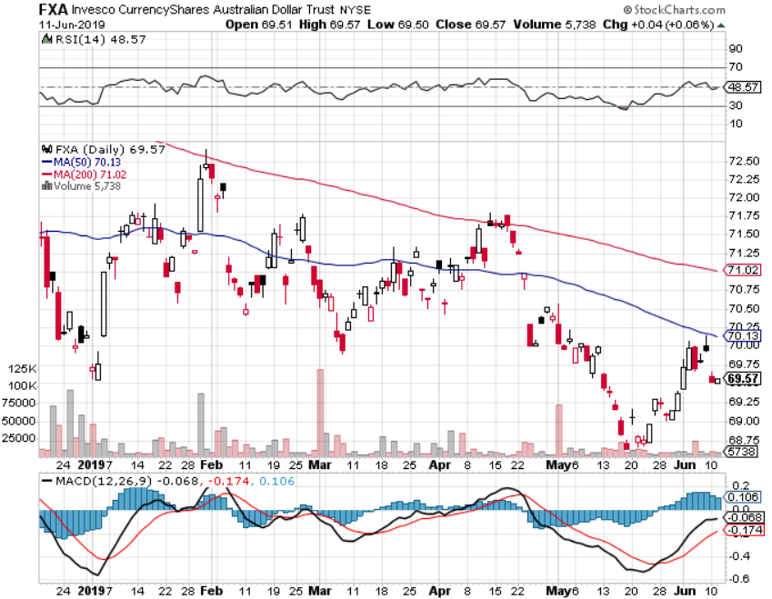
Australian Dollar (FXA)-

Slide 59
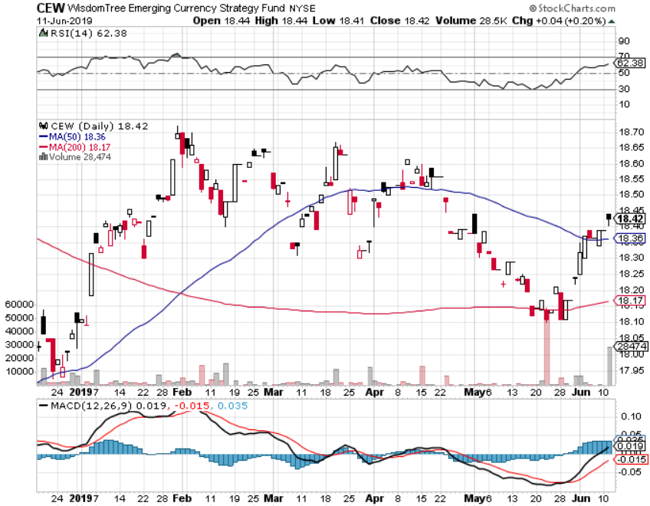
Emerging Market Currencies (CEW)

Slide 60
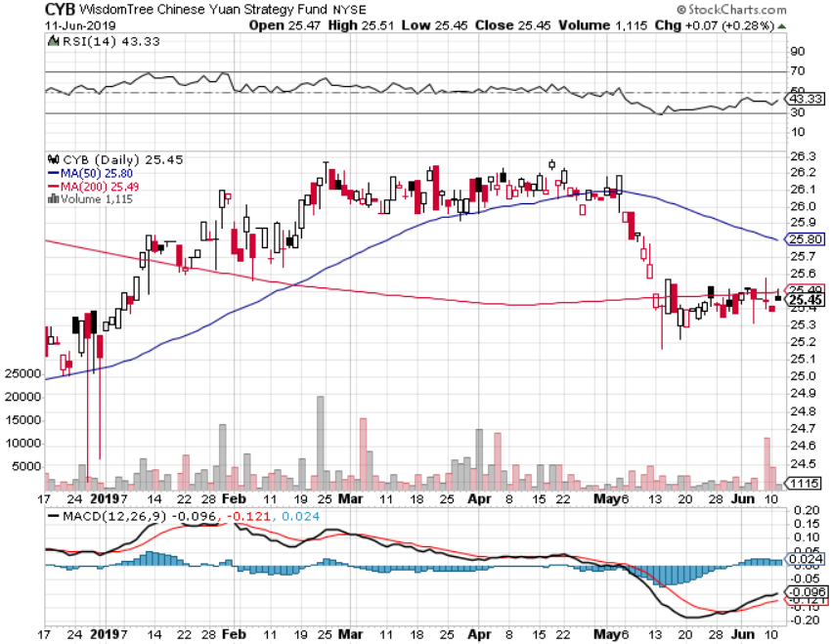
Chinese Yuan- (CYB)-

Slide 61
Bitcoin- 45% Rally Global Liquidity Surge

Slide 62
Energy – Global Recession Fears Ramp Up
*Oil plunges 20% on sudden global recession fears prompted by China trade war *US oil production soars to 12.3 million b/d, on the way to 17 million b/d, up from 5 million b/d in 2005. But China, the worlds largest marginal new buyer, has banned all US imports *Libya civil war still crimping supply *So is Venezuela failed state *Bottom Line: looks like $42 a barrel is in the cards Long term: Energy demand collapses and prices fall to $10/barrel as global transportation goes all electric

Slide 63
Oil-($WTIC)

Slide 64
United States Oil Fund (USO)

Slide 65
Energy Select Sector SPDR (XLE)-No Performance! (XOM), (CVX), (SLB), (KMI), (EOG), (COP)

Slide 66
Halliburton (HAL)-

Slide 67
Natural Gas (UNG)-

Slide 68
Precious Metals – The Ultimate Hedge
*Gold will break to new highs as investors look for “RISK OFF” flight to safety hedges *Central banks have become the principal buyers of gold in 2019, some 264 metric tonnes in 2018 , and that is increasing sharply *China and Russia and have been dominating purchases *Distrust of current US economic and monetary police is the incentive *Bitcoin is stealing gold’s thunder, sucking in global speculative activity *Bottom Line: buy every dip in gold and precious metals

Slide 69
Gold (GLD)- Where is the flight to safety bid? Stopped out of 3/$119-$122 vertical bull call spread

Slide 70
Market Vectors Gold Miners ETF- (GDX) – Yikes!

Slide 71
Barrick Gold (GOLD)

Slide 72
Newmont Mining- (NEM)-

Slide 73
Palladium - (PALL)-

Slide 74
Copper (COPX)-Collapse Trade War Disaster

Slide 75
Freeport McMoRan (FCX)-Collapse Trade War Disaster took profits on long 4/$10-$11 call spread took profits on short 4/$114 calls

Slide 76
Real Estate – Still Falling
*Mortgage applications up 12% YOY thanks to collapsing interest rates *30 Year conventional fixed rate mortgage now as low as 3.80%, a two year low *New refi boom underway *Home remodel spending declining in most of the country, killing (HD) and (LOW)
*March S&P 500 Case-Shiller drops to 3.7%, annual gain, the lowest gain in 6 1/2 years *Bottom Line: Stand aside for a trade but buy for long term investment

Slide 77
February Corelogic S&P Case Shiller Home Price Index Las Vegas (8.2%), Phoenix (6.1%), and Tampa (5.3%) showing biggest gains
Tradingeconomics.com

Slide 78
Simon Property Group (SPG)-

Slide 79
US Home Construction Index (ITB) (DHI), (LEN), (PHM), (TOL), (NVR)

Slide 80
Trade Sheet- So What Do We Do About All This?
*Stocks-buy the big 500 point down days *Bonds-stand aside *Commodities-stand aside *Currencies-stand aside *Precious Metals – stand aside *Volatility-buy dips *Real estate-stand aside

Slide 81
Next Strategy Webinar 12:00 EST Wednesday, July 24, from Zermatt, Switzerland by luncheon tickets at www.madhedgefundtrader.com email me at support@madhedgefundtrader.com
Good Luck and Good Trading!
Notes:
*

