Slide 1
The Mad Hedge Fund Trader “Profiting from the Chaos”
With John Thomas from Silicon Valley, CA www.madhedgefundtrader.com
Notes:
*

Slide 2
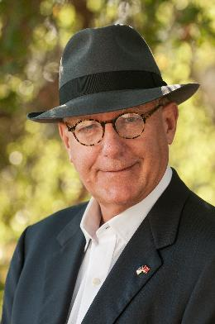
Why Listen to Me?
*50 years of experience in the global financial markets *10 years as The Economist correspondent in Tokyo and later the White House *10 years running the International Equity Division at Morgan Stanley *Marine Corps combat pilot in Desert Storm *10 years running the first international dedicated hedge fund *5 years fracking for natural gas in Texas *12 Years Publishing the Diary of a Mad Hedge Fund Trader *One of the founders of the modern hedge fund industry (2)

Slide 3
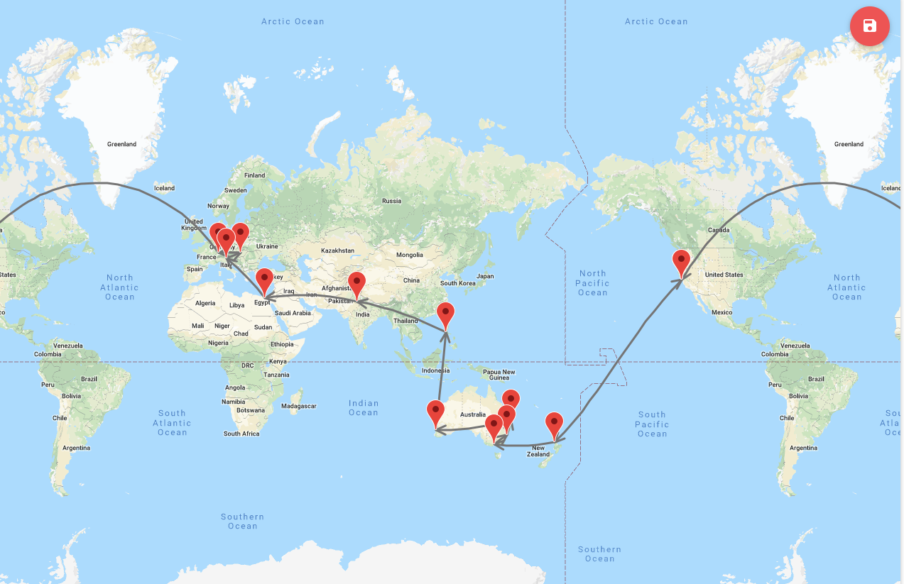
2019 Mad Hedge World Tour
START
You Are Here Now

Slide 4
MHFT Global Strategy Luncheons 2019 World Tour Buy tickets at www.madhedgefundtrader.com
Friday June 21 12:30 PM Auckland, New Zealand Monday June 24 12:30 PM Melbourne, Australia Tuesday June 25 12:30 PM Sydney, Australia Wednesday June 26 12:30 PM Brisbane, Australia Friday June 28 12:30 PM Perth, Australia Sunday June 30 12:30 PM Manila, Philippines Tuesday July 2 12:30 PM New Delhi, India Friday July 5 12:30 PM Cairo, Egypt Monday July 8 12:30 PM Venice, Italy Wednesday July 10 12:30 PM Budapest, Hungary Friday, July 19, 3:00 PM Zermatt, Switzerland

Slide 5
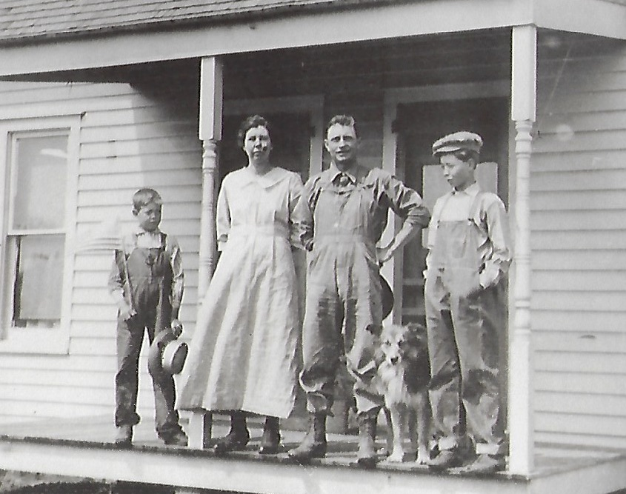
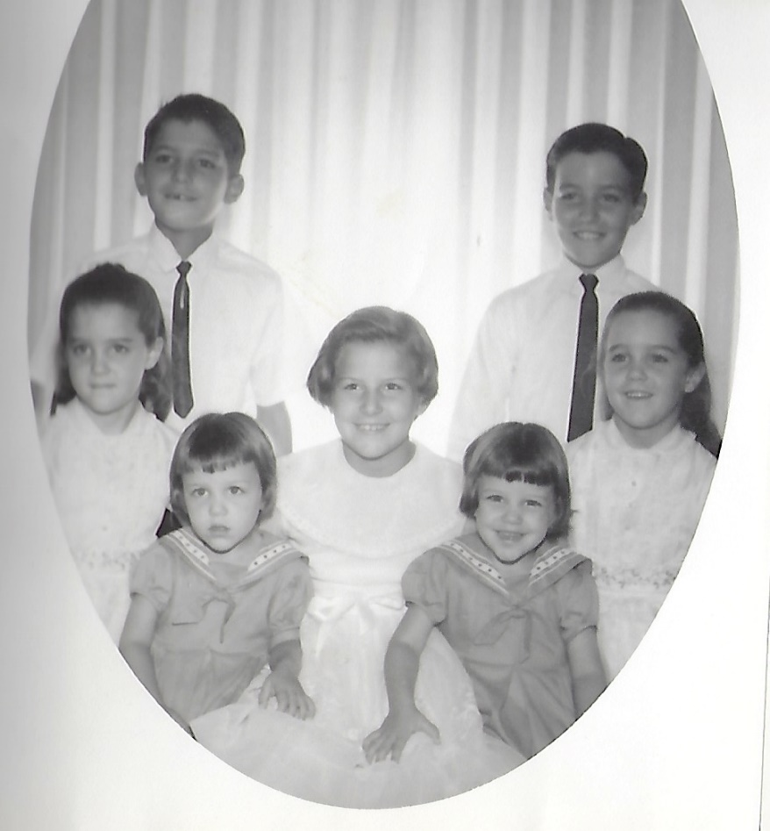
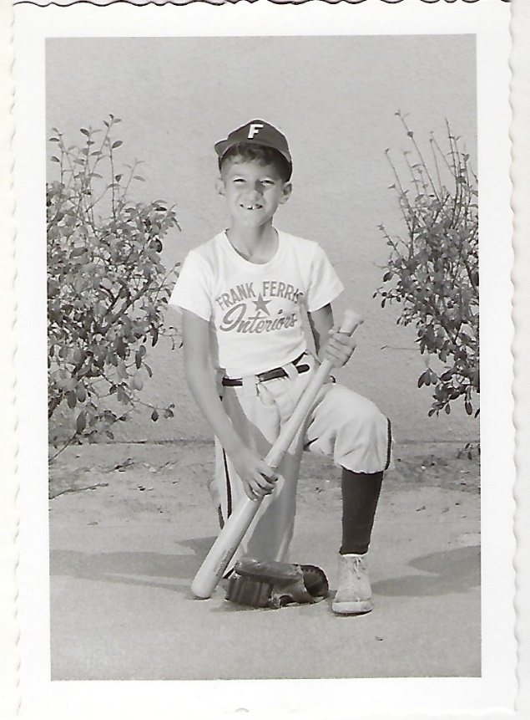
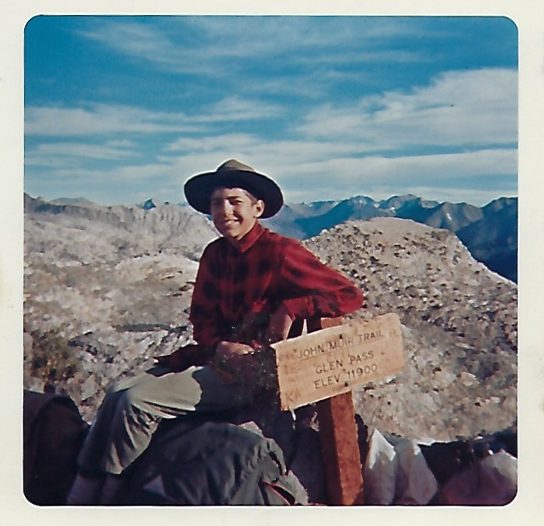
My family origins are very humble, growing up as the oldest of 7 children in southern California. I lived the all American childhood, playing little league baseball and becoming an Eagle Scout

Slide 6
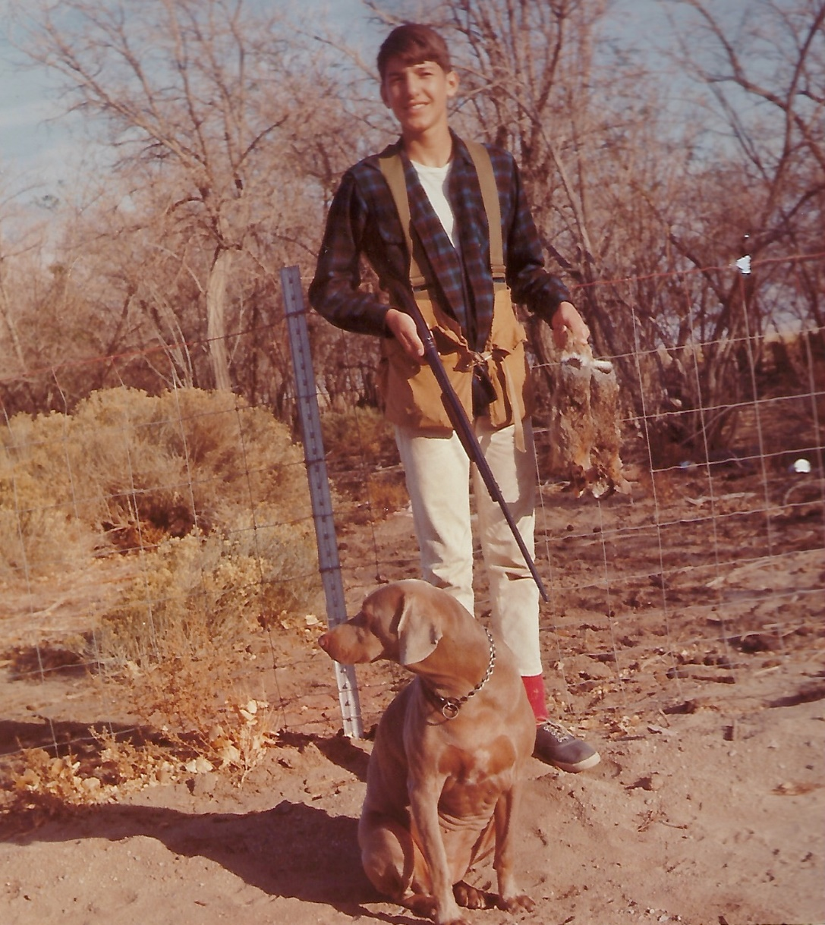
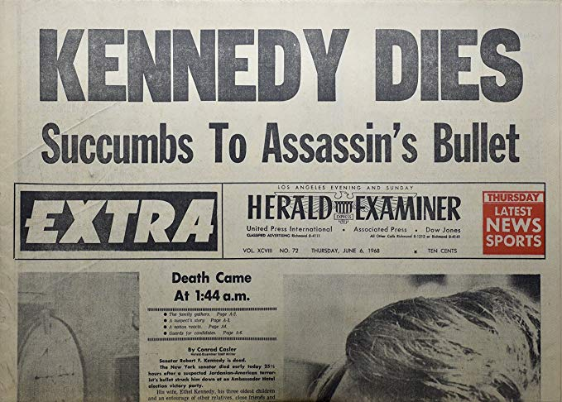
There wasn’t much to do in rural California in those days but hunting. So I picked up a job as a paper boy for the Los Angeles Herald Examiner. Found stock pages, bought IBM at $20 and sold it at $30 and found a far better way to make money than delivering newspapers on a bicycle. By the time I was 16, I earned enough money to fly to Europe. By the age of 17 I had visited more than 50 countries and spoke four languages.

Slide 7
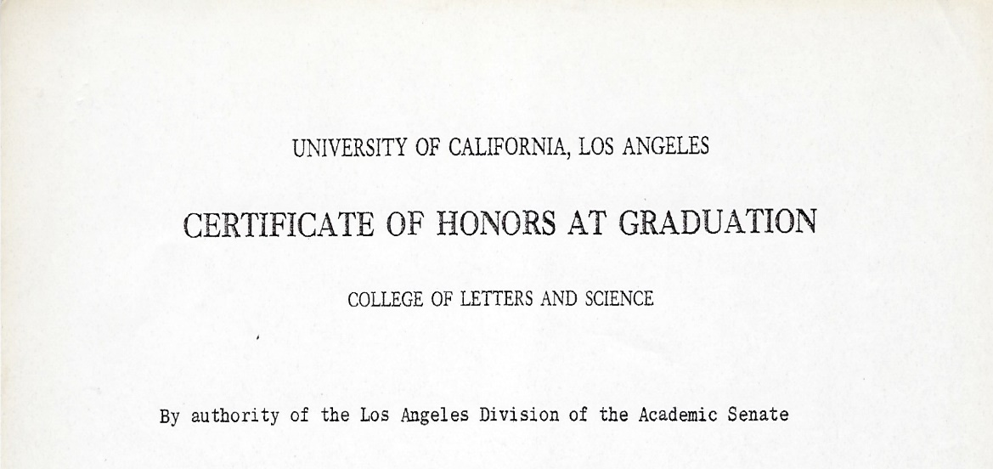
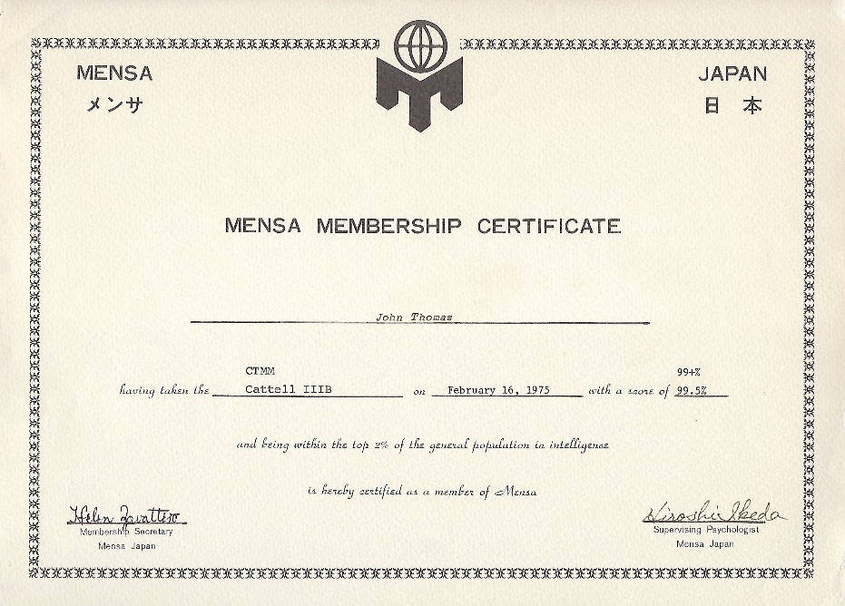
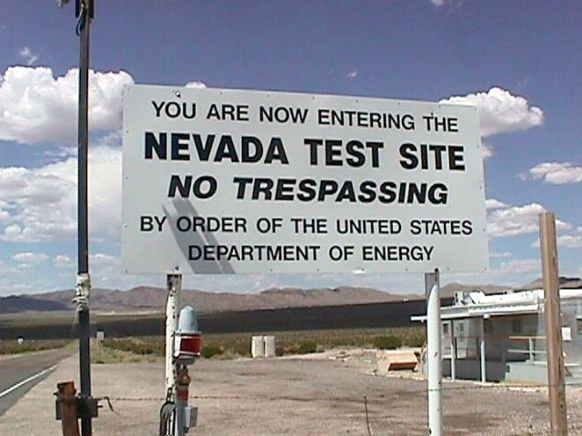
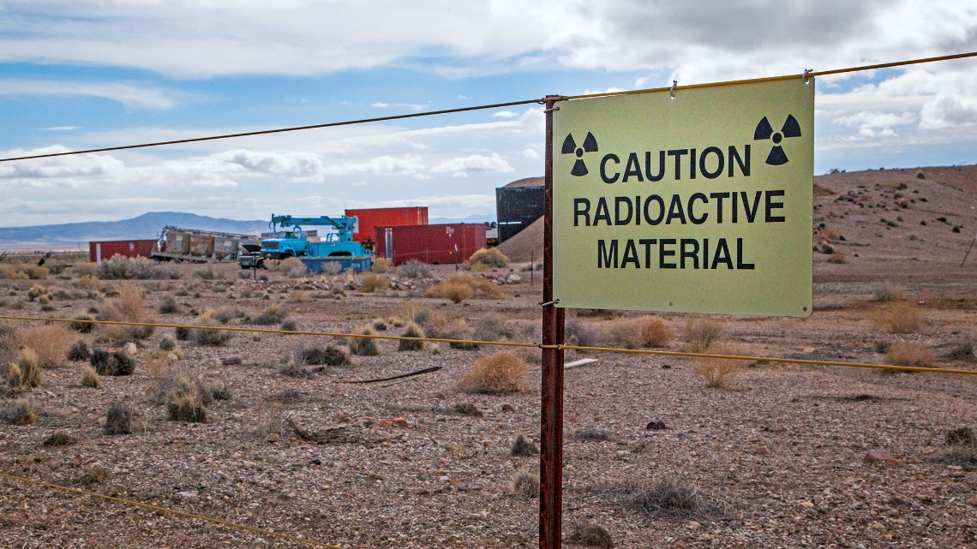
At UCLA I majored in Math and DNA research, which landed me a job at the Nuclear Test Site in Nevada. There, yield didn’t mean interest paid but millions killed. I didn't see a future in that so the government sent me to Southeast Asia for a few years of intelligence missions, where I learned to fly and jump out of perfectly good airplanes

Slide 8
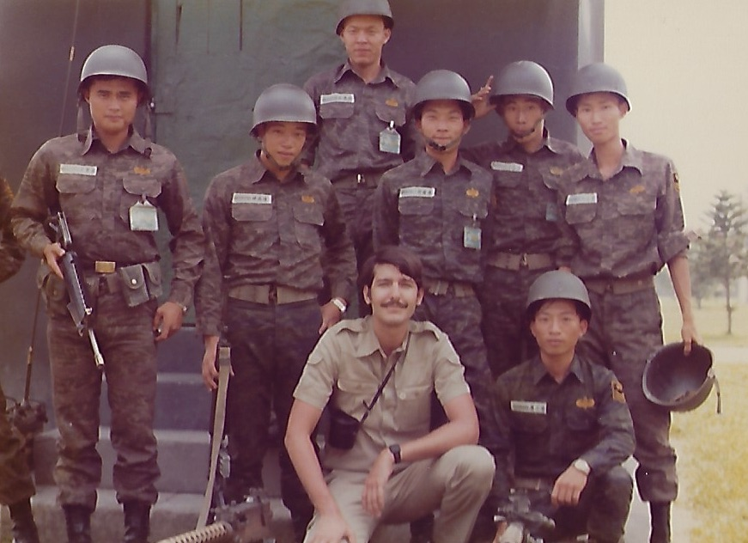
As the war wound down I became a foreign correspondent for the Economist. When they learned I had a math degree they switch me over to covering the Asian economy and the STOCK MARKET!

Slide 9
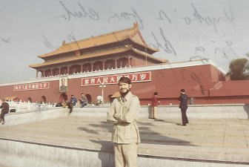
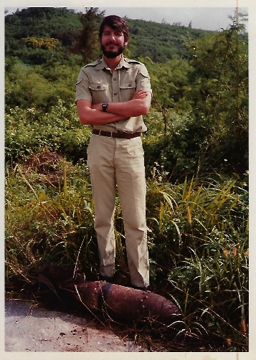
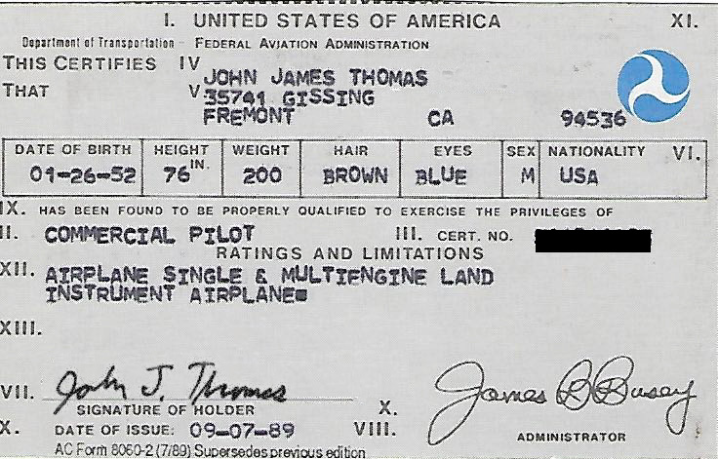
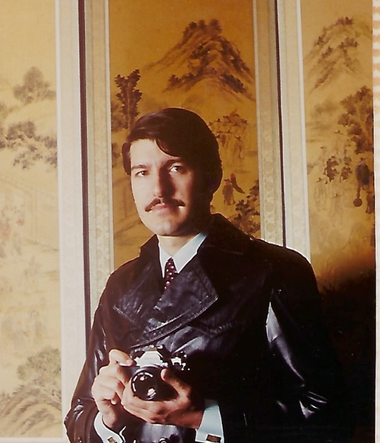
As a foreign correspondent I covered China during the cultural revolution, was the first American reporter to visit North Korea since the Korean war, and covered the rest of the continent all the way to India

Slide 10
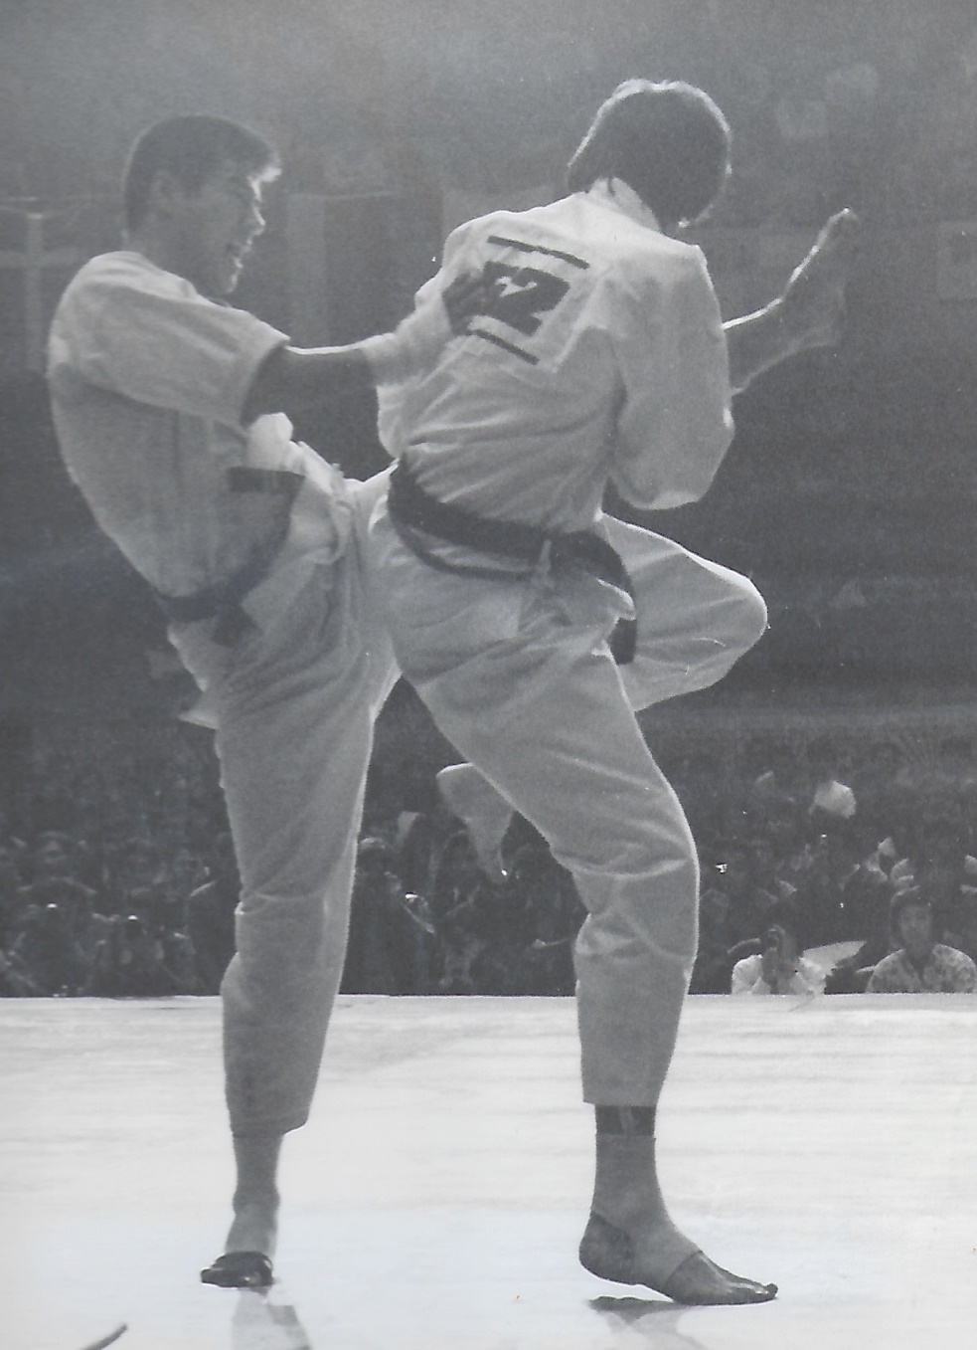
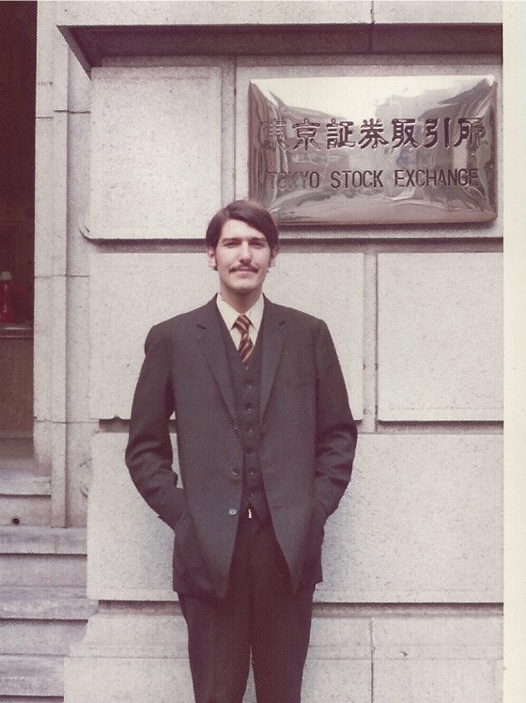
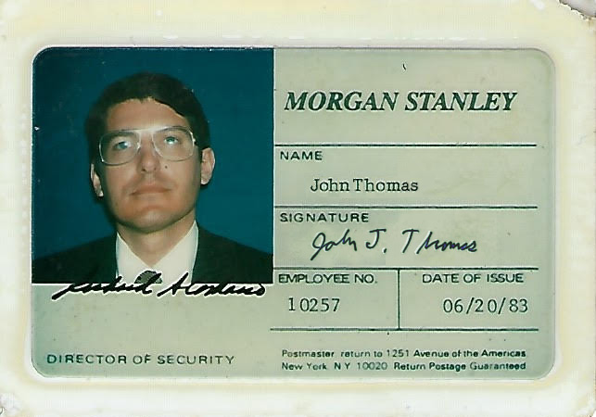
I figured out very quickly that you didn’t have to be that smart to make money in the stock market, so I got into the industry, joining Morgan Stanley. After 10 years there I started my own hedge fund

Slide 11
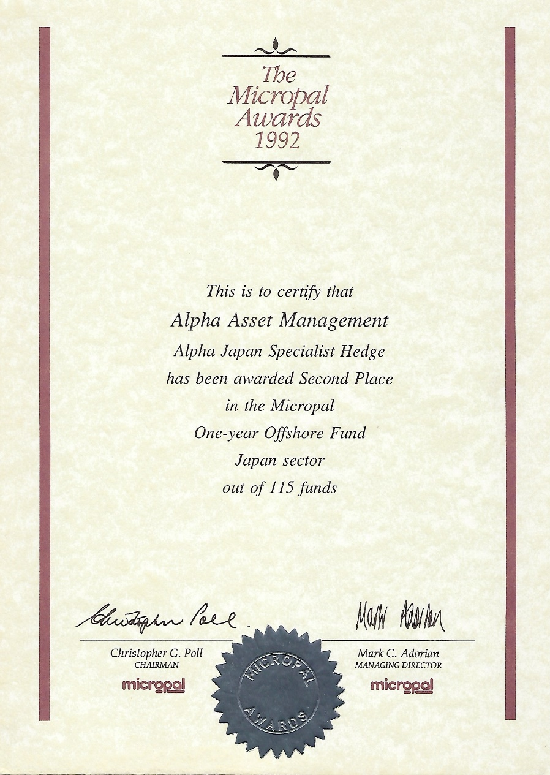
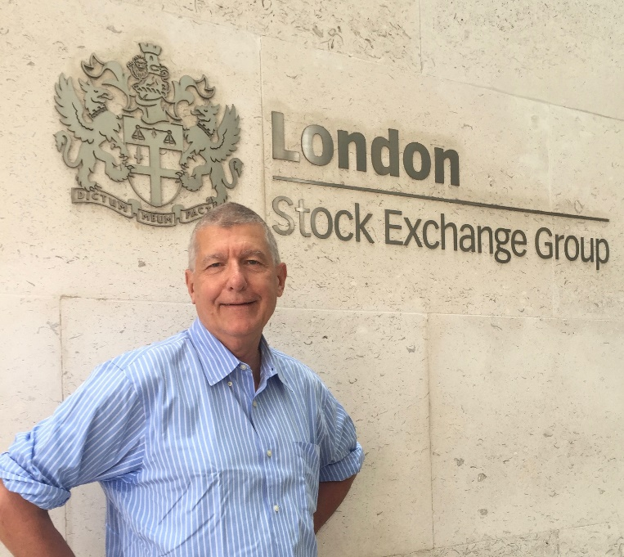
I rapidly became the top performing hedge fund of the 1990’s, eventually bringing in a 1,000% return in a decade.

Slide 12
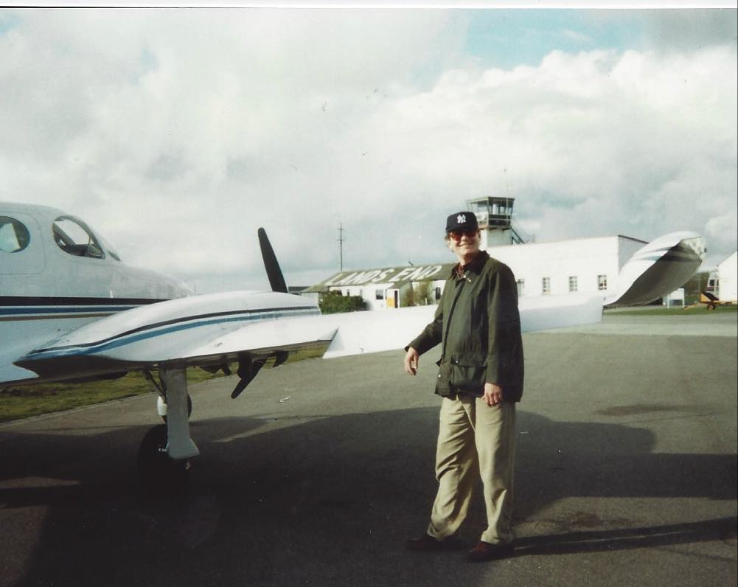
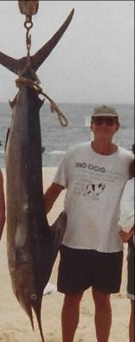
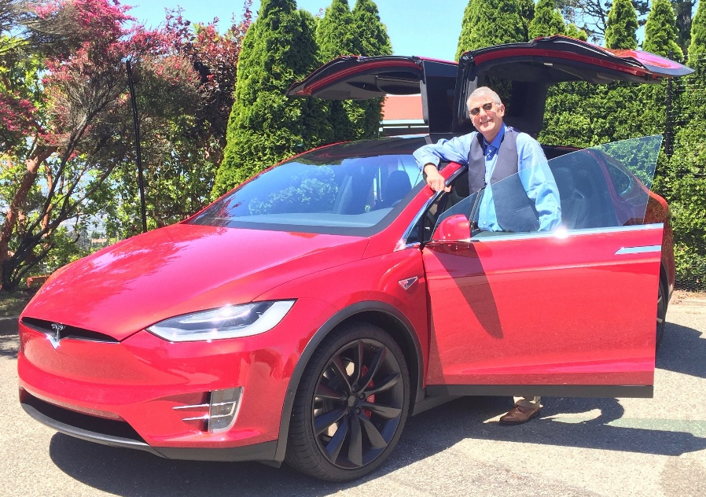
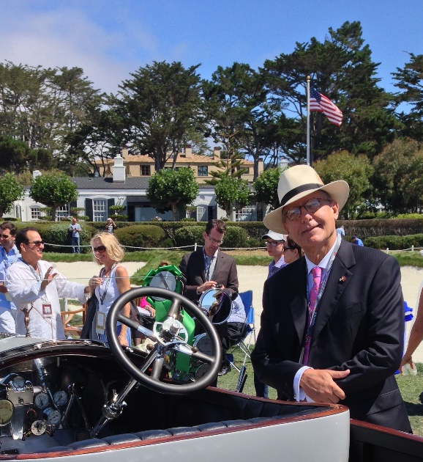
Then the money really started to pour in. It’s an understatement to say that when your income goes from the thousands to the tens of millions it has a really big impact on your lifestyle

Slide 13
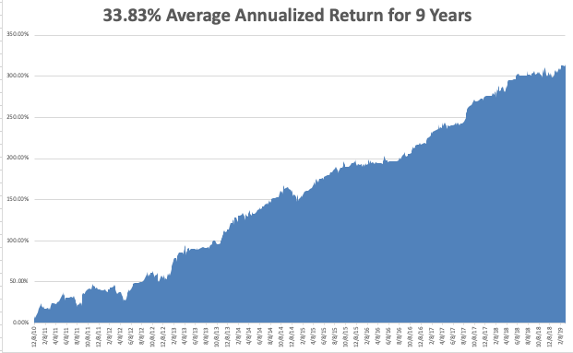
Started diary
I Sold my hedge fund in 2000 and retired to go into the oil and gas industry. After making a killing there, I missed the stock market and started the Diary in 2008

Slide 14
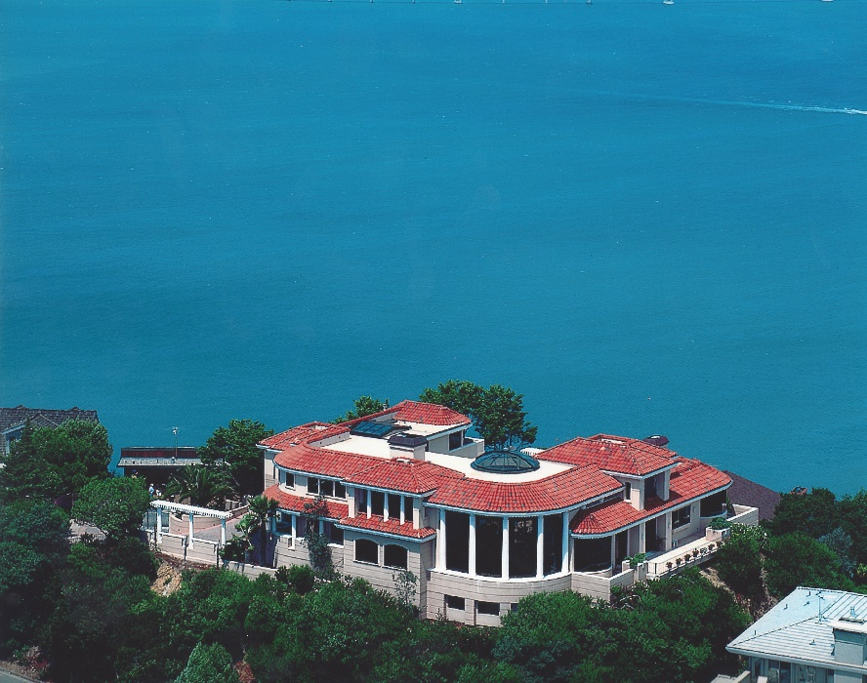
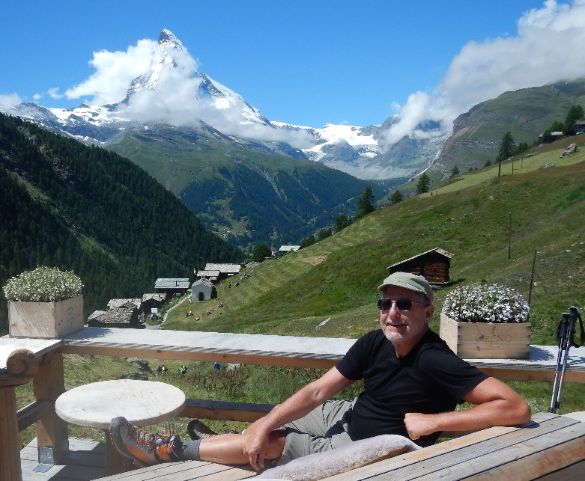
I now spend my days pursuing my first love, finding winning trade alerts, but now I do it from my three mansions in San Francisco, Lake Tahoe, and Zermatt Switzerland. And I’ve quit turning millionaires into billionaires. There is far more satisfaction leveling the playing field for the average guy and teaching them how to trade, and that includes you! If I can take a $50k account and turn it into $500k that is more job satisfaction than I could ever get anywhere

Slide 15
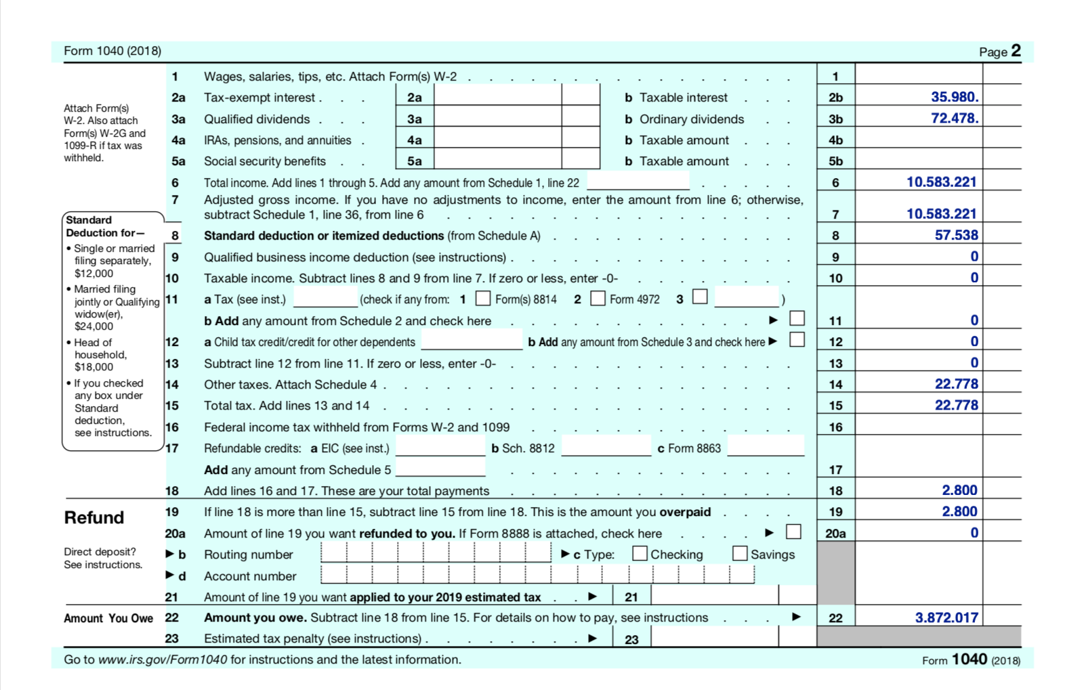
However, Every Silver Lining Has a Cloud $3,872,017 in taxes due on my 2018 $10,583,221 in trading income
YIKES!
It’s a problem you wish you had

Slide 16
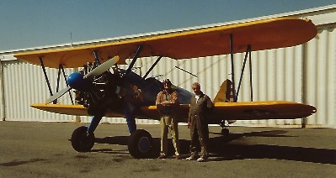
In the little free time I have left I pursue my other love, flying vintage aircraft on weekends. If you see an old plane flying loops over San Francisco or London these days its probably me.

Slide 17
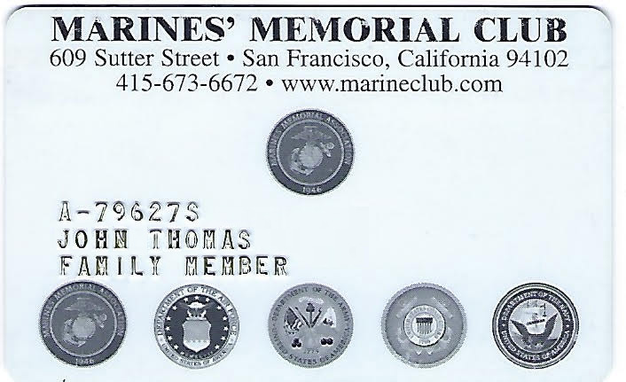
The Ultimate Luxury is to Give to Those who Need It
As a Marine Corps veteran I volunteer for grief counselling for widows and orphans and am a major donor to Wounded Warriors.

Slide 18
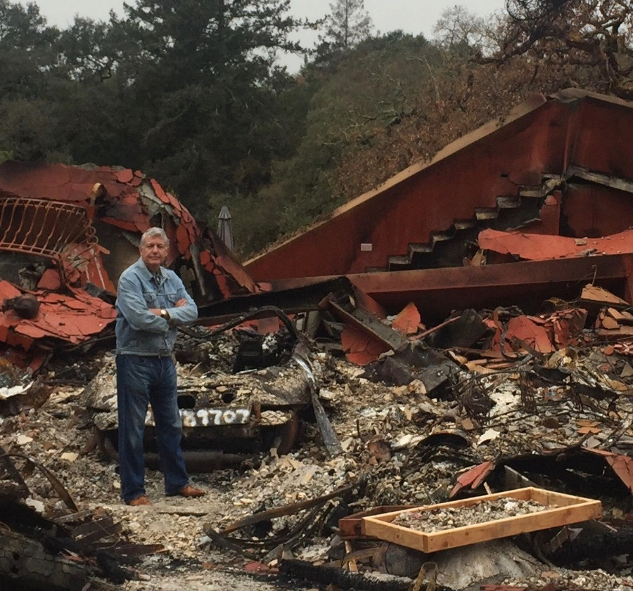
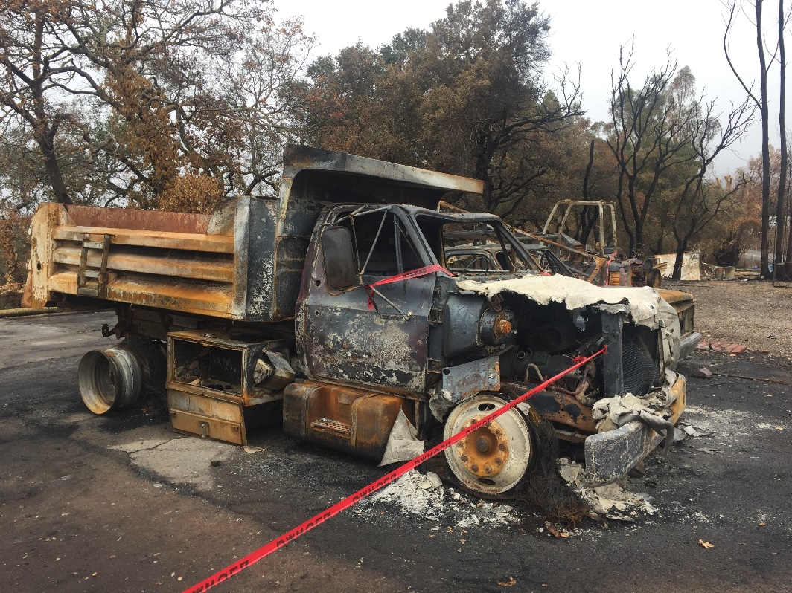
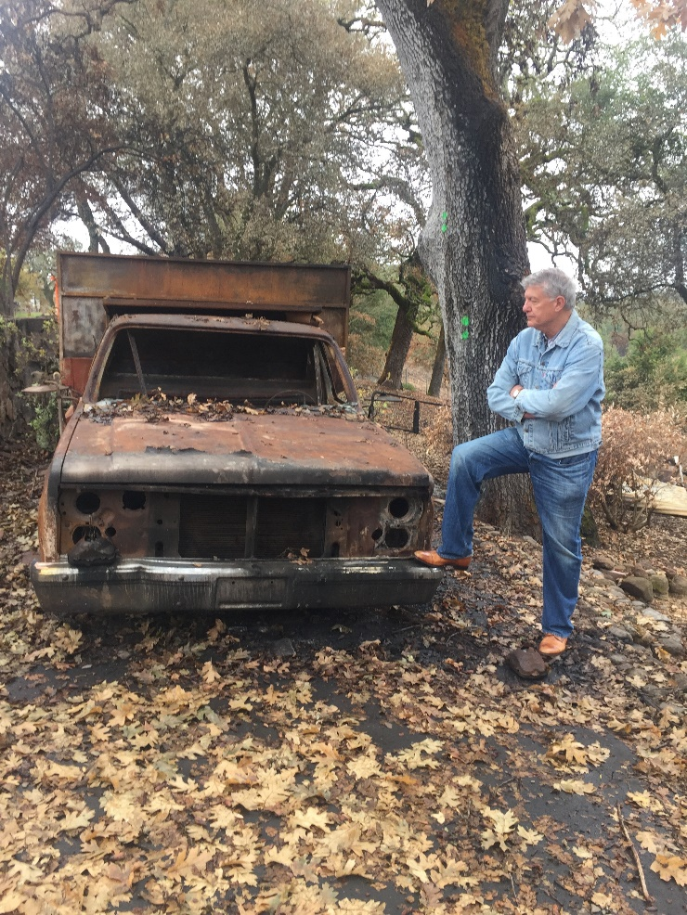
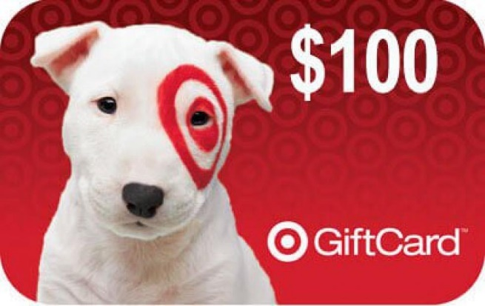
When wildfires hit California I visited the main evacuation centers and handed out $10,000 worth of Target gift cards. In one fire 11,000 homes burned

Slide 19
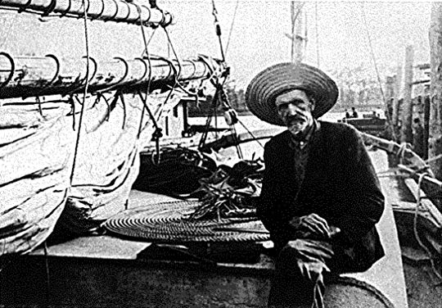
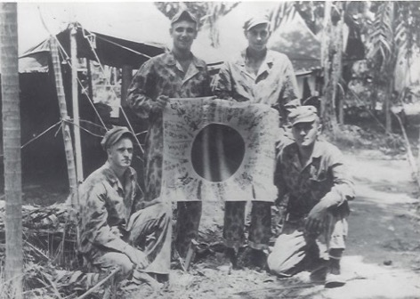
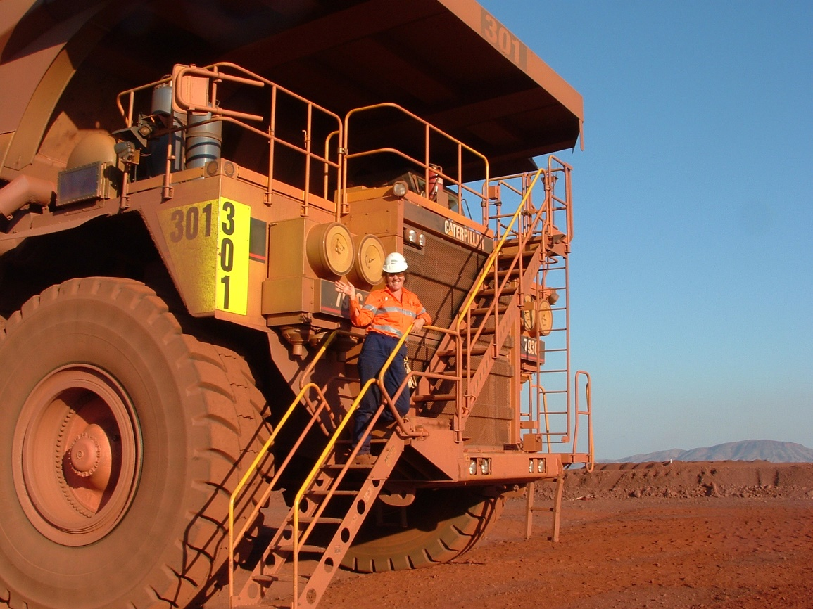
Dad lived in the Melbourne Cricket Ground for 6 Months, arriving barefoot and in rags, was given a WWI wool Australian Army uniform

Slide 20
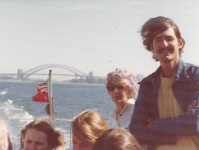
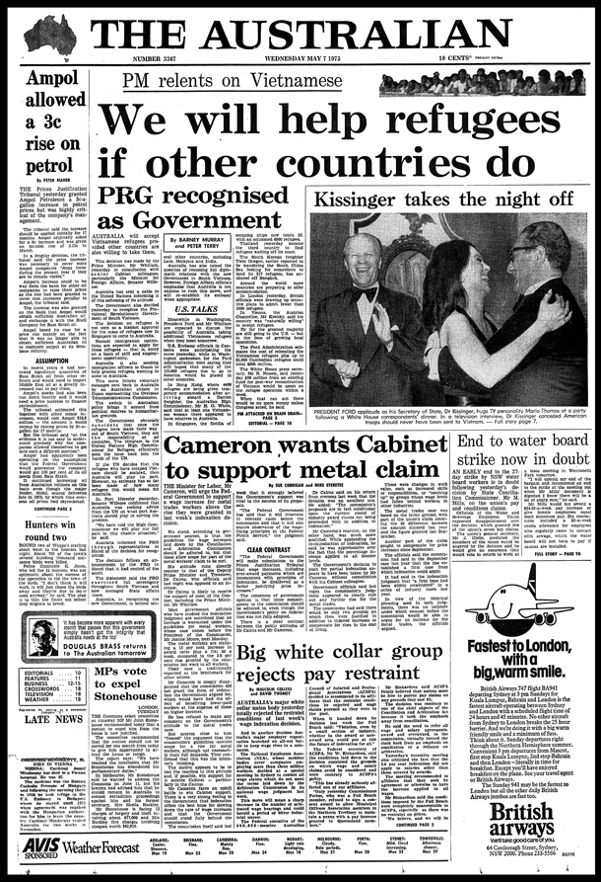
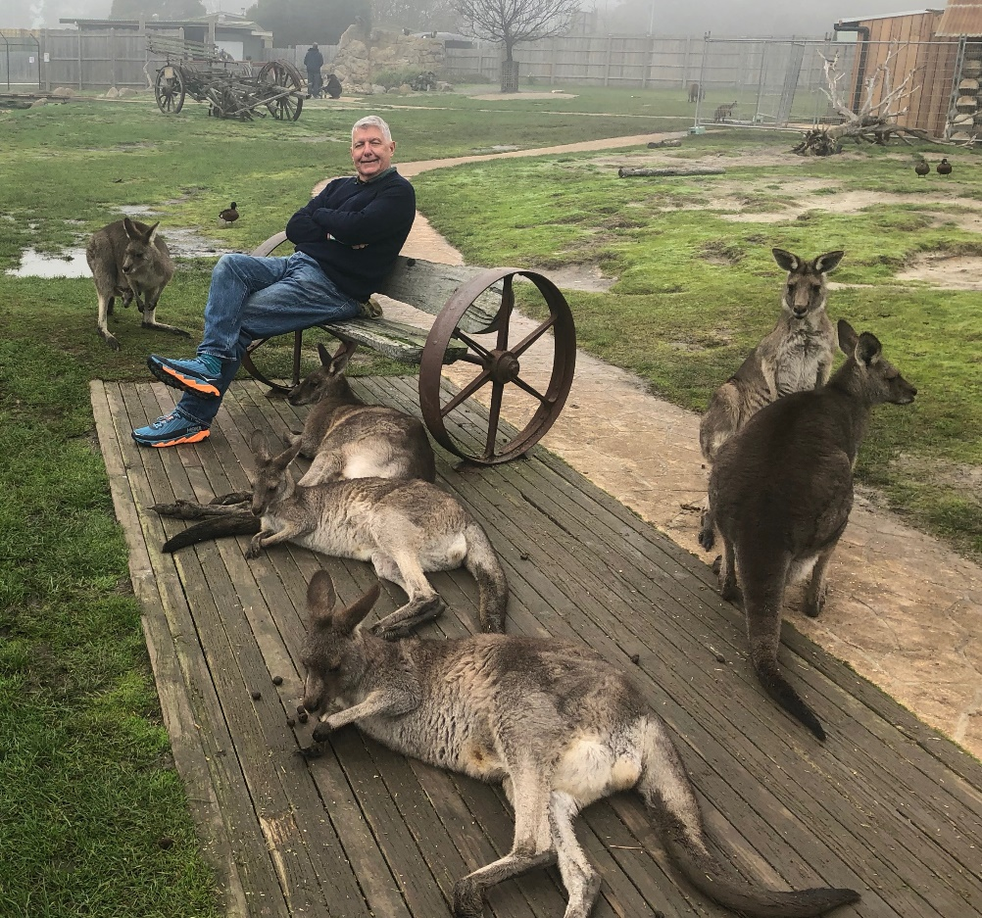
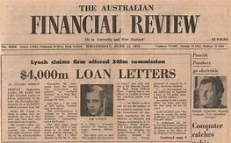

Slide 21
What the Smart Money is Doing Now
*Keeping positions small *Focusing on the highest quality growth stocks with the best long term earnings outlook *Hedging out downside risks with options and bear ETF’s *Buying gold and silver on dips for a return of a weak US dollar *Pouring into the major QE beneficiaries on dips, the big technology stocks why am I so happy? why am I so happy?

Slide 22
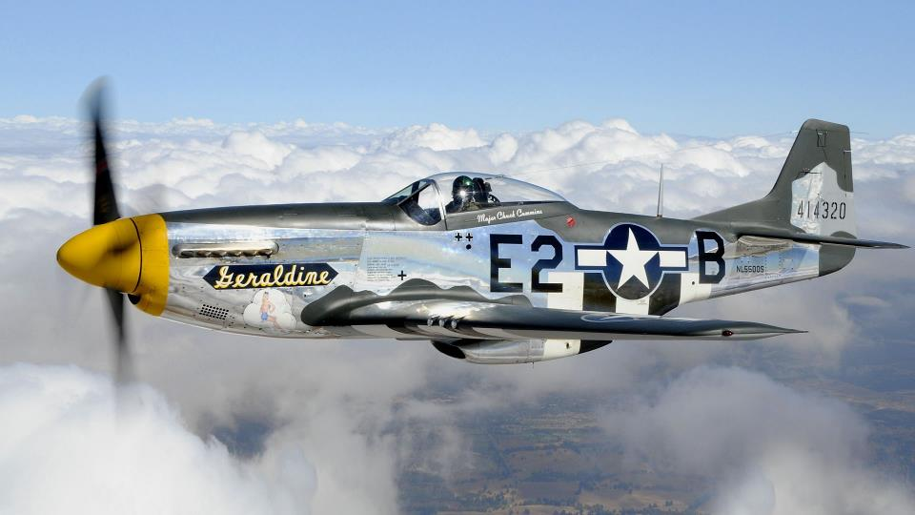

Slide 23
The Global Economy – Global Tailspin
*If the Chinese trade war continues to the max, a global recession will ensue *Big chunks of small US retailing and manufacturing will go under *The trade war is spilling into Europe, slowing economies there further *Big Chinese yuan devaluation is offsetting cost of tariffs, will continue, *The world turning to negative interest rates tells us that worst to come US at 2.0%, Australia at 1.30%, Japan at -0.11%, and Germany at -0.21% *”No Deal” Brexit acceleration throws the fat on the fire *All of the above has triggered a collapse in global interest rates

Slide 24
Stocks – The Coming Turbocharger for the Markets
*Trade wars are now weighing heavily on stocks *The longer it lasts the more damage it causes, and the Chinese are in no hurry to help Trump get reelected *July will bring a round of earnings downgrades and disappointments. No trade deal and no Fed rate cuts takes markets to new 2019 lows *Antitrust threats put a cloud over the FANG’s (FB), (AAPL), (NFLX), (GOOGL) *However, the prospect of sharp interest rate cuts is putting a high floor under stock prices *With interest rates approaching zero there is no place else to go except cash *Bottom line: flat to 10% down market for the next 3-6 months, then new highs propelled by ultra low interest rates and a China trade deal. Combined they are a real supercharger for risk assets *Bottom Line: its bet the ranch time on tech longs, but stay away from those with big China exposure, like Apple, and weak dollar plays like energy, and emerging markets

Slide 25
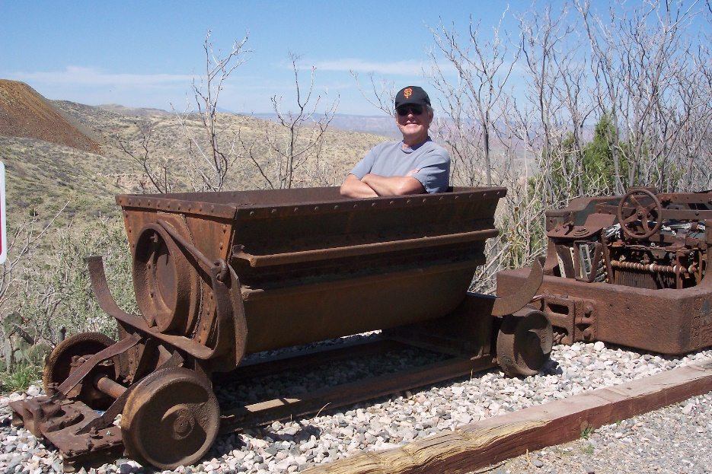
This Time Its Different! The Return of QE is Hugely Positive for Stocks
*The Fed announcement of no more interest rate hikes in 2019 is hugely positive for stocks *So is moving up the balance sheet unwind from September to March, selling of $60 billion a month worth of bond holdings driving rates sharply lower *That will inject $2.7 trillion of cash into he US economy and is equivalent to two interest rate CUTS *When the world goes from QT to QE overnight, you go “RISK ON” *China trade war settlement, will pour the gasoline on this trade, whenever it comes

Slide 26
S&P 500- The Final Target for the 10 Year Bull Market is Approaching
2020 Target 3,200
SELL
BUY

Slide 27
NASDAQ (QQQ)- 2 ½ Years
2020 Target 9,000
SELL
SELL
BUY
BUY

Slide 28
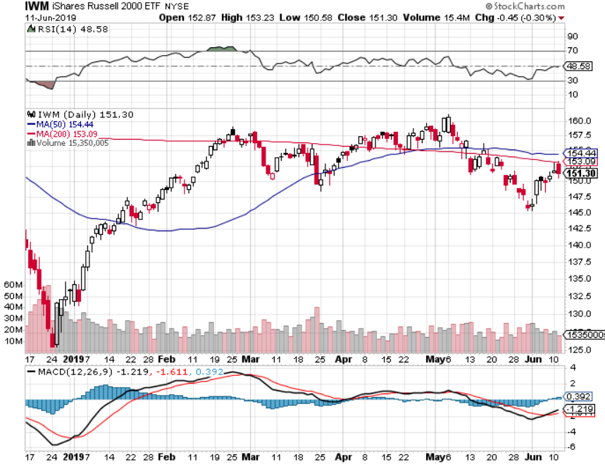
Russell 2000 (IWM)- Small Caps Fall Fastest
SELL
SELL

Slide 29
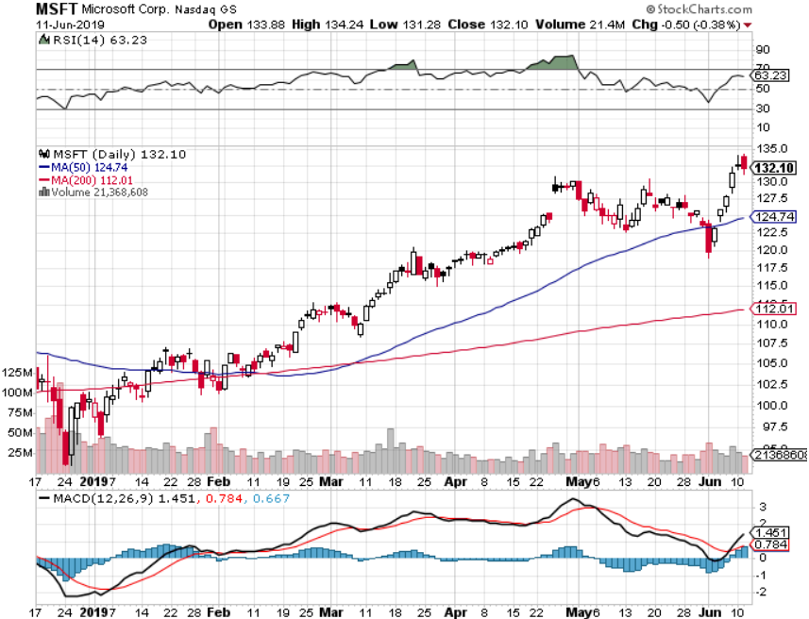
Microsoft (MSFT)- New High
BUY
BUY
BUY

Slide 30
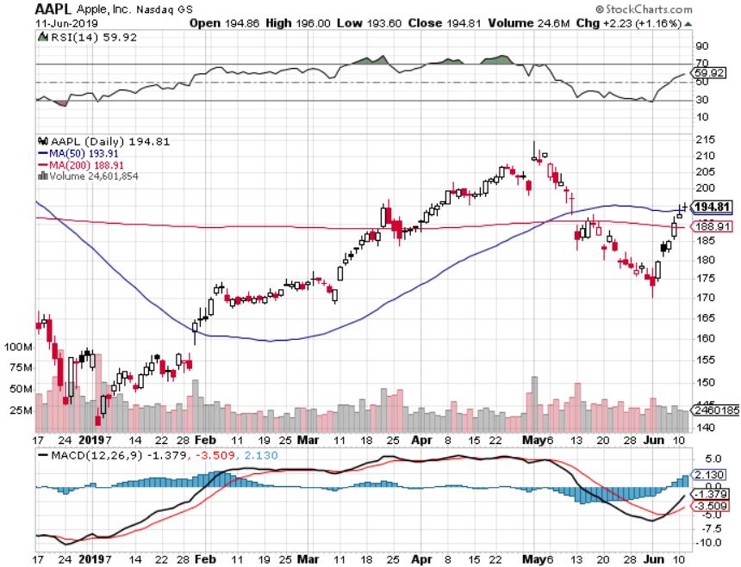
Apple (AAPL)- China Target
BUY
BUY
BUY

Slide 31
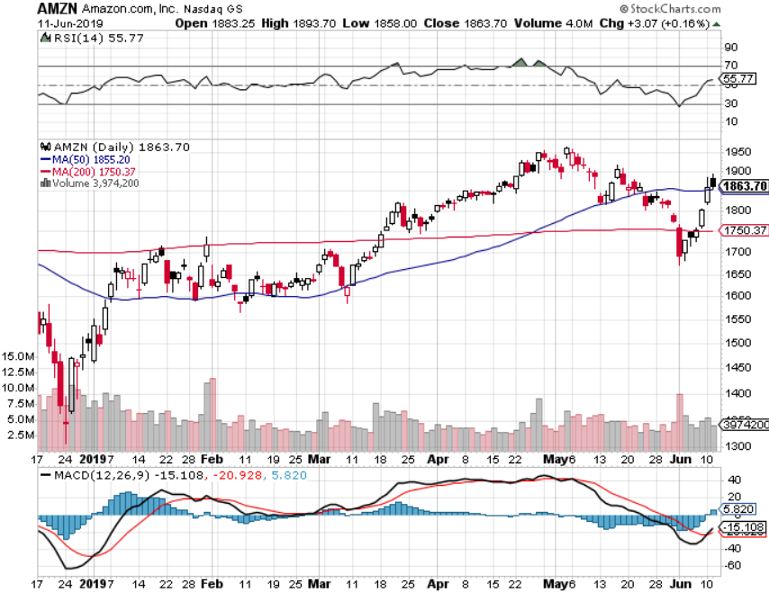
Amazon (AMZN)-New Highs
BUY
BUY
BUY

Slide 32
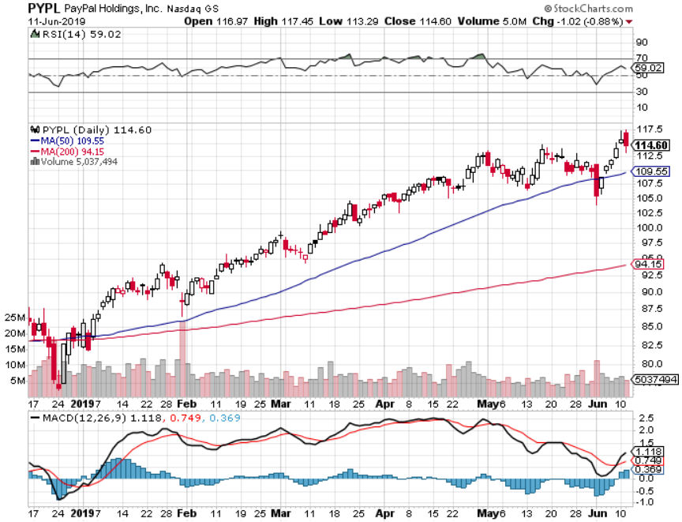
PayPal (PYPL)-Fintech Star
BUY
BUY
BUY

Slide 33
NVIDIA (NVDA)- Trade War Victim-Leading graphics card maker used in gaming and AI
SELL
BUY
BUY

Slide 34
Salesforce (CRM)-The Dominant Cloud Player
BUY

Slide 35
Boeing Aircraft (BA)-Trade War End Play Next to happen in the recertification of the 737 MAX bounce
SELL
BUY

Slide 36
Walt Disney (DIS)- Summer Blockbuster Wave
BUY
BUY

Slide 37
Bonds – The Recession is Here
*Or at least so says the bond market with the US at a 2.06% ten year yield, headed to 1.33% and then zero *Collapsing global economies sending a huge flight to safety bid to bonds *Yields have fallen nearly 1.19% since September, from 3.25% *The huge move has taken place despite a Chinese boycott of the market, historically 50% of the new issue market *German bund yields plunge to -0.21%, while Japan government bonds turn in a -0.11% yield *Global free money puts a high floor under all asset classes, but won’t spur them to new highs either

Slide 38
Treasury ETF (TLT) – Waiting for new range after major upside breakout
Target $150
SELL
SELL
BUY
BUY
BUY

Slide 39
Ten Year Treasury Yield ($TNX) 2.00% Breakdown
Target 1.33% Yield

Slide 40
Australian Ten Year Bonds 1.30% Yield
Target 0%

Slide 41
Foreign Currencies – Low Rates Kill the US Dollar
*Sudden decline of US interest rates has cut the knees out from under the US dollar, our rate of fall in interest rates is faster than there's *Japanese yen has taken off *In Britain the worst case scenario has happen with May resignation and “no deal” Brexit *Chinese yuan continues fall on weakening economy, will offset part of US tariffs *Bitcoin rallies big on flight to safety, capital flight from China fleeing weak Yuan replacing gold *Bottom Line: sell the US dollar against everything

Slide 42
US Dollar Basket (UUP)
SELL

Slide 43
Australian Dollar (FXA)-The long view Collapsing US interest rates, end of trade wars, and commodity boom take Aussie back to parity
Parity 1:1
BUY

Slide 44
Bitcoin- 150% Rally Global Liquidity Surge, 99% Chinese buying

Slide 45
Falling Dollar Not a New Thing US Dollar Priced in a Basket of Hard Goods 1790-2019
*It’s been going on for 229 years *United States started out as a bankrupt country *Is the plight of all fiat paper currencies *Bear market rallies can last 20 years, 3 years in modern history

Slide 46
Energy – Global Recession Fears Ramp Up
*Oil plunges 20% on sudden global recession fears prompted by China trade war *US oil production soars to 12.3 million b/d, on the way to 17 million b/d, up from 5 million b/d in 2005. But China, the worlds largest marginal new buyer, has banned all US imports *Oil has had every geopolitical reason to rise, like attacks on tankers in the Straights of Hormuz, but its falling instead. Recession Trumps war *Bottom Line: looks like $42 a barrel is in the cards so sell rallies Long term: Energy demand collapses and prices fall to $10/barrel as global transportation goes all electric

Slide 47
Oil-China Recovery
SELL
Target $42
BUY

Slide 48
Oil- 20 Years Downtrend - Going Out of Style

Slide 49
Precious Metals – The Ultimate Hedge
*Gold will break to new highs as investors look for “RISK OFF” flight to safety hedges *Central banks have become the principal buyers of gold in 2019, some 264 metric tonnes in 2018 , and that is increasing sharply *China and Russia have been dominating purchases *Distrust of current US economic and monetary polices is the incentive *Bitcoin is stealing gold’s thunder, sucking in global speculative activity *Bottom Line: buy every dip in gold and precious metals

Slide 50
Gold (GLD)- Imminent Upside Breakout
Target $1,920 +43%
SELL
SELL
BUY

Slide 51
Market Vectors Gold Miners ETF- (GDX) – Yikes!
SELL
BUY
BUY

Slide 52
Newmont Mining- (NEM)-
SELL
BUY
BUY

Slide 53
Barrick Gold (GOLD)
SELL
SELL
BUY
BUY
BUY

Slide 54
Real Estate: A 20-Year Boom
*Millennial demographic wave is about to drive US home prices northward for the next 20 years *Only 2.4 million homes are for sale, down -6.8% YOY, creating a severe shortage, normally rises in the fall, and predicts a very hot market in the spring *US homebuilding is proceeding at less than half the peak seen in the 2000s, despite rapidly rising demand, creating a structural shortage *Home equity has been the top performing individually owned asset class for the past 8 years *All this makes homebuilders a big long term “BUY”

Slide 55
US Home Construction Index (ITB) (DHI), (LEN), (PHM), (TOL), (NVR) Another Falling Rate Beneficiary -But Becoming a Favorite Sector to Buy

Slide 56
Another Alternative Investment Opportunity It’s where the futures lies-an investment sector of one
*Tesla’s total cumulative production will hit 900,000 this year, battery costs have dropped by 80% over the last ten years and will fall by another 80% over the next ten *Second factory under construction in Shanghai, Model Y small SUV comes out next year *US electric car sales have risen from 0% ten years ago to 4% of the market today, and will soar to 100% in 20 years *Tesla is already outselling all premium car brands in the US combined, including Mercedes, BMW, Audi, and Jaguar, and has a 10 year head start *Many countries and US states have banned the internal combustion engine by 2030 or 2040 *Tesla will become the world’s largest car company within a decade, causing the shares to rise tenfold

Slide 57
Tesla (TSLA)-The Next $1 trillion company Initial Cost $16.50 after the IPO, next, a tenfold increase coming in ten years
SELL
BUY
BUY NOW

Slide 58
Tesla Model X High Performance US$162,000 fully tricked out with “Ludicrous” mode

Slide 59
Oops!- Goodbye Chassis no. 125

Slide 60
I Gained Financial Independence for Life and so Can You! ALL of this can be yours!
*Discover how to make thousands of dollars a year in extra income *Go from complete beginner to seasoned pro in WEEKS *Learn how to quit you day job and trade for a living full time *Trade from anywhere, anytime *Supplement your retirement income with the satisfaction of booking winning trades by the hundreds

Slide 61
The Harsh Truth This is Why You Really Need My Help
*The majority of individual traders lose money *They lack the correct training and discipline to succeed *Most broker research suffers from grievous conflicts of interest *Wall Street is all about moving money from the uneducated to the educated *The easy solution to that problem is to get educated *Fidelity did a 20 year study and learned that their top performing investors were DEAD PEOPLE!

Slide 62
You Need a Real Pro to Guide You Though the Market Maze
*The market is not monolithic and 95% of it can be completely ignored *There are a few great sectors and a lot of awful ones *You can earn a 10X return on the great ones , but get wiped out by the losers *Let a 50 year veteran steer you to safe waters *Let me sit next to you and guide your hand on every winning trade

Slide 63
The Mad Hedge Profit Predictor Market Timing Index- My Secret Weapon! An artificial intelligence driven algorithm that analyzes 30 different economic, technical, and momentum driven indicators

Slide 64
Why Do You Need an Algorithm? Why Use a Toolbox Missing Its Most Important Tool? This is Your Cheapest Way to get in
*Algorithms have become so dominant in the market that you should never trade without one
*It does the work of a seasoned 100-man research department in seconds *It runs real time and optimizes returns with the addition of every new data point far faster than any human can. Imagine a trading strategy that upgrades itself 30 times a day! *Don’t go to a gunfight with a knife. If you are trading against algos alone you WILL lose! *Algorithms provide you with a defined systematic trading discipline that will enhance your profits

Slide 65
I’m not the only one using Algorithms. Some 80-90% of all current trading is algorithm driven

Slide 66
Three Years of Profit Predictor Performance
SELL!
SELL!
SELL!
SELL!
SELL!
SELL!
SELL!
SELL!
SELL!
SELL!
BUY!
BUY!
BUY!
BUY!
BUY!
BUY!
BUY!
BUY!
BUY!
BUY!

Slide 67
S&P 500 Index (SPY) Up 59.44% in Three Years

Slide 68
Mad Hedge 3 Year Performance +113.77% - Double the (SPY) Performance with less volatility

Slide 69
Bill was a struggling tobacco farmer in Virginia who wanted to supplement his fading agricultural income After making $3.4 million with the Mad Hedge Fund Trader, he still farms, but now he’s growing grapes in California’s Napa Valley for the high end wines

Slide 70
Phillip was tired of working in the boom and bust of the oil and gas industry in Texas. After doubling his money every year for several years, he now earns a generous living as a full time trader. Phillip now trades whenever and wherever he wants and doesn't carry a year round sunburn anymore. And says he’s never lost any money on a John Thomas trade

Slide 71
Jackie was an Australian hospital administrator who turned $50,000 into $2 million with the help of John Thomas and became a major player in technology stocks. She retired in her fifties and now spends her time cruising around the world.

Slide 72
Trade Sheet- So What Do We Do About All This?
*Stocks-buy dips *Bonds-buy dips *Commodities-buy dips *Energy – sell rallies *Currencies-sell US dollar rallies *Precious Metals –buy dips

Slide 73
If you are not up +32.90% in the past 12 months, as I am, you are reading the wrong newsletter, or following the wrong trade mentoring service!

Slide 74
GTD Daily Audited Performance
And if you think I’ve just been lucky

Slide 75
GTD 9 Year Daily Audited Performance

Slide 79
The Very Long View Here’s where the big money will really be made
*The 2000s and the 2010s were the hard decades for making money *The 2020s and 2030s will be easy ones, as a global demographic wave brings on a new “Golden Age” *85 million Millennials will become big spenders over the next 15 years, while 80 million baby boomers, a drag on the economy, fade from the scene *That will create an economic boom that will last another decade starting in 2021

Slide 80
Dow Average 1982-2000 Up 20 Times in 18 years-Ready for a Replay?
What happened the last time we had an demographic tailwind like this?

Slide 81
Dow Average 2009-Present Up 20 Times from the 2009 bottom in 18 years takes us to 120,000 by 2027
Yes, that sounds impossible, up 400% in 10 years, but that is exactly what we have done over the past 10 years

Slide 82
Dow Average 1982-2000 Up 20 Times in 18 years-Ready for a Replay?
You Are Here Now!
What happened the last time we had an demographic tailwind like this?

Slide 83
The Tech Turbocharger
*Technology is hyper accelerating on all fronts simultaneously *The development of functional quantum computers mean that computational ability is about to increase a trillion fold at no cost *The world’s major computational challenges will shortly be solved, such as weather forecasting and cancer cures *All major human diseases will be cured within ten years. Live another decade and you will have a shot at living to 150 years old *Needless to say, tech and biotech stocks dominate in this scenario and will account for the bulk of stock market gains in our lifetimes *The nineties had cheaper computers, cheap operating software, and a new Internet. The 2020’s will have ten times this number of technology drivers

Slide 84
Quantum Computing
*Old 2 X 2 X 2 X 2 = 16 possible solutions *New 16 X 16 X 16 X 16 = 65,536 possible solutions

Slide 85
The Only Chart You’ll Ever Need to Read Demographics turn to tailwind in 2022, Peaks in the 46-50 Spending group
2036 Peak
2006 Peak
1966 Peak
2022 Trough

Slide 86
Global Warming- Will it Destroy the Bull Case? How can the economy grow when it is under 200 feet of water?
*Green New Deal will spend $1 trillion a year on alternative energy mitigation from 2021 onward *Will be the greatest investment opportunity of the century, pouring billions into solar, wind, biomass, energy efficiencies, and non-toxic nuclear *Can reverse carbon accumulation and bring cooling within a decade *Will also finance the shutting down of the US
Coal and oil industries *100% of new US car production is electric by 2030

Slide 87
The US Presidential Election of 2020
*Trump won by 79,000 votes in 3 states in 2016, Michigan, Wisconsin, and Pennsylvania. That was .063% of the total vote cast *Trump can’t win without Pennsylvania *He is 14% behind in the polls now in PA *Trump lost by 3 million votes in 2016, and the Republican party by 9 million votes in 2018 *In the last election the suburbs totally flipped against Republicans *2016 election was a reaction to the US becoming a white minority country by 2040

Slide 88
A 2016 Repeat?
*Continued Russian influence could bring a 2016 repeat, and there is always the unexpected *Trump win brings the following polices: *Continuing trade wars bring a global recession *Massive subsidies of the oil and gas industry accelerate global warming *WW II alliances completely collapse, like NATO, the United Nations, and the World Trade Organization to the enormous benefit of Russia *Rise of white supremacists in the US

Slide 89
Who is Joe Biden?
*Joe Biden was Barrack Obama’s vice president for 8 years *Is far and away the front runner for the Democratic nomination, with 37% of the vote *Balance is spread among 23 other candidates *We won’t know who the candidate is until August 2020, or two months before the election *One big problem: Biden will be 79 when he takes office, so choice of a vice presidential running mate will be crucial

Slide 90
Who Will Show You How to Play the next 95,000 Dow Points?
Sit with me, John Thomas, The Mad Hedge Fund Trader and my Global Trading Dispatch Discover how you can tap into the top performing trade mentoring service in the industry Up 32.90% in volatile markets! Follow my research and market- beating Trade Alerts, and you will rake in the profits.

Slide 91
Let a Marine Combat Pilot Steer You to Big Profits…
*Single Stocks, Options, and ETFs for: *Global Equities *Bonds *Foreign Exchange *Energy *Commodities *Precious Metals *Real Estate

Slide 92
This Trading Record Can Be Yours! January Trade History 10 Out of 11 Trade Alerts Profitable!
Date | Position | Asset Class | Profit
1/3/17 | Buy S&P 500 (SPY) | equity | 16.30%
1/4/17 | Sell US Treasuries (TLT) | fixed income | 8.60%
1/5/17 | Buy Russell 2000 (IWM) | equity | 14.80%
1/6/17 | Buy Amazon (AMZN) | equity | 12.10%
1/6/17 | Buy Apple (AAPL) | equity | 7.60%
1/10/17 | Buy Biogen (BIIB) | equity | -21.30%
1/11/17 | Buy Palo Alto Networks (PANW) | equity | 12.20%
1/13/17 | Sell Japanese Yen (FXY) | foreign exchange | 15.60%
1/17/17 | Sell US Treasuries (TLT) | fixed income | 13.30%
1/27/17 | Buy S&P 500 (SPY) | equity | 15.60%
1/30/17 | Buy Gold (GLD) | precious metals | 13.30%

Slide 93
The Resolution
With the China trade war eventually to end, it is just a matter of time before technology stocks break out to new all time highs Watch this space melt up going into the end of 2019 Get ready to start reeling in those whoppers with Global Trading Dispatch as your guide

Slide 94
Here’s How it Works
BUY

Slide 95
I Shoot Out a Trade Alert At a Market Sweet Spot By text message and email You get it in 5 seconds
BUY the Micron Technology (MU) at $42.01 or best Opening Trade 2-7-2018 Portfolio weighting: 10% Number of Shares for $10,000 exposure = 238

Slide 96
A 15.63% Profit in 15 trading days
TAKE PROFITS

Slide 97
Another Trade Alert to Take Profits
Mad Technology Letter Trade Alert - (MU) – TAKE PROFITS SELL the Micron Technology (MU) at $48.58 or best
Closing Trade Trade date: 2-23-2018 Portfolio weighting: 10% Number of Shares = 238 for $10,000 exposure Profit: ($48.58 - $42.01) = $6.57 X 238 = $1,563.66

Slide 98
NVIDIA (NVDA) recommended at $68-Up 267%

Slide 99
Lam Research (LRCX) Recommended at $135 – Up 77% in 10 Months!

Slide 100
Baidu (BIDU) recommended at $12.50-Up 2,240%

Slide 101
With My Global Trading Dispatch Service You Get:
1) A daily research letter 2) Instant Trade Alerts sent out at market sweet spots, about 200 a year, and all the reasons to execute them 3) Live biweekly strategy webinars with an interactive Q&A 4) Special reports on urgent investment topics 5) Invitations to strategy luncheons around the world 6) More educational videos and webinars than you could consume in a lifetime 7) Access to a 12 year data base on investment ideas, searchable by names and ticker symbols.

Slide 102
Here’s What I’m NOT Going to Charge You for This Service
AUS$100,000 . That’s What I Charge my Big Hedge Fund Clients, and They’re Happy to Pay Because I Make Them Millions

Slide 103
Here’s What I’m NOT Going to Charge You for This Service
AUS$10,000 . That’s What I Charge my Concierge clients, who get my personal cell phone number

Slide 104
Here’s What I’m NOT Going to Charge You for This Service
AUS$6,500 . This is the cheapest price on my website and the lowest I have ever offered

Slide 105
This is The Real Deal…
BUT NOT FOR YOU!
Creating this product cost me millions of dollars With the best customer service in the industry, running it costs millions more

Slide 106
Here’s The Offer You Can’t Refuse…
Today and ONLY through this Webinar
1 Year for Just AUS$3,999! A 38% Discount from the Full Price

Slide 107
But This Is a Limited Offer!
I can only take 50 new subscribers at a time. So it’s First Come, First Serve!
I can’t wait to make you a top drawer trader!

Slide 108
Here’s The Offer You Can’t Refuse…
Today and ONLY through this Webinar
1 Year for Just AUS$3,999 Let me show you how to make the money to pay for your own subscription

Slide 109
Hedge Fund Manager Analysis For Fast Profits…
"We made a lot of money from your service this year.” “I don’t agree with all of John Thomas’ trades, but we really like his insight and timely and quick, short emails that he broadcasts, like on the ECB interest rate cut, the falling yen, etc. Thank you.”
Craig Herndon, Virginia

Slide 110
If you don’t believe me, listen to the thousands of followers who have become successful traders:
Hello John Thomas, Your Trade Alert service has changed my life. Some fight for their country, some talk for their country, and some write for their country. But you, John Thomas, have thought for us all. I admire the wonderful imagery and the vivacity of your letters. Some minds wear well, but yours doesn’t appear to wear at all. Bill, Langtry, Texas

Slide 111
STOP Losing Money in the Markets!
“After losing money with a million different advisory services and registered brokers I finally found YOU, and YOU make it all worth it!!! Thanks a bunch. I have so much confidence in you!”
Stefano Italy

Slide 112
Testimonial
“I can’t quite comprehend how he knows so many well-placed people, but he’s incredibly adept at grabbing insights from them, turning these into an investment thesis, and making it incredibly clear and actionable to his reader base.” Neil Dublin, Ohio

Slide 113
Testimonial
I can't tell you how much I enjoy your blog. It is the first place I go every morning, and I miss you on the weekends.
I stumbled upon your site about four months ago and have been addicted to it since day one. I really appreciate not only your insight into the markets, but also your global and historical perspectives.
All of this served up with your great sense of humor makes it a must read! Thanks for all your hard work.
Chip Bangor, Main

Slide 114
Testimonial
Going to renew my membership today because you provide great ideas. I think you have a lot of integrity in your messages.
You have nailed many of the concepts you shepherd.
I have become a fan and look forward to your writing every day
Don, Cleveland, Ohio

Slide 115
Testimonial
John's newsletter is, in my view, the Secretariat of the investment newsletter derby. No one else is even a close second.
Gary, New Jersey

Slide 116
Testimonial
Thank you for the suggestion you made during your last webinar. I bought two Micron Technology (MU) July $39 Calls for $7.80 and two January 2019 $37 Calls for $11.40. If I sell those now I will have earned $2,000 with this trade in one week!
Thanks a million,
Dirk Belgium

Slide 117
Free for New Subscribers!
In the Store Now for US$49
Sectors and Stocks that Will Lead the Market for the Next 20 Years

Slide 118
Benefits for Australians
*Is a one stop global view on all asset classes *Australian assets are driven more by what’s happening outside the country than inside *Get local time customer support and advice on trade execution *Take advantage of localcurrency pricing of Mad Hedge Fund Trader Services

Slide 119
Trade Alert!
*Buy now, and you will INSTANTLY receive a trade alert with an extremely high probability of success that you can execute immediately and make some of the most serious money in your life. Don’t leave good money on the table *90% of these trade alerts make money

Slide 120
Can You Guess This Trade Alert? Subscribe Now to Find Out! You have to go through 1,000 Charts to Find One this Good, Let Me do the Heavy Lifting for You Is this a “BUY” or a “SELL”

Slide 121
Here’s The Offer You Can’t Refuse…
Today and ONLY through this Webinar
1 Year for Just AUS$3,999 Let me show you how to make the money to pay for your own subscription
end

