Slide 1
The Mad Hedge Fund Trader “Flirting with the Summit”
With John Thomas from Silicon Valley, CA, July 24, 2019 www.madhedgefundtrader.com
Notes:
*

Slide 2
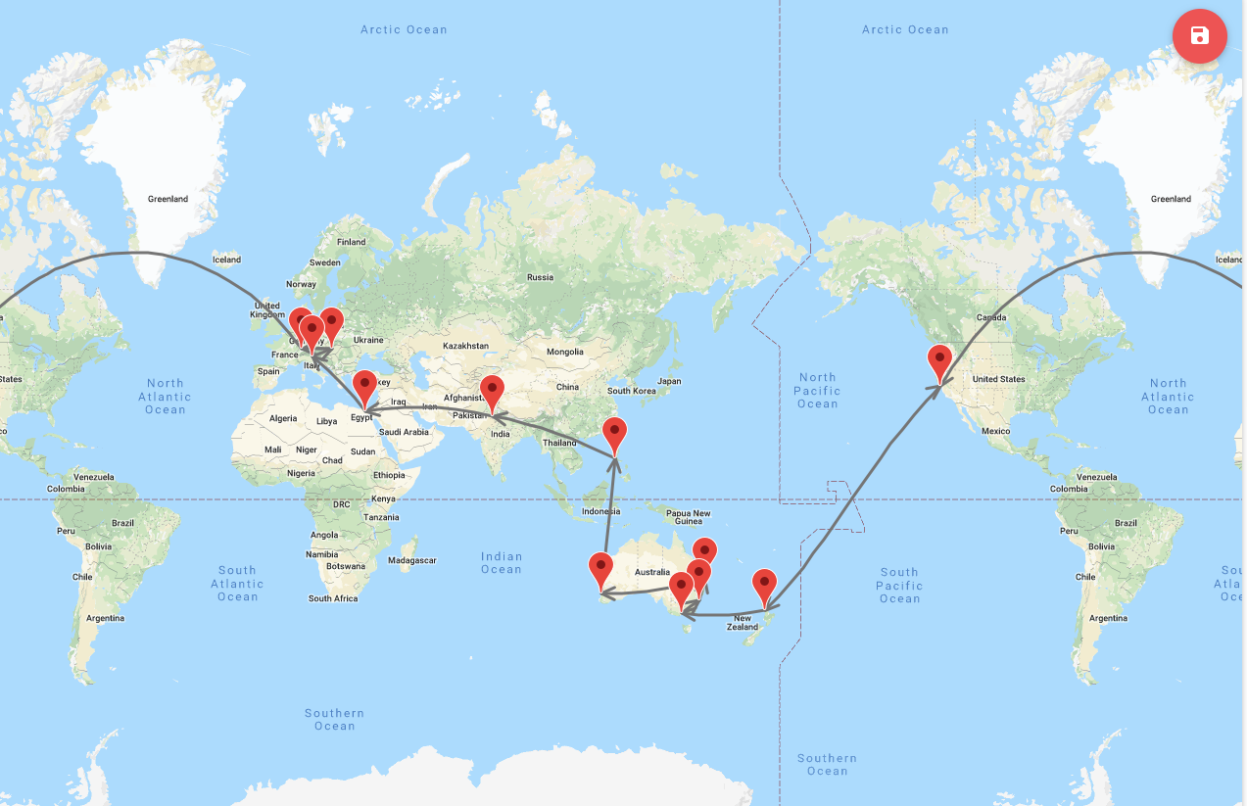
You Are Here Now
START

Slide 4
October 25-26 Lake Tahoe Conference 50% of seats already sold out
*Two days of informative speakers on crucial trading and investment issues *Trade tips with the most successful Mad Hedge traders *2 nights in the Hyatt, including all you can eat and drink *Tickets are a bargain at $699 to $1,999 *Buy now, upper ticket classes sell out first

Slide 5
Trade Alert Performance New Highs!
*January 9.49% Final *July +2.73% MTD *February +4.64% Final *August +2.19% MTD *March +1.78% Final *September 1.38% Final *April +0.30% Final *October +1.37% Final *May +0.25% Final *November -1.83% Final *June -0.50% Final *December -4.13% Final *2019 Year to Date +17.97% compared to +16.04% for the Dow Average *+318.11% since inception, *Average annualized return of 33.17% for 10 years

Slide 6
Portfolio Review Keeping Small Positions Only Buying Very Deep in-the-Money on Capitulation Days
Current Capital at Risk
Risk On
World is Getting Better
(FCX) 8/$9-$10 calls spread | 10.00%
Risk Off
Total Net Position | 10.00%
Expiration P&L 18.63%

Slide 7
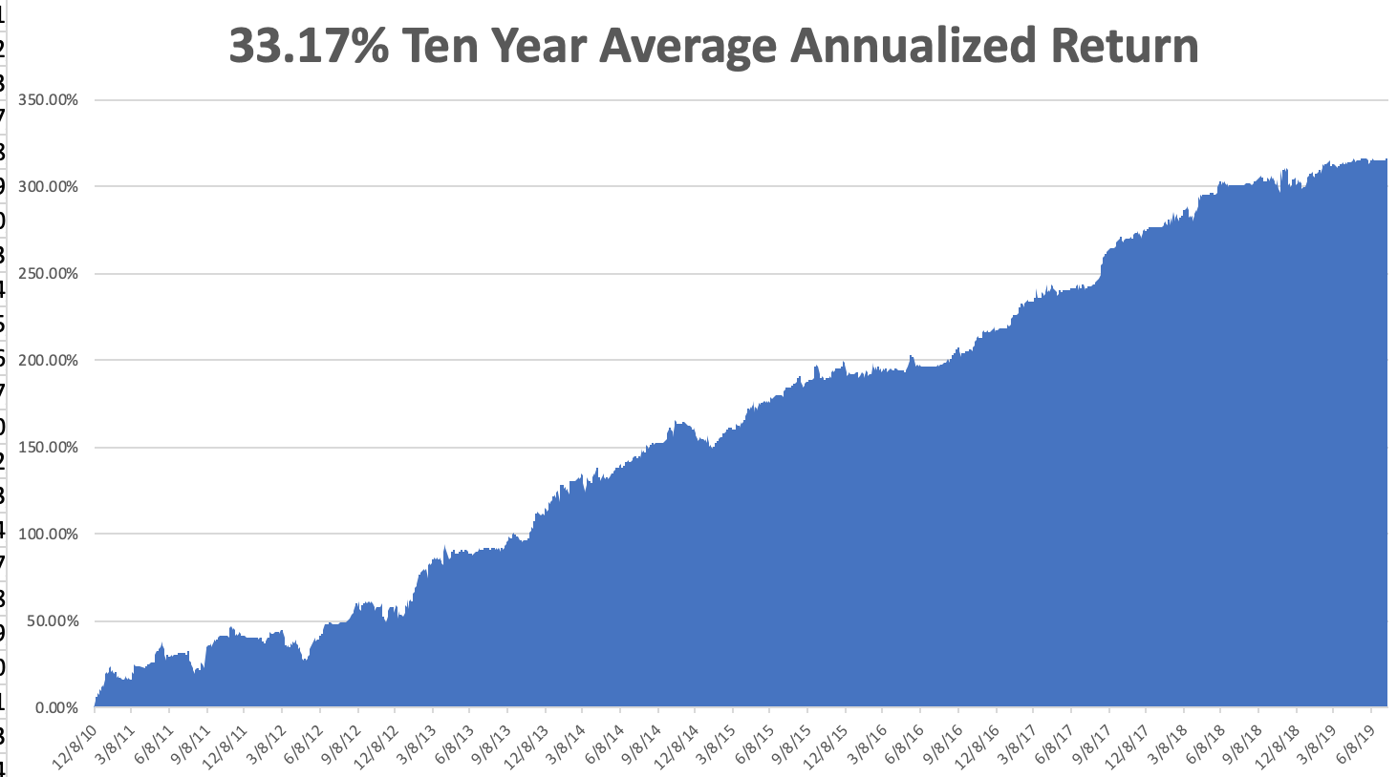
GTD 10 Year Daily Audited Performance

Slide 8
The Method to My Madness
*Risks are now asymmetrical, small upside potential with large downside risks *Market has given up on a resolution of the trade war, but nobody cares *Bonds now discounting an imminent recession at 1.95% *Expect Fed rate cuts by July, 0.15% or 0.50%, if not, stock market will collapse *Plunging rates have killed the US dollar, making weak dollar plays like (FXA), (TLT), (GLD), and (FCX) the number one pick for short term trading *Oil suffers instant 20% correction on global recession fears, no amount of tanker war can support it

Slide 9
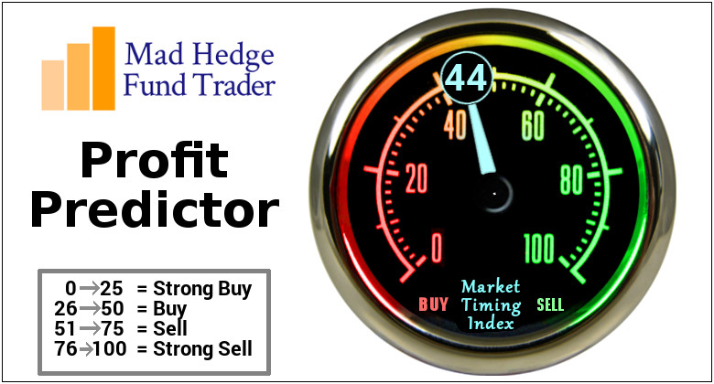
The Mad Hedge Profit Predictor Market Timing Index- An artificial intelligence driven algorithm that analyzes 30 different economic, technical, and momentum driven indicators

Slide 10
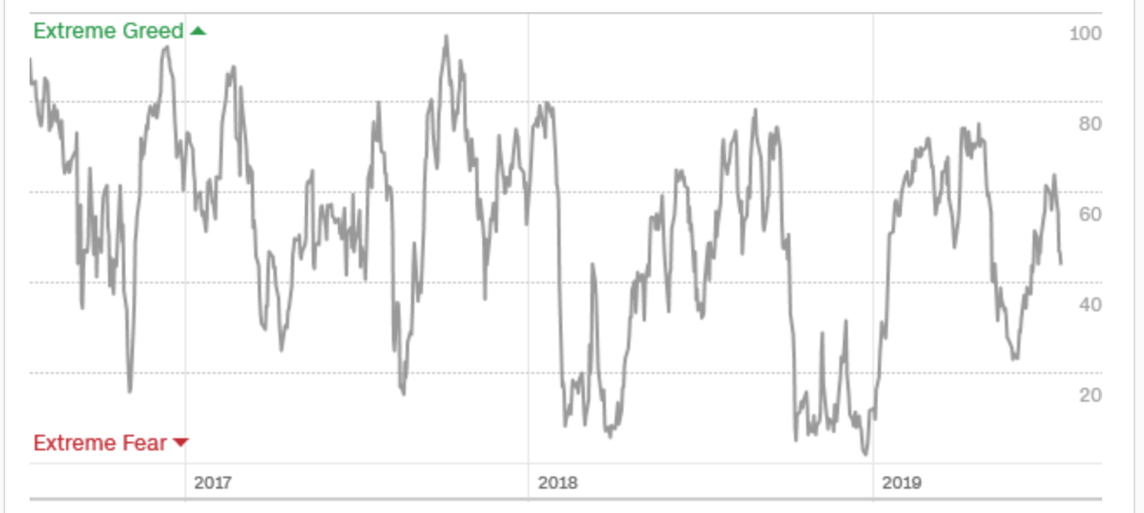
The Mad Hedge Profit Predictor Dead in the Middle Means Nothing to Do
SELL
BUY

Slide 11
The Global Economy – Rate Dependent
*All asset classes now totally dependent on US interest rates *Cuts bring a slow grind upward, no cuts bring a crash *Big chunks of small US retailing and manufacturing will go under *European is accelerated downward economic spiral, will spill into the US *Big Chinese yuan devaluation offsetting cost of tariffs, will continue, *The world turning to negative interest rates tells us that worst to come *”No Deal” Brexit acceleration throws the fat on the fire

Slide 12
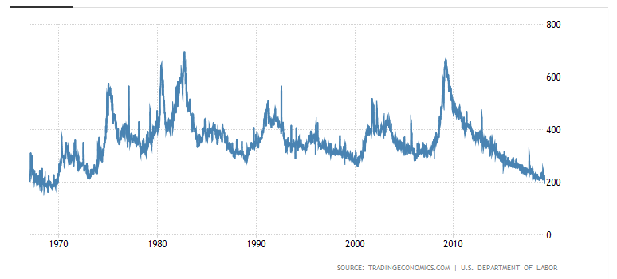
Weekly Jobless Claims +8,000 to 216,000

Slide 13
Soybeans (-20%)-Trade War Indicator Weather May Finally Be the Bigger Factor than Trade

Slide 14
The Bill Davis View A $1,500 Upgrade for the Mad Day Trader Service
Buys: | Entry | Target
Palo Alto Networks (PANW) | $ 213.00 | $ 240.00
International Business Mach (IBM) | $ 146.00 | $ 155.00
Zebra Technologies (ZBRA) | $ 182.00 | $ 200.00
Lennox Intl Inc. (LII) | $ 266.00 | $ 290.00
Johnson & Johnson (JNJ) | $ 131.00 | $ 142.00
Sells:
Arista Networks, Inc (ANET) | $ 282.00 | $ 250.00
Humana Inc. (HUM) | $ 292.00 | $ 255.00
Burlington Stores (BURL) | $ 185.00 | $ 163.00
Kohls Corp (KSS) | $ 57.00 | $ 42.00
Cognizant Technology (CTSH) | $ 70.00 | $ 55.00

Slide 16
Stocks – Topping Out
*The Fed is in the driver’s seat now, everything hangs on next weeks interest rate cuts *Growth stocks are beating earnings expectations, old line industrials disappointing *The trade war has gone on for so long it’s become a non issue *July has brought a round of earnings downgrades and disappointments *Antitrust threats and huge fines put a cloud over the FANG’s (FB), (AAPL), (NFLX), (GOOGL) *However, the prospect of sharp interest rate cuts is putting a high floor under stock prices *With interest rates approaching zero there is no place else to go except cash *Bottom line: flat to 10% down market for the next 3-6 months, then new highs propelled by ultra low interest rates or a China trade deal *Bottom Line: its bet the ranch time on tech longs, but stay away from those with big China exposure, like Apple, and weak dollar plays like energy, and emerging markets

Slide 17
S&P 500- Run at a New High stopped out of long 2/$285-$290 bear put spread took profits on long 2/$270-$275 bear put spread

Slide 18
Dow Average ($INDU)-

Slide 19
Russell 2000 (IWM)- Rolling Over out for even Long 4/$160-$165 vertical bear put spread

Slide 20
NASDAQ ($COMPQ) – New High

Slide 21
(VIX)- In “BUY” Territory

Slide 22
iPath S&P 500 VIX Short-Term Futures ETN (VXX) – New Low

Slide 23
Microsoft (MSFT)- Earnings beat- Looking for Another Entry Point long 6/$110-$115 call spread-out at cost took profits on long 4/$108-$113 call spread took profits on long 2/$85-$90 call spread

Slide 24
Facebook (FB)- FANG bounce

Slide 25
Apple (AAPL)- China Target – 5G Chip Buy stopped out of long 3/$180-$185 bear put spread stopped out of long 11/$175-$180 bear put spread took profits on long 11/$165-$175 bear put spread

Slide 26
Alphabet (GOOGL)- Earnings Shock stopped out of long 5/$1,100-$1,130 bull call spread took profits on long 4/$1,080-$1,120 bull call spread

Slide 27
Amazon (AMZN)-Back to Top of Range stopped out of long 4/$1,650-$1,700 call spread took profits on long 4/$1,600-$1,650 call spread took profits on long 2/$1,200-$1,300 call spread

Slide 28
PayPal (PYPL)-Fintech Star took profits on long 4/$90-$95 call spread

Slide 29
NVIDIA (NVDA) - earnings beat

Slide 30
Micron Technology (MU)-

Slide 31
Salesforce (CRM)- took profits on long 2/$105-$115 call spread

Slide 32
Boeing (BA)- took profits on long 4/$315-$335 call spread Next to happen in the recertification bounce

Slide 33
Walt Disney (DIS)- Summer Blockbuster Wave Stopped out of $125-$130 call spread for small loss took profits on long 4/$100-$104 call spread Covered Short 4/$114 calls

Slide 34
Adobe (ADBE)- The Quality Non-China tech play

Slide 35
Industrials Sector SPDR (XLI)- (GE), (MMM), (UNP), (UTX), (BA), (HON)

Slide 36
US Steel (X)-Tariffs Trouble Import duties cause users to abandon steel Unwound the entire Trump trade

Slide 37
Tesla (TSLA)- looking for big Q2 improvement announced in July took profits on long 6/$140-$150 call spread – expires in 7 trading days took profits on long 6/$240-$250 put spread – expires in 7 trading days stopped out of long 4/$300-$320 put spread
Major Support

Slide 38
Southwest Airlines (LUV) - Boeing 737 Max biggest buyer

Slide 39
Delta Airlines (DAL) – Non 737 User

Slide 40
Transports Sector SPDR (XTN)- (ALGT), (ALK), (JBLU), (LUV), (CHRW), (DAL)

Slide 41
Health Care Sector (XLV), (RXL)-New Highs (JNJ), (PFE), (MRK), (GILD), (ACT), (AMGN)

Slide 42
Goldman Sachs (GS)- Upside Breakout

Slide 43
Palo Alto Networks (PANW)- Hacking never goes out of fashion

Slide 44
Consumer Discretionary SPDR (XLY) (DIS), (AMZN), (HD), (CMCSA), (MCD), (SBUX)

Slide 45
Europe Hedged Equity (HEDJ)-

Slide 46
Japan (DXJ)-

Slide 47
Emerging Markets (EEM)- Time to Buy on Weak Dollar

Slide 49
Bonds – New Multi Year Highs
*US ten year rates plunge to 1.95%, discounting half of the next three Fed rate cuts *Record amounts of money pouring out of stock ETF’s into bond ETF’s *The huge move has taken place despite a Chinese boycott of the market, historically 50% of the new issue market *Collapsing global economies sending a huge flight to safety bid to bonds *25% of the world’s bonds now have negative interest rates *German bund yields plunge to -0.39%, while Japan government bonds turn in a -0.14% yield *Global free money puts a high floor under all asset classes, but won’t spur them to new highs either

Slide 50
Treasury ETF (TLT) – took profits on long 8/$125-$128 call spread took profits on long 6/$128-131 bear put spread took profits on long 5/$116-$119 bull call spread

Slide 51
Ten Year Treasury Yield ($TNX) – Bounce Back to 2.05% Breakdown

Slide 52
Junk Bonds (HYG) 5.58% Yield big jump in yields on stock selloff and recession fears

Slide 53
2X Short Treasuries (TBT)- 2 Month Topping Process

Slide 54
Emerging Market Debt (ELD) 5.80% Yield-

Slide 55
Municipal Bonds (MUB)-2.03% Mix of AAA, AA, and A rated bonds

Slide 57
Foreign Currencies – The US Dollar is Done
*With 3 Fed rate interest rates cuts now a sure thing the dollar is done *Major upside reversal in the Aussie is due with a seven year reversal in play *If Boris become prime minister in the UK the pound goes to parity *Massive Chinese intervention is stabilizing the yuan at low levels *Bitcoin rallies big on flight to safety, then crashes on regulation fears *Bottom Line: Sell the US dollar against everything

Slide 58
Japanese Yen (FXY), (YCS)

Slide 59
Euro ($XEU), (FXE), (EUO)- Trying to Break Down

Slide 60
Australian Dollar (FXA)- The Global Recovery Play took profits on long 8/$67-$69 call spread

Slide 61
Emerging Market Currencies (CEW)

Slide 62
Chinese Yuan- (CYB)-

Slide 63
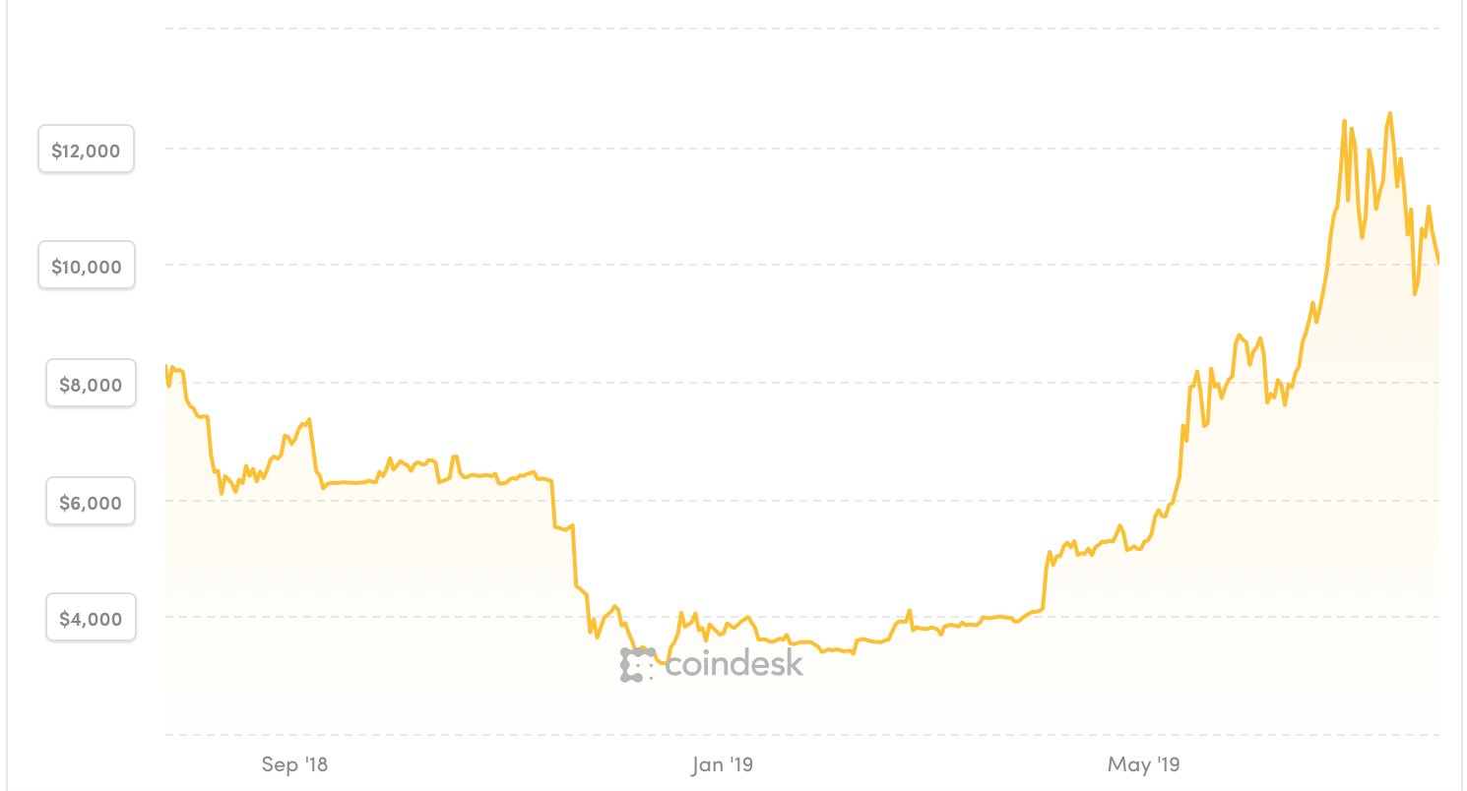
Bitcoin- 45% Rally Global Liquidity Surge

Slide 65
Energy – Global Recession Fears Ramp Up
*Oil takes another run at the lows prompted by slowing global economy and rising US production *US output to rise 5 million barrels a day to 17 million b/d over next five years *June China oil imports fall 7.2% due to slowing economy *Libya resumes oil production, putting a meager 290,000 barrels a day back on the market *Venezuela failed state is off the market *Bottom Line: looks like $42 a barrel is in the cards

Slide 66
Oil-($WTIC)

Slide 67
United States Oil Fund (USO)

Slide 68
Energy Select Sector SPDR (XLE)-No Performance! (XOM), (CVX), (SLB), (KMI), (EOG), (COP)

Slide 69
Halliburton (HAL)-

Slide 70
Natural Gas (UNG)-

Slide 72
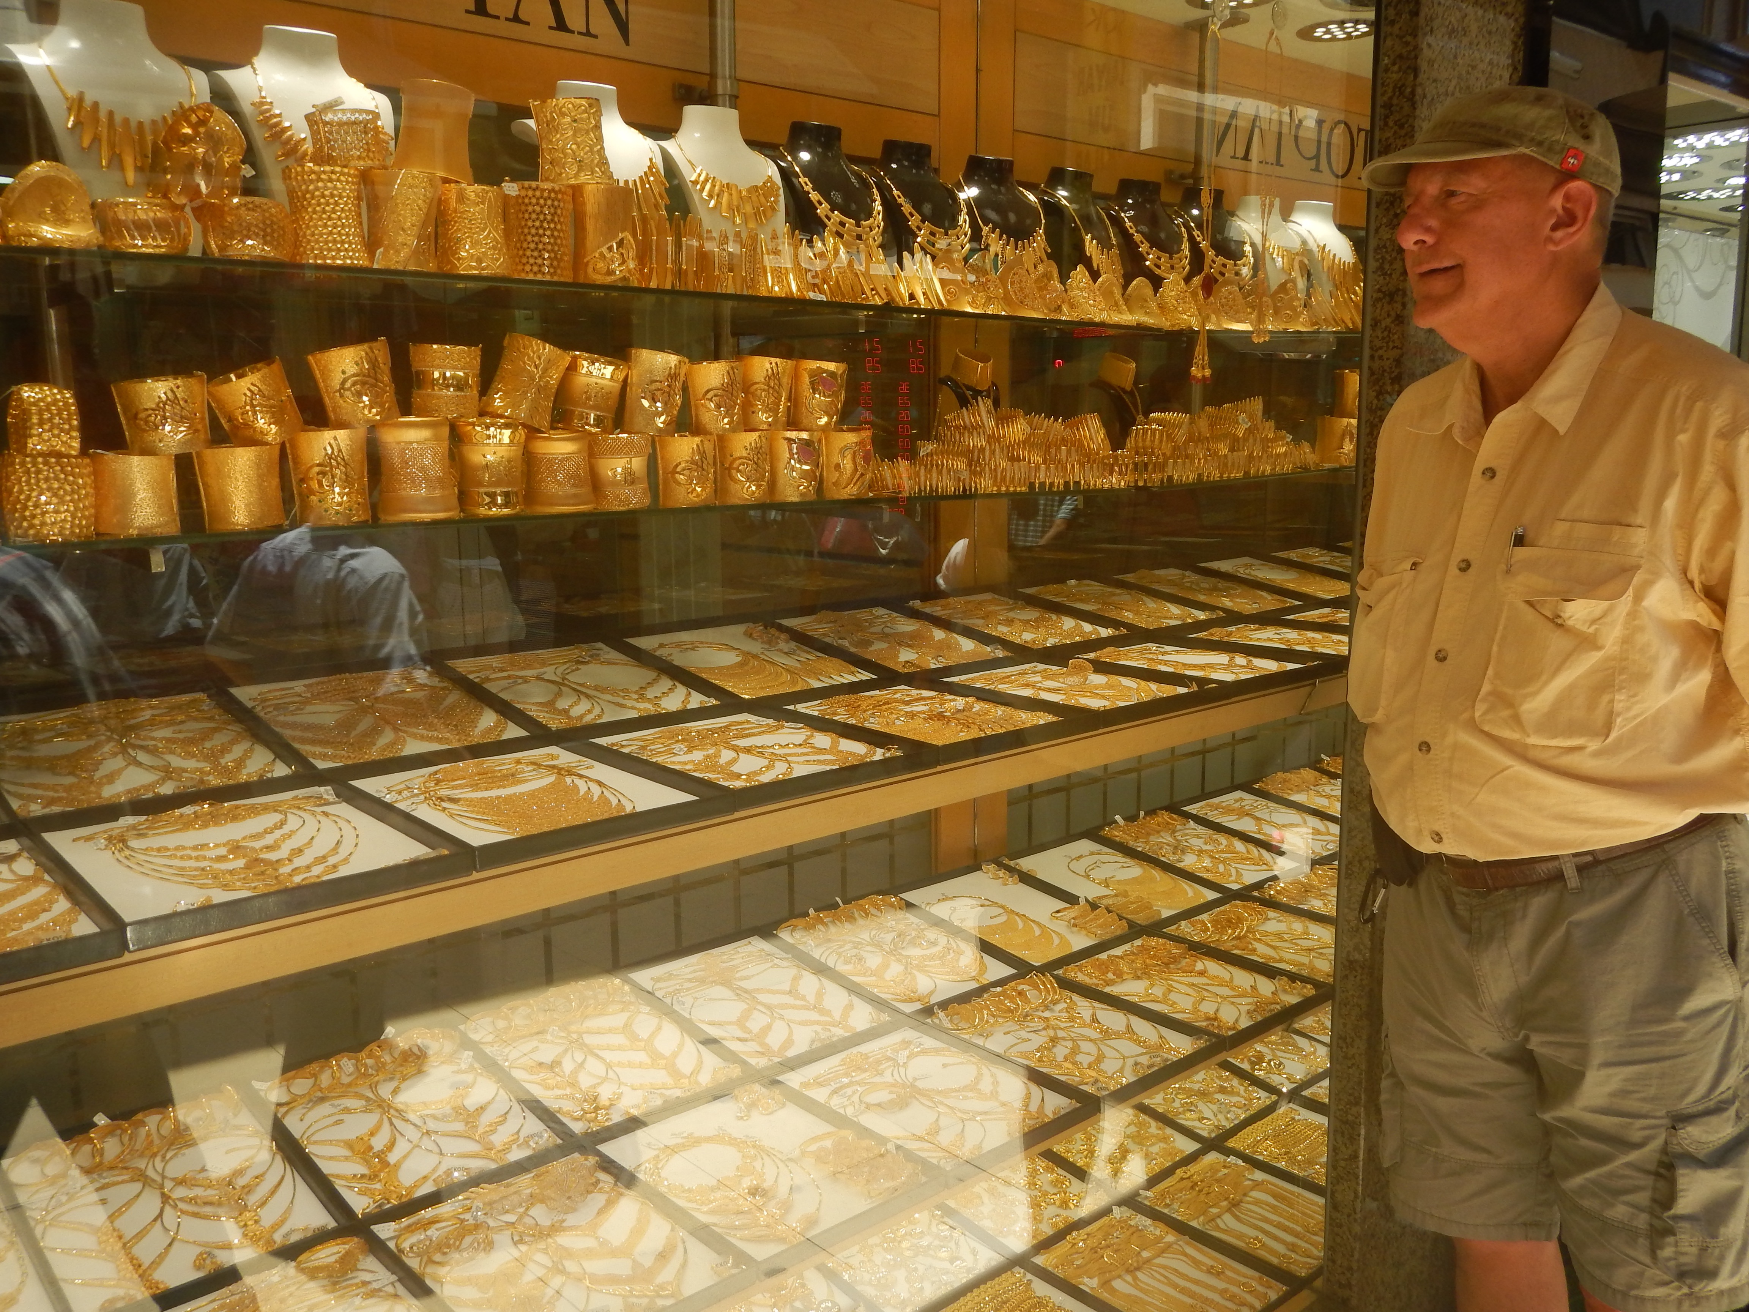
Precious Metals – Going Ballistic
*Gold breaks out to new five year new highs, charts are coiling for more upside breakout *Central banks accelerating gold purchases in the face of a falling dollar *China, Russia, and Iran have been dominating purchasers *Imminent collapse of US interest rates starting next week is the principal driver, and once started it could continue for a year *Bitcoin crashes again *Bottom Line: buy every dip in gold and precious metals

Slide 73
Gold (GLD)- New 5 Year Highs

Slide 74
Market Vectors Gold Miners ETF- (GDX) – Yikes!

Slide 75
Barrick Gold (GOLD)

Slide 76
Newmont Mining- (NEM)-

Slide 77
Palladium - (PALL)-

Slide 78
Copper (COPX)-Collapse Trade War Disaster

Slide 79
Freeport McMoRan (FCX)-World’s Largest Copper Producer long 8/$9.00-$10.00 call spread took profits on long 4/$10-$11 call spread took profits on short 4/$114 calls

Slide 80
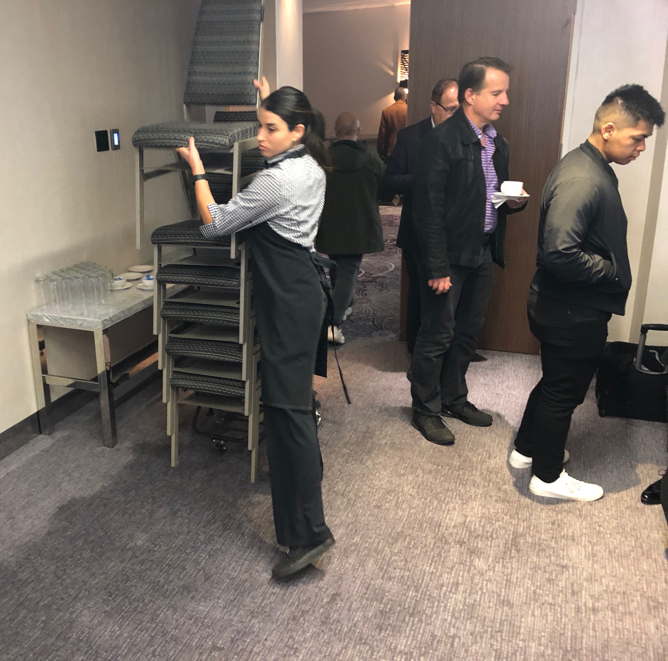

Slide 81
Real Estate – Still Falling
*Abandoned homes hit new all time high, up 20% on homes on rural areas and former midwestern manufacturing areas, with most already in foreclosure *30 Year conventional fixed rate mortgage now as low as 3.80%, a two year low *Market is dominated by a shortage of entry level homes and a glut of high end homes *July homebuilder sentiment rises one point to 65, anything above 50 is positive
*April S&P 500 Case-Shiller drops to a 3.5%, annual gain, the lowest gain in 6 1/2 years *Bottom Line: Stand aside for a trade but buy for long term investment

Slide 82
February Corelogic S&P Case Shiller Home Price Index Las Vegas (7.1%), Phoenix (6.0%), and Tampa (5.6%) showing biggest gains
Tradingeconomics.com

Slide 83
Simon Property Group (SPG)-

Slide 84
US Home Construction Index (ITB) (DHI), (LEN), (PHM), (TOL), (NVR)

Slide 85
Trade Sheet- So What Do We Do About All This?
*Stocks-buy the big 500 point down days *Bonds-buy dips *Commodities-buy dips *Currencies-sell US dollar again (FXA), (FXE) *Precious Metals – buy dips *Volatility-buy dips *Real estate-stand aside

Slide 86
Next Strategy Webinar 12:00 EST Wednesday, August 7, from Silicon Valley, CA email me at support@madhedgefundtrader.com
Good Luck and Good Trading!
Notes:
*

