Slide 1
The Mad Hedge Fund Trader “The Short Play is On”
With John Thomas from Silicon Valley, CA, August 7, 2019 www.madhedgefundtrader.com
Notes:
*

Slide 2
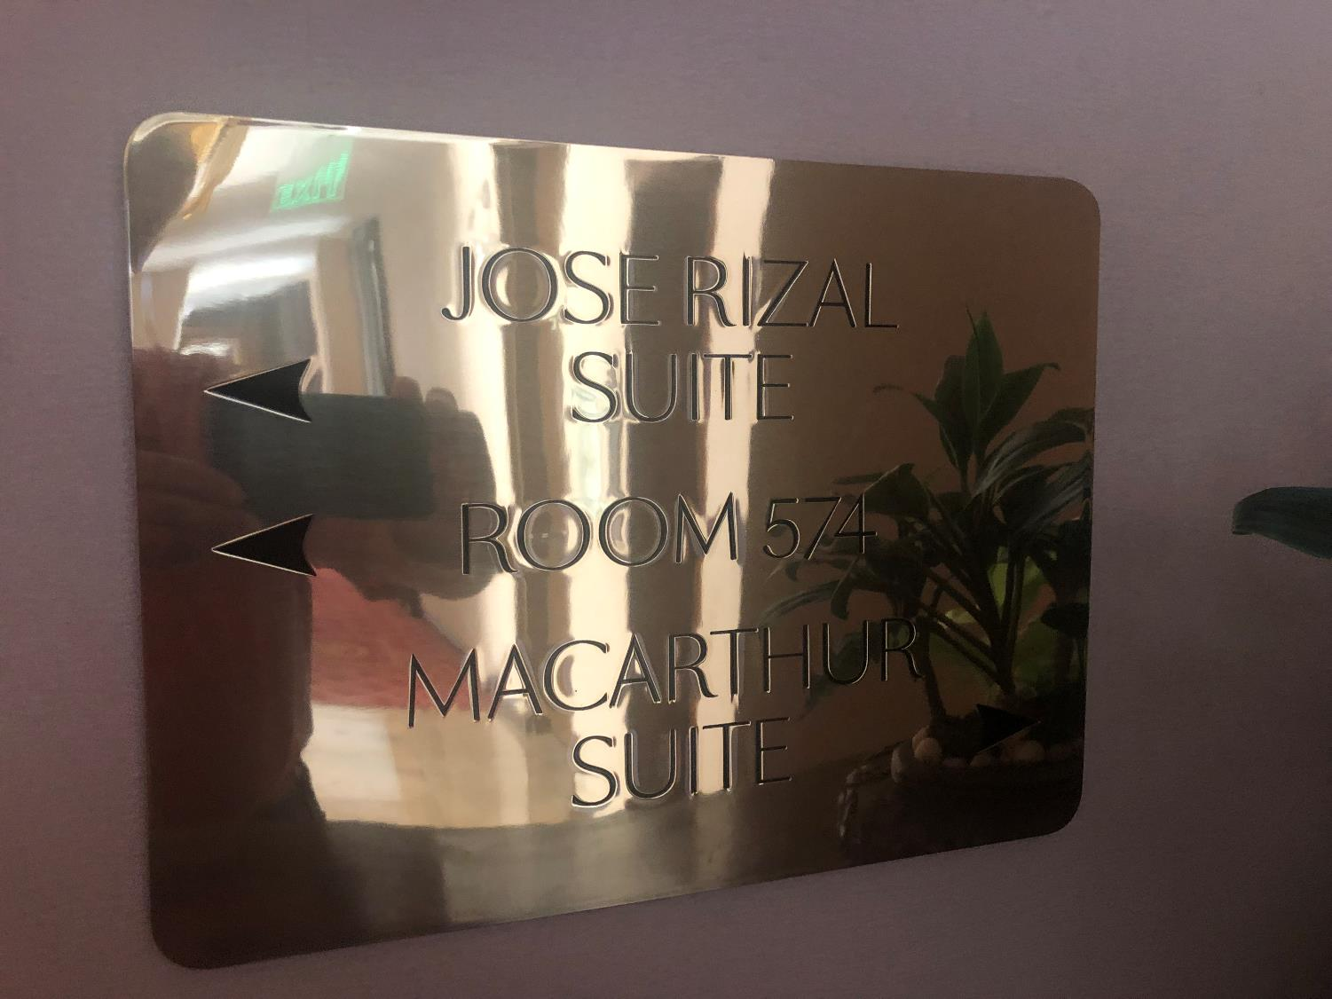

Slide 3
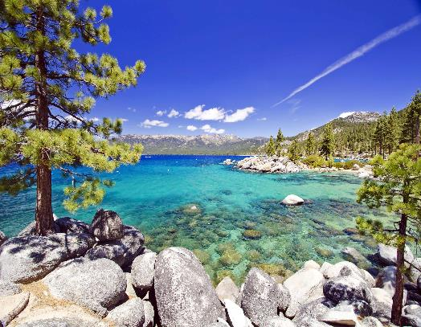
October 25-26 Lake Tahoe Conference
*Two days of informative speakers on crucial trading and investment issues *Trade tips with the most successful Mad Hedge traders *2 nights in the Hyatt, including all you can eat and drink *Tickets are a bargain at $699 to $1,999 *Buy now, upper ticket classes sell out first

Slide 4
Trade Alert Performance New Highs!
*January 9.49% Final *July +3.07% MTD *February +4.64% Final *August +3.63% MTD *March +1.78% Final *September 1.38% Final *April +0.30% Final *October +1.37% Final *May +0.25% Final *November -1.83% Final *June -0.50% Final *December -4.13% Final *2019 Year to Date +8.9% compared to +21.96% for the Dow Average *+322.10% since inception, *Average annualized return of 33.13% for 10 years

Slide 5
Portfolio Review Keeping Small Positions Only Buying Very Deep in-the-Money on Capitulation Days
Risk On
World is Getting Better
NO POSITIONS
Risk Off
(M) 8/$23-$25 put spread | -10.00%
(WMT) 8/$114-$117 put spread) | -10.00%
Total Net Position | -20.00%
Expiration P&L 23.22%

Slide 6
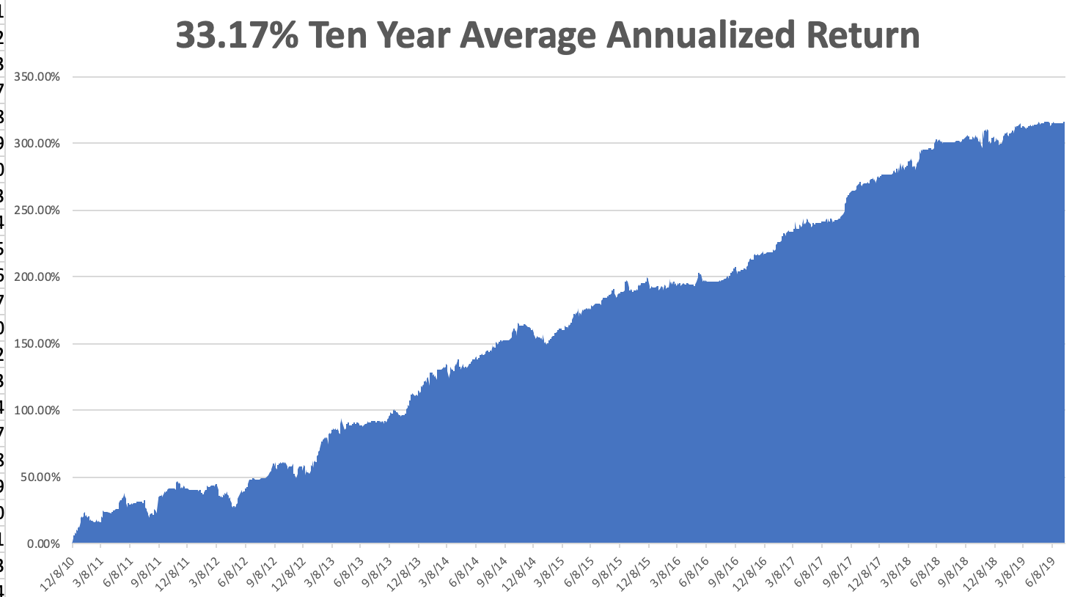
GTD 10 Year Daily Audited Performance

Slide 7
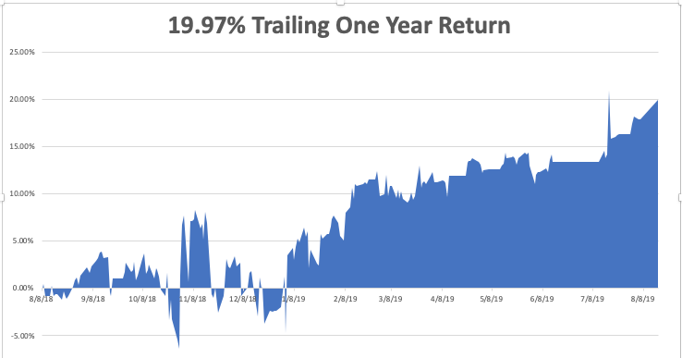

Slide 8
The Method to My Madness
*Long overdue correction now in play, sell every rally *Fed rate cut was the greatest “Sell the news” of all time, and was completed negated by Trumps dramatic escalation of the trade war within 24 hours *Is Trump inviting a recession to force interest rate cuts *Bonds now discounting a recession at 1.74% on ten year *Another Fed 25 basis point rate cut due in September *Plunging rates have killed the US dollar, making weak dollar plays like (TLT) and(GLD) the number one pick for short term trading *Oil suffers instant 20% correction on global recession fears, not even a tanker war can support it

Slide 9
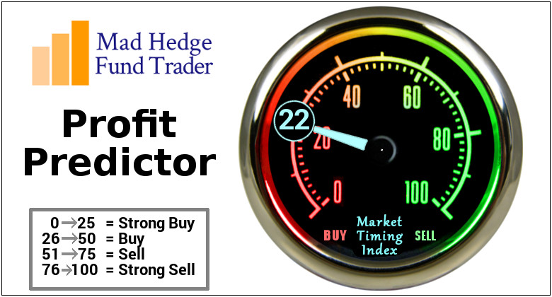
The Mad Hedge Profit Predictor Market Timing Index- An artificial intelligence driven algorithm that analyzes 30 different economic, technical, and momentum driven indicators

Slide 10
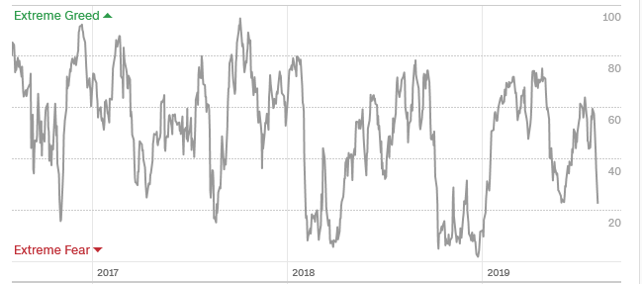
The Mad Hedge Profit Predictor Headed Towards a “BUY”
SELL
BUY

Slide 11
The Global Economy – Global Collapse
*All major economies are now slowing *The US is still the strongest economy in the world, but is fading fast *China tariff increases squarely aimed at retailers, right when the Christmas season is at sea *European is accelerated downward economic spiral, will spill into the US, Germany has dropped from 2.0% growth to 0.5% since January *Big Chinese yuan devaluation offsetting cost of tariffs, will continue, *The world turning to negative interest rates tells us that worst to come *”No Deal” Brexit acceleration throws the fat on the fire, pound in free fall

Slide 12
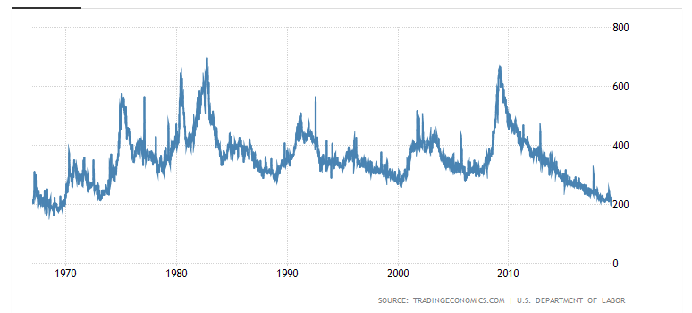
Weekly Jobless Claims +8,000 to 215,000

Slide 13
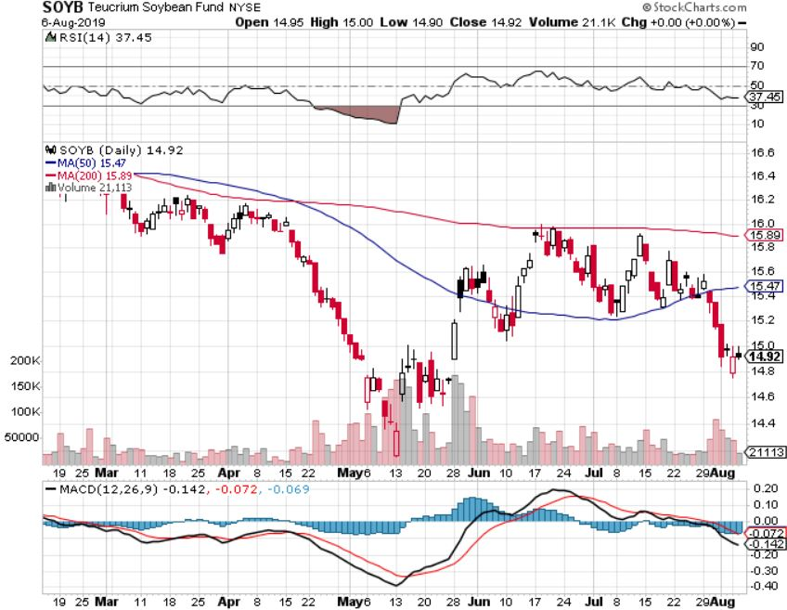
Soybeans - Trade War Indicator Trade Back to the Forefront

Slide 14
The Bill Davis View A $1,500 Upgrade for the Mad Day Trader Service
Buys: | Entry | Target
Palo Alto Networks (PANW) | $ 213.00 | $ 240.00
Zebra Technologies (ZBRA) | $ 196.00 | $ 225.00
Lennox Intl Inc. (LII) | $ 266.00 | $ 290.00
Adobe Systems, Inc (ADBE) | $ 275.00 | $ 295.00
Mastercard (MA) | $ 258.00 | $ 275.00
Sells:
Beldan Inc, (BDC) | $ 49.00 | $ 38.00
Grand Canyon Education (LOPE) | $ 122.00 | $ 108.00
GrubHub Inc. (GRUB) | $ 73.00 | $ 65.00
Clorox Co. (CLX) | $ 160.00 | $ 145.00
Beckton Dickinson (BDX) | $ 250.00 | $ 235.00

Slide 15
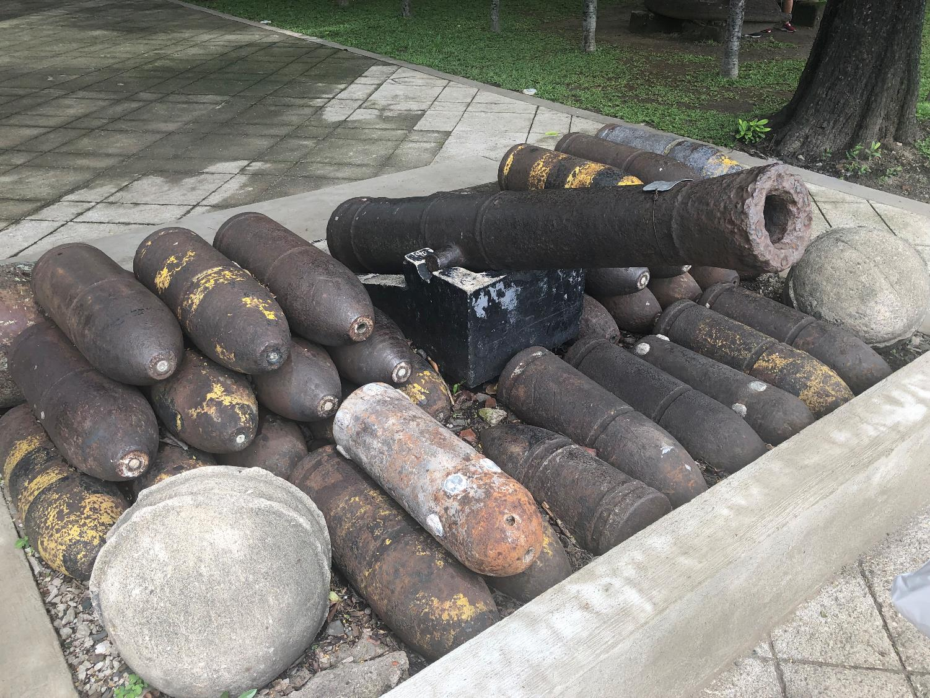

Slide 16
Stocks – The Short Play is On
*Fed rate cut was the turning point, then Trump poured gasoline of the fire with trade war *Tech stocks that led the upside are leading the downside, Apple is down $30, or 14% since earnings came out *Q2 earnings finished out weak, outlook is bleak *All eyes now on the trade war that could end on the next Tweet *Is this an 8% correction, or a December repeat at 20% *50% of stocks now yield more than ten year US Treasury bond yield at 1.75% *Bottom line: 8%-20% down market for the next 3 months, then new highs propelled by ultra low interest rates or a China trade deal *Bottom Line: its bet the ranch time on tech longs, but stay away from those with big China exposure, like Apple, and weak dollar plays like energy, and emerging markets

Slide 17
How to Play This Dip
*The bull market is not over, it’s only taking a rest *Don’t jump in too soon, we are only one week into this *Whatever has gone down the most will go up the most on the other side *But big tech and semis across the board *At the bottom buy long term 1-2 year LEAPS on the best quality names with 50%-100% potential returns *Don’t buy energy, retailers, industrials, or financials on pain of death

Slide 18
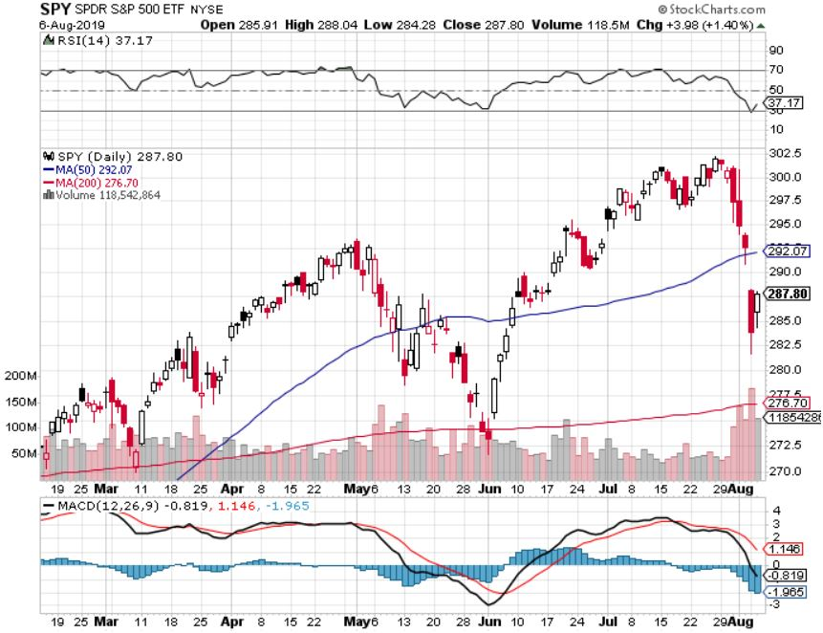
S&P 500- Run at a New High took profits on long 8/$305-$308 bear put spread stopped out of long 2/$285-$290 bear put spread took profits on long 2/$270-$275 bear put spread

Slide 19
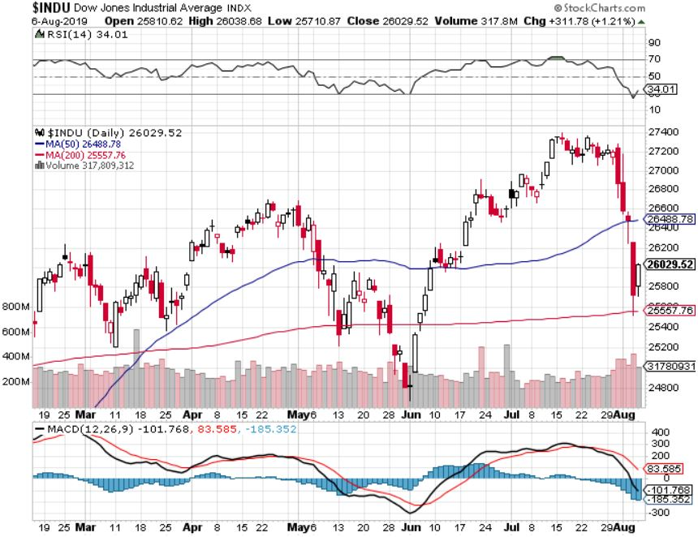
Dow Average ($INDU)-

Slide 20
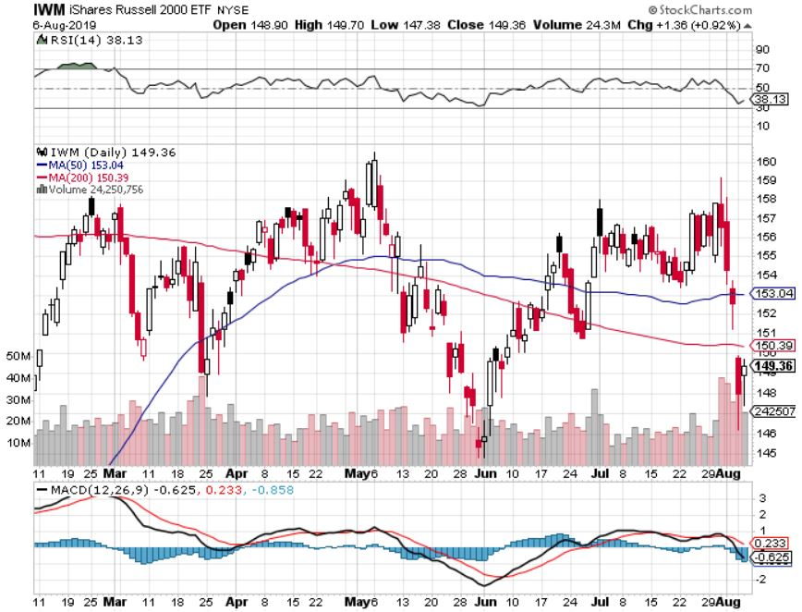
Russell 2000 (IWM)- Rolling Over Long 8/$158-$161 vertical bear put spread out for even Long 4/$160-$165 vertical bear put spread

Slide 21
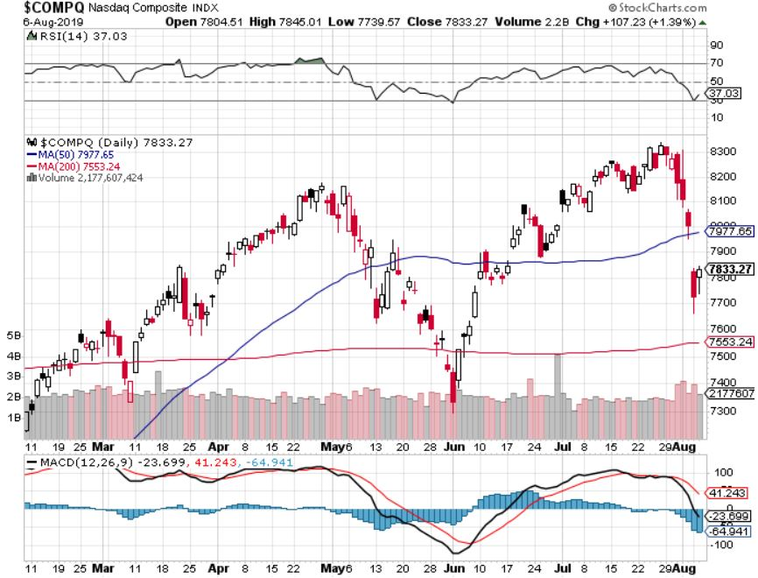
NASDAQ ($COMPQ) – New High

Slide 22
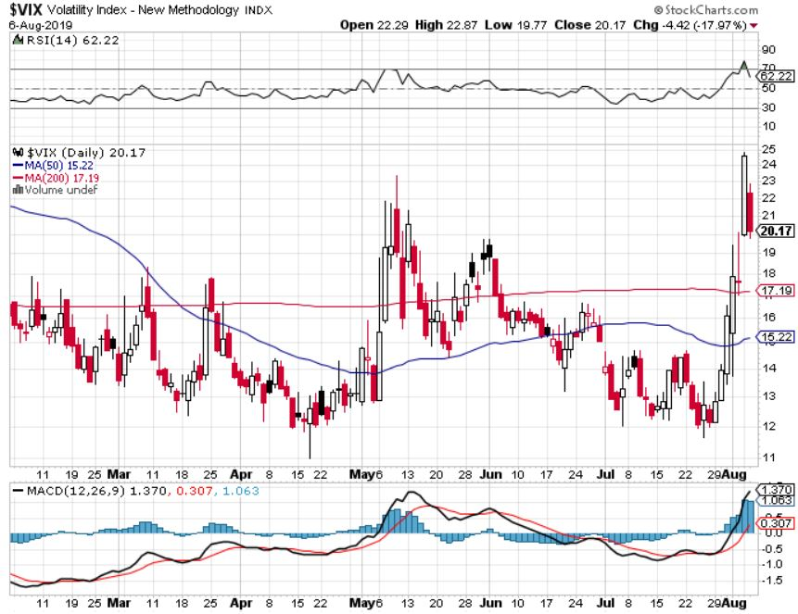
(VIX)- In “BUY” Territory

Slide 23
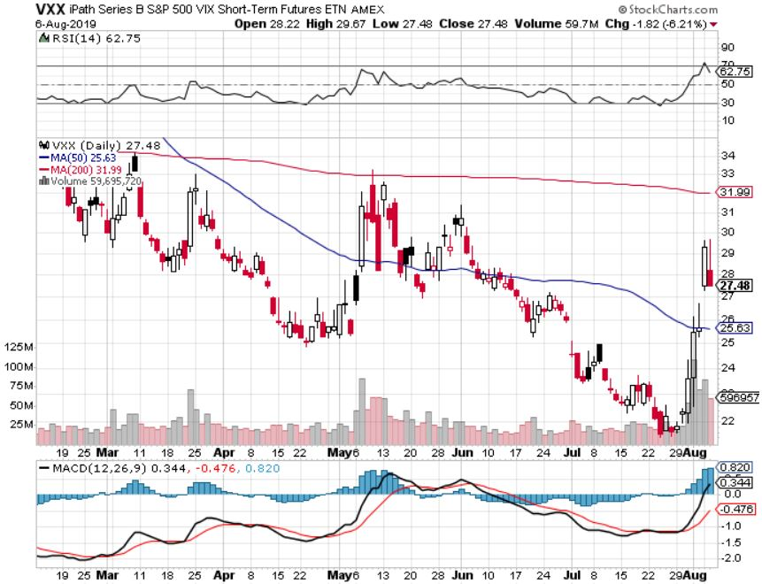
iPath S&P 500 VIX Short-Term Futures ETN (VXX) – New Low

Slide 24
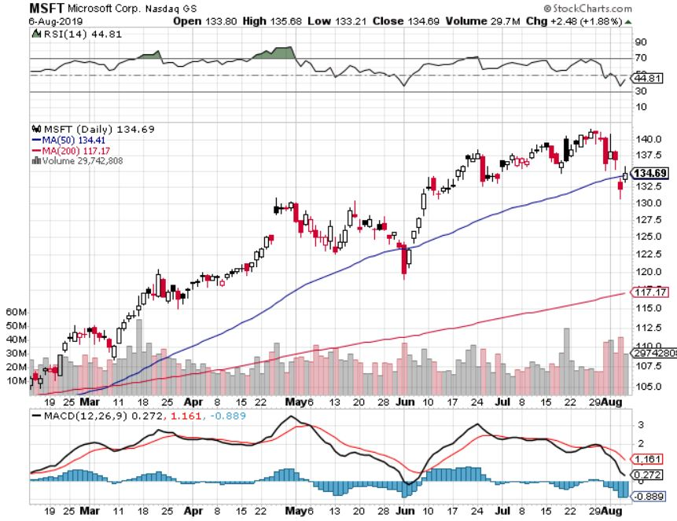
Microsoft (MSFT)- Earnings beat- Looking for Another Entry Point long 6/$110-$115 call spread-out at cost took profits on long 4/$108-$113 call spread took profits on long 2/$85-$90 call spread

Slide 25
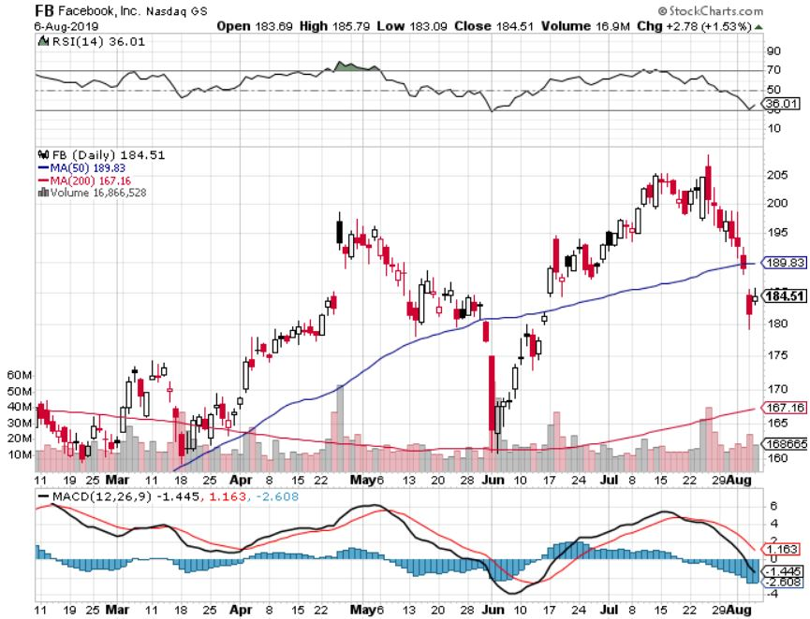
Facebook (FB)-

Slide 26
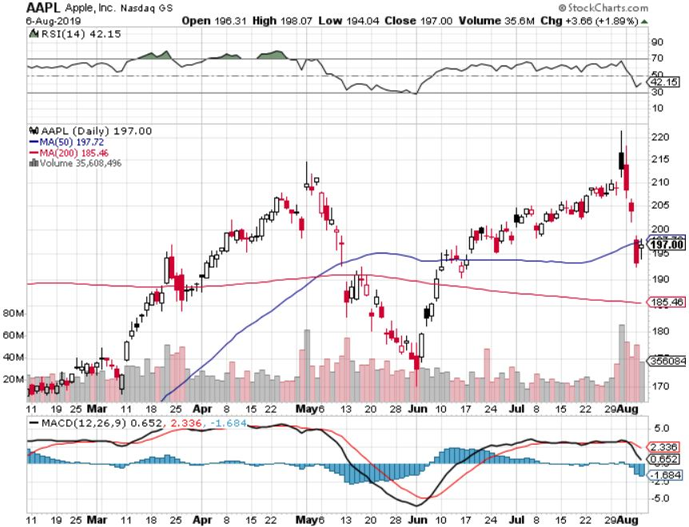
Apple (AAPL)- China Target – 5G Chip Buy

Slide 27
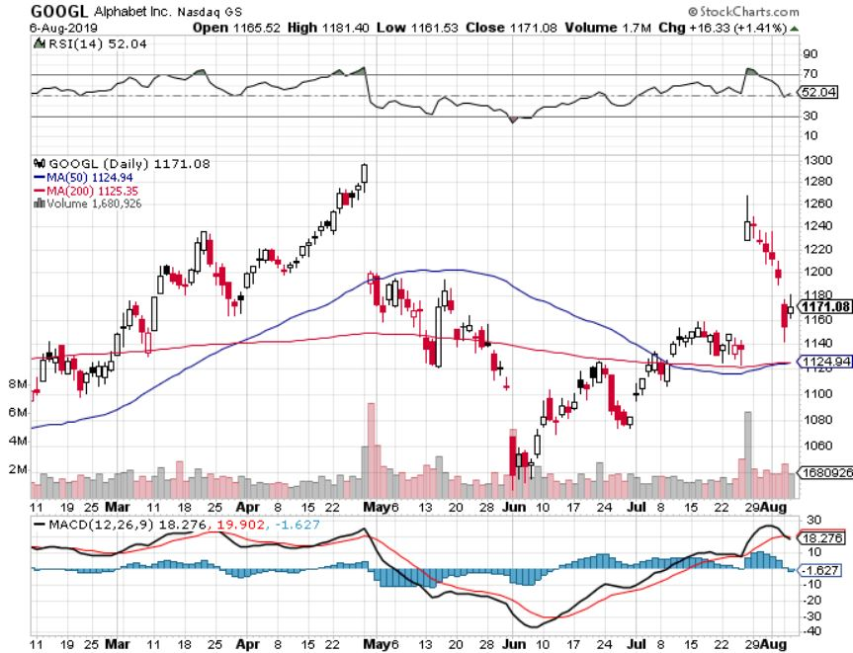
Alphabet (GOOGL)- Earnings Shock stopped out of long 5/$1,100-$1,130 bull call spread took profits on long 4/$1,080-$1,120 bull call spread

Slide 28
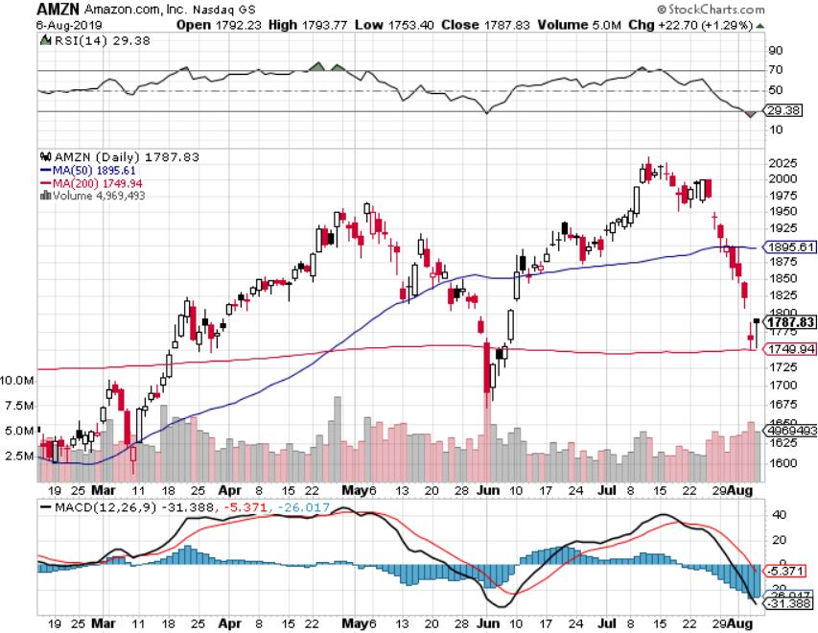
Amazon (AMZN)-Back to Top of Range stopped out of long 4/$1,650-$1,700 call spread took profits on long 4/$1,600-$1,650 call spread took profits on long 2/$1,200-$1,300 call spread

Slide 29
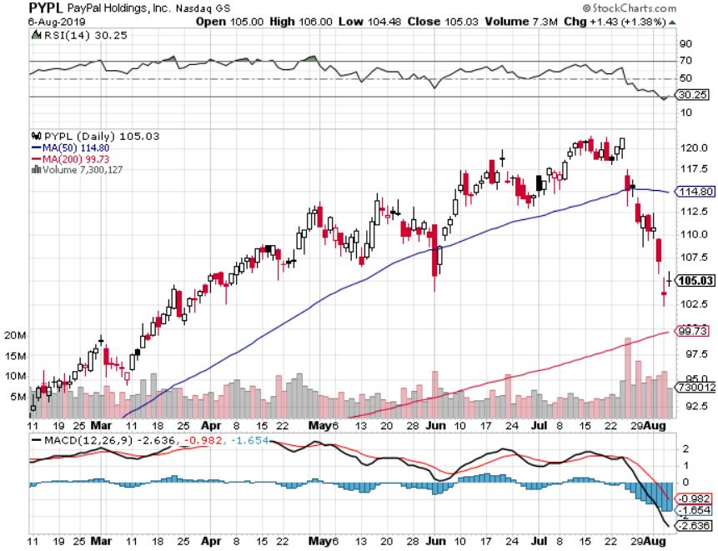
PayPal (PYPL)-Fintech Star took profits on long 4/$90-$95 call spread

Slide 30
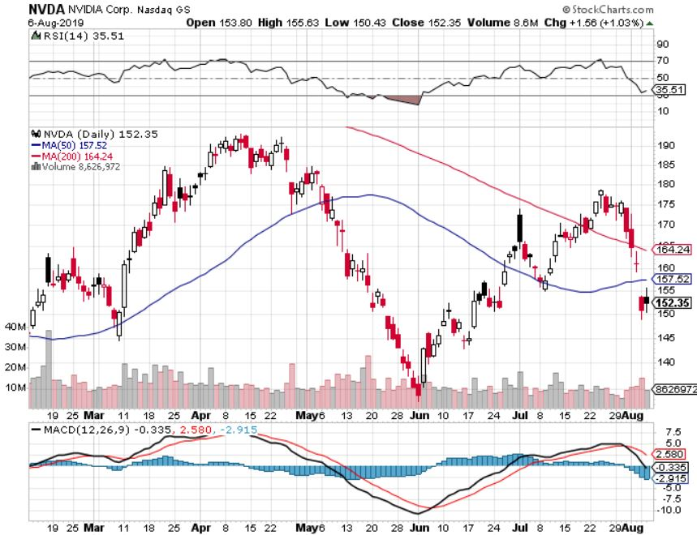
NVIDIA (NVDA) -

Slide 31
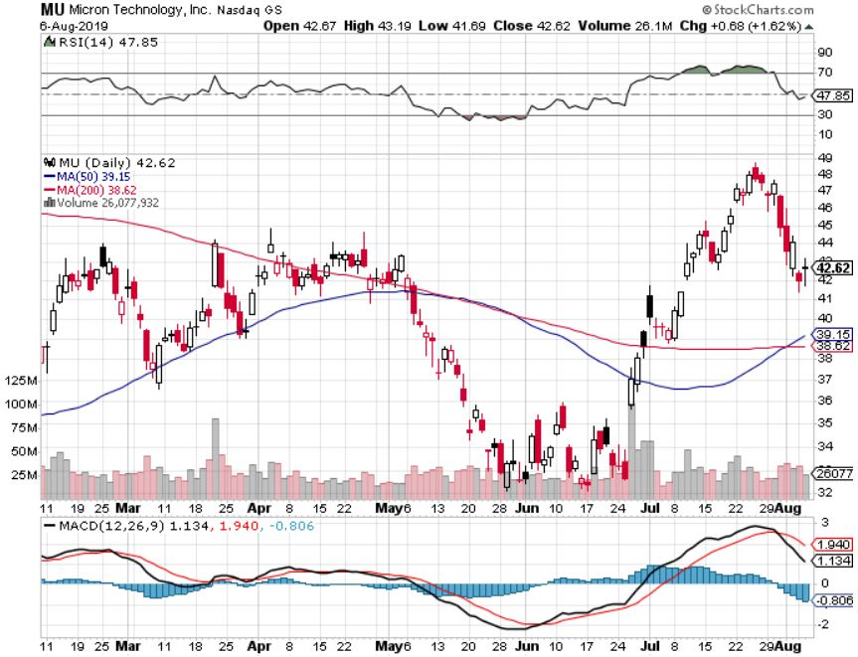
Micron Technology (MU)-

Slide 32
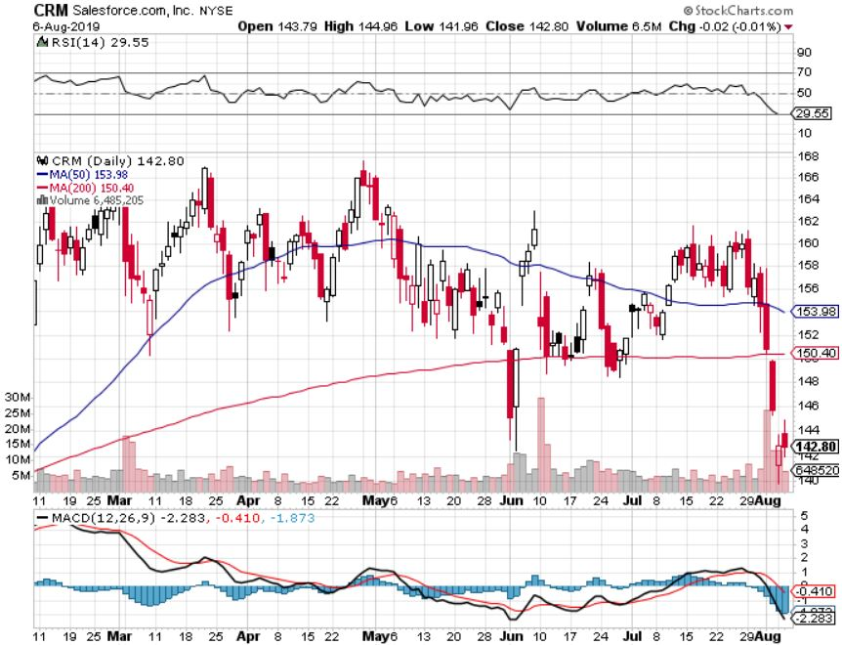
Salesforce (CRM)- took profits on long 2/$105-$115 call spread

Slide 33
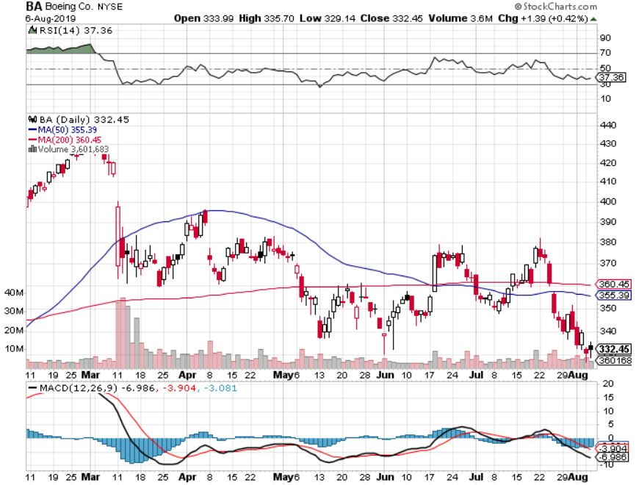
Boeing (BA)- took profits on long 4/$315-$335 call spread Next to happen in the recertification bounce

Slide 34
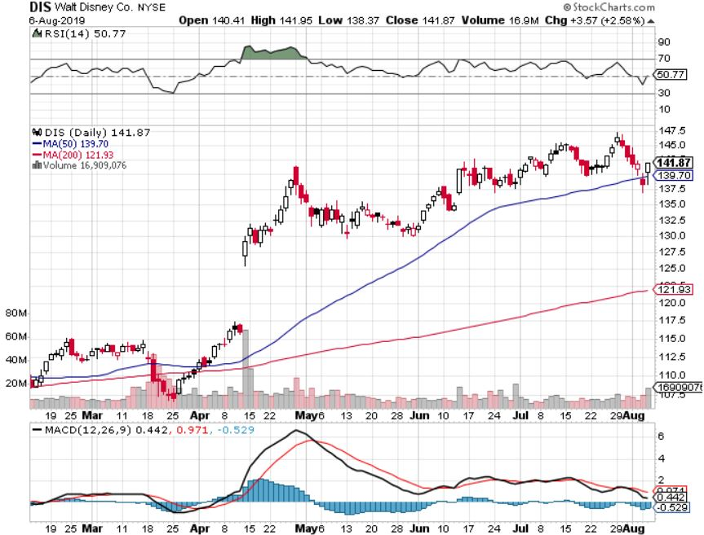
Walt Disney (DIS)- Summer Blockbuster Wave Stopped out of $125-$130 call spread for small loss took profits on long 4/$100-$104 call spread Covered Short 4/$114 calls

Slide 35
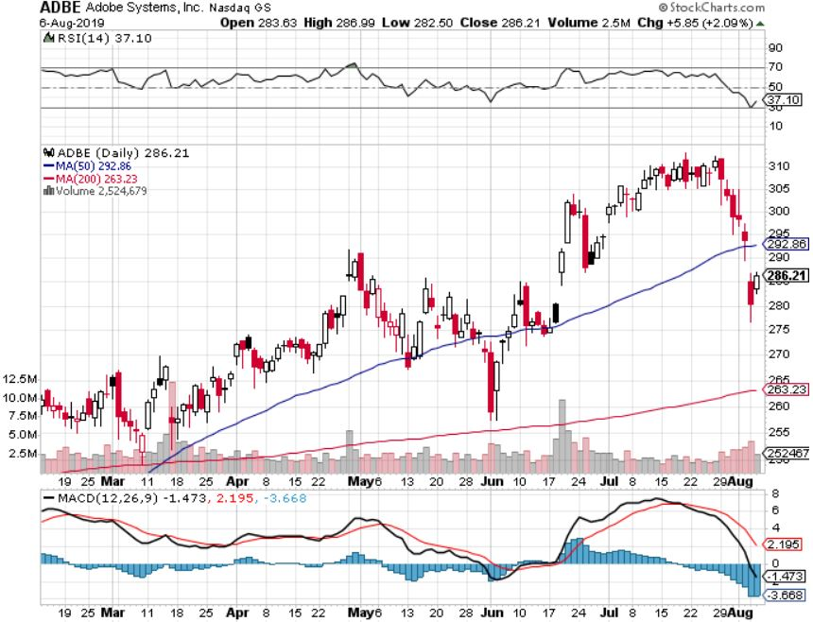
Adobe (ADBE)- The Quality Non-China tech play

Slide 36
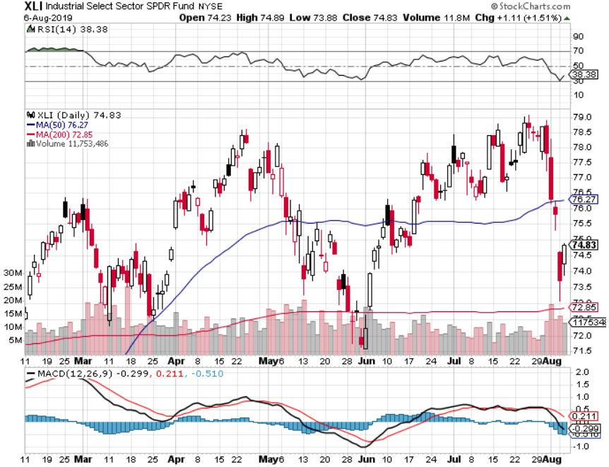
Industrials Sector SPDR (XLI)- (GE), (MMM), (UNP), (UTX), (BA), (HON)

Slide 37
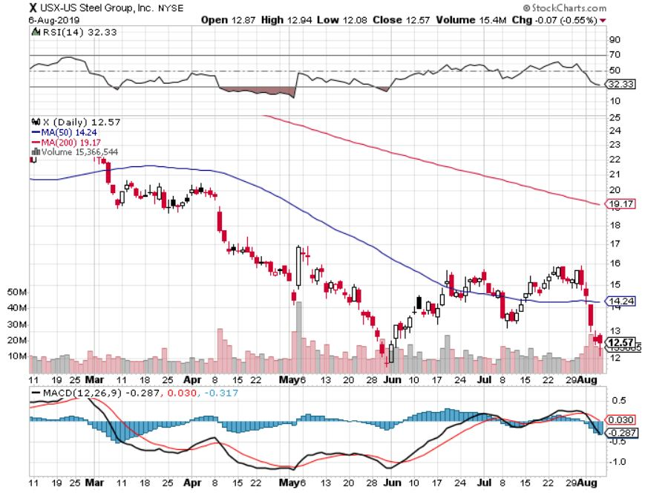
US Steel (X)-Tariffs Trouble Import duties cause users to abandon steel Unwound the entire Trump trade

Slide 38
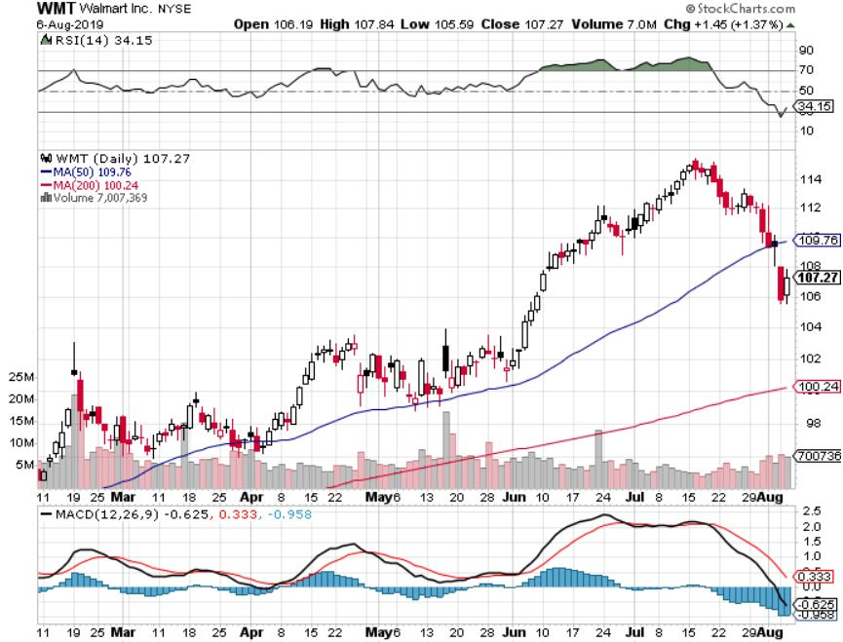
Wal-Mart (WMT)-Tariffs Trouble Long 8/$114-4117 bear put spread

Slide 39
Macys’ (M)-Tariffs Trouble Long 8/$23-$25 bear put spread

Slide 40
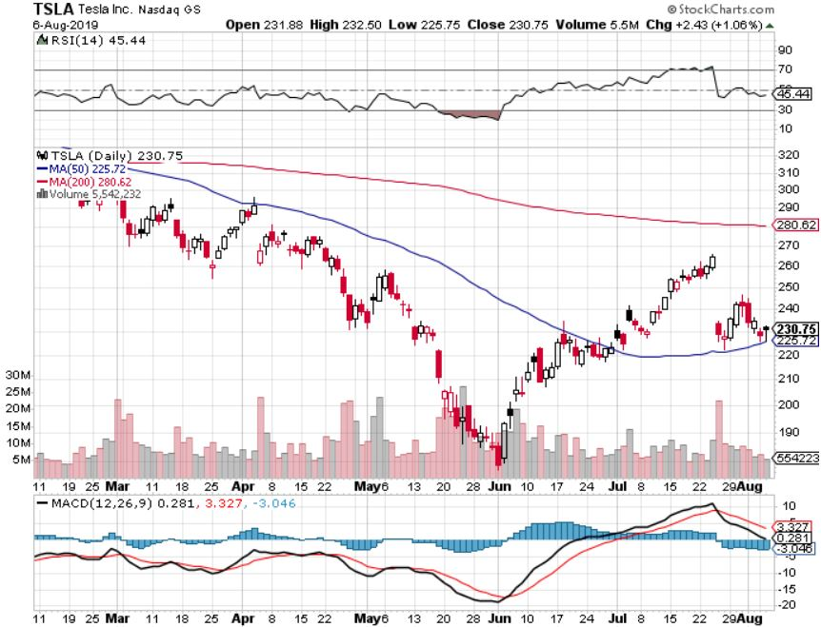
Tesla (TSLA)- looking for big Q2 improvement announced in July took profits on long 6/$140-$150 call spread – expires in 7 trading days took profits on long 6/$240-$250 put spread – expires in 7 trading days stopped out of long 4/$300-$320 put spread
Major Support

Slide 41
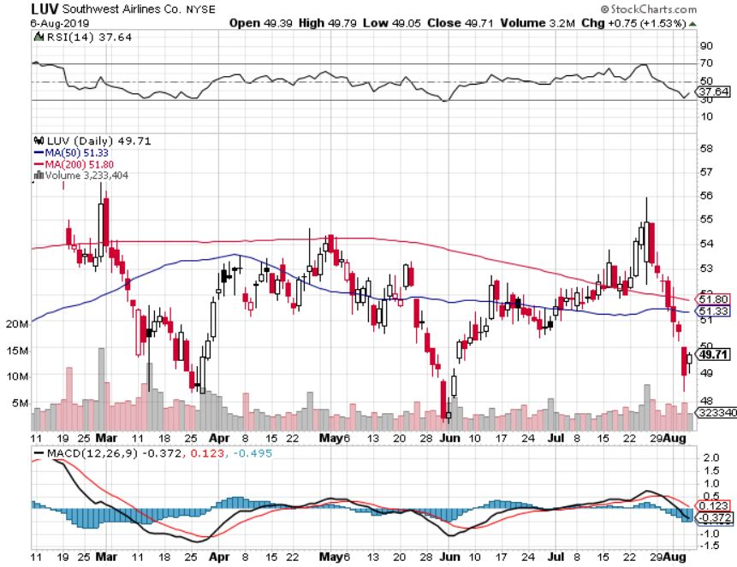
Southwest Airlines (LUV) - Boeing 737 Max biggest buyer

Slide 42
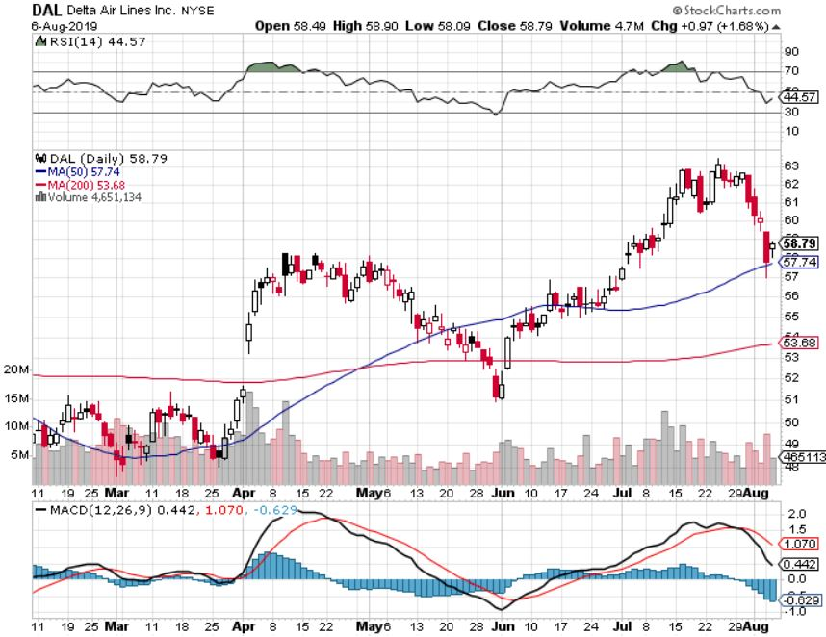
Delta Airlines (DAL) – Non 737 User

Slide 43
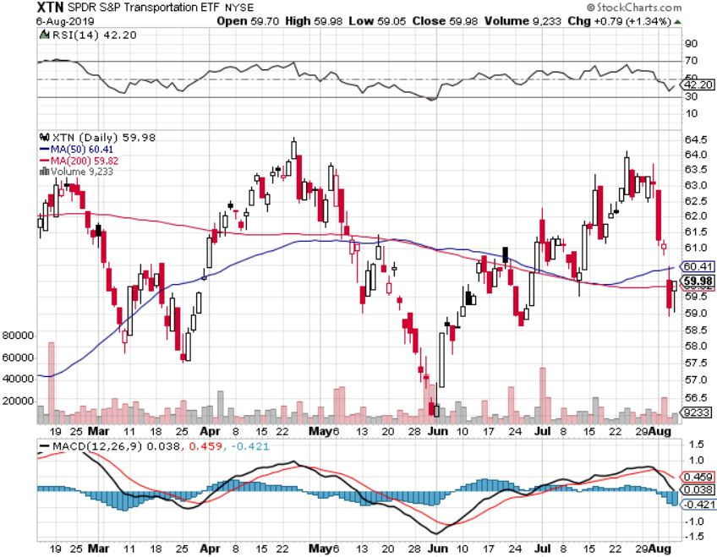
Transports Sector SPDR (XTN)- (ALGT), (ALK), (JBLU), (LUV), (CHRW), (DAL)

Slide 44
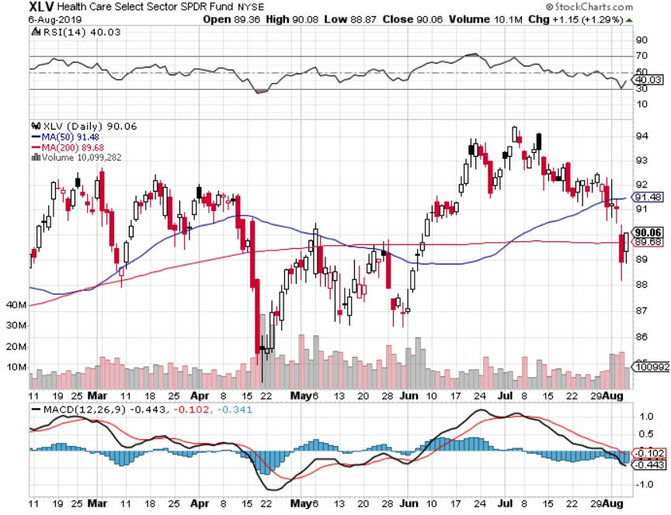
Health Care Sector (XLV), (RXL)-New Highs (JNJ), (PFE), (MRK), (GILD), (ACT), (AMGN)

Slide 45
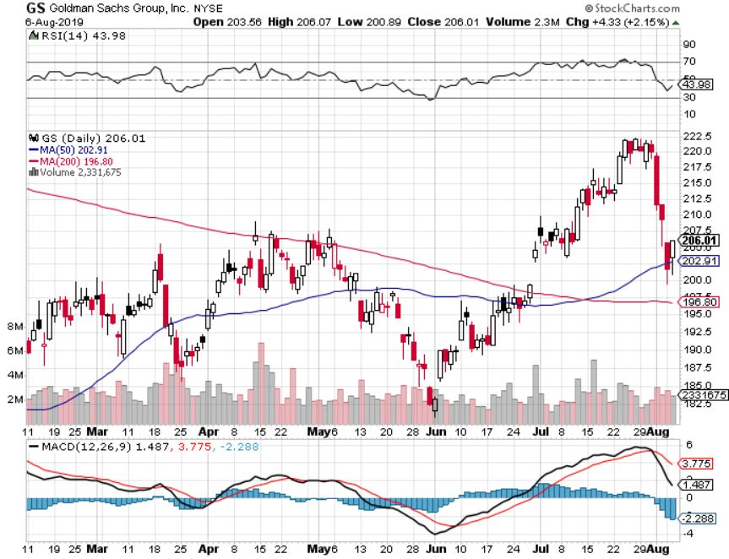
Goldman Sachs (GS)- Upside Breakout

Slide 46
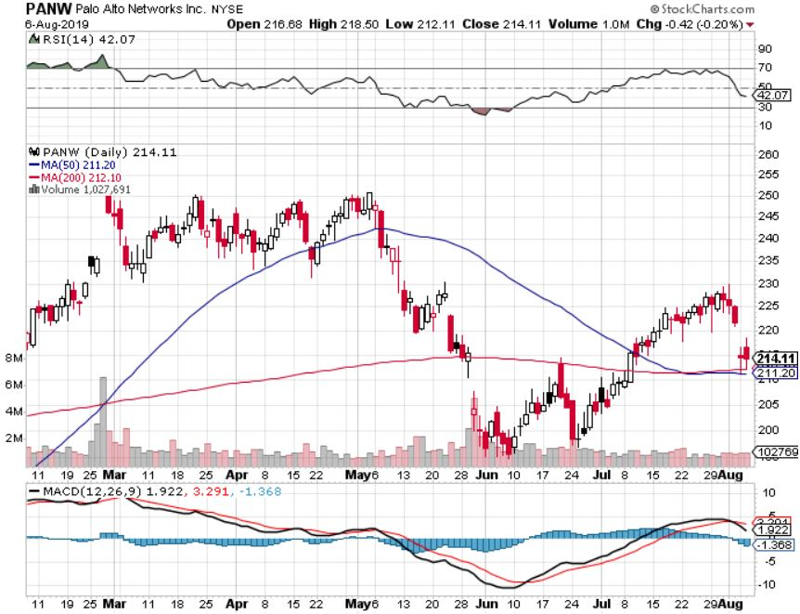
Palo Alto Networks (PANW)- Hacking never goes out of fashion

Slide 47
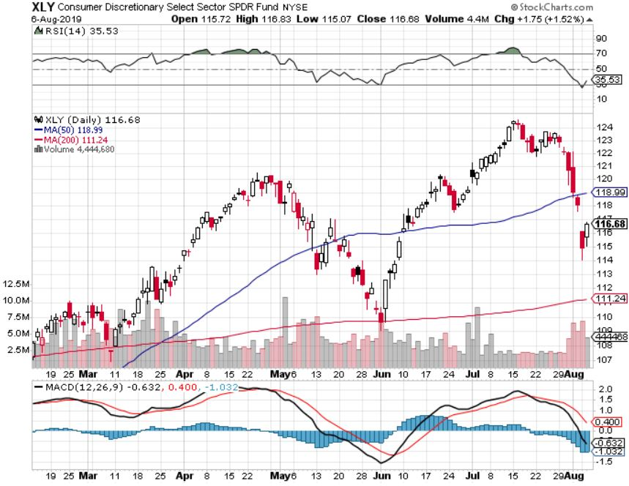
Consumer Discretionary SPDR (XLY) (DIS), (AMZN), (HD), (CMCSA), (MCD), (SBUX)

Slide 48
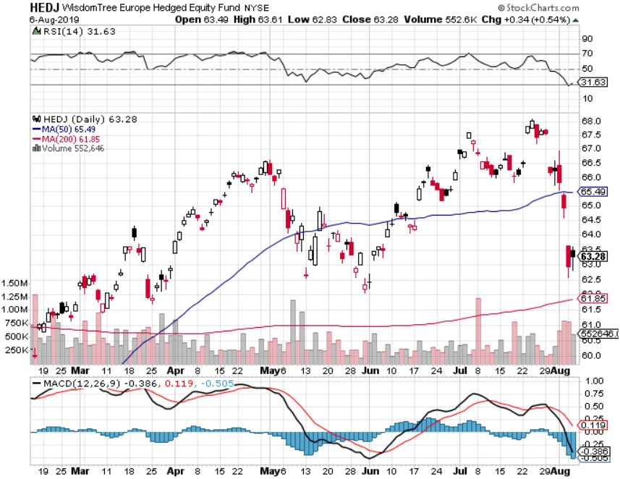
Europe Hedged Equity (HEDJ)-

Slide 49
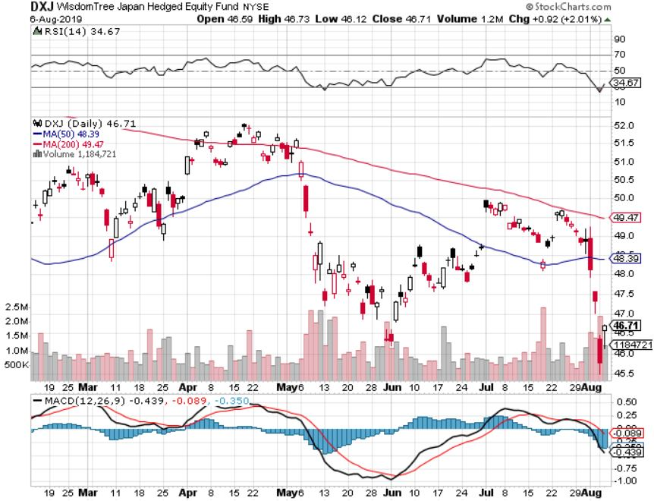
Japan (DXJ)-

Slide 50
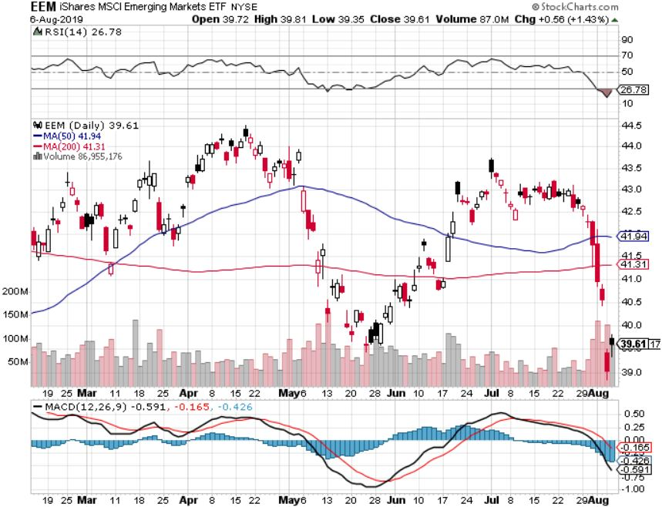
Emerging Markets (EEM)- Avoid on strong Weak Dollar

Slide 52
Bonds – On the Way to Zero
*US ten year rates plunge to 1.61%, discounting half of the next three Fed rate cuts *Buy panic hits bond after trade ware escalation *Record amounts of money pouring out of stock ETF’s into bond ETF’s *Collapsing global economies sending a huge flight to safety bid to bonds *25% of the world’s bonds now have negative interest rates *German bund yields plunge to -0.60%, while Japan government bonds turn in a -0.20% yield *Bottom line: Ten year US Treasury yields will fall below zero in 2020 to come in line with the rest of the world

Slide 53
Treasury ETF (TLT) – stopped out of long 8/$137-$140 put spread took profits on long 8/$125-$128 call spread took profits on long 6/$128-131 bear put spread took profits on long 5/$116-$119 bull call spread

Slide 54
Ten Year Treasury Yield ($TNX) – 1.68% Overnight Low

Slide 55
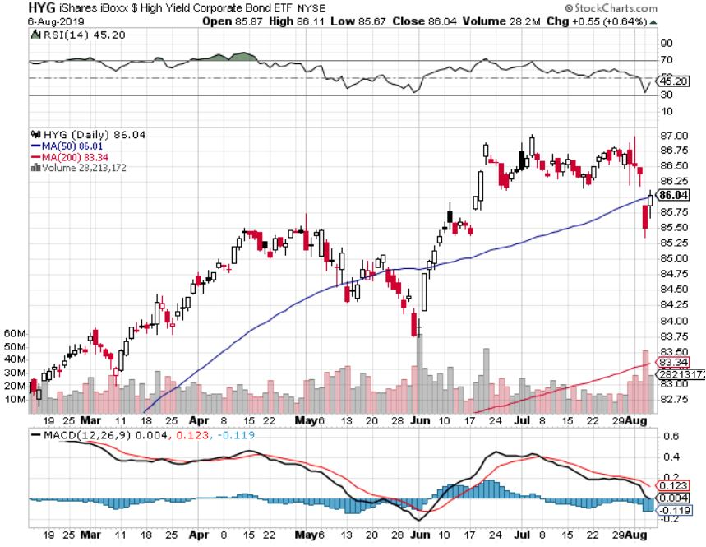
Junk Bonds (HYG) 5.13% Yield big jump in yields on stock selloff and recession fears

Slide 56
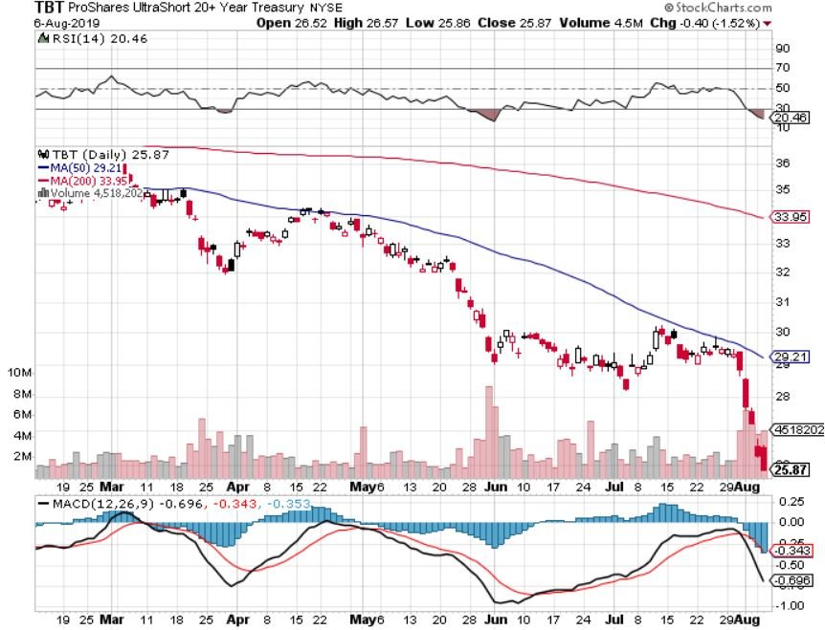
2X Short Treasuries (TBT)- 2 Month Topping Process

Slide 57
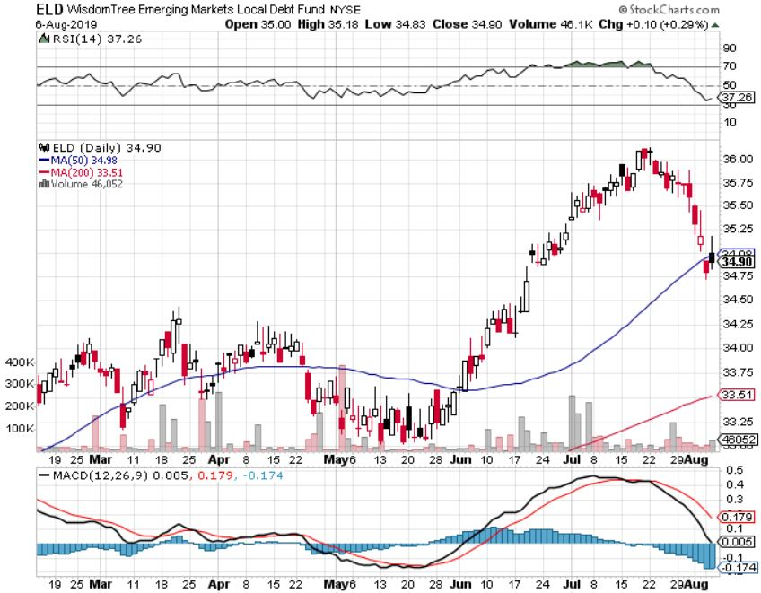
Emerging Market Debt (ELD) 5.21% Yield-

Slide 58
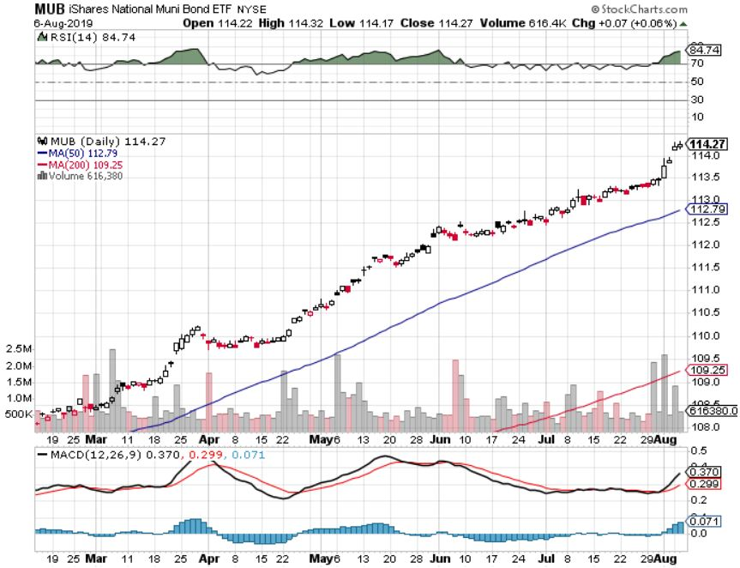
Municipal Bonds (MUB)-1.72% Mix of AAA, AA, and A rated bonds

Slide 60
Foreign Currencies – Dollar Dive
*Fed rate cut brings a dollar pop, then trade war escalation kills it *Three Interest rate cuts in 2019 now a sure thing *That makes the US the fastest interest rate cutting country in the world because everyone else can’t cut from zero *Boris Johnson as prime minister in the UK guarantees the pound goes to parity *Chinese Yuan in free fall as Beijing withdraws support *Bitcoin rallies big on Chinese fleeing Yuan devaluation *Bottom Line: Sell the US dollar against everything, except the Yuan (CYB) and pound (FXB)

Slide 61
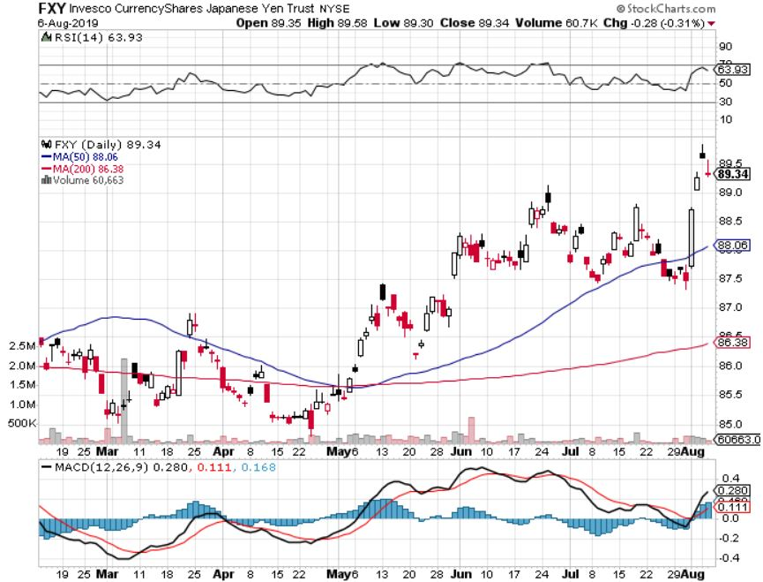
Japanese Yen (FXY), (YCS)

Slide 62
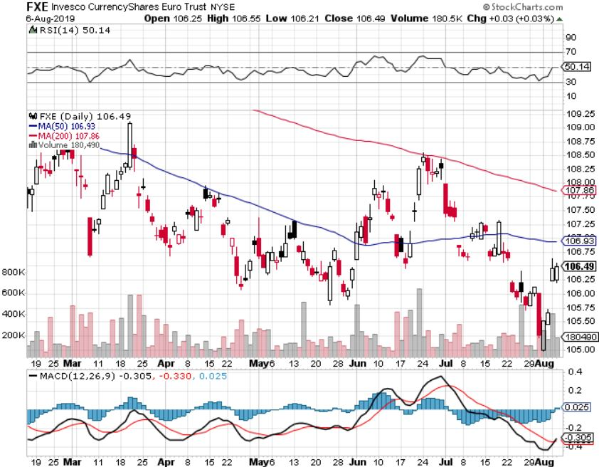
Euro ($XEU), (FXE), (EUO)-

Slide 63
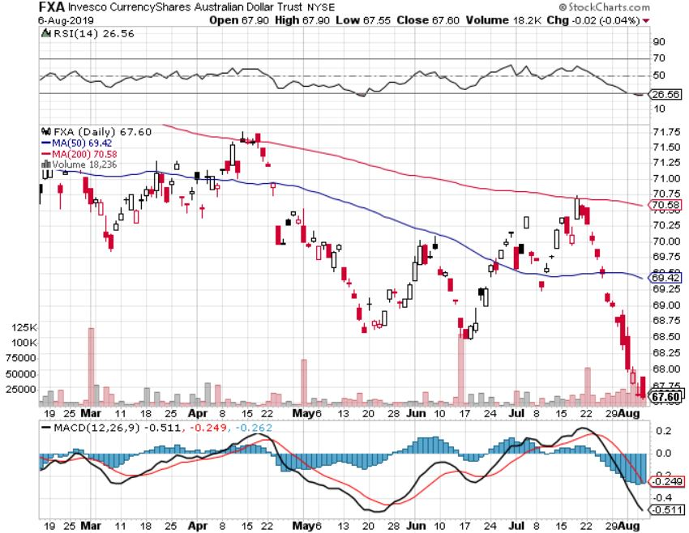
Australian Dollar (FXA)- The Global Recovery Play took profits on long 8/$67-$69 call spread

Slide 64
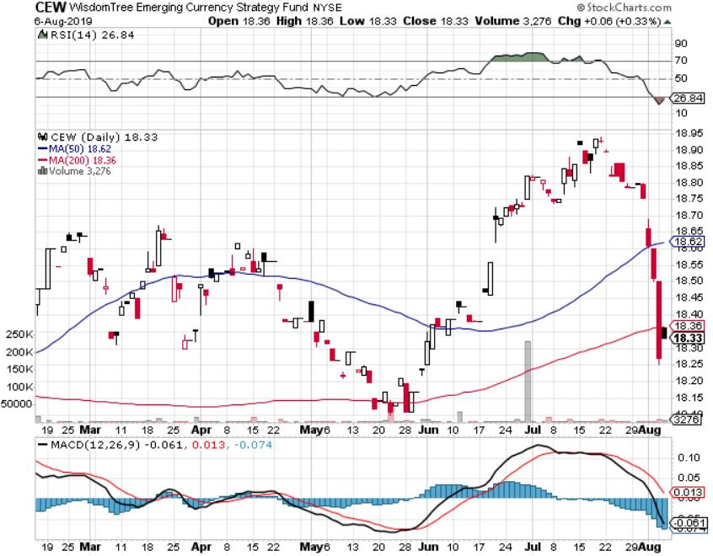
Emerging Market Currencies (CEW)

Slide 65
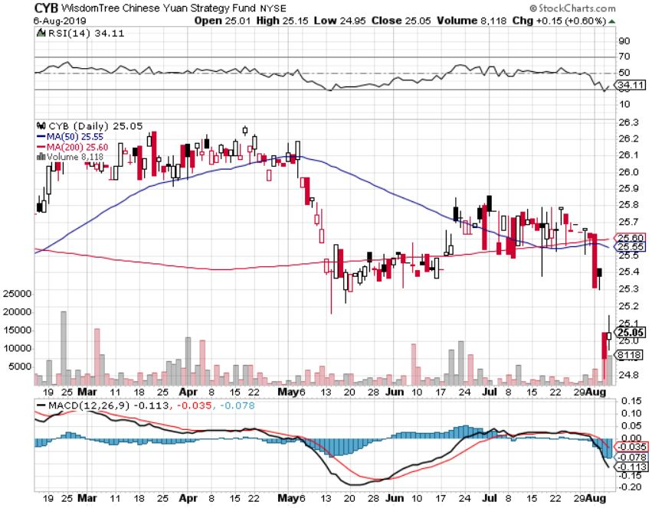
Chinese Yuan- (CYB)-

Slide 66
Bitcoin- Chinese flight from Yuan is 99% of the trade

Slide 68
Energy – Another Run at the Lows
*OPEC cuts production by 130,000 barrels a day *Massive tax subsidies are driving new investment in US production and distribution, even though prices are falling *However, the largest buyer of US oil, China, has banned US oil in response to the trade war *Hurricane shuttered Mexican production coming back on stream *Geopolitics is having no positive impact with the tanker wars in the Straights of Hormuz *Bottom Line: looks like $42 a barrel is in the cards

Slide 69
Oil-($WTIC)

Slide 70
United States Oil Fund (USO)

Slide 71
Energy Select Sector SPDR (XLE)-No Performance! (XOM), (CVX), (SLB), (KMI), (EOG), (COP)

Slide 72
Halliburton (HAL)-

Slide 73
Natural Gas (UNG)-

Slide 75
Precious Metals – Going Ballistic
*Gold breaks out to new five year highs, charts are coiling for more upside breakout *Central banks accelerating gold purchases in the face of a falling dollar, buying 347 metric tonnes in H1, more than double last year’s rate *China, Russia, and Iran have been dominating purchasers *Imminent collapse of US interest rates starting next week is the principal driver, and once started it could continue for a year *Bitcoin rallies on Chinese capital flight from yuan *Bottom Line: buy every dip in gold and precious metals

Slide 76
Gold (GLD)- New 5 Year Highs

Slide 77
Market Vectors Gold Miners ETF- (GDX) – Yikes!

Slide 78
Barrick Gold (GOLD)

Slide 79
Newmont Mining- (NEM)-

Slide 80
Palladium - (PALL)-

Slide 81
Copper (COPX)-Collapse Trade War Disaster

Slide 82
Freeport McMoRan (FCX)-World’s Largest Copper Producer long 8/$9.00-$10.00 call spread took profits on long 4/$10-$11 call spread took profits on short 4/$114 calls

Slide 84
Real Estate – Still Falling
*Mortgage rates hit three year low at 3.70% for 30 year fixed, down from 4.5% in January *June New Home Sales comes in light, May revised down, affordability is the main issue *June Pending Home Sales rise modestly to 2.8% *Homeowners Equity has doubled during the last six years to $16 trillion
*May S&P 500 Case-Shiller drops to a 3.4%, annual gain, the lowest gain in 6 1/2 years *Bottom Line: Stand aside for a trade but buy for long term investment

Slide 85
February Corelogic S&P Case Shiller Home Price Index Las Vegas (6.4%), Phoenix (5.7%), and Tampa (5.1%) showing biggest gains
Tradingeconomics.com

Slide 86
Simon Property Group (SPG)-

Slide 87
US Home Construction Index (ITB) (DHI), (LEN), (PHM), (TOL), (NVR)

Slide 88
Trade Sheet- So What Do We Do About All This?
*Stocks-sell rallies *Bonds-buy dips *Commodities-stand aside *Currencies-sell US dollar again (FXA), (FXE) *Precious Metals – buy dips *Energy - avoid *Volatility-buy dips *Real estate-stand aside

Slide 89
Next Strategy Webinar 12:00 EST Wednesday, August 21, from Silicon Valley, CA email me at support@madhedgefundtrader.com
Good Luck and Good Trading!
Notes:
*

