Slide 1
The Mad Hedge Fund Trader “Recession Fears”
With John Thomas from Silicon Valley, CA, August 21, 2019 www.madhedgefundtrader.com
Notes:
*

Slide 3
October 25-26 Lake Tahoe Conference
*Two days of informative speakers on crucial trading and investment issues *Trade tips with the most successful Mad Hedge traders *2 nights in the Hyatt, including all you can eat and drink *Tickets are a bargain at $699 to $1,999 *Buy now, upper ticket classes sell out first

Slide 4
Trade Alert Performance New Highs! Best Month in Two Years
*January 9.49% Final *July +3.07% MTD *February +4.64% Final *August +13.92% MTD *March +1.78% Final *September 1.38% Final *April +0.30% Final *October +1.37% Final *May +0.25% Final *November -1.83% Final *June -0.50% Final *December -4.13% Final *2019 Year to Date +32.25% compared to +8.5% for the Dow Average *+332.99% since inception, *Average annualized return of 34.44% for 10 years

Slide 5
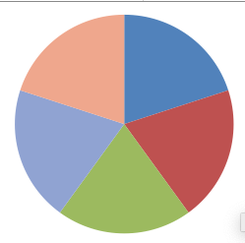
Portfolio Review Keeping Small Positions Only Buying Very Deep in-the-Money on Capitulation Days
Risk On
World is Getting Better
(GOOGL) 9/$1030-$1080 call spread | 10.00%
(AMZN) 9/$1500-1550 | 10.00%
(FB) 9/$150-$160 call spread | 10.00%
(DIS) 9/$115-$120 call spread | 10.00%
Risk Off
(WMT) 9/$119-$122 put spread | -10.00%
(IWM) 9/$157-$160 put spread | -10.00%
Total Net Position | 20.00%
Expiration P&L 36.28% YTD

Slide 6
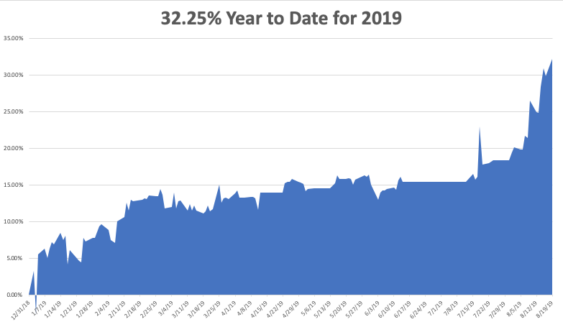

Slide 7
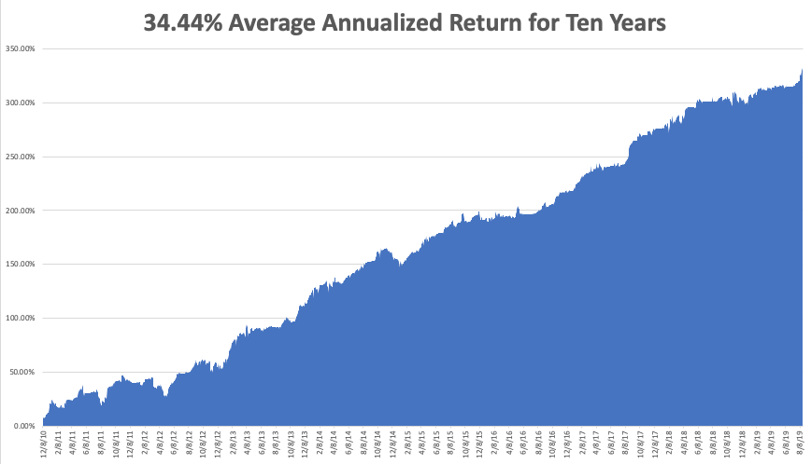
GTD 10 Year Daily Audited Performance

Slide 8
The Method to My Madness
*Inverted yield curve has caused recession fears to run rampant *US interest rates now headed to zero to come in line with global rates *US induced China slowdown dragging down the rest of the world *Rising risk of a Hong Kong massacre would knock 1,000 points off the Dow Average and accelerate any global recession *Strong dollar adds to recession fears *”Hard Brexit” moving full speed ahead, further adding to European woes *Three more Fed 25 basis point rate cuts due over next six months *Oil in free fall, while gold takes a break from severely overbought condition

Slide 9
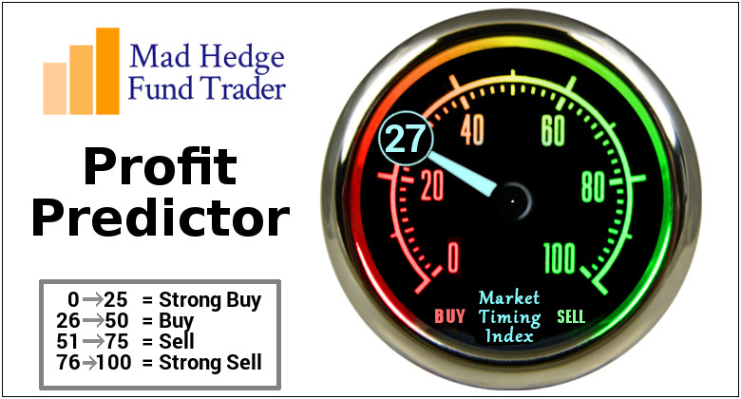
The Mad Hedge Profit Predictor Market Timing Index- An artificial intelligence driven algorithm that analyzes 30 different economic, technical, and momentum driven indicators

Slide 10
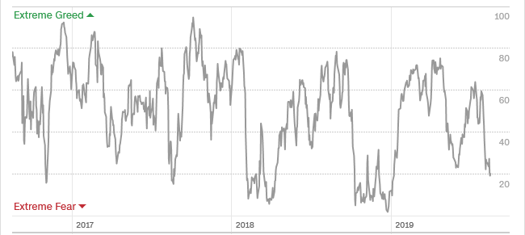
The Mad Hedge Profit Predictor Headed Towards a “BUY”
SELL
BUY

Slide 11
The Global Economy – Hitting the Brakes
*All major economies are now slowing rapidly, with a 40% chance of a recession in the next 12 months *Global rush to zero interest rates means confidence is in free fall *The US is still the strongest economy in the world, but is fading fast, July Industrial Production -0.2%, job growth is screeching to a halt, Consumer Sentiments dives from 97.0 to 92.1, July Housing Starts off 4%, *Tariff war is exacting a very high economic price *Europe has accelerated downward economic spiral, will spill into the US, Germany has dropped from 2.0% growth to -0.1% since January *”No Deal” Brexit acceleration throws the fat on the fire, pound in free fall, Q2 GDP -0.1%

Slide 12
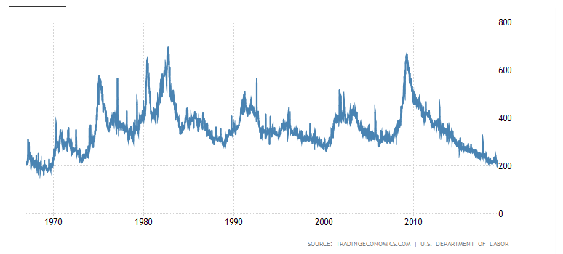
Weekly Jobless Claims-Bottomed Out +9,000 to 220,000

Slide 13
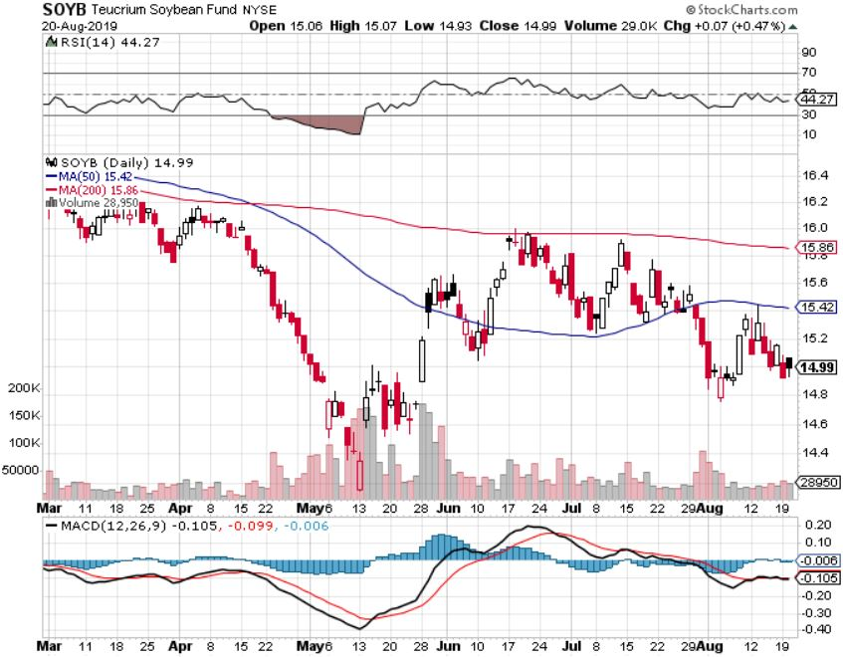
Soybeans - Trade War Indicator Trade Back to the Forefront

Slide 14
The Bill Davis View A $1,500 Upgrade for the Mad Day Trader Service
Buys: | Entry | Target
Lam Research Corp. (LRCX) | $ 200.00 | $ 225.00
Adobe Systems Inc.(ADBE) | $ 285.00 | $ 300.00
NVIDIA Corp (NVDA) | $ 164.00 | $ 185.00
Visa Inc.(V) | $ 173.00 | $ 185.00
Roku Inc.(ROKU) | $ 129.00 | $ 138.00
Sells:
DexCom Inc. (DXCM) | $ 170.00 | $ 135.00
Grand Canyon Education (LOPE) | $ 126.50 | $ 115.00
Dillards Inc. (DDS) | $ 66.50 | $ 50.00
Polaris Inds, Inc.(PII) | $ 86.00 | $ 75.00
Bunge Ltd.(BG) | $ 53.50 | $ 47.00

Slide 16
Stocks – Play the Volatility
*Pour the positions on whenever the Volatility Index (VIX) rises above 20%, buy every dip and sell every rally *Worst sectors, like financials, retailers, and energy, have fallen so fast that they are now too low to sell *Big long term money is diving in to buy big tech on every dip *Q2 earnings finished out weak, outlook is getting cut daily *”Trump put” Tweets are creating large one day only rallies perfect for selling into *Mad Hedge Market Timing Index under 20 says its safe to start buy big dips in best quality names *Bottom line: 10%-20% down market for the next 3 months, then new highs propelled by ultra low interest rates or a China trade deal *Bottom Line: its bet the ranch time on tech longs, but stay away from those with big China exposure, like Apple, and weak dollar plays like energy, and emerging markets

Slide 17
How to Play This Dip
*The bull market is not over, it’s only taking prolonged rest *Don’t jump in too soon, we are only three weeks into this *Whatever has gone down the most will go up the most on the other side *But big tech and semis across the board *At the bottom buy long term 1-2 year LEAPS on the best quality names with 100%-500% potential returns *Don’t buy energy, retailers, industrials, or financials on pain of death

Slide 18
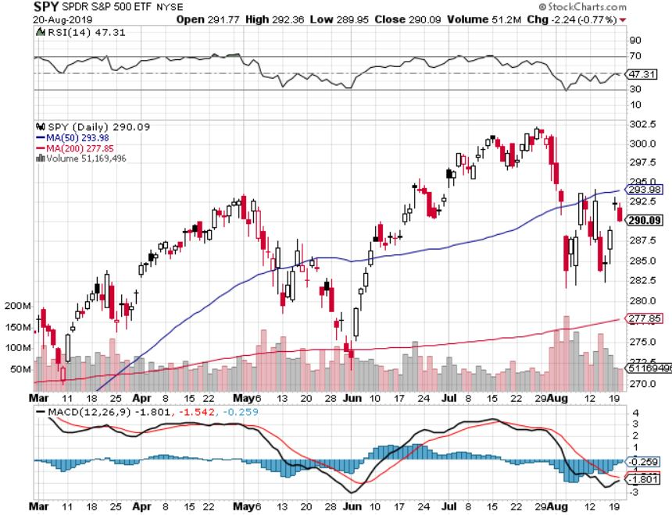
S&P 500- Run at a New High took profits on long 8/$305-$308 bear put spread stopped out of long 2/$285-$290 bear put spread took profits on long 2/$270-$275 bear put spread

Slide 19
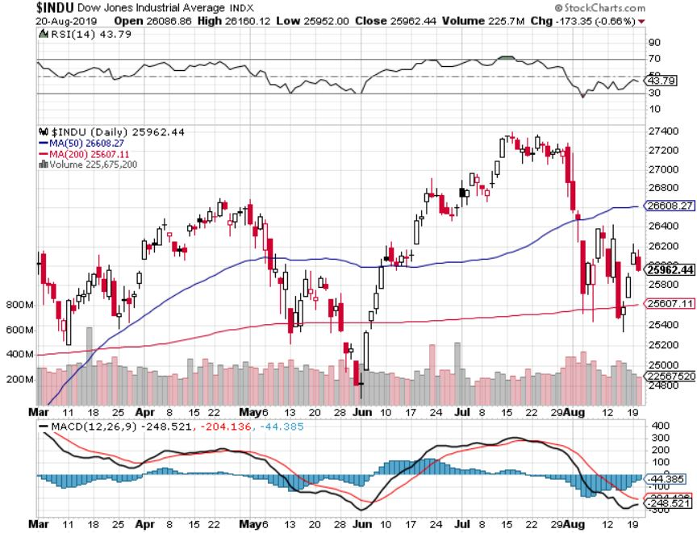
Dow Average ($INDU)-

Slide 20
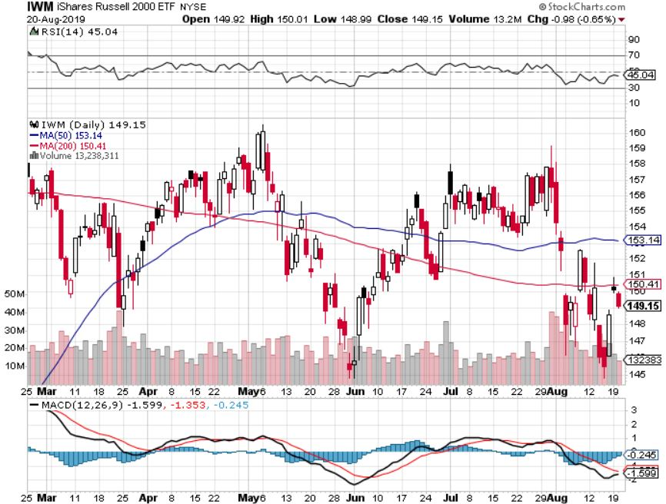
Russell 2000 (IWM)- Triple Top took profits on Long 9/$157-$160 vertical bear put spread took profits on Long 8/$158-$161 vertical bear put spread out for even Long 4/$160-$165 vertical bear put spread

Slide 21
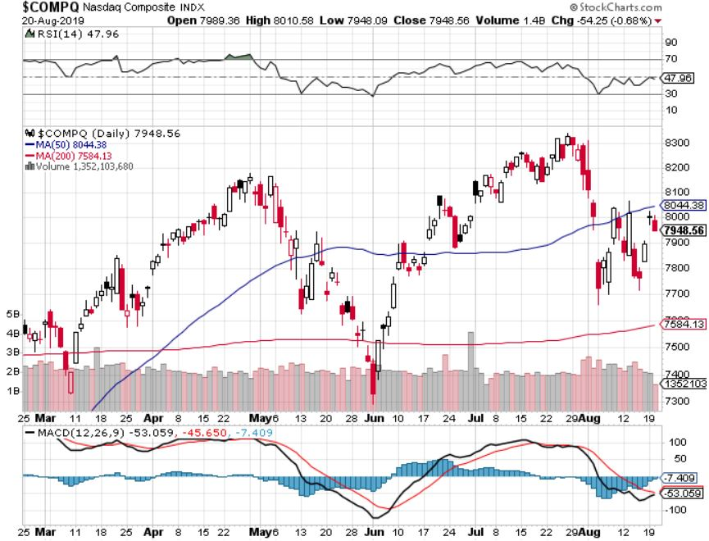
NASDAQ ($COMPQ) – New High

Slide 22
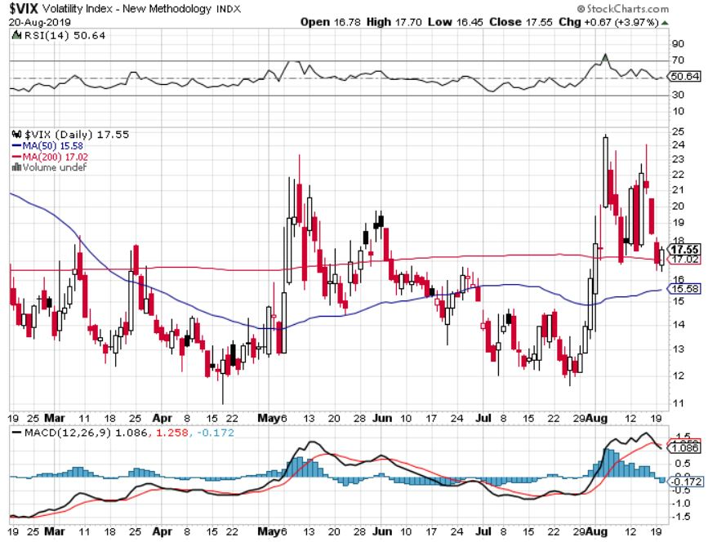
(VIX)- In “SELL” Territory

Slide 23
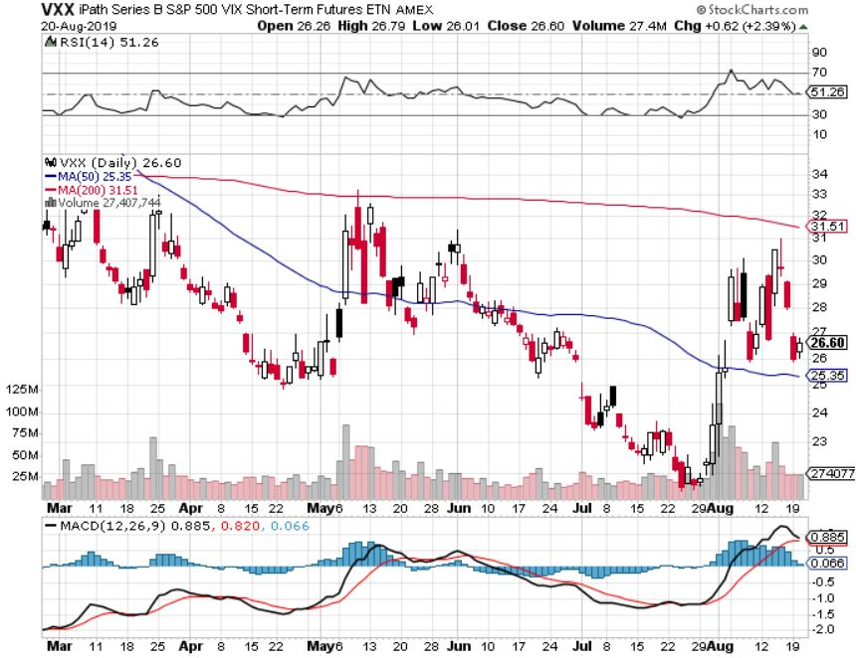
iPath S&P 500 VIX Short-Term Futures ETN (VXX) – New Low

Slide 24
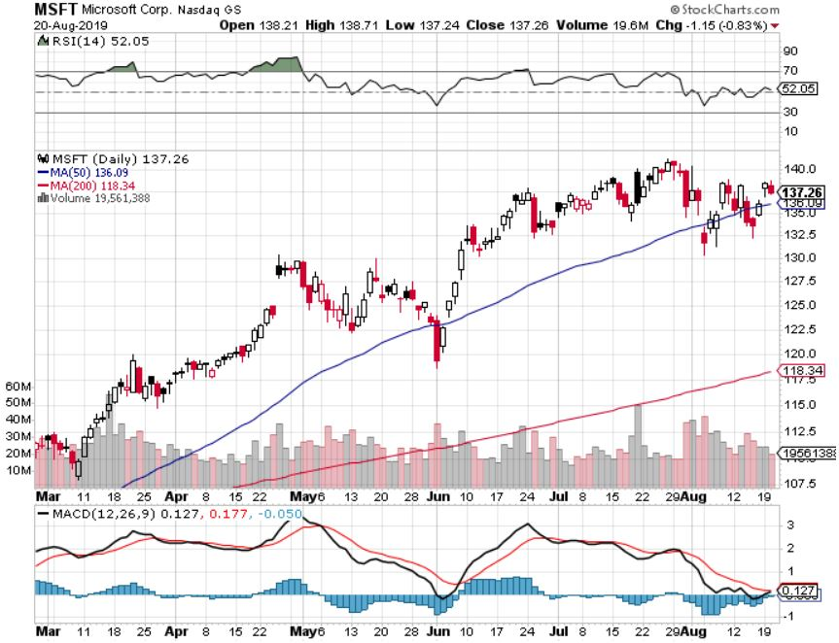
Microsoft (MSFT)- Earnings beat- Looking for Another Entry Point long 6/$110-$115 call spread-out at cost took profits on long 4/$108-$113 call spread took profits on long 2/$85-$90 call spread

Slide 25
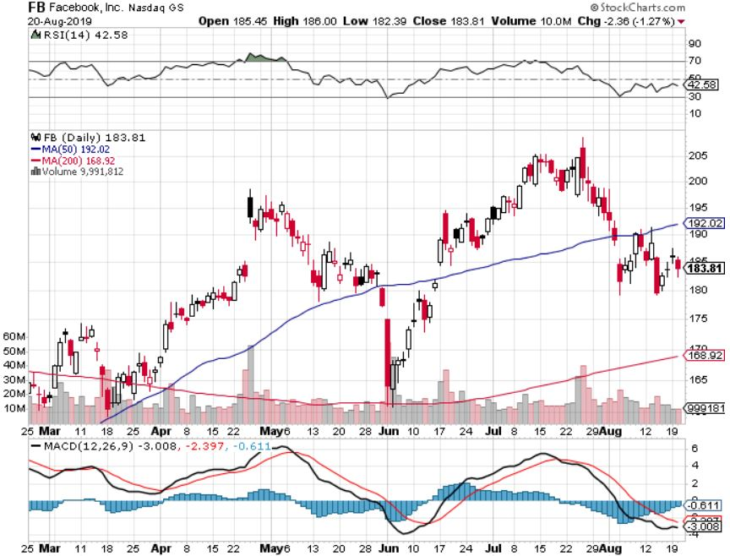
Facebook (FB)- Long 9/$150-$160 vertical bull call spread took profits on Long 8/$167.50-$172.50 vertical bull call spread

Slide 26
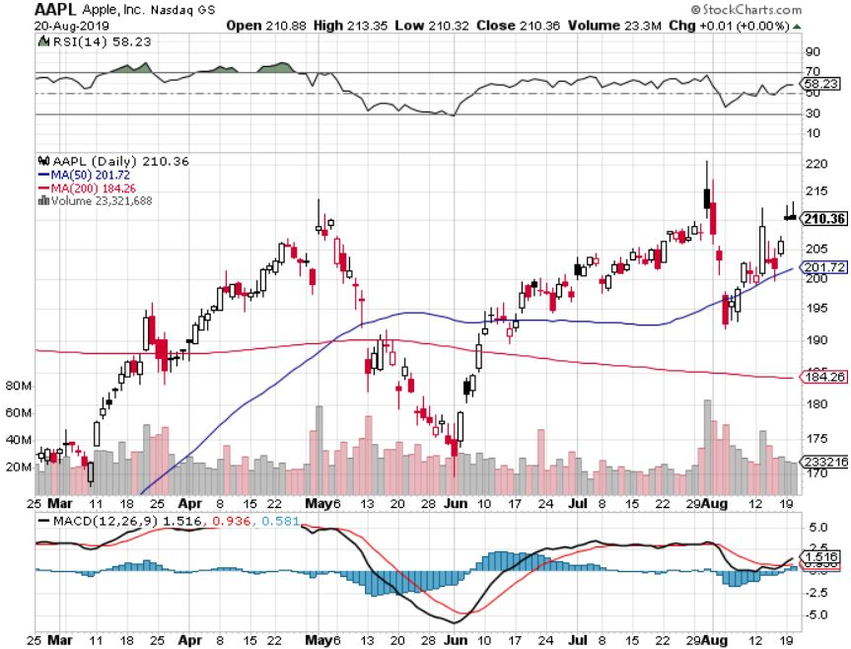
Apple (AAPL)- China Target – 5G Chip Buy

Slide 27
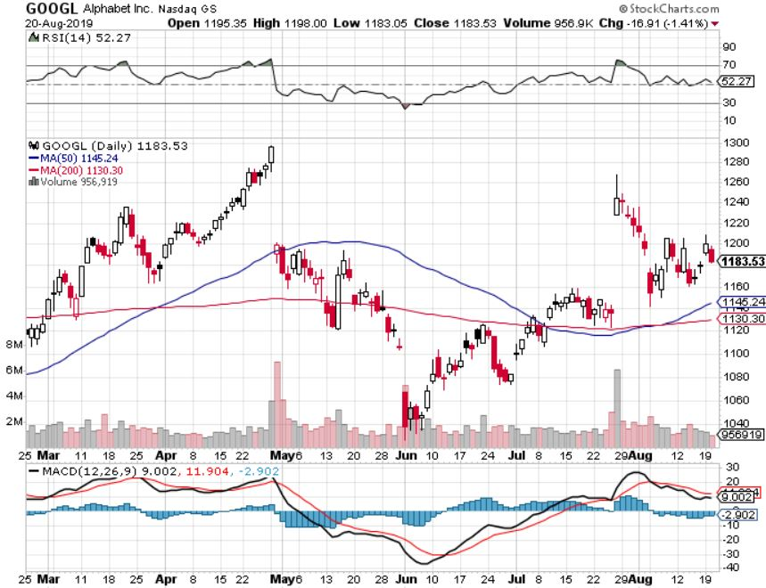
Alphabet (GOOGL)- Earnings Shock Long 9/$1,030-$1,080 vertical bull call spread stopped out of long 5/$1,100-$1,130 bull call spread took profits on long 4/$1,080-$1,120 bull call spread

Slide 28
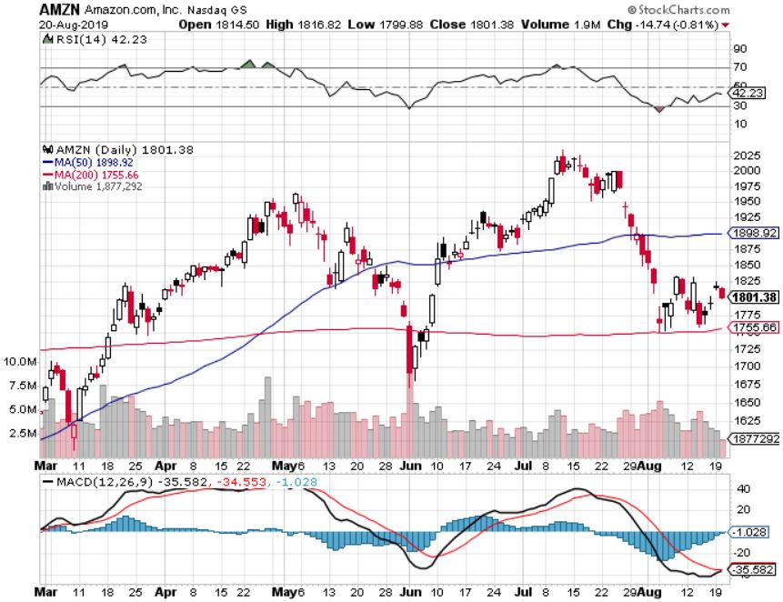
Amazon (AMZN)-Back to Top of Range Long 9/$1,500-$1,600 vertical bull call spread stopped out of long 4/$1,650-$1,700 call spread took profits on long 4/$1,600-$1,650 call spread took profits on long 2/$1,200-$1,300 call spread

Slide 29
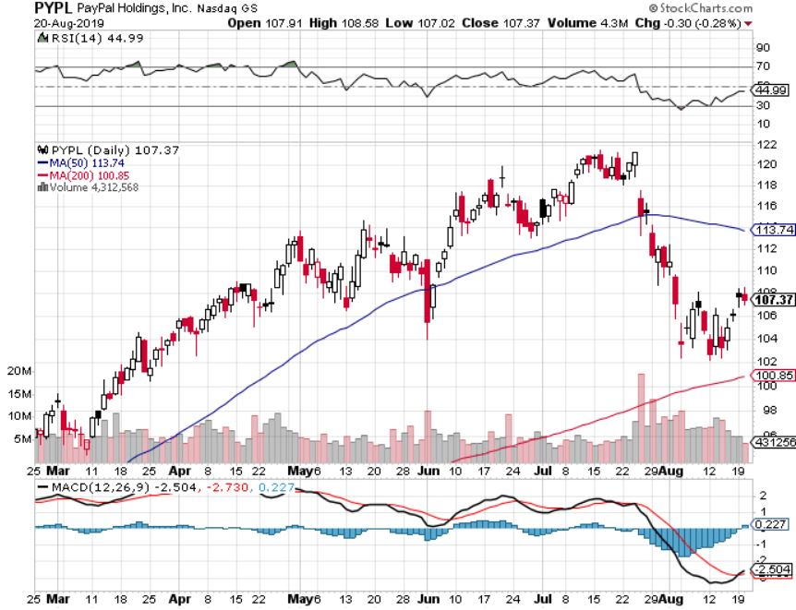
PayPal (PYPL)-Fintech Star took profits on long 4/$90-$95 call spread

Slide 30
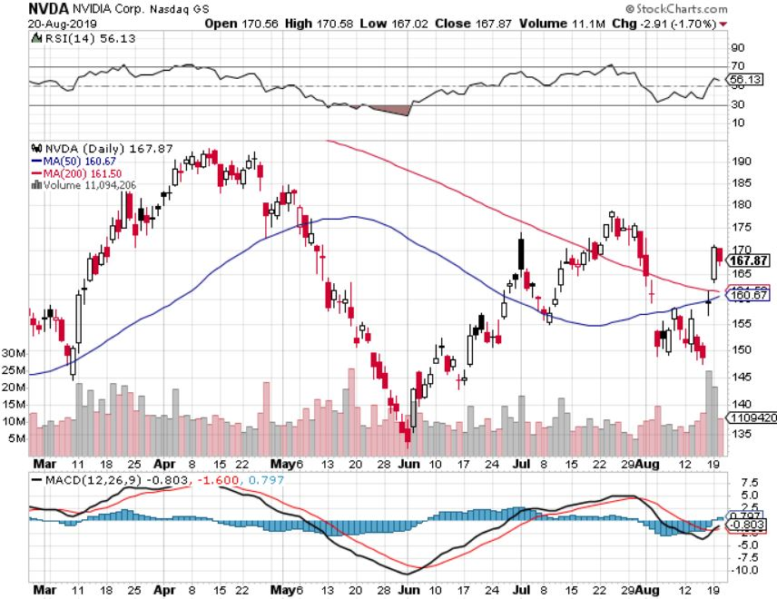
NVIDIA (NVDA) -

Slide 31
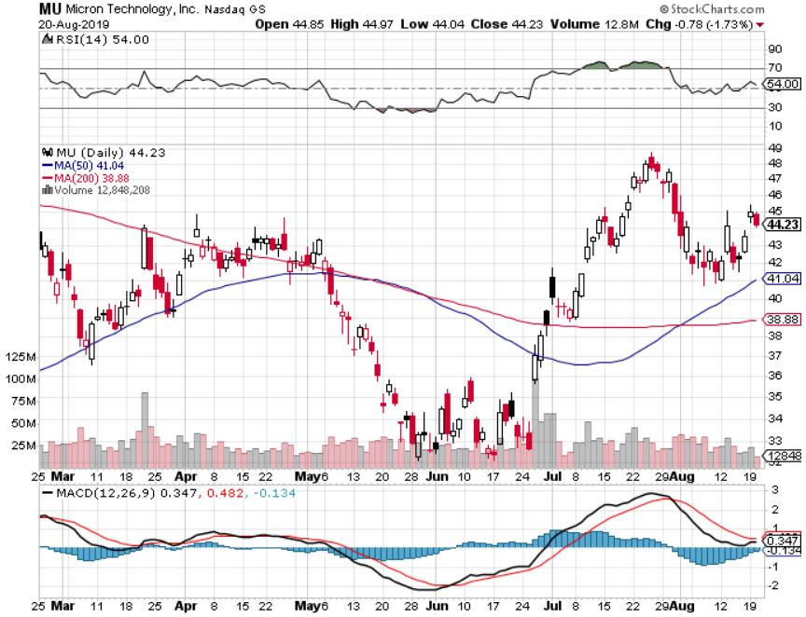
Micron Technology (MU)-

Slide 32
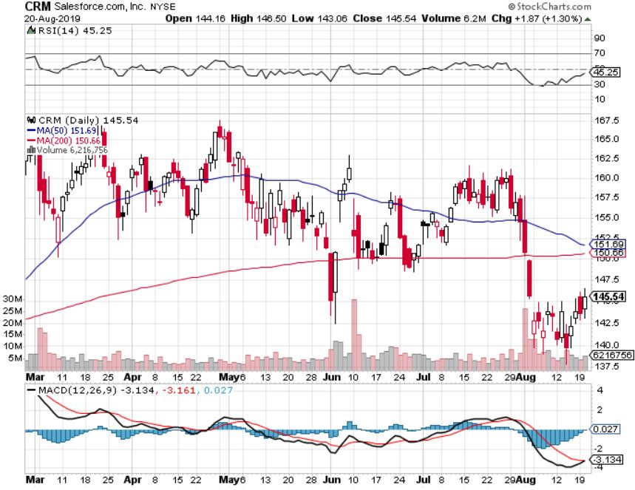
Salesforce (CRM)- took profits on long 9/$125-$130 vertical bull call spread took profits on long 2/$105-$115 call spread

Slide 33
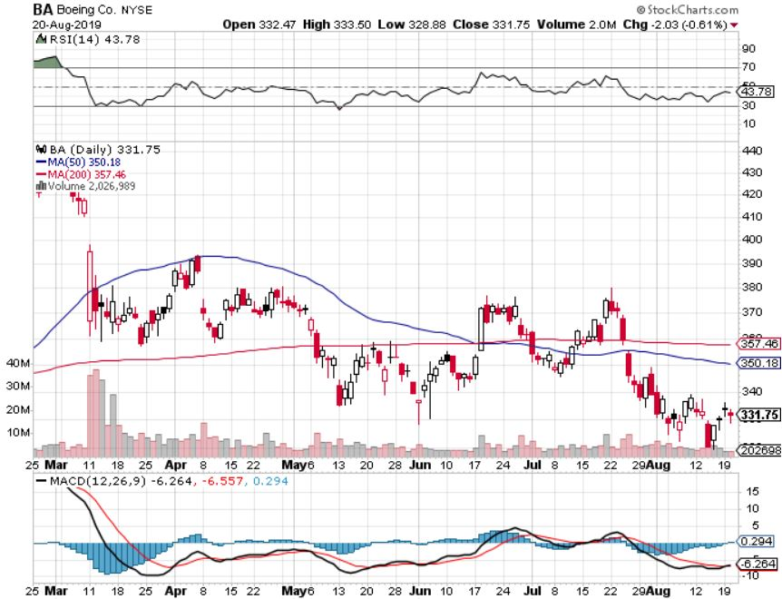
Boeing (BA)- took profits on long 4/$315-$335 call spread Next to happen in the recertification bounce

Slide 34
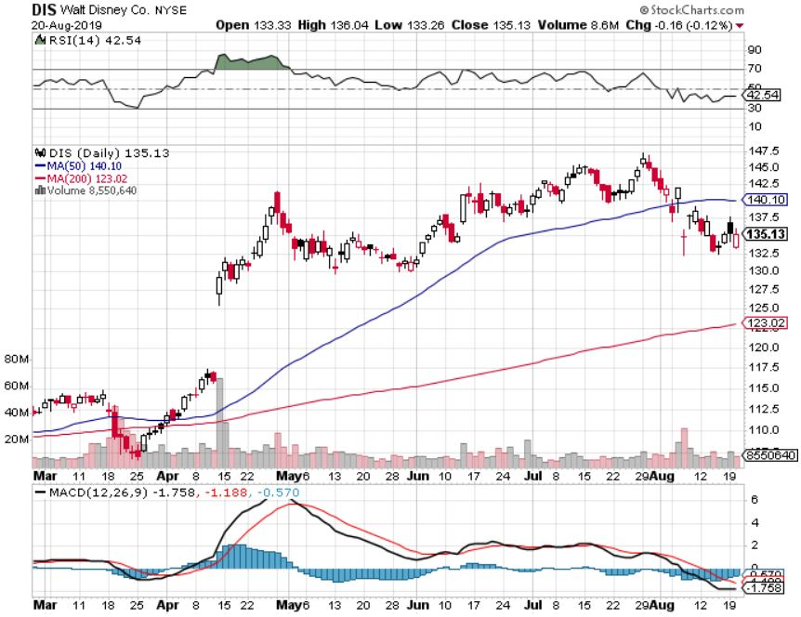
Walt Disney (DIS)- The Next Netflix long 9/$115-$120 call spread 8/$125-$130 call spread expired at max profit Stopped out of 4/$125-$130 call spread for small loss took profits on long 4/$100-$104 call spread

Slide 35
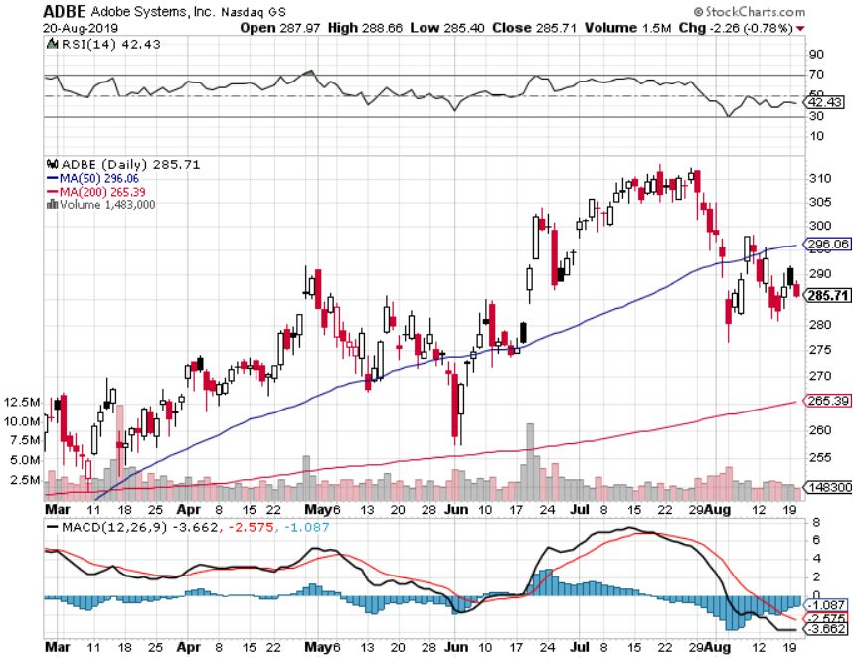
Adobe (ADBE)- The Quality Non-China tech play

Slide 36
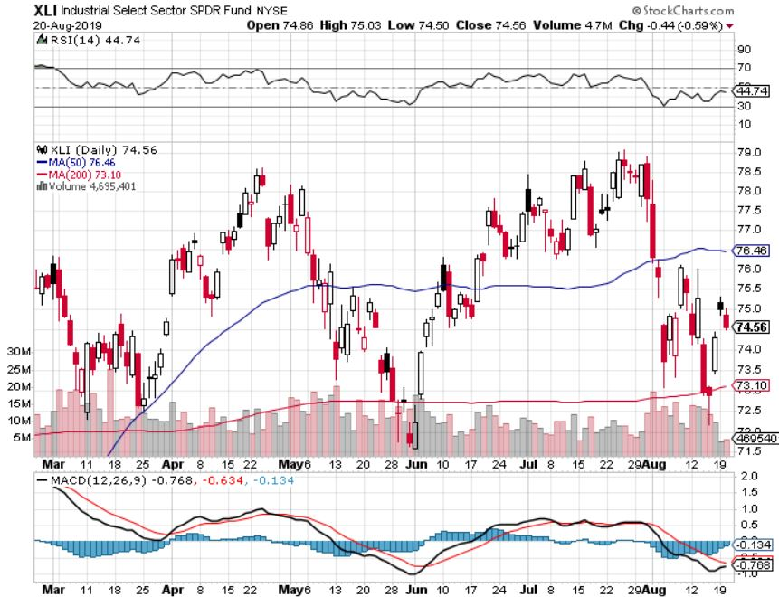
Industrials Sector SPDR (XLI)- (GE), (MMM), (UNP), (UTX), (BA), (HON)

Slide 37
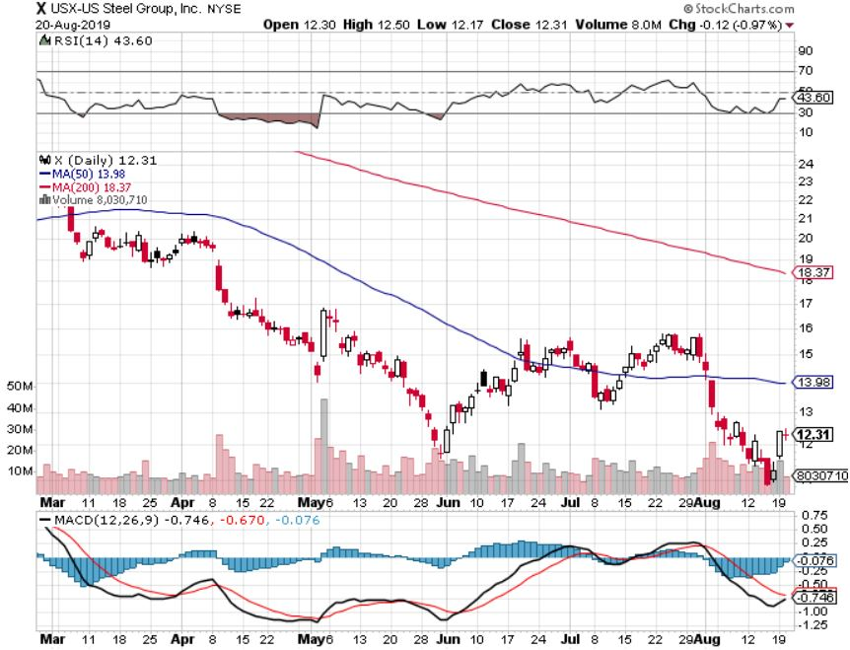
US Steel (X)-Tariffs Trouble Import duties cause users to abandon steel Unwound the entire Trump trade

Slide 38
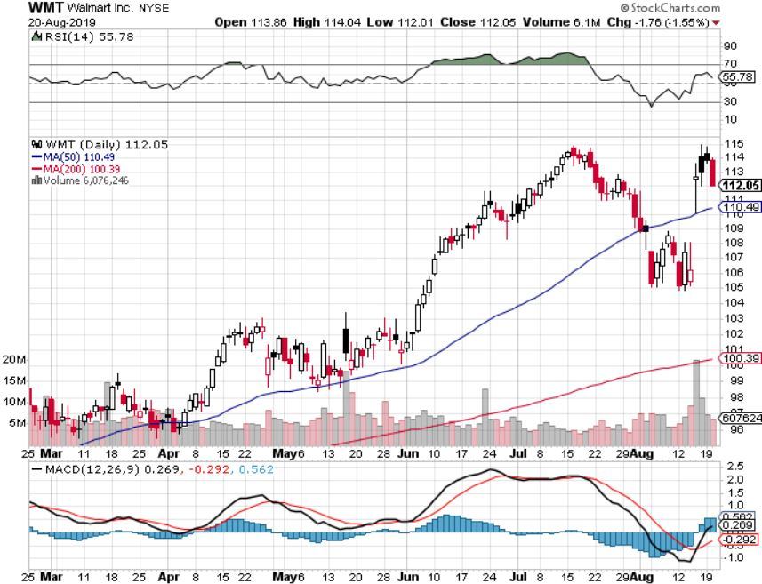
Wal-Mart (WMT)-Tariffs Trouble Long 9/$119-$121 bear put spread took profits on Long 8/$114-$117 bear put spread

Slide 39
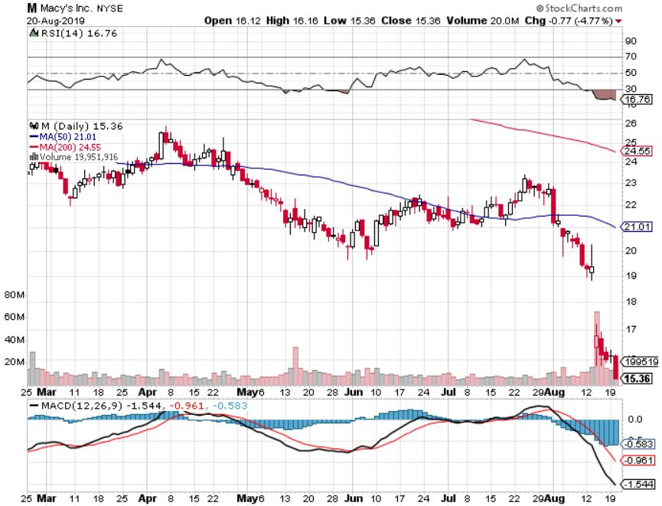
Macys’ (M)-Tariffs Trouble took profits on Long 8/$23-$25 bear put spread

Slide 40
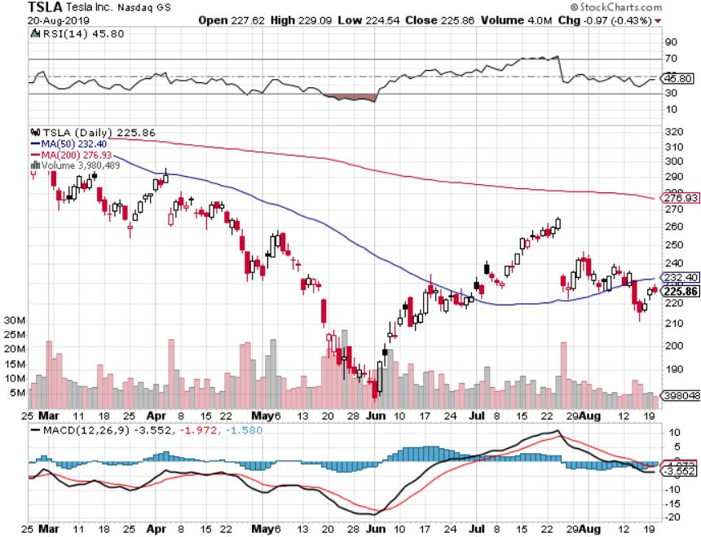
Tesla (TSLA)- looking for big Q2 improvement announced in July took profits on long 6/$140-$150 call spread – expires in 7 trading days took profits on long 6/$240-$250 put spread – expires in 7 trading days stopped out of long 4/$300-$320 put spread
Major Support

Slide 41
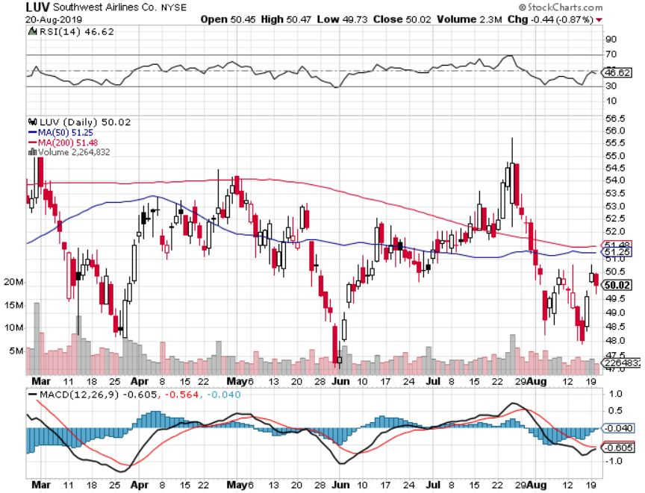
Southwest Airlines (LUV) - Boeing 737 Max biggest buyer

Slide 42
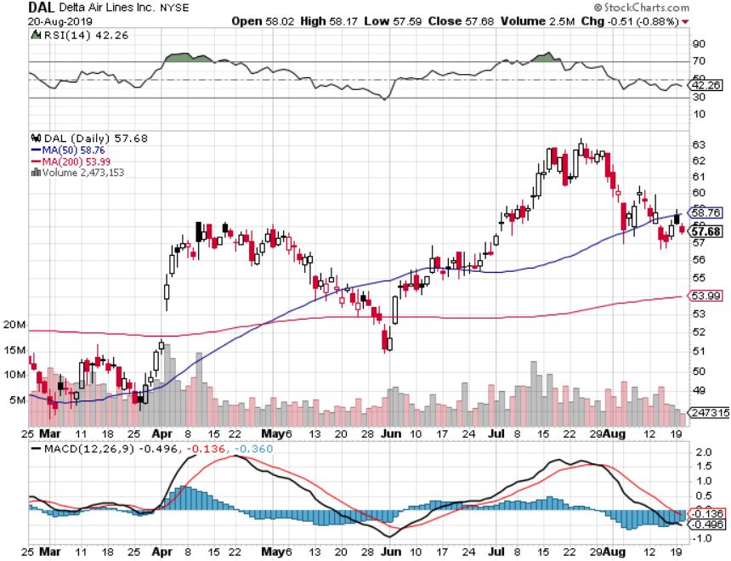
Delta Airlines (DAL) – Non 737 User

Slide 43
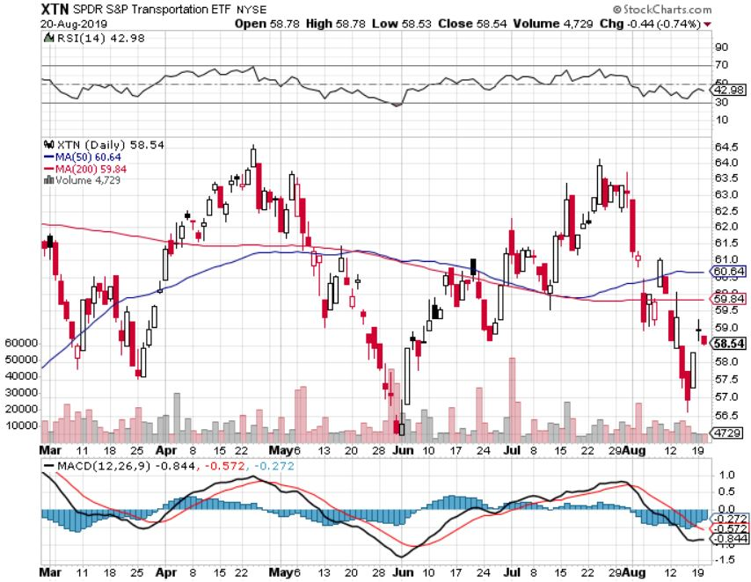
Transports Sector SPDR (XTN)- (ALGT), (ALK), (JBLU), (LUV), (CHRW), (DAL)

Slide 44
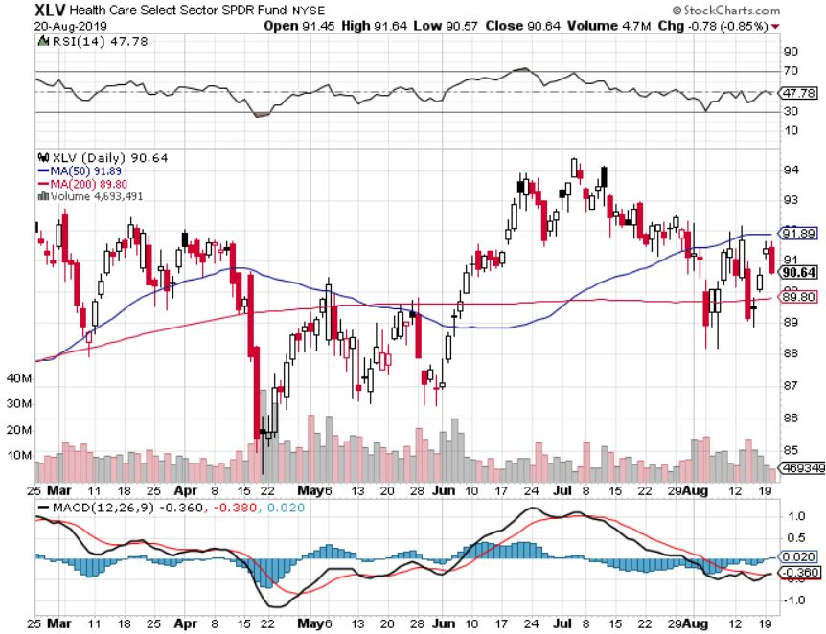
Health Care Sector (XLV), (RXL)-New Highs (JNJ), (PFE), (MRK), (GILD), (ACT), (AMGN)

Slide 45
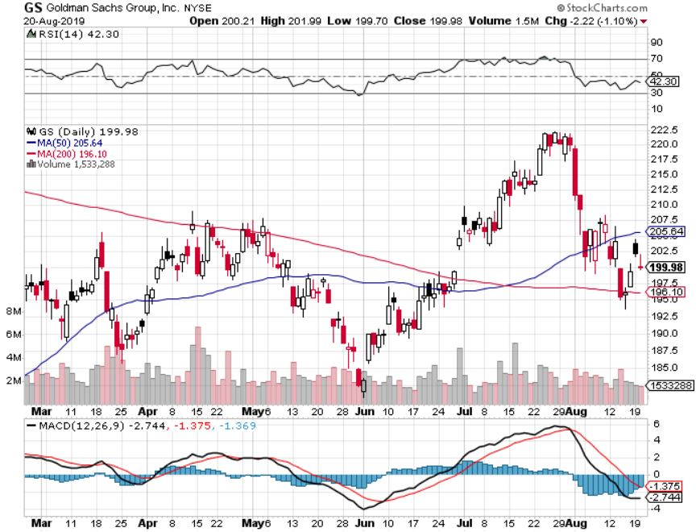
Goldman Sachs (GS)- Swan dive on low rates

Slide 46
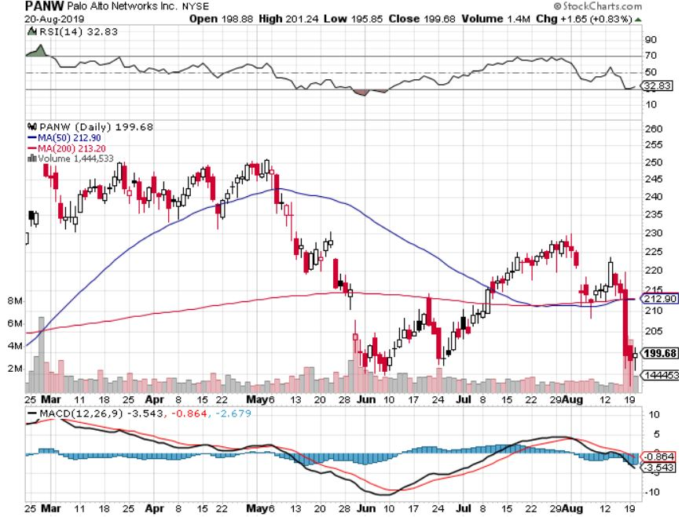
Palo Alto Networks (PANW)- Hacking never goes out of fashion

Slide 47
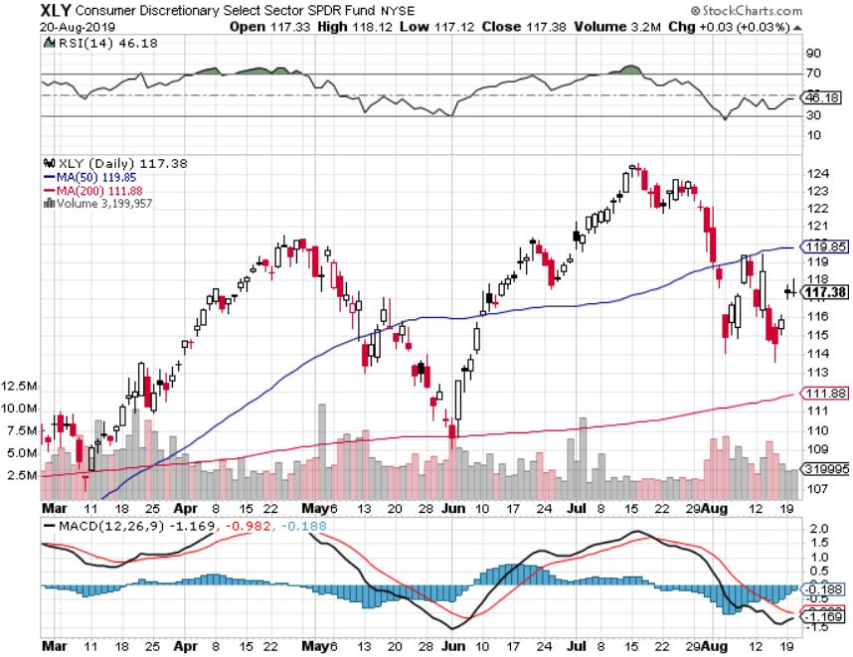
Consumer Discretionary SPDR (XLY) (DIS), (AMZN), (HD), (CMCSA), (MCD), (SBUX)

Slide 48
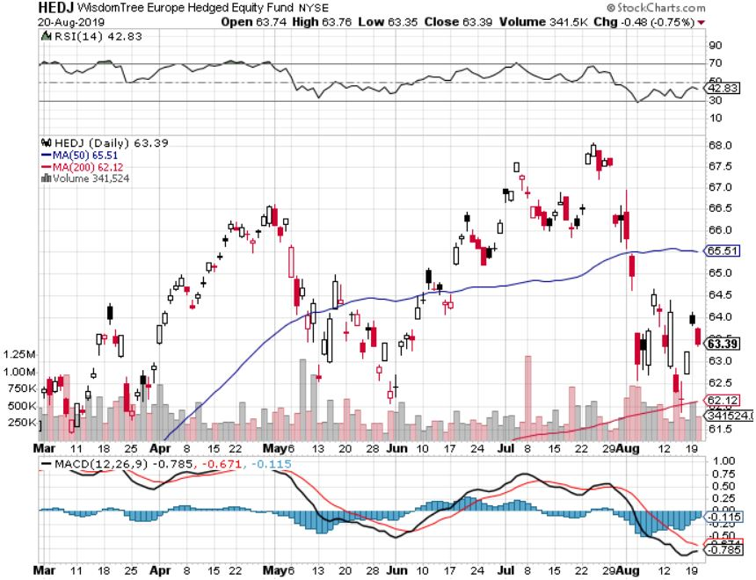
Europe Hedged Equity (HEDJ)-

Slide 49
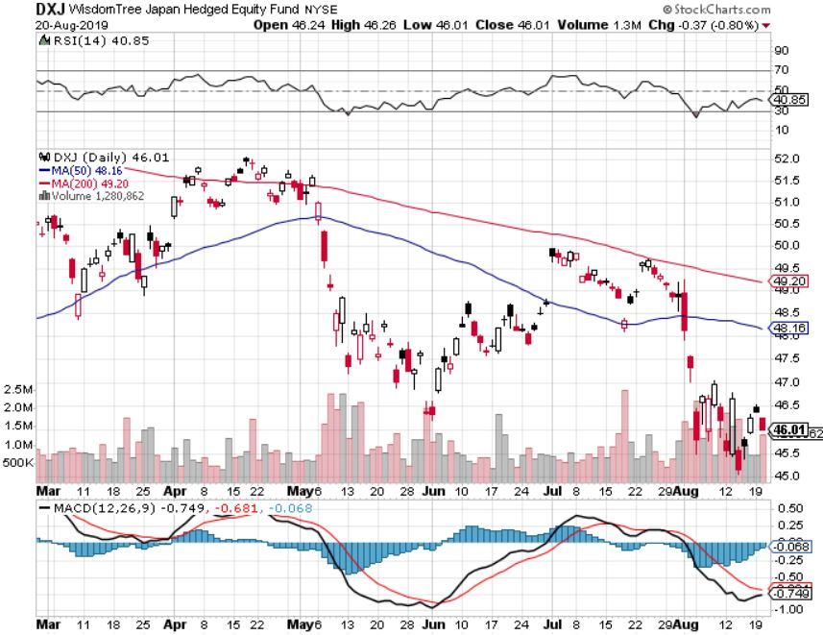
Japan (DXJ)-

Slide 50
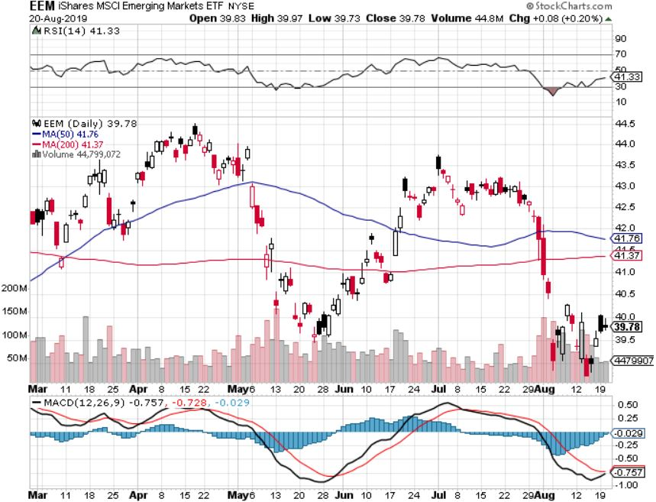
Emerging Markets (EEM)- Avoid on strong Weak Dollar

Slide 52
Bonds – Exhausted Short Term
*US ten year rates plunge to 1.61%, prices near record highs, discounting half of the next three Fed rate cuts. 30 year rates hit new all time low at 1.91% *However, we have seen a short term peak in prices and bottom in yields as markets work off extreme overbought conditions *Buy panic hits bond after trade ware escalation ramps up recession fears *$16 billion poured into bond ETF’s last week *30% of the world’s bonds now have negative interest rates *German bund yields plunge to -0.90%, while Japan government bonds turn in a -0.25% yield *Bottom line: Ten year US Treasury yields will fall below zero in 2020 to come in line with the rest of the world

Slide 53
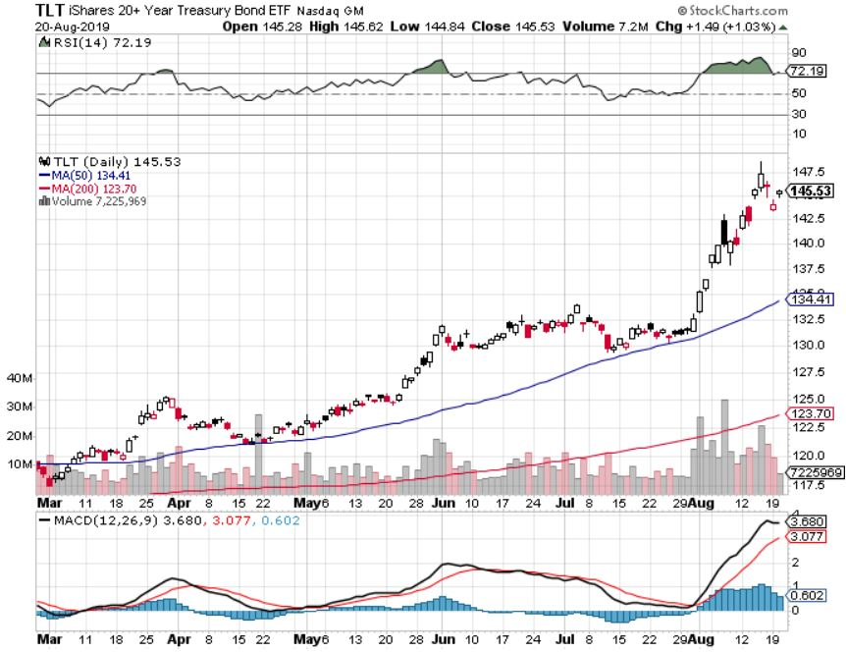
Treasury ETF (TLT) – stopped out of long 8/$137-$140 put spread took profits on long 8/$125-$128 call spread took profits on long 6/$128-131 bear put spread took profits on long 5/$116-$119 bull call spread

Slide 54
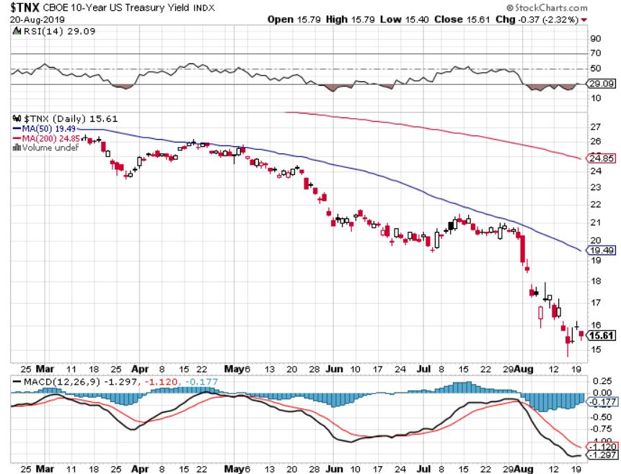
Ten Year Treasury Yield ($TNX) – 1.61% Overnight Low

Slide 55
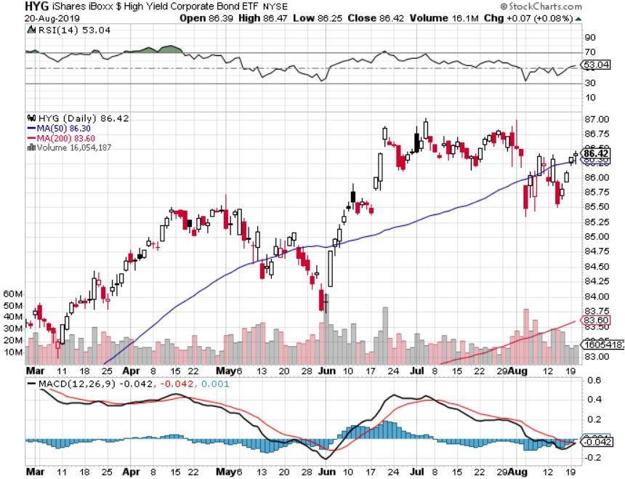
Junk Bonds (HYG) 5.31% Yield big jump in yields on stock selloff and recession fears

Slide 56
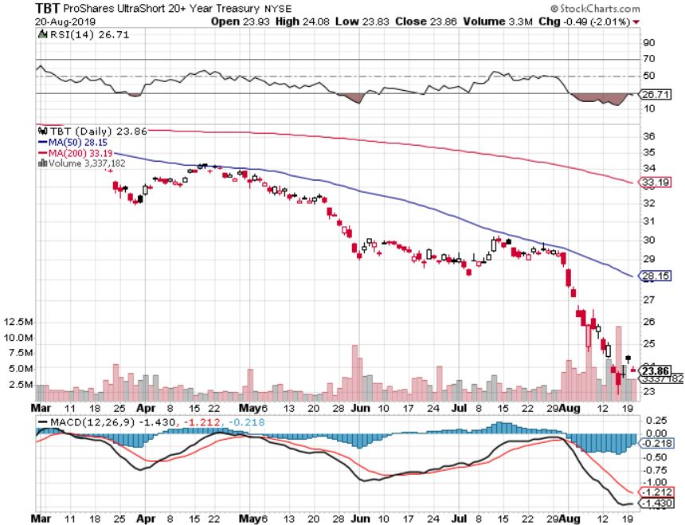
2X Short Treasuries (TBT)- 2 Month Topping Process

Slide 57
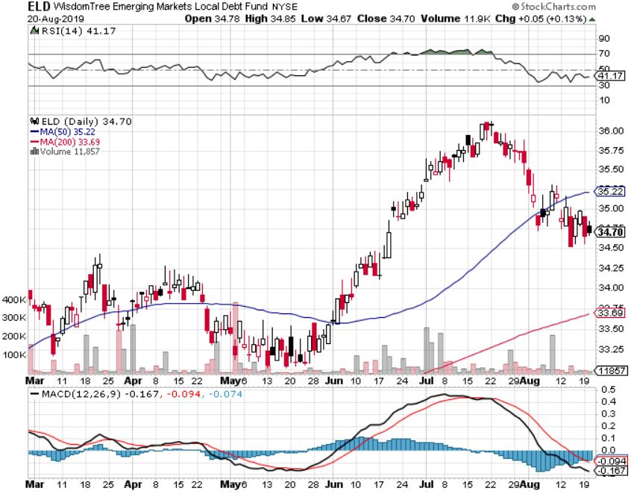
Emerging Market Debt (ELD) 5.09% Yield-

Slide 58
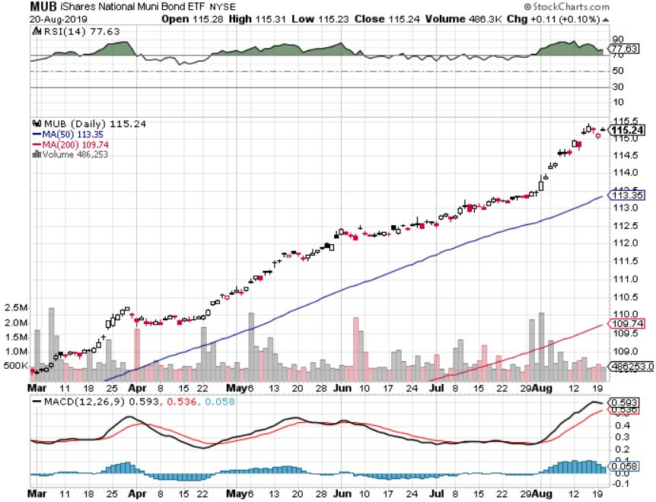
Municipal Bonds (MUB)-1.59% Mix of AAA, AA, and A rated bonds

Slide 60
Foreign Currencies – Dollar Spike
*US dollar takes another run at the highs based on economic strength *Three more Interest rate cuts by 2020 now in the market *Whenever markets ignore interest rate differentials the move is short term only *British pound takes a break from free fall, waiting to see what happens next *Chinese Yuan stabilizes at ten year low, but will weaken again on next trade war escalation *Bitcoin collapses on Ponzi scheme liquidation *Bottom Line: Sell the US dollar against everything, except the Yuan (CYB) and pound (FXB)

Slide 61
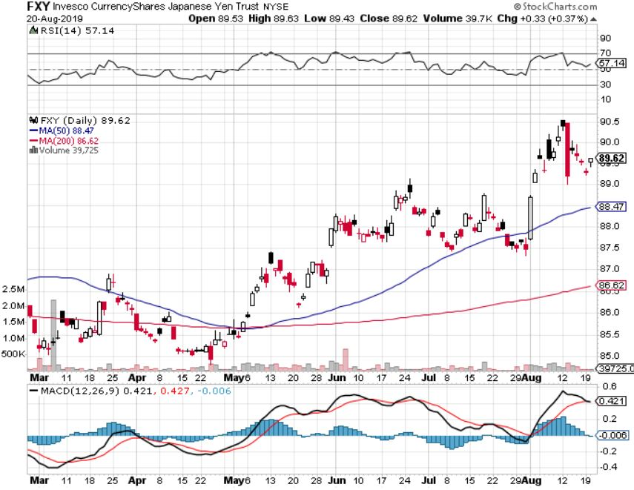
Japanese Yen (FXY), (YCS)

Slide 62
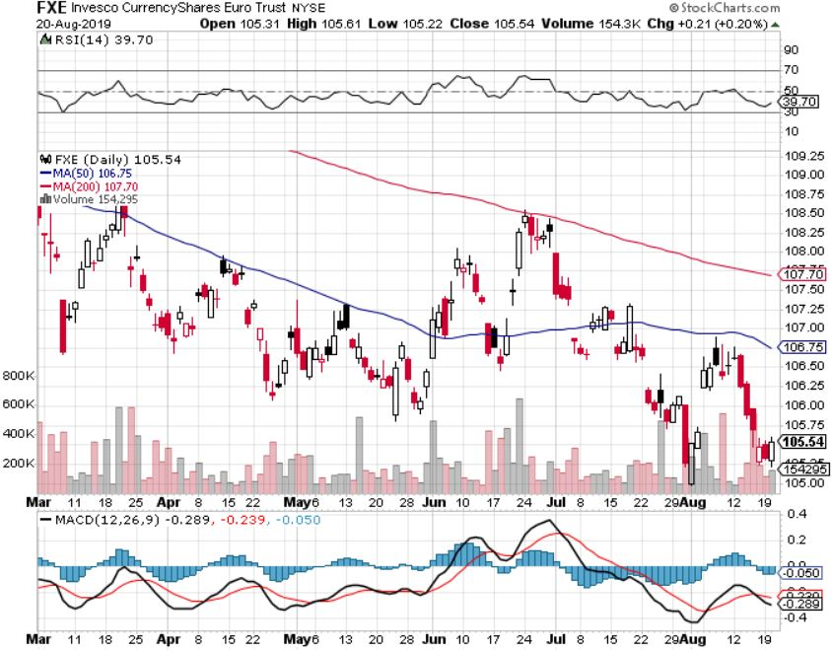
Euro ($XEU), (FXE), (EUO)-

Slide 63
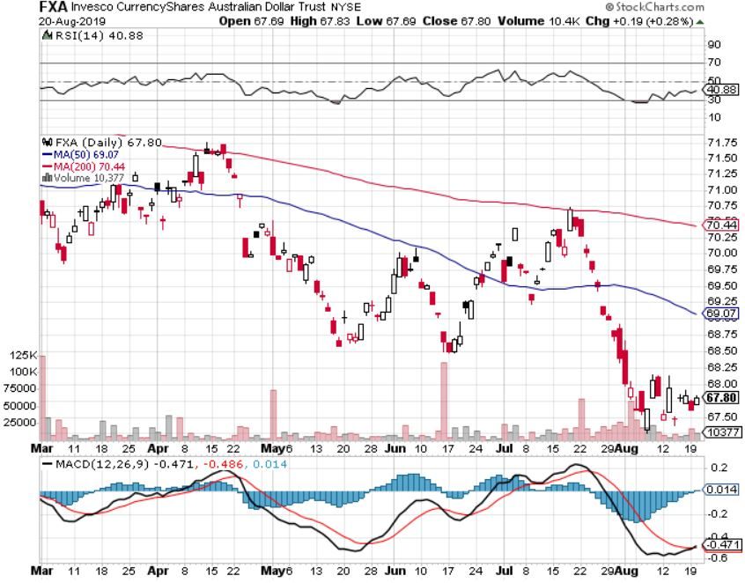
Australian Dollar (FXA)- The Global Recovery Play took profits on long 8/$67-$69 call spread

Slide 64
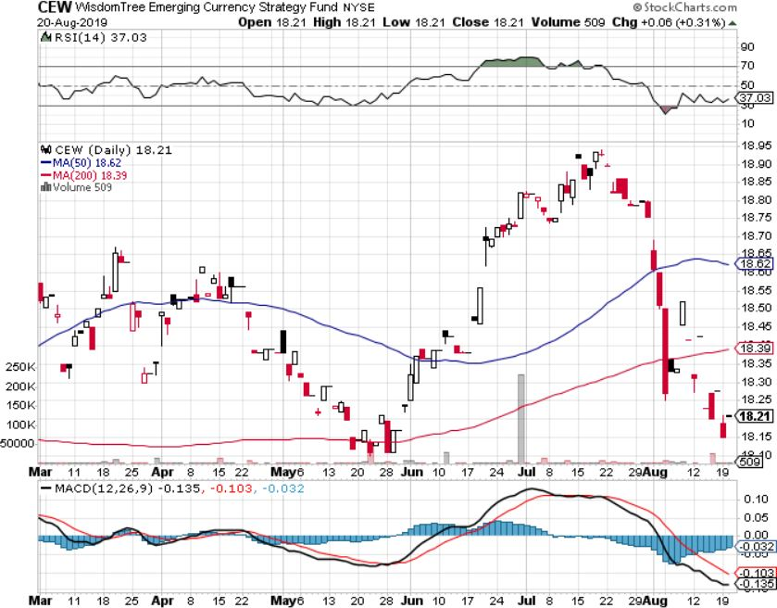
Emerging Market Currencies (CEW)

Slide 65
Chinese Yuan- (CYB)-

Slide 66
Bitcoin- Dow 20% in a heart beat Chinese flight from Yuan is 99% of the trade

Slide 68
Energy – Supply Glut
*Saudi Arabia looking to cut production by 700,000 barrels a day to stabilize prices in the face of slowing global demand from recession fears *Russia producing above quota at 11.32 million b/d, adding to glut *Massive tax subsidies are driving new investment in US production and distribution, even though prices are falling *However, the largest buyer of US oil, China, has banned US oil in response to the trade war *Geopolitics is having no positive impact with the tanker wars in the Straights of Hormuz *Bottom Line: looks like $42 a barrel is in the cards

Slide 69
Oil-($WTIC)

Slide 70
United States Oil Fund (USO)

Slide 71
Energy Select Sector SPDR (XLE)-No Performance! (XOM), (CVX), (SLB), (KMI), (EOG), (COP)

Slide 72
Halliburton (HAL)-

Slide 73
Natural Gas (UNG)-

Slide 75
Precious Metals – Melting UP
*Gold now has a positive yield relative to the Euro and the yen for the first time in history *However, we have blasted up to the top end of the recent channel and risk is rising *China, Russia, and Iran have been dominating purchases looking to evade US economic sanctions *Physical gold market can’t handle high prices, with India and China cutting imports sharply *Bottom Line: buy a bigger dip in gold and precious metals

Slide 76
Gold (GLD)- New 5 Year Highs

Slide 77
Market Vectors Gold Miners ETF- (GDX) – Yikes!

Slide 78
Barrick Gold (GOLD)

Slide 79
Newmont Mining- (NEM)-

Slide 80
Palladium - (PALL)-

Slide 81
Copper (COPX)-Collapse Trade War Disaster

Slide 82
Freeport McMoRan (FCX)-World’s Largest Copper Producer took profits on long 4/$10-$11 call spread took profits on short 4/$114 calls

Slide 84
Real Estate – Still Weak
*July Housing Starts down 4% at 1.19 million *H1 Single Family Home Starts down 6% *August Builder Sentiment rises from 65 to 66 on lower rates, anything about 50 is positive, according to the NAHB *July Mortgage Applications for single family homes up 30%, 30 year rates could drop to 2.0% at the end of this cycle, same as where they are in Europe now
*May S&P 500 Case-Shiller drops to a 3.4%, annual gain, the lowest gain in 6 1/2 years *Bottom Line: Stand aside for a trade but buy for long term investment

Slide 85
February Corelogic S&P Case Shiller Home Price Index Las Vegas (6.4%), Phoenix (5.7%), and Tampa (5.1%) showing biggest gains
Tradingeconomics.com

Slide 86
Simon Property Group (SPG)-

Slide 87
US Home Construction Index (ITB) (DHI), (LEN), (PHM), (TOL), (NVR)

Slide 88
Trade Sheet- So What Do We Do About All This?
*Stocks-sell rallies *Bonds-buy dips *Commodities-stand aside *Currencies-sell US dollar again (FXA), (FXE) *Precious Metals – buy dips *Energy - avoid *Volatility-buy dips *Real estate-stand aside

Slide 90
Next Strategy Webinar 12:00 EST Wednesday, September 4, from Silicon Valley, CA email me at support@madhedgefundtrader.com
Good Luck and Good Trading!
Notes:
*

