Slide 1
The Mad Hedge Fund Trader “Waiting on Tenterhooks”
With John Thomas from Silicon Valley, CA, September 18, 2019 www.madhedgefundtrader.com
Notes:
*

Slide 2
October 25-26 Lake Tahoe Conference
*Two days of informative speakers on crucial trading and investment issues *Trade tips with the most successful Mad Hedge traders *2 nights in the Hyatt, including all you can eat and drink *Tickets are a bargain at $699 to $1,999 *Buy now, upper ticket classes sell out first

Slide 3
Trade Alert Performance New Highs! Best Month in Two Years
*January 9.49% Final *July +3.07% MTD *February +4.64% Final *August +16.01% Final *March +1.78% Final *September 1.59% MTD *April +0.30% Final *October +1.37% Final *May +0.25% Final *November -1.83% Final *June -0.50% Final *December -4.13% Final *2019 Year to Date +35.87% compared to +16.32% for the Dow Average *+336.07% since inception, *Average annualized return of 34.35% for 10 years

Slide 4
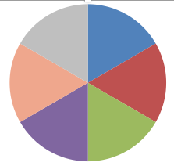
Portfolio Review Keeping Small Positions Only Buying Very Deep in-the-Money on Capitulation Days
Current Capital at Risk
Risk On
World is Getting Better
(AMZN) 9/$1500-1550 | 10.00%
(FB) 9/$150-$160 call spread | 10.00%
(DIS) 9/$115-$120 call spread | 10.00%
(MSFT) 9/115-$120 call spread | 10.00%
Risk Off
(TLT) 10/$129-$132 call spread | -10.00%
(USO) 10/$14-$15 put spread | -10.00%
Total Net Position | 20.00%
Expiration P&L 38.02% YTD

Slide 5
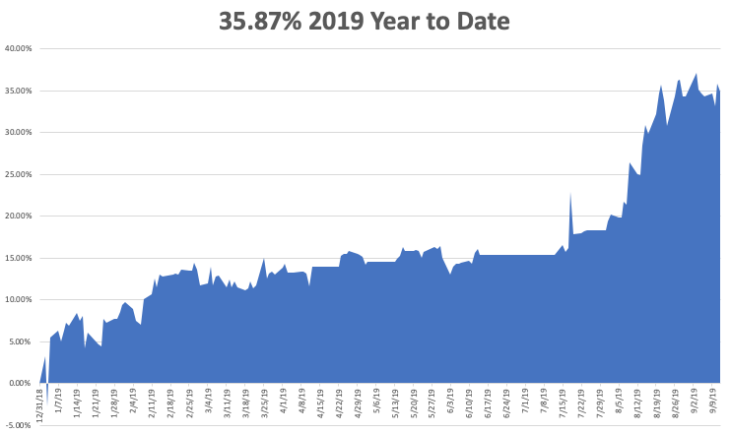

Slide 6
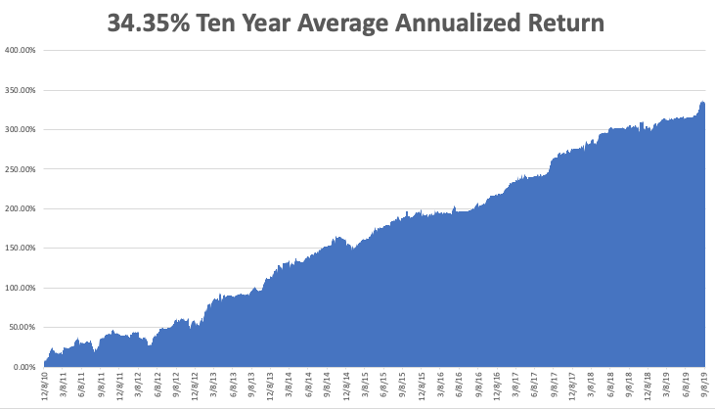
GTD 10 Year Daily Audited Performance

Slide 7
The Method to My Madness
*We managed to completely sidestep the September short squeeze *Saudi oil attack was was a one day event only, like 9/11, creating great selling opportunity *Our core longs in technology will all expire at max profit in 2 days *Ease off in China trade war, even incrementally is massively pro risk *We’re not buying the shift into value (junk) stocks with terrible fundamentals, like banks, industrials, and retailers because it is just a temporary short term trend *Eventually, a failure of a real deal to arrive will take stocks down to new lows *Brexit may be on its way out, a big positive for the global economy *All on hold until Fed cuts rates on Wednesday, or not

Slide 8
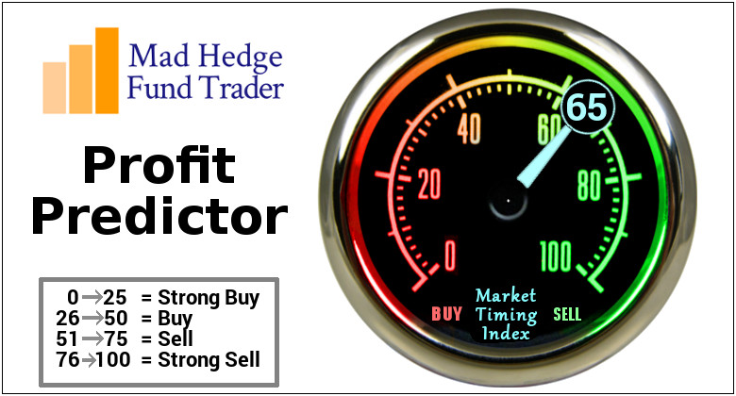
The Mad Hedge Profit Predictor Market Timing Index- An artificial intelligence driven algorithm that analyzes 30 different economic, technical, and momentum driven indicators

Slide 9
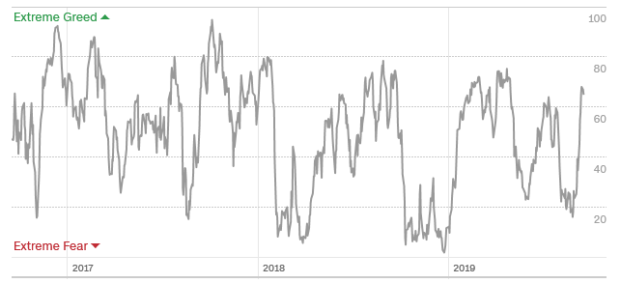
The Mad Hedge Profit Predictor Headed Towards a “BUY”
SELL
BUY

Slide 10
The Global Economy – Turmoil
*40% chance of a US recession in 12 months, 100% in 24 months, yield inversion is freaking out global strategists, Job openings fell 31,000 in August to 7.2 million *Saudi oil attac permanently raises the price of oil there through higher insurance and defense costs *European Central Bank cuts rates by 10 basis point to head off a recession, QE is renewed *China’s Economy Slows More, with Industrial output up 4.4%, the slowest since 2002 *The US is still the strongest economy in the world, but is fading fast, *Europe has accelerated downward economic spiral, will spill into the US, Germany has dropped from 2.0% growth to -0.1% since January *If Brexit is put up for another vote it will lose

Slide 11
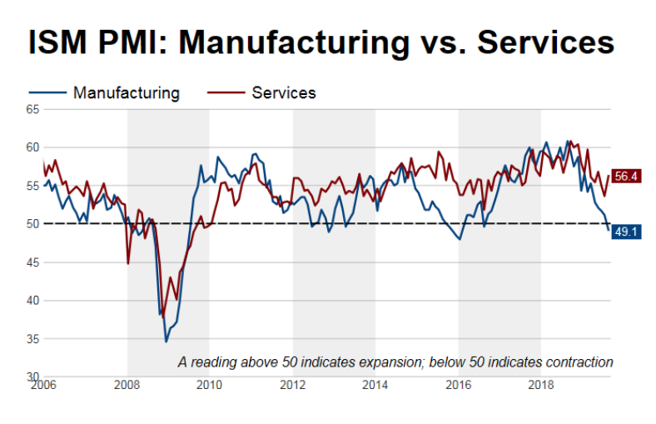

Slide 12
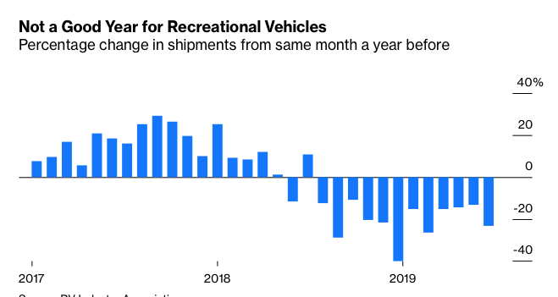
RV Sales Have Fallen of a Cliff – A Great Pre Recession Indicator

Slide 13
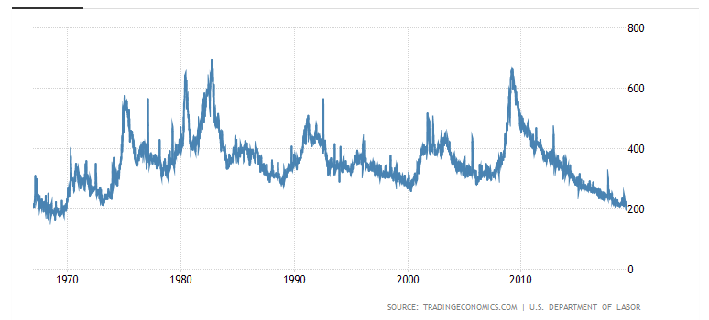
Weekly Jobless Claims-Bottomed Out -15,000 to 204,000

Slide 14
Soybeans - Trade War Indicator Chinese Buy Ten Shiploads as an Olive Branch

Slide 15
The Bill Davis View A $1,500 Upgrade for the Mad Day Trader Service

Slide 16
Stocks – Air Pocket
*Stock Cross the $270-$290 air pocket for the eighth time in 18 months with zero net return *Valuations are now high, with the Mad Hedge Market Timing Index at a risky 70, energy stocks have best day in a decade on Saudi attack but it was all short covering *The entire August “RISK OFF” trade has been unwound, with value stock beating growth ones *The junk has led, with companies with poor fundamentals leading those with good ones, is temporary at best *Trading volume is falling in up markets, rising in down markets, always a negative indicator *All hangs on Fed interest rates decision out 2 ½ hours *Bottom line: 10% down market for the next 3 months, then new highs propelled by ultra low interest rates or a China trade deal *Bottom Line: its bet the ranch time on tech longs, but stay away from those with big China exposure, like Apple, and weak dollar plays like energy, and emerging markets

Slide 17
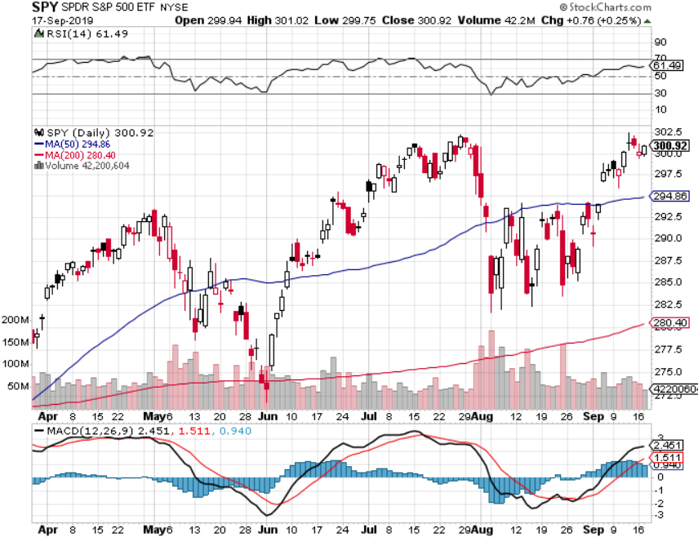
S&P 500 – Top of Range took profits on long 8/$305-$308 bear put spread stopped out of long 2/$285-$290 bear put spread took profits on long 2/$270-$275 bear put spread

Slide 18
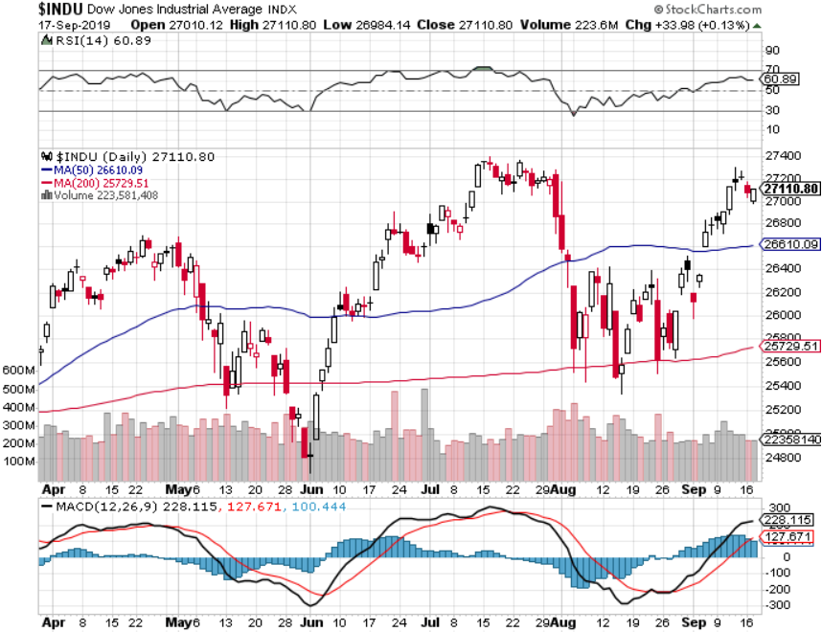
Dow Average ($INDU)-

Slide 19
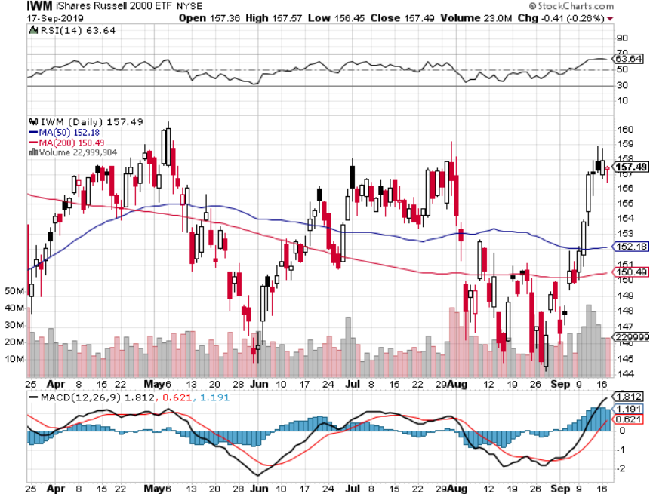
Russell 2000 (IWM)- Quadruple Top Long 9/$153-$156 vertical bear put spread took profits on Long 9/$157-$160 vertical bear put spread took profits on Long 8/$158-$161 vertical bear put spread out for even Long 4/$160-$165 vertical bear put spread

Slide 20
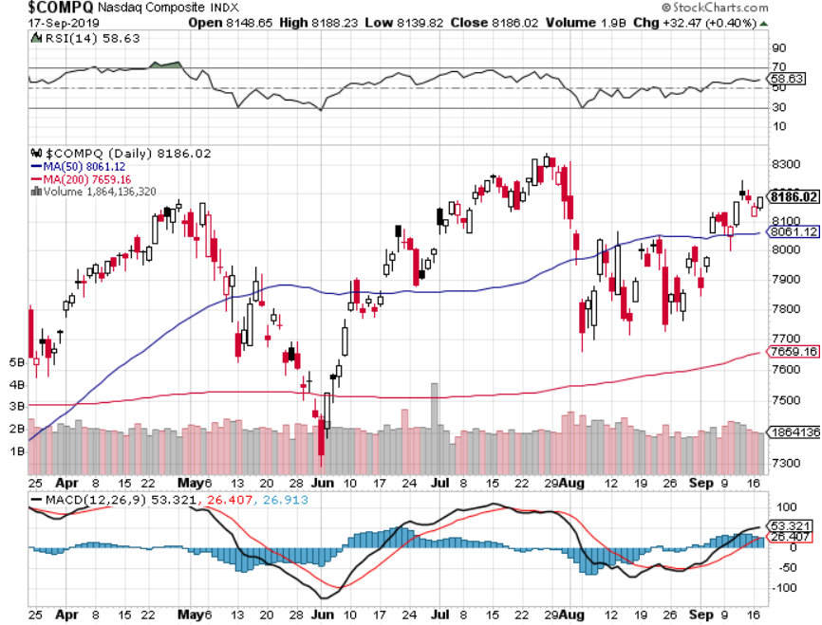
NASDAQ ($COMPQ) – Profit Taking

Slide 21
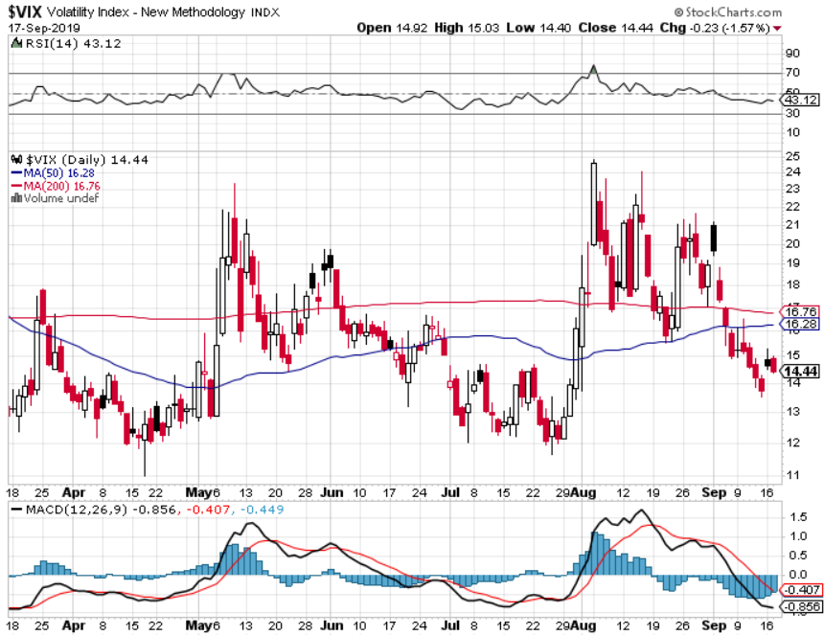
(VIX)-Back in the Dumps

Slide 22
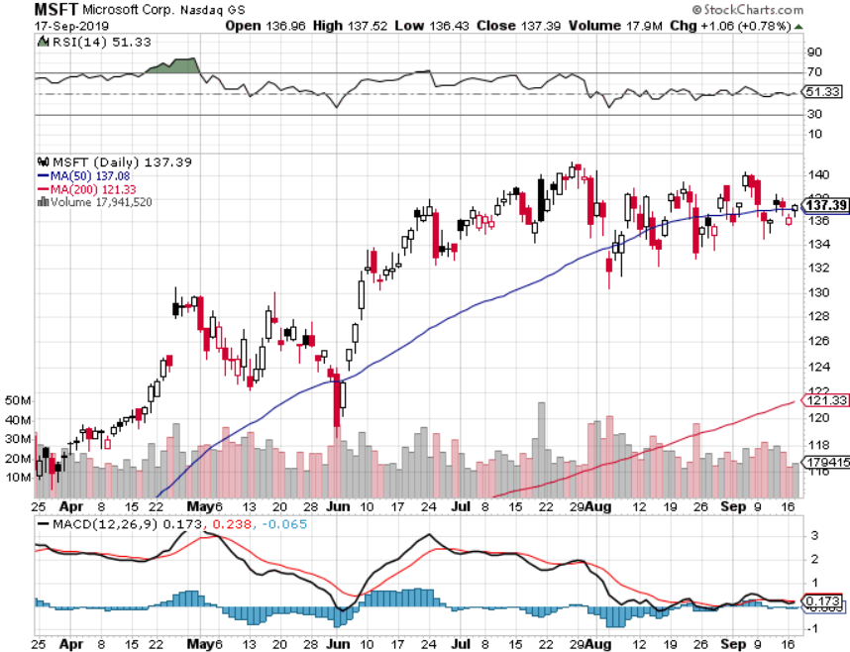
Microsoft (MSFT)- Earnings beat- Looking for Another Entry Point long 9/$115-$120 call spread – expires in 22 trading days long 6/$110-$115 call spread-out at cost took profits on long 4/$108-$113 call spread took profits on long 2/$85-$90 call spread

Slide 23
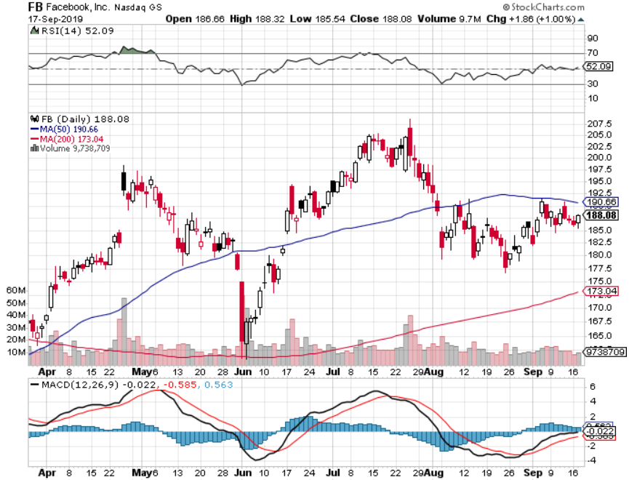
Facebook (FB)- Long 9/$150-$160 vertical bull call spread - expires in 2 trading days took profits on Long 8/$167.50-$172.50 vertical bull call spread

Slide 24
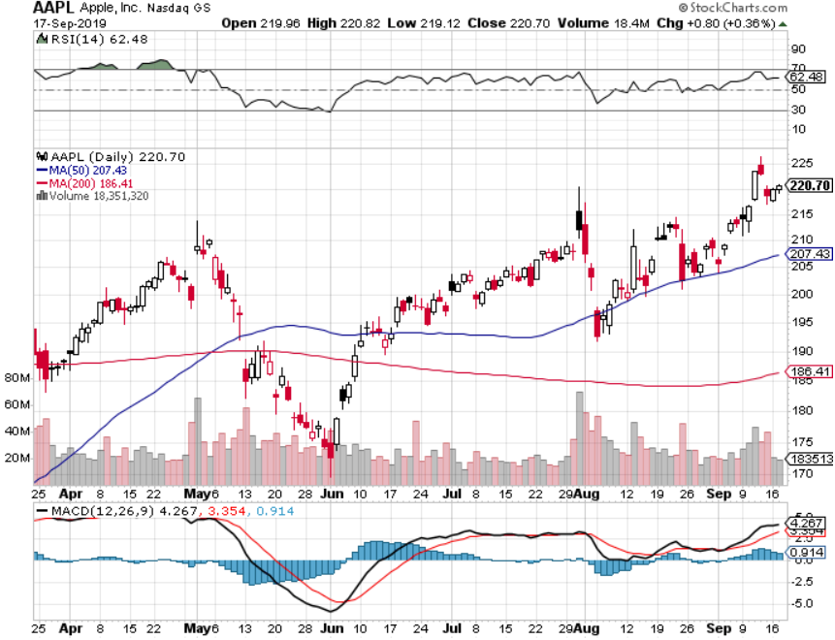
Apple (AAPL)- China Target – 5G Chip Buy

Slide 25
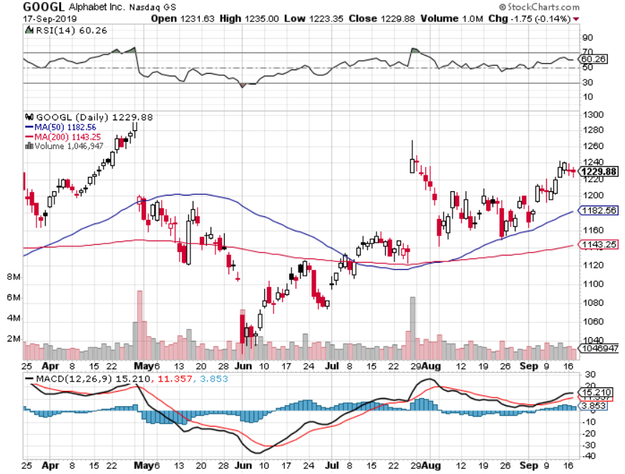
Alphabet (GOOGL)-Antitrust Target took profits on long 9/$1,030-$1,080 vertical bull call spread stopped out of long 5/$1,100-$1,130 bull call spread took profits on long 4/$1,080-$1,120 bull call spread

Slide 26
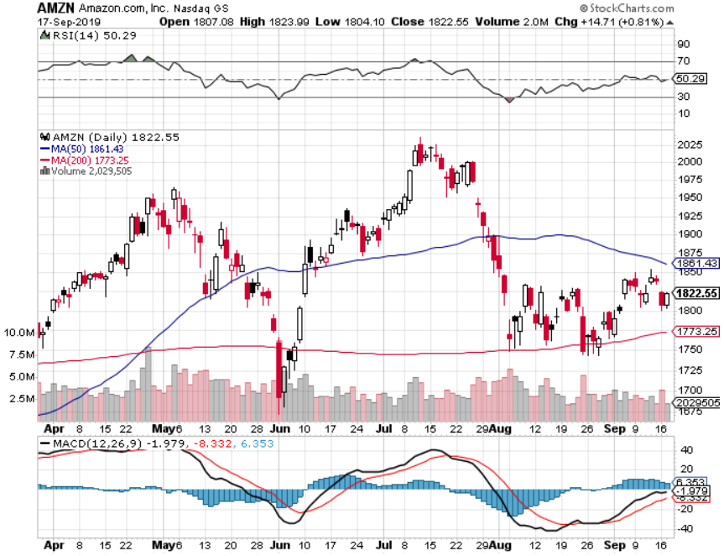
Amazon (AMZN)-Back to bottom of range Long 9/$1,500-$1,500 vertical bull call spread - expires in 2 trading days stopped out of long 4/$1,650-$1,700 call spread took profits on long 4/$1,600-$1,650 call spread took profits on long 2/$1,200-$1,300 call spread

Slide 27
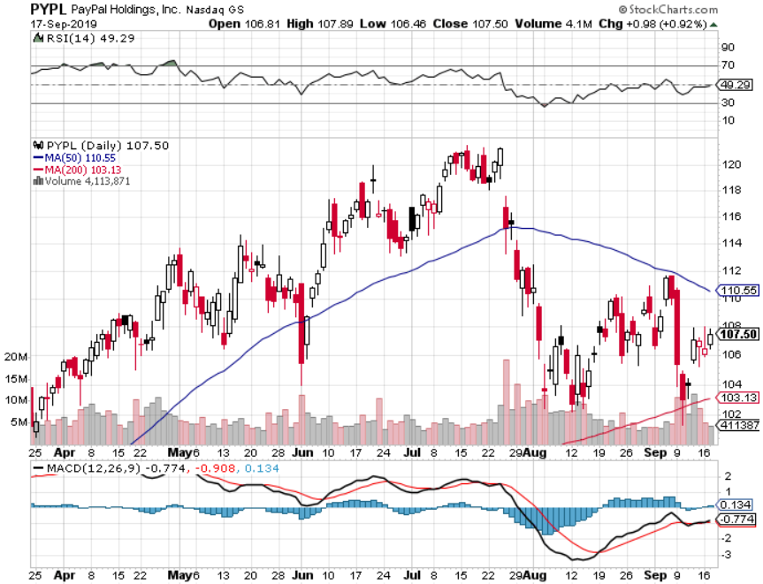
PayPal (PYPL)-Fintech Star took profits on long 4/$90-$95 call spread

Slide 28
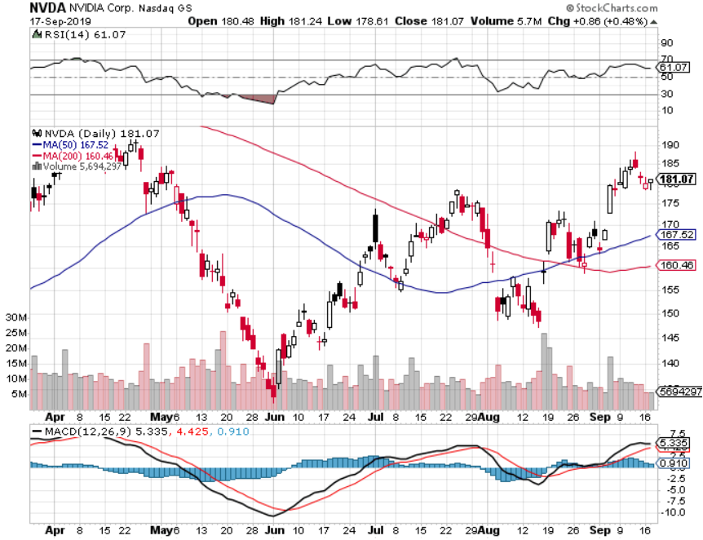
NVIDIA (NVDA) -

Slide 29
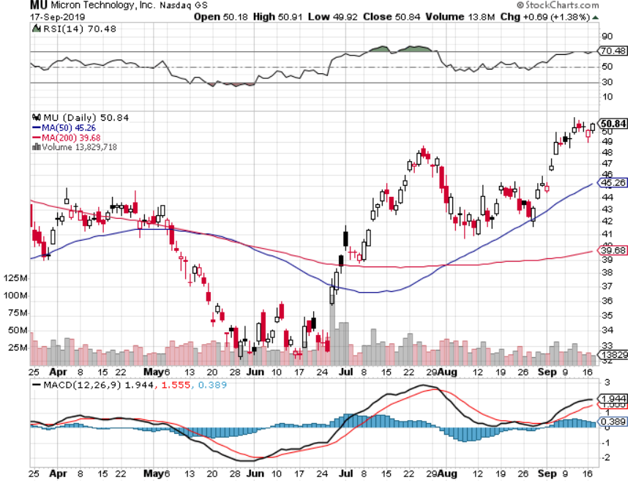
Micron Technology (MU)-

Slide 30
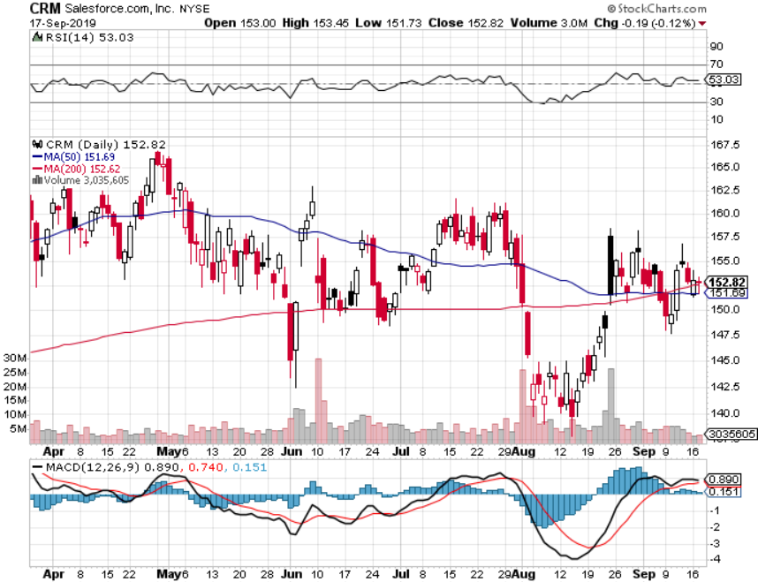
Salesforce (CRM)- took profits on long 9/$125-$130 vertical bull call spread took profits on long 8/$125-$130 vertical bull call spread took profits on long 2/$105-$115 call spread

Slide 31
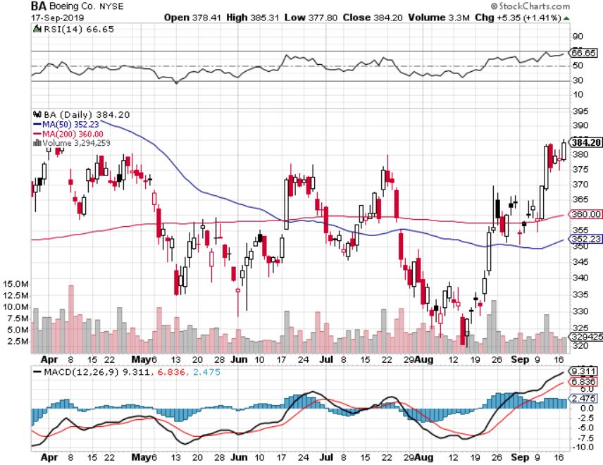
Boeing (BA)- took profits on long 4/$315-$335 call spread Next to happen in the recertification bounce

Slide 32
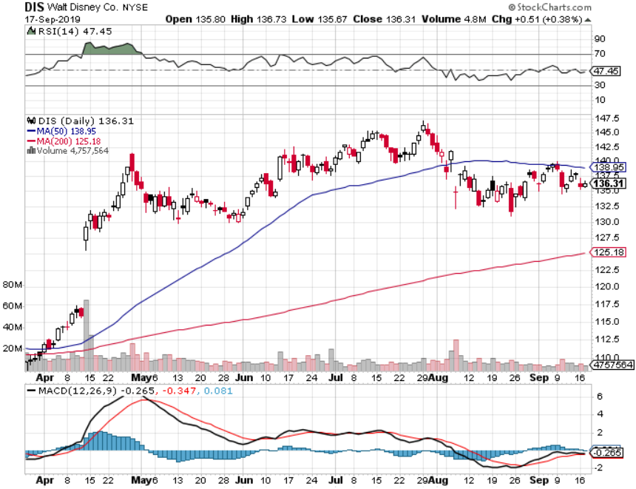
Walt Disney (DIS)- The Next Netflix long 9/$115-$120 call spread - expires in 12 trading days 8/$125-$130 call spread expired at max profit Stopped out of 4/$125-$130 call spread for small loss took profits on long 4/$100-$104 call spread

Slide 33
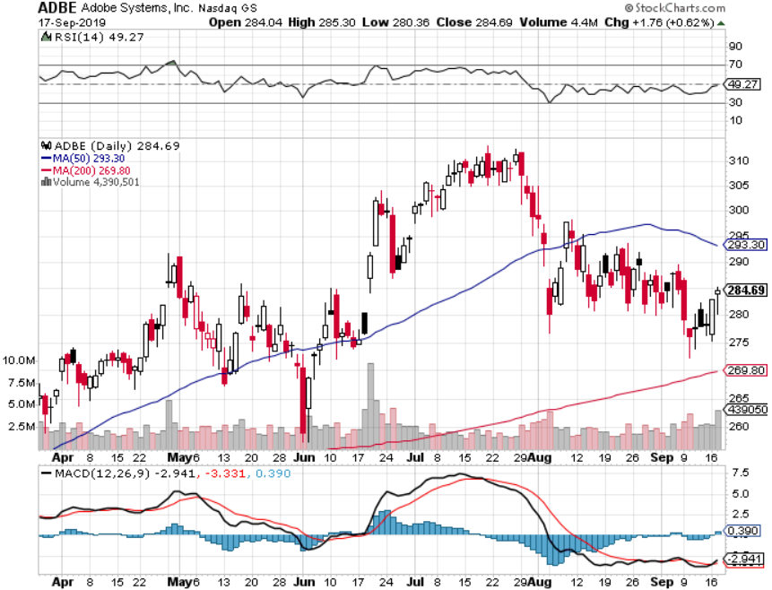
Adobe (ADBE)- The Quality Non-China tech play

Slide 34
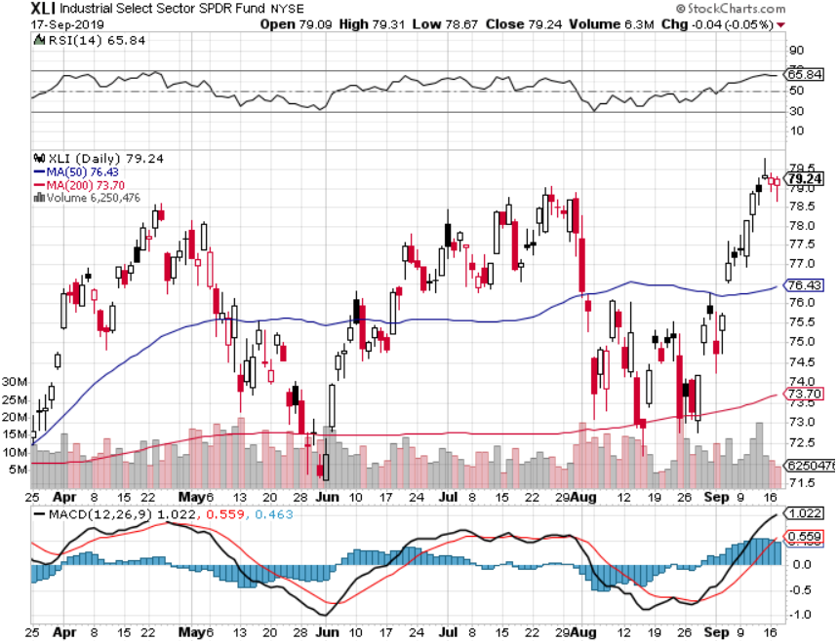
Industrials Sector SPDR (XLI)- (GE), (MMM), (UNP), (UTX), (BA), (HON)

Slide 35
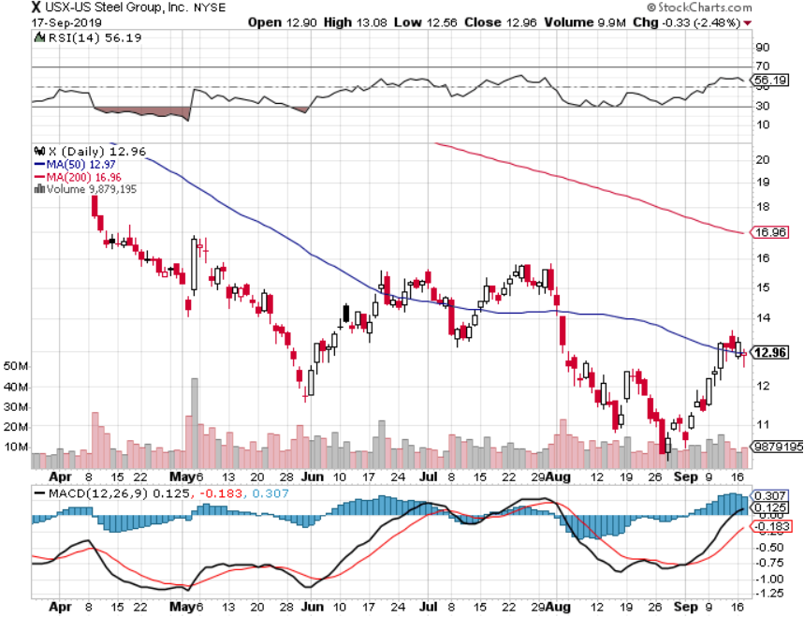
US Steel (X)-Tariffs Trouble Import duties cause users to abandon steel Down by 50% since the election

Slide 36
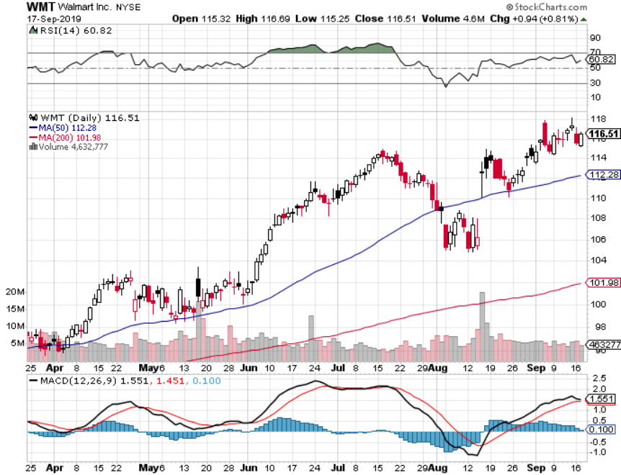
Wal-Mart (WMT)-Tariffs Trouble Long 9/$119-$121 bear put spread took profits on Long 8/$114-$117 bear put spread

Slide 37
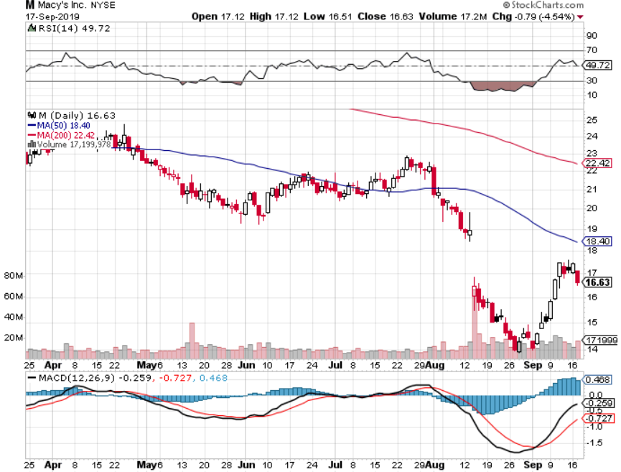
Macys’ (M)-Tariffs Trouble took profits on Long 8/$23-$25 bear put spread

Slide 38
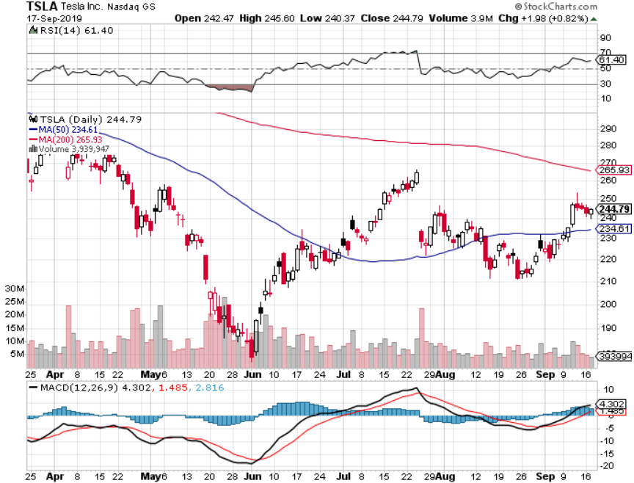
Tesla (TSLA)- 900,000 on the road by yearend took profits on long 6/$140-$150 call spread – expires in 7 trading days took profits on long 6/$240-$250 put spread – expires in 7 trading days stopped out of long 4/$300-$320 put spread
Major Support

Slide 39
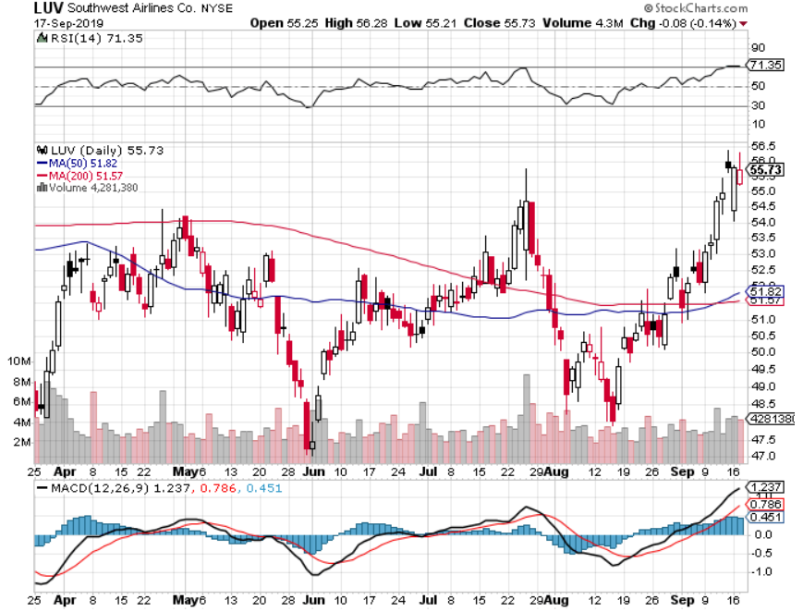
Southwest Airlines (LUV) - Boeing 737 Max biggest buyer

Slide 40
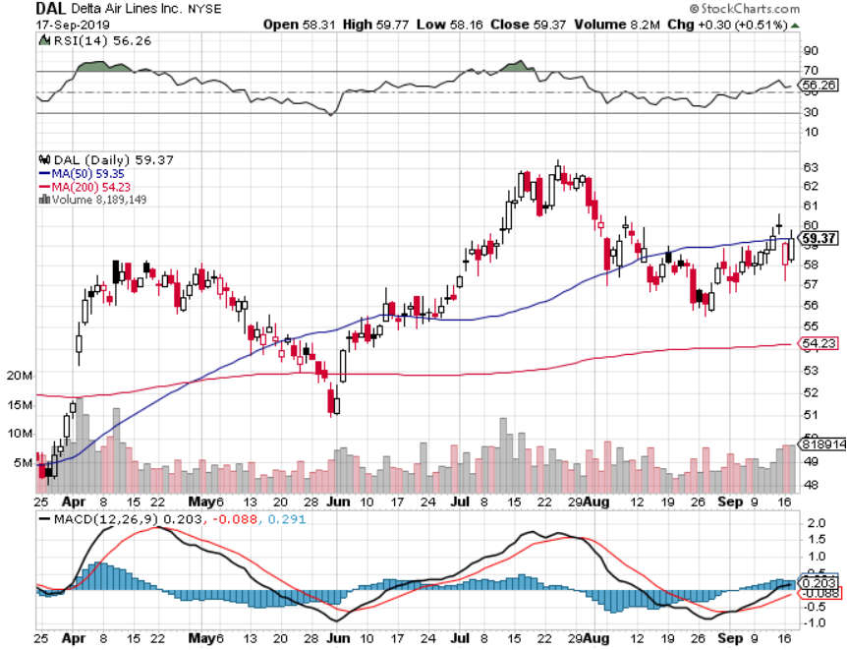
Delta Airlines (DAL) – Non 737 User

Slide 41
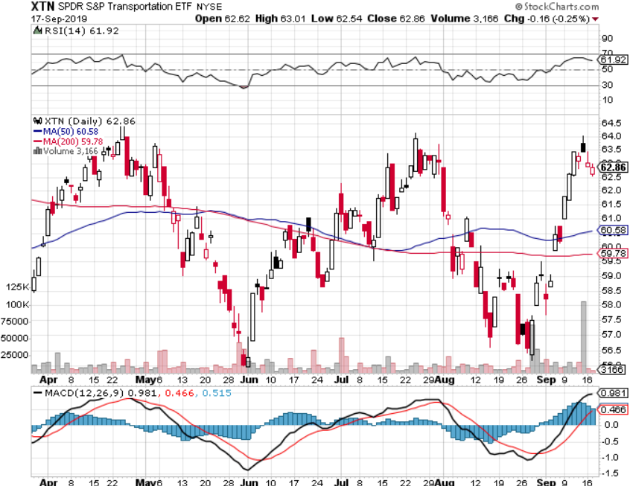
Transports Sector SPDR (XTN)- (ALGT), (ALK), (JBLU), (LUV), (CHRW), (DAL)

Slide 42
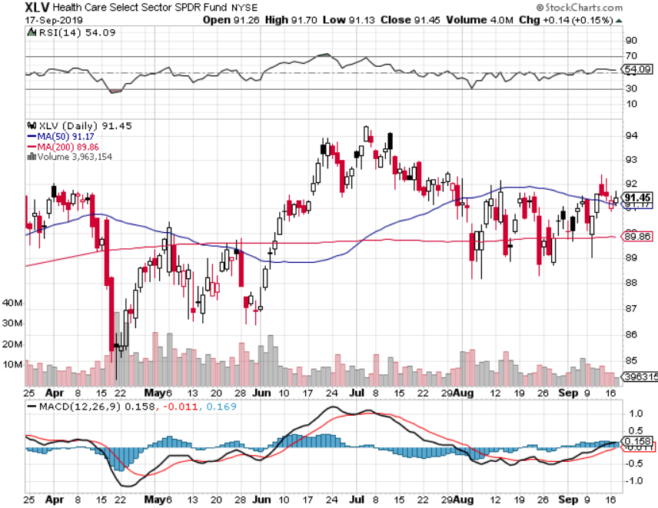
Health Care Sector (XLV), (RXL)-New Highs (JNJ), (PFE), (MRK), (GILD), (ACT), (AMGN)

Slide 43
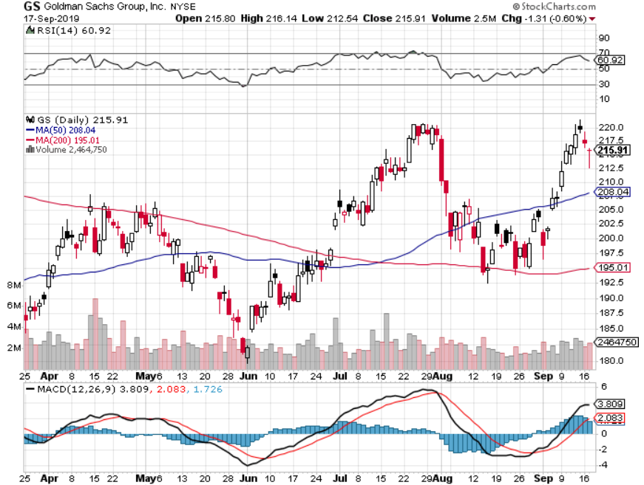
Goldman Sachs (GS)- Swan dive on low rates

Slide 44
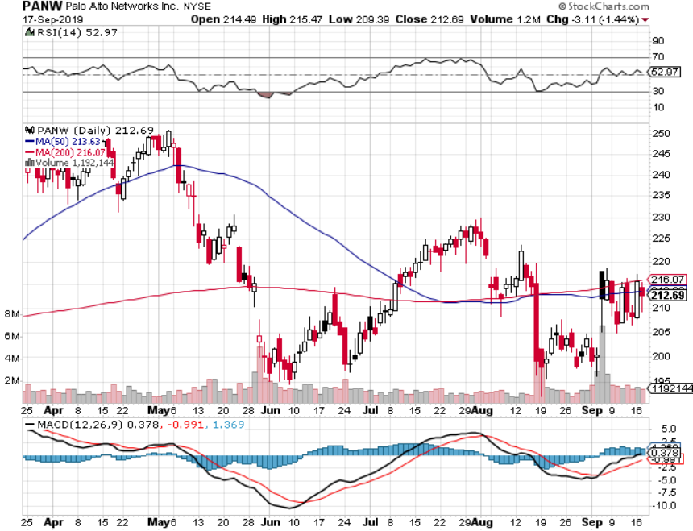
Palo Alto Networks (PANW)- Hacking never goes out of fashion

Slide 45
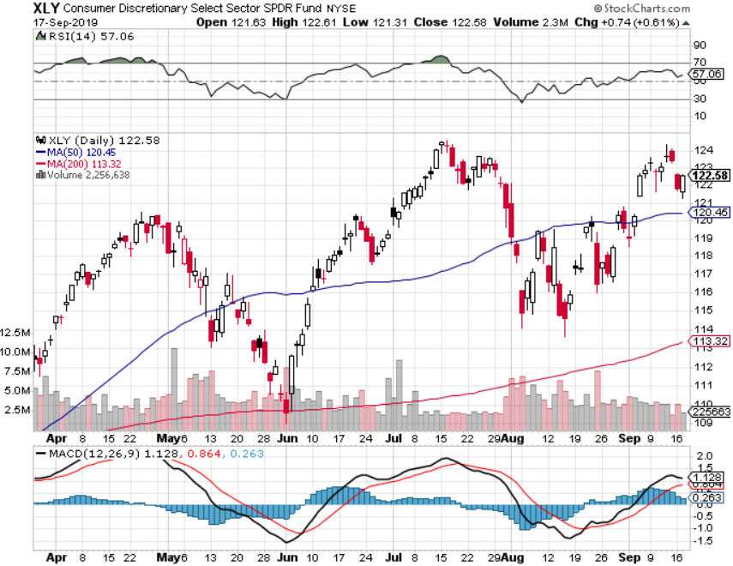
Consumer Discretionary SPDR (XLY) (DIS), (AMZN), (HD), (CMCSA), (MCD), (SBUX)

Slide 46
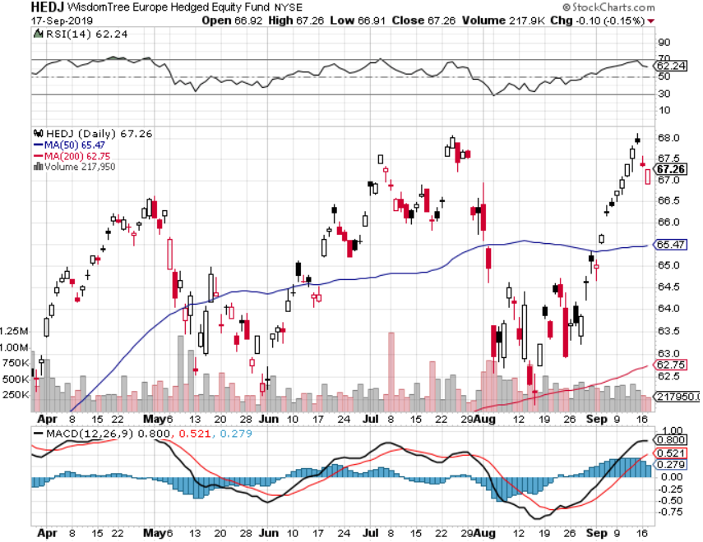
Europe Hedged Equity (HEDJ)-

Slide 47
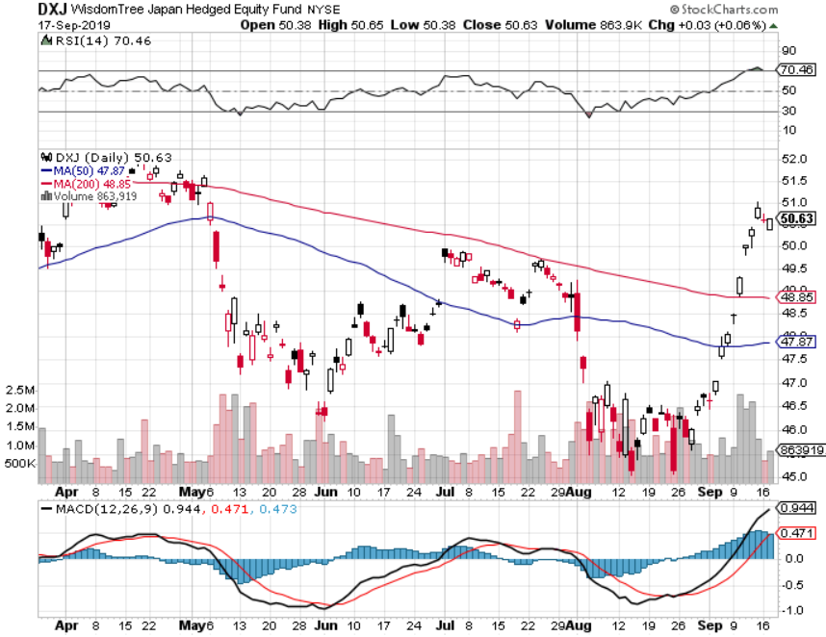
Japan (DXJ)-

Slide 48
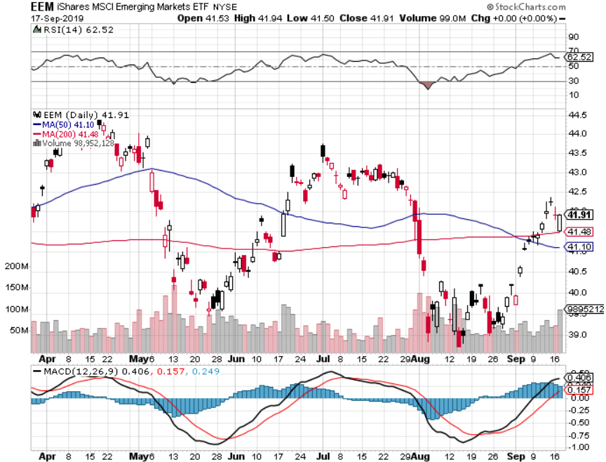
Emerging Markets (EEM)- Avoid on strong Weak Dollar

Slide 49
Bonds – The Big Spike
*US ten year bonds collapse in price, rocket in yields, take yields from 1.44% to 1.90% in a week *The bond selloff was global, taking bunds from -1.00% to -45% and JGB’s from -0.25% to -0.17% *The spike is in, it will take months of digestions before rates take a new run at lows *US budget deficit tops $1 trillion for the first 11 months of the federal fiscal year, did that cause the dive? *I used the 11 point crash to go long again *40% of the world’s bonds now have negative interest rates *Bottom line: Ten year US Treasury yields will fall below zero in 2020 to come in line with the rest of the world

Slide 50
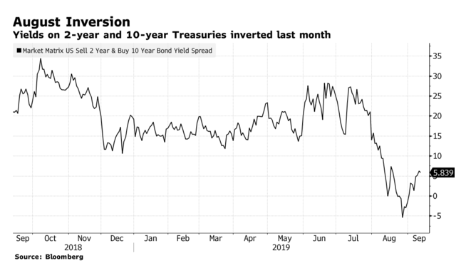

Slide 51
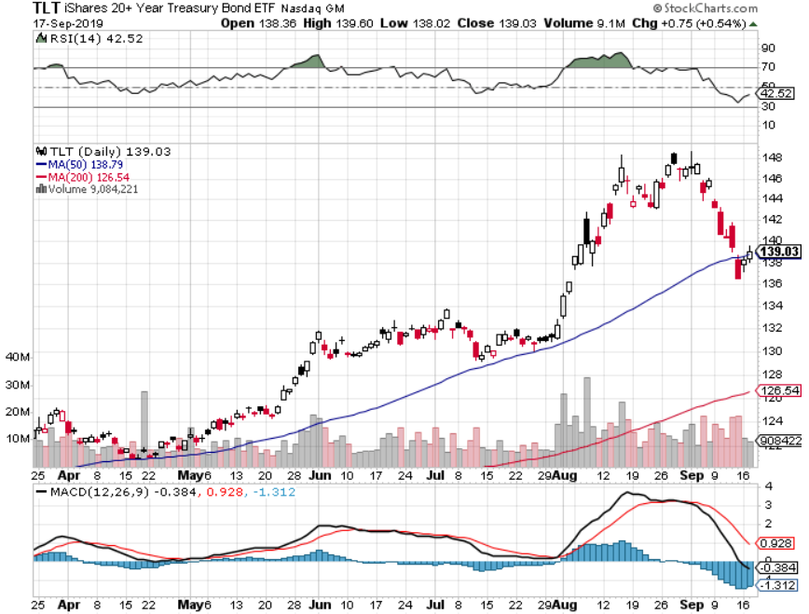
Treasury ETF (TLT) – long 10/$129-$132 call spread-22 days to expiration stopped out of long 8/$137-$140 put spread took profits on long 8/$125-$128 call spread took profits on long 6/$128-131 bear put spread took profits on long 5/$116-$119 bull call spread

Slide 52
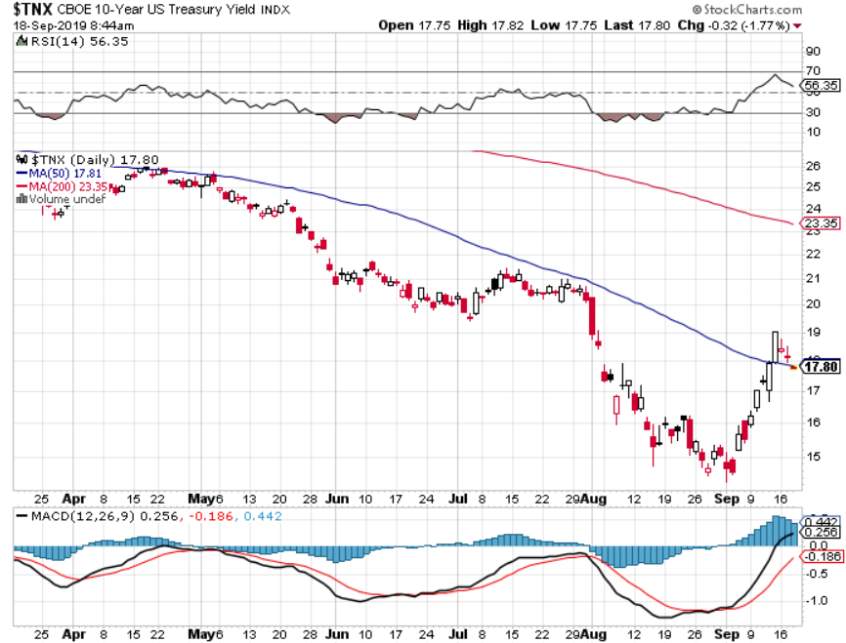
Ten Year Treasury Yield ($TNX) – 1.44% Overnight Low

Slide 53
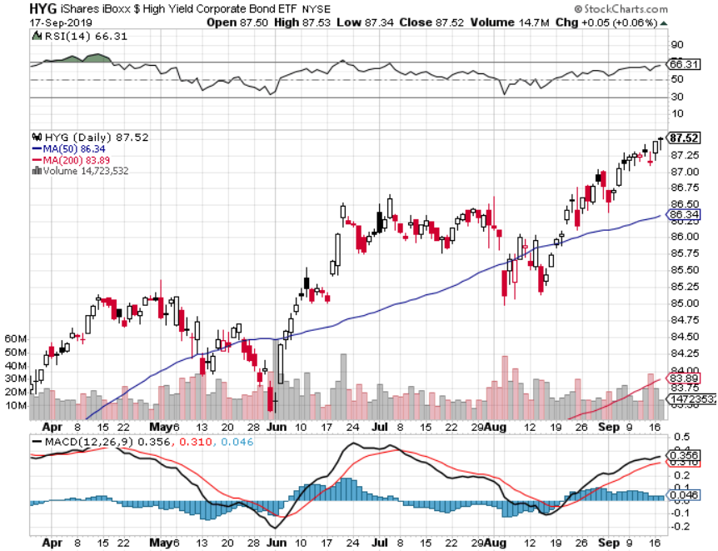
Junk Bonds (HYG) 5.31% Yield big jump in yields on stock selloff and recession fears

Slide 54
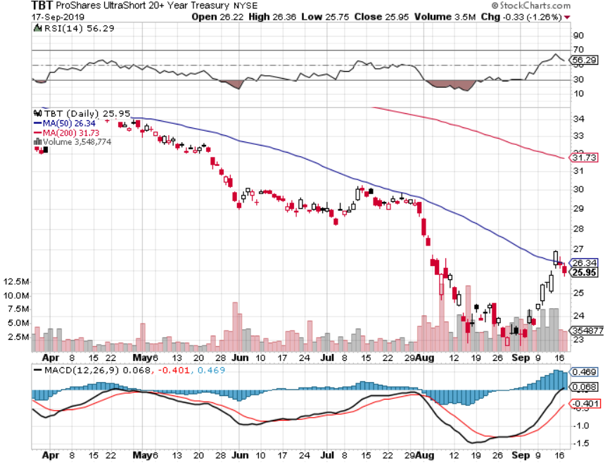
2X Short Treasuries (TBT)- 2 Month Topping Process

Slide 55
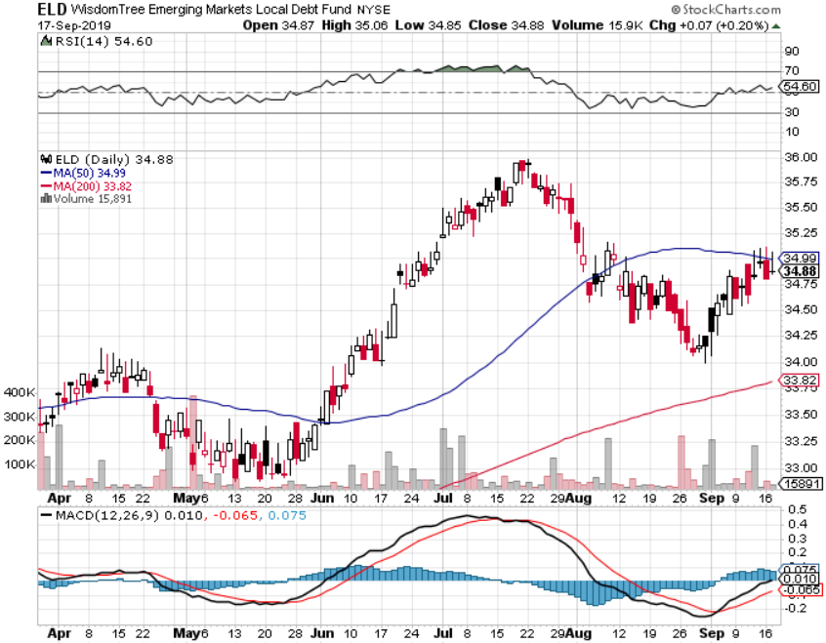
Emerging Market Debt (ELD) 5.09% Yield-

Slide 56
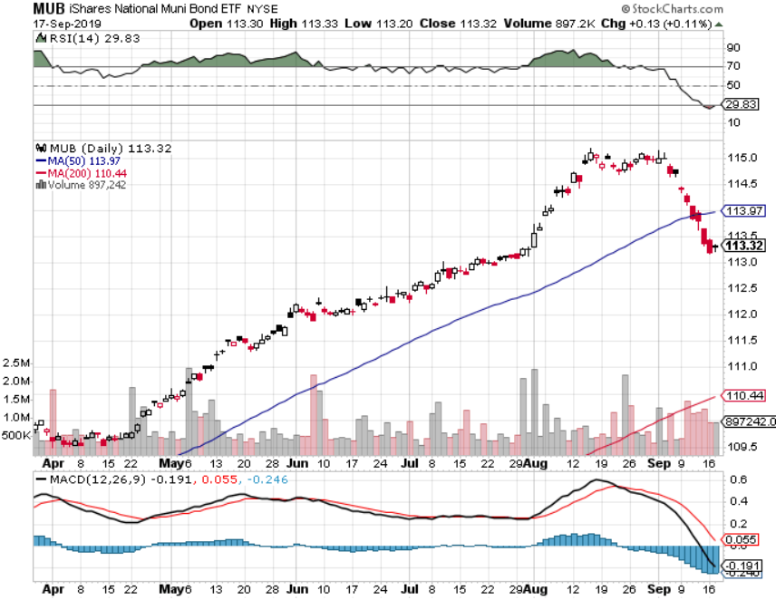
Municipal Bonds (MUB)-1.59% Mix of AAA, AA, and A rated bonds

Slide 57
Foreign Currencies – European QE is Back
*Euro rallies on latest QE because it was not as big as expected *Japanese yen sells of on return to risk taking *British pound rallies on failing Brexit *Chinese Yuan rallies on easing trade war *Bitcoin dead in the water *Aussie rallies big on global return to ”RISK ON” *Bottom Line: Sell the US dollar against everything, except the Yuan (CYB) and pound (FXB)

Slide 58
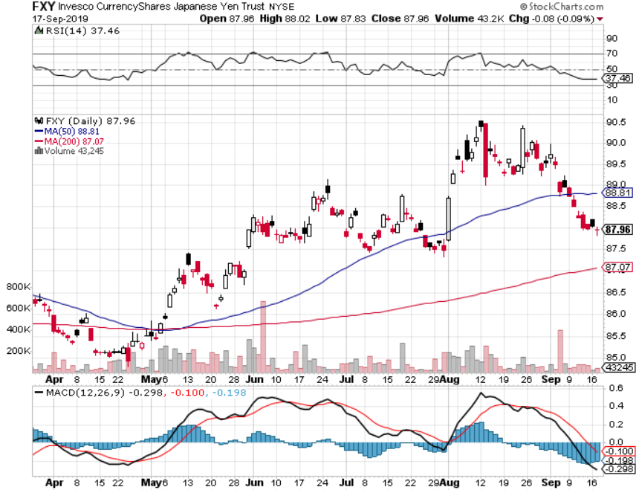
Japanese Yen (FXY), (YCS)

Slide 59
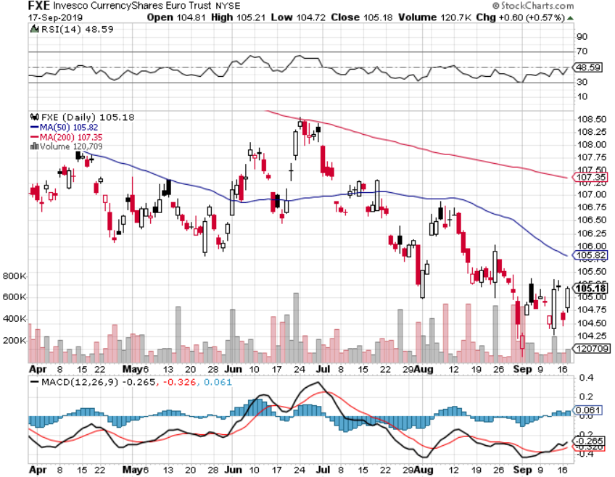
Euro ($XEU), (FXE), (EUO)-

Slide 60
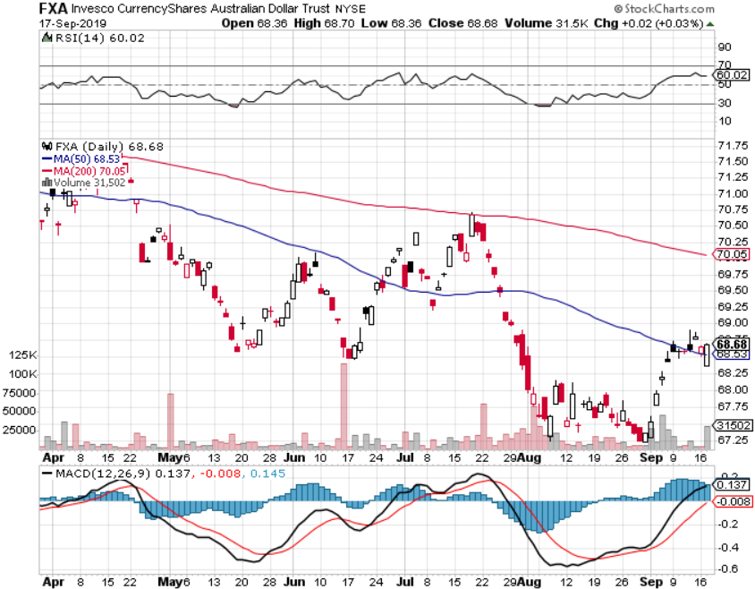
Australian Dollar (FXA)- The Global Recovery Play took profits on long 8/$67-$69 call spread

Slide 61
Emerging Market Currencies (CEW)

Slide 62
Chinese Yuan- (CYB)- New Lows

Slide 63
Bitcoin- Stalling at a High Chinese flight from Yuan is 99% of the trade

Slide 64
Energy – Drone Attack
*Surprise attack by ten drones on Saudi processing facilities cut production by half, causing prices to spike *It’s looking like a one time event only, like 9/11, creating a great short selling opportunity *Saudi Arabia needs $80/barrel to cover budget deficit *Venezuela production down 50% in a year *IEA cuts energy demand in 2019 by 10% citing slowing economies, meaning Saudis won’t get $80 *Bottom Line: looks like $42 a barrel is in the cards

Slide 65
Oil-($WTIC)

Slide 66
United States Oil Fund (USO)

Slide 67
Energy Select Sector SPDR (XLE)-No Performance! (XOM), (CVX), (SLB), (KMI), (EOG), (COP)

Slide 68
Halliburton (HAL)-

Slide 69
Natural Gas (UNG)-

Slide 70
Precious Metals – Taking a Break
*Return to global quantitative easing is now the principal driver of all had asset prices, now in a correction *Gold/silver ratio drops to a bullish 78:1 and then rebounds to 83:1 , A falling ratio is always hugely positive for a continued bull market in precious metals, has fallen from 93:1 since July *Russian gold Reserves hit a new high to avoid US economic sanctions *Trade war is giving the yellow metal and extra spin *The catch up play is in silver, which only started a month ago, and has soaring industrial demand from solar panels *Bottom Line: buy a bigger dip in gold and precious metals

Slide 71
Where’s All that Gold Going?

Slide 72
Gold (GLD)- New 5 Year Highs

Slide 73
Market Vectors Gold Miners ETF- (GDX) – Yikes!

Slide 74
Barrick Gold (GOLD)

Slide 75
Newmont Mining- (NEM)-

Slide 76
Silver- (SLV)-

Slide 77
Silver Miners - (SIL)-

Slide 78
Wheaton Precious Metals - (WPM)-

Slide 79
Palladium - (PALL)-

Slide 80
Copper (COPX)-Collapse Trade War Disaster

Slide 81
Freeport McMoRan (FCX)-World’s Largest Copper Producer took profits on long 4/$10-$11 call spread took profits on short 4/$114 calls

Slide 82
Real Estate – Rate Shock
*Mortgage interest rates see worst week in three year, jumping 36 basis points this month *Number of consumers that can benefit from a refi at all time high *NAHB Homebuilder Sentiment rises slightly from 67 to 68, better than expected thanks to ultra low rates, however trade ware is starting to drag *Fannie Mae and Freddie Mac privatization threaten a systematic risk to the residential real estate market
*May S&P 500 Case-Shiller drops to a 2.1%, annual gain, the lowest gain in 6 1/2 years *Bottom Line: Stand aside for a trade but buy for long term investment

Slide 83
February Corelogic S&P Case Shiller Home Price Index Phoenix (5.8%), Las Vegas (5.5%), and Tampa (4.7%) showing biggest gains
Tradingeconomics.com

Slide 84
Simon Property Group (SPG)-

Slide 85
US Home Construction Index (ITB) (DHI), (LEN), (PHM), (TOL), (NVR)

Slide 86
Trade Sheet- So What Do We Do About All This?
*Stocks-sell rallies *Bonds-buy dips *Commodities-stand aside *Currencies-sell US dollar again (FXA), (FXE), (FXB) *Precious Metals – buy dips *Energy - avoid *Volatility-buy dips *Real estate-stand aside

Slide 87
Next Strategy Webinar 12:00 EST Wednesday, October 2, from Silicon Valley, CA email me at support@madhedgefundtrader.com
Good Luck and Good Trading!
Notes:
*

