Slide 1
The Mad Hedge Fund Trader “The Outlook is Cloudy”
With John Thomas from Silicon Valley, CA, September 4, 2019 www.madhedgefundtrader.com
Notes:
*

Slide 2
October 25-26 Lake Tahoe Conference
*Two days of informative speakers on crucial trading and investment issues *Trade tips with the most successful Mad Hedge traders *2 nights in the Hyatt, including all you can eat and drink *Tickets are a bargain at $699 to $1,999 *Buy now, upper ticket classes sell out first

Slide 3
Trade Alert Performance New Highs! Best Month in Two Years
*January 9.49% Final *July +3.07% MTD *February +4.64% Final *August +16.01% Final *March +1.78% Final *September 2.40% MTD *April +0.30% Final *October +1.37% Final *May +0.25% Final *November -1.83% Final *June -0.50% Final *December -4.13% Final *2019 Year to Date +36.74% compared to +12.8% for the Dow Average *+336.88% since inception, *Average annualized return of 34.30% for 10 years

Slide 4
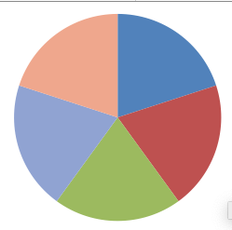
Portfolio Review Keeping Small Positions Only Buying Very Deep in-the-Money on Capitulation Days
Risk On
World is Getting Better
(AMZN) 9/$1500-1550 | 10.00%
(FB) 9/$150-$160 call spread | 10.00%
(DIS) 9/$115-$120 call spread | 10.00%
(MSFT) 9/115-$120 call spread | 10.00%
Risk Off
(WMT) 9/$119-$122 put spread | -10.00%
(IWM) 9/$153-$156 put spread | -10.00%
Total Net Position | 20.00%
Expiration P&L 39.29% YTD

Slide 5
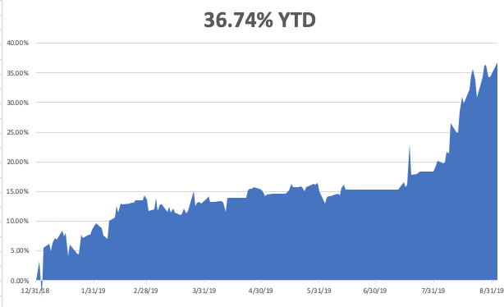

Slide 6
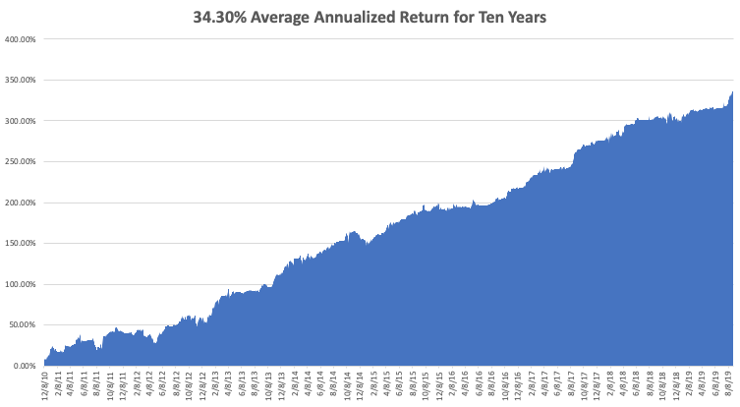
GTD 10 Year Daily Audited Performance

Slide 7
The Method to My Madness
*Inverted yield curve has caused recession fears to run rampant *US interest rates now headed to zero to come in line with global rates *US induced China slowdown dragging down the rest of the world *Possibility of an overnight trade deal is keeping short positions small *Strong dollar adds to recession fears, is killing emerging markets *”Hard Brexit” may be derailed by a new election, saving Europe *Three more Fed 25 basis point rate cuts due over next six months *Oil in free fall, while gold takes a run at new highs

Slide 8
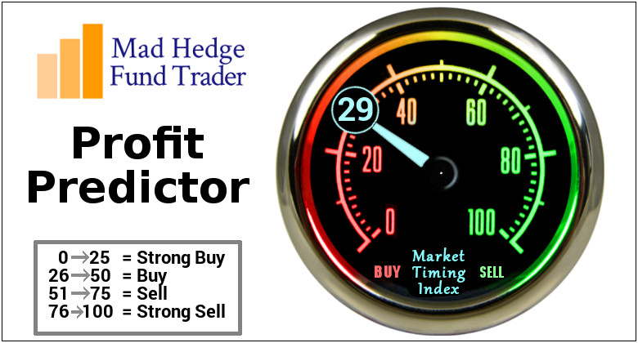
The Mad Hedge Profit Predictor Market Timing Index- An artificial intelligence driven algorithm that analyzes 30 different economic, technical, and momentum driven indicators

Slide 9
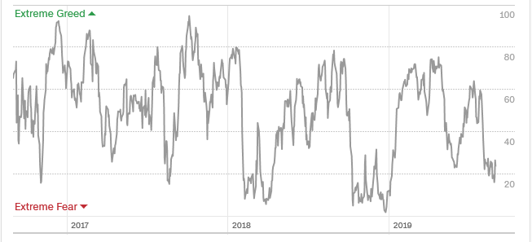
The Mad Hedge Profit Predictor Headed Towards a “BUY”
SELL
BUY

Slide 10
The Global Economy – Motion Sickness
*40% chance of a US recession in 12 months, 100% in 24 months, yield inversion is freaking out global strategists, US 15% tariffs hit on Sunday, US Consumer Sentiment took a dive, from 98.4 to 89.8 in August, Manufacturing PMI craters from an average 56.5 to 49.1, a three year low *Fed 2.0% GDP growth rate forecast for 2019 now has major downside risks, Q2 downgraded from 2.1% to 2.0% *Global rush to zero interest rates means confidence is in free fall *The US is still the strongest economy in the world, but is fading fast, *Europe has accelerated downward economic spiral, will spill into the US, Germany has dropped from 2.0% growth to -0.1% since January *If Brexit is put up for another vote it will lose

Slide 11
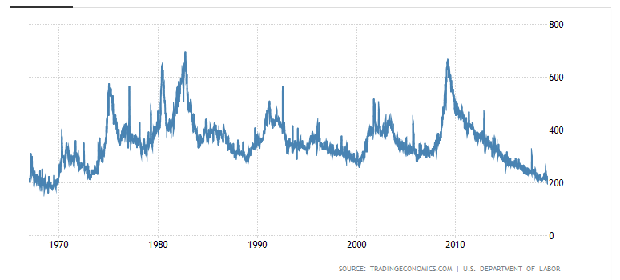
Weekly Jobless Claims-Bottomed Out +4,000 to 215,000

Slide 12
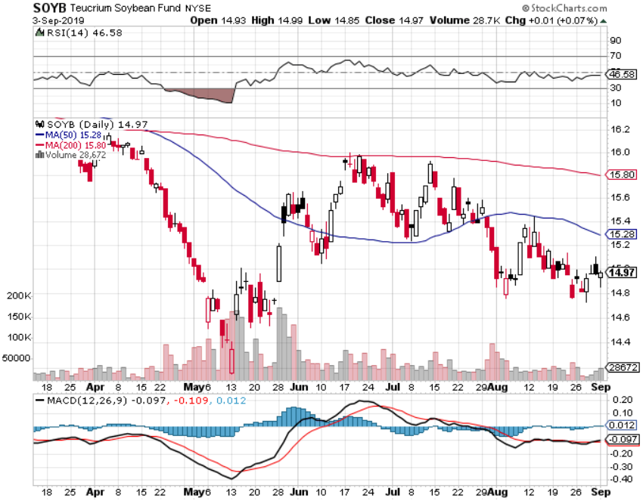
Soybeans - Trade War Indicator Trade Back to the Forefront – No Rally

Slide 13
The Bill Davis View A $1,500 Upgrade for the Mad Day Trader Service
Buys: | Entry | Target
Penumbra, Inc. (PEN) | $ 142.00 | $ 150.00
Roku, Inc. (ROKU) | $ 146.00 | $ 156.00
Ulta Beauty, Inc (ULTA) | $ 230.00 | $ 245.00
Shopify, Inc (SHOP) | $ 375.00 | $ 395.00
Costco Wholesale (COST) | $ 285.00 | $ 305.00
Sells:
Splunk Inc. (SPLK) | $ 115.00 | $ 107.00
Workday, Inc.(WDAY) | $ 178.00 | $ 165.00
J.M. Smucker (SJM) | $ 109.00 | $ 95.00
United Health Group (UNH) | $ 238.00 | $ 224.00
iRobot Corp (IRBT) | $ 64.00 | $ 58.00

Slide 14
Stocks – Trapped in the Middle
*Welcome to September, the worst month of the year since 1950. So far markets are trapped between to the 50-day and 200-day moving averages, could continue until the Sept 18 Fed rate decision *We usually see an annual bottom at the end of September/beginning of October, then a yearend rally *But this time it’s different, because everything is different *Bearishness growing – Surveys say investors are now 26.1% bullish and 31.7% neutral, the worst reading in years *Pour the positions on whenever the Volatility Index (VIX) rises above 20%, buy every dip and sell every rally *Big long term money is diving in to buy big tech on every dip *Bottom line: 10%-20% down market for the next 3 months, then new highs propelled by ultra low interest rates or a China trade deal *Bottom Line: its bet the ranch time on tech longs, but stay away from those with big China exposure, like Apple, and weak dollar plays like energy, and emerging markets

Slide 15
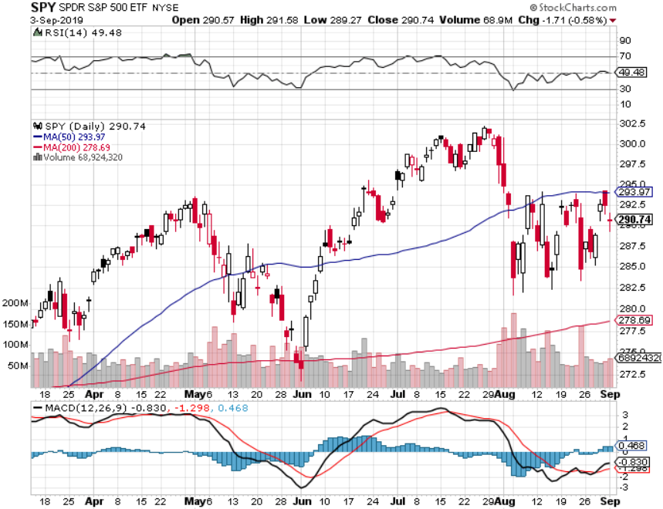
S&P 500-Churning took profits on long 8/$305-$308 bear put spread stopped out of long 2/$285-$290 bear put spread took profits on long 2/$270-$275 bear put spread

Slide 16
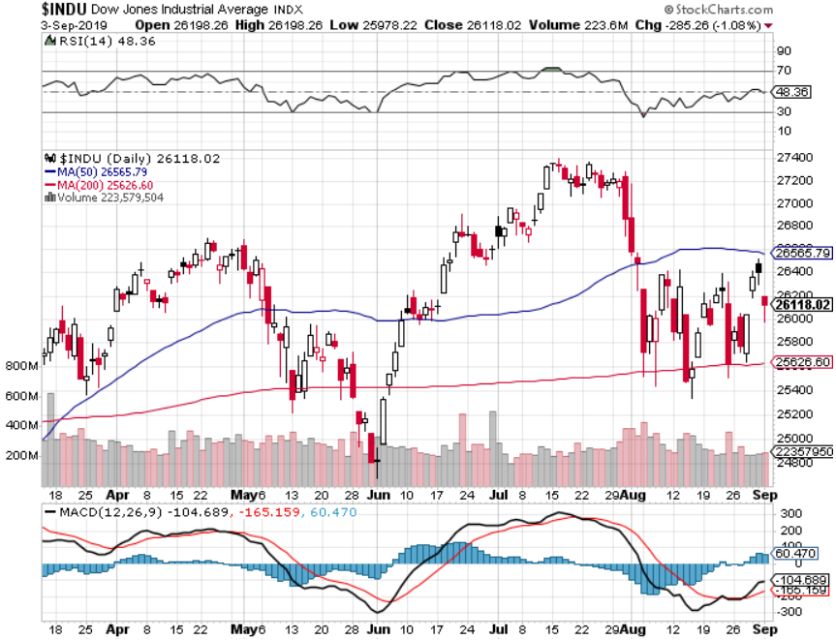
Dow Average ($INDU)-

Slide 17
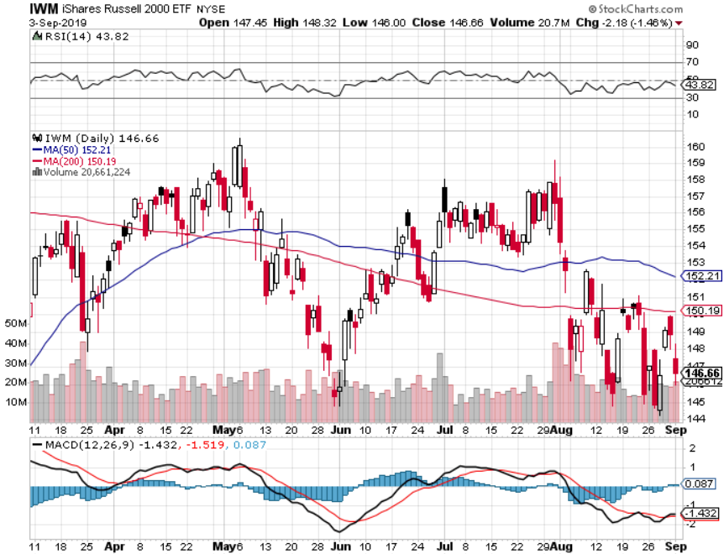
Russell 2000 (IWM)- Triple Top Long 9/$153-$156 vertical bear put spread took profits on Long 9/$157-$160 vertical bear put spread took profits on Long 8/$158-$161 vertical bear put spread out for even Long 4/$160-$165 vertical bear put spread

Slide 18
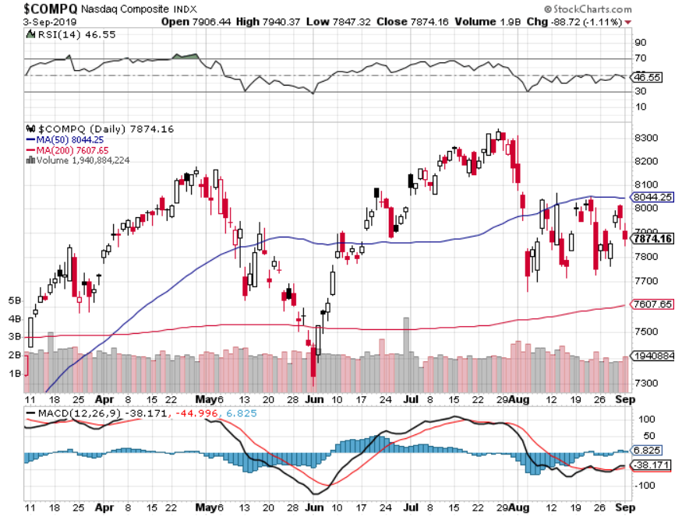
NASDAQ ($COMPQ) – Profit Taking

Slide 19
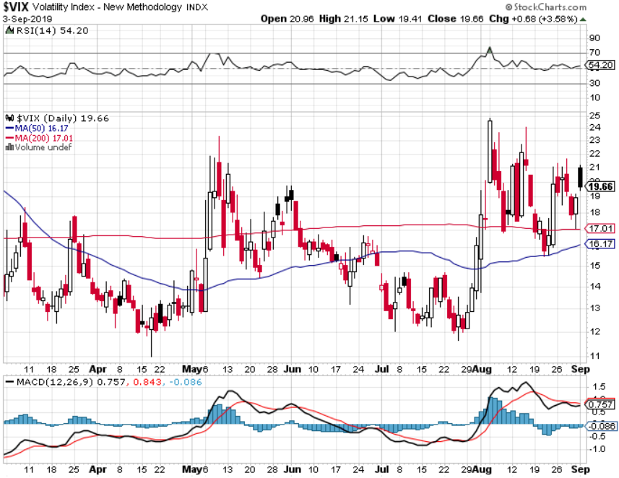
(VIX)- Maintaining High suggests higher

Slide 20
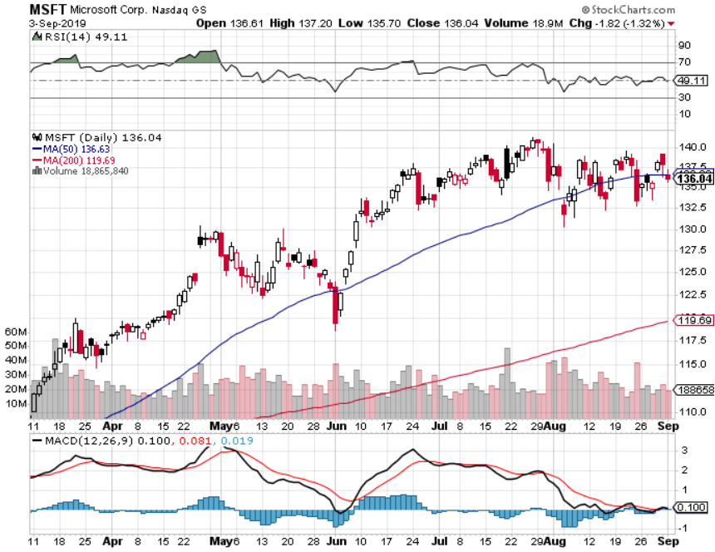
Microsoft (MSFT)- Earnings beat- Looking for Another Entry Point long 9/$115-$120 call spread – expires in 12 trading days long 6/$110-$115 call spread-out at cost took profits on long 4/$108-$113 call spread took profits on long 2/$85-$90 call spread

Slide 21
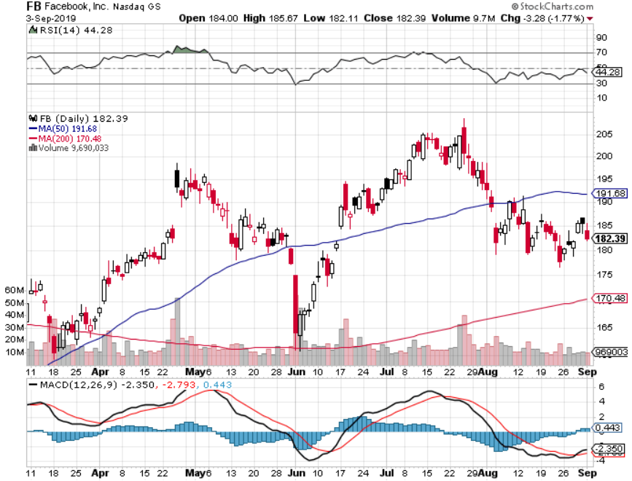
Facebook (FB)- Long 9/$150-$160 vertical bull call spread - expires in 12 trading days took profits on Long 8/$167.50-$172.50 vertical bull call spread

Slide 22
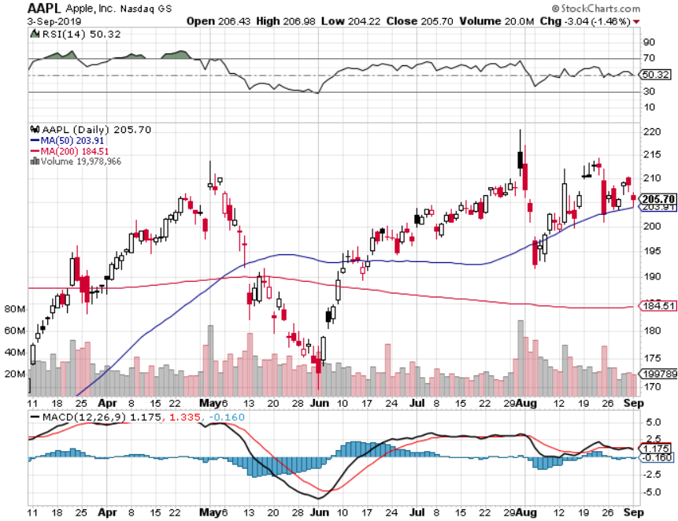
Apple (AAPL)- China Target – 5G Chip Buy

Slide 23
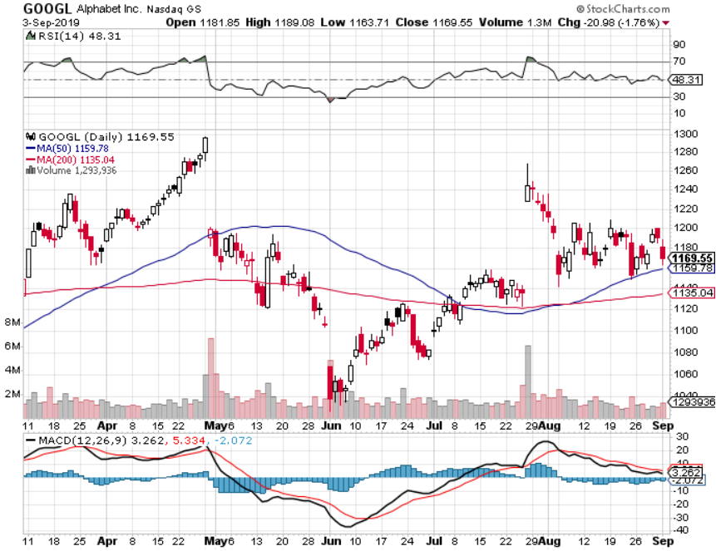
Alphabet (GOOGL)- Earnings Shock took profits on long 9/$1,030-$1,080 vertical bull call spread stopped out of long 5/$1,100-$1,130 bull call spread took profits on long 4/$1,080-$1,120 bull call spread

Slide 24
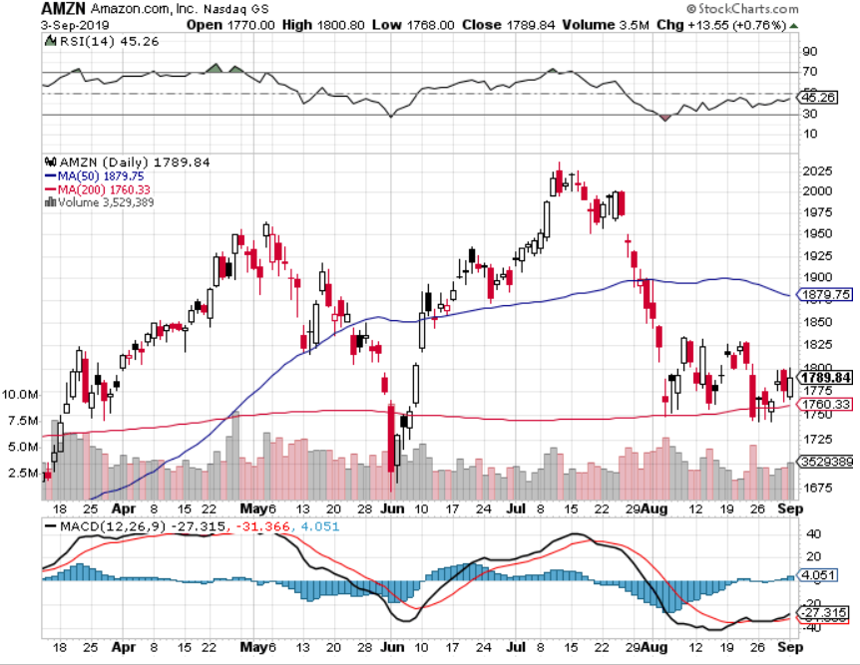
Amazon (AMZN)-Back to bottom of range Long 9/$1,500-$1,500 vertical bull call spread - expires in 12 trading days stopped out of long 4/$1,650-$1,700 call spread took profits on long 4/$1,600-$1,650 call spread took profits on long 2/$1,200-$1,300 call spread

Slide 25
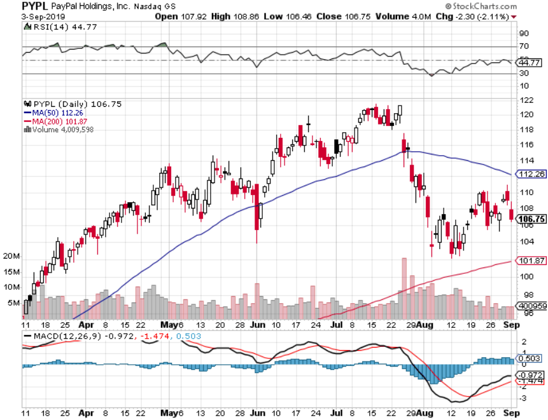
PayPal (PYPL)-Fintech Star took profits on long 4/$90-$95 call spread

Slide 26
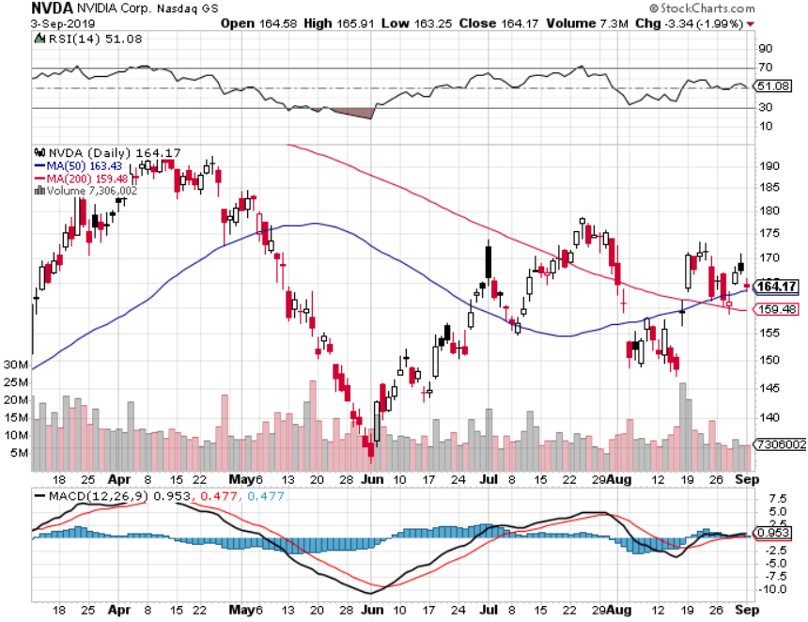
NVIDIA (NVDA) -

Slide 27
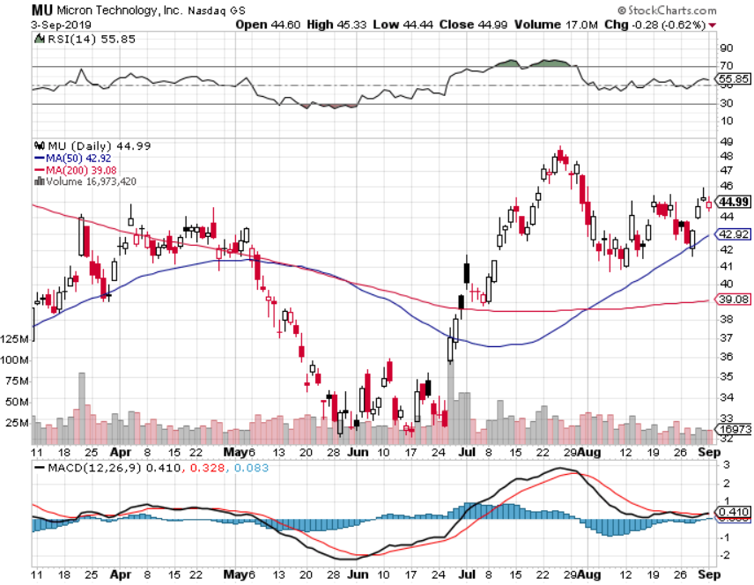
Micron Technology (MU)-

Slide 28
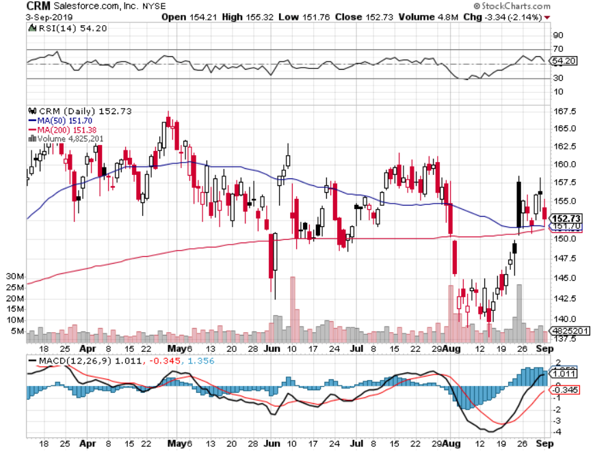
Salesforce (CRM)- took profits on long 9/$125-$130 vertical bull call spread took profits on long 8/$125-$130 vertical bull call spread took profits on long 2/$105-$115 call spread

Slide 29
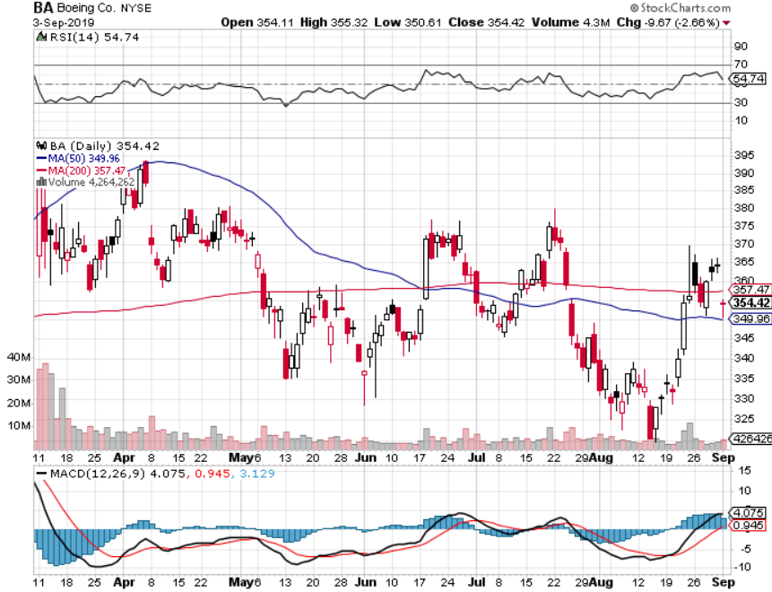
Boeing (BA)- took profits on long 4/$315-$335 call spread Next to happen in the recertification bounce

Slide 30
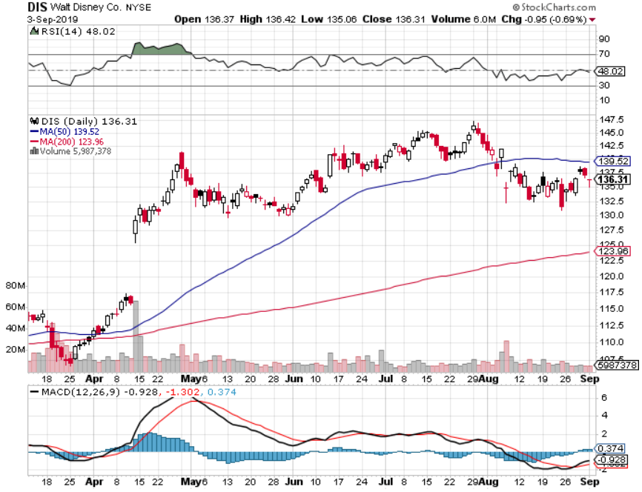
Walt Disney (DIS)- The Next Netflix long 9/$115-$120 call spread - expires in 12 trading days 8/$125-$130 call spread expired at max profit Stopped out of 4/$125-$130 call spread for small loss took profits on long 4/$100-$104 call spread

Slide 31
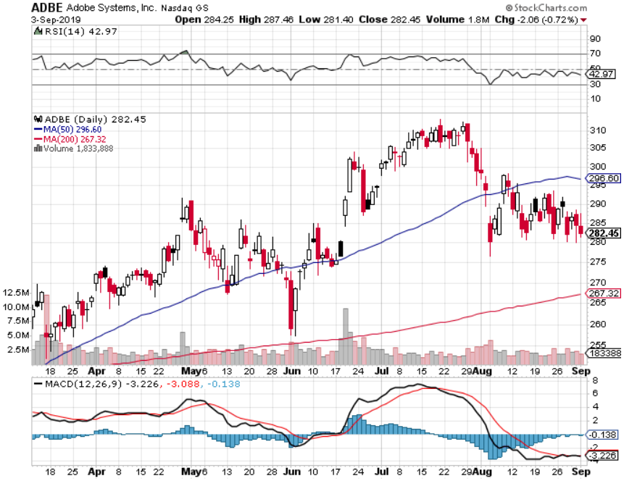
Adobe (ADBE)- The Quality Non-China tech play

Slide 32
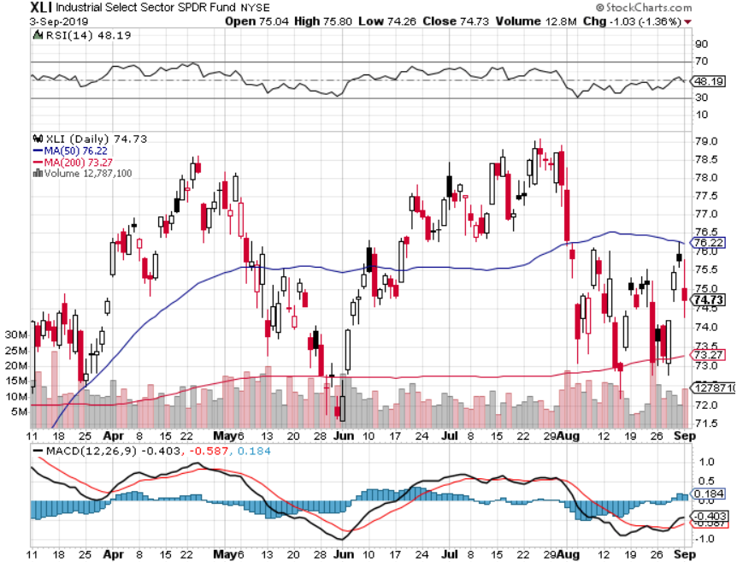
Industrials Sector SPDR (XLI)- (GE), (MMM), (UNP), (UTX), (BA), (HON)

Slide 33
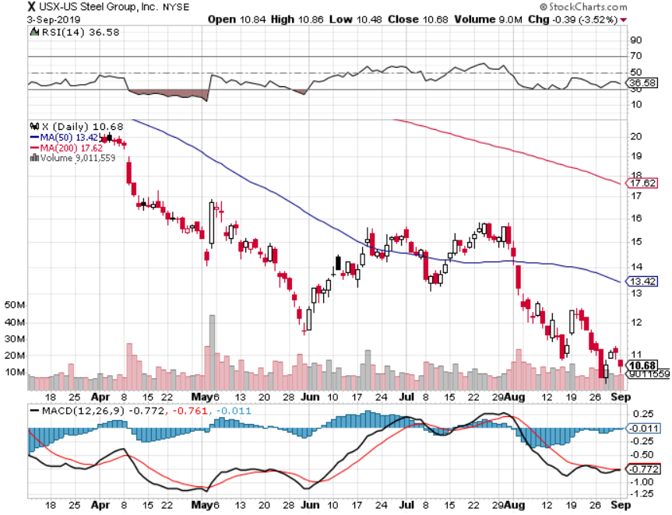
US Steel (X)-Tariffs Trouble Import duties cause users to abandon steel Down by 50% since the election

Slide 34
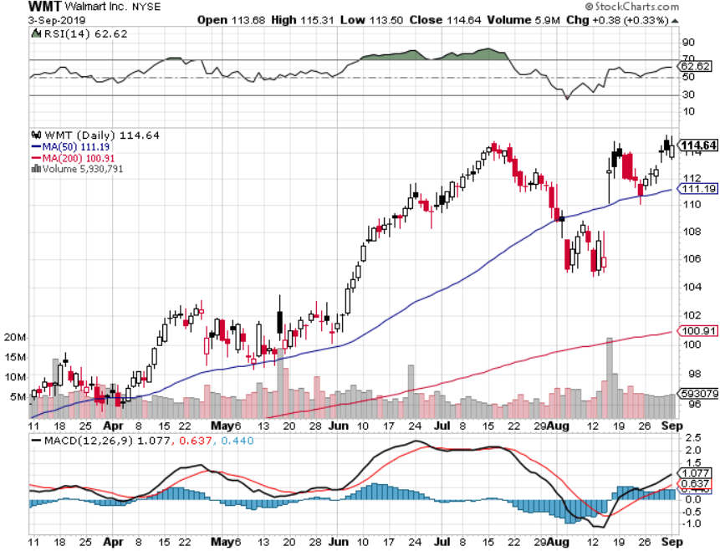
Wal-Mart (WMT)-Tariffs Trouble Long 9/$119-$121 bear put spread took profits on Long 8/$114-$117 bear put spread

Slide 35
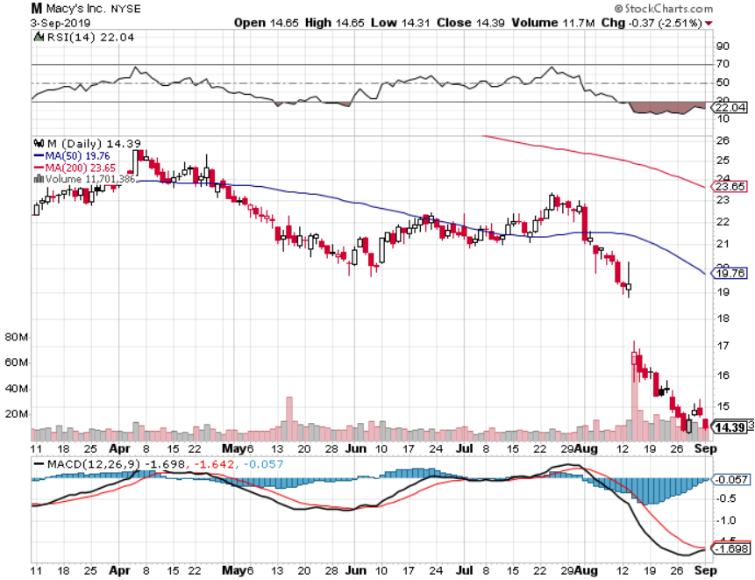
Macys’ (M)-Tariffs Trouble took profits on Long 8/$23-$25 bear put spread

Slide 36
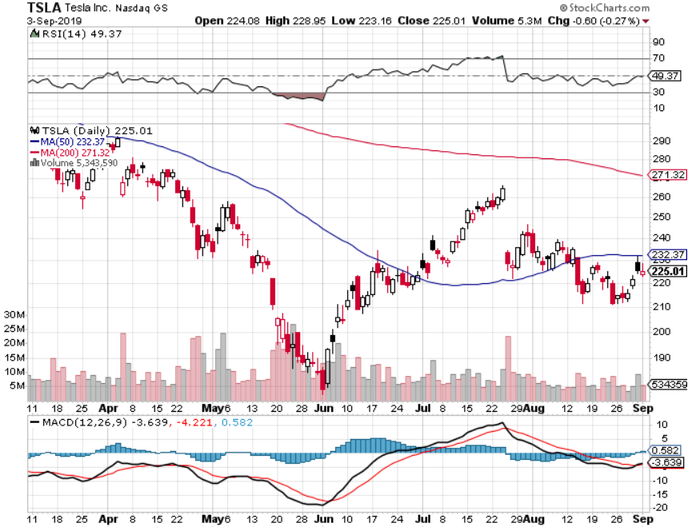
Tesla (TSLA)- looking for big Q2 improvement announced in July took profits on long 6/$140-$150 call spread – expires in 7 trading days took profits on long 6/$240-$250 put spread – expires in 7 trading days stopped out of long 4/$300-$320 put spread
Major Support

Slide 37
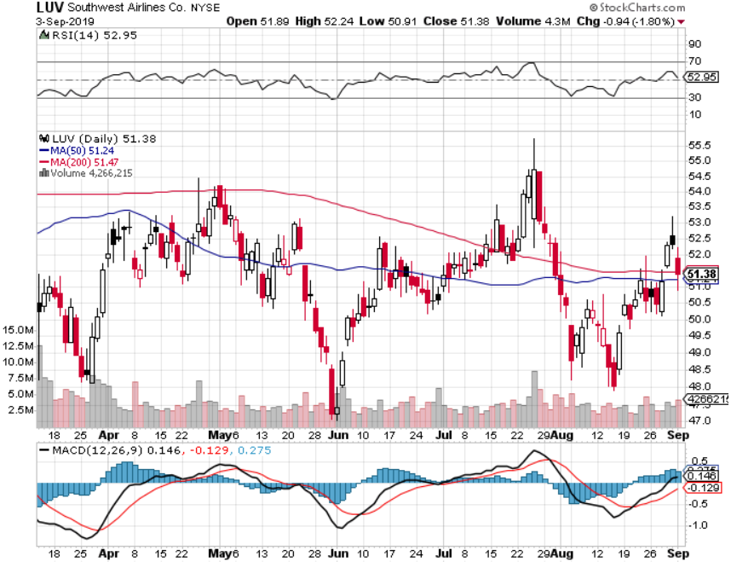
Southwest Airlines (LUV) - Boeing 737 Max biggest buyer

Slide 38
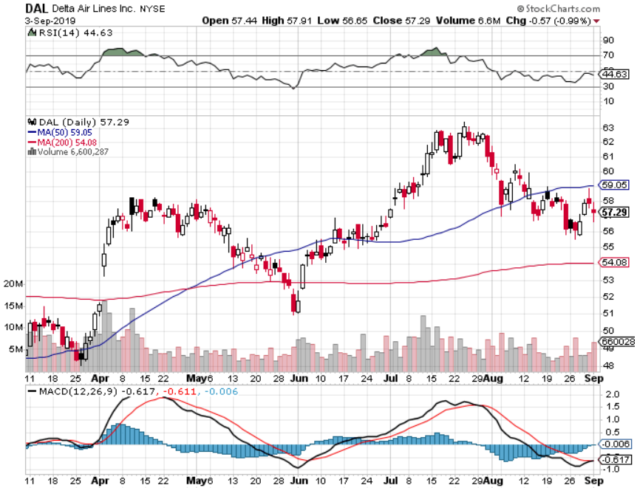
Delta Airlines (DAL) – Non 737 User

Slide 39
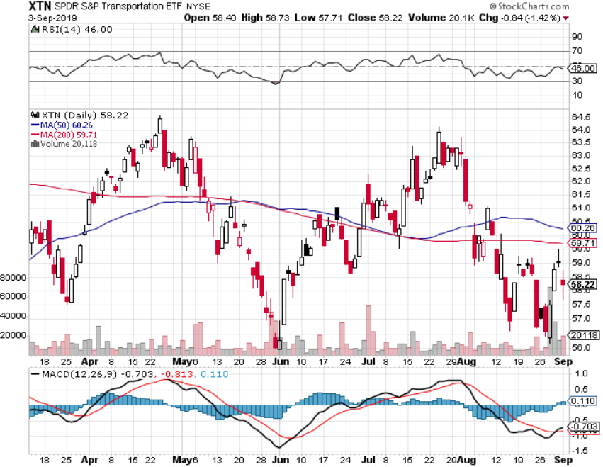
Transports Sector SPDR (XTN)- (ALGT), (ALK), (JBLU), (LUV), (CHRW), (DAL)

Slide 40
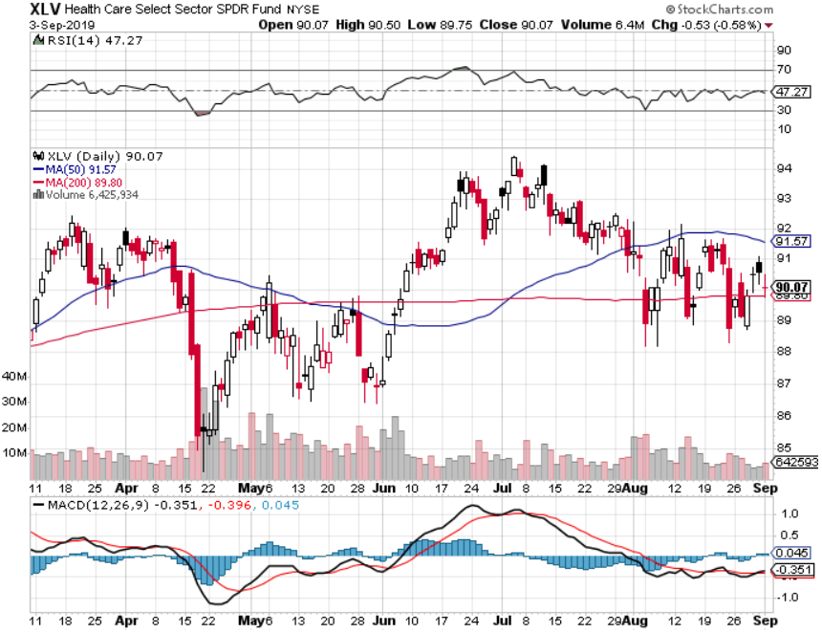
Health Care Sector (XLV), (RXL)-New Highs (JNJ), (PFE), (MRK), (GILD), (ACT), (AMGN)

Slide 41
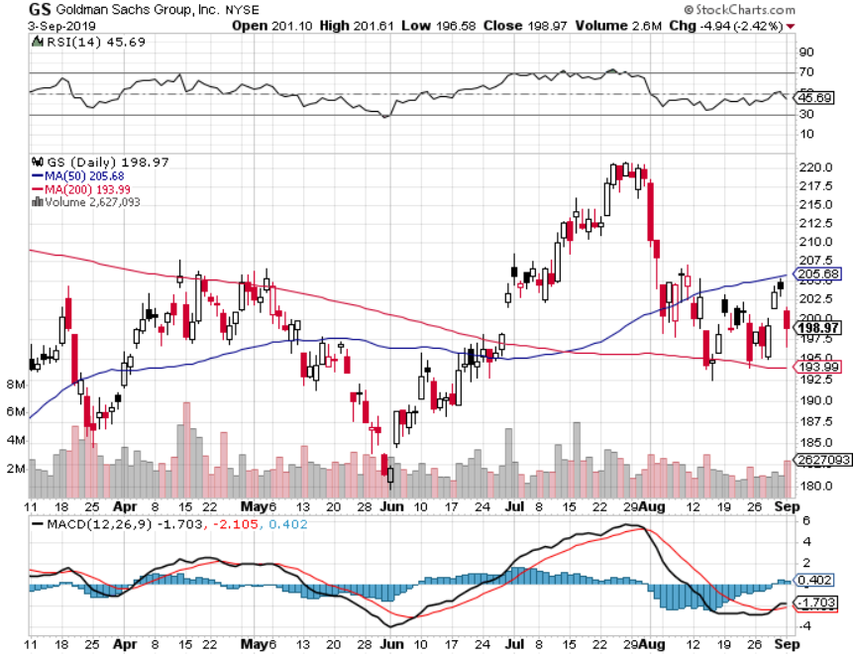
Goldman Sachs (GS)- Swan dive on low rates

Slide 42
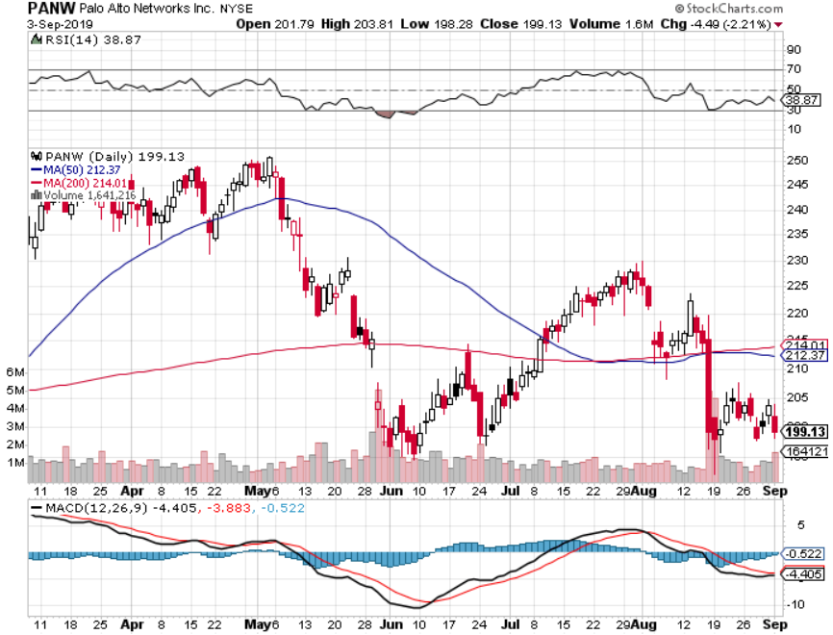
Palo Alto Networks (PANW)- Hacking never goes out of fashion

Slide 43
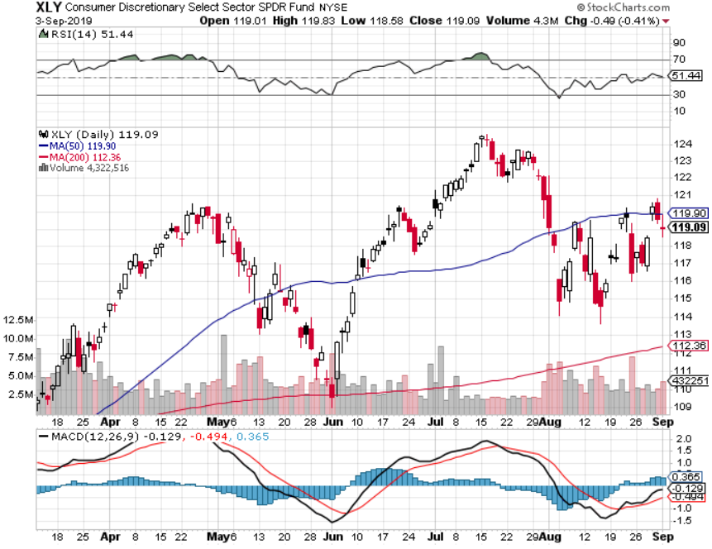
Consumer Discretionary SPDR (XLY) (DIS), (AMZN), (HD), (CMCSA), (MCD), (SBUX)

Slide 44
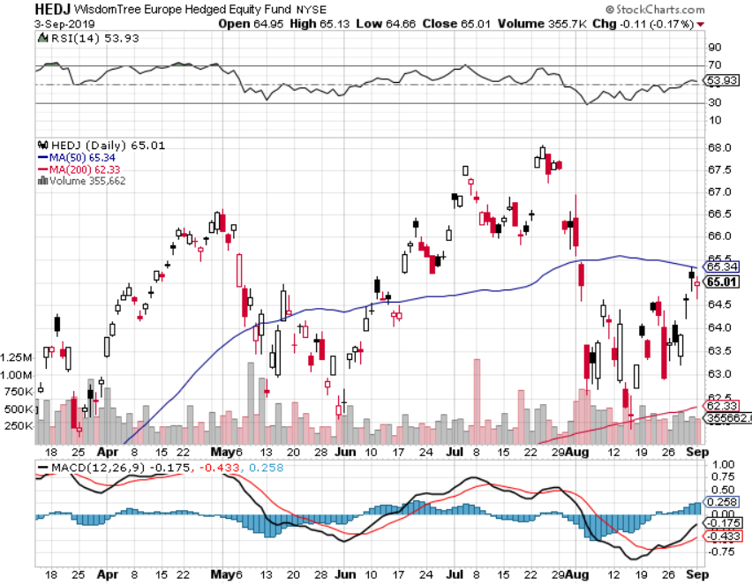
Europe Hedged Equity (HEDJ)-

Slide 45
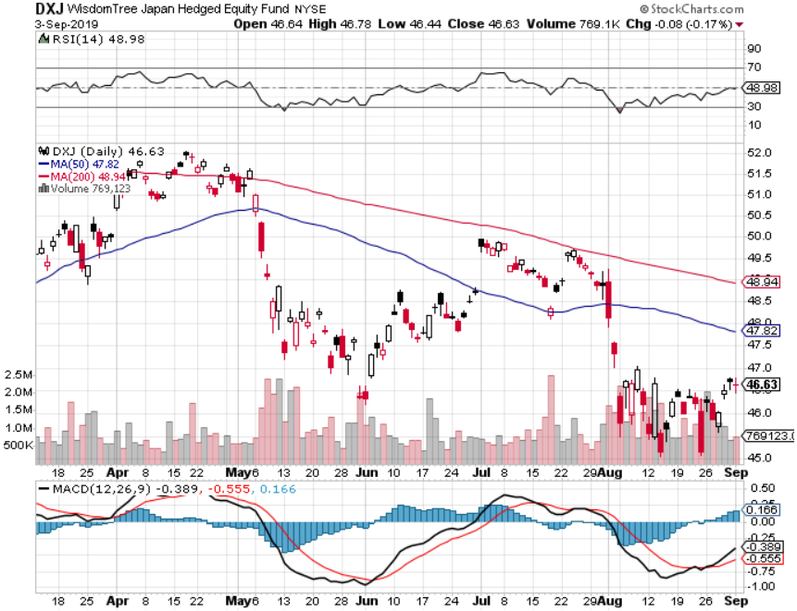
Japan (DXJ)-

Slide 46
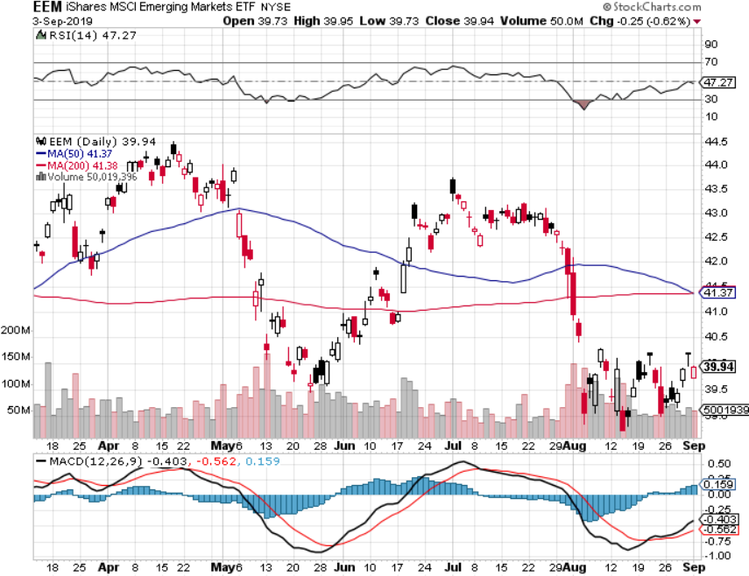
Emerging Markets (EEM)- Avoid on strong Weak Dollar

Slide 47
Bonds – Still Exhausted
*US ten year rates plunge to 1.44%, prices near record highs, discounting half of the next three Fed rate cuts. 30 year rates hit new all time low at 1.91% *However, we have seen a short term peak in prices and bottom in yields as markets work off extreme overbought conditions *Some $3.1 trillion in negative yielding bonds created worldwide in August *$16 billion poured into bond ETF’s last week *40% of the world’s bonds now have negative interest rates *German bund yields plunge to -0.90%, while Japan government bonds turn in a -0.25% yield *Bottom line: Ten year US Treasury yields will fall below zero in 2020 to come in line with the rest of the world

Slide 48
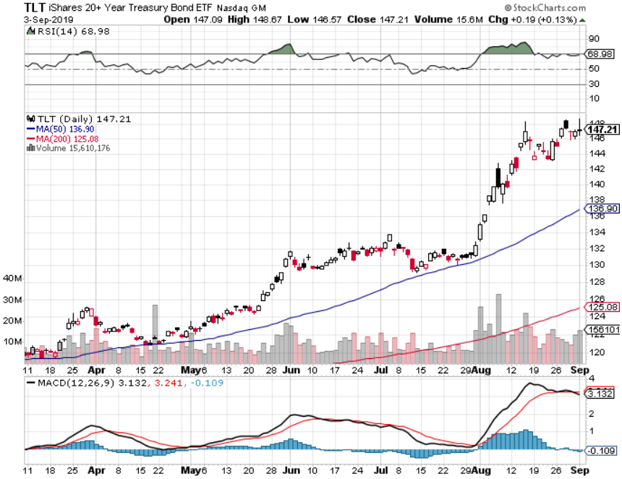
Treasury ETF (TLT) – stopped out of long 8/$137-$140 put spread took profits on long 8/$125-$128 call spread took profits on long 6/$128-131 bear put spread took profits on long 5/$116-$119 bull call spread

Slide 49
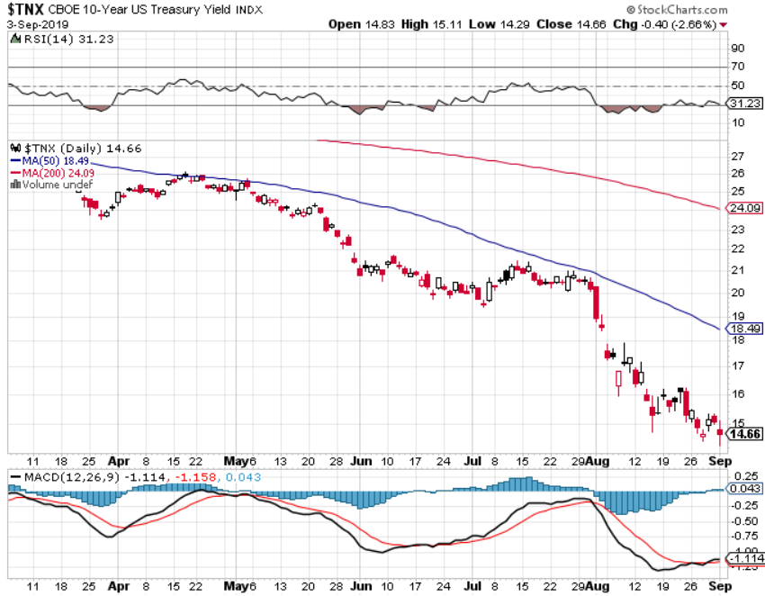
Ten Year Treasury Yield ($TNX) – 1.44% Overnight Low

Slide 50
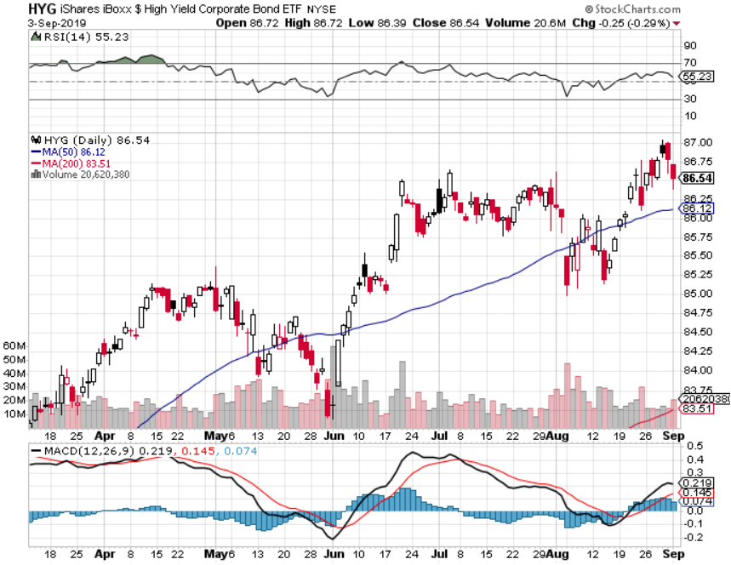
Junk Bonds (HYG) 5.31% Yield big jump in yields on stock selloff and recession fears

Slide 51
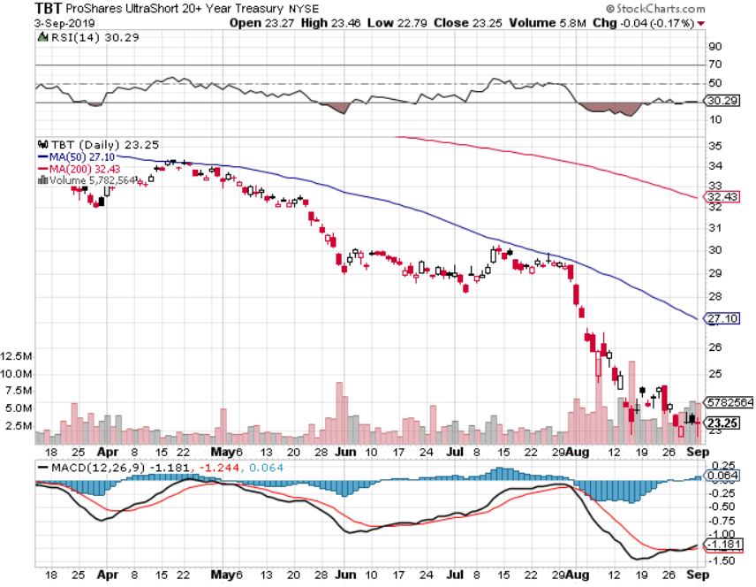
2X Short Treasuries (TBT)- 2 Month Topping Process

Slide 52
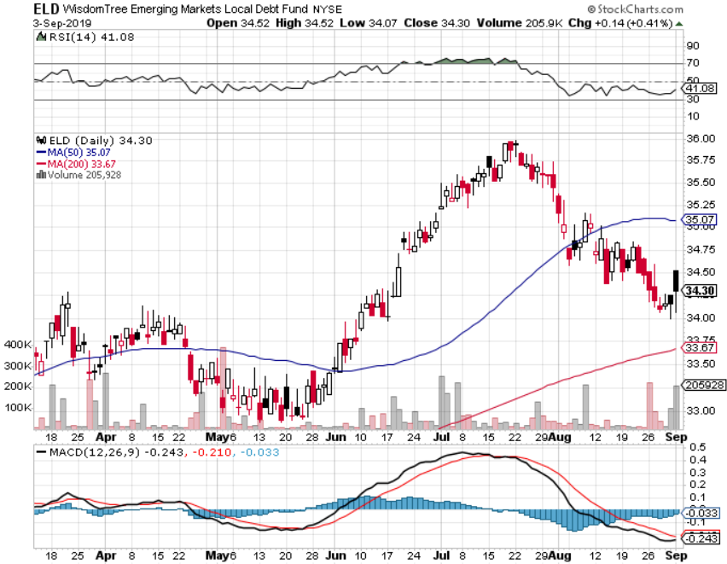
Emerging Market Debt (ELD) 5.09% Yield-

Slide 53
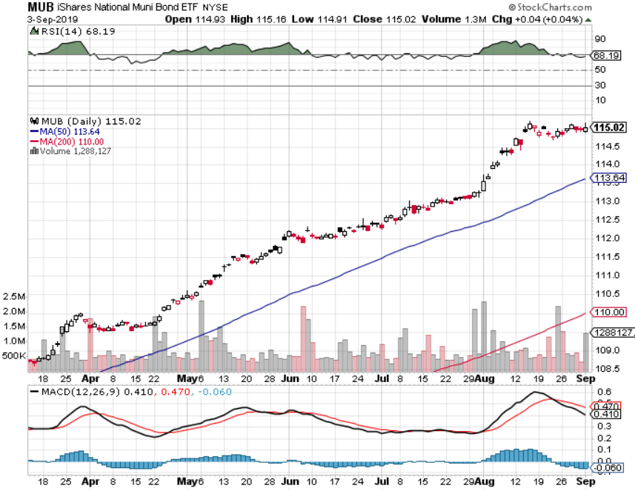
Municipal Bonds (MUB)-1.59% Mix of AAA, AA, and A rated bonds

Slide 54
Foreign Currencies – New Highs for the Buck
*US dollar takes another run at the highs based on economic strength, stalling rates *Three more Interest rate cuts by 2020 now in the market *Whenever markets ignore interest rate differentials the move is short term only *British pound on the possible end of Brexit *Chinese Yuan falls on Hong Kong Instability *Bitcoin stalling at highs *Bottom Line: Sell the US dollar against everything, except the Yuan (CYB) and pound (FXB)

Slide 55
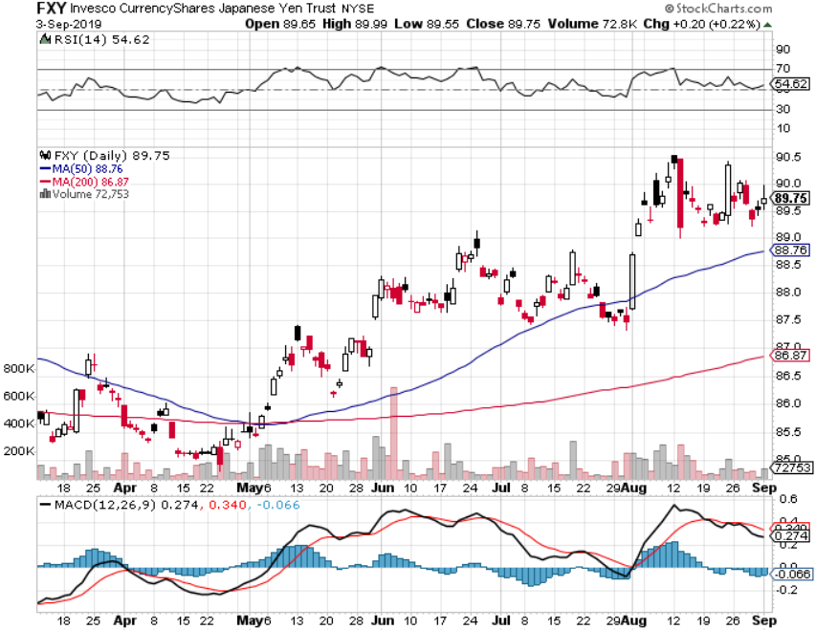
Japanese Yen (FXY), (YCS)

Slide 56
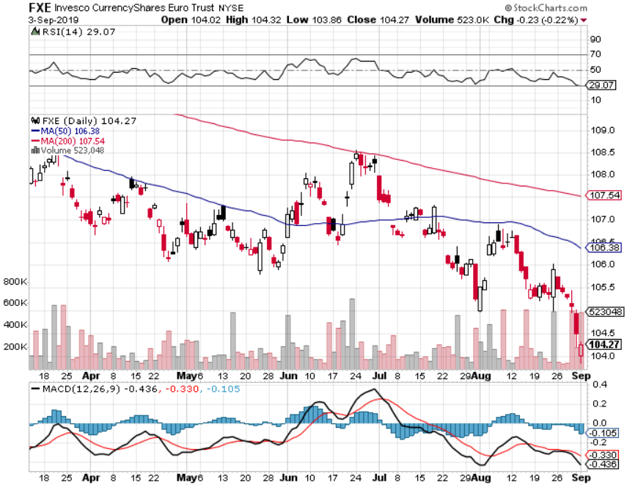
Euro ($XEU), (FXE), (EUO)-

Slide 57
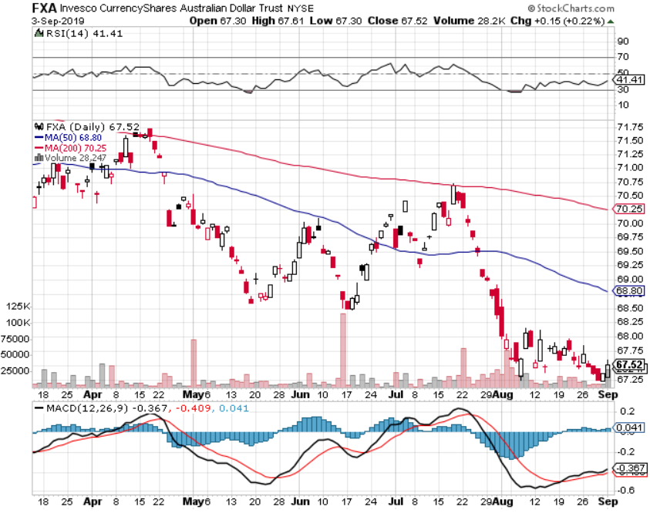
Australian Dollar (FXA)- The Global Recovery Play took profits on long 8/$67-$69 call spread

Slide 58
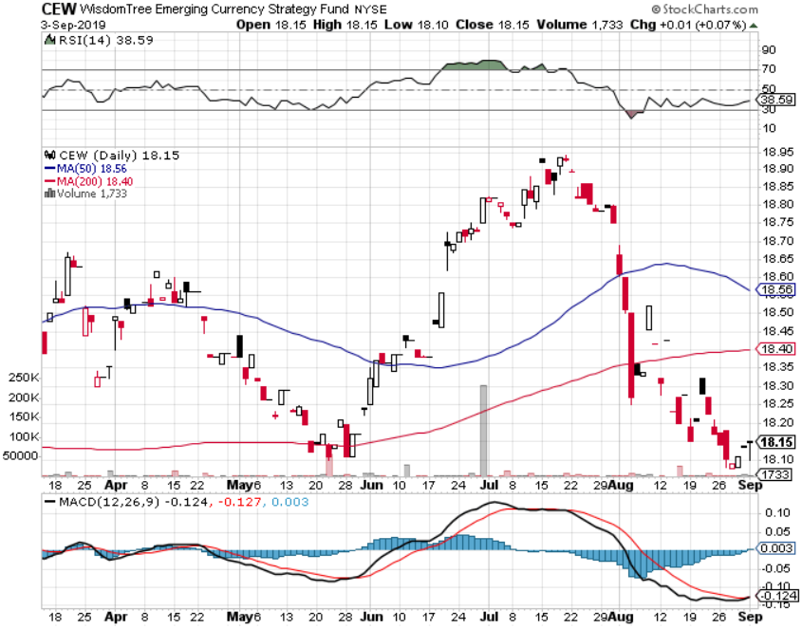
Emerging Market Currencies (CEW)

Slide 59
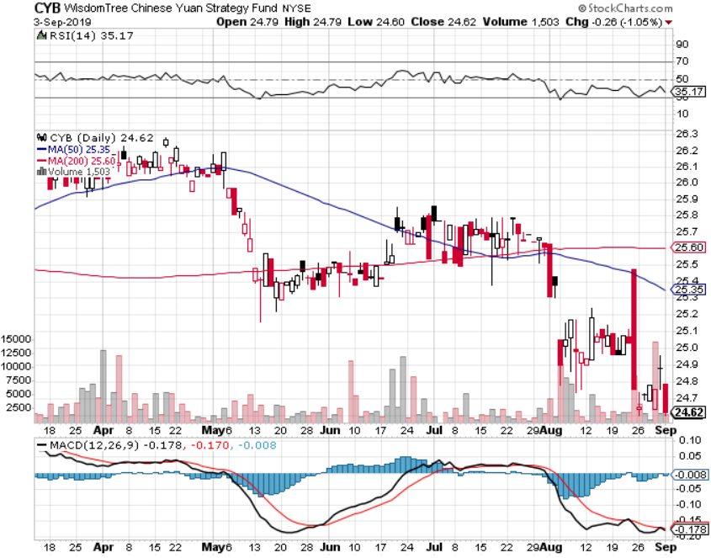
Chinese Yuan- (CYB)- New Lows

Slide 60
Bitcoin- Stalling at a High Chinese flight from Yuan is 99% of the trade

Slide 61
Energy – Supply Glut
*Saudi Arabia looking to cut production by 700,000 barrels a day to stabilize prices in the face of slowing global demand from recession fears *Russia producing above quota at 11.32 million b/d, adding to glut *Massive tax subsidies are driving new investment in US production and distribution, even though prices are falling *However, the largest buyer of US oil, China, has banned US oil in response to the trade war *Geopolitics is having no positive impact with the tanker wars in the Straights of Hormuz *Bottom Line: looks like $42 a barrel is in the cards

Slide 62
Oil-($WTIC)

Slide 63
United States Oil Fund (USO)

Slide 64
Energy Select Sector SPDR (XLE)-No Performance! (XOM), (CVX), (SLB), (KMI), (EOG), (COP)

Slide 65
Halliburton (HAL)-

Slide 66
Natural Gas (UNG)-

Slide 67
Precious Metals – Still in Play
*Gold/silver ratio at 82:1 and falling, which is always hugely positive for a continued bull market in precious metals, has fallen from 93:1 since July *Investors bought 101.4 metric tonnes in August, a six year high *Trade war is giving the yellow metal and extra spin *The catch up play is in silver, which only started a month ago, and has soaring industrial demand from solar panels *Bottom Line: buy a bigger dip in gold and precious metals

Slide 70
Gold (GLD)- New 5 Year Highs

Slide 71
Market Vectors Gold Miners ETF- (GDX) – Yikes!

Slide 72
Barrick Gold (GOLD)

Slide 73
Newmont Mining- (NEM)-

Slide 74
Silver- (SLV)-

Slide 75
Silver Miners - (SIL)-

Slide 76
Wheaton Precious Metals - (WPM)-

Slide 77
Palladium - (PALL)-

Slide 78
Copper (COPX)-Collapse Trade War Disaster

Slide 79
Freeport McMoRan (FCX)-World’s Largest Copper Producer took profits on long 4/$10-$11 call spread took profits on short 4/$114 calls

Slide 80
Real Estate – Sliding
*July Exiting Homes Sales UP 2.5% to 5.42 million units annualized *Foreign Investors net sellers of US commercial real estate anticipating a recession, down 37% YOY, Canada, Germany, and Singapore are the biggest investors *July Pending Home Sales down 2.5%, despite ultra low interest rates *”Tappable Equity” hits new all time high at $6.3 trillion, is the amount that can be pulled out in a refi and leave 20% equity. The home ATM is back!
*May S&P 500 Case-Shiller drops to a 2.1%, annual gain, the lowest gain in 6 1/2 years *Bottom Line: Stand aside for a trade but buy for long term investment

Slide 81
February Corelogic S&P Case Shiller Home Price Index Phoenix (5.8%), Las Vegas (5.5%), and Tampa (4.7%) showing biggest gains
Tradingeconomics.com

Slide 82
Simon Property Group (SPG)-

Slide 83
US Home Construction Index (ITB) (DHI), (LEN), (PHM), (TOL), (NVR)

Slide 84
Trade Sheet- So What Do We Do About All This?
*Stocks-sell rallies *Bonds-buy dips *Commodities-stand aside *Currencies-sell US dollar again (FXA), (FXE), (FXB) *Precious Metals – buy dips *Energy - avoid *Volatility-buy dips *Real estate-stand aside

Slide 85
Next Strategy Webinar 12:00 EST Wednesday, September 18, from Silicon Valley, CA email me at support@madhedgefundtrader.com
Good Luck and Good Trading!
Notes:
*

