Slide 1
Mad Day Trader
Bill Davis
Webinar – October 23, 2019

Slide 2
Monthly Charts

Slide 3
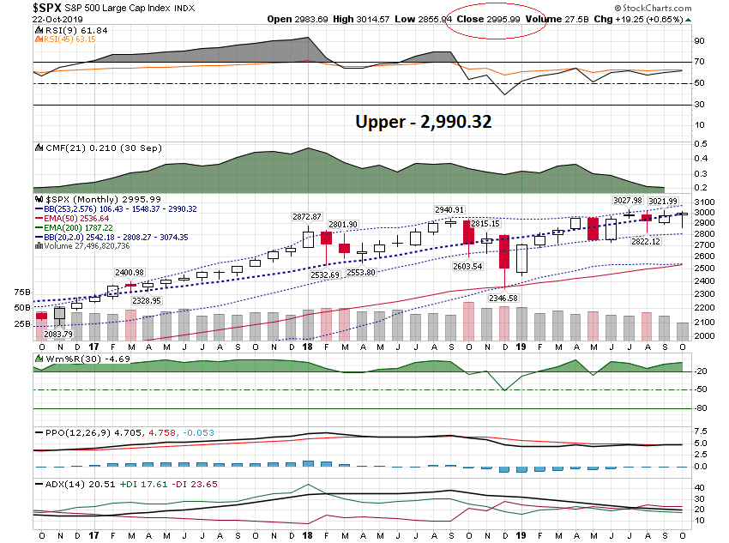

Slide 4
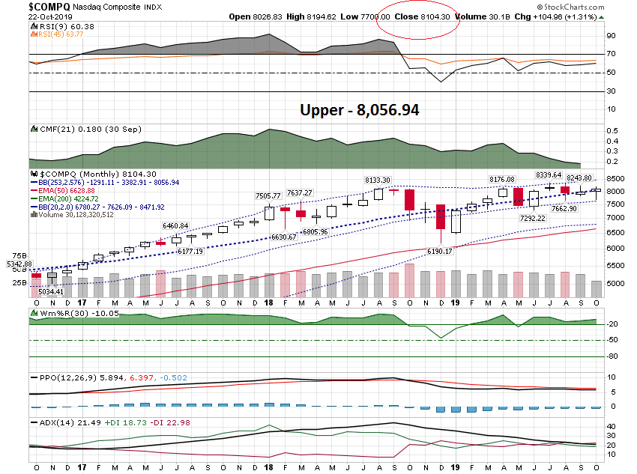

Slide 5
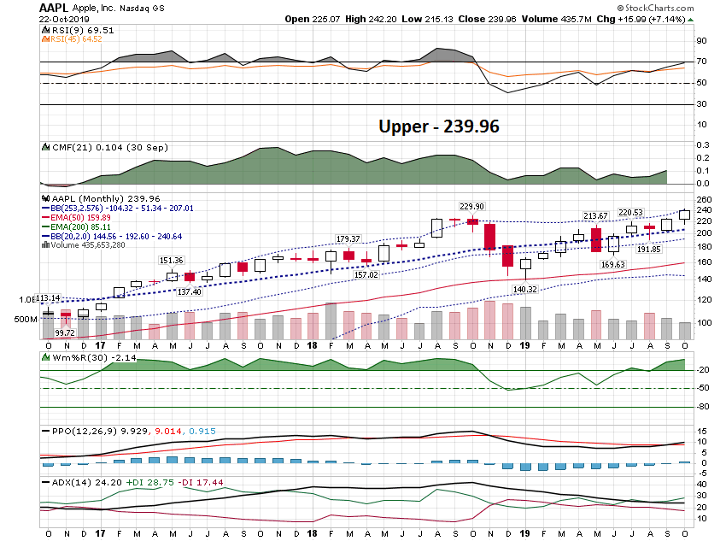

Slide 6
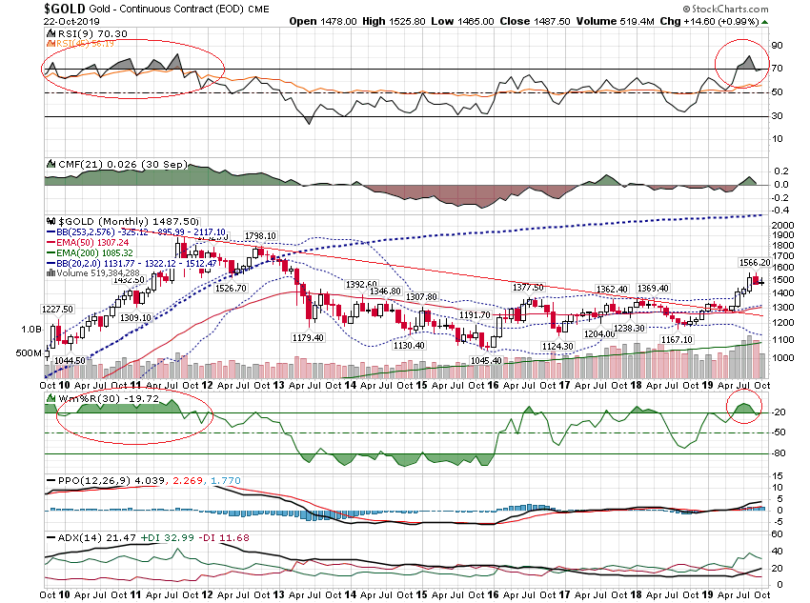

Slide 7
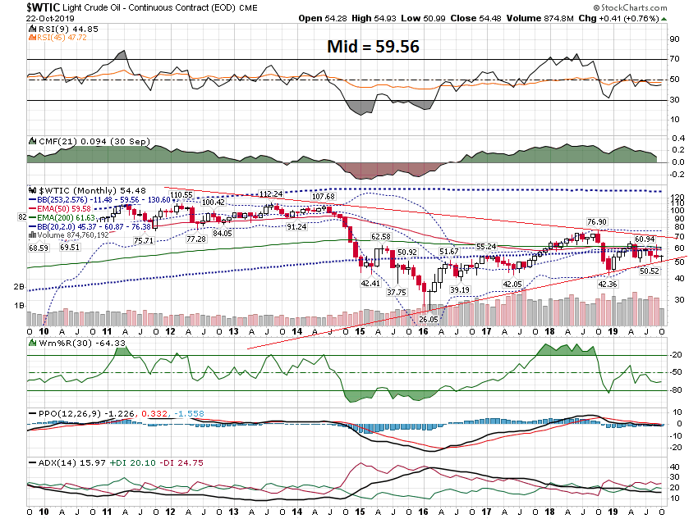

Slide 8
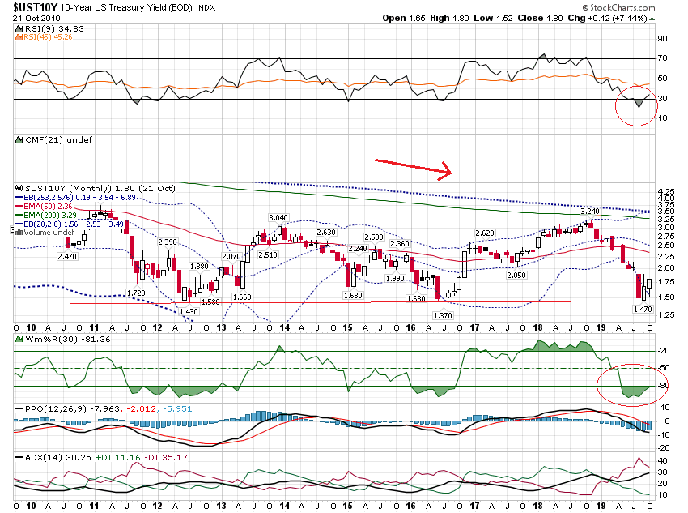

Slide 9
Daily Charts

Slide 10
S & P 500 From Last Webinar

Slide 11
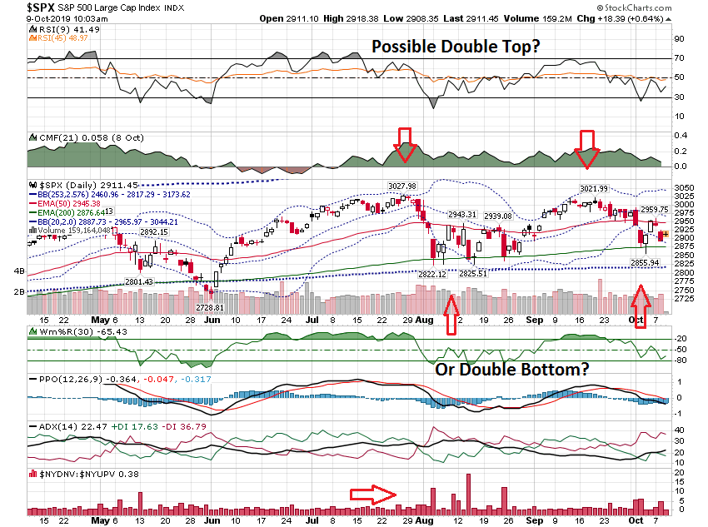

Slide 12
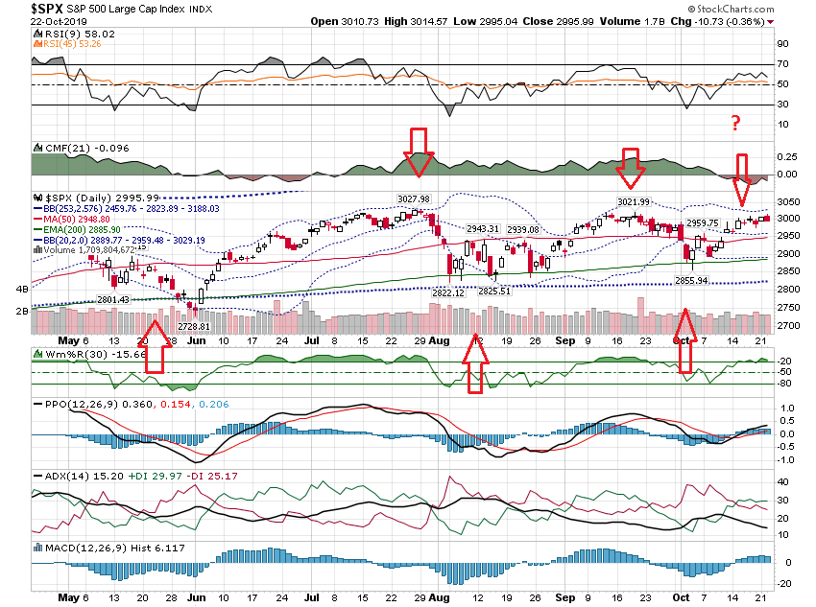

Slide 13
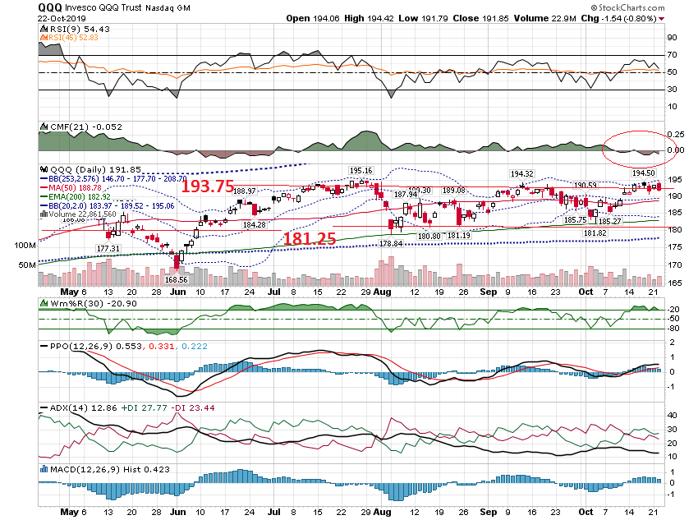

Slide 14
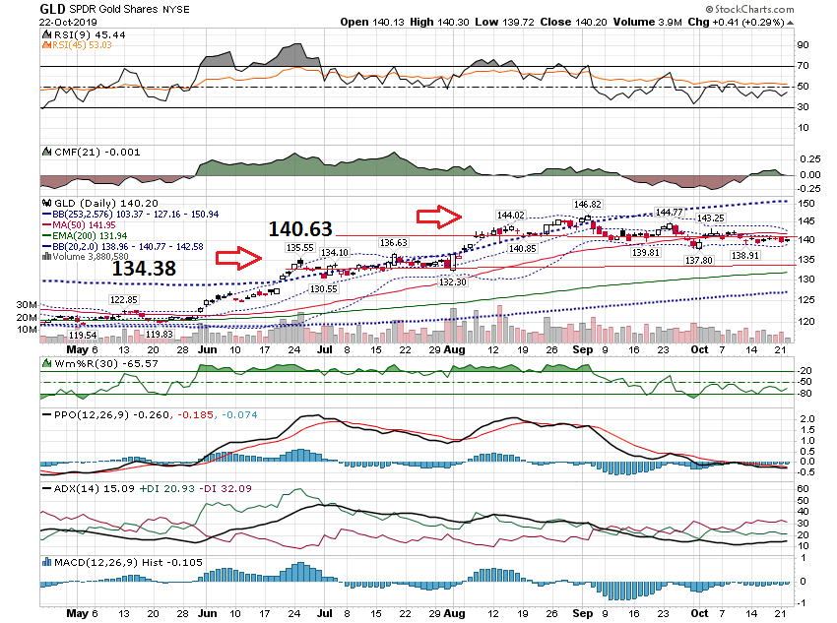

Slide 15
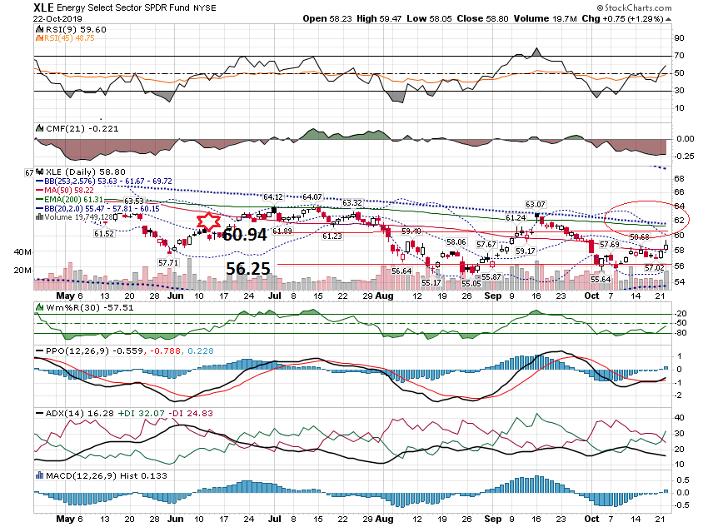

Slide 16
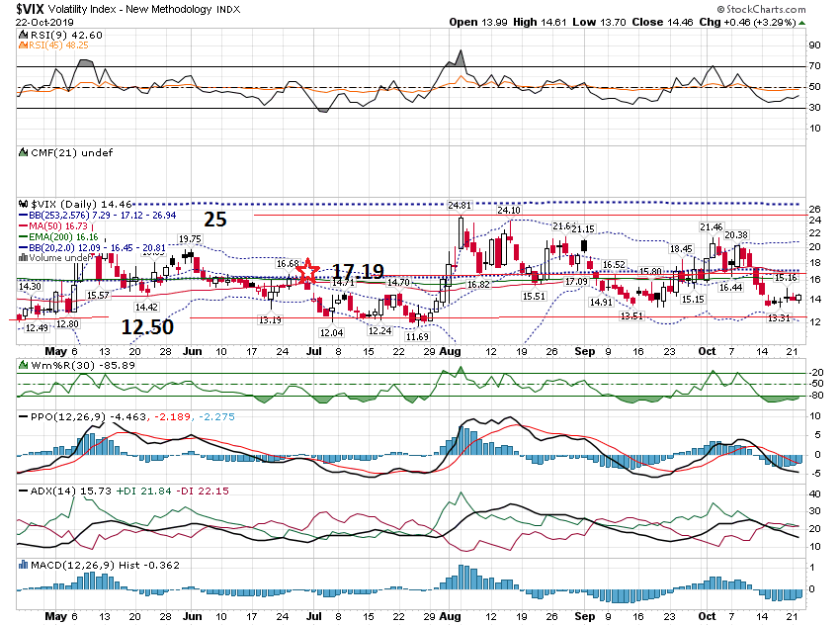

Slide 17
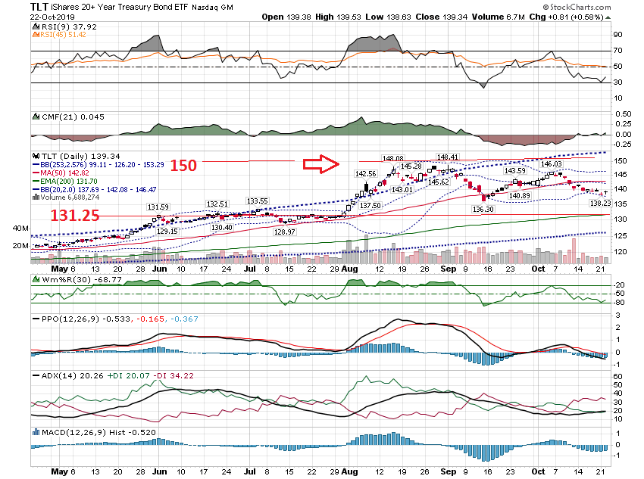

Slide 18
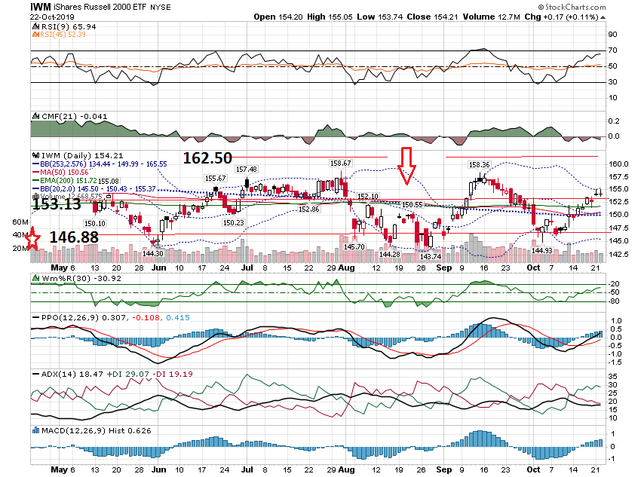

Slide 20
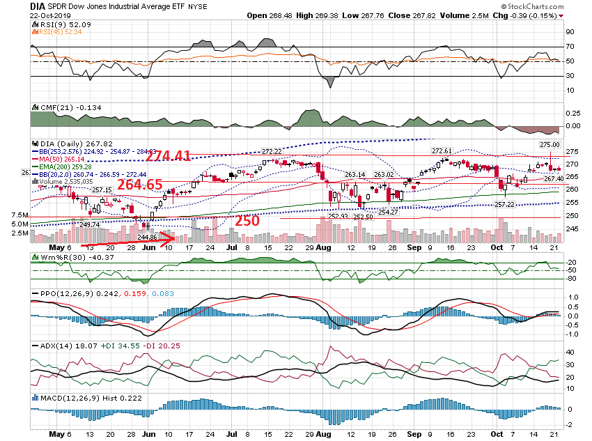

Slide 21
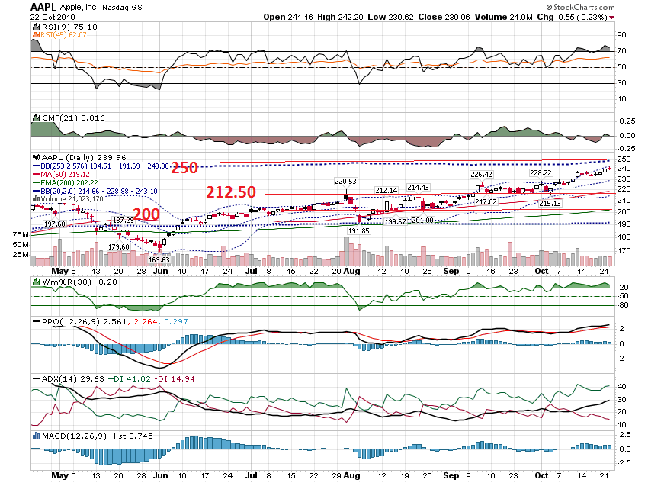

Slide 22
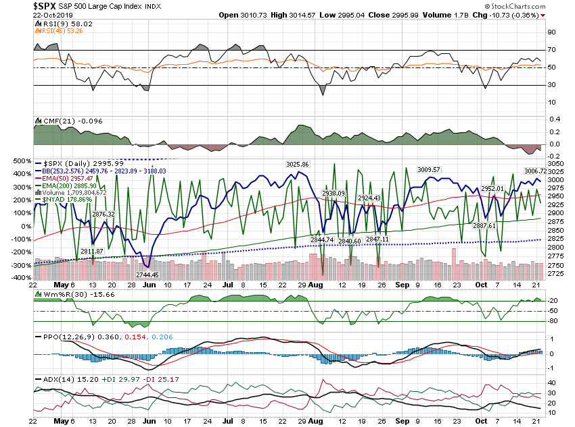

Slide 23
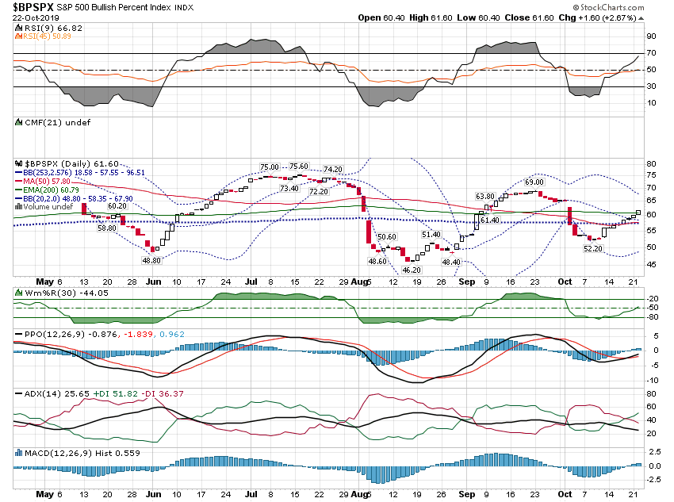

Slide 24
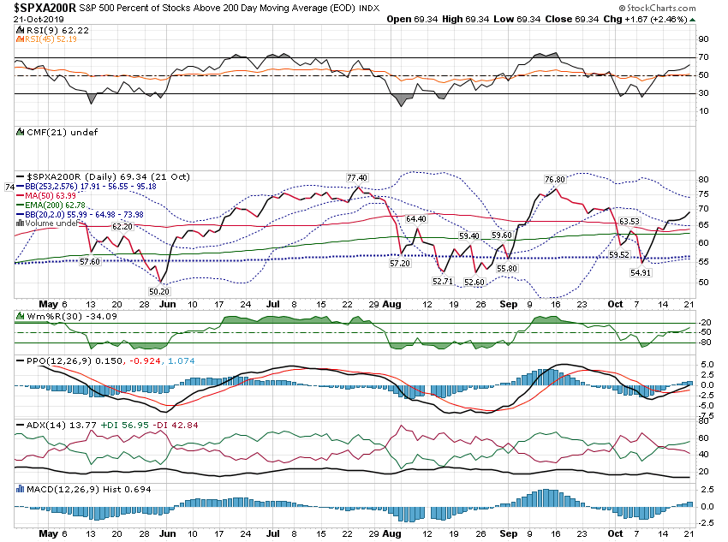

Slide 25
Short Term

Slide 26
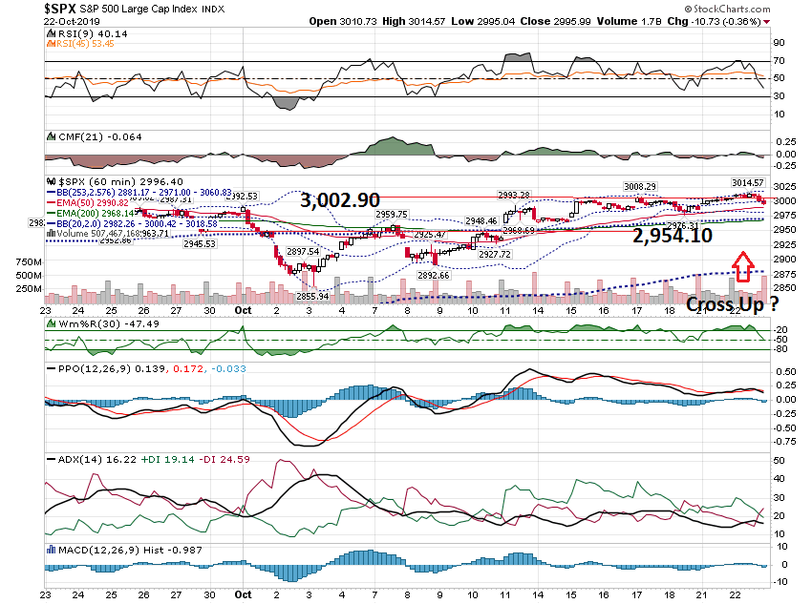

Slide 27
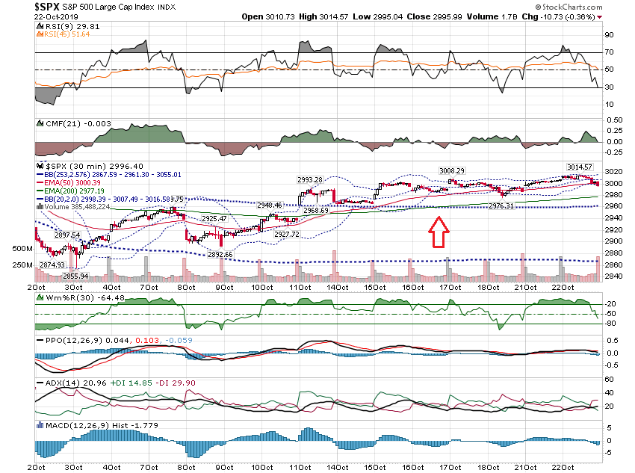

Slide 28
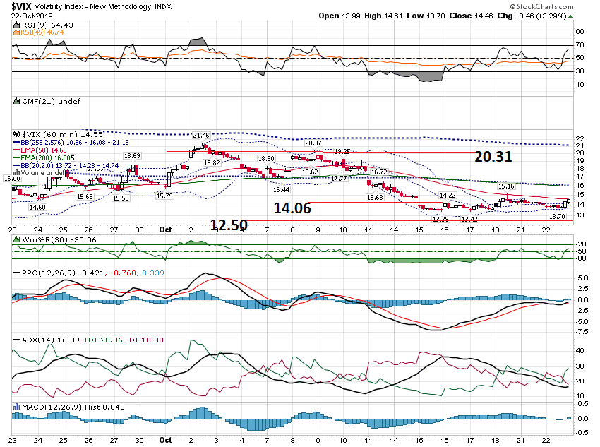

Slide 29
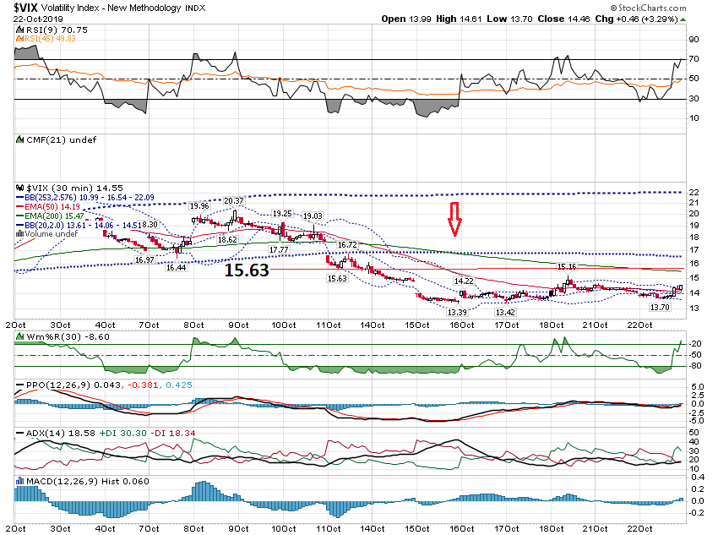

Slide 30
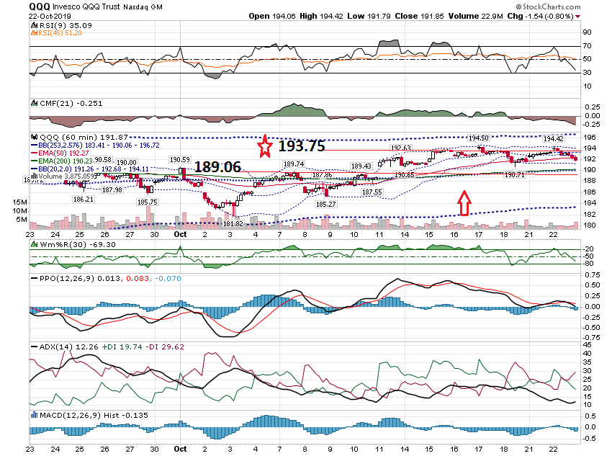

Slide 31
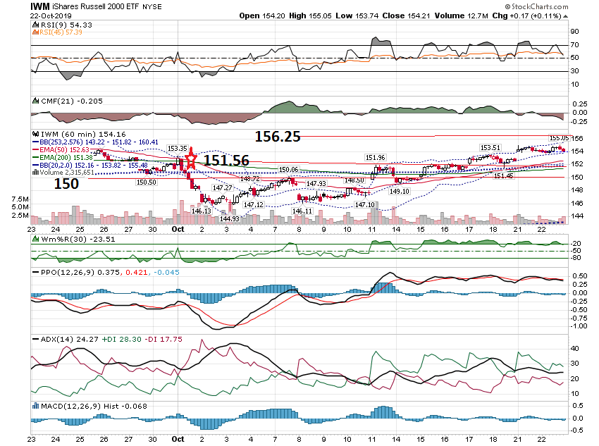

Slide 32
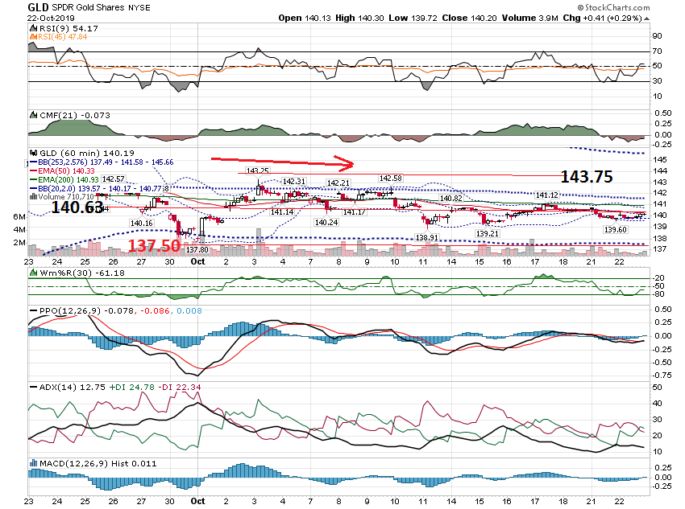

Slide 33
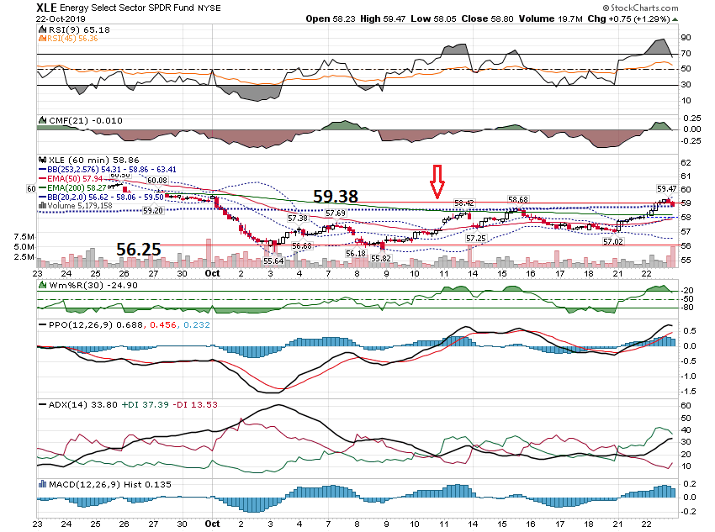

Slide 34
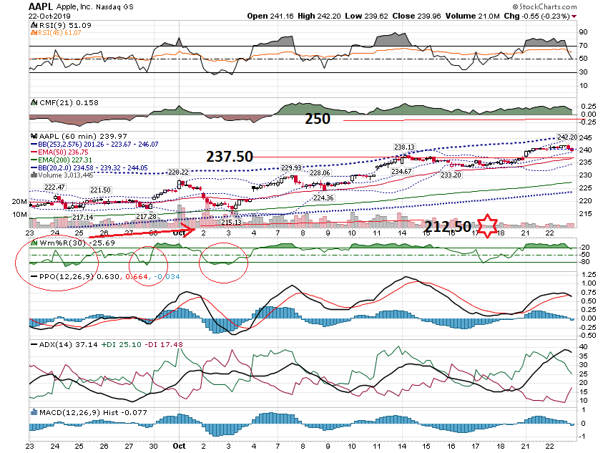

Slide 35
Earnings

Slide 36
Sell a Spread above the 150% Projection or Below the 150% Projection. CMG Example

Slide 37
CMG – Close Tues 10/21 @ $825 $825 Call - $28 $825 Put - $27 Total - $55 Add 50% = $82.50

Slide 38
CMG Example $825 - $82 = $740 Sell $740 Put - $3.50 Buy $735 Put - $3.00 Credit = $.50

Slide 39
You could also sell the $905 Call & Buy the $910 call

Slide 40
Let’s look at the Chart …

Slide 41
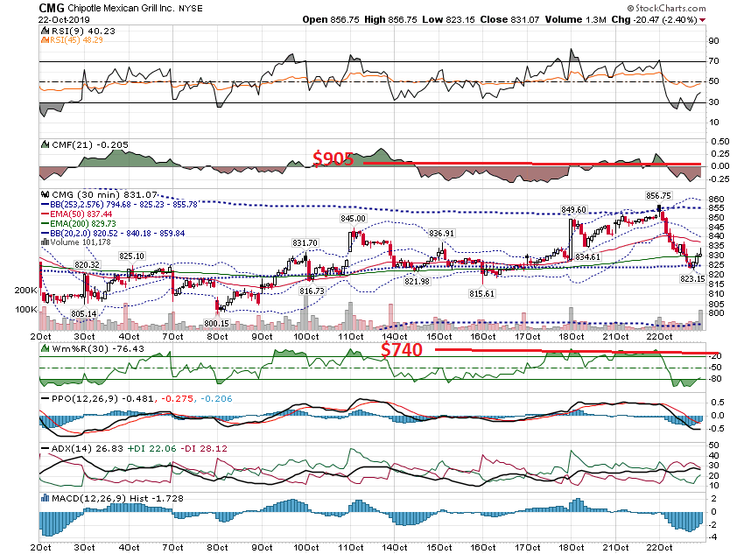

Slide 42
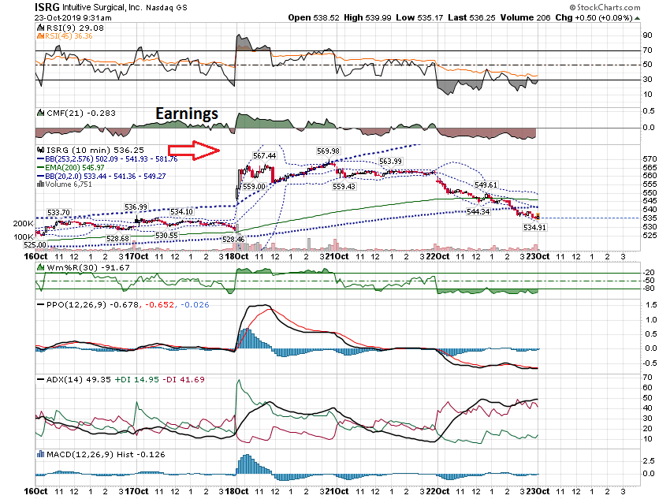

Slide 43
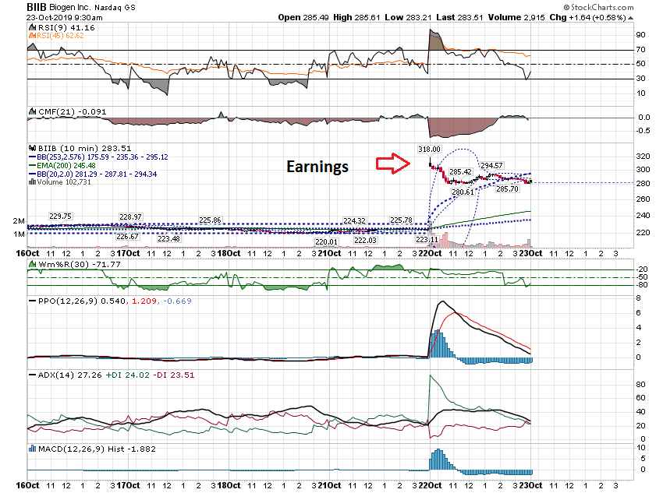

Slide 44
Thanks for watching! Bill Davis Mad Day Trader October 23, 2019 davismdt@gmail.com

