Slide 1
The Mad Hedge Fund Trader “The Next Scandal”
With John Thomas from Silicon Valley, CA, October 2, 2019 www.madhedgefundtrader.com
Notes:
*

Slide 2
October 25-26 Lake Tahoe Conference
*Two days of informative speakers on crucial trading and investment issues *Trade tips with the most successful Mad Hedge traders *2 nights in the Hyatt, including all you can eat and drink *Tickets are a bargain at $699 to $1,999 *Buy now, upper ticket classes sell out first

Slide 3
Trade Alert Performance New Highs! Best Month in Two Years
*January 9.49% Final *July +3.07% MTD *February +4.64% Final *August +16.01% Final *March +1.78% Final *September 3.08% Final *April +0.30% Final *October +1.99% MTD *May +0.25% Final *November -1.83% Final *June -0.50% Final *December -4.13% Final *2019 Year to Date +39.47% compared to +12.51% for the Dow Average *+339.56% since inception, *Average annualized return of 34.53% for 10 years

Slide 4
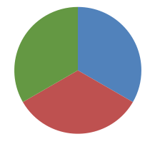
Portfolio Review Keeping Small Positions Only Buying Very Deep in-the-Money on Capitulation Days
Current Capital at Risk
Risk On
World is Getting Better
(IWM) 10/$137-$142 call spread | 10.00%
(SPY) 10/$270-$275 call spread | 10.00%
Risk Off
(SPY) 10/$300-$305 put spread | -10.00%
Total Net Position | 10.00%
Expiration P&L 42.44% YTD

Slide 5
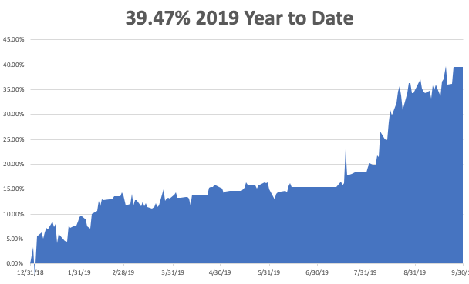

Slide 6
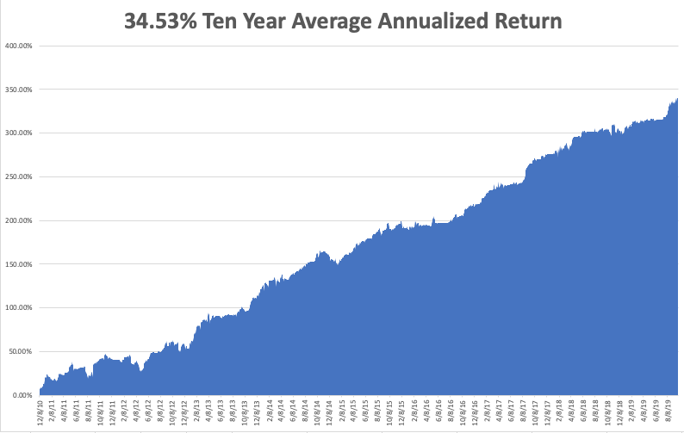
GTD 10 Year Daily Audited Performance

Slide 7
The Method to My Madness
*Risk in the market now is extremely high, both on the long and short side *Do you want to pay high multiples for fading earnings? *Do you want to sell short ahead of a possible China trade deal? *Now we have another new Watergate type scandal to further muddy the investment waters *We’re not buying the shift into value (junk) stocks with terrible fundamentals, like banks, industrials, and retailers because it is just a temporary short term trend *Eventually, a failure of a real deal to arrive will take stocks down to new lows *Brexit may be on its way out, a big positive for the global economy

Slide 8
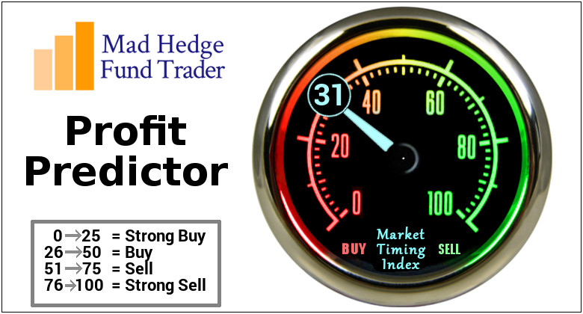
The Mad Hedge Profit Predictor Market Timing Index- An artificial intelligence driven algorithm that analyzes 30 different economic, technical, and momentum driven indicators

Slide 9
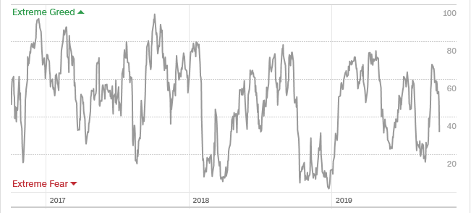
The Mad Hedge Profit Predictor Headed Towards a “BUY”
SELL
BUY

Slide 10
The Global Economy – Turmoil
*40% chance of a US recession in 12 months, 100% in 24 month, US Manufacturing PMI Collapses, in August from 47 to 42.9, A Weak Q2 GDP Final Read Comes in at 2.0%, super low interest rates starting to have a major impact on the real estate market, US Consumer Confidence Dove, in September, from 133 estimated down to 125.1, Consumer Spending Flat in August * Weekly Jobless Claims come in at 213,000, still hugging a 50 year low *Any anti trade, anti globalization mentions by Trump are triggering precipitous stock market selloffs *The US is still the strongest economy in the world, but is fading fast *Thomas Cook bankruptcy underlines the weakness of the European economy, more big companies to fail, Eurozone Sept Markit falls to a seven year low *Brexit is proving too volatile to follow, China Q3 the weakest this year

Slide 11
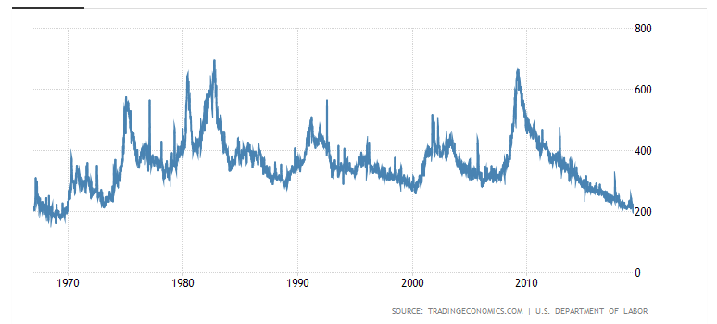
Weekly Jobless Claims-Bottomed Out -15,000 to 204,000

Slide 12
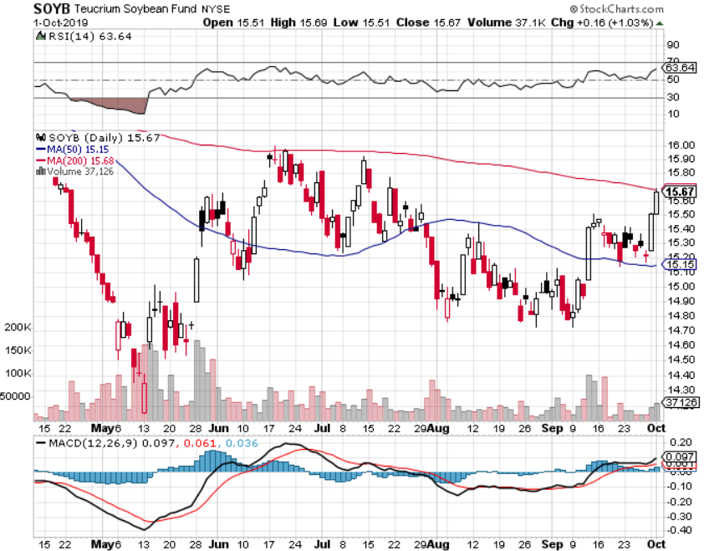
Soybeans - Trade War Indicator Chinese Buy Ten Shiploads as an Olive Branch But the Price Gains are Temporary

Slide 13
The Bill Davis View A $1,500 Upgrade for the Mad Day Trader Service
Buys: | Entry | Target
Penumbra, Inc.(Pen) | $ 130.00 | $ 145.00
Tractor Supply Co. (TSCO) | $ 87.00 | $ 100.00
ServiceNow, Inc.(NOW) | $ 230.00 | $ 275.00
CME Group (CME) | $ 208.00 | $ 225.00
Upland Software Inc.(UPLD) | $ 39.00 | $ 55.00
Sells:
Citrix Systems, Inc. (CTXS) | $ 95.00 | $ 85.00
Stamps.Com (STMP) | $ 82.00 | $ 40.00
PTC, Inc. (PTC) | $ 68.00 | $ 59.00
Illumina, Inc. (ILMN) | $ 300.00 | $ 280.00
F5 Networks,Inc. (FFIV) | $ 138.00 | $ 120.00

Slide 14
Stocks – Flirting with Death
*Potential top risk in the market is huge, going into the highest risk quarter of the year. One year ago today began a 20% plunge in the index and a 60% cratering of lead stocks *All depends on Q3 earnings which start in a few week and the outlook is bleak *Politics could enter the market at any time and the impact won’t be positive *The junk has led, with companies with poor fundamentals leading those with good ones, is temporary reach or rebalancing at best *Trading volume is falling in up markets, rising in down markets, always a negative indicator *Bottom line: 10% down market for the next 3 months, then new highs propelled by ultra low interest rates or a China trade deal *Bottom Line: its bet the ranch time on tech longs, but stay away from those with big China exposure, like Apple, and weak dollar plays like energy, and emerging markets

Slide 15
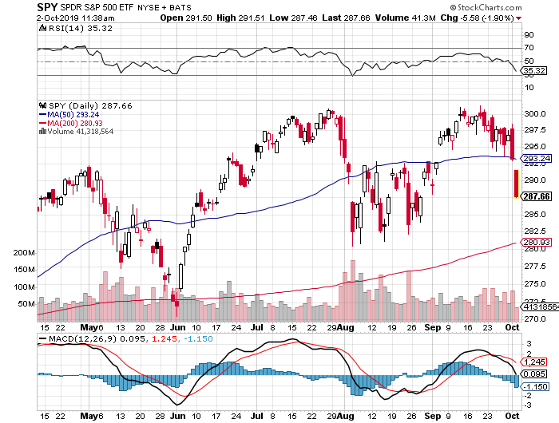
S&P 500 – Double Top long 8/$270-$175 bull call spread long 8/$300-$305 bear put spread took profits on long 8/$305-$308 bear put spread stopped out of long 2/$285-$290 bear put spread took profits on long 2/$270-$275 bear put spread

Slide 16
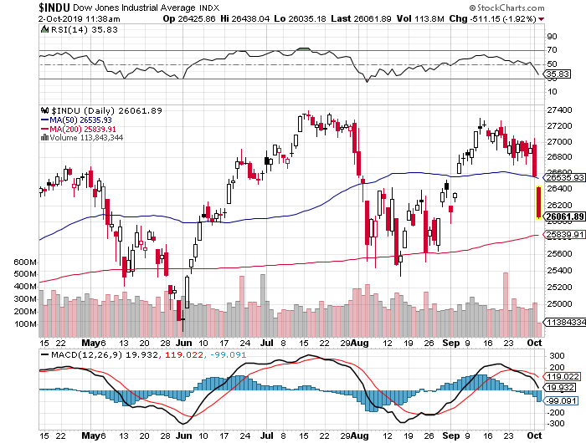
Dow Average ($INDU)-

Slide 17
Russell 2000 (IWM)- Quadruple Top Long 9/$137-$142 vertical bull call spread stopped out of Long 9/$153-$156 vertical bear put spread took profits on Long 9/$157-$160 vertical bear put spread took profits on Long 8/$158-$161 vertical bear put spread out for even Long 4/$160-$165 vertical bear put spread

Slide 18
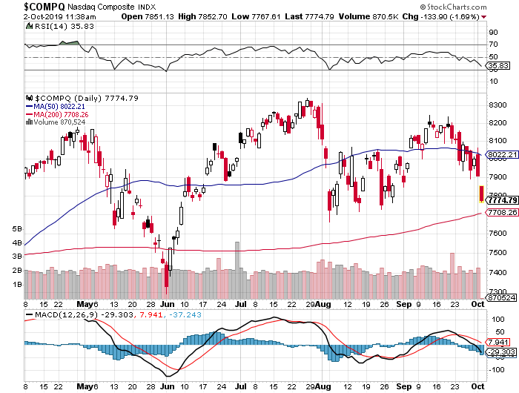
NASDAQ ($COMPQ) – Profit Taking

Slide 19
(VIX)-Back in the Dumps

Slide 20
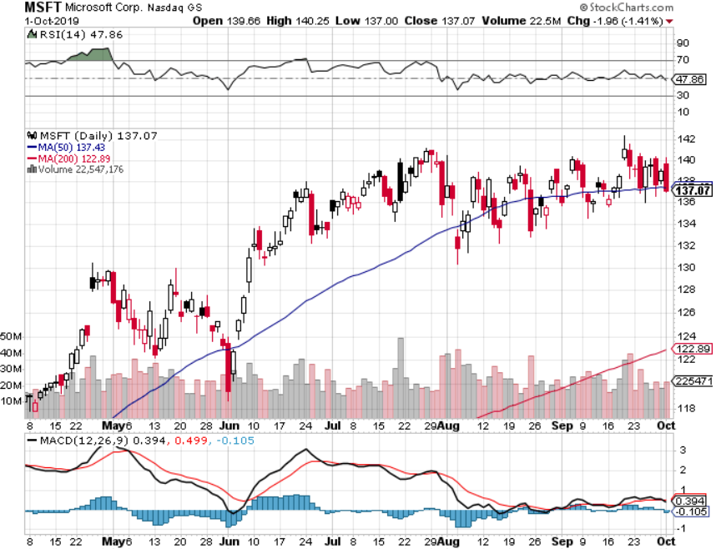
Microsoft (MSFT)- Earnings beat- Looking for Another Entry Point took profits on long 9/$115-$120 call spread took profits on long 6/$110-$115 call spread took profits on long 4/$108-$113 call spread took profits on long 2/$85-$90 call spread

Slide 21
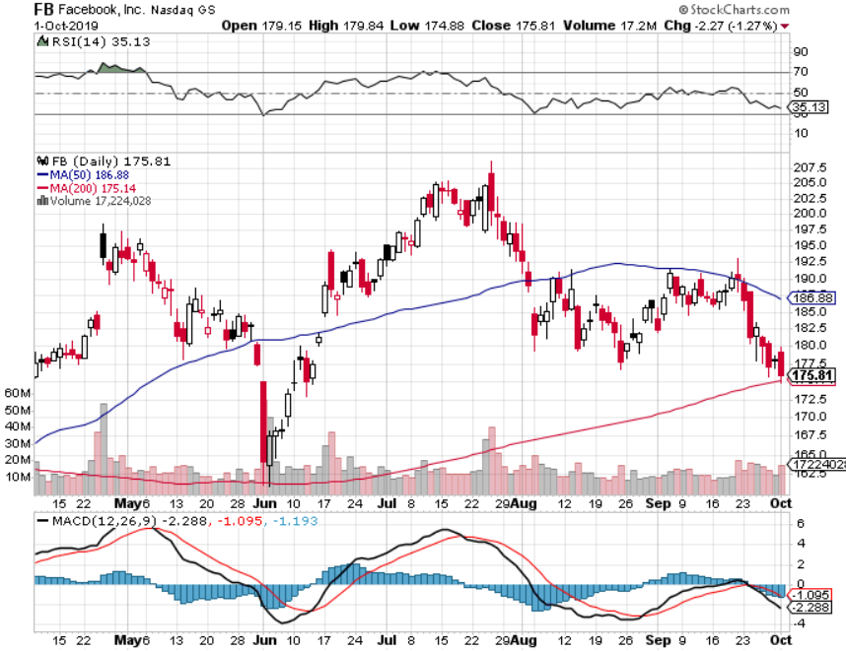
Facebook (FB)- took profits on Long 9/$150-$160 vertical bull call spread took profits on Long 8/$167.50-$172.50 vertical bull call spread

Slide 22
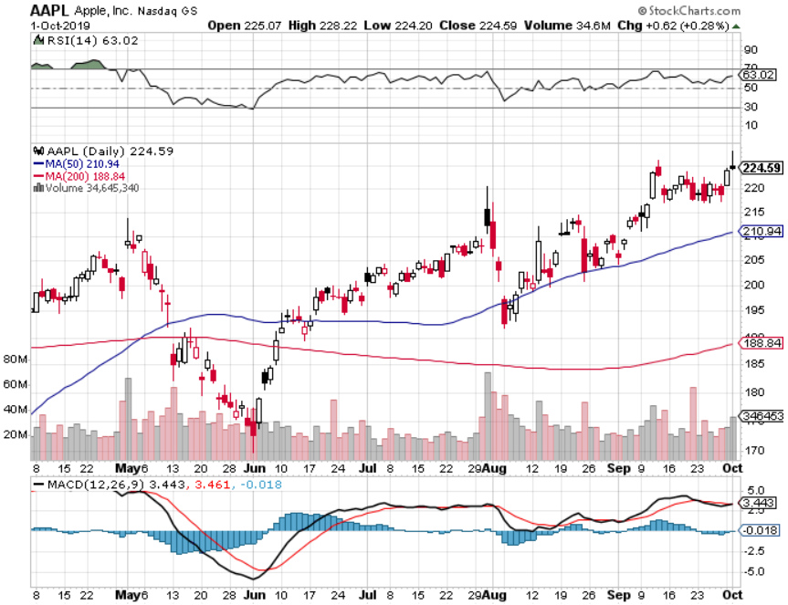
Apple (AAPL)- China Target – 5G Chip Buy

Slide 23
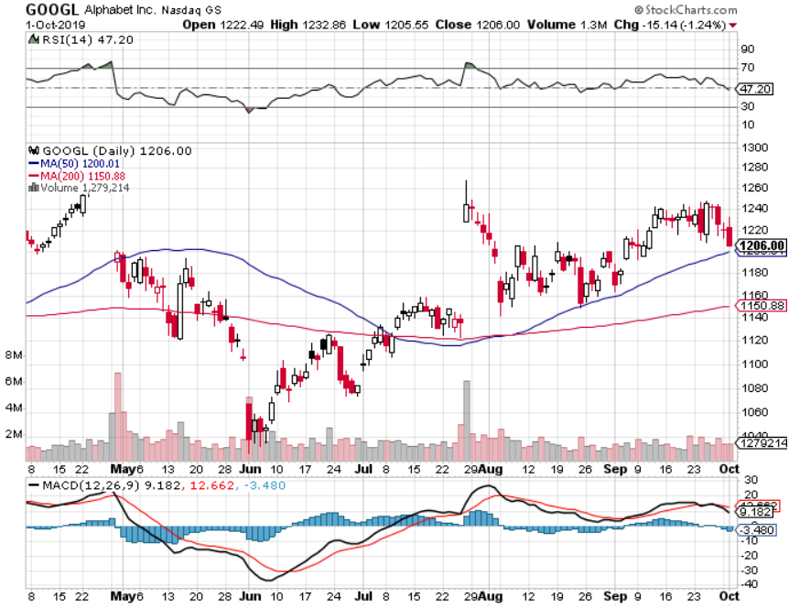
Alphabet (GOOGL)-Antitrust Target took profits on long 9/$1,030-$1,080 vertical bull call spread stopped out of long 5/$1,100-$1,130 bull call spread took profits on long 4/$1,080-$1,120 bull call spread

Slide 24
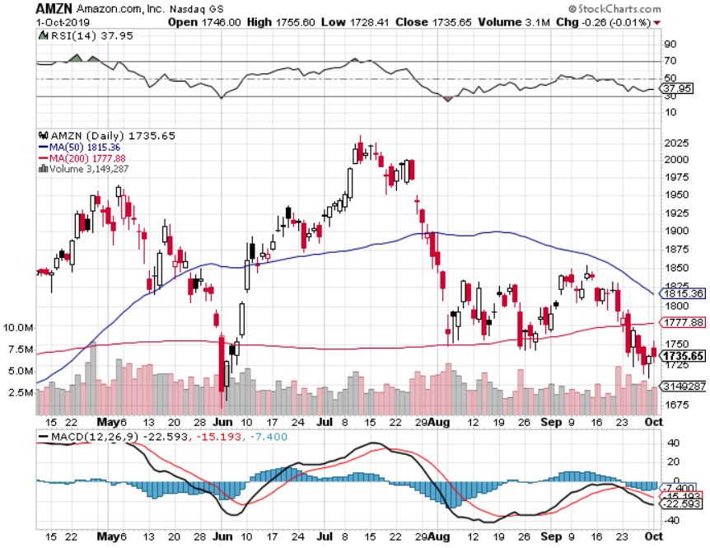
Amazon (AMZN)-Back to bottom of range took profits on 9/$1,500-$1,500 vertical bull call spread stopped out of long 4/$1,650-$1,700 call spread took profits on long 4/$1,600-$1,650 call spread took profits on long 2/$1,200-$1,300 call spread

Slide 25
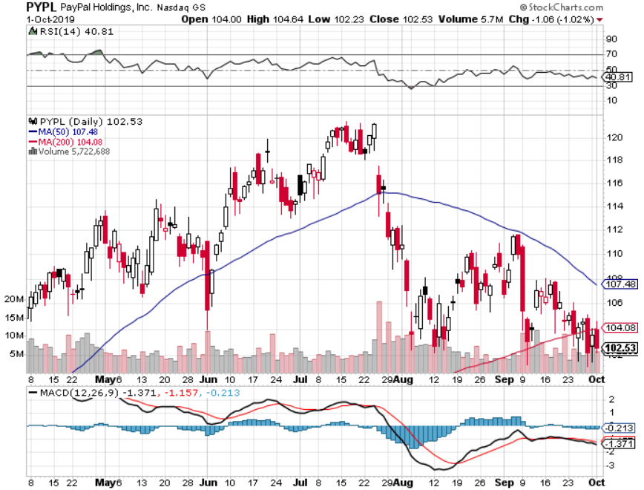
PayPal (PYPL)-CEO resigns took profits on long 4/$90-$95 call spread

Slide 26
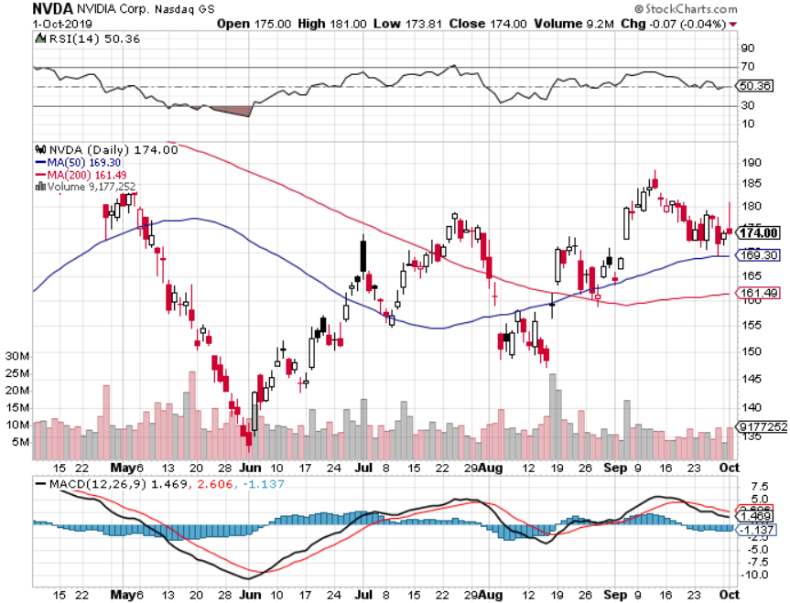
NVIDIA (NVDA) -

Slide 27
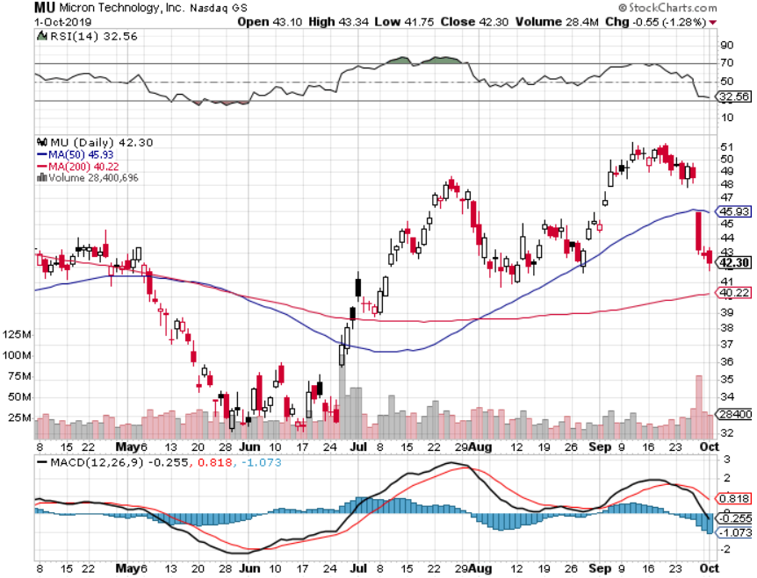
Micron Technology (MU)-

Slide 28
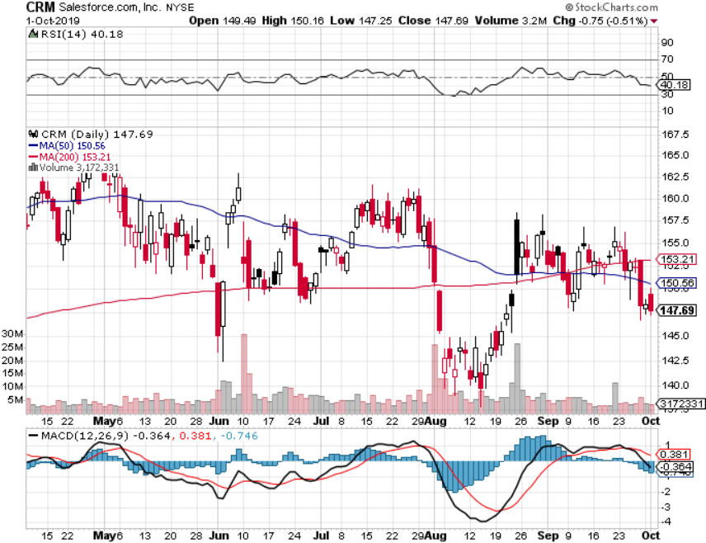
Salesforce (CRM)- took profits on long 9/$125-$130 vertical bull call spread took profits on long 8/$125-$130 vertical bull call spread took profits on long 2/$105-$115 call spread

Slide 29
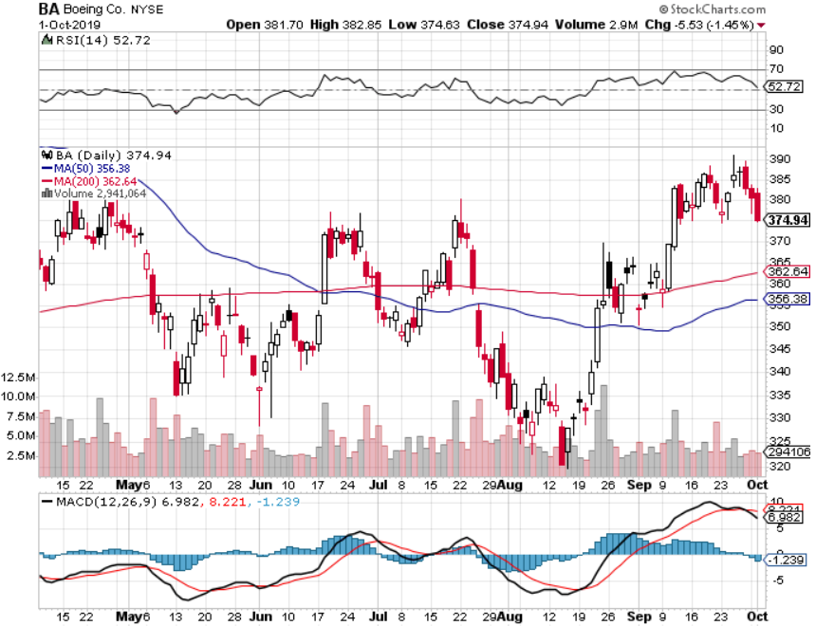
Boeing (BA)- took profits on long 4/$315-$335 call spread Next to happen in the recertification bounce

Slide 30
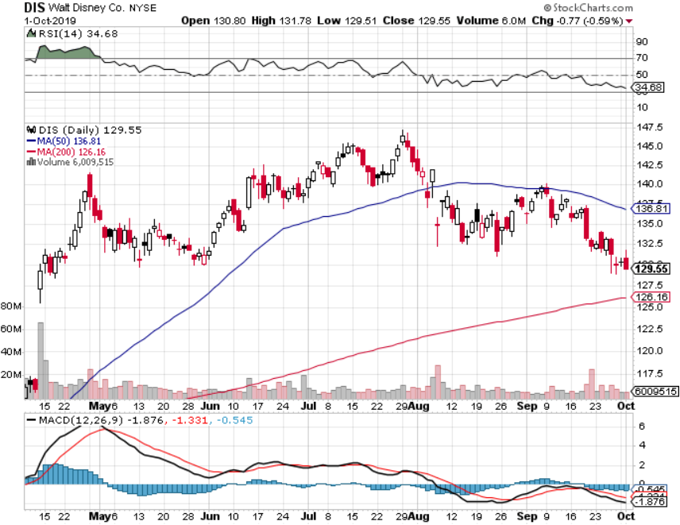
Walt Disney (DIS)- The Next Netflix took profits on long 9/$115-$120 call spread 8/$125-$130 call spread expired at max profit Stopped out of 4/$125-$130 call spread for small loss took profits on long 4/$100-$104 call spread

Slide 31
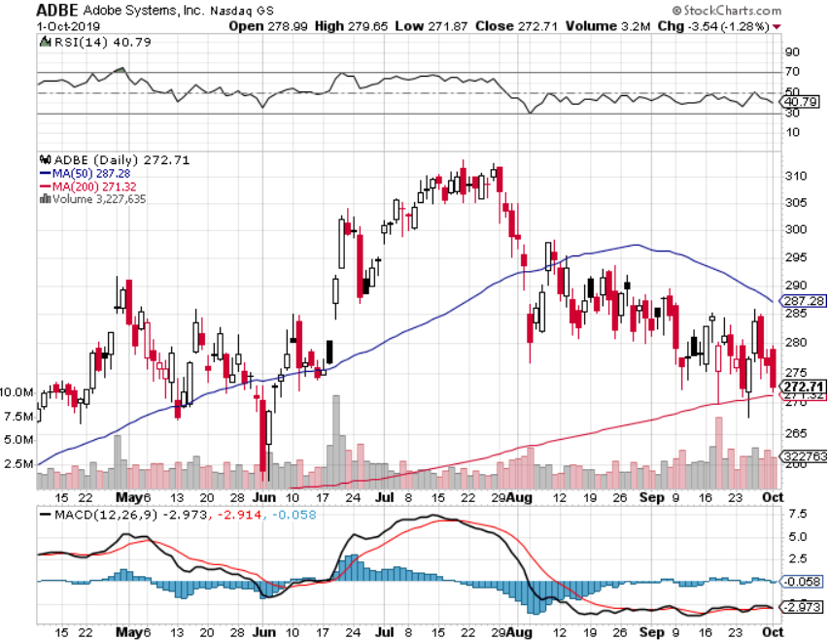
Adobe (ADBE)- The Quality Non-China tech play

Slide 32
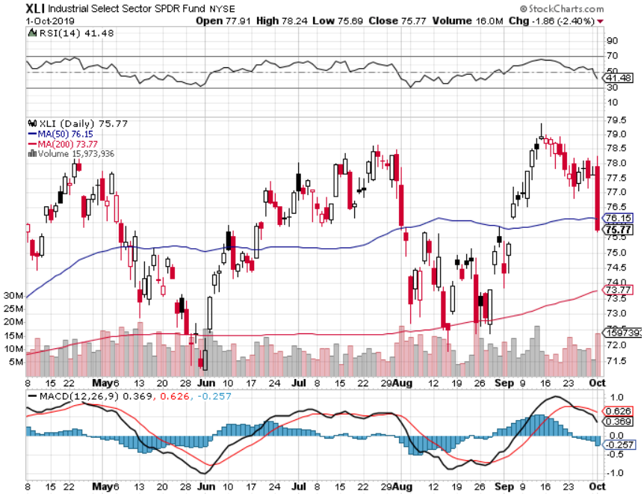
Industrials Sector SPDR (XLI)- (GE), (MMM), (UNP), (UTX), (BA), (HON)

Slide 33
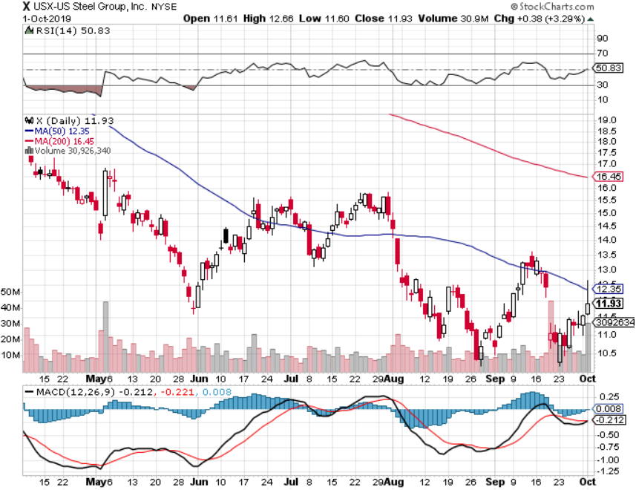
US Steel (X)-Tariffs Trouble Import duties cause users to abandon steel Down by 50% since the election

Slide 34
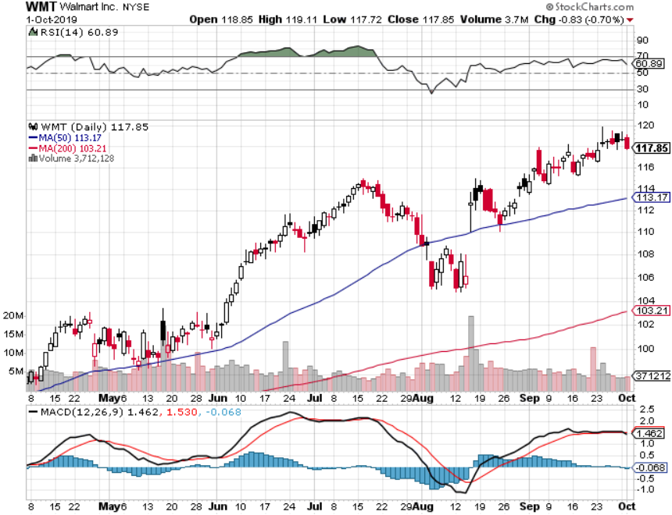
Wal-Mart (WMT)-Tariffs Trouble Long 9/$119-$121 bear put spread took profits on Long 8/$114-$117 bear put spread

Slide 35
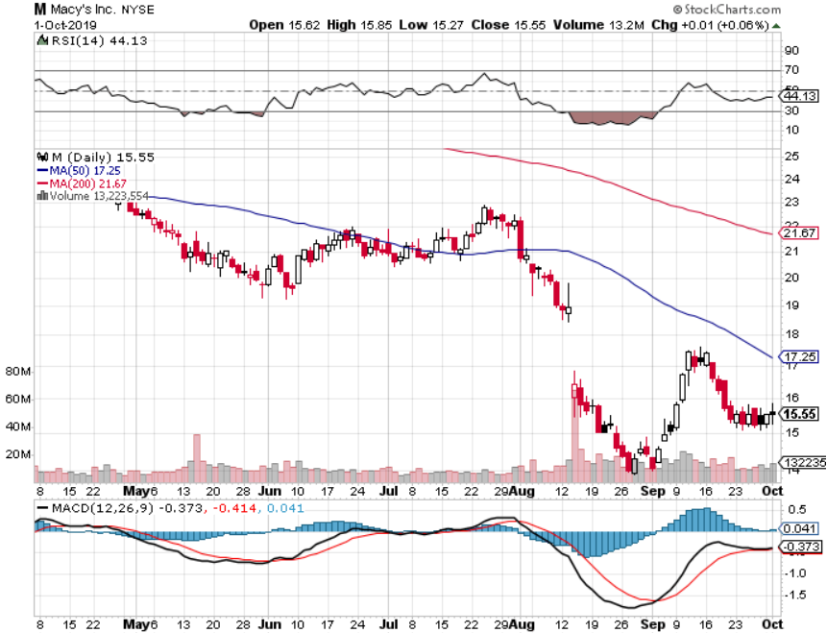
Macys’ (M)-Tariffs Trouble took profits on Long 8/$23-$25 bear put spread

Slide 36
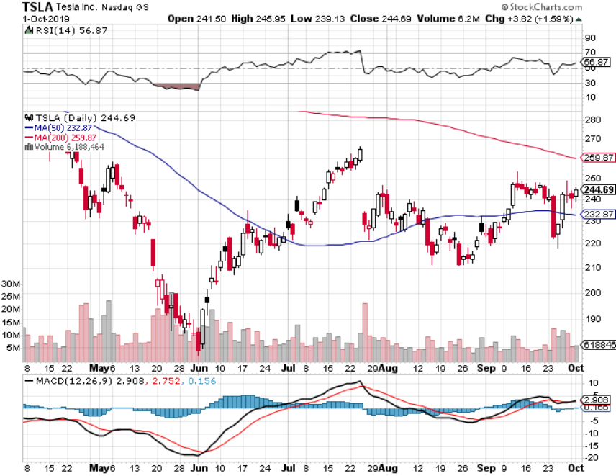
Tesla (TSLA)- 900,000 on the road by yearend took profits on long 6/$140-$150 call spread – expires in 7 trading days took profits on long 6/$240-$250 put spread – expires in 7 trading days stopped out of long 4/$300-$320 put spread
Major Support

Slide 37
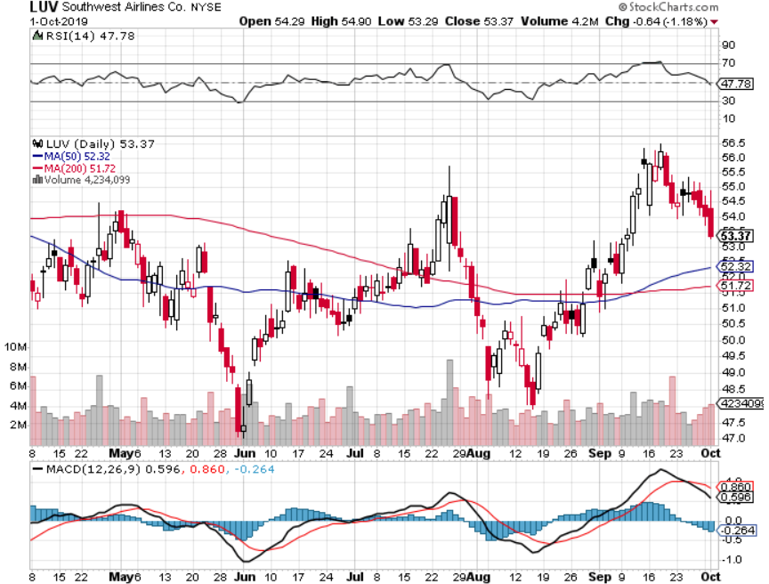
Southwest Airlines (LUV) - Boeing 737 Max biggest buyer

Slide 38
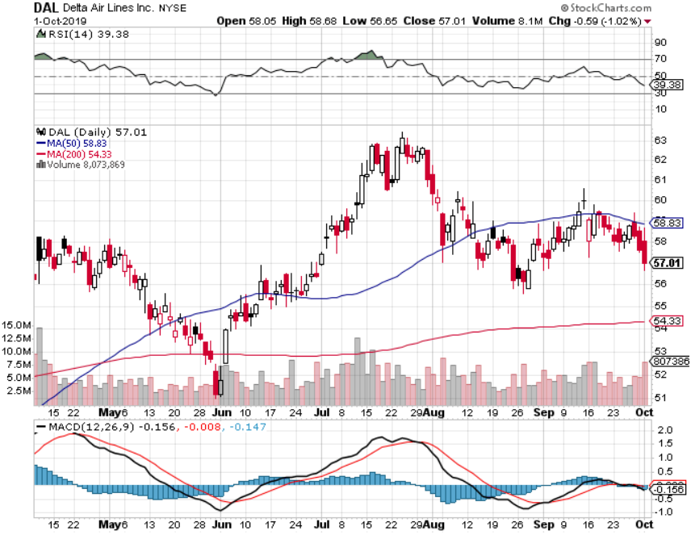
Delta Airlines (DAL) – Non 737 User

Slide 39
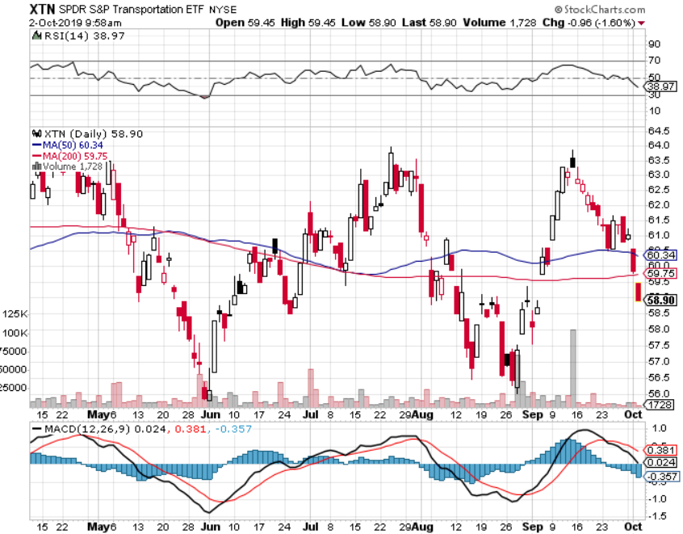
Transports Sector SPDR (XTN)- (ALGT), (ALK), (JBLU), (LUV), (CHRW), (DAL)

Slide 40
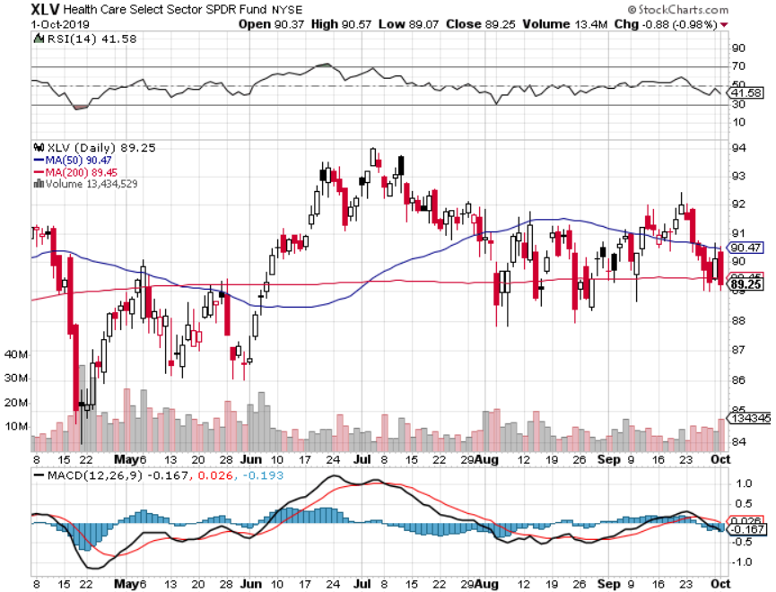
Health Care Sector (XLV), (RXL)-New Highs (JNJ), (PFE), (MRK), (GILD), (ACT), (AMGN)

Slide 41
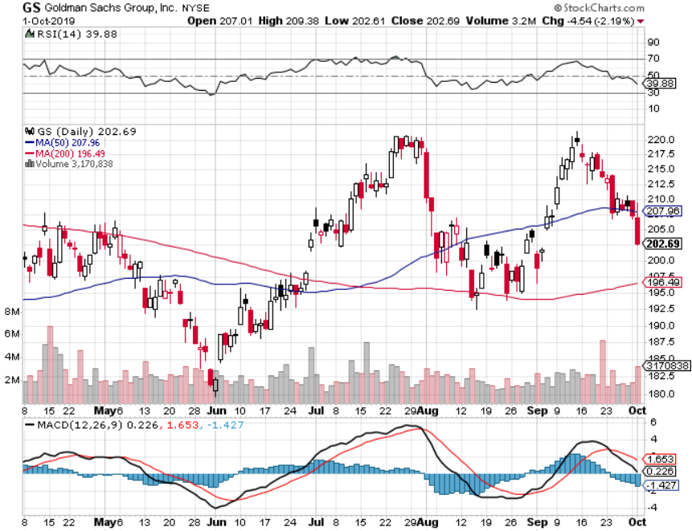
Goldman Sachs (GS)- Swan dive on low rates

Slide 42
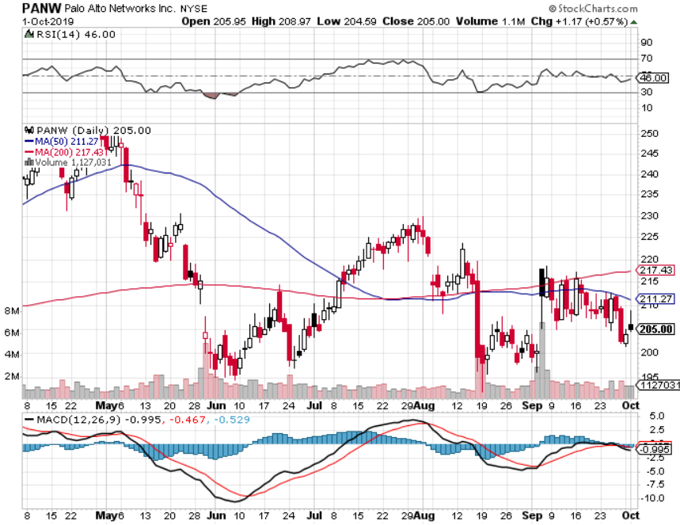
Palo Alto Networks (PANW)- Hacking never goes out of fashion

Slide 43
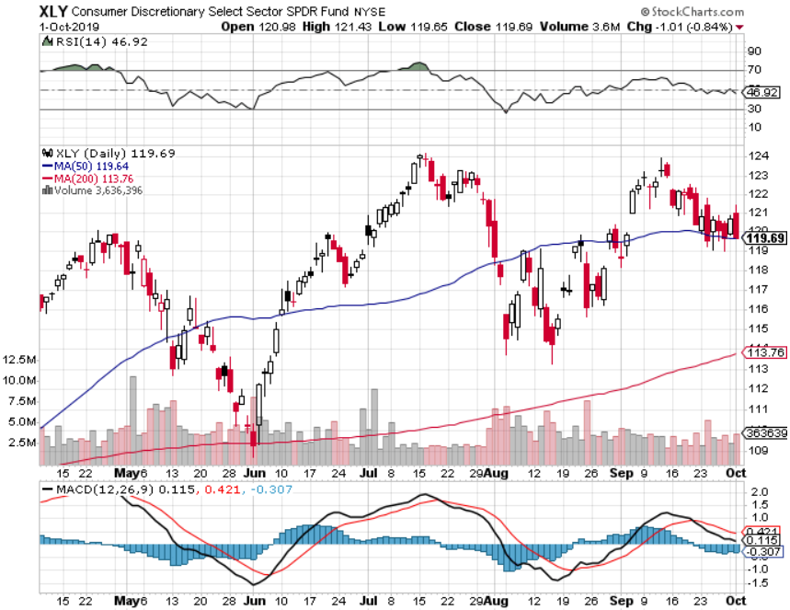
Consumer Discretionary SPDR (XLY) (DIS), (AMZN), (HD), (CMCSA), (MCD), (SBUX)

Slide 44
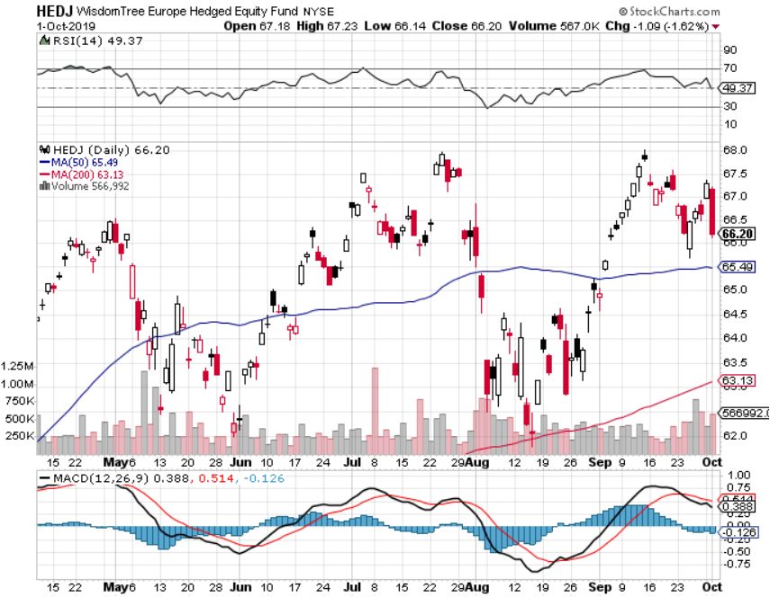
Europe Hedged Equity (HEDJ)-

Slide 45
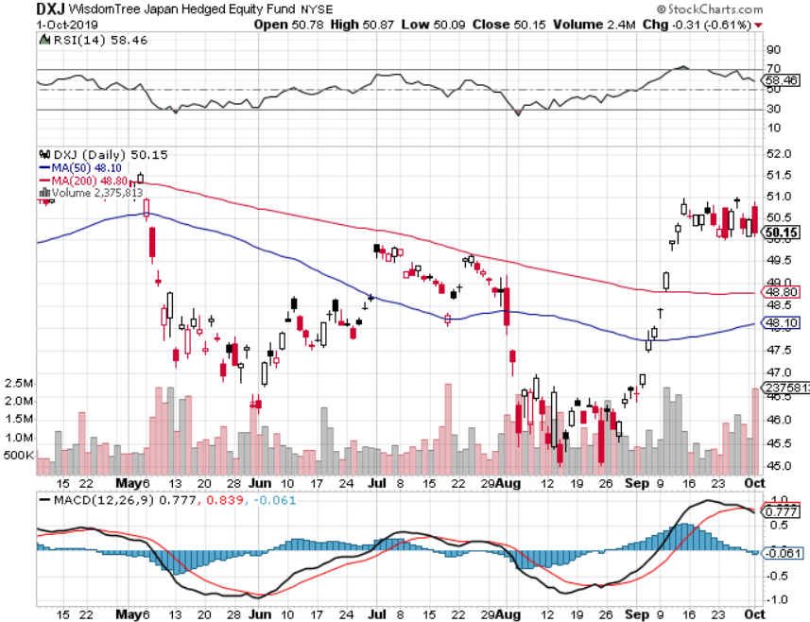
Japan (DXJ)-

Slide 46
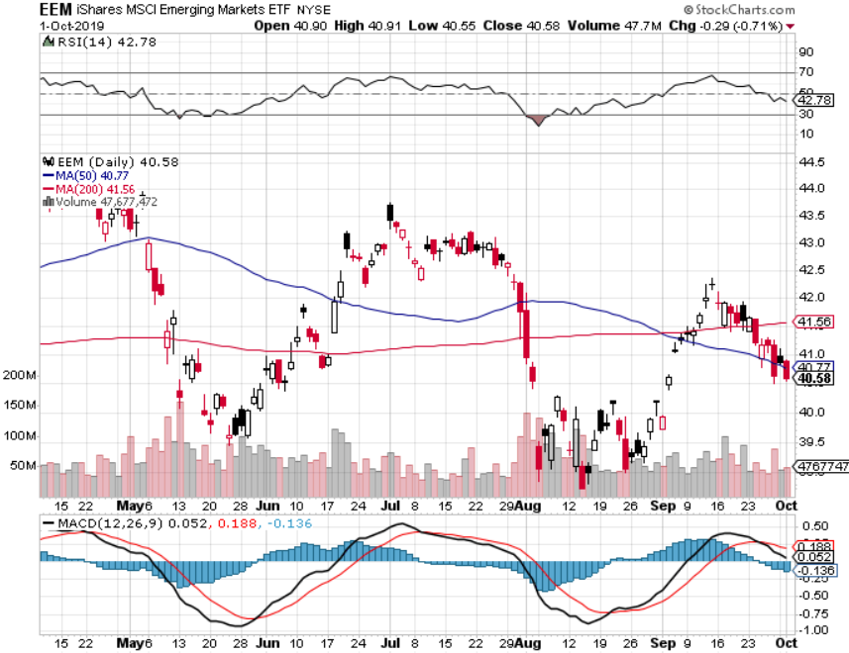
Emerging Markets (EEM)- Avoid on strong Weak Dollar

Slide 47
Bonds – Churning
*After record volatility, bonds have been churning in a narrow range, digesting recent gains *Any further evidence of a weakening global economy will trigger a new run at record low interest rates *Took a quick profit on a six point rally in the (TLT), now sitting it out waiting for another entry point, long or short *40% of the world’s bonds now have negative interest rates *Bottom line: Ten year US Treasury yields will fall below 1.0% in 2020 to come in line with the rest of the world

Slide 48
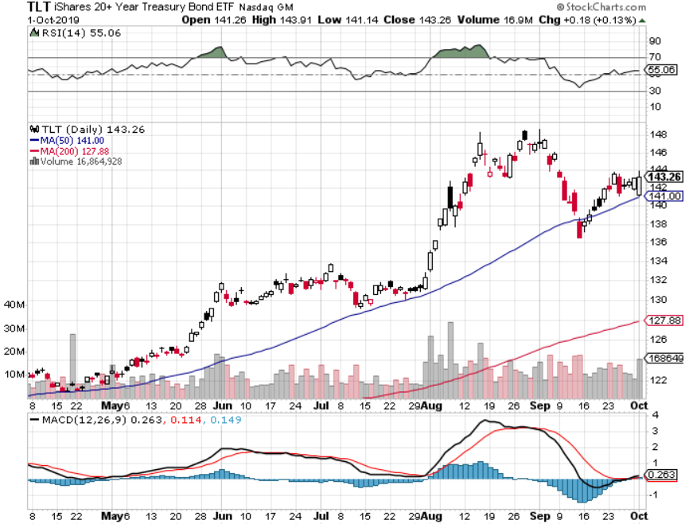
Treasury ETF (TLT) – took profits on long 10/$129-$132 call spread stopped out of long 8/$137-$140 put spread took profits on long 8/$125-$128 call spread took profits on long 6/$128-131 bear put spread took profits on long 5/$116-$119 bull call spread

Slide 49
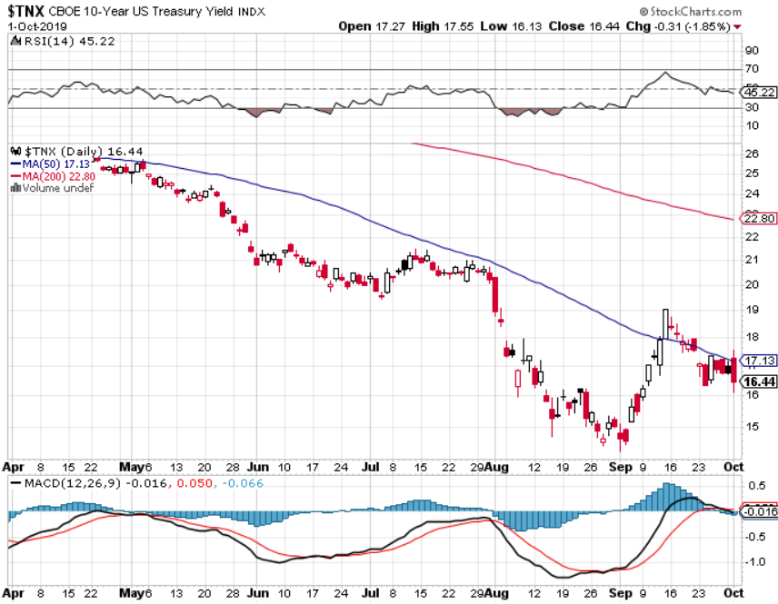
Ten Year Treasury Yield ($TNX) – 1.67% Overnight Low

Slide 50
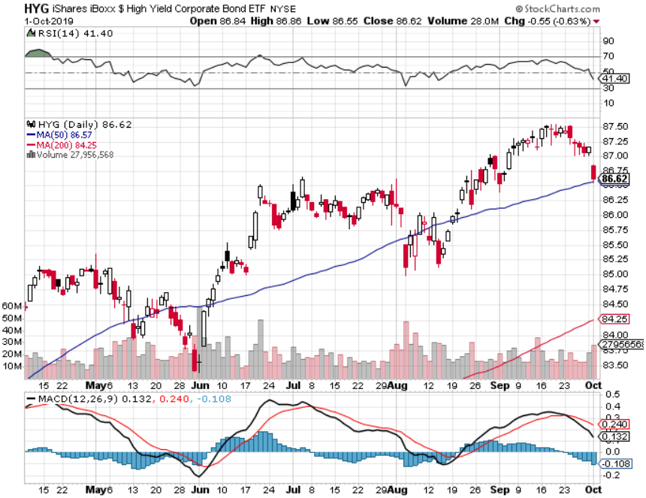
Junk Bonds (HYG) 5.28% Yield big jump in yields on stock selloff and recession fears

Slide 51
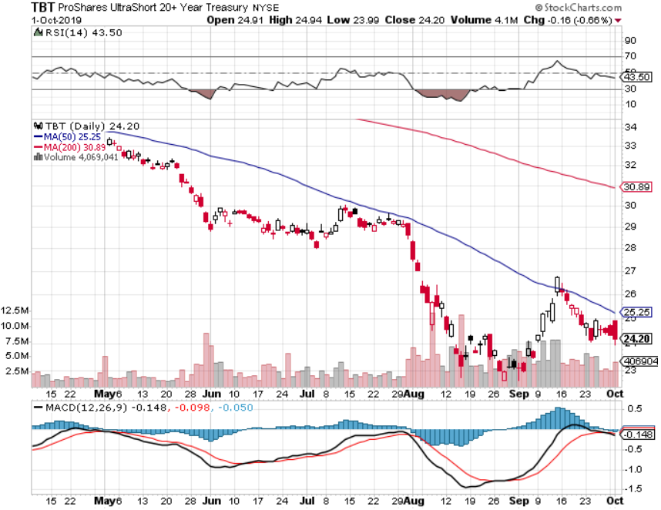
2X Short Treasuries (TBT)- 2 Month Topping Process

Slide 52
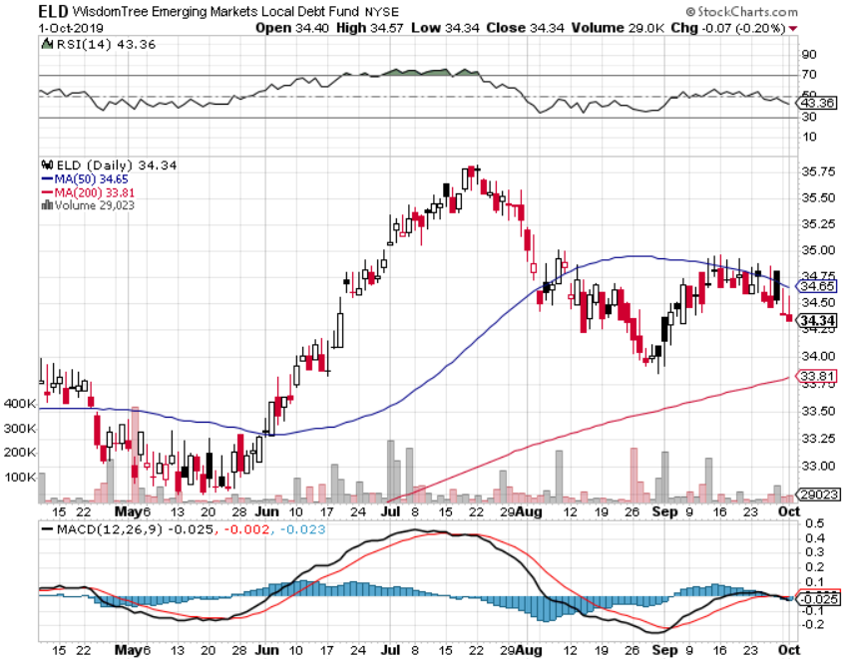
Emerging Market Debt (ELD) 5.01% Yield-

Slide 53
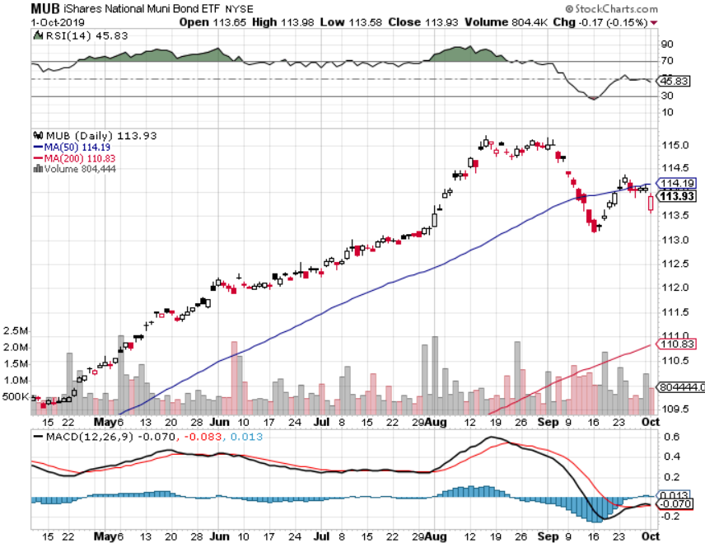
Municipal Bonds (MUB)-1.60% Mix of AAA, AA, and A rated bonds

Slide 54
Foreign Currencies – New Highs for the Buck
*US Dollars hits a new two year high because everyone is lowering rates faster than we are, is a classic pre recessionary move *Euro smashes major support on QE expansion, more of them means its worth less *British pound gives up half of recent gains on Brexit turmoil *Trade confusion brings Chinese Yuan weakness *Bitcoin Crashes 15%, to a new three month low, hitting $7,944. Other cryptos fell 20%. *More recession fears demo Aussie, Reserve Bank cuts interest rates by 25 basis points to 0.75% *Avoid the FX market for now, there are too many contrary indicators

Slide 55
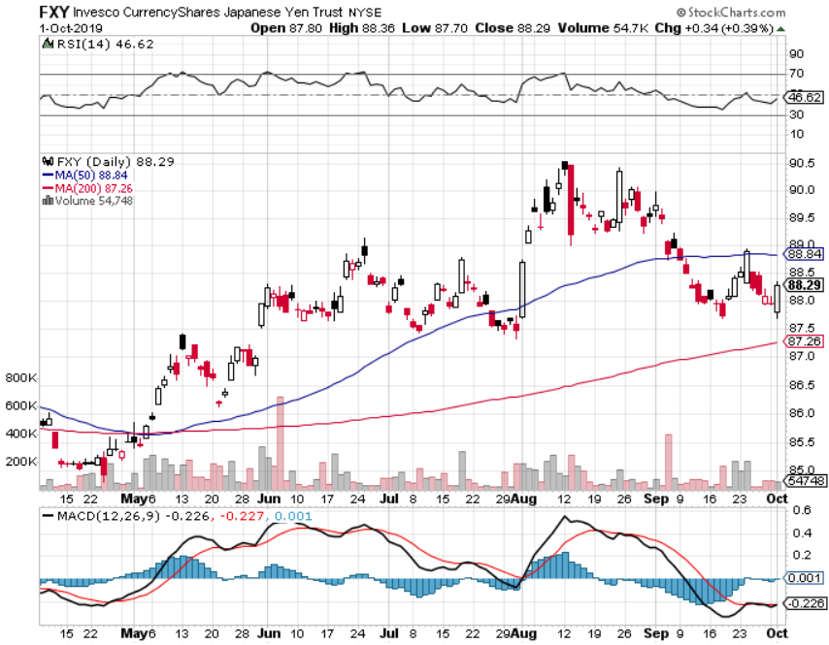
Japanese Yen (FXY), (YCS)

Slide 56
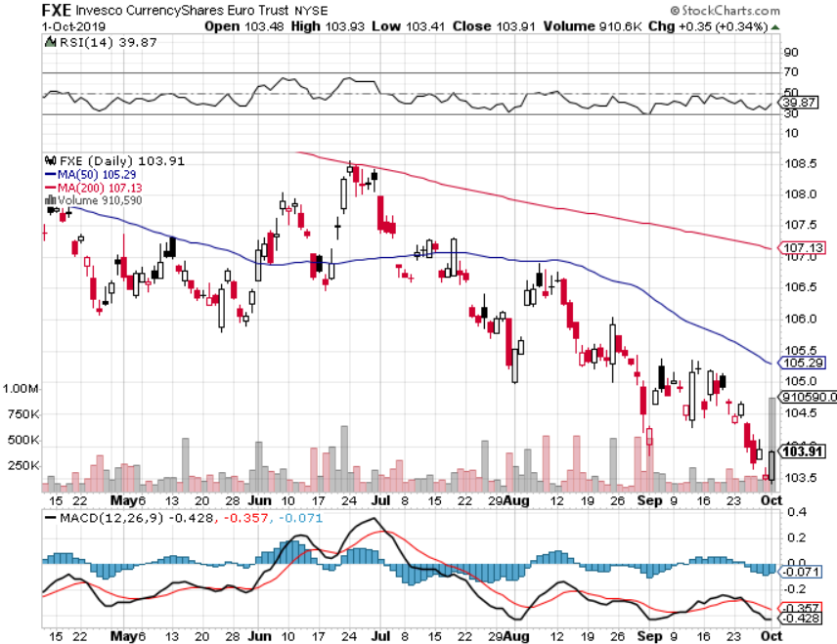
Euro ($XEU), (FXE), (EUO)-

Slide 57
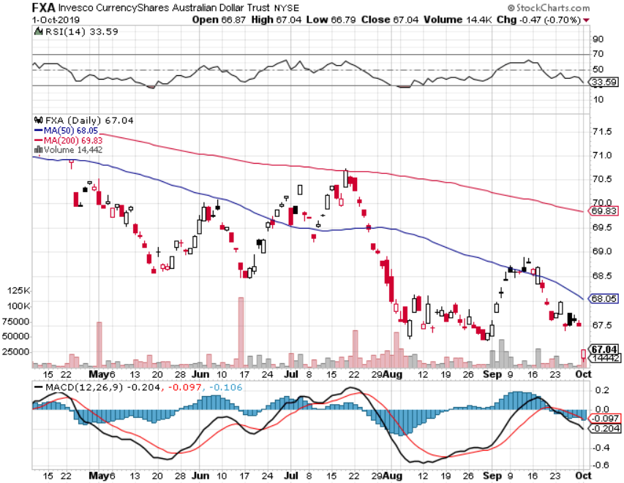
Australian Dollar (FXA)- The Global Recovery Play took profits on long 8/$67-$69 call spread

Slide 58
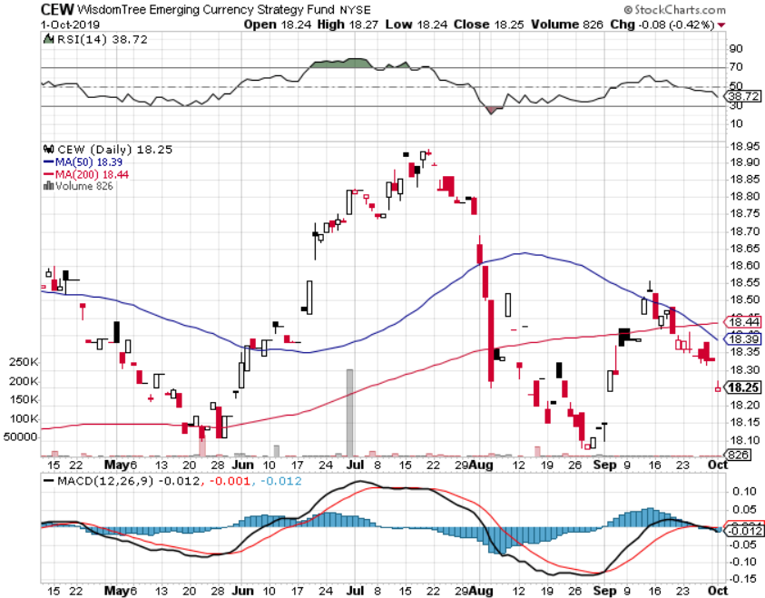
Emerging Market Currencies (CEW)

Slide 59
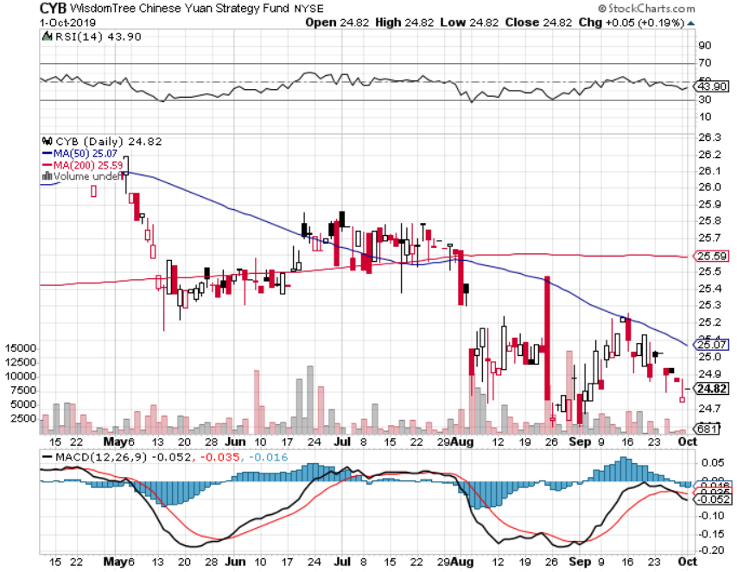
Chinese Yuan- (CYB)- New Lows

Slide 60
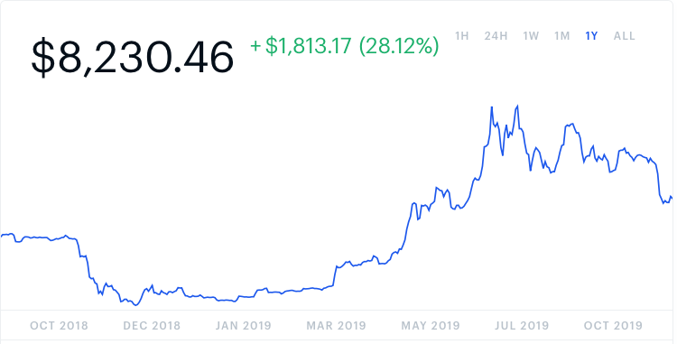
Bitcoin- Yet Another Crash Chinese flight from Yuan is 99% of the trade

Slide 61
Energy – Back to the Dumps
*Oil gives up all gains from the Saudi drone attack, production back up to pre attack levels of 9.9 barrels a day *We caught a major part of the selloff on the short side, then took quick profits *Oil stocks give up half of ephemeral gains *Offshore drillers, the world’s most expensive supply of oil, are taking the biggest hits *Avoid all energy plays like the plague, could drop by half in the coming recession *Bottom Line: looks like $42 a barrel is in the cards, more later

Slide 62
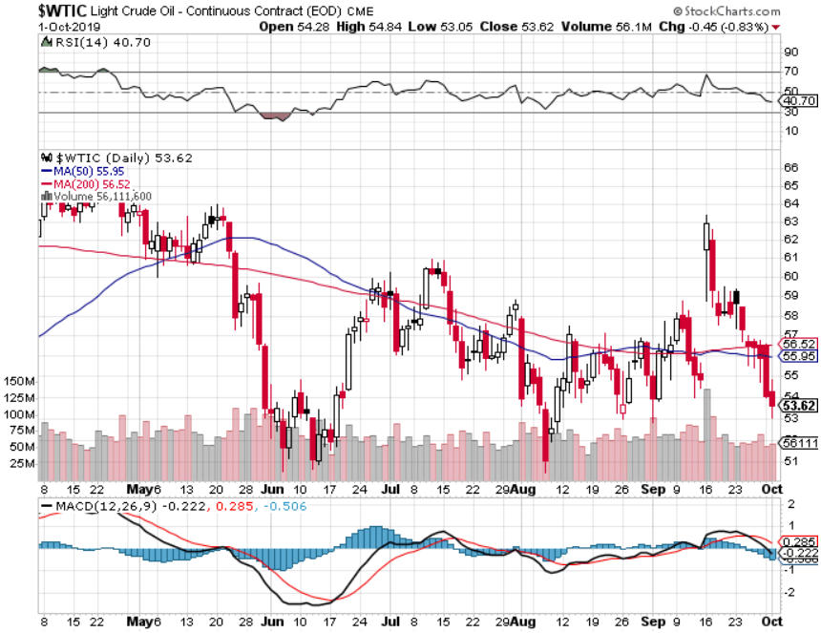
Oil-($WTIC)

Slide 63
United States Oil Fund (USO)

Slide 64
Energy Select Sector SPDR (XLE)-No Performance! (XOM), (CVX), (SLB), (KMI), (EOG), (COP)

Slide 65
Halliburton (HAL)-

Slide 66
Natural Gas (UNG)-

Slide 67
Precious Metals – Trouble
*Potential head and shoulders top setting up for precious metals *Rising US rates are the killer *It setts up a quandary because you only see everything going down at the onset of a recession *We still thing gold has a future, I’m just waiting for a bigger capitulation selloff *Bottom Line: buy a bigger dip in gold and precious metals

Slide 68
Gold (GLD)-

Slide 69
Market Vectors Gold Miners ETF- (GDX) – Yikes!

Slide 70
Barrick Gold (GOLD)

Slide 71
Newmont Mining- (NEM)-

Slide 72
Silver- (SLV)-

Slide 73
Silver Miners - (SIL)-

Slide 74
Wheaton Precious Metals - (WPM)-

Slide 75
Palladium - (PALL)-

Slide 76
Copper (COPX)-Collapse Trade War Disaster

Slide 77
Freeport McMoRan (FCX)-World’s Largest Copper Producer took profits on long 4/$10-$11 call spread took profits on short 4/$114 calls

Slide 78
Real Estate –
*Pending Home Sales are Up 1.6% *New Homes Sales Soared 7.1% in August *Mortgage interest rates give back half of September rate increase, now at 3.72% for the 30 year *Lending to house flipper hits 13 year high, another pre recession indicator
*May S&P 500 Case-Shiller pops to a 3.2%, annual gain, the first improvement in 18 months *Bottom Line: Stand aside for a trade but buy for long term investment

Slide 79
February Corelogic S&P Case Shiller Home Price Index Phoenix (5.8%), Las Vegas (5.5%), and Tampa (4.7%) showing biggest gains
Tradingeconomics.com

Slide 80
Simon Property Group (SPG)-

Slide 81
US Home Construction Index (ITB) (DHI), (LEN), (PHM), (TOL), (NVR)

Slide 82
Trade Sheet- So What Do We Do About All This?
*Stocks-sell rallies *Bonds-buy dips *Commodities-stand aside *Currencies- stand aside *Precious Metals – buy dips *Energy – sell rallies *Volatility-buy dips *Real estate-stand aside

Slide 83
Next Strategy Webinar 12:00 EST Wednesday, October 16, from Silicon Valley, CA email me at support@madhedgefundtrader.com
Good Luck and Good Trading!
Notes:
*

