Slide 1
The Mad Hedge Fund Trader “Let’s Make a Deal!”
With John Thomas from Silicon Valley, CA, October 16, 2019 www.madhedgefundtrader.com
Notes:
*

Slide 2
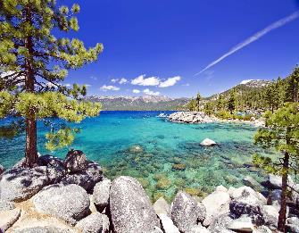
October 25-26 Lake Tahoe Conference LAST CHANCE! Only 9 More Days!
*Two days of informative speakers on crucial trading and investment issues *Trade tips with the most successful Mad Hedge traders *2 nights in the Hyatt, including all you can eat and drink *Tickets are a bargain at $699 to $1,999 *Buy now, upper ticket classes sell out first

Slide 3
Trade Alert Performance New Highs! Best Month in Two Years
*January 9.49% Final *July +3.07% MTD *February +4.64% Final *August +16.01% Final *March +1.78% Final *September 3.08% Final *April +0.30% Final *October +11.53% MTD *May +0.25% Final *November -1.83% Final *June -0.50% Final *December -4.13% Final *2019 Year to Date +48.95% compared to +15.6% for the Dow Average *+349.09% since inception, *Average annualized return of 34.53% for 10 years

Slide 4
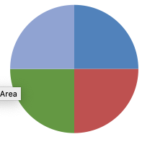
Portfolio Review Keeping Small Positions Only Buying Very Deep in-the-Money on Capitulation Days
Current Capital at Risk
Risk On
World is Getting Better
(IWM) 10/$137-$142 call spread | 10.00%
(USO) 10/$9.50-$10.00 call spread | 10.00%
Risk Off
(SPY) 11/$305-$310 puts spread | -10.00%
(WMT) 11/$125-$130 call spread | -10.00%
Total Net Position | 0.00%
Expiration P&L 52.72% YTD

Slide 5
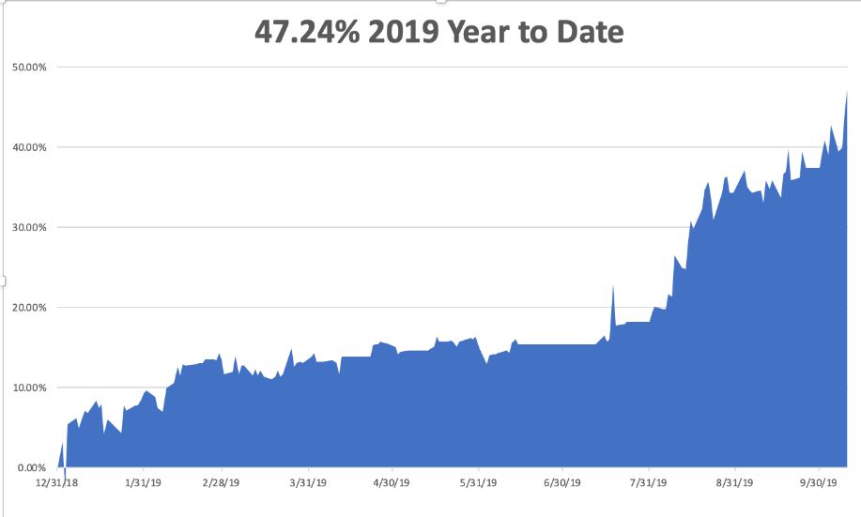

Slide 6
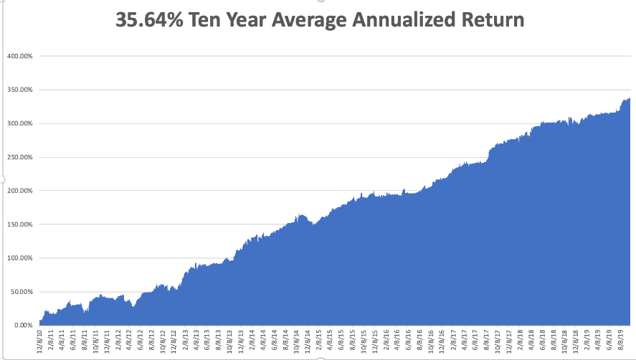
GTD 10 Year Daily Audited Performance

Slide 7
The Method to My Madness
*It’s Hard to fight the Fed, possible rate cut coming on October 30 *No deal with China, but no escalation is better than nothing *This unleashed a lot of buying pent up over the last six months *New Ukraine and tax scandals having no market impact *We’re not buying the shift into value (junk) stocks with terrible fundamentals, like banks, industrials, and retailers because it is just a temporary short term trend *Eventually, a failure of a real deal to arrive will take stocks down to new lows *Revived Brexit hopes have been another market

Slide 8
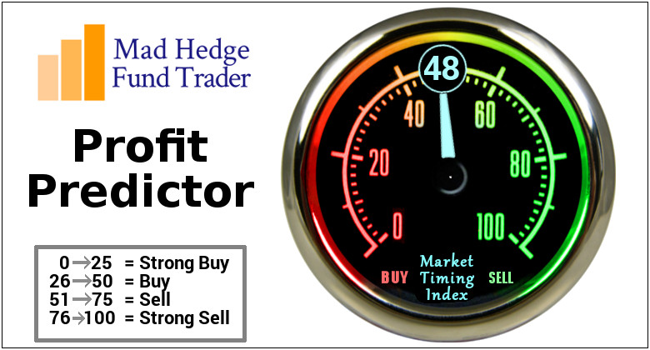
The Mad Hedge Profit Predictor Market Timing Index- Back to the Middle-Nothing to do An artificial intelligence driven algorithm that analyzes 30 different economic, technical, and momentum driven indicators

Slide 9
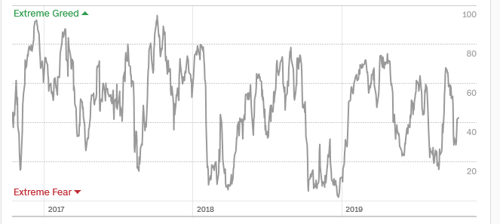
The Mad Hedge Profit Predictor Dead in the Middle-Nothing to do
SELL
BUY

Slide 10
The Global Economy – Rolling Over
* Hiring is Slowing, Says the ADP report, which saw only 135,000 private sector jobs created in September, Rail Traffic Down 7% Last Week, and off 4% YOY, Services PMI Hit Three Year Low, US Producer Prices Plunge in September, down 0.3%, New Job Openings Hit 18 Month Low, down 123,000 * The Fed September Minutes are Out, and traders seem to be expecting more rate cuts than the Fed is. * Inflation was Zero in September, with the Consumer Price Index up 1.8% YOY. * IMF Downgrades Global Growth, from 3.2% to 3% and trade gets the blame. At 2.5% growth many major economies will be in recessions. *German ZEW at a recessionary -22.8

Slide 11
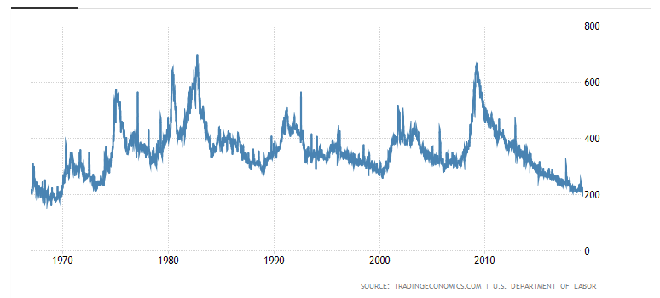
Weekly Jobless Claims-Bottomed Out +1,000 to 214,000

Slide 12
Soybeans - Trade War Indicator Chinese Buy Ten Shiploads as an Olive Branch But the Price Gains are Temporary

Slide 13
The Bill Davis View A $1,500 Upgrade for the Mad Day Trader Service
Buys: | Entry | Target
Darden Resturants, Inc. (DRI) | $ 110.00 | $ 125.00
Shake Shack, Inc. (SHAK) | $ 90.00 | $ 108.00
Heico Corp. (HEI) | $ 120.00 | $ 140.00
Twitter, Inc. (TWTR) | $ 40.00 | $ 50.00
CBS Corp (CBS) | $ 37.00 | $ 48.00
Sells:
Illumina, Inc. (ILMN) | $ 312.00 | $ 250.00
VMWare, Inc. (VMW) | $ 160.00 | $ 130.00
National Beverage Corp (FIZZ) | $ 51.00 | $ 42.00
Align Technology, Inc.(ALGN) | $ 219.00 | $ 185.00
Ameriprise Financial inc.(AMP) | $ 140.00 | $ 125.00

Slide 14
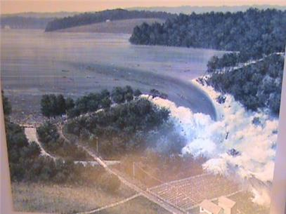
Stocks – The Dam is Broken
*The damn of unrequited buying has broken, but with global fundamentals deteriorating fast how long will it last? There are a lot of contradictory signals now *All depends on Q3 earnings which start in a few week and the outlook is bleak, down 4% est. vs 26% a year ago *Insider selling at Fortune 500 companies at 20 year highs. What do they know that we don’t? *Trading volume is falling in up markets, rising in down markets, always a negative indicator *Bottom line: Marginal new high, then 7% down market for the next 3 months, then new highs propelled by ultra low interest rates or an eventual China trade deal *Bottom Line: its bet the ranch time on tech longs, but stay away from those with big China exposure, like Apple, and weak dollar plays like energy, and emerging markets

Slide 15
S&P 500 – Breakout Attempt long 10/$305-$310 bear put spread took profits on long 10/$270-$275 bull call spread took profits on long 10/$300-$305 bear put spread took profits on long 8/$305-$308 bear put spread

Slide 16
Dow Average ($INDU)-

Slide 17
Russell 2000 (IWM)- Back to the Middle Long 10/$137-$142 vertical bull call spread - expires in 2 days took profits on Long 10/$153-$156 vertical bear put spread stopped out of Long 9/$153-$156 vertical bear put spread took profits on Long 9/$157-$160 vertical bear put spread

Slide 18
NASDAQ ($COMPQ) – Profit Taking

Slide 19
(VIX)-Back in the Dumps

Slide 20
Microsoft (MSFT)- Earnings beat- Looking for Another Entry Point took profits on long 9/$115-$120 call spread took profits on long 6/$110-$115 call spread took profits on long 4/$108-$113 call spread took profits on long 2/$85-$90 call spread

Slide 21
Facebook (FB)- took profits on Long 9/$150-$160 vertical bull call spread took profits on Long 8/$167.50-$172.50 vertical bull call spread

Slide 22
Apple (AAPL)- China Target – 5G Chip Buy

Slide 23
Alphabet (GOOGL)-Antitrust Target took profits on long 9/$1,030-$1,080 vertical bull call spread stopped out of long 5/$1,100-$1,130 bull call spread took profits on long 4/$1,080-$1,120 bull call spread

Slide 24
Amazon (AMZN)-Back to bottom of range took profits on 9/$1,500-$1,500 vertical bull call spread stopped out of long 4/$1,650-$1,700 call spread took profits on long 4/$1,600-$1,650 call spread took profits on long 2/$1,200-$1,300 call spread

Slide 25
PayPal (PYPL)-CEO resigns took profits on long 4/$90-$95 call spread

Slide 26
NVIDIA (NVDA) -

Slide 27
Micron Technology (MU)-

Slide 28
Salesforce (CRM)- took profits on long 9/$125-$130 vertical bull call spread took profits on long 8/$125-$130 vertical bull call spread took profits on long 2/$105-$115 call spread

Slide 29
Boeing (BA)- took profits on long 4/$315-$335 call spread Next to happen is the recertification bounce

Slide 30
Walt Disney (DIS)- The Streaming Wars are On took profits on long 9/$115-$120 call spread 8/$125-$130 call spread expired at max profit Stopped out of 4/$125-$130 call spread for small loss took profits on long 4/$100-$104 call spread

Slide 31
Adobe (ADBE)- The Quality Non-China tech play

Slide 32
Industrials Sector SPDR (XLI)- (GE), (MMM), (UNP), (UTX), (BA), (HON)

Slide 33
US Steel (X)-Tariffs Trouble Import duties cause users to abandon steel Down by 50% since the election

Slide 34
Wal-Mart (WMT)-Tariffs Trouble Long 11/$125-$130 bear put spread Long 10/$119-$121 bear put spread took profits on Long 8/$114-$117 bear put spread

Slide 35
Macys’ (M)-Tariffs Trouble took profits on Long 8/$23-$25 bear put spread

Slide 36
Tesla (TSLA)- 900,000 on the road by yearend took profits on long 6/$140-$150 call spread – expires in 7 trading days took profits on long 6/$240-$250 put spread – expires in 7 trading days
Major Support

Slide 37
Southwest Airlines (LUV) - Boeing 737 Max biggest buyer

Slide 38
Delta Airlines (DAL) – Non 737 User

Slide 39
Transports Sector SPDR (XTN)- (ALGT), (ALK), (JBLU), (LUV), (CHRW), (DAL)

Slide 40
Health Care Sector (XLV), (RXL)-New Highs (JNJ), (PFE), (MRK), (GILD), (ACT), (AMGN)

Slide 41
Goldman Sachs (GS)- Swan dive on low rates

Slide 42
Palo Alto Networks (PANW)- Hacking never goes out of fashion

Slide 43
Consumer Discretionary SPDR (XLY) (DIS), (AMZN), (HD), (CMCSA), (MCD), (SBUX)

Slide 44
Europe Hedged Equity (HEDJ)- Pip on Brexit News

Slide 45
Japan (DXJ)-

Slide 46
Emerging Markets (EEM)- Avoid on strong Weak Dollar

Slide 47
Bonds – Looking for Direction
*After record volatility, bonds have been churning in a broad 8 point range, digesting recent gains *Any further evidence of a weakening global economy will trigger a new run at record low interest rates *Sitting it out waiting for another entry point, long or short *Resumption of Global QE will boost supply of negative yielding bonds *Bottom line: Ten year US Treasury yields will fall below 1.0% in 2020 to come in line with the rest of the world, then go to zero in the next recession

Slide 48
Treasury ETF (TLT) – took profits on long 10/$129-$132 call spread stopped out of long 8/$137-$140 put spread took profits on long 8/$125-$128 call spread took profits on long 6/$128-131 bear put spread took profits on long 5/$116-$119 bull call spread

Slide 49
Ten Year Treasury Yield ($TNX) – 1.73%

Slide 50
Junk Bonds (HYG) 5.28% Yield big jump in yields on stock selloff and recession fears

Slide 51
2X Short Treasuries (TBT)- 2 Month Bottoming Process

Slide 52
Emerging Market Debt (ELD) 5.01% Yield-

Slide 53
Municipal Bonds (MUB)-1.60% Mix of AAA, AA, and A rated bonds

Slide 54
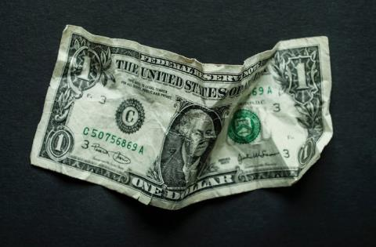
Foreign Currencies – Dollar Weakness
*Profit taking hits US dollar *Euro bounces of major support on QE expansion *British pound bounces hard on the possible end of the 4 year Brexit saga *Chinese Yuan stabilizes on trade hopes *Bitcoin dead on the water, not recovering from recent crash *Aussie stabilizes on no escalation of trade war *Avoid the FX market for now, there are too many contrary indicators

Slide 55
Japanese Yen (FXY), (YCS)

Slide 56
Euro ($XEU), (FXE), (EUO)-

Slide 57
Australian Dollar (FXA)- The Global Recovery Play took profits on long 8/$67-$69 call spread

Slide 58
Emerging Market Currencies (CEW)

Slide 59
Chinese Yuan- (CYB)- New Lows

Slide 60
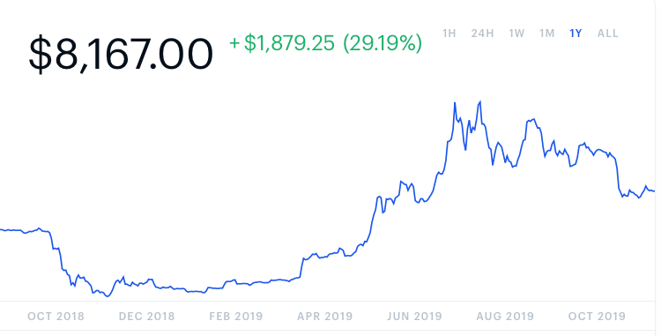
Bitcoin- Going Nowhere

Slide 61
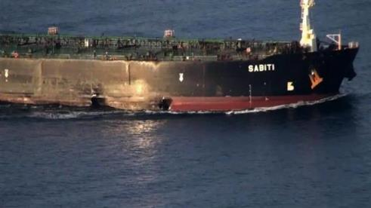
Energy – Another Attack
*An attack on an Iran tanker in the Red Sea delivers a brief 10% rally, which we caught on the long side *Over supply against fading demand will last for years *Natural gas suffers collapse on massive fracking over supply *Energy still the most unloved sector in the stock market *Avoid all energy plays like the plague, could drop by half in the coming recession *Bottom Line: looks like $42 a barrel is in the cards, more later

Slide 62
Oil-($WTIC)

Slide 63
United States Oil Fund (USO) long 10/$9.50-$10 Vertical bull call spread – expires in 2 days

Slide 64
Energy Select Sector SPDR (XLE)-No Performance! (XOM), (CVX), (SLB), (KMI), (EOG), (COP)

Slide 65
Halliburton (HAL)-

Slide 66
Natural Gas (UNG)- Collapse

Slide 67
Precious Metals – Downtrend
*Head and shoulders top turns into downtrend, next support in (GLD) is $136 *”RISK ON” means ”SELL GOLD” *People’s Bank of China gold holdings are exploding to the upside, from 1,0000 metric tonnes in 2015 to above 1,850 tonnes today, potential trade deal means throttling back of Chinese buying *We still thing gold has a future, I’m just waiting for a bigger capitulation selloff *Bottom Line: buy a bigger dip in gold and precious metals

Slide 68
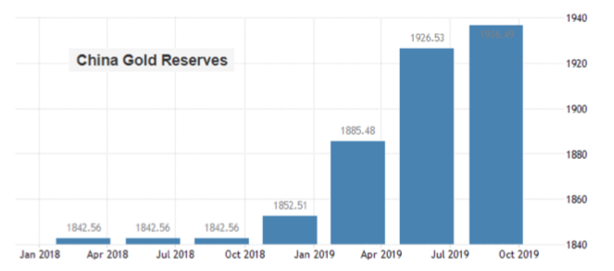

Slide 69
Gold (GLD)-
support

Slide 70
Market Vectors Gold Miners ETF- (GDX) – Yikes!

Slide 71
Barrick Gold (GOLD)

Slide 72
Newmont Mining- (NEM)-

Slide 73
Silver- (SLV)-

Slide 74
Silver Miners - (SIL)-

Slide 75
Wheaton Precious Metals - (WPM)-

Slide 76
Copper (COPX)-Collapse Trade War Disaster

Slide 77
Freeport McMoRan (FCX)-World’s Largest Copper Producer took profits on long 4/$10-$11 call spread took profits on short 4/$114 calls

Slide 78
Real Estate – Recovering
*Ultra low interest rates causing housing inventories to quickly disappear, down 2.5% in September and 1.8% in August *NAHB Homebuilder Sentiment jumps from 68 to 71, near a two year high *Entry level homes under $200,000 see inventory down an amazing 10% YOY *Homes priced between $200,000 and $750,000, 60% of the market, suddenly saw supplies level off after 18 months of increases and will fall in coming months *New mortgage applications up a massive 5% on the week, banks scrambling to hire new staff
*May S&P 500 Case-Shiller pops to a 3.2%, annual gain, the first improvement in 18 months *Bottom Line: Stand aside for a trade but buy for long term investment

Slide 79
February Corelogic S&P Case Shiller Home Price Index Phoenix (5.8%), Las Vegas (5.5%), and Tampa (4.7%) showing biggest gains
Tradingeconomics.com

Slide 80
Simon Property Group (SPG)-

Slide 81
US Home Construction Index (ITB) (DHI), (LEN), (PHM), (TOL), (NVR)

Slide 82
Trade Sheet- So What Do We Do About All This?
*Stocks-stand aside *Bonds-stand aside *Commodities-stand aside *Currencies- stand aside *Precious Metals – buy bigger dip *Energy – sell rallies *Volatility-buy dips *Real estate-stand aside

Slide 83
Next Strategy Webinar 12:00 EST Wednesday, October 30, from Silicon Valley, CA email me at support@madhedgefundtrader.com
Good Luck and Good Trading!
Notes:
*

