Slide 1
The Mad Hedge Fund Trader “Waiting for the Fed”
With John Thomas from Silicon Valley, CA, October 30, 2019 www.madhedgefundtrader.com
Notes:
*

Slide 2
Fire Update
*Nearest mandatory evacuation in 5 miles away, nearest blackout is 100 yards away *Yesterday I watched big planes drop red fire retardant from my office, they showed up in only 15 minutes *Power was supposed to go out at 5:00 AM but then wind died down *100 homes burned compared to 10,000 two years ago, Calfire is doing a great job *Drove between two close fires on the way home from Tahoe last Sunday *I am on the volunteer list of Calfire reserve pilots

Slide 4
Trade Alert Performance New Highs! Best Quarter in Ten Years
*January 9.49% Final *July +3.07% MTD *February +4.64% Final *August +16.01% Final *March +1.78% Final *September 3.08% Final *April +0.30% Final *October +12.21% MTD *May +0.25% Final *November -1.83% Final *June -0.50% Final *December -4.13% Final *2019 Year to Date +49.63% compared to +15.6% for the Dow Average *+349.77% since inception, *Average annualized return of 34.53% for 10 years

Slide 5
Portfolio Review Keeping Small Positions-90% cash, 10% (BA) Only Buying Very Deep in-the-Money on Capitulation Days
Current Capital at Risk
Risk On
World is Getting Better
(BA) 11/$300-$310 call spread | 10.00%
Risk Off
none
Total Net Position | 10.00%
Expiration P&L 49.79% YTD

Slide 6
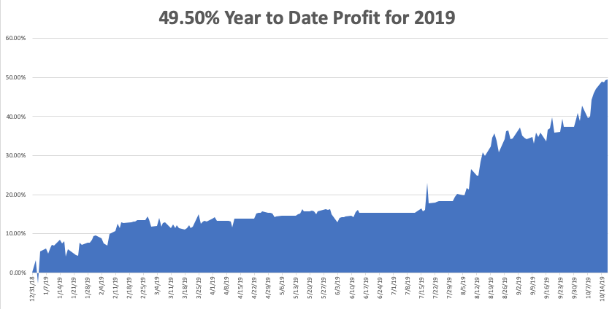

Slide 7
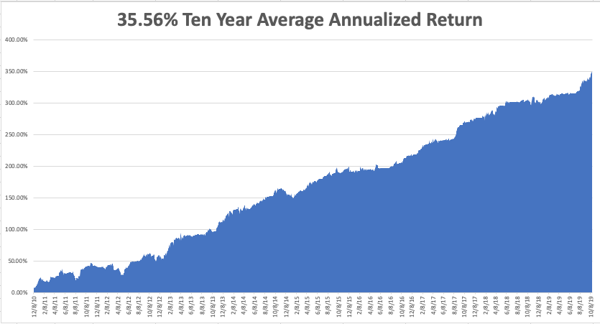
GTD 10 Year Daily Audited Performance

Slide 8
The Method to My Madness
*It’s Hard to fight the Fed, with a likely rate cut coming at 2:00 PM EST today, but will it be “one and done” or a continuation of a trends. The press conference afterwards will be more important than the actual rate cut itself *New all-time highs going into Fed decision could trigger the “Curse of the Fed” for the third time this year *No deal with China, but no escalation is better than nothing, letting stocks drift up *New Ukraine and tax scandals having no market impact *We’re not buying the shift into value (junk) stocks with terrible fundamentals, like banks, industrials, and retailers because it is just a temporary short term trend *Eventually, a failure of a real deal to arrive will take stocks down to new lows

Slide 9
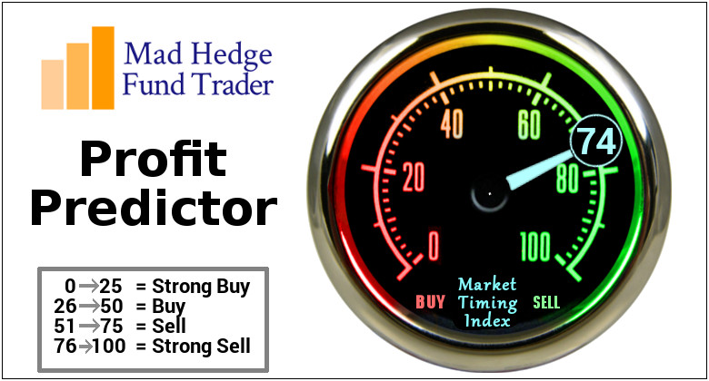
The Mad Hedge Profit Predictor Market Timing Index-Top of Range-Close to a “SELL” An artificial intelligence driven algorithm that analyzes 30 different economic, technical, and momentum driven indicators

Slide 10
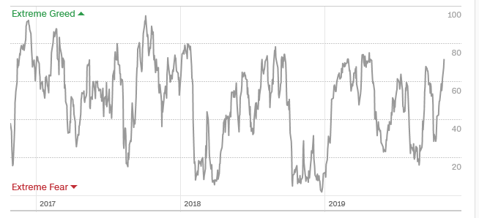
The Mad Hedge Profit Predictor Dead in the Middle-Nothing to do
SELL
BUY

Slide 11
The Global Economy – Punched in the Nose
* US Capital Investment has ground to a halt, with business fixed investment down 1% YOY, US Consumer Confidence Dives, down three months in a row, off from 126.3 to 125.1, the US Economy is currently growing at a low 1.6% but at least it’s growing, unlike Europe, US corporate earnings largely flat YOY setting up a growth recession *The Trade War is back in business, with the Chinese demanding a total end to tariffs before any big ag buys *Protracted weakness seen by the ECB, German Consumer Confidence hits a three year low *Brexit Fails Again, taking the quagmire into its fourth year * Trade War Pain Goes Global, with Europe taking the biggest hit. Some 40% of Germany’s GDP comes from exports.

Slide 12
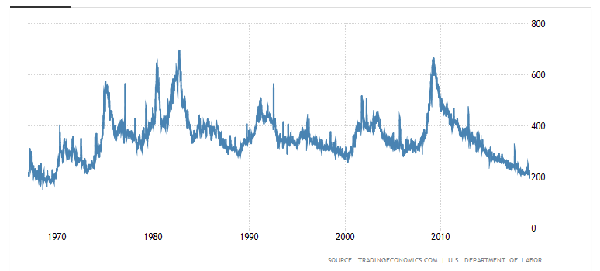
Weekly Jobless Claims-Bottomed Out +10,000 to 210,000

Slide 13
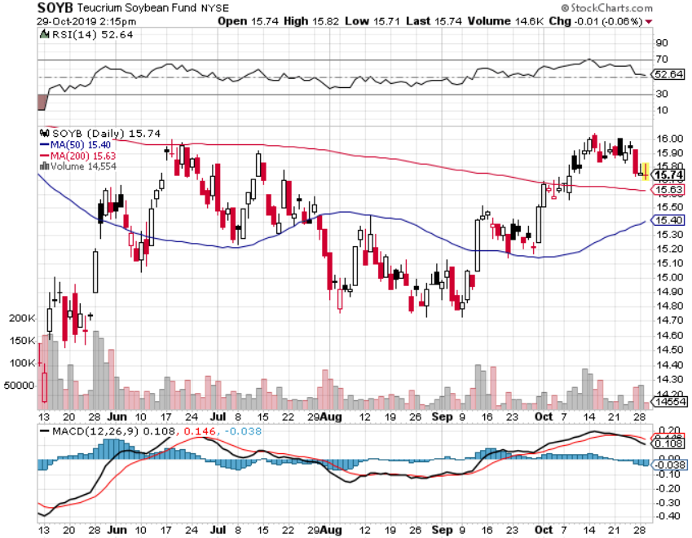
Soybeans - Trade War Indicator “Head and shoulders” top means faith in a trade deal is gone for now

Slide 14
The Bill Davis View A $1,500 Upgrade for the Mad Day Trader Service
Buys: | Entry | Target
Shake Shack, Inc. (SHAK) | $ 80.00 | $ 95.00
CBS Corp (CBS) | $ 37.00 | $ 48.00
Splunk Inc. (SPLK) | $ 117.00 | $ 125.00
Kraton Corp (KRA) | $ 24.50 | $ 32.00
Concho Resources (CXO) | $ 67.50 | $ 81.00
Sells:
Stamps,com Inc. (STMP) | $ 90.00 | $ 55.00
National Beverage Corp (FIZZ) | $ 47.00 | $ 38.00
Crocs, Inc. (CROX) | $ 34.00 | $ 25.00
Federal Express Corp (FDX) | $ 165.00 | $ 150.00
Chipotle Mexican Grill Inc. | $ 815.00 | $ 760.00

Slide 15
Stocks – Marginal New Highs
*Best quality stocks are breaking out to the upside, like Apple (AAPL) *Mediocre stocks like small caps (IWM) are at the top of ranges *Weak stocks like (GRUB) are crashing *It all adds up to marginal new highs in the major index with little confidence or excitement, a classic topping indicator *Trading volume is falling in up markets, rising in down markets, always a negative indicator *Bottom line: Marginal new high, then 7% down market for the next 3 months, then new highs propelled by ultra low interest rates or an eventual China trade deal *Bottom Line: its bet the ranch time on tech longs, but stay away from those with big China exposure, like Apple, and weak dollar plays like energy, and emerging markets

Slide 16
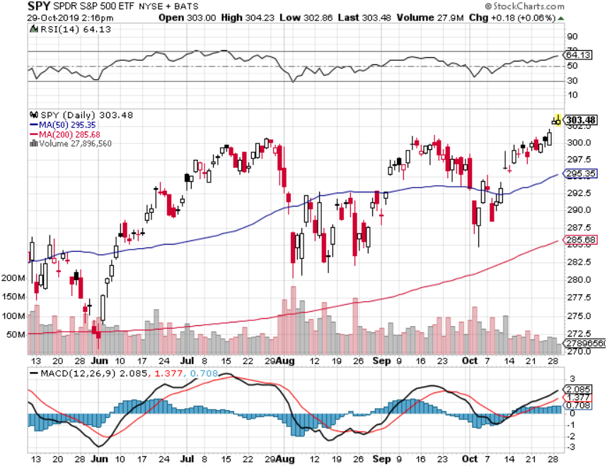
S&P 500 – Breakout took profits on long 10/$305-$310 bear put spread took profits on long 10/$270-$275 bull call spread took profits on long 10/$300-$305 bear put spread took profits on long 8/$305-$308 bear put spread

Slide 17
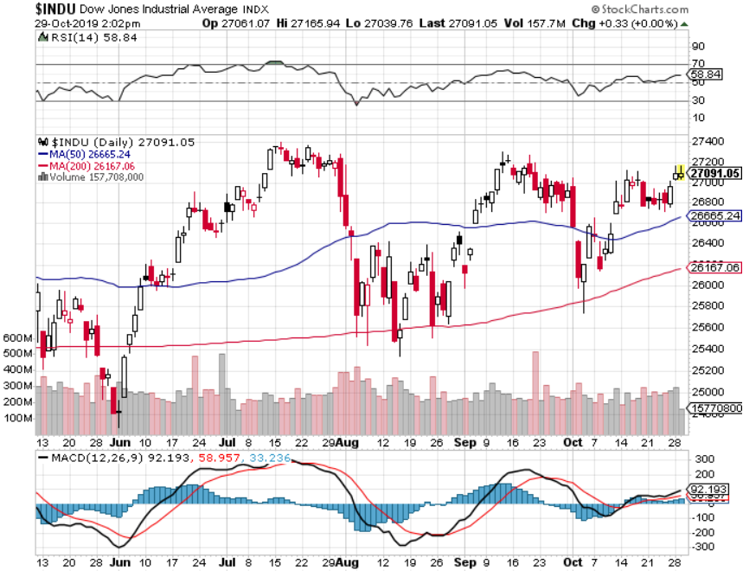
Dow Average ($INDU)- Trending Up

Slide 18
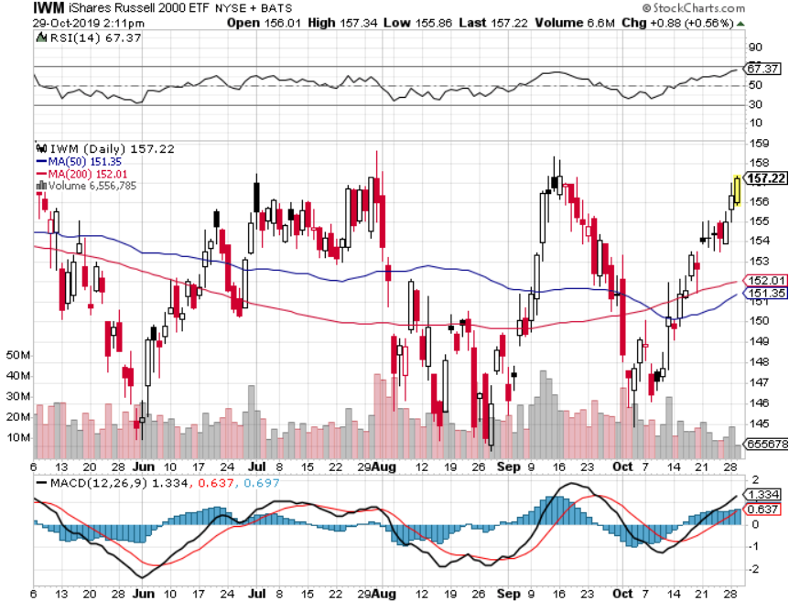
Russell 2000 (IWM)- Top of the Range took profits on Long 10/$137-$142 vertical bull call spread took profits on Long 10/$153-$156 vertical bear put spread stopped out of Long 9/$153-$156 vertical bear put spread took profits on Long 9/$157-$160 vertical bear put spread

Slide 19
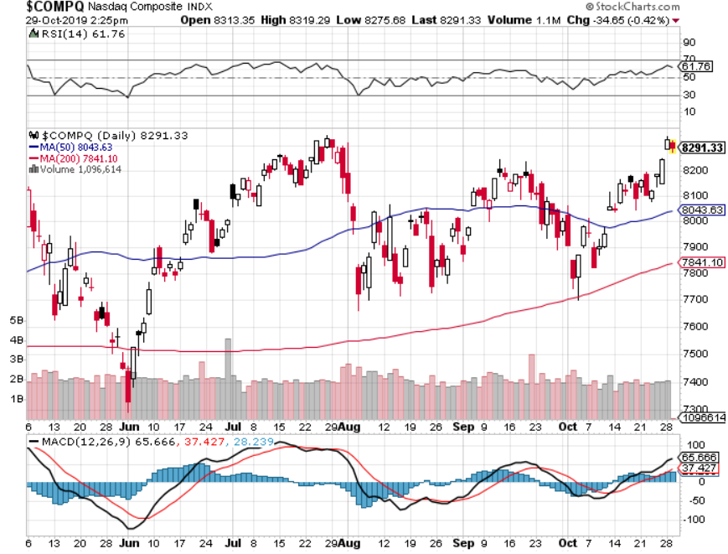
NASDAQ ($COMPQ) – Profit Taking

Slide 20
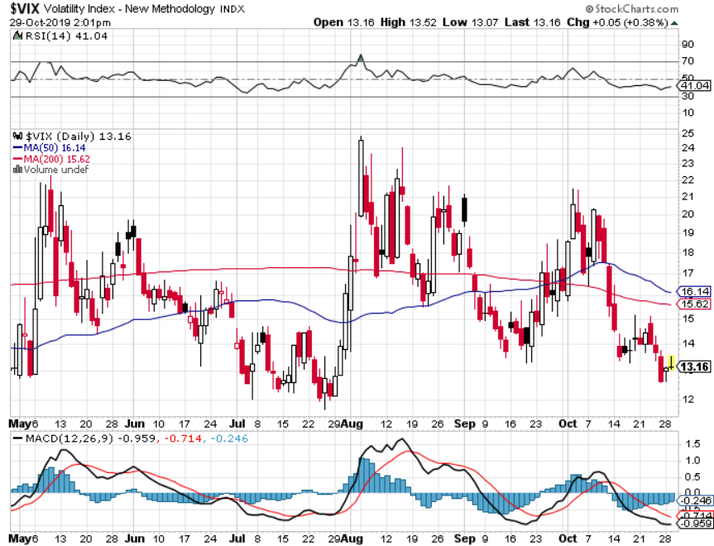
(VIX)-Back in the Dumps

Slide 21
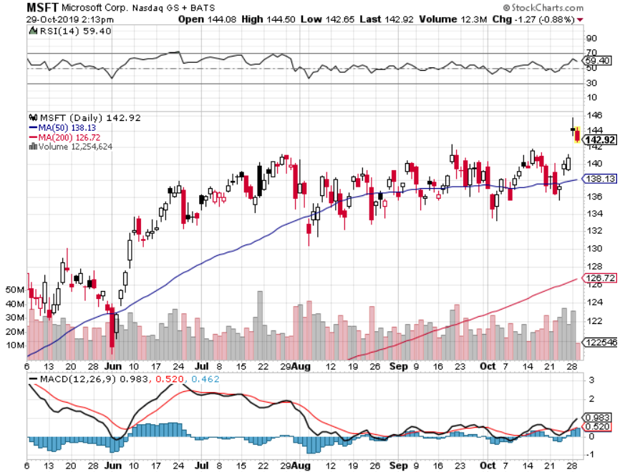
Microsoft (MSFT)- Earnings beat- Looking for Another Entry Point took profits on long 9/$115-$120 call spread took profits on long 6/$110-$115 call spread took profits on long 4/$108-$113 call spread took profits on long 2/$85-$90 call spread

Slide 22
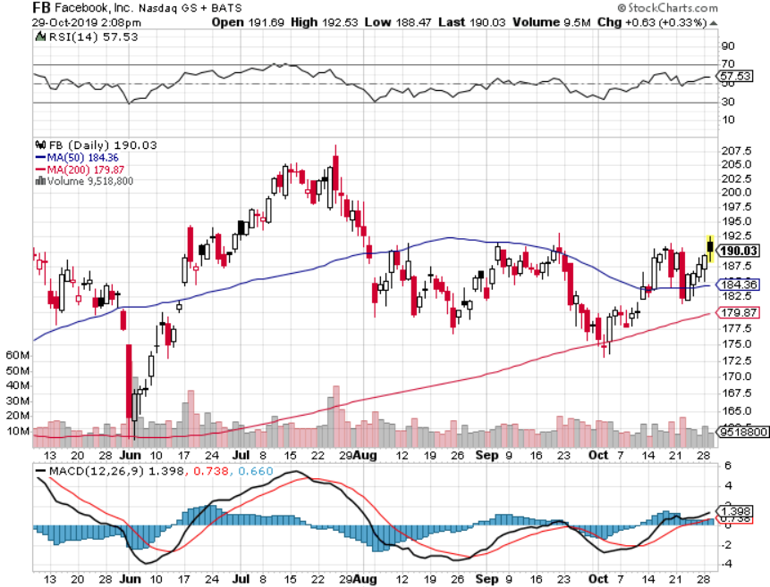
Facebook (FB)- Breaking Out took profits on Long 9/$150-$160 vertical bull call spread took profits on Long 8/$167.50-$172.50 vertical bull call spread

Slide 23
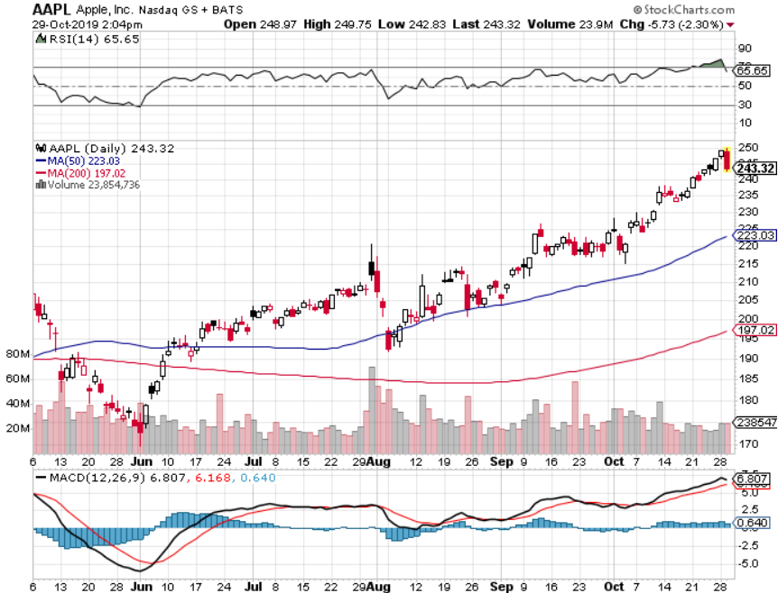
Apple (AAPL)-New All Time High as Services Soar

Slide 24
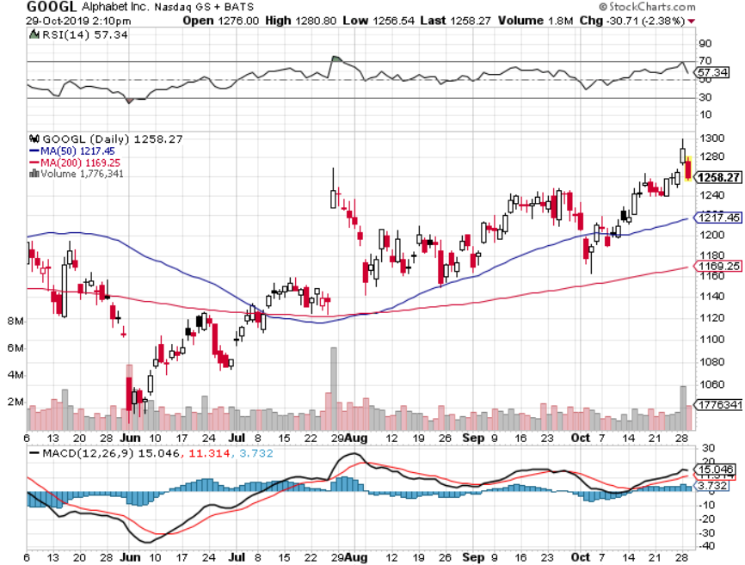
Alphabet (GOOGL) – Earnings Disappointment took profits on long 9/$1,030-$1,080 vertical bull call spread stopped out of long 5/$1,100-$1,130 bull call spread took profits on long 4/$1,080-$1,120 bull call spread

Slide 25
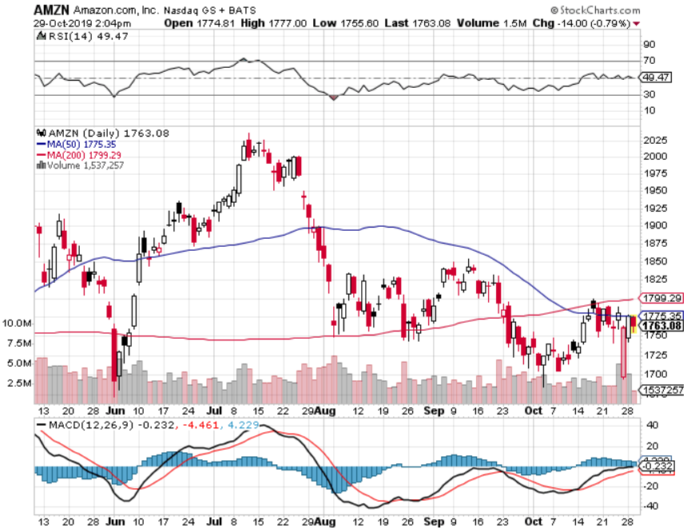
Amazon (AMZN) – Terrible Guidance took profits on 9/$1,500-$1,500 vertical bull call spread stopped out of long 4/$1,650-$1,700 call spread took profits on long 4/$1,600-$1,650 call spread took profits on long 2/$1,200-$1,300 call spread

Slide 26
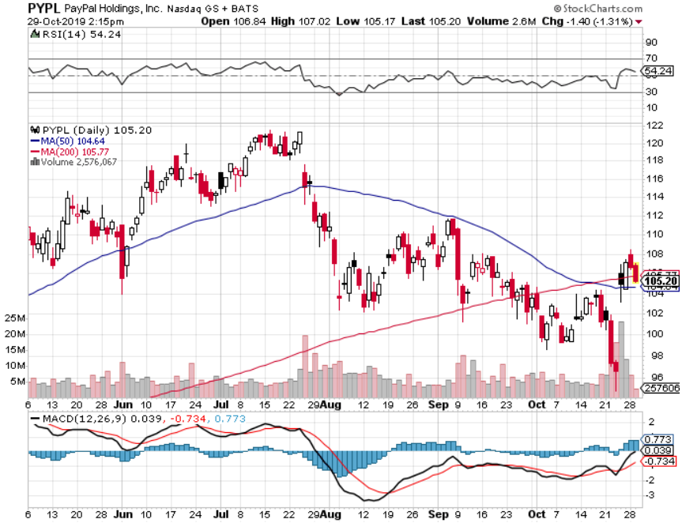
PayPal (PYPL)-CEO resigns took profits on long 4/$90-$95 call spread

Slide 27
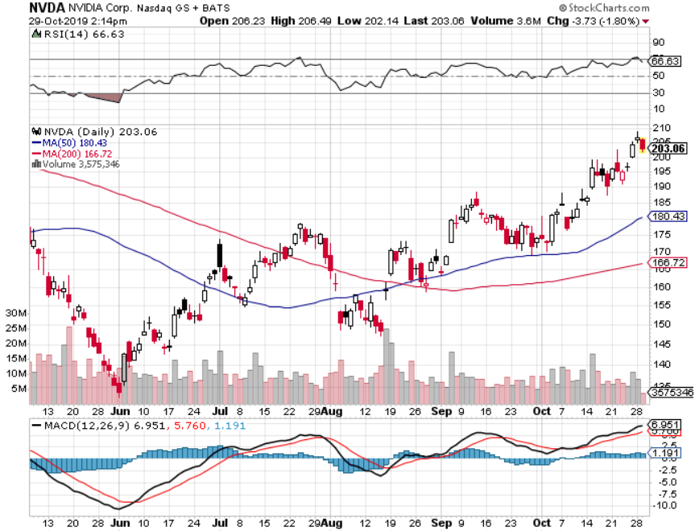
NVIDIA (NVDA) – Off to the Races

Slide 28
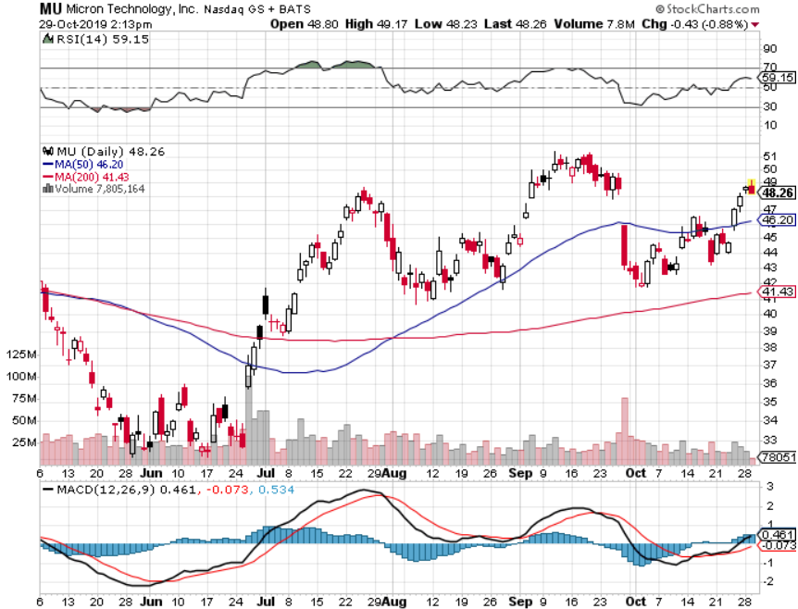
Micron Technology (MU)-

Slide 29
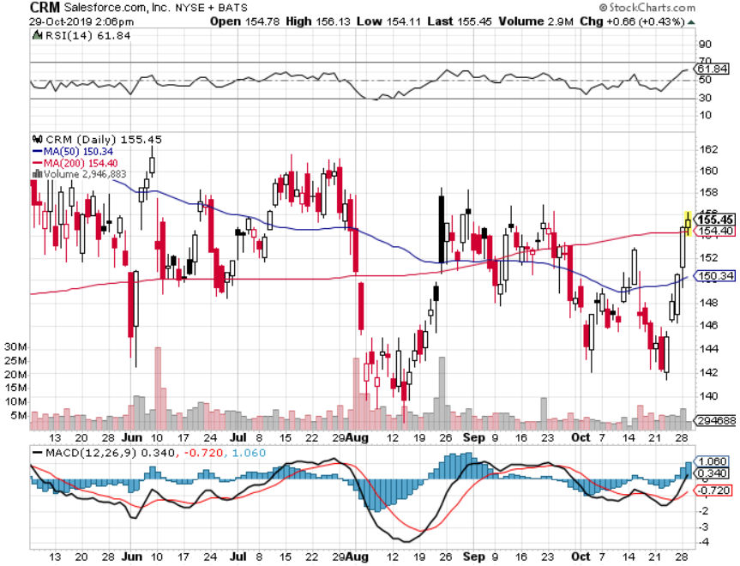
Salesforce (CRM)- took profits on long 9/$125-$130 vertical bull call spread took profits on long 8/$125-$130 vertical bull call spread took profits on long 2/$105-$115 call spread

Slide 30
Boeing (BA) – The Bad News is Out long 4/$315-$335 call spread – expires in 12 trading days took profits on long 4/$315-$335 call spread

Slide 31
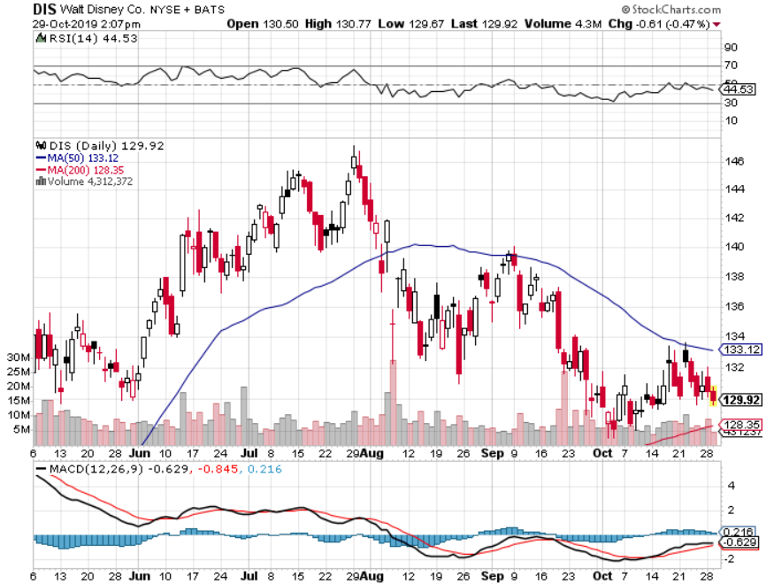
Walt Disney (DIS)- The Streaming Wars are On took profits on long 9/$115-$120 call spread 8/$125-$130 call spread expired at max profit Stopped out of 4/$125-$130 call spread for small loss took profits on long 4/$100-$104 call spread

Slide 32
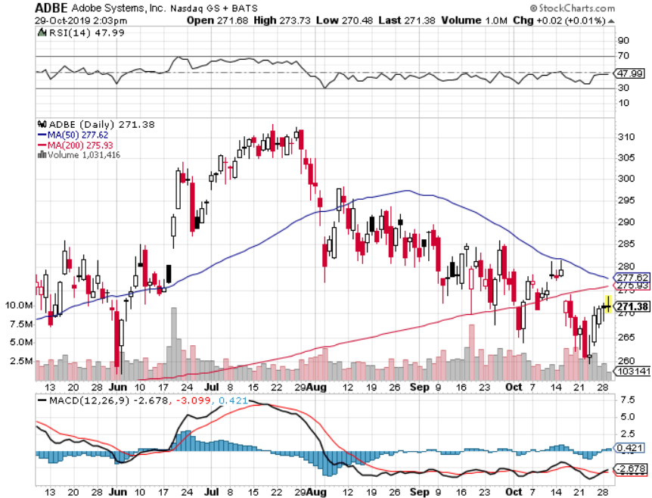
Adobe (ADBE)- The Quality Non-China tech play

Slide 33
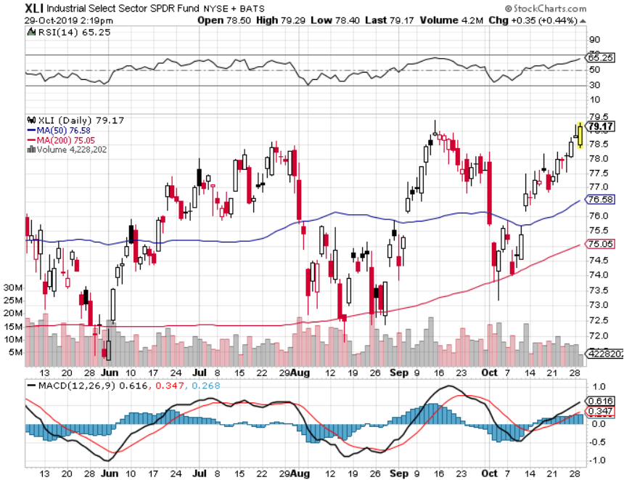
Industrials Sector SPDR (XLI)- (GE), (MMM), (UNP), (UTX), (BA), (HON)

Slide 34
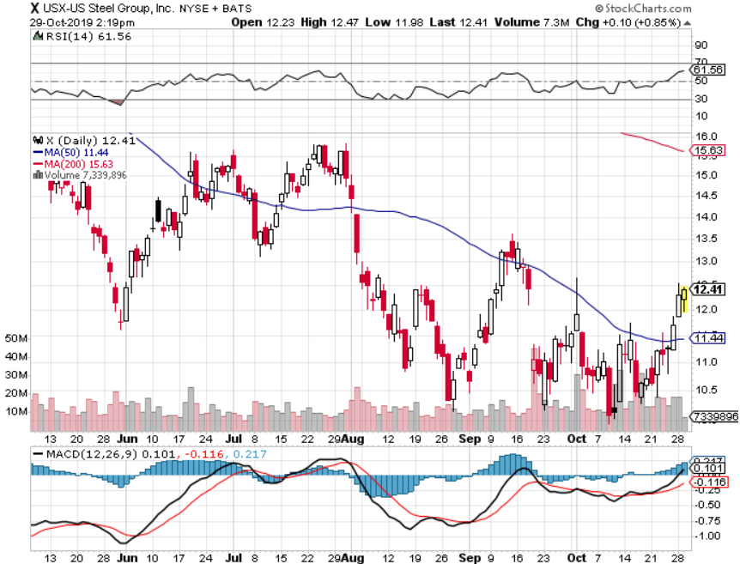
US Steel (X)-Tariffs Trouble Import duties cause users to abandon steel Down by 50% since the election

Slide 35
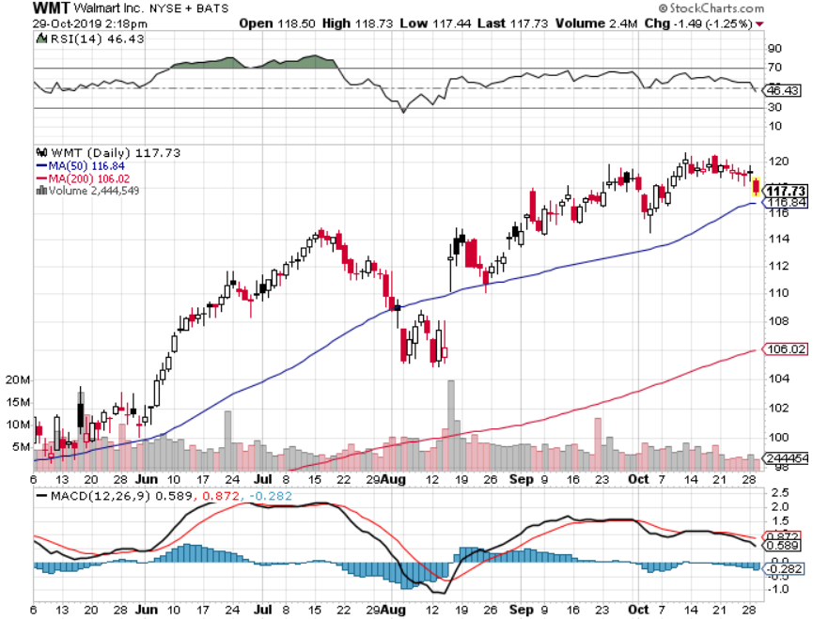
Wal-Mart (WMT)-Tariffs Trouble Long 11/$125-$130 bear put spread Long 10/$119-$121 bear put spread took profits on Long 8/$114-$117 bear put spread

Slide 36
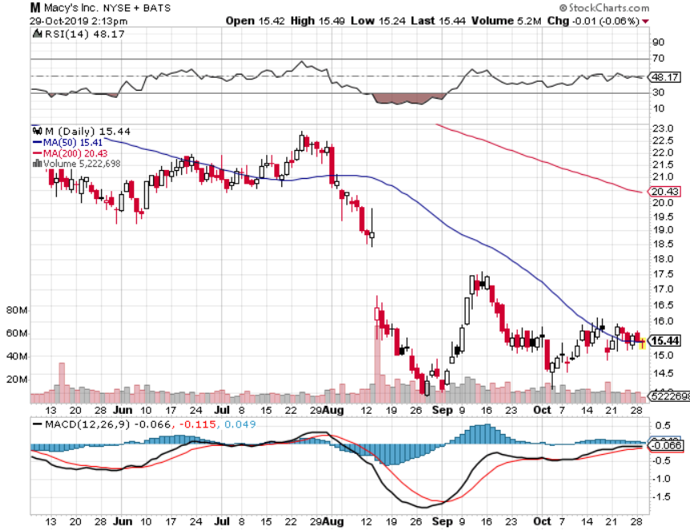
Macys’ (M)-Tariffs Trouble took profits on Long 8/$23-$25 bear put spread

Slide 37
Tesla (TSLA)- 900,000 on the road by yearend took profits on long 6/$140-$150 call spread – expires in 7 trading days took profits on long 6/$240-$250 put spread – expires in 7 trading days
Major Support

Slide 38
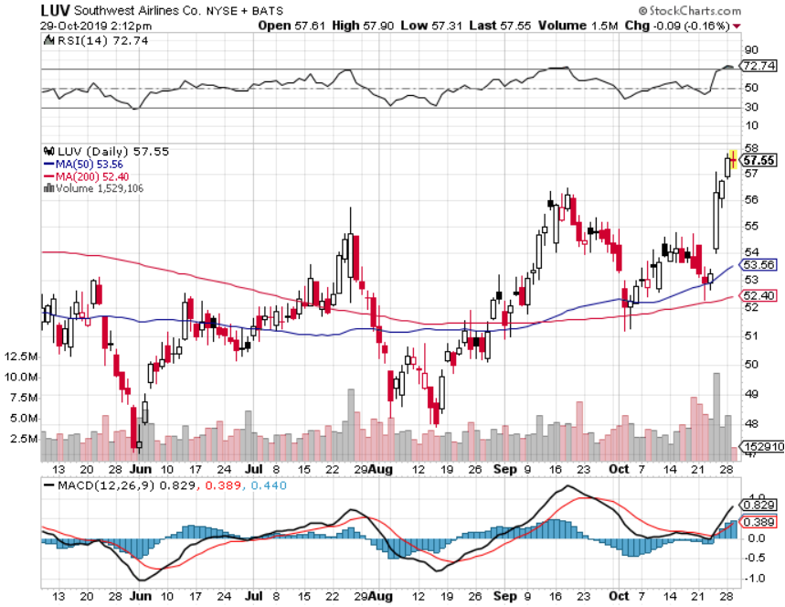
Southwest Airlines (LUV) - Boeing 737 Max biggest buyer

Slide 39
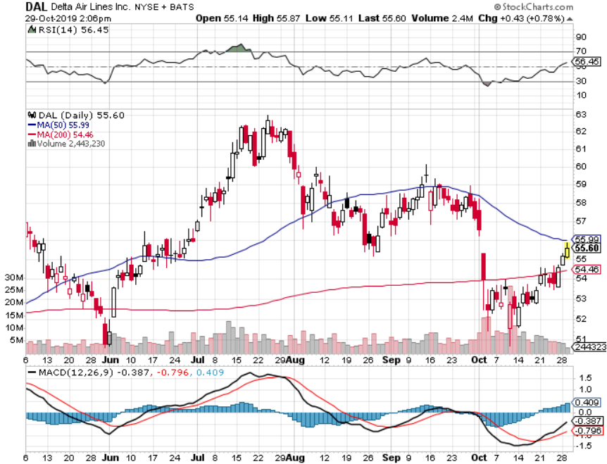
Delta Airlines (DAL) – Non 737 User

Slide 40
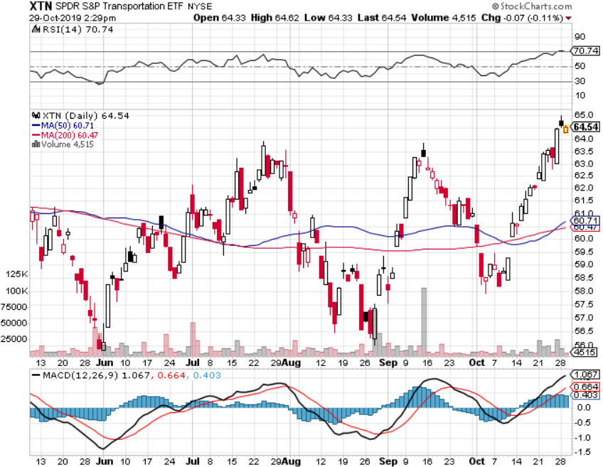
Transports Sector SPDR (XTN)- (ALGT), (ALK), (JBLU), (LUV), (CHRW), (DAL)

Slide 41
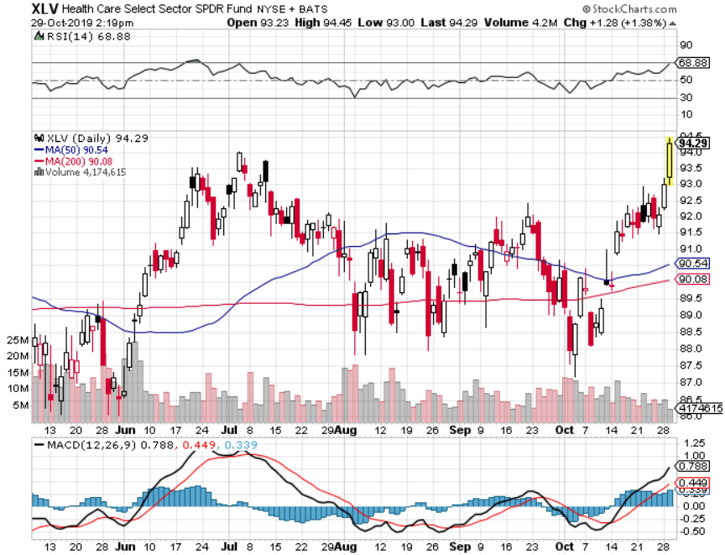
Health Care Sector (XLV), (RXL)-New Highs (JNJ), (PFE), (MRK), (GILD), (ACT), (AMGN)

Slide 42
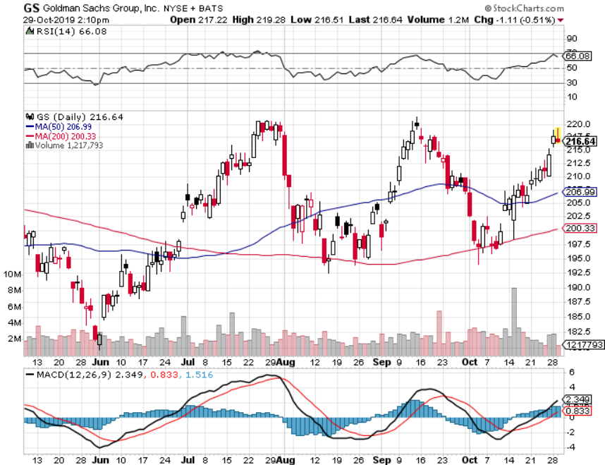
Goldman Sachs (GS)-Top of Range

Slide 43
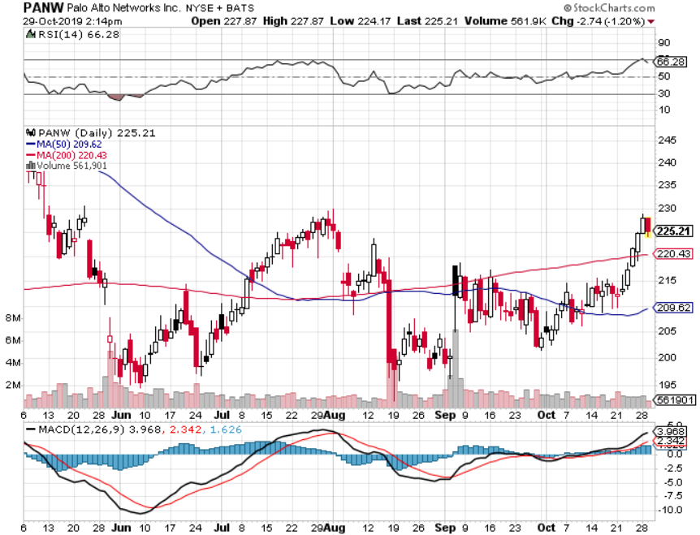
Palo Alto Networks (PANW)- Hacking never goes out of fashion

Slide 44
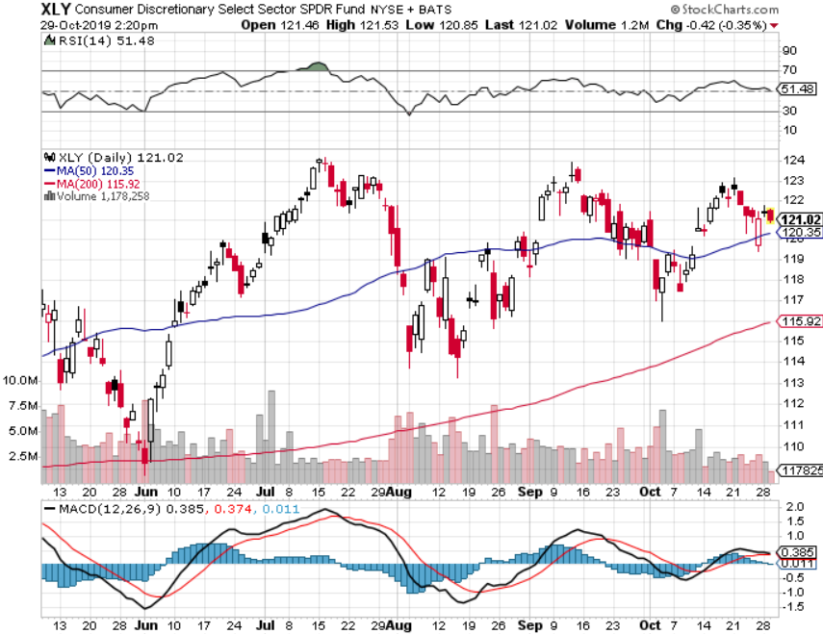
Consumer Discretionary SPDR (XLY) (DIS), (AMZN), (HD), (CMCSA), (MCD), (SBUX)

Slide 45
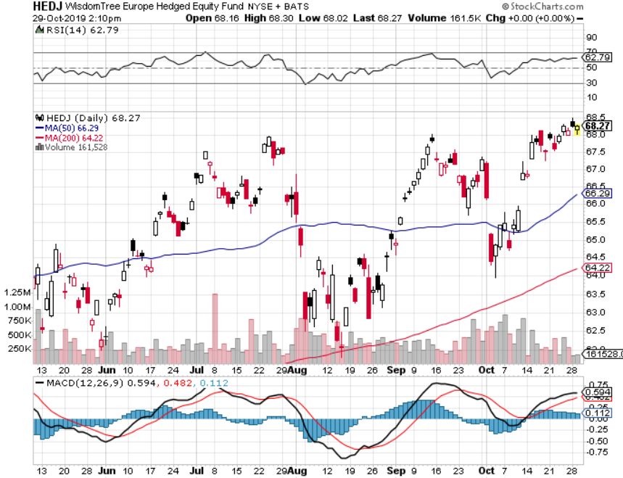
Europe Hedged Equity (HEDJ)- Pip on Brexit News

Slide 46
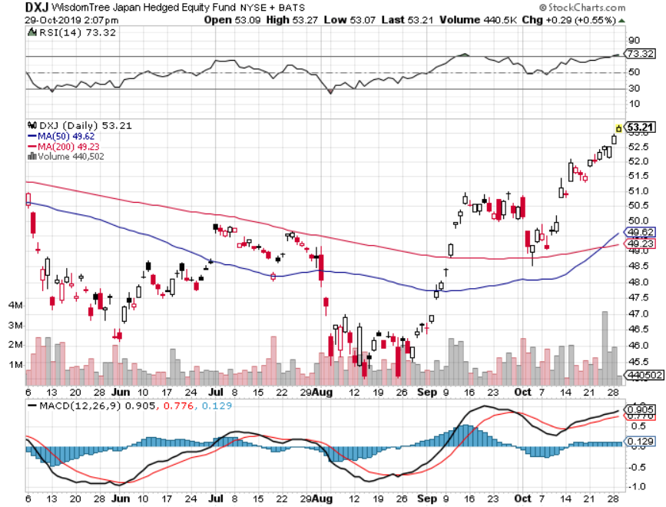
Japan (DXJ)-

Slide 47
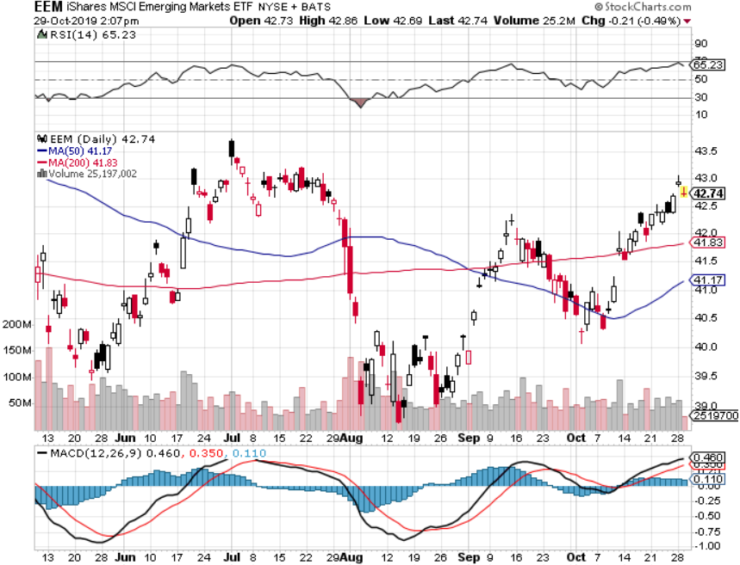
Emerging Markets (EEM)- Weak Dollar Play

Slide 48
Bonds – Snoring
*After record volatility, bonds have been churning in a broad 8 point range, digesting recent gains *Any further evidence of a weakening global economy will trigger a new run at record low interest rates, highs in bond prices *Sitting it out waiting for another entry point, long or short *Resumption of Global QE will boost supply of negative yielding bonds *Bottom line: Ten year US Treasury yields will fall below 1.0% in 2020 to come in line with the rest of the world, then go to zero in the next recession

Slide 49
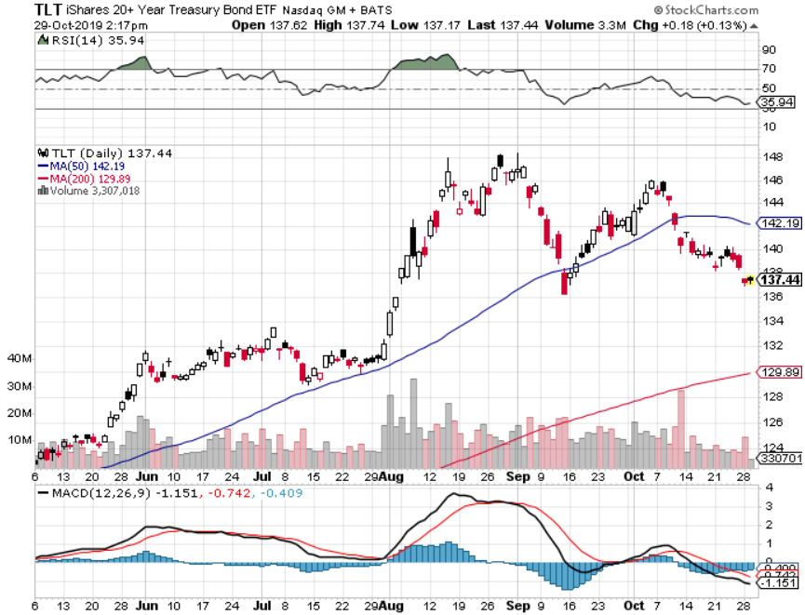
Treasury ETF (TLT) – Touching the Bottom took profits on long 10/$129-$132 call spread stopped out of long 8/$137-$140 put spread took profits on long 8/$125-$128 call spread

Slide 50
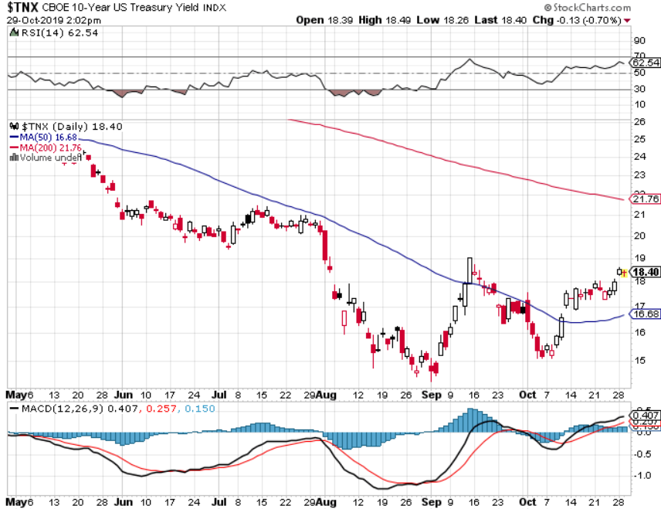
Ten Year Treasury Yield ($TNX) – 1.84%

Slide 51
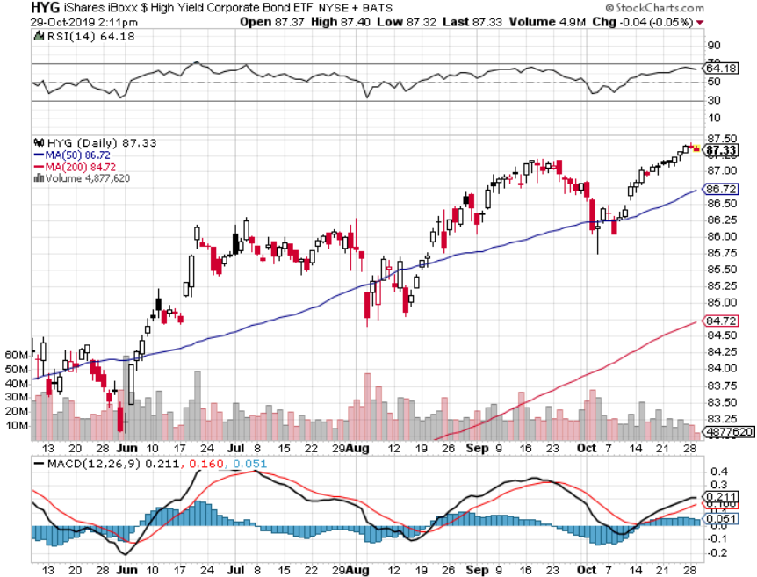
Junk Bonds (HYG) 4.82% Yield big jump in yields on stock selloff and recession fears

Slide 52
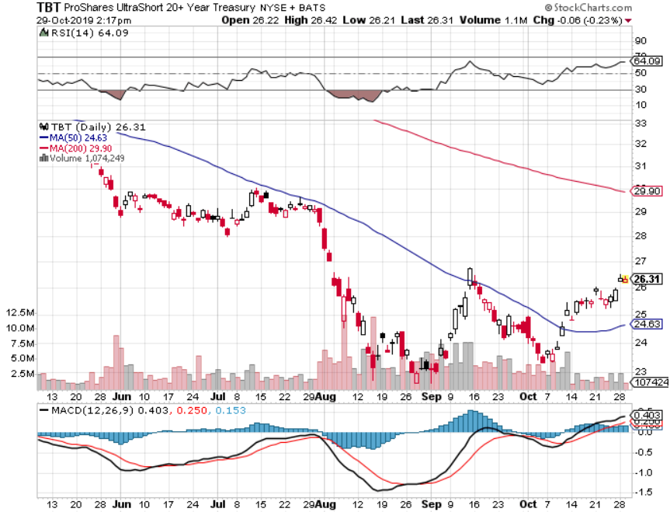
2X Short Treasuries (TBT)- 2 Month Bottoming Process

Slide 53
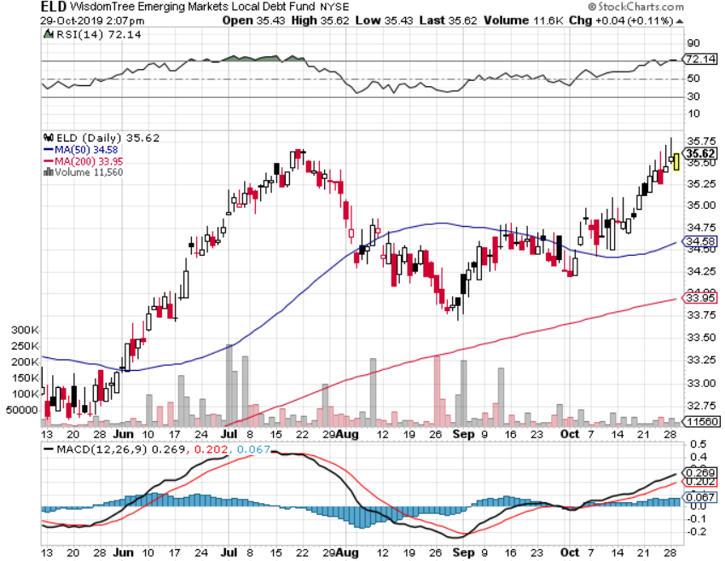
Emerging Market Debt (ELD) 4.78% Yield-

Slide 54
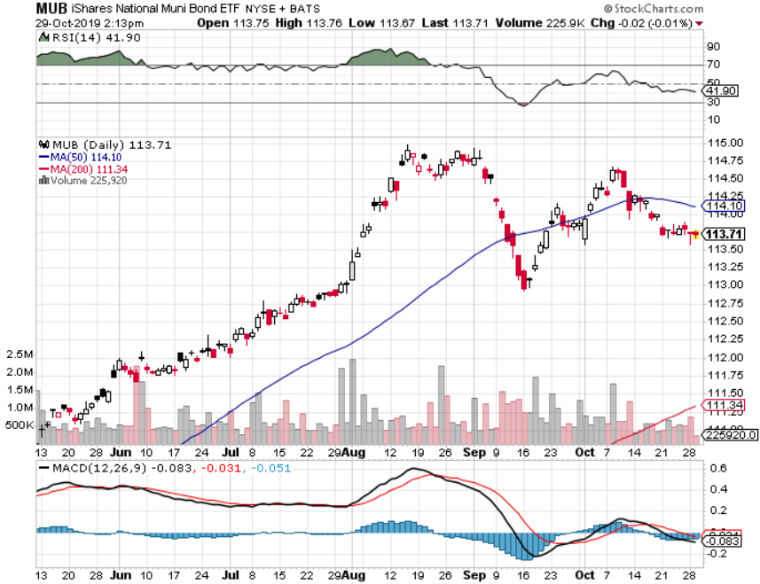
Municipal Bonds (MUB)-1.62% Mix of AAA, AA, and A rated bonds

Slide 55
Foreign Currencies – Dollar Weakness
*Profit taking hits US dollar *Euro bounces of major support on QE expansion *British pound soars on possible Brexit end *Chinese Yuan catches a bid on trade hopes *Bitcoin has 40% bounce in one week as congress puts the brakes on Facebook’s Libra *Aussie rallies hard on no escalation of trade war *Avoid the FX market for now, there are too many contrary indicators

Slide 56
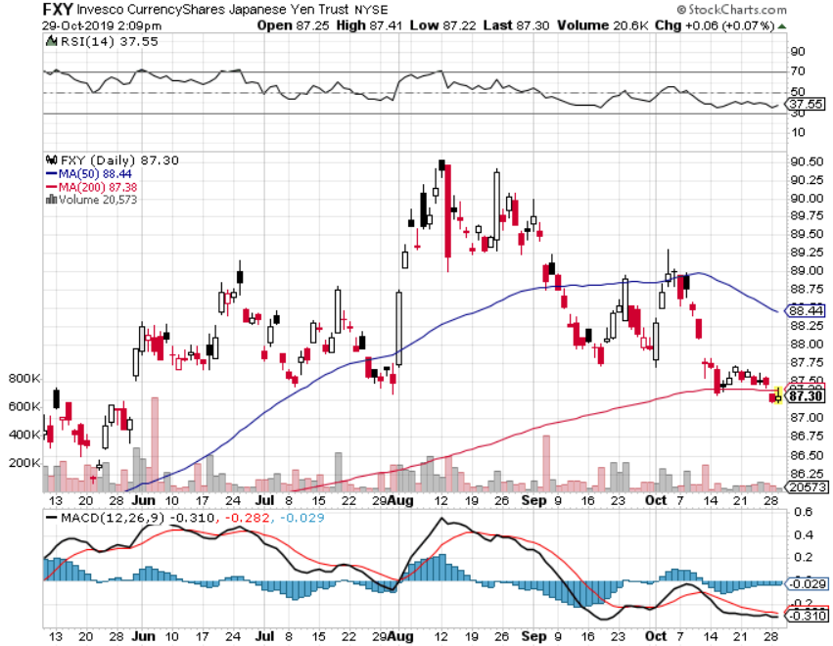
Japanese Yen (FXY), (YCS)

Slide 57
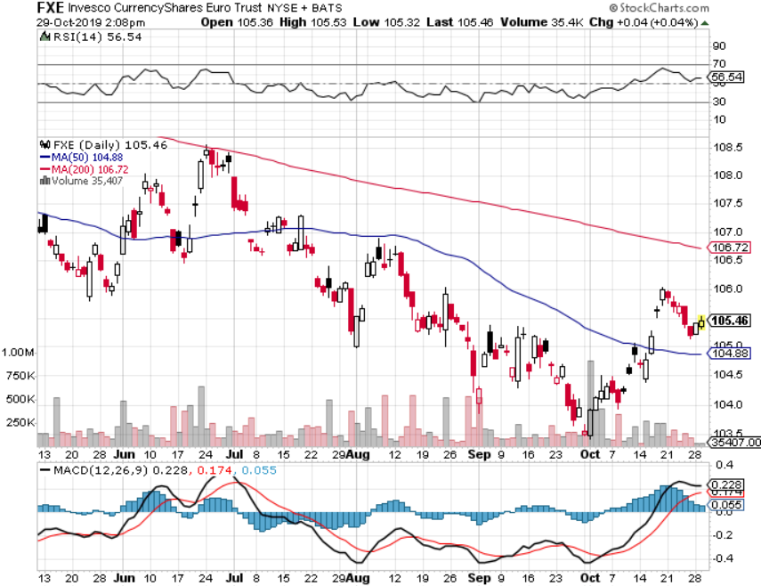
Euro ($XEU), (FXE), (EUO)-

Slide 58
British Pound (FXB)-

Slide 59
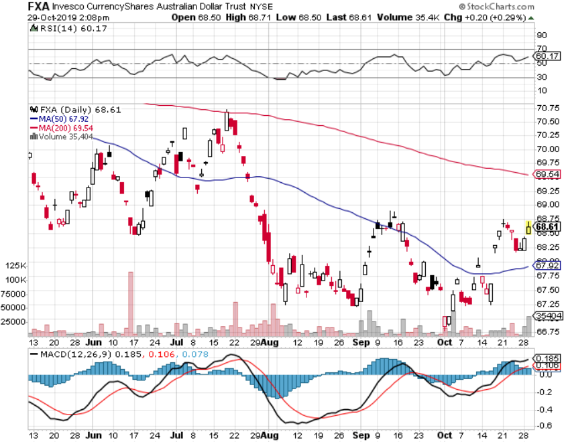
Australian Dollar (FXA)- The Global Recovery Play took profits on long 8/$67-$69 call spread

Slide 60
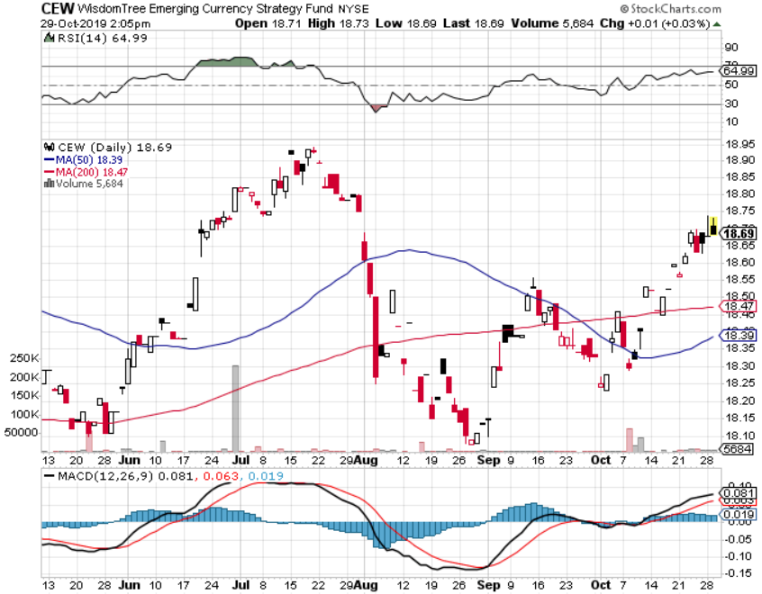
Emerging Market Currencies (CEW)

Slide 61
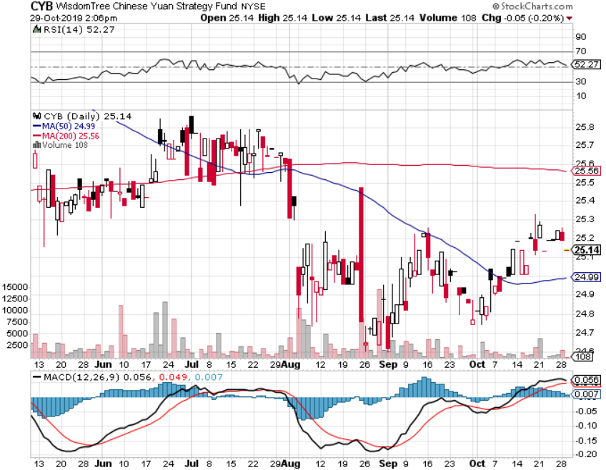
Chinese Yuan- (CYB)- New Lows

Slide 62
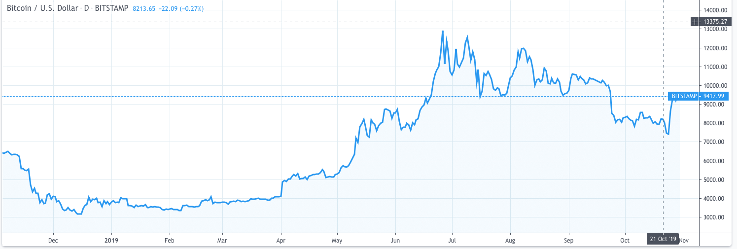
Bitcoin- 40% Rally

Slide 63
Energy – Dead Cat Bounce
*Global “RISK ON” into Fed meeting takes oil up with it *Over supply against fading demand will last for years *Natural gas gets a hard bounce *Energy still the most unloved sector in the stock market *Avoid all energy plays like the plague, could drop by half in the coming recession *Bottom Line: looks like $42 a barrel is in the cards, more later

Slide 64
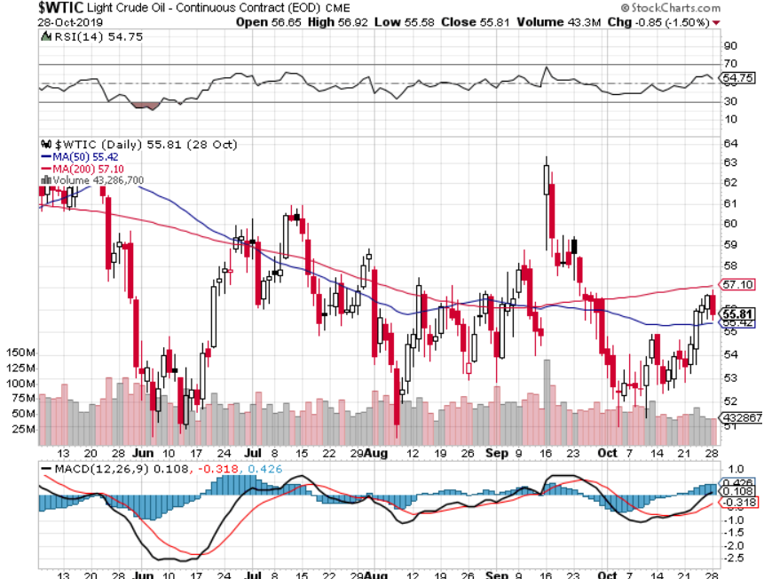
Oil-($WTIC)

Slide 65
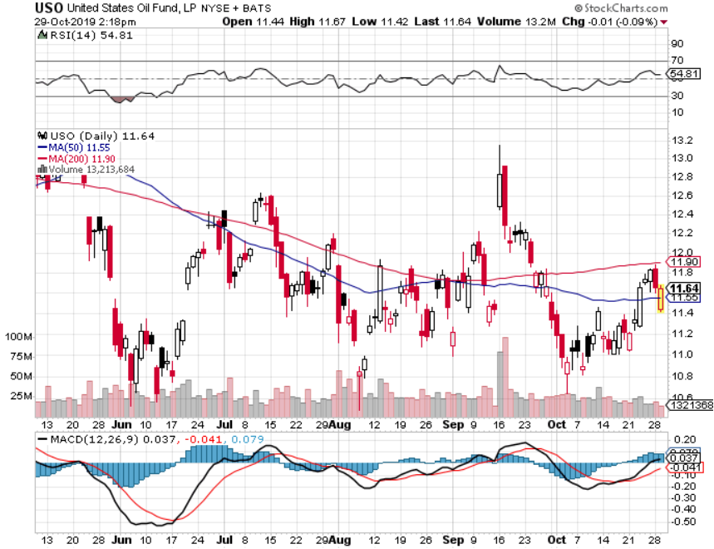
United States Oil Fund (USO) long 10/$9.50-$10 Vertical bull call spread – expires in 2 days

Slide 66
Energy Select Sector SPDR (XLE)-No Performance! (XOM), (CVX), (SLB), (KMI), (EOG), (COP)

Slide 67
Halliburton (HAL)-

Slide 68
Natural Gas (UNG) -

Slide 69
Precious Metals – Stabilizing
*Gold could be setting up a “teacup handle” with price stabilization *Indian Diwali festival takes the world’s second largest buyer out of the market The longer this continues the greater the chance of an upside breakout *”RISK ON” means ”SELL GOLD” *We still thing gold has a future, I’m just waiting for a bigger capitulation selloff *Bottom Line: buy a bigger dip in gold and precious metals

Slide 70
Gold (GLD)-
support

Slide 71
Market Vectors Gold Miners ETF- (GDX) – Yikes!

Slide 72
Barrick Gold (GOLD)

Slide 73
Newmont Mining- (NEM)-

Slide 74
Silver- (SLV)-

Slide 75
Silver Miners - (SIL)-

Slide 76
Wheaton Precious Metals - (WPM)-

Slide 77
Copper (COPX)-Collapse Trade War Disaster

Slide 78
Freeport McMoRan (FCX)-World’s Largest Copper Producer took profits on long 4/$10-$11 call spread took profits on short 4/$114 calls

Slide 79
Real Estate – Recovering
* Existing Home Sales Drop, down 2.2% in September to 5.38 million units *Pending Homes Sales jump 1.5% in September, 3.9% YOY, on a singed contract basis *30 year fixed rate loans back up to 3.80% *Shortage of supply hurting the market now that Millennials are pouring in *Backyard construction is booming
*May S&P 500 Case-Shiller pops to a 3.2% annual gain in August, the second improvement in 18 months *Bottom Line: Stand aside for a trade but buy for long term investment

Slide 80
February Corelogic S&P Case Shiller Home Price Index Phoenix (6.3%), Charlotte, NC (4.5%), and Tampa (4.3%) showing biggest gains
Tradingeconomics.com

Slide 81
Simon Property Group (SPG)-

Slide 82
US Home Construction Index (ITB) (DHI), (LEN), (PHM), (TOL), (NVR)

Slide 83
Trade Sheet- So What Do We Do About All This?
*Stocks-stand aside *Bonds-stand aside *Commodities-stand aside *Currencies- stand aside *Precious Metals – buy bigger dip *Energy – sell rallies *Volatility-buy dips *Real estate-stand aside

Slide 84
Next Strategy Webinar 12:00 EST Wednesday, October 30, from Silicon Valley, CA email me at support@madhedgefundtrader.com
Good Luck and Good Trading!
Notes:
*

