Slide 1
The Mad Hedge Fund Trader “The Capitulation Top is Here”
With John Thomas from Silicon Valley, CA, November 13, 2019 www.madhedgefundtrader.com
Notes:
*

Slide 2
Trade Alert Performance New Highs Again!
*January 9.49% Final *July +3.07% MTD *February +4.64% Final *August +16.01% Final *March +1.78% Final *September 3.08% Final *April +0.30% Final *October +12.13% Final *May +0.25% Final *November -1.56% MTD *June -0.50% Final *December -4.13% Final *2019 Year to Date +48.00% compared to +18.3% for the Dow Average *+348.3% since inception, *Average annualized return of 35.10% for 10 years

Slide 3
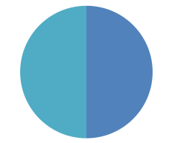
Portfolio Review Keeping Small Positions-90% cash, 10% (BA) Only Buying Very Deep in-the-Money on Capitulation Days
Current Capital at Risk
Risk On
World is Getting Better
(BA) 11/$300-$310 call spread | 10.00%
Risk Off
(TLT) 12/$128-$131 put spread | -10.00%
Total Net Position | 0.00%
Expiration P&L 49.15% YTD

Slide 4
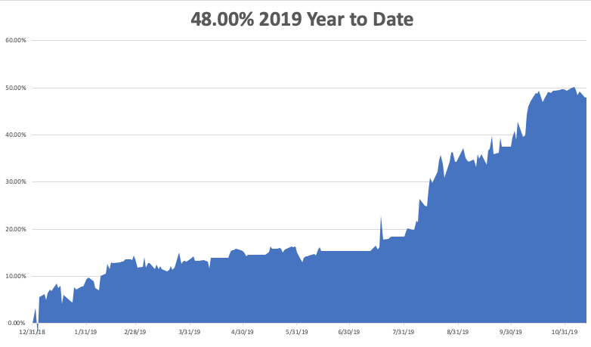

Slide 5
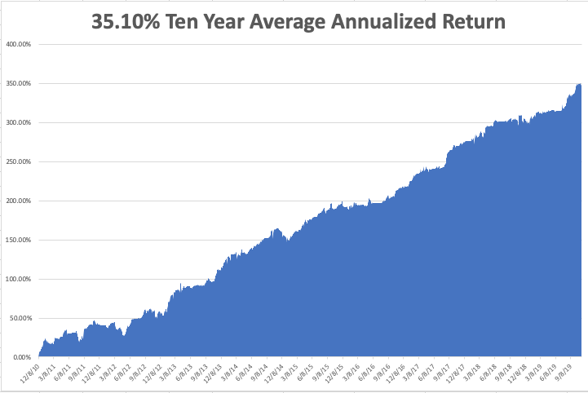
GTD 10 Year Daily Audited Performance

Slide 6
The Method to My Madness
*The Capitulation high is here, but how long will it last? * Markets Hit New Highs on Trade Optimism, but no substance. It’s really the three Fed rate cuts that is doing it and the eternal promise of a China trade deal with no details *The rally is global with markets powering on with another dose of QE * The Government Runs Out of Money on November 21 but will anyone care? *Bonds give back 12 points reversing the inverted yield curve *Dollar rallies on higher US rates, so does oil *”RISK OFF” hedges get crushed, like gold, silver, and REITS

Slide 7
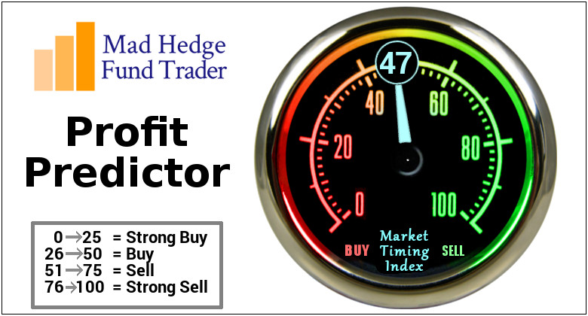
The Mad Hedge Profit Predictor Market Timing Index-Top of Range-Close to a “SELL” An artificial intelligence driven algorithm that analyzes 30 different economic, technical, and momentum driven indicators

Slide 8
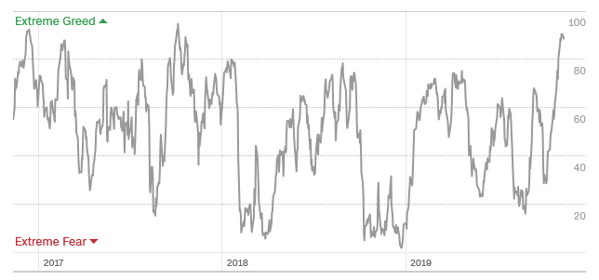
The Mad Hedge Profit Predictor Solid in SELL Territory But too soon to sell
SELL
BUY

Slide 10
The Global Economy – A Pulse Return
* October Nonfarm Payroll Surprises to the Upside, at 128,000. The headline Unemployment Rate ticked up 0.1% to 3.6%. Chicago PMI Crashes, plunging from to 43.2, a four-year low, US Construction Spending is up, gaining 0.5% in September a nine-month high *Q3 US GDP falls to 1.9%, continuing an 18-month plunge *Much of the global rally is on slightly improving PMI’s and that’s it, it’s all hope and speculation *Weekly Jobless Claims fall to 211,000, close to a half century low *US Productivity Plunges Sharply, down 0.3% in Q3
It’s completely a result of the trade war induced freeze
on capital spending by US businesses this year.
*China cuts interest rates for the first time in three years, PMI’s tick up

Slide 11
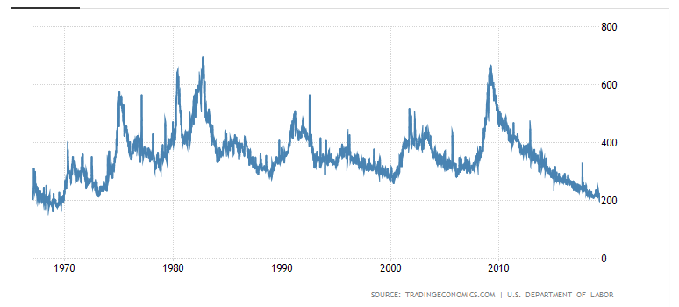
Weekly Jobless Claims-Bottomed Out +8,000 to 211,000

Slide 12
Soybeans - Trade War Indicator “Head and shoulders” top means faith in a trade deal is gone for now

Slide 13
The Bill Davis View A $1,500 Upgrade for the Mad Day Trader Service
Buys: | Entry | Target
McDonalds Corp (MCD) | $ 196.00 | $ 210.00
Wix.com Ltd. (WIX) | $ 128.00 | $ 138.00
Twillo Inc. (TWLO) | $ 101.00 | $ 118.00
Baidu, Inc.(BIDU) | $ 116.00 | $ 130.00
Domino's Pizza (DPZ) | $ 275.00 | $ 290.00
Sells:
Black Knight, Inc (BKI) | $ 62.00 | $ 48.00
HubSpot Inc. (HUBS) | $ 148.00 | $ 125.00
Advance Auto Parts (AAP) | $ 160.00 | $ 140.00
Tiffany & Company (TIF) | $ 120.00 | $ 105.00
Reliance Steel (RS) | $ 118.00 | $ 100.00

Slide 14
Stocks – The Final Run
*The final capitulation top is here, could last for weeks, months….or even years, PE Multiples are already at 20X, the top of a 50-year range *Stocks are melting up in the face of plunging earnings, which always end in tears *The bait of a China trade deal and ultra low rates is pulling buyers in off the sidelines *It all adds up to marginal new highs in the major index with little confidence or excitement, a classic topping indicator *Trading volume is falling in up markets, rising in down markets, always a negative indicator *Bottom line: Marginal new high, then 7% down market for the next 3 months, then new highs propelled by ultra low interest rates or an eventual China trade deal *Bottom Line: its bet the ranch time on tech longs, but stay away from those with big China exposure, like Apple, and weak dollar plays like energy, and emerging markets

Slide 15
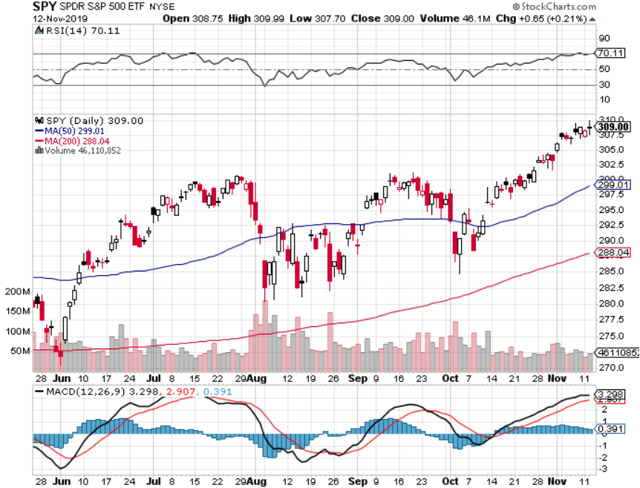
S&P 500 – Breakout took profits on long 10/$305-$310 bear put spread took profits on long 10/$270-$275 bull call spread took profits on long 10/$300-$305 bear put spread took profits on long 8/$305-$308 bear put spread

Slide 16
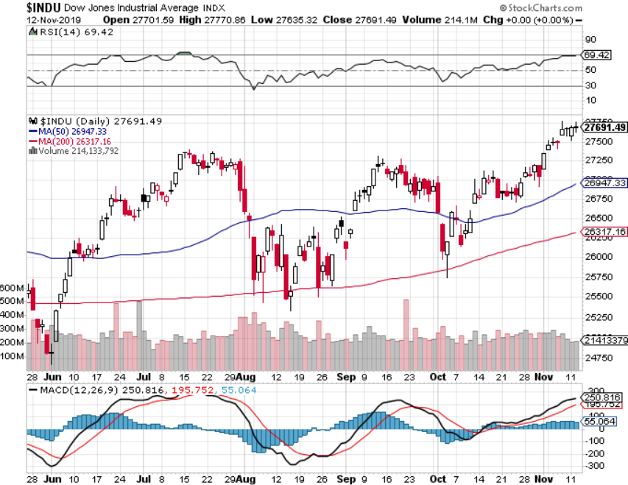
Dow Average ($INDU)- Trending Up

Slide 17
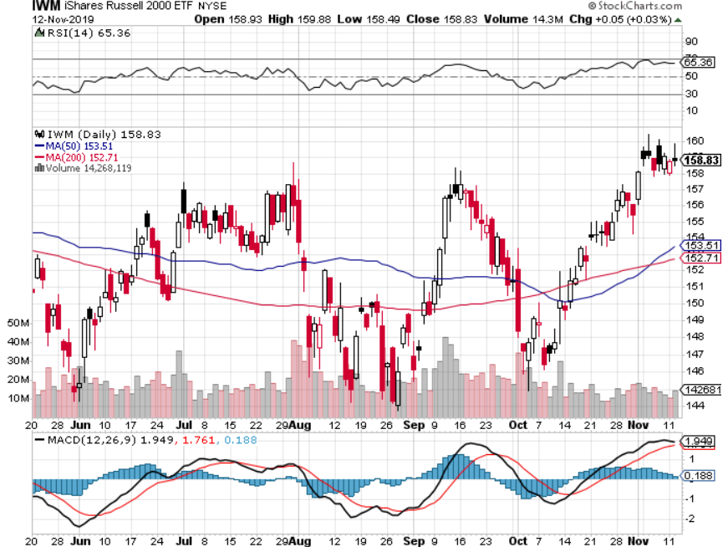
Russell 2000 (IWM)- Top of the Range took profits on Long 10/$137-$142 vertical bull call spread took profits on Long 10/$153-$156 vertical bear put spread

Slide 18
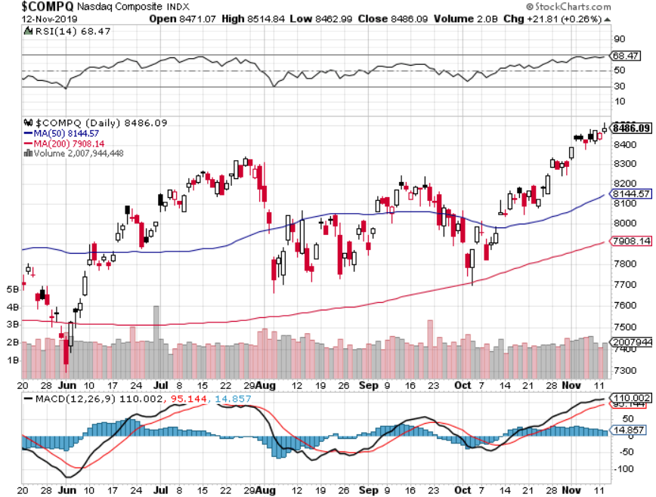
NASDAQ ($COMPQ) – New Highs

Slide 19
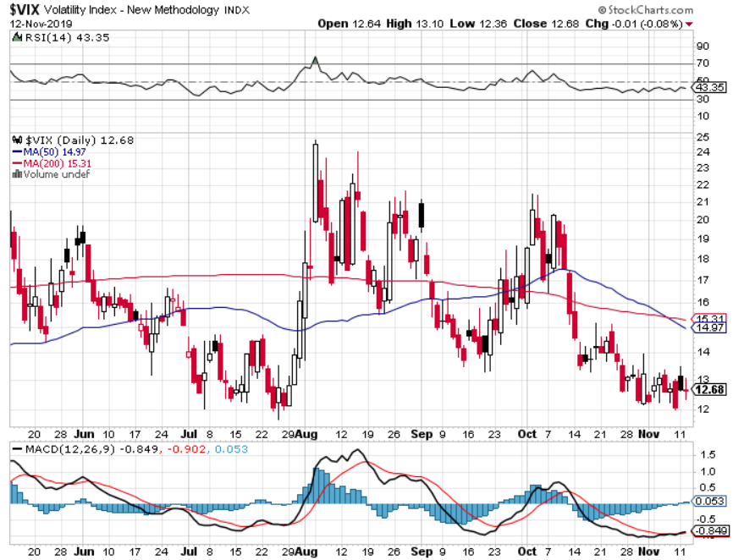
(VIX)-Back in the Dumps

Slide 20
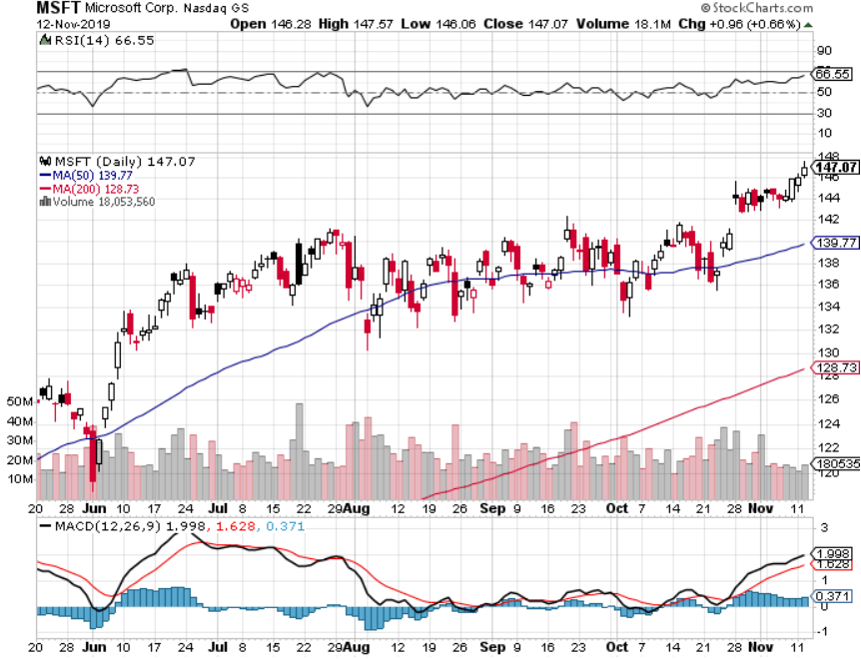
Microsoft (MSFT)- Earnings beat- Looking for Another Entry Point took profits on long 9/$115-$120 call spread took profits on long 6/$110-$115 call spread took profits on long 4/$108-$113 call spread took profits on long 2/$85-$90 call spread

Slide 21
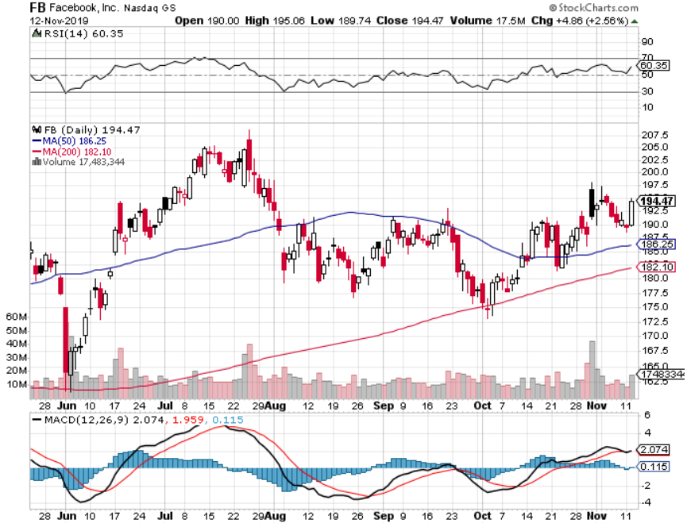
Facebook (FB)- Breaking Out took profits on Long 9/$150-$160 vertical bull call spread took profits on Long 8/$167.50-$172.50 vertical bull call spread

Slide 22
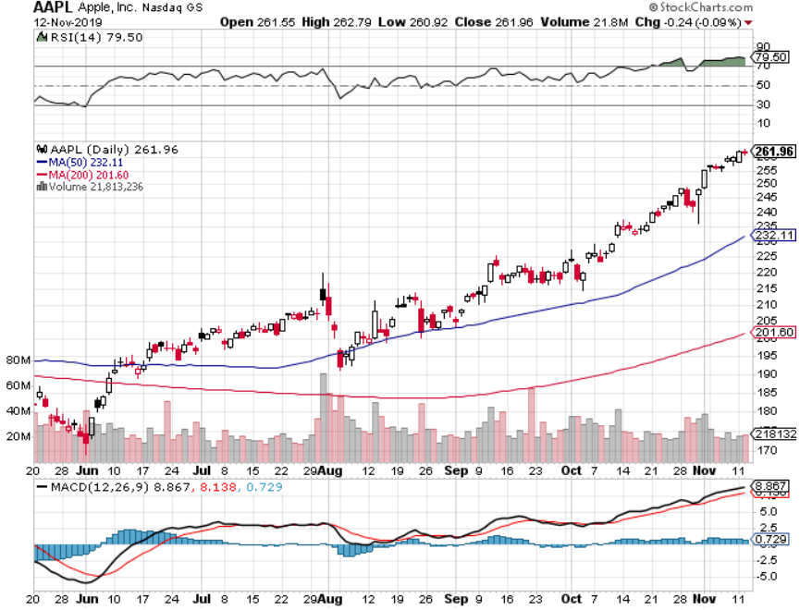
Apple (AAPL)-New All Time High as Services Soar market cap now $1.2 trillion

Slide 23
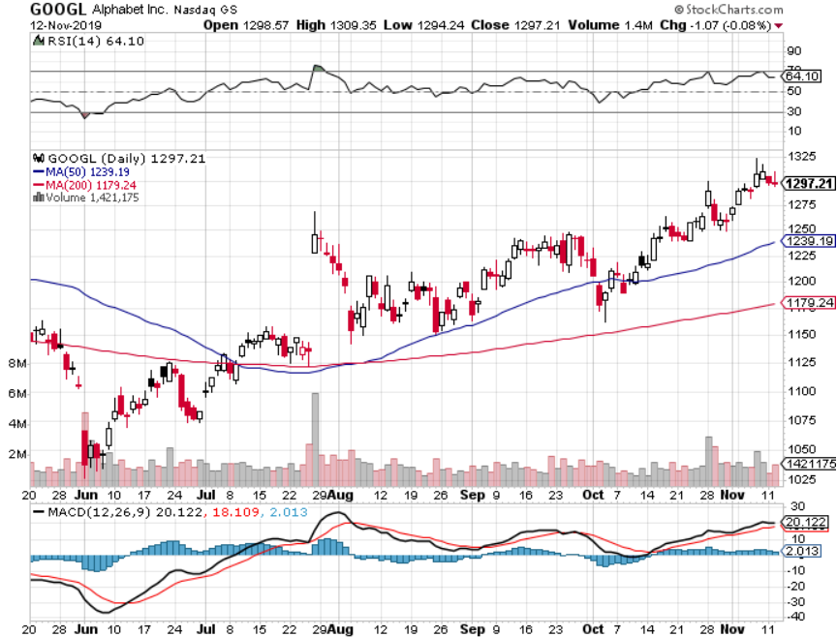
Alphabet (GOOGL) – took profits on long 9/$1,030-$1,080 vertical bull call spread stopped out of long 5/$1,100-$1,130 bull call spread took profits on long 4/$1,080-$1,120 bull call spread

Slide 24
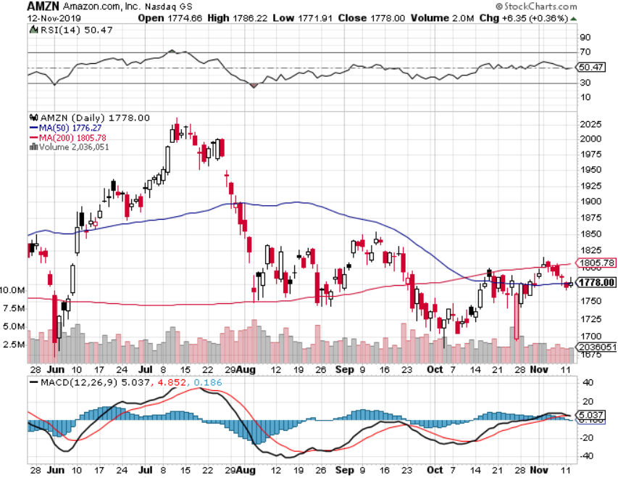
Amazon (AMZN) – Terrible Guidance took profits on 9/$1,500-$1,500 vertical bull call spread stopped out of long 4/$1,650-$1,700 call spread took profits on long 4/$1,600-$1,650 call spread took profits on long 2/$1,200-$1,300 call spread

Slide 25
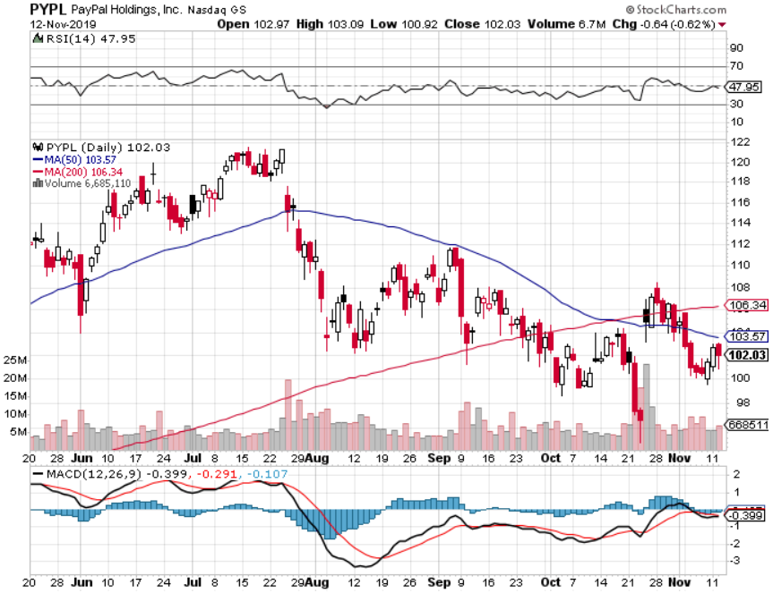
PayPal (PYPL)-CEO resigns took profits on long 4/$90-$95 call spread

Slide 26
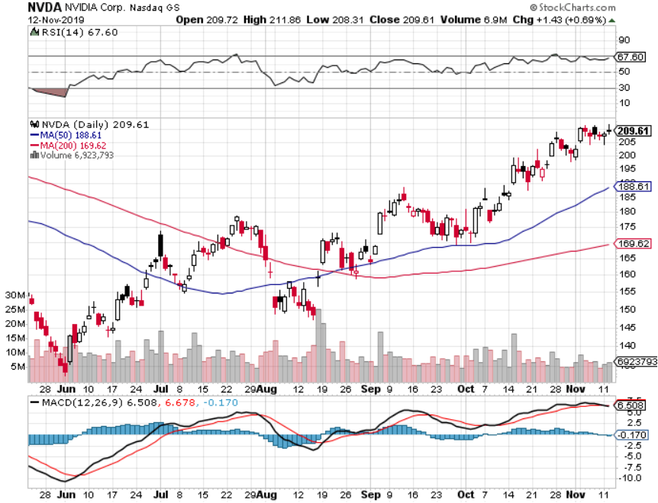
NVIDIA (NVDA) – Off to the Races

Slide 27
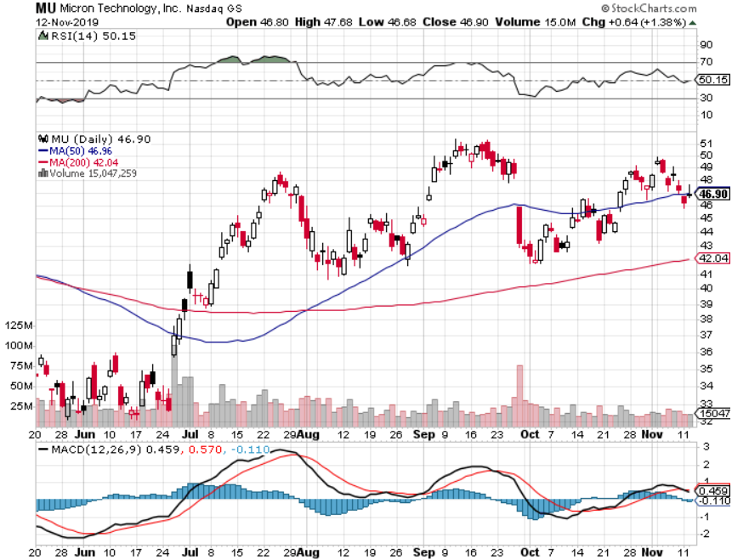
Micron Technology (MU)-

Slide 28
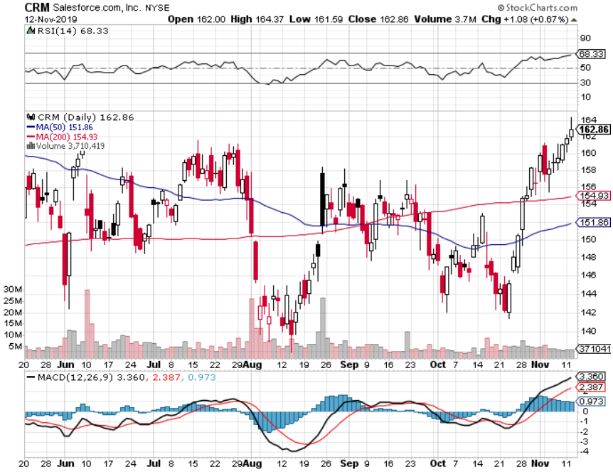
Salesforce (CRM)- took profits on long 9/$125-$130 vertical bull call spread took profits on long 8/$125-$130 vertical bull call spread took profits on long 2/$105-$115 call spread

Slide 29
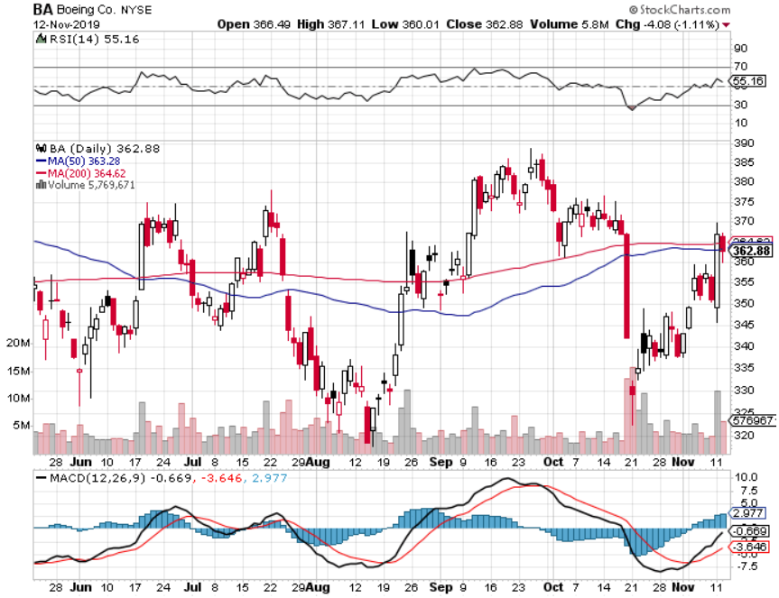
Boeing (BA) – The Bad News is Out 737 MAX flies again in January long 4/$300-$310 call spread – expires in 2 trading days took profits on long 4/$315-$335 call spread

Slide 30
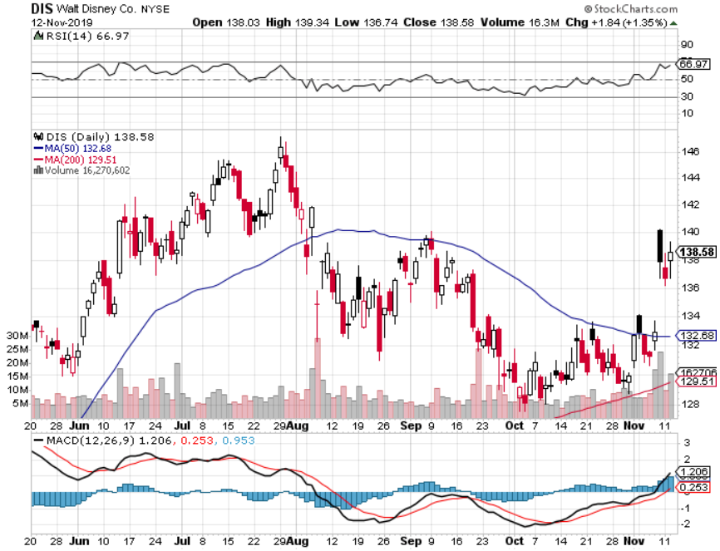
Walt Disney (DIS)- Disney Plus is Open for Business took profits on long 9/$115-$120 call spread 8/$125-$130 call spread expired at max profit Stopped out of 4/$125-$130 call spread for small loss took profits on long 4/$100-$104 call spread

Slide 31
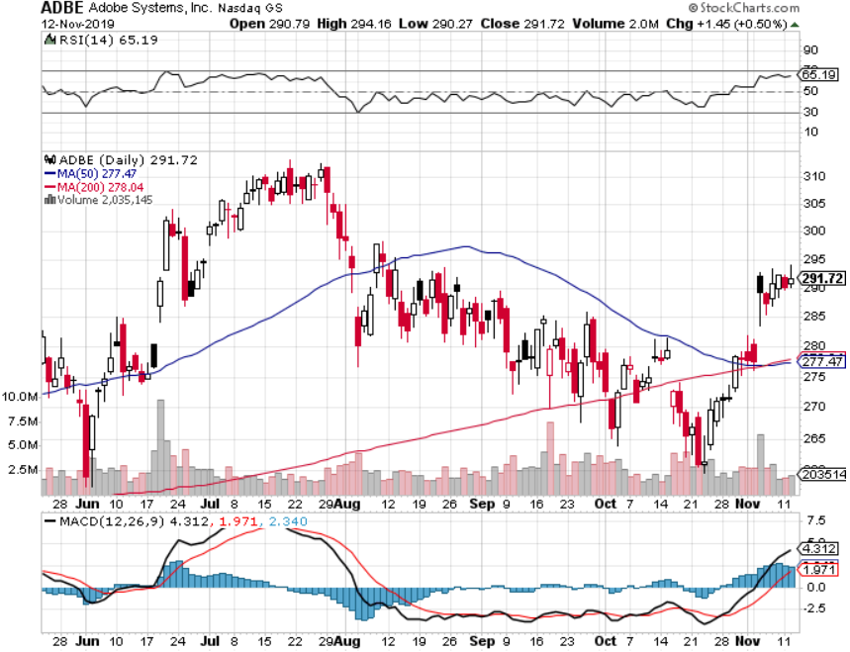
Adobe (ADBE)- The Quality Non-China tech play

Slide 32
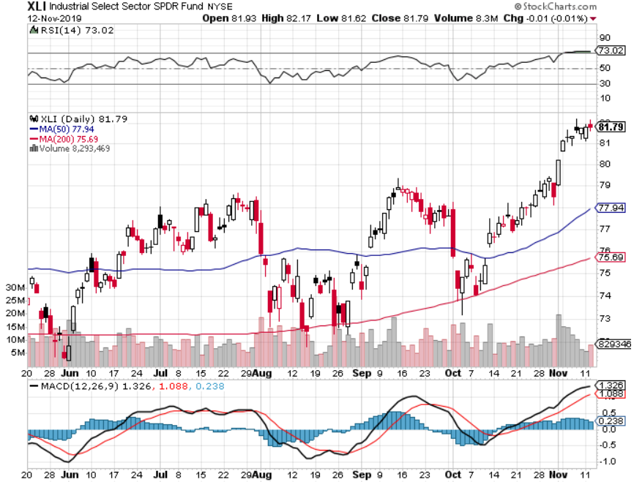
Industrials Sector SPDR (XLI)- (GE), (MMM), (UNP), (UTX), (BA), (HON)

Slide 33
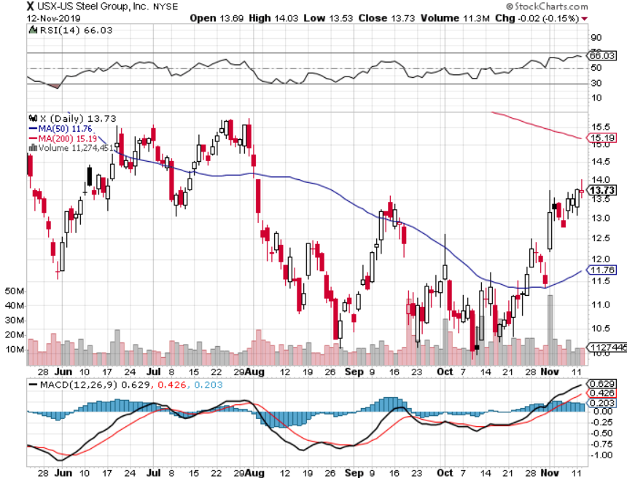
US Steel (X)-Trade deal respite

Slide 34
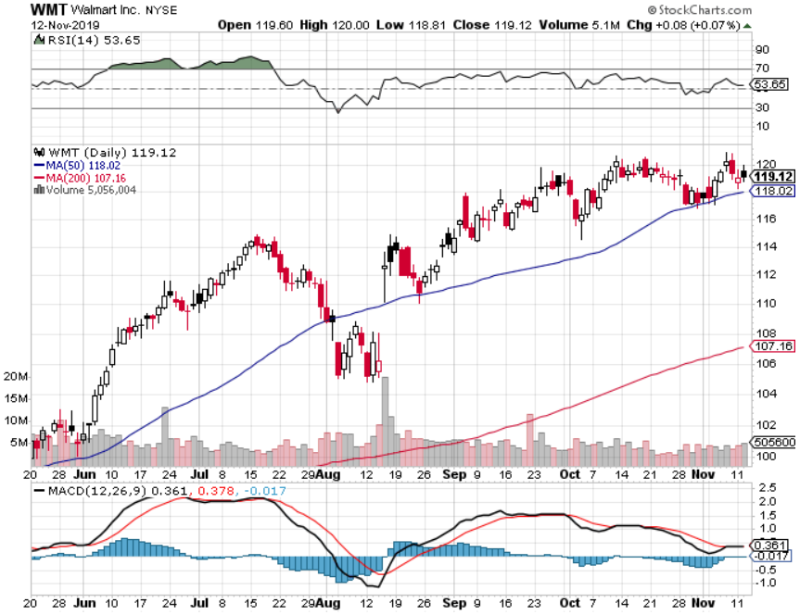
Wal-Mart (WMT)-Tariffs Trouble took profit on Long 11/$125-$130 bear put spread took profit on Long 10/$119-$121 bear put spread took profits on Long 8/$114-$117 bear put spread

Slide 35
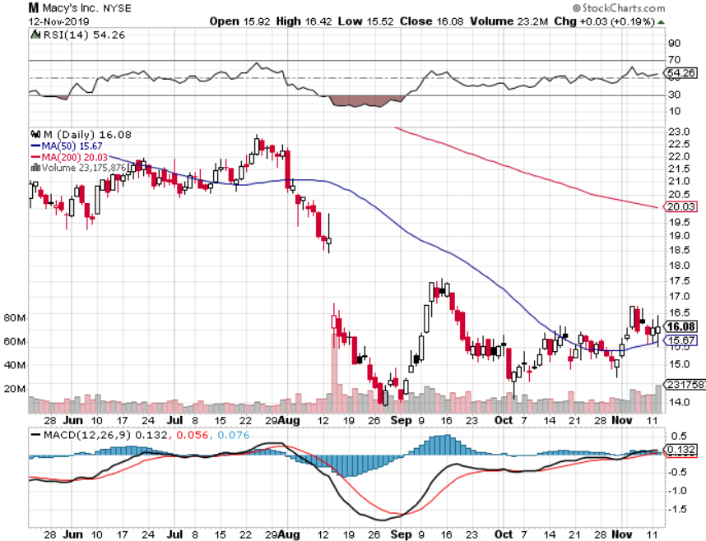
Macys’ (M)-Now bounce in dying industry took profits on Long 8/$23-$25 bear put spread

Slide 36
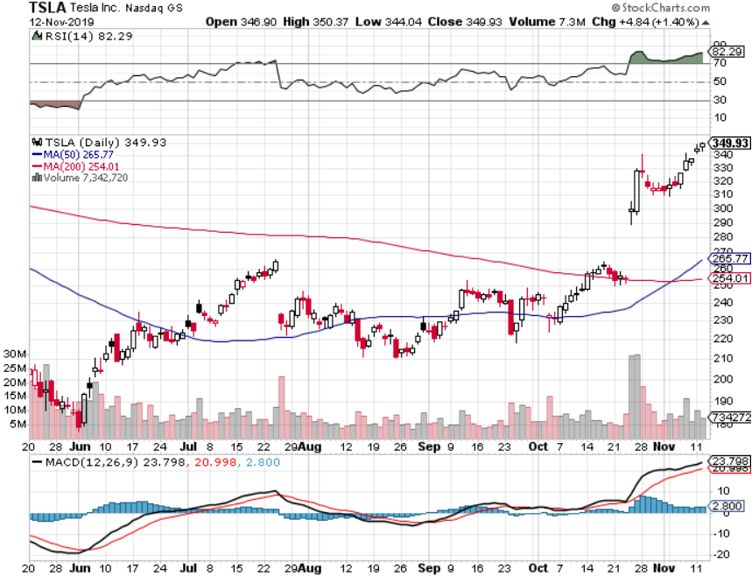
Tesla (TSLA)- 900,000 on the road by yearend fourth factory in Berlin announced, Model Y pickup out next week stopped out of long 6/$260-$270 put spread took profits on long 6/$140-$150 call spread took profits on long 6/$240-$250 put spread

Slide 37
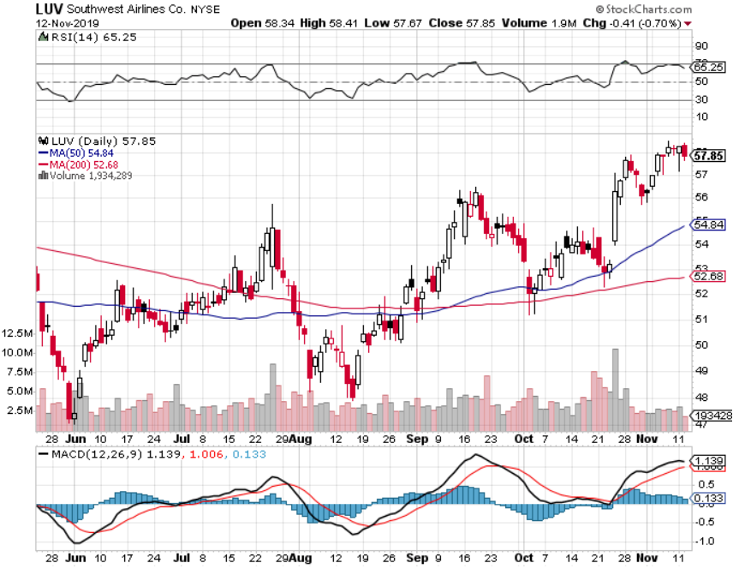
Southwest Airlines (LUV) - Boeing 737 Max biggest buyer

Slide 38
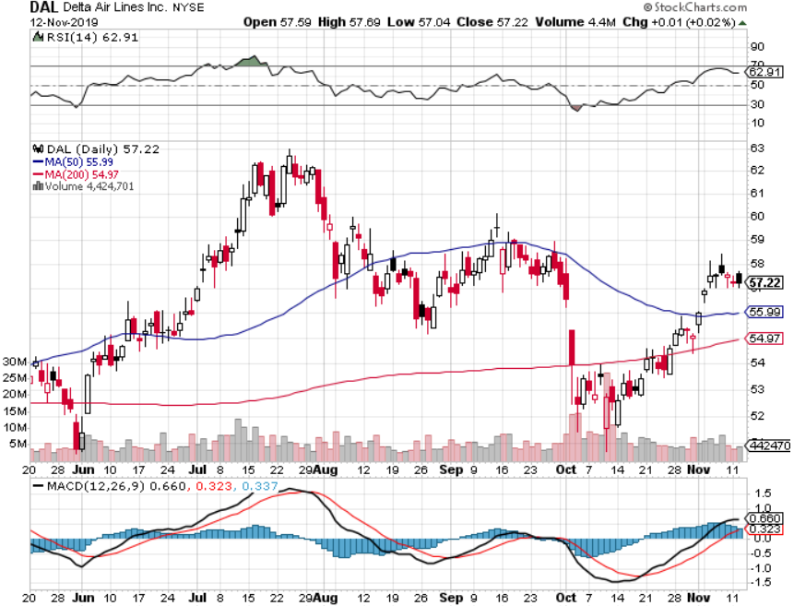
Delta Airlines (DAL) – Non 737 User

Slide 39
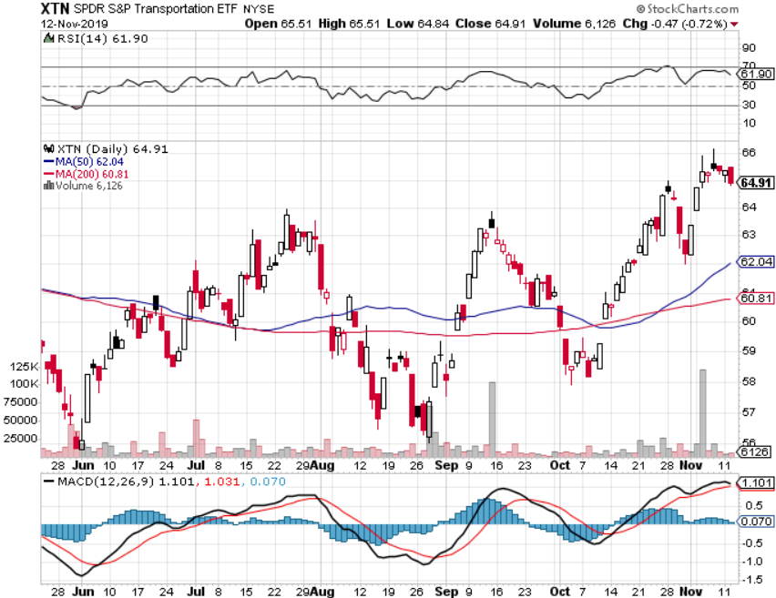
Transports Sector SPDR (XTN)- (ALGT), (ALK), (JBLU), (LUV), (CHRW), (DAL)

Slide 40
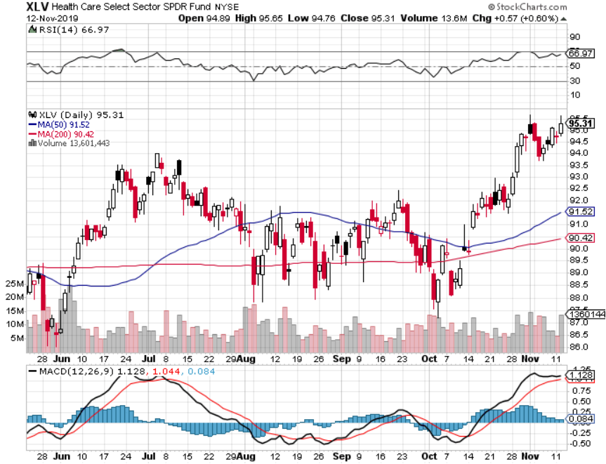
Health Care Sector (XLV), (RXL)-New Highs (JNJ), (PFE), (MRK), (GILD), (ACT), (AMGN)

Slide 41
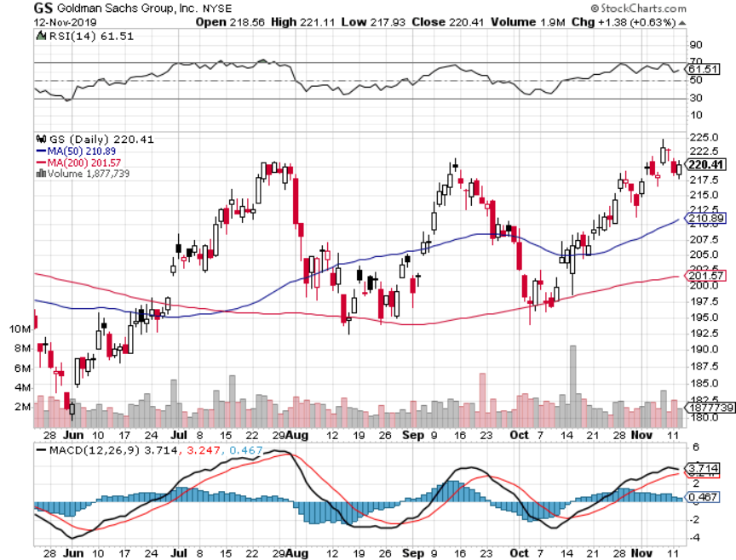
Goldman Sachs (GS)-Top of Range

Slide 42
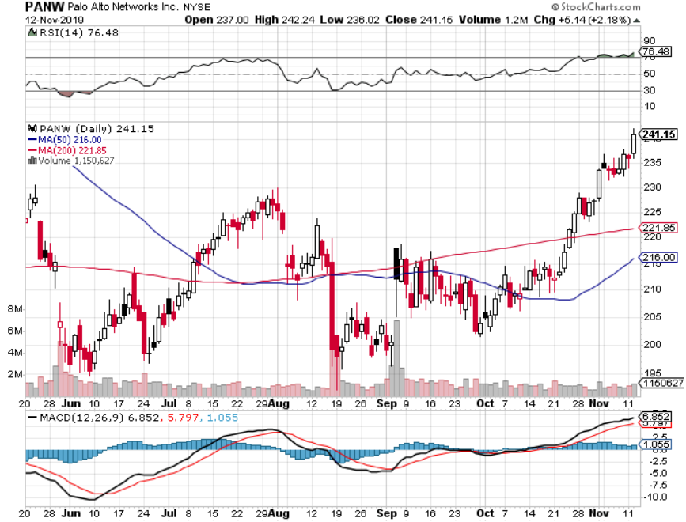
Palo Alto Networks (PANW)- Hacking never goes out of fashion

Slide 43
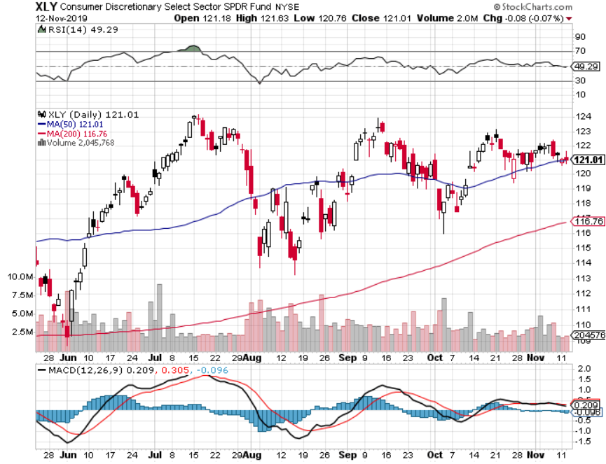
Consumer Discretionary SPDR (XLY) (DIS), (AMZN), (HD), (CMCSA), (MCD), (SBUX)

Slide 44
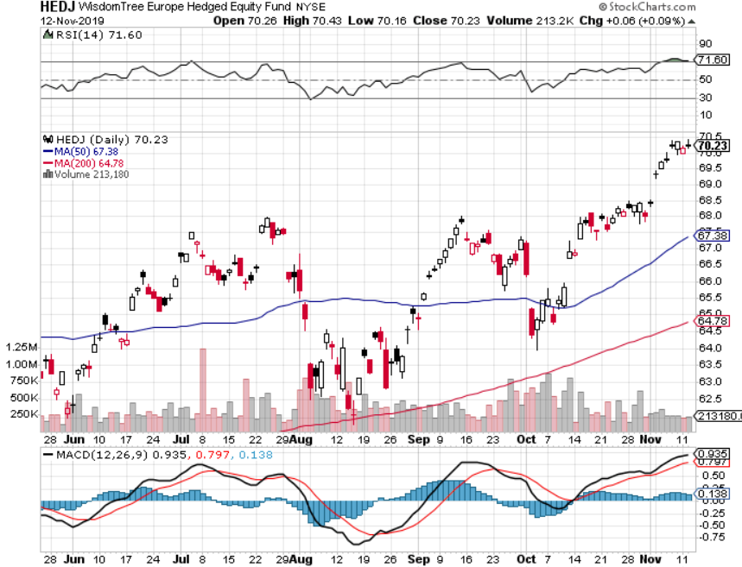
Europe Hedged Equity (HEDJ)- Pip on Brexit News

Slide 45
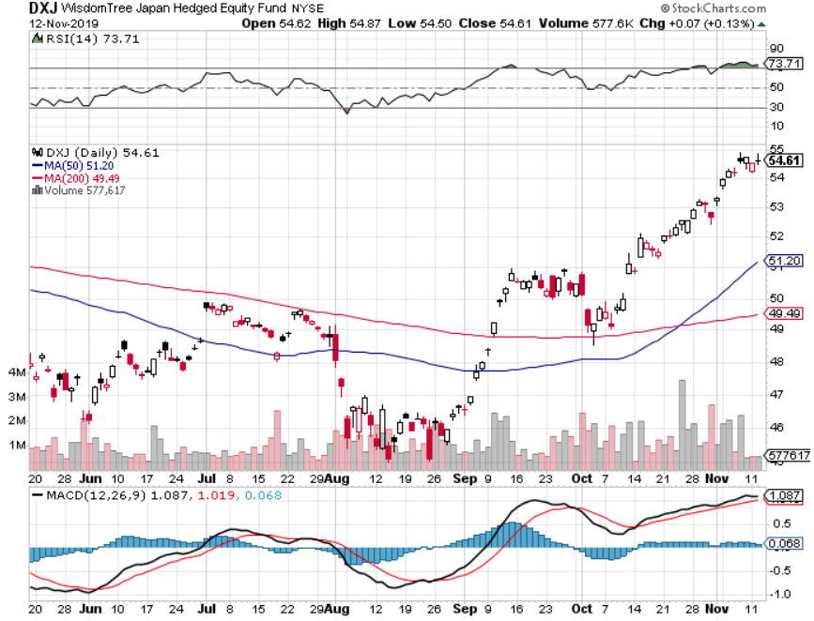
Japan (DXJ)-

Slide 46
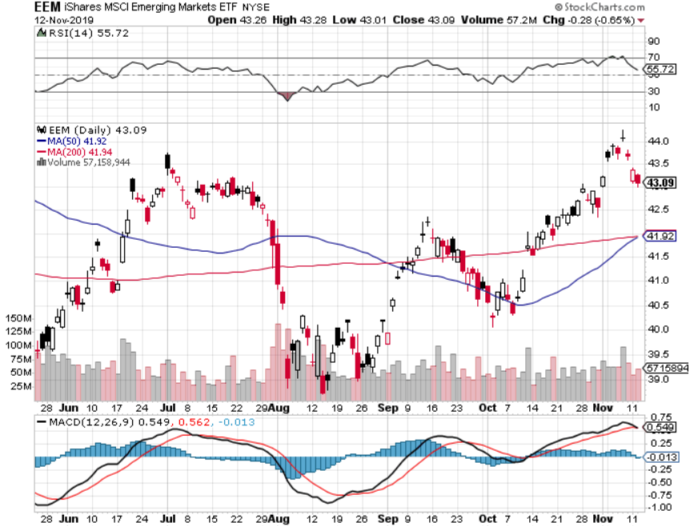
Emerging Markets (EEM)- Weak Dollar Play

Slide 48
Bonds – Exhaustion
*12 Point selloff creates a new long side entry point *No US interest rates cuts in 2020 sets up a prolonged range trading market *Global QE 5 is about to unleash another new wave of bond buying *It looks like a 1.44%-2.15% range in yields is selling up *Another refi window will open up in a few months *Bottom line: Ten-year US Treasury yields will fall below 1.0% in 2020 to come in line with the rest of the world, then go to zero in the next recession

Slide 49
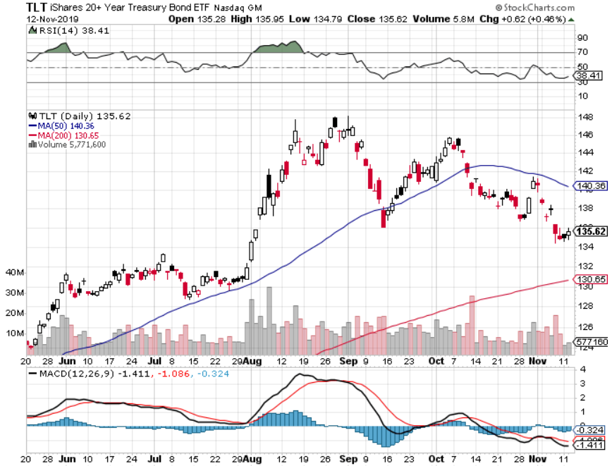
Treasury ETF (TLT) – Touching the Bottom took profits on long 10/$129-$132 call spread stopped out of long 8/$137-$140 put spread took profits on long 8/$125-$128 call spread

Slide 50
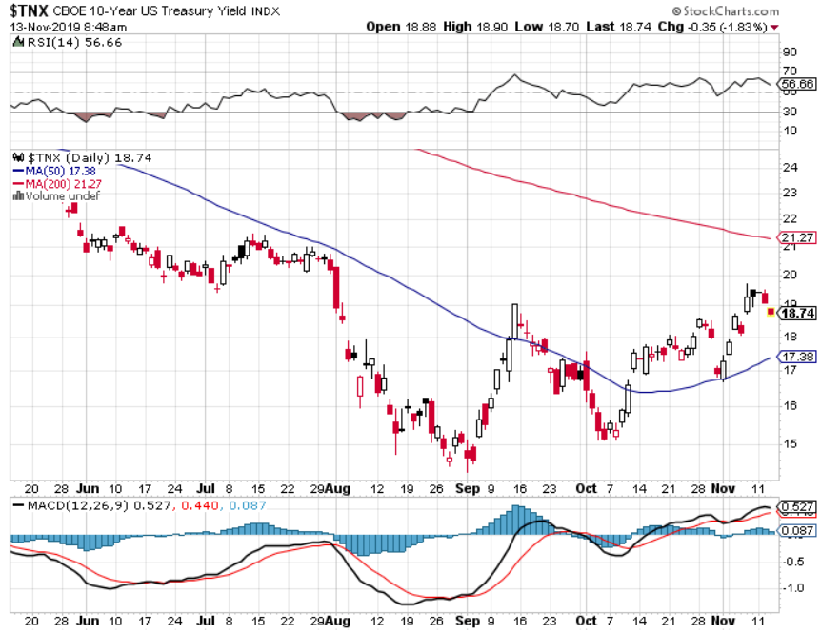
Ten Year Treasury Yield ($TNX) – 1.87%

Slide 51
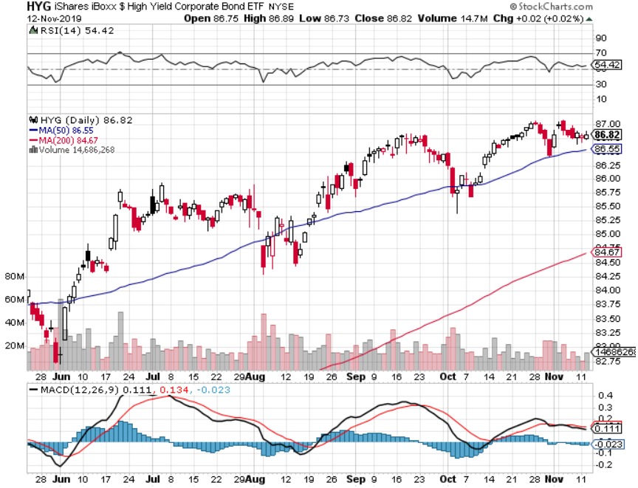
Junk Bonds (HYG) 4.82% Yield big jump in yields on stock selloff and recession fears

Slide 52
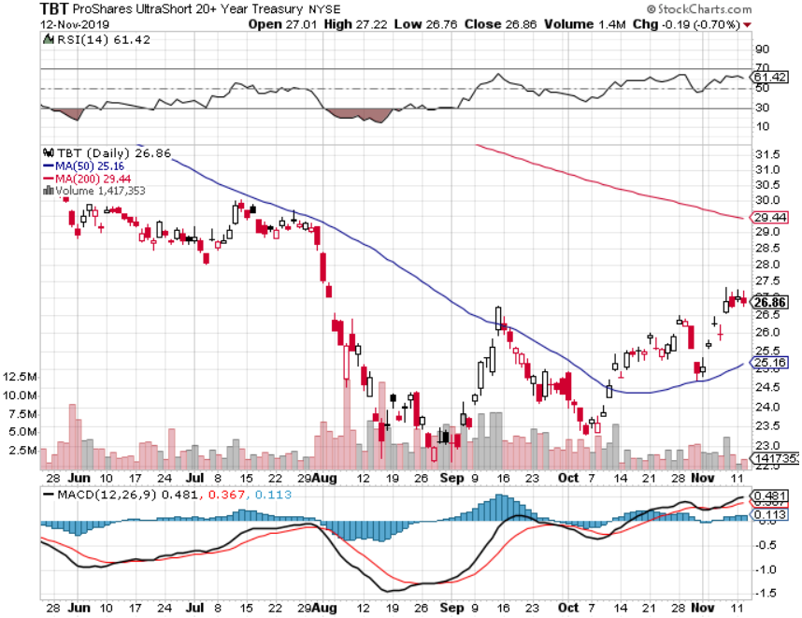
2X Short Treasuries (TBT)- 2 Month Bottoming Process

Slide 53
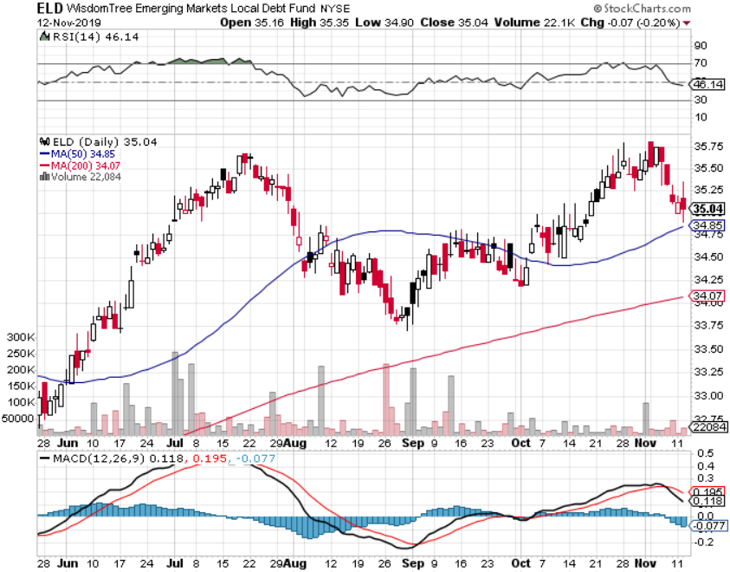
Emerging Market Debt (ELD) 4.78% Yield-

Slide 54
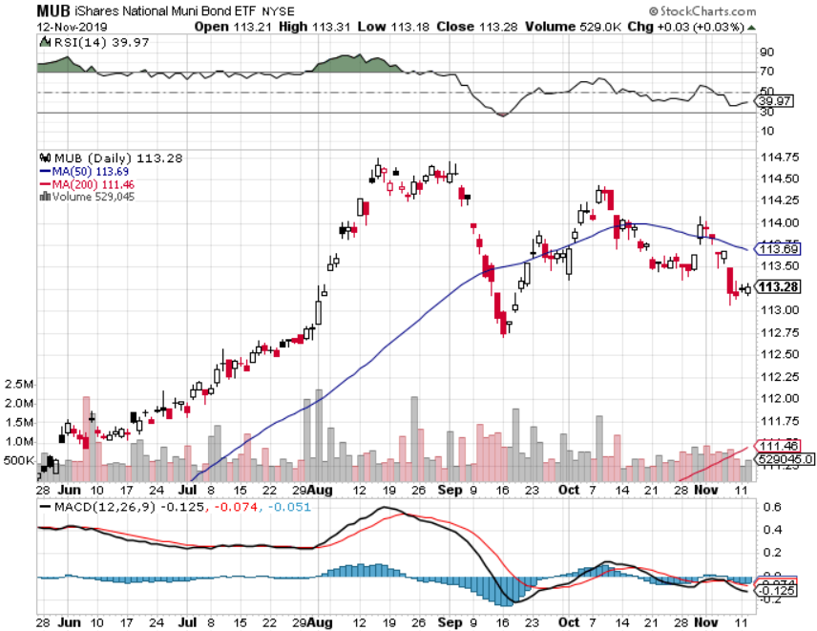
Municipal Bonds (MUB)-1.62% Mix of AAA, AA, and A rated bonds

Slide 56
Foreign Currencies – Dollar Recovery
*Rising interest rates give Uncle Buck a boost, but the head and shoulders is still in place *Double top and weak economies demolish the Euro *Brexit stagnation stalls British pound *Chinese Yuan soars on trade hopes *Bitcoin gives up recent rally *Aussie jumps on global “RISK ON” *Avoid the FX market for now, there are too many contrary indicators

Slide 57
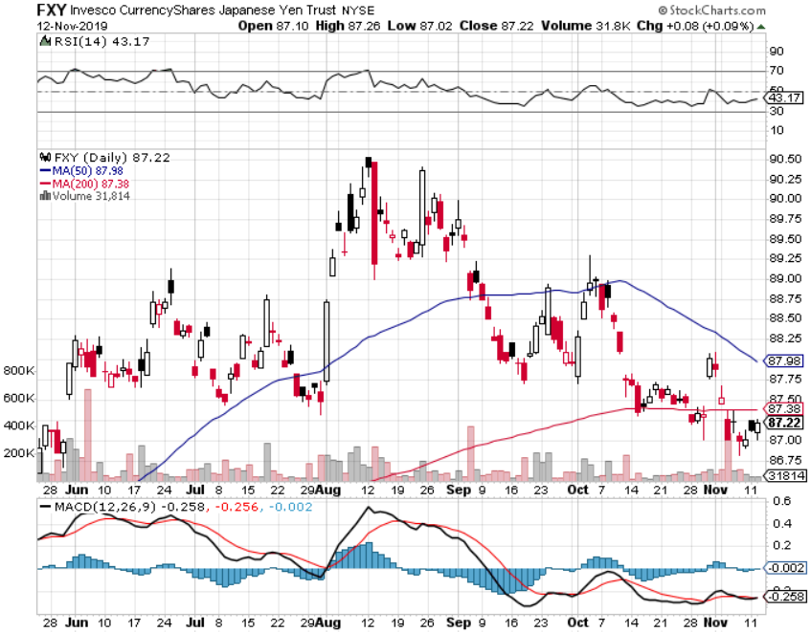
Japanese Yen (FXY), (YCS)

Slide 58
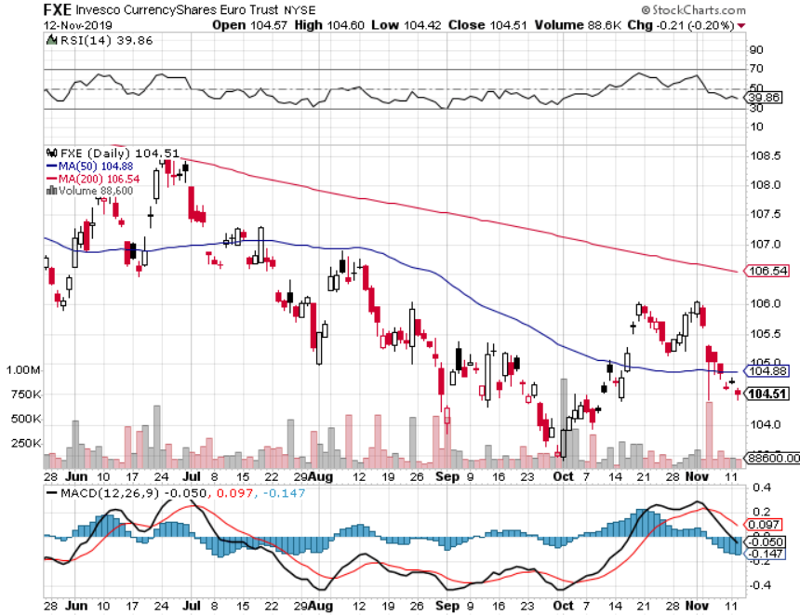
Euro ($XEU), (FXE), (EUO)-

Slide 59
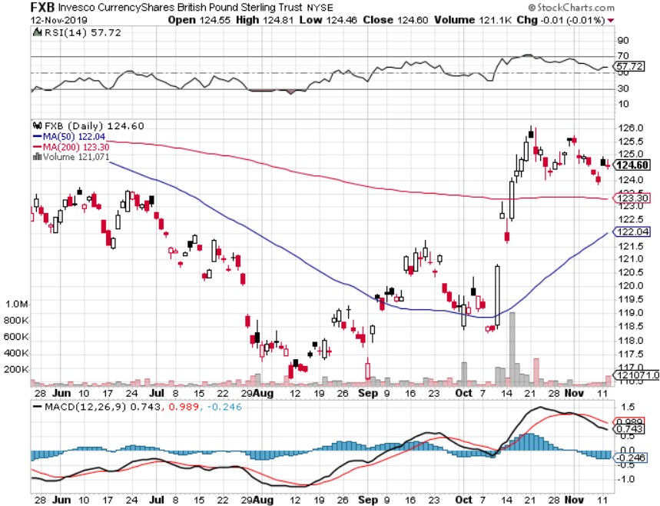
British Pound (FXB)-

Slide 60
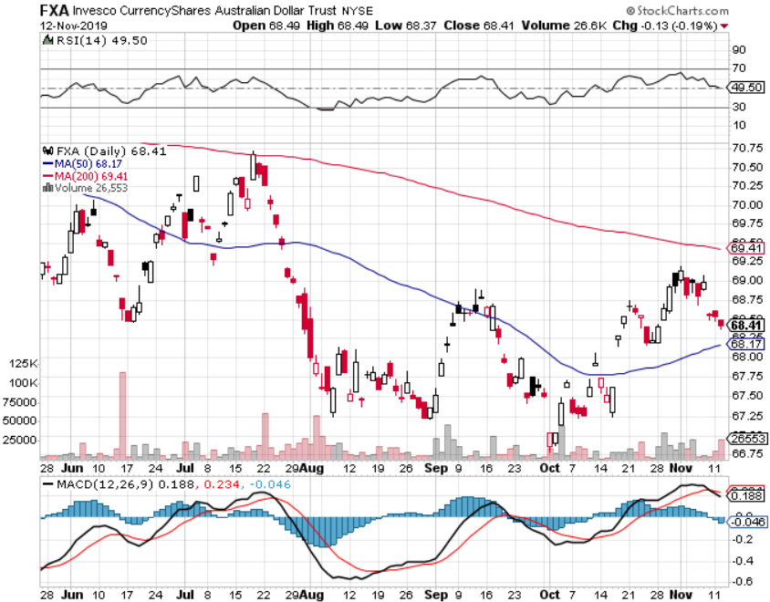
Australian Dollar (FXA)- The Global Recovery Play took profits on long 8/$67-$69 call spread

Slide 61
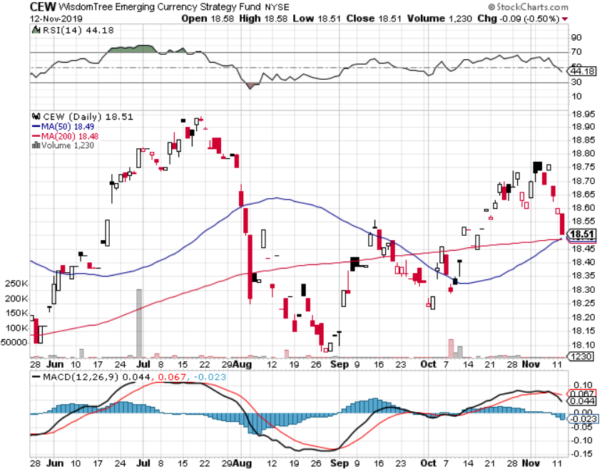
Emerging Market Currencies (CEW)

Slide 62
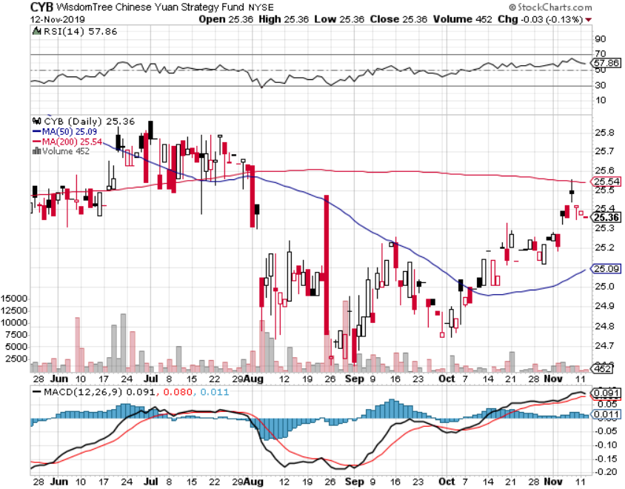
Chinese Yuan- (CYB)- New Lows

Slide 63
Bitcoin- 40% Rally

Slide 65
Energy – Top of the Range
*Global “RISK ON” into Fed meeting takes oil up with it * Saudi Aramco IPO to List, in Saudi Arabia only. Only 3% of outstanding shares will be sold, but it will still be one of the biggest IPO’s in history *Over supply against fading demand will last for years *OPEC seeks to cut Quotas in December Vienna meeting *Energy still the most unloved sector in the stock market *Avoid all energy plays like the plague, could drop by half in the coming recession *Bottom Line: looks like $42 a barrel is in the cards, more later

Slide 66
Oil-($WTIC)

Slide 67
United States Oil Fund (USO) took profits on long 10/$9.50-$10 Vertical bull call spread

Slide 68
Energy Select Sector SPDR (XLE)-No Performance! (XOM), (CVX), (SLB), (KMI), (EOG), (COP)

Slide 69
Halliburton (HAL)-

Slide 70
Natural Gas (UNG) -

Slide 72
Precious Metals – Breakdown
*Gold breaks all support on global “RISK ON” *”RISK ON” means ”SELL GOLD” *Rising rates are another nail in the coffin, increasing the opportunity cost of owning precious metals *Backing the recession risk out also dumps flight to safety trades *We still think gold has a future, I’m just waiting for a bigger capitulation selloff *Bottom Line: buy a bigger dip in gold and precious metals

Slide 73
Gold (GLD)-
support

Slide 74
Market Vectors Gold Miners ETF- (GDX) – Yikes!

Slide 75
Barrick Gold (GOLD)

Slide 76
Newmont Mining- (NEM)-

Slide 77
Silver- (SLV)-

Slide 78
Silver Miners - (SIL)-

Slide 79
Wheaton Precious Metals - (WPM)-

Slide 80
Copper (COPX)-Collapse Trade War Disaster

Slide 81
Freeport McMoRan (FCX)-World’s Largest Copper Producer took profits on long 4/$10-$11 call spread took profits on short 4/$114 calls

Slide 82
Real Estate – Rate Shock
*Interest rate rise puts cheap refi’s to bed, weekly mortgage applications are flatlining as the the windows closes once again *30-year fixed rate loans back up to 3.90%
*May S&P 500 Case-Shiller pops to a 3.2% annual gain in August, the second improvement in 18 months *Bottom Line: Stand aside for a trade but buy for long term investment

Slide 83
February Corelogic S&P Case Shiller Home Price Index Phoenix (6.3%), Charlotte, NC (4.5%), and Tampa (4.3%) showing biggest gains
Tradingeconomics.com

Slide 84
Simon Property Group (SPG)-

Slide 85
American Tower (AMT) – 1.75% Yield

Slide 86
US Home Construction Index (ITB) (DHI), (LEN), (PHM), (TOL), (NVR)

Slide 87
Trade Sheet- So What Do We Do About All This?
*Stocks-stand aside *Bonds-buy dips *Commodities-stand aside *Currencies- stand aside *Precious Metals – buy bigger dip *Energy – sell rallies *Volatility-buy dips *Real estate-stand aside

Slide 88
Next Strategy Webinar 12:00 EST Wednesday, December 4, from Silicon Valley, CA email me at support@madhedgefundtrader.com
Good Luck and Good Trading!
Notes:
*

