Slide 1
The Mad Hedge Fund Trader “Trump Dump”
With John Thomas from Silicon Valley, CA, December 4, 2019 www.madhedgefundtrader.com
Notes:
*

Slide 2
Trade Alert Performance New Highs Again!
*January 9.49% Final *July +3.07% Final *February +4.64% Final *August +16.01% Final *March +1.78% Final *September 3.08% Final *April +0.30% Final *October +12.13% Final *May +0.25% Final *November -1.26% Final *June -0.50% Final *December +2.84% MTD *2019 Year to Date +53.64% compared to +16.67% for the Dow Average *+353.78% since inception, *Average annualized return of 35.78% for 10 years

Slide 3
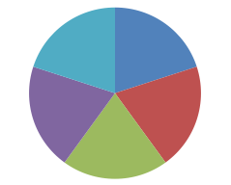
Portfolio Review Keeping Small Positions-90% cash, 10% (BA) Only Buying Very Deep in-the-Money on Capitulation Days
Current Capital at Risk
Risk On
World is Getting Better
(MSFT) 12/$134-$137 call spread | 10.00%
(GOOGL) 12/$1200-$1230 call spread | 10.00%
(TLT) 12/$145-$148 put spread | 10.00%
(SPY) 12/$297-$302 call spread | 10.00%
(BA) 12/$310-$330 call spread | 10.00%
Risk Off
World is Getting Worse
No Positions | 0.00%
Total Net Position | 50.00%
Expiration P&L 56.69% YTD

Slide 4
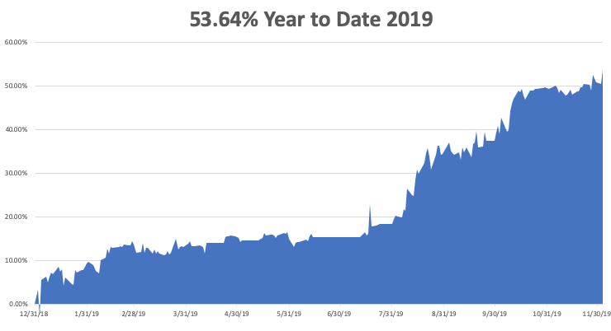

Slide 5
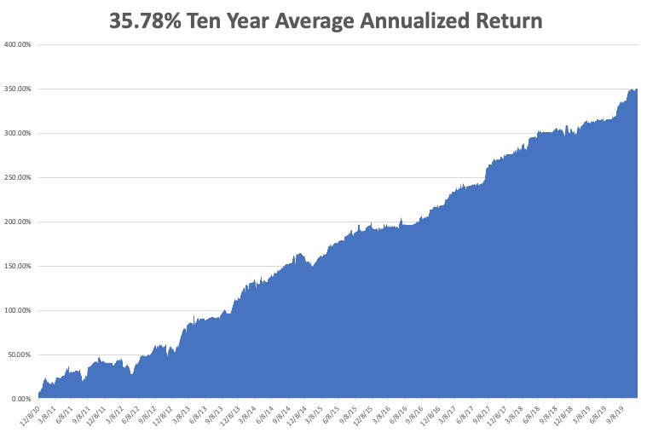
GTD 10 Year Daily Audited Performance

Slide 6
The Method to My Madness
*Trade speed bump triggers 900-point Dow selloff, or 3.2%, creating a nice long side entry point. We went to 50% long, 50% cash, with very very short 13-day positions *If it continues, we’re looking for a 20% selloff, but it won’t happen until 2020 *More likely, Trump extends the December 15 tariff increases by 3 more months, eking out one more new all-time high and calling it a great victory *Bonds deliver a monster 4-point rally on the bad news, creating a great short selling point *Value stocks like industrials, banks, and commodities may continue until yearend *Liquidity starts to dry up from here, effectively closing the markets on December 20 at the options expirations *”RISK OFF” move causing major dollar selloff, send (VIX) soaring

Slide 7
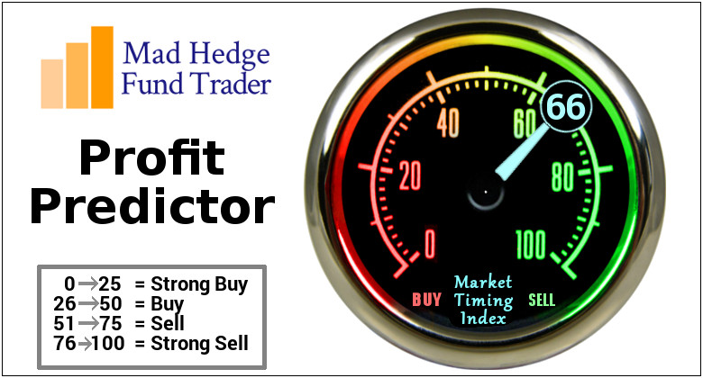
The Mad Hedge Profit Predictor Market Timing Index-Top of Range-Close to a “SELL” An artificial intelligence driven algorithm that analyzes 30 different economic, technical, and momentum driven indicators

Slide 8
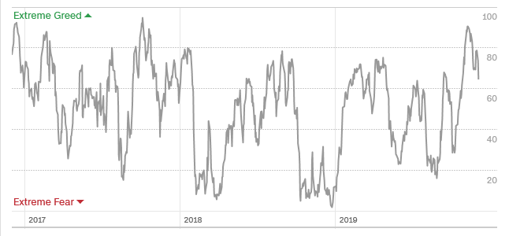
The Mad Hedge Profit Predictor From Extreme Overbought to Almost Neutral
SELL
BUY

Slide 9
The Global Economy – Looking for a Bottom
*US Q3 GDP Revised Up to 2.1%, an improvement of 0.2% *Jay Powell Gives the Market Another Boost, promising to hit the Fed’s 2% inflation target *Consumer Sentiment Rises Slightly, from 95.5 to 96.8. *US Retail Sales Jump, in October, by 0.3% *Durable Goods came in at 0.6% in October, a nine-month high, US Consumer Confidence Drops for Fourth Month *Factory Orders Fall in November, with the ISM dropping by 0.2% to 48.1. An increase was expected.
*Europe still in a funk *China is showing weak data

Slide 10
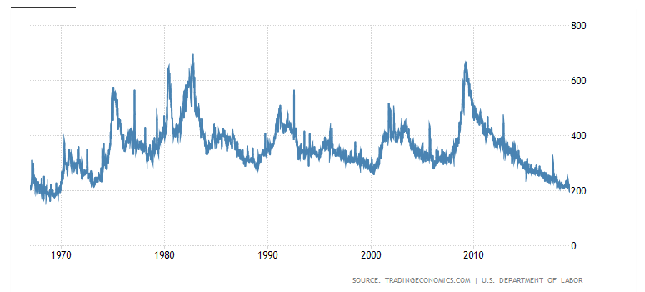
Weekly Jobless Claims-Bottomed Out +15,000 to 213,000

Slide 11
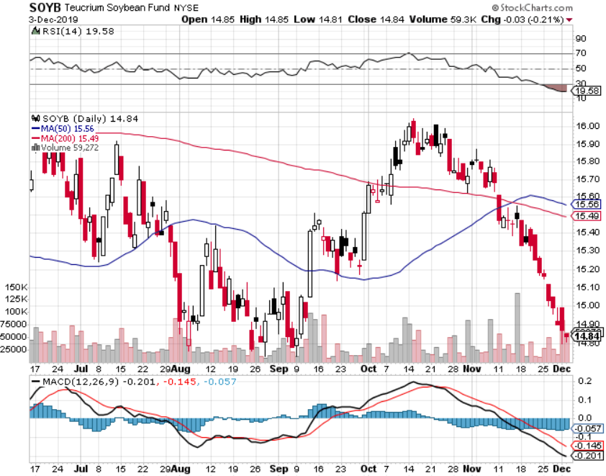
Soybeans - Trade War Indicator Didn’t Like the Trade Deal Delay

Slide 12
The Bill Davis View A $1,500 Upgrade for the Mad Day Trader Service
Buys: | Entry | Target
Wix.com Ltd. (WIX) -X | $ 124.00 | $ 140.00
Palo Alto Networks (PANW) | $ 225.00 | $ 245.00
Deere & Co. (DE) | $ 160.00 | $ 170.00
Vmware Inc. (VMW) | $ 151.00 | $ 173.00
Cummins, Inc.(CMI) | $ 179.00 | $ 190.00
Sells:
Check Point Software(CHKP) | $ 114.00 | $ 105.00
Netfix, Inc. (NFLX) | $ 320.00 | $ 280.00
Cignizant Technology (CTSH) | $ 63.00 | $ 45.00
PTC,Inc.(PTC) | $ 74.00 | $ 62.00
Netease.com, Inc.(NTES) | $ 325.00 | $ 290.00

Slide 13
Stocks – Trump Dump
*Trump Trade failure brings 900-point Dow plunge. How long will it take him to reverse himself? A day, it turns out. No major crash possible with 1.75% overnight interest rates at 1.75% ten year *With the market devoid of fundamentals, every market move is politically driven, unpredictable, and exaggerated *Buyers will be much more cautious going into yearend. The melt up is over, look for range trading *Continue to focus on big tech, the market leaders *Global Funds Moving out of Cash Back into Equities. The allocation has moved up to 47.5% from an August low of 42.9%. *Bottom line: Marginal new high, then 7% down market for the next 3 months, then new highs propelled by ultra low interest rates or an eventual China trade deal *Bottom Line: its bet the ranch time on tech longs, but stay away from those with big China exposure, like Apple, and weak dollar plays like energy, and emerging markets

Slide 14
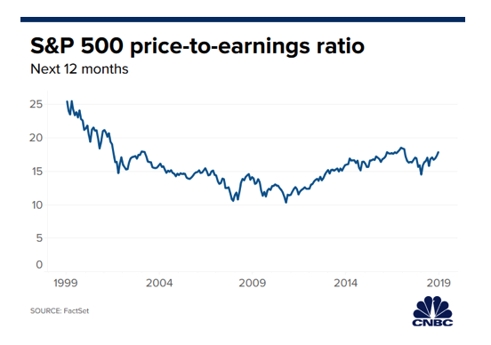
Approaching 16 Year High

Slide 15
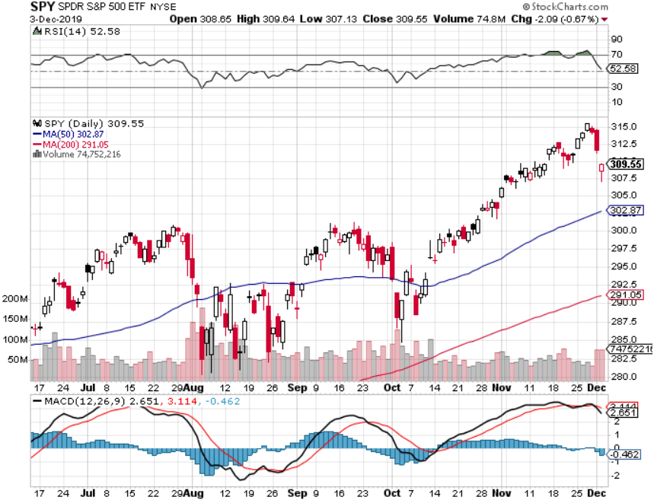
S&P 500 – Snacked Down long 8/$297-$302 bull call spread – expires in 12 trading days took profits on long 10/$305-$310 bear put spread took profits on long 10/$270-$275 bull call spread took profits on long 10/$300-$305 bear put spread took profits on long 8/$305-$308 bear put spread

Slide 16
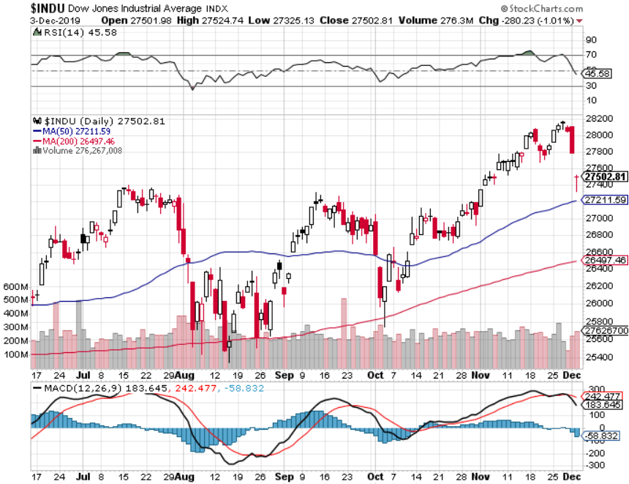
Dow Average ($INDU)- Retest

Slide 17
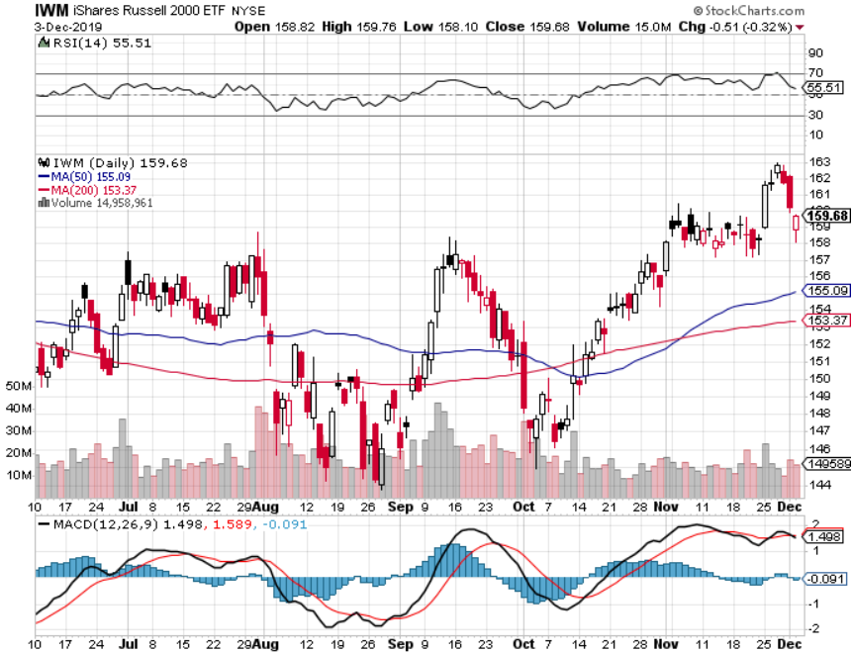
Russell 2000 (IWM)- Brief Breakout took profits on Long 10/$137-$142 vertical bull call spread took profits on Long 10/$153-$156 vertical bear put spread

Slide 18
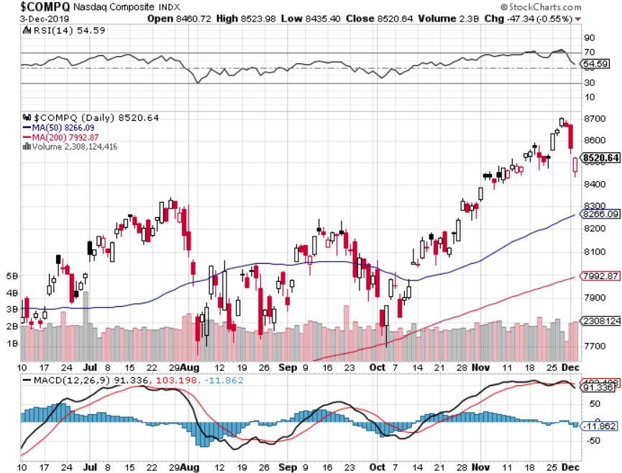
NASDAQ ($COMPQ) – Profit Taking

Slide 19
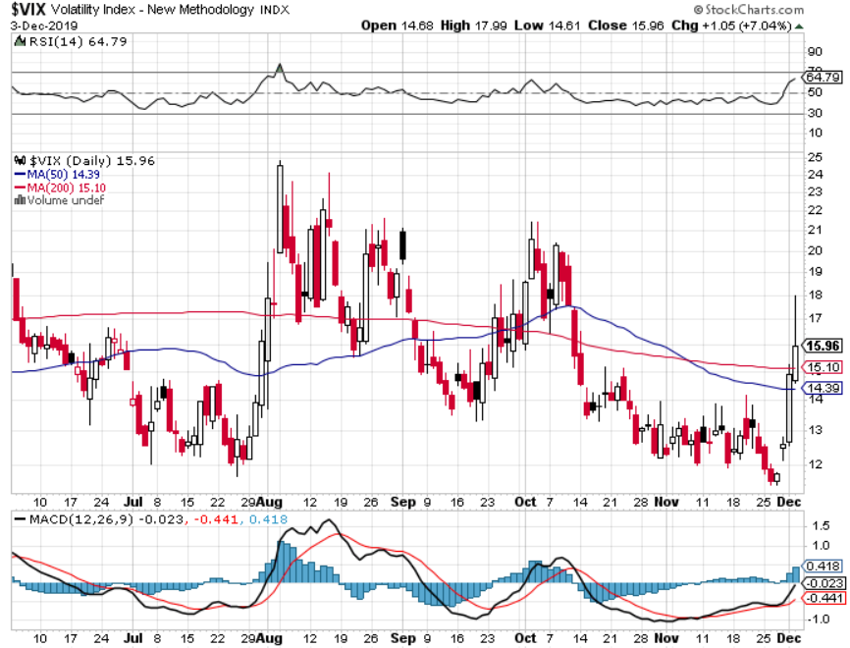
(VIX)-Panic Buy

Slide 20
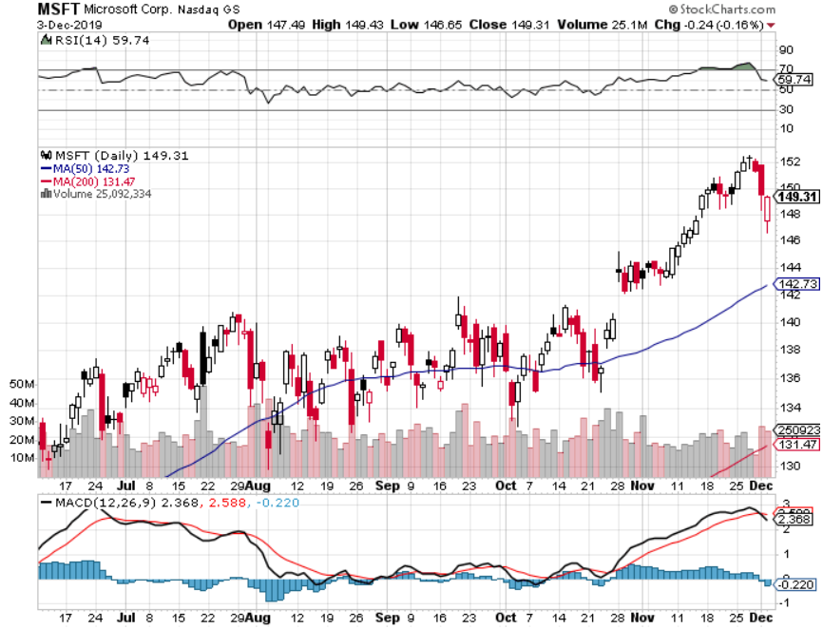
Microsoft (MSFT)- Earnings beat- Looking for Another Entry Point long 12/$135-$138 call spread – expires in 12 days took profits on long 9/$115-$120 call spread took profits on long 6/$110-$115 call spread took profits on long 4/$108-$113 call spread

Slide 21
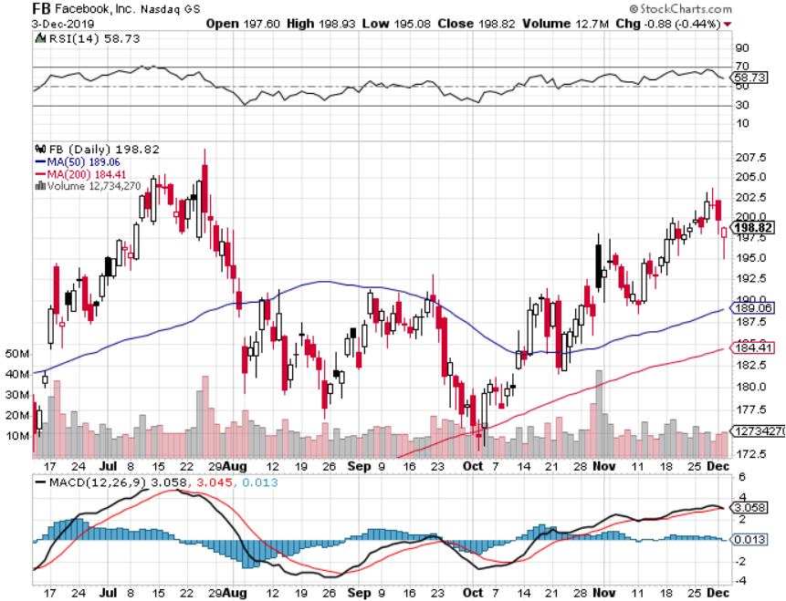
Facebook (FB)- Breaking Out took profits on Long 9/$150-$160 vertical bull call spread took profits on Long 8/$167.50-$172.50 vertical bull call spread

Slide 22
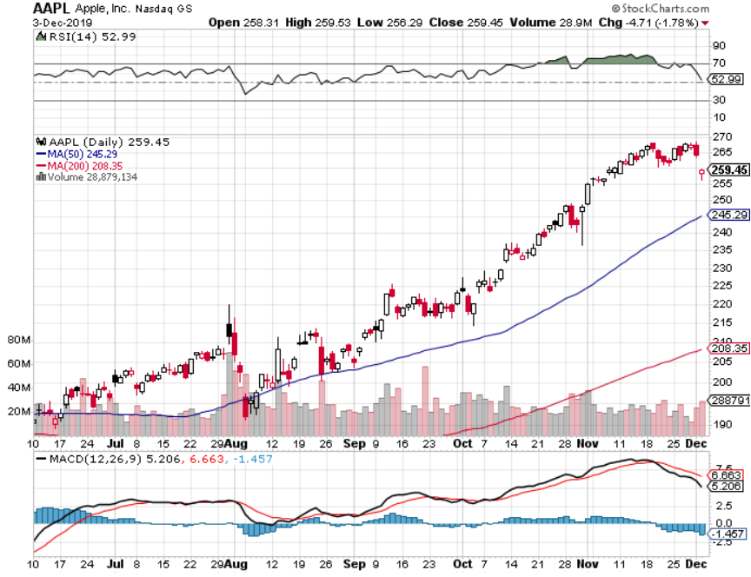
Apple (AAPL)-New All Time High as Services Soar

Slide 23
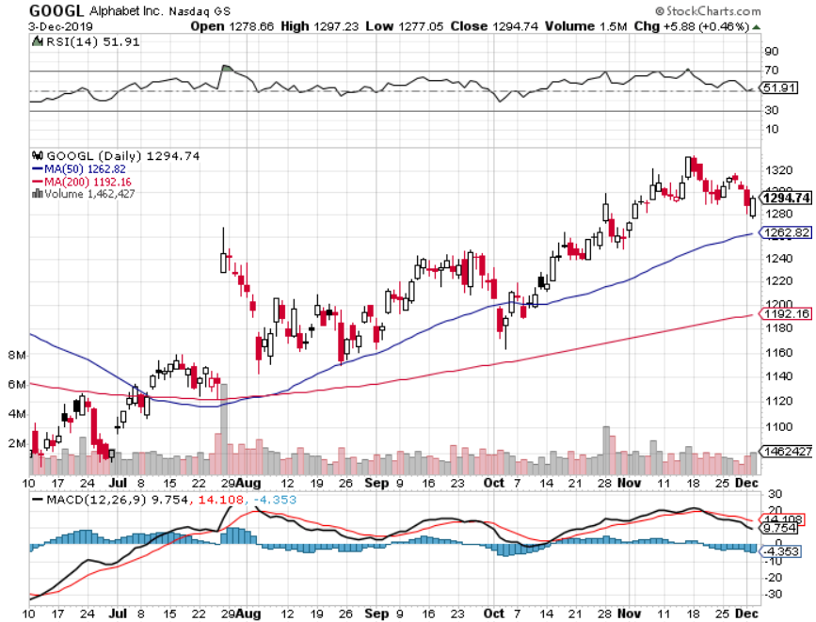
Alphabet (GOOGL) – Co-Founders retires long 12/$1,200-$1,230 bull call spread – expires in 12 days took profits on long 9/$1,030-$1,080 vertical bull call spread stopped out of long 5/$1,100-$1,130 bull call spread took profits on long 4/$1,080-$1,120 bull call spread

Slide 24
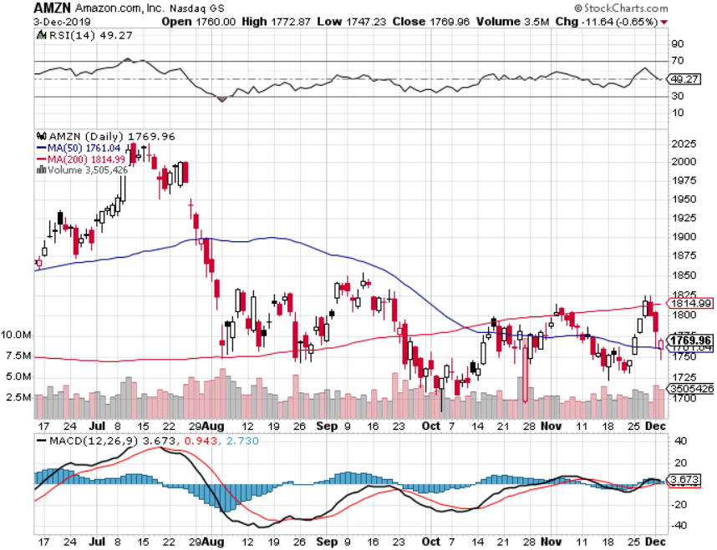
Amazon (AMZN) – Terrible Guidance took profits on 9/$1,500-$1,500 vertical bull call spread stopped out of long 4/$1,650-$1,700 call spread took profits on long 4/$1,600-$1,650 call spread took profits on long 2/$1,200-$1,300 call spread

Slide 25
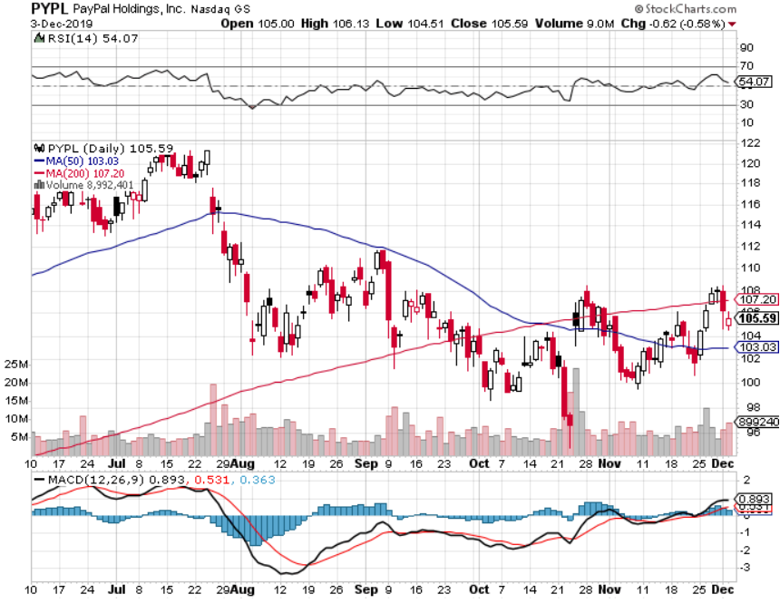
PayPal (PYPL)-CEO resigns took profits on long 4/$90-$95 call spread

Slide 26
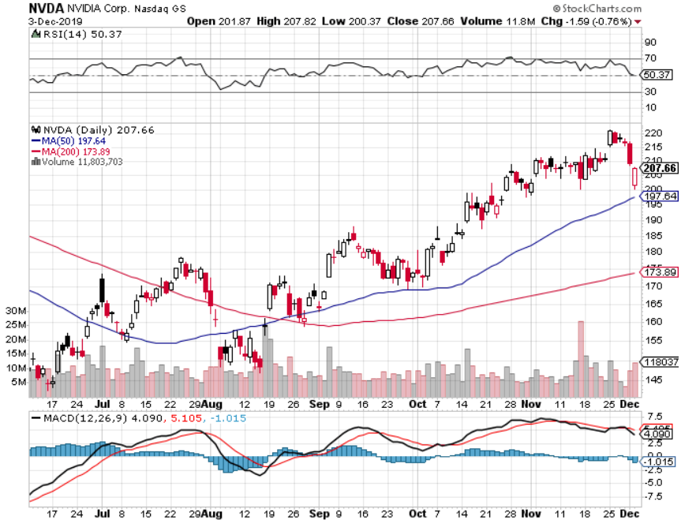
NVIDIA (NVDA) – Off to the Races

Slide 27
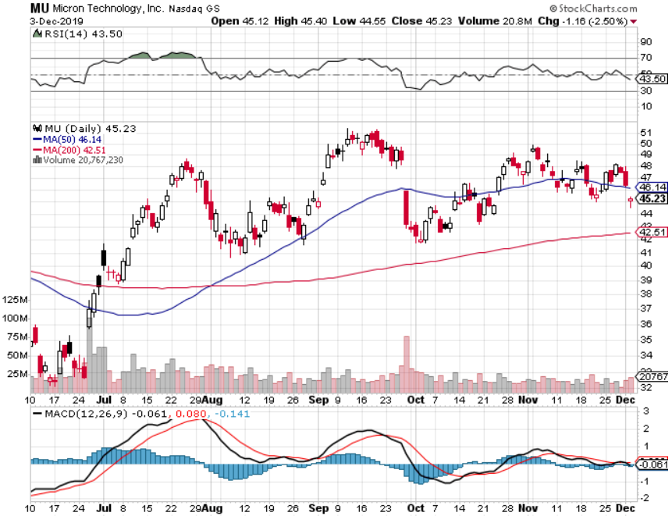
Micron Technology (MU)-

Slide 28
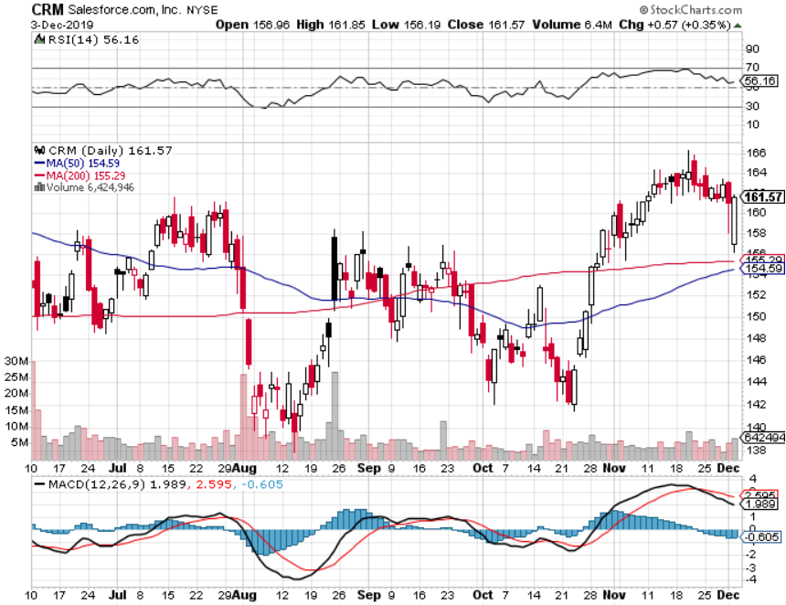
Salesforce (CRM)- Great earnings report took profits on long 9/$125-$130 vertical bull call spread took profits on long 8/$125-$130 vertical bull call spread took profits on long 2/$105-$115 call spread

Slide 29
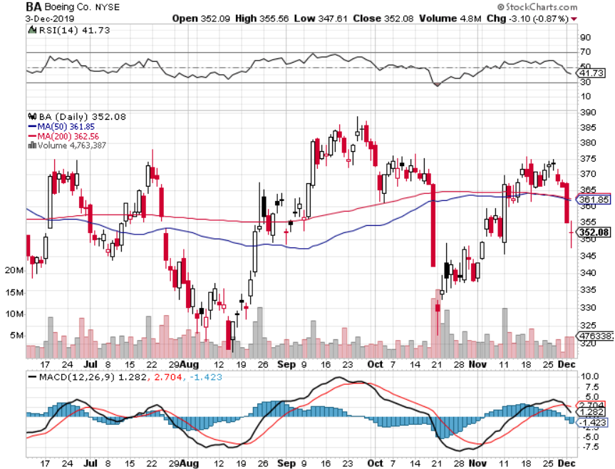
Boeing (BA) – The Bad News is Out 737 MAX flies again in January long 12/$310-$330 call spread – expires in 12 trading days took profits on long 4/$300-$310 call spread took profits on long 4/$315-$335 call spread

Slide 30
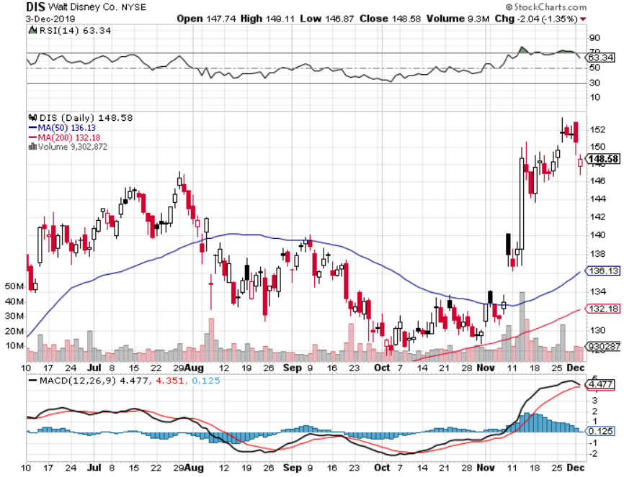
Walt Disney (DIS)- Disney Plus is Open for Business took profits on long 9/$115-$120 call spread 8/$125-$130 call spread expired at max profit Stopped out of 4/$125-$130 call spread for small loss took profits on long 4/$100-$104 call spread

Slide 31
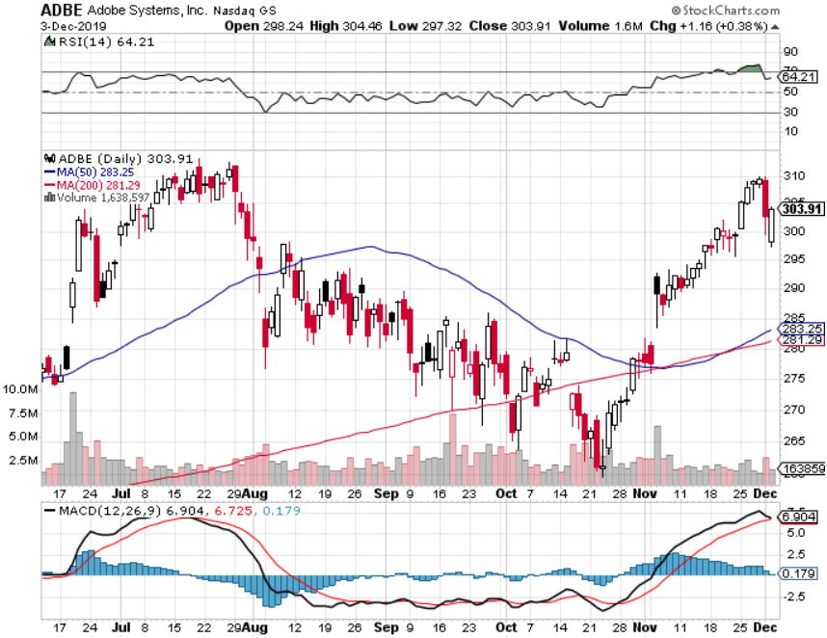
Adobe (ADBE)- The Quality Non-China tech play

Slide 32
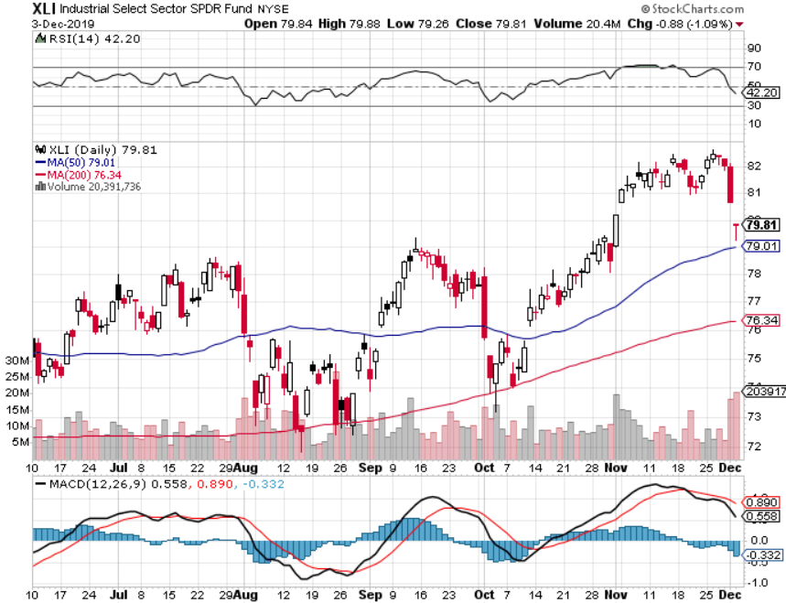
Industrials Sector SPDR (XLI)- (GE), (MMM), (UNP), (UTX), (BA), (HON)

Slide 33
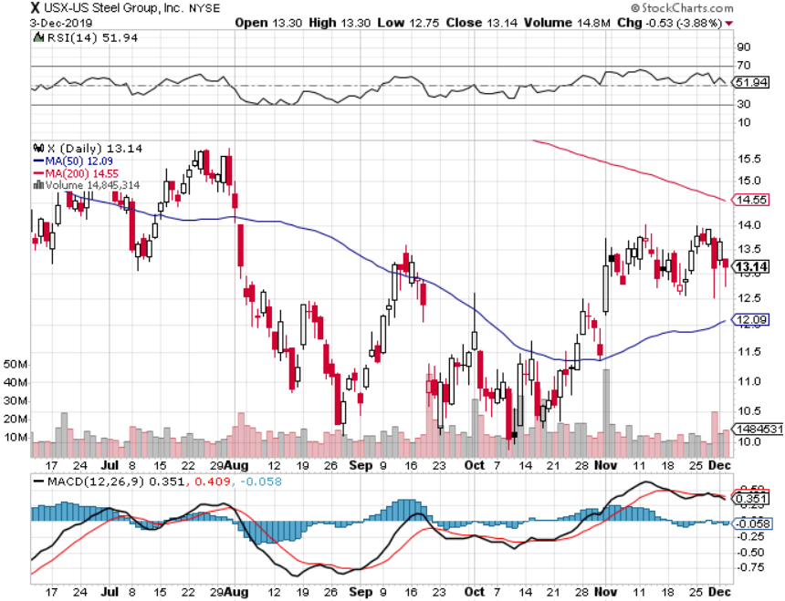
US Steel (X)-Tariffs Trouble

Slide 34
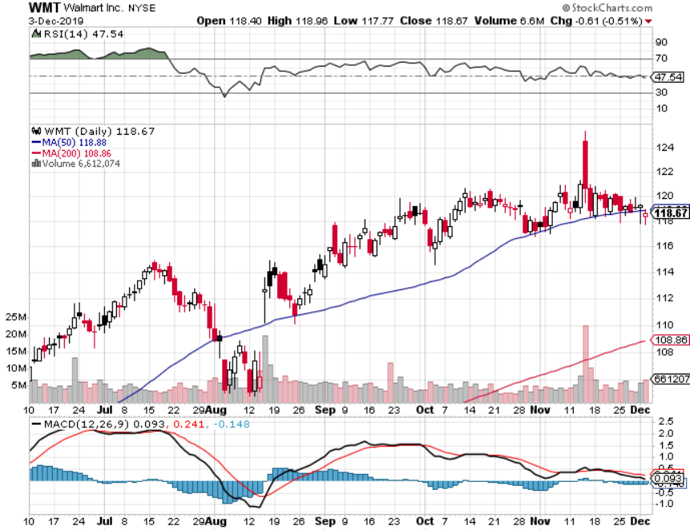
Wal-Mart (WMT)-Tariffs Trouble took profit on Long 11/$125-$130 bear put spread took profit on Long 10/$119-$121 bear put spread took profits on Long 8/$114-$117 bear put spread

Slide 35
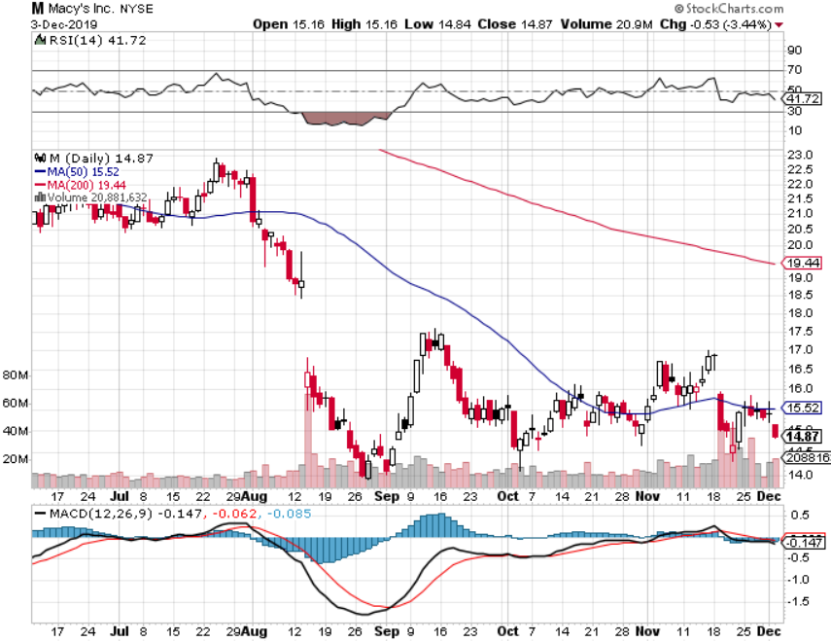
Macys’ (M)-Tariffs Trouble took profits on Long 8/$23-$25 bear put spread

Slide 36
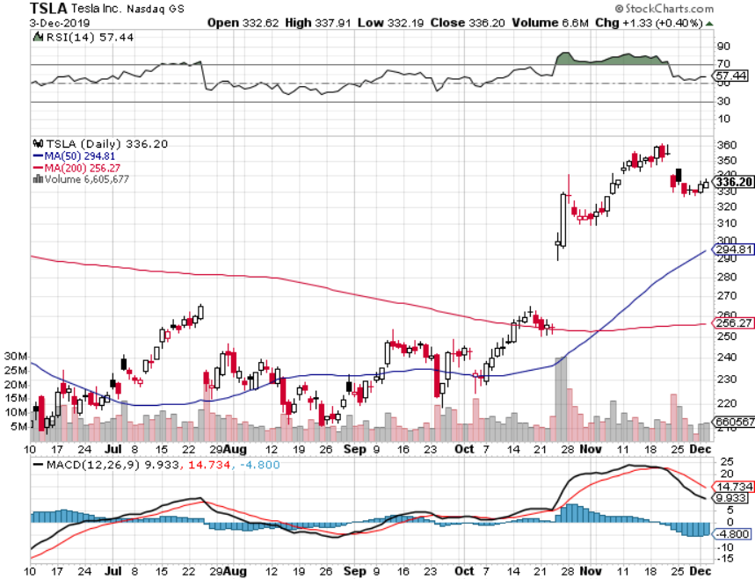
Tesla (TSLA)- 900,000 on the road by yearend fourth factory in Berlin announced, Model Y pickup out next week stopped out of long 6/$260-$270 put spread took profits on long 6/$140-$150 call spread took profits on long 6/$240-$250 put spread

Slide 37
Tesla (TSLA)-10 Year Chart fourth factory in Berlin announced, Model Y pickup out next week stopped out of long 6/$260-$270 put spread took profits on long 6/$140-$150 call spread took profits on long 6/$240-$250 put spread

Slide 38
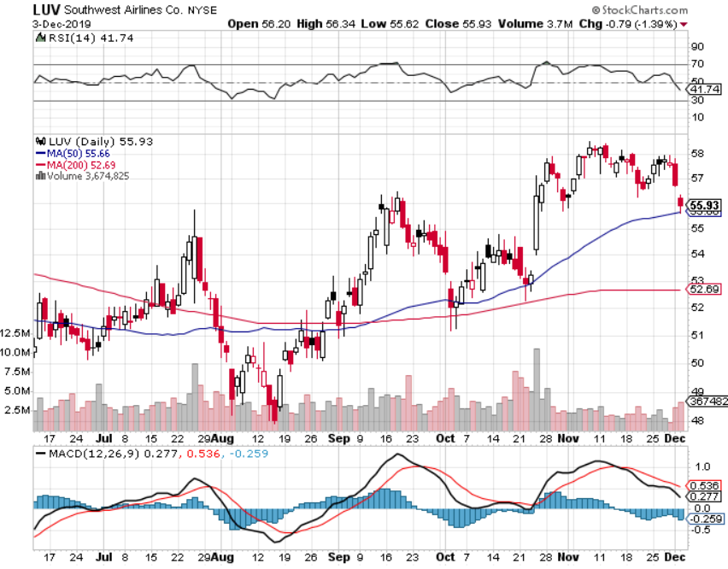
Southwest Airlines (LUV) - Boeing 737 Max biggest buyer

Slide 39
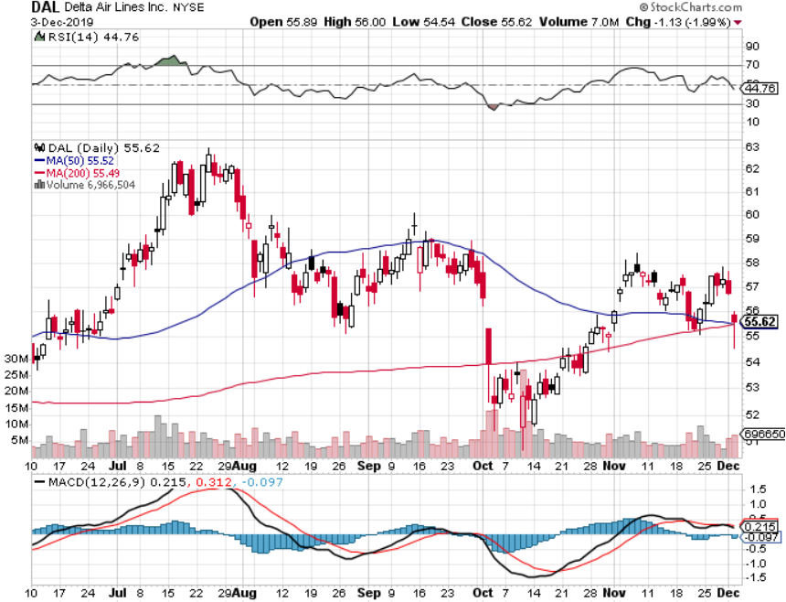
Delta Airlines (DAL) – Non 737 User

Slide 40
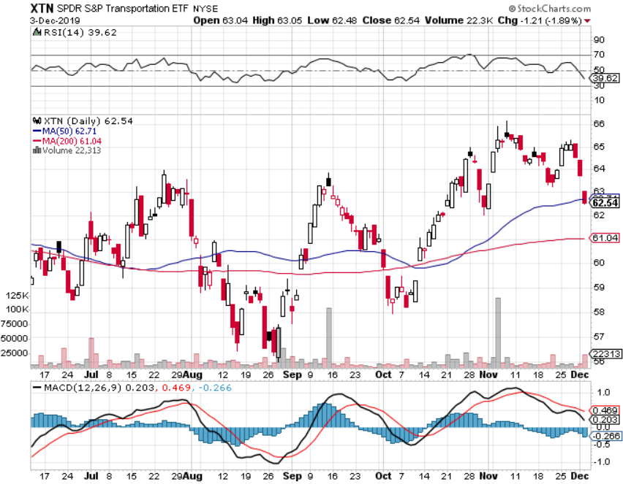
Transports Sector SPDR (XTN)- (ALGT), (ALK), (JBLU), (LUV), (CHRW), (DAL)

Slide 41
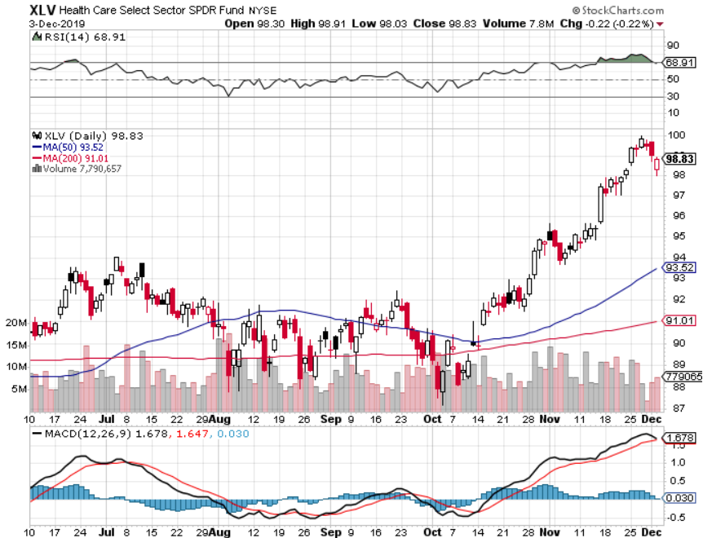
Health Care Sector (XLV), (RXL)-New Highs (JNJ), (PFE), (MRK), (GILD), (ACT), (AMGN)

Slide 42
Amgen (AMGN) First Biotech Letter Trade Alert-up 21% in two months

Slide 43
CRISPR Therapeutics (CRSP) Best Biotech Letter Trade Alert-up 100% in two months

Slide 44
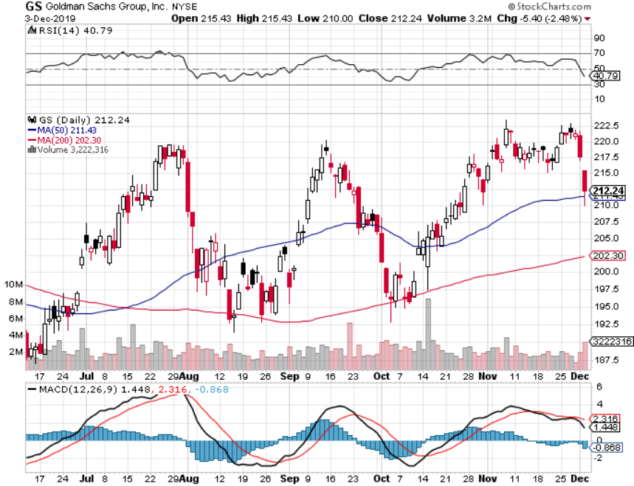
Goldman Sachs (GS)-Top of Range

Slide 45
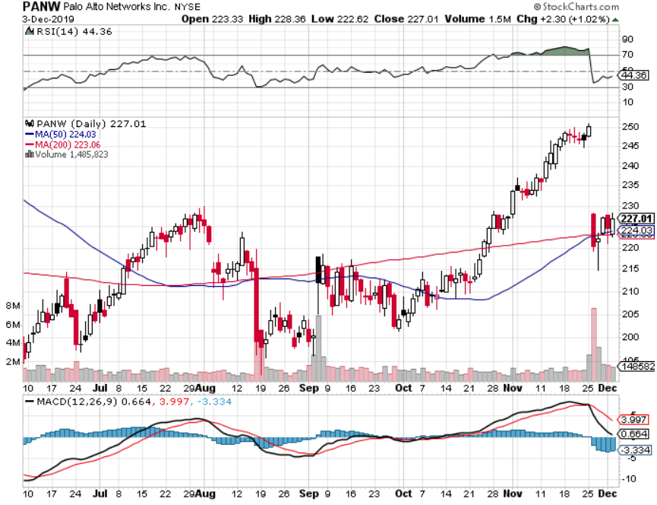
Palo Alto Networks (PANW)- Breakout Hacking never goes out of fashion

Slide 46
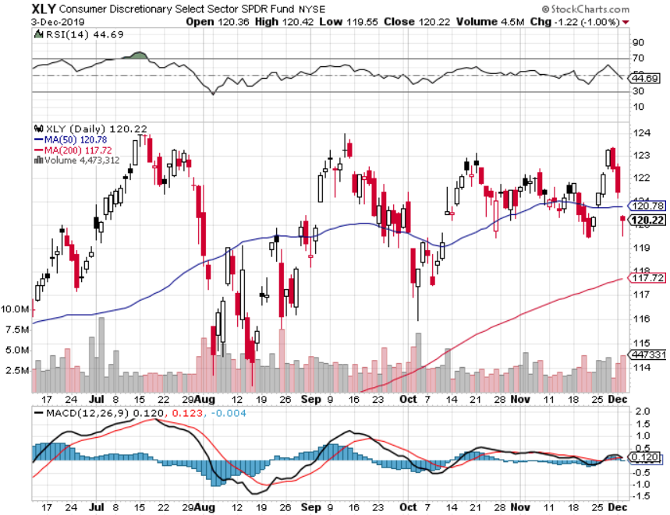
Consumer Discretionary SPDR (XLY) (DIS), (AMZN), (HD), (CMCSA), (MCD), (SBUX)

Slide 47
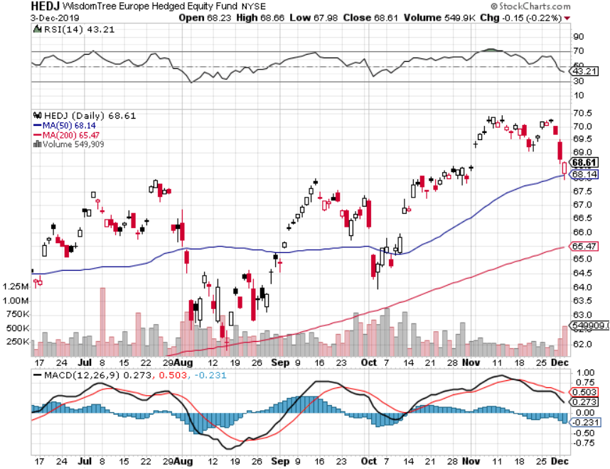
Europe Hedged Equity (HEDJ)- Pip on Brexit News

Slide 48
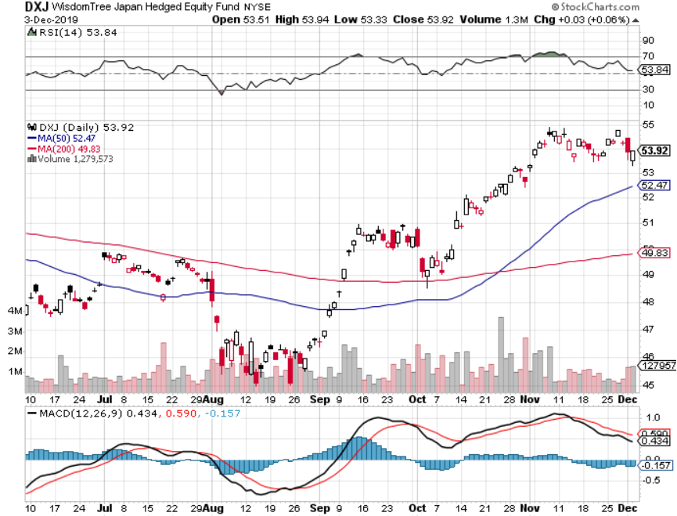
Japan (DXJ)-

Slide 49
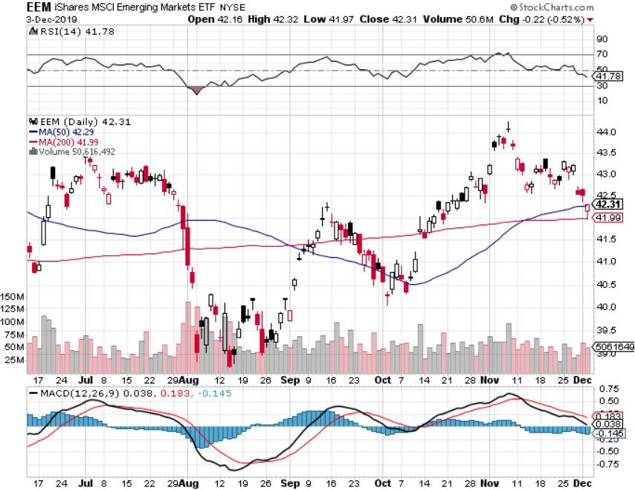
Emerging Markets (EEM)- Weak Dollar Play

Slide 50
Bonds – Home on the Range
*Four-dollar bounce creates a new short side entry point on the back of Trump threats to delay trade talks by a dollar *Global QE 5 is about to unleash another new wave of bond buying *It looks like a 1.44%-2.05% range in yields is in place *Another refi window will open up in a few months *Bottom line: Ten-year US Treasury yields will fall below 1.0% in 2020 to come in line with the rest of the world, then go to zero in the next recession

Slide 51
Treasury ETF (TLT) – Trading the Range long 12/$145-$148 put spread – expires in 12 trading days profits on long 10/$129-$132 call spread stopped out of long 8/$137-$140 put spread took profits on long 8/$125-$128 call spread

Slide 52
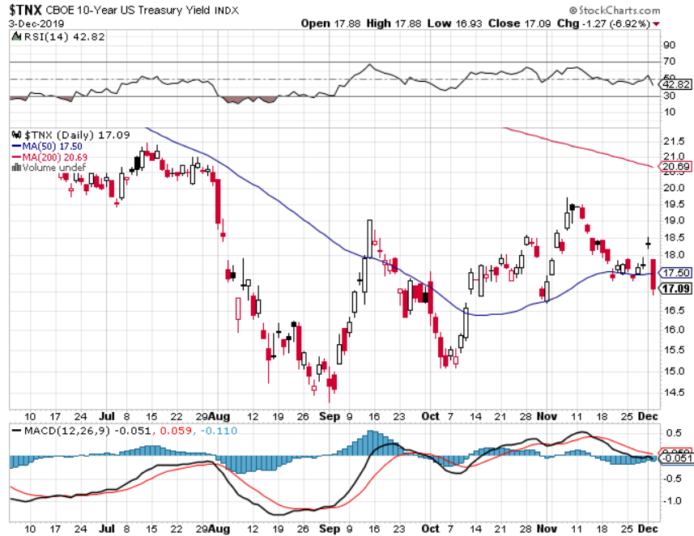
Ten Year Treasury Yield ($TNX) – 1.70%

Slide 53
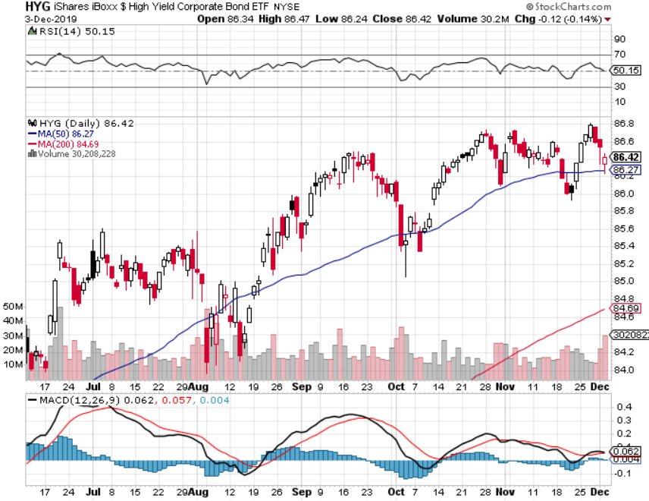
Junk Bonds (HYG) 4.82% Yield big jump in yields on stock selloff and recession fears

Slide 54
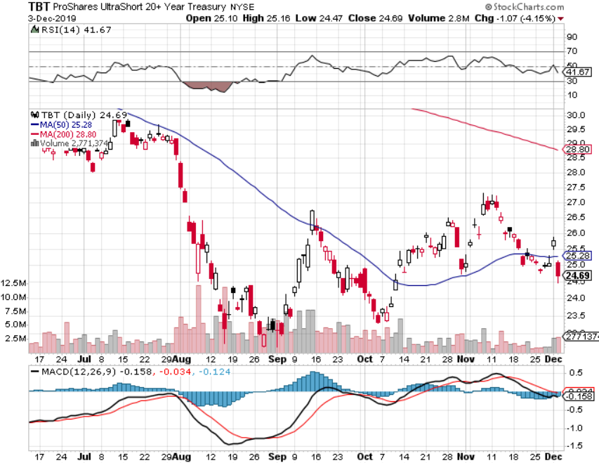
2X Short Treasuries (TBT)- 2 Month Bottoming Process

Slide 55
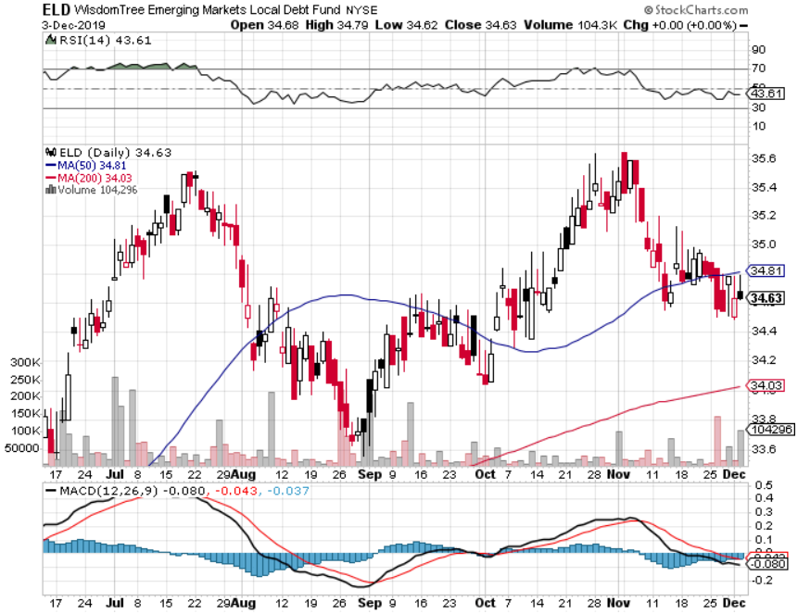
Emerging Market Debt (ELD) 4.78% Yield-

Slide 56
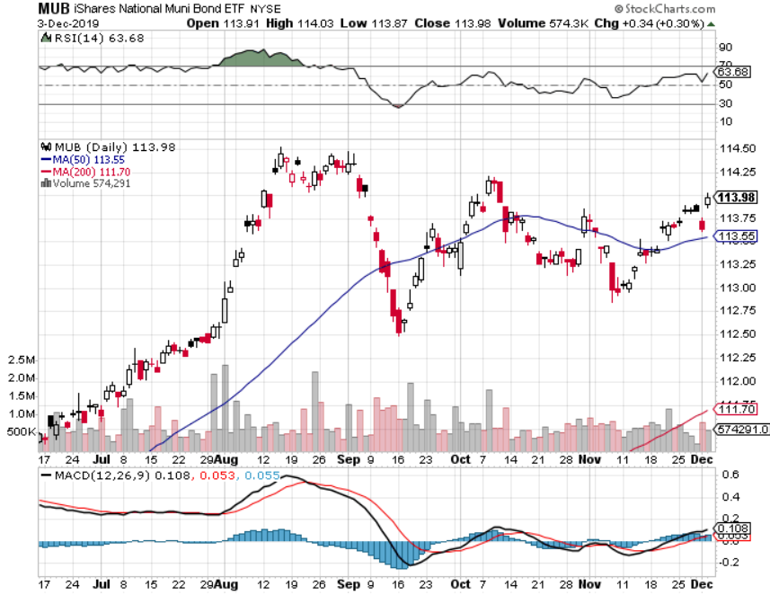
Municipal Bonds (MUB)-1.62% Mix of AAA, AA, and A rated bonds

Slide 57
Foreign Currencies – Trump Dump Hits Dollar too
*Trade fears demolish US dollar *Euro bouncing along a bottom on weak economy *New high on British pound on Boris Johnson weakness in polls *Chinese Yuan stall on trade deadlock *Bitcoin has horrible November, down 3,000 *Aussie jumps on global “RISK ON” *Avoid the FX market for now, there are too many contrary indicators

Slide 58
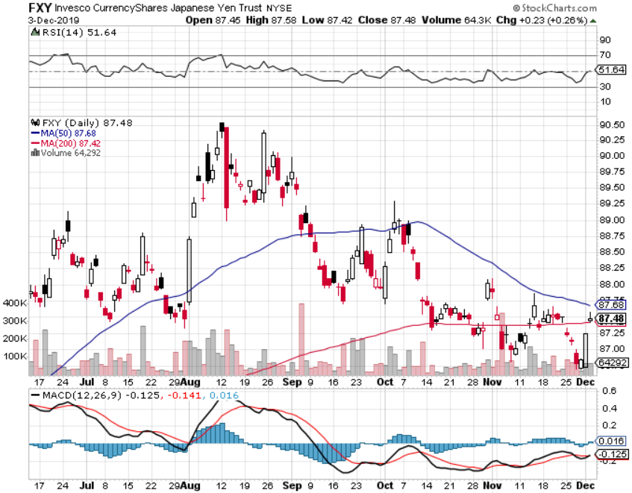
Japanese Yen (FXY), (YCS)

Slide 59
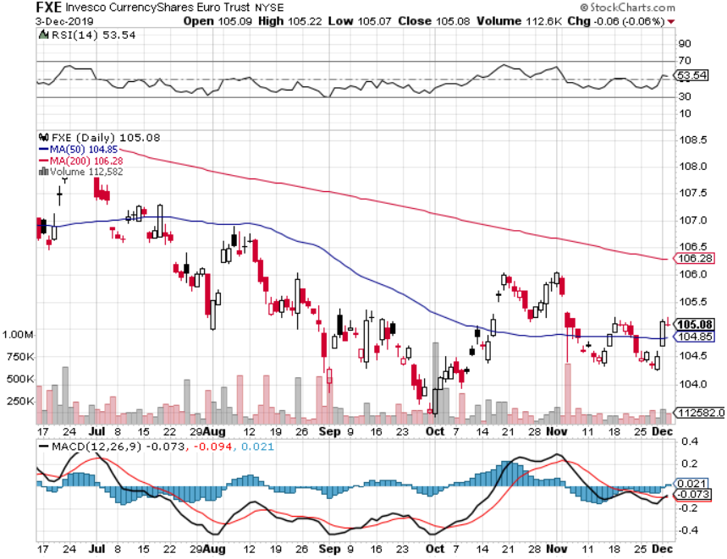
Euro ($XEU), (FXE), (EUO)-

Slide 60
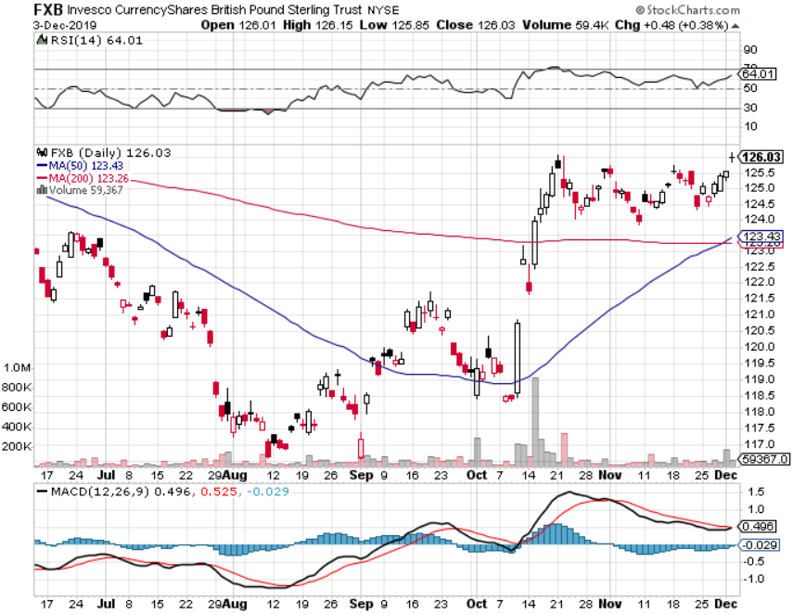
British Pound (FXB)-

Slide 61
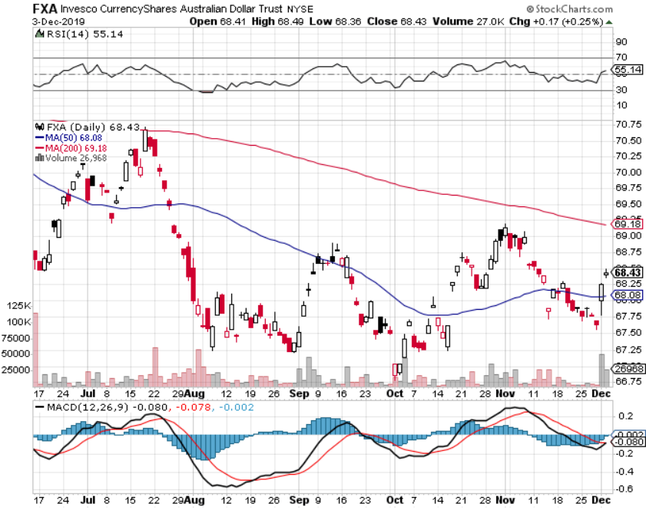
Australian Dollar (FXA)- The Global Recovery Play took profits on long 8/$67-$69 call spread

Slide 62
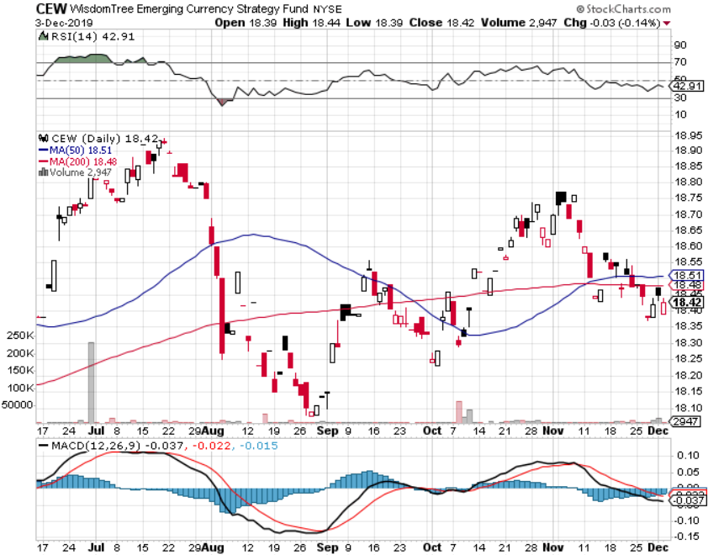
Emerging Market Currencies (CEW)

Slide 63
Chinese Yuan- (CYB)- New Lows

Slide 64
Bitcoin- 40% Rally

Slide 65
Energy –
*All Eyes on OPEC+ meeting in Vienna Next week *Without substantial production cuts a huge glut of oil is developing next year off the back of slowing global economy *Over supply against fading demand will last for years *Saudi Arabia will do anything possible to keep oil high going into the ARAMCO pricing, potentially setting up one of the greatest shorts of all time *Energy still the most unloved sector in the stock market *Avoid all energy plays like the plague, could drop by half in the coming recession *Bottom Line: looks like $42 a barrel is in the cards, more later

Slide 66
Oil-($WTIC)

Slide 67
United States Oil Fund (USO) long 10/$9.50-$10 Vertical bull call spread

Slide 68
Energy Select Sector SPDR (XLE)-No Performance! (XOM), (CVX), (SLB), (KMI), (EOG), (COP)

Slide 69
Halliburton (HAL)-

Slide 70
Natural Gas (UNG) -

Slide 71
Precious Metals – Taking a Break
*Who is the Mystery Gold Buyer? Someone made a massive bet in the options market that gold will rise above $4,000 an ounce in 18 months. It would take a 32% move just to get gold back to its old $1,927 high. If the trade war continues we may get it *Gold breaks all support on global “RISK ON” *”RISK ON” means ”SELL GOLD” *Backing the recession risk out also dumps flight to safety trades *We still think gold has a future, I’m just waiting for a bigger capitulation selloff *Bottom Line: buy a bigger dip in gold and precious metals

Slide 72
Gold (GLD)- Short Term downtrend
support

Slide 73
Market Vectors Gold Miners ETF- (GDX) – Yikes!

Slide 74
Barrick Gold (GOLD)

Slide 75
Newmont Mining- (NEM)-

Slide 76
Silver- (SLV)-

Slide 77
Silver Miners - (SIL)-

Slide 78
Wheaton Precious Metals - (WPM)-

Slide 79
Copper (COPX)-Collapse Trade War Disaster

Slide 80
Freeport McMoRan (FCX)-World’s Largest Copper Producer took profits on long 4/$10-$11 call spread took profits on short 4/$114 calls

Slide 81
Real Estate – Bubbling Away
*Housing Starts up 4%, in October to a seasonally adjusted 1.314 million rate. Permits were up 5%, the highest in 12 years *Existing Home Sales up 1.9%, 3.75% 30-year rates stabilizing demand *New Home Sales Drop 0.7%, in October, but are still up a massive 31.6% YOY S&P Case Shiller Rose 3.2%, in September, the third consecutive month of price increases. Only San Francisco is showing falling prices.

Slide 82
February Corelogic S&P Case Shiller Home Price Index Phoenix (6.0%), Charlotte, NC (4.6%), and Tampa (4.5%) showing biggest gains
Tradingeconomics.com

Slide 83
Simon Property Group (SPG)- Mall REIT

Slide 84
American Tower (AMT) – 1.75% Yield-Cell Phone Tower REIT

Slide 85
US Home Construction Index (ITB) (DHI), (LEN), (PHM), (TOL), (NVR)

Slide 86
Trade Sheet- So What Do We Do About All This?
*Stocks-buy bigger dip *Bonds-sell rallies *Commodities-buy bigger dip *Currencies- stand aside *Precious Metals – stand aside *Energy – sell rallies *Volatility-buy dips *Real estate-stand aside

Slide 87
Next Strategy Webinar 12:00 EST Wednesday, December 18, from Lake Tahoe, NV last strategy webinar of the year! email me at support@madhedgefundtrader.com
Good Luck and Good Trading!
Notes:
*

