Slide 1
The Mad Hedge Fund Trader “The Bubble is On”
With John Thomas from Silicon Valley, CA, December 18, 2019 www.madhedgefundtrader.com
Notes:
*

Slide 3
Trade Alert Performance New Highs Again!
*January 9.49% Final *July +3.07% Final *February +4.64% Final *August +16.01% Final *March +1.78% Final *September 3.08% Final *April +0.30% Final *October +12.13% Final *May +0.25% Final *November -1.26% Final *June -0.50% Final *December +5.16% MTD *2019 Year to Date +55.86% compared to +20.8% for the Dow Average *+356.10% since inception, *Average annualized return of 35.60% for 10 years

Slide 4
Portfolio Review Keeping Small Positions-80% cash, 20% stocks Only Buying Very Deep in-the-Money Call Spreads on Capitulation Days
Current Capital at Risk
Risk On
World is Getting Better
(MSFT) 12/$134-$137 call spread | 10.00%
(SPY) 12/$297-$302 call spread | 10.00%
Risk Off
World is Getting Worse
No Positions | 0.00%
Total Net Position | 20.00%
Expiration P&L 55.58% YTD

Slide 5
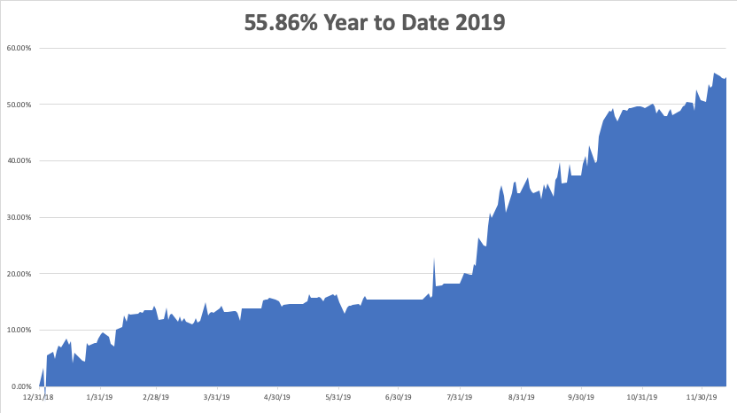

Slide 6
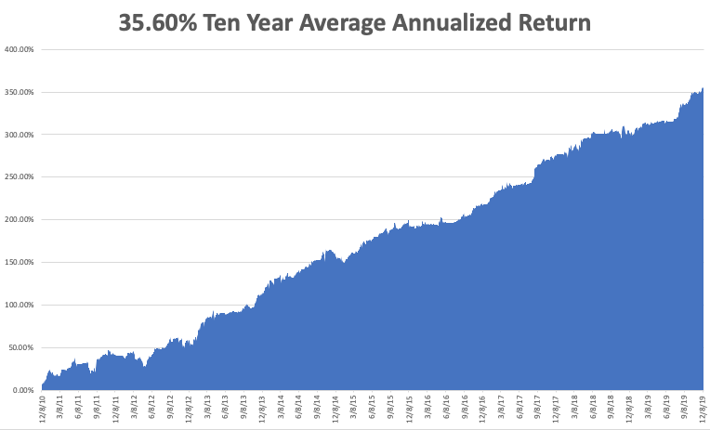
GTD 10 Year Daily Audited Performance

Slide 7
The Method to My Madness
*Don’t fight the Fed. Global liquidity is flooding into the US stock market *If it continues, we’re looking for a 20% selloff, but it won’t happen until 2020 *Trump cancels December 15 tariff increases, eking out more new all-time highs and calling it a great victory *Bonds dead in the water *Value stocks like industrials, banks, and commodities may continue until yearend *Exploding deficits finally becoming a factor with the dollar and US bonds *Three years of performance are piling into one

Slide 9
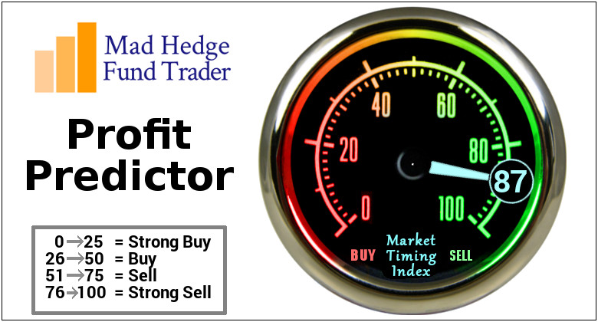
The Mad Hedge Profit Predictor Market Timing Index-Top of Range-Close to a “SELL” An artificial intelligence driven algorithm that analyzes 30 different economic, technical, and momentum driven indicators

Slide 10
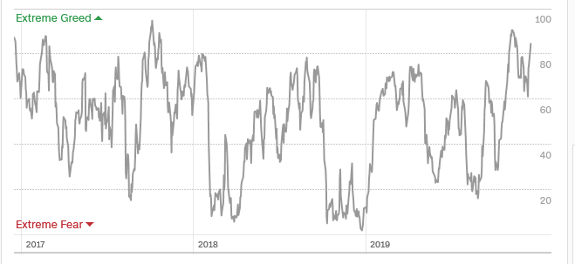
The Mad Hedge Profit Predictor From Extreme Overbought to Almost Neutral
SELL
BUY

Slide 11
The Global Economy – Looking for Legs
*Nonfarm Payroll Blows it Away, with a 266,000 report for November, a ten-month high. Inflation Heats Up, triggering a major move up in the bond market. The Consumer Price Index was up 0.3% following a red hot 0.4% rise in October. *ISM Non-Manufacturing Index Disappoints, coming in at 53.9 versus and expected 54.5 *NAFTA 2.0 is Signed with Mexico and Canada, China trade deal lite is announced *Brexit win says “RISK ON” for all things British, dragging Europe up as well *Chinese Copper Purchases Hit 13 Month High, up 12.1% in November, to 483,000 metric tonnes *European Growth Plummets, from 2.2% to 1.4% in Q3

Slide 12
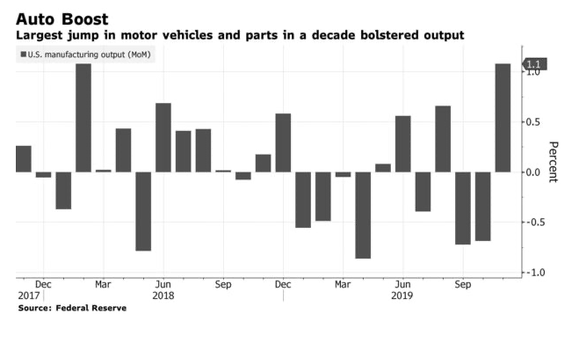

Slide 13
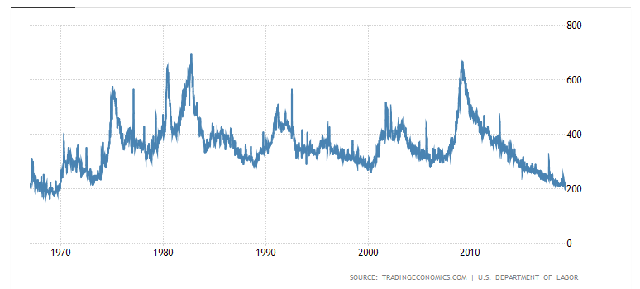
Weekly Jobless Claims-Bottomed Out +49,000 to 252,000

Slide 14
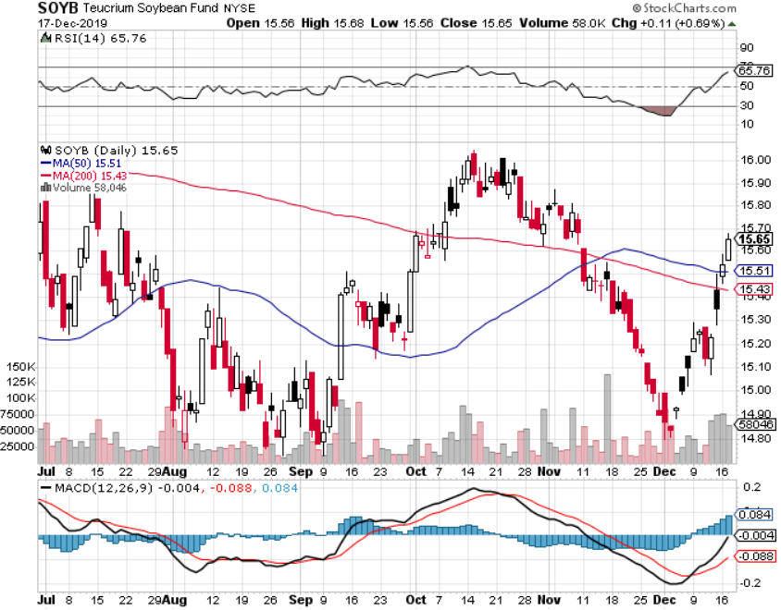
Soybeans - Trade War Indicator Didn’t Like the Trade Deal Delay

Slide 15
The Bill Davis View A $1,500 Upgrade for the Mad Day Trader Service
Buys: | Entry | Target
TopBuild Corp (BLD) | $ 105.00 | $ 120.00
Gartner Group, Inc. (IT) | $ 148.00 | $ 160.00
Guidewire Software (GWRE) | $ 100.00 | $ 120.00
Dillards Inc. (DDS) | $ 66.00 | $ 82.00
Beazer Homes (BZH) | $ 14.80 | $ 18.00
Sells:
Check Point Software(CHKP)-X | $ 112.00 | $ 105.00
ZenDesk Inc (ZEN) | $ 78.00 | $ 62.00
Xilinx, Inc. (XLNX) | $ 98.00 | $ 86.00
Autohome, Inc.(ATHM) | $ 86.00 | $ 65.00
Nutanix, Inc. (NTNX) | $ 34.00 | $ 22.00

Slide 16
Stocks – Melt Up
*Massive Fed created liquidity causes stocks to melt up *Could continue until yearend as stockholders seek to defer gains until 2020, thus postponing tax bills by 12 months, but cause a stock shortage *Risk is rocketing as price earnings multiples approach 20-year highs at 20X *Biggest gains in the biggest losers to September, like banks and industrials *Continue to focus on big tech, the market leaders *End 2020 targets could get hit in the next two weeks, then what? *Bottom line: Marginal new high in Q1, then 20% selloff on fears of Democratic election win *Bottom Line: its bet the ranch time on tech longs, but stay away from those with big China exposure, like Apple, and weak dollar plays like energy, and emerging markets

Slide 17
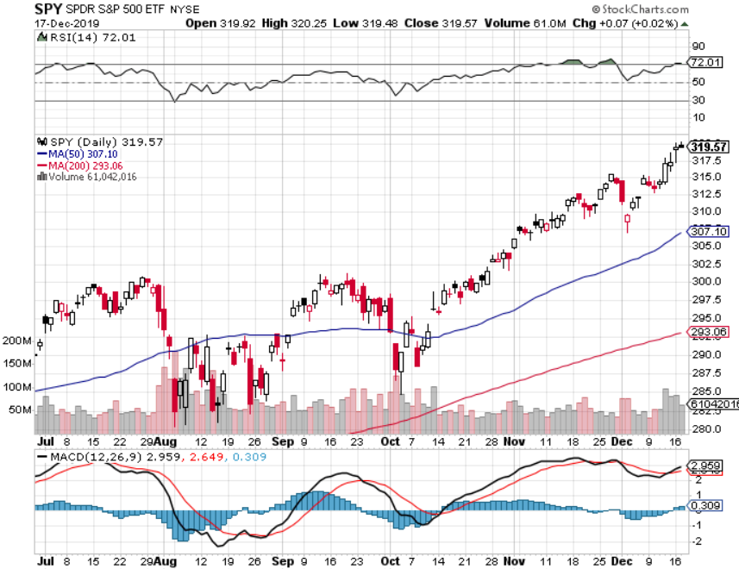
S&P 500 – Snacked Down long 8/$297-$302 bull call spread – expires in 2 trading days took profits on long 10/$305-$310 bear put spread took profits on long 10/$270-$275 bull call spread took profits on long 10/$300-$305 bear put spread took profits on long 8/$305-$308 bear put spread

Slide 18
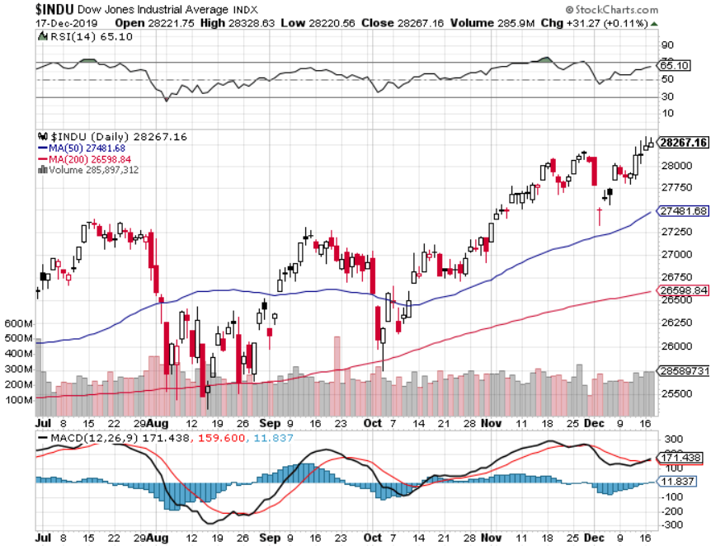
Dow Average ($INDU)- Retest

Slide 19
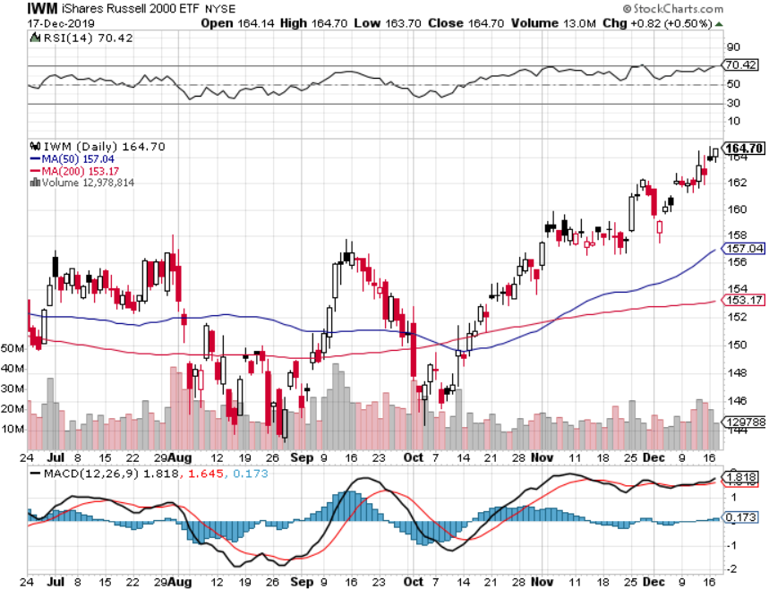
Russell 2000 (IWM)- Brief Breakout took profits on Long 10/$137-$142 vertical bull call spread took profits on Long 10/$153-$156 vertical bear put spread

Slide 20
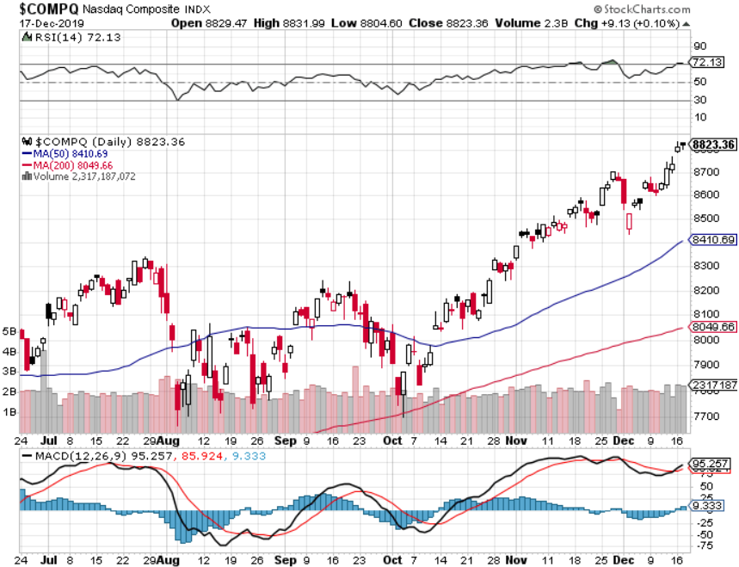
NASDAQ ($COMPQ) – Profit Taking

Slide 21
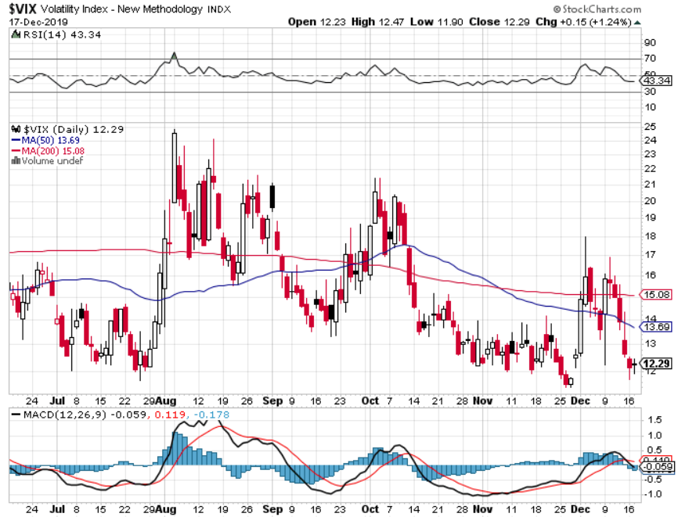
(VIX)-Panic Dump

Slide 22
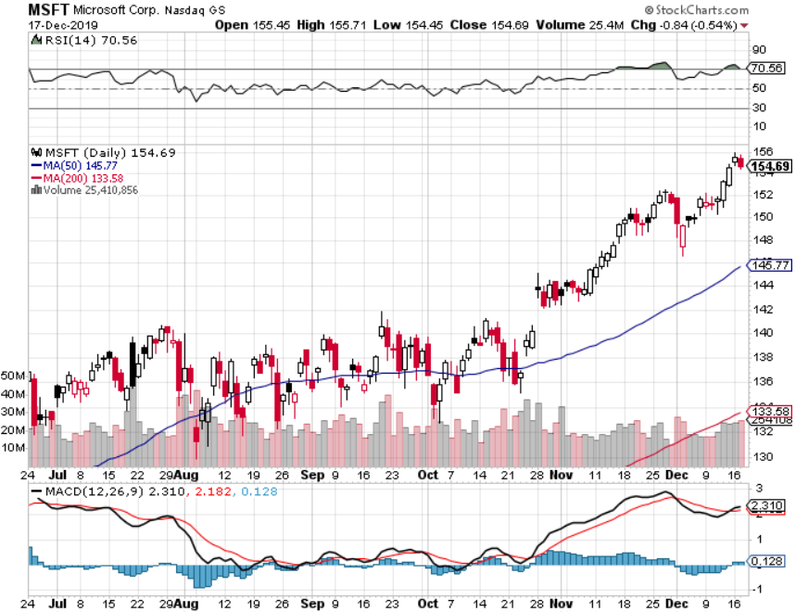
Microsoft (MSFT)- Earnings beat- Looking for Another Entry Point long 12/$135-$138 call spread – expires in 2 days took profits on long 9/$115-$120 call spread took profits on long 6/$110-$115 call spread took profits on long 4/$108-$113 call spread

Slide 23
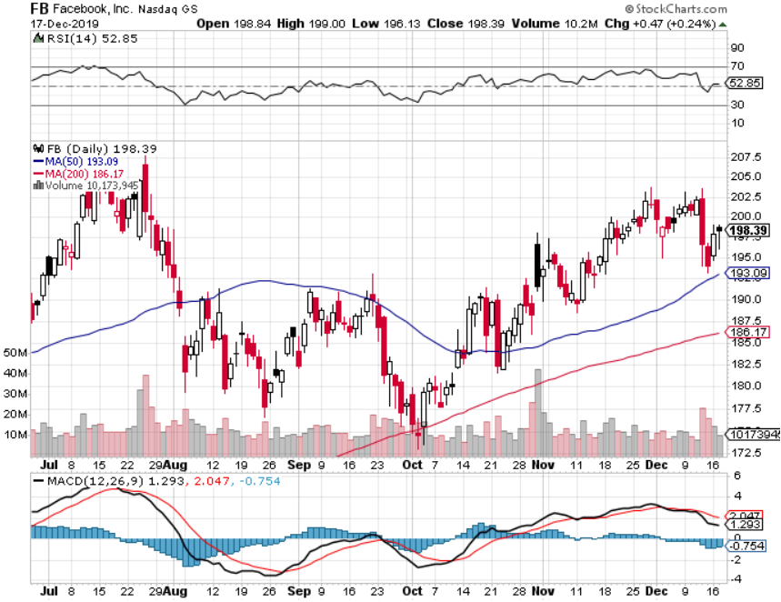
Facebook (FB)- Breaking Out took profits on Long 9/$150-$160 vertical bull call spread took profits on Long 8/$167.50-$172.50 vertical bull call spread

Slide 24
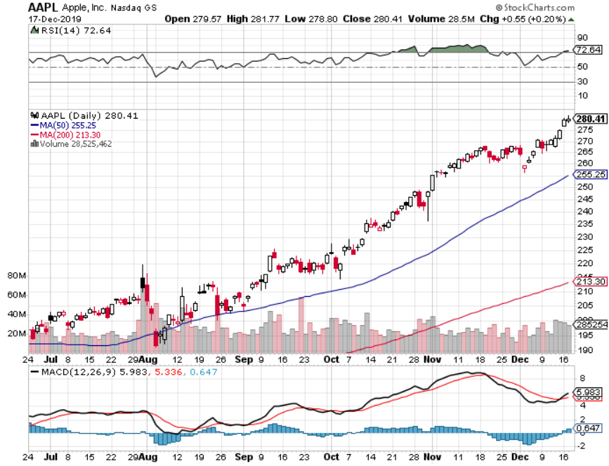
Apple (AAPL)-New All Time High as Services Soar Approaching 20X multiple, up from 7X

Slide 25
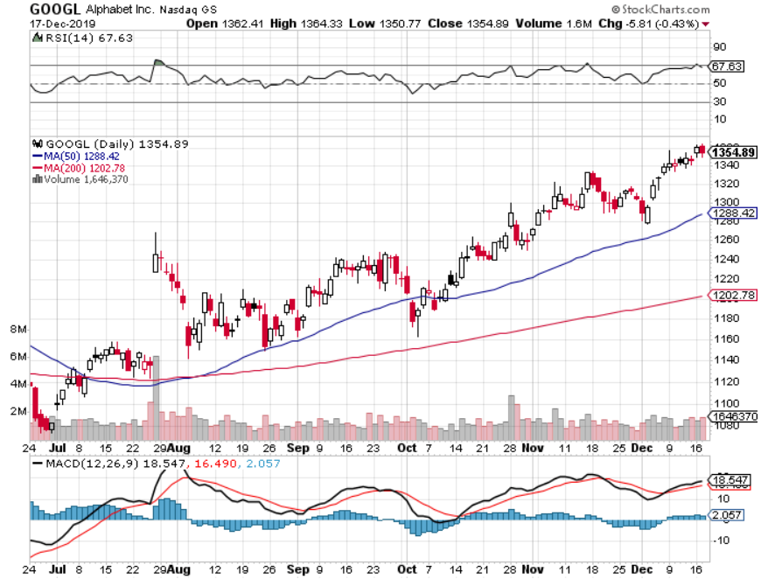
Alphabet (GOOGL) – Co-Founders retires long 12/$1,200-$1,230 bull call spread – expires in 2 days took profits on long 9/$1,030-$1,080 vertical bull call spread stopped out of long 5/$1,100-$1,130 bull call spread took profits on long 4/$1,080-$1,120 bull call spread

Slide 26
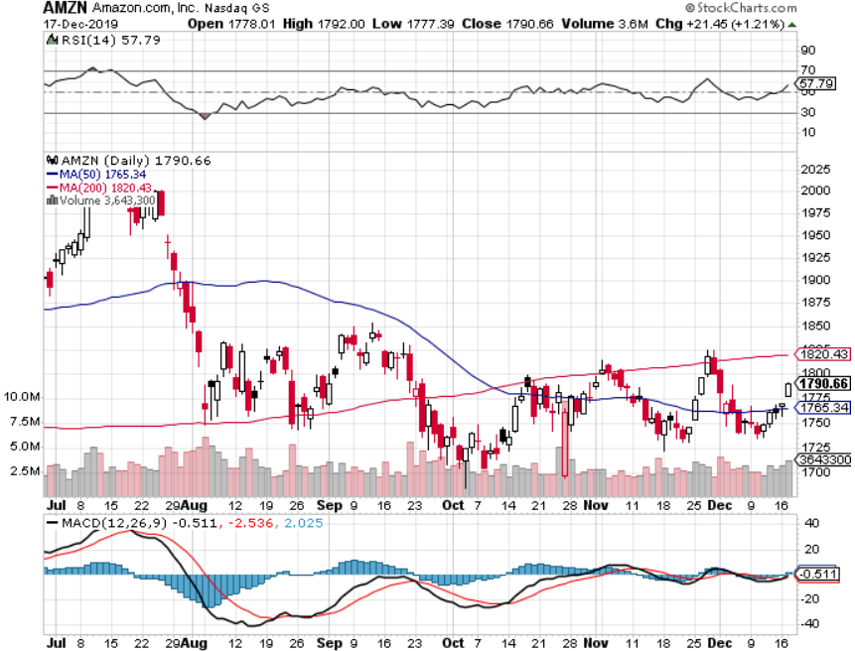
Amazon (AMZN) – Terrible Guidance – Retail hex took profits on 9/$1,500-$1,500 vertical bull call spread stopped out of long 4/$1,650-$1,700 call spread took profits on long 4/$1,600-$1,650 call spread took profits on long 2/$1,200-$1,300 call spread

Slide 27
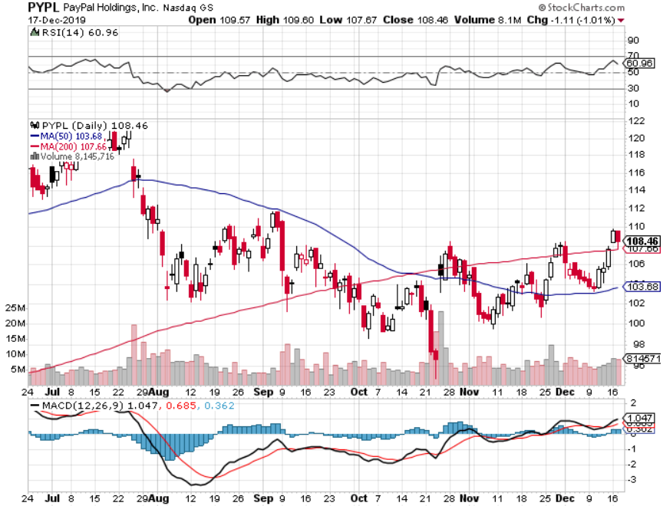
PayPal (PYPL)-CEO resigns took profits on long 4/$90-$95 call spread

Slide 28
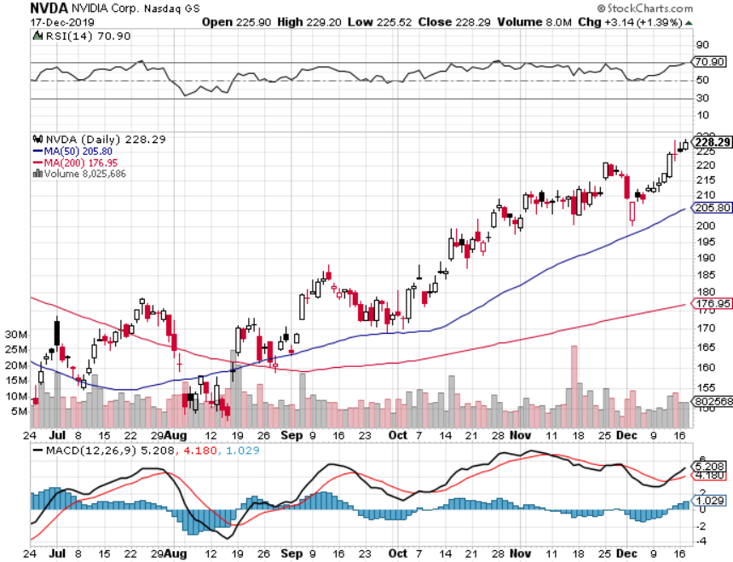
NVIDIA (NVDA) – Off to the Races

Slide 29
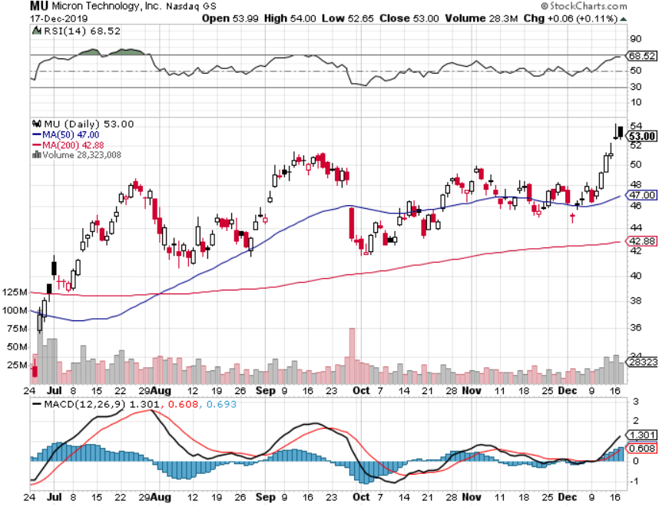
Micron Technology (MU)-

Slide 30
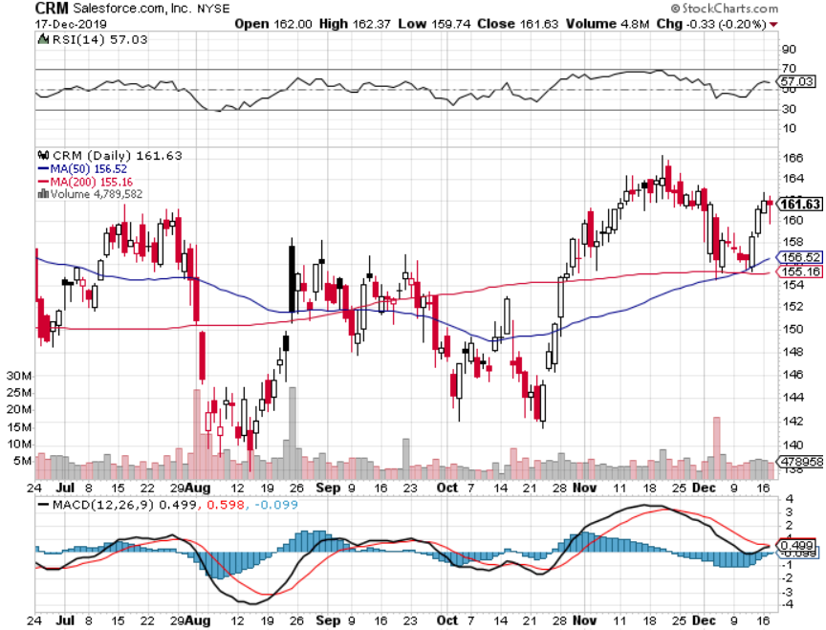
Salesforce (CRM)- Great earnings report took profits on long 9/$125-$130 vertical bull call spread took profits on long 8/$125-$130 vertical bull call spread took profits on long 2/$105-$115 call spread

Slide 31
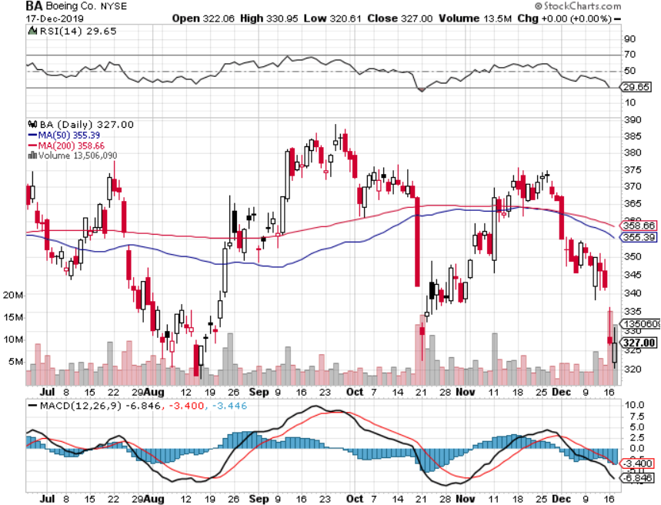
Boeing (BA) – The Bad News Keeps Coming 737 MAX production shutdown took profits on long 12/$310-$330 call spread took profits on long 4/$300-$310 call spread took profits on long 4/$315-$335 call spread

Slide 32
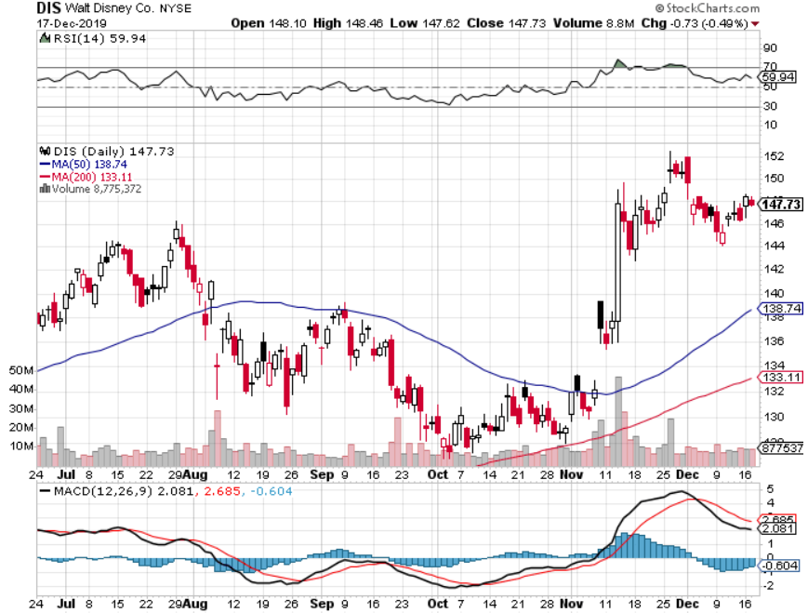
Walt Disney (DIS)- Disney Plus is Open for Business took profits on long 9/$115-$120 call spread 8/$125-$130 call spread expired at max profit Stopped out of 4/$125-$130 call spread for small loss took profits on long 4/$100-$104 call spread

Slide 33
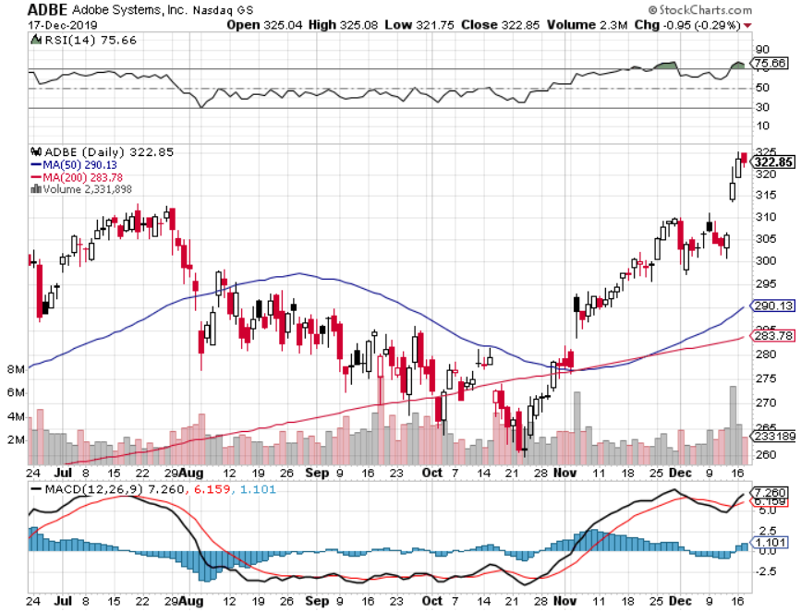
Adobe (ADBE)- The Quality Non-China tech play

Slide 34
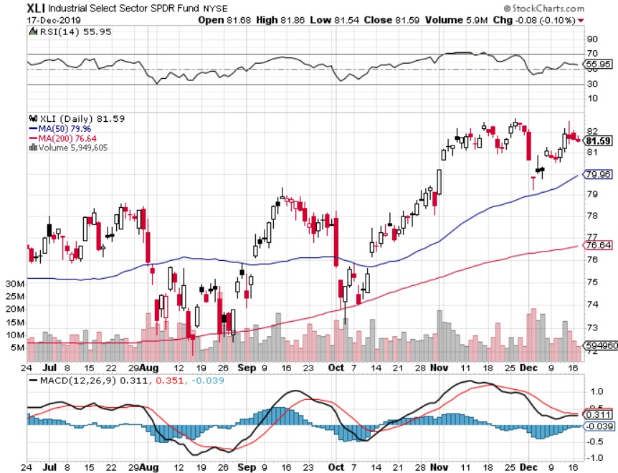
Industrials Sector SPDR (XLI)- (GE), (MMM), (UNP), (UTX), (BA), (HON)

Slide 35
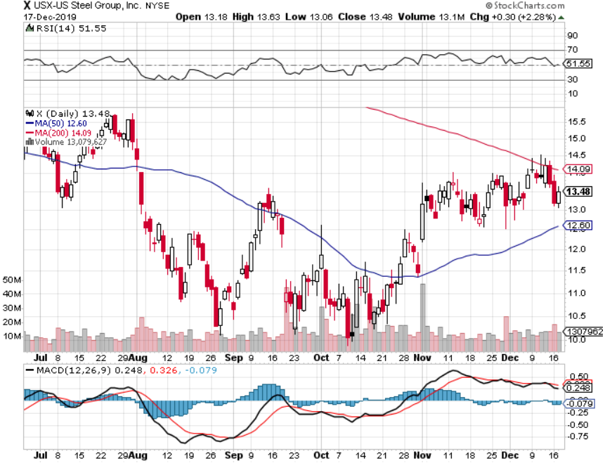
US Steel (X)-Tariffs Trouble

Slide 36
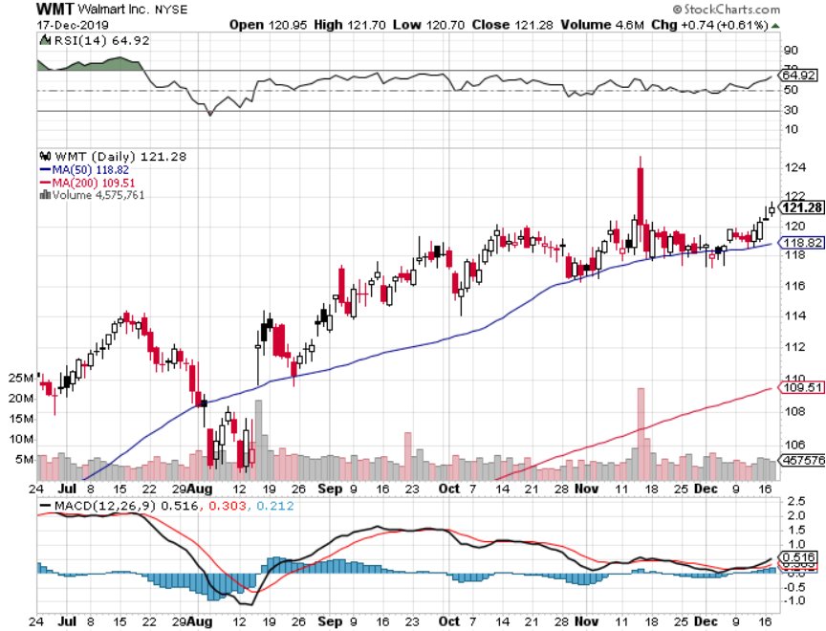
Wal-Mart (WMT)-Tariffs Trouble took profit on Long 11/$125-$130 bear put spread took profit on Long 10/$119-$121 bear put spread took profits on Long 8/$114-$117 bear put spread

Slide 37
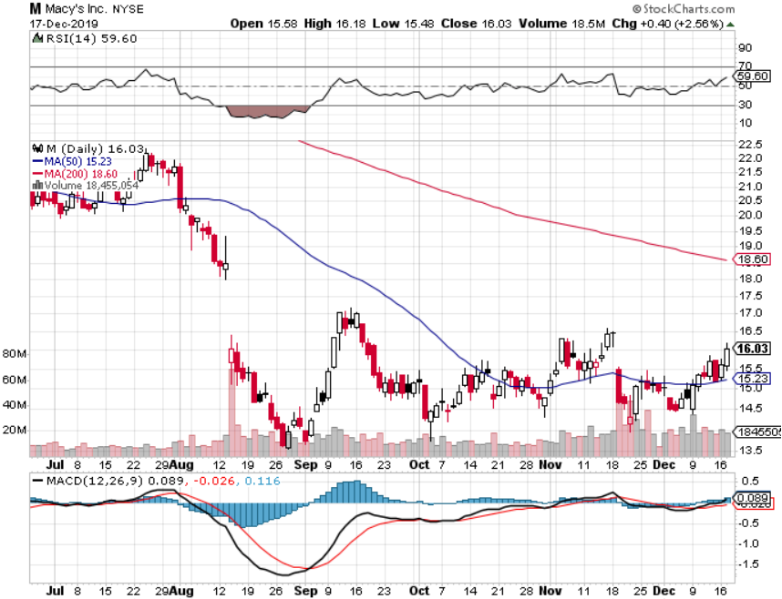
Macys’ (M)-Tariffs Trouble took profits on Long 8/$23-$25 bear put spread

Slide 38
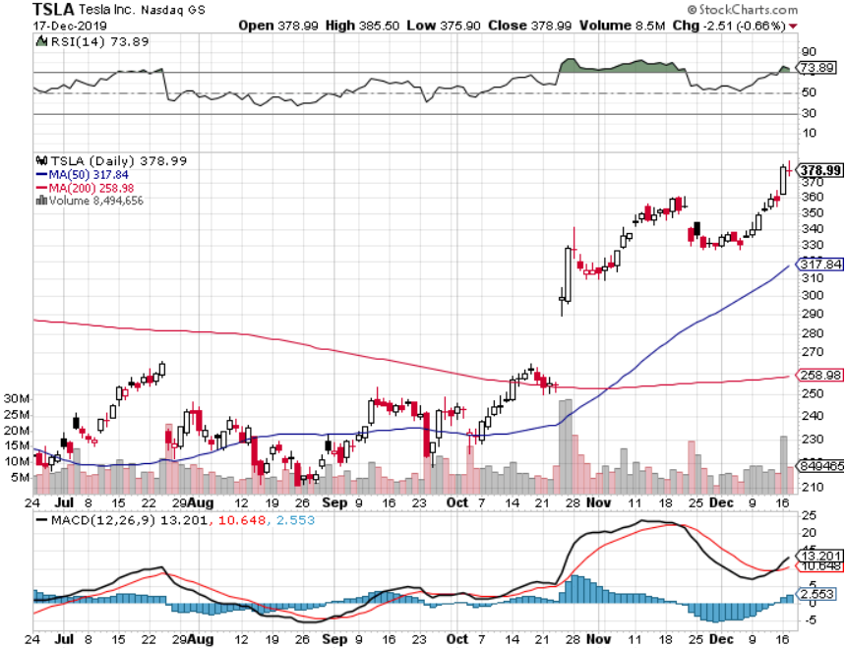
Tesla (TSLA)- 900,000 on the road by yearend fourth factory in Berlin announced, Model Y pickup out next week stopped out of long 6/$260-$270 put spread took profits on long 6/$140-$150 call spread took profits on long 6/$240-$250 put spread

Slide 39
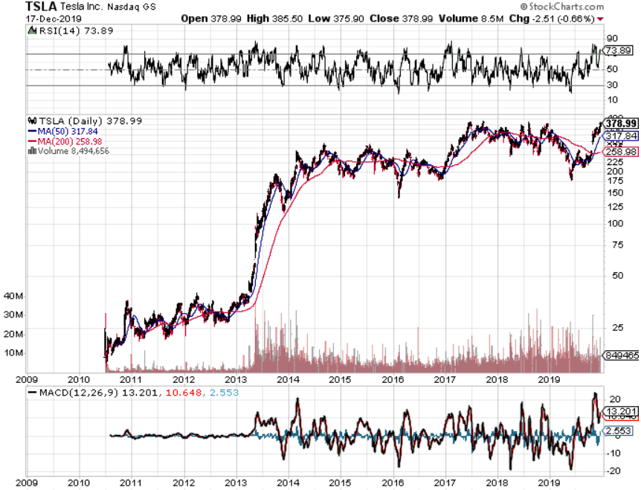
Tesla (TSLA)-10 Year Chart fourth factory in Berlin announced, Model Y pickup out next week stopped out of long 6/$260-$270 put spread took profits on long 6/$140-$150 call spread took profits on long 6/$240-$250 put spread

Slide 40
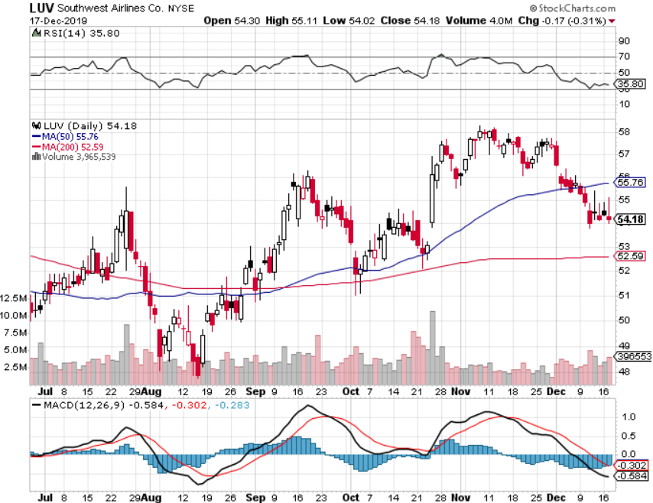
Southwest Airlines (LUV) - Boeing 737 Max biggest buyer

Slide 41
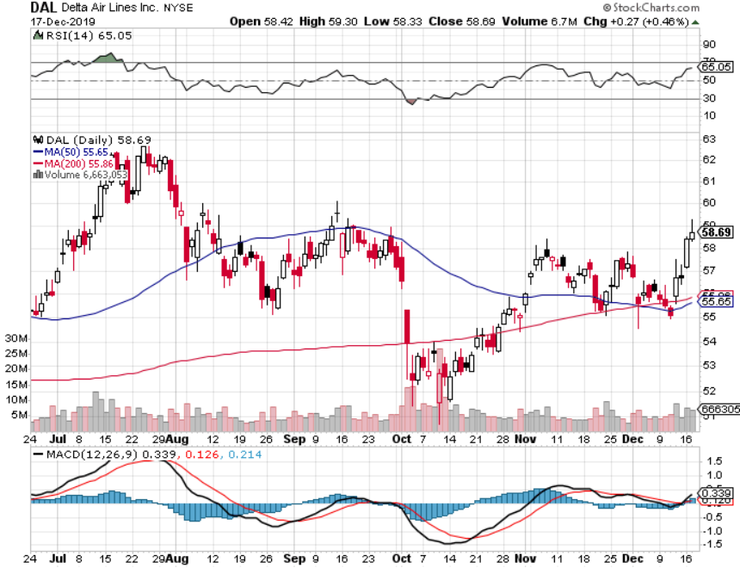
Delta Airlines (DAL) – Non 737 User

Slide 42
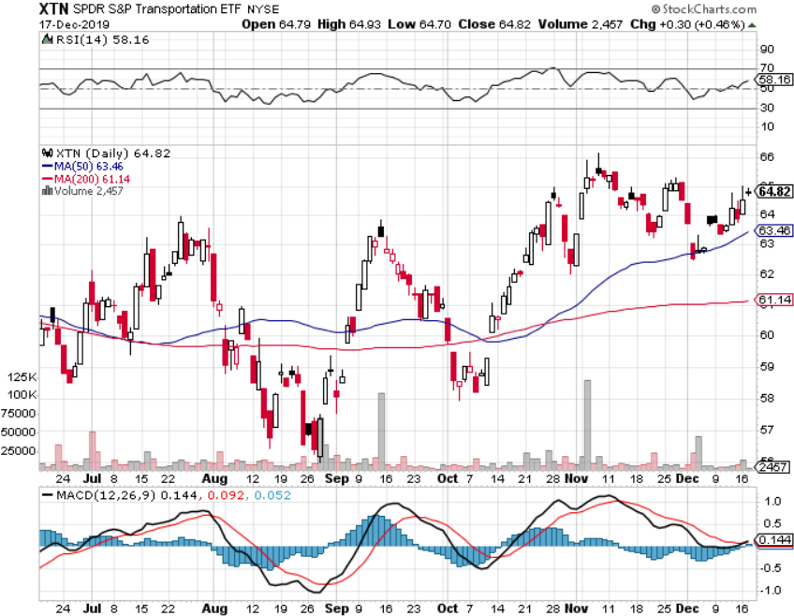
Transports Sector SPDR (XTN)- (ALGT), (ALK), (JBLU), (LUV), (CHRW), (DAL)

Slide 43
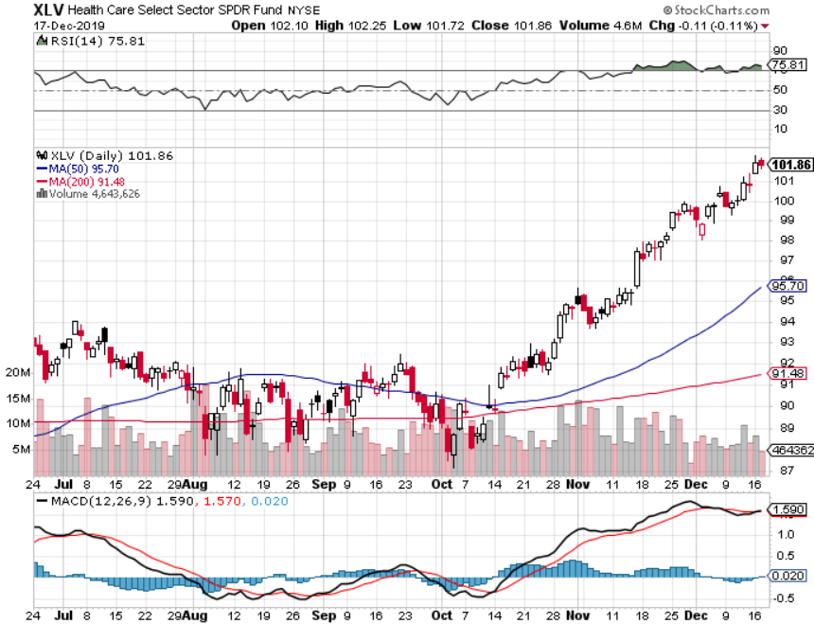
Health Care Sector (XLV), (RXL)-New Highs (JNJ), (PFE), (MRK), (GILD), (ACT), (AMGN)

Slide 44
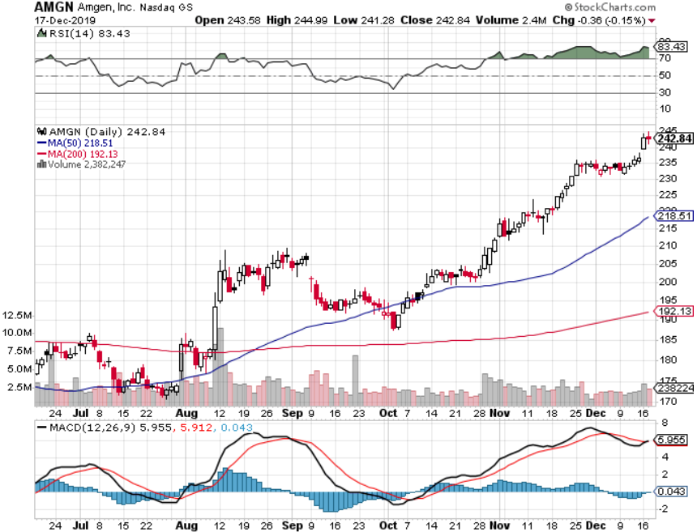
Amgen (AMGN) First Biotech Letter Trade Alert-up 21% in two months

Slide 45
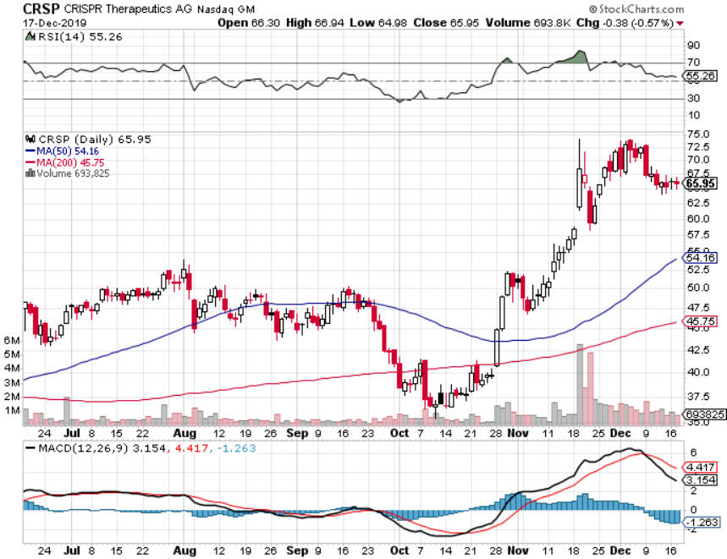
CRISPR Therapeutics (CRSP) Best Biotech Letter Trade Alert-up 100% in two months

Slide 46
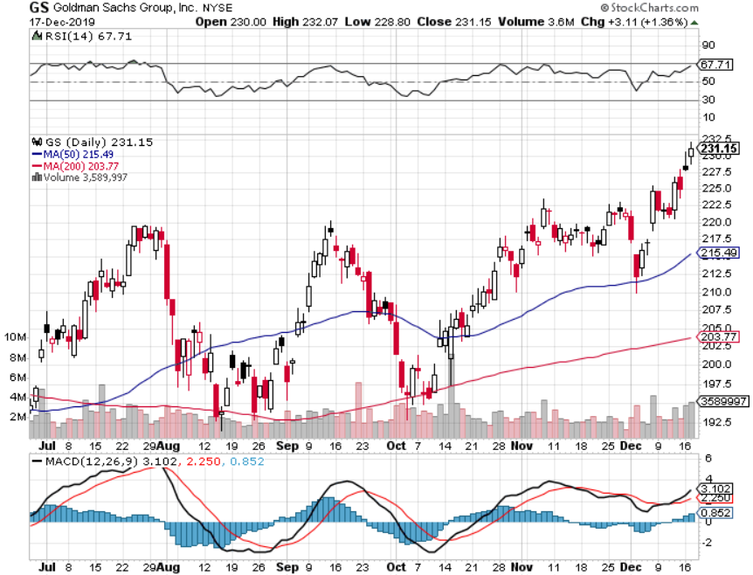
Goldman Sachs (GS)-Top of Range

Slide 47
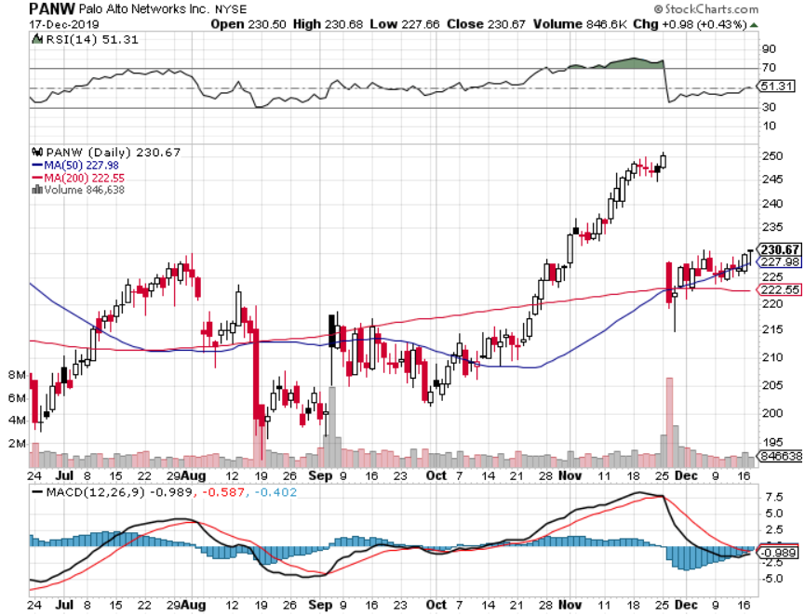
Palo Alto Networks (PANW)- Breakout Hacking never goes out of fashion

Slide 48
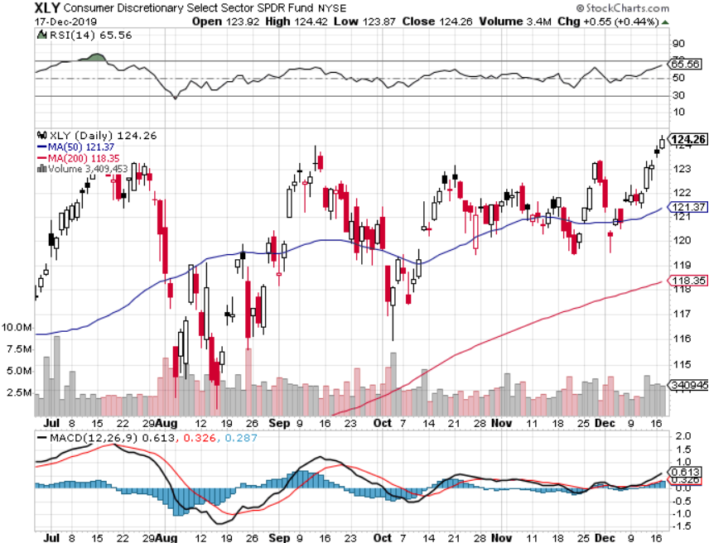
Consumer Discretionary SPDR (XLY) (DIS), (AMZN), (HD), (CMCSA), (MCD), (SBUX)

Slide 49
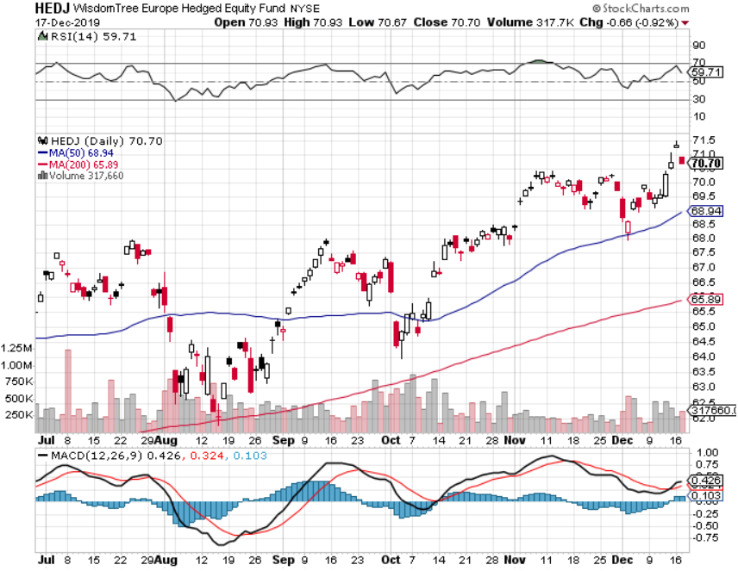
Europe Hedged Equity (HEDJ)- Pip on Brexit News

Slide 50
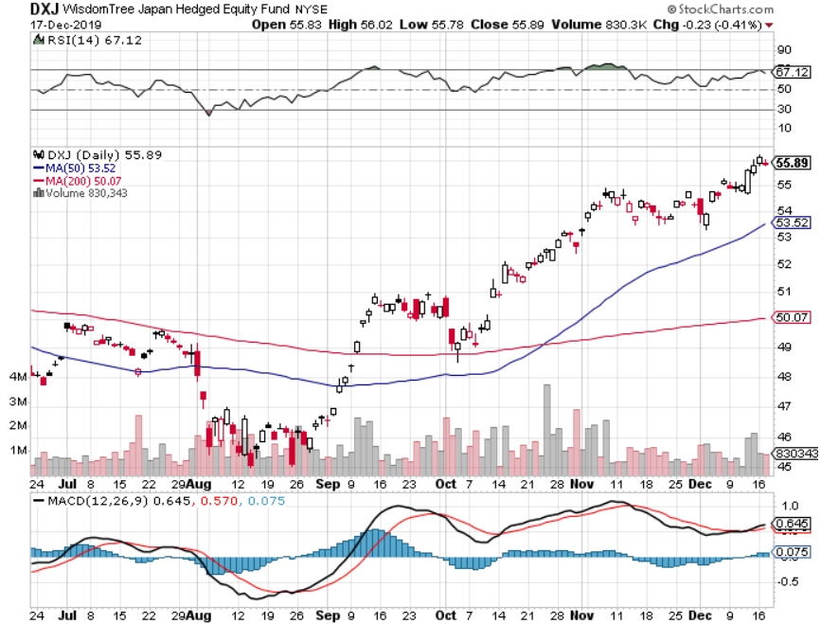
Japan (DXJ)-

Slide 51
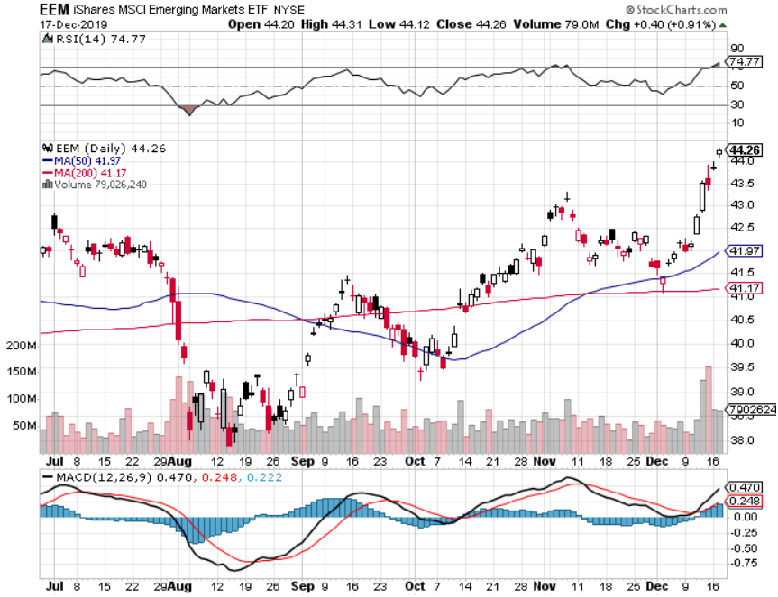
Emerging Markets (EEM)- Weak Dollar Play

Slide 53
Bonds – Trendless
*Bonds have been trendless since August *Narrowing wedge has made ranges too small to trade *Weak US dollar triggered by exploding US deficits is capping all rallies *Stay away until we get more volatility *Bottom line: Ten-year US Treasury yields go nowhere as long as stocks are rallying hard

Slide 54
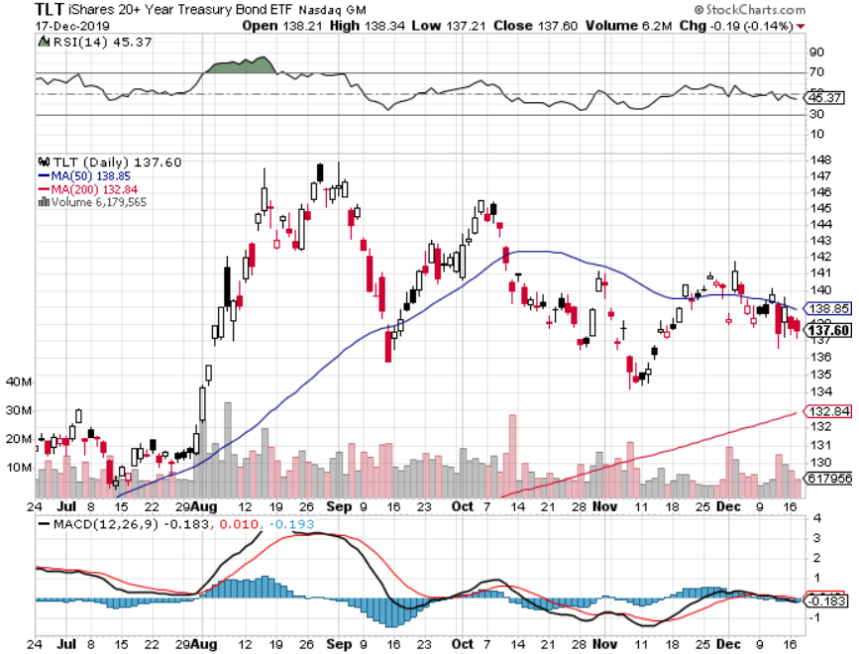
Treasury ETF (TLT) – Trading the Range long 12/$145-$148 put spread – expires in 12 trading days profits on long 10/$129-$132 call spread stopped out of long 8/$137-$140 put spread took profits on long 8/$125-$128 call spread

Slide 55
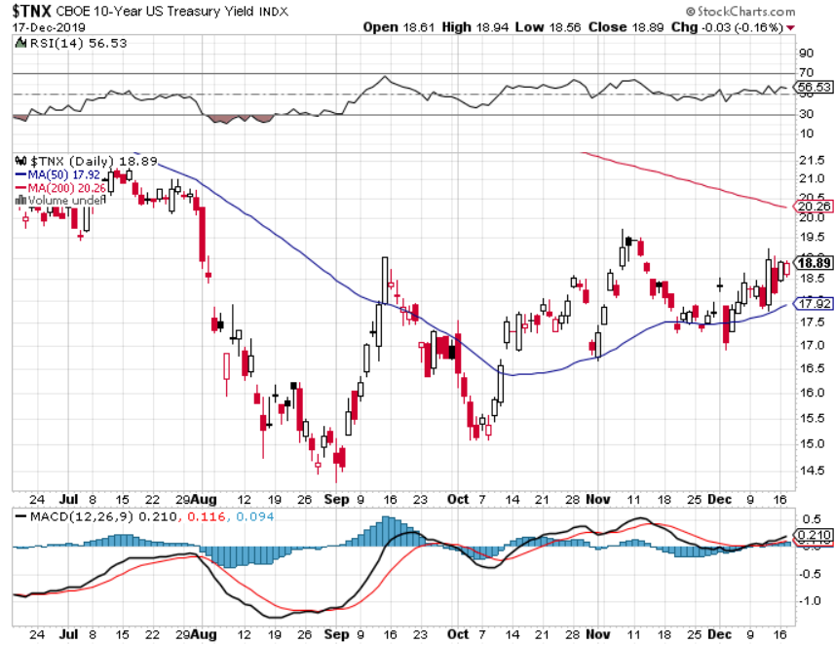
Ten Year Treasury Yield ($TNX) – 1.70%

Slide 56
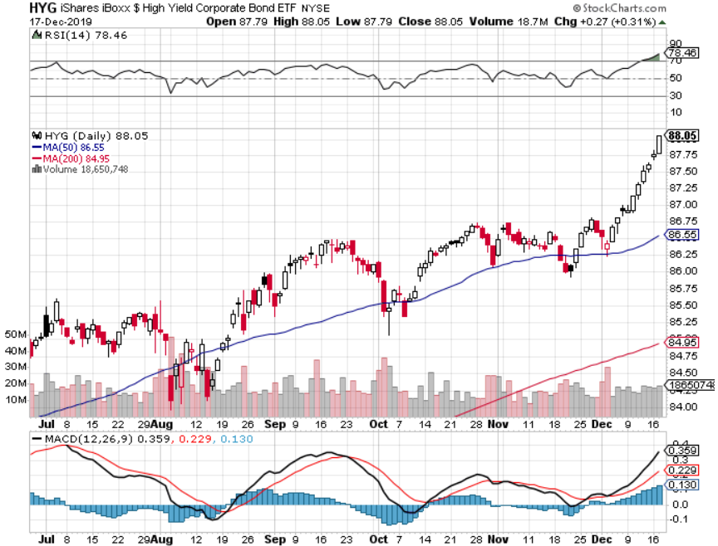
Junk Bonds (HYG) 4.82% Yield big jump in yields on stock selloff and recession fears

Slide 57
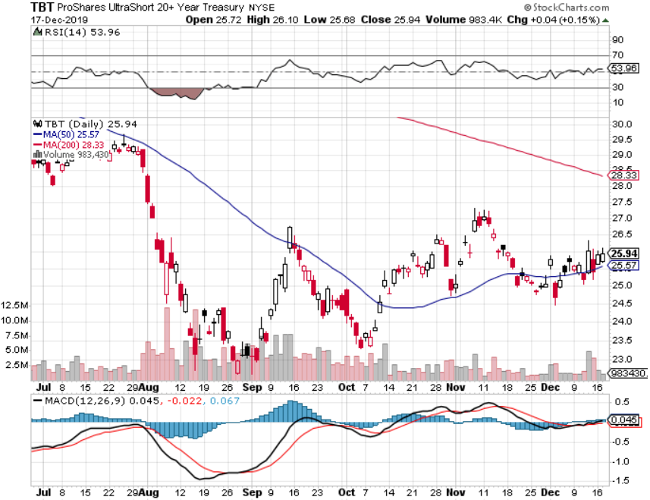
2X Short Treasuries (TBT)- 2 Month Bottoming Process

Slide 58
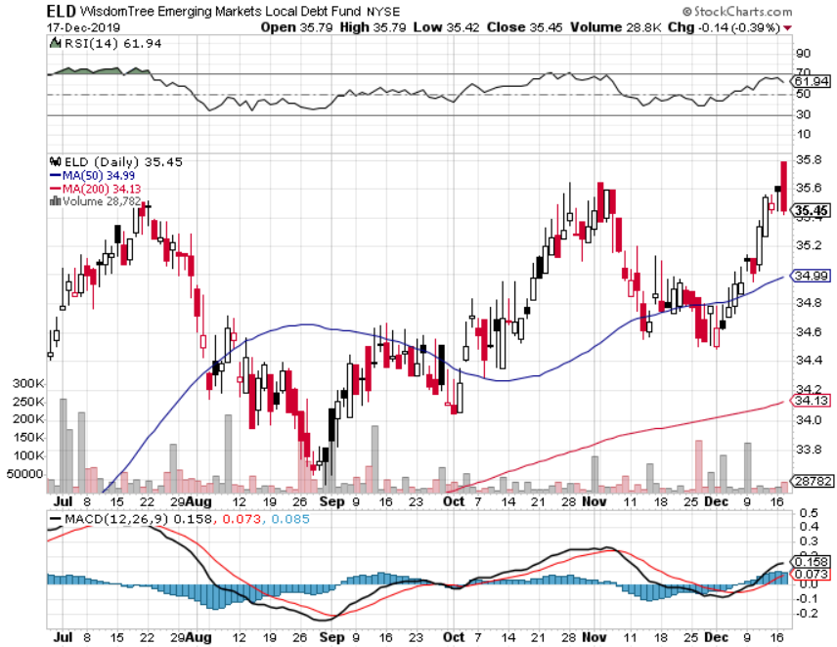
Emerging Market Debt (ELD) 4.78% Yield-

Slide 59
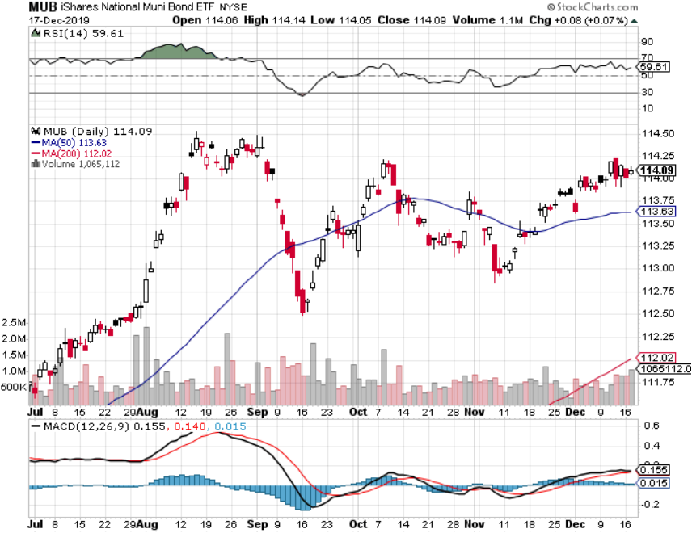
Municipal Bonds (MUB)-1.62% Mix of AAA, AA, and A rated bonds

Slide 61
Foreign Currencies – Dollar is Rolling Over
*Massive government borrowing will bring structural dollar weakness, US national debt to hit $25 trillion in two years *Euro bouncing on Brexit win *British pound soars on Johnson election win, biggest majority in 32 years *Chinese Yuan doesn’t buy trade deal *Bitcoin has horrible November, down 3,000 *Aussie jumps on trade deal lite *Starting selling short all dollar rallies

Slide 62
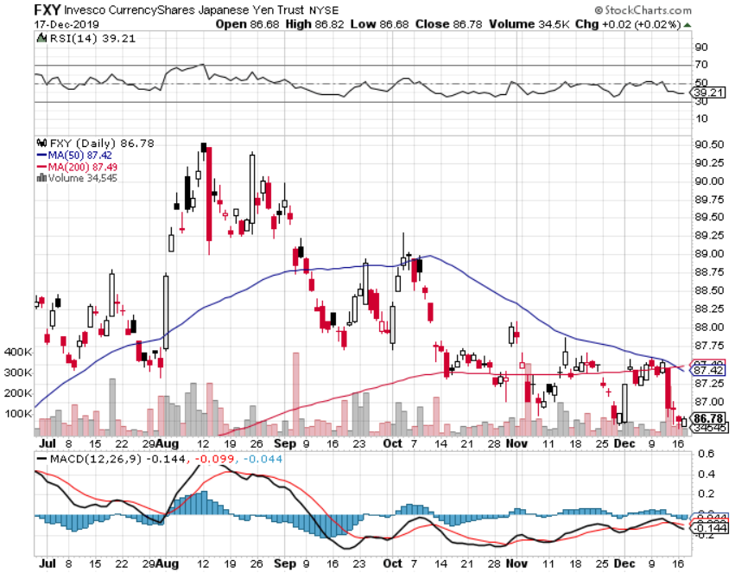
Japanese Yen (FXY), (YCS)

Slide 63
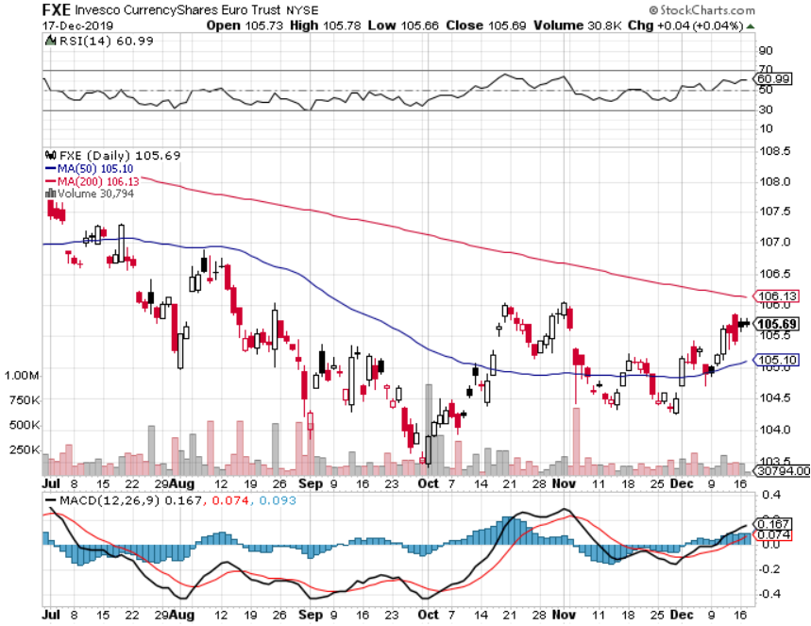
Euro ($XEU), (FXE), (EUO)-

Slide 64
British Pound (FXB)-

Slide 65
Australian Dollar (FXA)- The Global Recovery Play took profits on long 8/$67-$69 call spread

Slide 66
Emerging Market Currencies (CEW)

Slide 67
Chinese Yuan- (CYB)- New Lows

Slide 68
Bitcoin- Downtrend Continues killed by stock rally

Slide 70
Energy – Production Cut
*OPEC+ Russia surprises with an extra 500,000 b/d cuts, prompting a rare sustainable rally *Saudi ARAMCO deal is done, the largest IPO in history and immediately trades to 20%, even though only 1.5% of the company is floated. Most global index funds are forced to buy it *Over supply against fading demand will last for years *Energy shares are rallying, but few are convinced it is sustainable *Avoid all energy plays like the plague, could drop by half in the coming recession

Slide 71
Oil-($WTIC)

Slide 72
United States Oil Fund (USO) long 10/$9.50-$10 Vertical bull call spread

Slide 73
Energy Select Sector SPDR (XLE)-No Performance! (XOM), (CVX), (SLB), (KMI), (EOG), (COP)

Slide 74
Halliburton (HAL)-

Slide 75
Natural Gas (UNG) -

Slide 77
Precious Metals – Friendless
*Stock melt up brings slow motion melt down in precious metals *Will continue until stock top out early next year *”RISK ON” means ”SELL GOLD” *Backing the recession risk out also dumps flight to safety trades *We still think gold has a future, I’m just waiting for a bigger capitulation selloff *Bottom Line: buy a bigger dip in gold and precious metals

Slide 78
Gold (GLD)- Short Term downtrend

Slide 79
Market Vectors Gold Miners ETF- (GDX) – Yikes!

Slide 80
Barrick Gold (GOLD)

Slide 81
Newmont Mining- (NEM)-

Slide 82
Silver- (SLV)-

Slide 83
Silver Miners - (SIL)-

Slide 84
Wheaton Precious Metals - (WPM)-

Slide 85
Copper (COPX)-Collapse Trade War Disaster

Slide 86
Freeport McMoRan (FCX)-World’s Largest Copper Producer took profits on long 4/$10-$11 call spread took profits on short 4/$114 calls

Slide 88
Real Estate – Comeback
*US Housing Starts Soar, up 3.2% to 1.32 million annualized in November, *Housing permits for new constructions hit a 12 ½ year high *Ultra low interest rates are the turbocharger *Homebuilder Confidence Jumps to 20 Year High, up from 71 to 76, says the National Association of Homebuilders. *All the price action is in the entry and middle levels, high end mega mansions in oversupply S&P Case Shiller Rose 3.2%, in September, the third consecutive month of price increases. Only San Francisco is showing falling prices.

Slide 90
February Corelogic S&P Case Shiller Home Price Index Phoenix (6.0%), Charlotte, NC (4.6%), and Tampa (4.5%) showing biggest gains
Tradingeconomics.com

Slide 91
Simon Property Group (SPG)- Mall REIT

Slide 92
American Tower (AMT) – 1.75% Yield-Cell Phone Tower REIT

Slide 93
US Home Construction Index (ITB) (DHI), (LEN), (PHM), (TOL), (NVR)

Slide 94
Trade Sheet- So What Do We Do About All This?
*Stocks-buy bigger dip *Bonds-sell rallies *Commodities-buy bigger dip *Currencies- start selling dollar rallies *Precious Metals – stand aside *Energy – sell rallies *Volatility-buy dips to $11 *Real estate-stand aside

Slide 95
Next Strategy Webinar 12:00 EST Wednesday, January 8, from Lake Tahoe, NV last strategy webinar of the year! email me at support@madhedgefundtrader.com
Good Luck and Good Trading!
Notes:
*

