Slide 1
Mad Day Trader
Bill Davis
Webinar – February 19, 2020

Slide 2
Monthly Charts

Slide 3
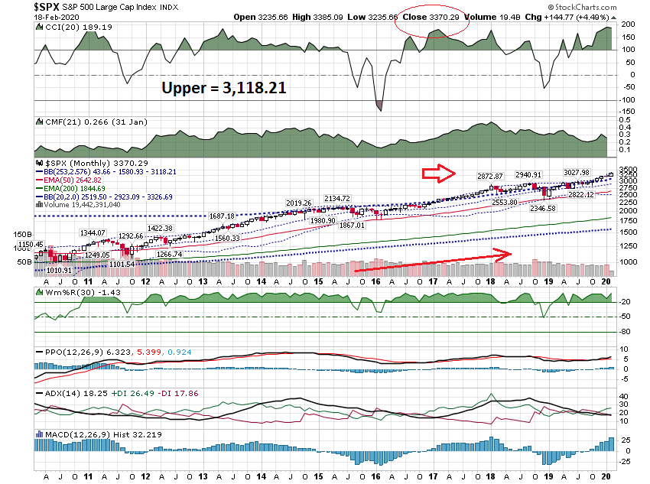

Slide 4
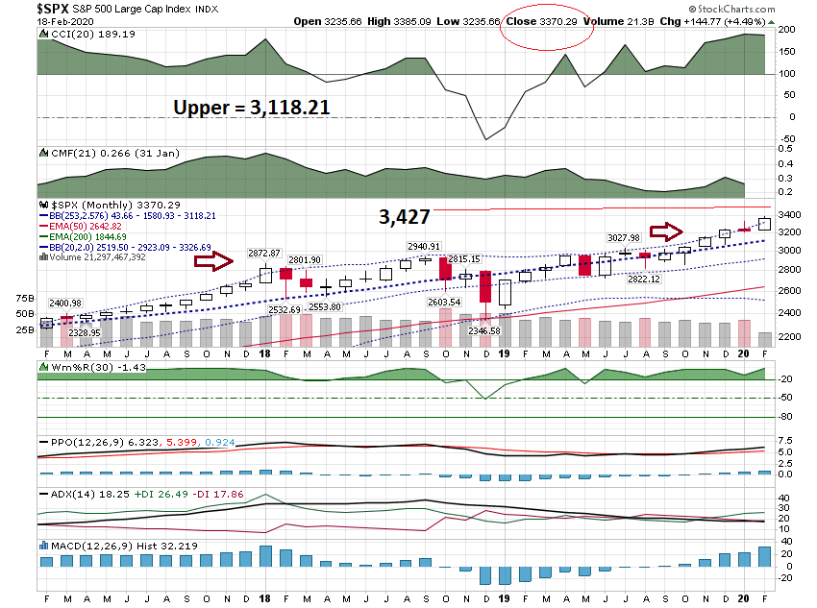

Slide 5
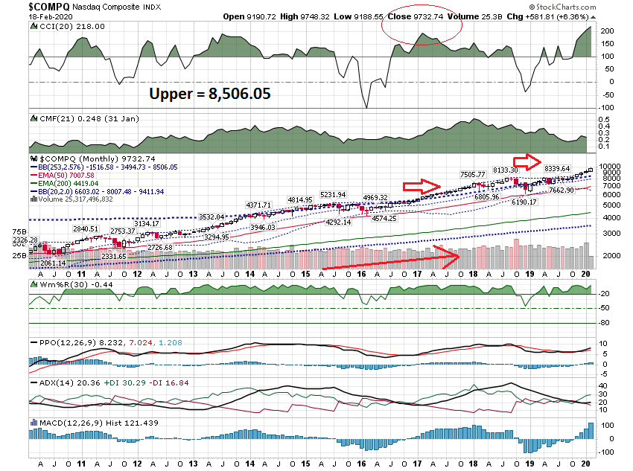

Slide 6
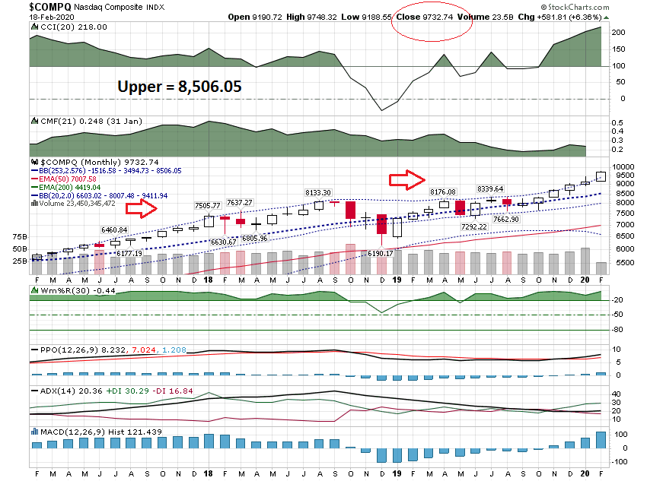

Slide 7
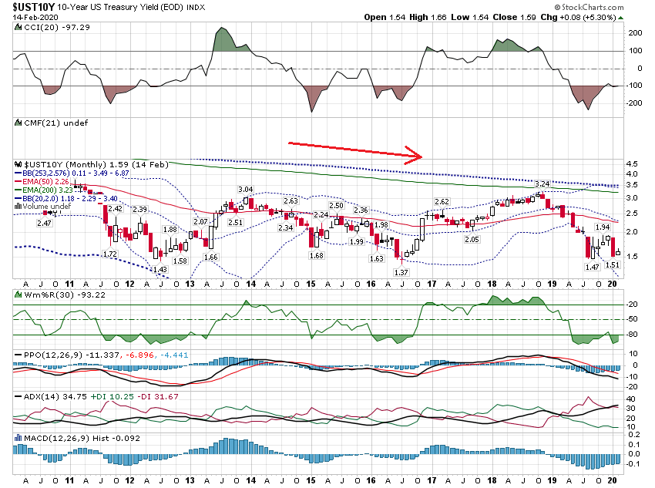

Slide 8
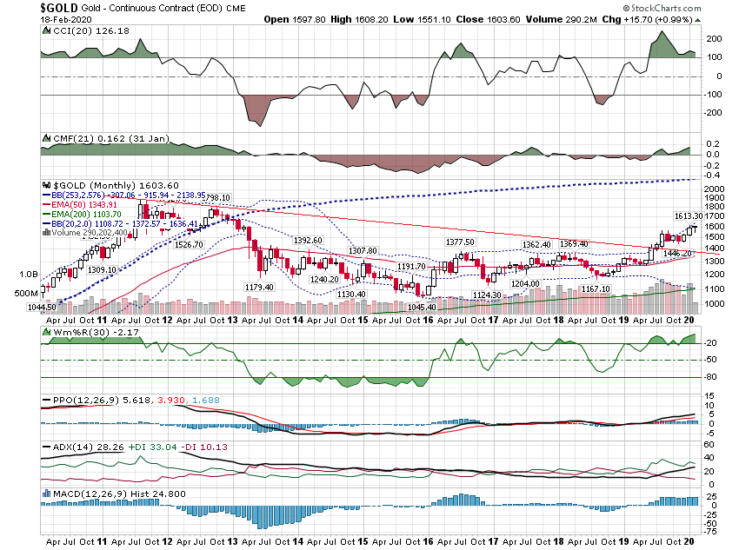

Slide 9
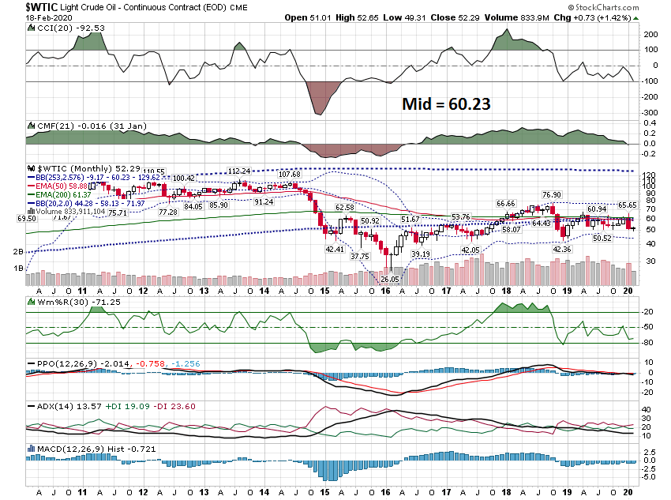

Slide 10
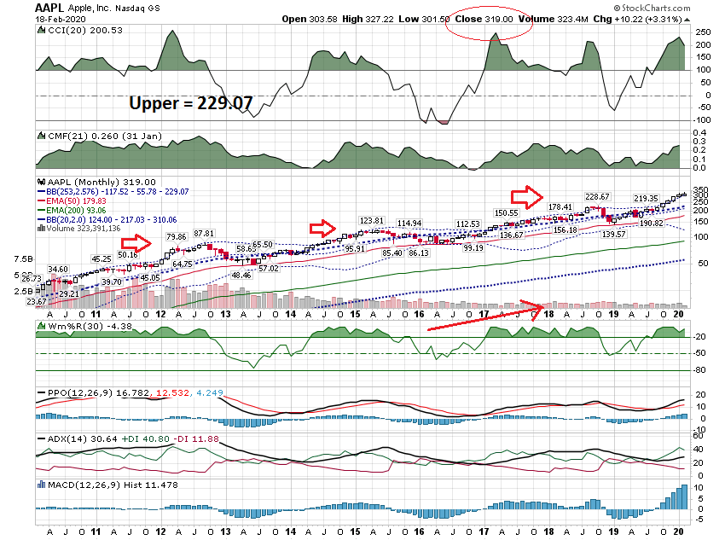

Slide 11
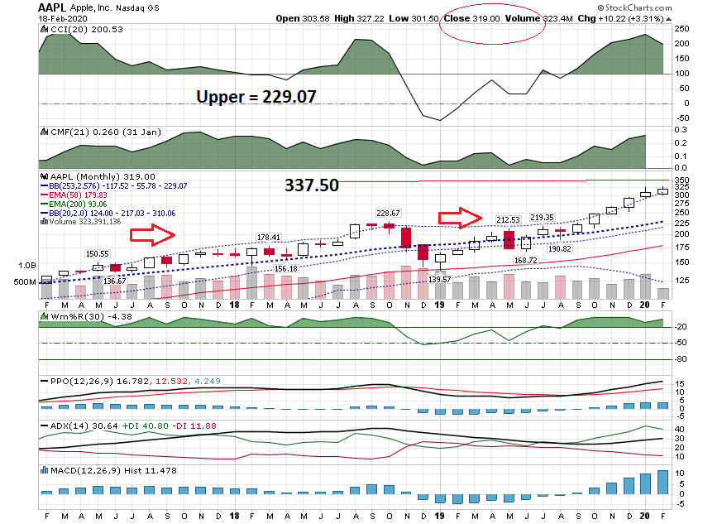

Slide 12
Daily Charts

Slide 13
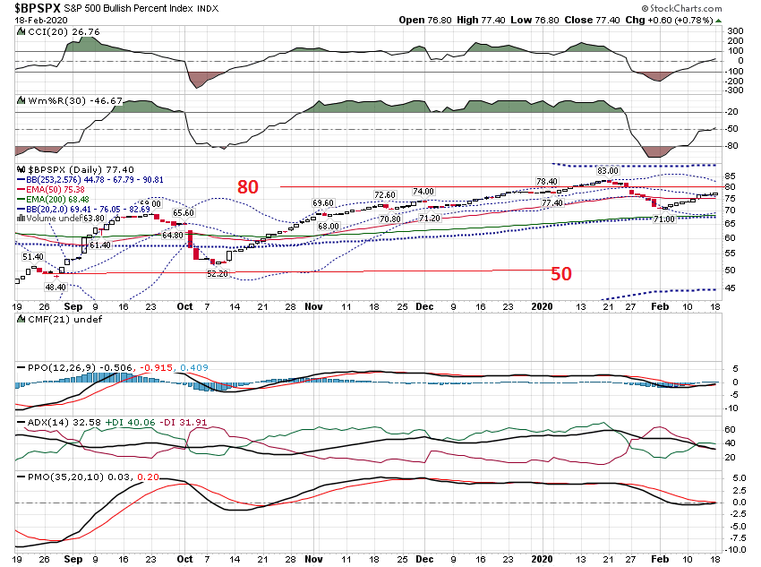

Slide 14
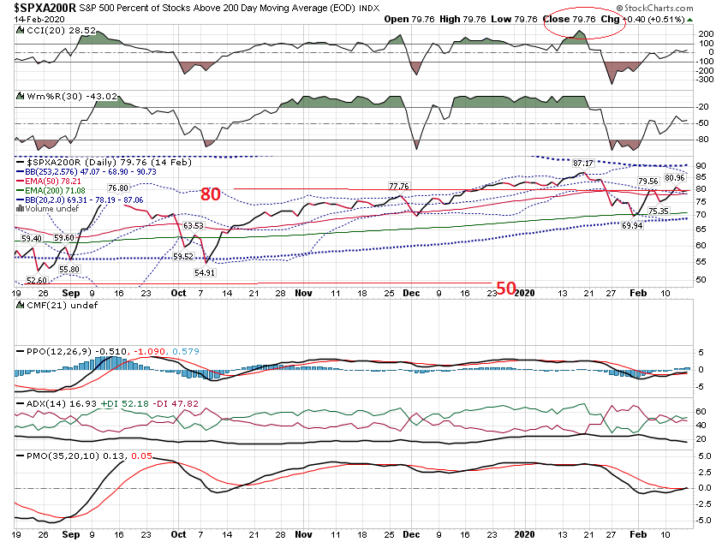

Slide 15
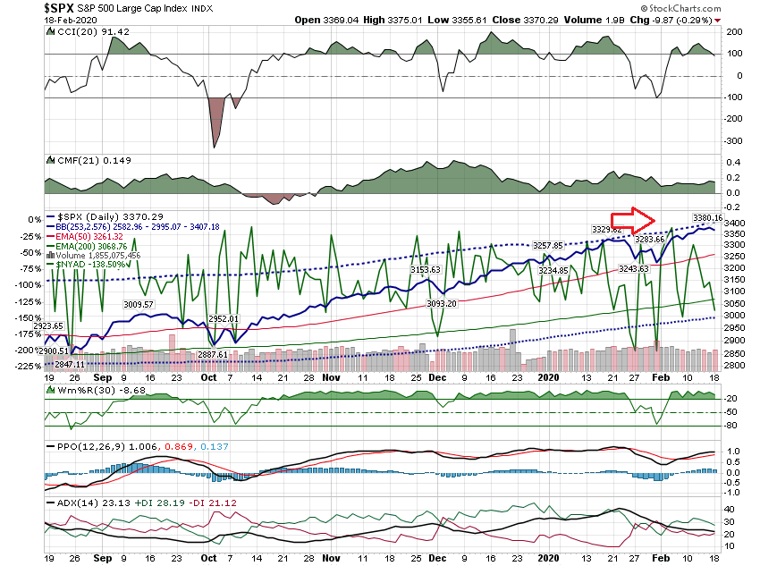

Slide 16
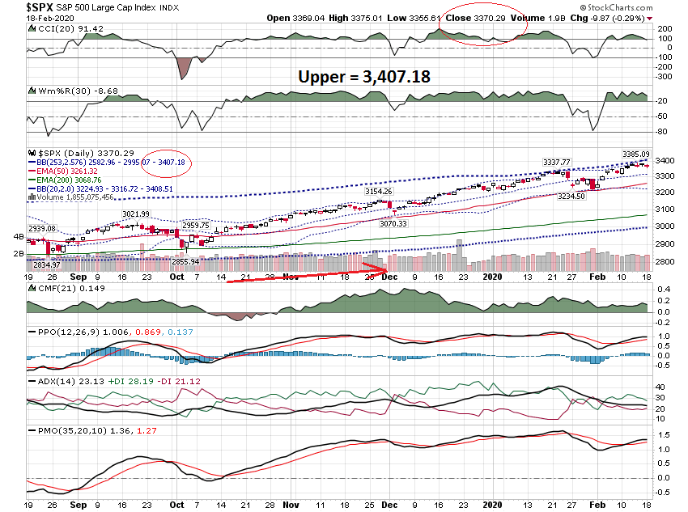

Slide 17
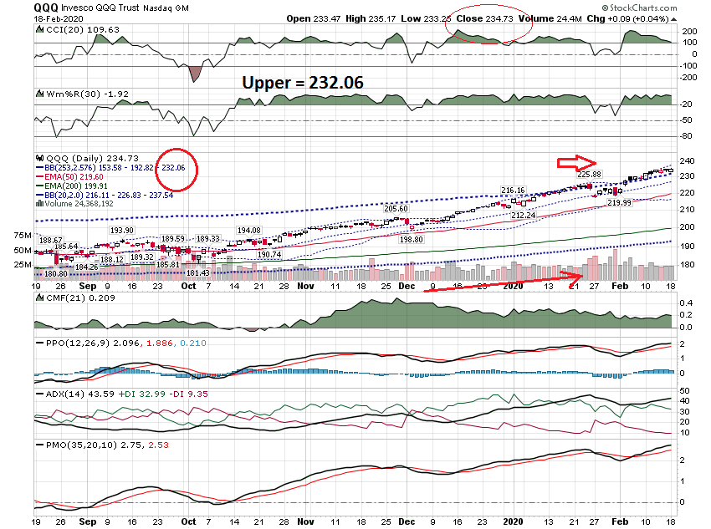

Slide 18
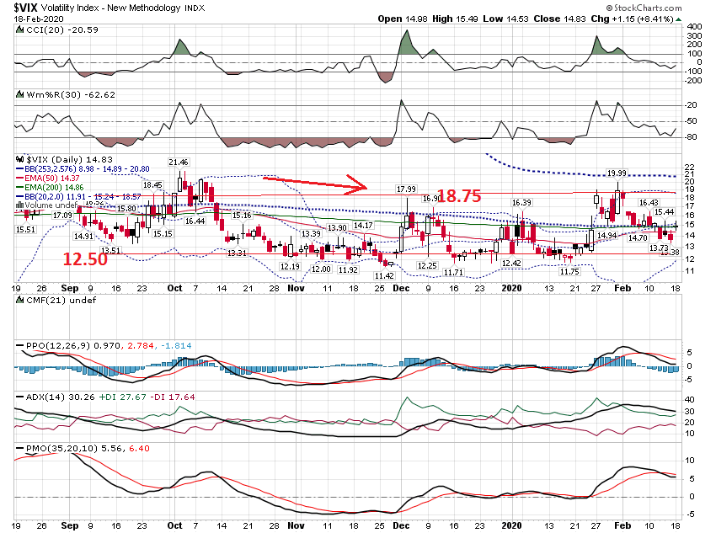

Slide 19
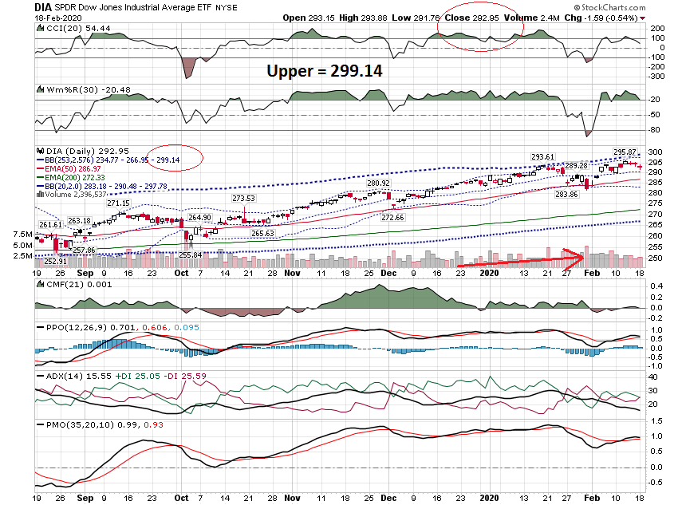

Slide 20
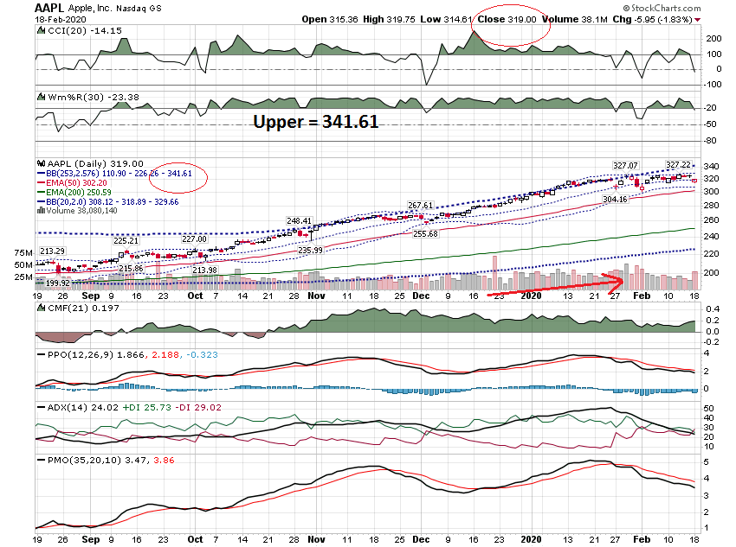

Slide 21
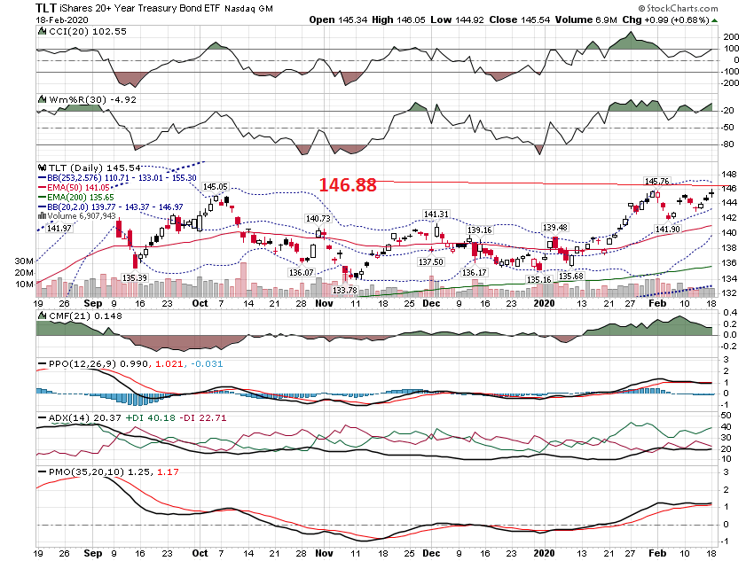

Slide 22
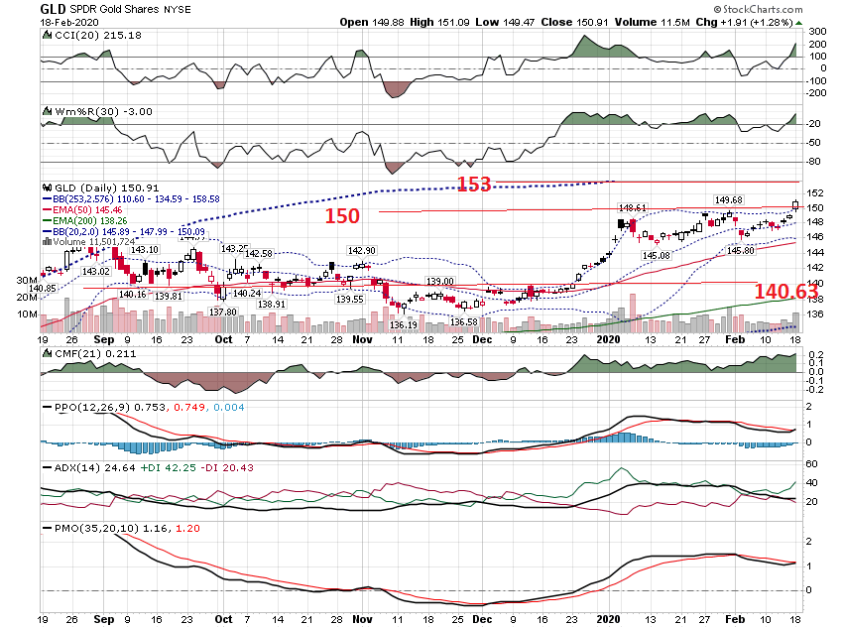

Slide 23
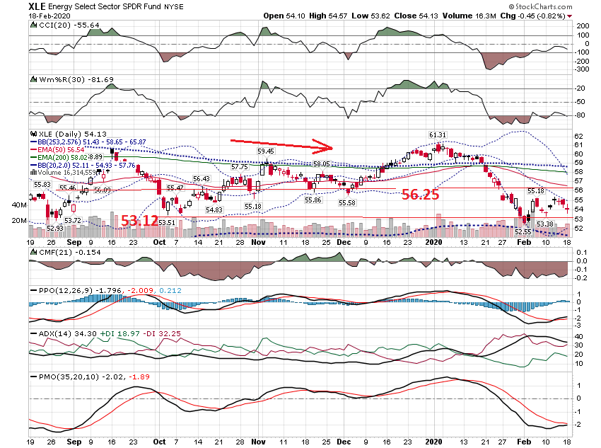

Slide 24
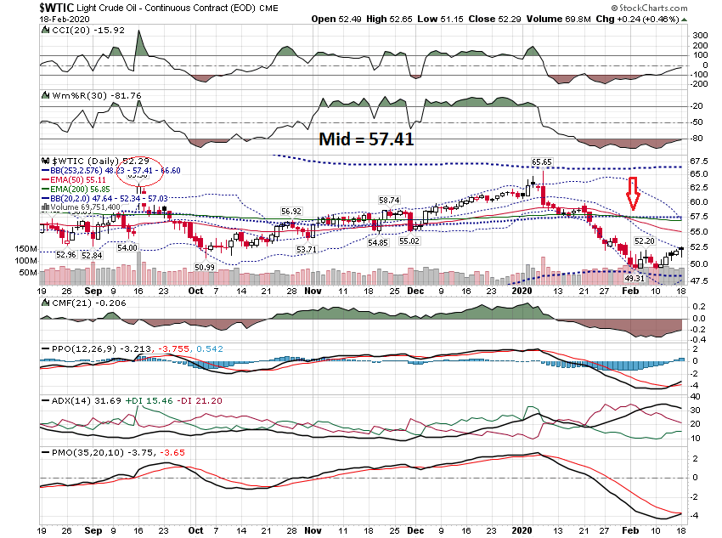

Slide 25
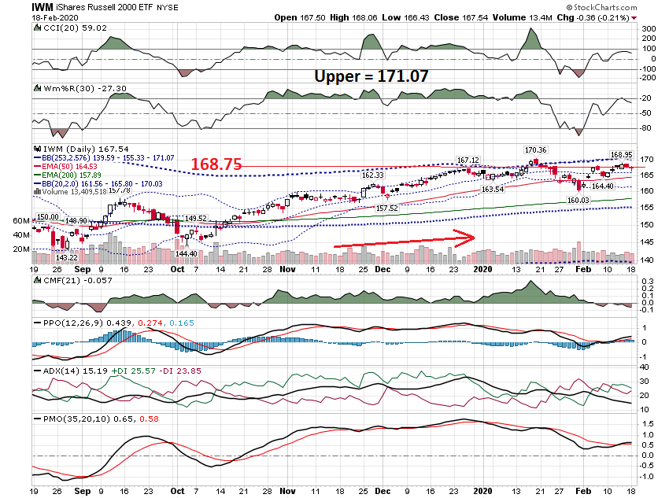

Slide 26
60 Minute Charts

Slide 27
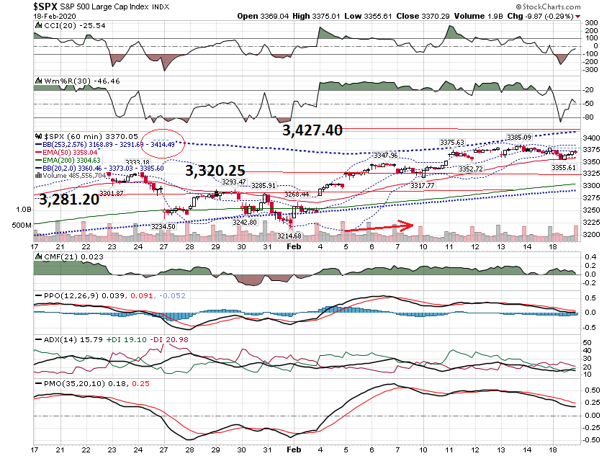

Slide 28
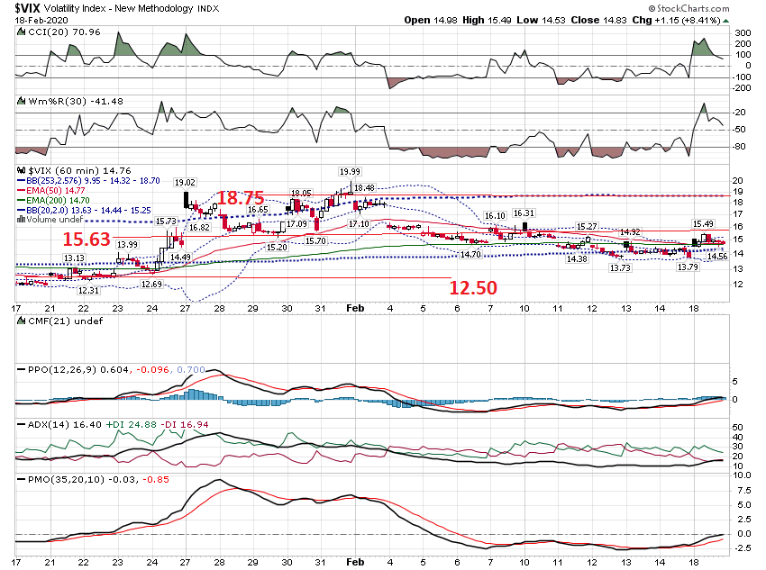

Slide 29
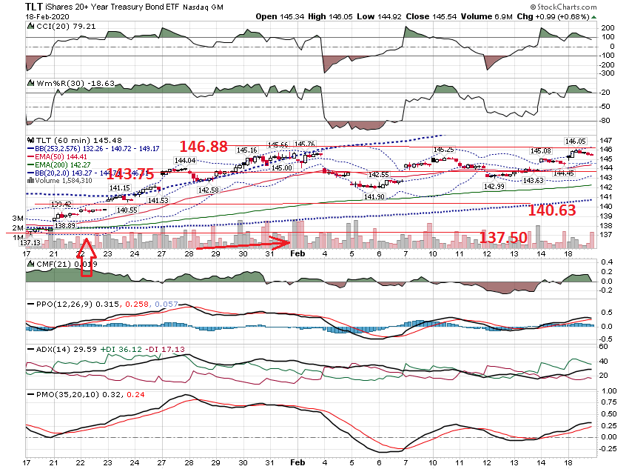

Slide 30
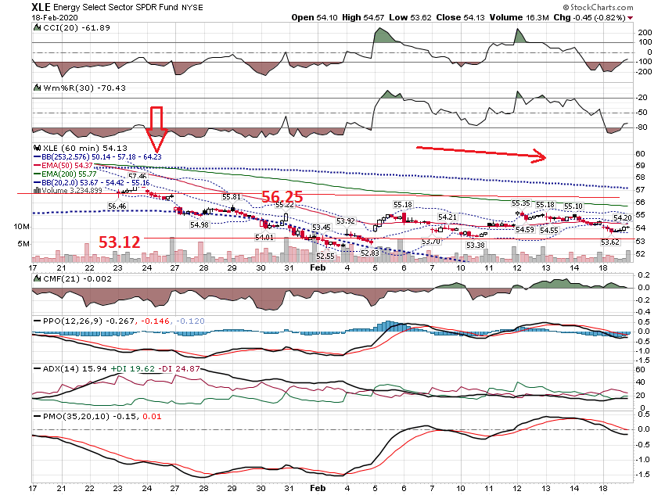

Slide 31
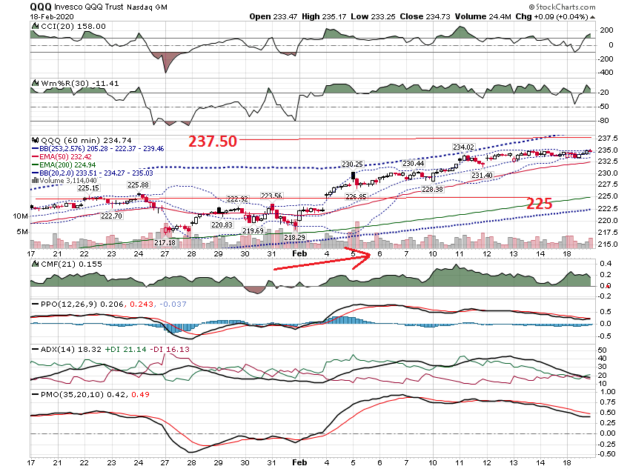

Slide 32
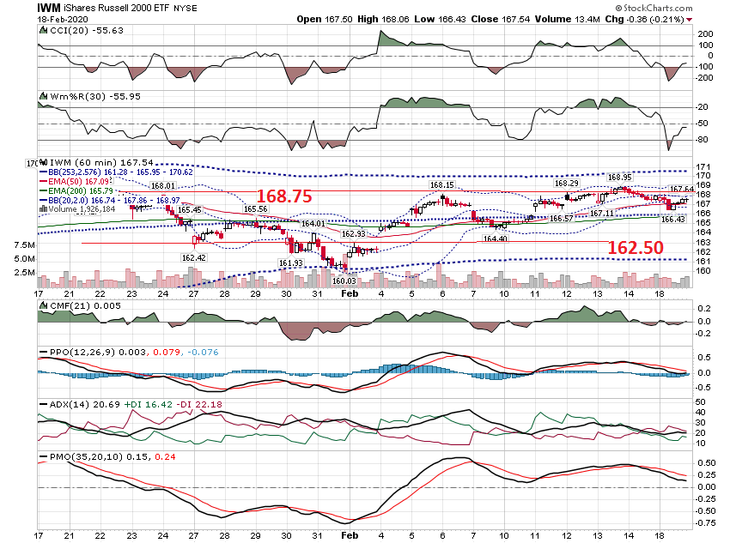

Slide 33
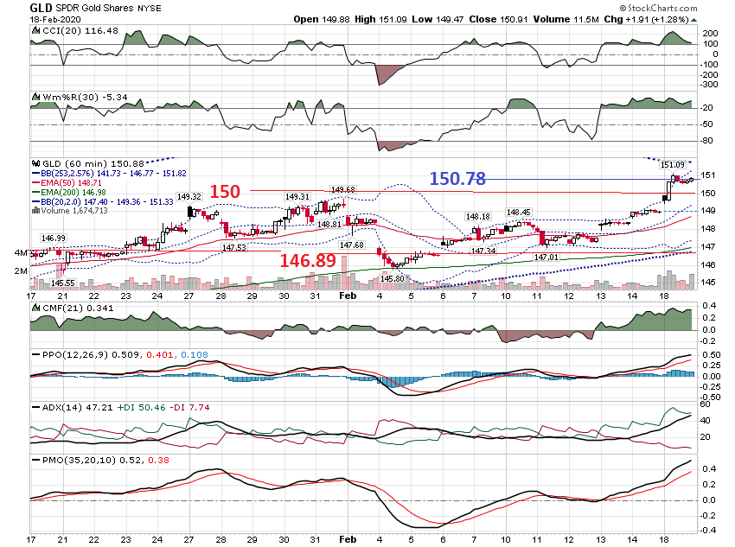

Slide 34
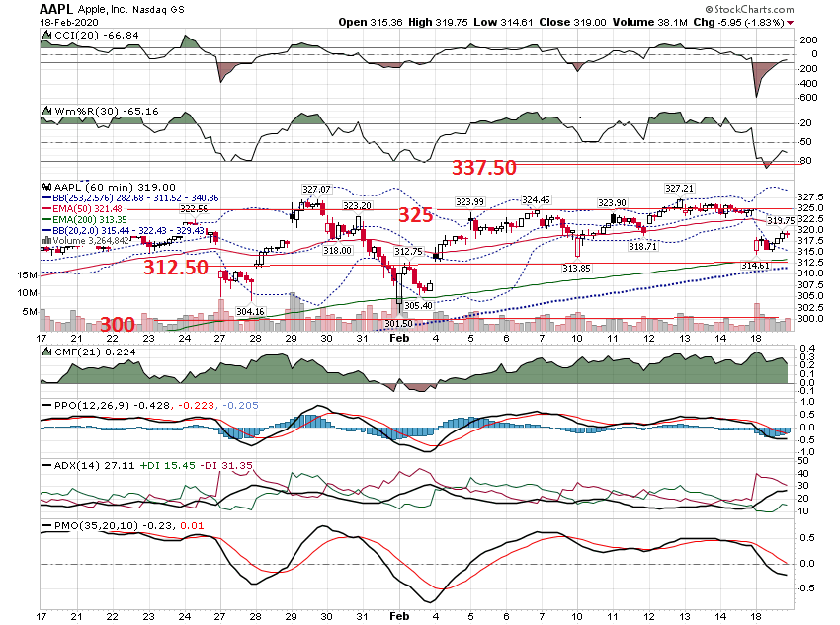

Slide 35
Chart Set Up

Slide 36
Higher Timeframe in Uptrend & Under Lower Band on Lower Timeframe Examples from Tues 2/18

Slide 37
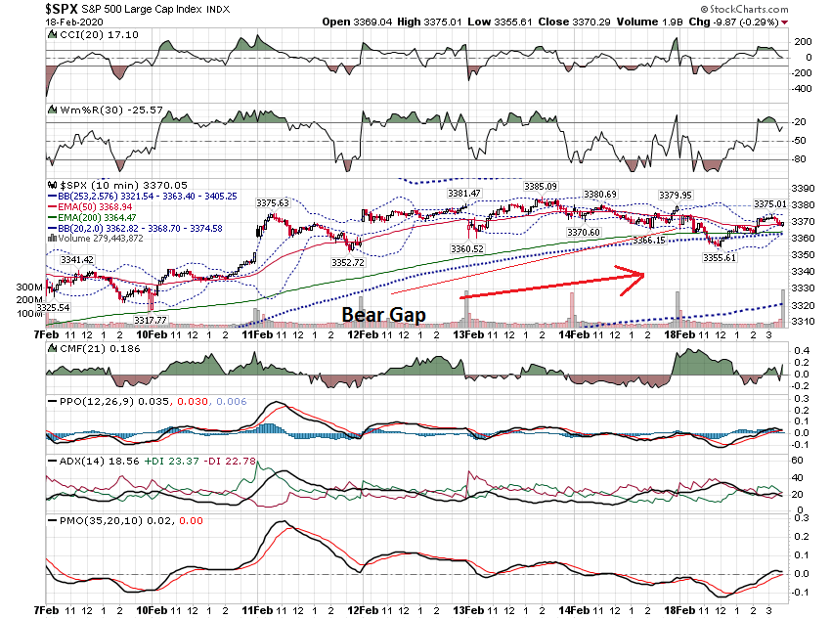

Slide 38
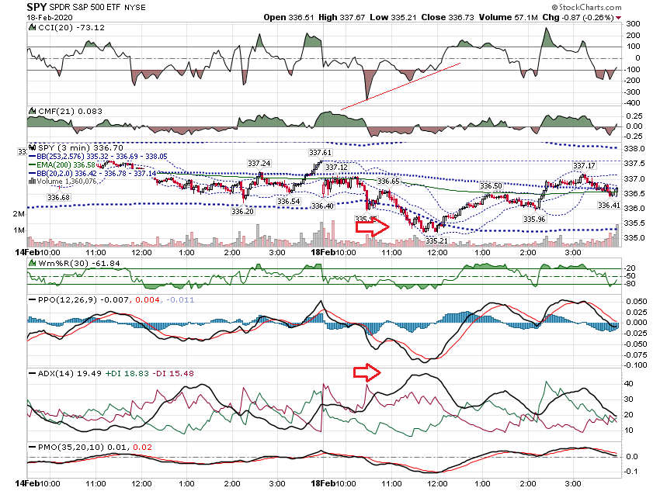

Slide 39
SPY Intra Day Range on Tues 2/18 = 2.46 Points Affects on Calls expiring Tues Afternoon

Slide 40
Previous Close 2.9900 Open 2.8900 Bid 1.6500 Ask 1.7000 Strike 335.00 Expire Date 2020-02-18 Day's Range -- 0.6900 - 2.2100 Volume 24,429 Open Interest N/A

Slide 41
Previous Close 2.2100 Open 2.2000 Bid 0.6500 Ask 0.7000 Strike 336.00 Expire Date 2020-02-18 Day's Range 0.2100 - 1.3500 Volume 90,150 Open Interest N/A

Slide 42
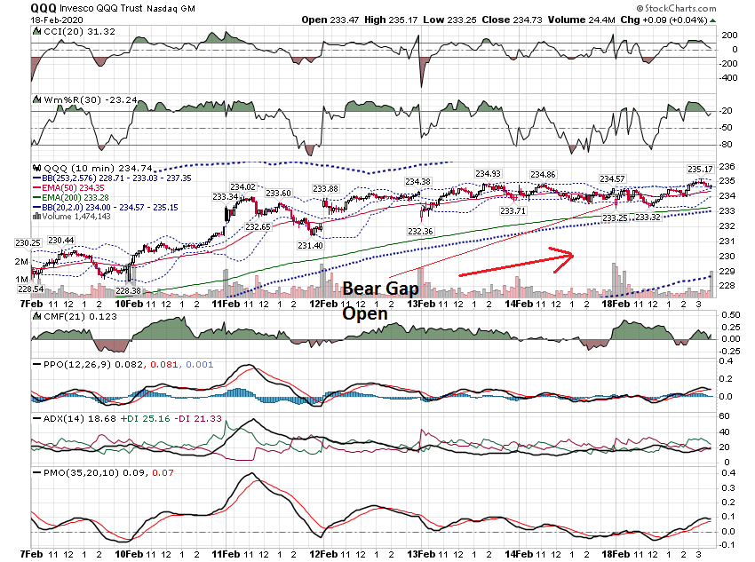

Slide 43
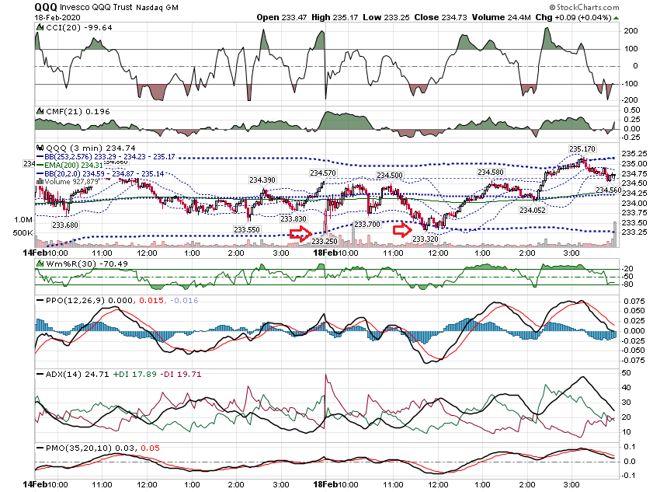

Slide 44
QQQ Intra Day Range on Tues 2/18 = 1.92 Points Affects on Calls expiring in 4 Days

Slide 45
Previous Close 2.3700 Open 2.43 Bid 2.26 Ask 2.32 Strike 233.50 Expire Date 2020-02-21 Day's Range 1.40 - 2.56 Volume 3,525 Open Interest N/A

Slide 46
Previous Close 2.04 Open 2.15 Bid 1.91 Ask 1.98 Strike 234.00 Expire Date 2020-02-21 Day's Range 1.27 - 2.21 Volume 13,322 Open Interest N/A

Slide 47
Thanks for watching! Bill Davis Mad Day Trader February 19, 2020 davismdt@gmail.com

