Slide 1
The Mad Hedge Fund Trader “The Plague is On”
With John Thomas from Silicon Valley, CA, February 12, 2020 www.madhedgefundtrader.com
Notes:
*

Slide 3
Trade Alert Performance New Highs Again!
*January 3.13% Final *July +3.07% Final *February +0.10% MTD *August +16.01% Final *March +1.78% Final *September 3.08% Final *April +0.30% Final *October +12.13% Final *May +0.25% Final *November -1.26% Final *June -0.50% Final *December +4.97% Final *Year to date +3.23% compared to +2.70% for the Dow Average *+359.04% since inception, *Average annualized return of 35.31% for 10 years

Slide 4
Portfolio Review Keeping Small Positions-90% cash, 10% stocks Only Buying Very Deep in-the-Money Call Spreads on Capitulation Days
Current Capital at Risk
Risk On
World is Getting Better
(BA) 2/$270-$280 call spread | 10.00%
Risk Off
World is Getting Worse
Total Net Position | 10.00%
Expiration P&L 3.13% YTD

Slide 5
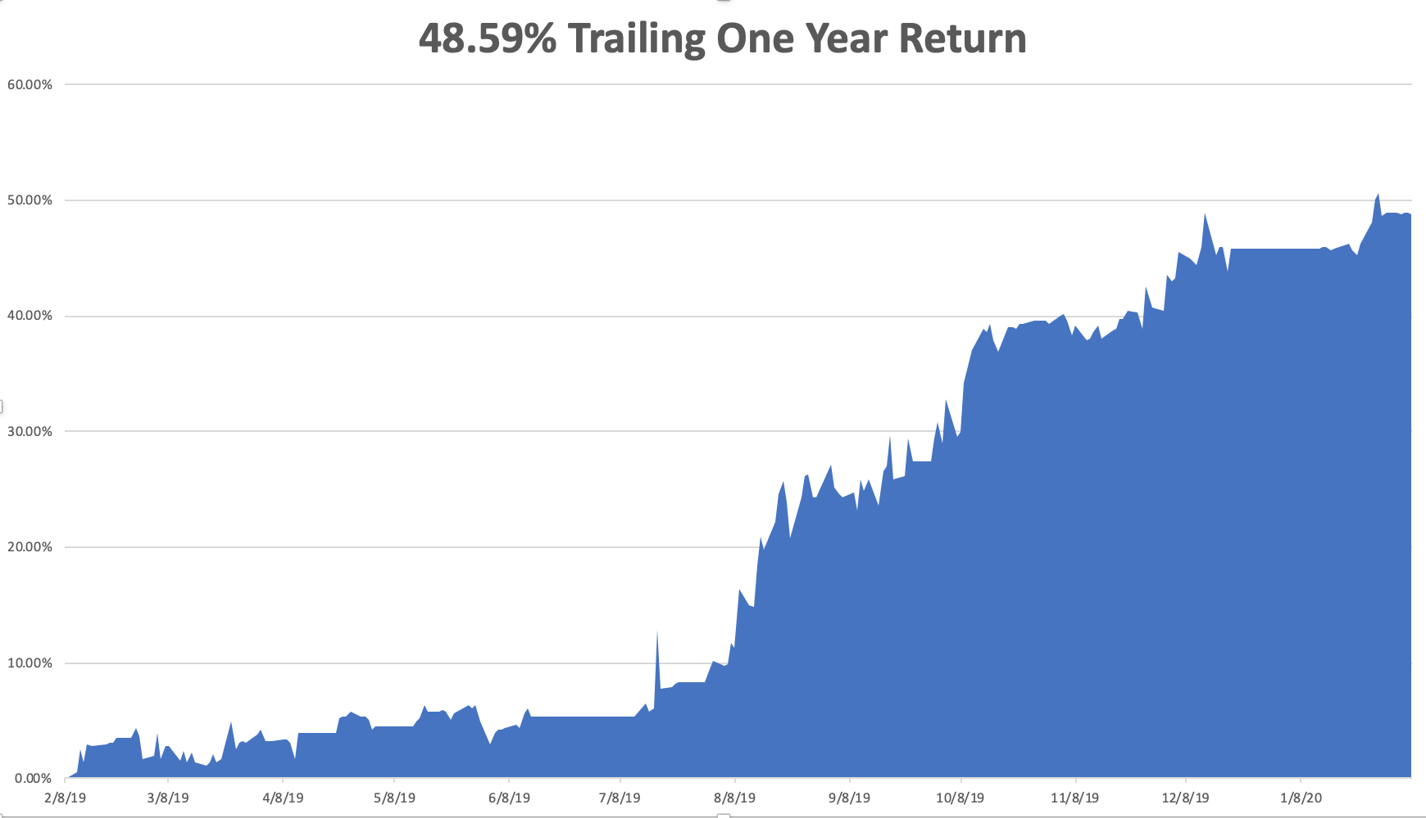

Slide 6
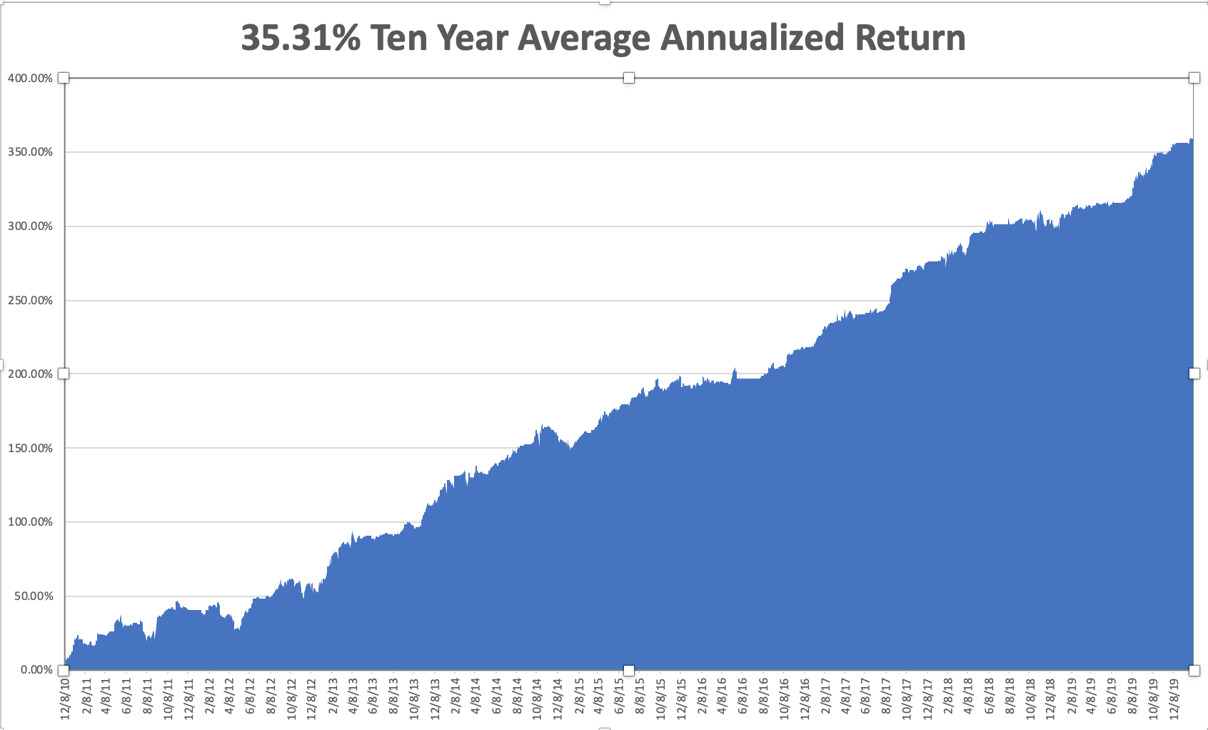
GTD 10 Year Daily Audited Performance

Slide 7
The Method to My Madness
*Corona virus is driving everything right now and the US stock market is vastly underestimating the risks, with a major economic slowdown in the cards *Market risks right now are at extremes, and the Fed is starting to pull back on QE. All asset classes are expecting a recession and bear market except stocks, and all stock gains due to multiple expansion except top 20 tech stocks *Bonds rally big on recession risks *US Dollar enjoys huge spike *Gold is holding on to a major gains, gearing up for a run at all time highs *Volatility is becoming volatile and is too high to buy *Keep positions to a minimum in the current environment

Slide 8
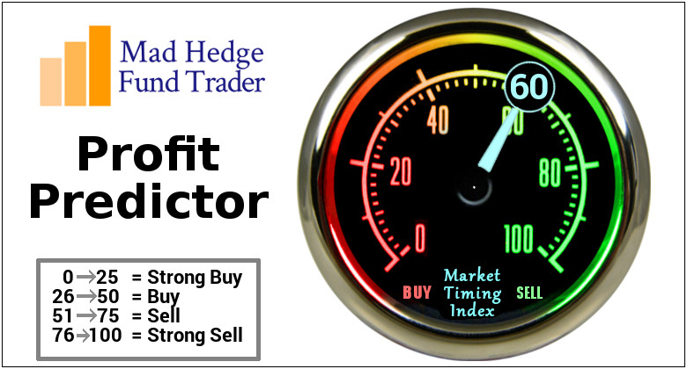
The Mad Hedge Profit Predictor Market Timing Index-Top of Range-Close to a “SELL” An artificial intelligence driven algorithm that analyzes 30 different economic, technical, and momentum driven indicators

Slide 9
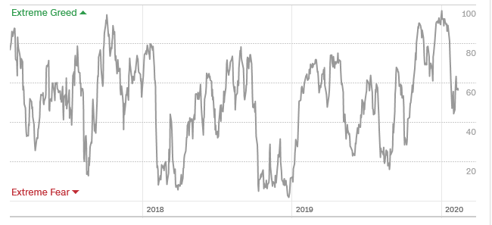
The Mad Hedge Profit Predictor From Extreme Overbought to Almost Neutral
SELL
BUY

Slide 10
The Global Economy – Epidemic
*Corona virus epidemic is now the principal factor in the global economy *It’s a question of how much, not if the virus is slowing down the economy *China’s GDP growth will slow down from a 6% growth rate to 2%, and maybe zero *Companies around the world, like Hyundai in South Korea, are shutting down for lack of parts *Travel restrictions are also a big damper, with 10,000 flights a week cancelled *US January Nonfarm Payroll comes in at a strong 225,000, with the headline Unemployment Rate rising to 3.6%

Slide 11
Six Months to Peak, We are Two Months into Corona

Slide 12
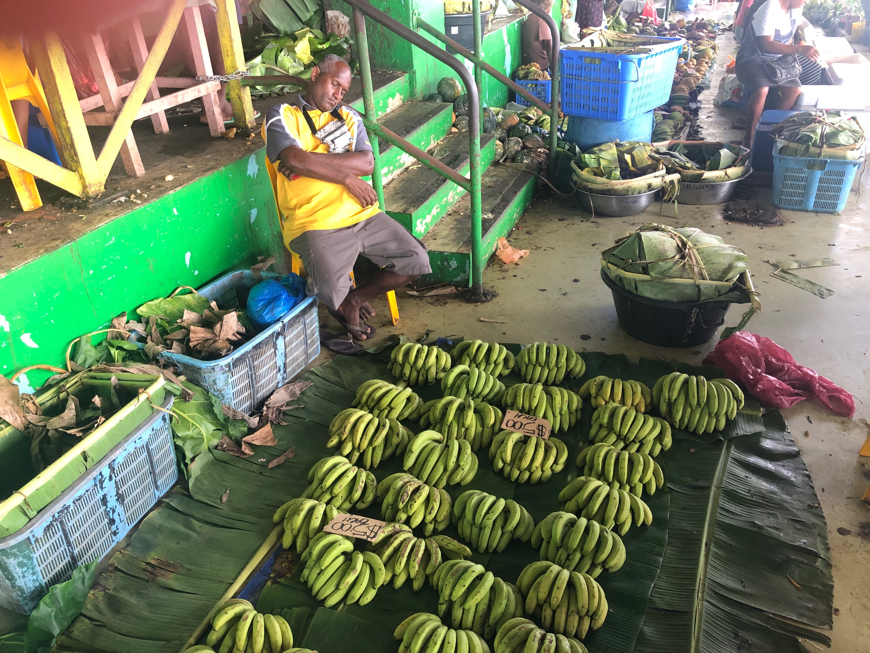

Slide 13
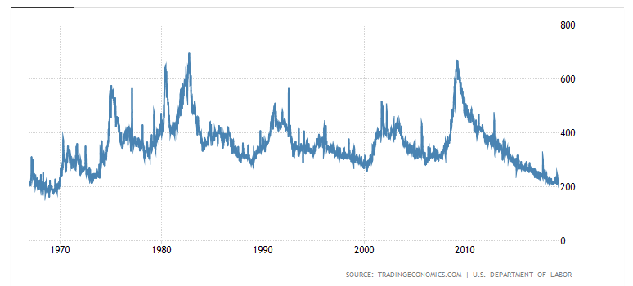
Weekly Jobless Claims-Bottomed Out -xx to 204,000

Slide 14
Soybeans - Trade War Indicator The Corona Crash

Slide 15
The Bill Davis View A $1,500 Upgrade for the Mad Day Trader Service
Buys: | Entry | Target
Cantel Medical Corp (CMD) | $ 64.00 | $ 75.00
Seagate Technology (STX) | $ 56.00 | $ 66.00
Quanta Services (PWR) | $ 41.00 | $ 50.00
PPG Industries (PPG) | $ 124.00 | $ 138.00
Advance Auto Parts (AAP) | $ 133.00 | $ 155.00
Sells:
Workday, Inc. (WDAY) | $ 190.00 | $ 170.00
Ulta Beauty (ULTA) | $ 290.00 | $ 265.00
JM Smucker (SJM) | $ 110.00 | $ 98.00
Fortive Corp (FTV) | $ 80.00 | $ 72.00
Group 1 Automotive (GPI) | $ 100.00 | $ 84.00

Slide 16
Stocks – Contagion Fears
*Stocks are stretching the limits, at two-decade valuation highs at 20X earnings *Corona triggered a 5% correction; do we get another one? *Buying long dated Volatility Index (VIX) positions on dips is the smart trade today *Continue to focus on big tech and biotech, the market leaders *Over concentration in a few stocks is typical of market tops *Apple and Microsoft are now 10% of the total market *Bottom line: buy the next big dip for a run to new highs after the November election *Bottom Line: its bet the ranch time on tech longs, but stay away from those with big China exposure, like Apple, and weak dollar plays like energy, and emerging markets

Slide 17
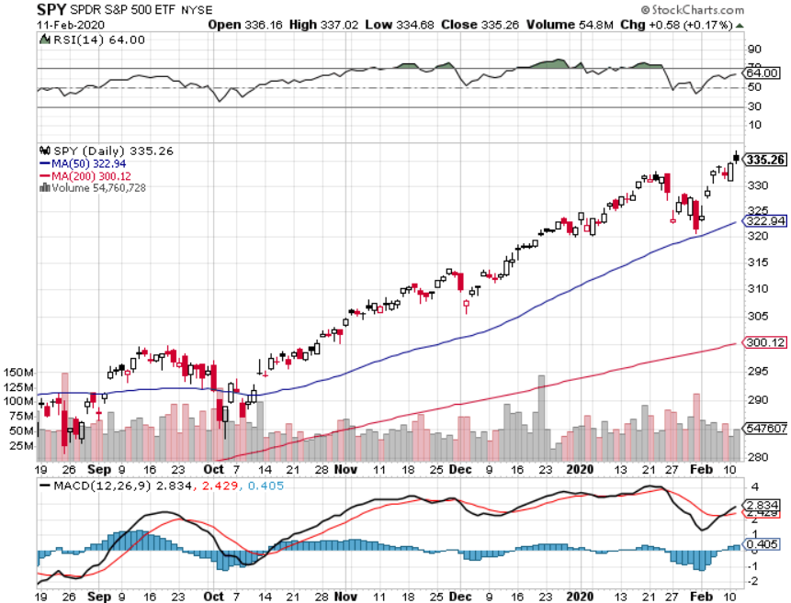
S&P 500 – Bounce Back took profits on long 8/$297-$302 bull call spread took profits on long 10/$305-$310 bear put spread took profits on long 10/$270-$275 bull call spread took profits on long 10/$300-$305 bear put spread took profits on long 8/$305-$308 bear put spread

Slide 18
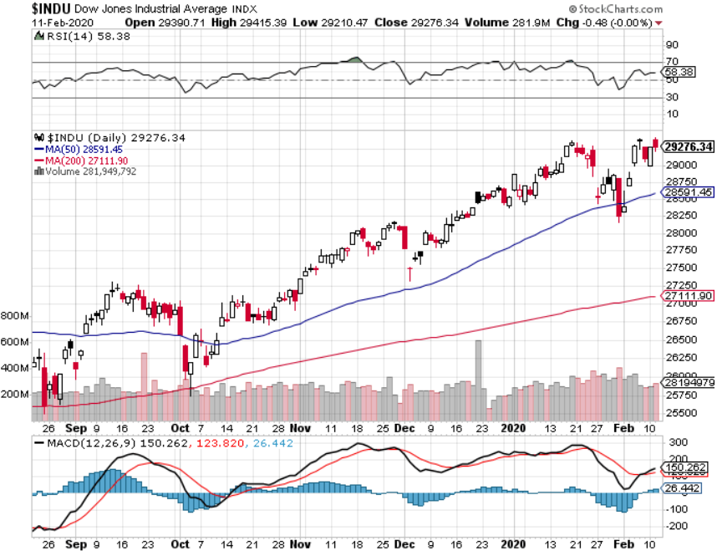
Dow Average ($INDU)- New High

Slide 19
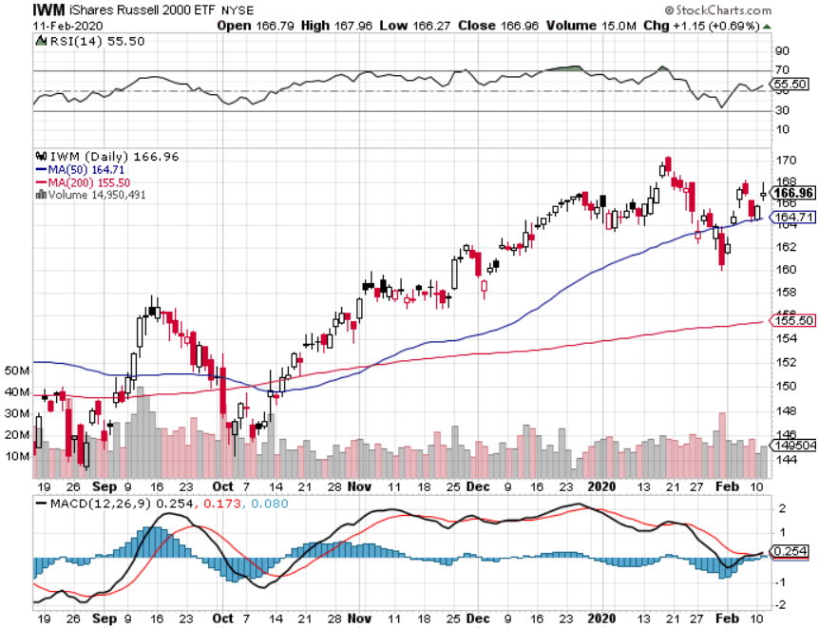
Russell 2000 (IWM)- Brief Breakout took profits on Long 10/$137-$142 vertical bull call spread took profits on Long 10/$153-$156 vertical bear put spread

Slide 20
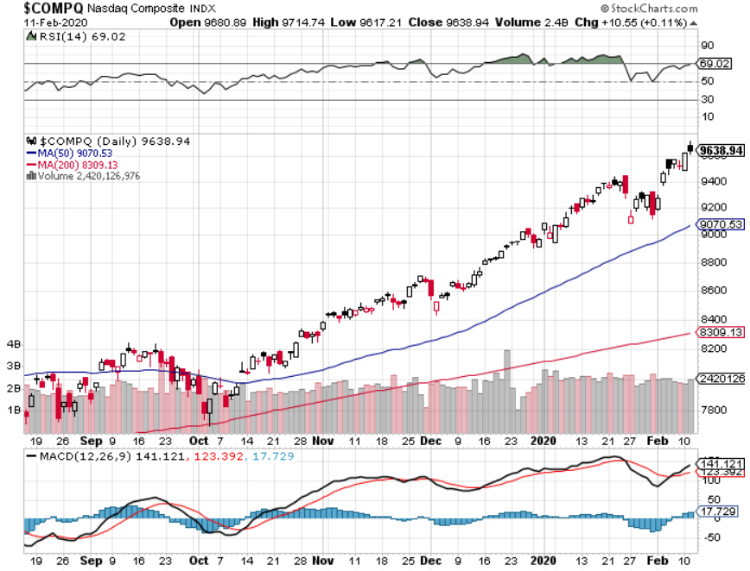
NASDAQ ($COMPQ) – Number One focus

Slide 21
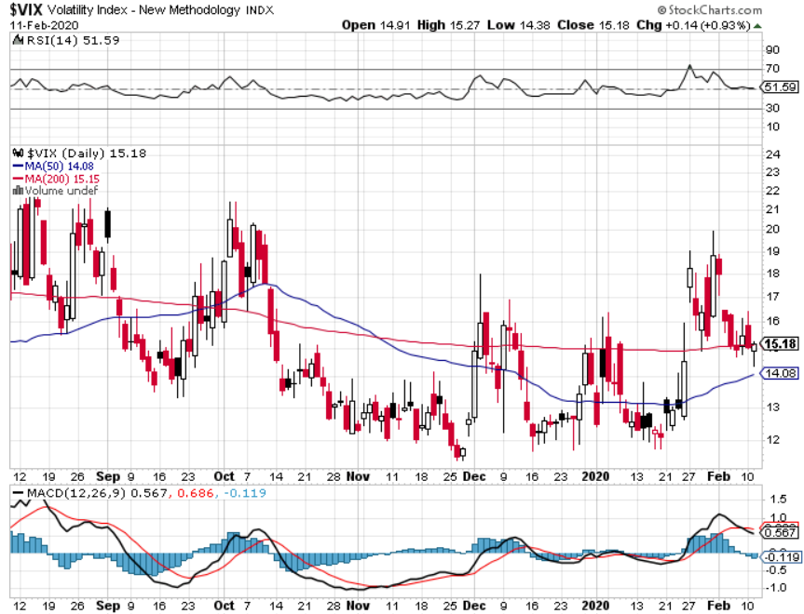
(VIX)-Back in Play

Slide 22
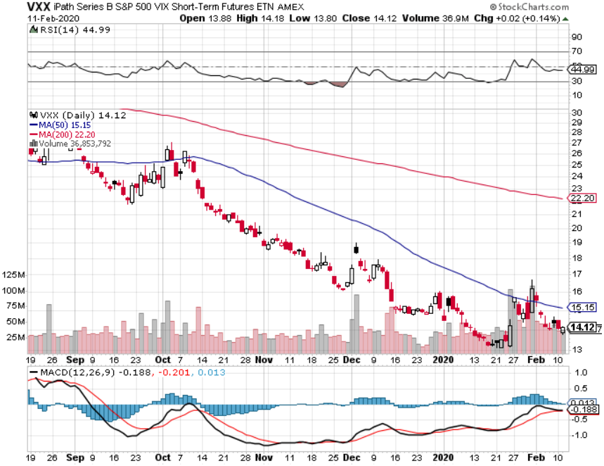
(VXX)- Buy the Dips took profits on long 1/2021 $16 calls

Slide 23
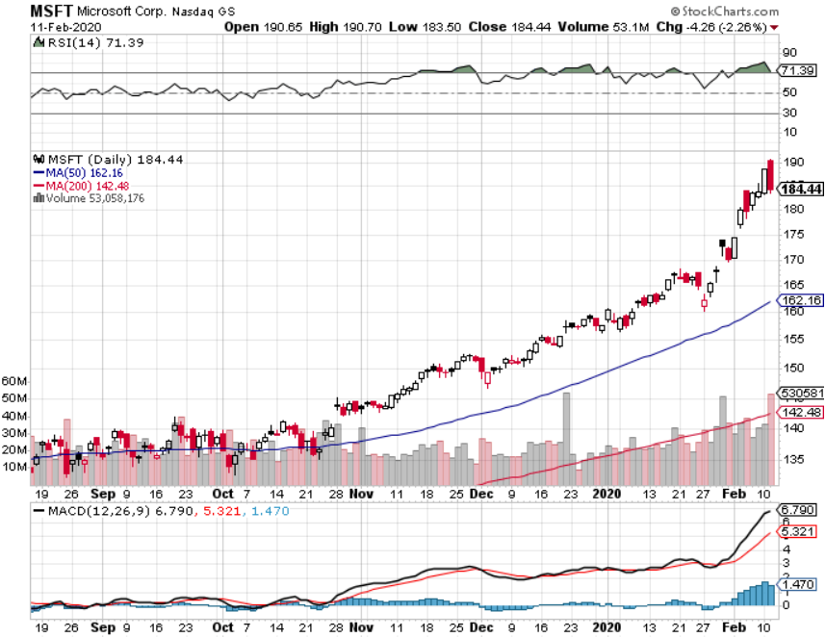
Microsoft (MSFT)- Earnings beat- Looking for Another Entry Point took profits on long 12/$135-$138 call spread took profits on long 9/$115-$120 call spread took profits on long 6/$110-$115 call spread took profits on long 4/$108-$113 call spread

Slide 24
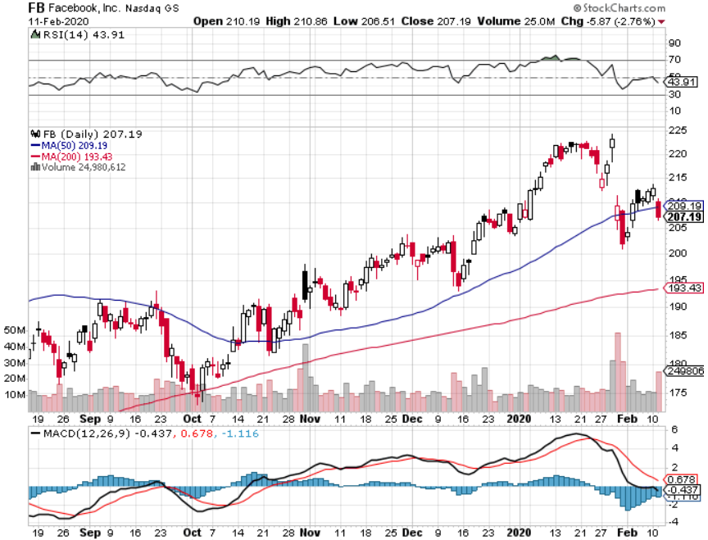
Facebook (FB)- Downgrade took profits on Long 9/$150-$160 vertical bull call spread took profits on Long 8/$167.50-$172.50 vertical bull call spread

Slide 25
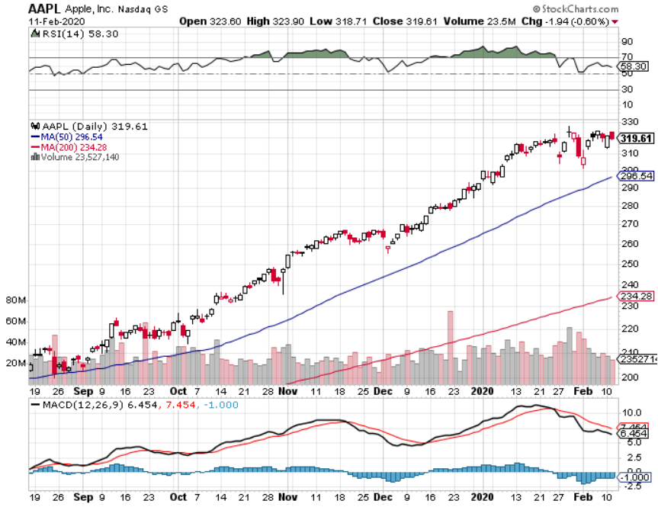
Apple (AAPL)-New All Time High as Services Soar Approaching 20X multiple, up from 7X took profits on long 2/$245-$255 put spread

Slide 26
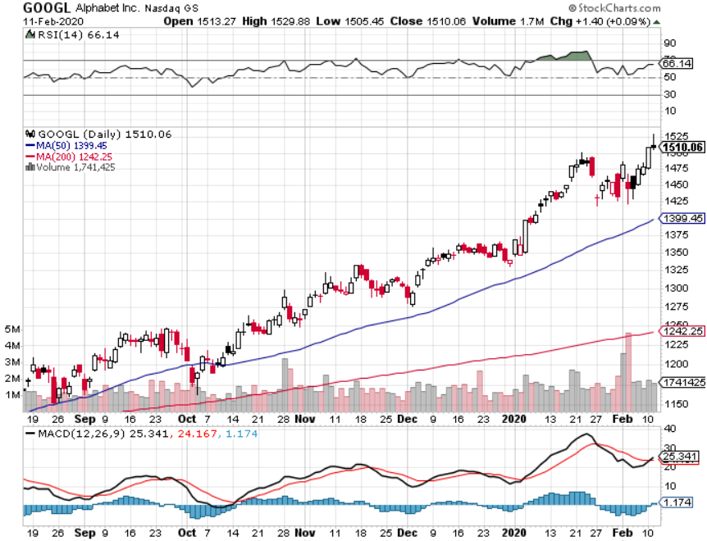
Alphabet (GOOGL) – Advertising recovers took profits on long 12/$1,200-$1,230 bull call spread took profits on long 9/$1,030-$1,080 vertical bull call spread stopped out of long 5/$1,100-$1,130 bull call spread took profits on long 4/$1,080-$1,120 bull call spread

Slide 27
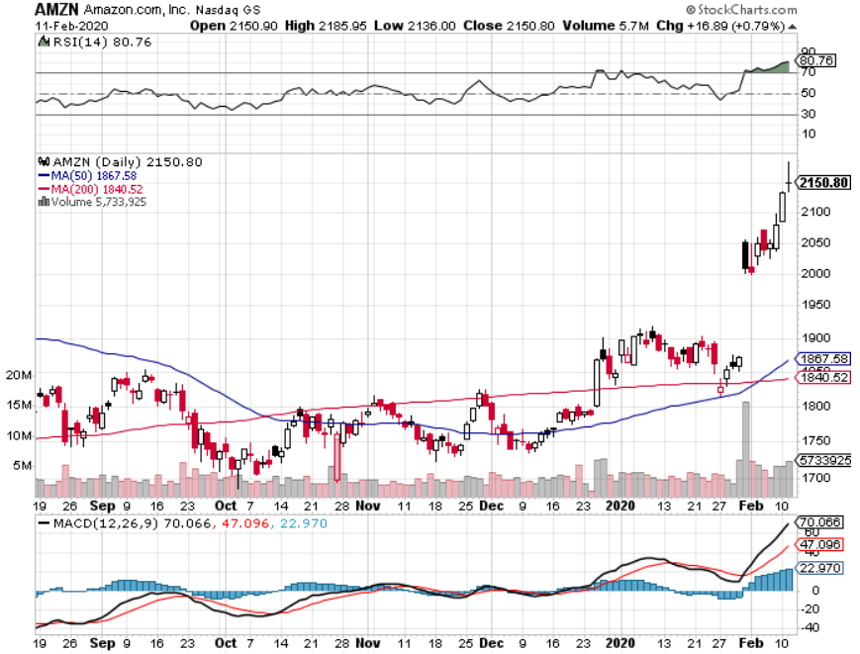
Amazon (AMZN) – The Catch Up Play took profits on 9/$1,500-$1,500 vertical bull call spread stopped out of long 4/$1,650-$1,700 call spread took profits on long 4/$1,600-$1,650 call spread took profits on long 2/$1,200-$1,300 call spread

Slide 28
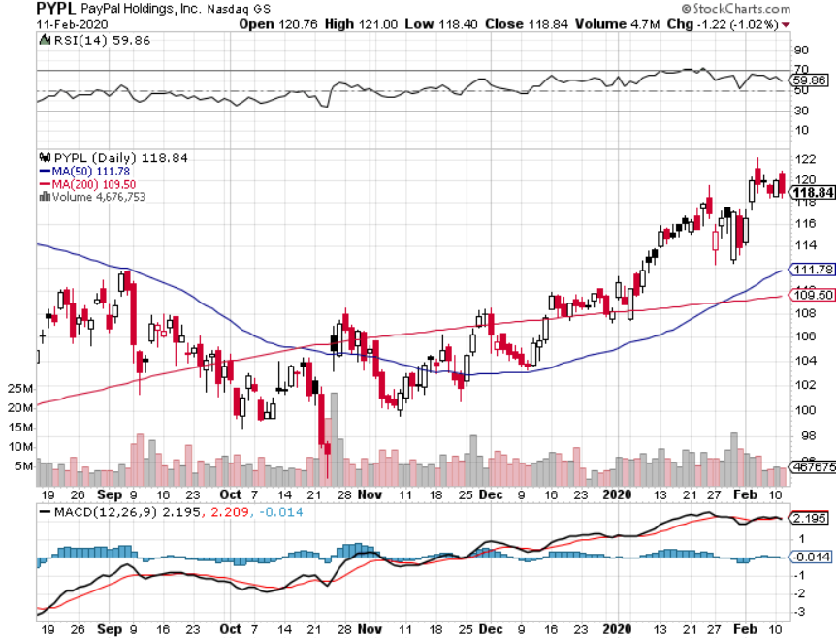
PayPal (PYPL)-CEO resigns took profits on long 4/$90-$95 call spread

Slide 29
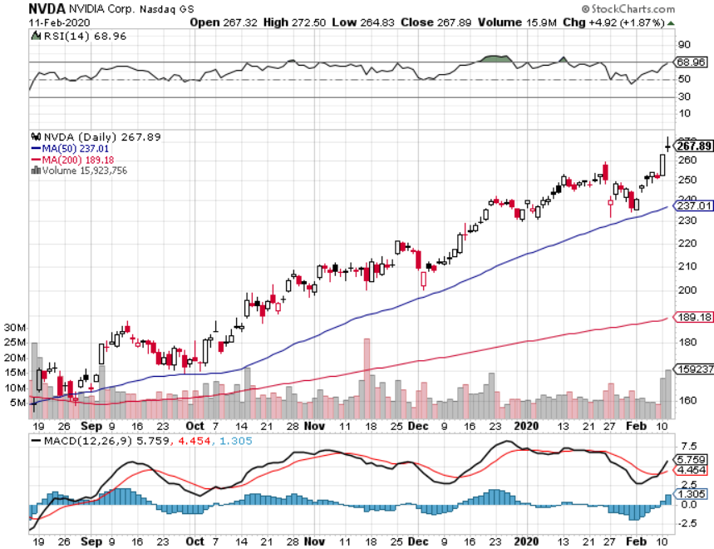
NVIDIA (NVDA) – Off to the Races

Slide 30
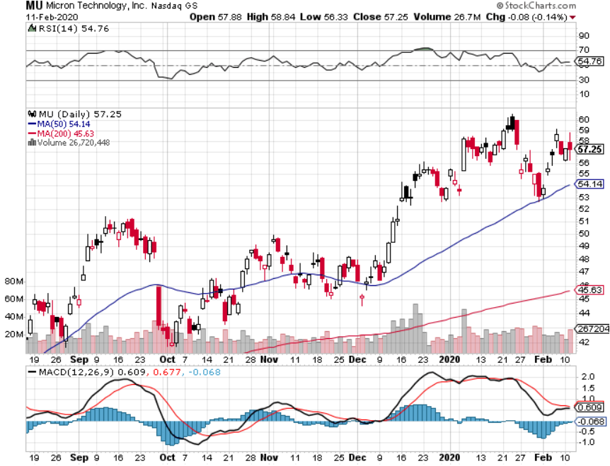
Micron Technology (MU)-

Slide 31
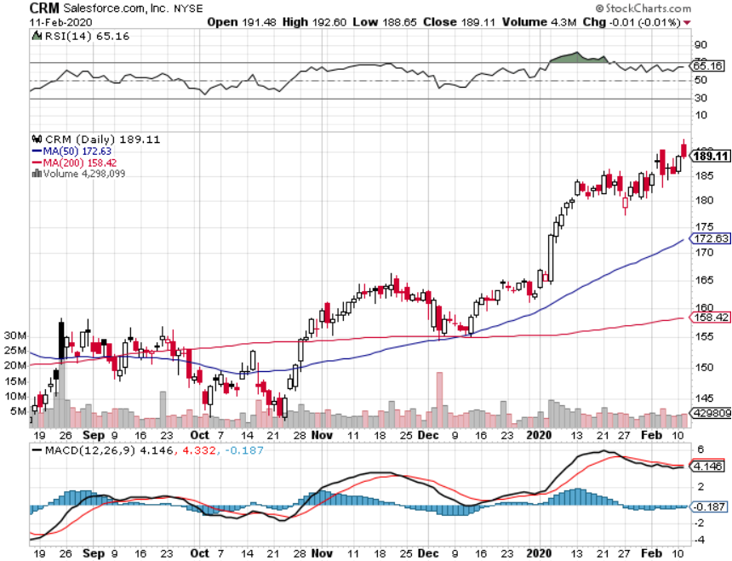
Salesforce (CRM)- Great earnings report took profits on long 9/$125-$130 vertical bull call spread took profits on long 8/$125-$130 vertical bull call spread took profits on long 2/$105-$115 call spread

Slide 32
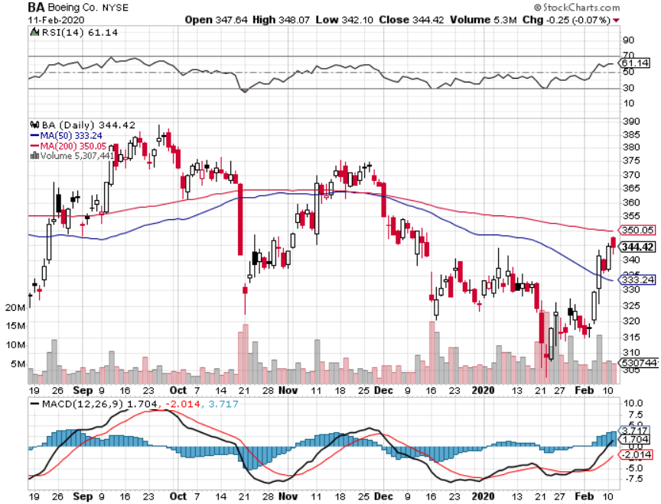
Boeing (BA) – The Capitulation is Here 737 MAX production shutdown-No Net Orders in January long 2/$270-$280 call spread – 7 days to expiration took profits on long 12/$310-$330 call spread took profits on long 4/$300-$310 call spread took profits on long 4/$315-$335 call spread

Slide 33
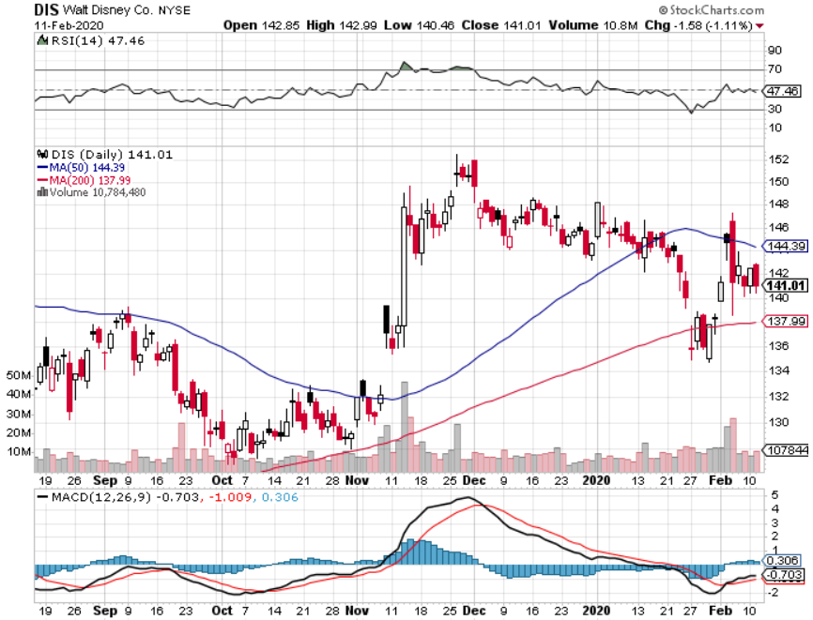
Walt Disney (DIS)- Corona Hit took profits on long 9/$115-$120 call spread 8/$125-$130 call spread expired at max profit Stopped out of 4/$125-$130 call spread for small loss took profits on long 4/$100-$104 call spread

Slide 34
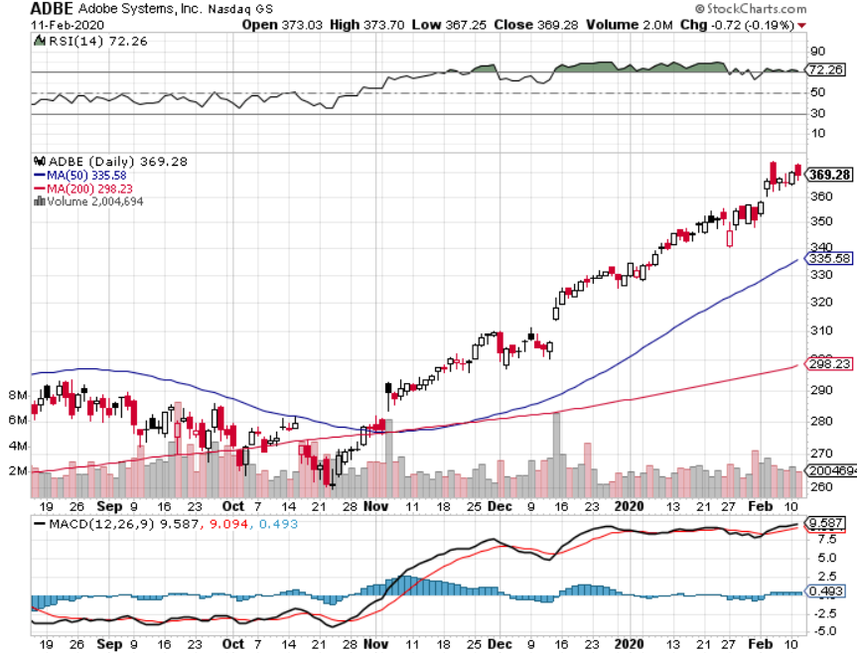
Adobe (ADBE)- The Quality Non-China tech play

Slide 35
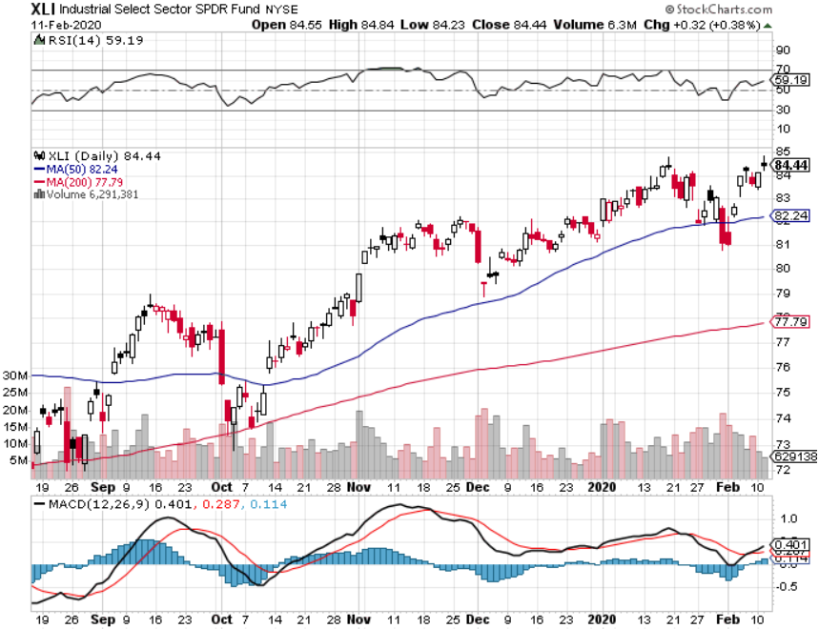
Industrials Sector SPDR (XLI)- (GE), (MMM), (UNP), (UTX), (BA), (HON)

Slide 36
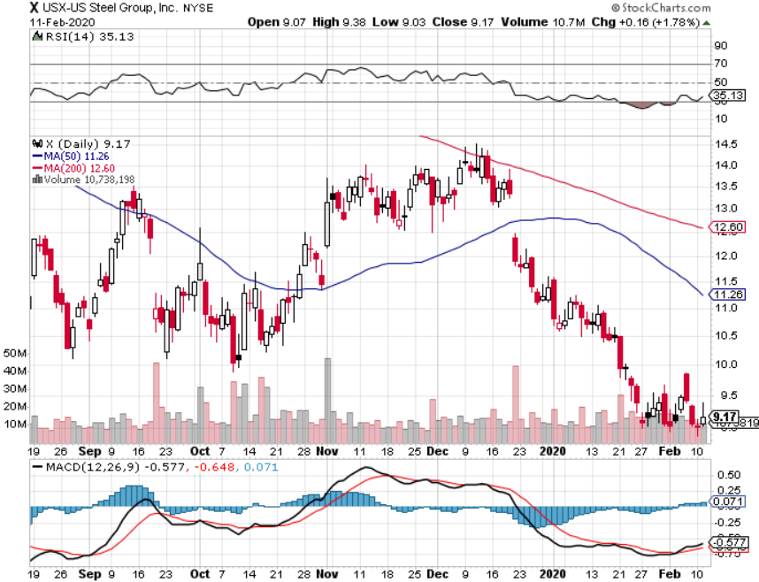
US Steel (X)-Tariffs Trouble

Slide 37
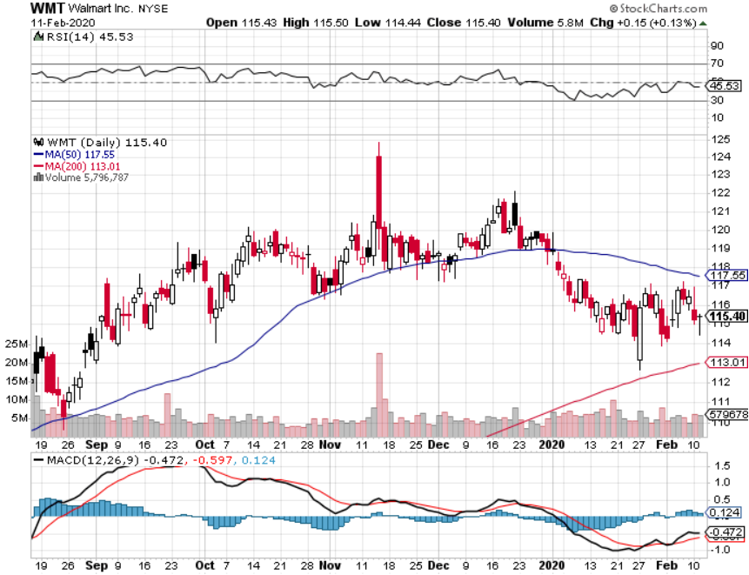
Wal-Mart (WMT)-Tariffs Trouble took profit on Long 11/$125-$130 bear put spread took profit on Long 10/$119-$121 bear put spread took profits on Long 8/$114-$117 bear put spread

Slide 38
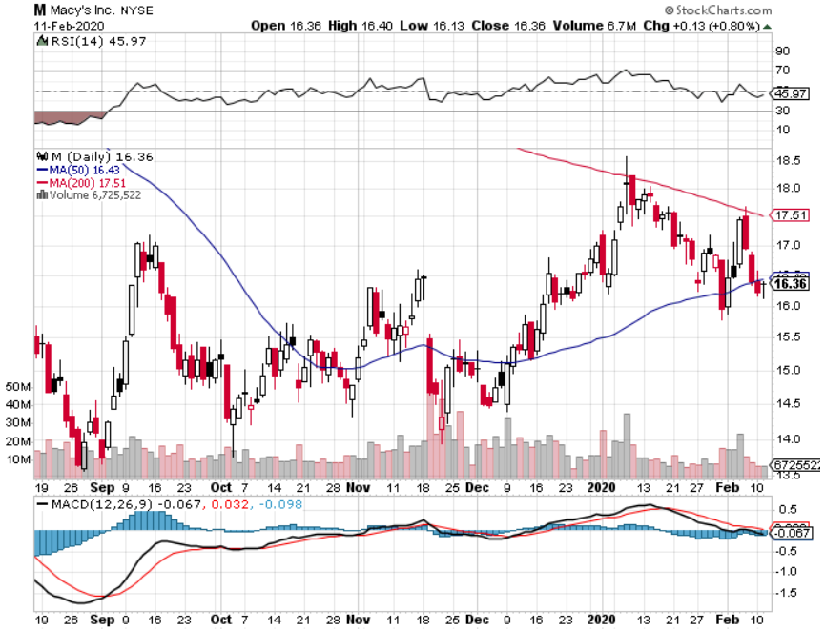
Macys’ (M)-Tariffs Trouble took profits on Long 8/$23-$25 bear put spread

Slide 39
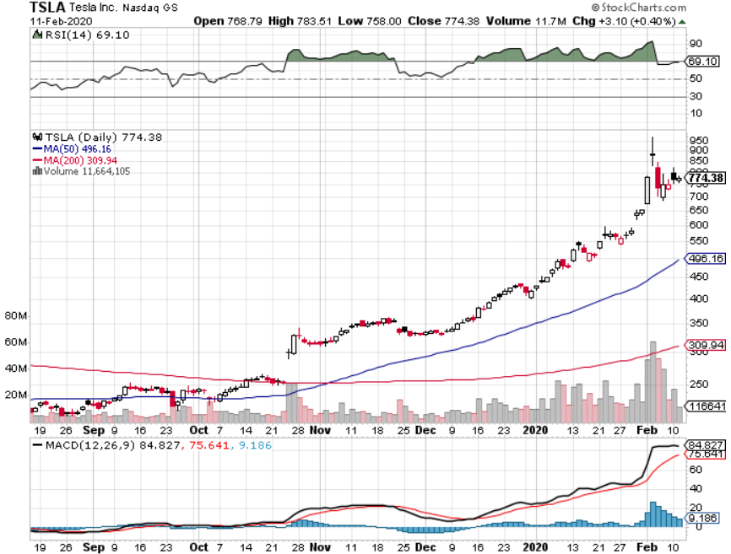
Tesla (TSLA)- Gone Ballistic Shanghai shutdown, New German subsidies, up 60X from original recommendation stopped out of long 6/$260-$270 put spread took profits on long 6/$140-$150 call spread took profits on long 6/$240-$250 put spread

Slide 40
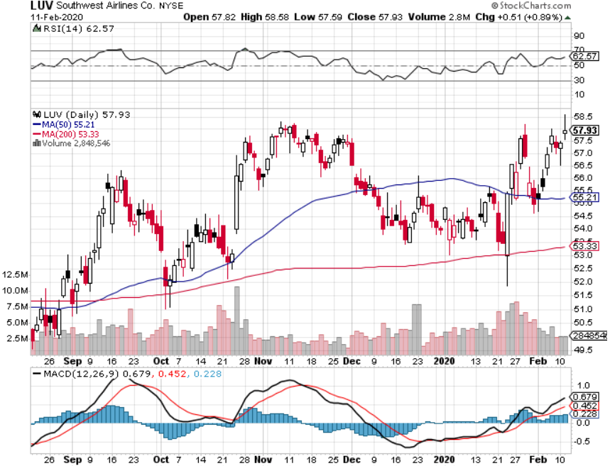
Southwest Airlines (LUV) - Boeing 737 Max biggest buyer

Slide 41
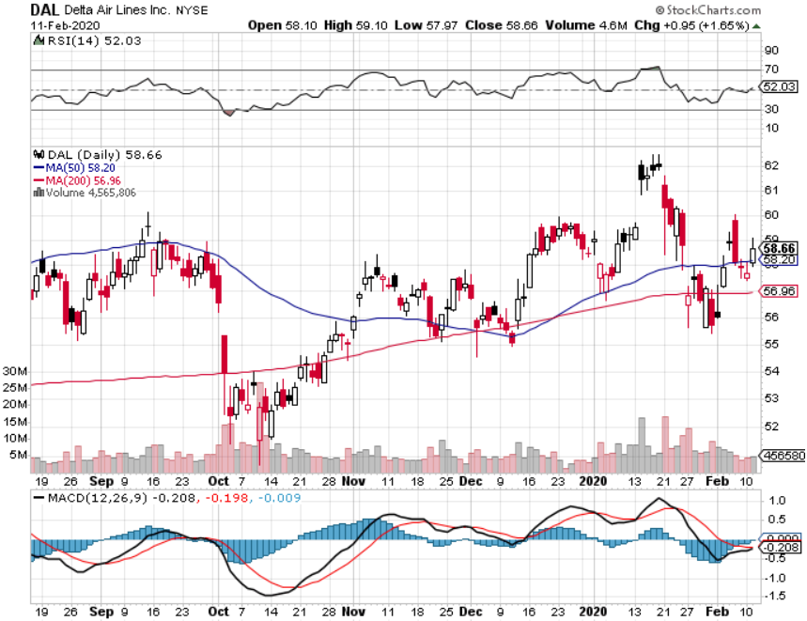
Delta Airlines (DAL) – Non 737 User

Slide 42
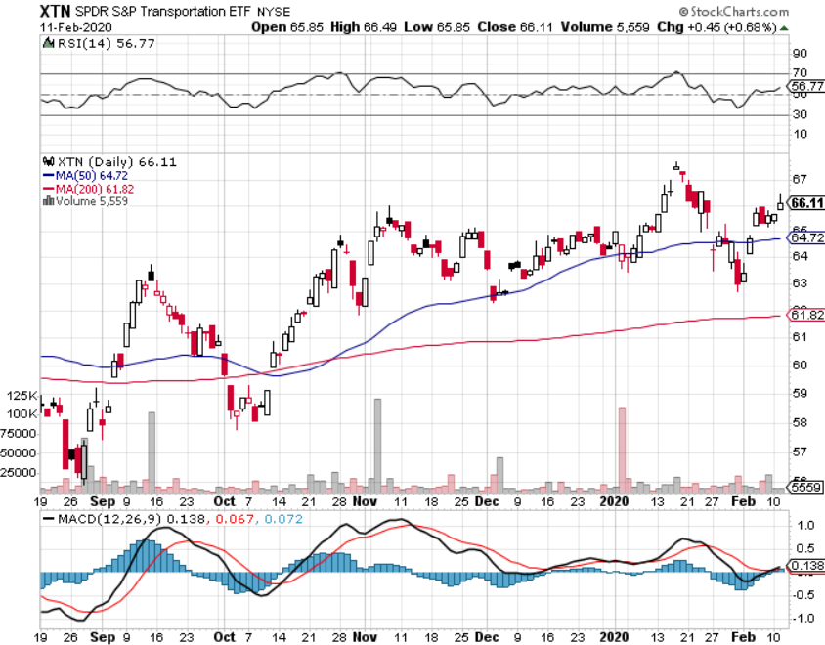
Transports Sector SPDR (XTN)- (ALGT), (ALK), (JBLU), (LUV), (CHRW), (DAL)

Slide 43
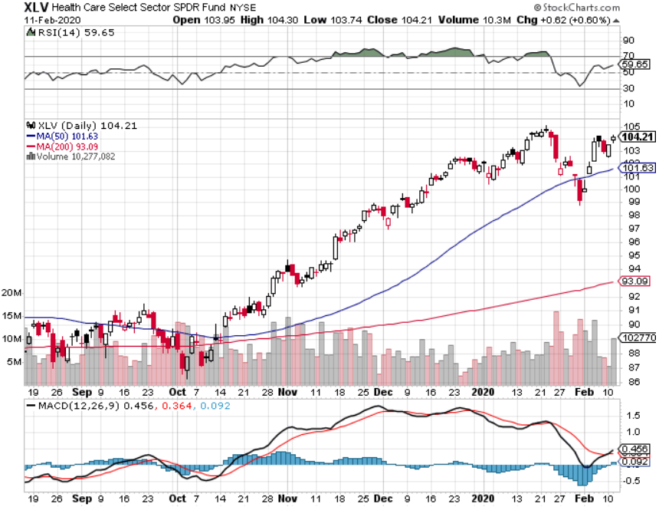
Health Care Sector (XLV), (RXL)-New Highs (JNJ), (PFE), (MRK), (GILD), (ACT), (AMGN)

Slide 44
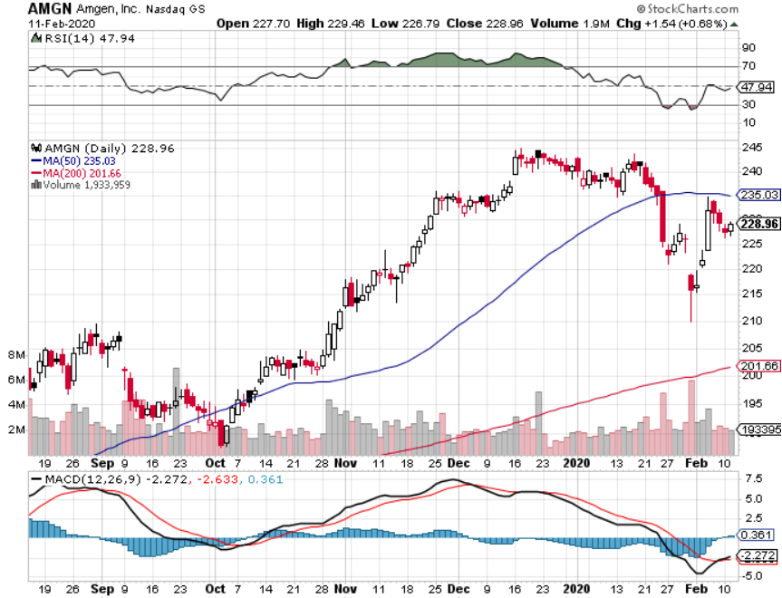
Amgen (AMGN) First Biotech Letter Trade Alert-up 21% in two months

Slide 45
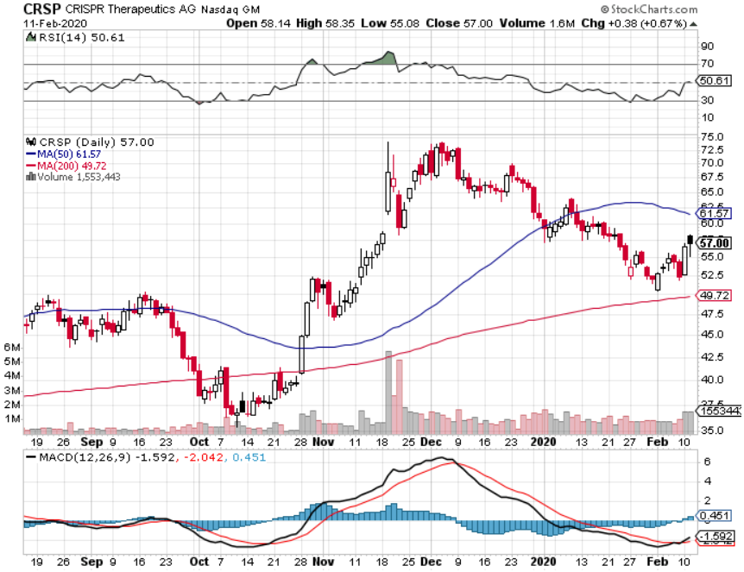
CRISPR Therapeutics (CRSP) Best Biotech Letter Trade Alert-up 100% in two months

Slide 46
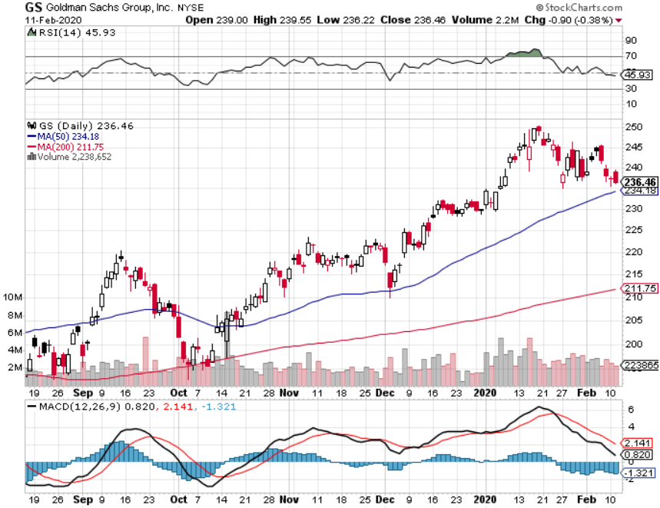
Goldman Sachs (GS)-Losing Breakout

Slide 47
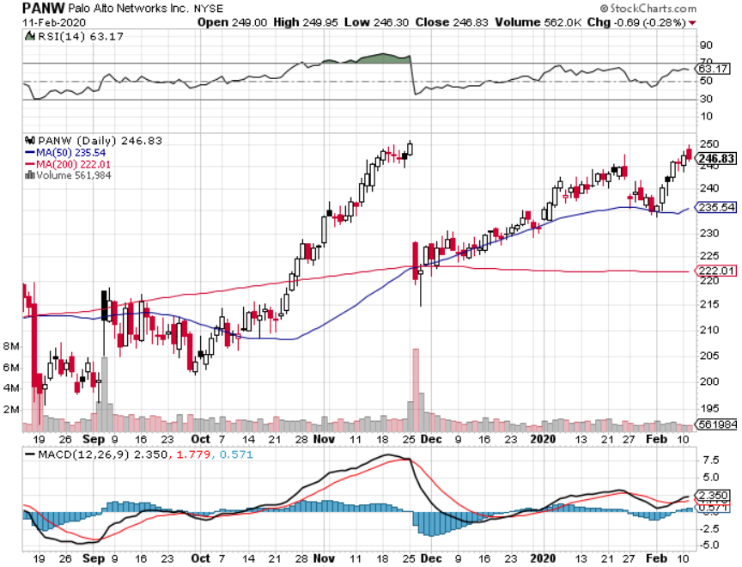
Palo Alto Networks (PANW)- Breakout Hacking never goes out of fashion

Slide 48
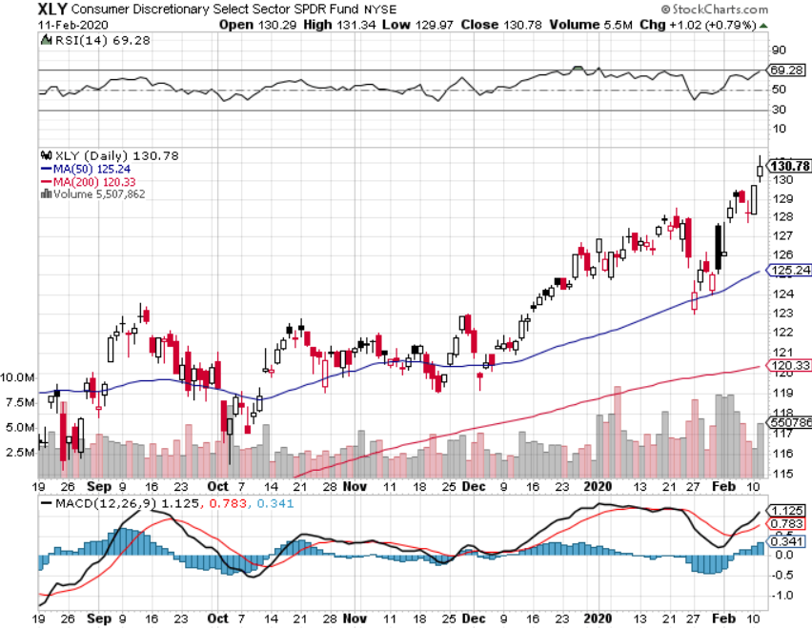
Consumer Discretionary SPDR (XLY) (DIS), (AMZN), (HD), (CMCSA), (MCD), (SBUX)

Slide 49
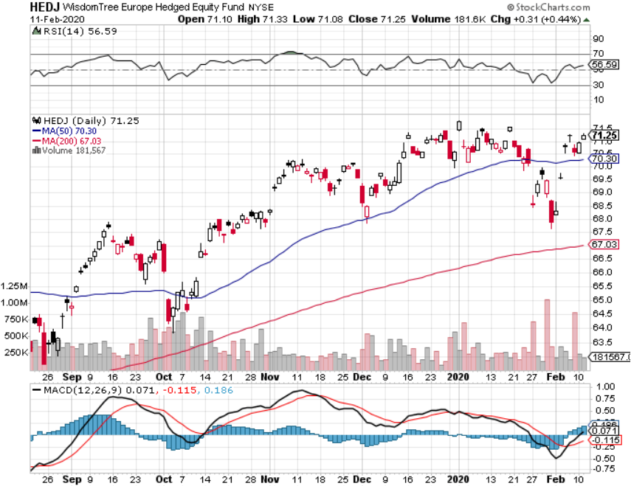
Europe Hedged Equity (HEDJ)- Pip on Brexit News

Slide 50
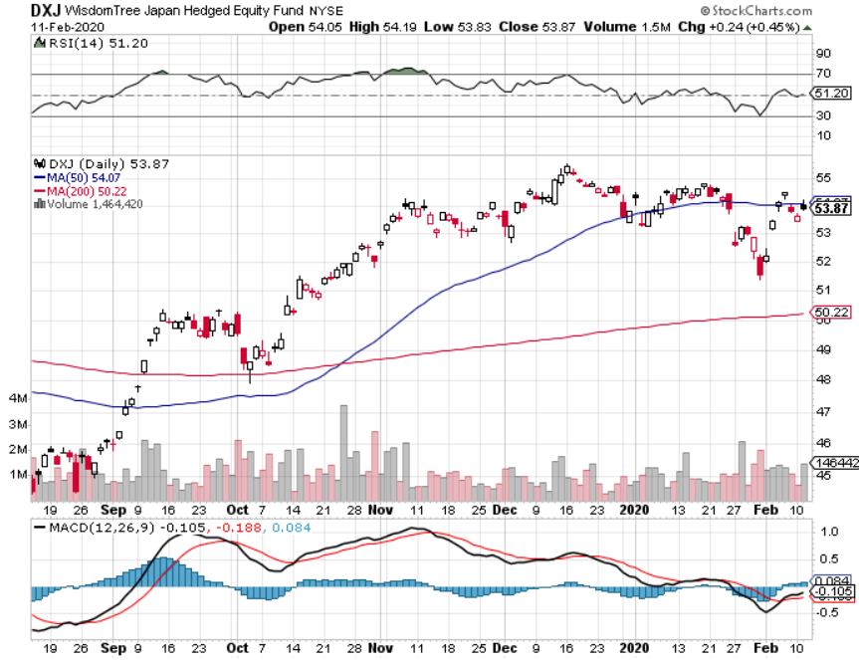
Japan (DXJ)-

Slide 51
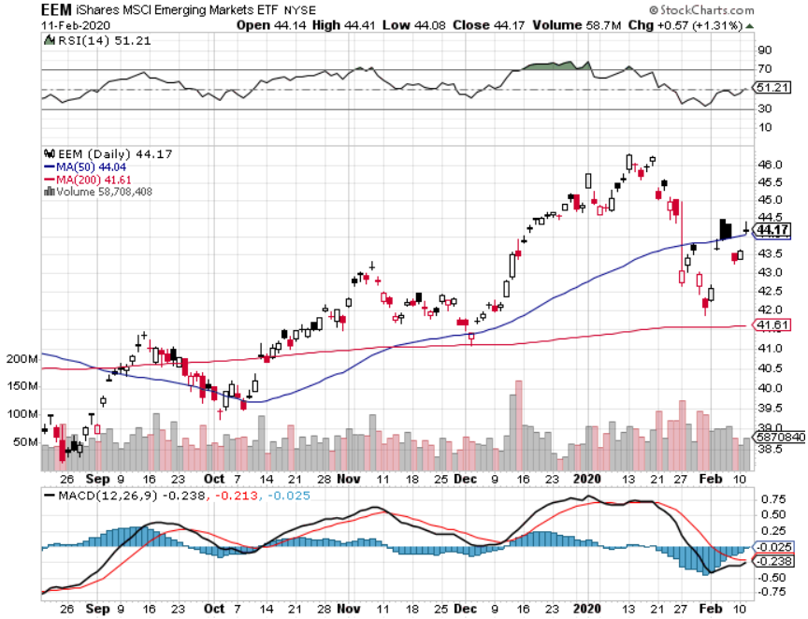
Emerging Markets (EEM)- Weak Dollar Play

Slide 53
Bonds – The Inversion is Back
*Bonds enjoy monster rally in the wake of the Corona epidemic *Yield inversion is almost back, with long rates about to drop below short rates, another recessionary indicator *Flight to safety combines with global recession fears *US dollar rally also gives fixed income a push *Get ready to sell short *Bottom line: bonds will fall back once recession fears fade

Slide 54
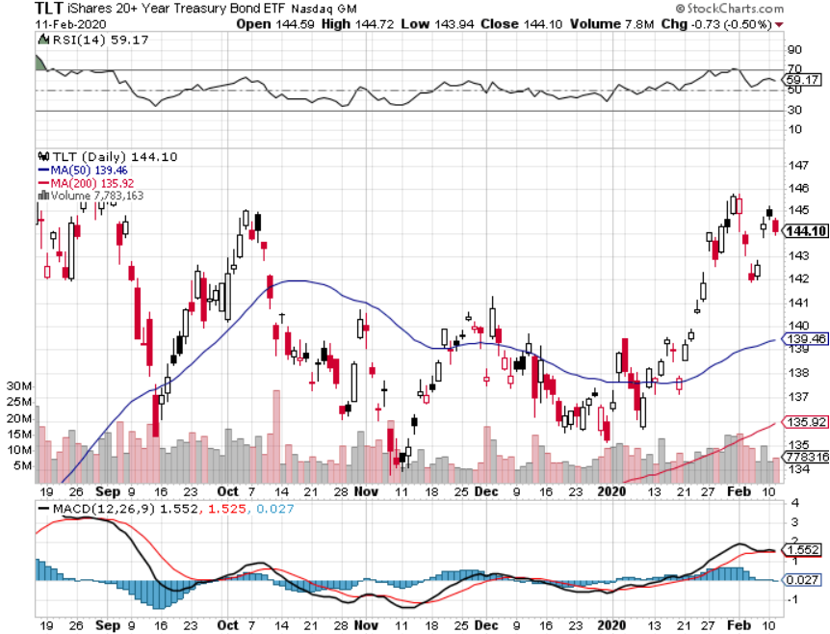
Treasury ETF (TLT) – Trading the Range long 12/$145-$148 put spread – expires in 12 trading days profits on long 10/$129-$132 call spread stopped out of long 8/$137-$140 put spread took profits on long 8/$125-$128 call spread

Slide 55
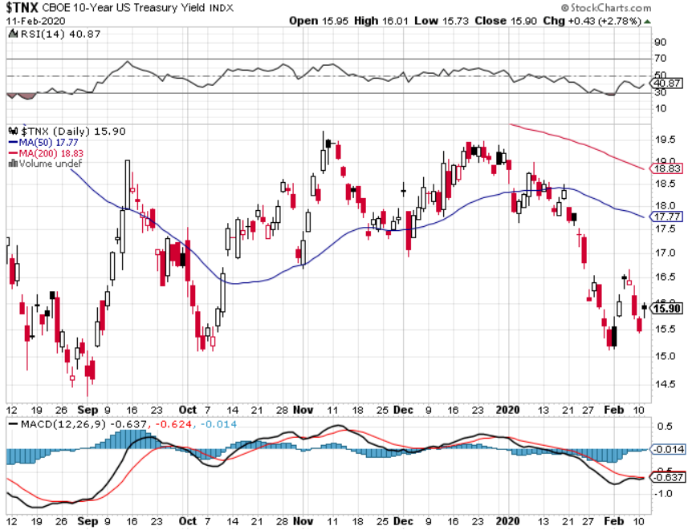
Ten Year Treasury Yield ($TNX) – 1.62%

Slide 56
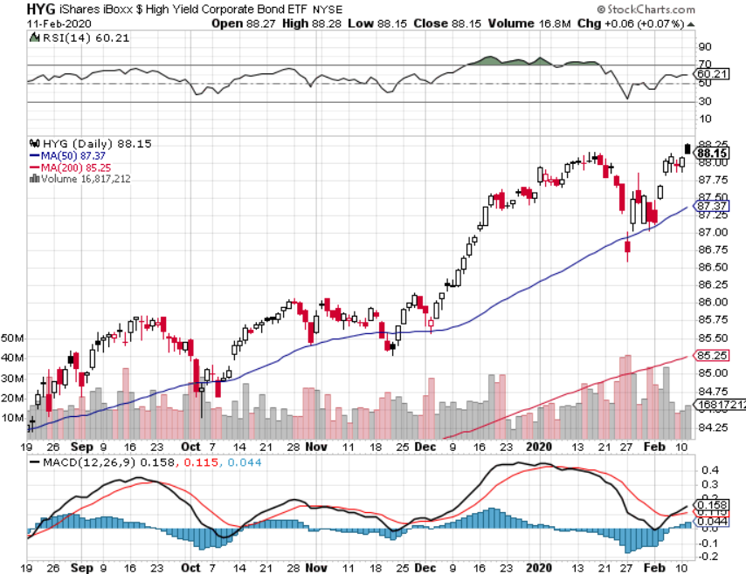
Junk Bonds (HYG) 4.82% Yield big jump in yields on stock selloff and recession fears

Slide 57
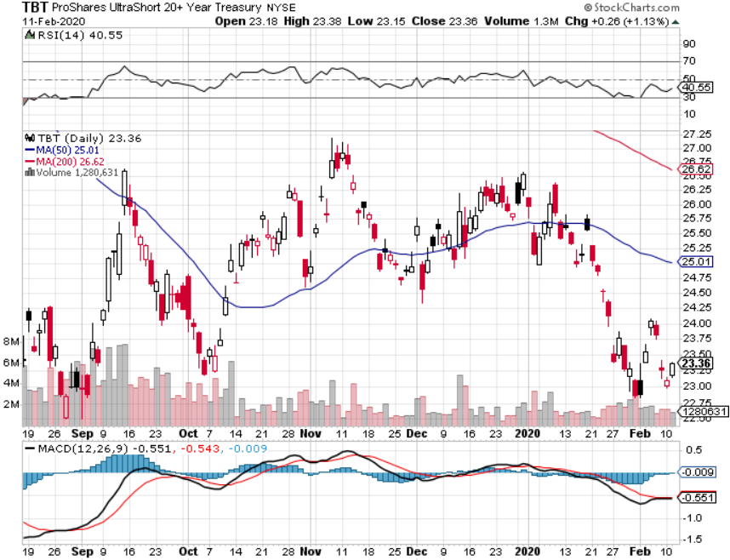
2X Short Treasuries (TBT)- 2 Month Bottoming Process

Slide 58
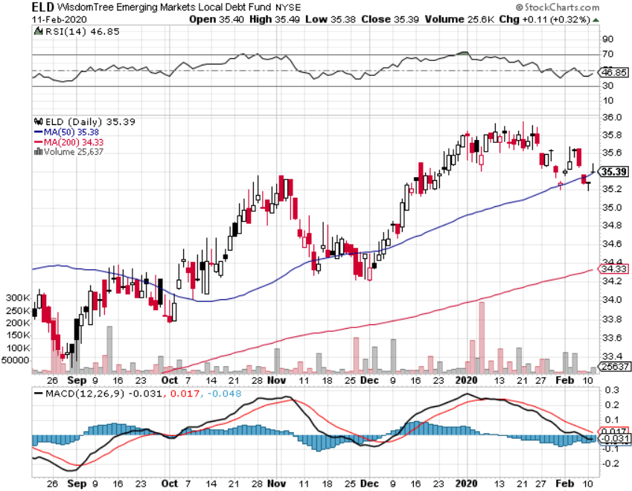
Emerging Market Debt (ELD) 4.78% Yield-

Slide 59
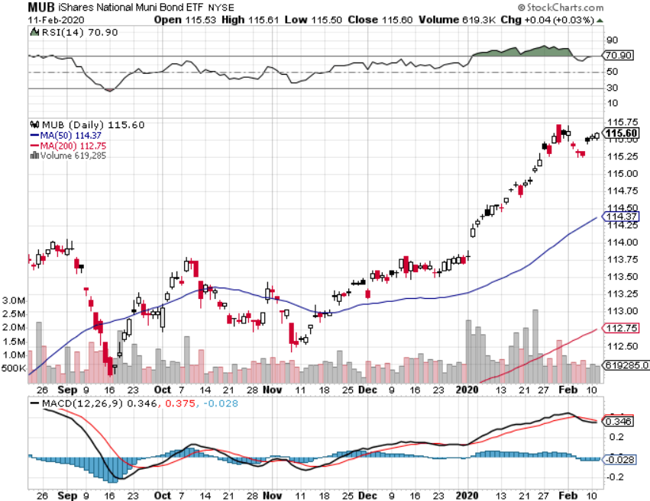
Municipal Bonds (MUB)-1.62% Mix of AAA, AA, and A rated bonds

Slide 61
Foreign Currencies – Dollar Spike
*Global Recession fears and flight to safety also produce a big dollar spike *Euro(FXE) gets crushed to six-month lows *British pound fades as Brexit finally goes through, but the government only has until yearend to negotiate a trade deal with Europe *Bitcoin breaks above $10,000 on panic Chinese buying *Aussie suffers from Corona virus fears *Starting selling short all dollar rallies

Slide 62
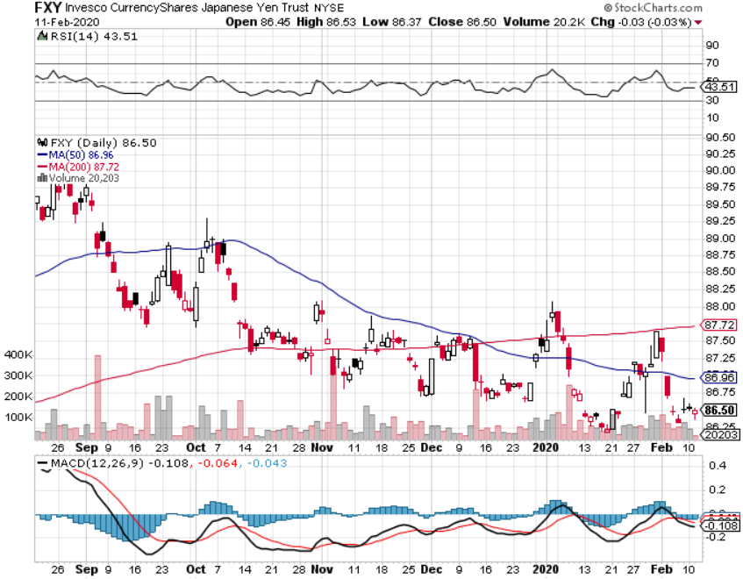
Japanese Yen (FXY), (YCS)

Slide 63
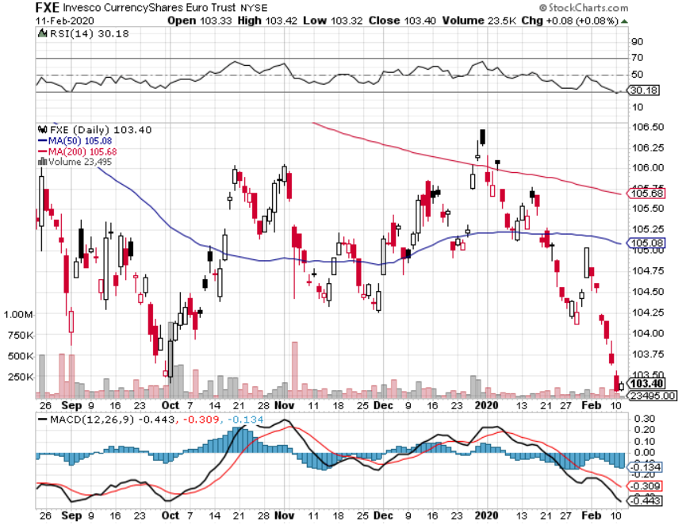
Euro ($XEU), (FXE), (EUO)-

Slide 64
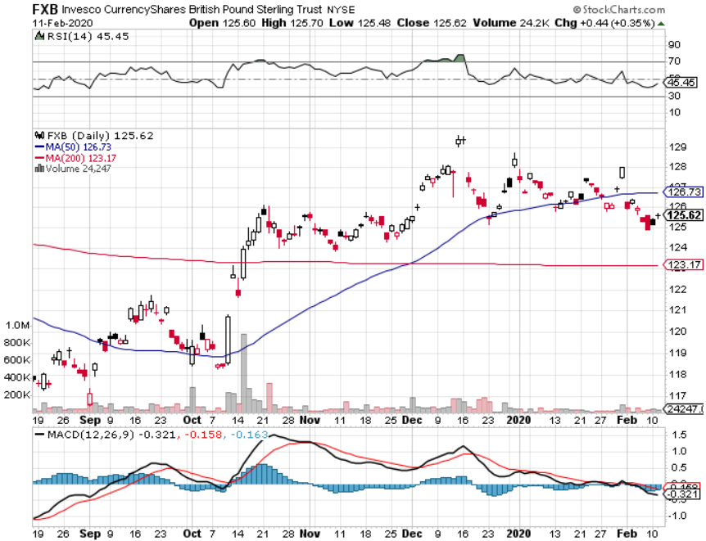
British Pound (FXB)-

Slide 65
Australian Dollar (FXA)- The Global Recovery Play took profits on long 8/$67-$69 call spread

Slide 66
Emerging Market Currencies (CEW)

Slide 67
Chinese Yuan- (CYB)- New Lows

Slide 68
Bitcoin- Mideast Crisis Brings Brief Respite

Slide 70
Energy – Corona Crash
*Oil collapses below $50 on Corona recession fears *China is the world’s largest marginal oil consumer, so oil had to take the big hit *Any price spike was be temporary, as over supply against fading demand will last for years *Avoid all energy plays like the plague, could drop by half in the coming recession

Slide 71
Oil-($WTIC)

Slide 72
United States Oil Fund (USO) long 10/$9.50-$10 Vertical bull call spread

Slide 73
Energy Select Sector SPDR (XLE)-No Performance! (XOM), (CVX), (SLB), (KMI), (EOG), (COP)

Slide 74
Halliburton (HAL)-

Slide 75
Natural Gas (UNG) -

Slide 77
Precious Metals – Holding Up
*Gold remains bid with potential stock weakness coming *Sideway move after big spike up is very bullish *Only a 22% move takes gold prices to new all-time highs *”RISK OFF” means ”BUY GOLD” *Central banks still pouring into gold every month *Bottom Line: buy a bigger dip in gold and precious metals

Slide 78
Gold (GLD)- Short Term downtrend

Slide 79
Market Vectors Gold Miners ETF- (GDX) – Yikes!

Slide 80
Barrick Gold (GOLD)

Slide 81
Newmont Mining- (NEM)-

Slide 82
Silver- (SLV)-

Slide 83
Silver Miners - (SIL)-

Slide 84
Wheaton Precious Metals - (WPM)-

Slide 85
Copper (COPX)-Collapse Trade War Disaster

Slide 86
Freeport McMoRan (FCX)-World’s Largest Copper Producer took profits on long 4/$10-$11 call spread took profits on short 4/$114 calls

Slide 88
Real Estate – Spring Blooms
*Pending Home Sales down a horrific 4.9% in December, as supply hits an all time low *Corona virus may delay the spring opening of the housing market *Commercial real estate is also facing a hit as global commerce slows *30-year fixed rate mortgage hits one year low at 3.59% *Refi’s hit a seven year high on super low rates S&P Case Shiller Rose 3.5%, in November, the third consecutive month of price increases. Only San Francisco is showing falling prices.

Slide 89
February Corelogic S&P Case Shiller Home Price Index Phoenix (5.9%), Tampa (5.0%), and Charlotte, NC (5.2%) showing biggest gains
Tradingeconomics.com

Slide 90
Simon Property Group (SPG)- Mall REIT

Slide 91
Crown Castle International (CCI) – 3.40% yielding cell phone Tower REIT

Slide 92
US Home Construction Index (ITB) (DHI), (LEN), (PHM), (TOL), (NVR)

Slide 94
Trade Sheet- So What Do We Do About All This?
*Stocks-buy bigger dip *Bonds-sell rally *Commodities-buy bigger dip *Currencies- sell dollar rallies *Precious Metals – buy dips *Energy – stand aside *Volatility-buy dips to $12 *Real estate-stand aside

Slide 95
Next Strategy Webinar 12:00 EST Wednesday, February 26, from Silicon Valley email me at support@madhedgefundtrader.com
Good Luck and Good Trading!
Notes:
*

