Slide 1
The Mad Hedge Fund Trader “A MARKET OF EXTRMES”
With John Thomas from Silicon Valley, CA, March 11, 2020 www.madhedgefundtrader.com
Notes:
*

Slide 2
Trade Alert Performance New Highs Again!
*January 3.13% Final *July +3.07% Final *February -6.05% Final *August +16.01% Final *March -1.83% MTD *September 3.08% Final *April +0.30% Final *October +12.13% Final *May +0.25% Final *November -1.26% Final *June -0.50% Final *December +4.97% Final *Year to date -4.75% compared to -19% for the Dow Average *+351.16% since inception, *Average annualized return of 34.00% for 10 years

Slide 3
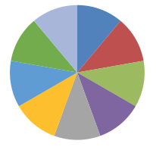
Portfolio Review Betting the Ranch-90% invested, 10% cash, Only Buying Very Deep in-the-Money Call and Put Spreads and LEAP’s on Extreme Capitulation Days with (VIX) over $50
Risk On
World is Getting Better
(VXX) 1/2021 $16 puts | 10.00%
(VXX) 1/2021 $24 puts | 10.00%
(AAPL) 3/$220-$230 call spread | 10.00%
(BA) 3/$170-$175 calls | 10.00%
Risk Off
World is Getting Worse
(AAPL) 3/$325-$330 put spread | -10.00%
(UAL) 3/$75-$80 put spread | -10.00%
(CCL) 3/$36-$38 put spread | -10.00%
(WYNN) 3/$110-$115 put spread | -10.00%
(FB) 3/$190-$200 put spread | -10.00%
Total Net Position | -10.00%
Expiration P&L +0.64% YTD

Slide 4
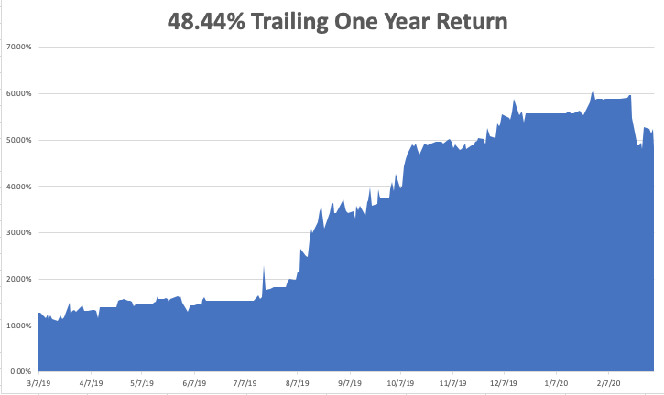

Slide 5
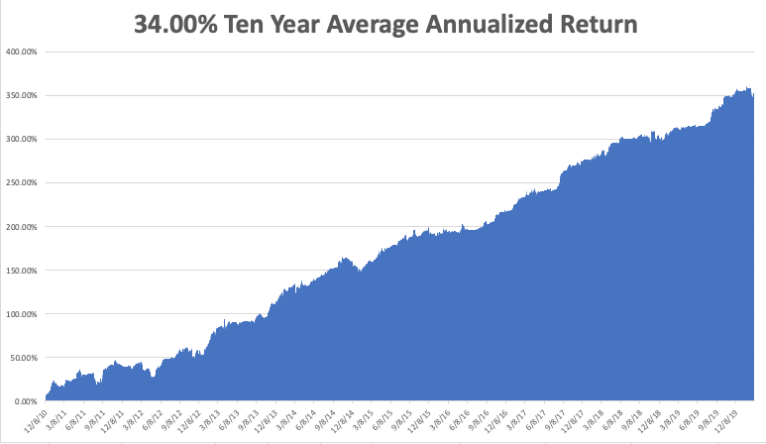
GTD 10 Year Daily Audited Performance

Slide 6
The Method to My Madness
*Japan and the US are already in recession, will the US follow? *Market risks right now at three year low, time to pile on the positions *Bonds hit new all-time highs on flight to safety, precedes demise of the bond market *US Dollar collapses, sell every rally for years *Gold hits 7 year high, headed to all-time high *Volatility hits 10 year high at $60 *Best buying opportunity of the decade is setting up

Slide 7
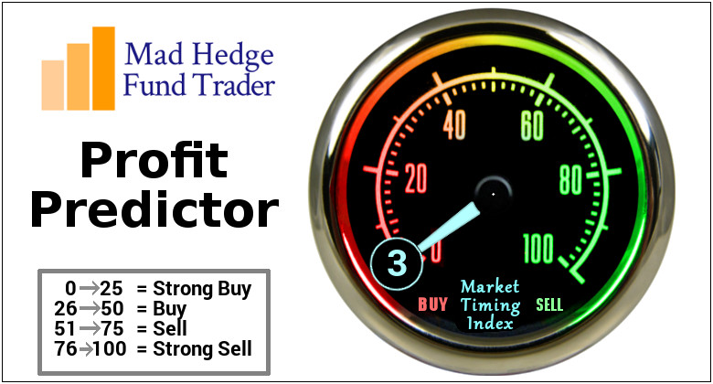
The Mad Hedge Profit Predictor Market Timing Index-Top of Range-Close to a “SELL” An artificial intelligence driven algorithm that analyzes 30 different economic, technical, and momentum driven indicators

Slide 8
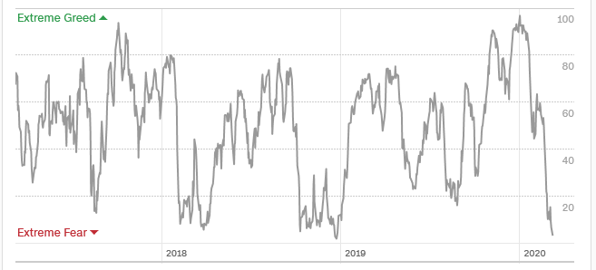
The Mad Hedge Profit Predictor From Extreme Overbought to Oversold
SELL
BUY

Slide 9
The Global Economy – Corona, Corona, Corona
*Corona virus epidemic is now the principal factor in the global economy, but we won’t see the data for 2-3 months *Europe was marginal before, is certainly now in recession *Global travel industry is imploding, an $8.8 Trillion a year business, Italy is the world’s biggest destination and it is closed *Market has gone from ignoring the pandemic to obsessing about it *US cases won’t peak for two months, expect markets to bottom before then *Chinese are massively stimulating economy with more QE, cutting interest rates as economy slows from a 6% GRD growth rate to negative numbers

Slide 10
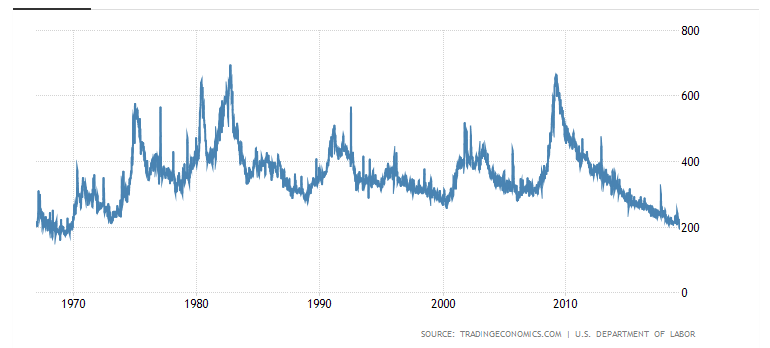
Weekly Jobless Claims-Bottomed Out -3,000 to 219,000

Slide 11
Soybeans - Trade War Indicator The Corona Crash

Slide 12
The Bill Davis View A $1,500 Upgrade for the Mad Day Trader Service
Buys: | Entry | Target
Facebook (FB) | $ 166.00 | $ 192.00
Apple (AAPL) | $ 269.00 | $ 305.00
Becton Dickinson (BDX) | $ 226.00 | $ 260.00
Crown Castle (CCI) | $ 156.00 | $ 175.00
KLA Corp (KLAC) | $ 151.00 | $ 185.00
Sells:
General Mills (GIS) | $ 56.00 | $ 48.00
O'Reilly Automotive (ORLY) | $ 400.00 | $ 350.00
Take-Two Software (TTWO) | $ 118.00 | $ 106.00
GrubHub (GRUB) | $ 50.00 | $ 38.00
ABIOMED, Inc. (ABMD) | $ 159.00 | $ 145.00

Slide 13
Stocks – Whipsaw
*Earnings multiples drop from 20X to 16X in two weeks, 15.5X is the 100-year average *At yesterday’s low we hit the November 2017 low, wiping out two ½ years of stock market performance *$165 EPS x 15.5 = (SPX) of 2,557, 176 below the Monday and Tuesday 2,734 low, or 6.4% *It’s time to start scaling into those 2-year LEAP’s in your favorite names *Continue to focus on big tech and biotech, the market leaders, on 20%-30% selloffs *The best buying point of the year is approaching *Bottom line: buy the next big dip for a run to new highs after the November election *Bottom Line: its bet the ranch time on tech longs, but stay away from those with big China exposure, like Apple, and weak dollar plays like energy, and emerging markets

Slide 14
S&P 500 – Collapse –Targeting 2,557 took profits on long 8/$297-$302 bull call spread took profits on long 10/$305-$310 bear put spread
The Bottom 2557

Slide 15
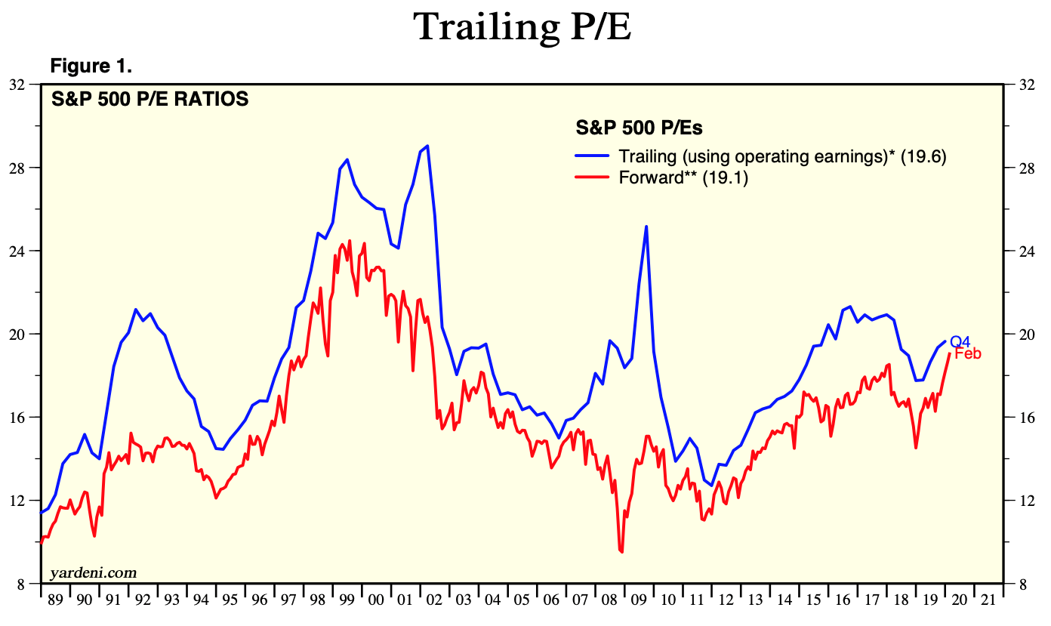
S&P 500 – 100 Year Multiple Average is 15X
You are Here Now

Slide 16
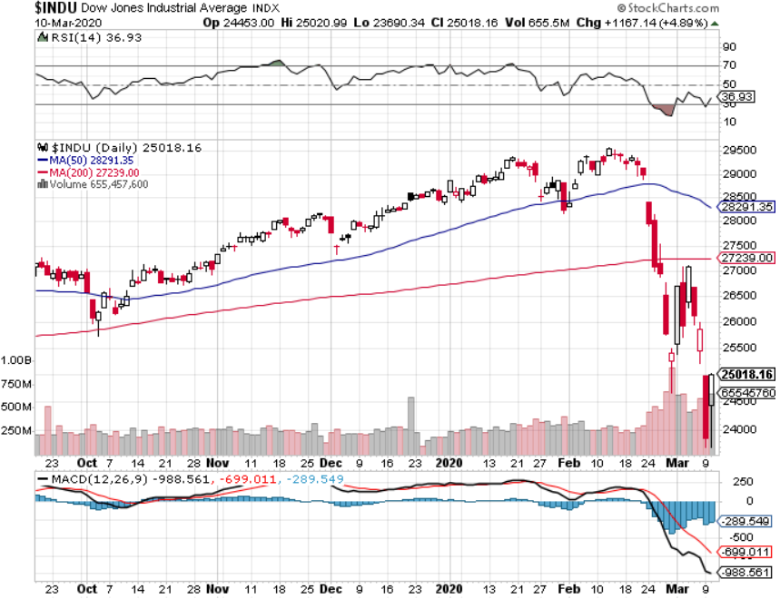
Dow Average ($INDU)- Giving Up 2019 and 2018

Slide 17
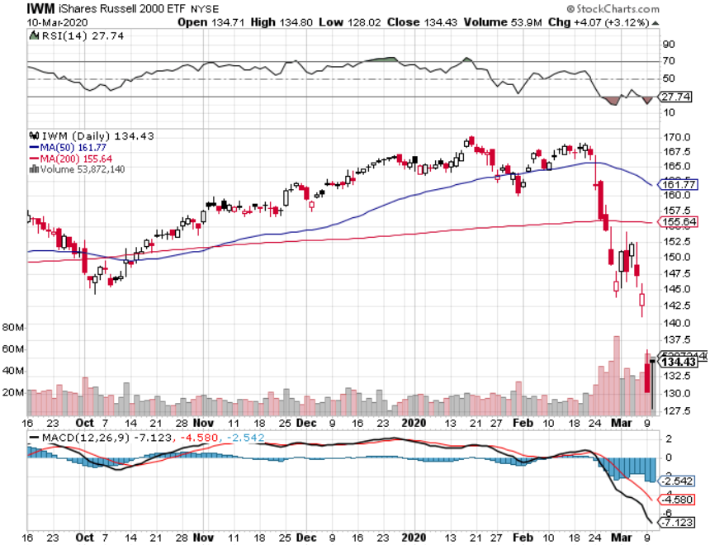
Russell 2000 (IWM)- Free Fall took profits on Long 10/$137-$142 vertical bull call spread took profits on Long 10/$153-$156 vertical bear put spread

Slide 18
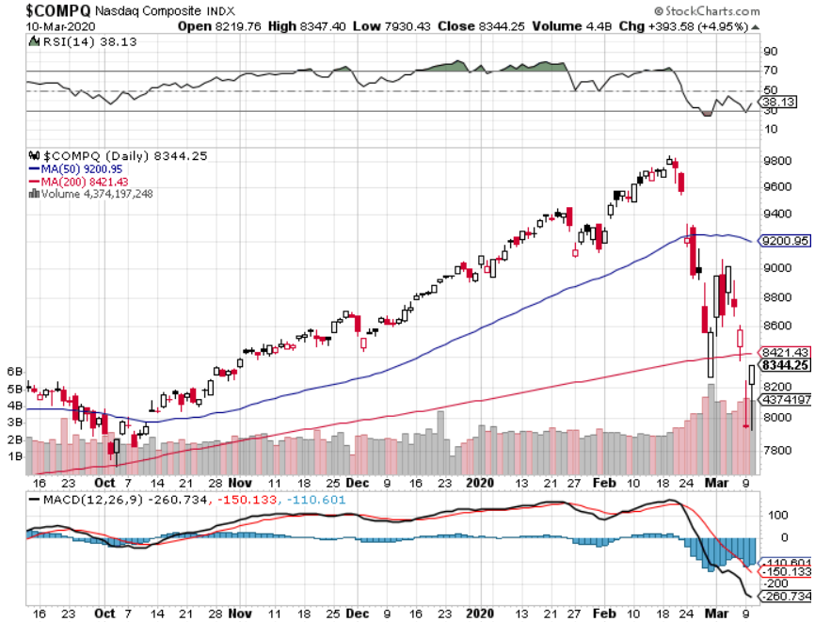
NASDAQ ($COMPQ) – Monster Declines

Slide 19
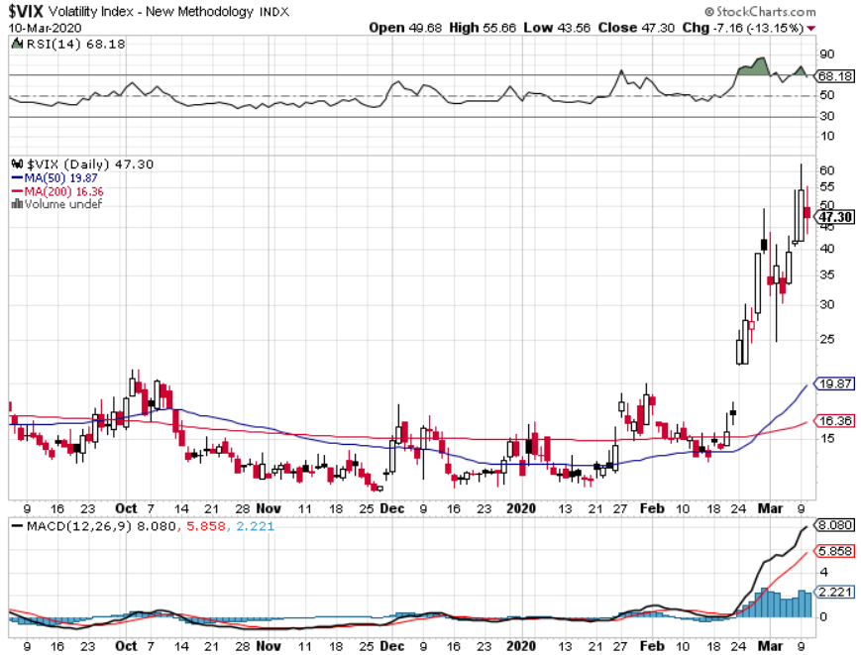
(VIX)- 11 Year High

Slide 20
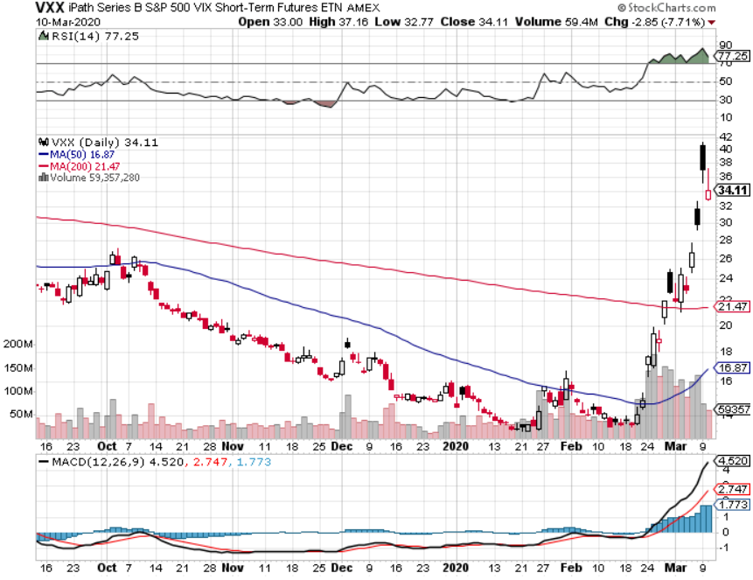
(VXX)- Buy the Dips took profits on long 1/2021 $16 calls

Slide 21
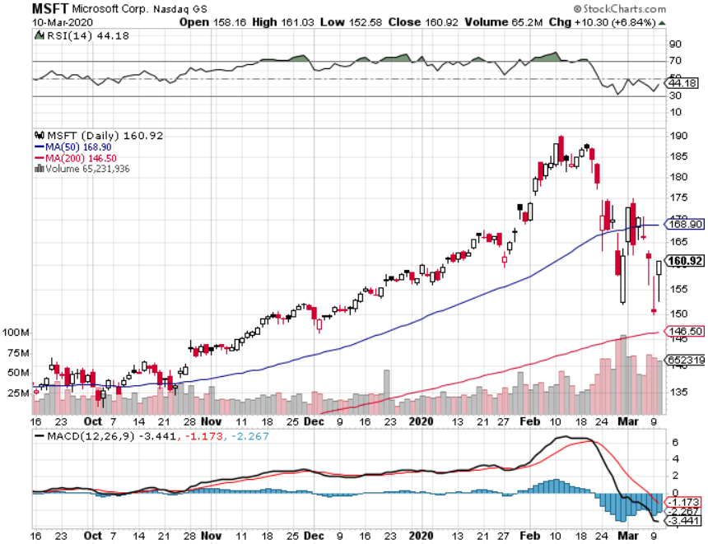
Microsoft (MSFT)- Earnings beat- Looking for Another Entry Point stop loss on long 12/$170-$180 call spread took profits on long 12/$135-$138 call spread took profits on long 9/$115-$120 call spread took profits on long 6/$110-$115 call spread took profits on long 4/$108-$113 call spread

Slide 22
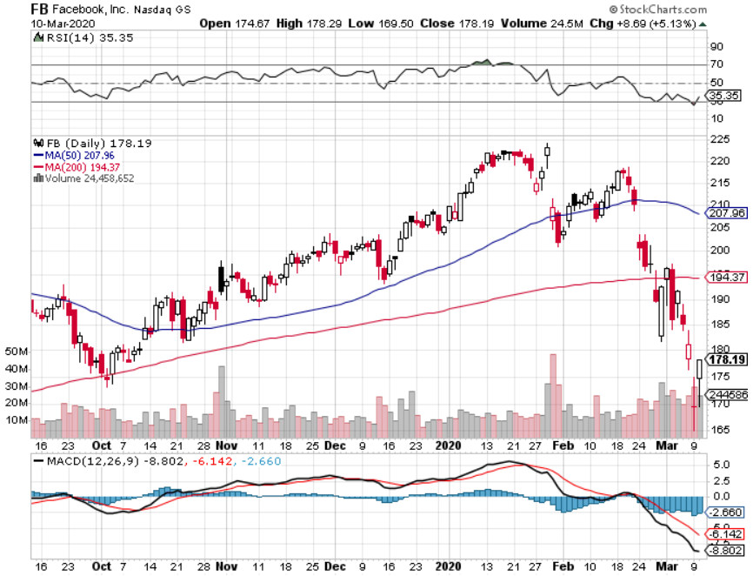
Facebook (FB)- Breaking Dow Paying Full Salaries on all gig workers took profits on Long 9/$150-$160 vertical bull call spread took profits on Long 8/$167.50-$172.50 vertical bull call spread

Slide 23
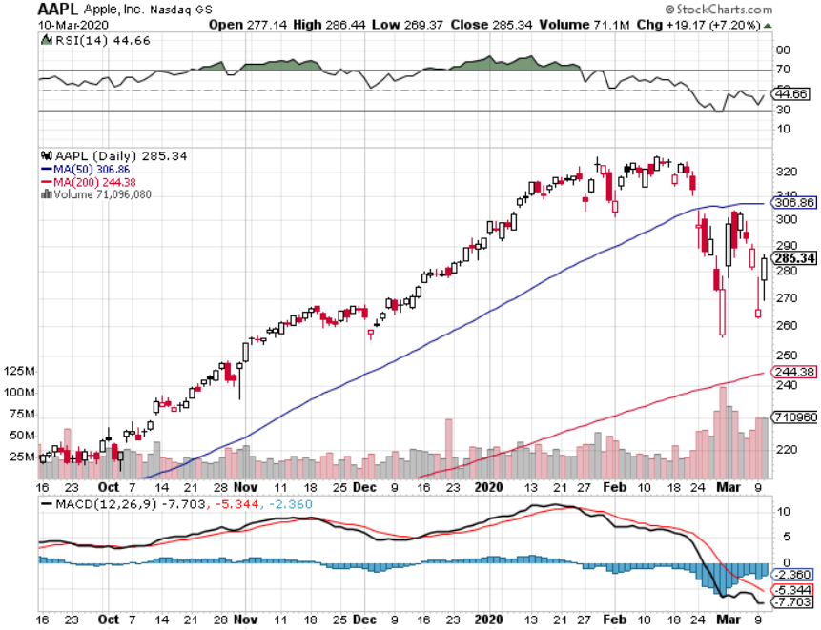
Apple (AAPL)- Tosses Q2 Guidance took profits on long $3/$250-$260 call spread stopped out of long $3/$285-$295 call spread took profits on long 2/$245-$255 put spread

Slide 24
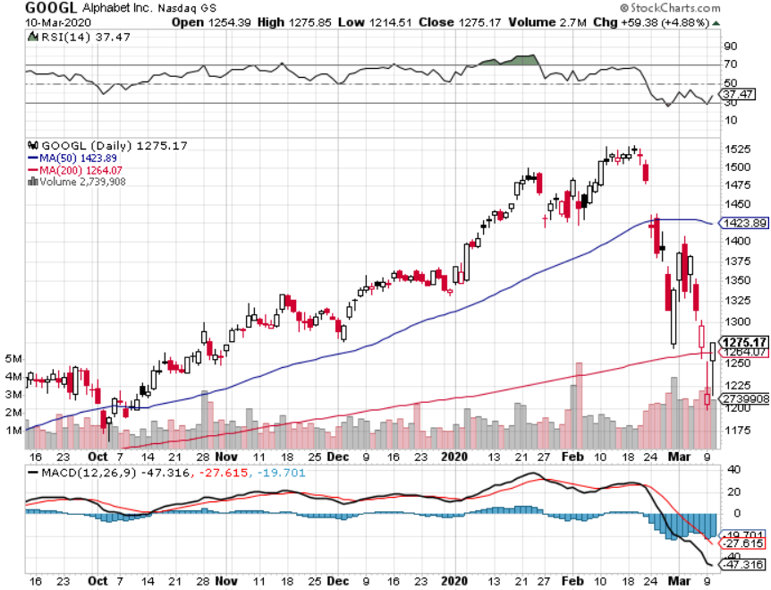
Alphabet (GOOGL) – Advertising Hit took profits on long 12/$1,200-$1,230 bull call spread took profits on long 9/$1,030-$1,080 vertical bull call spread stopped out of long 5/$1,100-$1,130 bull call spread took profits on long 4/$1,080-$1,120 bull call spread

Slide 25
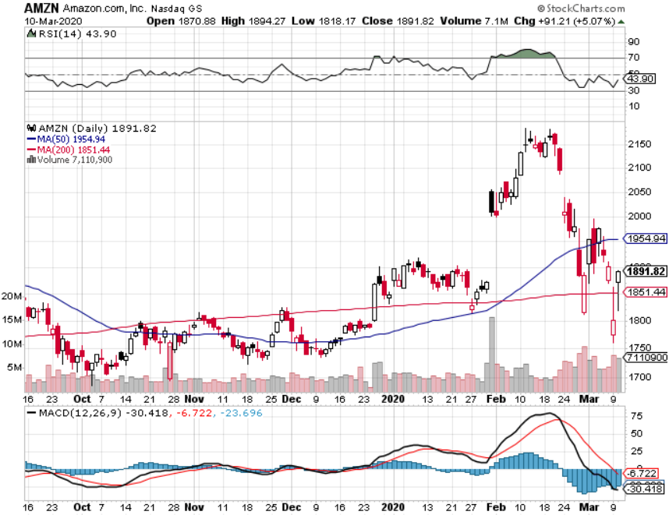
Amazon (AMZN) – Terrible Guidance – stopped out of long 3/$1,700-$1,800 bull call spread took profits on 9/$1,500-$1,500 bull call spread stopped out of long 4/$1,650-$1,700 call spread took profits on long 4/$1,600-$1,650 call spread took profits on long 2/$1,200-$1,300 call spread

Slide 26
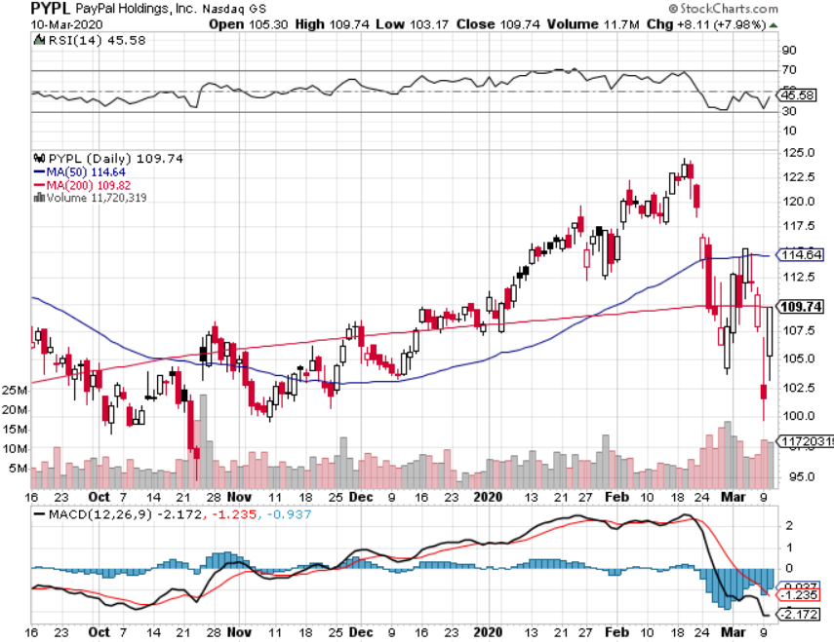
PayPal (PYPL)-CEO resigns took profits on long 4/$90-$95 call spread

Slide 27
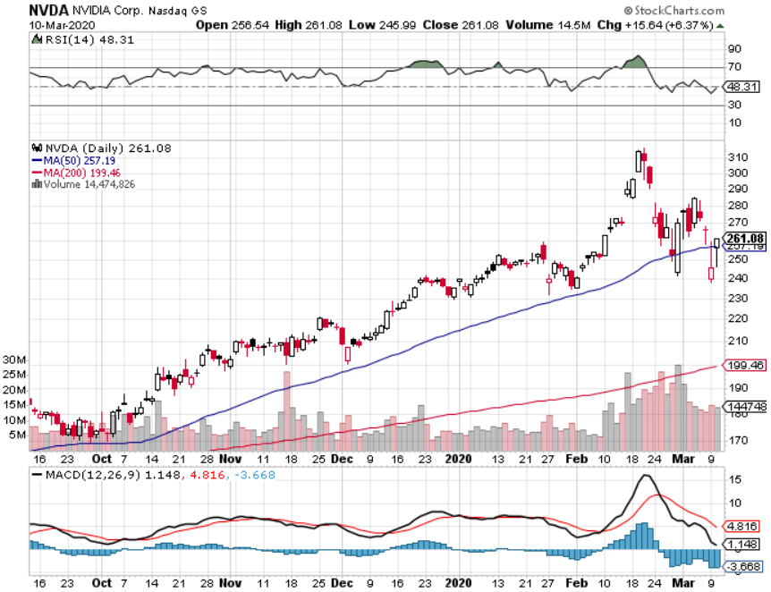
NVIDIA (NVDA) – Crash leader

Slide 28
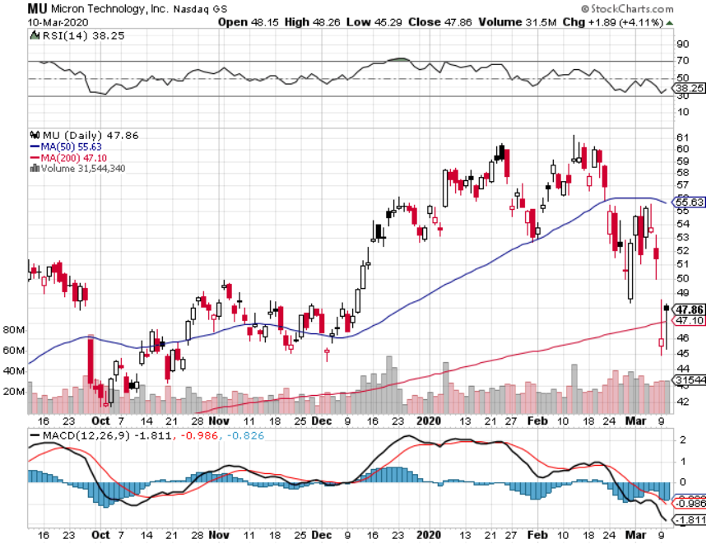
Micron Technology (MU)-Ditto

Slide 29
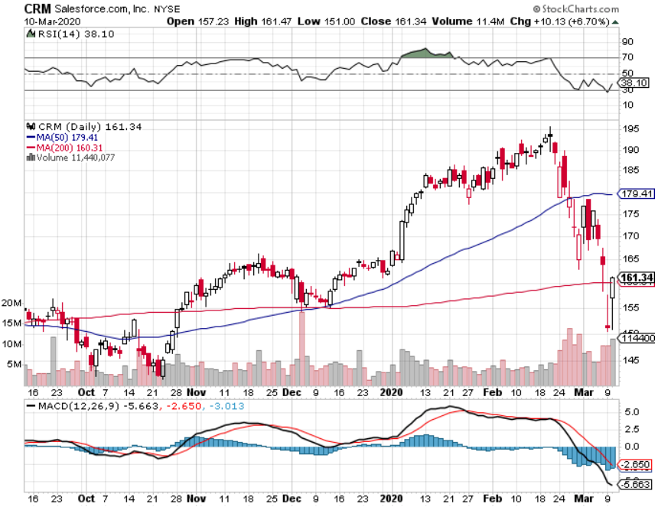
Salesforce (CRM)- Great earnings report took profits on long 9/$125-$130 vertical bull call spread took profits on long 8/$125-$130 vertical bull call spread took profits on long 2/$105-$115 call spread

Slide 30
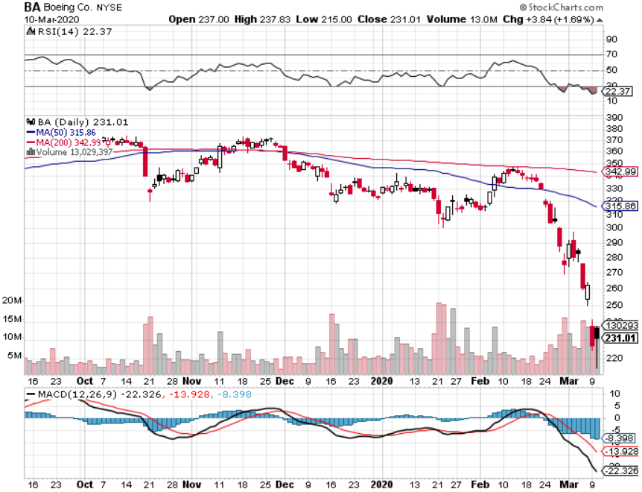
Boeing (BA) – The Capitulation is Here 737 MAX production shutdown-Criminal investigation took profits on long 2/$270-$280 call spread took profits on long 12/$310-$330 call spread took profits on long 4/$300-$310 call spread took profits on long 4/$315-$335 call spread

Slide 31
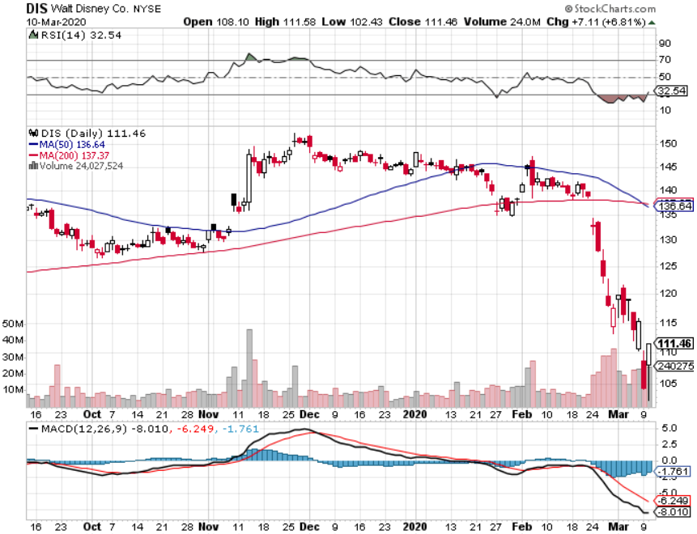
Walt Disney (DIS)- Corona Hit took profits on long 9/$115-$120 call spread 8/$125-$130 call spread expired at max profit Stopped out of 4/$125-$130 call spread for small loss took profits on long 4/$100-$104 call spread

Slide 32
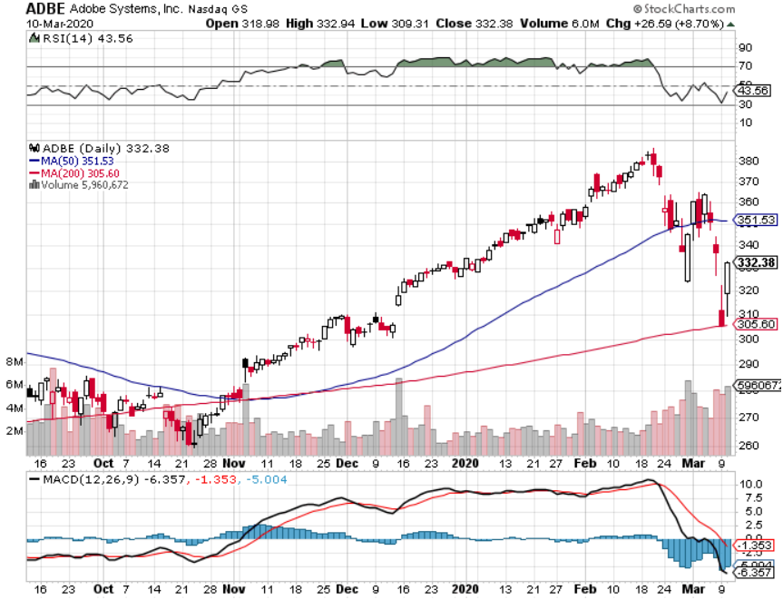
Adobe (ADBE)- The Quality Non-China tech play

Slide 33
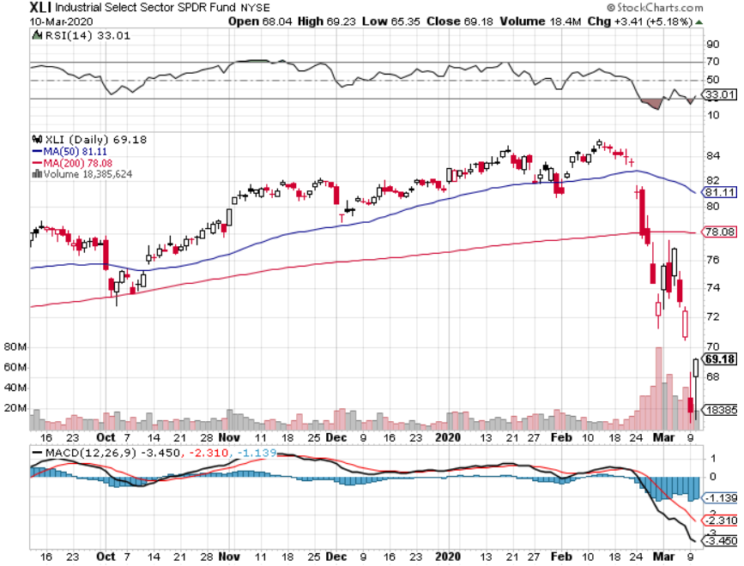
Industrials Sector SPDR (XLI)- (GE), (MMM), (UNP), (UTX), (BA), (HON)

Slide 34
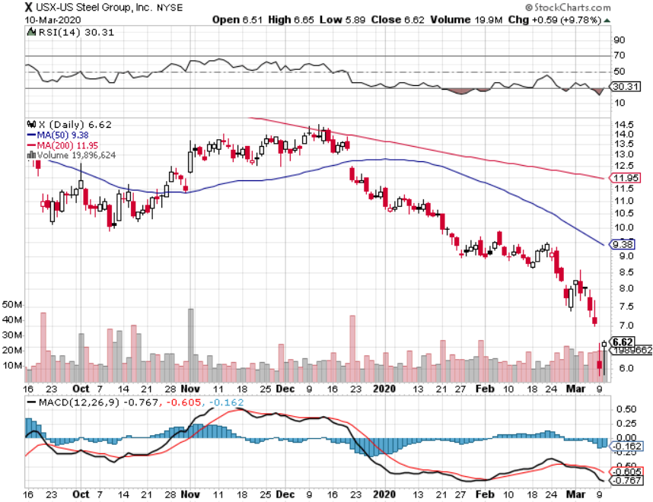
US Steel (X)-Tariffs Trouble

Slide 35
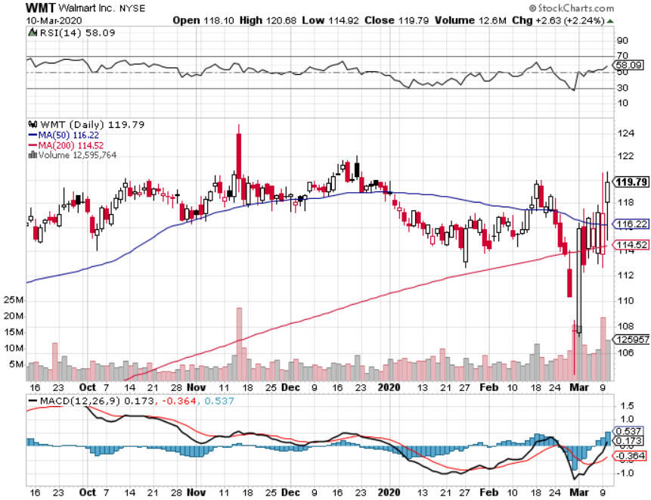
Wal-Mart (WMT)-Tariffs Trouble took profit on Long 11/$125-$130 bear put spread took profit on Long 10/$119-$121 bear put spread took profits on Long 8/$114-$117 bear put spread

Slide 36
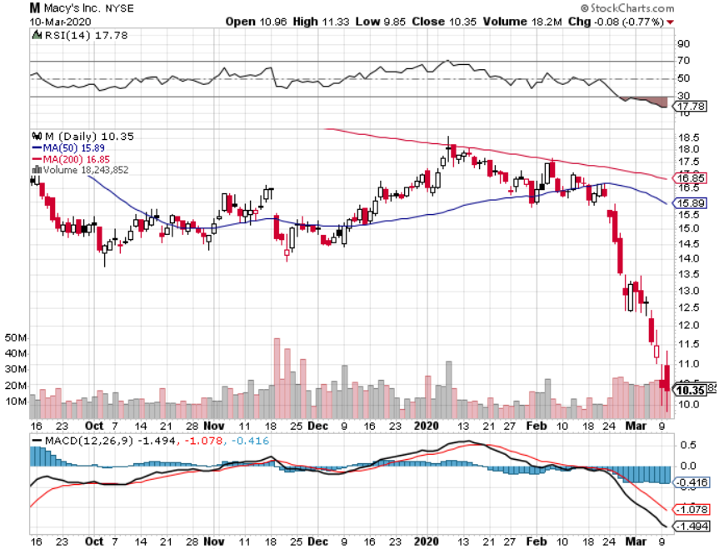
Macys’ (M)- More Store Closings took profits on Long 8/$23-$25 bear put spread

Slide 37
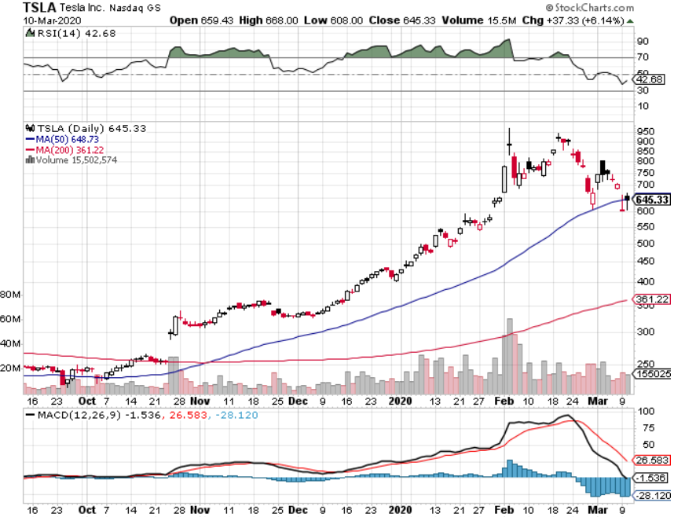
Tesla (TSLA)- Oil Crash Makes Electric Expensive stopped out of long 6/$260-$270 put spread took profits on long 6/$140-$150 call spread took profits on long 6/$240-$250 put spread

Slide 38
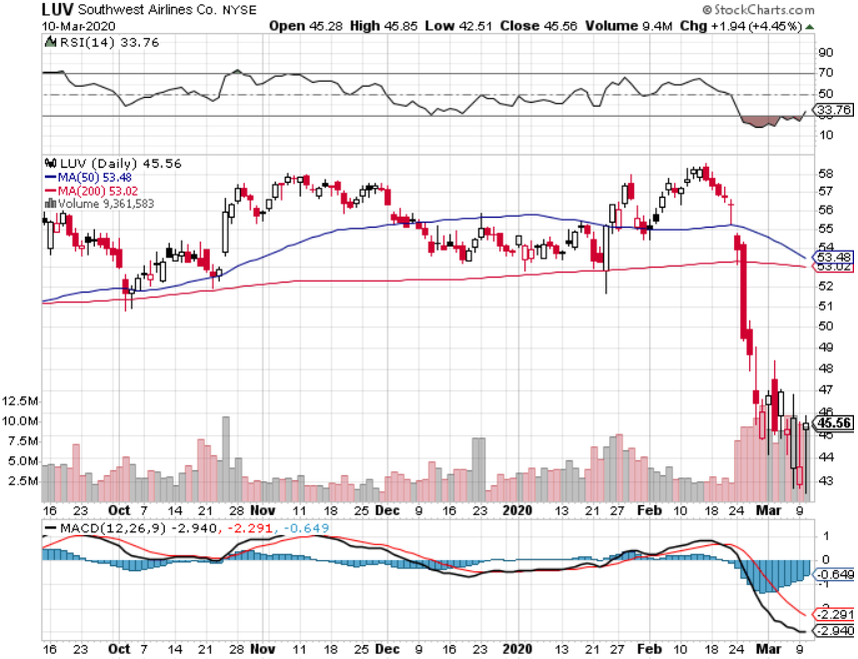
Southwest Airlines (LUV) - Boeing 737 Max biggest buyer Travels Bans

Slide 39
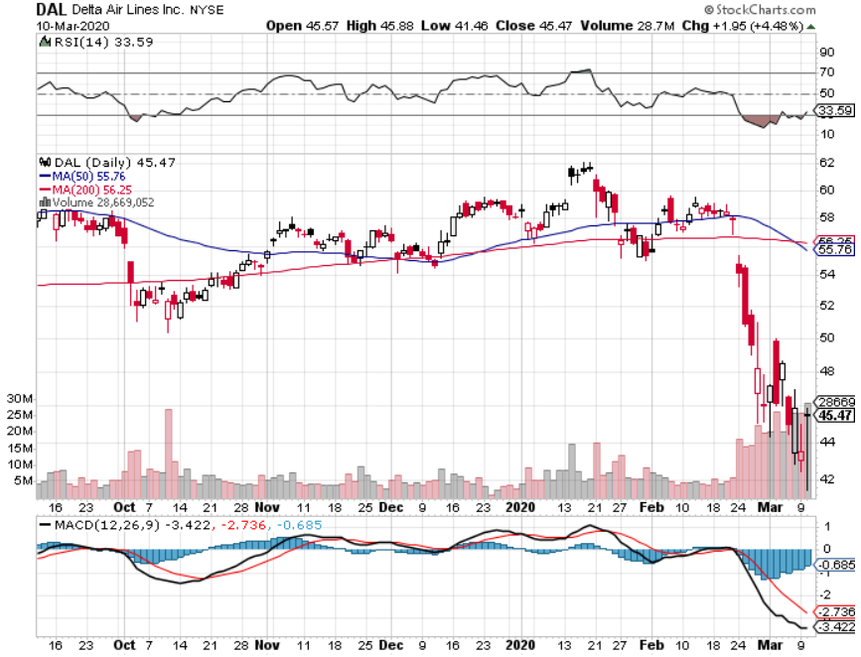
Delta Airlines (DAL) – Non 737 User

Slide 40
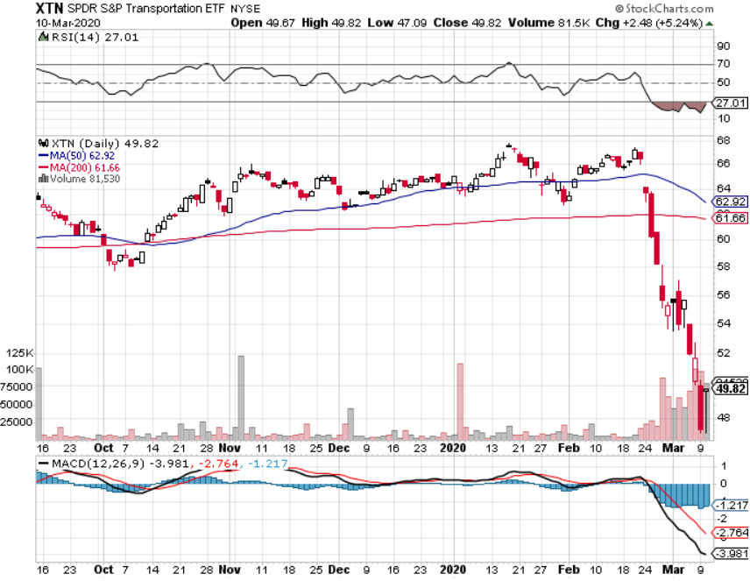
Transports Sector SPDR (XTN)- Worst Hit Sector (ALGT), (ALK), (JBLU), (LUV), (CHRW), (DAL)

Slide 41
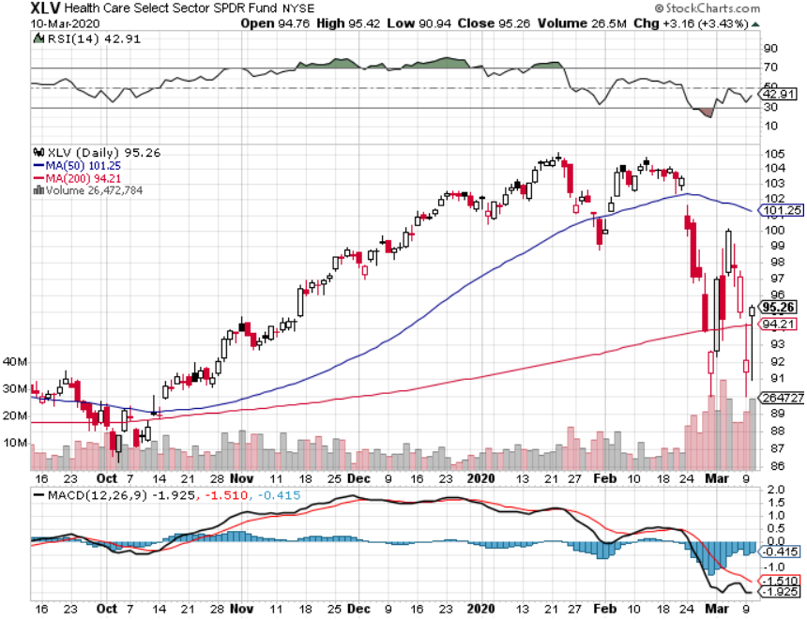
Health Care Sector (XLV), (RXL)-New Highs (JNJ), (PFE), (MRK), (GILD), (ACT), (AMGN)

Slide 42
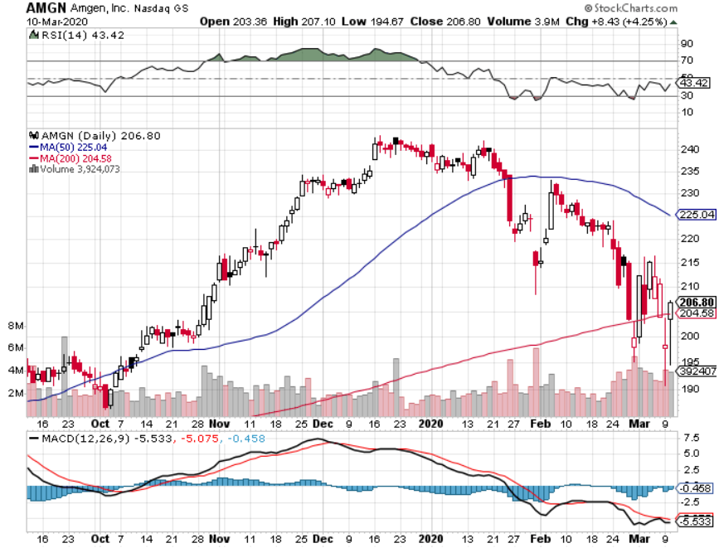
Amgen (AMGN)

Slide 43
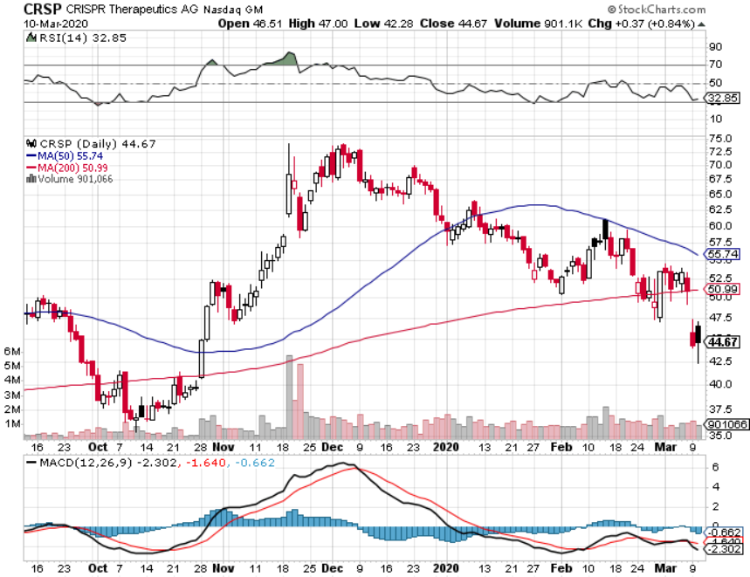
CRISPR Therapeutics (CRSP)

Slide 44
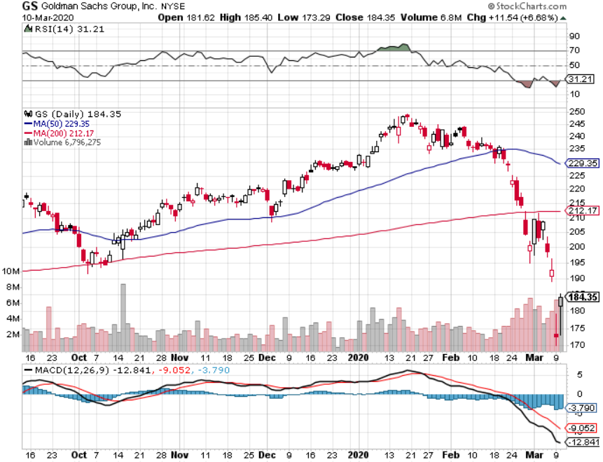
Goldman Sachs (GS) – Slaughtered by Low Rates

Slide 45
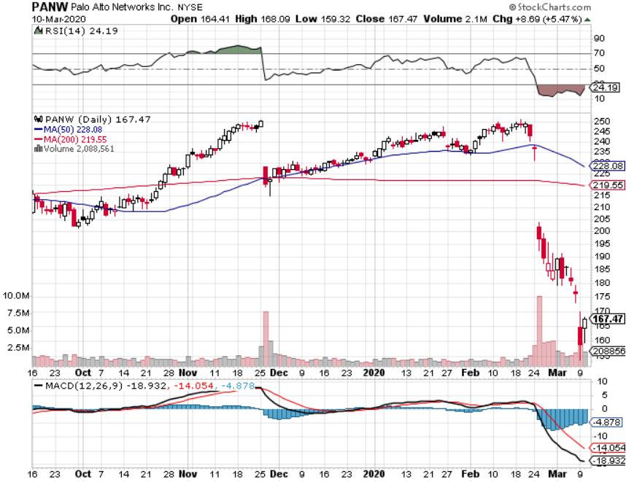
Palo Alto Networks (PANW)- Earnings shortfall Hacking never goes out of fashion

Slide 46
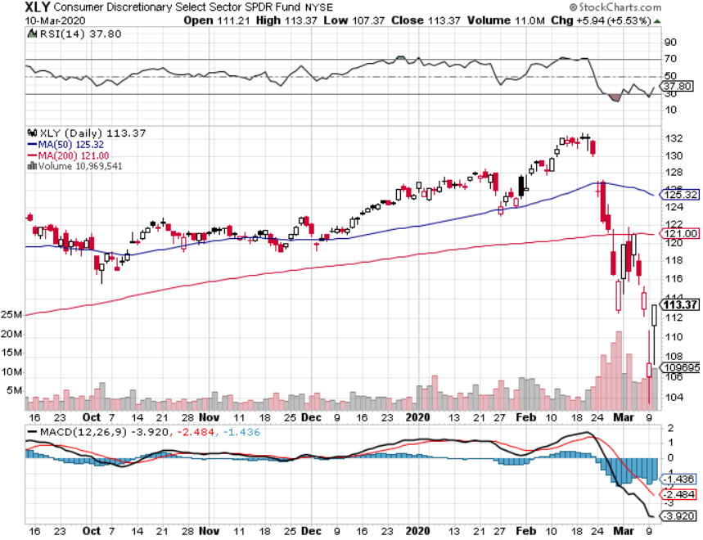
Consumer Discretionary SPDR (XLY) (DIS), (AMZN), (HD), (CMCSA), (MCD), (SBUX)

Slide 47
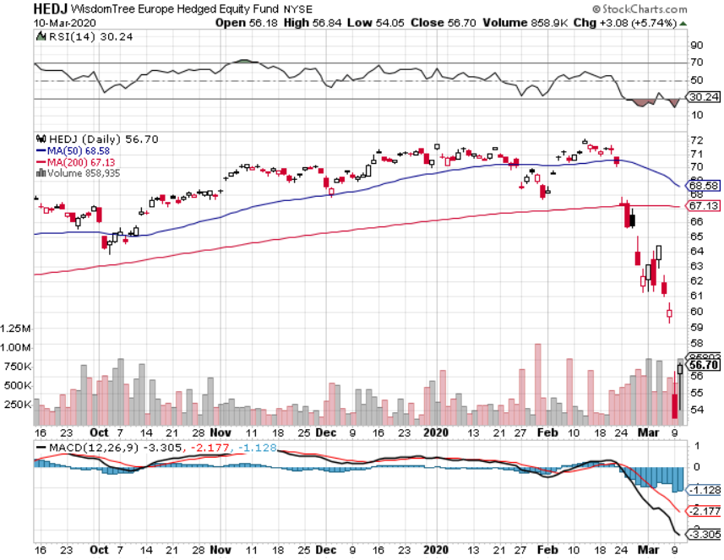
Europe Hedged Equity (HEDJ)- Pip on Brexit News

Slide 48
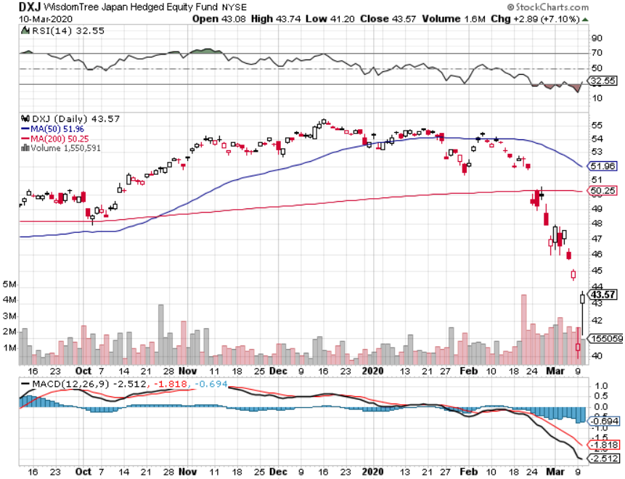
Japan (DXJ)-

Slide 49
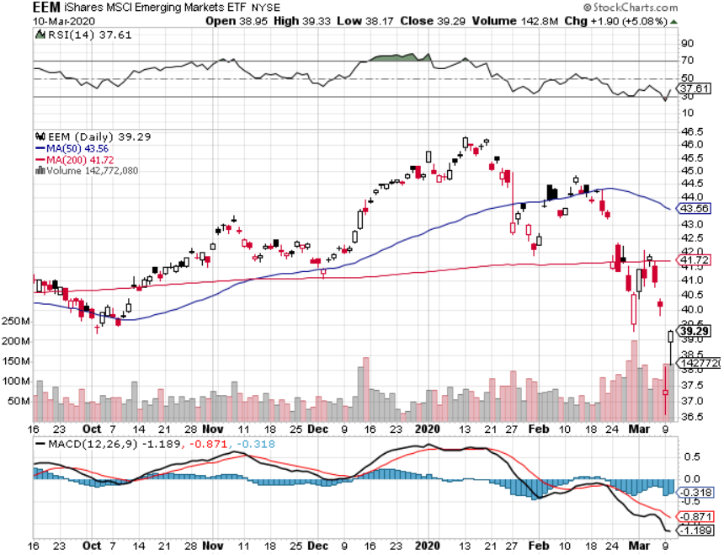
Emerging Markets (EEM)- Weak Dollar Play

Slide 50
Bonds – True Melt Up - Target Hit
*30-Year Treasury Bond Yields Hit All Time Low at 1.29% yield, ten year drops to 0.39%, and zero yields are within reach *A record 9-point gap up opening on Friday is followed by a record 13-point gap up opening on Monday *The death of the bond market is upon us, prices from here either go nowhere, or down big *Massive flight to safety drives cash out of stocks into bonds on a huge scale *Default risk soars for the heaviest debt industries, | including energy, cruise lines, hotels, and airlines *US dollar rally also gives fixed income a push *Bottom line: no bond trades for the foreseeable future

Slide 51
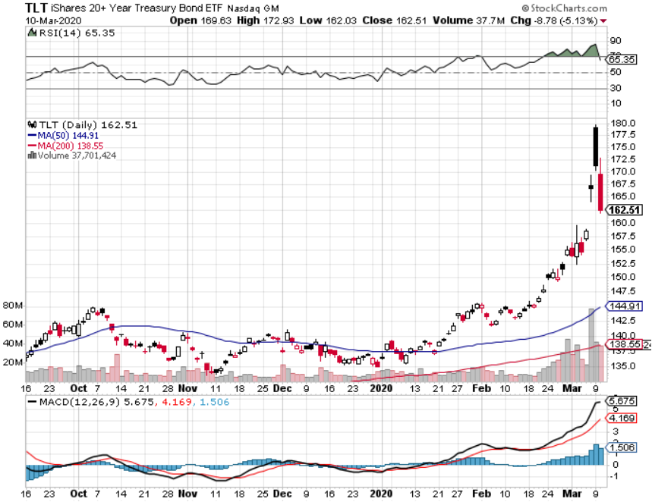
Treasury ETF (TLT) – Trading the Range STOP LOSS on long 3/$162-$165 put spread took profits on long 12/$145-$148 put spread profits on long 10/$129-$132 call spread stopped out of long 8/$137-$140 put spread took profits on long 8/$125-$128 call spread

Slide 52
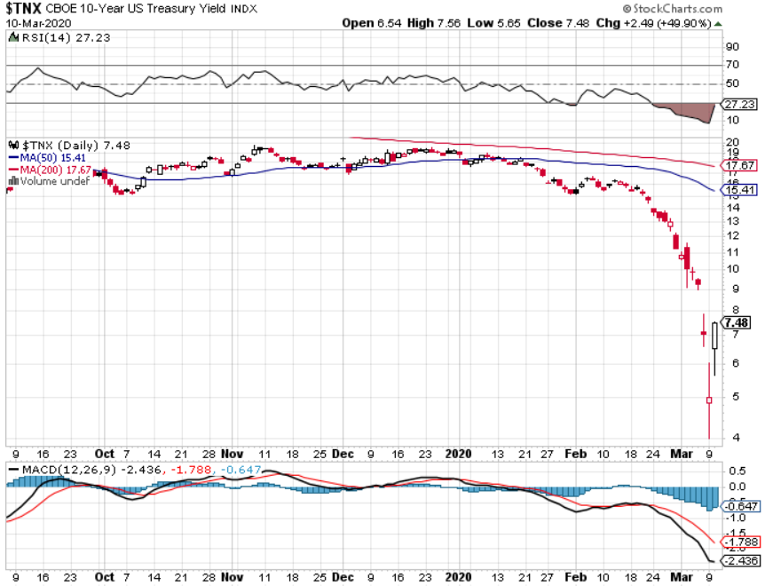
Ten Year Treasury Yield ($TNX) – 0.74%

Slide 53
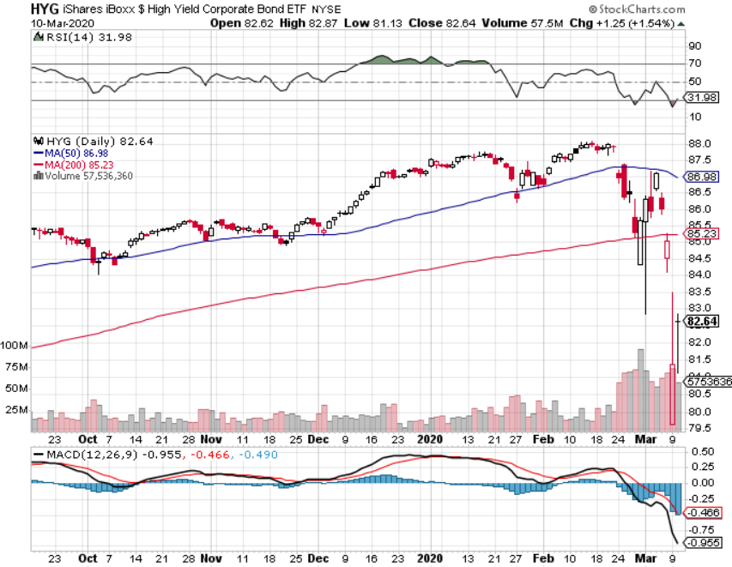
Junk Bonds (HYG) 5.10% Yield big jump in spreads on stock selloff and recession fears

Slide 54
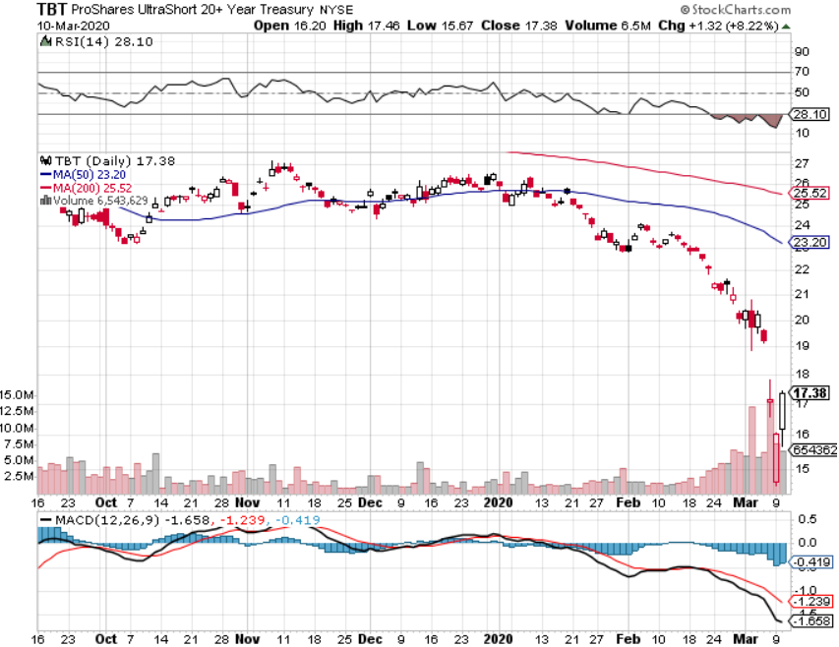
2X Short Treasuries (TBT)- 2 Month Bottoming Process

Slide 55
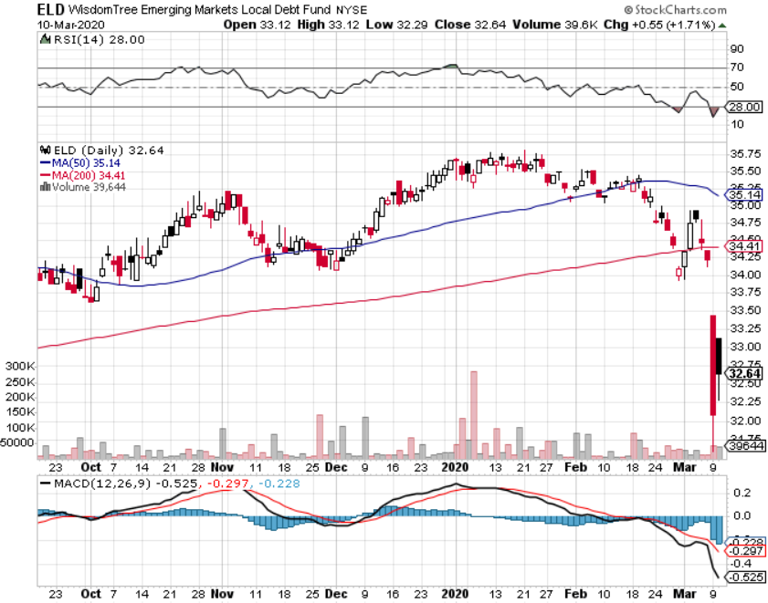
Emerging Market Debt (ELD) 4.36% Yield-

Slide 56
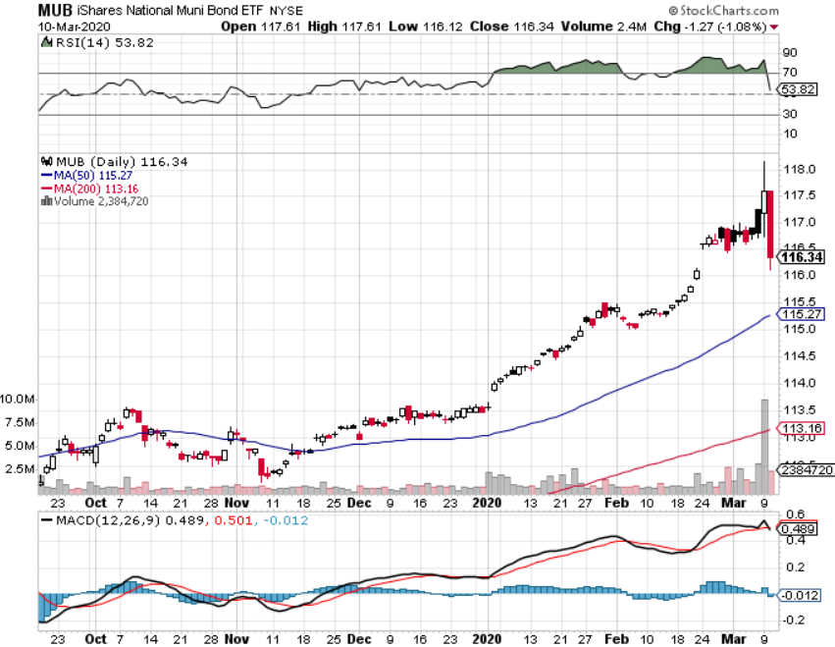
Municipal Bonds (MUB)-1.18% Mix of AAA, AA, and A rated bonds

Slide 57
Foreign Currencies – Dollar Collapse
*150 basis point drop in bond yields crush the US dollar *Euro (FXE) gets crushed to 18-month high, up 6% in two weeks *British pound stalls on trade worries, Europe going into recession *Bitcoin collapses, offering owners no protection in falling markets *Aussie hits new lows on Asia recession fears *Starting selling short all dollar rallies, its yield support is gone forever

Slide 58
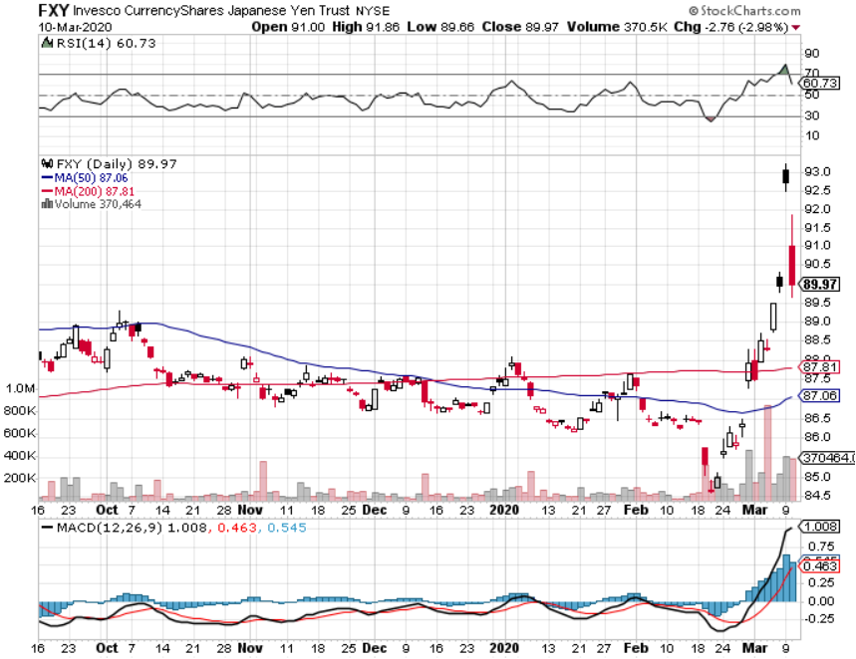
Japanese Yen (FXY), (YCS)

Slide 59
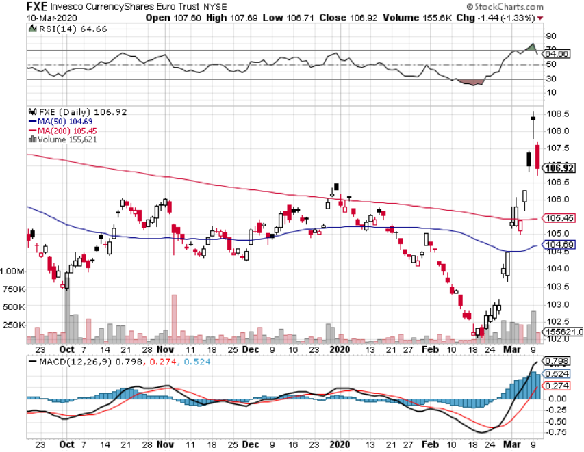
Euro ($XEU), (FXE), (EUO)-

Slide 60
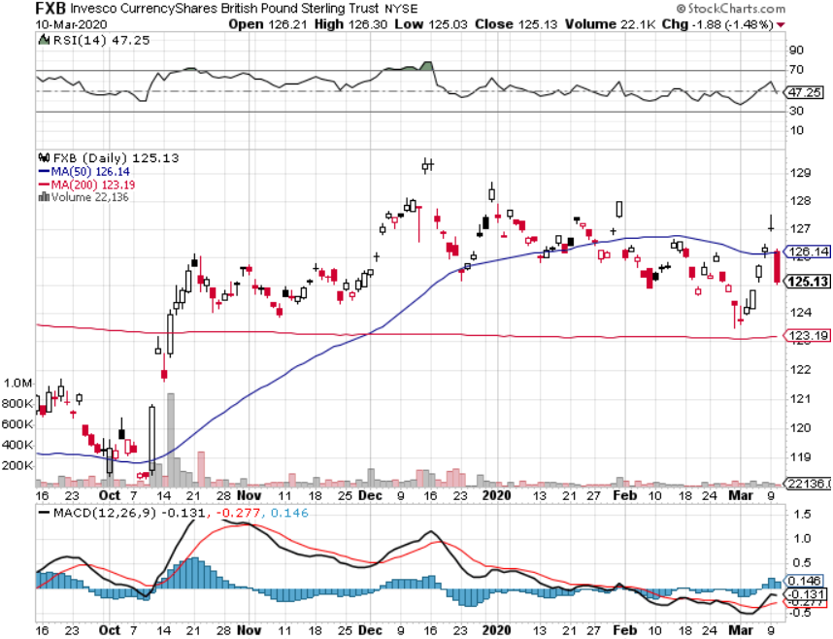
British Pound (FXB)-

Slide 61
Australian Dollar (FXA)- The Global Recovery Play took profits on long 8/$67-$69 call spread

Slide 62
Emerging Market Currencies (CEW)

Slide 63
Chinese Yuan- (CYB)- New Lows

Slide 64
Bitcoin- No Hedge

Slide 65
Energy – Blowup!
*Price war between Saudi Arabia and Russia takes oil from $80 to $28 in two months *The real goal is to put the US fracking industry out of business, which has added 4 million b/d over the last five years *China is the world’s largest marginal oil consumer at $13.5 million barrels a day, so oil had to take the big hit, possibly dropping to 8 million b/d *Any price spike will be temporary, as over supply against fading demand will last for years *Avoid all energy plays like the plague, could drop by half in the coming recession *Is it all Elon Musk’s fault? Adding 1 million electric cars to the roads, and other 500,000 this year

Slide 66
Oil-($WTIC)

Slide 67
United States Oil Fund (USO) long 10/$9.50-$10 Vertical bull call spread

Slide 68
Energy Select Sector SPDR (XLE)-No Performance! (XOM), (CVX), (SLB), (KMI), (EOG), (COP)

Slide 69
Halliburton (HAL)-

Slide 70
Natural Gas (UNG) -

Slide 71
Precious Metals – 7 Year High
*Gold rockets to 7 year high at $1,720 on Corona crash *Hedging demand piles on top of central bank buying *Only a 11% move takes gold prices to new all-time highs, after that we could run to $3,000 *”RISK OFF” means ”BUY GOLD” *Central banks still pouring into gold every month *Bottom Line: buy a bigger dip in gold and precious metals

Slide 72
Gold (GLD)- Short Term downtrend

Slide 73
Market Vectors Gold Miners ETF- (GDX) – Yikes!

Slide 74
Barrick Gold (GOLD)

Slide 75
Newmont Mining- (NEM)-

Slide 76
Silver- (SLV)-

Slide 77
Silver Miners - (SIL)-

Slide 78
Wheaton Precious Metals - (WPM)-

Slide 79
Copper (COPX)-Collapse Trade War Disaster

Slide 80
Freeport McMoRan (FCX)-World’s Largest Copper Producer took profits on long 4/$10-$11 call spread took profits on short 4/$114 calls

Slide 81
Real Estate – Still Moving
*Ultra low rates keep housing market on fire *Mortage rates not keeping up with the bond market *30-year fixed rate mortgage hits one year low at 3.30%, versus 0.39% for the ten year US Treasury bond *Refi requests overwhelming all mortgage brokers S&P Case Shiller Rose 3.8%, in December, the third consecutive month of price increases. Only San Francisco is showing falling prices.

Slide 82
February Corelogic S&P Case Shiller Home Price Index Phoenix (5.9%), Tampa (5.0%), and Charlotte, NC (5.2%) showing biggest gains
Tradingeconomics.com

Slide 83
Simon Property Group (SPG)- Mall REIT

Slide 84
Crown Castle International (CCI) – 3.40% yielding cell phone Tower REIT

Slide 85
US Home Construction Index (ITB) (DHI), (LEN), (PHM), (TOL), (NVR)

Slide 86
Trade Sheet- So What Do We Do About All This?
*Stocks-buy bigger dip, sell big rallies *Bonds-stand aside, its gone crazy *Commodities-buy bigger dip *Currencies- sell US dollar rallies *Precious Metals – buy dips *Energy – stand aside *Volatility-sell short over $50 *Real estate-stand aside

Slide 87
Next Strategy Webinar 12:00 EST Wednesday, March 25, from Silicon Valley to buy lunch tickets go to www.madhedgefundtrader.com email me questions at support@madhedgefundtrader.com
Good Luck and Good Trading!
Notes:
*

