Slide 1
The Mad Hedge Fund Trader “Mad Hedge Goes Positive for 2020”
With John Thomas from Silicon Valley, CA, April 8, 2020 www.madhedgefundtrader.com
Notes:
*

Slide 2
Trade Alert Performance New Highs in Reach!
*January 3.13% Final *July +3.07% Final *February -6.05% Final *August +16.01% Final *March -5.50% Final *September 3.08% Final *April +11.02% MTD *October +12.13% Final *May +0.25% Final *November -1.26% Final *June -0.50% Final *December +4.97% Final *Year to date -2.60% compared to -27% for the Dow Average *+358.51% since inception, *Average annualized return of 33.85% for 10 years

Slide 3
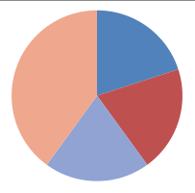
Portfolio Review Massive Shorts Covered for Huger Profits, Using (VIX) over $50 to Keep Larger Short Positions a 10% market drop will boost YTD to 8.5%
Current Capital at Risk
Risk On
World is Getting Better
(VXX) 1/2021 $16 puts | 10.00%
(VXX) 1/2021 $24 puts | 10.00%
Risk Off
World is Getting Worse
(SPY) 4/$270-$280 put spread | -10.00%
(SDS) | -20.00%
Total Net Position | -10.00%
Expiration P&L 4.51% YTD with (VXX) unchanged

Slide 4
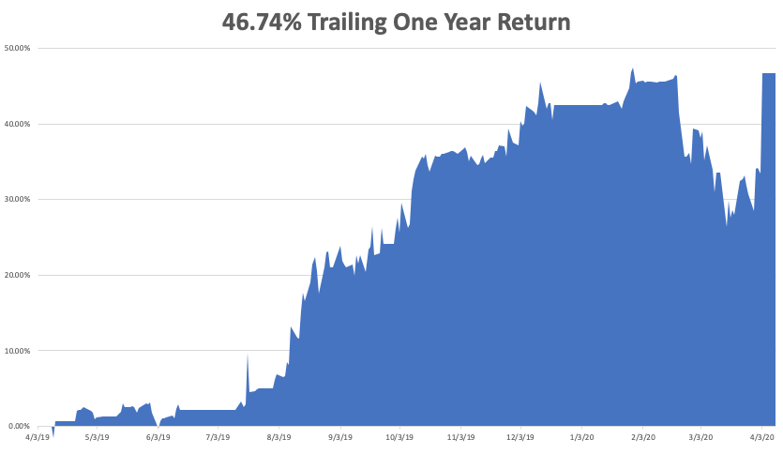

Slide 5
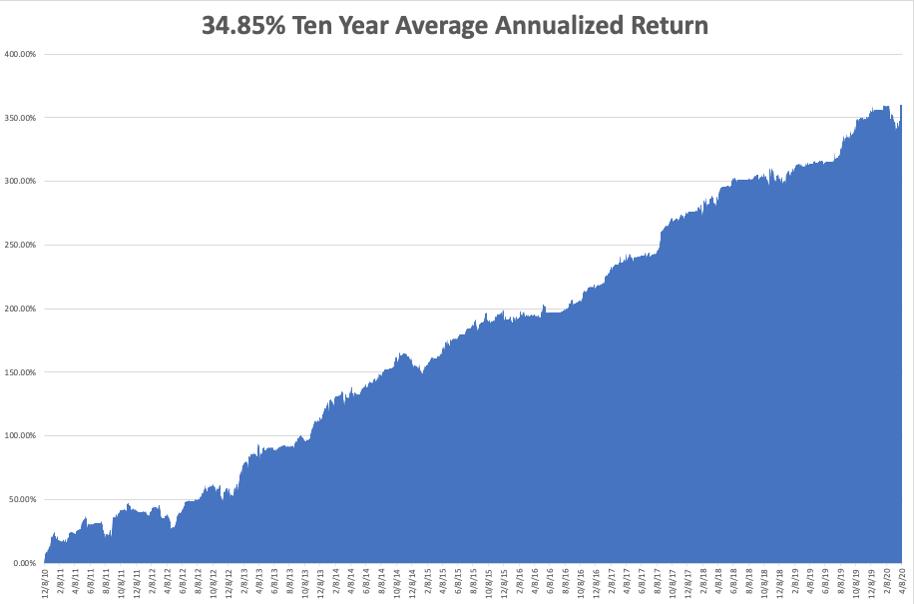
GTD 10 Year Daily Audited Performance

Slide 6
The Method to My Madness
*The Great Depression is here, but it should be a quick one, no more than two quarters *Market risks right now at decade lows, time to pile on the positions is coming *$8 trillion in QE and $6 trillion in fiscal stimulus will be hitting the economy soon *US Dollar has super spike, then collapses from loss of yield support *Gold remains strong with huge volatility *Volatility backs off from $80 to $42 *Best buying opportunity of the decade is setting up

Slide 7
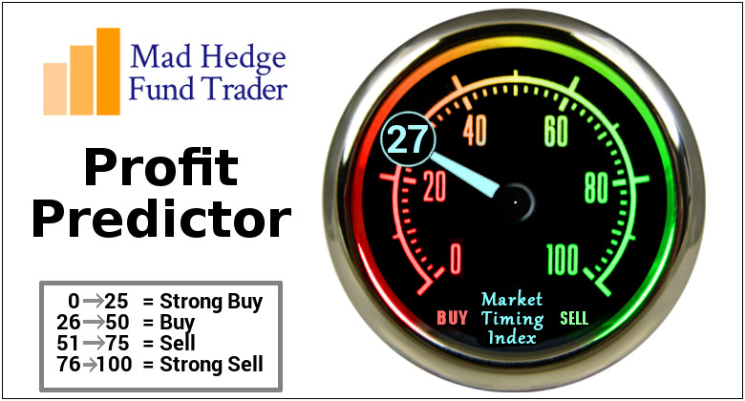
The Mad Hedge Profit Predictor Market Timing Index-Bottom of Range-at to a “BUY” An artificial intelligence driven algorithm that analyzes 30 different economic, technical, and momentum driven indicators

Slide 8
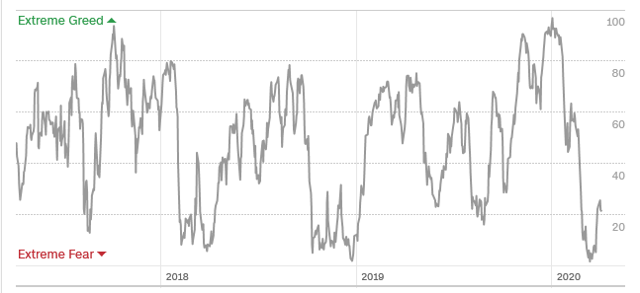
The Mad Hedge Profit Predictor From Extreme Overbought to Oversold
SELL
BUY

Slide 9
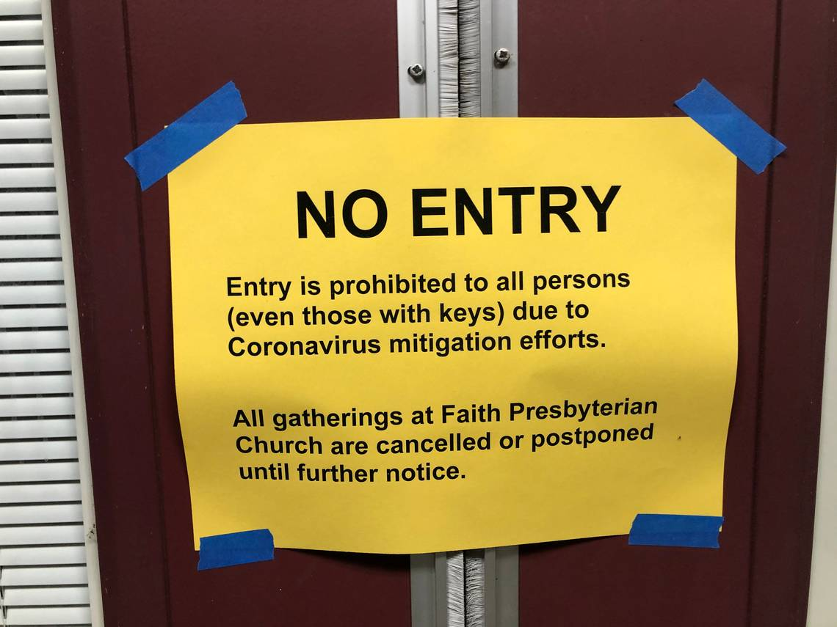
The Global Economy – Closed for Business
*We are now in the worst economic conditions since the Great Depression, with Morgan Stanley predicting a -30% Q2 annualized rate, the Fed calling for 32% unemployment *Most are expecting a huge “V” or “U” shaped recovery in the second half, both in the economy and the stock market *Corona virus epidemic is now the only factor in the global economy, but we won’t see the data for 2-3 months *Global travel industry is gone and much of it is never coming back *Chinese says their epidemic is over, returning economy back to normal, and shipping medical supplies to the US and the rest of the world

Slide 10
Pandemic
*Global cases at 1,309,439 deaths at 72,637, are doubling every three days *US Cases at 377,003 and 10,335 deaths, with a third in New York City *Shelter in place will bring peak in May and and a return to a normal economy in June, then a second smaller wave will come in the fall *Still at exponential growth phase in all countries, except China, South Korea, and Italy *20 vaccines are in development around the world But will take a year to reach mass production *Almost all international borders are closed

Slide 11
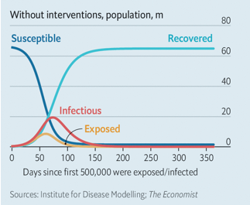
How Long Will it Take?

Slide 12
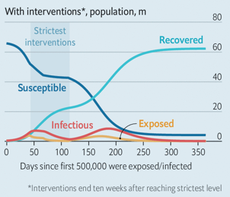

Slide 13
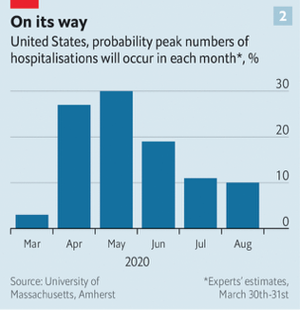
BULL Market Begins

Slide 14
The Historic Antidote
*The government has already implemented the greatest economic stimulus in history at $2 trillion, and it will triple from here to $6 trillion *The Fed has unleashed the greatest QE in history of $8 trillion, increasing all the global QE of the past decade by 50% in one shot *When people come out of lockdown, they will engage in the greatest spending binge in history. Most consumption hasn’t been lost, just deferred *This will create the strongest economic growth in history, starting in H2 *Stocks will rocket sooner but may not his new all-time highs for years. *Don’t sell anything now. Most of the damage has already been done. You are only looking at buying opportunities from here. *The worst stocks are already down 90%, like cruise lines and airlines, so there are no good short plays left

Slide 15
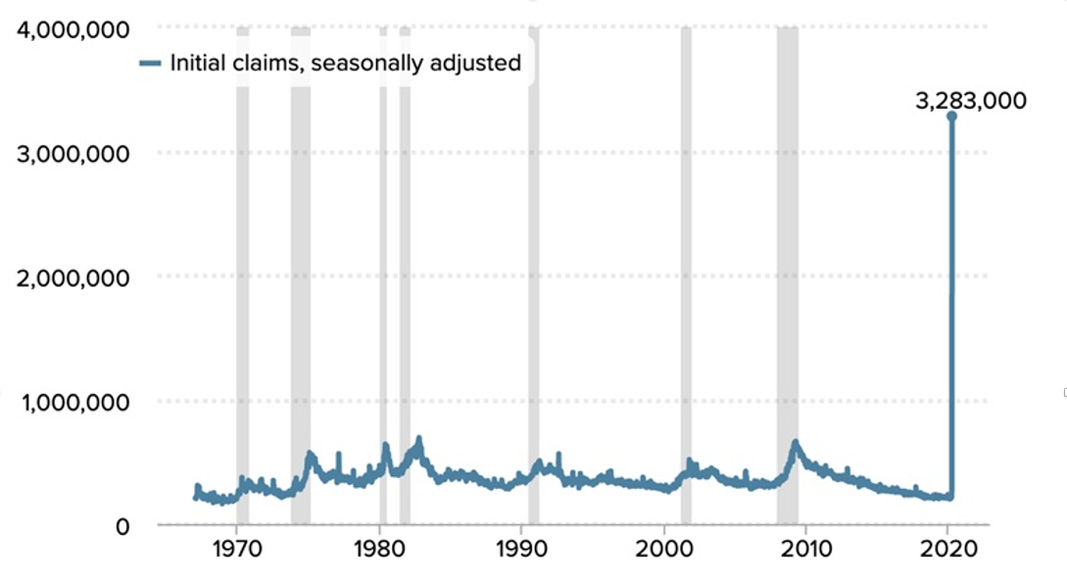
Weekly Jobless Claims-Bottomed Out +70,000 to 281,000 Total US unemployment doubles to 14.4 million in a week, will double and double again

Slide 16
The Bill Davis View A $1,500 Upgrade for the Mad Day Trader Service
Buys: | Entry | Target
ZenDesk, Inc (ZEN) | $ 63.00 | $ 80.00
FedEx Corp. (FDX) | $ 117.00 | $ 140.00
Becton Dickinson and Co. (BDX) | $ 234.00 | $ 260.00
Quest Diagnostics (DGX) | $ 78.00 | $ 95.00
DaVita Inc.(DVA) | $ 72.00 | $ 84.00
Sells:
BioMarin Pharmaceuticals (BMRN) | $ 82.00 | $ 68.00
Inogen, Inc.(INGN) | $ 50.00 | $ 30.00
LuLulemon (LULU) | $ 203.00 | $ 178.00
eHealth Inc. (EHTH) | $ 124.00 | $ 95.00
Arista Networks (ANET) | $ 220.00 | $ 185.00

Slide 17
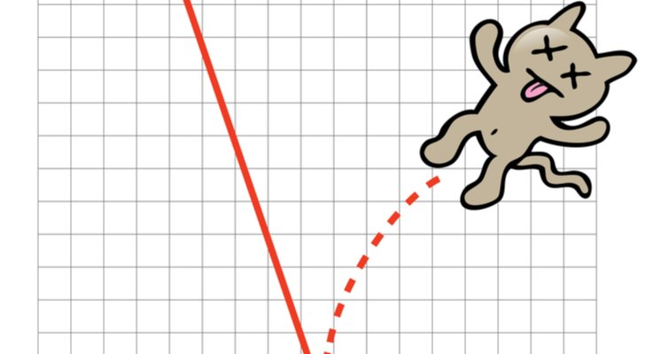
Stocks – Dead Cat Bounce
*”Get me out at any price” is over, but ”Get me out” will still cap all rallies for months *S&P 500 Earnings multiples drop from 20X to 12X 2019 earnings in six weeks, 15.5X is the 100-year average, but stock are still expensive *If US earnings drop from $160 to $80 this year the 2020 multiple is at 24X, a century high. The last time we saw valuations this high was 1929. A 9X multiple would take the Dow down to 7,500 *It’s time to start scaling into those 2-year LEAP’s in your favorite big tech names *Continue to focus on big tech and biotech, the market leaders, on 30%-40% selloffs, and the 2X (ROM) *The best buying point of the century is near *Bottom line: buy the next big dip for a massive recovery starting in the summer-fall *Bottom Line: its bet the ranch time on tech longs, but stay away from those with big China exposure, like Apple, and weak dollar plays like energy, and emerging markets

Slide 18
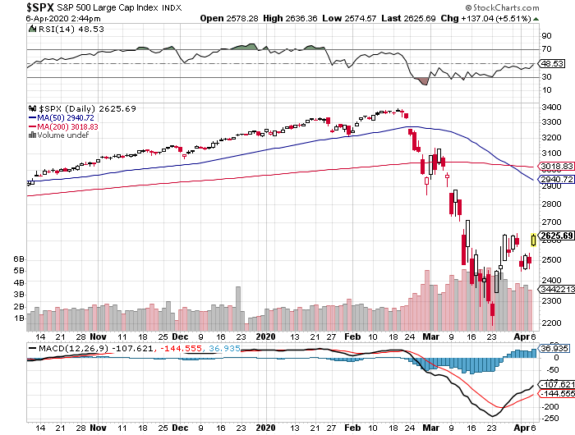
S&P 500 – Collapse –Targeting 2,000, down 42%, PE multiple of 11X long 4/$270-$280 bear put spread took profits on long 4/$280-$290 bear put spread took profits on long 4/$275-$280 bear put spread
The Bottom 2,000 -42%

Slide 19
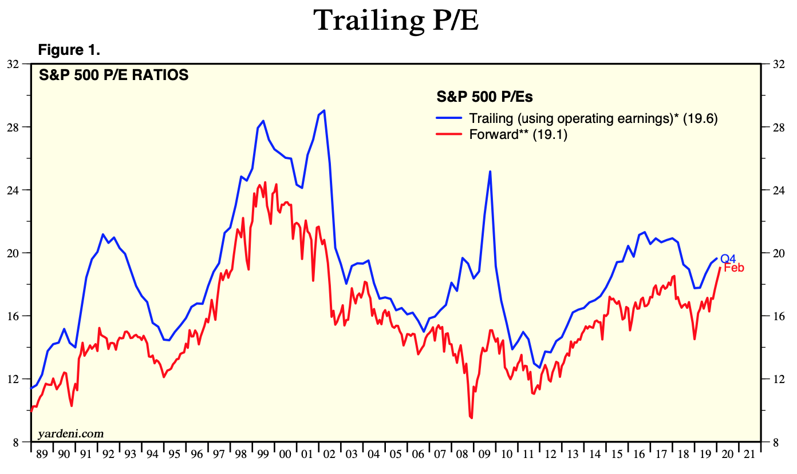
S&P 500 – 100 Year Multiple Average is 15X
You are Here Now

Slide 20
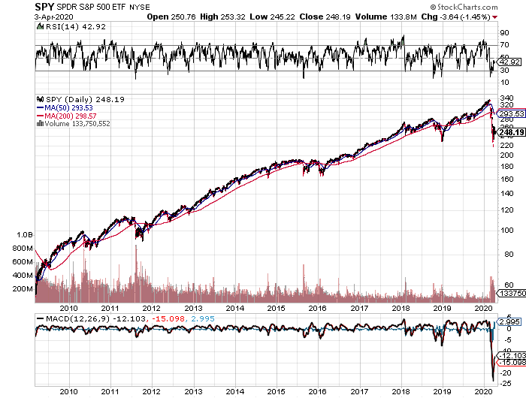
S&P 500 (SPY)- Giving Up 2019, 2018, and 2017 If I’m Wrong the Final Target is 1,600
TARGET
TARGET

Slide 21
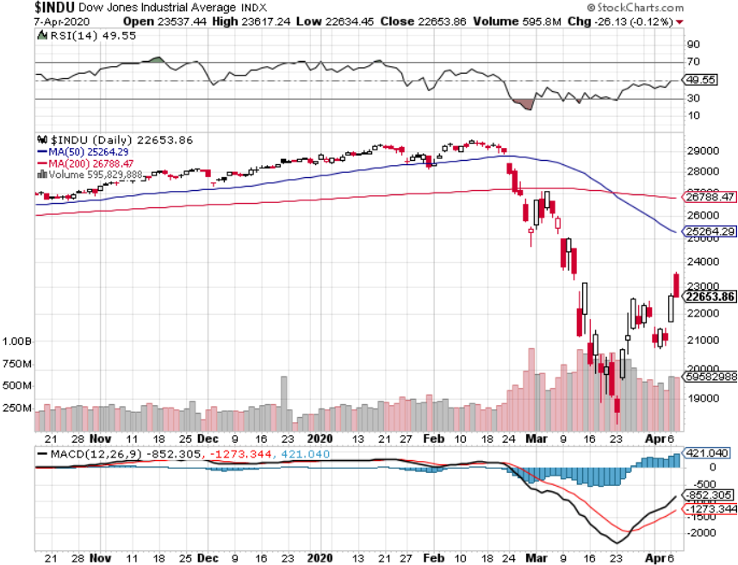
Dow Average ($INDU)- Giving Up Three Years of Gains

Slide 22
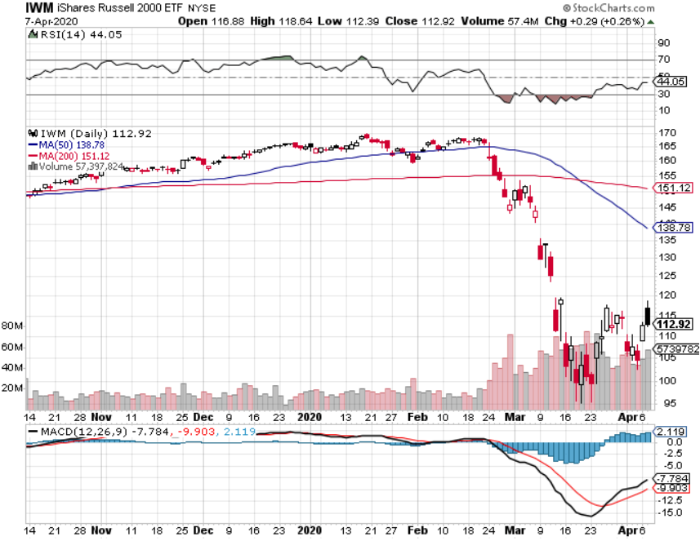
Russell 2000 (IWM)- Free Fall took profits on Long 10/$137-$142 vertical bull call spread took profits on Long 10/$153-$156 vertical bear put spread

Slide 23
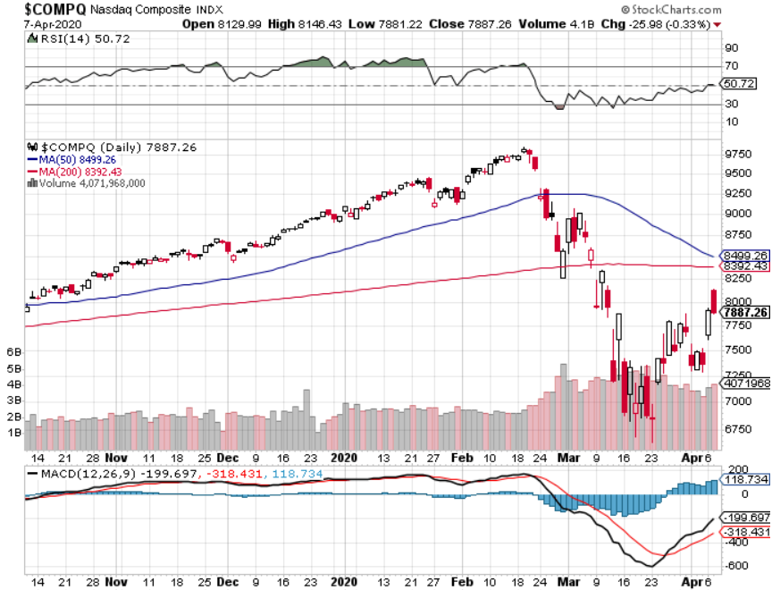
NASDAQ ($COMPQ) – Monster Declines

Slide 24
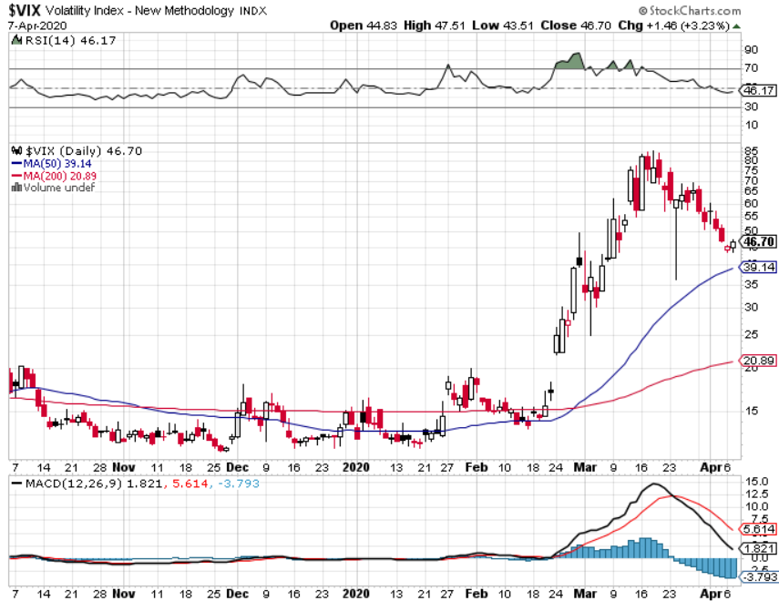
(VIX)- 11 Year High

Slide 25
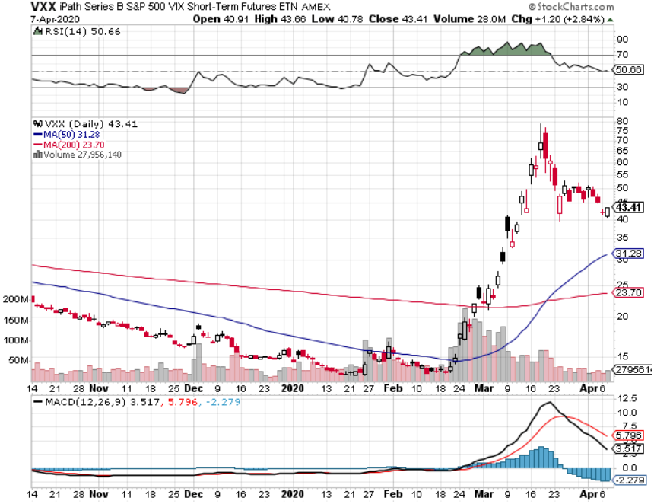
(VXX)- Sell Rallies-Down $38 from top long 1/2021 $16 puts long 1/2021 $24 puts

Slide 26
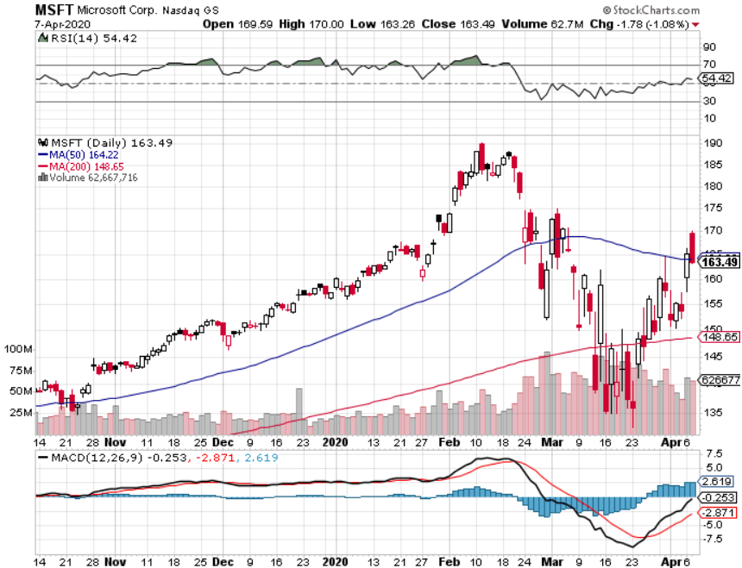
Microsoft (MSFT)- Earnings beat- Looking for Another Entry Point took profit on long 4/$120-$130 call spread stop loss on long 12/$170-$180 call spread took profits on long 12/$135-$138 call spread

Slide 27
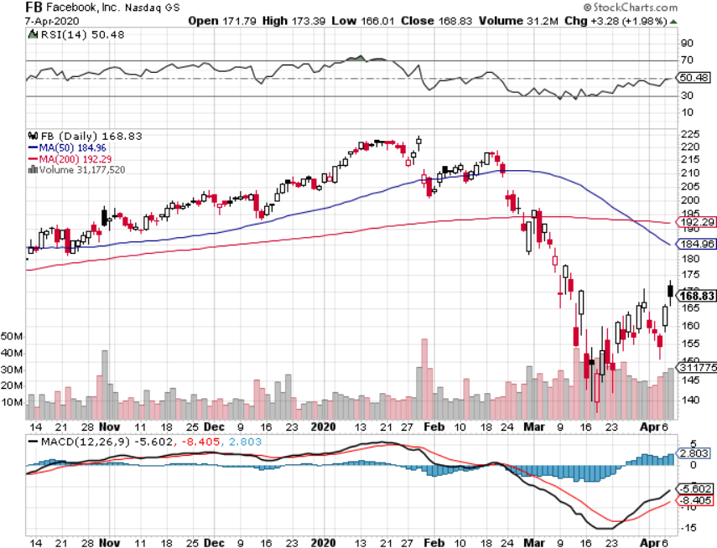
Facebook (FB)- Breaking Down Paying Full Salaries on all gig workers took profits on Long 9/$150-$160 vertical bull call spread took profits on Long 8/$167.50-$172.50 vertical bull call spread

Slide 28
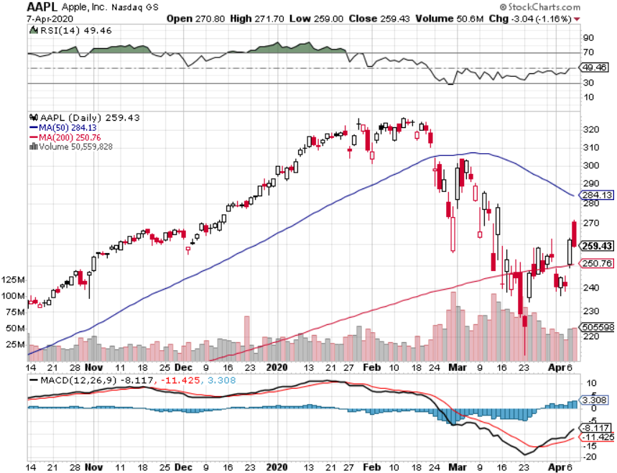
Apple (AAPL)- Tosses Q2 Guidance took profits on long $3/$250-$260 call spread stopped out of long $3/$285-$295 call spread took profits on long 2/$245-$255 put spread

Slide 29
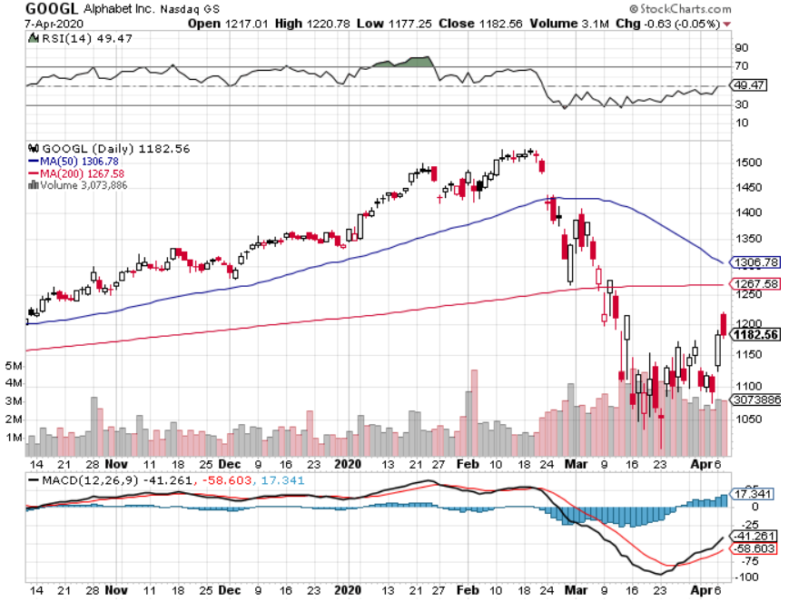
Alphabet (GOOGL) – Advertising Hit took profits on long 12/$1,200-$1,230 bull call spread took profits on long 9/$1,030-$1,080 vertical bull call spread stopped out of long 5/$1,100-$1,130 bull call spread took profits on long 4/$1,080-$1,120 bull call spread

Slide 30
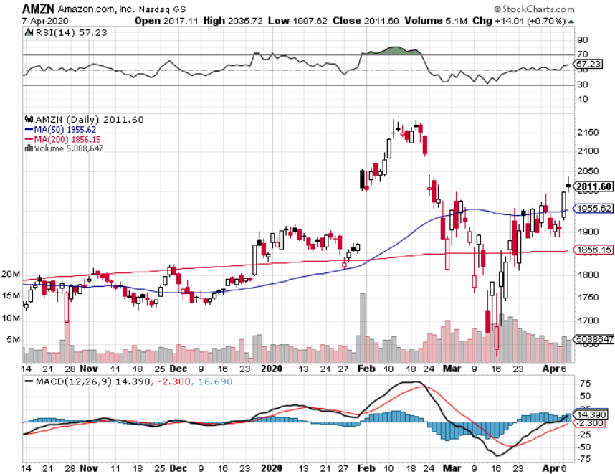
Amazon (AMZN) – hiring 100,000 took profits on long 4/$1,600-$1,650 bull call spread stopped out of long 3/$1,700-$1,800 bull call spread took profits on 9/$1,500-$1,500 bull call spread stopped out of long 4/$1,650-$1,700 call spread

Slide 31
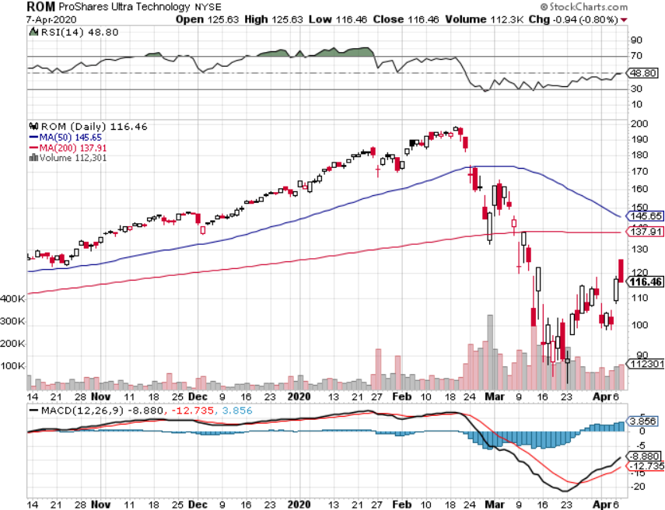
ProShares Ultra Technology (ROM) – Terrible Guidance – stopped out of long at $100.10

Slide 32
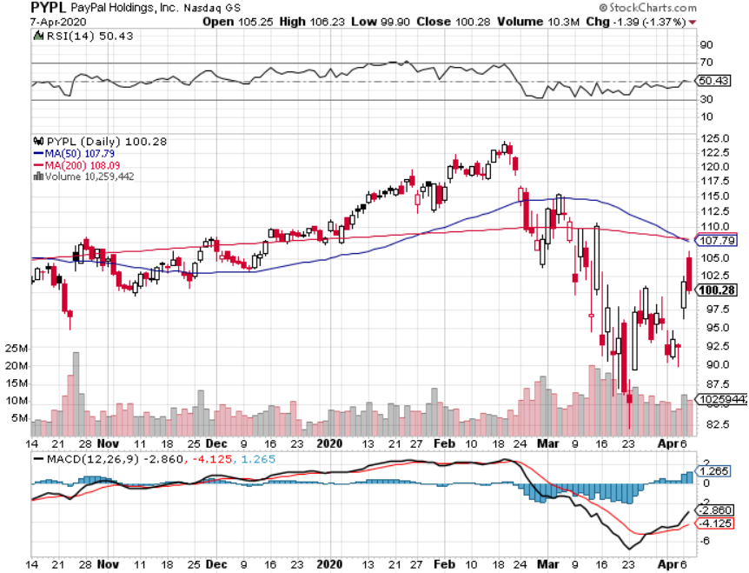
PayPal (PYPL)-Fintech Rules took profits on long 4/$90-$95 call spread

Slide 33
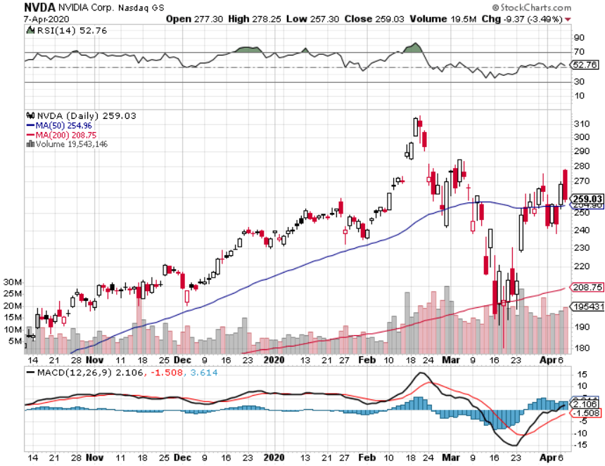
NVIDIA (NVDA) – Crash leader

Slide 34
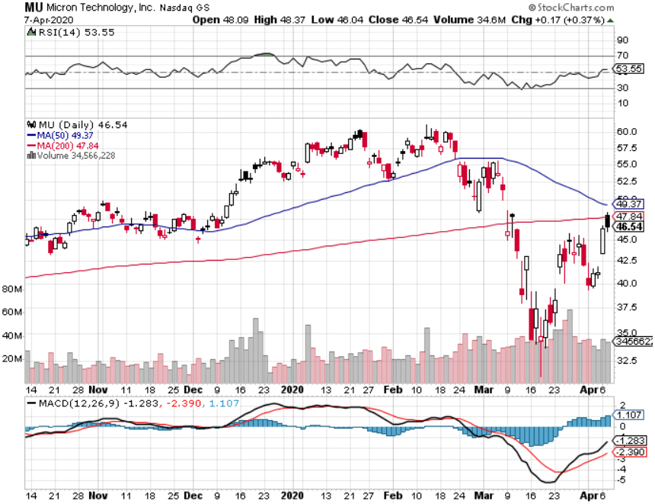
Micron Technology (MU)-Ditto

Slide 35
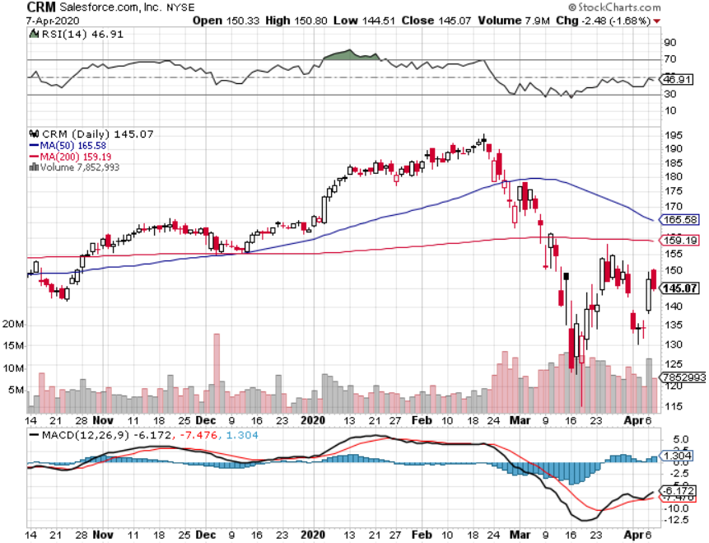
Salesforce (CRM)- Massive Online Migration took profits on long 9/$125-$130 vertical bull call spread took profits on long 8/$125-$130 vertical bull call spread took profits on long 2/$105-$115 call spread

Slide 36
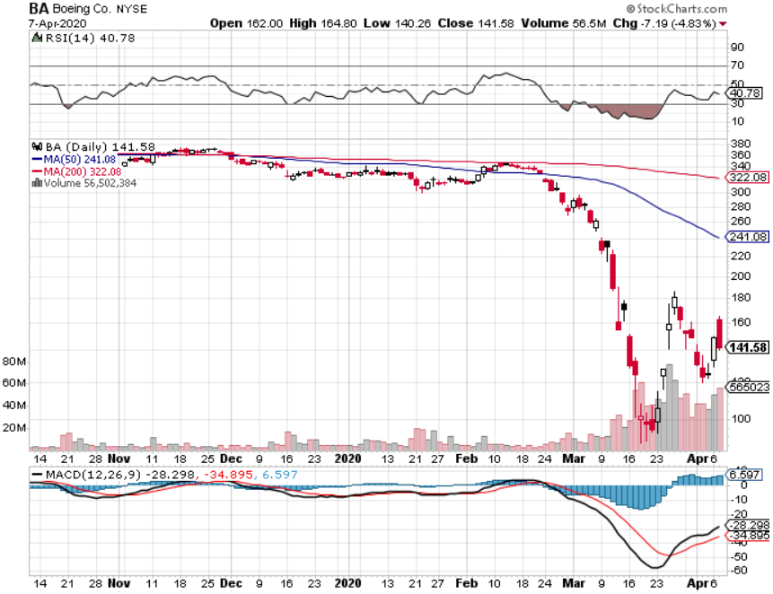
Boeing (BA) –GM Or Bank Style Takeover? 737 MAX production shutdown-Criminal investigation took profits on long 2/$270-$280 call spread took profits on long 12/$310-$330 call spread took profits on long 4/$300-$310 call spread took profits on long 4/$315-$335 call spread

Slide 37
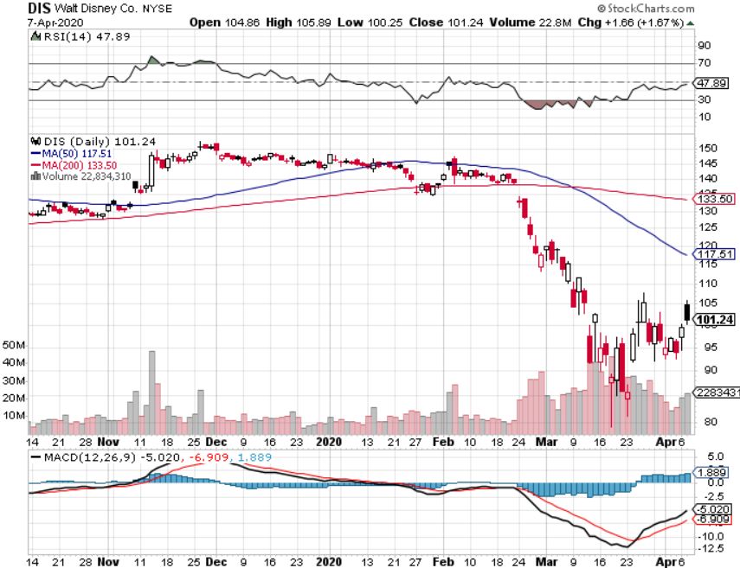
Walt Disney (DIS)- Corona Hit took profits on long 9/$115-$120 call spread 8/$125-$130 call spread expired at max profit Stopped out of 4/$125-$130 call spread for small loss took profits on long 4/$100-$104 call spread

Slide 38
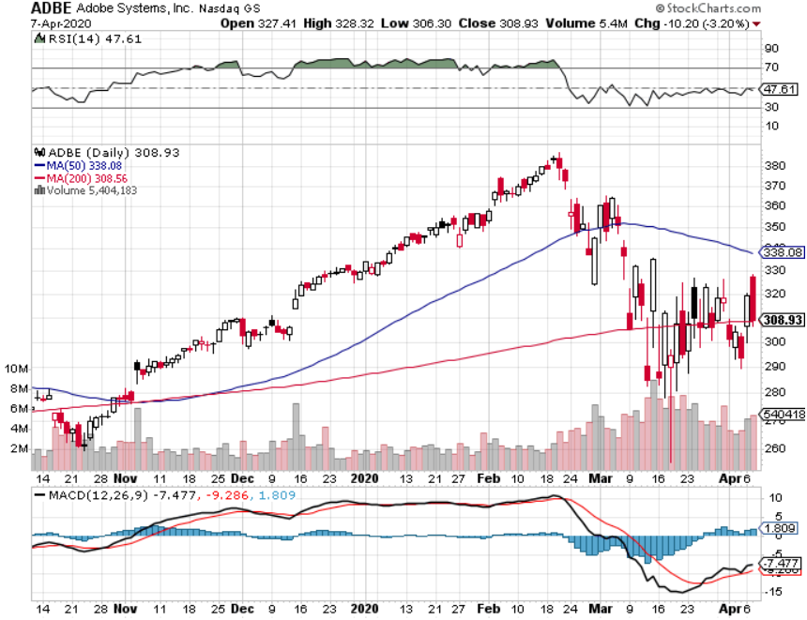
Adobe (ADBE)- The Quality Non-China tech play

Slide 39
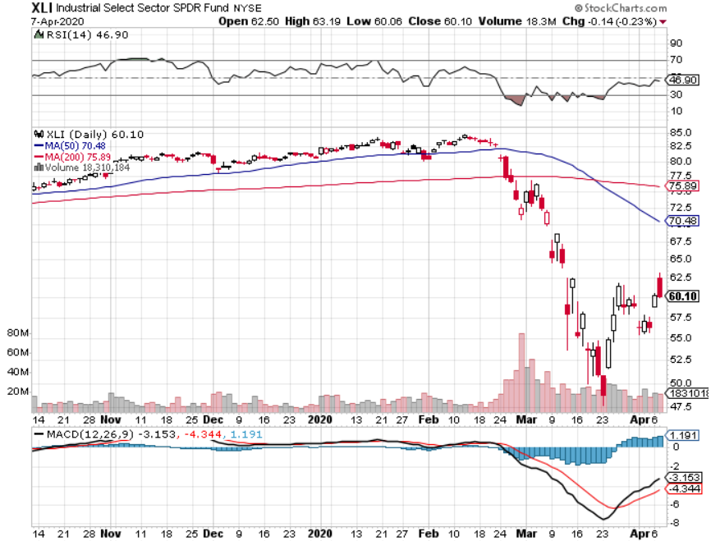
Industrials Sector SPDR (XLI)- (GE), (MMM), (UNP), (UTX), (BA), (HON)

Slide 40
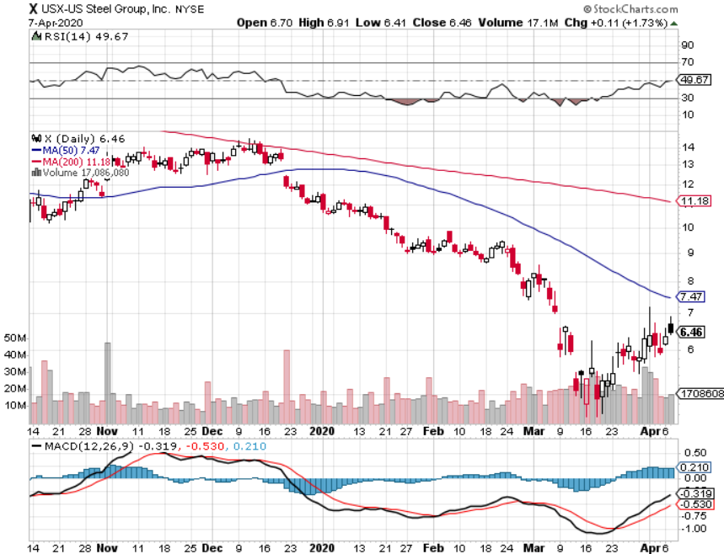
US Steel (X)-Tariffs Trouble

Slide 41
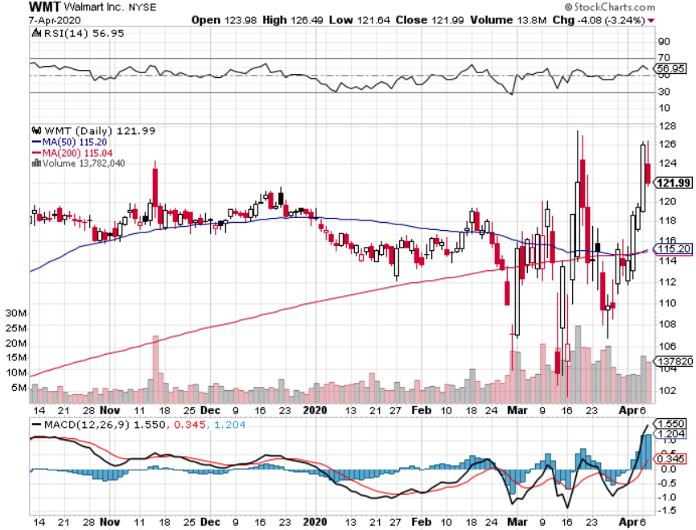
Wal-Mart (WMT)-Hiring 150,000 took profit on Long 11/$125-$130 bear put spread took profit on Long 10/$119-$121 bear put spread took profits on Long 8/$114-$117 bear put spread

Slide 42
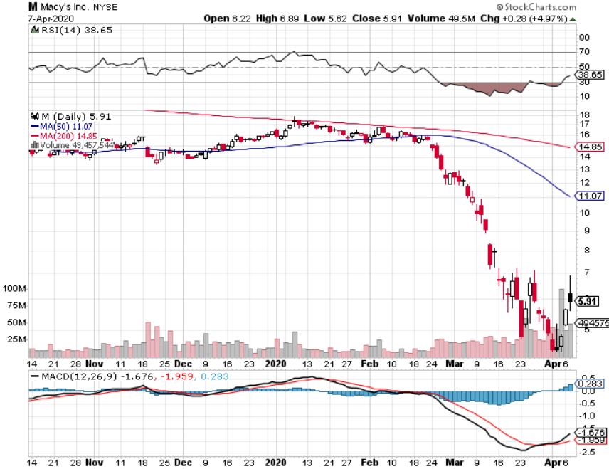
Macys’ (M) - More Store Closings took profits on Long 8/$23-$25 bear put spread

Slide 43
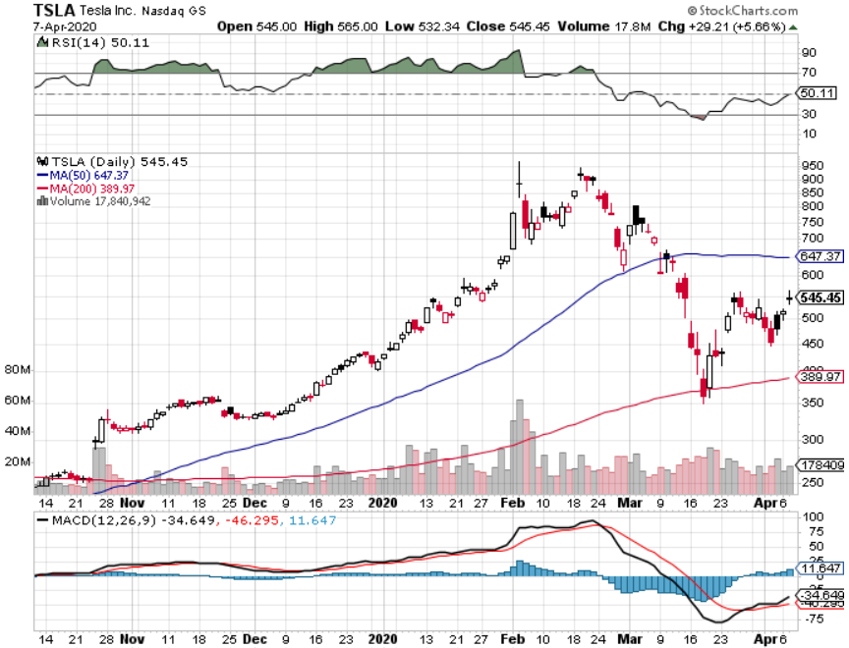
Tesla (TSLA)- Oil Crash Makes Electric Expensive Fremont factory closed stopped out of long 6/$260-$270 put spread took profits on long 6/$140-$150 call spread took profits on long 6/$240-$250 put spread

Slide 44
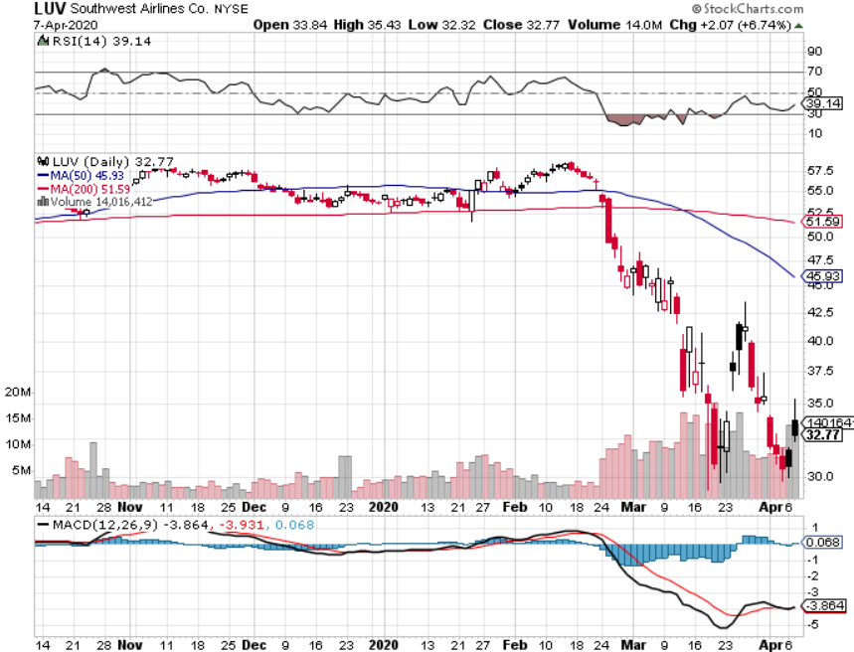
Southwest Airlines (LUV) – Warren Buffett big seller

Slide 45
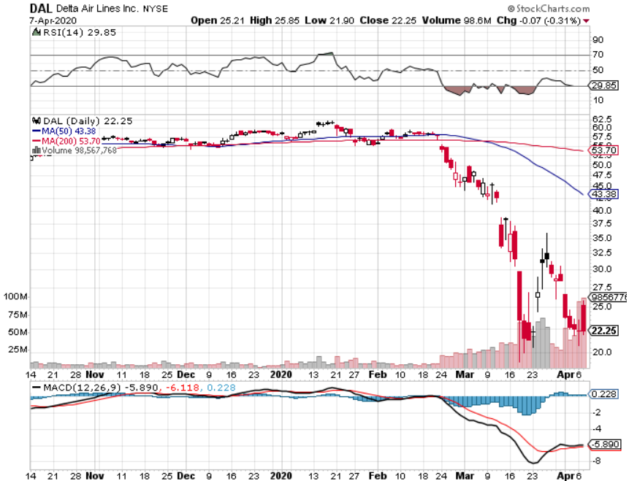
Delta Airlines (DAL) – Warren Buffett big seller

Slide 46
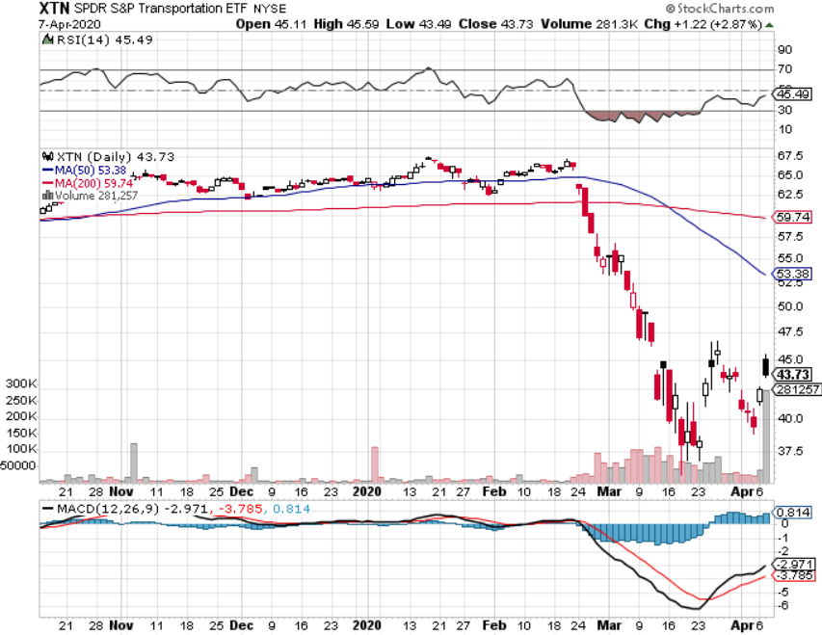
Transports Sector SPDR (XTN)- Worst Hit Sector (ALGT), (ALK), (JBLU), (LUV), (CHRW), (DAL)

Slide 47
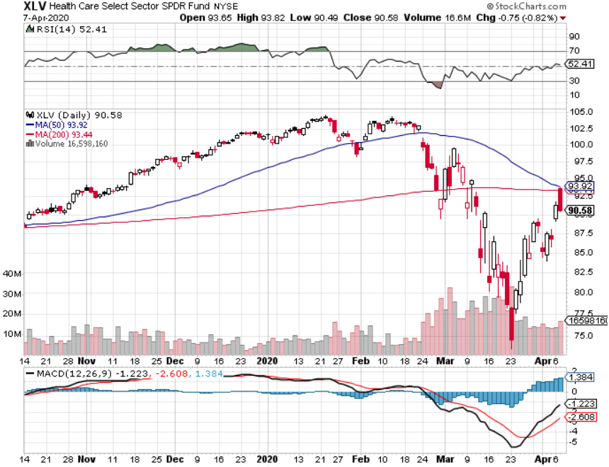
Health Care Sector (XLV), (RXL)-New Highs (JNJ), (PFE), (MRK), (GILD), (ACT), (AMGN) The new favorite sector

Slide 48
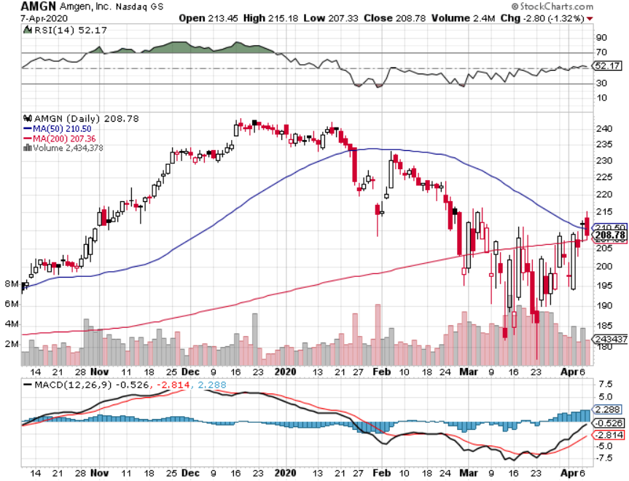
Amgen (AMGN)

Slide 49
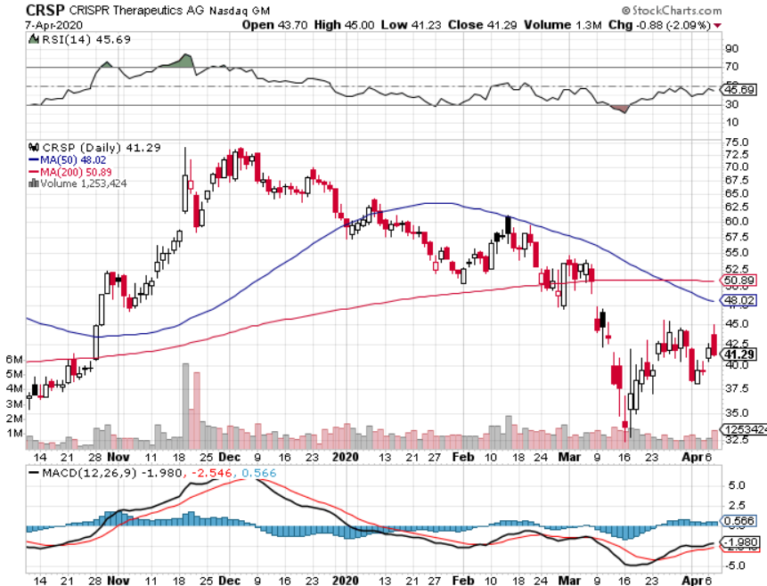
CRISPR Therapeutics (CRSP)

Slide 50
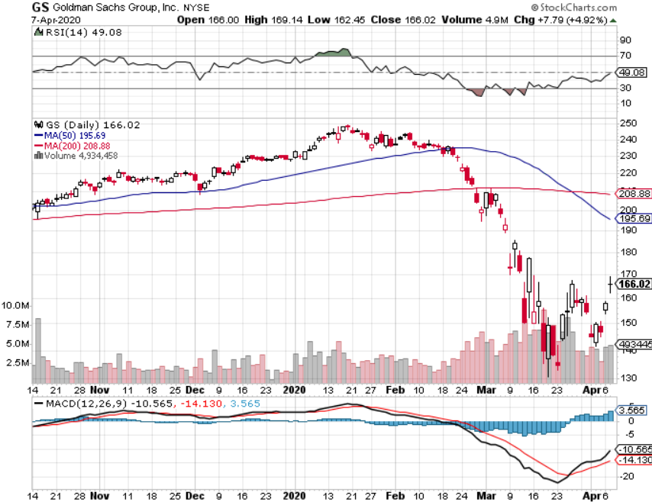
Goldman Sachs (GS) – Slaughtered by Low Rates

Slide 51
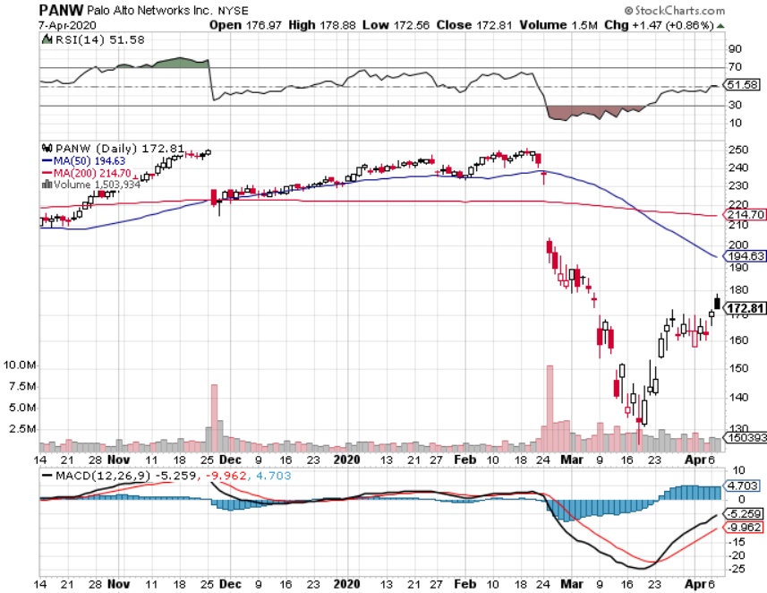
Palo Alto Networks (PANW)- Hacking never goes out of fashion

Slide 52
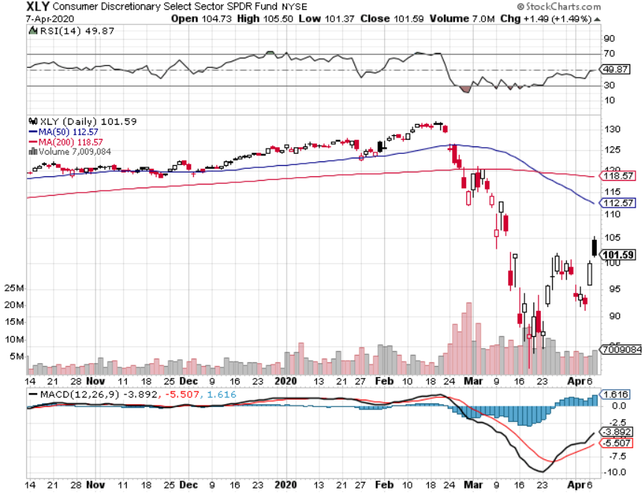
Consumer Discretionary SPDR (XLY) (DIS), (AMZN), (HD), (CMCSA), (MCD), (SBUX)

Slide 53
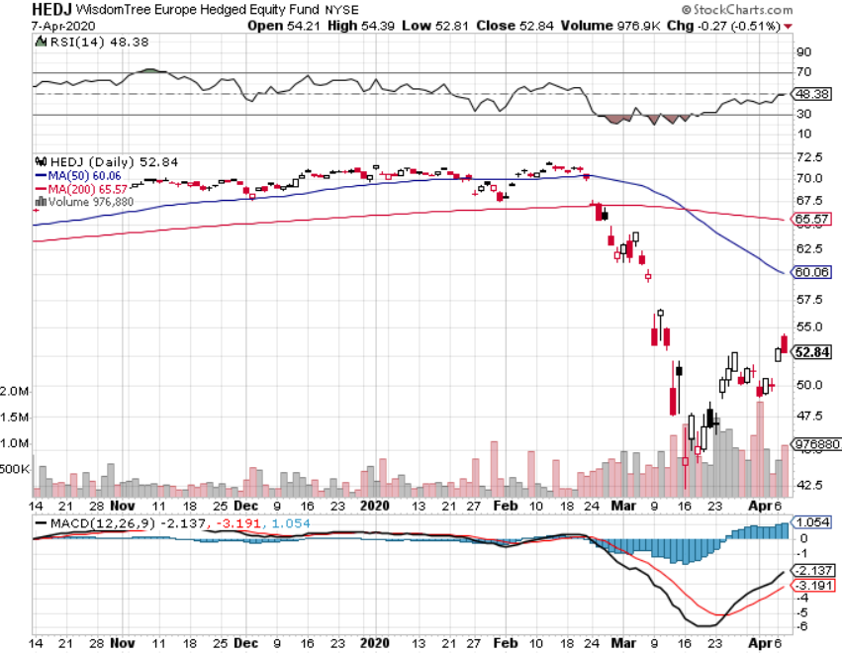
Europe Hedged Equity (HEDJ)- Pip on Brexit News

Slide 54
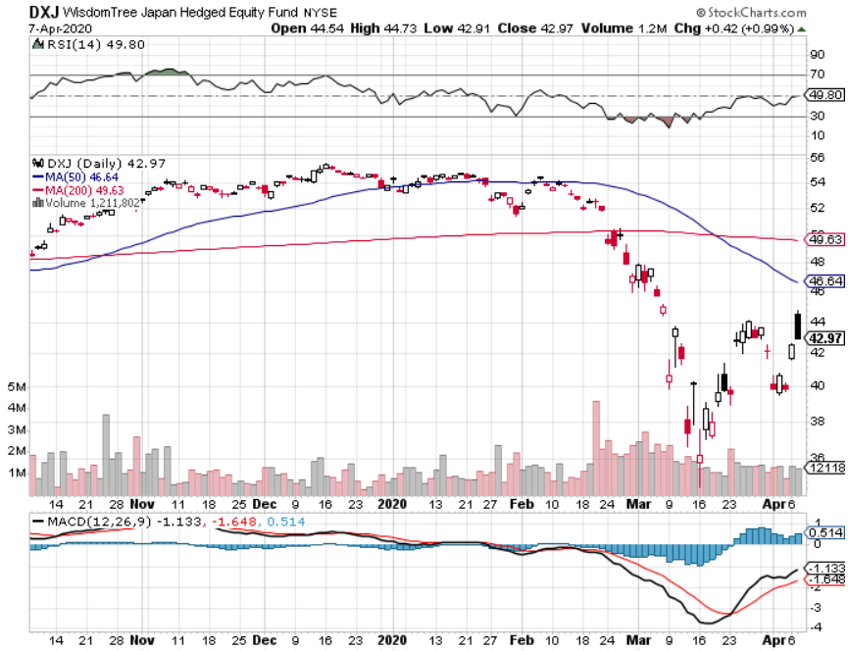
Japan (DXJ)-

Slide 55
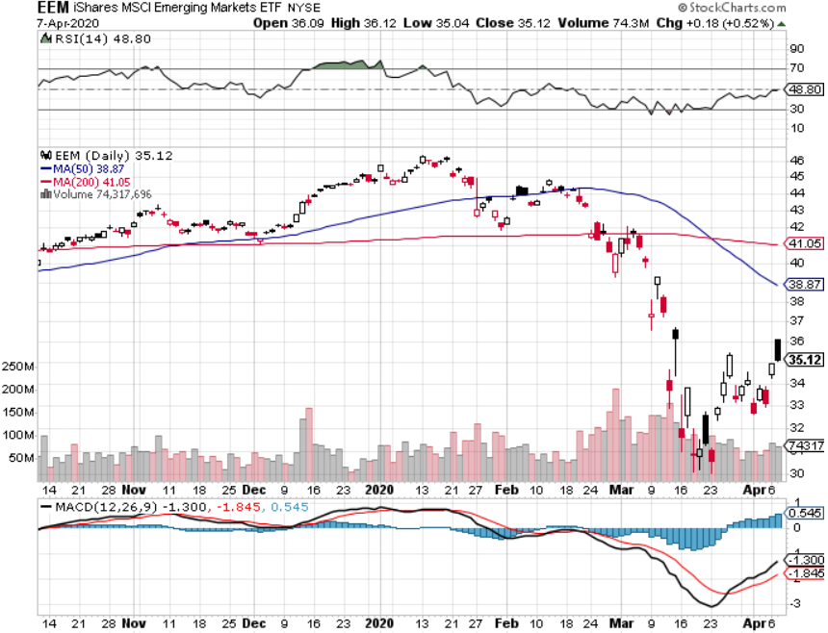
Emerging Markets (EEM)- Weak Dollar Play

Slide 56
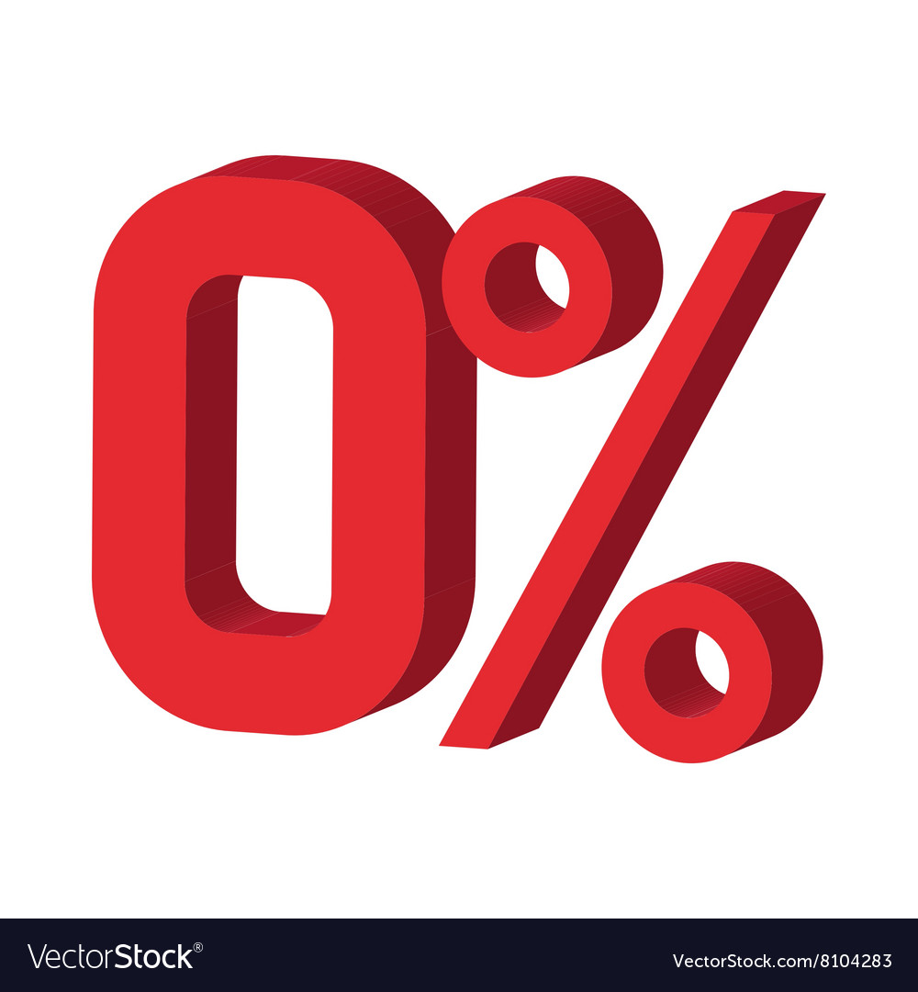
Bonds – Going to Zero Rates
*Fed launches massive $8 trillion QE to keep the bond markets open *Bonds markets were starting to shut down before Fed came into backstop, securities for credit card debt, municipal bond debt, student loans *Fed supports commercial paper market with massive $125 billion a day to enable corporate short-term borrowing *The death of the bond market was upon us, prices from here either go nowhere, or down big *Massive flight to safety drives cash out of stocks into bonds on a huge scale *Default risk soars for the heaviest debt industries, including energy, cruise lines, hotels, and airlines *Bottom line: no bond trades for the foreseeable future

Slide 57
Treasury ETF (TLT) – Trading the Range STOP LOSS on long 3/$162-$165 put spread took profits on long 12/$145-$148 put spread profits on long 10/$129-$132 call spread stopped out of long 8/$137-$140 put spread took profits on long 8/$125-$128 call spread

Slide 58
Ten Year Treasury Yield ($TNX) – 0.66%

Slide 59
Junk Bonds (HYG) 7.64% Yield big jump in spreads on stock selloff and recession fears

Slide 60
2X Short Treasuries (TBT)- 2 Month Bottoming Process

Slide 61
Emerging Market Debt (ELD) 4.69% Yield-

Slide 62
Municipal Bonds (MUB)-1.59% Mix of AAA, AA, and A rated bonds

Slide 63
Foreign Currencies – Dollar Panic Buying
*Global flight to safety triggers panic buying of dollar *150 basis point drop in bond yields then weakens the US dollar when fear resided *Euro (FXE) gets crushed to three-year low, breaking parity *British pound bounces hard *Bitcoin jumps by half to $7,500 in weeks *Aussie finding a bottom *Starting selling short all dollar rallies, its yield support is gone forever

Slide 64
Japanese Yen (FXY), (YCS)

Slide 65
Euro ($XEU), (FXE), (EUO)-

Slide 66
British Pound (FXB)-

Slide 67
Australian Dollar (FXA)- The Global Recovery Play took profits on long 8/$67-$69 call spread

Slide 68
Emerging Market Currencies (CEW)

Slide 69
Chinese Yuan- (CYB)- New Lows

Slide 70
Bitcoin- No Hedge

Slide 71
Energy – Super Glut
*Global depression fears beat oil prices to death, dialing consumption crashes from 82 million barrels to 48 million *Price war between Saudi Arabia and Russia takes oil from $80 to $20 in two months *The real goal is to put the US fracking industry out of business, which has added 4 million b/d over the last five years *China is the world’s largest marginal oil consumer at 13.5 million barrels a day, so oil had to take the big hit, possibly dropping to 8 million b/d *Any price spike will be temporary, as over supply against fading demand will last for years *Avoid all energy plays like the plague, could drop by half in the coming recession

Slide 72
Oil-($WTIC)

Slide 73
United States Oil Fund (USO) long 10/$9.50-$10 Vertical bull call spread

Slide 74
Energy Select Sector SPDR (XLE)-No Performance! (XOM), (CVX), (SLB), (KMI), (EOG), (COP)

Slide 75
Halliburton (HAL)-

Slide 76
Natural Gas (UNG) -

Slide 77
Precious Metals – Another Run at the Highs
*Gold jumps 13% on massive dollar spike, then recovers 10% *Hedging demand piles on top of central bank buying *New of QE Infinity spark huge rally *Collapsing US dollar is another incentive *Central banks still pouring into gold every month *Bottom Line: buy a bigger dip in gold and precious metals

Slide 78
Gold (GLD)- Short Term downtrend

Slide 79
Market Vectors Gold Miners ETF- (GDX) – Yikes!

Slide 80
Barrick Gold (GOLD)

Slide 81
Newmont Mining- (NEM)-

Slide 82
Silver- (SLV)-

Slide 83
Silver Miners - (SIL)-

Slide 84
Wheaton Precious Metals - (WPM)-

Slide 85
Copper (COPX)-Collapse Trade War Disaster

Slide 86
Freeport McMoRan (FCX)-World’s Largest Copper Producer took profits on long 4/$10-$11 call spread took profits on short 4/$114 calls

Slide 87
Real Estate – Frozen
*The market is frozen. Nobody can buy, but nobody can sell either *A huge wave of defaults is about to turn the mortgage market upside down with a very generous forbearance program *With banks running skeleton staffs few mortgage loans can be processed *Notaries and title companies are shut down *Bond market loss of liquidity spikes 30-year fixed mortgage rates back up to 3.70% *Fed will eventually push rates back down and rates will come back down in line with 10-year US Treasury yields at 0.66% S&P Case Shiller Rose 3.8%, in January

Slide 88
February Corelogic S&P Case Shiller Home Price Index Phoenix (5.9%), Tampa (5.0%), and Charlotte, NC (5.2%) showing biggest gains
Tradingeconomics.com

Slide 89
Simon Property Group (SPG)- Mall REIT

Slide 90
Crown Castle International (CCI) – 3.40% yielding cell phone Tower REIT

Slide 91
US Home Construction Index (ITB) (DHI), (LEN), (PHM), (TOL), (NVR)

Slide 92
Trade Sheet- So What Do We Do About All This?
*Stocks-buy bigger dip, sell big rallies *Bonds-stand aside, get ready to sell *Commodities-stand aside *Currencies- sell US dollar rallies *Precious Metals – buy dips *Energy – stand aside *Volatility-sell short over $50 *Real estate-stand aside

Slide 93
Next Strategy Webinar 12:00 EST Wednesday, April 22, from Lake Tahoe email me questions at support@madhedgefundtrader.com
Good Luck and Good Trading!
Notes:
*

