Slide 1
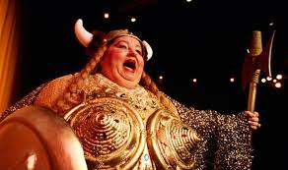
The Mad Hedge Fund Trader “The Fat Lady is Singing for the Bond Market”
With John Thomas from Silicon Valley, CA, May 6, 2020 www.madhedgefundtrader.com
Notes:
*

Slide 2
Trade Alert Performance Back to Positive for 2020!
*January 3.13% Final *July +3.07% Final *February -6.05% Final *August +16.01% Final *March -5.50% Final *September 3.08% Final *April +4.55% Final *October +12.13% Final *May +6.86% MTD *November -1.26% Final *June -0.50% Final *December +4.97% Final *Year to date +2.99% compared to -17.8% for the Dow Average *+355.91% since inception, 1.3% short of a new all time high *Average annualized return of 34.00% for 11 years

Slide 3
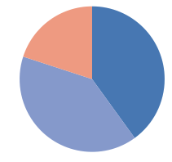
Portfolio Review Massive Bond Shorts Covered for Huge Profits, cut back positions from 90% to 50%, neutral but big profits on downside
Risk On
World is Getting Better
(TLT) 6/$175-$180 put spread | 20.00%
Risk Off
World is Getting Worse
(SDS) | -20.00%
(SPY) 5/$305-$315 put spread | -10.00%
Total Net Position | -10.00%
Expiration P&L +4.46% YTD

Slide 4
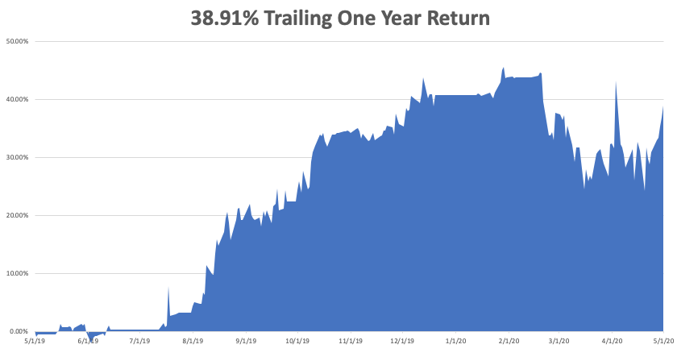

Slide 5
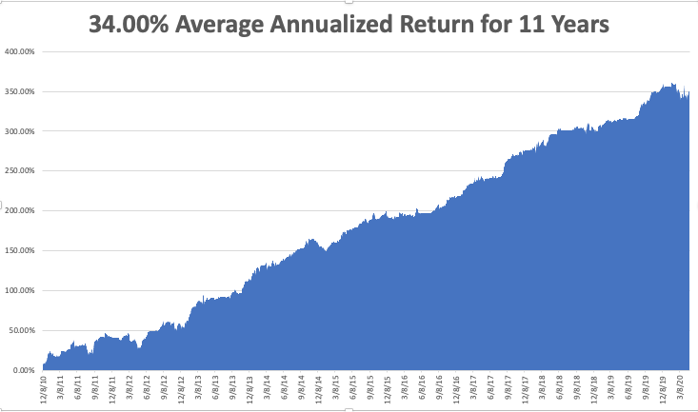
GTD 10 Year Daily Audited Performance

Slide 6
The Method to My Madness
*The administration is forcing early opening which will bring a second Corona wave worse than the first on, triggering a secondary crash in the stock market *Stocks are now wildly overpriced counting heavily on a free put from the Fed *Even if you open up everything, the customers afraid of infection won’t show. That has been the case in China. That means a deeper and longer depression, with jobless hitting 52 million *Corona curves are flattening but it will take a long time before anyone feels safe to go out *Gold taking a run at all time high *Volatility backs off from $80 to $30, so it could be a sleepy summer *Best buying opportunity of the decade is setting up, the next big dip is the one you buy

Slide 7
Corona Update
*US cases top 1.2 million, deaths at 71,152 *Early opening states in Midwest are setting up a second wave in the summer/fall *Death rates in New York are falling, down to only 500 a day *50% of cases show no symptoms, but they become spreaders *There are at least two variants out there, so you can get it twice *There appears to be a genetic element where some people appear immune and other die quickly *We may need masks in public for years, or until there is a vaccine, best hope is for serum *A true vaccine is years off, or never

Slide 8
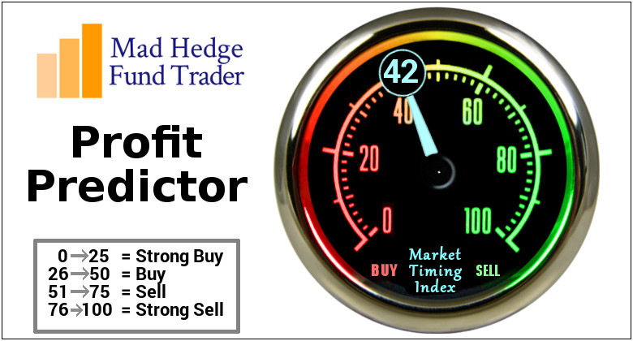
The Mad Hedge Profit Predictor Market Timing Index-Bottom of Range-at to a “BUY” An artificial intelligence driven algorithm that analyzes 30 different economic, technical, and momentum driven indicators

Slide 9
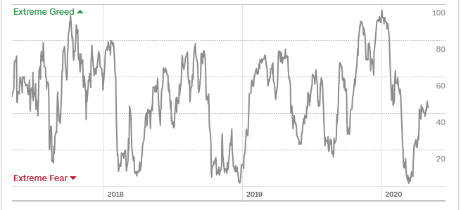
The Mad Hedge Profit Predictor From Extreme Overbought to Oversold
SELL
BUY

Slide 10
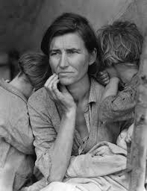
The Global Economy – Great Depression Repeat
*We are now in the worst economic conditions since the Great Depression, with the worst forecasts at a -40% Q2 annualized rate *A huge “V” recovery in the stock market, but will it last? A “U” shaped recovery in the second half is the best we can hope for *Unemployed top 30 million, 40 million with U-6, may jump another 5 million in Thursday *Global travel industry is gone and much of it is never coming back *West coast will recover first, then the east and Midwest *Government handouts will take many months to hit the economy

Slide 11
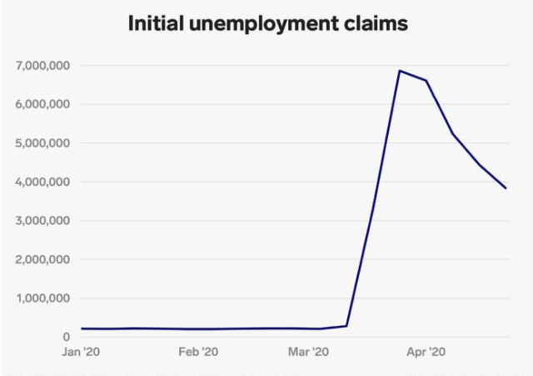
Weekly Jobless Claims-Bottomed Out 3.8 Million to 30 million will surpass Great Depressions this week

Slide 12
The Bill Davis View A $1,500 Upgrade for the Mad Day Trader Service
Buys: | Entry | Target
Shutterstock, Inc. (SSTK) X | $ 36.00 | $ 42.00
American Tower Corp (AMT) | $ 238.00 | $ 260.00
Albemarle Corp (ALB) | $ 58.00 | $ 70.00
Applied Materials Inc. (AMAT) | $ 50.00 | $ 62.00
Lockheed Martin Corp (LMT) | $ 385.00 | $ 420.00
Sells:
Cummins Inc. (CMI) | $ 160.00 | $ 140.00
ABMIOD, Inc. (ABMD) | $ 182.00 | $ 155.00
Wayfair Inc. (W) | $ 166.00 | $ 140.00
Itron, Inc. (ITRI) | $ 65.00 | $ 42.00
MKS Instruments Inc. (MKSI) | $ 94.00 | $ 74.00

Slide 13
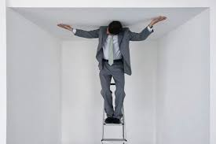
Stocks – Hitting a Ceiling
*Monster rally stalls, bumping up against 200-day moving average *S&P 500 Earnings multiples soar from 18X 2019 earnings and likely 36X 2020 earnings, assuming they drop by half *Tech has a great run but now appear exhausted *On the next dip scale into those 2-year LEAP’s in your favorite big tech names, but low bids under the market *Continue to focus on big tech and biotech, the market leaders, on 30%-40% selloffs, and the 2X (ROM) which rocketed 58% in three weeks *Bottom line: buy the next big dip for a massive recovery starting in the summer-fall *Bottom Line: its bet the ranch time on tech longs, but stay away from those with big China exposure, like Apple, and weak dollar plays like energy, and emerging markets

Slide 14
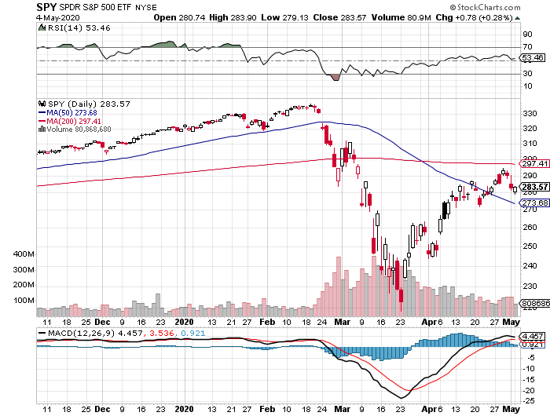
S&P 500 – Bounce –Targeting 2,400 and a Head and Shoulders Bottom took profits on long $305-$315 bear put spread took profits on long 4/$310-$320 bear put spread stopped out of long 4/$235-$245 bull call spread took profits on long 4/$280-$290 bear put spread took profits on long 4/$275-$280 bear put spread
The Bottom 2,500 -42%

Slide 15
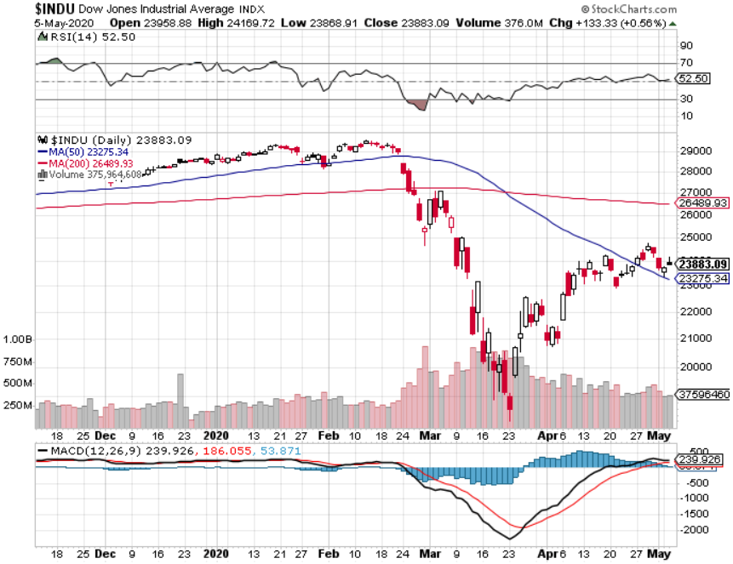
Dow Average ($INDU)- Giving Up Three Years of Gains

Slide 16
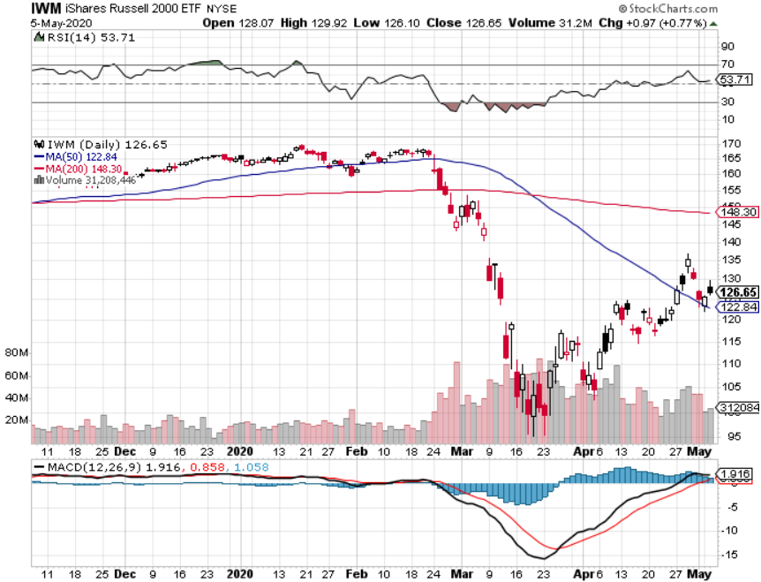
Russell 2000 (IWM)- took profits on Long 10/$137-$142 vertical bull call spread took profits on Long 10/$153-$156 vertical bear put spread

Slide 17
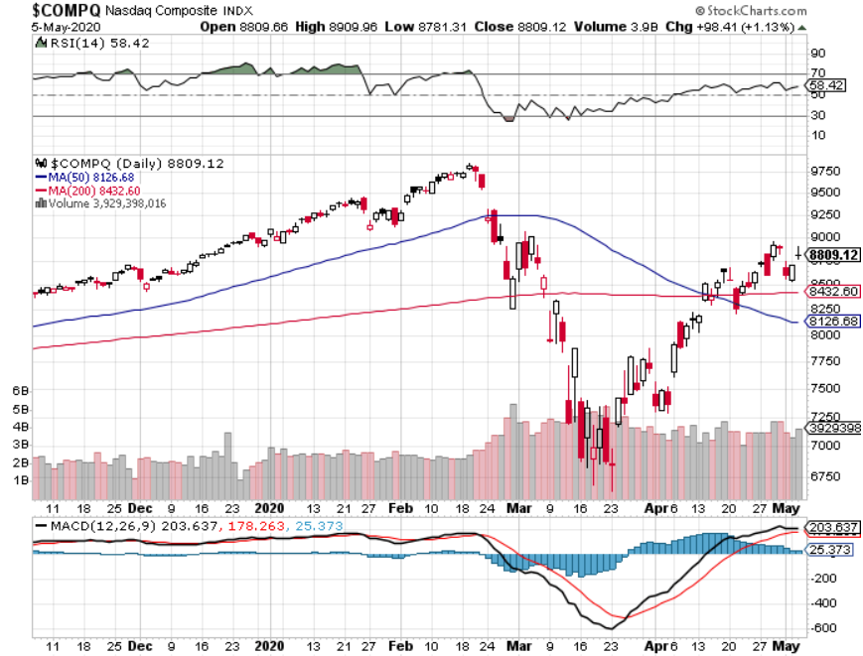
NASDAQ ($COMPQ) – Monster Recovery

Slide 18
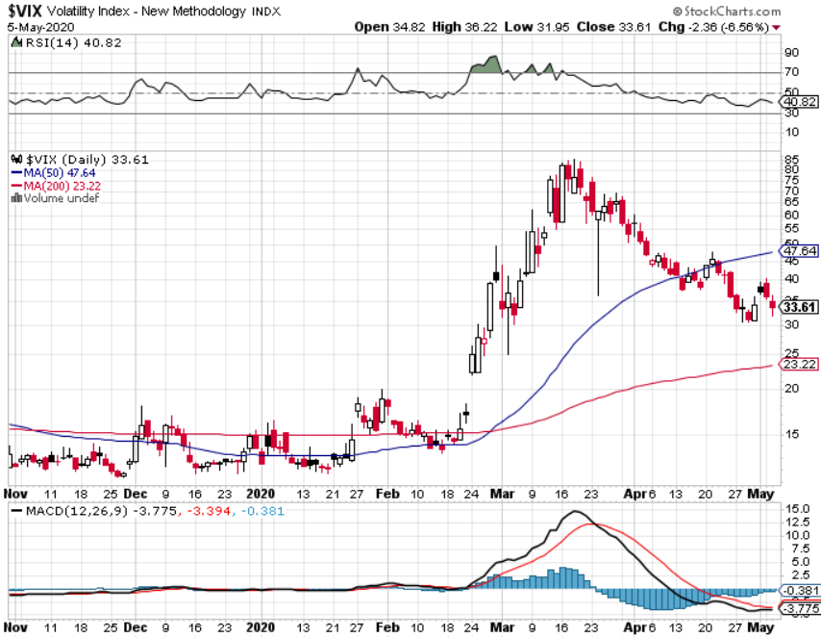
(VIX)- Half of the Peak

Slide 19
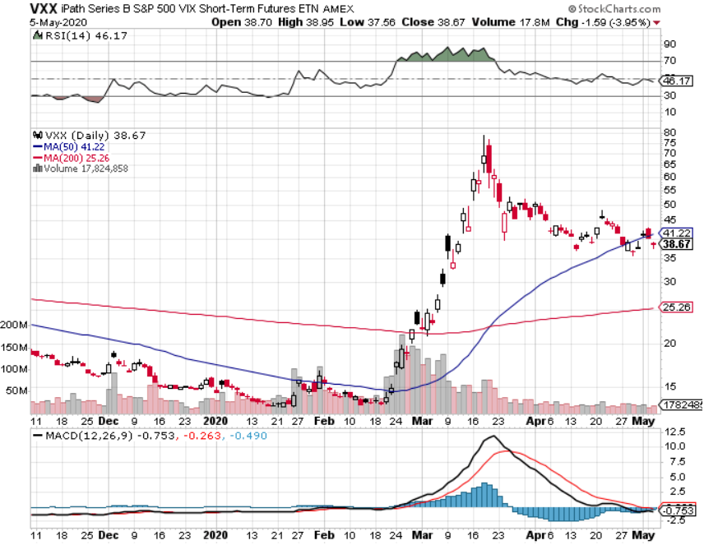
(VXX)- Sell Rallies-Down $38 from top stopped out of long 1/2021 $16 puts stopped out of long 1/2021 $24 puts

Slide 20
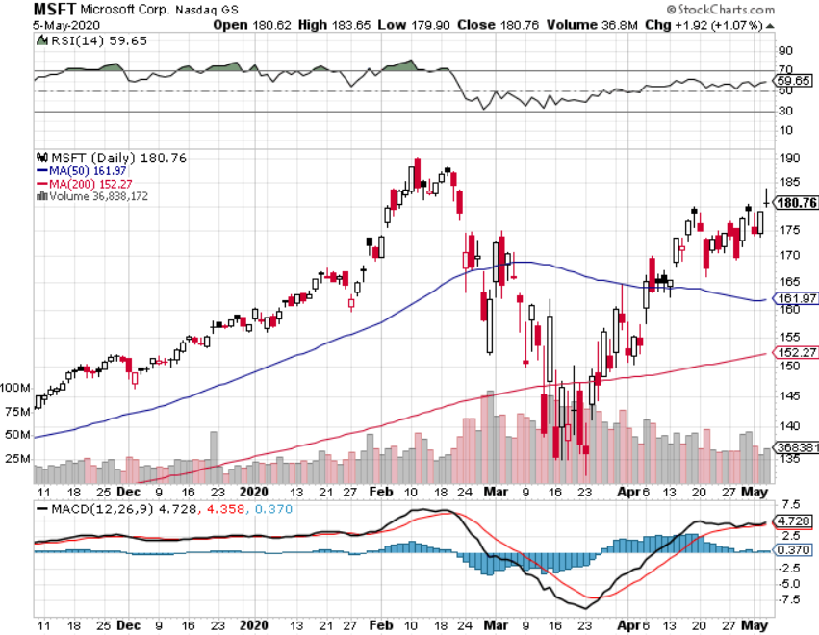
Microsoft (MSFT)- Earnings beat- Looking for Another Entry Point Stopped out of long 4/$120-$130 call spread took profit on long 4/$120-$130 call spread stop loss on long 12/$170-$180 call spread took profits on long 12/$135-$138 call spread

Slide 21
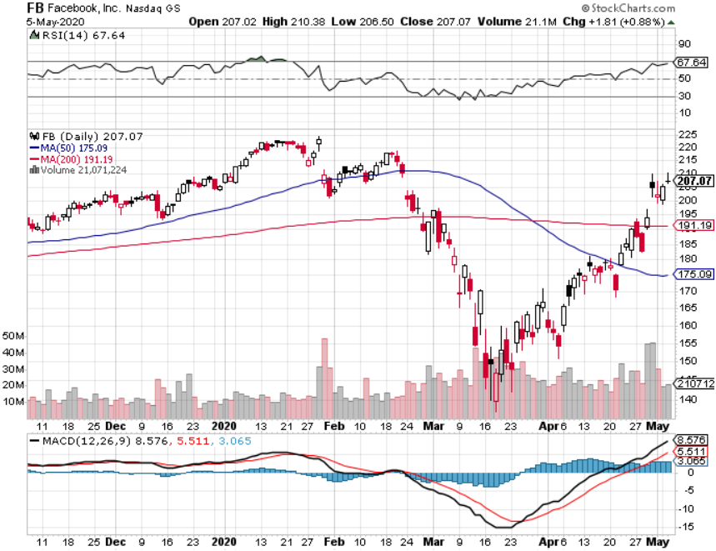
Facebook (FB)- Breaking Down stopped out of Long 9/$190-$200 vertical bear put spread took profits on Long 9/$145-$155 vertical bull call spread took profits on Long 9/$150-$160 vertical bull call spread took profits on Long 8/$167.50-$172.50 vertical bull call spread

Slide 22
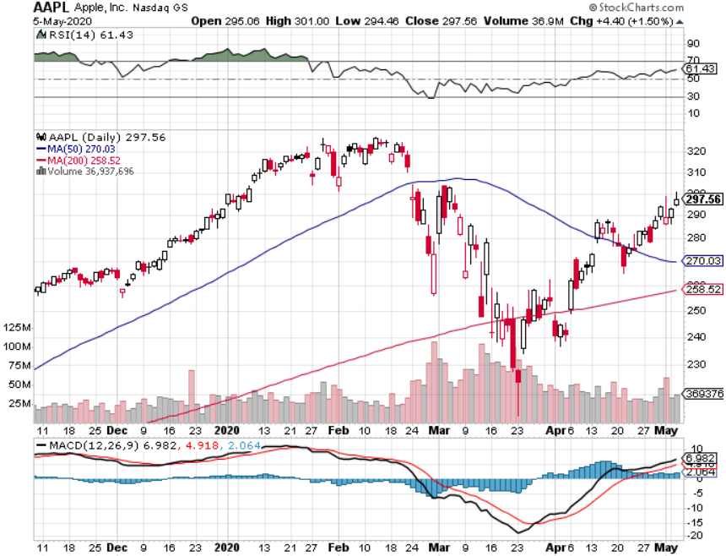
Apple (AAPL)- took profits on long 4/24/$250-$260 call spread took profits on long 5/$250-$260 call spread took profits on long 4/$250-$260 call spread took profits on long 3/$250-$260 call spread

Slide 23
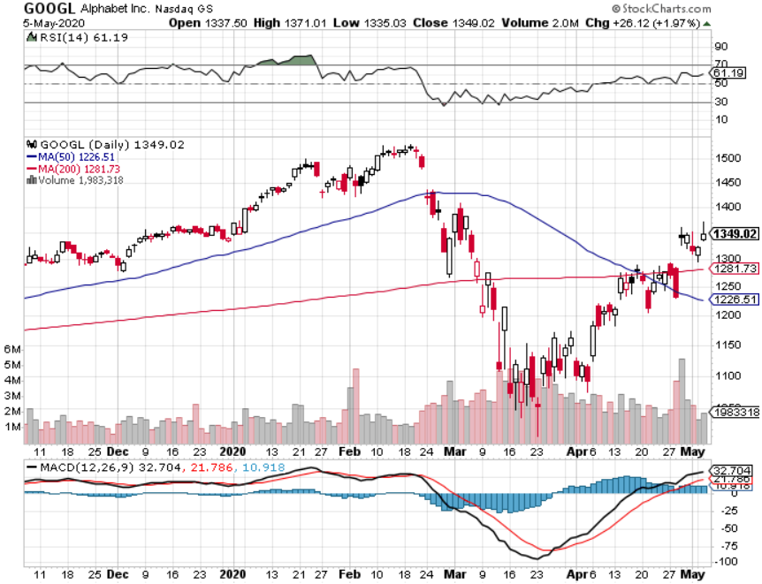
Alphabet (GOOGL) – took profits on long 12/$1,200-$1,230 bull call spread took profits on long 9/$1,030-$1,080 vertical bull call spread stopped out of long 5/$1,100-$1,130 bull call spread took profits on long 4/$1,080-$1,120 bull call spread

Slide 24
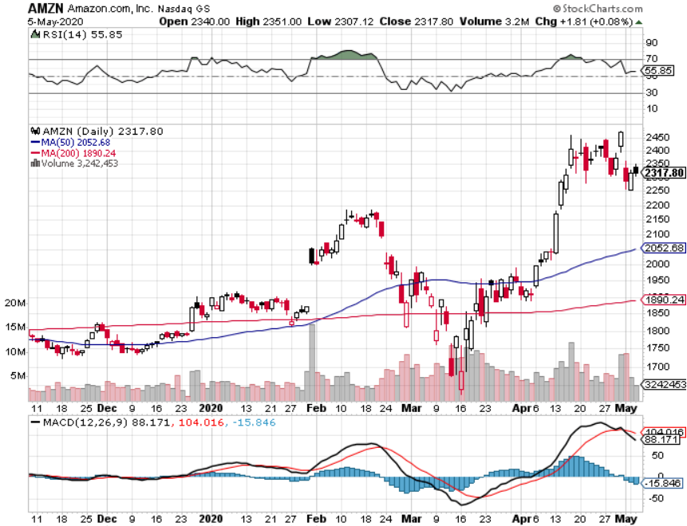
Amazon (AMZN) – New High took profits on long 4/$1,600-$1,650 bull call spread stopped out of long 3/$1,700-$1,800 bull call spread took profits on 9/$1,500-$1,500 bull call spread

Slide 25
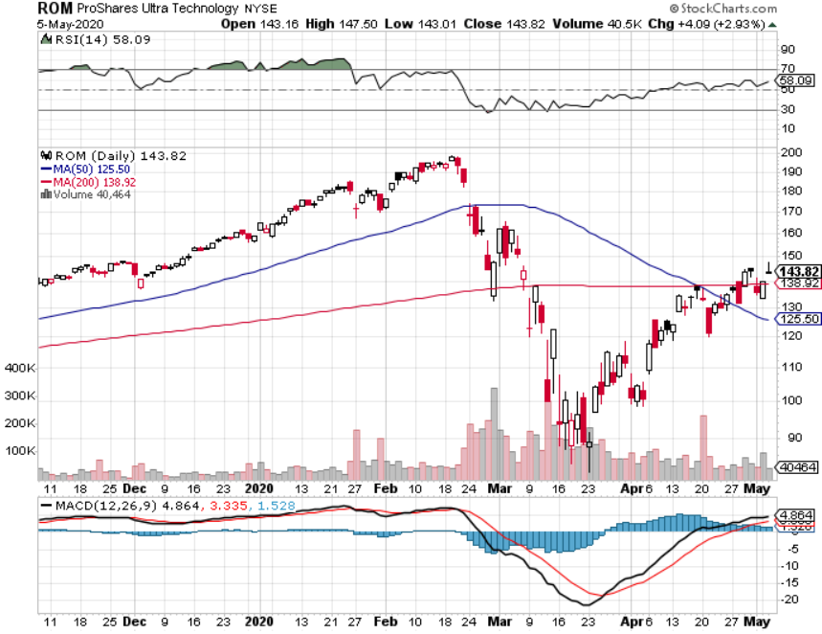
ProShares Ultra Technology (ROM) – Up 58% in 3 Weeks stopped out of long at $100.10

Slide 26
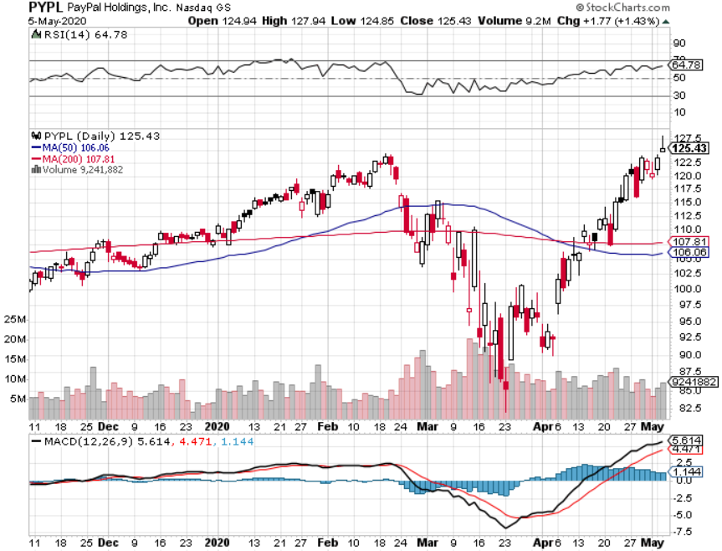
PayPal (PYPL)-Fintech Rules took profits on long 4/$90-$95 call spread

Slide 27
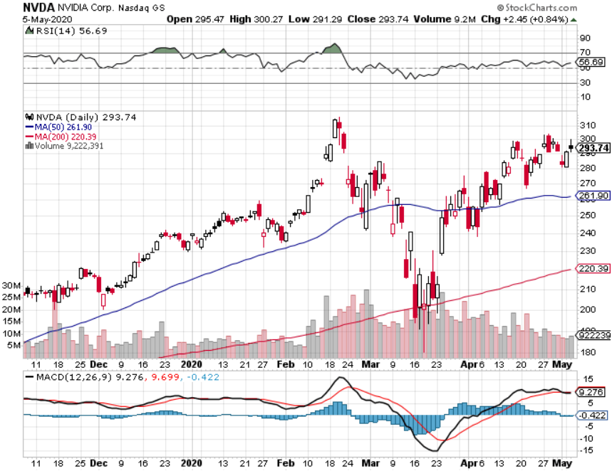
NVIDIA (NVDA) – Leading the charge on every recovery

Slide 28
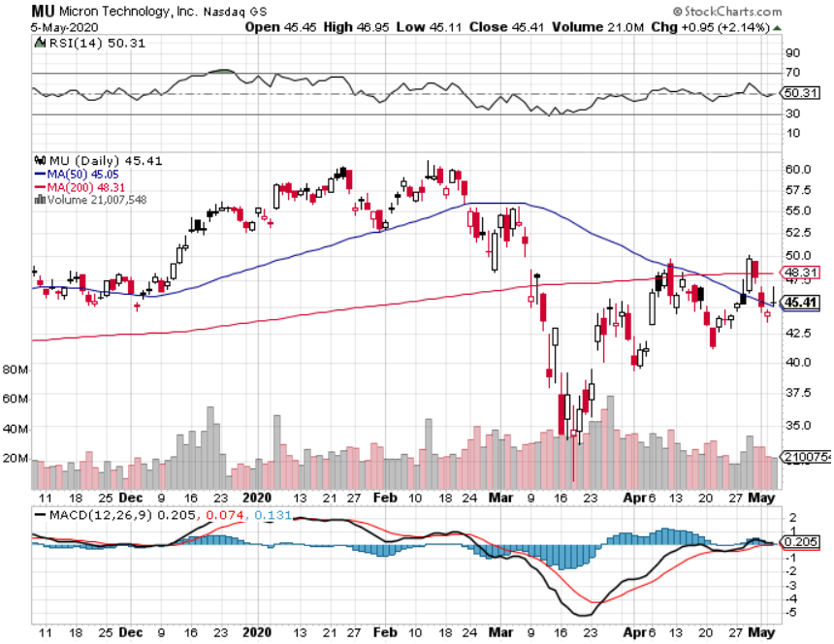
Micron Technology (MU)-Ditto

Slide 29
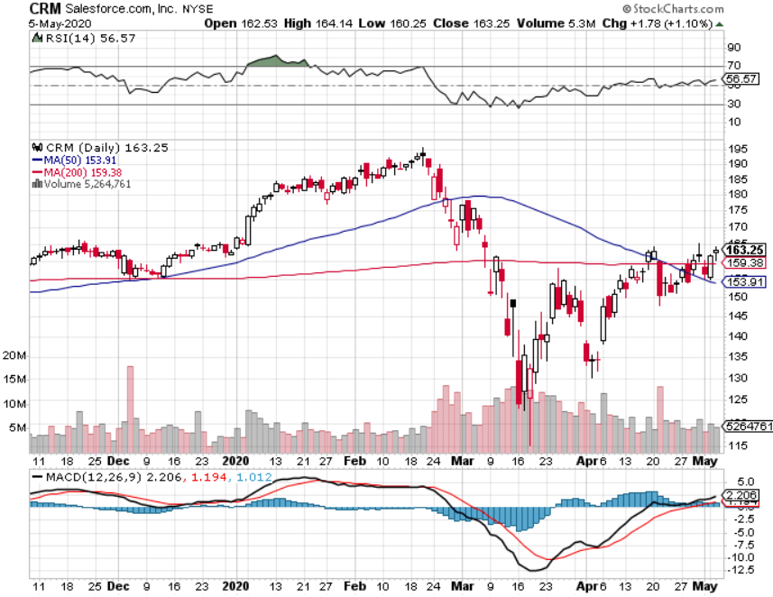
Salesforce (CRM)- Massive Online Migration took profits on long 9/$125-$130 vertical bull call spread took profits on long 8/$125-$130 vertical bull call spread took profits on long 2/$105-$115 call spread

Slide 30
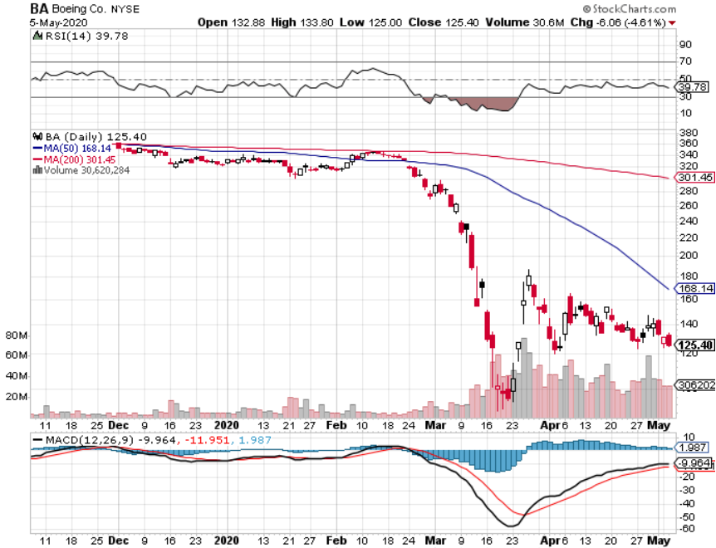
Boeing (BA) –GM Or Bank Style Takeover? 737 MAX production shutdown-Criminal investigation took profits on long 2/$270-$280 call spread took profits on long 12/$310-$330 call spread took profits on long 4/$300-$310 call spread took profits on long 4/$315-$335 call spread

Slide 31
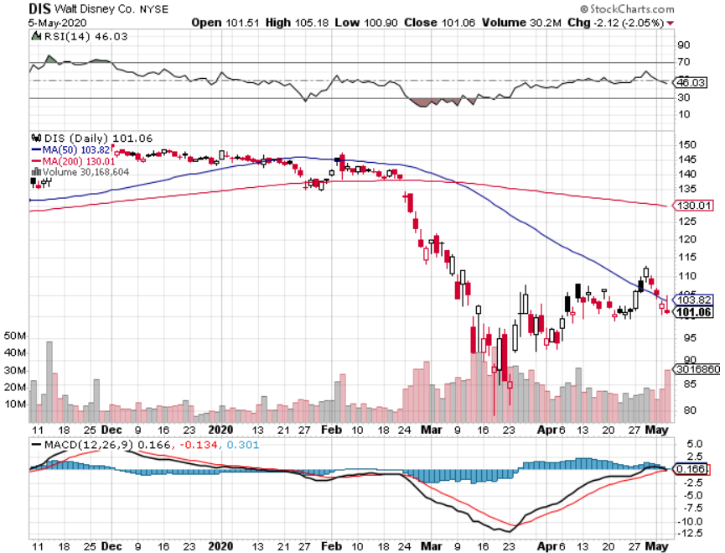
Walt Disney (DIS)- Corona Hit took profits on long 9/$115-$120 call spread 8/$125-$130 call spread expired at max profit Stopped out of 4/$125-$130 call spread for small loss took profits on long 4/$100-$104 call spread

Slide 32
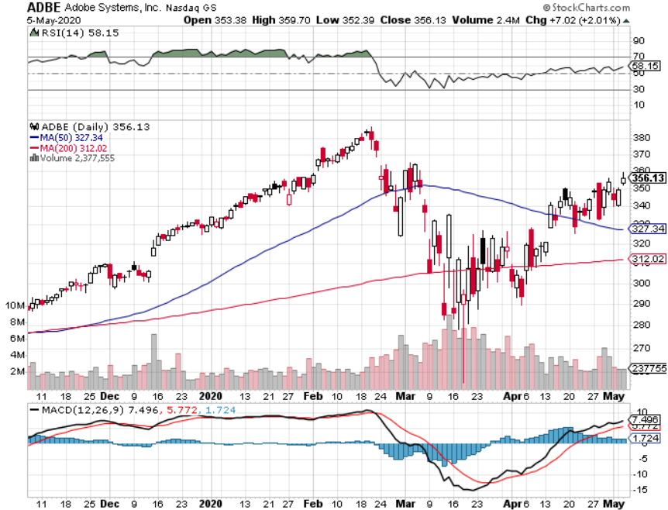
Adobe (ADBE)- The Quality Non-China tech play

Slide 33
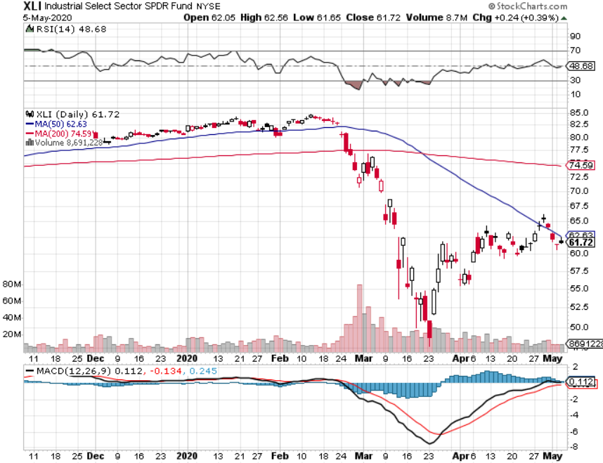
Industrials Sector SPDR (XLI)- (GE), (MMM), (UNP), (UTX), (BA), (HON)

Slide 34
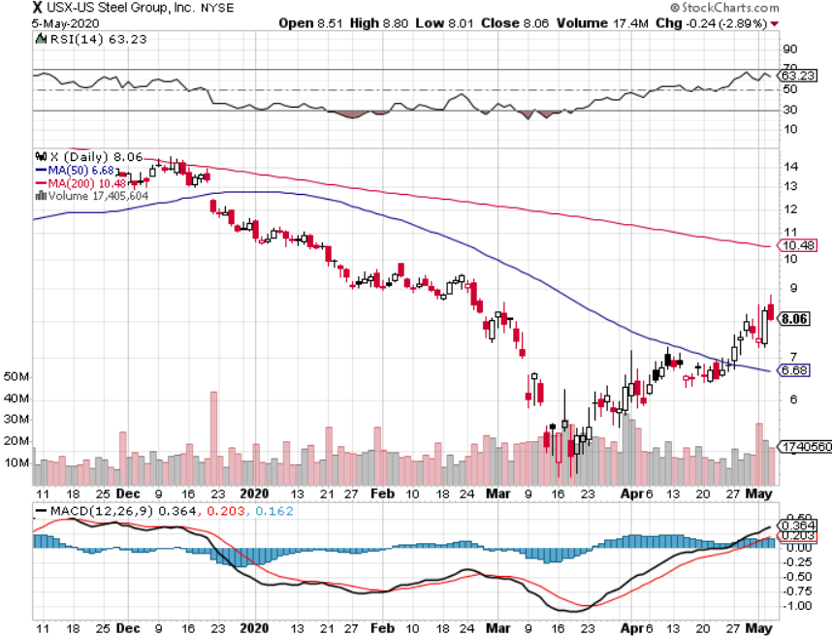
US Steel (X)-Tariffs Trouble

Slide 35
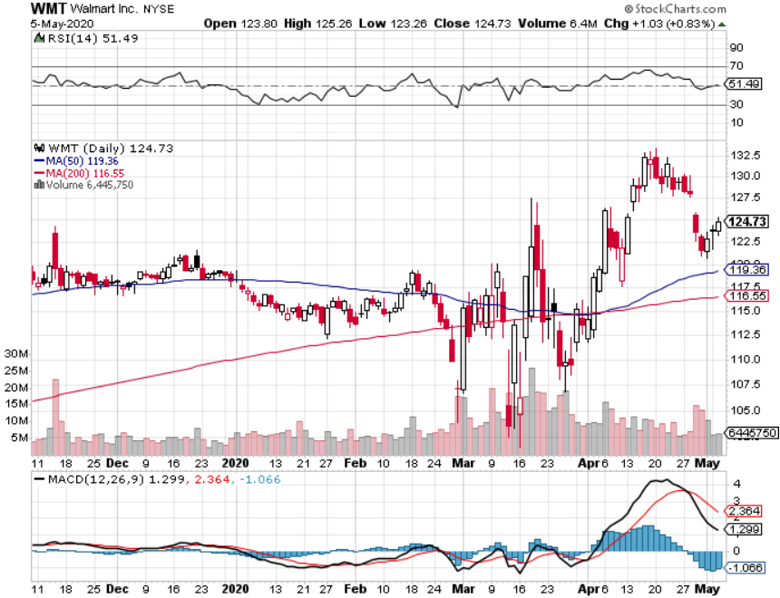
Wal-Mart (WMT)-Hiring 150,000 took profit on Long 11/$125-$130 bear put spread took profit on Long 10/$119-$121 bear put spread took profits on Long 8/$114-$117 bear put spread

Slide 36
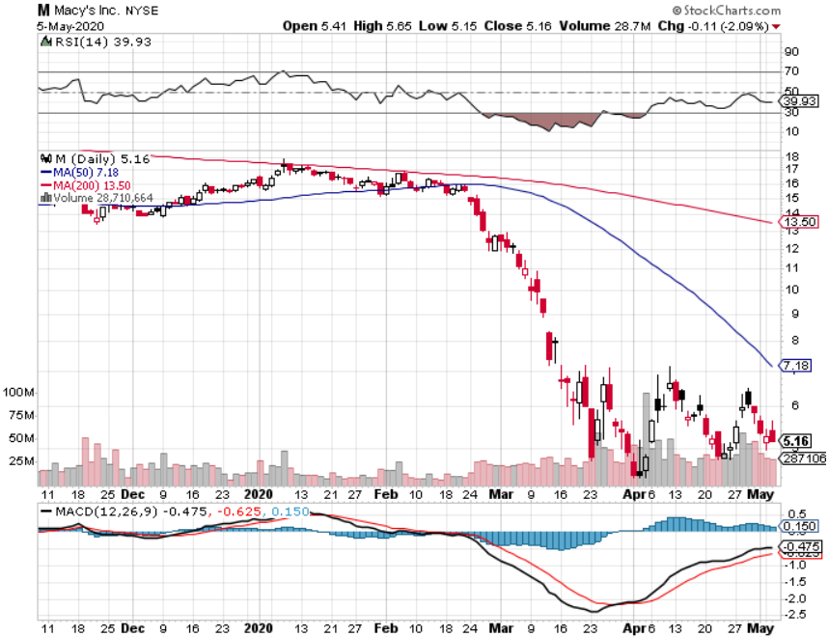
Macys’ (M) - More Store Closings took profits on Long 8/$23-$25 bear put spread

Slide 37
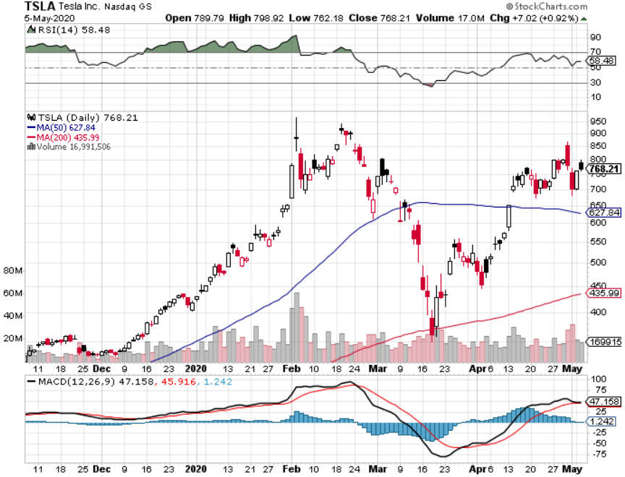
Tesla (TSLA)- Oil Crash Makes Electric Expensive Fremont factory closed stopped out of long 6/$260-$270 put spread took profits on long 6/$140-$150 call spread took profits on long 6/$240-$250 put spread

Slide 38
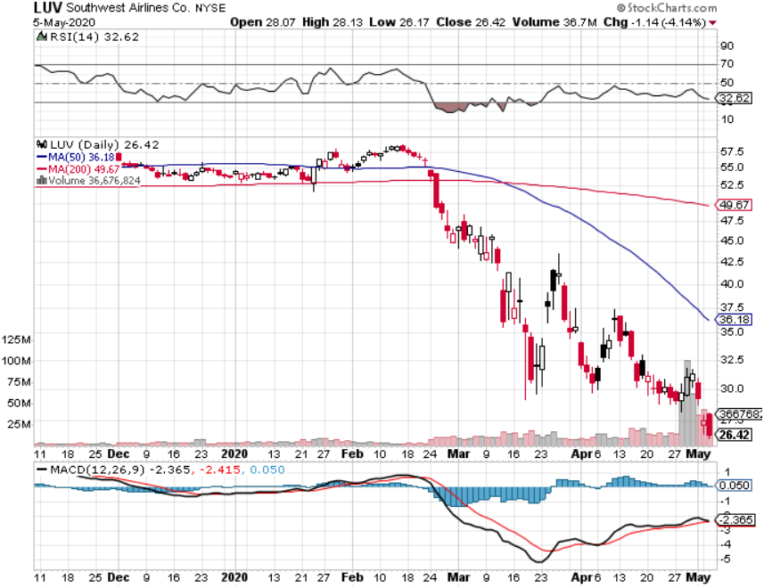
Southwest Airlines (LUV) – Warren Buffett big seller

Slide 39
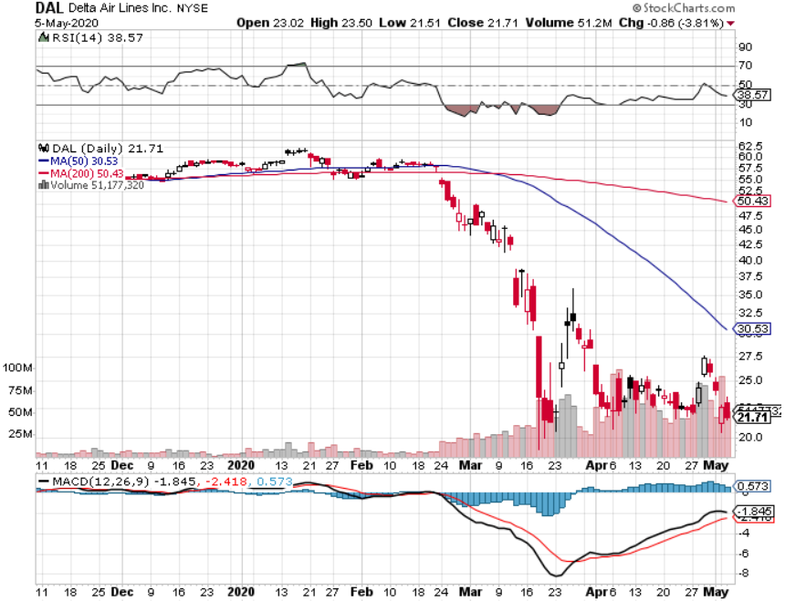
Delta Airlines (DAL) – Warren Buffett big seller

Slide 40
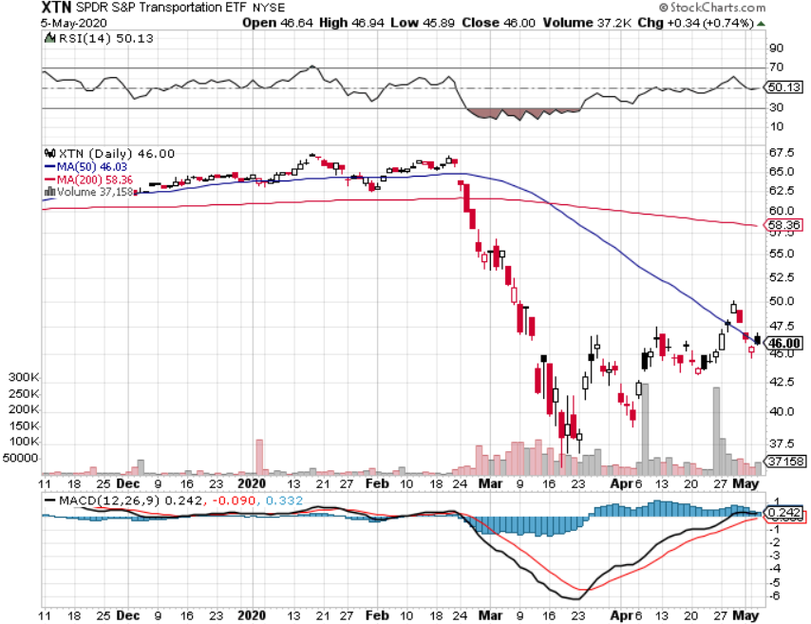
Transports Sector SPDR (XTN)- Worst Hit Sector (ALGT), (ALK), (JBLU), (LUV), (CHRW), (DAL)

Slide 41
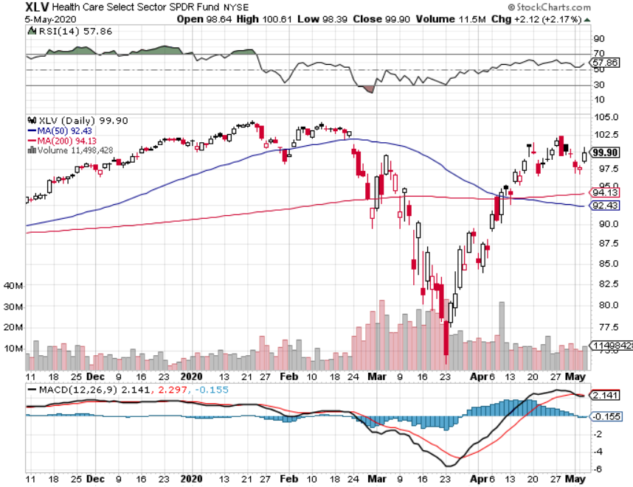
Health Care Sector (XLV), (RXL)-New Highs (JNJ), (PFE), (MRK), (GILD), (ACT), (AMGN) The new favorite sector

Slide 42
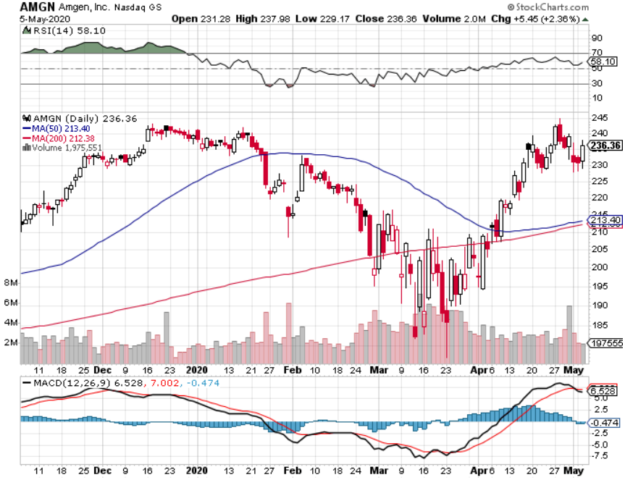
Amgen (AMGN)

Slide 43
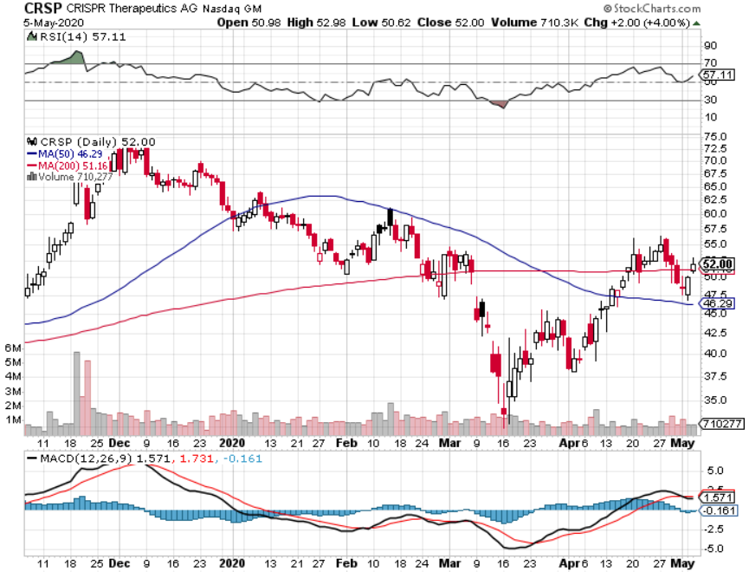
CRISPR Therapeutics (CRSP)

Slide 44
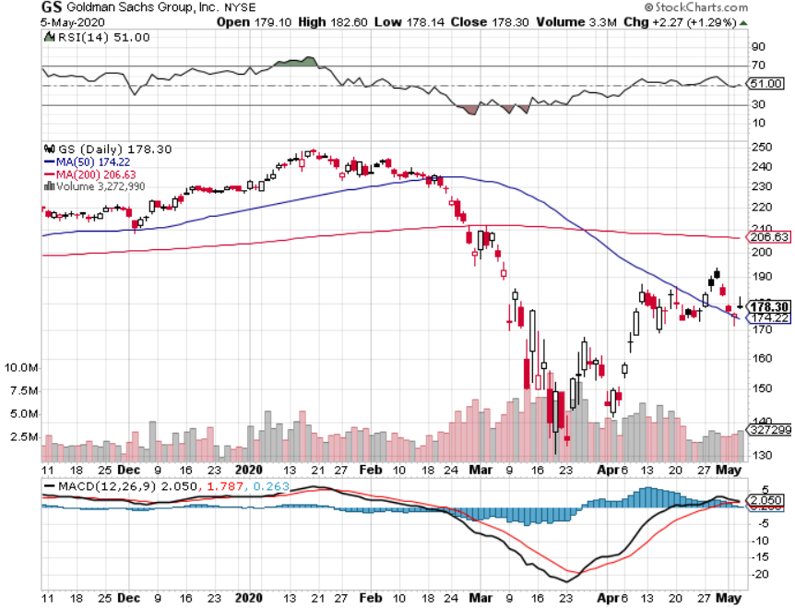
Goldman Sachs (GS) – Slaughtered by Low Rates

Slide 45
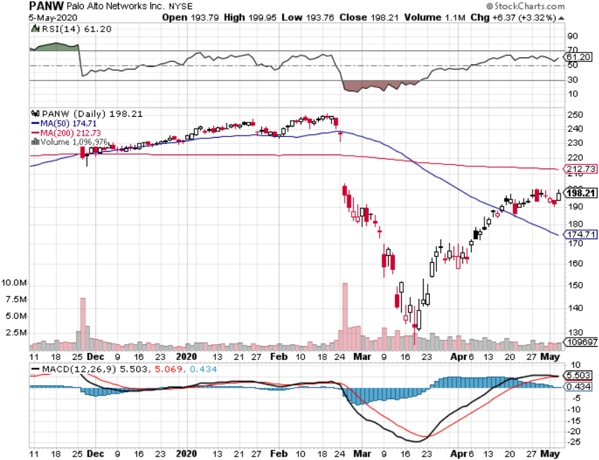
Palo Alto Networks (PANW)- Hacking never goes out of fashion

Slide 46
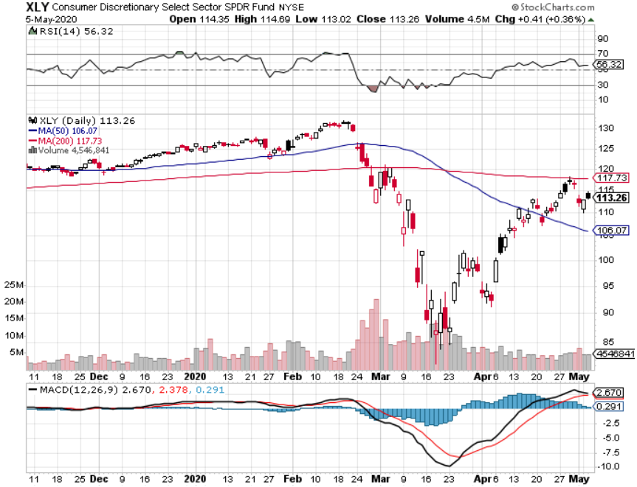
Consumer Discretionary SPDR (XLY) (DIS), (AMZN), (HD), (CMCSA), (MCD), (SBUX)

Slide 47
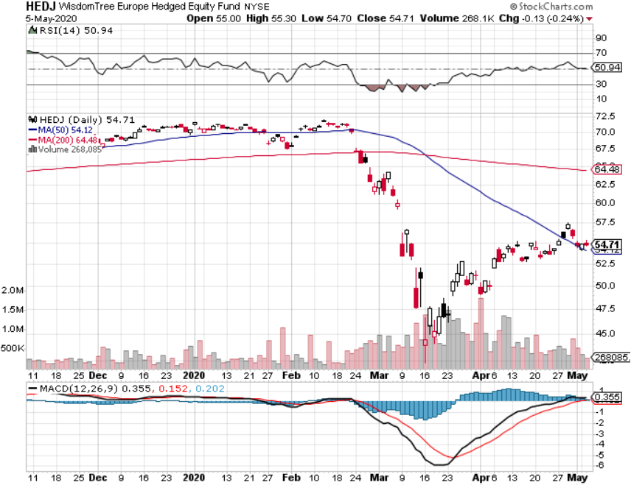
Europe Hedged Equity (HEDJ)- Pip on Brexit News

Slide 48
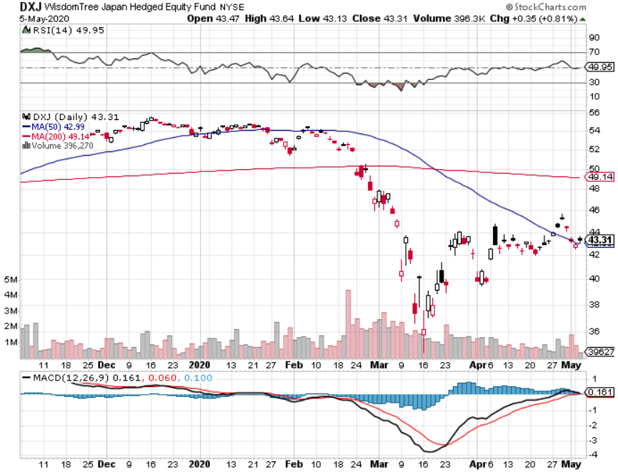
Japan (DXJ)-

Slide 49
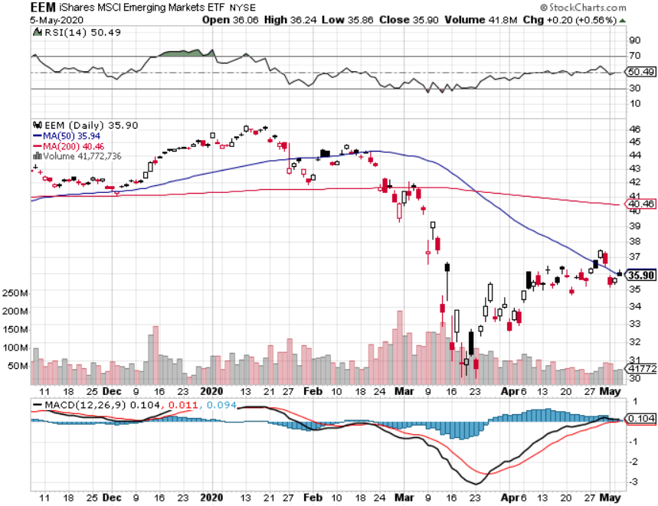
Emerging Markets (EEM)- Weak Dollar Play

Slide 50
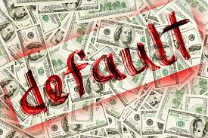
Bonds – Home Run
*7 short positions in 2 weeks boosted out performance by 10.51% *Short selling opportunity of the century is in play, down 18 points from the high, we cought ten of those points *National debt is soaring from $24 to $32 trillion in 18 months, with $3 trillion in Q2 *Massive crowding out by US Treasury borrowing is imminent to fund $6 trillion in Corona bailout programs on top of existing $1.5 trillion budget deficit *The century worst case scenario is setting up, going into a Great Depression with interest rates already at zero and massive budget deficits *US Treasury bond bond fund (TLT) could plunge from $180 to $105, taking interest rates from 0.31% to 3.25% *Trump threatening default throws gasoline on the fire *Bottom line: no bond trades for the foreseeable future

Slide 51
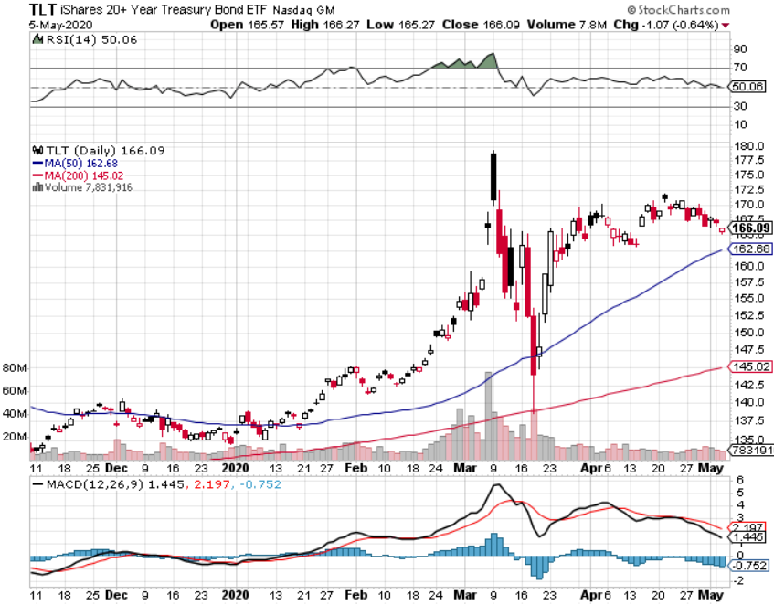
Treasury ETF (TLT) – Selling at All-Time High long 6/$175-$180 put spread took profits on long long 5/$176-$177 put spread took profits on long long 5/$175-$178 put spread took profits on long 15/$176-$179 put spread took profits on long 15/$177-$180 put spread

Slide 52
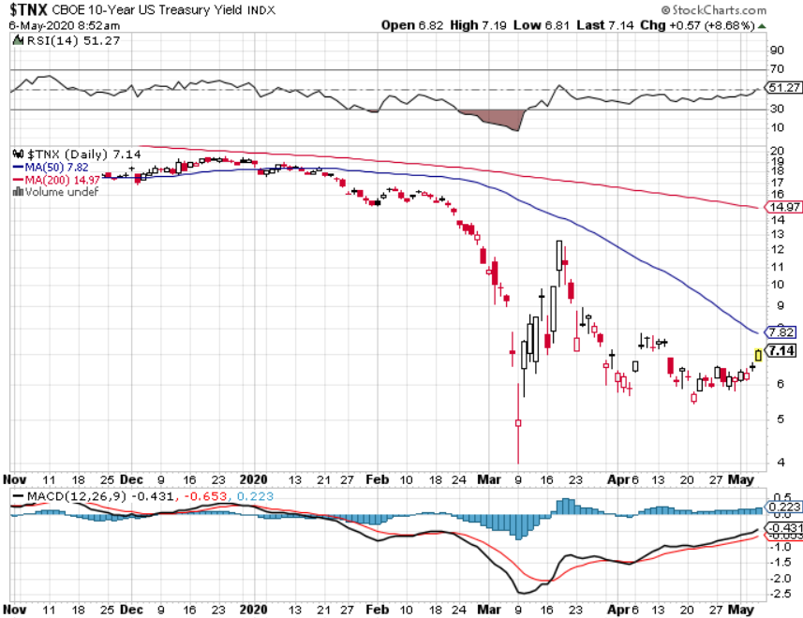
Ten Year Treasury Yield ($TNX) – 0.71%

Slide 53
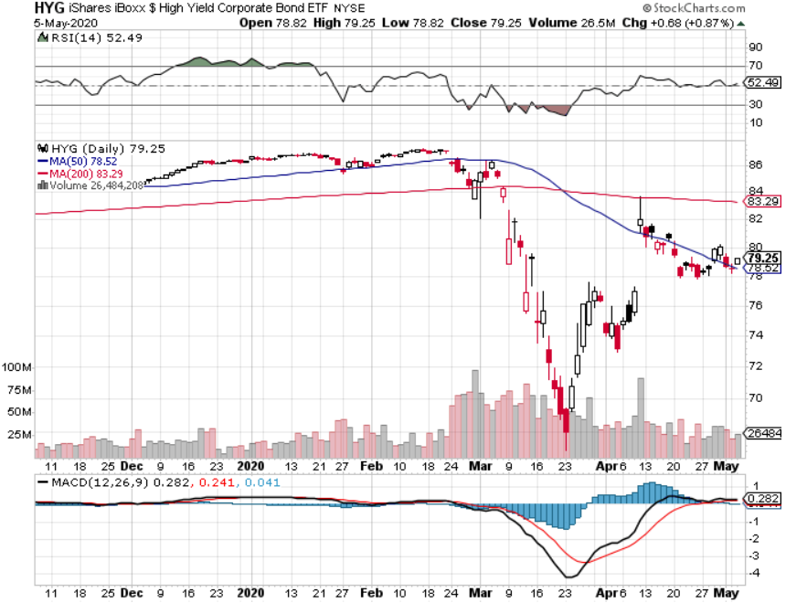
Junk Bonds (HYG) 7.23% Yield big jump in spreads on stock selloff and recession fears

Slide 54
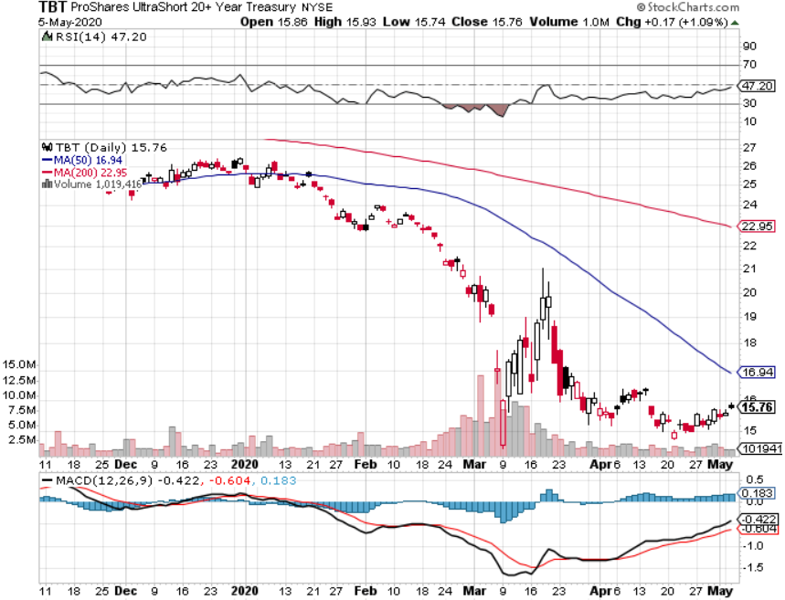
2X Short Treasuries (TBT)- 2 Month Bottoming Process

Slide 55
Emerging Market Debt (ELD) 4.77% Yield-

Slide 56
Municipal Bonds (MUB)-2.11% Mix of AAA, AA, and A rated bonds

Slide 57
Foreign Currencies – Dead in the Water
*Global flight to safety ceases *Interest rate support for US dollar is gone for good *Euro (FXE) stabilizes at three year low *British pound holds big gains *Bitcoin bounces on supply restriction *Aussie dollar makes new recovery high *Starting selling short all dollar rallies, its yield support is gone forever

Slide 58
Japanese Yen (FXY), (YCS)

Slide 59
Euro ($XEU), (FXE), (EUO)-

Slide 60
British Pound (FXB)-

Slide 61
Australian Dollar (FXA)- The Global Recovery Play took profits on long 8/$67-$69 call spread

Slide 62
Emerging Market Currencies (CEW)

Slide 63
Chinese Yuan- (CYB)- New Lows

Slide 64
Bitcoin- No Hedge

Slide 65
Energy – Dead Cat Bounce
*Short covering rally takes oil to $20, over 1 million b/d capped in the US, shrinking the supply demand gap *US government leases 20 million barrels of storage in SPR to big Texas oil companies when they should have bought the oil close to zero *Negative prices still threaten with June futures expiration in mid May *US Consumption is running at half normal levels, with no driving or flights *Maybe half of all listed energy names will go bankrupt in 2020 *Any price spike will be temporary, as over supply against fading demand will last for years *Avoid all energy plays like the plague, could drop by half in the coming recession

Slide 66
Oil-($WTIC)

Slide 67
United States Oil Fund (USO) stopped out of long stopped out of long (USO) long 10/$9.50-$10 Vertical bull call spread

Slide 68
Energy Select Sector SPDR (XLE)-No Performance! (XOM), (CVX), (SLB), (KMI), (EOG), (COP)

Slide 69
Halliburton (HAL)-

Slide 70
Natural Gas (UNG) -

Slide 71
Precious Metals – New Highs in Range
*No change in bullish picture *Corona plague cutting gold production as workers get sick *Hedging demand piles on top of central bank buying *New QE Infinity sparks huge rally *Near zero interest rates and Collapsing US dollar is another incentive *Central banks still pouring into gold every month *Bottom Line: buy a bigger dip in gold and precious metals

Slide 72
Gold (GLD)- Short Term downtrend

Slide 73
Market Vectors Gold Miners ETF- (GDX) – Yikes!

Slide 74
Barrick Gold (GOLD)

Slide 75
Newmont Mining- (NEM)-

Slide 76
Silver- (SLV)-

Slide 77
Silver Miners - (SIL)-

Slide 78
Wheaton Precious Metals - (WPM)-

Slide 79
Copper (COPX)-Collapse Trade War Disaster

Slide 80
Freeport McMoRan (FCX)-World’s Largest Copper Producer took profits on long 4/$10-$11 call spread took profits on short 4/$114 calls

Slide 81
Real Estate – Green Shoots
*Many states reopen, letting open houses return *Pending Home Sales Down a Staggering 20.8%, in March, and off 16.3% YOY. The worst is yet to come. *Existing Home Sales Collapse by 15.4%, in March. *Existing Home Sales Plunge by 8.5% in March *Mortgage forbearance hit 4 million, read defaults *Fed intervention takes 30-year fixed mortgage rates back down to 3.20% *Housing prices were ready to explode to the upside with S&P Case Shiller Rose 4.2%, in February

Slide 82
February Corelogic S&P Case Shiller Home Price Index Phoenix (7.5%), Seattle (6.0%), Tampa (5.2%) showing biggest gains
Tradingeconomics.com

Slide 83
Simon Property Group (SPG)- Mall REIT

Slide 84
Crown Castle International (CCI) – 3.40% yielding cell phone Tower REIT

Slide 85
US Home Construction Index (ITB) (DHI), (LEN), (PHM), (TOL), (NVR)

Slide 86
Trade Sheet- So What Do We Do About All This?
*Stocks - sell rallies *Bonds – sell rallies aggresively *Commodities-stand aside *Currencies- sell US dollar rallies *Precious Metals – buy dips *Energy – stand aside *Volatility - sell short over $50 *Real estate-stand aside

Slide 87
Next Strategy Webinar 12:00 EST Wednesday, May 20, from Lake Tahoe email me questions at support@madhedgefundtrader.com
Good Luck and Good Trading!
Notes:
*

