Slide 1
The Mad Hedge Fund Trader “Bracketed”
With John Thomas from Silicon Valley, CA, May 6, 2020 www.madhedgefundtrader.com
Notes:
*

Slide 2
Trade Alert Performance New All Time High! 78 Trade Alerts since April 1 generated a 10.23% profit in 2 months
*January 3.13% Final *July +3.07% Final *February -6.05% Final *August +16.01% Final *March -5.50% Final *September 3.08% Final *April +4.55% Final *October +12.13% Final *May +13.71% MTD *November -1.26% Final *June -0.50% Final *December +4.97% Final *Year to date +9.84% compared to -15.4% for the Dow Average *+365.57% since inception, a new all time high *Average annualized return of 34.59% for 11 years

Slide 3
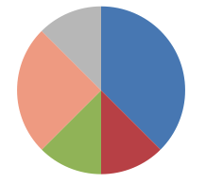
Portfolio Review Massive Shorts Covered for Huger Profits, Using (VIX) over $50 to Keep Larger Short Positions a 10% market drop will boost YTD to 8.5%
Risk On
World is Getting Better
(TLT) 6/$175-$180 put spread | 30.00%
(SPY) 6/$235-$245 call spread | 10.00%
(TLT) 6/$150-$153 put spread | 10.00%
Risk Off
World is Getting Worse
(SDS) | -20.00%
(SPY) 7/$320-$330 puts spread | -10.00%
Total Net Position | 20.00%
Expiration P&L +13.40% YTD

Slide 4
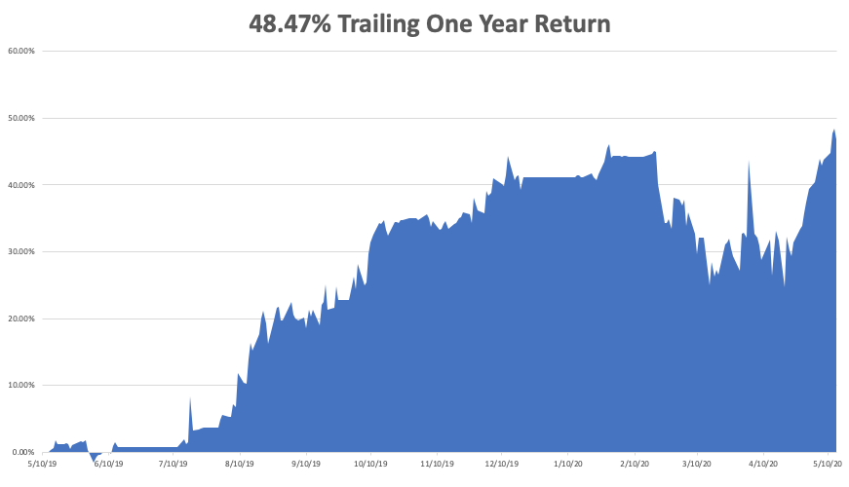

Slide 5
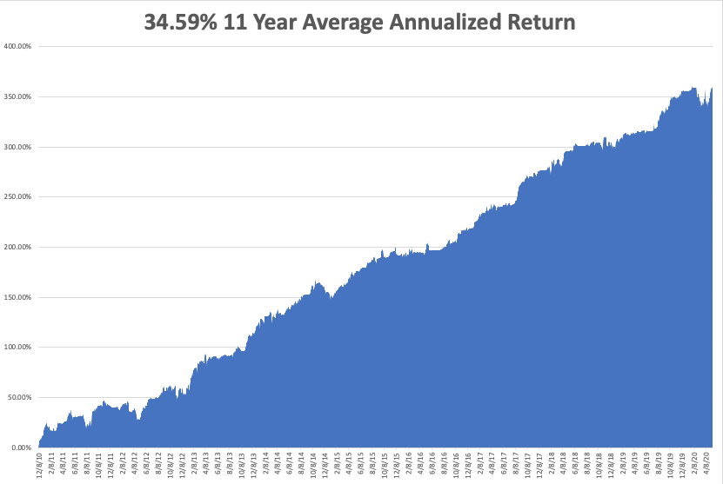
GTD 10 Year Daily Audited Performance

Slide 6
The Method to My Madness
*As long as markets are bracketed, buy every dip and sell every rally *Stocks are now wildly overpriced counting heavily on a free put from the Fed which is working *Markets could remain bracketed for 3-6 months, or until a vaccine is discovered *Head and shoulders top is in for bonds *The big fear is for a second larger Corona spike in the fall *Gold taking a run at all time high *Volatility backs off from $80 to $36, so it could be a sleepy summer *Best buying opportunity of the decade is setting up, the next big dip is the one you buy

Slide 7
Corona Update
*US cases top 1.53 million, deaths at 72,000 and Second Waves are Hitting Asia, and their stock markets. 20,000 American are getting Covid-19 every day *New CDC Forecasts Calls for 200,000 US Deaths by August, or 2,500 a day *Early opening states in Midwest are setting up a second wave now *Death rates in New York are falling, down to only 150 a day *Any concentration of people creates hot spots, like meat packing plants and prisons All the president’s scientific advisors say early reopening will lead to another super spike *We may need masks in public for years, or until there is a vaccine, best hope is for serum *A true vaccine is years off, or never

Slide 8
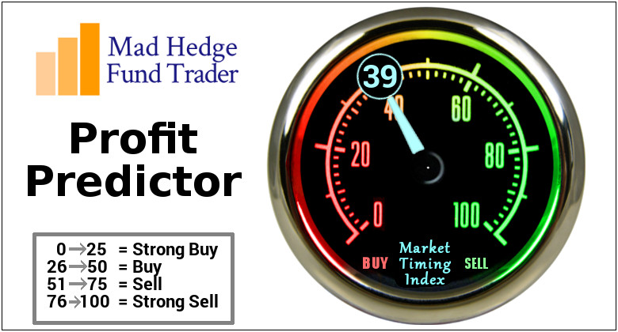
The Mad Hedge Profit Predictor Market Timing Index-Bottom of Range-at to a “BUY” An artificial intelligence driven algorithm that analyzes 30 different economic, technical, and momentum driven indicators

Slide 9
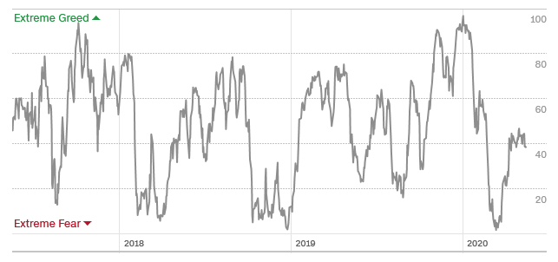
The Mad Hedge Profit Predictor From Extreme Overbought to Oversold
SELL
BUY

Slide 10
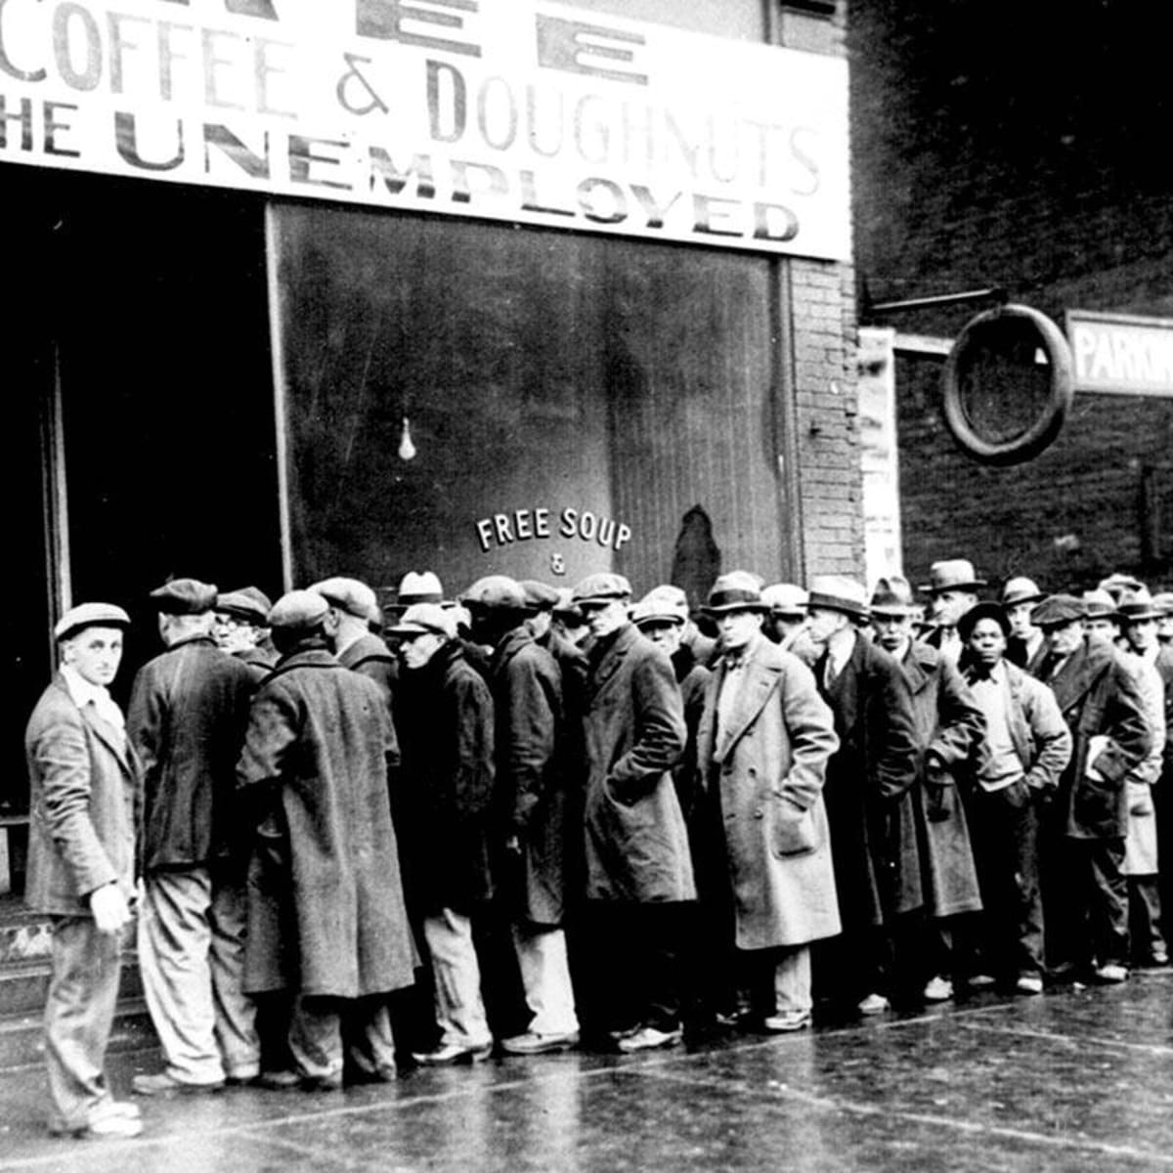
The Global Economy – Great Depression Deepens
*The new Great Depression deepens, with 36 million new unemployed in two months, and the Fed targeting 52 million. One in three Americans will be jobless at the peak *Trade War with China Heats up, with the president banning more export items, especially chips for telecom giant Huawei. *The House and the Fed are pushing for another $3 trillion stimulus package, but the Republican Senate is blocking it *The huge “V” recovery in the stock market is fading in the face of an onslaught of horrific data *Fed Governor Powell Warns the Worst is Yet to Come, and the need for more stimulus is paramount. *US food distribution system is breaking down, with prices up 20% and shortages everywhere

Slide 11
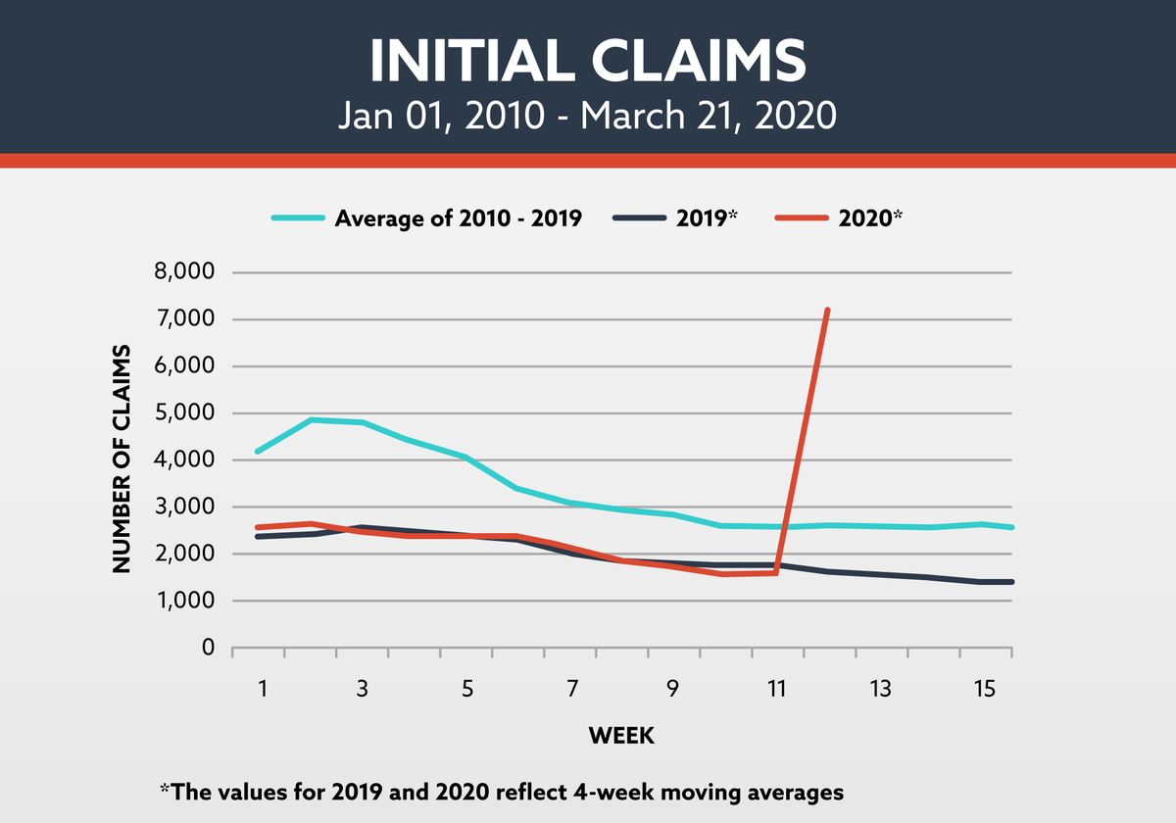
Weekly Jobless Claims-Bottomed Out 3 Million to 36.5 million will surpass Great Depressions this week

Slide 12
The Bill Davis View A $1,500 Upgrade for the Mad Day Trader Service
Buys: | Entry | Target
Molson Coors Brewing (TAP) | $ 37.00 | $ 50.00
Paychex, Inc. (PAYX) | $ 64.00 | $ 80.00
Hartford Financial Group, Inc. (HIG) | $ 34.00 | $ 44.00
Edwards Lifesciences Corp (EW) | $ 217.00 | $ 240.00
Intel Corp. (INTC) | $ 58.00 | $ 70.00
Sells:
Amgen Inc. ( AMGN) | $ 235.00 | $ 200.00
Etsy Inc. (ETSY) | $ 82.00 | $ 55.00
Ingredion Inc. | $ 80.00 | $ 65.00
Align Techology (ALGN) | $ 235.00 | $ 190.00
General Dynamics (GD) | $ 140.00 | $ 120.00

Slide 13
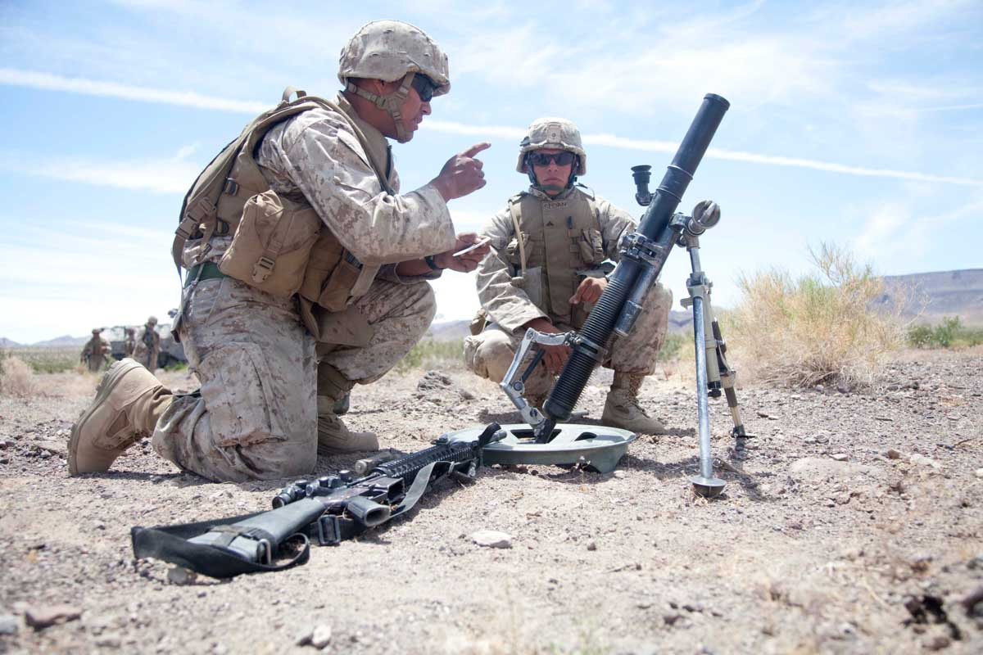
Stocks – Bracketed
*Stocks are stuck in a 2,000-point range with falling volatility, a head and shoulders top is on the table *Stocks are still the most expensive in market history with earnings in free fall and whole industries disappearing, like retailers *Market veterans are calling the worst risk/reward for stocks ever seen *Tech has a great run but now appear exhausted *On the next dip scale into those 2-year LEAP’s in your favorite big tech names, but low bids under the market in tech and biotech *Bottom line: buy the next big dip for a massive recovery starting in the fall *Bottom Line: its bet the ranch time on tech longs, but stay away from those with big China exposure, like Apple, and weak dollar plays like energy, and emerging markets

Slide 14
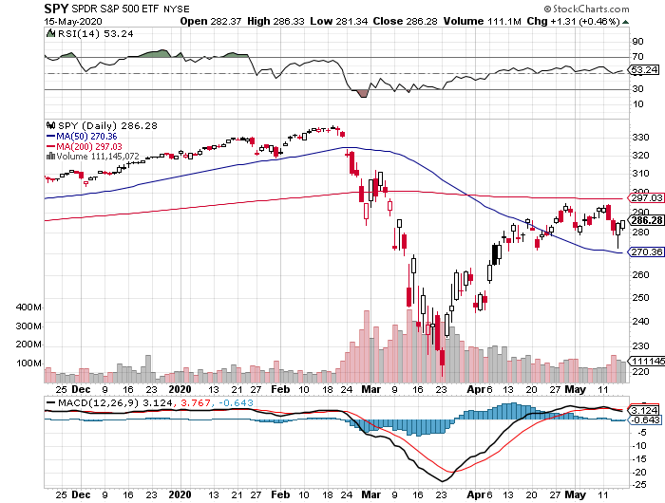
S&P 500 – Bounce –Targeting 2,400 and a Head and Shoulders Bottom took profits on long $305-$315 bear put spread took profits on long 4/$310-$320 bear put spread stopped out of long 4/$235-$245 bull call spread took profits on long 4/$280-$290 bear put spread took profits on long 4/$275-$280 bear put spread
The Bottom 2,500 -42%

Slide 15
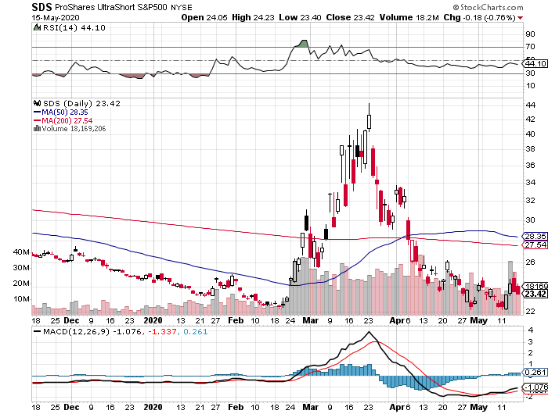
ProShares Ultra Short S&P 500 (SDS)- a Great Hedge for long stocks and bonds

Slide 16
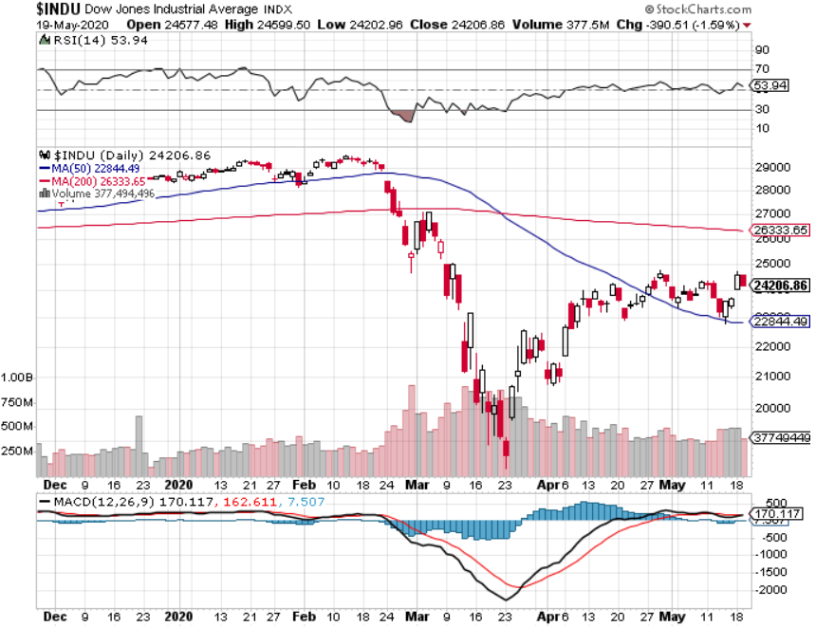
Dow Average ($INDU)- Giving Up Three Years of Gains

Slide 17
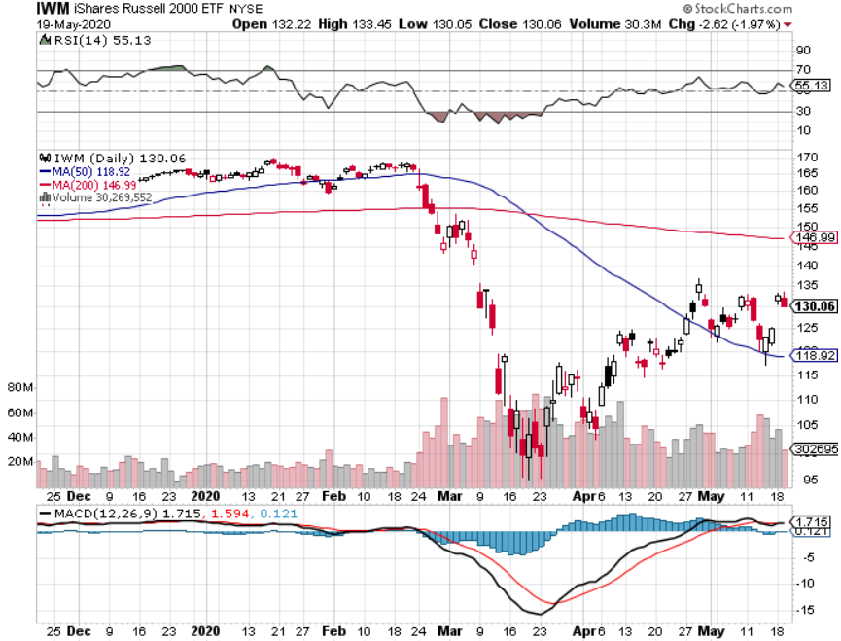
Russell 2000 (IWM)- took profits on Long 10/$137-$142 vertical bull call spread took profits on Long 10/$153-$156 vertical bear put spread

Slide 18
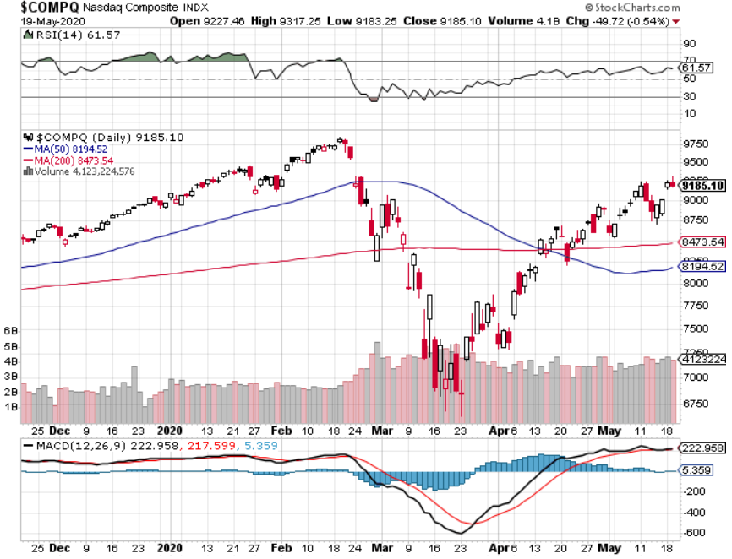
NASDAQ ($COMPQ) – Monster Recovery

Slide 19
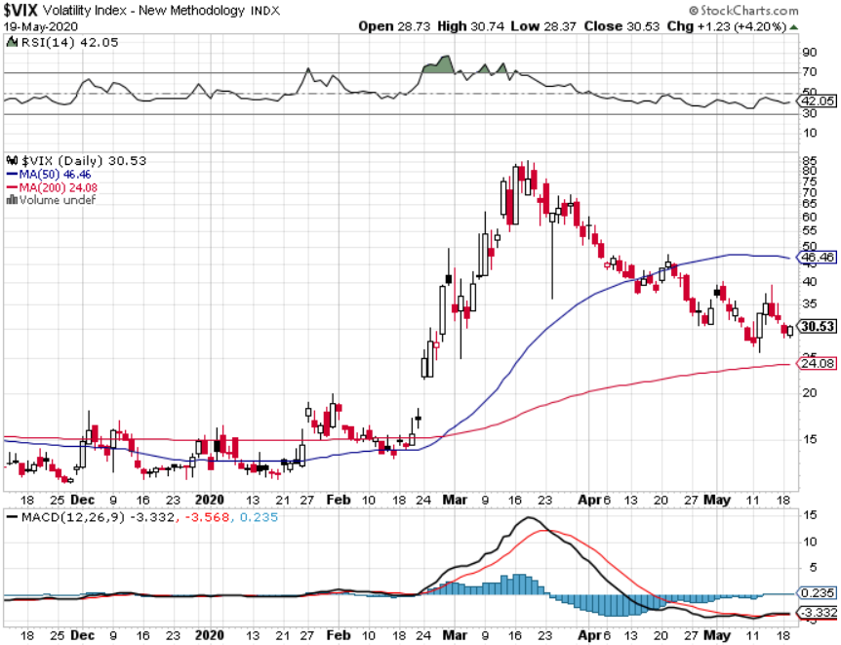
(VIX)- One Third of the Peak

Slide 20
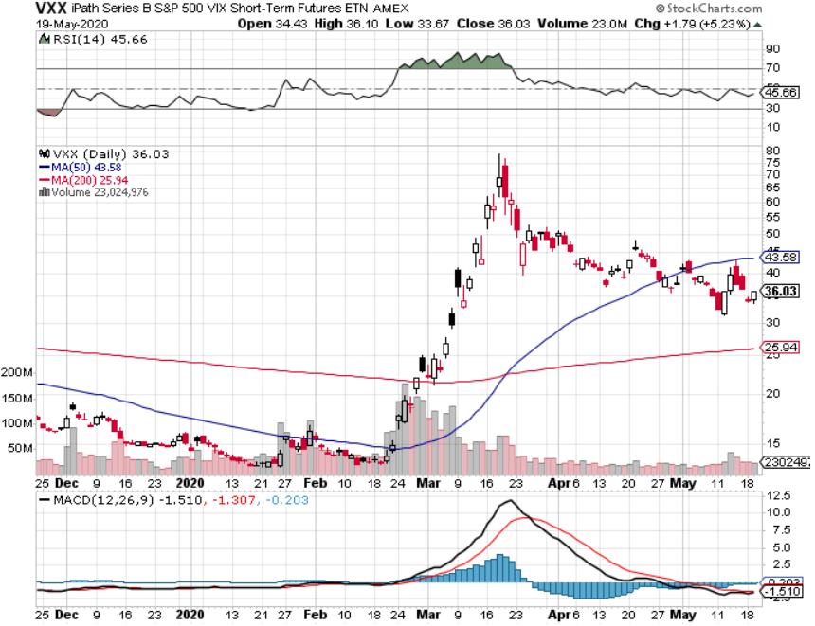
(VXX)- Sell Rallies-Down $85 to $26 from top stopped out of long 1/2021 $16 puts stopped out of long 1/2021 $24 puts

Slide 21
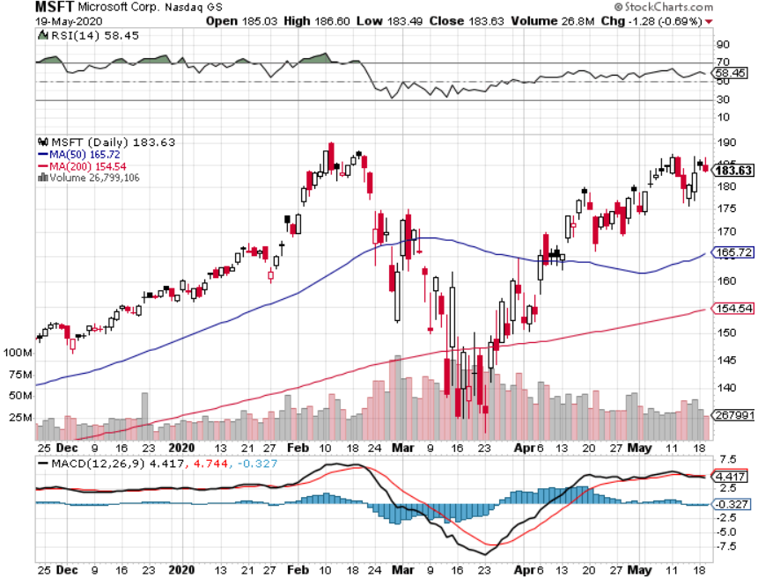
Microsoft (MSFT)- Earnings beat- Looking for Another Entry Point Stopped out of long 4/$120-$130 call spread took profit on long 4/$120-$130 call spread stop loss on long 12/$170-$180 call spread took profits on long 12/$135-$138 call spread

Slide 22
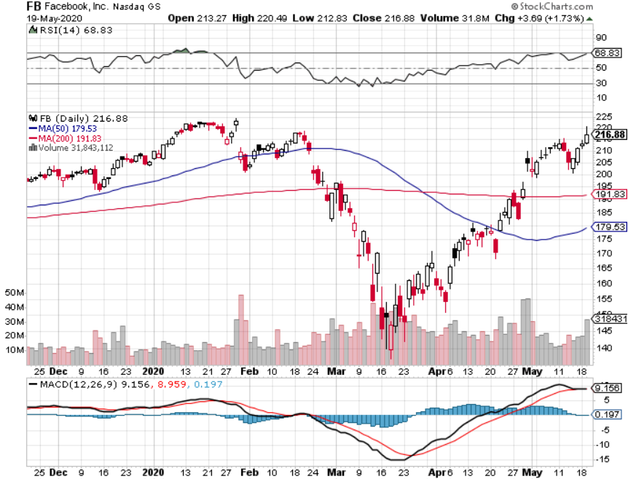
Facebook (FB)- New High stopped out of Long 9/$190-$200 vertical bear put spread took profits on Long 9/$145-$155 vertical bull call spread took profits on Long 9/$150-$160 vertical bull call spread took profits on Long 8/$167.50-$172.50 vertical bull call spread

Slide 23
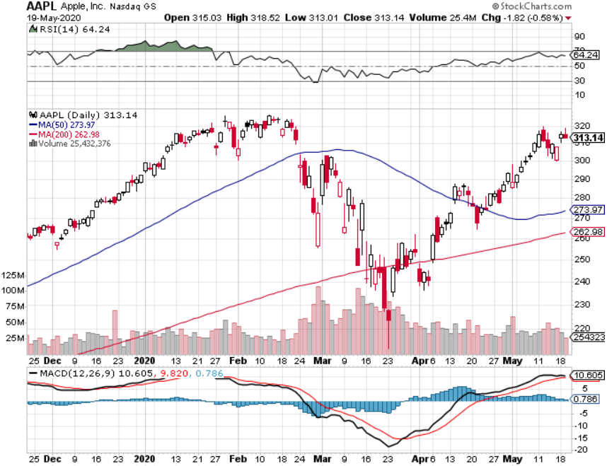
Apple (AAPL)- New High or Double Top took profits on long 4/24/$250-$260 call spread took profits on long 5/$250-$260 call spread took profits on long 4/$250-$260 call spread took profits on long 3/$250-$260 call spread

Slide 24
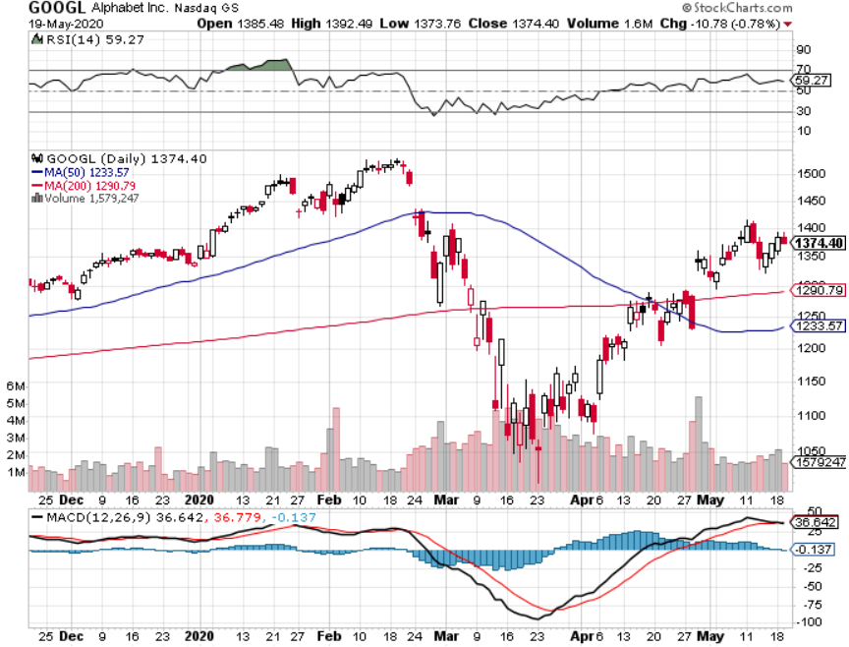
Alphabet (GOOGL) – took profits on long 12/$1,200-$1,230 bull call spread took profits on long 9/$1,030-$1,080 vertical bull call spread stopped out of long 5/$1,100-$1,130 bull call spread took profits on long 4/$1,080-$1,120 bull call spread

Slide 25
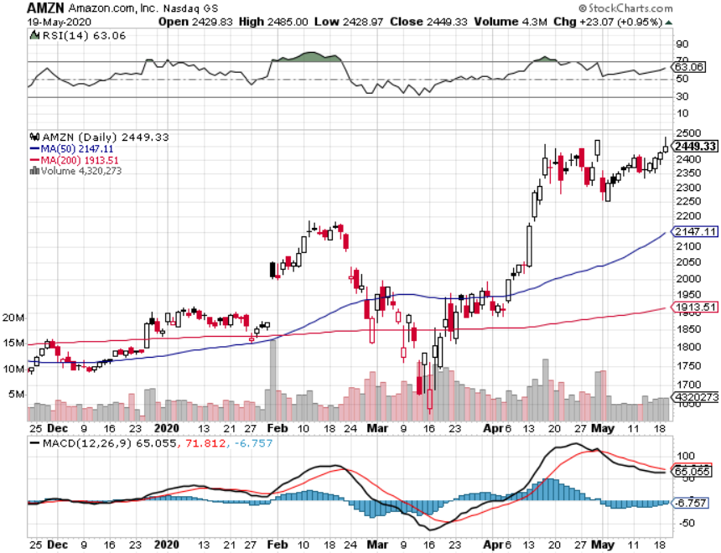
Amazon (AMZN) – New High took profits on long 4/$1,600-$1,650 bull call spread stopped out of long 3/$1,700-$1,800 bull call spread took profits on 9/$1,500-$1,500 bull call spread

Slide 26
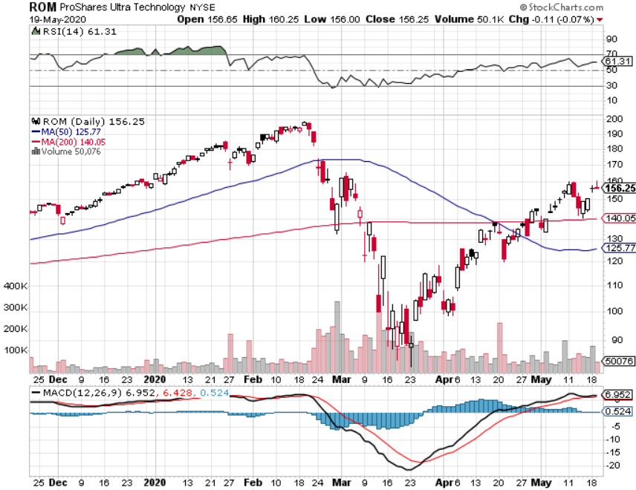
ProShares Ultra Technology (ROM) – Up 58% in 3 Weeks stopped out of long at $100.10

Slide 27
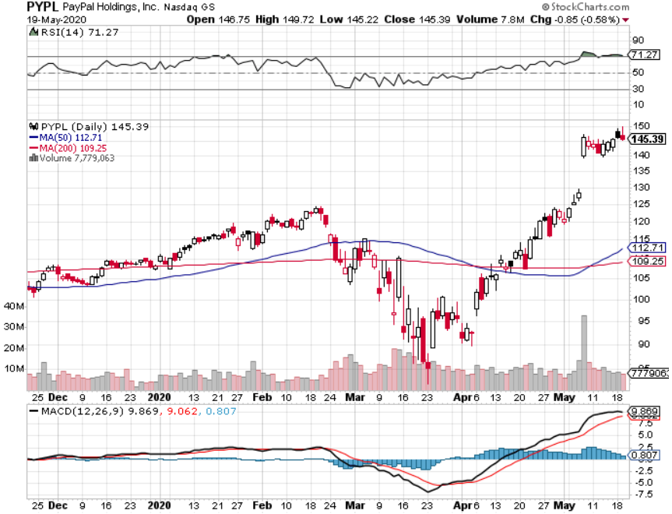
PayPal (PYPL)-Fintech Rules took profits on long 4/$90-$95 call spread

Slide 28
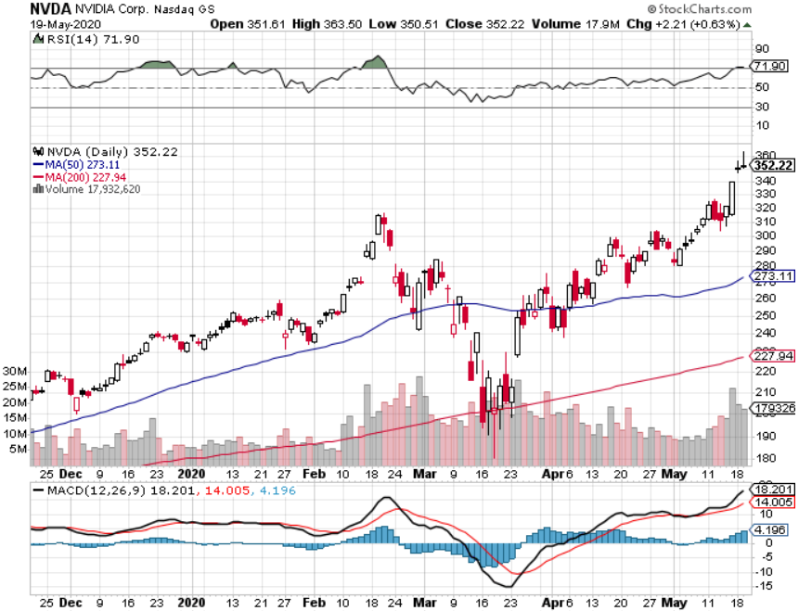
NVIDIA (NVDA) – Leading the charge on every recovery

Slide 29
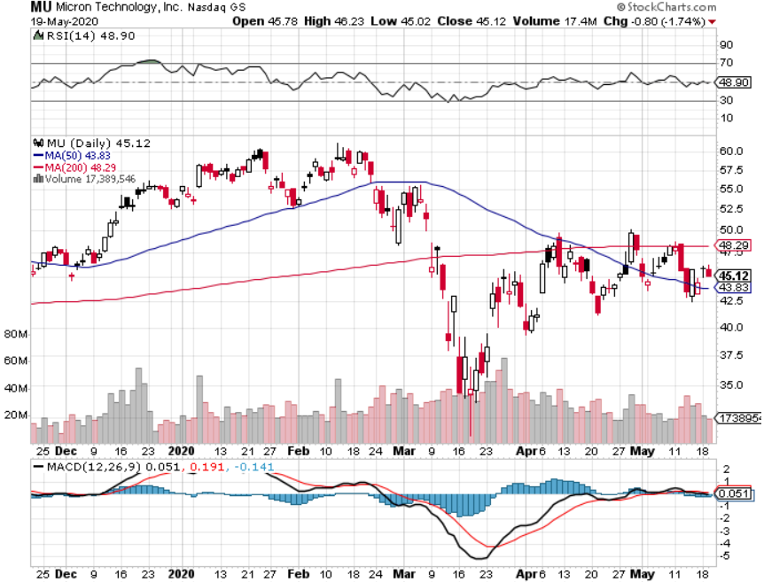
Micron Technology (MU)-Ditto

Slide 30
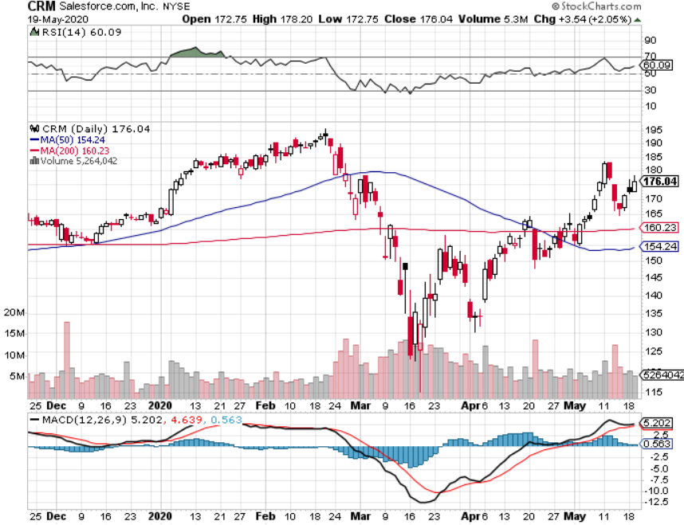
Salesforce (CRM)- Massive Online Migration took profits on long 9/$125-$130 vertical bull call spread took profits on long 8/$125-$130 vertical bull call spread took profits on long 2/$105-$115 call spread

Slide 31
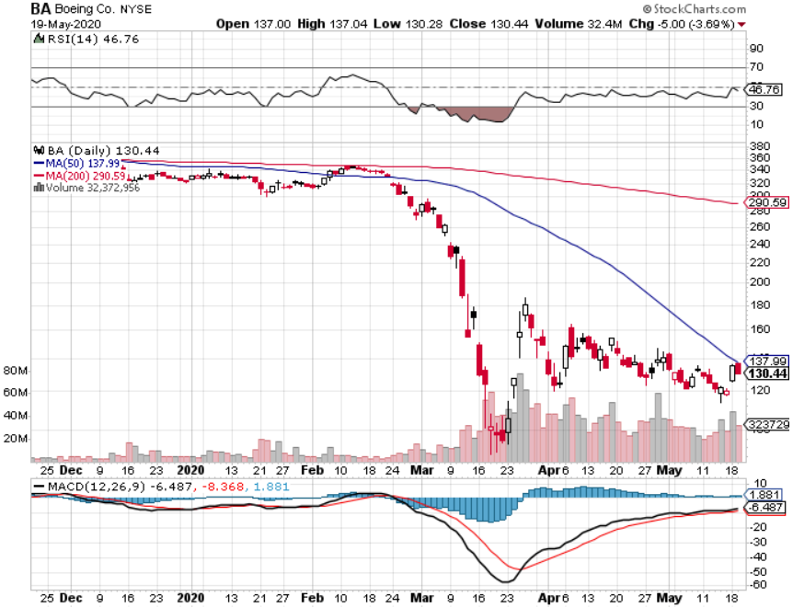
Boeing (BA) –GM Or Bank Style Takeover? 737 MAX production shutdown-Criminal investigation took profits on long 2/$270-$280 call spread took profits on long 12/$310-$330 call spread took profits on long 4/$300-$310 call spread took profits on long 4/$315-$335 call spread

Slide 32
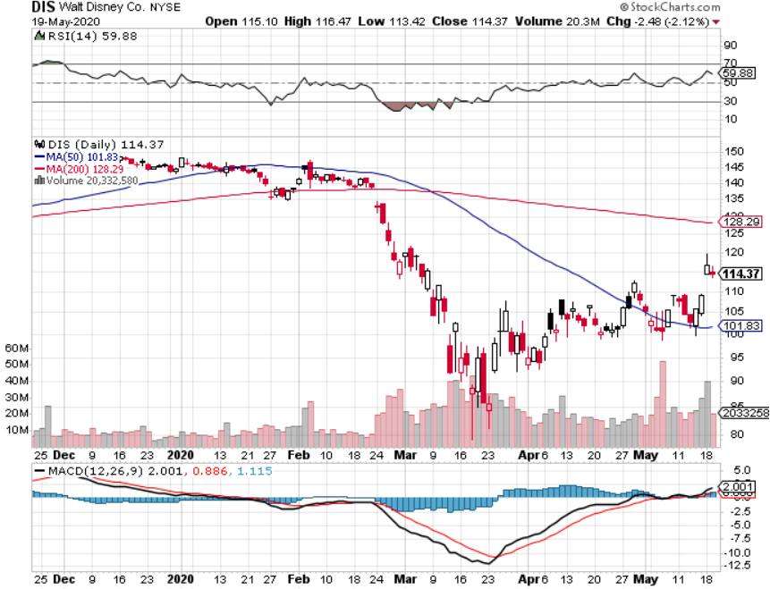
Walt Disney (DIS)- Lead Recovery Stock stopped out of long 9/$120-$125 put spread took profits on long 6/$85-$90 call spread

Slide 33
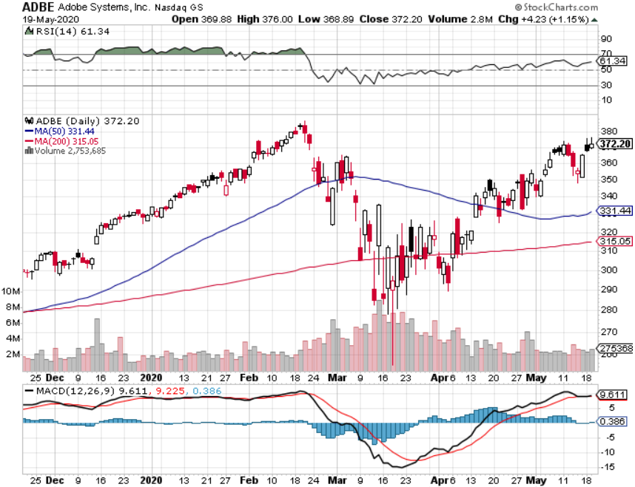
Adobe (ADBE)- The Quality Non-China tech play

Slide 34
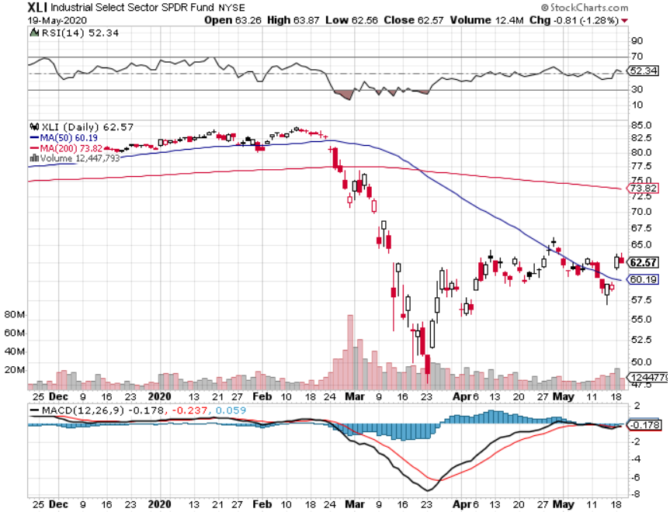
Industrials Sector SPDR (XLI)- (GE), (MMM), (UNP), (UTX), (BA), (HON)

Slide 35
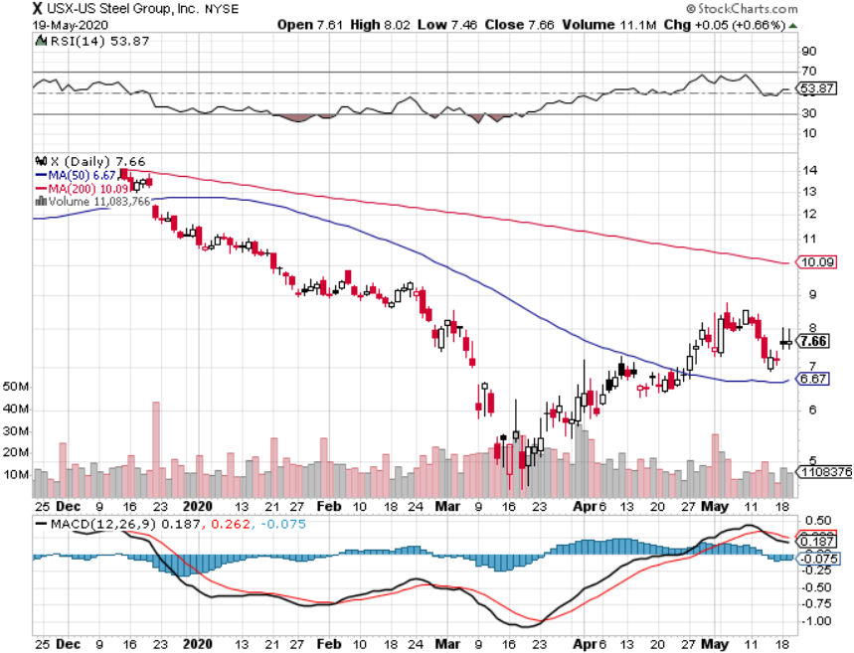
US Steel (X)- Avoid

Slide 36
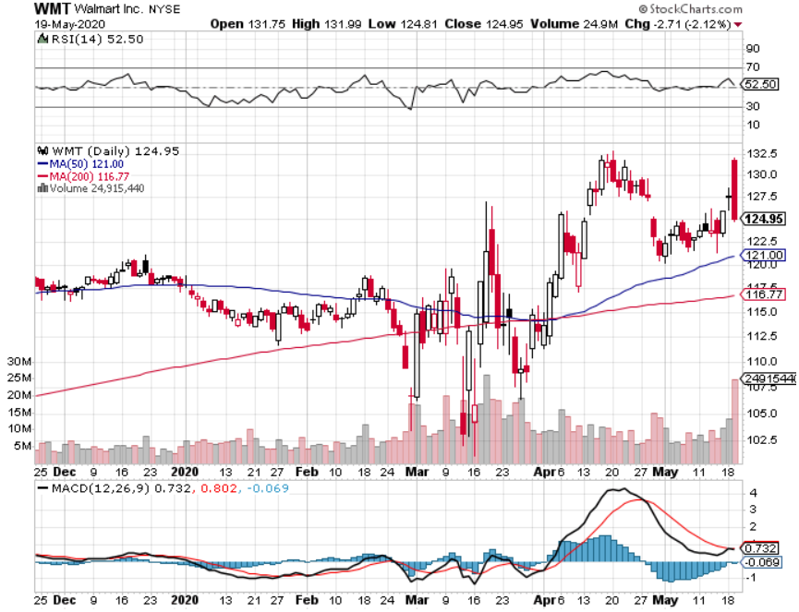
Wal-Mart (WMT) – Earnings Beat took profit on Long 11/$125-$130 bear put spread took profit on Long 10/$119-$121 bear put spread took profits on Long 8/$114-$117 bear put spread

Slide 37
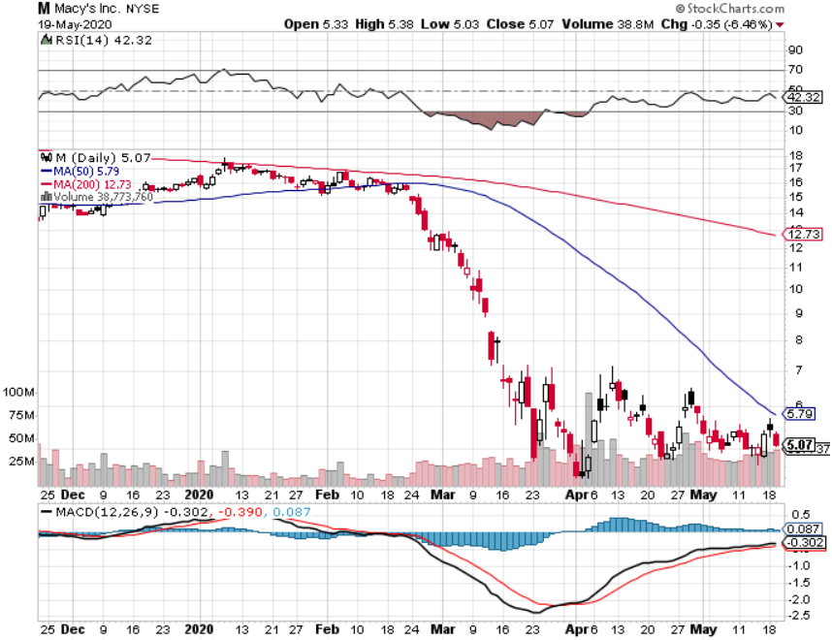
Macys’ (M) – Going Under took profits on Long 8/$23-$25 bear put spread

Slide 38
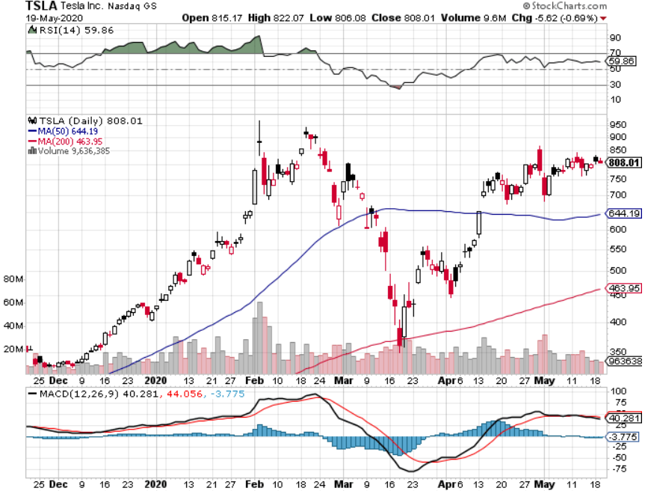
Tesla (TSLA)-World’s Second Largest Car Company right behind Toyota Fremont factory reopens took profits on long 6/$140-$150 call spread took profits on long 6/$240-$250 put spread

Slide 39
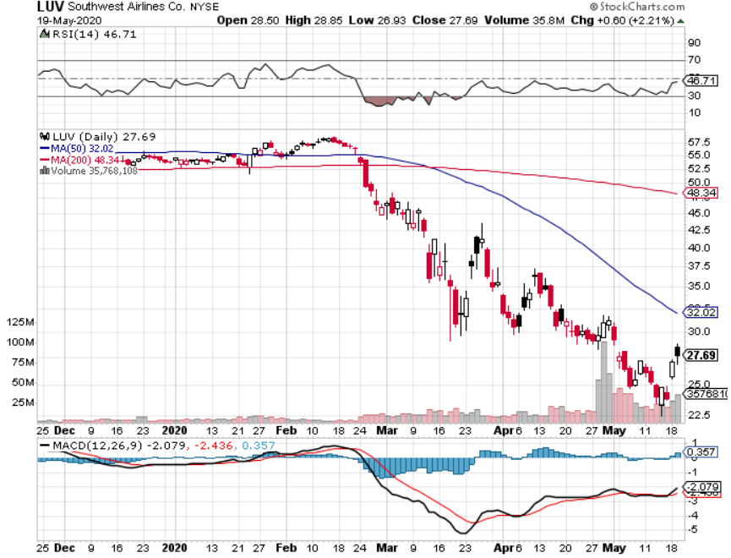
Southwest Airlines (LUV) – Warren Buffett big seller

Slide 40
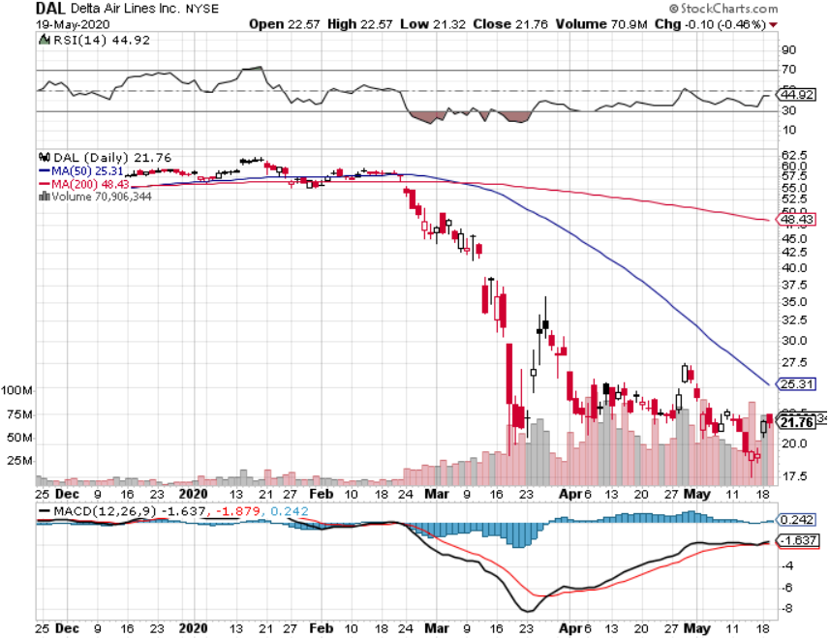
Delta Airlines (DAL) – Warren Buffett big seller

Slide 41
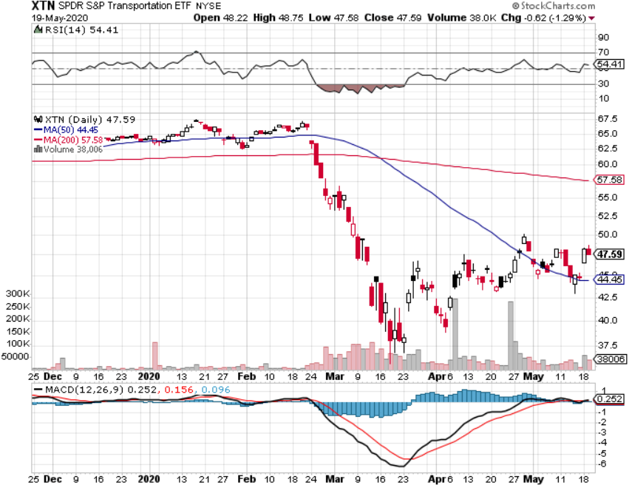
Transports Sector SPDR (XTN)- Worst Hit Sector (ALGT), (ALK), (JBLU), (LUV), (CHRW), (DAL)

Slide 42
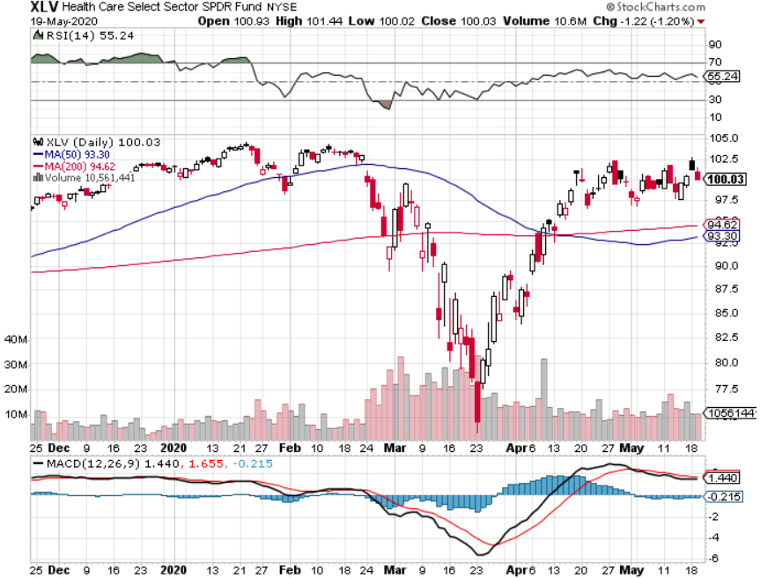
Health Care Sector (XLV), (RXL)-New Highs (JNJ), (PFE), (MRK), (GILD), (ACT), (AMGN) The new favorite sector

Slide 43
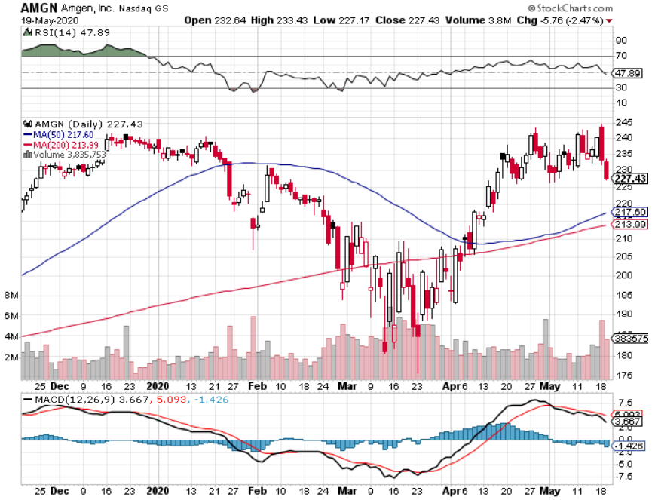
Amgen (AMGN)

Slide 44
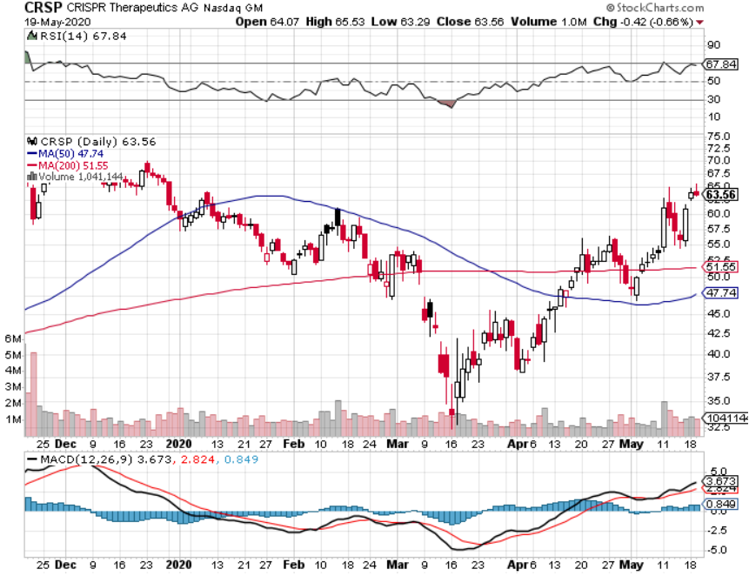
CRISPR Therapeutics (CRSP) – Double Off the Bottom

Slide 45
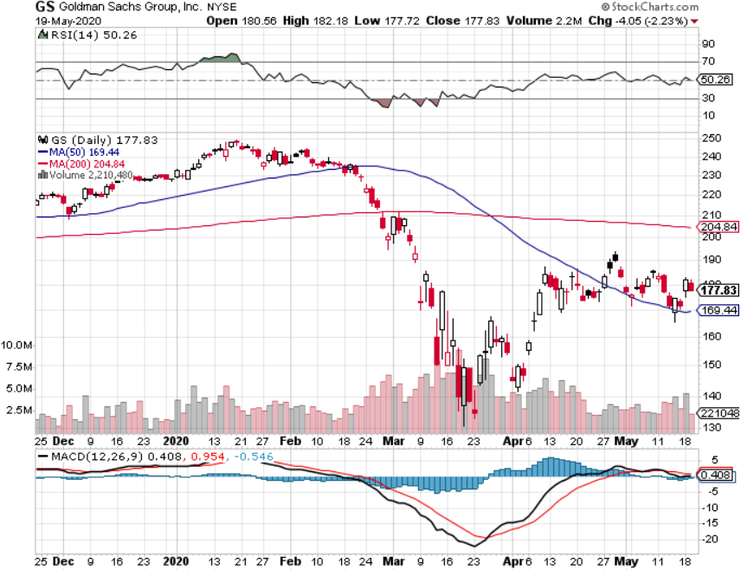
Goldman Sachs (GS) – Slaughtered by Low Rates Buy for a steepening yield curve

Slide 46
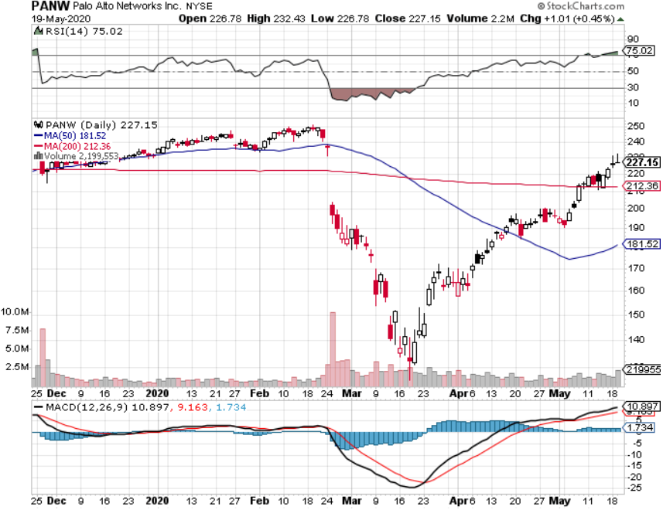
Palo Alto Networks (PANW)- The Golden Age of Internet Fraud Hacking never goes out of fashion

Slide 47
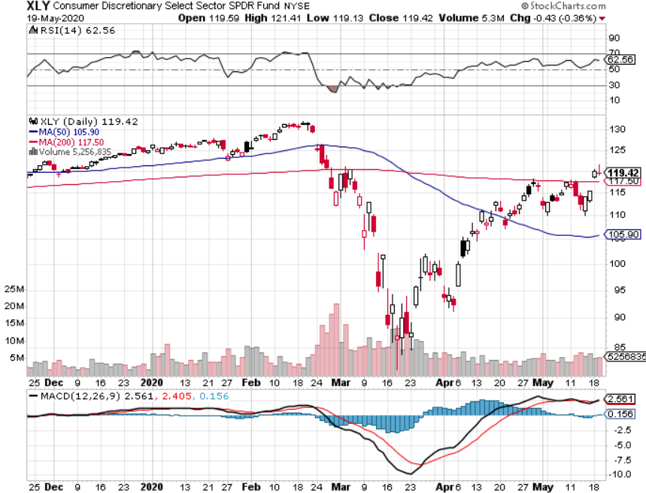
Consumer Discretionary SPDR (XLY) (DIS), (AMZN), (HD), (CMCSA), (MCD), (SBUX)

Slide 48
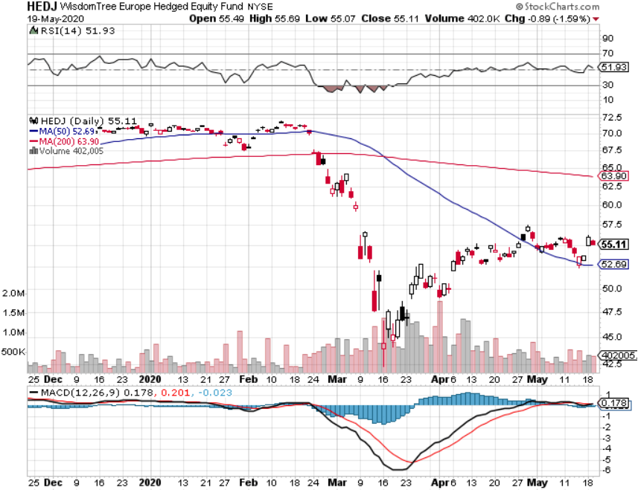
Europe Hedged Equity (HEDJ)- Pip on Brexit News

Slide 49
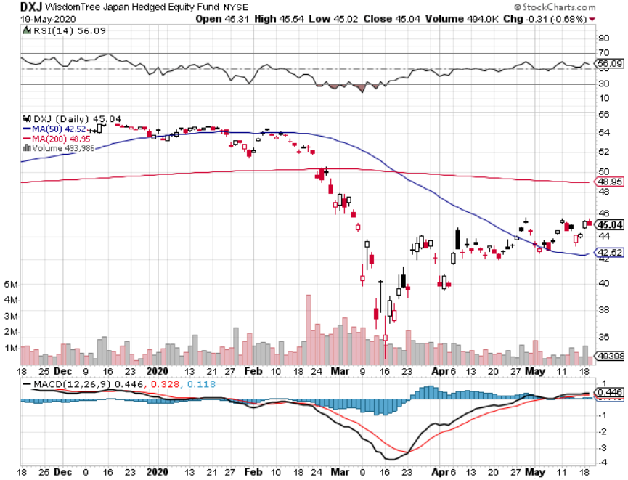
Japan (DXJ)-

Slide 50
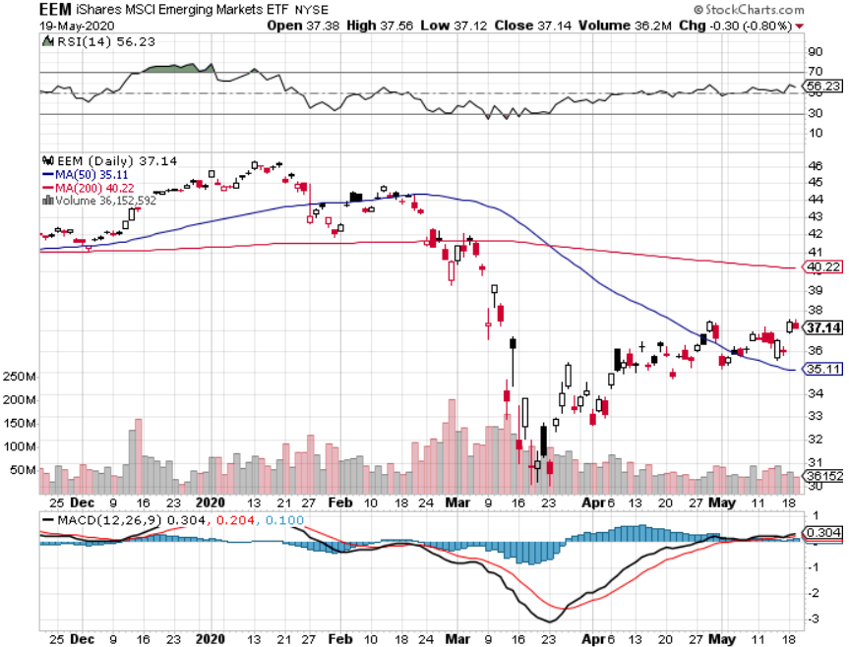
Emerging Markets (EEM)- Weak Dollar Play

Slide 51
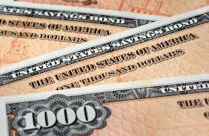
Bonds – Dead Cat Bounce
*Short selling opportunity of the century is in play, head and shoulders top is in play *April budget deficit hit a record $738 billion, or a $8.85 trillion annual rate *National debt is soaring from $24 to $32 trillion in 18 months, with $3 trillion in Q2 *Fed Fund Futures Discounting Negative Interest Rates in a Year, setting up a very steep yield curve, with overnight rates at zero, and ten-year Treasuries at 3.0% *US Treasury bond bond fund (TLT) could plunge from $180 to $105, taking interest rates from 0.31% to 3.25% *Trump threatening default throws gasoline on the fire *Bottom line: sell short every major rally in the (TLT)

Slide 52
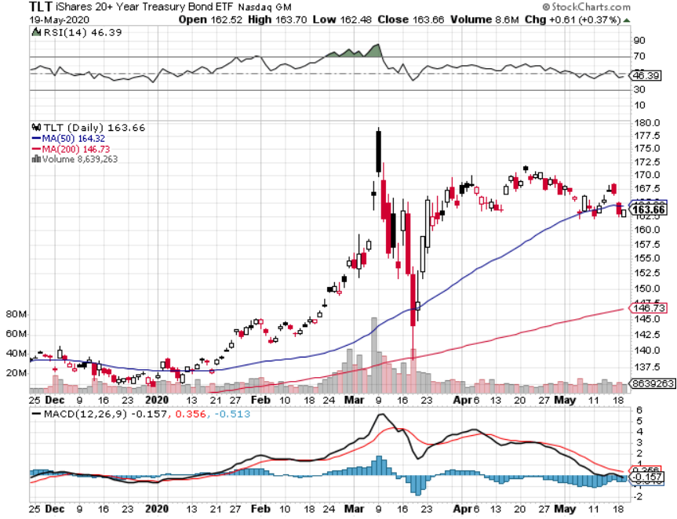
Treasury ETF (TLT) – Selling at All-Time High long 6/$175-$180 put spread long 5/$176-$177 put spread long 5/$175-$178 put spread took profits on long 15/$176-$179 put spread took profits on long 15/$177-$180 put spread

Slide 53
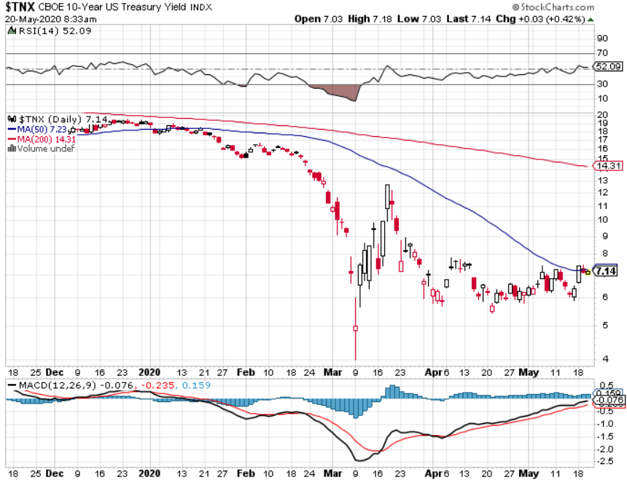
Ten Year Treasury Yield ($TNX) – 0.64%

Slide 54
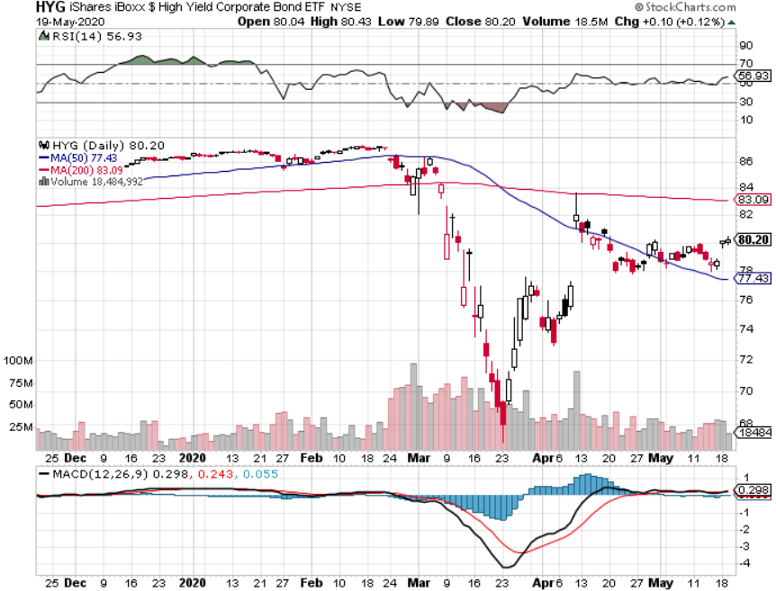
Junk Bonds (HYG) 7.23% Yield big jump in spreads on stock selloff and recession fears

Slide 55
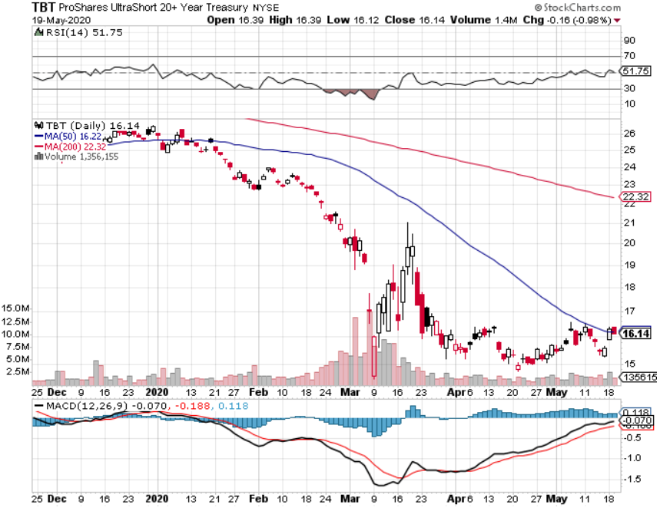
2X Short Treasuries (TBT)- 2 Month Bottoming Process

Slide 56
Emerging Market Debt (ELD) 4.77% Yield-

Slide 57
Municipal Bonds (MUB)-2.11% Mix of AAA, AA, and A rated bonds

Slide 58
Foreign Currencies – More Confused than Stocks and Bonds
*Global flight to safety ceases, all currencies flatlining for lack of direction *Interest rate support for US dollar is gone for good *Euro (FXE) stabilizes at three year low *British pound holds big gains *Bitcoin hit $10,000 on supply restriction and miner payout cut *Aussie dollar flatlines up 20% from low *Start selling short all dollar rallies, its yield support is gone forever

Slide 59
Japanese Yen (FXY), (YCS)

Slide 60
Euro ($XEU), (FXE), (EUO)-

Slide 61
British Pound (FXB)-

Slide 62
Australian Dollar (FXA)- The Global Recovery Play took profits on long 8/$67-$69 call spread

Slide 63
Emerging Market Currencies (CEW)

Slide 64
Chinese Yuan- (CYB)- New Lows

Slide 65
Bitcoin- No Hedge

Slide 66
Energy – Signs of Life
*Short covering rally takes oil to $26 *Production cuts happening only 1 million barrels at a time to cover a $35 million barrel supply/demand gap *Demand is increasing slightly *Negative prices still threaten with June futures expiration in May *Maybe half of all listed energy names will go bankrupt in 2020 *Any price spike will be temporary, as over supply against fading demand will last for years *Avoid all energy plays like the plague, could drop by half in the coming recession

Slide 67
Oil-($WTIC)

Slide 68
United States Oil Fund (USO) stopped out of long stopped out of long (USO) long 10/$9.50-$10 Vertical bull call spread

Slide 69
Energy Select Sector SPDR (XLE)-No Performance! (XOM), (CVX), (SLB), (KMI), (EOG), (COP)

Slide 70
Halliburton (HAL)-

Slide 71
Natural Gas (UNG) -

Slide 72
Precious Metals – Still Pushing for Highs
*No change in bullish picture *Corona plague cutting gold production as workers get sick *Hedging demand piles on top of central bank buying *New QE Infinity sparks huge rally *Near zero interest rates and Collapsing US dollar is another incentive *Central banks still pouring into gold every month *Bottom Line: buy a bigger dip in gold and precious metals

Slide 73
Gold (GLD)- Short Term downtrend

Slide 74
Market Vectors Gold Miners ETF- (GDX) – Yikes!

Slide 75
Barrick Gold (GOLD)

Slide 76
Newmont Mining- (NEM)-

Slide 77
Silver- (SLV)-

Slide 78
Silver Miners - (SIL)-

Slide 79
Wheaton Precious Metals - (WPM)-

Slide 80
Copper (COPX)-Collapse Trade War Disaster

Slide 81
Freeport McMoRan (FCX)-World’s Largest Copper Producer took profits on long 4/$10-$11 call spread took profits on short 4/$114 calls

Slide 82
Real Estate – MyDMV@dmv.nv.gov
*Real Estate is almost the only domestic sector that has led the rebound *Buyers are back, especially in lower priced cities, but sellers sitting on their hands *Real estate will be of the best performing asset classes of the 2020 crash *Big move out of the cities to the suburbs is in progress *Mortgage forbearance tops 4.7 million for six months, presenting a threat to the banking system *Fed intervention takes 30-year fixed mortgage rates back down to 2.75% - 3.00% *Housing prices were ready to explode to the upside with S&P Case Shiller Rose 4.2%, in February

Slide 83
February Corelogic S&P Case Shiller Home Price Index Phoenix (7.5%), Seattle (6.0%), Tampa (5.2%) showing biggest gains
Tradingeconomics.com

Slide 84
Simon Property Group (SPG)- Mall REIT

Slide 85
Crown Castle International (CCI) – 3.40% yielding cell phone Tower REIT

Slide 86
US Home Construction Index (ITB) (DHI), (LEN), (PHM), (TOL), (NVR)

Slide 87
Trade Sheet- So What Do We Do About All This?
*Stocks - sell rallies, buy big dips *Bonds – sell rallies aggressively *Commodities-stand aside *Currencies- sell US dollar rallies *Precious Metals – buy dips *Energy – stand aside *Volatility - sell short over $50 *Real estate – buy dips

Slide 88
Next Strategy Webinar 12:00 EST Wednesday, June 3, from Lake Tahoe email me questions at support@madhedgefundtrader.com
Good Luck and Good Trading!
Notes:
*

