Slide 1
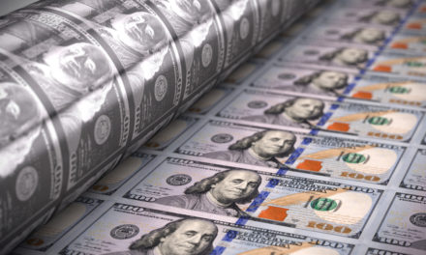
The Mad Hedge Fund Trader “QE Infinity”
With John Thomas from Silicon Valley, CA, June 17, 2020 www.madhedgefundtrader.com
Notes:
*

Slide 2
Trade Alert Performance New All Time High! – A record 82 Trade Alerts since April 1
*January 3.13% Final *July +3.07% Final *February -6.05% Final *August +16.01% Final *March -5.50% Final *September 3.08% Final *April +4.55% Final *October +12.13% Final *May +14.19% Final *November -1.26% Final *June -1.02% MTD *December +4.97% Final *Year to date +8.87% compared to -9.00% for the Dow Average *+364.78% since inception, just short of a new all time high *Average annualized return of 34.34% for 11 years

Slide 3
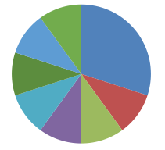
Portfolio Review Staying Aggressively “RISK ON” in Rising Market,
Risk On
World is Getting Better
(TLT) 6/$175-$180 put spread | 30.00%
(TLT) 7/$172-$175 put spread | 10.00%
(TLT) 7/$168-$171 put spread | 10.00%
(SPY) 6/$235-$245 call spread | 10.00%
(SPY) 7/$260-$270 call spread | 10.00%
(AAPL) 7/$280-$290 call spread | 10.00%
Risk Off
World is Getting Worse
(TLT) 7/$150-$153 call spread | -10.00%
(SPY) 7/$235-$340 put spreat | -10.00%
Total Net Position | 60.00%
Expiration P&L +14.07% YTD

Slide 4
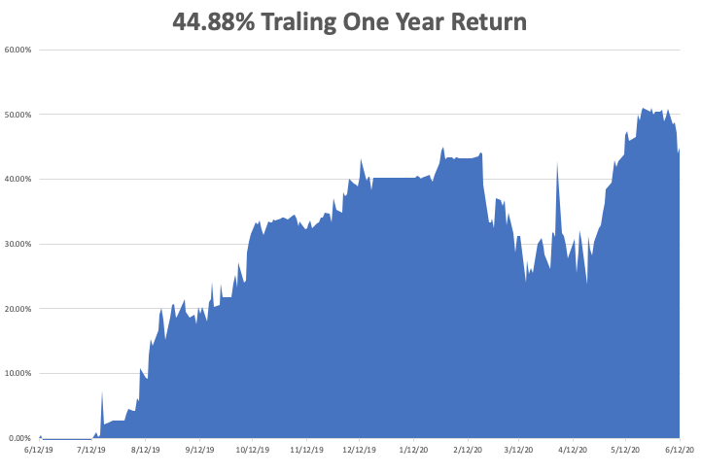

Slide 5
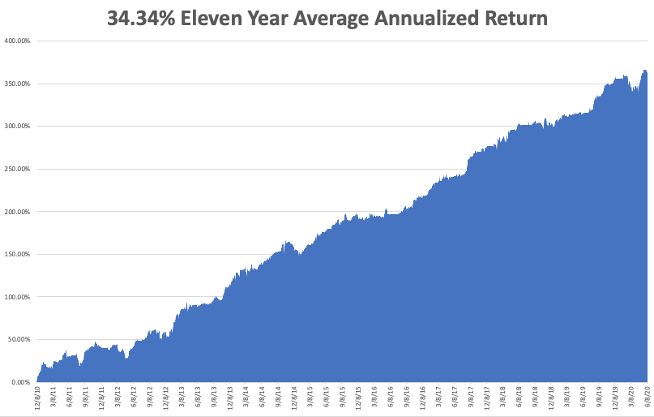
GTD 10 Year Daily Audited Performance

Slide 6
The Method to My Madness
*The Fed has proven its intention to step in and run the printing presses on any 10% market correction *Stocks are now wildly overpriced counting heavily on a free put from the Fed, which is working *A bond short is far and away the better trade, based on massive over issuance of US government bonds *Head and shoulders top is now well established for bonds *The big fear remains for a second larger Corona spike in the fall, already starting in the South *Gold is biding its time before taking a run at all time highs *The US dollar is toast because of exploding deficits *Best buying opportunity of the decade is setting up, the next big dip is the one you buy

Slide 7
Corona Update
*US cases top 2.2 million, deaths at 119,000 and new cases are exploding in 25 states *New CDC Forecasts Calls for 250,000 US Deaths by August, or 2,500 a day *New Zealand became the first Corona free country *Hospitals in Texas and Arizona are on the verge of getting overwhelmed, as happened in NY *New York is down to 23 deaths a day, subway ridership is back to 19% of pre-pandemic levels *At least five companies are close to delivering a vaccine in a year, as trillions are poured into the sector *A true vaccine is years off, or never

Slide 8
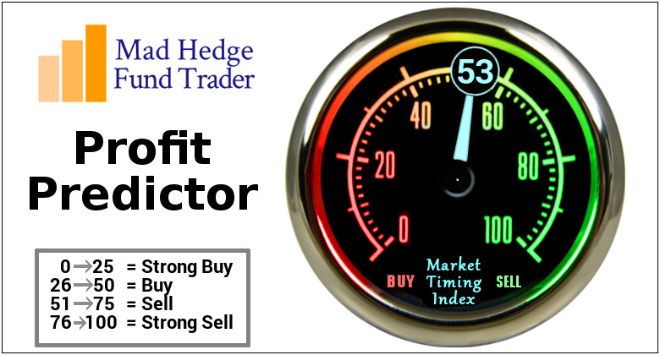
The Mad Hedge Profit Predictor Market Timing Index-Bottom of Range-at to a “BUY” An artificial intelligence driven algorithm that analyzes 30 different economic, technical, and momentum driven indicators

Slide 9
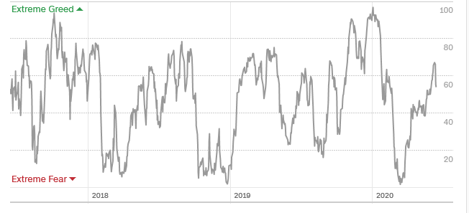
The Mad Hedge Profit Predictor From Extreme Overbought to Oversold
SELL
BUY

Slide 10
The Global Economy – Official Recession
* The Economy Officially Entered a Recession in February. Most companies are being allowed to reopen to the extent that they go bankruptcy by yearend, operating at 30%-70% rates *The new Great Depression deepens, with 44 million new unemployed in ten weeks, and the Fed targeting 52 million. Some 20% of these jobs are never coming back * May Unemployment Rate Delivers a Blockbuster FALL, from 14.7% to 13.3%, sets up a big reversal for June *Weekly Jobless Claims Hit 1.54 Million, still falling but still horrendous. *The next $3 trillion stimulus package is still stuck in Washington *The huge “V” recovery in the stock market is fading with an explosion of new cases *US Factory Orders Collapse Further, down 13% in May after a 14% crash in April

Slide 11
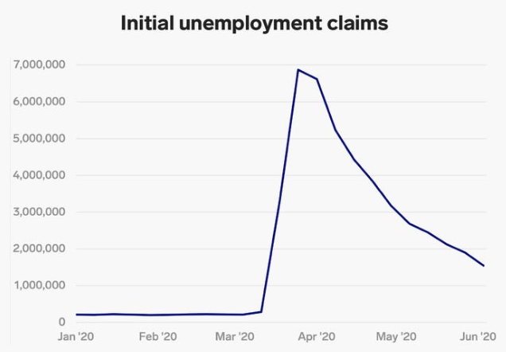
Weekly Jobless Claims - Disaster +1.5 Million to 44 million, One out of Four Already Surpassed Great Depressions Peak

Slide 12
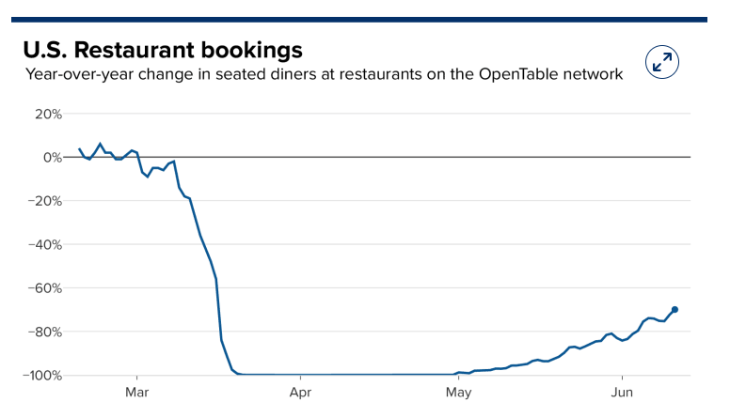

Slide 13
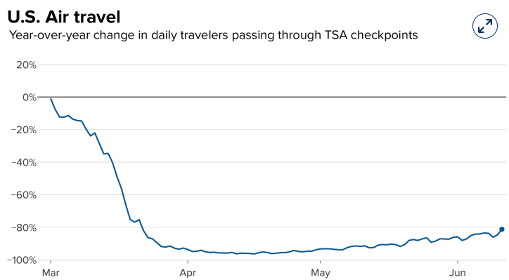

Slide 14
The Bill Davis View A $1,500 Upgrade for the Mad Day Trader Service
Buys: | Entry | Target
Bristol Myers Squibb (BMY) | $ 58.00 | $ 70.00
John Bean Technologies (JBT) | $ 82.00 | $ 105.00
Gartner Group (IT) | $ 124.00 | $ 140.00
Guidewire Software, Inc. (GWRE) | $ 104.00 | $ 125.00
Hartford Financial Group (HIG) | $ 40.00 | $ 52.00
Sells:
Masimo Corp (MASI)-X | $ 230.00 | $ 200.00
Beckton Dickinson (BDX)-X | $ 248.00 | $ 225.00
Anthem, Inc.(ANTM) | $ 280.00 | $ 250.00
W.P.Carey & Co.(WPC) | $ 77.00 | $ 60.00
Wayfair Inc. (W) | $ 204.00 | $ 177.00

Slide 15
Stocks – Tipping The Punch Bowl
*Corona fears trigger first market correction in ten weeks, knocking 10% off NASDAQ *Big short squeeze puts in final market top, with small lot retail buying as a turbocharger *Reopening sectors take biggest dive, like airlines, casinos, and cruise lines, then bounce back *Artificial manipulation of stock prices through the biggest stimulus in history is prompting wild swings and 2,000-point days, making traditional fundamental and technical benchmarks useless. The playbook is out the window *The market is not close to reflecting the long-term damage to the economy *We could be entering a wide trading range until the November election

Slide 16
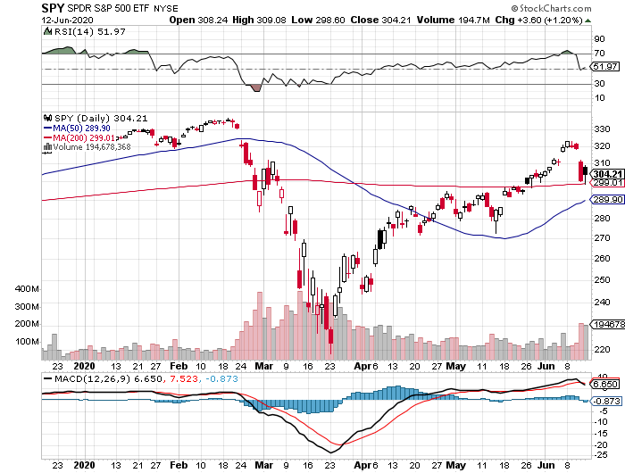
S&P 500 – Trending sideways long 7/$260-$270 bull call spread long 6/$235-$245 bull call spread stopped out of long 7/$320-$330 bear put spread took profits on long 4/$280-$290 bear put spread took profits on long 4/$275-$280 bear put spread
New Highs
The Bottom 2,700

Slide 17
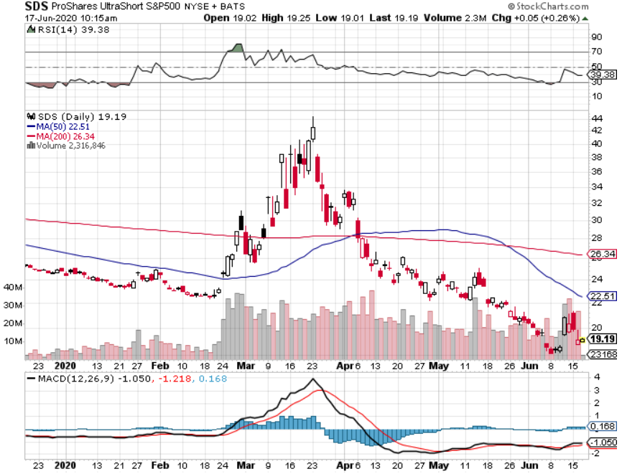
ProShares Ultra Short S&P 500 (SDS)- a Great Hedge for long stocks and bonds Long 2X position has a hedge against longs and bond shorts

Slide 18
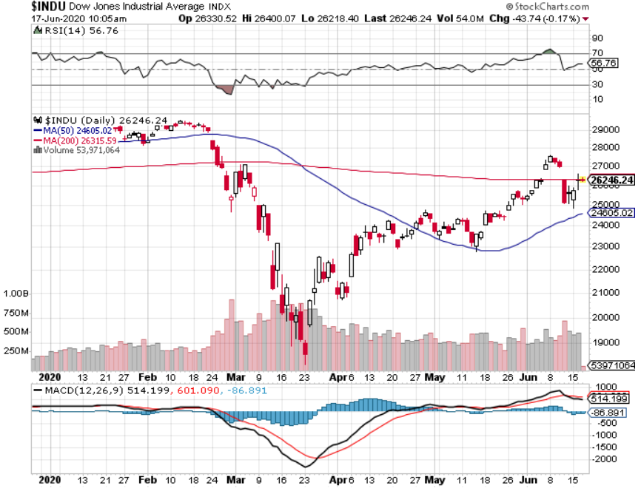
Dow Average ($INDU)-

Slide 19
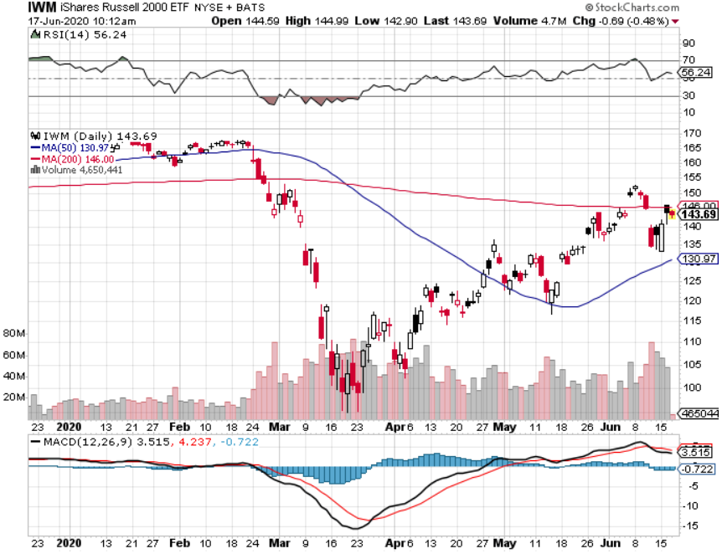
Russell 2000 (IWM)- took profits on Long 10/$137-$142 vertical bull call spread took profits on Long 10/$153-$156 vertical bear put spread

Slide 20
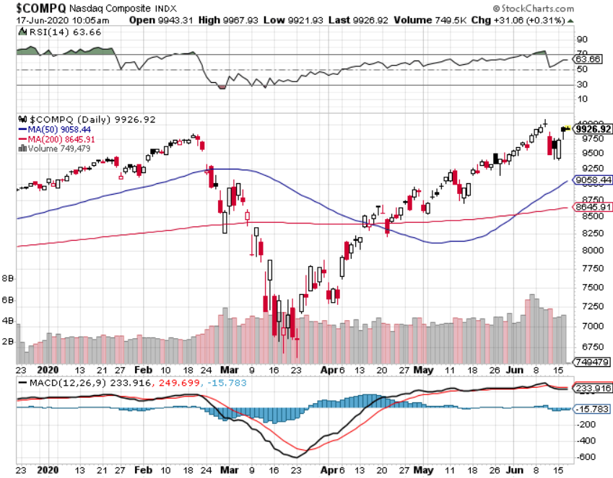
NASDAQ ($COMPQ) – Peaking Out

Slide 21
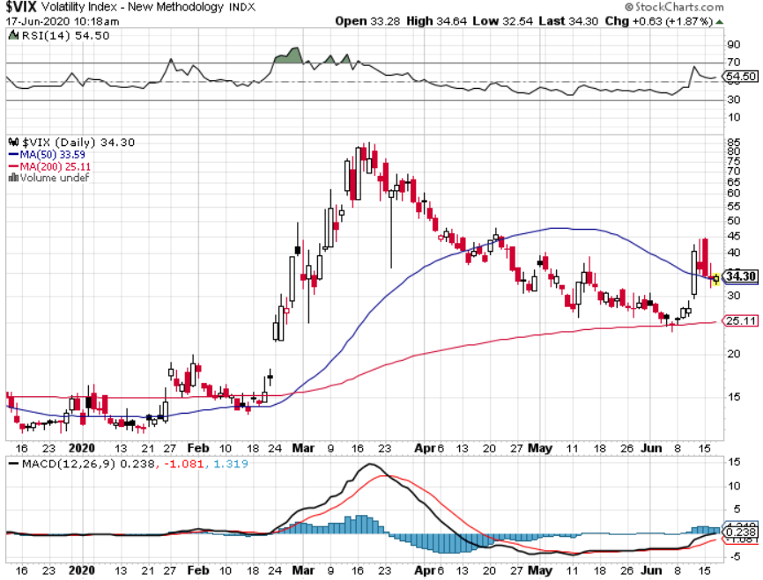
(VIX)- A Third of the Peak

Slide 22
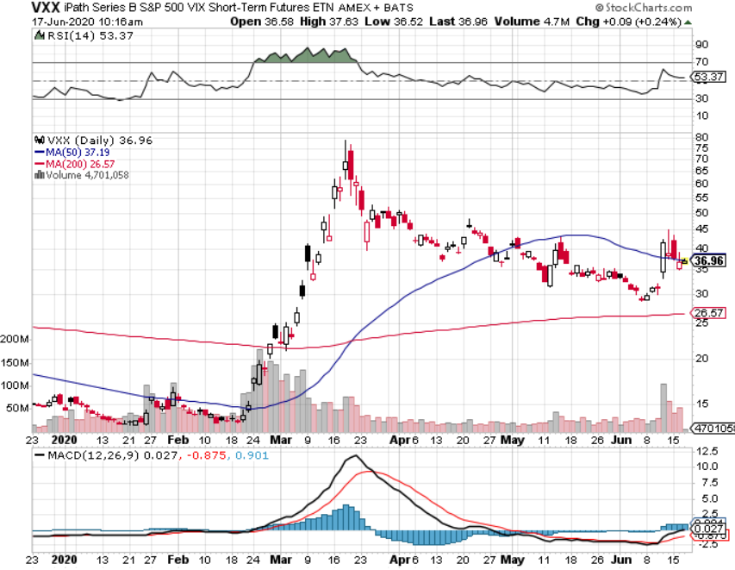
(VXX)- Sell Rallies-Down $85 to $26 from top stopped out of long 1/2021 $16 puts stopped out of long 1/2021 $24 puts

Slide 23
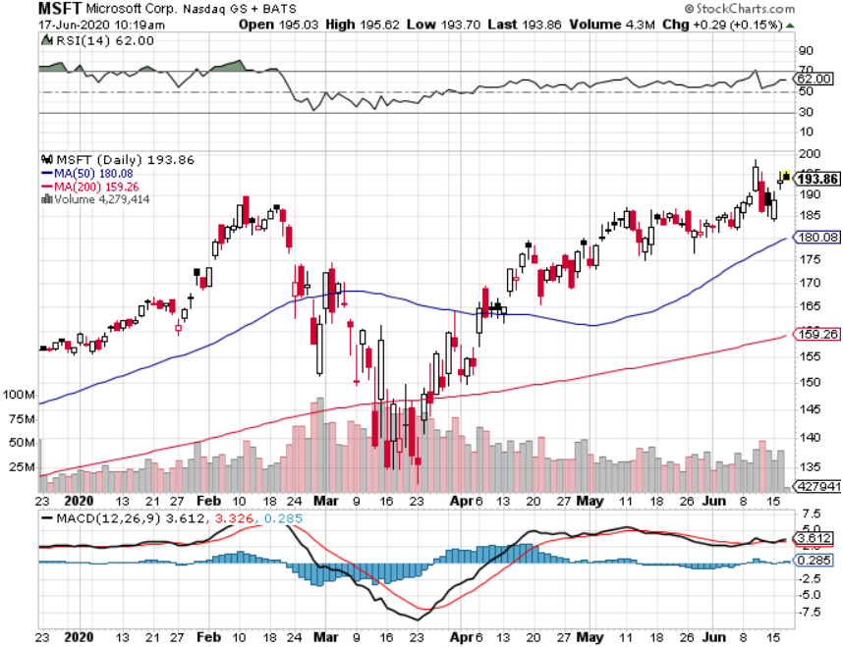
Microsoft (MSFT)- Earnings beat- Looking for Another Entry Point Stopped out of long 4/$120-$130 call spread took profit on long 4/$120-$130 call spread stop loss on long 12/$170-$180 call spread took profits on long 12/$135-$138 call spread

Slide 24
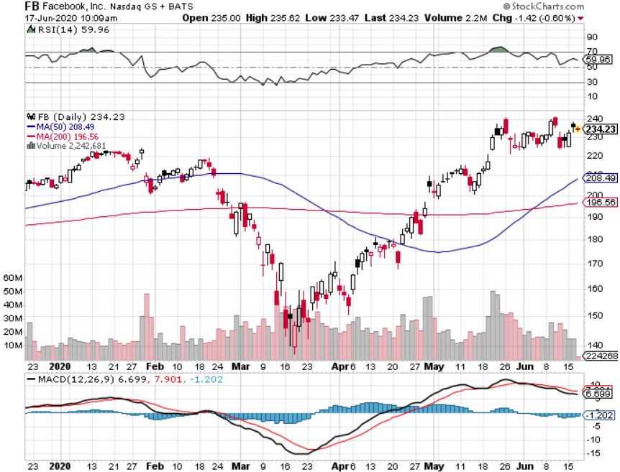
Facebook (FB)- New High stopped out of Long 9/$190-$200 vertical bear put spread took profits on Long 9/$145-$155 vertical bull call spread took profits on Long 9/$150-$160 vertical bull call spread took profits on Long 8/$167.50-$172.50 vertical bull call spread

Slide 25
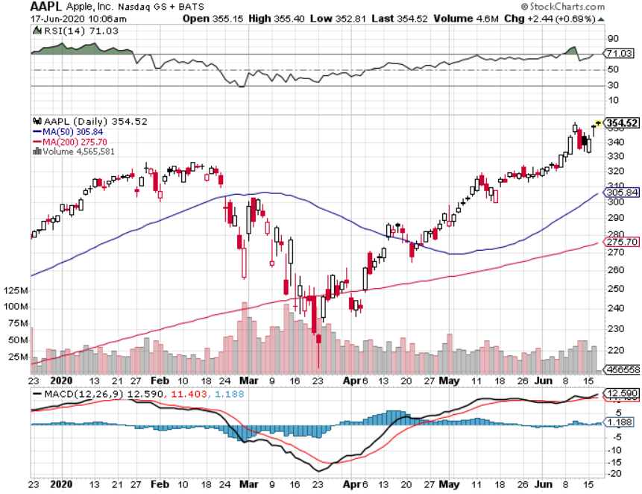
Apple (AAPL)- New Highs long 7/$280-$290 call spread took profits on long 5/$250-$260 call spread took profits on long 4/$250-$260 call spread took profits on long 3/$250-$260 call spread

Slide 26
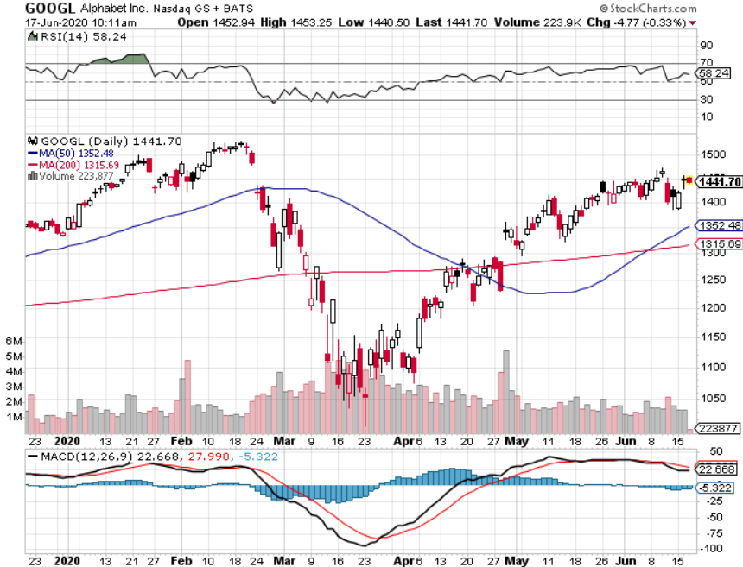
Alphabet (GOOGL) – Europe Antitrust took profits on long 12/$1,200-$1,230 bull call spread took profits on long 9/$1,030-$1,080 vertical bull call spread stopped out of long 5/$1,100-$1,130 bull call spread took profits on long 4/$1,080-$1,120 bull call spread

Slide 27
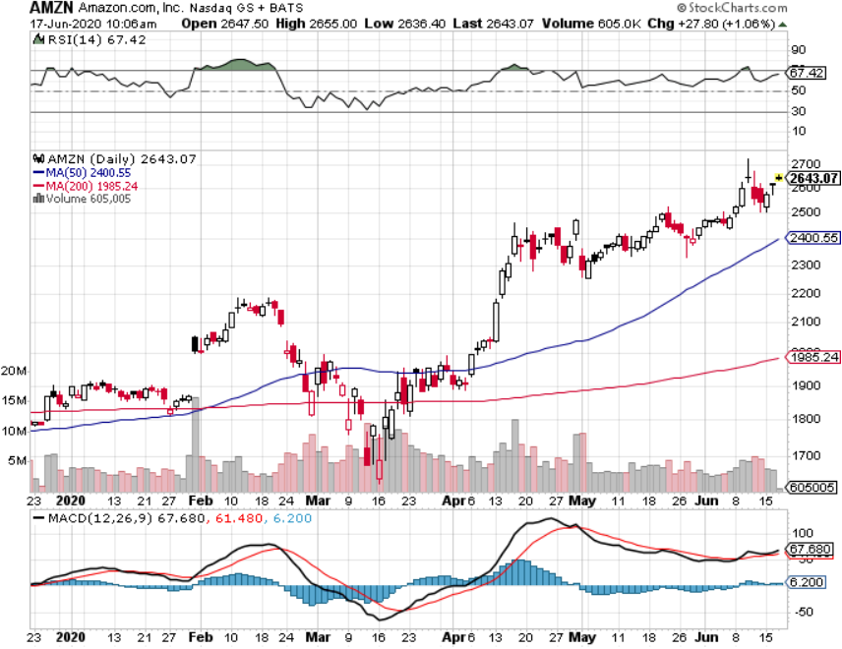
Amazon (AMZN) – New Highs - $3,000 here we come took profits on long 4/$1,600-$1,650 bull call spread stopped out of long 3/$1,700-$1,800 bull call spread took profits on 9/$1,500-$1,500 bull call spread

Slide 28
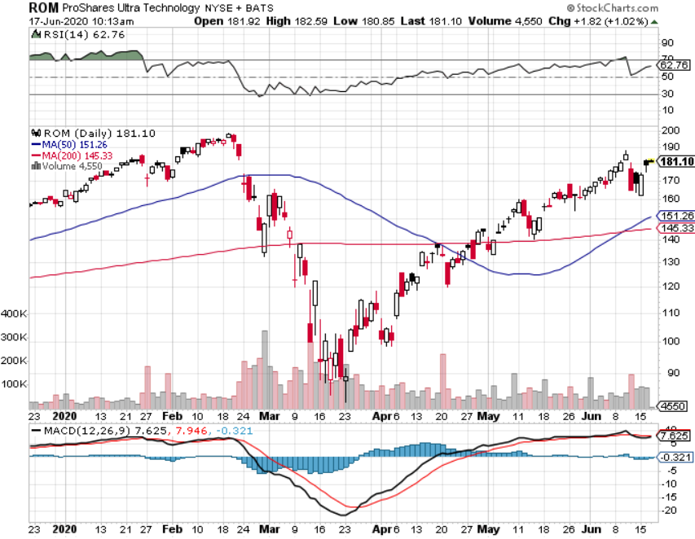
ProShares Ultra Technology (ROM) – Up 110% in 10 Weeks

Slide 29
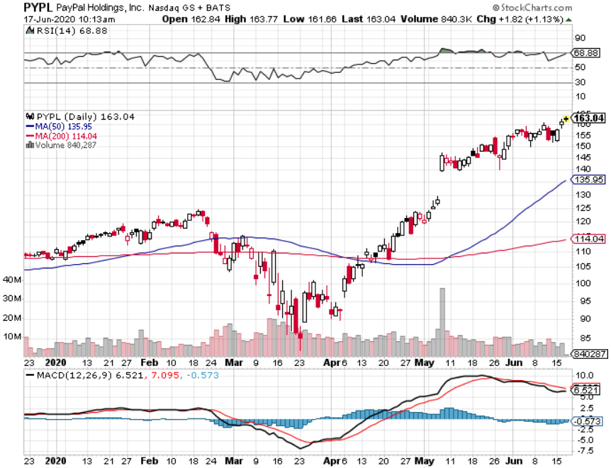
PayPal (PYPL)-Fintech Rules took profits on long 4/$90-$95 call spread

Slide 30
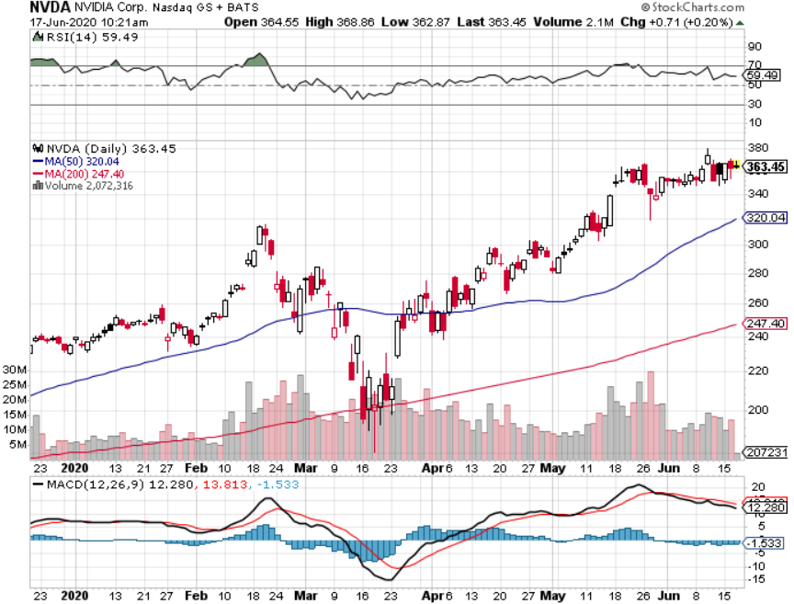
NVIDIA (NVDA) – New Highs on 39% Jump in Earnings

Slide 31
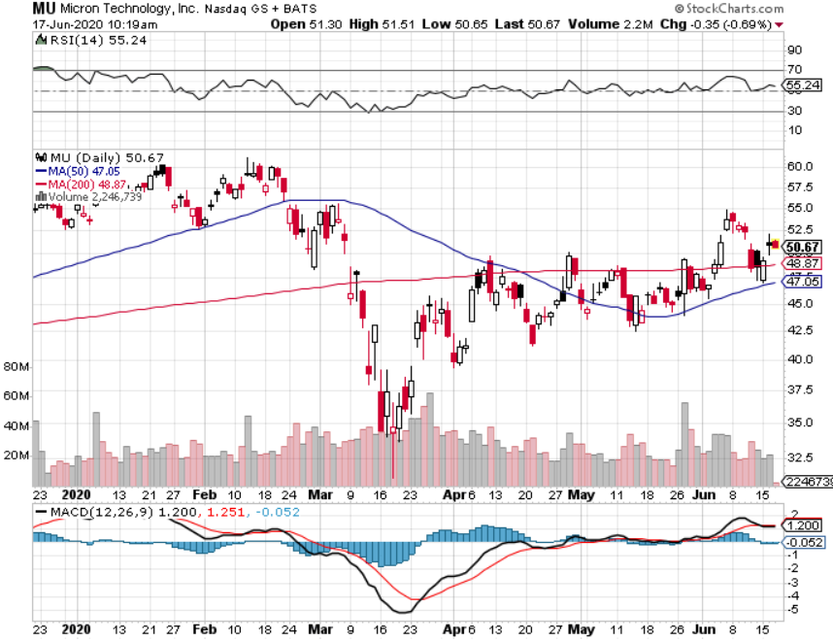
Micron Technology (MU)-Ditto

Slide 32
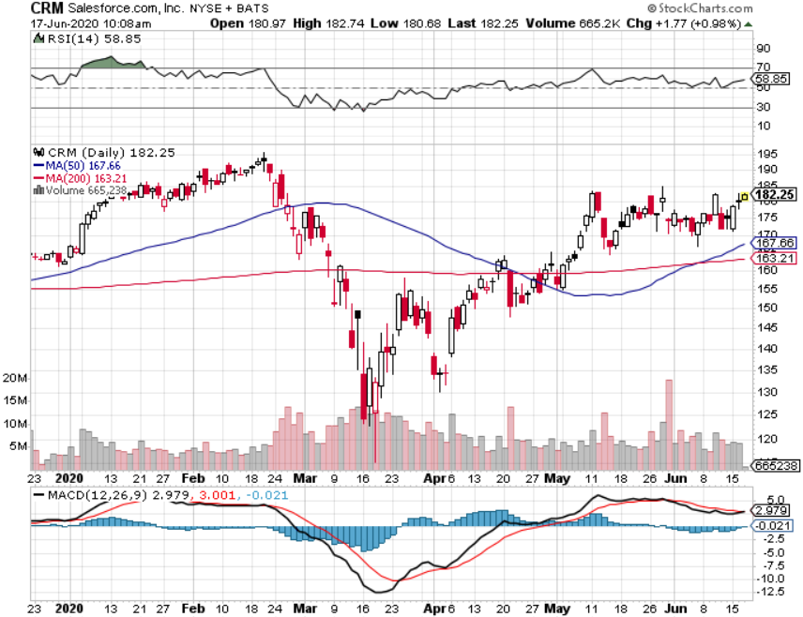
Salesforce (CRM)- Massive Online Migration took profits on long 9/$125-$130 vertical bull call spread took profits on long 8/$125-$130 vertical bull call spread took profits on long 2/$105-$115 call spread

Slide 33
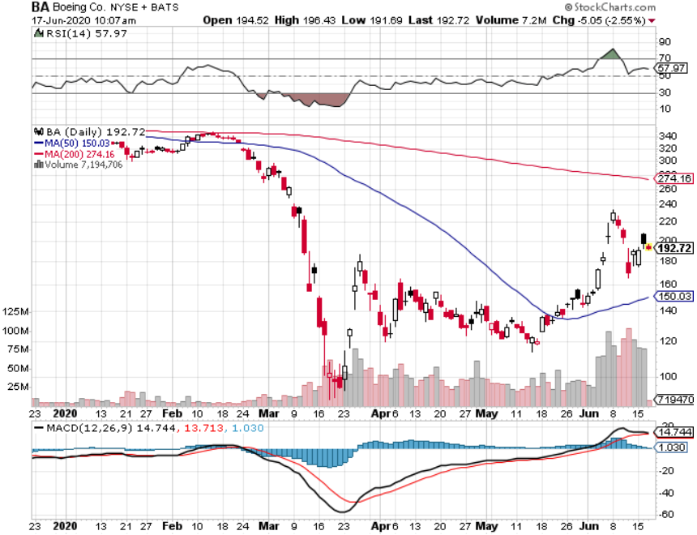
Boeing (BA) –GM Or Bank Style Takeover? 737 MAX production shutdown-Criminal investigation took profits on long 2/$270-$280 call spread took profits on long 12/$310-$330 call spread took profits on long 4/$300-$310 call spread took profits on long 4/$315-$335 call spread

Slide 34
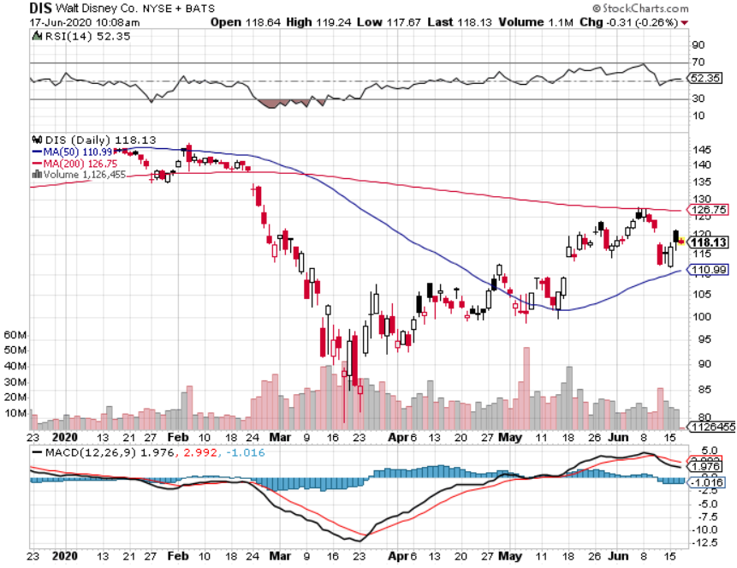
Walt Disney (DIS)- Corona Hit long 9/$120-$125 put spread took profits on long 6/$85-$90 call spread

Slide 35
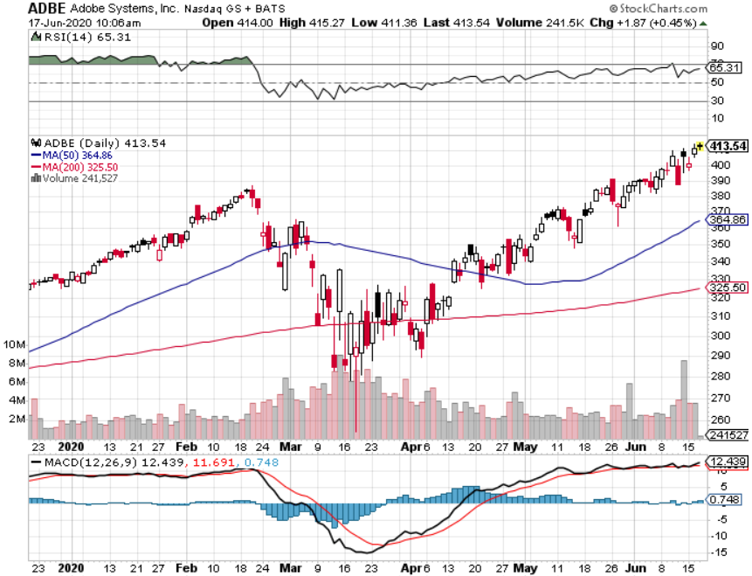
Adobe (ADBE)- The Quality Non-China tech play

Slide 36
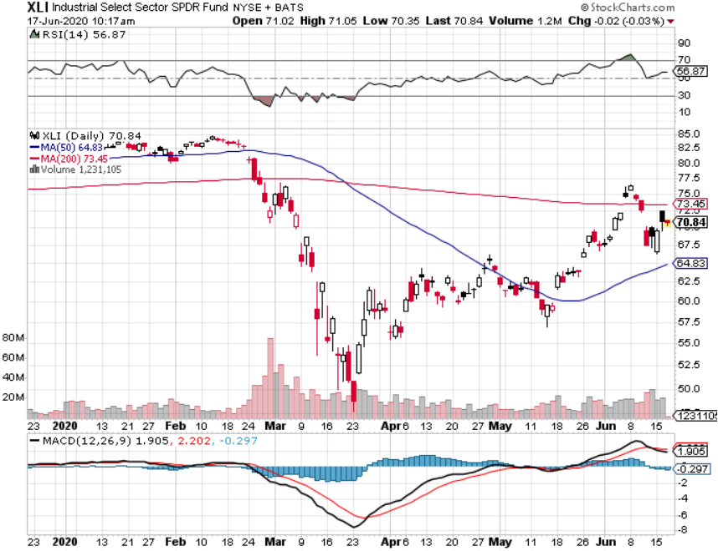
Industrials Sector SPDR (XLI)- (GE), (MMM), (UNP), (UTX), (BA), (HON)

Slide 37
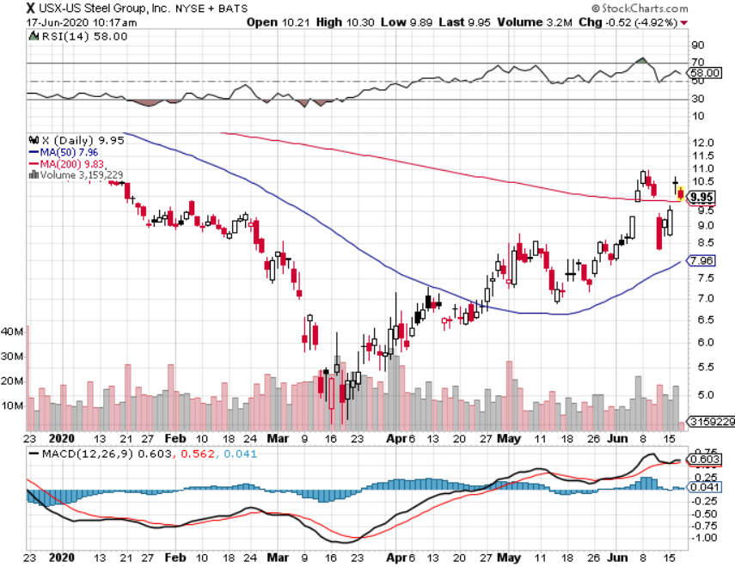
US Steel (X) – Industrials Play

Slide 38
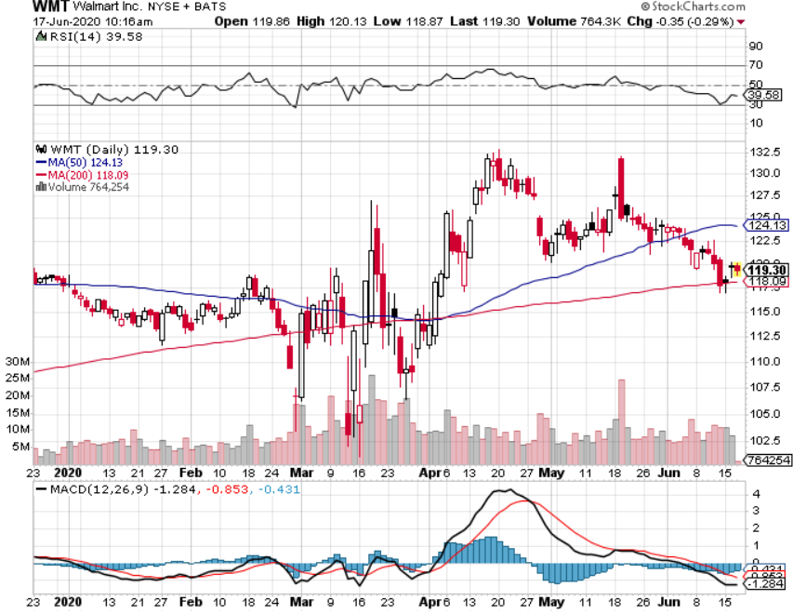
Wal-Mart (WMT)-Hiring 150,000 took profit on Long 11/$125-$130 bear put spread took profit on Long 10/$119-$121 bear put spread took profits on Long 8/$114-$117 bear put spread

Slide 39
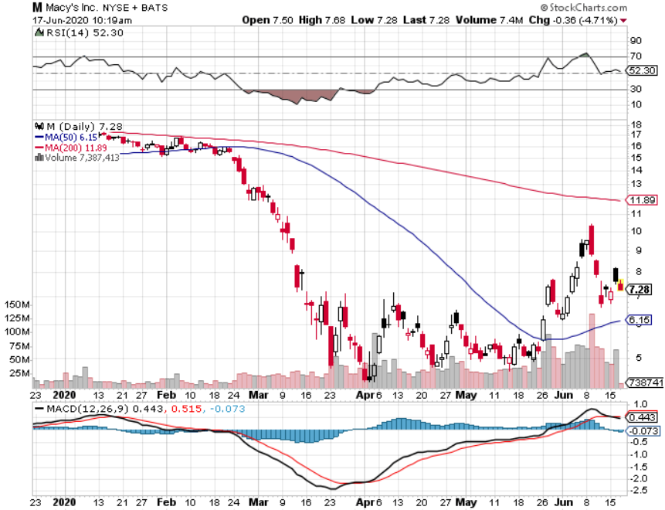
Macys’ (M) – $4.5 Billion Loan took profits on Long 8/$23-$25 bear put spread

Slide 40
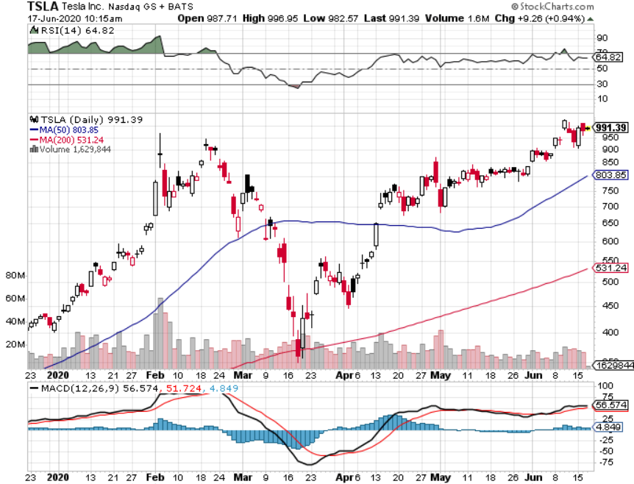
Tesla (TSLA)-New Highs Model Y will be a blockbuster stopped out of long 6/$260-$270 put spread took profits on long 6/$140-$150 call spread took profits on long 6/$240-$250 put spread

Slide 41
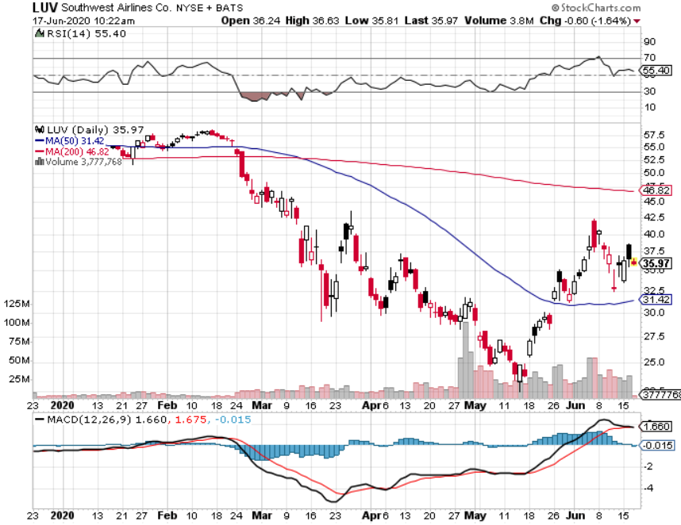
Southwest Airlines (LUV) – Warren Buffett big seller

Slide 42
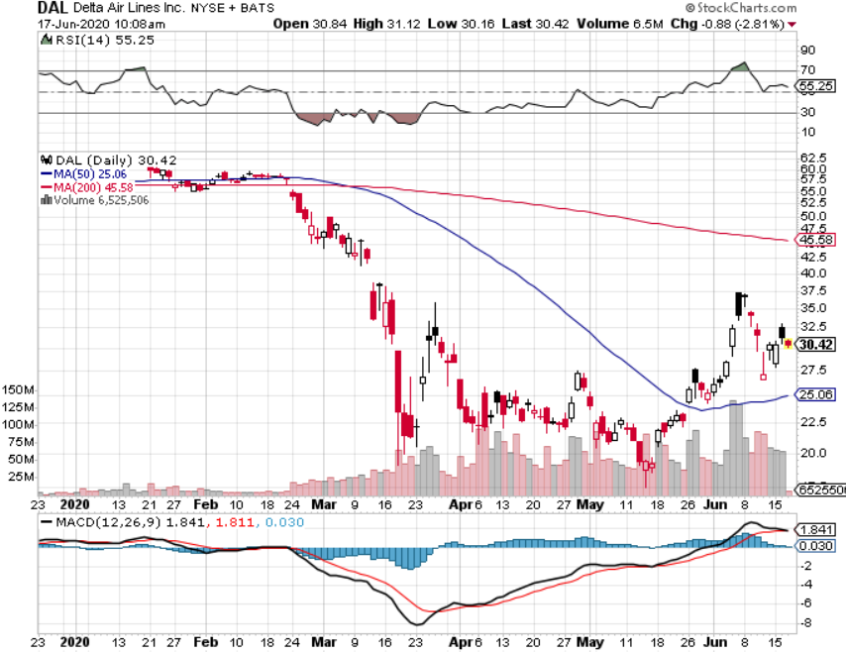
Delta Airlines (DAL) – Warren Buffett big seller

Slide 43
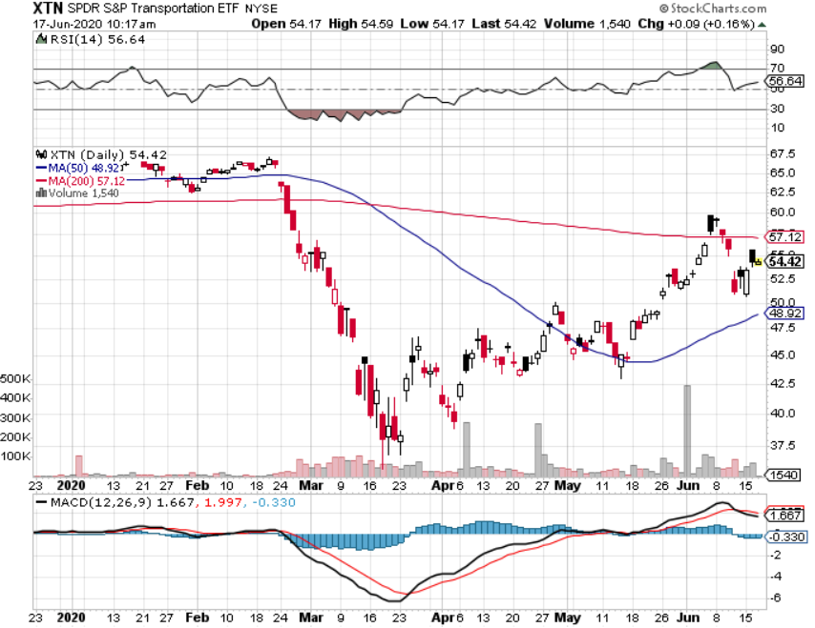
Transports Sector SPDR (XTN)- Worst Hit Sector (ALGT), (ALK), (JBLU), (LUV), (CHRW), (DAL)

Slide 44
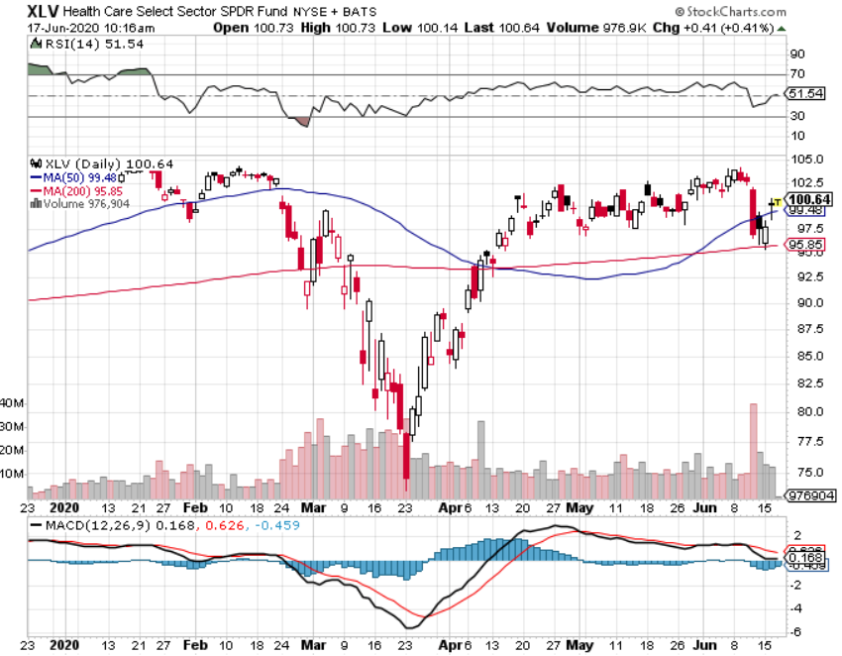
Health Care Sector (XLV), (RXL)-New Highs (JNJ), (PFE), (MRK), (GILD), (ACT), (AMGN) The new favorite sector

Slide 45
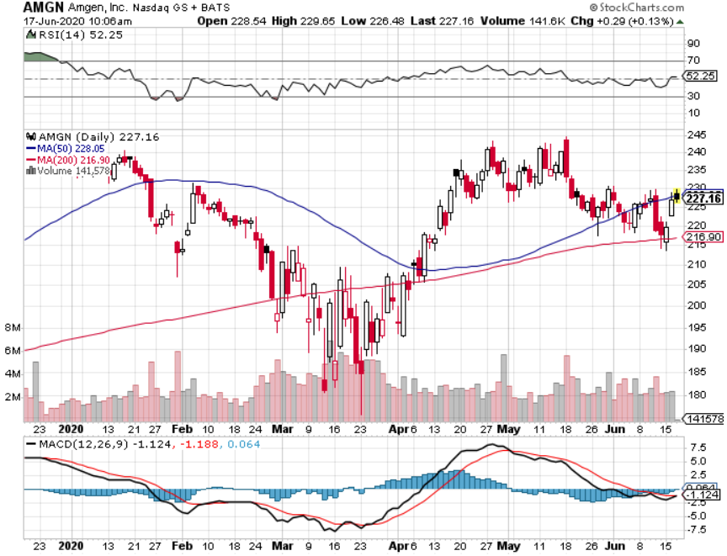
Amgen (AMGN)

Slide 46
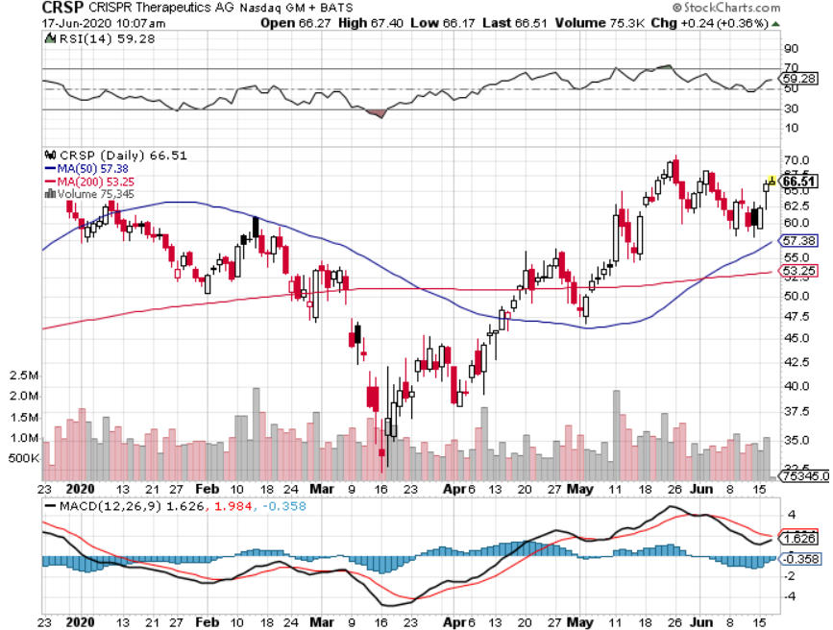
CRISPR Therapeutics (CRSP)

Slide 47
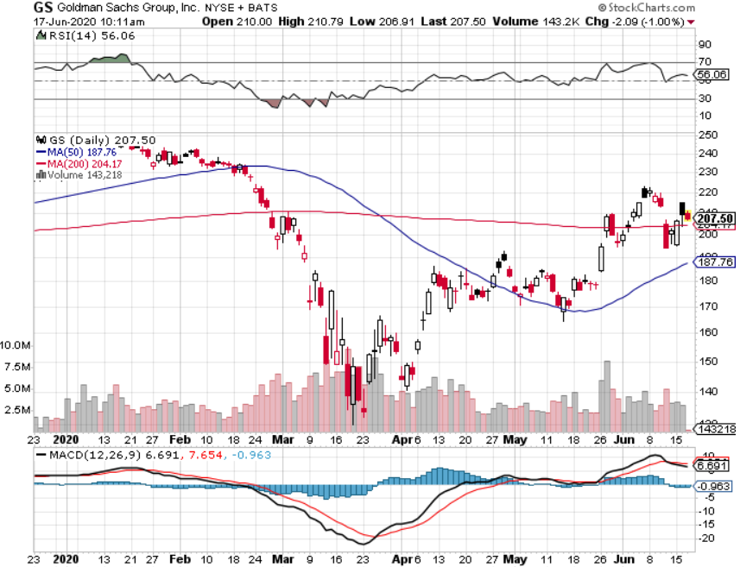
Goldman Sachs (GS) – Trading Volume Burst-Steepening Yield Curve

Slide 48
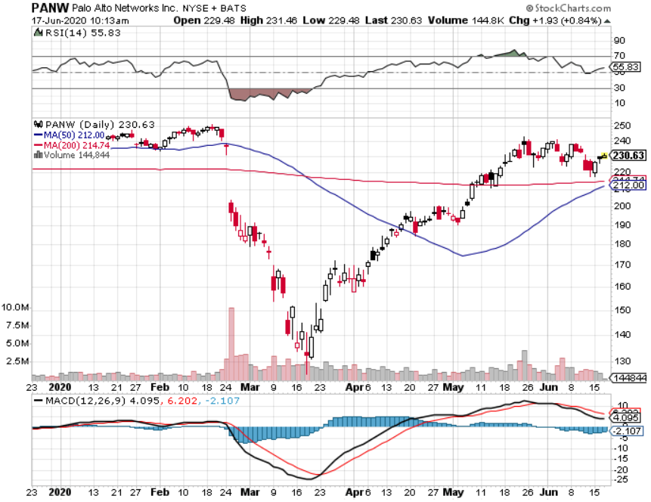
Palo Alto Networks (PANW)- Hacking never goes out of fashion

Slide 49
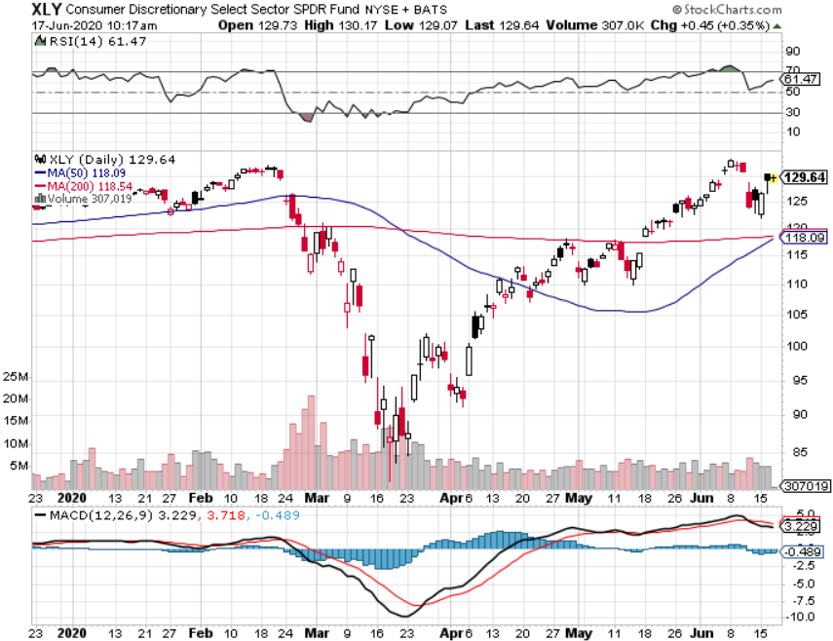
Consumer Discretionary SPDR (XLY) (DIS), (AMZN), (HD), (CMCSA), (MCD), (SBUX)

Slide 50
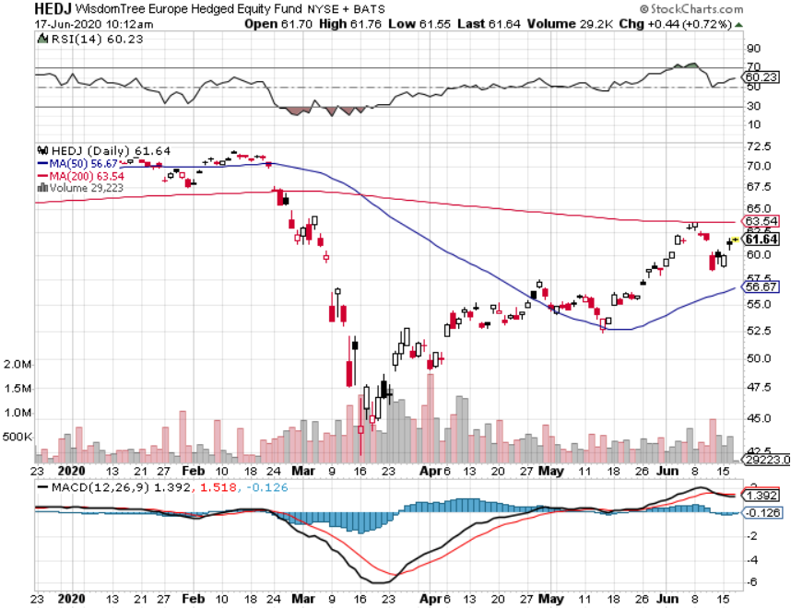
Europe Hedged Equity (HEDJ)-

Slide 51
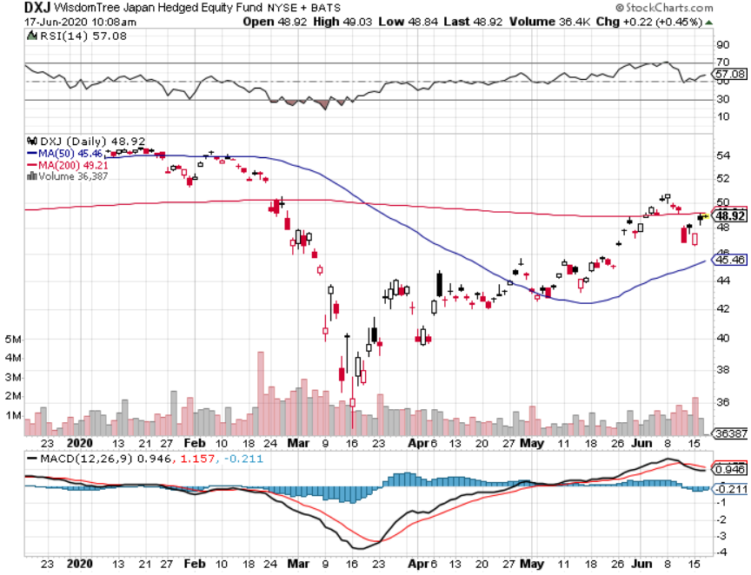
Japan (DXJ)-

Slide 52
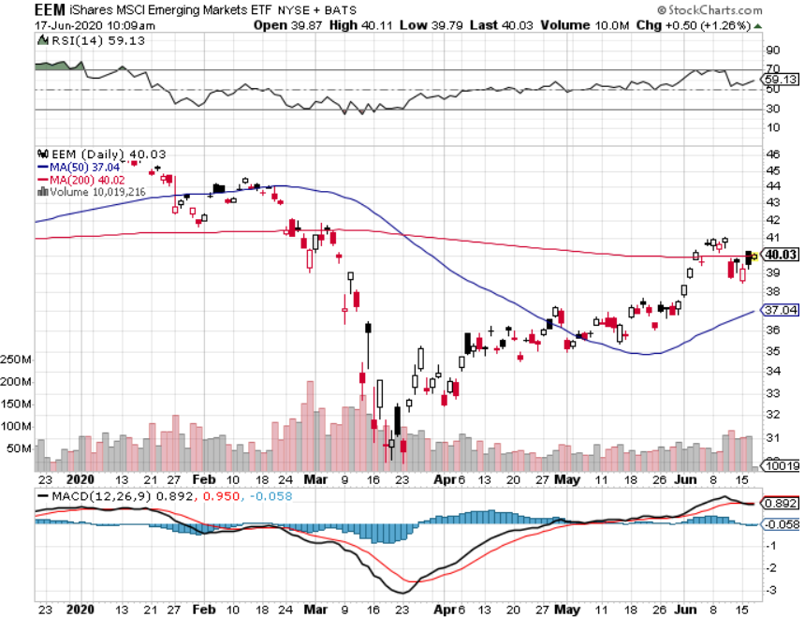
Emerging Markets (EEM)- Weak Dollar Play

Slide 53
Bonds – QE Expanded
*Fading “V” economic recovery fears brings monster 12-point short covering rally in bonds *Then Jay Powell expanded QE on Monday, extending it to individual corporate bonds *That means less money for buying US Treasuries, knocking six points off that market in two days *Powell says he won’t raise short term rates for three years *Another short selling opportunity of the century is in play, head and shoulders top is in place *Q3 will deliver positive growth, crushing bonds, despite zero overnight rates *US Treasury bond bond fund (TLT) could plunge from $180 to $105, taking interest rates from 0.31% to 3.25% *Bottom line: sell short every major rally in the (TLT)

Slide 54
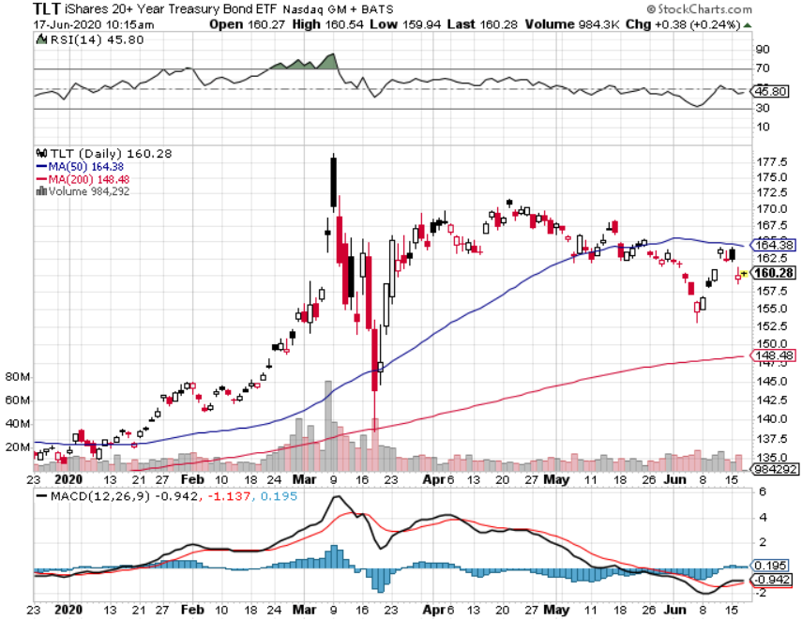
Treasury ETF (TLT) – Huge Short Play 3 X long 6/$175-$180 put spread-2 days to expiration long 7/$172-$175 put spread long 7/$168-$171 put spread stopped out of long 7/$165-$168 put spread took profits on long 5/$176-$177 put spread took profits on long 5/$175-$178 put spread

Slide 55
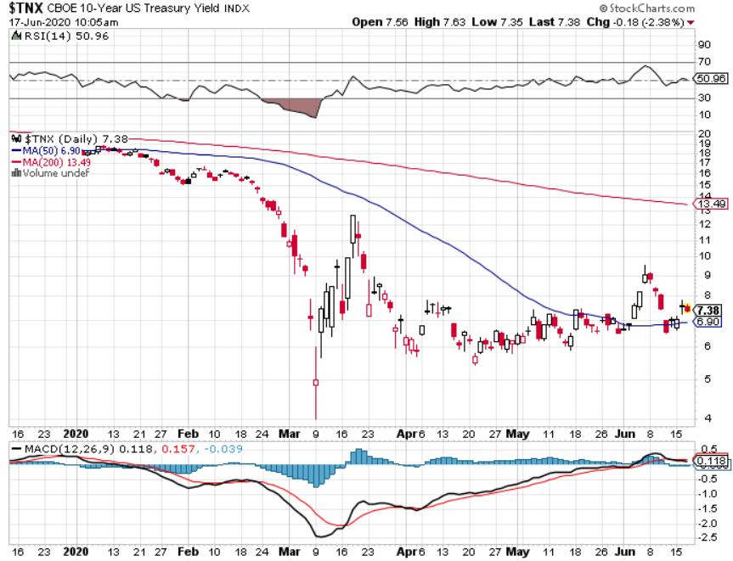
Ten Year Treasury Yield ($TNX) – 0.70%

Slide 56
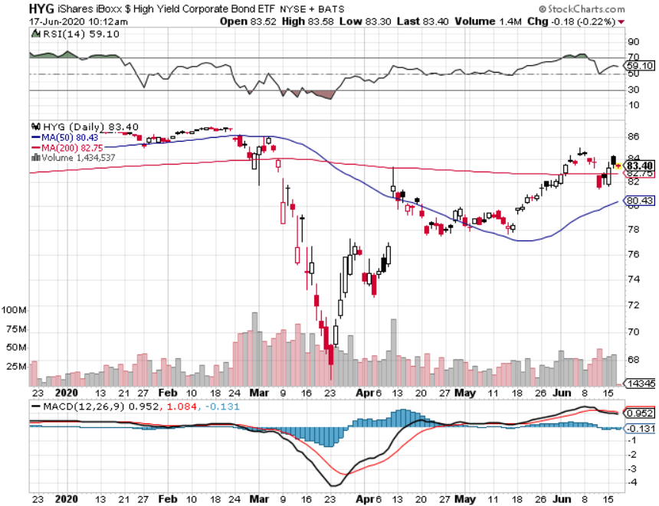
Junk Bonds (HYG) 5.90% Yield to Maturity Next Fed QE Target?

Slide 57
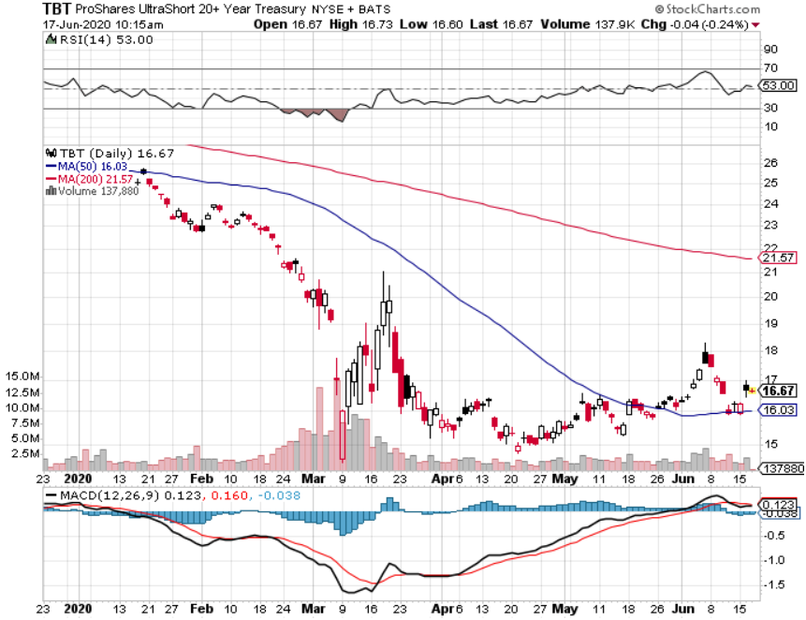
2X Short Treasuries (TBT)- 2 Month Bottoming Process

Slide 58
iShares IBoxx $ Investment Grade Corporate Bond ETF (LQD)

Slide 59
Emerging Market Debt (ELD) 4.77% Yield-

Slide 60
Municipal Bonds (MUB) – 1.41% Mix of AAA, AA, and A rated bonds

Slide 61
Foreign Currencies – Dollar Swan Dive
*US Dollar falls for 14 consecutive days *Massive QE and bond issuance is sucking the life out of the Greenback *Euro double top? *British pound spikes *Bitcoin hanging on to $10,000 on supply restriction and miner payout cut *Aussie dollar soars *Keep selling short all US dollar rallies, its yield support is gone forever

Slide 62
Japanese Yen (FXY), (YCS)

Slide 63
Euro ($XEU), (FXE), (EUO)-

Slide 64
British Pound (FXB)-

Slide 65
Australian Dollar (FXA)- The Global Recovery Play took profits on long 8/$67-$69 call spread

Slide 66
Emerging Market Currencies (CEW)

Slide 67
Chinese Yuan- (CYB)-

Slide 68
Bitcoin- Hanging on to $10,000

Slide 69
Energy – Rally Fades
*Growth fears kill rally and brings 15% selloff; oil is the canary in the coalmine for Corona generated economic shocks *Production supply/demand gap is shrinking but is still historically huge *Much of lost demand is permanent as US economy restructures to a less transportation-oriented economy. *Maybe half of all listed energy names will go bankrupt in 2020 *Any price spike will be temporary, as over supply against fading demand will last for years *Avoid all energy plays like the plague, could drop by half in the coming recession

Slide 70
Oil-($WTIC)

Slide 71
United States Oil Fund (USO) stopped out of long stopped out of long (USO) long 10/$9.50-$10 Vertical bull call spread

Slide 72
Energy Select Sector SPDR (XLE)-No Performance! (XOM), (CVX), (SLB), (KMI), (EOG), (COP)

Slide 73
Halliburton (HAL)-

Slide 74
Natural Gas (UNG) -

Slide 75
Precious Metals – Still Pushing for Highs
*No change in bullish picture-narrow sideways consolidation is bullish *Hedging demand piles on top of central bank buying *New QE Infinity sparks huge rally, worthless dollar make valuable gold *Near zero interest rates and Collapsing US dollar is another incentive *Central banks still pouring into gold every month *Bottom Line: buy a bigger dip in gold and precious metals

Slide 76
Gold (GLD)- Short Term downtrend

Slide 77
Market Vectors Gold Miners ETF- (GDX) –

Slide 78
Barrick Gold (GOLD)

Slide 79
Newmont Mining- (NEM)-

Slide 80
Silver- (SLV)-

Slide 81
Silver Miners - (SIL)-

Slide 82
Wheaton Precious Metals - (WPM)-

Slide 83
Copper (COPX)-Collapse Trade War Disaster

Slide 84
Freeport McMoRan (FCX)-World’s Largest Copper Producer took profits on long 4/$10-$11 call spread took profits on short 4/$114 calls

Slide 85
Real Estate – From Strength to Strength
*Buyers are back in force, lured by 3.0% 30-year fixed rate mortgages *30-year fixed rate mortgage falls below 3.00% for the first time ever, but jumbo rates remain stubbornly high at 4.00% as banks brace for defaults *Inventories have collapsed to record lows as buyers rush back in but there are few homes for sale, rental prices are crashing high highest price cities like New York and San Francisco *Big move out of the cities to the suburbs is in progress, and office is now the most requested upgrade, most requested upgrade is a home office *Mortgage forbearance falling sharply, many qualified are not using it *Housing prices were ready to explode to the upside with S&P Case Shiller Rose 3.9%, in March

Slide 87
February Corelogic S&P Case Shiller Home Price Index Phoenix (8.2%), Seattle (6.9%), Charlotte (5.8%) showing biggest gains
Tradingeconomics.com

Slide 88
Simon Property Group (SPG)- Mall REIT Up to 60% of Mall Tenants Aren’t Paying Rent

Slide 89
Crown Castle International (CCI) – 3.40% yielding cell phone Tower REIT

Slide 90
US Home Construction Index (ITB) (DHI), (LEN), (PHM), (TOL), (NVR)

Slide 91
Trade Sheet- So What Do We Do About All This?
*Stocks - sell rallies, buy big dips *Bonds – sell rallies aggressively *Commodities-stand aside *Currencies- sell US dollar rallies *Precious Metals – buy dips *Energy – stand aside *Volatility - sell short over $50 *Real estate – buy dips

Slide 92
The Mad Hedge June 4 Traders & Investors Summit
*The Summit recording is Up. *I have posted all 9:15 hours of recordings of every speaker. *This is a collection of some of the best traders and investors I have stumbled across over the past five decades. *To find it please click here at https://www.madhedge.com/replay-06042020/

Slide 93
Next Strategy Webinar 12:00 EST Wednesday, July 1, from Silicon Valley email me questions at support@madhedgefundtrader.com
Good Luck and Good Trading!
Notes:
*

