Slide 1
Mad Day Trader
Bill Davis
Webinar – July 8, 2020

Slide 2
Monthly Charts

Slide 3
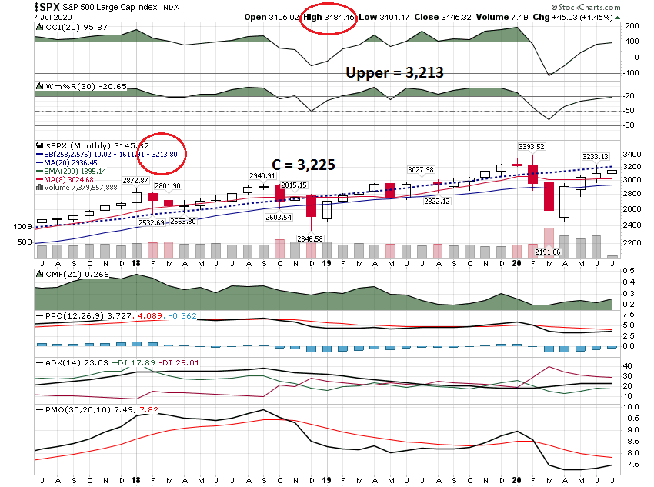

Slide 4
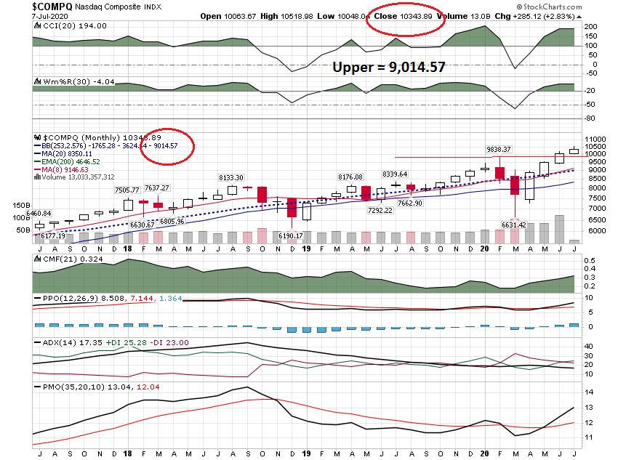

Slide 5
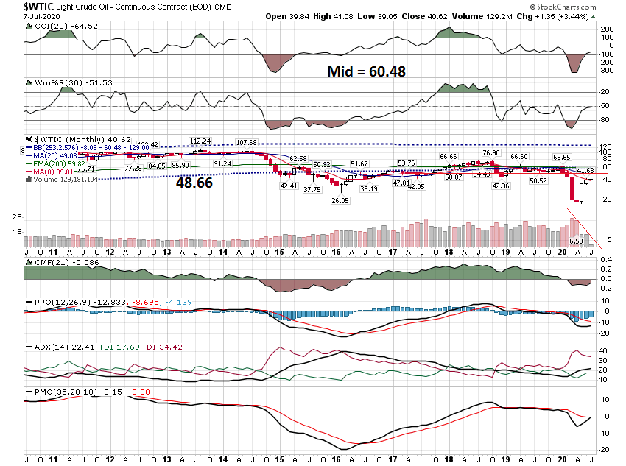

Slide 6
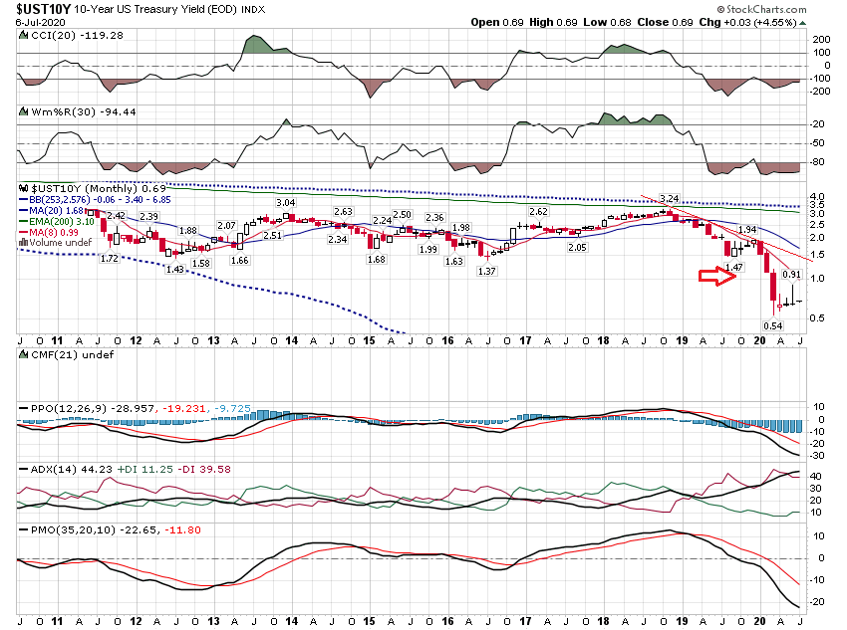

Slide 7
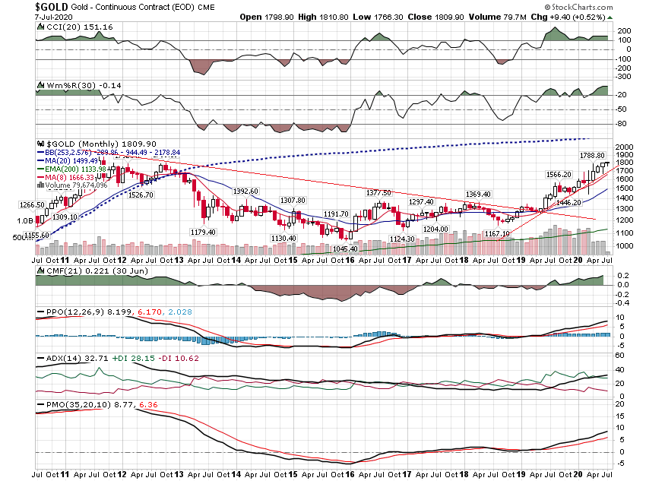

Slide 8
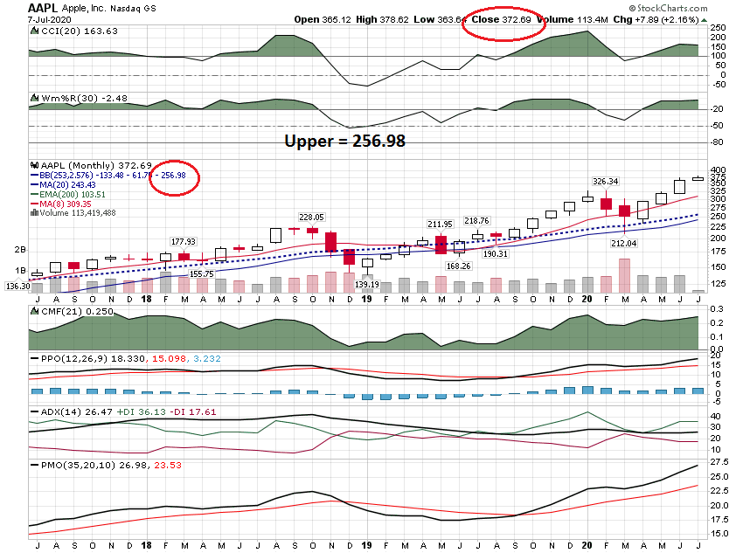

Slide 9
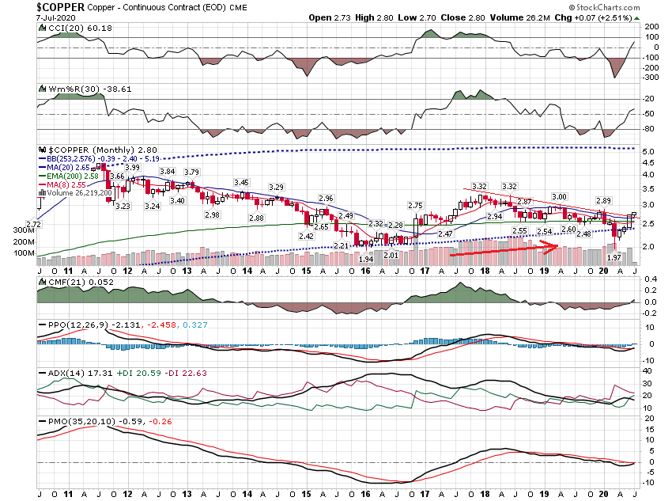

Slide 10
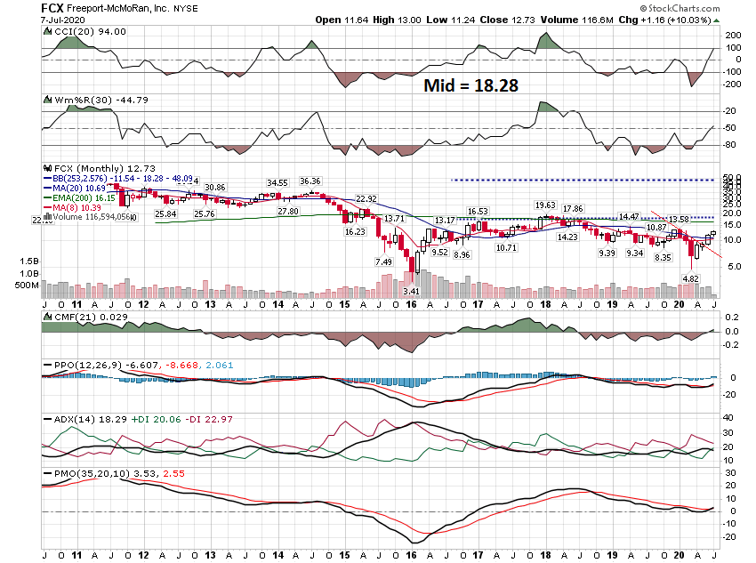

Slide 11
Daily Charts

Slide 12
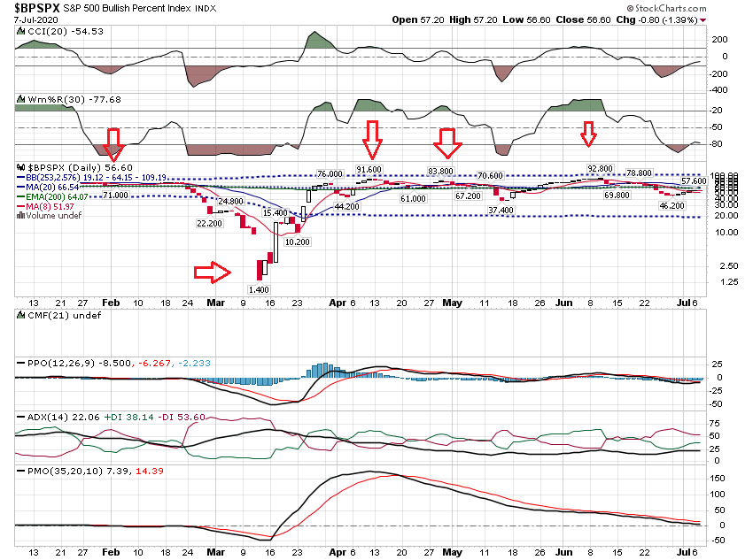

Slide 13
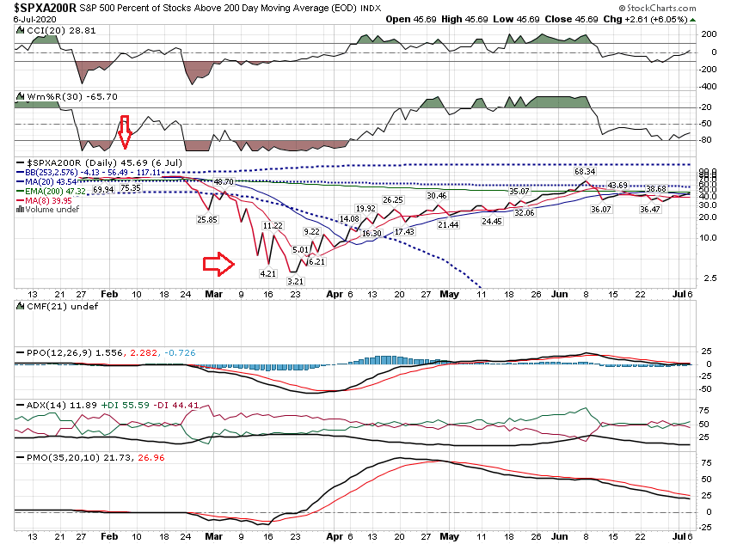

Slide 14
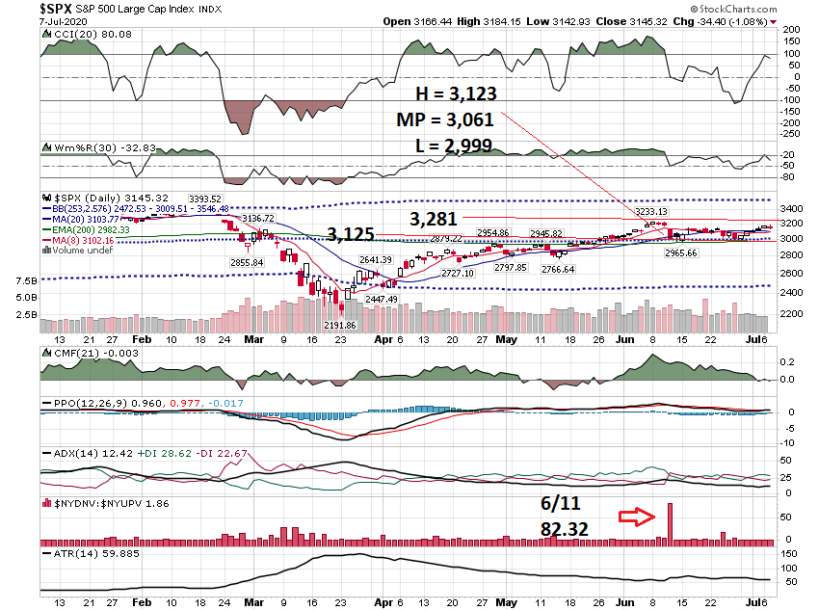

Slide 15
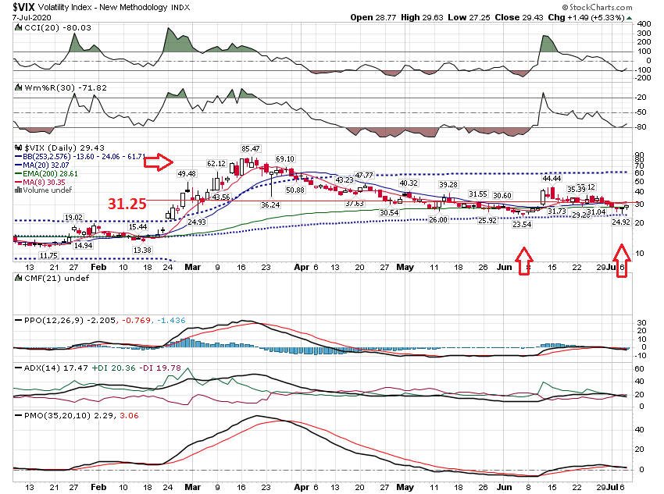

Slide 16
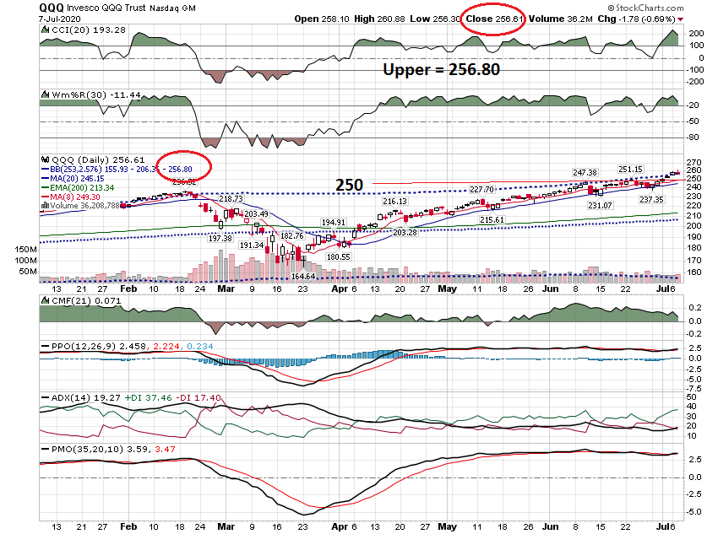

Slide 17
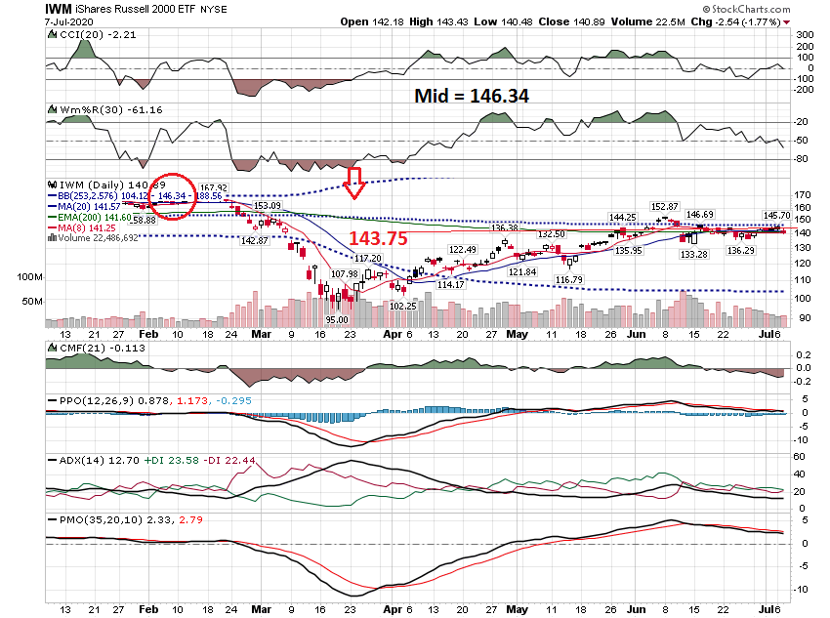

Slide 18
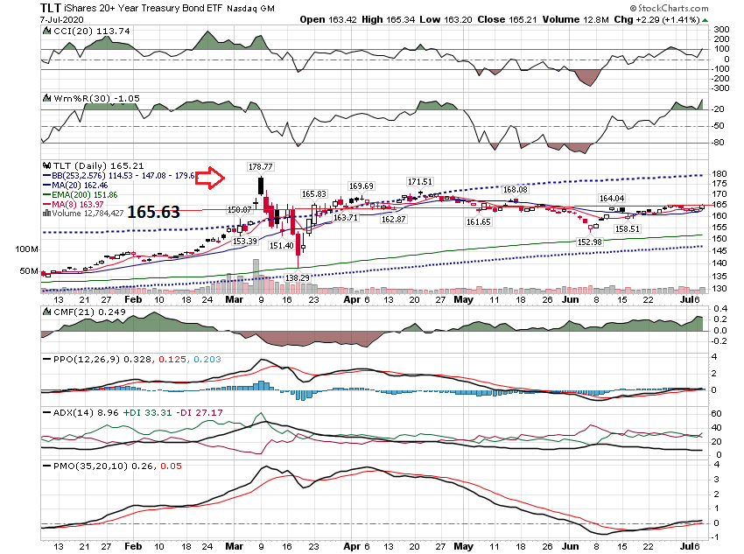

Slide 19
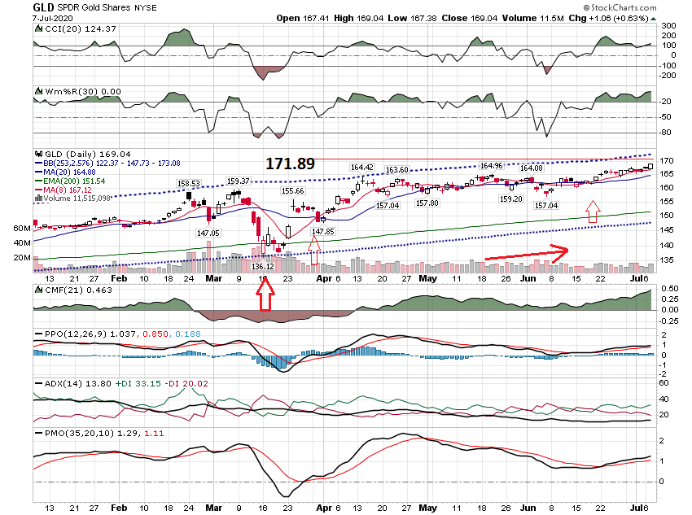

Slide 20
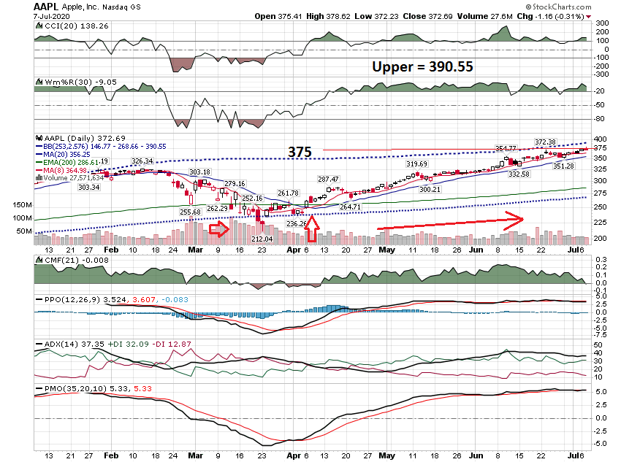

Slide 21
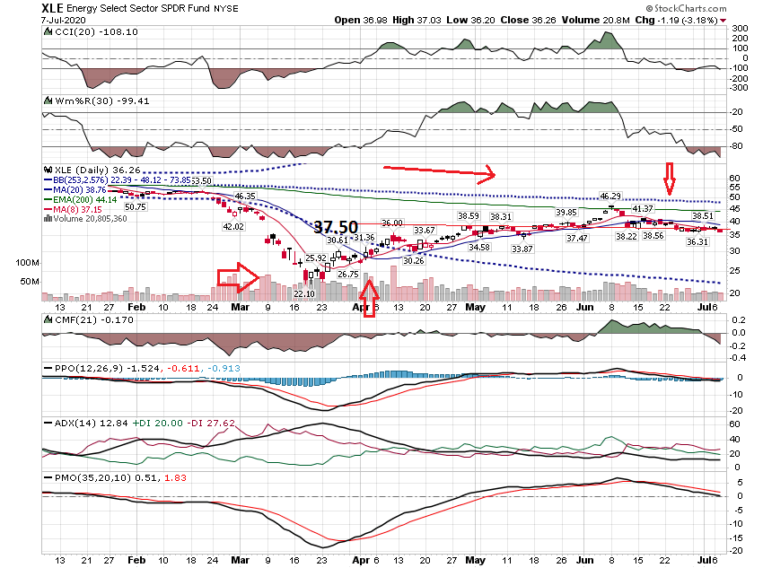

Slide 22
60 Minute Chart

Slide 23
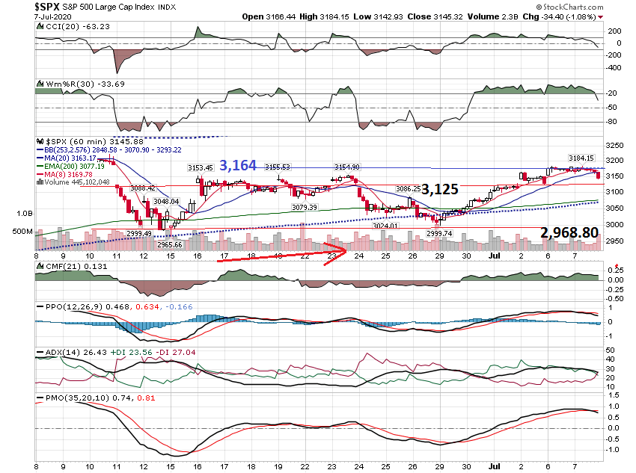

Slide 24
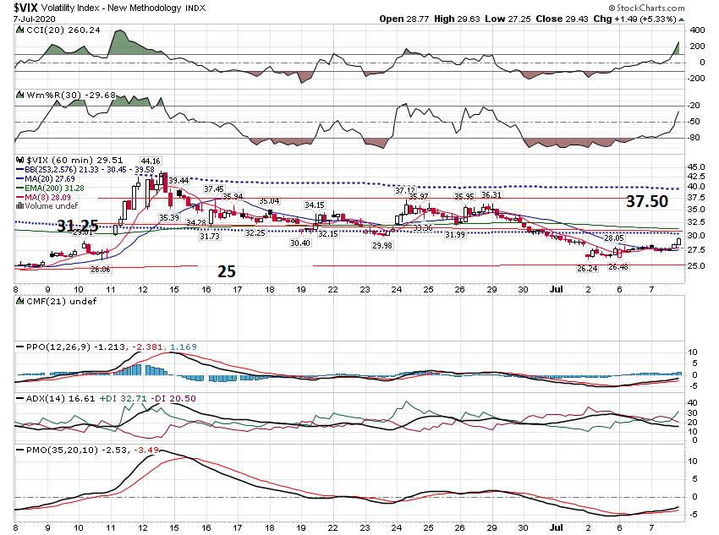

Slide 25
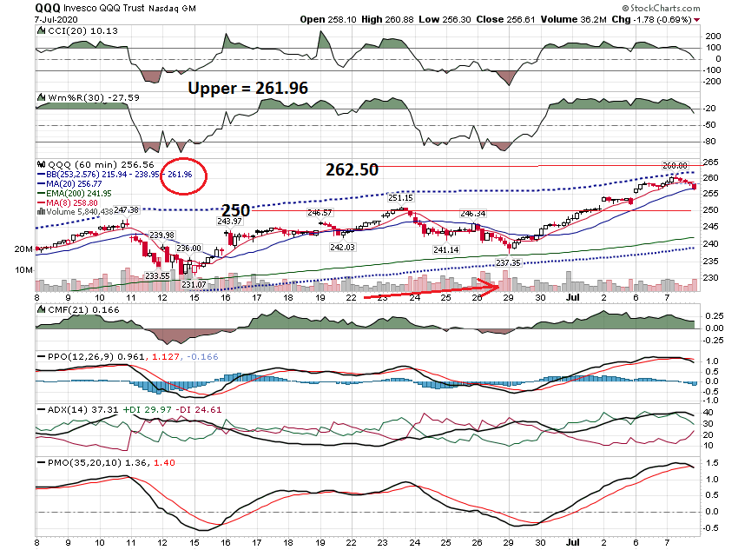

Slide 26
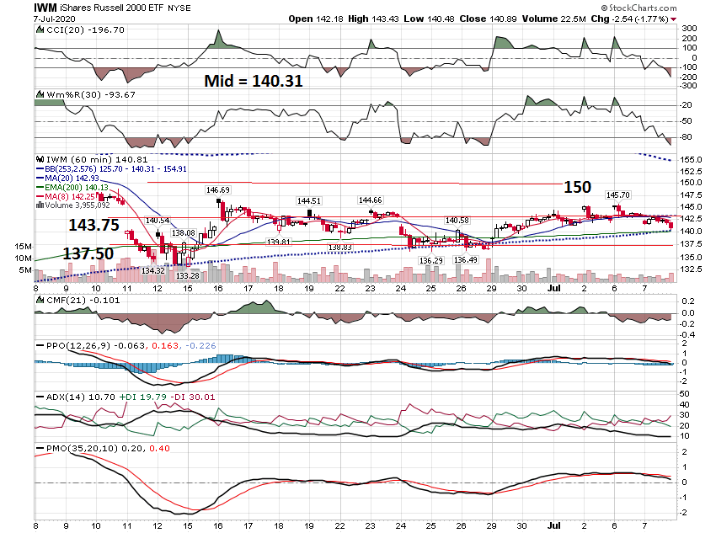

Slide 27
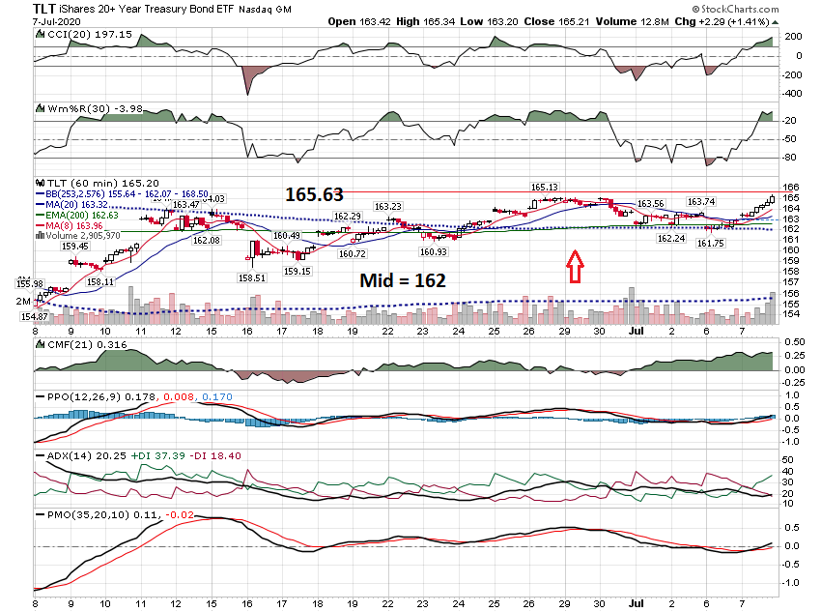

Slide 28
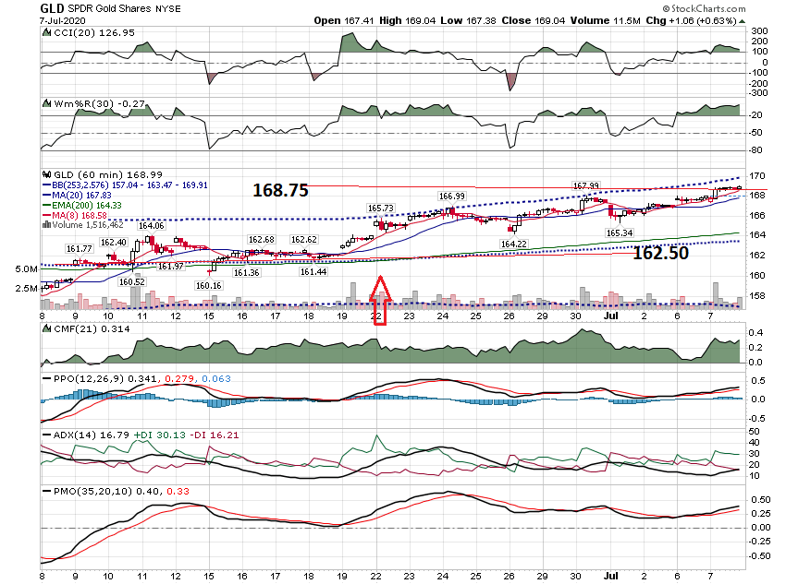

Slide 29
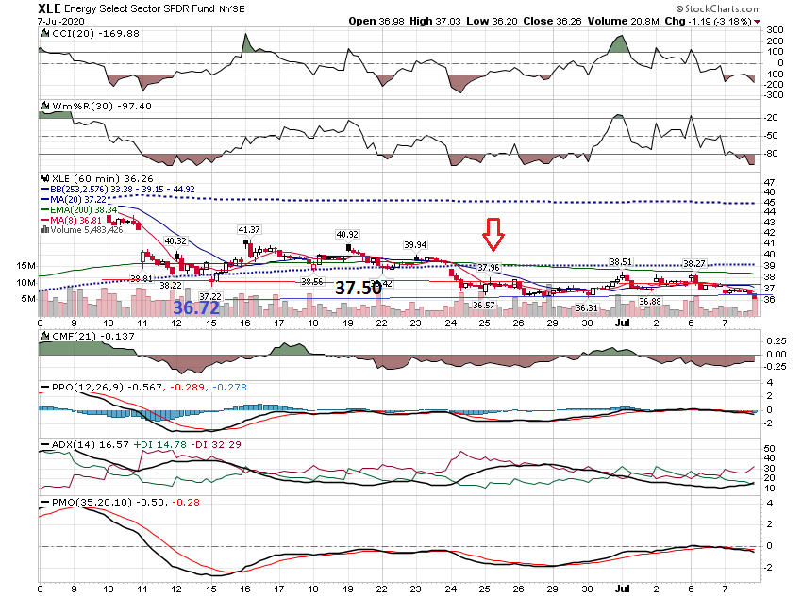

Slide 30
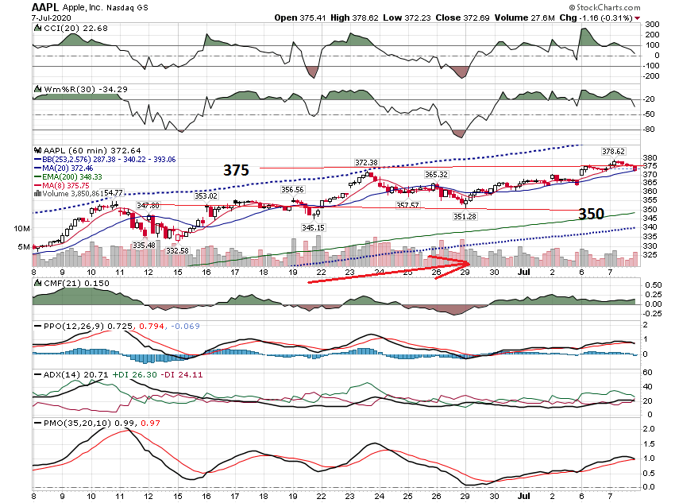

Slide 31
Hedging

Slide 32
Buy Write with Put Protection Trade Structure Stock Price $32.95 Sell July 23rd-$33 Call @ $1 Buy July 23rd-$30.50 Put @ $.24

Slide 33
Settles at $33.50 – Assignment - $.55 Net Option - $.76 Total Profit - $1.31 Return = 4%

Slide 34
Settles at $31.00 – Net Option Premium - $.76 Adjusted Basis – 32.95 - .76 = 32.19 Loss = 1.19 or 3.7%

Slide 35
FCX $12.73 Sell July 31st - $13 Call @ $.70 Buy July 21st - $11.50 Call @ $.35 If Assigned - Profit = $.62 or 4.9% Price Closes at $12 Profit Booked = $.35 Break even = $12.38 Price drops under $11.50 & Closes at $11. Net Call Premium $.35 Net Put Value $.50 Profit = $.85 Cost = $.35 Net = $.50 Loss on Stock = $1.23 Net Loss = $.73 per share or 5.7% Loss without Call & Hedge = 13.5%

Slide 36
FCX $12.73 Sell July 31st - $13 Call @ $.70 Buy July 21st - $11.50 Call @ $.35 If Assigned - Profit = $.62 or 4.9% Price Closes at $12 Profit Booked = $.35 Break even = $12.38 Price drops under $11.50 & Closes at $11. Net Call Premium $.35 Net Put Value $.50 Profit = $.85 Cost = $.35 Net = $.50 Loss on Stock = $1.23 Net Loss = $.73 per share or 5.7% Loss without Call & Hedge = 13.5%

Slide 37
Married Put Strategy FCX

Slide 38
Stock Symbol |  | FCX
Cost of Stock |  | 12.73
Cost of Put – Sept 2020 Strike |  | 1.45
Total Investment |  | 14.18
Guaranteed Exit Price |  | 13.00
Total At Risk |  | $1.18
% at Risk |  | 8.32%
Cost of Put/Cost of Stock |  | 11%
# of Months to Expiration |  | 2
Put Purchased |  | 8-Jul

Slide 39
# of Months to Expiration |  | 2
Put Purchased |  | 8-Jul
Sell Sept $15 call |  | $0.50
Adjusted Risk |  | $0.68
Risk % |  | 5.3%

Slide 40
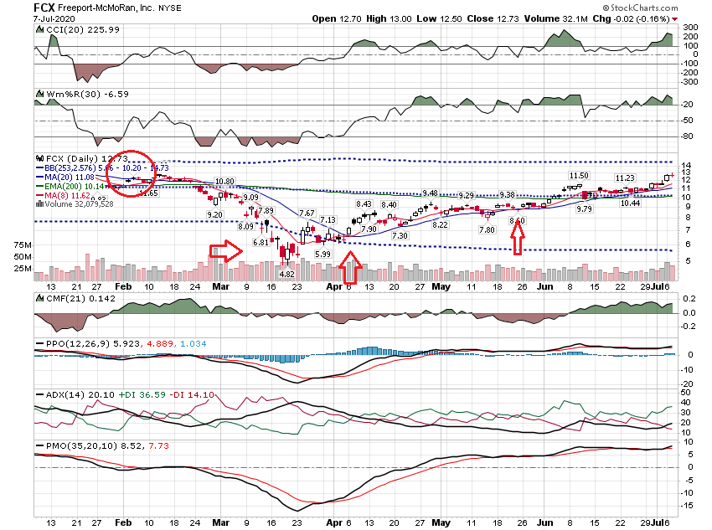

Slide 41
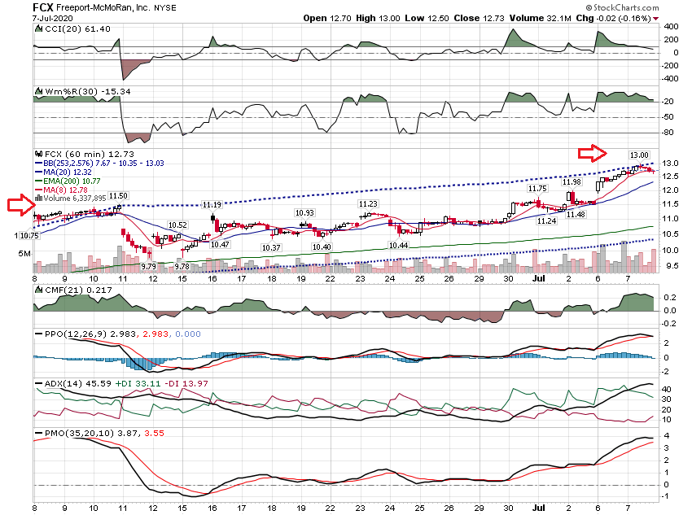

Slide 42
If you would like an Excel Spreadsheet that analyzes the Collared / Married Put trade structure, send an email: Davismdt@gmail.com

Slide 43
Thanks for watching! Bill Davis Mad Day Trader July 8, 2020 davismdt@gmail.com

