Slide 1
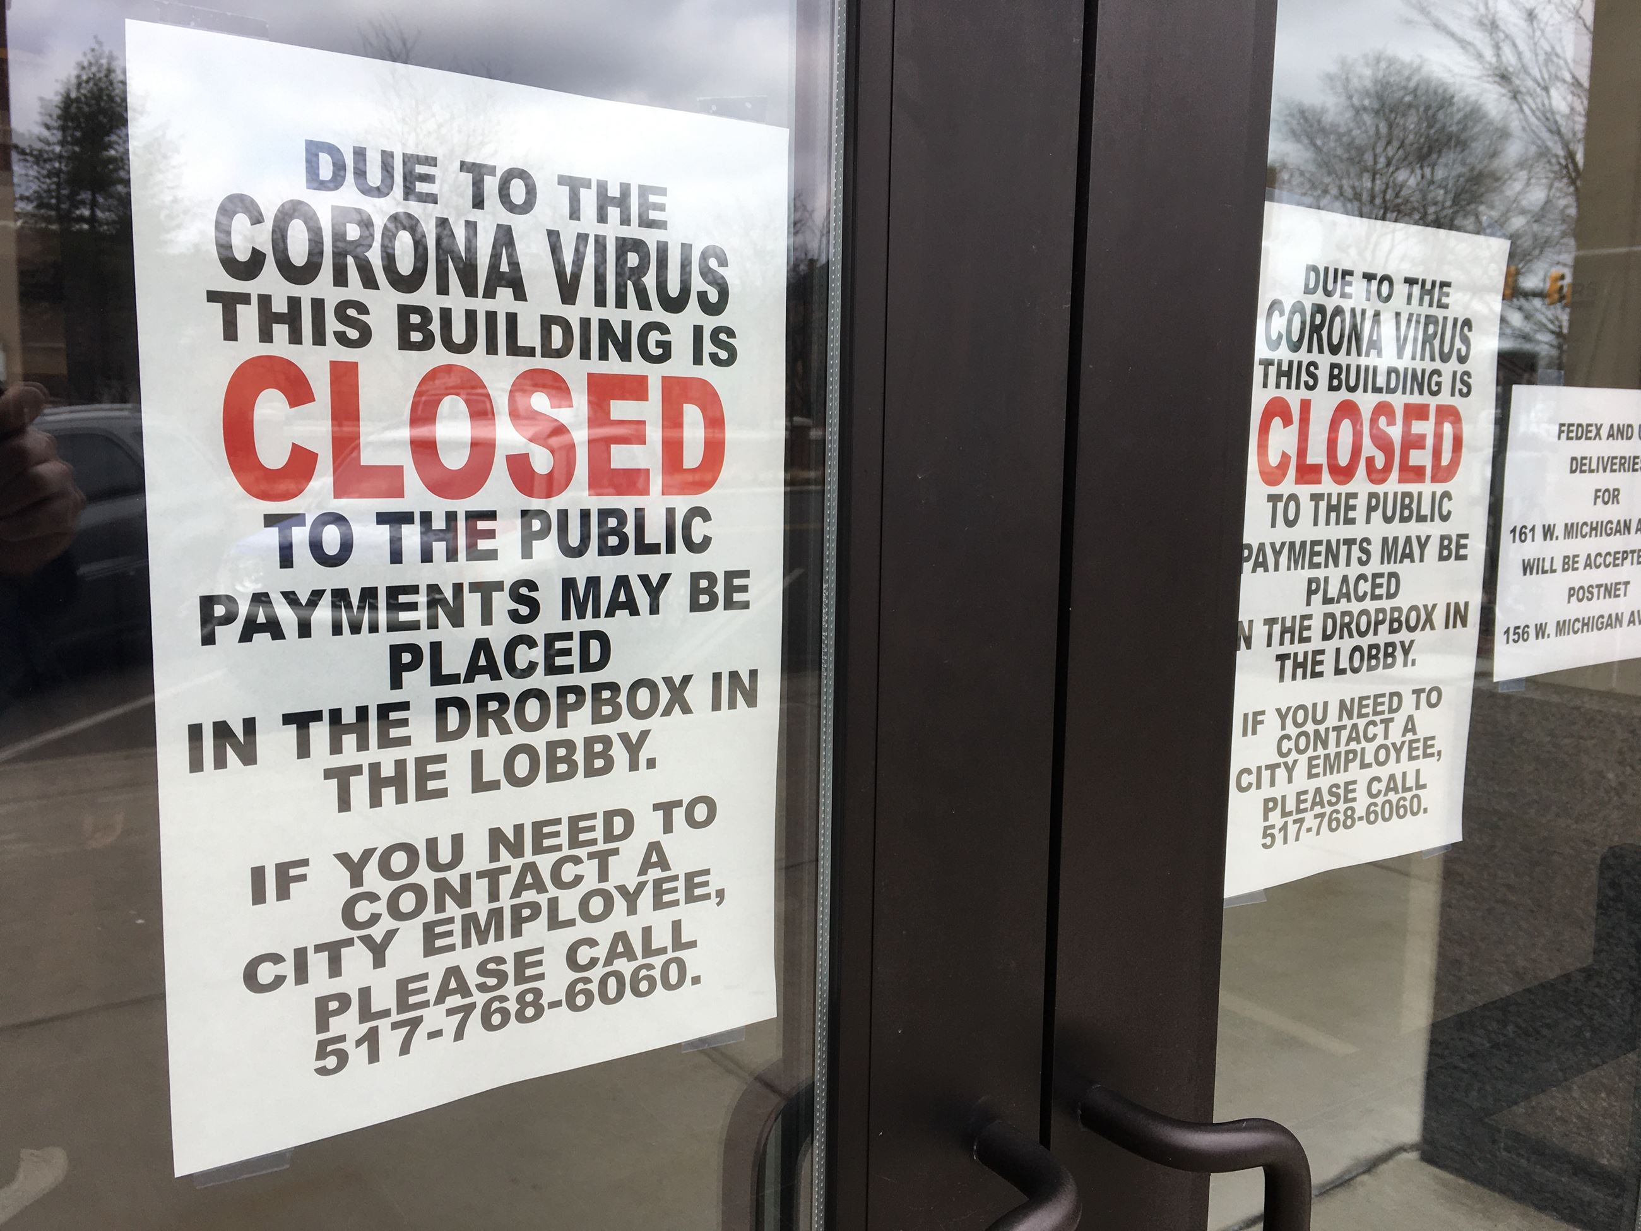
The Mad Hedge Fund Trader “Covid is Back!”
With John Thomas from Silicon Valley, CA, July 1, 2020 www.madhedgefundtrader.com
Notes:
*

Slide 2
Trade Alert Performance New All Time High! – A record 82 Trade Alerts since April 1
*January 3.13% Final *July +0.28% MTD *February -6.05% Final *August +16.01% Final *March -5.50% Final *September 3.08% Final *April +4.55% Final *October +12.13% Final *May +14.19% Final *November -1.26% Final *June +10.38% Final *December +4.97% Final *Year to date +20.70% compared to -9.4% for the Dow Average *+376.61% since inception, a new all time high *Average annualized return of 35.58% for 11 years

Slide 3
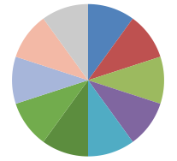
Portfolio Review Staying Aggressively “RISK ON” in Rising Market,
Risk On
World is Getting Better
(TLT) 7/$168-$171 put spread | 10.00%
(SPY) 7/$260-$270 call spread | 10.00%
(TSLA) 7/$750-$800 call spread | 10.00%
(SGEN) 7/140-$145 call spread | 10.00%
(AMZN) 7/$1,500-$1,550 call spread | 10.00%
(AAPL) 7/$320-$330 call spread | 10.00%
(ILMN) 7/$320-$330 call spread | 10.00%
Risk Off
World is Getting Worse
(TLT) 7/$151-$154 call spread | -10.00%
(SPY) 7/$335-$340 put spread | -10.00%
(GLD) 7/$157-$160 call spread | -10.00%
Total Net Position | 40.00%
Expiration P&L +25.97% YTD

Slide 4
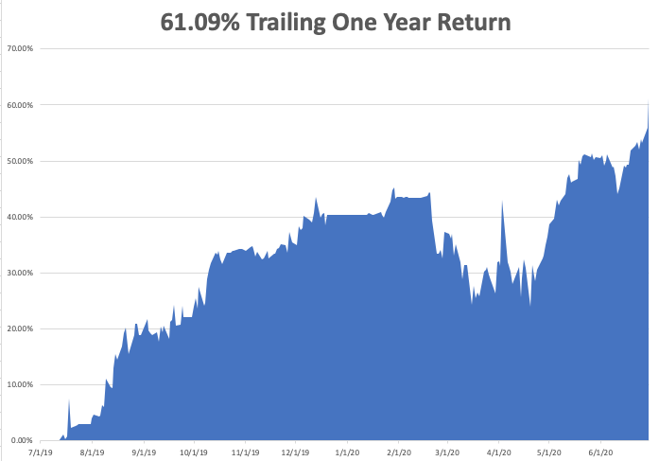

Slide 5
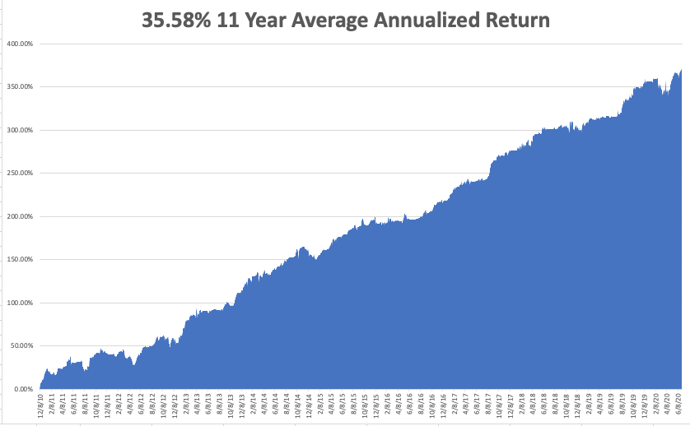
GTD 10 Year Daily Audited Performance

Slide 6
The Method to My Madness
*The Fed has proven its intention to step in and run the printing presses on any 10% market correction, which is imminent *Stocks still overpriced after a 10% correction *A bond short is far and away the better trade based on massive over issuance of US government bonds and now we have a big rally to sell into *The big fear remains for a second larger Corona spike now, with a second bigger one in the fall *Gold is breaking out from hedging demand *The US dollar is toast because of exploding deficits *Best buying opportunity of the decade is setting up, the next big dip is the one you buy

Slide 7
Corona Update
*US cases top 2.7 million, deaths at 129,000 and new cases are exploding in 25 states *New CDC Forecasts Calls for 250,000 US Deaths by August, or 2,500 a day *Arizona and Texas hospitals are getting overwhelmed, returning field hospitals *New wave is spreading to younger victims, so the death rate is falling under 1% *At least five companies are close to delivering a vaccine in a year, as trillions are poured into the sector *All companies will be involved in production to quickly turn out one billion vaccine doses *A true vaccine is years off, or never

Slide 8
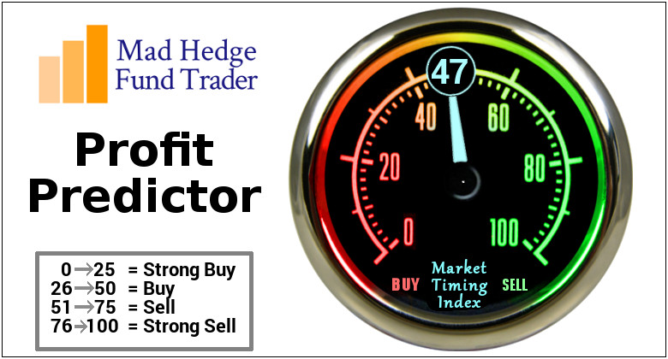
The Mad Hedge Profit Predictor Market Timing Index-Bottom of Range-at to a “BUY” An artificial intelligence driven algorithm that analyzes 30 different economic, technical, and momentum driven indicators

Slide 9
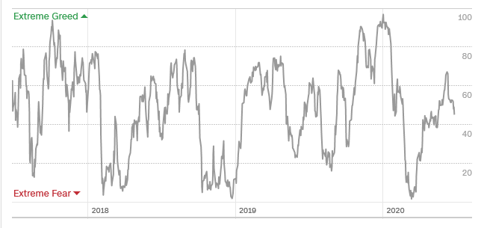
The Mad Hedge Profit Predictor From Extreme Overbought to Oversold
SELL
BUY

Slide 10
The Global Economy – From a “V” to a “W”
*Recovery is shifting from a “V” to a “W” as another wave of shutdowns hobbles the economy *The unemployment rate is about to soar, as PPP and state unemployment money runs out *The new Great Depression deepens, with 43 million new unemployed in ten weeks, and the Fed targeting 52 million. Some 20% of these jobs are never coming back *Weekly Jobless Claims Hit 1.5 Million, still falling but still horrendous. *Will the next $1 trillion stimulus package go straight into the stock market?

Slide 11
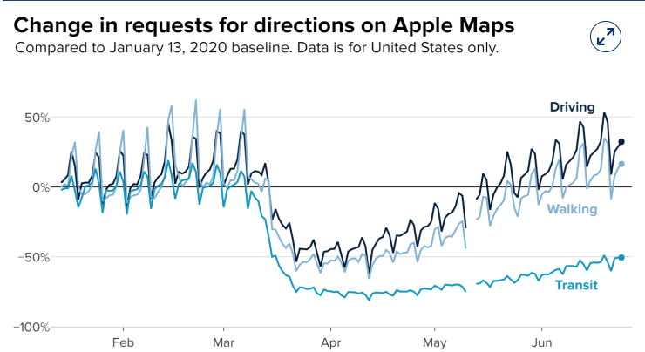

Slide 12
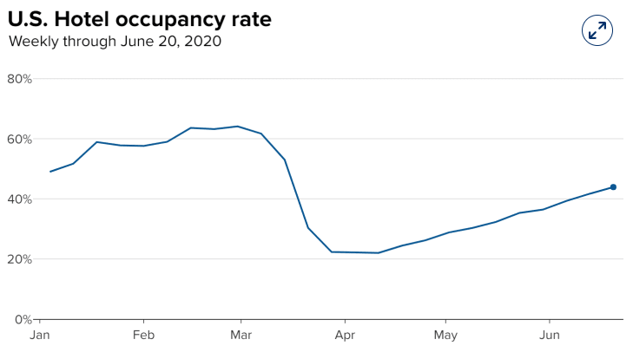

Slide 13
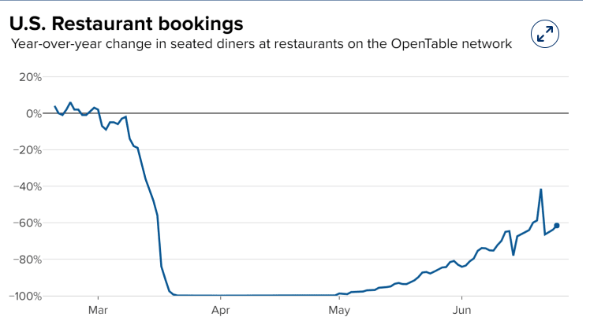

Slide 14
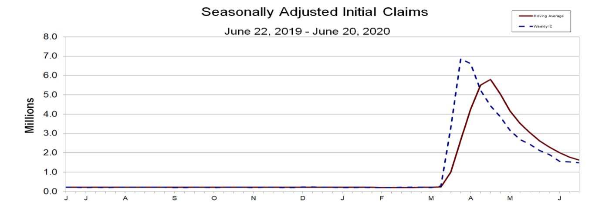
Weekly Jobless Claims - Disaster +1.5 Million to 44 million, One out of Four Already Surpassed Great Depressions Peak

Slide 15
The Bill Davis View A $1,500 Upgrade for the Mad Day Trader Service
Buys: | Entry | Target
TreeHouse Foods Inc. (THS) | $ 43.00 | $ 52.00
VeriSign, Inc. (VRSN) | $ 206.00 | $ 230.00
Scotts Co. (SMG) | $ 134.00 | $ 148.00
Keysight Technologies Inc. (KEYS) | $ 98.00 | $ 110.00
Moelis & Company (MC) | $ 32.00 | $ 40.00
Sells:
Facebook, Inc. (FB) | $ 231.00 | $ 198.00
Moody's Corp (MCO) | $ 266.00 | $ 235.00
Dollar Tree,Inc. (DLTR) | $ 93.00 | $ 70.00
Workiva Inc. (WK) | $ 55.00 | $ 46.00
Resmed, Inc. (RMD) | $ 192.00 | $ 170.00

Slide 16
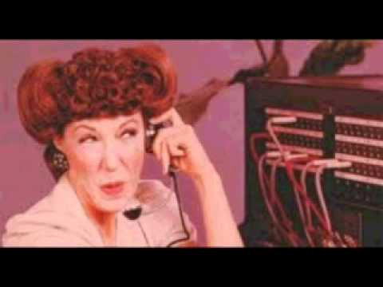
Stocks – The Reclosing Trade
*Corona fears trigger first market correction in three months, knocking 10% off (SPY), 4.8% off NASDAQ and that tells the whole story *Big short squeeze puts in a classic market top, with small lot retail buying as a turbocharger *Reopening sectors take biggest dive, like airlines, casinos, and cruise lines, then bounce back *Banks banned from paying dividends and buying back shares, *The market is not close to reflecting the long-term damage to the economy *We could be entering a wide $2,700 - $3,200 range until the election

Slide 17
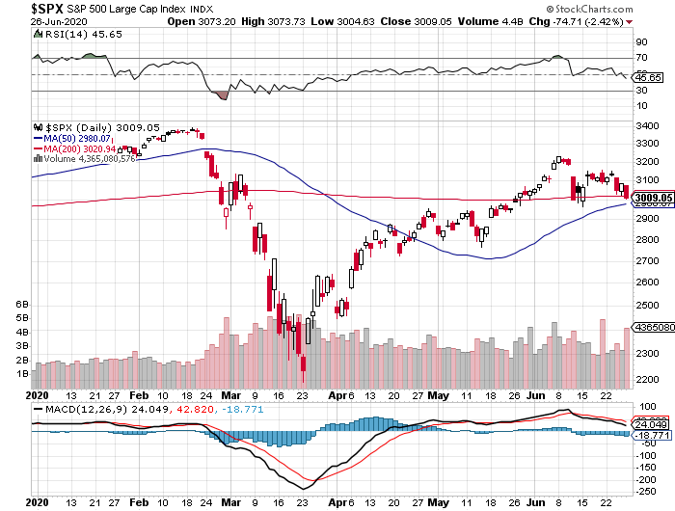
S&P 500 – Trending sideways stopped out of long 7/$320-$330 bear put spread long 6/$235-$245 bull call spread took profits on long 4/$280-$290 bear put spread took profits on long 4/$275-$280 bear put spread
New Highs
The Bottom 2,700

Slide 18
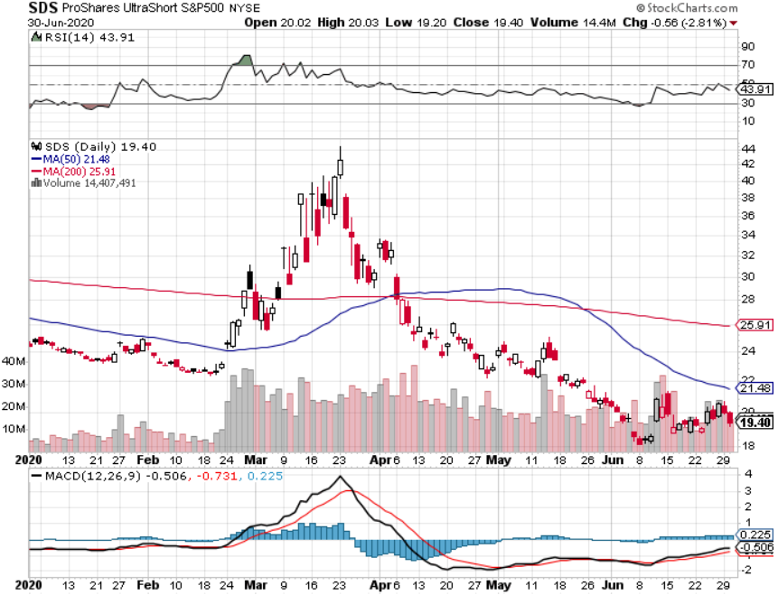
ProShares Ultra Short S&P 500 (SDS)- a Great Hedge for long stocks and bonds Long 2X position has a hedge against longs and bond shorts

Slide 19
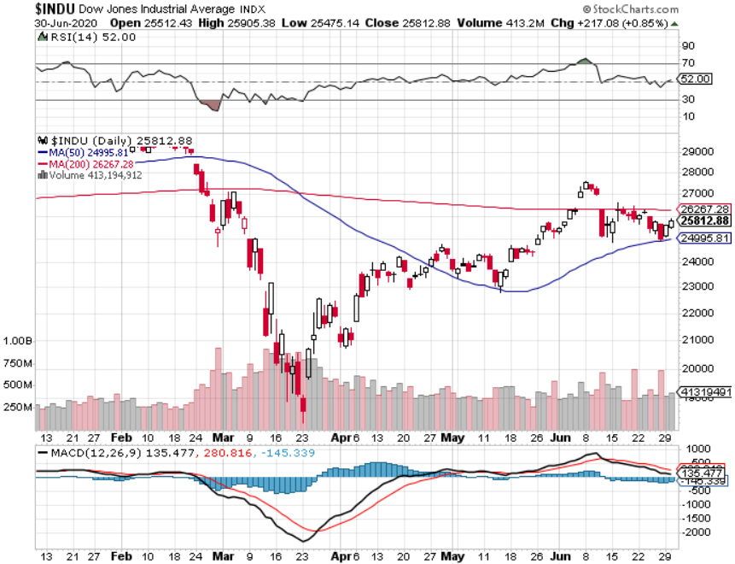
Dow Average ($INDU)-

Slide 20
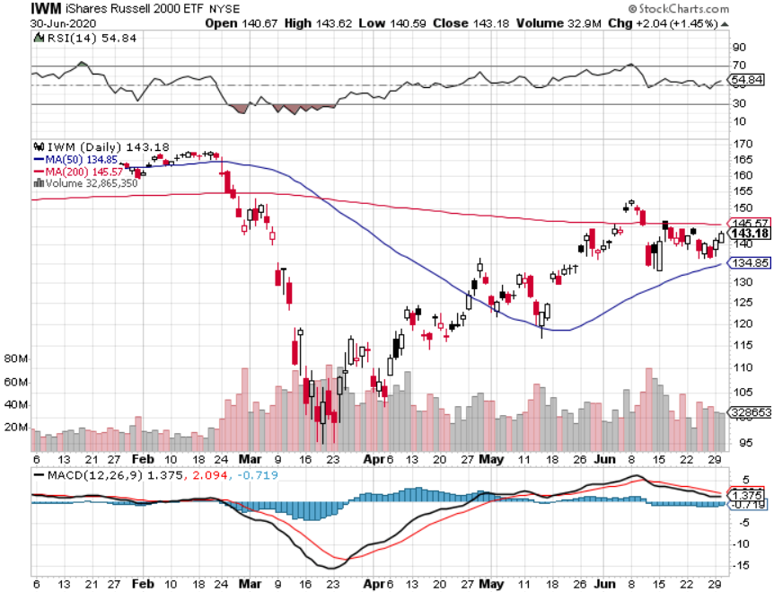
Russell 2000 (IWM)- took profits on Long 10/$137-$142 vertical bull call spread took profits on Long 10/$153-$156 vertical bear put spread

Slide 21
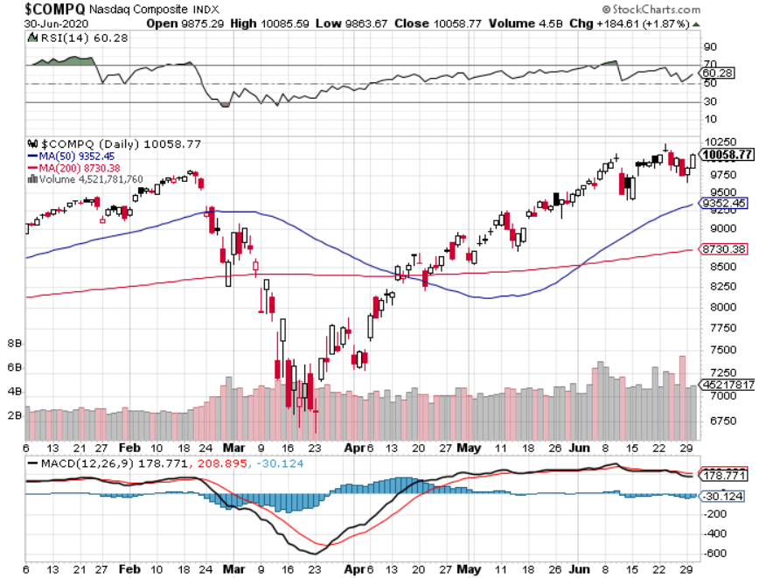
NASDAQ ($COMPQ) – Peaking Out

Slide 22
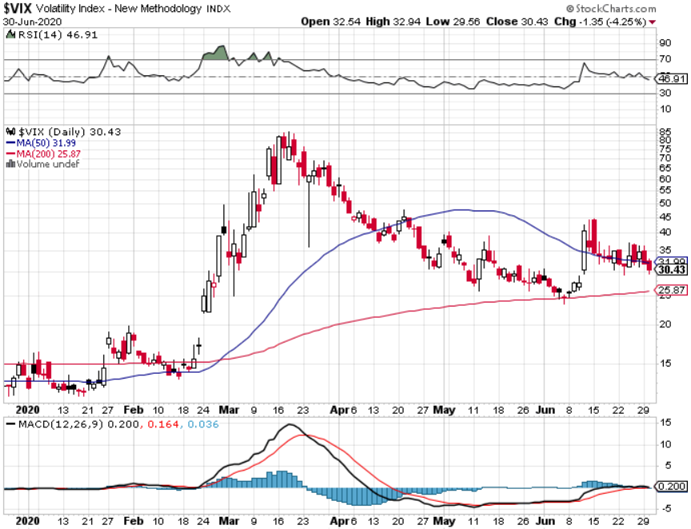
(VIX)-Big Rally

Slide 23
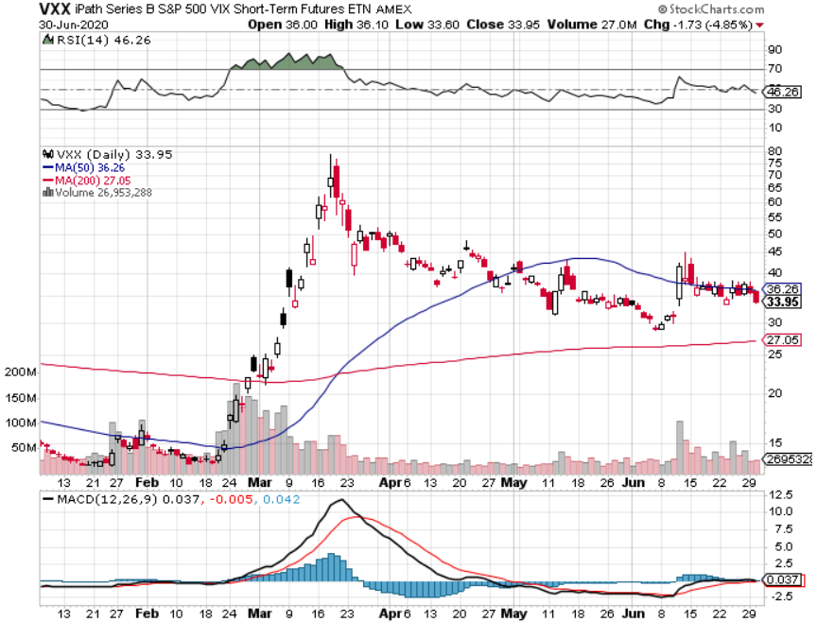
(VXX)- Sell Rallies-Down $85 to $26 from top stopped out of long 1/2021 $16 puts stopped out of long 1/2021 $24 puts

Slide 24
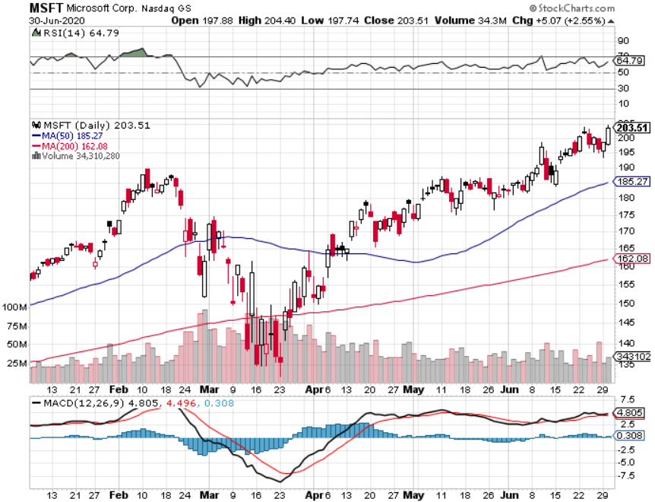
Microsoft (MSFT)- Earnings beat- Looking for Another Entry Point Stopped out of long 4/$120-$130 call spread took profit on long 4/$120-$130 call spread stop loss on long 12/$170-$180 call spread took profits on long 12/$135-$138 call spread

Slide 25
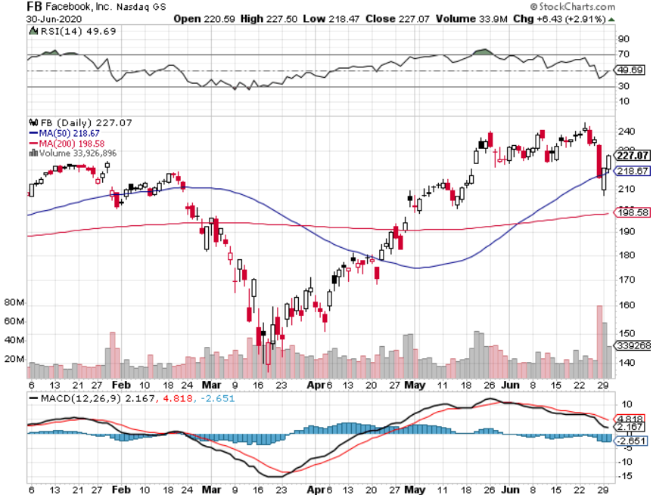
Facebook (FB)- Breaking Down on Ad Boycott stopped out of Long 9/$190-$200 vertical bear put spread took profits on Long 9/$145-$155 vertical bull call spread took profits on Long 9/$150-$160 vertical bull call spread took profits on Long 8/$167.50-$172.50 vertical bull call spread

Slide 26
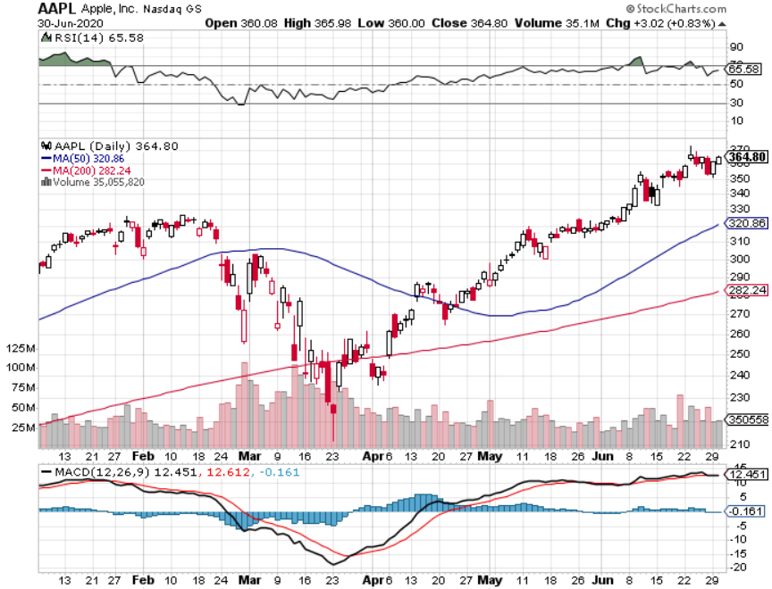
Apple (AAPL)- New Highs long 7/$320-$330 call spread took profits on long 4/24/$250-$260 call spread took profits on long 5/$250-$260 call spread took profits on long 4/$250-$260 call spread took profits on long 3/$250-$260 call spread

Slide 27
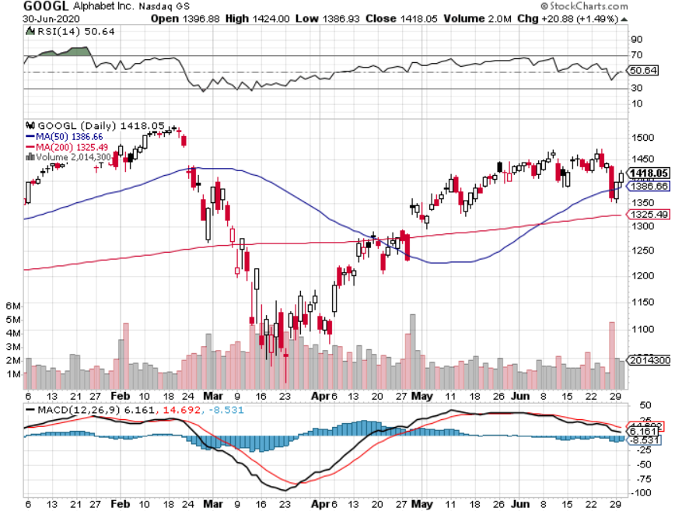
Alphabet (GOOGL) – Europe Antitrust took profits on long 12/$1,200-$1,230 bull call spread took profits on long 9/$1,030-$1,080 vertical bull call spread stopped out of long 5/$1,100-$1,130 bull call spread took profits on long 4/$1,080-$1,120 bull call spread

Slide 28
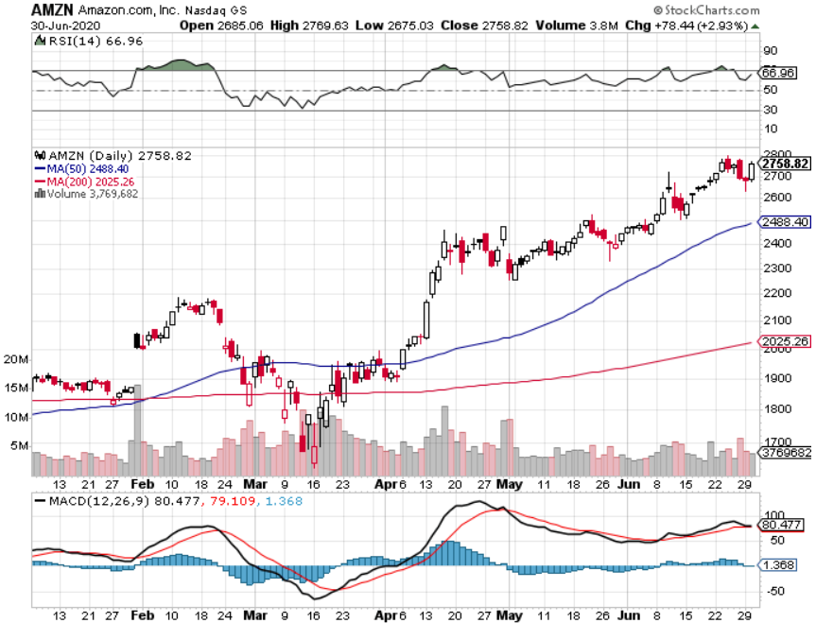
Amazon (AMZN) – New Highs long 4/$1,500-$1,550 bull call spread took profits on long 4/$1,600-$1,650 bull call spread stopped out of long 3/$1,700-$1,800 bull call spread took profits on 9/$1,500-$1,500 bull call spread

Slide 29
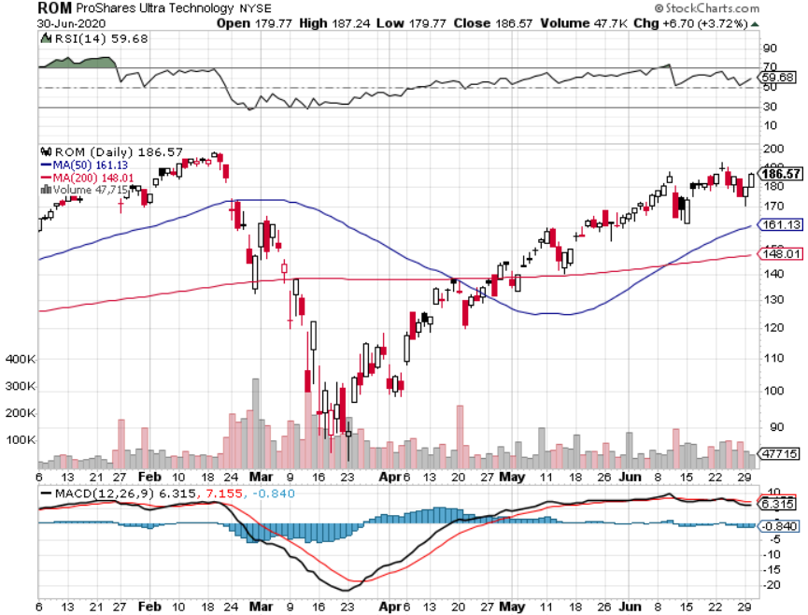
ProShares Ultra Technology (ROM) – Up 110% in 10 Weeks stopped out of long at $100.10

Slide 30
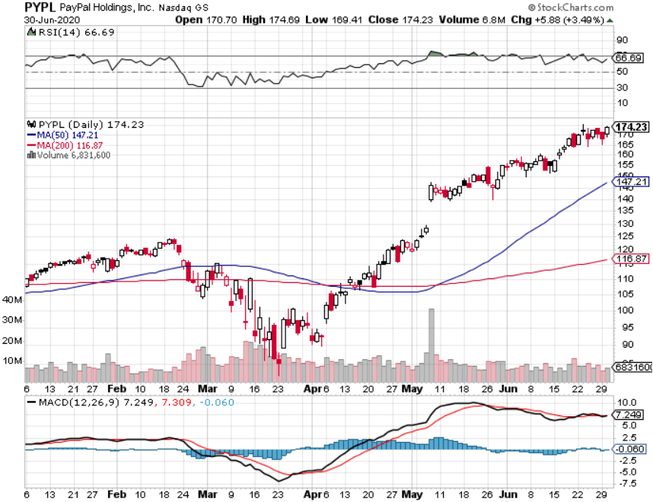
PayPal (PYPL)-Fintech Rules took profits on long 4/$90-$95 call spread

Slide 31
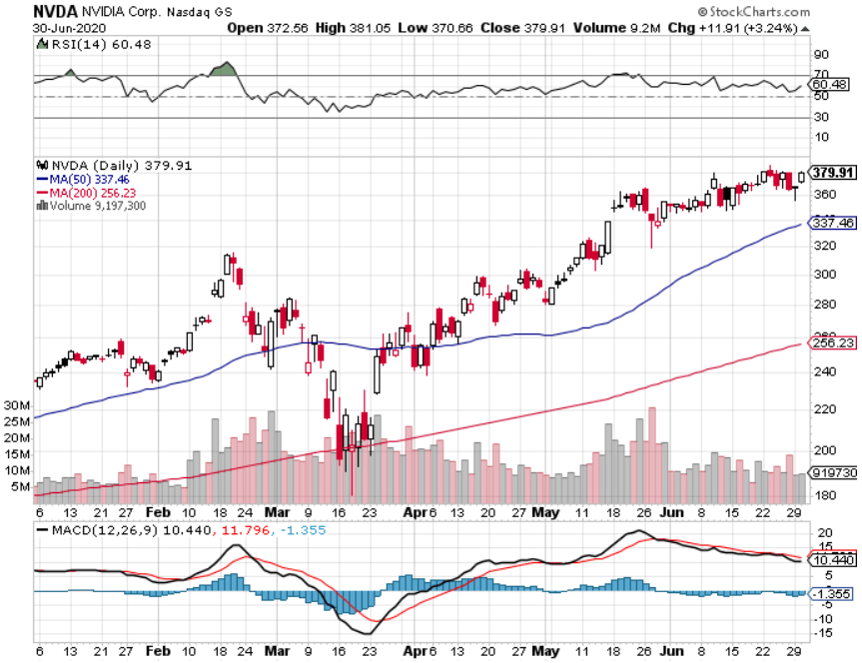
NVIDIA (NVDA) – New Highs on 39% Jump in Earnings

Slide 32
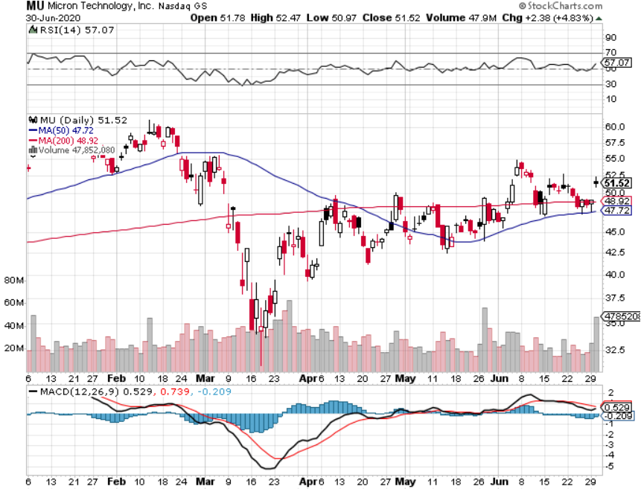
Micron Technology (MU)-Ditto

Slide 33
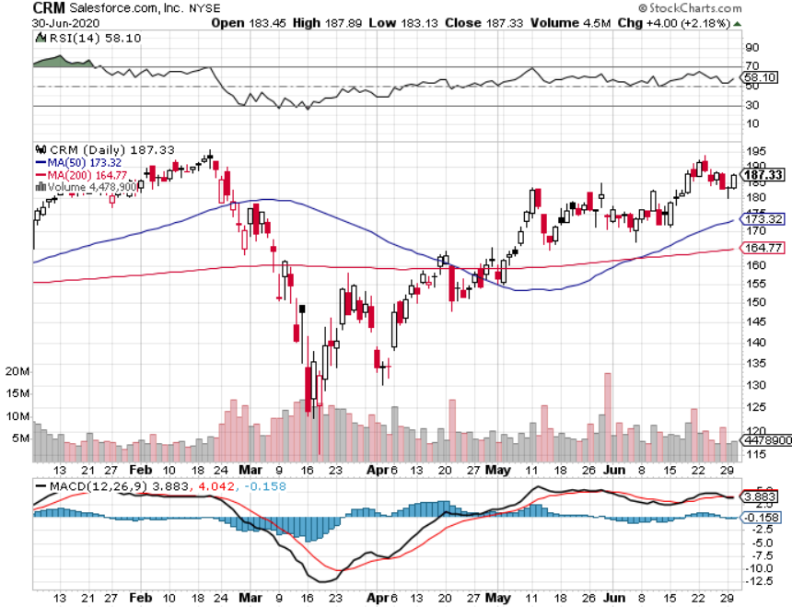
Salesforce (CRM)- Massive Online Migration took profits on long 9/$125-$130 vertical bull call spread took profits on long 8/$125-$130 vertical bull call spread took profits on long 2/$105-$115 call spread

Slide 34
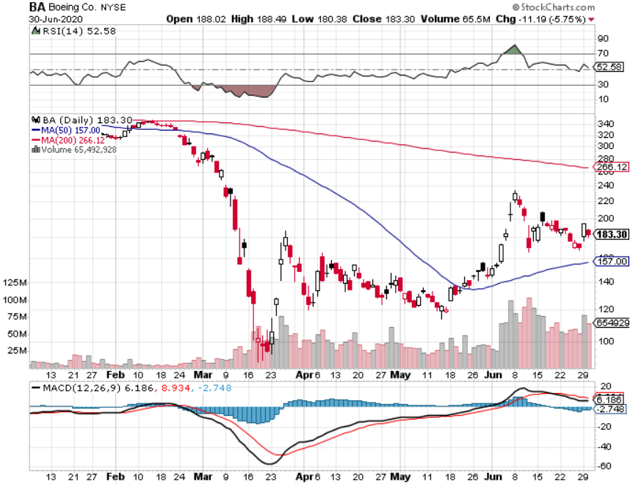
Boeing (BA) –GM Or Bank Style Takeover? 737 MAX production shutdown-Criminal investigation took profits on long 2/$270-$280 call spread took profits on long 12/$310-$330 call spread took profits on long 4/$300-$310 call spread took profits on long 4/$315-$335 call spread

Slide 35
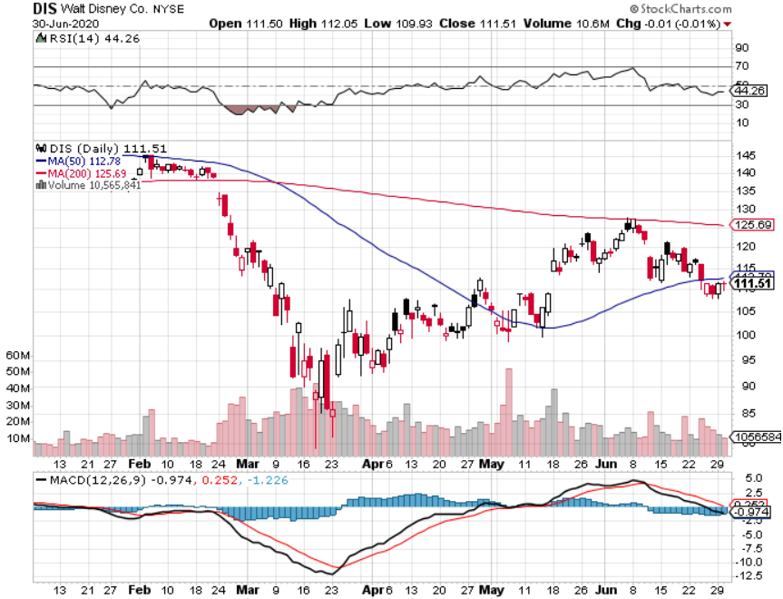
Walt Disney (DIS)- Corona Hit long 9/$120-$125 put spread took profits on long 6/$85-$90 call spread

Slide 36
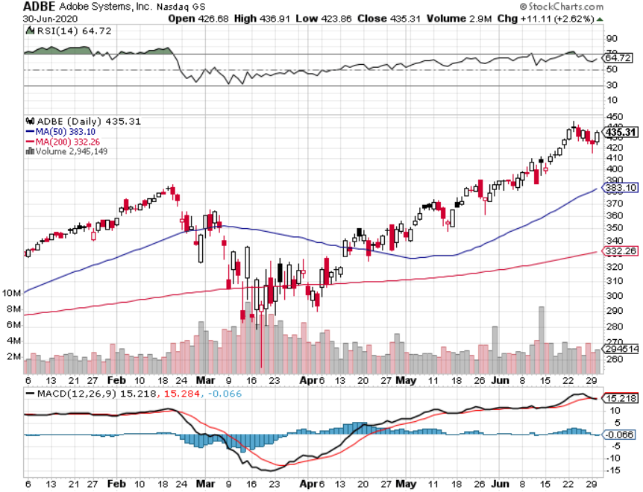
Adobe (ADBE)- The Quality Non-China tech play

Slide 37
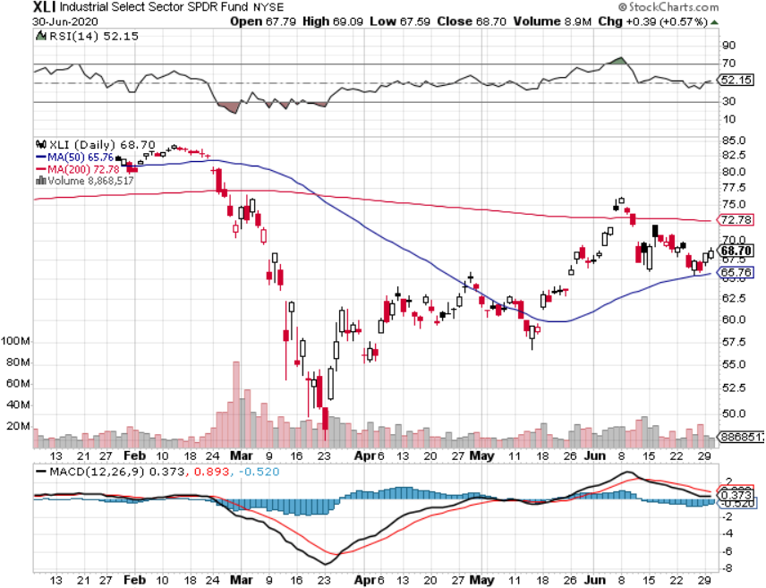
Industrials Sector SPDR (XLI)- (GE), (MMM), (UNP), (UTX), (BA), (HON)

Slide 38
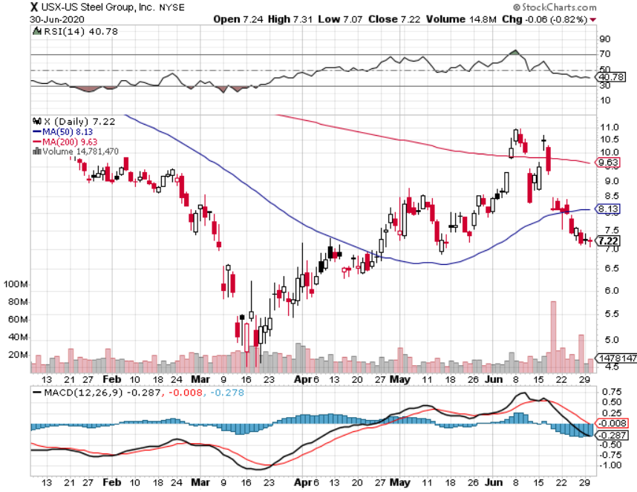
US Steel (X)-Tariffs Trouble

Slide 39
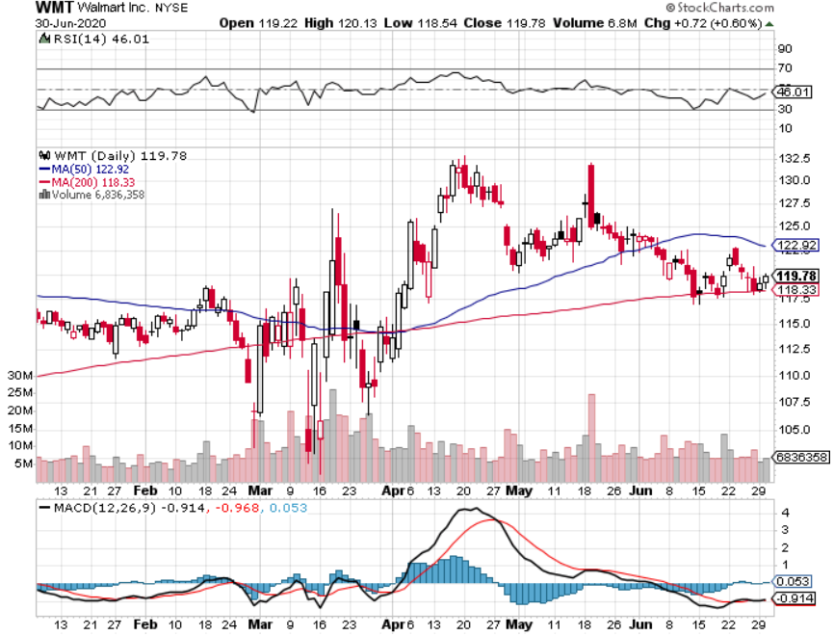
Wal-Mart (WMT)-Hiring 150,000 took profit on Long 11/$125-$130 bear put spread took profit on Long 10/$119-$121 bear put spread took profits on Long 8/$114-$117 bear put spread

Slide 40
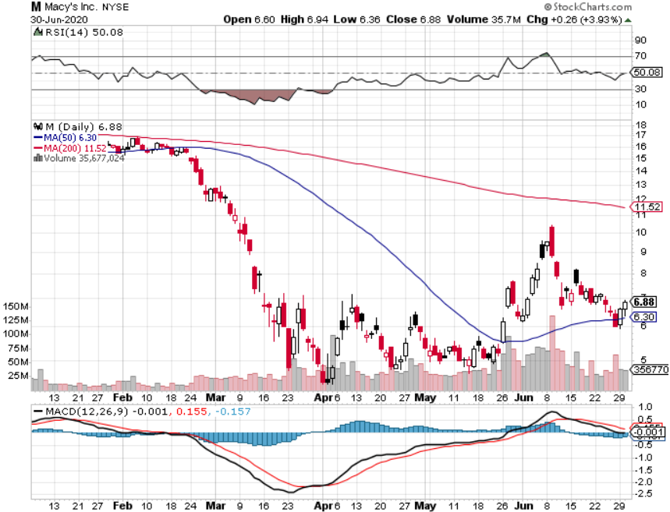
Macys’ (M) – $4.5 Billion Loan took profits on Long 8/$23-$25 bear put spread

Slide 41
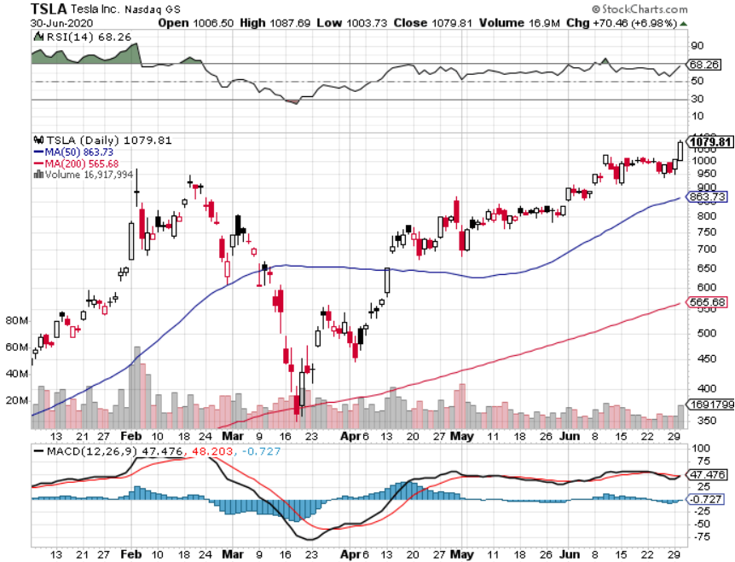
Tesla (TSLA)-New Highs Model Y will be a blockbuster stopped out of long 6/$260-$270 put spread took profits on long 6/$140-$150 call spread took profits on long 6/$240-$250 put spread

Slide 42
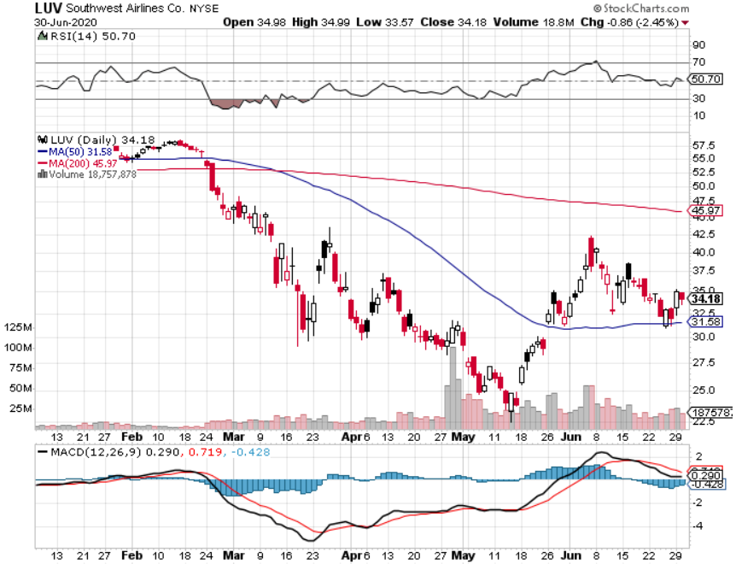
Southwest Airlines (LUV) – Warren Buffett big seller

Slide 43
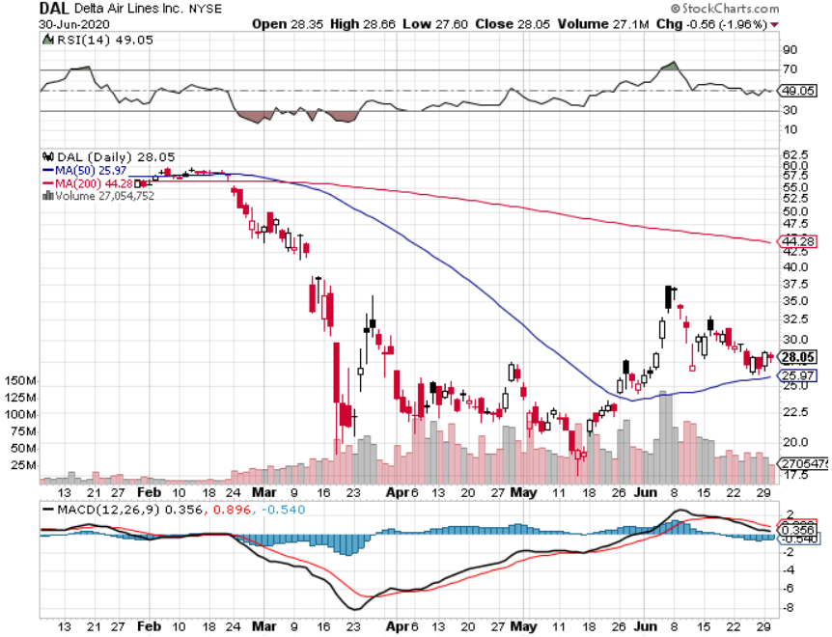
Delta Airlines (DAL) – Warren Buffett big seller

Slide 44
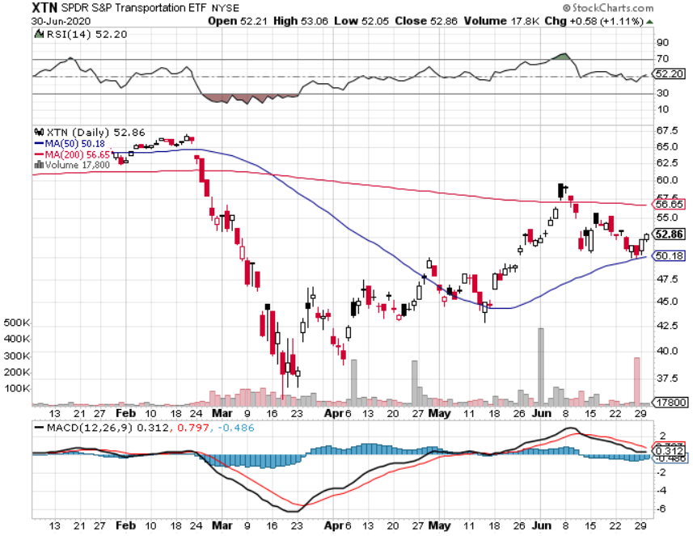
Transports Sector SPDR (XTN)- Worst Hit Sector (ALGT), (ALK), (JBLU), (LUV), (CHRW), (DAL)

Slide 45
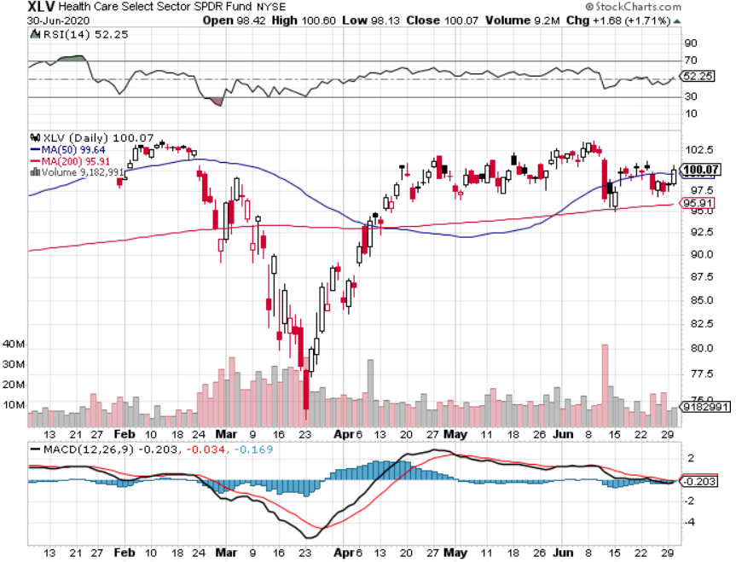
Health Care Sector (XLV), (RXL)-New Highs (JNJ), (PFE), (MRK), (GILD), (ACT), (AMGN) The new favorite sector

Slide 46
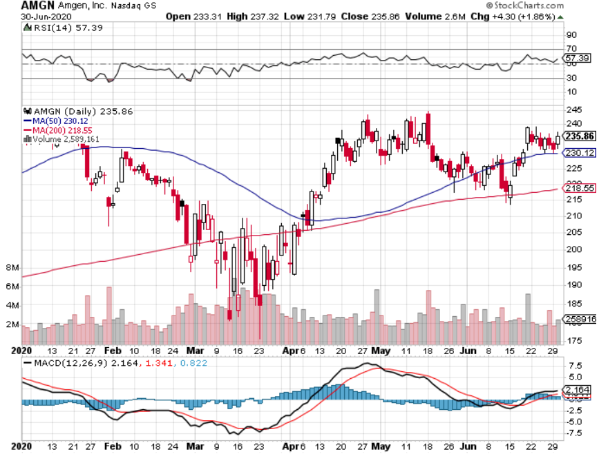
Amgen (AMGN)

Slide 47
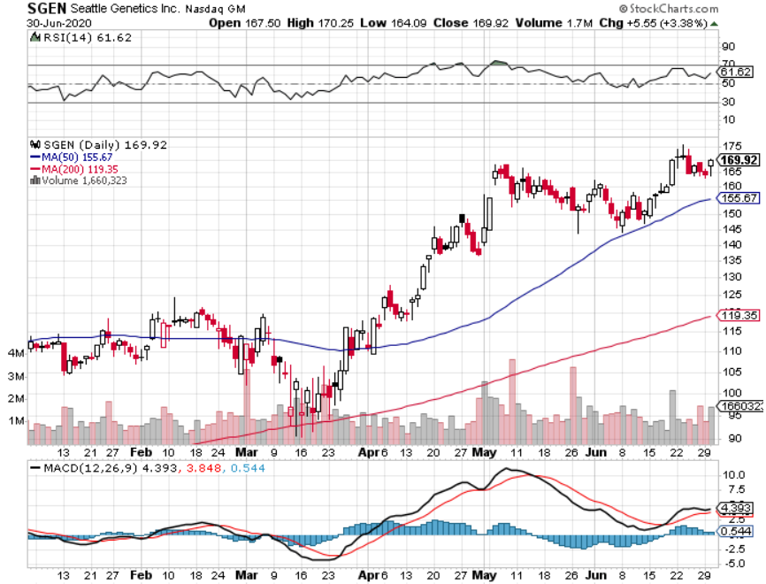
Seattle Genetics (SGEN) long 7/$140-$145 call spread

Slide 48
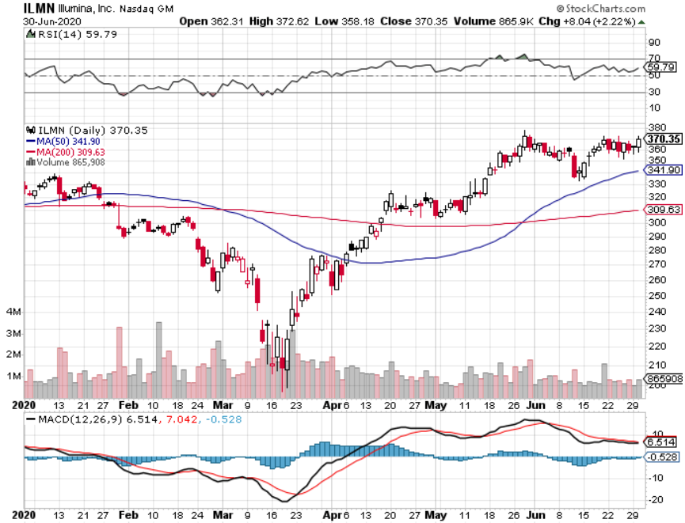
Illumina (ILMN) long 7/$320-$330 call spread

Slide 49
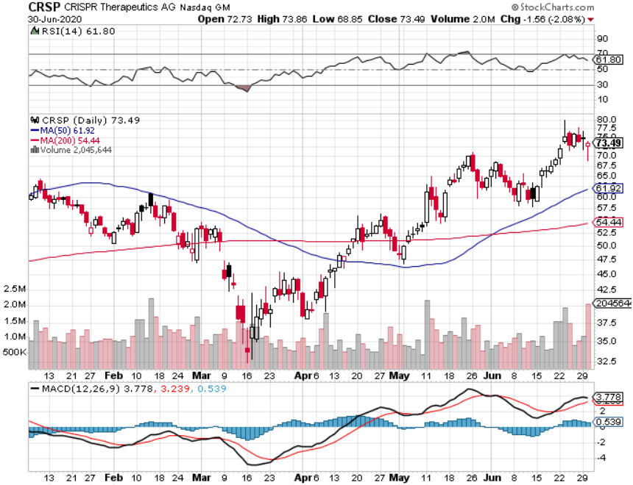
CRISPR Therapeutics (CRSP)

Slide 50
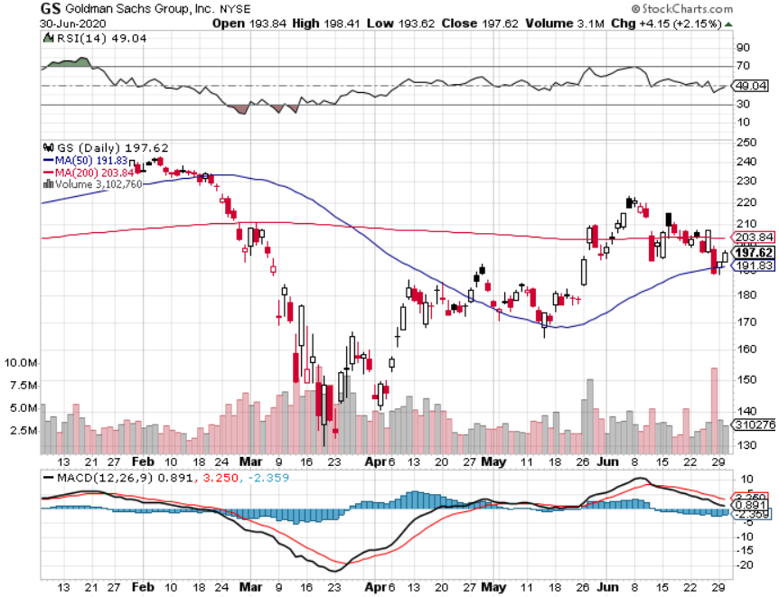
Goldman Sachs (GS) – Trading Volume Burst

Slide 51
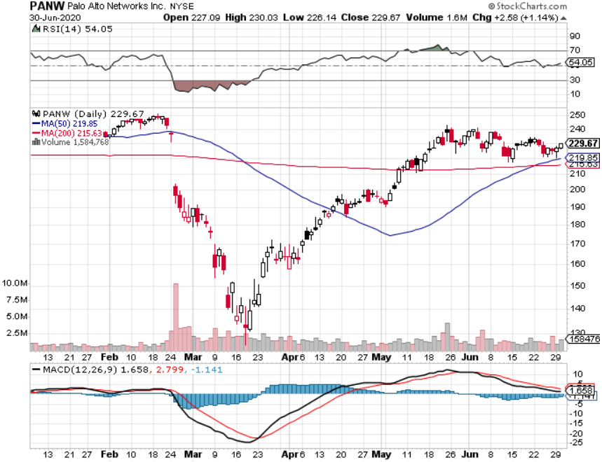
Palo Alto Networks (PANW)- Hacking never goes out of fashion

Slide 52
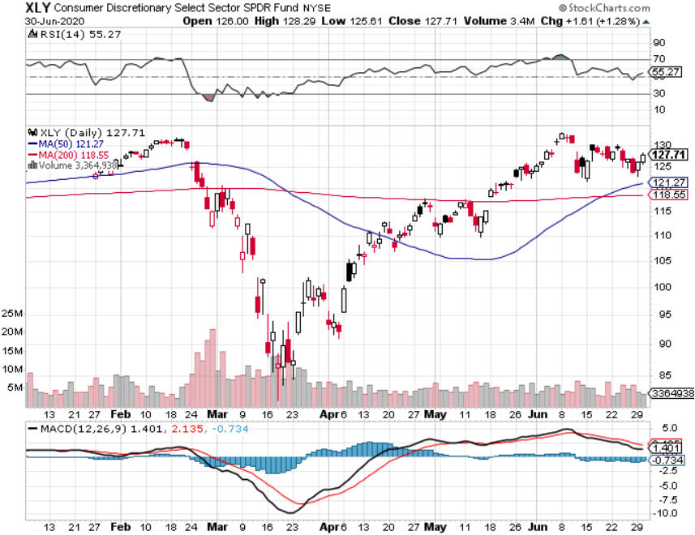
Consumer Discretionary SPDR (XLY) (DIS), (AMZN), (HD), (CMCSA), (MCD), (SBUX)

Slide 53
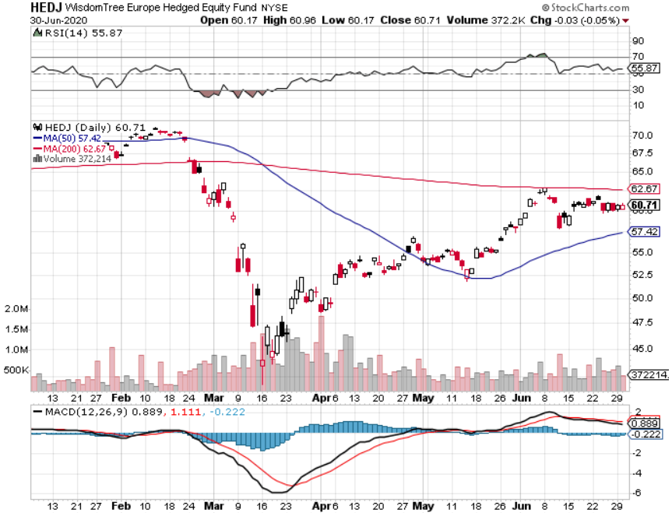
Europe Hedged Equity (HEDJ)-

Slide 54
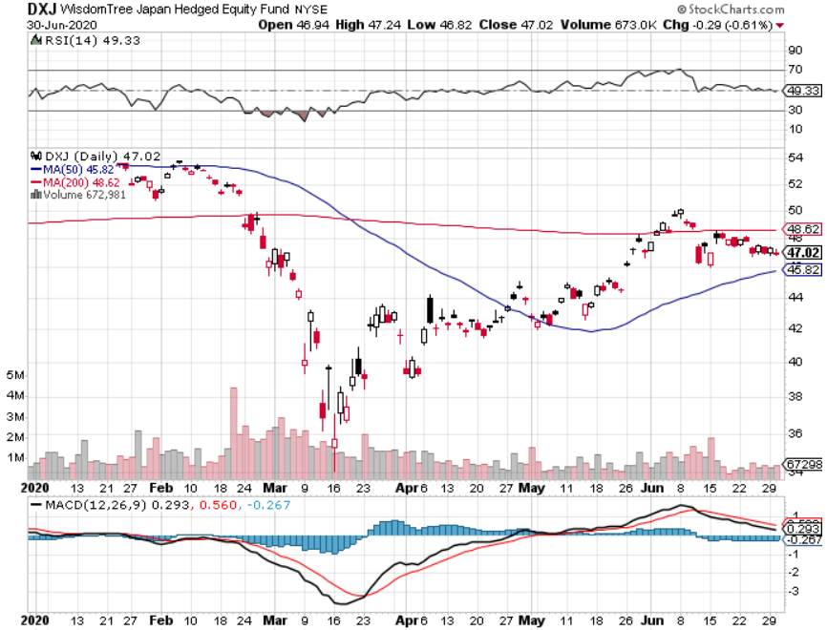
Japan (DXJ)-

Slide 55
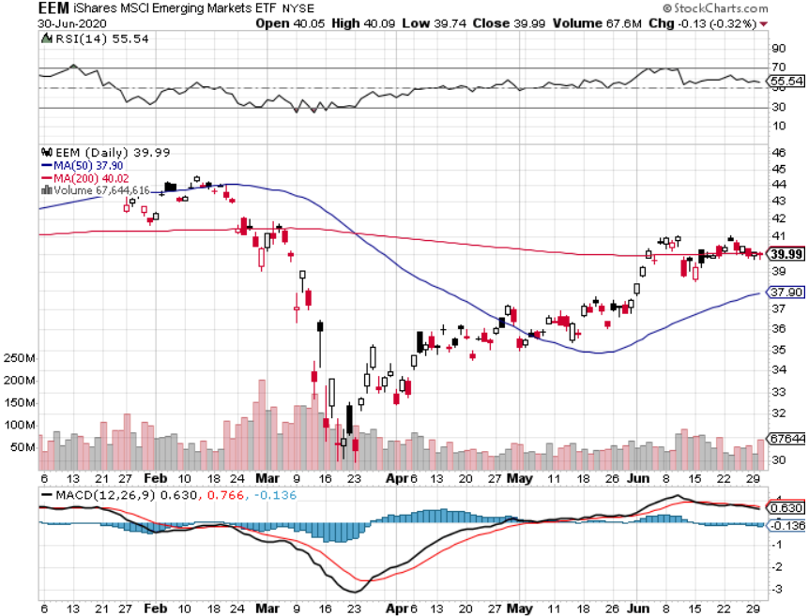
Emerging Markets (EEM)- Weak Dollar Play

Slide 56
Bonds – The Reclosing Trade is On
*Shift from a “V” to a “W” recovery delivers 12-point short covering rally in bonds *We took profits on ten short bond positions and have only one left, then made money with two long positions *Largest five-year bond issue in history comes off without a hitch *Powell says he won’t raise short term rates for three years *Another short selling opportunity of the century is in play, once corona cases peak out again *US Treasury bond fund (TLT) could plunge from $180 to $105, taking interest rates from 0.31% to 3.25% *Bottom line: sell short every major rally in the (TLT)

Slide 57
Treasury ETF (TLT) – Huge Short Play long 7/$168-$171 put spread long 7/$151-$154 call spread took profits on long 7/$172-$175 put spread took profits on long 6/$175-$180 put spread stopped out of long 7/$165-$168 put spread

Slide 58
Ten Year Treasury Yield ($TNX) – 0.62%

Slide 59
Junk Bonds (HYG) 5.90% Yield to Maturity big jump in spreads on stock selloff and recession fears

Slide 60
2X Short Treasuries (TBT)- 2 Month Bottoming Process

Slide 61
Emerging Market Debt (ELD) 4.77% Yield-

Slide 62
Municipal Bonds (MUB) – 1.41% Mix of AAA, AA, and A rated bonds

Slide 63
Foreign Currencies – Dollar Rebound
*US Dollar stabilizes on “RISK OFF” bid *Massive QE and bond issuance is sucking the life out of the Greenback *Euro double top? *Profit taking hits British pound *Bitcoin hanging on to $10,000 on supply restriction and miner payout cut *Aussie dollar consolidates strength *Keep selling short all US dollar rallies, its yield support is gone forever

Slide 64
Japanese Yen (FXY), (YCS)

Slide 65
Euro ($XEU), (FXE), (EUO)-

Slide 66
British Pound (FXB)-

Slide 67
Australian Dollar (FXA)- The Global Recovery Play took profits on long 8/$67-$69 call spread

Slide 68
Emerging Market Currencies (CEW)

Slide 69
Chinese Yuan- (CYB)-

Slide 70
Bitcoin- Hanging on to $10,000

Slide 71
Energy – Reclosing Dive
*Fear of slowing recovery causes energy stocks to dive along with oil *Production supply/demand gap is shrinking but is still historically huge *Much of lost demand is permanent as US economy restructures to a less transportation-oriented economy. *Maybe half of all listed energy names will go bankrupt in 2020 *Any price spike will be temporary, as over supply against fading demand will last for years *Avoid all energy plays like the plague, could drop by half in the coming recession

Slide 72
Oil-($WTIC)

Slide 73
United States Oil Fund (USO) stopped out of long stopped out of long (USO) long 10/$9.50-$10 Vertical bull call spread

Slide 74
Energy Select Sector SPDR (XLE)-No Performance! (XOM), (CVX), (SLB), (KMI), (EOG), (COP)

Slide 75
Halliburton (HAL)-

Slide 76
Natural Gas (UNG) -

Slide 77
Precious Metals – Breakout Imminent
*No change in bullish picture-upside breakout is imminent *Hedging demand piles on top of central bank buying *New QE Infinity sparks huge rally, worthless dollar make valuable gold *Near zero interest rates and Collapsing US dollar is another incentive *Central banks still pouring into gold every month *Bottom Line: buy a bigger dip in gold and precious metals

Slide 78
Gold (GLD)- Short Term downtrend long 7/$157-$160 call spread

Slide 79
Market Vectors Gold Miners ETF- (GDX) –

Slide 80
Barrick Gold (GOLD)

Slide 81
Newmont Mining- (NEM)-

Slide 82
Silver- (SLV)-

Slide 83
Silver Miners - (SIL)-

Slide 84
Wheaton Precious Metals - (WPM)-

Slide 85
Copper (COPX)-Collapse Trade War Disaster

Slide 86
Freeport McMoRan (FCX)-World’s Largest Copper Producer took profits on long 4/$10-$11 call spread took profits on short 4/$114 calls

Slide 87
Real Estate – Embracing the new world
*Existing Home Sales are Down 9.7%, in May, the worst in ten years. They are off 26.6% YOY * Homebuilder Confidence is Off the Charts, with Sales Expectations jumping 22 points to 68. *Buyers are back in force, lured by 2.90% 30-year fixed rate mortgages *Inventories have collapsed to record lows as buyers rush back in but there are few homes for sale, rental prices are crashing in high highest price cities like New York and San Francisco *Big move out of the cities to the suburbs is in progress, and office is now the most requested upgrade, most requested upgrade is a home office *Housing prices were ready to explode to the upside with S&P Case Shiller Rose 3.9%, in April

Slide 89
February Corelogic S&P Case Shiller Home Price Index Phoenix (8.2%), Seattle (6.9%), Charlotte (5.8%) showing biggest gains
Tradingeconomics.com

Slide 90
Simon Property Group (SPG)- Mall REIT Up to 60% of Mall Tenants Aren’t Paying Rent

Slide 91
Crown Castle International (CCI) – 3.40% yielding cell phone Tower REIT

Slide 92
US Home Construction Index (ITB) (DHI), (LEN), (PHM), (TOL), (NVR)

Slide 93
Trade Sheet- So What Do We Do About All This?
*Stocks – trade the range *Bonds – sell rallies aggressively *Commodities-stand aside *Currencies- sell US dollar rallies *Precious Metals – buy dips *Energy – stand aside *Volatility - sell short over $50 *Real estate – buy dips

Slide 94
The Mad Hedge June 4 Traders & Investors Summit
*The Summit recording is Up. *I have posted all 9:15 hours of recordings of every speaker. *This is a collection of some of the best traders and investors I have stumbled across over the past five decades. *To find it please click here at https://www.madhedge.com/replay-06042020/

Slide 95
Next Strategy Webinar 12:00 EST Wednesday, July 15, from Silicon Valley email me questions at support@madhedgefundtrader.com
Good Luck and Good Trading!
Notes:
*

