Slide 1
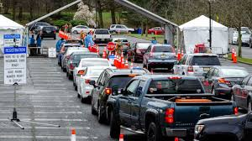
The Mad Hedge Fund Trader “Covid-19 Comes Back”
With John Thomas from Silicon Valley, CA, July 15, 2020 www.madhedgefundtrader.com
Notes:
*

Slide 2
Trade Alert Performance New All Time High! – A record 82 Trade Alerts since April 1
*January 3.13% Final *July +5.13% MTD *February -6.05% Final *August +16.01% Final *March -5.50% Final *September 3.08% Final *April +4.55% Final *October +12.13% Final *May +14.19% Final *November -1.26% Final *June +10.38% Final *December +4.97% Final *Year to date +25.83% compared to -8.8% for the Dow Average *+381.74% since inception, a new all time high *Average annualized return of 36.07% for 11 years, new all time high

Slide 3
Portfolio Review Moving to Cash in Very High Risk Market
Current Capital at Risk
Risk On
World is Getting Better
(SGEN) 7/140-$145 call spread | 10.00%
(ILMN) 7/$320-$330 call spread | 10.00%
(REGN) 7/$570-$580 call spread | 10.00%
(TLT) 8/$175-$180 put spread | 10.00%
Risk Off
World is Getting Worse
Total Net Position | 40.00%
Total Aggregate Position | 40.00%
Expiration P&L +28.89% YTD

Slide 4
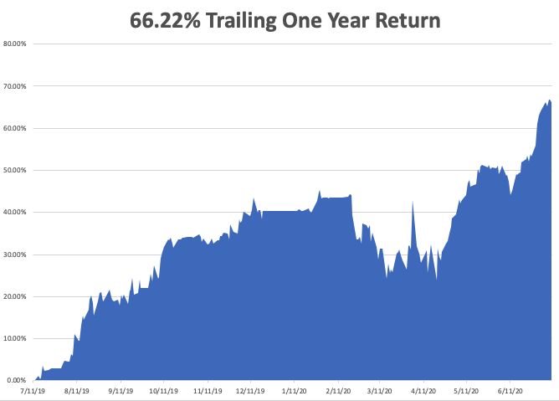

Slide 5
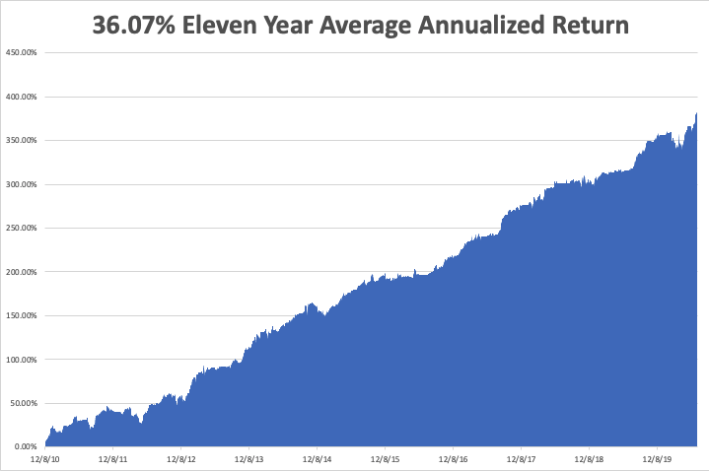
GTD 11 Year Daily Audited Performance

Slide 6
The Method to My Madness
*The Fed has proven its intention to step in and run the printing presses on any 10% market correction, which is imminent *Stocks overpriced just short on an all time high, but cheap on a three-year view *A bond short is far and away the better trade based on massive over issuance of US government bonds and now we have a big rally to sell into *The big fear remains for a larger Corona spike now, with a second, bigger one in the fall *Gold is breaking out from hedging demand *The US dollar is toast because of exploding deficits *Best buying opportunity of the decade is setting up, the next big dip is the one you buy

Slide 7
Corona Update
*US cases top 3.2 million, deaths at 135,000 and new cases are exploding in 26 states *New CDC Forecasts Calls for 250,000 US Deaths by August, or 2,500 a day *Arizona, Texas, and Florida hospitals are getting overwhelmed *New wave is spreading to younger victims, so the death rate is falling under 1% *At least five companies are close to delivering a vaccine in a year, as trillions are poured into the sector *All companies will be involved in production to quickly turn out one billion vaccine doses *A true vaccine is a year off, or never

Slide 8
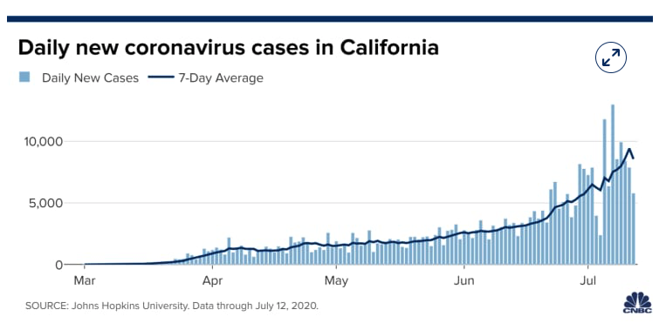

Slide 9
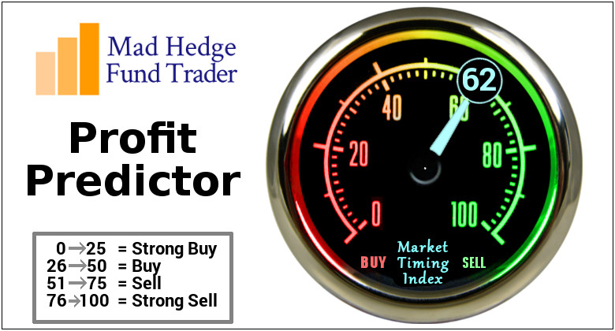
The Mad Hedge Profit Predictor Market Timing Index - Flashing “Yellow” Overbought An artificial intelligence driven algorithm that analyzes 30 different economic, technical, and momentum driven indicators

Slide 10
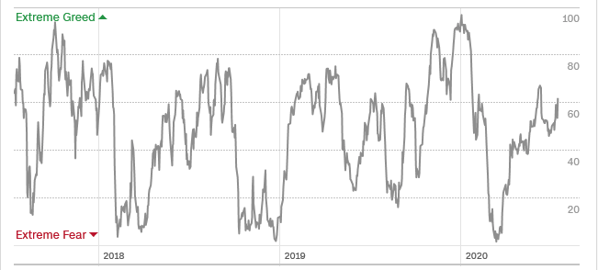
The Mad Hedge Profit Predictor From Extreme Overbought to Oversold
SELL
BUY

Slide 11
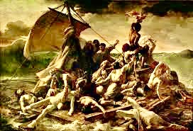
The Global Economy – In Turmoil
*June Nonfarm Payrolls Blow it Away, up 4.8 million, taking the unemployment rate to a still half century high of 11.1%. *Weekly Jobless Claims Still a Blockbuster 1.3 Million. However, gigantic layoffs loom with a resurging pandemic pouring gasoline on the fire. I’m moving towards cash to protect against a summer selloff. *Goldman Sachs Chops Growth Forecast, in the face of soaring Covid-19 cases, paring their Q3 prediction from +33% to +25%. *Chicago Purchasing Managers Index Dives to 43.5, a multi decade low, delivering another nail in the coffin for the “V” shaped recovery.

Slide 12
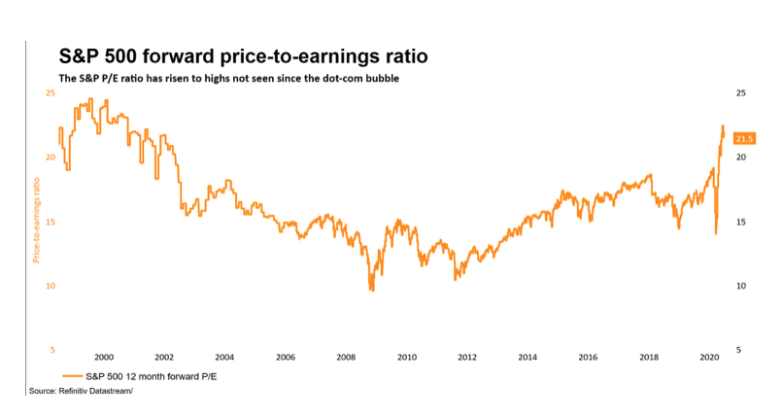
You are Here Now

Slide 13
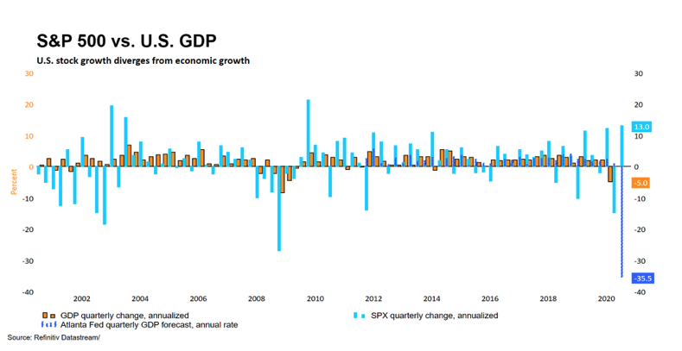

Slide 14
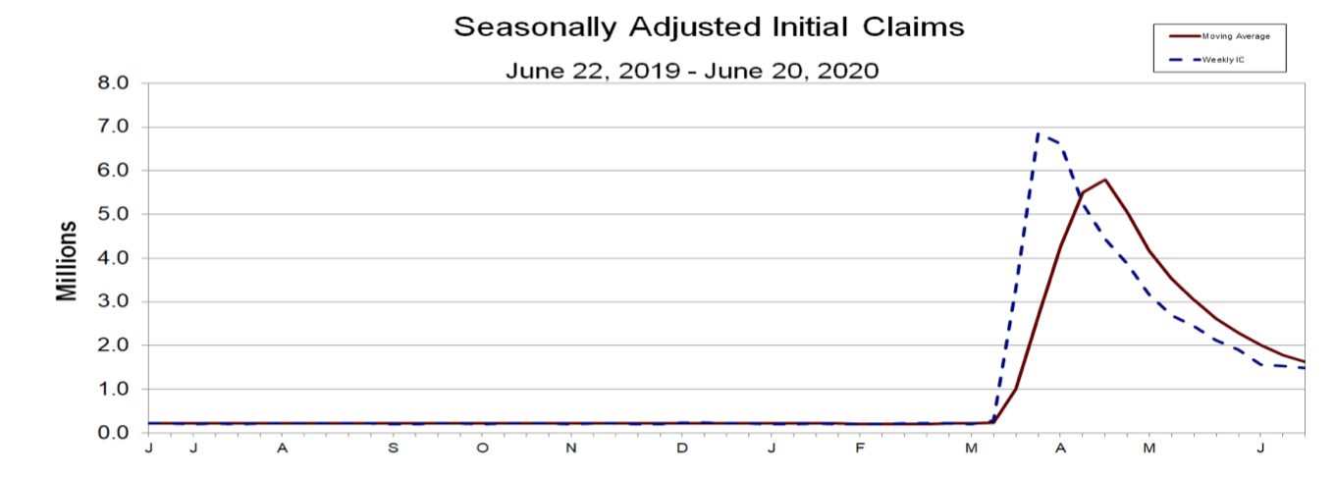
Weekly Jobless Claims - Disaster +1.3 Million to 46 million, One out of Four Already Surpassed Great Depressions Peak

Slide 15
The Bill Davis View A $1,500 Upgrade for the Mad Day Trader Service
Buys: | Entry | Target
TreeHouse Foods Inc. (THS) X | $ 45.00 | $ 54.00
eHealth, Inc. (EHTH) | $ 112.00 | $ 138.00
McDonalds Corp. (MCD) | $ 188.00 | $ 200.00
United Rentals Inc. (URI) | $ 155.00 | $ 170.00
Intel Corp. (INTC) | $ 56.00 | $ 70.00
Sells:
Lockheed Marriot Corp (LMT) | $ 363.00 | $ 340.00
Paycom Software,Inc. (PAYC) | $ 298.00 | $ 270.00
Aspen Technology, Inc. (AZPN) | $ 102.00 | $ 92.00
Reata Pharmaceuticals, Inc. (RETA) | $ 160.00 | $ 125.00
Moderna Inc. ( MRNA) | $ 76.00 | $ 55.00

Slide 16
Stocks – Paying up for the Future
*Stocks hit new highs as US Corona cases explode, with tech and biotech leading the charge *”Recovery stocks like banks, energy, cruise lines, and hotels have been thrown back into the trash can *Stocks are expensive relative to the old America, but cheap relative to the new one *Pandemic is forcing massive economies and cist cutting, evolving companies towards much more profitable business models at incredible speed *That’s what investors are paying up for *Fear of being left behind at the station is dragging in $5 trillion in cash from the sidelines *We could be entering a wide $2,700 - $3,200 range until the election

Slide 17
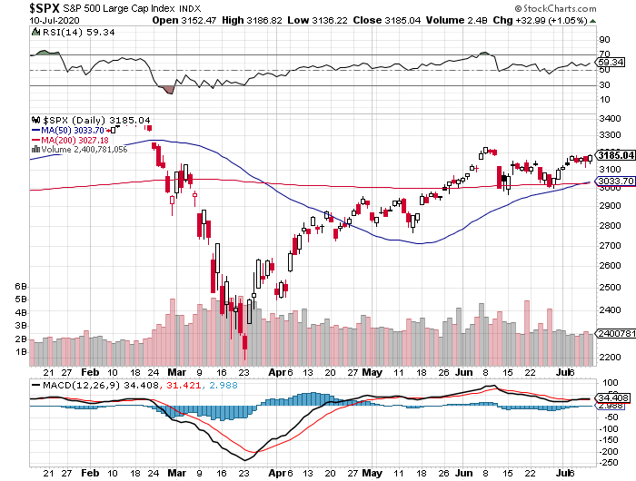
S&P 500 – Trending sideways stopped out of long 7/$320-$330 bear put spread long 6/$235-$245 bull call spread took profits on long 4/$280-$290 bear put spread took profits on long 4/$275-$280 bear put spread
New Highs
The Bottom 2,700

Slide 18
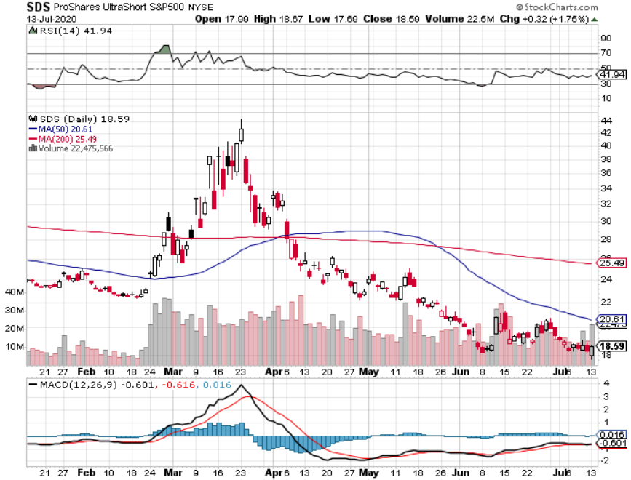
ProShares Ultra Short S&P 500 (SDS)- a Great Hedge for long stocks and bonds Long 2X position has a hedge against longs and bond shorts

Slide 19
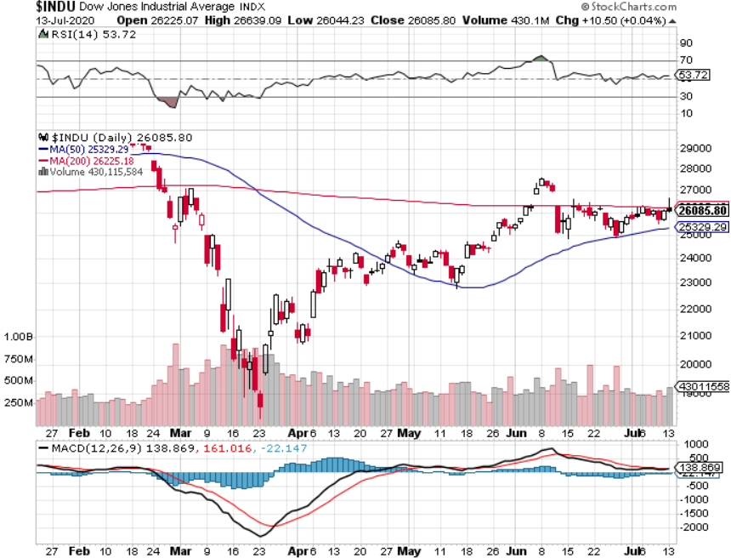
Dow Average ($INDU)-

Slide 20
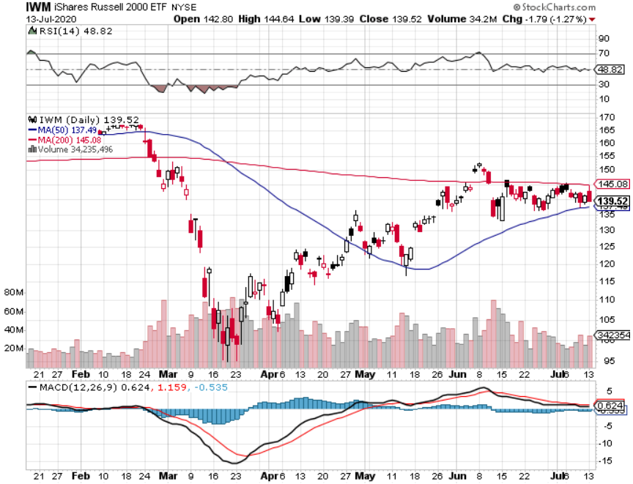
Russell 2000 (IWM)- took profits on Long 10/$137-$142 vertical bull call spread took profits on Long 10/$153-$156 vertical bear put spread

Slide 21
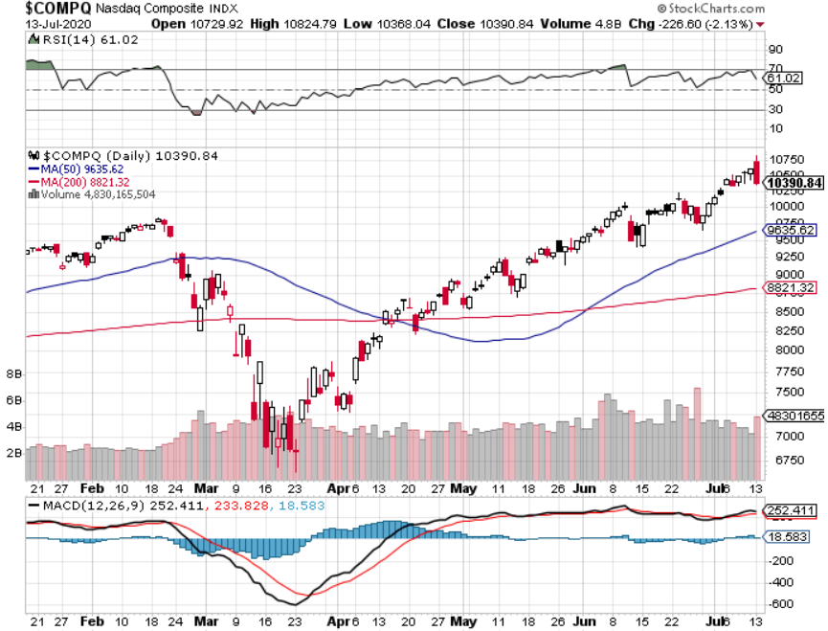
NASDAQ ($COMPQ) – Peaking Out

Slide 22
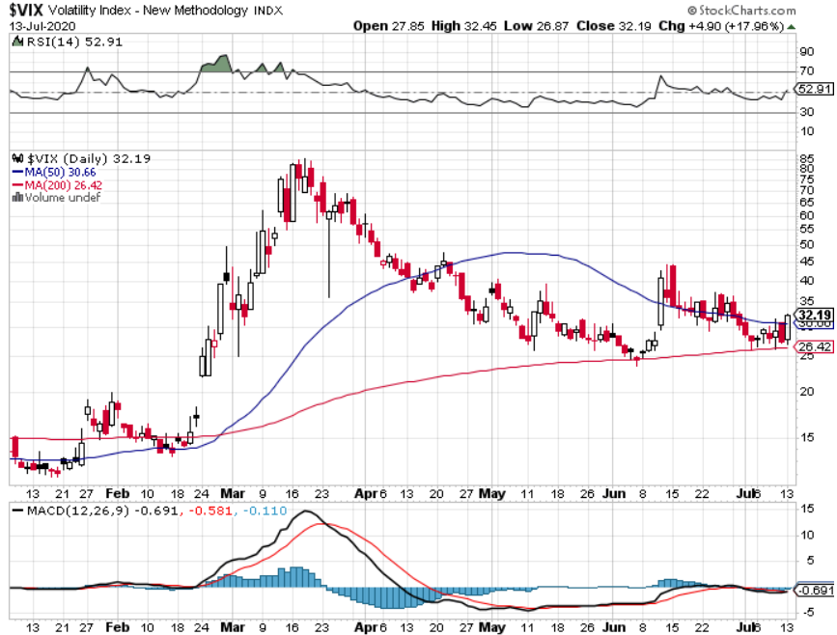
(VIX)-Big Rally

Slide 23
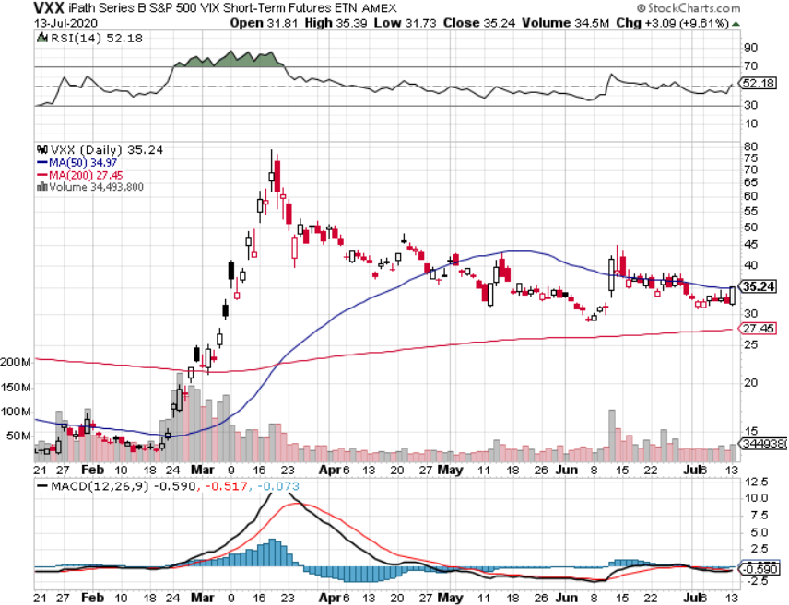
(VXX)- Sell Rallies-Down $85 to $26 from top stopped out of long 1/2021 $16 puts stopped out of long 1/2021 $24 puts

Slide 24
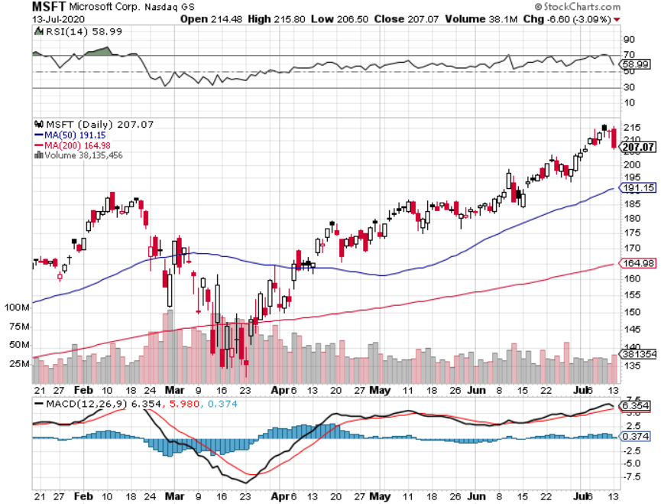
Microsoft (MSFT)- Earnings beat- Looking for Another Entry Point Stopped out of long 4/$120-$130 call spread took profit on long 4/$120-$130 call spread stop loss on long 12/$170-$180 call spread took profits on long 12/$135-$138 call spread

Slide 25
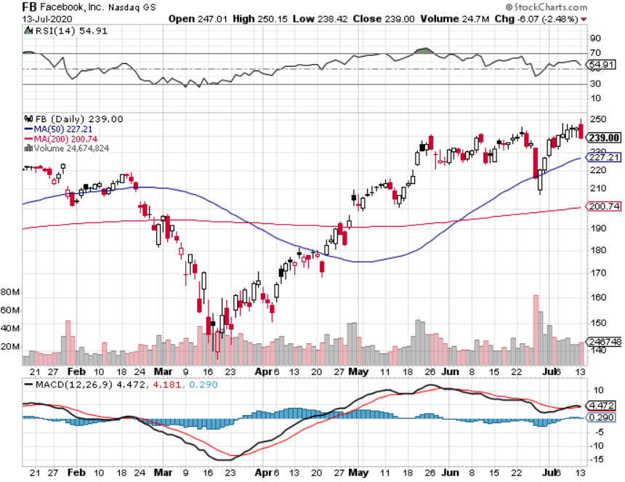
Facebook (FB)- Breaking Down on Ad Boycott stopped out of Long 9/$190-$200 vertical bear put spread took profits on Long 9/$145-$155 vertical bull call spread took profits on Long 9/$150-$160 vertical bull call spread took profits on Long 8/$167.50-$172.50 vertical bull call spread

Slide 26
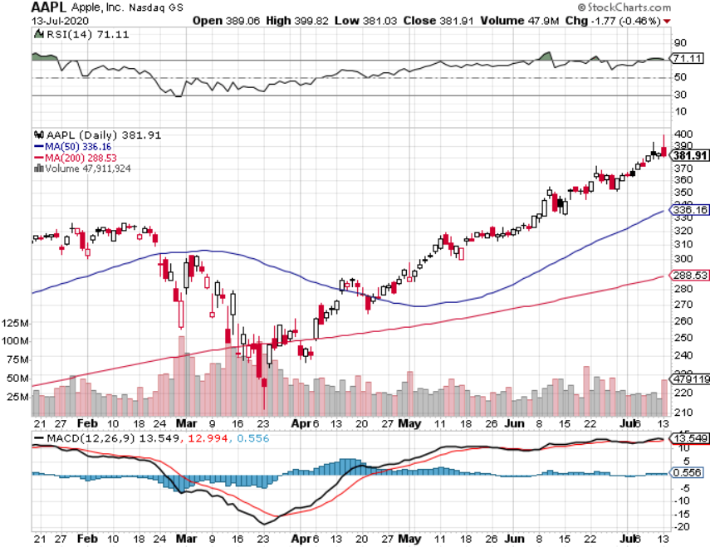
Apple (AAPL)- New Highs took profits on long 7/$320-$330 call spread took profits on long 4/24/$250-$260 call spread took profits on long 5/$250-$260 call spread took profits on long 4/$250-$260 call spread took profits on long 3/$250-$260 call spread

Slide 27
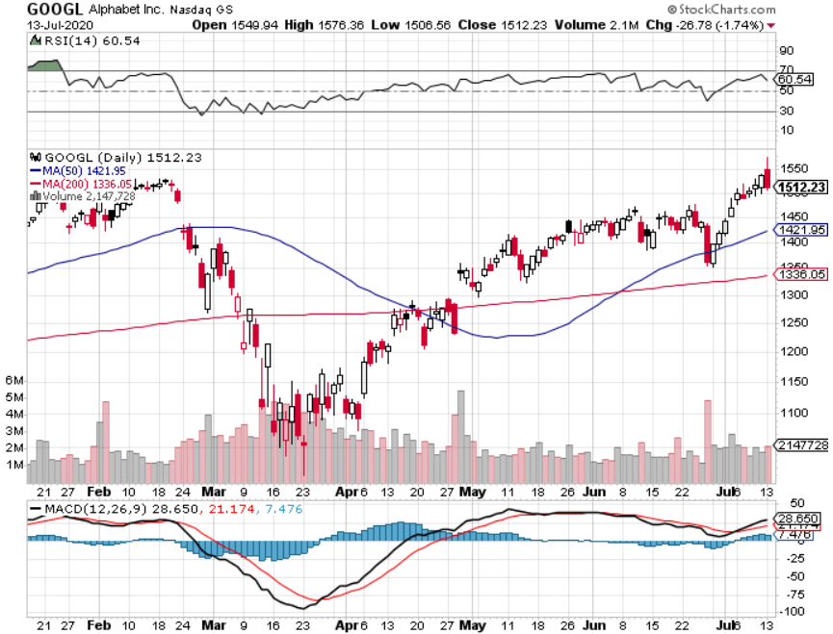
Alphabet (GOOGL) – Europe Antitrust took profits on long 12/$1,200-$1,230 bull call spread took profits on long 9/$1,030-$1,080 vertical bull call spread stopped out of long 5/$1,100-$1,130 bull call spread took profits on long 4/$1,080-$1,120 bull call spread

Slide 28
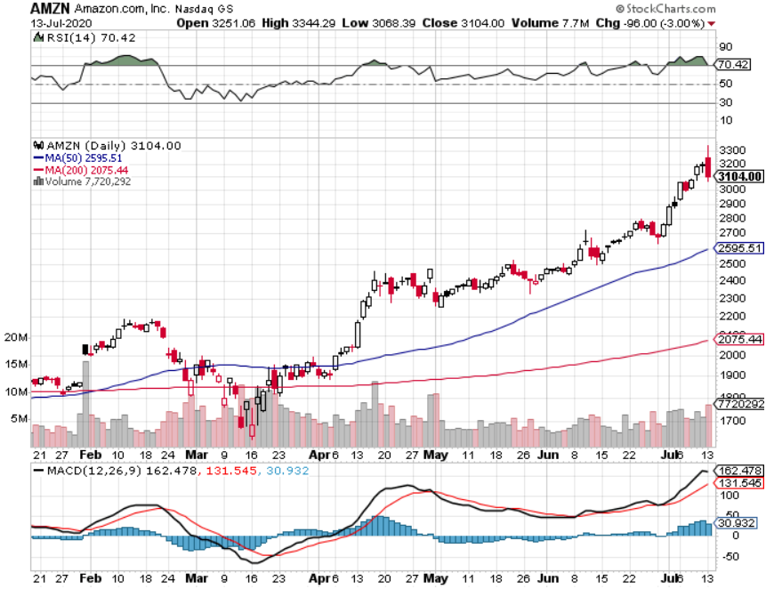
Amazon (AMZN) – New Highs took profits on long 4/$1,500-$1,550 bull call spread took profits on long 4/$1,600-$1,650 bull call spread stopped out of long 3/$1,700-$1,800 bull call spread took profits on 9/$1,500-$1,500 bull call spread

Slide 29
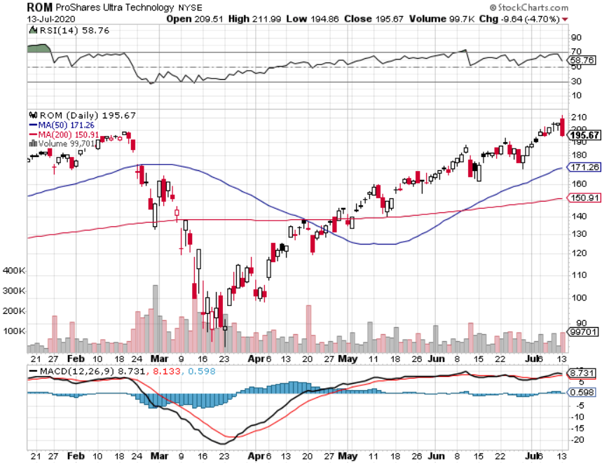
ProShares Ultra Technology (ROM) – Up 110% in 10 Weeks

Slide 30
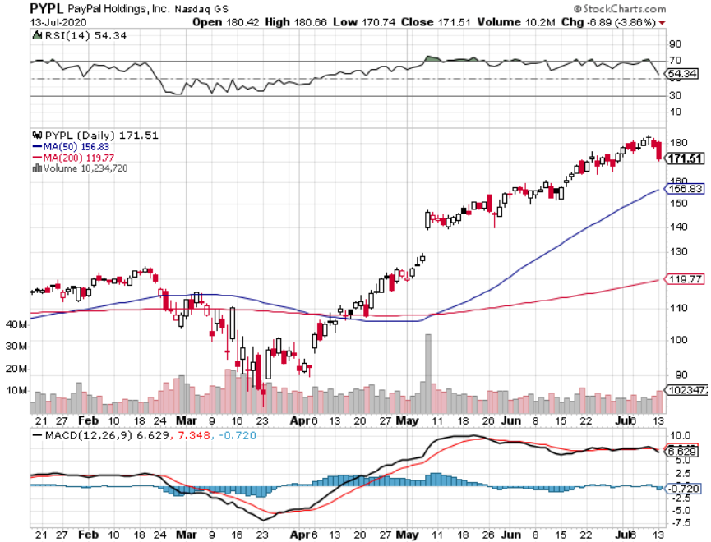
PayPal (PYPL)-Fintech Rules took profits on long 4/$90-$95 call spread

Slide 31
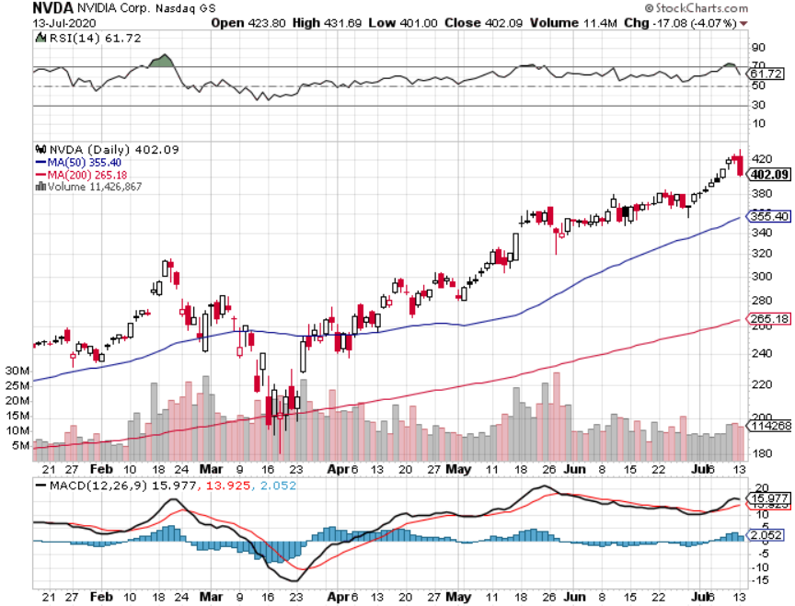
NVIDIA (NVDA) – New Highs on 39% Jump in Earnings

Slide 32
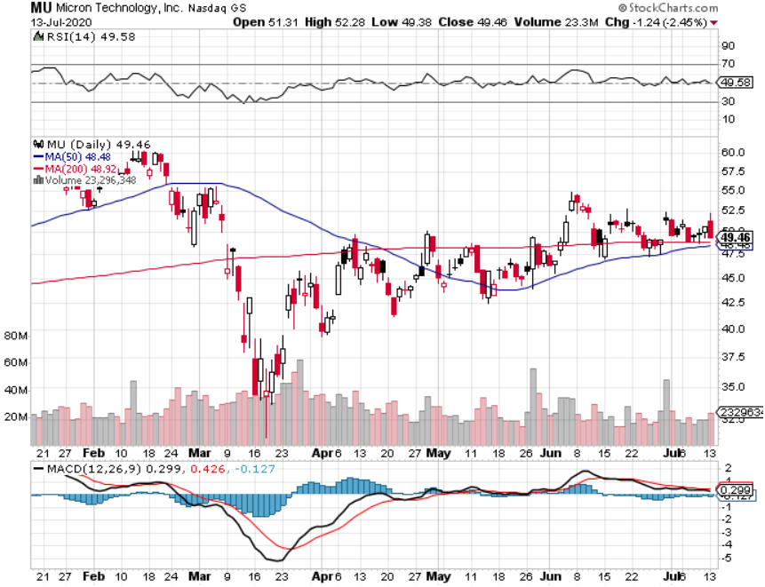
Micron Technology (MU)-Ditto

Slide 33
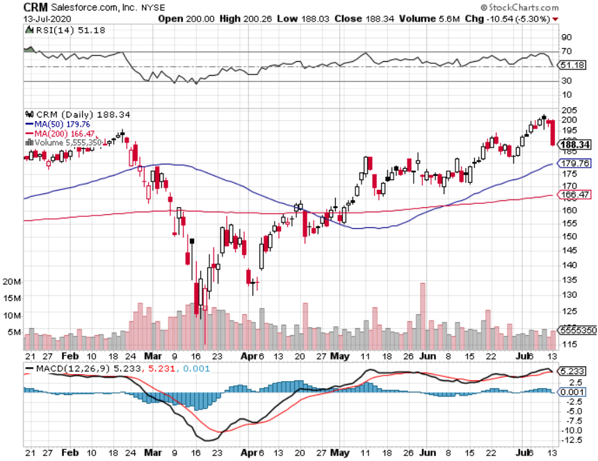
Salesforce (CRM)- Massive Online Migration took profits on long 9/$125-$130 vertical bull call spread took profits on long 8/$125-$130 vertical bull call spread took profits on long 2/$105-$115 call spread

Slide 34
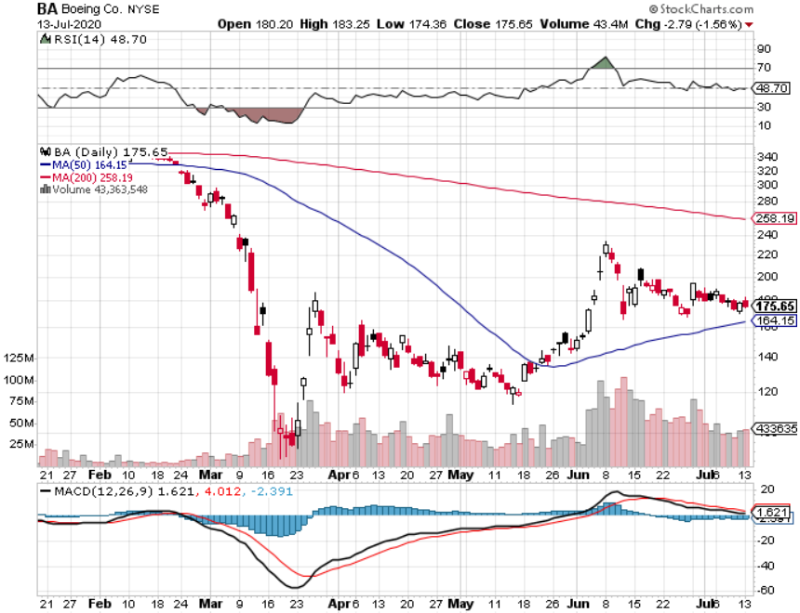
Boeing (BA) –GM Or Bank Style Takeover? 737 MAX production shutdown-Criminal investigation took profits on long 2/$270-$280 call spread took profits on long 12/$310-$330 call spread took profits on long 4/$300-$310 call spread took profits on long 4/$315-$335 call spread

Slide 35
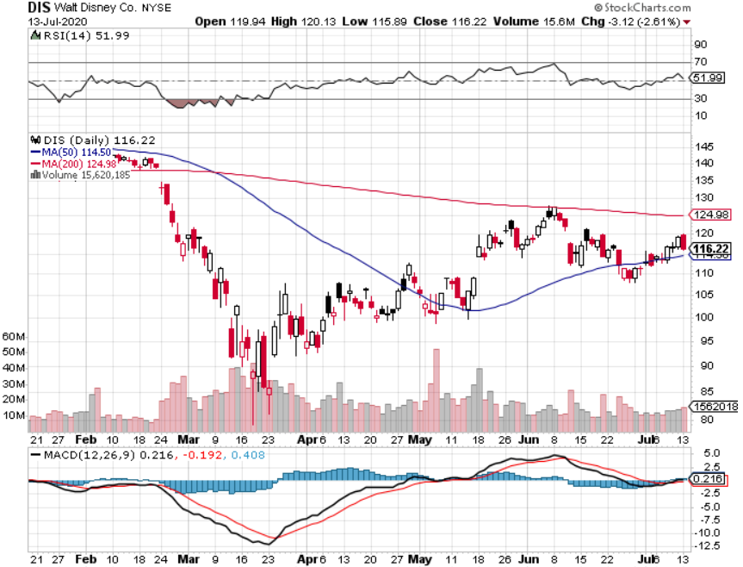
Walt Disney (DIS)- Corona Hit long 9/$120-$125 put spread took profits on long 6/$85-$90 call spread

Slide 36
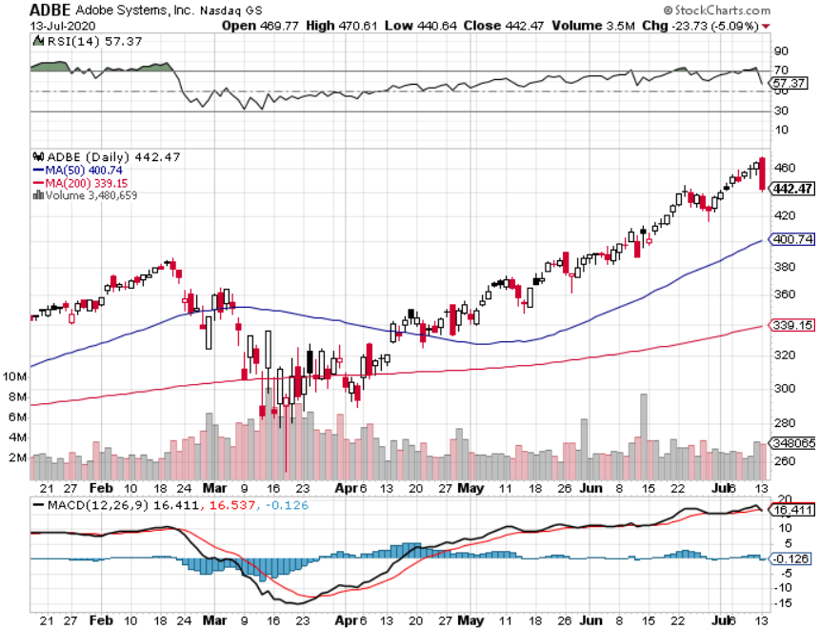
Adobe (ADBE)- The Quality Non-China tech play

Slide 37
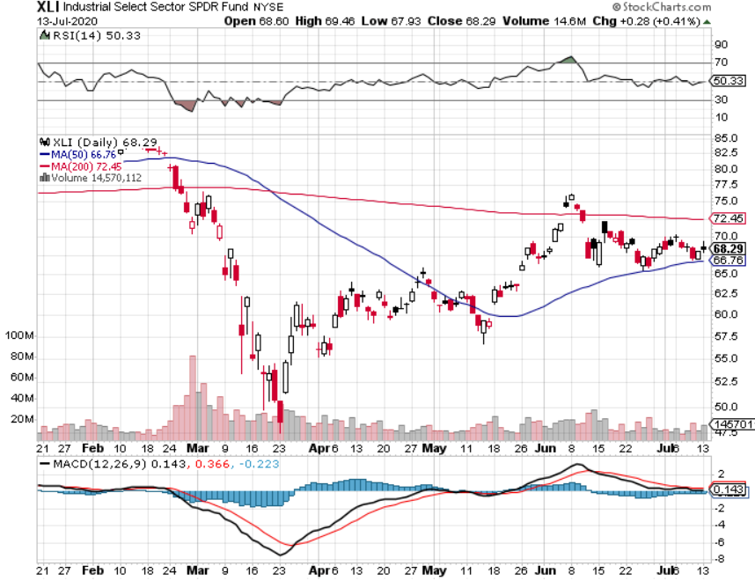
Industrials Sector SPDR (XLI)- (GE), (MMM), (UNP), (UTX), (BA), (HON)

Slide 38
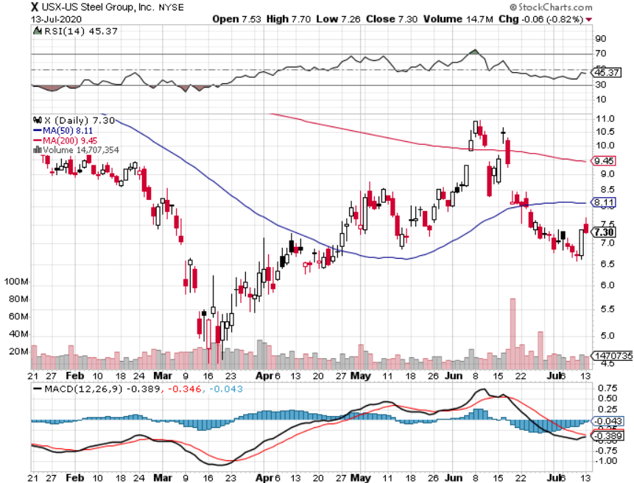
US Steel (X)-Tariffs Trouble

Slide 39
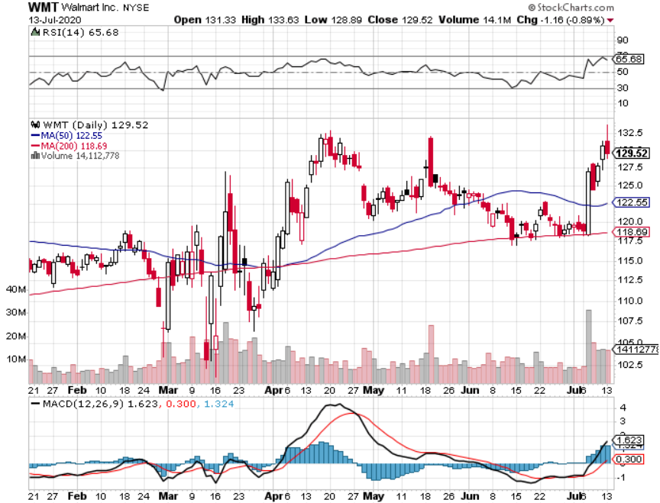
Wal-Mart (WMT)-Hiring 150,000 took profit on Long 11/$125-$130 bear put spread took profit on Long 10/$119-$121 bear put spread took profits on Long 8/$114-$117 bear put spread

Slide 40
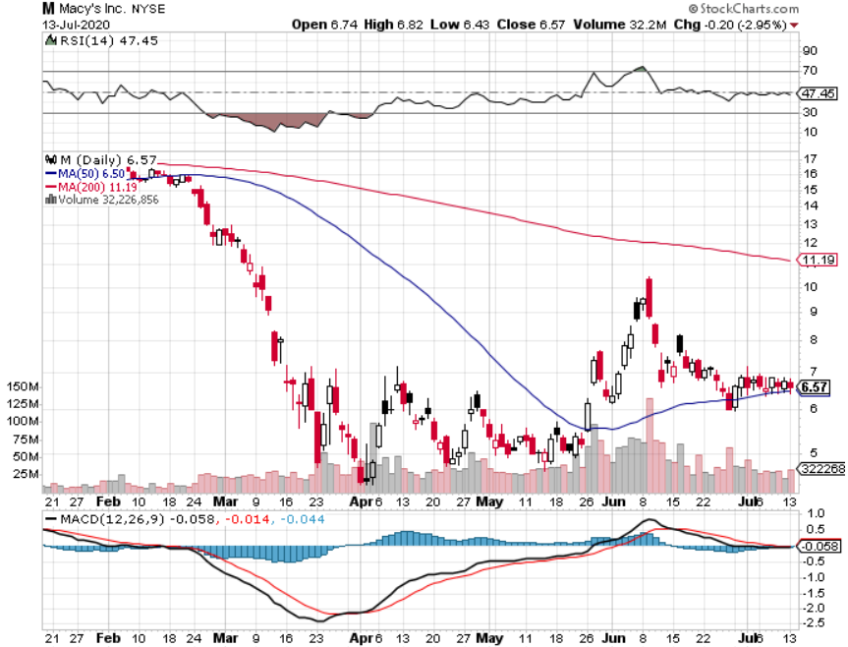
Macys’ (M) – $4.5 Billion Loan took profits on Long 8/$23-$25 bear put spread

Slide 41
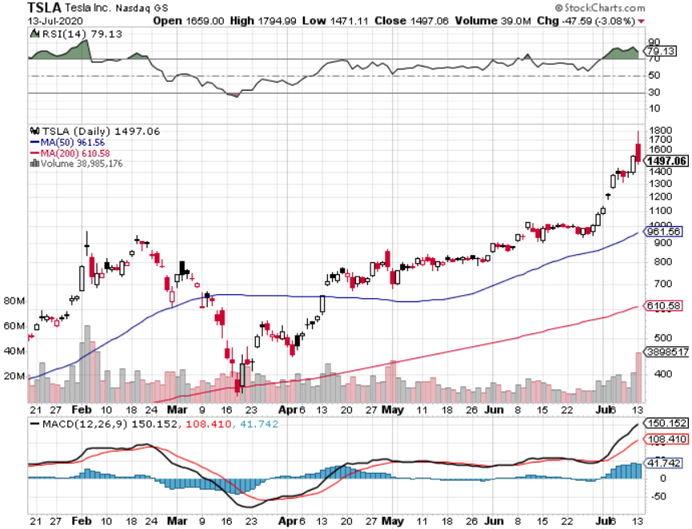
Tesla (TSLA)-New Highs Up 110X from my first recommendation Model Y will be a blockbuster long 6/$850-$900 call spread long 7/$750-$800 call spread stopped out of long 6/$260-$270 put spread took profits on long 6/$140-$150 call spread

Slide 42
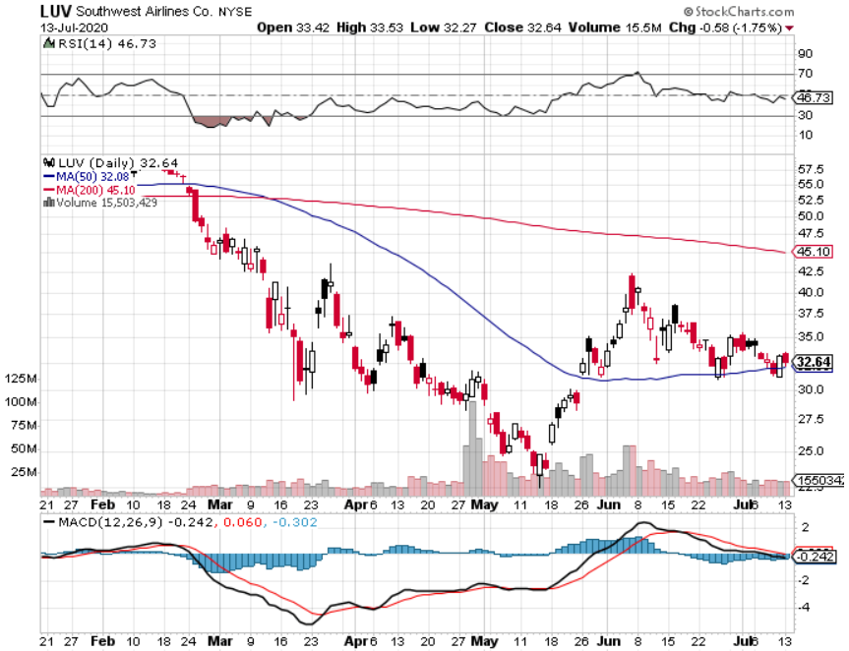
Southwest Airlines (LUV) – Warren Buffett big seller

Slide 43
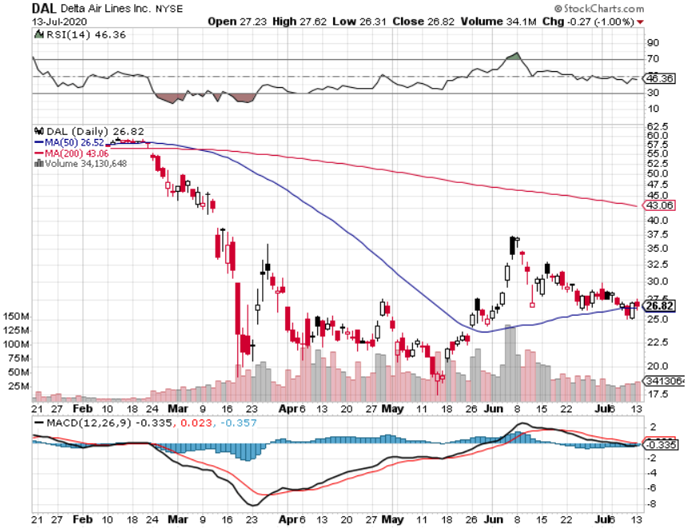
Delta Airlines (DAL) – Warren Buffett big seller

Slide 44
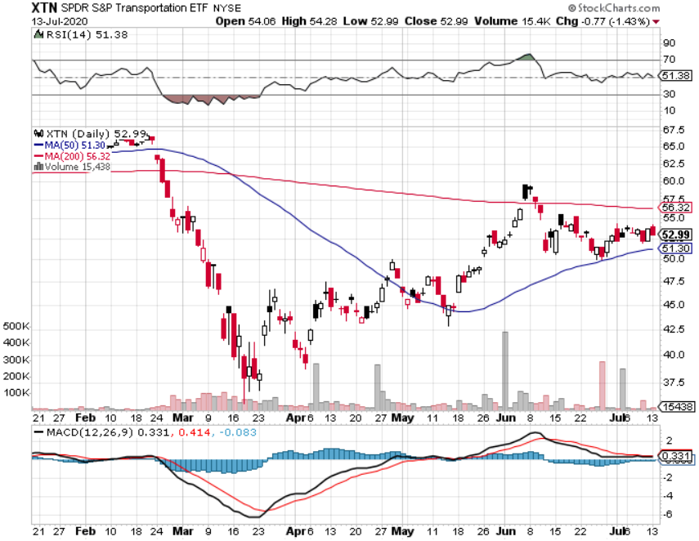
Transports Sector SPDR (XTN)- Worst Hit Sector (ALGT), (ALK), (JBLU), (LUV), (CHRW), (DAL)

Slide 45
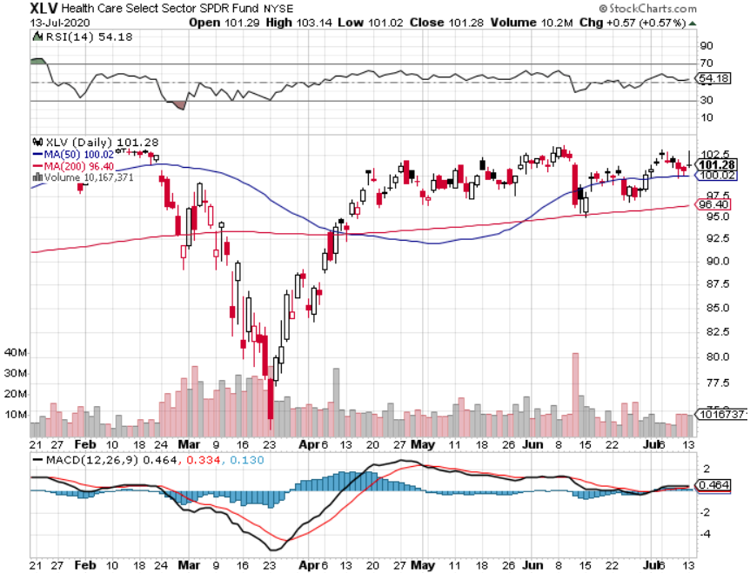
Health Care Sector (XLV), (RXL)-New Highs (JNJ), (PFE), (MRK), (GILD), (ACT), (AMGN) The new favorite sector

Slide 46
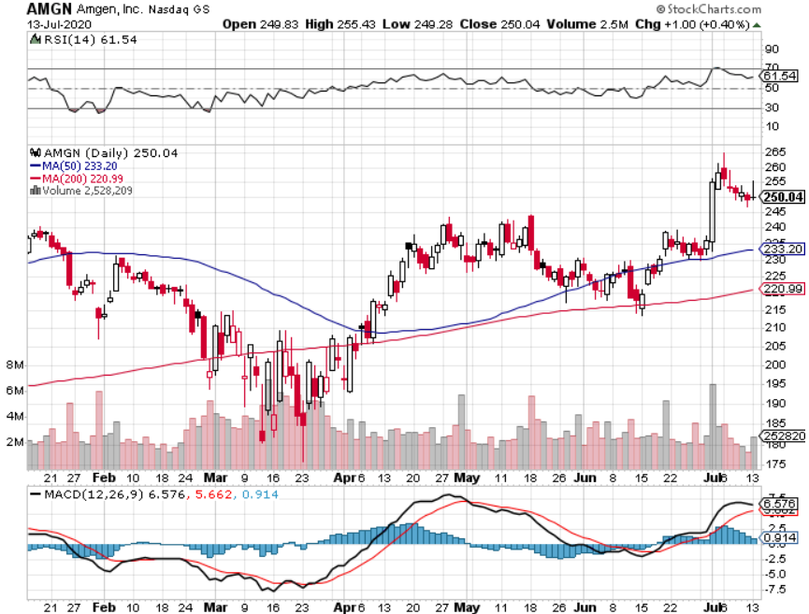
Amgen (AMGN) – Corona gains

Slide 47
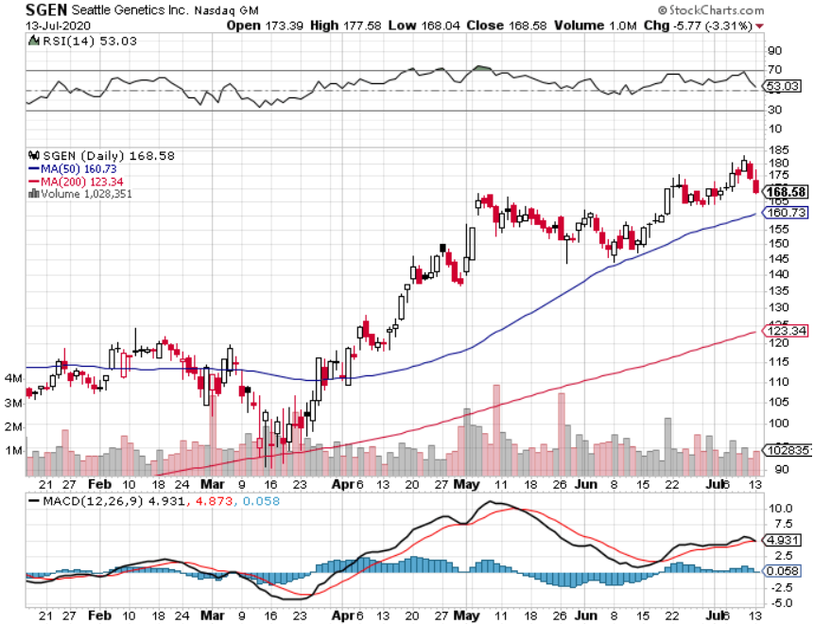
Seattle Genetics (SGEN) long 7/$140-$145 call spread-expires in two days

Slide 48
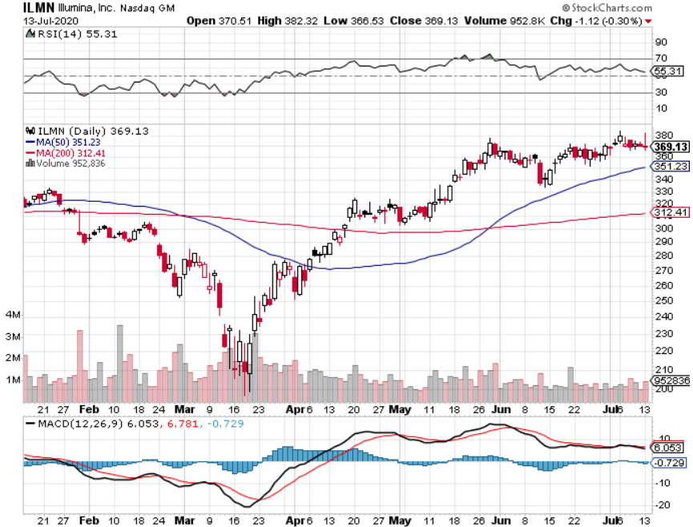
Illumina (ILMN) long 7/$320-$330 call spread-expires in two days

Slide 49
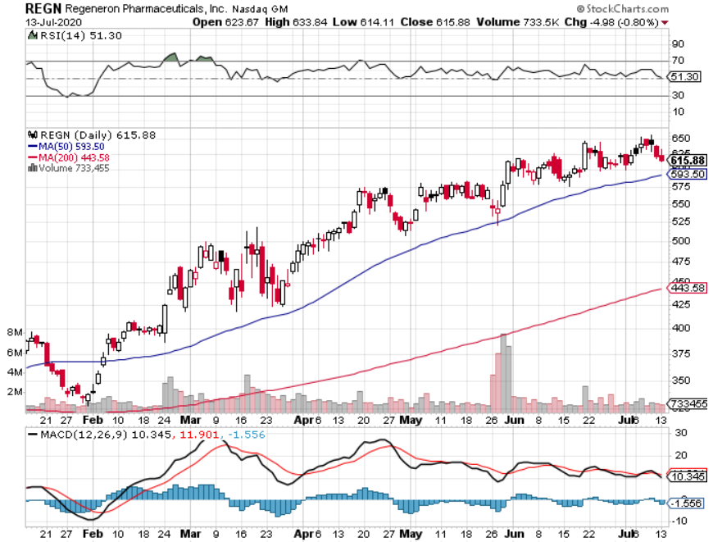
Regeneron (REGN) long 7/$570-$580 call spread-expires in two days

Slide 50
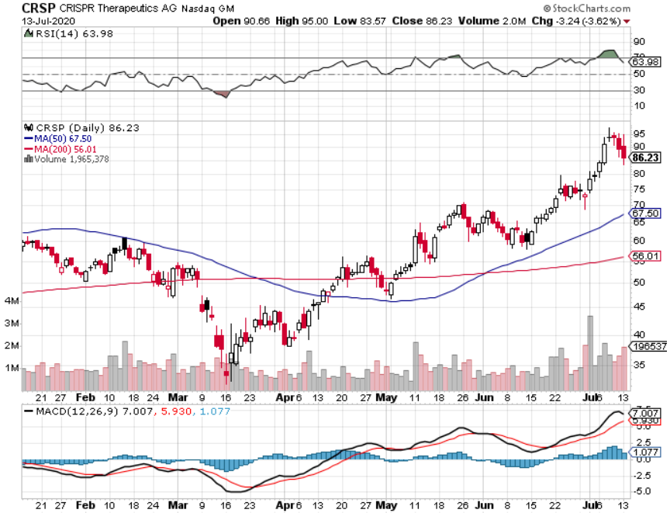
CRISPR Therapeutics (CRSP)

Slide 51
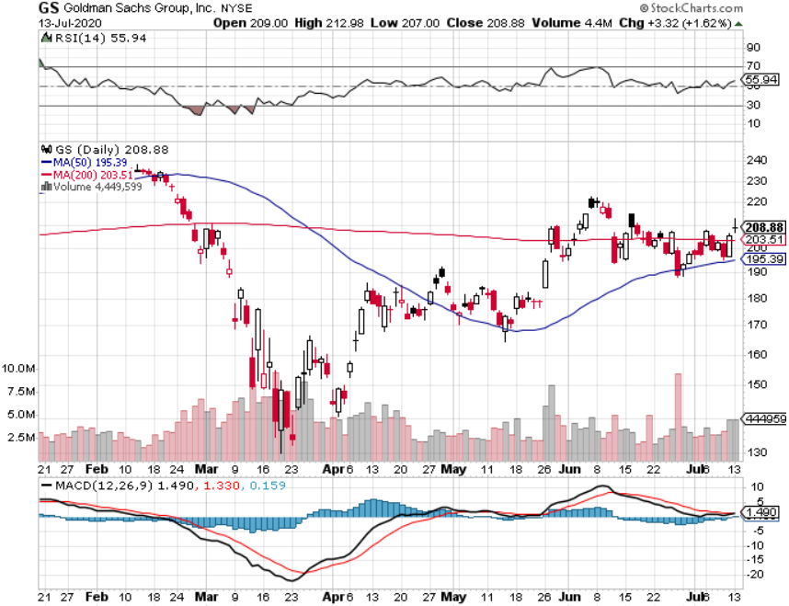
Goldman Sachs (GS) – Trading Volume Burst

Slide 52
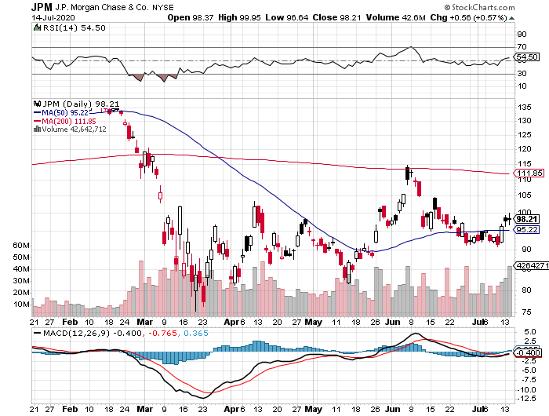
JP Morgan (JPM) – Great Earnings Surprise took profits on 7/$80-$85 calls spread

Slide 53
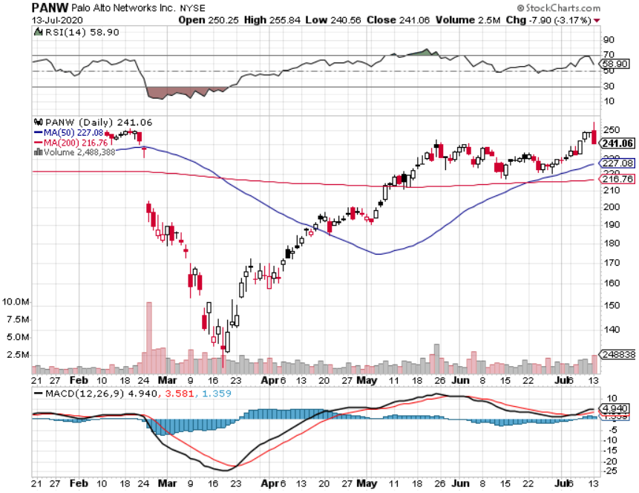
Palo Alto Networks (PANW)- Hacking never goes out of fashion

Slide 54
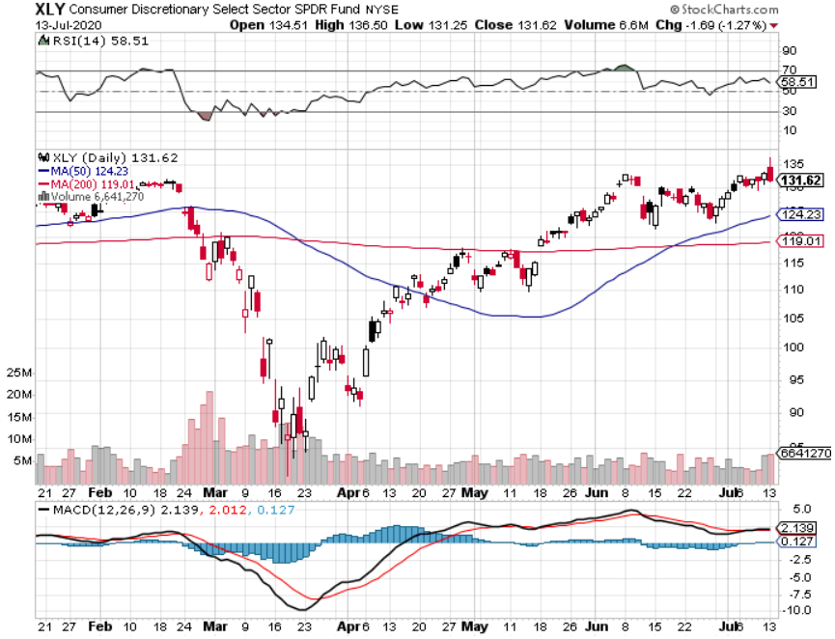
Consumer Discretionary SPDR (XLY) (DIS), (AMZN), (HD), (CMCSA), (MCD), (SBUX)

Slide 55
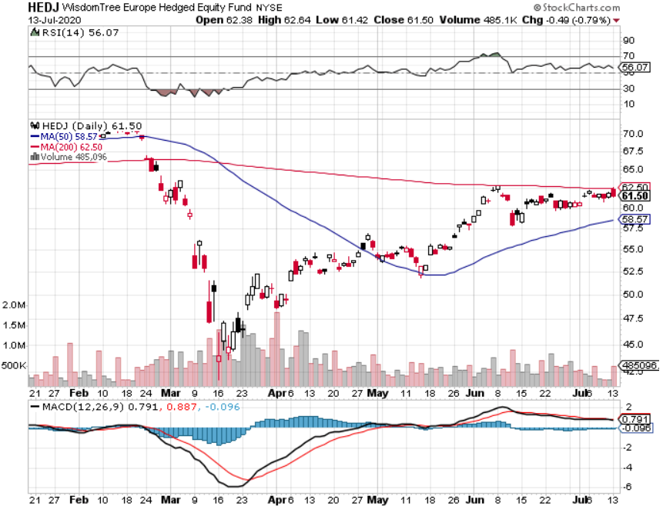
Europe Hedged Equity (HEDJ)-

Slide 56
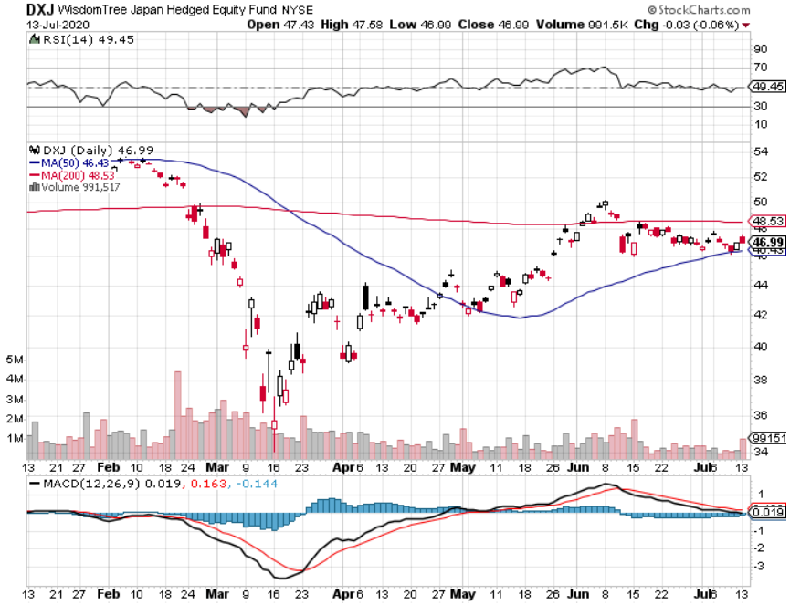
Japan (DXJ)-

Slide 57
Emerging Markets (EEM)- Weak Dollar Play

Slide 58
Bonds – Second Dip
*A second wave if the Corona virus is bringing a second dip in interest rates and spike in prices *US Budget Deficit Soars to $867 Billion in June, taking it to an unprecedented $10.4 trillion annual rate, taking the national debt up 50% in one year *While stock market ignores soaring Corona cases, bonds are keeping a laser focus *Shift from a “V” to a “W” recovery delivers 15-point short covering rally in bonds *We added an entry level short position on latest spike *Another short selling opportunity of the century is in play, once corona cases peak out again *US Treasury bond fund (TLT) could plunge from $180 to $105, taking interest rates from 0.31% to 3.25% *Bottom line: sell short every major rally in the (TLT)

Slide 59
Treasury ETF (TLT) – Huge Short Play long 7/$168-$171 put spread long 7/$151-$154 call spread took profits on long 7/$172-$175 put spread took profits on long 6/$175-$180 put spread stopped out of long 7/$165-$168 put spread

Slide 60
Ten Year Treasury Yield ($TNX) – 0.61%

Slide 61
Junk Bonds (HYG) 5.90% Yield to Maturity big jump in spreads on stock selloff and recession fears

Slide 62
2X Short Treasuries (TBT)- 4 Month Bottoming Process

Slide 63
Emerging Market Debt (ELD) 4.77% Yield-

Slide 64
Municipal Bonds (MUB) – 1.41% Mix of AAA, AA, and A rated bonds

Slide 65
Foreign Currencies – A Tale of Two Economies
*US Dollar weakens on soaring Corona pandemic *Massive QE and bond issuance is sucking the life out of the Greenback, $8 trillion in new debt by yearend *Euro takes a new run at the highs as their economy recovers and the US doesn’t *British pound strengthens *Aussie dollar consolidates strength *Bitcoin hanging on to $10,000 on supply restriction and miner payout cut *Keep selling short all US dollar rallies, its yield support is gone forever

Slide 66
Japanese Yen (FXY), (YCS)

Slide 67
Euro ($XEU), (FXE), (EUO)-

Slide 68
British Pound (FXB)-

Slide 69
Australian Dollar (FXA)- The Global Recovery Play took profits on long 8/$67-$69 call spread

Slide 70
Emerging Market Currencies (CEW)

Slide 71
Chinese Yuan- (CYB)-

Slide 72
Bitcoin- Hanging on to $10,000

Slide 73
Energy – Resurging Corona Hammers Texas Tea
*Fear of slowing recovery causes energy stocks to dive along with oil *Production supply/demand gap is shrinking but is still historically huge *Much of lost demand is permanent as US economy restructures to a less transportation-oriented economy. *Maybe half of all listed energy names will go bankrupt in 2020 *Any price spike will be temporary, as over supply against fading demand will last for years *Avoid all energy plays like the plague, could drop by half in the coming recession

Slide 74
Oil-($WTIC)

Slide 75
United States Oil Fund (USO) stopped out of long stopped out of long (USO) long 10/$9.50-$10 Vertical bull call spread

Slide 76
Energy Select Sector SPDR (XLE)-No Performance! (XOM), (CVX), (SLB), (KMI), (EOG), (COP)

Slide 77
Halliburton (HAL)-

Slide 78
Natural Gas (UNG) -

Slide 79
Precious Metals – Teasing All Time Highs
*No change in bullish picture-upside breakout is in play *Hedging demand piles on top of central bank buying *New QE Infinity sparks huge rally, worthless dollar make valuable gold *Near zero interest rates and Collapsing US dollar is another incentive *Central banks still pouring into gold every month *Bottom Line: buy a bigger dip in gold and precious metals

Slide 80
Gold (GLD)- Breaking Out took profits on long 7/$158-$161 call spread took profits on long 7/$157-$160 call spread

Slide 81
Market Vectors Gold Miners ETF- (GDX) – Breaking Out

Slide 82
Barrick Gold (GOLD)- Breaking Out

Slide 83
Newmont Mining- (NEM)- Breaking Out

Slide 84
Silver- (SLV)- Breaking out

Slide 85
Silver Miners - (SIL)- Breaking Out

Slide 86
Wheaton Precious Metals - (WPM)- Breaking Out

Slide 87
Copper (COPX)- Breaking Out Europe and Asia are recovering, but no the US

Slide 88
Freeport McMoRan (FCX)-World’s Largest Copper Producer took profits on long 4/$10-$11 call spread took profits on short 4/$114 calls

Slide 89
Real Estate – The Bidding Wars are Back
*There is a massive move by the real estate industry online, which may be permanent with virtual open houses and tours *Enormous eviction wave is imminent as state holidays expire, 28 million may get thrown on to the street *Buyers are back in force, lured by 2.90% 30-year fixed rate mortgages *Suburban search ads soaring as urban dwellers flee Corona virus *Mortgage bailouts drop by 435,000 but remain at a high 4.14 million, 7% of all mortgages *Housing prices were ready to explode to the upside with S&P Case Shiller Rose 4.7%, in April

Slide 90
April Corelogic S&P Case Shiller Home Price Index Phoenix (8.8%), Seattle (7.3%), Minneapolis (6.4%) showing biggest gains
Tradingeconomics.com

Slide 91
Simon Property Group (SPG)- Mall REIT Up to 60% of Mall Tenants Aren’t Paying Rent

Slide 92
Crown Castle International (CCI) – 3.40% yielding cell phone Tower REIT

Slide 93
US Home Construction Index (ITB) (DHI), (LEN), (PHM), (TOL), (NVR)

Slide 94
Trade Sheet- So What Do We Do About All This?
*Stocks – trade the range *Bonds – sell rallies aggressively *Commodities-buy dips *Currencies- sell US dollar rallies *Precious Metals – buy dips *Energy – stand aside *Volatility - sell short over $50 *Real estate – buy dips

Slide 95
Next Strategy Webinar 12:00 EST Wednesday, August 5, from Lake Tahoe, Nevada email me questions at support@madhedgefundtrader.com
Good Luck and Good Trading!
Notes:
*

