Slide 1
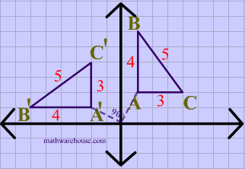
The Mad Hedge Fund Trader “The Rotation Trade is Here”
With John Thomas from Silicon Valley, CA, August 12, 2020 www.madhedgefundtrader.com
Notes:
*

Slide 2
Trade Alert Performance New All Time High! – A record 82 Trade Alerts since April 1
*January 3.13% Final *July +7.93% Final *February -6.05% Final *August +5.89% MTD *March -5.50% Final *September 3.08% Final *April +4.55% Final *October +12.13% Final *May +14.19% Final *November -1.26% Final *June +10.38% Final *December +4.97% Final *Year to date +34.53% compared to -1.7% for the Dow Average *+390.44% since inception, a new all time high *Average annualized return of 36.60% for 11 years, new all time high

Slide 3
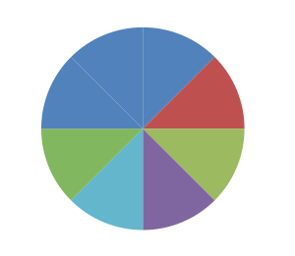
Portfolio Review Huge Aggressive “Recovery” Rotation Play
Current Capital at Risk
Risk On
World is Getting Better
(JPM) 8/$92-$95 call spread | 10.00%
(TLT) 8/$175-$177.50 put spread | 10.00%
(TLT) 8/$172.50-$175.00 put spread | 10.00%
(TLT) 8/$170-$172.50 put spread | 10.00%
Risk Off
World is Getting Worse
(AAPL) 8/$480-$490 put spread | -10.00%
(AMZN) 8/$3,000-3,350 put spread | -10.00%
(TSLA) 8/1,700-$1,750 put sprerad | -10.00%
(FB) 8/$290-$300 put spread | -10.00%
Total Net Position | 0.00%
Total Aggregate Position | 80.00%
Expiration P&L +39.23% YTD

Slide 4
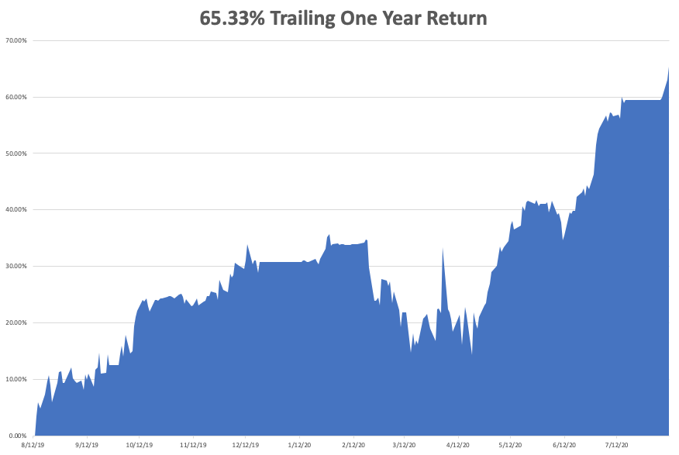

Slide 5
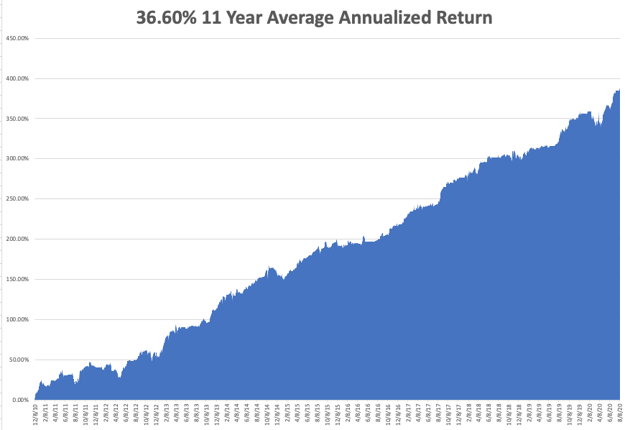
GTD 11 Year Daily Audited Performance

Slide 6
The Method to My Madness
*The Fed has proven its intention to step in and run the printing presses on any 10% market correction, which is imminent *Stocks overpriced at all time high, but cheap on a three-year view. The double top risk is here *A bond short is far and away the better trade based on massive over issuance of US government bonds and now we have a big rally to sell into *The big fear remains for a larger Corona spike now, with a second, bigger one in the fall *Gold broke out from hedging and diversification demand *The US dollar is toast because of exploding deficits *Best buying opportunity of the decade is setting up, the next big dip is the one you buy

Slide 7
Corona Update
*US cases top 4.9 million, deaths at 164,690 and new cases are exploding in most states, BUT COULD BE PEAKING HERE FOR THE SHORT TERM *New CDC Forecasts Calls for 180,000 US Deaths by end August, or 1,000 a day *Arizona, Texas, and Florida hospitals are getting overwhelmed *New wave is spreading to younger victims, so the death rate is falling under 1% *At least five companies are close to delivering a vaccine in a year, as trillions are poured into the sector *70 vaccines now in development worldwide, but some of these MAY KILL YOU *A true vaccine is a year off, or never

Slide 8
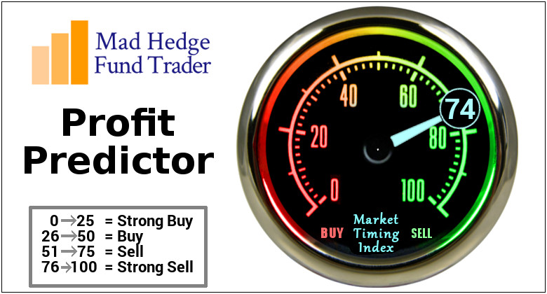
The Mad Hedge Profit Predictor Market Timing Index-Bottom of Range-at to a “BUY” An artificial intelligence driven algorithm that analyzes 30 different economic, technical, and momentum driven indicators

Slide 9
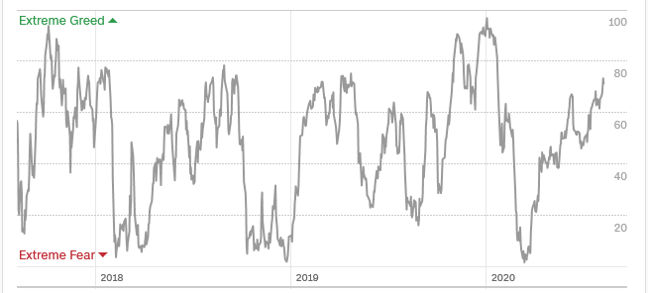
The Mad Hedge Profit Predictor From Extreme Overbought to Oversold
SELL
BUY

Slide 10
The Global Economy – The Biggest Hit
*July Nonfarm Payroll Report comes in at 1.73 million, with the headline Unemployment rate falling from 11.1% to 10.2%. *Weekly Jobless Claims at 1,186,000 still the worst in history *July ADP Private Sector Report shows companies only rehired 167,000, a weak recovery at best *Q2 GDP at 32.9% is the worst in American history. Will there be a big rebound in Q3, or do we have to wait until Q4? *Europe shrinks by 10% in Q2 at an annualized showing, showing their Corona policies succeeded where ours failed miserably. *New trade war with China threatens an added drag on the US economy.

Slide 11
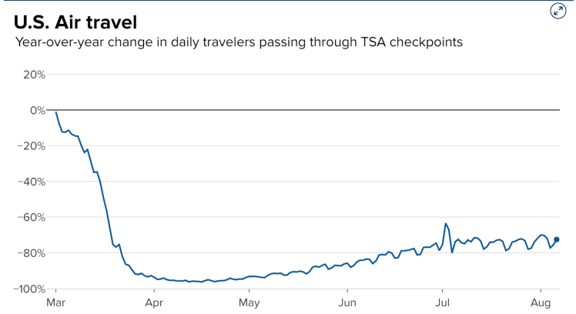

Slide 12
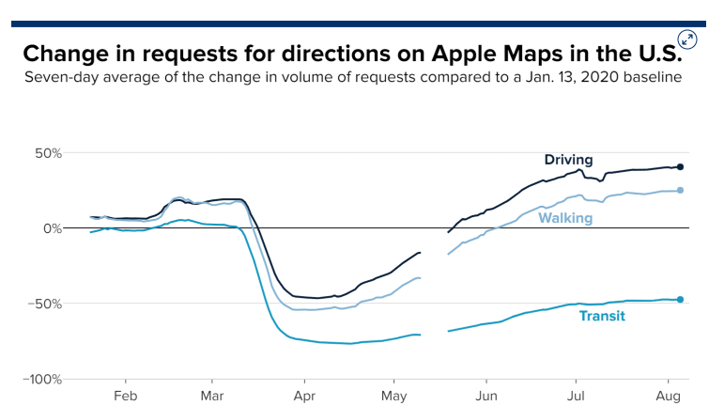

Slide 13
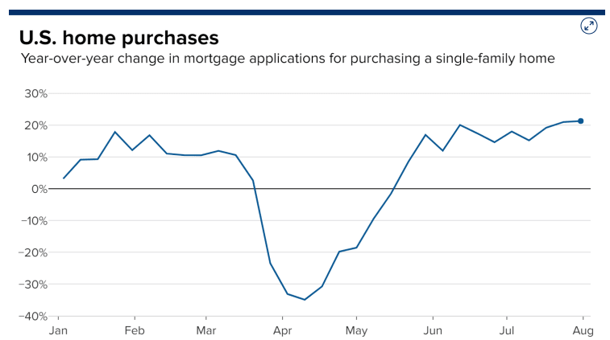

Slide 14
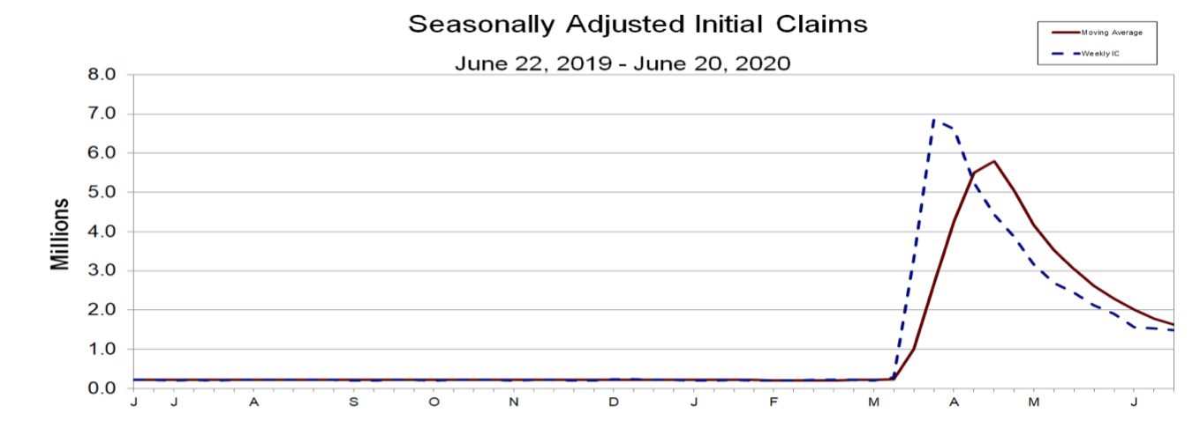
Weekly Jobless Claims - Disaster +1.18 Million

Slide 15
The Bill Davis View A $1,500 Upgrade for the Mad Day Trader Service
Buys: | Entry | Target
Perrigo Co. (PRGO) | $ 55.00 | $ 64.00
American Express Co. (AXP) | $ 108.00 | $ 130.00
CDW Corp (CDW) | $ 119.00 | $ 140.00
CME Group Inc. (CME) | $ 167.00 | $ 190.00
WEX Inc, (WEX) | $ 165.00 | $ 190.00
Sells:
MercadoLibre Inc. (MELI) | $ 1,160.00 | $ 1,000.00
NetEase.com Inc. (NTES) | $ 465.00 | $ 400.00
Quidel Corp. (QDEL) | $ 248.00 | $ 200.00
Jazz Pharmaceuticals (JAZZ) | $ 125.00 | $ 107.00
Cogent Communications (CCOI) | $ 70.00 | $ 55.00

Slide 16
Stocks – Rotation is Here
*Stocks hit new highs as US Corona cases explode, with tech and biotech leading the charge, but are way overdue for a correction *”Recovery stocks like banks, energy, cruise lines, and hotels have been thrown back into the trash can, but are ripe for a major bounce when corona cases peak again *Stocks are expensive relative to the old America, but cheap relative to the new one *Pandemic is forcing massive economies and cist cutting, evolving companies towards much more profitable business models at incredible speed *That’s what investors are paying up for *Fear of being left behind at the station is dragging in $5 trillion in cash from the sidelines *We could be entering a wide $2,700 - $3,400 range until the election

Slide 17
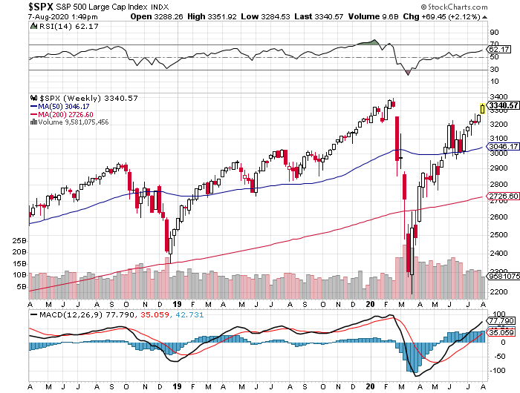
S&P 500 – Double Top Risk stopped out of long 7/$320-$330 bear put spread took profits on long 6/$235-$245 bull call spread took profits on long 4/$280-$290 bear put spread took profits on long 4/$275-$280 bear put spread
New Highs
The Bottom 2,800

Slide 18
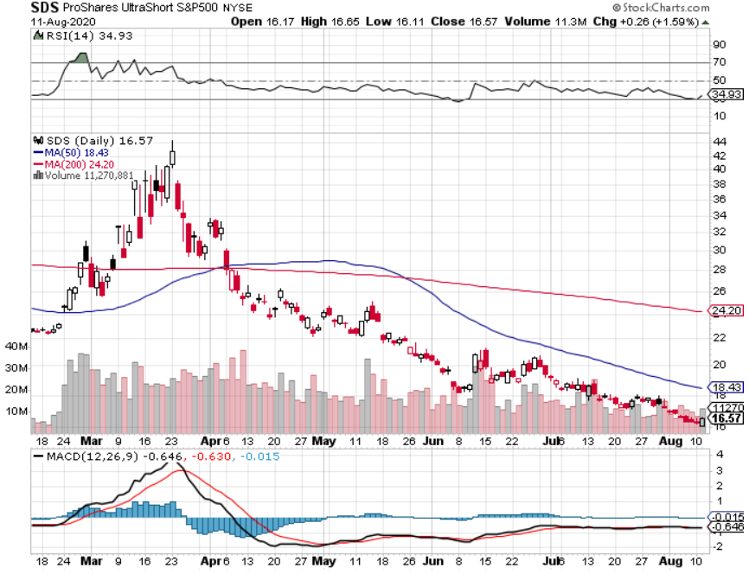
ProShares Ultra Short S&P 500 (SDS)- a Great Hedge for long stocks and bonds Long 2X position has a hedge against longs and bond shorts

Slide 19
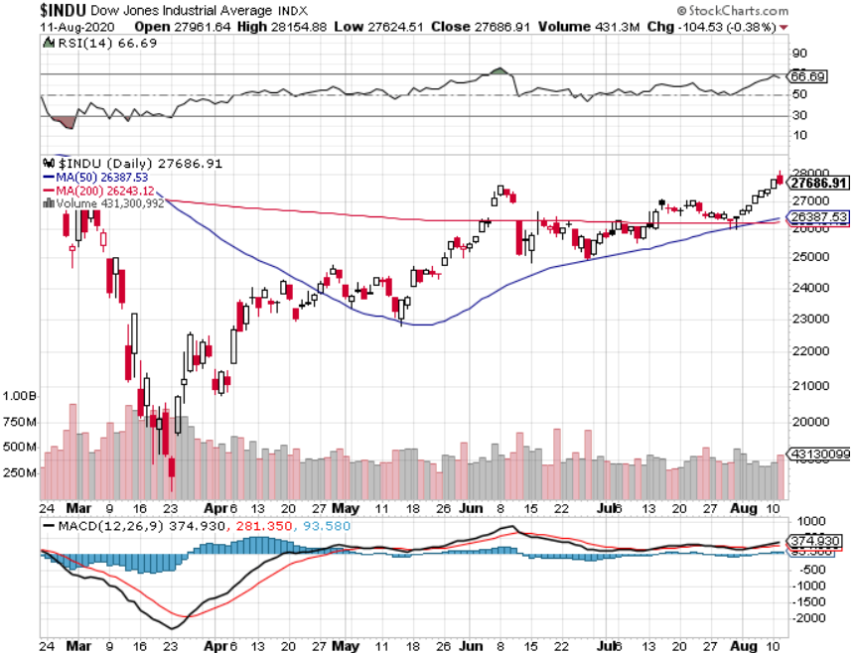
Dow Average ($INDU)-

Slide 20
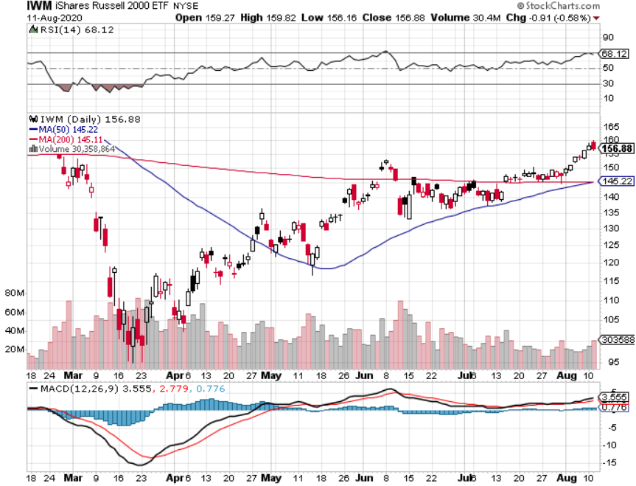
Russell 2000 (IWM)- took profits on Long 10/$137-$142 vertical bull call spread took profits on Long 10/$153-$156 vertical bear put spread

Slide 21
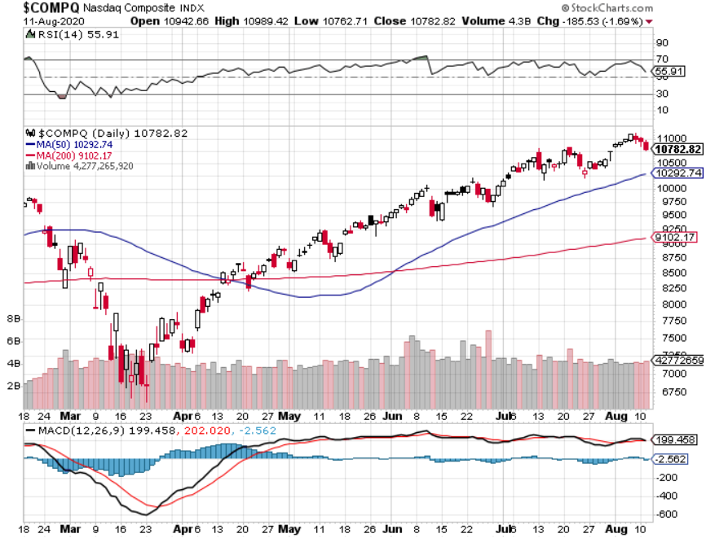
NASDAQ ($COMPQ) – Peaking Out

Slide 22
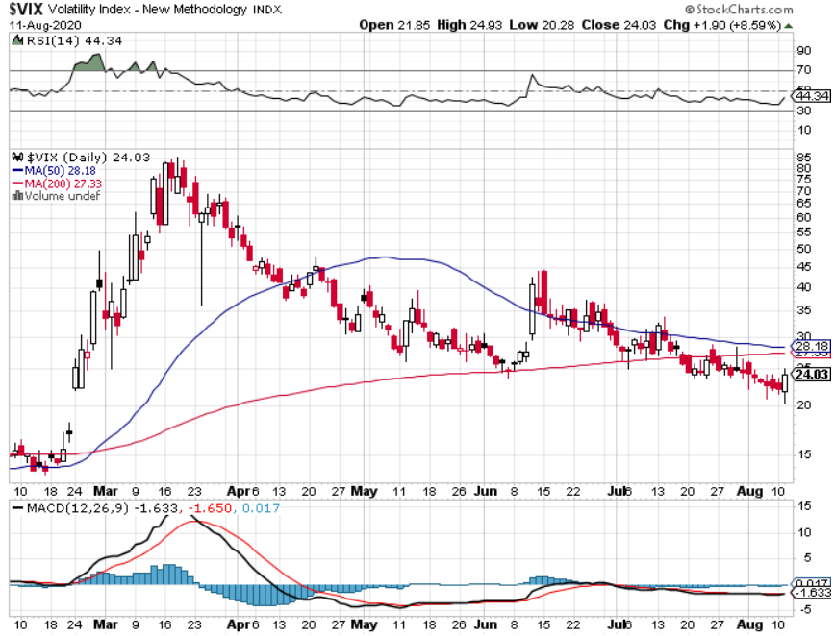
(VIX)-”BUY” Territory

Slide 23
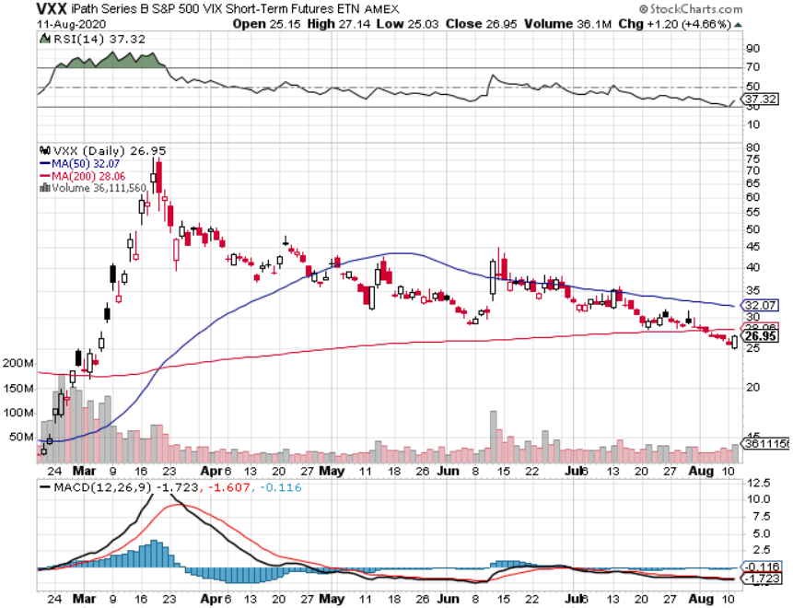
(VXX)- Sell Rallies-Down $85 to $26 from top stopped out of long 1/2021 $16 puts stopped out of long 1/2021 $24 puts

Slide 24
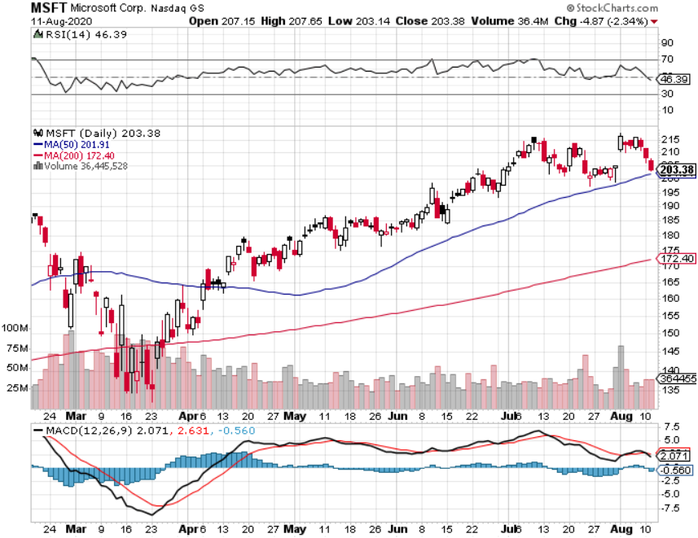
Microsoft (MSFT)- Earnings beat- Looking for Another Entry Point Stopped out of long 4/$120-$130 call spread took profit on long 4/$120-$130 call spread stop loss on long 12/$170-$180 call spread took profits on long 12/$135-$138 call spread

Slide 25
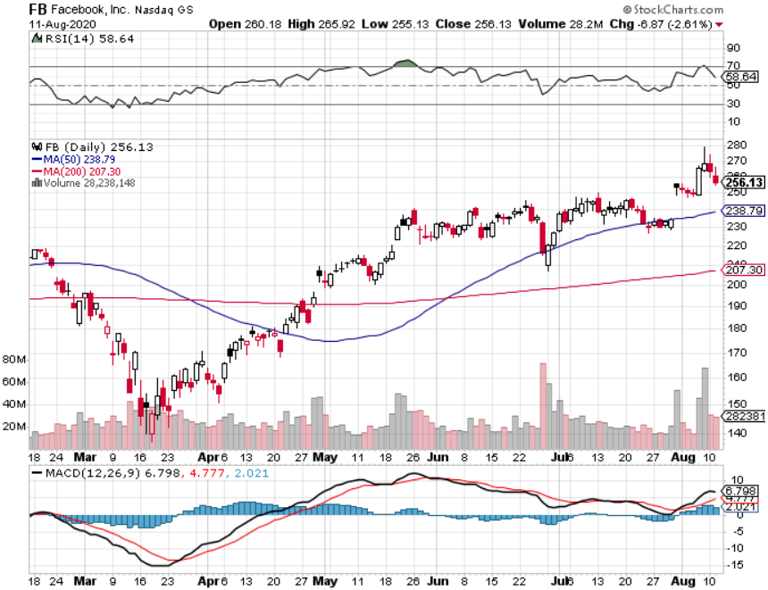
Facebook (FB)-New High Long 9/$290-$300 vertical bear put spread stopped out of Long 9/$190-$200 vertical bear put spread took profits on Long 9/$145-$155 vertical bull call spread took profits on Long 9/$150-$160 vertical bull call spread took profits on Long 8/$167.50-$172.50 vertical bull call spread

Slide 26
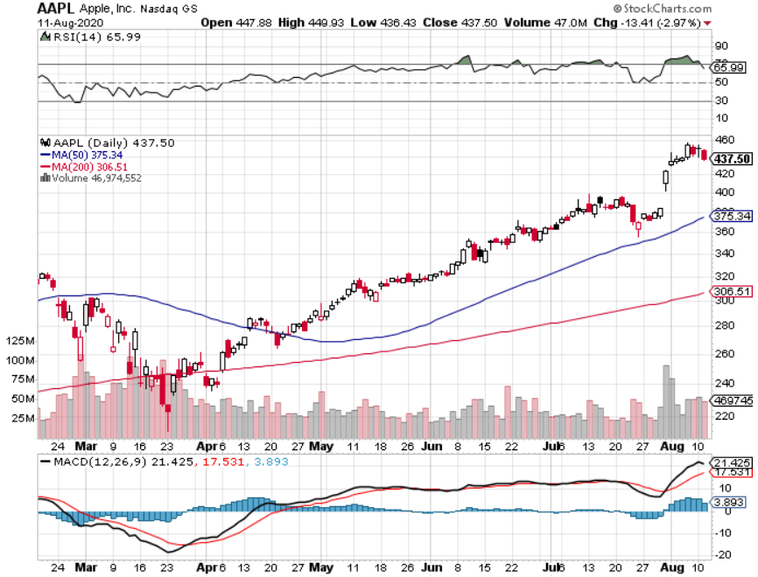
Apple (AAPL)- New Highs long 8/$480-$490 bear put spread took profits on long 7/$320-$330 call spread took profits on long 4/24/$250-$260 call spread took profits on long 5/$250-$260 call spread

Slide 27
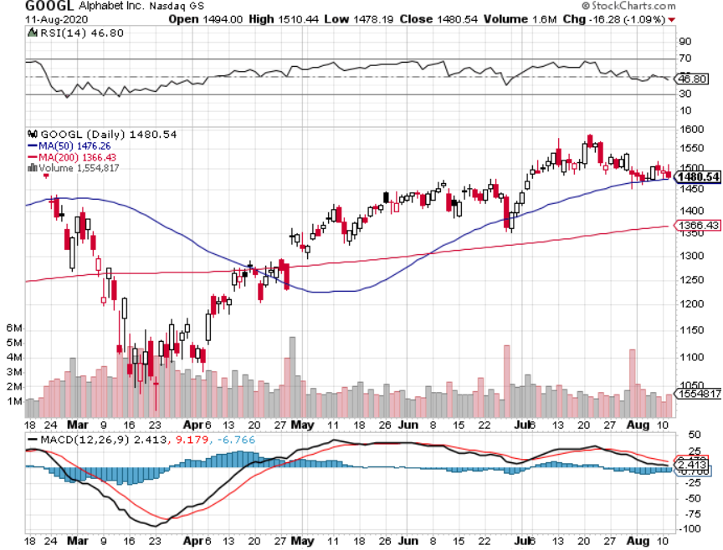
Alphabet (GOOGL) – New High took profits on long 12/$1,200-$1,230 bull call spread took profits on long 9/$1,030-$1,080 vertical bull call spread stopped out of long 5/$1,100-$1,130 bull call spread took profits on long 4/$1,080-$1,120 bull call spread

Slide 28
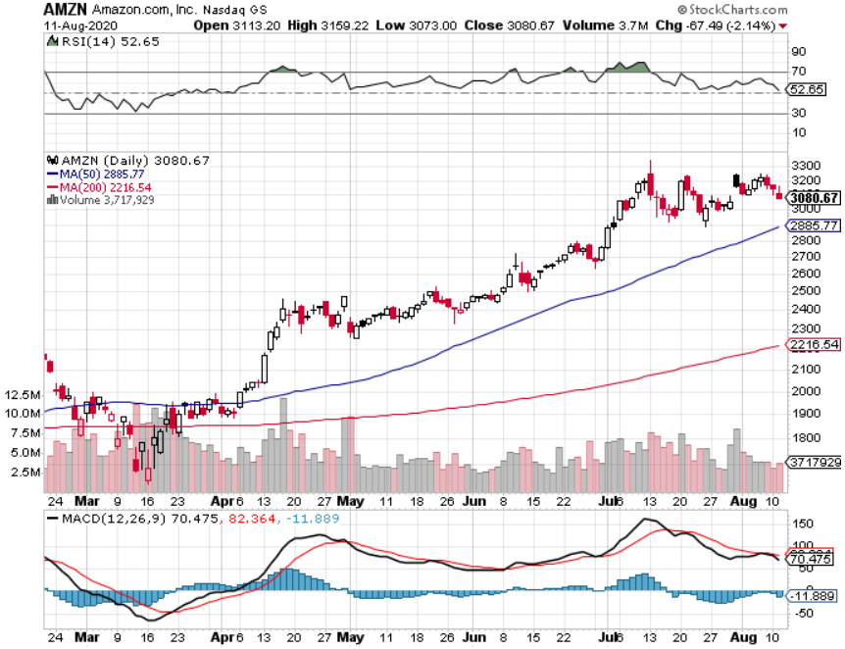
Amazon (AMZN) – Major New High long 8/$3,000-$3,500 bear put spread took profits on long 4/$1,500-$1,550 bull call spread took profits on long 4/$1,600-$1,650 bull call spread stopped out of long 3/$1,700-$1,800 bull call spread took profits on 9/$1,500-$1,500 bull call spread

Slide 29
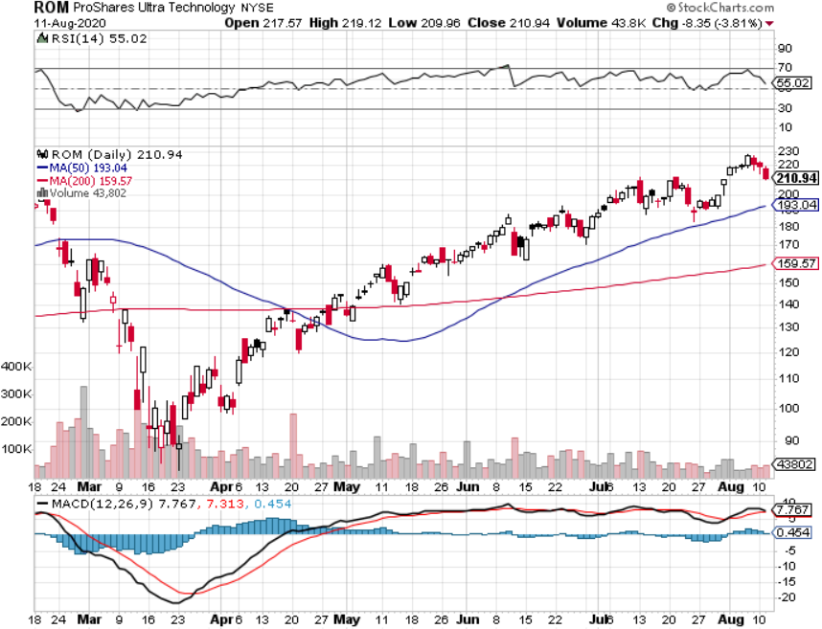
ProShares Ultra Technology (ROM) – Up 187% in 4 Months

Slide 30
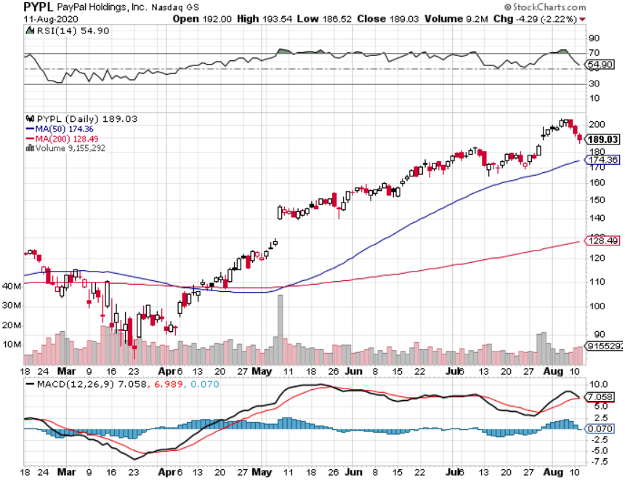
PayPal (PYPL)-Fintech Rules took profits on long 4/$90-$95 call spread

Slide 31
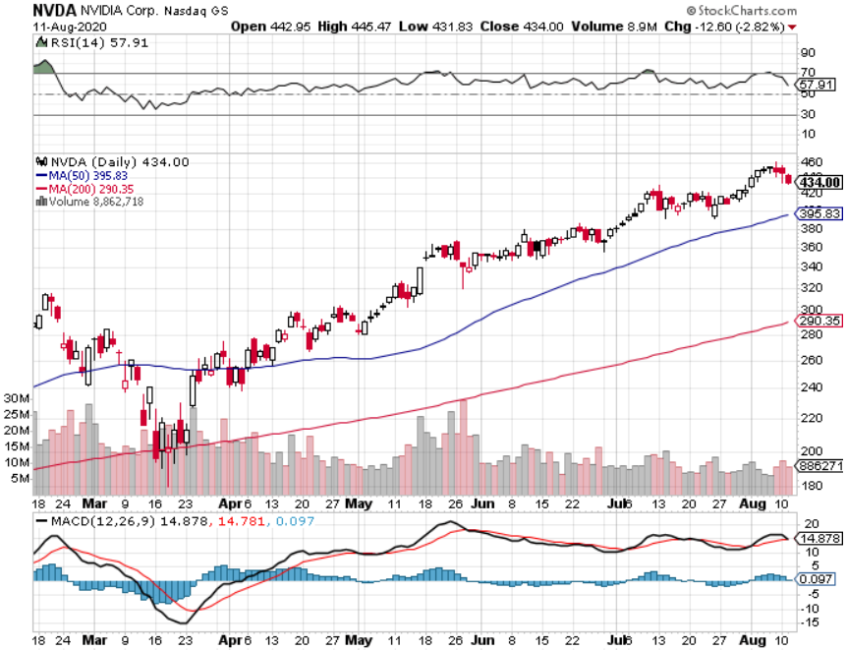
NVIDIA (NVDA) – New Highs on 39% Jump in Earnings

Slide 32
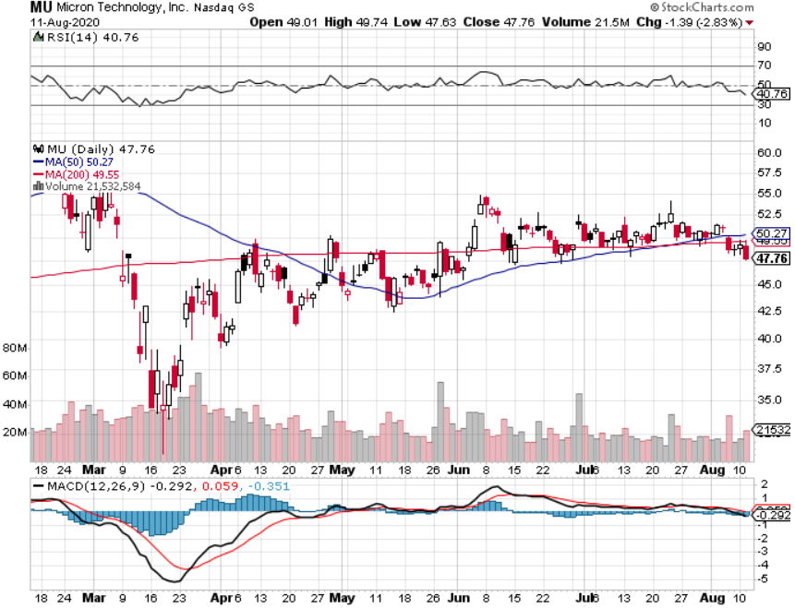
Micron Technology (MU)-Ditto

Slide 33
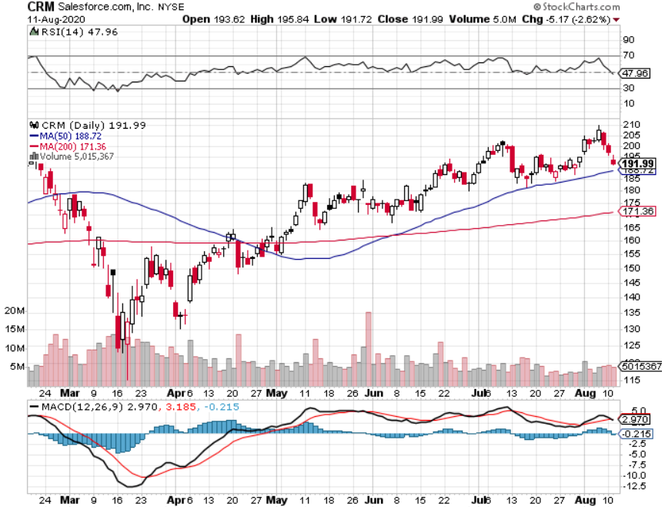
Salesforce (CRM)- Massive Online Migration took profits on long 9/$125-$130 vertical bull call spread took profits on long 8/$125-$130 vertical bull call spread took profits on long 2/$105-$115 call spread

Slide 34
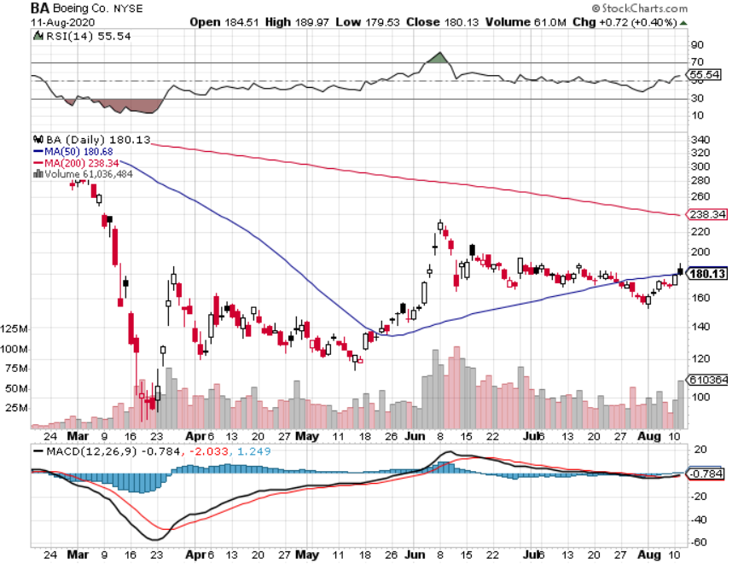
Boeing (BA) –GM Or Bank Style Takeover? 737 MAX production shutdown-Criminal investigation took profits on long 2/$270-$280 call spread took profits on long 12/$310-$330 call spread took profits on long 4/$300-$310 call spread took profits on long 4/$315-$335 call spread

Slide 35
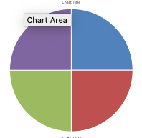
The Mad Hedge Technology Letter A $2,500 Upgrade
Current Capital at Risk
Risk On
CSCO 8/$38-$41 August 2020 call spread | 10.00%
MSFT 8/$190-$195 August 2020 call spread | 10.00%
ADBE 8/$400-$405 August 2020 call spread | 10.00%
EBAY 8/ $50-$53 August call spread | 10.00%
Risk Off
No positions
Net Position | 40.00%
32.28% Expiration P&L

Slide 36
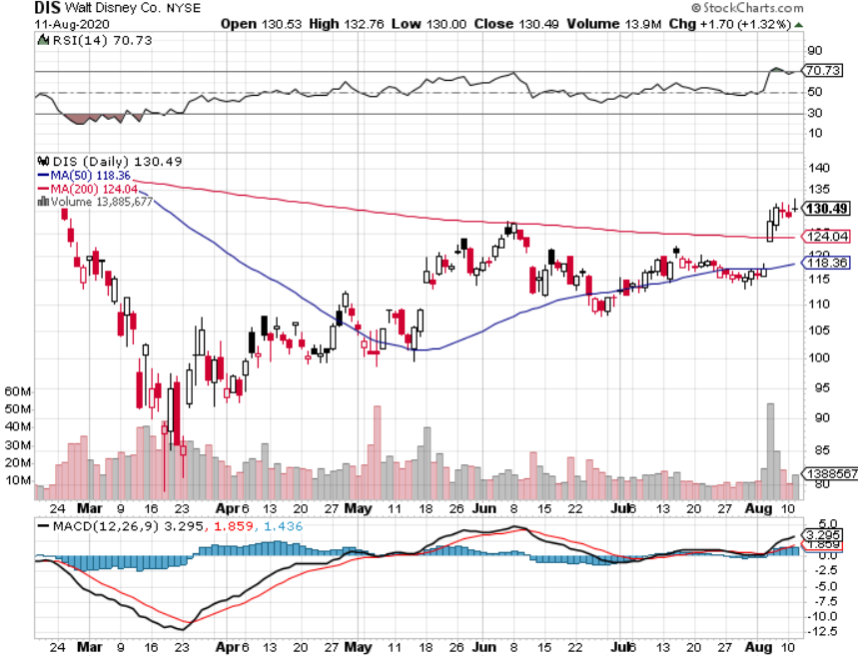
Walt Disney (DIS)- Corona Hit long 9/$120-$125 put spread took profits on long 6/$85-$90 call spread

Slide 37
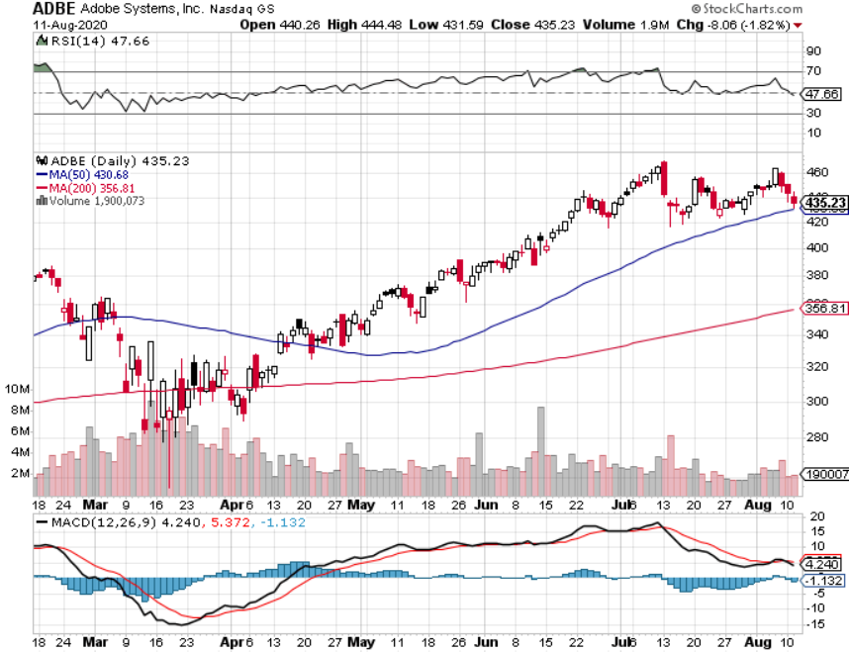
Adobe (ADBE)- The Quality Non-China tech play

Slide 38
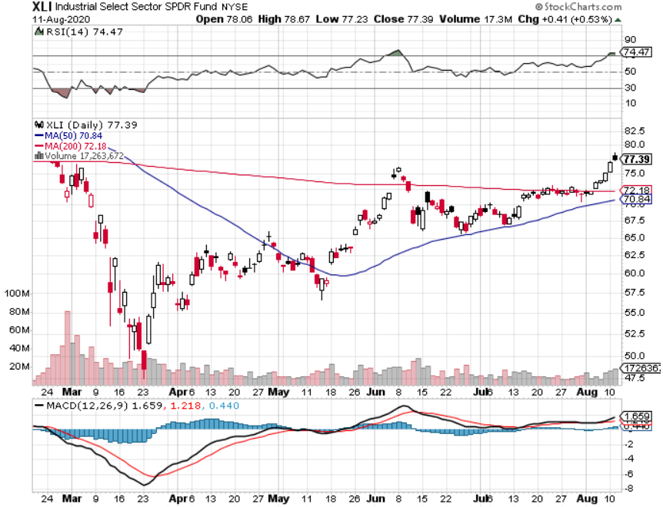
Industrials Sector SPDR (XLI)- (GE), (MMM), (UNP), (UTX), (BA), (HON)

Slide 39
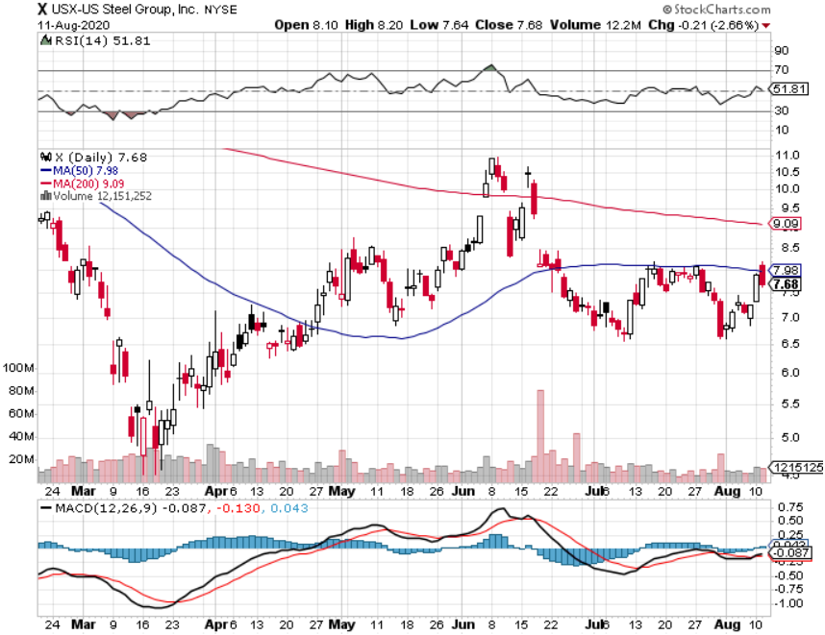
US Steel (X)-Dying Old Economy

Slide 40
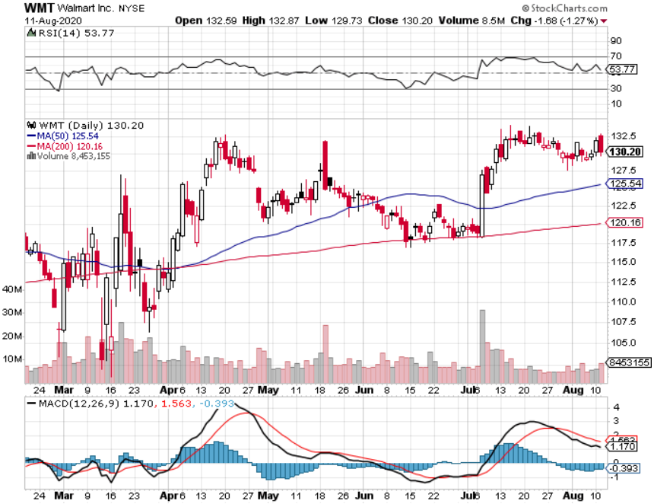
Wal-Mart (WMT)-Hiring 150,000 took profit on Long 11/$125-$130 bear put spread took profit on Long 10/$119-$121 bear put spread took profits on Long 8/$114-$117 bear put spread

Slide 41
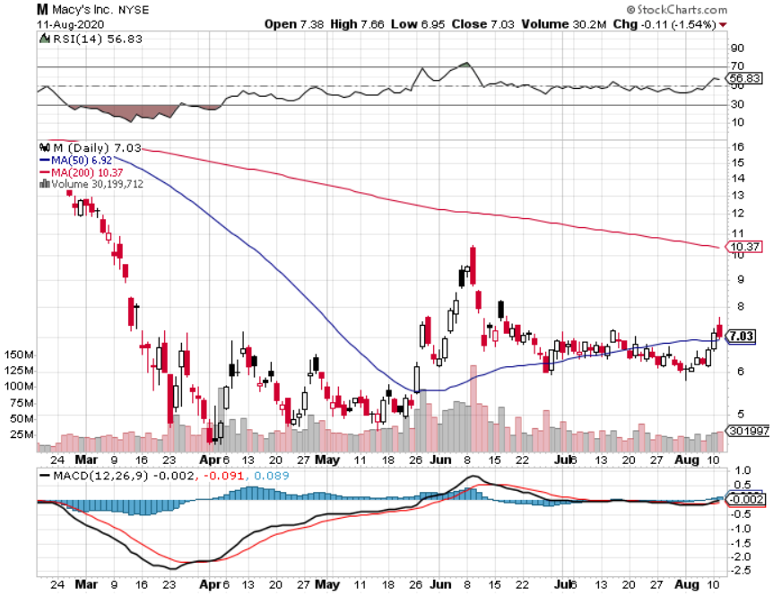
Macys’ (M) – Waiting for Chapter 11 took profits on Long 8/$23-$25 bear put spread

Slide 42
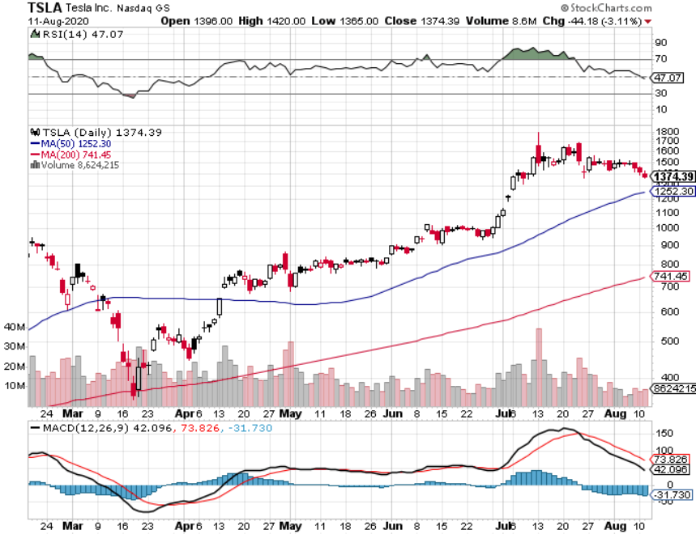
Tesla (TSLA)-New Highs-Model Y will be a blockbuster long 8/$1,700-$1,750 bear put spread long 6/$850-$900 call spread long 7/$750-$800 call spread stopped out of long 6/$260-$270 put spread took profits on long 6/$140-$150 call spread

Slide 43
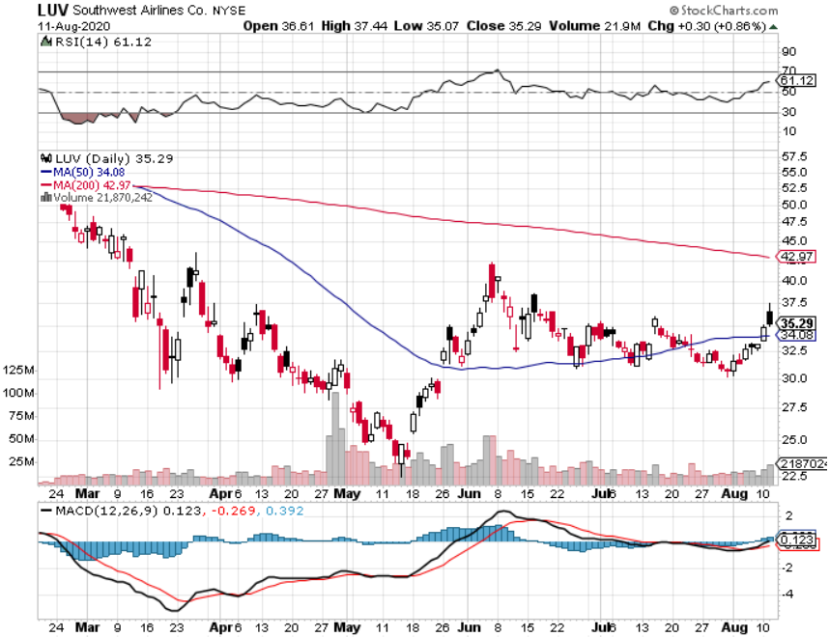
Southwest Airlines (LUV) – Warren Buffett big seller

Slide 44
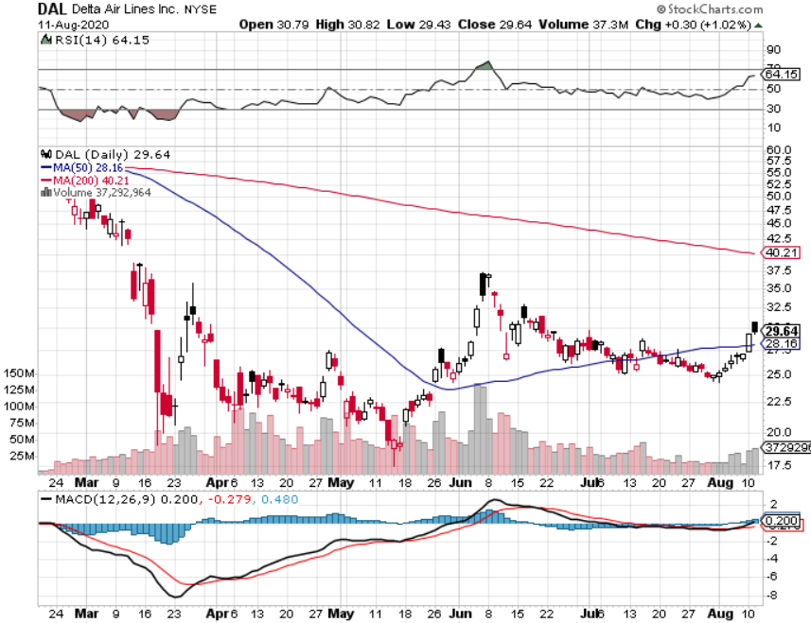
Delta Airlines (DAL) – Warren Buffett big seller

Slide 45
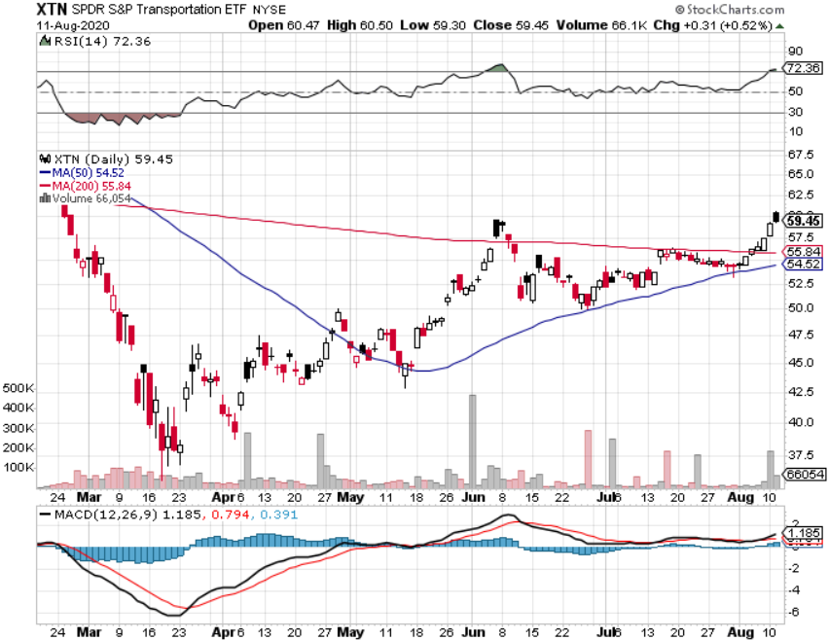
Transports Sector SPDR (XTN)- Worst Hit Sector (ALGT), (ALK), (JBLU), (LUV), (CHRW), (DAL)

Slide 46
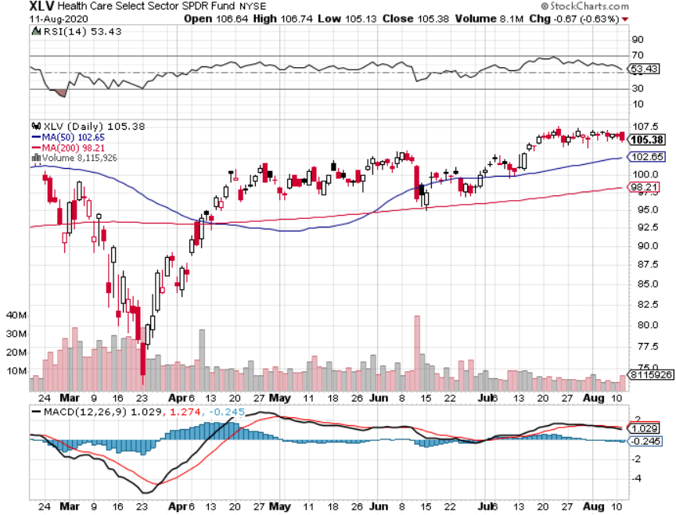
Health Care Sector (XLV), (RXL)-New Highs (JNJ), (PFE), (MRK), (GILD), (ACT), (AMGN) The new favorite sector

Slide 47
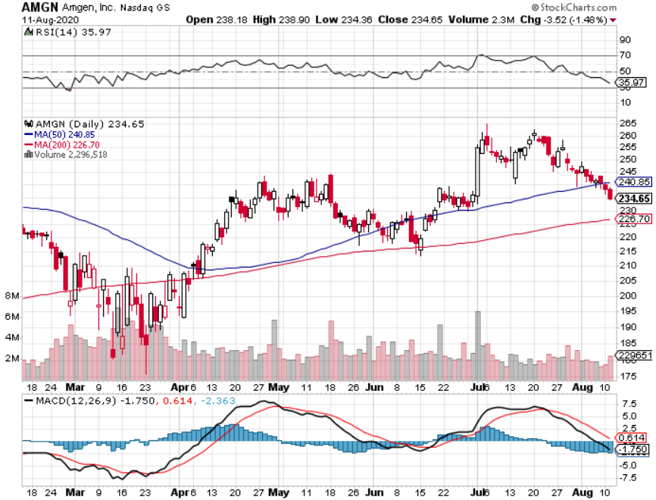
Amgen (AMGN)

Slide 48
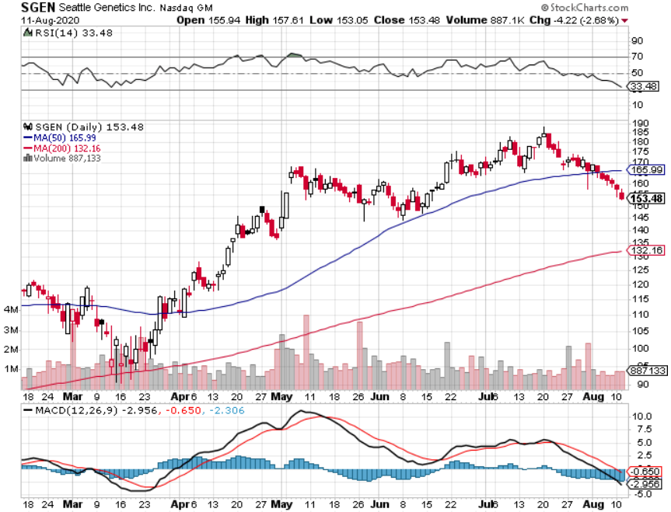
Seattle Genetics (SGEN) took profits on long 7/$140-$145 call spread

Slide 49
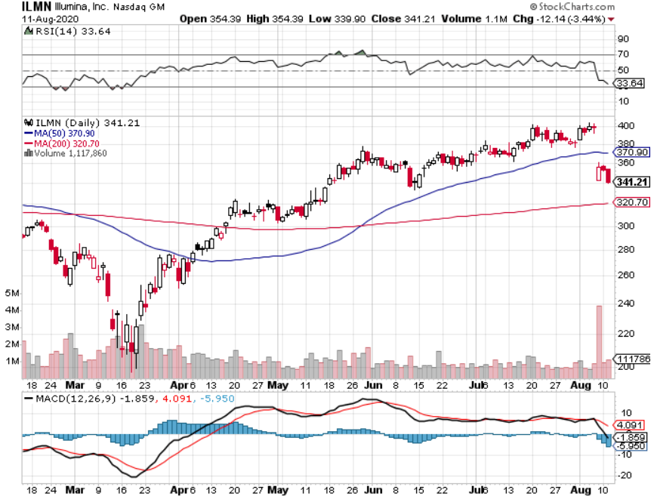
Illumina (ILMN) took profits on long 7/$320-$330 call spread

Slide 50
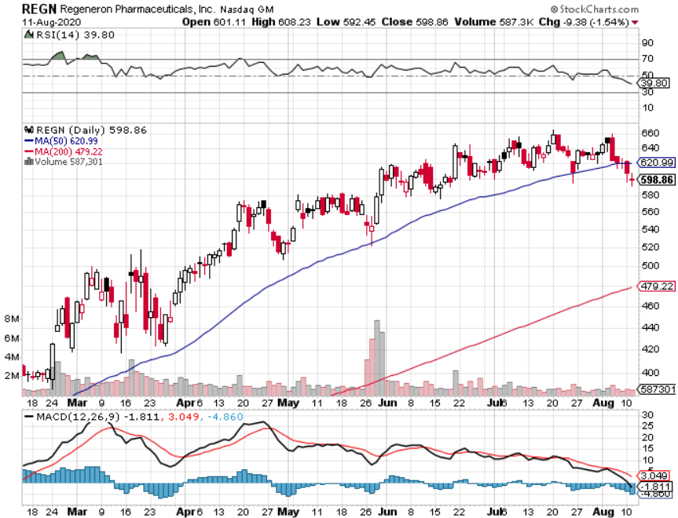
Regeneron (REGN) took profits on long 7/$570-$580 call spread

Slide 51
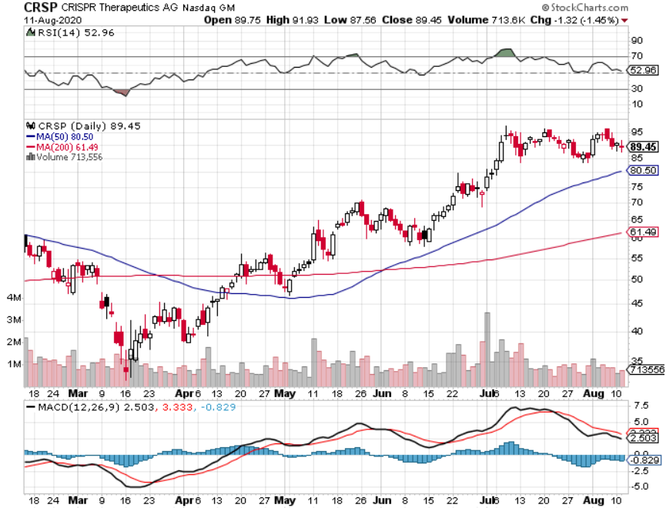
CRISPR Therapeutics (CRSP)

Slide 52
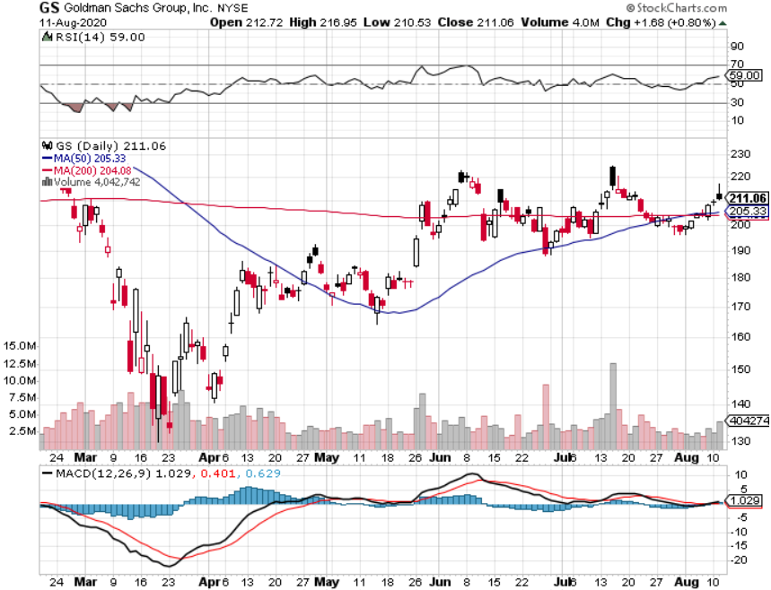
Goldman Sachs (GS) – Trading Volume Burst

Slide 53
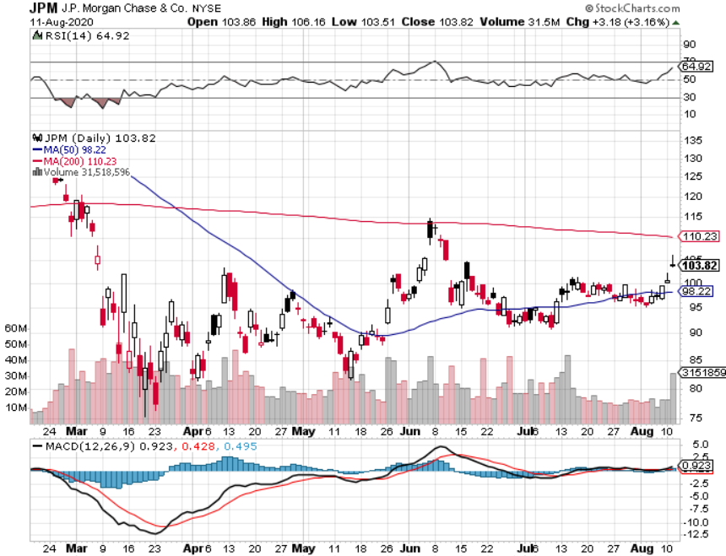
JP Morgan Chase (JPM) – “Recovery” Rotation Play long 8/$92-$95 bull call spread

Slide 54
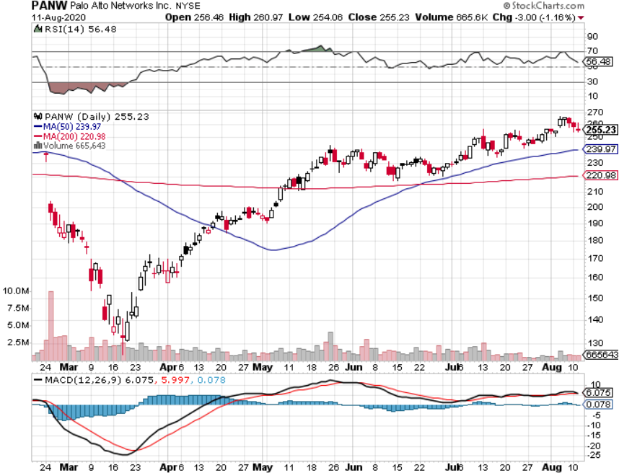
Palo Alto Networks (PANW)- New High Hacking never goes out of fashion

Slide 55
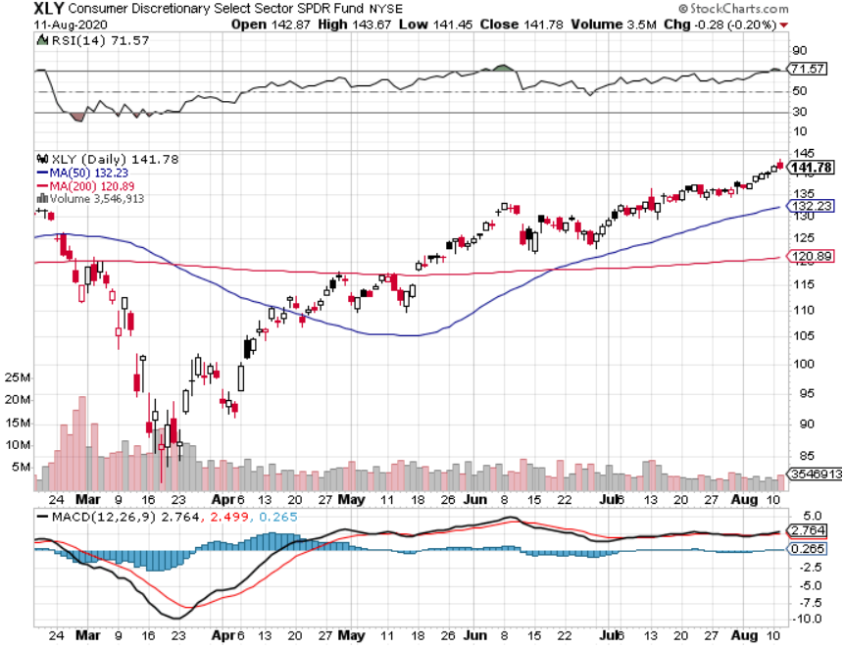
Consumer Discretionary SPDR (XLY) (DIS), (AMZN), (HD), (CMCSA), (MCD), (SBUX)

Slide 56
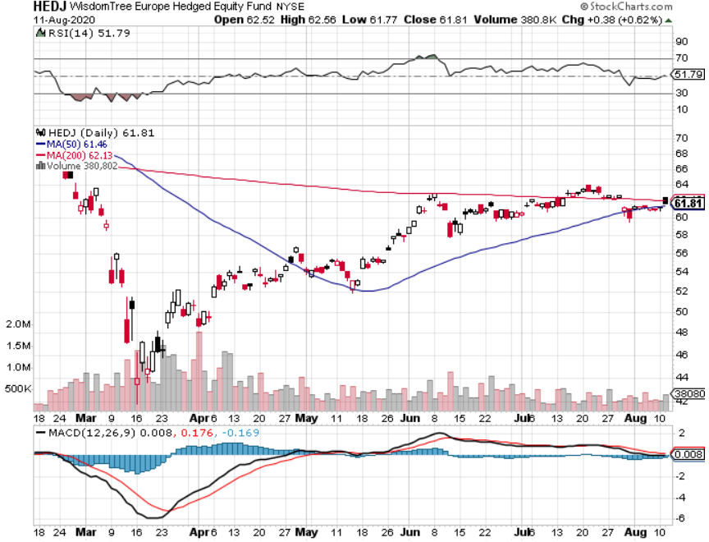
Europe Hedged Equity (HEDJ)-

Slide 57
Japan (DXJ)-

Slide 58
Emerging Markets (EEM)- Weak Dollar Play

Slide 59
Bonds – Second Dip is Here
*A second peak in the Corona virus will bring a second peak in interest rates and plunge in prices *While stock market ignores soaring Corona cases, bonds are keeping a laser focus *Rotation to domestic “recovery” stocks will bring another bond selloff *Another short selling opportunity of the century is in play, once corona cases peak out again *US Treasury bond fund (TLT) could plunge from $180 to $105, taking interest rates from 0.31% to 3.25% *Bottom line: sell short every major rally in the (TLT)

Slide 60
Treasury ETF (TLT) – Huge Short Play long 8/$172.50-$175.00 bear put spread long 8/$175.00-$177.50 bear put spread took profits on long 7/$168-$171 put spread took profits on long 7/$151-$154 call spread took profits on long 7/$172-$175 put spread

Slide 61
Ten Year Treasury Yield ($TNX) – 0.53%

Slide 62
Junk Bonds (HYG) 5.90% Yield to Maturity big jump in spreads on stock selloff and recession fears

Slide 63
2X Short Treasuries (TBT)- 2 Month Bottoming Process

Slide 64
Emerging Market Debt (ELD) 4.77% Yield-

Slide 65
Municipal Bonds (MUB) – 1.41% Mix of AAA, AA, and A rated bonds

Slide 66
Foreign Currencies – New US Dollar Lows
*US Dollar weakens on soaring Corona pandemic and poor policy responses *Massive QE and bond issuance is sucking the life out of the Greenback, $2 trillion in new government borrowing *Euro takes a new run at the highs as their economy recovers and the US doesn’t *British pound strengthens *Aussie dollar consolidates strength *Bitcoin new four month high at $11,400 *Keep selling short all US dollar rallies, its yield support is gone forever

Slide 67
Japanese Yen (FXY), (YCS)

Slide 68
Euro ($XEU), (FXE), (EUO)-

Slide 69
British Pound (FXB)-

Slide 70
Australian Dollar (FXA)- The Global Recovery Play took profits on long 8/$67-$69 call spread

Slide 71
Emerging Market Currencies (CEW)

Slide 72
Chinese Yuan- (CYB)-

Slide 73
Bitcoin- New 2020 High

Slide 74
Energy – Flat Lining
*Short term bounce is possible if Corona cases peak *Production supply/demand gap is shrinking but is still historically huge *Much of lost demand is permanent as US economy restructures to a less transportation-oriented economy. *Maybe half of all listed energy names will go bankrupt in 2020 *Any price spike will be temporary, as over supply against fading demand will last for years *Avoid all energy plays like the plague, could drop by half in the coming recession

Slide 75
Oil-($WTIC)

Slide 76
United States Oil Fund (USO) stopped out of long stopped out of long (USO) long 10/$9.50-$10 Vertical bull call spread

Slide 77
Energy Select Sector SPDR (XLE)-No Performance! (XOM), (CVX), (SLB), (KMI), (EOG), (COP)

Slide 78
Halliburton (HAL)-

Slide 79
Natural Gas (UNG) -

Slide 80
Precious Metals – All Time Highs
*No change in bullish picture-upside breakout is in play *Hedging demand piles on top of central bank buying *New QE Infinity sparks huge rally, worthless dollar make valuable gold *Near zero interest rates and Collapsing US dollar is another incentive *Central banks still pouring into gold every month *Bottom Line: buy a bigger dip in gold and precious metals

Slide 81
Gold (GLD)- Short Term downtrend long 7/$157-$160 call spread

Slide 82
Market Vectors Gold Miners ETF- (GDX) –

Slide 83
Barrick Gold (GOLD)

Slide 84
Newmont Mining- (NEM)-

Slide 85
Silver- (SLV)-

Slide 86
Silver Miners - (SIL)-

Slide 87
Wheaton Precious Metals - (WPM)-

Slide 88
Copper (COPX)-Collapse Trade War Disaster

Slide 89
Freeport McMoRan (FCX)-World’s Largest Copper Producer took profits on long 4/$10-$11 call spread took profits on short 4/$114 calls

Slide 90
Real Estate – Running Out of Supply
*Commercial real estate may see a “hollowing out” continue as 10% of worker migration to homes may be permanent *Home remodel market is booming as families spend much 24 hours a day at home *30-year fixed rate mortgage hits record low at 3.14% *Suburban search ads soaring as urban dwellers flee Corona virus *Buyer demand is very strong with supply shrinking, so affordability is plunging *Up to 40 million could be evicted, four times the peak seen during the Great Depression *Housing prices were ready to explode to the upside with S&P Case Shiller Rose 4.5%, in May

Slide 91
April Corelogic S&P Case Shiller Home Price Index Phoenix (9.0%), Seattle (6.8%), Tampa (6.0%) showing biggest gains
Tradingeconomics.com

Slide 92
Simon Property Group (SPG)- Mall REIT Up to 60% of Mall Tenants Aren’t Paying Rent

Slide 93
Crown Castle International (CCI) – 3.40% yielding cell phone Tower REIT

Slide 94
US Home Construction Index (ITB) (DHI), (LEN), (PHM), (TOL), (NVR)

Slide 95
Trade Sheet- So What Do We Do About All This?
*Stocks – buy dips *Bonds – sell rallies aggressively *Commodities-stand aside *Currencies- sell US dollar rallies *Precious Metals – buy dips *Energy – stand aside *Volatility - sell short over $50 *Real estate – buy dips

Slide 96
Next Strategy Webinar 12:00 EST Wednesday, September 2, from Lake Tahoe, Nevada email me questions at support@madhedgefundtrader.com
Good Luck and Good Trading!
Notes:
*

