Slide 1
The Mad Hedge Fund Trader “Between a Rock and a Hard Place”
With John Thomas from Silicon Valley, CA, September 16, 2020 www.madhedgefundtrader.com
Notes:
*

Slide 2
Trade Alert Performance New All Time High! – A record 82 Trade Alerts since April 1
*January 3.13% Final *July +7.93% Final *February -6.05% Final *August -2.08% Final *March -5.50% Final *September 8.96% MTD *April +4.55% Final *October +12.13% Final *May +14.19% Final *November -1.26% Final *June +10.38% Final *December +4.97% Final *Year to date +35.51% compared to -1.6% for the Dow Average *+391.42% since inception, a new all time high *Average annualized return of 36.41% for 11 years, new all time high

Slide 3
Portfolio Review Super Aggressive Long at Market Bottom-the 2-day portfolio Three +5% weeks in a row
Current Capital at Risk
Risk On
World is Getting Better
(TLT) 9/$170.00-$172.50 call spread | 10.00%
(AMZN) 9/$2,800-$2,900 call spread | 10.00%
(JPM) 9/$90-$95 call spread | 10.00%
(V) 9/$180-$185 call spread | 10.00%
(GLD) 9/$171-$174 call spread | 10.00%
(C) 10/$37.50-$40 call spread | 10.00%
Risk Off
World is Getting Worse
(SPY) 9/$360-$365 put spread | -10.00%
Total Net Position | 50.00%
Total Aggregate Position | 70.00%
Expiration P&L +38.03% YTD

Slide 4
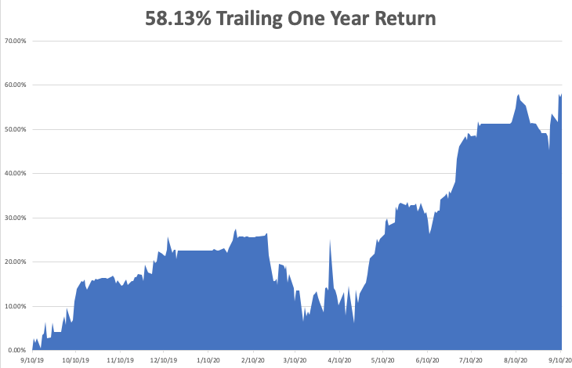

Slide 5
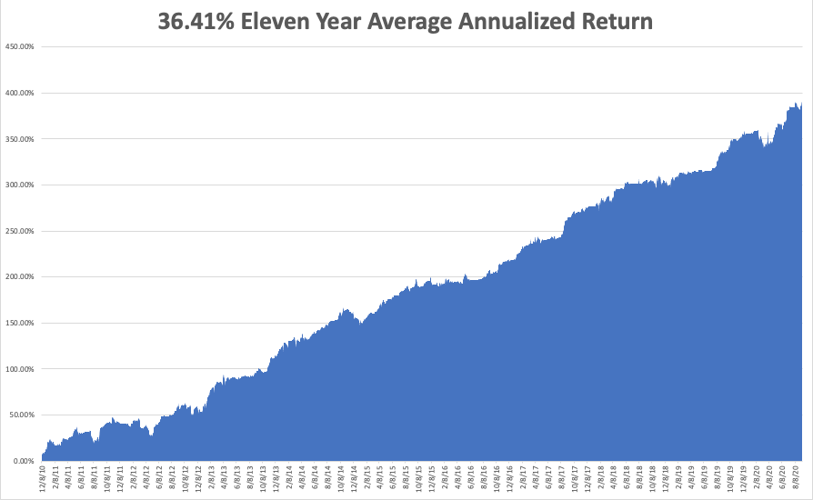
GTD 11 Year Daily Audited Performance

Slide 6
The Method to My Madness
*The Fed put still lives, more proof at 2:00 EST today *Tech Stocks overpriced at all time highs, so the market is begging for a rotation into cheap value plays like banks *A bond short is far and away the better trade based on massive over issuance of US government bonds and now we have a big rally to sell into *The big fear remains for a second, bigger Corona spike in the fall *Gold will imminently break out to new highs *The US dollar is bouncing along a bottom-election support *Best buying opportunity of the decade is setting up, the next big dip is the one you buy

Slide 7
Corona Update
*US cases top 6.5 million, deaths at 194,000,000 and are still rising at 1,000 a day, and could reach 250,000 by election day *New IHI Forecasts Calls for 400,000 US Deaths by end 2020, or 1,000 a day *Center of the US epidemic has moved to the northern Midwest, with North Dakota the worst hot spot in the US, the meat packing capital of the US *AstraZeneca Phase III vaccine trial resumes after an illness induced halt *At least six companies are close to delivering a partially effective vaccine in a year, as trillions are poured into the sector *70 vaccines now in development worldwide, but some of these MAY KILL YOU, at least 4 years until you get it *A true vaccine is a year off, or never

Slide 8
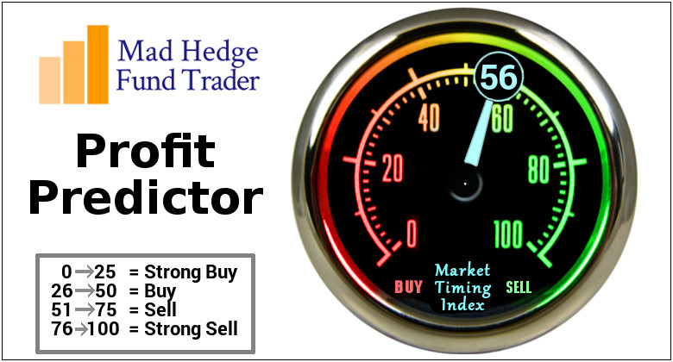
The Mad Hedge Profit Predictor Market Timing Index-Bottom of Range-at to a “BUY” An artificial intelligence driven algorithm that analyzes 30 different economic, technical, and momentum driven indicators

Slide 9
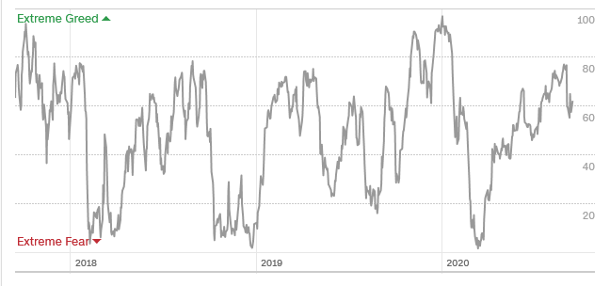
The Mad Hedge Profit Predictor Danger Territory
SELL
BUY

Slide 10
The Global Economy – Green Shoots
*Fed Meeting ends at 2:00 PM EST, no interest rate move likely * Skinny Fails, tanking the Dow Average by 450 points. There will be no more economic stimulus to fight the corona great depression until a new administration takes office *US Inflation Jumps, with the Consumer Price Index up 1.3% YOY in August, compared to only 1% in July * US Unemployment Rate Plunges to 8.4%, in August, from 10.2% *The August Nonfarm Payroll report jumps by 1.37 million * US Car Sales Recover to 15.2 Million, in August on an annualized basis. That brings us almost back to pre-pandemic levels

Slide 11
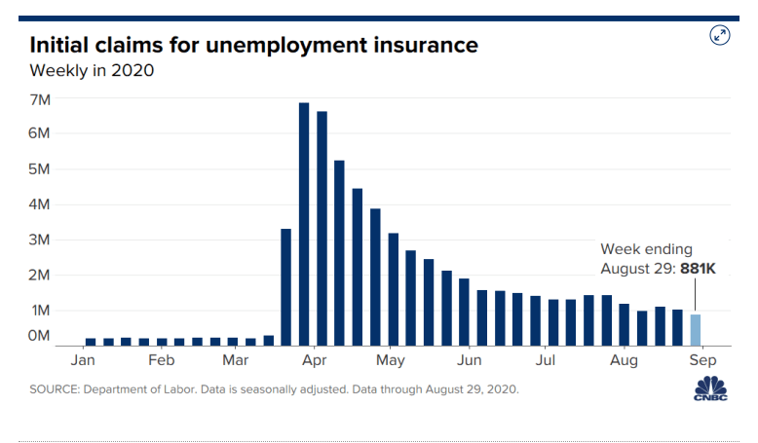
Weekly Jobless Claims – Trending Down +885,000

Slide 12
The Bill Davis View A $1,500 Upgrade for the Mad Day Trader Service

Slide 13
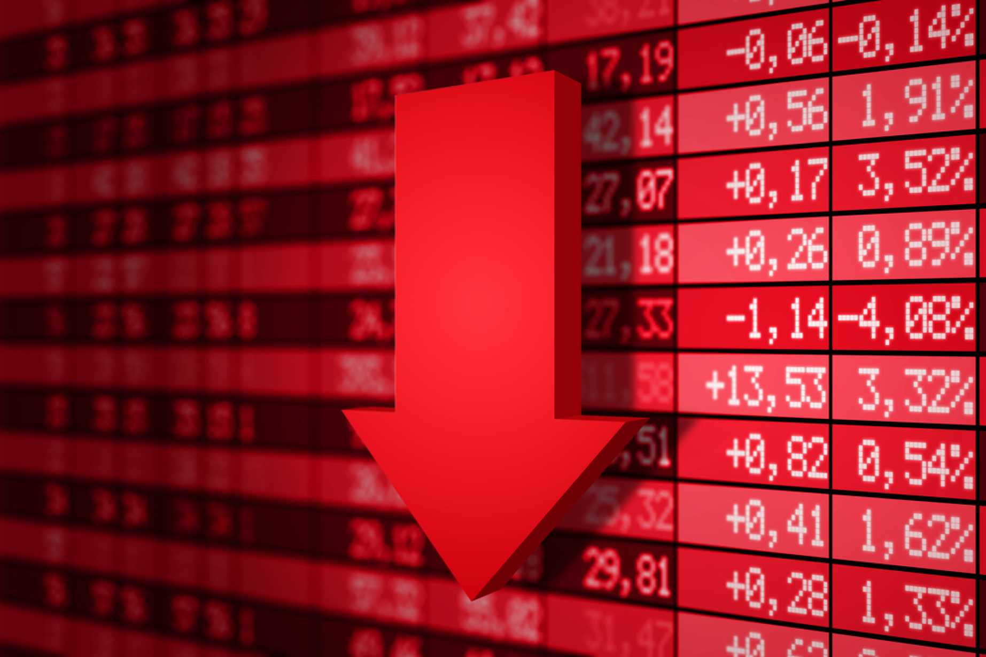
Stocks – The Correction is Here!
*Long awaited correction arrives, taking (SPX) down 8.3% and NASDAQ down 10% in a week, the fastest correction in history. Apple (AAPL) drops 20%. We may get one or two more ahead of the November election, almost all analysts are targeting (SPX) 3,600 by yearend *Volatility soared to $38, up 70% in two days, August option trading is up 140% YOY *Goldman Sachs Moves Global Stocks to “Overweight”. They’re preparing for the post pandemic world. *The Elephant Unwinds. Softbank dumped $3 billion worth of technology call options in a week *IPO’s and SPAC’s are flooding the market, taking hundreds of billions out of the market and signaling an interim market top. Palantir is an elephant, along with Snowflake, Doordash, *”Recovery stocks” like banks, energy, cruise lines, and hotels are ripe for a major bounce when corona cases peak again *We could be entering a wide $2,700 - $3,600 range until the election

Slide 14
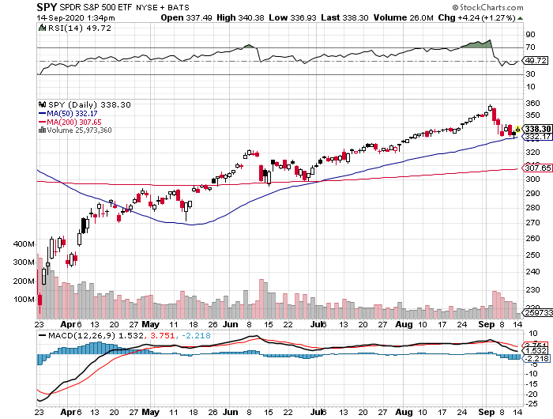
S&P 500 – Major Reversal Risk stopped out of long 7/$320-$330 bear put spread took profits on long 6/$235-$245 bull call spread took profits on long 4/$280-$290 bear put spread took profits on long 4/$275-$280 bear put spread
New Highs
You are Here Now
The Bottom 3,000

Slide 15
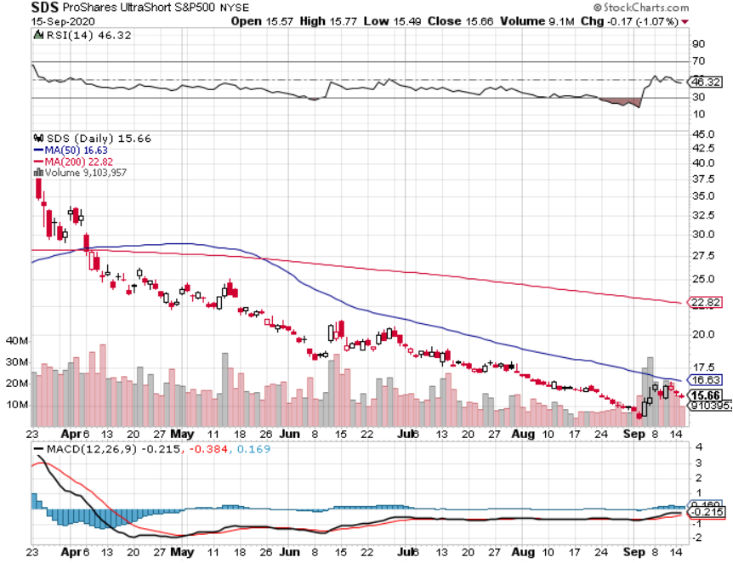
ProShares Ultra Short S&P 500 (SDS)- a Great Hedge for long stocks and bonds Long 2X position has a hedge against longs and bond shorts

Slide 16
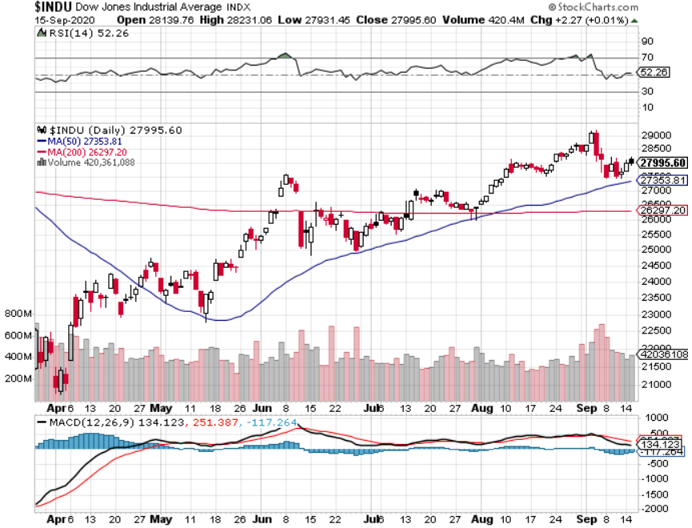
Dow Average ($INDU)- Head & Shoulders Top?

Slide 17
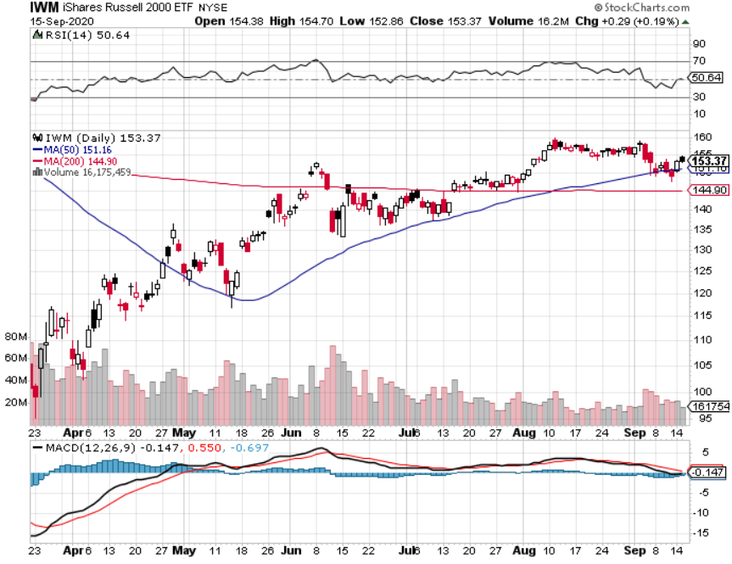
Russell 2000 (IWM)- took profits on Long 10/$137-$142 vertical bull call spread took profits on Long 10/$153-$156 vertical bear put spread

Slide 18
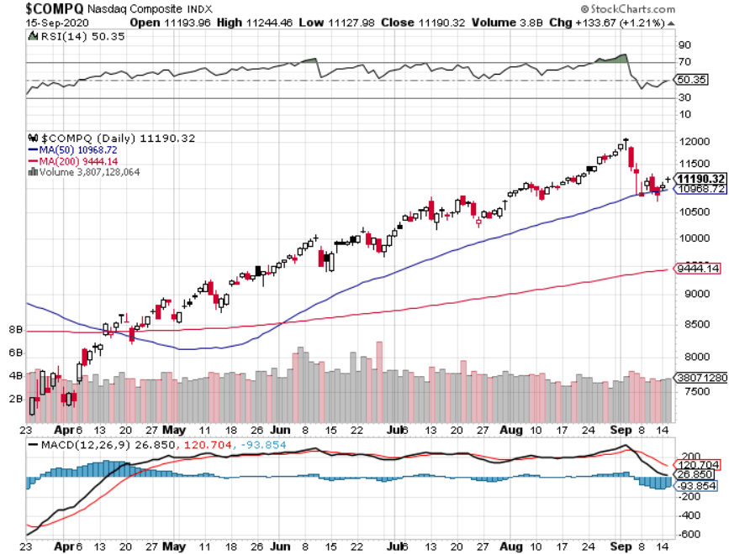
NASDAQ ($COMPQ) – Peaking Out

Slide 19
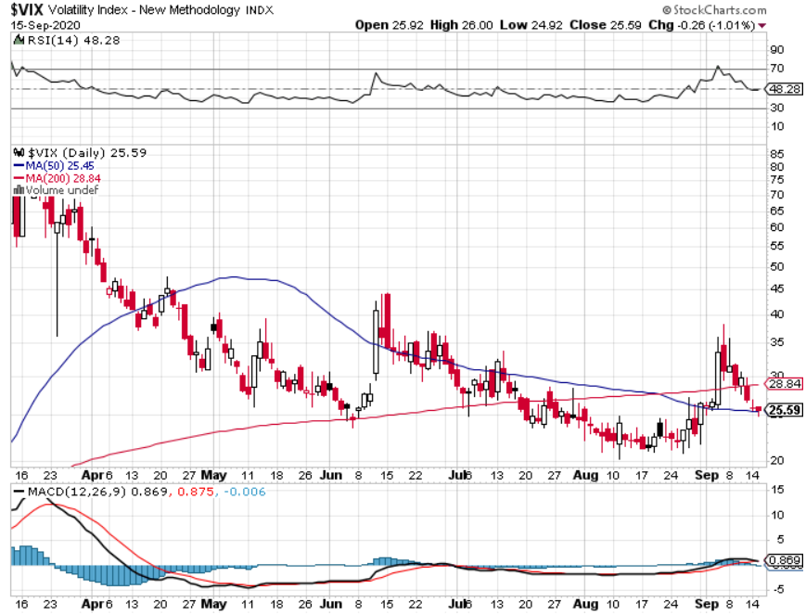
(VIX)- The Correction may be done

Slide 20
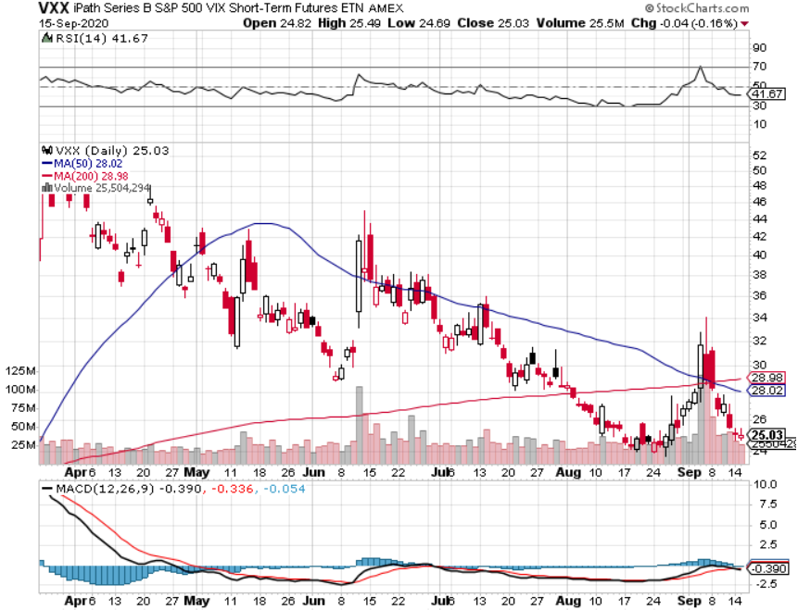
(VXX)- Sell Rallies-Down $85 to $23 from top stopped out of long 1/2021 $16 puts stopped out of long 1/2021 $24 puts

Slide 21
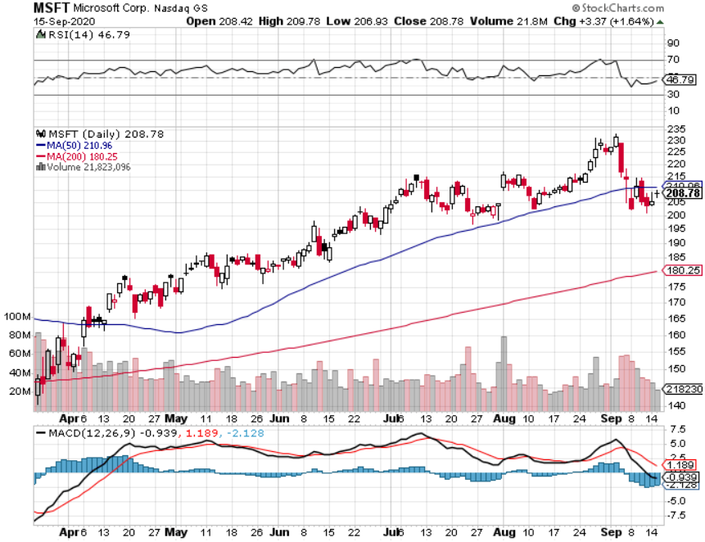
Microsoft (MSFT)- Earnings beat- Looking for Another Entry Point Stopped out of long 4/$120-$130 call spread took profit on long 4/$120-$130 call spread stop loss on long 12/$170-$180 call spread took profits on long 12/$135-$138 call spread

Slide 22
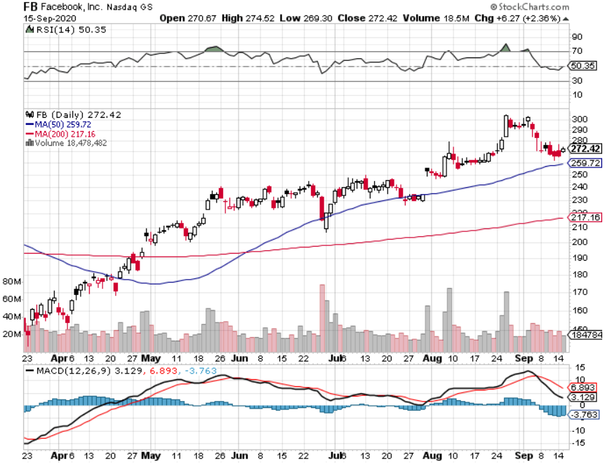
Facebook (FB)- took profits on Long 9/$290-$300 vertical bear put spread stopped out of Long 9/$190-$200 vertical bear put spread took profits on Long 9/$145-$155 vertical bull call spread took profits on Long 9/$150-$160 vertical bull call spread took profits on Long 8/$167.50-$172.50 vertical bull call spread

Slide 23
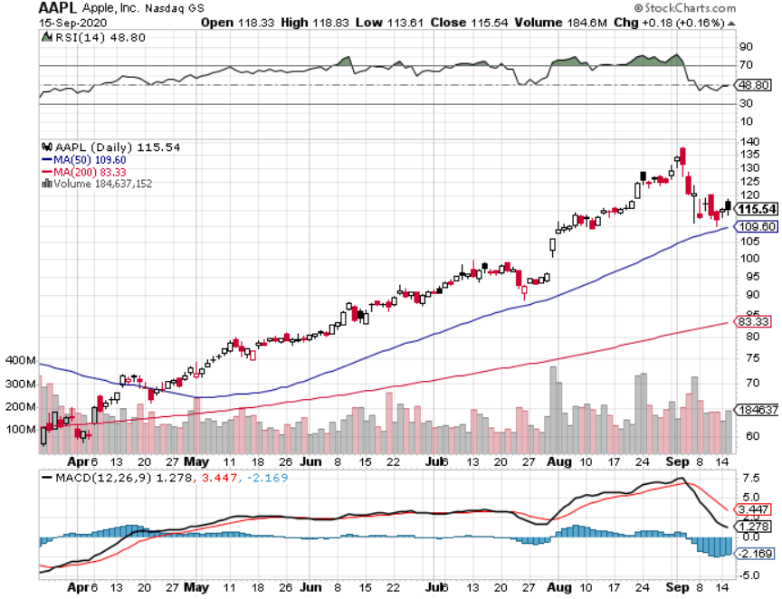
Apple (AAPL)- Capitulation stopped out of long 9/$100-$105 call spread stopped out of long 8/$480-$490 bear put spread took profits on long 7/$320-$330 call spread took profits on long 4/24/$250-$260 call spread took profits on long 5/$250-$260 call spread

Slide 24
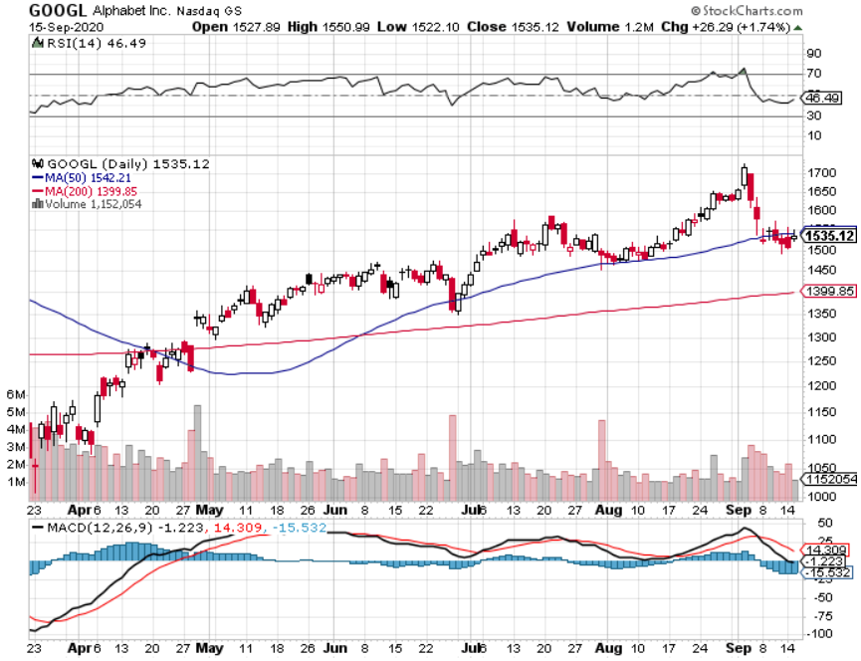
Alphabet (GOOGL) – Selloff took profits on long 12/$1,200-$1,230 bull call spread took profits on long 9/$1,030-$1,080 vertical bull call spread stopped out of long 5/$1,100-$1,130 bull call spread took profits on long 4/$1,080-$1,120 bull call spread

Slide 25
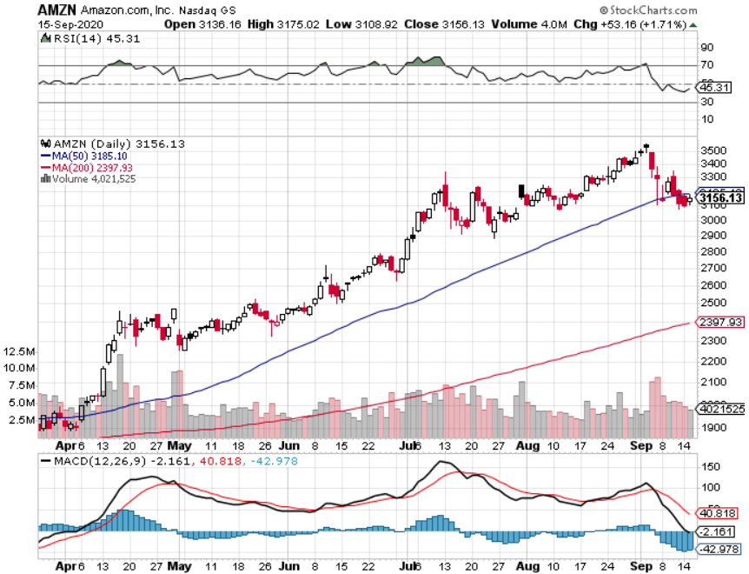
Amazon (AMZN) – Profit taking long 9/$2,800-$2,900 bull call spread stopped out of long 8/$3,000-$3,500 bear put spread took profits on long 4/$1,500-$1,550 bull call spread took profits on long 4/$1,600-$1,650 bull call spread stopped out of long 3/$1,700-$1,800 bull call spread took profits on 9/$1,500-$1,500 bull call spread

Slide 26
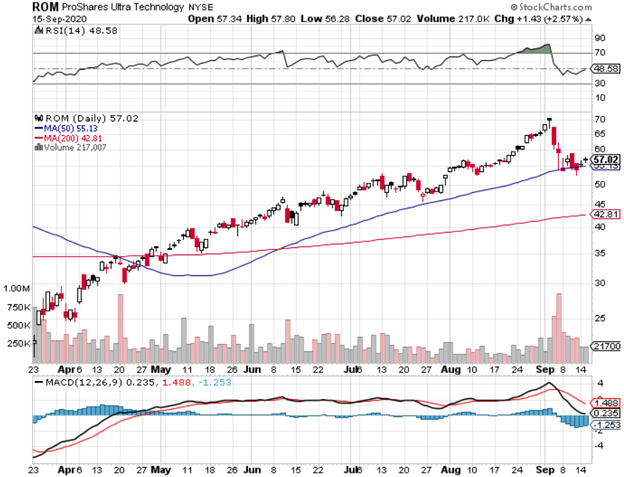
ProShares Ultra Technology (ROM) – Up 240% in 5 Months

Slide 27
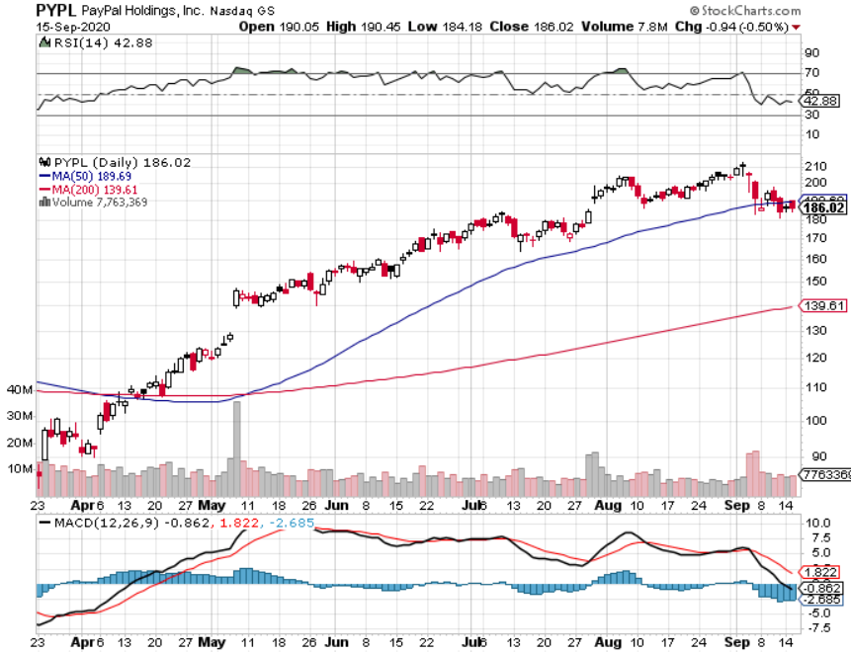
PayPal (PYPL)-Fintech Rules took profits on long 4/$90-$95 call spread

Slide 28
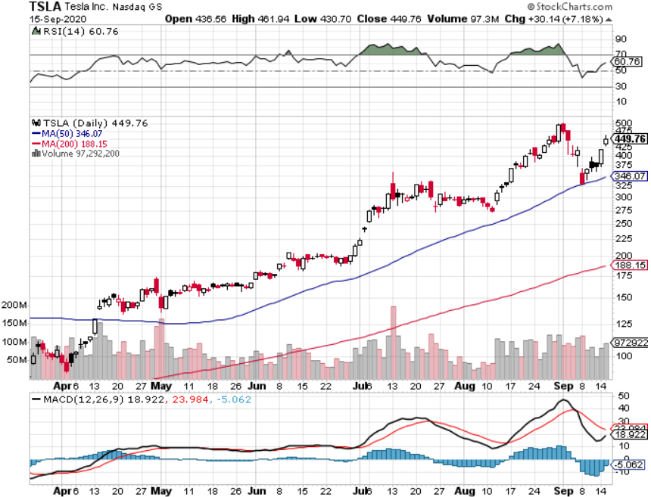
Tesla (TSLA)- Didn’t Make the S&P 500 Dropped a Record 22% in One Day

Slide 29
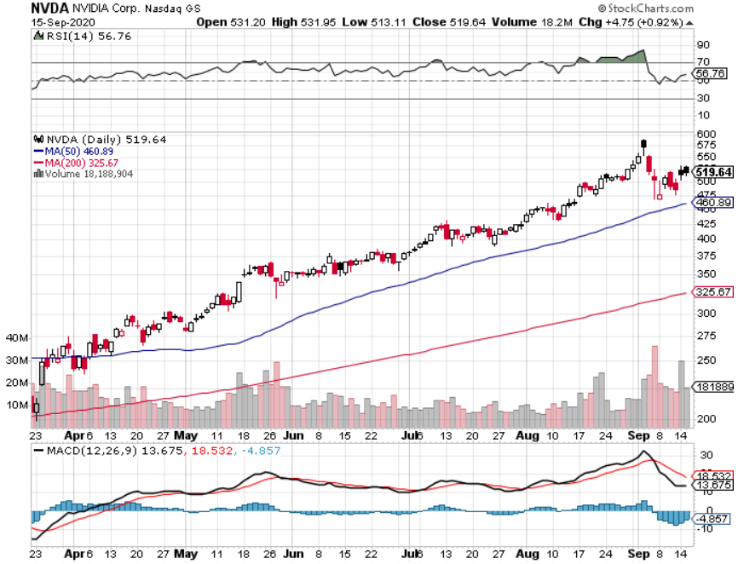
NVIDIA (NVDA) – The Biggest Chip Deal in History $40 billion of Arm Holdings-one of the greatest concentrations of AI talent in the world

Slide 30
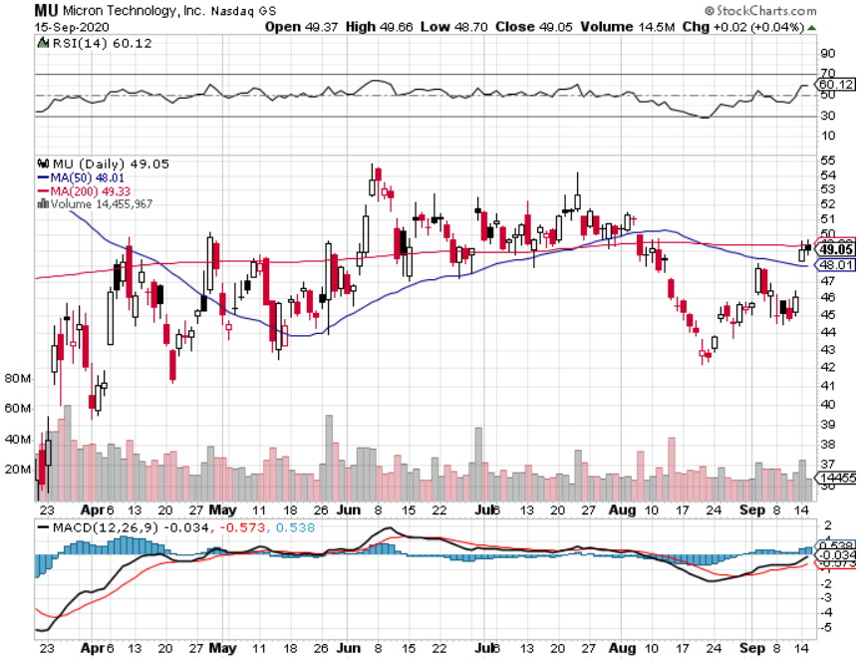
Micron Technology (MU)-

Slide 31
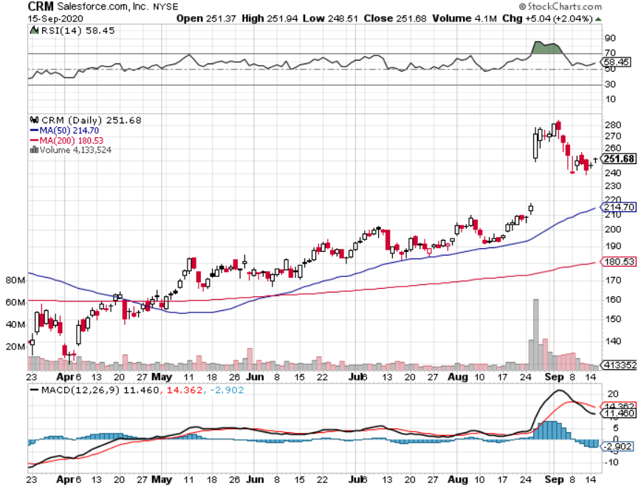
Salesforce (CRM)- Massive Online Migration took profits on long 9/$125-$130 vertical bull call spread took profits on long 8/$125-$130 vertical bull call spread took profits on long 2/$105-$115 call spread

Slide 32
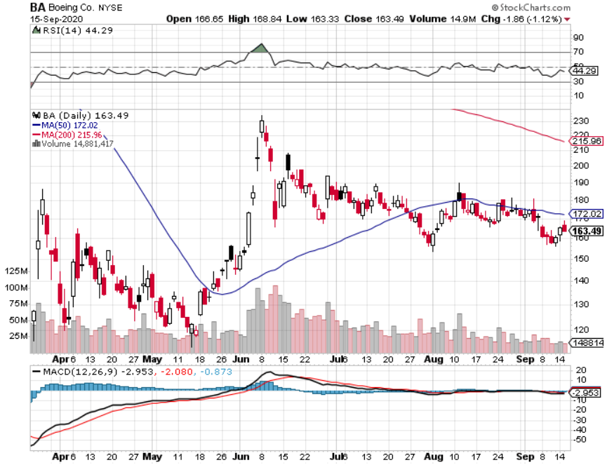
Boeing (BA) –GM Or Bank Style Takeover? 737 MAX production shutdown-Criminal investigation took profits on long 2/$270-$280 call spread took profits on long 12/$310-$330 call spread took profits on long 4/$300-$310 call spread took profits on long 4/$315-$335 call spread

Slide 33
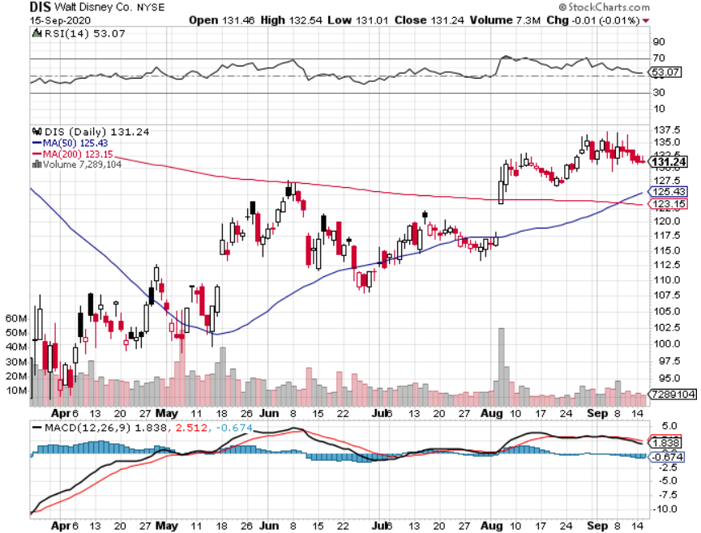
Walt Disney (DIS)- Corona Hit took profits on long 6/$85-$90 call spread

Slide 34
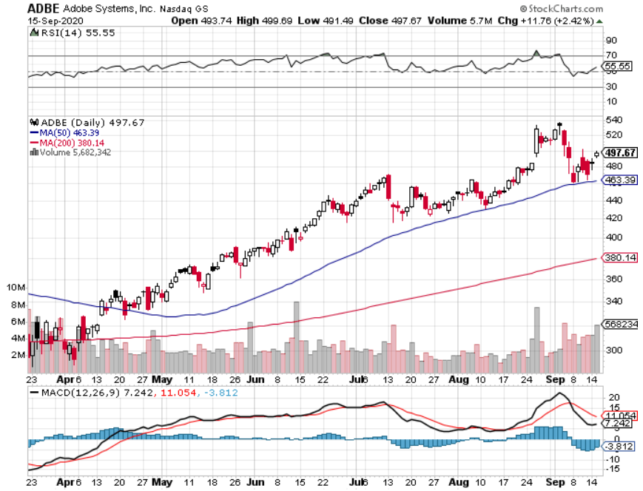
Adobe (ADBE)- The Quality Non-China tech play

Slide 35
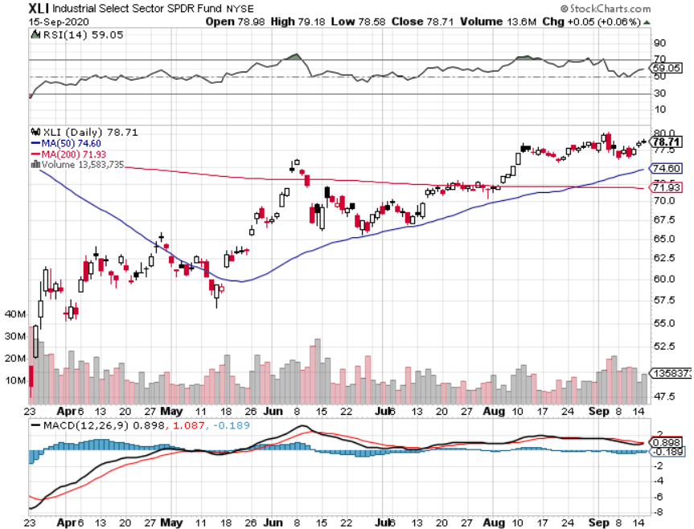
Industrials Sector SPDR (XLI)- (GE), (MMM), (UNP), (UTX), (BA), (HON)

Slide 36
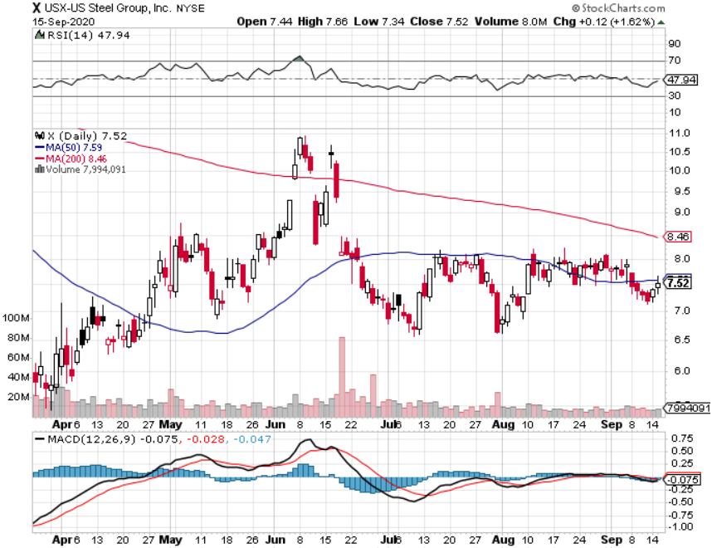
US Steel (X)-Dying Old Economy

Slide 37
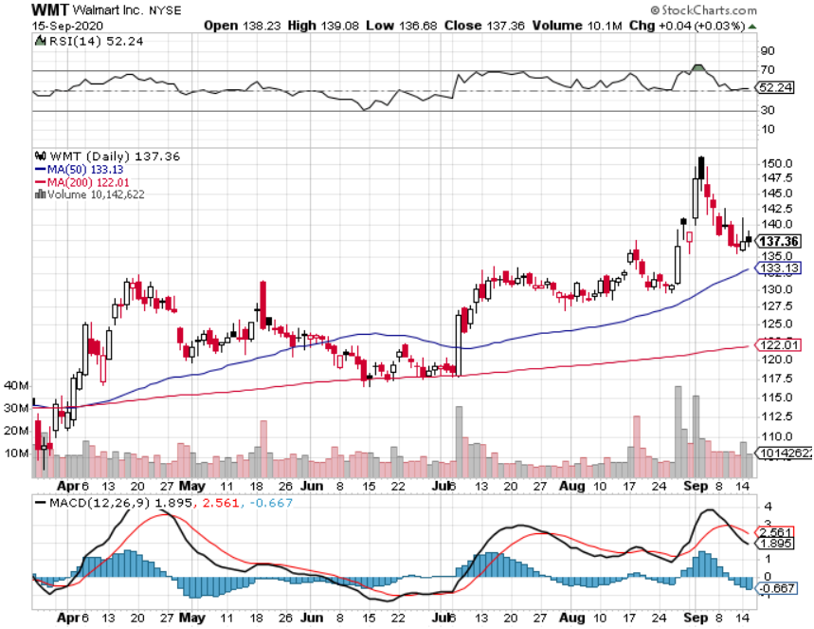
Wal-Mart (WMT)-New High-Next FANG took profit on Long 11/$125-$130 bear put spread took profit on Long 10/$119-$121 bear put spread took profits on Long 8/$114-$117 bear put spread

Slide 38
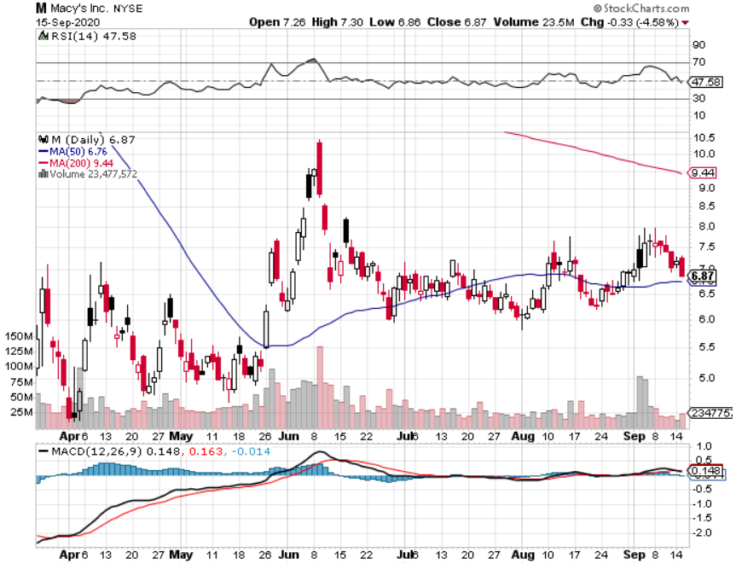
Macys’ (M) – Waiting for Chapter 11 took profits on Long 8/$23-$25 bear put spread

Slide 39
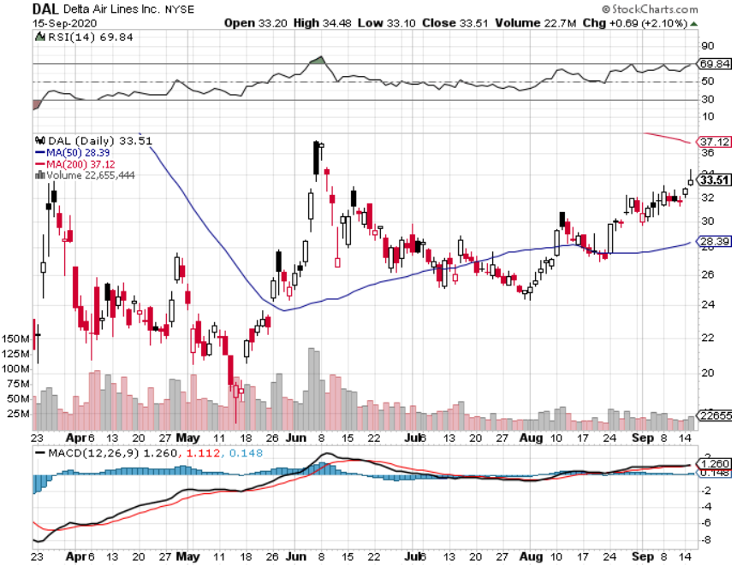
Delta Airlines (DAL) – Warren Buffett big seller

Slide 40
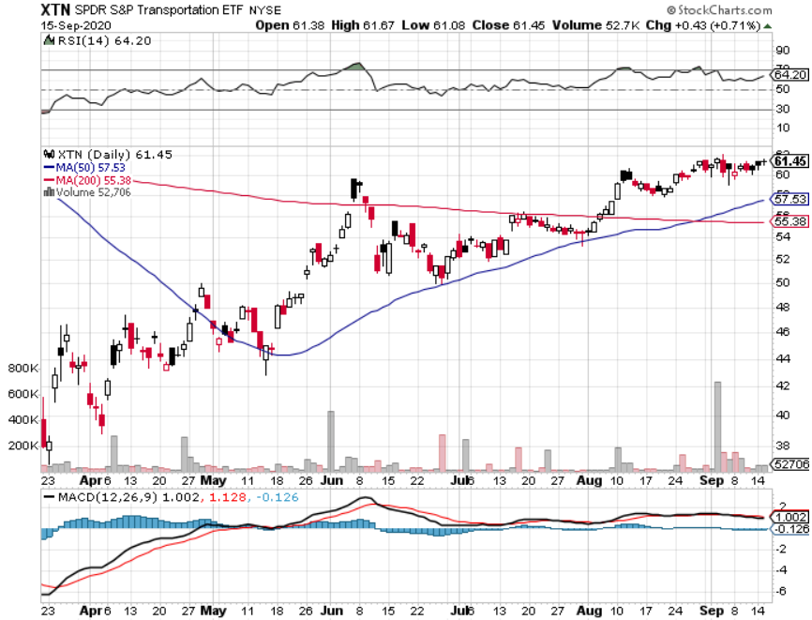
Transports Sector SPDR (XTN)- (ALGT), (ALK), (JBLU), (LUV), (CHRW), (DAL)

Slide 41
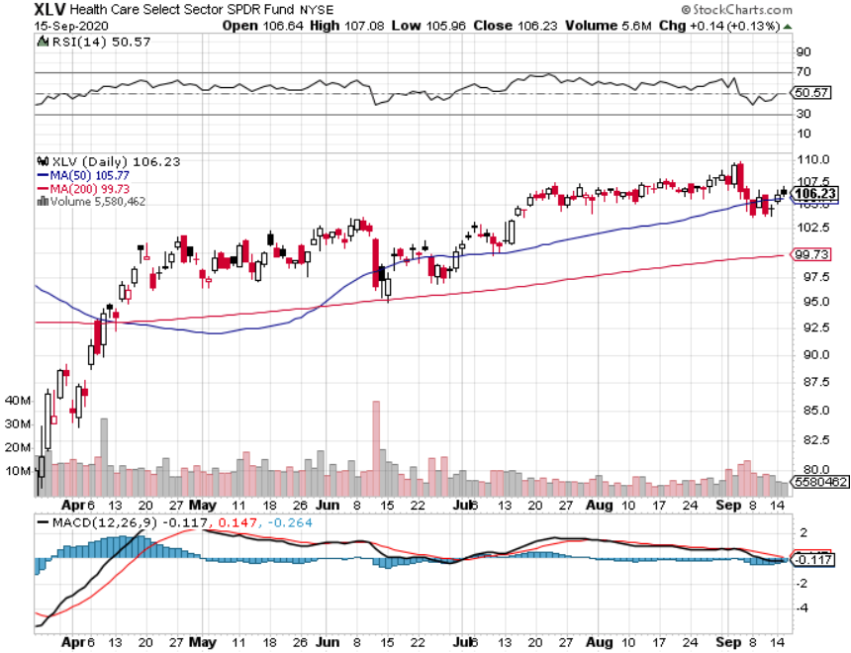
Health Care Sector (XLV), (RXL) (JNJ), (PFE), (MRK), (GILD), (ACT), (AMGN)

Slide 42
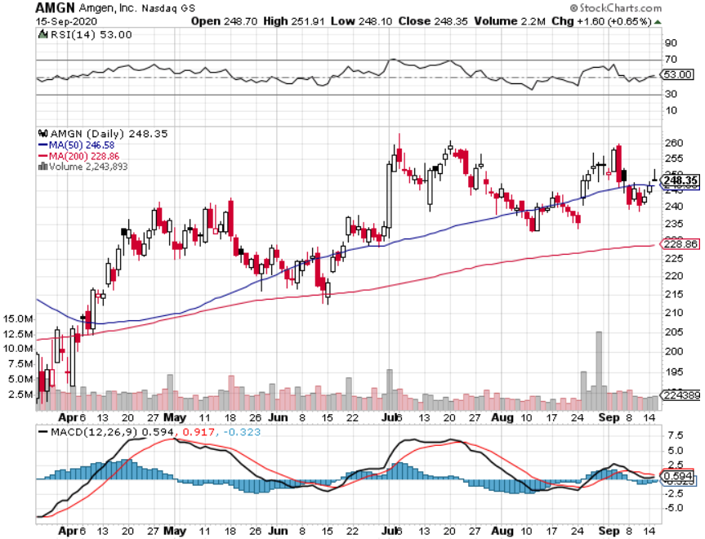
Amgen (AMGN)

Slide 43
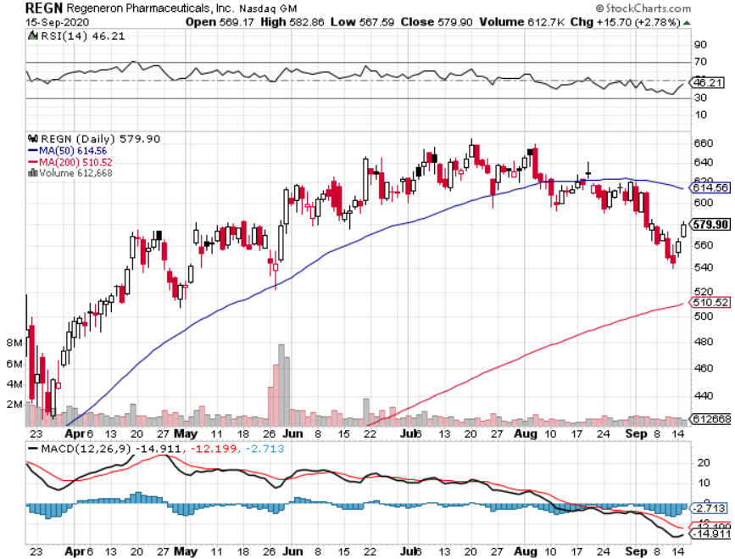
Regeneron (REGN) took profits on long 7/$570-$580 call spread

Slide 44
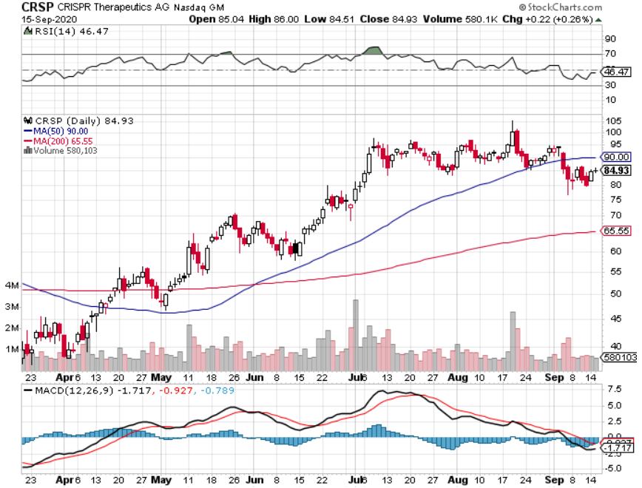
CRISPR Therapeutics (CRSP)

Slide 45
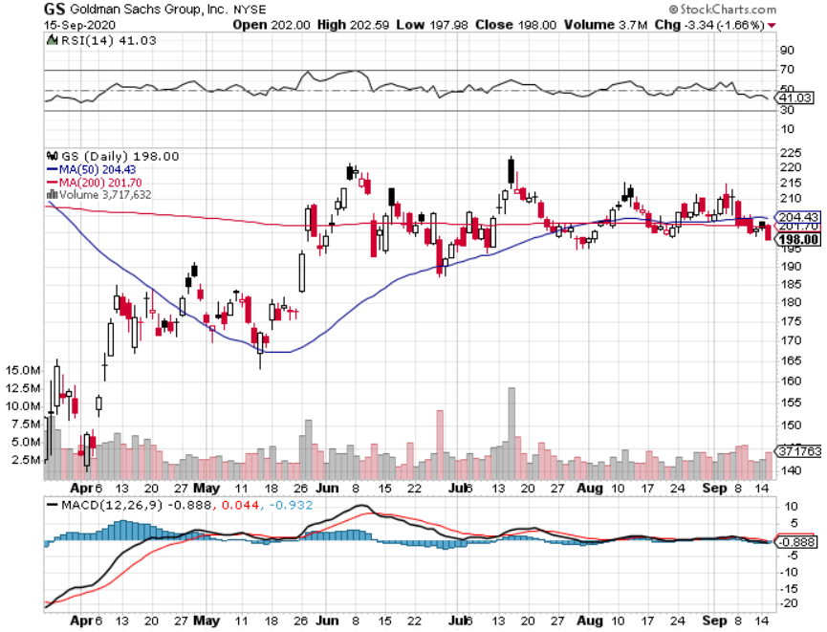
Goldman Sachs (GS) – Trading Volume Burst

Slide 46
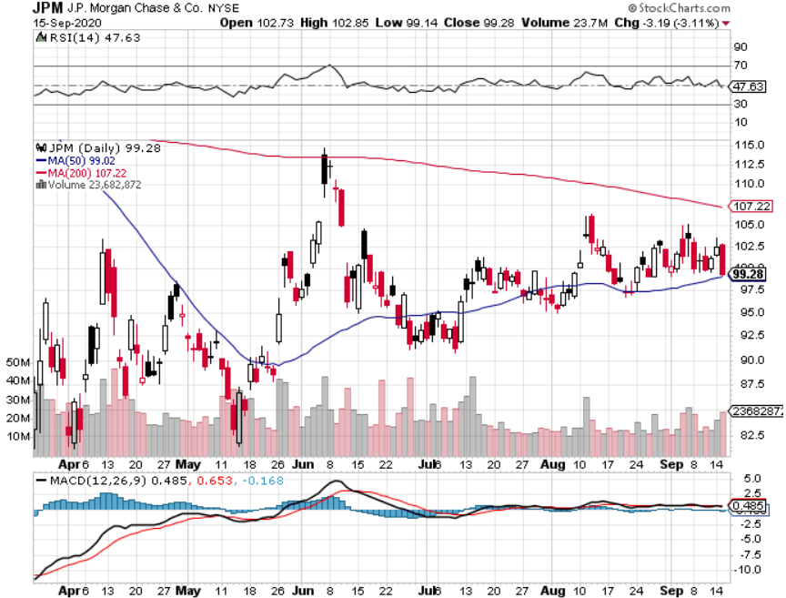
JP Morgan Chase (JPM) – “Recovery” Rotation Play long 9/$90-$95 bull call spread took profits on long 8/$92-$95 bull call spread

Slide 47
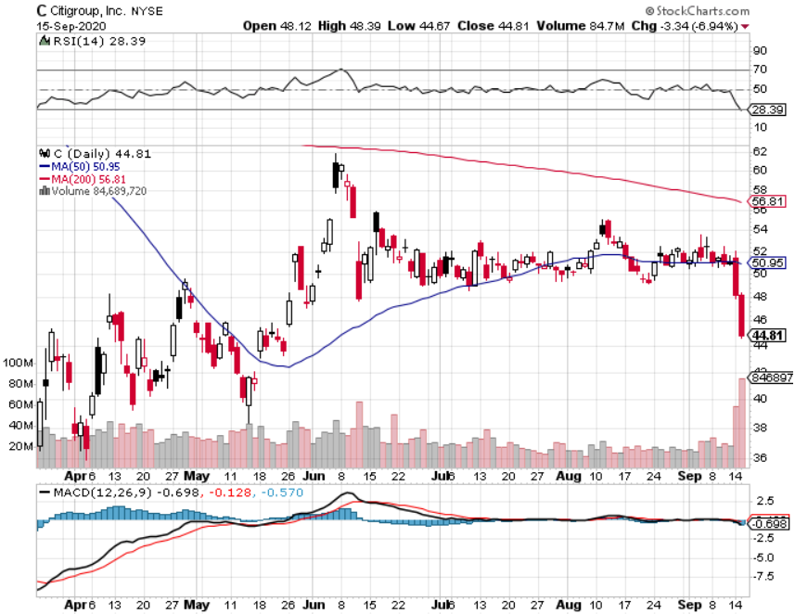
Citigroup (C) – “Recovery” Rotation Play stopped out of long 9/$45-$48 bull call spread

Slide 48
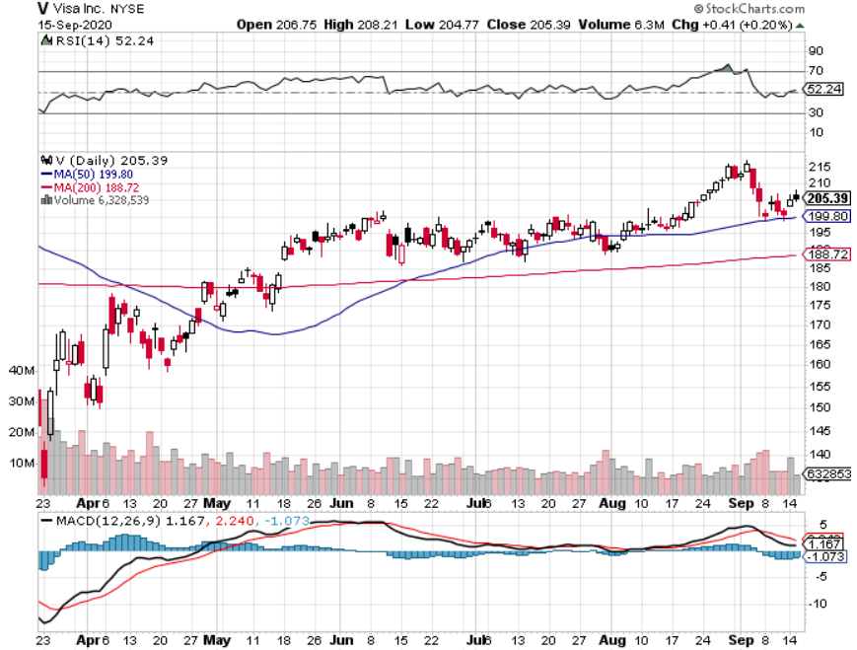
Visa (V) – “Touchless” Fintech Play long 9/$180-$185 bull call spread

Slide 49
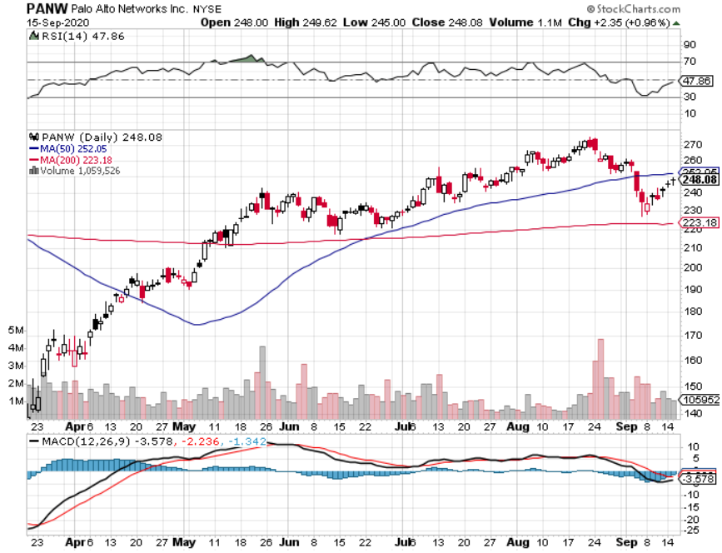
Palo Alto Networks (PANW)- New High Hacking never goes out of fashion

Slide 50
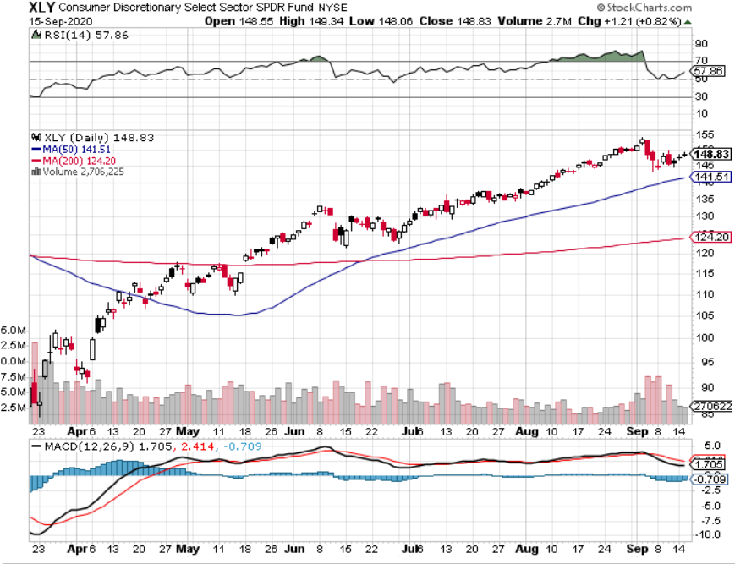
Consumer Discretionary SPDR (XLY) (DIS), (AMZN), (HD), (CMCSA), (MCD), (SBUX)

Slide 51
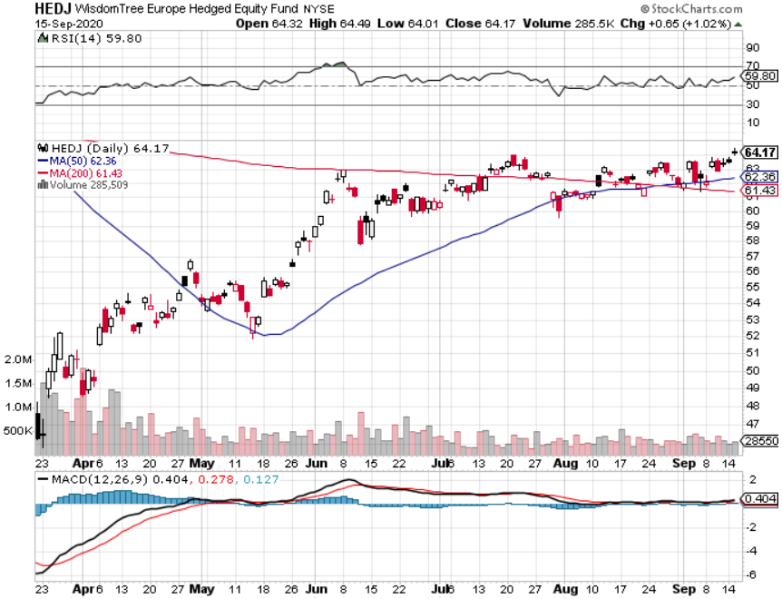
Europe Hedged Equity (HEDJ)-

Slide 52
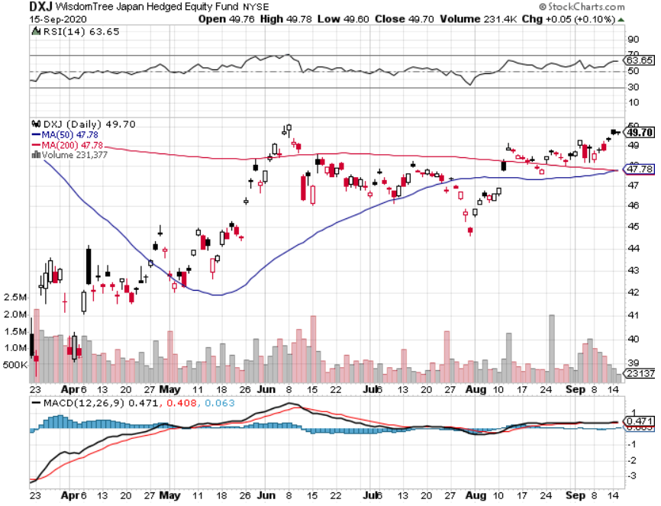
Japan (DXJ)-

Slide 53
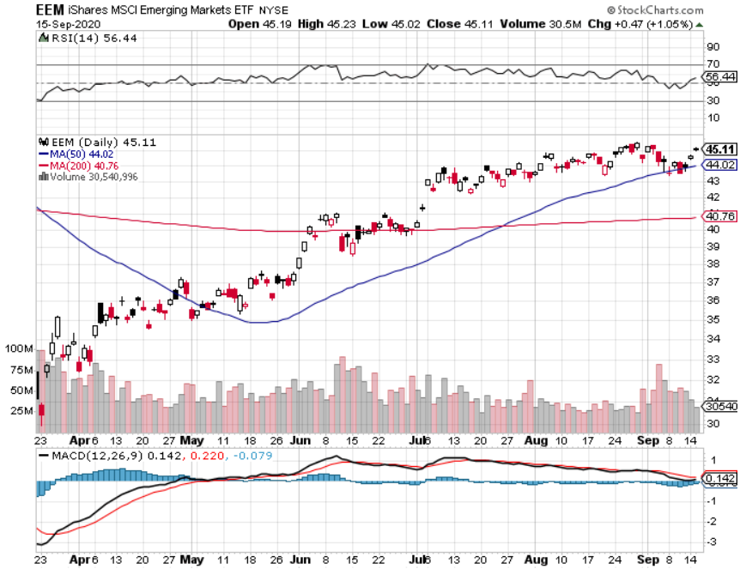
Emerging Markets (EEM)- Weak Dollar Play

Slide 54
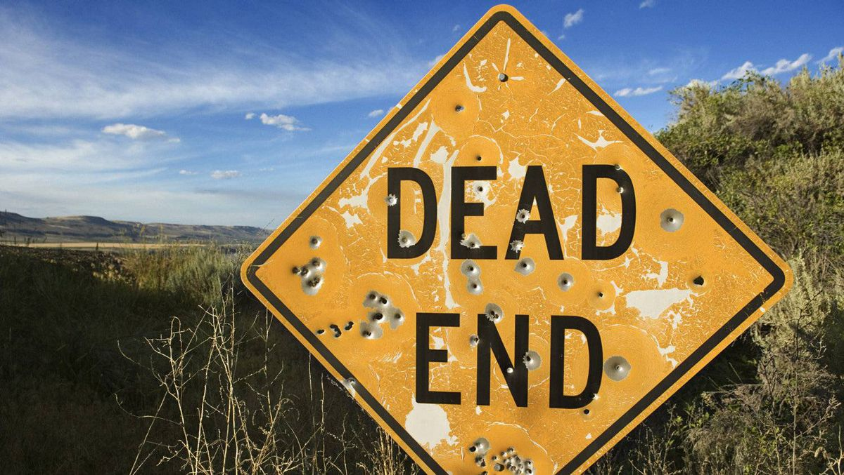
Bonds – Going Nowhere
*Since governor Jay Powell promised to run the economy hot weeks ago, ten-year US treasury bonds have only eked out a paltry rise from 60 to 72 basis points * China to Dump US Treasury Bonds, in response to Trump’s escalating trade war, putting $200 billion in paper up for sale. *Rotation to domestic “recovery” stocks will bring another big bond selloff *Another short selling opportunity of the century is in play, once corona cases peak out again *US Treasury bond fund (TLT) could plunge from $180 to $105, taking interest rates from 0.31% to 3.25% *Bottom line: sell short every major rally in the (TLT)

Slide 55
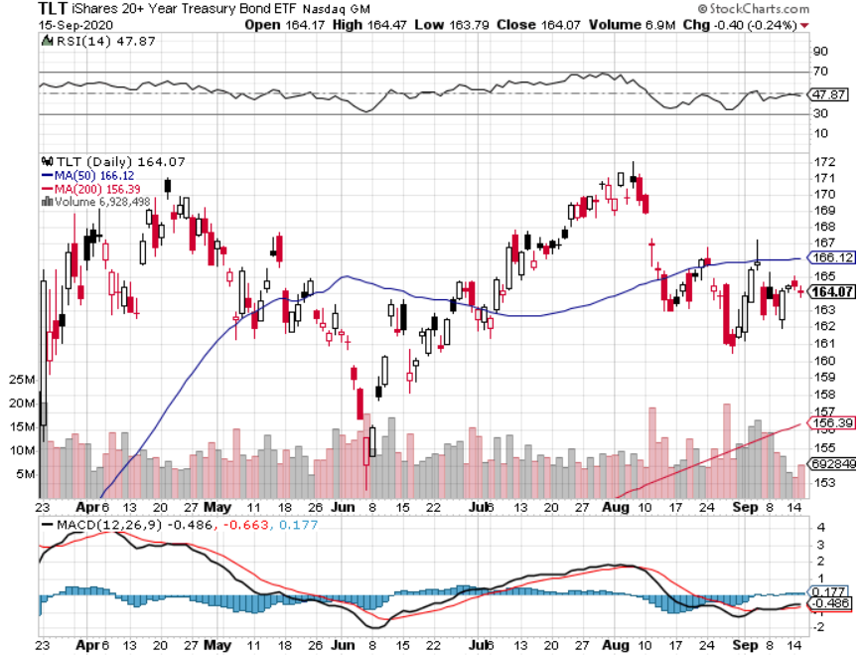
Treasury ETF (TLT) – Huge Short Play long 9/$170-$172.50 bear put spread took profits on long 9/$172.50-$175 put spread took profits on long 9/$172.50-$175 put spread

Slide 56
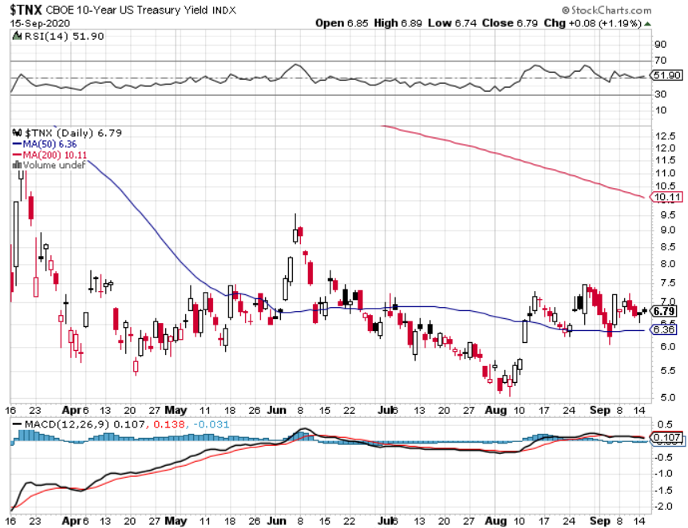
Ten Year Treasury Yield ($TNX) – 0.72%

Slide 57
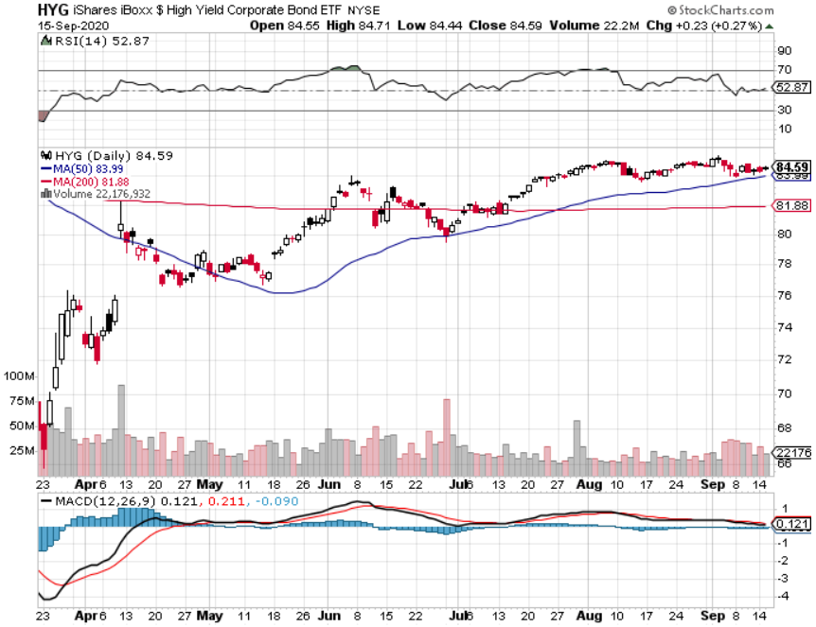
Junk Bonds (HYG) 4.34% Yield to Maturity big jump in spreads on stock selloff and recession fears

Slide 58
2X Short Treasuries (TBT)- 2 Month Bottoming Process

Slide 59
Emerging Market Debt (ELD) 4.00% Yield-

Slide 60
Municipal Bonds (MUB) – 1.00% Mix of AAA, AA, and A rated bonds

Slide 61
Foreign Currencies – Bouncing Along the Bottom
*US Dollar looking for a bottom in pre-election stall *Massive QE and bond issuance is sucking the life out of the Greenback, $23 trillion in new government borrowing to $30 trillion by end 2020 *Euro churns sideways *British pound dives *Aussie dollar holding highs *Bitcoin lost momentum *Keep selling short all US dollar rallies, its yield support is gone forever

Slide 62
Japanese Yen (FXY), (YCS)

Slide 63
Euro ($XEU), (FXE), (EUO)-

Slide 64
British Pound (FXB)-

Slide 65
Australian Dollar (FXA)- The Global Recovery Play took profits on long 8/$67-$69 call spread

Slide 66
Emerging Market Currencies (CEW)

Slide 67
Chinese Yuan- (CYB)-

Slide 68
Bitcoin- Stalling

Slide 69
Energy – Breakdown
*Global demand to be 10 million barrels less in 2020 than last year from 100 million b/d to 90 million b/d, off 15% in a week *Saudi liquidation of assets does not bode well for oil’s long term *Virus spike in India is suddenly cutting into demand again *Much of lost demand is permanent as US economy restructures to a less transportation-oriented economy. *Russia loses 50% of its budget at $37/barrel, triggering an economic disaster *Avoid all energy plays like the plague, could drop by half in the coming recession

Slide 70
Oil-($WTIC)

Slide 71
United States Oil Fund (USO) long 10/$9.50-$10 Vertical bull call spread

Slide 72
Energy Select Sector SPDR (XLE)-No Performance! (XOM), (CVX), (SLB), (KMI), (EOG), (COP)

Slide 73
Halliburton (HAL)-

Slide 74
Natural Gas (UNG) -

Slide 75
Precious Metals – The Lunch Break Continues
*Gold consolidates recent gains awaiting next upside breakout *Hedging demand piles on top of central bank buying *New QE Infinity sparks huge rally, worthless dollar makes valuable gold *Near zero interest rates and Collapsing US dollar is another incentive *Copper holds high, but (FCX) continues gains *Bottom Line: buy a bigger dip in gold and precious metals

Slide 76
Gold (GLD)- Short Term downtrend took profits on long 8/$169-$172 call spread took profits on long 7/$157-$160 call spread

Slide 77
Market Vectors Gold Miners ETF- (GDX) –

Slide 78
Barrick Gold (GOLD)

Slide 79
Newmont Mining- (NEM)-

Slide 80
Silver- (SLV)-

Slide 81
Silver Miners - (SIL)-

Slide 82
Wheaton Precious Metals - (WPM)-

Slide 83
Copper (COPX)-New Highs on China Demand Trade War Disaster

Slide 84
Freeport McMoRan (FCX)-World’s Largest Copper Producer took profits on long 4/$10-$11 call spread took profits on short 4/$114 calls

Slide 85
Real Estate – Bidding Wars in the ‘Burbs
*30-year fixed rate mortgage drop to record low od 2.86% *The refi boom continues as 20 million borrowers still qualify *With 3.7 million still in forbearance a foreclosure crisis is still in the cards *Big city rental market is still in free fall, with 15,000 unrented apartments in New York, 5% vacancy rate versus a normal 2%, worse than aftermath of 9/11 and Hurricane Sandy However, New York is not dead, it’s just resting and will come back in a year or two *Housing prices were ready to explode to the upside with S&P Case Shiller Rose 4.3%, in June

Slide 89
June Corelogic S&P Case Shiller Home Price Index Phoenix (9.0%), Seattle (6.5%), Tampa (5.9%) showing biggest gains
Tradingeconomics.com

Slide 90
Simon Property Group (SPG)- Mall REIT Up to 60% of Mall Tenants Aren’t Paying Rent

Slide 91
Crown Castle International (CCI) – 3.40% yielding cell phone Tower REIT

Slide 92
US Home Construction Index (ITB) (DHI), (LEN), (PHM), (TOL), (NVR)

Slide 93
Trade Sheet- So What Do We Do About All This?
*Stocks – buy bigger dips *Bonds – sell rallies aggressively *Commodities-stand aside *Currencies- sell US dollar rallies *Precious Metals – buy dips *Energy – stand aside *Volatility - sell short over $40 *Real estate – buy dips

Slide 94
Next Strategy Webinar 12:00 EST Wednesday, September 30, from Silicon Valley, CA email me questions at support@madhedgefundtrader.com
Good Luck and Good Trading!
Notes:
*

