Slide 1
The Mad Hedge Fund Trader “Election Jitters”
With John Thomas from Silicon Valley, CA, September 30, 2020 www.madhedgefundtrader.com
Notes:
*

Slide 2
Trade Alert Performance New All Time High! – Major Double Digits in a Falling Market
*January 3.13% Final *July +7.93% Final *February -6.05% Final *August -2.08% Final *March -5.50% Final *September 7.95% MTD *April +4.55% Final *October +12.13% Final *May +14.19% Final *November -1.26% Final *June +10.38% Final *December +4.97% Final *Year to date +34.50% compared to -3.6% for the Dow Average *+390.42% since inception, a new all time high *Average annualized return of 36.06% for 11 years, new all time high

Slide 3
Portfolio Review 100% Cash in Melting Market
Expiration P&L +34.50 YTD
NO POSITIONS

Slide 4
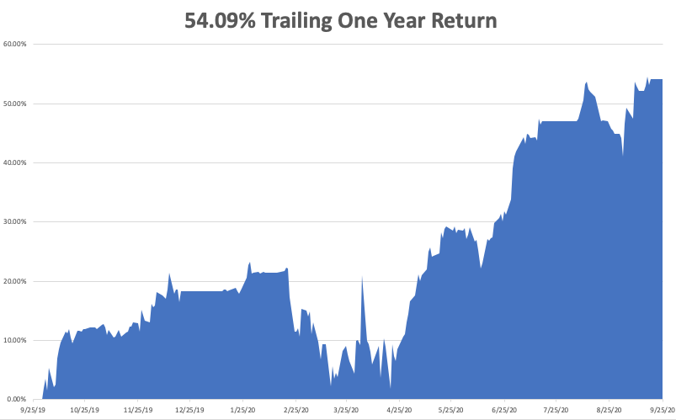

Slide 5
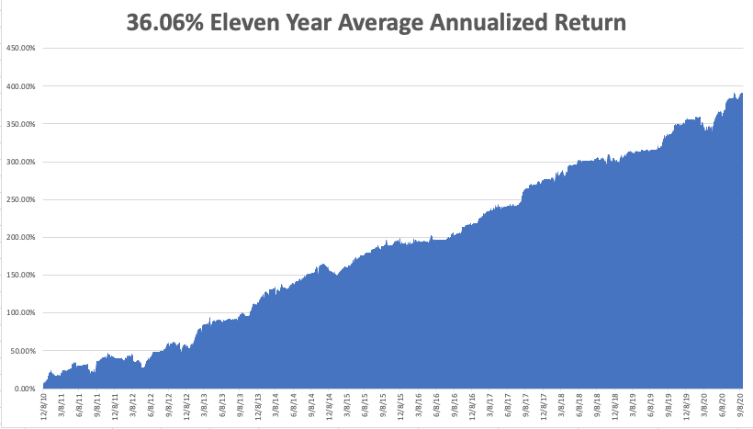
GTD 11 Year Daily Audited Performance

Slide 6
The Method to My Madness
*Election jitters are running rampant in the run up to the election, as volatility rises *This is only a short-term dip in a 20 year bull market that may have another decade to run *The Fed has proven its intention to step in and run the printing presses on any 10% market correction, which is imminent *Stocks overpriced at all time high, but cheap on a three-year view *A bond short is far and away the better trade based on massive over issuance of US government bonds and now we have a big rally to sell into *The big fear is of a building Corona spike in the fall leading to another global shutdown

Slide 7
Corona Update
*US cases top 7.2 million, deaths at 205,000,000 and are still rising at 500 a day, and could reach 250,000 by election day *New IHI Forecasts Calls for 400,000 US Deaths by end 2020 *Center of the US epidemic has moved to the northern Midwest, with North Dakota, South Dakota, and Wisconsin the leading hot spots. The “non-mask”, open bar states are getting hardest hit. *AstraZeneca obtains liability release from Europe in case it initial vaccine kills millions *While the US tops 7 million cases, antibody testing shows the true figure is close to 33 million, or 10% of the population *70 vaccines now in development worldwide, but some of these MAY KILL YOU *A true vaccine is a year off, or never

Slide 8
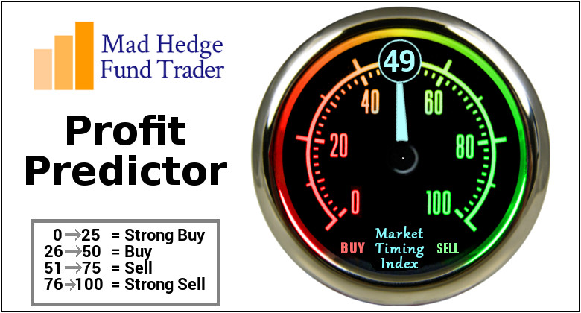
The Mad Hedge Profit Predictor Market Timing Index-Bottom of Range-at to a “BUY” An artificial intelligence driven algorithm that analyzes 30 different economic, technical, and momentum driven indicators

Slide 9
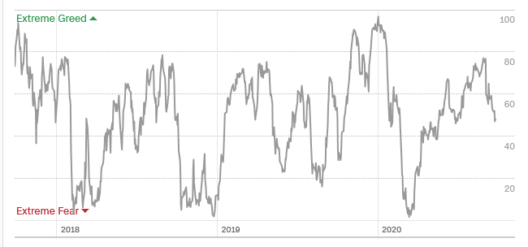
The Mad Hedge Profit Predictor Danger Territory
SELL
BUY

Slide 10
The Global Economy – Green Shoots
*All will be clear with September Nonfarm Payroll Report on Friday *Exhaustion of stimulus is major factor driving the economy *Economy Needs No More Stimulus, as the “V” shaped recovery is on, says Trump economic advisor and former talk show host, Larry Kudlow *Economy Slows as Stimulus Hopes Fade as confirmed by last week’s economic data. US Consumer Sentiment dove in August, while Weekly Jobless Claims hover just below a Great Recessionary one million *US Consumer Sentiment Hits Six Month High, up from a 75 estimate to 78.9 *US Consumer Confidence soared in September, 84.8 to 101.8

Slide 11
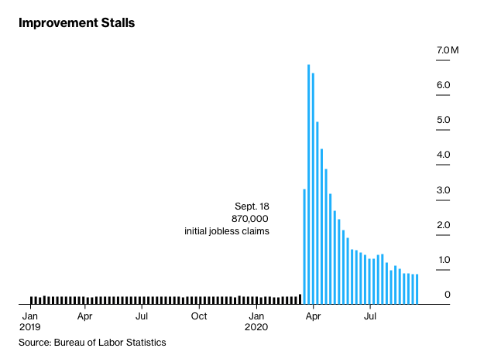
Weekly Jobless Claims – Flatlining at record highs +870,000

Slide 12
The Bill Davis View A $1,500 Upgrade for the Mad Day Trader Service

Slide 13
Stocks – Election Jitters
*Election chaos is starting to price in, sending traders running to the sidelines *Interactive Brokers Increase Margin by 35% and others to 70% to protect themselves from increased market volatility (VIX) brought on by the upcoming presidential election *The fastest recovery in history is followed by the fastest selloff in history *Investors Pull $25 Billion from Equity Funds, last week as a new wave of nervousness hit the market *12 IPO’s to Hit last Week. Apparently, there is an extreme shortage of high growth large cap technology stocks and Silicon Valley is more than happy to meet that demand. *Stocks may have more downside but not much, the (SPY) 200-day average is only 4% away from Friday low *We could be entering a wide $2,700 - $3,600 range until the election

Slide 14
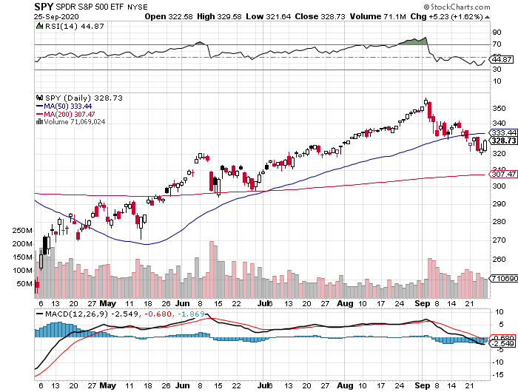
S&P 500 – Major Reversal Risk stopped out of long 7/$320-$330 bear put spread took profits on long 6/$235-$245 bull call spread took profits on long 4/$280-$290 bear put spread took profits on long 4/$275-$280 bear put spread
New Highs
The Bottom 3,000
You are here now

Slide 15
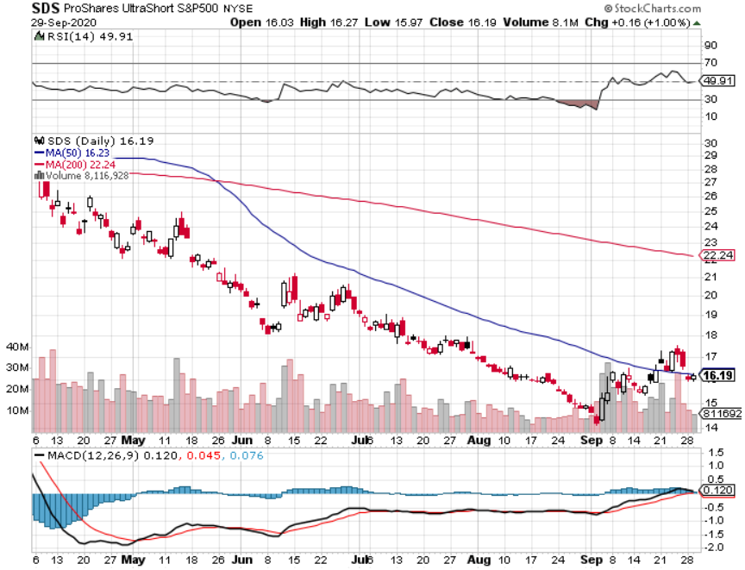
ProShares Ultra Short S&P 500 (SDS)- a Great Hedge for long stocks and bonds Long 2X position has a hedge against longs and bond shorts

Slide 16
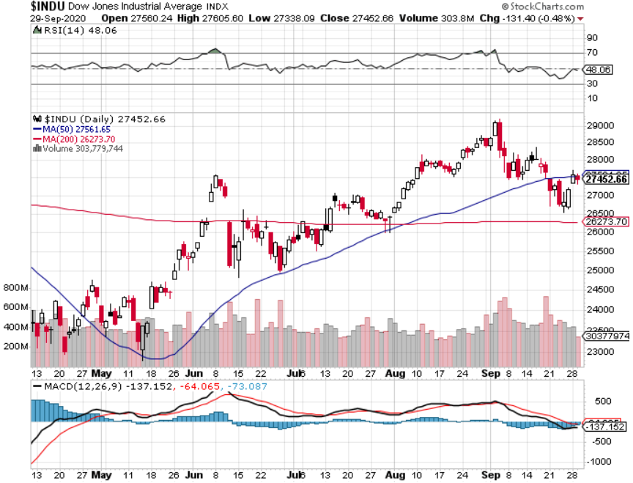
Dow Average ($INDU)-

Slide 17
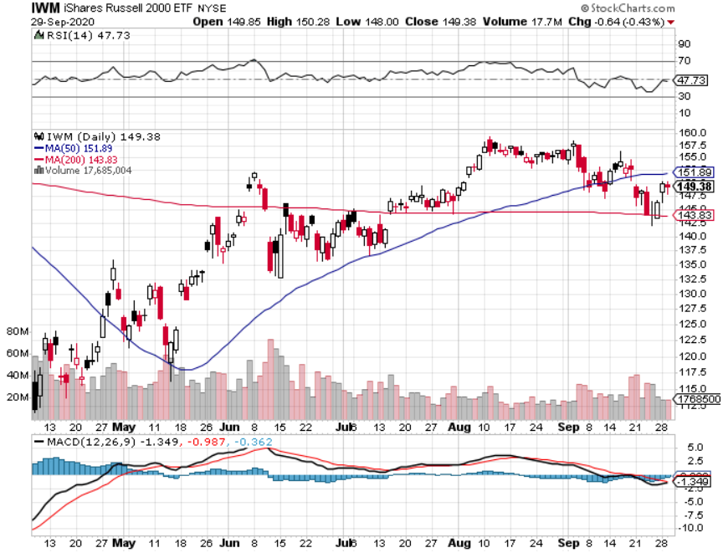
Russell 2000 (IWM)- took profits on Long 10/$137-$142 vertical bull call spread took profits on Long 10/$153-$156 vertical bear put spread

Slide 18
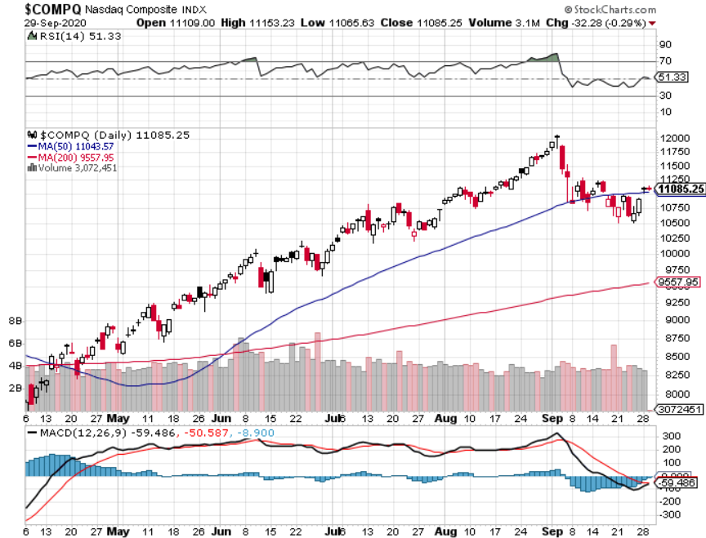
NASDAQ ($COMPQ) – Classic Correction

Slide 19
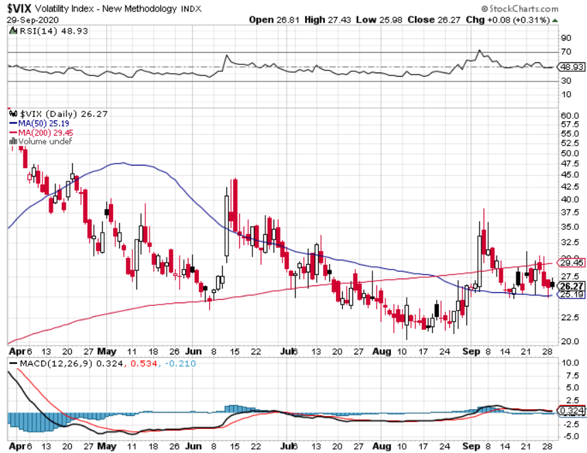
(VIX)-Another spike-but smaller

Slide 20
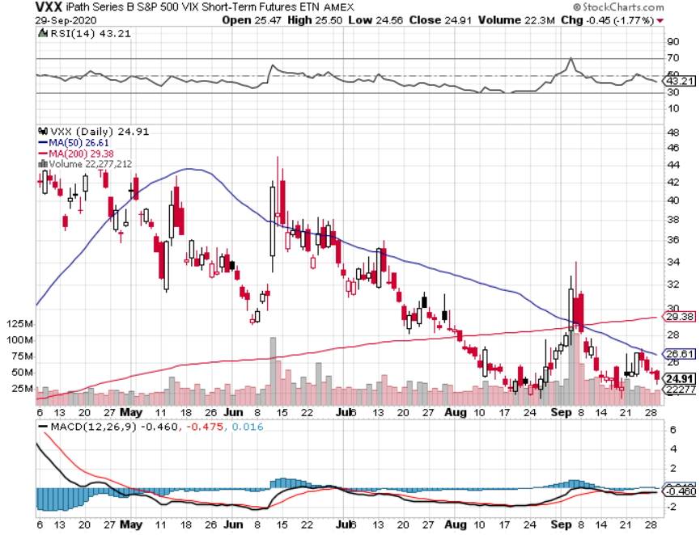
(VXX)- Sell Rallies-Down $85 to $26 from top stopped out of long 1/2021 $16 puts stopped out of long 1/2021 $24 puts

Slide 21
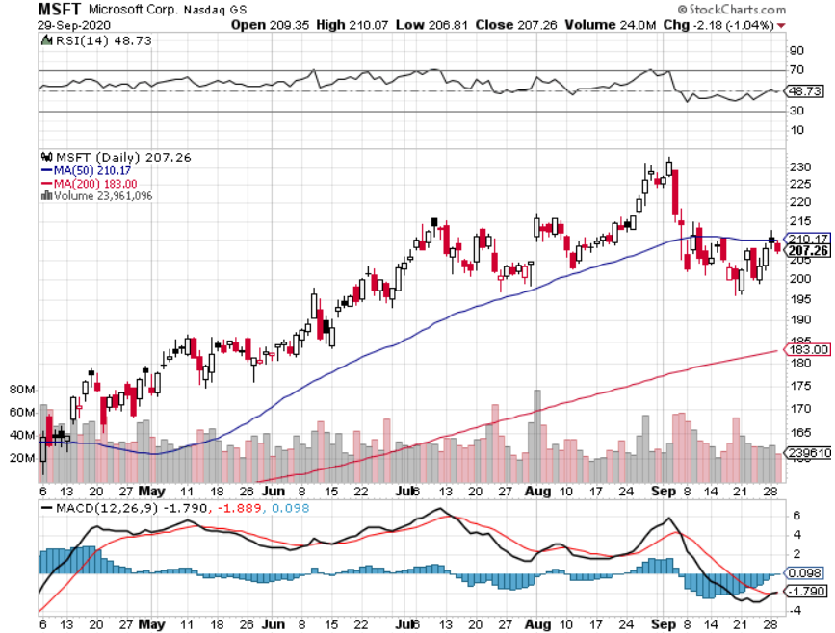
Microsoft (MSFT)- Earnings beat- Looking for Another Entry Point Stopped out of long 4/$120-$130 call spread took profit on long 4/$120-$130 call spread stop loss on long 12/$170-$180 call spread took profits on long 12/$135-$138 call spread

Slide 22
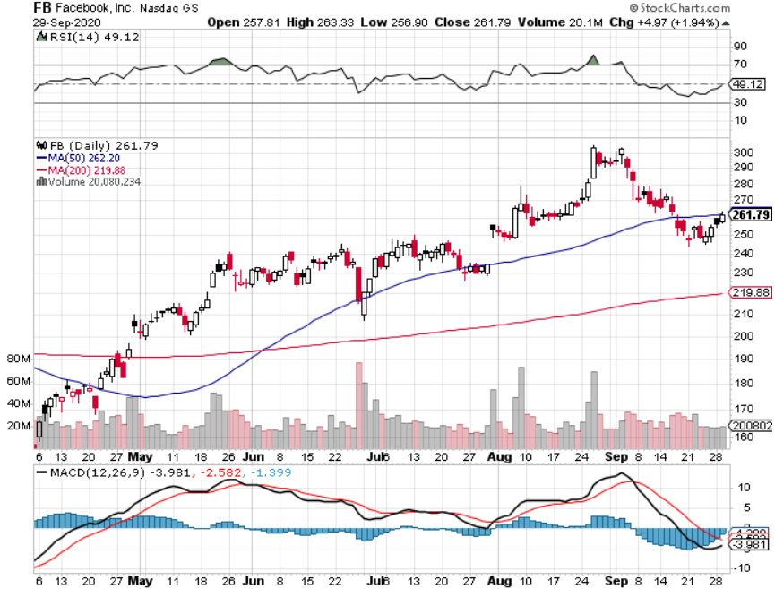
Facebook (FB)-New High took profits on Long 9/$290-$300 vertical bear put spread stopped out of Long 9/$190-$200 vertical bear put spread took profits on Long 9/$145-$155 vertical bull call spread took profits on Long 9/$150-$160 vertical bull call spread took profits on Long 8/$167.50-$172.50 vertical bull call spread

Slide 23
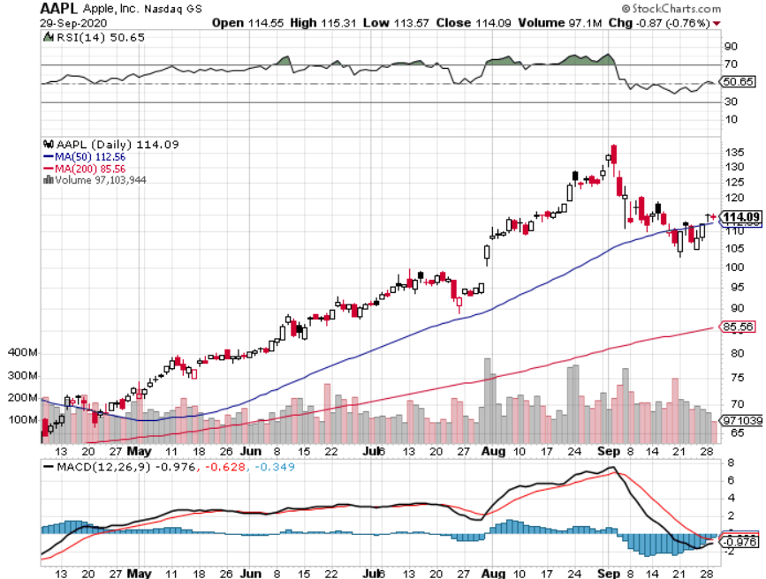
Apple (AAPL)- Capitulation stopped out of long 9/$100-$105 call spread stopped out of long 8/$480-$490 bear put spread took profits on long 7/$320-$330 call spread took profits on long 4/24/$250-$260 call spread took profits on long 5/$250-$260 call spread

Slide 24
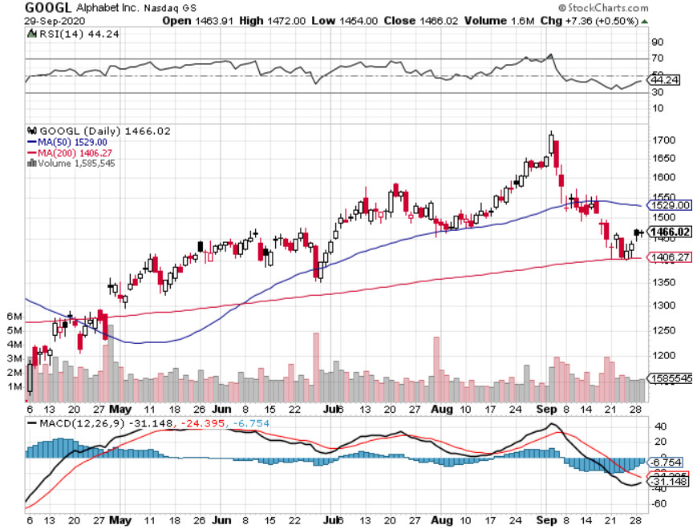
Alphabet (GOOGL) – Selloff took profits on long 12/$1,200-$1,230 bull call spread took profits on long 9/$1,030-$1,080 vertical bull call spread stopped out of long 5/$1,100-$1,130 bull call spread took profits on long 4/$1,080-$1,120 bull call spread

Slide 25
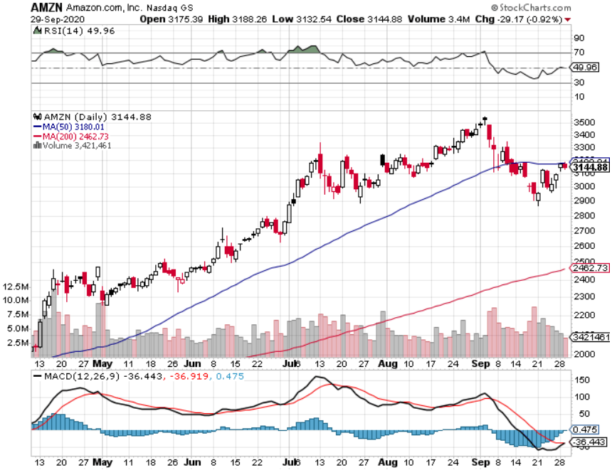
Amazon (AMZN) – Profit taking took profits on long 9/$2,800-$2,900 bull call spread stopped out of long 8/$3,000-$3,500 bear put spread took profits on long 4/$1,500-$1,550 bull call spread

Slide 26
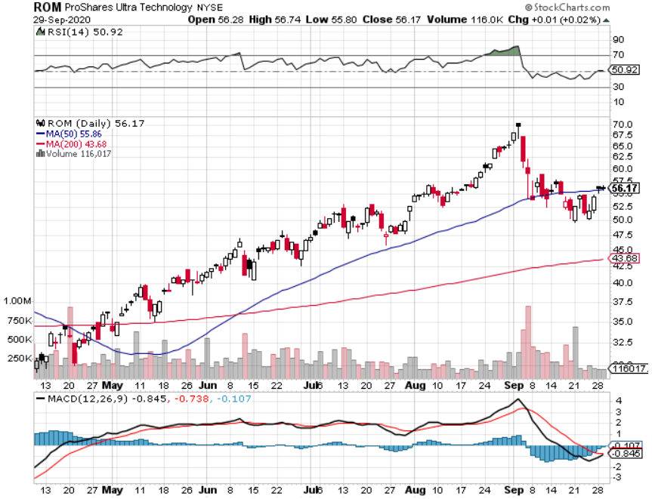
ProShares Ultra Technology (ROM) – Up 240% in 5 Months

Slide 27
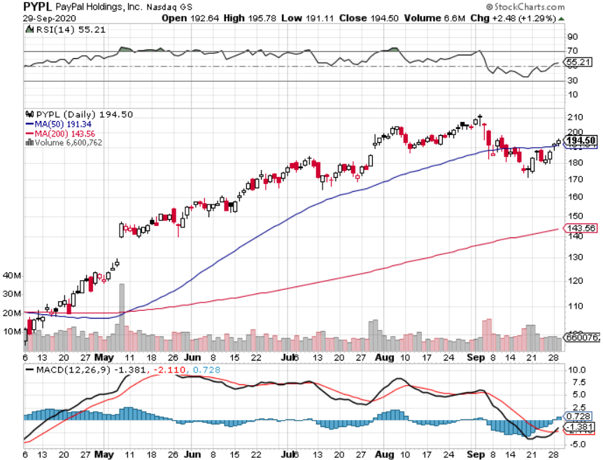
PayPal (PYPL)-Fintech Rules took profits on long 4/$90-$95 call spread

Slide 28
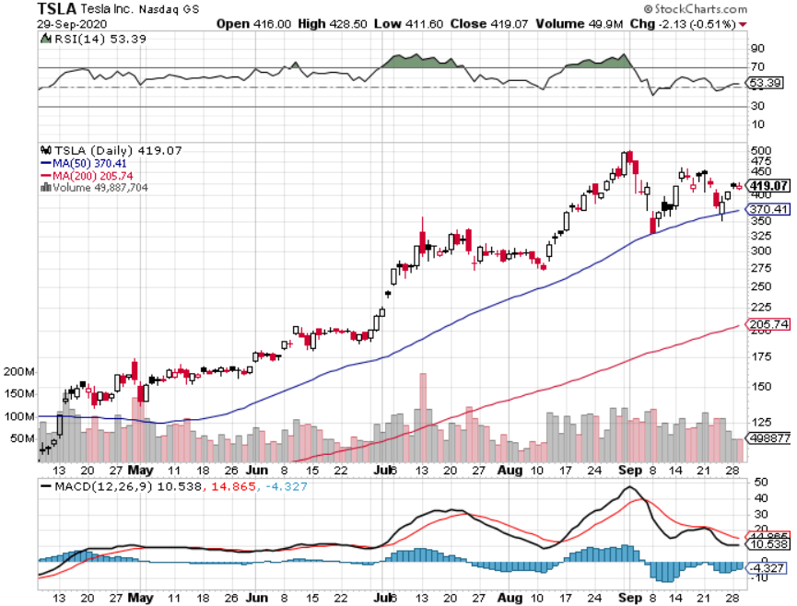
Tesla (TSLA)- Promises a $25,000 Car in Three Years 20-fold increase in battery output in 10 years

Slide 29
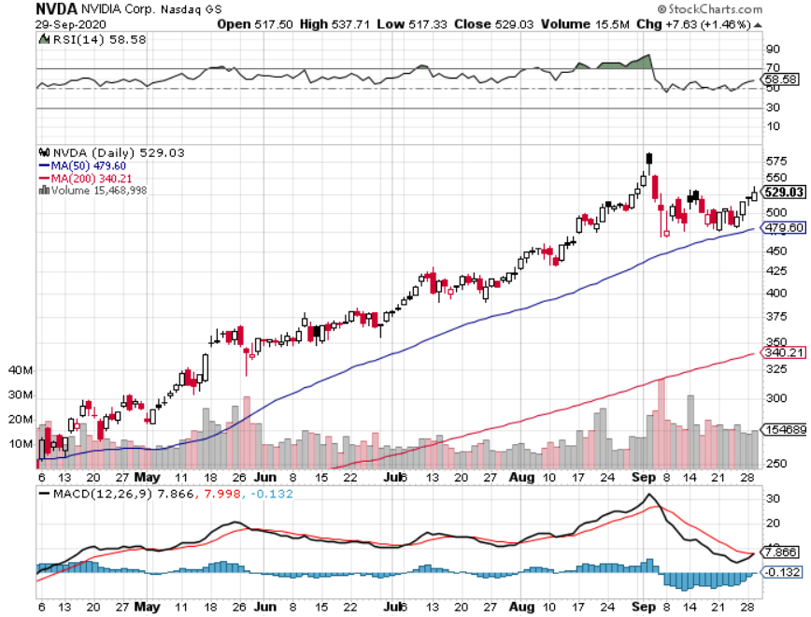
NVIDIA (NVDA) – The Biggest Chip Deal in History $40 billion of Arm Holdings-one of the greatest concentrations of AI talent in the world

Slide 30
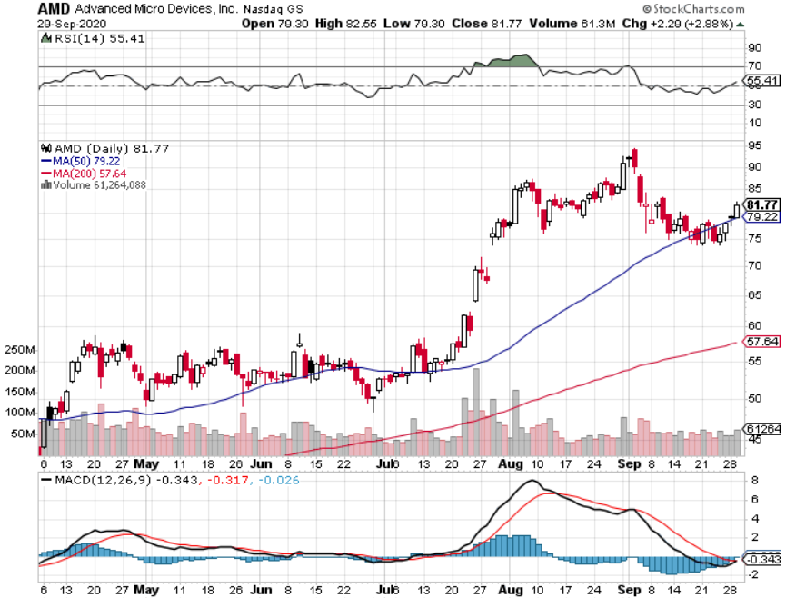
Advanced Micro Devices (AMD)- the next ten bagger

Slide 31
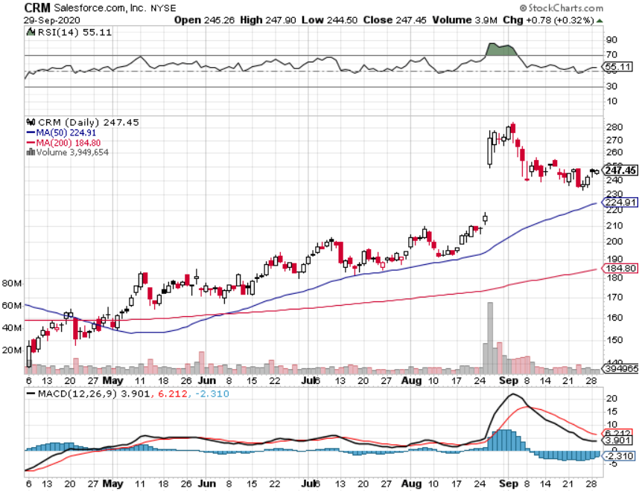
Salesforce (CRM)- Massive Online Migration took profits on long 9/$125-$130 vertical bull call spread took profits on long 8/$125-$130 vertical bull call spread took profits on long 2/$105-$115 call spread

Slide 32
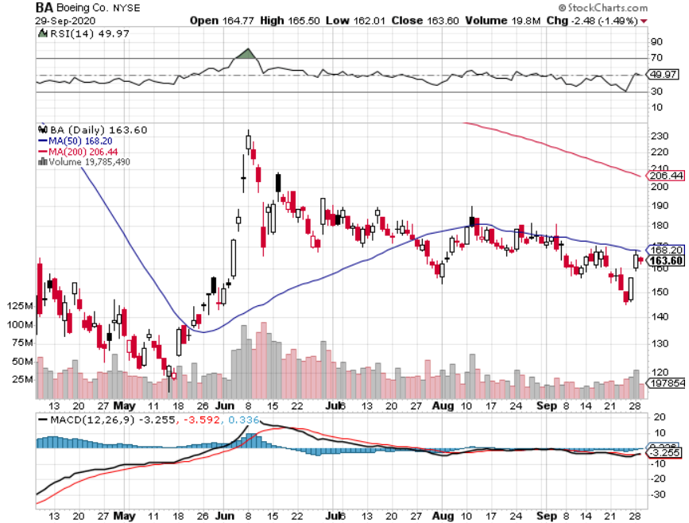
Boeing (BA) – A scathing House report assaulting the company and its regulator, the FAA took profits on long 4/$300-$310 call spread took profits on long 4/$315-$335 call spread

Slide 33
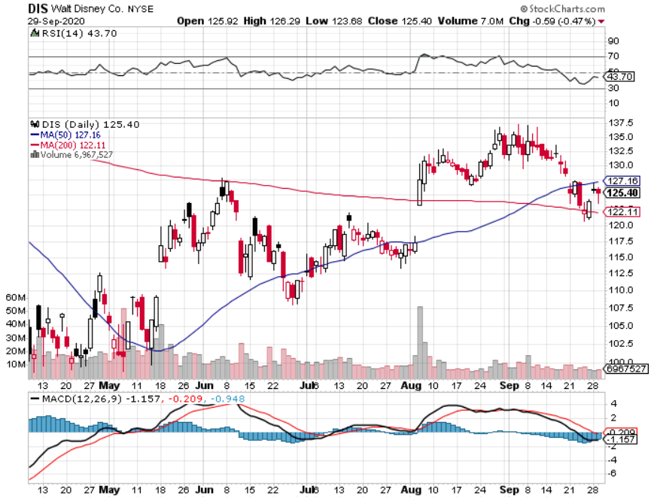
Walt Disney (DIS)- Corona Hit took profits on long 6/$85-$90 call spread

Slide 34
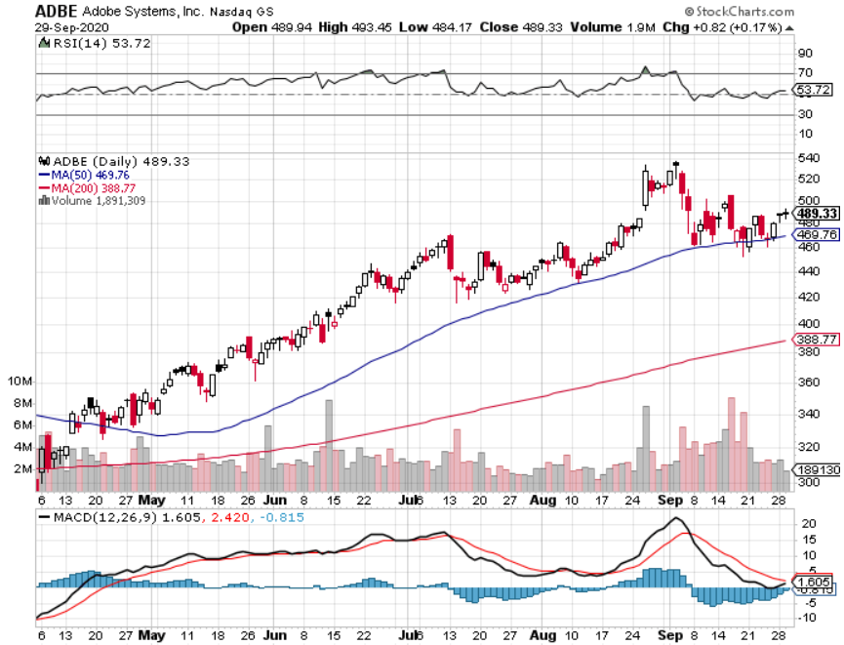
Adobe (ADBE)- Cloud play The Quality Non-China tech play

Slide 35
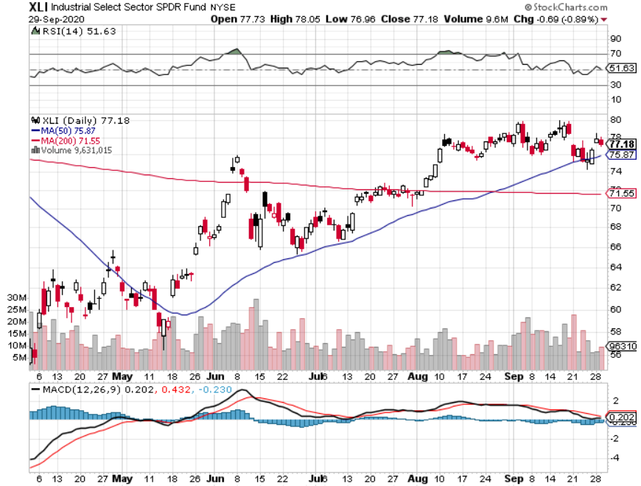
Industrials Sector SPDR (XLI)- (GE), (MMM), (UNP), (UTX), (BA), (HON)

Slide 36
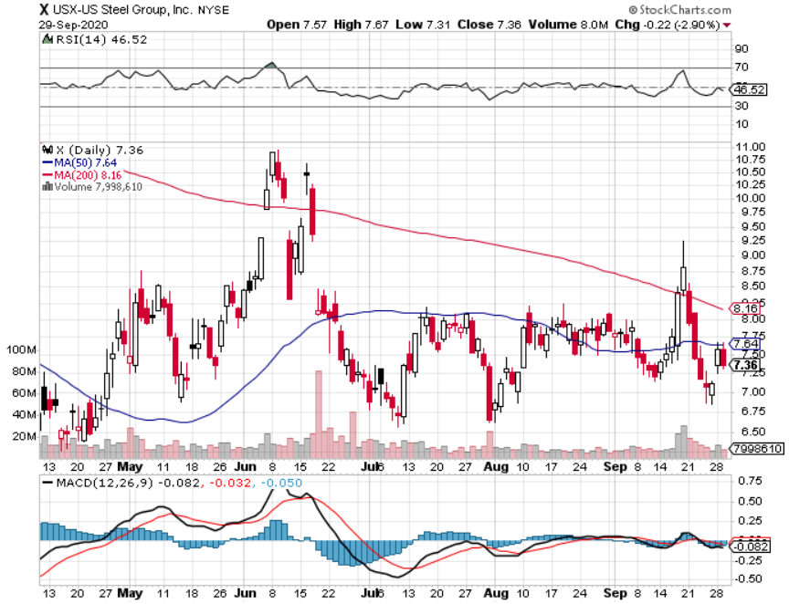
US Steel (X)-Dying Old Economy

Slide 37
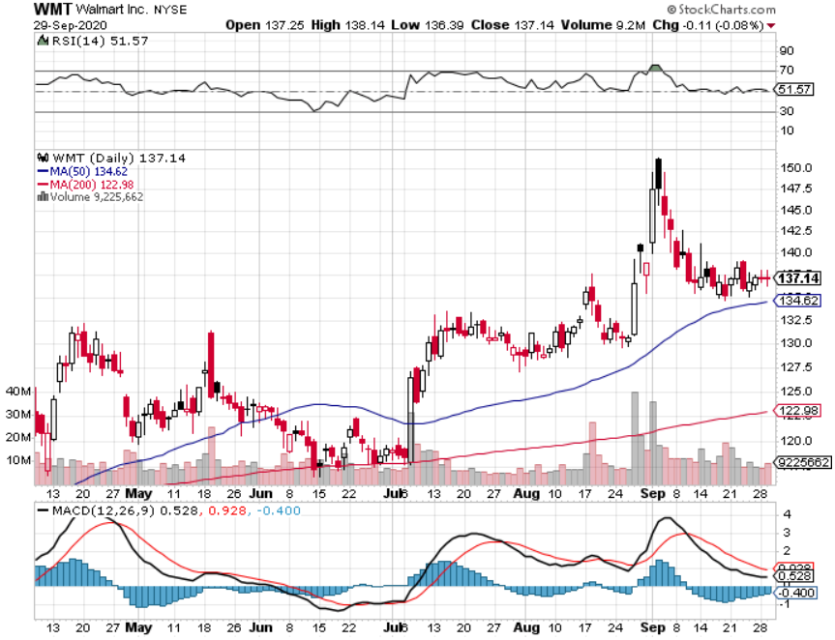
Wal-Mart (WMT)-New High took profit on Long 11/$125-$130 bear put spread took profit on Long 10/$119-$121 bear put spread took profits on Long 8/$114-$117 bear put spread

Slide 38
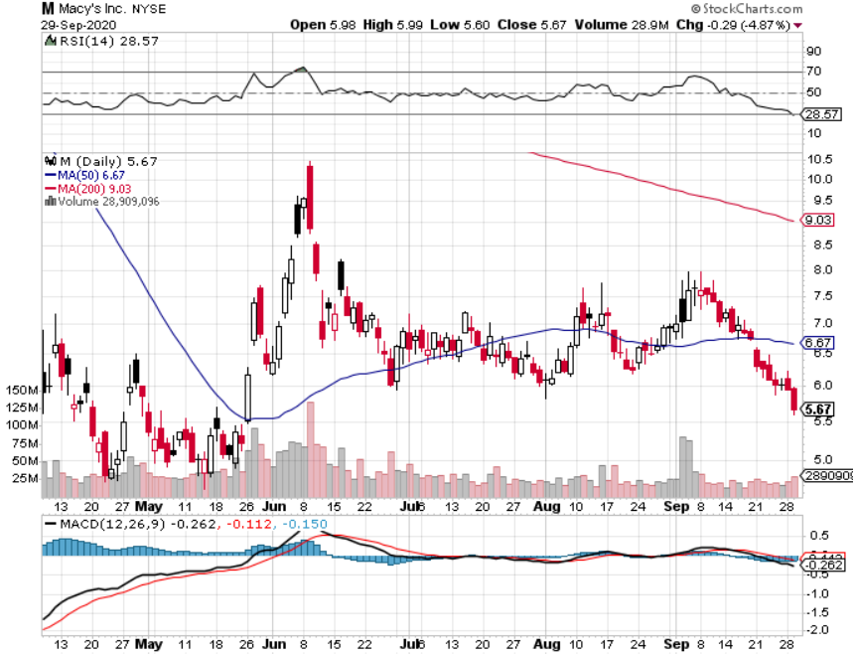
Macys’ (M) – Waiting for Chapter 11 took profits on Long 8/$23-$25 bear put spread

Slide 39
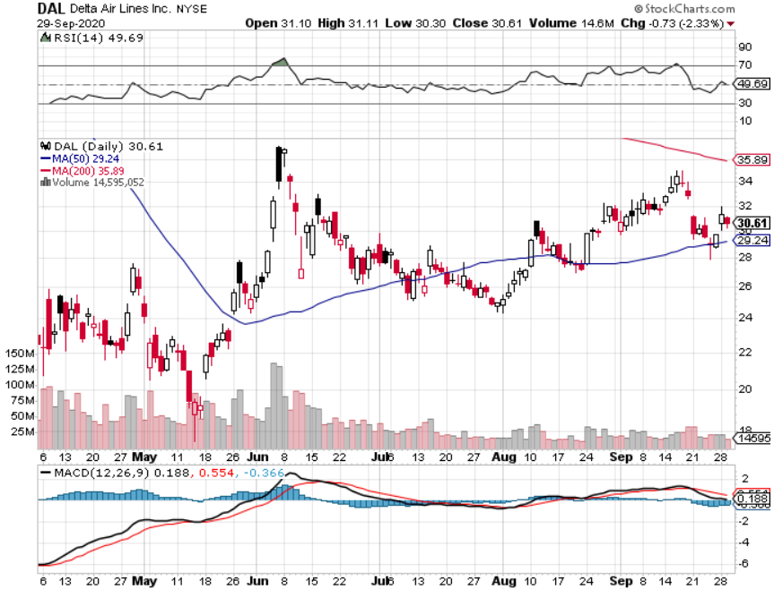
Delta Airlines (DAL) – Subsidy runs out

Slide 40
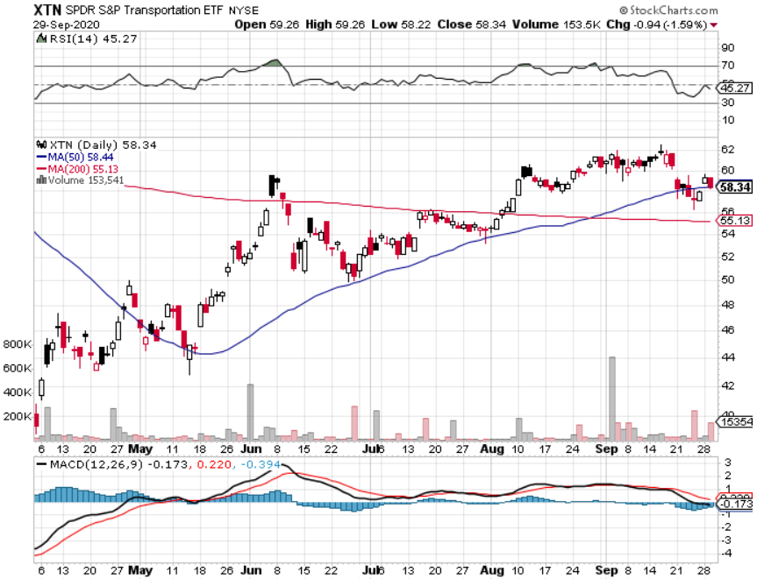
Transports Sector SPDR (XTN)- Worst Hit Sector (ALGT), (ALK), (JBLU), (LUV), (CHRW), (DAL)

Slide 41
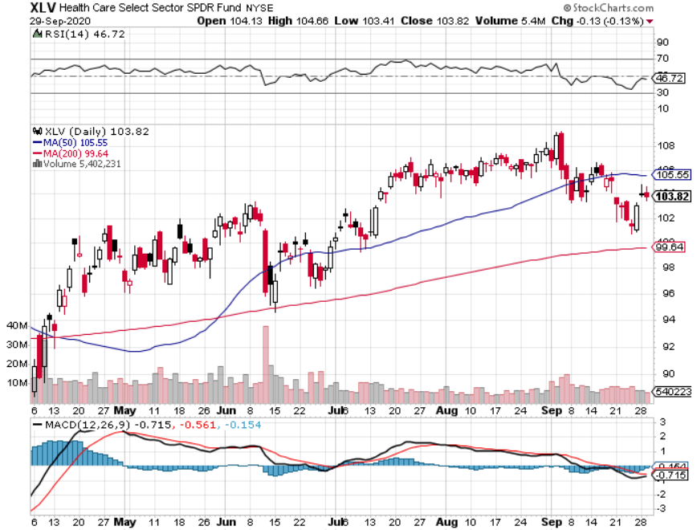
Health Care Sector (XLV), (RXL) (JNJ), (PFE), (MRK), (GILD), (ACT), (AMGN)

Slide 42
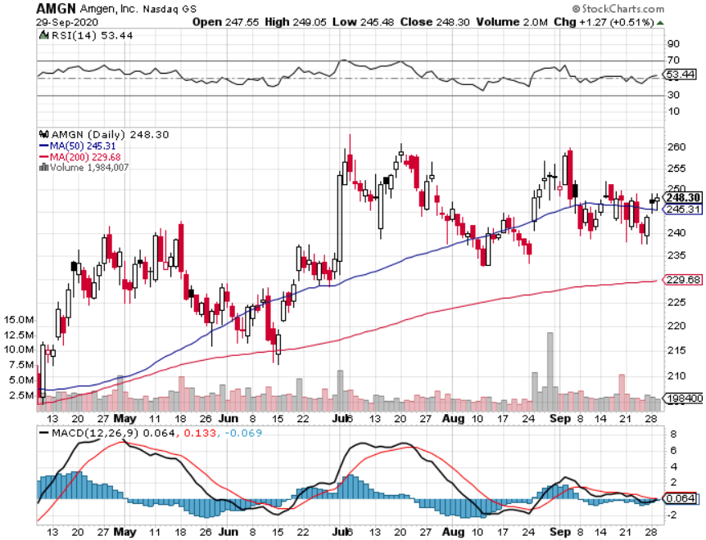
Amgen (AMGN)

Slide 43
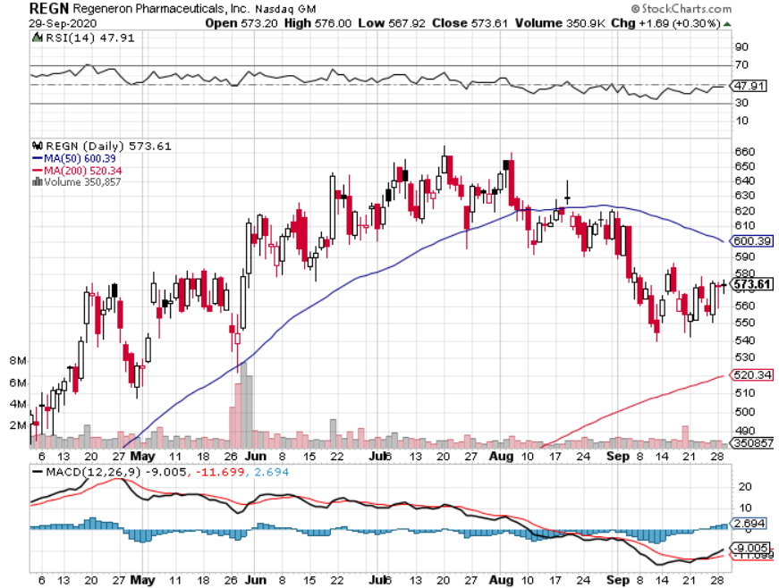
Regeneron (REGN) took profits on long 7/$570-$580 call spread

Slide 44
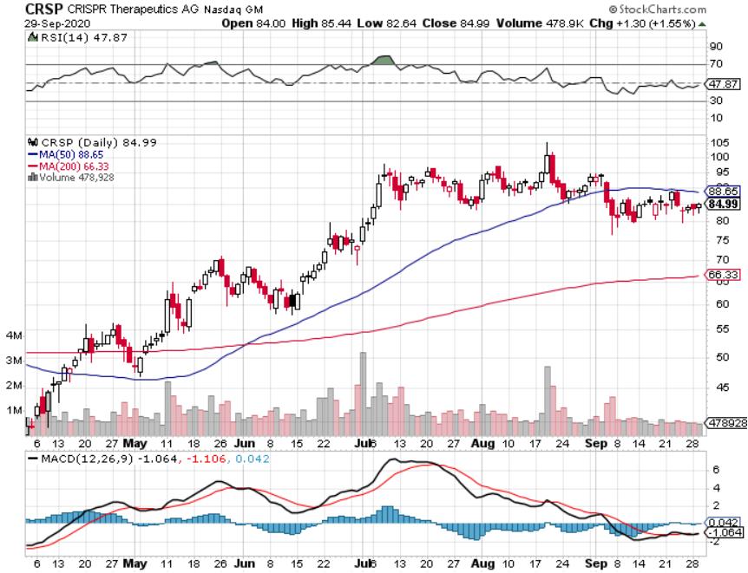
CRISPR Therapeutics (CRSP)

Slide 45
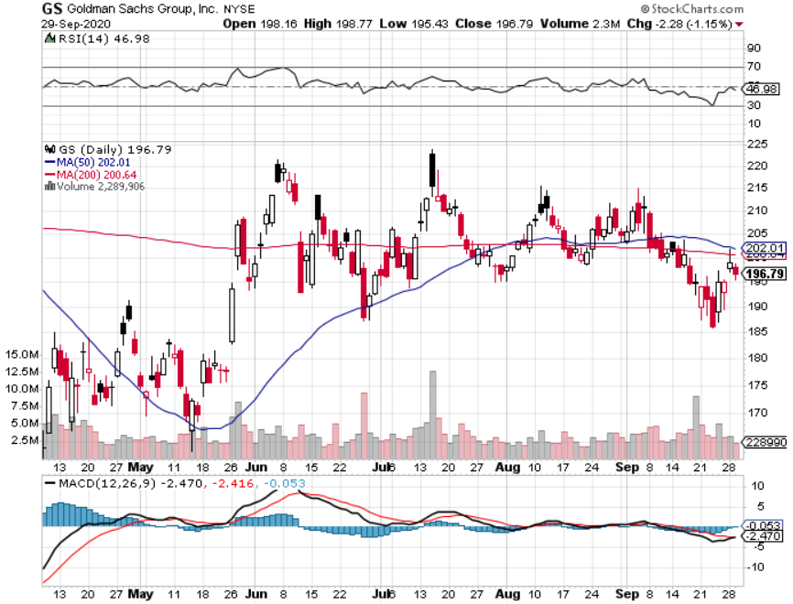
Goldman Sachs (GS) – Trading Volume Burst

Slide 46
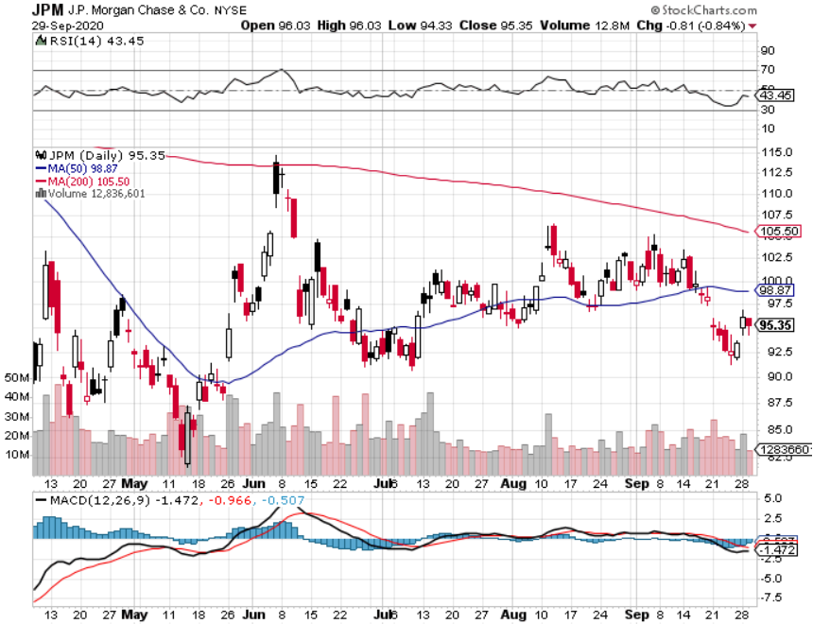
JP Morgan Chase (JPM) – “Recovery” Rotation Play took profits on long 9/$90-$95 bull call spread stopped out of long 8/$92-$95 bull call spread

Slide 47
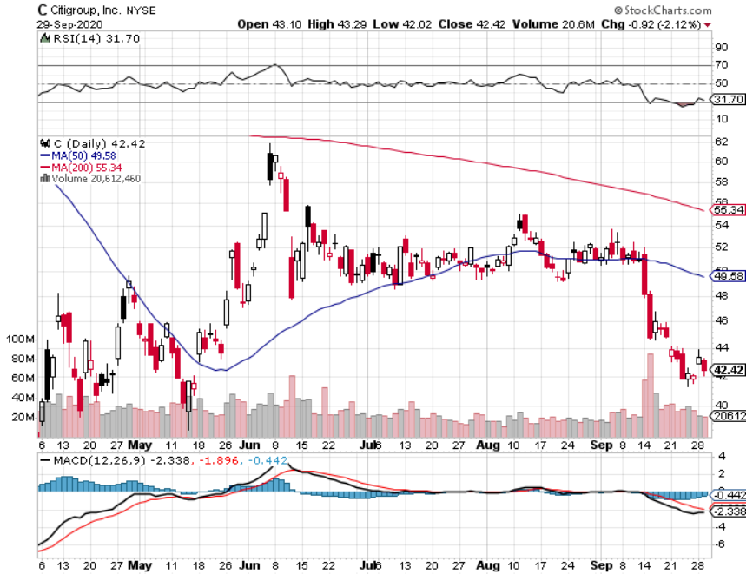
Citigroup (C) – “Recovery” Rotation Play stopped out of long 9/$45-$48 bull call spread

Slide 48
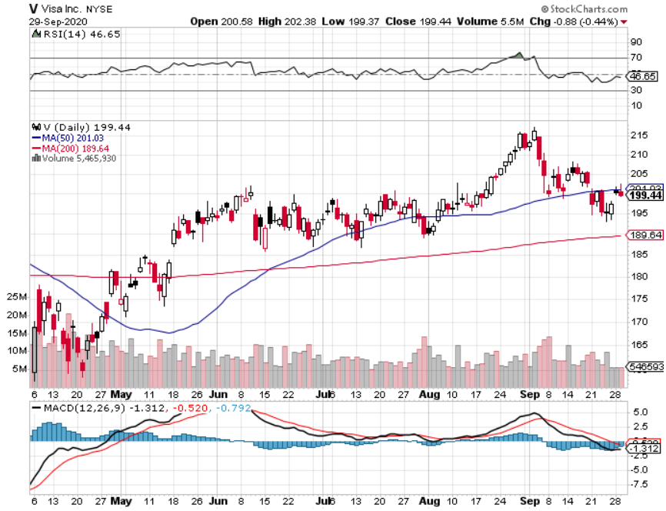
Visa (V) – “Touchless” Fintech Play took profits on long 9/$180-$185 bull call spread

Slide 49
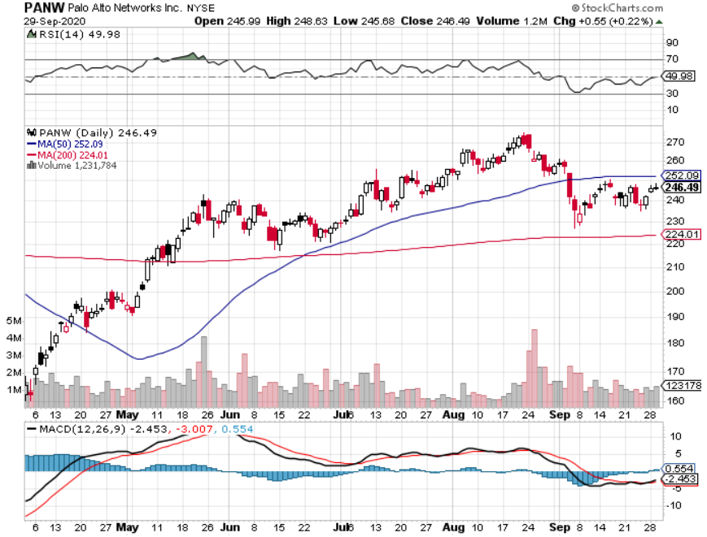
Palo Alto Networks (PANW)- New High Hacking never goes out of fashion

Slide 50
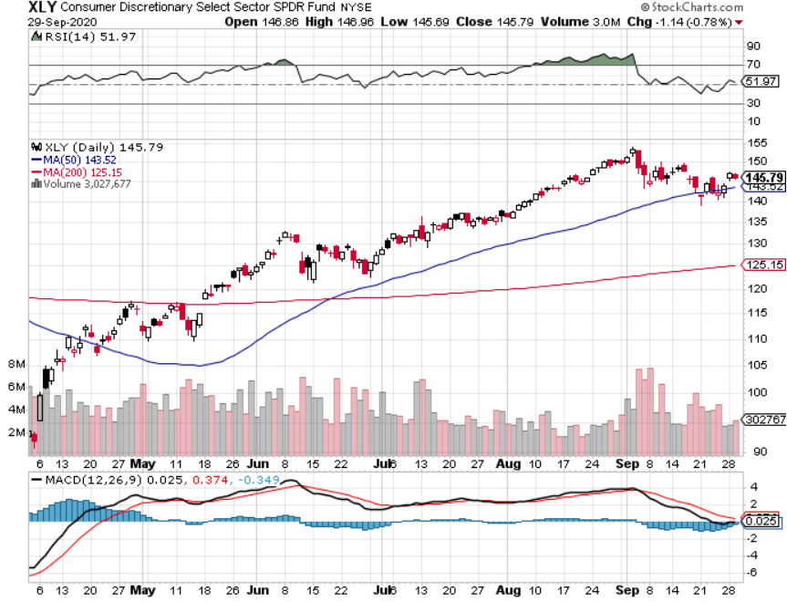
Consumer Discretionary SPDR (XLY) (DIS), (AMZN), (HD), (CMCSA), (MCD), (SBUX)

Slide 51
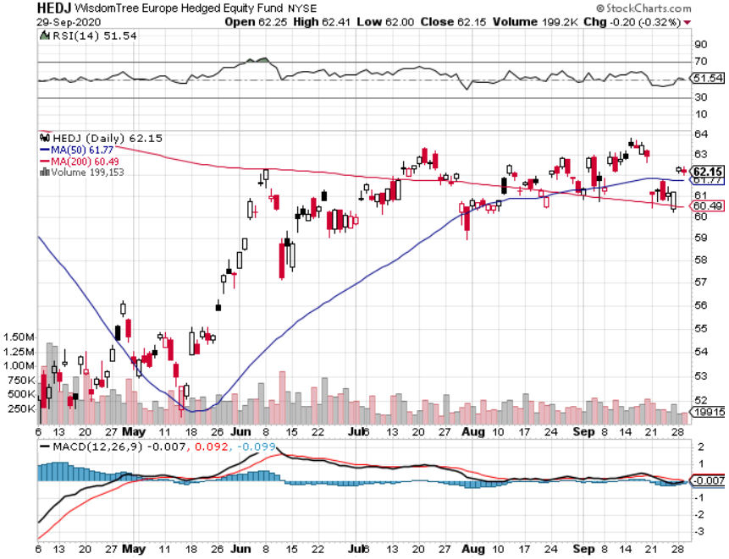
Europe Hedged Equity (HEDJ)-

Slide 52
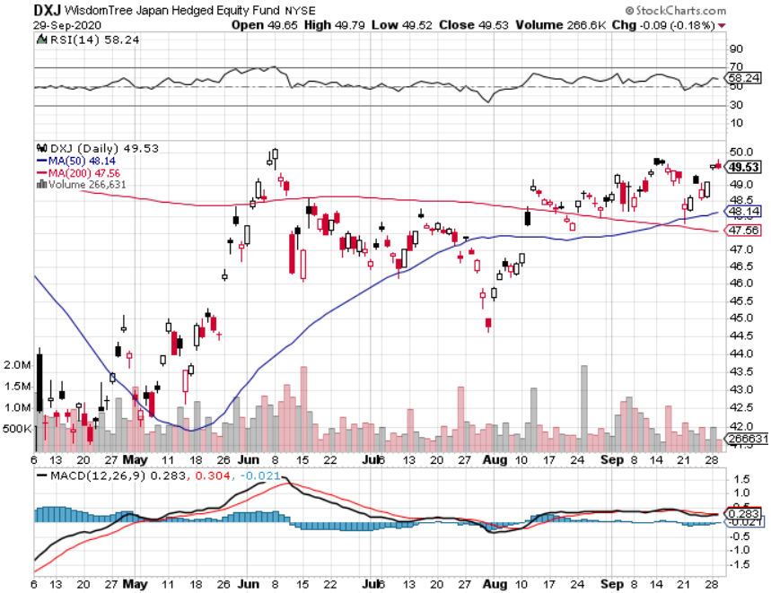
Japan (DXJ)-

Slide 53
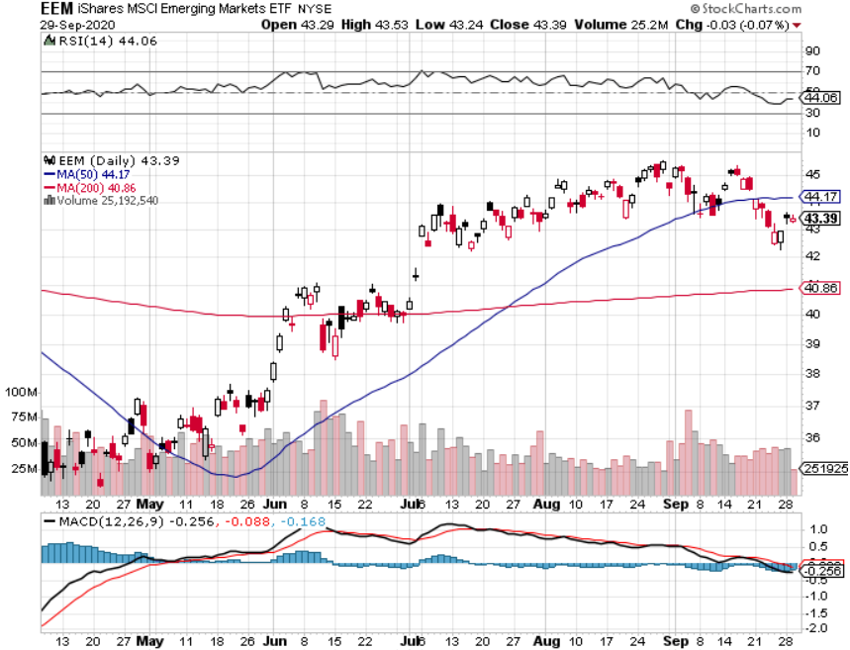
Emerging Markets (EEM)- Weak Dollar Play

Slide 54
Bonds – Hands Out
*The Biggest Debt Increase in History Also Happened, with Federal government borrowing up an eye popping 59% YOY *Great government borrowing since WWII is now underway, Biden administration could ad another $6 trillion
*Double dip recession could send ten year yields back to the 0.30’s *Inflation is failing to show *Another short selling opportunity of the century is in play, once corona cases peak out again *US Treasury bond fund (TLT) could plunge from $180 to $105, taking interest rates from 0.31% to 3.25% *Bottom line: sell short every major rally in the (TLT)

Slide 55
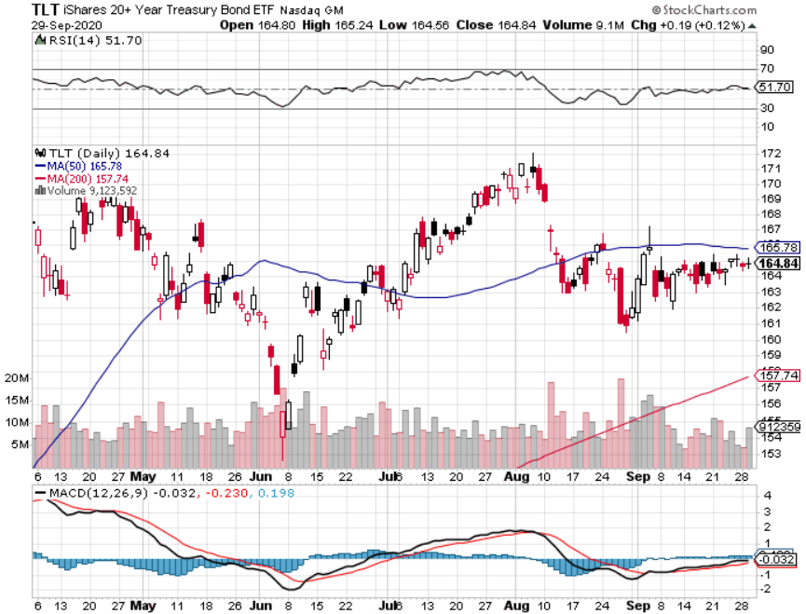
Treasury ETF (TLT) – Huge Short Play took profits on long 9/$170-$172.50 bear put spread took profits on long 9/$172.50-$175 put spread took profits on long 9/$172.50-$175 put spread

Slide 56
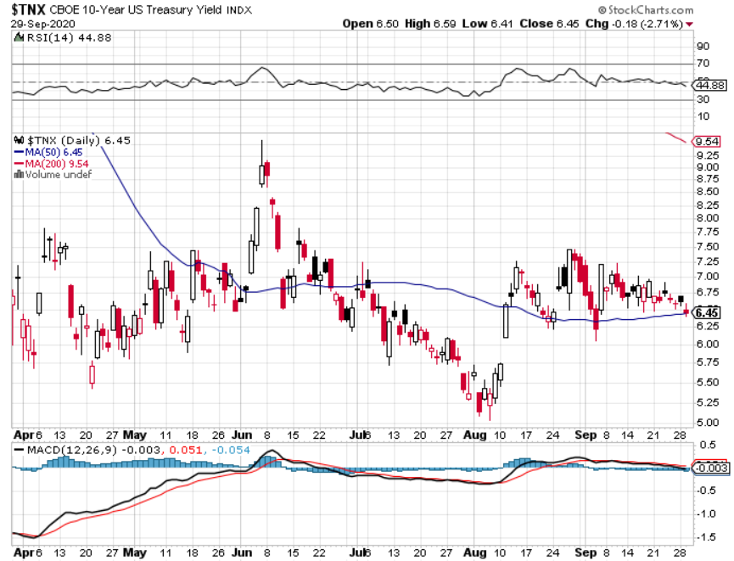
Ten Year Treasury Yield ($TNX) – 0.72%

Slide 57
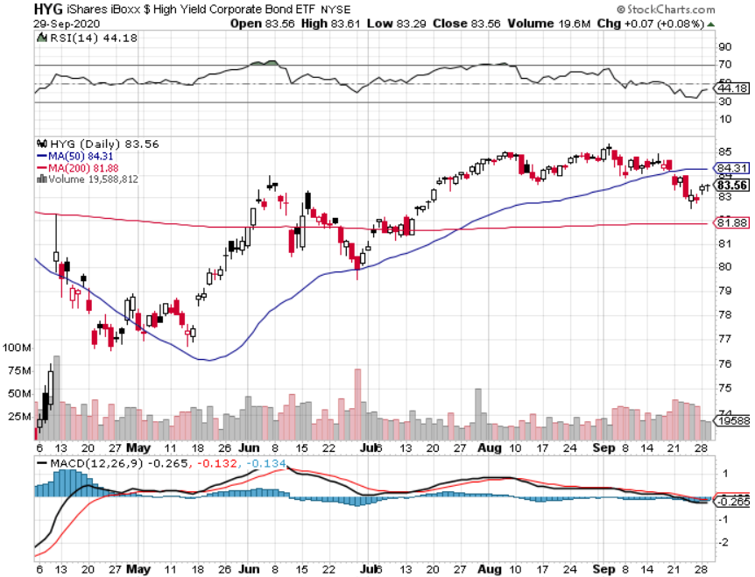
Junk Bonds (HYG) 4.64% Yield to Maturity big jump in spreads on stock selloff and recession fears

Slide 58
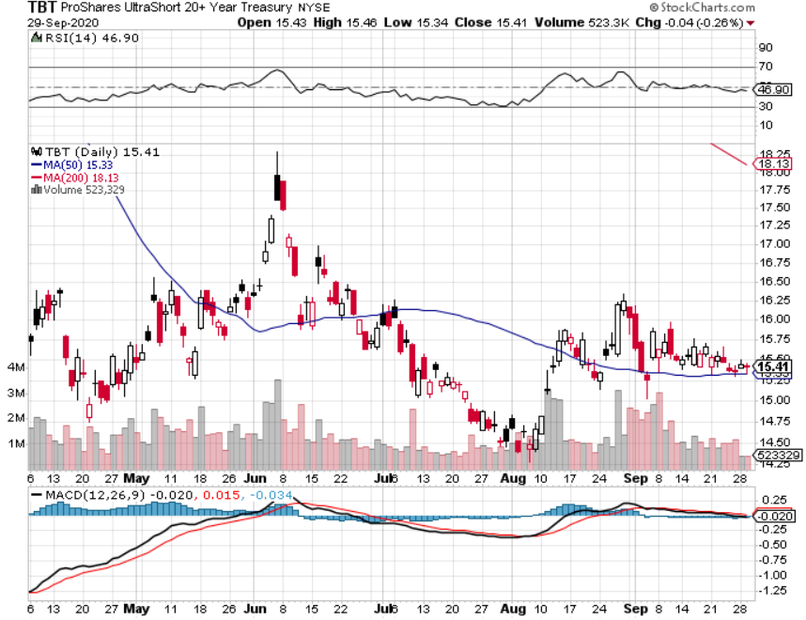
2X Short Treasuries (TBT)- 2 Month Bottoming Process

Slide 59
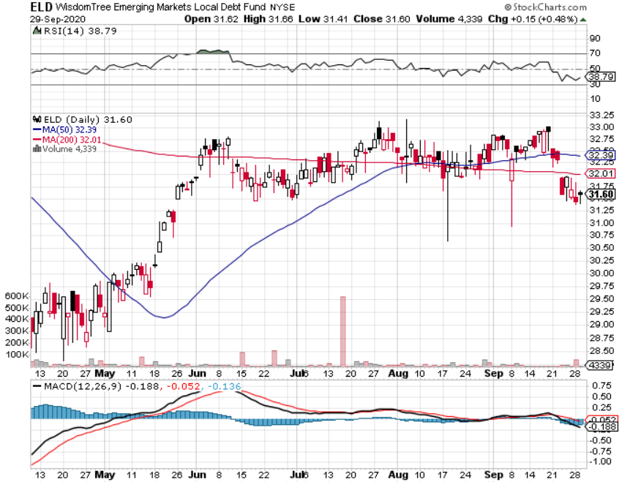
Emerging Market Debt (ELD) 4.31% Yield-

Slide 60
Municipal Bonds (MUB) – 1.08% Mix of AAA, AA, and A rated bonds

Slide 61
Foreign Currencies – Dollar Rally
Municipal Bonds (MUB) The double dip recession is here, inviting even lower interest rates. *Threats of US political instability giving a flight to safety bid for the US dollar *Any dollar rallies are temporary and short-term and a crash is imminent *Euro dives, British pound sees steeper correction *Aussie dollar profit taking *Bitcoin lost momentum *Keep selling short all US dollar rallies, its yield support is gone forever

Slide 62
Japanese Yen (FXY), (YCS)

Slide 63
Euro ($XEU), (FXE), (EUO)-

Slide 64
British Pound (FXB)-

Slide 65
Australian Dollar (FXA)- The Global Recovery Play took profits on long 8/$67-$69 call spread

Slide 66
Emerging Market Currencies (CEW)

Slide 67
Chinese Yuan- (CYB)-

Slide 68
Bitcoin- Stalling

Slide 69
Energy – Long Term Loser
*California to Ban Gasoline Cars by 2035. It a response to three years of massive wildfires. Is 20% of US gasoline use *Conventional ICE cars will be long gone by then, unable to compete on price. Electric cars are already cheaper now on a lifetime cost basis *Oil rallies small, but don’t hang you hat on it *Russia lost half its revenues from oil price collapse *Much of lost demand is permanent as US economy restructures to a less transportation-oriented economy. *Avoid all energy plays like the plague, could drop by half in the coming recession

Slide 70
Oil-($WTIC)

Slide 71
United States Oil Fund (USO) long 10/$9.50-$10 Vertical bull call spread

Slide 72
Energy Select Sector SPDR (XLE)-No Performance! (XOM), (CVX), (SLB), (KMI), (EOG), (COP)

Slide 73
Halliburton (HAL)-

Slide 74
Natural Gas (UNG) -

Slide 75
Precious Metals – The Big Dip is Here
*Gold sells off on wholesale asset dumping *It’s all about short-term profit taking, the long-term bull trend still lives *New QE Infinity will continue for years *Near zero interest rates and Collapsing US dollar is another incentive *Copper finally see major profit taking *Bottom Line: buy this dip in gold and precious metals

Slide 76
Gold (GLD)- Short Term downtrend took profits on long 9/$171-$174 call spread took profits on long 8/$169-$172 call spread took profits on long 7/$157-$160 call spread

Slide 77
Market Vectors Gold Miners ETF- (GDX) –

Slide 78
Barrick Gold (GOLD)

Slide 79
Newmont Mining- (NEM)-

Slide 80
Silver- (SLV)-

Slide 81
Silver Miners - (SIL)-

Slide 82
Wheaton Precious Metals - (WPM)-

Slide 83
Copper (COPX)-Finally a break

Slide 84
Freeport McMoRan (FCX)-World’s Largest Copper Producer took profits on long 4/$10-$11 call spread took profits on short 4/$114 calls

Slide 85
Real Estate – Bidding Wars in the ‘Burbs
*30-year fixed rate mortgage drop to record low od 2.86% *The refi boom continues, mortgage applications up 86% YOY *New Home Sales Rocket, to a 14-year high. They gained 4.8% last month to a spectacular 1.01 million units *Existing Home Sales Soar in August, up 2.4% MOM to 6 million units, the hottest since 2006. Prices are up a huge 11.4% YOY *Refi rates hover at record lows *Housing prices were ready to explode to the upside with S&P Case Shiller Rose 4.8% in July

Slide 86
June Corelogic S&P Case Shiller Home Price Index Phoenix (9.2%), Seattle (67.2%), Charlotte (6.0%) showing biggest gains
Tradingeconomics.com

Slide 87
Simon Property Group (SPG)- Mall REIT Up to 60% of Mall Tenants Aren’t Paying Rent

Slide 88
Crown Castle International (CCI) – 3.40% yielding cell phone Tower REIT

Slide 89
US Home Construction Index (ITB) (DHI), (LEN), (PHM), (TOL), (NVR)

Slide 90
Trade Sheet- So What Do We Do About All This?
*Stocks – buy the 200-day *Bonds – sell rallies aggressively *Commodities-stand aside *Currencies- sell US dollar rallies *Precious Metals – buy dips *Energy – stand aside *Volatility - sell short over $40 *Real estate – buy dips

Slide 91
Next Strategy Webinar 12:00 EST Wednesday, October 14, from Lake Tahoe, NV email me questions at support@madhedgefundtrader.com
Good Luck and Good Trading!
Notes:
*

