Slide 1
The Mad Hedge Fund Trader “Covid Crash”
With John Thomas from Silicon Valley, CA, October 28, 2020 www.madhedgefundtrader.com
Notes:
*

Slide 2
Trade Alert Performance New All Time High!
*January 3.13% Final *July +7.93% Final *February -6.05% Final *August -2.08% Final *March -5.50% Final *September 7.95% Final *April +4.55% Final *October +3.06% MTD *May +14.19% Final *November -1.26% Final *June +10.38% Final *December +4.97% Final *Year to date +37.56% compared to +1.0% for the Dow Average *+393.47% since inception, a new all time high *Average annualized return of 36.21% for 11 years, new all time high

Slide 3
Portfolio Review 100% Cash in Melting Market
Expiration P&L
No Positions

Slide 4
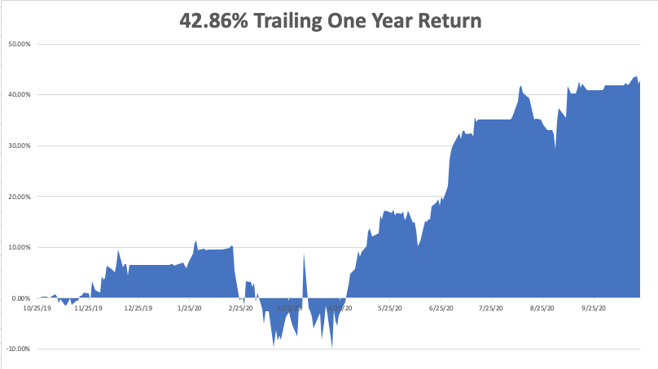

Slide 5
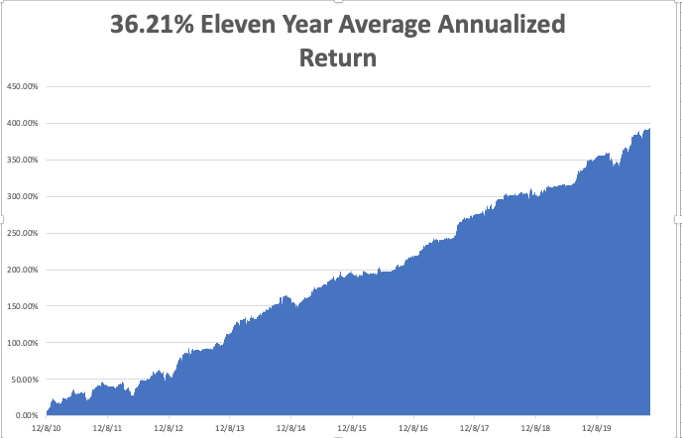
GTD 11 Year Daily Audited Performance

Slide 6
The Method to My Madness
*Market has flipped from the election to Covid-19 as the main concern *With cases at new highs and no government action to stop it, the 200-day moving average is in play *This is only a short-term dip in a 20-year bull market that may have another decade to run *The Fed has proven its intention to step in and run the printing presses on any 10% market correction, which is imminent *Stocks overpriced at all time high, but cheap on a three-year view *2021 will be the year of the barbell, a tech/domestic recovery portfolio *A bond short is far and away the better trade based on massive over issuance of US government bonds and now we have a big rally to sell into

Slide 7
Corona Update – Exponential Growth
*US cases top 8.8 million, deaths at 227,000,000 and are still rising at 1,000 a day, and could reach 300,000 by yearend *Center of the US epidemic has moved to the northern Midwest, with North Dakota, South Dakota, Montana, and Wisconsin the leading hot spots. The “non-mask”, open bar states are getting hardest hit. *Vaccine mass production is gearing up with Sanofi (SNY) a front runner, with AstraZeneca and Pfizer right behind *While the US tops 8.8 million cases, antibody testing shows the true figure is close to 35 million, or 10% of the population *A true vaccine is a year off, or never

Slide 8
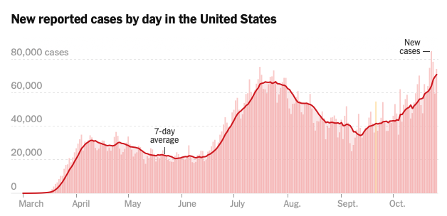
Targeting 100,000 cases a day by end November

Slide 9
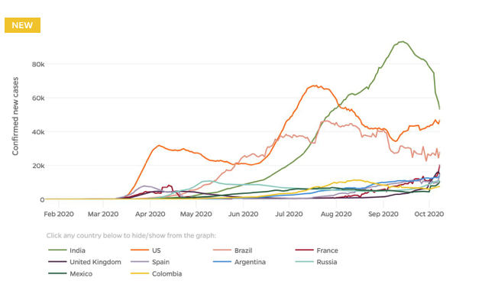

Slide 10
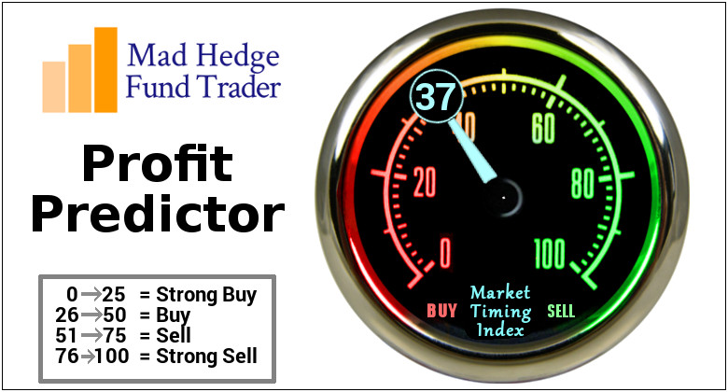
The Mad Hedge Profit Predictor Market Timing Index-Bottom of Range-at to a “BUY” An artificial intelligence driven algorithm that analyzes 30 different economic, technical, and momentum driven indicators

Slide 11
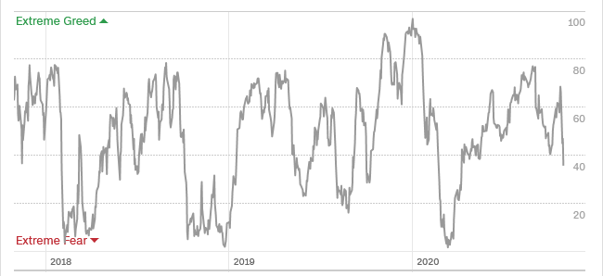
The Mad Hedge Profit Predictor Stuck in the Middle-No Trade
SELL
BUY

Slide 12
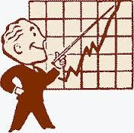
The Global Economy – Anticipating a Boom
*Q3 GDP first read expected at a record 31% or better, will soar more in 2021 *Weekly Jobless Claims drop to 787,000, better, but still horrible. California is finally reporting again US Producer Prices pop in September, bring the first YOY gain since March *China’s Economy soars by 4.9%, in Q3 YOY with the pandemic in the rear-view mirror Ships are backed up in Los Angeles waiting to unload. America’s import boom and soaring trade deficit with China leaves no available dock space on the west coast. *IMF predicts negative 4.4% growth for 2020

Slide 13
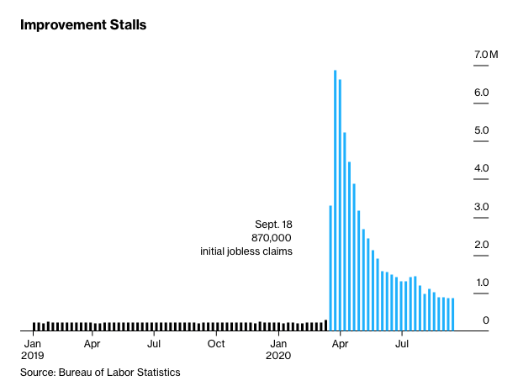
Weekly Jobless Claims – Flatlining at record highs +877,000

Slide 14
The Bill Davis View A $1,500 Upgrade for the Mad Day Trader Service
Buys: | Entry | Target
Par Technology (PAR) | $ 37.00 | $ 50.00
Mastercard (MA) | $ 300.00 | $ 345.00
Moody's Corp (MCO) | $ 265.00 | $ 285.00
Palo Alto Networks (PANW) | $ 228.00 | $ 260.00
Clorox Co. (CLX) | $ 215.00 | $ 230.00
Sells:
Penn National Gaming, Inc.(PENN) | $ 65.00 | $ 45.00
W.R.Grace & Co.(GRA) | $ 47.00 | $ 37.00
Carter Holdings Inc. (CRI) | $ 88.00 | $ 75.00
Becton Dickinson (BDX) | $ 250.00 | $ 220.00
Wayfair Inc.(W) | $ 280.00 | $ 240.00

Slide 15
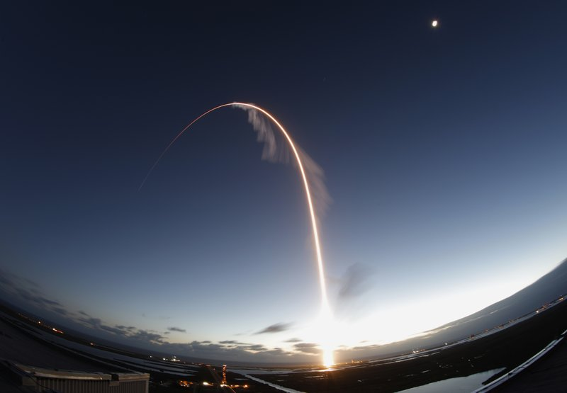
Stocks – Back to Earth
*Covid-19 returns back to the forefront as main market driver, and that’s bad Beware the coming Tax Loss Selling. A Biden win could unleash a torrent of selling as investors rush to beat an increase in the capital gains tax. That’s when you buy. *Alternative Energy Stocks soar on blue wave, especially those focused on solar Tesla generates a record profit for the fifth consecutive quarter in a row *Baby Boomers are unloading stocks, to Gen Xer’s mostly, but Millennials as well *In 2021 both tech and recovery stocks run, meaning everything goes up *We could be entering a wide $2,700 - $3,600 range until the election

Slide 16
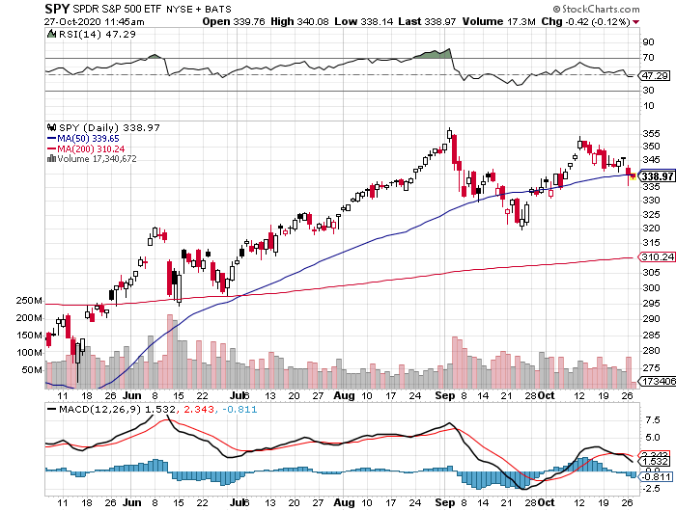
S&P 500 – Upside Breakout at Hand-Huge swing in the polls stopped out of long 7/$320-$330 bear put spread took profits on long 6/$235-$245 bull call spread took profits on long 4/$280-$290 bear put spread took profits on long 4/$275-$280 bear put spread
New Highs
The Bottom 3,10
You are here now

Slide 17
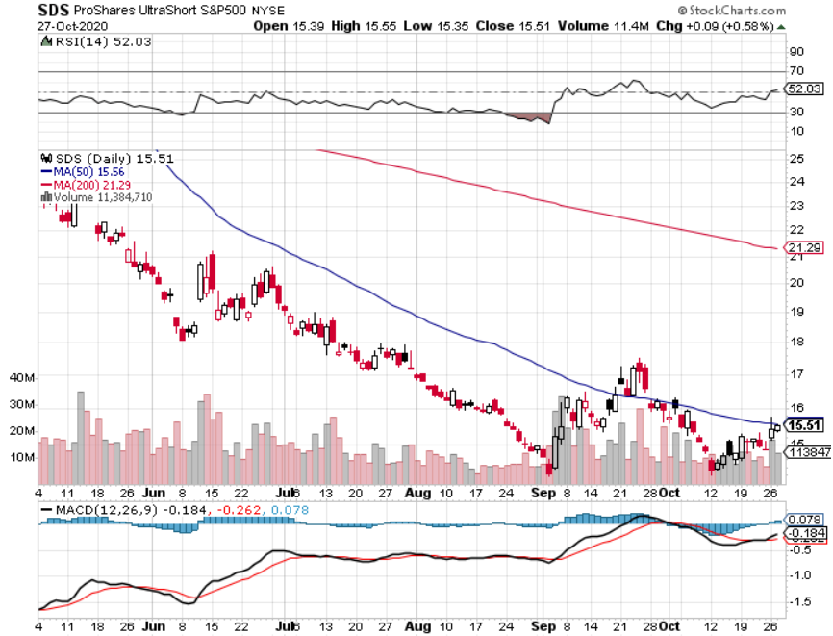
ProShares Ultra Short S&P 500 (SDS)- a Great Hedge for long stocks and bonds Long 2X position has a hedge against longs and bond shorts

Slide 18
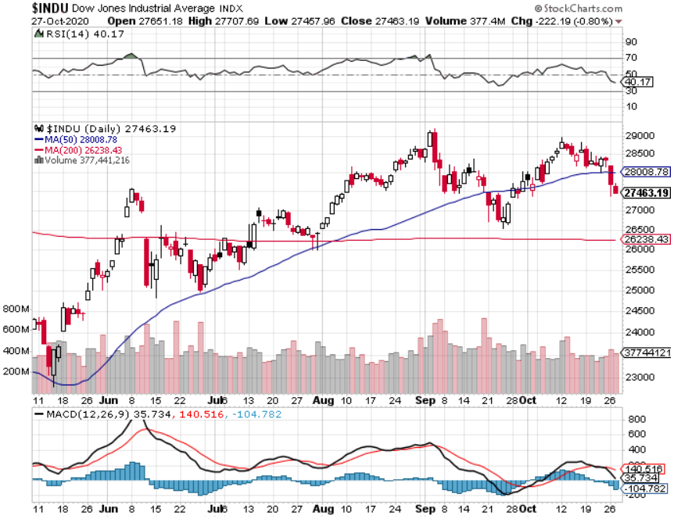
Dow Average ($INDU)-

Slide 19
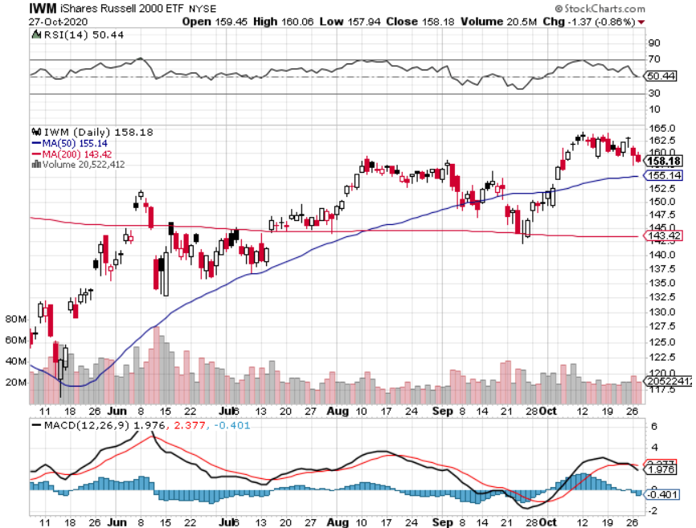
Russell 2000 (IWM)- took profits on Long 10/$137-$142 vertical bull call spread took profits on Long 10/$153-$156 vertical bear put spread

Slide 20
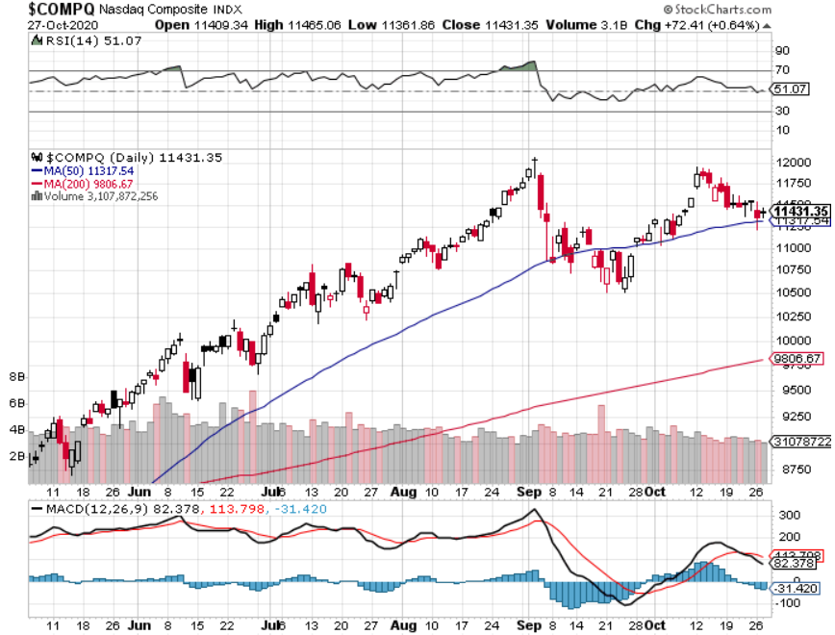
NASDAQ ($COMPQ) – Classic Correction

Slide 21
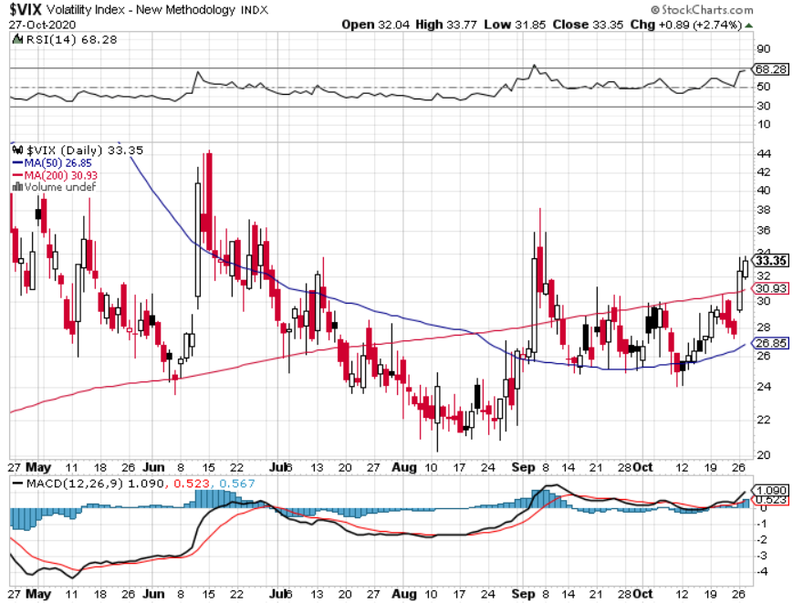
(VIX)-Another spike-but smaller

Slide 22
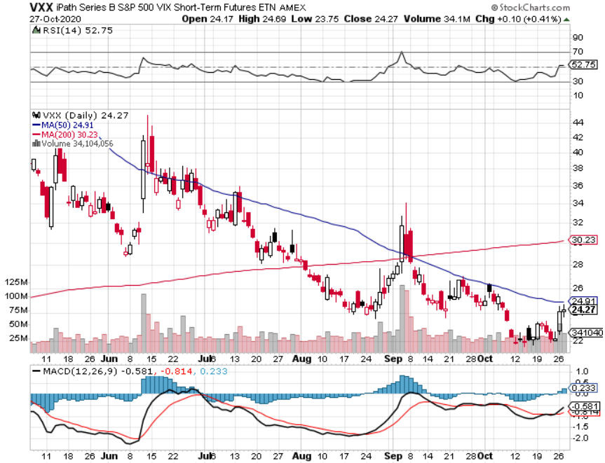
(VXX)- Sell Rallies-Down $85 to $26 from top stopped out of long 1/2021 $16 puts stopped out of long 1/2021 $24 puts

Slide 23
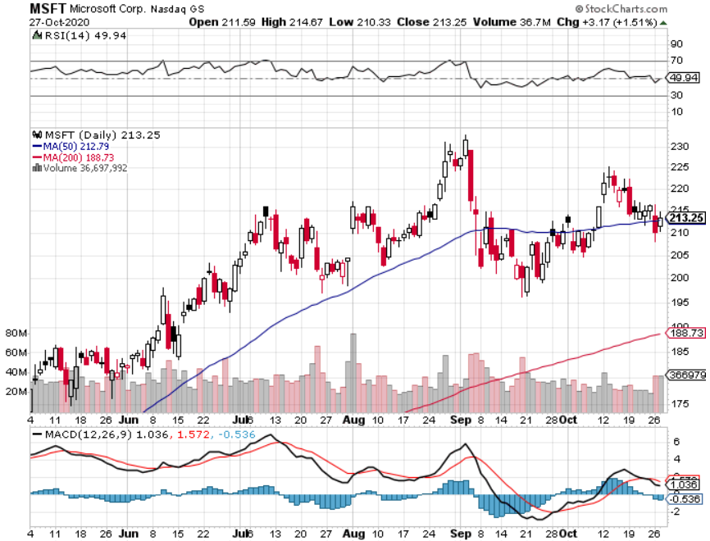
Microsoft (MSFT)- Earnings beat- Looking for Another Entry Point Stopped out of long 4/$120-$130 call spread took profit on long 4/$120-$130 call spread stop loss on long 12/$170-$180 call spread took profits on long 12/$135-$138 call spread

Slide 24
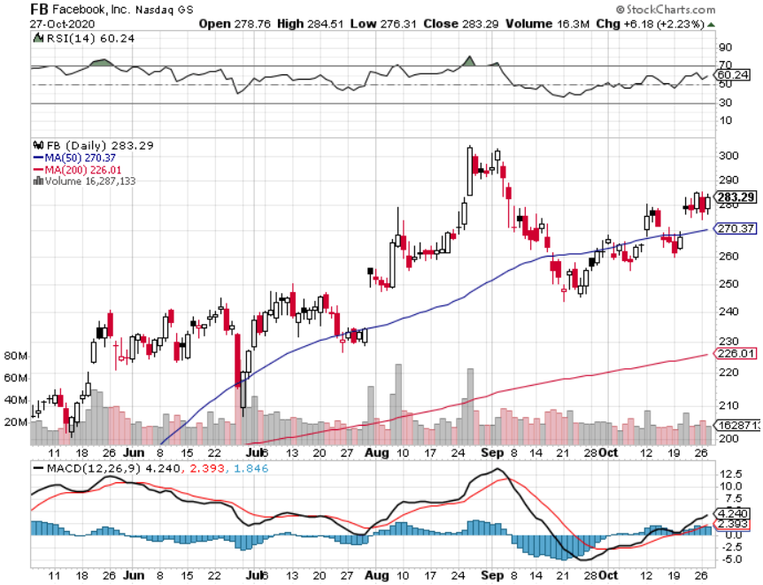
Facebook (FB)-New High took profits on Long 9/$290-$300 vertical bear put spread stopped out of Long 9/$190-$200 vertical bear put spread took profits on Long 9/$145-$155 vertical bull call spread took profits on Long 9/$150-$160 vertical bull call spread took profits on Long 8/$167.50-$172.50 vertical bull call spread

Slide 25
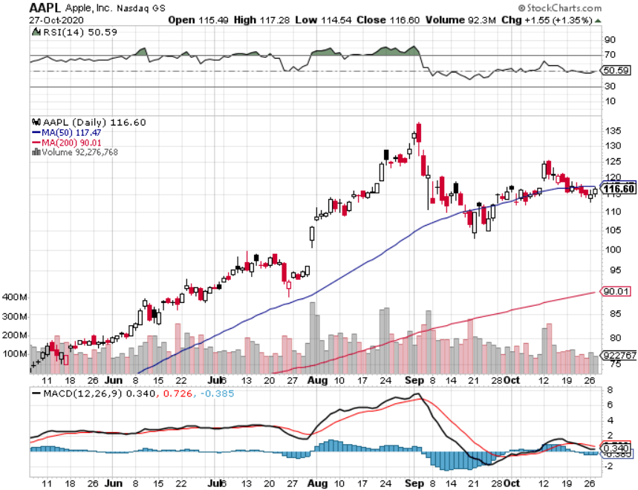
Apple (AAPL)- New 5G iPhone This Week stopped out of long 9/$100-$105 call spread stopped out of long 8/$480-$490 bear put spread took profits on long 7/$320-$330 call spread took profits on long 4/24/$250-$260 call spread took profits on long 5/$250-$260 call spread

Slide 26
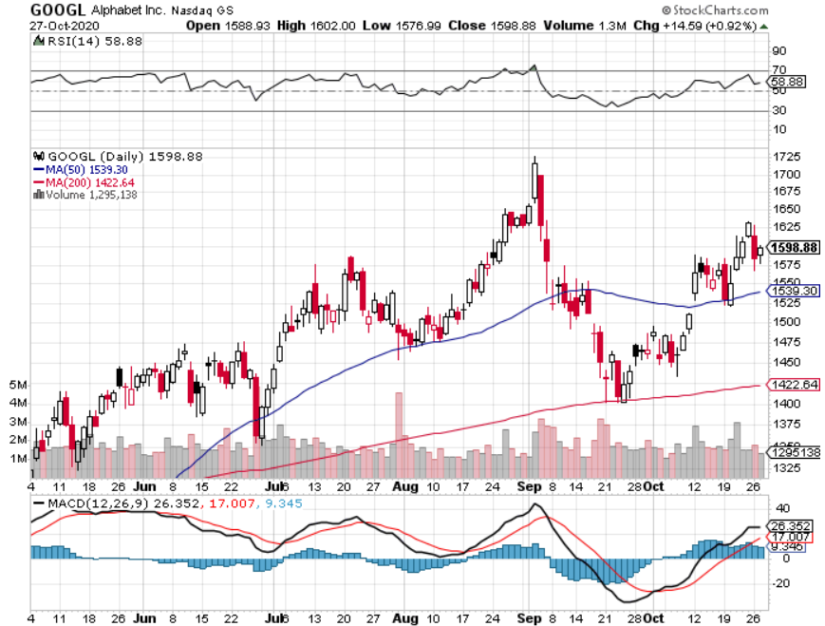
Alphabet (GOOGL) – Deutsche Bank upgrade to $2,020 took profits on long 12/$1,200-$1,230 bull call spread took profits on long 9/$1,030-$1,080 vertical bull call spread stopped out of long 5/$1,100-$1,130 bull call spread took profits on long 4/$1,080-$1,120 bull call spread

Slide 27
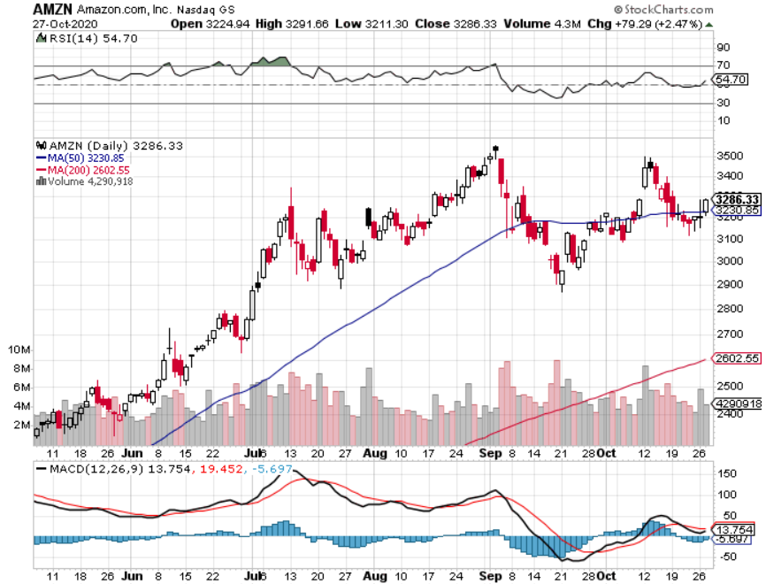
Amazon (AMZN) – Profit taking took profits on long 9/$2,800-$2,900 bull call spread stopped out of long 8/$3,000-$3,500 bear put spread took profits on long 4/$1,500-$1,550 bull call spread

Slide 28
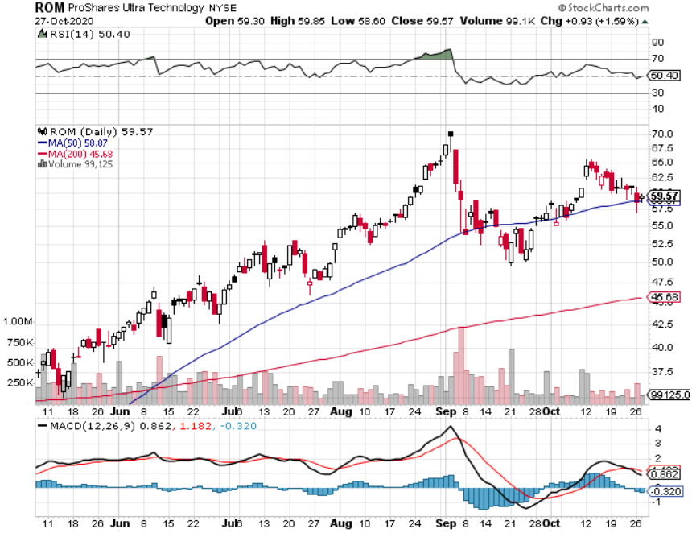
ProShares Ultra Technology (ROM) – Up 240% in 5 Months

Slide 29
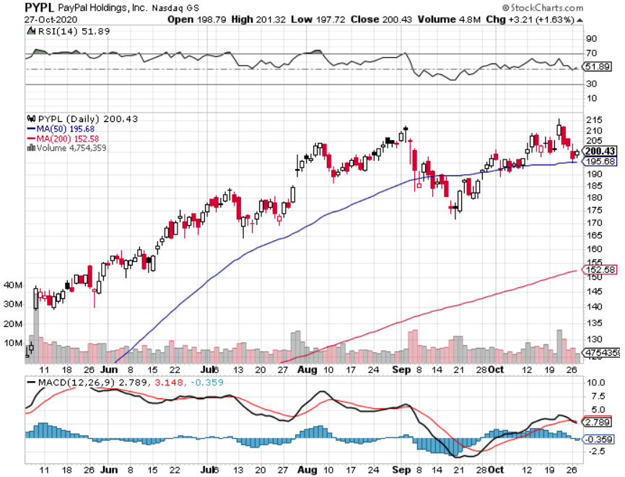
PayPal (PYPL)-Fintech Rules took profits on long 4/$90-$95 call spread

Slide 30
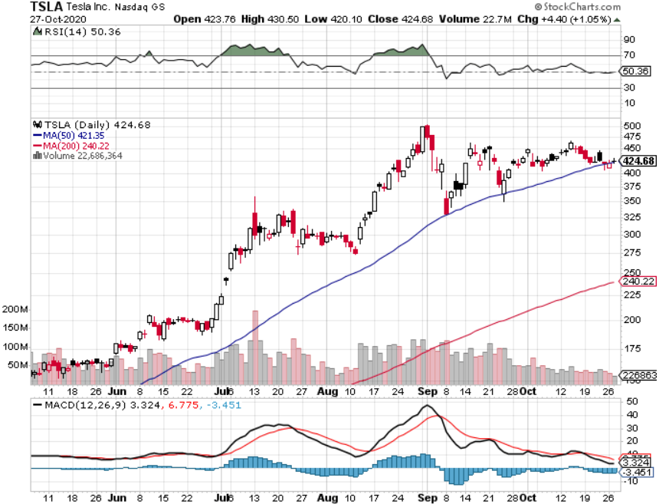
Tesla (TSLA)- Promises a $25,000 Car in Three Years 20-fold increase in battery output in 2-3 years

Slide 31
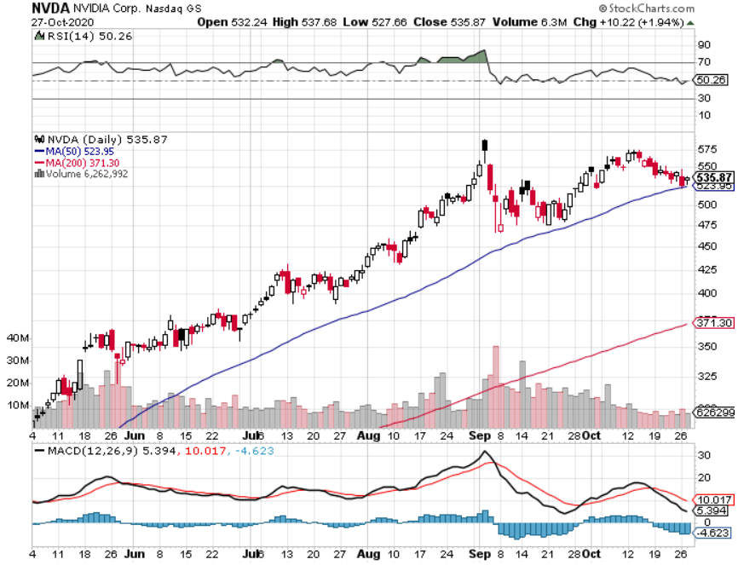
NVIDIA (NVDA) – The Biggest Chip Deal in History $40 billion of Arm Holdings-one of the greatest concentrations of AI talent in the world

Slide 32
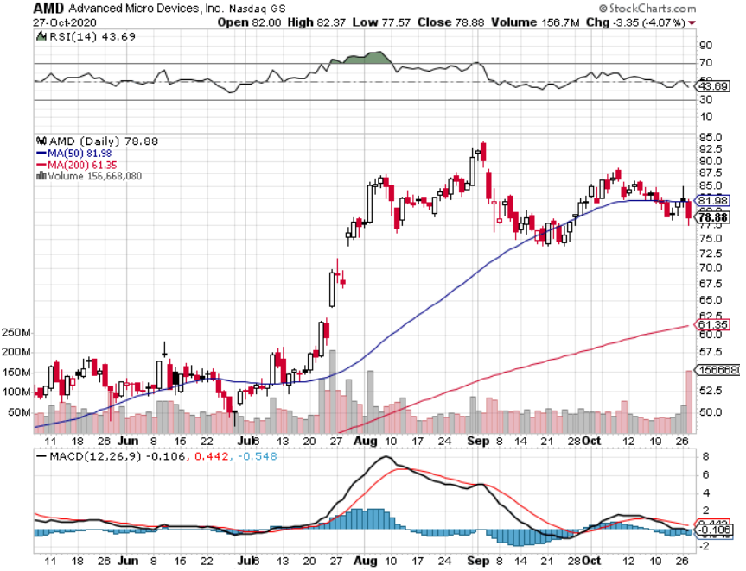
Advanced Micro Devices (AMD)- the next ten bagger-buys Xylinx

Slide 33
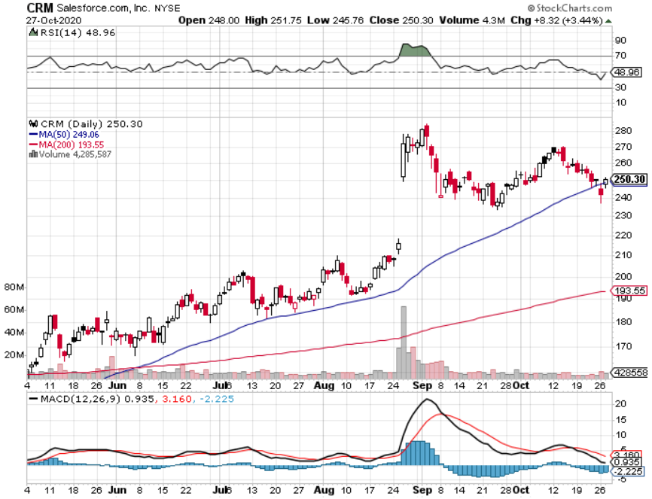
Salesforce (CRM)- Massive Online Migration took profits on long 9/$125-$130 vertical bull call spread took profits on long 8/$125-$130 vertical bull call spread took profits on long 2/$105-$115 call spread

Slide 34
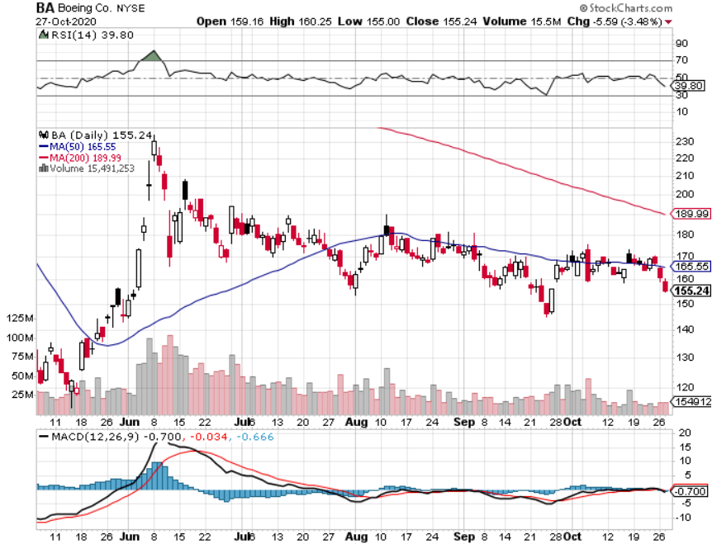
Boeing (BA) –LEAP Candidate A scathing House report assaulting the company and its regulator, the FAA took profits on long 4/$300-$310 call spread took profits on long 4/$315-$335 call spread

Slide 35
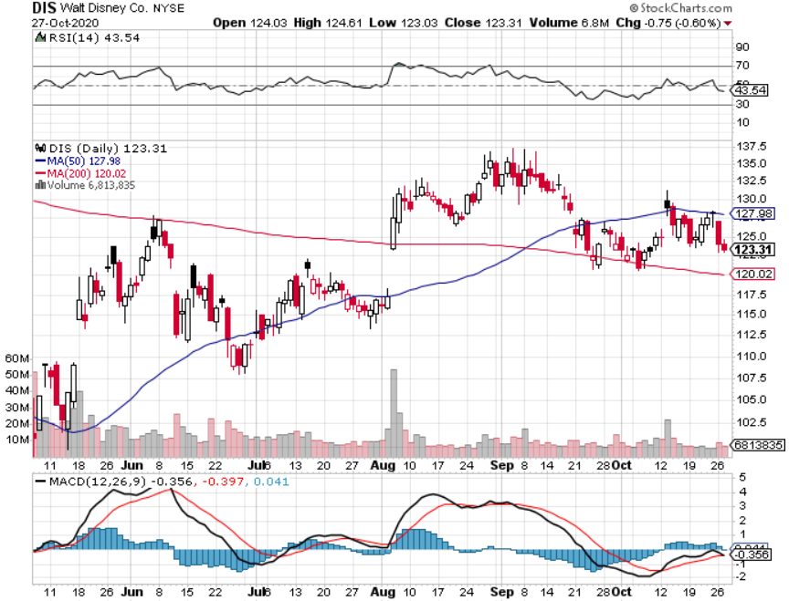
Walt Disney (DIS)- Big Streaming Move took profits on long 6/$85-$90 call spread

Slide 36
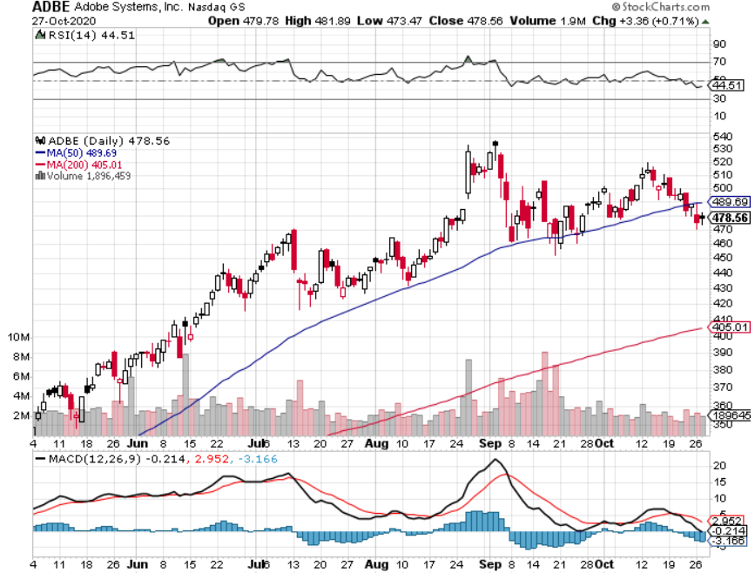
Adobe (ADBE)- Cloud play The Quality Non-China tech play

Slide 37
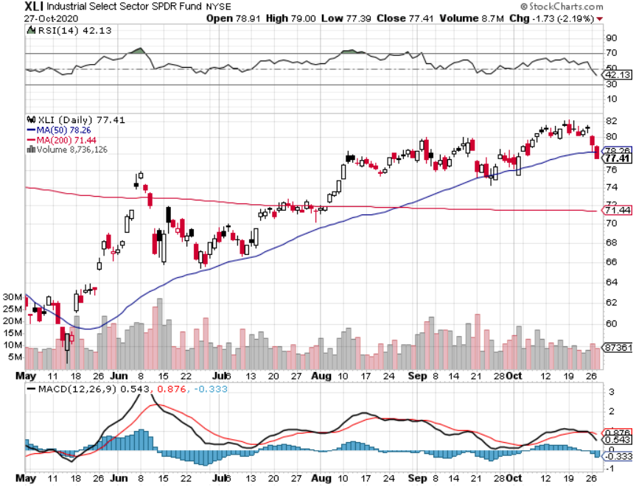
Industrials Sector SPDR (XLI)- (GE), (MMM), (UNP), (UTX), (BA), (HON)

Slide 38
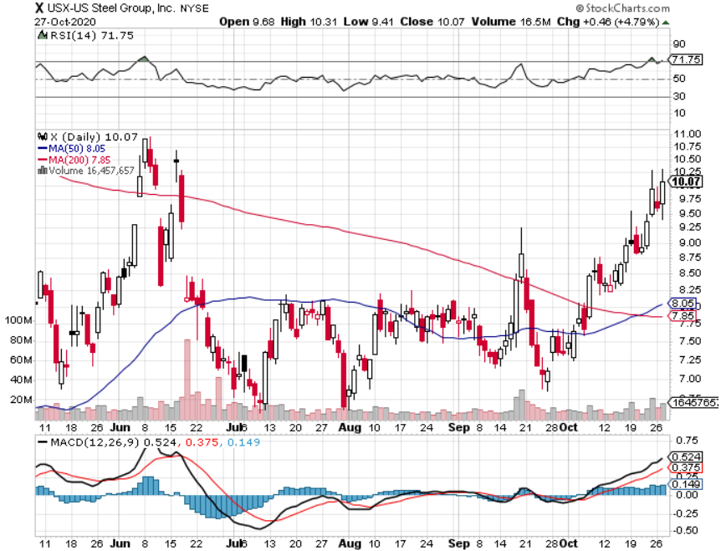
US Steel (X)-Dying Old Economy

Slide 39
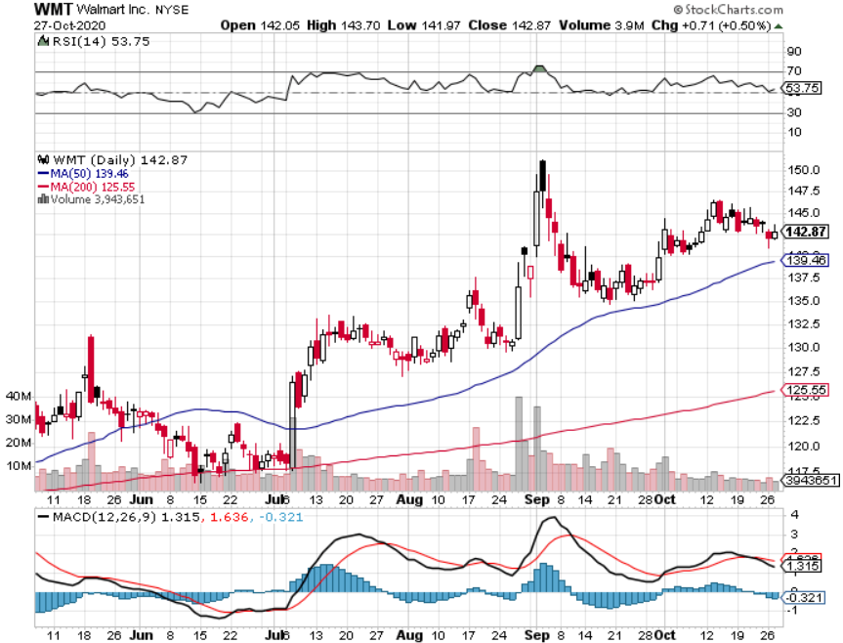
Wal-Mart (WMT)-New High took profit on Long 11/$125-$130 bear put spread took profit on Long 10/$119-$121 bear put spread took profits on Long 8/$114-$117 bear put spread

Slide 40
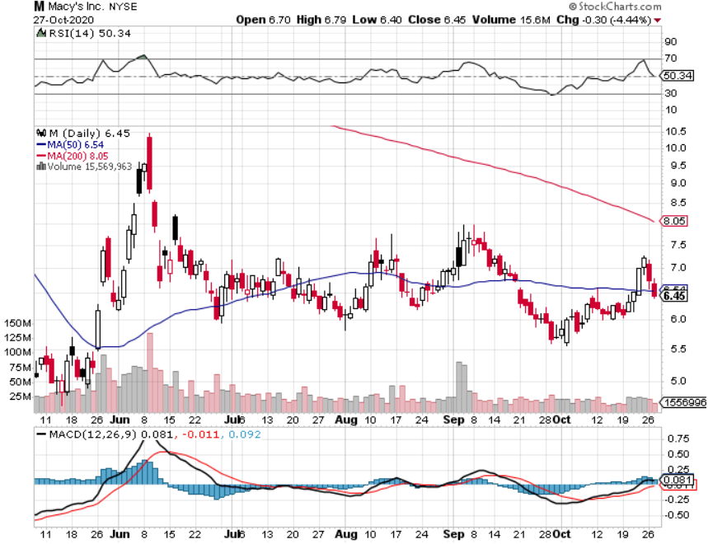
Macys’ (M) – Waiting for Chapter 11 took profits on Long 8/$23-$25 bear put spread

Slide 41
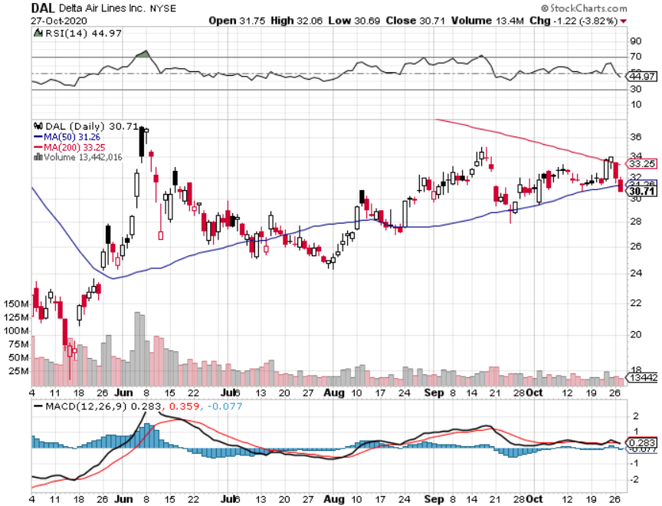
Delta Airlines (DAL) – Subsidy runs out

Slide 42
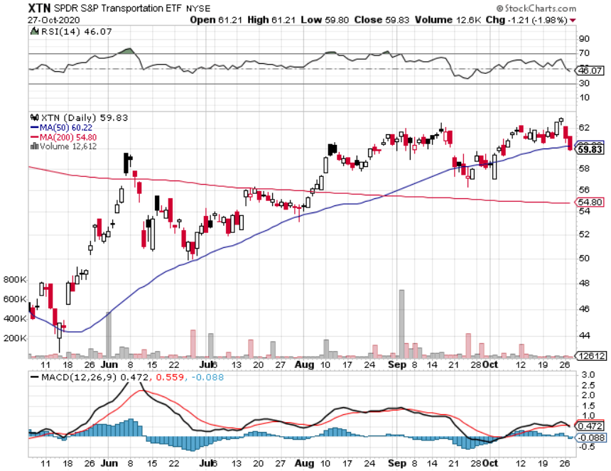
Transports Sector SPDR (XTN)- Worst Hit Sector (ALGT), (ALK), (JBLU), (LUV), (CHRW), (DAL)

Slide 43
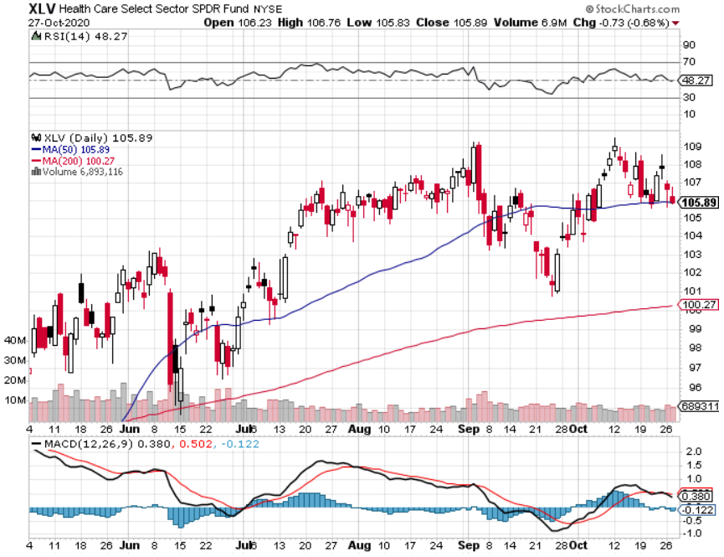
Health Care Sector (XLV), (RXL) (JNJ), (PFE), (MRK), (GILD), (ACT), (AMGN)

Slide 44
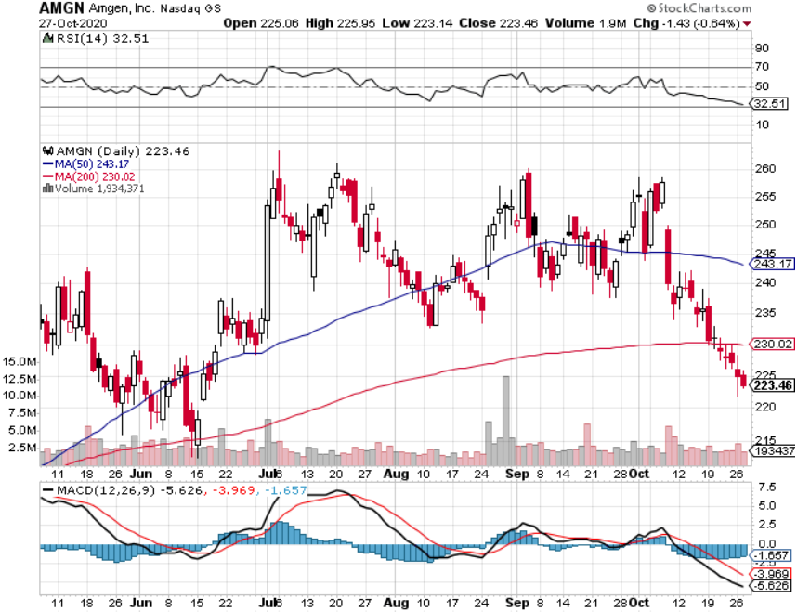
Amgen (AMGN)

Slide 45
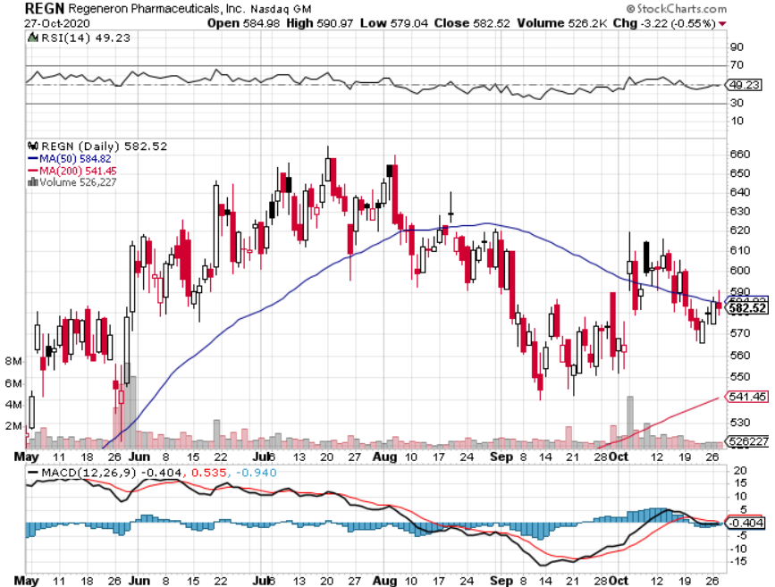
Regeneron (REGN) took profits on long 7/$570-$580 call spread

Slide 46
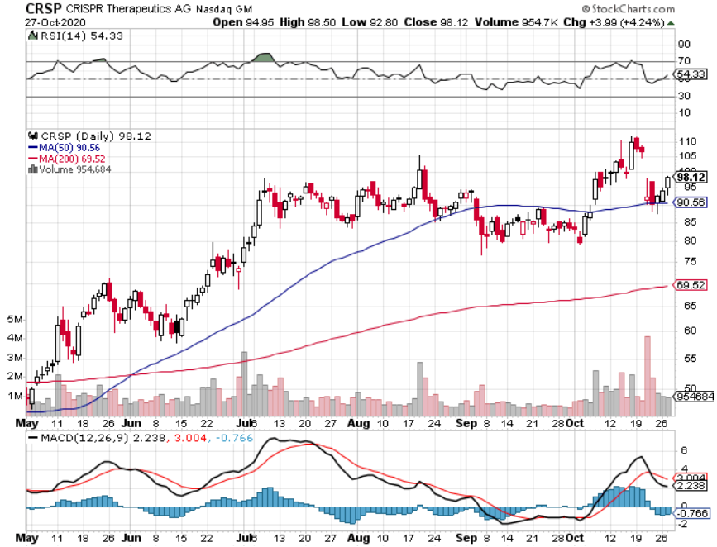
CRISPR Therapeutics (CRSP)

Slide 47
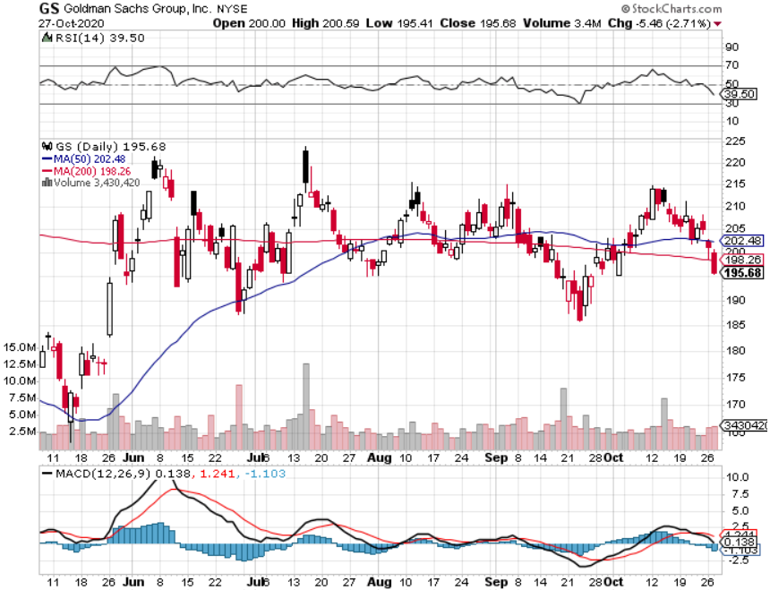
Goldman Sachs (GS) – $3 billion Settlement

Slide 48
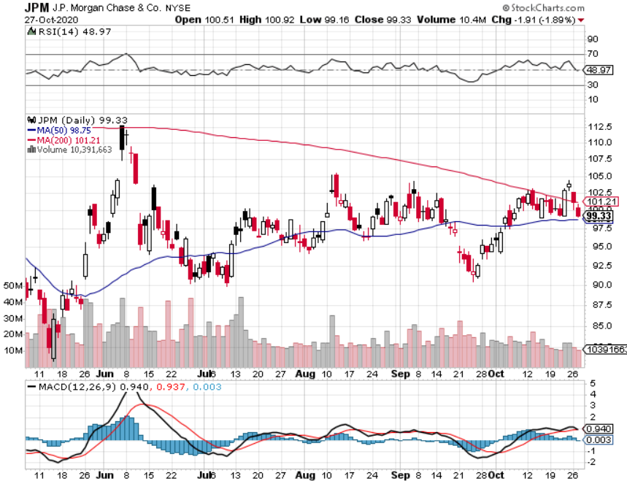
JP Morgan Chase (JPM) Recession Fears took profits on long 11/$110-$115 bear put spread took profits on long 9/$90-$95 bull call spread stopped out of long 8/$92-$95 bull call spread

Slide 49
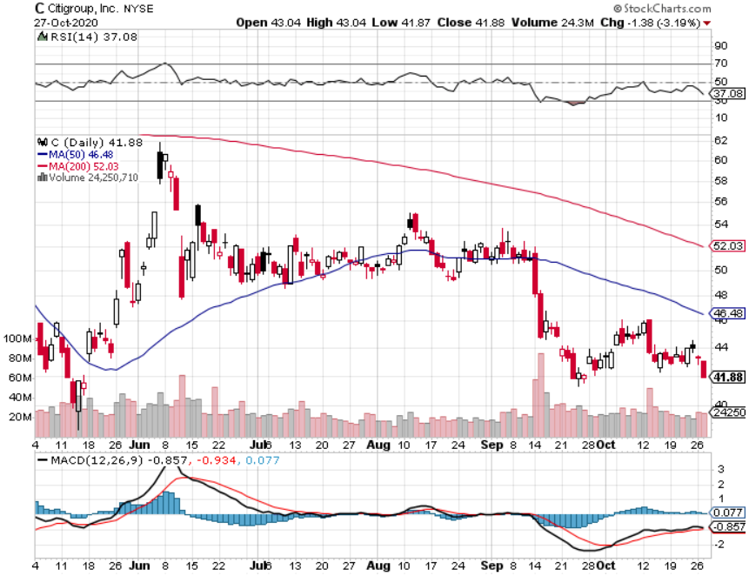
Citigroup (C) – “Recovery” Rotation Play stopped out of long 9/$45-$48 bull call spread

Slide 50
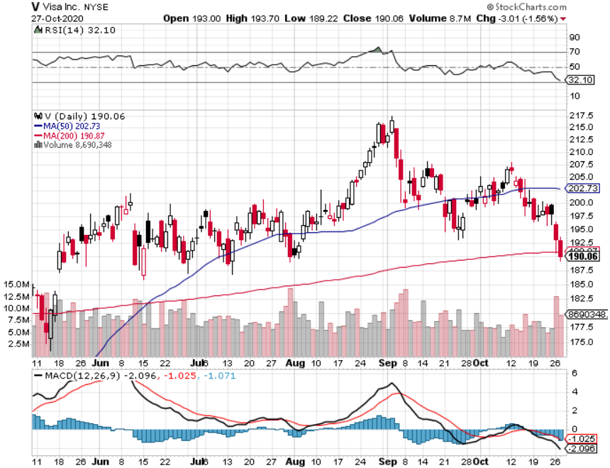
Visa (V) – “Touchless” Fintech Play long 11/$180-$185 bull call spread took profits on long 9/$180-$185 bull call spread

Slide 51
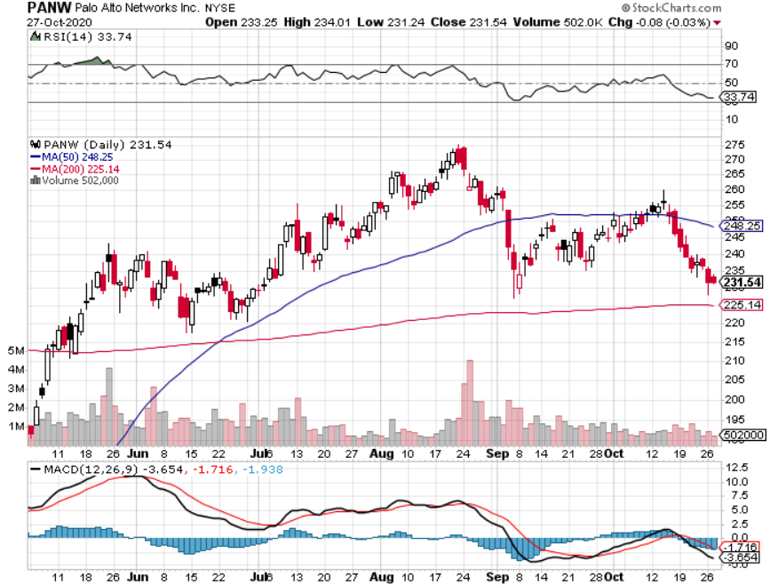
Palo Alto Networks (PANW)- New High Hacking never goes out of fashion

Slide 52
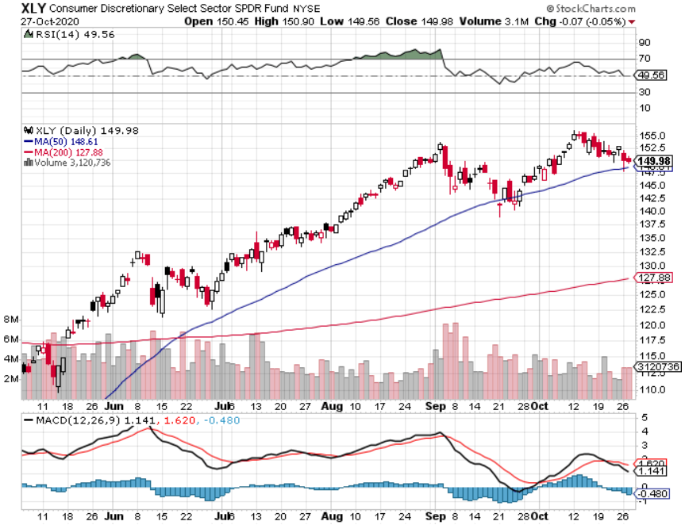
Consumer Discretionary SPDR (XLY) (DIS), (AMZN), (HD), (CMCSA), (MCD), (SBUX)

Slide 53
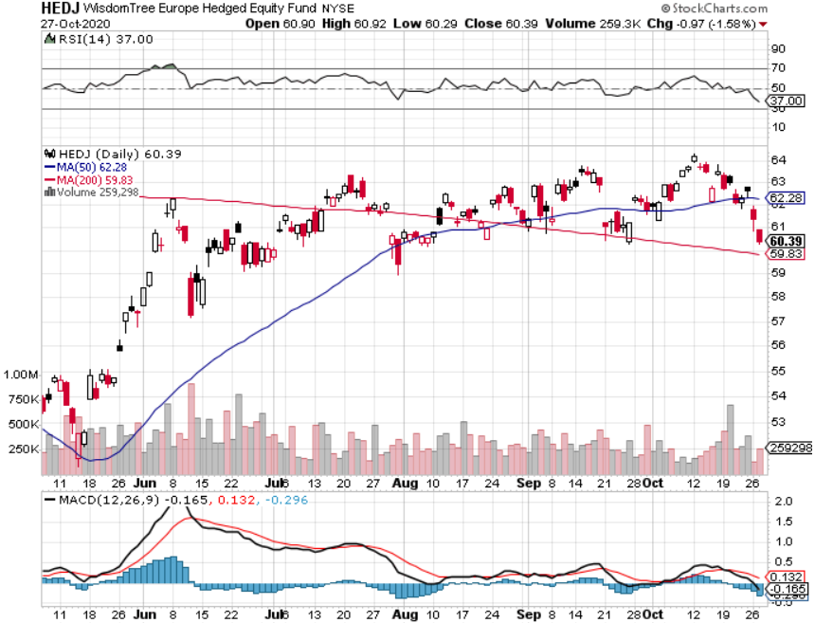
Europe Hedged Equity (HEDJ)-

Slide 54
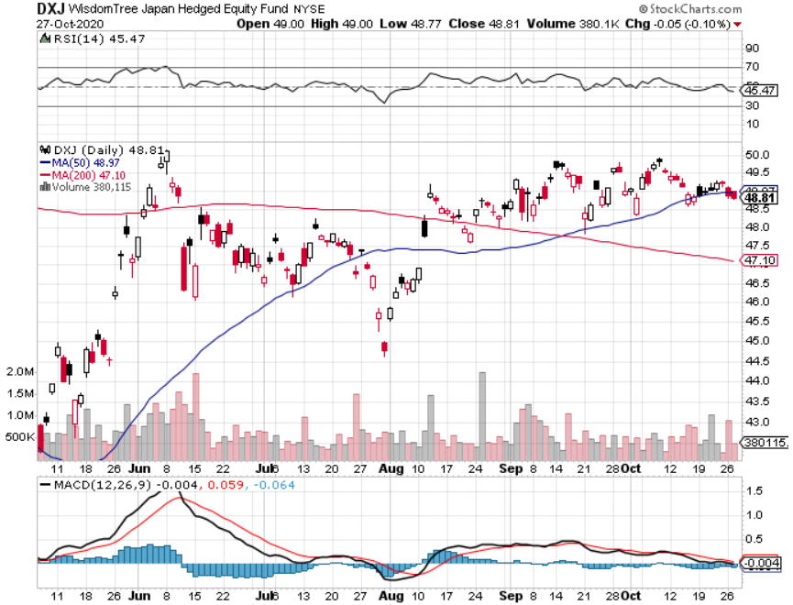
Japan (DXJ)-

Slide 55
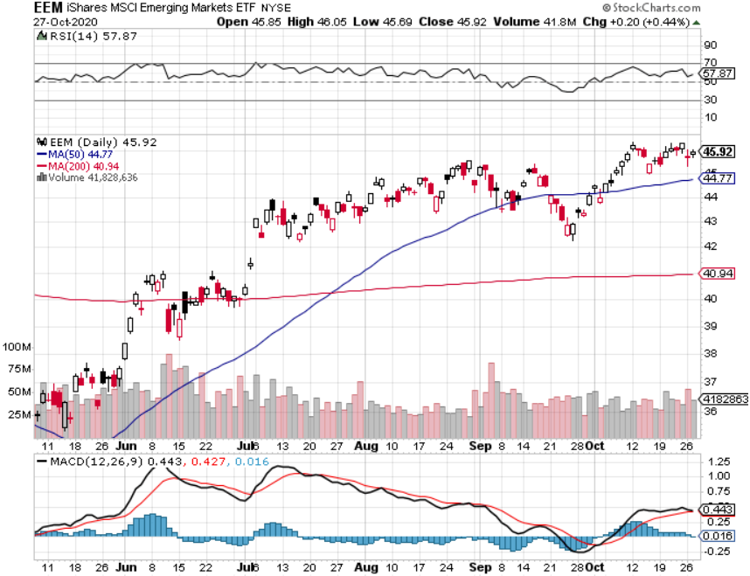
Emerging Markets (EEM)- Weak Dollar Play

Slide 56
Bonds – From Breakdown Downtrend
*Crashing Bond Prices Show that a Recovery is Imminent, with ten-year US Treasury yields jumping 20 basis points in a month to a four-month high. *Record strong economic data is pushing up interest rates and crushing prices *Bonds break from a sideways range to a new downtrend *Inflation is failing to show *Blue wave could accelerate Fed interest rate RISES *Another short selling opportunity of the century is in play, once corona cases peak out again *US Treasury bond fund (TLT) could plunge from $180 to $105, taking interest rates from 0.31% to 3.25% *Bottom line: sell short every major rally in the (TLT)

Slide 57
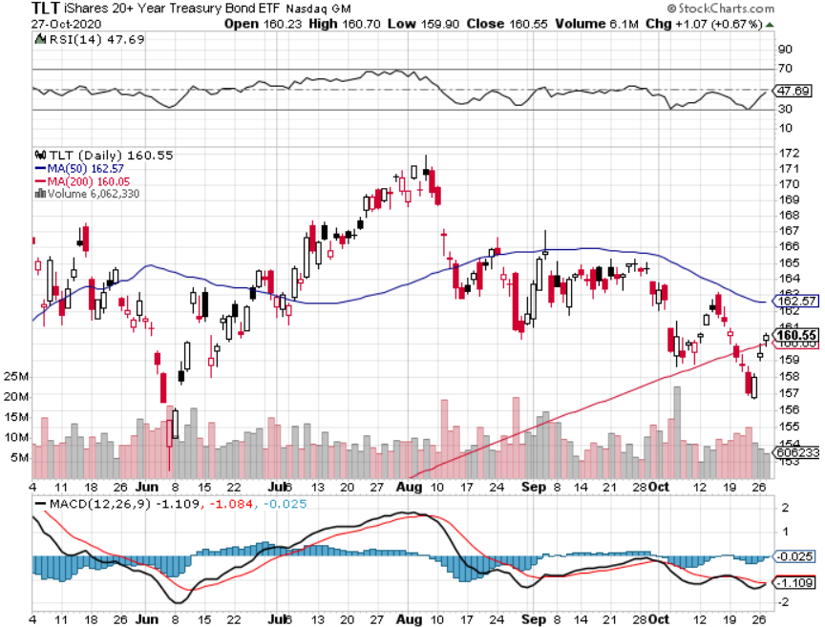
Treasury ETF (TLT) – Huge Short Play took profits on long 9/$170-$172.50 bear put spread took profits on long 9/$172.50-$175 put spread took profits on long 9/$172.50-$175 put spread

Slide 58
Ten Year Treasury Yield ($TNX) – 0.85%

Slide 59
Junk Bonds (HYG) 4.64% Yield to Maturity big jump in spreads on stock selloff and recession fears

Slide 60
2X Short Treasuries (TBT)- 2 Month Bottoming Process

Slide 61
Emerging Market Debt (ELD) 4.31% Yield-

Slide 62
Municipal Bonds (MUB) – 1.08% Mix of AAA, AA, and A rated bonds

Slide 63
Foreign Currencies – Dollar Dive
*Foreign exchange markets are ignoring rising US rates and keep dollar low *Most foreign exchange plays are poised to break to new highs *Any dollar rallies are temporary and short-term, and a crash is imminent *Euro rallies back to top of range *Aussie dollar maintaining highs *Bitcoin flight to safety bid *Keep selling short all US dollar rallies, its yield support is gone forever

Slide 64
Japanese Yen (FXY), (YCS)

Slide 65
Euro ($XEU), (FXE), (EUO)-

Slide 66
British Pound (FXB)-

Slide 67
Australian Dollar (FXA)- The Global Recovery Play took profits on long 8/$67-$69 call spread

Slide 68
Emerging Market Currencies (CEW)

Slide 69
Chinese Yuan- (CYB)-

Slide 70
Bitcoin- Rallying on Flight to Safety

Slide 71
Energy – Biden Bomb
*Biden campaigns on on carbon free economy *This does not include coal, oil, or natural gas….or fracking *Saudi production increase will cap any oil rally….forever *Much of lost demand is permanent as US economy restructures to a less transportation-oriented economy. *Avoid all energy plays like the plague, could drop by half in the coming recession

Slide 72
Oil-($WTIC)

Slide 73
United States Oil Fund (USO) long 10/$9.50-$10 Vertical bull call spread

Slide 74
Energy Select Sector SPDR (XLE)-No Performance! (XOM), (CVX), (SLB), (KMI), (EOG), (COP)

Slide 75
Halliburton (HAL)-

Slide 76
Natural Gas (UNG) -

Slide 77
Precious Metals – Holding Lows
*Gold sells off on wholesale QE asset dumping *It’s all about short-term profit taking, the long-term bull trend still lives *New QE Infinity will continue for years *Near zero interest rates and Collapsing US dollar is another gold incentive *Copper finally sees new multiyear highs on recovering Chinese economy *Bottom Line: buy this dip in gold and precious metals

Slide 78
Gold (GLD)- Short Term downtrend took profits on long 9/$171-$174 call spread took profits on long 8/$169-$172 call spread took profits on long 7/$157-$160 call spread

Slide 79
Market Vectors Gold Miners ETF- (GDX) –

Slide 80
Barrick Gold (GOLD)

Slide 81
Newmont Mining- (NEM)-

Slide 82
Silver- (SLV)-

Slide 83
Silver Miners - (SIL)-

Slide 84
Wheaton Precious Metals - (WPM)-

Slide 85
Copper (COPX)-Finally a break

Slide 86
Freeport McMoRan (FCX)-World’s Largest Copper Producer took profits on long 4/$10-$11 call spread took profits on short 4/$114 calls

Slide 87
Real Estate – Peak numbers
*Existing Home Sales Soar by 9.4% in September, up a staggering 20% YOY *Inventories fall to a record low 2.7 months * Median prices are up an astounding 14.8% YOY to $311,800. *Zillow believes this madness will continue for at least another year. *Sales were strongest in the Northeast, with most of the action is single family homes. *Homes over $1 million have doubled, and vacation homes are up 35% *US Housing Permits Blow the Roof Off at 1.55 million, up a staggering 22% YOY and a 13-year high. *Housing prices were ready to explode to the upside with S&P Case Shiller Rose 5.8% in July

Slide 88
July Corelogic S&P Case Shiller Home Price Index Phoenix (9.9%), Seattle (8.5%), San Diego (7.6%) showing biggest gains
Tradingeconomics.com

Slide 89
Simon Property Group (SPG)- Mall REIT Up to 60% of Mall Tenants Aren’t Paying Rent

Slide 90
Crown Castle International (CCI) – 3.40% yielding cell phone Tower REIT

Slide 91
US Home Construction Index (ITB) (DHI), (LEN), (PHM), (TOL), (NVR)

Slide 92
Trade Sheet- So What Do We Do About All This?
*Stocks – buy dips into the election and Covid spikes *Bonds – sell rallies aggressively *Commodities-stand aside *Currencies- sell US dollar rallies *Precious Metals – buy dips *Energy – stand aside *Volatility - sell short over $40 *Real estate – buy dips

Slide 93
Next Strategy Webinar 12:00 EST Wednesday, November 11, from Lake Tahoe, NV Veteran’s Day email me questions at support@madhedgefundtrader.com
Good Luck and Good Trading!
Notes:
*

