Slide 1
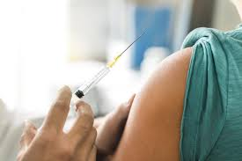
The Mad Hedge Fund Trader “The Vaccine Put”
With John Thomas from Silicon Valley, CA, November 25, 2020 www.madhedgefundtrader.com
Notes:
*

Slide 2
Mad Hedge Trader & Investors Summit December 1-3
*A collection of the 24 best traders and managers in the world, or 8 a day *Back-to-back One-hour presentations followed by an interactive Q&A *Covering all stocks, bonds, commodities, foreign exchange, precious metals, and real estate *It’s the best look at 2021 money making opportunities you will get anywhere *An invitation wills be sent to you shortly and it is FREE to attend

Slide 3
Trade Alert Performance New All Time High!
*January 3.13% Final *July +7.93% Final *February -6.05% Final *August -2.08% Final *March -5.50% Final *September 7.95% Final *April +4.55% Final *October +1.51% Final *May +14.19% Final *November +20.50% MTD *June +10.38% Final *December +4.97% Final *Year to date +56.53% compared to +5.4% for the Dow Average *+412.44% since inception, a new all time high *Average annualized return of 37.24% for 11 years, new all time high

Slide 4
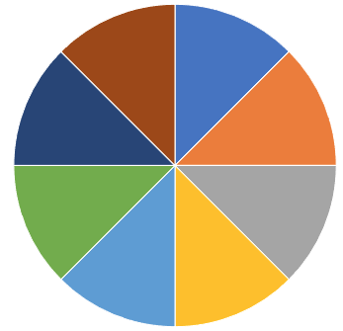
Portfolio Review 80% Cash in Melting Market
Current Capital at Risk
Risk On
World is Getting Better
(TLT) 12/$164-$167 put spread | 10.00%
(JPM) 12/$100-$105 call spread | 10.00%
(TSLA) 12/$380-$410 call spread | 10.00%
(TSLA) 12/$392-$420 call spread | 10.00%
(TSLA) 12/$400-$430 call spread | 10.00%
(TSLS) 12/$380-$410 calls spread | 10.00%
(CAT) 12/$145-$150 call spread | 10.00%
(BABA) 12/$220-$240 call spread | 10.00%
Risk Off
World is Getting Worse
Total Net Position | 80.00%
Total Aggregate Position | 80.00%
Expiration P&L +61.90 YTD

Slide 5
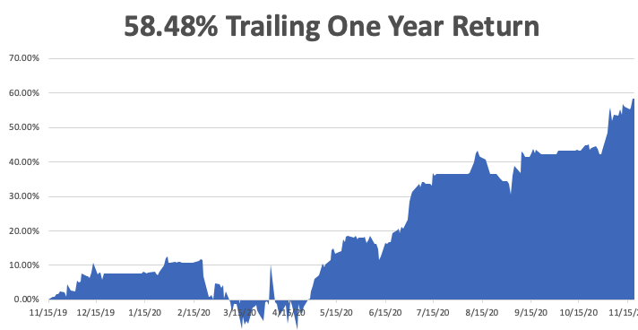

Slide 6
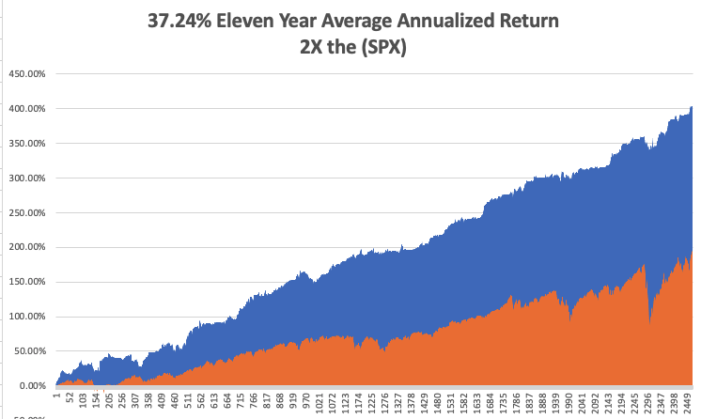
GTD 11 Year Daily Audited Performance

Slide 7
The Method to My Madness The Roaring Twenties are Here
*Market has flipped from the election to Covid-19 as the main concern, and Pfizer has brought us a game changer-Stocks could gain another 10% by yearend after a 5% correction *It’s now all about a global economic recovery and “RISK ON”, but we are now waiting for the next dip which Covid-19 will give us *2020 was only a short-term dip in a 20-year bull market that may have another decade to run *VIX collapse from $41 to $20 has cut the potential profit call spreads by more than half *A bond shorts are back on the table after a $7 rally *Perennial dollar weakness will give us opportunities to buy foreign currencies, commodities, and emerging markets

Slide 8
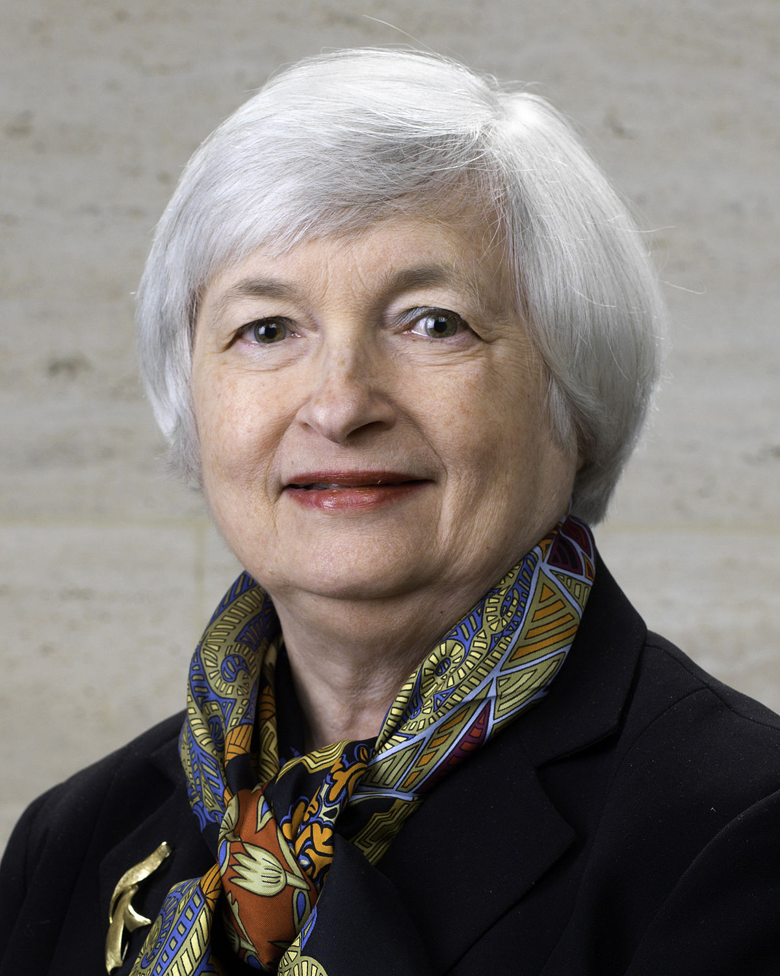
My Friend Janet Yellen
*My former UC Berkeley economics professor has been appointed Secretary of the Treasury by the Biden administration *As a former Fed governor and academic she is the most qualified Treasury Secretary ever appointed *While Fed governor, Janet implemented five years of near record easing, thanks to the absence of inflation. Dow up 500 on the news *As president of the San Francisco Fed she gained insights into the effect of technology on the financial system *As a former student John Thomas will be an informal advisor to Secretary Yellen, as are he other favorite students

Slide 9
Corona Update – The Priority List
*Pfizer, Moderna, and AstraZeneca vaccines puts end to the pandemic in sight and there are vaccines from three other companies to come *US cases top 12 million, deaths at 270,000,000 and are still rising at 2,000 a day, and could reach 300,000 by yearend *US capacity to vaccinate now at 20 million a month, and these people go first: 4 million military 20 million health care workers 53 million over 65 60-80 million essential front line workers 100 million preexisting conditions *If you're not in one of these groups you can forget about a vaccination in 2021, unless production is vastly speeded up *Russia and China are already vaccinating large numbers now?

Slide 10
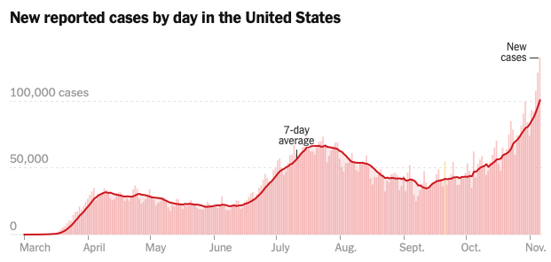
Targeting 300,000 cases a day by end 2020

Slide 11
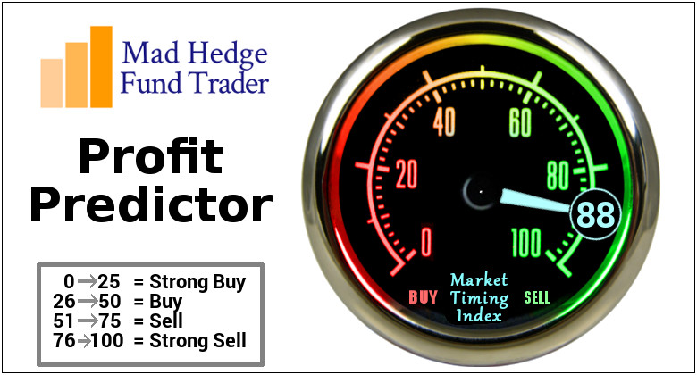
The Mad Hedge Profit Predictor Market Timing Index-Bottom of Range-at to a “BUY” An artificial intelligence driven algorithm that analyzes 30 different economic, technical, and momentum driven indicators

Slide 12
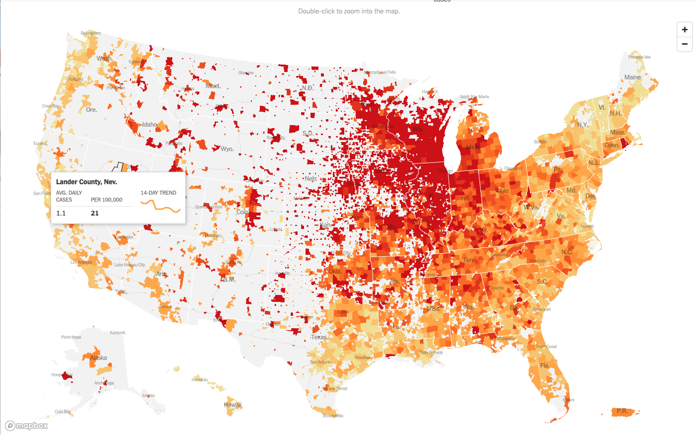

Slide 13
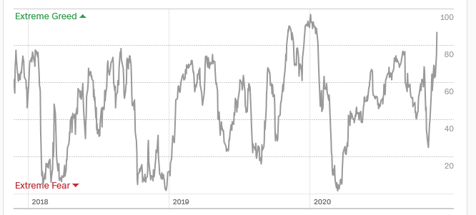
The Mad Hedge Profit Predictor Entering “SELL” Territory
SELL
BUY

Slide 14
The Global Economy – Turning Mixed
*GDP is looking at a dip in Q1, but will bring in a robust 5%-6% for full year 2021, making it the best growth year in 35 years *Weekly Jobless Claims increase by 31,000 to 741,000, continuing claims are at 12 million, long term unemployment is soaring *50% of Business Travel Will Never Recover, says Bill Gates. The cost savings for companies are just too great *US Manufacturing Output Rose in October, up 1.0%, taking us to a suddenly mixed picture about the economy. *US Consumer Confidence Cratered in November, from 81.8 to 77, thanks to exploding Corona cases *American Consumers are Loaded with Cash, after enduring a spending diet that is approaching a year, some $2 trillion which will mostly go into stocks. It’s like a second QE

Slide 15
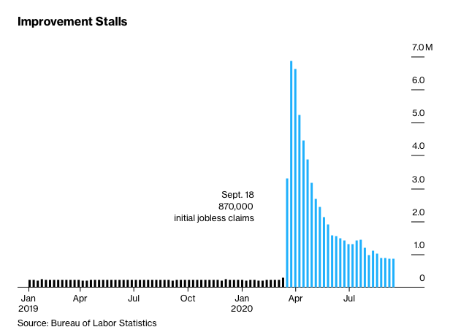
Weekly Jobless Claims – Flatlining at record highs +778,000

Slide 16
The Bill Davis View A $1,500 Upgrade for the Mad Day Trader Service
Buys: | Entry | Target
Skyworks Solutions Inc.(SWKS) | $ 140.00 | $ 160.00
VeriSign, Inc.(VRSN) | $ 203.00 | $ 220.00
Guidewire Software, Inc.(GWRE) | $ 110.00 | $ 125.00
Western Digital Corp (WDC) | $ 40.00 | $ 50.00
Western Union Co (WU) | $ 22.00 | $ 30.00
Sells:
Biohaven Pharmeceuticals (BHVN) | $ 95.00 | $ 70.00
New Oriental Education (EDU) | $ 176.00 | $ 155.00
Arista Networks (ANET) | $ 270.00 | $ 230.00
Penumbra, Inc. (PEN) | $ 255.00 | $ 220.00
Ferrari NV (RACE) | $ 210.00 | $ 185.00

Slide 17
Stocks – Uncertainty: Gone!
*The election delivered the best possible result for the stock market, with gridlocked government *Stocks are looking straight through the pandemic to the other side of the recovery *After some much needed back and fill, stocks could add another 10% by end 2020 after a 5% correction. Individuals have saved $2 trillion in 2020, most of which is going into stocks Tax Loss Selling has been written off. Republican control of the Senate makes a substantial tax increase impossible, so no there is reason to sell *Reopening stocks soared, while stay at home ones crashed. Economic recovery stocks have only just begun a prolonged multi-year bull move *Pfizer vaccine means that ‘high touch’ stocks like movie theaters, gyms, cruise lines, concert organizers will be back in business by summer *Use every dip to BUY, it’s a 100% “RISK ON” market *In 2021 both tech and recovery stocks run, meaning everything goes up *We could be entering a wide $2,700 - $3,600 range until the election

Slide 18
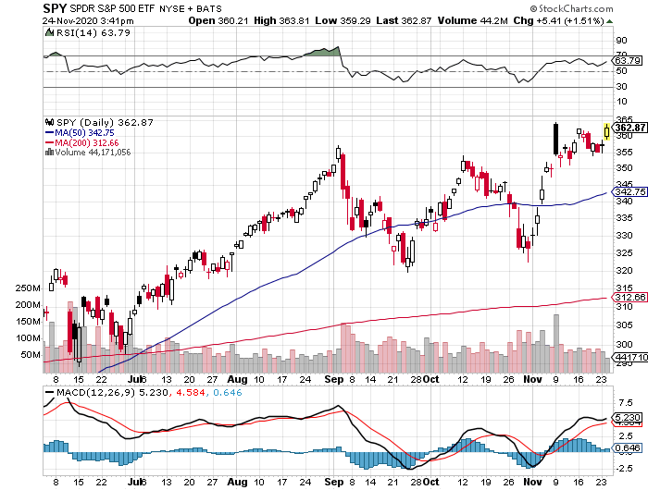
S&P 500 – Everything Worked! stopped out of long 7/$320-$330 bear put spread took profits on long 6/$235-$245 bull call spread
New Highs
You are here now
The Bottom Held 320

Slide 19
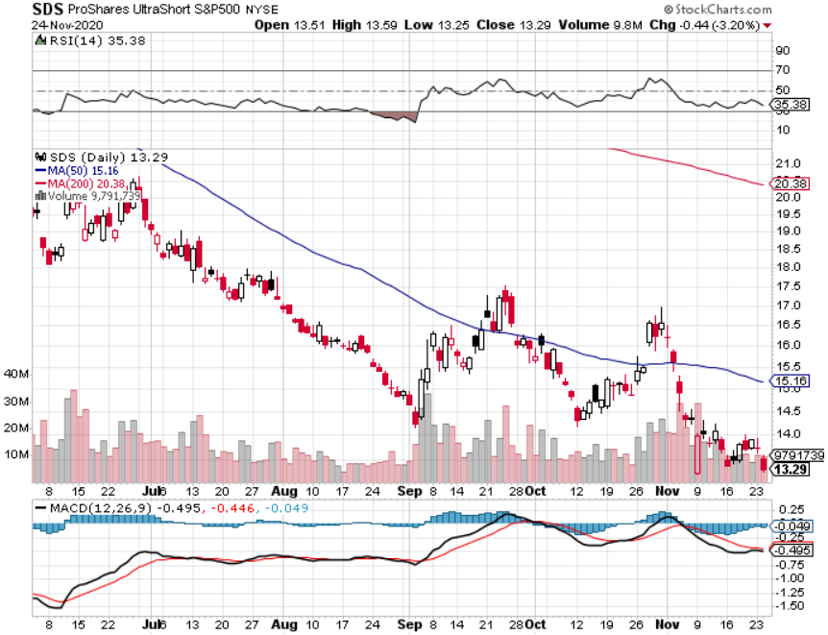
ProShares Ultra Short S&P 500 (SDS)- a Great Hedge for long stocks and bonds Long 2X position has a hedge against longs and bond shorts

Slide 20
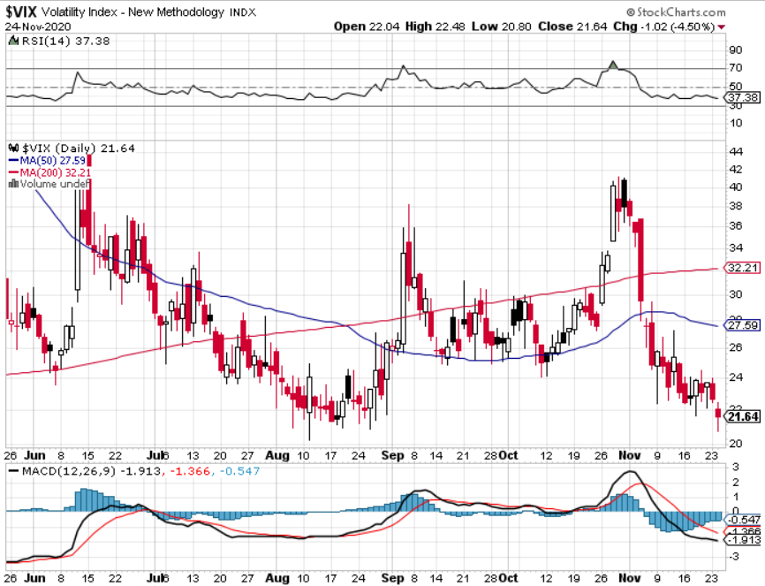
(VIX)-Crash!

Slide 21
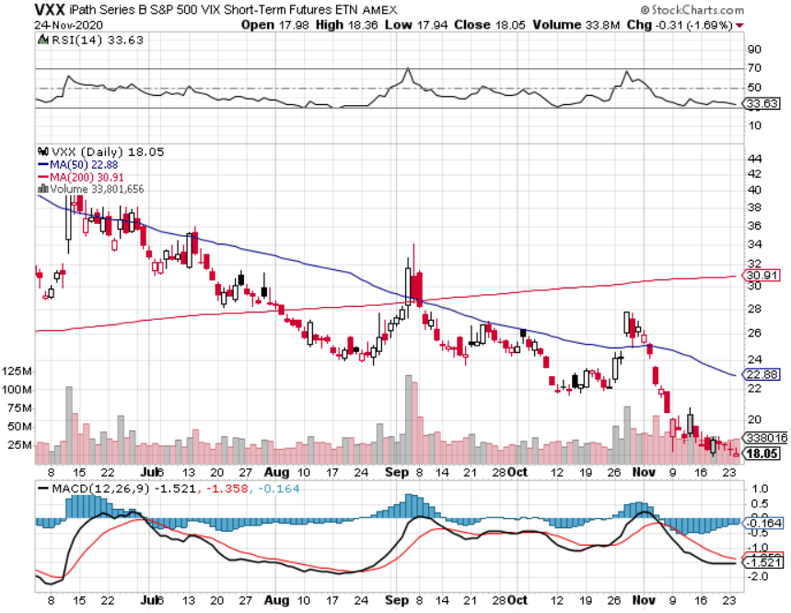
(VXX)- Sell Rallies-Down $85 to $26 from top stopped out of long 1/2021 $16 puts stopped out of long 1/2021 $24 puts

Slide 22
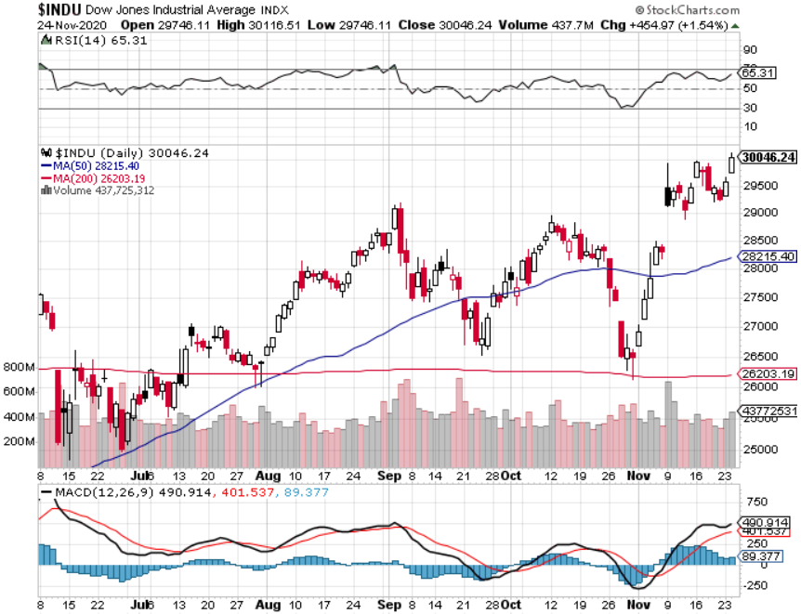
Dow Average ($INDU)-

Slide 23
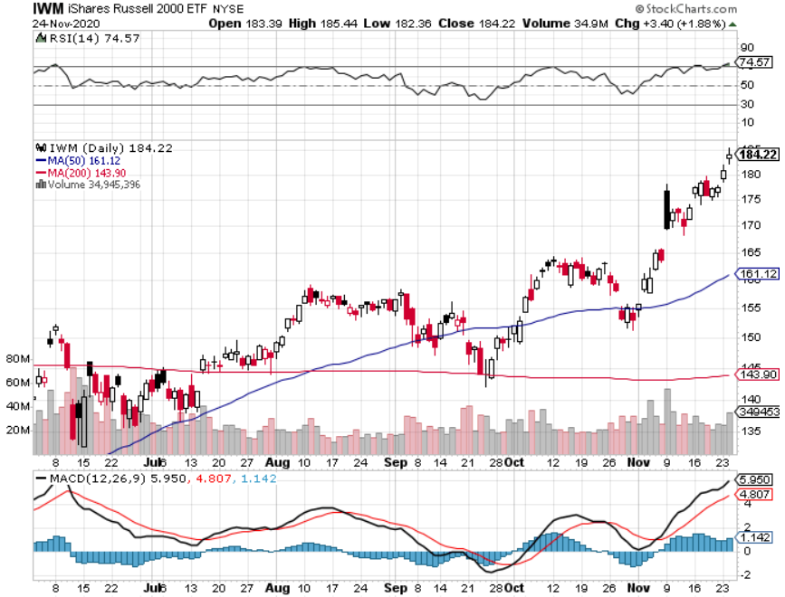
Russell 2000 (IWM)- took profits on Long 10/$137-$142 vertical bull call spread took profits on Long 10/$153-$156 vertical bear put spread

Slide 24
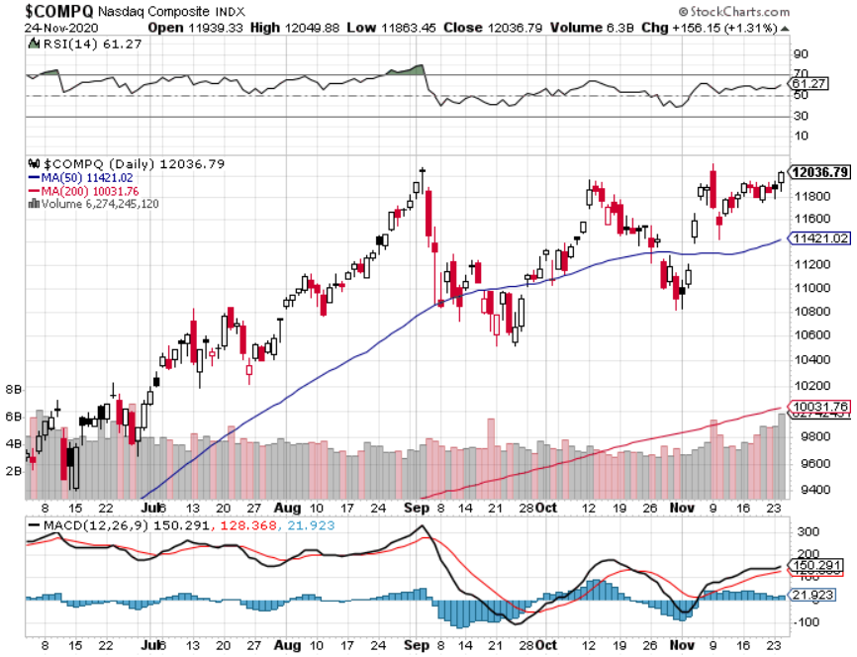
NASDAQ ($COMPQ) –

Slide 25
The Barbell Portfolio
*50% Big Tech 50% Domestic Recovery, including: Railroads Couriers Banks Construction Credit Cards

Slide 26
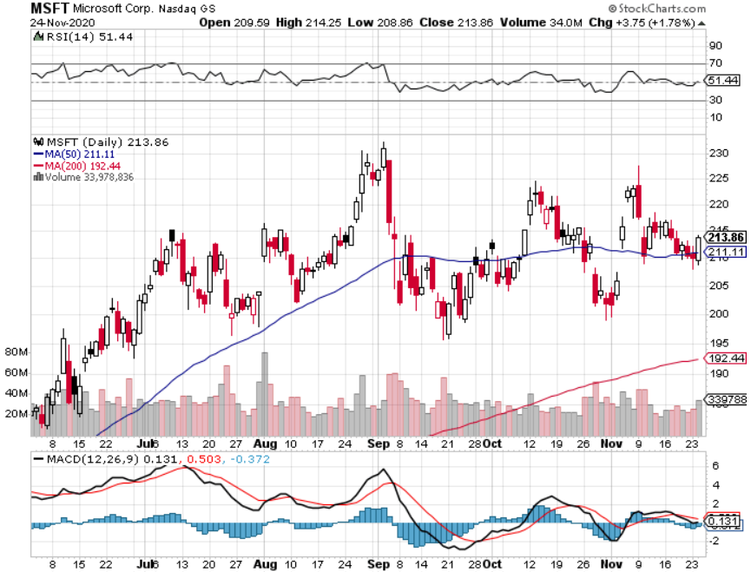
Microsoft (MSFT)- Earnings beat- Looking for Another Entry Point Stopped out of long 4/$120-$130 call spread took profit on long 4/$120-$130 call spread stop loss on long 12/$170-$180 call spread took profits on long 12/$135-$138 call spread

Slide 27
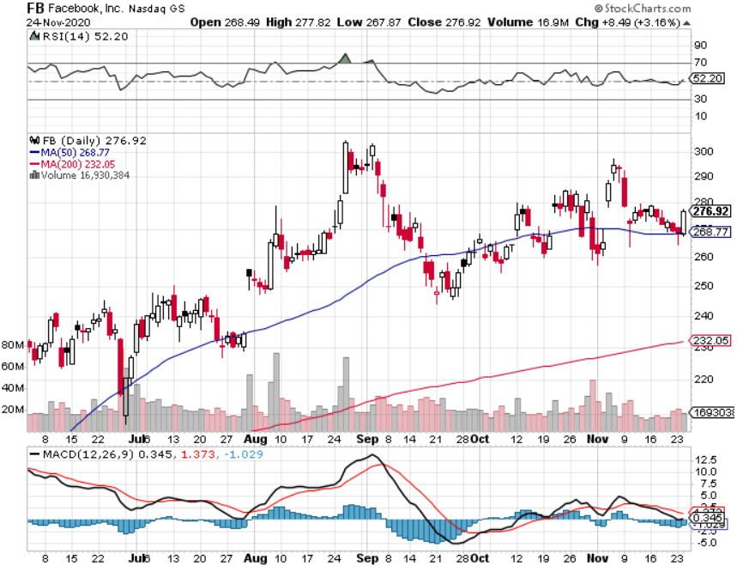
Facebook (FB)-New High took profits on Long 9/$290-$300 vertical bear put spread stopped out of Long 9/$190-$200 vertical bear put spread took profits on Long 9/$145-$155 vertical bull call spread took profits on Long 9/$150-$160 vertical bull call spread took profits on Long 8/$167.50-$172.50 vertical bull call spread

Slide 28
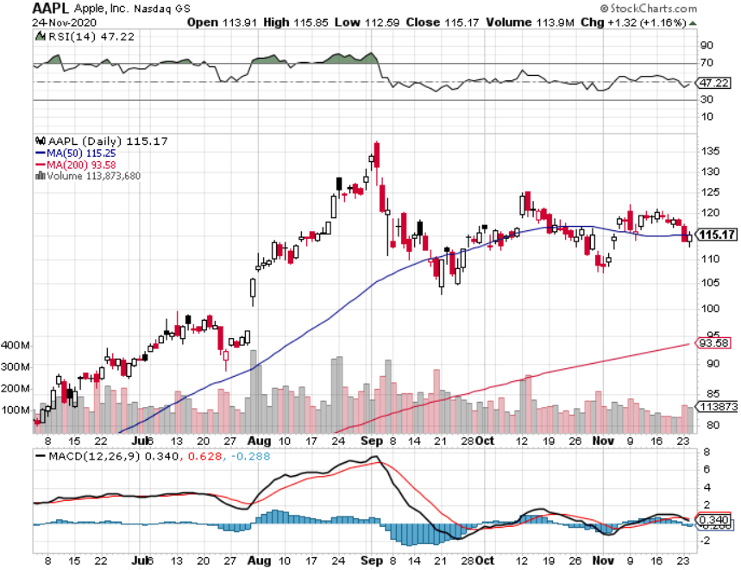
Apple (AAPL)- New 5G iPhone This Week stopped out of long 9/$100-$105 call spread stopped out of long 8/$480-$490 bear put spread took profits on long 7/$320-$330 call spread took profits on long 4/24/$250-$260 call spread took profits on long 5/$250-$260 call spread

Slide 29
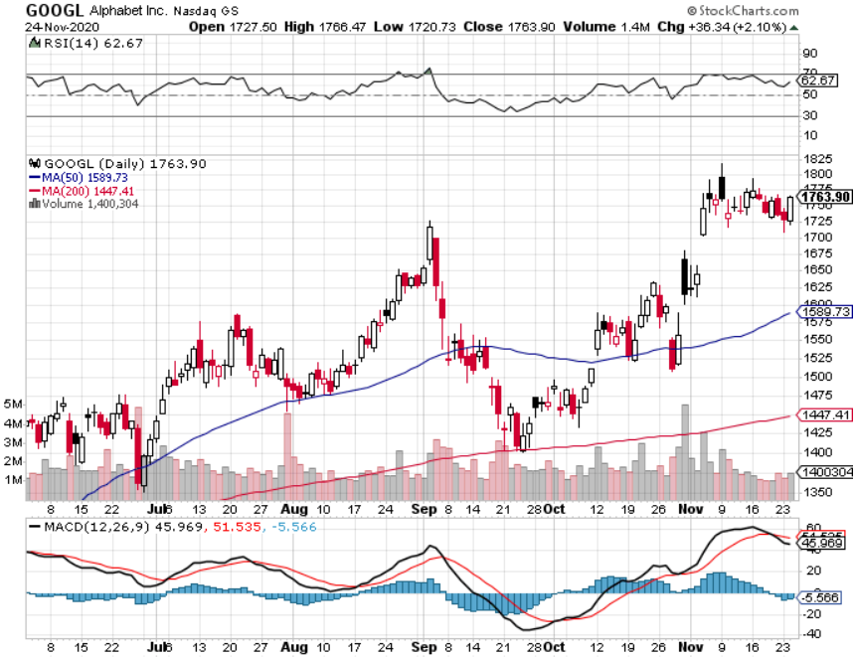
Alphabet (GOOGL) – Deutsche Bank upgrade to $2,020 took profits on long 12/$1,200-$1,230 bull call spread took profits on long 9/$1,030-$1,080 vertical bull call spread stopped out of long 5/$1,100-$1,130 bull call spread took profits on long 4/$1,080-$1,120 bull call spread

Slide 30
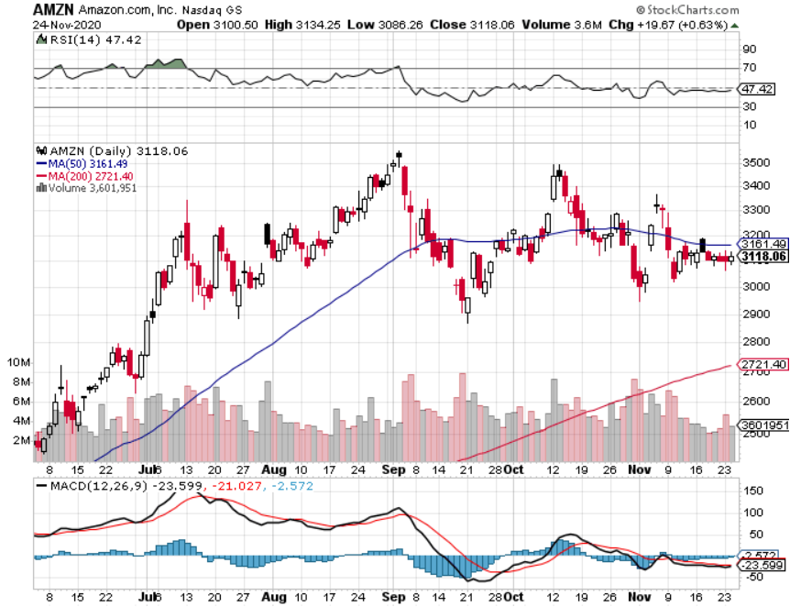
Amazon (AMZN) – Profit taking took profits on long 9/$2,800-$2,900 bull call spread stopped out of long 8/$3,000-$3,500 bear put spread took profits on long 4/$1,500-$1,550 bull call spread

Slide 31
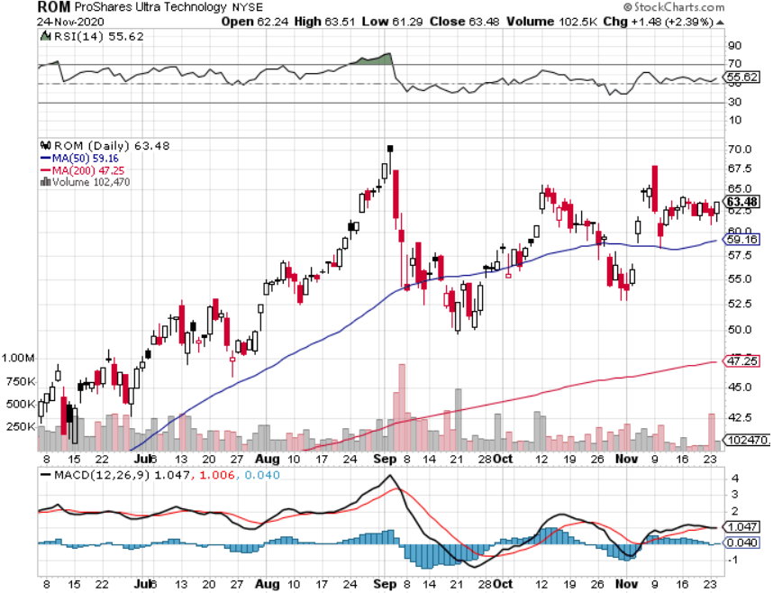
ProShares Ultra Technology (ROM) – Up 240% in 5 Months

Slide 32
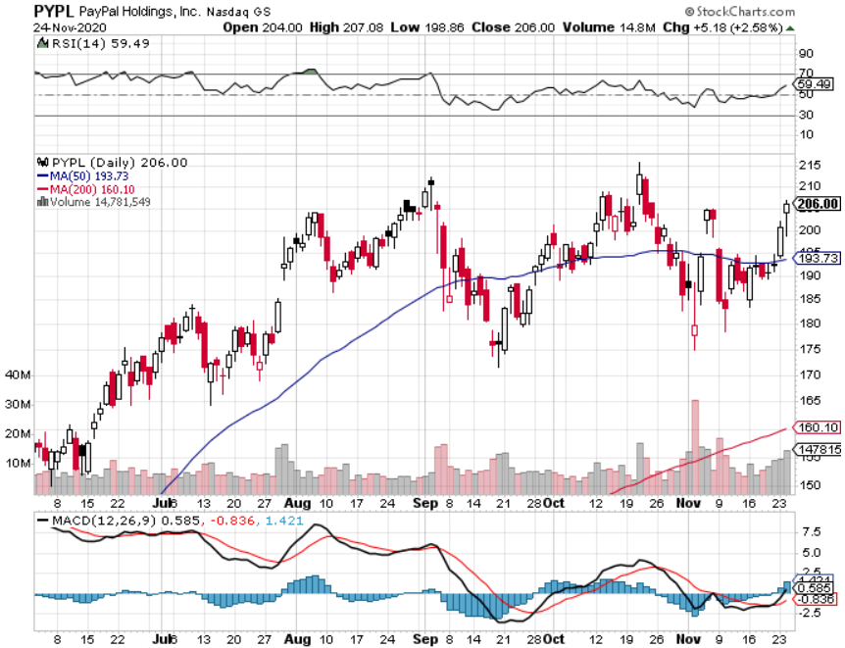
PayPal (PYPL)-Fintech Rules took profits on long 4/$90-$95 call spread

Slide 33
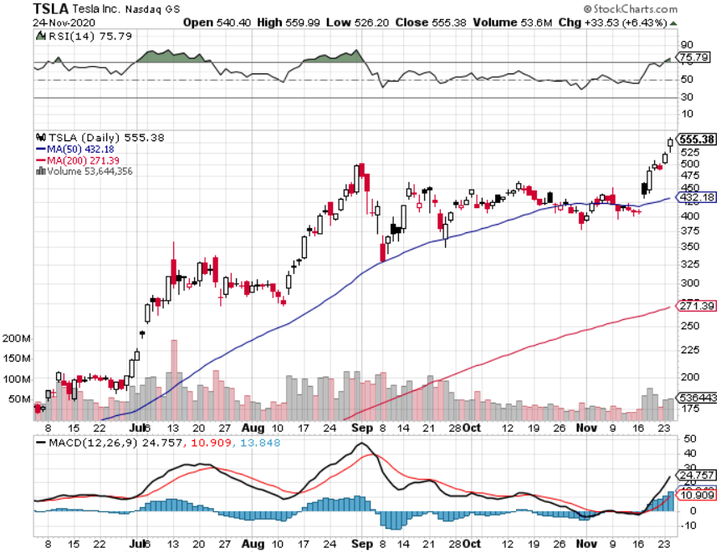
Tesla (TSLA)- Joining the S&P 500-Record 40% Long Promises a $25,000 Car in Three Years Elon Musk earned a record $100 billion in 2020, or $17 million and hour! 20-fold increase in battery output in 3 years-Morgan Stanley Raises Target to $540 long 12/$380-$410 bull call spread, long 12/$392--$420 bull call spread, long 12/$400-$430 bull call spread long 11/$300-$325 bull call spread, long 12/$350-$380 bull call spread

Slide 34
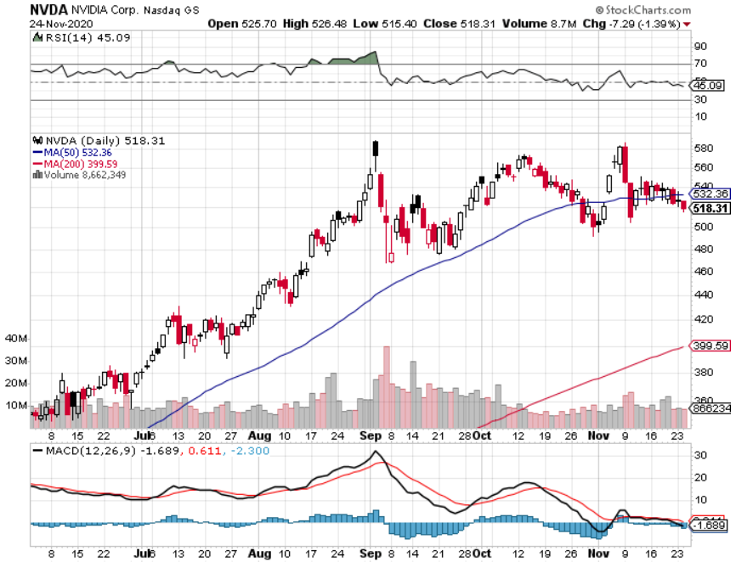
NVIDIA (NVDA) – The Biggest Chip Deal in History A Mad Hedge 10 bagger

Slide 35
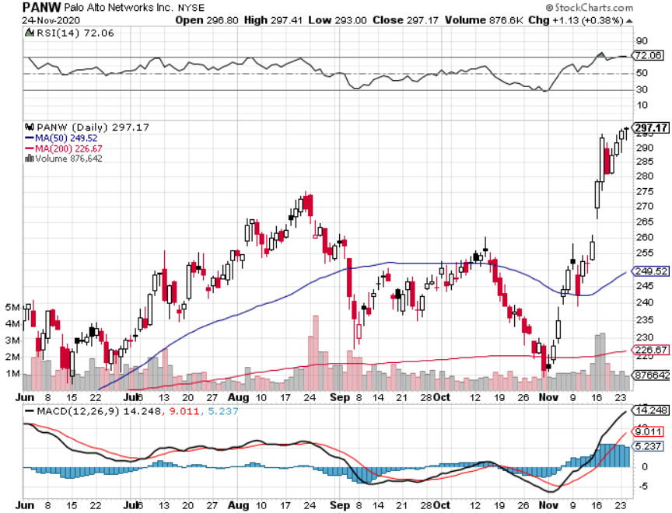
Palo Alto Networks (PANW)- New High Hacking never goes out of fashion

Slide 36
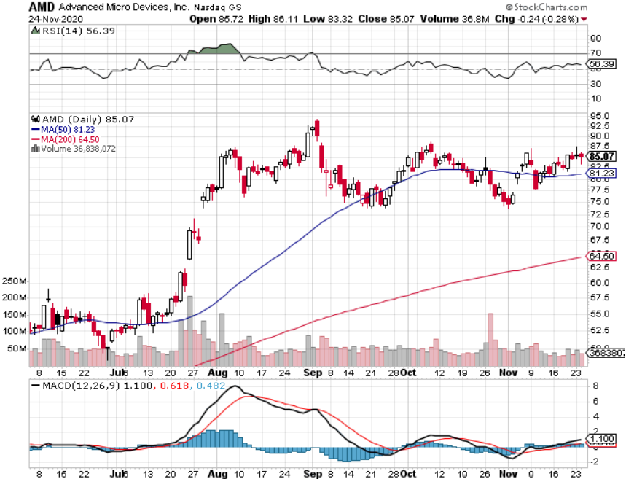
Advanced Micro Devices (AMD)- the next ten bagger-buys Xylinx

Slide 37
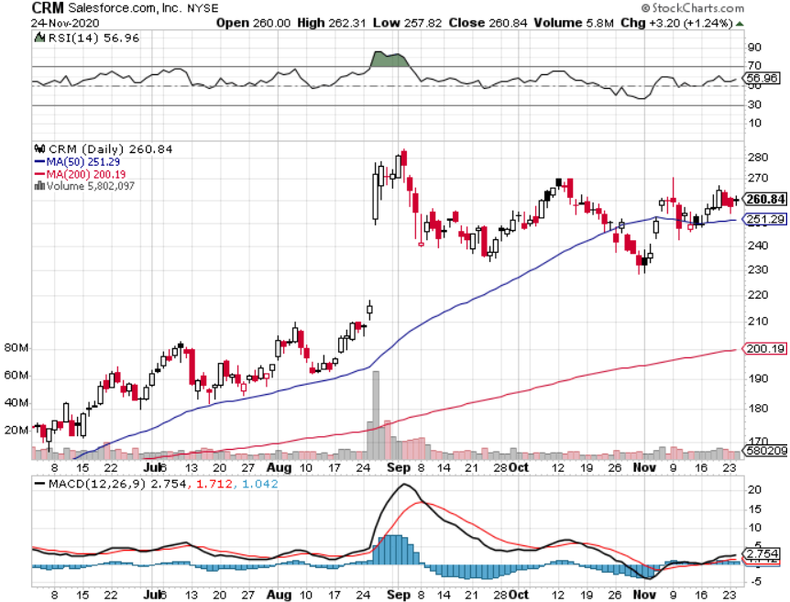
Salesforce (CRM)- Massive Online Migration took profits on long 9/$125-$130 vertical bull call spread took profits on long 8/$125-$130 vertical bull call spread took profits on long 2/$105-$115 call spread

Slide 38
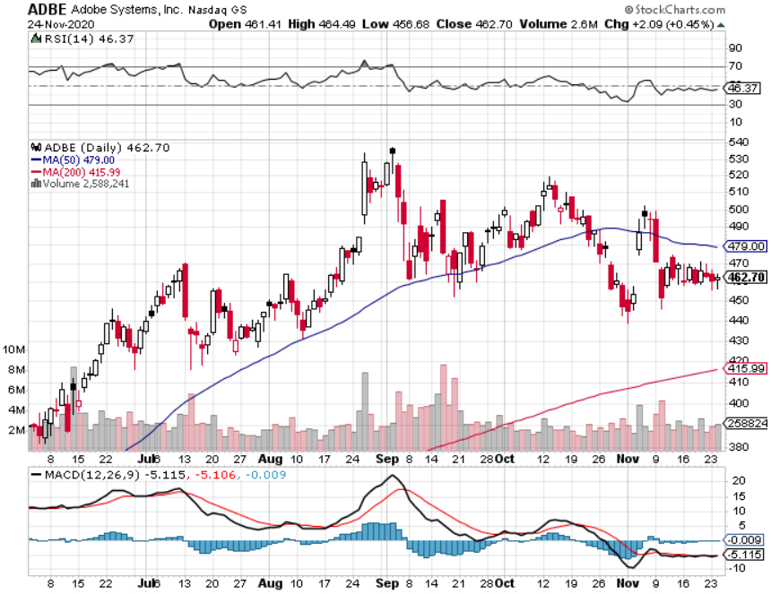
Adobe (ADBE)- Cloud play The Quality Non-China tech play

Slide 39
The Second Half of the Barbell
*Bets on a domestic recovery in 2021 *Upside potential in 2021 far greater than tech *Some of these have not moved for 5 or 10 years *Focuses on economically sensitive cyclical industries *Makes a great counterweight to high growth technology *We could spend all of next year rotating between the two groups

Slide 40
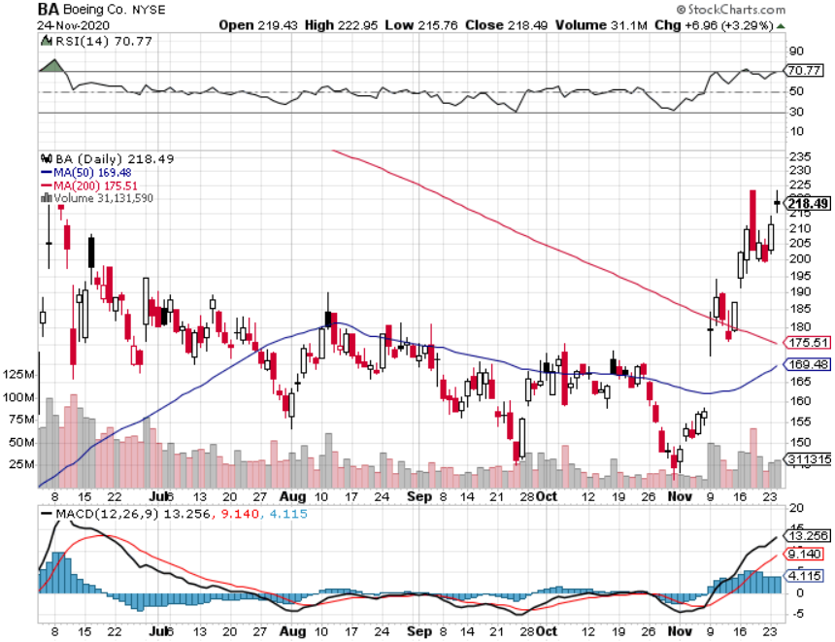
Boeing (BA) – former LEAP Candidate - The 737 MAX Flies Again! took profits on long 4/$300-$310 call spread took profits on long 4/$315-$335 call spread

Slide 41
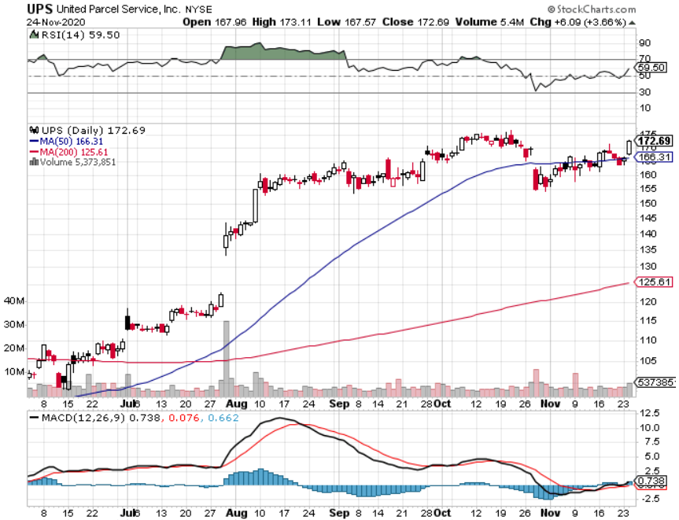
Package Delivery- United Parcel Service (UPS) massive increase in overnight deliveries took profits on long 11/$130-$140 call spread

Slide 42
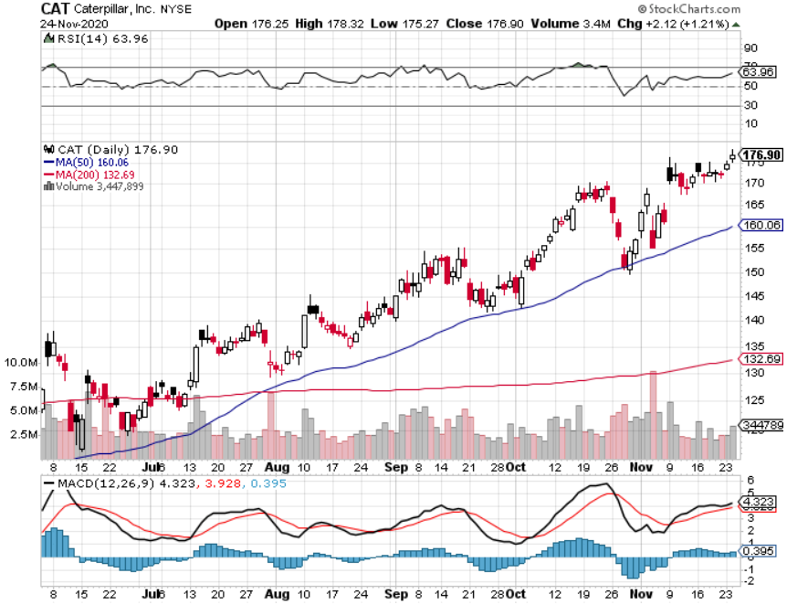
Caterpillar (CAT)- Ag + Infrastructure + Housing long 12/$145-$150 call spread took profits on long 11/$125-$135 call spread

Slide 43
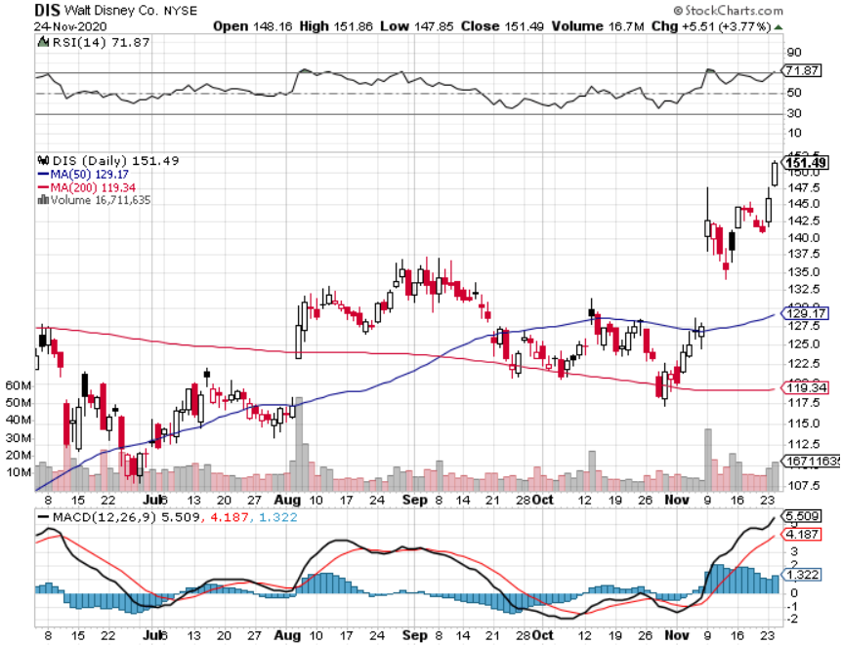
Walt Disney (DIS)- Big Recovery Move took profits on long 6/$85-$90 call spread

Slide 44
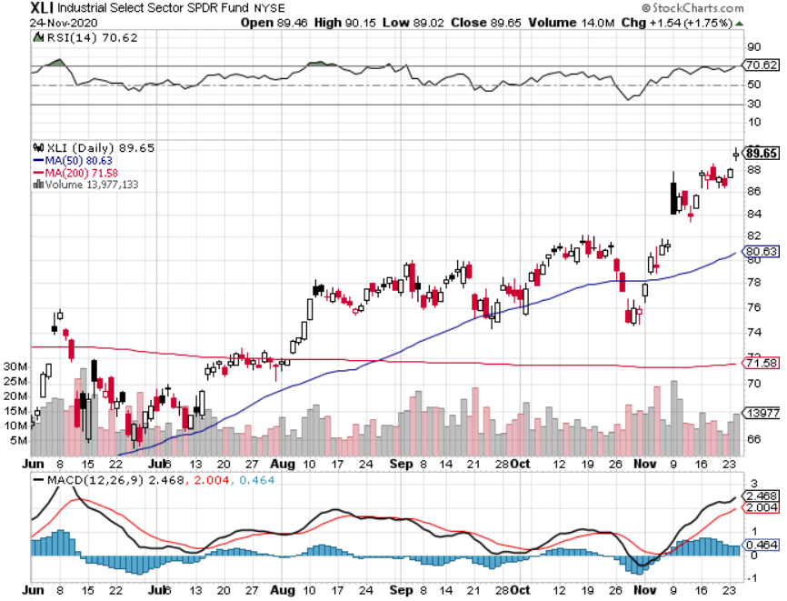
Industrials Sector SPDR (XLI)- (GE), (MMM), (UNP), (UTX), (BA), (HON)

Slide 45
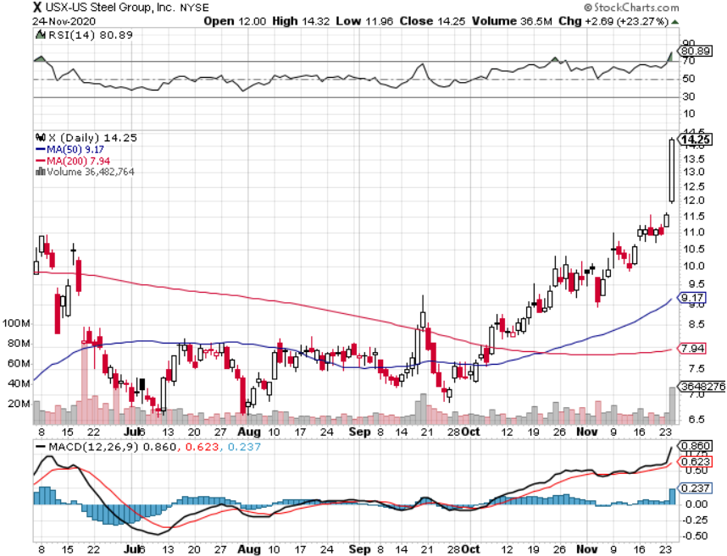
US Steel (X)-Dying Old Economy

Slide 46
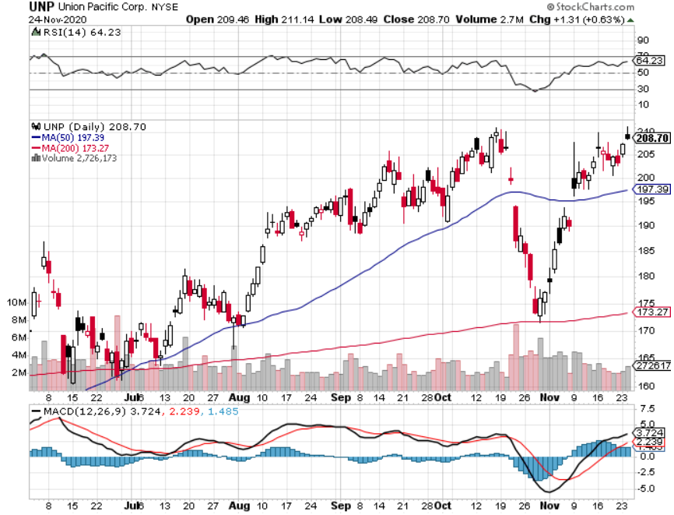
Union Pacific RR (UNP)- More stuff to ship took profits on 11/$150-$160 call spread

Slide 47
United Parcel Service (UPS)- Bouncing traffic volume took profits on Long 11/$130-$140 bull call spread

Slide 48
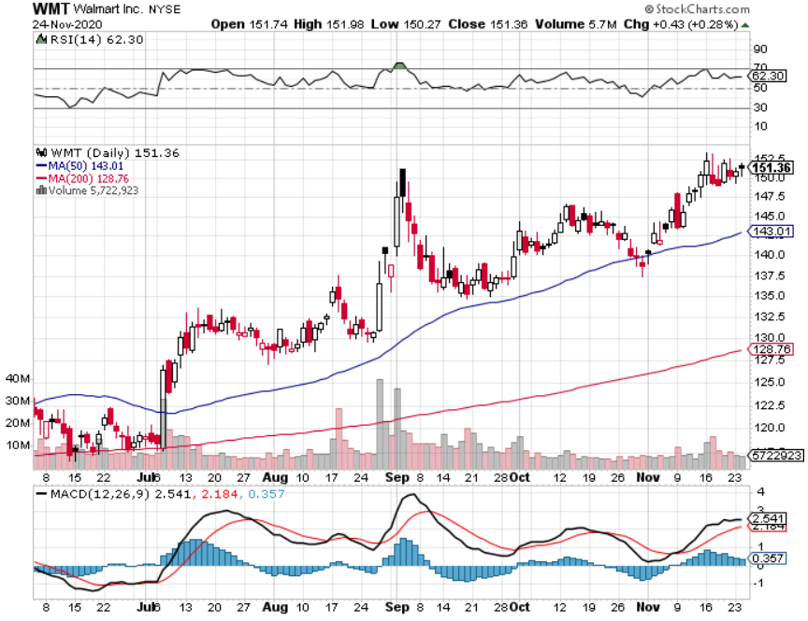
Wal-Mart (WMT)-New High took profit on Long 11/$125-$130 bear put spread took profit on Long 10/$119-$121 bear put spread took profits on Long 8/$114-$117 bear put spread

Slide 49
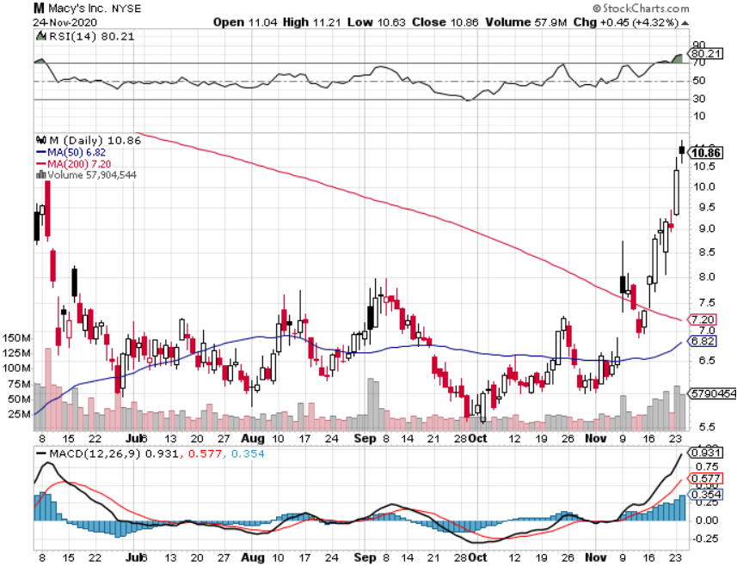
Macys’ (M) – Waiting for Chapter 11 took profits on Long 8/$23-$25 bear put spread

Slide 50
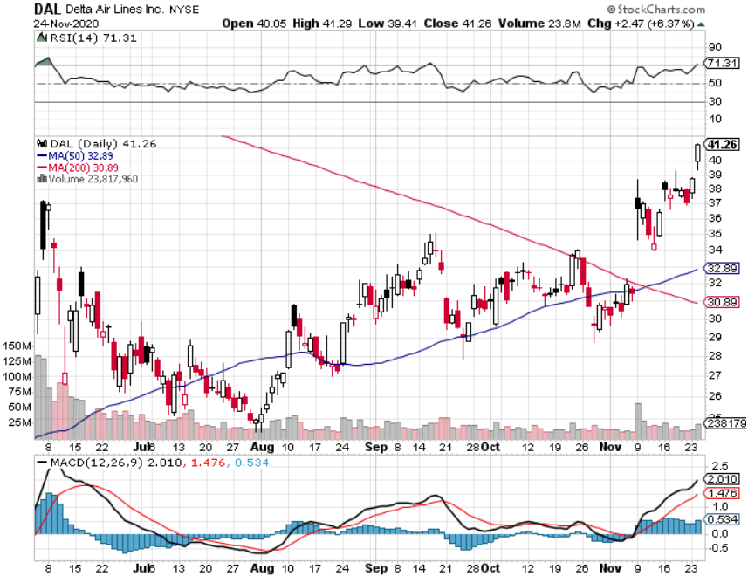
Delta Airlines (DAL) – Subsidy runs out

Slide 51
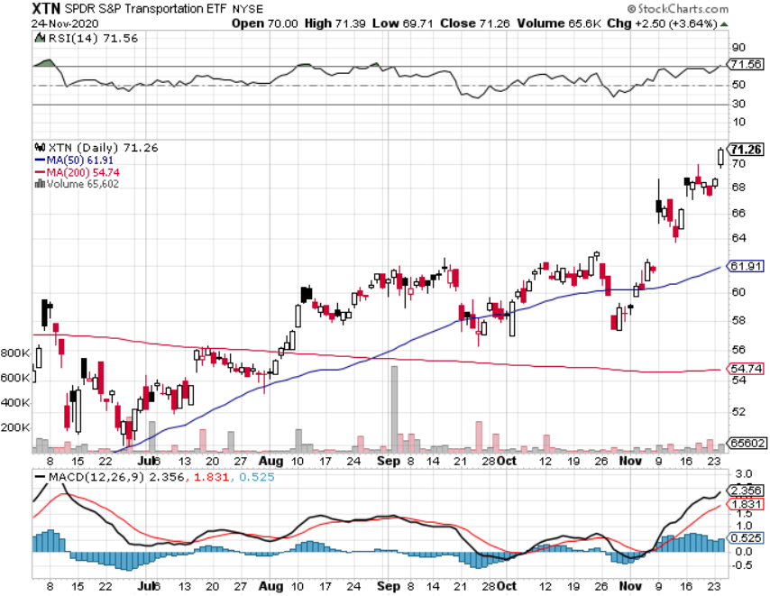
Transports Sector SPDR (XTN)- Worst Hit Sector (ALGT), (ALK), (JBLU), (LUV), (CHRW), (DAL)

Slide 52
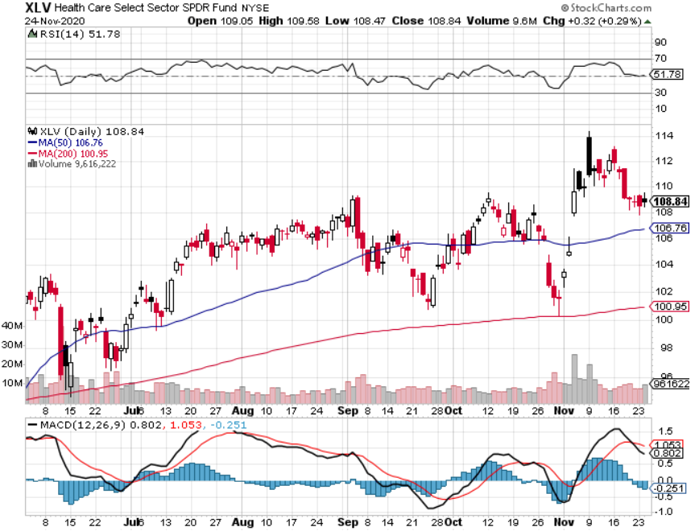
Health Care Sector (XLV), (RXL) (JNJ), (PFE), (MRK), (GILD), (ACT), (AMGN)

Slide 53
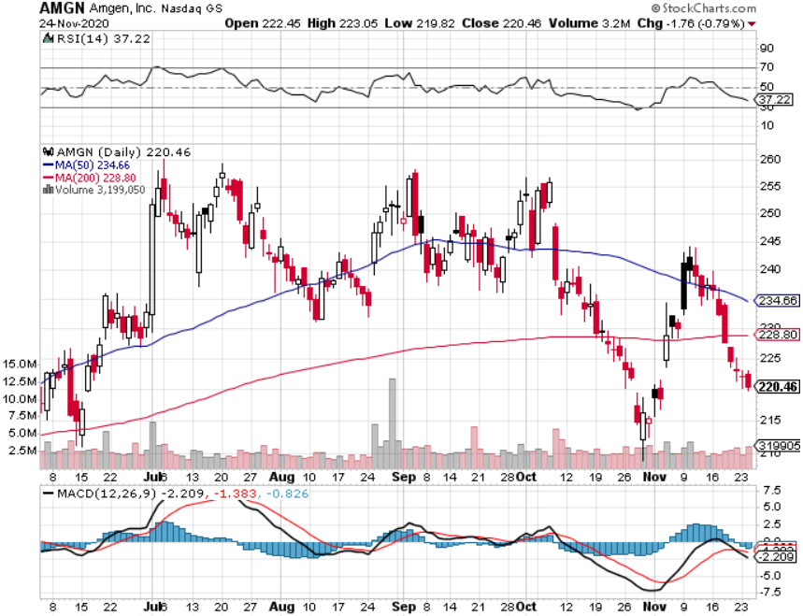
Amgen (AMGN) took profits on long 11/$185-$200 bull call spread

Slide 54
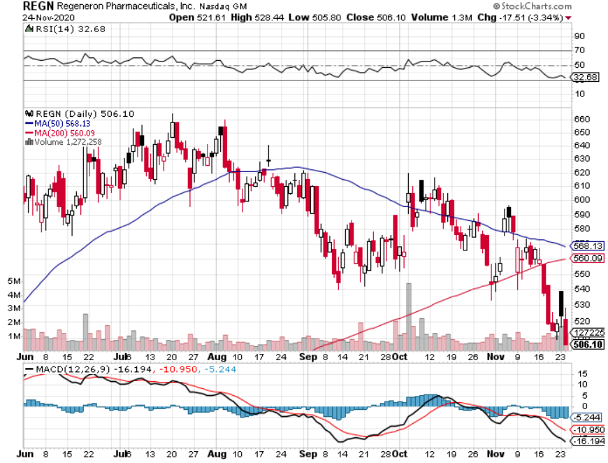
Regeneron (REGN) took profits on long 7/$570-$580 call spread

Slide 55
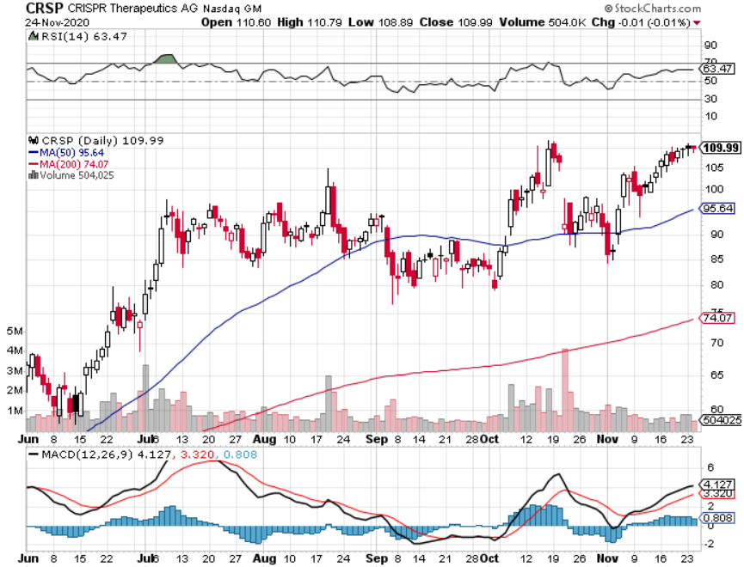
CRISPR Therapeutics (CRSP) A Mad Hedge 5 Bagger

Slide 56
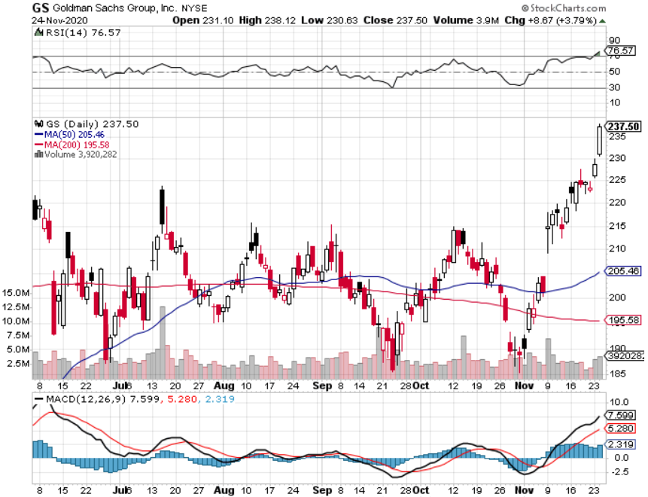
Goldman Sachs (GS) – $3 billion Settlement

Slide 57
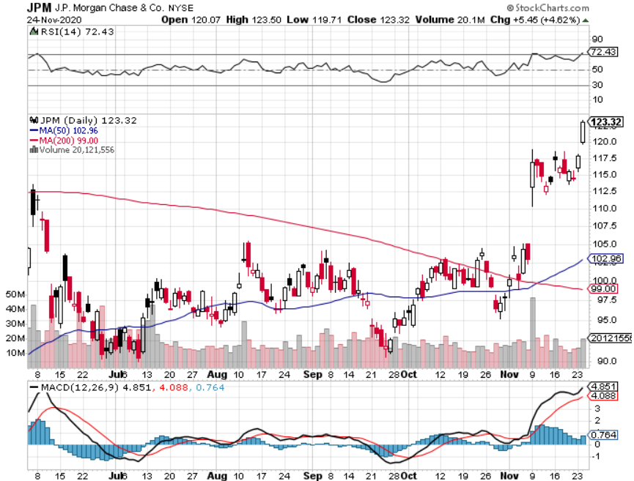
JP Morgan Chase (JPM) Recession Fears long 12/$100-$105 bull call spread took profits on long 11/$85-$90 bull call spread, took profit on long 11/$110-$115 bear put spread took profits on long 9/$90-$95 bull call spread, stopped out of long 8/$92-$95 bull call spread

Slide 58
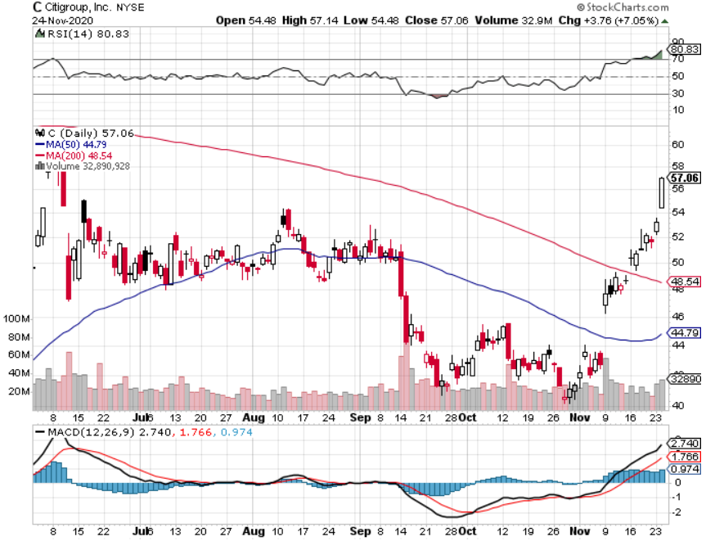
Citigroup (C) – “Recovery” Rotation Play stopped out of long 9/$45-$48 bull call spread

Slide 59
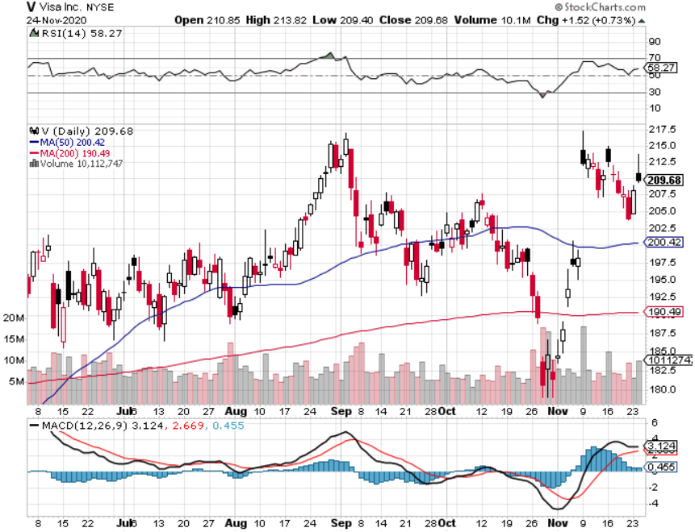
Visa (V) – “Touchless” Fintech Play stopped out of long 11/$180-$185 bull call spread took profits on long 9/$180-$185 bull call spread

Slide 60
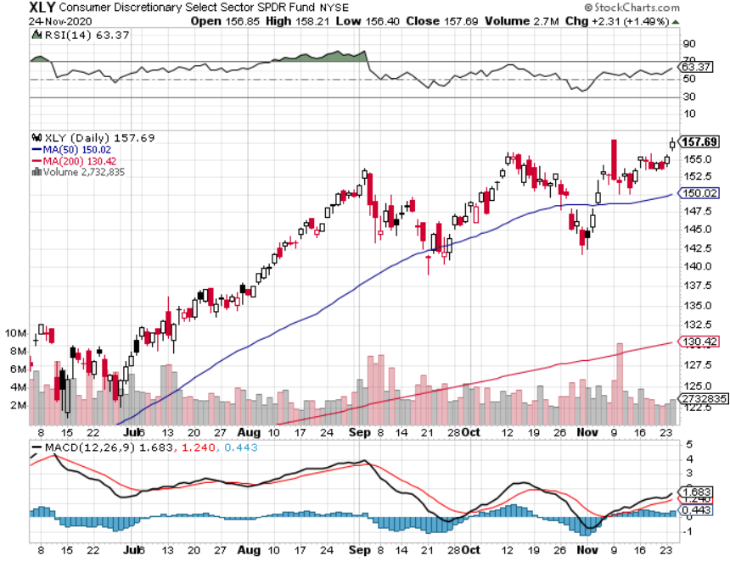
Consumer Discretionary SPDR (XLY) (DIS), (AMZN), (HD), (CMCSA), (MCD), (SBUX)

Slide 61
Europe Hedged Equity (HEDJ)-

Slide 62
Japan (DXJ)-

Slide 63
Emerging Markets (EEM)- Pro trade, Weak Dollar, long recovery Play

Slide 64
Bonds – Scorched Earth
*Treasury move to cancel all remining stimulus programs takes $459 billion of the economy, prolonging the recession, and sending bonds up $7 points *Global Debt to Hit $227 Trillion by end 2020, thanks to the pandemic. Governments accounted for half of the increase. US Debt jumped from $71 in 2019 to $80 trillion. *Ten-year US Treasury yields plunge 16 basis points in a week. *Fading economic data is giving the bond bear market a break *Bonds break from a sideways range to a new downtrend *US Treasury bond fund (TLT) could plunge from $180 to $105, taking interest rates from 0.31% to 3.25% *Bottom line: sell short every major rally in the (TLT)

Slide 65
Treasury ETF (TLT) – Huge Short Play long 12/$164-$167 put spread, profits on long 11/$162-$165 put spread profits on long 9/$170-$172.50 bear put spread, took profits on long 9/$172.50-$175 put spread, took profits on long 9/$172.50-$175 put spread

Slide 66
Ten Year Treasury Yield ($TNX) – 0.82%

Slide 67
Junk Bonds (HYG) 4.64% Yield to Maturity big jump in spreads on stock selloff and recession fears

Slide 68
2X Short Treasuries (TBT)- 2 Month Bottoming Process

Slide 69
Emerging Market Debt (ELD) 4.31% Yield-

Slide 70
Municipal Bonds (MUB) – 1.08% Mix of AAA, AA, and A rated bonds

Slide 71
Foreign Currencies – Interest rates hit
*Surprise drop in US interest rates knock the breath out of the dollar *Most foreign exchange plays are poised to break to new highs *Any dollar rallies are temporary and short-term, and a crash is imminent *Euro rallies back to top of range *Aussie dollar maintaining highs *Bitcoin soars on massive liquidity surge *Keep selling short all US dollar rallies, its yield support is gone forever

Slide 72
Japanese Yen (FXY), (YCS)

Slide 73
Euro ($XEU), (FXE), (EUO)-

Slide 74
British Pound (FXB)-

Slide 75
Australian Dollar (FXA)- The Global Recovery Play took profits on long 8/$67-$69 call spread

Slide 76
Emerging Market Currencies (CEW)

Slide 77
Chinese Yuan- (CYB)-

Slide 78
Bitcoin- Rallying on Extended QE

Slide 79
Energy – Dollar Boost
*Oil rallies big on weak dollar *Cushing is Full, with 53 million barrels of Texas tea overflowing storage in Oklahoma, so another oil price crash may be imminent. *Reviving global economy means greater demand for Texas tea, but any rally will be short term *Global commodity boom is also dragging oil up *Saudi production increase will cap any oil rally….forever *Much of lost demand is permanent as US economy restructures to a less transportation-oriented economy. *Avoid all energy plays like the plague, could drop by half in the coming recession

Slide 80
Oil-($WTIC)

Slide 81
United States Oil Fund (USO) long 10/$9.50-$10 Vertical bull call spread

Slide 82
Energy Select Sector SPDR (XLE)-No Performance! (XOM), (CVX), (SLB), (KMI), (EOG), (COP)

Slide 83
Halliburton (HAL)-

Slide 84
Natural Gas (UNG) -

Slide 85
Precious Metals – Bitcoin Bite
*Bitcoin surge is pulling cash out of precious metals *However, any declines will be temporary and QE demand continues *The long-term bull trend still lives *Traders are shifting to Silver as an economic, industrial plays *Near zero interest rates and Collapsing US dollar is another gold & silver incentive *Copper finally sees new multiyear highs on recovering Chinese economy *Bottom Line: buy this dip in gold and precious metals

Slide 86
Gold (GLD)- Short Term downtrend took profits on long 9/$171-$174 call spread took profits on long 8/$169-$172 call spread took profits on long 7/$157-$160 call spread

Slide 87
Market Vectors Gold Miners ETF- (GDX) –

Slide 88
Barrick Gold (GOLD) took profits on long 11/$22-$24 call spread

Slide 89
Newmont Mining- (NEM)-

Slide 90
Silver- (SLV)- took profits on long 11/$19-$20 call spread

Slide 91
Silver Miners - (SIL)-

Slide 92
Wheaton Precious Metals - (WPM)-

Slide 93
Copper (COPX)-Finally a break

Slide 94
Freeport McMoRan (FCX)-World’s Largest Copper Producer took profits on long 4/$10-$11 call spread took profits on short 4/$114 calls

Slide 95
Real Estate – The Bubble Continues
*Existing Homes Sales hit 14 year high, up 4.3%, up a spectacular 26.6% YOY *Inventories shrink to record low of 2.5 months, so Housing Starts are through the roof *Median Home Price soars by 15.5% YOY to $313,000, a new all time high *“Urban flight” will continue for years, cities down, suburbs up *Million dollar plus homes selling at double year ago rate *Which vacation destination resort is seeing the highest growth in sales? Good old Incline Village, NV, up 87% YOY *Housing prices are still exploding to the upside with S&P Case Shiller Rose 6.2% in September , biggest spike in six year

Slide 96
September Corelogic S&P Case Shiller Home Price Index Phoenix (11.4%), Seattle (10.1%), San Diego (9.5%) showing biggest gains
Tradingeconomics.com

Slide 97
Simon Property Group (SPG)- Mall REIT A Huge Vaccine Play

Slide 98
Crown Castle International (CCI) – 3.40% yielding cell phone Tower REIT

Slide 99
US Home Construction Index (ITB) (DHI), (LEN), (PHM), (TOL), (NVR)

Slide 100
Trade Sheet- So What Do We Do About All This?
*Stocks – buy dips aggressively *Bonds – sell rallies aggressively *Commodities-buy dips *Currencies- sell US dollar rallies *Precious Metals – buy dips *Energy – stand aside *Volatility - sell short over $40 *Real estate – buy dips

Slide 101
Next Strategy Webinar 12:00 EST Wednesday, December 9, from Lake Tahoe, NV Last webinar of 2020! email me questions at support@madhedgefundtrader.com
Good Luck and Good Trading!
Notes:
*

