Slide 1
The Mad Hedge Fund Trader “Back to Normal”
With John Thomas from Incline Village, NV, December 9, 2020 www.madhedgefundtrader.com
Notes:
*

Slide 2
Mad Hedge Trader & Investors Summit December 1-3 – The Recordings are Up!
*Go to www.madhedge.com *A collection of the 27 best traders and managers in the world, or 9 a day *Back-to-back One-hour presentations followed by an interactive Q&A *Covering all stocks, bonds, commodities, foreign exchange, precious metals, and real estate *It’s the best look at 2021 money making opportunities you will get anywhere *An invitation will be sent to you shortly and it is FREE to attend

Slide 3
Trade Alert Performance New All Time High!
*January 3.13% Final *July +7.93% Final *February -6.05% Final *August -2.08% Final *March -5.50% Final *September 7.95% Final *April +4.55% Final *October +1.51% Final *May +14.19% Final *November +20.41% Final *June +10.38% Final *December +6.44% MTD *Year to date +62.89% compared to +5.5% for the Dow Average *+418.80% since inception, a new all time high *Average annualized return of 38.00% for 11 years, new all time high

Slide 4
Portfolio Review 80% Invested in Hot Market
Current Capital at Risk
Risk On
World is Getting Better
(TLT) 12/$164-$167 put spread | 10.00%
(JPM) 12/$100-$105 call spread | 10.00%
(TSLA) 12/$380-$410 call spread | 10.00%
(TSLA) 12/$392-$420 call spread | 10.00%
(TSLA) 12/$400-$430 call spread | 10.00%
(TSLA) 12/$450-$480 call spread | 10.00%
(CAT) 12/$145-$150 call spread | 10.00%
(BABA) 12/$220-$240 call spread | 10.00%
Risk Off
World is Getting Worse
(TLT) 12/$148-$151 call spread | -10.00%
Total Net Position | 70.00%
Total Aggregate Position | 90.00%
Expiration P&L +64.85 YTD

Slide 5
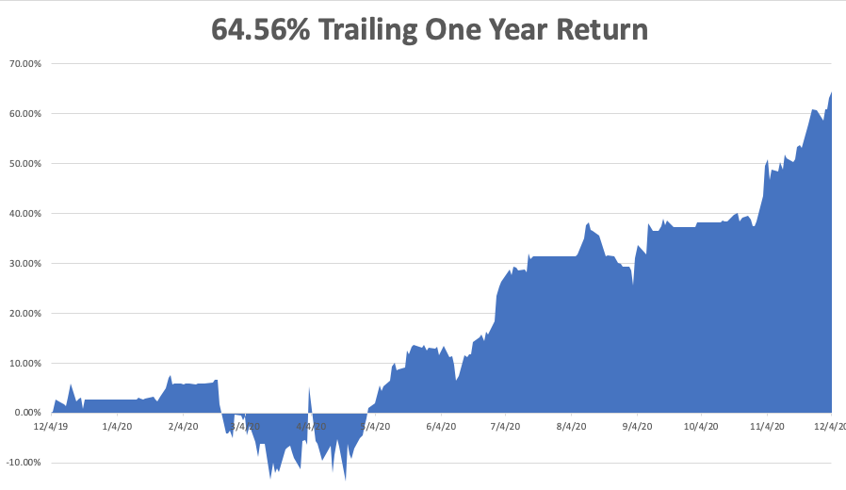

Slide 6
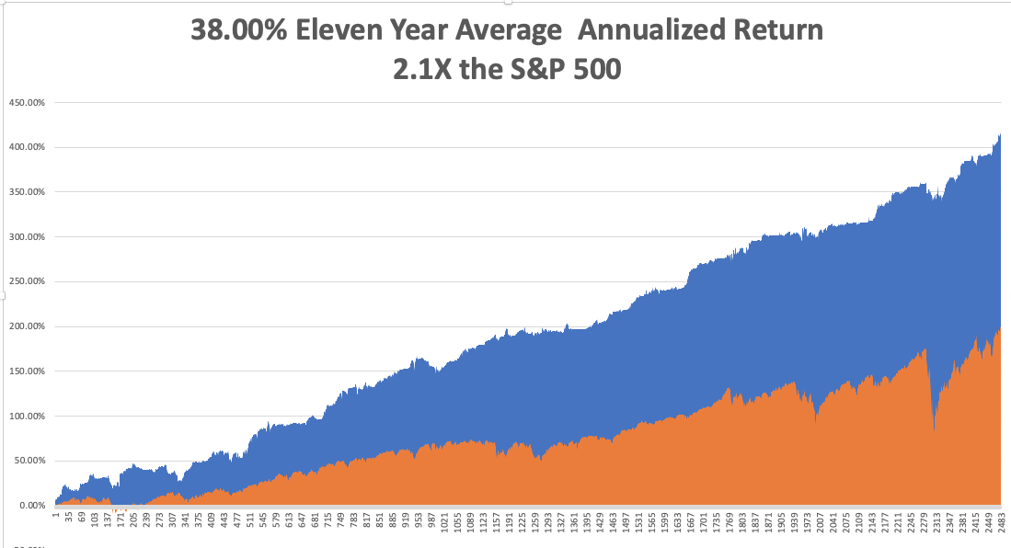
GTD 11 Year Daily Audited Performance

Slide 7
The Method to My Madness The Roaring Twenties are Here
*”Look Through” trading dominating the market, wit investors focusing on the end of the pandemic and not the peak *It’s now all about a global economic recovery and “RISK ON”, but we are now waiting for the next dip which Covid-19 will give us *2020 was only a short-term dip in a 20-year bull market that may have another decade to run *VIX collapse from $41 to $20 has cut the potential profit call spreads by more than half, so focus on the most volatile stocks like Tesla *A bond breakdown is imminent, with a 1.0% for the ten year Treasury within reach *Perennial dollar weakness will give us opportunities to buy foreign currencies, commodities, and emerging markets

Slide 8
Corona Update – The Priority List
*Pfizer, Moderna, and AstraZeneca vaccines puts end to the pandemic in sight and there are vaccines from three other companies to come *US cases top 15.2 million, deaths at 287,000 and are still rising at up to 3,000 a day, and could reach 350,000 by yearend *US capacity soon to vaccinate 60 million a month, 2 each needed, and these people go first: *The US passed on another 100 million doses from Pfizer delaying vaccination of the US population by 3 months *In the meantime, we have 96 million doses of Chloroquine which can only be used for Malaria (1949) *Russia and China are already vaccinating large numbers now

Slide 9
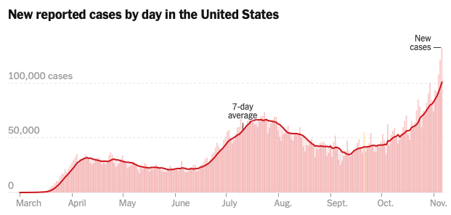
Targeting 350,000 cases a day by end 2020 The Worst-Case Scenario is Here

Slide 10
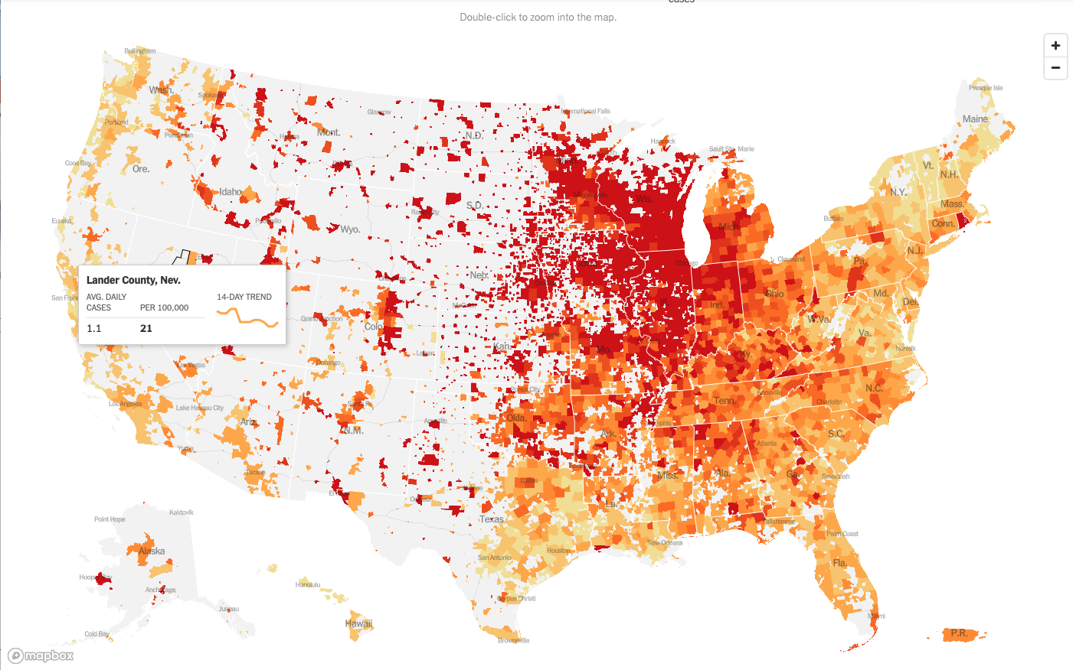

Slide 11
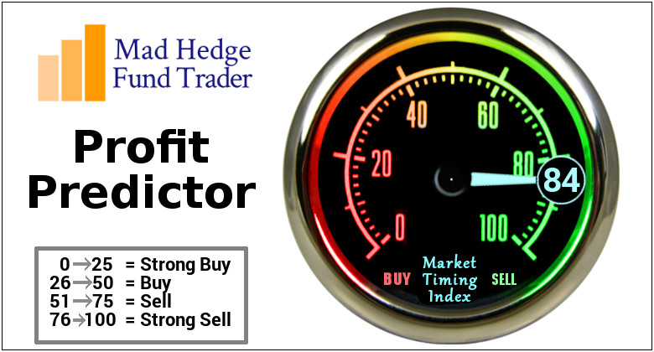
The Mad Hedge Profit Predictor Market Timing Index-Bottom of Range-at to a “BUY” An artificial intelligence driven algorithm that analyzes 30 different economic, technical, and momentum driven indicators

Slide 12
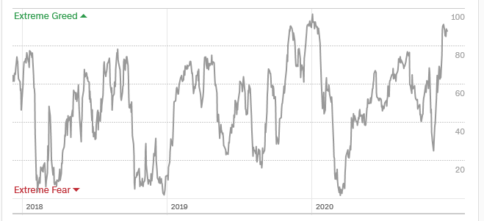
The Mad Hedge Profit Predictor Entering “SELL” Territory
SELL
BUY

Slide 13
The Global Economy – Weakening
*A $908 Billion Stimulus May Happen, and would be a major stock market positive * Nonfarm Payroll Hits 245,000 in November, taking the headline unemployment rate down to 6.9%. Some 10.7 million remain jobless. The U-6 is 20 million *Black Friday was a Disaster, with in store shopping down 52%. Long lines and 25% of capacity restrictions kept the crows at bay. *Amazon Hires 437,000 in 2020, probably the greatest hiring binge since WWII.

Slide 14
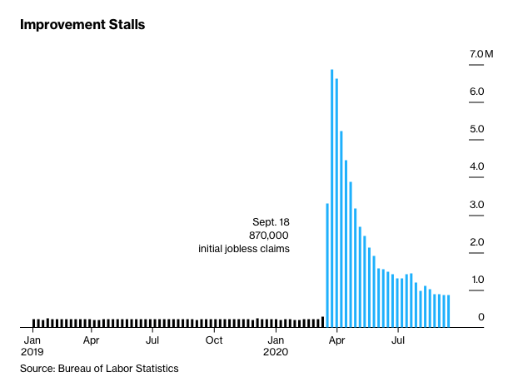
Weekly Jobless Claims – Flatlining at record highs +712,000

Slide 15
The Bill Davis View A $1,500 Upgrade for the Mad Day Trader Service
Buys: | Entry | Target
Winnebago Industries (WGO) | $ 58.00 | $ 70.00
Ilumina, Inc. (ILMN) | $ 345.00 | $ 400.00
Datadog, Inc. (DDOG) | $ 102.00 | $ 120.00
Home Depot, Inc. (HD) | $ 263.00 | $ 285.00
McDonalds Corp (MCD) | $ 210.00 | $ 235.00
Sells:
Becton Dickinson (BDX) | $ 240.00 | $ 220.00
NovoCure Ltd.(NVCR) | $ 150.00 | $ 130.00
Dollar Tree, Inc.(DLTR) | $ 108.00 | $ 95.00
DaVita Inc.(DVA) | $ 107.00 | $ 90.00
Stanley Black & Decker (SWK) | $ 182.00 | $ 160.00

Slide 16
Stocks – Back to Normal
*$908 billion stimulus bill will keep stocks hot until the end of 2020 *Vaccine delivery has set pharma and biotech stocks on fire *US economy may be back to normal by summer, but stocks and the economy will be anything but normal. Dow 40,000 here we come! *The stock rally is global, with every market delivering ballistic returns, anticipating a Global Synchronized Recovery *Emerging markets like China (FXI), Brazil (EWZ), Thailand (THD), and Peru (EPU) have turned hot *Use every dip to BUY, it’s a 100% “RISK ON” market *In 2021 both tech and recovery stocks run, meaning everything goes up *We could be entering a wide $2,700 - $3,600 range until the election

Slide 17
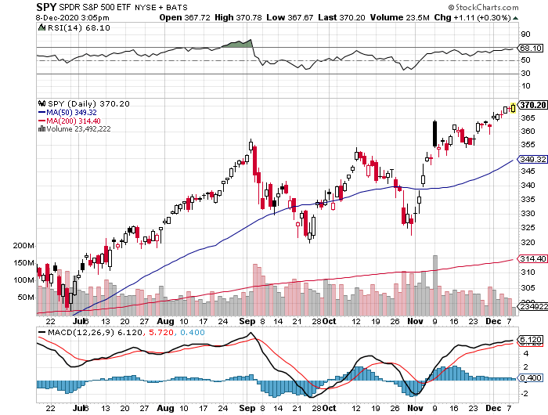
S&P 500 – Everything Worked! stopped out of long 7/$320-$330 bear put spread took profits on long 6/$235-$245 bull call spread
New Highs
You are here now
The Bottom 355

Slide 18
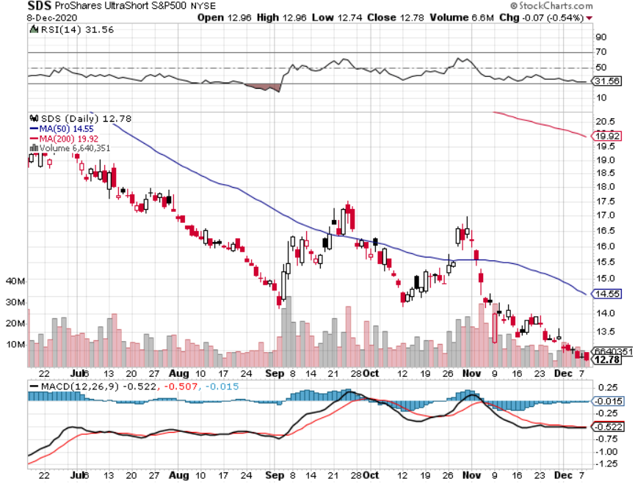
ProShares Ultra Short S&P 500 (SDS)- a Great Hedge for long stocks and bonds Long 2X position has a hedge against longs and bond shorts

Slide 19
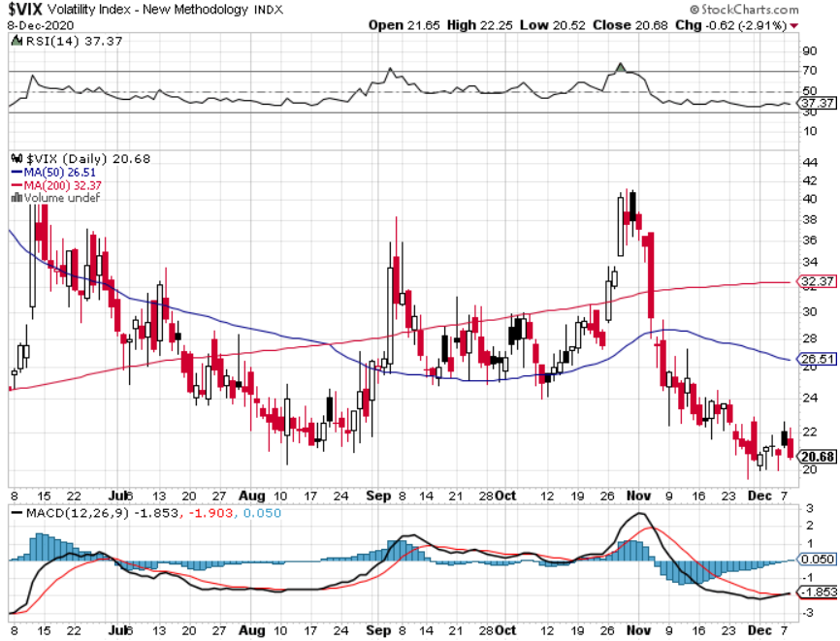
(VIX)-Crash!

Slide 20
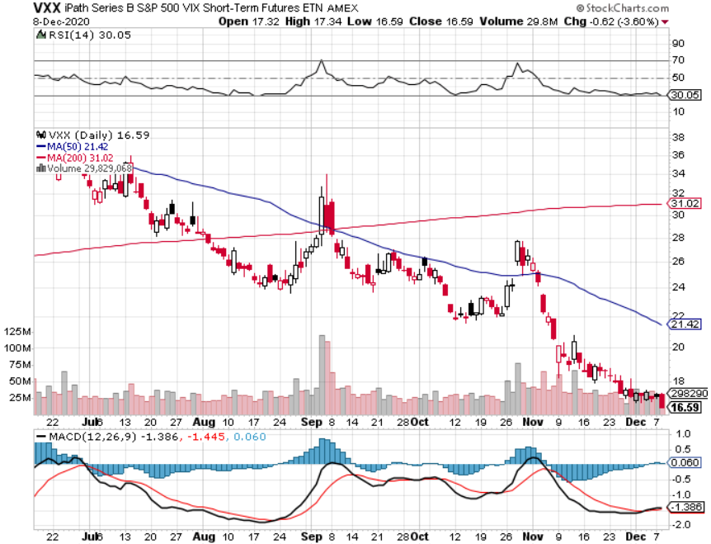
(VXX)- Sell Rallies-Down $85 to $26 from top stopped out of long 1/2021 $16 puts stopped out of long 1/2021 $24 puts

Slide 21
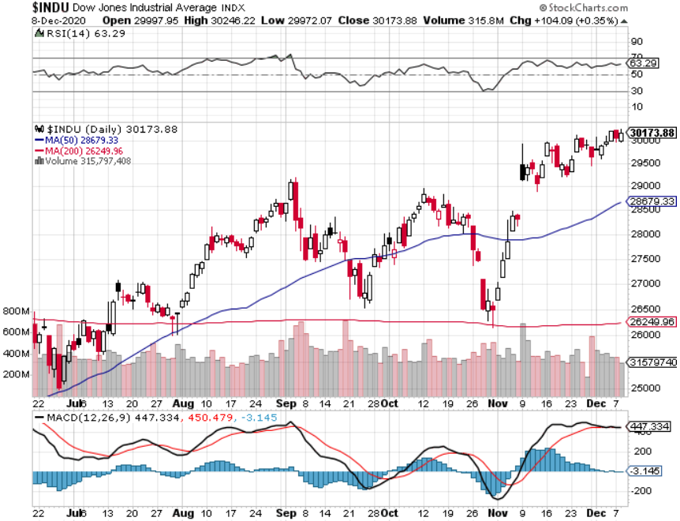
Dow Average ($INDU)-

Slide 22
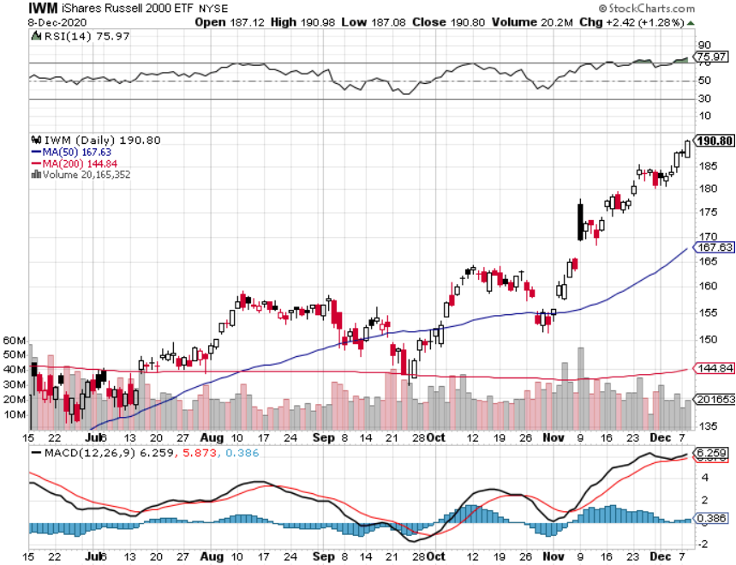
Russell 2000 (IWM)- took profits on Long 10/$137-$142 vertical bull call spread took profits on Long 10/$153-$156 vertical bear put spread

Slide 23
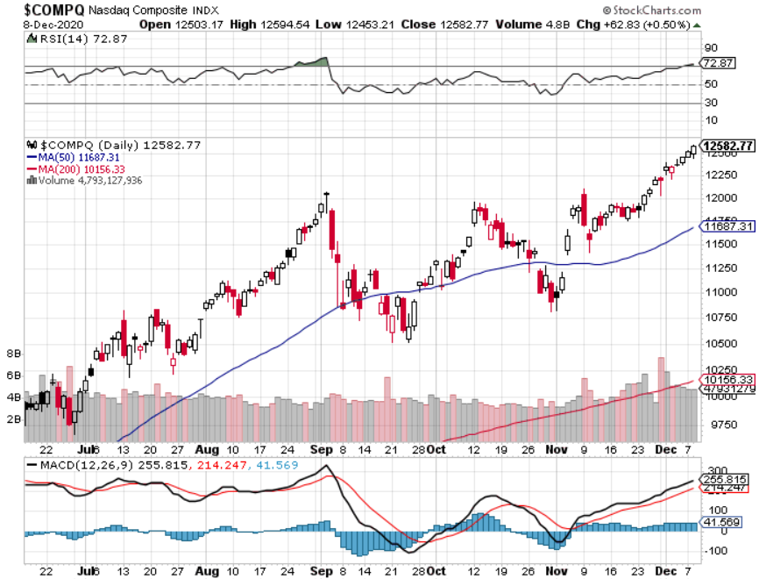
NASDAQ ($COMPQ) –

Slide 24
The Barbell Portfolio
*50% Big Tech 50% Domestic Recovery, including: Railroads Couriers Banks Construction Credit Cards

Slide 25
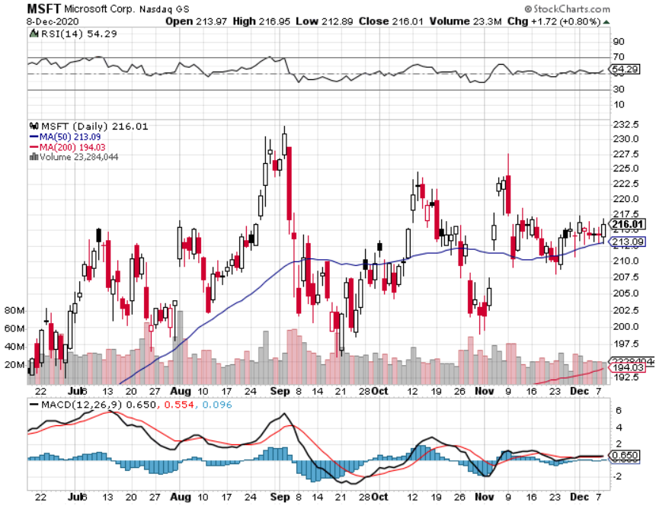
Microsoft (MSFT)- Earnings beat- Looking for Another Entry Point Stopped out of long 4/$120-$130 call spread took profit on long 4/$120-$130 call spread stop loss on long 12/$170-$180 call spread took profits on long 12/$135-$138 call spread

Slide 26
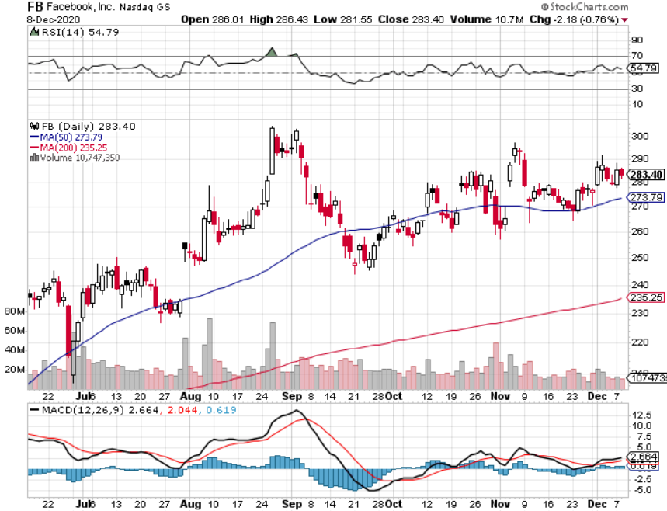
Facebook (FB)-New High took profits on Long 9/$290-$300 vertical bear put spread stopped out of Long 9/$190-$200 vertical bear put spread took profits on Long 9/$145-$155 vertical bull call spread took profits on Long 9/$150-$160 vertical bull call spread took profits on Long 8/$167.50-$172.50 vertical bull call spread

Slide 27
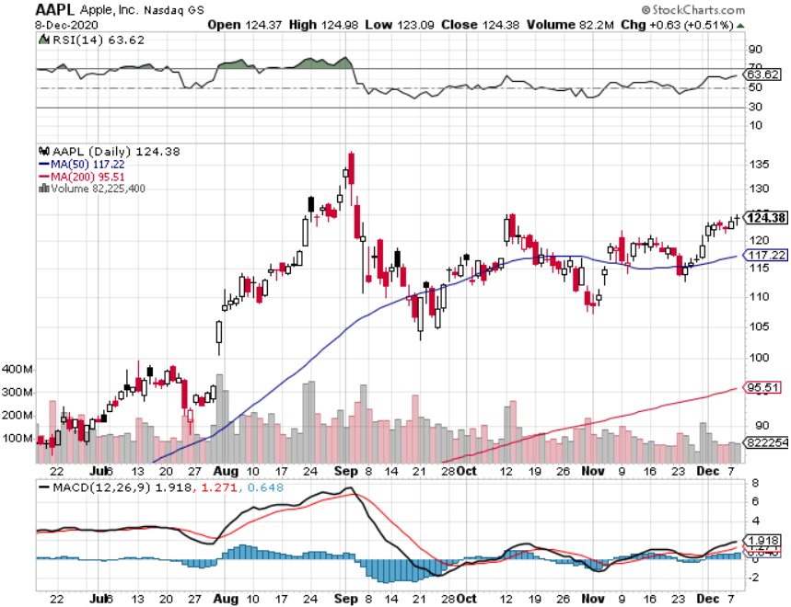
Apple (AAPL)- New 5G iPhone This Week stopped out of long 9/$100-$105 call spread stopped out of long 8/$480-$490 bear put spread took profits on long 7/$320-$330 call spread took profits on long 4/24/$250-$260 call spread took profits on long 5/$250-$260 call spread

Slide 28
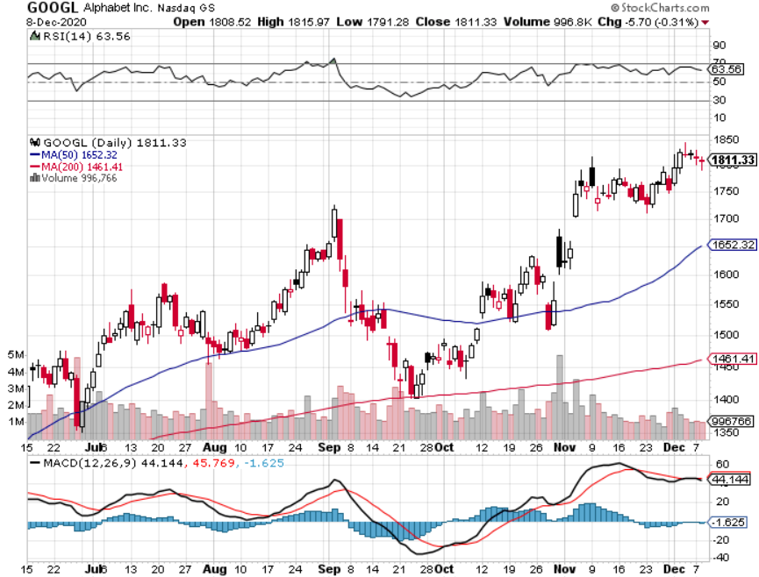
Alphabet (GOOGL) – Deutsche Bank upgrade to $2,020 took profits on long 12/$1,200-$1,230 bull call spread took profits on long 9/$1,030-$1,080 vertical bull call spread stopped out of long 5/$1,100-$1,130 bull call spread took profits on long 4/$1,080-$1,120 bull call spread

Slide 29
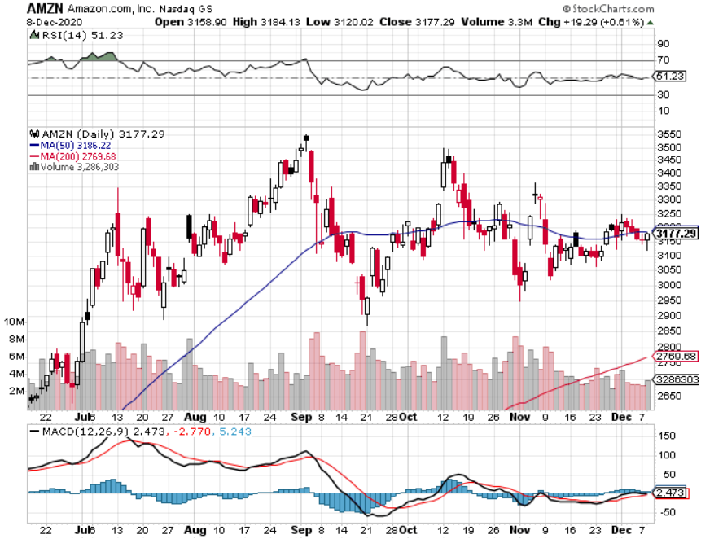
Amazon (AMZN) – Profit taking took profits on long 9/$2,800-$2,900 bull call spread stopped out of long 8/$3,000-$3,500 bear put spread took profits on long 4/$1,500-$1,550 bull call spread

Slide 30
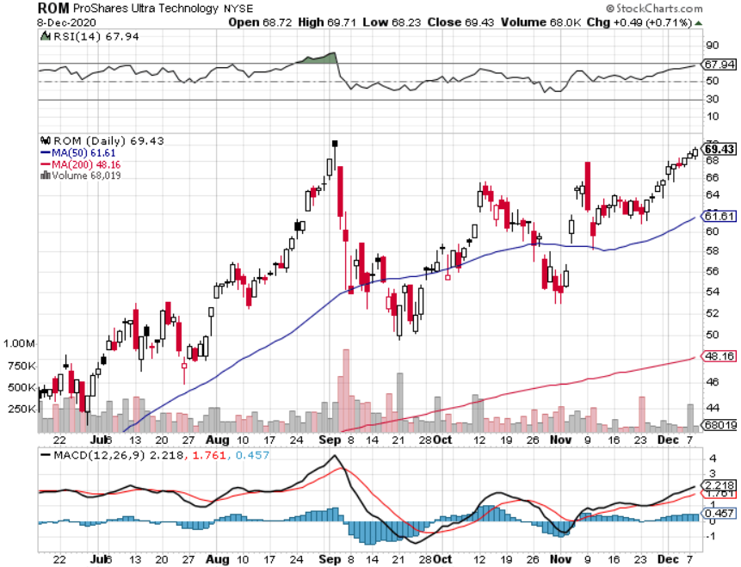
ProShares Ultra Technology (ROM) – Up 240% in 5 Months

Slide 31
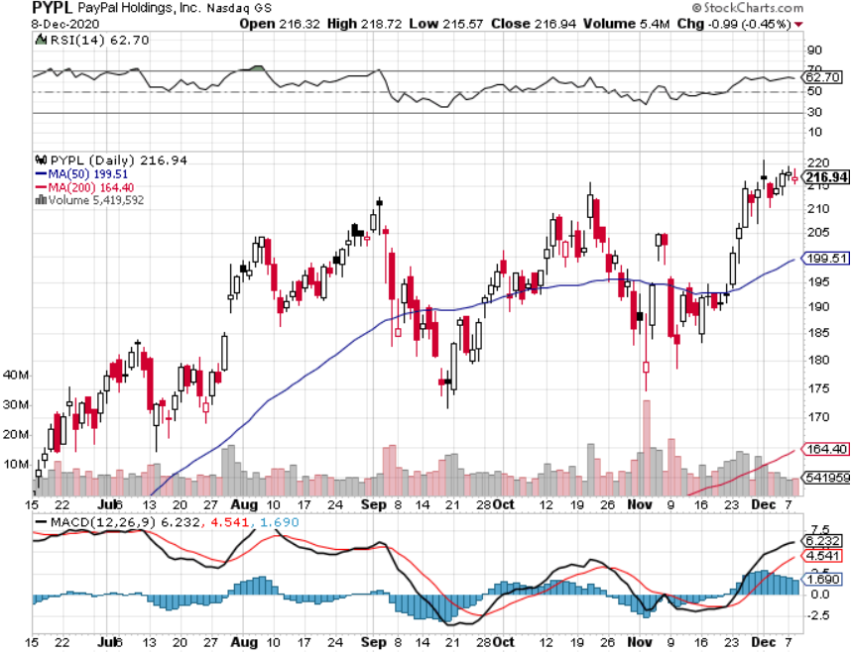
PayPal (PYPL)-Fintech Rules took profits on long 4/$90-$95 call spread

Slide 32
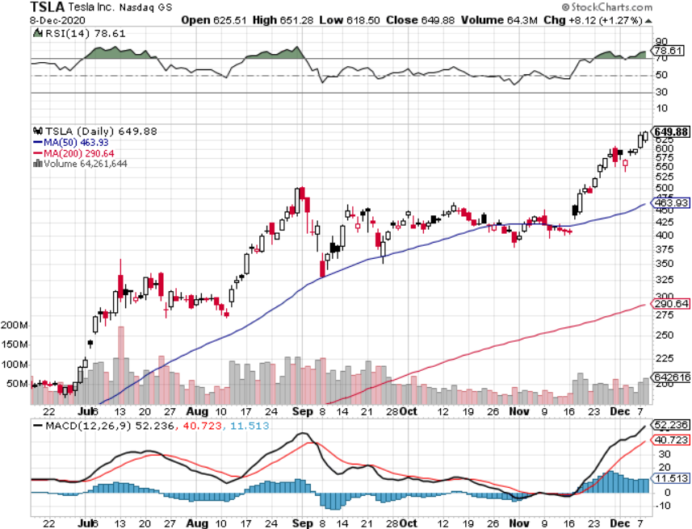
Tesla (TSLA)- Joining the S&P 500-Record 50% Long Goldman Sachs Raises Target to $780 long 12/$392-$420 bull call spread, long 12/$400-$430 bull call spread, long 12/$450-$480 bull call spread took profits on long 12/$380-$410 bull call spread took profits on long long 11/$300-$325 bull call spread, took profits on long 12/$350-$380 bull call spread

Slide 33
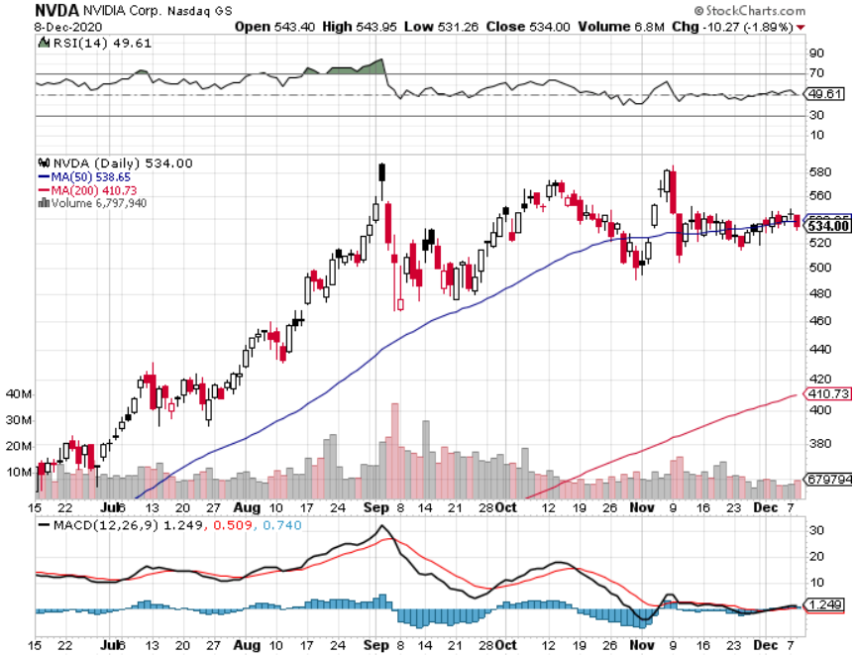
NVIDIA (NVDA) – The Biggest Chip Deal in History A Mad Hedge 10 bagger

Slide 34
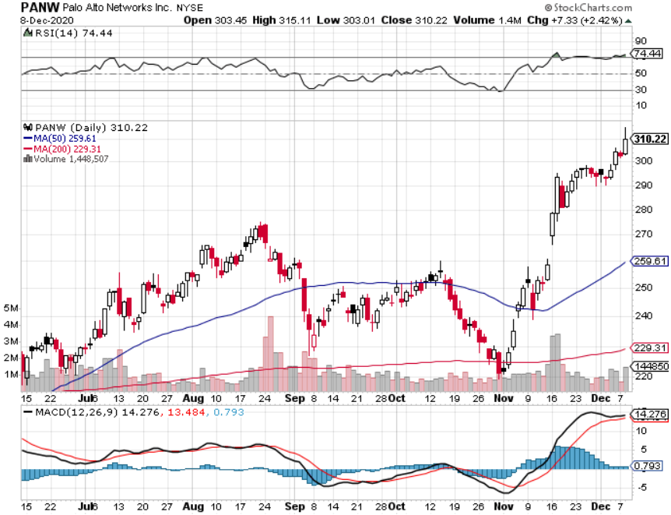
Palo Alto Networks (PANW)- New High Hacking never goes out of fashion

Slide 35
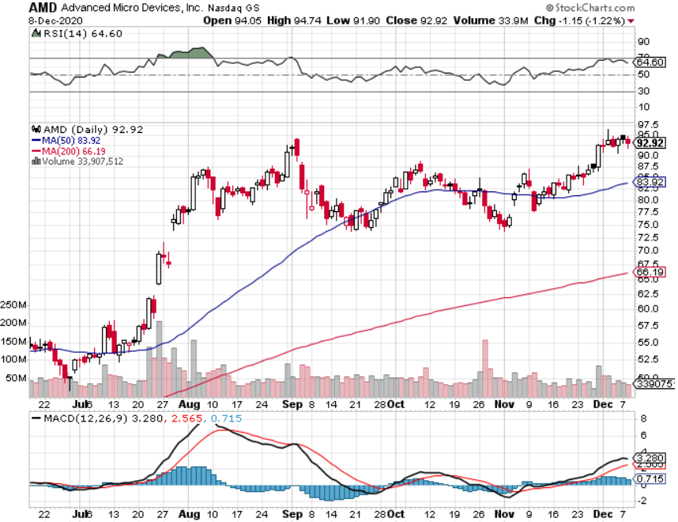
Advanced Micro Devices (AMD)- the next ten bagger-buys Xylinx

Slide 36
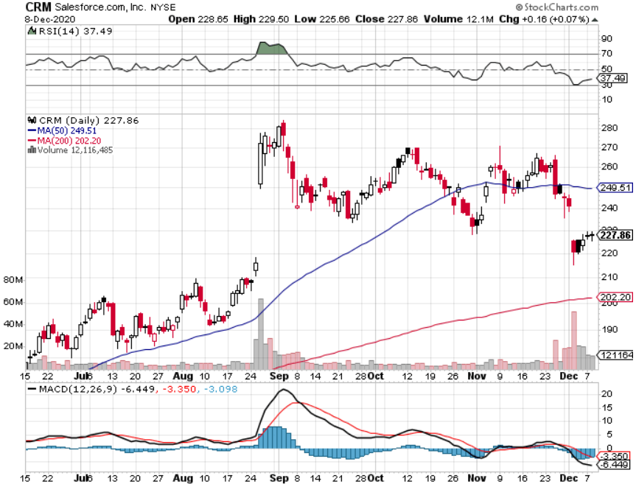
Salesforce (CRM)- Massive Online Migration took profits on long 9/$125-$130 vertical bull call spread took profits on long 8/$125-$130 vertical bull call spread took profits on long 2/$105-$115 call spread

Slide 37
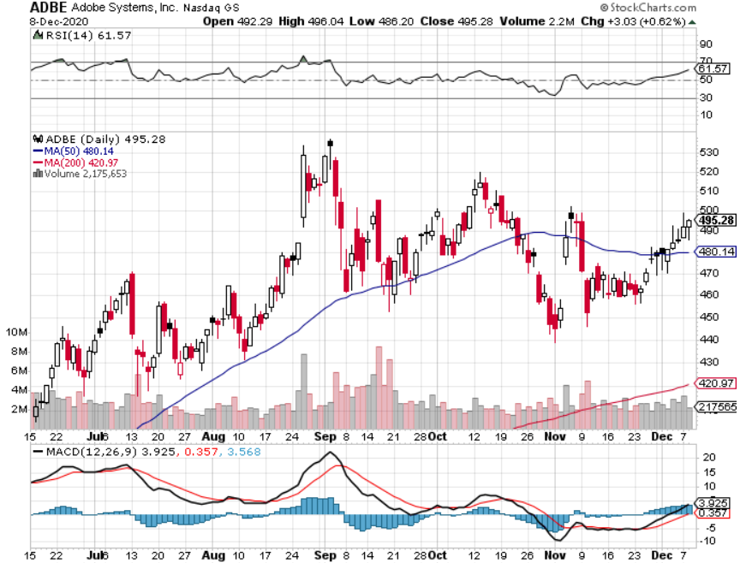
Adobe (ADBE)- Cloud play The Quality Non-China tech play

Slide 38
The Second Half of the Barbell
*Bets on a domestic recovery in 2021 *Upside potential in 2021 far greater than tech *Some of these have not moved for 5 or 10 years *Focuses on economically sensitive cyclical industries *Makes a great counterweight to high growth technology *We could spend all of next year rotating between the two groups

Slide 39
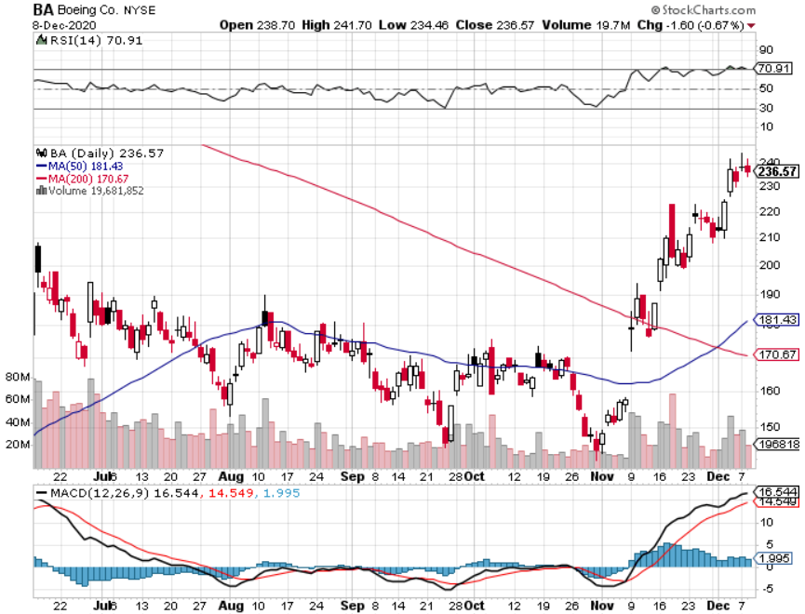
Boeing (BA) – former LEAP Candidate - The 737 MAX Flies Again! took profits on long 4/$300-$310 call spread took profits on long 4/$315-$335 call spread

Slide 40
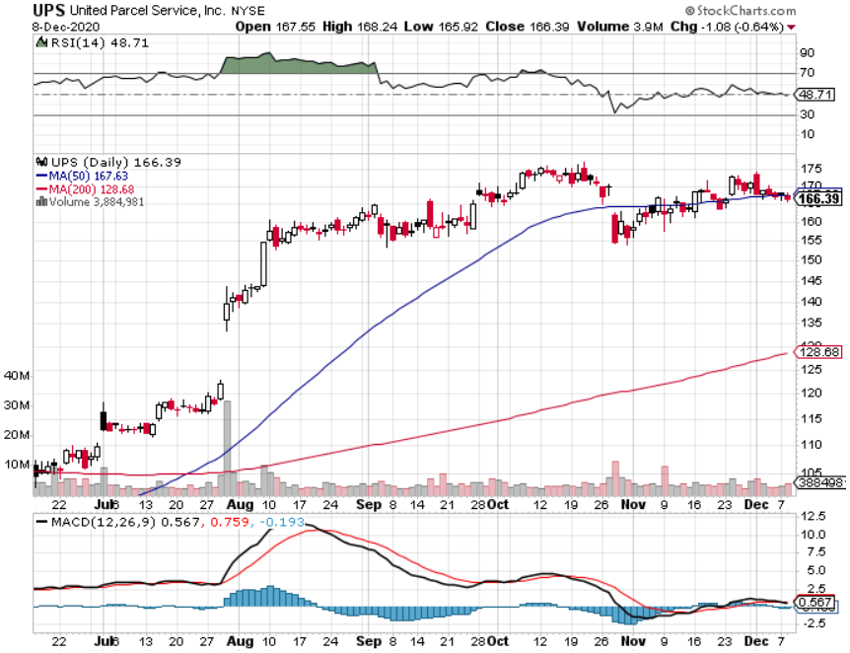
Package Delivery- United Parcel Service (UPS) massive increase in overnight deliveries took profits on long 11/$130-$140 call spread

Slide 41
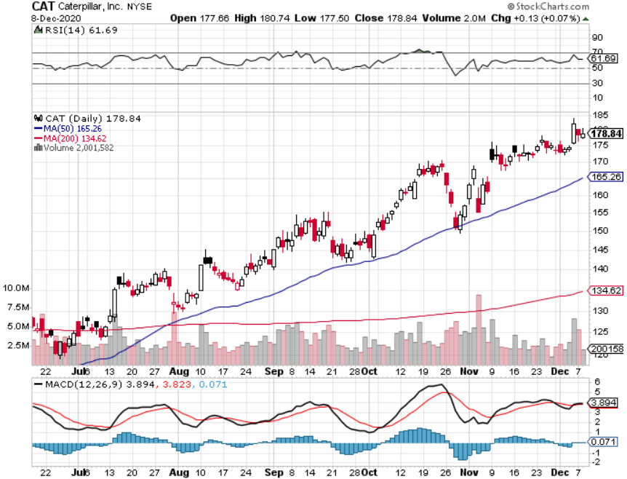
Caterpillar (CAT)- Ag + Infrastructure + Housing long 12/$145-$150 call spread took profits on long 11/$125-$135 call spread

Slide 42
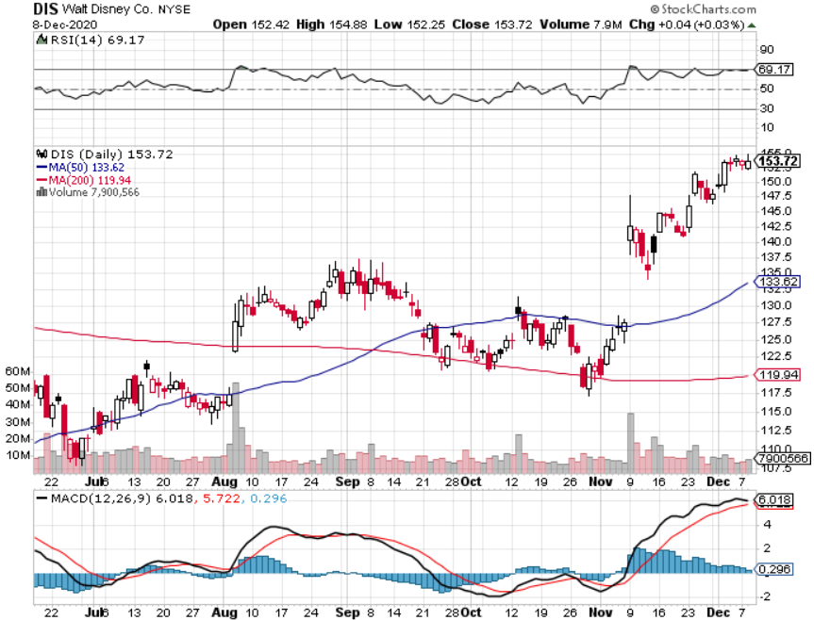
Walt Disney (DIS)- Big Recovery Move took profits on long 6/$85-$90 call spread

Slide 43
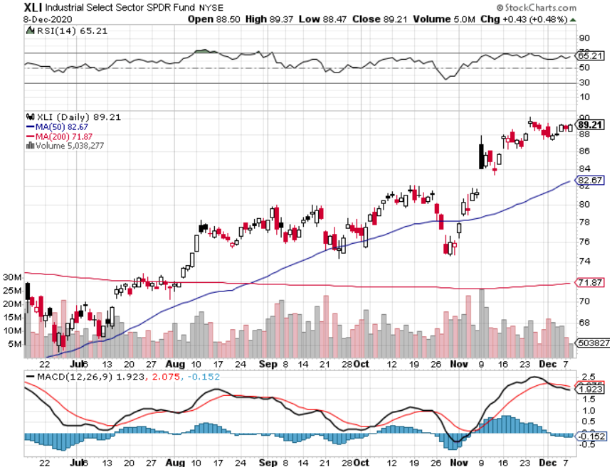
Industrials Sector SPDR (XLI)- (GE), (MMM), (UNP), (UTX), (BA), (HON)

Slide 44
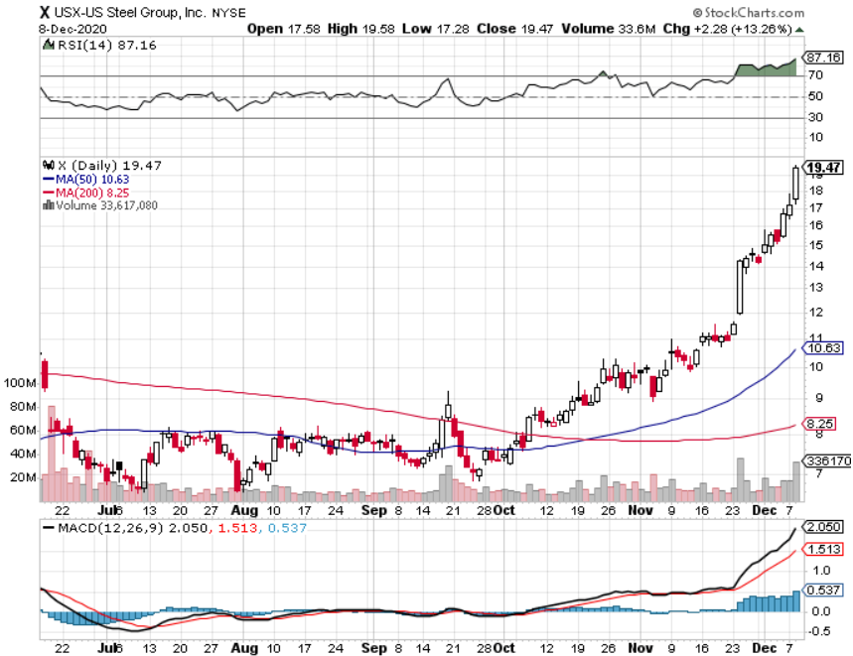
US Steel (X)-Back from the Grave

Slide 45
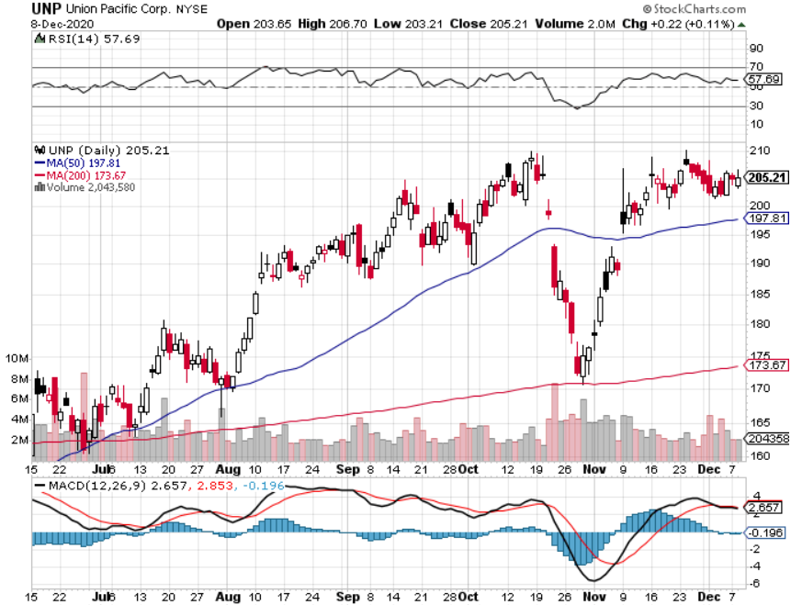
Union Pacific RR (UNP)- More stuff to ship took profits on 11/$150-$160 call spread

Slide 46
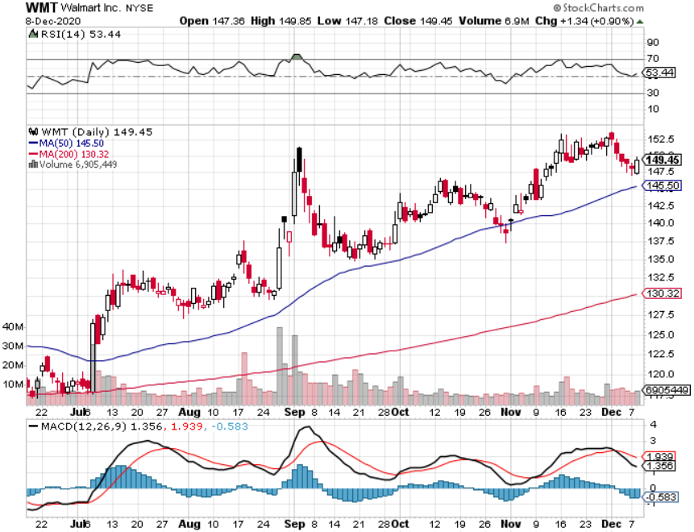
Wal-Mart (WMT)-New High took profit on Long 11/$125-$130 bear put spread took profit on Long 10/$119-$121 bear put spread took profits on Long 8/$114-$117 bear put spread

Slide 47
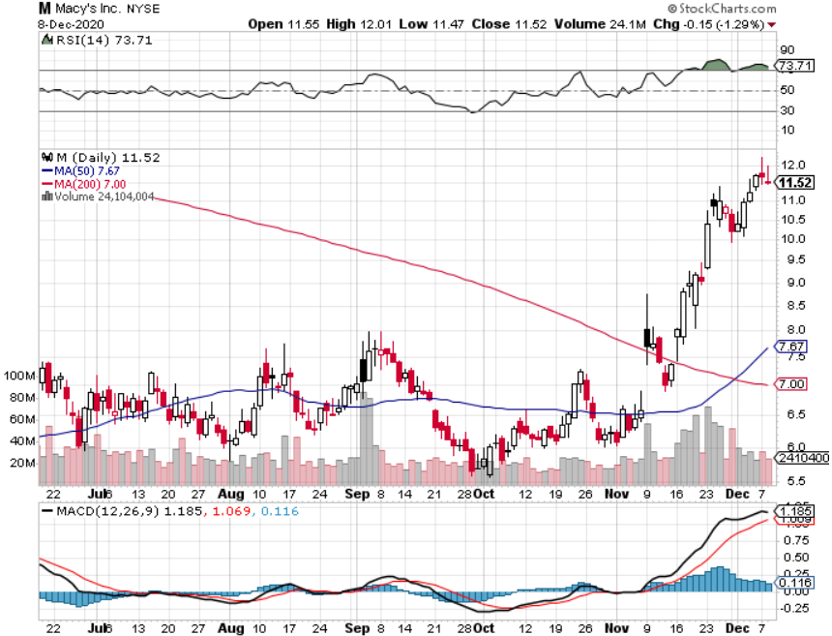
Macys’ (M) – Back from near Chapter 11 took profits on Long 8/$23-$25 bear put spread

Slide 48
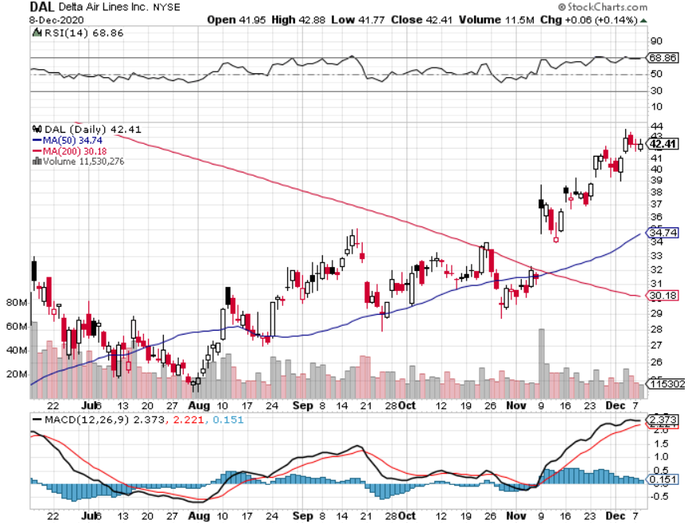
Delta Airlines (DAL) – Subsidy runs out

Slide 49
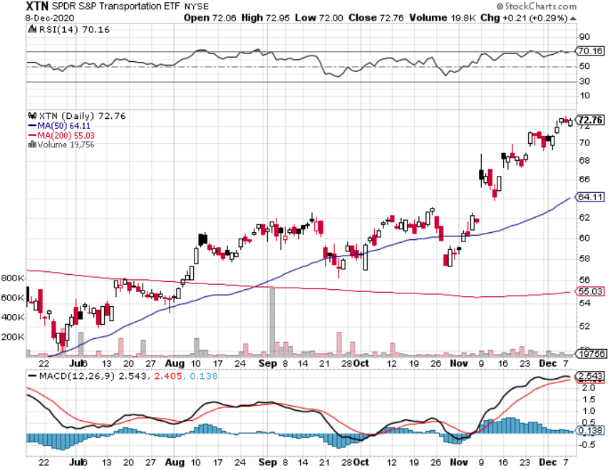
Transports Sector SPDR (XTN)- Worst Hit Sector (ALGT), (ALK), (JBLU), (LUV), (CHRW), (DAL)

Slide 50
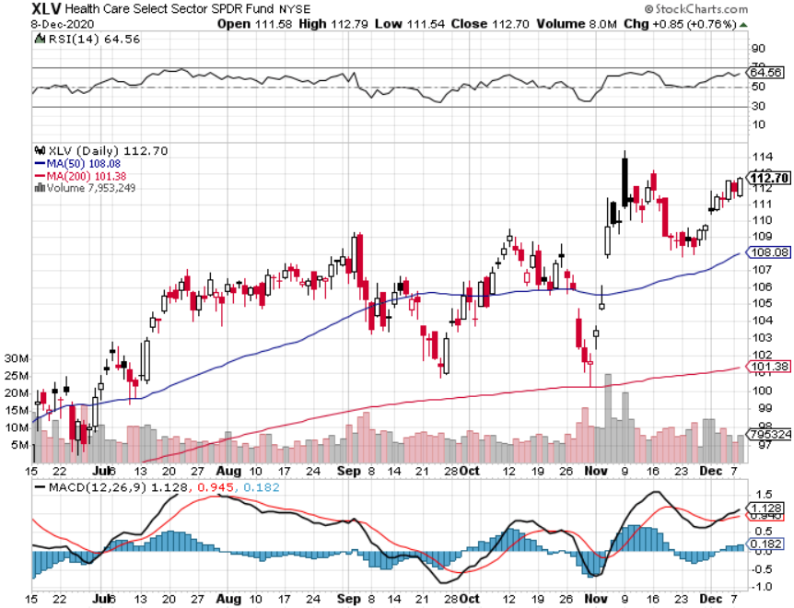
Health Care Sector (XLV), (RXL) (JNJ), (PFE), (MRK), (GILD), (ACT), (AMGN)

Slide 51
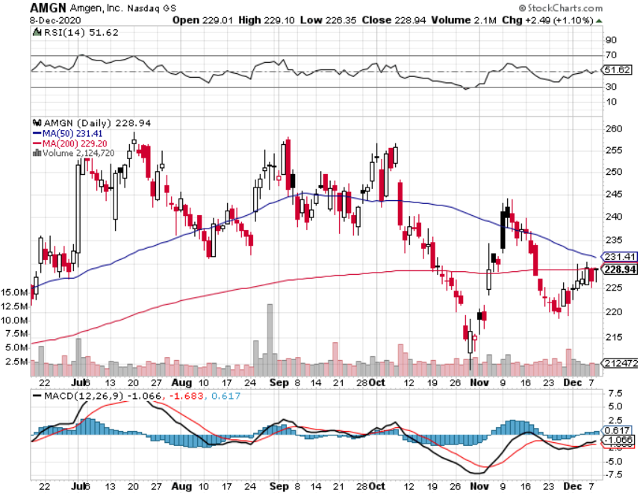
Amgen (AMGN) took profits on long 11/$185-$200 bull call spread

Slide 52
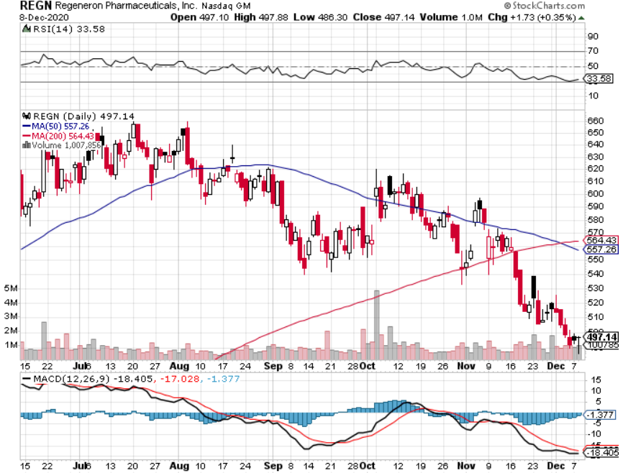
Regeneron (REGN) took profits on long 7/$570-$580 call spread

Slide 53
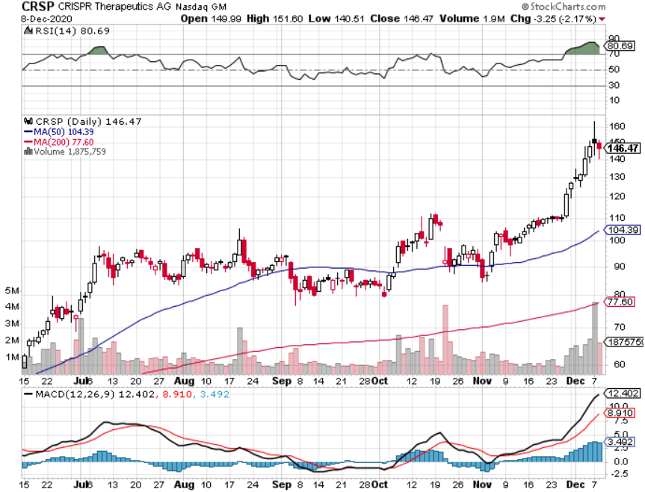
CRISPR Therapeutics (CRSP) A Mad Hedge 6 Bagger

Slide 54
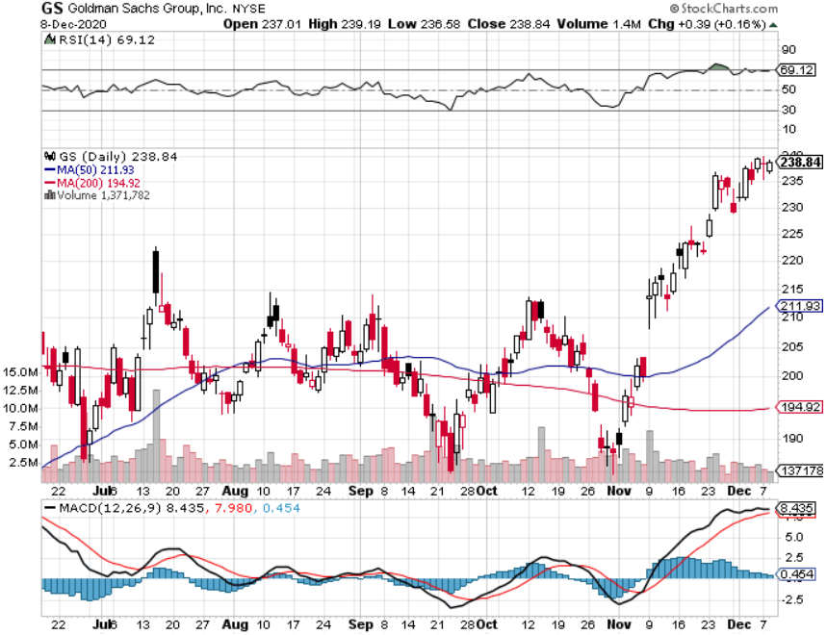
Goldman Sachs (GS) – $3 billion Settlement

Slide 55
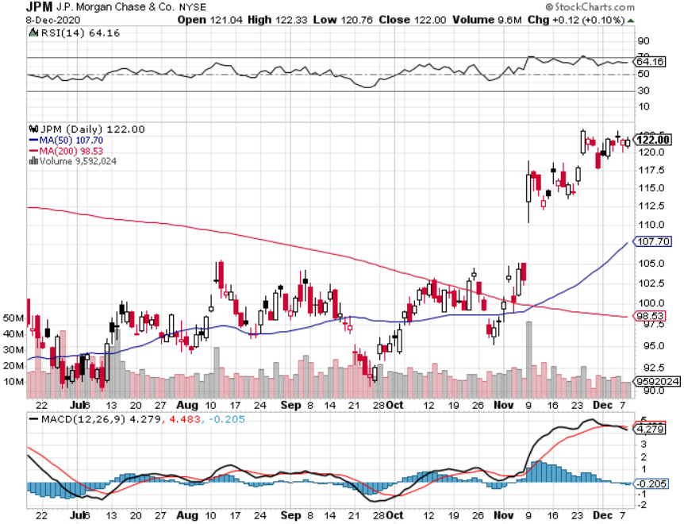
JP Morgan Chase (JPM) Recession Fears long 12/$100-$105 bull call spread took profits on long 11/$85-$90 bull call spread took profit on long 11/$110-$115 bear put spread took profits on long 9/$90-$95 bull call spread stopped out of long 8/$92-$95 bull call spread

Slide 56
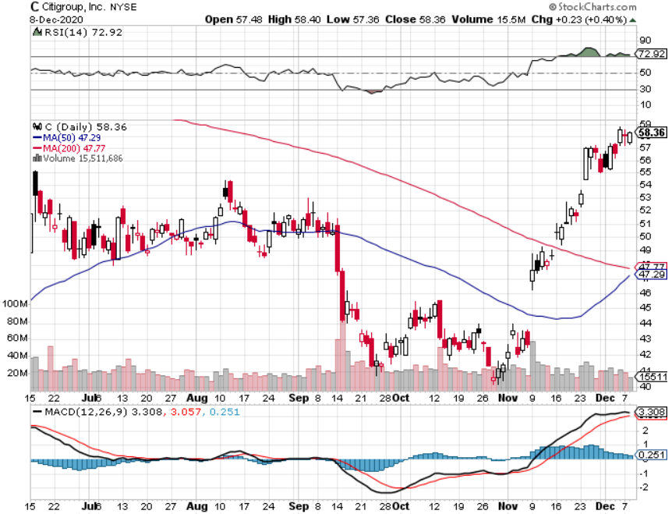
Citigroup (C) – “Recovery” Rotation Play stopped out of long 9/$45-$48 bull call spread

Slide 57
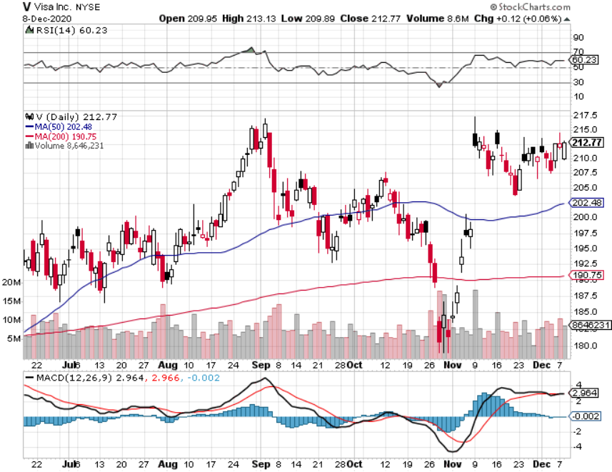
Visa (V) – “Touchless” Fintech Play stopped out of long 11/$180-$185 bull call spread took profits on long 9/$180-$185 bull call spread

Slide 58
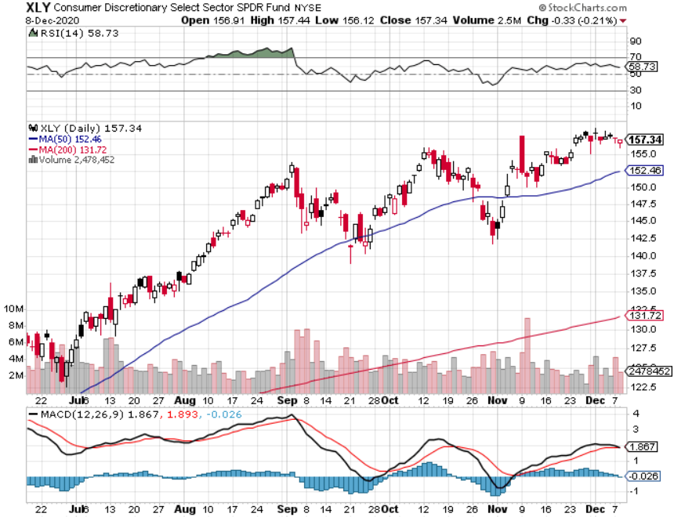
Consumer Discretionary SPDR (XLY) (DIS), (AMZN), (HD), (CMCSA), (MCD), (SBUX)

Slide 59
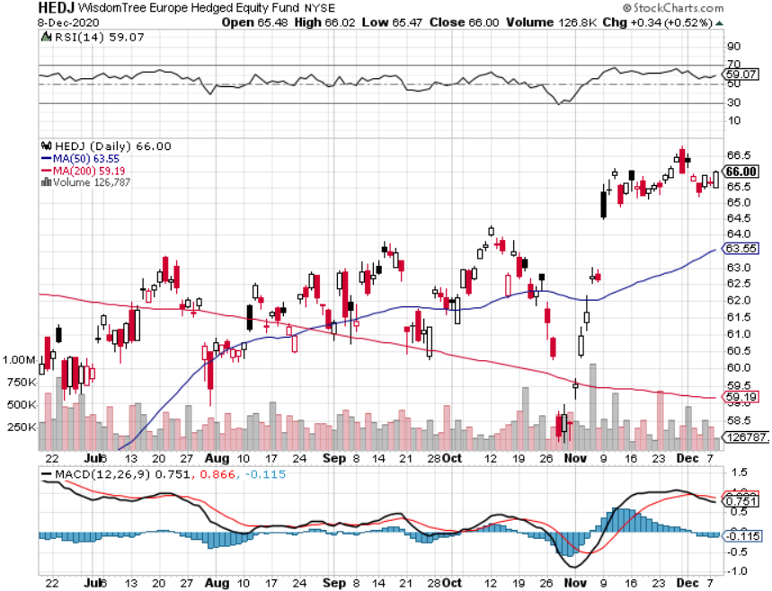
Europe Hedged Equity (HEDJ)-

Slide 60
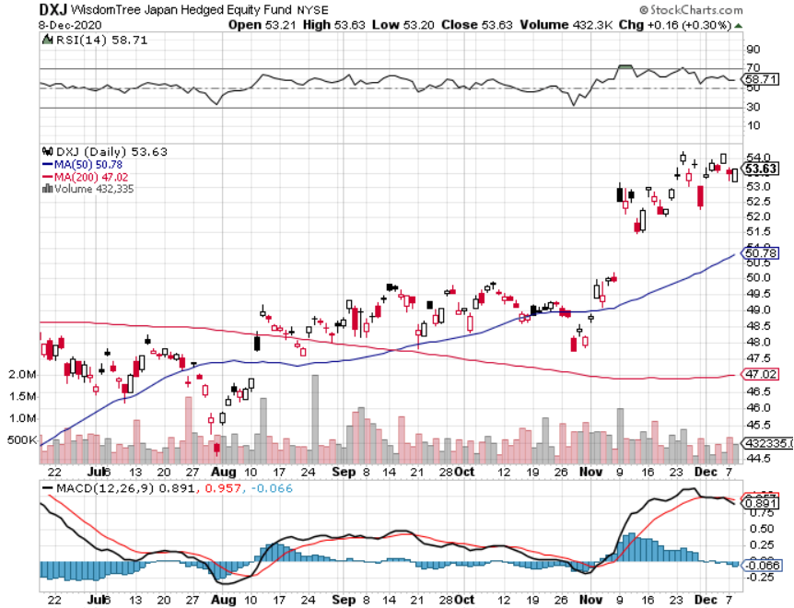
Japan (DXJ)-

Slide 61
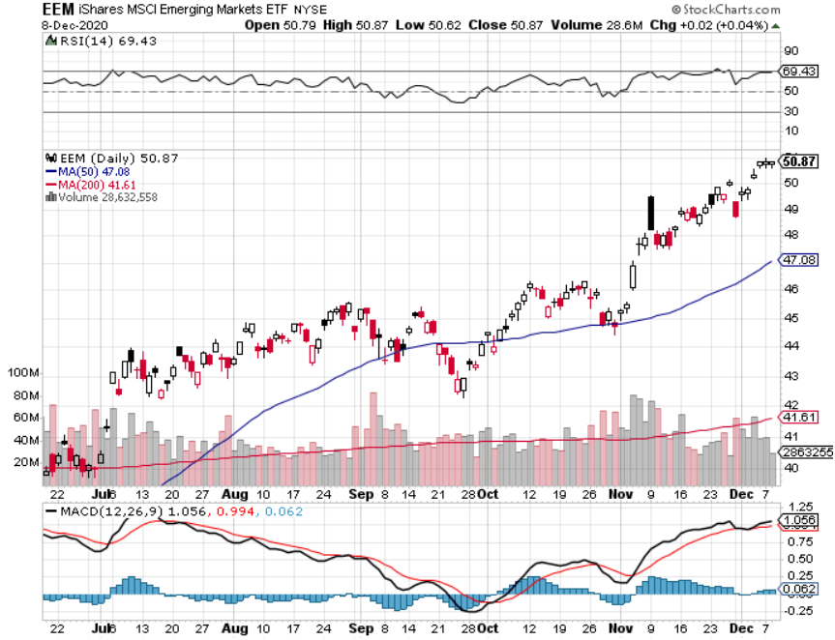
Emerging Markets (EEM)- Pro trade, Weak Dollar, long recovery Play

Slide 62
Bonds – Stimulus Burden
*$908 billion stimulus bill weighs heavily on bonds, may see new lows by yearend *Weakening dollar has scared away many foreign buyers *Ten-year US Treasury yields pop 15 basis points in a week and it is just a matter of time before we break 1.00% *Fading economic data is outweighed by stimulus demands on the bond market *Bonds break from a sideways range to a new downtrend *US Treasury bond fund (TLT) could plunge from $180 to $105, taking interest rates from 0.31% to 3.25% *Bottom line: sell short every major rally in the (TLT)

Slide 63
Treasury ETF (TLT) – Huge Short Play long 12/$164-$167 put spread, long 12/$148-$152 call spread profits on long 11/$162-$165 put spread profits on long 9/$170-$172.50 bear put spread took profits on long 9/$172.50-$175 put spread took profits on long 9/$172.50-$175 put spread

Slide 64
Ten Year Treasury Yield ($TNX) – 0.82%

Slide 65
Junk Bonds (HYG) 4.64% Yield to Maturity big jump in spreads on stock selloff and recession fears

Slide 66
2X Short Treasuries (TBT)- 2 Month Bottoming Process

Slide 67
Emerging Market Debt (ELD) 4.31% Yield-

Slide 68
Municipal Bonds (MUB) – 1.08% Mix of AAA, AA, and A rated bonds

Slide 69
Foreign Currencies – Brexit hit
*No deal Brexit is crushing the life out of the pound *Most foreign exchange plays are poised to break to new highs *Any dollar rallies are temporary and short-term, and a crash is imminent *Euro rallies back to top of range *Aussie dollar maintaining highs *Bitcoin soars on massive liquidity surge *Keep selling short all US dollar rallies, its yield support is gone forever

Slide 70
Japanese Yen (FXY), (YCS)

Slide 71
Euro ($XEU), (FXE), (EUO)-

Slide 72
British Pound (FXB)-

Slide 73
Australian Dollar (FXA)- The Global Recovery Play took profits on long 8/$67-$69 call spread

Slide 74
Emerging Market Currencies (CEW)

Slide 75
Chinese Yuan- (CYB)-

Slide 76
Bitcoin- Double Top Risk

Slide 77
Energy – Dollar Boost
*A weak US dollar is always positive for oil, a commodity like all others *Thanksgiving Gasoline Demand Lowest in 23 Years. *OPEC Cuts a Deal, adding 500,000 barrels a day to the global supply. The hopes are that a synchronized global recovery can take additional supply. *Reviving global economy means greater demand for Texas tea, but any rally will be short term *Global commodity boom is also dragging oil up *Saudi production increase will cap any oil rally….forever *Avoid all energy plays like the plague, could drop by half in the coming recession

Slide 78
Oil-($WTIC)

Slide 79
United States Oil Fund (USO) long 10/$9.50-$10 Vertical bull call spread

Slide 80
Energy Select Sector SPDR (XLE)-No Performance! (XOM), (CVX), (SLB), (KMI), (EOG), (COP)

Slide 81
Halliburton (HAL)-

Slide 82
Natural Gas (UNG) -

Slide 83
Precious Metals –
*Bitcoin surge is pulling cash out of precious metals *However, any declines will be temporary and QE demand continues *The long-term bull trend still lives *Traders are shifting to Silver as an economic, industrial plays *Near zero interest rates and Collapsing US dollar is another gold & silver incentive *Copper finally sees new multiyear highs on recovering Chinese economy *Bottom Line: buy this dip in gold and precious metals

Slide 84
Gold (GLD)- Short Term downtrend took profits on long 9/$171-$174 call spread took profits on long 8/$169-$172 call spread took profits on long 7/$157-$160 call spread

Slide 85
Market Vectors Gold Miners ETF- (GDX) –

Slide 86
Barrick Gold (GOLD) took profits on long 11/$22-$24 call spread

Slide 87
Newmont Mining- (NEM)-

Slide 88
Silver- (SLV)- took profits on long 11/$19-$20 call spread

Slide 89
Silver Miners - (SIL)-

Slide 90
Wheaton Precious Metals - (WPM)-

Slide 91
Copper (COPX)-Finally a break

Slide 92
Freeport McMoRan (FCX)-World’s Largest Copper Producer took profits on long 4/$10-$11 call spread took profits on short 4/$114 calls

Slide 93
Real Estate – Hotter than Hot
*New Home Sales Explode, up 41% YOY to 999,000, and gaining 1.5% in October *Inventories plunged to 3.5 months and prices are rising due to shortages of labor and materials. This is where inflation begins. *Homes sold but still under construction are up 60% YOY *Renting Millennials are moving back in with parents on massive scale *San Francisco rents plunge by 35% as the flight to the suburbs accelerates *Housing prices are still exploding to the upside with S&P Case Shiller Rose 6.2% in September , biggest spike in six year

Slide 94
September Corelogic S&P Case Shiller Home Price Index Phoenix (11.4%), Seattle (10.1%), San Diego (9.5%) showing biggest gains
Tradingeconomics.com

Slide 95
Simon Property Group (SPG)- Mall REIT A Huge Vaccine Play

Slide 96
Crown Castle International (CCI) – 3.40% yielding cell phone Tower REIT

Slide 97
US Home Construction Index (ITB) (DHI), (LEN), (PHM), (TOL), (NVR)

Slide 98
Trade Sheet- So What Do We Do About All This?
*Stocks – buy dips aggressively *Bonds – sell rallies aggressively *Commodities-buy dips *Currencies- sell US dollar rallies *Precious Metals – buy dips *Energy – stand aside *Volatility - sell short over $40 *Real estate – buy dips

Slide 99
Next Strategy Webinar 12:00 EST Wednesday, January 6, from Lake Tahoe, NV First webinar of 2021! email me questions at support@madhedgefundtrader.com
Good Luck and Good Trading!
Notes:
*

