Slide 1
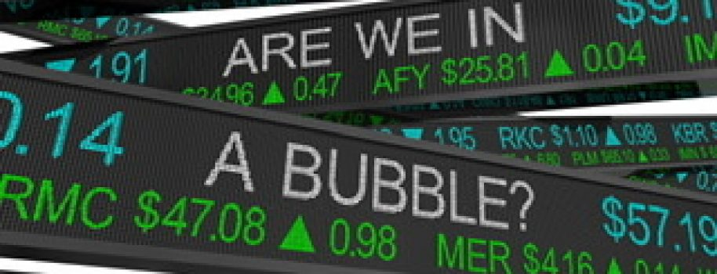
The Mad Hedge Fund Trader “Irrational Exuberance”
With John Thomas from Incline Village, NV, February 17, 2021 www.madhedgefundtrader.com
Notes:
*

Slide 2
Trade Alert Performance New All Time Highs!
*January 10.21% MTD *July +7.93% Final *February -16.48% Final *August -2.08% Final *March -5.50% Final *September 7.95% Final *April +4.55% Final *October +1.51% Final *May +14.19% Final *November +20.41% Final *June +10.38% Final *December +10.20% Final *2020 FINAL +66.64% compared to +2.9% for the Dow Average *2021 Year to Date +26.69% compared to +2.80% for the Dow Average *+449.24% since inception, a new all time high *Average annualized return of 40.29% for 11 years, new all time high

Slide 3
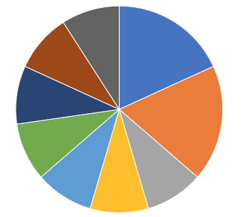
Portfolio Review 100% long Invested in Toppy Market
Current Capital at Risk
Risk On
World is Getting Better
(TSLA) 2/$650-$700 call spread | 20.00%
(TSLA) 3/$600-$650 call spread | 20.00%
(MS) 2/$55-$60 call spread | 10.00%
(BA) 2/$150-$160 call spread | 10.00%
(BLK) 2/$640-$660 call spread | 10.00%
(GS) 2/$240-$260 call spread | 10.00%
(AMD) 2/$75-$80 call spread | 10.00%
(BAC) 2/$28-$30 call spread | 10.00%
(KO) 2/$44-$47 call spread | 10.00%
Risk Off
World is Getting Worse
Total Net Position | 110.00%
Total Aggregate Position | 110.00%
Expiration P&L +29.36 YTD

Slide 4
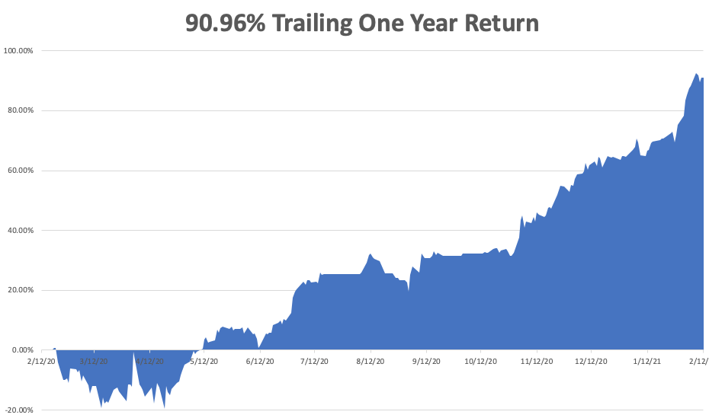

Slide 5
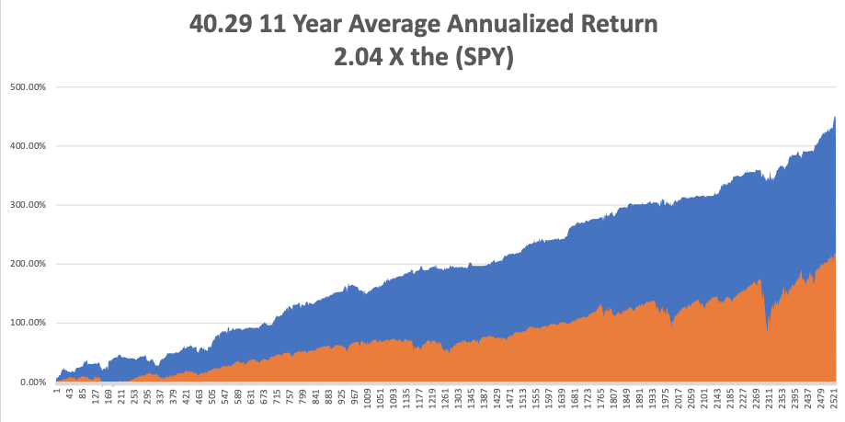
GTD 11 Year Daily Audited Performance

Slide 6
The Method to My Madness The Roaring Twenties are Here
*A sideways range is followed by an up leg in stocks. This could continue for years *Buy before the $20 trillion hits the market: $10 trillion in stimulus and $10 trillion in new QE at zero rates *It’s now all about a global economic recovery and “RISK ON”, but we are now waiting for the next dip *Commodity boom continues, with industrial metals hitting new highs, dragging oil upward *Bitcoin has become the best risk indicator in the market *A bond breakdown resumes, hitting new 2021 lows *Perennial dollar weakness will give us opportunities to buy foreign currencies, commodities, and emerging markets

Slide 7
Corona Update – Mutations Everywhere
*Distribution is improving slowly, 30 million have been given, about half of what’s in inventory *Every pandemic parameter started shrinking two weeks ago *At least 50 variants now in circulation, the race is to inoculate before the more fatal ones spread *We may be moving towards an annual booster shot to catch all the new variants, like a flue shot *We may hit a vaccine glut by May *An annual updated Covid booster shot may become a fact of life *US cases top 28 million, deaths approaching 500,000 and are still rising at 3,000 a day, and could reach 800,000 at the peak

Slide 8
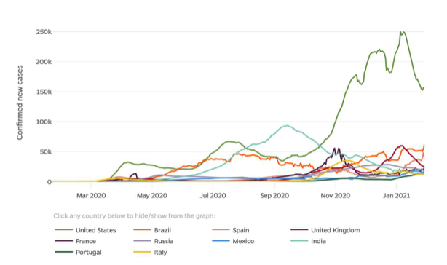

Slide 9
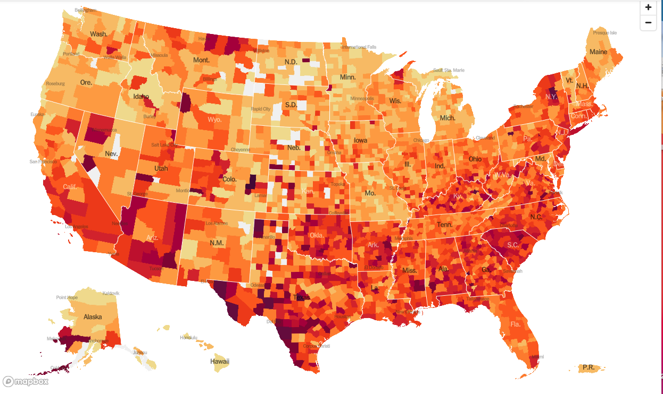

Slide 10
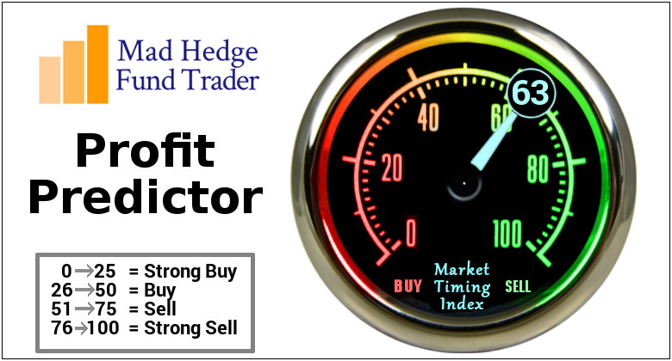
The Mad Hedge Profit Predictor Market Timing Index-Bottom of Range-at a “BUY” An artificial intelligence driven algorithm that analyzes 30 different economic, technical, and momentum driven indicators

Slide 11
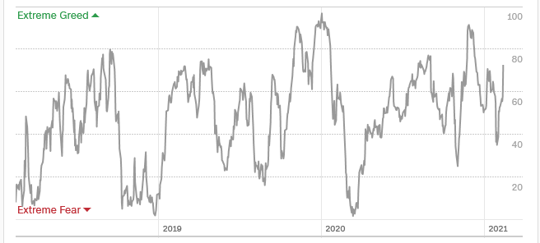
The Mad Hedge Profit Predictor Almost Neutral
SELL
BUY

Slide 12
The Global Economy – The Teeth Bite Deeper
*Nonfarm Payroll Report Comes in Weak, at 49,000 in January. *The headline Unemployment Rate is at 6.3%, a decline, as more people are leaving the workforce. *The U-6 broader “discouraged worker” unemployment rate is still at 11%, or 18 million, just short of the Great Depression high *Weekly Jobless Claims are Still Weak, at 793,000 *No Hint of Rising Rates Soon, hints Fed governor Jay Powell. Recovery is the only goal, damn the inflation torpedoes. *Ford Closes Three Plants Over Chip Shortage, joining GM and Toyota, slowing global recovery *Mall REITs are Rebounding, with Collection improving from 85% to 90% of tenants.

Slide 13
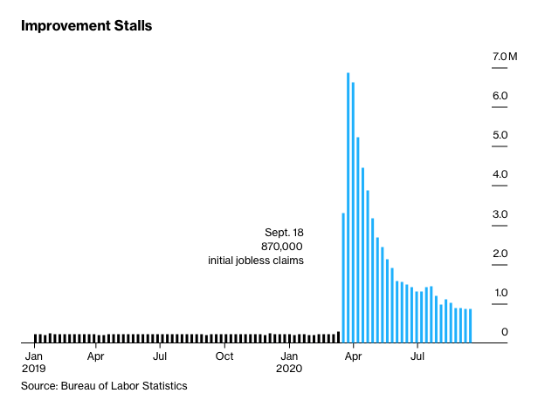
Weekly Jobless Claims – Flatlining at record highs 793,000

Slide 14
Stocks – Another Leg Up
*Will the Dow Double in a Year? We only have 4,500 points to go for a 100% gain from the last March 20 low. *We have already seen the sharpest gain in history, Will passage of the $1.9 trillion rescue package take us over the finish line? *Are we setting up for a “Buy the rumor, sell the news? *US economy may be back to normal by summer, but stocks and the economy will be anything but normal. Dow 40,000 here we come! *Stick with the barbell strategy, we’ll keep rotating back and forth all year *Use every dip to BUY, it’s a 100% “RISK ON” market *In 2021 both tech and recovery stocks run, meaning everything goes up *We could be entering a wide $2,700 - $3,600 range until the election

Slide 15
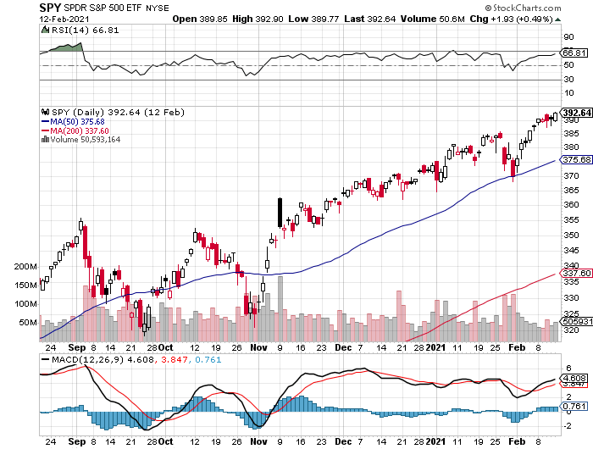
S&P 500 – The Bottom Held-Show How Much Cash is Out of the Market stopped out of long 7/$320-$330 bear put spread took profits on long 6/$235-$245 bull call spread
New Highs
The Bottom 370

Slide 16
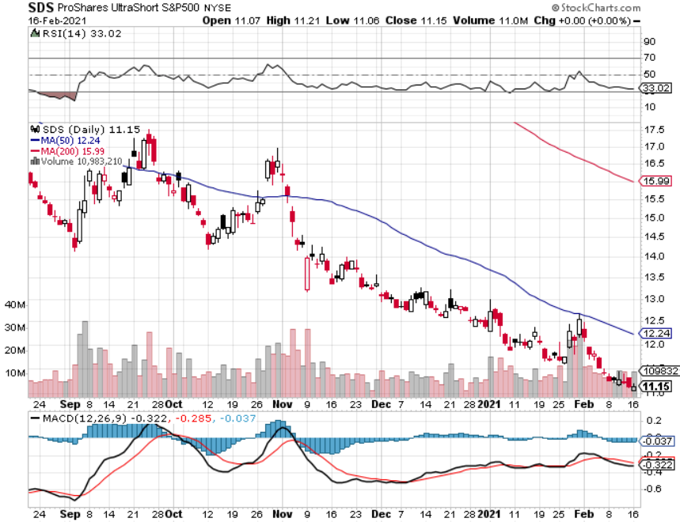
ProShares Ultra Short S&P 500 (SDS)- a Great Hedge for long stocks and bonds Long 2X position has a hedge against longs and bond shorts

Slide 17
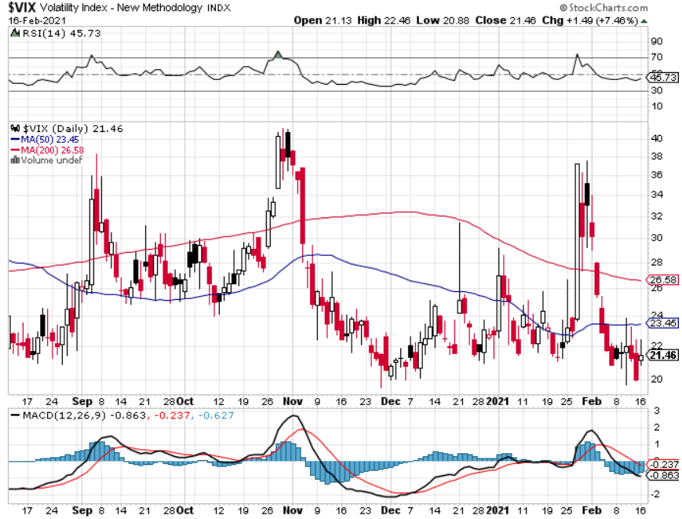
(VIX) – Mega Spike

Slide 18
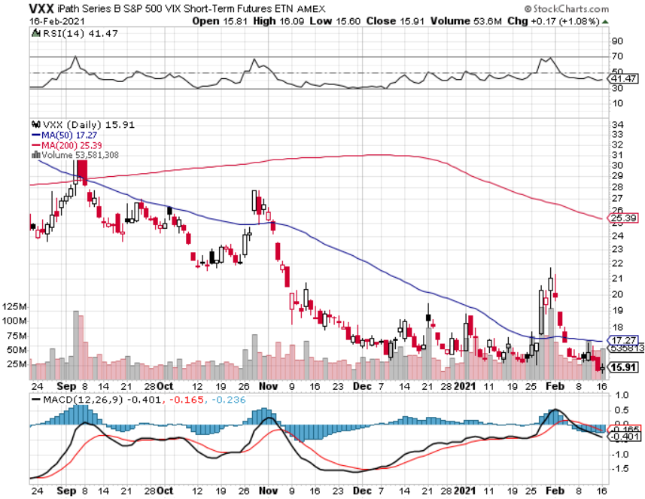
(VXX)-

Slide 19
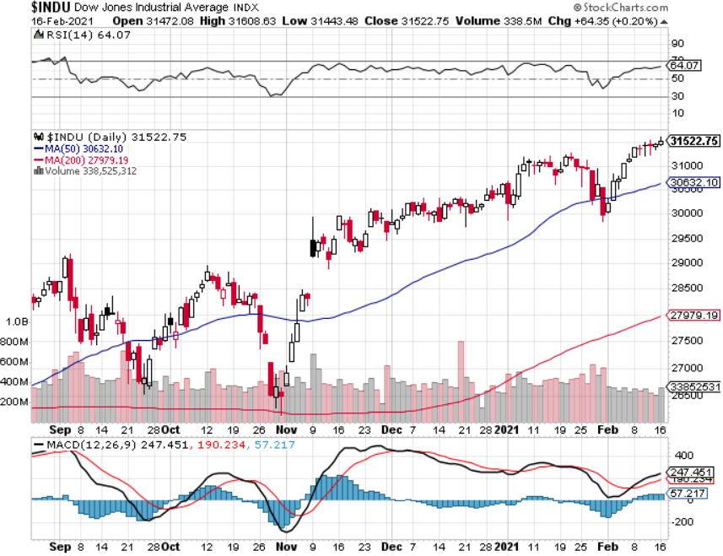
Dow Average ($INDU)-

Slide 20
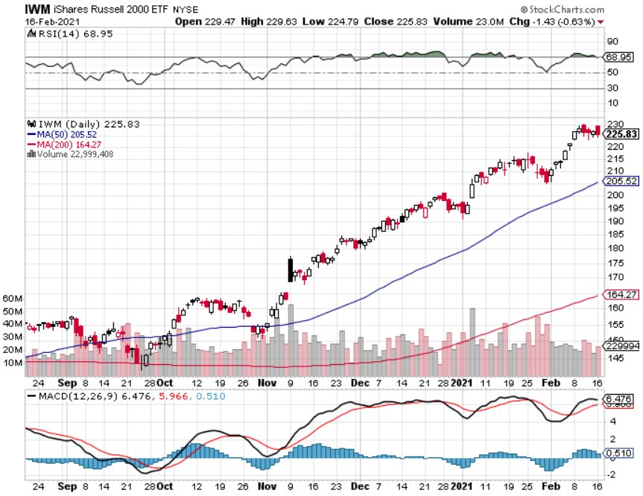
Russell 2000 (IWM)- took profits on Long 10/$137-$142 vertical bull call spread took profits on Long 10/$153-$156 vertical bear put spread

Slide 21
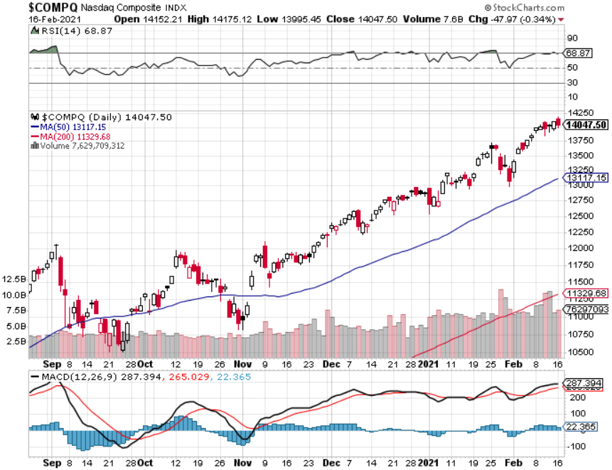
NASDAQ ($COMPQ) –

Slide 22
The Barbell Portfolio
*50% Big Tech - 2% of US Employment but 27% of Market Cap and 38% of Profits 50% Domestic Recovery, including: Railroads Couriers Banks Construction Credit Cards Event organizers Ticket sales Retailers

Slide 23
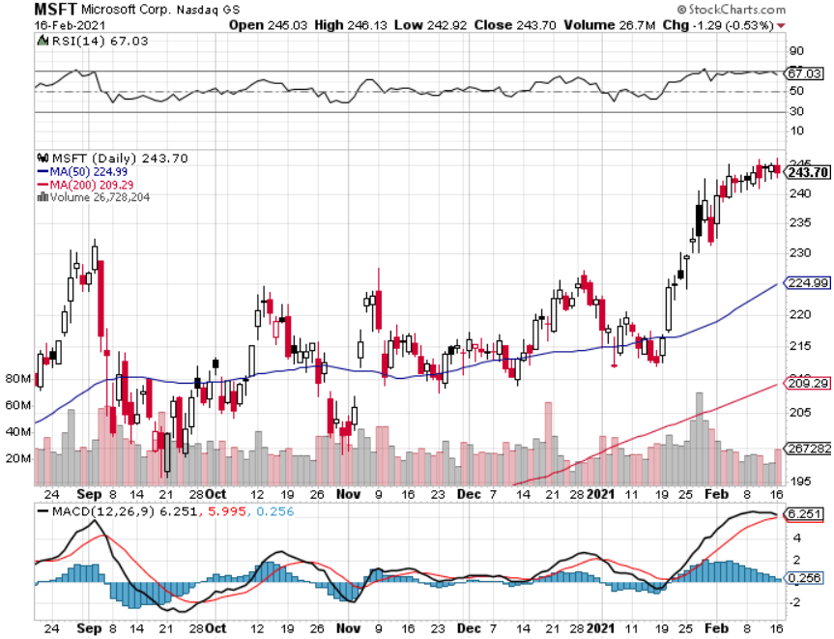
Microsoft (MSFT)- Earnings beat- Looking for Another Entry Point stop loss on long 12/$170-$180 call spread took profits on long 12/$135-$138 call spread

Slide 24
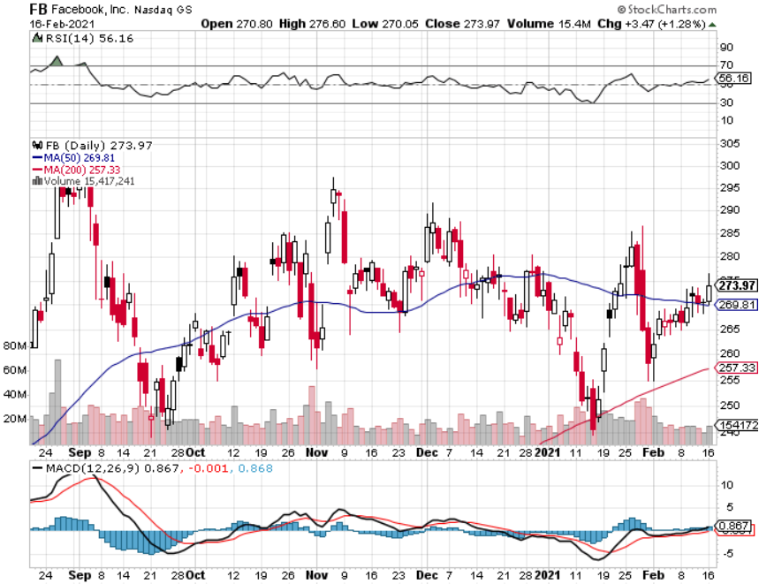
Facebook (FB)-New High took profits on Long 9/$290-$300 vertical bear put spread stopped out of Long 9/$190-$200 vertical bear put spread took profits on Long 9/$145-$155 vertical bull call spread took profits on Long 9/$150-$160 vertical bull call spread

Slide 25
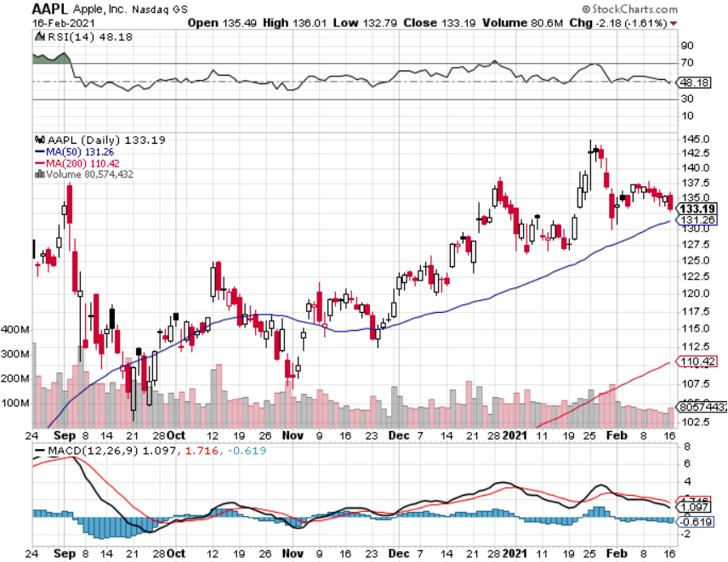
Apple (AAPL)- New 5G iPhone Surge Apple car moving forward with KIA took profits on long 7/$320-$330 call spread took profits on long 4/24/$250-$260 call spread took profits on long 5/$250-$260 call spread

Slide 26
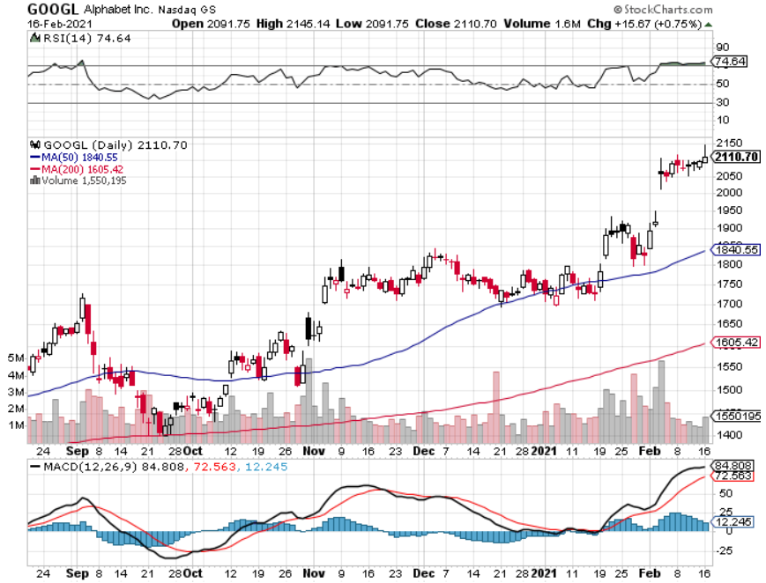
Alphabet (GOOGL) – took profits on long 12/$1,200-$1,230 bull call spread took profits on long 9/$1,030-$1,080 vertical bull call spread

Slide 27
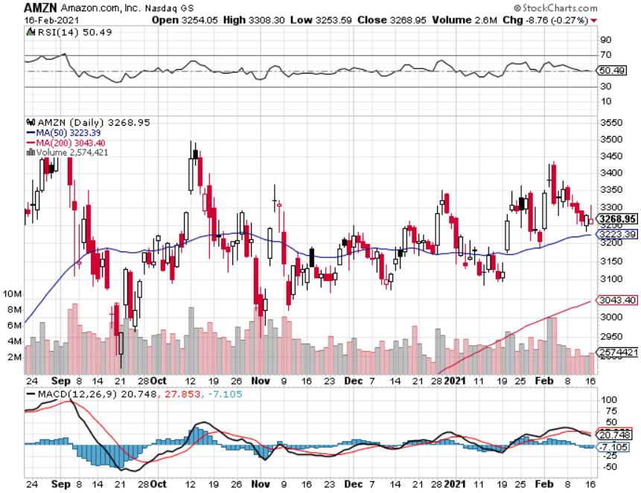
Amazon (AMZN) – Time correction took profits on long 9/$2,800-$2,900 bull call spread

Slide 28
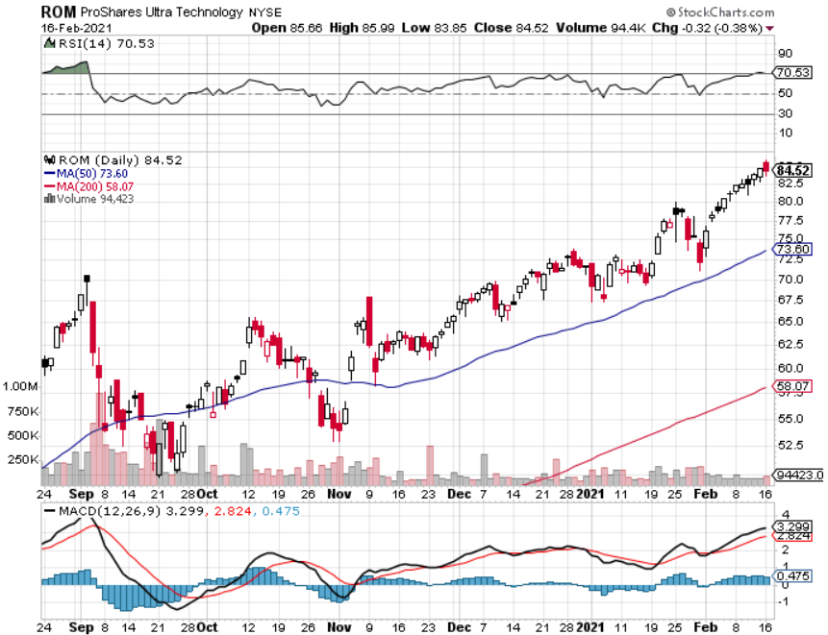
ProShares Ultra Technology (ROM) – Up 270% in 9 Months

Slide 29
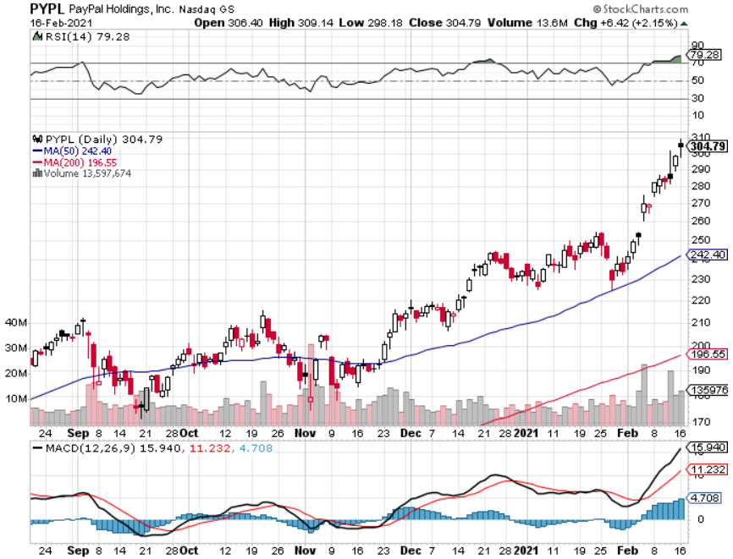
PayPal (PYPL)-Fintech Rules took profits on long 4/$90-$95 call spread

Slide 30
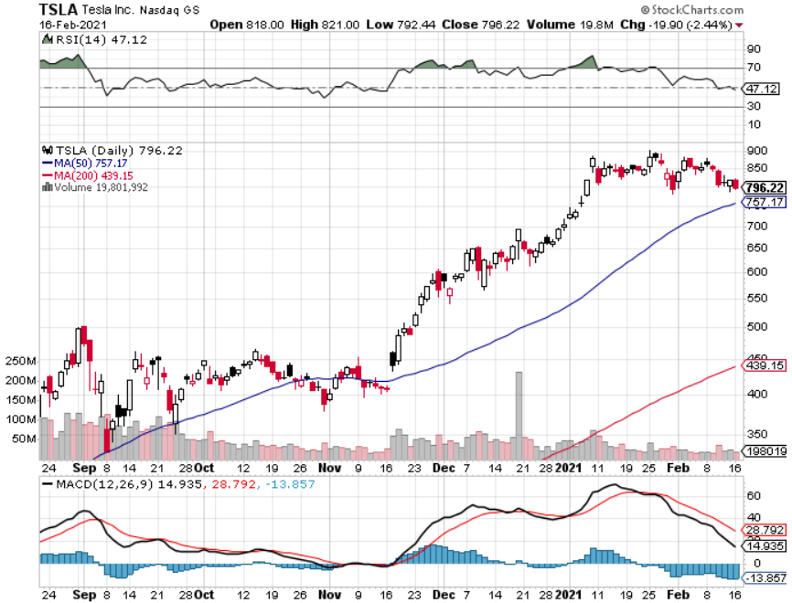
Tesla (TSLA)- Joining the S&P 500- 500,000 Target Achieved Piper Sandler Raises Target to $1,200, long 2/$650-$700 call spread-expires in 2 days, long 2/$600-$650 call spread-22 days Took profits on long 2/$600-$650 bull call spread, Took profits on long 2/$550-$600 bull call spread

Slide 31
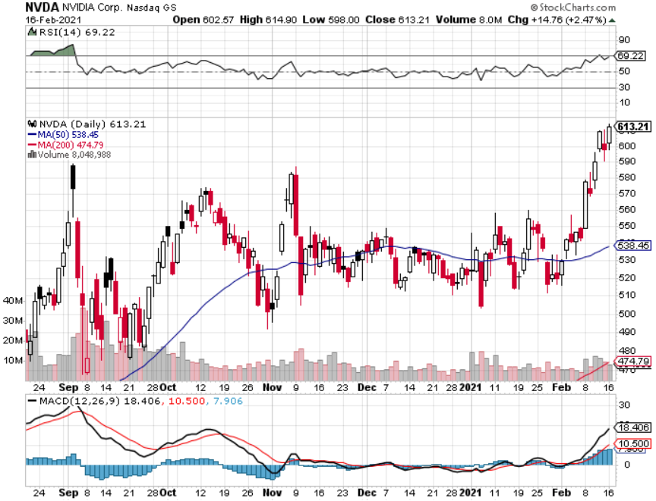
NVIDIA (NVDA) – The Biggest Chip Deal in History A Mad Hedge 10 bagger – Global Semiconductor Shortage Slows Auto Industry,

Slide 32
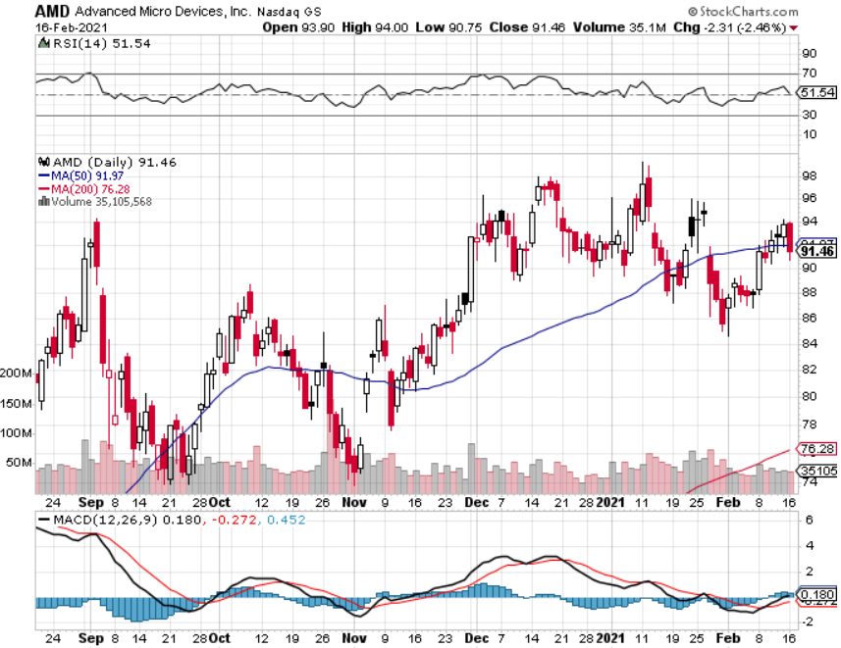
Advanced Micro Devices (AMD) – Global chips shortage long 2/$75-$80 call spread-expires in 2 days

Slide 33
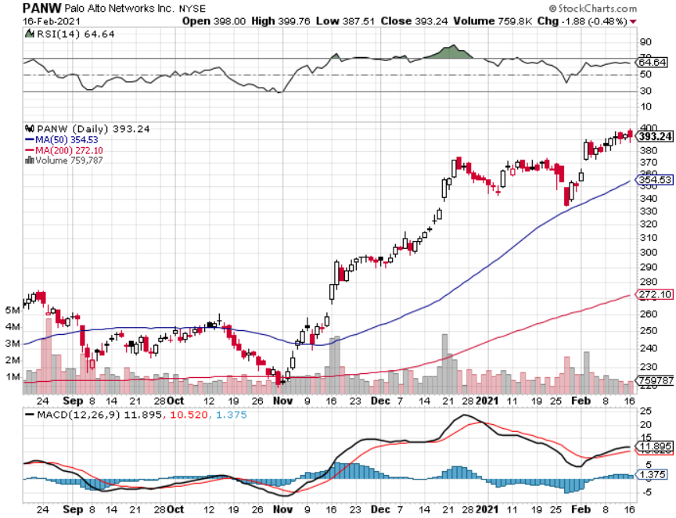
Palo Alto Networks (PANW)- New High Hacking never goes out of fashion

Slide 34
Advanced Micro Devices (AMD)- the next ten bagger - buys Xilinx – Programable logic devices long 2/$75-$80 call spread

Slide 35
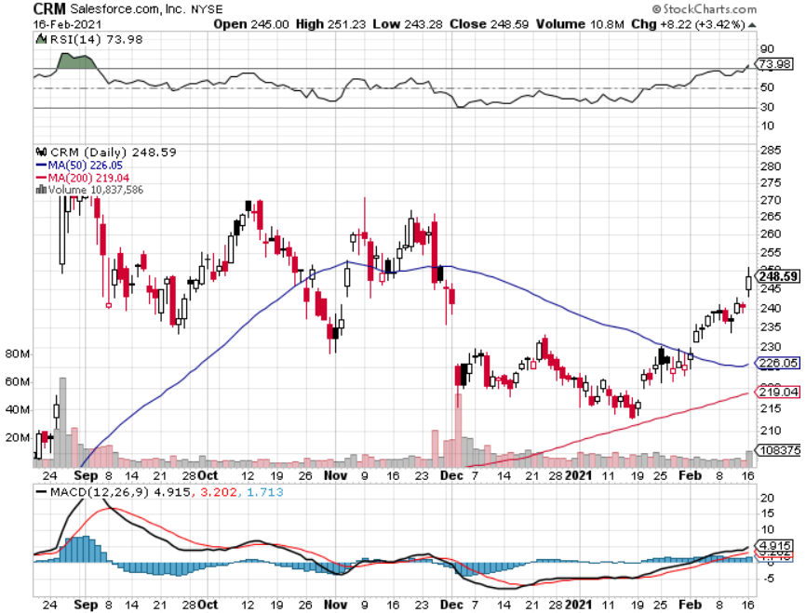
Salesforce (CRM)- Massive Online Migration took profits on long 9/$125-$130 vertical bull call spread took profits on long 8/$125-$130 vertical bull call spread took profits on long 2/$105-$115 call spread

Slide 36
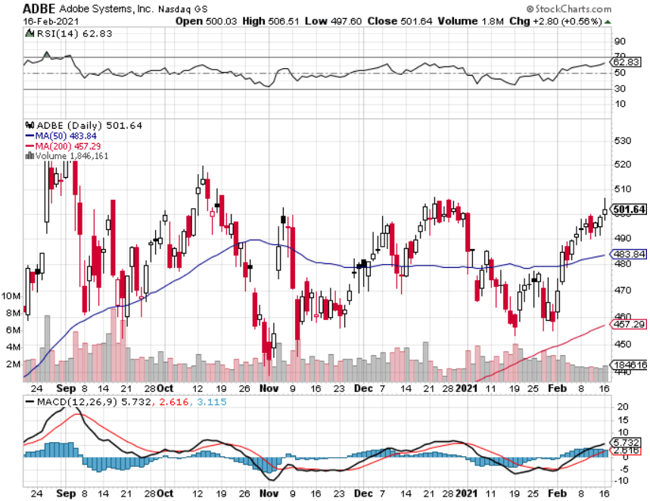
Adobe (ADBE)- Cloud play The Quality Non-China tech play

Slide 37
The Second Half of the Barbell
*Bets on a domestic recovery in 2021 *Upside potential in 2021 far greater than tech *Some of these have not moved for 5 or 10 years *Focuses on economically sensitive cyclical industries *Makes a great counterweight to high growth technology *We could spend all of next year rotating between the two groups

Slide 38
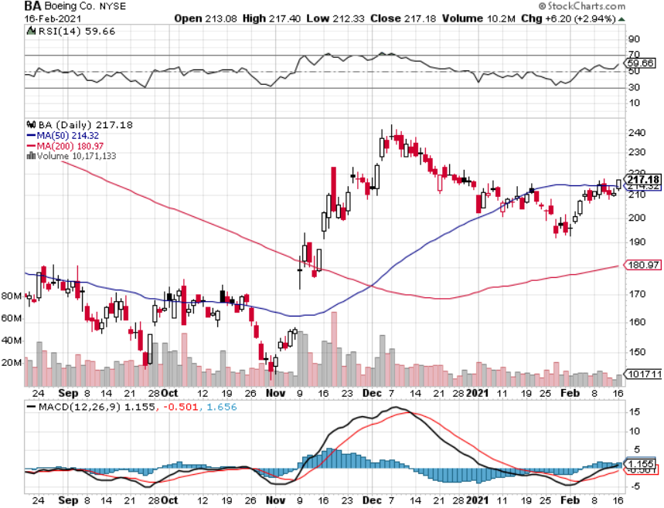
Boeing (BA) – former LEAP Candidate - The 737 MAX Flies Again! long 2/$150-$160 call spread-expires in 2 days

Slide 39
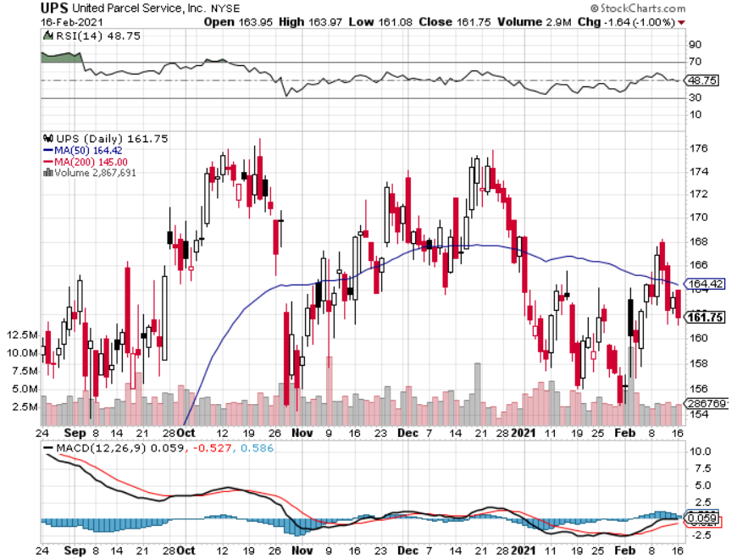
Package Delivery- United Parcel Service (UPS) – Weather Armageddon massive increase in overnight deliveries, announces blowout earnings took profits on long 11/$130-$140 call spread

Slide 40
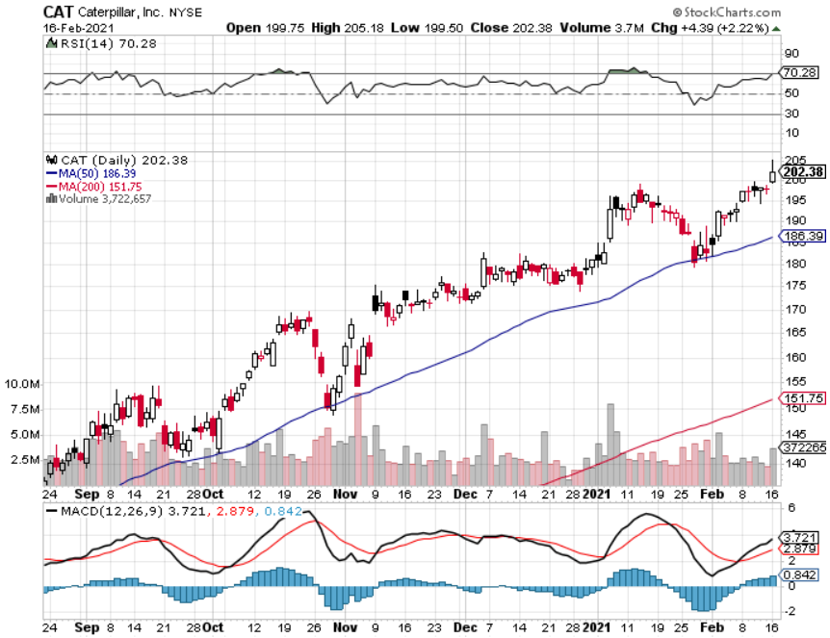
Caterpillar (CAT)- Ag + Infrastructure + Housing long 12/$145-$150 call spread took profits on long 11/$125-$135 call spread

Slide 41
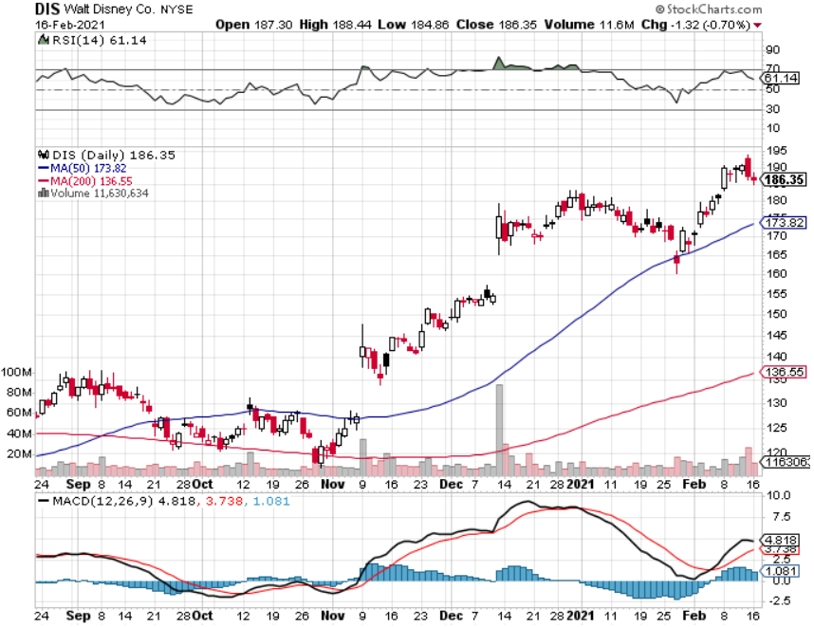
Walt Disney (DIS)- Big Recovery Move took profits on long 6/$85-$90 call spread

Slide 42
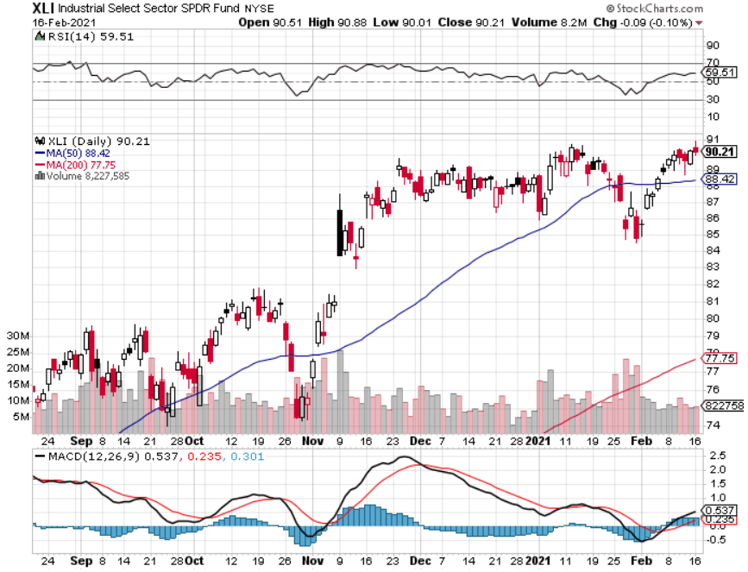
Industrials Sector SPDR (XLI)- (GE), (MMM), (UNP), (UTX), (BA), (HON)

Slide 43
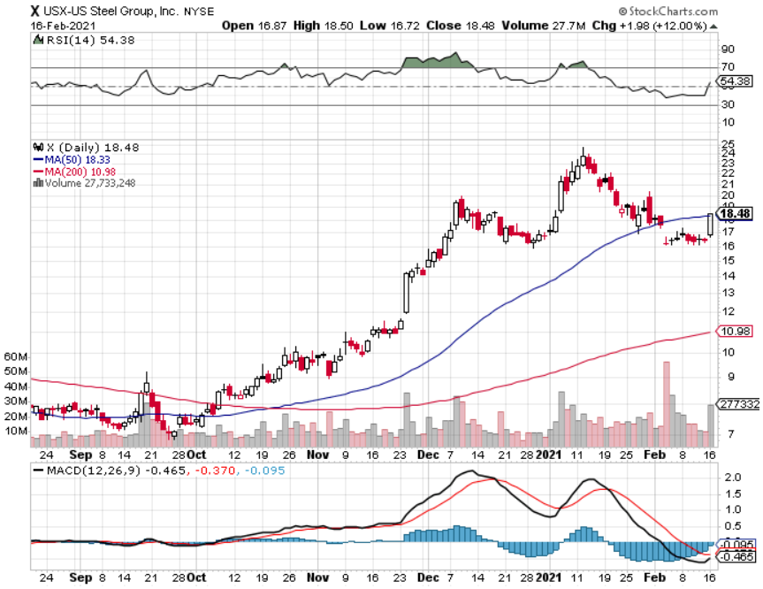
US Steel (X) – Commodity Boom

Slide 44
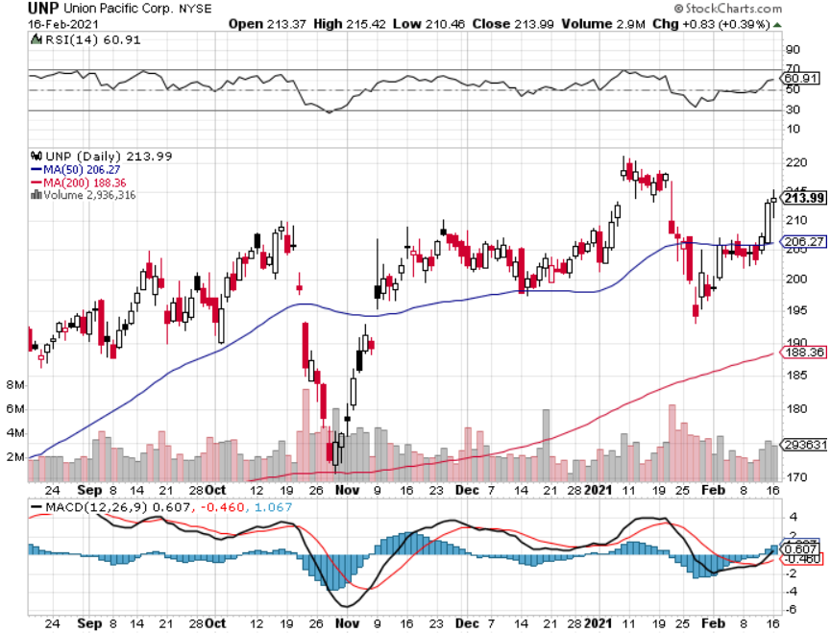
Union Pacific RR (UNP)- More stuff to ship near record earnings announced took profits on 11/$150-$160 call spread

Slide 45
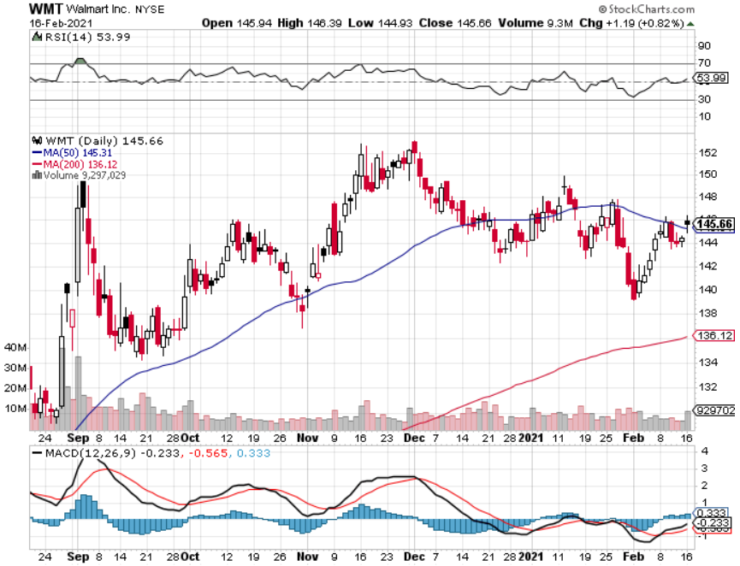
Wal-Mart (WMT)-New High took profit on Long 11/$125-$130 bear put spread took profit on Long 10/$119-$121 bear put spread took profits on Long 8/$114-$117 bear put spread

Slide 46
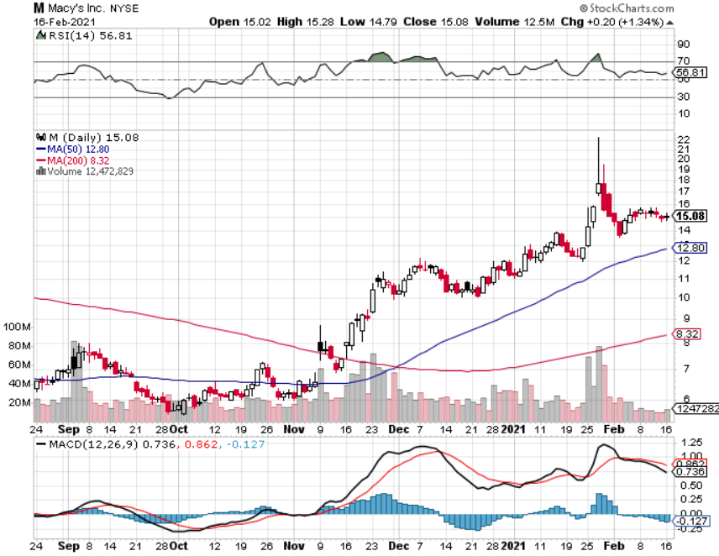
Macys’ (M) – Retail Return from the Grave took profits on Long 8/$23-$25 bear put spread

Slide 47
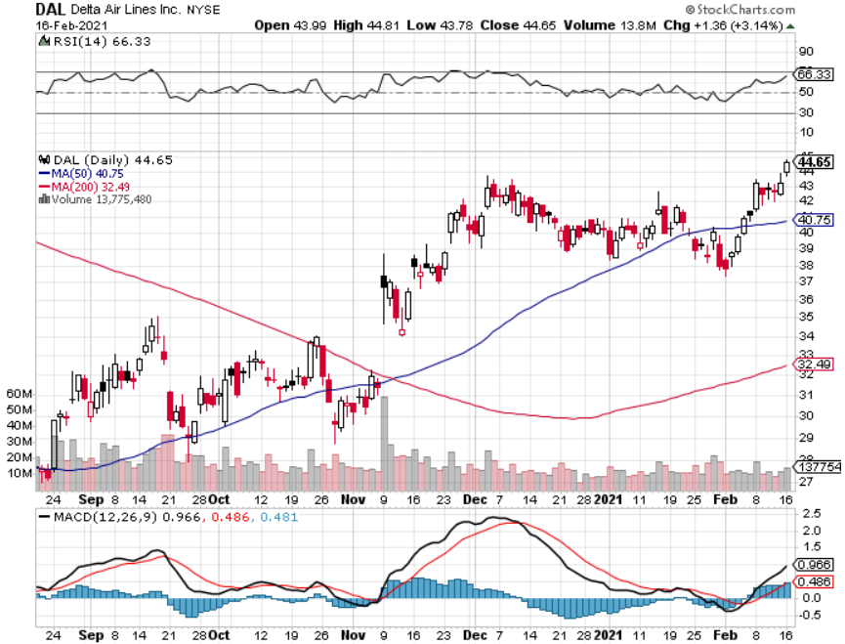
Delta Airlines (DAL) – Travel Renaissance coming

Slide 48
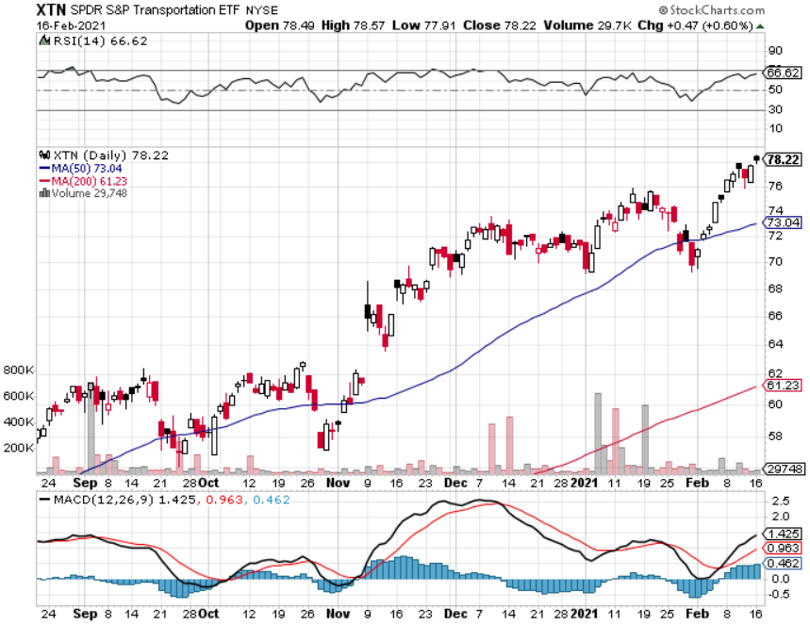
Transports Sector SPDR (XTN)- (ALGT), (ALK), (JBLU), (LUV), (CHRW), (DAL)

Slide 49
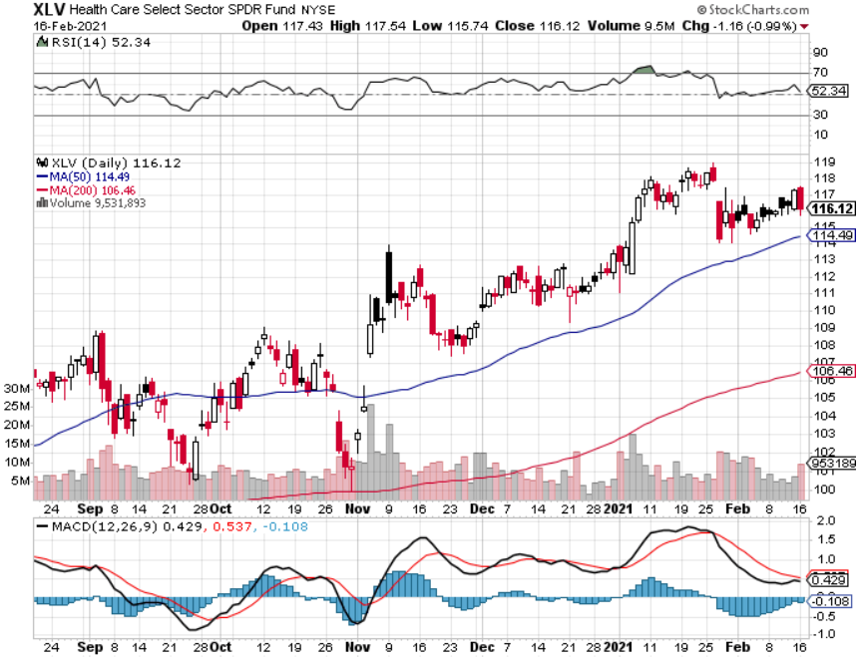
Health Care Sector (XLV), (RXL) (JNJ), (PFE), (MRK), (GILD), (ACT), (AMGN)

Slide 50
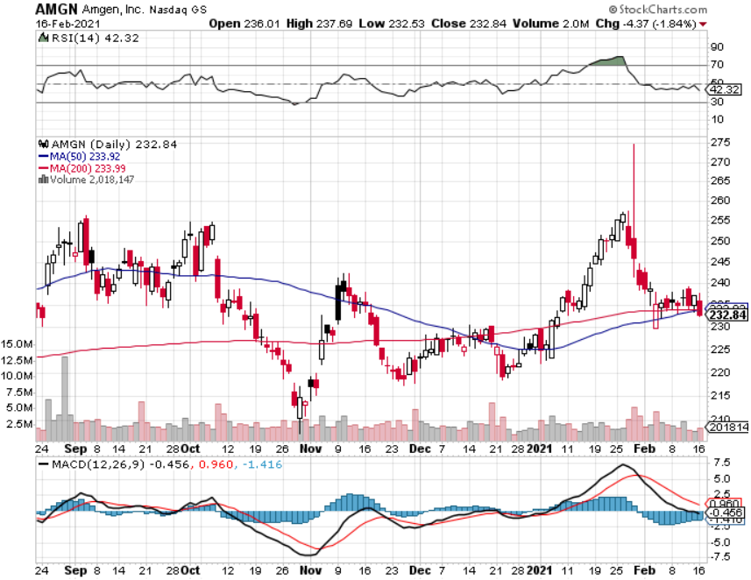
Amgen (AMGN) took profits on long 11/$185-$200 bull call spread

Slide 51
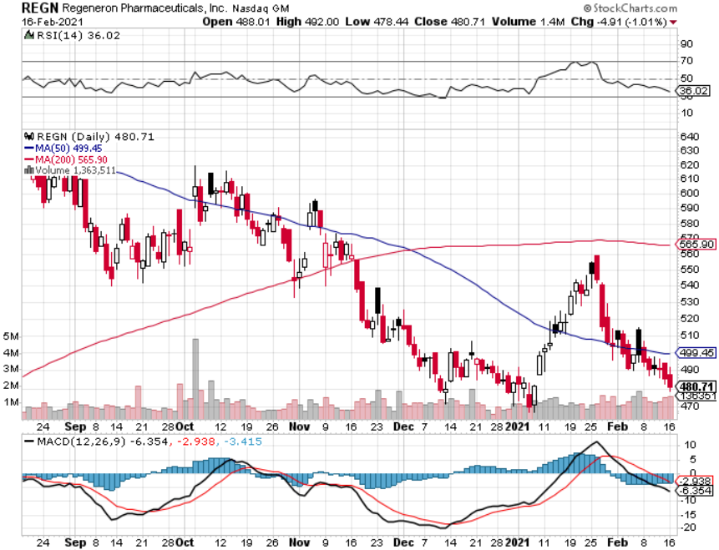
Regeneron (REGN) took profits on long 7/$570-$580 call spread

Slide 52
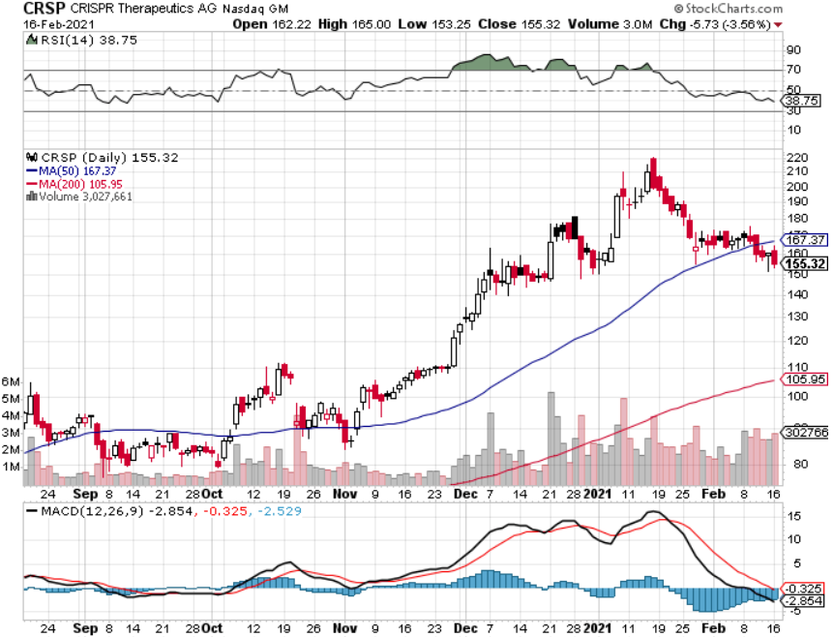
CRISPR Therapeutics (CRSP)

Slide 53
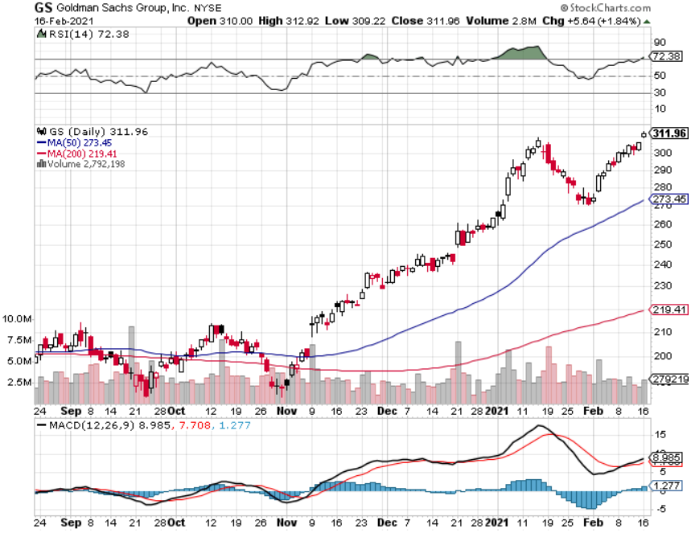
Goldman Sachs (GS) – Blowout earnings long 2/$240-$260 call spread-expires in 2 days

Slide 54
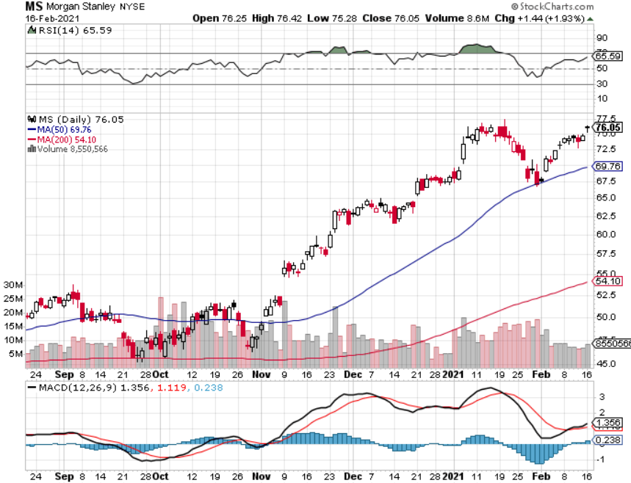
Morgan Stanley (MS) – Blowout Earnings long 2/$55-$60 call spread-expires in 2 days

Slide 55
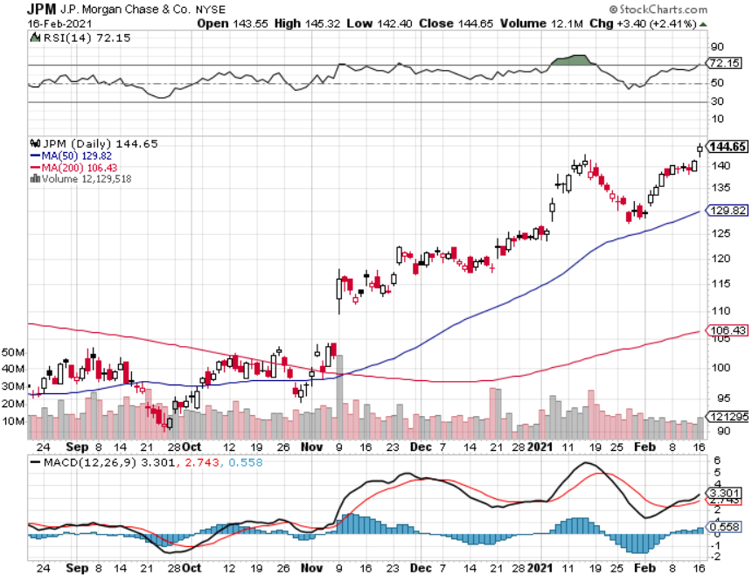
JP Morgan Chase (JPM)-Rising Rates took profits on long 2/$110-$115 call spread took profits on long 12/$100-$105 bull call spread took profits on long 11/$85-$90 bull call spread took profit on long 11/$110-$115 bear put spread took profits on long 9/$90-$95 bull call spread

Slide 56
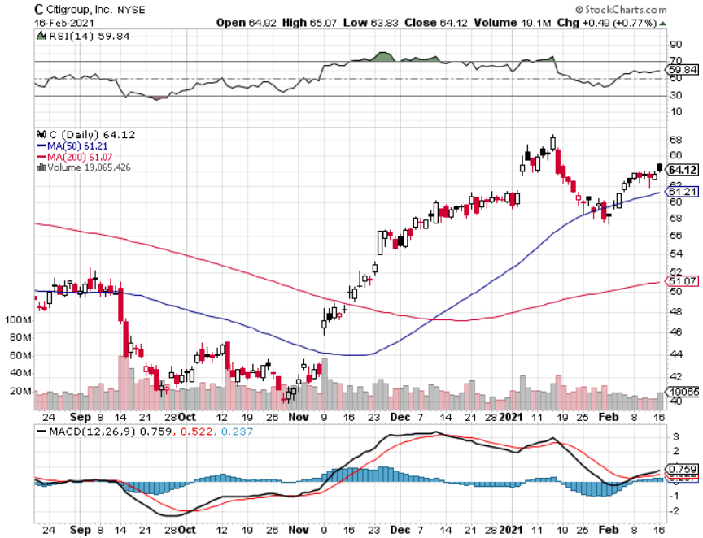
Citigroup (C) – “Recovery” Rotation Play

Slide 57
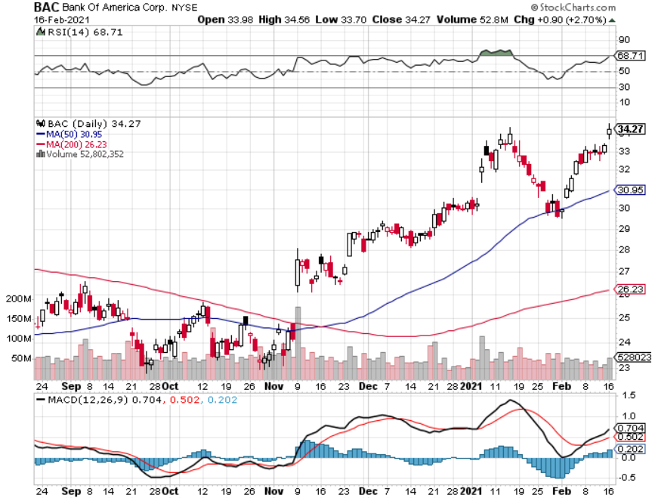
Bank of America (BAC) – long 2/$28-$30 call spread-expires in 2 days

Slide 58
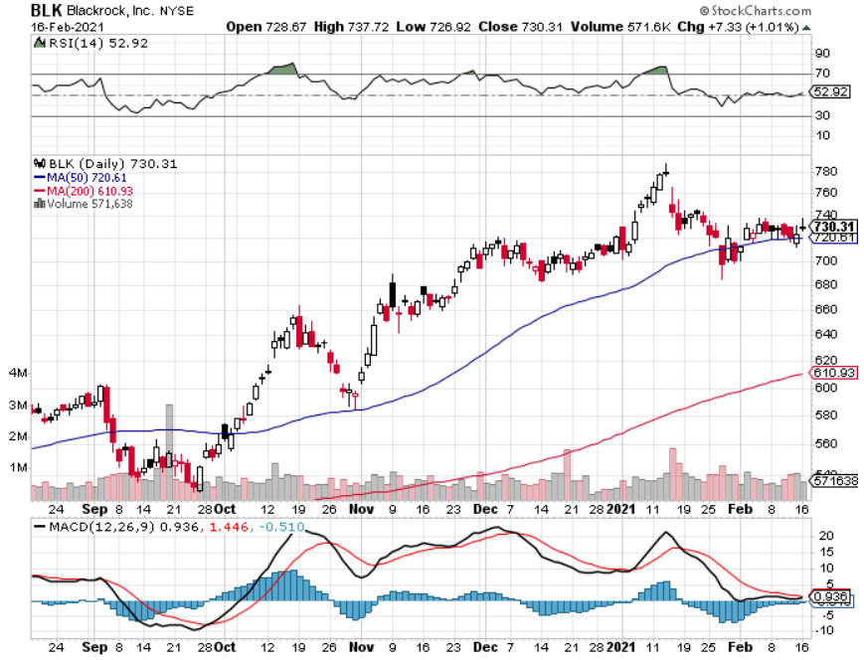
Blackrock (BLK)-Asset Collection Boom long 2/$640-$660 call spread-expires in 2 days

Slide 59
Visa (V) – “Touchless” Fintech Play stopped out of long 11/$180-$185 bull call spread took profits on long 9/$180-$185 bull call spread

Slide 60
Consumer Discretionary SPDR (XLY) (DIS), (AMZN), (HD), (CMCSA), (MCD), (SBUX)

Slide 61
Coca-Cola (KO)- Dividend Play and bond broxy-3.24% yield long 2/$44-$47 call spread-expires in 2 days

Slide 62
Europe Hedged Equity (HEDJ)-

Slide 63
Japan (DXJ)-

Slide 64
Emerging Markets (EEM) - Pro trade, Weak Dollar, long recovery Play

Slide 65
Bonds – Bombs Away!
*Bombs Away for the Bond Market, as the (TLT) hits a new 2021 low, taking ten year yields up to 1.32%. *I’m piling money into financials, which love higher interest rates and are an indirect bond short *Buy (JPM), (BAC), (C), (MS), (GS), and (BLK) on dips. *A 1.50% yield on the ten-year US Treasury bond here we come! This is the quality trade of 2021 *(TBT) up 40% in 3 months *Weakening dollar has scared away many foreign buyers *US Treasury bond fund (TLT) could plunge from $180 to $105, taking interest rates from 0.31% to 3.25%

Slide 66
Treasury ETF (TLT) – Huge Short Play took profits on long 2/$158-$161 put spread took profits on long 2/$159-$162 put spread took profits on long 2/$162-$165 put spread

Slide 67
Ten Year Treasury Yield ($TNX) – 1.32%

Slide 68
Junk Bonds (HYG) 3.45% Yield to Maturity

Slide 69
2X Short Treasuries (TBT)-Another run at highs

Slide 70
Emerging Market Debt (ELD) 4.20% Yield-

Slide 71
Municipal Bonds (MUB) – 0.85% Mix of AAA, AA, and A rated bonds

Slide 72
Foreign Currencies – New Dollar Lows
*Jay Powell says no rate rise, prompting dollar dive and strong currencies *Any dollar rallies are temporary and short-term *With equities soaking up the world’s cash, trading volume and volatility is falling in the forex markets *Bitcoin hits new high at $49,000 *Aussie takes another run towards parity *Keep selling short all US dollar rallies, its yield support is gone forever

Slide 73
Japanese Yen (FXY), (YCS)

Slide 74
Euro ($XEU), (FXE), (EUO)-

Slide 75
British Pound (FXB)-

Slide 76
Australian Dollar (FXA)- The Global Recovery Play took profits on long 8/$67-$69 call spread

Slide 77
Emerging Market Currencies (CEW)

Slide 78
Chinese Yuan- (CYB)-

Slide 79
Bitcoin- Gone Ballistic, up 10X in 9 Months Volatility is 10X that of (SPX)

Slide 80
Energy – New Highs
*Energy Armageddon in Texas spikes prices $10, cuts off 4 million energy consumers, and freezes windmills. Climate change comes home to roost *Biden creates an oil shortage driving prices higher by banning drilling on federal lands, taking 3 million barrels a day off the market *Banning new drilling on federal lands takes 3 million barrels a day off the market *Will Biden bring Iran oil back on to the market, another 3 million b/d? *Demand won’t reach 2019 levels until well into 2022 *Saudi production increase will cap any oil rally….forever *Avoid all energy plays like the plague, it’s the new buggy whip industry as the US de-carbonizes

Slide 81
Oil-($WTIC)

Slide 82
United States Oil Fund (USO) long 10/$9.50-$10 Vertical bull call spread

Slide 83
Energy Select Sector SPDR (XLE)-No Performance! (XOM), (CVX), (SLB), (KMI), (EOG), (COP)

Slide 84
Halliburton (HAL)-

Slide 85
Natural Gas (UNG) -

Slide 86
Precious Metals – Gone to Sleep
*Gold has turned into a bond long and and Bitcoin short and I don’t want either *Bitcoin surge is pulling cash out of precious metals *However, any declines will be temporary and QE demand continues *The long-term bull trend still lives, with gold up 20% in 2020, the best in 10 years *Traders are shifting to Silver as an economic, industrial plays *Near zero interest rates and collapsing US dollar is another gold & silver incentive *Bottom Line: buy this dip in gold and precious metals

Slide 87
Gold (GLD)- Short Term downtrend took profits on long 9/$171-$174 call spread took profits on long 8/$169-$172 call spread took profits on long 7/$157-$160 call spread

Slide 88
Market Vectors Gold Miners ETF- (GDX) –

Slide 89
Barrick Gold (GOLD) took profits on long 1/$21-$23 call spread took profits on long 11/$22-$24 call spread

Slide 90
Newmont Mining- (NEM)- took profits on long $55-60 call spread

Slide 91
Silver- (SLV)- took profits on long 11/$19-$20 call spread

Slide 92
Silver Miners - (SIL)-

Slide 93
Wheaton Precious Metals - (WPM)- took profits on long 2/$39-41 call spread

Slide 94
Copper (COPX)-Finally a break

Slide 95
Freeport McMoRan (FCX)-World’s Largest Copper Producer took profits on long 4/$10-$11 call spread took profits on short 4/$114 calls

Slide 96
Real Estate – Bidding Wars
*Bidding wars soar on inventory shortage, topping 56% of all transactions *More than half of homes closing in two weeks *Existing Home Sales Soar to 15-year High, up an amazing 22% YOY in December to a seasonally adjusted 6.76 million units. *Inventories hit all-time lows at only 1.9 months *Housing prices are still exploding to the upside with S&P Case Shiller Rose 9.5% in November, the one-month biggest spike in history

Slide 97
November Corelogic S&P Case Shiller Home Price Index Phoenix (13.8%), Seattle (12.7%), and San Diego (12.3%)
Tradingeconomics.com

Slide 98
Simon Property Group (SPG)- Mall REIT A Huge Vaccine Play

Slide 99
Crown Castle International (CCI) – 3.40% yielding cell phone Tower REIT

Slide 100
US Home Construction Index (ITB) (DHI), (LEN), (PHM), (TOL), (NVR)

Slide 101
Trade Sheet- So What Do We Do About All This?
*Stocks – buy dips aggressively *Bonds – sell rallies aggressively *Commodities-buy dips *Currencies- sell US dollar rallies *Precious Metals – buy dips *Energy – stand aside *Volatility - sell short over $40 *Real estate – buy dips

Slide 102
Next Strategy Webinar 12:00 EST Wednesday, March 3, from Lake Tahoe, NV email me questions at support@madhedgefundtrader.com
Good Luck and Good Trading!
Notes:
*

