Slide 1
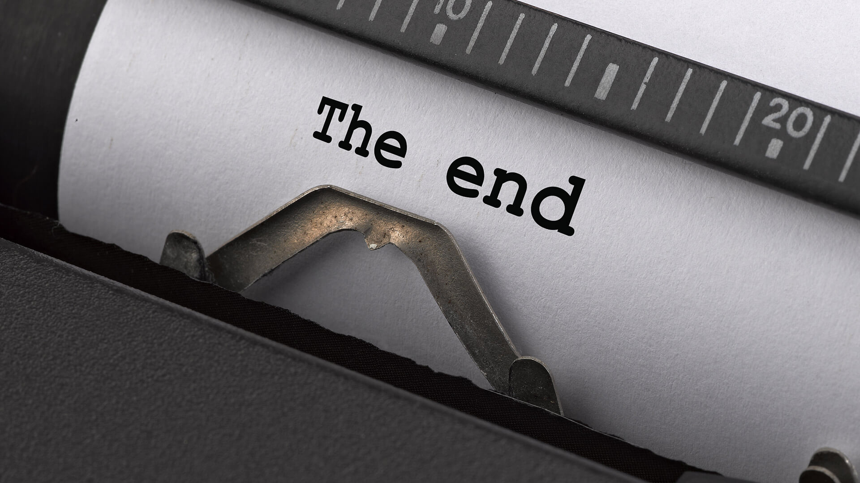
The Mad Hedge Fund Trader “The Correction is Over”
With John Thomas from Silicon Valley, April 28, 2021 www.madhedgefundtrader.com
Notes:
*

Slide 2
Trade Alert Performance New All Time Highs!
*January 10.21% MTD *July +7.93% Final *February +13.28% Final *August -2.08% Final *March +20.60% Final *September 7.95% Final *April +12.67% MTD *October +1.51% Final *May +14.19% Final *November +20.41% Final *June +10.38% Final *December +10.20% Final *2021 Year to Date +56.76% compared to +11.50% for the Dow Average *+479.31% since inception, a new all time high *Average annualized return of 42.01% for 11 years, new all time high

Slide 3
Portfolio Review 80% long Invested in a low volatility Long Term Bull Market
Current Capital at Risk
Risk On
World is Getting Better
(TLT) 5/$143-$146 put spread | 10.00%
(TLT) 5/$144-$147 put spread | 10.00%
(TLT) 5/$145-$148 put spread | 10.00%
(V) 5/$195-$205 call spread | 10.00%
(JPM) 5/$135-$140 call spread | 10.00%
(FCX) 5/$30-$33 call spread | 10.00%
(GS) 5/$310-$320 call spread | 10.00%
(UNP) 5/$200-$210 call spread | 10.00%
Risk Off
World is Getting Worse
No positions
Total Net Position | 80.00%
Expiration P&L +62.63 YTD

Slide 4
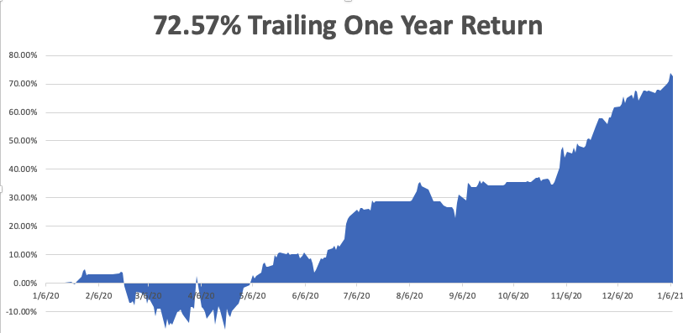
January 28-What Happens When Goldilocks Moves In?

Slide 5
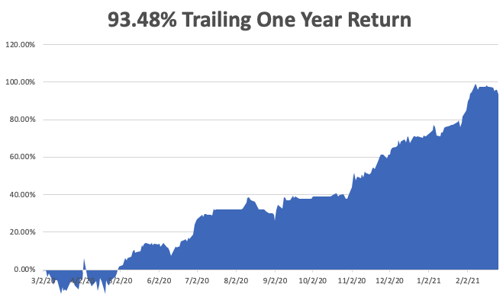
March 4

Slide 6
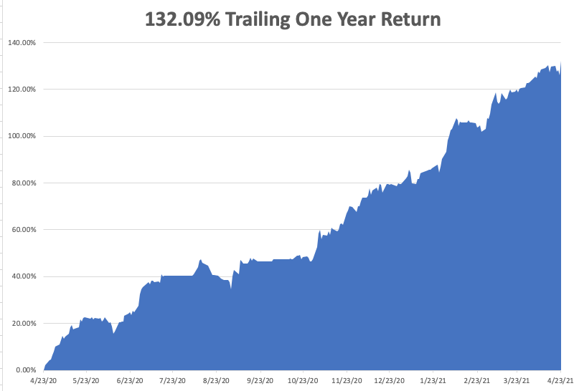

Slide 7
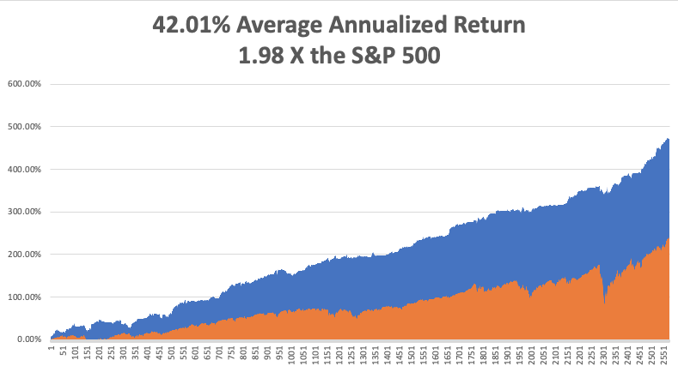
GTD 11 Year Daily Audited Performance

Slide 8
The Method to My Madness The Roaring Twenties are Here
*Bonds are still the driver, with the ten-year yield hitting 1.76%, then dropping to 1.51% *A range trading Bond Market brings a range trading stock market *It’s now, all about a global economic recovery and “RISK ON” *Commodity boom continues, with industrial metals hitting new highs, dragging oil upward *Bitcoin has become the best risk indicator in the market, topping a new high of $66,000, then crashing to 41,000 *A VIX at $16 means that stock moves will be limited in the near future, bringing a slow grind up *Historically interest rates are still extremely low and will be until a 3.0% ten-year yield

Slide 9
Corona Update – End of the Pandemic
*Massive distribution effort is proving hugely successful, 200 million of the US population has been vaccinated, or 5 million a day, 12–16-year-olds soon to qualify for the Pfizer vaccine *New cases have fallen off a cliff, from 250,000 a day to 60,000, down 76%. The population is acting like herd immunity has already begun! *In a year, everyone with either be vaccinated, have had the disease, or be dead. *Every pandemic parameter started shrinking dramatically on January 20 *At least 50 variants now in circulation, with the most contagious and fatal one now dominant *We may hit a vaccine glut by May so watch out for (PFE), (JNJ), (MRNA) *US cases top 32 million, deaths topping 572,000 and are down to 600 a day

Slide 10
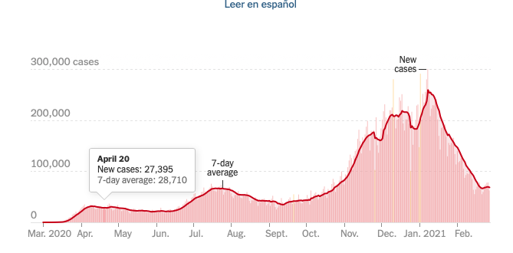
On the Way to Zero

Slide 11
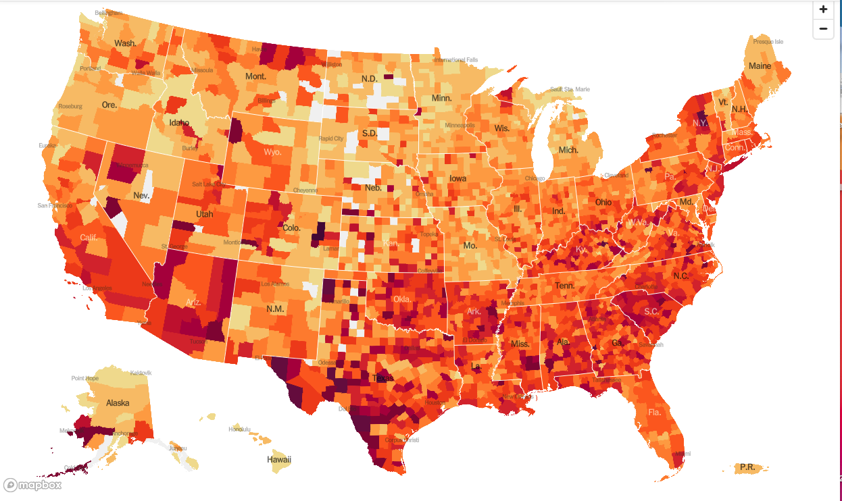
January 20 Infection Rate

Slide 12
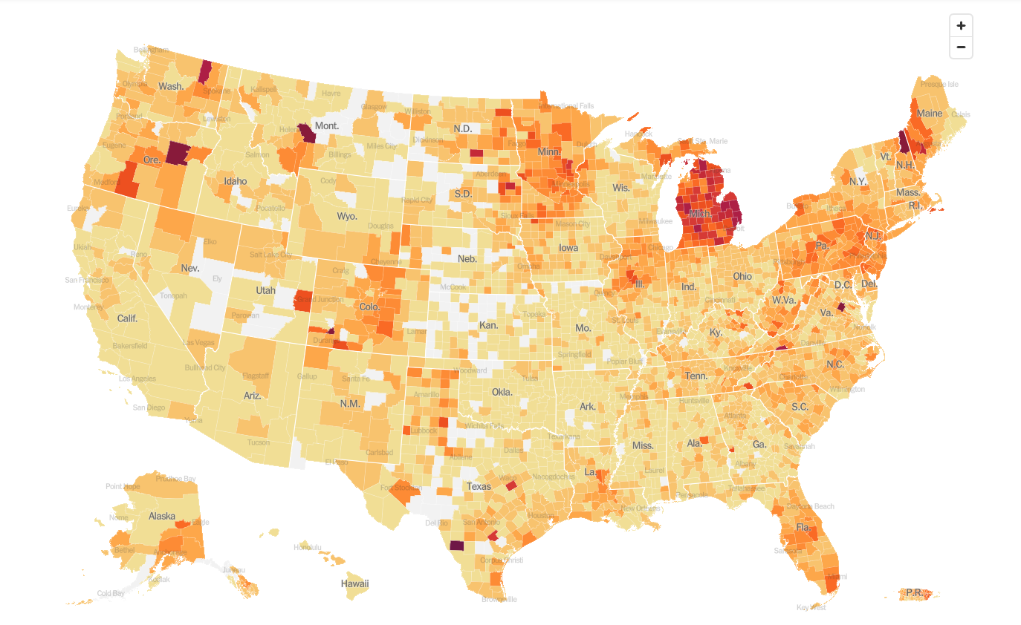
April 28 Infection Rate

Slide 13
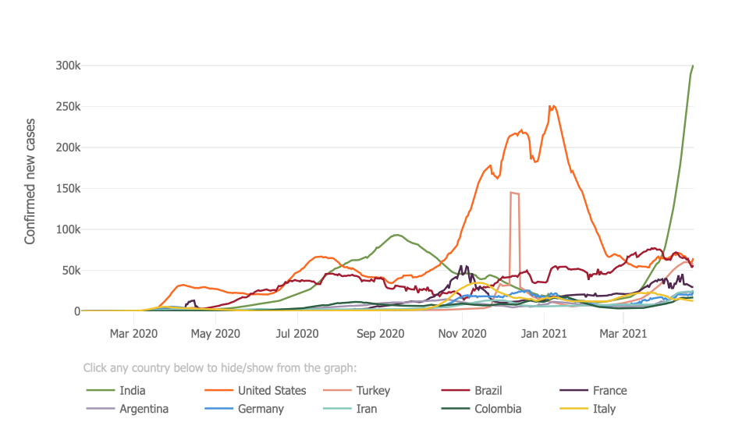

Slide 14
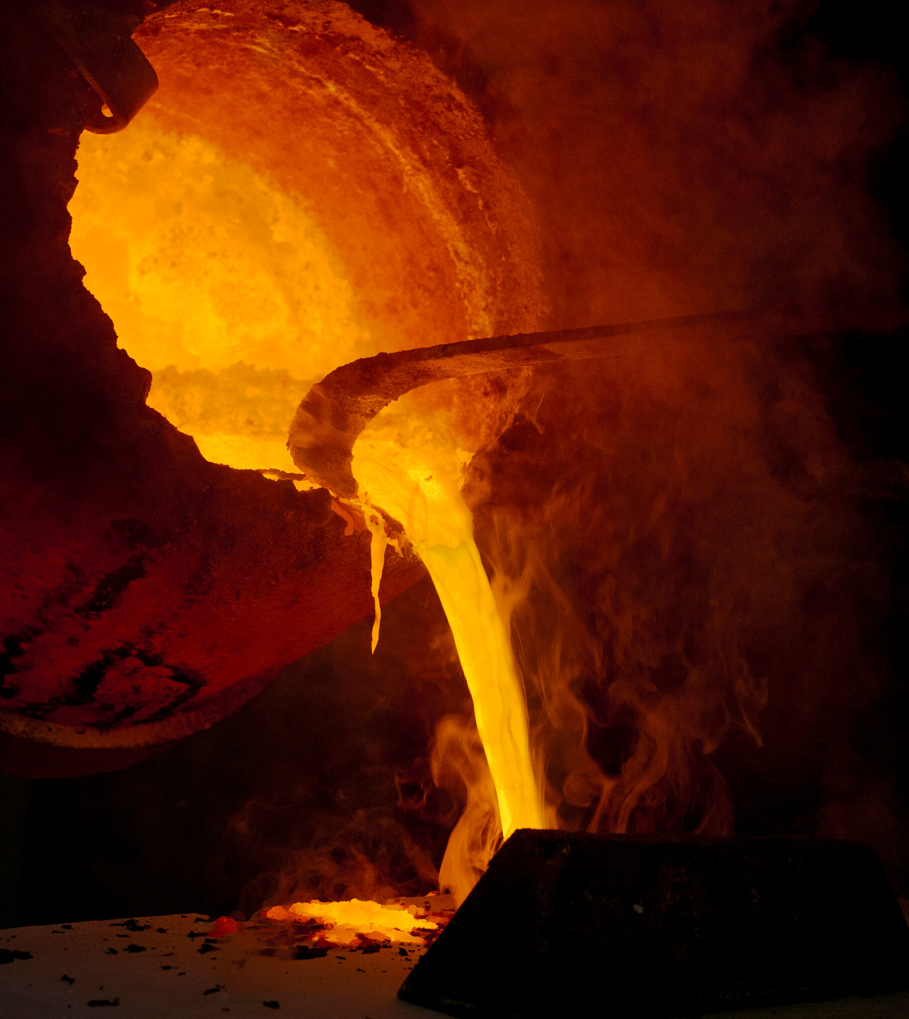
The Global Economy – Hot to Hotter
*Retail Sales Explode in March, up a staggering 9.8% *Weekly Jobless Claims Collapse to 576,000, a new pandemic low *Yellen Sets Zero Emissions Target for 2035. That sets up one of the biggest investment opportunities of the century *Labor shortages are developing across the country *Analysts are now looking for 43% earnings growth in Q2, 55% in Q3, and 75% in Q4 *These are WWII type numbers.
*China’s GDP Grew by a Staggering Record 18.3% in Q1

Slide 15
Stocks – New Highs
*Biden’s rumored proposal that high end earners will see doubled capital gains taxes knocked 500 points of the Dow in seconds. But 90% of stock held in tax exempt accounts. Only affects earners over $1 million *US Stock Funds Take in Record $157 Billion in March. Cash is Still Pouring off the Sidelines *The $1.9 trillion rescue package could be the turbocharger for hyper growth and greater gains and a $2.3 trillion infrastructure deal could keep stocks running for years *Tech comes Back from the dead, ending an eight-month correction *Bond rally and falling interest rates bring a tech rally that could last to yearend *At least another 18% in gains left for 2021, (SPX) 4,800 here we come *Stick with the barbell strategy, we’ll keep rotating back and forth all year between tech & domestic recovery *We could be entering a wide $2,700 - $3,600 range until the election

Slide 16
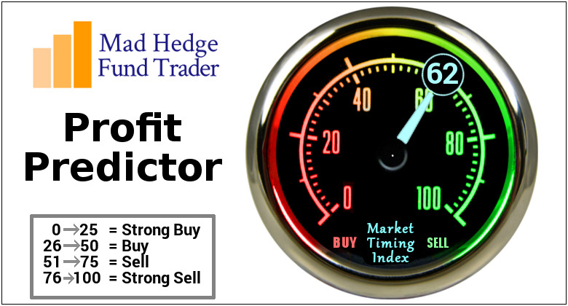
The Mad Hedge Profit Predictor Market Timing Index-Bottom of Range-at a “BUY” An artificial intelligence driven algorithm that analyzes 30 different economic, technical, and momentum driven indicators

Slide 17
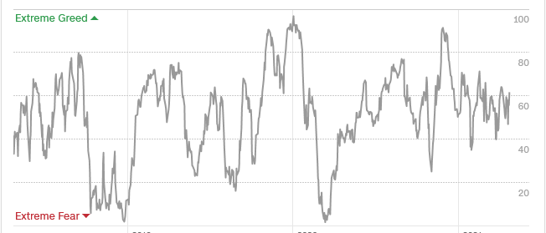
The Mad Hedge Profit Predictor Springboard for a Monster Rally
SELL
Do Nothing
BUY

Slide 18
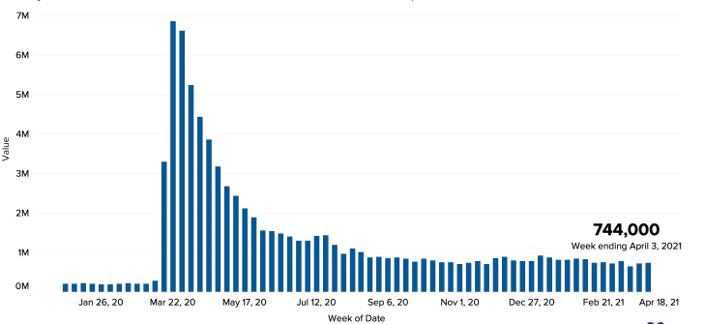
Weekly Jobless Claims – Flatlining at record highs 547,000New Pandemic Low

Slide 19
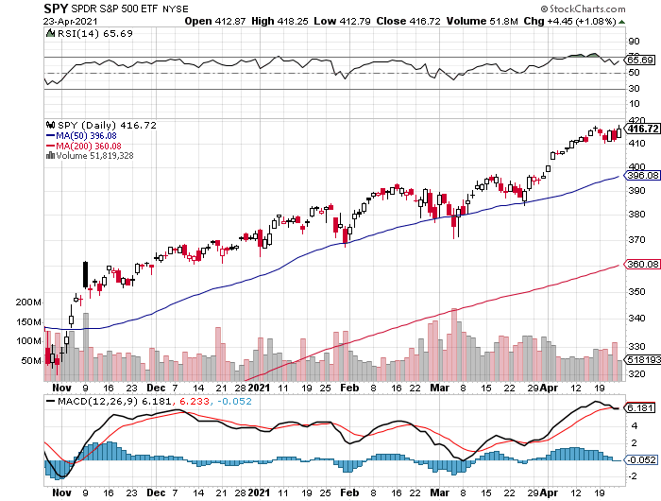
S&P 500 – New Highs
New Highs
The Bottom 390

Slide 20
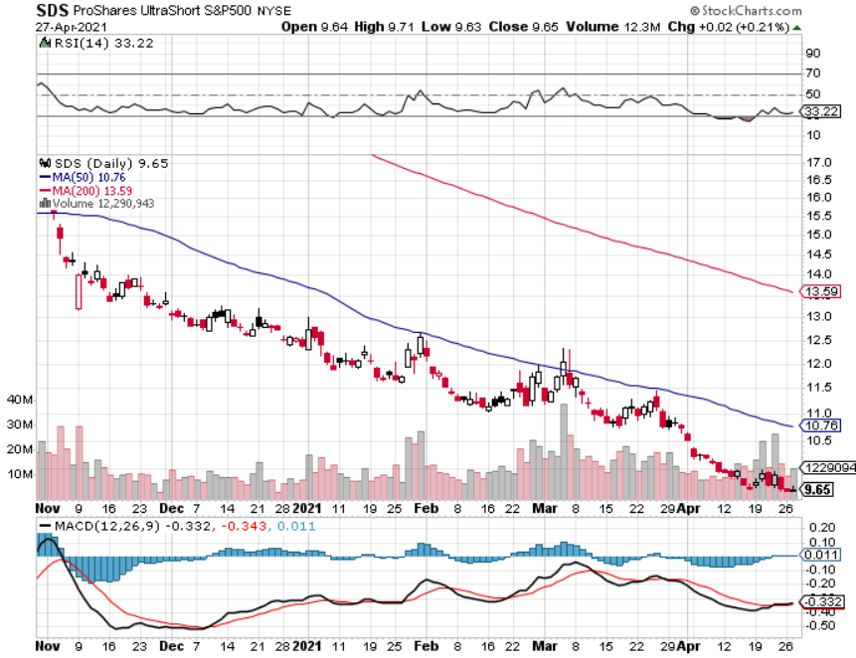
ProShares Ultra Short S&P 500 (SDS)- a Great Hedge for long stocks and bonds Long 2X position has a hedge against longs and bond shorts

Slide 21
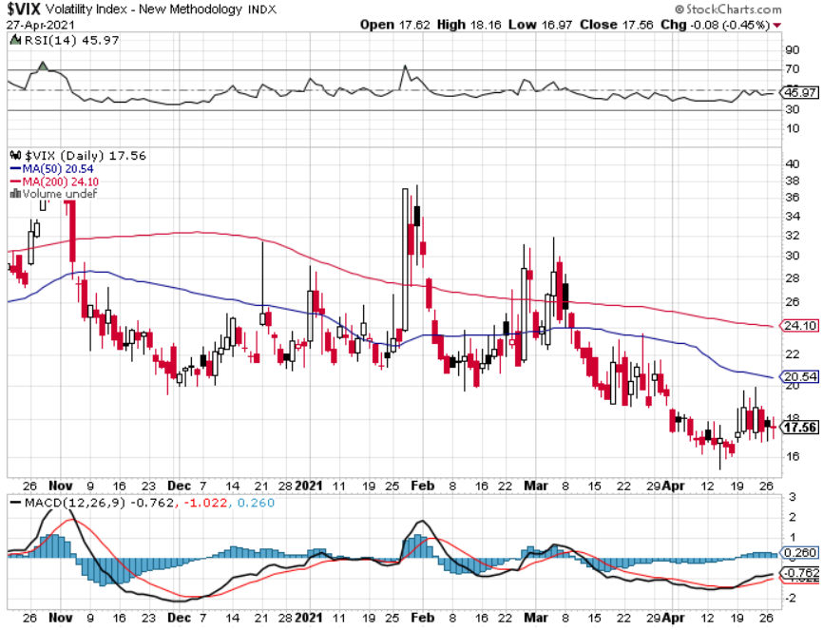
(VIX) – Dying a Slow Death The summer market is early

Slide 22
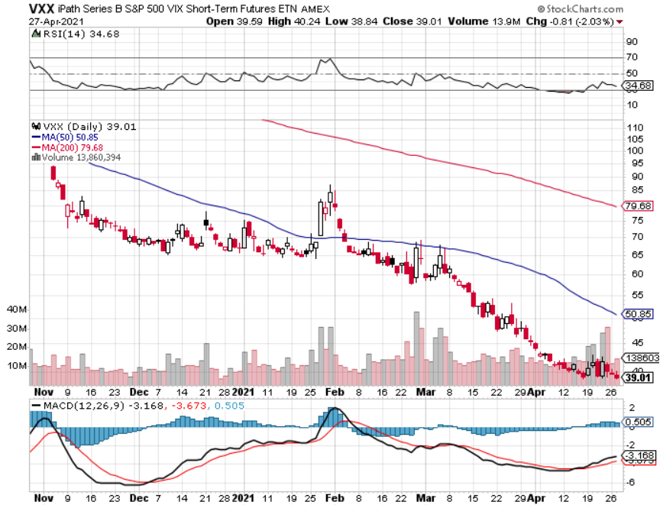
(VXX)-

Slide 23
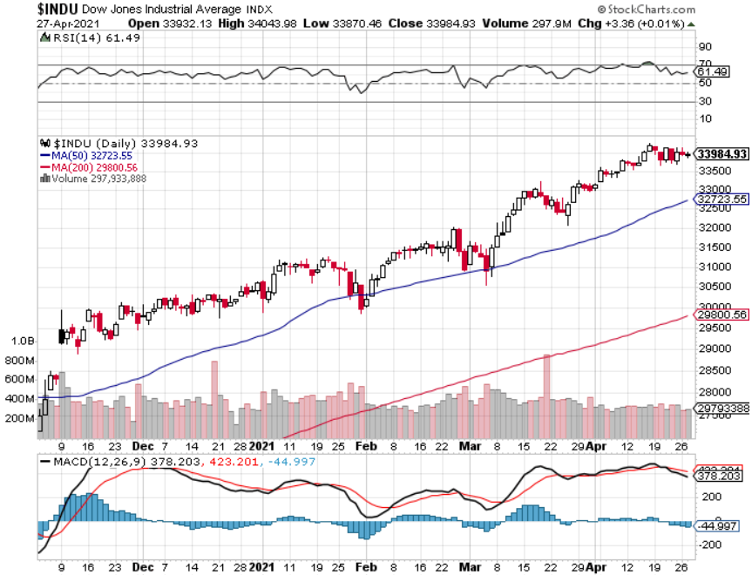
Dow Average ($INDU)- New High

Slide 24
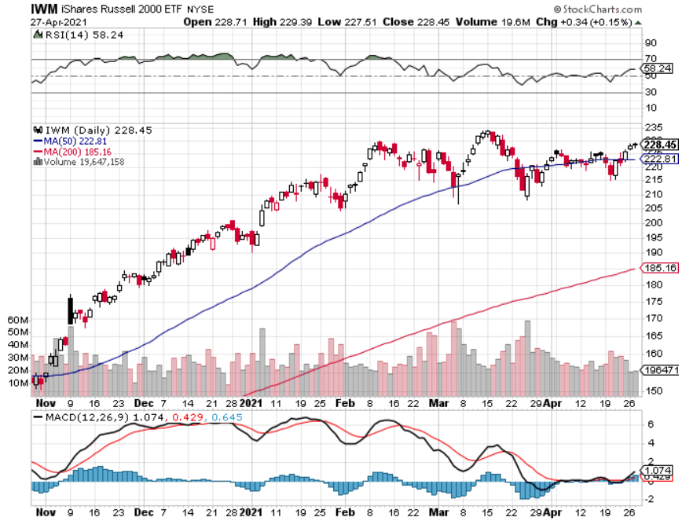
Russell 2000 (IWM)- Rejecting a “Head and Shoulders” took profits on Long 10/$137-$142 vertical bull call spread took profits on Long 10/$153-$156 vertical bear put spread

Slide 25
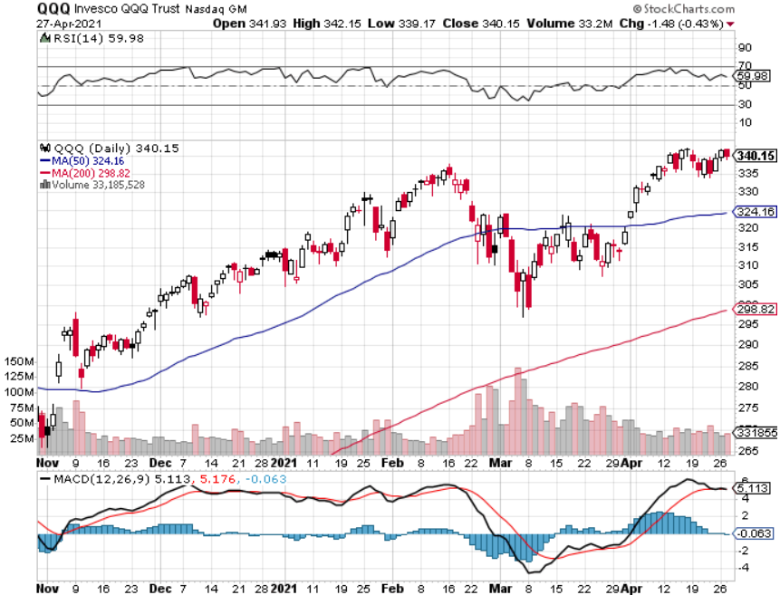
NASDAQ (QQQ) – long (QQQ) 4/$330-$335 put spread took profits on long (QQQ) 3/$340-$345 put spread covered long (QQQ) $325-$330 put spread

Slide 26
The Barbell Portfolio
*50% Big Tech - 2% of US Employment but 27% of Market Cap and 38% of Profits 50% Domestic Recovery, including: Railroads Couriers Banks Construction Credit Cards Event organizers Ticket sales Retailers

Slide 27
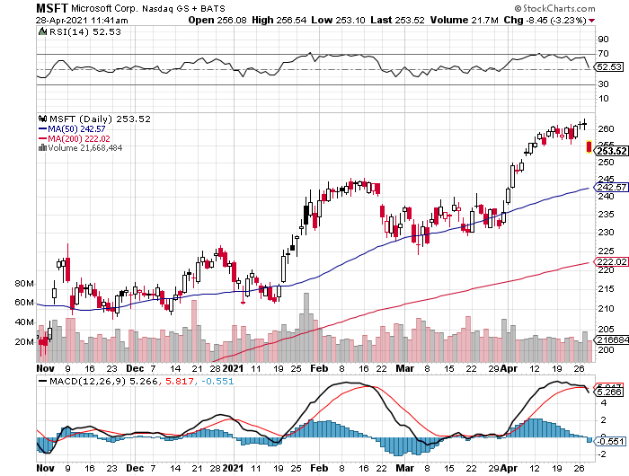
Microsoft (MSFT)- Earnings beat- Looking for Another Entry Point took profits on long 12/$220-$230 call spread stop loss on long 12/$170-$180 call spread took profits on long 12/$135-$138 call spread

Slide 28
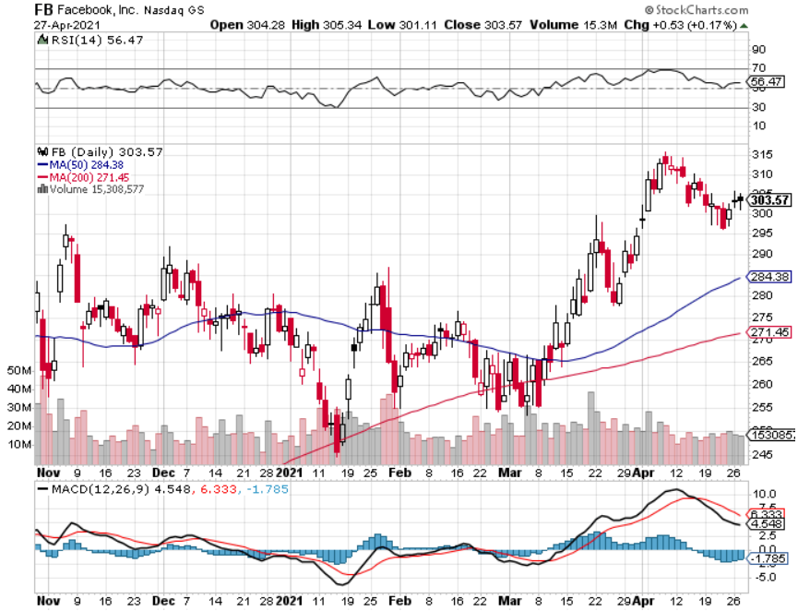
Facebook (FB)- took profits on Long 9/$290-$300 vertical bear put spread stopped out of Long 9/$190-$200 vertical bear put spread took profits on Long 9/$145-$155 vertical bull call spread took profits on Long 9/$150-$160 vertical bull call spread

Slide 29
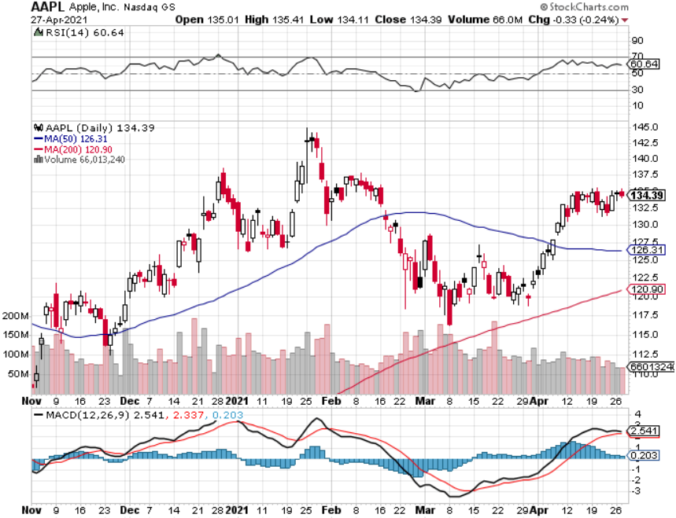
Apple (AAPL)- New 5G iPhone Surge-earnings after close earnings out after the close took profits on long 7/$320-$330 call spread took profits on long 4/24/$250-$260 call spread took profits on long 5/$250-$260 call spread

Slide 30
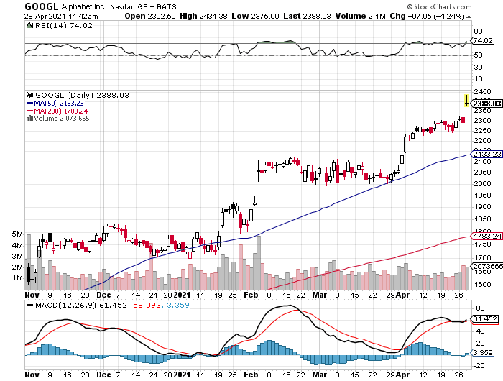
Alphabet (GOOGL) – Ad king on economic recovery Spectacular Ad Earnings took profits on long 12/$1,200-$1,230 bull call spread took profits on long 9/$1,030-$1,080 vertical bull call spread

Slide 31
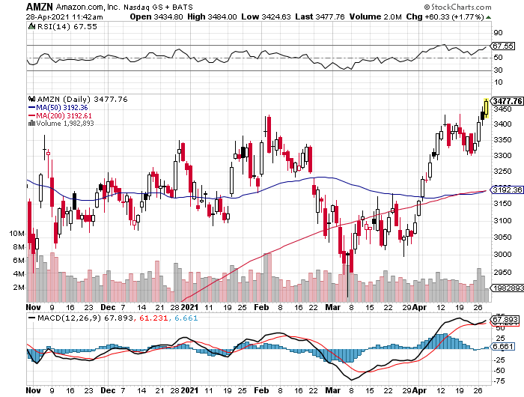
Amazon (AMZN) – New High took profits on long 9/$2,800-$2,900 bull call spread

Slide 32
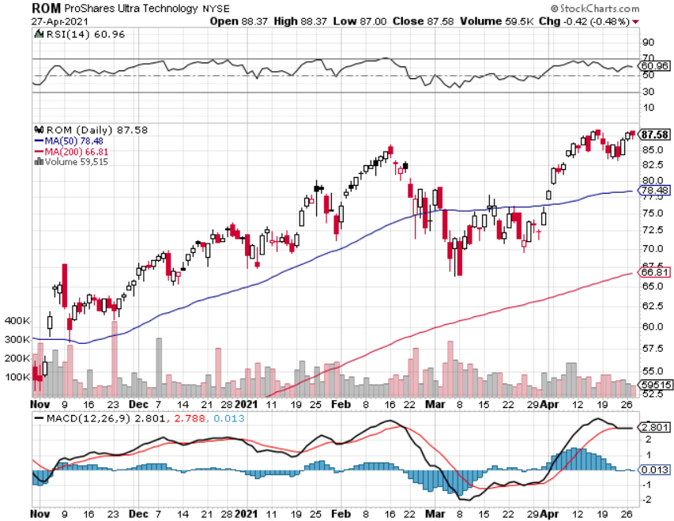
ProShares Ultra Technology (ROM) – Up 163% in 9 Months

Slide 33
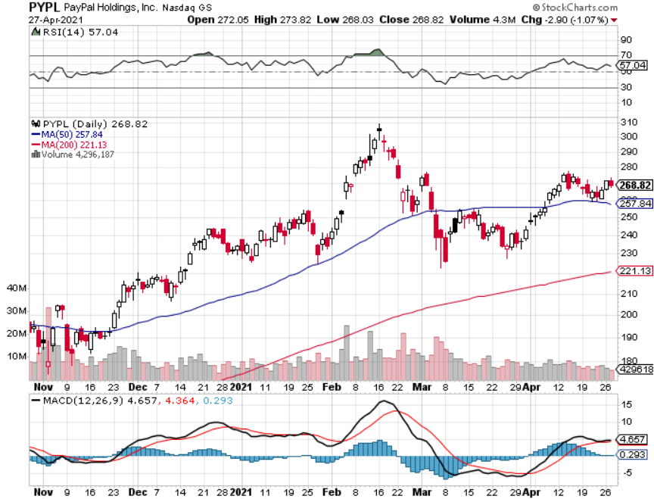
PayPal (PYPL)-Fintech Rules took profits on long 4/$90-$95 call spread

Slide 34
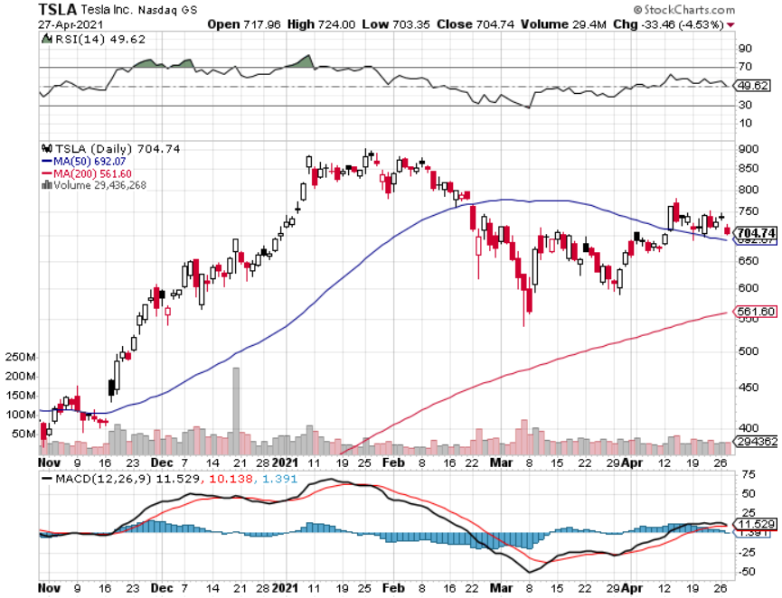
Tesla (TSLA)- Blows Away Q1 Deliveries, with a 184,400 print, or 47.5% high than the 2021 rate took profits on long 2X 4/$450-$500 call spread took profits on long 3/$400-$450 call spread took profits on long 2/$650-$700 call spread-expires, stopped out of long 3/$600-$650 call spread Took profits on long 2/$600-$650 bull call spread, Took profits on long 2/$550-$600 bull call spread

Slide 35
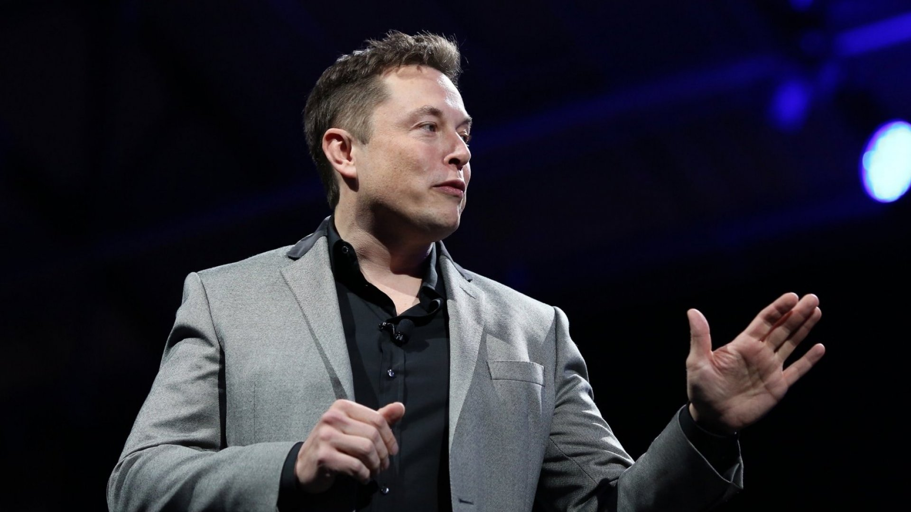
Elon Musk’s Latest Comments - He never fails to amaze
*Tesla is evolving into the world’s preeminent robotics and AI company. *It is building the largest neural network in history, which all the Tesla’s ever made talking to each other, some two million by the end of this year. *When the US goes all electric in a decade, the size of the power grid is going to triple (buy copper), or else brownouts and outages will become constant. Every home in the country is going to need solar roofs to meet the demand. *Demand for cars is the greatest Tesla has ever seen, far beyond their ability to produce them, and Q1 is the slow quarter for the auto industry. *Oh, and the company made $100 million trading Bitcoin in Q1, about a quarter of its total profits.

Slide 36
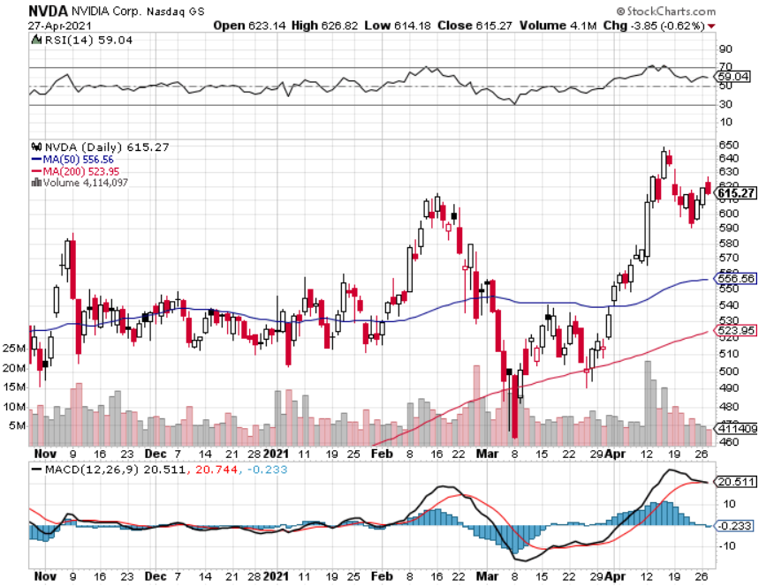
NVIDIA (NVDA) – The Biggest Chip Deal in History A Mad Hedge 10 bagger – Global Semiconductor Shortage Slows Auto Industry,

Slide 37
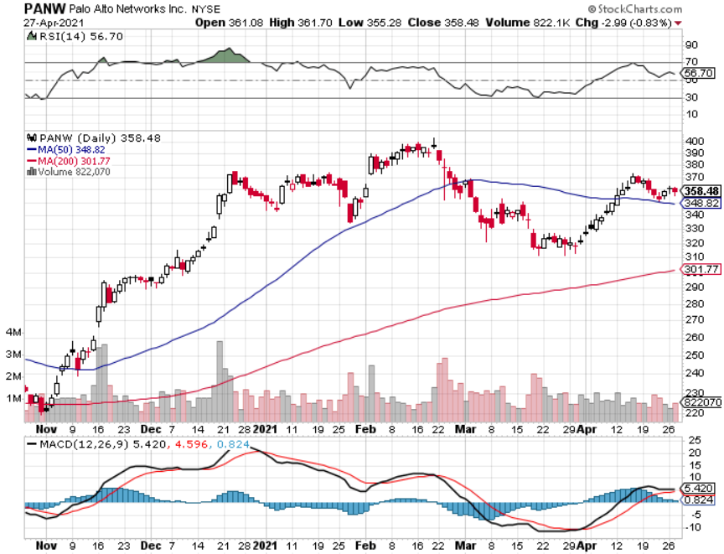
Palo Alto Networks (PANW)- Hacking never goes out of fashion

Slide 38
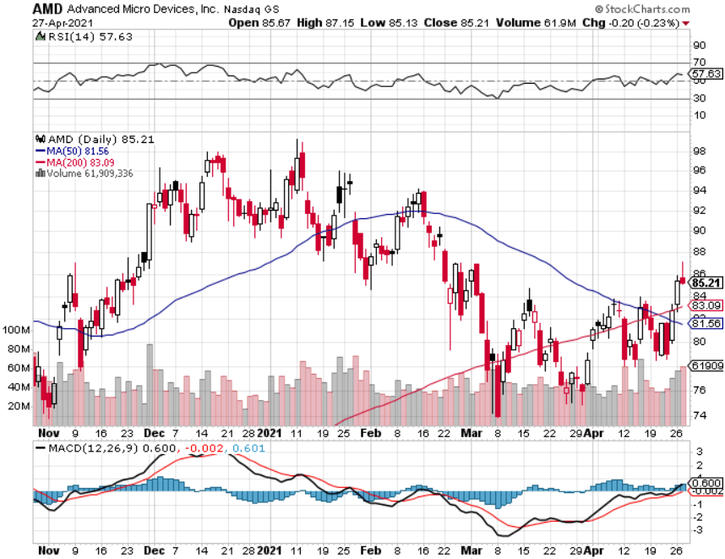
Advanced Micro Devices (AMD)- the next ten bagger - buys Xilinx – Programable logic devices took profits on long 2/$75-$80 call spread

Slide 39
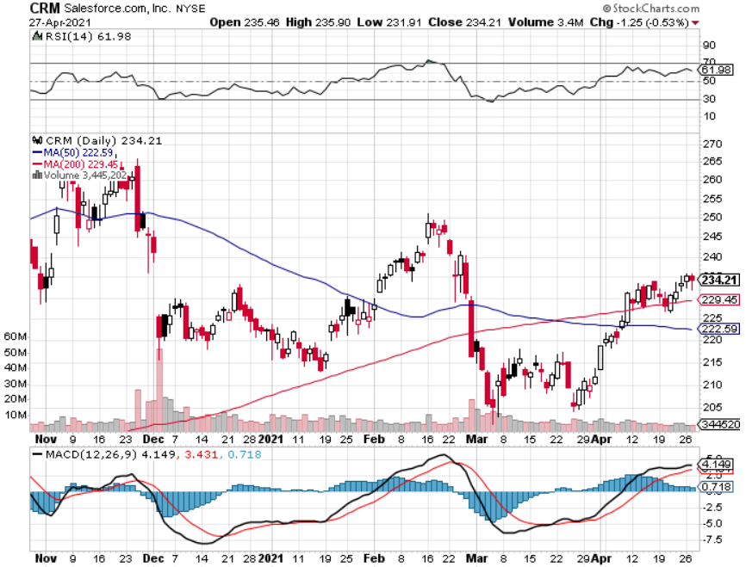
Salesforce (CRM)- Massive Online Migration took profits on long 9/$125-$130 vertical bull call spread took profits on long 8/$125-$130 vertical bull call spread took profits on long 2/$105-$115 call spread

Slide 40
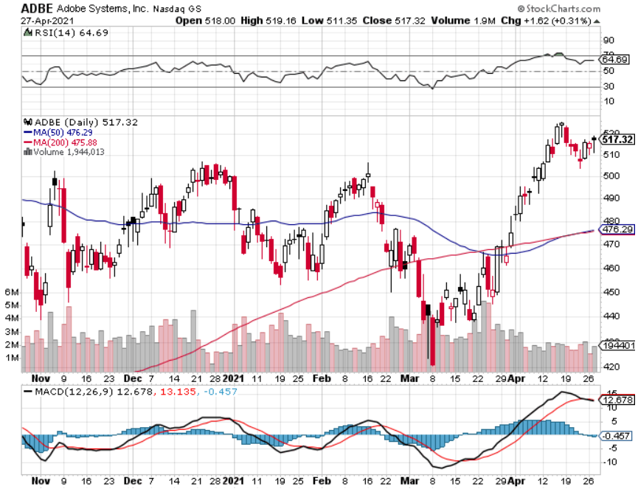
Adobe (ADBE)- Cloud play The Quality Non-China tech play

Slide 41
The Second Half of the Barbell
*Bets on a domestic recovery in 2021 *Upside potential in 2021 far greater than tech *Some of these have not moved for 5 or 10 years *Focuses on economically sensitive cyclical industries *Makes a great counterweight to high growth technology *We could spend all of next year rotating between the two groups

Slide 42
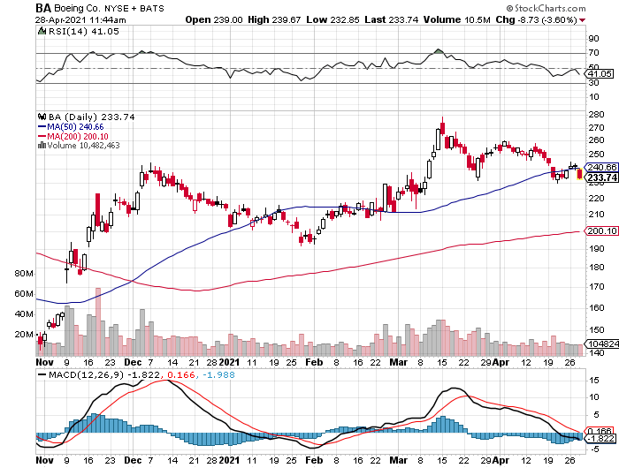
Boeing (BA) – former LEAP Candidate - The 737 MAX Flies Again! Earnings Let Down long 3/$146-$149 call spread took profits on long 2/$150-$160 call spread took profits on long 4/$300-$310 call spread took profits on long 4/$315-$335 call spread

Slide 43
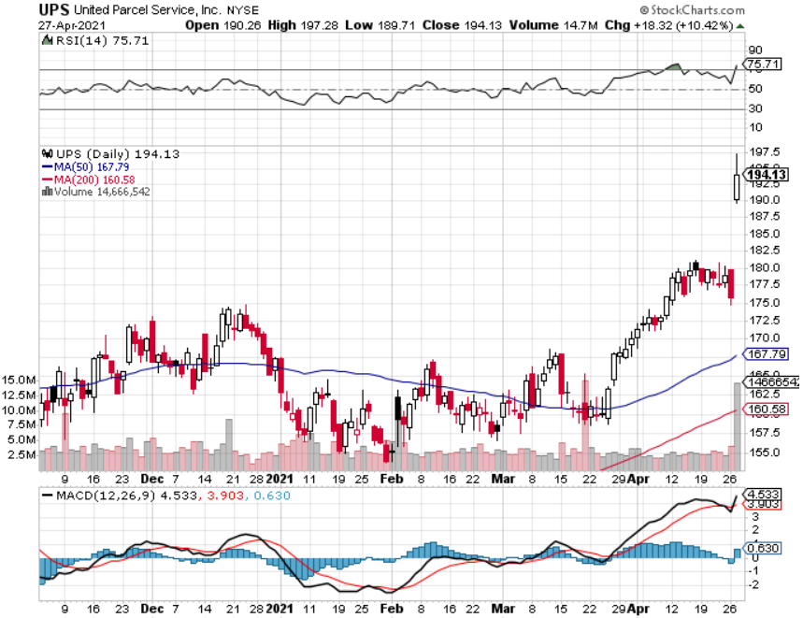
Package Delivery- United Parcel Service (UPS) massive increase in overnight deliveries, announces blowout earnings took profits on long 11/$130-$140 call spread

Slide 44
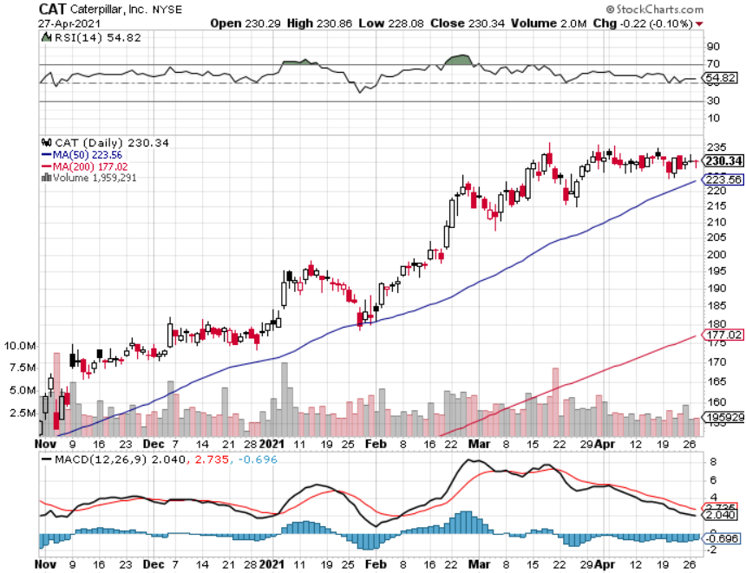
Caterpillar (CAT)- Ag + Infrastructure + Housing took profits on long 12/$145-$150 call spread took profits on long 11/$125-$135 call spread

Slide 45
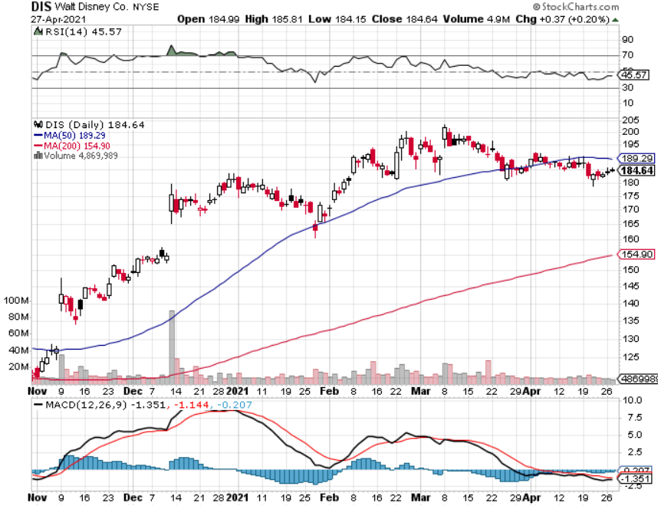
Walt Disney (DIS)- Big Recovery Move Disney Plus Streaming top 100 million subscribers in 15 months took profits on long 3/$170-$180 call spread

Slide 46
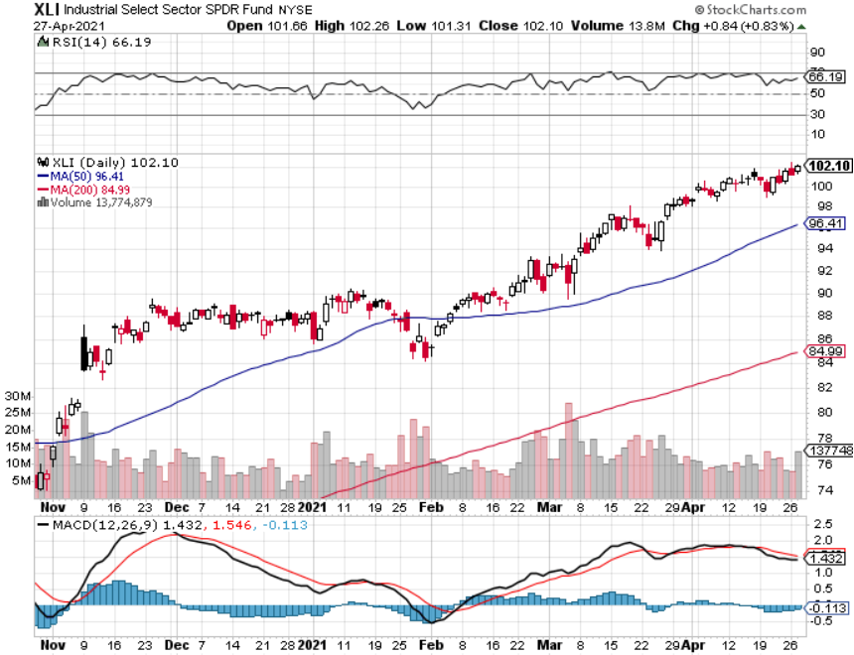
Industrials Sector SPDR (XLI)- (GE), (MMM), (UNP), (UTX), (BA), (HON)

Slide 47
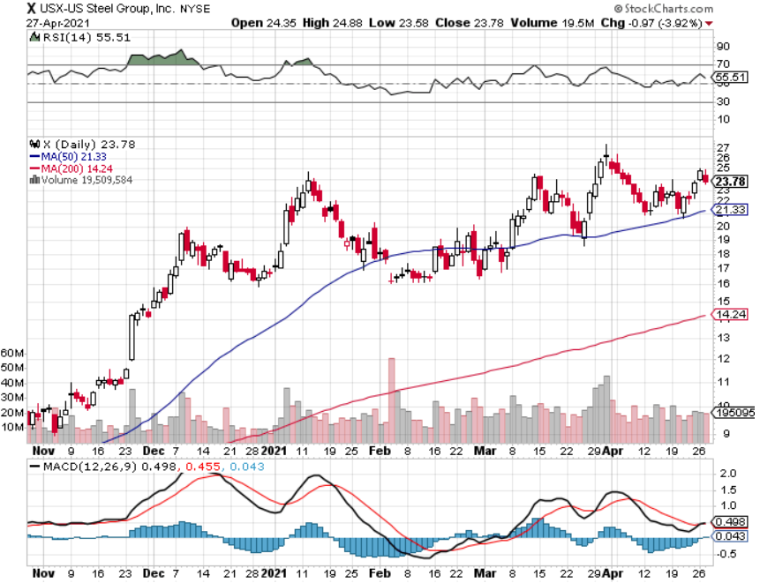
US Steel (X) – Commodity Boom

Slide 48
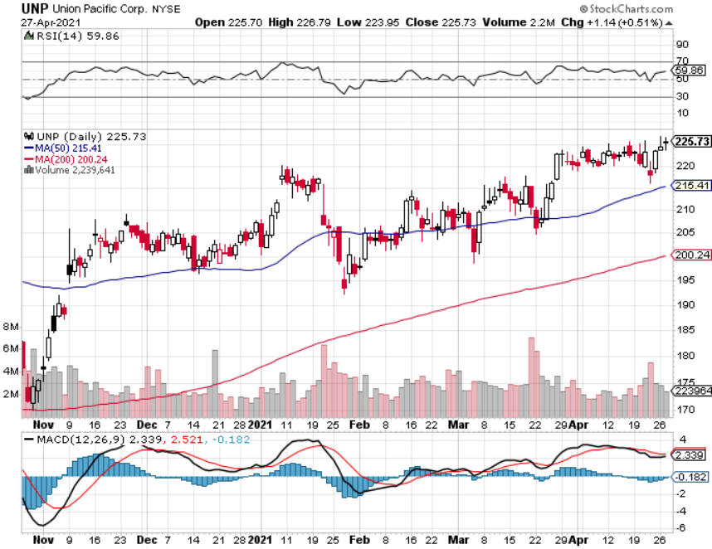
Union Pacific RR (UNP)- More stuff to ship near record earnings announced-new high long 5/$200-$210 call spread – 12 days to expiration took profits on 11/$150-$160 call spread

Slide 49
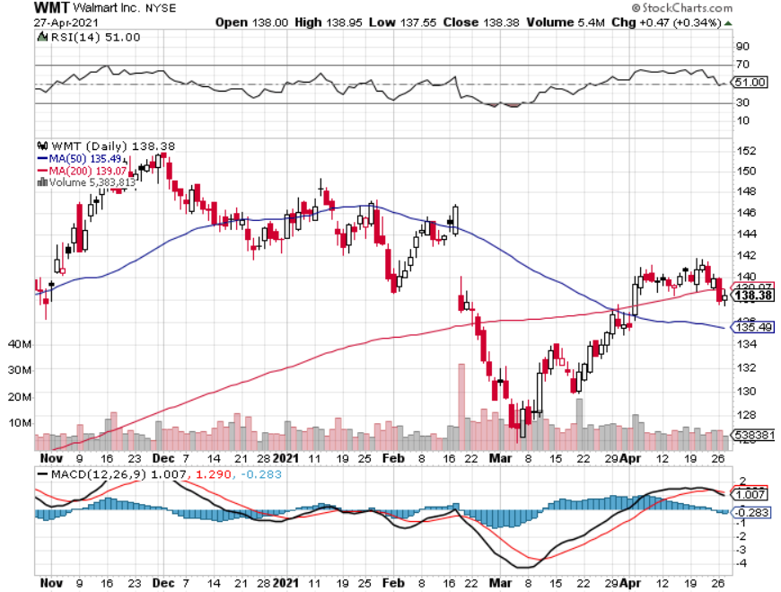
Wal-Mart (WMT)-New High took profit on Long 11/$125-$130 bear put spread took profit on Long 10/$119-$121 bear put spread took profits on Long 8/$114-$117 bear put spread

Slide 50
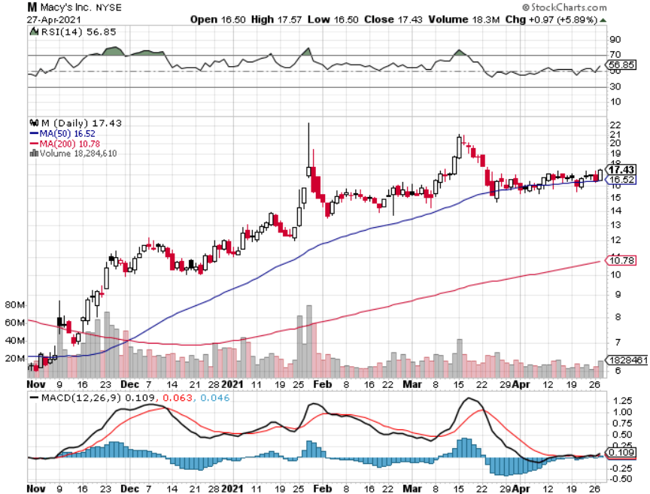
Macys’ (M) – Retail Return from the Grave took profits on Long 8/$23-$25 bear put spread

Slide 51
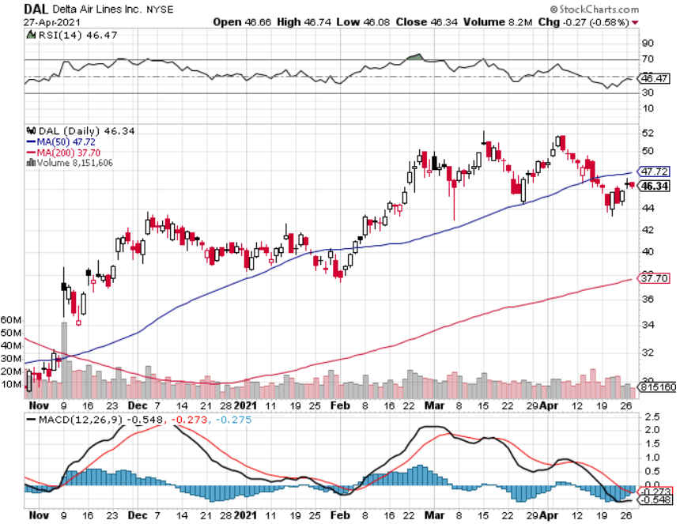
Delta Airlines (DAL) –

Slide 52
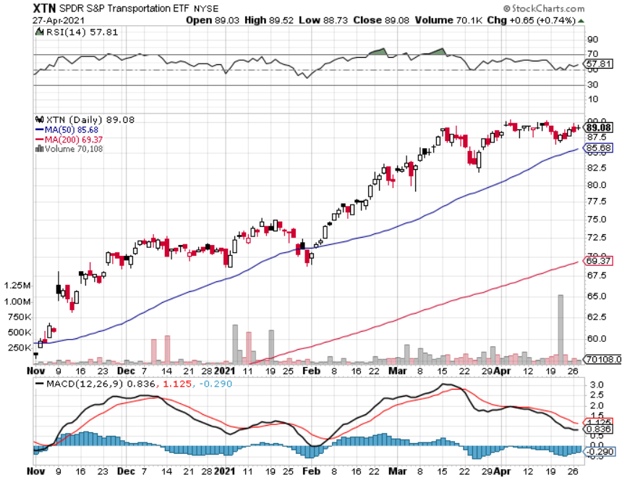
Transports Sector SPDR (XTN)- Worst Hit Sector (ALGT), (ALK), (JBLU), (LUV), (CHRW), (DAL)

Slide 53
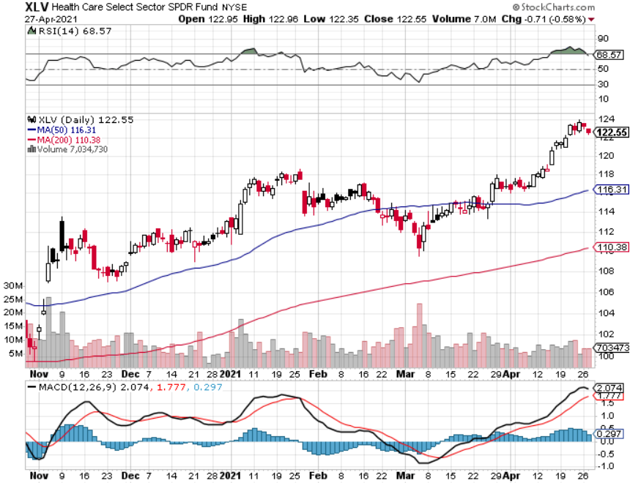
Health Care Sector (XLV), (RXL) (JNJ), (PFE), (MRK), (GILD), (ACT), (AMGN)

Slide 54
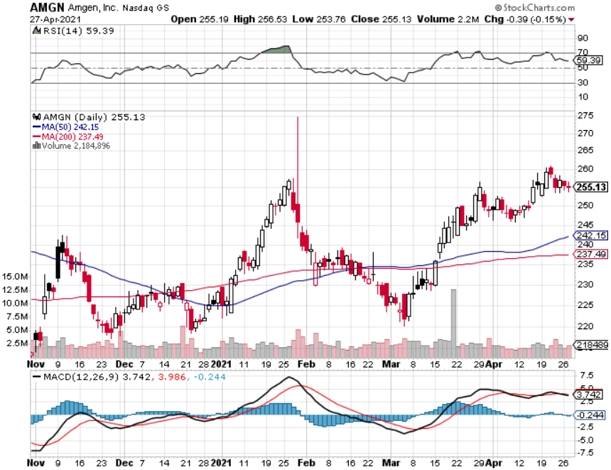
Amgen (AMGN) took profits on long 11/$185-$200 bull call spread

Slide 55
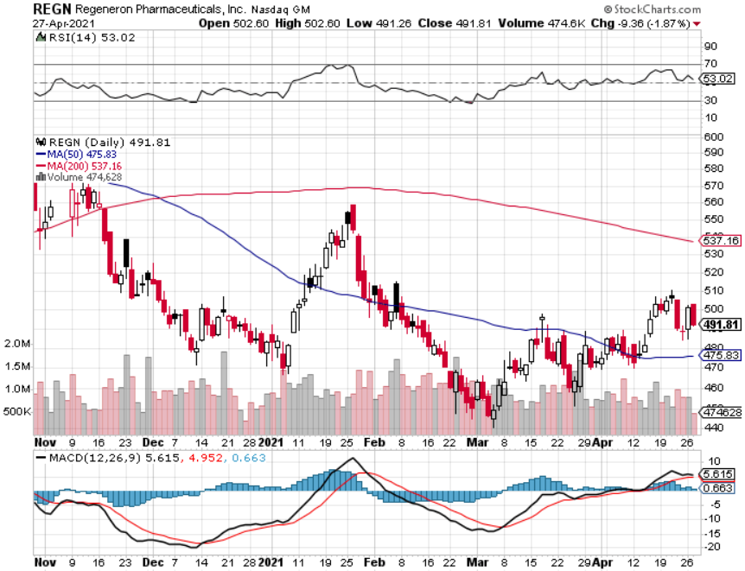
Regeneron (REGN) took profits on long 7/$570-$580 call spread

Slide 56
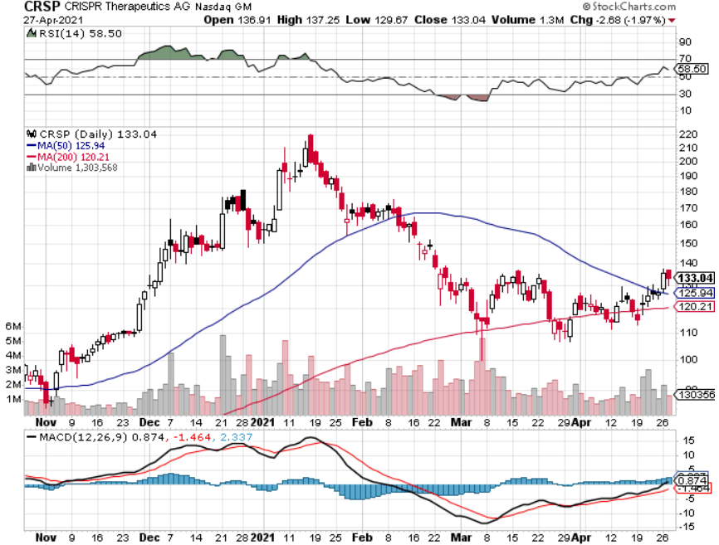
CRISPR Therapeutics (CRSP)

Slide 57
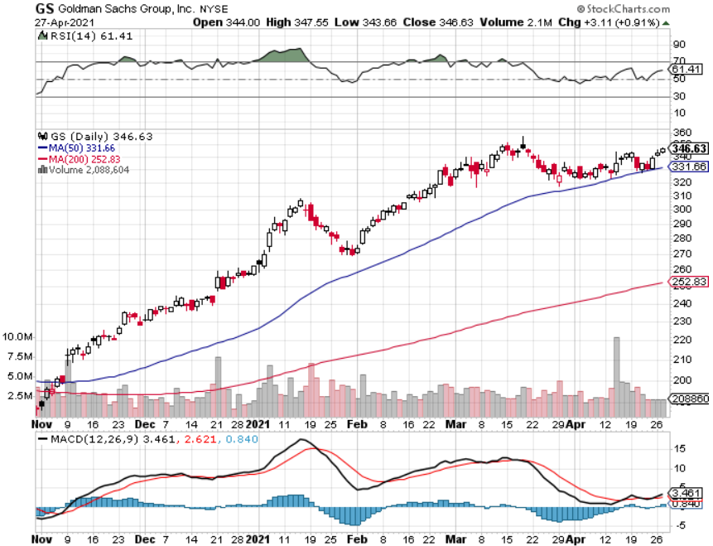
Goldman Sachs (GS) – long 5/$310-$320 call spread - 12 days to expiration took profits on long 2/$240-$260 call spread

Slide 58
Morgan Stanley (MS) – Blowout Earnings took profits on long 2/$55-$60 call spread

Slide 59
JP Morgan Chase (JPM)-Rising Rates long 5/$135-$140 call spread took profits on long 2/$135-$140 call spread, took profits on long 2/$110-$115 call spread took profits on long 12/$100-$105 bull call spread, took profits on long 11/$85-$90 bull call spread

Slide 60
Citigroup (C) – “Recovery” Rotation Play

Slide 61
Bank of America (BAC) – took profits on long 2/$28-$30 call spread

Slide 62
SPDR Metals & Mining ETF (XME) – New High long 2/$28-$30 call spread

Slide 63
Blackrock (BLK)-Asset Collection Boom took profits on long 3/$31-$34 call spread

Slide 64
Visa (V) – “Touchless” Fintech Play long 5/$195-$205 bull call spread- expires in 12 days took profits on long 9/$180-$185 bull call spread

Slide 65
Consumer Discretionary SPDR (XLY) (DIS), (AMZN), (HD), (CMCSA), (MCD), (SBUX)

Slide 66
Berkshire Hathaway (BRKB)- Natural Barbell – New High took profits on long 3/$230-$240 call spread

Slide 67
Europe Hedged Equity (HEDJ)-

Slide 68
Japan (DXJ)-

Slide 69
Emerging Markets (EEM) - Pro trade, Weak Dollar, long recovery Play

Slide 70
Bonds – Gone to Sleep
*Bonds remain trapped in a narrow range and could stay there for months *Quantitative Easing to Continue, says Fed governor Jay Powell, even if the economy improves *The $120 billion in monthly bond buying remains *The Fed is doing everything possible to create inflation, but is failing *I’m piling money into financials, which love higher interest rates and are an indirect bond short *A 2.00% yield on the ten-year US Treasury bond here we come! This is the quality trade of 2021 *US Treasury bond fund (TLT) could plunge from $180 to $105, taking interest rates from 0.31% to 3.25%

Slide 71
Treasury ETF (TLT) – Huge Short Play long 5/$143-$146 put spread, long 5/$144-$147 put spread, long 5/$145-$148 put spread expires in 12 days took profits on 2X long 4/$142-$145 put spread, 4/$127-$130 call spread took profits on 2X long 5/$142-$145 put spread, took profits on long 2/$146-$149 put spread took profits on long 3/$147-$150 put spread, took profits on long 2/$158-$161 put spread, took profits on long 2/$159-$162 put spread, took profits on long 2/$162-$165 put spread

Slide 72
Ten Year Treasury Yield ($TNX) – 1.63%

Slide 73
Junk Bonds (HYG) 3.33% Yield to Maturity

Slide 74
2X Short Treasuries (TBT)-Another run at highs

Slide 75
Emerging Market Debt (ELD) 4.27% Yield-

Slide 76
Municipal Bonds (MUB) – 0.93% Mix of AAA, AA, and A rated bonds

Slide 77
Foreign Currencies – Ebbing US Dollar
*US Dollar Hits One Month Low as it’s yield support disappears *Q1 strength unwinds, and yield support continues to ebb. *A stronger American economy leads to a weaker greenback, as imports surge. Expect more of the same. Buy (FXA) and (FXE) on dips. *Massive US government borrowing is debasing the dollar at an epic rate *Any dollar rallies are temporary and short-term *Bitcoin hits new high at $66,000, then plunges to $47,000, down 27% in a week *Keep selling short all US dollar rallies, its yield support is gone forever, Buy (FXA) and (FXE) on dips.

Slide 78
Japanese Yen (FXY), (YCS)

Slide 79
Euro ($XEU), (FXE), (EUO)-

Slide 80
British Pound (FXB)-

Slide 81
Australian Dollar (FXA)- The Global Recovery Play took profits on long 8/$67-$69 call spread

Slide 82
Emerging Market Currencies (CEW)

Slide 83
Chinese Yuan- (CYB)-

Slide 84
Bitcoin- Losing Momentum-27% in a Week Upside Momentum is Gone

Slide 85
Energy – Going Out if Business
*Oil has been trapped in narrow two-month range. Economic recovery boost is offset by long term bear trend *The end of oil is upon us, but it may take 30 years to unwind existing infrastructure *All US car production will be electric by 2035, wiping out half of all US oil consumption *A hugely anti oil US administration will do what it can to accelerate the process with taxes and alternative energy subsidies *Oil consumption will become a China only business, with them already taking 80% of all Persian Gulf output *Avoid all energy plays like the plague, it’s the new buggy whip industry as the US de-carbonizes

Slide 86
Oil-($WTIC)

Slide 87
United States Oil Fund (USO) long 10/$9.50-$10 Vertical bull call spread

Slide 88
Energy Select Sector SPDR (XLE)-No Performance! (XOM), (CVX), (SLB), (KMI), (EOG), (COP)

Slide 89
Halliburton (HAL)-

Slide 90
Natural Gas (UNG) -

Slide 91
Precious Metals – Stalled at a Bottom
*Long-term rising interest rates remain a threat to precious metals *No one believes we have come close to peaking in rates yet *Gold has turned into the worst trade of 2021 *Is struggling to make a new bottom around here *It has turned into a bond long and and Bitcoin short and I don’t want either *Silver is the better play here on solar and EV demand *Gold will eventually recover when US borrowing becomes so massive it undermines the value of the US dollar, even in the face of higher interest rates

Slide 92
Gold (GLD)- Meltdown

Slide 93
Market Vectors Gold Miners ETF- (GDX) –

Slide 94
Barrick Gold (GOLD) took profits on long 1/$21-$23 call spread took profits on long 11/$22-$24 call spread

Slide 95
Newmont Mining- (NEM)- took profits on long $55-60 call spread

Slide 96
Silver- (SLV)- took profits on long 11/$19-$20 call spread

Slide 97
Silver Miners - (SIL)-

Slide 98
Wheaton Precious Metals - (WPM)- took profits on long 2/$39-41 call spread

Slide 99
Copper (COPX)-Uptrend Resumes

Slide 100
Freeport McMoRan (FCX)-Largest US Copper Producer-New High long 5/$30-$33 call spread took profits on long 4-2020/$10-$11 call spread took profits on short 4-2020/$14 calls

Slide 101
Real Estate – Record Highs
*There are Four Million Houses Missing in the US, according to the FHA. New construction hitting a 15-year high is not enough. *Housing Starts surged by 1.7 million units in March to 1.613 million units *Existing Home Sales Down 12.3% YOY, down 3.7% in March *New Home Sales Up a Ballistic 20.7% YOY, in March *Flight to the suburbs and bigger houses continues *Housing prices are still exploding to the upside with S&P Case Shiller Rose 12.0% in February, a 15 year high, despite a 50-basis point rise in home mortgage interest rates

Slide 102
November Corelogic S&P Case Shiller Home Price Index Phoenix (17.4%), Seattle (17.0%), and San Diego (15.4%)
Tradingeconomics.com

Slide 103
Simon Property Group (SPG)- Mall REIT A Huge Vaccine Play

Slide 104
Crown Castle International (CCI) – 3.42% yielding cell phone Tower REIT

Slide 105
US Home Construction Index (ITB) (DHI), (LEN), (PHM), (TOL), (NVR)

Slide 106
Trade Sheet- So What Do We Do About All This?
*Stocks – buy dips aggressively *Bonds – sell rallies aggressively *Commodities-buy dips *Currencies- sell US dollar rallies *Precious Metals – buy dips *Energy – stand aside *Volatility - sell short over $30 *Real estate – buy dips

Slide 107
Next Strategy Webinar 12:00 EST Wednesday, May 12, from Lake Tahoe email me questions at support@madhedgefundtrader.com
Good Luck and Good Trading!
Notes:
*

