Slide 1
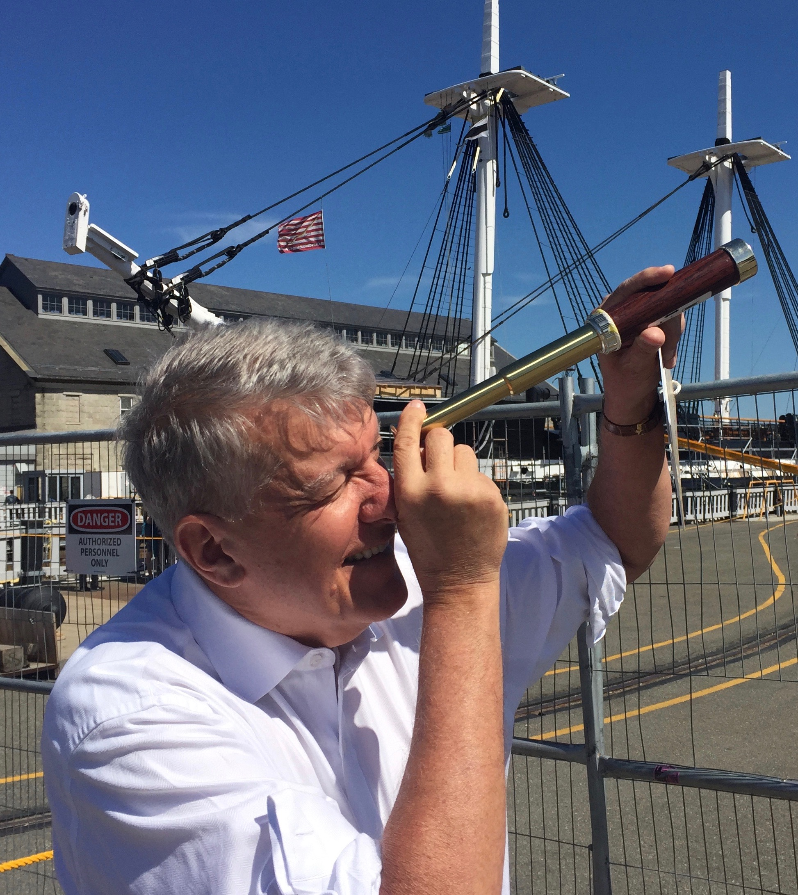
The Mad Hedge Fund Trader “2022 All Asset Class Forecast”
With John Thomas Incline Village, NV, January 5, 2022 www.madhedgefundtrader.com
Notes:
*

Slide 2
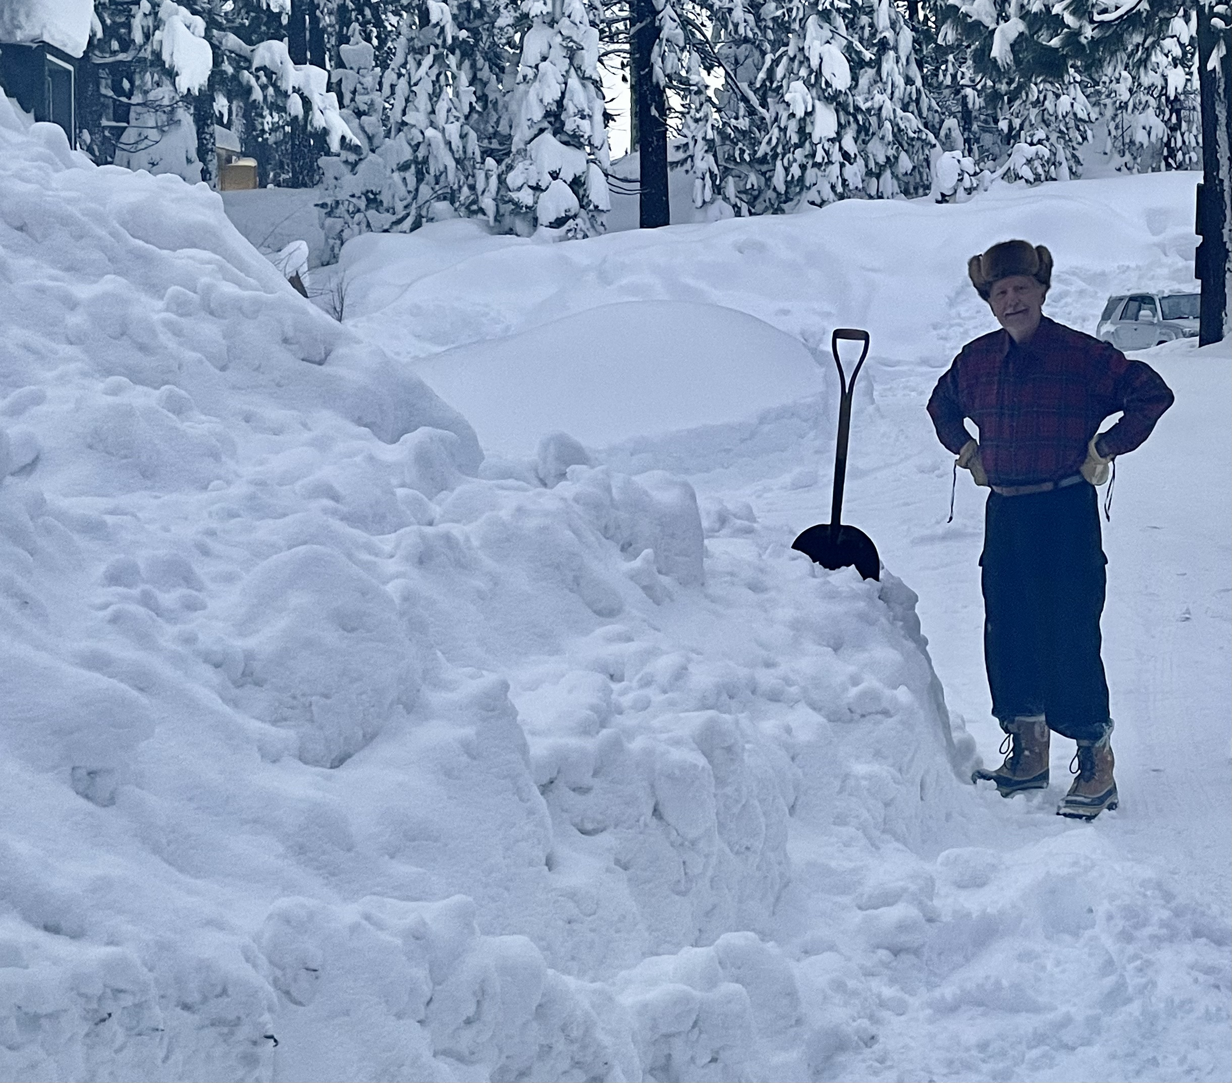

Slide 3
JOIN ME ON CUNARD’S MS QUEEN VICTORIA FOR MY JULY 9, 2022 SEMINAR AT SEA
*Accompany John Thomas on a seven-day Norwegian Fiord Cruise on the 90,000 tonne Cunard HM Queen Victoria *Luncheon tickets in my private cabin are $499 *Cruise bookings can be had for as little as $995 *I’ll be giving you my up-to-date view on stocks, bonds, currencies, commodities, precious metals, Bitcoin, and real estate. *The ship has seven restaurants, thirteen bars, three swimming pools, a ballroom, and a theatre.

Slide 4
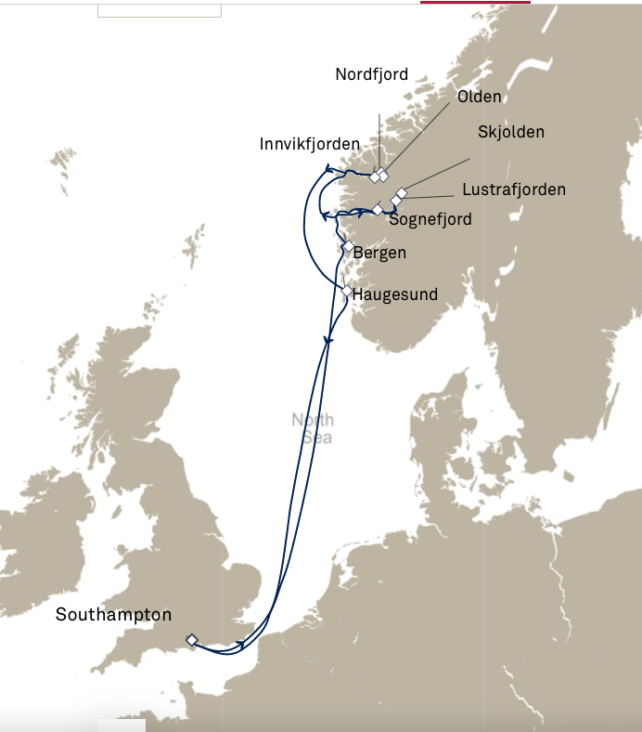

Slide 5
Trade Alert Performance New All Time Highs! 32 consecutive profitable trade alerts- 93.5% success rate in 2021-ony 7 losers
*January 10.21% MTD *July +0.61% Final *February +13.28% Final *August +9.36% Final *March +20.60% Final *September 1.03% Final *April +15.67% Final *October +8.91% MTD *May +8.13% Final *November -11.79% Final *June +0.71% Final *December +11.26% Final *2021 FINAL +90.02% compared to +18.75% for the Dow Average *+512.57% since inception *Average annualized return of 42.41% for 12 years

Slide 6
Portfolio Review 100% cash Long Term Bull Market Waiting to Sell the next big rally or buy the next big dip
Expiration Value 0%
No Positions

Slide 7
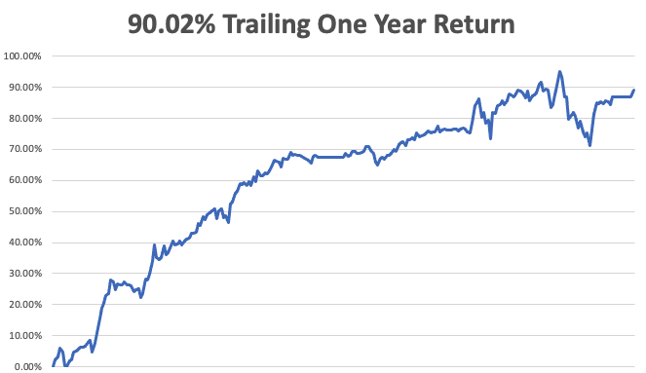

Slide 8
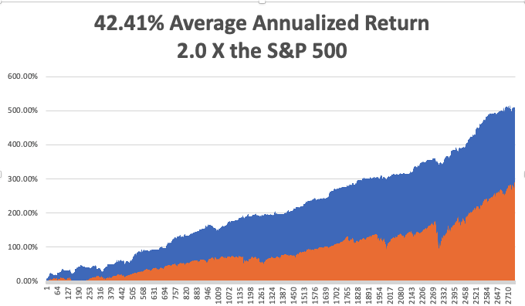
GTD 12 Year Daily Audited Performance

Slide 9
The Method to My Madness The Roaring Twenties are Here
*Another barbell year begins *The game will be to rotate from big tech to financials and then back into tech with interest rates as your market timer *A core short in bonds will be key, but trade this too *Bonds could see another repeat of the January $20 crash as hedge funds add new positions for 2022, is already down $12.00 since November *Omicron is three times more contagious but one third as fatal, meaning peak could be here. Only anti vaxer's are dieing *Bitcoin goes dead in the face of rising rates *VIX over $30 is the ideal entry point for new positions *First Fed interest rate hike in 5 years has been moved up to June or even March, triggering a 10% correction stock market

Slide 10
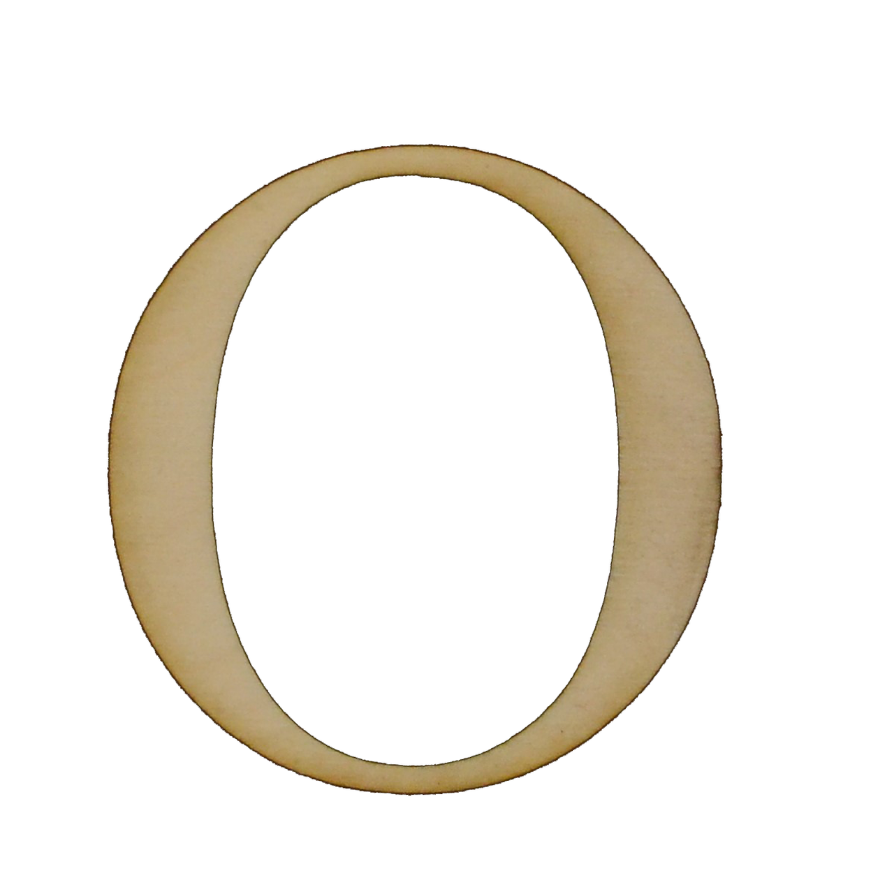
Corona Update – Variant Volatility
*Variant volatility will track one for one with stock market volatility *Vaccine cocktails mixing Pfizer, Moderna, and AstraZeneca appear to provide greater immunity *A year ago, hospitalizations hit 1450,000/day. Now it’ 1 million/day *12-15-year-olds are now eligible for boosters *Omicron will only kill the anti vaxer's *Omicron is hitting children worse than adults because they are the largest unvaccinated population *Pandemic is still going to zero by summer, book those cruises *US cases top 57 million, deaths topping 830,000 and deaths are limited to 1,000 a day

Slide 11
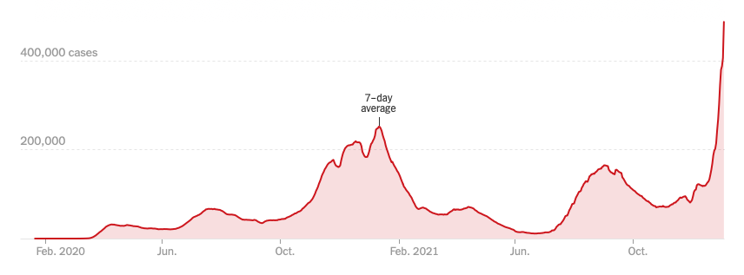
Bump on the Way to Zero

Slide 12
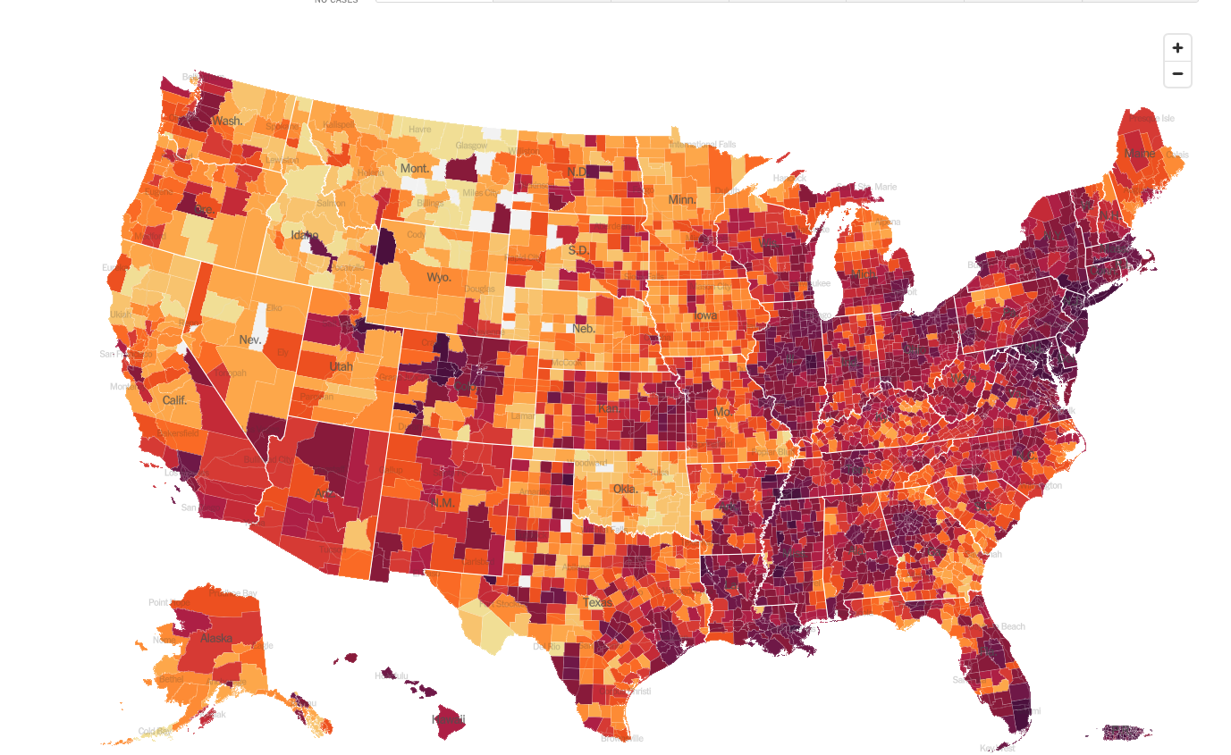
January 4 Infection Rate

Slide 13
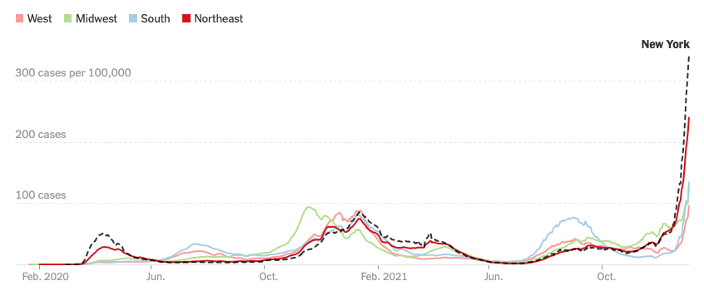

Slide 14
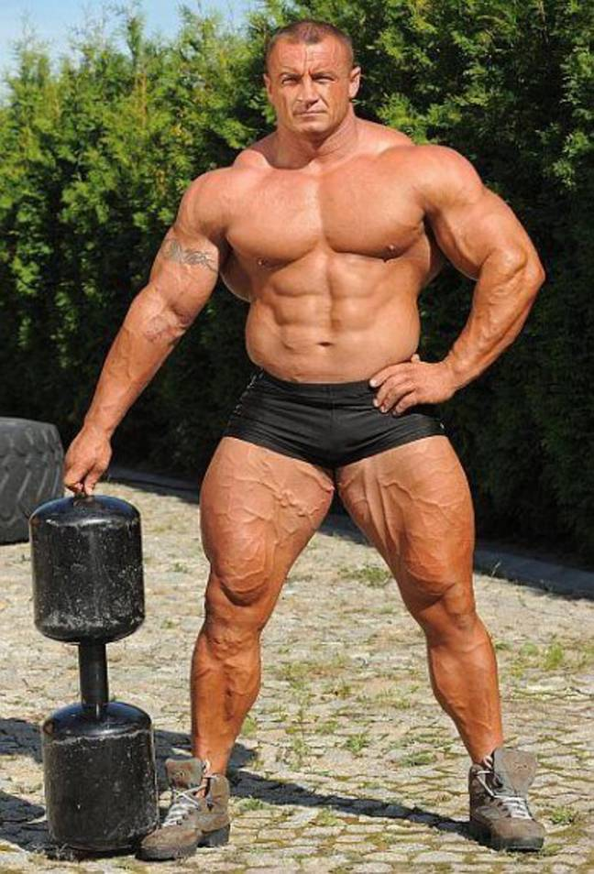
The US Economy – From Strength to Strength
*Two variant induced mini recession in 2021 will be followed by an historically strong 2022 *Growth will downshift from 7% to 5%, but it’s still a blockbuster number *If covid disappears by summer the labor shortage will disappear *One threat will be the end of supply chain problems result in over orders getting delivered and future orders cut back *The big question for traders is how much of this growth was already priced in during 2021 *No classical recessions are due for several years

Slide 15
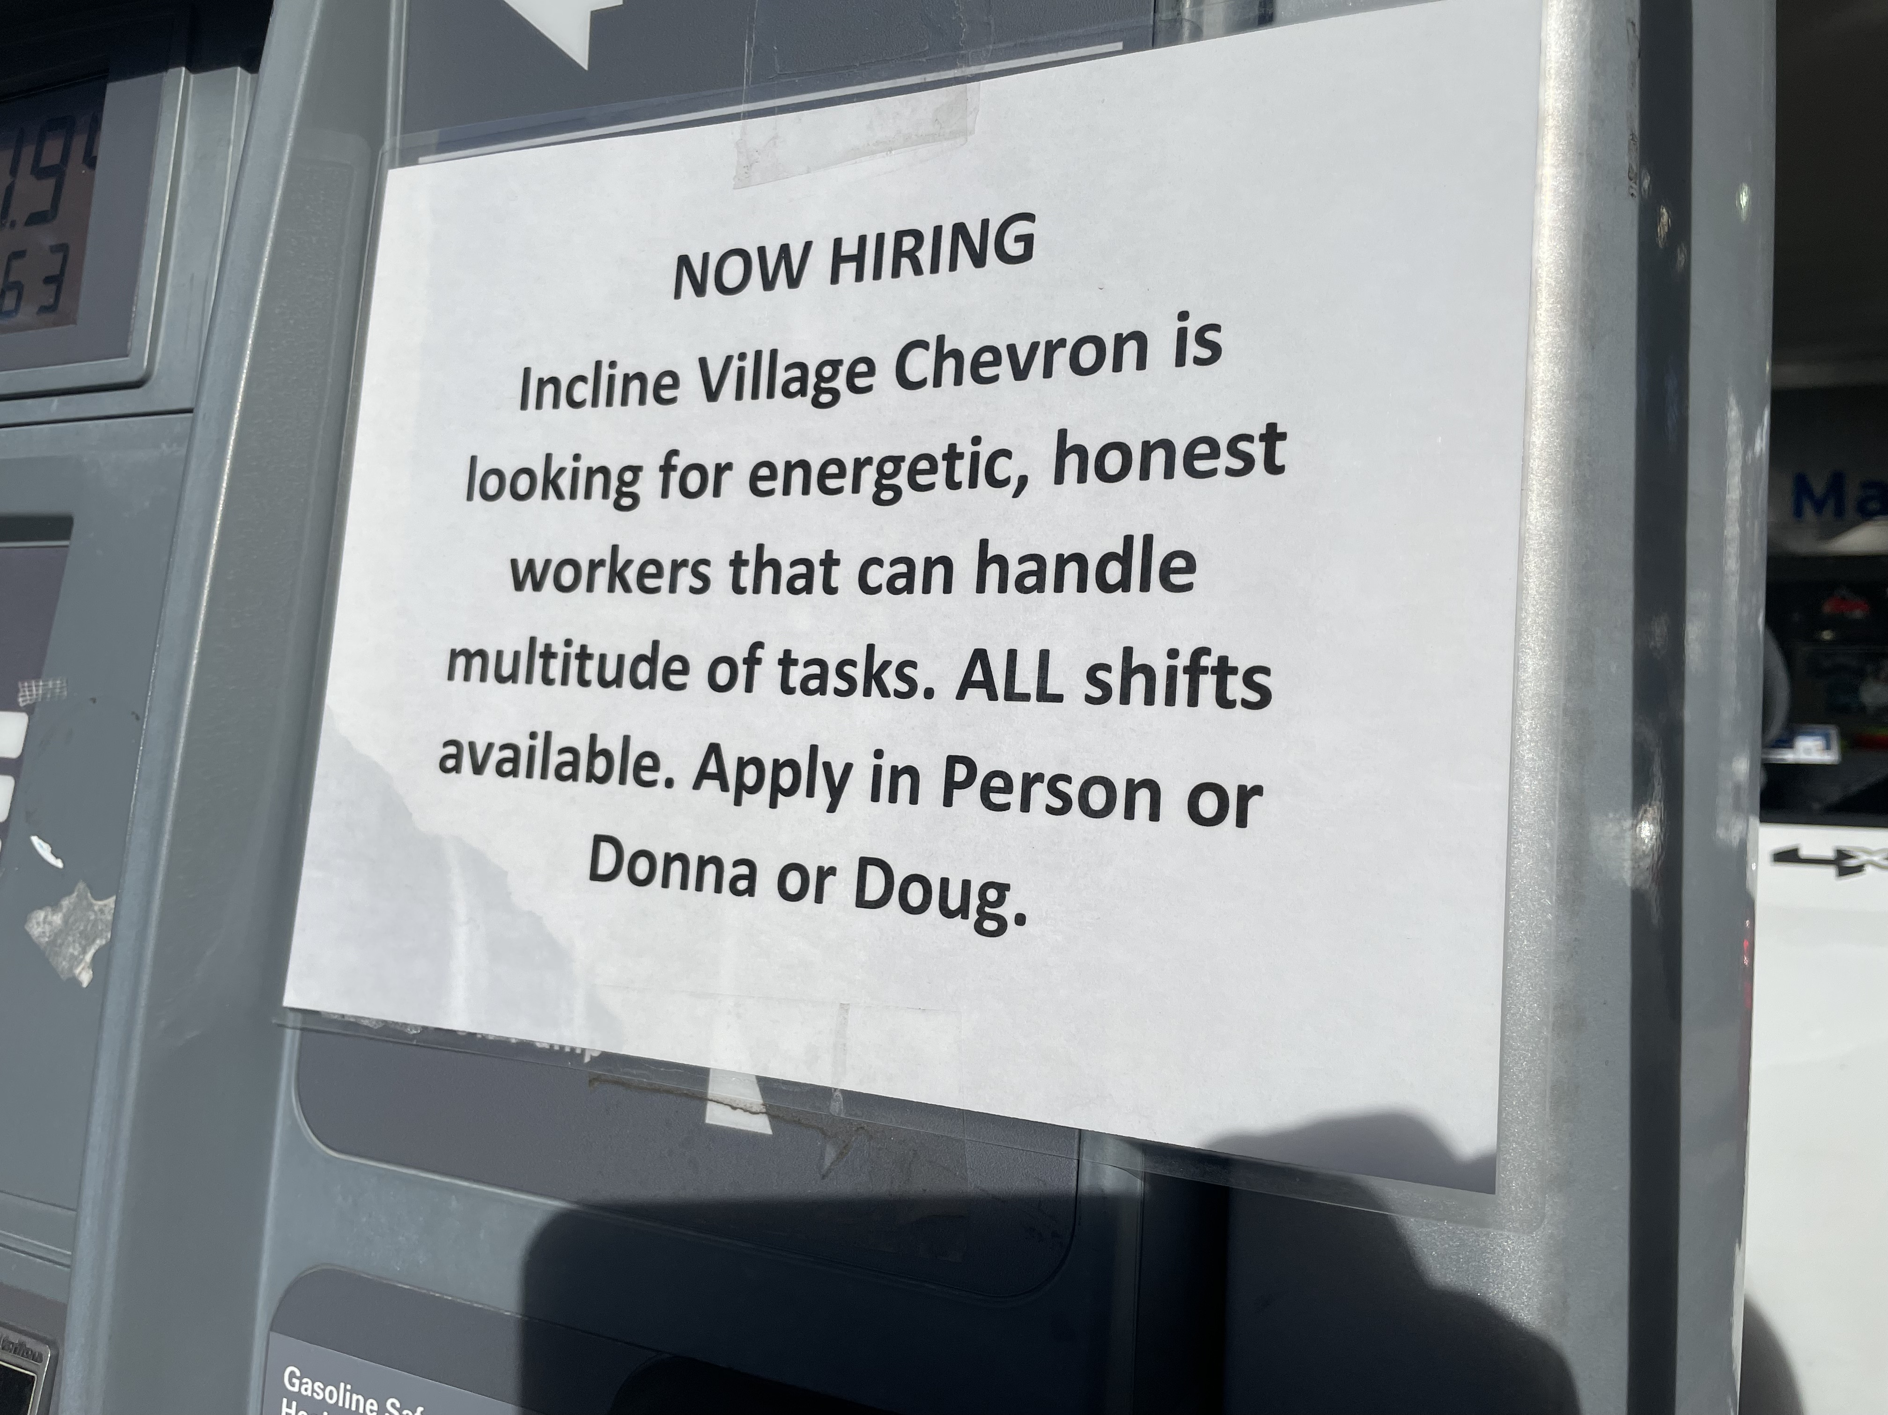

Slide 16
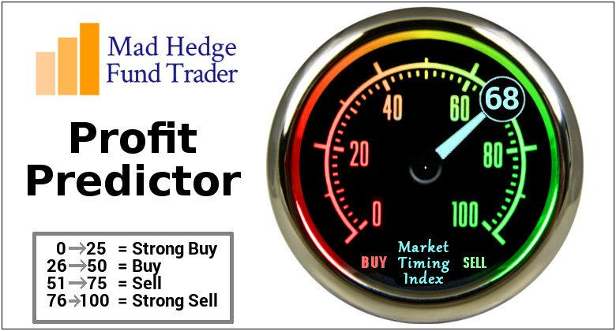
The Mad Hedge Profit Predictor Market Timing Index – Buy Territory An artificial intelligence driven algorithm that analyzes 30 different economic, technical, and momentum driven indicators

Slide 17
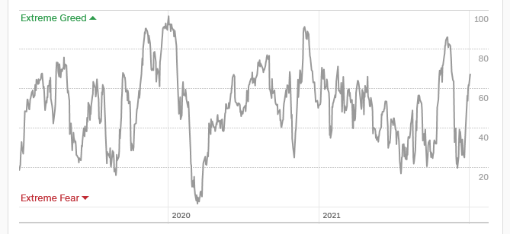
The Mad Hedge Profit Predictor From Extreme “BUY” to Neutral
SELL
Do Nothing
BUY

Slide 18
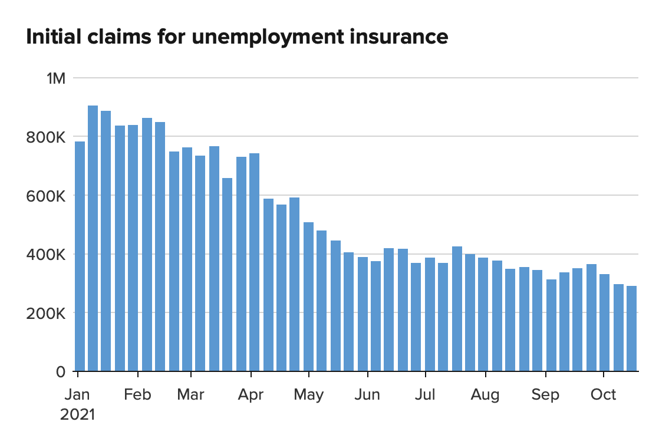
Weekly Jobless Claims – New Lows 198,000 – Near a 31 Year Low

Slide 19
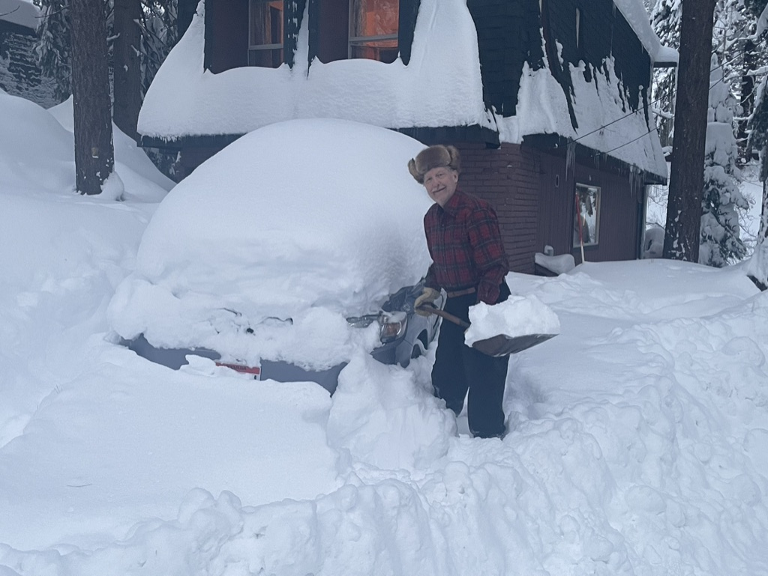

Slide 20
Stocks – What Got you Here Won’t Get You There
*A major sector rotation took place at the end of November, out of growth tech and into financials, industrial, commodities, and value *It could continue for 5 more months *Soaring interest rates, up 30 bp in two weeks is a major driver *We will have to work twice as hard to make half the money in 2022 *Look for a weak index in H1 and a strong one in H2 leaving us up 10% on the year *Buy every 10% dip and Volatility Index pops above $30 *2020 and 2021 were characterized by multiple expansion. 2022 will be all about earnings expansion, with tech leading at 30% growth *Dow 240,000 by 2030 here we come!

Slide 21
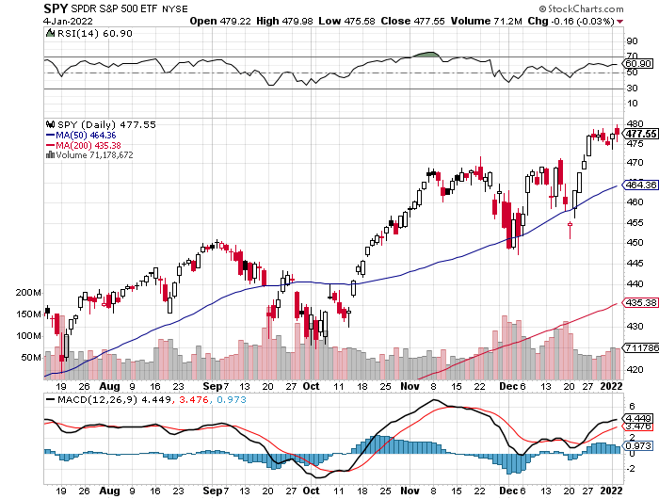
S&P 500 – Year End Melt Up! Took profits on long 10/$410-$420 bull call spread stopped out of long 10/$419-$429 bull call spread took profits on long 6/$375-$385 bull call spread
New Highs Yearend Target $475 Achieved
First Bottom 450
11% Bottom $425

Slide 22
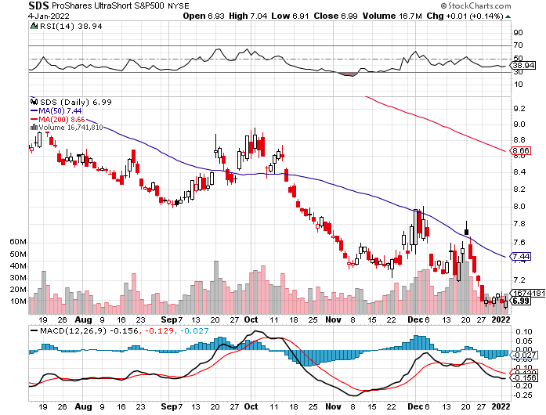
ProShares Ultra Short S&P 500 (SDS)- a great hedge for long stocks and bonds long 2X position has a hedge against longs and bond shorts

Slide 23
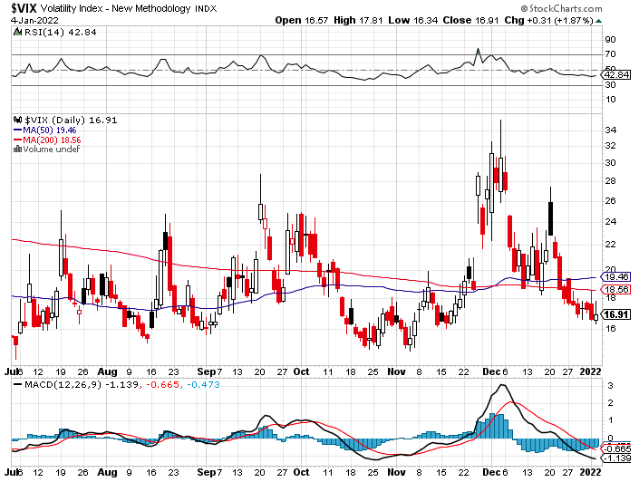
(VIX) – Dying a Slow Death classic summer market

Slide 24
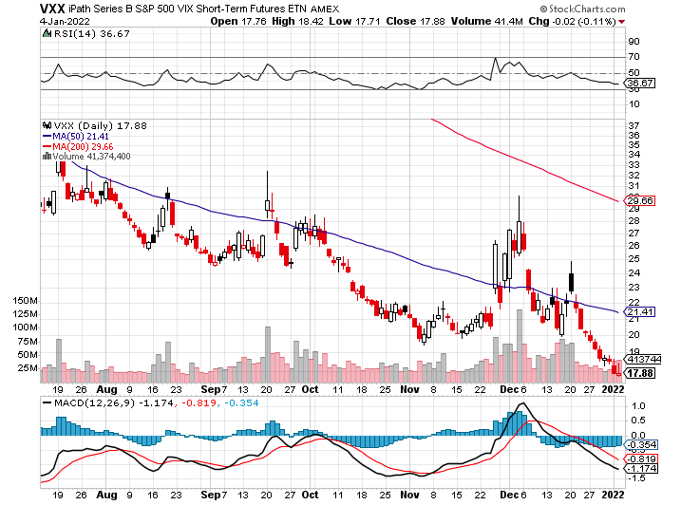
(VXX)-

Slide 25
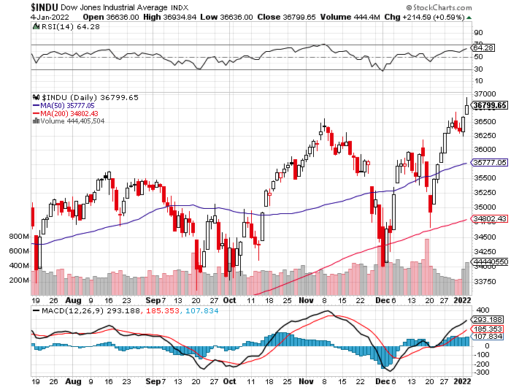
Dow Average ($INDU)- New High

Slide 26
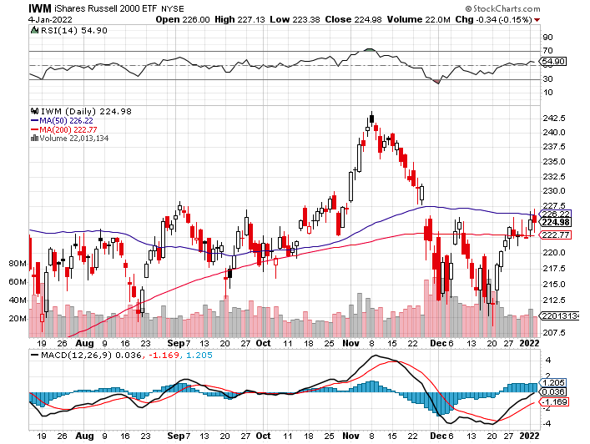
Russell 2000 (IWM)- took profits on Long 10/$137-$142 vertical bull call spread took profits on Long 10/$153-$156 vertical bear put spread

Slide 27
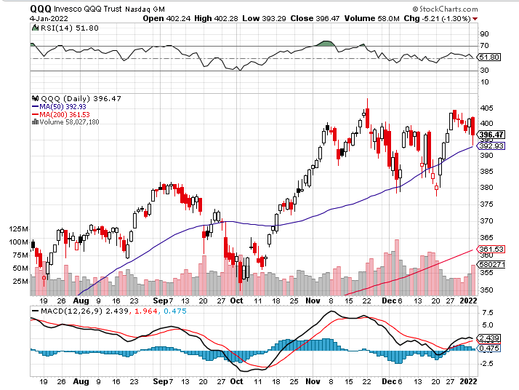
NASDAQ (QQQ) – long (QQQ) 4/$330-$335 put spread took profits on long (QQQ) 3/$340-$345 put spread covered long (QQQ) $325-$330 put spread

Slide 28
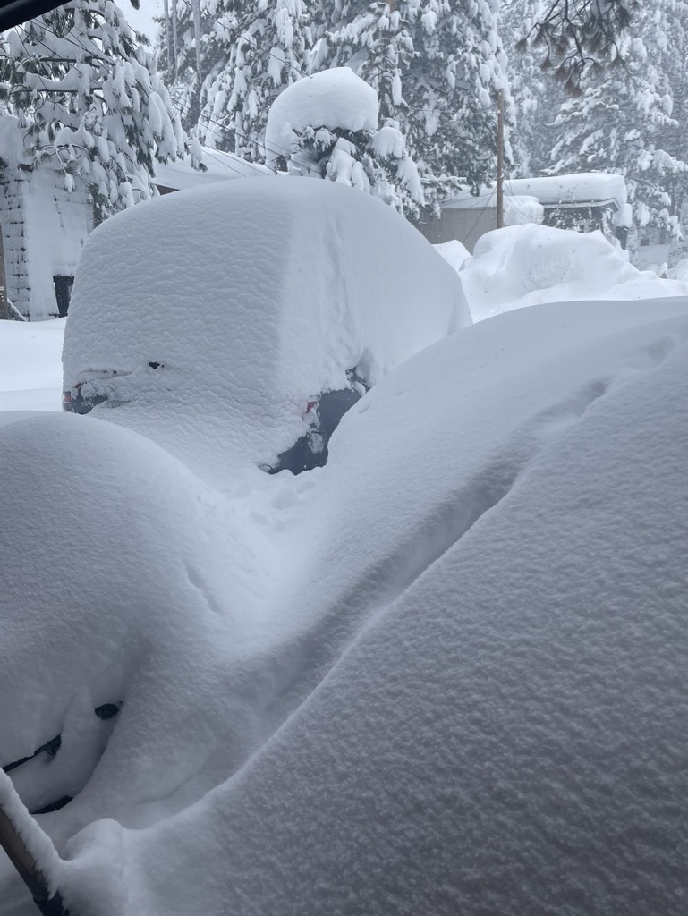

Slide 29
The Barbell Portfolio
*50% Big Tech - 2% of US Employment but 27% of Market Cap and 38% of Profits 50% Domestic Recovery, including: Railroads Couriers Banks Construction Credit Cards Event organizers Ticket sales Retailers

Slide 30
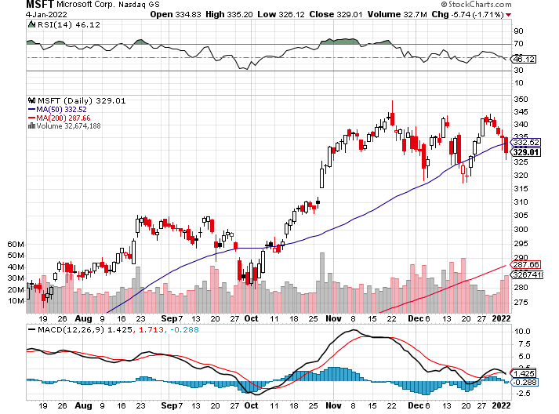
Microsoft (MSFT)- Microsoft to Raise Dividend by 11% and increased a $60 billion stock buyback program took profits on long 12/$220-$230 call spread stop loss on long 12/$170-$180 call spread took profits on long 12/$135-$138 call spread

Slide 31
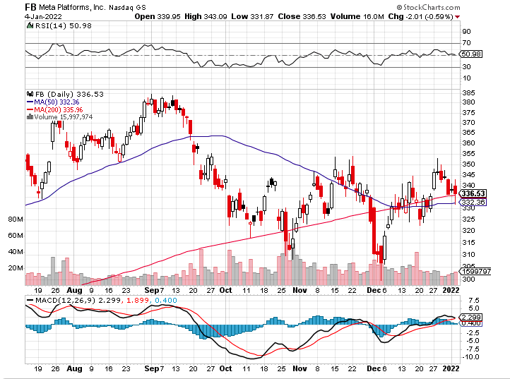
Facebook (FB)- Changes Name to “Meta” took profits on Long 9/$290-$300 vertical bear put spread stopped out of Long 9/$190-$200 vertical bear put spread took profits on Long 9/$145-$155 vertical bull call spread took profits on Long 9/$150-$160 vertical bull call spread

Slide 32
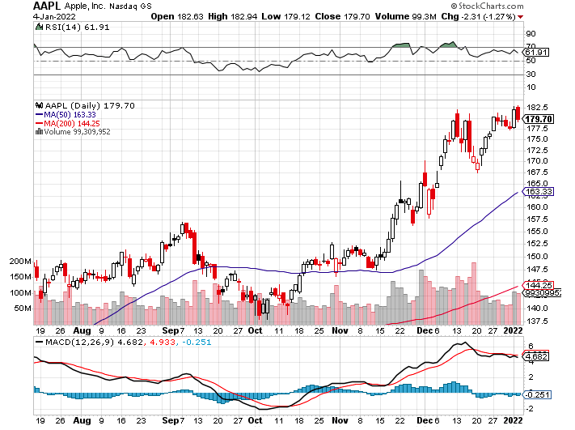
Apple (AAPL)- the First $3 Trillion Market Cap took profits on long 7/$320-$330 call spread took profits on long 4/24/$250-$260 call spread took profits on long 5/$250-$260 call spread

Slide 33
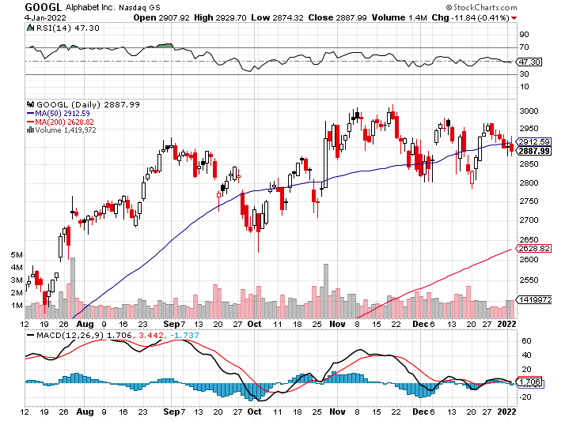
Alphabet (GOOGL) – Ad king on economic recovery 15% of search is travel related took profits on long 12/$1,200-$1,230 bull call spread took profits on long 9/$1,030-$1,080 vertical bull call spread

Slide 34
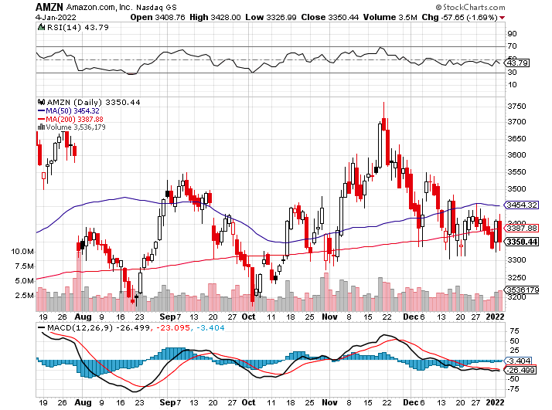
Amazon (AMZN) – Amazon to Hire 125,000 and boost wages to $18 an hour took profits on long 9/$2,800-$2,900 bull call spread

Slide 35
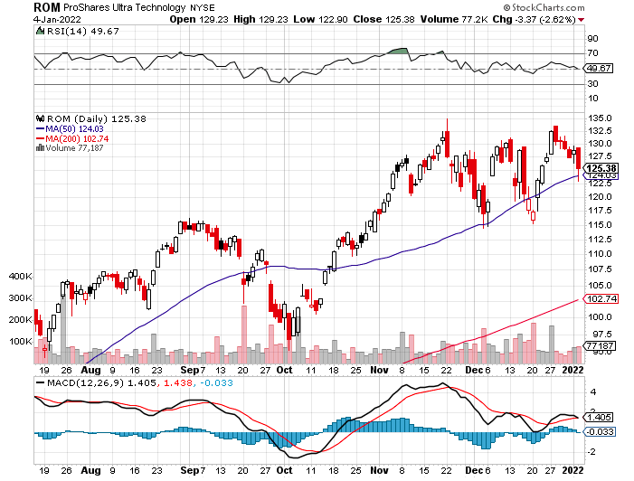
ProShares Ultra Technology (ROM) – New Highs

Slide 36
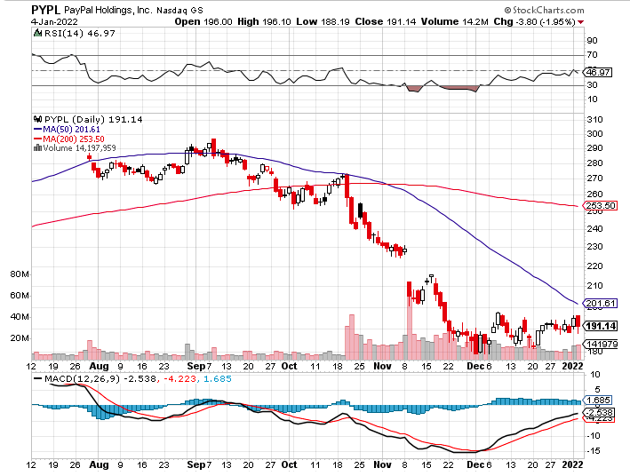
PayPal (PYPL) – “Buy now pay latter” becomes “buy now pay never” took profits on long 4/$90-$95 call spread

Slide 37
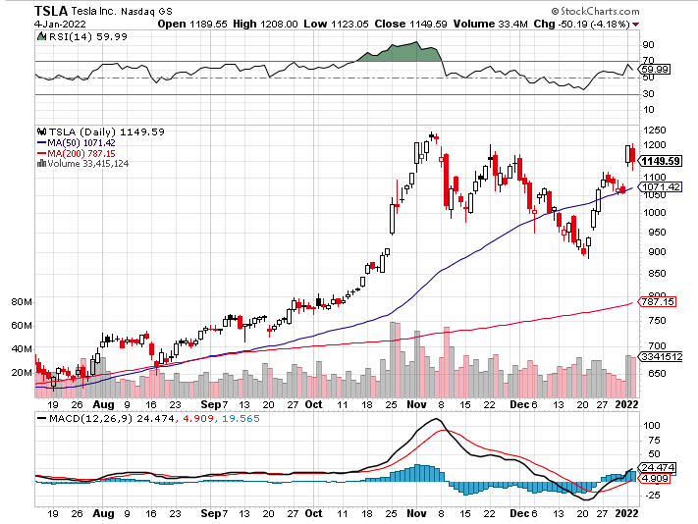
Tesla (TSLA) - Hits $1.2 Trillion in Market Cap 308,000 EV’s delivered in Q4 took profits on long 2X 4/$450-$500 call spread, took profits on long 3/$400-$450 call spread took profits on long 2/$650-$700 call spread-expires, stopped out of long 3/$600-$650 call spread Took profits on long 2/$600-$650 bull call spread, Took profits on long 2/$550-$600 bull call spread

Slide 38
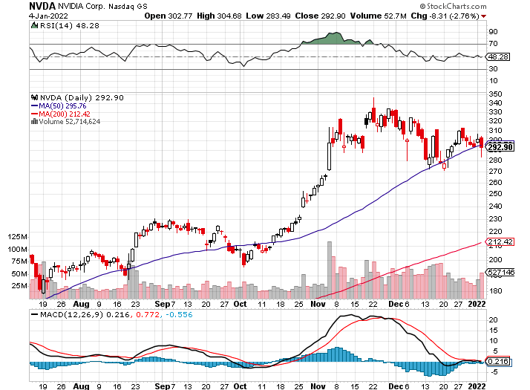
NVIDIA (NVDA) – A Mad Hedge 10 bagger – Global Semiconductor Shortage Slows Auto Industry, Graphic card sales up 87% in Q2

Slide 39
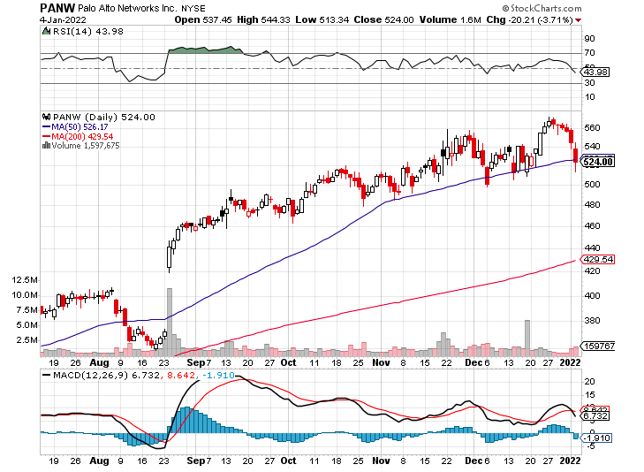
Palo Alto Networks (PANW)- Hacking never goes out of fashion

Slide 40
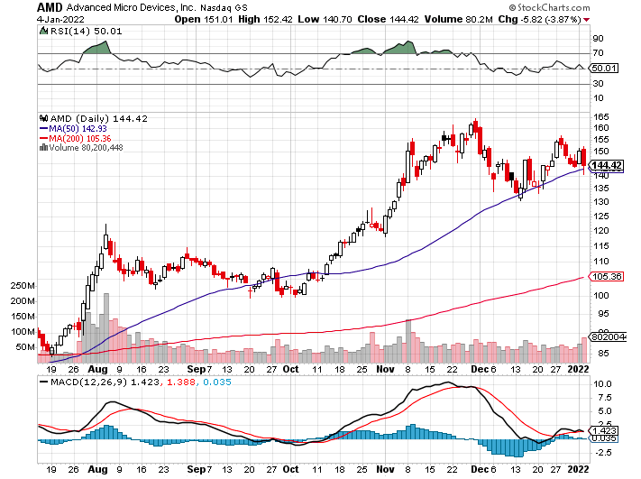
Advanced Micro Devices (AMD)- programable logic devices took profits on long 2/$75-$80 call spread

Slide 41
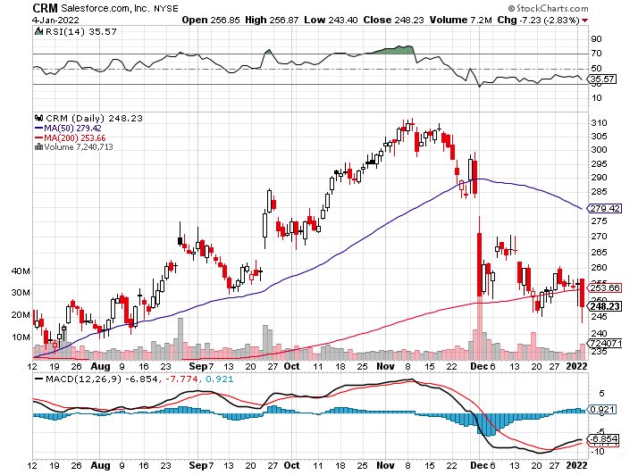
Salesforce (CRM)- Massive Online Migration took profits on long 9/$125-$130 vertical bull call spread took profits on long 8/$125-$130 vertical bull call spread took profits on long 2/$105-$115 call spread

Slide 42
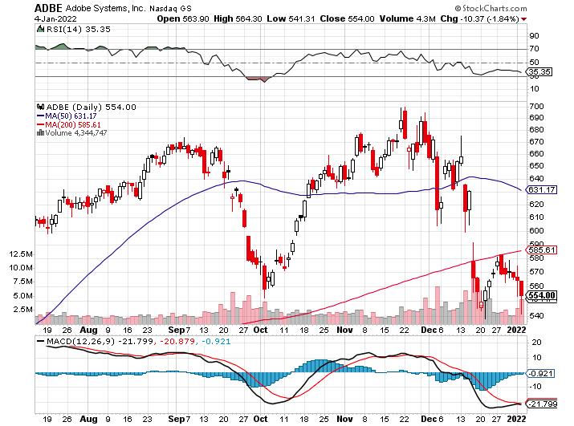
Adobe (ADBE)- Cloud play The Quality Non-China tech play

Slide 43
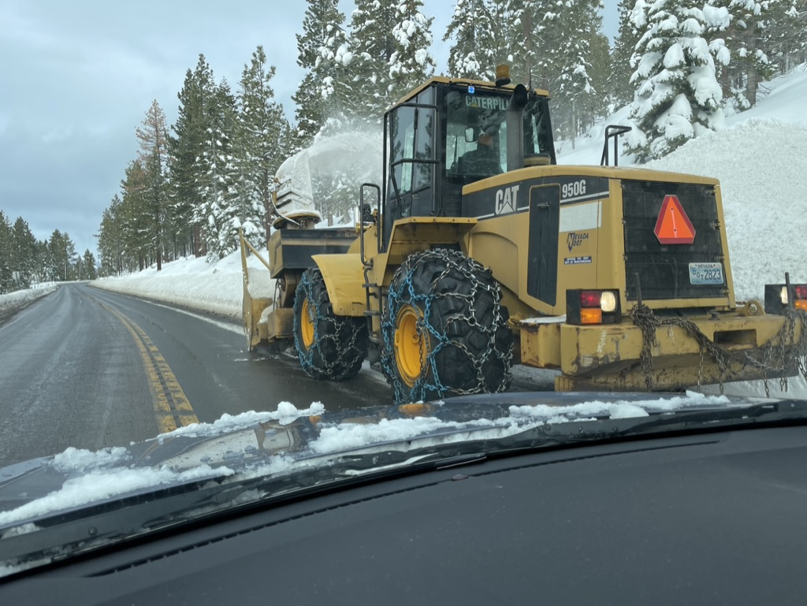

Slide 44
The Second Half of the Barbell
*Bets on a domestic recovery in 2021 Q4 *Upside potential in 2021 far greater than tech *Some of these have not moved for 5 or 10 years *Focuses on economically sensitive cyclical industries *Makes a great counterweight to high-growth technology *We could spend all of next year rotating between the two groups

Slide 45
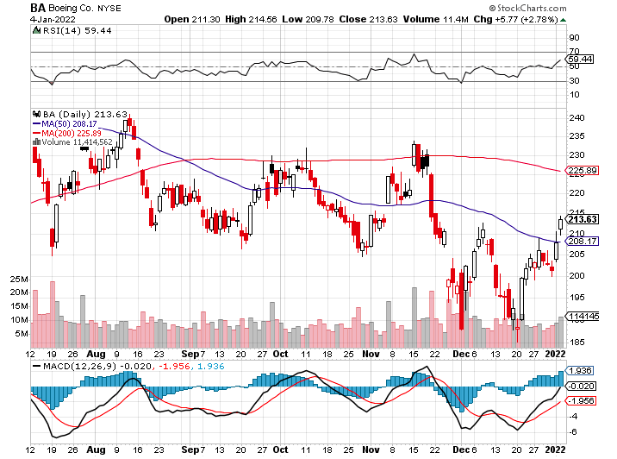
Boeing (BA) –LEAP Candidate China Orders Boeing 737 Max Back into the Air Boeing Wins a Major Order, for 30 737 MAX’s long 3/$146-$149 call spread took profits on long 2/$150-$160 call spread

Slide 46
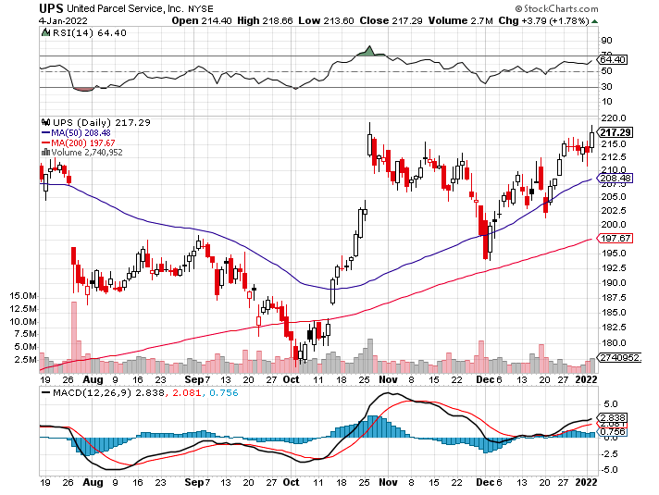
Package Delivery- United Parcel Service (UPS) - Package Delivery massive increase in overnight deliveries, announces blowout earnings, vaccine deliveries took profits on long 11/$130-$140 call spread

Slide 47
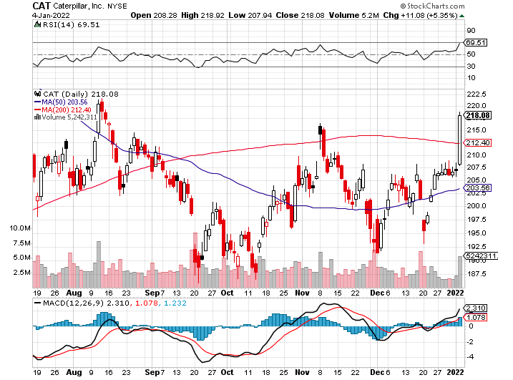
Caterpillar (CAT)- Ag + Infrastructure + Housing took profits on long 12/$145-$150 call spread took profits on long 11/$125-$135 call spread

Slide 48
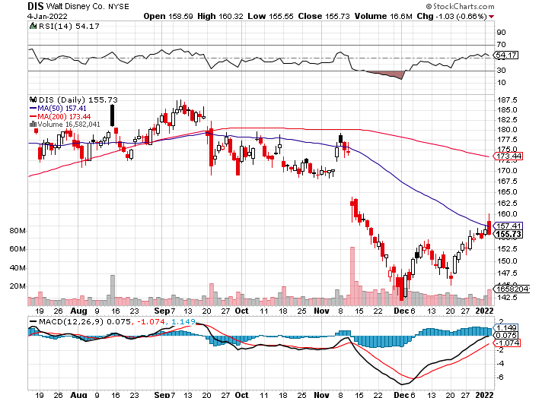
Walt Disney (DIS)- Earnings fail Highest quality recovery play stopped out of long 10/$165-$175 call spread took profits on long 3/$170-$180 call spread

Slide 49
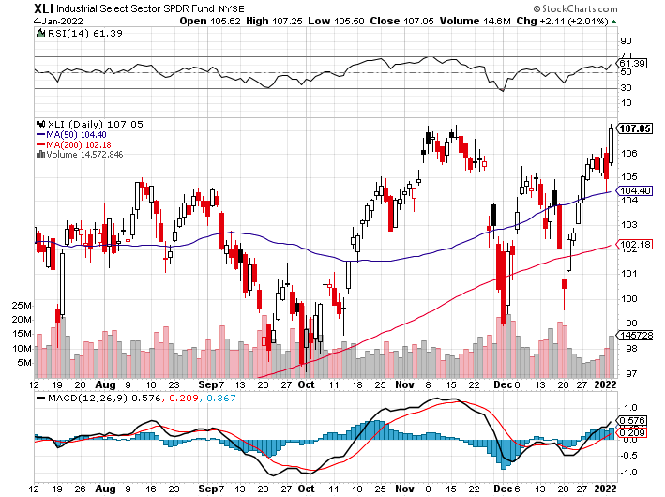
Industrials Sector SPDR (XLI)- (GE), (MMM), (UNP), (UTX), (BA), (HON)

Slide 50
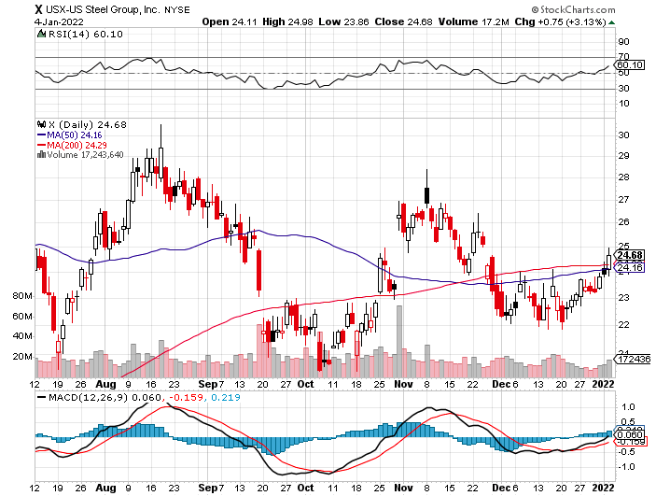
US Steel (X) – Commodity Drag

Slide 51
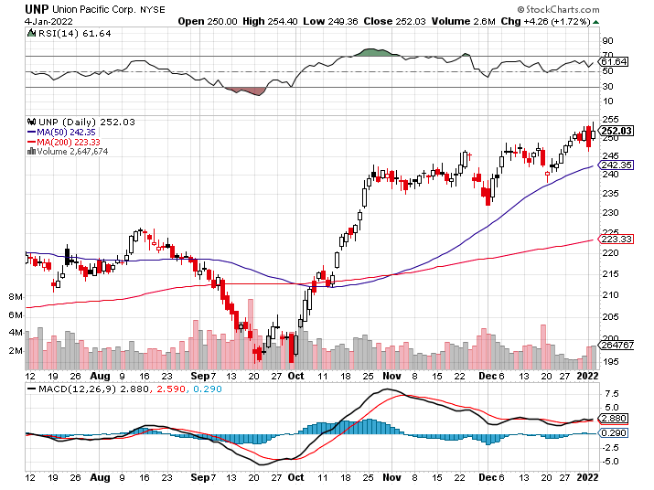
Union Pacific RR (UNP)- Big Stuff to Ship near record earnings announced took profits on long 5/$200-$210 call spread took profits on 11/$150-$160 call spread

Slide 52
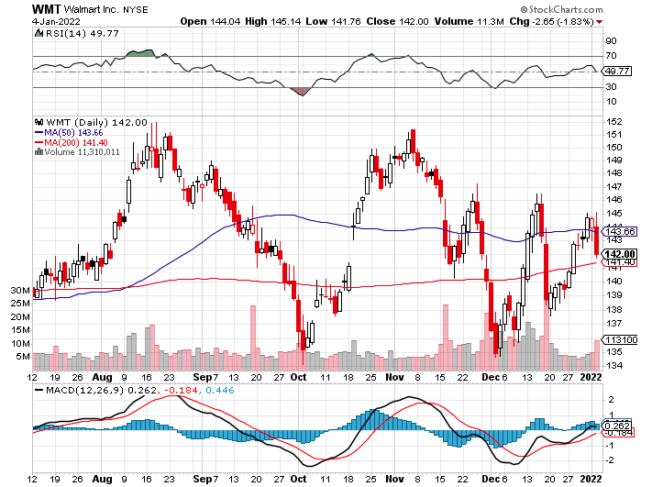
Wal-Mart (WMT)- took profit on Long 11/$125-$130 bear put spread took profit on Long 10/$119-$121 bear put spread took profits on Long 8/$114-$117 bear put spread

Slide 53
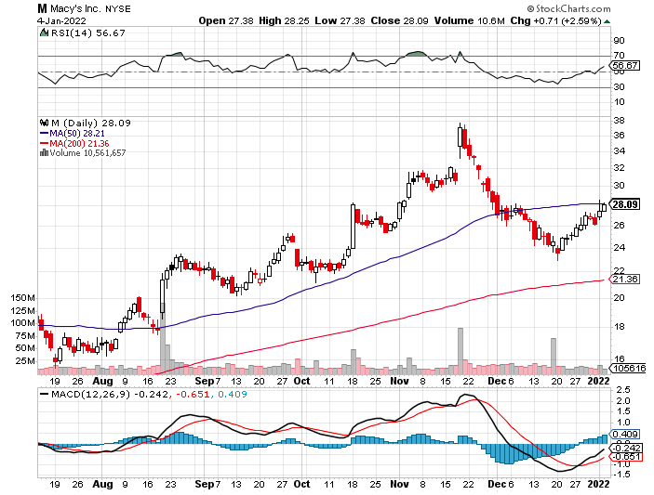
Macys’ (M) – Retail Punished took profits on Long 8/$23-$25 bear put spread

Slide 54
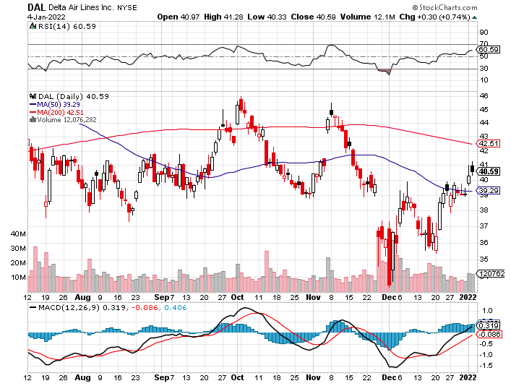
Delta Airlines (DAL) –

Slide 55
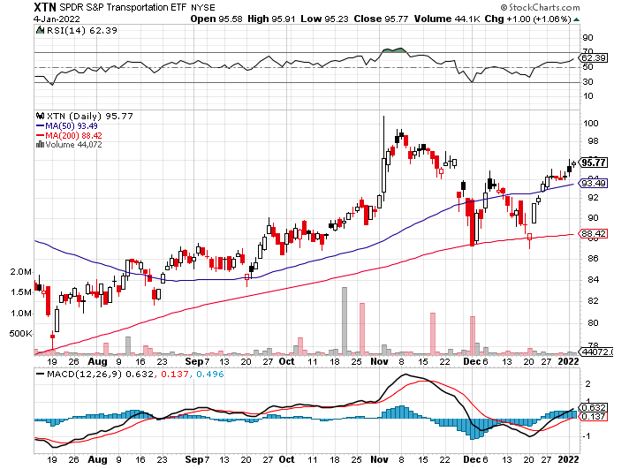
Transports Sector SPDR (XTN)- Worst Hit Sector (ALGT), (ALK), (JBLU), (LUV), (CHRW), (DAL)

Slide 56
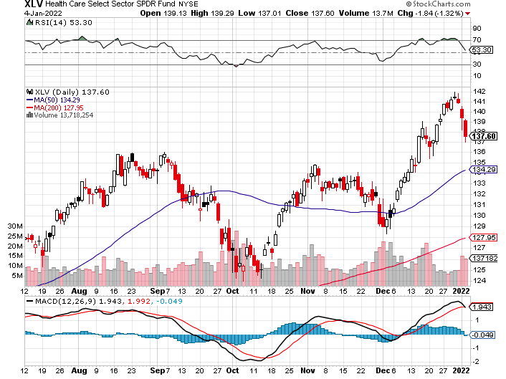
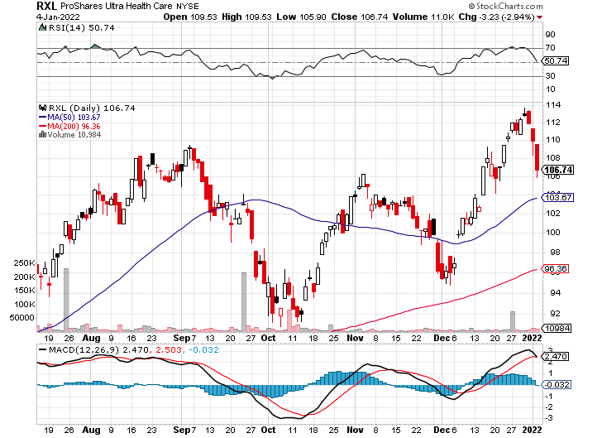
Health Care Sector (XLV), (RXL) (JNJ), (PFE), (MRK), (GILD), (ACT), (AMGN)

Slide 57
Biogen (BIIB) Why you invest in Biotech

Slide 58
Amgen (AMGN) took profits on long 11/$185-$200 bull call spread

Slide 59
CRISPR Therapeutics (CRSP)

Slide 60
Goldman Sachs (GS) – took profits 12/$330-$350 call spread took profits 11/$330-$350 call spread stop loss on long 11/$385-$395 call spreads took profits on long 10/$320-$330 call spread took profits on long 8/$325-$335 call spread

Slide 61
Morgan Stanley (MS) – Doubled Dividend took profits on long 11/$85-$90 call spread stop loss on long 11/$95-$98 call spread took profits on long 10/$85-$90 call spread profits on long 2/$55-$60 call spread

Slide 62
JP Morgan Chase (JPM)-Back to Life took profits 12/$148-$152.50 call spread took profits on long 10/$130-$140 call spread took profits on long 8/$140-$145 call spread took profits on long 7/$140-$145 call spread

Slide 63
ProShares Ultra Technology ETF (ROM) – 2X Long Technology ETF took profits on long 10/$62-65 call spread

Slide 64
Bank of America (BAC) – took profits long 12/$39-$42 call spread stop loss on long 11/$43-$45 call spread took profits on 11/$37-$40 call spread took profits on long 2/$28-$30 call spread

Slide 65
SPDR Metals & Mining ETF (XME) – long 2/$28-$30 call spread

Slide 66
Blackrock (BLK)-Asset Collection Boom took profits on long 3/$770-$790 call spread took profits on long 3/$310-$340 call spread

Slide 67
Visa (V) – “Touchless” Bitcoin Drag took profits on long 5/$220-$225 bull call spread took profits on long long 5/$195-$205 bull call spread took profits on long 9/$180-$185 bull call spread

Slide 68
Consumer Discretionary SPDR (XLY) (DIS), (AMZN), (HD), (CMCSA), (MCD), (SBUX)

Slide 69
Berkshire Hathaway (BRKB)- Natural Barbell resume buy backs at $25 billion a year, Profits Jump 18%, long 10/$275-$280 call spread long 10/$272.50-$277.50 call spread took profits on long 10/$255-$265 call spread took profits on long 3/$230-$240 call spread

Slide 70
Europe Hedged Equity (HEDJ)-

Slide 71
Japan (DXJ)-

Slide 72
Emerging Markets (EEM) - Pro trade, Weak Dollar, Long Recovery Play

Slide 74
Bonds – High Dive
*Omicron peak brings anticipation of economic recovery and a spike in interest rates, down $12 in a month in the (TLT) *Fed is fanning the flames by ending QE and promising three interest rate hikes *The final bond auctions of 2021 were a disaster across the maturity spectrum *US bond funds took in a staggering $612 billion during the first 11 months of 2021, and all time high *Bond funds deliver 0.8% returns in 2021, the worst real returns in 40 years. *The previous record was the $486 billion absorbed in 2019. *In a year, yield on the ten-year US Treasury bond will be at 2.50% or higher *US Treasury bond fund (TLT) could plunge from $180 in 2020 to $105 by 2023

Slide 75
Treasury ETF (TLT) – Crash! took profits on long 12/$152-$155 put spread, took profits on 11/$150-$153 put spread took profits on long 10/$154-$157 put spread, took profits on long 10/$137-$140 call spread profits on long 10/$155-$158 put spread, took profits on 9/$155-$158 put spread took profits on long 8/$157-$160 put spread, took profits on long 8/$156-$159 put spread,

Slide 76
Ten Year Treasury Yield ($TNX) – 1.69%

Slide 77
Junk Bonds (HYG) 3.67% Yield to Maturity

Slide 78
2X Short Treasuries (TBT)-Another run at highs

Slide 79
Emerging Market Debt (ELD) 5.67% Yield- Strong dollar disease

Slide 80
Emerging Market Debt (ELD) 5.81% Yield- Mix of AAA, AA, and A rated bonds

Slide 82
Foreign Currencies – Dollar New Highs
*Soaring interest rates cause US dollar to maintain one-year highs *New $4.5 trillion in spending assure higher interest rates sooner, so does a double taper rate *The forex market will notice monster US twin deficits someday, but not today *The Japanese yen (FXY) has been especially hard hit. *Currency with the fastest appreciating interest rates always does best *Long-term fundamentals are still poor, a dollar short could be the new ten-year trade, but not yet *Stand aside from forex for now, there are better fish to fry

Slide 83
Japanese Yen (FXY)

Slide 84
Euro ($XEU), (FXE), (EUO)-

Slide 85
British Pound (FXB)-

Slide 86
Australian Dollar (FXA)- The Global Recovery Play took profits on long 8/$67-$69 call spread

Slide 87
Emerging Market Currencies (CEW) Strong dollar disease

Slide 88
Chinese Yuan- (CYB)-

Slide 90
Bitcoin – Rising Rate Hit - Strong dollar disease Buy the Mad Hedge Bitcoin Letter at https://www.madhedgefundtrader.com/store/
* Bitcoin trading around 200-Day Moving Average, as sharply rising interest rates deliver body blow *Omicron variant delivered a new mini recession and crypto is no place to hide *Major Bitcoin plays like (MSTR), (BLOK), and (BITO) are entering “BUY” territory *Long term “BUY” signal for Bitcoin still intact *Buy Bitcoin and Ethereum on the dip

Slide 91
Bitcoin ($BTCUSD) – Wake Up Time

Slide 92
Ethereum (ETHE) –

Slide 93
MicroStrategy (MSTR) –

Slide 94
Amplify Transformational Data Sharing ETF (BLOK) – Cross Imminent

Slide 96
Energy –
*OPEC+ Agrees to Oil Production Increase, in January *Screaming from its largest customer, China, prompted the move *Some 400,000 barrels a day will be placed on the market *Oil fell 2.5% on the news *The Saudis want to keep Texas tea under $100 a barrel, the price that causes recessions and less long-term consumption *The end of oil is upon us, but it may take 30 years to unwind existing infrastructure *Avoid all energy plays like the plague, it’s the new buggy whip industry as the US de-carbonizes

Slide 97
Oil-($WTIC)

Slide 98
United States Oil Fund (USO) long 10/$9.50-$10 Vertical bull call spread

Slide 99
Energy Select Sector SPDR (XLE)-No Performance! (XOM), (CVX), (SLB), (KMI), (EOG), (COP)

Slide 100
Halliburton (HAL)-

Slide 101
Natural Gas (UNG) -

Slide 103
Precious Metals – No Trade
*Not a hint of downside protection offered by gold in this global selloff *Gold has been the worst performing asset of 2021 *Gold provided absolutely no downside protection during the pandemic crash *If $9 trillion of investment demand decamps for the crypto world, leaving only jewelry demand, $9 trillion could go into Bitcoin. *Rising interest rates bode poorly for precious metals as it raises the opportunity cost for non-yielding assets *Bitcoin is clearly sucking capital out of precious metals *Stay away until this plays out *Silver is still the bigger and better long-term play

Slide 104
Gold (GLD)- Meltdown

Slide 105
Market Vectors Gold Miners ETF- (GDX) –

Slide 106
Barrick Gold (GOLD) took profits on long 1/$21-$23 call spread took profits on long 11/$22-$24 call spread

Slide 107
Newmont Mining- (NEM)- took profits on long $55-60 call spread

Slide 108
Silver- (SLV)- took profits on long 11/$19-$20 call spread

Slide 109
Silver Miners - (SIL)-

Slide 110
Wheaton Precious Metals - (WPM)- took profits on long 2/$39-41 call spread

Slide 111
Copper (COPX)-Trapped in a Range

Slide 113
Real Estate – No Rest
*US Home Prices Soar 18.4%, in October according to S&P Case Shiller *Phoenix (32.3%), Tampa (28.1%), and Miami (25.7%) led *30-year fixed rate mortgages at 3.05% were a huge help *Major flight from New York to Florida continues *Prices will continue to appreciate but at a third the 2021 18% rate *Rents now soaring faster than home prices and low earnings are priced out

Slide 114
S&P Case Shiller Up 18.4% for October Phoenix (33.1%), Tampa (27.2%), Miami 25.2% lead

Slide 115
Crown Castle International (CCI) – 2.70% yielding cell phone tower REIT

Slide 116
US Home Construction Index (ITB) (DHI), (LEN), (PHM), (TOL), (NVR)

Slide 118
Trade Sheet- So What Do We Do About All This?
*Stocks – buy dips aggressively *Bonds – sell rallies aggressively *Commodities-stand aside *Currencies- stand aside *Precious Metals – stand aside *Energy – stand aside *Volatility - sell short over $30 *Real estate – buy dips *Bitcoin – buy dips

Slide 119
Next Strategy Webinar 12:00 EST Wednesday, January 19 from Incline Village, NV email me questions at support@madhedgefundtrader.com
Good Luck and Good Trading!
Notes:
*

