Slide 1

The Mad Hedge Fund Trader
“Turmoil”
With John Thomas
Incline Village, NV, February 2, 2022
www.madhedgefundtrader.com
Notes:
*

Slide 2

Trade Alert Performance
New All Time Highs!
*January 14.59% MTD *July +0.61% Final
*February +13.28% Final *August +9.36% Final
*March +20.60% Final *September 1.03% Final
*April +15.67% Final *October +8.91% MTD
*May +8.13% Final *November -11.79% Final
*June +0.71% Final *December +11.26% Final
*2022 YTD +14.59%
compared to -3.2% for the Dow Average
*+527.15% since inception
*Average annualized return of 43.19% for 12 years

Slide 3
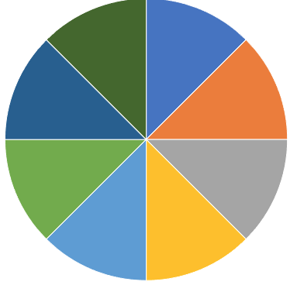
Portfolio Review
60% Long, 30% short, 10% cash
Long Term Bull Market
Current Capital at Risk
Risk On
World is Getting Better
(TLT) 2/$149-$152 put spread | 10.00%
(TLT) 2/$147-$150 put spread | 10.00%
(TLT) 3/$150-$153 Put spread | 10.00%
(SPY) 2/$400-$410 call spread | 10.00%
(BRKB) 2/$270-$280 call spread | 10.00%
(TSLA) 2/$600-$650 call spread | 10.00%
Risk Off
World is Getting Worse
(MSFT) 2/$340-$350 puts spread | -10.00%
(AAPL) 2/$180-$190 put spread | -10.00%
(SPY) 2/$465-$475 calls spread | -10.00%
Total Net Position | 30.00%
Total Aggregate Position | 90.00%
Expiration Value
21.68%

Slide 4
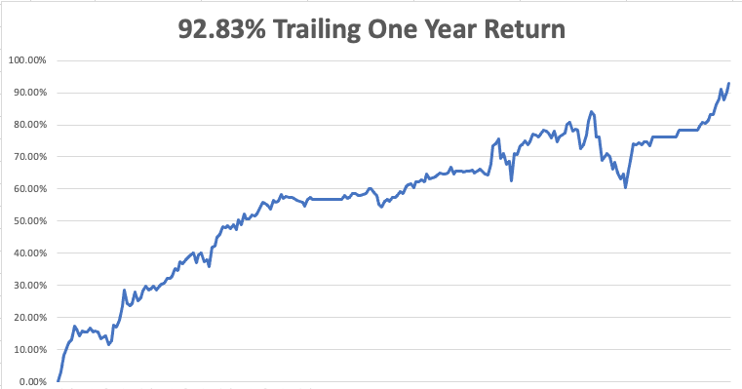

Slide 5
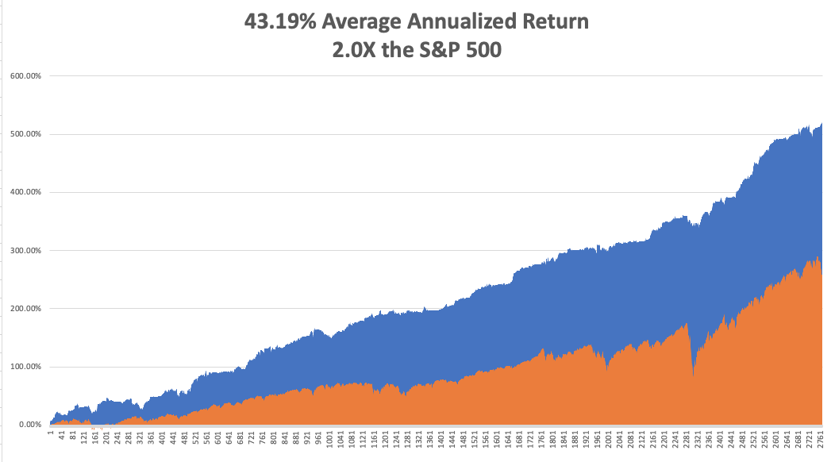
GTD 12 Year Daily Audited Performance

Slide 6

The Method to My Madness
The Roaring Twenties are Here
*Keep trading this market. (VIX) in the high $20’s is the sweet spot
*The first three interest rate rises are in the market, but not the 9 that follow
*Rapidly tightening Fed policy has triggered a global “RISK OFF”
*A core short in bonds will be key, but trade this too
*Omicron is slowing growth everywhere,
but a quick bounce back is expected
*VIX over $30 is the ideal entry point for new positions
*Ukraine war is all talk and no do. It already succeeded because
it got Putin’s oil prices up high

Slide 7
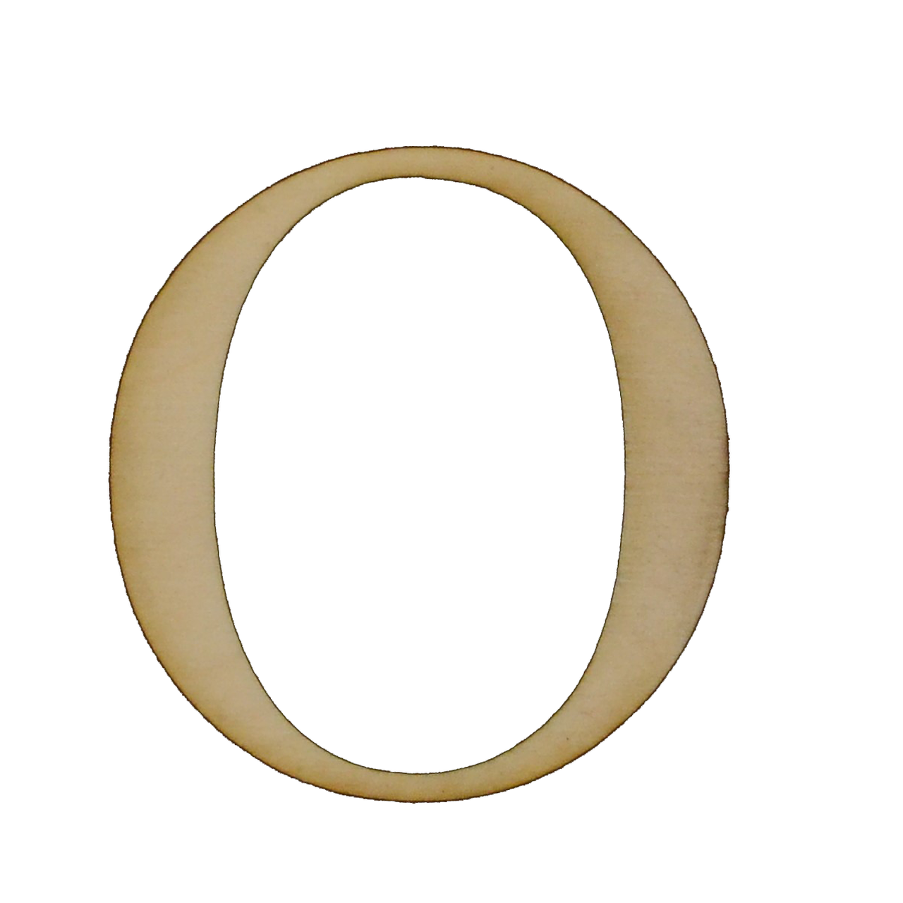

Corona Update – Explosive Growth
*Omicron is now dominating the US economy, but cases have peaked
*A year ago, hospitalizations hit 450,000/day. Now it’ 1 million/day.
*Vaccines for children under 5 will be out in March
*Fatalities are a fifth less than last years peak
*Hospitalizations are at 80% from the unvaccinated
*Pandemic is still going to be zero by summer, book those cruises
*US cases top 90 million, deaths topping 854,000 and deaths are
limited to 2,000 a day

Slide 8
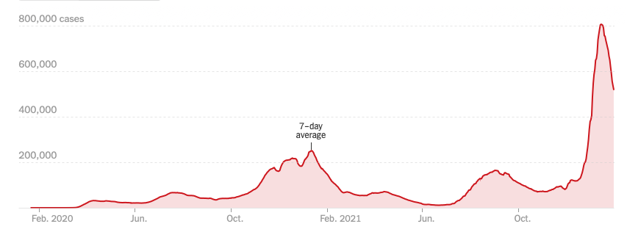
Bump on the Way to Zero

Slide 9
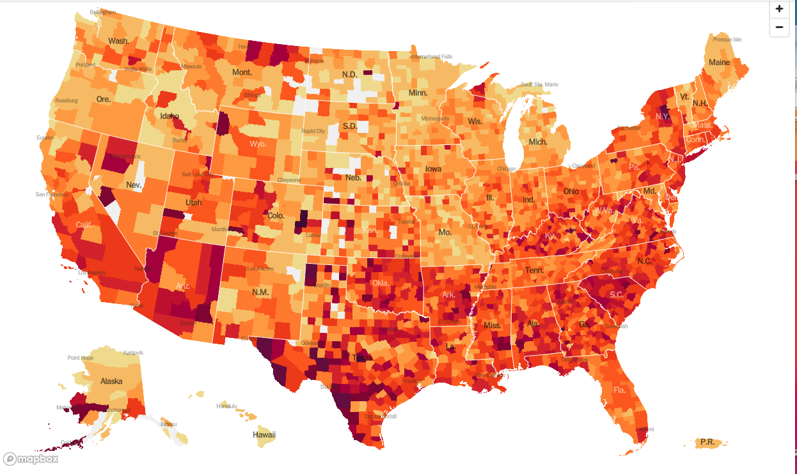
January 20 2021 Infection Rate

Slide 10
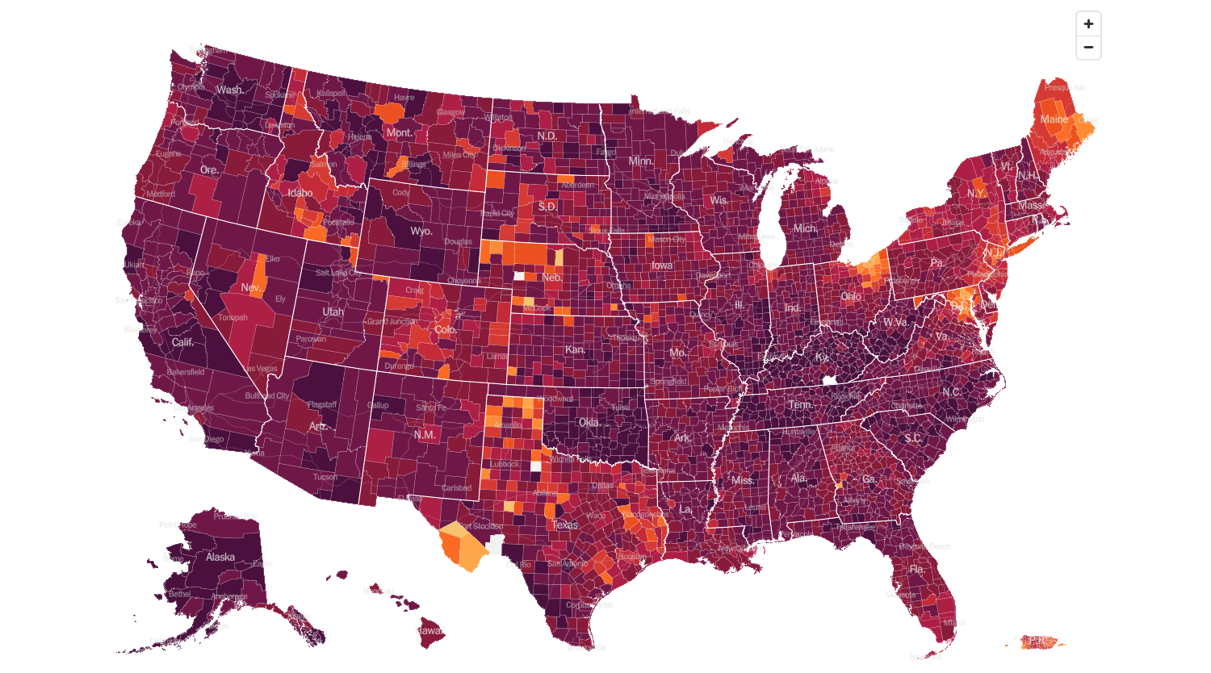
February 2nd 2022 Infection Rate

Slide 11
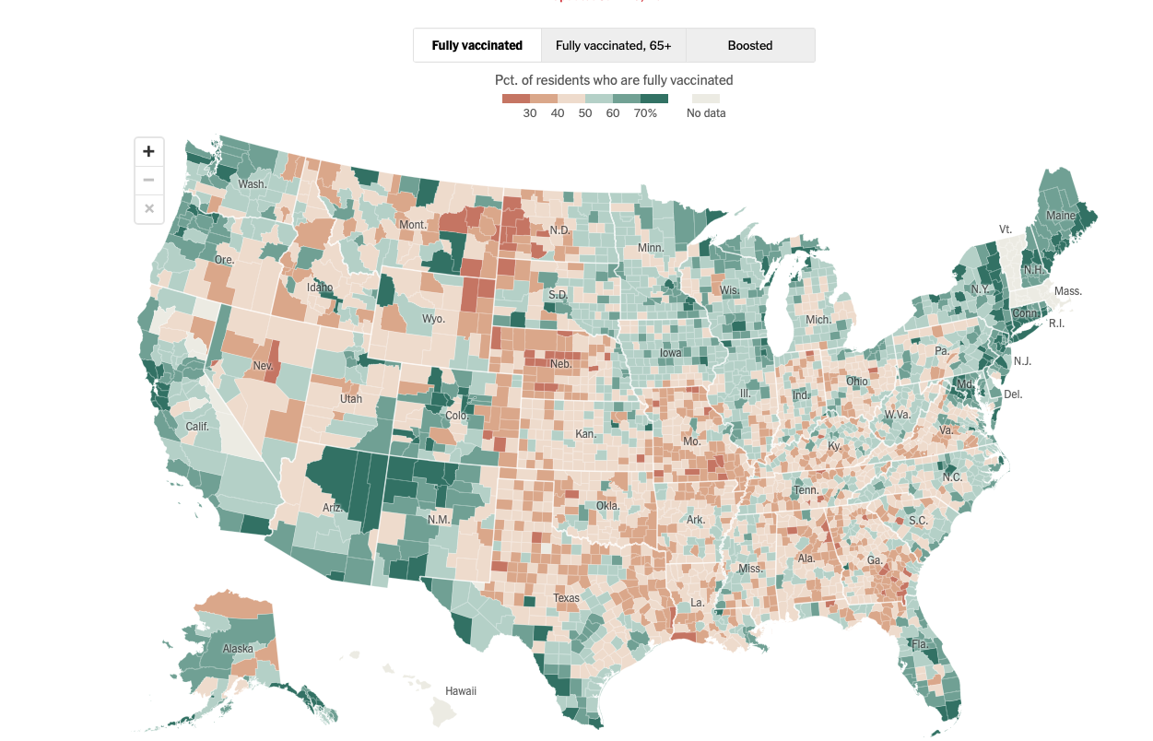

Slide 12
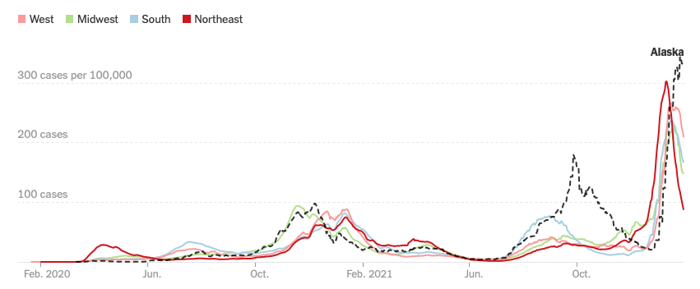

Slide 13

The Global Economy – Powering On
*Fed to Raise Rates Eight Times. That’s what will be needed to curb the current runaway inflation which is now at 7.0% and still rising
*Personally, I think it will be 12 quarter point increments to peak out at a 3 ¼% overnight rate.
*The economy is still very strong, but Omicron is a concern
*Q4 GDP Explodes at 6.9%, continuing the highest economic growth rate in decades
*Watch for growth to slow to 2.0% in Q1
*China’s Zero Covid Policy to Continue Through Fall,
and so will our supply chain and inflation problems
*China GDP Grows 8.1% YOY but is rapidly slowing
now thanks to Omicron

Slide 14
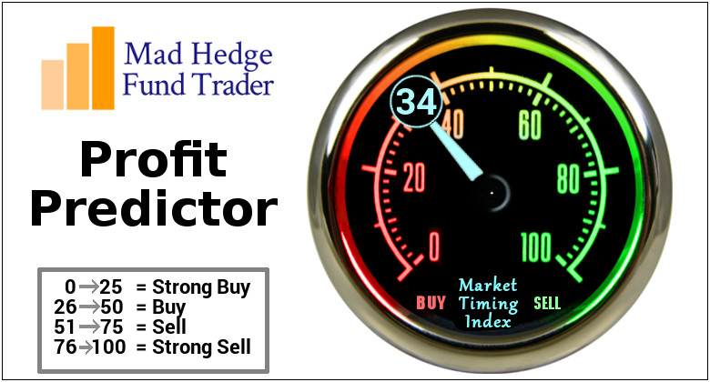
The Mad Hedge Profit Predictor
Market Timing Index – Buy Territory
An artificial intelligence driven algorithm that analyzes 30 different economic, technical, and momentum driven indicators

Slide 15
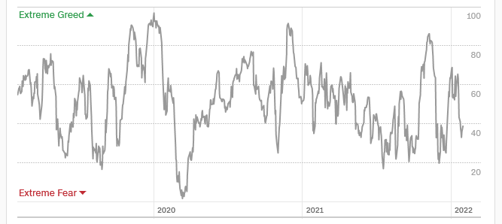
The Mad Hedge Profit Predictor
From Extreme “BUY” to Neutral
SELL
Do
Nothing
BUY

Slide 16
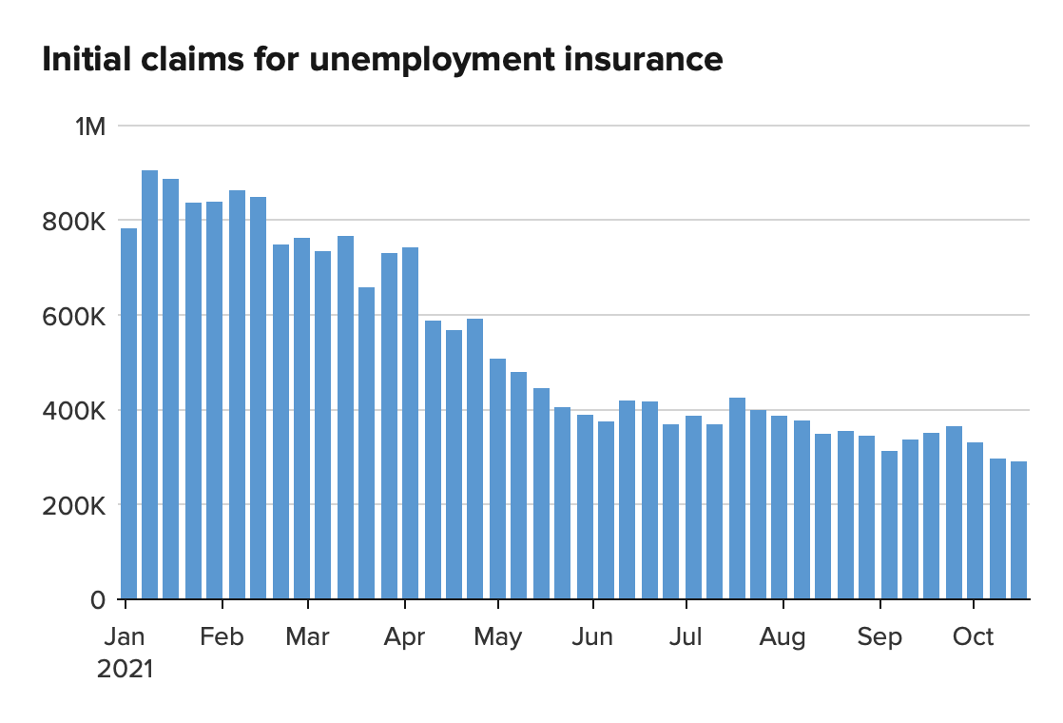
Weekly Jobless Claims – New Lows
260,000 – 4 Month High

Slide 17
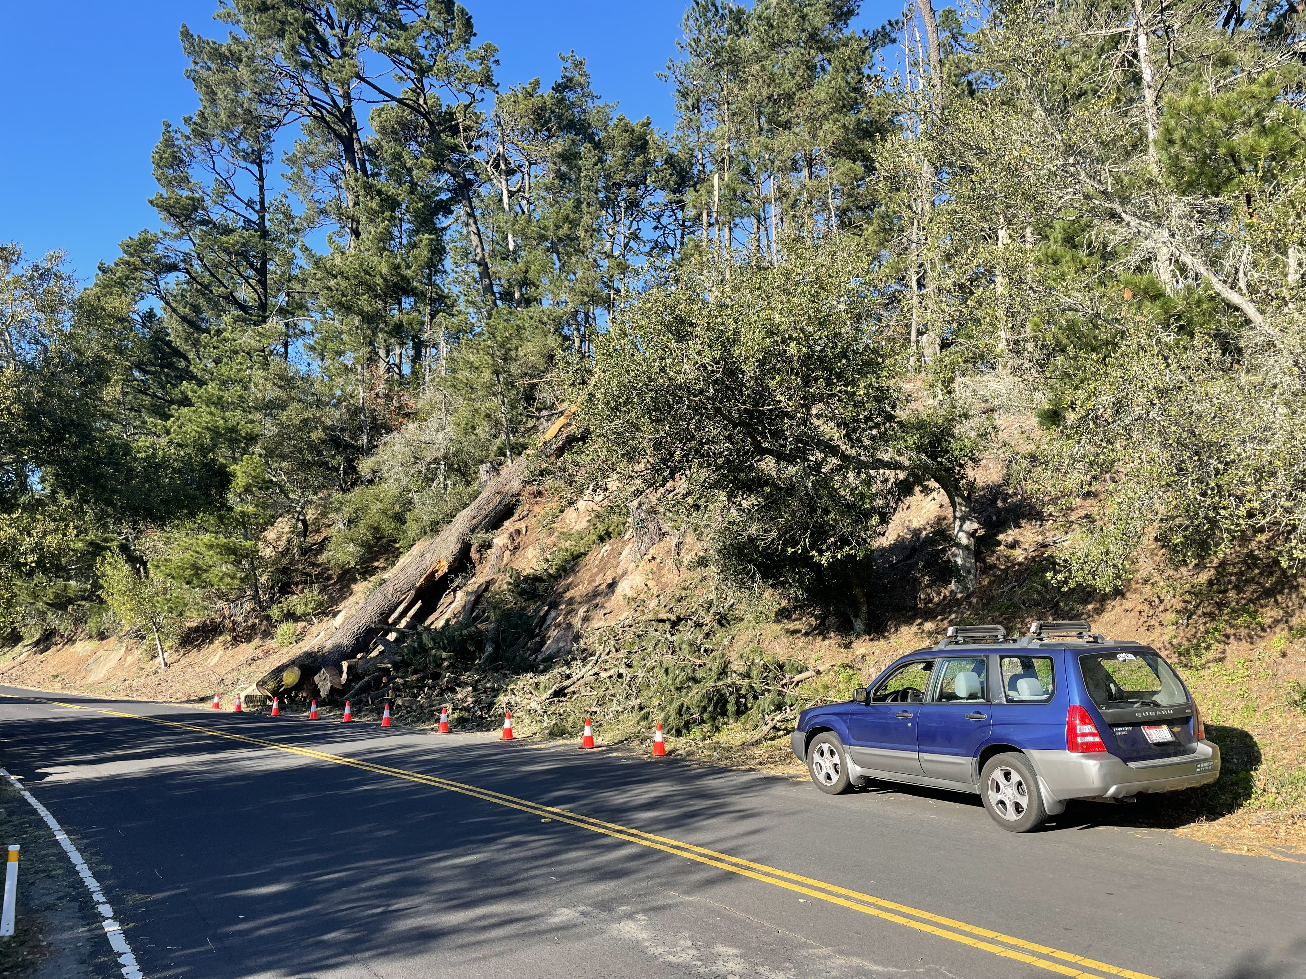

Slide 18

Stocks – Palpitations
*Dow Dives Nearly $4,000 points in 14 days, in the mother of all corrections.
*The Market is De-Grossing Big Time. That means cutting total market exposure and selling everything, regardless of stock or sector.
*Interest sensitives will be leaders for the next six months, like banks, brokers, and fund managers
*NASDAQ Stocks suffer worst January in history
*Stocks to Fall Another 10%, says Wharton Prof Jeremy Siegel,
who has been uncannily accurate for the past decade.
*Volatility to remain high, a money maker for Mad Hedge
*S&P 500 Profits Jump 22.4% in Q4, possibly taking the full
year figure up an incredible 49%.

Slide 19
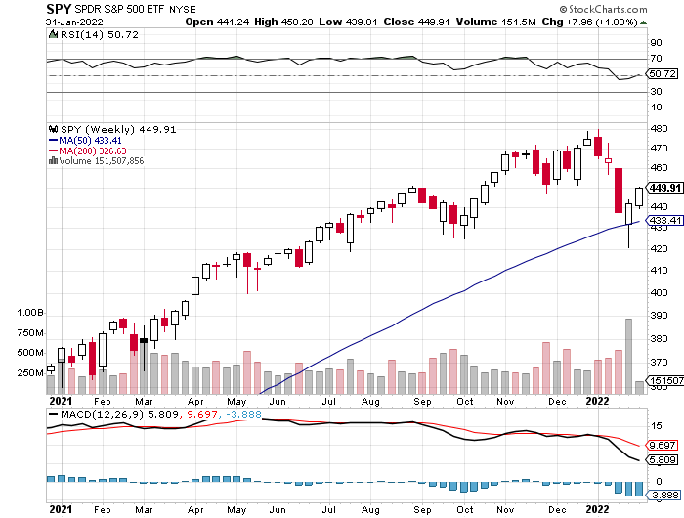
S&P 500 – Year End Melt Up! long 2/$410-$420 bull call spread, long 2/$465-$475 bear put spread
Took profits on long 2/$480-$500 bear put spread, Took profits on long 10/$410-$420 bull call spread
First Support
$420
-12.5%
The Bottom
395
Down
17.7%

Slide 20
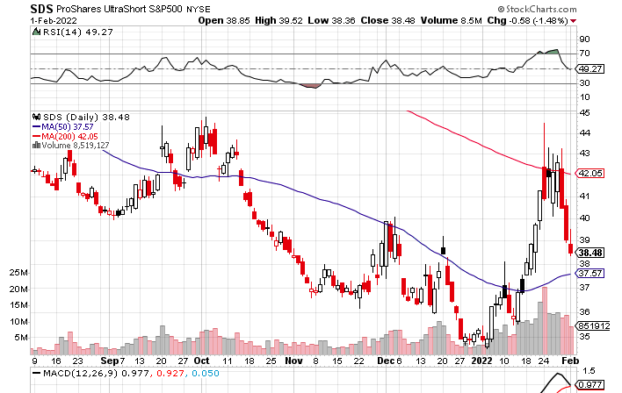
ProShares Ultra Short S&P 500 (SDS)- a great hedge for long stocks and bonds long 2X position has a hedge against longs and bond shorts

Slide 21
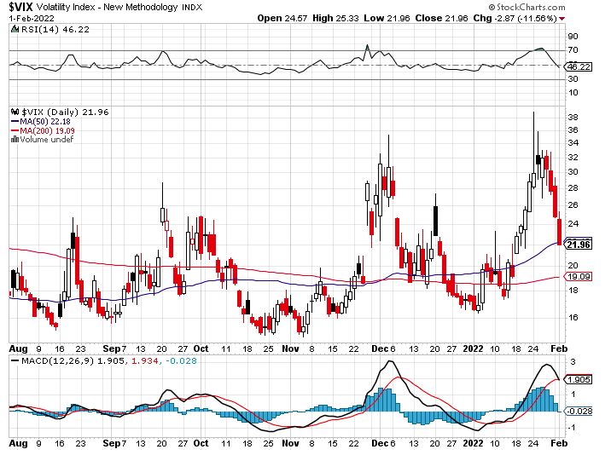
(VIX) – Dying a Slow Death classic summer market

Slide 22
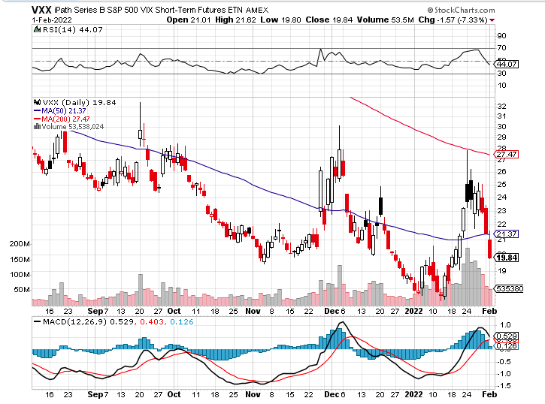
(VXX)-

Slide 23
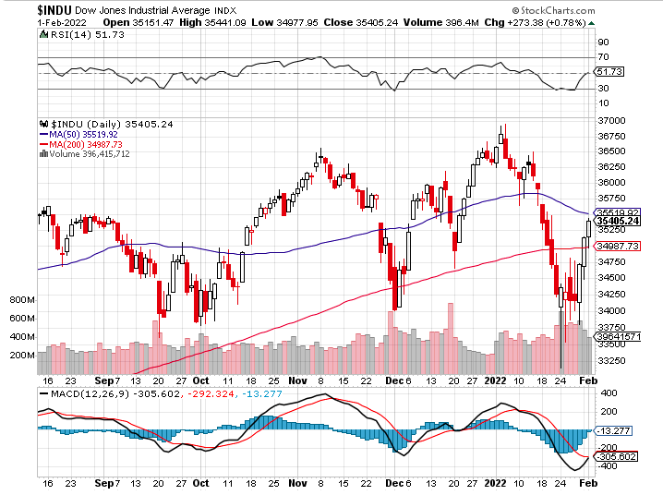
Dow Average ($INDU)-

Slide 24
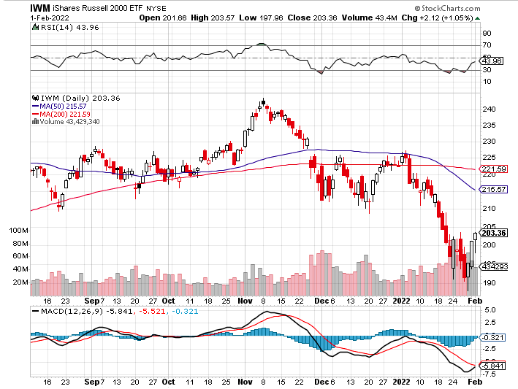
Russell 2000 (IWM)- took profits on Long 10/$137-$142 vertical bull call spread took profits on Long 10/$153-$156 vertical bear put spread

Slide 25
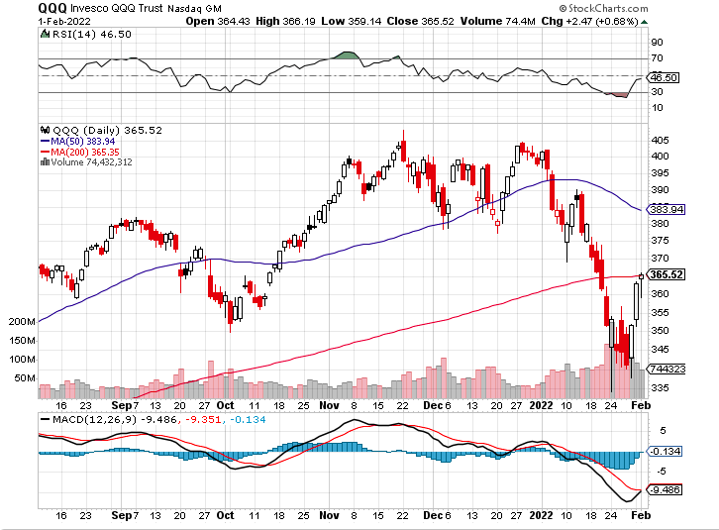
NASDAQ (QQQ) – long (QQQ) 4/$330-$335 put spread took profits on long (QQQ) 3/$340-$345 put spread covered long (QQQ) $325-$330 put spread

Slide 26
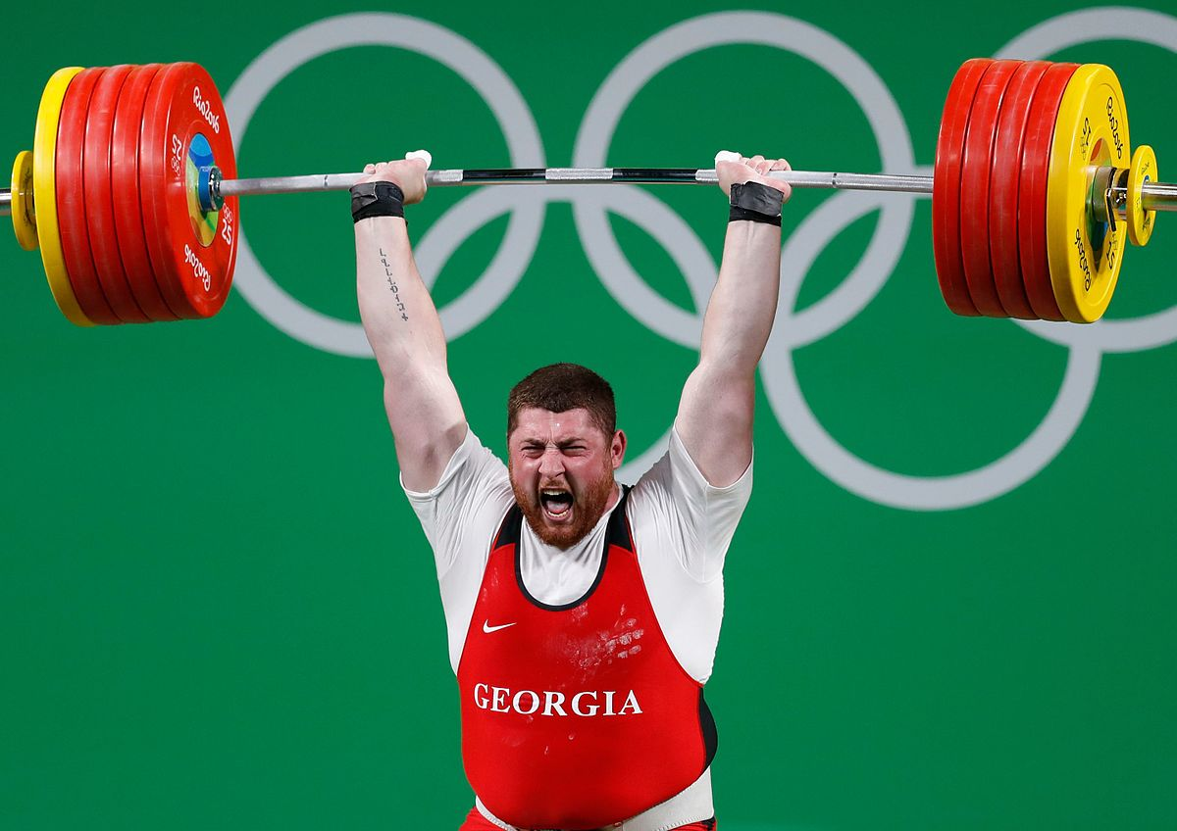
The Barbell Portfolio
*50% Big Tech - 2% of US Employment but 27% of Market Cap and 38% of Profits
50% Domestic Recovery, including:
Railroads
Couriers
Banks
Construction
Credit Cards
Event organizers
Ticket sales
Retailers

Slide 27
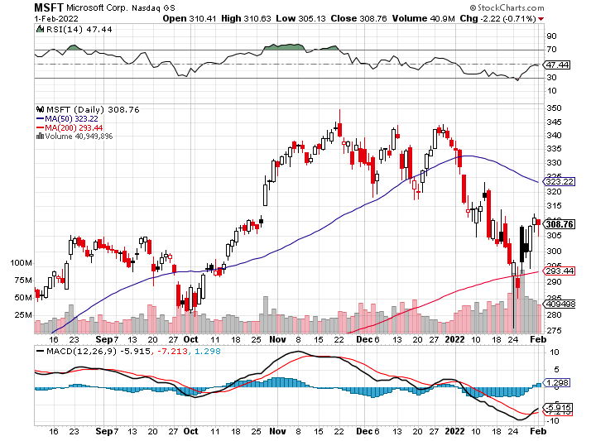
Microsoft (MSFT)- long 2/$340-$350 bear put spread took profits on long 12/$220-$230 call spread stop loss on long 12/$170-$180 call spread

Slide 28
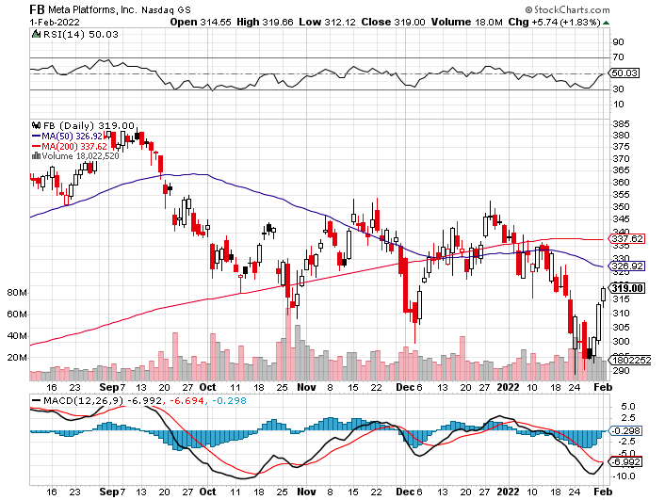
Facebook (FB)- Changes Name to “Meta” took profits on Long 9/$290-$300 vertical bear put spread stopped out of Long 9/$190-$200 vertical bear put spread

Slide 29
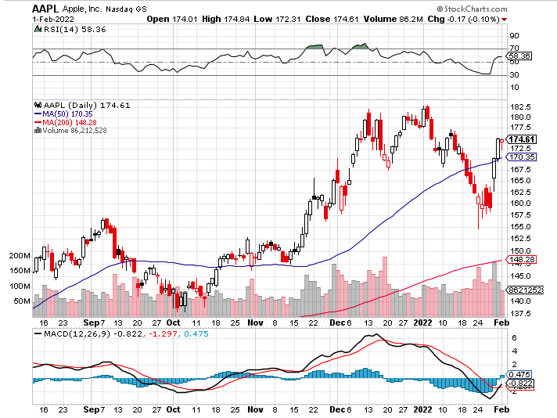
Apple (AAPL)-
Apple Blows it Away, with Q4 revenues of an eye popping $124 billion, up 11% YOY. Some $27 billion in dividends and share buy backs was returned to shareholders. long 2/$180-$190 put spread

Slide 30
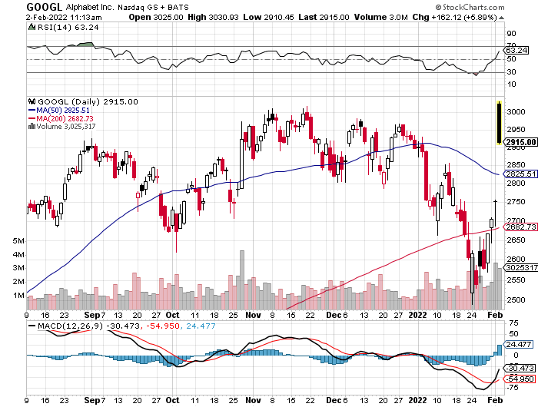
Alphabet (GOOGL) – 20:1 Share Split took profits on long 12/$1,200-$1,230 bull call spread took profits on long 9/$1,030-$1,080 vertical bull call spread

Slide 31
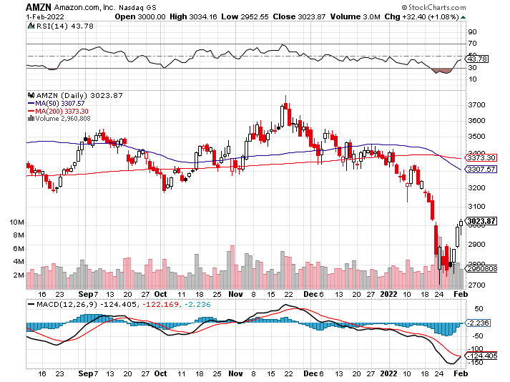
Amazon (AMZN) – took profits on long 9/$2,800-$2,900 bull call spread

Slide 32
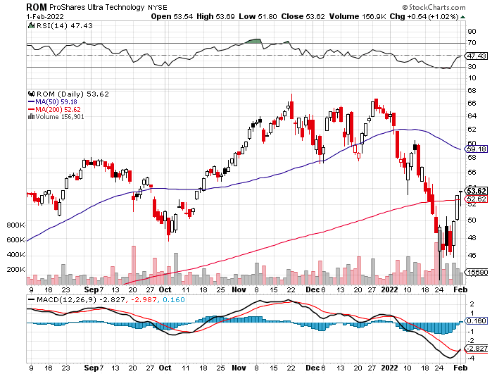
ProShares Ultra Technology (ROM) – New Highs

Slide 33
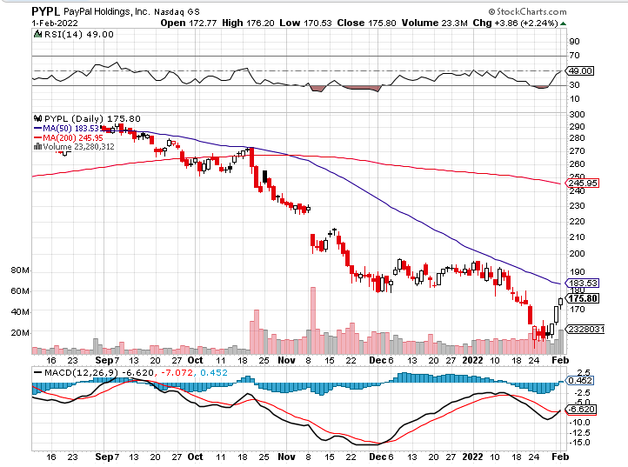
PayPal (PYPL) - Cancels Pinterest Buy took profits on long 4/$90-$95 call spread

Slide 34
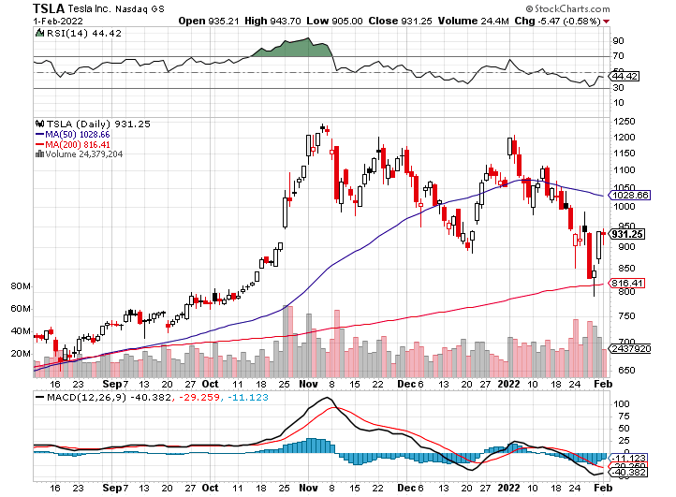
Tesla (TSLA) –Aiming for 1.5 million cars in 2022 long 2/$600-$650 call spread

Slide 35
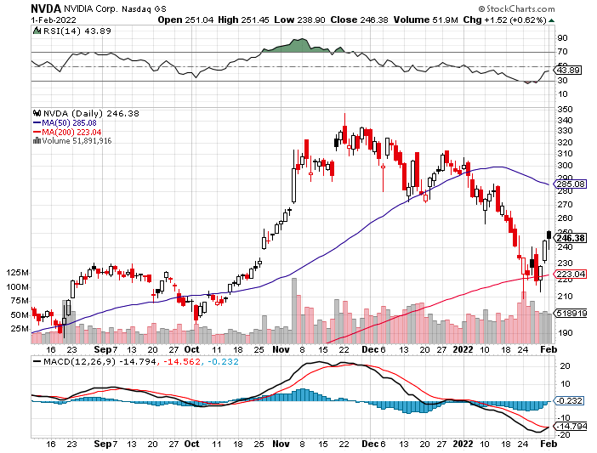
NVIDIA (NVDA) –
A Mad Hedge 10 bagger – Global Semiconductor Shortage Slows Auto Industry,
Graphic card sales up 87% in Q2

Slide 36
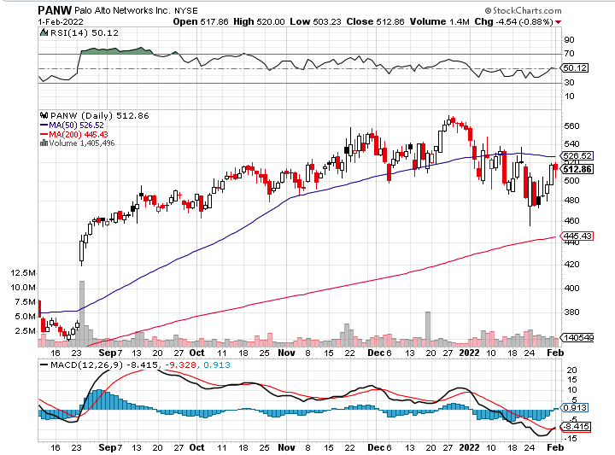
Palo Alto Networks (PANW)-
Hacking never goes out of fashion

Slide 37
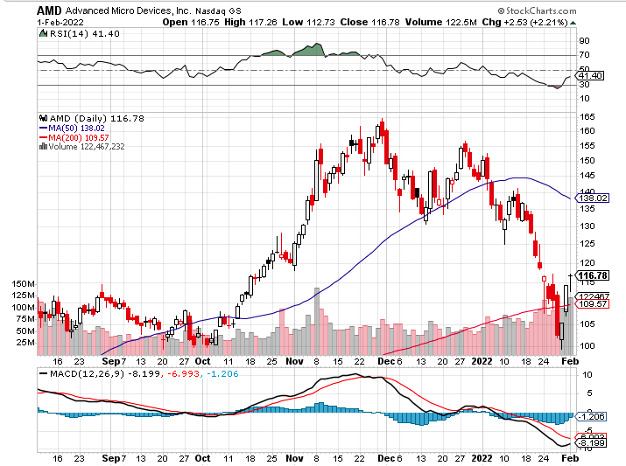
Advanced Micro Devices (AMD)- programable logic devices took profits on long 2/$75-$80 call spread

Slide 38
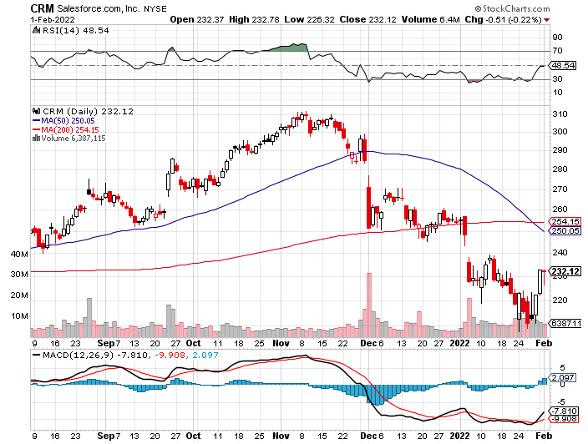
Salesforce (CRM)- Massive Online Migration took profits on long 9/$125-$130 vertical bull call spread took profits on long 8/$125-$130 vertical bull call spread took profits on long 2/$105-$115 call spread

Slide 39
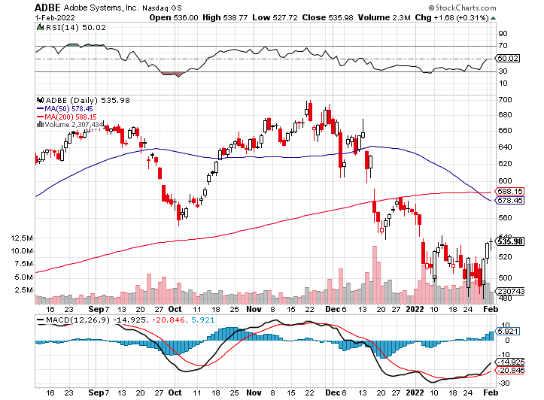
Adobe (ADBE)- Cloud play
The Quality Non-China tech play

Slide 40
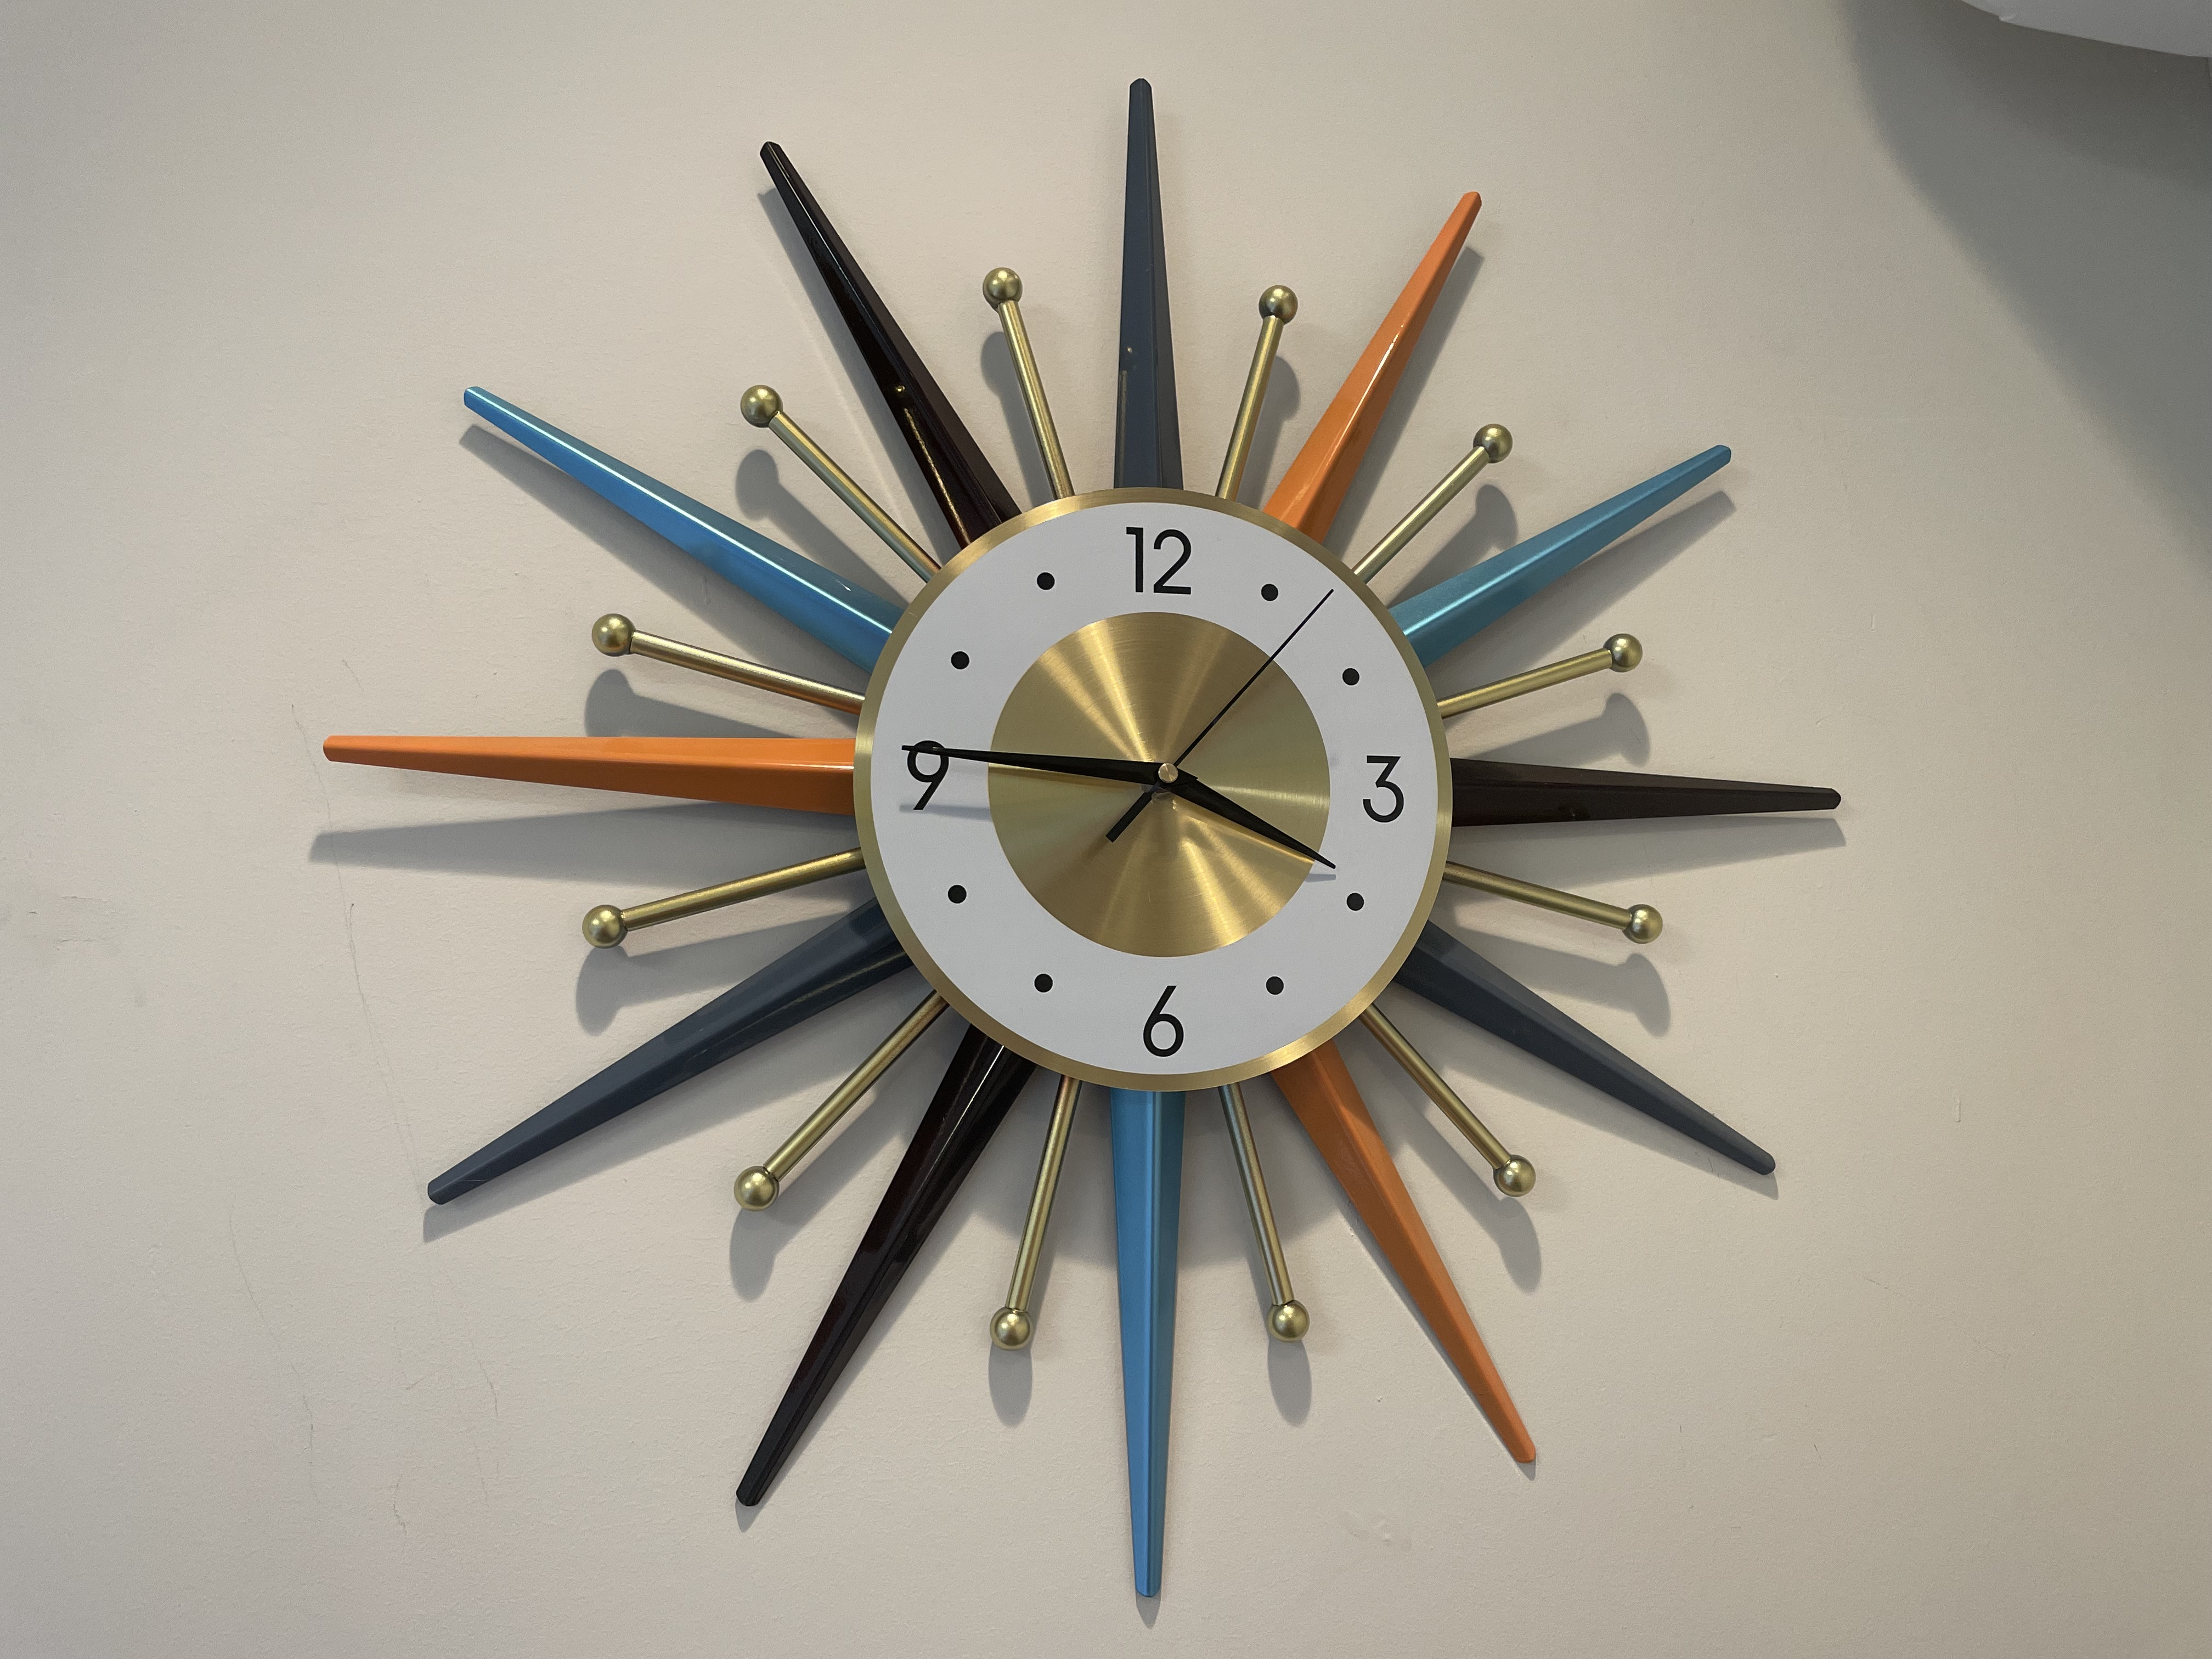

Slide 41
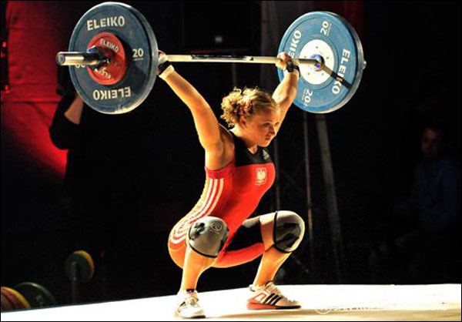
The Second Half of the Barbell
*Bets on a domestic recovery in 2022 Q4
*Upside potential in 2022 far greater than tech
*Some of these have not moved for 5 or 10 years
*Focuses on economically sensitive cyclical industries
*Makes a great counterweight to
high-growth technology
*We could spend all of next year rotating
between the two groups

Slide 42
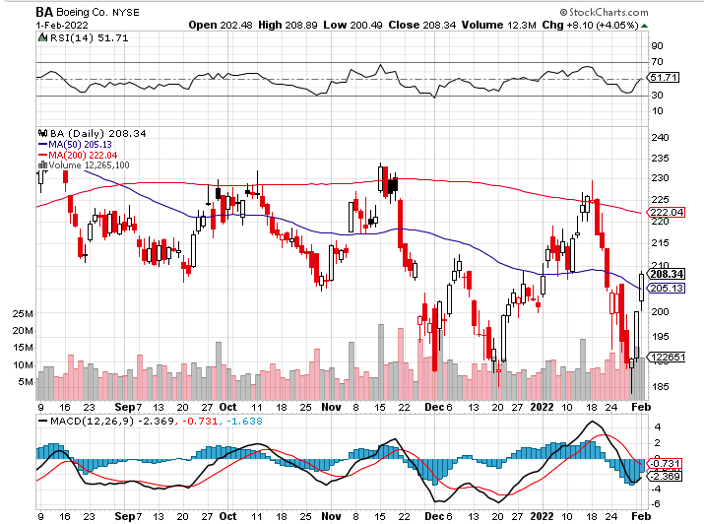
Boeing (BA) –LEAP Candidate
China Orders Boeing 737 Max Back into the Air
Boeing Wins a Major Order, for 30 737 MAX’s long 3/$146-$149 call spread took profits on long 2/$150-$160 call spread

Slide 43
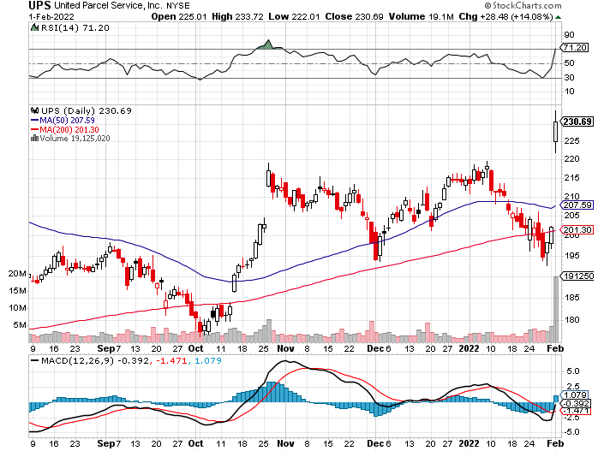
Package Delivery- United Parcel Service (UPS) - Package Delivery record profits took profits on long 11/$130-$140 call spread

Slide 44
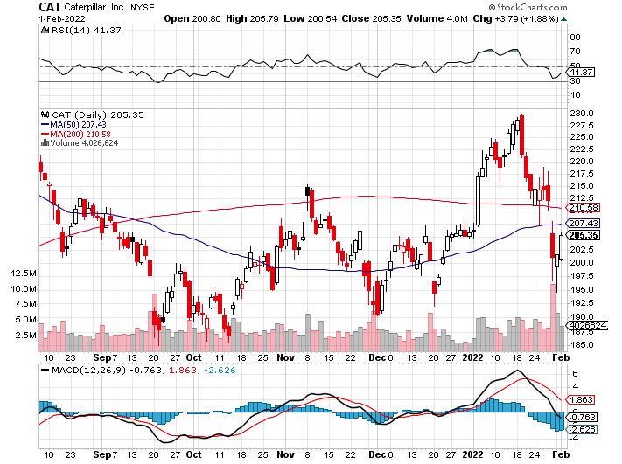
Caterpillar (CAT)- Ag + Infrastructure + Housing took profits on long 12/$145-$150 call spread took profits on long 11/$125-$135 call spread

Slide 45
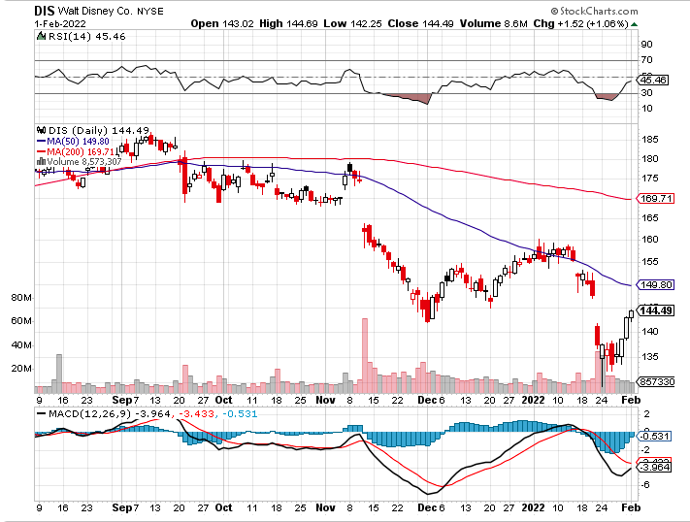
Walt Disney (DIS)- Earnings fail
Streaming Growth Shortfall stopped out of long 10/$165-$175 call spread took profits on long 3/$170-$180 call spread

Slide 46
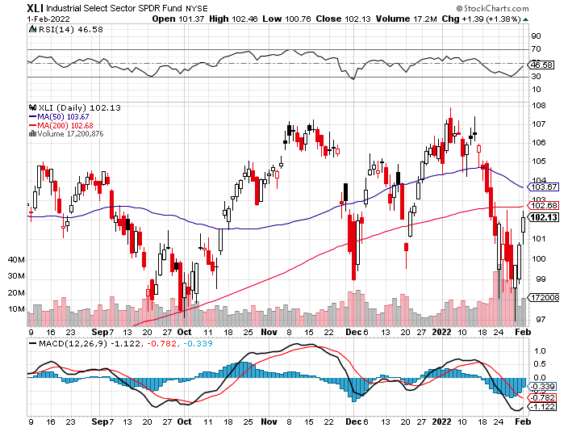
Industrials Sector SPDR (XLI)-
(GE), (MMM), (UNP), (UTX), (BA), (HON)

Slide 47
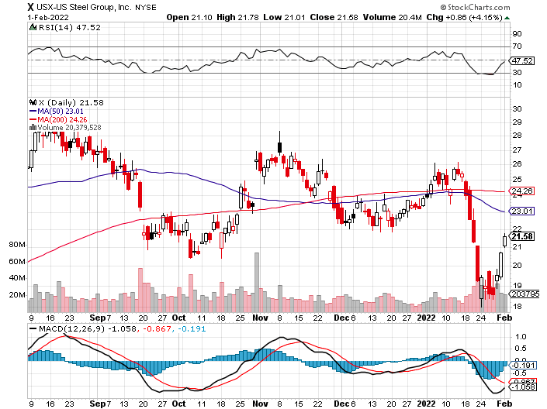
US Steel (X) – Commodity Drag

Slide 48
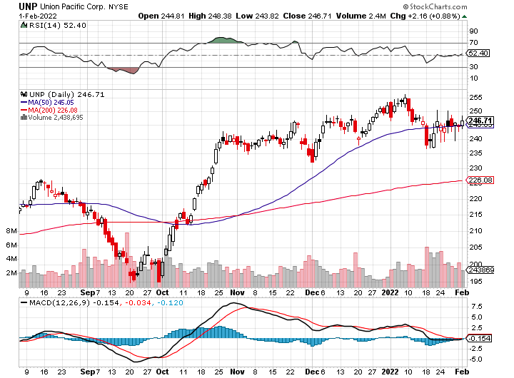
Union Pacific RR (UNP)- Big Stuff to Ship near record earnings announced took profits on long 5/$200-$210 call spread took profits on 11/$150-$160 call spread

Slide 49
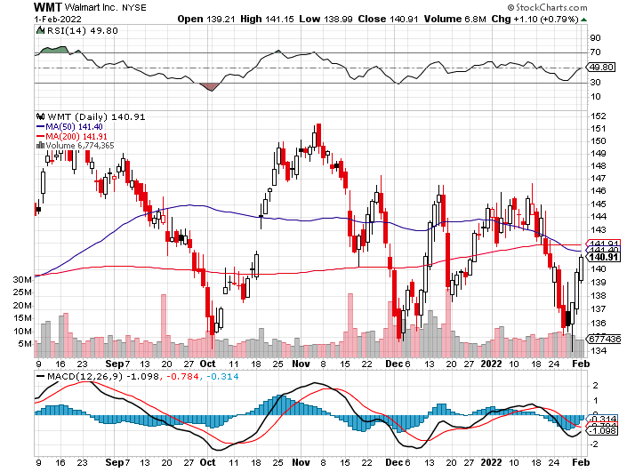
Wal-Mart (WMT)- took profit on Long 11/$125-$130 bear put spread took profit on Long 10/$119-$121 bear put spread took profits on Long 8/$114-$117 bear put spread

Slide 50
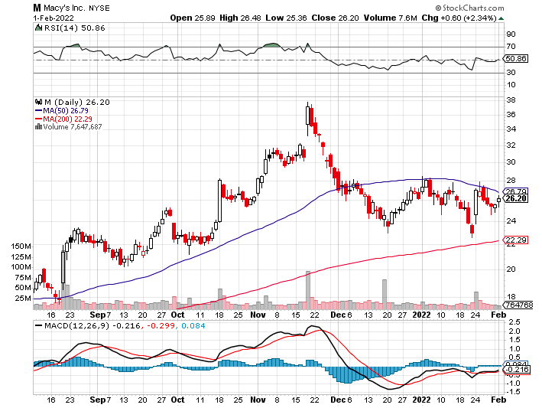
Macys’ (M) – Retail Punished took profits on Long 8/$23-$25 bear put spread

Slide 51
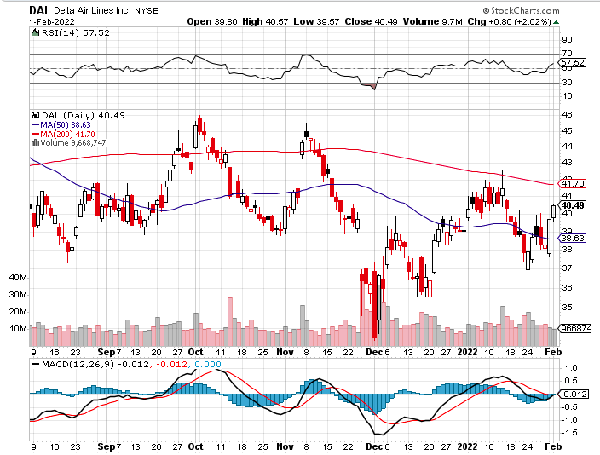
Delta Airlines (DAL) –

Slide 52
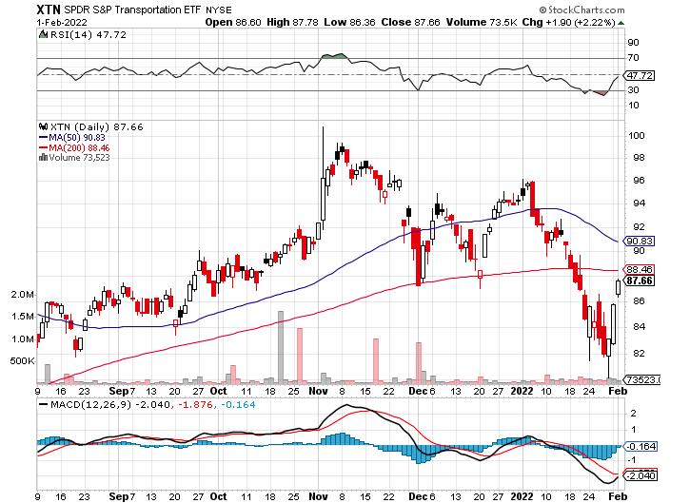
Transports Sector SPDR (XTN)- Worst Hit Sector
(ALGT), (ALK), (JBLU), (LUV), (CHRW), (DAL)

Slide 53
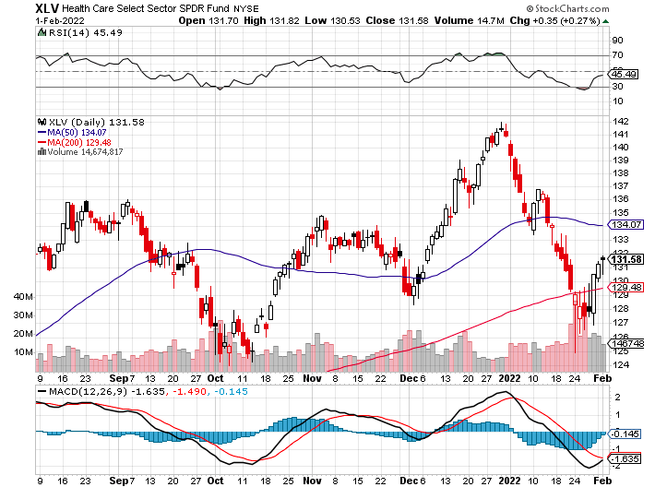
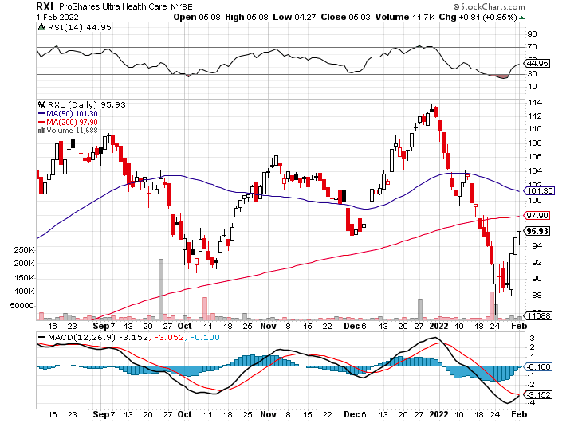
Health Care Sector (XLV), (RXL)
(JNJ), (PFE), (MRK), (GILD), (ACT), (AMGN)

Slide 54
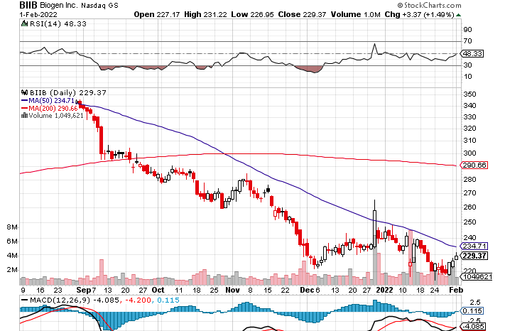
Biogen (BIIB)
Why you invest in Biotech

Slide 55

Amgen (AMGN) took profits on long 11/$185-$200 bull call spread

Slide 56

CRISPR Therapeutics (CRSP)

Slide 57

Goldman Sachs (GS) – took profits 12/$330-$350 call spread took profits 11/$330-$350 call spread stop loss on long 11/$385-$395 call spreads

Slide 58

Morgan Stanley (MS) – Doubled Dividend took profits on long 11/$85-$90 call spread stop loss on long 11/$95-$98 call spread took profits on long 10/$85-$90 call spread profits on long 2/$55-$60 call spread

Slide 59

JP Morgan Chase (JPM)-Back to Life took profits 12/$148-$152.50 call spread took profits on long 10/$130-$140 call spread took profits on long 8/$140-$145 call spread took profits on long 7/$140-$145 call spread

Slide 60

ProShares Ultra Technology ETF (ROM) – 2X Long Technology ETF took profits on long 10/$62-65 call spread

Slide 61

Bank of America (BAC) – took profits long 12/$39-$42 call spread stop loss on long 11/$43-$45 call spread took profits on 11/$37-$40 call spread took profits on long 2/$28-$30 call spread

Slide 62

SPDR Metals & Mining ETF (XME) – long 2/$28-$30 call spread

Slide 63

Blackrock (BLK)-Asset Collection Boom took profits on long 3/$770-$790 call spread took profits on long 3/$310-$340 call spread

Slide 64

Visa (V) – “Touchless” Bitcoin Drag took profits on long 5/$220-$225 bull call spread took profits on long long 5/$195-$205 bull call spread took profits on long 9/$180-$185 bull call spread

Slide 65

Consumer Discretionary SPDR (XLY)
(DIS), (AMZN), (HD), (CMCSA), (MCD), (SBUX)

Slide 66

Berkshire Hathaway (BRKB)- Natural Barbell
New All-Time High long 2/$270-$280 call spread

Slide 67

Europe Hedged Equity (HEDJ)-

Slide 68

Japan (DXJ)-

Slide 69

Emerging Markets (EEM) - Pro trade, Weak Dollar, Long Recovery Play

Slide 70


Slide 71

Bonds – Pariah
*The Bond Collapse Goes Global, with German 10-year bunds going positive for the first time in three years, up 40 basis points in a month
*Interest rates hit new two-year high taking ten – year US Treasury to 1.92%
*Is a half point rate hike in store for March? Next week’s inflation rate will tell.
*Mortgage Interest Rates Hit 22 Month High, with the 30-year fixed
hitting 3.56%.
*Sell any six-point rally in the (TLT)
*In a year, yield on the ten-year US Treasury bond
will be at 2.50% or higher
*US Treasury bond fund (TLT) could plunge from
$180 in 2020 to $105 by 2023

Slide 72

Treasury ETF (TLT) – Breaking Down long 12/$149-$152 put spread, long 2/$147-$150 put spread long 3/$150-$153 put spread

Slide 73

Ten Year Treasury Yield ($TNX) – 1.81%

Slide 74

Junk Bonds (HYG) 4.32% Yield to Maturity

Slide 75

2X Short Treasuries (TBT)-Another run at highs

Slide 76

Emerging Market Debt (ELD) 5.81% Yield-

Slide 77

Emerging Market Debt (ELD) 5.81% Yield-
Mix of AAA, AA, and A rated bonds

Slide 78

Foreign Currencies – Dollar Rebound
*US Dollar shows new signs of life
*As long as the US interest rates keep rising the greenback will remain strong
*China Posts Record Trade Surplus in 2021, at $676 billion, on global economic recovery, further undermining the buck
*Currency with the fastest appreciating interest rates
always does best
*Long-term fundamentals are still poor,
a dollar short could be the
new ten-year trade, but not yet
*Stand aside from forex for now, they are getting fish to fry

Slide 79

Japanese Yen (FXY), (YCS)

Slide 80

Euro (FXE)-

Slide 81

British Pound (FXB)-

Slide 82

Australian Dollar (FXA)- The Global Recovery Play took profits on long 8/$67-$69 call spread

Slide 83

Emerging Market Currencies (CEW)

Slide 84

Chinese Yuan- (CYB)-

Slide 85

Bitcoin – Rising Rate Hit
Buy the Mad Hedge Bitcoin Letter at https://www.madhedgefundtrader.com/store/
*Bitcoin Gets Crushed, approaching a one year low at $31,000, and will continue to do so
*Any noninterest bearing instrument gets punished when rates rise and crypto is no exception
*Omicron variant delivered a new mini recession and crypto is no place to hide
*Will this be a 50% correction or and 80% one, as in years past
*Long term “BUY” signal for Bitcoin still intact
*Buy Bitcoin and Ethereum on the bigger dip

Slide 86

Bitcoin ($BTCUSD) – Wake Up Time

Slide 87

Ethereum (ETHE) –

Slide 88

MicroStrategy (MSTR) –

Slide 89

Amplify Transformational Data Sharing ETF (BLOK) – Cross Imminent

Slide 90

Energy – Russian Roulette
*Oil Hits Seven Year High
*Inventories hit 21-year low
*No new capital is entering the industry, crimping supplies as old fields play out
*The threat of a Russian invasion of the Ukraine is prompting advance stockpiling
*Russia is the world’s second largest oil exporter.
*The risk/reward for a new oil trade here is terrible
*$100/barrel oil is possible, but with rising volatility
*Avoid all energy plays like the plague, it’s the new
buggy whip industry as the US de-carbonizes

Slide 91

Oil-($WTIC)

Slide 92

United States Oil Fund (USO) long 10/$9.50-$10 Vertical bull call spread

Slide 93

Energy Select Sector SPDR (XLE)-No Performance!
(XOM), (CVX), (SLB), (KMI), (EOG), (COP)

Slide 94

Halliburton (HAL)-

Slide 95

Natural Gas (UNG) -

Slide 96

Precious Metals – Still No Pulse
*Not a hint of downside protection offered by gold in this global selloff
*Gold has been the worst performing asset of 2021
*Gold provided absolutely no downside protection during the recent pandemic crash
*If $9 trillion of investment demand decamps for the crypto world, leaving only jewelry demand, $9 trillion could go into Bitcoin.
*Rising interest rates bode poorly for precious metals as
it raises the opportunity cost for non-yielding assets
*Bitcoin is clearly sucking capital out of precious metals
*Stay away until this plays out
*Silver is still the bigger and better long-term play

Slide 97

Gold (GLD)- Meltdown

Slide 98

Market Vectors Gold Miners ETF- (GDX) –

Slide 99

Barrick Gold (GOLD) took profits on long 1/$21-$23 call spread took profits on long 11/$22-$24 call spread

Slide 100

Newmont Mining- (NEM)- took profits on long $55-60 call spread

Slide 101

Silver- (SLV)- took profits on long 11/$19-$20 call spread

Slide 102

Silver Miners - (SIL)-

Slide 103

Wheaton Precious Metals - (WPM)- took profits on long 2/$39-41 call spread

Slide 104

Copper (COPX)-Uptrend Resumes
Copper Unions Vote to Strike in Chile, cutting off 33% of the global supply

Slide 105

Real Estate – No Rest
*Existing Homes Sales Hit a 15 Year High, at 6.12 million, the best since 2006
*Extreme inventory shortage is the issue, with only 910,000 homes for sale at the end of the year, an incredibly low 1.8-month supply.
*You can’t find anything on the market now, to buy or rent
*The medium price of a home sold in December was $358,000, a 15.8% gain YOY
*New Home Sales Skyrocket to an eye popping 811,000 in December, up 11.7% YOY
*Median sales prices jump to $377,700, up 3% YOY
*S&P Case Shiller Rockets 18.8%, in November
with its National Home Price Index
The real estate boom is years away from a peak.

Slide 106

S&P Case Shiller
S&P Case Shiller Rockets 18.8%, in November with its National Home Price Index
Phoenix 32.2%, Tampa (29%), and Miami (26.6%) were the big gainers

Slide 107

Crown Castle International (CCI) – 2.70% yielding cell phone tower REIT

Slide 108

US Home Construction Index (ITB)
(DHI), (LEN), (PHM), (TOL), (NVR)

Slide 109


Slide 110

Trade Sheet-
So What Do We Do About All This?
*Stocks – sell rallies
*Bonds – sell rallies aggressively
*Commodities-stand aside
*Currencies- stand aside
*Precious Metals – stand aside
*Energy – stand aside
*Volatility - sell short over $30
*Real estate – stand aside
*Bitcoin – stand aside

Slide 111

Next Strategy Webinar
12:00 EST Wednesday, February 16 from Incline Village, NV email me questions at support@madhedgefundtrader.com
Good Luck and Good Trading!
Notes:
*

