Slide 1
The Mad Hedge Fund Trader “Comatose”
With John Thomas Silicon Valley, CA, September 20, 2023 www.madhedgefundtrader.com
Notes:
*

Slide 3
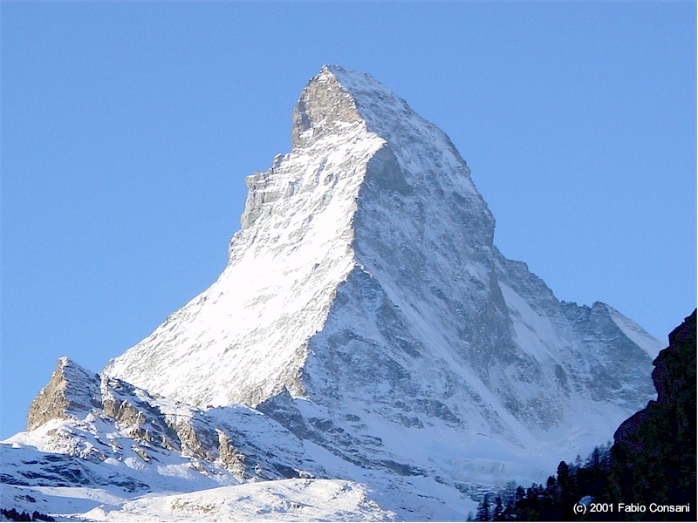
FRIDAY, SEPTEMBER 29 ZERMATT SWITZERLAND STRATEGY LUNCHEON
*An excellent meal will be followed by a wide-ranging discussion and an extended question and answer period *The lunch will be held in an exclusive hotel near the train station *please go to my online store at http://www.madhedgefundtrader.com/store and click on “luncheons.” Tickets are available for $277

Slide 4
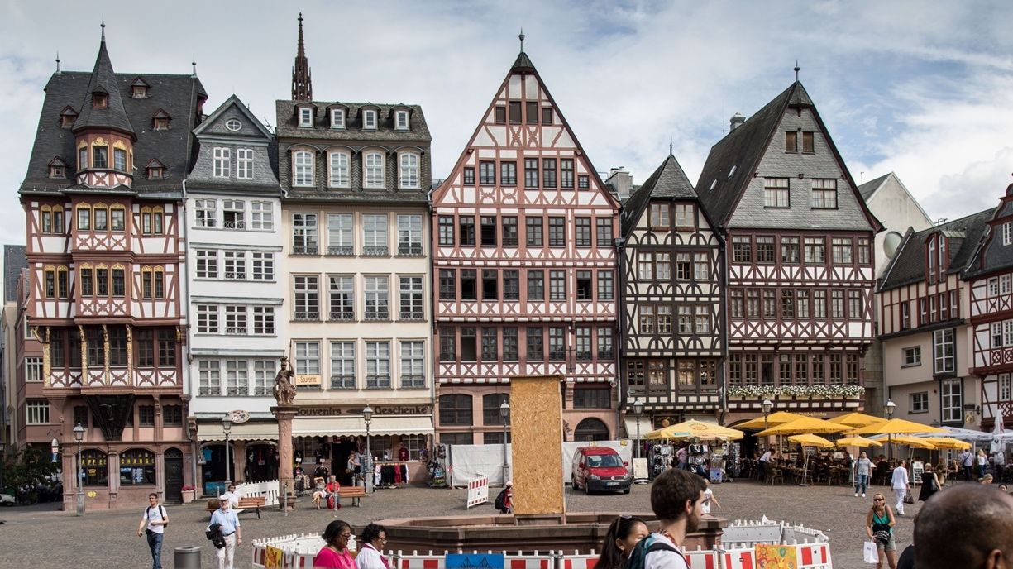
FRIDAY, OCTOBER 6 FRANKFURT GERMANY STRATEGY DINNER
*An excellent meal will be followed by a wide-ranging discussion and an extended question and answer period *The lunch will be held in an exclusive downtown hotel *please go to my online store at http://www.madhedgefundtrader.com/store and click on “luncheons.” Tickets are available for $277

Slide 5
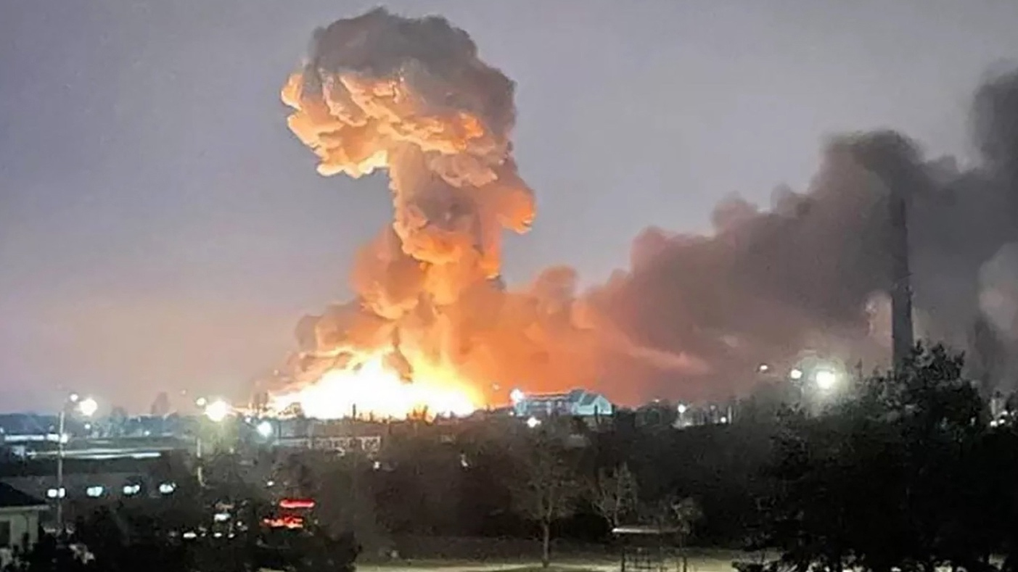
FRIDAY, OCTOBER 13 KIEV UKRAINE STRATEGY LUNCHEON
*An excellent meal will be followed by a wide-ranging discussion and an extended question and answer period *The lunch will be held in an exclusive downtown hotel *please go to my online store at http://www.madhedgefundtrader.com/store and click on “luncheons.” Tickets are available for $187

Slide 6
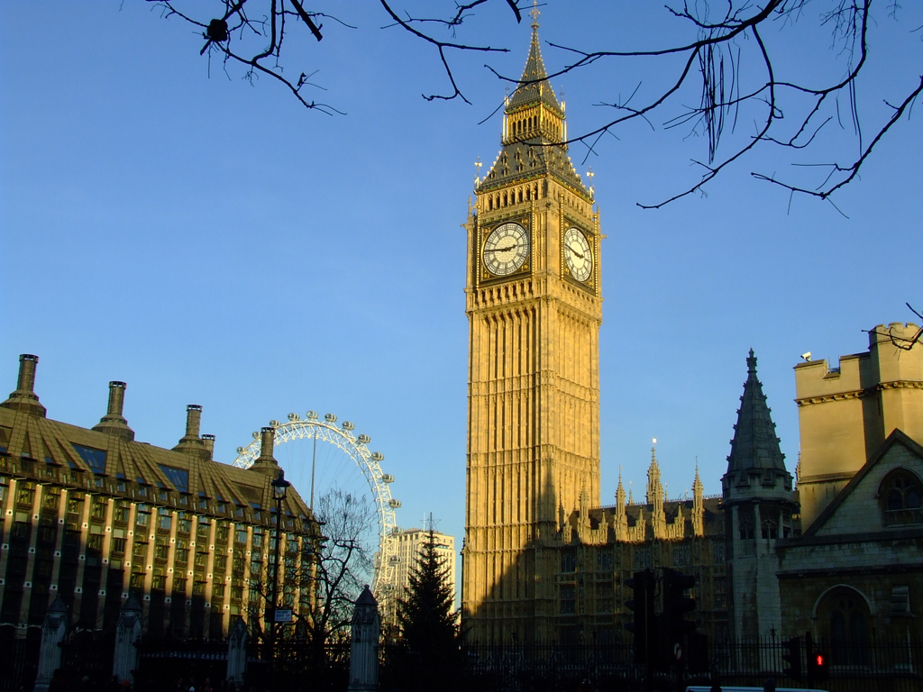
FRIDAY, OCTOBER 20 LONDON ENGLAND STRATEGY LUNCHEON
*An excellent meal will be followed by a wide-ranging discussion and an extended question and answer period *The lunch will be held in private club near Picadilly *please go to my online store at http://www.madhedgefundtrader.com/store and click on “luncheons.” Tickets are available for $297

Slide 7
TUESDAY, OCTOBER 31 MIAMI FLORIDA STRATEGY LUNCHEON
*An excellent meal will be followed by a wide-ranging discussion and an extended question and answer period *The lunch will be held in an exclusive Coconut Grove Hotel *please go to my online store at http://www.madhedgefundtrader.com/store and click on “luncheons.” Tickets are available for $307

Slide 8
Trade Alert Performance Summer Doldrums 40 out of 46 trade alerts profitable
*January +22.35% Final *July +0.44% Final *February +3.41% Final *August -4.70% Final *March +20.85% Final *September +00% MTD *April +15.13% Final *October +5.69% Final *May +0.30%% Final *November +8.31 Final *June +3.01% Final *December +0.95% Final *2022 Final +84.63% compared to -18.63% for the S&P 500 *2023 Year to Date +60.80%, versus +8.51% for the S&P 500 +657.99% since inception *Average annualized return of +48.15% for 15 years

Slide 9
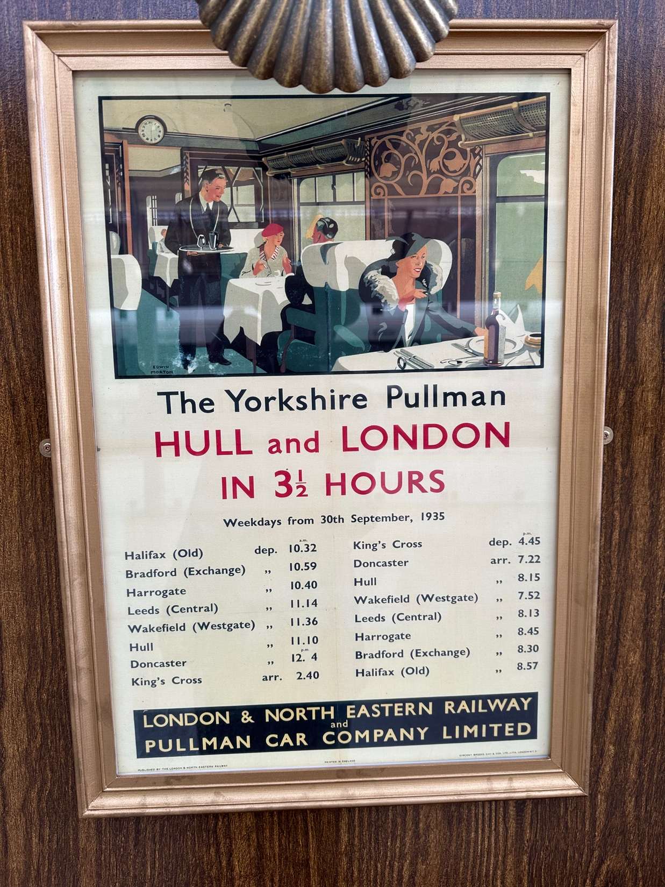

Slide 10
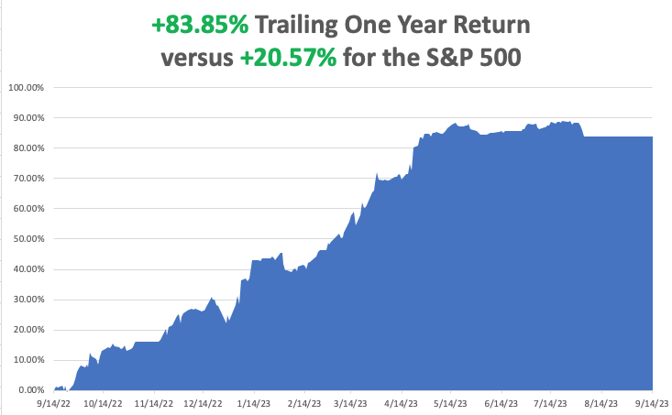

Slide 11
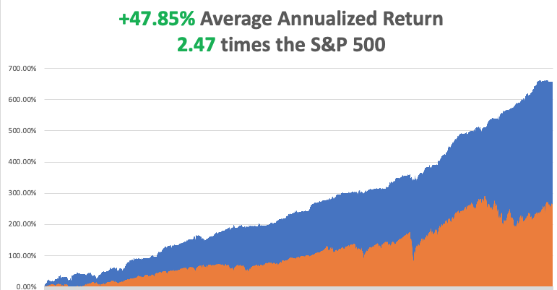

Slide 12
Portfolio Review 0% Long, 0% Short, 100% cash with VIX at $15 no new positions
NO POSITIONS
Expiration Value +60.80%

Slide 14
The Method to My Madness
*Big Tech flat lines, leading to a comatose market *Government shutdown risk is a new drag on all risk assets *But the tech selloff will be brief. Too many people are trying to get into accelerating long term earnings *Bonds probing lows on rising interest rate fears *Fall will present the best buying opportunities of the year *Precious metals and commodities should be at the top of and “BUY” list to cash in on an economic recovery *In this market patience is a virtue, let the market come to you

Slide 15
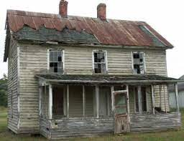
The Global Economy – Best House in a Bad Neighborhood
*The US has the strongest major economy in the world, while Europe, China, and Russia are in recession *The United Auto Workers Go on Strike, bringing the Big 3 Detroit automakers to a grinding halt. *US Wholesale Prices Jump 0.7% in August, *Consumer Price Index Rises 0.6% in August, the hottest read in 18 months *US Jobless Claims Fall Again, to 220,000, a drop of 5,000. The US economy is reigniting again. * Beige Book Shows Consumer Spending Slowing *Rate Hikes Will Drag on the Economy for at Least a Decade, as the Fed $8.24 trillion balance sheet unwinds *Australian Economy Surges, as the return of Asian tourists and infrastructure spending kick in

Slide 16
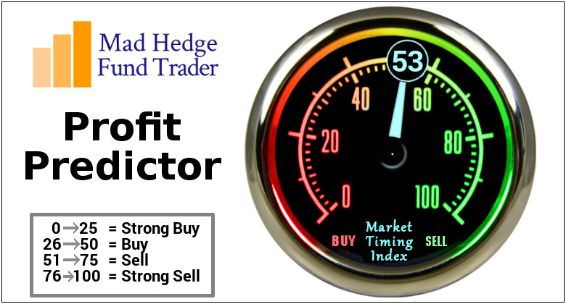
The Mad Hedge Profit Predictor Market Timing Index – Drops Below 50, for the first time since April An artificial intelligence driven algorithm that analyzes 30 different economic, technical, and momentum driven indicators

Slide 17
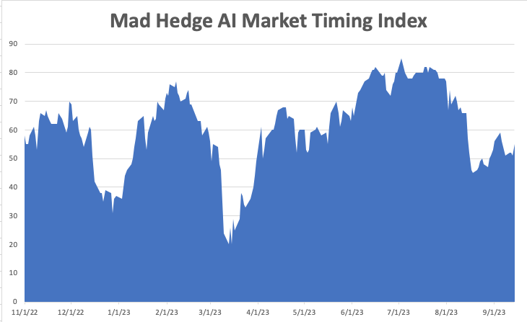
Do Nothing!!
SELL
BUY

Slide 18
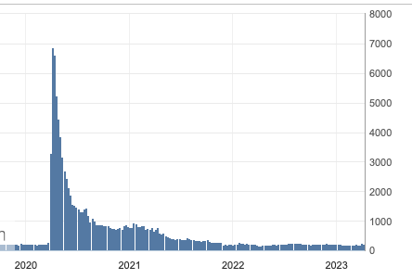
Weekly Jobless Claims – Falling 220,000 – Down 5,000

Slide 20
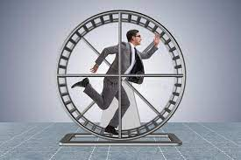
Stocks – Going Nowhere
*Stocks are chopping around in a narrow range on low volume with a slight downward tilt wait for the Fed to make its move. Government shutdown prospect is pouring water on any spark *Salesforce Beats, with revenues up 11% YOY *Raytheon Takes a Hit from Jet Engine Problems. *Arm Holdings Jumps 25% on First Day of Trading. Masayoshi Sohn is happy because he still owns the remaining 90% of the company. This is where the hot money is going *Caesars Entertainment and MGM suffer Major Hack *Oracle Disappoints on fading cloud growth in the recent quarter *Vinfast IPO Burns Latecomers, as the money losing Vietnamese EV maker crashes after launch, down 83%. *No short term or short-term trade here. Keep you powder dry

Slide 21
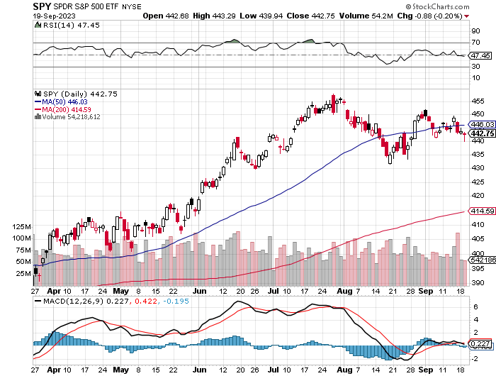
S&P 500 – Back to support took profits on long 5/$420-$430 put spread, took profits on long 1/$420-$430 put spread, took profits on long 11/$420-$430 put spread
$480 2023 Target
$411 -6.11% 2nd support
The Bottom $380 Down –17.03%

Slide 22
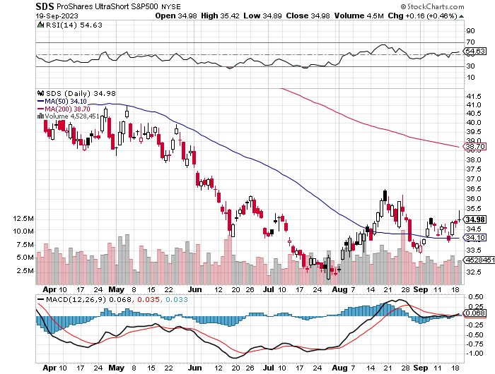
ProShares Ultra Short S&P 500 (SDS)- a great hedge for long stocks and bonds long 2X position has a hedge against longs and bond shorts

Slide 23
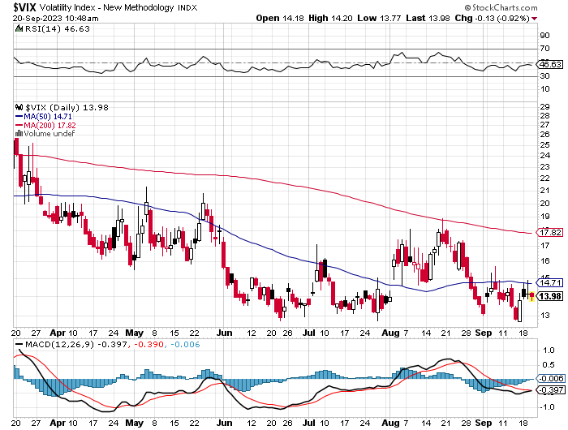
(VIX) – Bargain of the Century

Slide 24
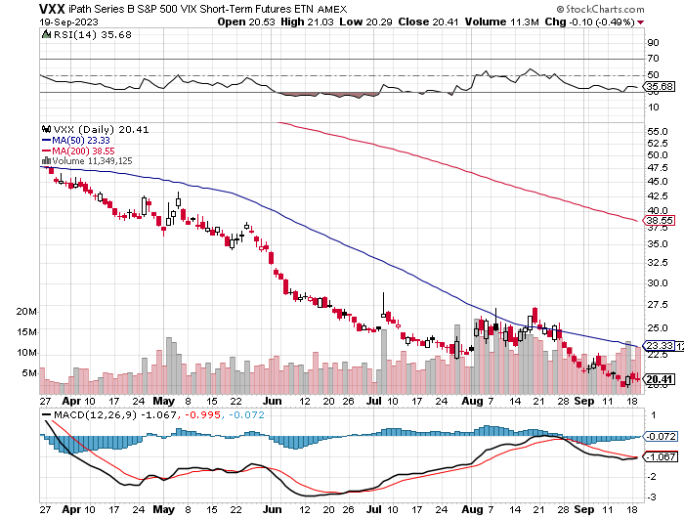
(VXX)-

Slide 25
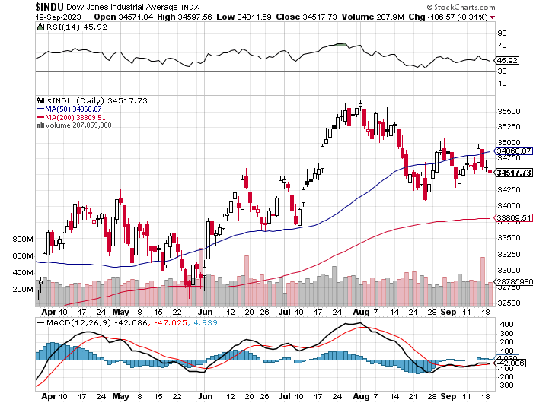
Dow Average ($INDU)-

Slide 26
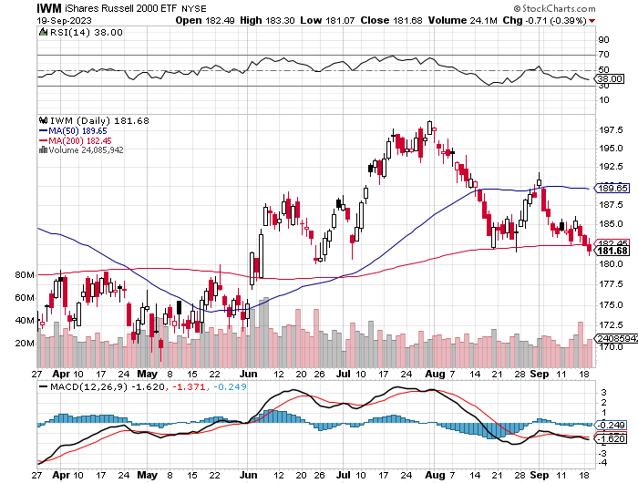
Russell 2000 (IWM)- took profits on Long 10/$137-$142 vertical bull call spread took profits on Long 10/$153-$156 vertical bear put spread

Slide 27
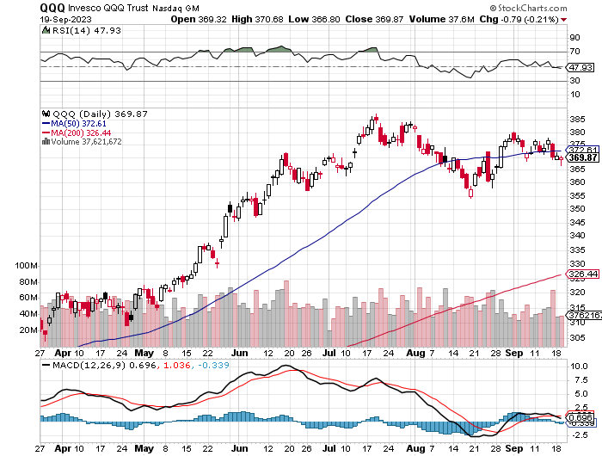
NASDAQ (QQQ) – took profits on Long 5/$335-$345 put spread took profits on long (QQQ) 1/$290-$300 put spread, took profits on long (QQQ) 4/$330-$335 put spread took profits on long (QQQ) 3/$340-$345 put spread, covered long (QQQ) $325-$330 put spread

Slide 28
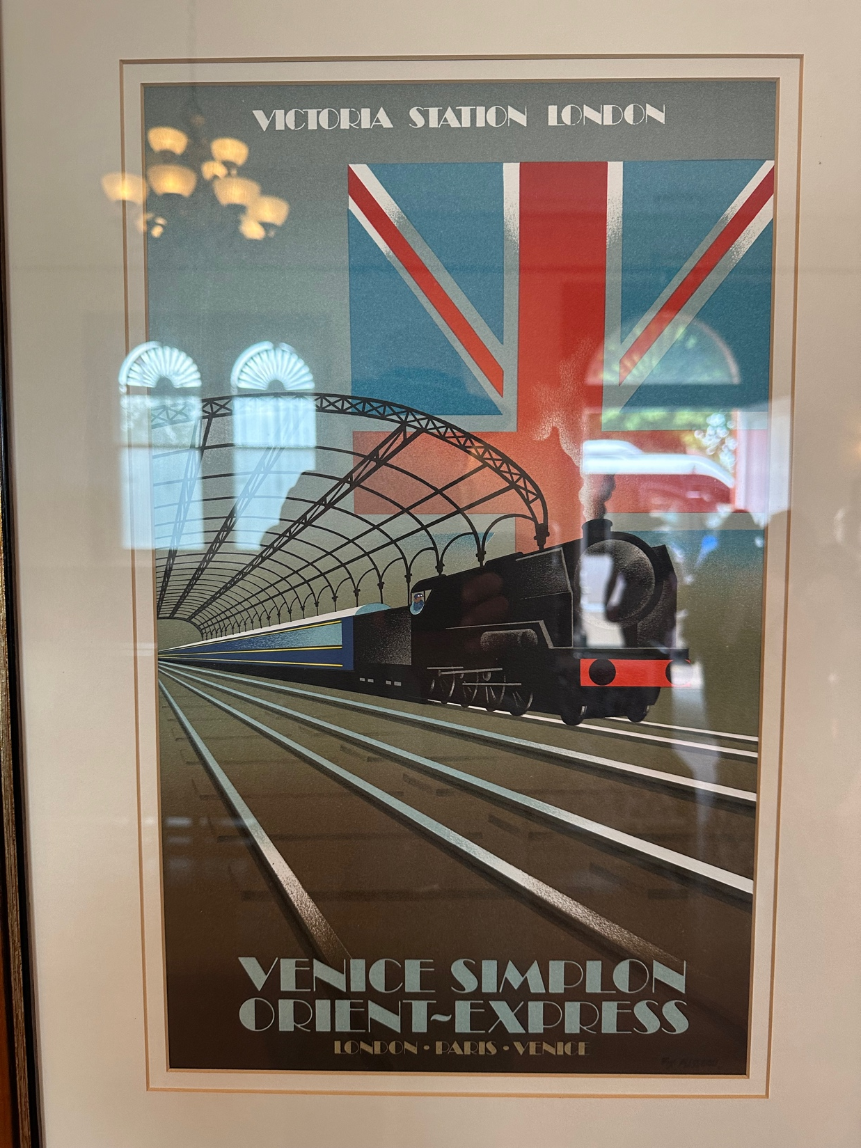

Slide 29
THE MAD HEDGE FUND TRADER
The Barbell Portfolio
*75% Big Tech – 2% of US workforce, 25% of market cap and 25% of US earnings 25% Domestic Recovery, including: Railroads, airlines, cruise lines, Couriers, steel companies Banks, commodities Construction Credit Card Companies Hotels, casinos Online Ticket Sales

Slide 30
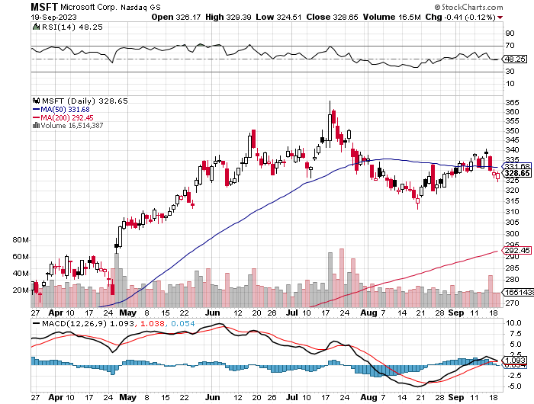
Microsoft (MSFT)- Earnings Beat took profits on 9/$235-$245 call spread, took profits on long 7/$220-$210 call spread, took profits on long 6/$220-$230 call spread, took profits on long 2/$200-$210 bear put spread

Slide 31
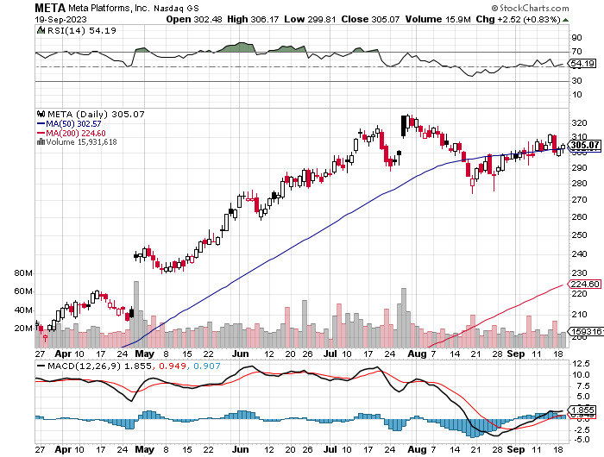
Meta (META)- Soars an Incredible 20% took profits on Long 9/$290-$300 vertical bear put spread stopped out of Long 9/$190-$200 vertical bear put spread

Slide 32
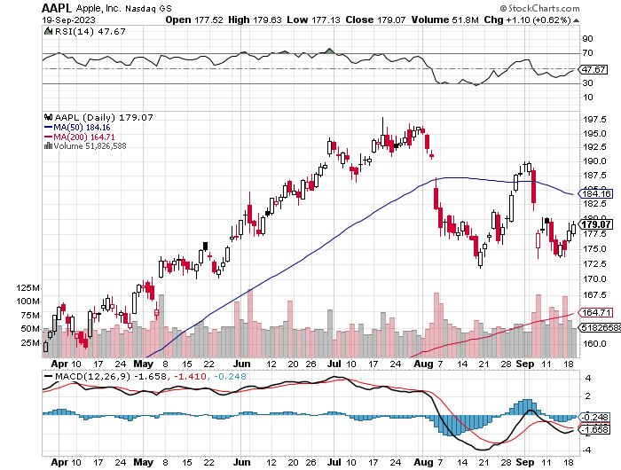
Apple (AAPL) Apple is Still a Hold, for the long term and a “BUY” on any 10% correction with the new iPhone 15 There is a major increase in the use of artificial intelligence. took profits on long 1/$145-$155 put spread, Took profits on long 10/$165-$175 put spread took profits on long 6/$155-$165 put spread, stopped out of long 6/$125-135 call spread, took profits on long 6/$110-$120 call spread, took profits on long 2/$180-$190 put spread

Slide 33
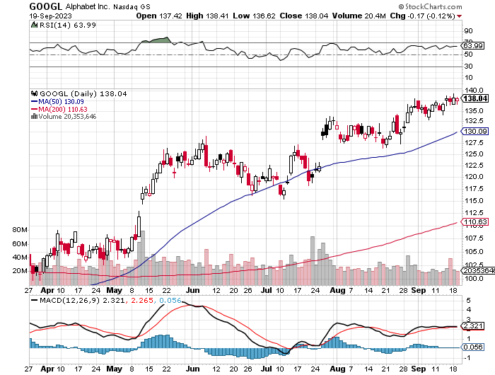
Alphabet (GOOGL) – Google Ramps Up AI Effort EU Accuses Google of Abusing Monopoly Power took profits on long 12/$1,200-$1,230 bull call spread took profits on long 9/$1,030-$1,080 vertical bull call spread

Slide 34
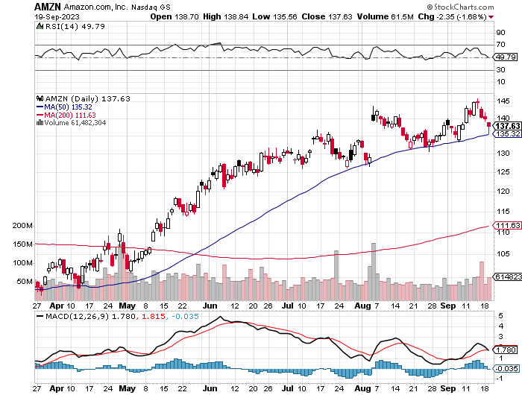
Amazon (AMZN) – Amazon Soars on Earnings Beat, nearly double Wall Street estimates as its massive bet on AI pays off bigtime took profits on long 2/$3,400-$3,500 bear put spread took profits on long 9/$2,800-$2,900 bull call spread

Slide 35
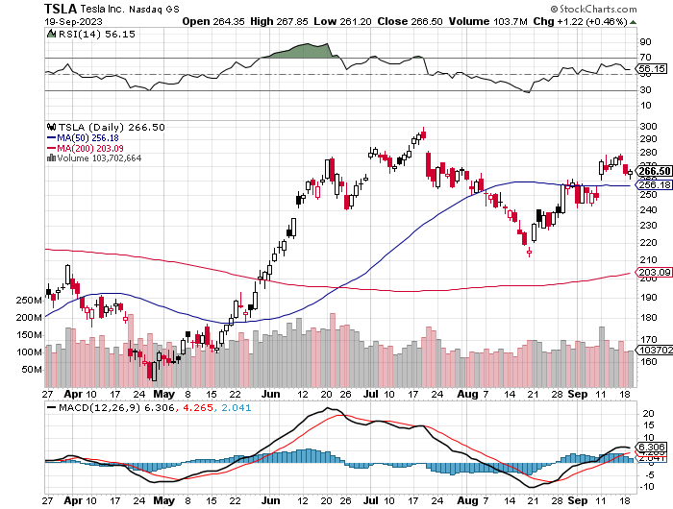
Tesla (TSLA) – Volatility Collapse to 43% Watch out for “Gigacasting” Huge beneficiary from UAW strike EV Sales Soared by 70% in California in August took profits on long 6/$120-$130 call spread, stopped out of long 6/$210-$220 put spread took profits on long 5/$110-$120 call spread, took profits on long 5/$220-$230 put spread took profits on long 4/$130-$140 call spread, took profits on long 4/$250-$260 put spread

Slide 36
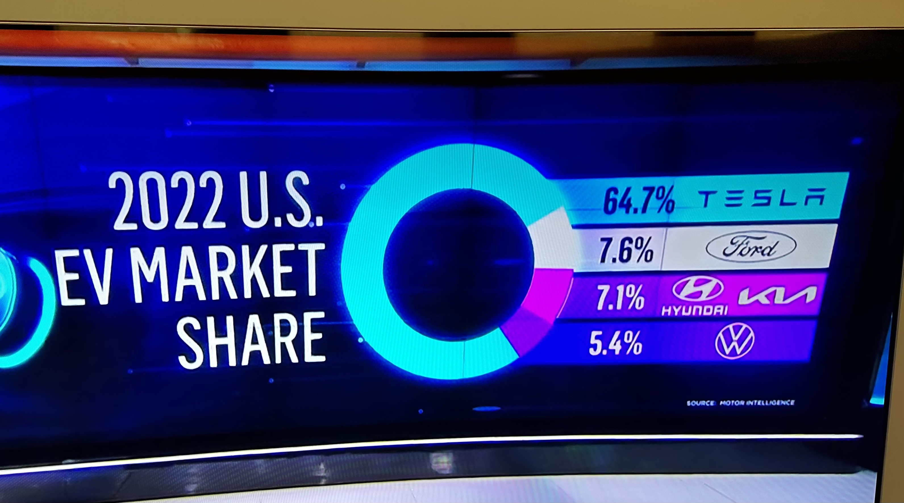

Slide 37
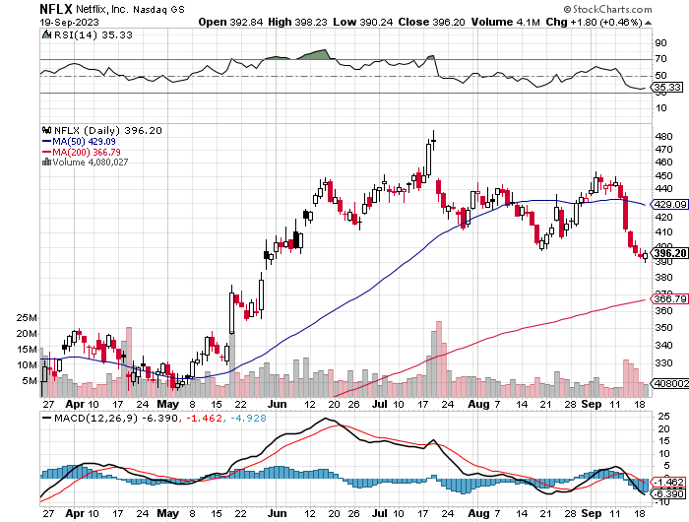
Netflix (NFLX) – Netflix subscribers beat - Netflix Password Sharing Crackdown Goes Global

Slide 38
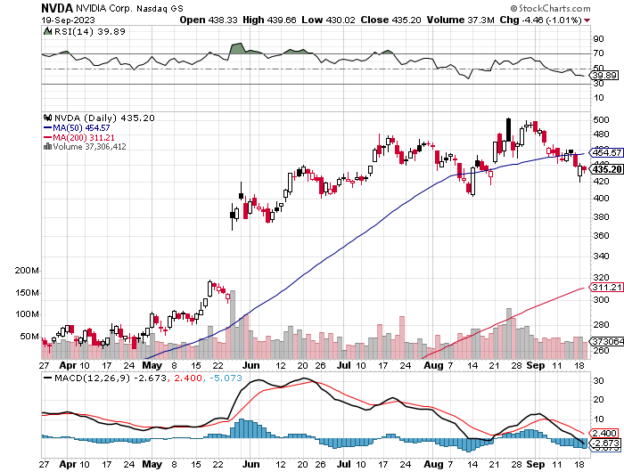
NVIDIA (NVDA) – Blowout Profits NVIDIA Blows Away Earnings, taking its shares up an astonishing 10% in the after-market to an eye-popping $517 took profits on long 3/$260-$270 put spread, took profits on long 10/$95-$100 call spread took profits on long 7/$120-$130 call spread, took profits on long 6/$120-$130 call spread

Slide 39
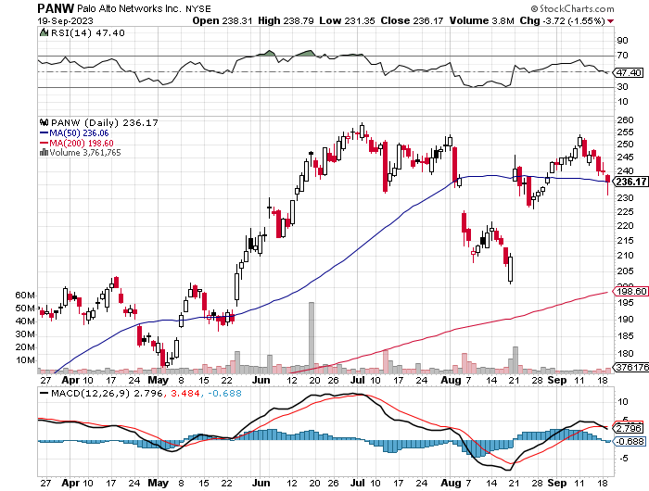
Palo Alto Networks (PANW)- Hacking never goes out of fashion Palo Alto Networks (PANW) Goes into the S&P 500 took profits on long 10/$130-$140 call spread

Slide 40
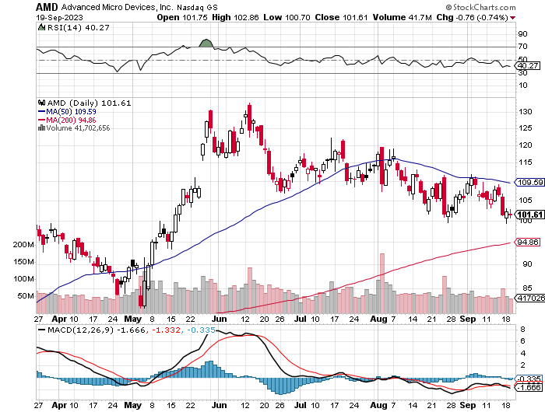
Advanced Micro Devices (AMD)- Recession fears programable logic devices took profits on long 2/$75-$80 call spread

Slide 41
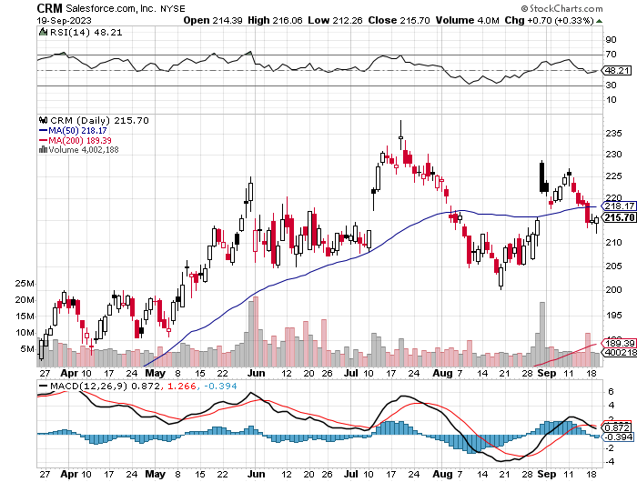
Salesforce (CRM)- Massive Online Migration Salesforce Soars 16%, on better-than-expected guidance took profits on long 9/$125-$130 vertical bull call spread took profits on long 8/$125-$130 vertical bull call spread took profits on long 2/$105-$115 call spread

Slide 42
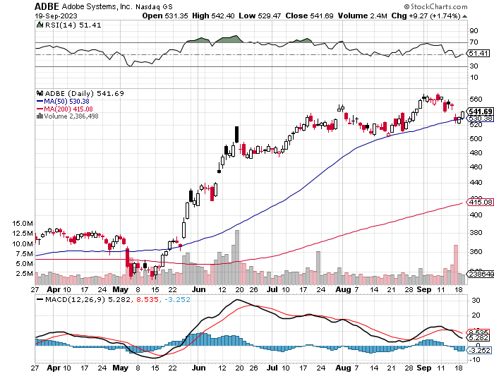
Adobe (ADBE)- Cloud play The Quality Non-China tech play

Slide 43
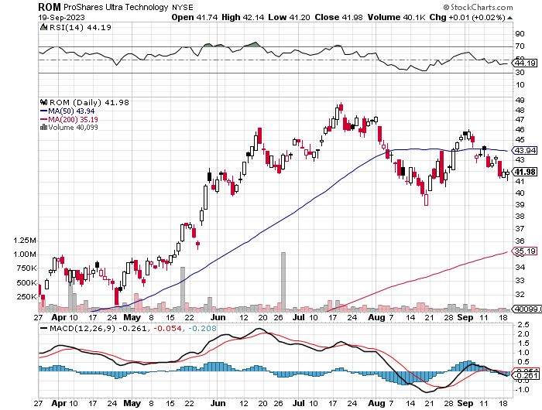
ProShares Ultra Technology ETF (ROM) – 2X Long Technology ETF took profits on long 10/$62-65 call spread

Slide 45
The Second Half of the Barbell
*Bets on a domestic recovery in 2022 Q4 *Upside potential in 2022 far greater than tech *Some of these have not moved for 5 or 10 years *Focuses on economically sensitive cyclical industries *Makes a great counterweight to high-growth technology *We could spend all of next year rotating between the two groups

Slide 46
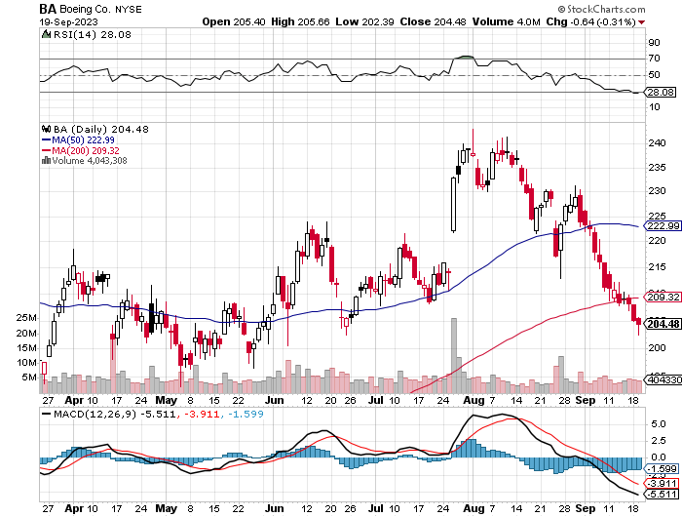
Boeing (BA) – Another Recall took profits on long 5/$17-$175 call spread

Slide 47
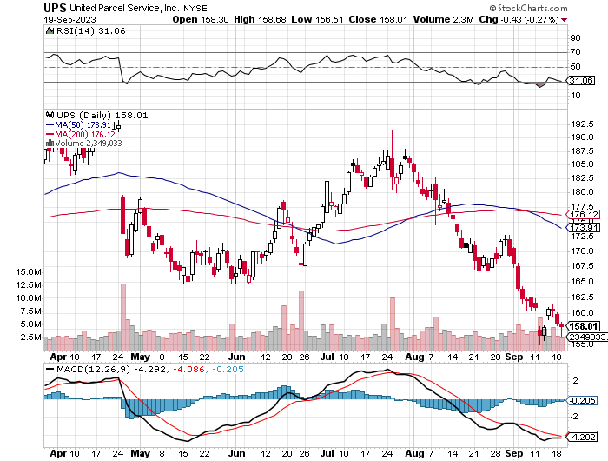
Package Delivery- United Parcel Service (UPS) – strike averted took profits on long 11/$130-$140 call spread

Slide 48
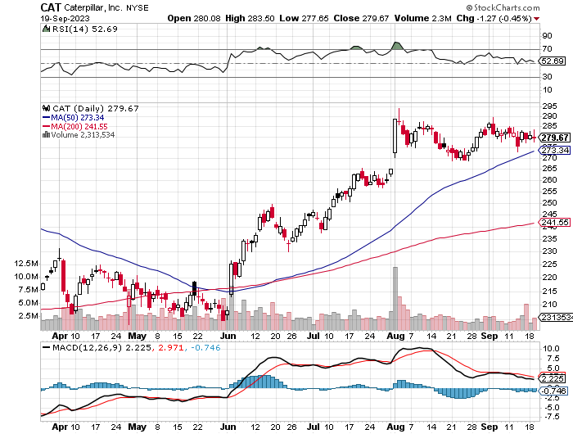
Caterpillar (CAT)- Ag + Infrastructure + Housing Raises Dividend by 50% took profits on long 12/$145-$150 call spread took profits on long 11/$125-$135 call spread

Slide 49
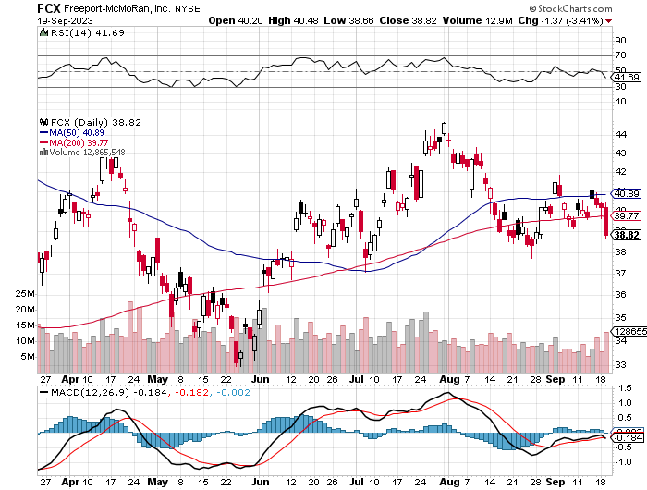
Freeport McMoRan - (FCX)- Coming Copper Crisis took profits on long 6/$32-$35 call spread took profits on long 4/$30-$33 call spread, took profits on long 10/$20-$23 call spread

Slide 50
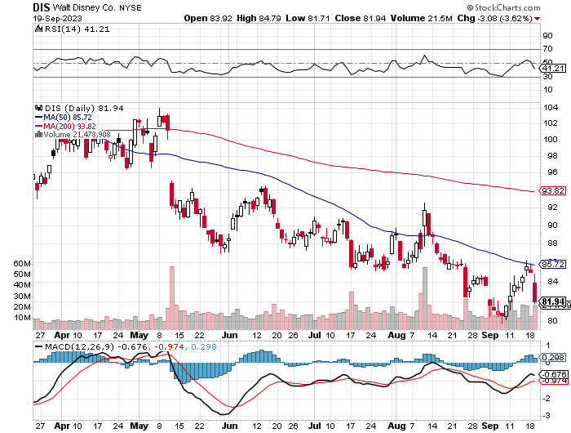
Walt Disney (DIS) - Disney Earnings are Flat, with parks jam packed and maxed out. But streaming in a nosedive, down 4 million subscribers in Q1 at 157.8 million

Slide 51
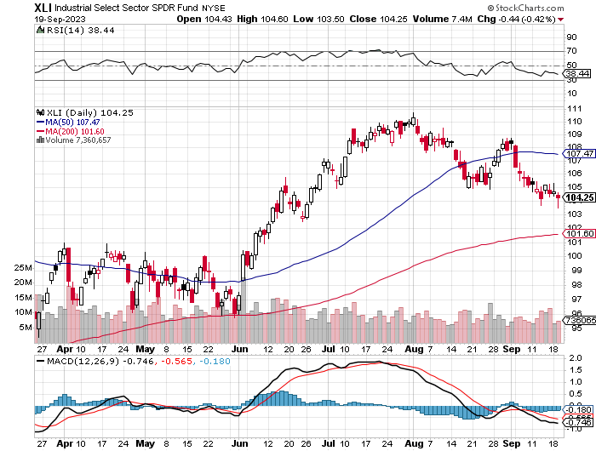
Industrials Sector SPDR (XLI)- (GE), (MMM), (UNP), (UTX), (BA), (HON)

Slide 52
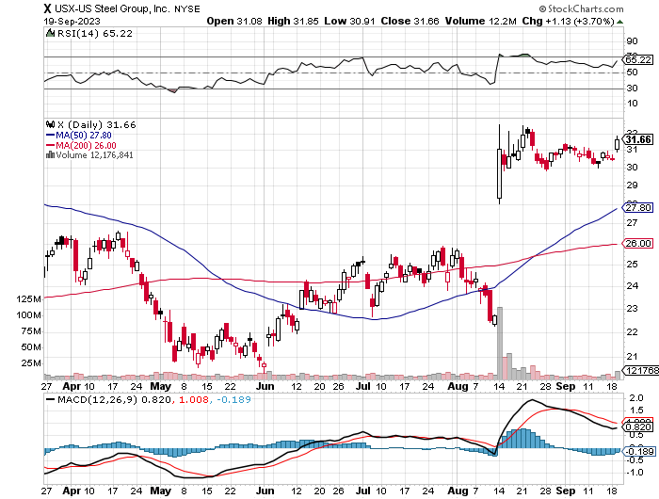
US Steel (X) – Commodity Boom and commodity Bidding war breaks out, taking stock up 50% and LEAPS up 101%

Slide 53
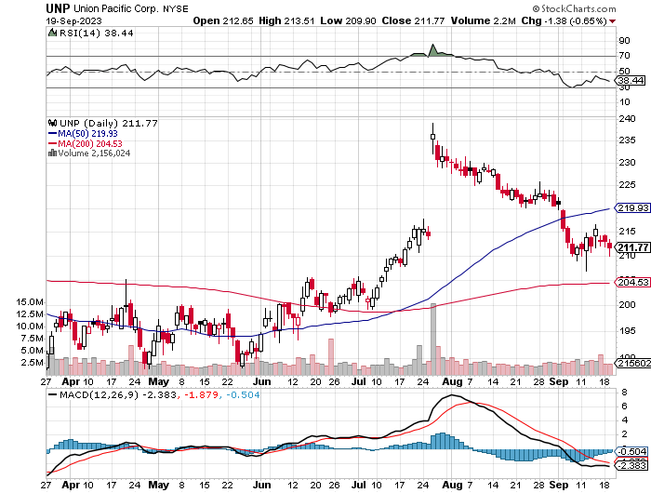
Union Pacific RR (UNP)- Big Stuff to Ship took profits on long 5/$200-$210 call spread took profits on 11/$150-$160 call spread

Slide 54
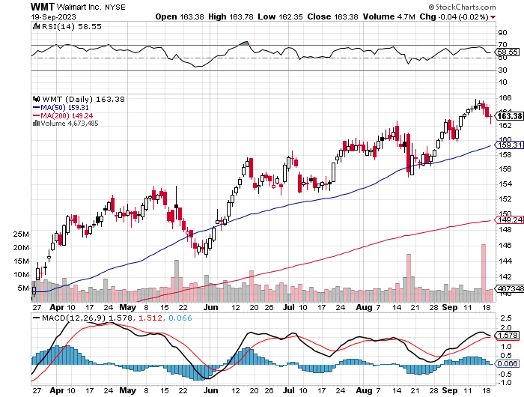
Wal-Mart (WMT)- took profit on Long 11/$125-$130 bear put spread took profit on Long 10/$119-$121 bear put spread took profits on Long 8/$114-$117 bear put spread

Slide 55
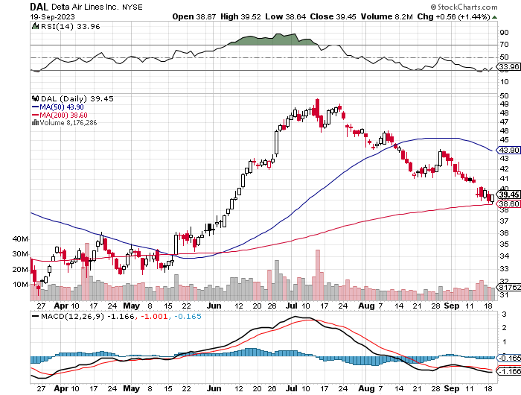
Delta Airlines (DAL) – Travel is Back! Returns dividend for first time in 3 years entering a summer perfect storm of profits

Slide 56
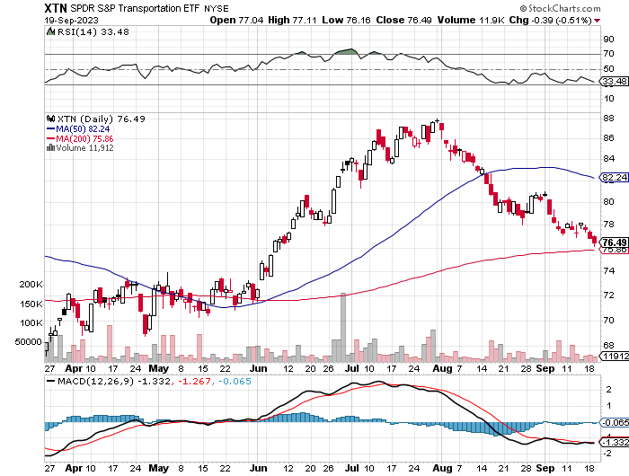
Transports Sector SPDR (XTN)- Worst Hit Sector (ALGT), (ALK), (JBLU), (LUV), (CHRW), (DAL)

Slide 57
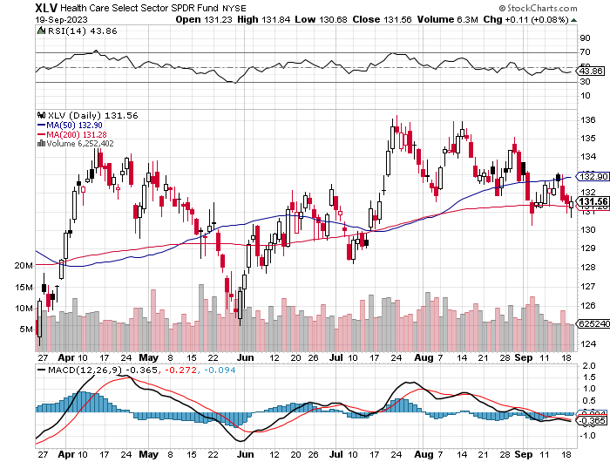
Health Care Sector (XLV) (JNJ), (PFE), (MRK), (GILD), (ACT), (AMGN)

Slide 58
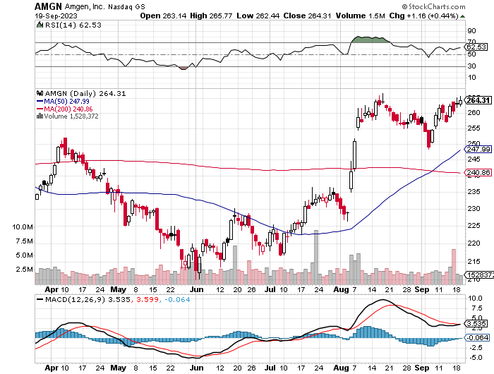
Amgen (AMGN) took profits on long 11/$185-$200 bull call spread

Slide 59
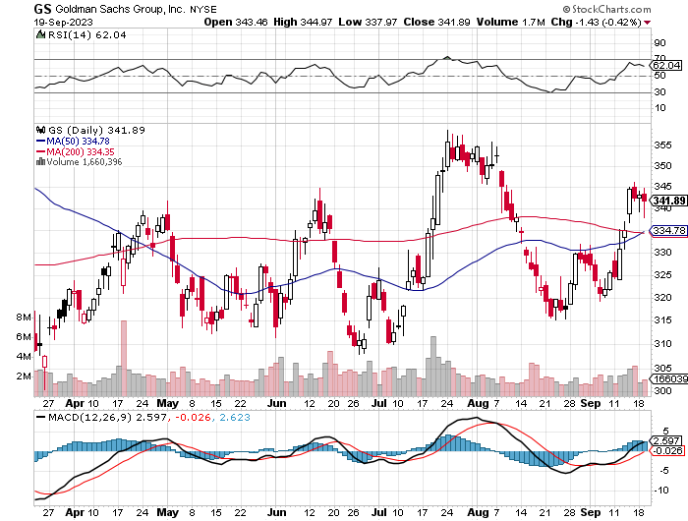
Goldman Sachs (GS) – Highest Capital ratio net of mark to market took profits 12/$330-$350 call spread took profits 11/$330-$350 call spread stop loss on long 11/$385-$395 call spreads

Slide 60
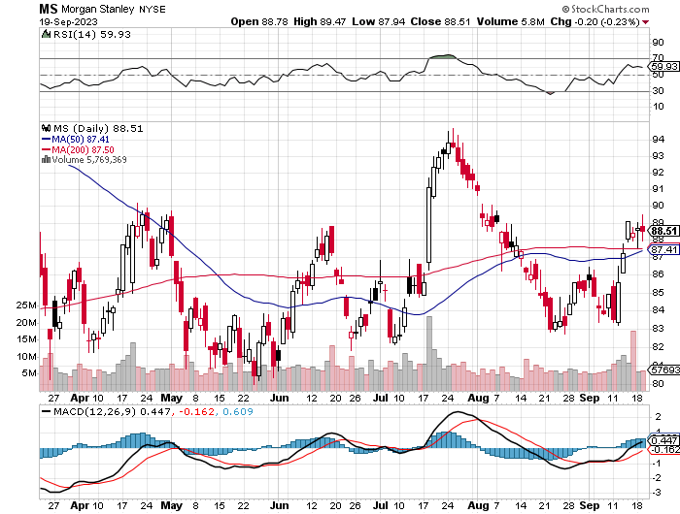
Morgan Stanley (MS) – Highest Capital ratio net of mark to market CEO to Step Down in a Year took profits on long 4/$65-$70 call spread

Slide 61
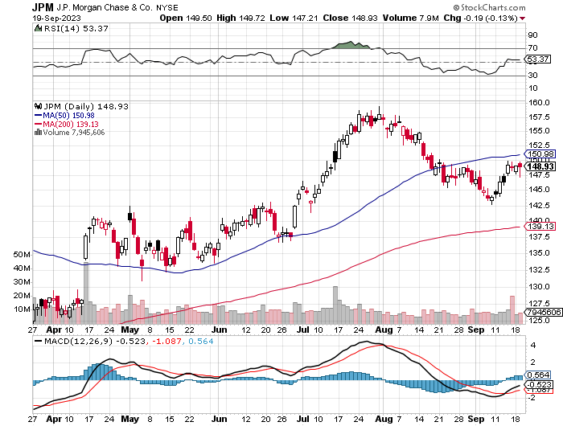
JP Morgan Chase (JPM) - Highest Capital ratio net of mark to market JP Morgan Picks Up an Annual $3 Billion, in interest income on the First Republic deal took profits on long 4/$105-$115 call spread

Slide 62
Bank of America (BAC) – Bank of America Rips, on a great earnings report took profits on long 4/$20-$23 call spread

Slide 63
Citigroup (C) – took profits on long 4/$30-$35 call spread

Slide 64
Charles Schwab (SCHW) – LEAPS up 67% in three months took profits on long 4/$30-$35 call spread

Slide 65
Interactive Brokers (IBKR) – Best Risk Control took profits on long 4/$60-$65 call spread

Slide 66
SPDR Metals & Mining ETF (XME) – long 2/$28-$30 call spread

Slide 67
Blackrock (BLK)-Asset Collection Boom took profits on long 3/$770-$790 call spread took profits on long 3/$310-$340 call spread

Slide 68
Visa (V) – Inflation boost Transaction grew by an inflationary 10% back to pre-pandemic levels took profits on long 10/$160-$170 bull call spread took profits on long 6/$150-$160 bull call spread

Slide 69
Consumer Discretionary SPDR (XLY) (DIS), (AMZN), (HD), (CMCSA), (MCD), (SBUX)

Slide 70
Berkshire Hathaway (BRKB)- Natural Barbell operating earnings soar in Q2, LEAPS up 350% took profits on long 4/$260-$270 call spread took profits on long 1/$290-$300 call spread, took profits on long 10/$220-$230 call spread, took profits on long 7/$220-$230 call spread, took profits on long 7/$220-$230 call spread took profits on long 6/$260-$270 call spread

Slide 71
Europe Hedged Equity (HEDJ)-

Slide 72
Japan (DXJ)-

Slide 73
Emerging Markets (EEM) - Pro trade, Weak Dollar, Long Recovery Play

Slide 75
Bonds – Looking for the Double Bottom
*Ten Year Treasury yields Hit New 16-year High, at 4.38% *Government shutdown is a new negative *The US Budget Deficit is Climbing Once Again increasing Treasury bond sales *The whole falling interest rate, rising bond price trade has been delayed for six months thanks to the Fitch downgrade and hotter than expected economic growth at 2.40% for Q2. *Keep Buying 90-Day T-Bills, now pushing a 5.48% risk free yield *Still looking like 3.50% ten-year yield by end 2023 *Junk bond ETF’s (JNK) and (HYG) are holding up extremely well with a 6.5% yield *Bonds (TLT) still likely to hit $110 by yearend

Slide 76
Treasury ETF (TLT) – took profits on long 5/$98-$101 call spread took profits on long 5/$97-$100 call spread, long 2/$98-$101 call spread, took profits on long 4/$96-$99 call spread took profits on long 4/$113-$116 put spread, took profits on long 4/$114-$117 put spread

Slide 77
Ten Year Treasury Yield ($TNX) – 4.38%

Slide 78
Junk Bonds (JNK) 6.50% Yield to Maturity

Slide 79
Municipal Bonds (MUB) 2.50% Yield-

Slide 80
Emerging Market Debt (ELD) 6.83% Yield-

Slide 81
2X Short Treasuries (TBT)-Out of Favor

Slide 83
Foreign Currencies – New Dollar HIGHS
*”Higher for Longer” gives an adrenaline shot for the US dollar taking it to new 2023 highs *Is the Bank of Japan About to Cave on the Yen? *It might be setting of the long of the year in the foreign exchange market, which has dropped 33% in recent years. *That could spell the end of a zero-interest rate policy in the Land of the Rising Sun, the last country to use it. *Maybe this is why the Nikkei has been in the doldrums since June. *Collapse of dollar is now a 2024 story *Aussie dollar collapse prompted by slowing Chinese economy no buying their energy or commodities *Buy (FXE), (FXB), (FXA), (FXY)

Slide 84
THE MAD HEDGE FUND TRADER
Australian Dollar (FXA) - Major Long-Term Bottom is In Targeting Parity – A call option on a global synchronized recovery
1:1
BUY

Slide 85
Japanese Yen (FXY)

Slide 86
Japanese Yen (FXY) 5 Year – Down 33%

Slide 87
Euro (FXE)-
2023 Target 25%

Slide 88
British Pound (FXB)-
2023 Target 15%

Slide 89
Emerging Market Currencies (CEW)
2023 Target 40%

Slide 91
Energy & Commodities – new 2023 Highs
*Saudi production cutback is now at 4 million barrels/day, a 20 year high, squeezing prices to a new 2023 high *Will Biden counter with a release from the Strategic Petroleum Reserve, or SPR? *Gas Prices Jump 10% In Europe, as a long-threatened strike ensues at Australian export facilities. Chevron used the strike to cancel contracts in anticipation of long-term falling gas demand * It’s All About the Weather, if you are a natural gas investor praying for an upturn. European storage capacity is full, but one cold snap could tip the balance especially if China comes back online *Hydrogen is Going Nowhere, and the stocks are a great short, *Electrification Will be the Big Theme of this Century. The power grid has to increase fivefold in size to accommodate the electrifications projects already underway

Slide 92
Oil-($WTIC)

Slide 93
United States Oil Fund (USO)

Slide 94
Energy Select Sector SPDR (XLE)-No Performance! (XOM), (CVX), (SLB), (KMI), (EOG), (COP)

Slide 95
ExxonMobile (XOM)- took profits on long 12/$120-$125 put spread

Slide 96
Occidental Petroleum (OXY)- Buffet’s a Buyer long 2/$55-$60 call spread, took profits on long 12/$77.50-$82.50 put spread

Slide 97
Natural Gas (UNG) - Long January 2025 $14 - $15 Call Spread LEAPS

Slide 98
Freeport McMoRan (FCX) - Codelco Sees Profit Slump, the world’s largest copper producer based in Chile

Slide 99
Cameco (CCJ) - took profits on long 5/$20-$23 bull call spread

Slide 101
Precious Metals – Correction Time
*”Higher for Longer” on interest rates knocks the wind out of precious metals *Interest rate rises in Europe and Australia aren’t helping either *Gold headed for $3,000 by 2025, but back off first from new all-time highs *The new drivers are soon to fall interest rates and the demise of crypto *Silver is the better play with a higher beta *Russia and China are also stockpiling gold to sidestep international sanctions *A Severe Short Squeeze in Copper is Developing, leading to a massive price spike later in 2023 once the Chinese economy comes back on line

Slide 102
Gold (GLD) - Deflation call took profits on long 5/$165-$170 bull call spread

Slide 103
Market Vectors Gold Miners ETF- (GDX) –

Slide 104
Barrick Gold (GOLD) took profit on long 1/$15.50-$16.50 call spread

Slide 105
Newmont Mining- (NEM)- took profits on long $55-60 call spread

Slide 106
Silver- (SLV)- took profits on long 11/$19-$20 call spread

Slide 107
Silver Miners - (SIL)-

Slide 108
Wheaton Precious Metals - (WPM)- took profits on long 1/$36-$39 call spread

Slide 109
Platinum- (PPLT)- 556,000-ounce shortage this year took profits on long 1/$36-$39 call spread

Slide 111
Real Estate – A Slow Awakening
*New US Home Mortgages Hit 27 Year Low and have virtually ground to a halt *A 30-year fixed rate at 7.27% is the cause, which no one can qualify for *Yet, home prices are going up *Climate Risk is a Growing Factor in Home Selection, says Zillow *Homebuilder Sentiment Turns Down, for the first time in seven months in August, to 45 *High mortgage rates are taking their pound of flesh *Home Builder Incentives are making a comeback *Some 42% of buyers were for the first time, showing the true extent of Millennial buying

Slide 112
S&P Case Shiller Plunges S&P Case Shiller Rises to +0.70%, with its National Home Price Index Chicago gained +4.6%, Cleveland +3.9%, and New York +3.5%. Seattle down -11.3%, San Francisco -11.0%

Slide 113
Crown Castle International (CCI) – 6.26% yielding cell phone tower REIT loses Verizon as major customer

Slide 114
US Home Construction Index (ITB) (DHI), (LEN), (PHM), (TOL), (NVR)

Slide 116
Trade Sheet- So What Do We Do About All This?
*Stocks – buy the big dips at bottom of range, ………………sell big rallies to hedge holdings *Bonds – buy dips *Commodities-buy dips *Currencies- sell dollar rallies, buy currencies *Precious Metals – buy dips *Energy – buy dips *Volatility - sell short over $30 *Real estate – buy dips

Slide 121
Next Strategy Webinar 12:00 EST Wednesday, October 4 from Zermatt Switzerland email me questions at support@madhedgefundtrader.com
Good Luck and Good Trading!
Notes:
*

